Slide 1
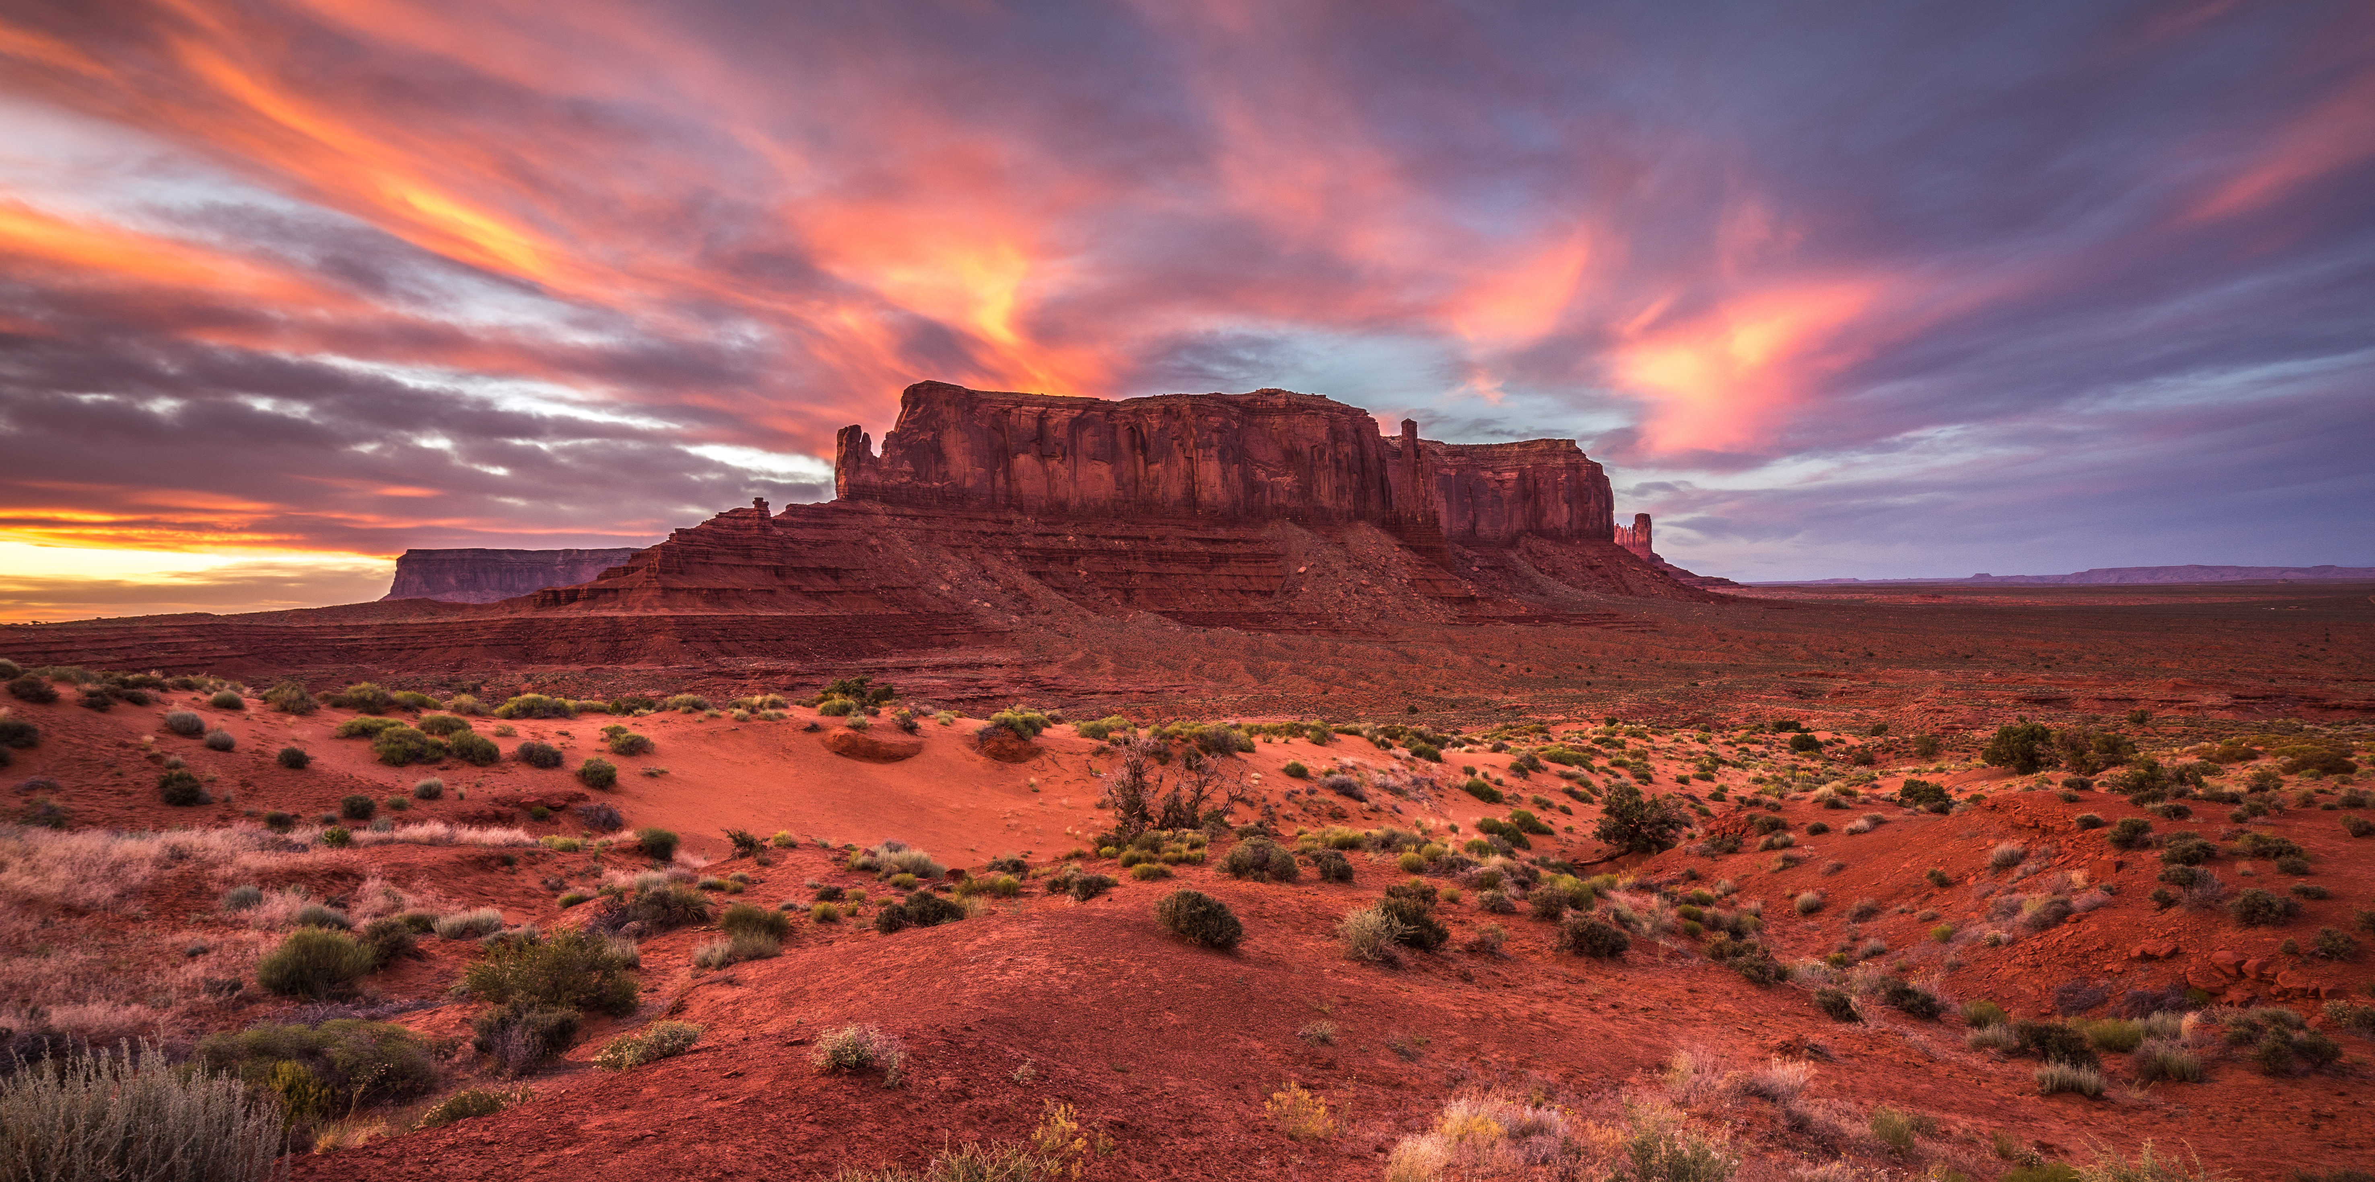

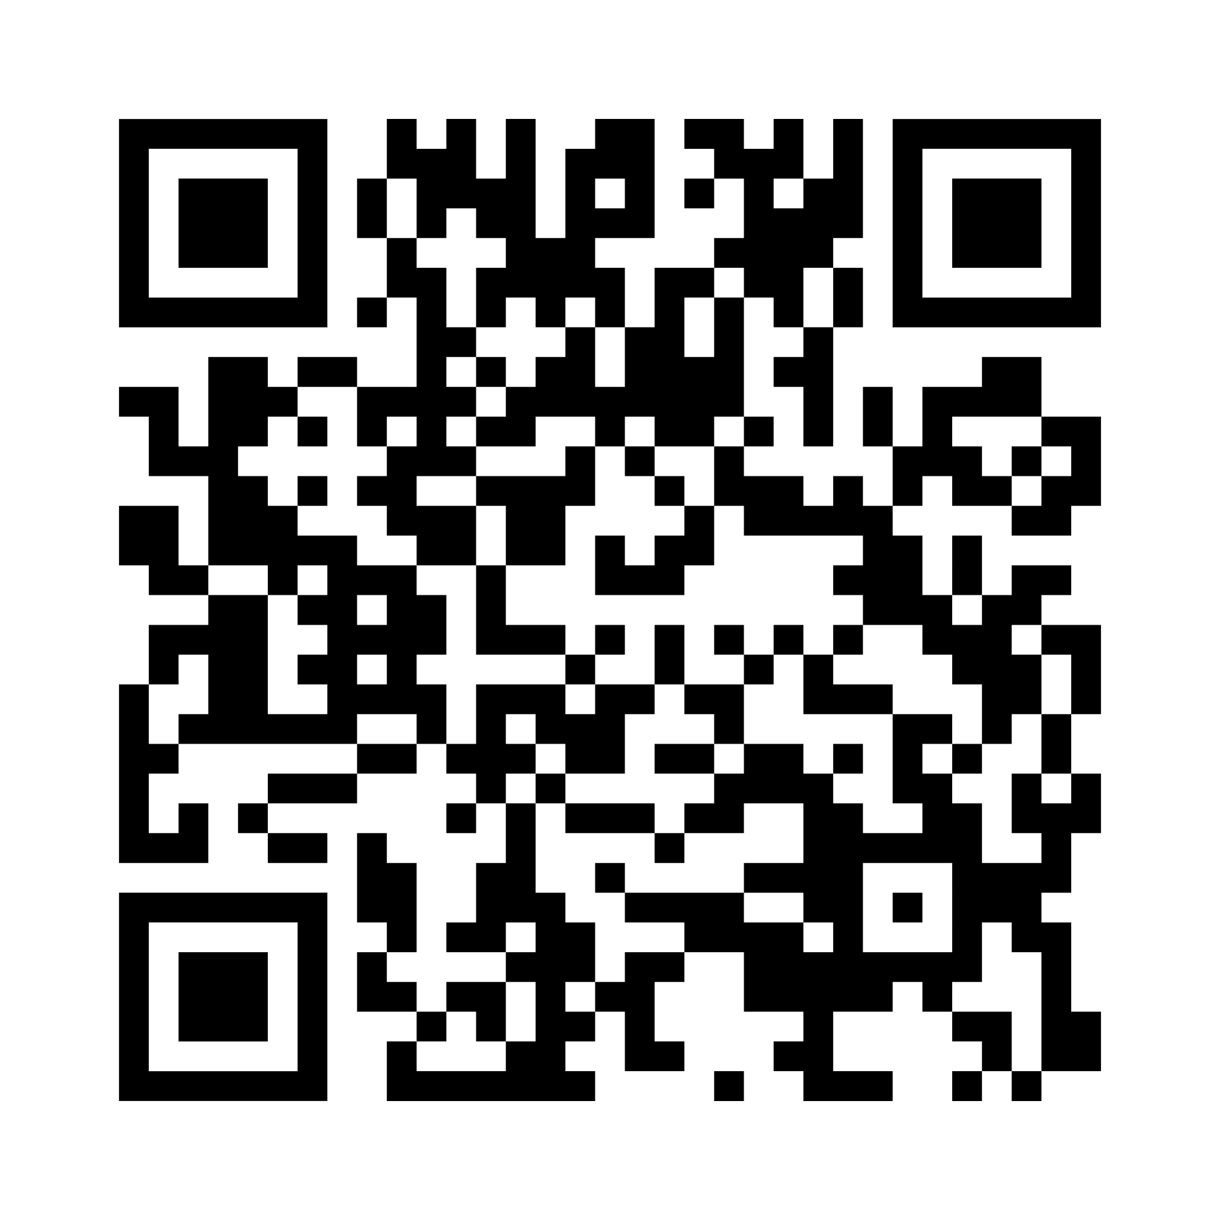
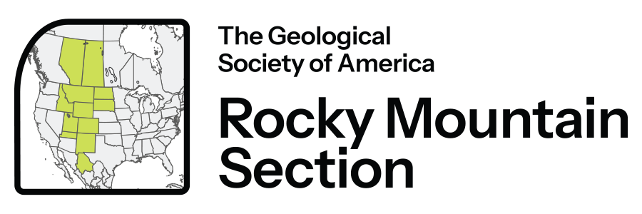
2026 Rocky Mountain
Section Meeting
17 - 20 May 2026
Albuquerque,
New Mexico, USA
Registration Opens
1 December 2025
Abstract Deadline
24 February 2026, 11:59 p.m. PST
Geoscience at the Heart of the
High Desert
Join GSA for the 2026 Rocky Mountain Section Meeting at the Hotel Albuquerque at Old Town in Albuquerque, New Mexico.
Join engaging technical sessions, networking events, and field trips across iconic landscapes!
Set against the dramatic backdrop of the Southwestern United States, this meeting offers an exceptional opportunity to explore the intricate geology of the region—from ancient rift systems to volcanic terrain and sedimentary basins.

