Slide 1
Further Energizing Innovation: Assessing the Federal Energy RD&D Budget for FY24 and Beyond
Hoyu Chong Senior Policy Analyst
May 30, 2023
@ITIFdc

Slide 2
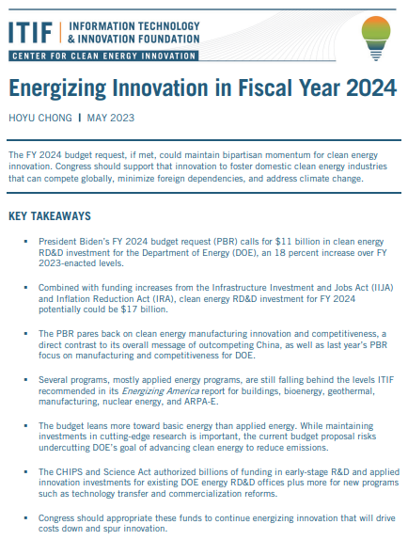
New ITIF Report on U.S. Energy RD&D Spending
Overview with historical and comparative context.
Discussion of programs and subprograms that make up the clean energy innovation budget.
Interactive Data Visualization: A Community Resource.
Recommendations for DOE and Congress.
Updated throughout the FY24 cycle.
Available here: report & dataviz

Slide 3
Recent and Current Legislation
Columbia CGEP’s and ITIF’s Energizing America recommends $25 billion for clean energy innovation by 2025.
Recent Legislation: Infrastructure Investment and Jobs Act (IIJA), CHIPS and Science Act, and Inflation Reduction Act (IRA). ~$6 billion.
President’s Budget in FY 2024: $11 billion.
Many great developments, but some programs are still relatively underfunded.

Slide 4
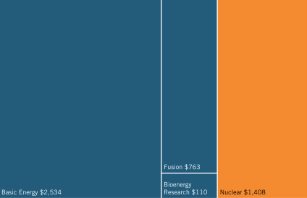
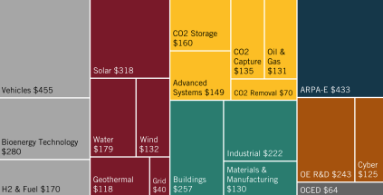
DOE Energy RD&D Programs Overview
DOE has many functions: Energy RD&D is just a small fraction (only 1/5 of DOE’s total budget.)
Nuclear security and defense make up about 1/2 of DOE’s total budget.
DOE’s energy RD&D programs span across ARPA-E, the new OCED, and 7 technology categories.
Fusion, $763
Basic Energy, $2,534
Office of Science . Nuclear Energy TS&D ARPA-E OCED
Sustainable Transp. Renewable Energy Energy Efficiency Fossil Energy & Carbon Mgmt

Slide 5
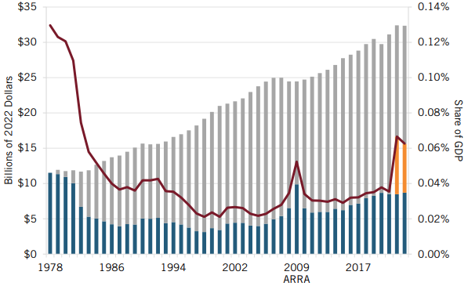
Federal Energy R&D Funding, FY 1978–2023
Spending
Appropriated from IIJA & IRA
Gap from 1978 Level
Share of GDP
Notes:
Congress has increased budgets for DOE's energy programs for 11 of the last 15 years, but annual appropriations have fallen short of doubling targets, and funding has not yet returned to its 1978 levels

Slide 6
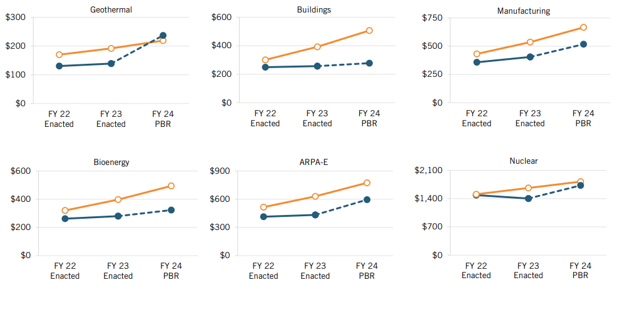
FY22 - FY24 Levels vs. EA Recommendations

Slide 7
Next Steps: Keeping Up the Momentum and More
Several programs, mostly applied energy programs, are still falling behind the levels ITIF recommended:
Geothermal, buildings, manufacturing, bioenergy, nuclear energy, and ARPA-E.
Other issues:
Balancing basic research vs. applied research.
Oversight and implementation of funds.
CHIPS and Science Act authorized billions of funding in early-stage R&D and applied innovation investments for existing DOE energy RD&D offices plus more for new programs.

Slide 8
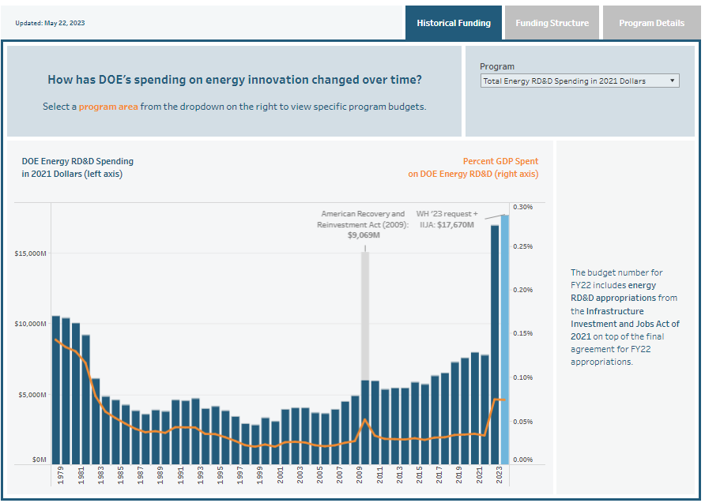
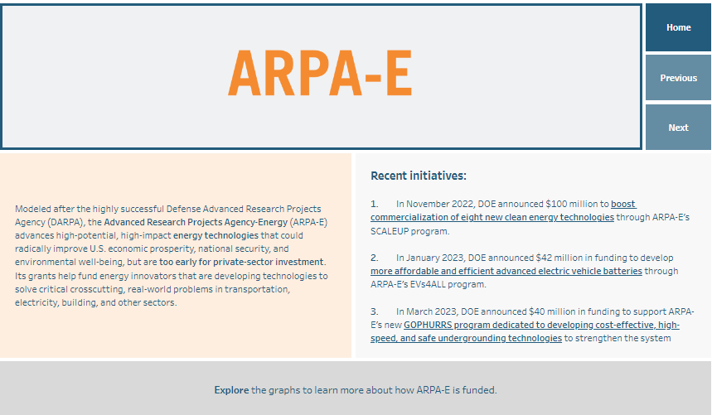
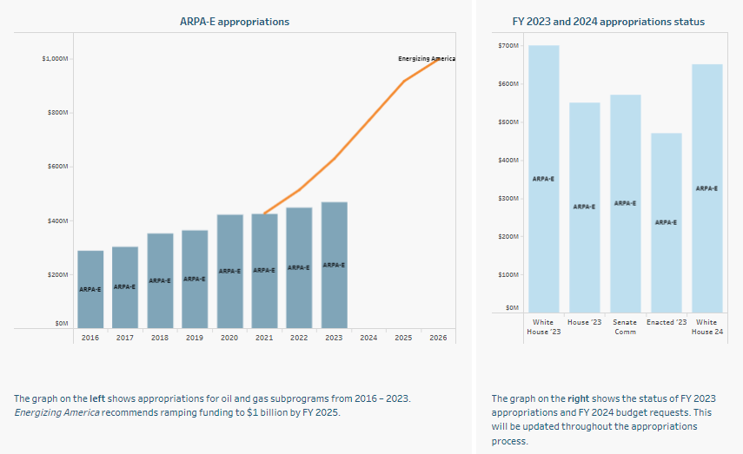
More! Data Visualization Site
Interactive Data Visualization
Notes:
Will add URL to the report once it is out on 10 Jan.

Slide 9
Thank You!
Hoyu Chong | hchong@itif.org | @HoyuChong
@ITIFdc

