Slide 1
The Impact of Recent Legislation on Energy and Climate Innovation Policy in the United States
David M. Hart
Senior Fellow, Center for Clean Energy Innovation, ITIF
Professor, Schar School, George Mason University
@ProfDavidHart
STEPI
November 1, 2022
@ITIFdc

Slide 2
About ITIF
Independent, nonpartisan research and education institute focusing on intersection of technological innovation and public policy, including:
Innovation and competitiveness
Clean energy and climate-tech
IT and data
Telecommunications
Trade and globalization
Life sciences and agricultural biotech
Formulates and promotes policy solutions that accelerate innovation and boost productivity to spur growth, opportunity, and progress
World’s top think tank for science and technology policy, according to the University of Pennsylvania’s authoritative Global Go To Think Tank Index

Slide 3
About ITIF’s Center for Clean Energy Innovation
ITIF’s Center for Clean Energy Innovation exists to elevate this imperative in the policy debate in the United States and around the world. We conduct research, provide nonpartisan analysis, generate policy proposals, and convene members of the analytical and policymaking communities with this mission firmly in focus.

Slide 4
Contents
The End of Magical Thinking (At Least for Now)?
Federal Energy RD&D Funding
Bipartisan Infrastructure Law and OCED
CHIPS Plus Science and FESI
Inflation Reduction Act
What Happens Next?
1
2
3
4
5
6

Slide 5
Climate Change: It’s Real, It’s Big, and It’s Bad

Slide 6
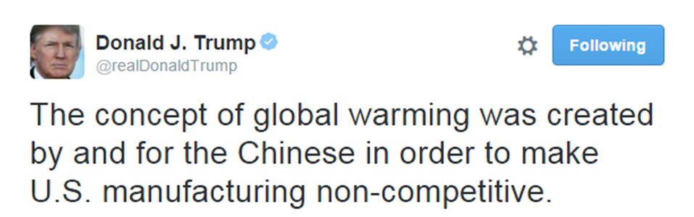
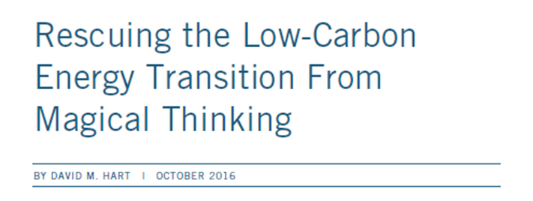
Four Forms of Magical Thinking
Denial
Science-push
Premature triumphalism
Carbon price obsession
“We already know everything we need to know to effectively address this problem. ...”

Slide 7
The Climate & Clean Energy Innovation Imperative
Nearly half of annual emissions reductions necessary to decarbonize the global economy by 2050 will likely come from technologies that are in the demonstration or prototype stage.
Global CO2 emissions changes by technology maturity category in the IEA Net-Zero Emissions by 2050 Scenario
Source: IEA, 2021
Notes:
Not that we don’t want basic science spending, deployment, or carbon price, but….

Slide 8
Our Key Messages
Governments should enact and implement robust climate innovation policies now (and throughout the 2020s), so that solutions will be ready for harder-to-abate sectors globally when they are needed in the 2030s.
Governments should sustain and strengthen climate innovation policies for sectors like renewable energy and light-duty transportation to ensure that solutions are systemic and deployable globally.
The U.S. government should adopt strategic industrial policies that support the competitiveness of U.S. producers in key sectors that may be transformed by climate policies.
Notes:
#3 to build political support in the US and perhaps to accelerate solutions

Slide 9
Contents
The End of Magical Thinking (At Least for Now)?
Federal Energy RD&D Funding
Bipartisan Infrastructure Law and OCED
CHIPS Plus Science and FESI
Inflation Reduction Act
What Happens Next?
1
2
3
4
5
6

Slide 10
Annual Report on U.S. Energy RD&D Spending
Overview with historical and comparative context.
Discussion of programs and subprograms that make up the clean energy innovation budget.
Interactive Data Visualization: A community resource.
Recommendations for DOE and Congress.
Updated throughout the FY23 cycle.
Available here: report & dataviz

Slide 11
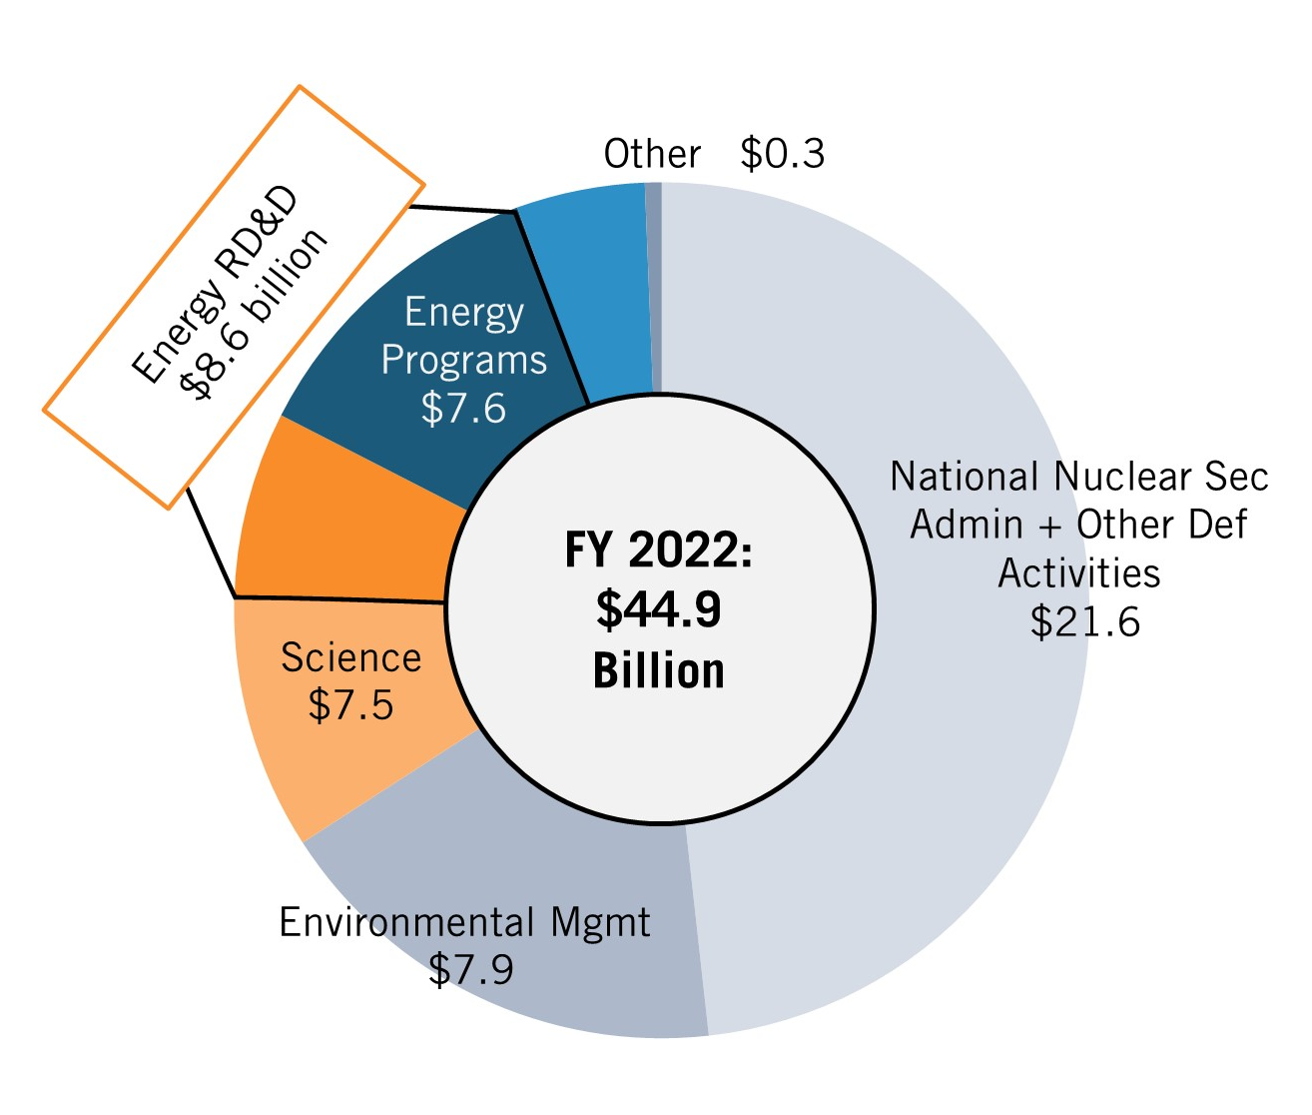
DOE is the Department of Everything, Not Just Energy
DOE has many functions: Energy RD&D is just a small fraction.
DOE's energy programs include both RD&D (dark blue and orange) and non-RD&D (light blue and orange) functions.
Energy RD&D thus makes up only 19 percent of DOE’s total budget.
Notes:
Not the same as official sources, not necessarily the same as other NGOs. But we are transparent about methods

Slide 12
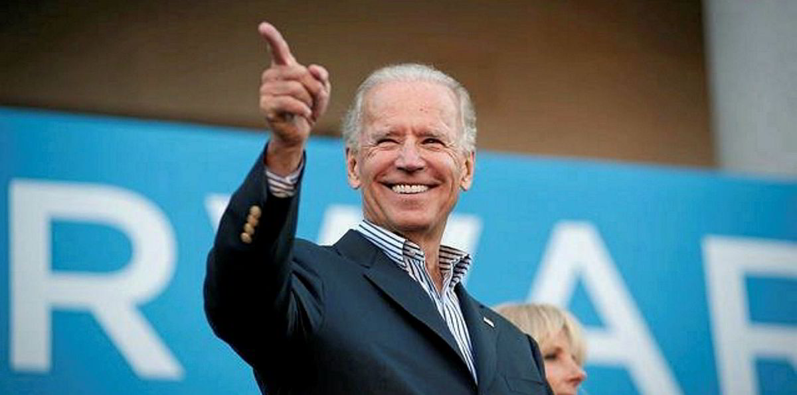
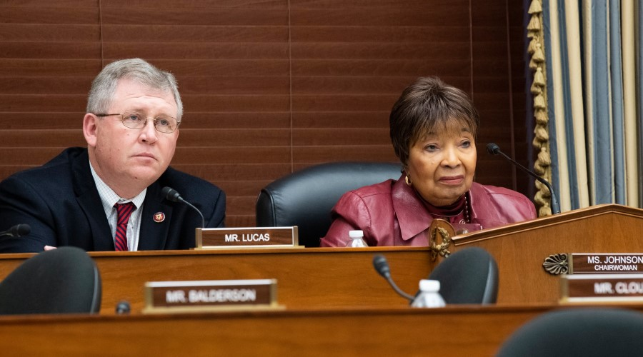
2021: Bipartisan Support for Clean Energy Innovation Surging
DOE energy RD&D budgets have increased by 40% over the past four years.
Energy Act of 2020 reauthorized many DOE programs, and included measures sponsored by 100+ Members from both parties
President Joe Biden has pledged to quadruple government-wide clean energy RD&D over four years.
Notes:
Energy R&D not controversial with many Republicans in Congress
Trump era budgets “dead on arrival”

Slide 13
Govt-Wide 3X Growth Proposed in Energizing America (2020)
Notes:
Blueprint for Biden
DOE + demo = most
Varun and Colin in the admin.

Slide 14
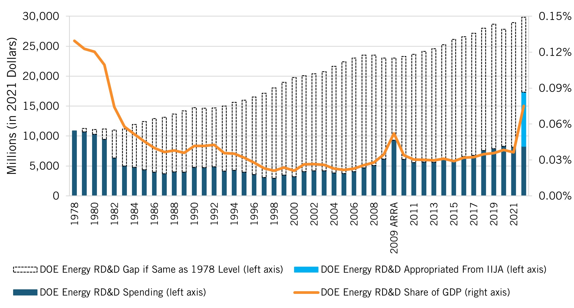
Federal Energy R&D Funding, FY 1978–2022
Notes:
Hasn’t gone quite the way we hoped
Funding has not yet returned to its 1978 levels
But a big bump with BIL

Slide 15
Congressional Favorite: Carbon Dioxide Removal
Notes:
Not spread evenly
Focus on the orange line – EA proposed growing toward $200 million/year by 2025
Actually budget this year = close to vs $800 million
All in BIL
Dataviz has hover-over numbers

Slide 16
Congressional Dis-Favorite: Building Technologies
Notes:
Hope to see rapid growth but we aren’t seeing it grow as fast as we would like yet - $365M expected in 2023 vs $392M proposed
Hoyu’s recent report

Slide 17
Contents
The End of Magical Thinking (At Least for Now)?
Federal Energy RD&D Funding
Bipartisan Infrastructure Law and OCED
CHIPS Plus Science and FESI
Inflation Reduction Act
What Happens Next?
1
2
3
4
5
6

Slide 18
Bipartisan Infrastructure Law Overview
“Infrastructure Week” had become a long-running joke
President Biden proposed $2.6 trillion “Build Back Better” plan
Bipartisan Senate group developed alternative (some items left out eventually became the Inflation Reduction Act)
Bill passed Senate in August 2021, House in November 2021
Total new spending $550 billion over 5 years, including:
$73 billion for electric power sector
$15 billion for EVs and charging infrastructure
Notes:
https://ballotpedia.org/Infrastructure_Investment_and_Jobs_Act_of_2021
https://www.ncsl.org/documents/statefed/IIJA-Section-by-Section.pdf

Slide 19
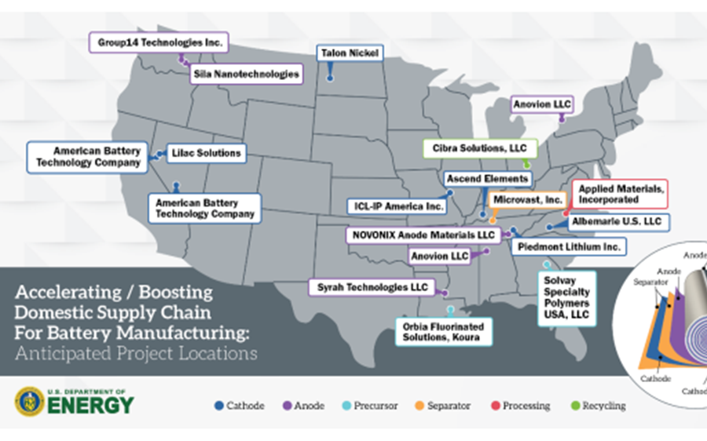
BIL: Power and Transportation Highlights
Power (and industry)
Transmission build-out ($27B)
Demonstration program ($21.5B)*
Transportation
Battery materials and manufacturing ($6B)
EVs and charging infrastructure ($15B)
Notes:
https://www.ncsl.org/documents/statefed/IIJA-Section-by-Section.pdf
$27 billion for grid – esp resilience and flexibility
$6 billion for battery materials and manfg + 48C tax credit ($8 billion)
$15 billion for EV charging and electric school buses and ferries [vs $174 billion in BBB]

Slide 20
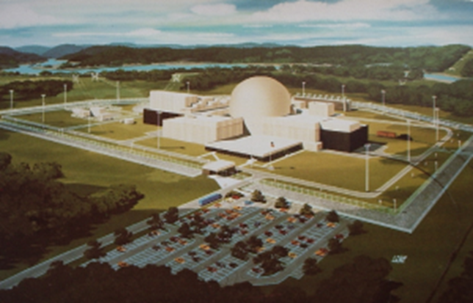
Demonstration: Weak Link in US Energy Innovation System
Necessary for large, complex projects
Unattractive to private investors
Expensive – projects can cost $100s of millions to billions
Risky – some first-of-a-kind projects will fail
Modest payoffs – knowledge spillover limits first-mover advantage
Obstacles for federal investment
Ideological opposition
Checkered history
Weak trust in public-private partnerships
Clinch River Breeder Reactor
(Source: ANS)

Slide 21
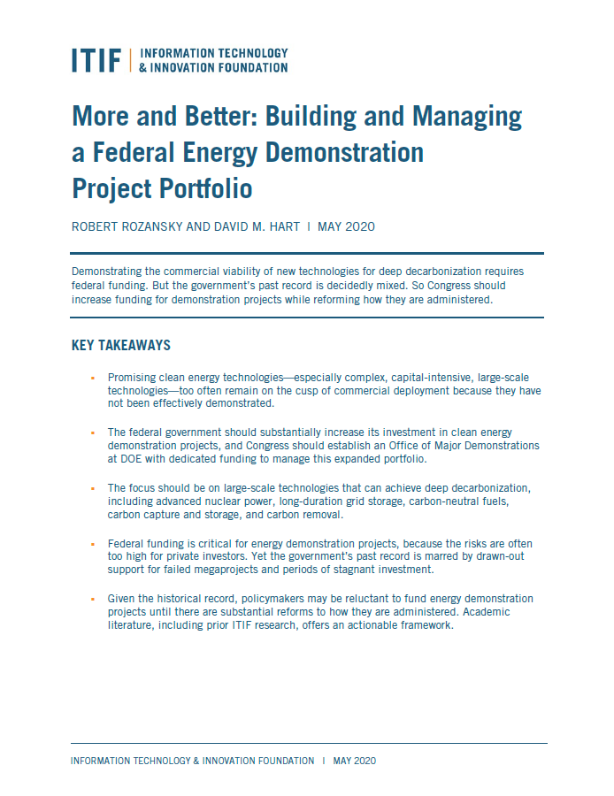
“More and Better” (2020)
Recommendation 1: Spend $5B/year on demonstration projects
Recommendation 2: Establish a DOE Office of Major Demonstrations

Slide 22
Targets for More Investment
Advanced Nuclear Power
Small modular reactors
Coupling advanced nuclear power with non-electric applications
Long-Duration Storage
Concentrated solar power and molten salt thermal storage
Compressed and liquid air energy storage
Hydrogen transport infrastructure
CCS with industrial processes
Carbon-Neutral Fuels
Clean hydrogen produced through low-carbon electrolysis
Carbon Capture and Storage (CCS)
CCS with natural gas electricity generation
Carbon Dioxide Removal
Direct air capture
ITIF Deep Decarbonization Innovation Mission:
Examples of demo-ready technologies:
Technologies that (a) support deep decarbonization, (b) are large/complex, (c) are demo-ready

Slide 23
Principles for Better Investments
Insulate project decisions from politics
Share costs in rough proportion to benefits
Engage all segments of value chain
Foster open information exchange
Undertake only if reasonable expectation of follow-on investment

Slide 24
BIL Creates DOE Office of Clean Energy Demonstrations

Slide 25
BIL Funds OCED
Office of Clean Energy Demonstration
 | FY2022-2026 (5 Years) (In millions)
Sec. 41001 (a) Energy storage Demonstration projects | $355
Sec. 41001 (b) Long-duration Demonstration Initiative | $150
Sec. 41002. Advanced Reactor Demonstration Program | $2,477
Sec. 41004 (a) Carbon Capture Large-Scale Pilot Projects | $937
Sec. 41004 (b) Carbon Capture Demonstration Projects | $2,537
Sec. 41008. Industrial Emissions Demonstration Projects | $500
Sec. 40342. Clean energy demonstration program on current and former mine land. | $500
Sec. 813. Regional Clean Hydrogen Hubs | $8,000
Sec. 40103 (b) Program Upgrading Our Electric Grid and Ensuring Reliability and Resiliency | $5,000
Sec. 40103 (c) Energy Improvement in Rural or Remote Areas | $1,000
Total | $21,456

Slide 26
Contents
The End of Magical Thinking (At Least for Now)?
Federal Energy RD&D Funding
Bipartisan Infrastructure Law and OCED
CHIPS Plus Science and FESI
Inflation Reduction Act
What Happens Next?
1
2
3
4
5
6

Slide 27
CHIPS Plus Science Highlights (Except Energy)
Semiconductor manufacturing incentives and R&D funding*
NSF Directorate for Technology, Innovation, and Partnerships
Regional Technology Hubs (Department of Commerce)
NIST and NASA reauthorizations
OSTP National Science and Technology Strategy
*Appropriated

Slide 28
CHIPS Plus Science Energy Innovation Provisions
$12B authorization of approps. for DOE applied energy offices
DOE Office of Science reauthorization
Clean energy tech transfer and commercialization reforms
Regional clean energy innovation programs
Steel manufacturing emissions reduction innovation program
Foundation for Energy Security and Innovation (FESI)
Notes:
Small DOE regional CEI program
Incubator program
OTT auth and coordination function
LEEP, SBV, entrepreneurial leave
$11.2B + 800M for adv fission

Slide 29
FESI’s Models: Agency-Related Private (501c3) Foundations
“Official” imprimatur of Congress
Funded by public or private sources
Streamlined partnership creation
Nimble and responsive
Semi-autonomous
Gift authority

Slide 30
FESI’s Core Concept: Catalyze Commercialization Collaboration
Research Learnings
Private-Sector Input
Collaboration Strategies
Private-Sector
Investment
and Activities
Government- Funded Academic and Lab Research
Resources
Research Input
Private-Sector Learnings
Invention
Translation
Adoption
Diffusion
Process of Technological Innovation

Slide 31
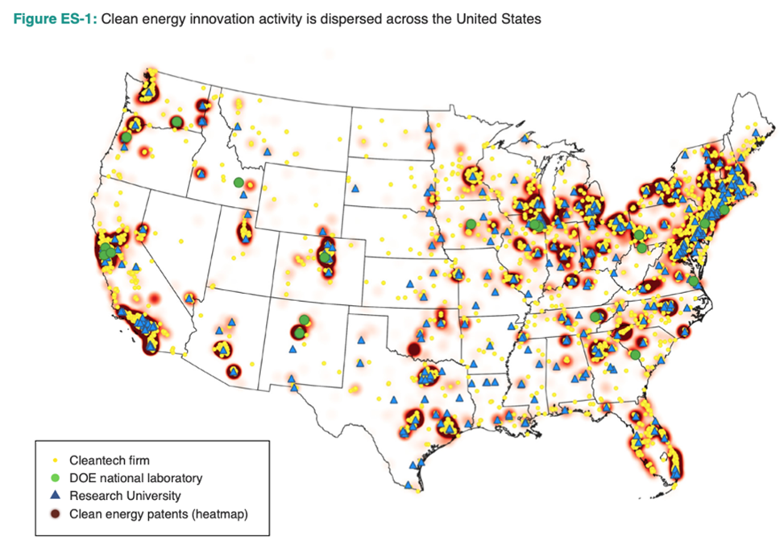
Potential FESI Focus: Regional Energy Innovation Ecosystems
Source: University of Maryland, Center for Global Sustainability

Slide 32
FESI’s Congressional Authorization
Establish self-governing private nonprofit organization (501c3)
Appoint diverse board representing key institutions and regions (plus ex officio DOE leaders)
Support DOE and advance collaboration to accelerate commercialization of energy technology
Supplement and complement, not duplicate, DOE activities
Streamline contracting authority
Notes:
Trust is ultimately essential

Slide 33
Contents
The End of Magical Thinking (At Least for Now)?
Federal Energy RD&D Funding
Bipartisan Infrastructure Law and OCED
CHIPS Plus Science and FESI
Inflation Reduction Act
What Happens Next?
1
2
3
4
5
6

Slide 34
Inflation Reduction Act: Background
Roots in President Biden’s Build Back Better plan (see above)
$555 billion package passed House in November 2021
Given up for dead in the Senate by early summer 2021
Surprise passage of $369 billion package in August 2022
Also includes major health and tax policy provisions
Will it really reduce inflation? Maybe a little if you squint…

Slide 35
IRA: Tax Incentive Highlights
Extended: Renewables
Expanded: Carbon capture
New: Energy storage, hydrogen, existing nuclear
Revised: Electric vehicles
Incentives plus assistance: Manufacturing
Labor, location, and domestic content incentives: Most

Slide 36
IRA: Spending Highlights
DOE OCED: $5.8B for industrial demos
DOE: $2.7B for lab infrastructure and R&D (incl. HALEU)
DOE LPO loan authority: $100B for existing programs + 250B for new “energy infrastructure reinvestment” program
EPA: $27B for grants to states, localities, and non-profits
GSA & Postal Service: $6B for green buildings and EVs
And much much more
Notes:
LPO - $40B each for title 17 & ATVM + up to $20B for tribes

Slide 37
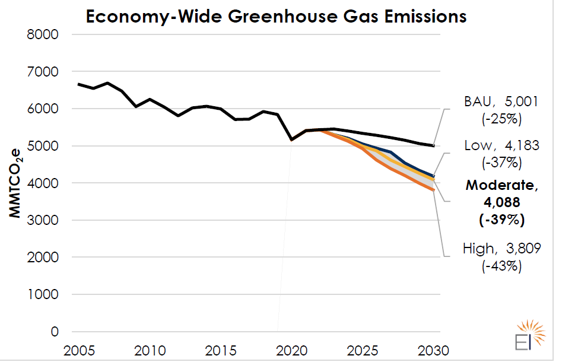
IRA: Projected Impacts on Emissions
Source: Energy Innovation
Source: DOE Office of Policy
Notes:
https://www.energy.gov/sites/default/files/2022-08/8.18%20InflationReductionAct_Factsheet_Final.pdf
Energy Innovation, “Updated IRA Modeling…” August 2022

Slide 38
What About Innovation?
Strong, durable demand-pull signals
Complementary to supply-push programs in other bills
Emphasis on domestic responses which might limit impact
Questions:
Will it drive true cost reductions (or only subsidize high costs)?
When will “sticks” (regulation or carbon pricing) also be needed?

Slide 39
Contents
The End of Magical Thinking (At Least for Now)?
Federal Energy RD&D Funding
Bipartisan Infrastructure Law and OCED
CHIPS Plus Science and FESI
Inflation Reduction Act
What Happens Next?
1
2
3
4
5
6

Slide 40
My Favorite “Take”
“It is not just the sheer volume of spending, but its strategic application that could be transformative. In a sense, the CHIPS and Science Act is the “brains” of the operation, dedicating billions toward the cutting edge research and development needed to accelerate innovation in emerging clean energy technologies. The Infrastructure Investment and Jobs Act is the “backbone,” providing much of the infrastructure these technologies need to scale at speed. Finally, the IRA is the “engine,” driving investment growth through demand-pull measures that provide the security for these technologies to reach market maturity. Significantly, each bill is suffused with an industrial policy perspective that strategically prioritizes key industries while maintaining a technology-neutral approach.”
Lachlan Carey and Jun Ukita Shepard, RMI
“Congress’s Climate Triple Whammy:
Innovation, Investment, and Industrial Policy”
August 22, 202
Notes:
https://rmi.org/climate-innovation-investment-and-industrial-policy/

Slide 41
Executive Branch Implementation
Suddenly, enormous new responsibilities
Staffing challenges
Schedule challenges
Coordination challenges

Slide 42
Regional, State, and Local Execution
Tension between national and subnational units, between subnational units, and within subnational units
NIMBYism
Environmental justice vs. economic development
Incumbent vs. new energy and industrial interests

Slide 43
Congressional Oversight
Potential stakes in Nov. 8 midterm elections:
Principled oversight?
Claw back or compensate for spending commitments?
Reduce regulatory barriers?
Tweak specific provisions (eg domestic content of EVs)?
Toughen strategy vs. Russia and China?

Slide 44
Thank You!
David M. Hart | dhart@itif.org or dhart@gmu.edu | @ProfDavidHart
@ITIFdc

