Slide 1
How Digital Services Empower SMEs and Start-Ups
Trelysa Long
Policy Analyst
@Trelysa_Long
August 27, 2025

Slide 2

About ITIF
Leading think tank for science and tech policy
Independent, nonprofit, nonpartisan
Champions innovation, productivity, and competitiveness
  Innovation processes, policies, and metrics
  Science policy related to economic growth
  Digital policy, AI and data innovation
  Broadband and spectrum policy
  Life science
  And more

Slide 3
Contents
SMEs in the Economy and Their Challenges
Digital Services Address SME Challenges
Internet Platforms Connect SMEs to Customers
Digital Services for SME Advertising and Marketing
Digital Services for SME HR and Operations
Digital Services for SME Sales
Case Studies
Policy Recommendations

Slide 4
SMEs in the Economy and Their Challenges
SMEs…
  Make up 99% of all firms across the 38 OECD nations
  Generate 50-60% of value added
  Are a main source of jobs
SMEs face challenges…
  Limited customer reach
  Fewer financial resources
  Larger skills gaps

Slide 5
Digital Services Address SME Challenges
Digital services range from AI and cloud computing to e-commerce, social media, and blockchain.
Internet platforms, such as Amazon, give SMEs low-cost access to large, diverse markets.
Cloud services, such as Microsoft 365, improve SME collaboration and productivity.
Yet SMEs adopt digital services at lower rates than large firms.

Slide 6

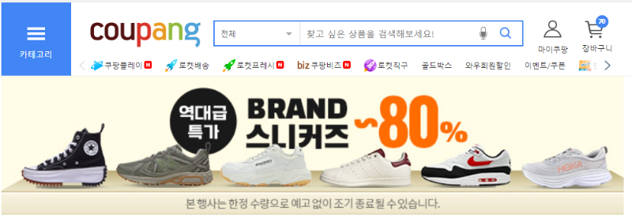


Digital Services Address SME Challenges

Slide 7


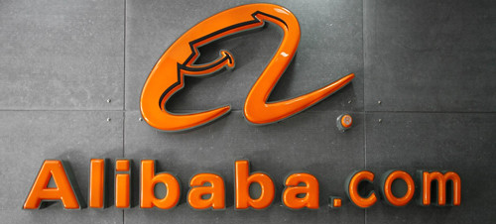
Internet Platforms Connect SMEs to Customers
Platforms reduce the costs of connecting buyers and sellers, helping SMEs reach more customers.
They take different forms depending on the transaction.
  Examples: Amazon, Coupang, DoorDash, Thumbtack, OroCommerce
Impact:
  10,000+ SMEs scaled into larger firms via Coupang
  55,000+ independent Amazon sellers generated more than $1 million in sales last year

Slide 8



Digital Services for SME Advertising and Marketing
AI tools, such as Google Smart Bidding, help SMEs optimize ads, target customers, and generate content at scale.
Generative AI tools, such as Jasper, Copy.ai, and Canva’s Magic Write, help SMEs produce blogs, social posts, and ads with minimal effort.
Customer relationship management (CRM) platforms, such as HubSpot, allow SMEs to automate outreach and personalize engagement.

Slide 9
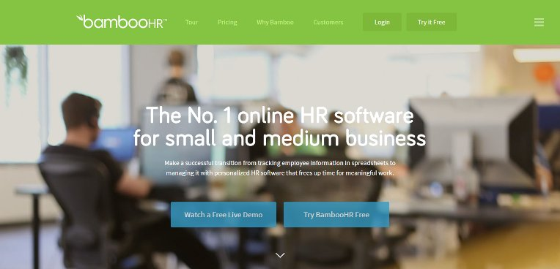
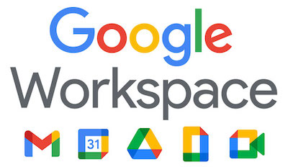

Digital Services for SME HR and Operations
Strong HR and operations capabilities drive SME growth and competitiveness.
Digital payroll, HR management, cloud computing, and analytics save time and reduce costly errors.
Examples:
  Gusto and BambooHR streamline compliance and reporting
  Google Workspace and Microsoft 365 enable real-time collaboration
  Workday People Analytics provides insights into recruitment, mobility, and performance

Slide 10
Digital Services for SME Sales
E-commerce expands sales, broadens customer bases, and strengthens relationships.
  Examples: Amazon, Coupang, Shopify, Wix
Social media platforms also function as e-commerce platforms.
  Examples: Instagram Shops, Facebook Marketplace, TikTok Shop

Slide 11
Case Studies
Jambalaya Girl…
Amarra…
Small business selling jambalaya rice boxes
Struggled to reach customers beyond local grocery stores
Amazon enabled nationwide sales
Fulfillment by Amazon enabled bulk shipping, lowered costs, and expanded distribution
New Jersey-based dress wholesaler and manufacturer
Needed better marketing workflows and engagement
Generative AI, such as ChatGPT, streamlined product descriptions and content
Cut development time by about 60%

Slide 12
Policy Recommendations
Provide public cloud credits and SME-focused AI tool kits from tech firms.
Support digital literacy and cybersecurity awareness and training.
Encourage SME experimentation with low-cost digital tools.
Promote public-private partnerships to scale digital transformation.

Slide 13
Thank You!
Trelysa Long
Policy Analyst
tlong@itif.org | @Trelysa_Long

