Slide 1
The Foundation for Energy Security and Innovation
David M. Hart, Senior Fellow
ITIF Center for Clean Energy Innovation
November 2022
@ITIFdc

Slide 2
About ITIF
Independent, nonpartisan research and education institute focusing on intersection of technological innovation and public policy, including:
Innovation and competitiveness
IT and data
Telecommunications
Trade and globalization
Life sciences and agricultural biotech
Clean energy innovation
Formulates and promotes policy solutions that accelerate innovation and boost productivity to spur growth, opportunity, and progress
World’s top think tank for science and technology policy, according to the University of Pennsylvania’s authoritative Global Go To Think Tank Index

Slide 3
About ITIF’s Center for Clean Energy Innovation
ITIF’s Center for Clean Energy Innovation exists to elevate the climate innovation imperative in the policy debate in the United States and around the world. We conduct research, provide nonpartisan analysis, generate policy proposals, and convene members of the analytical and policymaking communities with this mission firmly in focus.

Slide 4
ITIF’s Current FESI Project
ITIF is working with SustainabiliD to accelerate FESI’s creation and ability to contribute to energy and climate innovation
Our project is a continuation of prior work that led to FESI’s recent authorization by Congress
It is funded by Schmidt Futures
It is not sanctioned or endorsed by the Department of Energy, which has set up a task force to determine its next steps in implementing FESI

Slide 5
The Origin Story

Slide 6
2019-2020 DOE Foundation Project (led by Jetta Wong)
Understand how a Department of Energy Foundation (DOEF) should be organized and operated.
Share this understanding with and build support, if appropriate, for it among key stakeholders in a future DOEF.
Research on models and pain points
Workshops
Write Report
Rollout event
Agency-affiliated foundations
Interviews of stakeholders
Workshop I
More interviews
Progress update
Workshop II
Feedback on report

Slide 7
Precedents from Established Agency-Related Foundations
National Park Foundation was established in 1935 and works with “friends” groups for individual parks around the country.
Foundation for the National Institutes of Health has raised over $1 billion and sustains public-private R&D partnerships.
Foundation for Food and Agriculture works with the USDA and makes creative use of innovation prizes and challenges.
Many more! All different, reflecting varied missions.

Slide 8
Agency-Related Foundations: What makes them special?
Everyday Implementation of Congressional Authorization
Direct connection to agency
Public-private partnerships
Flexible and fast
“Official” imprimatur or prestige
501(c)3, so non-federal contract mechanisms

Slide 9
Agency-Related Foundations In Action: COVID-19
CDC Foundation: Raised over $560 Million for pandemic response
investing in the work of those on the frontlines
health campaigns focused on promoting protective behaviors, and
research and projects to understand and address health equity issues.
Regan-Udall Foundation for FDA
COVID-19 Evidence Accelerator
Foundation for the National Institutes for Health
Accelerating COVID-19 Therapeutic Interventions and Vaccines (ACTIV)

Slide 10
Three frameworks discussed during 2019 workshops
Energy Technology Commercialization Foundation
Commercialize energy technology throughout the whole energy innovation ecosystem (including universities).
National Association of DOE Lab Foundations
Support lab foundations, increase access to capabilities, and commercialize lab-developed technology across lab complex.
Individual National Lab Foundations
Strengthen lab capabilities and connections to local and regional communities.

Slide 11
ITIF Proposes an Energy Technology Commercialization Foundation (2020)
Sets forth a vision and design for a foundation to work with DOE for Congress to consider
Diagnoses commercialization gap in U.S. energy innovation system
Explores structure and functions of existing federal agency-related foundations
“The need for an Energy Technology Commercialization Foundation is urgent. The United States, in spite of its scientific prowess, is not making rapid enough progress toward solving the diverse and difficult decarbonization challenges it faces. ETCF’s creation would not solve all that ails the U.S. energy innovation system. But it would help DOE to lower the mortality rate of innovators seeking to cross the valley of death and encourage other actors in the system to take actions that would have that effect as well.
We call on Congress to authorize ETCF, provide it and DOE with the tools and incentives they need to work together harmoniously, and jump-start it with a modest one-time appropriation of $30 million, which would leverage substantially larger contributions from nongovernmental donors.”

Slide 12
The Clean Energy Technology Commercialization Gap
Nobody in the United States is responsible for the middle phases of the innovation cycle.
Government and philanthropic funding tends to come too early for innovators to get to market.
Private funders (with a few exceptions) prefer investments that pay off more quickly and with more certainty.

Slide 13
ETCF Could Fill the Gap

Slide 14
Core Concept: Catalyze Collaboration
Research Learnings
Private-Sector Input
Collaboration Strategies
Private-Sector
Investment
and Activities
Government- Funded Academic and Lab Research
Resources
Research Input
Private-Sector Learnings
Invention
Translation
Adoption
Diffusion
Process of Technological Innovation

Slide 15
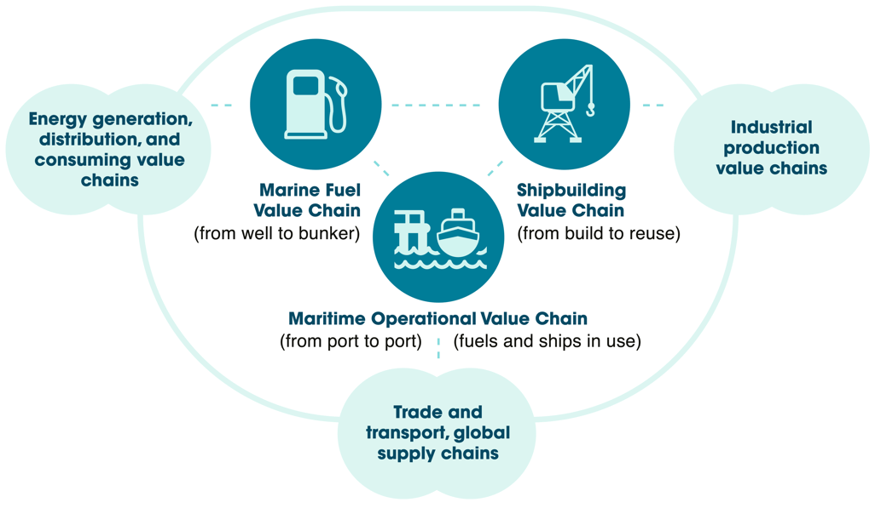
Potential Context: National Energy Innovation Challenges
Example: Decarbonizing Maritime Shipping
Source: https://maritime-executive.com/editorials/the-three-maritime-value-chains-decarbonization-playbook-part-2

Slide 16
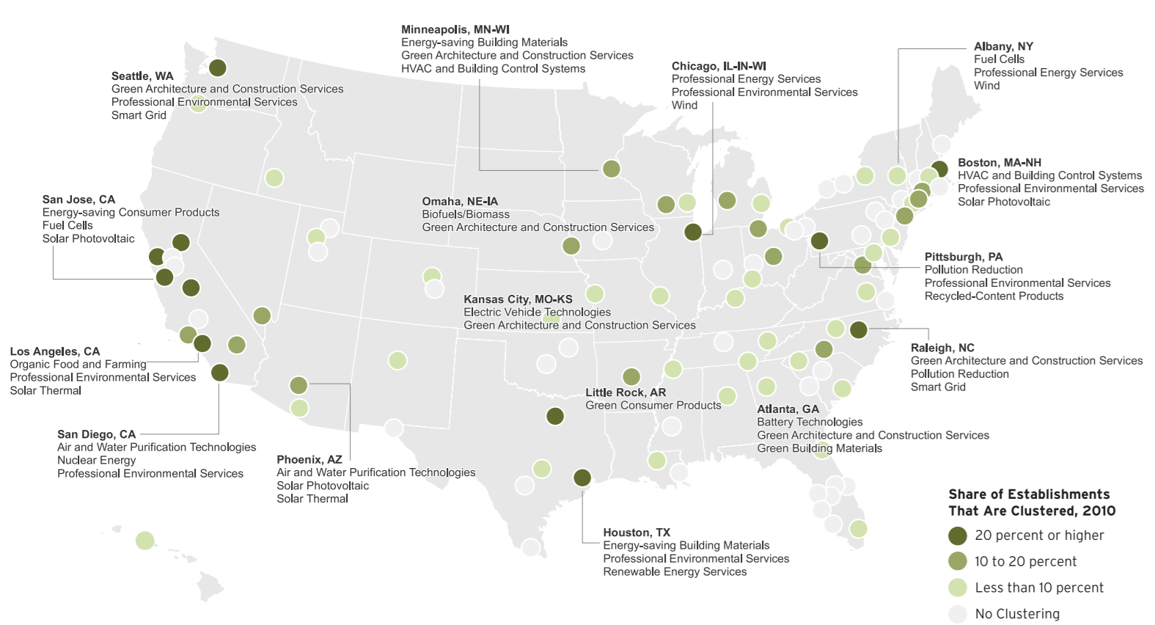
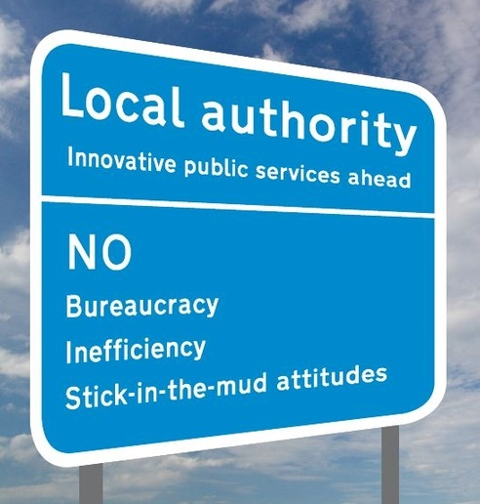
Potential Context: Regional Energy Innovation Ecosystems
Source: Brookings-Battelle Clean Economy Database An establishment in a given segment is defined to be in a cluster if other establishments in the same county comprised at least one percent of all U.S. employment for the given segment.

Slide 17
Some Endorsements and Actions on DOE Foundation
House Select Committee on the Climate Crisis Report
“Congress should establish a DOE foundation to coordinate public-private philanthropic partnerships and fund clean energy innovation and commercialization.”
Bipartisan Policy Center/American Energy Innovation Council
National Academy of Public Administration study, recommended the creation of the DOE Foundation
Confluence Philanthropy
"Confluence Philanthropy has been closing following the development of the Foundation for Energy Security and Innovation and whole-heartedly endorses it...to accelerate the commercialization of energy technologies.”
Support letters to Congress and the White House with 80+ organizations (and growing)

Slide 18
Major Congressional Actions on a DOE Foundation
2017: bipartisan, bicameral bills introduced
2019: appropriations request for NAPA to conduct a study on a DOE Foundation
2020: House Science Committee hearing, House passed authorization
2021: Senate passed authorization (83-14 vote).
January 2022: House passed authorization again.
July 2022: Bipartisan Partnerships for Energy Security and Innovation Act incorporated into CHIPS Plus Science bill…
…..and is now law!

Slide 19
Changes Since ITIF’s March 2020 Report
New name: Foundation for Energy Security and Innovation
Full scope of DOE mission: Energy, environment, science, and security
Additional activities: Fellowships, support for basic research, STEM education, etc.
More interest in diversity, equity, and inclusion

Slide 20
Congressional Authorization for FESI (pp. 865-900 of bill)
Instructs the Secretary of Energy to establish FESI within 180 days of enactment (February 5, 2023)
Assigns mission to support DOE and advance collaboration to accelerate commercialization of energy technologies
Specifies composition of governing board, designates 3 ex officio members from DOE, and gives the Secretary the power to appoint the initial board from a list provided by the National Academies
Lists activities including (but not strictly limited to): studies, competitions, and projects; fellowships and grants; accessing DOE and lab expertise; training and education; maturation funding; and stakeholder engagement
Requires collaboration with lab foundations (and authorizes NETL to create one).
Allows FESI to solicit and accept gifts.

Slide 21
FESI Structure, Governance, and Management
Self-governing private nonprofit organization (501c3)
Governed by a diverse board representing key institutions in national energy innovation ecosystem and regions of the country (plus ex officio DOE leadership).
Board is self-perpetuating after initial appointment and must adhere to strict conflict of interest guidelines
Run by a staff with exceptional technical and business expertise and a strong understanding of DOE and the philanthropic sector as well.
Must prepare strategic plan and annual report and be evaluated by GAO

Slide 22
DOE Collaboration with FESI
FESI should supplement and complement, not duplicate, DOE activities
National labs should have streamlined contracting with FESI, including transfer of equipment and funds from FESI
The Secretary shall appoint liaisons from across the Department to collaborate and coordinate with FESI
Not mentioned in statute, but necessary: internal orders and directives…but trust is ultimately essential

Slide 23
Next Steps
Work with advisors to develop proposals for FESI operations and activities
Work with industrial and philanthropic leaders to build visibility and interest among potential supporters, collaborators, and donors
Work with the broader stakeholder community to identify potential project opportunities and FESI board members
Expand stakeholder community through targeted and general outreach
Work to secure one-time start-up ($30M) and continuing annual appropriations ($1.5-3M)
Create FESI!

Slide 24
Timeline
115th-116th Congresses
Bipartisan bicameral bills Introduced
117th Congress
Passage of authorization, seeking small operational appropriation for FY23, seeking philanthropic support.
118th Congress
Launch with private contributions and $30M seed funding in FY24 appropriations.
118th -119th Projects begin to achieve objectives, scale and scope expanding rapidly
2019-2021
2021-2022
2023
2024-2025
Understanding
the opportunity
Seeding
Accelerating
Establishing
Growing

Slide 25
What I Would Like to Learn from You
What does DOE need to do well, but doesn’t now (or isn’t allowed to) that FESI can help with?
What projects would benefit from public-private collaborations that FESI might broker?
Which projects might be well-suited to become “early wins” for FESI?
Who else should we be talking with?

Slide 26
Thank You!
Kerry Duggan | CEO | SustainabiliD
David Hart | dhart@itif.org | @ProfDavidHart
@ITIFdc

