Slide 1
Marshaling National Power Industries to Preserve America’s Strength and Thwart China’s Campaign for Global Dominance
Robert D. Atkinson
President, ITIF
@RobAtkinsonITIF
December 15, 2025

Slide 2
Contents
Overview
China’s declaration of industrial war
The nature and importance of national power industries
America’s strategic options
Toward a national power industry strategy

Slide 3
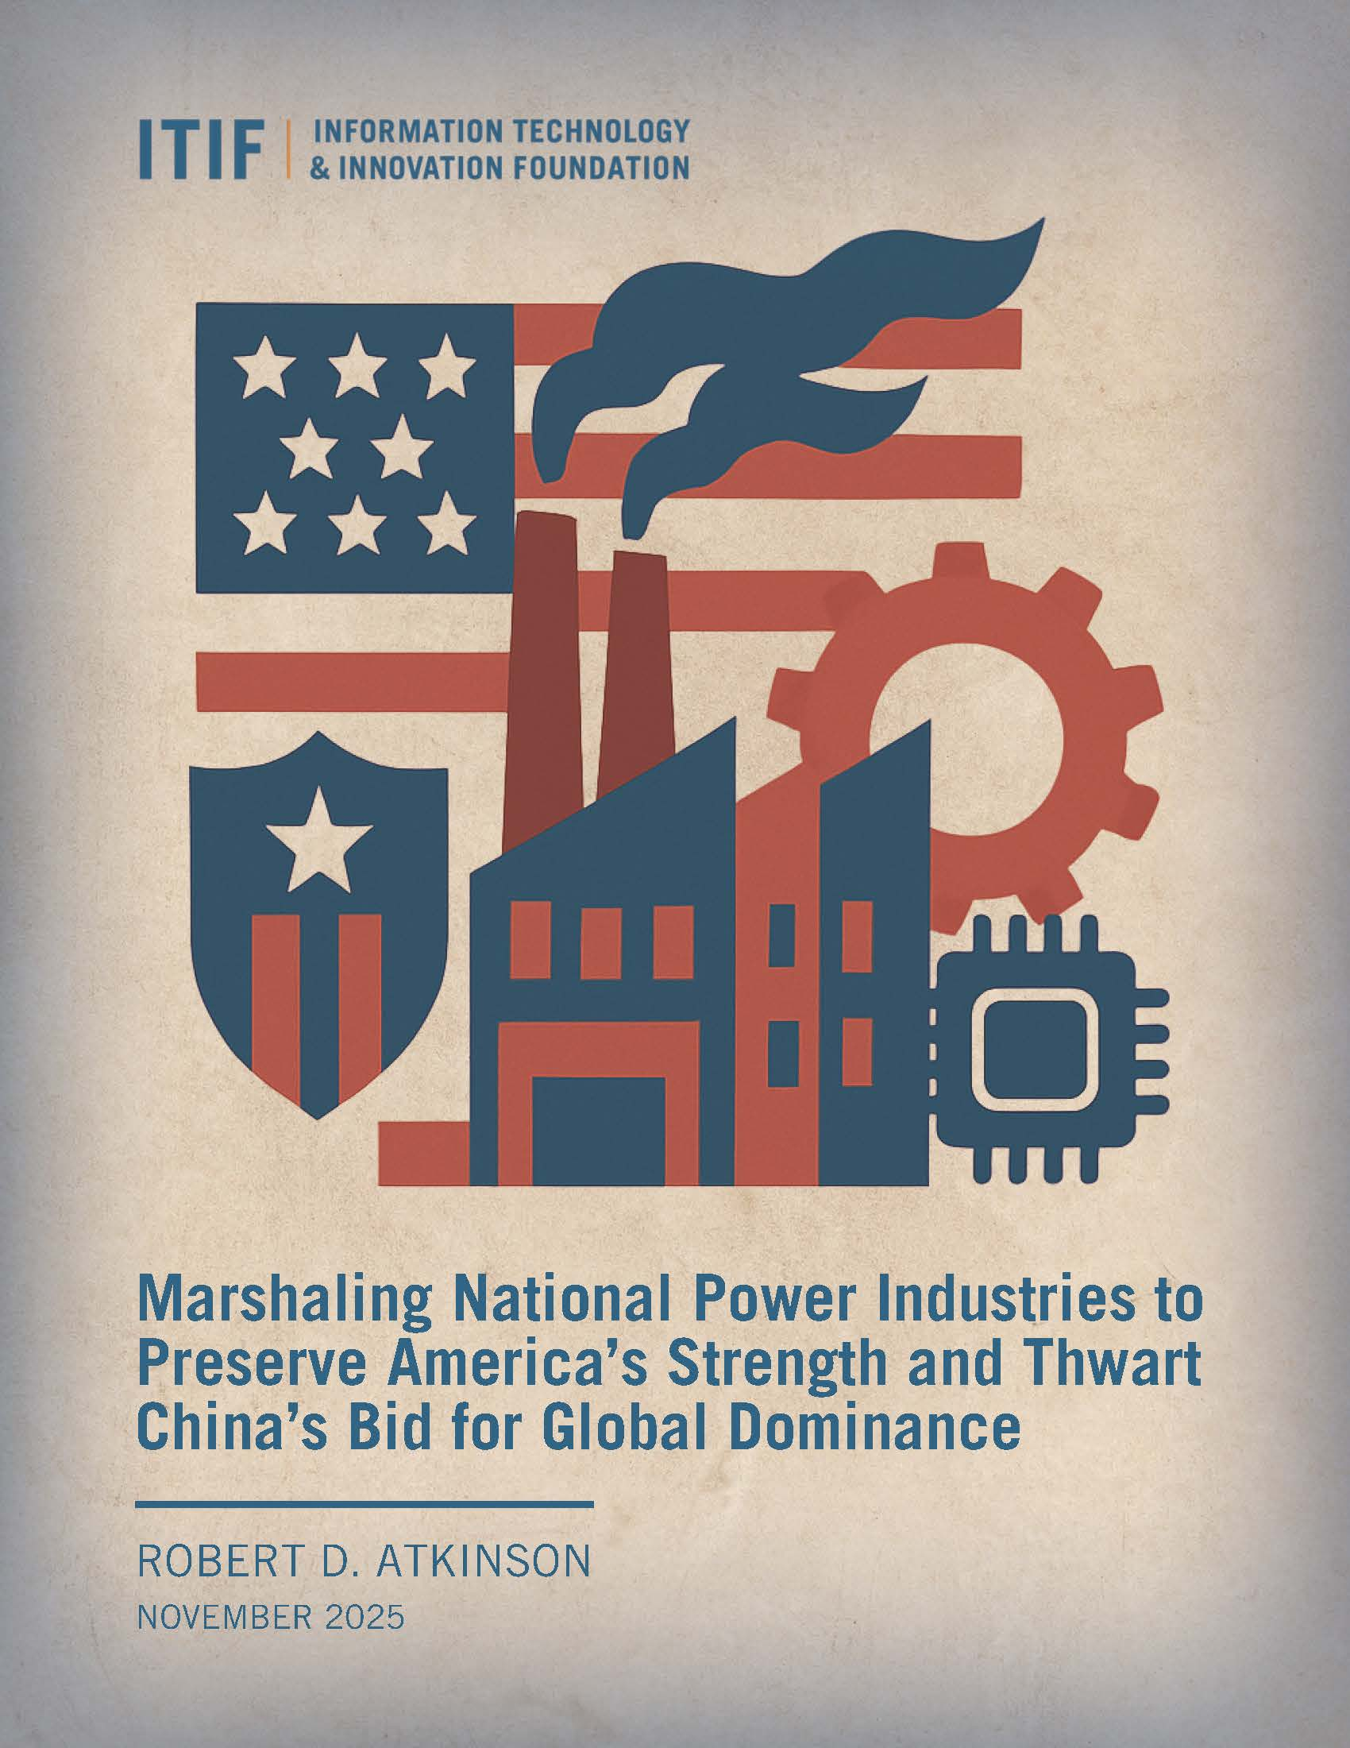
The Big Picture
China is executing a long-term techno-economic campaign to dominate the industries that underpin U.S. national power
America can’t rely on legacy economic doctrines or innovation alone
Policymakers must adopt a National Power Industry Strategy

Slide 4
Immutable Logic Chain
Is remaining the most powerful nation our top priority?
Does that power come from a select set of industries?
Is China gaining ground in those industries?
Are China’s gains coming at America’s expense?
Are status quo policy doctrines the right answer?

Slide 5
Contents
Overview
China’s declaration of industrial war
The nature and importance of national power industries
America’s strategic options
Toward a national power industry strategy

Slide 6
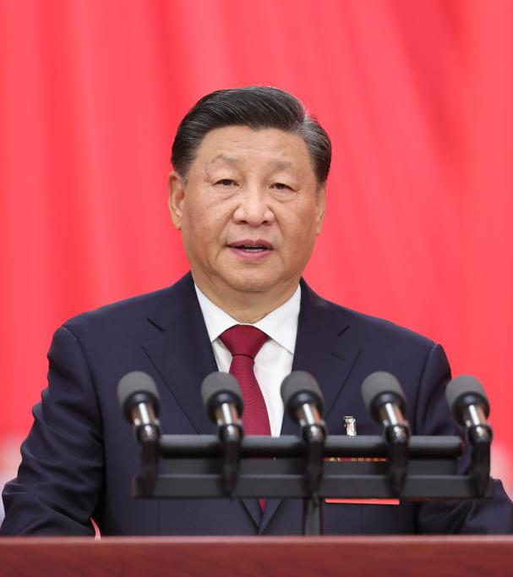
“Seize the initiative, win
the competitive edge, and secure our future…”
“Technological innovation has become the main battleground of the global playing field, and competition for tech dominance will grow unprecedentedly fierce.”
— Xi Jinping

Slide 7
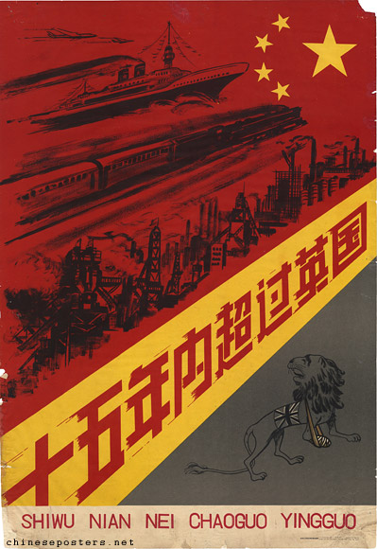
CCP Playbook
Attract foreign investment
Coerce technology transfer and steal IP
Use massive subsidies + protected domestic markets
Push Chinese firms to dominate global markets
Create irreversible dependence

Slide 8
Contents
Overview
China’s declaration of industrial war
The nature and importance of national power industries
America’s strategic options
Toward a national power industry strategy

Slide 9
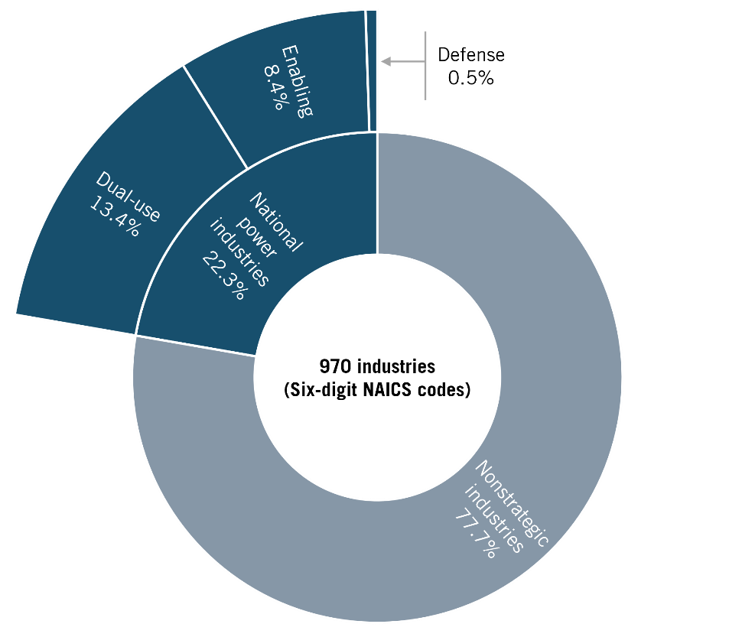
National Power Industry Typology
Power industries include:
  Defense production
  Dual-use technologies with military and commercial applications
  Enabling technologies that support the industrial commons
22% of all industries
Must be the focus of a national power industry strategy

Slide 10
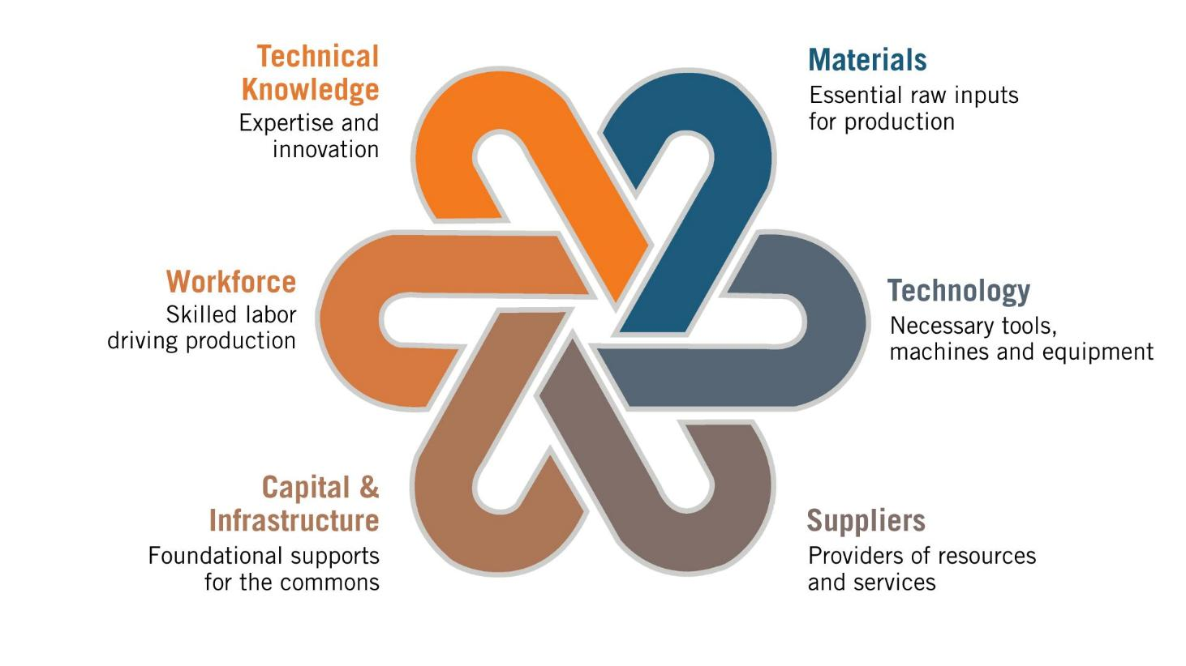
Components of an Industrial Commons

Slide 11
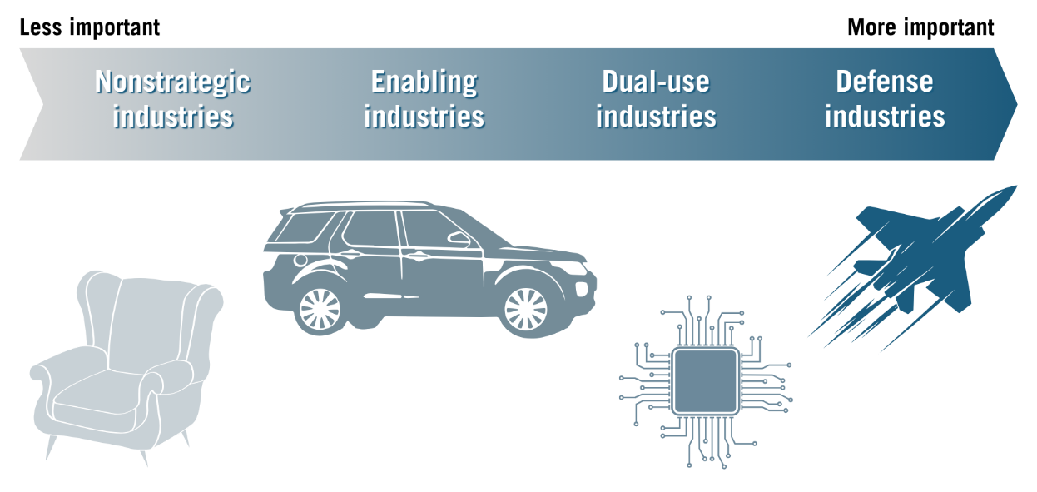
Industrial Power Scale

Slide 12






Once an Industry or Firm Is Lost, It’s Gone for Good

Slide 13
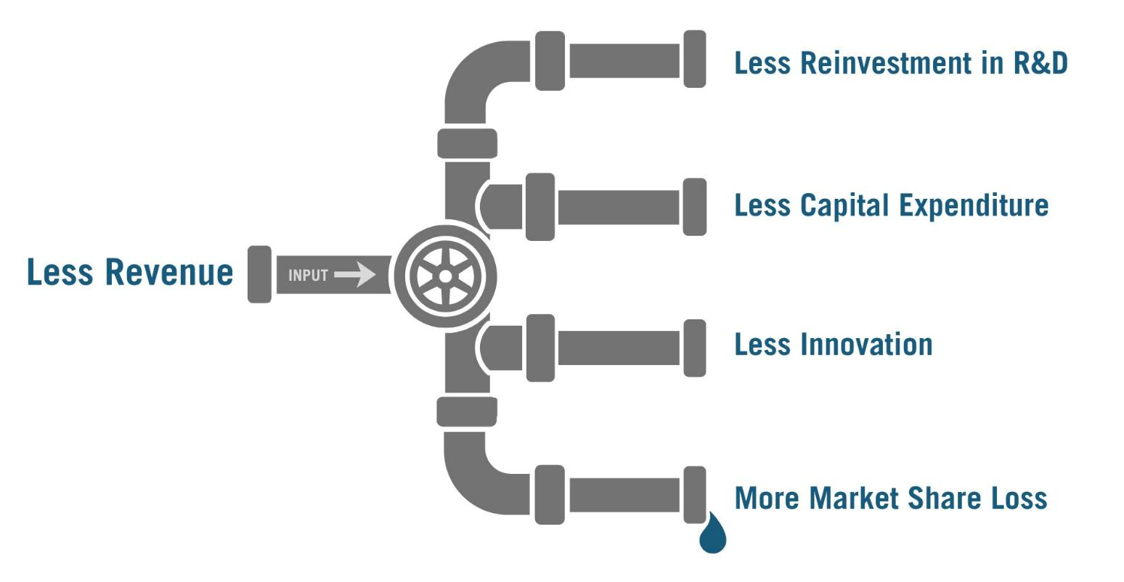
Downstream Impact of Losing Market Share

Slide 14
Major Barriers to Reentry
Technological and knowledge barriers
Capital and investment requirements
Market structure and competitive dynamics
Regulatory and compliance hurdles
Human capital and organizational capabilities
Supply chain and ecosystem dependencies
Political economy factors
Strategic timing and windows of opportunity
Downward cumulative causation

Slide 15
Contents
Overview
China’s declaration of industrial war
The nature and importance of national power industries
America’s strategic options
Toward a national power industry strategy

Slide 16

Why U.S. Policy Is Failing
Ideological fallacies:
All industries are created equal
Trade is always win-win
Markets preserve strategic capacity
U.S. innovation > China
China = “normal” competitor

Slide 17
Three Flawed Strategic Foreign Policy Camps
Engagers:
China is not a threat; let’s cooperate
Deniers:
China will stagnate or collapse; just wait
Innovationists:
U.S. tech superiority will save us

Slide 18
Three Flawed Strategic Economic Frameworks
Neoclassical economics
Computer chips
= potato chips
Progressive economics
Prioritizes redistribution, social spending, and anticorporate regulation
Undermines national champions
Competitiveness
& innovation policy
Focuses on inputs, not structure
Views foreign subsidies and offshoring as beneficial
Assumes markets self-correct and will preserve strategic capabilities
Sees China’s state-driven industrial strategy as own-goal
Favors climate and health care over defense, dual-use, and enabling industries
Distrusts public-private industrial collaboration
Fails to address flawed capital market incentives
Ignores industry-specific strategies
Fails to prevent the PRC from capturing market share

Slide 19

Business Strategy Is the Right Framework
Views competition as a win-lose proposition
Accounts for barriers to entry
Focuses on chokepoints, scale economies, and learning curves
Addresses long-term positioning, not just short-term efficiency

Slide 20
What Policymakers Must Recognize
Some industries matter more than others
Production matters, not just R&D
Market forces alone will not protect strategic capacity
Government must strategically shape industrial structure

Slide 21
Contents
Overview
China’s declaration of industrial war
The nature and importance of national power industries
America’s strategic options
Toward a national power industry strategy

Slide 22
National Power Industry Strategy in Practice
Identify priority sectors
Support production, not just invention
Restrict unfairly traded Chinese goods
Mobilize public and private capital
Prioritize long-term power over short-term efficiency

Slide 23

Strategic Cost Calculation
Higher consumer prices
More industrial spending
Less capital flow to nonstrategic sectors
Stronger state capacity
China dominates key industries
America becomes dependent
Defense costs skyrocket
Allies drift or submit
Liberal order collapses

Slide 24

Historical precedent:
Post-1812 industrialization
Post-Civil War manufacturing revolution
WWII + Cold War science and defense buildup

Slide 25
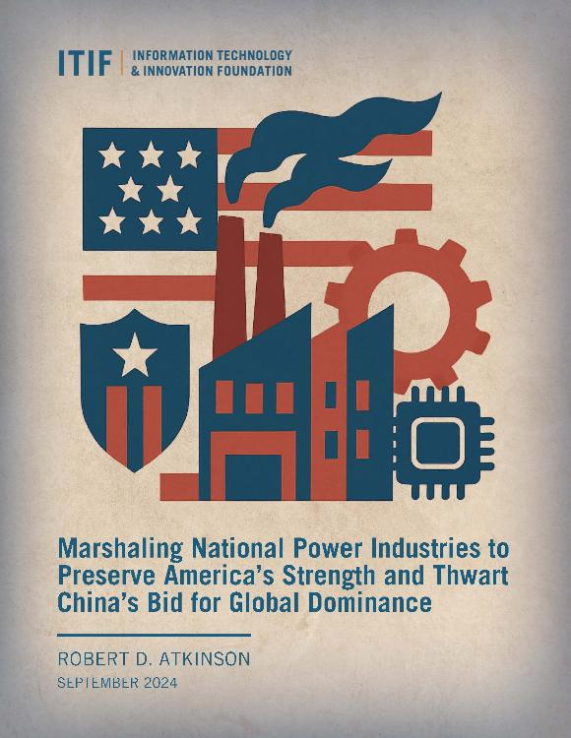
The Charge to Policymakers
We must:
Abandon outdated dogmas
Rebuild strategic industrial capacity
Invest at scale
Align allies
Accept costs of leadership
Read more at itif.org

Slide 26
Thank You!
Robert D. Atkinson
President, ITIF
ratkinson@itif.org | @RobAtkinsonITIF

