Slide 1
The Future of Psychosocial Oncology: AI, Innovation, and the Next Era of Supportive Care
Jennifer Bires, MSW, LCSW, OSW-C, CST
Executive Director, Peterson Life with Cancer
Inova Schar Cancer Institute
Notes:
Jennifer Bires. Clinical Social Worker. Talking about the Future of Psychosocial Oncology, especially as it relates to AI and digital solutions
I am hoping today I can educate you in a way that will allow you to ask better questions.
but might even get you excited about what is possible and maybe even excited about influencing what comes next
We’ll move into learning objectives next, but if people can put in the chat who they work for and their discipline if it’s relevant. it would be great to know who is in the room

Slide 2
Association of Cancer Care Centers
Leading education and advocacy for the cancer care community
ACCC translates clinical findings into “how-to” action
Designing quality and process improvement programs to help the cancer team accelerate
the integration of effective practices, guidelines, new treatment paradigms, and technical solutions into practice.
ACCC is a community
of cancer centers
Representing more than 1,700 private practices, hospital-based cancer programs, large healthcare systems, and major academic centers across the country.
ACCC is a
multidisciplinary association
Representing 40,000+ practitioners from clinicians to researchers, hospital executives, administrators, advanced practitioners, financial advocates, supportive care staff, and more.
*ACCC has changed its name in 2024 from "Association of Community Cancer Centers" to the "Association of Cancer Care Centers.” The change is a step forward to better align with the dynamic landscape of cancer care, while assuring our members, stakeholders, and the broader community that the values and principles we stand for remain unchanged.

Slide 3

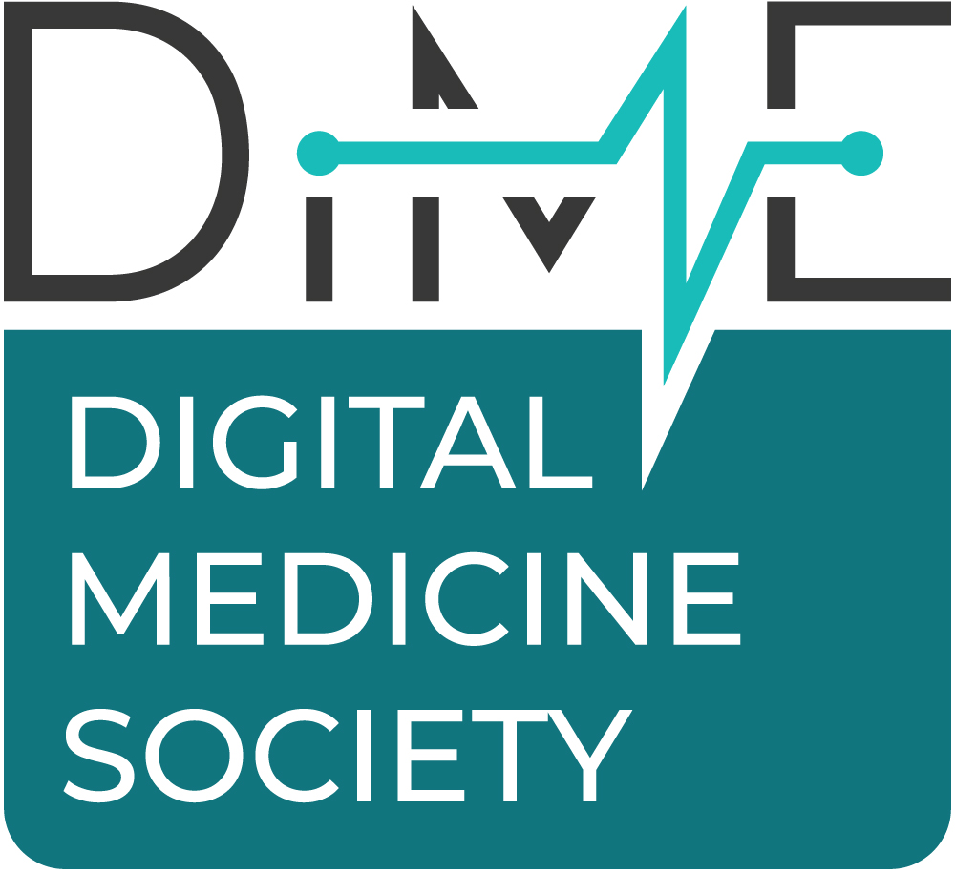
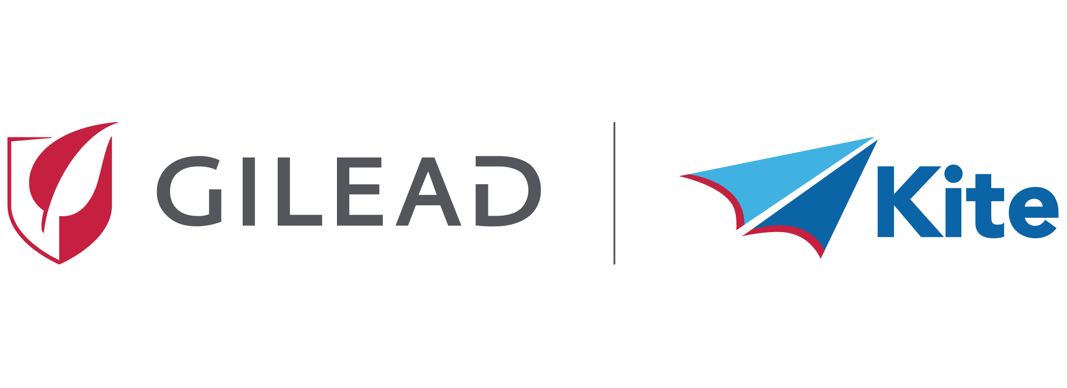

Webinar Supporters
Thank You on Behalf of the ACCC Team
In partnership with:
Made possible with support from:

Slide 4

Meet the Faculty
Jennifer Bires, MSW, LCSW, OSW-C, CST
Executive Director, Peterson Life with Cancer
Inova Schar Cancer Institute

Slide 5
Disclosures
Nothing to disclose.

Slide 6
Learning Objectives
Name 4 categories of artificial intelligence (AI)-enabled psychosocial technology and
what they do
Describe what the research says—and what it does not say—about these tools
Identify ethical questions every clinician and administrator should be asking right now
Leave with 1 concrete action you can take in the next 30 days.
Notes:
These are our learning objectives for the day. Like probably many of you, I have spent to many years watching people navigate cancer diagnoses with inadequate psychosocial support: long wait times, after-hours gaps, geographic barriers. I’m hoping at the end of today you’ll have a better idea of how AI can better support some of these gaps, and what your role can be in assessing the evidence behind tools as well as their potential impact.
AI is not a cure for all of that. But it is a tool — and the question is not whether to use it. It is how to use it wisely.

Slide 7
Poll
How familiar are you with artificial intelligence (AI) tools in clinical care?
I use them regularly.
I have tried a few.
I know they exist but have not tried them.
I am skeptical and want to learn more.
Notes:
So to warm us up:

Slide 8
Setting the Stage
Why This Moment Matters
Notes:
I am excited about what AI can offer our patients. AND I have seen enough to know that excitement without discernment is dangerous. So today we are going to hold both of those things at the same time.’ – something we ask our patients to do every day.
To our skeptics on the call – I’m so glad you’re here—that skepticism will serve patients well. For those already using tools at various levels or ready to get started, —today we get to build the evidence language to help support that use.
I want to center us with a patient story: Maria is 47. She was diagnosed with Stage 3 breast cancer three weeks ago. Two kids at home, husband working nights, lives 45 minutes from the cancer center. On a Friday evening at 6pm, she picks up her phone. She does not call a friend. She does not call her husband. She calls our office — and gets our voicemail. She leaves a message. She spends the next 60 hours alone with her fear. By Monday morning when we call back, she has been on Google for two days reading survival statistics at 2am.
This is not an abstract problem. Every clinician in this room has their version of Maria. Technology does not replace what we do Monday morning — but it has the potential to reach her Friday night.
The gap between when patients need support and when we can provide it is real, measurable, and can be harmful
It is not a failure of clinicians — it is a failure of the current tools we have available today and perhaps even institutional priorities, national policies and reimbursement.
The question this webinar is trying to answer is: How can technology close any part of that gap? Can it be a part of the solution to problems we all know exist? And if so, how do we make sure it does so safely and equitably?

Slide 9
Why Do We Need to Have This Conversation Now?
Research Shift: Large language model (LLM)-based chatbots surged to 45% of new mental health chatbot studies in 2024—up from just 16% in 2022.
  Systematic review of 160 studies (2020-2024): rule-based systems dominated until 2023; LLMs now leading (Hua et al, 2025)
Regulatory Moment: As of late 2024, the FDA has approved over 1016 AI/machine learning (ML)-enabled medical devices in the US (Joshi et al, 2024).
Institutional Reality: Health care institutions are making procurement decisions—whether or not clinicians are at the table.
Notes:
I want to highlight that we’ve reached a point where this conversation is no longer optional.
Decisions about AI in healthcare are being made right now — in board rooms, vendor contracts, and procurement committees. The question is not "will AI come to your organization?" It is "will clinicians have a voice in how it arrives?"
And it is arriving fast. We're seeing dramatic shifts in both how patients are accessing mental health information and the solutions vendors are bringing to market.
Chatbots are not new — but what they can do has changed fundamentally. Earlier rule-based chatbots followed rigid scripts. If you said this, they said that. They were essentially decision trees dressed up as conversation. LLM-based chatbots are different. They generate flexible, contextually responsive language in real time. The conversation can go anywhere. They can hold nuance, follow emotional threads, and adapt their tone.
They feel more human. And that is both the opportunity and the risk.
The research reflects how quickly this shift is happening. LLM-based chatbots jumped from 16% of new mental health chatbot studies in 2022 to 45% in 2024. Rule-based systems dominated the literature until just last year. That is not a gradual trend — that is a field reorganizing itself in real time.
Regulators are moving too. The FDA has now cleared over 1,000 AI and machine learning-enabled medical devices. The infrastructure for these tools is being built whether we engage with it or not.
The pace of that shift is outrunning our clinical and regulatory frameworks. That gap — between what's being deployed and what we actually know is safe and effective — needs to be top of mind.

Slide 10
In 1 or 2 words, describe what your patients most often need between your sessions with them.

Slide 11
The Problem We Are Trying to Solve
~40% of patients with cancer experience clinically significant psychosocial distress
(Deshields et al, 2021).
The majority of those patients never receive any psychosocial care.
Over 150 million Americans live in areas with too few mental health providers to meet
demand (HSRA, 2024).
On average, patients wait 3 to 6 weeks for a first mental health appointment after a
cancer diagnosis.
Notes:
“Distress is high. The majority of patients are never making it to psychosocial care. Even if they try, there are not enough trained clinicians, and the wait times don’t allow many of us to respond in a timely manner that we know is needed.
This is the honest reality of our workforce right now.
I want to take you through the categories of technology that are being developed to meet this gap.

Slide 12
What Is Being Built
Four categories of AI-enabled technology are actively being studied and deployed
in psychosocial care:
🤖 AI Chatbots and Virtual Companions Conversational agents delivering psychoeducation, cognitive behavioral therapy (CBT)-based support, and emotional companionship | 📊 Predictive Analytics and Early Screening ML models identifying patients at risk for distress, depression, or symptom escalation before crisis
⌚ Wearables and Remote Monitoring Biosensors tracking physiological markers (eg, heart rate variability [HRV], sleep, activity) as proxies for mental health status | 📱 Digital Therapeutics and Apps Evidence-based platforms delivering structured psychological interventions (eg, CBT, mindfulness)
Notes:
Each of these four technologies represents a different answer to the same question: how do we reach Maria before Monday morning?’
AI Chatbots: Could have been there when Maria called Friday night
Predictive Analytics: Could have flagged Maria as high risk before she spiraled
Wearables: Could have shown us Maria was not sleeping – weeks before she said anything
Digital Therapeutics: Could have given Maria skills to use at 2am
evidence varies considerably across these categories — some have robust RCT data, others are still in feasibility stage, especially in oncology-specific populations. We’ll look at some of the evidence that exists next.

Slide 13
The Technology Landscape
What Is Being Built?

Slide 14
AI Chatbots—What They Actually Are
Not all AI chatbots are the same
Three generations of mental health chatbots—understanding the difference matters clinically.
  Gen 1—Rule-Based Systems: Follow scripted decision trees. Safe and predictable. Example: early Woebot. They cannot go off-script, which is both their protection and their limitation.
  Gen 2—ML Systems: Learned patterns from data. More flexible. But what they learned depends entirely on what data they were trained on.
  Gen 3—LLMs: Generative, conversational, contextually aware. They feel genuinely human. ChatGPT, GPT-4, and similar engines. This is both the most exciting development and the one that requires the most clinical scrutiny.
Notes:
Maria’s story continued:
It's 2am. She's lying in bed, phone in hand. And She's scared — she has questions no one has answered yet. So she opens a chat window and types: "I can't stop thinking about dying."
What happens next depends entirely on what is on the other end of that conversation.
Take a moment with that. What do you hope is there? What do you fear is there?
That scenario is not hypothetical. It is happening tonight — in thousands of homes — and the chatbot on the other end may be any one of these three generations.
A Gen 1 rule-based system will follow its script. It might say: "It sounds like you're having a hard time. Would you like to connect with a counselor?" Predictable. Limited. But safe. It cannot go off-script, which means it cannot improvise something harmful.
A Gen 2 system learned from patterns in data. It may respond with something more flexible, more personalized — but what it learned depends entirely on what it was trained on. Bias and gaps in the training data become bias and gaps in the response.
A Gen 3 LLM will generate something that feels genuinely human. It may be warm, nuanced, even moving. It might feel like exactly what Maria needed to hear at 2am. But there is some risk in that
The more human an AI feels, the more a distressed patient will trust it. And the more harm it can do if it gets the response wrong. A chatbot that says the wrong thing to someone in crisis at 2am is not a minor product flaw. It is a clinical event.
This is not theoretical. In December 2024, the APA filed a complaint with the FTC regarding a generative AI chatbot that caused measurable harm to children. That complaint exists because clinicians were not in the room when that product was designed, tested, or deployed. Which can be a cost of our absence from these conversations.
Not all chatbots are created equal. And marketing language is not clinical evidence. Our job — as the people who understand what distressed humans actually need — is to know the difference. But it is also our job to start assessing patients for chatbot use and educating them on the limits.

Slide 15
Chatbots—What the Research Shows
Mental Health
The Study Heinz et al. (2025). NEJM AI | Therabot RCT •N ≈ 200 adults with clinical depression •Statistically significant reductions in depressive symptoms vs control •Effect sizes in the moderate range, with a subset achieving clinically meaningful improvement •Durability effects unclear
The Study Straw et al. PMC Systematic Review—160 studies, 2020-2024, 2025. | LLM-based chatbots now represent 45% of new studies. But only 16% of LLM chatbot studies have undergone clinical efficacy testing; 77% are still in early validation.
Notes:
When we look at research we want to make sure we are paying attention to what is being researched.
The Therabot randomized controlled trial evaluated:
A generative AI chatbot (LLM-based)
Delivered CBT-informed interactions (not a rigid script)
Designed to simulate elements of therapy:
Cognitive reframing
Behavioral activation
Emotional reflection
On-demand, asynchronous, text-based support
Use of the therabot showed a clinically significant reduction in depression.
Compared to Cognitive Behavioral Therapy (CBT)
Gold standard: Cognitive Behavioral Therapy
Typical effect size: ~0.6–1.0 (moderate to large)
Strong evidence for durability over time
Therabot comparison:
Effect size: ~0.4–0.6 (moderate range)
Suggests approaching lower bound of CBT, but not equivalent
Lacks:
Human therapeutic alliance
Long-term outcome data
👉 Takeaway:
Promising, but not a replacement for CBT
Could function as a scalable adjunct or step-care option
Of all the LLM-based mental health chatbots on the market right now, only 16% have been tested in clinical efficacy trials. That means 84% of what is being sold to patients and institutions has not yet been proven to help.
→ WHAT THIS LOOKS LIKE IN YOUR CLINIC
When a patient tells you they have been using a mental health chatbot, ask: 'What has it been like for you?' Do not assume it helped. Do not assume it hurt. Listen first. Then look up whether the specific tool has been clinically tested

Slide 16
What Does the Oncology Research Actually Show?
The Study Akdogan et al. European Journal of Cancer 2025. ChatGPT RCT, N=160. | First oncology LLM chatbot RCT—newly diagnosed patients Newly diagnosed patients with cancer beginning chemotherapy were randomly assigned to ChatGPT-assisted counseling vs standard education. The ChatGPT group had significantly lower anxiety and depression scores (HADS) before their second chemo cycle.
The Study Schmidmaier et al. JMIR Cancer, 2026. AYA melanoma evaluation study. | AYA patients with cancer and chatbot literacy—a caution Researchers tested AI chatbot responses to the top unmet needs of adolescent and young adult (AYA) patients with melanoma. Empathy ratings were acceptable. Readability often exceeded the recommended eight-grade target. ~25%-28% of AYA survivors have cancer-related cognitive impairment that makes complex text even harder to process.
Notes:
Read the studies
THE MIXED EVIDENCE STORY — THIS IS THE HONEST FRAMING
Psychosocial oncology studies are small by design — cancer populations are heterogeneous and hard to recruit at scale. Pair these small oncology studies with larger mental health RCTs and you get the full picture: the mechanism works (mental health data); the question is how to adapt it for our patients (oncology data).

Slide 17
CBT Chatbots—The Mechanism Behind the Results
Behavioral Activation Works in Apps | Wysa RCT—Chronic Disease | NEJM AI—Generative Chatbot RCT
Im C-H, et al. JMIR Mental Health. 2025(12). Narrative review, 12 studies, 2015-2025. Apps delivering goal-setting, mood tracking, and scheduled pleasant activities produced PHQ-9 reductions of 3-5 points. Clinically meaningful improvement through the same mechanism we use in session. | Im C-H, et al. JMIR Mental Health. 2025(12). Narrative review, 12 studies, 2015-2025. Apps delivering goal-setting, mood tracking, and scheduled pleasant activities produced PHQ-9 reductions of 3-5 points. Clinically meaningful improvement through the same mechanism we use in session. | NEJM AI. 2025. Generative AI chatbot mental health RCT. Publication in NEJM AI signals the field has arrived at mainstream clinical credibility.
Notes:
Why do these tools works. CBT chatbots are not doing something magical. They are delivering behavioral activation, thought records, mood monitoring, and psychoeducation — the same tools we use. The difference is availability: 24/7, no waitlist, no cost at point of use. The therapeutic alliance is thinner. But the tools are real.
Reflection — 30 seconds, no typing needed: 'Think about a patient from the last month you were worried about between sessions. What specific skill from your clinical toolkit would have been most useful for them to access at 2am — if you could have sent it home with them?' 'That skill — that is what a digital therapeutic is attempting to deliver. The question is whether it delivers it well enough, and safely enough, for your patient population.’
'I can see people thinking. That is the right response. When we can name what our patients need between sessions, we can start evaluating whether any technology is actually providing it.'

Slide 18
Predictive Analytics—Seeing Distress Coming
ML as a Clinical Early Warning System
ML models trained on electronic health record (EHR) data, patient-reported outcomes (PROs), and social determinants of health can identify which patients are most likely to experience distress escalation.
Natural language processing (NLP) applied to clinical notes can flag distress signals that may not appear in a structured screening tool.
Deep learning models have been applied to daily self-reported symptom logs during chemotherapy to predict escalation—including fatigue, nausea, pain, and psychological distress.
Notes:
Have you ever wished...
MARIA'S STORY — continued
What if the system had known Maria was high-risk before she even called? Her diagnosis type, her proximity to treatment center, her prior PHQ-9 score, her housing situation — all of it pointing toward: this patient needs a proactive outreach. Not on Monday. Now.
Have you ever wished

Slide 19
Identifying Distress Before It Escalates
Study Spotlight
Citation Zeinali et al. JMIR Cancer. 2024;10:e52322. Population People with cancer experiencing treatment-related symptoms—systematic review Design Systematic review (PRISMA); database search spanning 1984-2023 | Key Finding: ML algorithms can predict cancer symptom development with meaningful accuracy. Key predictors include prior system burden, PRO data, and treatment variables. Gap: Most studies focus on physical symptoms—psychosocial symptom prediction significantly lags behind physical symptom modeling.
Notes:
Don’t read the slide
WHAT THIS LOOKS LIKE IN YOUR CLINIC
Imagine a dashboard flag appears in the EHR: 'Based on this patient's profile and PRO data, she has a 78% probability of significant distress in the next 4 weeks.' You would act on that. That is what predictive analytics can offer — if built on the right data.
Earlier identification means earlier intervention, which means fewer crisis presentations, better treatment adherence, lower readmission rates. Predictive distress analytics is not just a clinical good — it is an economic one.
: it’s like a vital sign. A blood pressure reading does not replace the clinician's judgment — it informs it. Predictive distress analytics works the same way.

Slide 20
Wearables—When the Body Tells You What the Patient Will Not
Wearables as Psychosocial Signal
HRV—autonomic nervous system stress marker, sensitive to anxiety and depression
Electrodermal activity/galvanic skin response—arousal and emotional stress signal
Sleep disruption and actigraphy—among the strongest depression and fatigue proxies available passively
Daily step counts in oncology—positively correlated with provider-assessed performance status, quality of life, fatigue, an depressive symptoms.
Notes:
MARIA'S STORY — continued
Maria comes to her 3-month oncology appointment. She says she is 'doing okay.' She looks okay. But her Fitbit data tells a different story: she has averaged 3 hours of sleep a night for 6 weeks. Her step count dropped 70%. Her resting heart rate is elevated. Her body has been screaming what her words were not saying.
The wearable story is compelling because it shifts monitoring from episodic (clinic visits) to continuous. A patient who looks 'fine' at their 3-month oncology visit may be sleeping 3 hours a night and barely leaving the house. A wearable knows that.
limitations: device burden, cost equity (who can afford a smartwatch?), data privacy, and the unsolved challenge of integrating continuous data streams into clinical EHR workflows without overwhelming care teams. – we also recently did a fitness study with a fitbit – and we were able to catch some cardiac irregularities – which then forced us to ask the question what is our responsibility with this data, how quickly do we need to respond to it…

Slide 21
Identifying Distress Before It Escalates
Systematic Review: Wearable Sensors and Mental Health | Wearable AI for Depression Detection | Fitbit Feasibility in Cancer Survivors
Gomes et al. Sensors. 2023;23(3):1330. HRV, sleep, and accelerometry data are validated mental health biomarkers. Most studies still in feasibility stage. | Abd-Alrazaq et al. NPJ Dig Med. 2023;6:84. Meta-analysis: Wearable AI shows meaningful performance in detecting depression. HRV and sleep most predictive. | Liao et al. Am Soc Clin Oncol Educ Book. 2019;39:115-121. Activity-monitor data correlates with provider-assessed performance status and depressive symptoms in cancer populations.
Notes:
Read the slide: Note: Most studies validation-stage; oncology-specific wearable mental health research remains sparse – read the slide

Slide 22
The Strongest Oncology Evidence—App-Based Digital Therapeutics
The Study Zion et al. JCO Onc Pract. 2023;19(12):1179-1189. | CBSM app for patients with cancer—a double-blind RCT A CBT-based Cognitive Behavioral Stress Management (CBSM) app vs a health education sham app The CBSM arm produced significant reductions in anxiety and depression. Double-blinding controls for the placebo effect of simply having an app—and the active arm still won
The Study Springer et al. J Med Internet Res. 2024;26:e51949. | Mika app—nationwide oncology RCT (waitlist) across all cancer types Mika (an app designed specifically for oncology distress) Significantly reduced NCCN Distress Thermometer scores at 12 weeks vs control. Improved depression, anxiety, fatigue. Designed for the full cancer trajectory—not just 1 phase.
Notes:
MARIA'S STORY — continued
It is 2am. Maria is awake. She opens an app her care team recommended. It walks her through a breathing exercise, then a thought record. She names the fear. She challenges it. She falls asleep at 3am instead of 5am. When she comes to session Thursday, she has something to bring. The therapeutic hour was extended — not replaced.
Study 1: Industry-funded (Blue Note Therapeutics) — important to disclose. But the double-blind design is genuinely rigorous. - The CBSM arm produced significant reductions in anxiety and depression
Study 2: Honest take: German healthcare context. Replication in the U.S. system is needed. Mika is notable because it targets the full cancer trajectory. Distress fluctuates enormously — at diagnosis, during treatment, at recurrence, in survivorship. A tool designed to adapt across that arc could be a really useful tool.
The Maria scenario at the top is important — instead of talking about 'technology replacing therapy’ we’re talking about 'technology extending the therapeutic hour.'.

Slide 23
Have you recommended any mental health apps to a patient in the last year?
Notes:
In the Chat
YES / NO / I WASN'T SURE WHICH TO RECOMMEND
'I wasn't sure which to recommend' — that is exactly why evidence standards matter.

Slide 24
The Evidence
What Does the Research Show?

Slide 25
Reading the Evidence—A Clinician’s Framework
Before We Review Studies: 3-Tier Evaluation Framework
Tier | Name | Question | What It Means for You
Tier 1 | Technical validation | Does it work technically? Is the NLP accurate? Is it safe? | Most studies are here. This is a starting point.
Tier 2 | Pilot feasibility | Is it usable? Do patients engage? Is it accessible? | Promising; watch for next studies
Tier 3 | Clinical efficacy testing | Does it actually improve patient outcomes? | This is what you need before recommending it.
Notes:
Tier 1 evidence is not bad. Every tool starts there. But Tier 1 evidence at Tier 3 prices and Tier 3 clinical trust is the problem.

Slide 26
Why Both Mental Health and Oncology Research Matter
The Mixed Evidence Story—Reading Across Fields
Psychosocial oncology trials are small by design; cancer populations are diagnosis-specific, treatment-variable, and hard to recruit at scale.
Larger mental health trials tell us the mechanism works. If CBT-based behavioral activation reduces depression in a 1000-person mental health trial, that same mechanism is available when the tool is used by a cancer survivor.
Mental health research gives us the foundation; oncology research gives us the clinical fit and the feasibility signal.
Notes:
Mental health trials are helpful and give us a starting point, but until data is validated in oncology patients, we have to proceed with caution.

Slide 27
What the Science Cannot Yet Tell Us
Long-term outcomes
Oncology subpopulation fit
Who drops out
The therapeutic alliance question.
Notes:
Long-term outcomes: Almost no digital health studies follow patients beyond 3–6 months. We do not know if improvements last.
Oncology subpopulation fit: Most chatbot RCTs were in sub-clinical or general anxiety populations. Cancer patients face existential distress, grief, mortality fear, and treatment toxicity — dimensions that app-based CBT has not been fully tested against.
Engagement data is often missing or underreported. Apps that show good outcomes for completers may have high dropout rates among the most distressed patients.
The therapeutic alliance question: No study has yet measured what happens to the human therapeutic relationship when patients also use AI support tools. Does it help? Does it change the relationship? We can’t say yet.
These are not arguments against the technology. They are the questions that should drive the next generation of research — and that should inform how carefully you introduce these tools to patients.

Slide 28
Poll
What is your biggest concern about AI tools in your setting right now?
Patient safety and crisis response
Lack of strong clinical evidence
Privacy and data security
Equity—not all my patients can access these tools
Staff time and workflow integration.

Slide 29
Ethics, Bias, and Concerns
The Critical Conversation

Slide 30
Bias Is Not Hypothetical, It Is Documented
A landmark Science study found that commercial health algorithms using cost as a proxy for illness systematically under identified the health needs of Black patients (Obermeyer et al, 2019).
NLP-based mental health AI reflects the biases in its training data, including racial, gender, and socioeconomic biases embedded in clinical documentation (Straw and Callison-Burch, 2020).
The digital divide is a clinical divide: Wearables and apps require smartphones, data plans, and digital literacy.
Notes:
MARIA'S STORY — continued
Now imagine a different Maria. She is 52, works two jobs, has a limited smartphone data plan, and her first language around medical topics is not English. Every AI tool we have discussed today was designed with someone else in mind. That is not a reason to abandon these technologies. It is a mandate to demand better ones.
In the previous poll many of you told us equity was your biggest concern. You were right.'
A landmark Science study found that commercial health algorithms using cost as a proxy for illness systematically under-identified the health needs of Black patients — directing fewer resources to sicker Black patients relative to healthier White patients - 'This is not a mental health AI study. It is a general health algorithm study. But it shows us — in peer-reviewed Science — that AI bias causes real harm to real Black patients. (Obermeyer et al., 2019).
NLP-based mental health AI reflects the biases in its training data — including racial, gender, and socioeconomic biases embedded in clinical documentation (Straw & Callison-Burch, 2020).
The digital divide is a clinical divide: wearables and apps require smartphones, data plans, and digital literacy — the patients most likely to need psychosocial support are often the least likely to have equitable access.
If an AI distress screening tool was trained on EHR data from a predominantly White, English-speaking, commercially insured cancer center — what does it miss about your patients? This is not a hypothetical. It is a question to ask about available tools.

Slide 31
The Ethical Infrastructure We Cannot Skip
Privacy
Mental health data is among the most sensitive data that exist.
Many consumer mental health apps collect behavioral, linguistic, and biometric data far beyond what HIPAA covers.
Patients disclose to AI what they will not tell a clinician.
Informed Consent
Patients often do not know they are talking to AI.
Consent must cover what data are collected, who sees it, how it is used, and critically.
LLMs can generate plausible-sounding but clinically wrong information—documented in oncology chatbot evaluations.
ChatGPT produced NCCN-inconsistent treatment recommendations in 12.5% of outputs in one study (Verlingue et al, 2024).
Accountability
Who is responsible when AI misses suicidal ideation? This remains legally and ethically unresolved.
In 2023, the AMA committed to developing policies addressing unforeseen conflicts in AI-driven health care, but that process is not yet complete.

Slide 32
Six Questions to Ask Before Adopting Any AI Tool
Question | Red Flag | Green Flag
What tier is the evidence? | White papers and testimonials only | Peer-reviewed RCTs; independent replication
Who is in the training data? | No demographic disclosure | Diverse, representative datasets documented
How are crises handled? | Vague answers; no escalation protocol | Documented crisis detection + human escalation pathway
Is AI disclosure built in? | Designed to feel human without disclosure | Explicit disclosure; consent workflow documented
Who owns patient data? | Vendor retains all data | Patient data ownership; clear governance policy
Was bias tested across demographics? | Not mentioned | Bias testing across race, gender, socioeconomic status, and language
Notes:
What are some questions we can ask to start evaluating available technology?

Slide 33
The Road Ahead
Your Role as a Clinician Leader

Slide 34
What You Can Do—Clinicians
In your clinical practice:
Ask the question, “Are you using any health apps or AI tools to manage your care?”
If a patient is using a tool, listen before you evaluate.
Document patient use of digital tools in your clinical notes.
Use the tier framework before recommending any app.
Notes:
Most clinicians are not asking. Most patients are using tools anyway. You want to know.
Ask what it has been like for them. Then look up whether the tool has clinical evidence behind it.
It is part of their care context and affects your clinical picture.
before recommending any app, ask yourself — do I know what tier the evidence is at?

Slide 35
What You Can Do
Join your organization’s AI or digital health committee.
The next time an AI tool is discussed in any meeting, ask what the training data demographics look like.
Advocate for psychosocial outcomes to be measured in any digital health initiative.
Protect the therapeutic relationship.
Notes:
Join your organization's AI or digital health committee — and if one does not exist, say so out loud. Advocate for creating one with clinical representation.
The next time an AI tool is discussed in any meeting: ask what the training data demographics look like. Even if you are the only one who asks. Especially if you are the only one who asks.
Advocate for psychosocial outcomes to be measured in any digital health initiative — physical metrics alone are not the full picture.
Protect the therapeutic relationship. Use AI as augmentation. The hour you have with a patient is not replicable by any technology — protect it.
Story: 'The year I started asking patients about app use, I was surprised by two things: how many were using them, and how relieved they were that I asked. It made them feel like their whole experience — not just the clinical piece — was visible to me.'

Slide 36
Leadership Road Map for Responsible Adoption
Before You Buy: Build governance before deployment.
Evidence Standard: Understand the evidence for any patient-facing mental health AI tool.
Equity First: Conduct an equity impact analysis. Who in your patient population cannot access this tool?
Monitoring: Build in outcome monitoring. Patient-reported outcomes and adverse-event tracking related to AI tool use should be part of your quality infrastructure.
Workforce: Invest in clinical staff training.
Notes:
BEFORE YOU BUY: Build governance before deployment — not after an incident. Include clinicians, legal, ethics, IT, patient advocates, and DEI staff.
EVIDENCE STANDARD: Require Tier 3 evidence for any patient-facing mental health AI tool. Vendor white papers are not clinical evidence.
EQUITY FIRST: Conduct an equity impact analysis: Who in your patient population cannot access this tool? Design around them from the start — not as an afterthought.
MONITORING: Build in outcome monitoring: patient-reported outcomes and adverse event tracking related to AI tool use should be part of your quality infrastructure.
WORKFORCE: Invest in clinical staff training — staff need to know what tools exist, how they work, and how to support patients who are using them.
Earlier distress identification means earlier intervention. Earlier intervention correlates with better treatment adherence, fewer crisis presentations, and potentially lower readmission rates. Responsible investment in psychosocial AI is not just clinically right. It is economically defensible.

Slide 37
The Future
AI check-ins in the first 24 hours after diagnosis
Wearable data that tells us what the patient cannot put into words
Predictive models that identify the patient who is quietly spiraling before the next visit
Digital therapeutics that extend the therapeutic hour into the spaces between sessions
All of it is transparent, based on consent, equity-centered, and with human clinical oversight at every critical point.
Notes:
MARIA'S STORY — continued
It is Friday evening at 6pm. Maria picks up her phone. This time: she opens an app her care team introduced her to at her first appointment. She types how she is feeling. The app walks her through a thought record — the same one her therapist taught her. It notices she has not slept well this week and flags her care team dashboard gently. By Monday morning, her clinician already knows. And the conversation starts there — not from zero.
THE NORTH STAR
Technology does not replace the clinician. It extends the clinician's reach to 2am on a Friday night. That is the future we are building toward. And it requires people like you — clinicians and administrators who know the stakes — to help shape it

Slide 38
How I Try to Stay Up to Date
ACCC: AI in Cancer Care (accc-cancer.org/AI)
Steve Duke: The Hemingway Report (thehemingwayreport.com)
Library at Institution: Weekly articles on AI and mental health
AI to learn about AI
LinkedIn
  Bertalan Mesko
  John Torous
  Scott Wallace
  Xuan Zhao

Slide 39
Choose Your Own Adventure
What is 1 thing you are taking away from today’s conversation?
What is 1 thing you want to learn more about based on what you heard today?
Notes:
The evidence is real but uneven — apply clinical rigor to every tool claim
Small oncology studies paired with larger mental health trials give us the full picture
Ethics and equity are not obstacles to innovation — they are the conditions for innovation worth trusting
Clinicians and administrators must be in the room when these decisions are made. Your patients need you there.

Slide 40
Questions?
Please share via the chat or unmute yourself.
Notes:
While the poll loads: I want to start by telling you something honest. I am genuinely excited about what AI can offer our patients. AND I have seen enough to know that excitement without discernment is dangerous. So today we are going to hold both of those things at the same time.’
Poll Results: If most are skeptical — great, that skepticism will serve your patients. If most are already using tools — great, today we get to build the evidence language to go with your instincts.
Maria is 47. She was diagnosed with Stage 3 breast cancer three weeks ago. Two kids at home, husband working nights, lives 45 minutes from the cancer center. On a Friday evening at 6pm, she picks up her phone. She does not call a friend. She does not call her husband. She calls our office — and gets our voicemail. She leaves a message. She spends the next 60 hours alone with her fear. By Monday morning when we call back, she has been on Google for two days reading survival statistics at 2am.
This is not an abstract problem. Every clinician in this room has their version of Maria. Technology does not replace what we do Monday morning — but it has the potential to reach her Friday night.
The gap between when patients need support and when we can provide it is real, measurable, and harmful
It is not a failure of clinicians — it is a structural failure we inherited
The question this entire webinar is trying to answer: Can technology close any part of that gap? And if so, how do we make sure it does so safely and equitably?

Slide 41
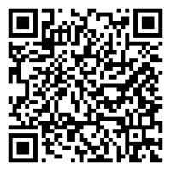
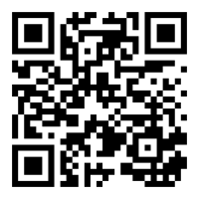
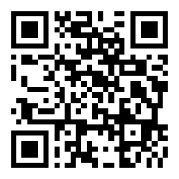
Additional ACCC Resources
Live Streaming Webinar:
May 21, 2026
Downloadable PDFs
Cutting Through the Noise: Practical Insights About AI in Cancer Care
Tip Sheet: Getting
Started With Generative AI
accc-cancer.org/AI-Tip-Sheet
Survey: AI in
Cancer Care Delivery
accc-cancer.org/AI-Survey

Slide 42
References
Abd-Alrazaq A, AlSaad R, Shuweihdi F, Ahmed A, Aziz S, Sheikh J. Systematic review and meta-analysis of performance of wearable artificial intelligence in detecting and predicting depression. NPJ Digital Medicine. 2023;6:84. doi:10.1038/s41746-023-00828-5
Akdogan O, Uyar GC, Yesilbas E, Baskurt K, Malkoc NA, Ozdemir N, et al. Effect of a ChatGPT-based digital counseling intervention on anxiety and depression in patients with cancer: a prospective, randomized trial. European Journal of Cancer. 2025;221:115408. doi:10.1016/j.ejca.2025.115408
American Medical Association. AMA issues new principles for AI development, deployment and use. American Medical Association. Published November 28, 2023. Accessed May 12, 2026. https://www.ama-assn.org/press-center/ama-press-releases/ama-issues-new-principles-ai-development-deployment-use
Deshields TL, Wells-Di Gregorio S, Flowers SR, Irwin KE, Nipp R, Padgett L, Zebrack B. Addressing distress management challenges: recommendations from the consensus panel of the American Psychosocial Oncology Society and the Association of Oncology Social Work. CA: A Cancer Journal for Clinicians. 2021;71(5):407-436. doi:10.3322/caac.21672
Gomes N, Pato M, Lourenco AR, Datia N. A survey on wearable sensors for mental health monitoring. Sensors. 2023;23(3):1330. doi:10.3390/s23031330
Health Resources and Services Administration. Designated health professional shortage areas statistics. U.S. Department of Health and Human Services. Published 2024. Accessed May 12, 2026. https://data.hrsa.gov
Heinz MV, Mackin DM, Trudeau BM, Bhattacharya S, Wang Y, Banta HA, et al. Randomized trial of a generative AI chatbot for mental health treatment. NEJM AI. 2025;2(4):AIoa2400802. doi:10.1056/AIoa2400802
Hua Y, Siddals S, Ma Z, Galatzer-Levy I, Xia W, Hau C, Na H, Flathers M, Linardon J, Ayubcha C, Torous J. Charting the evolution of artificial intelligence mental health chatbots from rule-based systems to large language models: a systematic review. World Psychiatry 2025
Im CH, Woo M. Clinical efficacy, therapeutic mechanisms, and implementation features of cognitive behavioral therapy-based chatbots for depression and anxiety: narrative review. JMIR Mental Health. 2025;12:e78340. doi:10.2196/78340

Slide 43
References
Jafarnia JL, Haff PL, Moore RP, Osheim AL, Riley KM, Zheng S, Roth M, Salge MH, Nelson KC. Quality, empathy, and readability of AI chatbot responses to the survivorship needs of adolescents and young adults with melanoma: evaluation study. JMIR Cancer. 2026;12:e84234. doi:10.2196/84234
Joshi G, Jain A, Araveeti SR, Adhikari S, Garg H, Bhandari M. FDA-approved artificial intelligence and machine learning (AI/ML)-enabled medical devices: an updated landscape. Electronics. 2024;13(3):498. doi:10.3390/electronics13030498
Liao Y, Thompson C, Peterson S, Mandrola J, Beg MS. The future of wearable technologies and remote monitoring in health care. American Society of Clinical Oncology Educational Book. 2019;39:115-121. doi:10.1200/EDBK_238919
Obermeyer Z, Powers B, Vogeli C, Mullainathan S. Dissecting racial bias in an algorithm used to manage the health of populations. Science. 2019;366(6464):447-453. doi:10.1126/science.aax2342
Springer F, Maier A, Friedrich M, et al. Digital therapeutic (Mika) targeting distress in patients with cancer: results from a nationwide waitlist randomized controlled trial. Journal of Medical Internet Research. 2024;26:e51949. doi:10.2196/51949
Straw I, Callison-Burch C. Artificial intelligence in mental health and the biases of language-based models. PLOS One. 2020;15(12):e0240376. doi:10.1371/journal.pone.0240376
Verlingue L, Boyer C, Olgiati L, et al. Artificial intelligence in oncology: ensuring safe and effective integration of language models in clinical practice. The Lancet Regional Health – Europe. 2024;46:101064. doi:10.1016/j.lanepe.2024.101064
Zeinali N, Youn N, Albashayreh A, Fan W, Gilbertson White S. Machine learning approaches to predict symptoms in people with cancer: systematic review. JMIR Cancer. 2024;10:e52322. doi:10.2196/52322
Zion SR, Taub CJ, Heathcote LC, et al. Effects of a cognitive behavioral digital therapeutic on anxiety and depression symptoms in patients with cancer: a randomized controlled trial. JCO Oncology Practice. 2023;19(12):1179-1189. doi:10.1200/OP.23.00210

Slide 44
