Slide 1


Considerations in Systemic Neoadjuvant and Postneoadjuvant Therapy for Localized Triple Negative Breast Cancer
Joseph A. Sparano, MD
Ezra Greenspan MD Professor in Clinical Cancer Therapeutics
Icahn School of Medicine at Mt. Sinai
Chief, Division of Hematology/Oncology
Deputy Director, Tisch Cancer Institute
New York, NY, USA
Disclaimer: This presentation is intended for personal use and for informational purposes only and does not replace independent professional judgment. This presentation is the property of Physicians’ Education Resource, LLC (“PER”) and is protected by U.S. and international copyright laws. You may not copy, reproduce, distribute, transmit, modify, or create derivative works of the presentation without the prior written permission from PER.

Slide 2
Triple-Negative Breast Cancer Compared with Other Phenotypes in the California Cancer Registry Study
Population-based study
  6370 with “triple-negative” disease (12%) vs. with 44,704 “other” cases
TNBC more likely to be associated with
  Younger age (<40): OR 1.53
  Non-Hispanic black (OR 1.77) or Hispanic (OR 1.23)
  Higher grade (72% grade 3)
  More advanced stage (66% > stage II vs. 50% ER+HER2-)
  Poorer 5-year RFI irrespective of stage
    TNBC: 76% (similar to 76% for HER2-Pos)
    HR-Pos, HER2-Neg: 94%
Bauer KR et al. Cancer 2007 (PMID: 17387718); Parise CA et al. The Breast Journal 2009 (PMID: 19764994)

Slide 3
Adjuvant Therapy
Without Prior Neoadjuvant Chemotherapy

Slide 4
Timing of Adjuvant Chemotherapy in TNBC
Interval of < 120 days between diagnosis and ACT quality metric for stage II-III ER/PR-neg BC in women < 70 years (National Quality Forum, ASCO, NCCN)¹
Population-based studies have shown > 90 day interval between surgery and ACT associated with inferior BCSS in TNBC²
Systematic review and metaanalysis³
  78,462 patients in 12 reports
  Compared interval </= 30 days vs. 31-60 days
  Inferior OS in TNBC (HR 1.26, 95% CI 1.08-1.48)
  No impact on OS in HER2+ or ER+ BC
  Not adjusted for comorbidities or type of surgery
1. Desch et al. J Clin Oncol 2018 (PMID:18640941).
2. Chavez-MacGregor et al. JAMA Oncol 2016 (PMID: 26659132).
3 . Zhan et al. Oncotarget 2017 (PMID: 29416807)

Slide 5
E1199: AC followed by Paclitaxel or Docetaxel (Weekly vs. Every 3 Weeks)
Exploratory Analysis in TNBC (N=1025) – Weekly Paclitaxel Associated with Improved DFS and OS
Sparano et al. N Engl J Med. 2008 (PMID: 18420499); Sparano et al. J Clin Oncol. 2015 (PMID: 26077235)
Notes:
When evaluating outcomes by breast cancer subtype, weekly paclitaxel was associated with improved outcomes.
(Advance) Weekly paclitaxel was associated with improved 10 year OS rate from 66% to 75%.
(Advance) The hazard ratio was 0.69 for this comparison.
(Advance) 10 year DFS rates improved from 59% to 69% with weekly paclitaxel, (advance) with a similar hazard ratio of 0.69.
Similar benefits were not observed for every 3 week docetaxel.

Slide 6
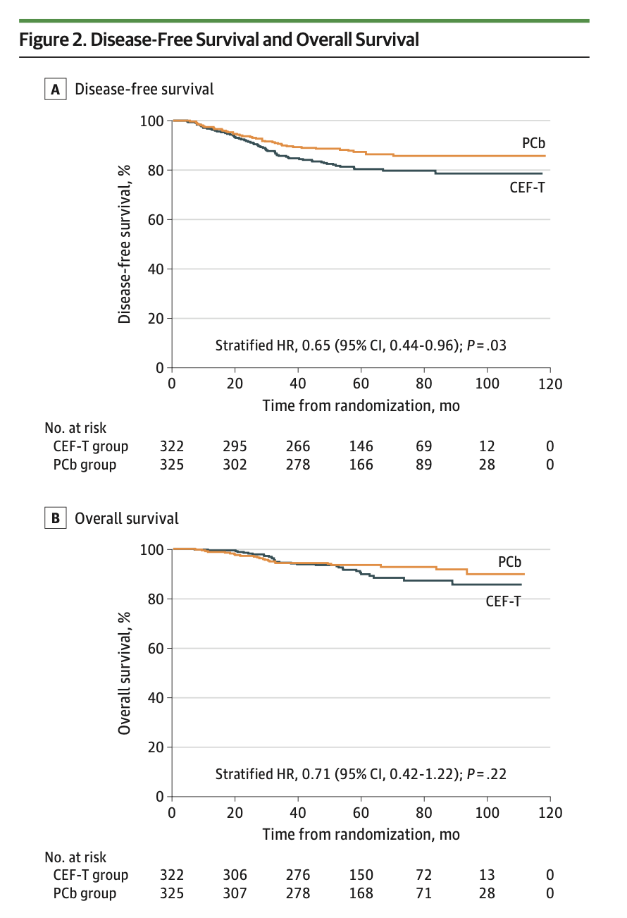
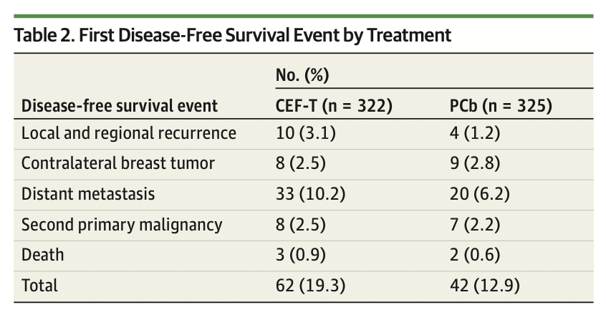
Adjuvant Paclitaxel + Carboplatin in Early TNBC
N=647 1:1 randomization to (mg/m2)
Weekly paclitaxel 80/carboplatin AUC 2 D1, 8, 15 q28d x 6 cycles
CEF (500/100/500) x3 cycles then docetaxel 100 x 3 cycles
74% Node- & 26% Node+
54% T1 & 46% T2/T3
27% Grade 1/2 & 73% Grade 3
Yu et al. JAMA Oncol. 2020 (PMID: 32789480)

Slide 7
Neoadjuvant Chemotherapy

Slide 8
Pros and Cons of Neoadjuvant Chemotherapy
Pros
  High clinical response rates
  Downstaging in breast and regional nodes
    Facilitates breast conservation
    Facilitates sparing of axillary dissection
  Pharmacodynamic biomarker - prognostic based on presence/absence of residual disease
    Provides opportunity to tailor adjuvant therapy
    Additional time for genetic testing may inform local therapy decisions
Cons
  Some experience disease progression
  Serious toxicities could lead to delays in potentially curable surgery
  Higher false negative sentinel node biopsy rates
  Compared with same treatment given as adjuvant therapy, there is no recurrence or survival advantage and higher local recurrence rates for breast conservation surgery if there is not proper attention to primary tumor and nodal clip placement

Slide 9
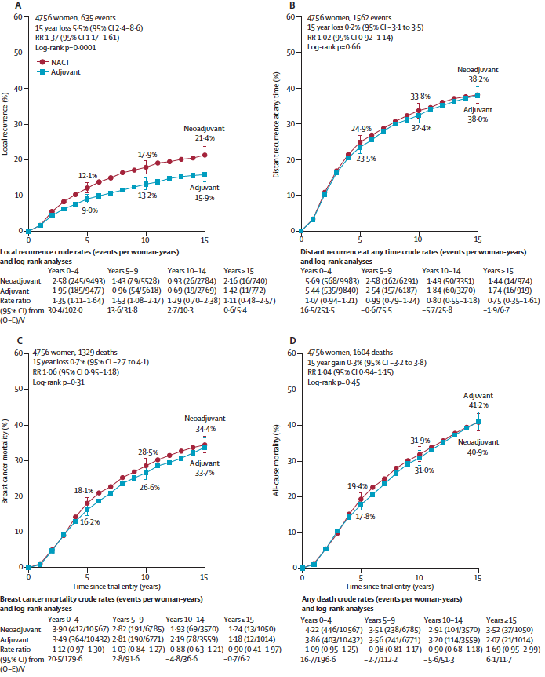
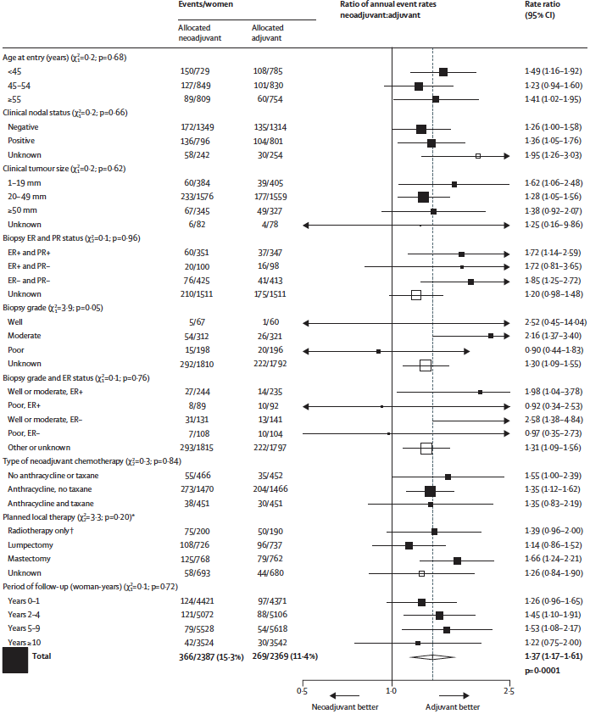
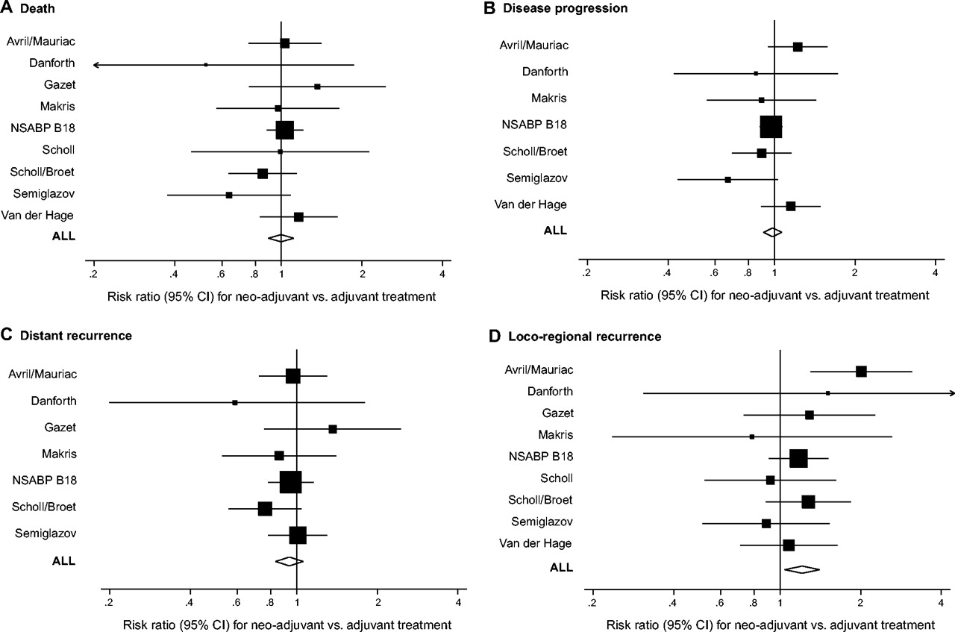
Metaanalyses of Randomized Trials Comparing Pre vs. Postoperative Systemic Chemotherapy
Distant Recurrence
Death
Progression
LRR Recurrence
Recurrence
LRR Recurrence
BCA Mortality
Overall Mortality
9 trials, 3046 patients
Higher local recurrence rates with NACT
LRR stratified by ER/PR status
10 trials conducted between 1983-2002 including 4756 patients (median followup 9 years)
Mauri et al. JNCI 2005;97:188-194 (PMID: 15687361)
EBCTCG. Lancet Oncol 2018;19(1):27-39 (PMID: 29242041)

Slide 10
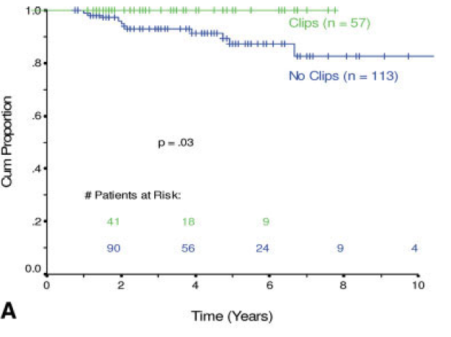
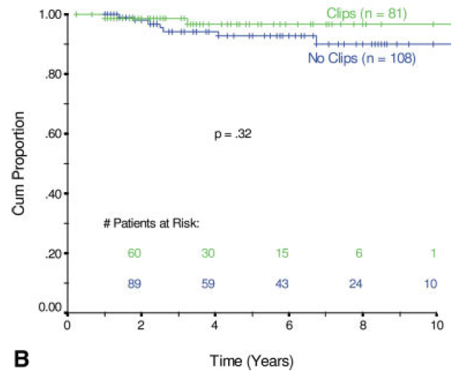
Placement of Radiopaque Clips for Tumor Localization in Patients Undergoing
Neoadjuvant Chemotherapy for Breast Conservation Therapy
Retrospective review of 373 patients who received neoadjuvant doxorubicin-containing chemotherapy between 1990-2005
Locoregional recurrence patterns evaluated in patients with (N=138) and without (N=211) clip placement
Clip placement more likely to be node-negative (52% vs. 31%) and less likely to have stage III disease (20% vs. 38%)
pCR or residual disease < 1 cm
Residual disease > 1 cm
Oh et al. Cancer 2007 (PMID: 17941034)

Slide 11
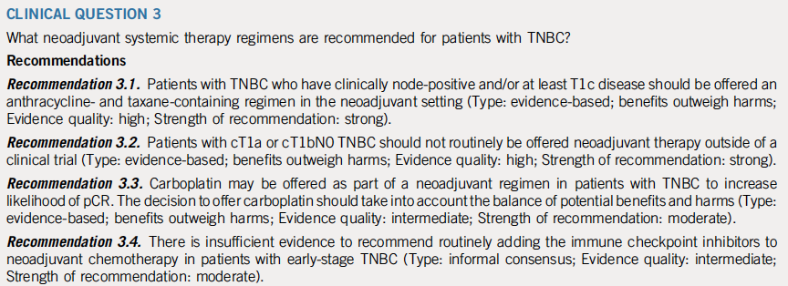
Neoadjuvant Chemotherapy, Endocrine Therapy, and Targeted Therapy for Breast Cancer: ASCO Guideline
Korde et al. J Clin Oncol. 2021 (PMID: 33507815)

Slide 12
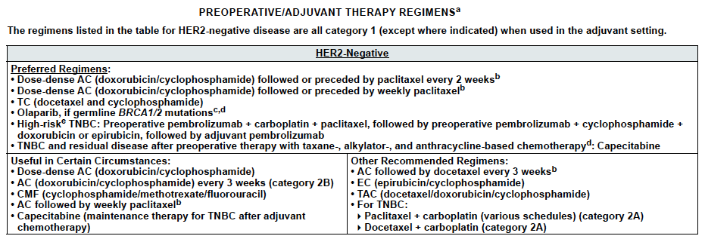
NCCN Guidelines V5.2024 (10/15/24)
High risk: clinical stage II-III TNBC; the use of adjuvant pembrolizumab (category 2A) may be individualized

Slide 13
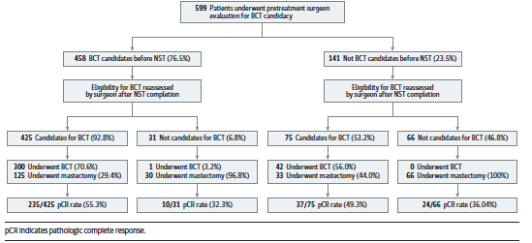
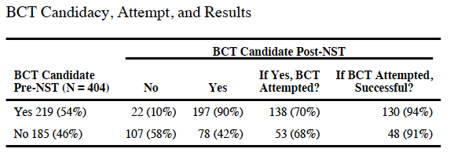
Neoadjuvant Chemotherapy Facilitates Breast Conservation
BrightNess trial - 634 randomized
604 had prospective pre- and post-NST assessments
BCT eligibility rate increased 76% to 88%
342/502 (68%) deemed BCT eligible after NST had BCT
141 (23%) deemed BCT ineligible at baseline
    75 (53%) converted to BCT eligible
C40603 trial - 443 randomized
404 assessable for surgical outcomes
BCT eligibility rate increased 54% to 68%
185 (46%) deemed BCT ineligible at baseline
    78 (42%) converted to BCT eligible
    53 (29%) chose BCT
    48 (26%) had successful BCT
Golshan et al. JAMA Surgery 2020 (PMID: 31913413)
Golshan et al. Ann Surg 2015 (PMID: 26222764)

Slide 14
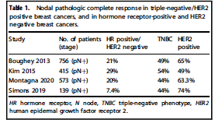
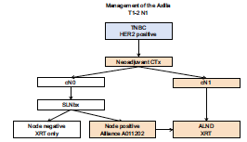
Management of the Axilla after Neoadjuvant Chemotherapy
Proposed Criteria for SLNB after NAC For Nodal Disease at Presentation
Limit to N1 disease at presentation
Clinically node negative after NAC
Well versed team in sentinel node procedures
Use of dual mapping techniques
Resect all sentinel nodes/harvest >3 nodes
Evaluate for treatment effect in SN
El Tamer M, Kovacs T. NPJ Breast Cancer 2022 (PMID: 35637226)

Slide 15


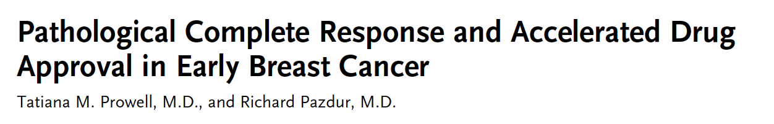
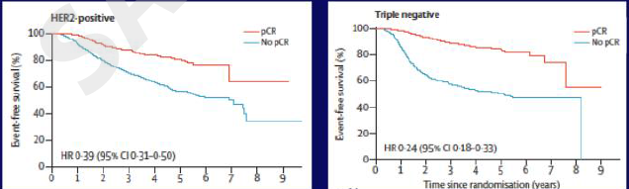
N Engl J Med. 2012;366: 2438-41
Cortazar et al. Lancet. 2014 (PMID: 24529560)

Slide 16
Metaanalysis: pCR after neoadjuvant chemotherapy and impact on breast cancer recurrence and mortality stratified by breast cancer subtypes and adjuvant chemotherapy usage:
Individual patient-level meta-analyses of over 27,000 patients
Confirmed conclusion of original metaanalysis (that included 12 randomized neoadjuvant trials including 12,993 patients)
Now including nearly 2-fold more patients (27,895), but with most new data derived from retrospective cohort studies
Novel analytical method that simulates individual patient data analysis without requiring the actual data
New information
No benefit from additional adjuvant chemotherapy if pCR to NACT
Model to project trial level EFS improvement associated with improved pCR rates
Remaining challenges
Large improvements in pCR (> 20%) required to achieve detectable and clinically meaningful improvements in EFS at the trial level
Cortazar et al. Lancet. 2014 (PMID: 24529560); Spring et al. SABCS 2018; Clin Cancer Res 2020 (PMID: 32046998)

Slide 17
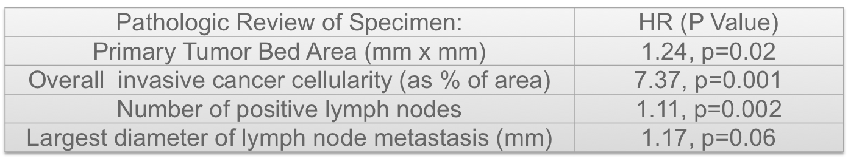
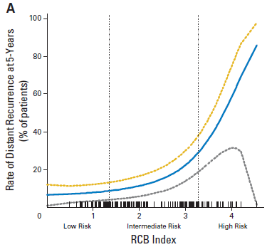
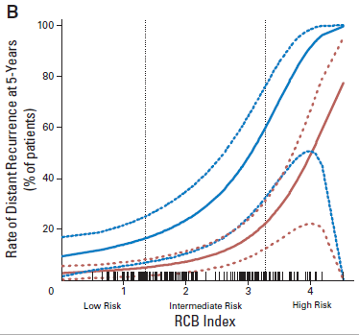
Measurement of Residual Breast Cancer Burden to Predict
Survival After Neoadjuvant Chemotherapy http://www3.mdanderson.org/app/medcalc/index.cfm?pagename=jsconvert3
All Patients
ER-Neg
ER-Pos
Symmans et al. J Clin Oncol 2007 (PMID: 17785706)

Slide 18
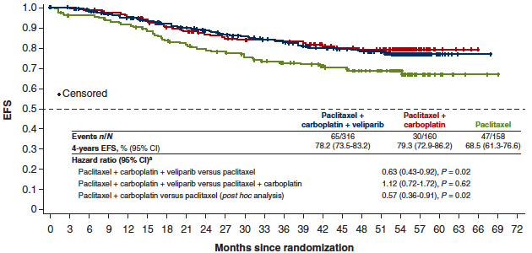
Addition of neoadjuvant carboplatin to taxanes/anthracycline regimens in TNBC
CALGB 40603
GeparSixto
BrighTNess
2x2 factorial randomized phase II (n=443)
pCR increased: 41% to 54% (p=0.003)
Addition of Cb did not improve EFS:
5-yr EFS HR 0.99 (0.70-1.40)
Randomized phase II (n=588)
pCR: 43% to 53% (p=0.015)
Addition of Cb improved DFS (not OS):
3-yr DFS HR 0.56 (0.34-0.93): 76% to 86%
Randomized phase III (n=634)
pCR increased: 49% (T), 58% (TCb), 53% (TCbV)
Addition of Cb improved EFS (not OS): 4-yr EFS
  T vs. TCbV: HR 0.63 (0.43-0.92): 69% to 78%
  T vs. TCb: HR 0.57 (0.36-0.91): 69% to 79%
Sikov W et al. J Clin Oncol. 2015; Sikov W et al. ASCO 2019; Modified from von Minckwitz G et al. Lancet Oncol. 2014; Loibl S et al. Ann Oncol. 2018; Loibl S et al. Lancet Oncol. 2018; Geyer CE et al. Ann Oncol. 2022

Slide 19
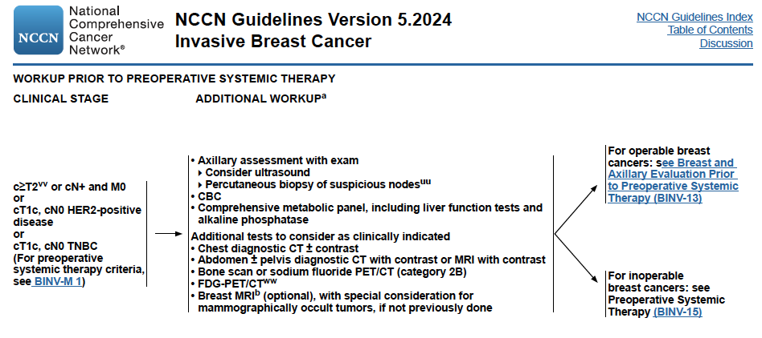

Slide 20
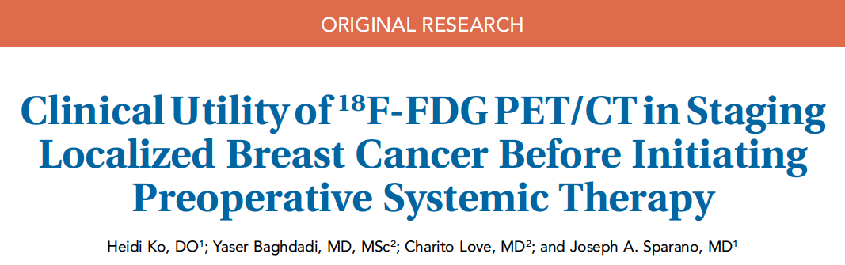
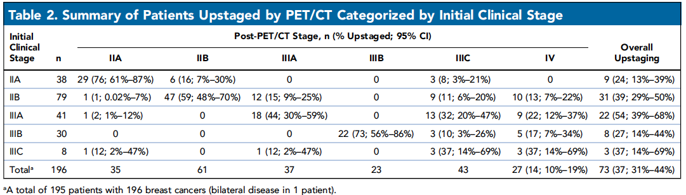
PET/CT as Staging Test
195 patients - neoadjuvant therapy (35% TNBC)
Single center – retrospective review PET/CT
Upstaging rate: 37% for LR and distant disease
Advantages of PET/CT
  Convenience: 1 vs. 2 procedures
  Safety: no contrast
  Lower radiation dose: 14 vs. 21 mSV
  Lower cost: $1,604 vs. $1,680 (Medicare)
Ko et al. J Natl Compr Canc Netw. 2020 (PMID: 32886897)

Slide 21
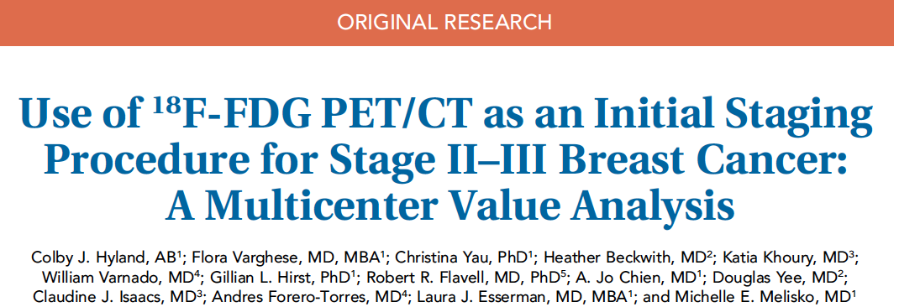
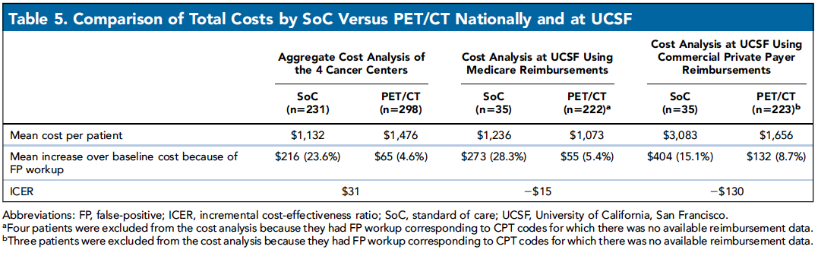
PET/CT vs. CT C/A/P + BS (SoC) in Staging
529 patients in I-SPY trial (32% TNBC)
4 centers – retrospective review
Advantages of PET/CT
  Reduce false pos risk by 50%
  Decreased workup of incidental ﬁndings
  Allowed earlier treatment
  Cost-effective or saving
Hyland et al. J Natl Compr Canc Netw. 2020 (PMID: 33152704)

Slide 22
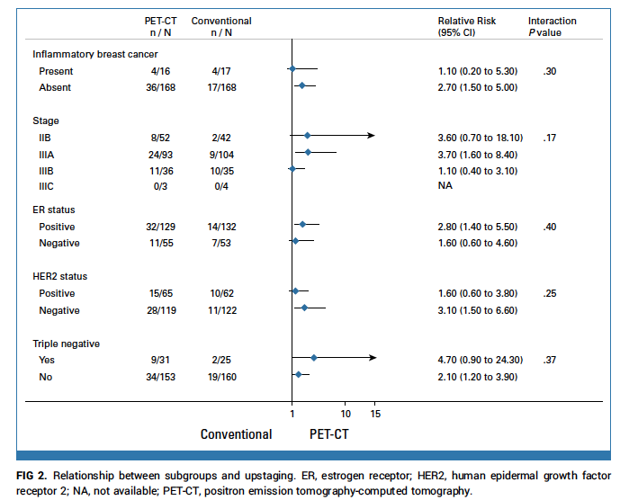
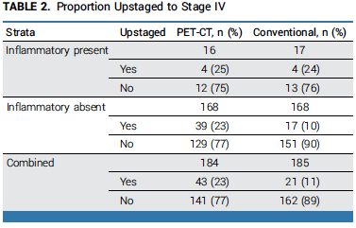
Impact of 18F-Labeled Fluorodeoxyglucose Positron Emission Tomography Computed Tomography Versus Conventional Staging in Patients With Locally Advanced Breast Cancer
Study Design:
Inclusion Criteria:
- IDC TNM stage III or IIB (T3N0, but not T2N1)
Randomized to:
  18F-labeled fluorodeoxyglucose PET-CT
  Bone scan, CT-C/A/P
Primary end point:
Upstaging to stage IV
Secondary endpoint:
Curative intent combined modality therapy
Dayes et al. J Clin Oncol. 2023 (PMID: 37235845)

Slide 23
Adjuvant Therapy after Prior Neoadjuvant Chemotherapy

Slide 24
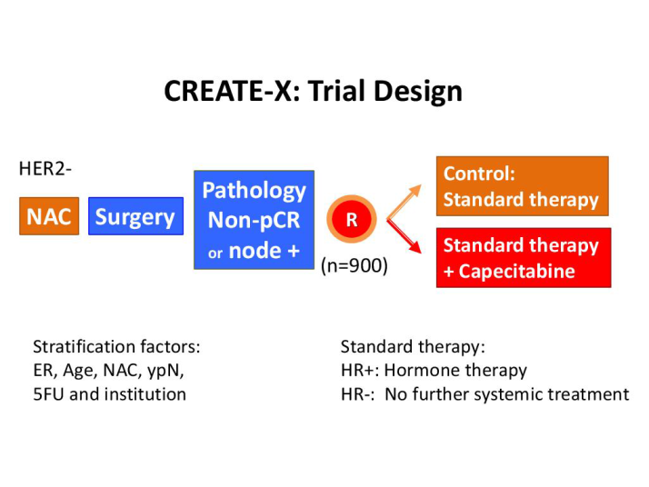
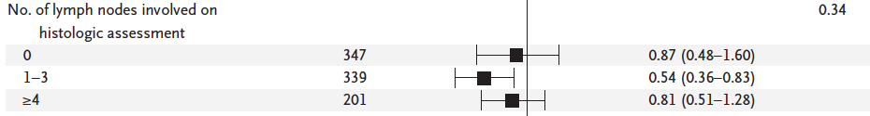
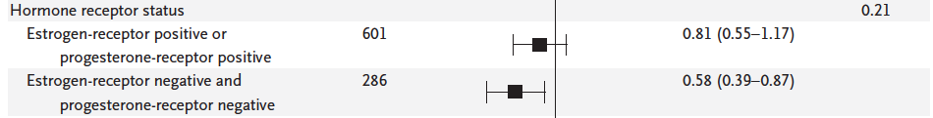
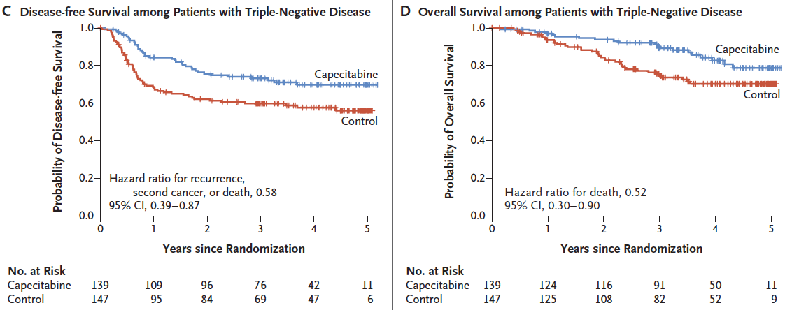
Adjuvant Capecitabine for Breast Cancer after
Preoperative Chemotherapy
Masuda et al. N Engl J Med. 2017 (PMID: 28564564)

Slide 25
Mayer et al. J Clin Oncol 2021 (PMID: 34092112)

Slide 26
EA1131 – Results: Adjuvant platinum not better than capecitabine in residual
TNBC after prior taxane-containing neoadjuvant chemotherapy
Mayer et al. J Clin Oncol 2021 (PMID: 34092112)

Slide 27
Tutt et al. NEJM 2021 (PMID: 34081848)

Slide 28
Tutt et al. NEJM 2021 (PMID: 34081848)

Slide 29
Tutt et al. NEJM 2021 (PMID: 34081848)

Slide 30
Tutt et al. NEJM 2021 (PMID: 34081848)

Slide 31
Tutt et al. NEJM 2021 (PMID: 34081848)

Slide 32
ESMO Virtual Plenary March 2022
Second prespecified event-driven analysis
Olaparib significantly improved OS
Hazard ratio = 0.68 (P = .009)
3.8% absolute improvement
Tutt et al. NEJM 2021 (PMID: 34081848); Geyer et al. Ann Oncol 2022 (PMID: 36228963)

Slide 33
Tutt et al. NEJM 2021 (PMID: 34081848)

Slide 34
Antiemetic therapy often required with olaparib
Tutt et al. NEJM 2021 (PMID: 34081848)

Slide 35
Tutt et al. NEJM 2021 (PMID: 34081848)

Slide 36
Neoadjuvant and Adjuvant
Immune Checkpoint Blockade

Slide 37
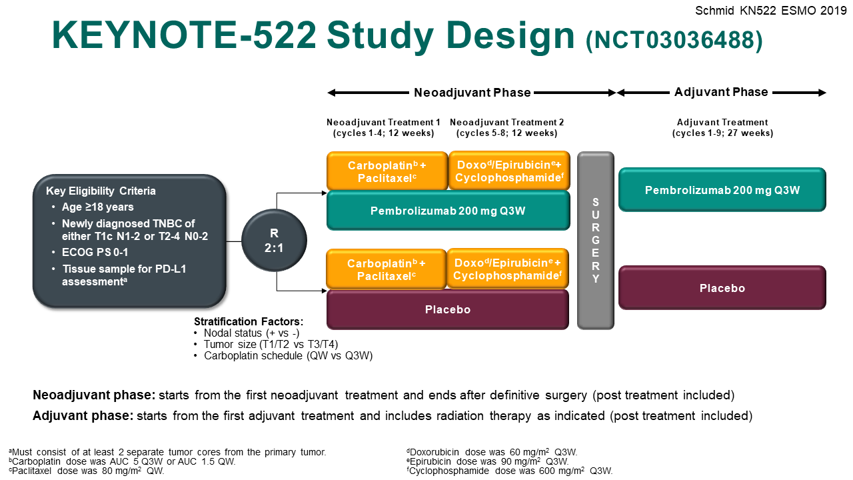
Schmid et al. N Engl J Med 2020 (PMID: 32101663)

Slide 38
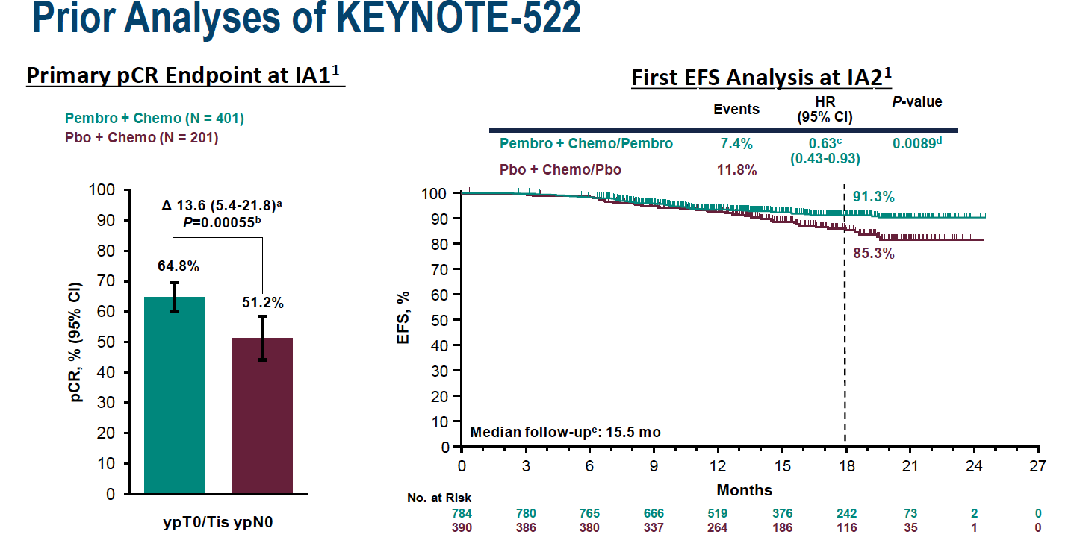
Keynote 522 – Results at IA1 and IA2: Improved pCR and EFS
Schmid et al. N Engl J Med 2020 (PMID: 32101663)

Slide 39
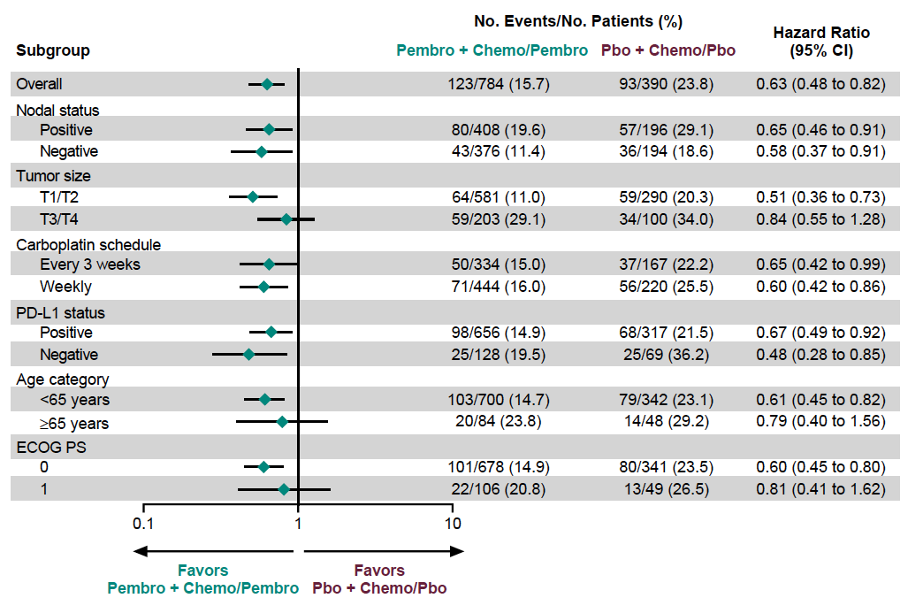
Keynote 522 – Results: PD-L1 (CPS Score) Prognostic but Not
Predictive of Benefit from Pembrolizumab for both pCR or EFS
Schmid et al. N Engl J Med 2020 (PMID: 32101663): Schmid et al. NEJM 2022 (PMID: 35139274) and ESMO Virtual Plenary Session 7/16/21 (Interim Analysis IA4)

Slide 40
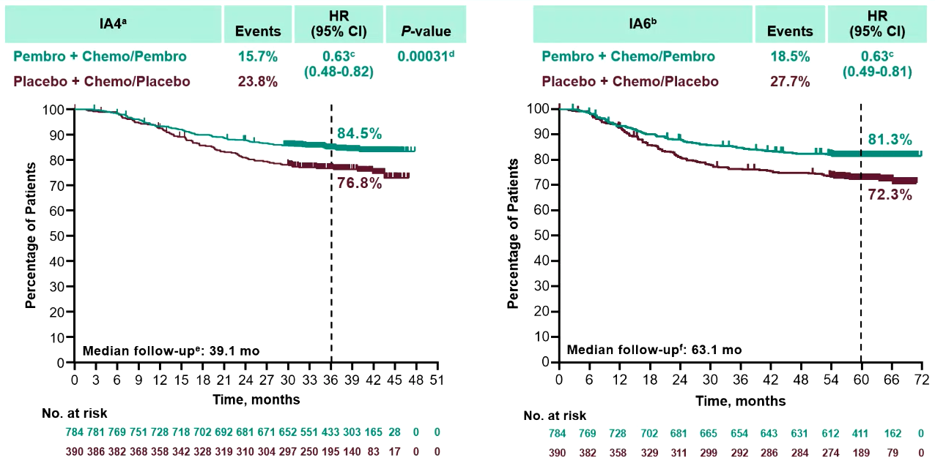
KEYNOTE-522 (Phase 3): Efficacy – EFS
EFS subgroup analyses: benefit with Pembro was generally consistent across prespecified subgroups, including those defined by PD-L1 expression and nodal involvement
Schmid P, et al. ESMO 2023. Abstract LBA18

Slide 41
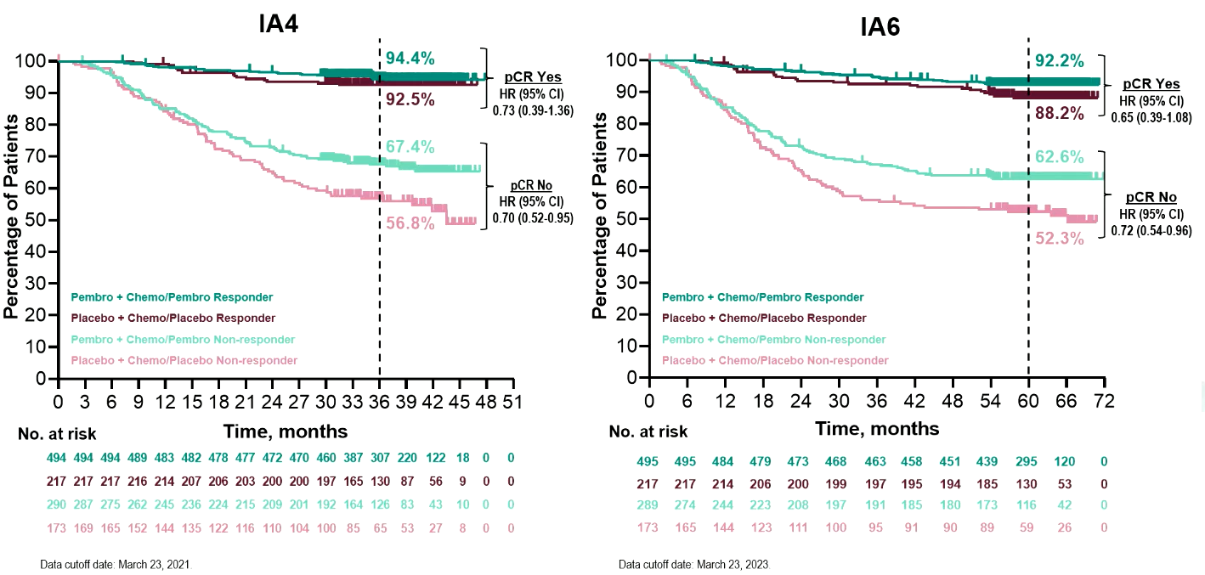
KEYNOTE-522 (Phase 3): Efficacy – EFS by pCR (ypT0Tis ypN0)
Schmid P, et al. ESMO 2023. Abstract LBA18

Slide 42
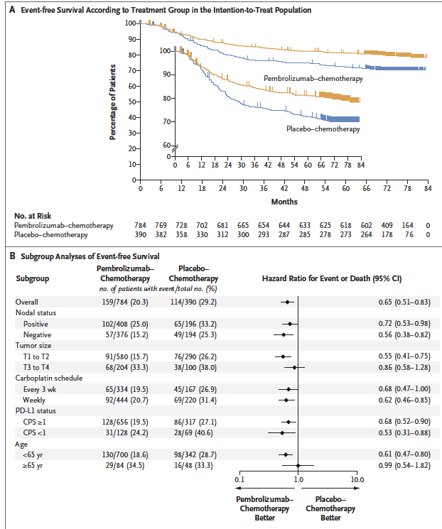
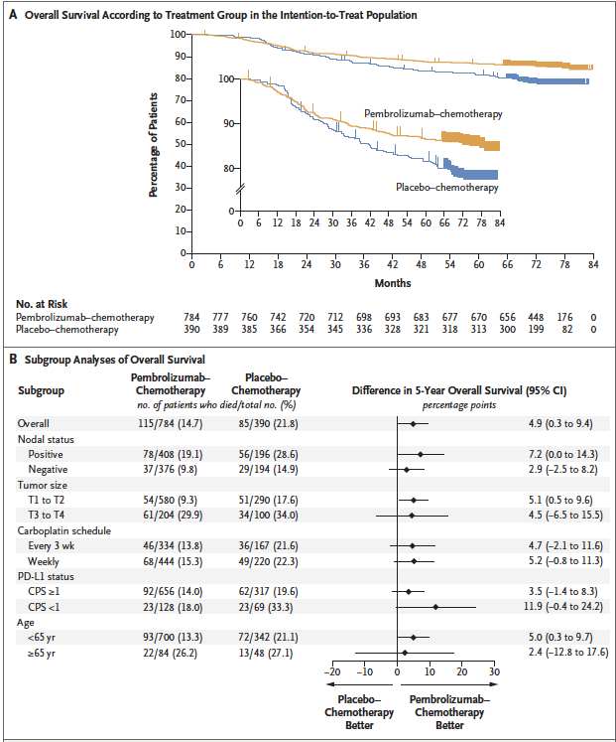
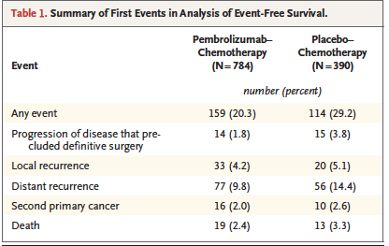
KEYNOTE-522 (Phase 3): FINAL EFS & OS
EFS
OS
Schmid et al. NEJM 2024 (PMID 39282906)

Slide 43
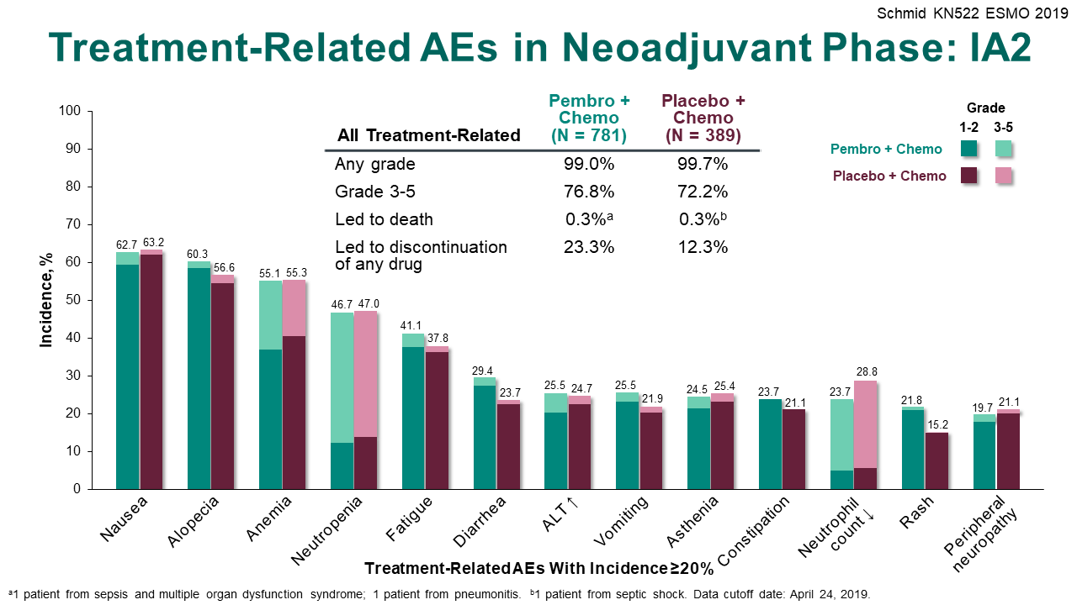
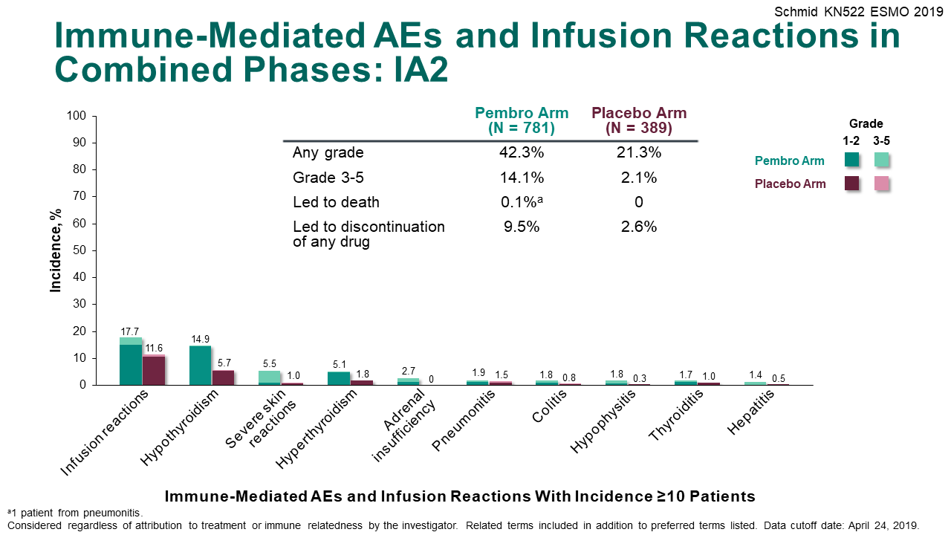
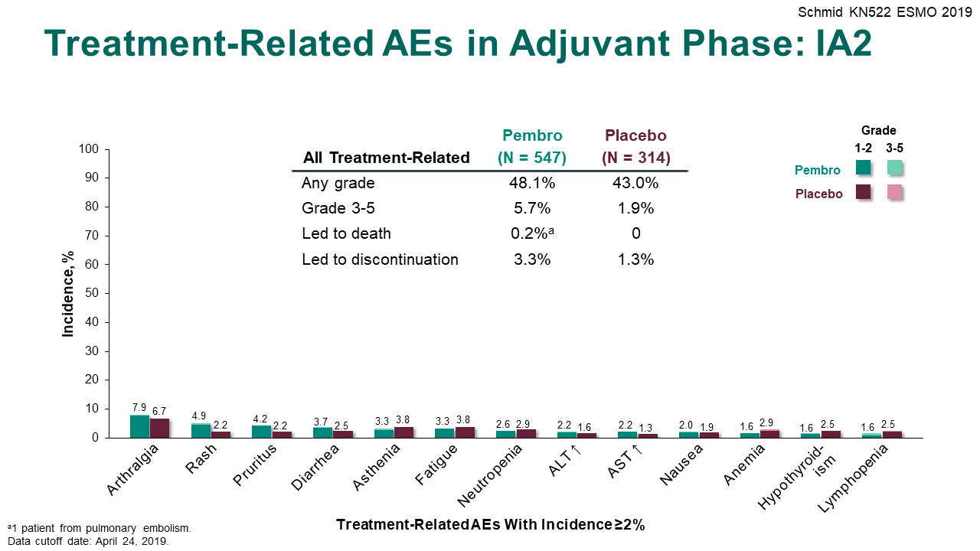
Keynote 522 – Results: More Adverse Events with Pembrolizumab
Schmid P, et al. N Engl J Med 2020;382:810-21 (PMID: 32101663); IA4 presented at ESMO Virtual Plenary Session 7/16/21

Slide 44
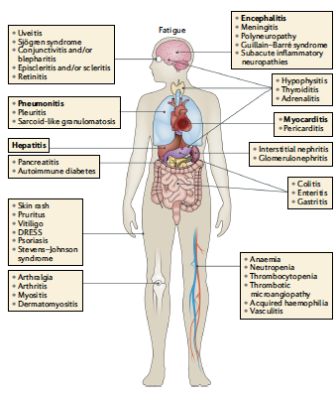
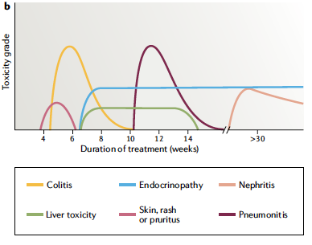
Timing and Severity of Immune Adverse Events
Martins et al. Nature Reviews Clinical Oncology 2019 (PMID: 31092901)

Slide 45
Key points in the management of irAEs
Organ-specific system-based toxicity management is recommended
 | ICI therapy | irAE treatment | Exception
Grade 1 | Continue with close monitoring |  | Some neuro, heme, & cardiac
Grade 2 | Hold until reverts to </= G1 May rechallenge | Steroids
Grade 3 | Hold until to </-G1 Consider rechallenge | High-dose steroids until </= G1 Add other immunosuppressives s if not improved in 1-3 days Slow taper over 2-4 wks or longer
Grade 4 | Permanently discontinue |  | Endocrinopathies
Adapted from Brahmer et al, JCO 2018
Brahmer JR, et al. J Clin Oncol 2018; Haanen JB, et al. Ann Oncol 2017; Thompson JA, et al. JNCCN 2020

Slide 46
Is there a role for PARPi + checkpoint inhibitor maintenance therapy in the metastatic setting?
KEYLYNK-009: Olaparib + Pembrolizumab vs Chemotherapy + Pembrolizumab after Induction with 1L Chemotherapy + Pembrolizumab

Slide 47
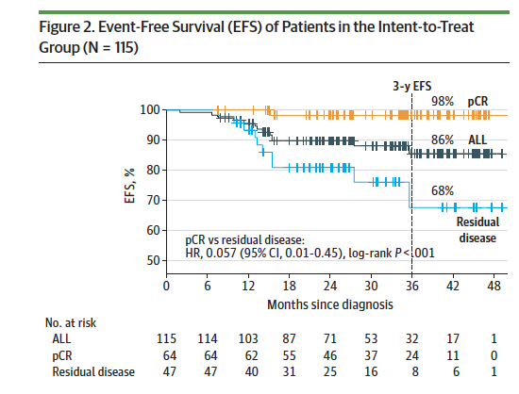
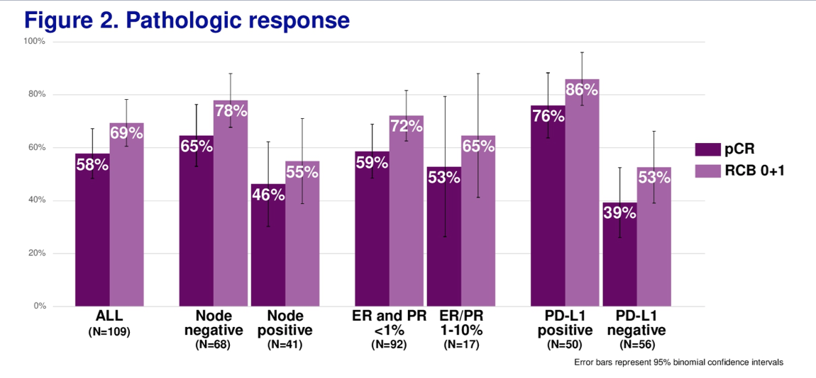
Phase II NeoPACT: Neoadjuvant Pembrolizumab + Carboplatin/Docetaxel without Anthracyclines (n=115)
Overall pCR 58%
>Grade 3 IRAEs 3.8%
Median FU 27.4 months
Sharma et al. JAMA Oncol 2024 (PMID: 37991778)

Slide 48
Take Home Messages
Systemic Neoadjuvant and Post-neoadjuvant Therapy for Localized Triple Negative Breast Cancer
Initial workup should include
  Biopsy confirmation of breast and axillary nodes (if suspected) with biomarkers (ER, PR, HER)
  Clip placement in tumor bed and suspicious/positive axillary node
  Radiographic assessment of breast and axilla (mammo, sonogram, and MRI in selected cases)
  Systemic workup to assess for distant and locoregional metastases (CT+BS or PET-CT)
  Genetic testing for germline BRCA mutation status
Neoadjuvant systemic chemotherapy recommended for majority of women with localized TNBC
  Histologically confirmed positive nodes and/or primary tumor > 1.5 cm
  Sequential anthracycline/cyclophosphamide-taxane regimen recommended
  Addition of carboplatin improves pCR rate, reduces distant recurrence, improves EFS (in absence of immunotherapy)
  Facilitates breast conservation, downstages axilla, and spares axillary dissection in selected patients
Immune checkpoint blockade (pembrolizumab) – neoadjuvant/adjuvant
  Improves pathCR rates, EFS , and OS – recommended for higher risk stage II-IIIC disease
  In contrast to MBC, PD-L1 CPS Score (>10) not predictive for pembrolizumab benefit
Adjuvant therapy after neoadjuvant therapy
  Adjuvant pembrolizumab recommended after neoadjuvant pembrolizumab + NAC (if no prior serious IRAE)
  Capecitabine recommended if residual disease – benefit unclear if neoadjuvant/adjuvant pembrolizumab used
  Adjuvant olaparib improved DDFS and OS in BRCA mutation carriers

Slide 49
Clinical Questions Raised by Recent Trials in TNBC
Chemotherapy de-escalation: When pembrolizumab is used as a component of neoadjuvant systemic therapy for TNBC, what is the optimal chemotherapy regimen and can fewer chemotherapy agents be used without comprising results?
Role of adjuvant pembrolizumab: Is adjuvant pembrolizumab necessary after neoadjuvant pembrolizumab plus chemotherapy, especially in those who have achieved a pCR?
Role of adjuvant capecitabine: For those treated with neoadjuvant chemoimmunotherapy who have residual disease at surgery and do not have a pathogenic germline BRCA1/2 variant, is adjuvant capecitabine beneﬁcial, and should it be combined with adjuvant pembrolizumab?
Management of pathogenic BRCA variants: For those treated with neoadjuvant chemoimmunotherapy who have residual disease at surgery and have a pathogenic germline BRCA1/2 variant, is adjuvant olaparib beneﬁcial, and should it be combined with adjuvant pembrolizumab?
Role of antibody drug conjugates: Will sacituzumab govitecan be effective as adjuvant therapy in those with residual disease after neoadjuvant chemotherapy (with or without immunotherapy), and can it be combined with immunotherapy in this context, as well as in metastatic TNBC?
Kessler A, Sparano J. Critical Reviews in Oncology and Hematology 2022 (PMID: 35093499)

Slide 50
Ongoing Post-Neoadjuvant Studies
Study | Treatment Arms
Pathologic Complete Response After Prior Neoadjuvant Chemotherapy Plus Pembrolizumab
OptimICE (Alliance) NCT05812807 | Adjuvant pembrolizumab x 9 cycles vs. No further pembrolizumab
Residual Disease After Prior Neoadjuvant Chemotherapy
ASCENT-05/OptimICE-RD NCT05633654 | Sacituzumab Govitecan-hziy and Pembrolizumab Vs. Treatment of Physician's Choice
TROPION-Breast03 NCT05629585 | Dato-DXd Vs. Dato-DXd plus Durvalumab Vs. Investigator's Choice of Therapy

