Slide 1



Clinical Utility of PET in
Breast Cancer Management
David Schuster, MD
Director, Division of Nuclear Medicine and Molecular Imaging
Department of Radiology and Imaging Sciences
Emory University
In Memory: Edward V. Staab, M.D., co-author
Disclaimer: This presentation is intended for personal use and for informational purposes only and does not replace independent professional judgment. This presentation is the property of Physicians’ Education Resource, LLC (“PER”) and is protected by U.S. and international copyright laws. You may not copy, reproduce, distribute, transmit, modify, or create derivative works of the presentation without the prior written permission from PER.

Slide 2
Take Aways
FDG PET:
  Indicates level of glycolysis in normal and abnormal tissues
Notes:
2

Slide 3
Take Aways
FDG PET:
  Indicates level of glycolysis in normal and abnormal tissues
  Whole body imaging has limited value in detection and initial axillary nodal staging
Notes:
3

Slide 4
Take Aways
FDG PET:
  Indicates level of glycolysis in normal and abnormal tissues
  Whole body imaging has limited value in detection and initial axillary nodal staging
  Useful for high risk, recurrence and restaging
Notes:
4

Slide 5
Take Aways
FDG PET:
  Indicates level of glycolysis in normal and abnormal tissues
  Whole body imaging has limited value in detection and initial axillary nodal staging
  Useful for high risk, recurrence and restaging
  Useful for monitoring treatment response and predicting outcome
Notes:
5

Slide 6
Take Aways
FDG PET:
  Indicates level of glycolysis in normal and abnormal tissues
  Whole body imaging has limited value in detection and initial axillary nodal staging
  Useful for high risk, recurrence and restaging
  Useful for monitoring treatment response and predicting outcome
  Best used in appropriate patient population
Notes:
6

Slide 7
Take Aways
FDG PET:
  Indicates level of glycolysis in normal and abnormal tissues
  Whole body imaging has limited value in detection and initial axillary nodal staging
  Useful for high risk, recurrence and restaging
  Useful for monitoring treatment response and predicting outcome
  Best used in appropriate patient population
  This concept includes FES PET (Cerianna).
Notes:
7

Slide 8
¹⁸F-FDG Concentration in the Cell Is Proportional to Glucose Metabolism
(GLUT transporters)
GLUT
Glycogen
Glucose
Glucose
Hexokinase II
Glk-6-P
Glycolysis
Pyruvate
Oxidation
x
FDG
FDG
Hexokinase II
FDG-6-P
x
Notes:
8

Slide 9
  Biologic Correlates of FDG Uptake in Human Breast Cancer on PET
ER, PR status
  Higher uptake with triple negative, HER2 positive, HR negative
  Lower with Luminal A
Uptake inversely correlates with prognosis (DFS and OS)
  ALN/Tumor ratio + correlates with risk
Mitotic activity index
Histology grade
P53 mutation
Tumor cells/volume
Microvessel density
Amount of necrosis
Recurrence Score
BRCA Mutation
Bos R et al. J Clin Oncol 2002; 20, 379-87; Osborne et al. J Nucl Med 2010;51:543;
Groheux et al. Nucl Med Comm 2010;31:271; Tchou et al. Mol Imaging Biol 2009;
Wang et al. AJR 2011;197:W247; Morris et al. Cancer 2012;118(22):5454;
Kanserlerinde et al. Mol Imaging Radionucl Ther 2021;30:158
Jin at al. J Surg Onc 2013;107:180; Kadoya et al. Breast Ca Res Treat 2013;141:269
Miyake, et al. AJR 2014;203:272; Kim et al. J Breast Ca 2015;18:173; Ahn et al. Plos One 2017;12:e0175048

Slide 10
FDG Uptake in Breast – Variants
False positives:
  Dysplasia
  10% fibroadenomas
      usually mild
  Ductal ectasia
  Complex cysts
  Fibrocystic change
  Inflammation/infection
  Post-surgical/hematoma
  Silicon leak
  Fat necrosis
  Even a bee sting
Benveniste et al. Eur J Rad 2014;83:919
Miyake et al. Br Ca Res Treat 2018;169:437

Slide 11
FDG Uptake in Breast – Variants
False negatives:
  Lesions < 1 cm
  Tubular carcinoma
  Lobular carcinoma
    primary and metastases
  Carcinoma in-situ
Benveniste et al. Eur J Rad 2014;83:919
Miyake et al. Br Ca Res Treat 2018;169:437

Slide 12
FDG Uptake in Breast – Variants
Diffuse Uptake
  Dense breasts
  Lactating breasts
  Menstrual cycle
    Luminal A lesion SUVmax
Benveniste et al. Eur J Rad 2014;83:919
Miyake et al. Br Ca Res Treat 2018;169:437

Slide 13
FDG Uptake in Breast – Variants
GCSF within 2-3 weeks and chemotherapy within 10 days may alter FDG uptake.
Wait 3 months > RT for field recurrence.
Benveniste et al. Eur J Rad 2014;83:919
Miyake et al. Br Ca Res Treat 2018;169:437

Slide 14
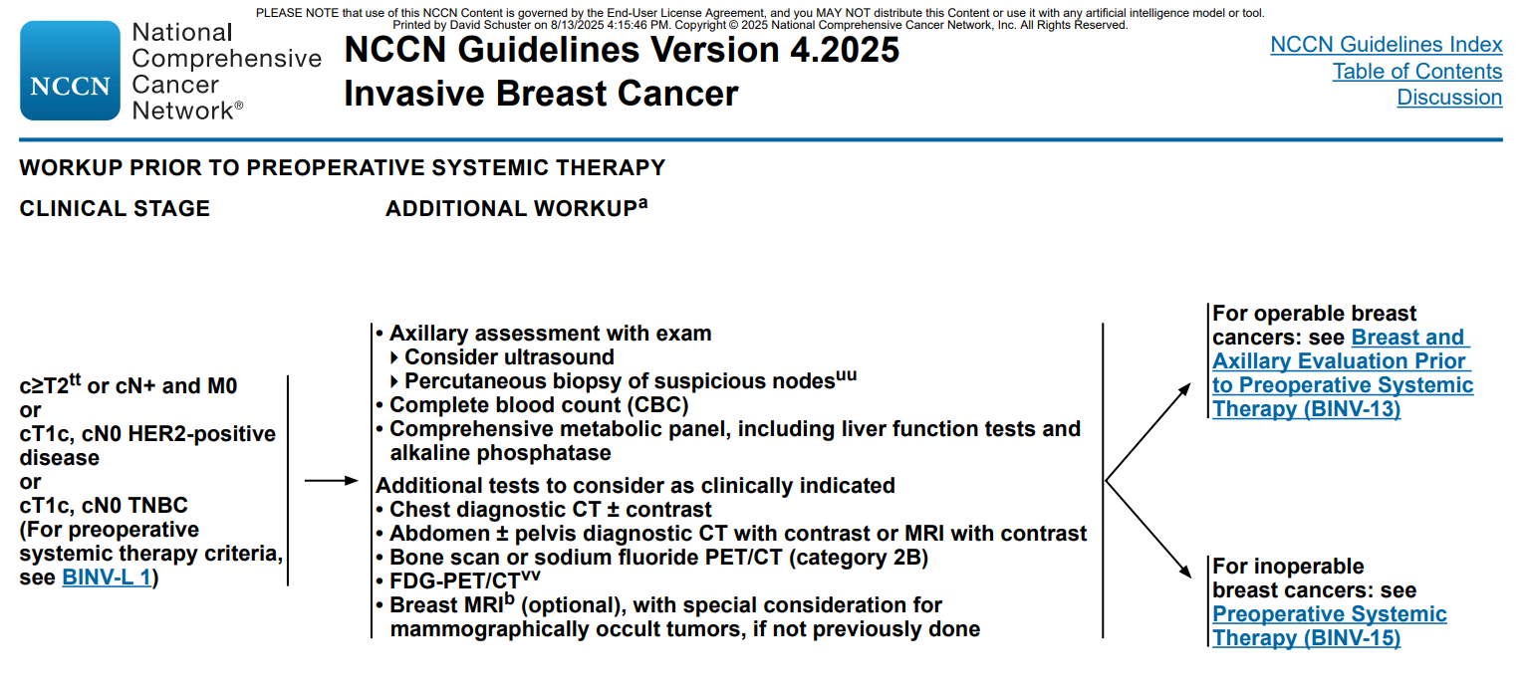
NCCN 4.2025
FDG-PET/CT is most beneficial and accurate for advanced disease (stage III) and invasive ductal (compared to lobular) histology but may be useful in selected circumstances of earlier stage disease (stage IIA disease: T1N1, T2N0) such as: equivocal CT+ bone scan results; suspicion of undetected nodal and/or distant disease; and treatment response assessment. An FDG-PET/CT may be utilized as an adjunct to, or in lieu of, initial standard staging and may be performed simultaneously with diagnostic CT. Conversely, a bone scan or sodium fluoride PET/CT may not be needed if an upfront FDG-PET/CT clearly indicates consistent findings on both PET and CT components.

Slide 15
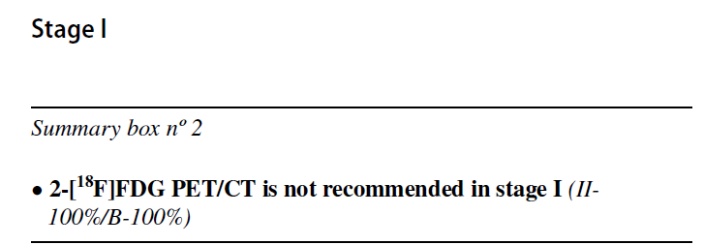
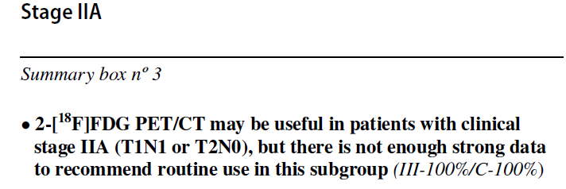
Joint EANM-SNMMI Guidelines
Vaz et al. EJNMMI 2024;51(9):2701-2705

Slide 16
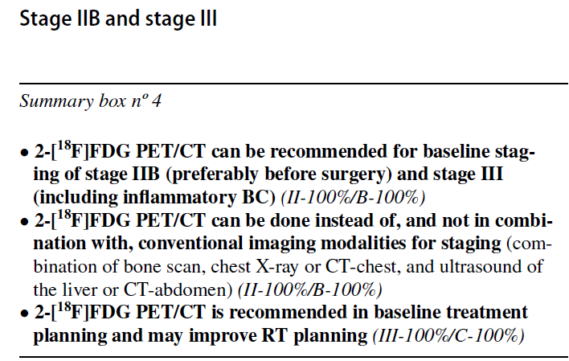
Joint EANM-SNMMI Guidelines
PET has much higher diagnostic performance than CI. Instead of makes more sense than combination.
Vaz et al. EJNMMI 2024;51(9):2701-2705

Slide 17
What is the evidence?
Meta-analysis 4276 patients FDG PET
  Stage change
    11% stage I; 20% stage II; 34% in stage III
  For studies that reported HR status, majority of subjects were ER+
      Han et al. Clin Nucl Med 2021;46:271–282
      Editorial: Ulaner et al. Clin Nucl Med 2021;46:569.

Slide 18

Let’s Break it Down

Slide 19
FDG PET in Breast Cancer
Clinical Applications
Detection of the Primary Lesion
Initial Lymph Node Assessment
Evaluation of Distant Metastasis / Bone Metastasis
Monitoring Response to Chemotherapy
Monitoring Response to Hormonal / Targeted / Immune
Recurrence

Slide 20
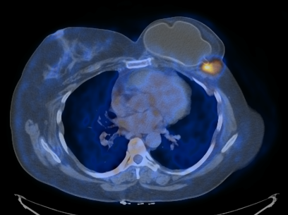
Whole body PET not useful for primary tumor screening/detection
PEM and BSGI/MBI subjects of a separate talk.

Slide 21
Incidental Cancers
Any incidental FDG avid breast lesion merits evaluation
  Cancer in 29.7-56% incidental breast uptake on PET
      Kang et al. AJR 2011;197:341
      Kim et al. Acta Radiol 2012;53:249
      Dunne et al. Br J Radiol 2013;86:20130034
      Shin et al. J Breast Ca 2015;18:73

Slide 22
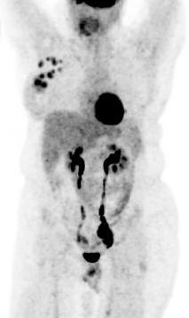
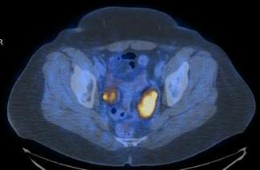
Incidental Cancers
Also, incidental other primary cancers found on PET for breast cancer management
Any incidental FDG avid breast lesion merits evaluation
  Cancer in 29.7-56% incidental breast uptake on PET
      Kang et al. AJR 2011;197:341
      Kim et al. Acta Radiol 2012;53:249
      Dunne et al. Br J Radiol 2013;86:20130034
      Shin et al. J Breast Ca 2015;18:73
Incidental bilateral ovarian cancer found during staging for breast cancer

Slide 23
FDG PET in Breast Cancer
Clinical Applications
Detection of the Primary Lesion
Initial Lymph Node Assessment
Evaluation of Distant Metastasis / Bone Metastasis
Monitoring Response to Chemotherapy
Monitoring Response to Hormonal / Targeted / Immune
Recurrence

Slide 24
  Can PET take Place of Axillary Nodal Dissection/SLN?

Slide 25
  Can PET take Place of Axillary Nodal Dissection/SLN?
Consensus is NO

Slide 26
  Can PET take Place of Axillary Nodal Dissection/SLN?
Consensus is NO
Veronesi et al. Annals Onc 2007;18:473
  236 patients; PET-CT
  Interpretation geared for highest sensitivity
  All SLN; full ALND if PET or SLN positive
  37% sensitivity; 96% specificity
    Many other studies show good PPV for ax nodes.

Slide 27
  What if PET positive and ultrasound negative?
560 patients reviewed
  Divergent PET (+) and US (-) in 20
    17/20 had positive histology
      Parisse-Di Martino et al. Ca Treat Res Comm 2021;27:100344
Recommend repeat focused US with core if possible.

Slide 28
PET Excellent for Mediastinal or IM Metastases
Eubank et al. J Clin Oncol 2001;19:3516
  PET: 85% sens; 90% spec; 88% accuracy; upstaged 10/33
  CT: 50% sens; 83% spec; 70% accuracy
Seo et al. EJNM 2014;41:438
  Used any minimal IM uptake as positive; PPV 87.1%
Sutton et al. Radiology 2015;277:381
  Benign uptake common with implants
Guide decision and field for radiation therapy in high-risk disease by detecting level 3, supraclavicular and IM nodes
  Koolen et al. Br Ca Res Tr 2012;135:231
  Choi et al. J Breast Ca 2013;16:202.

Slide 29
FDG PET in Breast Cancer
Clinical Applications
Detection of the Primary Lesion
Lymph Node Assessment
Evaluation of Distant Metastasis / Bone Metastasis
Monitoring Response to Chemotherapy
Monitoring Response to Hormonal / Targeted / Immune
Recurrence

Slide 30
Distant Disease
6 comparative studies (664 patients) for distant disease
    Sensitivity/specificity of PET-CT 97%/95%
    Conventional imaging 56%/91%.
      Hong et al. Surg Oncol 2013;22(2):139-43
PET is superior to CI for confirming oligometastatic disease.
  Moser et al. J Nucl Med 2024;65:845
  Metser et al. Radiology 2025;316(2):e243788

Slide 31
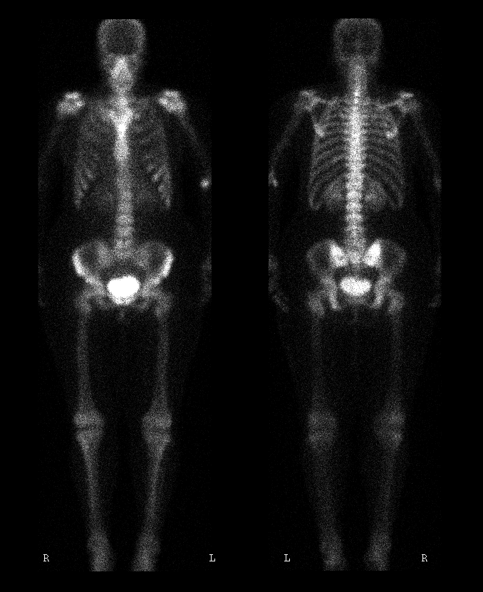
Bone Scan
33 y/o woman, invasive ductal carcinoma, s/p partial right mastectomy, axillary dissection, chemotherapy and radiation therapy

Slide 32
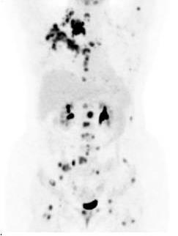
FDG PET

Slide 33
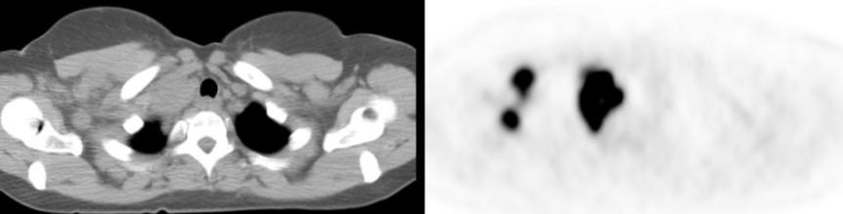
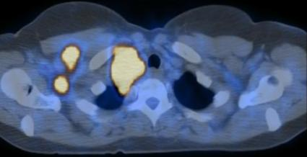
Unsuspected Disease
Extensive malignant lymphadenopathy

Slide 34
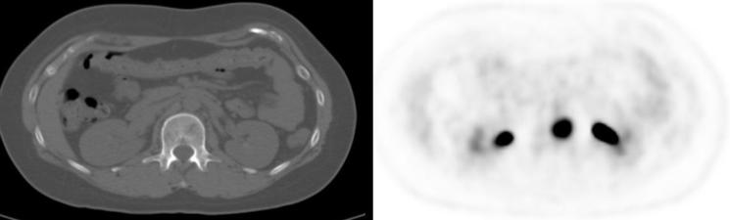
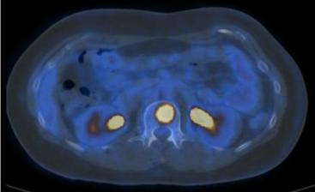
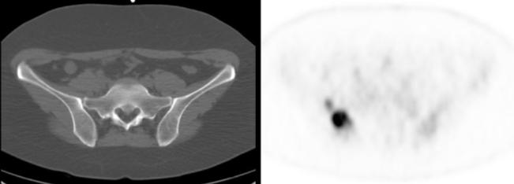
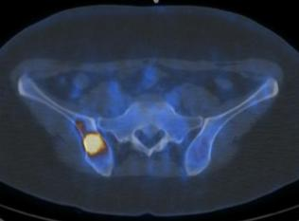
Unsuspected Disease
Extensive malignant lymphadenopathy
Skeletal metastasis unsuspected on CT.

Slide 35
Controversy: PET in Early-Stage Breast Carcinoma
Pritchard, et al. J Clin Onc 2012;30:1274
  325 patient prospective multicenter early stage
    T1=207, T2=110, T3=8
    PET positive 13 patients for distant mets: TP=3, FP=10

Slide 36
Controversy: PET in Early-Stage Breast Carcinoma
Pritchard, et al. J Clin Onc 2012;30:1274
  325 patient prospective multicenter early stage
    T1=207, T2=110, T3=8
    PET positive 13 patients for distant mets: TP=3, FP=10
  Editorial by David Mankoff. J Clin Onc 2012;30:1252
    Do the math…
      At low disease prevalence even a highly accurate test will have far more FP vs TP and result in low yield
      But in advanced and recurrent disease prevalence rises and also more aggressive disease so greater FDG uptake.

Slide 37
Other Studies More Balanced
254 patient prospective
    PET-CT changed stage in 30.3%
    Staging modified 4.5% 2A, 16.1% 2B, 31.7% 3A, 51.4% 3B, 47.1% 3C
        Groheux et al. JNCI 2012;104:1879

Slide 38
Other Studies More Balanced
184 patient multicenter with stage 2B or 3
    Randomized PET vs CI
    23% upstaged to stage 4 with PET vs 11% for CI
    Fewer patients had futile curative therapy with PET
        Dayes et al. J Clin Onc 2023;41:3909
Depending on facility, cost effective/cost saving
For ILC, PET not as great impact
      Ulaner et al. EJNMMI 2017;44:1420
      Hogan et al. J Nucl Med 2015;56:1674
      Hyland et al. JNCCN 2020;18:1510

Slide 39
PET Useful for Inflammatory Breast Cancer Staging
Carkaci et al. JNM 2009;50:231
  PET-CT found 20/41 IBC patients with distant disease
    7 unsuspected
NCCN Guidelines removed “optional”
Yeh et al. Radiographics 2013;33:2003
  Nice review on inflammatory breast cancer.

Slide 40
Show Me the Cutoff!
Not stage 1 but selective 2A
Good case can be made for routine 2B, with bad actors histologically and node positive
Should do systemic staging with stage 3
  PET done well and backed up by biopsy
If clinical suspicion use even for early stage
      Chia, et al. J Clin Onc 2008;26:786
      Jager, et al. Acta Onc 2010;49:185
      Groheux, et al. Radiology 2013;266:388
      Vaz et al. EJNMMI 2024;51:2706
      Groheux et al. J Clin Onc 2025;43(17):1942

Slide 41
Bone Metastases in Breast Cancer
Nakai et al. EJNM 2005;32:1253
  89 patients both FDG and MDP (Planar + SPECT)
FDG MDP
Osteoblastic 55.6% 100%
Osteolytic 100% 70%
Mixed 94.7% 84.2%
Invisible 87.5% 25%
Notes:
41

Slide 42
Bone Metastases in Breast Cancer
Most strongly support PET-CT vs bone scan
      Morris, et al. J Clin Onc 2010;28:19
      Han, et al. Acta Radiol 2011;52:1009
      Bourgeois, et al. Rad Clin N Am 2013;51:781
      Cook et al. J Nucl Med 2016;57:27S
      van Es et al. J Nucl Med 2021;62:177
  And much better reader agreement with PET
      Holm et al. Diagnostics 2020;10:1021
Notes:
42

Slide 43
Bone Metastases in Breast Cancer
Most strongly support PET-CT vs bone scan
      Morris, et al. J Clin Onc 2010;28:19
      Han, et al. Acta Radiol 2011;52:1009
      Bourgeois, et al. Rad Clin N Am 2013;51:781
      Cook et al. J Nucl Med 2016;57:27S
      van Es et al. J Nucl Med 2021;62:177
  And much better reader agreement with PET
      Holm et al. Diagnostics 2020;10:1021
PET better for treatment response
Notes:
43

Slide 44
Bone Metastases in Breast Cancer
Most strongly support PET-CT vs bone scan
      Morris, et al. J Clin Onc 2010;28:19
      Han, et al. Acta Radiol 2011;52:1009
      Bourgeois, et al. Rad Clin N Am 2013;51:781
      Cook et al. J Nucl Med 2016;57:27S
      van Es et al. J Nucl Med 2021;62:177
  And much better reader agreement with PET
      Holm et al. Diagnostics 2020;10:1021
PET better for treatment response
Start with PET/CT
  If negative, and suspect bone or sclerotic lesion on CT, obtain bone scan (with SPECT/CT)
    ILC bone lesions tend to be sclerotic without FDG uptake.
Notes:
44

Slide 45
FDG PET in Breast Cancer
Clinical Applications
Detection of the Primary Lesion
Lymph Node Assessment
Evaluation of Distant Metastasis / Bone Metastasis
Monitoring Response to Chemotherapy
Monitoring Response to Hormonal / Targeted / Immune
Recurrence

Slide 46
FDG PET for
Neoadjuvant Chemotherapy Response
Meta-analysis of subgroup for NAC (7 studies)
  Cutoff reduction SUV 55-65% best correlation with pathology
    Wang et al. Breast Cancer Res Treat 2012;131(2):357
Problem: Studies have heterogenous tumor phenotypes/methodology, uptake parameters (SUV vs TLG or MTV), definition of histopathologic response (+/- in situ), overlap of FDG response on ultimate responders vs NR.

Slide 47
Neoadjuvant Chemotherapy Response
Yet, initial FDG uptake, including prognostic value, and response is predicated on histology, type and even sequence of chemotherapy
  Goheux et al. PET Clinics 2018;13:395
Groheux et al. Radiology 2015;277:358
  TNBC and luminal (ER+/HER2-): ΔSUVmax or TLG > 2 cycles
  HER2+: absolute SUVmax or peak > 2 cycles
  TNBC: pCR related to high initial SUVmax (>13.6)
  HER2+: pCR related to lower initial SUVmax (<5.9)

Slide 48
PET vs MR NAC Response
Dynamic contrast MR gold-standard for imaging NAC
Also provides anatomy for surgical planning
      Fowler et al. Radiology 2017;285:358

Slide 49
PET vs MR NAC Response
Dynamic contrast MR gold-standard for imaging NAC
Also provides anatomy for surgical planning
      Fowler et al. Radiology 2017;285:358
Yet…
Schrading and Kuhl. Radiology 2015;277:687
  66.7% overestimation MR response with taxane-NAC

Slide 50
PET vs MR NAC Response
Dynamic contrast MR gold-standard for imaging NAC
Also provides anatomy for surgical planning
      Fowler et al. Radiology 2017;285:358
Yet…
Schrading and Kuhl. Radiology 2015;277:687
  66.7% overestimation MR response with taxane-NAC
Sheikhbahaei et al. The Oncologist 2016;21:931
  Meta-analysis MR more sensitive; PET more specific.

Slide 51
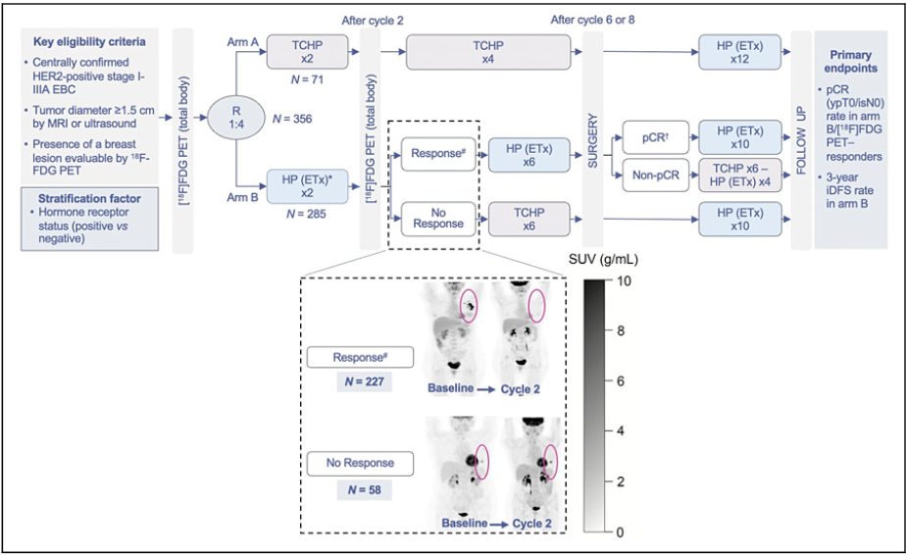
PHERGain Trial
Randomized Phase-2;
45 hospitals
Perez-Garcia et al. Lancet Onc 2021;22:858
Perez-Garcia et al. Lancet 2024;403:1649
Gebhart et al. J Nucl Med 2024; 65:708

Slide 52
PHERGain Trial
Primary endpoint met: Out of 227/285 (79.6%) PET responders, 37.9% had pCR
            Perez-Garcia et al. Lancet Onc 2021;22:858
Co-primary: Arm B pCR and no chemo: 96.4% iDFS
  Arm A: 98.3% iDFS
  Toxicity much lower in Arm B
Perez-Garcia et al. Lancet 2024;403:1649
Perez-Garcia et al. Lancet Onc 2021;22:858
Perez-Garcia et al. Lancet 2024;403:1649
Gebhart et al. J Nucl Med 2024; 65:708

Slide 53
PET with NAC to Monitor Response
Consensus is early or mid-therapy PET best predictor of ultimate response
  Tumor should initially be FDG avid
    Limits use with luminal A
Notes:
53

Slide 54
PET with NAC to Monitor Response
Consensus is early or mid-therapy PET best predictor of ultimate response
  Tumor should initially be FDG avid
    Limits use with luminal A
  Poor response predictive of treatment failure
    High PPV for failure with <15% decrease SUVmax
  Absence of uptake is not sensitive for pCR
    Ueda, et al. Int J Clin Oncol 2012;17:276; Tateishi, et al. Radiology 2012;263:53; Keam, et al. BMC Cancer 2011;11:452; Martoni, et al. Cancer 2010;116:805.
Notes:
54

Slide 55
Monitoring Therapy for
Metastatic Disease
Traditional approach is RECIST but anatomic imaging inadequate since metabolic response can be uncoupled from morphologic

Slide 56
Monitoring Therapy for
Metastatic Disease
Traditional approach is RECIST but anatomic imaging inadequate since metabolic response can be uncoupled from morphologic
Bone scan: flare 3-6 months post chemo/HT

Slide 57
Monitoring Therapy for
Metastatic Disease
Traditional approach is RECIST but anatomic imaging inadequate since metabolic response can be uncoupled from morphologic
Bone scan: flare 3-6 months post chemo/HT
FDG PET is useful
    Mostly no chemo flare
      few case reports
    No consensus on timing or response criteria
      baseline, then mid-therapy and at end
Use at least 20-30% change in SUV
    appearance of new lesions.

Slide 58
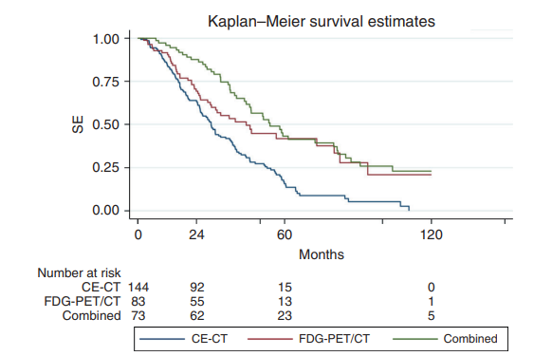
Monitoring Therapy for
Metastatic Disease
300 patient single center non-randomized
FDG PET alone or in combination with ceCT, leads to longer OS than using ceCT alone
  PET detected 1st progression 4.7 months earlier than ceCT
    Naghavi-Behzad et al. BJC 2022;126:1271

Slide 59
Monitoring Therapy for
Metastatic Disease
Bone disease is nonmeasurable on CT
    FDG PET-CT especially useful
      As lesion treated, uptake decrease and increased sclerosis
      Can find new activation in prior dormant disease.

Slide 60
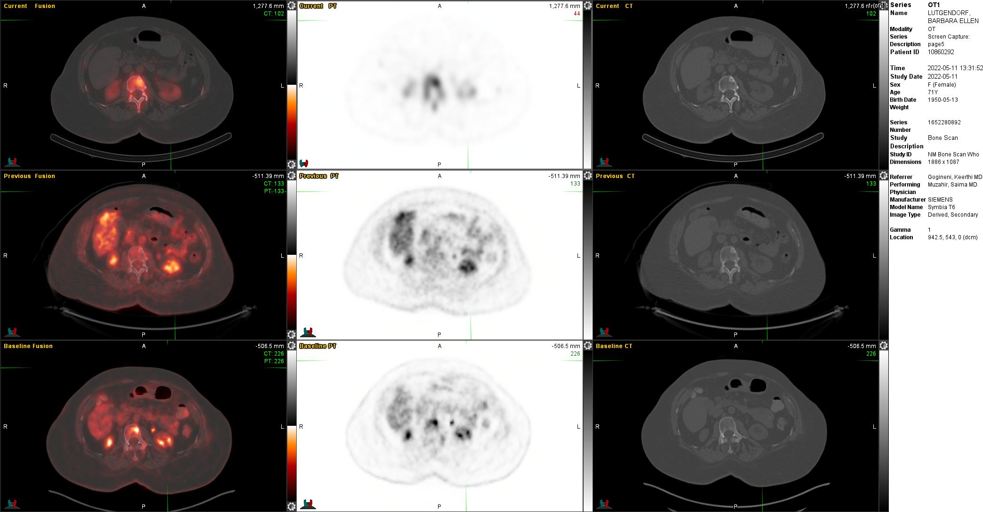
Treated healing bone metastasis:
FDG metabolic CR / Flare on bone scan
Baseline: CT-silent; FDG positive.

Slide 61
Treated healing bone metastasis:
FDG metabolic CR / Flare on bone scan
Baseline: CT-silent; FDG positive.
Systemic therapy:
CT becomes sclerotic and FDG negative
But SPECT-CT bone scan:
CT is sclerotic and MDP positive.

Slide 62
What if patient has bone disease and PET denied by insurance?
Adapt Prostate Cancer Clinical Trials Working Group 3?
      Warning: not validated in breast cancer
  At least two new lesions on first post-treatment scan, with at least two additional lesions on the next scan (2+2 rule).
Scher et al. JCO 2016;34:1402

Slide 63
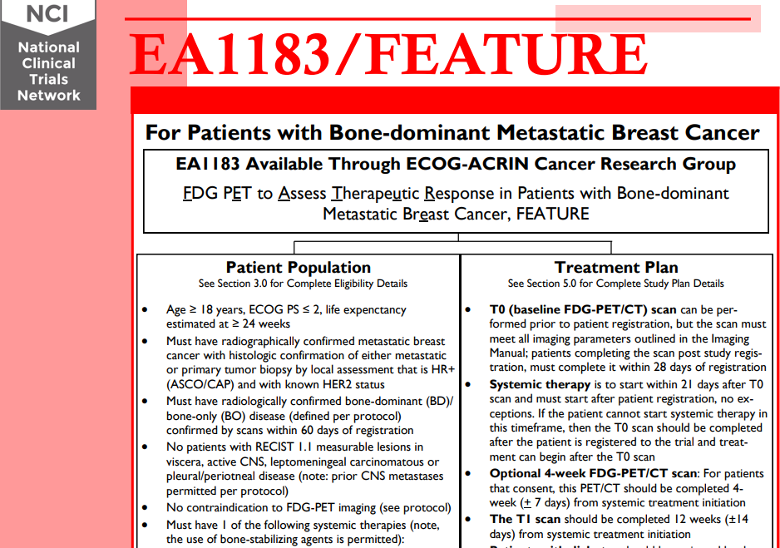
4- and 12-week PET predictive ability being tested in multicenter trial in HR+ bone dominant MBC compared to bone scan
Accrued

Slide 64
FDG PET in Breast Cancer
Clinical Applications
Detection of the Primary Lesion
Lymph Node Assessment
Evaluation of Distant Metastasis / Bone Metastasis
Monitoring Response to Chemotherapy
Monitoring Response to Hormonal / Targeted / Immune
Recurrence

Slide 65
      Hormonal / Targeted / Immune Therapy
PET metabolic flare 7 to 10 days after tamoxifen
    Mortimer, et al. J Clin Oncol 2001;19:2797
Not as much data but PET can be used to follow response
    Mortazavi-Jehanno, et al. Eur J Nucl Med 2012;39:450
    Forero-Torres, et al. Clin Br Ca 2010;10:275

Slide 66
      Hormonal / Targeted / Immune Therapy
PET metabolic flare 7 to 10 days after tamoxifen
    Mortimer, et al. J Clin Oncol 2001;19:2797
Not as much data but PET can be used to follow response
    Mortazavi-Jehanno, et al. Eur J Nucl Med 2012;39:450
    Forero-Torres, et al. Clin Br Ca 2010;10:275
TBCRC026: 88 patients neoadjuvant pertuzumab and trastuzumab (PT)
  PET after 15 days
    Take home if no response by day 15, unlikely to have pCR by targeted therapy alone
      Connolly et al. J Clin Oncol 2021;39:2247.

Slide 67
      Hormonal / Targeted / Immune Therapy
Immunomodulatory Therapy
  May be associated with delayed decrease in tumor size
  New or enlarging tumors and increased FDG uptake soon after completion of treatment may not reflect disease progression
  Follow-up (serial) imaging should be performed at least 4 weeks later to assess for further changes
    Kwak et al. Radiographics 2015;35:424.

Slide 68
FDG PET in Breast Cancer
Clinical Applications
Detection of the Primary Lesion
Lymph Node Assessment
Evaluation of Distant Metastasis / Bone Metastasis
Monitoring Response to Chemotherapy
Monitoring Response to Hormonal / Targeted / Immune
Recurrence

Slide 69
PET Excellent for Recurrence
With CI, difficult to differentiate true recurrence from post-surgical and radiation sequelae but PET-CT performs well
    Manohar, et al. Nucl Med Comm 2012;33:591
      Sensitivity 98.7%; Specificity 85.3%
    Dirisamer, et al. Eur J Rad 2010;73:294
      Sensitivity 93%; Specificity 100%
    Radan, et al. Cancer 2006;107:2545
      Changed management in 51%
    Evangelista et al. Clin Nucl Med 2014;32:e135
      Accurate on or off HT
Notes:
69

Slide 70
PET Excellent for Recurrence
With CI, difficult to differentiate true recurrence from post-surgical and radiation sequelae but PET-CT performs well
    Manohar, et al. Nucl Med Comm 2012;33:591
      Sensitivity 98.7%; Specificity 85.3%
    Dirisamer, et al. Eur J Rad 2010;73:294
      Sensitivity 93%; Specificity 100%
    Radan, et al. Cancer 2006;107:2545
      Changed management in 51%
    Evangelista et al. Clin Nucl Med 2014;32:e135
      Accurate on or off HT
Not Recommended for
Asymptomatic Surveillance
Notes:
70

Slide 71
Ordering/Peer to Peer
Extra minute up front can save hours later
Never use surveillance

Slide 72
Ordering/Peer to Peer
Extra minute up front can save hours later
Never use surveillance
Document why
  Symptoms, symptoms, symptoms

Slide 73
Ordering/Peer to Peer
Extra minute up front can save hours later
Never use surveillance
Document why
  Symptoms, symptoms, symptoms
  May be forced to get CI first
  Be adamant that if CI “negative” (and few reports are that definitive) the situation is equivocal and therefore advanced imaging needed per NCCN guidelines
  Put “per NCCN guidelines” in your order/note.

Slide 74
ILC (ER 90% PR 59%, HER2 2+) with axillary nodal metastasis.
Questionable enhancing sternal metastasis on MR.
CT CAP and bone scan negative for distant disease, but suspicious prevascular node on CT.
New Tools

Slide 75
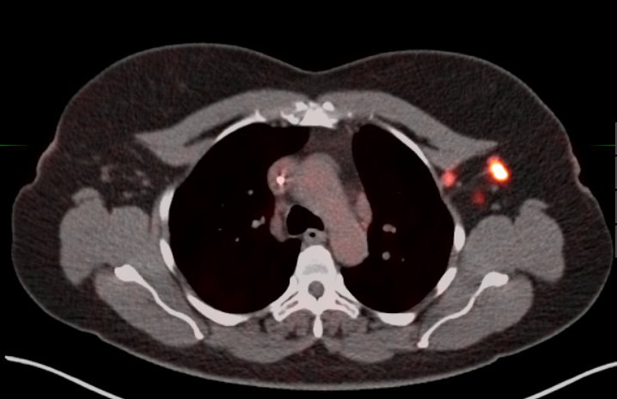
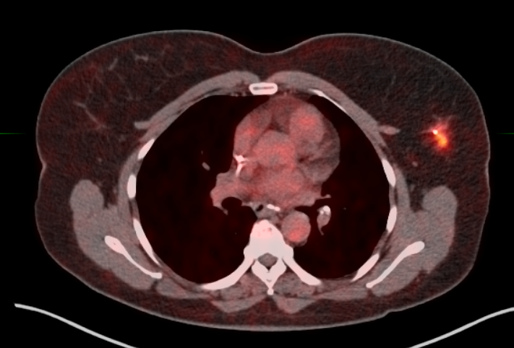
FES PET Ordered.
Left breast ILC and axillary/subpectoral nodes seen.
Prevascular node negative.

Slide 76
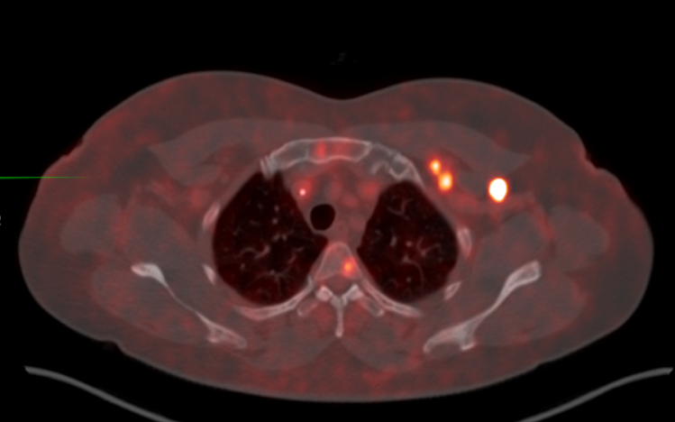
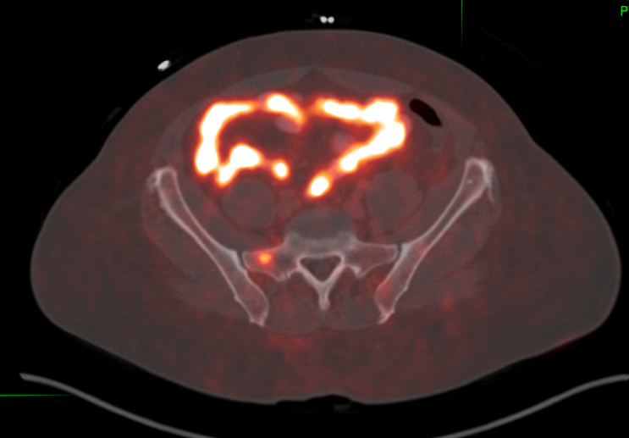
Sternal disease but also vertebral body and other skeletal lesions.

Slide 77
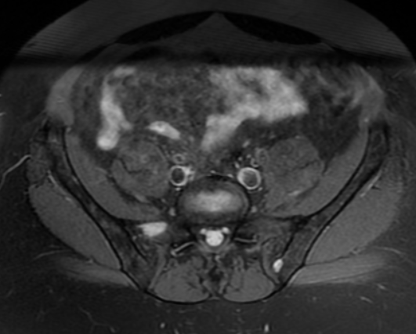
MR and Biopsy Confirmed Distant Disease.
Patient on Letrozole.

Slide 78
¹⁸F-Fluoroestradiol (FES) PET
Binds to the estrogen receptor (ER) in the nucleus of ER-expressing cells.
  Enables whole body ER survey
    Off Tamoxifen (SERM) 8 weeks
    Fulvestrant (IM SERD) 28 weeks
    Elacestrant (oral SERD) 11 days
    AI OK
    No need to fast (unlike FDG).
O’Brien et al. Semin Nucl Med 2024;54(6):812-826

Slide 79


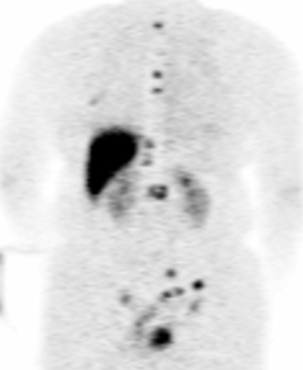
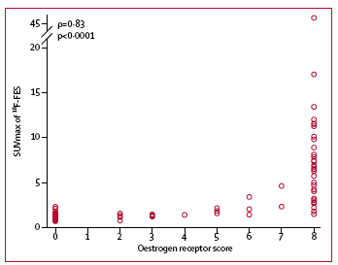

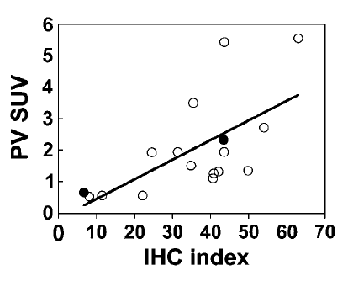



Radiopharmaceutical Diagnostics:
Quantify Target Expression by in vivo Radioligand Binding Assay
Measure Target Expression
Estrogen Receptor PET
(Breast Cancer)
Well-designed prospective studies of FES PET accuracy versus tissue IHC
Uptake (SUV) vs Tissue Assay
85 pts; prospective FES and IHC criteria (Allred score 3 or higher)
Agreement Qualitative Quantitative (SUV >1.5)
For positive 77% [62% - 88%] 85%.
For negative 100% [91% - 100%] 95%
Radioligand Binding
(Mintun, Radiology 169:45, 1988)
16α-[¹⁸F]fluoroestradiolol (FES)
Immunohisto-chemistry
(Van Gael, J Clin Oncol 40:3642-3652, 2022)
(Katzenellenbogen, Nucl Med Biol 92:24, 2021)
(Chae, Lancet Oncol 20:546, 2019)
(Peterson, J Nucl Med 49: 367, 2008)
Courtesy, Dave Mankoff, MD PhD

Slide 80
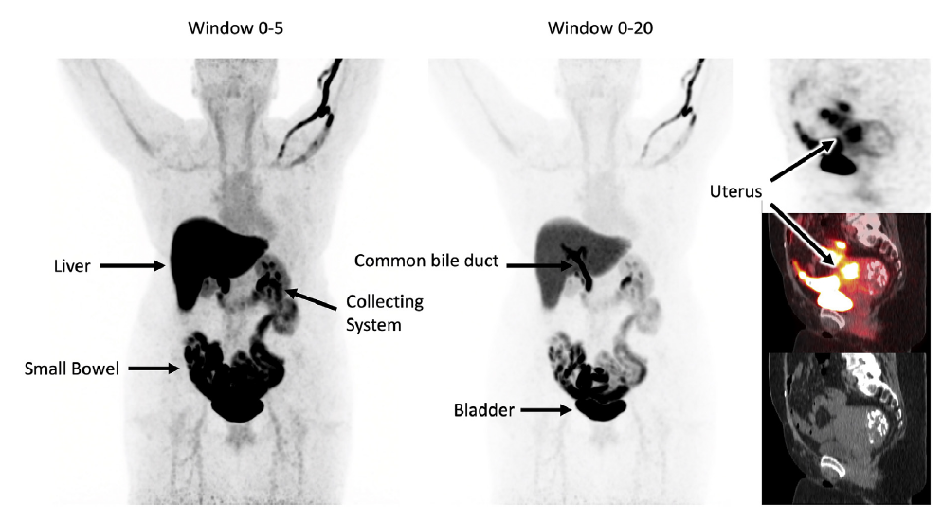
Biodistribution
False positive “rare”
  Post RT lung
  The more we scan the more we find.
False negative
  Low ER
  Nonfunctioning ER
  Small volume
  SERD/SERM
Liver Metastases Difficult to Detect
O’Brien et al. Semin Nucl Med 2024;54(6):812-826

Slide 81
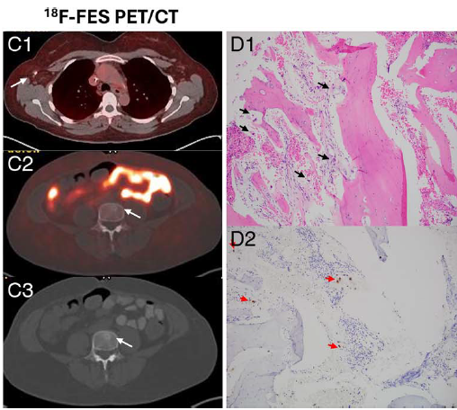
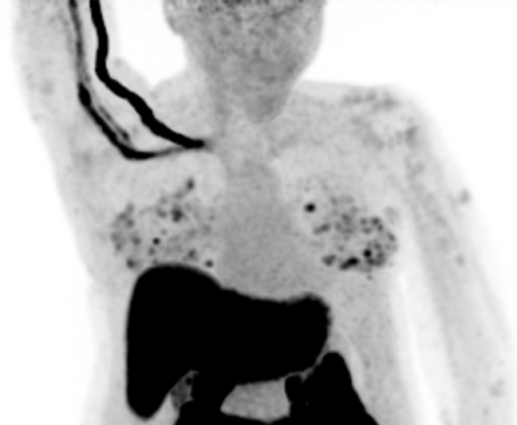
Emory Case Reports
False Negative FES despite 50% ER on L4 biopsy
False Positive FES due to underlying benign complex papillary sclerosing adenosis. IHC shows 30% ER.
Lawal et al. Clin Nucl Med. 2025 Jun 6. Online ahead of print.

Slide 82
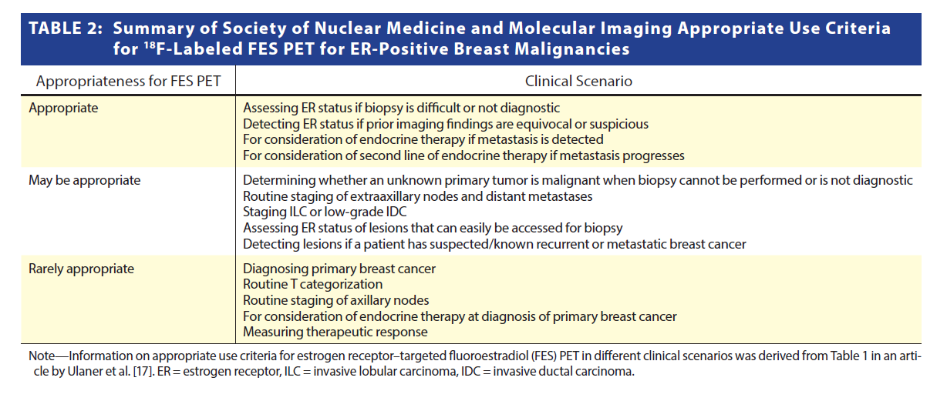
Appropriate Use
Ulaner et al. J Nucl Med 2023; 64:351–354.
Covington et al. AJR 2024;223(4):e2330330

Slide 83
Appropriate Use
Ulaner et al. J Nucl Med 2023; 64:351–354.
Covington et al. AJR 2024;223(4):e2330330

Slide 84
ER Status
Up to 50% of ER+ breast cancer may not respond to endocrine therapy
  Presence of ER on IHC on single lesion may not be optimal reflection
  FES PET “whole body” biopsy.
344 patient study: Use of FES PET resulted in 35% change of management (44% FES-; 36% FES+)
      Ryu et al. J Nucl Med 2024;65:1689
473 retrospective: Use of FES PET to screen for front line therapy HR + /HER2- MBC had better PFS than non-use.
      Xie et al. Eur J Nucl Med Mol Imaging 2025 Jul 19. Online ahead of print

Slide 85
ER Status
Metanalyses demonstrate FES PET as a biomarker in assessing in vivo ER expression and in predicting those who will not respond to therapy, despite ER + on IHC
  Most trials are with initial diagnosis metastatic disease and progression during endocrine therapy
  FES positivity does not guarantee response
  But FES negativity portends poor response
    Parihar et al J Nucl Med 2025; 66:692–699
    Kurland et al. Oncologist 2020;25(10):835-844
Best used in conjunction with FDG or other exam that definitively identifies presence of tumor.

Slide 86
Is the Target Present?
FES Uptake Predicts Breast Cancer Response to Hormonal Therapy
FDG Pre
FES Pre
FDG Post
Response
Progression
(Linden, J Clin Onc, 24:2793, 2006)
(Boers, Eur J Cancer 126:11e20, 2020)
Courtesy, Dave Mankoff, MD PhD

Slide 87
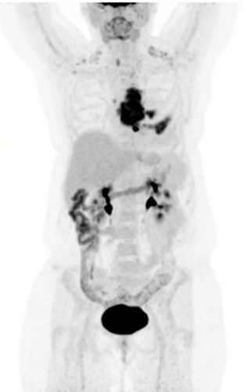
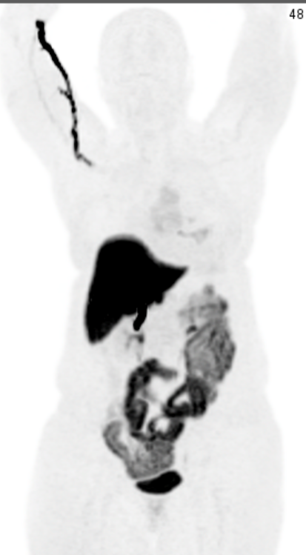
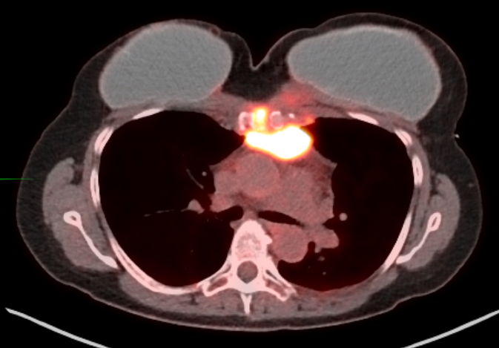

BRCA2 Recurrent IDC:
ER 3+ 90% PR 0
Her2 IHC 2+
PET: FDG High; FES Low
Given biopsy showed strongly ER+ disease, began first-line therapy with CDK inhibitor and endocrine blockade.
Progressed.
Switched to PARPi.
FDG
FES

Slide 88
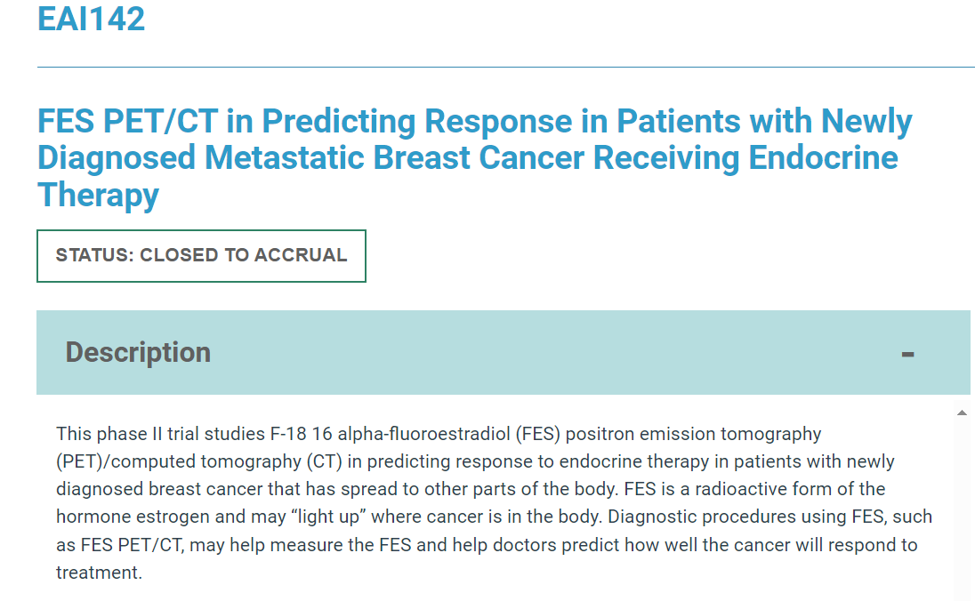

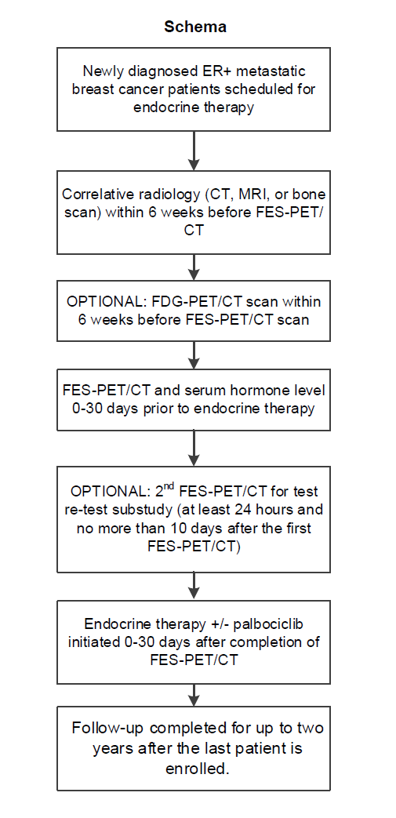
ECOG ACRIN - EAI142
How about first line?
Fully accrued (n=105).
98 patients FES and HR therapy.
SABCS 2025 abstract.
Predefined primary aim of NPV could not be assessed since no patient had an average SUVmax for the most prominent lesions less than the pre-specified cut-off of 1.5
https://aacrjournals.org/clincancerres/article/31/12_Supplement/PS11-01/753685/Abstract-PS11-01-18F-Fluoroestradiol-FES-PET-as-a

Slide 89
Appropriate Use
Ulaner et al. J Nucl Med 2023; 64:351–354.
Covington et al. AJR 2024;223(4):e2330330

Slide 90
Appropriate Use
Ulaner et al. J Nucl Med 2023; 64:351–354.
Covington et al. AJR 2024;223(4):e2330330

Slide 91
Staging…
Grade 1-2 and ILC: mixed results FES vs FDG
  Ulaner et al. J Nucl Med 2021;62:326–331
  Covington et al. AJR 2023;221:228–2
  Knip et al. Radiology 2025;314(3):e241850
  Ulaner et al. JAMA Netw Open. 2024;7:e2423435
Knowledge gap: When should FES be done instead of or in addition to FDG PET?
Grade 2: get FDG first
Grade 1 IDC or ILC: No right answer
  Reasonable to try in ILC for FES first
  But if insurance makes you get FDG first, OK.
    there are some lesions that may not have sufficient ER receptors to have significant uptake or have clonal dedifferentiation
    and FDG more studied for therapy response.

Slide 92
Appropriate Use
Ulaner et al. J Nucl Med 2023; 64:351–354.
Covington et al. AJR 2024;223(4):e2330330

Slide 93
Appropriate Use
Ulaner et al. J Nucl Med 2023; 64:351–354.
Covington et al. AJR 2024;223(4):e2330330

Slide 94
Summary
PET has most utility in patients with:
  Suspected distant metastases
  Evaluate locoregional extent in the high-risk patient

Slide 95
Summary
PET has most utility in patients with:
  Suspected distant metastases
  Evaluate locoregional extent in the high-risk patient
FDG PET more accurate for lymph node and distant metastasis compared to conventional imaging
  Not worthwhile routinely for stage 1
  Use in ≥ 2A depending on clinical presentation
    not as useful for lobular cancer
  More sensitive than bone scan for most lesions
    start with PET, then go to bone scan if still suspicion.

Slide 96
Summary
Prognostic information and following response to therapy
  Early or mid-therapy PET better predictors than post-therapy
  Lack of PET response highly predictive for residual disease
    minimal residual tumor cannot be reliably detected
  No well-defined universal criteria for PET response
Notes:
96

Slide 97
Summary
Prognostic information and following response to therapy
  Early or mid-therapy PET better predictors than post-therapy
  Lack of PET response highly predictive for residual disease
    minimal residual tumor cannot be reliably detected
  No well-defined universal criteria for PET response
Great efficacy with suspected recurrence
  Surpasses conventional imaging for whole body evaluation
Notes:
97

Slide 98
Summary
Prognostic information and following response to therapy
  Early or mid-therapy PET better predictors than post-therapy
  Lack of PET response highly predictive for residual disease
    minimal residual tumor cannot be reliably detected
  No well-defined universal criteria for PET response
Great efficacy with suspected recurrence
  Surpasses conventional imaging for whole body evaluation
Do not routinely use advanced imaging for asymptomatic surveillance (more than 6 months -1 year after CR).
Notes:
98

Slide 99
Summary
FDG PET is still useful in HR+ breast cancer for staging/restaging and for monitoring response to therapy
  Limitations with low grade ILC and Grade 1 IDC
FES PET has added value in ER+ disease for whole body ER survey and to detect otherwise occult disease especially with ER+ ILC
  Best used with FDG PET in most instances
  If FES (-) but suspicious on CI, get biopsy or FDG
  Not yet recommended for monitoring therapy response.
Ulaner et al. J Nucl Med 2023; 64:351–354.
Covington et al. AJR 2024;223(4):e2330330

Slide 100


