Slide 1


Managing Skeletal Metastases
Beverly Moy, MD, MPH
Professor of Medicine, Harvard Medical School
Assistant Chief Medical Officer
Mass General Brigham Cancer Institute
Disclaimer: This presentation is intended for personal use and for informational purposes only and does not replace independent professional judgment. This presentation is the property of Physicians’ Education Resource, LLC (“PER”) and is protected by U.S. and international copyright laws. You may not copy, reproduce, distribute, transmit, modify, or create derivative works of the presentation without the prior written permission from PER.

Slide 2
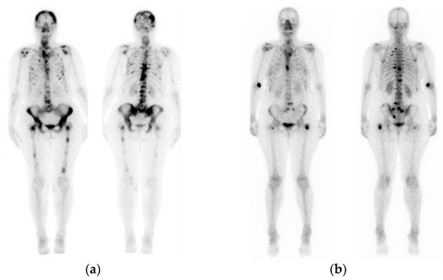
Case 1: 55-year-old woman
2019: Stage T2N1 HR+ left breast cancer s/p surgery/XRT
Adjuvant dd AC+T
Tamoxifen X 1 year
Had BSO and switched tamoxifen to anastrozole
c/o persistent hip and pelvic pain

Slide 3
Skeletal Metastases in Breast Cancer
Bone is the single most frequent site for metastasis in breast cancer patients and is involved in ~ 70% of all MBC patients^{1,2}
Patients with bone-only metastasis have a fairly good prognosis when compared with patients with visceral disease
Cornerstone of treatment is optimal anticancer systemic therapy
Bone-only metastatic BC has a median overall survival ranging from 40–65 months³
Nevertheless, cancer-induced bone disease carries an important risk of developing skeletal related events that impact quality of life
¹Manders K, et al. BMC Cancer 2006
²Coleman RE, et al. Br J Cancer 1998
³Lee S J, et al. Cancer Res Treat. 2011

Slide 4
Primary Objectives of Managing Metastatic Bone Disease
Palliation of symptoms
Prevention of serious skeletal-related complications
Maintenance of quality of life

Slide 5
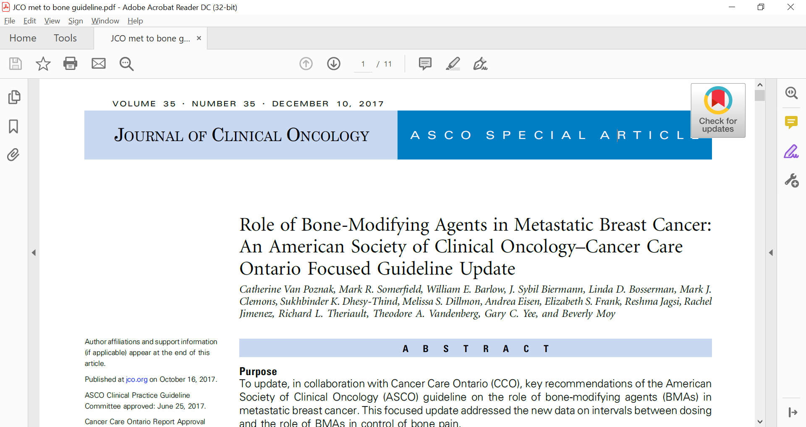
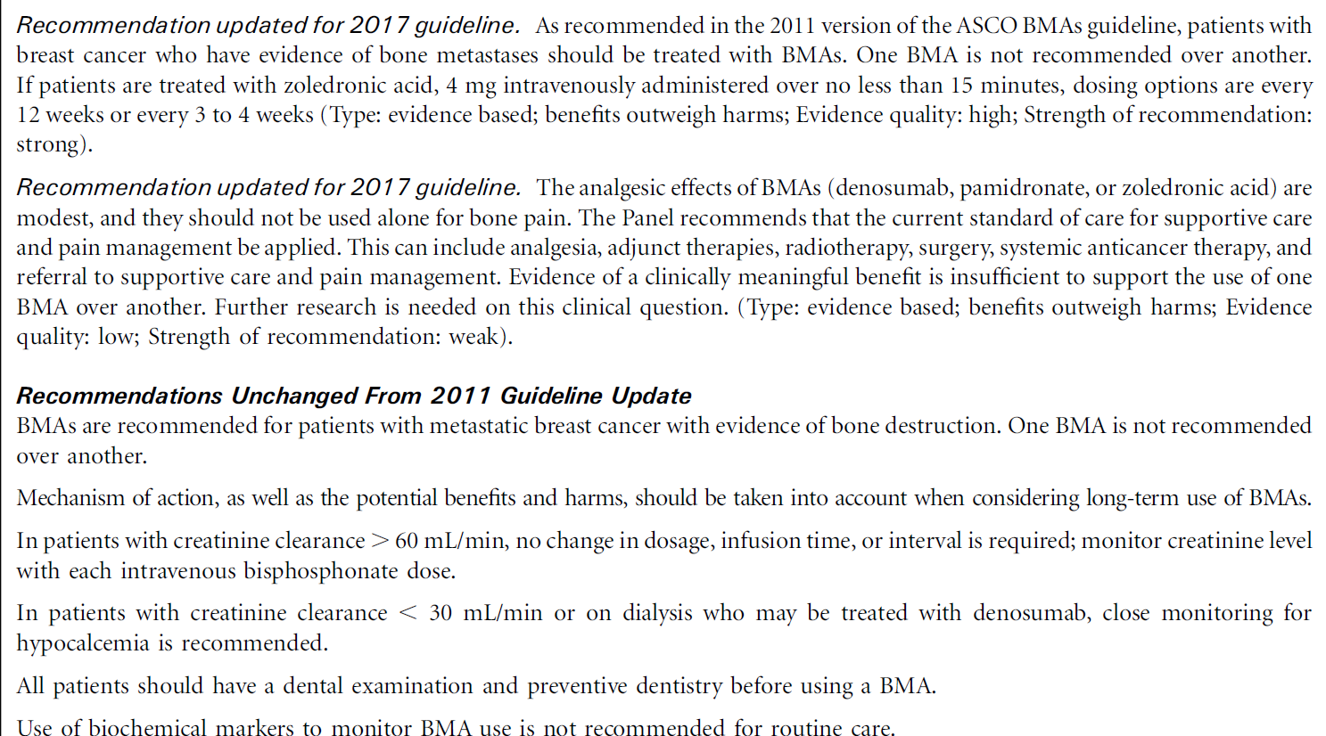

Slide 6
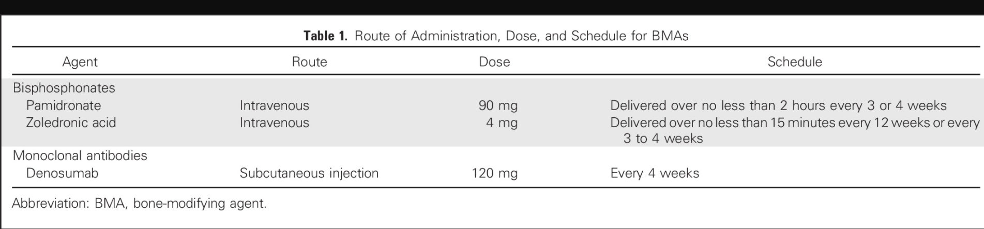
Bone Modifying Agents
Three RCT’s and a meta-analysis of ZA q4 weeks vs 12 weeks with similar rates of SREs
Zoom and OPTIMIZE-2 were industry-sponsored and CALGB was NIH-sponsored¹⁻⁴
¹Van Poznak,…Moy. J Clin Oncol 2017
²Amadori, et al. Lancet Oncol 2013
³Himelstein, et al. JAMA 2017
⁴Hortobagyi, et al. JAMA Oncol 2017

Slide 7
Zoledronic acid q4 weeks vs q12 weeks: Clinical trials
Trial | ZOOM¹ | CALGB 70604² | OPTIMIZE-2³
Study sponsor | Industry | NIH | Industry
Primary endpoint | SRE/pt/year | SRE within 2 years | SRE rate
Patient population | MBC to bone, completed 12-15 mos of monthly ZA | Metastatic breast cancer, metastatic prostate cancer, or multiple myeloma to bone. | MBC to bone previously on monthly ZA or pamidronate
Sample size | 425 | 911 (855 with MBC) | 416
Primary results | SRE rate -0·26 (95% CI 0·15–0·37) in the 12-week group -0·22 (0·14–0·29) in the 4-week group | SRE 4 week vs 12 week: -29.5 vs 28.6 -Risk difference of −0.3%[1-sided 95%CI, −4% to ∞]; Noninferiority P < .001 | SREs 4 week vs 12 week: -22.0% vs 23.2% -Proportional difference of -1.2%; 1-sided 97.5% CI bound of difference in SRE rate, -9.8%; noninferiority P = .02
Grade 3/4 adverse events (12 week vs 4 week) | -Bone pain 27% vs 30% -Nausea 11% vs 15% -Asthenia 9% vs 15% -Renal <1% vs 1% -ONJ: 4 pts vs 3 pts | No different between groups -ONJ 1.0% vs 2.0% -Renal 0.5% vs 1.2% | No different between groups -ONJ 2 patients, both in 4 week dosing group
¹Amadori, et al. Lancet Oncol 2013
²Himelstein, et al. JAMA 2017
³Hortobagyi, et al. JAMA Oncol 2017

Slide 8
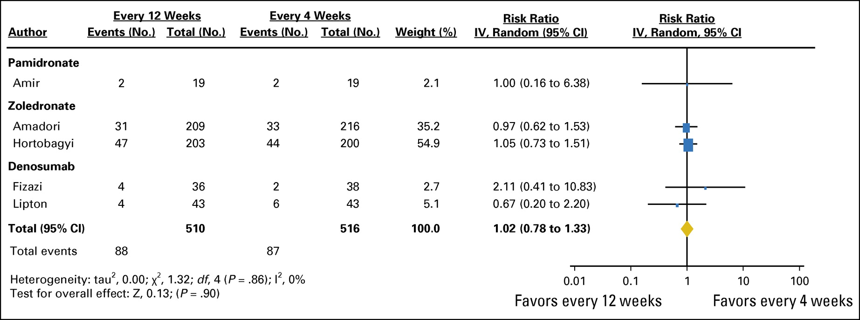
Meta-analysis of skeletal related events
No difference in SREs or pain with de-escalated therapy
Ibrahim MFK, et al. Ann Oncol 2015

Slide 9
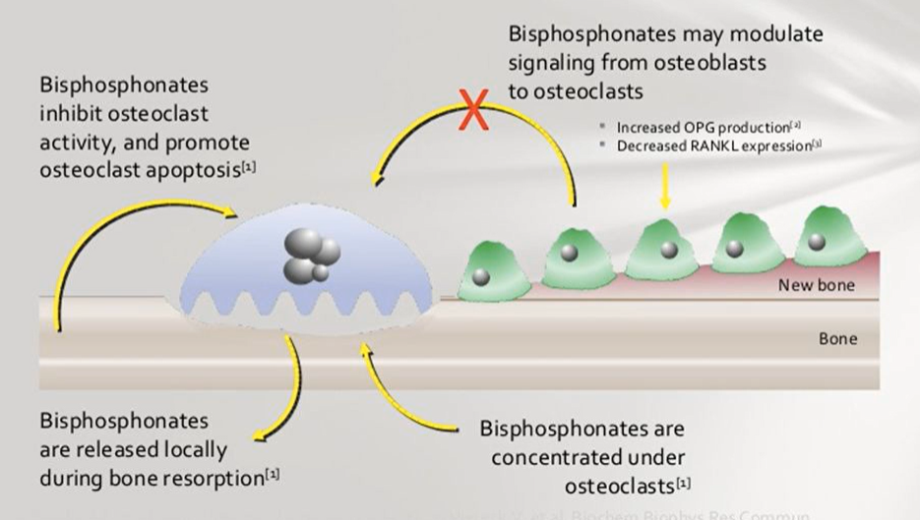
Bisphosphonates inhibit osteoclast activity

Slide 10
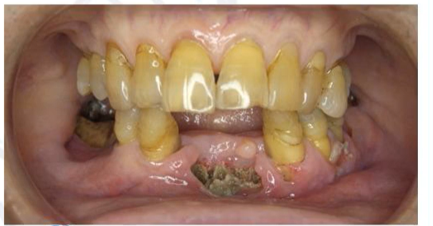
Bisphosphonates Adverse Events
Acute phase reactions (typically subside after 72 h)
Atypical fragility fractures
Osteonecrosis of the jaw
  1-2.8% (up to 10% in patients with risk factors)
  Risk factors: shorter dosing intervals, fewer current teeth, smoking, presence of dentures, dental disease with invasive procedures
  Oral care assessment should be undertaken before initiating therapy
    Comprehensive dental, periodontal, and oral radiographic exam when feasible
Treatment is limited debridement, antibiotics, and oral rinses
•Yarom et al. The Medication-Related Osteonecrosis of the Jaw: MASCC/ISOO/ASCO Clinical Practice Guideline J Clin Oncol 2019

Slide 11
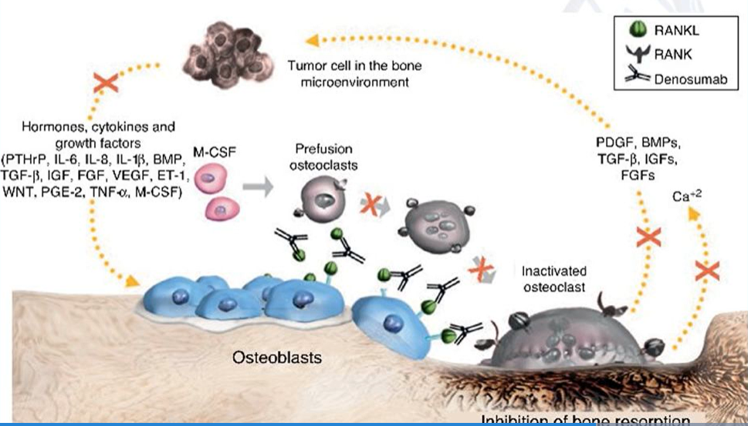
Denosumab
Fully humanized monoclonal antibody binding to RANKL
  Surface of osteoclast and osteoclast precursors
  RANK-RANKL interaction key mediator of osteoclastic activation
  Decreased cancer induced bone destruction
  Found on mammary cells and may have direct inhibitory function in tumorigenesis
Adverse effects
  ONJ (similar to BP’s)
  Atypical fractures
  Hypocalcemia
Notes:
Upon denosumab cessation and withdrawal of its effect, there is a rebound increase in bone resorption which is highlighted clinically as a rapid rise in the bone turnover markers. Both markers of bone formation, such as procollagen 1 intact N-terminal propeptide (P1NP), and bone resorption including C-terminal telopeptide (CTX) and TRAP-5b are increased following the offset of denosumab’s effect indicating a high bone turnover state [66, 68]. The net effect of this is bone loss, observed as a decrease in BMD which occurs throughout the skeleton and especially in the spine [66]. This has led to increases in the rates of preventable fractures following denosumab discontinuation [69]. Concerningly, prescription data in Australia shows that denosumab treatment is frequently discontinued or interrupted, placing many patients at increased risk of fractures [57].

Slide 12
Duration of bone modifying agents?
No direct data
Most osteoporosis literature and guidelines: bisphosphonates are recommended for 3-5 years
Side effects increase significantly when they are used for 10 years or more
Long term use may not be needed
Osteoporosis trials FLEX (ClinicalTrials.gov Identifier: NCT00398931) and HORIZON (ClinicalTrials.gov Identifier: NCT00049829) suggest that alendronate and zoledronic acid suppress bone turnover markers for up to 5 and 3 years after treatment discontinuation, respectively
Denosumab: Rebound fracture risk (perhaps 8-10%) soon after discontinuation
Duration of bone modifying agents in MBC patients is worthy of being investigated in a research setting

Slide 13
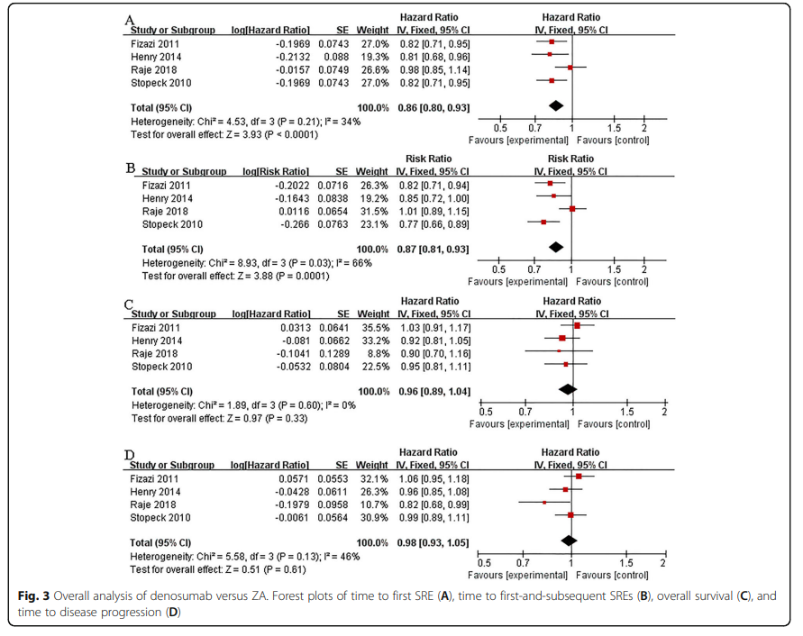
Is denosumab or zoledronic acid superior? Meta-analysis
-4 RCT’s with 7201 patients
-Denosumab was superior to zoledronic acid in delaying time to first SRE (hazard ratio = 0.86; 95% confidence interval, 0.80-0.93; P < 0.01)
-Denosumab had lower incidence of renal toxicity and acute phase reaction but higher incidence of hypocalcemia and osteonecrosis of the jaw
-No significant differences in SRE rate, overall survival, time to disease progression
Jiang C, et al. J Orthop Surg Res 2021

Slide 14
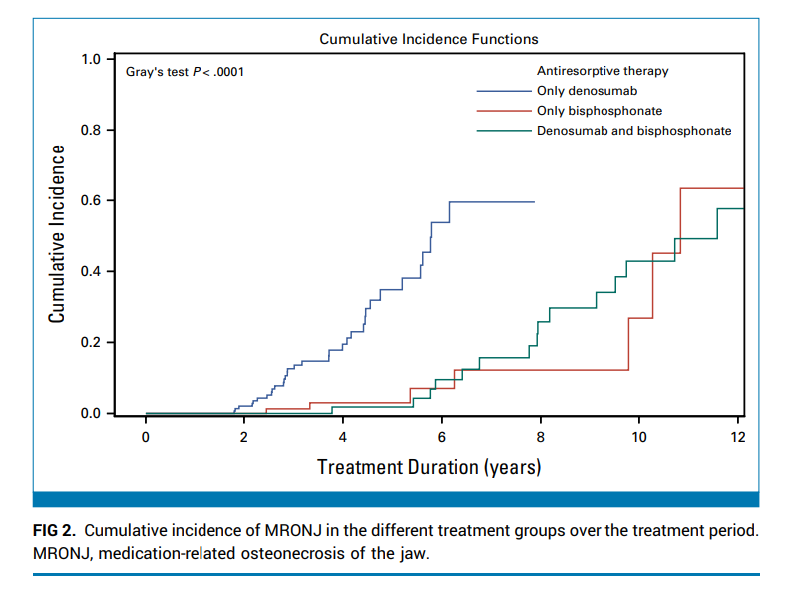
ONJ not less common with denosumab
20 year f/u of multicenter retrospective study in Austria
Patients received antiresorptive therapy once per month without de-escalation of therapy.
ONJ was diagnosed in 8.8% of patients (95% CI, 6.6 to 11.0) patients.
Incidence of ONJ was 11.6% with denosumab only, 2.8% with bisphosphonates only, and 16.3% with bisphosphonates followed by denosumab.
Time to ONJ after treatment initiation was 4.6 years for individuals treated with denosumab only, 5.1 years for individuals treated with bisphosphonates only, and 8.4 years for individuals treated with both consecutively
Brunner C, et al. J Clin Oncol 2025 Jan 10;43(2):180-188.

Slide 15
Safety Profiles and Cost of Care
Bone Modifying Agent | AWP per dose | AWP/1 year of therapy
Zoledronic acid (4 mg) | $0.72-$2.16 | $2.88 to $8.64
Denosumab (120 mg) | $2,435.11 | $29,221.32
Source: LexiDrug search on Sep 16, 2025
Bisphosphonate | Denosumab
Higher risk of renal toxicity | Higher risk of hypocalcemia
Higher risk of acute phase reactions | Higher risk of osteonecrosis of the jaw
Requires renal monitoring | Does not require renal monitoring
Stopeck AT, et al. J Clin Oncol 2010; Menshawy A, et al. Supp Care Cancer 2018

Slide 16
Denosumab: Increasingly removed from insurance formularies
Recent FDA approval of several biosimilars
Wyost (denosumab-bbdz): FDA-approved in March 2024
Xbryk (denosumab-dssb): Approved in February 2025
Osenvelt (denosumab-bmwo) and Bomyntra (denosumab-bnht): Approved in March 2025

Slide 17
Radiation for skeletal metastases
External beam radiotherapy can rapidly provide site specific pain control
~50-80% of patients experience partial pain relief and ~ 33% of patients have complete pain relief
Secondary analysis of 238 patients from the NCIC-CTG Symptom Control Trial treated with 8-Gy X 1¹
  Clinically meaningful improvements in pain and QOL as early as 10 days after radiotherapy and more extensive improvements in QOL at 42 days after treatment
Multiple trials show 8Gy x 1 is equivalent to longer regimens re: pain relief and ability to retreat with further radiation^{2,3,4}
Radiation for painful bone metastases can improve pain and QOL quickly after treatment and should be considered even for those with a limited expected survival^{5,6}
¹McDonald R, et al. JAMA Oncol 2017
²Steenland E, et al. Radiotherapy and Oncology 1999
³Chow E, et al. Lancet Oncol 2014
⁴Hartsell WF, et al. J Natl Cancer Inst 2005
⁵Kim et. al. J Palliat Med. 2015
⁶Aman MM, et al. J Pain Research 2021

Slide 18
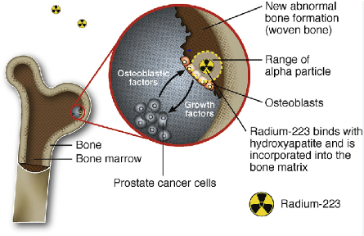
Radium-223
Alpha-emitting radionuclide that selectively targets areas of bone metastases
Metastatic prostate cancer
  ALSYPMPCA trial: Statistically significant OS benefit compared to placebo in MPC with symptomatic bone only disease without known visceral metastases or large nodal (>3 cm in short axis) metastatic disease (14.9 months vs. 11.3 months; HR 0.70; 95% CI, 0.58 to 0.83; P<0.001)¹
Breast cancer: Pooled analysis of two international, phase 2, randomized, double-blind, placebo-controlled trials (n = 382)²
  Primary endpoint: skeletal event-free survival
  HR was 0.809 (0.610-1.072) for radium-223 + ET vs placebo + ET
  Primary endpoint suggested efficacy but no benefit in secondary progression or survival
  Adverse events more frequent with radium-223 vs placebo
    50.3% versus 35.1% of patients (grade 3/4: 25.7% vs. 8.5%)
    Fractures/bone-associated events was 23.5% versus 23.9%.
¹Parker C, et al. N Engl J Med 2013
²Rugo H, et al. Breast Cancer Res Treat 2024

Slide 19
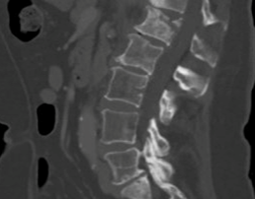
Case 2: 65-year-old woman
De novo metastatic HR+ BC to bone only on letrozole + ribociclib for 3 years with increased back pain
Burst fracture with complicated morphology and general sclerosis with ligamentous injury posteriorly
Radiation and opioid analgesics not relieving pain

Slide 20
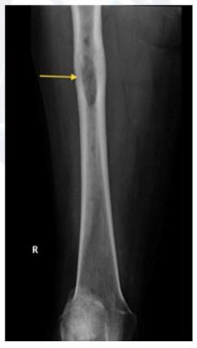
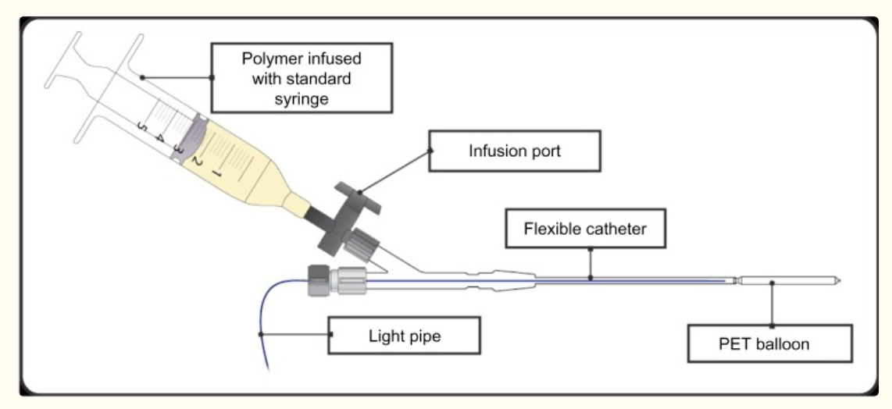
Surgical Intervention
Acute or impending spinal cord compression
Pain management
Prevention of pathologic fracture
  Metastasis eroding the cortex
  Large expansile metastasis
Management of fracture
Followed by radiation
Intramedullary rods
Balloon photodynamic stabilization
Total joint replacements

Slide 21
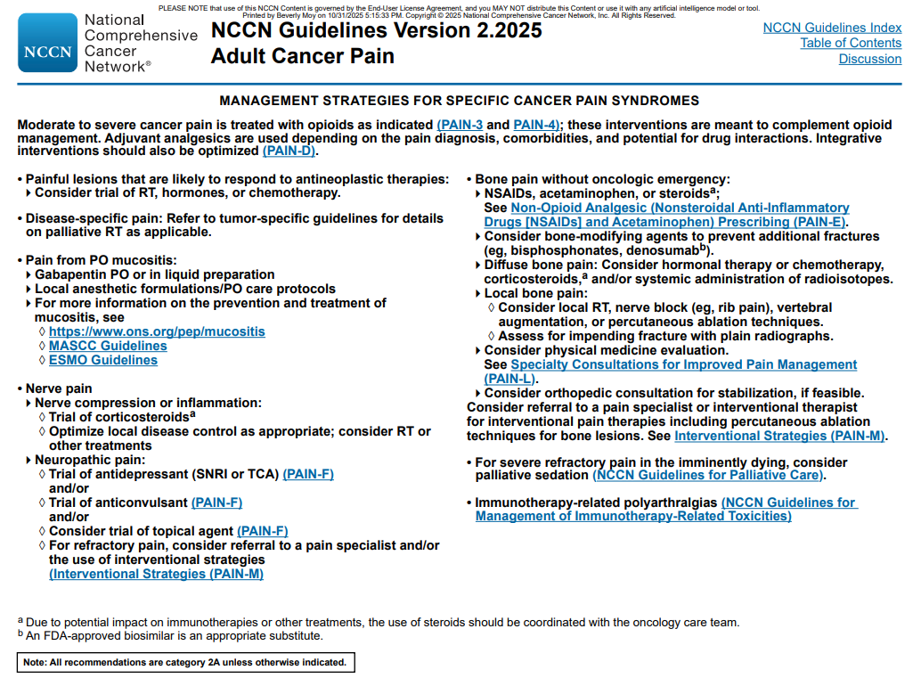
Vertebral Augmentation

Slide 22
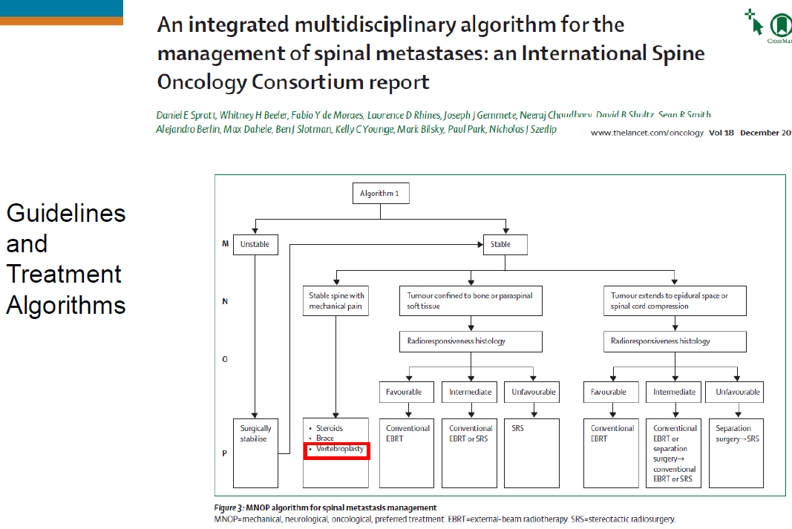
Spratt DE, et al. Lancet 2017

Slide 23
Conclusions
Bone is the most frequent site of metastases from breast cancer
Goals of treatment are palliation of symptoms, prevention of SREs, and maintenance of QOL
Bone modifying agents reduce SREs and should be recommended
Multidisciplinary approach
  Radiation, surgery, interventional radiology, and palliative care

