Slide 1


Primary Surgical Considerations
Terry Mamounas, M.D., M.P.H., F.A.C.S.
Medical Director Breast Program and Research Activities
AdventHealth Cancer Institute
Professor of Surgery, University of Central Florida College of Medicine
Clinical Professor of Clinical Sciences
Florida State University College of Medicine
Disclaimer: This presentation is intended for personal use and for informational purposes only and does not replace independent professional judgment. This presentation is the property of Physicians’ Education Resource, LLC (“PER”) and is protected by U.S. and international copyright laws. You may not copy, reproduce, distribute, transmit, modify, or create derivative works of the presentation without the prior written permission from PER.

Slide 2
Outline
2
Breast Cancer Diagnosis & Preoperative Local Staging
Primary Surgical Management of Invasive/Non-Invasive BC
  RCT of Lumpectomy vs. Mastectomy
  Lumpectomy Indications/Contraindications/Optimal margins
  Contralateral Prophylactic and Nipple-Sparing Mastectomy
Special Circumstances in Primary Surgical Management
  Family History/BRCA mutation carriers
  Multicentric Breast Cancer
  Occult Breast Cancer
  Large Tumors/Neoadjuvant Chemotherapy
  Management of Patients Presenting with Stage IV Disease
  De Novo Oligometastatic Breast Cancer

Slide 3
3
Breast Cancer Diagnosis
&
Preoperative Local Staging

Slide 4
4
Core Needle Biopsy
Advantages:
  Differentiates between invasive and non-invasive cancer
  Allows one-stage surgical procedures (including SLNB before lumpectomy)
  Provides adequate material for biomarkers (ER/PR/HER2)
  Neoadjuvant chemo can be given with invasive ca on core
Limitations:
  False negative rate 1-2%
  If non-invasive cancer on core, invasive cancer may still be present in 10-25% of cases
  If atypical hyperplasia on core, invasive or non-invasive cancer may be present in 15-40% of cases and excisional biopsy should follow
Dershaw DD et al. Breast J. 2003;9:1-3; Rao A et al. Am J Surg. 2002;184:534-7; Shin SJ et al. Arch Pathol Lab Med. 2002;126:697-701; Renshaw AA. Am J Clin Pathol. 2001;116:87-91; Berg WA et al. Radiology. 2001;218:503-9; Darling ML et al. AJR Am J Roentgenol. 2000;175:1341-6; Tocino I et al. Ann Surg Oncol. 1996;3:483-8; Liberman L et al. AJR Am J Roentgenol. 1995;165:551-4; Jackman RJ et al. Radiology. 1994;193:91-5; Adrales G et al. Am J Surg. 2000;180:313-5.

Slide 5
5
Core Needle Biopsy
Advantages:
  Differentiates between invasive and non-invasive cancer
  Allows one-stage surgical procedures (including SNB before lumpectomy)
  Provides adequate material for biomarkers (ER/PR/HER2)
  Neoadjuvant chemo can be given with invasive ca on core
Limitations:
  False negative rate 1-2%
  If non-invasive cancer on core, invasive cancer may still be present in 10-25% of cases
  If atypical hyperplasia on core, invasive or non-invasive cancer may be present in 15-40% of cases and excisional biopsy should follow
NCCN Guidelines (v1.2022-BSCR-7):
For ADH, ALH, LCIS on core Bx: Surgical Excision or Follow-up with examination +/- ultrasound and/or mammogram at 6 months X 1 year to assess for changes if the pathology findings are concordant with imaging findings
Dershaw DD et al. Breast J. 2003;9:1-3; Rao A et al. Am J Surg. 2002;184:534-7; Shin SJ et al. Arch Pathol Lab Med. 2002;126:697-701; Renshaw AA. Am J Clin Pathol. 2001;116:87-91; Berg WA et al. Radiology. 2001;218:503-9; Darling ML et al. AJR Am J Roentgenol. 2000;175:1341-6; Tocino I et al. Ann Surg Oncol. 1996;3:483-8; Liberman L et al. AJR Am J Roentgenol. 1995;165:551-4; Jackman RJ et al. Radiology. 1994;193:91-5; Adrales G et al. Am J Surg. 2000;180:313-5.

Slide 6
6
MRI in Preoperative Local Staging
High sensitivity
Increasingly utilized in preoperative local staging
  NCCN Guidelines v4.2022: Breast MRI optional with special consideration for mammographically occult tumors
Identifies additional cancer foci, otherwise undetected by clinical assessment and conventional imaging in both breasts
No consensus on whether MRI improves outcomes regarding margin positivity, reoperation rates, IBTR, DFS or OS
Concern: May increase unnecessary biopsies and mastectomies
Houssami N et al. J Clin Oncol. 2008;26(19):3248-58; Schnall M et al. Magn Reson Imaging Clin N Am. 2006;14(3):329-37; Liberman L et al. Magn Reson Imaging Clin N Am. 2006;14(3):339-49; Smith RA et al. N Engl J Med. 2007;356(13):1362-4; Morrow M et al. Magn Reson Imaging Clin N Am. 2006;14(3):363-78.

Slide 7
7
MRI in Preoperative Local Staging
Potential Candidates
Not necessary for all patients who undergo BCS
May be helpful in patients with:
  Mammographically-dense breasts and/or ill-defined tumors
  Invasive lobular carcinoma
  Multi-centric disease at presentation
  Candidates for neoadjuvant therapy
MRI is important in patients who present with axillary adenopathy and clinically and radiographically occult breast lesions
False + findings are common: Surgical decisions should not be based solely on MRI findings (NCCN)

Slide 8
8
Primary Surgical Management in Patients with Invasive and
Non-Invasive BC

Slide 9
9
Primary Surgical Management
Evolution in the paradigm of surgical management over the past 40 years
Trend towards increasing use of breast conserving procedures without compromising patient outcome
Breast conserving surgery has become the preferred surgical treatment for the majority of early-stage BC patients

Slide 10
10
RCTs in Invasive Breast Cancer
Breast Conserving Surgery vs. Mastectomy
From 1973-1989, six randomized trials
Two overview analyses
Compared mastectomy to BCS + XRT
Maximum tumor size for entry: 2-5 cm
No differences in overall survival
XRT significantly reduced the rates of IBTR
Fisher B et al: N Engl J Med 1985, 1989, 1995, 2002; Veronesi U et al: Eur J Cancer 1990, 1995, World J Surg 1994, N Engl J Med 1981, 2002; Van Dongen JA et al: Eur J Cancer 1992, J Natl Cancer Inst 2000; Lichter AS et al: J Clin Oncol 1992; Sarrazin D et al: Radiother Oncol 1989; Blichert-Toft M et al: J Natl Cancer Inst 1992; EBCTCG: N Engl J Med 1995; Morris AD et al: Cancer J Sci Am 1997.

Slide 11
11
Breast Conserving Surgery vs. Mastectomy
Invasive Breast Cancer
1990: NIH CDC Statement
  “Breast Conservation Treatment is an appropriate method of primary therapy for the majority of women with stage I and II breast cancer and is preferable because it provides survival equivalent to total mastectomy while preserving the breast.”
From 1973-1989, six randomized trials
Two overview analyses
Compared mastectomy to BCS + XRT
Maximum tumor size for entry: 2-5 cm
No differences in overall survival
XRT significantly reduced the rates of IBTR
NIH CDC. JAMA. 1991;265(3):391-395.

Slide 12
Optimal Lumpectomy Candidates
12
Tumors < 5 cm in diameter
Limited to one quadrant
Breast size/tumor size ratio permitting lumpectomy with acceptable cosmetic result
Patient is desirous of breast conservation
Negative margins following resection
No contraindications to breast XRT
Newman LA et al. Surg Clin North Am. 2003;83(4):841-883.
Winchester DP et al. CA Cancer J Clin. 1998;48(2):83-107.

Slide 13
Lumpectomy Contraindications
Absolute
13
Multi-centric disease in more than one quadrant*
Diffuse suspicious microcalcifications
Inability to obtain clear margins after multiple resections
First or second trimester of pregnancy
History of therapeutic radiation to the region
Hooning MJ et al. Neth J Surg. 1991;43(4):102-104.
Morrow M et al. Ann Surg. 1998;227(4):502-506.
Jakesz R et al. Chirug. 1999;70(4):394-399.

Slide 14
Lumpectomy Contraindications
Relative
14
Large tumor size/breast size ratio for acceptable cosmesis
History of collagen vascular disease (relative contraindication to XRT)
Tumor location beneath nipple
Unavailability of radiotherapy
Hooning MJ et al. Neth J Surg. 1991;43(4):102-104.
Morrow M et al. Ann Surg. 1998;227(4):502-506.
Jakesz R et al. Chirug. 1999;70(4):394-399.

Slide 15
SSO/ASTRO/ASCO:
IBC Margins Consensus Guideline
15
A multidisciplinary consensus panel considered:
  Large, study level meta-analysis of margin width and IBTR (33 studies, 28,162 pts)
  Results of randomized trials
  Reproducibility of margin assessment
  Current patterns of multimodality care
Recommendations:
  Use of no ink on tumor as the standard for an adequate margin in IBC in the era of multidisciplinary Rx results in low rates of IBTR
  This approach has the potential to decrease re-excision rates, improve cosmetic outcomes, and decrease healthcare costs
Moran MS et al. J Clin Oncol. 2014;32(104):1507-1515.

Slide 16
SSO/ASTRO/ASCO:
DCIS Margins Consensus Guideline
16
Multidisciplinary consensus panel considered:
  Meta-analysis of margin width and IBTR (20 studies, 7883 pts) and other published literature
  2-mm margin minimizes the risk of IBTR compared with smaller negative margins
  More widely clear margins do not significantly decrease IBTR vs. 2-mm margins
Recommendations:
  2-mm margin is adequate margin in DCIS treated with lumpectomy + whole-breast irradiation
  Clinical judgment should be used in determining the need for further surgery in patients with negative margins <2 mm
Morrow M et al. Ann Surg Oncol. 2016;23(12):3801-3810.

Slide 17
SSO/ASTRO/ASCO:
DCIS Margins Consensus Guideline
17
Multidisciplinary consensus panel considered:
  Meta-analysis of margin width and IBTR (20 studies, 7883 pts) and other published literature
  2-mm margin minimizes the risk of IBTR compared with smaller negative margins
  More widely clear margins do not significantly decrease IBTR vs. 2-mm margins
Recommendations:
  2-mm margin is adequate margin in DCIS treated with lumpectomy + whole-breast irradiation
  Clinical judgment should be used in determining the need for further surgery in patients with negative margins <2 mm
NCCN Guidelines (v4.2023-BINV-F 1 of 2):
The NCCN Panel accepts the definitions of negative margins after BCT from the 2014 SSO/ASTRO/ASCO margin guideline for invasive BC and the 2016 guideline for DCIS.
Morrow M et al. Ann Surg Oncol. 2016;23(12):3801-3810.

Slide 18
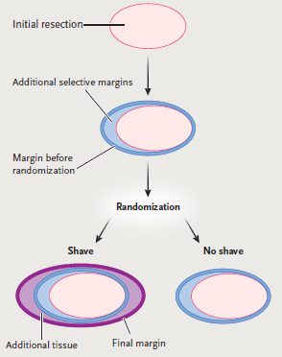
18
A Randomized, Controlled Trial of Cavity Shave Margins
235 patients, stage 0 to III BC
BCS +/- resection of selective margins
Intraoperative Randomization:
  Cavity Shave Margins vs. Not
Primary Outcome: Rate of (+) margins
Secondary Outcomes: Cosmesis and Volume of tissue resected
Chagpar AB et al. N Engl J Med. 2015;373(6):503-510.

Slide 19
19
A Randomized, Controlled Trial of Cavity Shave Margins
235 patients, stage 0 to III BC
BCS +/- resection of selective margins
Intraoperative Randomization:
  Cavity Shave Margins vs. Not
Primary Outcome: Rate of (+) margins
Secondary Outcomes: Cosmesis and Volume of tissue resected
Results: Shave group associated with:
  Lower rates of (+) margins: 19% vs. 34%, P = .01
  Lower re-excision rates: 10% vs. 21%, P = 0.02
No differences in complications, cosmesis and rates of complex tissue rearrangements
Chagpar AB et al. N Engl J Med. 2015;373(6):503-510.

Slide 20

20
Intraoperative Margin Assessment
Inking of specimen by pathologist
Gross margin inspection
Resection of additional tissue if necessary
Normal
Breast
Tissue
Ink
Tumor

Slide 21
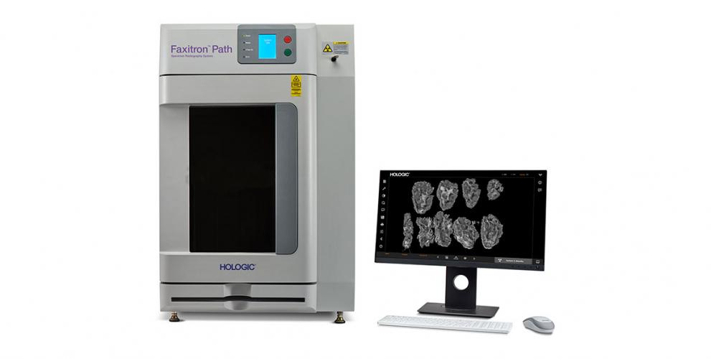
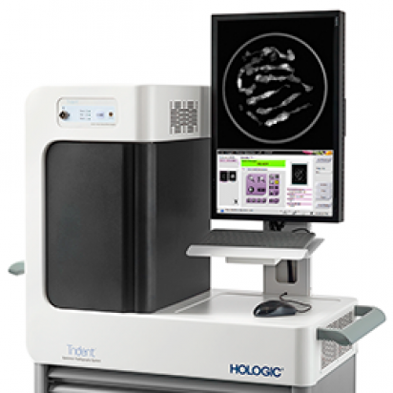
21
Intraoperative Imaging Systems
  Increasing role in
intraoperative assessment
of lumpectomy specimens

Slide 22
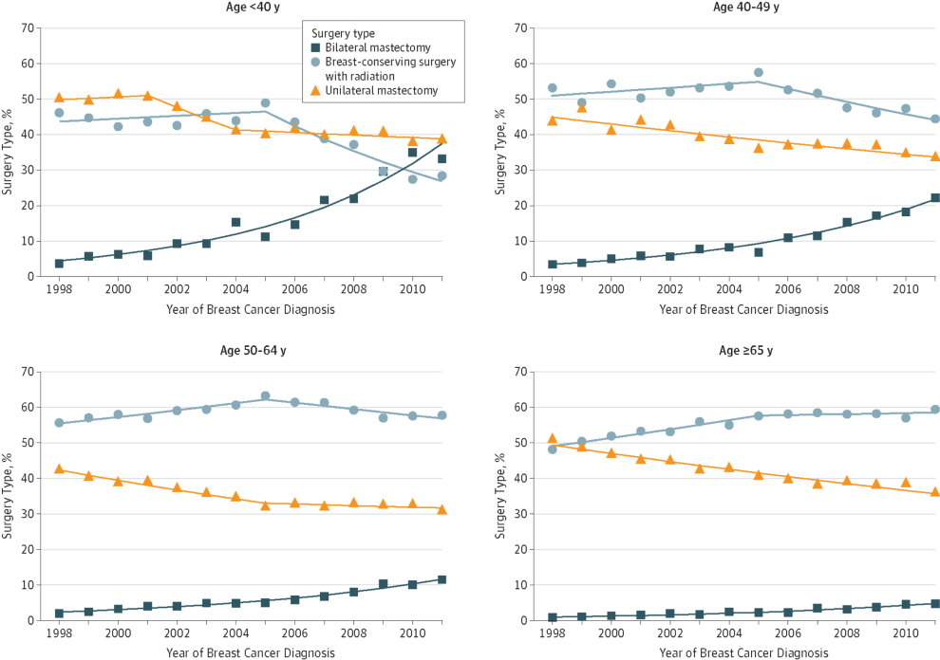
Increasing Use of Contralateral
Prophylactic Mastectomy
22
Tuttle TM et al. J Clin Oncol. 2007;25(33):5203-5209.
Kurian AW et al. JAMA. 2020;312(9):902-914.

Slide 23
Factors Contributing to CPM Trends
23
Patients may overestimate their risk of CBC
Misperception of reducing recurrence with CPM
Preference of better symmetry associated with bilateral mastectomy and reconstruction
Increasing use of genetic testing and pre-operative breast MRI
Results of observational studies demonstrating an association between CPM and lower breast cancer-specific and all-cause mortality (selection bias)
Societal shift regarding the acceptability of mastectomy (mostly in US)

Slide 24
24
Nipple-Sparing Mastectomy
Rationale
In recent mastectomy series NAC involvement is seen only in 6-11% but in the majority it is not appreciated preoperatively
Careful intraoperative or postoperative evaluation of the NAC is necessary for NSM
Several series have demonstrated the oncologic safety of NSM
Main advantages: cosmesis and preservation of some nipple sensation (variable)
Potential concerns: nipple necrosis/nipple-loss and long-term oncologic safety
Laronga C et al. Ann Surg Oncol. 1999;6(6):609-13; Simmons RM et al. Ann Surg Oncol. 2002;9(2):165-8; Klimberg VS et al. Ann Surg Oncol. 1998;5(3):220-6; Crowe Jr JP et al. Arch Surg. 2004;139(2):148-50; Pennisi VR et al. Aesthetic Plast Surg. 1989;13(1):15-21.

Slide 25
25
Nipple-Sparing Mastectomy
Appropriate Candidates
Tumor size 3 cm or less
Tumor location at least 2 cm away from the nipple-areola complex
Absence of multi-centricity
Absence of segmental malignant calcifications extending to the nipple-areola complex
Clinically negative nodes
Negative intraoperative or postoperative biopsy of nipple-areola complex
Spear SL et al. Plast Reconstr Surg. 2009;124(3):695-703.
Golshan M. In: Diseases of the Breast. 5th ed. 2015:504-509.

Slide 26
26
Nipple-Sparing Mastectomy
Technical Aspects
Incisions:
  Peri-areolar with lateral extension
  Trans-areolar, peri-nipple with lateral extension
  Trans-areolar, trans-nipple with medial and lateral extensions
  Inferior-lateral mammary crease incision
  Nipple-sparing omega (mastopexy) incision
  Vertical incision
Laronga C et al. Ann Surg Oncol. 1999;6(6):609-13; Simmons RM et al. Ann Surg Oncol. 2002;9(2):165-8; Klimberg VS et al. Ann Surg Oncol. 1998;5(3):220-6; Crowe Jr JP et al. Arch Surg. 2004;139(2):148-50; Pennisi VR et al. Aesthetic Plast Surg. 1989;13(1):15-21.

Slide 27
27
Special Circumstances in Breast Cancer Primary Surgery

Slide 28
28
Family History/BRCA Status and IBTR
Family history is not an independent predictor of IBTR in case-control studies
Whether BRCA mutations increase IBTR rates after BCS is controversial:
  Pierce et al: No significant increase in 10-year IBTR rate for BRCA+ pts (12%) vs. BRCA- pts (9%)
  Robson et al: Non-significant increase in IBTR rate for BRCA+ Ashkenazi Jewish pts vs. BRCA- pts (RR = 1.79; 95% CI = 0.64-5.03)
  Haffty et al: Significant increase in 12-year IBTR rate for BRCA+ pts (49%) vs. BRCA- pts (21%). No oophorectomy or tamoxifen used
Pierce LJ et al. J Clin Oncol. 2006;24(16):2437-43; Robson M et al. J Natl Cancer Inst. 1999;91(24):2112-7; Haffty BG et al. Lancet. 2002;359(9316):1471-7.
Notes:
In conclusion:
Seventy-five to 80% of DCIS are ER positive.
Tamoxifen reduces the risk of subsequent breast cancer by about 50% in patients with ER-positive DCIS.
Tamoxifen is probaby ineffective in reducing subsequent breast cancer in patients with ER-negative DCIS.
And finally…accurate assessment of ER-status with standardized methodology is essential in properly identifying patients for tamoxifen therapy.

Slide 29
29
Surgical Approach of BRCA+ Patients
Known Mutation Carriers:
  Discuss BCS vs. bilateral mastectomy
  XRT is effective without excess toxicity
  Higher rate of IBTR (or 2nd primary in the ipsilateral breast) and CBC
Suspected Mutation Carrier:
  Proceed with genetic counseling and testing and use results for decision making
  Proceed with surgery as planned based on tumor presentation (consider neoadjuvant Rx)
  - Revisit the surgical management after systemic therapy is given and before XRT
Notes:
In conclusion:
Seventy-five to 80% of DCIS are ER positive.
Tamoxifen reduces the risk of subsequent breast cancer by about 50% in patients with ER-positive DCIS.
Tamoxifen is probaby ineffective in reducing subsequent breast cancer in patients with ER-negative DCIS.
And finally…accurate assessment of ER-status with standardized methodology is essential in properly identifying patients for tamoxifen therapy.

Slide 30

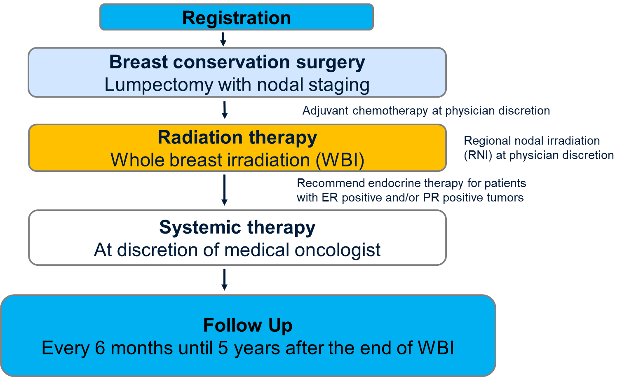
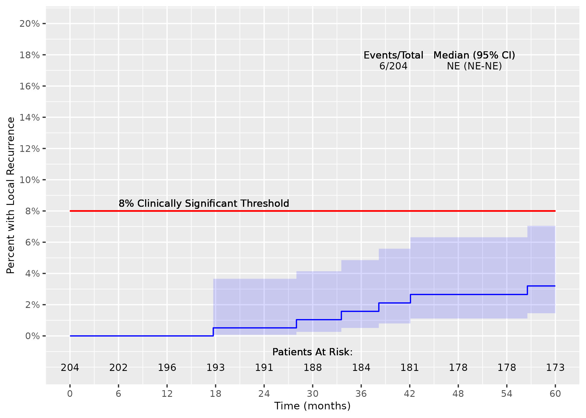
ACOSOG Z11102 (Alliance)
BCT in Patients with Multiple Ipsilateral BC
30
To assess LR rate with BCT in patients with multiple ipsilateral breast cancer
204 Evaluable Patients
Acceptable 5-year LR rate for BCT was defined as less than 8%
Estimated cumulative incidence of
local recurrence at 5 years of
3.1% (95% CI: 1.3 - 6.4)
Boughey JC et al. SABCS 2022 GS3-01 and J Clin Oncol 2023
Notes:
Thank you for the opportunity to present the results of the Alliance Z11102 clinical trial evaluating breast conserving therapy for women with multiple ipsilateral breast cancer

Slide 31
31
Occult Breast Cancer
Incidence and Diagnosis
0.3%-1% of breast cancers present with clinical axillary adenopathy with an occult breast primary
Breast MRI identifies the occult primary in 75-85% of the cases
In most cases with negative MRI, no tumor can be identified in the mastectomy specimen
Baron PL et al. Arch Surg. 1990;125(2):210-4; Merson M et al Cancer. 1992;70(2):504-8; Patel J et al. Cancer. 1981;47(12):2923-7; Sakorafas GH et al. Surg Oncol. 1999;8(1):27-33; Orel SG et al. Radiology. 1999;211(3):845-50; Henry-Tillman RS et al. Am J Surg. 1999;178(6):496-500; Morris EA et al. Radiology. 1997;205(2):437-40; Tilanus-Linthorst MM et al. Breast Cancer Res Treat. 1997;44(2);179-82; Baker DR. Clin Breast Cancer. 2000;1(1):66-7.
Notes:
In conclusion:
Seventy-five to 80% of DCIS are ER positive.
Tamoxifen reduces the risk of subsequent breast cancer by about 50% in patients with ER-positive DCIS.
Tamoxifen is probaby ineffective in reducing subsequent breast cancer in patients with ER-negative DCIS.
And finally…accurate assessment of ER-status with standardized methodology is essential in properly identifying patients for tamoxifen therapy.

Slide 32
32
Occult Breast Cancer
Loco-Regional Management
Traditionally, MRM followed by PMRT +RNI has been the standard approach
Acceptable approaches with proven safety (in small series) include:
  Axillary node dissection followed by breast XRT + RNI as appropriate
  Neoadjuvant chemotherapy followed by either one of the above options (consider SLNB+TAD)
If mastectomy is not performed, omission of breast XRT increases the rates of IBTR (from about 12-33% to about 14-83%)
Baron PL et al. Arch Surg. 1990;125(2):210-4; Merson M et al Cancer. 1992;70(2):504-8; Patel J et al. Cancer. 1981;47(12):2923-7; Sakorafas GH et al. Surg Oncol. 1999;8(1):27-33; Ellerbroek N et al. Cancer. 1990;66(7):1461-7; Kemeny MM et al. Am J Surg. 1986;152(1):43-7; Vlastos G et al. Ann Surg Oncol. 2001;8(5):425-31; Foroudi F et al. Int J Radiat Oncol Biol Phys. 2000;47(1):143-7.
Notes:
In conclusion:
Seventy-five to 80% of DCIS are ER positive.
Tamoxifen reduces the risk of subsequent breast cancer by about 50% in patients with ER-positive DCIS.
Tamoxifen is probaby ineffective in reducing subsequent breast cancer in patients with ER-negative DCIS.
And finally…accurate assessment of ER-status with standardized methodology is essential in properly identifying patients for tamoxifen therapy.

Slide 33
Neoadjuvant Chemotherapy
Loco-Regional Effects
33
NC in operable BC induces clinical response in 80-90% of the pts
pCR rates have been steadily increasing
NC increases the rates of BCS with a small increase in IBTR (3%) vs. adjuvant chemo
Potential to increase cosmetic result by decreasing the amount of breast tissue needed to be removed at lumpectomy

Slide 34
Challenges in the Surgical Management of the Primary Breast Tumor After NAC
34
Defining the extent of residual tumour to determine the amount of
breast tissue to be removed at lumpectomy
Concentric pattern of shrinkage
Honeycomb/patch-like pattern of shrinkage
Tumor subtype and breast imaging findings (including breast MRI) can help identify the pattern
of shrinkage and extent of residual disease
Notes:
Challenges in the Management of the Primary Breast Tumour:
Ability to define the extent of residual tumour and as a result the amount of breast tissue to be removed at lumpectomy (how do tumours shrink in response to NAC: concentric vs. honeycomb pattern?)
Tumour subtype and breast imaging findings (mammogram, ultrasound, breast MRI) can help identify the pattern of shrinkage and extent of residual disease.

Slide 35
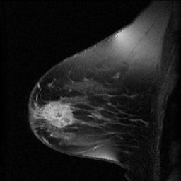
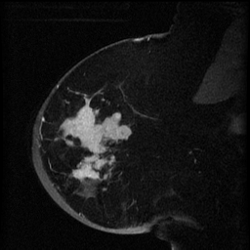
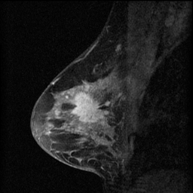
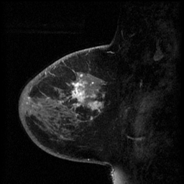
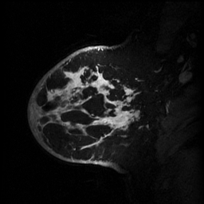

35
MRI Phenotypes
1 2 3 4 5
1: Single predominant mass with identifiable rim, displacing
2: Nodular pattern, irregular borders
3: Diffuse infiltrative pattern
4: Patchy enhancement
5: Septal spread
Esserman L et al. Ann Surg Oncol. 2001;8(6):549-59.

Slide 36
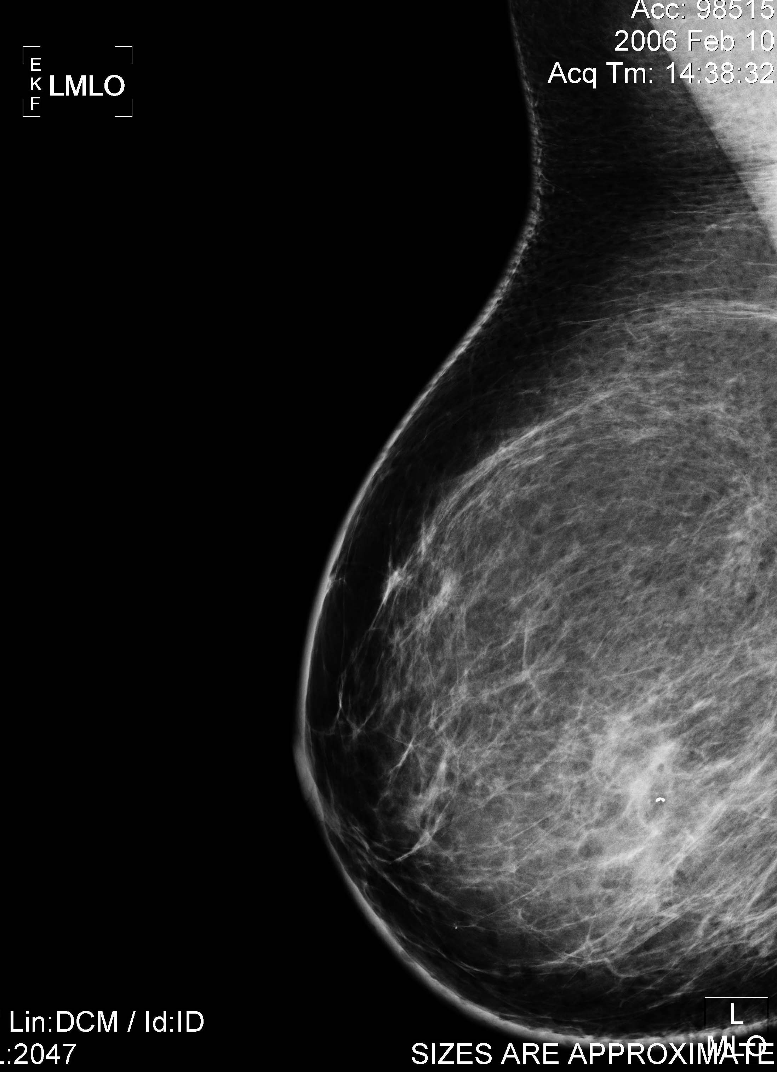
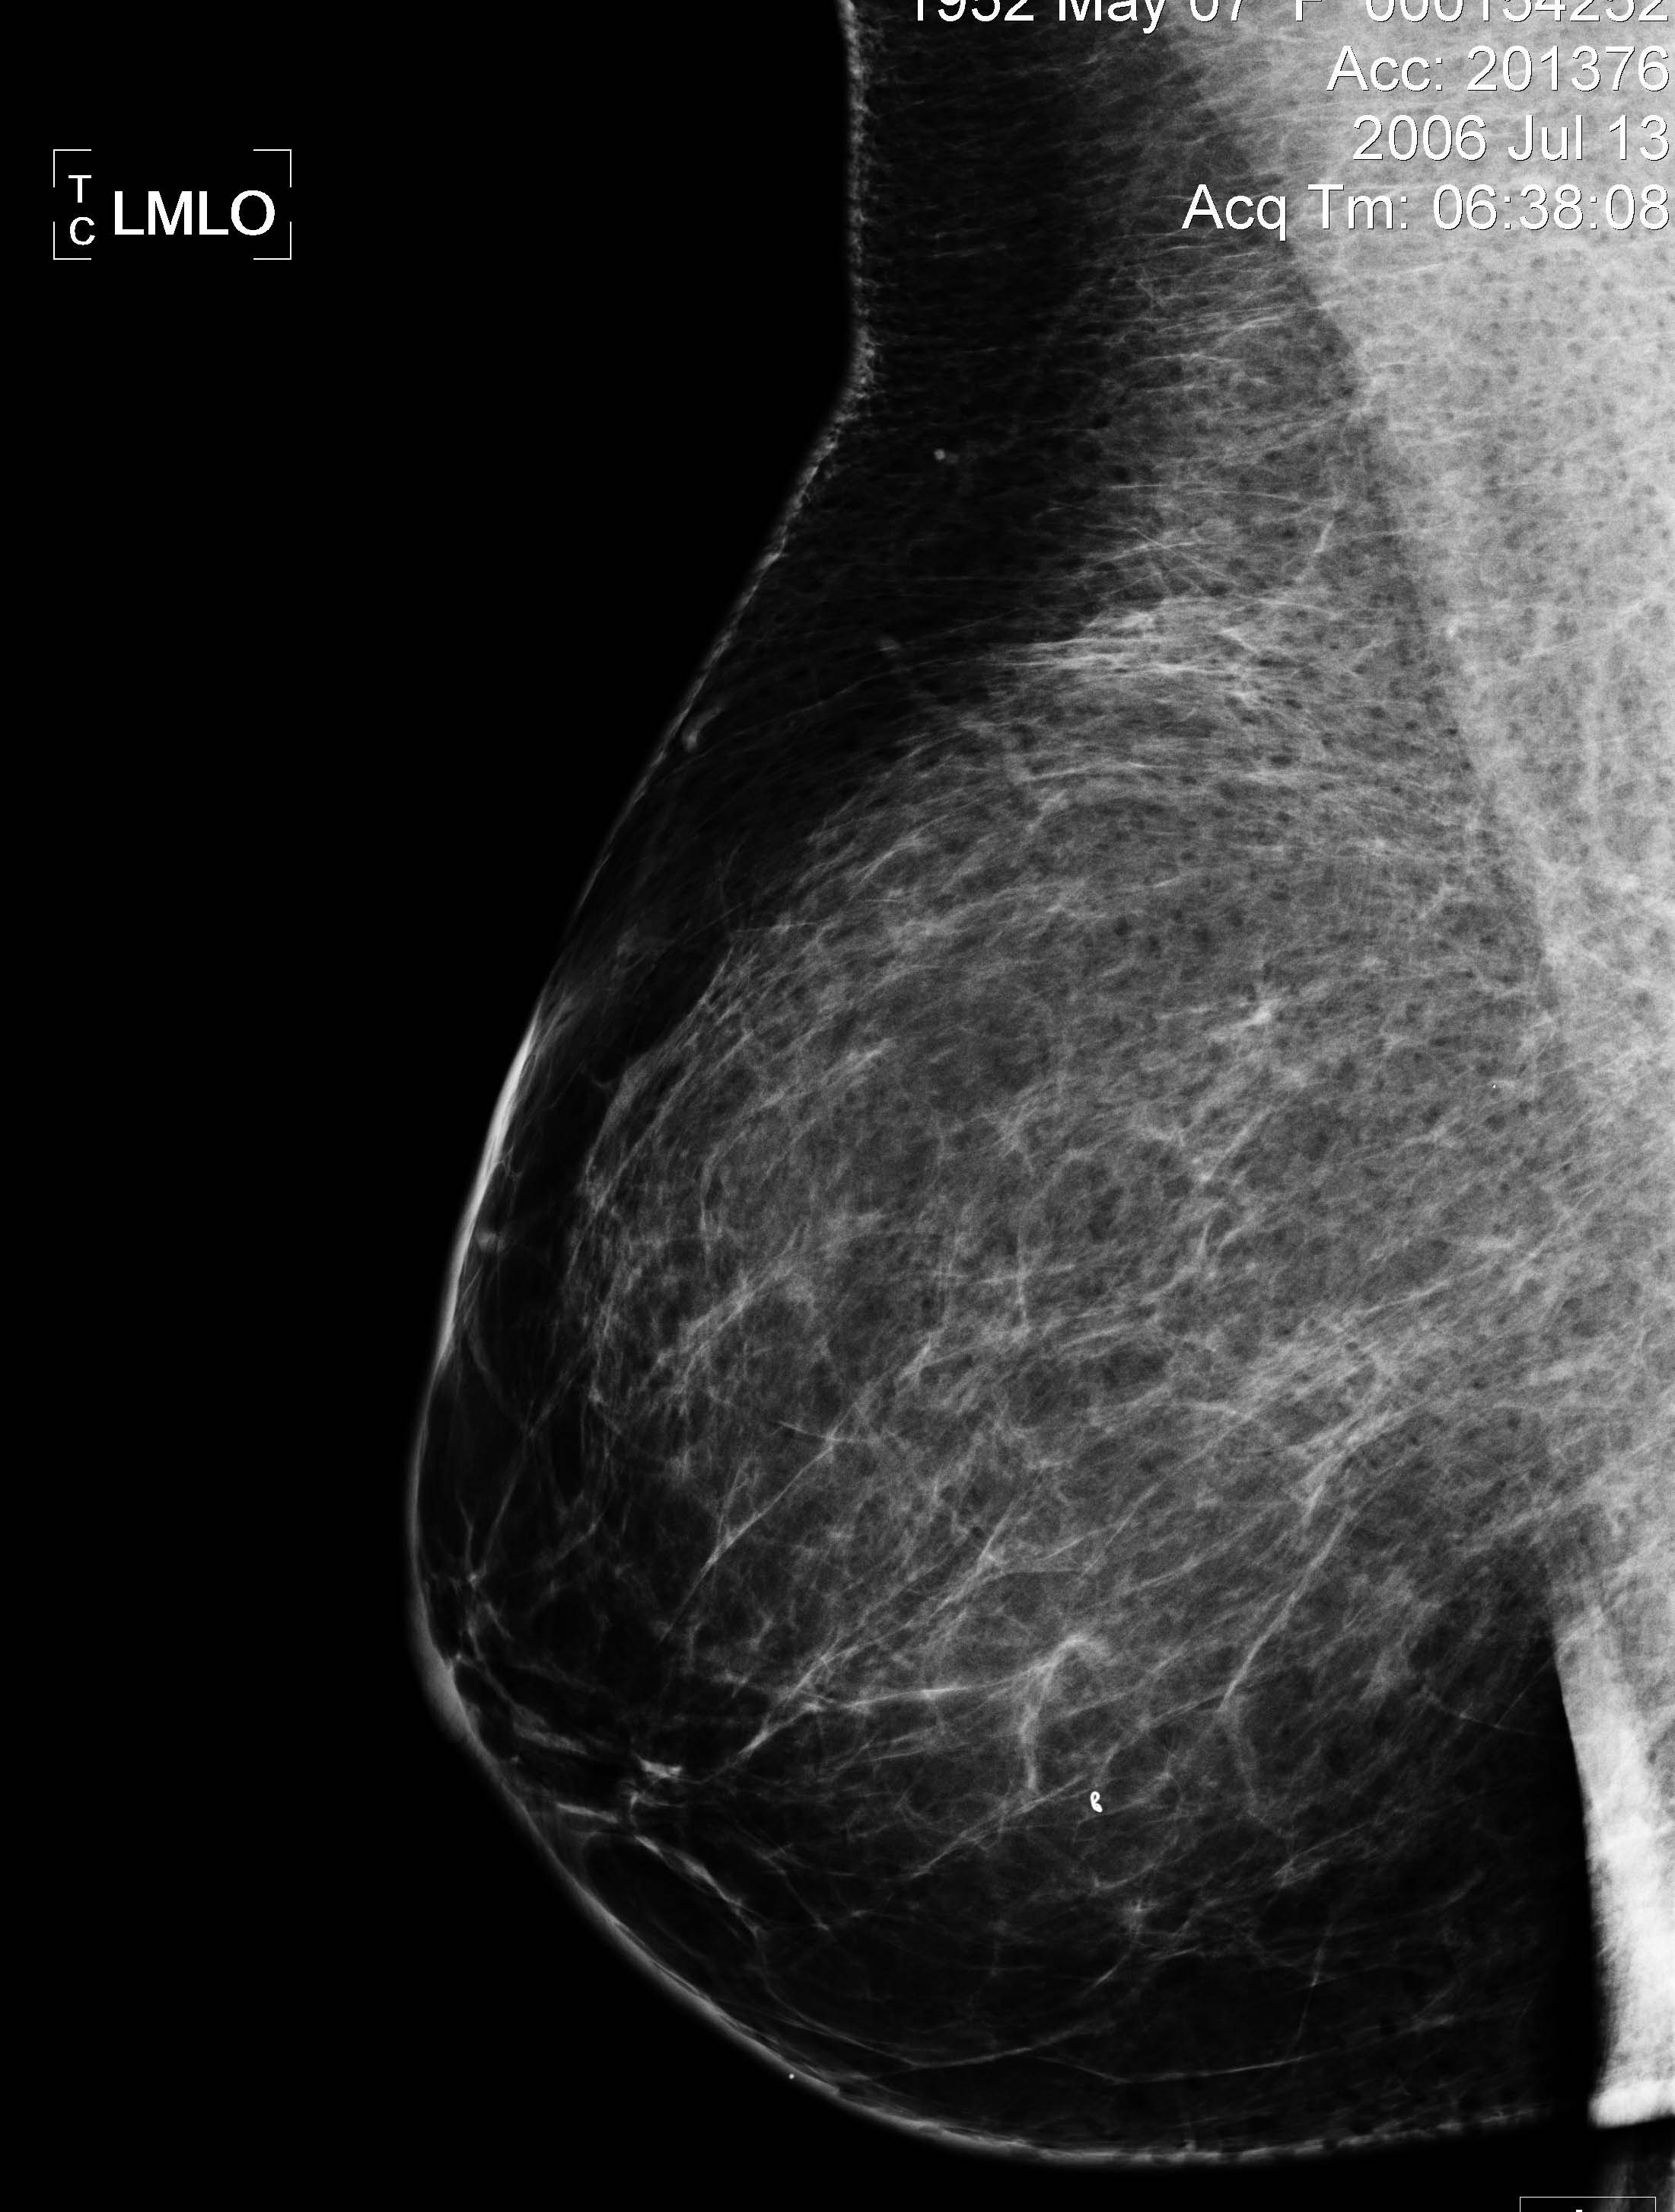
Neoadjuvant Chemotherapy
Surgical Planning
36
Identification of the exact tumor location in cases of cCR
  Preoperative titanium clip placement and wire or wireless localization
Before NC
After NC
Kuerer HM et al. Am J Surg. 2001;182(6):601-8; Kaufmann M et al. J Clin Oncol. 2003;21(13):2600-8; Baron LF et al. AJR Am J Roentgenol. 2000;174(2):539-40; Edeiken BS et al. Radiology. 1999;213(3):895-900; Dash N et al. AJR Am J Roentgenol. 1999;173(4):911-7.
Notes:
36

Slide 37
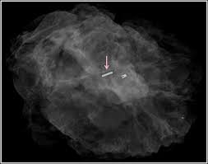
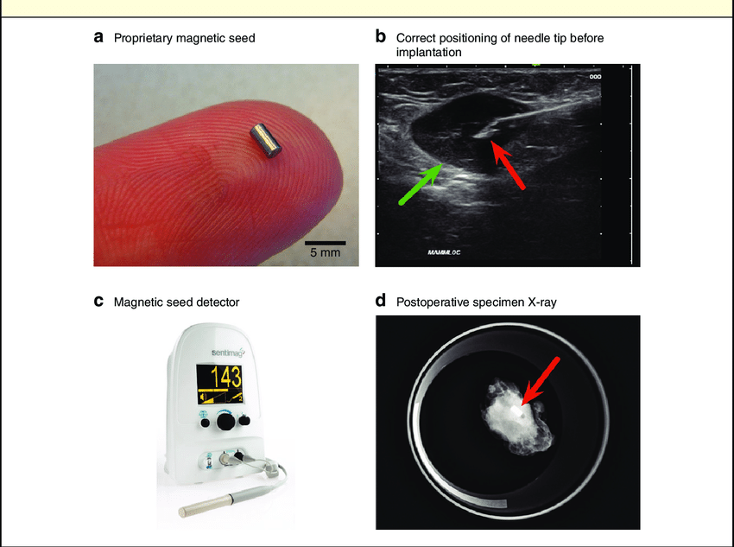
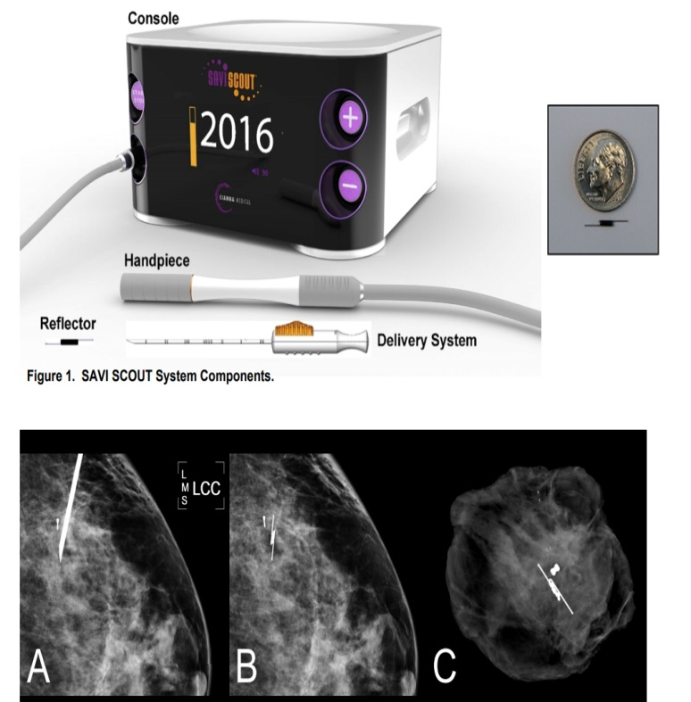

37
New Methods of Wireless Lesion Localization
Radioactive Seeds
Savi Scout
Magnetic Seeds

Slide 38
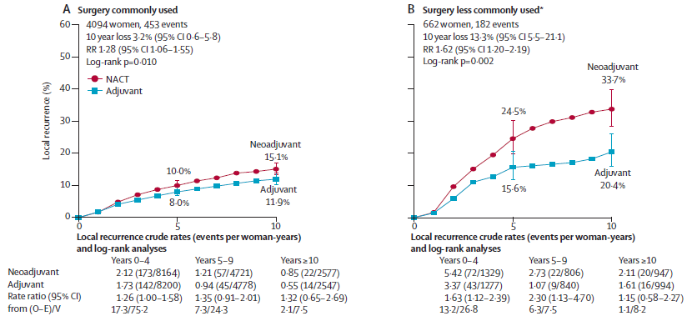
38
EBCTCG Meta-Analysis: Neoadjuvant vs Adjuvant Chemo
LRR According to Surgery Use
Early Breast Cancer Trialists' Collaborative Group (EBCTCG). Lancet Oncol. 2018;19(1):27-39.

Slide 39
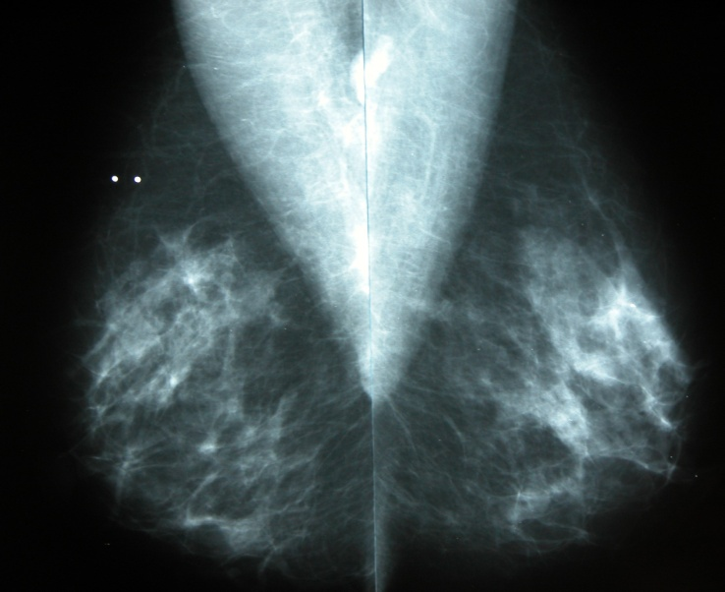
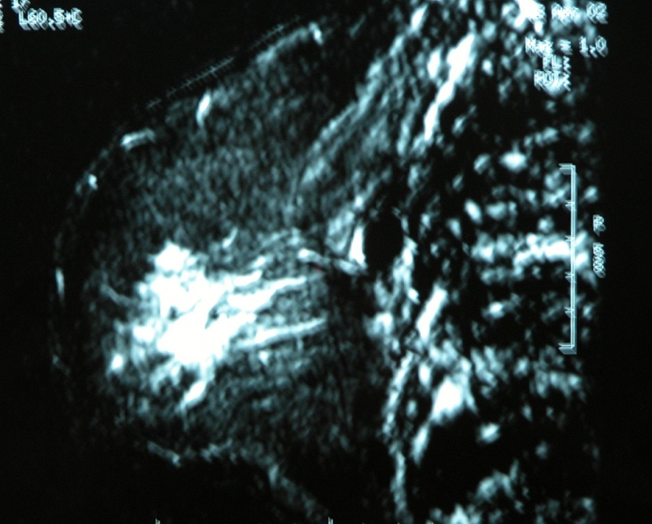
Invasive Lobular Carcinoma and NC
39
Particular attention when planning BCS in pts with ILC after NC
ILC often multicentric and can extensively involve the breast without significant clinical or mammographic findings
MRI is useful in defining the extent in the breast (but not in the axilla)
Very low pCR rates with ILC (0-3%)
ILC predicts for ineligibility of BCS
Unlikely that pts with extensive ILC will be converted to BCS candidates by NC
Lesser ML et al. Surgery. 1982;91(2):234-40; Cocquyt VF et. Eur J Surg Oncol. 2003;29(4):361-7; Newman LA et al. Ann Surg Oncol. 2002;9(3):228-34.

Slide 40
Primary Surgical Therapy in Patients Presenting with Stage IV BC
40
Conventional wisdom is that once metastases have occurred, aggressive local therapy provides no survival advantage and should not be pursued except to prevent local complications (bleeding, ulceration, infection)
Several retrospective studies have shown significantly better outcomes for women who had surgical removal of their tumor vs. those who did not (particularly for those who had negative margins)
Khan SA et al. Surgery. 2002;132(4):620-6; Rapiti E et al. J Clin Oncol. 2006;24(18):2743-9; Gnerlich J et al. Ann Surg Oncol. 2007;14(8):2187-94; Bafford AC et al. Breast Cancer Res Treat. 2009;115(1):7-12; Babiera GV et al: Ann Surg Oncol. 2006;13(6):776-82; Blanchard DK et al. Ann Surg. 2008;247(5):732-8; Le Scodan R et al. J Clin Oncol. 2009;27(9):1375-81; Ruiterkamp J et al. Eur J Surg Oncol. 2009;35(11):1146-51; Shien T et al. Oncol Rep. 2009;21(3):827-32; Cady B et al. Ann Surg Oncol. 2008;15(12):3384-95; Fields RC et al. Ann Surg Oncol. 2007;14(12):3345-51.

Slide 41
41
Primary Surgical Therapy in Patients
Presenting with Stage IV BC
Most studies adjusted for imbalances in known prognostic factors (such as number of mets, location of mets, type of systemic therapy or use of radiotherapy)
Most studies concluded that unrecognized selection bias may have accounted for the observed benefit of surgery and only large prospective RCTs could reliably answer the question
Khan SA et al. Surgery. 2002;132(4):620-6; Rapiti E et al. J Clin Oncol. 2006;24(18):2743-9; Gnerlich J et al. Ann Surg Oncol. 2007;14(8):2187-94; Bafford AC et al. Breast Cancer Res Treat. 2009;115(1):7-12; Babiera GV et al: Ann Surg Oncol. 2006;13(6):776-82; Blanchard DK et al. Ann Surg. 2008;247(5):732-8; Le Scodan R et al. J Clin Oncol. 2009;27(9):1375-81; Ruiterkamp J et al. Eur J Surg Oncol. 2009;35(11):1146-51; Shien T et al. Oncol Rep. 2009;21(3):827-32; Cady B et al. Ann Surg Oncol. 2008;15(12):3384-95; Fields RC et al. Ann Surg Oncol. 2007;14(12):3345-51.

Slide 42

Tata Memorial Center
Randomized Phase III Trial
42
Stage IV BC At Presentation
Loco-Regional Treatment*
Anthracyclines
+/- Taxanes
(CR /PR )
R
N=350
No Loco-Regional Treatment
Stratification by:
Hormone-Receptor Status
Site of metastases (visceral vs. bone vs. both)
Number of metastatic lesions (< 3 vs. > 3)
Median F/U:
17 mos
*LRT: BCS or Mastectomy + AND followed by radiation therapy (RT), as per standard adjuvant guidelines
Badwe R et al. Lancet Oncol. 2015;16(13):1380-1388.

Slide 43
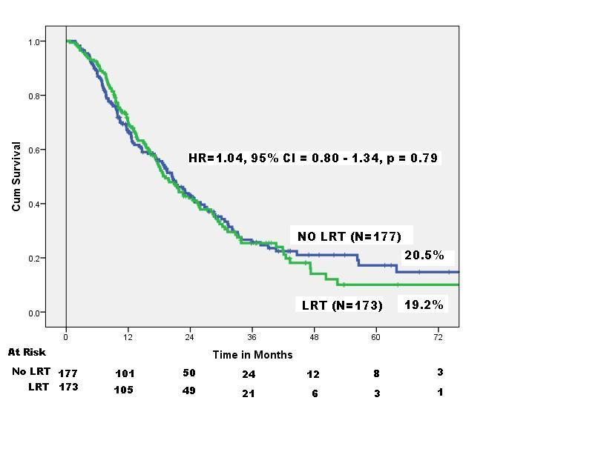
Tata Memorial Center Phase III Trial
Results: Overall Survival
43
The median OS in LRT and No-LRT arms were 18.8 and 20.5 months (HR = 1.04, P = .79)
Corresponding 2-year OS were 40.8% and 43.3%, respectively
No significant difference in OS between the two groups after adjusting for age, ER status, HER2 status, site and number of mets (HR = 1.00, 95%CI = 0.76-1.33, P = .98)
Badwe R et al. Lancet Oncol. 2015;16(13):1380-1388.

Slide 44
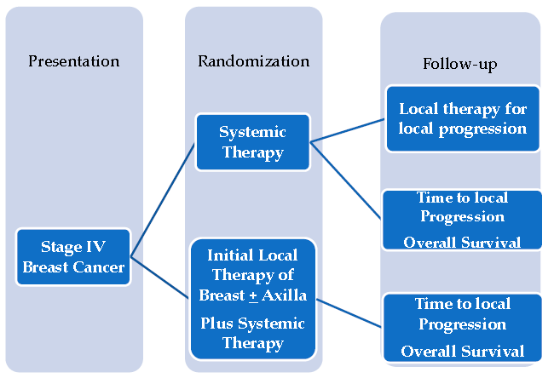
MF07-01 Turkish Study: Design
44
Chemotherapy to all patients either after randomization in the ST treatment arm or after surgical resection the surgery arm
Hormone therapy for HR positive BC and trastuzumab for HER-2 positive BC
Surgery-RT at discretion of investigator
Soran A et al. Ann Surg Oncol. 2018;25(11):3141-3149.

Slide 45
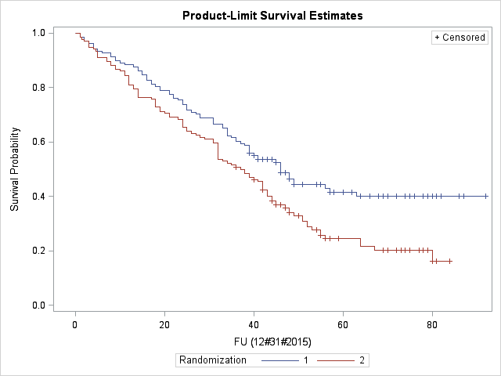
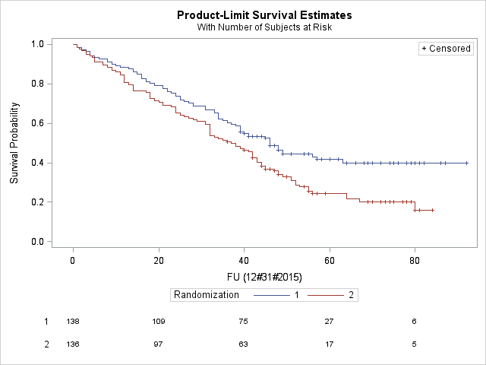
MF07-01 Turkish Study: Results
5-Year Overall Survival
45
5-year Survival
41.6%
24.4%
HR: 0.66
P = .005
Overall Survival
Surgery
 | N | Death | Median (mos)
Surgery | 138 | 76 | 46
ST | 136 | 101 | 37
ST
Follow-up Time (months)
Surgery
ST
Number at Risk
Soran A et al. ASCO 2016. Abstract 1005.

Slide 46
MF07-01 Turkish Study: Results
5-Year Overall Survival
46
Subgroup
ER/PR Positive
ER/PR Negative
HER2 Positive
HER2 Negative
Triple Negative
Age<55
Age≥55
Bone only Met
Other Mets no Bone
Solitary Bone Met
Multiple Bone Met
Solitary Pulmonary/Liver Met
Multiple Pulmonary/Liver Mets
Survival OR 95%CI
Favors surgery
Favors No Surgery
Soran A et al. Ann Surg Oncol. 2018;25(11):3141-3149.

Slide 47
47
ECOG-ACRIN E2108: Design
Primary Endpoint: Overall Survival
Khan S et al. ASCO 2020. Abstract LBA2.

Slide 48
48
ECOG-ACRIN E2108: LR Therapy
Khan S et al. ASCO 2020. Abstract LBA2.

Slide 49
49
ECOG-ACRIN E2108: Results
Overall Survival
Progression-Free Survival
Khan S et al. ASCO 2020. Abstract LBA2.

Slide 50
50
ECOG-ACRIN E2108:
Overall Survival by Subtype
Khan S et al. ASCO 2020. Abstract LBA2.

Slide 51
51
ECOG-ACRIN E2108:
Loco-regional Progression
Khan S et al. ASCO 2020. Abstract LBA2.

Slide 52
52
Japanese Randomized Trial:
Primary Tumor Resection + Systemic Therapy vs. Systemic Therapy Alone
570 de novo stage IV BC patients
First registration: Systemic Therapies according to clinical subtypes
Patients without progression after 3 months of primary systemic therapy were randomly assigned 1:1
  Systemic therapy alone (arm A)
  PTR plus systemic therapy (arm B)
The primary endpoint was overall survival
Secondary endpoints included local relapse-free survival
Shien T, et al: Br J Cancer 133, 625-632; 2025

Slide 53
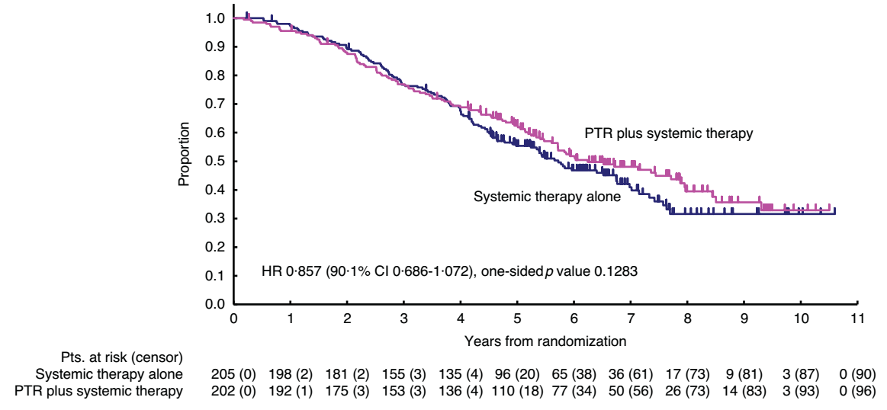
53
Japanese Randomized Trial:
Overall Survival
Shien T, et al: Br J Cancer 133, 625-632; 2025

Slide 54
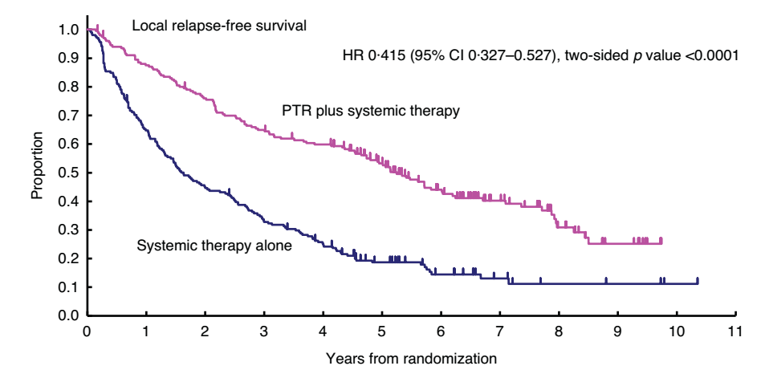
54
Japanese Randomized Trial:
Local Relapse-Free Survival
Shien T, et al: Br J Cancer 133, 625-632; 2025

Slide 55
55
Primary Surgical Therapy in Patients Presenting with Stage IV BC
Not removing the primary tumor remains the standard in pts presenting with Stage IV disease
Surgery can be entertained in selected cases for local control if local manifestations are more likely to contribute to morbidity than distant ones
In such cases, BCS is preferable if it can encompass the scope of the surgical resection
Axillary node surgery or breast XRT are generally not advisable

Slide 56
De Novo Oligometastatic BC (OMBC)
56
In the context of new systemic therapies for MBC with the ability to destroy micrometastases and extend survival, metastasis-directed therapies for patients with oligometastatic disease (< 5 metastases) may become more relevant
SBRT has gained popularity in the setting of OMBC due to its excellent efficacy and lower rates of associated toxicity but surgical removal of oligometastatic sites or radiofrequency ablation are other options
In the case of metastases-directed therapies, control of the breast primary and involved axillary nodes becomes part of the treatment algorithm

Slide 57
SABR-COMET Randomized Phase II Trial of SBRT
57
Assessed standard treatment +/- SBRT in patients with controlled primary tumor who had < 5 metastatic lesions
The study enrolled 99 patients with different tumor types
18 patients had a breast cancer primary
93% of patients had 1-3 lesions
SBRT significantly increased median PFS (12 vs 6 months, P = .001) and median OS (41 vs 28 months, P = .09)
Palma DA et al. Lancet. 2020;38(25):2830-2838.

Slide 58
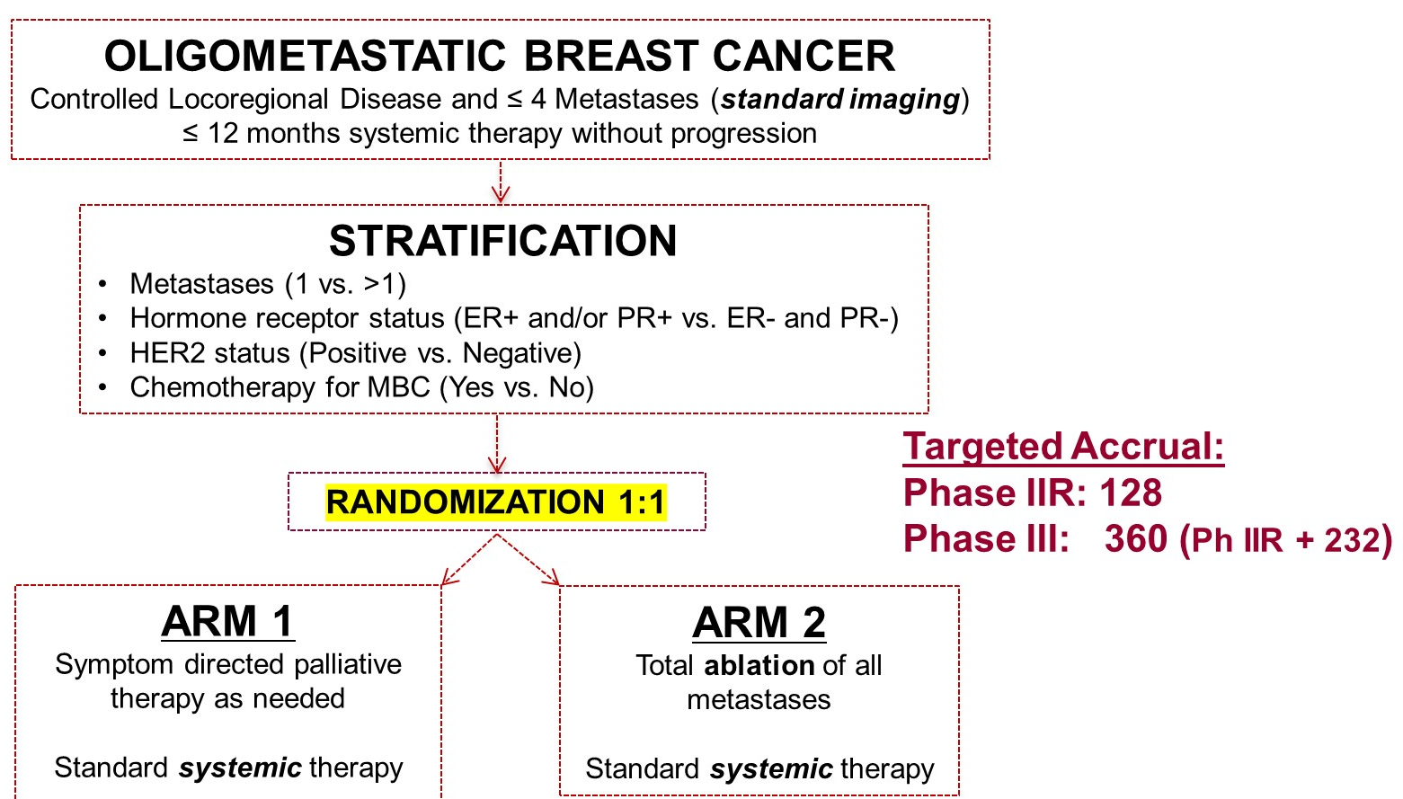
NRG-BR002 Schema: Phase IIR/III Design
58
Chimura S et al. ASCO 2022. Abstract 1007.

Slide 59
NRG-BR002: Patient and Tumor Characteristics
59
 | Standard of Care (n = 65) | Standard of Care + Ablation (n = 60) | Total (N = 125)
Age (years)
Median | 53 | 55.5 | 54
Performance Status (Zubrod)
0 | 41 (63%) | 41 (68%) | 82 (66%)
1 | 24 (37%) | 19 (32%) | 43 (34%)
Patient Metastasis Count
1 | 39 (60%) | 36 (60%) | 75 (60%)
>1 | 26 (40%) | 24 (40%) | 50 (40%)
Hormone Receptor/HER2 Status
ER and PR-; HER2- | 5 (8%) | 5 (8%) | 10 (8%)
ER and PR-; HER2+ | 2 (3%) | 1 (2%) | 3 (2%)
ER and/or PR+; HER2+ | 6 (9%) | 7 (12%) | 13 (10%)
ER and/or PR+; HER2- | 52 (80%) | 47 (78%) | 99 (79%)
Metastatic Timing
Synchronous | 12 (18%) | 15 (25%) | 27 (22%)
Not synchronous | 52 (80%) | 45 (75%) | 97(78%)
Pending | 1 (2%) | 0 (0%) | 1 (1%)
Chimura S et al. ASCO 2022. Abstract 1007.

Slide 60
NRG-BR002: Patient and Tumor Characteristics
60
 | Standard of Care (n = 65) | Standard of Care + Ablation (n = 60) | Total (N = 125)
Age (years)
Median | 53 | 55.5 | 54
Performance Status (Zubrod)
0 | 41 (63%) | 41 (68%) | 82 (66%)
1 | 24 (37%) | 19 (32%) | 43 (34%)
Patient Metastasis Count
1 | 39 (60%) | 36 (60%) | 75 (60%)
>1 | 26 (40%) | 24 (40%) | 50 (40%)
Hormone Receptor/HER2 Status
ER and PR-; HER2- | 5 (8%) | 5 (8%) | 10 (8%)
ER and PR-; HER2+ | 2 (3%) | 1 (2%) | 3 (2%)
ER and/or PR+; HER2+ | 6 (9%) | 7 (12%) | 13 (10%)
ER and/or PR+; HER2- | 52 (80%) | 47 (78%) | 99 (79%)
Metastatic Timing
Synchronous | 12 (18%) | 15 (25%) | 27 (22%)
Not synchronous | 52 (80%) | 45 (75%) | 97(78%)
Pending | 1 (2%) | 0 (0%) | 1 (1%)
Chimura S et al. ASCO 2022. Abstract 1007.

Slide 61
NRG-BR002: Patient and Tumor Characteristics
61
 | Standard of Care (n = 65) | Standard of Care + Ablation (n = 60) | Total (N = 125)
Age (years)
Median | 53 | 55.5 | 54
Performance Status (Zubrod)
0 | 41 (63%) | 41 (68%) | 82 (66%)
1 | 24 (37%) | 19 (32%) | 43 (34%)
Patient Metastasis Count
1 | 39 (60%) | 36 (60%) | 75 (60%)
>1 | 26 (40%) | 24 (40%) | 50 (40%)
Hormone Receptor/HER2 Status
ER and PR-; HER2- | 5 (8%) | 5 (8%) | 10 (8%)
ER and PR-; HER2+ | 2 (3%) | 1 (2%) | 3 (2%)
ER and/or PR+; HER2+ | 6 (9%) | 7 (12%) | 13 (10%)
ER and/or PR+; HER2- | 52 (80%) | 47 (78%) | 99 (79%)
Metastatic Timing
Synchronous | 12 (18%) | 15 (25%) | 27 (22%)
Not synchronous | 52 (80%) | 45 (75%) | 97(78%)
Pending | 1 (2%) | 0 (0%) | 1 (1%)
Chimura S et al. ASCO 2022. Abstract 1007.

Slide 62
NRG-BR002: Patient and Tumor Characteristics
62
 | Standard of Care (n = 65) | Standard of Care + Ablation (n = 60) | Total (N = 125)
Age (years)
Median | 53 | 55.5 | 54
Performance Status (Zubrod)
0 | 41 (63%) | 41 (68%) | 82 (66%)
1 | 24 (37%) | 19 (32%) | 43 (34%)
Patient Metastasis Count
1 | 39 (60%) | 36 (60%) | 75 (60%)
>1 | 26 (40%) | 24 (40%) | 50 (40%)
Hormone Receptor/HER2 Status
ER and PR-; HER2- | 5 (8%) | 5 (8%) | 10 (8%)
ER and PR-; HER2+ | 2 (3%) | 1 (2%) | 3 (2%)
ER and/or PR+; HER2+ | 6 (9%) | 7 (12%) | 13 (10%)
ER and/or PR+; HER2- | 52 (80%) | 47 (78%) | 99 (79%)
Metastatic Timing
Synchronous | 12 (18%) | 15 (25%) | 27 (22%)
Not synchronous | 52 (80%) | 45 (75%) | 97(78%)
Pending | 1 (2%) | 0 (0%) | 1 (1%)
Chimura S et al. ASCO 2022. Abstract 1007.

Slide 63
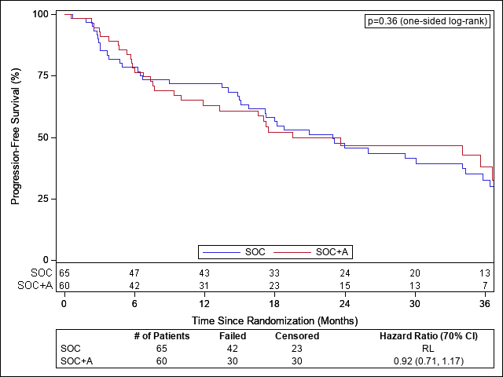
NRG-BR002: PFS by Treatment Arm
63
 | SOC (n = 65) | SOC+A (n = 60)
24-month estimate (70% CI) | 45.7% (38.9%, 52.5%) | 46.8% (39.2%, 54.3%)
36-month estimate (70% CI) | 32.8% (26.0%, 39.5%) | 38.1% (29.7%, 46.6%)
mPFS
Design | 10.5 months | 19 months
Observed | 23 months | 19.5 months
HR [SOC+A/SOC] (70% CI): 0.92 (0.71, 1.17)
Median Follow-up = 35 months
(min-max: 0.03-62.74)
Chimura S et al. ASCO 2022. Abstract 1007.

Slide 64
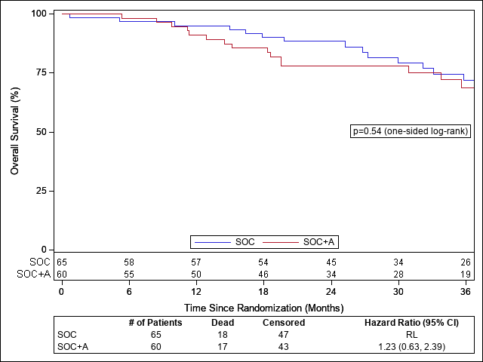
NRG-BR002: Overall Survival by Treatment Arm
64
 | SOC (n=65) | SOC+A (n=60)
36-month estimate (95% CI) | 71.8% (58.9%, 84.7%) | 68.9% (55.1%, 82.6%)
HR [SOC+A/SOC] (95% CI): 1.23 (0.63, 2.39)
Chimura S et al. ASCO 2022. Abstract 1007.

Slide 65
NRG BR002: Conclusions
65
Metastatic-directed therapy failed to show signal for improved PFS for patients with Oligometastatic breast cancer.
Therefore, there is a “No-Go Signal” to continue accrual to answer the Phase III OS research question.
Patients with Oligometastatic breast cancer as defined by NRG-BR002 have long PFS and OS.
High quality/dose SBRT was safe with low rates of treatment-related adverse events, which were similar to the SOC arm.
Chimura S et al. ASCO 2022. Abstract 1007.

Slide 66
Practical Takeaways (1)
66
Core needle biopsy is the standard diagnostic procedure for primary BC
MRI is not indicated for all pts who undergo BCS
Lumpectomy + breast XRT is the preferred surgical option in the absence of absolute contraindications
No “ink on tumor” is adequate margin for invasive BC and 2 mm margin is optimal for DCIS
There has been a recent increase in use of CPM
Nipple-sparing mastectomy requires careful consideration and patient selection

Slide 67
Practical Takeaways (2)
67
Family history of breast cancer and multicentric breast cancer do not increase the rates of IBTR and are not contraindications to BCS
BRCA mutations likely increase IBTR and CBC
In patients presenting with “occult” BC and axillary metastases, MRI plays an important role in identifying the breast primary. Breast XRT is an acceptable alternative to mastectomy, if MRI does not identify a distinct lesion

Slide 68
Practical Takeaways (3)
68
In patients undergoing NAC, unique primary surgical issues relate to assessing extent of residual disease and exact location of residual tumor/tumor bed in patients with complete clinical and/or radiologic response
Primary breast surgery in patients presenting with stage IV disease does not improve overall survival
For patients with oligometastatic disease (de novo or metachronous), SBRT to oligometastatic sites does not appear to prolong DFS or OS in a Phase II trial

