Slide 1



Risk Assessment and Reduction
Moderate-High Risk Women
Carol J. Fabian, M.D.
University of Kansas Cancer Center
Disclaimer: This presentation is intended for personal use and for informational purposes only and does not replace independent professional judgment. This presentation is the property of Physicians’ Education Resource, LLC (“PER”) and is protected by U.S. and international copyright laws. You may not copy, reproduce, distribute, transmit, modify, or create derivative works of the presentation without the prior written permission from PER.

Slide 2
Disclosures
None
Notes:
I have no disclosures

Slide 3

Outline
Risk Factors and Estimation Models
Screening by Risk Level
Risk Reduction by Risk Level/Life Phase
Development of New Prevention Rx
Hormone Replacement Therapy and Alternatives
Notes:
Will first cover risk factors and risk estimation models and screening by risk level. I will then move on to risk reduction by risk level and life phase, how we develop new prevention interventions and close with hormone replacement and alternatives.

Slide 4
Major Risk Factors Increase Relative Risk by 2x or More
Relative Risk
Absolute Risk/Year
High Penetrance Mutations ≥ age 30
(BRCA 1/2, P53, PTEN, PALB2)
Breast XRT under age 30
DCIS
LCIS
AH + Family HX
AH
Prior Invasive Breast Cancer
Moderate Penetrance Mutations
(RAD51D, ATM , BARD1, CHEK2)*
First Degree Relative <50
Up to 20 x
Up to 20x
Up to 20x
10x
8-10x
4-5x
3- 8x
2-3 x
2x
1.5-2%
1.5-2%
1.5-2%
1-2%
1%
0.5%
0.6%
*Couch JAMA Oncol 2017;3(9):1190-1196.
Notes:
Major risk factors increase risk by 2-fold or more and includes high and moderate penetrance gene mutations a prior precancerous breast biopsy, breast radiation under age 30, and a first degree relative less than 50 years of age at disease onset . A single major risk factor generally places a woman in an elevated risk category such that an appropriate age she might consider supplementary screening and or prevention interventions.

Slide 5
Minor Risk Factors Increase Relative Risk Up to 2x
Relative Risk
Early menarche 1.05 year <12
Late menopause 1.05 / year >50
None or >30 first birth vs <20 2x
No Lactation 0.96 / 12 months
Hyperplasia/flat atypia 1.4 x
≥ 5 years recent hormone contraceptives 1.2x
5 years estrogen and progestin HRT 1.25 x
Obesity BMI >30 vs <25 1.3 x
Inactivity vs 3-5 hours exercise/week 1.25 x
Alcohol 1.1 / drink / day
Notes:
Individual minor risk factors such as reproductive variables, hormones, obesity inactivity and alcohol are associated with less than a 2- fold relative risk and women with multiple minor risk factors will often achieve a moderately increased risk level.
.

Slide 6

Several Web-Based Tools for Risk Prediction
Quick
Gail (BCRAT) 5yr and lifetime
  . http://www.cancer.gov/bcrisktool/
Breast Cancer Surveillance Consortium (BCSC) 5, 10 yr
  https://tools.bcsc-scc.org/BC5yearRisk.
Tyrer–Cuzick (IBIS) 5,10 yr, remaining lifetime
. http://www.ems-trials.org/riskevaluator/
Boadicea (CANRISK) 5, 10-year, lifetime
  https://www.canrisk.org/
Time Consuming
Paige J Gen Intern Med 2023;38:2584
Notes:
There are now several web-based tools for risk prediction. The most commonly used risk models in the US are the GAIL or BCRAT, Breast cancer surveillance consortium, and the Tyrer-Cuzick or IBIS. CAN Risk is primarily used by genetic risk counselors

Slide 7
Model Differences
Risk Factor | BCRAT | BCSCv3 | IBIS v8 | CanRisk
Age | X if≥35 | X if ≥ 35 | X any | X any
1st degree relative | X | X | X | X
2nd degree relative |  | X | X | X
BRCA1/2 |  |  | X | X
ATM,CHEK2,PALB2 |  |  |  | X
Polygenic Risk Score |  |  | X | X
AH, Proliferative Breast | X | X | X | X
LCIS |  | X | X | X
BIRADs Density |  | X | X | X
% Dense area or volume |  |  | X
Age 1st live birth | X | X | X | X
Prior oophorectomy |  |  | X | X
HRT/Type/years use |  |  | X | X
Age Menarche | X |  | X | X
BMI |  | X | X | X
BCRAT: Pros Simple: Age, affected first degree relative, breast bx, atypical hyperplasia (AH), reproductive factors
Cons: Cannot use if <age 35 or LCIS. Should not use if high penetrance mutation or paternal FH.
BCSC: Pros Simple: Adds LCIS, BIRADS density, BMI and 2nd degree relative to BCRAT variables
Cons: Cannot use if <35. Should not use if high penetrance gene mutation such as BRCA1/2
IBIS: Pros Can use for age <35. Considers LCIS, BRCA1/2 testing, mammographic breast dense area (estimated) or Volpara dense volume in addition to BIRADs if ≥ 40, oophorectomy and HRT use.
Cons: Does not consider moderate penetrance genes. May overestimate risk if AH, LCIS + additional factors.
CanRisk: Pros Can use if <35 Adds moderate penetrance genes to IBIS variables, predicts risk of ovarian cancer
Cons: Only BIRADs mam density, very time consuming
Notes:
There are substantial differences in what information the models collect and conditions in which each model can be used. The 2 simple models BCRAT and BCSC cannot be used for women under age 35. BCRAT ( Gail Model) also does not consider LCIS or mammographic density or second degree relatives which ignores paternal family history. Breast Cancer Surveillance Consortium adds LCIS BMI, BIRADs density and paternal FH IBIS considers almost every risk variable besides moderate penetrance mutations and is relatively quick to complete if all information is available . CanRisk which does consider common moderate penetrance gene mutations but is extremely time consuming in terms of collecting all the information it requests. Currently IBIS 8 is used in most high- risk clinics.

Slide 8
IBIS v 8 Comprehensive but Easy to Complete: Print out For Chart and Patient
Use with Any Age
Considers HRT use
Several Types of Mammographic Density
Caution:
1) Gives remaining not total lifetime risk
2) Does not consider moderate penetrance gene mutations.
3) May overestimate risk for women with LCIS/AH
4) Does not factor in pharmacologic measures for risk reduction such as tamoxifen
Brentnall Breast Ca Res 2015
Lo Brit J Ca 2018
Notes:
IBIS version 8 is comprehensive but easy to complete. It can be used for any age, considers HRT use and can insert several different measures of mammographic density into the model if at least age 40. A few cautions-the lifetime risk is really remaining lifetime risk and it does not factor in moderate penetrance genes. It may overestimate risk in those with multiple major risk factors especially LCIS and atypical hyperplasia and does not consider pharmaceutical risk reduction measures such as tamoxifen.

Slide 9
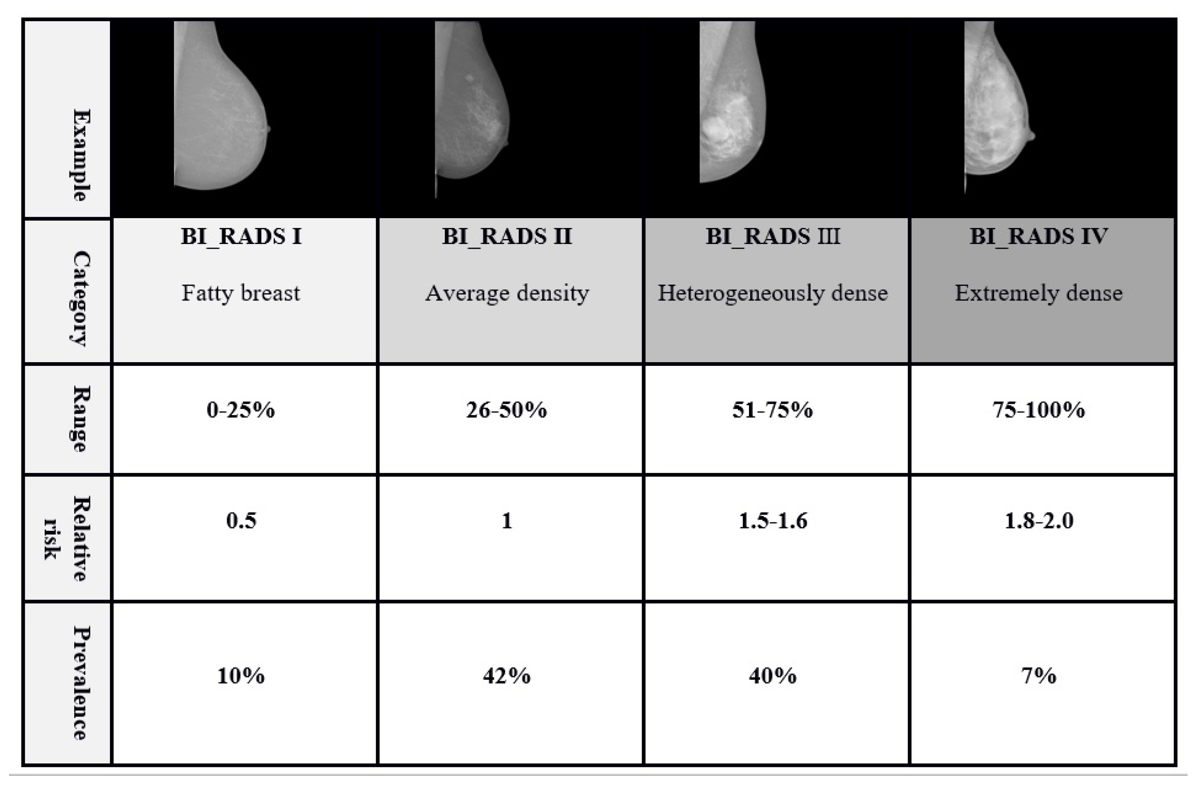
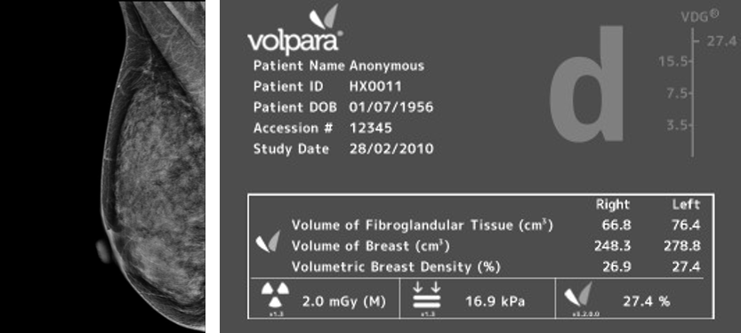
Very High Mammographic Density (BIRADs d (Extremely Dense), ≥ 75% Visual Dense Area, or Volpara d (≥ 15.5% Dense Volume) 2-fold increase in risk
a
b
c
d
Fully Automated Dense Volume (Volpara/Hologic)
Fatty
Scattered
Density
Heterogenous
Density
Extremely
Dense
Visual Dense Area
Visual Dense Area
Visual Dense Area
Visual Dense Area
Notes:
Mammographic density is also a risk factor. Very high mammographic density (BIRADs d (Extremely Dense), ≥ 75% Visual Dense Area, or Volpara d (≥ 15.5% Dense Volume) is associated with a 2-fold increase in risk and as such is a major risk factor.

Slide 10
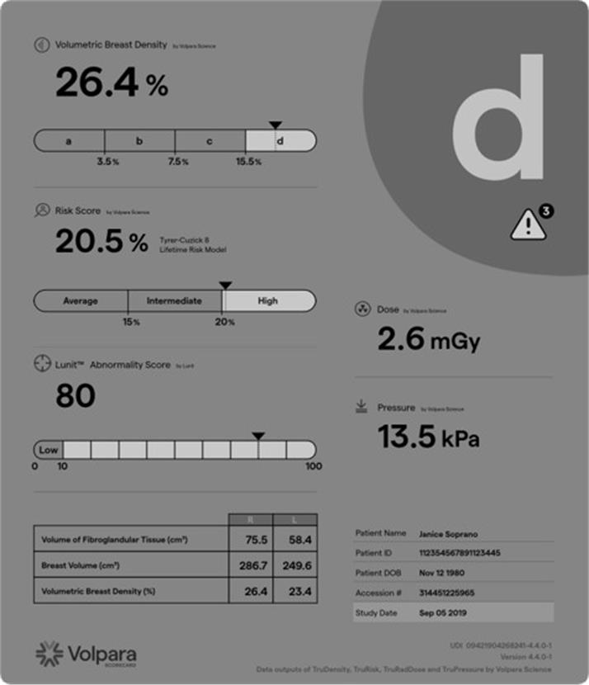
Automated Volumetric Density Use with IBIS for Long Term Risk, AI Assisted Risk of Interval Cancer, and Response to Interventions
Output of Volpara™ Algorithm with Lunit™ Al
  % Dense volume (~1/3 % dense area)
  Remaining lifetime risk (combo with IBIS)
  AI score for underlying presence or interval cancer
  Absolute Dense Volume (FGV)
    Change in absolute FGV best with weight loss interventions
    Volumetric density better for assessing change with interventions in postmenopausal women
Vachon J Clin Oncol 2023;41:3172-3183
Larson J Am Coll Radiol 2024;21:1119-1129 SE
Notes:
Automated estimates of dense area or volume have been developed. Note that % dense volume is much less than % dense area. Newer algorithms in combo with IBIS give absolute and % dense volume, estimate remaining lifetime risk, and an AI score for underlying presence or likelihood of interval cancer. Dense volume compared to dense are is more sensitive to change with prevention interventions particularly in postmenopausal or obese women

Slide 11



AI + Mammography for 5-year Risk Prediction
AI trained on serial exams to develop algorithm
2 FDA Approved Summer 2025 after validation in external screening cohorts
Both higher AUC 5-year Risk (.7-.8) than IBIS (.54-.6)
One developed by Lehmann commercially available for a fee
Rights to Jing/Colditz model acquired by Volpara/Lunit and may see soon as part of mammogram reports or biomarker in prevention trials.
Graham Colditz
Constance Lehman
Shu (Joy) Jiang
Yala, Lehman et al J Clin Oncol 2021; 40: 1732
Colditz and Jiang Cancer Res. 2024;84(6)(suppl):6619
Notes:
Constance Lehman used 2 D mammography and AI and Grahm Colditz and Joy Jiang used serial breast tomosynthesis exams with AI to develop 5-yr risk prediction models for breast cancer. The FDA has approved both models for use in risk prediction as they have been validated in additional large screening cohorts. They have a higher area under the curve than IBIS. The model developed by Lehman is commercially available for a fee. The right to the Jing-Colditz model has been acquired by Volpara/Lunit and we may soon see some version of this attached to mammogram reporting which use Volpara software.

Slide 12
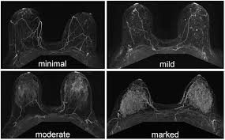
Marked MRI Background Parenchymal Enhancement (BPE) a Risk Biomarker
ACR BPE Classification
Response Biomarker to SERMs/AIs?
  Minimal BPE most postmenopausal
  Change with menstrual cycle premenopausal women
.
Jennifer Brooks npj Breast Cancer (2022) 8:97
Notes:
Another risk biomarker gaining attention is high background parenchymal enhancement on MRI which is currently being assessed as a response marker to SERMs and AIs. BPE is generally low in postmenopausal women and can change with phase of menstrual cycle in premenopausal women so its ultimate usefulness as a response indicator in prevention remains to be defined.
.

Slide 13
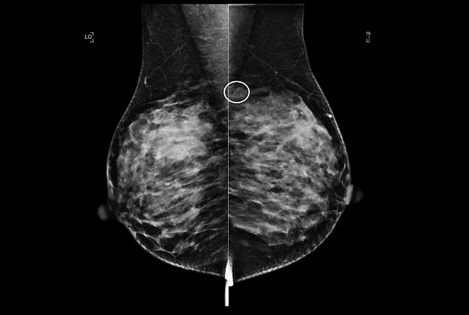
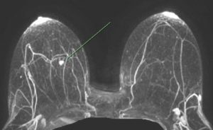

Risk Estimation Helps with Decisions on:
Age to start screening
Screening interval
Addition of supplementary surveillance imaging
Type of risk reduction intervention offered
Notes:
Risk estimation helps with decisions on age to start screening, screening interval and addition of supplementary surveillance imaging as well as the type of risk reduction intervention offered.

Slide 14
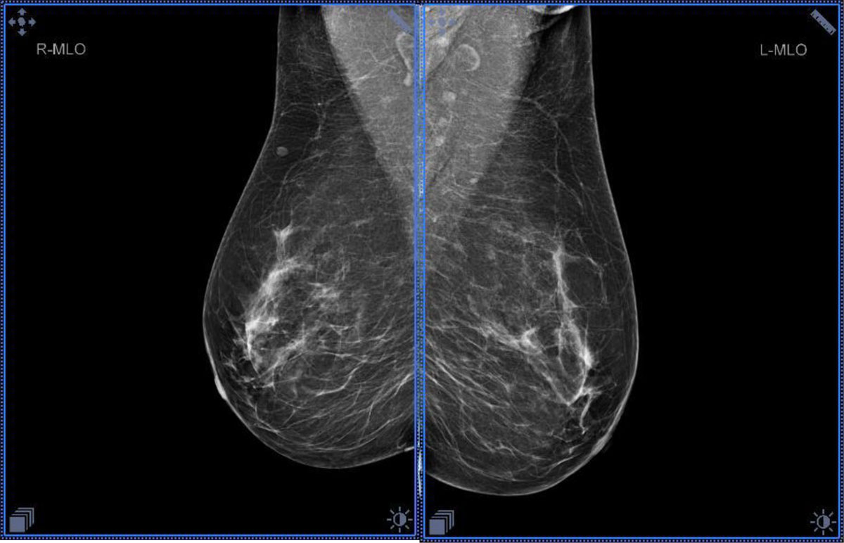


Approach to Average Risk (Lifetime Risk < 20%)
Begin Mammography @ age 40
Mammography Frequency every 1-2 years
  NCCN guidelines yearly
  US Preventive Task Force (USPTF) q 2 years
+/-Supplemental screen if dense breasts
  NCCN Yes if BIRADs c or d
  USPT No
Risk Reduction: Healthy behaviors only.
+
NCCN Guidelines v1.2023 JAMA 2023
US Preventive Task Force JAMA. 2024;331:1918
Notes:
An average risk woman is generally advised to start screening at age 40, screen every 1-2 years and consider supplemental screen imaging if dense breasts at least by NCCN criteria. Healthy behaviors and not pharmacologic interventions are advised for risk reduction.

Slide 15
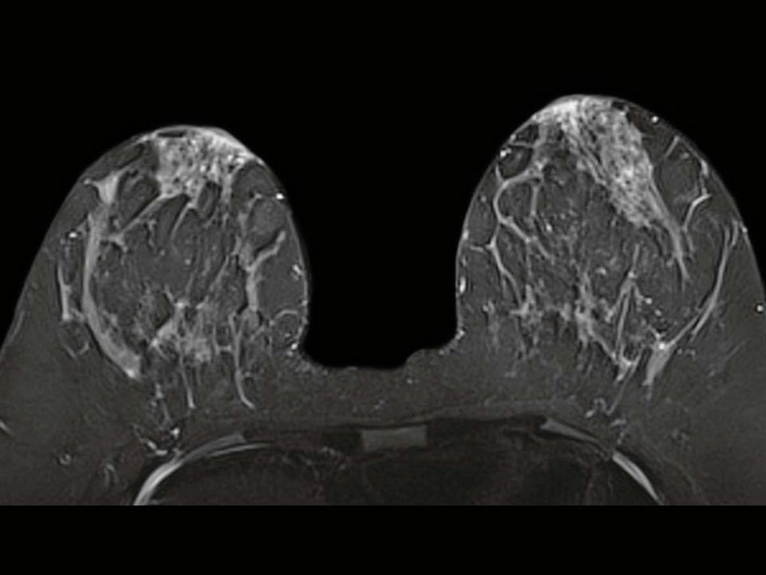
Approach Elevated Risk: (10 year ≥ 5%; Remaining Lifetime ≥ 20%)
Yearly mammography
  Starts 7-10 years prior to age at onset youngest affected relative (but not <age 30) or
  Development of AH, LCIS, DCIS or
  Per germline mutation guidelines
Yearly supplemental imaging usually separated from mammography by 6 months
  Abbreviated or Full MRI
  Contrast Enhanced Mammography (CEM)
  US (less sensitive)
Consider Endocrine Rx or Prevention Trials
Prophylactic surgery option very high risk
+
+
+/-
ASCO Risk Reduction Visvanathan, Fabian JCO 2019
NCCN Guidelines Breast Cancer Risk Reduction, v1.2025
NCCN Guidelines Breast Screening v1.2023 JAMA 2023
Notes:
The general approach to women at elevated risk is to begin yearly mammography 7-10 years prior to the youngest affected relative although not before age 30 or after a diagnosis of breast precancer or per germline mutation guidelines. Supplemental imaging generally consisting of abbreviated or full MRI, or contrast enhanced mammogram.
There is usually consideration of endocrine treatment or prevention trials depending life phase and other symptoms or co-morbidities. Prophylactic surgery options reserved for women whose lifetime risk exceeds 50%.

Slide 16
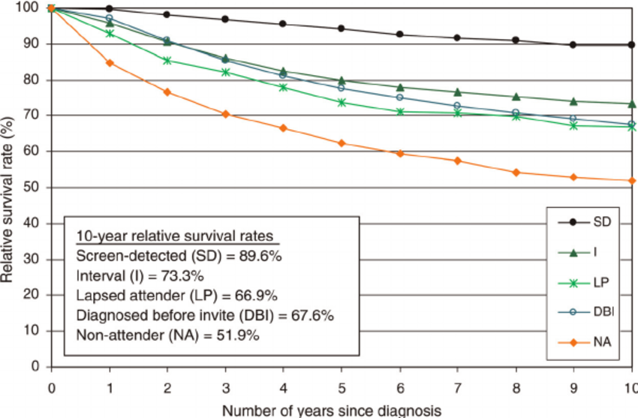
Regular Screening ~40% Improved Breast Cancer Survival Primarily Due to Earlier Stage at Diagnosis
,
,
From O’Sullivan J Med Screen 2009
Rahman WT, Helvie MA Best Pract Res Clin Obstet Gynaecol. 2022;83:3-14.
Notes:
Appropriate screening is extremely important as it substantially impacts breast cancer survival.

Slide 17

Screening/Surveillance Women with Germline Mutations
Moderate Penetrance Mutations
  CHEK2, ATM: Start MRI @ 30-35, mammogram @40
  RAD51C, RAD51D: MRI and mammogram @40
High Penetrance Mutations
  P53: Annual MRI @20, mammogram @30
  BRCA1/2: Annual MRI @ 25, mammogram @30
  PALB2, CDH1, PTEN, SKT11: MRI & mammogram @30
NCCN Screening Guidelines v2.2024
Notes:
For the moderate penetrance gene mutation carriers CHEK2 and ATM MRI at 30-35 but mammogram at 40 unless otherwise indicated by FH. For p53 mutation carriers annual MRI at 20 and mammogram at 30. BRCA1-2 mutation carriers MRI should be started at 25 with mammography added at 30. Most other high penetrance mutation carriers as well as PALB2 both MRI and mammogram should start at 30.

Slide 18
Risk Reduction: Healthy Lifestyle for all, Other Risk Reduction Options Depend on Risk Level, Life Phase, Symptoms
Risk Level (10- year risk at age 50) | Healthy Lifestyle | Endocrine Alterations | Clinical Trials | Prophylactic Surgery
Average Risk (10 year 2.3% at 50 ) | x
Moderately Increased 2-3x average or (10 year 5-7% at age 50 ) | x | +/- | x
High risk 4-9x average or (10 year 8-22% at age 50 ) | x | x | x
Very High ≥ 10x average or (10 year ≥ 23% at age 50 ) | x | x | x | x
Notes:
Healthy Lifestyle is stressed for all but other risk reduction options depend on risk level life phase and symptoms

Slide 19


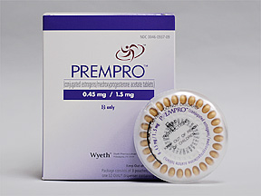
Healthy Behaviors Reduce Risk By Up to 30%
Dos
  ≥ 150-300 min moderate intensity physical activity/week.
  Healthy diet
  Maintain normal weight
Don’ts
  ≥3 alcoholic beverages/week
  Combined Estrogen + Progestin HRT after 50
ASCO Position Statement on Obesity. and Cancer JCO 2014; 32:3568
Lammert Breast Cancer Res Treat 2018;69(3):561
Moore, JAMA Intern Med. 2016;176(6):816
Notes:
Healthy behaviors including maintaining normal weight , 3-5 hours of moderate intensity physical activity a week, limiting alcohol and avoiding combined estrogen progestin hormone replacement after age 50 can reduce risk for breast cancer by a relative 30 % as well as risk for CV disease. Adding healthy behaviors to augmented screening with both MRI and mammography is often all that is needed for the moderately increased risk woman

Slide 20

Mechanism of Physical Activity Induced Risk Reduction
All Women
Young BRCA1 Mutation Carriers
Increase BRCA1 and p53 expression
Increase ERβ:Erα
Increase Irisin levels
Decrease visceral adipose, insulin resistance
Reduce mitochondrial dysfunction
BRCA mutation carriers sensitive to progesterone signaling
Exercise decreases luteal progesterone decreasing
RANK Ligand and stem cell proliferation
Sigl Open Biol 2016;
Sorrenito Front Physiol 2021.
Brown & Ligibel J Cachexia, Sarcopenia and Muscle 2024
Cuyàs Oncotarget 2017;
Trapp Int J Obes (Lond) 2008;
Ziegler Metabolism 2015
Notes:
Exercise has impact at several levels including an increase in irisin levels and BRCA1, p53 expression, and the ER beta to alpha ratio in mammary tissue. Visceral adipose, insulin resistance, and mitochondrial dysfunction is also reduced. Exercise in premenopausal women reduces luteal phase progesterone which in turn reduces RANK L and stem cell proliferation.

Slide 21

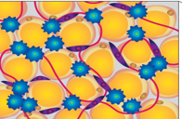
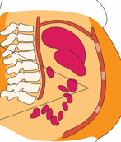
Postmenopausal Obesity Breast Cancer Risk & Mortality
Postmenopausal women
BMI 30kg/m2 increased risk of primarily ER+ breast cancer and all cause mortality
BMI of ≥35kg/m2 (severe obesity) increased risk of dying from breast cancer
35kg/m2
30kg/m2
Breast Ca Risk
Ca Mortality
Excess visceral fat (>1-1.2 kg), inflammatory adipocytokines, bioavailable hormones
Chlebowski WHI Cancer 2024 1-10
Neeland Circulation 2018;37:1391
Notes:
Postmenopausal obesity increases risk of developing breast cancer and severe obesity increases risk of dying from breast cancer. Excess visceral fat ( more than 1-1.2 kg) results in increased secretion of bioavailable hormones.

Slide 22

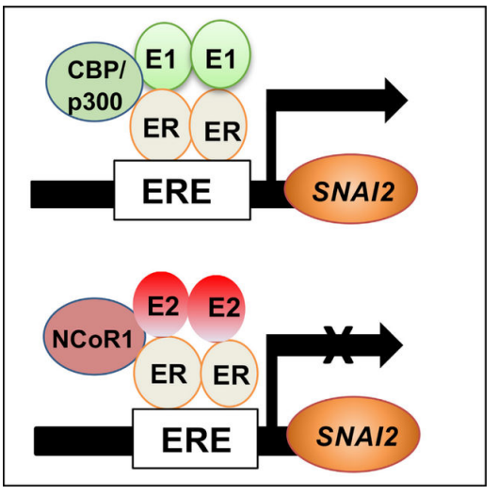
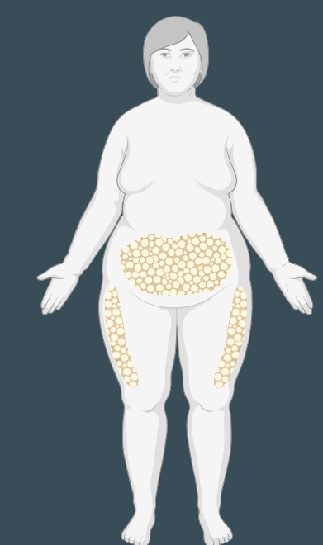

Why is Obesity Primarily Associated with Risk in Postmenopausal Women?
Predominant Estrone (E1) + Inflammation Facilitates EMT /Stemness
Post-menopausal Obesity
Obese Breast
Hi E1:E2 Ratio with NFKB Increases Stemness/EMT
EMT, stemness
NF-KB
E1:E2 Ratio
+ NF-KB
Pro-inflammatory adipocytokines
Higher E2 in premenopausal blocks NFKB SNAI2 /EMT
NF-KB
Early breast differentiation, anovulatory cycles with decreased progesterone likely also factors
Strongest inverse association obese age 18-24
Qureshi and Slingerland Cell Rep. 2022; 41: 111672.
Premenopausal Breast Cancer Grp JAMA Oncol 2018 4:e181771
Notes:
The reasons why obesity is primarily associated with postmenopausal women has been attributed to chronic inflammation combined with elevations in systemic as well as breast hormones. Premenopausal women have 10x or more the estrogen as postmenopausal women so why is premenopausal obesity not a risk factor ?
Slingerlands group has suggested that at least one reason is that obesity increases the ratio of estrone to estradiol in breast tissue. Estrone when bound to ER and in the presence of inflammation induced NFKB increases EMT and stemness with SNAI2 activation whereas an abundance of estradiol relative to estrone observed in premenopausal women blocks this activation and stemness. Further obesity in very young women promotes early breast differentiation and anovulatory cycles which reduces progesterone and risk.

Slide 23

Some Premenopausal Women with Obesity May Also be at Increased Risk for Breast Cancer
BRCA1/2 Mutation carriers
African American Women (TNBC)
Weight gain of ≥10 kg after age 35 if previously lean ( Korean study)
Dietze, Am J Pathol 2018; 188: 280,
Bhardwaj & Brown Sci Trans Med 2023.
De LaTorre Biol Med Cancer Biol Med. 2024;21:651
Notes:
Some premenopausal women with obesity may also be at increased risk for breast cancer. These are often those with an underlying degree of oxidative DNA damage such as BRCA1/2 mutation carriers. Cancers are often triple negative. Premenopausal African-American women with obesity also have an increased risk of TNBC
A recent large Korean study suggested that weight gain of more than 10 kg after age 35 if previously lean was also associated with an increased risk of premenopausal breast cancer.

Slide 24
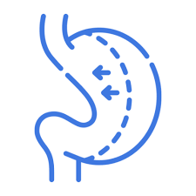
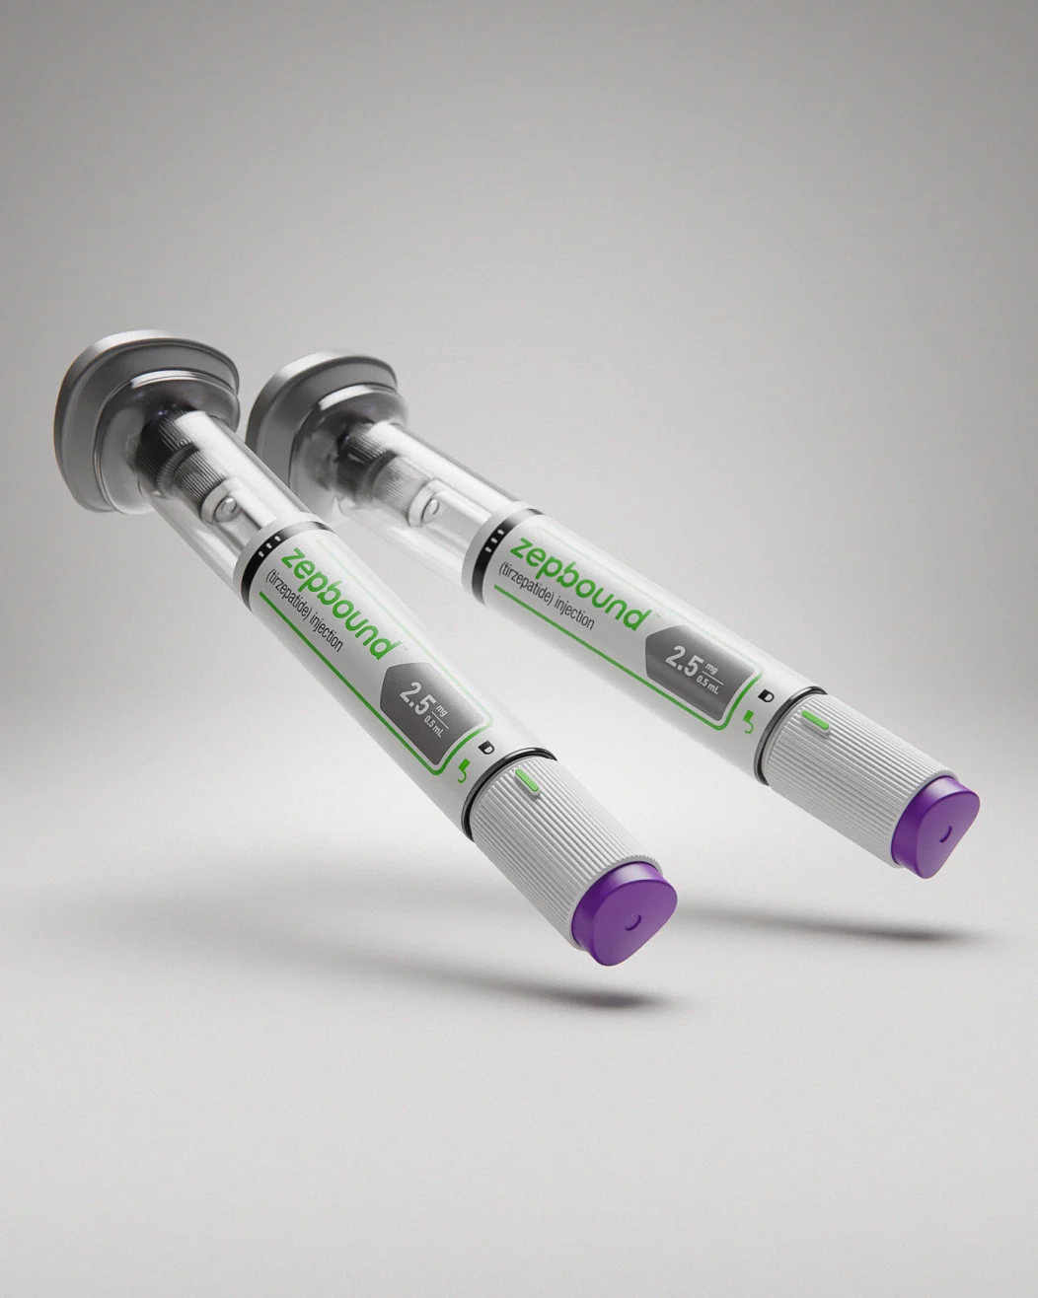
How Much Weight loss to Reduce Obesity Associated Breast Cancer Risk ?
Behavioral interventions if achieve ≥ 10% weight loss improve risk biomarkers; if sustained breast cancer risk.
Bariatric surgery with mean ≥ 20% weight reduction reduce breast cancer risk by 45%.
GLP-1/GIPR agonists 10-20% weight loss in non-diabetic cohorts. Unclear if reduce risk for breast cancer.
Teras Cancer Causes Control 2011
Fabian Breast Ca Res Treat 2013, Rubino JAMA 2022;327:138
Jastreboff NEJM 2022;387:205
Piccoli. J Clin Endocrinol Metab. 2021 106:912
.
Notes:
How much weight loss does it take to reduce obesity associated breast cancer risk and which type of interventions do the job?
Behavioral interventions which achieve a 10 % or greater sustained weight loss improve risk biomarkers and if loss is sustained reduce breast cancer risk. Bariatric surgery with a mean 20% weight reduction has been reported to reduce breast cancer risk by 45%. The eight loss in GLP-1 GIP receptor agonists achieve a 10-20% in non-diabetic individuals but unclear if associated with reduced risk of breast cancer

Slide 25
Endocrine Pharmacotherapy for Women at Elevated Risk
 | Heathy Lifestyle | Endocrine Pharmaco- Therapy | Clinical Trials | Prophylactic Surgery
Average Risk | x
Moderate | x | +/- | x
High | x | x | x
Very High | x | x | x | x
Notes:
Endocrine pharmacotherapy is generally reserved for moderately elevated to high and very high risk women

Slide 26
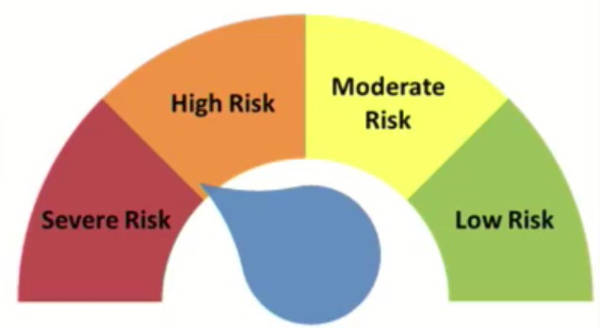
Consider Endocrine Pharmacotherapy Can be Considered in Moderate to Very High-Risk Women
Absolute Estimated Risk
  5-year BCRAT ≥ 3%*
  10-yr IBIS (Tyrer-Cuzick) ≥ 5%*
Relative Risk ≥ 2X Population for age if 45-65 , or
  ≥ 4X Population if 40-44
Moderate Penetrance Gene Mutation
Strong FH
Atypical Hyperplasia (AH) LCIS
ER+ DCIS
High Penetrance Gene Mutation
FH, ATM, CHEK2,
AH, LCIS
Minimum
Risk
High
Moderate
BRCA1/2
Very High
Average
* Using models without breast density or SNPs
Visvanathan, Fabian ASCO Prevention Guidelines Update JCO 2019;
US Preventive Services Task Force 2019;
NCCN Guidelines v1.2025
Notes:
Endocrine pharmacotherapy may be considered if a woman’s 5 year risk is 3% or higher or 10 year risk is 5% or higher by a standard model such as IBIS. This risk level will be obtained for women with moderate or high penetrance gene mutations, significant FH, precancerous breast disease

Slide 27
Standard Pharmacotherapy: 40-66% Risk Reduction But No Improvement In Breast Cancer Mortality in Women Undergoing Regular Screening
20 mg
Notes:
Standard pharmacotherapy for breast cancer risk reduction is tamoxifen for pre or postmenopausal women or raloxifene, anastrozole or exemestane for postmenopausal women. These agents at full ( standard dose) are associated with a 44-66% risk reduction but no improvement in Breast Cancer mortality in women undergoing regular screening particularly those who are being screened with both mammography and breast MRI.

Slide 28
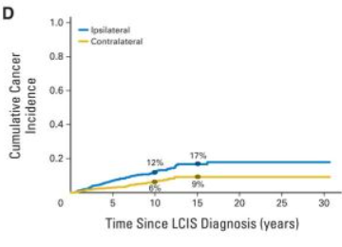
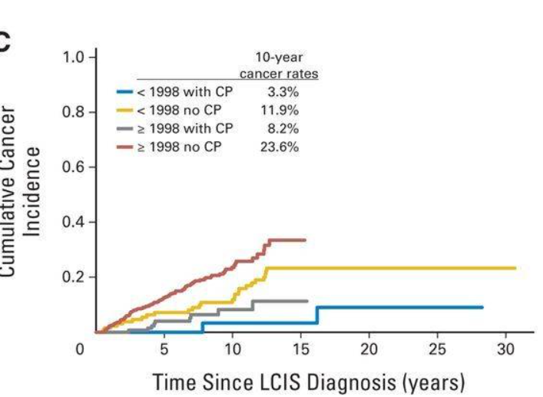
Endocrine Rx Strong Recommendation after Bx/Excision AH, LCIS
.
ADH, ALH LCIS often multifocal and bilateral. 10-year risk of DCIS/IC After AH 10%, LCIS 15-20%.
  Surgical excision after vacuum assisted large bore core bx for LCIS done if suspicion for upgrade to DCIS/IC
  Endocrine Rx reduces subsequent DCIS/IC by 2/3
  Unilateral mastectomy not a “treatment option”
  Bilateral mastectomy a consideration if other factors but generally not favored
DCIS/IC with SERM/AI
King JCO 2015;33:3945
Notes:
Endocrine treatment is a strong recommendation after biopsy and excision of atypical hyperplasia or LCIS. Note that the main purpose of surgical excision after large bore core biopsy is potential for upgrade to DCIS. Endocrine Rx such as tamoxifen can reduce DCIS/IC by 2/3 for women with AH and LCIS Unilateral mastectomy is not a treatment option for LCIS. Bilateral mastectomy is a consideration if there are other factors.

Slide 29
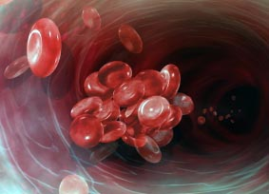
When Should Endocrine Pharmacologic Rx Not Be Used?
Tamoxifen contraindicated
  Prior DVT
  Inherited clotting disorder
  Currently considering childbearing
Tamoxifen poor choice if
  Age < 35 or > 69 or > 59 if intact uterus
  Endometriosis, ovarian cysts
  Migraines
  Abnormal liver functions
  Insulin resistance, dyslipidemia
  Current vasomotor symptoms
AIs poor choice if
  Osteopenia/osteoporosis
  Joint pain
  Vaginal dryness
  Current vasomotor symptoms
ASCO Breast Cancer Prevention Guidelines Update Visvanathan, Fabian J Clin Oncol 2019
Notes:
When should endocrine agents not be used?
Tamoxifen is contraindicated in women with prior DVT or currently considering childbearing
Tamoxifen a poor choice for women under 35 or over 69, those with endometriosis, ovarian cysts, migraines, abnormal liver functions, insulin resistance and dyslipidemia. Women who already have vasomotor symptoms are likely to discontinue. AIs a poor choice if a woman has osteopenia, joint pain, vaginal dryness or current vasomotor symptoms.

Slide 30
Majority of Eligible Women Without Atypia/LCIS Refuse Standard Dose Endocrine preventive Therapy Due To Concerns About Side Effects
Tamoxifen
  Hot Flashes,
  Vaginal Discharge
  Ovarian Cysts
  Uterine problems and cancer
  DVT, PE, Cataracts
  If overweight- Insulin resistance, fatty liver
Exemestane/ Anastrozole
  Hot Flashes
  Vaginal Dryness
  Joint & Muscle pain
  Bone Density Loss
  Fatigue
Raloxifene
  Hot flashes, Vaginal Dryness
  Leg cramps, DVT
Fisher J Natl Cancer Inst 1998
Smith Ann Oncol 2016;575
Vogel JAMA 2006;295:2727
Goss NEJM 2011;364:2381
Cuzick Lancet 2014;383:1041
Notes:
Side effects of the endocrine agents which all cause hotflashes is the primary reason for the <5% uptake in risk eligible women with atypia and LCIs. Whereas tamoxifen may cause vaginal discharge, raloxifene and exemestane are often associated with vaginal dryness. Tamoxifen can cause an increase in ovarian cysts uterine problems and cancer. Both tamoxifen and raloxifene are associated with an increased risk of DVT and PE. Tamoxifen is associated with an increase risk for cataracts. Exemestane is not associated with an increase in the risk for uterine abnormalities, uterine cancer, DVT or PE, or cataracts but is associated with joint and muscle pain and bone density loss. Raloxifene and tamoxifen can be associated with leg cramps but musculoskeletal symptoms are not as severe as with the AIs. Both tamoxifen and raloxifene when given to postmenopausal women are associated with no change to a small increase in bone mineral density but tamoxifen is associated with bone density loss in premenopausal women. All 3 drugs can cause fatigue and headache but the fatigue is generally worse for AIs than tamoxifen or raloxifene.

Slide 31

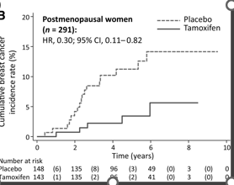
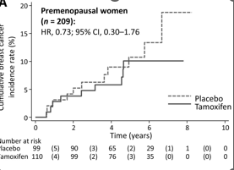
TAM-01: 3 Yrs Low-Dose Tamoxifen (5 mg) vs Placebo Women with AH, LCIS, or DCIS not on CYP2D6 Inhibitors
Minimal Increase Vasomotor Symptoms, No increase DVT/PE
Significant Decrease DCIS/IC if Postmenopausal
  HR, 0.30 (.11-.82)
Non-Significant Change in Premenopausal women
  HR, 0.73 (0.3-1.76) Premenopausal
Andrea De Censi
De Censi Clin Cancer Res 2021
Notes:
In The tam 01 trial 3 years of low dose tamoxifen in ¼ of standard dose were compared to Placebo for women with recent diagnosis of atypical hyperplasia, LCIS or DCIS Results were favorable for postmenopausal women with marked reduction in 2/3 in risk for DCIS or IC for postmenopausal women with no increase in DVT/PE or uterine cancer. Hot flashes occurred but were less intense than would be expected for full dose tamoxifen. A 27% non-significant risk reduction for premenopausal women was observed.

Slide 32
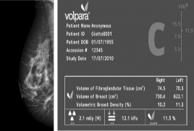

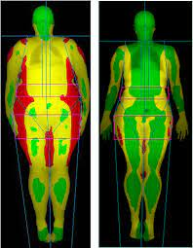

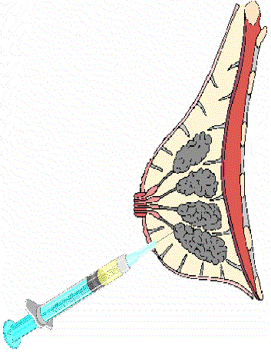
Phase II Investigational Priorities: 1) Low Doses Standard Prevention Drugs 2) New SERMS 3) FDA Approved Agents which Address Additional Symptoms or Health Problems 4) Vaccines
 | Heathy Lifestyle | Endocrine Pharmaco- Therapy | Clinical Trials | Prophylactic Surgery
Average Risk | x
Moderate | x | +/- | x
High | x | x | x
Very High | x | x | x | x
Phase II Trials use change in risk biomarkers instead of cancer incidence as endpoints
Notes:
A number of phase II trials are ongoing investigating agents likely to improve or minimally impact QOL. 1) Low Doses Standard Prevention Drugs 2) New SERMS 3) FDA Approved Agents which Address Additional Symptoms or Health Problems 4) Vaccines These trials use change in risk biomarkers instead of cancer incidence as endpoints.

Slide 33
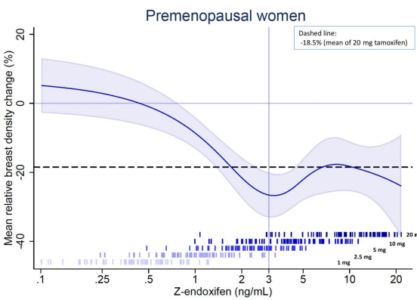
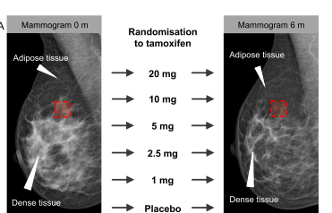
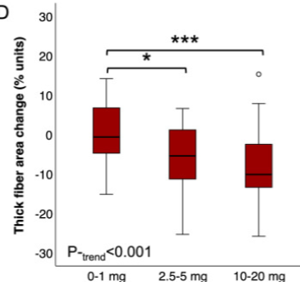
Swedish Phase II Trial Tamoxifen Doses of 0, 1,2.5,5,10,20 mg x 6 months in Population Risk Women Ages 40-65: Change in Mammographic Dense Area Primary Endpoint
Significant decrease in mammographic dense area only in premenopausal women.
Tissue correlates ~5 % of the 1440 entrants
Tissue changes (Ki-67, ER, PR, epithelial area) maximal at highest tamoxifen doses in premenopausal women
Change in collagen organization beginning at lower doses pre and postmenopausal.
.
Maximum density decrease at 3 ng/ml endoxifen achieved with 5 mg Tam5mg
KARISMA
Collagen Area
Eriksson J Clin Oncol. 2021, Goransson Breast Ca Res 2024, Hammerstrom JNCI,2025, Gabrielson Int J Ca 2023
Notes:
A Swedish Phase II trial investigated the effect of multiple doses of tamoxifen on area of mammographic density in women undergoing screening. In contradistinction to the Italian trial, they found significant decrease in mammographic dense area only in premenopausal women with maximum reduction in density at 3 ng/ml endoxifen which was observed by the 5 mg dose. Tissue correlates were obtained in ~ 5% of entrants. Change in collagen organization was observed beginning at the lowest dose in both pre and postmenopausal women but change in epithelial area which correlated with change in Ki-67 was only seen in premenopausal women and seemed to correlate with change in Ki-67. Change in Ki67 was maximal at higher doses

Slide 34

Confused??
Biomarker Change Context/Cohort Dependent
Dense area on mammogram difficult to reduce in postmenopausal women in short period of time.
Ki-67 minimal in postmenopausal women at baseline and changes with cycle in premens
Expansion of risk/response biomarker research is needed tailored to type of agent and baseline characteristics
Notes:
Confused? I think this is a good example of biomarker modulation is likely context and cohort dependent and there is no perfect endpoint for all agents or cohorts. Dense area on mammogram difficult to reduce in postmenopausal women in short period of time. Ki-67 minimal in postmenopausal women at baseline and changes with cycle in premens. We clearly need to continue work in prevention biomarker research

Slide 35



NCI Sponsored Primary Prevention Trials of Low Dose Tamoxifen
Premenopausal High Risk
Post menopausal High Risk
LDTAM vs Acolbifene NCT05941520
  Fabian-U Kansas/U Michigan Early Phase Consortium. Tissue changes primary endpoint, Volume mammographic density (FGV) secondary
  LD TAM with Dose Escalation if no Decrease Area of Mammographic density NCT06184750
  Seema Khan-Northwestern/ Early Phase Consortium
LDTAM +/- Omega-3 in Overweight/Obese NCT06195306 Lauren Nye-U Kansas/U Michigan Early Phase Consortium. Blood adipocytokines primary endpoint.
Notes:
Low dose tamoxifen is being examined in premenopausal women and compared to another late generation SERM Acolbifene with some SERD like properties which may make it less susceptible to inducing its own resistance . In the Renaissance trial lack of change in breast density is being used as a surrogate to guide need for dose escalation. In overweight and obese postmenopausal women high dose omega-3 is added to reduce tamoxifen’s unfavorable effects on some metabolic parameters and improve effectiveness

Slide 36

The Swedes Are Not Confused and Are Moving on with the Active Metabolite of Tamoxifen (Endoxifen) in Premenopausal Women
N=240 (Accrued)
E
L
I
G
I
B
I
L
I
T
y
Age 40-55
BIRADS b, c, d
Birth control
BMI < 30
Normal liver and renal functions
Not taking tamoxifen, CD46 inhibitors or anticoagulants
Mammo
g
R
am
Mammo
g
R
am
Mammo
g
R
am
Endoxifen 1 mg
Endoxifen 2 mg
Placebo
Per Hall Karolinska Institute
Primary endpoint is change in mammographic dense area (cm2)
Secondary QOL, endoxifen levels
Notes:
The Swedes are Not Confused and Are Moving on with the active Metabolite of Tamoxifen ( Endoxifen) in Premenopausal Women. They hope to circumvent problems with interaction with other drugs. Both the 1 and 2 mg dose generally exceed the 3 ng/ml threshold.

Slide 37
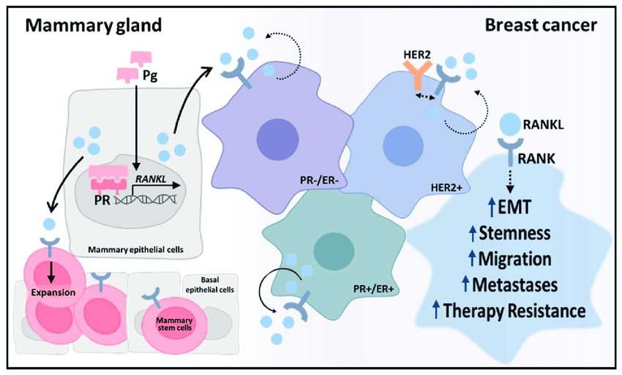
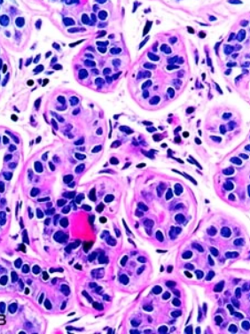
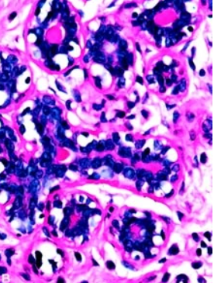
Progestins/Progesterone in Presence of Estrogen Increase Epithelial Proliferation, Mammographic Density and Risk for Breast Cancer
Progesterone increases Cyclin D1 and RANK Ligand (RANKL) in Luminal PR+ cells.
RANKL combines with RANK even in hormone receptor negative cells to increase stem cell proliferation
Day 0-5 of Cycle
Day 16-24
BRCA1 mutation carriers may be particularly sensitive to RANKL
Pictures from Ramakrishnan 2008 Modern Pathology; 15:348
Figure from Casimiro Cells 2021;10:1978
Notes:
Progestins increase luminal epithelial proliferation due to down stream increases in cyclin D1 and RANK L. Rank L in addition promotes proliferation in all cells including stem cells

Slide 38


Reducing Progesterone Signaling in Premenopausal Women
RANK L inhibitor Denosumab vs placebo for 12 months
Cohort Premen high breast density
Primary Endpoint Change in Mammographic Volumetric density over 1 year
Other: Benign breast Ki-67, RANK L, PGR
Anticipated Results 2026
Ulipristal (anti-progestin) single arm in premenopausal women (N=24) for 3 mos
Cohort Premen high risk and breast density
Primary Endpoint Change in Ki-67 breast tissue women age 25-45 regular periods.
Other MRI and tissue changes over 3 months
Anticipated results 2026
NCT 04067726 R01 funded
NCT02408770 U Manchester Foundation
T Toriola et al Ca Prev Research 2018;11:789
S Howell @Manchester.edu
Notes:
Another approach to reduce breast cancer risk in premenopausal women who have completed childbearing is to reduce progesterone signaling with either a RANKl inhibitor denosumab or the anti-progestin ulipristal. Surrogate endpoints used in these trials include volumetric breast density and Ki-67. Results are expected in 2026

Slide 39
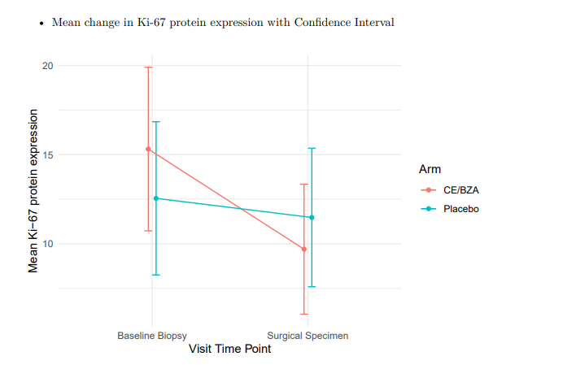

Reducing Breast Cancer Risk and Vasomotor Symptoms? Bazedoxifene and Conjugated Estrogens (BZA/CE)
Multisite 1 month Window Trial BZA/CE vs Placebo in Women With Evaluable DCIS
94 evaluable for change in Ki-67decrease greater in BZA/CE (Duavee) p=.016
Multi-site 6-month study BZA/CE vs wait list control hi-risk postmenopausal with vasomotor symptoms.
Accrual complete, 115 likely evaluable for 1 endpoint (∆ automated fibroglandular volume) Other endpoints are ∆ change benign breast Ki-67, estrogen response genes, insulin resistance, MENQOL
NCT04821141
R01 funded
Results expected 2026
NCT02694809 R01 Funded
Swati Kulkarni ASCO Annual Meeting 2025
Fabian Ca Prev Res 2019 & Contemp ClinTrials 2024
Notes:
At the top of the list in terms of multi-tasking agents for perimenopausal women is bazedoxifene and conjugated estrogen marketed as Duavee. Duavee is FDA approved for relief of hot flashes and prevention of osteoporosis. Swati Kulkarni in a multisite window trial of Duavee vs Placebo in ER+ DCIS reported that women randomized to 1 month of Duavee had reduced Ki-67 in their surgical excision compared to the placebo group. 40. We have just completed accrual to a longer duration multisite trial of Duavee vs a wait list control in high- risk women with vasomotor symptoms. This trial which follows on a positive pilot is assessing both imaging and benign breast tissue risk biomarkers. Results are anticipated in 2026

Slide 40
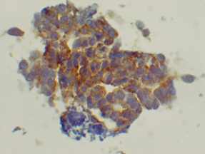

Pilot: Effects of 6 Months Tirzepatide (GLP-1/GIPR agonist) on Risk Biomarkers in High-Risk Women With Obesity NCT06485089
Eligibility
Age ≥ 35-64
BMI ≥ 30kg/m2 + additional risk factors for breast ca
Not diabetic or on GLP-1/GIP agents
Accrual (N=24) 11 months.
Biomarkers (0,6 months)
Preliminary Results (18)
Baseline BMI 37 kg/m2, GIPR ~1/2
Biomarker and BMI Change
15% Median decrease BMI
19% Median decrease visceral fat
26% Median decrease insulin, 34% HOMA IR
Reduction in mammographic FGV by 20%
Decrease breast Ki-67 pre but not postmenopausal
Spatial Genomics, miRNA, microbiome pending
GIPR
cfabian@kumc.edu
cbeaver @kumc.edu
SABCS 2025 Abstract 773 PS3-01-28 Thurs 1230-200, BCRF, Frontiers funded
Notes:
Tirzepatide with its 15-20% relative loss has potential to reduce risk for breast cancer as well as diabetes and CV disease. We conducted a 6 month pilot to assess results on breast cancer risk biomarkers in both older premens and postmenopausal women with additional risk factors for breast cancer to date 8 women. The Pilot is fully accrued and to date 18 women have completed. Median Baseline BMI was 37 kg/m2, median weight loss at 6 months was 15% with marked decreases in measures of insulin resistance. GIPR was present by spatial genomics at baseline in ~ 2/3 of women assessed to date. Mammographic FGV has been reduced by a relative 20% with a decrease in Ki-67 in pre- but not postmenopausal women.

Slide 41

HRT and Alternatives for High-Risk Women with Symptoms
Notes:
What about hormone replacement for the high-risk woman with moderate to severe vasomotor and other menopausal symptoms?

Slide 42
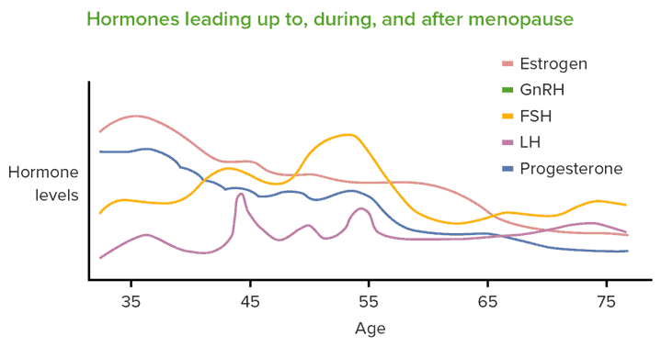


. 2023 Feb 7;329(5):405
~70% of Women Develop Vasomotor Symptoms (VSM) During Menopause Transition/Early Menopause; 25% Severe
Basis VSM
  Gonadotropin hyperstimulation triggers neurokinin-1,3 receptor signaling & narrows thermoneutral zone
How Long Do They Last
  Average duration 7 years until fluctuations in hormone levels subside & hypothalamus adjusts to chronic low estrogen
Hormonal Change and Onset VSM
Premenopausal Thermoneutral Zone
Postmenopausal Thermoneutral Zone
Anxiety, Alcohol
Crandall JAMA 2023;329:405
Johnson KA J Clin Endocrinol Metab 2023;108:1981
Notes:
Gonadotropin hyperstimulation as the result of decline in estrogen and progesterone triggers increase neurokinin 1-3 receptor (NK3) signaling and narrows thermoneutral zone. Body temps outside if this results in flushing and sweats or shivering if too cold . Average duration is ~ 7 years and hormones are most effective .

Slide 43
Treatment of Vasomotor Symptoms
  Hormonal:
    Estrogen Alone (No Uterus) ≥ 70% effective
    Estrogen and progestin ≥ 75% effective
    Bazedoxifene and conjugated estrogen ≥ 75% effective
  Non-hormonal:
    Gabapentin 30% effective
    SSRI or SSNI 50% effective
    Neurokinin (NK) 3 inhibitors (fezolinetant) or NK1/N3 inhibitors (elinzanetant) >50% effective
Crandall JAMA 2023;329:405
Johnson KA J Clin Endocrinol Metab 2023;108:1981
Notes:
Estrogen with or without progestins are the most effective in relieving symptoms. However. the SERM bazedoxifene added to conjugated estrogen is also 75 % effective and counteracts estrogen effects in breast and uterus. Some non-hormonal drugs such as SSRIs, SSNIs, and NK3 inhibitors are about 50% effective but may have other undesirable side effects.

Slide 44
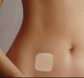

Risks for Developing Breast Cancer with Postmenopausal HRT Vary by Type, Route, Age at Start, and Duration
No Increased Risk Breast Cancer with
  Conjugated estrogen (CE) alone for 7-8 years (WHI)
    Possible all cause mortality benefit when started < 60 women prior BSO
  Vaginal troches/creams/rings
  Any HRT after Premenopausal BSO up to age 45-50
    Includes BRCA1/2 mutation carriers
Small Increased Risk Breast Cancer
  Oral or Transdermal Estradiol (E2) (HR 1.19 for 5 and up to 1.3 for 10 yrs)
  CE+ Medoxyprogesterone Acetate (MPA) (HR 1.25 up to 5 years)
Moderate Increased Risk
    CE+ MPA or other estrogen +progestin HR 2.0 for 5-10 years
Anderson Lancet Oncol 2012; Beral Lancet 2003;
Rebbeck JNCI 2009; Manson Annals Intern Med 2019, Crandall JAMA 2023
Notes:
Risks for developing breast cancer with postmenopausal HRT vary by type of drug, route of administration, age at start and duration of therapy.
.
From the WHI conjugated estrogen alone for 8 years was not associated with increased risk and is associated with a decrease in all cause mortality when given to women whose ovaries were removed prior to age 60. Conjugated estrogen which is a mixture of estrogenic substances from pregnant mare urine some of which may act as SERMS may be associated with a small decrease in risk for breast cancer. Oral or transdermal estradiol is associated with small increase in risk but transdermal preps are associated with fewer clots. Vaginal hormones are associated with no excess risk. By far the preparations associated with greatest risk are the combinations of estrogen with synthetic progestins. For example oral CE and MPA after is associated with a HR of 1.25 for 5 years of treatment.

Slide 45
Hormonal Contraceptives & Fertility Drugs Little Impact
Hormonal Contraceptives
Fertility Agents
Breast Cancer
Danish Registry ages 15-49, 11 million, 10- year FU
HR 1.2 (1.14-1.28) Use mostly E+P OC or LNG IUD
    Higher < 20 to start
    Higher long duration, > age 45
    Risk dissipates within 5 years stop
Other Cohorts or Case Control with long FU
  General population: No long-term increase in Risk
  BRCA mutation carriers HR ~1.2 for cancer before <40
Ovarian Cancer
  General population HR 0.7
  BRCA mutation carriers, HR 0.6
Ever use clomiphene, HR 1.05
  Multiple cycles, HR 1.69
  Women who remained nulli-gravid, HR 1.98
Morch NEJM 2017;77:2228; Kaunitz Menopause 2018;25:477;
Moorman JCO 2013;31:4188; Huber Arch Gyn & Obstet 2020;301:875;
Beebeejaun Fertil Steril 2021;116:198
Notes:
The Danish registry study suggested increased risk for combo E+P OC, progestin only pills and the LNG IUD. Risk may be higher with long duration ( women now using into their 50s with blessing of their gynecologists) or starting under the age of 20. Risk seems to dissipate within 5 years of stopping. Case control studies suggest that risks for BRCA1/2 mutation carriers are similar. The Increased risk for breast cancer with oral contraceptives is offset by reduced risk for ovarian cancer.
,

Slide 46
.
HRT in Women with Prior Cancer: Observational Studies OK but Randomized Trials with Estrogen and Progestin Probably Not
Observational Studies
Randomized Trials
Breast cancer recurrence
  Triple negative no difference
  Danish study (Cold) no difference early-stage ER+ breast cancer with 10 years of FU except if on AIs
Breast Cancer Mortality
  Long Island study (Wang) : better breast cancer specific and CVD related mortality with HRT
Caution: Selection Bias
HABITS: 447 Stage I-II
  Estradiol + Norethisterone (continuous) vs none
  Early stop 2 years increase recurrence HRT arm
Stockholm: 380 Stage I-II
  Estradiol + MPA (q3mo) vs none
  Allowed tamoxifen (50%)
  Early stop due to increase contralateral new ca but @ 10-year follow-up equal events
Col Breast Ca Res 2005; 9:2357
Wang International J Cancer 2020; 147: 3404
Cold JNCI 2022 114: 1347.
Holmberg JNCI 2008; 100:475
Fahlén Eur J Cancer 2013; 49:52
Notes:
Observational studies show little difference in breast cancer survival with triple negative or early stage ER+ breast cancer unless taking an AI. In the 2 most famous randomized trials there was an increase in the early recurrence rate in the HABITs trial but the Stockholm trial showed little difference at 10 years. One should probably avoid using traditional hormone replacement therapy in women with ER+ breast cancer

Slide 47
Possible Rx Menopausal Symptoms in Cancer Survivors
Cancer Treatment Ongoing
Cancer Treatment Complete
Dyspareunia
  Vaginal testosterone 1% + estriol 2 mg 2-3 x/week
  DHEA 10 mg gel or suppositories 2-3x/week
Vasomotor
  Gabapentin 300-900mg at HS
  SNRI, SSRIs
  Fezolinetant ( N3K inhibitor) $$$
  Elinzanetant (N1, N3K inhibitor (likely $$$)
ER- >2 years dx
  Treat symptoms as per women on treatment, or
  Off-Label bazedoxifene conjugated estrogens if symptoms severe $$
ER+
  Treat symptoms as per women on treatment
Johnson KA J Clin Endocrin Metab 2023
Pinkerton Oasis 1,2 JAMA 2024
Notes:
There are multiple alternatives with symptoms and whether or not the woman is on treatment dictating use . For dyspareunia vaginal testosterone 1% + 2 mg estriol or DHEA suppositories. For vasomotor symptoms gabapentin, SNRIs or SSRIs, or one of the new N3K inhibitors. For women in whom treatment is complete off-label bazedoxifene and CE can be used in women with ER- tumors.
,

Slide 48
Summary Screening and Prevention By Risk Level
Moderate RR 2-3x Average
High (RR 4-9x) or Very High (RR≥10x)
Mammogram +/-MRI
Healthy Behaviors
Standard Endocrine therapy an option if > 35 and completed childbearing
Clinical Trials
Mammogram + MRI
Healthy Behaviors
Standard Endocrine Agents recommended if >35 and completed childbearing
  Tamoxifen (low dose ok for Peri-Postmen)
  Raloxifene*
  Anastrozole*, Exemestane*
Clinical Trials
Prophylactic surgery if very high risk
* Postmenopausal only
Notes:
Surveillance and Prevention Interventions are suggested by Risk Level. Heightened surveillance and healthy behaviors are the primary intervention for women with moderately increased risk but endocrine therapy also an option in women over 35 and who have completed childbearing. These women may also want to take advantage of clinical trials. Women at high at high risk should be encouraged to consider endocrine therapy with prophylactic surgery reserved for those at very high risk.

