Slide 1

Mammography, Tomosynthesis, and Ultrasound
Connie Lehman MD PHD
Harvard Medical School
Professor of Radiology
Disclaimer: This presentation is intended for personal use and for informational purposes only and does not replace independent professional judgment. This presentation is the property of Physicians’ Education Resource, LLC (“PER”) and is protected by U.S. and international copyright laws. You may not copy, reproduce, distribute, transmit, modify, or create derivative works of the presentation without the prior written permission from PER.

Slide 2
2025 Disclosures:
Institutional Grants/Research Support from: Breast Cancer Research Foundation, National Cancer Institute, GE Healthcare, Inc.
Founder of Clairity, Inc.

Slide 3
Objectives
See societal recommendations for screening mammography
Understand benefits and harms of screening mammography (2D and 3D) and screening ultrasound
Understand current applications of AI in breast imaging

Slide 4
Breast Cancer Screening
Screening is performed to evaluate an asymptomatic population in order to detect disease before clinically apparent

Slide 5
Breast Cancer Screening
Mammography
Ultrasound
MRI
  CEM

Slide 6
Breast Cancer Screening
Benefits
  Randomized controlled trials of screening mammography have consistently demonstrated a 15-30% reduction in breast cancer deaths
    Apart from the CNBSS trial
  Potentially minimize axillary surgery
  Potentially less chemotherapy¹
¹Barth RJ Jr, Gibson GR, Carney PA, Mott LA, Becher RD, Poplack SP. Detection of breast cancer on screening mammography allows patients to be treated with less-toxic therapy. AJR 2005:184:324–329.
Notes:
The most significant flaws of the CNBSS (Canadian Naitonal Breast Screening Study) trials are (1) inadequate power to detect significant differences in breast cancer mortality; (2) very poor quality mammography with low sensitivity and cancer detection rates; (3) inclusion of women with symptoms of breast cancer; and (4) study design that allowed for violation of the randomization of the allocation process. Finally, we demonstrate that the conditions of the screening intervention in the CNBSS do not reflect the environment of modern population-based screening mammography programs

Slide 7
Breast Cancer Screening
Harms
  False positive mammograms
  Unnecessary biopsies
  Overdiagnosis
    DCIS
  Patient anxiety

Slide 8
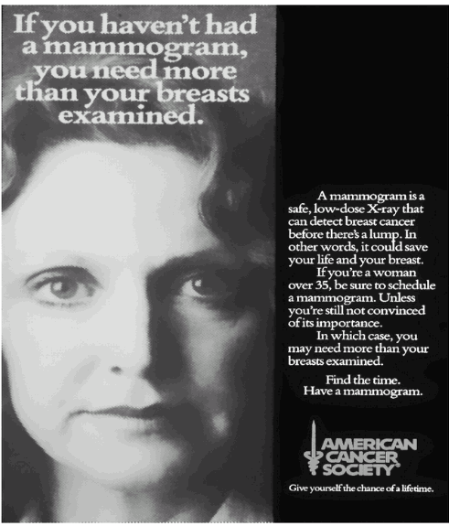
Mammography Screening Advertisement from the American Cancer Society, 1970s
“if you are a woman over 35…..
1995:
Over 40…
2016:
Over 50
2023:
Over 40 (agreement!)
Notes:
This change is long overdue. Because age alone is such a crude way of estimating a woman’s risk of breast cancer, we have intense arguments by smart people of what ages should be screened…. In the 1970s….
Should we be screening for 50 years of a woman’s life? 24 years of her life? 15?

Slide 9
USPSTF Recommendations
Biennial screening mammography for women aged 40-74
Insufficient evidence to assess benefits / harms of screening mammography in women >75 years
Insufficient evidence to assess benefits / harms of clinical breast exam
Insufficient evidence to assess benefits / harms of digital mammography, MRI, or tomosynthesis as screening modalities for breast cancer
Siu AL, et al. Ann Intern Med 2016;164(4):279.

Slide 10
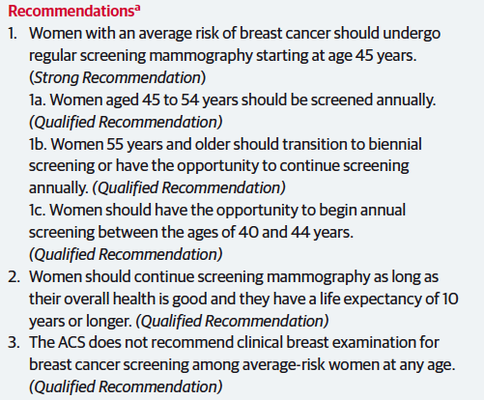
ACS Recommendations
Oeffinger KC, et al. JAMA, 2015;314;(15):1599-1614.

Slide 11
ACS Recommendations
Oeffinger KC, et al. JAMA, 2015;314;(15):1599-1614.
Notes:
CISNET analysis (Stanford) Screening biennially maintained 81% of the mortality benefit with half the number of false positive results

Slide 12
ACS Recommendations
Oeffinger KC, et al. JAMA, 2015;314;(15):1599-1614.

Slide 13
ACS Recommendations
Oeffinger KC, et al. JAMA, 2015;314;(15):1599-1614.

Slide 14
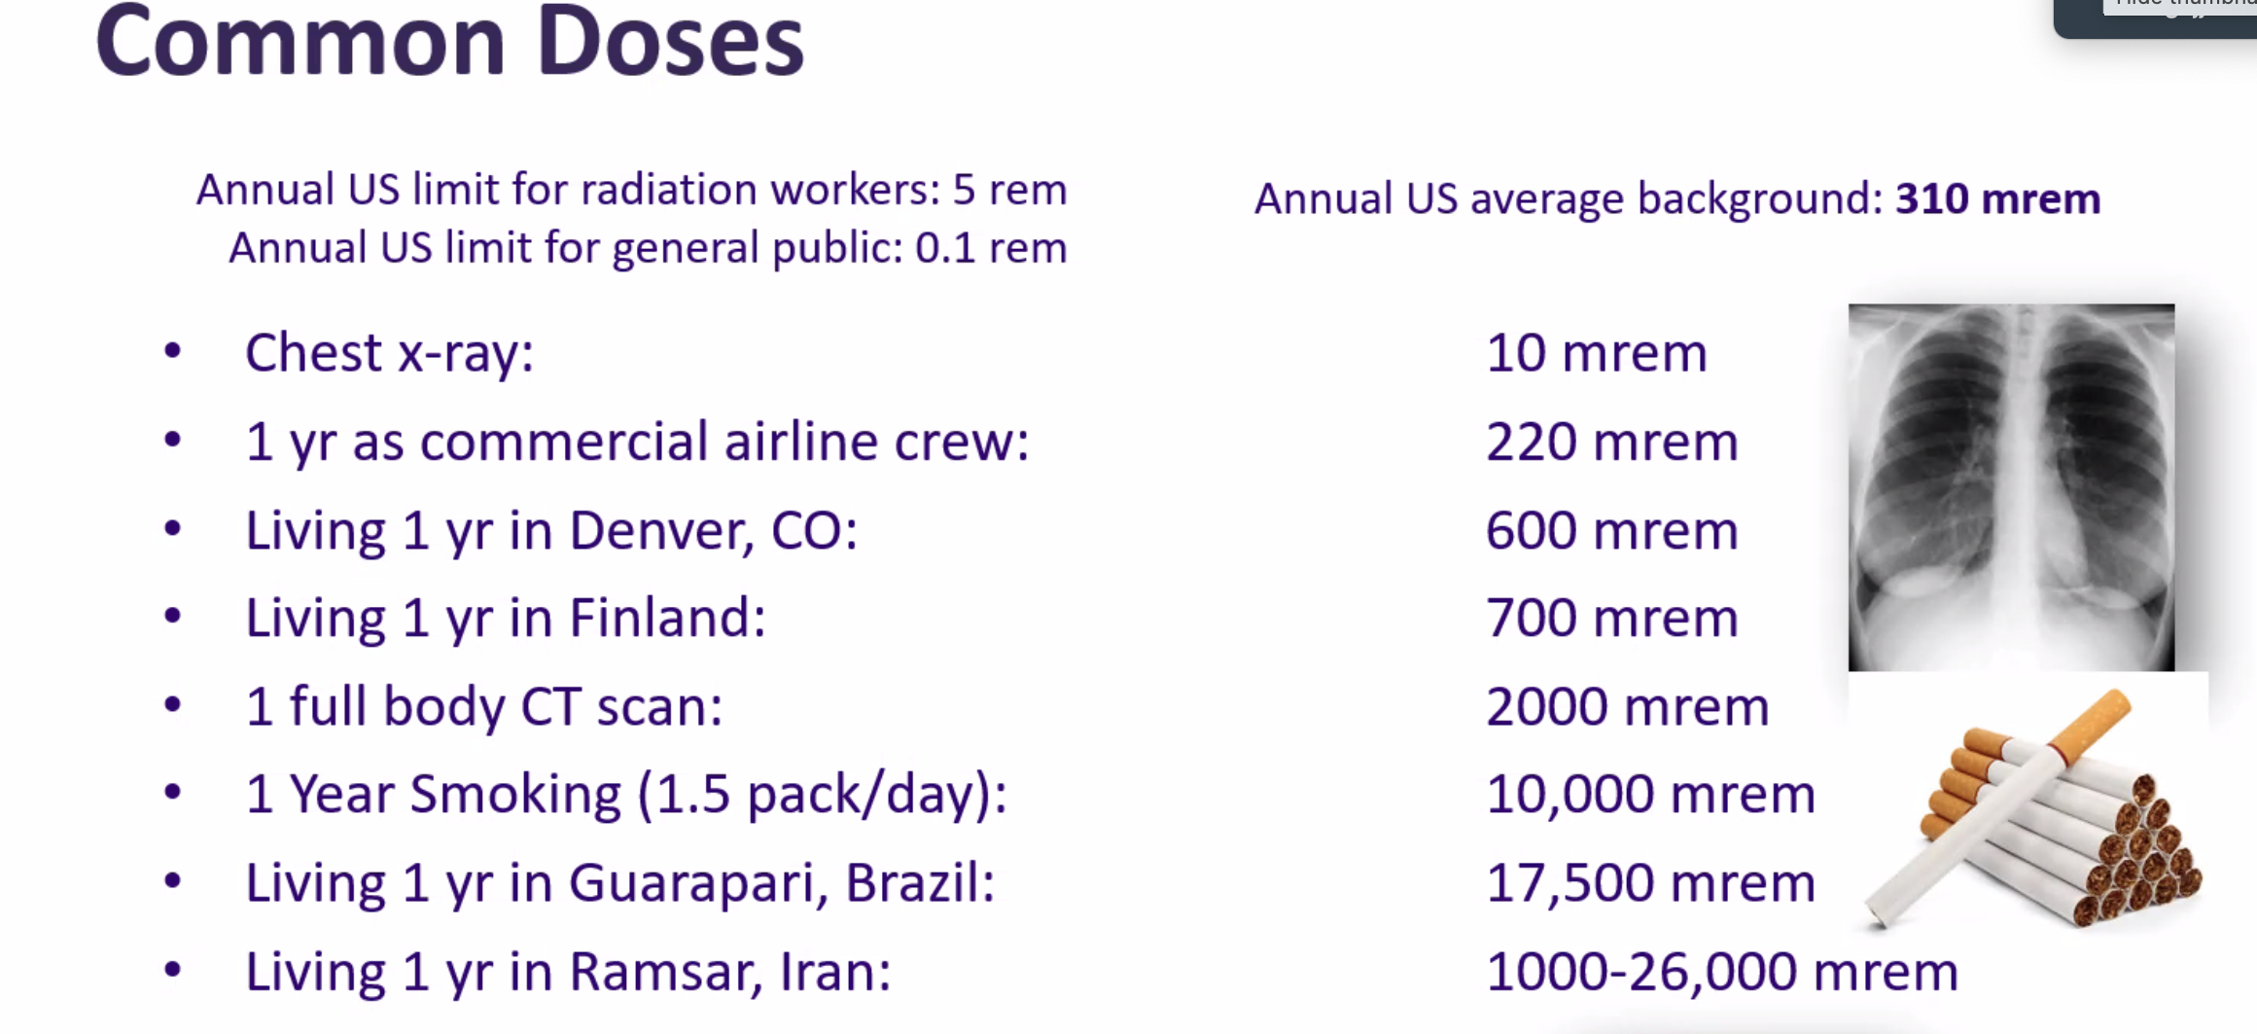
Breast Cancer Screening and Radiation

Slide 15
Breast Cancer Screening and Radiation
The mortality benefit of screening far outweighed the risk of a radiation-induced breast cancer (60-fold)
Miglioretti DL, Lange J, van denBroek JJ, Lee CI, vanRavesteyn NT, Ritley D, et al. Radiation-induced breast cancer incidence and mortality from digital mammography screening: a modeling study. Ann Intern Med 2016;164:205–14.

Slide 16
Mammographic Assessment
What is the radiologist looking for?

Slide 17
Mammographic Findings
Masses and Focal Asymmetries
Calcifications
Architectural Distortion

Slide 18
Mammographic Findings
Massesalcifications of Suspicious or Architectural Distortion

Slide 19
Masses and Focal Asymmetries
  A mass is a space-occupying finding which is seen in two projections
  A focal asymmetry is a non-space occupying finding which is seen on two projections
      An asymmetry is seen only on one view

Slide 20
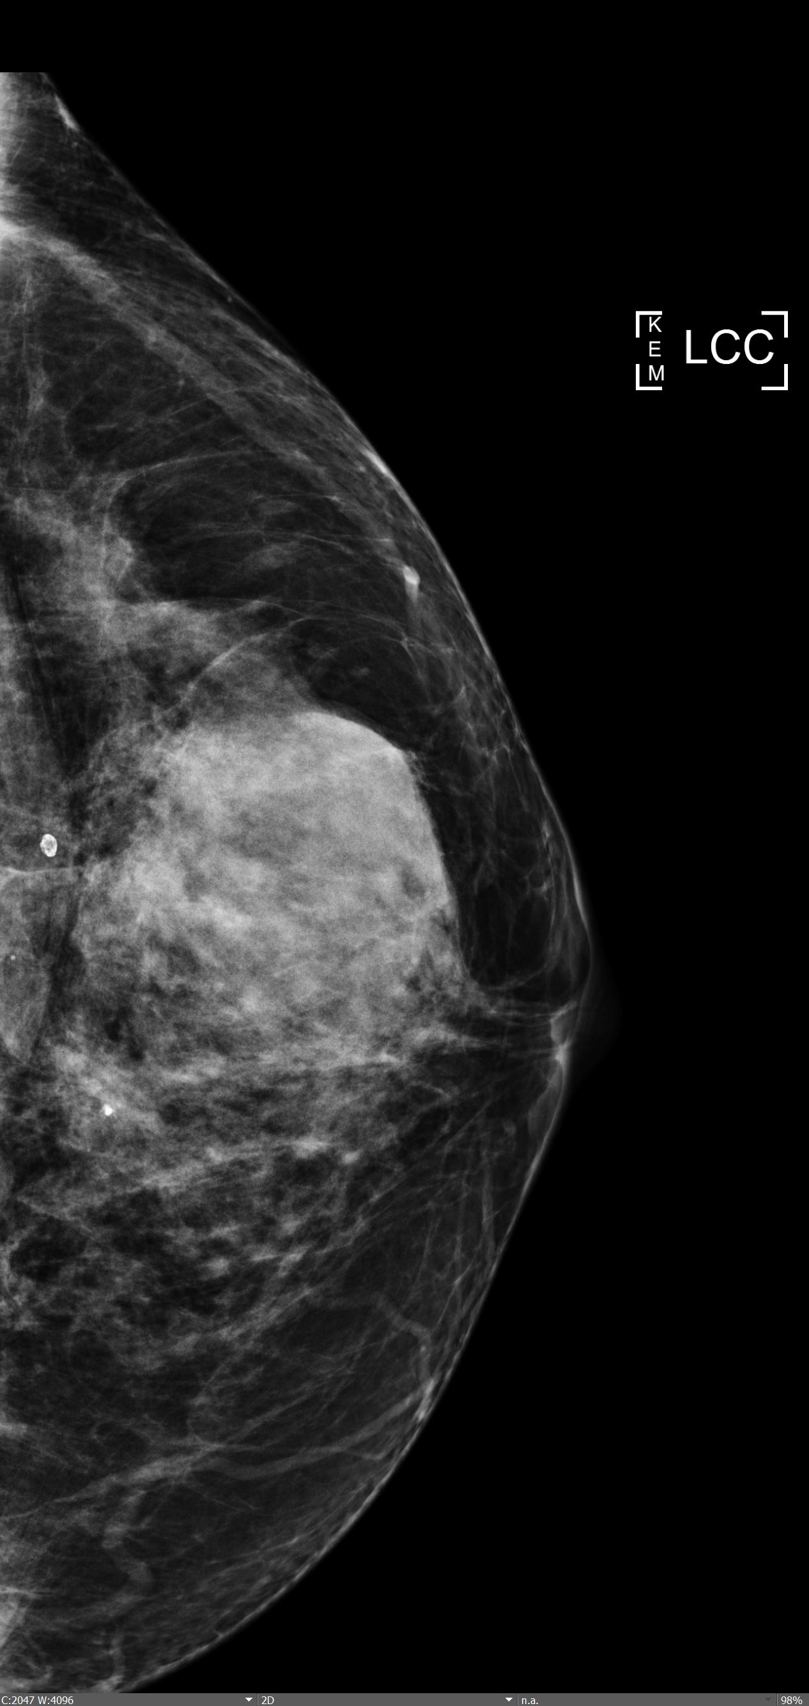
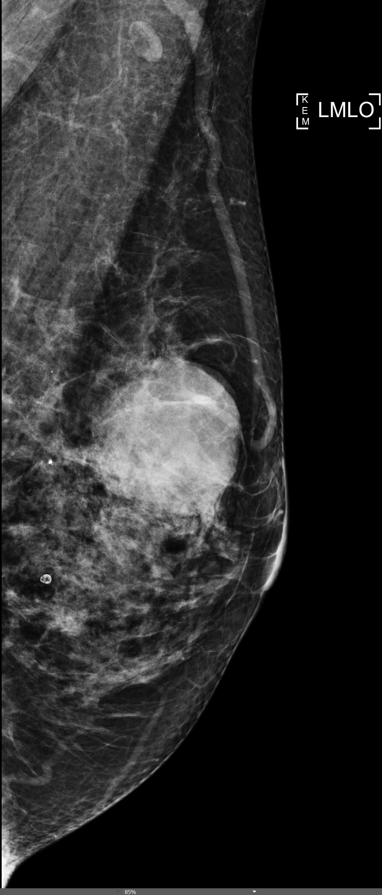
Notes:
Melanoma met

Slide 21
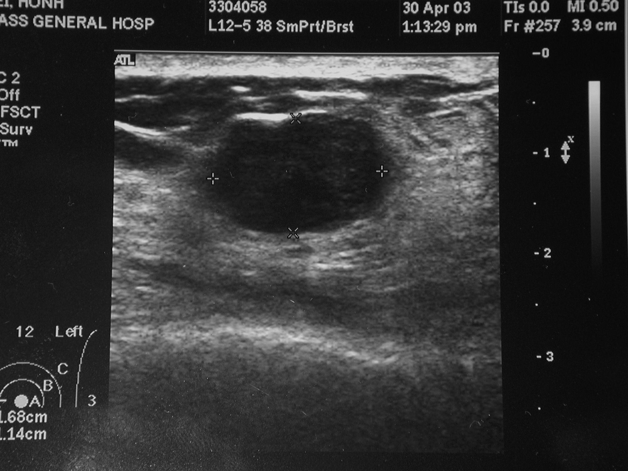
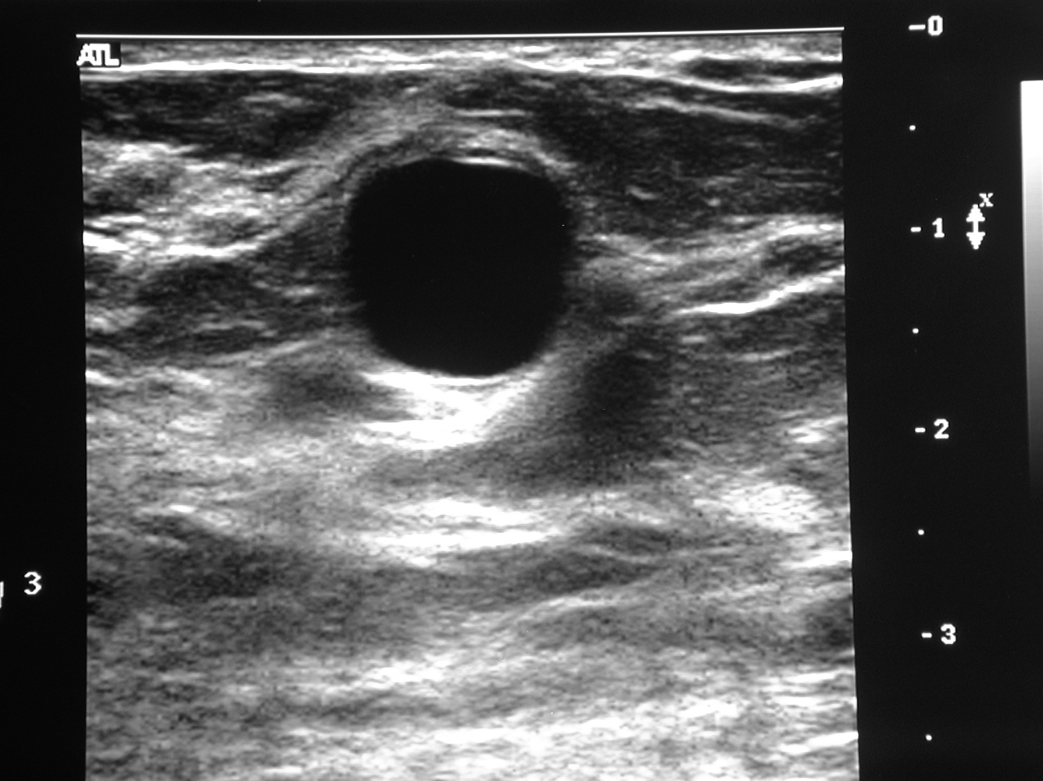
Examples of benign sonographic masses
Notes:
Rt cyst cyst

Slide 22
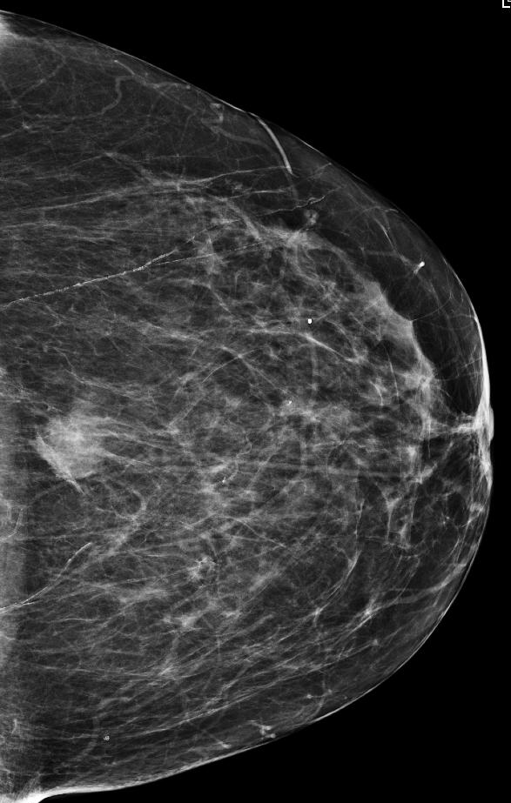
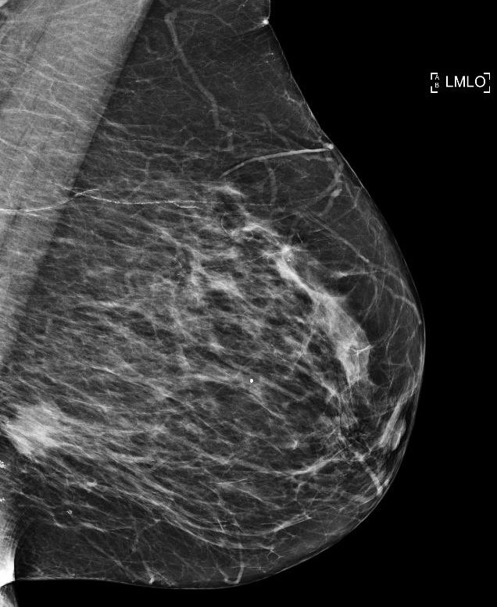

Slide 23
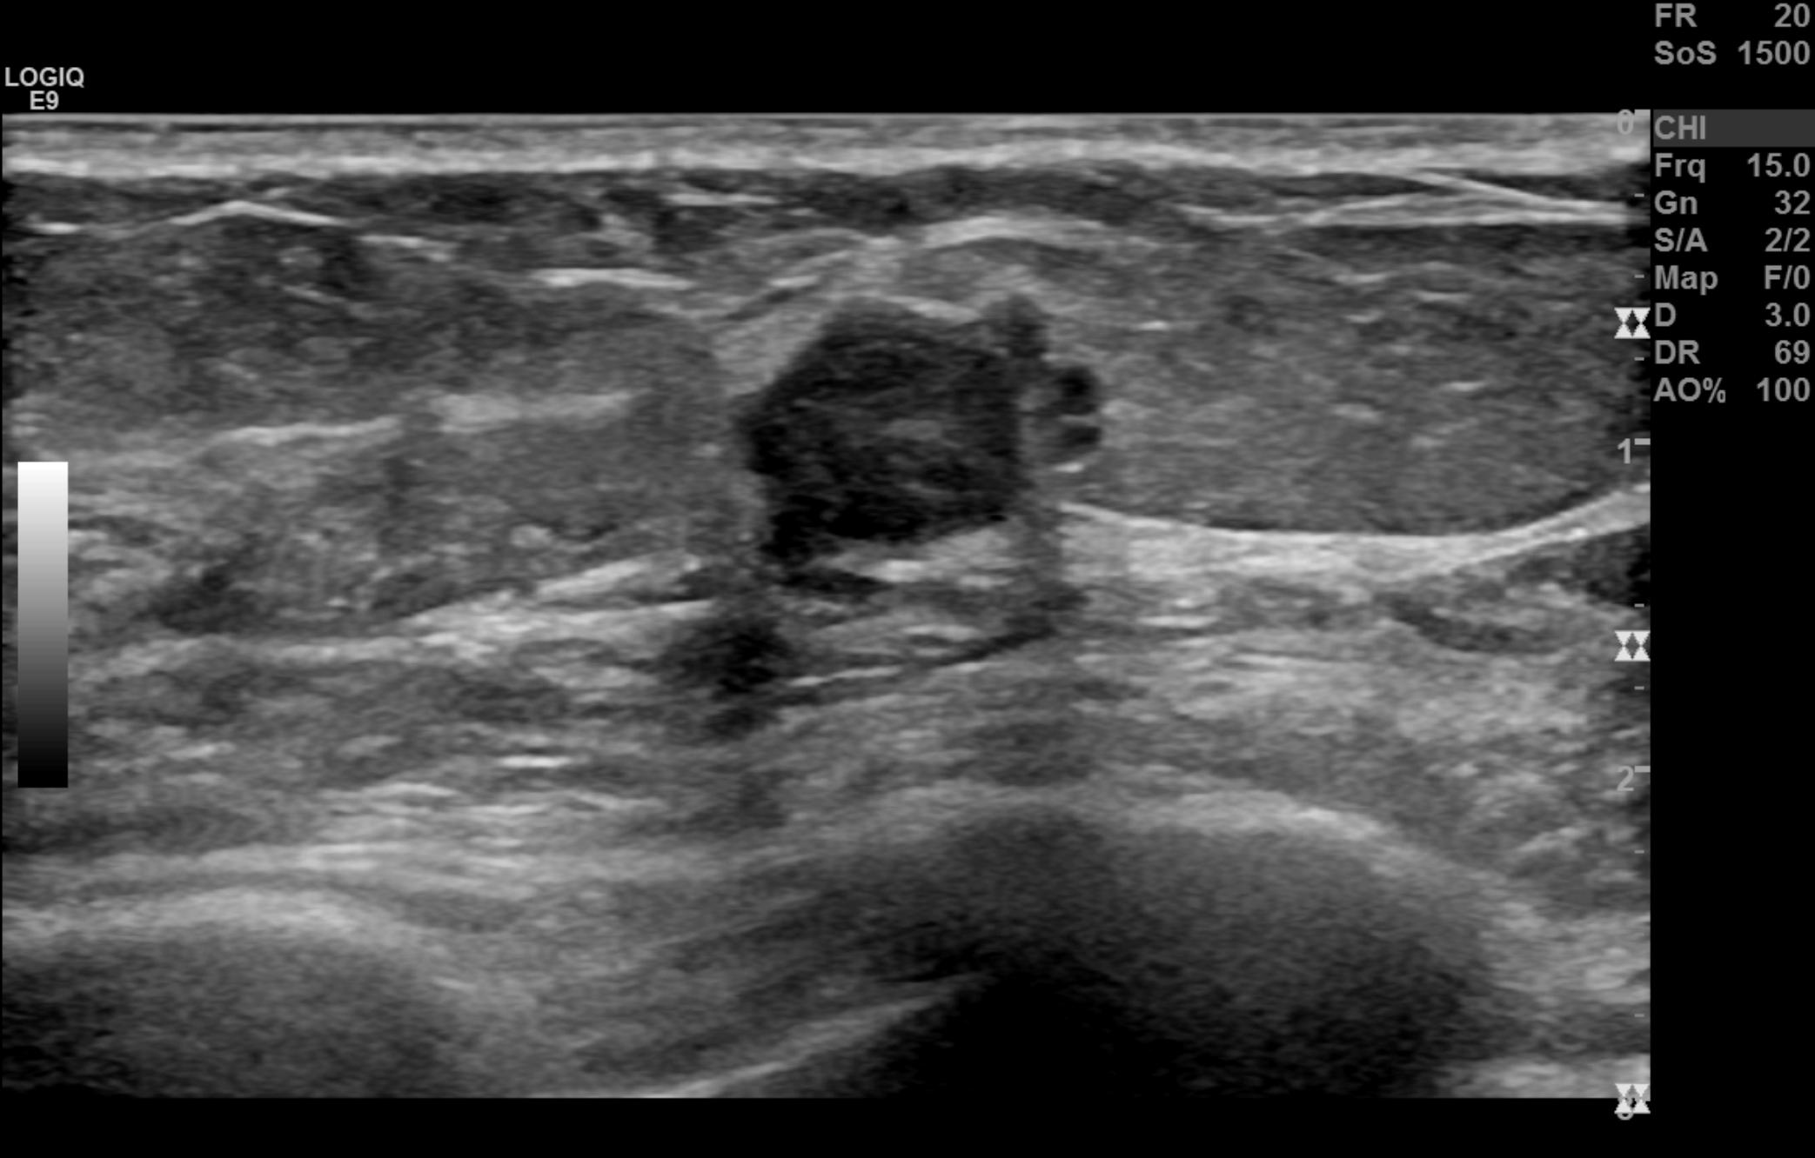
Example of a suspicious sonographic mass

Slide 24
Calcifications
Assessment is based on their morphology and distribution
Requires magnification mammography to determine morphology
  Screening mammography does not include magnification mammography

Slide 25
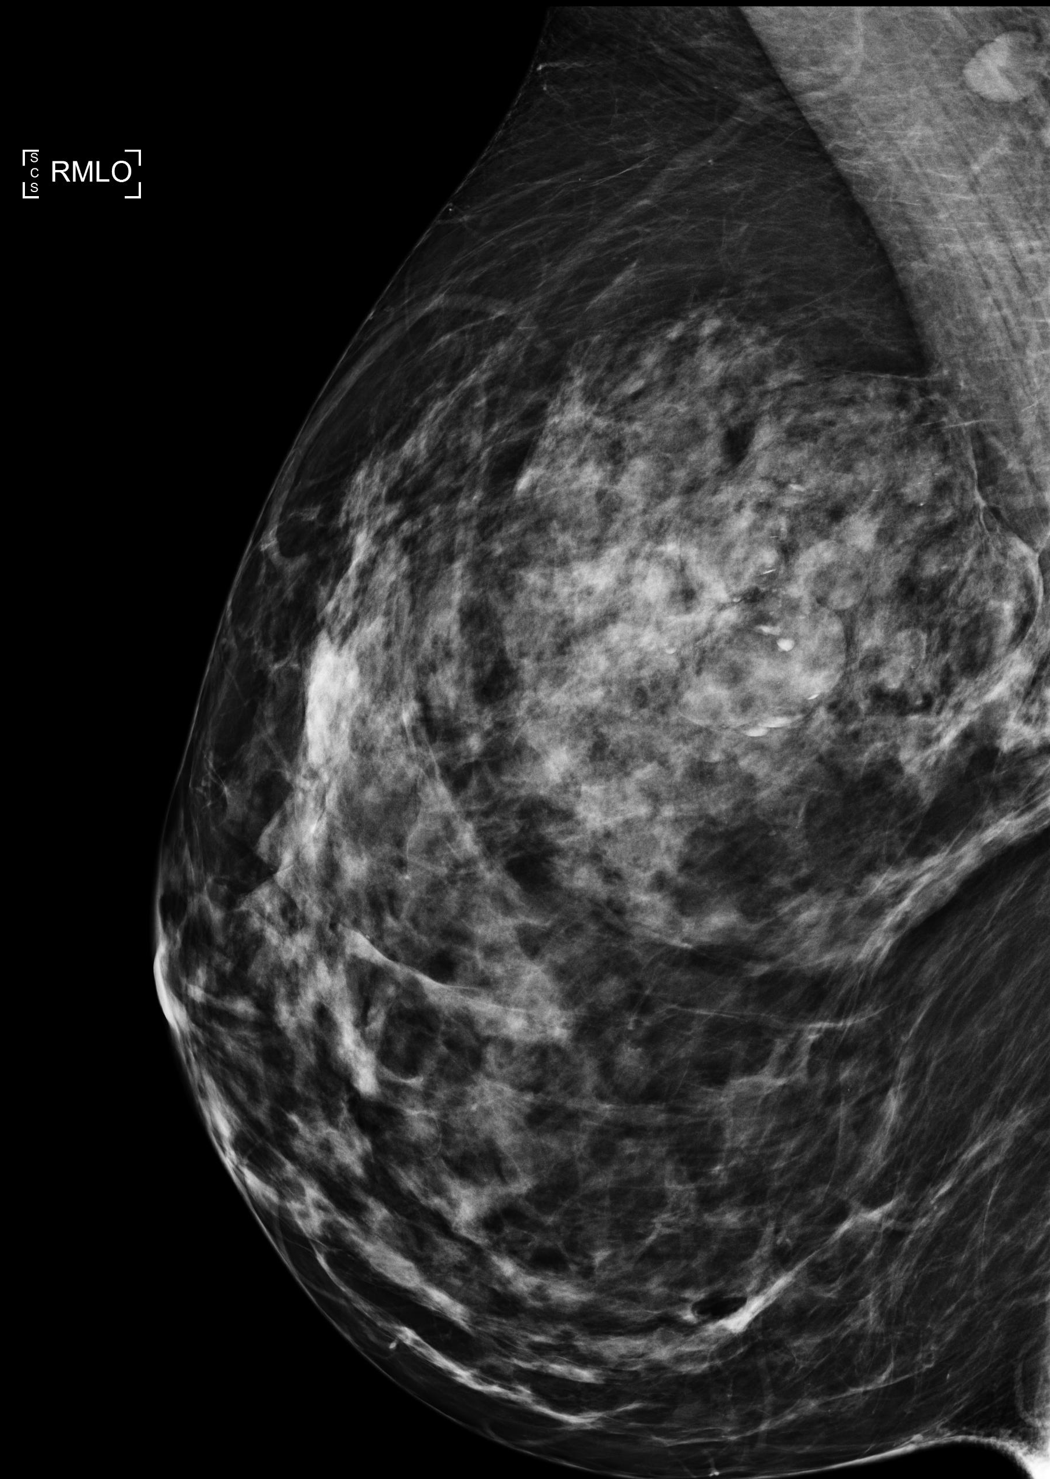
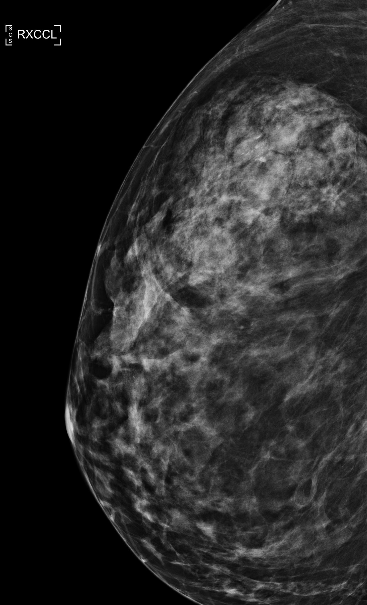
Case 1: Screening

Slide 26
Case 1: Screening

Slide 27
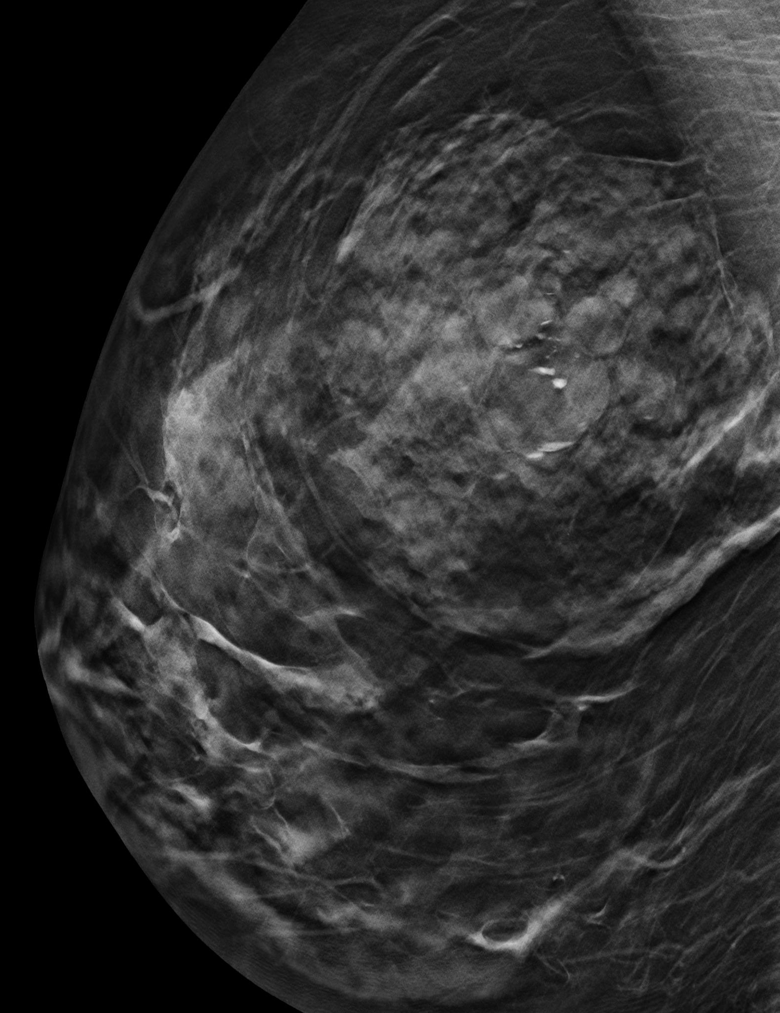
Example of benign calcifications
  Distribution is grouped
  Morphology is amorphous and layering
Case 1: Screening

Slide 28
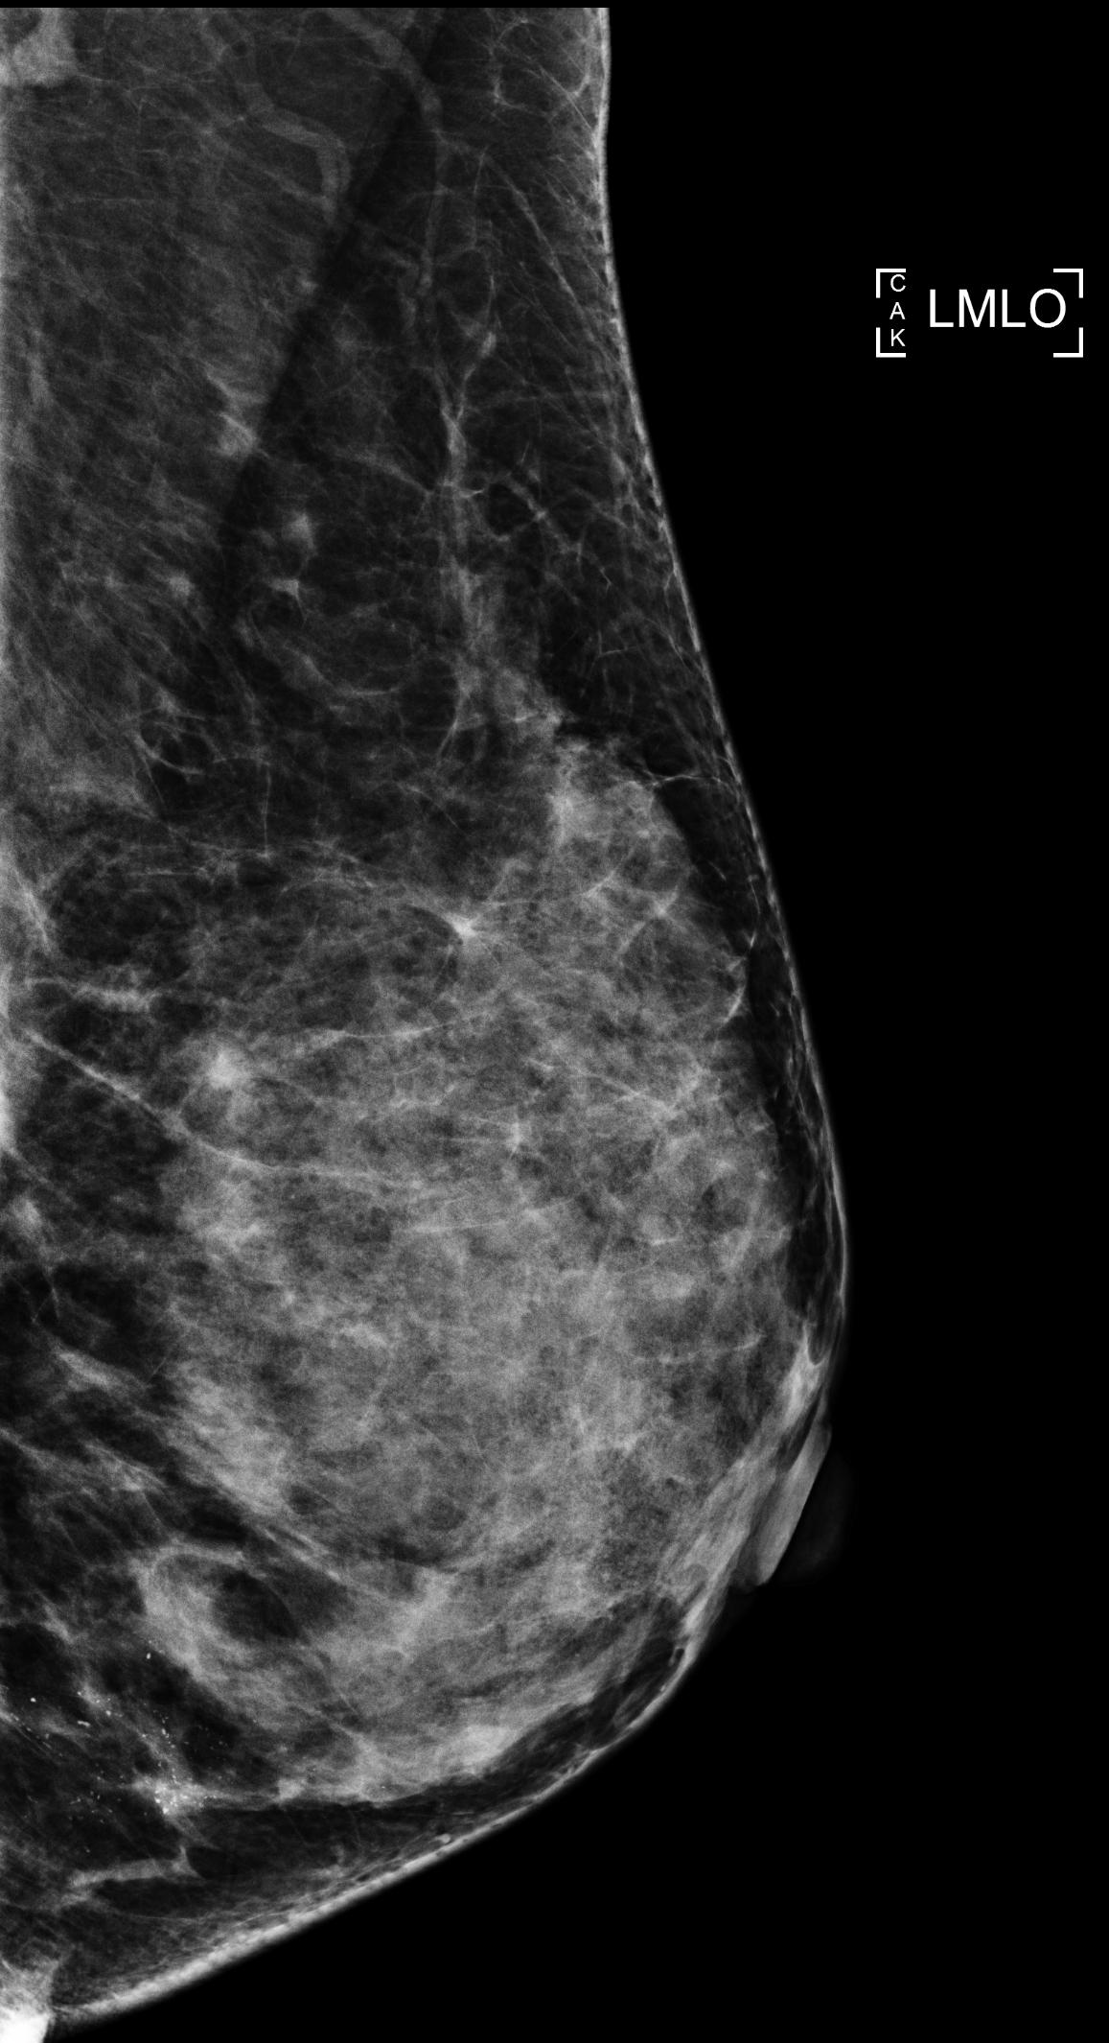
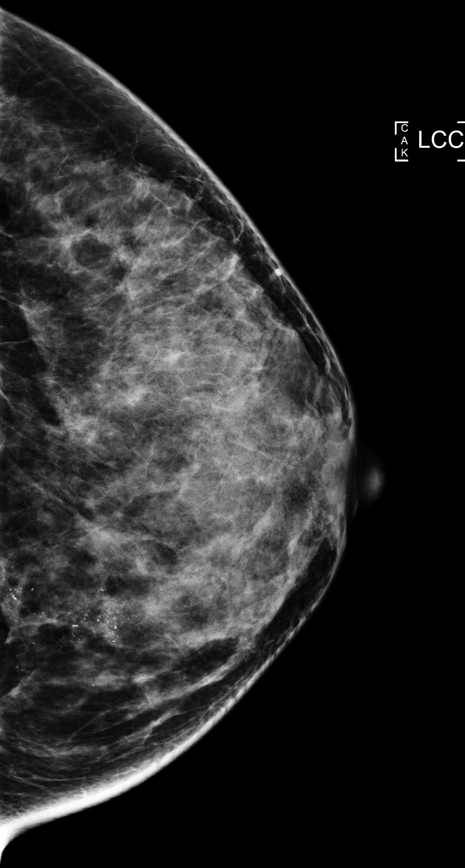
Case 2: Screening

Slide 29
Case 2: Screening

Slide 30
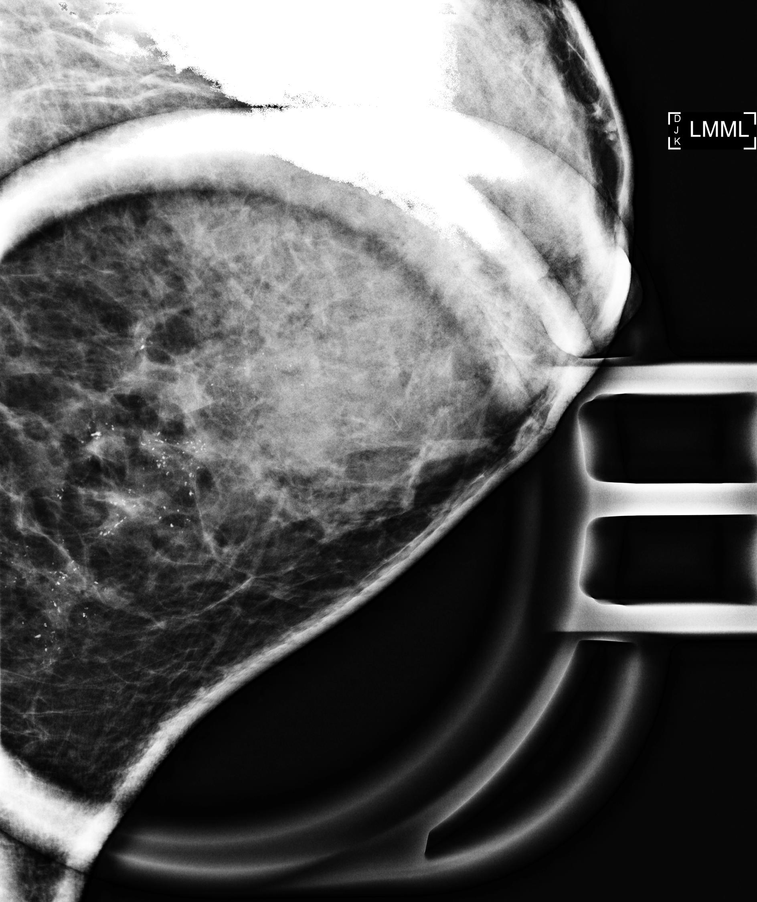
Case 2: Diagnostic mammogram
Example of suspicious calcifications
  Distribution is segmental
  Morphology is pleomorphic

Slide 31
Architectural Distortion

Slide 32
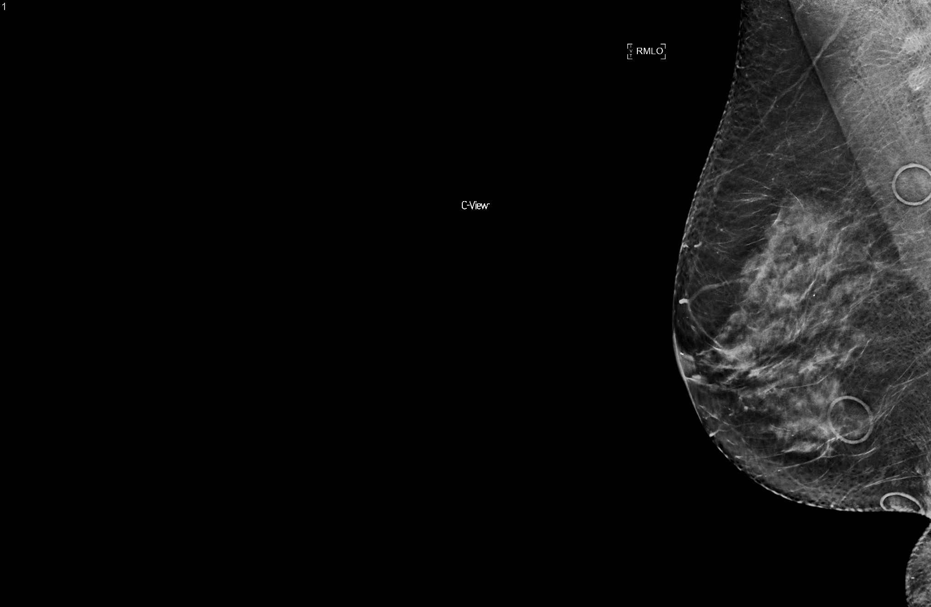
Case 1: Screening
Notes:
3365730

Slide 33
Case 1: Screening
Notes:
3365730

Slide 34
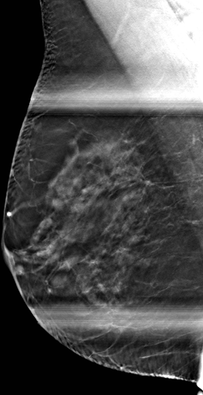
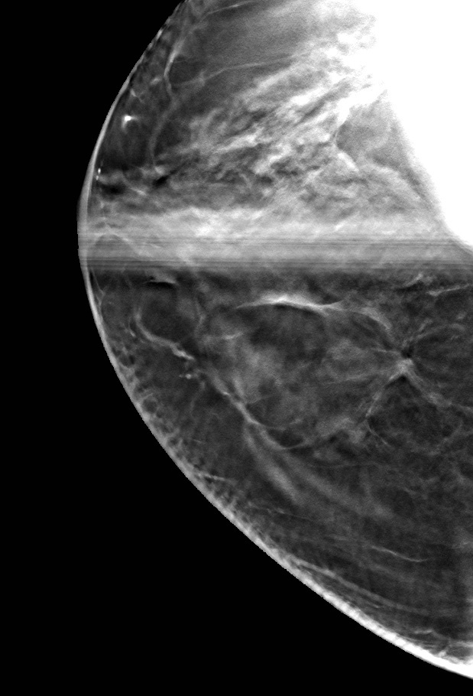
Case 1: Diagnostic mammogram
Notes:
3365730

Slide 35
Architectural Distortion
Differential diagnostics
  Superimposed tissue
  Surgical
  Radial scar, fibrosis
  Malignancy

Slide 36
Mammographic Assessment
The management of any breast abnormality should be based on its most worrisome appearance by modality

Slide 37
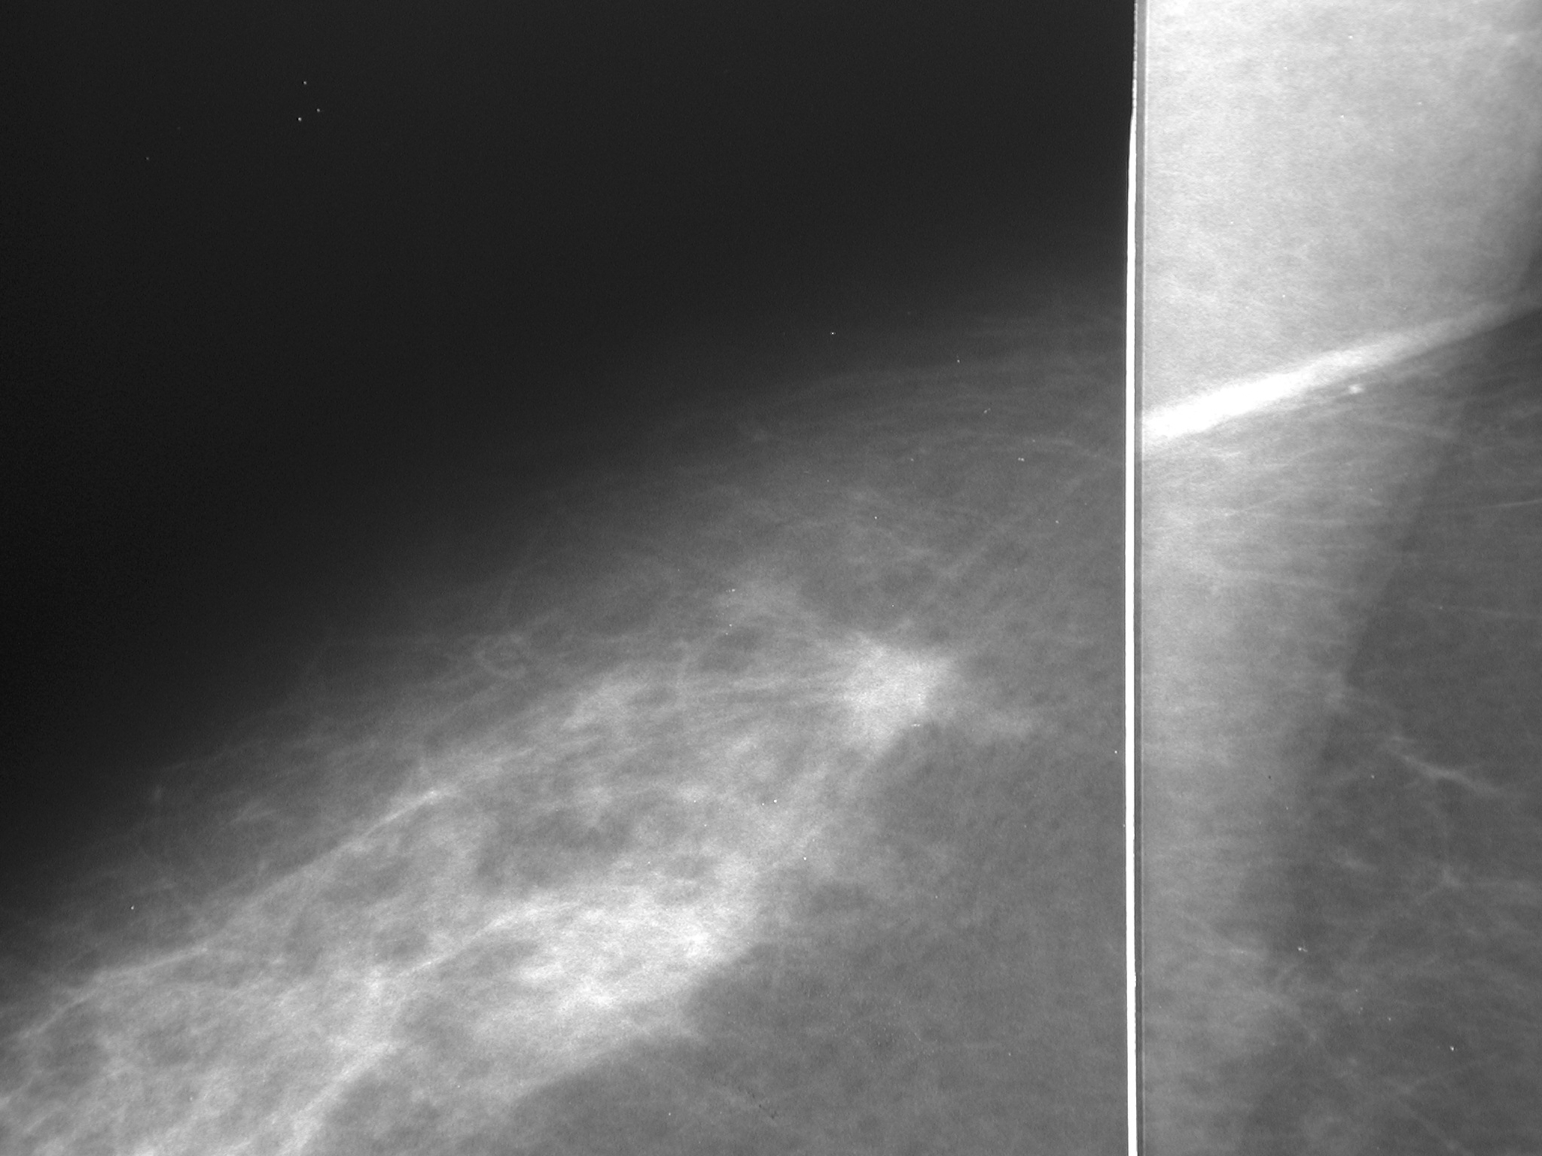
Case courtesy of Betty Rafferty, MD
Notes:
SPICULATED MASS WITH U/S CARCINOMA

Slide 38
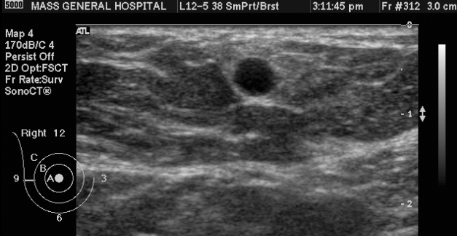
Case courtesy of Betty Rafferty, MD
Notes:
5110 u/s of rt mass—cyst (distractor– CA on left)

Slide 39
Case courtesy of Betty Rafferty, MD
Notes:
SPICULATED MASS WITH U/S CARCINOMA

Slide 40
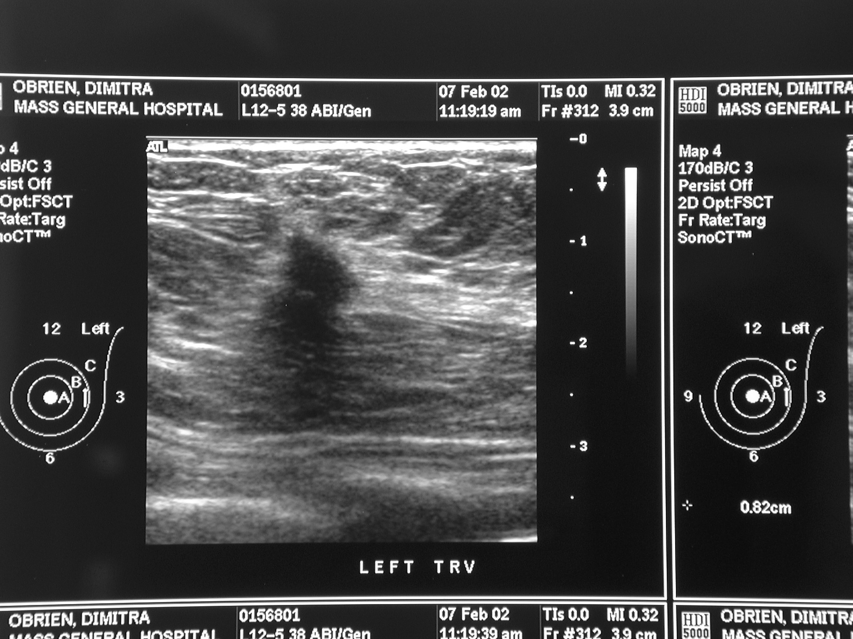
Case courtesy of Betty Rafferty, MD
Notes:
SPICULATED MASS WITH U/S CARCINOMA

Slide 41
Percutaneous Biopsy
Performed under each modality (mammography/tomosynthesis, ultrasound, and MRI)

Slide 42
Percutaneous Biopsy
In all breast biopsies, correlation of the radiologic and pathologic findings is critical to establish concordance and management

Slide 43
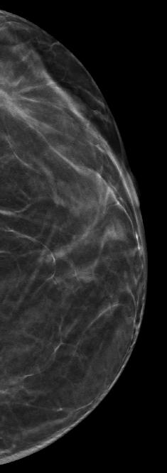
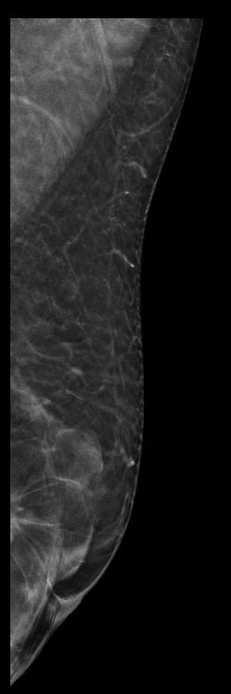
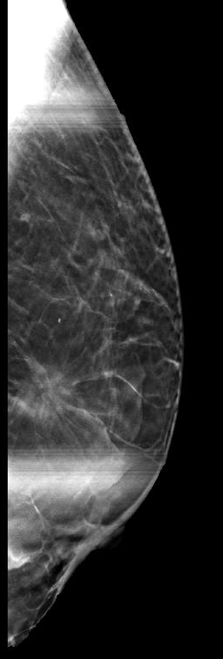

Slide 44
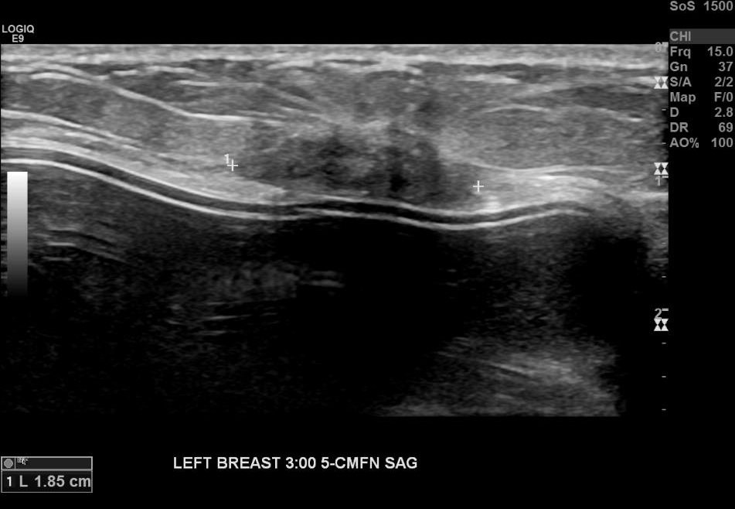

Slide 45
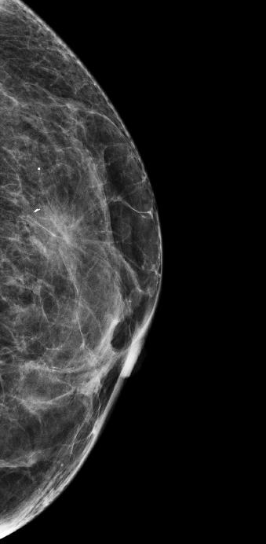

Slide 46
US guided biopsy yielded usual ductal hyperplasia
This was deemed discordant

Slide 47
Repeat stereotactic biopsy was performed and it revealed IDC

Slide 48
Breast Cancer Detection
Mammography is an imperfect tool
False negative rate is estimated at approximately 0.6 cancers/1,000 screening exams

Slide 49
Whole Breast Screening Ultrasound
ACRIN 6666 (2008)
  2809 women with dense breasts in at least one quadrant
  Elevated lifetime risk (family history, BRCA, radiation)
  MD performed handheld US + Mammography detected 4.2 additional cancers/1000 patients compared to Mammography alone
    91% invasive
    The vast majority of these were node negative and <10mm
  PPV of US + Mammography 11.2%
  PPV Mammography alone 22.6%
  Sensitivity of US + Mammography 76%
  Sensitivity of Mammography alone 52%
  Average of 19 minutes of physician time for examination
Berg WA, et al. Combined screening with ultrasound and mammography vs mammography alone in women at
elevated risk of breast cancer. JAMA. 2008;299(18):2151-63.

Slide 50
Whole Breast Screening Ultrasound
Automated Whole Breast Screening Ultrasound (ABUS)
  Examination uncoupled from interpretation
  Technologist performs examination
  Similar diagnostic performance to handheld US (HHUS) screening trials
    Additional cancer yield of 3-4/1000 over mammography alone
    PPV of 10-38%
    Overall agreement in findings between HHUS and ABUS

Slide 51
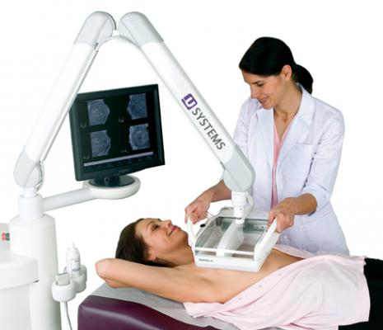
Whole Breast Screening Ultrasound
Automated Whole Breast Screening Ultrasound (ABUS)

Slide 52
Breast Tomosynthesis
X-ray source
X-ray tube moves through an arc over the breast
Multiple projection images are acquired during the sweep
Can reduce impact of summation artifact from overlapping structures
Compression
paddle
Detector

Slide 53
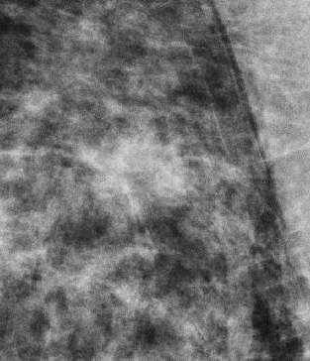
FFDM
Case courtesy of Betty Rafferty, MD

Slide 54
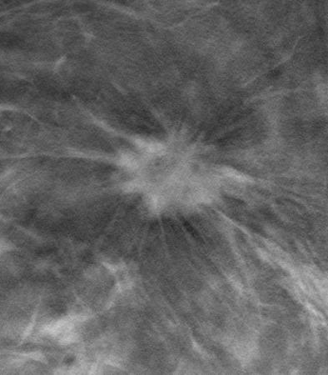
FFDM
Tomosynthesis
Case courtesy of Betty Rafferty, MD

Slide 55
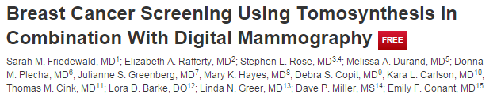
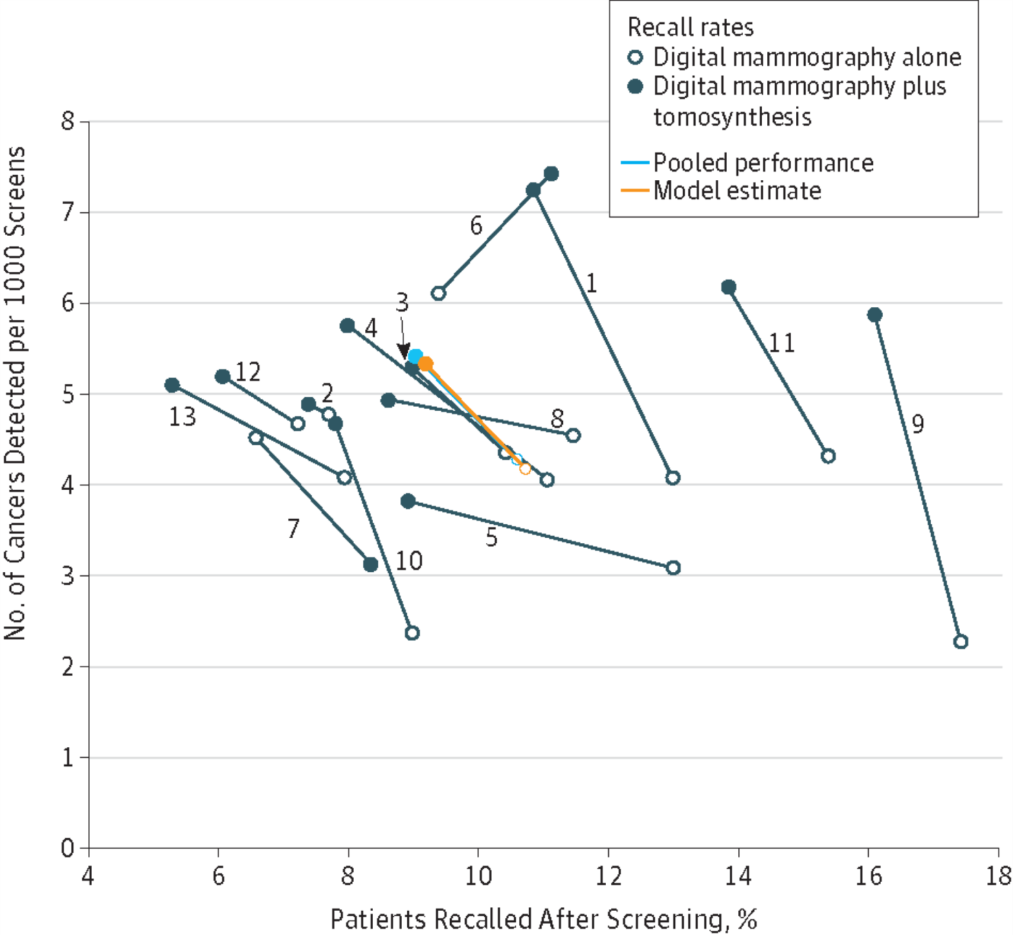
3D may be better but wide variation across radiologists
Early enthusiasm for improved performance has been tempered a bit
European and Canadian National Screening Programs remain 2D for the most part
US market is almost all 3D
Notes:
TEST, Patient, and the Radiologist!

Slide 56
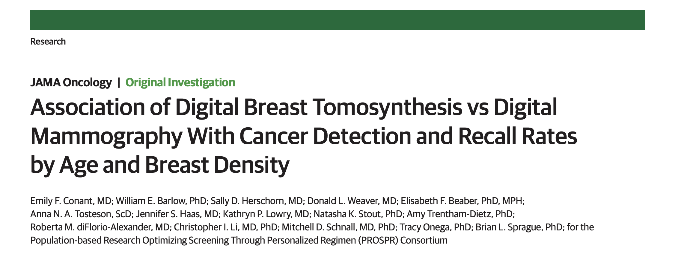
Tomosynthesis was associated with detection of smaller node-negative cancers
Tomosynthesis was associated with higher cancer detection rate and lower recall rate for all age groups and density categories
Cancer detection improvement was most pronounced in the 40-49 age group and among those with dense breasts
Conant EF, et al. JAMA Oncol. 2019;5(5):635-642.
Notes:
Among 96 269 women (mean [SD] patient age for all examinations, 55.9 [9.0] years), patient age was 56.4 (9.0) years for DM and 54.6 (8.9) years for DBT. Of 180 340 breast cancer screening examinations, 129 369 examinations (71.7%) used DM and 50 971 examinations (28.3%) used DBT. Screening examination with DBT (73 of 99 women [73.7%]) was associated with the detection of smaller, more often node-negative, HER2–negative, invasive cancers compared with DM (276 of 422 women [65.4%]). Screening examination with DBT was also associated with lower recall (odds ratio, 0.64; 95% CI, 0.57-0.72; P < .001) and higher cancer detection (odds ratio, 1.41; 95% CI, 1.05-1.89; P = .02) compared with DM for all age groups even when stratified by breast density. The largest increase in cancer detection rate and the greatest shift toward smaller, node-negative invasive cancers detected with DBT was for women aged 40 to 49 years. For women aged 40 to 49 years with nondense breasts, the cancer detection rate for examinations using DBT was 1.70 per 1000 women higher compared with the rate using DM; for women with dense breasts, the cancer detection rate was 2.27 per 1000 women higher for DBT. For these younger women, screening with DBT was associated with only 7 of 28 breast cancers (25.0%) categorized as poor prognosis compared with 19 of 47 breast cancers (40.4%) when screening with DM.

Slide 57
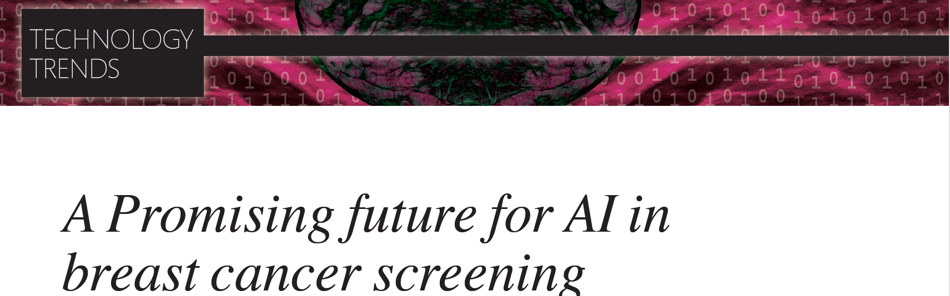
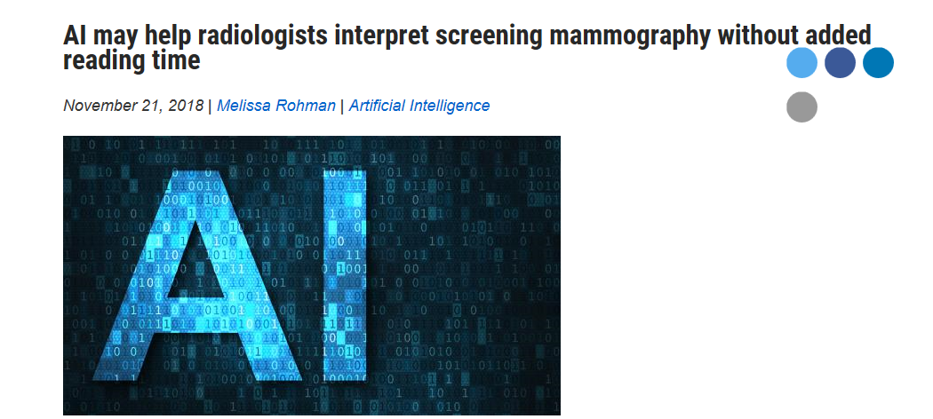
Notes:
While cautionary, the well-timed review provides clear guidelines for the future. Explosion of DL models has not yet been followed by implementation and assessment in routine clinical practice. We can learn from our history of CAD applied to mammography and leverage that knowledge to more rapidly translate our discoveries in AI to improved patient care. Future studies should consider how to design studies best suited for the precise clinical application intended for the DL model. A model to assist radiologists to interpret mammograms with a higher degree of accuracy will require a different study design from one designed to fully replace human screening interpretation—the fusion of machine and expert human vision is the package that needs to be emphasized.

Slide 58
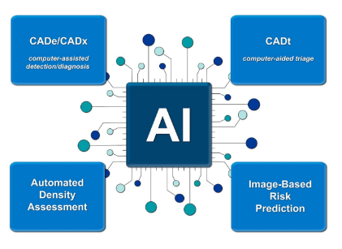
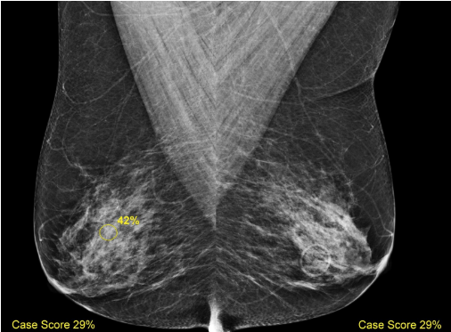
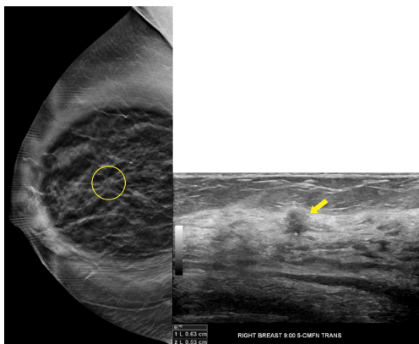
Notes:
While cautionary, the well-timed review provides clear guidelines for the future. Explosion of DL models has not yet been followed by implementation and assessment in routine clinical practice. We can learn from our history of CAD applied to mammography and leverage that knowledge to more rapidly translate our discoveries in AI to improved patient care. Future studies should consider how to design studies best suited for the precise clinical application intended for the DL model. A model to assist radiologists to interpret mammograms with a higher degree of accuracy will require a different study design from one designed to fully replace human screening interpretation—the fusion of machine and expert human vision is the package that needs to be emphasized.

Slide 59
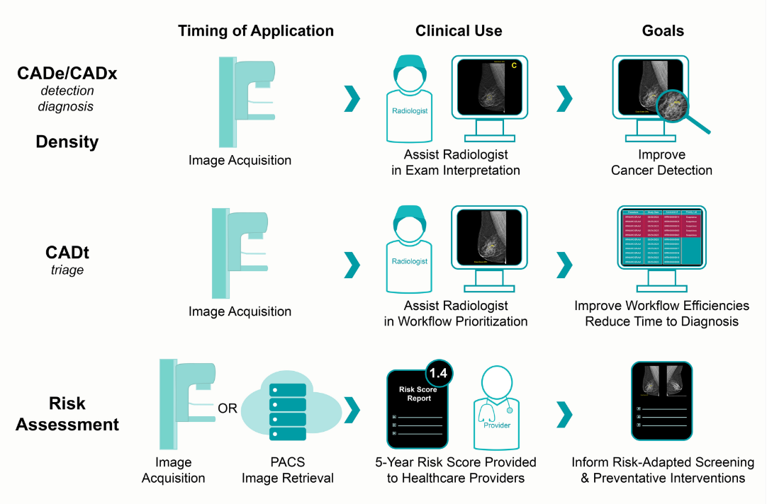
Notes:
While cautionary, the well-timed review provides clear guidelines for the future. Explosion of DL models has not yet been followed by implementation and assessment in routine clinical practice. We can learn from our history of CAD applied to mammography and leverage that knowledge to more rapidly translate our discoveries in AI to improved patient care. Future studies should consider how to design studies best suited for the precise clinical application intended for the DL model. A model to assist radiologists to interpret mammograms with a higher degree of accuracy will require a different study design from one designed to fully replace human screening interpretation—the fusion of machine and expert human vision is the package that needs to be emphasized.

Slide 60

Our challenges with current approaches to risk assessment
The majority of women diagnosed with breast cancer have no known risk factors
  Genetic mutations <10%
  Family history <15%
Traditional risk models (NCI, TC8) demonstrate modest accuracy (AUCs .62) and are racially biased
Age (and density to some extent) are two factors used to guide screening decisions
Notes:
TEST, Patient, and the Radiologist!

Slide 61
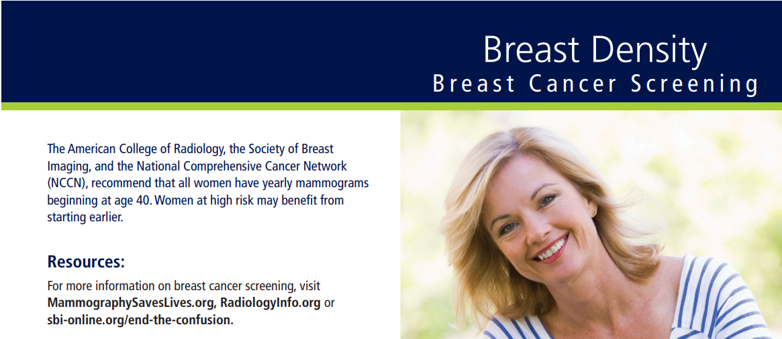
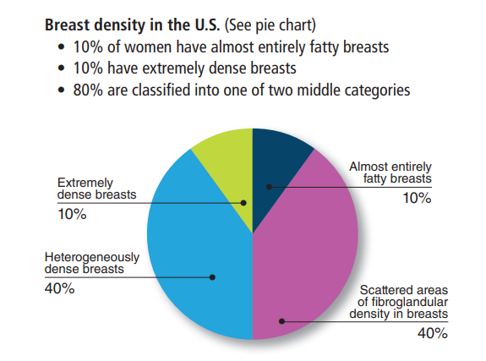
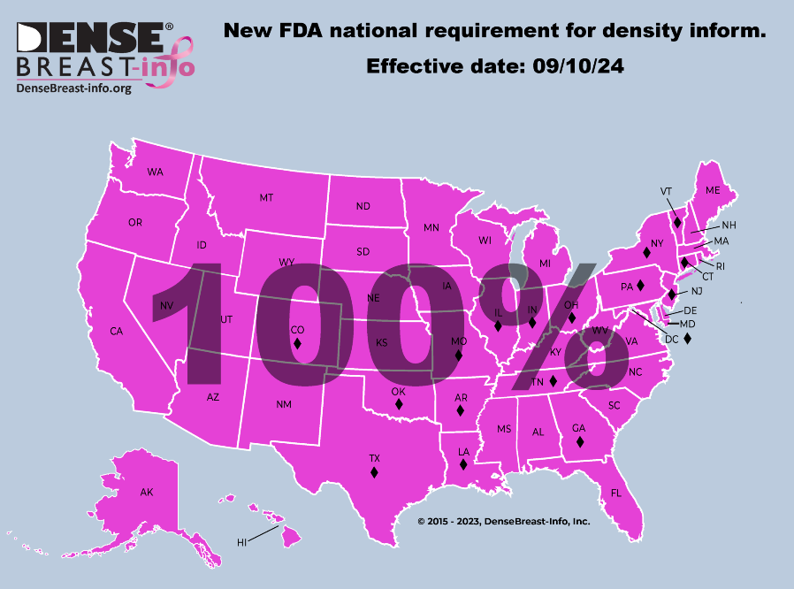


Slide 62
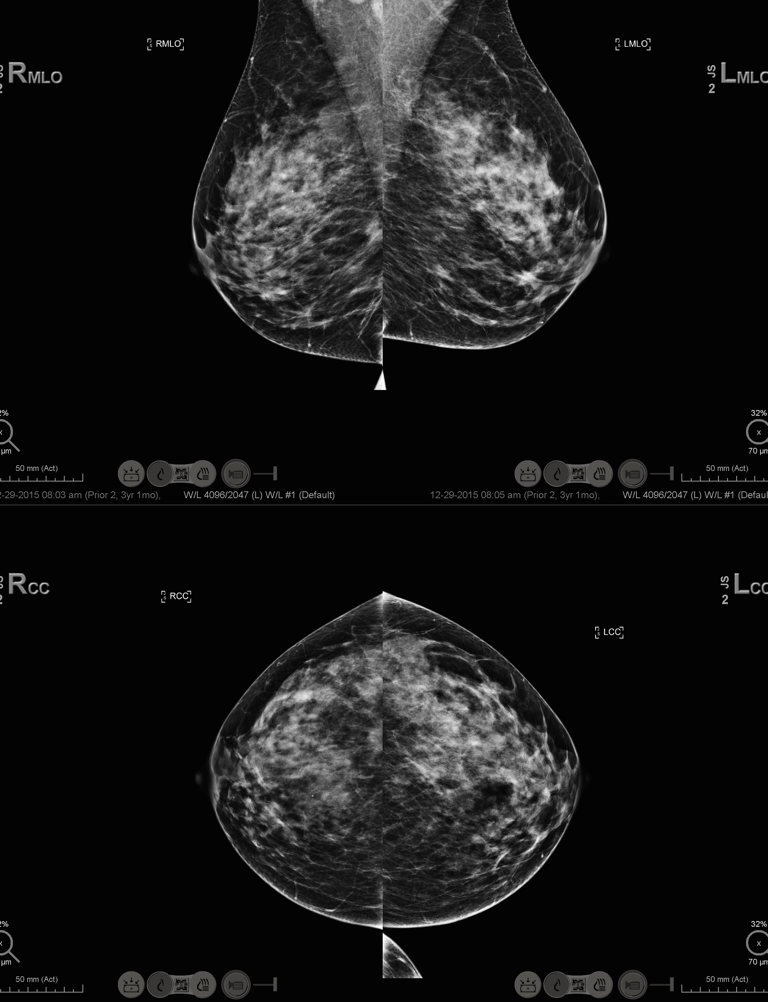
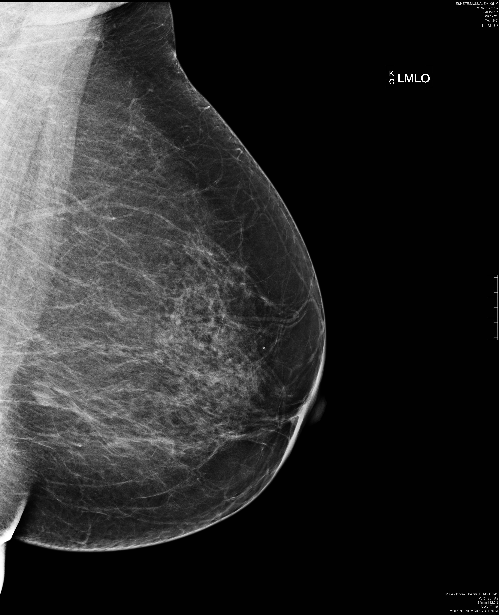
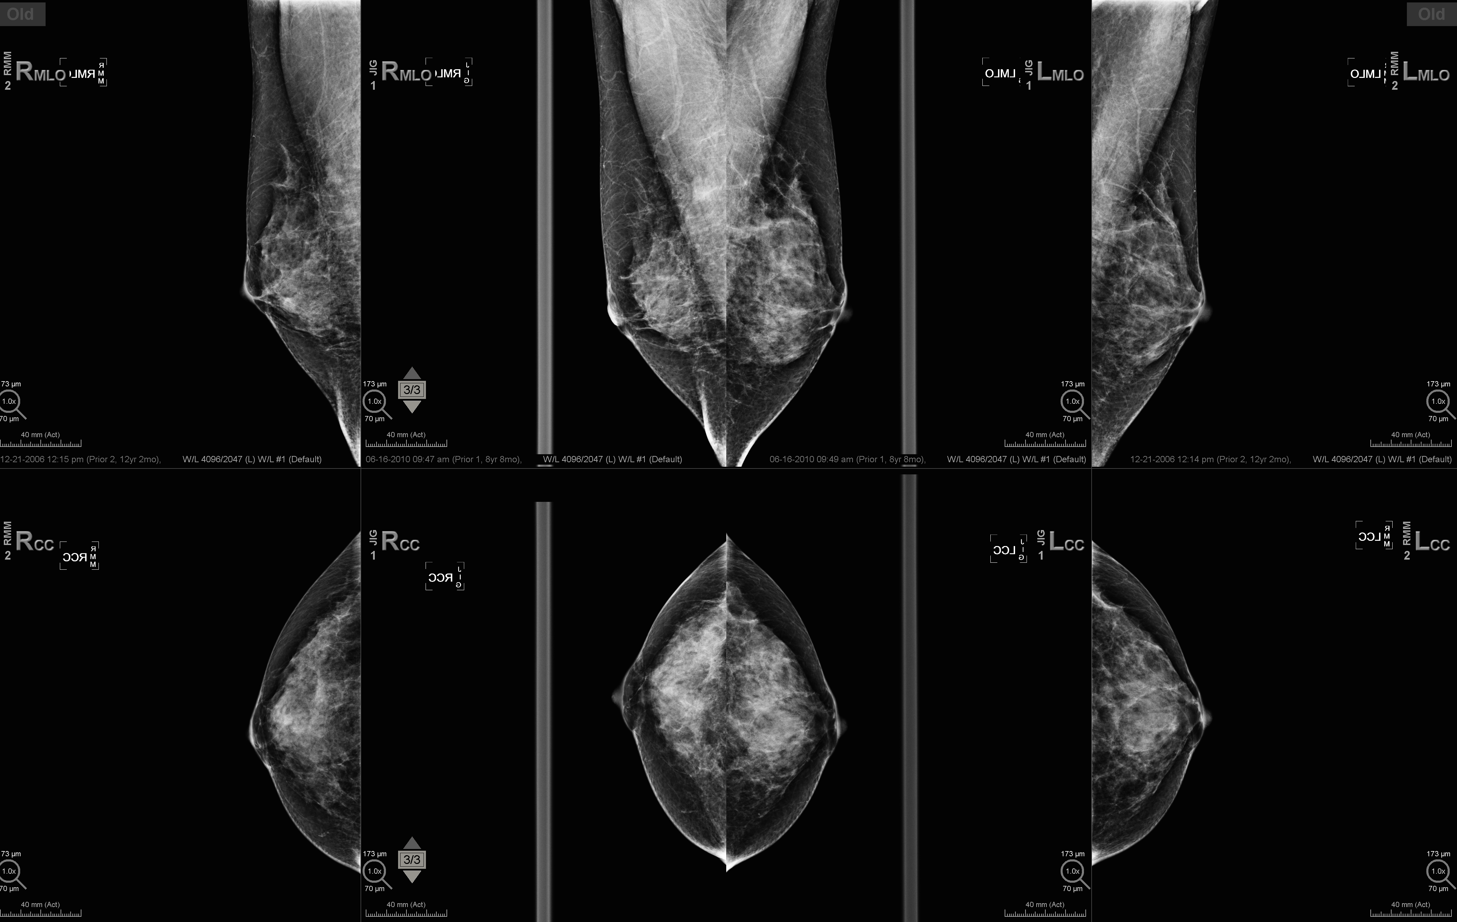
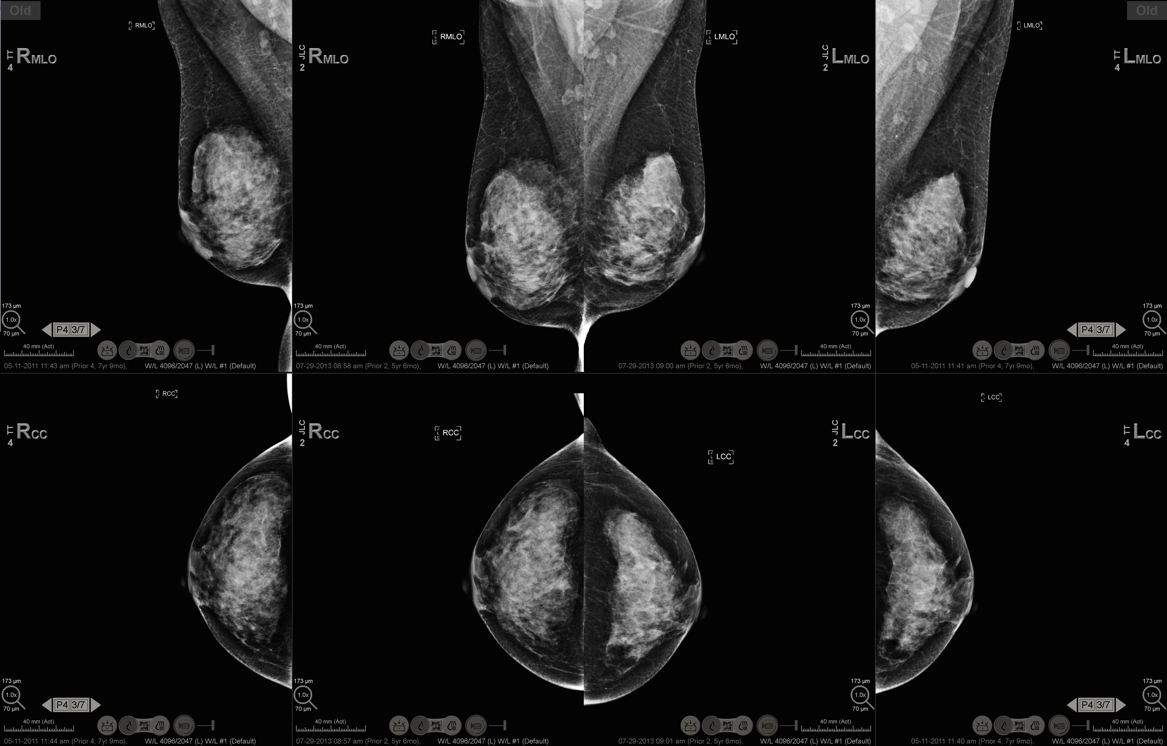
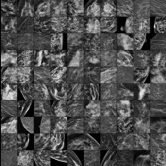
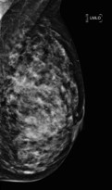
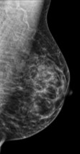
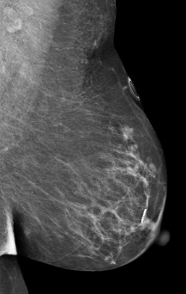
Performance
Leverage computer vision, power of AI, to extract more information than breast density or lesion (calcs, mass, distortion) presence
Notes:
So let’s do that with mammogram.s Let’s use the same techniques with images not of cats or dogs but of mammograms accurately labelled…in this case cancer now (interpret) or cancer out in the future –say 5 years in the future—assessing future risk. Current breast cancer risk models incorporate only a small fraction of patient data available ---family history, prior biopsies, binary density assessment from the mammogram…. …..

Slide 63


Consistent trends of improved performance of Image Only AI models compared to traditional clinical models
Most are 4-6 year risk prediction algorithms, some shorter term (1-3 years) and some 10 year
Notes:
While cautionary, the well-timed review provides clear guidelines for the future. Explosion of DL models has not yet been followed by implementation and assessment in routine clinical practice. We can learn from our history of CAD applied to mammography and leverage that knowledge to more rapidly translate our discoveries in AI to improved patient care. Future studies should consider how to design studies best suited for the precise clinical application intended for the DL model. A model to assist radiologists to interpret mammograms with a higher degree of accuracy will require a different study design from one designed to fully replace human screening interpretation—the fusion of machine and expert human vision is the package that needs to be emphasized.

Slide 64



AI Risk Assessment Model to empower women for effective personalized screening, supporting access to imaging
technology beyond the mammogram, to the right patient at the right time
Notes:
We have at our fingertips a new paradigm….

Slide 65





Computer Assistance vs Autonomous Interpretation
Fully Autonomous Interpretation of All Exams for Specific Case Use
Traditional CAD
Fully Autonomous Interpretation of Subset of Exams
AI Triage

Slide 66

Thank you

