Slide 1



Prognostic and Predictive Factors
in Early-Stage Breast Cancer
Claudine Isaacs, MD, FRCPC, FASCO
Professor of Medicine and Oncology
Director, Clinical Breast Cancer Program
Co-Director Fisher Center for Hereditary Cancer and Clinical Genomics Research
Georgetown University
Disclaimer: This presentation is intended for personal use and for informational purposes only and does not replace independent professional judgment. This presentation is the property of Physicians’ Education Resource, LLC (“PER”) and is protected by U.S. and international copyright laws. You may not copy, reproduce, distribute, transmit, modify, or create derivative works of the presentation without the prior written permission from PER.

Slide 2
Outline
Prognostic and predictive factors:
  For initial treatment decision making (focus on HR+/HER2- BC)
  For extended adjuvant endocrine therapy

Slide 3
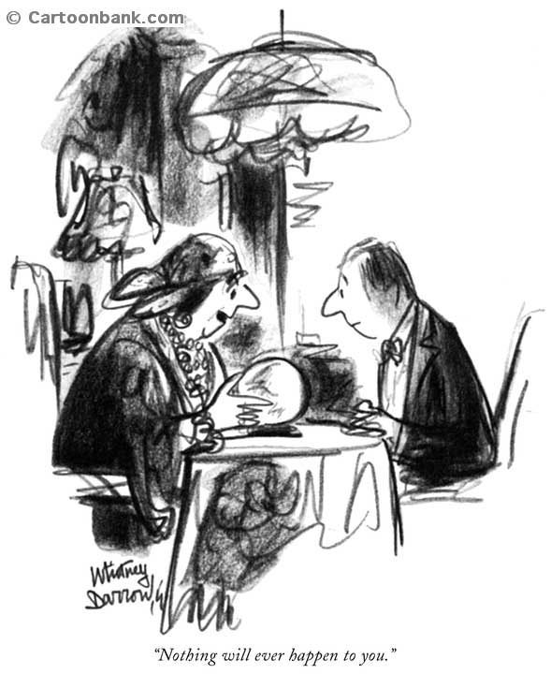
Prognostic Factors
Predicts outcome in absence of systemic therapy
Thus, tell us when (not how) to treat a patient
Notes:
Reflects natural history of disease

Slide 4
Prognostic Factors
PATHOLOGY
GENOMIC
Stage
  Lymph node status
  Tumour size
Histologic grade and subtype
ER/PgR status
HER2 status
Lymphovascular invasion
Proliferative status
21-gene recurrence score (Oncotype Dx)
70-gene signature (Mammaprint)
PAM50
12 gene (Endopredict)
Breast Cancer Index (BCI)
Notes:
Adjuvant online is not a factor in and of itself but an elegant computer algorithm which integrates a number of the classic prognostic factors and calculates (computes) a patient’s underlying risk of recurrence and the potential benefit from a variety of systemic therapies
A number of the newer factors are gene expression profiles (encompasses) such as 70-gene profile (also known as mammaprint), 21-gene recurrence score (aka Oncotype DX), intrinsic profiles as … by Sorlie and Perou, wound responses signature and others
Finally, in a series of carefully done studies, Dr. Harbeck and others have evaluated/demonstrated the utility of UPA/PAI-1
INTRINSIC SUBTYPES

Slide 5

Predictive Factor
Indicate tumour’s responsiveness to a particular therapy
ER
HER2
21-gene recurrence score (Oncotype DX)
Breast Cancer Index (BCI)
www.coverbrowser.com/covers/action-comics
Notes:
IN CONTRADISTINCTION, PREDICTIVE FACTORS INDICATE A TUMOR’S RESPONSIVENESS TO A PARTICULAR THERAPY
In reality (in fact) many breast cancer related factors are both predictive and prognostic but distinction between two is important.

Slide 6
Genomic Prognostic/Predictive Factors
Early-Stage HR+/HER2- Breast Cancer

Slide 7
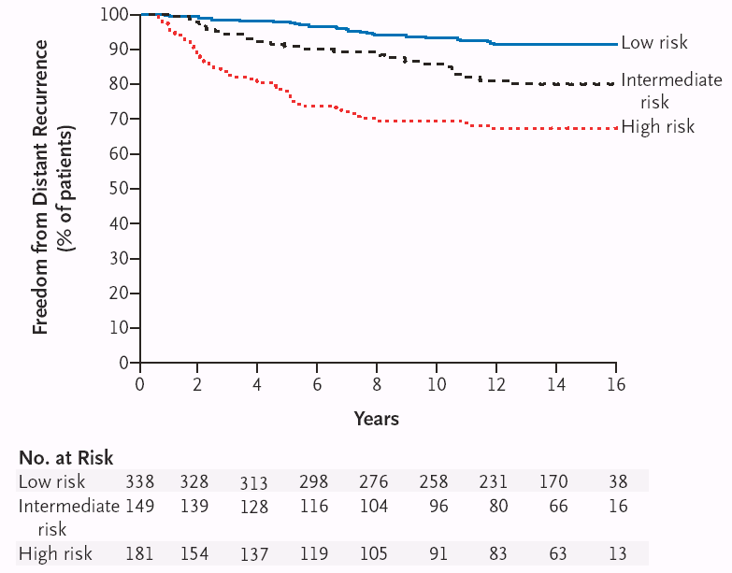
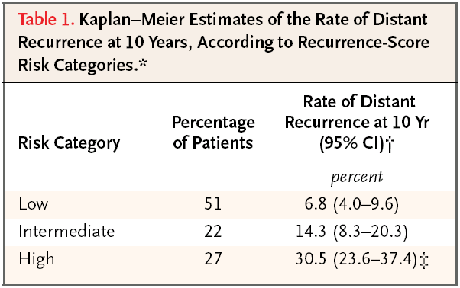
21-gene Recurrence Score
Prognostic and Predictive – Results from NSABP B14 and B20
DDFS 97% → 96%
DDFS 89% → 91%
DDFS 60% → 88%
Paik S et al. N Engl J Med. 2004;351(27):2817-2826; Paik S et al. J Clin Oncol. 2006;24(23):3726-3734.
Notes:
Tang and Cuzick JCO 2011;29:4365-72 for RCPC

Slide 8
Intergroup TAILORx Trial
Node Negative ER/PR positive, HER2 negative
21-gene Recurrence Score Assay
RS < 10
HT Registry (n=1629)
RS 11-25
RANDOMIZE (n=6711)
RS > 26
CTX +HT Registry (n=1389)
R
Endocrine Tx
Endo Tx + Chemo
Sparano JA et al. N Engl J Med. 2015;373(21):2005-14; Sparano JA et al. N Engl J Med. 2018;379(2):111-121; Sparano JA et al. JAMA Oncol. 2020;6(3):367-374. Sparano JA et al. SABCS 2022. Abstract GS1-05.

Slide 9
Intergroup TAILORx Trial
Node Negative ER/PR positive, HER2 negative
21-gene Recurrence Score Assay
RS < 10
HT Registry (n=1629)
RS 11-25
RANDOMIZE (n=6711)
RS > 26
CTX +HT Registry (n=1389)
Excellent outcome
5 yr freedom from distant recurrence 99.3%
9 yr freedom from distant recurrence 96.8%
12 yr freedom from distant recurrence 93.2%
Outcome
  5 yr freedom from distant recurrence 93.0%
  5 yr overall survival 95.9%
  12 yr freedom from distant recurrence 84.8%
R
Endocrine Tx
Endo Tx + Chemo
Sparano JA et al. N Engl J Med. 2015;373(21):2005-14; Sparano JA et al. N Engl J Med. 2018;379(2):111-121; Sparano JA et al. JAMA Oncol. 2020;6(3):367-374. Sparano JA et al. SABCS 2022. Abstract GS1-05.

Slide 10
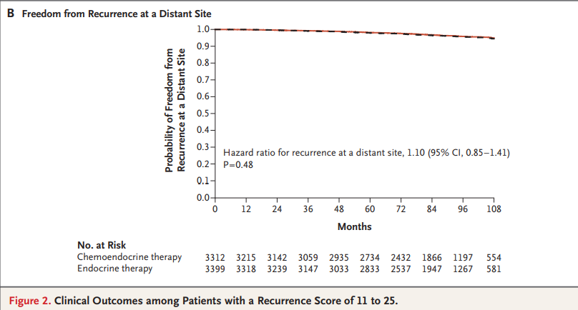
TAILORx Results – IIT RS 11-25
12 yr event rates for RS 11-25 for ITT
IDFS: ET 76.8% vs CET 77.4%
DRFS: ET 92.6% vs CET 92.8%
OS: ET 89.8% vs CET 89.8%
For women > 50 NO benefit for chemo if RS < 25
For women < 50 y.o. – 9 yr freedom from distant recurrence:
RS 11-15: No benefit from chemo
RS 16-20: 1.6% benefit (95.2 vs 93.6%)
RS 21-25: 6.5% benefit (93.4 vs 86.9%)
Sparano JA et al. N Engl J Med. 2018;379(2):111-121; Sparano JA et al. SABCS 2022. Abstract GS1-05.

Slide 11
TAILORx (LNN) - Incorporation of Clinical Risk in Women < 50
Low clinical risk: Grade 3 < 1 cm
Grade 2 < 2 cm
Grade 1 < 3 cm
High clinical risk: Anything else
CLINICAL RISK CATEGORY IMPACTS PROGNOSIS INDEPENDENTLY OF RS GROUP
Sparano J et al. N Engl J Med. 2019;380(25):2395-2405

Slide 12
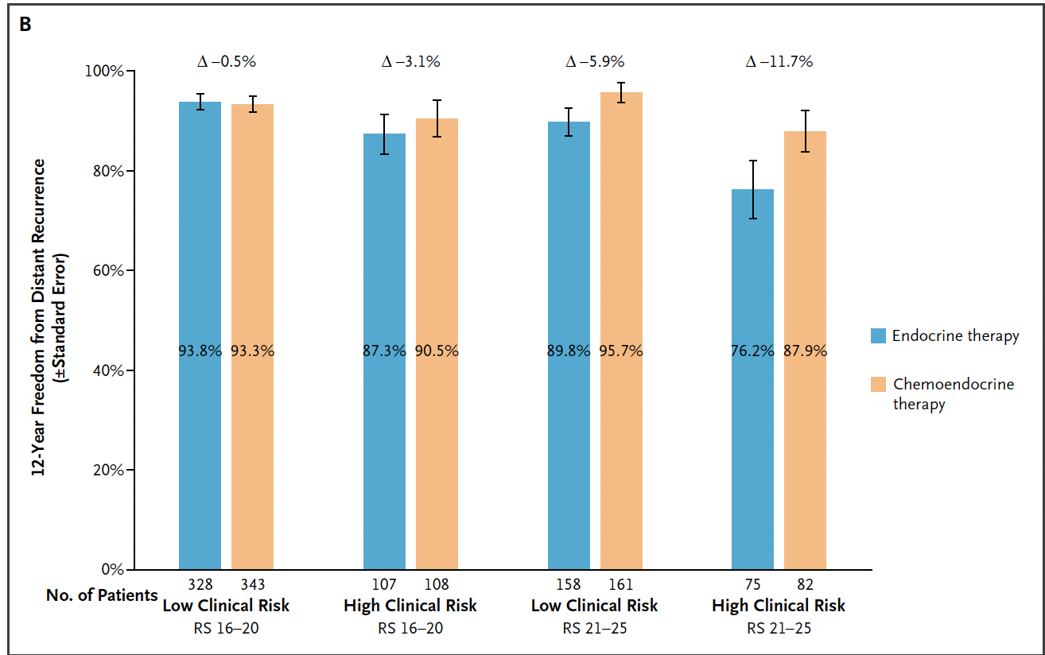
TAILORx (LNN) - Incorporation of Clinical Risk in Women < 50
12-Year Freedom from Distant Recurrence
Low clinical risk: Grade 3 < 1 cm
Grade 2 < 2 cm
Grade 1 < 3 cm
High clinical risk: Anything else
▲ -0.5%
▲ +3.1%
▲ +5.9%
▲ +11.7%
High clinical risk:
Benefit for chemo for RS ≥ 16
Low clinical risk:
Modest benefit chemo for RS 21-25
RS 16-20
RS 21-25
Sparano JA et al. NEJM Evid 2024;3(8)

Slide 13
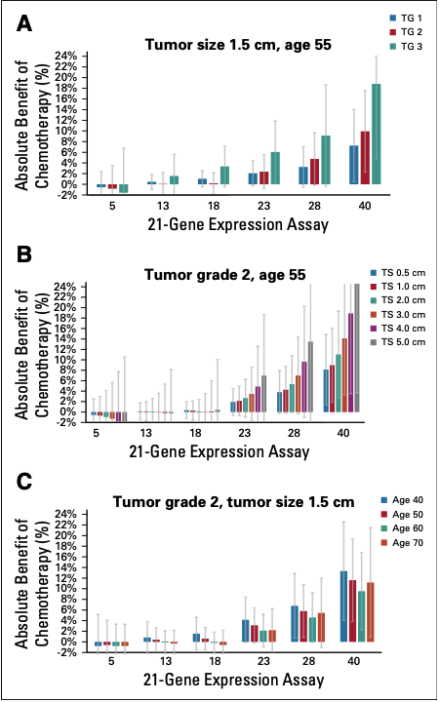
RSClinTM: Grade, Tumor Size and Age Predict Chemo Benefit
Patient specific meta-analysis based on TAILORx, NSABP B-14 & B-20 to predict individualized prognosis and prediction of chemo benefit
Varying grade
Varying tumor size
Varying age
Development set ~10,000 pts
Validation set ~ 1,000 pt RWE
Sparano et al. J Clin Oncol 2020;39:557-564

Slide 14
SWOG 1007 – RxPONDER Trial
Arm 1 (n = 2509)
Chemotherapy Followed by Endocrine Therapy
Key Entry Criteria
Women ≥ 18 yrs
1*-3 LN+
ER and/or PR ≥ 1%, HER2- BC
No distant mets
Able to receive adjuvant taxane and/or anthra-based chemo**
Axillary staging by SLNB or ALND
R
E
G
I
S
T
R
A
T
I
O
N
R
Recurrence Score 0-25
Arm 2 (n = 2506)
Endocrine Therapy Alone
Recurrence Score > 25
N = 5000 pts
Off Study – Chemo -> /ET recommended
Stratification Factors
Recurrence Score: 0-13 vs.14-25
Menopausal Status: pre vs. post
Axillary Surgery: ALND vs. SLNB
  * After randomization of 2493 pts, the protocol was amended to exclude enrollment of pts with pN1mic as only nodal disease.
  ** Approved chemotherapy regimens included TC, FAC (or FEC), AC/T (or EC/T), FAC/T (or FEC/T). AC alone or CMF not allowed.
Kalinsky K et al. SABCS 2020. Abstract GS3-00; Kalinsky K et al. NEJM 2021
Notes:
Primary Hypothesis
Chemotherapy benefit will increase as the RS increases from 0 to 25 in an Intent-to-Treat (ITT) analysis

Slide 15
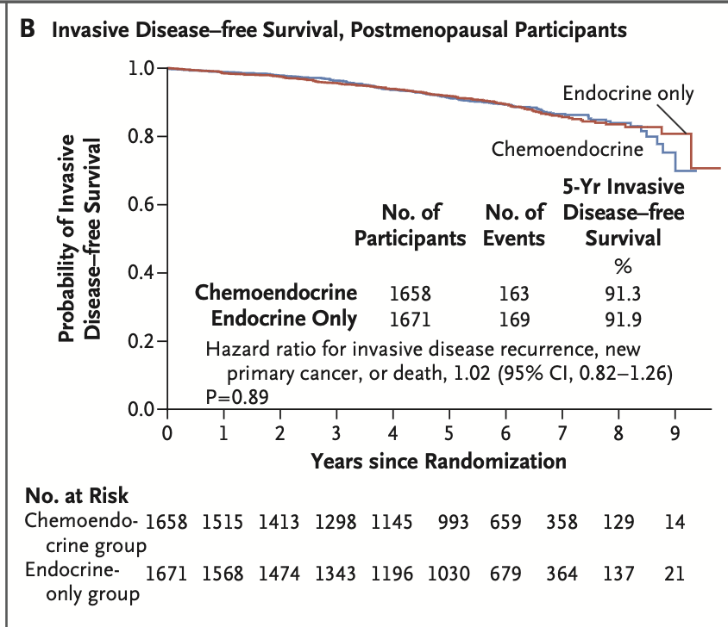
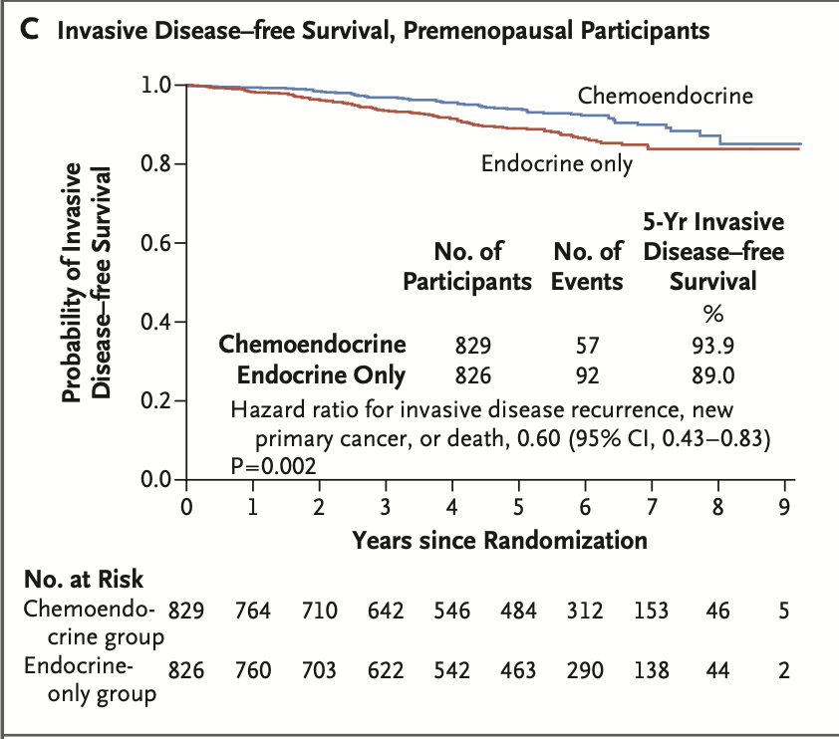
iDFS Stratified by Menopausal Status – Prespecified Analysis
Chemotherapy benefit for IDFS is different depending on menopausal status
Postmenopausal
Premenopausal
91.9%
93.9%
▲0.6%
▲4.9%
91.3%
89.0%
No Statistically Significant IDFS Difference
5-year IDFS Absolute Difference 5.2%
Absolute Difference in Distant Recurrence as 1st site: 0% (5.6% CET and ET)
Absolute Difference in Distant Recurrence as 1st site: 3.3% (3.9% CET vs. 7.2% ET)
Kalinsky K et al. SABCS 2020. Abstract GS3-00; Kalinsky K et al. N Engl J Med. 2021;385(25):2336-2347.

Slide 16
iDFS Stratified by Menopausal Status – Prespecified Analysis
Chemotherapy benefit for IDFS is different depending on menopausal status
Postmenopausal
Premenopausal
91.9%
93.9%
▲0.6%
▲4.9%
91.3%
89.0%
No Statistically Significant IDFS Difference
5-year IDFS Absolute Difference 5.2%
IS BENEFIT OF CHEMOTHERAPY IN PREMENOPAUSAL WOMEN DUE TO OS?
OFSET TRIAL ADDRESSING THIS
Absolute Difference in Distant Recurrence as 1st site: 0% (5.6% CET and ET)
Absolute Difference in Distant Recurrence as 1st site: 3.3% (3.9% CET vs. 7.2% ET)
Kalinsky K et al. SABCS 2020. Abstract GS3-00; Kalinsky K et al. N Engl J Med. 2021;385(25):2336-2347.

Slide 17
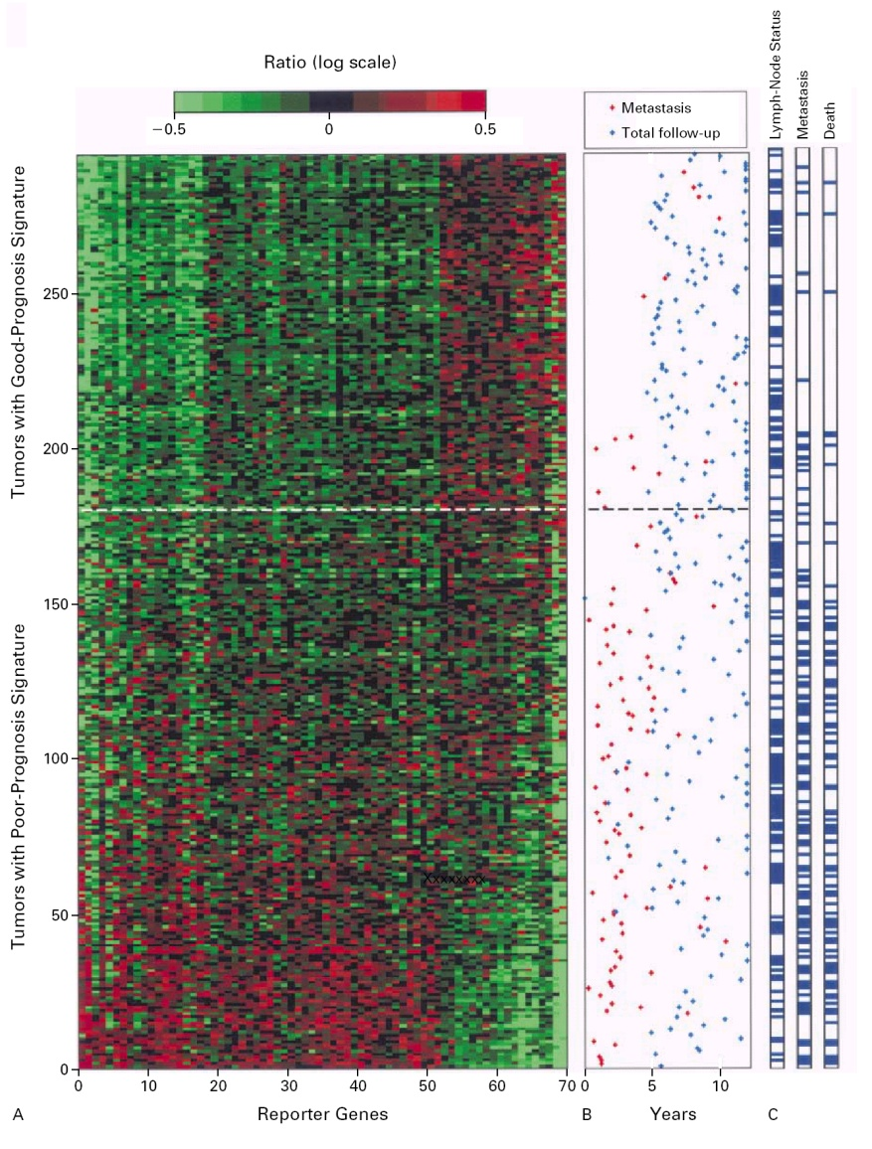
Gene Expression Profile
Rotterdam Study 70-Gene Profile
Prognostic in both LNN
(n = 151) and LNP (N = 144)
Validated in multi-institution study in untreated LNN patients (N = 307) and added to clinicopath factors
van de Vijver MJ et al. N Engl J Med. 2002;347(25):1999-2009; Buyse M et al. J Natl Cancer Inst. 2006;98(17):1183-1192.
Notes:
Studied 295 consecutive patients with ESB < 55 yrs old; 151 LNN (majority no adj tx); 115 good prognosis signature; 180 poor prognosis signature

Slide 18
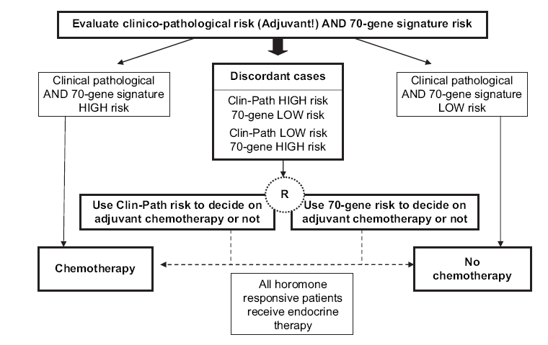
MINDACT (N = 6693) – EORTC Prospective RCT 0-3 LN+
Based on nodal status, tumor size, central grade, ER and HER2
High clinical risk*:
  TNBC:
    All LN+; if LNN G2/3 > 1 cm or if G1 > 2 cm
  HER2+
    ER negative: All LN+; if LNN any G3 and any G1/2 if > 1cm
    ER positive: All LN+; if LNN any G3 > 1 cm and any G1/2 > 2 cm
  ER+ and HER2-:
    any LN+ except if G1 and < 2 cm
    If LNN and G1 > 3 cm or if G2 > 2 cm or if G3 > 1 cm
88% HR+; 12% TNBC; 10% HER2+
NOTE: Trial not powered for yes/no to chemo
Cardoso F et al. N Engl J Med. 2016;375(8):717-729.
Notes:
Microarray in Node negative Disease May Avoid Chemotherapy
“Clinical profile” path done locally
“Molecular profile” sent to Agilent
Randomizations to different chemo and hormone therapy

Slide 19
MINDACT - Distant Metastasis Free Survival (%) at 8 yrs Prognostic
N = 2745
N = 592
N = 1550
N = 1806
C = clinical; G = genomic; L = low; H = high
Cardoso F et al. N Engl J Med. 2016;375(8):717-729; Cardoso F et al. ASCO 2020. Abstract 506.
Notes:
Discordant group ~1/3rd of total

Slide 20
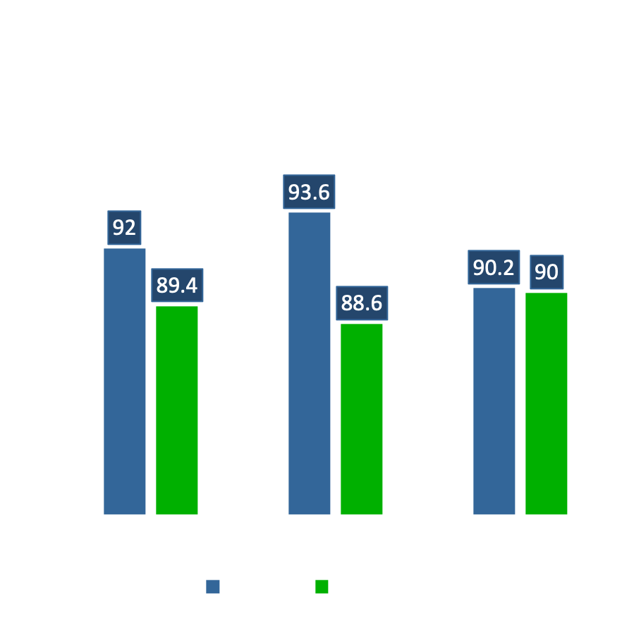
MINDACT – Secondary Endpoint
Clinical High/Genomic Low – Outcome by Chemo vs No Chemo
3356 patients at high-clinical risk – 46% low genomic risk
C-high/G-low group
  48% LN+; 93% G2/G3;34% < 50
Endo therapy – in ≤ 50, 55% received tam alone
Findings similar for LNN and N1
Note, in C-low/G-high no advantage to guiding treatment based on genomic risk – therefore, NO utility to sending Mammaprint in this group
▲ = 2.6 %
▲ = 5 %
▲ = 0.2 %
NOTE: Trial not powered for yes/no to chemo - PROGNOSTIC but not PREDICTIVE
Helps ID pts w/ low risk of recurrence who may safely avoid chemotherapy; not felt to have sufficient evidence to predict who will benefit from chemo
Cardoso F et al. N Engl J Med. 2016;375(8):717-729; Cardoso F et al. ASCO 2020. Abstract 506.

Slide 21
Predictors of benefit of other adjuvant agents

Slide 22
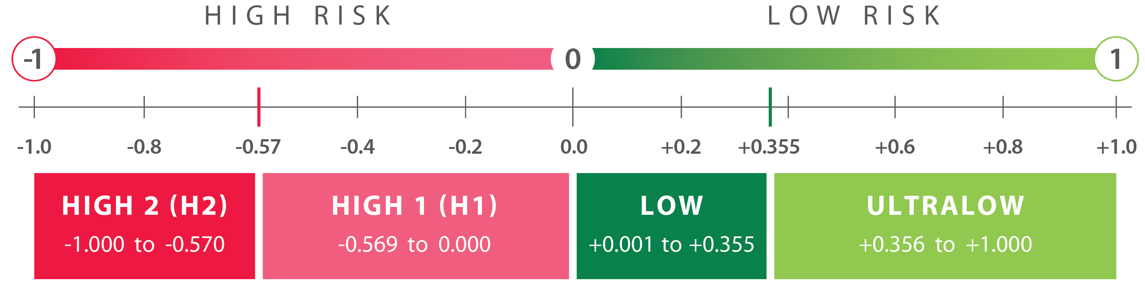
70-Gene Assay (Mammaprint) to Guide Therapy Decisions
MP classifies patients with HR+HER2- EBC as having an UltraLow, Low, High1, or High2 risk of distant recurrence
Knauer (Breast Cancer Res Treat 2010), NBRST (Whitworth, Ann Surg Oncol 2022), STO-3 (van’t Veer, Breast Cancer Res Treat, 2017; Esserman, JAMA Onc, 2017), I-SPY2 (https://www.ispytrials.org/i-spy-platform/i-spy2; Pusztai, Cancer Cell 2021), MINDACT (Piccart, Lancet Oncol, 2021; Lopes Cardozo, JCO, 2022), NSABP-B42 (Rastogi, ASCO, 2021), IDEAL (Liefers, SABCS, 2022)

Slide 23
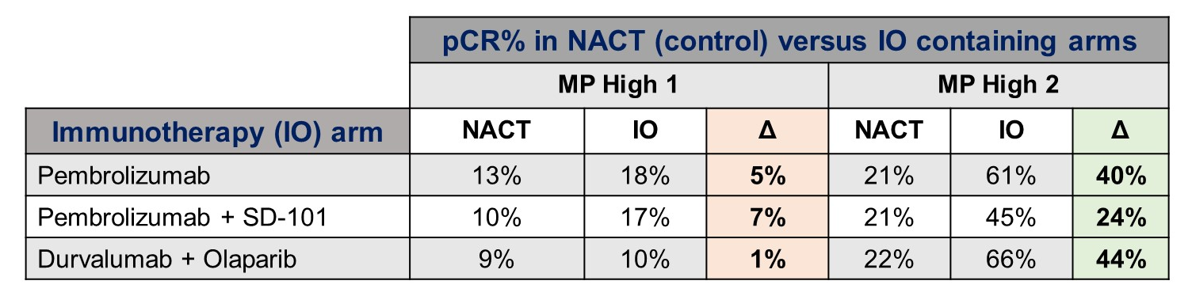
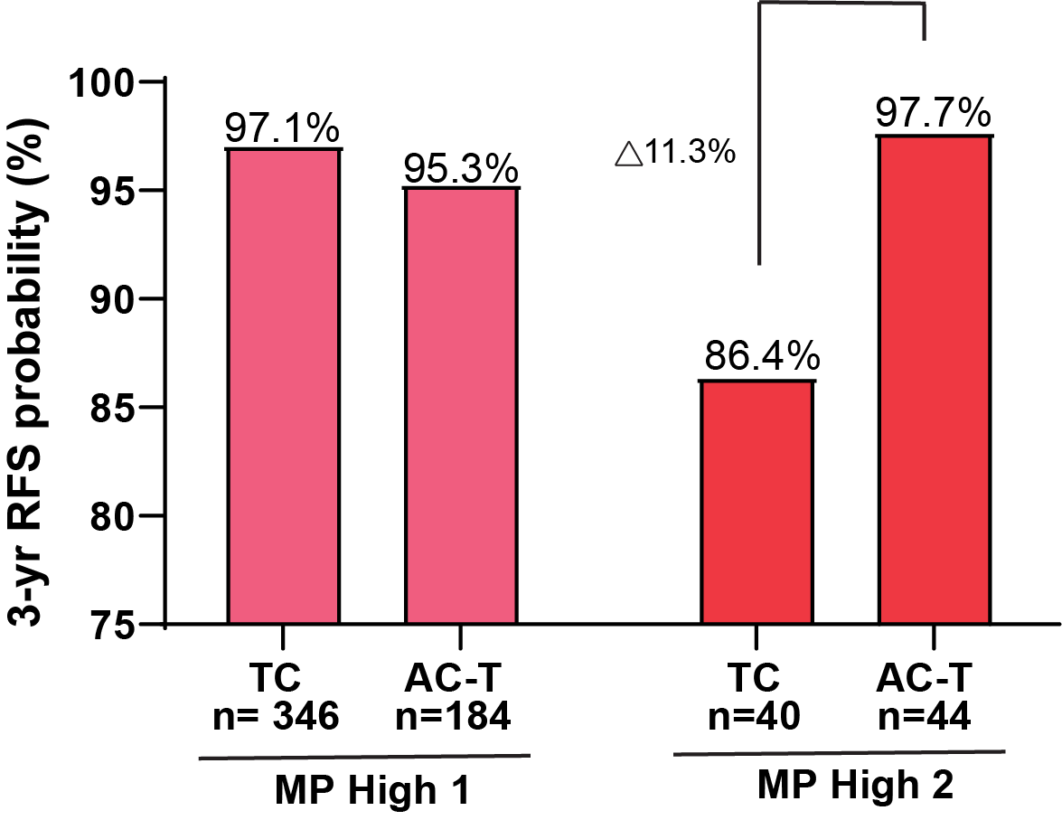
70-Gene Assay (Mammaprint) to Guide Therapy Decisions
MP High2 may predict benefit of IO in HR+/HER2 ESB
MP High2 may predict sensitivity to anthracycline
ISPY2 Data:
MP high risk localized BC
Pts not randomized
delta-pCR rate = 55%
Also developed signature of response to IO -- ImPrint
Data from FLEX RW Registry:
Pts with Stage I-III ESB
Pts not randomized
O’Shaughnessy, J. ASCO 2024; Wolf D AACR 2024

Slide 24
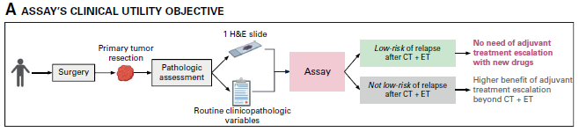
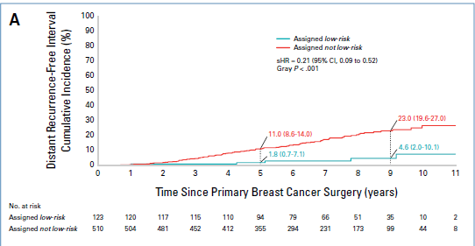
Digitized Pathology Slide Assay to Predict Benefit of Additional Adjuvant Therapies in High Risk ESB
High risk ESB definition:
> 4 LN+
1-3 LN+ and
  T3 or Grade 3 or Ki67 > 20%
Validation set
Model developed from digitized slides from a retrospective data set -- assay integrates 4 clinicopath variables and 10 slide-derived features (capturing tumor architecture, microenvironment, & proliferation)
Validated assay based on high risk patients from two prospective trials: CANTO and UNIRAD
Bidard FC et al. J Clin Oncol 2025; 43:3090-3101

Slide 25
Predictors of Late Recurrence
HR+/HER2- Breast Cancer

Slide 26
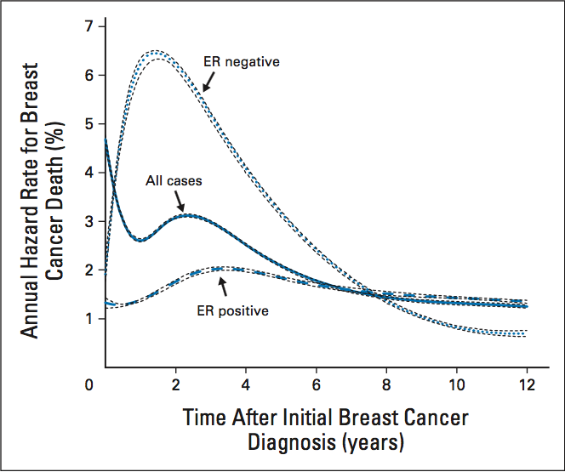
Annual Hazard of Recurrence
SEER Data 1992-2007
Multiple trials demonstrated benefit of extended adjuvant endocrine therapy
Identification of patients who benefit and those who can be spared toxicity is key
Jatoi I et al. J Clin Oncol. 2011;29(17):2301-2304.
Notes:
SEER Data

Slide 27
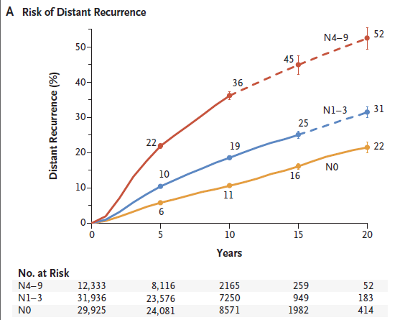
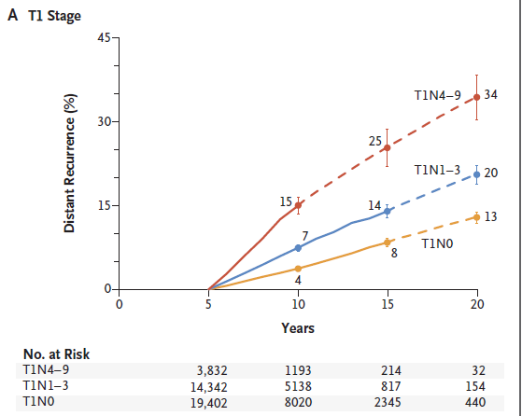
Extended Adjuvant Endocrine Therapy – Who Needs It?
ET for 5 yrs
25% fewer distant recurrences since 2000 vs pre-2000 in years 5-9 – may translate into similar benefit years 10-20
Pan H et al. N Engl J Med. 2017;377(19):1836-1846; Pan H et al. SABCS 2019. Abstract GS-04.
Notes:
Why is prognosis better since 2000 even controlling for tumor size, nodal status, use of chemo or AI?
Improvements in treatment (eg HER2 directed therapies; use of genomic tests to guide use of chemo)
Treatment guidelines – more patients getting optimal therapy
Screening leading to lower risk cancers
? Stage migration so apparent improvements in all TN categories

Slide 28
Extended Adjuvant Endocrine Therapy
Fundamental Principles
Predicting late recurrence is different than predicting risk of recurrence from years 0-10
Having a significant risk for late recurrence indicates a potential of benefit from therapy BUT DOES NOT necessarily imply sensitivity to treatment (and by extension a benefit from extended therapy)
Pan H et al. ASCO 2016. Abstract 505.

Slide 29
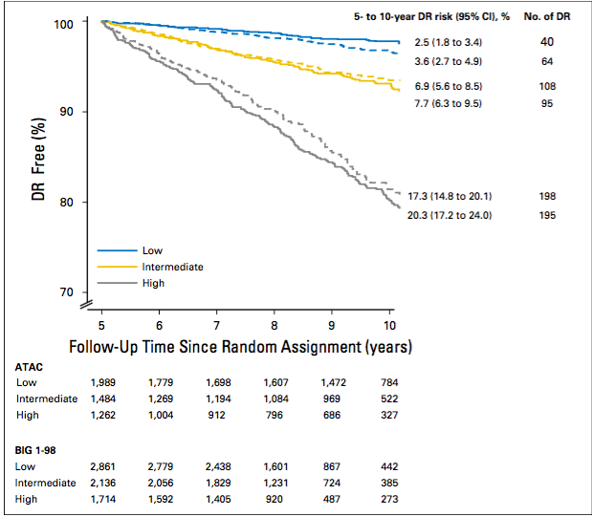
Clinical Treatment Score Post 5 Years (CTS5)
Clinicopathological Predictor of Late Recurrence
ATAC & BIG 1-98
FURTHER VALIDATION OF CTS5
In IDEAL (N=1591) and TEAM (N=5895) Studies:
CTS5 predicted risk of late recurrence
However, overestimated for high risk groups (and intermediate in IDEAL)
Did not predict benefit of EAET
In TAILORx (N=7353)
CTS5 predicted risk of recurrence in > 50 but not those < 50
Little data in HER2+
CTS5 performed similarly in chemo and no chemo group
About 43% of patients with low clinical risk
Dowsett M et al. J Clin Oncol. 2018;36(19):1941; Noordhoek I et al. JCO 2020;38(28):3273; SestakI et al. SABCS 2019. Abstract GS4-03

Slide 30
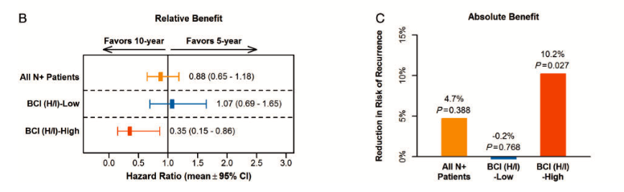
BCI – Trans aTTom Analysis
Trans-aTTom study – ~2600 pts with tissue available
Confirmed as HR+ and able to do BCI (n=1822); focused on node positive group (n = 583)
No significant differences in characteristics between Trans-aTTom and aTTom
49% classified as BCI high
BCI low recurrence-free interval (RFI): 29.8% vs 29.6%
BCI high recurrence-free interval (RFI): 27% vs 37.2%
Bartlett JMS et al. Ann Oncol. 2019;30(11):1776-1783.

Slide 31
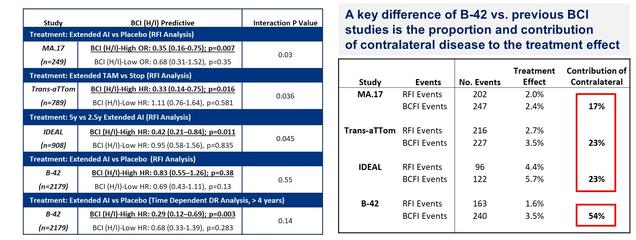
Summary of BCI Studies For Prediction of EET
Mamounas EP et al. ASCO 2021. Abstract 501.

Slide 32
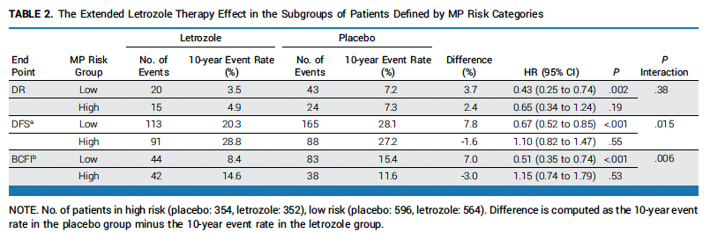
Mammaprint – NSABP B42
MP-low benefits from extended treatment
MP high risk no benefit – most recurrences in 1st 5 yrs, during which time benefited from ET
MP ultralow – no benefit from extended endo treatment (MP-UL DR ▲ -1.8%; MP-LNUL DR ▲ 9.5%)
UL: Ultralow; LNUL: Low not UL
Rastogi P et al. J Clin Oncol. 2024;42(30):3561-3569.

Slide 33
Predictor of Late Recurrence
PAM50 ROR* Score – TransATAC and ABCSG8
2,137 postmeno women LN- and LN+ disease-free s/p 5 yrs adjuvant endo therapy
16.6%
Similar findings from comprehensive Danish population database study
Lænkholm AV et al. J Clin Oncol. 2018;36(8):735-740.
8.3%
2.4%
Prognostic but not predictive of benefit from extended adjuvant endocrine therapy
*PAM50 ROR: PAM50 + clinical factors (T, N, prolif)
Sestak I et al. J Clin Oncol. 2015;33(8):916-922.
Notes:
PAM50 ROR strongest predictor in LNN, HER2-
10 yr risk of recurrence in low-risk 2%, int-risk 9%, hi-risk 11.5%
Danish study – 2164 women disease free at 5 years – got endo treatment alone
Late DR rate 10.2% high risk group; 6.1% int risk, 2.4% low risk

Slide 34
70-Gene Assay (Mammaprint) to Guide Therapy Decisions
MP classifies patients with HR+HER2- EBC as having an UltraLow, Low, High1, or High2 risk of distant recurrence
(Neo)Adj CT benefit
ET benefit 0-5 yrs
Increased sensitivity to: PARPi, IO, Platinum, Anthracycline
(Neo)Adjuvant CT benefit
ET benefit 0-5 yrs
No increased sensitivity to: PARPi, IO, Platinum
No CT benefit
ET benefit 0-5 yrs
Extended ET benefit 6-10 yrs
No CT benefit
ET benefit 2 to <5 yrs
Knauer, NBRST,
STO-3, I-SPY2, FLEX
Knauer, NBRST, STO-3, I-SPY2
MINDACT, STO-3,
NSABP-B42, IDEAL
MINDACT, STO-3
Knauer (Breast Cancer Res Treat 2010), NBRST (Whitworth, Ann Surg Oncol 2022), STO-3 (van’t Veer, Breast Cancer Res Treat, 2017; Esserman, JAMA Onc, 2017), I-SPY2 (https://www.ispytrials.org/i-spy-platform/i-spy2; Pusztai, Cancer Cell 2021), O’Shaughnessy, J. ASCO 2024; MINDACT (Piccart, Lancet Oncol, 2021; Lopes Cardozo, JCO, 2022), NSABP-B42 (Rastogi, ASCO, 2021), IDEAL (Liefers, SABCS, 2022)

Slide 35
70-Gene Assay (Mammaprint) to Guide Therapy Decisions
MP classifies patients with HR+HER2- EBC as having an UltraLow, Low, High1, or High2 risk of distant recurrence
Emerging data suggesting utility of MP in guiding other adjuvant therapies
(Neo)Adj CT benefit
ET benefit 0-5 yrs
Increased sensitivity to: PARPi, IO, Platinum, Anthracycline
(Neo)Adjuvant CT benefit
ET benefit 0-5 yrs
No increased sensitivity to: PARPi, IO, Platinum
No CT benefit
ET benefit 0-5 yrs
Extended ET benefit 6-10 yrs
No CT benefit
ET benefit 2 to <5 yrs
Knauer, NBRST,
STO-3, I-SPY2, FLEX
Knauer, NBRST, STO-3, I-SPY2
MINDACT, STO-3,
NSABP-B42, IDEAL
MINDACT, STO-3
Knauer (Breast Cancer Res Treat 2010), NBRST (Whitworth, Ann Surg Oncol 2022), STO-3 (van’t Veer, Breast Cancer Res Treat, 2017; Esserman, JAMA Onc, 2017), I-SPY2 (https://www.ispytrials.org/i-spy-platform/i-spy2; Pusztai, Cancer Cell 2021), O’Shaughnessy, J. ASCO 2024; MINDACT (Piccart, Lancet Oncol, 2021; Lopes Cardozo, JCO, 2022), NSABP-B42 (Rastogi, ASCO, 2021), IDEAL (Liefers, SABCS, 2022)

Slide 36
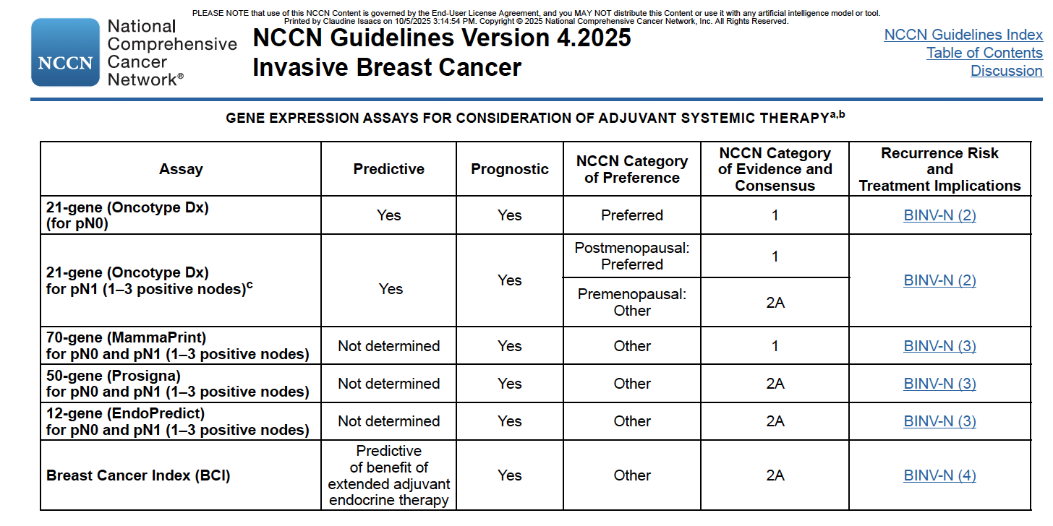
NCCN. Breast Cancer Guidelines. Version 4.2025
Notes:
Consider adjusting how present it

Slide 37
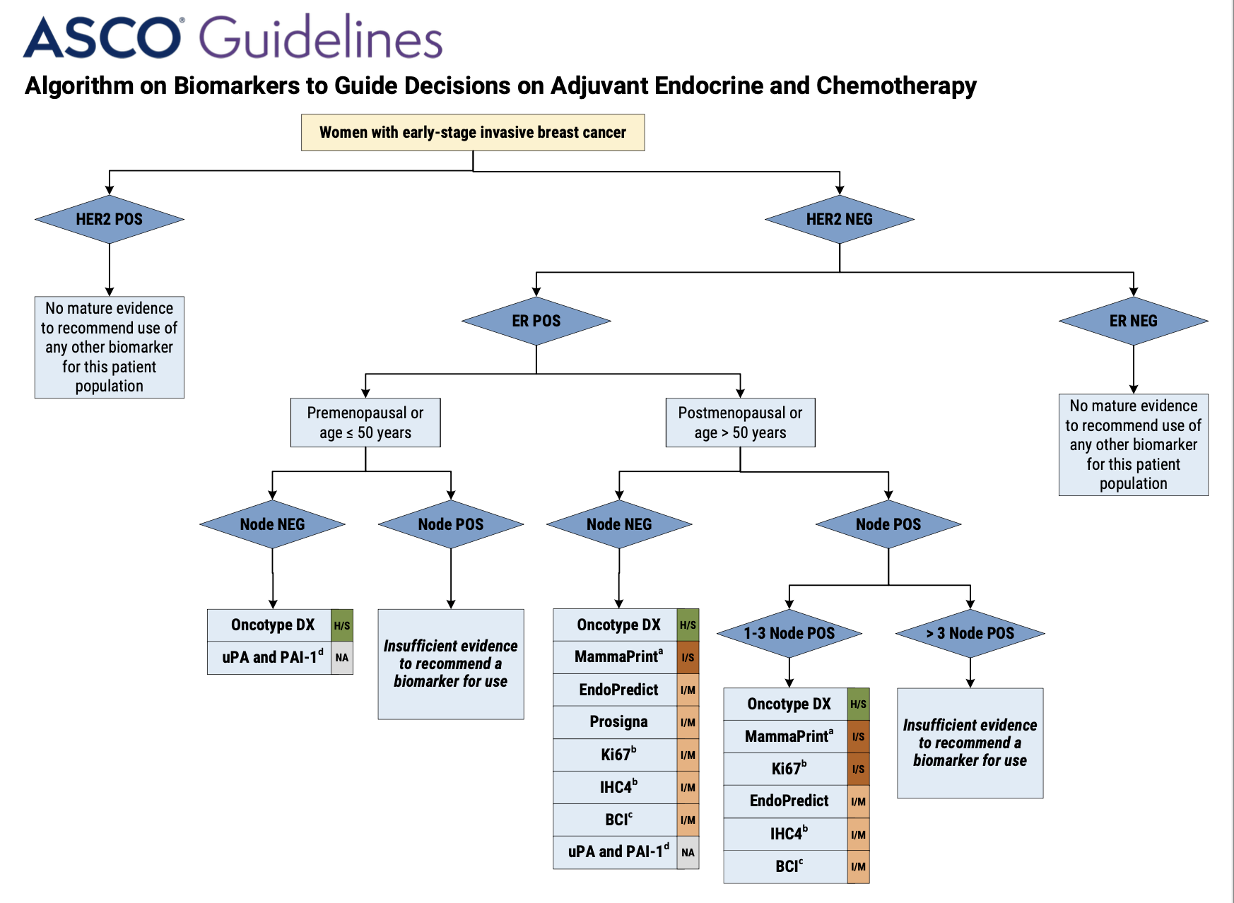

Andre F et al. J Clin Oncol. 2022;40(16):1816-1837.
Notes:
Consider adjusting how present it

Slide 38
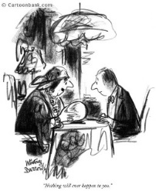

Summary
Assays provide important clinical information to guide initial systemic treatment recommendations
  21-gene recurrence score – integration of clinical features further refines utility
    In high RS, benefit of chemo
    Postmenopausal/50+: No benefit of chemo for scores < 26 for women with 0-3 LN+
    Premenopausal/< 50:
      Node negative: consider chemo in < 50 RS 16-25; in very low RS (<11) excellent outcome endo therapy alone
      1-3 LN+: chemo added to endo therapy (mainly tamoxifen) for all RS
  Mammaprint
    In clinical-high risk, allows consideration of sparing chemo in 46% patients
    Not helpful in distinguishing which C-low risk patients need chemo
Late recurrence in HR+
  CTS5 useful for predicting risk of late recurrence based on clinicopath features (only useful in those > 50)
  Data on utility of assays evaluating risk of late recurrence in HR+ disease (BCI, PAM50 ROR, EPclin) and benefit of extended treatment (BCI)
Emerging predictors of benefit of IO, HER2 therapy, type of chemo

Slide 39
Thank you!

