Slide 1

Endocrine Therapy in Premenopausal Breast Cancer
Kevin Kalinsky, MD, MS
Winship Cancer Institute
Division Director, Medical Oncology
Director, Glenn Family Breast Center
Disclaimer: This presentation is intended for personal use and for informational purposes only and does not replace independent professional judgment. This presentation is the property of Physicians’ Education Resource, LLC (“PER”) and is protected by U.S. and international copyright laws. You may not copy, reproduce, distribute, transmit, modify, or create derivative works of the presentation without the prior written permission from PER.

Slide 2
Does ovarian suppression improve outcome?

Slide 3
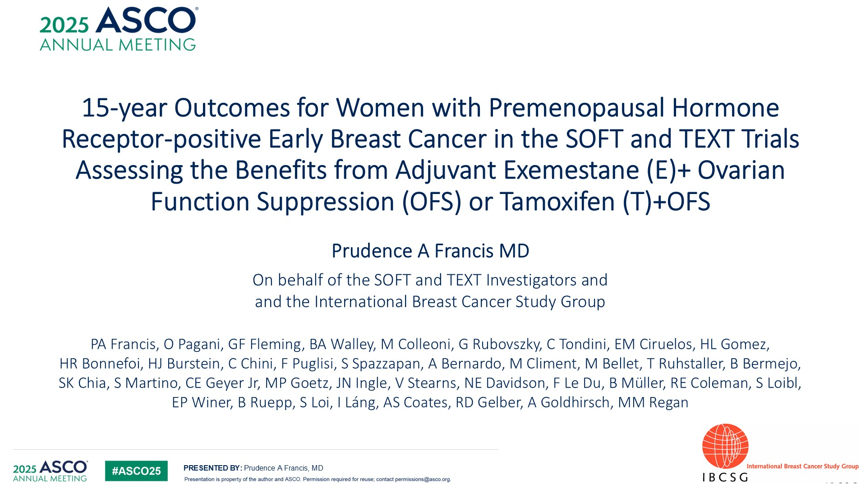
Text and Soft Joint Analysis

Slide 4
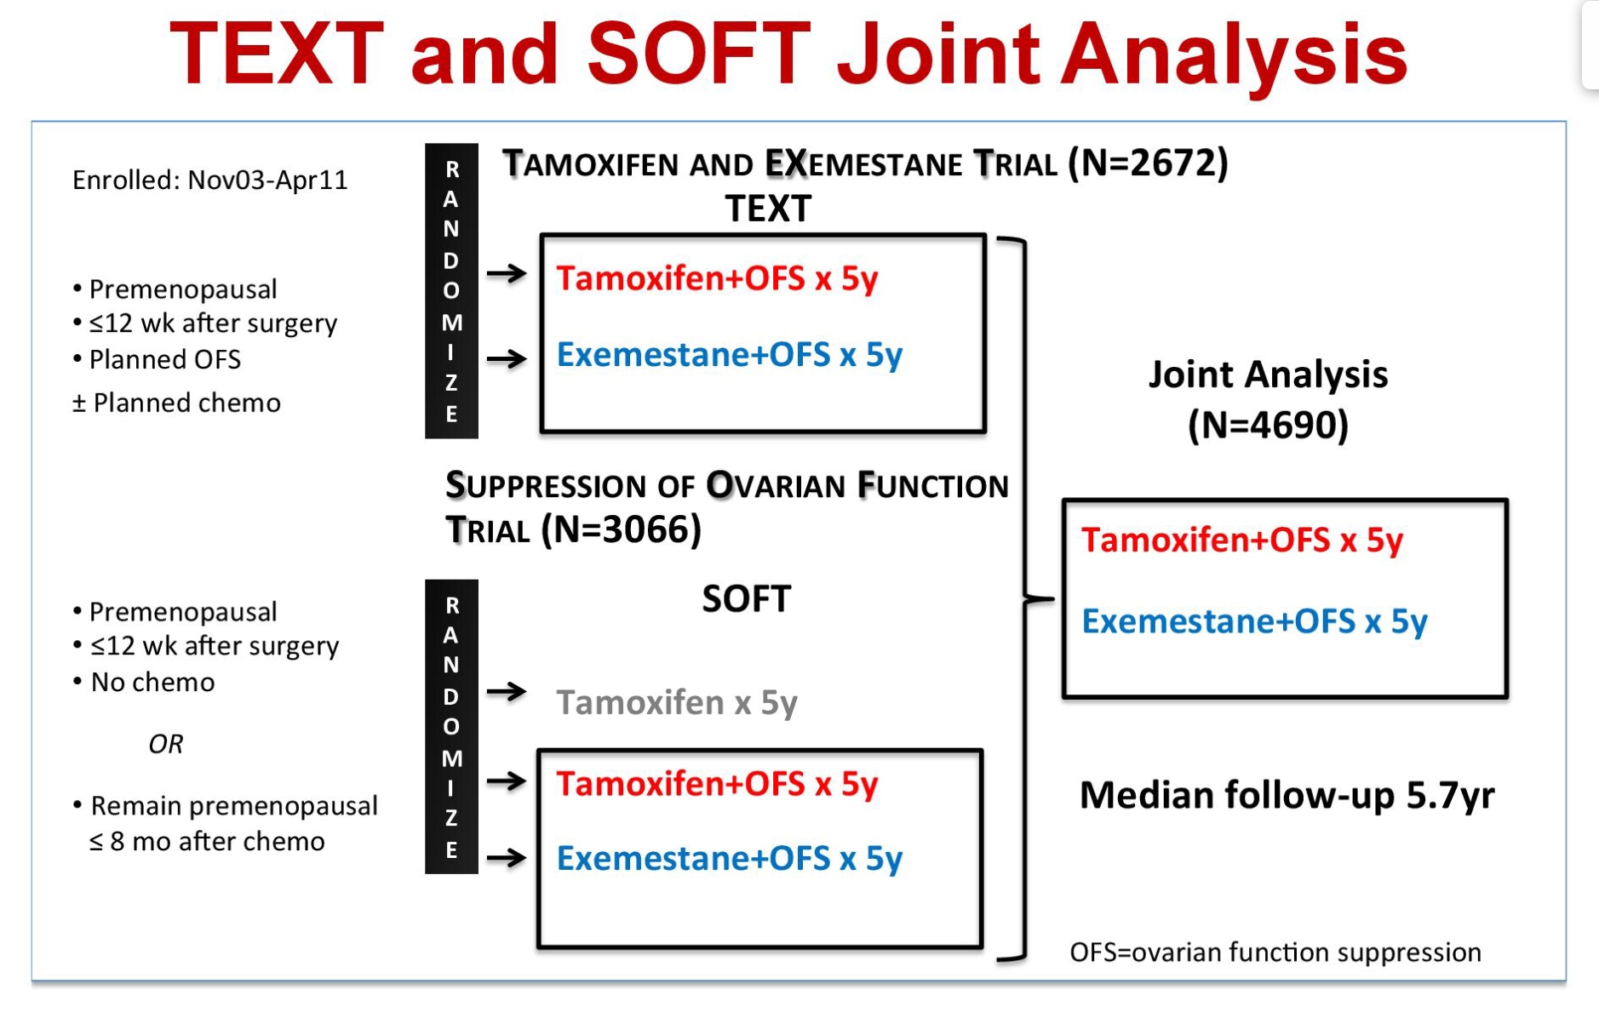
Text and Soft Joint Analysis

Slide 5
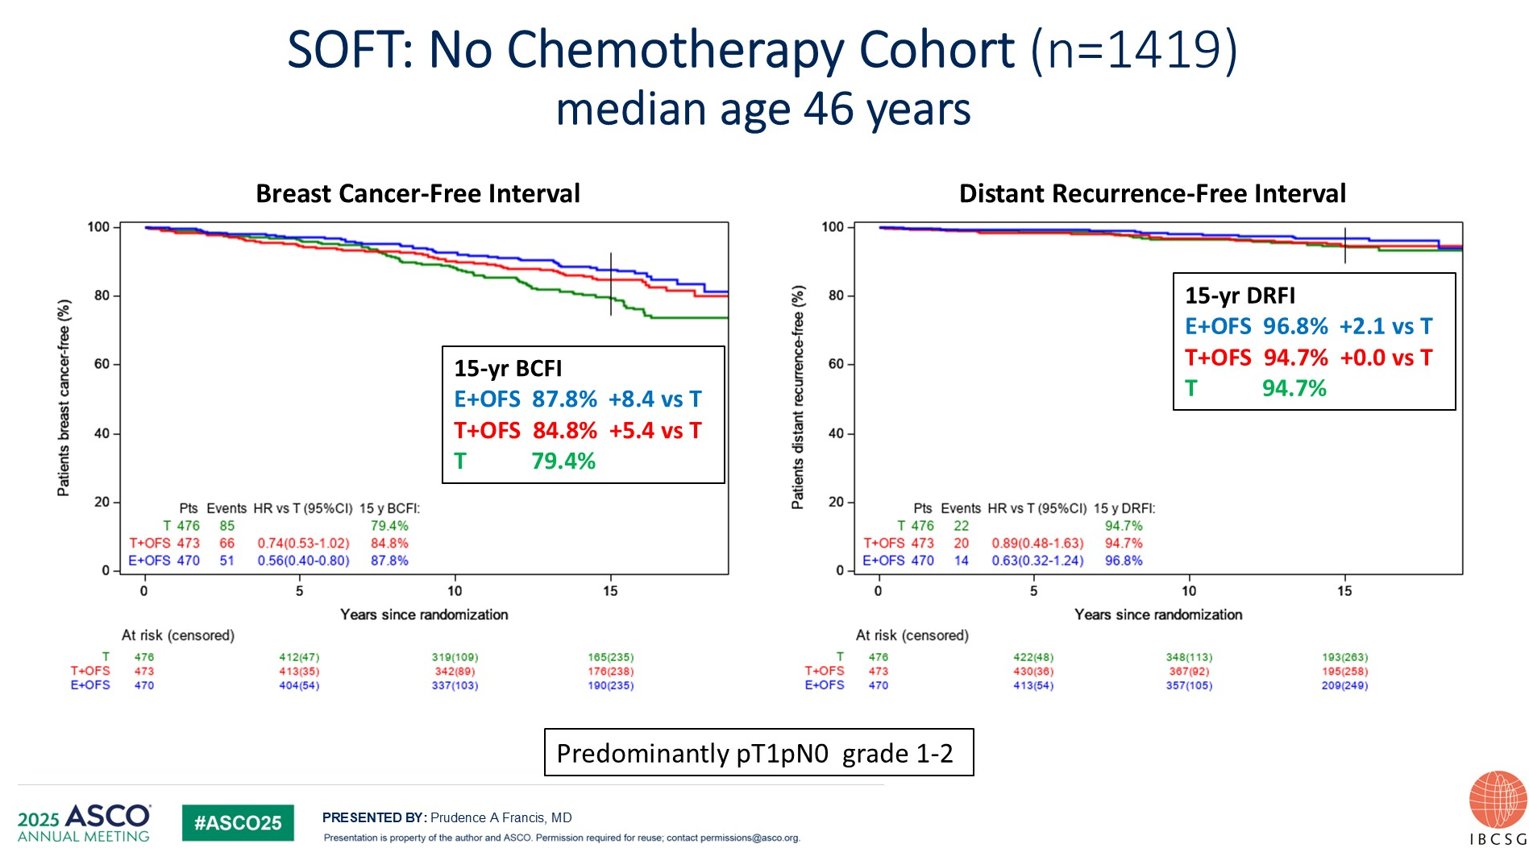
15 Year Update of SOFT

Slide 6
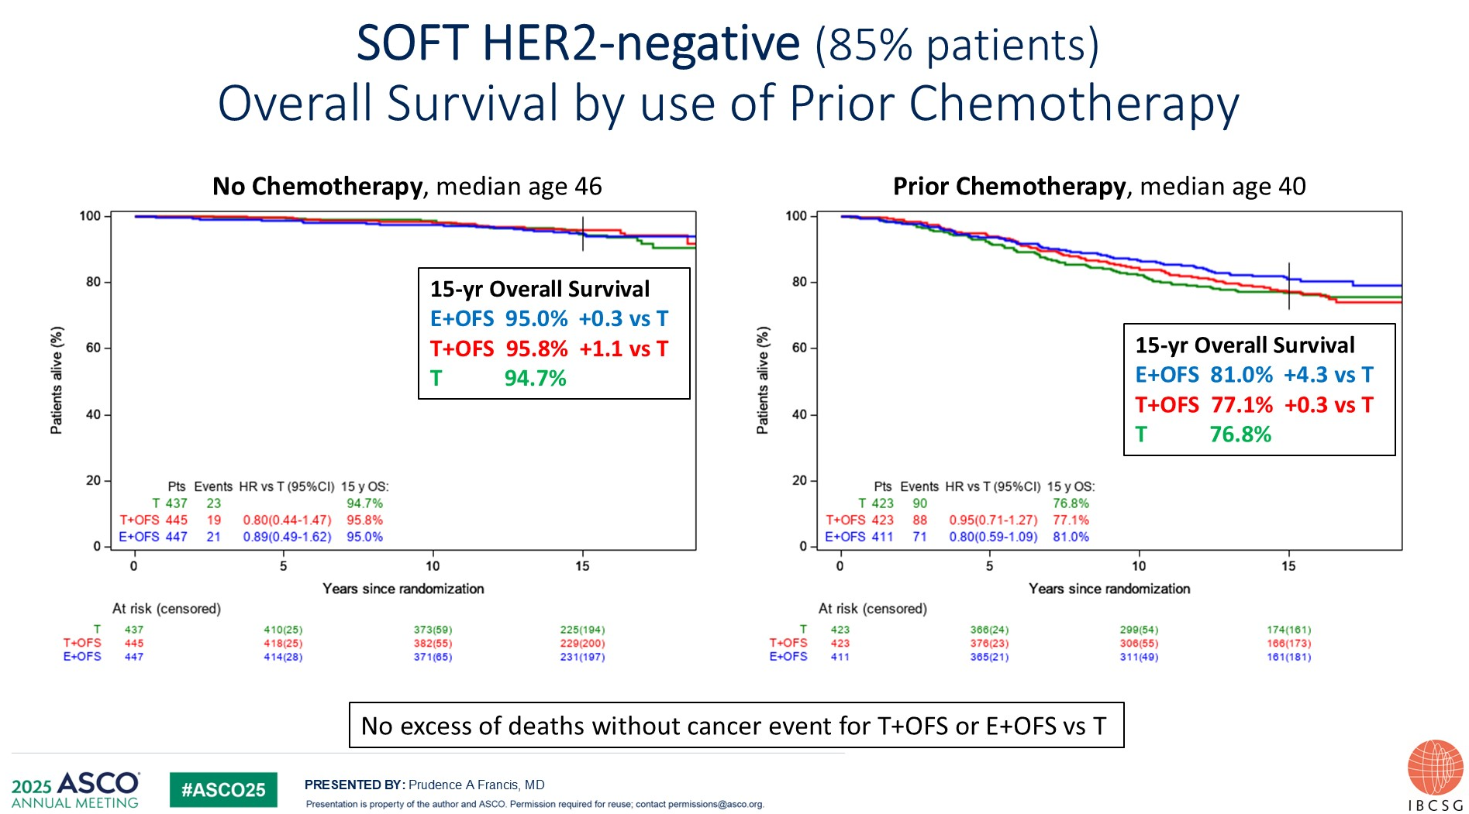
15 Year Update of SOFT

Slide 7
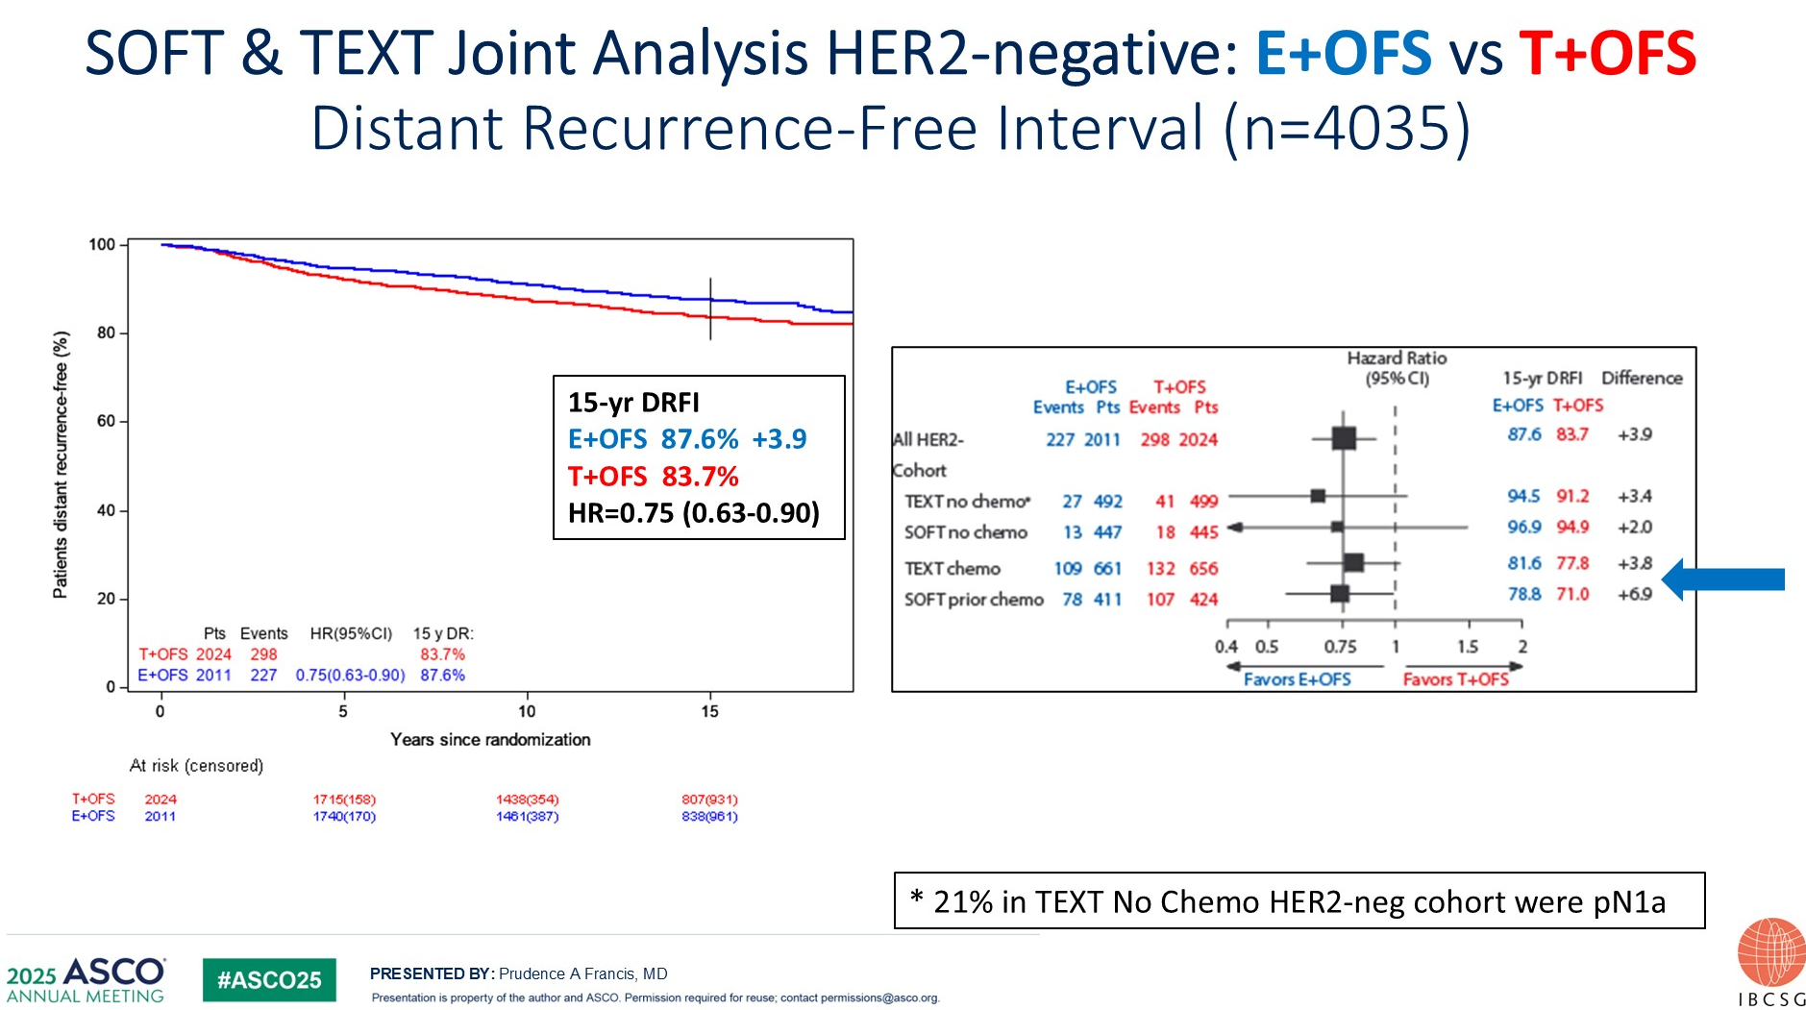
15 Year Update of SOFT and TEXT

Slide 8
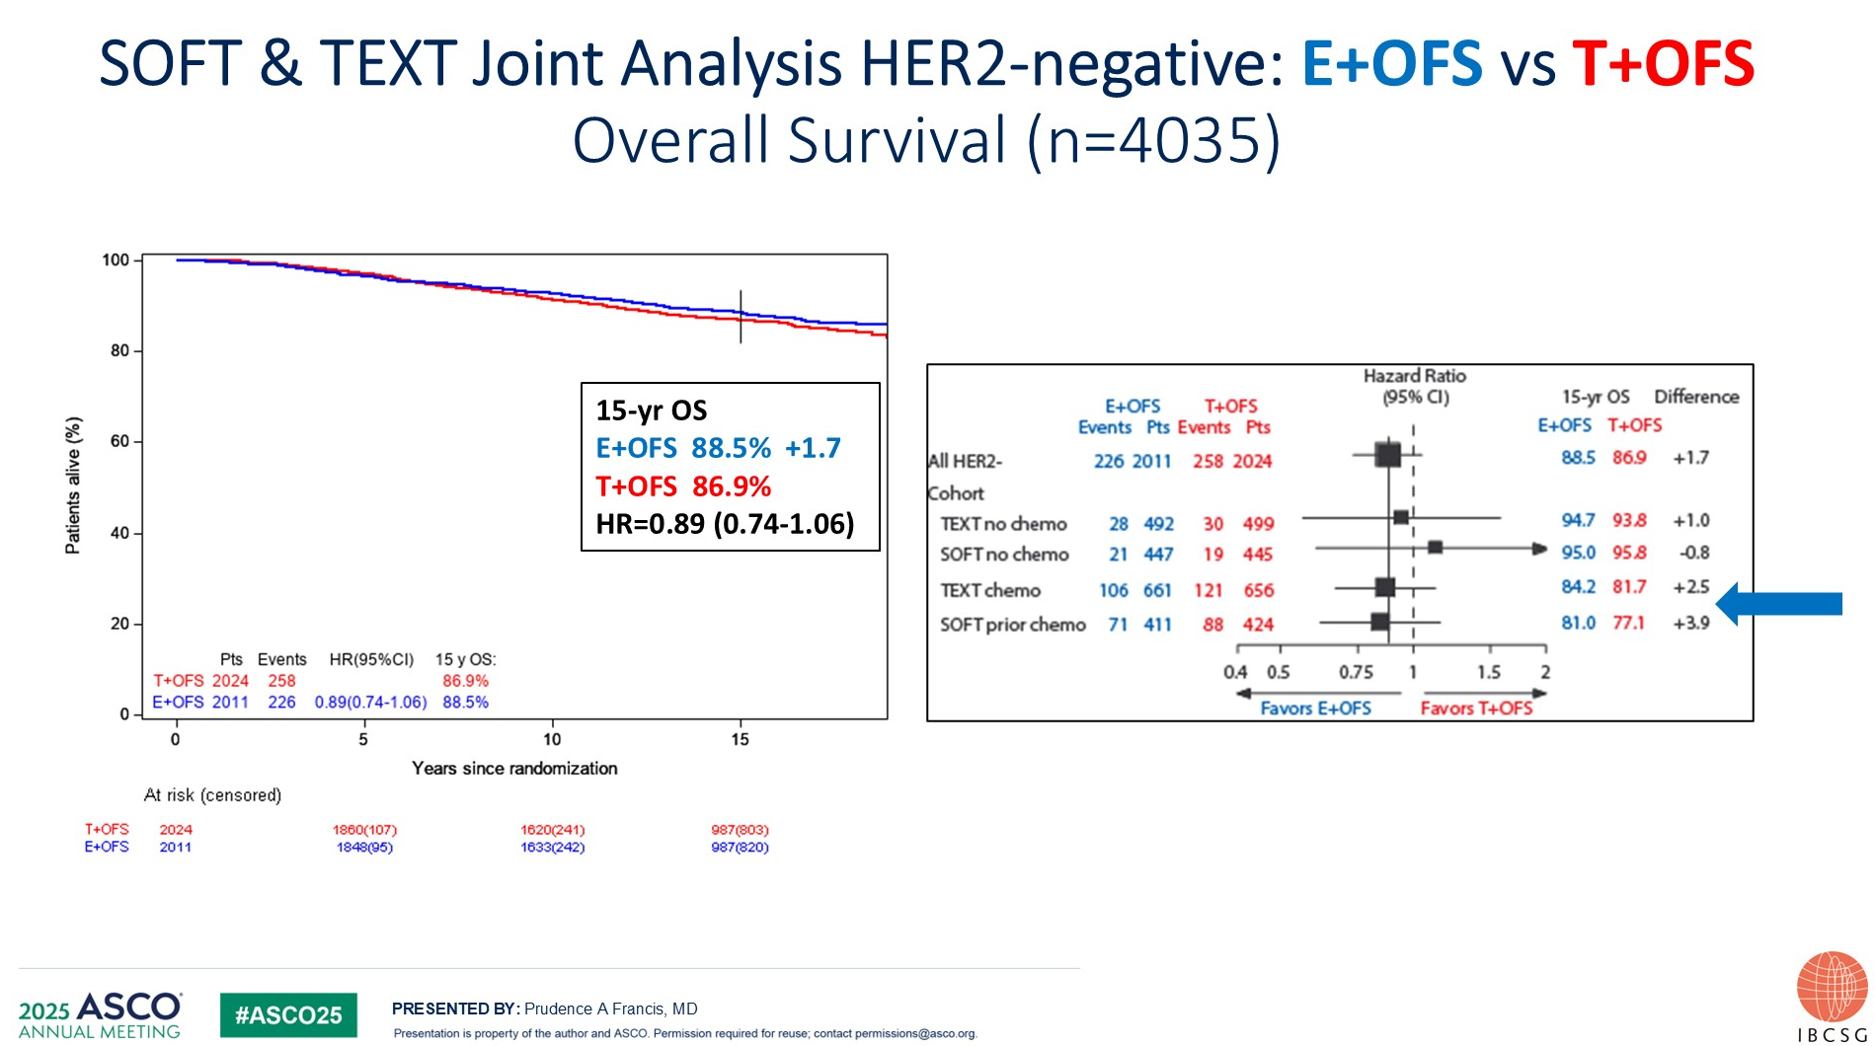
15 Year Update of SOFT and TEXT

Slide 9
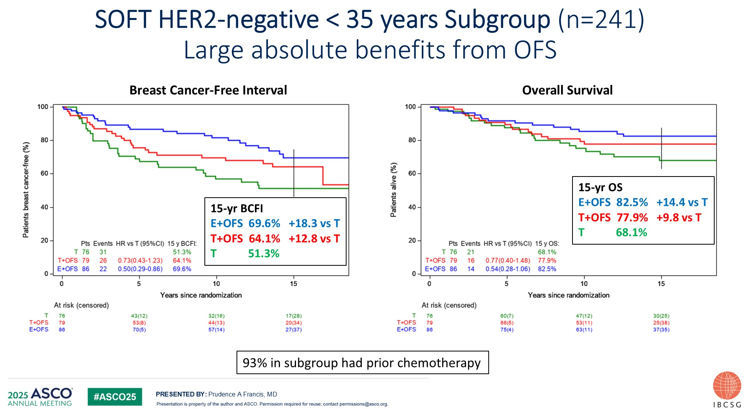
15 Year Update of SOFT and TEXT

Slide 10
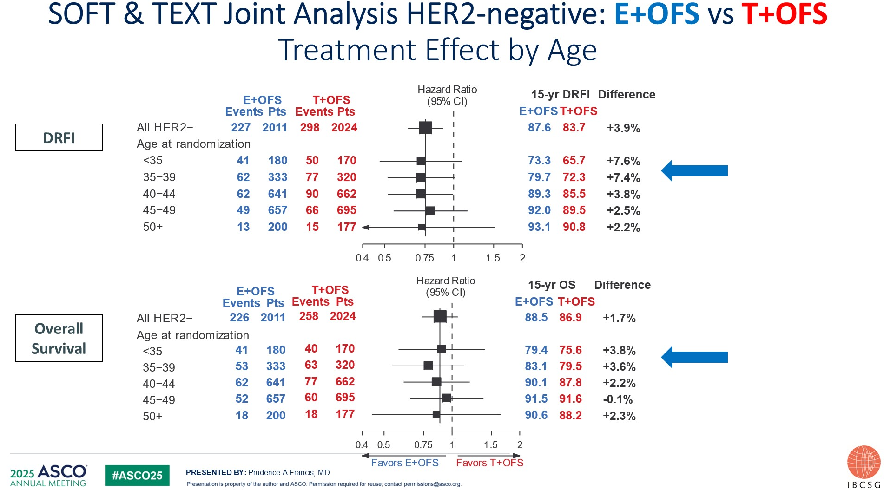
15 Year Update of SOFT and TEXT

Slide 11
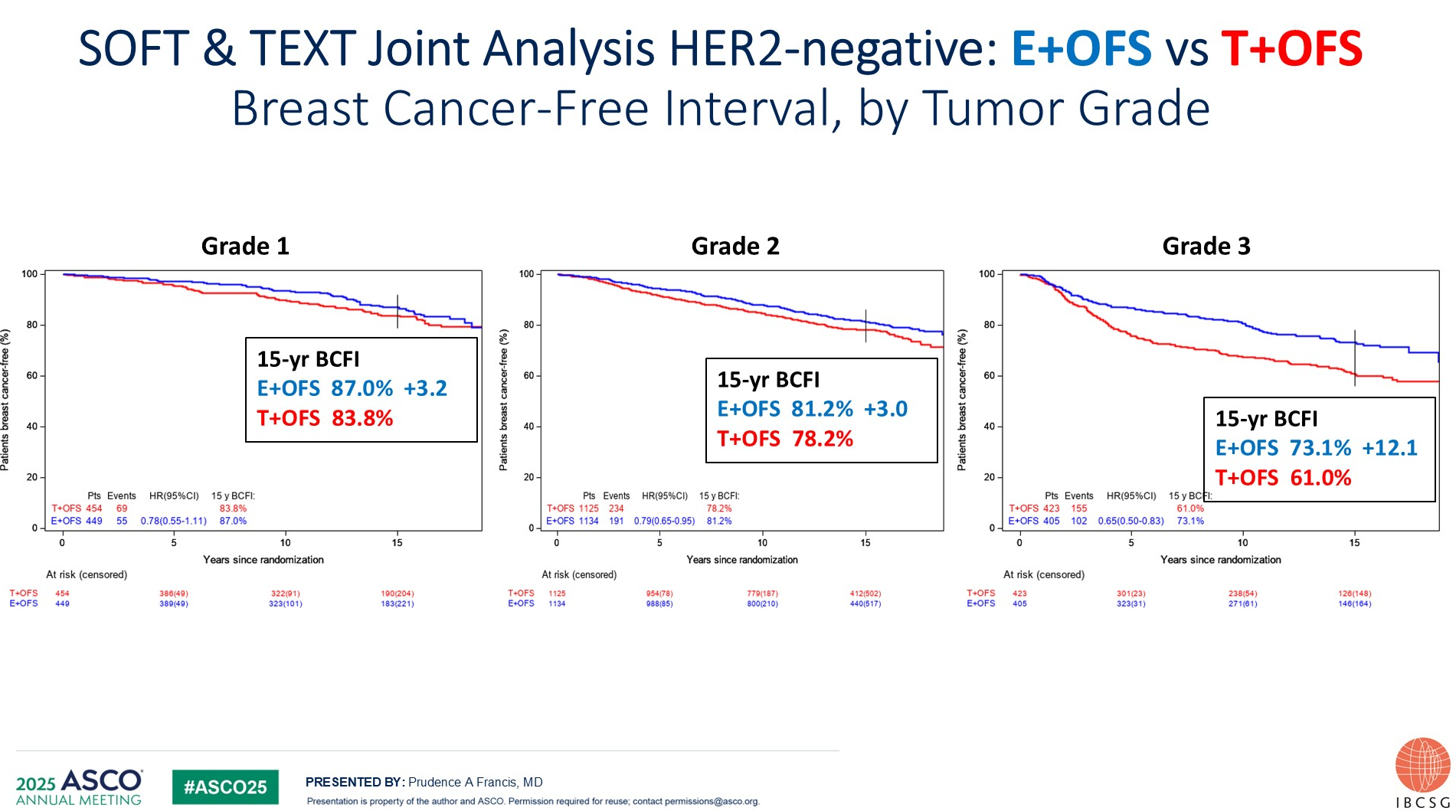
15 Year Update of SOFT and TEXT

Slide 12
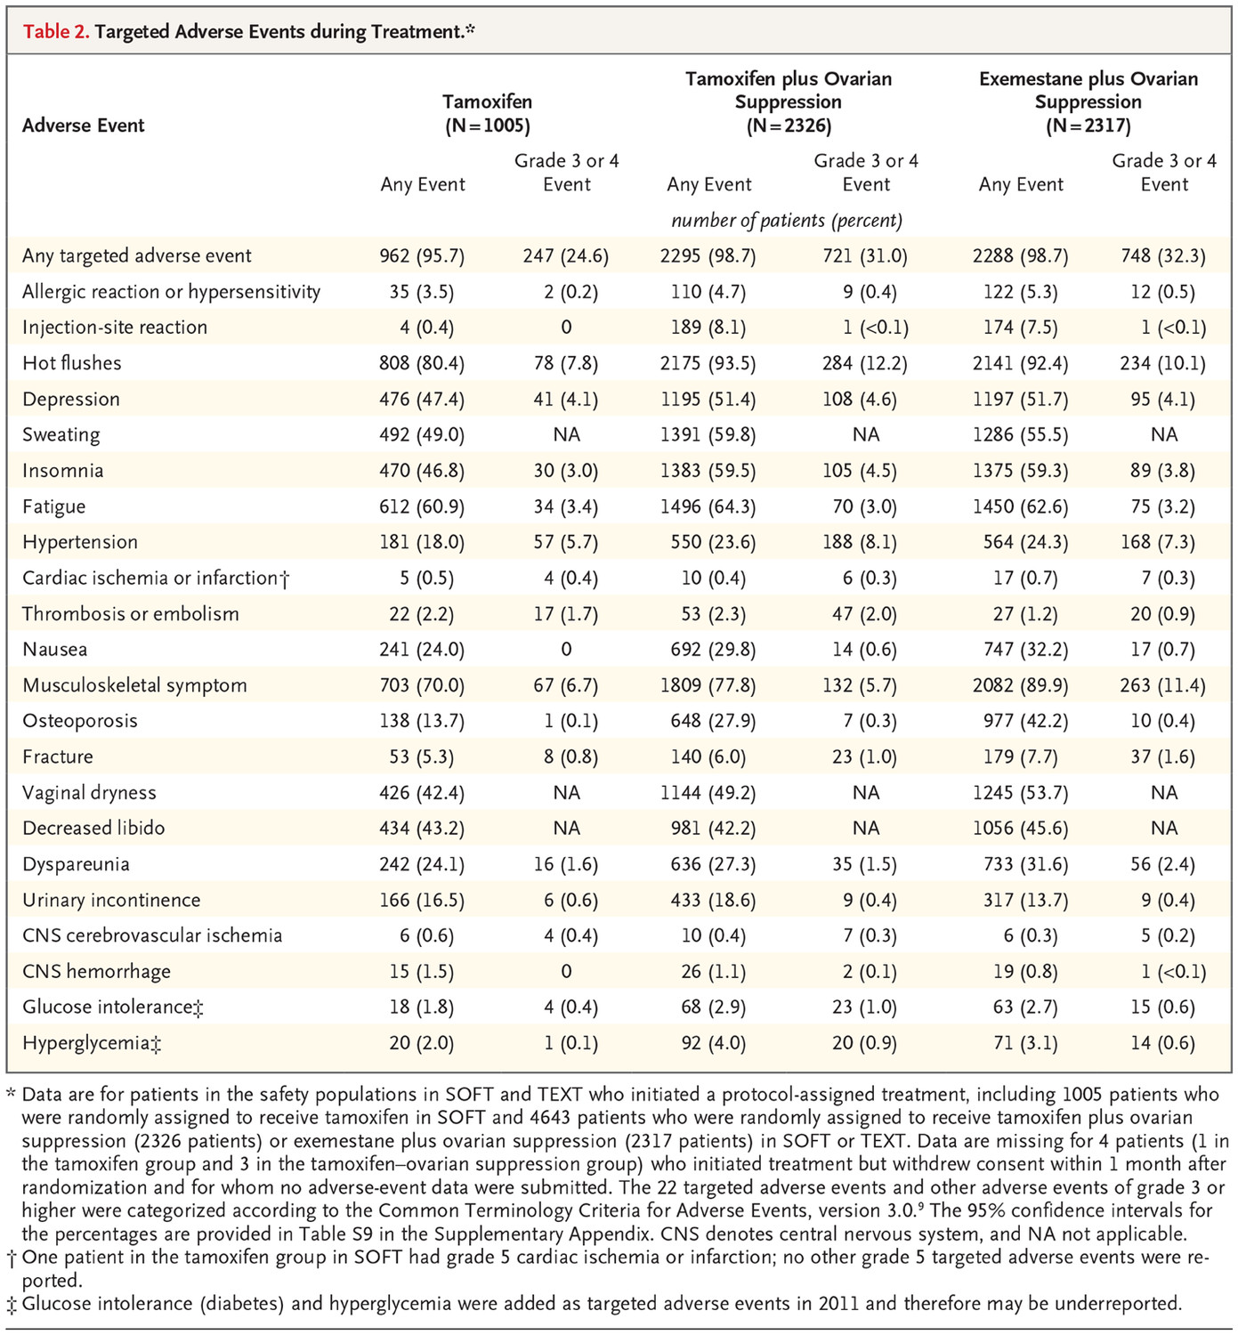
Targeted Adverse Events during Treatment
Francis PA et al. N Engl J Med. 2018;379(2):122-137.

Slide 13
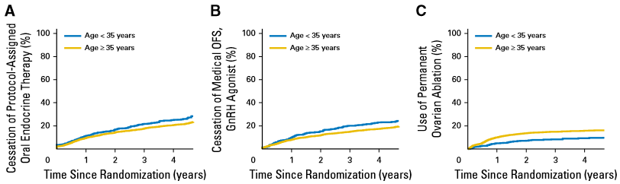
Adherence to Protocol Therapy in SOFT/TEXT
19.8% pts under 35 stopped all endocrine therapy prior to 5 years
No greater toxicity symptom burden in women < 35 compared with > 35
Hot flashes, decreased libido and arousal were most significant in women < 35
Saha P et al. J Clin Oncol. 2017;35(27):3113-3122.

Slide 14
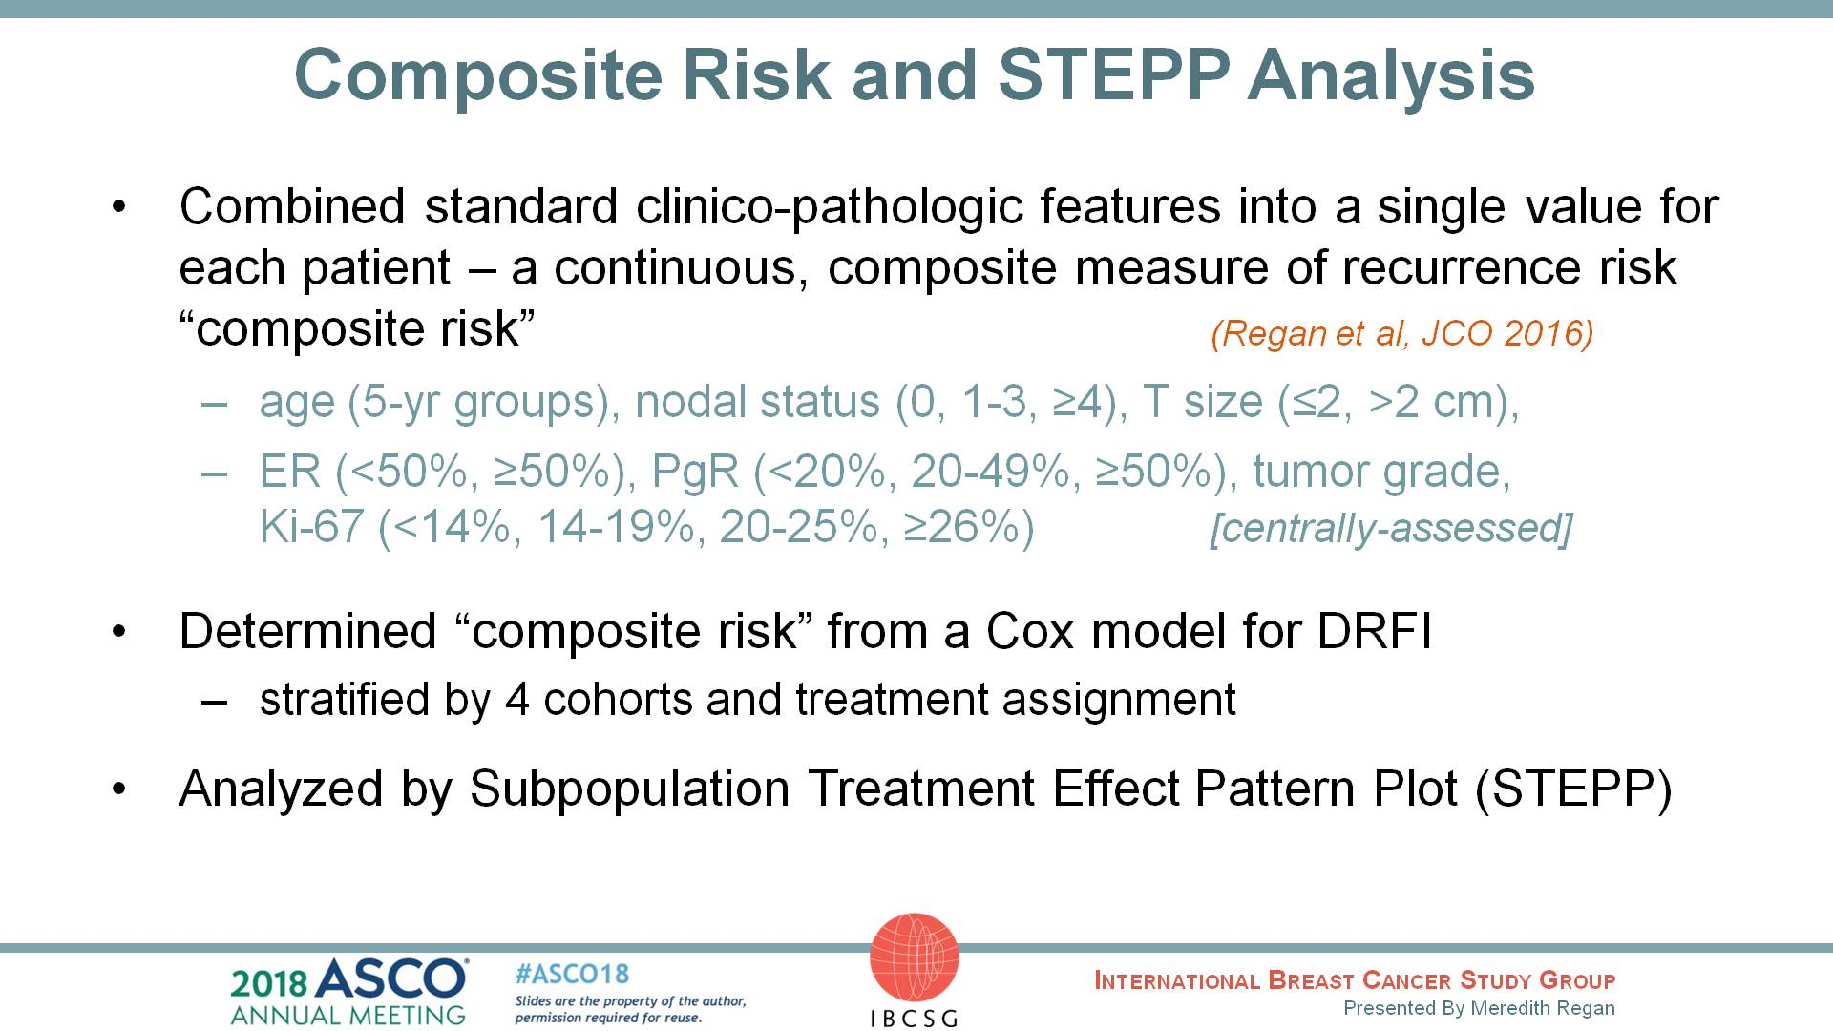
Composite Risk and STEPP Analysis
Regan et al. ASCO 2018. Abstract 503.

Slide 15
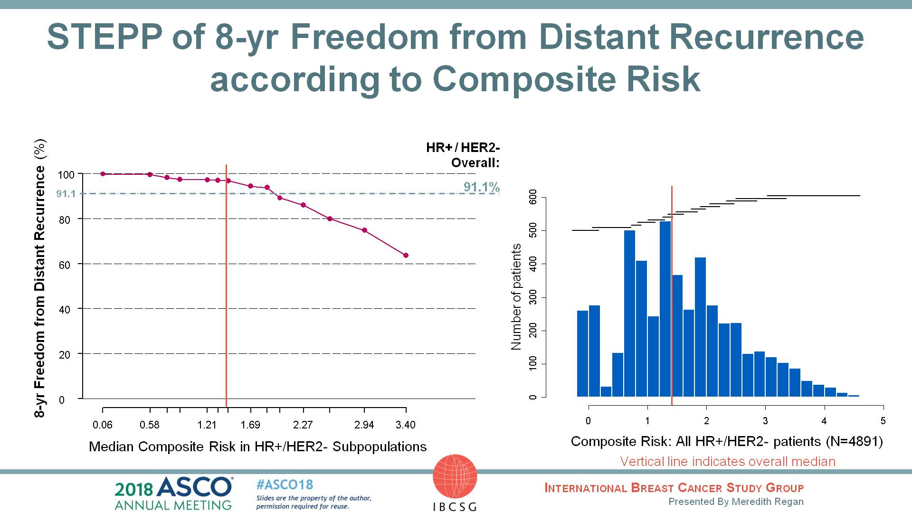
STEPP of 8-yr Freedom from Distant Recurrence according to Composite Risk
Regan et al. ASCO 2018. Abstract 503.

Slide 16
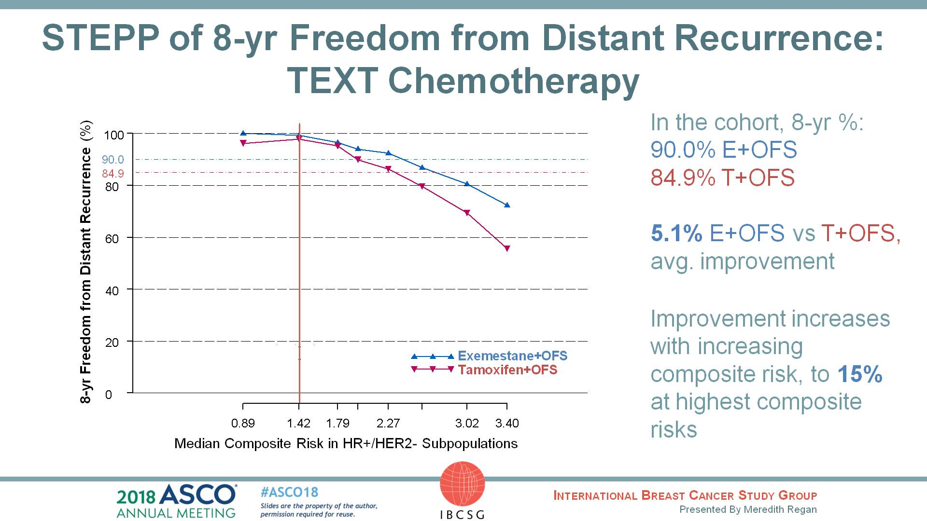
Slide 14
Composite Risk Application
https://rconnect.dfci.harvard.edu/CompositeRiskSTEPP/
8-year freedom from distant recurrence across composite risks in the 4 cohorts defined by trial and chemotherapy decision
Regan et al. ASCO 2018. Abstract 503.

Slide 17
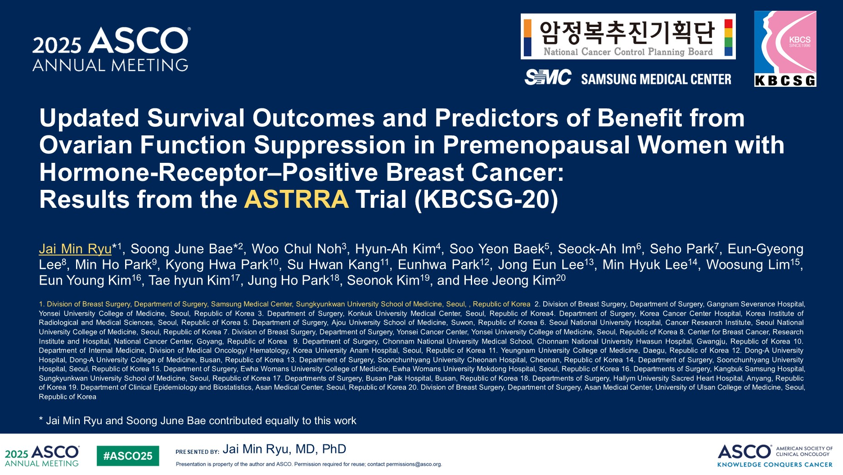
ASTRRA Trial

Slide 18
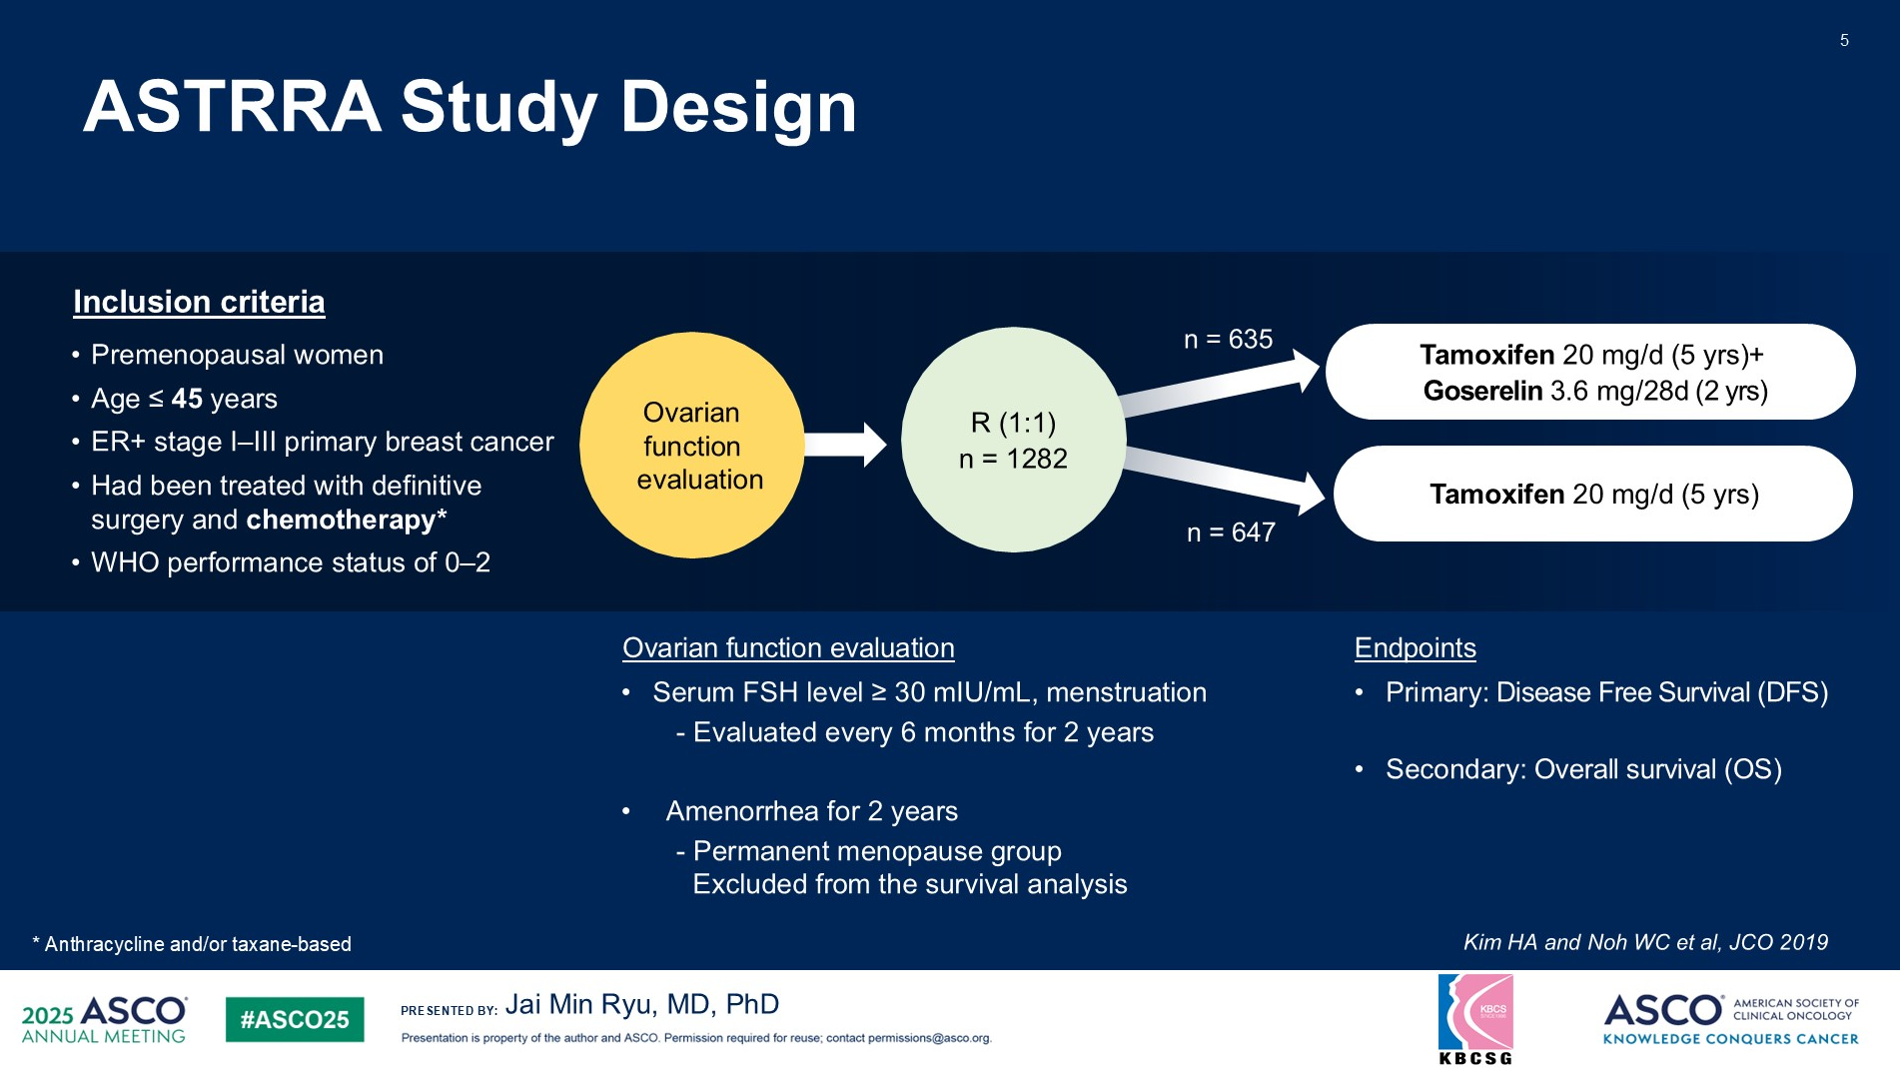
Content of this presentation is the property of the author, licensed by ASCO. Permission required for reuse.

Slide 19
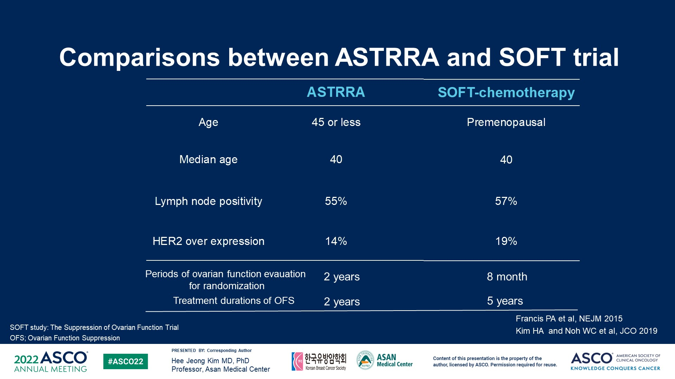
Comparisons between ASTRRA and SOFT trial
Content of this presentation is the property of the author, licensed by ASCO. Permission required for reuse.

Slide 20
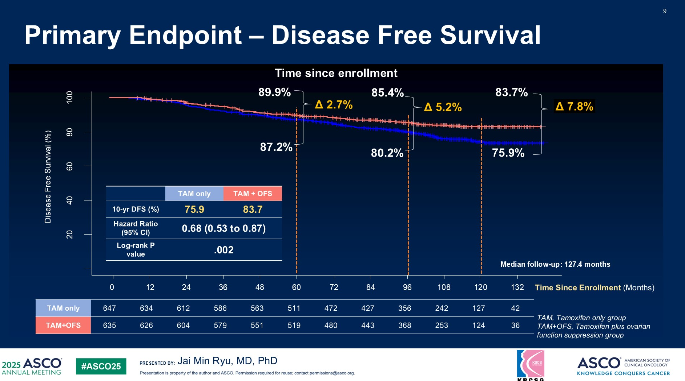
Content of this presentation is the property of the author, licensed by ASCO. Permission required for reuse.

Slide 21
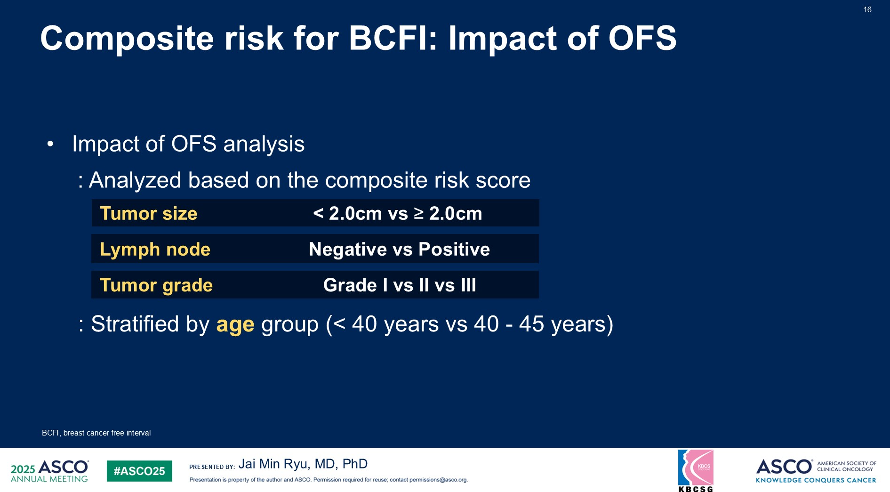
Content of this presentation is the property of the author, licensed by ASCO. Permission required for reuse.

Slide 22
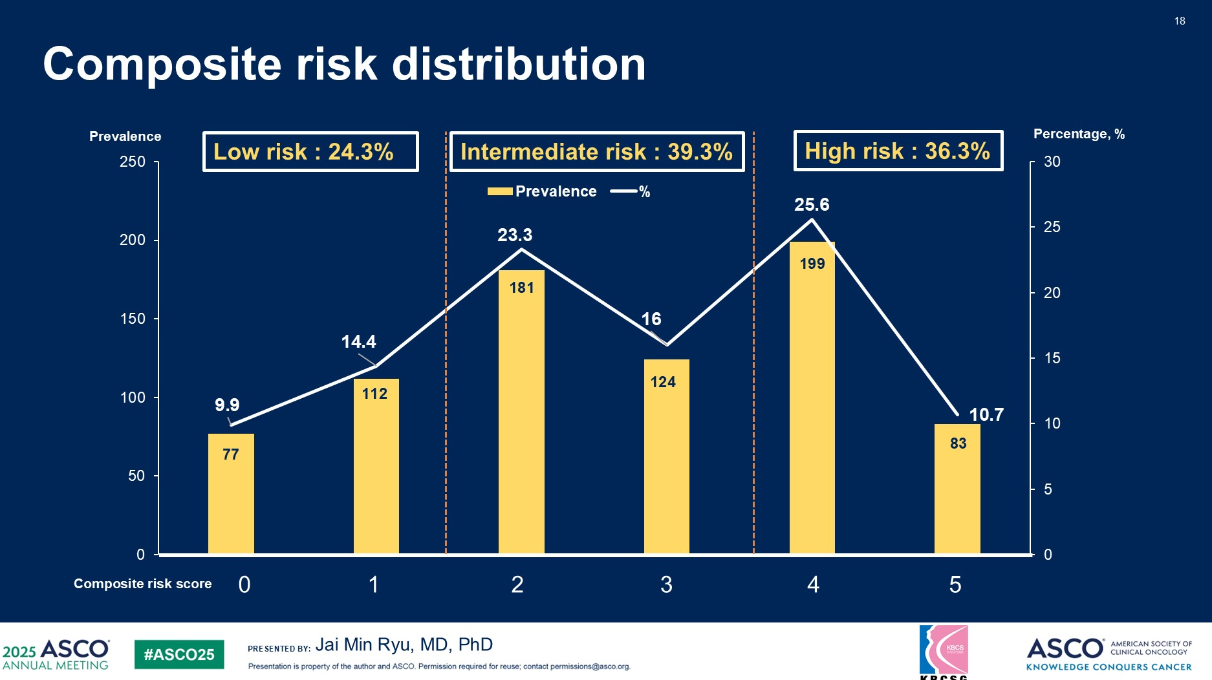
Content of this presentation is the property of the author, licensed by ASCO. Permission required for reuse.

Slide 23
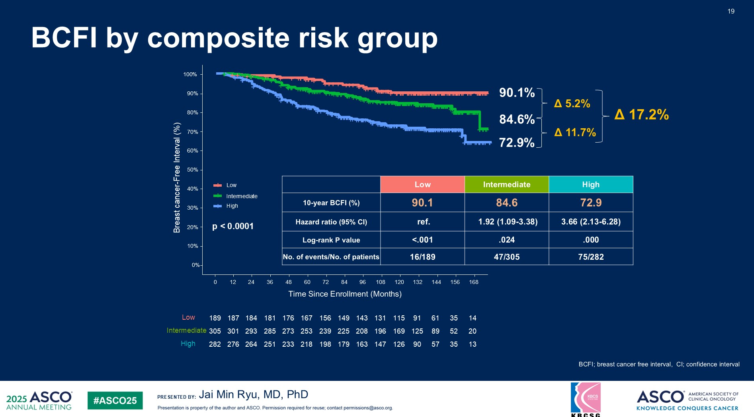
Content of this presentation is the property of the author, licensed by ASCO. Permission required for reuse.

Slide 24

Results - Exploratory Analysis: Impact of Age and Menopausal Status on Chemotherapy Benefit for RS 16-25
Age & Menopausal Status
Total #/#IDFS/DR
Events
IDFS
Hazard Ratio
DRFI
Hazard Ratio
Hazard ratio > 1 – chemo better
Chemo worse
Chemo better
Chemo worse
Chemo better
Sparano J et al. ASCO 2019 Abstract 503; and N Engl J Med. 2019;380(25):2395-2405.
Notes:
It is unclear with the chemo benefit noted in younger women with a RS 16-25 is due to a cytotoxic effect in eradicating micrometastatic disease, a castration effect in inducing early menopause, or both.
We therefore evaluated the association between age at diagnosis and chemo benefit
A hazard ratio of > 1 here indicates chemotherapy benefit
Here we see benefit for women 46-50 who were premenopausal but not postmenopausal, and a trend toward chemo benefit in women age 41-45, but no benefit in women 40 or under who are less likely to develop premature menopause from chemotherapy
(ADVANCE)
In addition, we saw no consistent effect favoring chemotherapy in older women.
Taken together, these findings suggest that the chemo benefit observed for the RS 16-25 group may in fact be due to a castration effect associated with cytotoxic therapy.

Slide 25
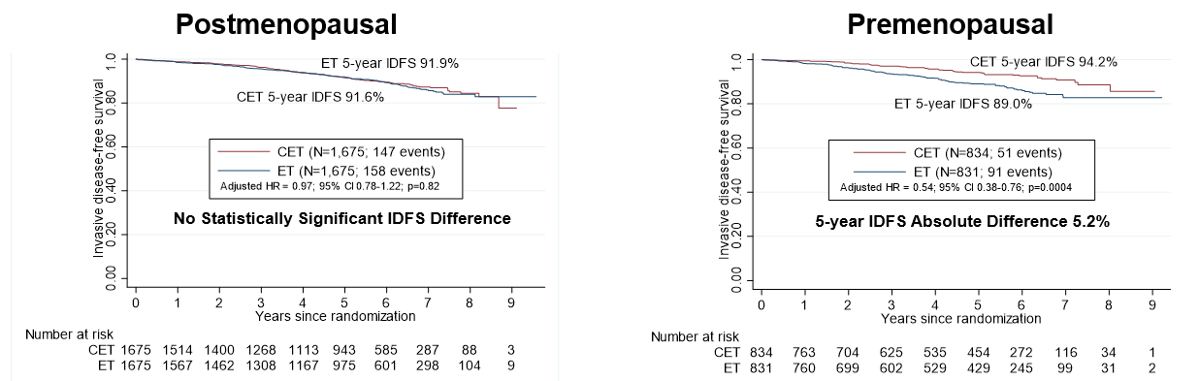
Chemotherapy benefit differed by menopausal status
“Premenopausal”
“Postmenopausal”
Last menstrual period < 6 mo*
Last menstrual period > 12 mo or BSO
*If LMP between 6-12 months and age < 50 years were classified as “premenopausal”
BSO = bilateral salpingo-oophorectomy
Kalinsky et al. N Engl J Med. 2021;385(25):2336-2347.
Kevin Kalinsky, MD, MS

Slide 26
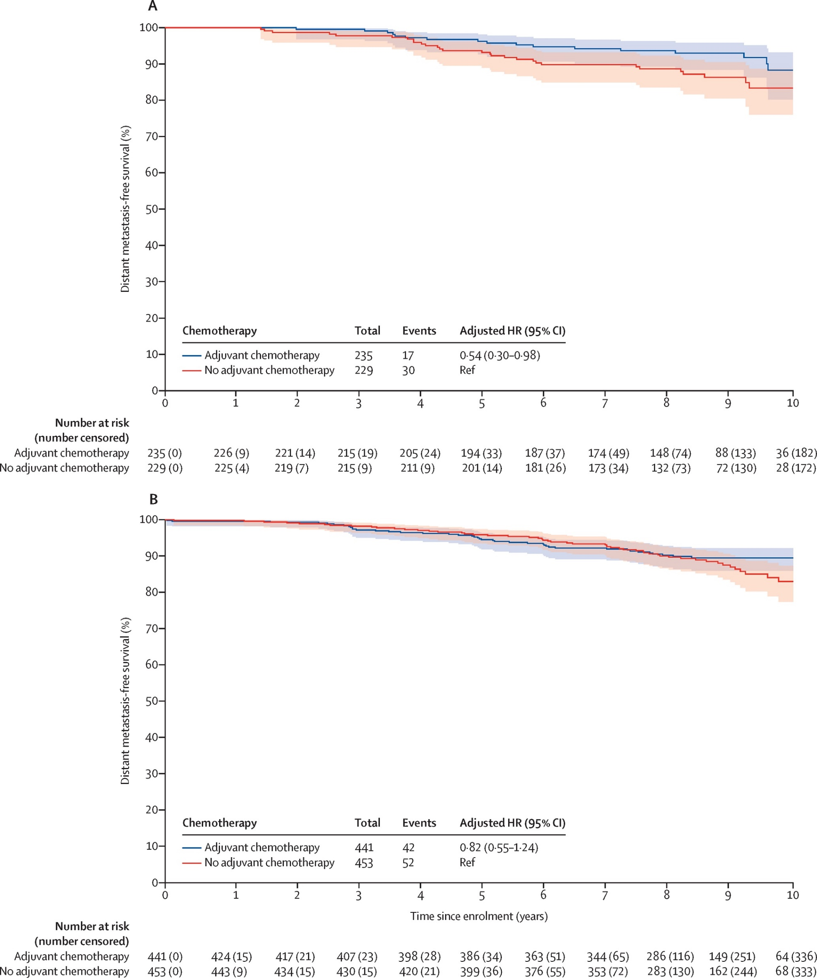
MINDACT: DMFS in ER+ HER2- with high clinical but low genomic risk
Age < 50
Age > 50
Piccart M, et al. Lancet Oncol. 2021;22:476-488.

Slide 27
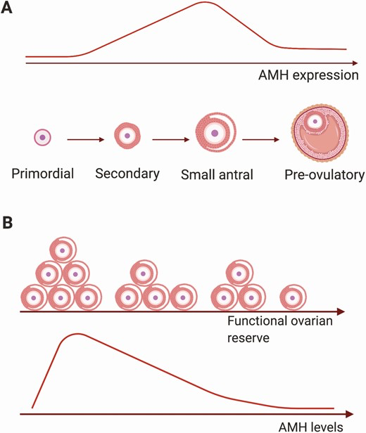
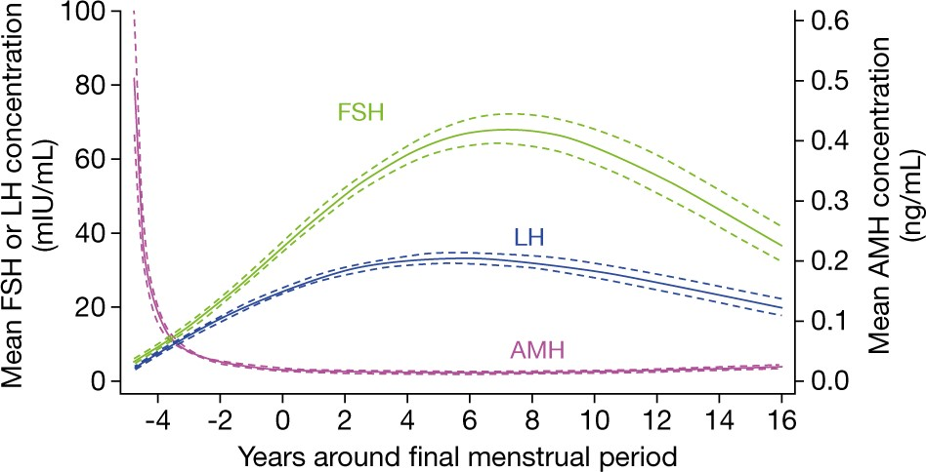
Low serum AMH and Inhibin B are markers of
diminished ovarian reserve
Functional Ovarian Reserve
Lower Anti-Mullerian hormone (AMH) reflects fewer growing follicles
  AMH is more stable and reliable during menstrual cycle than estradiol and FSH
  AMH decreases prior to final menstrual period (i.e., menopause) before FSH elevation
Inhibin B declines before menopause due to lower follicular number and function
Each slide:
  No more than 30-40 words per slide
  No more than 6 lines of text
  Include citations, where applicable
Serum AMH levels
Mean FSH or LH (ng/mL)
Mean AMH (ng/mL)
/Inhibin B
Years Around Final Menstrual Period
FSH = Follicular Stimulating Hormone
Bozza C et al Endo-Related Cancer 2014, Moolhuijsen L et al, J Clin Endo Metablism 2020, Wen J et al Front Endo 2021, Nelson P et al Human Reproduction Update 2023
Kevin Kalinsky, MD, MS
Notes:
Horone produced by

Slide 28
21% of “premenopausal” women < 55 years had serum AMH in postmenopausal range
Anti-Mullerian hormone
Category (AMH) | Menstrual Category (Final Menstrual Period) | picoAMH (pg/mL)
Low | At FMP or Later | < 10
Medium | < 5 years from FMP | 10-99.9
High | > 5 years from FMP | > 100
AMH (log10)
Category | Age < 45 | Age 45-49 | Age 50-54
Low AMH | 10/348 (2.9%) | 58/397 (14.6%) | 141/270 (52.2%)
Age in Years
Postmenopausal: < 10 pg/mL (20.6%)
10 pg/ML = 0.01 ng/ML
picoAMH package insert (ELISA) 2023
Kevin Kalinsky, MD, MS
Notes:
unit

Slide 29
“Premenopausal” < 55 years with low AMH have no IDFS benefit with chemotherapy
Low AMH (n=209)
Medium/High AMH (n=806)
No Difference in 5 yr IDFS
7.8% improvement in 5 yr IDFS with chemo
Postmenopausal: < 10 pg/mL
Premenopausal: > 10 pg/mL
Significant interaction p=0.019, adjusting for RS
Kevin Kalinsky, MD, MS
Notes:
Medium, high
Low ovarian function (!)
conclusin

Slide 30
“Premenopausal” < 55 years with low AMH have no DRFS benefit with chemotherapy
Low AMH (n=209)
Medium/High AMH (n=806)
No Difference in 5 yr DRFS
4.4% improvement in 5 yr DRFS with chemo
Postmenopausal: < 10 pg/mL
Premenopausal: > 10 pg/mL
Significant interaction p=0.012, adjusting for RS
Kevin Kalinsky, MD, MS

Slide 31
OFS Treatment in Gene Expression Profile-driven Adjuvant Chemotherapy Trials
Trial | % of patients premenopausal | % premenopausal patients on ET receiving ovarian suppression
TAILORx | 30% | 13%
RxPonder | 30% | 15%
MINDACT C-high, G-low | 34% | 16%

Slide 32
PAM50 ROR categories and prognosis: very young vs young
Very young, <40yrs n=301 (28%)
Young, >40yrs n=765 (72%)
HR (95% CI)
Int vs low 1.3 (0.4, 4.1)
High vs low 3.2 (1.1, 9.3)
HR (95% CI)
Int vs low 1.4 (0.6, 3.1)
High vs low 2.2 (0.98, 5.0)
 | Patients | Events | 10-yr DRFI (95% CI)
Low | 60 (20%) | 5 | 94.1 (87.9, -)
Int | 68 (20%) | 7 | 88.7 (81.1, 97.0)
High | 173 (57%) | 50 | 69.1 (62.1, 76.8)
 | Patients | Events | 10-yr DRFI (95% CI)
Low | 377 (49%) | 11 | 96.6 (94.6, 98.6)
Int | 175 (23%) | 13 | 92.5 (88.5, 96.7)
High | 213 (28%) | 40 | 81.7 (76.5, 87.2)
LAUREN C. BROWN, LAURENC.BROWN@PETERMAC.ORG

Slide 33
PAM50 Intrinsic subtype distribution and prognosis by age
Luminal A,
<40yr vs >40yr
 | Patients | Events | 10-yr DRFI (95% CI)
<40 | 165 | 28 | 82.4 (76.5, 88.8)
>40 | 583 | 38 | 93.1 (91.0, 95.3)
Luminal B,
<40yr vs >40yr
 | Patients | Events | 10-yr DRFI (95% CI)
<40 | 118 | 29 | 74.2 (66.3, 83.0)
>40 | 167 | 26 | 84.6 (79.2, 90.5)
* p= 0.005
LAUREN C. BROWN, LAURENC.BROWN@PETERMAC.ORG

Slide 34
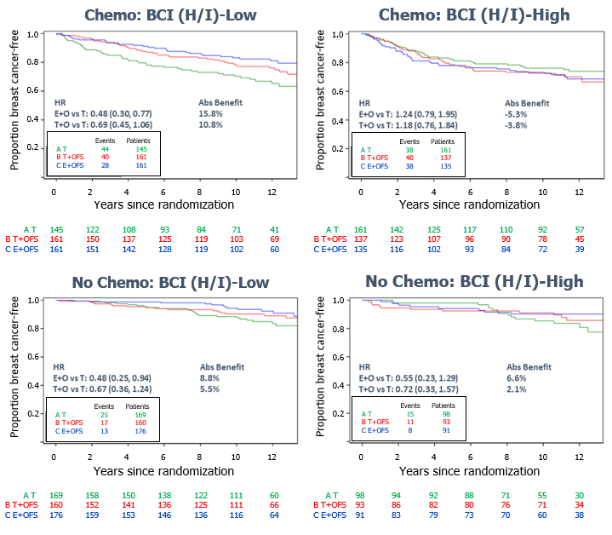
BCI (H/I) Predictive Results for BCFI –
Prior Chemo or No Chemo
San Antonio Breast Cancer Symposium®, December 6-10, 2022
HR
E+O vs T: 0.48 (0.30, 0.77)
T+O vs T: 0.69 (0.45, 1.06)
12y Abs Benefit
15.8%
10.8%
HR
E+O vs T: 1.24 (0.79, 1.95)
T+O vs T: 1.18 (0.76, 1.84)
12y Abs Benefit
-5.3%
-3.8%
HR
E+O vs T: 0.48 (0.25, 0.94)
T+O vs T: 0.67 (0.36, 1.24)
12y Abs Benefit
8.8%
5.5%
HR
E+O vs T: 0.55 (0.23, 1.29)
T+O vs T: 0.72 (0.33, 1.57)
12y Abs Benefit
6.6%
2.1%
This presentation is the intellectual property of the author/presenter. Contact them at Ruth_oregan@urmc.rochester.edu for permission to reprint and/or distribute.
Notes:
Pattern again consistent whether patients were premenopausal after chemotherapy; or had not received chemotherapy,
BCI (H/I)-Low group derived an absolute benefit at 12 years from EXE+OFS vs TAM
15.8% for chemo-treated
8.8% for no chemo
BCI (H/I)-Low group derived an absolute benefit at 12 years from TAM+OFS vs TAM
10.8% for chemo-treated
5.5% for no chemo

Slide 35
Incomplete Estrogen Suppression with Gonadotropin-Releasing Hormone Agonists may Reduce Clinical Efficacy in
Premenopausal Women with Early Breast Cancer
Incomplete suppression of ovarian estrogen synthesis with GnRHa can occur with recovery of FSH levels
May reduce impact of added aromatase inhibition in some pts
Particular attention in overweight/obese patients.
Monitoring estradiol levels cannot be recommended because our understanding is incomplete and sufficiently sensitive estradiol assays are not widely available.
Dowsett et al. J Clin Oncol. 2016;34(14):1580-3.

Slide 36
ASCO Guidelines Adjuvant Ovarian Suppression
Early Breast Cancer
High risk pts who have chemotherapy should receive OS
Pts with stage I breast cancers that do not warrant chemotherapy should not receive OS
Tamoxifen or an AI acceptable with OS
5 years of OS recommended
OS + AI > OS + Tam in high-risk women
CAUTION with OS + AI in younger or overweight/obese pts
(BSO + AI may be more effective?)
Burstein H, et al. J Clin Oncol. 2016;34(14):1689-701.

Slide 37
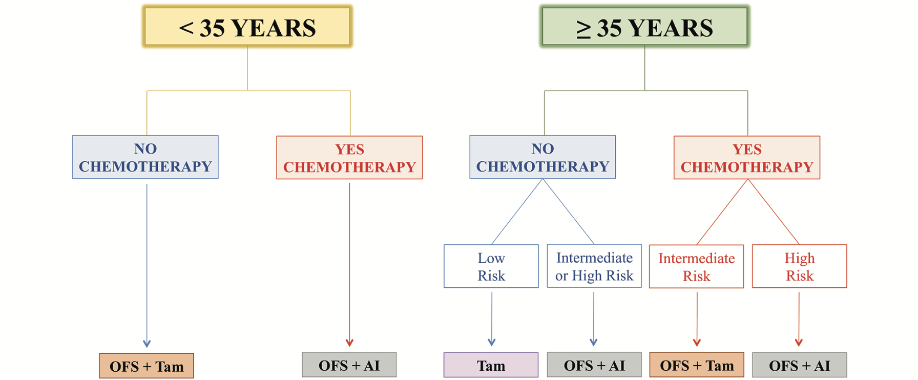
Premenopausal Adjuvant Endocrine Therapy
Lambertini M et al. ESMO Open, 2018.

Slide 38
Duration of adjuvant endocrine therapy for premenopausal patients

Slide 39
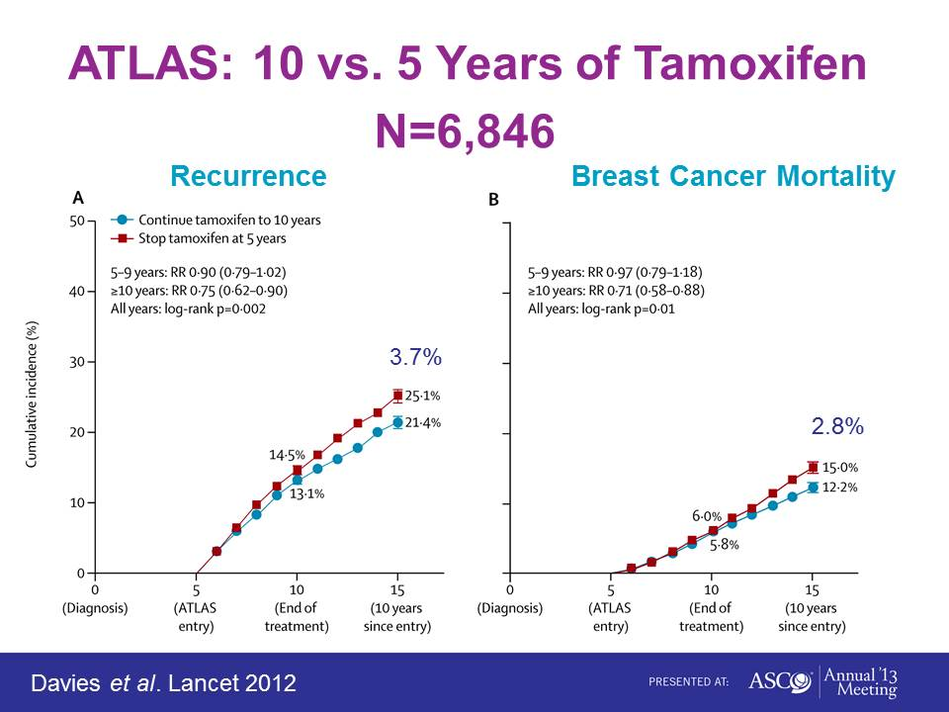
ATLAS: 10 vs. 5 Years of Tamoxifen
N=6,846
ATLAS: 19% < 45 years of age

Slide 40
ASCO Guideline Recommendations
Women who are pre- or perimenopausal
Options:
IA. Tamoxifen (+/- OS) for an initial duration of 5 years.
IB. After 5 years, women should receive additional therapy based on menopausal status.
IB1. If women are pre- or perimenopausal, or if menopausal status is unknown or cannot be determined, they should be offered continued tamoxifen for a total duration of 10 years. (Type: Evidence-Based, Evidence Quality: High, Strength of Recommendation: Strong)
Burstein H, et al. J Clin Oncol. 2014;32(21):2255-69.
Burstein H, et al. J Clin Oncol. 2016;34(14):1689-701.

Slide 41
ASCO Guideline Recommendations
pre- or perimenopausal, continued
IB2. If women have become definitively postmenopausal, they should be offered continued tamoxifen for a total duration of 10 years or switching to up to 5 years of an aromatase inhibitor (AI) for a total duration of up to 10 years of adjuvant endocrine therapy. (Type: Evidence-Based, Evidence Quality for tamoxifen: High, Evidence Quality for AI: High; Strength of Recommendation: Strong)
Burstein H, et al. J Clin Oncol. 2014;32(21):2255-69.
Burstein H, et al. J Clin Oncol. 2016;34(14):1689-701.

Slide 42
Endocrine Therapy for Premenopausal HR+ EBC Patients: Summary
Optimizing endocrine therapy of utmost importance in HR+ premenopausal EBC pts
Premen pts > 35 with HR+ node negative, RS < 11: Tamoxifen alone
Premen ER+ pts have improved DFS and DDFS with OFS + AI > OFS + tamoxifen > tamoxifen and improved OS with OFS + tamoxifen (longer f/u needed for OS in SOFT/TEXT)
OFS plus AI for premen high risk pts – high Ki-67, low PR, higher grade or under age 35 (overwt/obese?)
10 years of tamoxifen in pre- or perimen pts OR AI following tamoxifen in postmen pts (N- and N+)
Incomplete OFS + AI concerning – worse OS? CAUTION

