Slide 1


Clinical Utility of Molecular Diagnostics in Breast Cancer
Joyce O’Shaughnessy, MD
Celebrating Women Chair in Breast Cancer Research
Baylor University Medical Center
Texas Oncology
US Oncology
Disclaimer: This presentation is intended for personal use and for informational purposes only and does not replace independent professional judgment. This presentation is the property of Physicians’ Education Resource, LLC (“PER”) and is protected by U.S. and international copyright laws. You may not copy, reproduce, distribute, transmit, modify, or create derivative works of the presentation without the prior written permission from PER.

Slide 2
Actionable mutation detection and therapeutic target identification in metastatic breast cancer
ESR1 mutation (40%): Elacestrant
PIK3CA mutation (15%-35%): Alpelisib, Inavolisib
gBRCA mutation (5%-8%): Olaparib, Talazoparib
NTRK-ETV6 (<1%): Larotrectinib
High TMB (6%-8%): Pembrolizumab
MSI high (1%-2%): Pembrolizumab/Dostarlimab
RET fusion: Selpercatinib
BRAF mutation Dabrafenib + trametinib
HER2 mutation (3%-10%): Neratinib
AKT mutation: Capivasertib
PTEN genomic loss: Capivasertib
PIK3CA mutation: Capivasertib
Somatic BRCA mutation (3%-8%): Olaparib
gPALB mutation (1%-2%): Olaparib
PDL-1 copy number gain (5%): Durvalumab

Slide 3
PIK3CA and RB1 mutations are enriched at EOT
6% pts with PIK3CA mutation at progression on fulvestrant +/- palbociclib, not present at baseline
Palbociclib + fulvestrant
Placebo + fulvestrant
% at EOT
P+F
F
P = .00018
P = .041
Acquired
Acquired polyclonal
Maintained
Maintained polyclonal
Mixed
P values from McNemar’s test, mutations increased in frequency at EOT.
O’Leary B et al. Cancer Discov. 2018;8(11):1390-1403.

Slide 4
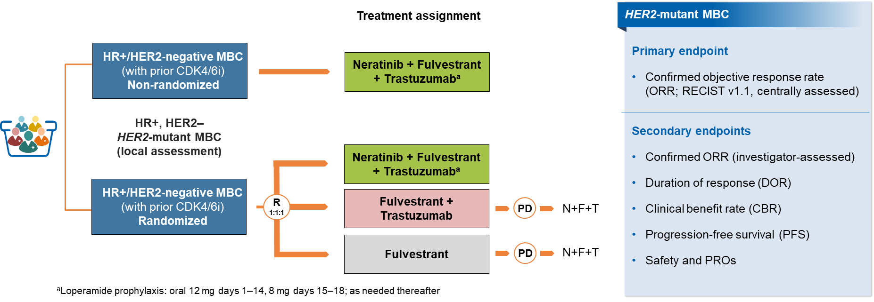
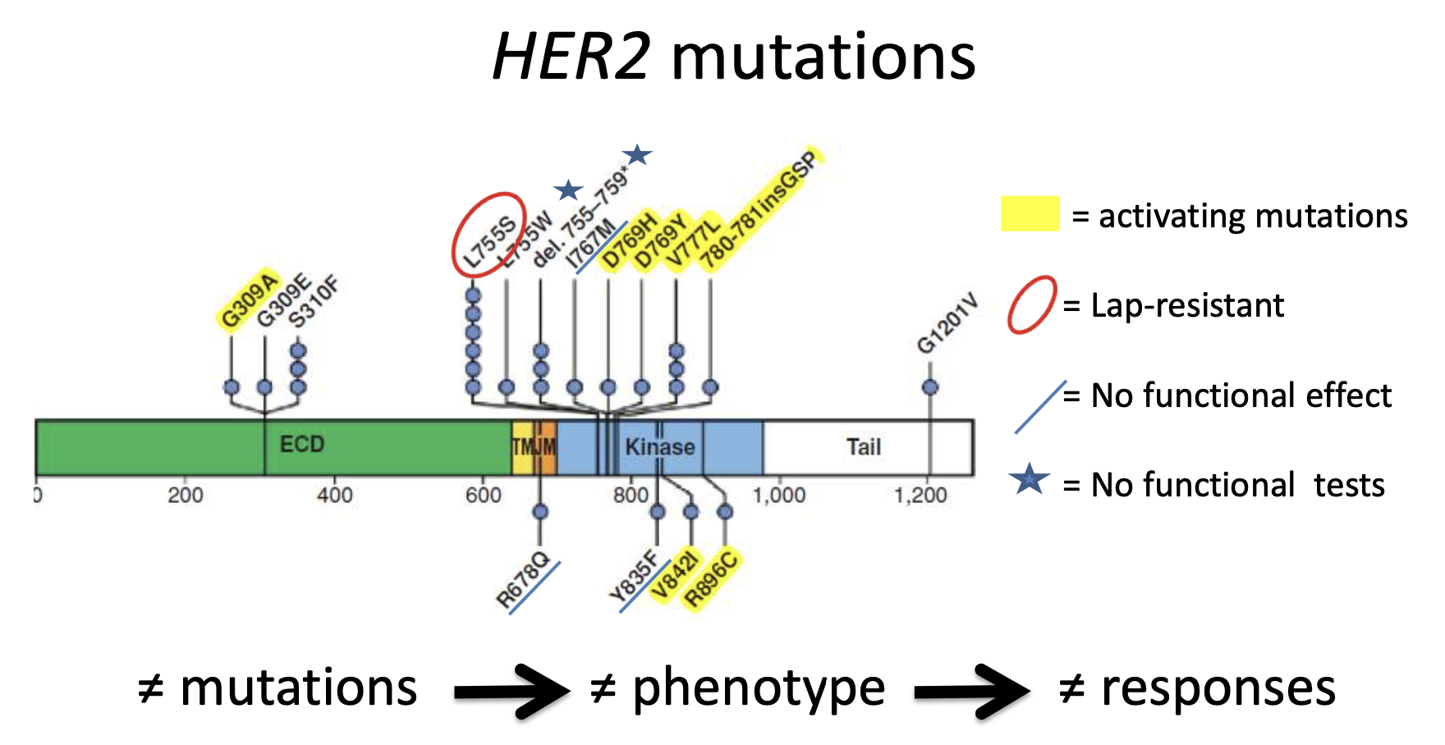
HER2 Mutation: Combinations Needed for Improved Efficacy and Durability
SUMMIT (NCT01953926): ER+ HER2- ERBB2 mut Cohort
HER2 mutation: 8% ER+ MBC
15%: met ILC
Treatment Regimen | ORR | PFS (months) | DOR (months)
Neratinib (n = 23) | 17% | 3.6 | 6.5
Neratinib + Fulvestrant (n = 47) | 30% | 5.4 | 9.2
Neratinib + Fulvestrant +Trastuzumab (n = 51) | 35.3% | 8.2 | 14.3
Addition of T to N prolongs suppression of HER3 phosphorylation in HR+, HER2-negative, HER2-mutant breast cancer cell line model
Jhaveri K et al. SABCS 2021. Abstract GS4-10. Jhaveri KL et al. ASCO 2022. Abstract 1028. Bose R et al. Cancer Discovery. 2013;3(20):224-237.

Slide 5
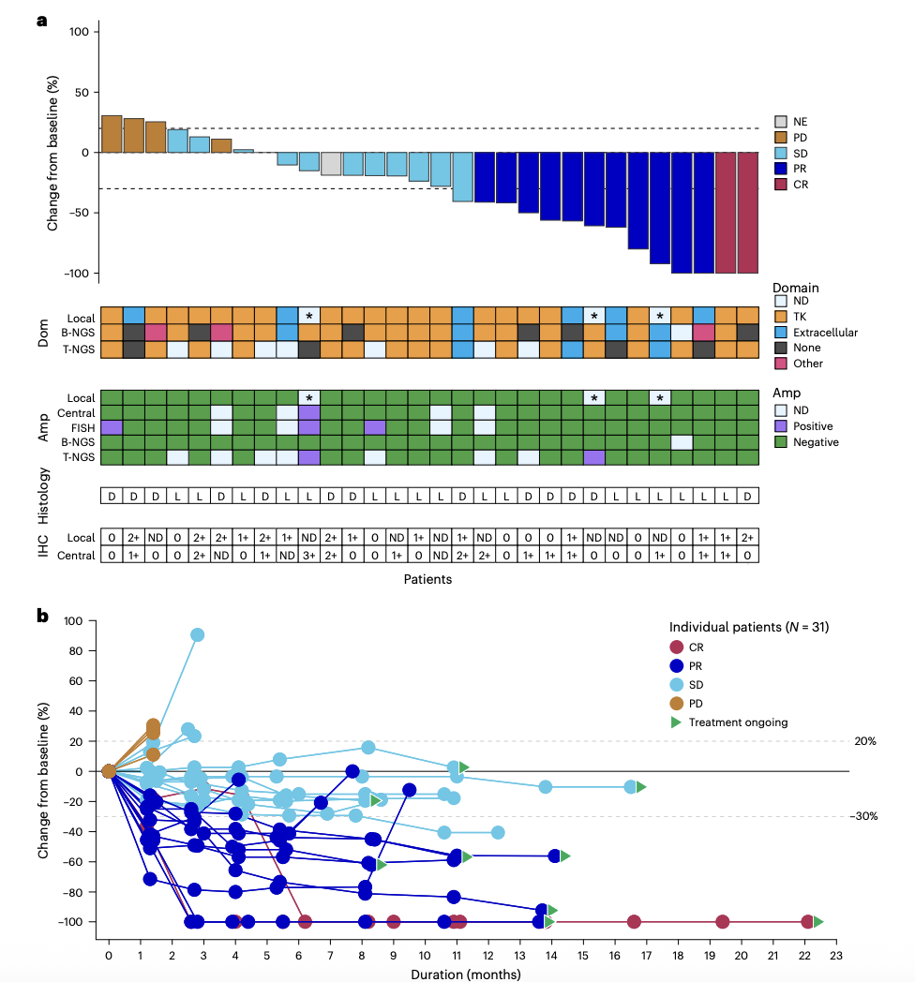
Tucatinib + Trastuzumab for HER2-mutant MBC
Durable responses to tucatinib, trastuzumab +/- fulvestrant for 31 heavily –pretreated HER2-mutant MBC
Okines AFC et al. Nature Med 2025;31(3):909-916.

Slide 6
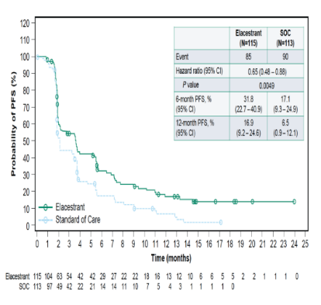
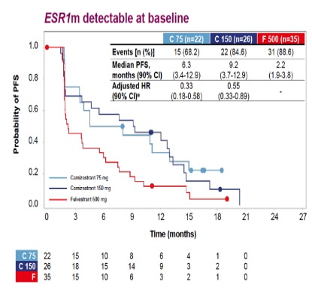
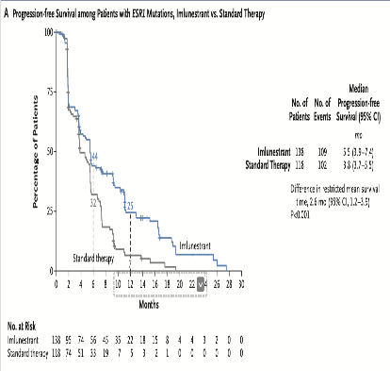
How Do Oral SERDs Perform in the ESR1m Cohorts?
EMERALD PFS^{[1,2]}
SERENA-2 PFS^{[3]}
EMBER-3 PFS^{[4]}
mPFS: 3.8 mo vs 1.9 mo
Hazard ratio 0.65
P = .0049
mPFS: 9.2 mo vs 2.0 mo
Hazard ratio 0.55
mPFS: 5.5 mo vs 3.8 mo
Hazard ratio NR
C 75, camizestrant 75 mg; C 150, camizestrant 150 mg; F, fulvestrant; NR, not reached; mPFS, median progression-free survival; SoC, standard of care.
1. Bardia A, et al. Cancer Res. 2023;83(suppl 5): Abstract GS3-01; 2. Bidard FC, et al. J Clin Oncol. 2022;40:3246-3256; 3. Oliveira M, et al. Lancet Oncol. 2024;25:1424-1439; 4. Jhaveri KL, et al; EMBER-3 Study Group. N Engl J Med. 2025;392:1189-1202.
Notes:
Oliveira M, Pominchuk D, Nowecki Z, et al. Camizestrant, a next-generation oral SERD, versus fulvestrant in post-menopausal women with oestrogen receptor-positive, HER2-negative advanced breast cancer (SERENA-2): a multi-dose, open-label, randomised, phase 2 trial. Lancet Oncol. 2024;25(11):1424-1439. doi:10.1016/S1470-2045(24)00387-5

Slide 7
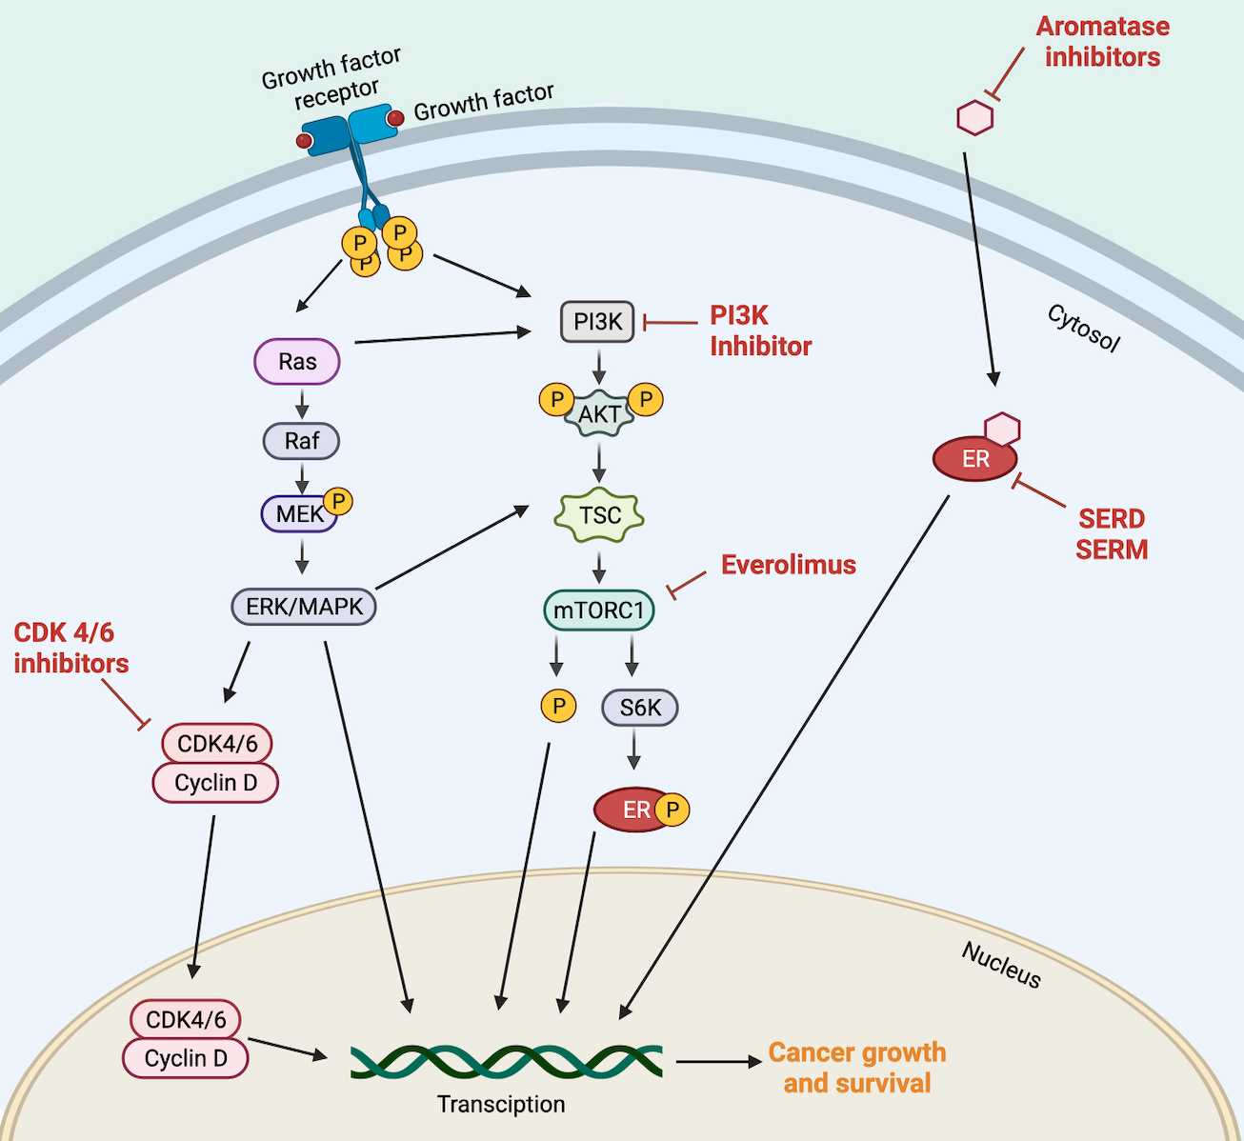
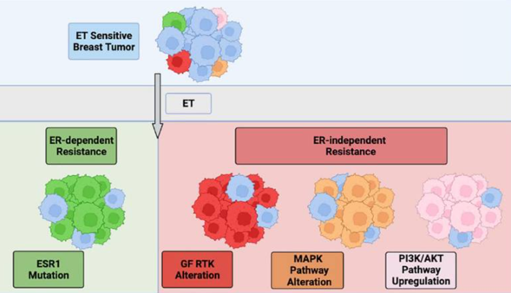

Resistance to ET + CDK4/6i: A High Unmet Clinical Need
ER dependent and independent mechanisms of resistance
AKT inhibitor
mTOR inhibitor
Alpelisib
Inavolisib
Capivasertib
Constitutive ER activity
Upregulated coactivator binding
Stability against proteolytic degradation
Growth factor-driver receptor tyrosine kinase
HER2
EGFR
FGFR
Alterations in MAPK
KRAS
BRAF
MAP2K1
NF1
Upregulation PIK3K/AKT
PIK3CA
AKT
Lloyd MR et al. Ther Adv Med Oncol. 2022;14:17588359221113694. Huppert LA et al. CA Cancer J Clin. 2023;73(5):480-515.
Notes:
Drivers of ET resistance can be broadly subdivided into two categories of (i) ER-dependent and (ii) ER-independent mechanisms. (a) Ligand binding domain Estrogen Receptor 1 (ESR1) mutations mediate ligand-independent ER signaling and promote ET resistance via constitutive ER activity, upregulated coactivator binding, and stability against proteolytic degradation; ER remains a viable therapeutic target in these tumors. ER-independent resistance may be mediated by several mechanisms including mutations or amplifications in growth factor-driven receptor tyrosine kinase (HER2, EGFR, and FGFR), alterations in MAPK pathway components including KRAS, BRAF, MAP2K1, and NF1, and upregulation in PI3K/AKT pathway signaling, though notably, PIK3CA and AKT mutations have not been shown to provoke resistance in the clinical setting. These alterations serve to upregulate mitogenic and survival signaling and promote cell cycle progression and drug resistance.

Slide 8
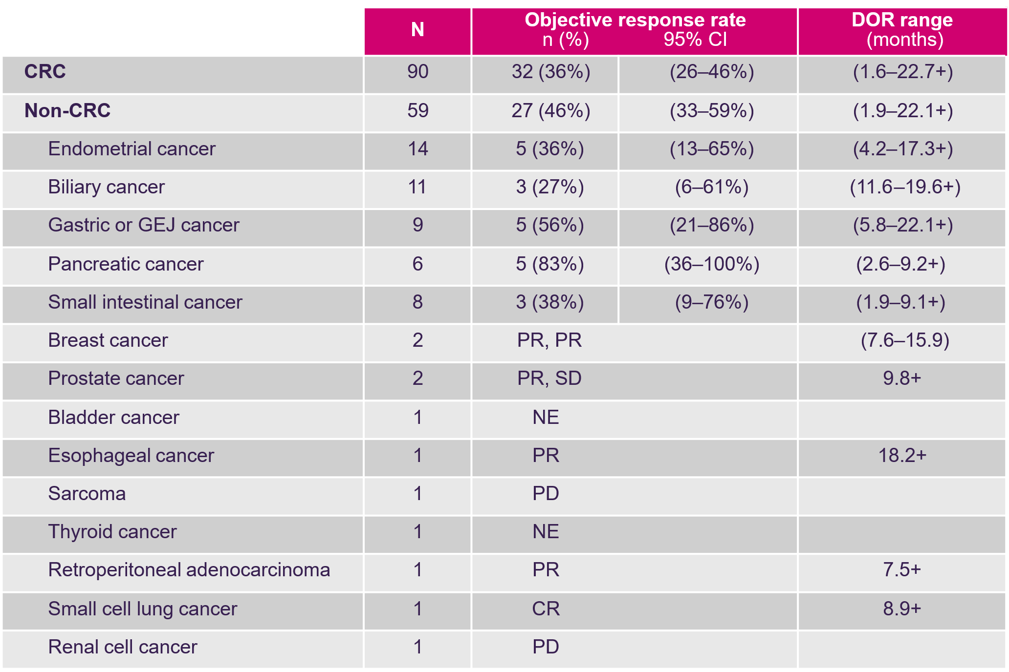
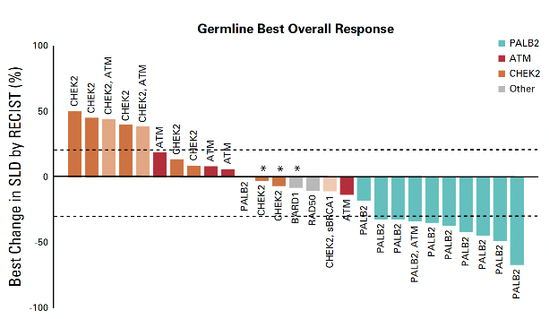
Molecular Phenotypes as Targets for Precision Therapy
gBRCA1, gBRCA2, gPALB2 and somatic BRCA1 & BRCA2
Tumour mutational burden (TMB)
Microsatellite-instability high (MSI-H)
RNA-based gene signatures: intrinsic subtype
Pembrolizumab in MSI-H solid tumours (N = 149)²
KEYNOTE-016 NCT01876511 (n = 58)
KEYNOTE-164 NCT02460198 (n = 61)
KEYNOTE-012 NCT01848834 (n = 6)
KEYNOTE-028 NCT02054806 (n = 5)
KEYNOTE-158 NCT02628067 (n = 19)
Olaparib in non-gBRCA1/2¹
* PD because of growth or appearance of new metastases.
ATM, serine/threonine kinase; BRCA1/2, breast cancer type1/type 2 gene; CHEK2, checkpoint kinase 2; CI, confidence interval; CR, complete response; CRC, colorectal cancer; DOR, duration of response; gBRCA1/2, germline BRCA1/2; GEJ, gastro-oesophageal junction; HRD, homologous recombination deficiency; NE, not evaluable; PALB2, partner and localiser of the BRCA2 gene; PD, progressive disease; PR, partial response; RECIST, Response Evaluation Criteria in Solid Tumours; RNA, ribonucleic acid; SD, stable disease; SLD, sum of longest diameters.
1. Tung NM et al. J Clin Oncol. 2020;38(36):4274-4282; 2. Pembrolizumab. Prescribing information. Merck Sharp & Dohme Corp; 2021.

Slide 9
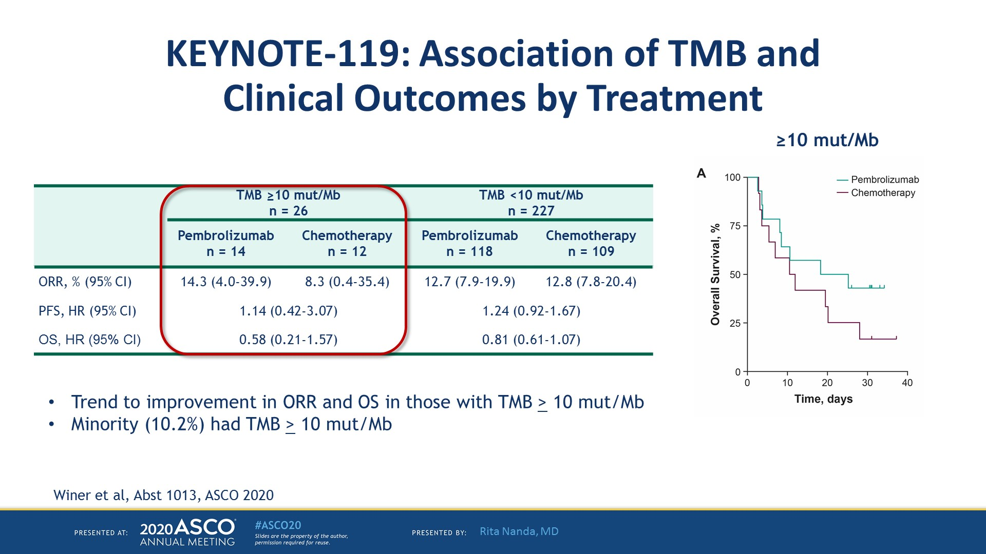
KEYNOTE-119: Association of TMB and
Clinical Outcomes by Treatment
Winer EP et al. Lancet Oncol. 2021;22(4):499-511.

Slide 10
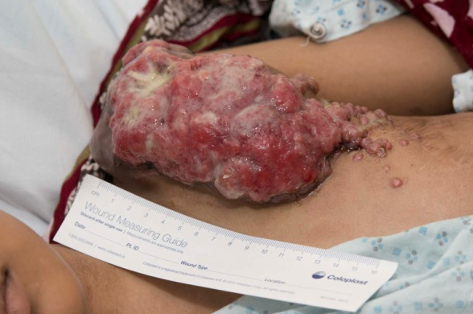
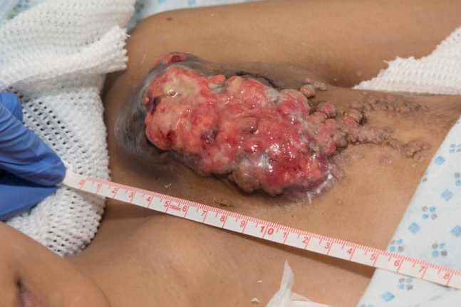
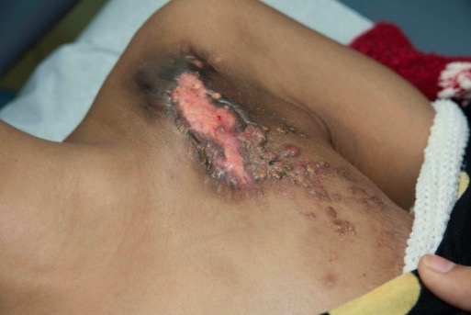
Patient With Secretory Breast Cancer and ETV6-NTRK3 Fusion
14-yr-old female with secretory breast cancer
Previously treated with 4 lines of chemotherapy, repeated resections
Received larotrectinib under expanded access
Baseline
Day 6
Day 20
Shukla N et al. JCO Precis Oncol. 2017;2017:PO.17.00034. Reprinted with permission.
© 2017 American Society of Clinical Oncology. All rights reserved.

Slide 11
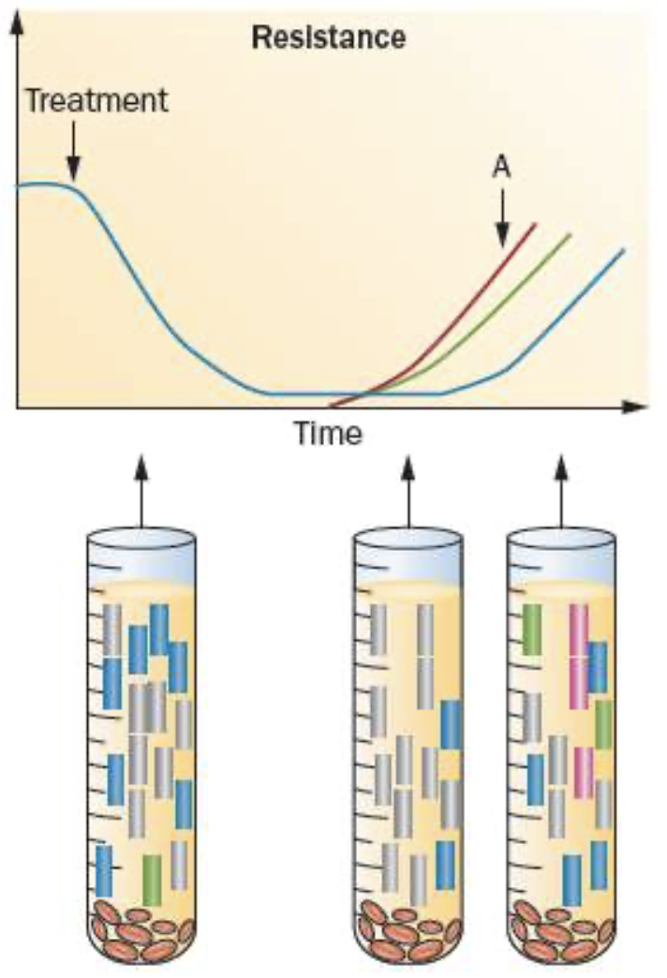
Early Detection of Molecular Progression on MBC Therapy

Slide 12
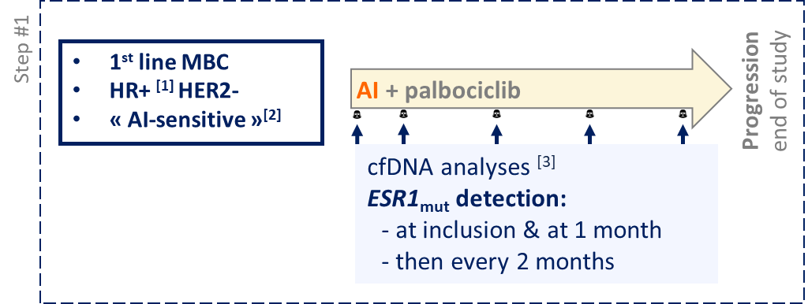
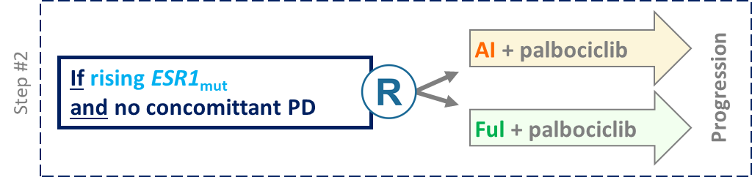
ctDNA changes as early predictors of response in metastatic disease
PAlbociclib & ctDNA for ESR1_{mut} detection (PADA-1) trial
N = 1017
N = 172
5.7 mo + 3.5 mo < 11.9 months
Is early switch better than sequential therapy ?
Bidard FC et al. Lancet Oncol. 2022;23(11):1367-1377.
Bidard FC, et al. The Lancet Oncology. 2022 Nov 1;23(11):1367-77.

Slide 13
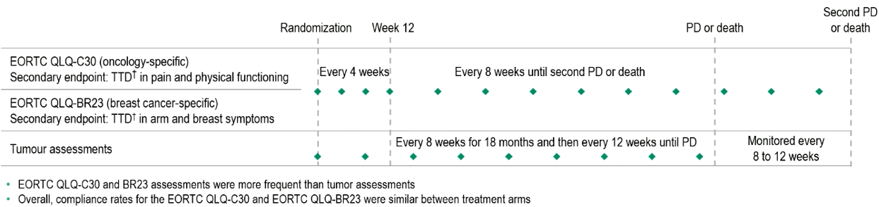
SERENA-6 (Phase 3): PROs of camizestrant + CDK4/6 inhibitor for patients with HR+/HER2– advanced breast cancer with emergent ESR1m disease during 1L ET prior to progressive disease
Key eligibility
Female/male patients with ER+/HER2– advanced breast cancer
All patients who have received AI + CDK4/6i (palbociclib, ribociclib, or abemaciclib) as initial endocrine-based therapy for advanced breast cancer for ≥6 months
ESR1m detected in ctDNA with no evidence of disease progression
ctDNA testing for ESR1m every 2–3 months
Primary endpoint:
PFS by investigator (RECIST v1.1)
Secondary endpoints:
PFS2
OS
Safety
PROs
Camizestrant (75 mg QD) + continuing CDK4/6i
+ placebo for AI
Until PD, unacceptable toxicity, patient withdrawal, or toxicity
R
1:1
Continuing AI (anastrozole/letrozole)
+ CDK4/6i + placebo for camizestrant
N=315
Stratification factors
Visceral vs non-visceral disease
ESR1m detection at first test vs subsequent test
Time from AI + CDK4/6i initiation to randomization: <18 months vs ≥18 months
Palbociclib vs ribociclib vs abemaciclib
Mayer E, et al. ESMO 2025. Abstract 486MO.

Slide 14
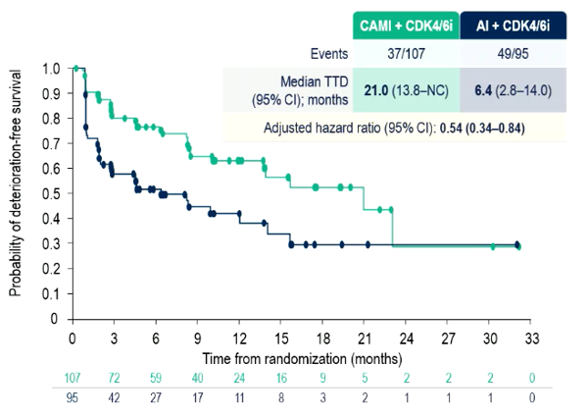
SERENA-6 (Phase 3): PFS and EORTC QLQ-C30
Data presented at ASCO 2025: Turner NC, et al.
PFS by investigator
Time to deterioration in GHS/QOL (EORTC QLQ-C30)¹
 | Camizestrant + CDK4/6i (n=157) | AI + CDK4/6i (n=158)
PFS events | 71 | 100
Median PFS, months (95% CI) | 16.0 (12.7, 18.2) | 9.2 (7.2, 9.5)
Adjusted HR (95% Cl) | 0.44 (0.31, 0.60); P<0.00001
100
90
80
70
60.7%
60
AI + CDK4/6i
Camizestrant + CDK4/6i
PFS (%)
50
40
29.7%
30
33.4%
20
10
5.4%
0
0
3
6
9
12
15
18
21
24
27
30
33
Months from randomization
Number at risk
Cam + CDK4/6i
157
138
105
82
55
41
26
11
9
7
6
0
AI + CDK4/6i
158
124
73
55
29
17
7
3
1
0
0
0
1. Bidard FC, et al. N Engl J Med 2025;393:569–80
Turner NC, et al. ASCO 2025. Abstract LBA4.

Slide 15
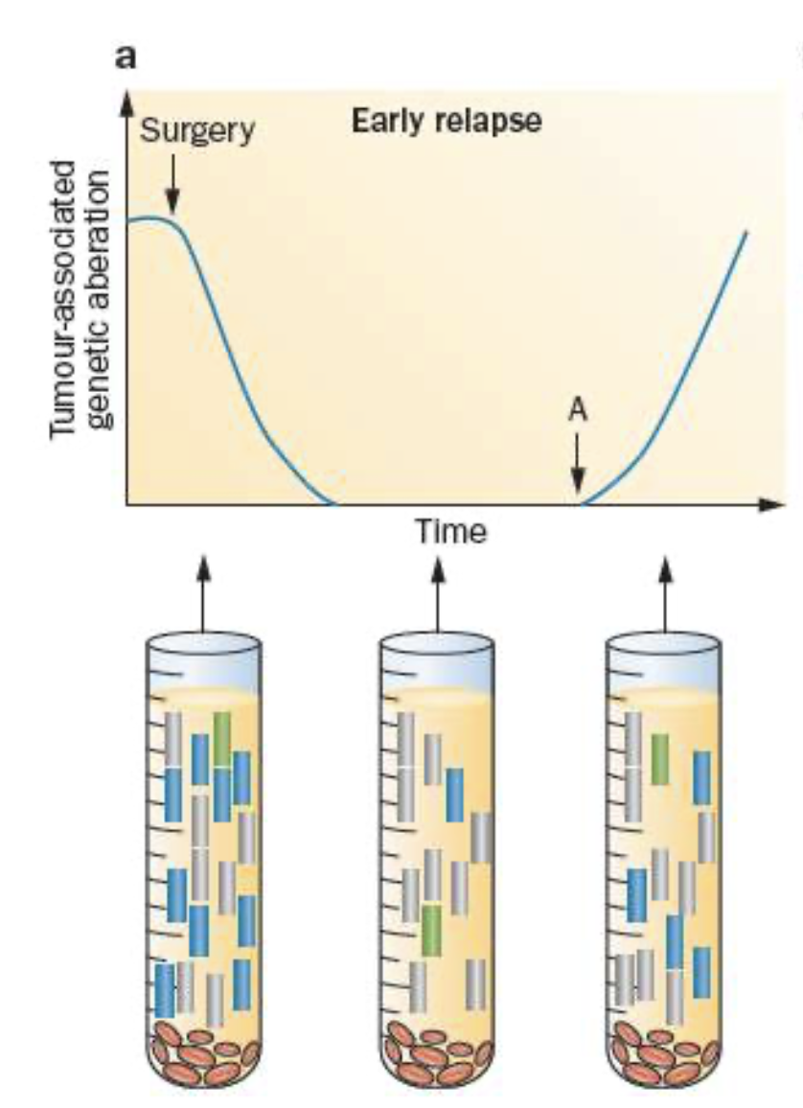

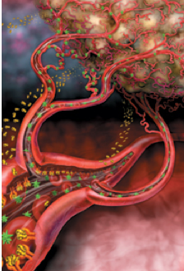
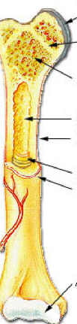

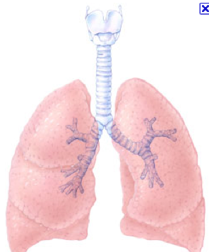
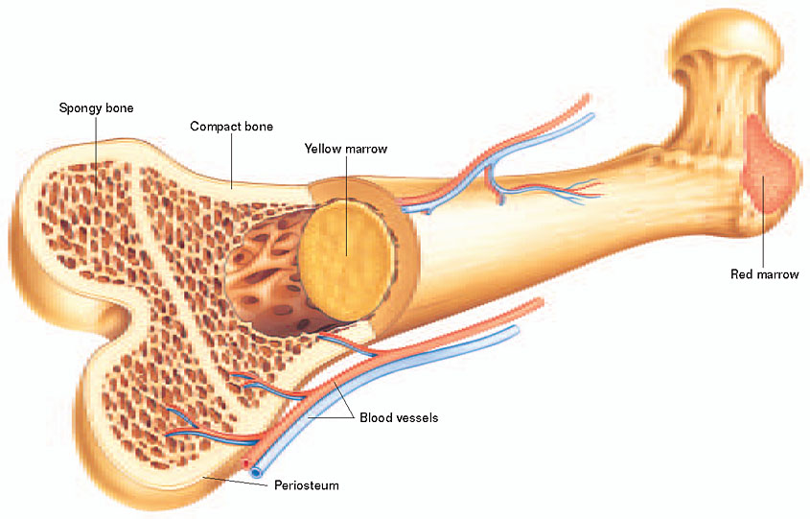
Detection of Minimal Residual Disease / Molecular Relapse After Curative Intent Therapy
Minimal Residual Disease
Blood & Bone Marrow
Recurrence
Metastatic Sites
Primary Cancer
CTCs
ctDNA
CTCs
ctDNA
DTCs

Slide 16
N = 170 stage II/III 14 driver genes sequenced personalized ddPCR N = 101 had mutation
screened in the primary tumor assay built for tracking
q3mo x 1yr q6m
ctDNA status at diagnosis (n = 80)
ctDNA status during follow up
51% ctDNA + before any therapy.
~ 16% become ctDNA + during f/u (median 3 yrs).

Slide 17
Relapse-Free Survival as Function of ctDNA Status During Follow Up by Breast Cancer Subtype
Median lead time was 10.7 months from ctDNA detection to clinical recurrence
Garcia-Murillas et al. JAMA Oncol. 2019;5(10):1473-1478.

Slide 18
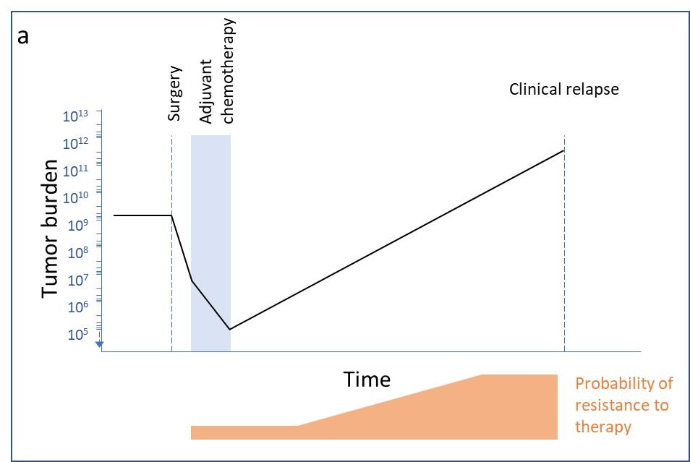
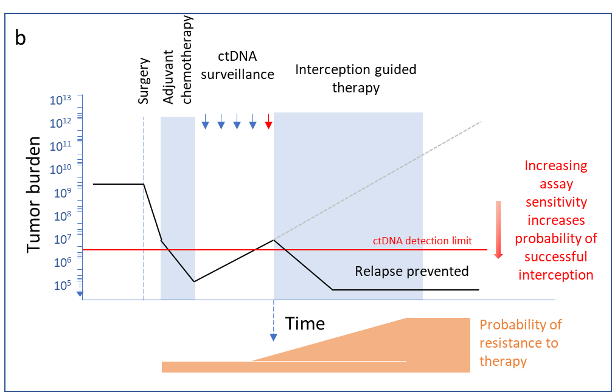
Hypothesis Behind Early Intervention at Molecular Relapse State
Why drugs that cure micro-metastatic disease as adjuvant therapy do not cure clinically apparent metastatic disease?
Hypothesis
At the time of molecular relapse, tumor bulk and tumor heterogeneity is still low, and the chance of therapy working is higher
As tumor bulk increase intratumor genomic heterogeneity increases
As intratumor heterogeneity increases the chance of drug-resistant clones also increases¹
Current Non-Curative Treatment Paradigm
Future Potentially Curative Treatment Paradigm
¹ Schiavon G et al. Sci Transl Med. 2015;7(313):313ra182.
Lajos Pusztai, MD. 2023.

Slide 19
ZEST Study Schema
Ph 3 trial of the Treatment of BRCAmut HER2-Negative or BRCAwt Triple Negative Breast Cancer Patients who have Detectable Circulating Tumor DNA Levels after Definitive Therapy; n = 800
Key Eligibility Criteria
Stage I-III breast cancer with surgical resection of the primary tumor that is confirmed to be either:
tBRCAmut HER2-negative, or
tBRCAwt TNBC
ctDNA detected by Signatera™ (central testing)
Prior adjuvant therapy allowed
No sign of radiographic disease recurrence
Prior exposure to checkpoint inhibitor allowed
Patients who had neoadj. chemotherapy and tumor showed no response are excluded
Niraparib
1º Endpoint: DFS (Investigator assessed)
Key 2º Endpoint: OS
Cohort 1 tBRCAmut HER2-
(both HR+ and TNBC)
R
1:1
Placebo
N = 200
Niraparib
1º Endpoint: DFS (Investigator assessed)
HRd and Full population
Key 2º Endpoint: OS
Cohort 2 tBRCAwt TNBC
R
1:1
Placebo
N = 600
  > 1600 pts received positive or negative ctDNA results
  7% of pts ctDNA+
  > 50% had asymptomatic metastatic disease on staging
  Trial closed due to very slow accrual to therapeutic intervention randomization

Slide 20
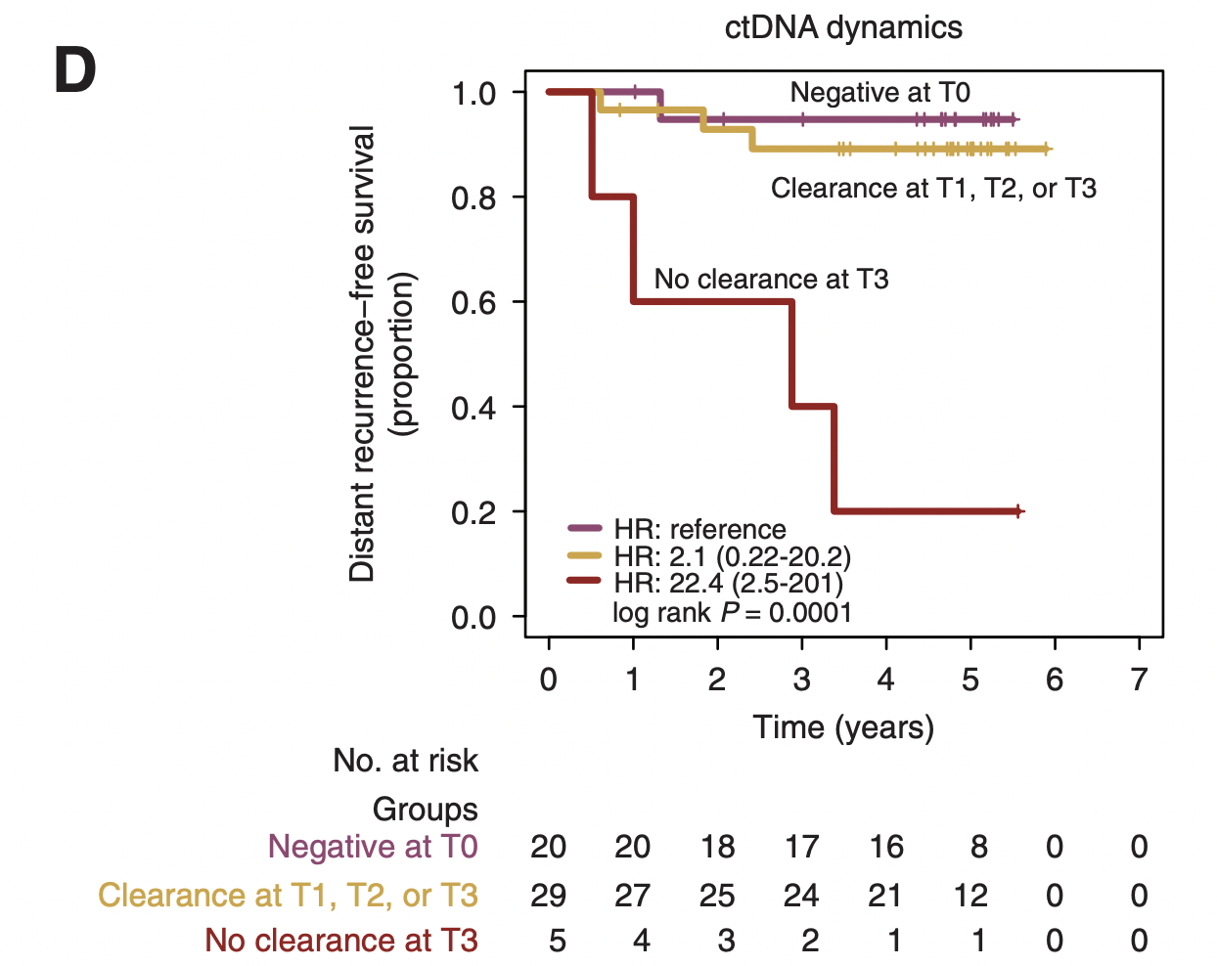
Clearance of ctDNA During Neoadjuvant Chemotherapy in High-Risk Early Breast Cancer Substantially Improves Outcome in I-SPY 2
Clearance of ctDNA associated
with improved DRFS even in
pts who did not have a pCR
Magbanua MJM et al. Ann Oncol. 2021;32(2):229-239.

Slide 21
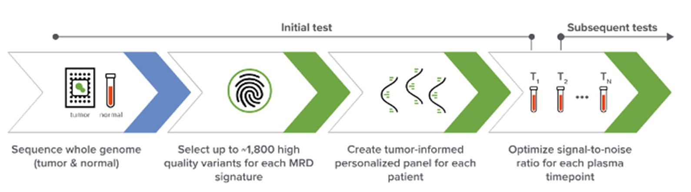
PREDICT-DNA trial (TBCRC-040)
n=184 TNBC or HER2+ EBC patients receiving neoadjuvant chemo
ctDNA: baseline, post-NAT/pre-surg, and f/u (6mo then q1y) w/ NeXT Personal tumor-informed assay (1-3ppm, up to 1800 variants)
Primary aim: assess NPV of post-NAT ctDNA for pCR
Hunter N, et al, ASCO 2025

Slide 22
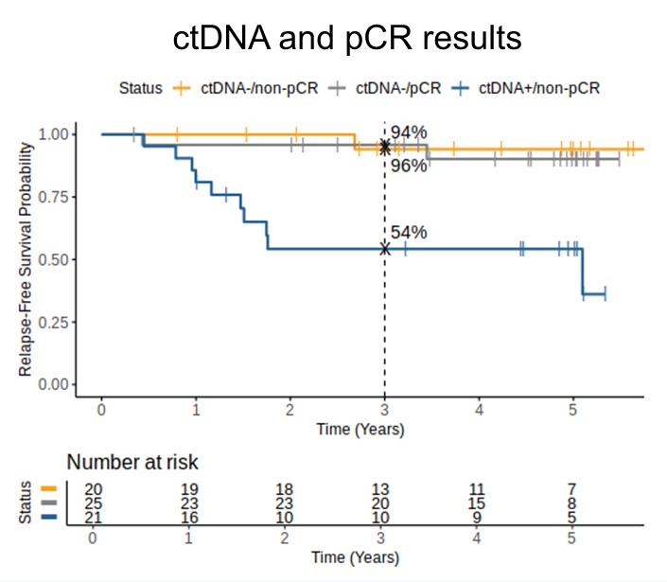
PREDICT-DNA: post-NAT ctDNA
40% of ctDNA- patients had non-pCR
All pCR patients were ctDNA-
Non-pCR/ctDNA+ TNBC had poor outcomes while non-pCR/ctDNA- had excellent outcomes
Hunter N, et al, ASCO 2025

Slide 23
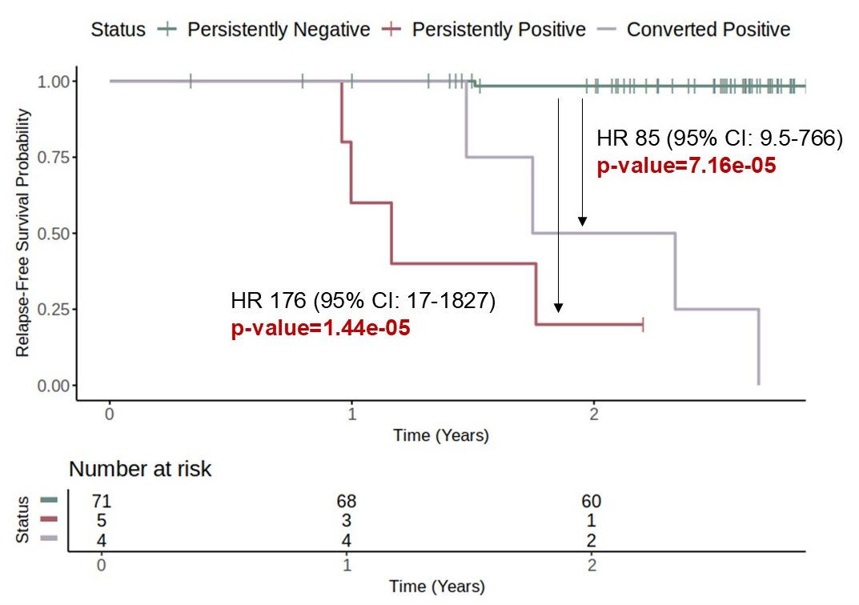
PREDICT-DNA: RFS and serial ctDNA
Persistent ctDNA- in TNBC is tantamount to not recurring during monitoring period
ctDNA+ conversion portends relapse
Hunter N, et al, ASCO 2025

Slide 24
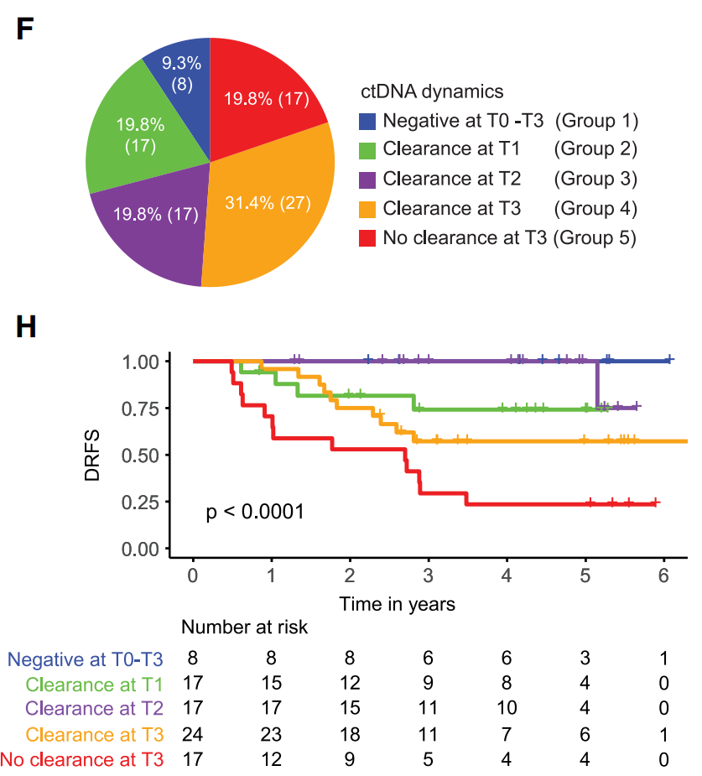
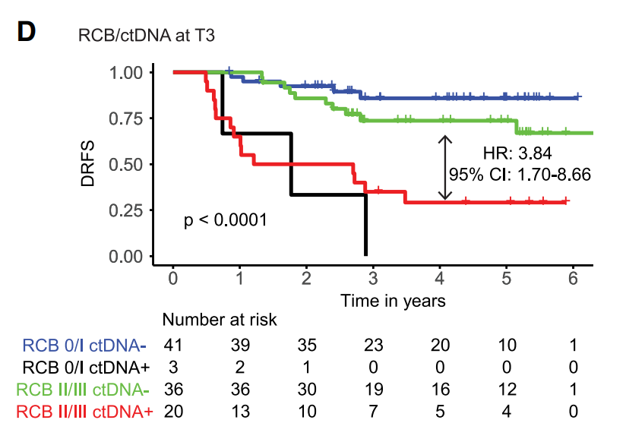
I-SPY2: post-NAT ctDNA
Recurrences are observed in post-NAT ctDNA- (Natera exome assay)
Magbanua MJM, et al, Cancer Cell 2023;41(6):1091-1102.e4.

Slide 25
DARE trial
Interim analysis of n=507 registered subjects
ctDNA monitoring and interventional study w/ Natera exome assay
  Pts with ctDNA+ randomized to switch to fulvestrant/palbociclib
Ongoing enrollment, not yet at target
ER+ high risk EBC
>15% predicted recurrence
(or) high genomic risk
(or) T>5cm
(or) 4+ LN
(or) grade 3 & 1-3LN/T>3cm
q6mo ctDNA
If ctDNA+:
Enroll 1:1 to switch to fulv/palbo
ctDNA
& CT
Pusztai L, et al, ASCO 2025

Slide 26
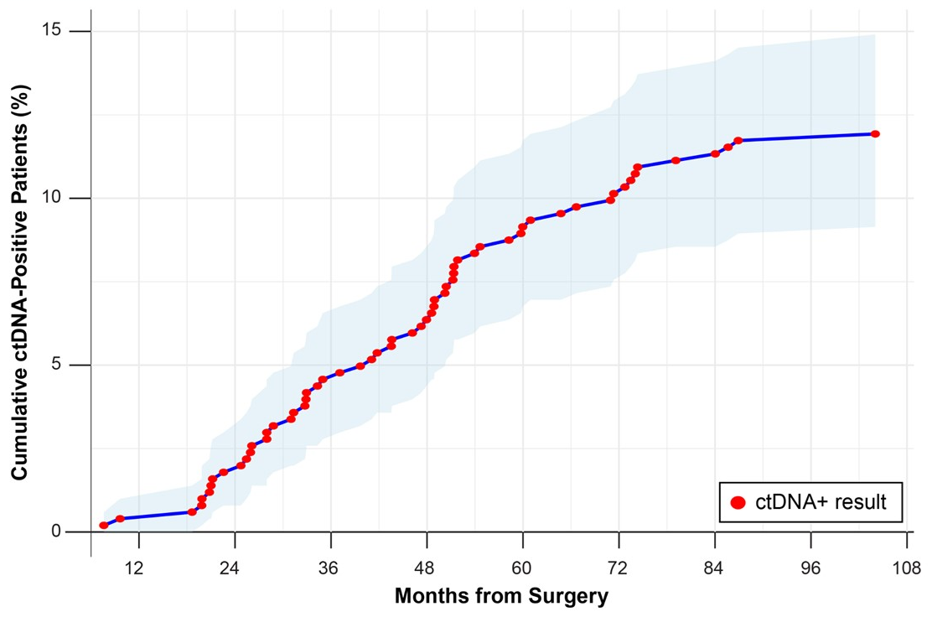
DARE: cumulative ctDNA+ detection
29m median f/u
n=37 positive initially & n=23 subsequent
First ctDNA could be 6mo to 7y post-surgery and therefore the curve does not reflect true incidence
27% (n=16/60) of ctDNA+ already had recurrence on imaging
Pusztai L, et al, ASCO 2025

Slide 27
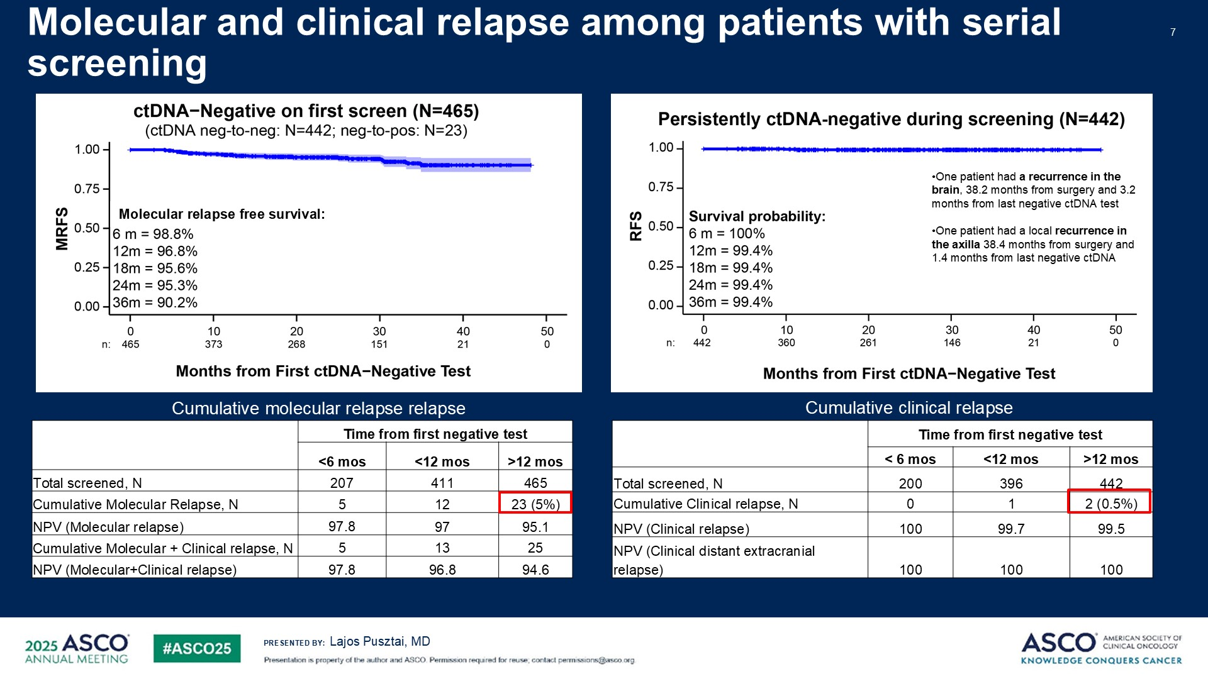
DARE: RFS curves
ctDNA+ conversion rate in high-risk ER+ was ~3% per year
Patients who persistently test ctDNA- have ~0% recurrence during that interval
Pusztai L, et al, ASCO 2025

Slide 28
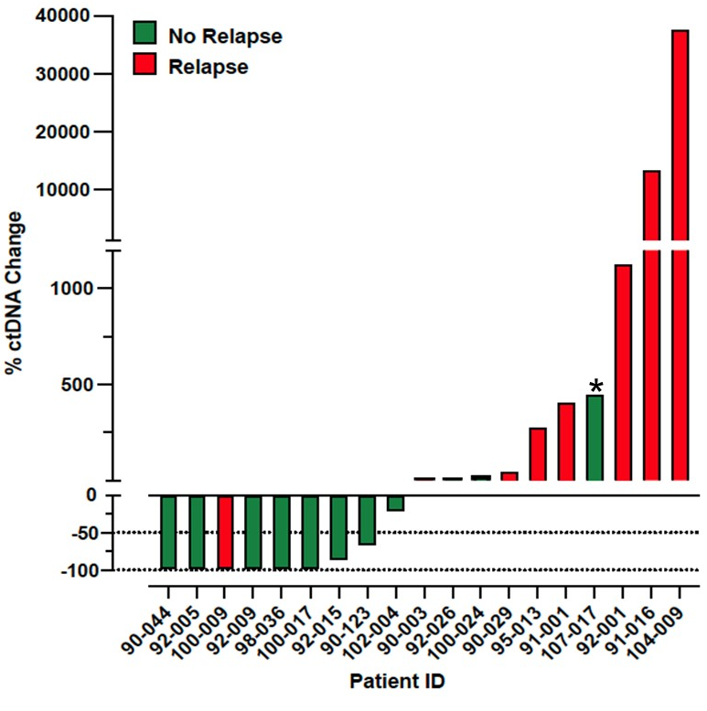
DARE: intervention
Fewer patients with ctDNA decrease at 3 months had clinical relapse
Pusztai L, et al, ASCO 2025

Slide 29
Clinical Utility of Molecular Diagnostics in Breast Cancer
Molecular analysis can be used to identify actionable mutations in luminal MBC (ESR1, PI3KCA, HER2, HER3, AKT, PIK3CA, PTEN) and subtype agnostic MBC (MSI High, High TMB, NTRK and RET fusion genes and mutant BRAF)
Serial genomic profiling identifies driver mutations occurring with clonal evolution with treatment resistance
ctDNA can identify MBC and EBC pts with resistant subclinical disease for trial participation
Not SOC to monitor ctDNA in EBC pts – benefit of changing therapy unknown
Caution: ctDNA or tissue NGS mutations with potential germline risk implications – need to obtain germline testing, inform patients and refer for genetic counselling

