Slide 1

Breast Cancer and Local Control
Michael Alvarado, MD, FACS
Professor of Surgery
Director Breast Surgical Oncology Fellowship
University of California San Francisco
Disclaimer: This presentation is intended for personal use and for informational purposes only and does not replace independent professional judgment. This presentation is the property of Physicians’ Education Resource, LLC (“PER”) and is protected by U.S. and international copyright laws. You may not copy, reproduce, distribute, transmit, modify, or create derivative works of the presentation without the prior written permission from PER.

Slide 2
Does Local Control Matter?
For survival: Probably…a little
For quality of life and well-being: A lot more

Slide 3
Quality Breast Surgery
Functioning
  physical
  psychosocial
  sexual
Local/regional
Control
Contour and symmetry
Sense of well being

Slide 4
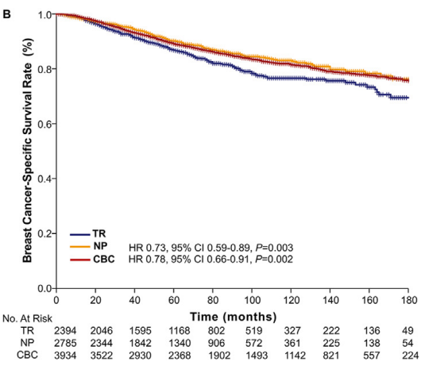
A “True Local Recurrence” Is a Marker of Biologically More Aggressive Disease
Second Primary
True Local Recurrence
Same quadrant
Same histologic subtype
True Recurrence
Wang J et al. Eur J Surg Oncol. 2021;47(10):2492-2498.

Slide 5
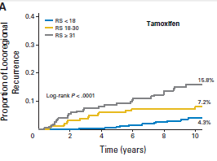
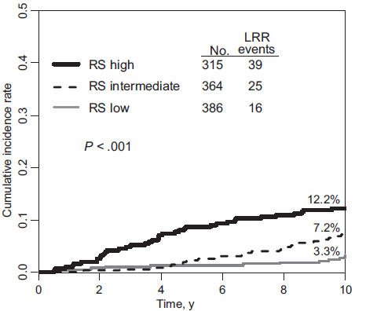
Biologically More Aggressive Disease (High-risk 21-gene RS) is More Likely to Recur Locally
Node Negative
Node Positive
Mamounas EP et al. J Clin Oncol. 2010;28(10):1677-1683.
Mamounas EP et al. J Natl Cancer Inst. 2017;109(4):djw259.

Slide 6
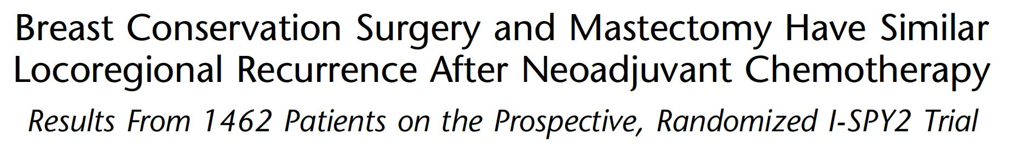
Muhktar et al, Ann Surg 2023
Evaluate LRR rates and Local-regional recurrence-free survival
Compare type of surgery
Relationship of Residual cancer burden (RCB) and LRR
Impact of age and clinical stage on LRR as a function of surgery type

Slide 7
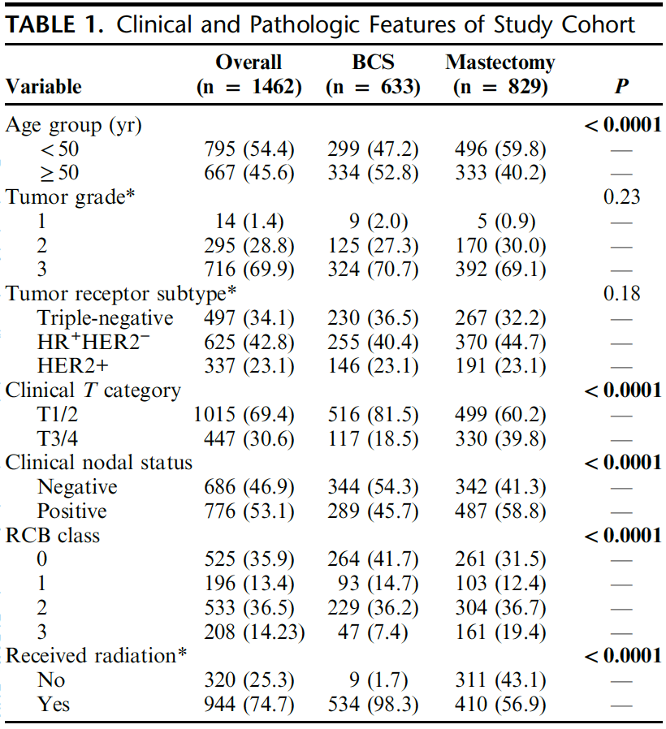
Muhktar et al, Ann Surg 2023

Slide 8
Factors Associated with Type of Surgery
Age
  <50 more likely to undergo mastectomy
Clinical T stage
  cT3/4 - 74% underwent mastectomy
  cT1/2 – 49% underwent mastectomy
Clinical N stage
  cN1- 63% underwent mastectomy
  cN0- 50% underwent mastectomy
RCB- rates of mastectomy increased with each RCB category
Muhktar et al, Ann Surg 2023

Slide 9
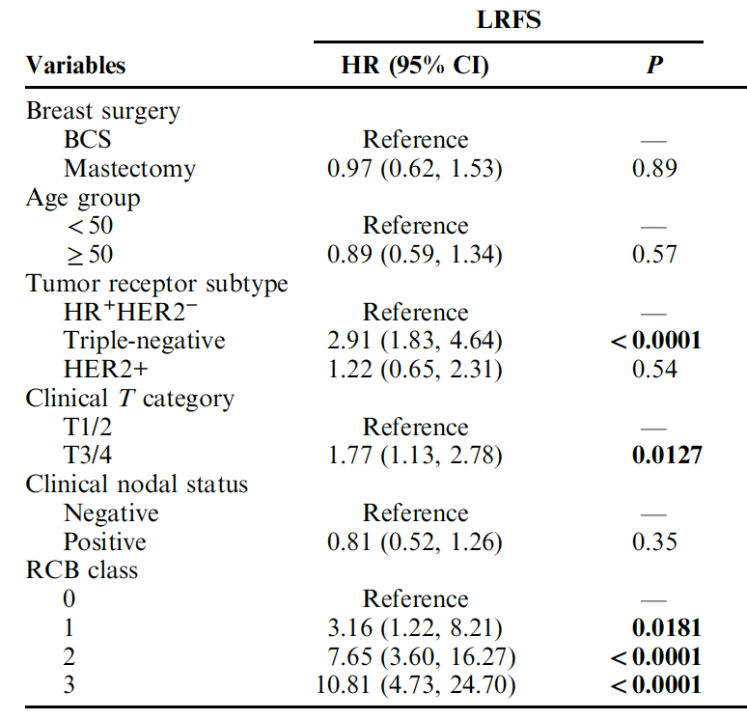
Multivariate
Analysis
Subtype
Clinical T stage
RCB class
Muhktar et al, Ann Surg 2023

Slide 10
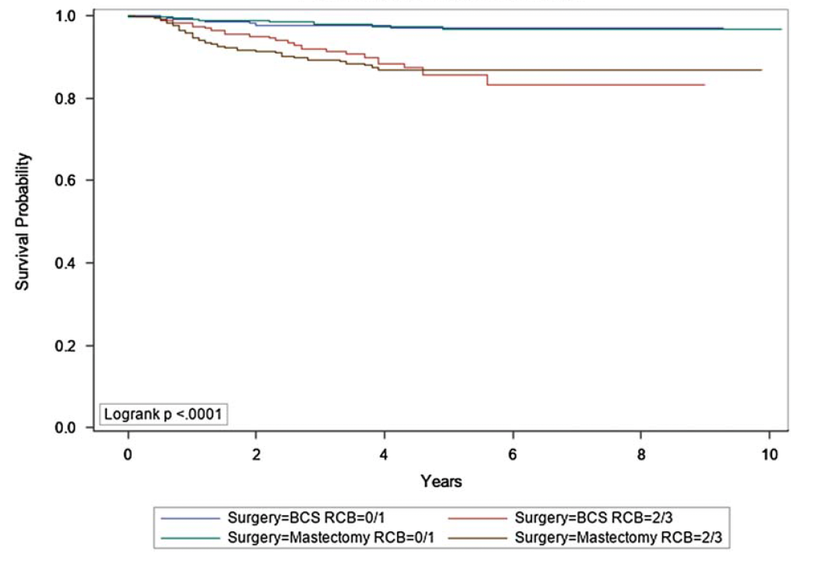
Response to
Therapy

Slide 11
Neoadjuvant Therapy and Node Positive Disease
A Changing Landscape
Axillary Sono +/- needle biopsy
pN(+)
pN(-)
Neoadjuvant Chemotherapy
ypN(+)
yPN0
ALND + Nodal RT
Axillary and Nodal RT
No Regional Nodal RT
Regional Nodal RT
Alliance A011202
NSABP B-51/RTOG 1304 (NRG9353)
Notes:
What about regional BIGGER therapy? Ax dissection or radiation?

Slide 12
Loco-regional Irradiation in Patients with Biopsy-proven Axillary Node Involvement at Presentation
Who Become Pathologically Node-negative After Neoadjuvant Chemotherapy: Primary Outcomes of
NRG Oncology/NSABP B-51/RTOG 1304
Eleftherios P. Mamounas ^{1*}, Hanna Bandos², Julia R. White^{3*}, Thomas B. Julian⁴, Atif J. Khan⁵, Simona F. Shaitelman⁶, Mylin A. Torres⁷, Frank
A. Vicini⁸, Patricia A. Ganz⁹, Susan A. McCloskey¹⁰, Peter C. Lucas^{11,12}, Nilendu Gupta³,
X. Allen Li¹³, Beryl McCormick⁵, Saumil Gandhi⁶, Rahul D. Tendulkar¹⁴, Vivek S. Kavadi,¹⁵, Masahiko Okamoto¹⁶, Samantha Andrews Seaward¹⁷, William J. Irvin, Jr.¹⁸, Jolinta Lin ⁷, Robert Mutter¹⁹, Thierry M. Muanza²⁰,
Andrew A. Muskovitz²¹, Reshma Jagsi²², Anna C. Weiss^{23,24}, Walter J. Curran, Jr.⁷, and Norman Wolmark¹²
*These authors contributed equally.

Slide 13
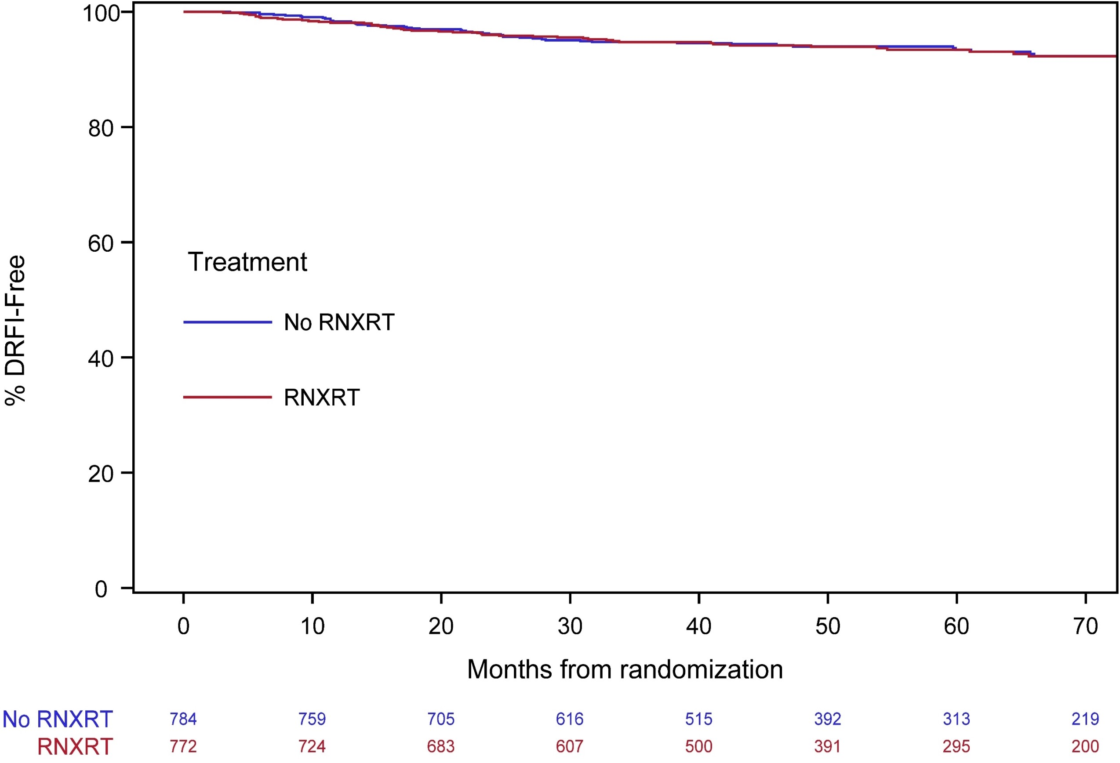
Secondary Endpoints (cont.)
Distant Recurrence-free Interval (DRFI)
Distant Recurrence-Free %
Treatment
No RNI
 | No RNI | RNI
# Events | 48 | 46
HR (95%CI), p-v | 1.00 (0.67, 1.51) p=0.99
5-Year Estimate | 93.4% | 93.4%
RNI
No RNI RNI
This presentation is the intellectual property of the author. Contact Dr. Mamounas at epmamounas@aol.com for permission to reprint and/or distribute.

Slide 14
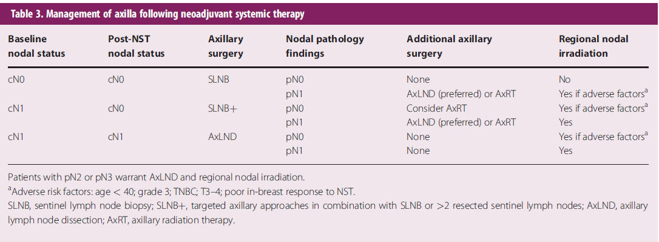
From St. Gallen International Consensus Guidelines - 2019
Burstein HJ et al. Ann Oncol. 2019;30:1541-1557.

Slide 15

Estimating Local Recurrence Risk for Breast Conserving Surgery/Mastectomy
No
No
No
No. No. n
Now Much More Challenging
No
No
No
No
No
No way
No way
Adjust up for:
Biology – TNBC, HER2(+)
Age < 45
Genetic predisposition
BIOLOGY
LVI
Nodal status
Tumor size
Response to therapy
Start At
0.5% per year (all comers)
1% per year (neoadjuvant cases)
Adjust down for:
Age > 50
Endocrine therapy
Gillon P et al. Eur J Cancer. 2017;79:226-234.
Gervais MK et al. J Surg Oncol. 2017;115(3):231-237.
Notes:
It used to be this simple… but not now. Response to therapy is alos very important

Slide 16
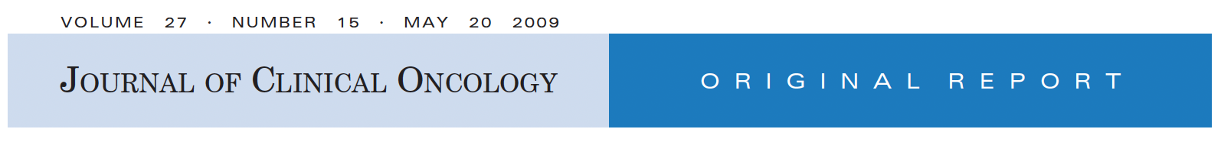
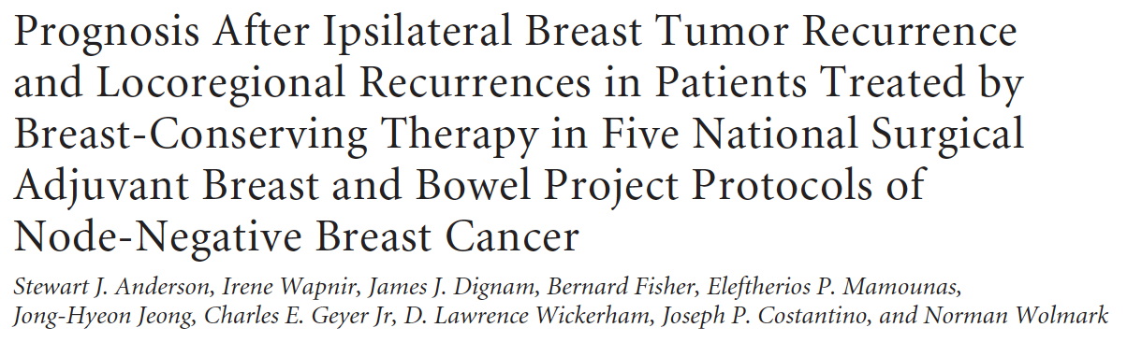
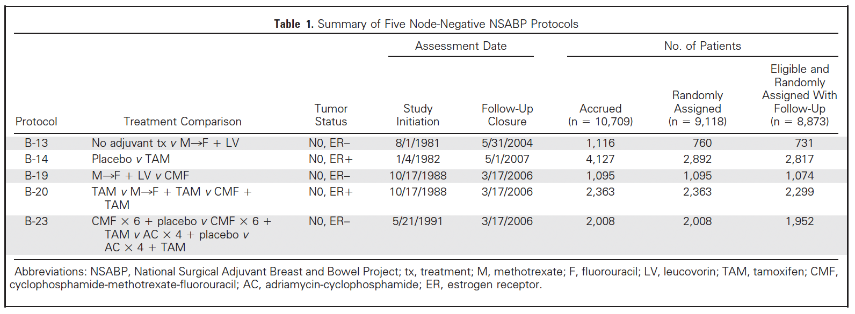
Results
3799 women randomized
419 pts w/ recurrence (11%)
342 (9%) IBTR
77 (2%) other LRR

Slide 17
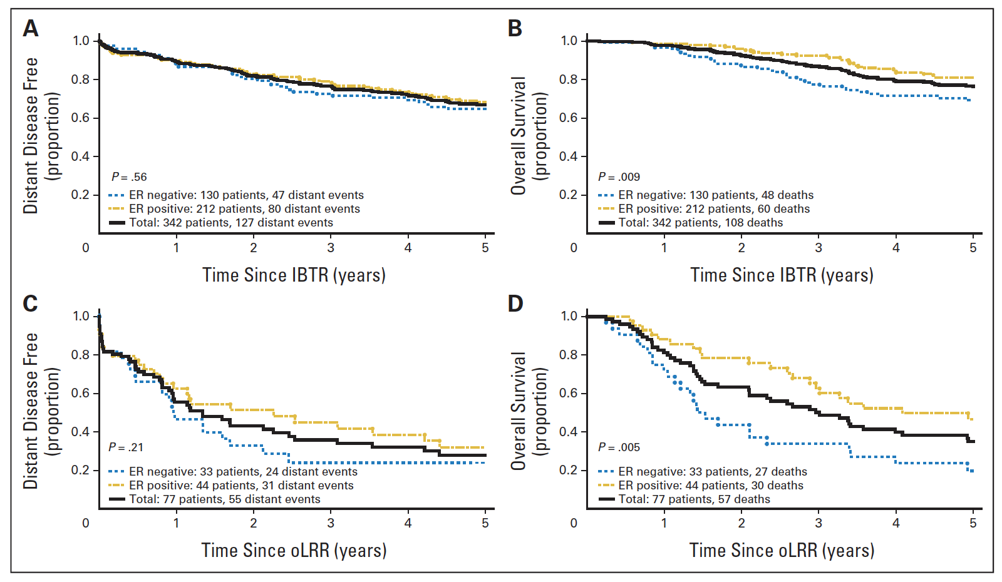
Outcome after IBTR or other LRR

Slide 18
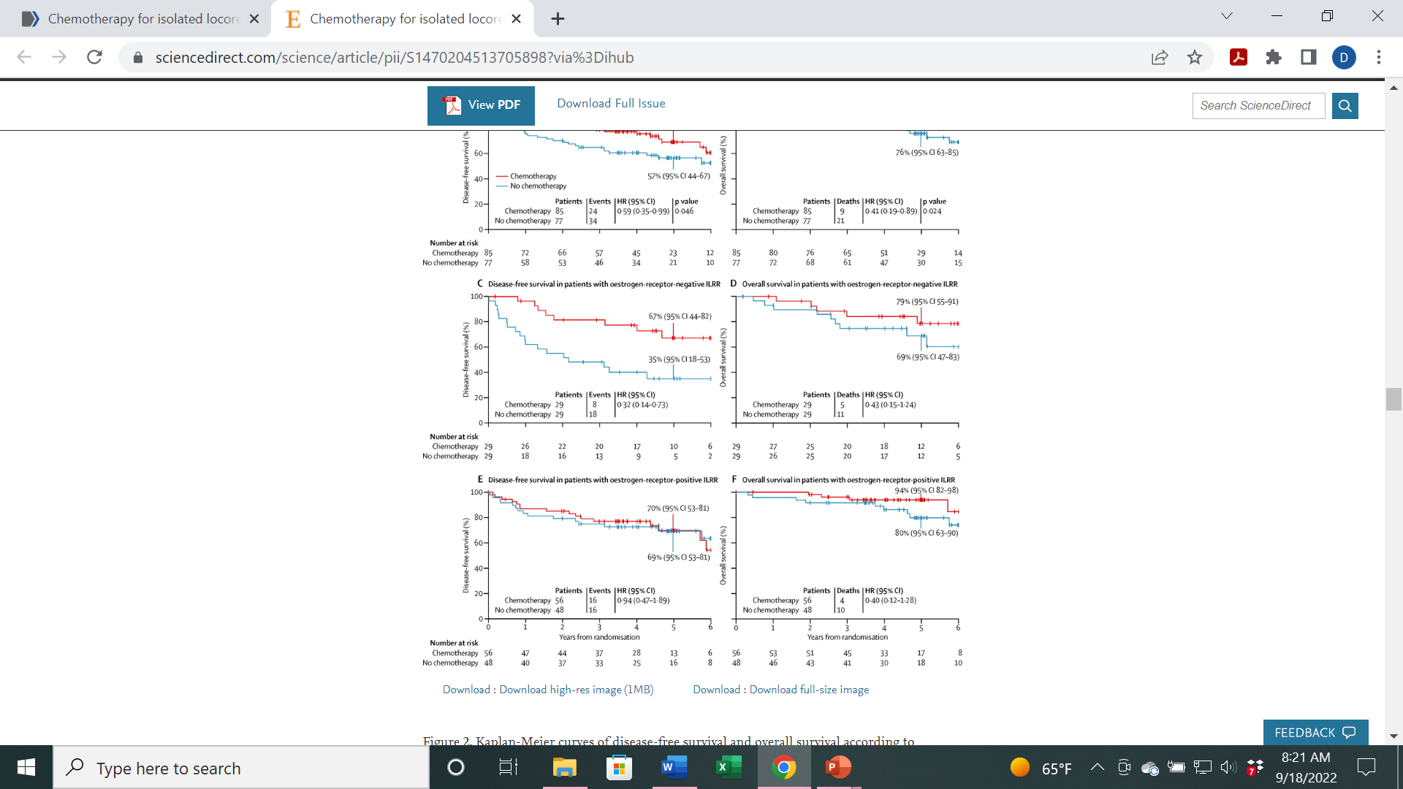
Treating an Ipsilateral Breast Tumor Recurrence after Breast-conserving Surgery
Mastectomy has been the standard
Local excision + Partial Breast Re-irradiation has acceptable outcomes in selected patients
Hannoun-Levi et al. Int J Radiat Oncol Biol Phys. 2021;110(2):452-461.
Wadasadawala et al. Clin Breast Cancer. 2017;17(7):493-505.
Chemotherapy generally recommended for HR(-) disease (no OS benefit)
CALOR Trial: Aebi S et al. Lancet Oncol. 2014;15(2):156-163.
HR(-)
Disease-free Survival
HR(+)

Slide 19
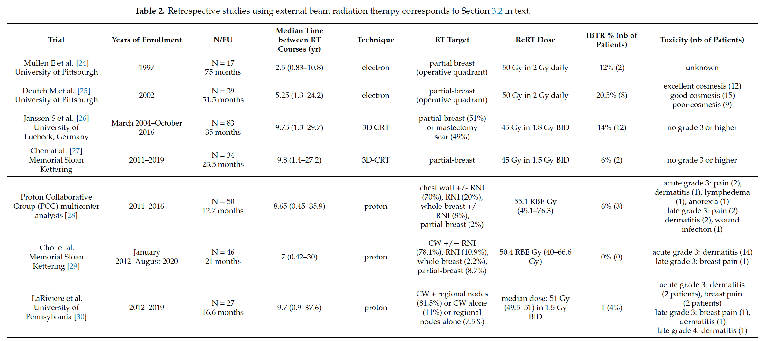
Curr Oncol 2023

Slide 20
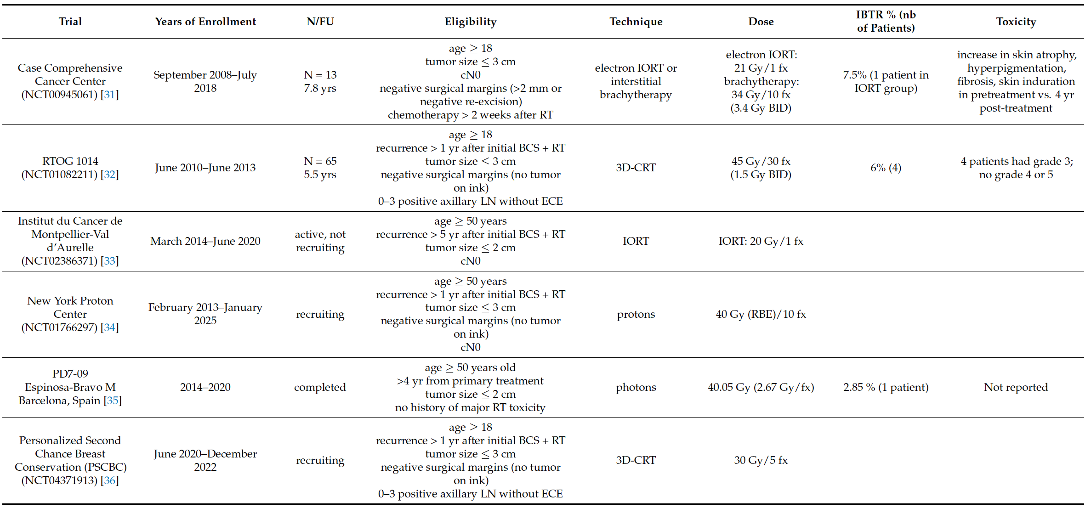

Slide 21
Mastectomy

Slide 22
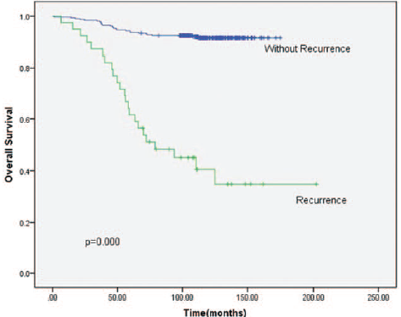
Local/Regional Recurrence and Survival After Mastectomy
Local recurrence after mastectomy is a potent marker of bad biology
N = 353
T1-2N0
No radiation
64% received chemotherapy
Site of Recurrence
Chest wall 54%
Supraclavicular 49%
46% had synchronous distant metastases
Li J-L et al. Medicine. 2017;96(26):e7343.

Slide 23
Approaches for Improving Margin-negative Excision Rates on the First Try
Routine shaving of additional margins
Intraoperative ultrasound guidance
Lesion localization devices
Intraoperative margin assessment devices
Redefine “Margin Negative”
Surgeons who focus on reducing re-excision rates are generally successful no mater which technology they adopt

Slide 24
Margin Assessment with Specimen Radiograph
“Old days”- send specimen to mammography for radiograph
  Time
  Interpretation
2D specimen Radiograph in room next to Operating Room
3D Tomosynthesis in the Operating Room

Slide 25
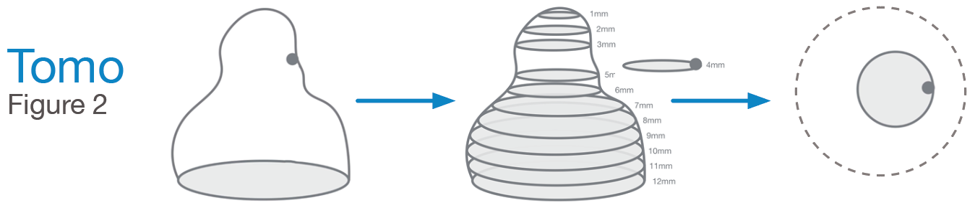
Specimen Tomosynthesis creates 1mm slices for a superior view of specimen anatomy
Coveroo
Breast specimen with a lesion on a peripheral margin
Tomosynthesis creates 1mm digital slices
What the physician sees: peripheral involvement on slice 4

Slide 26
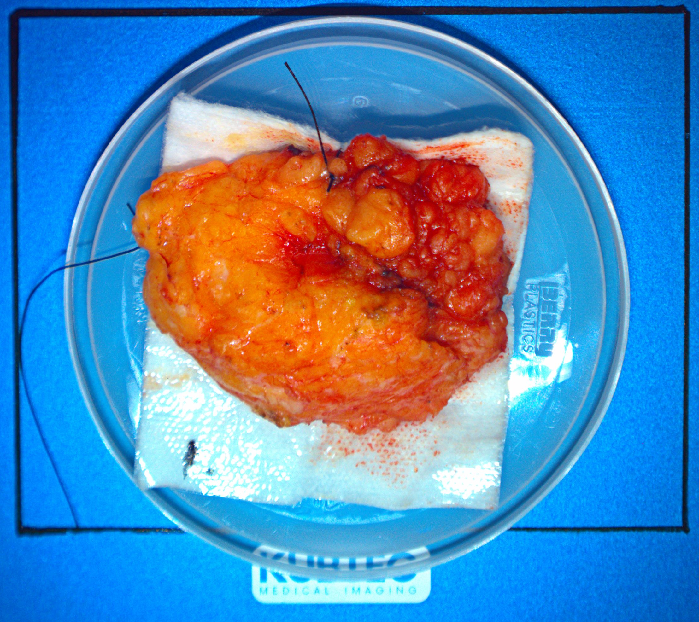
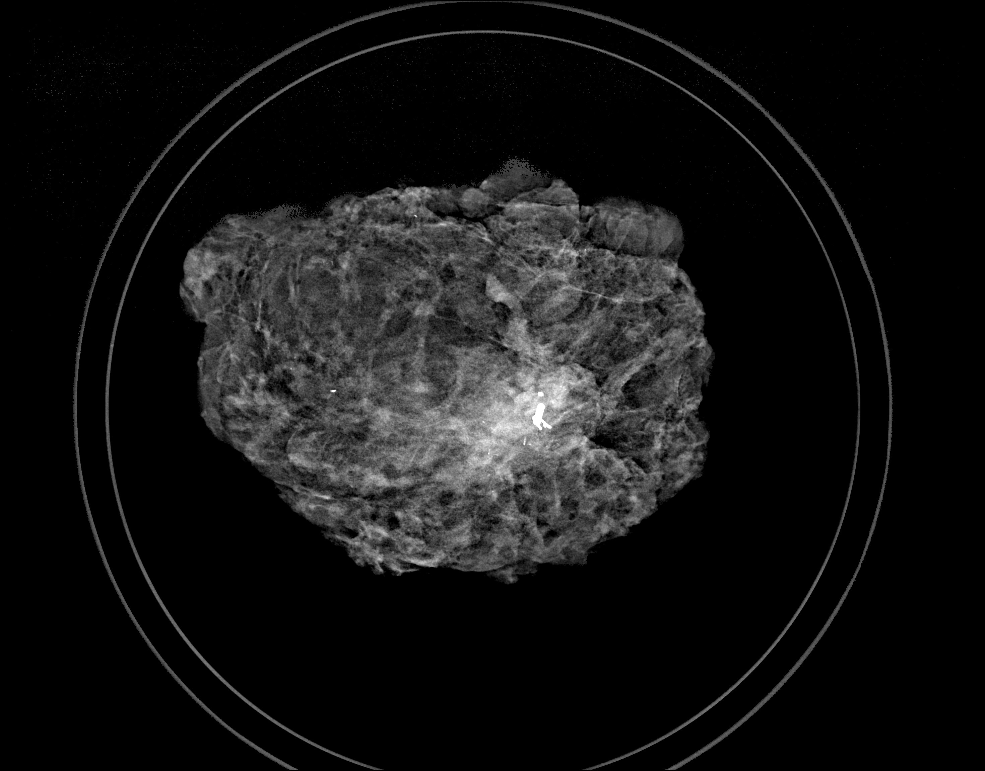
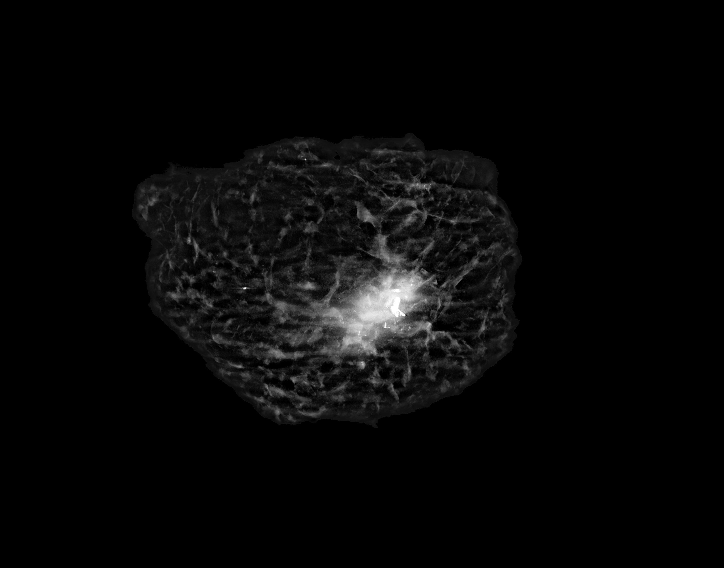
Example: 62 yo upper outer mass
IDC Grade 2 ER+ Her2-
Optical View
2-D View
K-View

Slide 27
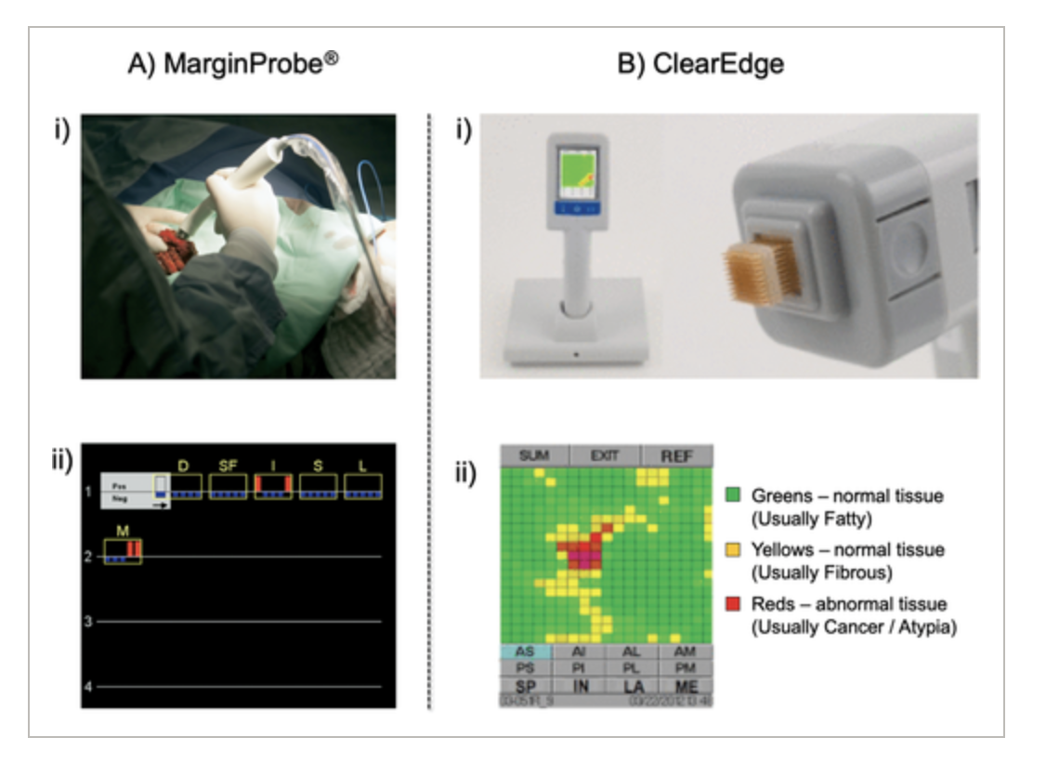
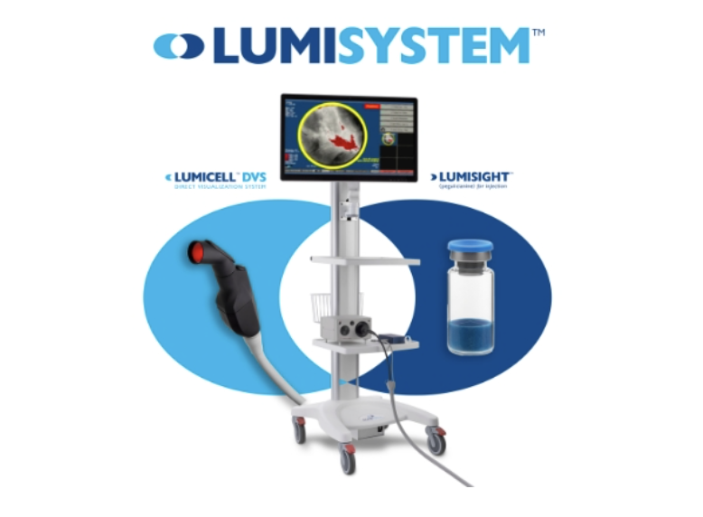
New concepts

Slide 28
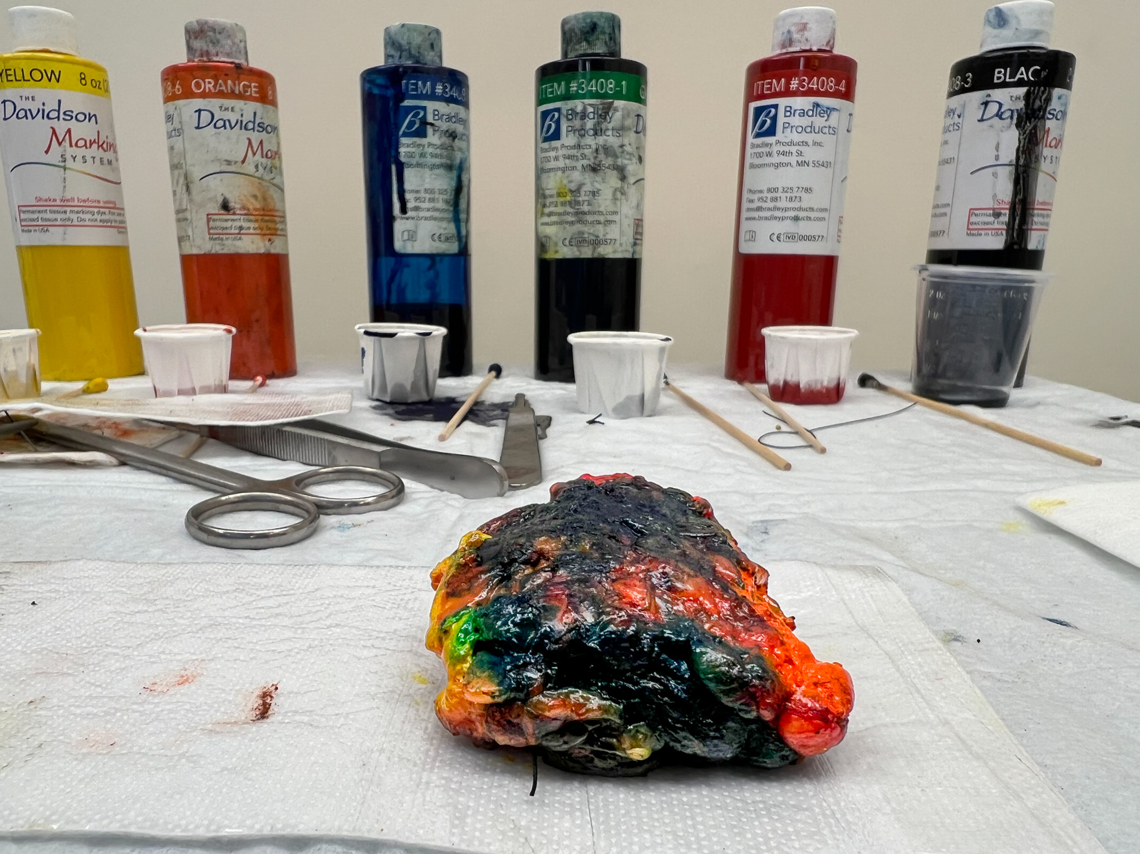
Inking the specimen

Slide 29
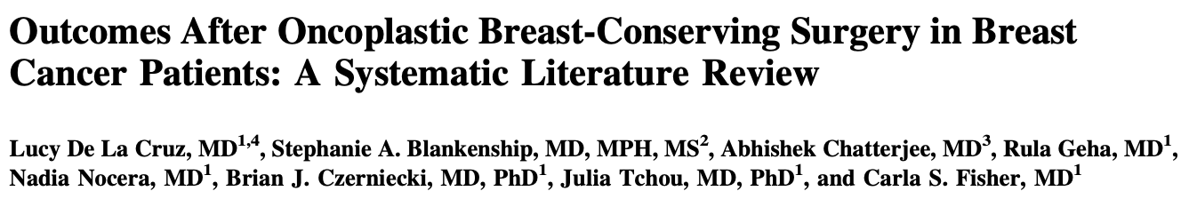

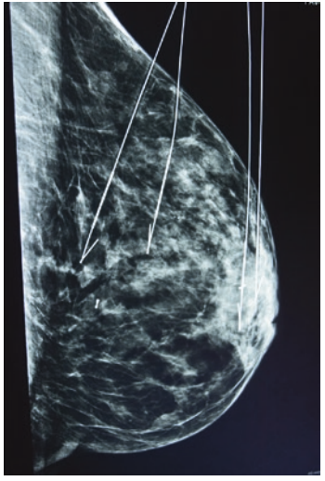
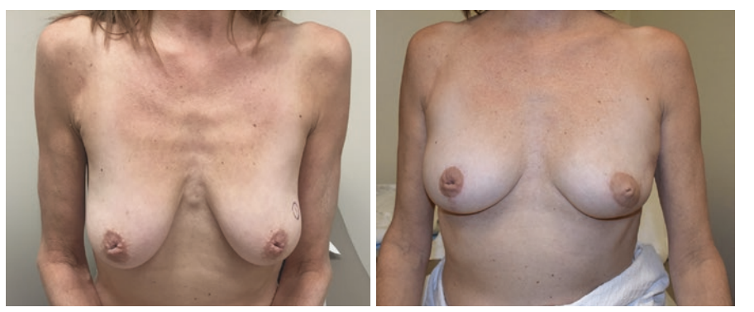
Data extracted form 55 studies evaluating 6055 pts
Margin positivity 7.8%

Slide 30
Local Recurrence vs New Primary

Slide 31
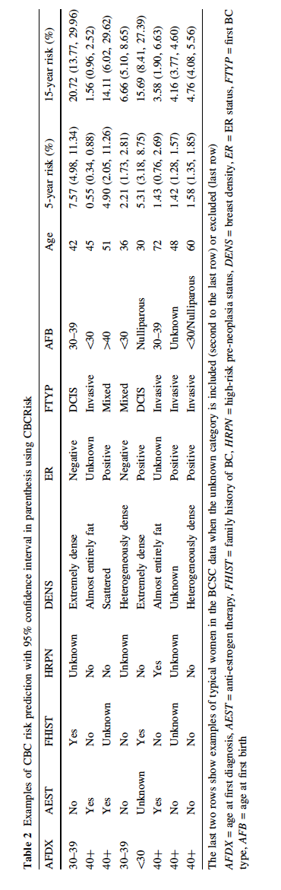
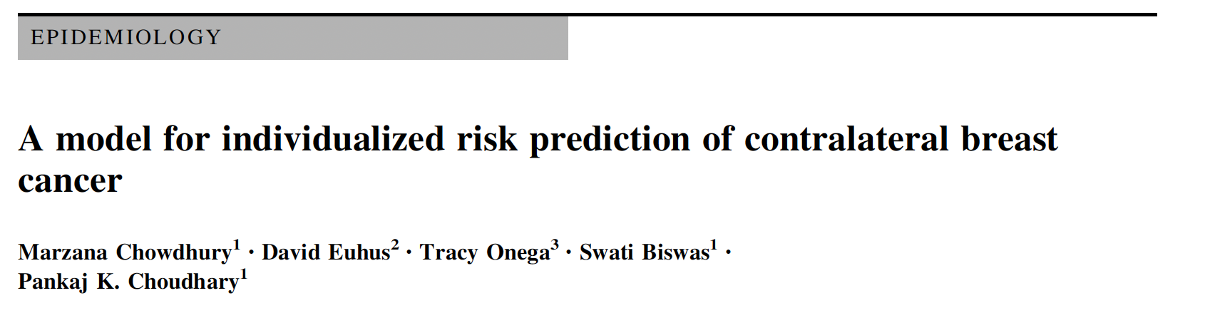

Slide 32
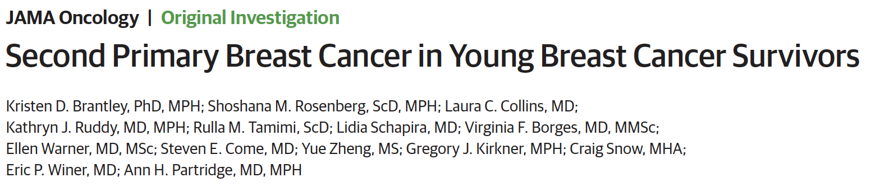
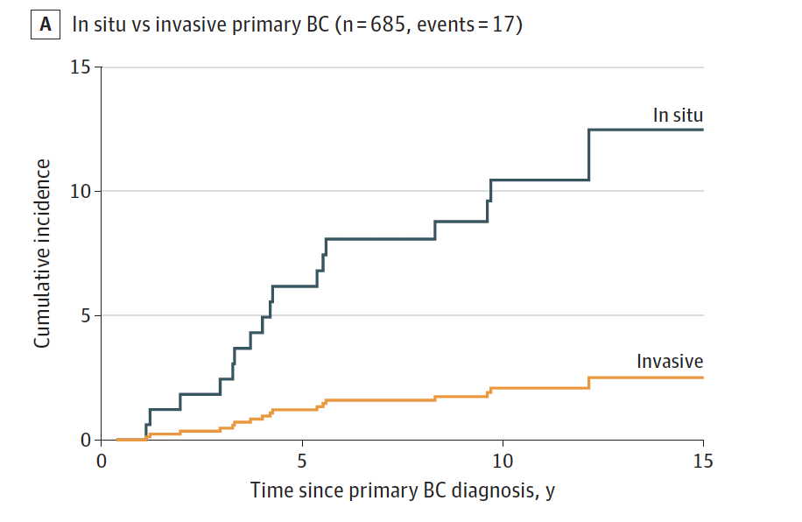
In situ 5-folder higher risk

Slide 33
Summary
Local control has a modest impact on survival
Local recurrence is a marker of bad biology – especially after mastectomy
Bigger is NOT better (surgery/radiation)
Integrate techniques to avoid re-excision
Consider excision + re-irradiation for selected IBTRs

Slide 34
Thank you

