Slide 1


Role of Sentinel Lymph Node
Biopsy and Axillary Dissection
Puneet Singh, MD, MS, FACS
Department of Breast Surgical Oncology
University of Texas
MD Anderson Cancer Center
Disclaimer: This presentation is intended for personal use and for informational purposes only and does not replace independent professional judgment. This presentation is the property of Physicians’ Education Resource, LLC (“PER”) and is protected by U.S. and international copyright laws. You may not copy, reproduce, distribute, transmit, modify, or create derivative works of the presentation without the prior written permission from PER.

Slide 2
Disclosure
None
Many slides courtesy of and adapted from Dr. Henry Kuerer

Slide 3
SLN Trials
Results from landmark
US Trials 1998-2004

Slide 4
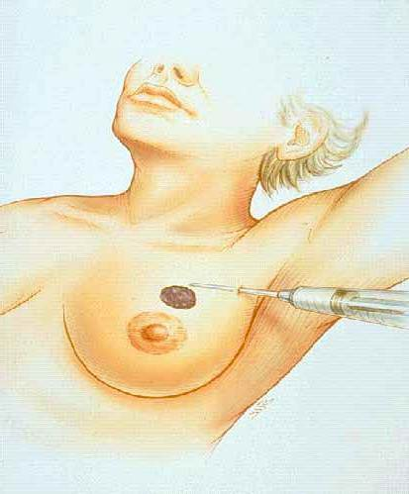

Lymphatic Mapping Technique
Radioactive agents, blue dye
Notes:
So what we do in lymphatic mapping is that we inject a blue-dye, lymphazurin around the tumor or a radioactive tracer to identify the SLN (point).

Slide 5
NSABP Protocol B-32 N = 5,611
Clinically Negative Axillary Nodes
Stratification
Age
Clinical Tumor Size
Type of Surgery
Randomization
GROUP 1
SN + AD
GROUP 2
SN
Intraop cytology & postop H&E
SN Pos
SN Neg
(SN+AD)
SN pos
+ AD
FU
SN Neg
(SN only)
1,975 patients
Krag DN et al. Lancet Oncol. 2010;11(10):927-33.
FU
2,011 patients
Notes:
07/16/96
##
*
*
In this randomized trial of 5,611 patients, women need to have invasive breast cancer (Operable invasive breast cancer, T1-T3, N0 Stage I and II) and a clinical node negative axilla. Patients undergoing a mastectomy or lumpectomy are eligible. In the first arm, all pts undergo complete axillary dissection after sln biopsy. In the other arm only the patients with a positive SLN undergo an axillary dissection. Those with a negative SLN are also blindly tested by IHC.
ONE problem - like many randomized trials - many women do NOT want to be randomized to standard axillary dissection.
Primary outcome results of NSABP B-32, a randomized phase III clinical trial to compare sentinel node resection (SNR) to conventional axillary dissection (AD) in clinically node-negative breast cancer patients.
NOTE 87% had lumpectomy
Abstract:Background: NSABP B-32 is the largest prospective randomized phase III trial designed to determine in SN negative patients that SNR alone results in the same survival and regional control as SNR + AD while reducing morbidity. It was designed to detect a survival difference of 2% between the 2 groups at 5 years. Methods: 5,611 women with operable, clinically N0, invasive breast cancer were randomized to SNR + AD (Group 1) or to SNR alone with AD only if SNs were positive (Group 2). 3,989 (71.1%) of the 5,611 patients were SN negative and followed for events. 99.9% of these SN negative patients had follow-up information: 1,975 in Group 1 and 2,011 in Group 2. Median time on study was 95.3 months. Patients were well balanced across clinical strata. Log-rank tests for unadjusted analyses and Cox proportional hazard models adjusting for study stratification variables were used to compare overall survival (OS) and disease-free survival (DFS) between the two groups. Two-sided p-values were used. HR values > 1 indicate a more favorable outcome in Group 1 (SNR + AD). Results: Comparisons of OS (Group 1 vs. Group 2) yielded an unadjusted HR of 1.20 (p = 0.12) and an adjusted HR of 1.19 (p=0.13). Five-year Kaplan-Meier estimates for OS are 96.4% in Group 1 and 95.0% in Group 2 and the 8-year estimates are 91.8% and 90.3%, respectively. Comparisons of DFS (Group 1 vs. Group 2) yielded an unadjusted HR of 1.05 (p=0.54) and an adjusted HR of1.07 (p=0.57). No substantial differences could be seen across sites for first treatment failure. Five-year Kaplan-Meier estimates for DFS are 89.0% in Group 1, and 88.6% in Group 2 and the 8-year estimates are 82.4% and 81.5%, respectively. Local and Regional Recurrences: There were 54 local recurrences in Group 1 and 49 in Group 2 (p=0.55). There were 8 regional node recurrences as first events in Group 1 and 14 in Group 2 (p=0.22). Conclusions: No significant differences were observed in OS, DFS, or regional control between the trial groups. Within the limits of this trial, SNR without AD is validated as a safe and effective method for regional node treatment of SN negative breast cancer patients.

Slide 6
B-32 Analysis Plan
3,989 - SN neg (71% of 5611)
99.9% - follow-up information
7.97 years – mean time on study
Primary endpoints OS, DFS, Regional Control
Study powered to detect 2% difference OS
Krag et al. 2010 ASCO.

Slide 7
NSABP B-32 False Negative Rate
9.8% (95% CI: 7.8 - 12.2)
Krag DN et al. Lancet Oncol. 2007;8(10):881-8.

Slide 8
NSABP B-32
Sentinel Node by Breast Biopsy Type
Type | Technical Success % | False Negative Rate %
Overall FNA/Core Incisional/ | 97.2 97.1 97.4 | 9.8 8.1 15.3
Excisional
 | P = .61 | P = .0082
Krag DN et al. Lancet Oncol. 2007;8(10):881-8.
Notes:
Also dual tracer w radiocolloid higher technical success

Slide 9
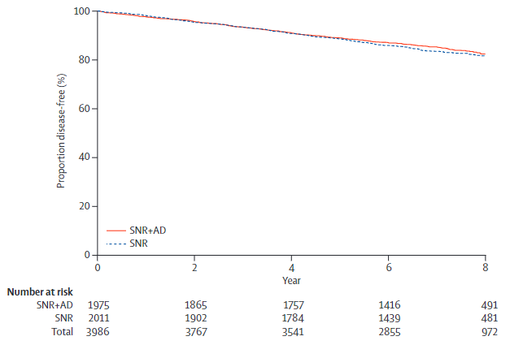
NSABP Protocol B-32
B-32 DFS
Disease-Free Survival for Sentinel Node Negative Patients
No difference in DFS between the two groups
Trt N Deaths
SNR+AD 1975 315
SNR 2011 336 HR=1.05 (95% CI: 0.90-1.22) P = .54
Krag DN et al. Lancet Oncol. 2010;11(10):927-33.

Slide 10
Local and Regional Recurrences
as First Events
B-32 RR
 | Group 1 | Group 2
Local | 54 (2.7%) | 49 (2.4%)
Axillary | 2 (0.1%) | 8 (0.3%)
Extra-axillary | 6 (0.3%) | 6 (0.3%)
No difference in locoregional events between the two groups
Krag DN et al. Lancet Oncol. 2010;11(10):927-33.
Krag et al. ASCO 2010.
Notes:
There was no difference in LR control among SLN vs SLN + AxDz
Important point here is that although the false negative rate was 9.8%; the clinical detectable axillary recurrence rate was significantly lower- in fact only 0.3%
(87% received BCT)

Slide 11
B-32 Morbidity
Residual Morbidity at End of Follow-up
Lower in SN group
Not nonexistent
 | Group 1 SN + AD | Group 2 SN
Shoulder abduction deficit | 19% | 13%
Arm volume difference >5% | 28% | 17%
Arm numbness | 31% | 8%
Arm tingling | 13% | 7%
Ashikaga T et al. J Surg Oncol. 2010;102(10):111-8.
All differences P < .001
Notes:
ARS question
Compared with axillary dissection, data from a randomized trial shows that patients having a sentinel node biopsy alone have less frequent:
A. Shoulder deficits
B. Evidence of lymphedema
C. Numbness and armed tingling
D. All of the above

Slide 12
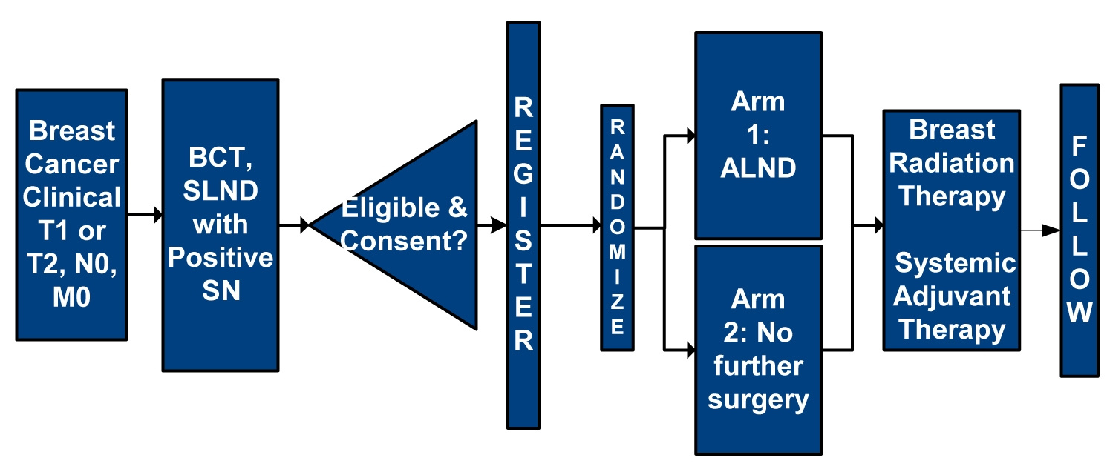
ACOSOG Z0011:
All patients node positive, detected by SLN biopsy
Primary Objective: Assess whether OS after SLND alone was not inferior to ALND for a positive SLN
Notes:
12
REMEMBER– you give good data on LRR among pts w ALND in this study- -point is that LRR is very very low- -
Ineligible if 3 or more positive SLN, matted, or gross nodal disease - -no third field radiation was allowed - -some pts who were randomized intraop and later found to have > 3 pos SLN were included in analysis
Even if the trial had accrued the 1900 targeted patients it would have taken more than 20 years of f/u to observe 500 deaths at the realized event rate

Slide 13
Patient Characteristics Z0011
Median age: 55 years
70% T1 tumors
82% ER-positive disease
All patients had node positive breast cancer (overall low burden)
  58% had only one node positive
  Only 21% had ≥ 3 positive nodes
Giuliano AE et al. Ann Surg. 2010;252(3):426-32.
Notes:
POINT low nodal burden
Selection bias for patients enrolled on Z0011 ?
69% of patients with Node Pos disease did not enroll on Z11 underwent cALND

Slide 14
Additional positive LNs
106 (27.3%) of patients treated with ALND had additional positive nodes removed beyond the SLN
Giuliano AE et al. Ann Surg. 2010;252(3):426-32.
Notes:
14

Slide 15
10-Year Loco-regional Recurrence
By Treatment Arm
ALND
(N = 420)
SLND
(N = 436)
P value
No difference in locoregional events between the two groups
Local
19 (5.6%)
12 (3.8%)
.13
Regional
2 (0.5%)
5 (1.5%)
.28
Total locoregional
21 (6.2%)
17 (5.3%)
.36
Median follow-up = 9.25 years (111 months)
Giuliano AE et al. Ann Surg. 2016;264(3):413-20.

Slide 16
Comparison of 10-Year Regional
Recurrence to Initial 5-Year Report
Nodal Recurrence
By 5 yrs
By 10 yrs
ALND
2 (0.5%)
2 (0.5%)
SLND
4 (0.9%)
5 (1.5%)
Only one additional regional recurrence was seen after 5 years
Giuliano AE et al. Ann Surg. 2010;252(3):426-32.
Giuliano AE et al. Ann Surg. 2016;264(3):413-20.

Slide 17
Adjuvant systemic therapy
 | ALND N = 420 | SLND N = 436
Chemotherapy | 57.9% | 58.0%
Hormonal therapy | 46.4% | 46.6%
Either/Both | 96.0% | 97.0%
Giuliano AE et al. Ann Surg. 2016;264(3):413-20.

Slide 18
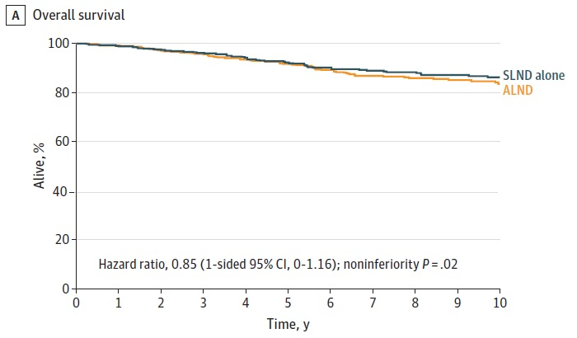
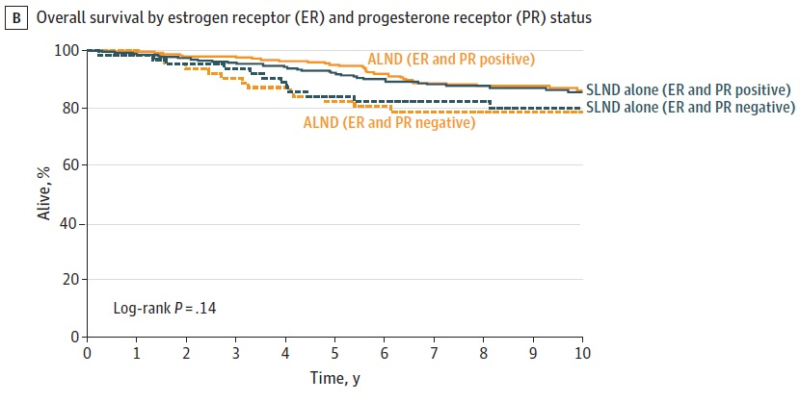
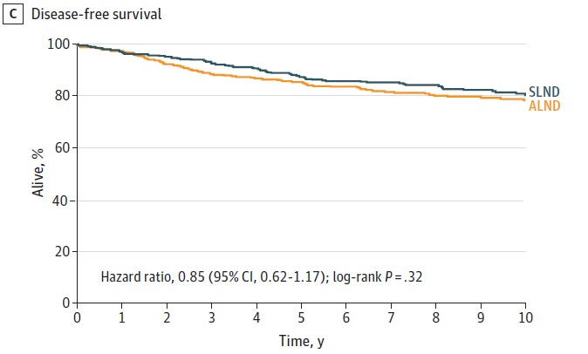
ACOSOG Z0011: OS and DFS
10-year overall and disease-free survival for patients treated with SLN alone was noninferior to survival for those treated with ALND
Giuliano AE et al. JAMA. 2017;318(10):918-26

Slide 19
Z0011: Conclusions
For patients with cT1-2 N0 breast cancer and 1-2+ SLN undergoing BCS with whole breast RT:
  No improvement in regional control with ALND
  No impact on 10-year survival
Does not apply to:
  Patients receiving neoadjuvant chemotherapy
  Patients undergoing mastectomy
  Patients receiving partial breast irradiation
Giuliano AE et al. JAMA. 2017;318(10):918-26
Notes:
19

Slide 20
International Breast Cancer Study Group (IBCSG) Trial 23-01
Phase III randomized trial of ALND vs SLND only
cT1-2 N0 patients with micromets (≤ 2mm) in ≥ 1 SLN
  In ALND group, 59 (13%) had additional positive nodes
  9% of patients in each arm underwent mastectomy
  Median follow-up = 9.7 yrs
 | ALND N = 464 | SLND only N = 467
Local recurrence | 14 (3%) | 13 (3%)
Regional recurrence | 3 (1%) | 9 (2%)
Ipsilateral axillary failure | 2 (<1%) | 8 (2%)
No difference in locoregional events between the two groups
Galimberti V et al. Lancet Oncol. 2018;19(10):1385-93.
Notes:
And even more recently in the international breast cancer study group trial 23-01, a randomized trial of ALND or SLN only in clinically node neg pts found to have micrometastatic dz in one or more SLN – there was no difference in LR recurrence with or without ALND at a median followup of 10 yrs – but there was an increased risk of regional and ipsi axillary failure 2 vs 8 – 4 times but the clinical significance of 2 % risk can be debated and 13% of pts in the ALND arm of this trial had additional positive nodes removed at the surgery

Slide 21
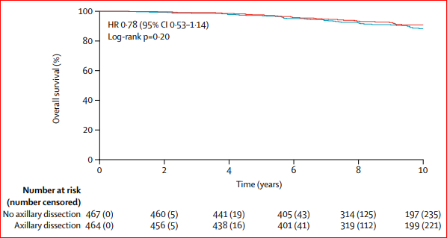
IBCSG 23-01 Survival
 | ALND N = 464 | SLND only N = 467 | HR (95% CI) | P value
10 yr DFS | 74.9% | 76.8% | 0.85 0.65-1.11 | .24
10-year overall and disease-free survival for patients treated with SLN alone was noninferior to those treated with ALND
Overall Survival
Galimberti V et al. Lancet Oncol. 2018;19(10):1385-93.
Notes:
In the IBCSG trial – although only a trial of micromets there was similarly no impact on DFS or overall survival for patients who did not undergo completion AND – and importantly 9% of patients in each arm of this study underwent mastectomy

Slide 22
Radiation Fields and RNI
ACOSOG Z0011 (Alliance) Trial
Case report forms: 605 patients
    89% WB; 11% NO RADIOTHERAPY
    15% supraclavicular field
228 detailed RT records
    81.1% tangents only, 18.9% ≥ 3 directed regional nodal RT fields, more common with greater nodal involvement (p<0.001)
    High-tangents used ≈ 50% of patients each arm
Jagsi R et al. J Clin Onc. 2014;32(32):3600-6.
Notes:
There was great concern that perhaps patients in the SLN arm had more comprehensive nodal radiotherapy- - jagsi et al looked at this and it is interesting to note that . . .that 11% and 15%

Slide 23
Radiation Fields and RNI
ACOSOG Z0011 (Alliance) Trial
No significant difference in RNI in SLN only versus ALND groups
The primary finding – that routine ALND is not necessary after +SLNB in one or two nodes– stands
Jagsi R et al. J Clin Onc. 2014;32(32):3600-6.
Notes:
This was a surgery trial- - we cant draw any conclusions regarding the need or lack thereof for additional nodal field radiotherapy

Slide 24
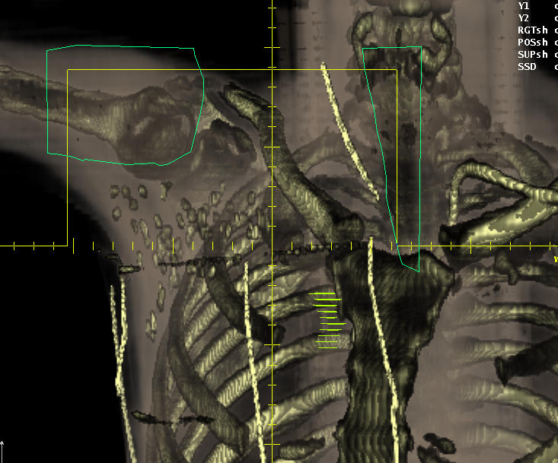
Axillary Radiotherapy?
*
Jagsi R et al. J Clin Onc. 2014;32(32):3600-6.
Notes:
24
14% had 4 or more pos nodes in ALND
21% 3 or more nodes in ALND
Many radiation oncologists will treat the axilla when a positive SLN is obtained and no dissection is performed

Slide 25
Can Axillary Radiation Be Substituted for Completion Axillary Lymph Node Dissection
When a Sentinel Lymph Node Contains Metastases?
(Is it necessary?)

Slide 26
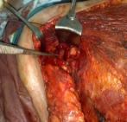
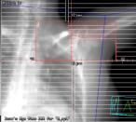
AMAROS: EORTC 10981-22023
After mapping axilla: radiation or surgery?
  Hypothesis: AxRT provides comparable local control and survival as ALND with fewer side effects
  cT1b-2 N0
  BCT or mastectomy
Positive SLN randomized to ALND or AxRT
N = 1,425
AxSN+
ALND
cT1-2
N0
SNB
R
AxRT
AxSN-
Donker M et al. Lancet Oncol. 2014;15(12):1303-10.
Notes:
26
The axillary recurrence rate was far below hypothesized, hence, the trial was underpowered
EORTC 10981-22023
Target volume
The contents of all 3 levels of the axilla together with the medial part of the supraclavicular fossa are
considered as target area for radiotherapy of the axilla. The levels are defined according to their
relation with the minor pectoral muscle, level I being lateral, level II directly beneath and level III
medial to this muscle. As a radiological landmark its origin, the coracoid process, will be used.
Treatment of full patient thickness is necessary for level II and I (lateral to the coracoid process). The
target volume of level III can be defined at a depth of 3 cm from the anterior skin surface. The
cranial border is determined by the sternoclavicular joint which should be included with a margin of
3 cm, the medial border by the midline of the sternum and the lateral border by the insertion of the
major pectoral muscle at the humerus. Special attention should be paid in sparing at least 1 cm skin in the cranial part of the field (m. trapezius) i. e. to avoid glancing of the field at this site. The caudal
border may be the cranial end of chest wall or breast fields but should be at least at the level of the
sternal insertion of the second rib (angulus sterni), medially and at the level of the fourth rib,
laterally. Dose Specification
The dose to the axilla should be given at full patient thickness at level II and I (lateral to coracoid
process) and at 3 cm depth at level III. The dose should therefore be specified both medially at 3 cm
depth from the anterior skin surface (3 cm from medial and cranial field borders) and laterally at half
patient’s thickness along the beam axis of the smaller posterior axillary field. The dose should be
specified and identical in both of the above mentioned points and not vary more than plus or minus
5% of the specified dose across the target volume.
Dose Prescription
The prescribed dose to the axilla as a whole is 50 Gy in 25 fractions of 2 Gy treated on a daily basis,
five days a week. A biologically equivalent dose may be used calculated according to the LQ model
using an a/ß ratio of 2 Gy. A maximum fraction dose of 2 Gy is allowed.

Slide 27
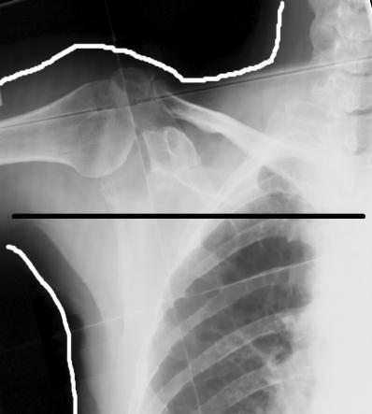
AMAROS Radiation Fields
Extent:
Level I + II + III + medial SC
Dose & schedule:
25 x 2 Gy or equivalent
Quality control:
Dummy run
Hurkmans CW et al. Radiother Oncol. 2003;68(3):233-40.
Rutgers EJ et al. ASCO 2013.

Slide 28
AMAROS Nodal Recurrence
In ALND group, 244 (32.8%) patients had additional positive nodes
Median follow-up = 10.0 years (IQR 8.4-10.3)
 | ALND N=744 | AxRT N=681
Axillary recurrence | 7 (0.9%) | 11 (1.6%)
Axillary recurrence in SLN negative patients = 0.72%
Rutgers EJ et al. ASCO 2013.
Bartels et al. J Clin Oncol. 2023;41(12):2159-65.
Notes:
28
Planned non-inferiority test was underpowered due to unexpectedly low number of events
Both studies z11 and amaros reported an ax recurrence rate of about 1%- QUESTIONING the actual need of additional Axillary RT

Slide 29
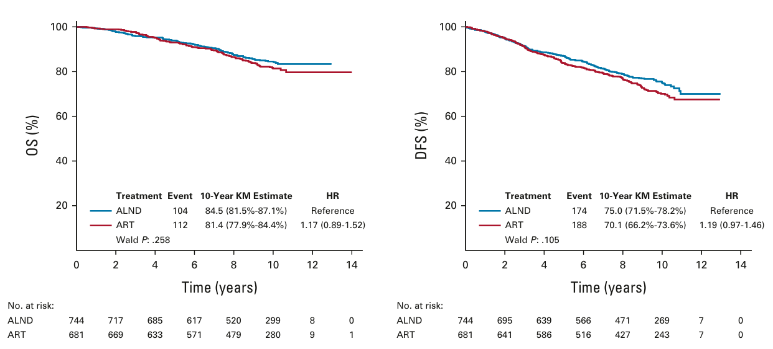
AMAROS
No difference in OS or DFS
OS
DFS
HR: 1.17; 95% CI: 0.89-1.52, p=0.26
HR: 1.19; 95% CI: 0.97-1.46, p=0.11
Bartels et al. J Clin Oncol. 2023;41(12):2159-65.
Notes:
29

Slide 30
AMAROS Lymphedema
Decreased lymphedema with AxRT
40.0%
Percentage
29.8%
21.7%
16.7%
13.6%
P < 0.0001
P < 0.0001
P < 0.0001
Years
Donker M et al. Lancet Oncol. 2014;15(12):1303-10.
Rutgers EJ et al. 2013 ASCO.
*Lymphedema observed or treated
Notes:
30

Slide 31
Z0011/AMAROS
Lymphedema rates
    ALND 44%
    AxRT 29%
    SLND 5%
  Based on Z0011, 82% of patients enrolled on AMAROS could have avoided both ALND and AxRT
Bartels et al. J Clin Oncol. 2023;41(12):2159-65.
Giuliano AE et al. JAMA. 2017;318(10):918-26
Notes:
31
But based simply on criteria for Z11 enrollment at least 80% of pts could have avoided Ax DZ and radiotherapy and the associated higher rates of lymphedema

Slide 32
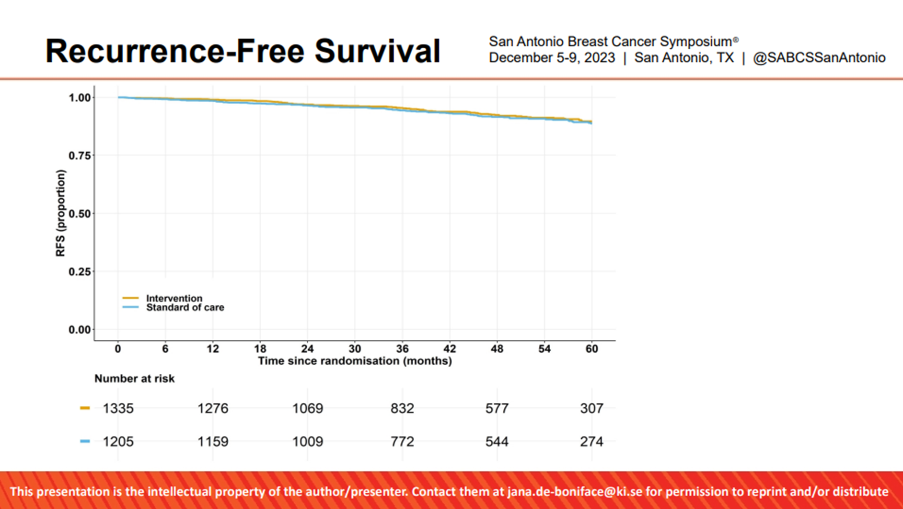
SENOMAC trial
International randomized non-inferiority trial comparing ALND versus no ALND
Enrolled T1-T3N0 (by palpation) male and female patients with 1-2 SLNs with macrometastases
2540 patients with 1205 in ALND arm and 1335 in intervention arm
Median follow-up 47 months
85% with 1 positive SLN
36.2% had mastectomy
Omission of ALND non-inferior to ALND
  88-89% received adjuvant RT including nodal regions
5-year recurrence-free survival
de Boniface et al. N Engl J Med. 2024;25(9);1222-1230.

Slide 33
RCTs evaluating omission of ALND in SLN+
 | ACOSOG Z0011 | IBCSG 23-01 | AMAROS | SENOMAC
Randomization | ALND vs no ALND | ALND vs no ALND | ALND vs Axillary RT | ALND vs no ALND (*88% had axillary RT)
N | 891 | 931 | 1425 | 2540
Population | cT1-2 N0 M0 invasive breast cancer, BCS, SLN 1-2+ | cT1-2 N0 M0 invasive breast cancer, SLN micrometastasis (<2 mm), no ENE | cT1-2N0 M0 invasive breast cancer, SLN + | cT1-3N0M0 invasive breast cancer, SLN 1-2+
% mastectomy | None – all BCS | 9% in each arm | 17% ALND, 18% Axillary RT | 36% ALND, 37% no ALND
Survival | 10 years - No difference OS, DFS | 5 years - No difference DFS | 10 years - No difference in OS, DFS | 5 years – No difference in OS, BCSS, RFS
Recurrence | 10 years - No difference 0.5% vs 1.5% (axillary) | 5 years - No difference Local 2% vs 2% Regional <1% vs 1% | 10 years - No difference 0.93% ALND vs 1.82% ART (axillary) | 5 years – No difference Local 0.9% vs 0.8% (ALND) Regional 0.4% vs 0.5% (ALND)
Lymphedema | ALND > SLN alone | ALND > SLN alone (13% vs 3%) | ALND >Axillary RT (44.2% vs 28.6%) | Not reported
Additional LN+ in ALND | 27% | 13% | 33% | 34.5%
Giuliano et al. JAMA 2011, Ann Surg 2010, Ann Surg 2016, JAMA 2017; Galimberti et al. Lancet Oncol 2013; Donker et al. Lancet Oncol 2014; Bartels et al. J Clin Oncol 2023; de Boniface et al. NEJM 2024.

Slide 34
RCTs evaluating omission of ALND in SLN+
 | ACOSOG Z0011 | IBCSG 23-01 | AMAROS | SENOMAC
Randomization | ALND vs no ALND | ALND vs no ALND | ALND vs Axillary RT | ALND vs no ALND (*88% had axillary RT)
N | 891 | 931 | 1425 | 2540
Population | cT1-2 N0 M0 invasive breast cancer, BCS, SLN 1-2+ | cT1-2 N0 M0 invasive breast cancer, SLN micrometastasis (<2 mm), no ENE | cT1-2N0 M0 invasive breast cancer, SLN + | cT1-3N0M0 invasive breast cancer, SLN 1-2+
% mastectomy | None – all BCS | 9% in each arm | 17% ALND, 18% Axillary RT | 36% ALND, 37% no ALND
Survival | 10 years - No difference OS, DFS | 5 years - No difference DFS | 10 years - No difference in OS, DFS | 5 years – No difference in OS, BCSS, RFS
Recurrence | 10 years - No difference 0.5% vs 1.5% (axillary) | 5 years - No difference Local 2% vs 2% Regional <1% vs 1% | 10 years - No difference 0.93% ALND vs 1.82% ART (axillary) | 5 years – No difference Local 0.9% vs 0.8% (ALND) Regional 0.4% vs 0.5% (ALND)
Lymphedema | ALND > SLN alone | ALND > SLN alone (13% vs 3%) | ALND >Axillary RT (44.2% vs 28.6%) | Not reported
Additional LN+ in ALND | 27% | 13% | 33% | 34.5%
No difference in survival or recurrence outcome with no ALND in patients with early-stage breast cancer and positive SLN (limited burden)
Giuliano et al. JAMA 2011, Ann Surg 2010, Ann Surg 2016, JAMA 2017; Galimberti et al. Lancet Oncol 2013; Donker et al. Lancet Oncol 2014; Bartels et al. J Clin Oncol 2023; de Boniface et al. NEJM 2024.

Slide 35
AMAROS, Z0011, IBCSG 23-01, SENOMAC
Conclusions
SLN alone for patient with T1/2 node positive disease in 2 or fewer nodes provide effective local control with breast conserving therapy
Ax radiotherapy or ALND provide effective local regional control in SLN + patients
Additional benefit of Level III and SC radiotherapy fields not clear
Long term lymphedema rate significant concern
Notes:
Note > 4 LNs in the Ax Dz arm also got additional XRT
THERE WAS NO SIG DIF AMONG IN DFS AND OS AMONG PTS WHO RECEIVED COMPREHENSIVE AXILLARY AND SC XRT TO THOSE WHO HAD ONLY AX DZ

Slide 36
Recommendations for Axillary Node Dissection at MD Anderson
Positive SLN
  > 2 positive SLNs
  Mastectomy with macrometastases in SLNs unless receiving PMRT (AMAROS, SENOMAC, NCCN 2017 forward)
  Neoadjuvant chemotherapy
Notes:
NCCN in 2015

Slide 37
2025 ASCO Axillary Management Guideline Updates
SLNB is not required for postmenopausal patients age ≥50 yrs with clinically node-negative ER-pos HER2-neg (T1N0) unifocal invasive breast cancer and negative axillary ultrasound
ALND should not be offered to patients without nodal metastases
ALND should not be performed if only 1 or 2 SLN positive and receiving BCT; ALND can also be avoided in mastectomy if PMRT planned
Among neoadjuvant cases: SLNB can be offered if initially clinically node neg after neo and not before, if initially node positive can perform SLNB with clipped node removal (TAD), if still path positive rec ALND
Use of radiocolloid sufficient for SLN mapping, dye can be added if no drainage
Lyman GH et al. J Clin Oncol. 2014;32(13):1365-83.
Lyman GH et al. J Clin Oncol. 2017;35(5):561-564.
Brackstone M et al. J Clin Oncol. 2021;39(27):3056-82.
Park KU et al. J Clin Oncol. 2025;43(14):1720-41.
Notes:
Guideline says Ontario health and asco in title: Also part of rec 5 is ultrasound of the axilla not necessary if T1 and T2 if no palpable nodes- they say risk outweighs benefit…

Slide 38
2025 ASCO SLN Consensus Guidelines
SLN biopsy is appropriate for patients:
receiving preoperative systemic therapy
with previous breast/axillary surgery
with ductal carcinoma in situ (DCIS) undergoing mastectomy
with multicentric carcinoma
with cT4a-c disease
[NOT FOR INFLAMMATORY BREAST CANCER or PURE DCIS getting lumpectomy]
Lyman GH et al. J Clin Oncol. 2014;32(13):1365-83.
Lyman GH et al. J Clin Oncol. 2017;35(5):561-564.
Park KU et al. J Clin Oncol. 2025;43(14):1720-41.

Slide 39
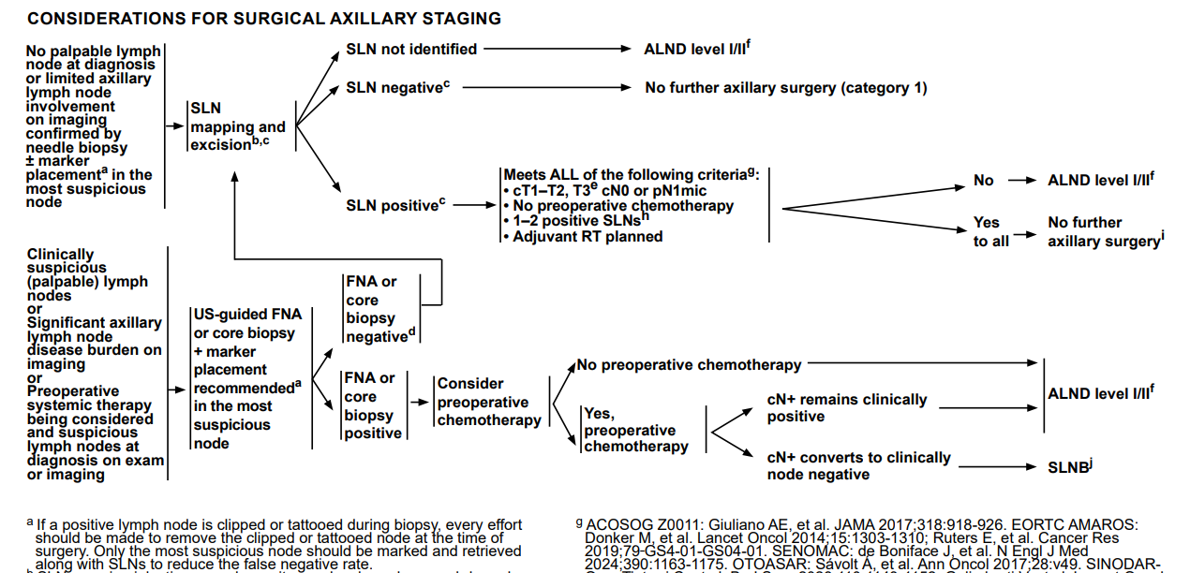
2025 NCCN Guidelines – Invasive Breast Cancer
Ensure clip removal

Slide 40
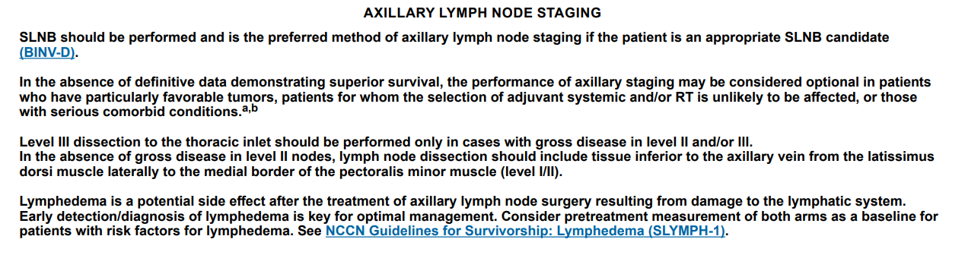
2025 NCCN Guidelines – Invasive Breast Cancer

Slide 41
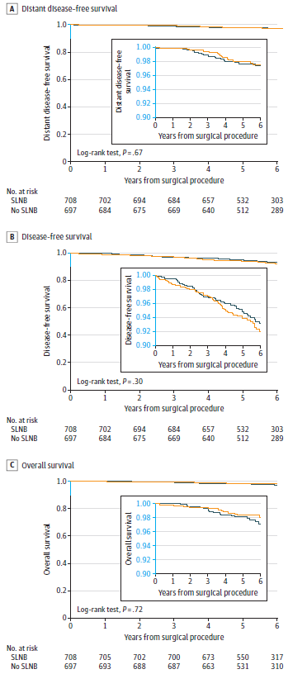
The SOUND RCT: Assessing role of SLNB
RCT from 2012-2017 across 18 European centers of patients of any age with:
  Invasive cancer up to 2cm
  cN0 with negative axillary US
  Undergoing breast conservation surgery with RT
1405 women – 708 had SLNB and 697 had no axillary surgery
Median age: 60 years
Gentilini OD et al. JAMA Onc. 2023;e233759.

Slide 42
The SOUND RCT: Assessing role of SLNB
 | SLNB | No axillary surgery
Locoregional relapse | 12 (1.7%) | 11 (1.6%)
Distant metastases | 13 (1.8%) | 14 (2.0%)
Deaths | 21 (3.0%) | 18 (2.6%)
Evidence further supporting that SLNB does not provide therapeutic benefit – for staging
Gentilini OD et al. JAMA Onc. 2023;e233759.
https://www.surgonc.org/wp-content/uploads/2020/11/SSO-5things-List_2020-Updates-11-2020.pdf

Slide 43
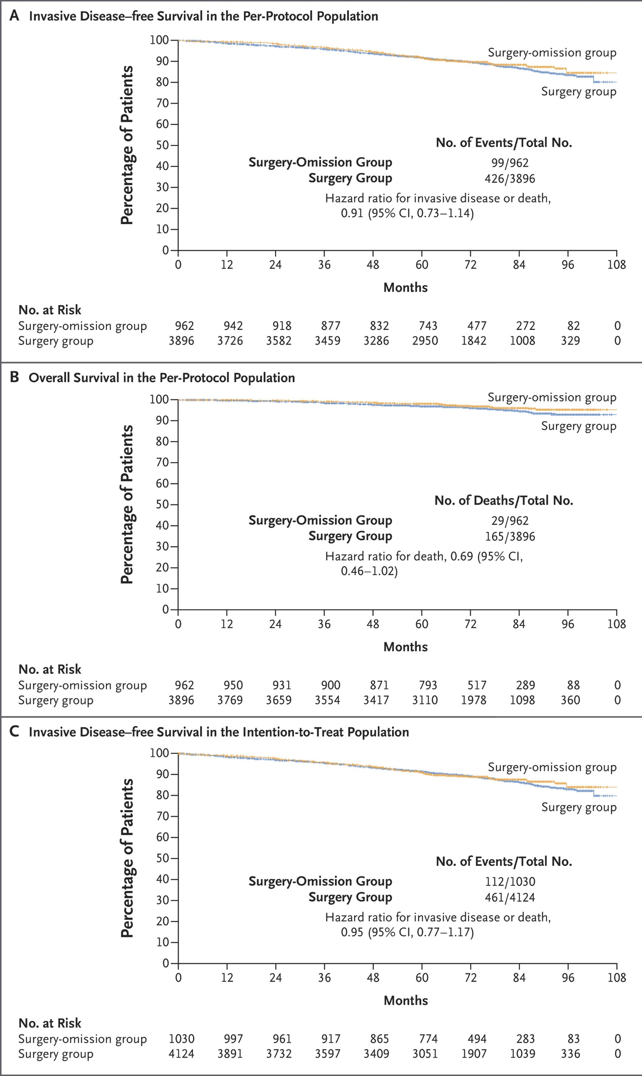
INSEMA
RCT from 2015-2019 enrolling patients of any age from centers across Germany & Austria with:
  Invasive cancer ≤ 5cm
  cN0 with negative axillary US
  Undergoing breast conservation surgery with RT
4858 women (4:1 randomization) – 3896 had SLNB and 962 had no axillary surgery
Median age: 62 years (53-68)
Reimer T et al. NEJM. 2025;392(11):1051-1064.

Slide 44
Omission of SLNB
 | SOUND | INSEMA
Randomization | SLNB vs no SLNB | SLNB vs no SLNB (4:1)
N | 1,405 708 SLNB vs 697 no SLNB | 4,858 3,896 SLNB vs 962 no SLNB
Population | cT <2cm, cN0 (including negative axillary ultrasound) invasive breast cancer, BCT | cT ≤5cm (90% ≤2cm), cN0 invasive breast cancer, BCT
Age | Median (IQR) 60 years (52-68) | Median (IQR) 62 years (53-68) Only 10.8% < 50 years of age
Survival | 5-year DDFS: 97.7% SLNB vs 98.0% no SLNB HR 0.84 (90% CI 0.45-1.54) 5-year OS: 98.2% vs 98.4% (p=0.72) | 5-year iDFS: 91.7% SLNB vs 91.9% no SLNB HR 0.91 (95% CI 0.73-1.14) 5-year OS: 98.2% vs 96.9%
Recurrence | Local 1.0% SLNB vs 0.9% no SLNB Axillary 0.4% vs 0.7% | Local 1.1% SLNB vs 0.8% no SLNB Axillary 0.3% vs 1.0%
Gentilini OD et al. JAMA Onc. 2023;e233759.
Reimer T et al. NEJM. 2025;392(11):1051-1064.

Slide 45
So when can SLNB safely be omitted?
Two RCTs with excellent survival outcomes and low rates of recurrence
Appropriate for smaller HR+ tumors (i.e. ≤ 2cm)
  Higher rate of SLN positivity with larger tumors
Ability to perform high quality axillary ultrasound, ie imaging N0
When adjuvant therapy decisions can be made independent of the SLNB information
  Most commonly in postmenopausal/older women
Choosing Wisely guidelines previously existed supporting omission of SLNB in women ≥ 70 years of age with early-stage, cN0 HR+, Her2-negative breast cancer
Lyman GH et al. J Clin Oncol. 2014;32(13):1365-83.
Lyman GH et al. J Clin Oncol. 2017;35(5):561-564.

Slide 46
When to do SLNB?
Premenopausal patients with SLN-positive, HR+ breast cancer may be recommended chemotherapy and/or CDK4/6i
Small subsets of patients with:
  Invasive lobular carcinomas
  Her2+ or triple negative breast cancers
Patients undergoing mastectomy
For RT options such as partial breast irradiation or omission

Slide 47
Omitting both SLNB and RT
Without axillary staging, patients may be limited in terms of:
  Radiotherapy options such as partial breast irradiation
  Clinical trials evaluating radiotherapy omission (IDEA¹, DEBRA²)
Omitting SLNB & RT may be appropriate in patients ≥ 70 years
  CALGB 9343 was a RCT of 636 patients age ≥ 70 with cT1cN0 HR+/Her2- tumors randomly assigned to Tamoxifen + RT versus Tamoxifen alone
  2/3 of the patients had no axillary dissection
  No improvement in 10-year OS or distant disease-free survival with TamRT though small improvement in locoregional control
SLNB is a staging modality that is
still necessary for many patients
Hughes K et al. J Clin Oncol. 2013;31(19):2382-2387.

Slide 48
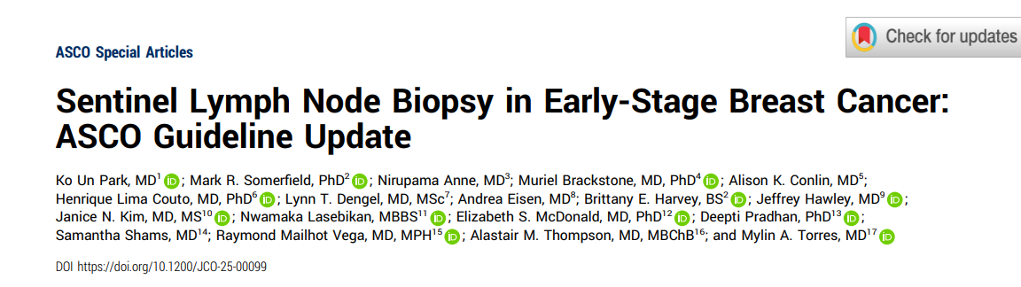
Comprehensive guidelines
Omitting SLNB recommended for postmenopausal patients ≥ 50 years of age with grade 1-2, small (≤2cm) HR+/Her2- with negative axillary US findings and undergoing breast conservation therapy
Park KU et al. J Clin Oncol. 2025;43(14):1720-1741.

Slide 49
Limiting Axillary Surgery in US-Guided Biopsy Proven Nodal Metastases
Targeted Axillary Dissection (TAD)

Slide 50
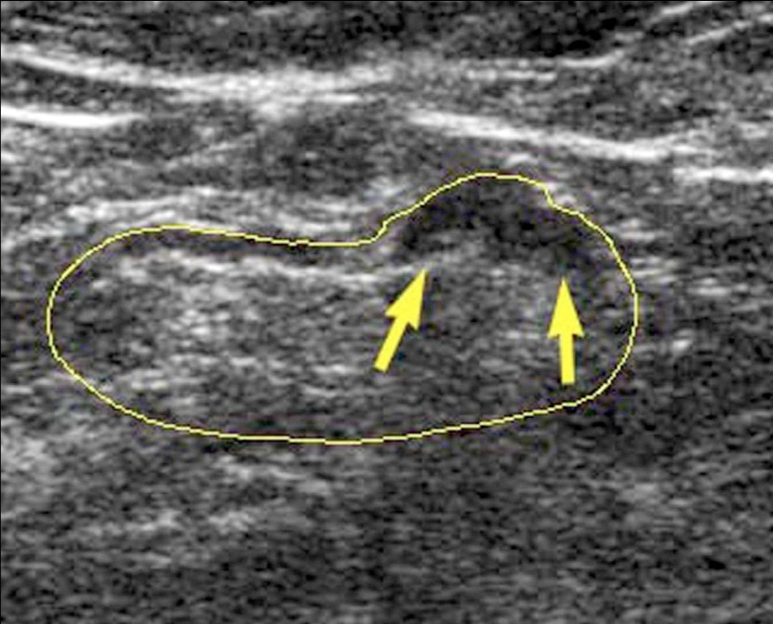
Nodal Ultrasound at Diagnosis
All patients with invasive disease at MD Anderson receive whole breast and regional nodal ultrasound
  Ipsilateral axilla, internal mammary, infra and supraclavicular
Minute metastatic foci can be detected
Courtesy Dr. Bruno Fornage
Notes:
For the past 19 years or so….Routinely ipsilateral axillary and internal mammary nodes- if abnormal then infra/supraclav and low neck nodes
Minute (measuring at least 4 or 5 mm) metastatic foci can be
detected at the periphery of a totally echogenic node or if they
produce a focal hypoechoic bulge on the surface of the node
Even when the central fat is hypoechoic, metastatic
deposits appear darker than the hypoechoic fat.

Slide 51
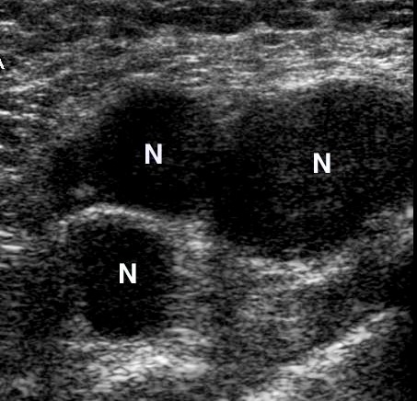
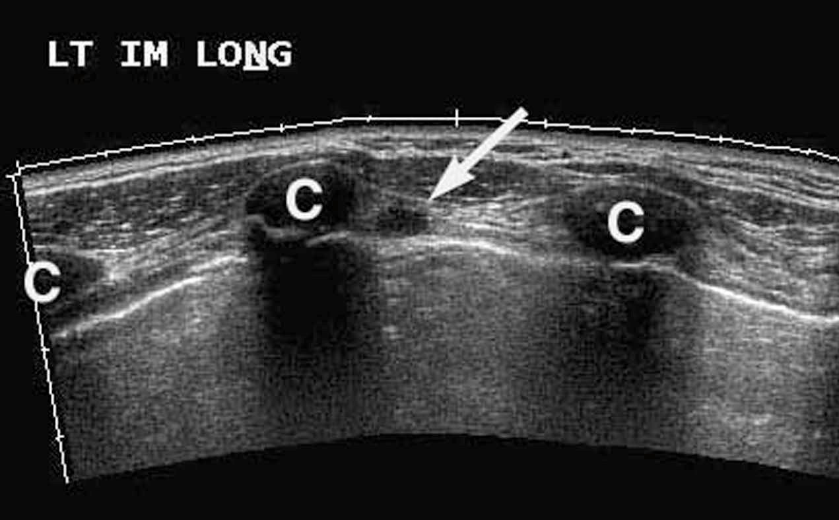
Metastatic Nodal Disease
Courtesy Dr. Bruno Fornage
Notes:
Lymph nodes that are massively involved with metastatic tumor are easily recognized on US as rounded (when small) or irregularly shaped (when large) masses with little or no residual central echogenic fat- - nodal disease can also be identified in the internal mammary nodes- when metastatic disease is not present- these nodes are not normally seen with ultrasound
CHECK
Metastatic internal mammary nodes are classified as N2 (in
the absence of clinically evident axillary lymph node metastasis)
or N3b (in the presence of clinically evident axillary lymph node
metastasis). Detection of an internal mammary nodal metastasis
(in addition to axillary metastases) therefore qualifies the disease
as stage IIIC. (See Chapter 13 for cancer staging tables.)

Slide 52
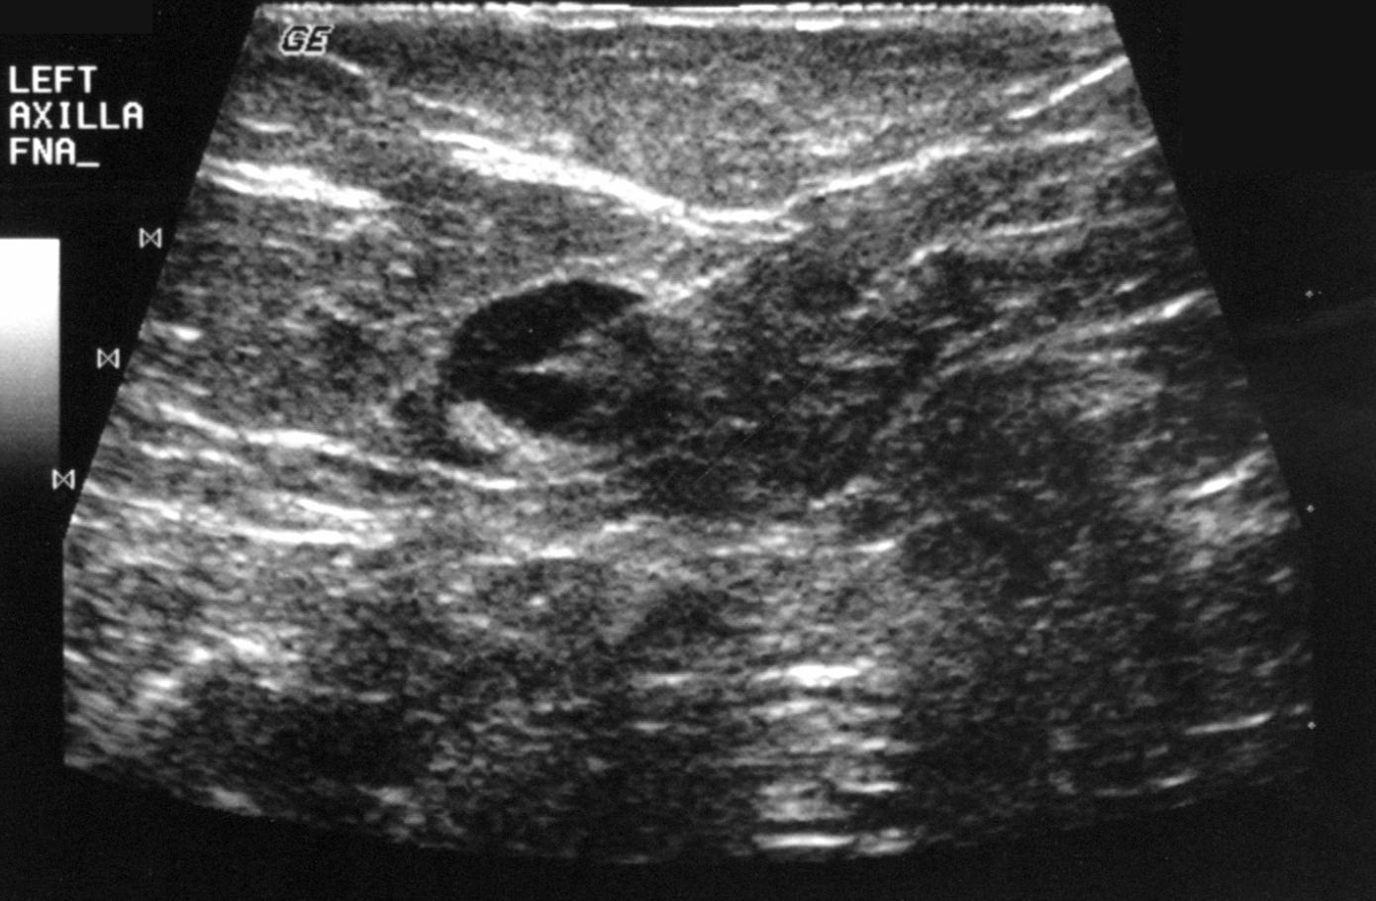
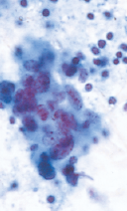
Ultrasound Guided FNA
Specificity: 100%
Positive Predictive Value: 100%
Krishnamurthy S et al. Cancer. 2002;95(5):982-8.
Notes:
In a review of 103 cases of US-guided FNA biopsy of nonpalpable
indeterminate or suspicious/metastatic-appearing
lymph nodes, the sensitivity of US combined with US-guided
FNA was 86%, the specificity was 100%, the overall accuracy
was 79%, the positive predictive value was 100%, and the
negative predictive value was 67%.
mets > 5 mm 93%
LNs mets < 5 mm 44%
Possible causes of discrepancies (essentially false-negative
results) in US-guided FNA biopsies of axillary nodes include
small size of the metastasis (metastases ≤ 5 mm cannot be visualized);
the small number of metastases; and human error, such
as incomplete examination of the axilla, the operator’s failure to
see the abnormality or to interpret it, and improper technique
in performing US-guided FNA (eg, error in targeting the lesion
or inadequate aspiration, resulting in insufficient specimen).
Because nodes are easy to aspirate, the rate of obtaining nondiagnostic
specimens from lymph nodes should be close to 0%.

Slide 53
Sentinel Node Biopsy after Preoperative Chemotherapy for Node Positive Breast Cancer?

Slide 54
Conversion of Axillary Metastases:
FNA Positive to Pathologic Negative
POSITIVE
191
patients
Pathologic
NEGATIVE
43 patients
FAC X 4
23%
Median # LNs Removed = 16
Kuerer HM et al. Ann Surg. 1999;230(1):72-8.
Notes:
LOCALLY ADVANCED BREAST CANCER
We and others have shown that neoadjuvant chemotherapy can completely erradicate axillary metastases prior to surgery. In this study, of 191 pts with documented ax mets by FNA 23% were completely converted to a completely negative axilla following chemotherapy. Therefore we wondered if SLN biopsy could guide the need for axillary dissection FOLLOWING chemotherapy.
[A larger percentage of patients who presented with N1 disease had a complete pathologic axillary response with neoadjuvant chemotherapy (18/54 patients, 33%) compared to those who presented with N2 disease (18/79 patients, 23%); although the difference was not statistically different (P = 0.179).]

Slide 55
Conversion of Axillary Metastases:
FNA Positive to Pathologic Negative
POSITIVE
109
patients
Pathologic
NEGATIVE
81 patients
Trastuzumab
+ A or T
HER2+
74%
Median # LNs Removed = 19
Dominici LS et al. Cancer. 2010;116(12):2884-9.

Slide 56
SLN after Preoperative Chemotherapy for
Node Positive Breast Cancer
Retrospective Studies
Prospective Studies
Author | Year | # Pts | FNR %
Mamounas | 2005 | 108 | 7.0
Shen | 2007 | 61 | 25
Classe | 2008 | 65 | 15
Gimberguess | 2008 | 27 | 29.6
Gomez | 2008 | 34 | 15
Chintamini | 2011 | 30 | 13.3
Canavese | 2011 | 64 | 5.1
Alvarado | 2012 | 121 | 20.8
Trial, Author | Year | # Pts | FNR %
ACOSOG Z1071* Boughey | 2013 | 525 | 12.6% (8.7)*
SENTINA Kuehn** | 2013 | 592 | 14.2
SN-FNAC Boileau | 2015 | 153 | 8.4% (13.3)#
*cN1 with at least 2 SLNs; FNR 8.7 if IHC used
**Most not biopsy proven, conversion from clinical pos to neg
#IHC used micromets and ITC considered ‘positive’
Notes:
Retrospective studies – some very small- lacked standardized technique and imaging – but showed that the FNR varied form 5 to 30%
** Sentina - dual tracer only 28%- but with dual tracer FNR in arm C 8.6% - 70 cases
(clinically positive versus radiologic etc)

Slide 57
Axillary management after neoadjuvant chemotherapy
Node negative
  SLND (after neoadjuvant chemotherapy)
  ALND if SLN +
Node positive-biopsy proven
  2014 NCCN guidelines → ALND
  2015 NCCN guidelines → Emerging role for targeted axillary dissection (TAD)
  2016 NCCN → SLN if clinically negative, marking of nodes to ensure removal, dual-tracer, at least 2 SLN

Slide 58
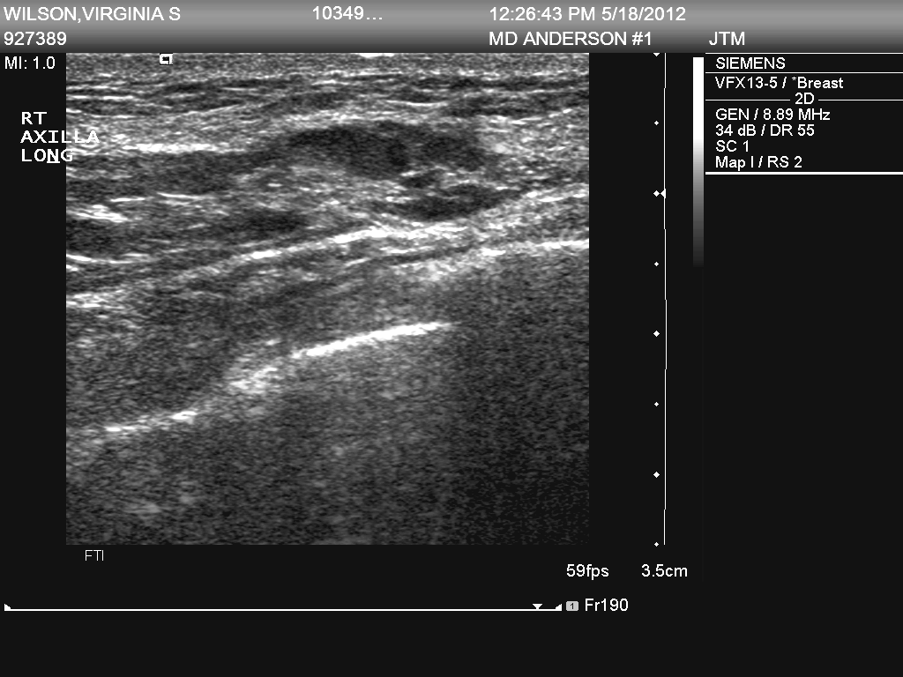
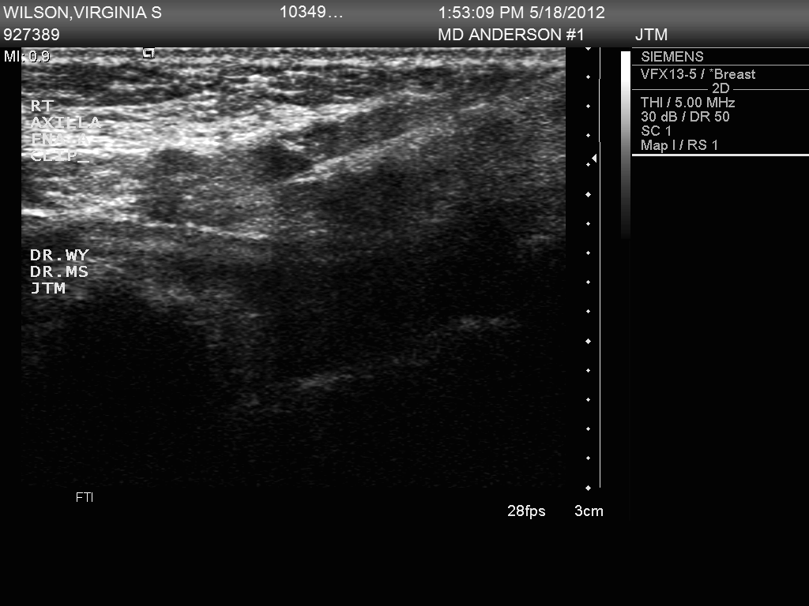
Nodal FNA and Placement of Clip Marker When Metastatic Disease Identified
Notes:
At MDA we place markers within the nodes identified with metastases JUST LIKE we ordinarily do with disease within the breast

Slide 59
Identification and removal of the clipped node with biopsy proven mets prior to chemo will increase accuracy of the SLN procedure after neoadjuvant chemo
Hypothesis

Slide 60
Prospective Registry of Breast Cancer Patients with Axillary Nodal Metastases Identified During Ultrasound Staging at MD Anderson Cancer Center: Protocol 11-1087
Eligibility:
  Abnormal axillary nodes on US metastases documented by cytology
  Marker clip placed in node with metastases
  Preoperative chemotherapy
  Routine axillary node dissection to determine the false-negative rate

Slide 61
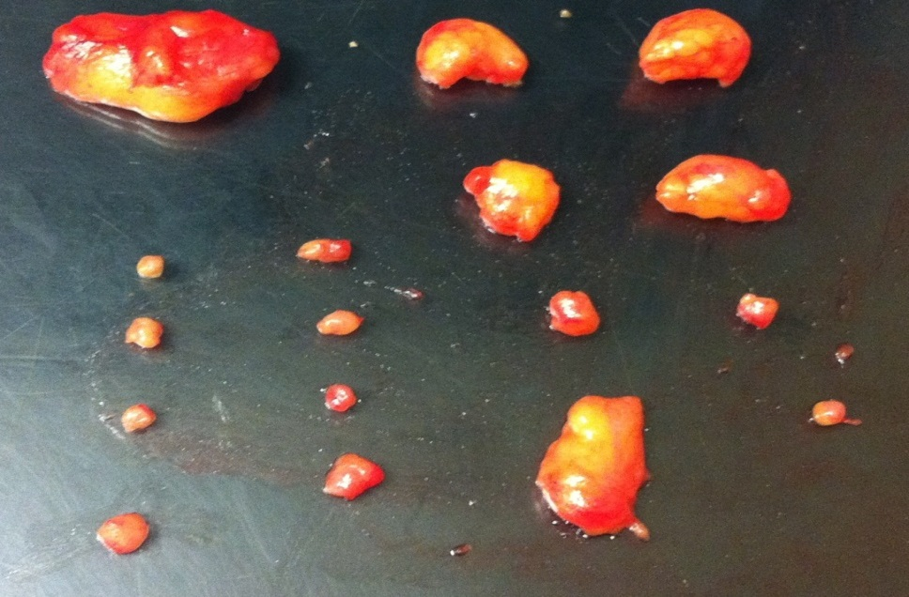
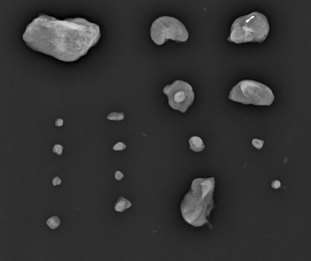
Prospective Registry of Breast Cancer Patients with Axillary Nodal Metastases Identified During Ultrasound Staging at MD Anderson Cancer Center: Protocol 11-1087
Routine ALND, identification of marked node, pathologic correlation (disease presence and size) with compared with other nodes
Notes:
OUR HYPOTHESIS was that just checking the node that had the DOCUMENTED nodal mets prior to chemo will predict the status of the remaining nodes
Patient 917097
2/17 LNs had mets – one with the clip- one without clip both mets < 2mm
Might the non clipped node be another SLN??? Who knows?

Slide 62
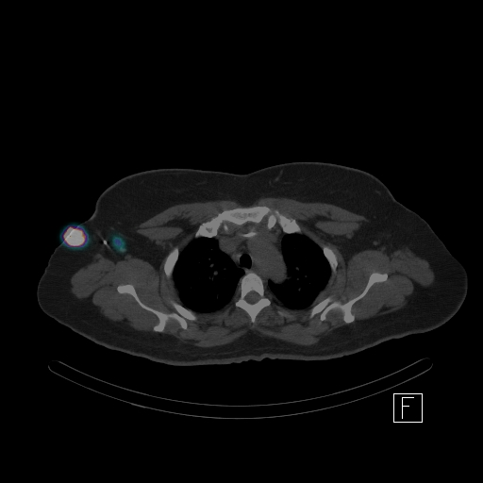
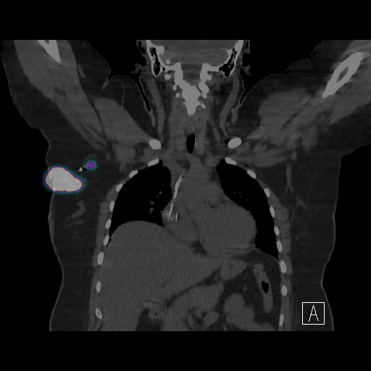
I¹²⁵ seed Technical Success with SLND
Technically successful with SLND (100%)
I¹²⁵ seed does not interfere with Tc99M lymphoscintigraphy
Node with radioisotope
Primary tumor
I¹²⁵ Seed
I¹²⁵ Seed
Node with radioisotope
Primary
tumor
Caudle AS et al. JAMA Surg. 2015;150(2):137-43.
Notes:
NOTE other groups use needle – localization- - and newer devices are being tested
Utilizing I125 seed placement into the clipped node prior to surgery allowed for a technical successful removal of the node that had been biopsied together using technetium sulphur colloid
We Initial concern that I-125 seed might interfere with isotope mapping
CT-spec

Slide 63
MD Anderson Experience with TAD
Clipped node not retrieved as a SLN in 23% of cases
  Not related to the presence or absence of residual disease (P = 0.66)
Caudle AS et al. J Clin Oncol. 2016;34(10):1072-8.
Notes:
NOTE- other groups will place clip and do SLN and then an x-ray and frozen – but if they do not retrieve the one w the prior mets- - do standard ax Dz

Slide 64
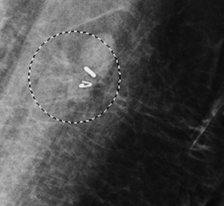
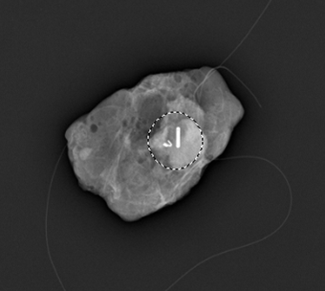
Targeted Axillary Dissection (TAD)
1-5 Days Before Surgery
Day of Surgery
Breast Imaging
I¹²⁵ seed placed in marked node
Node containing I¹²⁵ seed selectively removed
I¹²⁵ Seed
I¹²⁵ Seed
Clip
Clip
Nuclear Medicine
radioisotope injection for SLND
SLNs removed
Caudle AS et al. JAMA Surg. 2015;150(2):137-43.
Caudle AS et al. J Clin Oncol. 2016;34(10):1072-8.
Notes:
To localize the clipped node, patients go to breast imaging 1-5 days before surgery. Similar to our approach for localizing breast tumors with I125 seeds, the radiologist places an I125 seed in the clipped node under US guidance. If SLN is planned, they either go to Nuclear Medicine for radioisotope injection the day before surgery or the surgeon injects the isotope in the OR. During their axillary surgery, the surgeon uses a neoprobe to identify the node containing the I-125 seed and clip. The SLNs are also removed. At this time, patients also undergo completion ALND.

Slide 65
MD Anderson Experience with TAD
212 patients with completion dissection
Tumor stage
  T0/T1: 9.5%
  T2: 65%
  T3: 23%
  T4: 2%
Biopsy proven axillary node mets
# Abnormal nodes on US
  1 36%
  2 20%
  3 17%
  ≥ 4 28%
Caudle AS et al. J Clin Oncol. 2016;34(10):1072-8.
Notes:
Each case had biopsy proven axillary nodal metastases; note 45% of cases on this study had > = 3 abnl nodes- - clip ONLY placed in ONE node

Slide 66
Pathologic Evaluation of Clipped Node
Biopsy Node Positive N=230
Neoadjuvant therapy
No ALND
N=18
Evaluable Patients*
N=212
Path Node Negative
N=78 (37%)
Path Node Positive
N=134 (63%)
False Negative Results**
7/134
False Negative Rate
5.2% (95% CI 2.1 - 10.5)
*Update, +21 patients
(courtesy Dr. Henry Kuerer)
**Clipped node showed no disease but other nodes in axillary specimen contained metastases
Caudle AS et al. J Clin Oncol. 2016;34(10):1072-8.
Notes:
Overall 37% converted to node negative

Slide 67
Patients Undergoing TAD
TAD Performed After NCT
N = 109
No ALND
N = 12
Evaluable Patients*
N = 97
Path Node Negative
N = 40 (41%)
Path Node Positive
N=57 (59%)
SLN negative = 5/54
SLN not identified = 3
Clipped node and SLN negative
N = 2/57
*Updated,
+1 patients
(courtesy Dr. Henry Kuerer)
False Negative Rate
SLND Alone = 9.3% (95% CI, 3.1-20.3)
TAD (SLNs + Clipped Node) = 3.5% (95% CI, 0.4-12.1)
Caudle AS et al. J Clin Oncol. 2016;34(10):1072-8.

Slide 68
TAD UPDATE: Caudle AS et al. 2017 SSO. | N = 176
Nodal pCR | 49 (28%)
Clipped node not a SLN | 36/176 (20%)
FNR of clipped node alone | 5/127 3.9% (95% CI, 1.3-9.0)
FNR of SLND alone | 10/127 7.9% (95% CI, 3.8-14.0)
FNR of TAD | 3/127 2.4% (95% CI, 0.5-6.8)
Accuracy of TAD | 98%

Slide 69
How often are residual nodes positive when SLN/Clip Node Positive?
0 positive nodes | 1 positive node | 2 positive nodes | ≥ 3 positive nodes
51.4% | 17.6% | 5.3% | 25.7%
Caudle AS et al. J Clin Oncol. 2016;34(10):1072-8.
Notes:
JCO patient Using the patients included in the JCO analysis – There were 74 patients who had a SLN performed and had residual disease. In 36 of them (48.6%) of them had additional positive nodes beyond the clipped and sentinel nodes.
Number of additional nodes:
1 node – 13 cases
2 nodes - 4 cases
3 nodes – 3 cases
4 nodes – 2 cases
5 nodes – 7 cases
7 nodes – 2 cases
9 nodes – 1 vase
11 nodes – 2 cases
13 nodes – 1 case
17 nodes – 1 case

Slide 70
Positive Nodes after Pre-op Chemo Alliance A011202
N = 2,918
Clinical T1-T3, N1 Breast Cancer
Primary aim: Determine whether axillary radiation alone is not inferior to ALND + radiation
Chair: Judy Boughey
Neoadjuvant Chemotherapy; Clinically Node- Negative on Physical Exam after Treatment
Surgery with SLND and Intraoperative Pathologic Evaluation
No SLN identified
Positive SLN
Negative SLN
No Registration, Randomization
Intraoperative Registration, Randomization
Await Final Pathology
Negative
Positive
No Registration, Randomization
Arm 1: ALND + Nodal RT
Arm 2: Axillary and Nodal RT
Registration, Randomization
https://clinicaltrials.gov/study/NCT01901094
Cf. NRG B-51 for Node Neg pCR Conversion
Notes:
70
For women who receive neoadjuvant chemotherapy and whose lymph nodes remain pathologically positive after surgery, regional radiotherapy is indicated. However, these women can be enrolled onto the ALLIANCE (Alliance for Clinical Trials in Oncology) A011202 phase III clinical trial (NCT01901094) that is designed to answer whether axillary node dissection improves the rate of breast cancer recurrence over that seen with sentinel node biopsy alone when regional radiotherapy is delivered. Together, these trials will potentially allow us to fulfill our commitment to patients with breast cancer who receive neoadjuvant chemotherapy—to achieve maximal breast cancer survival while tailoring locoregional treatment to best fit their disease

Slide 71
Oncological Outcomes Following Sentinel Lymph Node Biopsy (SLNB) or Targeted Axillary Dissection (TAD) in Breast Cancer Patients Downstaging From Node Positive to Node Negative with Neoadjuvant Chemotherapy
Multicenter, international retrospective study with 1144 cases included
  666 SLNB – median f/u 4.2 years
  478 TAD – median f/u 2.7 years
5-year rate of any axillary recurrence:
1.0% (95% CI 0.49-2.0%)
Montagna G et al. 2022 SABCS. Abstract GS4-02
Montagna G et al. JAMA Oncol. 2024;10(6):793-798.
Notes:
2 studies on combination of clip nodes plus SLN

Slide 72
Oncological Outcomes Following Sentinel Lymph Node Biopsy (SLNB) or Targeted Axillary Dissection (TAD) in Breast Cancer Patients Downstaging From Node Positive to Node Negative with Neoadjuvant Chemotherapy
3-year rate of any axillary recurrence in TAD vs SLNB:
  0.5% vs 0.8%, P = .55
No difference in locoregional recurrence between TAD (0.8%) vs SLNB (1.9%; P = .19)
Study supported omission of ALND in patients who convert to node negative after neoadjuvant therapy
Montagna G et al. 2022 SABCS. Abstract GS4-02
Montagna G et al. JAMA Oncol. 2024;10(6):793-798.
Notes:
2 studies on combination of clip nodes plus SLN

Slide 73
Pros and Cons of
Clipping Positive Lymph Nodes
PRO
More accurate when removed specifically – FNR < 10%
Not a SLN in 19-37% (23% at in MDACC study)
Residual nodal disease, even if small volume, has prognostic and therapeutic implications
Precision matters!
  CON
FNR < 10% if ≥ 2 negative SLNs FNR > 10% with < 2 SLNs
More expensive
Potentially more procedures
Requires expertise to clip, localize and remove
Unknown long-term outcomes compared to SLNB
  Retrospective data shows low axillary recurrence with either procedure
Montagna G et al. 2022 SABCS. Abstract GS4-02
Notes:
BECAUSE THE CLIPPED NODE WILL NOT BE A SLN 25% of the time in our experience and also from the Magee womens hospital UPMC experience P56 Diego et al

Slide 74
Targeted Axillary Dissection (TAD): Removal of Known Axillary Disease
Ultrasound with FNA highly sensitive and specific for identification of nodal metastases
Marking of nodal metastases allows for targeted excision of disease
  Assessment of response when preoperative therapy utilized
Removal of known biopsy-positive lymph clipped node more accurate alone or in combination with SLN biopsy for known nodal disease after neoadjuvant chemo
Utilized at MDACC as standard for patients presenting with < 4 biopsy proven axillary nodal mets on ultrasound
Number of nodes removed with TAD or SLNB will depend on the individual patient – i.e., how many SLNs +/- clipped lymph node
  No set number of lymph nodes required though the more retrieved the more accurate the procedure
  Generally fewer SLNs retrieved after neoadjuvant therapy
Notes:
BECAUSE THE CLIPPED NODE WILL NOT BE A SLN 25% of the time in our experience and also from the Magee womens hospital UPMC experience P56 Diego et al

Slide 75
Diagnostic Accuracy of Surgical Axillary Staging After Neoadjuvant Systemic Therapy in Node-positive Breast Cancer: Systematic Review and Meta-analysis
2,217 patients from 20 studies all image guided/ and biopsy proved disease (not just clinical node-positive)
SLNB alone: ID rate = 89%; FNR = 17%; NPV 57-86%
Targeted Axillary Dissection:
ID rate = 100%; FNR = 2-4%; NPV 92-97%
Simons JM et al. Ann Surg. 2019;269(3):432-42.
Notes:
2 studies on combination of clip nodes plus SLN

Slide 76
Summary
Indications for Axillary Node Dissection:
Inflammatory and extensive LABC
Clinically node negative axilla with positive pN1 SLN:
  In mastectomy patients with macrometastatic nodal disease w/o PMRT
  In BCT patients not meeting Z11 criteria
Axillary recurrence
Axillary nodal disease with occult breast primary
  Node positive disease without or after preoperative systemic therapy

Slide 77
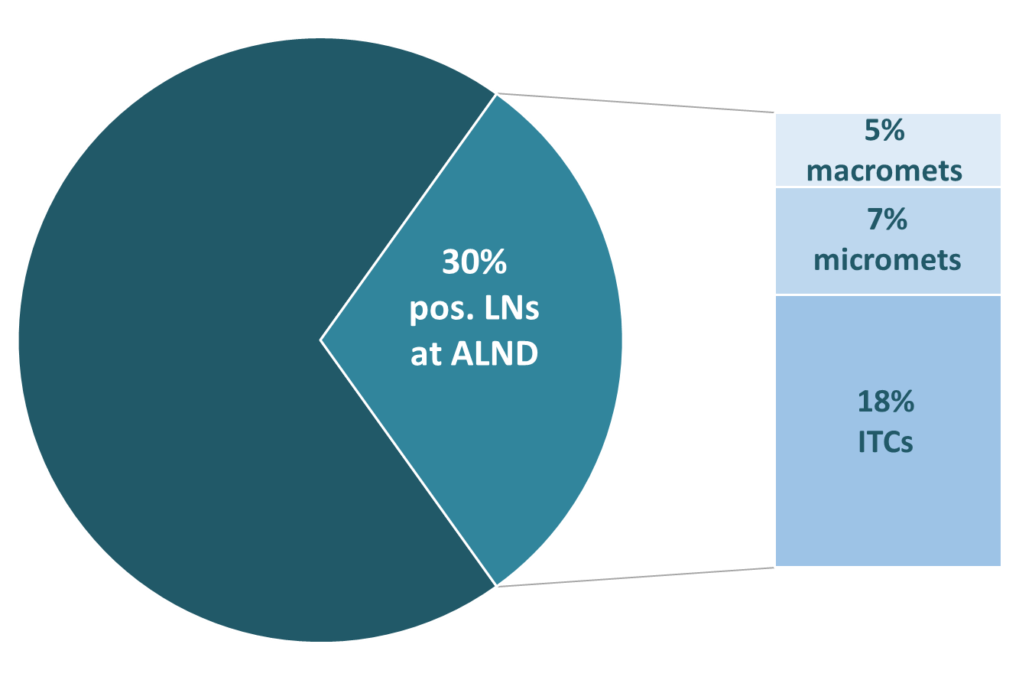
The OPBC-05/EUBREAST-14R/ICARO study
Are nodal isolated tumor cells (ITCs) after neoadjuvant chemotherapy an indication for axillary dissection?
583 patients with cT1-4 N0-3 → ypN0(i+) on SLNB
  102 completion ALND
  401 no ALND
77% had nodal irradiation
5-year rate of isolated axillary recurrence in no ALND vs ALND:
  1.1% vs 1.7%, P = .7
No difference in any axillary recurrence between no ALND (4.6%) vs ALND (4.1%; P = 0.8)
No difference in any invasive recurrence between no ALND (19%) vs ALND (16%; P = 0.13)
Study results show that routine completion ALND for ITCs after neoadjuvant chemotherapy is not warranted
Montagna G et al. 2023 SABCS. Abstract GS02-02.
Montagna G et al. J Clin Oncol. 2025;43(7):810-20.

Slide 78
Mitigating Lymphedema

Slide 79

SLN Biopsy: Standard for Clinical Node Negative Disease USA 2005
Revolutionized surgical practice
Marked decreased need for axillary dissection
Major decrease in lymphedema, shoulder dysfunction, pain & parasthesia rates
NCCN 2020 Survivorship Guidelines
  Early detection of lymphedema key
    Consider pre-treatment measurement both arms
    Detailed information on work-up, treatment, and surveillance

Slide 80
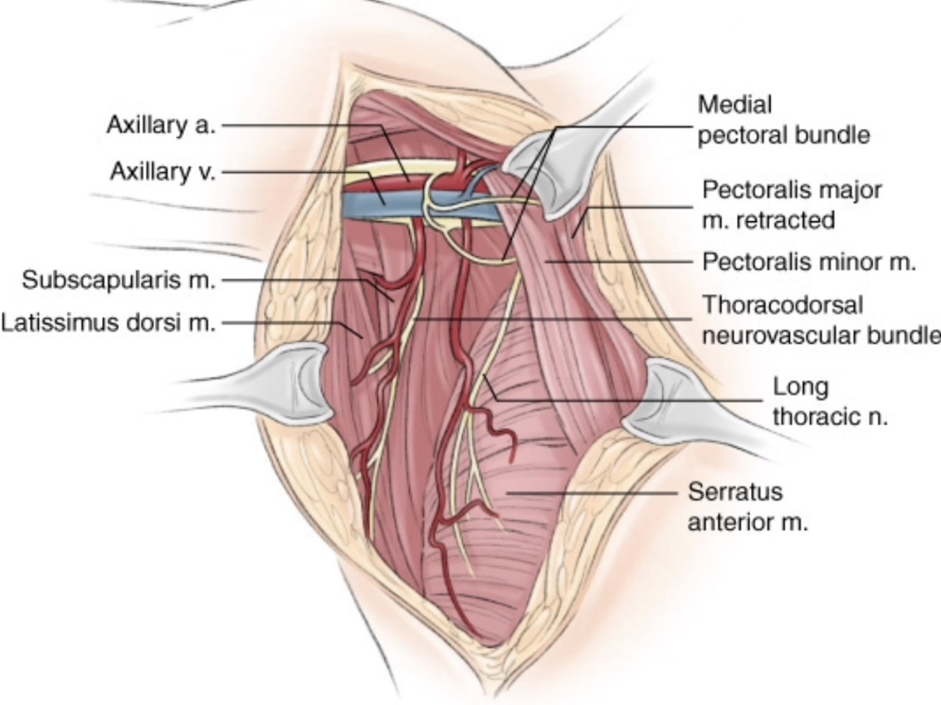
Axillary Lymph Node Dissection and Lymphedema
Incidence of lymphedema after breast cancer ALND
  Meta-analysis Disipio et al Lancet Oncol 2013 with ALND
  19.9%, (95% CI 13.5-28.2)
  Risk Factors: extent of node dissection, obesity (overweight or obese)
Kuerer HM. Kuerer’s Breast Surgical Oncology. 2010.

Slide 81
Methods for surgical prevention of lymphedema
Immediate lymphatic anastomosis
    Lymphatic Microsurgical Preventative Healing Approach (LYMPHA)
ARM procedure (Axillary Reverse Mapping)
Combination of both procedures
Hahamoff M et al. J Surg Res. 2019;244:604-11.
Boneti C et al. Am J Surg. 2009;198(4):482-7.
Notes:
LYMPHA- lymphatics re-routed into axillary vein tributary

Slide 82
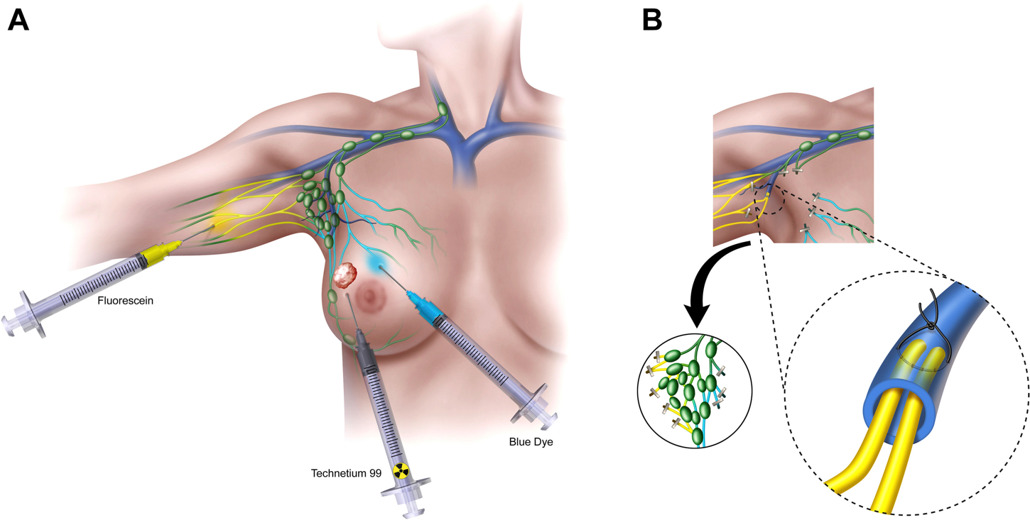
Immediate Lymphatic Reconstruction
Hahamoff M et al. J Surg Res. 2019;244:604-11.

Slide 83
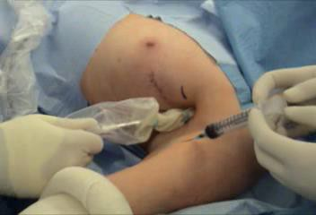
ARM: Axillary Reverse Mapping
Courtesy of Dr. Suzanne Klimberg, MD

Slide 84



Courtesy of Dr. Suzanne Klimberg, MD
Notes:
ARM uses split mapping of the breast and the upper extremity to distinguish lymphatics draining the breast from those draining the upper extremity and preserve them. Like NSABP-32 and many surgical trials, the ARM procedure will require training but is easy to learn and apply. This requires the surgeon to watch a YouTube video (https://youtu.be/v_Ln11PFvVg) and perform and submit two training cases. Thus, any practicing surgeon could apply this technique to their present practice of lymphadenectomy with minimal training and cost, with a potential huge benefit to the patient in the prevention or mitigation of lymphedema

Slide 85
Courtesy of Dr. Suzanne Klimberg, MD

Slide 86
Courtesy of Dr. Suzanne Klimberg, MD

Slide 87
Courtesy of Dr. Suzanne Klimberg, MD

Slide 88
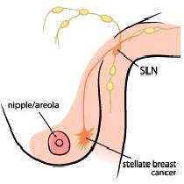

ARM Variations
Axillary Vein
1
2
5
4
SLN will not be blue in 96%
3
Thompson M et al. Ann Surg Oncol. 2007;14(6):1890-5.
Notes:
Ochoa Surgery 2014
RESULTS:
A group of 360 patients underwent SLNB and/or ALND, 348 of whom underwent a SLNB. Of those, 237 (68.1%) had a SLNB only, and 111 (31.9%) went on to an ALND owing to a positive axilla. An additional 12 of 360 (3.3%) axilla had ALND owing to a clinically positive axilla/preoperative core needle biopsy. In 96% of patients with SLNB (334/348), breast SLNs were hot but not blue; crossover (SLN hot and blue) was seen in 14 of 348 patients (4%). Blue lymphatics were identified in 80 of 237 SLN incisions (33.7%) and in 93 of 123 ALND (75.4%). Average follow-up was 12 months (range, 3-48) and resulted in a SLNB lymphedema rate of 1.7% (4/237) and ALND of 2.4% (3/123).
CONCLUSION:
ARM identified substantial lymphatic variations draining the upper extremities and facilitated preservation. Metastases in ARM-identified lymph nodes were acceptably low, indicating that ARM is safe. ARM added to present-day ALND and SLNB may be useful to lesser rates of lymphedema.

Slide 89
ALLIANCE A221702
ARM: Axillary Reverse Mapping-
A Prospective Randomized Study to Evaluate Rates of Lymphedema and Regional Recurrence after Sentinel Lymph Node Biopsy and Sentinel Lymph Node Followed by Axillary Lymph Node Dissection with and without Axillary Reverse Mapping
N= 516; PI: Klimberg

Slide 90
A221702 Eligibility Criteria
cT1-3 undergoing axillary surgery
cN0-3 (no matted nodes mastectomy)
Planned ALND for BCS
No prior axillary surgery
No prior ipsilateral breast cancer
No bilateral cancer
No history of lymphedema
No allergies to blue dye (including makeup/tattoo
Not pregnant or nursing

Slide 91
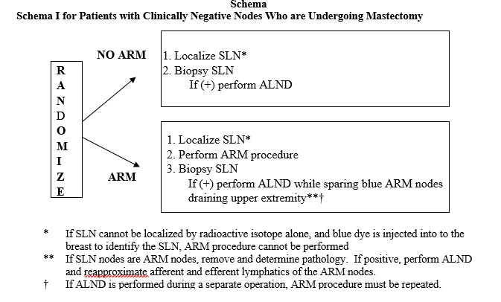
Mastectomy for cN0 axilla trial schema
https://www.facs.org/for-medical-professionals/news-publications/news-and-articles/bulletin/2019/11/could-axillary-reverse-mapping-be-useful-in-reducing-surgical-comorbidities/

Slide 92
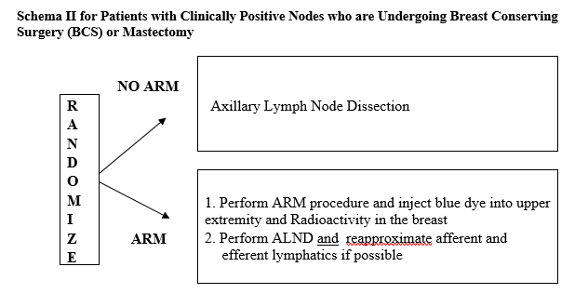
BCS or Mastectomy with Clinically
Positive Nodes With Planned ALND
https://www.facs.org/for-medical-professionals/news-publications/news-and-articles/bulletin/2019/11/could-axillary-reverse-mapping-be-useful-in-reducing-surgical-comorbidities/

Slide 93
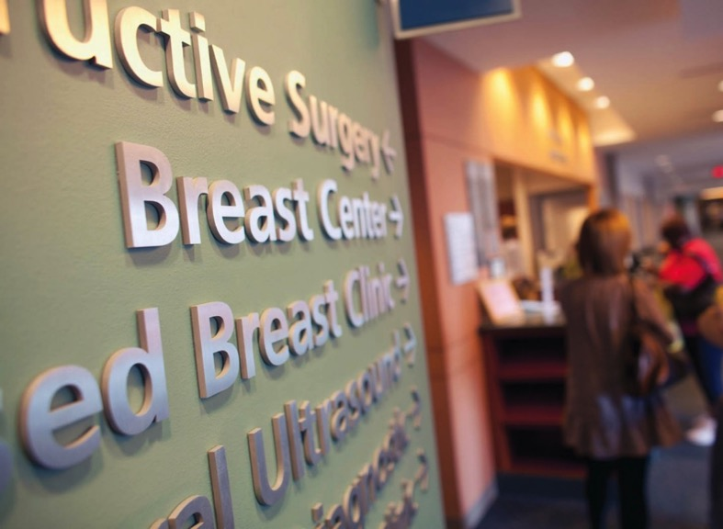
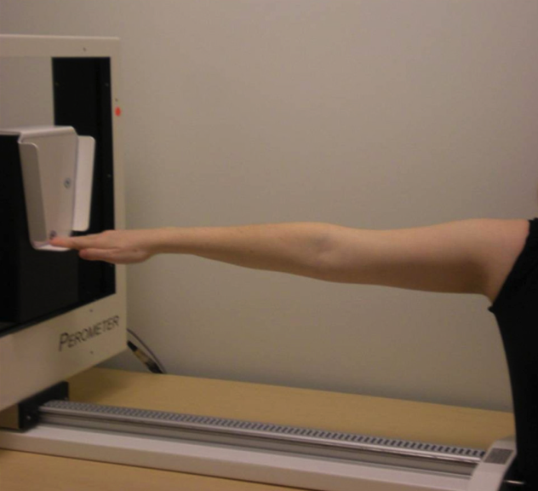
MD Anderson Lymphedema Screening Program: Surgical Correction of Lymphedema
Notes:
We try to capture all invasive patients for preoperative perometer measurements
Postoperative perometer measurements are focused on patients who have an an ALND and we try to capture them each visit they have to the breast center as long as they haven’t had a measurement within the past 30 days
We recommend referral to PT if there is a limb volume change >=5% for PT to do a thorough assessment and evaluate appropriate interventions (which at that stage might just be preventive in nature and not MLD until more progressed to beyond 5%)
We offer surgery for patients who have persistent lymphedema despite compliance with 3-6 months of conservative therapy

Slide 94
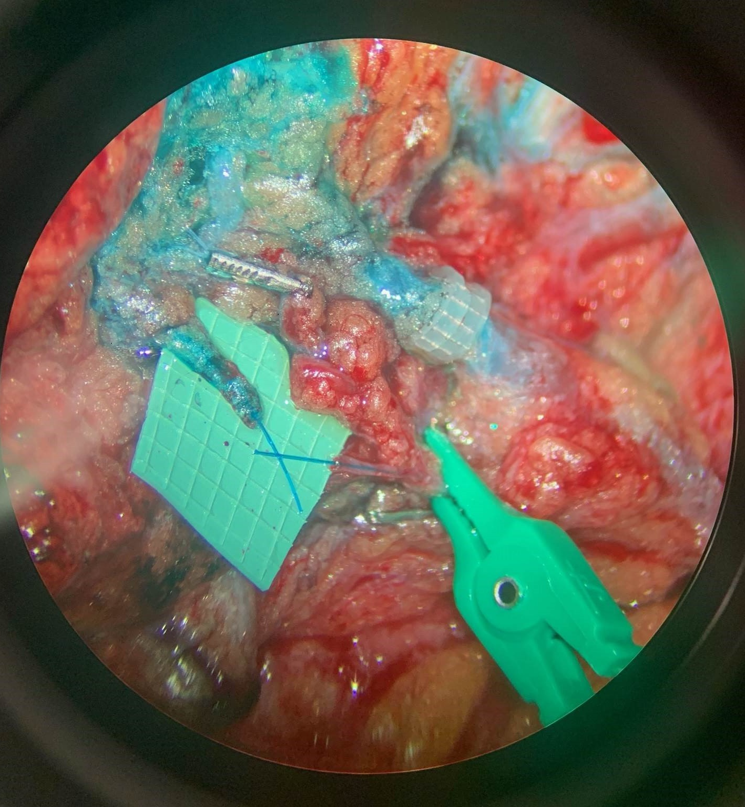
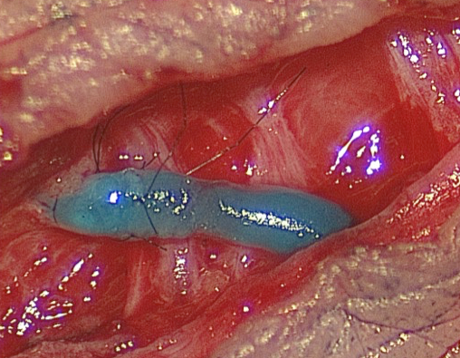
Lymphovenous Bypass Procedure
Carrie Chu, MD 2021 MDACC; Chang DW et al .Plast Reconstr Surg. 2013;132(5):1305-14.
Notes:
OPERATIVE MICROSCOPE VIEWS Head above- left are lymphatics after removal of the ax contents- tiny grids are 1 mm- 6-0 prolene lymphatic and vein; top one 1.5 mm- coupler- bottom to be hand sewn - -more and more being utilized. NOTE this is microvascular not always available- talk about ARM and surgeon tieing on trial - -could this work- ???

Slide 95
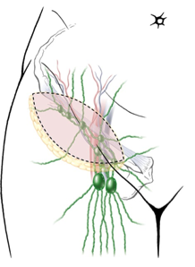
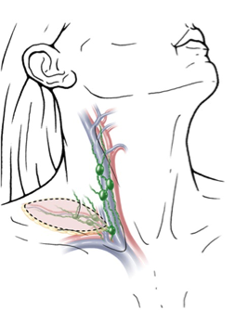
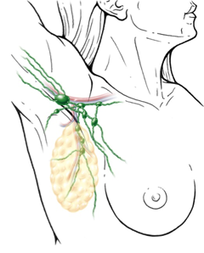
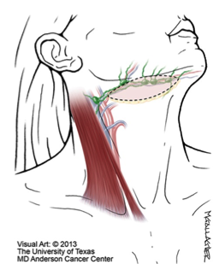
Vascularized Lymph Node Transplant Procedure
Superficial inguinal/ Groin
Supraclavicular
Lateral thoracic
Submental
Ito R, Suami H. Plast Reconstr Surg. 2014;134(3);548-556.

Slide 96
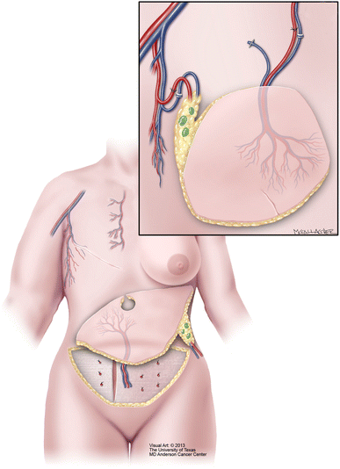
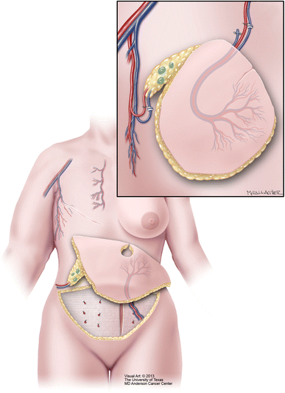
DIEP Flap / Groin VLNT Procedure
Nguyen AT et al. Ann Surg Oncol. 2015;22(9):2919-24.

Slide 97
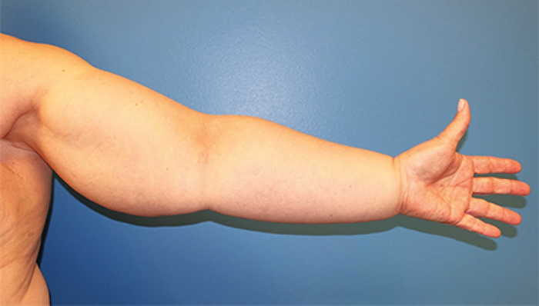
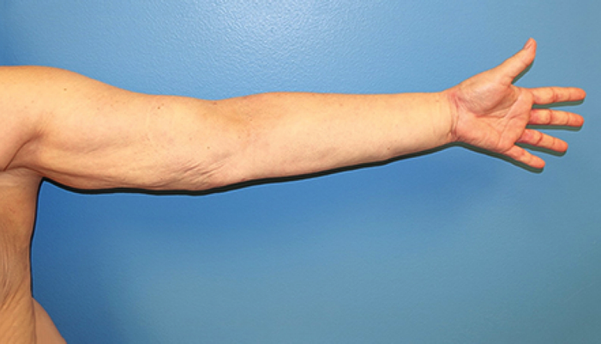
Suction-Assisted Lipectomy
Pre-op
12 mos post-op
Schaverien MV et al. Plast Reconstr Surg. 2019;144(3):738-58.

Slide 98
Evidence for Surgical Treatment of Lymphedema
Lymphovenous Anastamosis: Systematic Review; Scaglioni et al 2017
    18 studies with 939 patients
    All had objective reduction of circumferential measurements and subjective relief in 50-100%, and decreased episodes of cellulitis
Vascularized Lymph Node Transfer: Systematic Review; Ozturk et al 2016
    18 studies with 305 patients
    91% decrease circumference, 86% decreased volume, 93% high satisfaction and improved QOL, reduced episodes of cellulitis
Suction-Assisted Lipectomy; Hoffner et al 2018 & Lee et al 2016
    Prospective mean reduction at 5 years 117% +/-26%; cellulitis decreased by 87%
Courtesy Dr. Mark Schaverien, MDACC

Slide 99
Ongoing challenges in axillary management
Use of genomic assays is more routine in HR+/Her2- breast cancer including postmenopausal patients with node-positive (pN1) disease
SWOG RxPONDER study: 37% of patients had SLND
  Decisions on use of 21-gene recurrence score can be made based on SLND for patients Z0011/AMAROS candidates
  Do not need to do an ALND to determine nodal burden
Kalinsky K et al. N Engl J Med. 2021;385(25):2336-2347.

Slide 100
Association of Axillary Dissection with Systemic Therapy in Patients with Clinically Node-Positive Breast Cancer
Pre-planned substudy of TAXIS
RCT of 500 patients including 296 with clinically node-positive, HR+/Her2- breast cancer who were randomized to upfront tailored axillary surgery (TAS) with ALND vs no ALND
  TAS is SLNB plus clipped node removal without mandatory localization pre-operatively
No difference in adjuvant systemic therapy recommendations (chemotherapy or aromatase inhibitors)
Impact on CDK 4/6 inhibitor use in ER+ breast cancer not assessed, incomplete study
 | TAS + ALND 151 (51.0%) | TAS + no ALND 145 (49.0%)
Median # of nodes removed (IQR) | 19 (14-26) | 5 (4-8)
Median # of positive nodes (IQR) | 4 (2-9) | 3 (1-4)
Weber WP et al. 2022 SABCS.
Weber WP et al. JAMA Surg. 2023;158(10):1013-21.

Slide 101
Ongoing challenges in axillary management
Management is more complex in women with node-positive (cN1), HR+/Her2- breast cancer
If undergoing upfront surgery, standard is ALND
This is likely overtreatment though there is no strong evidence to guide management
Data on TAD in the upfront setting are needed

Slide 102


psingh6@mdanderson.org
Notes:
102

