Slide 1


Emerging Therapies for Metastatic Triple-Negative Breast Cancer
November 8th, 2025
Filipa Lynce, MD, FASCO
Assistant Professor of Medicine, Harvard Medical School
Senior Physician, Dana-Farber Cancer Institute
Director, Dana-Farber Inflammatory Breast Cancer Program
Disclaimer: This presentation is intended for personal use and for informational purposes only and does not replace independent professional judgment. This presentation is the property of Physicians’ Education Resource, LLC (“PER”) and is protected by U.S. and international copyright laws. You may not copy, reproduce, distribute, transmit, modify, or create derivative works of the presentation without the prior written permission from PER.
Notes:
45 minutes

Slide 2
Disclosures
Research to the Institution – AstraZeneca, Eisai, Incyte, Zentalis, Merck, Gilead, Ideaya
Consulting/Advisory Role – AstraZeneca, Pfizer, Daiichi Sankyo
Executive Officer, Alliance Foundation Trials
Notes:
Research to the Institution:
AstraZeneca, Eisai, Incyte, Zentalis, Merck, Gilead, Ideaya
Consulting/Advisory Role:
AstraZeneca, Pfizer, Daiichi Sankyo, Eli Lilly

Slide 3
Outline
Triple-Negative Breast Cancer (TNBC)
Standard of care therapies for Metastatic TNBC
Emerging Therapies in Metastatic TNBC
  Antibody Drug Conjugates (new and not so new!)
  PARP1 selective inhibitors
  Bispecific Antibodies
Questions that remain to be addressed
  Early relapsers during adjuvant therapy or with short DFI
  Sequencing questions
Notes:
Triple Negative Breast Cancer: still an area of unmet need

Slide 4
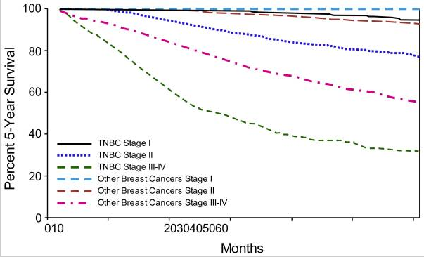
10-20% of breast cancers
Early recurrences
TNBC
ER < 1%, PR < 1%, HER2 negative per ASCO/CAP guidelines
Lower survival rates
Affects disproportionally young women, BRCA1 carriers, African Americans and Hispanics
Dent et al. Clin Cancer Res 2007; Bauer KR et al. Cancer 2007
Notes:
TNBC is clinically defined as ER/PR/HER negativity, represents 15-20% of breast cancers, associated with early recurrences and lower survival rates adjusted for stage, affects disporportionally young womenm BRCA carriers, AA and hispanics.
Since 2010, ER/PR are considered positive if at least 1% or higher per IHC
This slides shows the annual risk of recurrence for triple negative versus other breast cancer subtypes of early stage. The overall recurrence rate is higher, particularly in the first four years, after which recurrences are less likely.
Clinically defined as ER/PR/HER2 negativity
10-20% of all breast cancers
Aggressive, higher recurrence rates
More common in:
Young women
African Americans
Hispanics
BRCA1+ (80%)
Despite the successes of chemotherapy, TNBC of early stage may still recur, and tend to do so more quickly that hormone receptor positive cancers, with most recurrences occurring within four years. The lung is a predominant site of recurrence, but recurrences in bone and liver can occur as well. There is no unique pattern of recurrence for TNBC. When recurrences take place, patient survival tends to be shorter than for other subtypes of breast cancer.

Slide 5
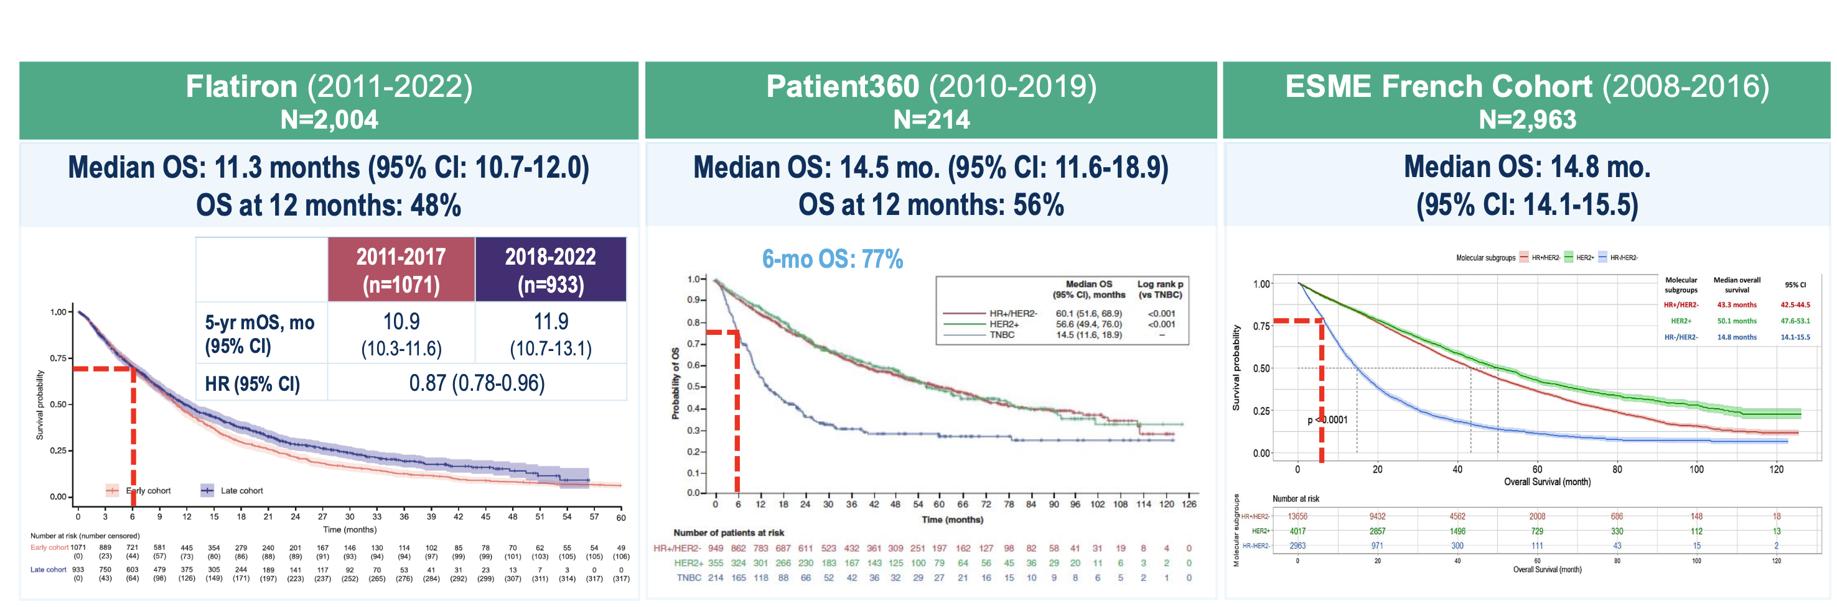
25-30% of Patients With mTNBC Do NOT Survive
Past 6 Months (RWD)
Garrido-Castro A. ESMO 2025; Punie K et al. Oncologist 2025; W DeClue R. Future Oncol 2023; Deluche E et al. Eur J Cancer 2020.

Slide 6
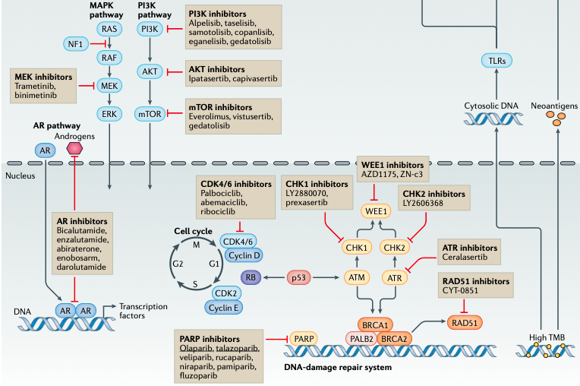
Key Oncogenic Signaling Pathways Associated with TNBC
Bianchini G, et al. Nature Rev Clin Oncol 2021
Notes:
Major effort over the last decade has focused on classifying TNBC into distinct clinical and molecular subtypes that can guide treatment decisions.
Characterization of the genomic, transcriptomic, proteomic, epigenomic alterations as well as the tumor microenvironment is expanding our knowledge of TNBC.
Key oncogenic signalling pathways associated with triple-negative breast cancer (TNBC)

Slide 7
Outline
Triple-Negative Breast Cancer (TNBC)
Standard of care therapies for Metastatic TNBC
Emerging Therapies in Metastatic TNBC
  Antibody Drug Conjugates (new and not so new!)
  PARP1 selective inhibitors
  Bispecific Antibodies
Questions that remain to be addressed
  Early relapsers during adjuvant therapy or with short DFI
  Sequencing questions
Notes:
Triple Negative Breast Cancer: still an area of unmet need

Slide 8
KEYNOTE-355: Study Design
Key Eligibility Criteria
Age ≥18 years
Central determination of TNBC and PD-L1 expressionª
Previously untreated locally recurrent inoperable or metastatic TNBC
De novo metastasis or completion of treatment with curative intent and DFI ≥6 months
ECOG PS 0 or 1
No systematic steroids
No active CNS metastases
No active autoimmune disease
Pembrolizumab^{b} + Chemotherapy^{c}
(n=566)
R
2:1
Progressive disease^{e}/cessation
of study therapy
Placebo^{d} + Chemotherapy^{c}
(n=281)
Primary Endpoints
PFS in PD-L1-positive population (CPS ≥10 and
CPS ≥1) and ITT population
OS in PD-L1-positive population (CPS ≥10 and
CPS ≥1) and ITT population
Stratification factors
Chemotherapy on study (taxane or gemcitabine-carboplatin)
PD-L1 tumor expression (CPS≥1 or CPS<1)
Prior treatment with same class chemotherapy in the neoadjuvant or adjuvant setting (yes or no)

Slide 9
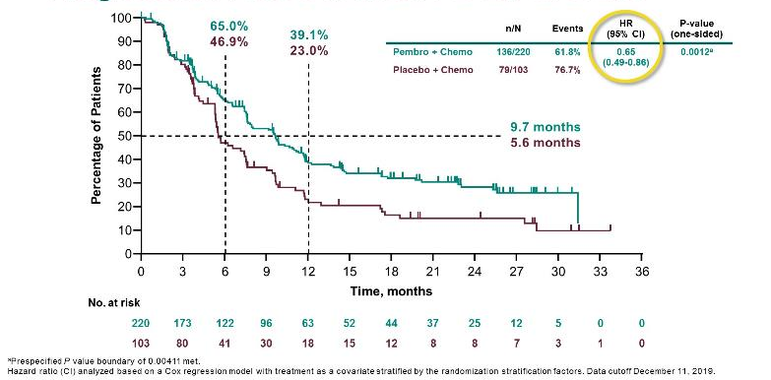
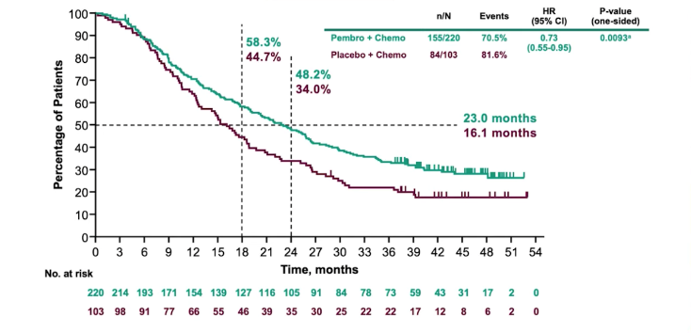
KEYNOTE-355:
The addition of Pembrolizumab prolongs PFS & OS
Progression-Free Survival: PD-L1 CPS ≥10
Overall Survival: PD-L1 CPS ≥10
Cortes J, et al. ASCO 2020. Abstract 1000; Cortes J, et al. Lancet. 2020;396:1817-1828; Rugo HS, et al. ESMO 2021. Abstract LBA16; Cortes J et al. N Engl J Med. 2022;387(3):217-226.
Notes:
On study chemotherapy:
Taxane HR 0.51 (0.33-0.76)
Gem/Carbo HR 0.77 (0.53-1.11)
Disease free interval:
De novo HR 0.48 (0.29-0.79)
<12 mo HR 1.00 (0.51-1.95)
>12mo HR 0.64 (0.43-0.95)

Slide 10
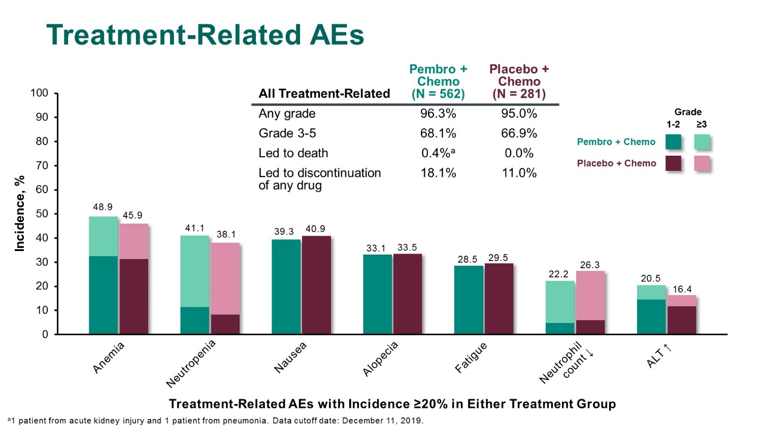
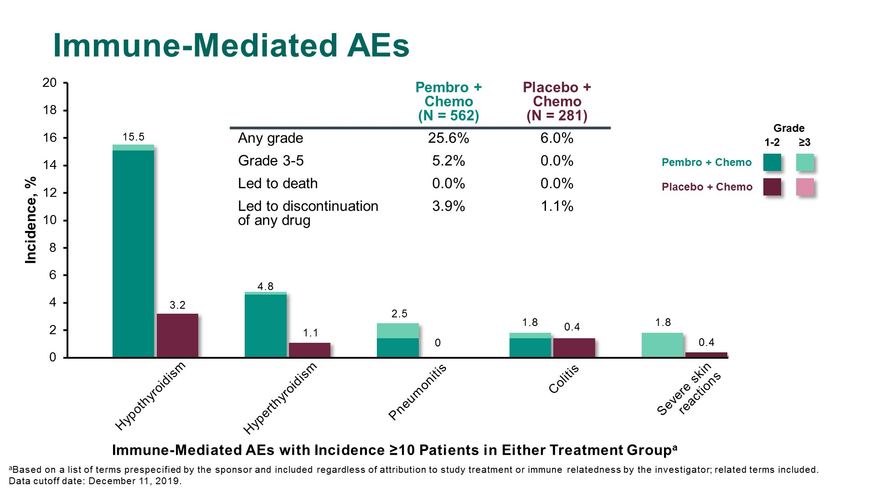
KEYNOTE-355: Adverse Events
Cortes J et al. ASCO 2020. Abstract 1000; Lancet. 2020;396(10265):1817-1828.
Notes:
On study chemotherapy:
Taxane HR 0.51 (0.33-0.76)
Gem/Carbo HR 0.77 (0.53-1.11)
Disease free interval:
De novo HR 0.48 (0.29-0.79)
<12 mo HR 1.00 (0.51-1.95)
>12mo HR 0.64 (0.43-0.95)

Slide 11
PARP Inhibitors in Germline BRCA-associated MBC
OlympiAD: OLAPARIB vs Chemotherapy
EMBRACA: TALAZOPARIB vs Chemotherapy
Robson M et al. N Engl J Med 2017;377(6):523-33; Robson M et al. Ann Oncol 2019;30(4):558-66; Litton J et al. N Engl J Med 2018;379:753-63.

Slide 12
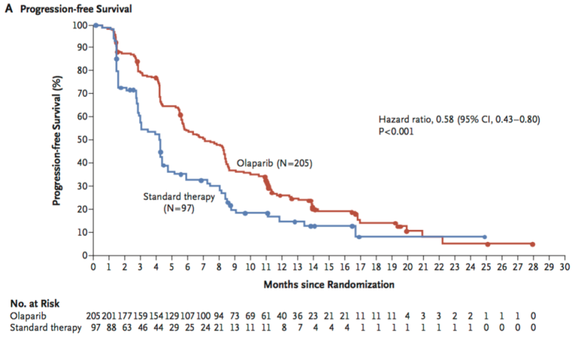
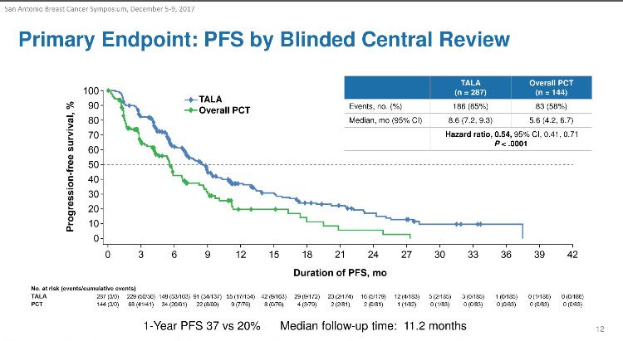
PARP Inhibitors in Germline BRCA-associated MBC: Improvement in Outcomes Compared to Chemotherapy
OlympiAD: OLAPARIB vs Chemotherapy
EMBRACA: TALAZOPARIB vs Chemotherapy
Robson M et al. N Engl J Med 2017;377(6):523-33; Robson M et al. Ann Oncol 2019;30(4):558-66; Litton J et al. N Engl J Med 2018;379:753-63.

Slide 13
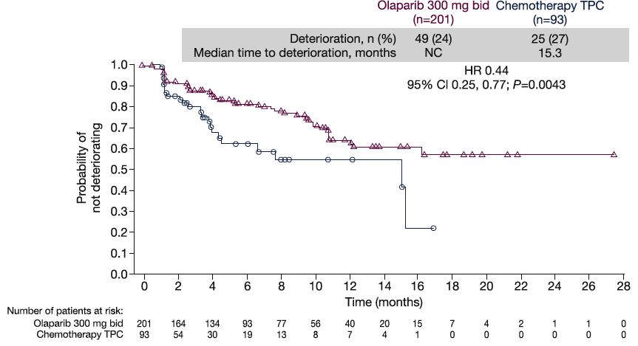
PARP Inhibitors in Germline BRCA-associated MBC: Improvement in QoL Compared to Chemotherapy
OlympiAD: OLAPARIB vs Chemotherapy
EMBRACA: TALAZOPARIB vs Chemotherapy
Robson M et al. Eur J Cancer 2019;120:20-30; Litton J et al. AACR 2020

Slide 14
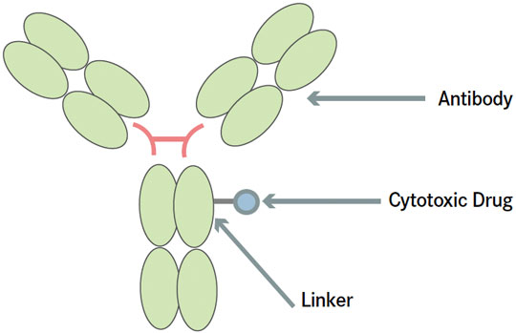
Antibody Drug Conjugates (ADCs)
Deliver a toxic payload directly to the cancer cell
All the approved
ADCs share the same basic ANTIBODY – LINKER – PAYLOAD structure
Image from: Gaertner KM et al. The Journal of Targeted Therapies in Cancer 2015
Notes:
Tumor antigen: Abundant in tumors, minimal in normal tissues; internalized upon ADC binding
Antibody: High affinity and avidity for antigen; optimal pharmacokinetics; internalized
Linker: Stable in plasma; efficient release of cytotoxic agent inside tumor cells
Payload: Drug cytotoxic to targeted tumor cells; not hydrophobic; must be potent as limited number of molecules can be attached to antibody
ADCs are targeted cancer medicines that deliver cytotoxic chemotherapy (“payload”) to cancer cells via a linker attached to a monoclonal antibody that binds to a specific target expressed on cancer cells.
SGN-LIV1A is an “antibody-drug conjugate.” It is comprised of an antibody (hLIV22) that binds to breast cancer cells which express (produce) the LIV1 protein, as well as a drug called monomethyl auristatin E (MMAE), which kills cancer cells. Most types of metastatic breast cancer express the LIV1 protein
Ado-trastuzumab emtansine (TDM1)
Trastuzumab Deruxtecan (DS-8201)

Slide 15
Current Landscape of ADCs in Advanced TNBC
Modified from Garrido-Castro AC. SABCS 2023; Modified from Bardia A et al. ESMO 2020; Modi S et al. ASCO 2022.

Slide 16
ASCENT: Sacituzumab Govitecan (SG) vs
Chemotherapy in mTNBC After Prior Chemotherapy
Bardia A et al. ESMO 2020; Rugo H et al. ASCO 2022; Rugo H et al. ESMO 2022.

Slide 17
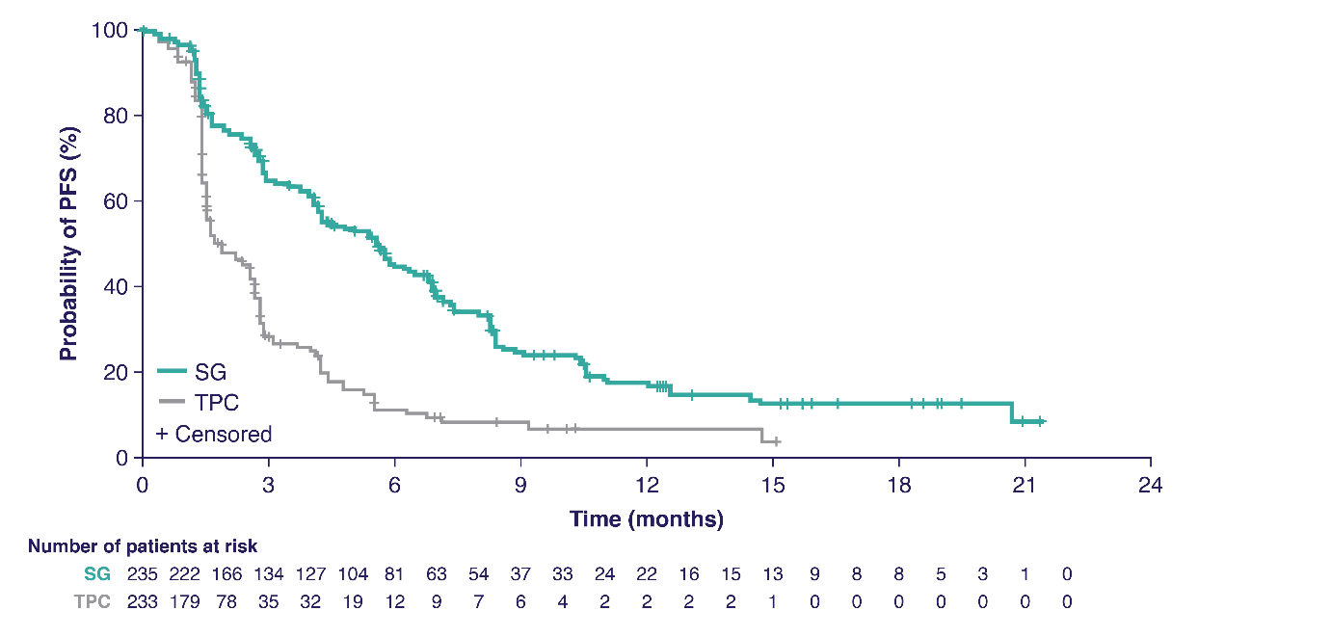
ASCENT: SG Prolongs mPFS
BICR Analysis | SG (n=235) | TPC (n=233)
No. of events | 166 | 150
Median PFS—mo (95% CI) | 5.6 (4.3-6.3) | 1.7 (1.5-2.6)
HR (95% CI), P-value | 0.41 (0.32-0.52), P<0.0001
Bardia A, et al. N Engl J Med. 2021;384:1529-1541; Bardia et al ASCO 2022.

Slide 18
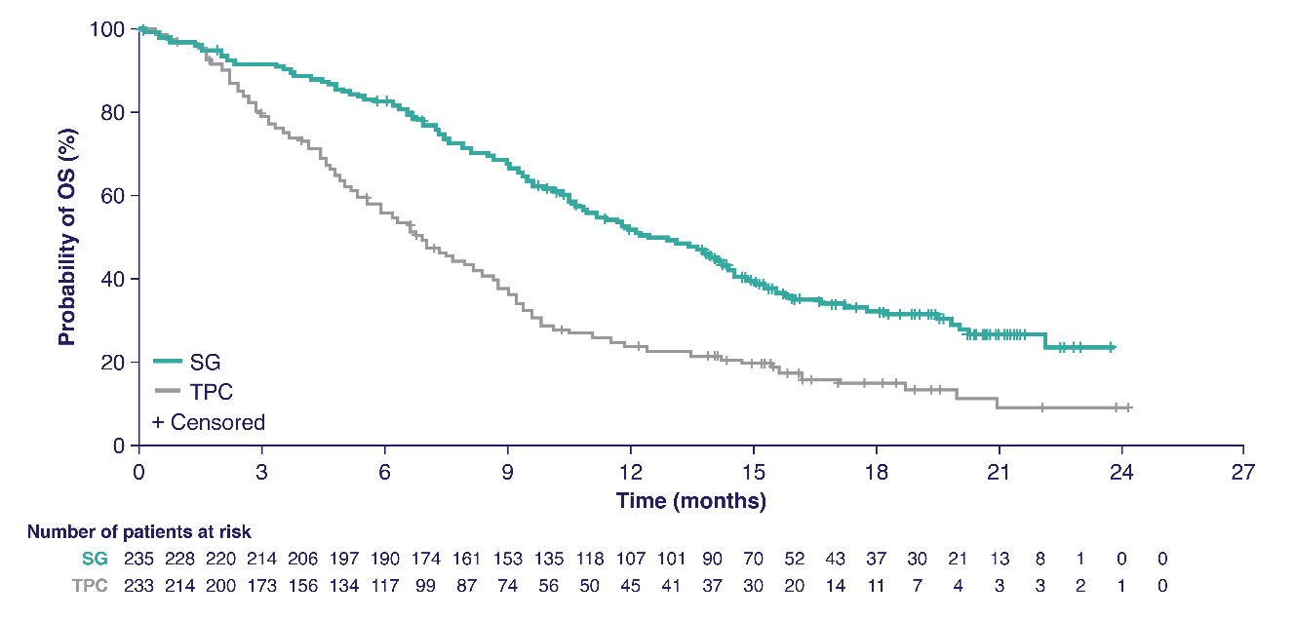
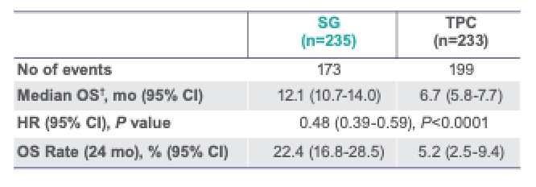
ASCENT: SG Significantly Improves OS
 | SG (n=235) | TPC (n=233)
No. of events | 155 | 185
Median OS—mo (95% CI) | 12.1 (10.7-14.0) | 6.7 (5.8-7.7)
HR (95% CI), P-value | 0.48 (0.38-0.59), P<0.0001
Bardia et al. ESMO 2020. Abstract LBA17; Bardia et al ASCO 2022. Bardia et al. J Clin Oncol. 2024;42(15):1738-1744.

Slide 19
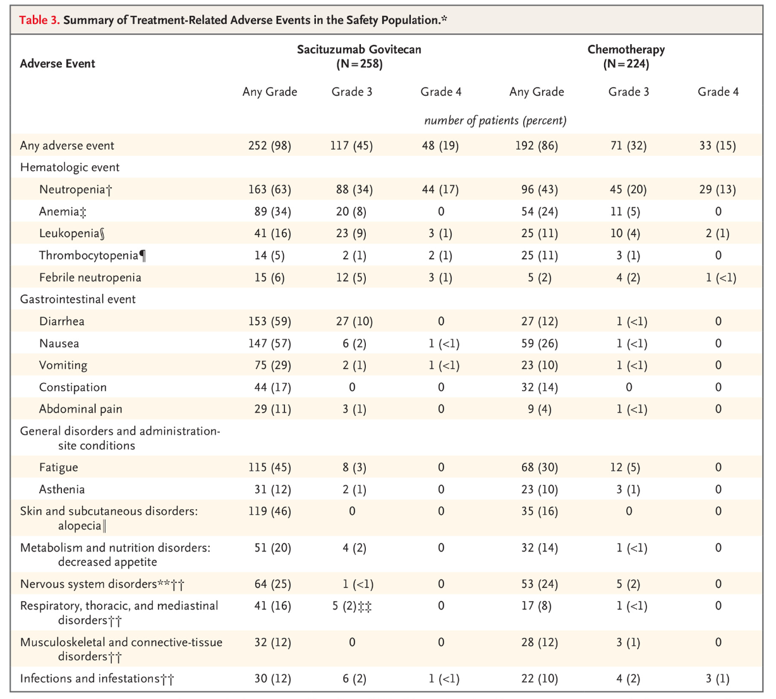
ASCENT:
Safety Profile
Treatment-related discontinuation rates: SG 4.7%; TPC 5.4%
Bardia A, et al. N Engl J Med. 2021;384:1529-1541.

Slide 20
DESTINY-Breast04: T-DXd vs Chemotherapy in HER2-low MBC After Prior Chemotherapy
KEY ELIGIBILITY CRITERIA
Advanced or metastatic breast cancer:
  ≥1 prior endocrine therapy if HR+
  1-2 prior chemotherapy regimens
  for metastatic disease or recurrence during or within 6 mo after adjuvant chemotherapy
HER2 IHC 1+ or 2+/ISH- (as confirmed
per central lab assessment) on archival
or recent tumor biopsy
T-DXd
R
2:1
Chemotherapy
Capecitabine, eribulin, gemcitabine,
paclitaxel, or nab-paclitaxel
STRATIFICATION FACTORS:
HER2 (1+ vs 2+/ISH-)
N prior lines of chemotherapy (1 vs 2)
HR status (positive [with vs without previous CDK4/6i] vs negative)
20
Modi S et al. ASCO 2022, Abstract LBA3; Modi S et al. N Engl J Med 2022;387(1):9-20.

Slide 21
DESTINY-Breast04: T-DXd vs Chemotherapy in HER2-low MBC After Prior Chemotherapy
KEY ELIGIBILITY CRITERIA
Advanced or metastatic breast cancer:
  ≥1 prior endocrine therapy if HR+
  1-2 prior chemotherapy regimens
  for metastatic disease or recurrence during or within 6 mo after adjuvant chemotherapy
HER2 IHC 1+ or 2+/ISH- (as confirmed
per central lab assessment) on archival
or recent tumor biopsy
T-DXd
R
2:1
Chemotherapy
Capecitabine, eribulin, gemcitabine,
paclitaxel, or nab-paclitaxel
STRATIFICATION FACTORS:
HER2 (1+ vs 2+/ISH-)
N prior lines of chemotherapy (1 vs 2)
HR status (positive [with vs without previous CDK4/6i] vs negative)
Drago JZ et al. Nat Rev Clin Oncol. 2021;18(6):327-344; Schettini ESMO Breast Virtual Meeting 2020 Abstr 23P
21
Modi S et al. ASCO 2022, Abstract LBA3; Modi S et al. N Engl J Med 2022;387(1):9-20.

Slide 22
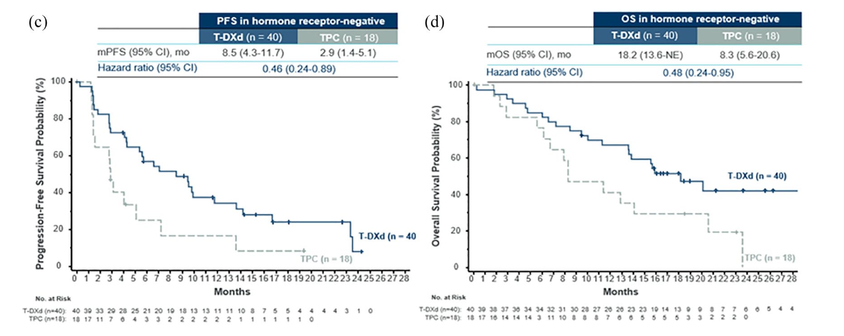
DB04: Results in the TNBC (HER2 low) cohort
22
Modi S et al. ASCO 2022, Abstract LBA3; Modi S et al. N Engl J Med 2022;387(1):9-20; Yang C. Ther Adv Med Oncol 2023.
Notes:
Ther Adv Med Oncol
2023,

Slide 23
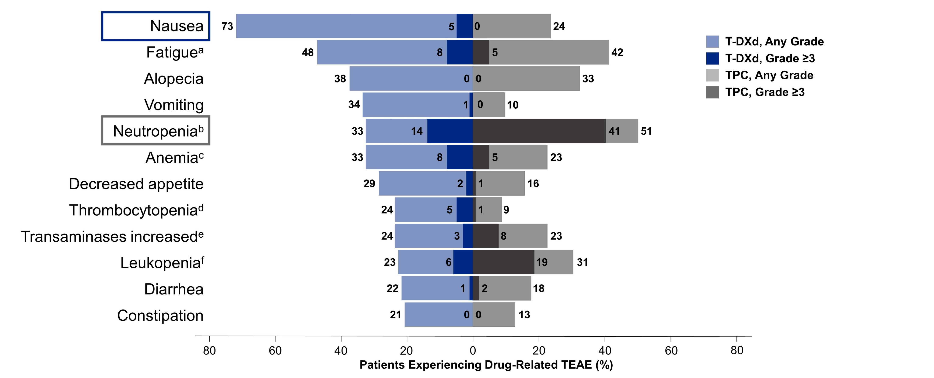
Slide 16
DB04: Drug-Related TEAEs in ≥20% of Patients
Modi S et al. ASCO 2022, Abstract LBA3; Modi S et al. N Engl J Med 2022;387(1):9-20.

Slide 24
DB04: Adverse Events of Special Interest
FAS
Median duration of follow-up:
32 months
AESI | Trastuzumab Deruxtecan | Treatment of Physician Choice
 | n=373 | n=184
Grade >3 Adverse Events, Total % | 54.4% | 67.4%
All-Grade
Nausea | 76.0% | 30.2%
Vomiting | 40.7% | 13.4%
Decreased Neutrophil Count | 22.1% | 36.0%
ILD or Pneumonitis, n (%): Primary Data Cutoff: 01.11.2022 | 45 (12.1%) | 1 (0.6%)
ILD
All grade 12%
Gr 1 3.5%
Gr 2 6.5%
Gr 3 1.3%
Gr 5 0.8%
Median Treatment Duration
Trastuzumab deruxtecan: 8.2 months (range, 0.2-39.1 months)
Treatment of Physician Choice: 3.5 months (range, 0.3-19.7 months)
Modi S et al. ASCO 2022, Abstract LBA3; Modi S et al. N Engl J Med 2022;387(1):9-20.

Slide 25
Side Effect Profiles Differ Across ADCs
 | Trastuzumab deruxtecan (DESTINY-Breast04) |  | Sacituzumab govitecan (ASCENT)
Adverse Event | Any grade | Grade ≥3 | Any grade | Grade ≥3
Low neutrophil count | 33% | 14% | 63% | 34%
Anemia | 33% | 8% | 34% | 8%
Low platelet count | 24% | 5% | 5% | 1%
Nausea | 73% | 5% | 57% | 2%
Vomiting | 34% | 1% | 29% | 1%
Diarrhea | 22% | 1% | 59% | 10%
Fatigue | 48% | 8% | 45% | 3%
Hair loss | 38% | N/A | 46% | N/A
Mouth sores | - | - | 10% | 1%
Inflammation of lungs | 12% | 2% | 0.4% | 0.4%
N/A, not applicable; ”-”, not reported. *Includes fatigue, asthenia and malaise.
25
Modi S et al. N Engl J Med 2022; Bardia A et al. ESMO 2023; Rugo HS et al. J Clin Oncol 2022; Rugo HS et al. Lancet 2023; Bardia A et al. N Engl J Med 2021; Fan Y et al. ASCO 2024.

Slide 26
Side Effect Profiles Differ Across ADCs
 | Trastuzumab deruxtecan (DESTINY-Breast04) |  | Sacituzumab govitecan (ASCENT)
Adverse Event | Any grade | Grade ≥3 | Any grade | Grade ≥3
Low neutrophil count | 33% | 14% | 63% | 34%
Anemia | 33% | 8% | 34% | 8%
Low platelet count | 24% | 5% | 5% | 1%
Nausea | 73% | 5% | 57% | 2%
Vomiting | 34% | 1% | 29% | 1%
Diarrhea | 22% | 1% | 59% | 10%
Fatigue | 48% | 8% | 45% | 3%
Hair loss | 38% | N/A | 46% | N/A
Mouth sores | - | - | 10% | 1%
Inflammation of lungs | 12% | 2% | 0.4% | 0.4%
N/A, not applicable; ”-”, not reported. *Includes fatigue, asthenia and malaise.
26
Modi S et al. N Engl J Med 2022; Bardia A et al. ESMO 2023; Rugo HS et al. J Clin Oncol 2022; Rugo HS et al. Lancet 2023; Bardia A et al. N Engl J Med 2021; Fan Y et al. ASCO 2024.

Slide 27
Side Effect Profiles Differ Across ADCs
 | Trastuzumab deruxtecan (DESTINY-Breast04) |  | Sacituzumab govitecan (ASCENT)
Adverse Event | Any grade | Grade ≥3 | Any grade | Grade ≥3
Low neutrophil count | 33% | 14% | 63% | 34%
Anemia | 33% | 8% | 34% | 8%
Low platelet count | 24% | 5% | 5% | 1%
Nausea | 73% | 5% | 57% | 2%
Vomiting | 34% | 1% | 29% | 1%
Diarrhea | 22% | 1% | 59% | 10%
Fatigue | 48% | 8% | 45% | 3%
Hair loss | 38% | N/A | 46% | N/A
Mouth sores | - | - | 10% | 1%
Inflammation of lungs | 12% | 2% | 0.4% | 0.4%
N/A, not applicable; ”-”, not reported. *Includes fatigue, asthenia and malaise.
27
Modi S et al. N Engl J Med 2022; Bardia A et al. ESMO 2023; Rugo HS et al. J Clin Oncol 2022; Rugo HS et al. Lancet 2023; Bardia A et al. N Engl J Med 2021; Fan Y et al. ASCO 2024.

Slide 28
Biomarkers for Treatment of Advanced TNBC
BIOMARKER | FREQUENCY | DIAGNOSTIC METHOD | TREATMENT
PD-L1-positive | ~35-40% of metastatic TNBC | IHC (22C3 assay) (tissue) | Pembrolizumab (+ chemotherapy)
gBRCA1/BRCA2 mutation | ~10% of metastatic TNBC | Germline testing (blood or saliva) | Olaparib Talazoparib
HER2-low | ~40% of metastatic TNBC | IHC (tissue) | Trastuzumab deruxtecan
MSI-high/MMR-deficient | ~0.5-1.5% of breast cancer | IHC, NGS, PCR | Pembrolizumab Dostarlimab
TMB-high (≥10 mut/Mb) | ~8.5% of metastatic breast cancer | NGS | Pembrolizumab
NTRK fusion | ~0.4% of breast cancer | FISH, NGS, PCR | Larotrectinib Entrectinib Repotrectinib
RET fusion | ~1% of breast cancer | NGS | Selpercatinib
Cortes J et al. Lancet. 2020; O’Shaughnessy J et al. Breast Cancer Res. 2020; Modi S et al. N Engl J Med 2022;
Bonneville R et al. JCO Precis Oncol. 2017; Barroso-Sousa R et al. Ann Oncol. 2020; Westphalen CB et al. npj Precis Oncol. 2021; Paratala BS et al. Nat Commun. 2018;9(1):4821.
28

Slide 29
Treatment Algorithm for mTNBC
Clinical trials are an option at any line!
PD-L1-positive
PD-L1-negative
1L
Chemotherapy + pembrolizumab
Chemotherapy
(e.g., taxane, platinum)
Olaparib or talazoparib (if BRCAm)
Olaparib or talazoparib
(if BRCAm)
Sacituzumab govitecan
T-DXd
(if HER2-low)
Chemotherapy
(e.g., taxane, platinum)
2L
Sacituzumab govitecan
T-DXd
(if HER2-low)
Olaparib or talazoparib
(if BRCAm)
Chemotherapy
(e.g., eribulin, capecitabine, gemcitabine, vinorelbine)
Biomarker positive*
(TMB-H, MSI-H/dMMR, NTRK fusion, RET fusion)
3L+
*TMB-H: Pembrolizumab; MSI-H: Pembrolizumab, Dostarlimab; NTRK fusion: Larotrectinib, Entrectinib, Repotrectinib; RET fusion: Selpercatinib
29

Slide 30
Outline
Triple-Negative Breast Cancer (TNBC)
Standard of care therapies for Metastatic TNBC
Emerging Therapies in Metastatic TNBC
  Antibody Drug Conjugates (new and not so new!)
  PARP1 selective inhibitors
  Bispecific Antibodies
Questions that remain to be addressed
  Early relapsers during adjuvant therapy or with short DFI
  Sequencing questions
Notes:
Triple Negative Breast Cancer: still an area of unmet need

Slide 31
Outline
Triple-Negative Breast Cancer (TNBC)
Standard of care therapies for Metastatic TNBC
Emerging Therapies in Metastatic TNBC
  Antibody Drug Conjugates (new and not so new!)
  PARP1 selective inhibitors
  Bispecific Antibodies
Questions that remain to be addressed
  Early relapsers during adjuvant therapy or with short DFI
  Sequencing questions
PD-L1 positive
Notes:
Triple Negative Breast Cancer: still an area of unmet need

Slide 32
ASCENT-04: Study Schema
Previously untreated, locally advanced unresectable, or metastatic TNBCª:
  PD-L1-positive (CPS ≥ 10 by the 22C3 assay^{b})
  ≥ 6 months since treatment in curative setting (prior anti-PD-[L]1 use allowed)
  N = 443
SG + pembrolizumab^{d}
(SG 10 mg/kg IV, days 1 and 8 of 21-day cycles; pembrolizumab 200 mg, day 1 of 21-day cycles)
n = 221
End points
Primary
PFS by BICR^{e}
Secondary
OS
ORR, DOR by BICR^{e}
Safety
QoL
All treatment, including SG or chemo, was continued until BICR-verified disease progression or unacceptable toxicity
R
1:1
Chemotherapy* + pembrolizumab^{d}
(paclitaxel 90 mg/m² OR nab-paclitaxel
100 mg/m² on days 1, 8, & 15 of 28-day cycles, OR gemcitabine 1000 mg/m² + carboplatin AUC 2 on days 1 & 8 of 21-day cycles; pembro 200 mg on day 1 of 21-day cycles)
n = 222
*Eligible patients who experienced BICR-verified disease progression were
offered to cross-over to
receive 2L SG monotherapy
32
Tolaney SM et al. ASCO 2025. Abstract LBA109.

Slide 33
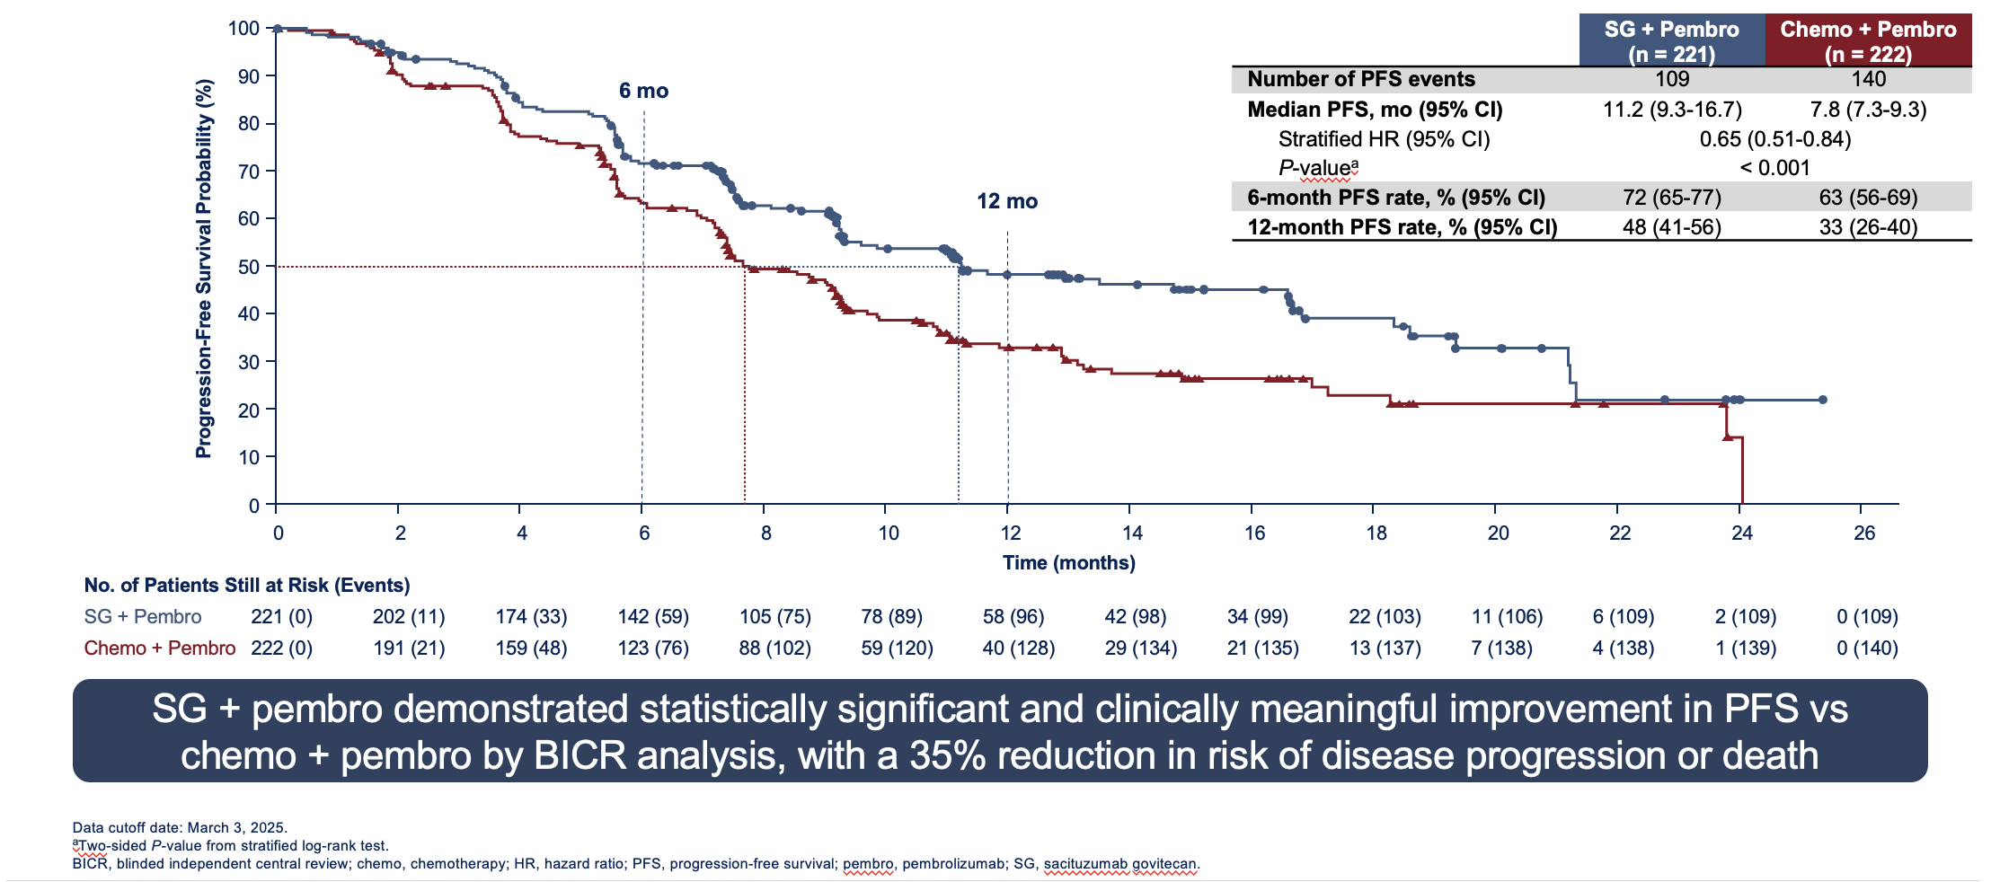
ASCENT-04: Primary endpoint (PFS by BICR)
33
Tolaney SM et al. ASCO 2025. Abstract LBA109.
Notes:
Adding Pembrolizumab to SG Improves Outcomes in 1L PD-L1+ mTNBC

Slide 34
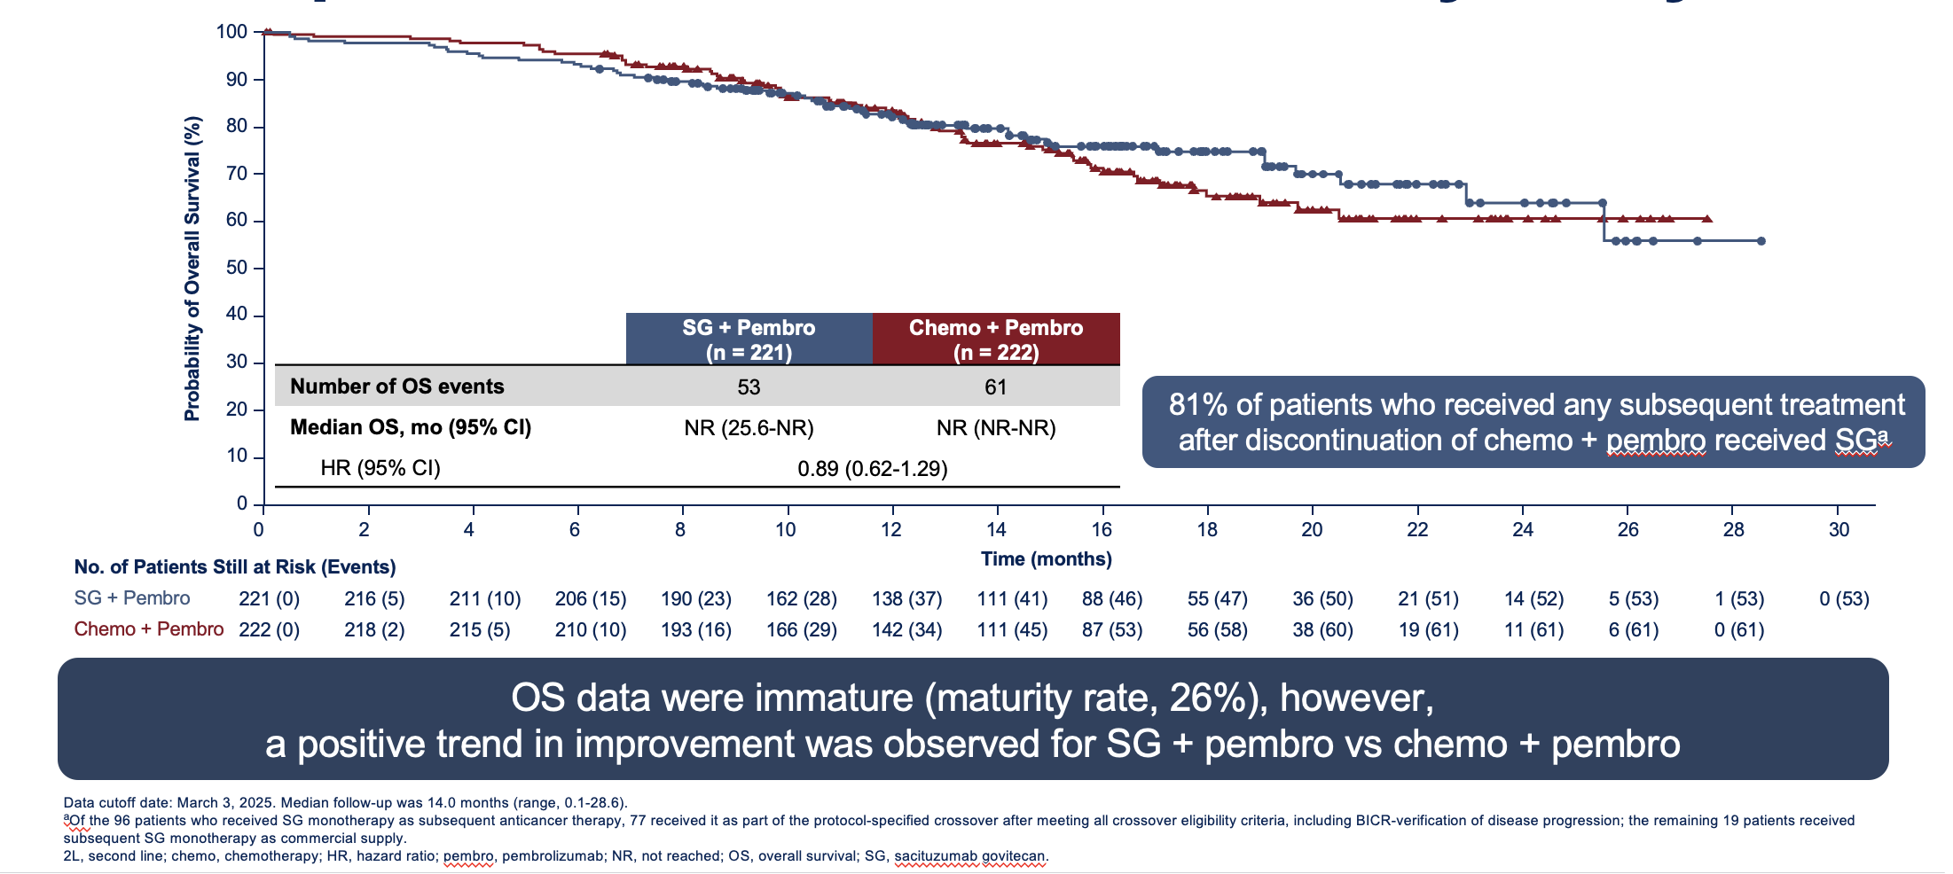
Descriptive Overall Survival at Primary Analysis
34
Tolaney SM et al. ASCO 2025. Abstract LBA109.
Notes:
Adding Pembrolizumab to SG Improves Outcomes in 1L PD-L1+ mTNBC

Slide 35
ASCENT-04: Conclusions
SG + pembro led to a statistically significant and clinically meaningful improvement in PFS vs chemo + pembro
  PFS benefit was observed across prespecified subgroups
OS data are immature, but an early trend in improvement was observed
The safety profile of SG + pembro was consistent with the established profiles of either agent; no additive toxicity was observed
Results from ASCENT-04/KEYNOTE-D19 support the use of SG + pembro as a potential new standard of care for patients with previously untreated, PD-L1+, locally advanced unresectable or metastatic TNBC
35
Tolaney SM et al. ASCO 2025. Abstract LBA109.
Notes:
ASCENT-04/KEYNOTE-D19 is the first randomized, phase 3 study to evaluate the efficacy and safety of an ADC/checkpoint inhibitor combination for first-line treatment of patients with PD-L1+ª mTNBC

Slide 36
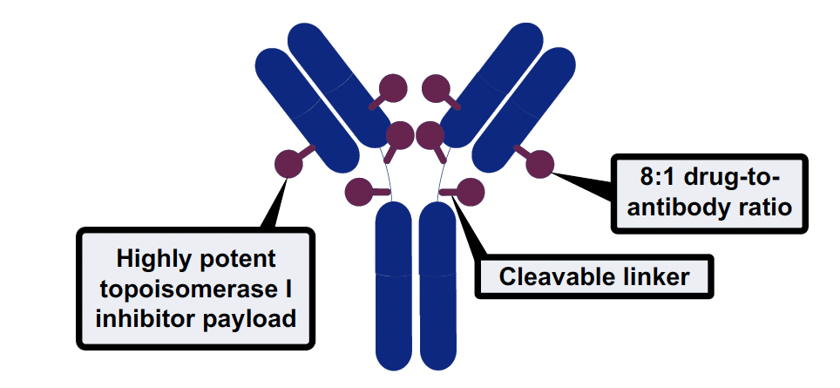
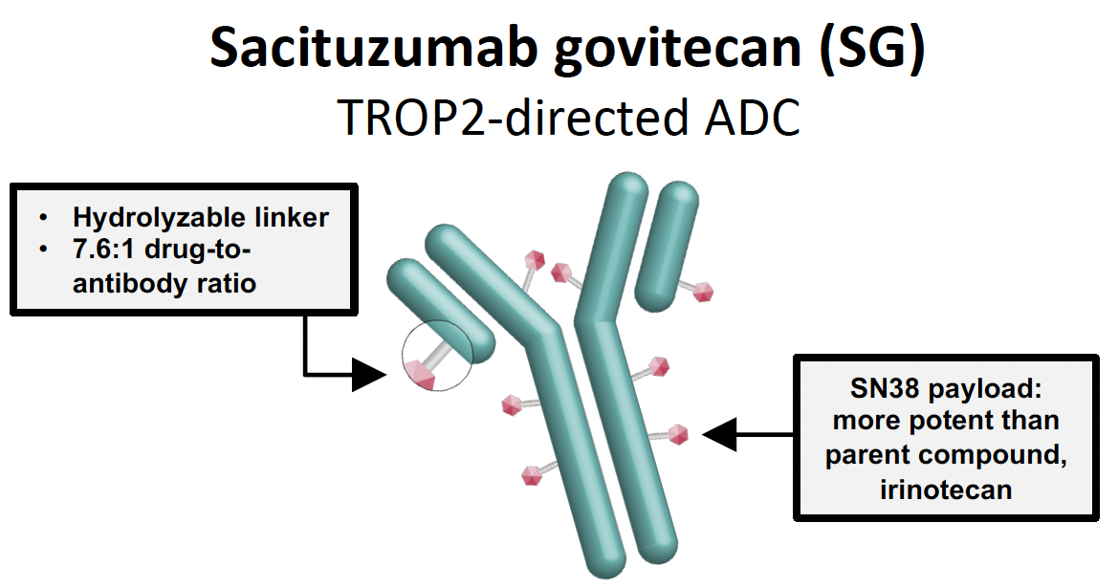
ADCs in advanced TNBC
Approved Jan 17, 2025 for HR+ BC
Trastuzumab deruxtecan (T-DXd)
anti-HER2 ADC
Sacituzumab Govitecan (SG)
anti-Trop2 ADC
Datopotamab Deruxtecan (Dato-DXd)
anti-Trop2 ADC
HER2-low
~100% (no biomarker)
~100% (no biomarker)

Slide 37









BEGONIA Study: Study design
Immune checkpoint inhibitors + chemotherapy is the standard of care for patients with PD-L1 positive a/mTNBC; still, most progress within a year (median PFS ~9–10 months)^{1,2}
BEGONIA is evaluating combinations of durvalumab (D), an anti−PD-L1 antibody, with other novel therapies in first-line a/mTNBC
Dato-DXd is a TROP2-directed ADC with a TOPO I inhibitor payload and a tumour- selective cleavable linker³
At median 7.2 months follow-up, ORR was 74% for patients treated with Dato-DXd + D in BEGONIA⁴
Eligibility criteria Treatment arms Part 1
Part 2 expansion
Females aged ≥18 years
Unresectable a/mTNBC
No prior treatment for Stage IV TNBC
≥12 months since prior
taxane therapy
ECOG PS 0-1
Adequate organ function
Measurable disease per RECIST v1.1
No prior treatment with checkpoint inhibitor
No prior treatment with TOPO I-based ADCª
Arm 1: Paclitaxel (P) + D (N=20)
Arm 2: Capivasertib + P + D (N=30)
Arm 5: Oleclumab + P + D (N=30) Arm 6: T-DXd + D (N=30)
Arm 7: Dato-DXd 6 mg/kg + D 1120 mg (N=30)
Q3W until PD
Safety run-in (up to
6 patients)
Simon
2-stage futility analysis for
Part 2 expansion^{c}
Arms that meet expansion criteria enrol additional 27 patients
Arm 8: Dato-DXd + D, PD-L1
positive (N=30)^{b}
1° endpoint: Safety and tolerability 2° endpoints: ORR, PFS, DoR, OS
1° endpoint: ORR
2° endpoints: PFS, DoR, PFS6, OS
Notes:
Eligibility criteria:
Metastatic TNBC
No prior treatment for MBC
> 12m DFI
Measurable disease
Normal organ function and no contraindication to IO
For TDxd cohort:
HER2 low
No pulmonary disorders

Slide 38

BEGONIA Arm 7 and 8: Dato-DXd + Durvalumab
Arm 7 (Median F/up: 35mos)
Arm 8 (Median F/up: 10.7mos)
N = 62
N = 33
79%
81.8%
cORR
cORR
Median DoR and PFS could not be determined due to short f/up
17.6
Months
14
Months
Median DoR*
Median PFS*
Schmid et al. ESMO 2025. Abstract 555MO.
Notes:
Discontinuation due to AE = 6.6%
Common AEs of any grade include:
Nausea 57%
Mucositis 56%
Alopecia 45%

Slide 39
TROPION-Breast05: Study Schema
39
Notes:
TROPION-Breast05: Dato-DXd + Durvalumab vs. TPC + Pembrolizumab
in 1L PD-L1+ mTNBC

Slide 40
Outline
Triple-Negative Breast Cancer (TNBC)
Standard of care therapies for Metastatic TNBC
Emerging Therapies in Metastatic TNBC
  Antibody Drug Conjugates (new and not so new!)
  PARP1 selective inhibitors
  Bispecific Antibodies
Questions that remain to be addressed
  Early relapsers during adjuvant therapy or with short DFI
  Sequencing questions
Notes:
Triple Negative Breast Cancer: still an area of unmet need

Slide 41
Outline
Triple-Negative Breast Cancer (TNBC)
Standard of care therapies for Metastatic TNBC
Emerging Therapies in Metastatic TNBC
  Antibody Drug Conjugates (new and not so new!)
  PARP1 selective inhibitors
  Bispecific Antibodies
Questions that remain to be addressed
  Early relapsers during adjuvant therapy or with short DFI
  Sequencing questions
PD-L1 negative
Notes:
Triple Negative Breast Cancer: still an area of unmet need

Slide 42
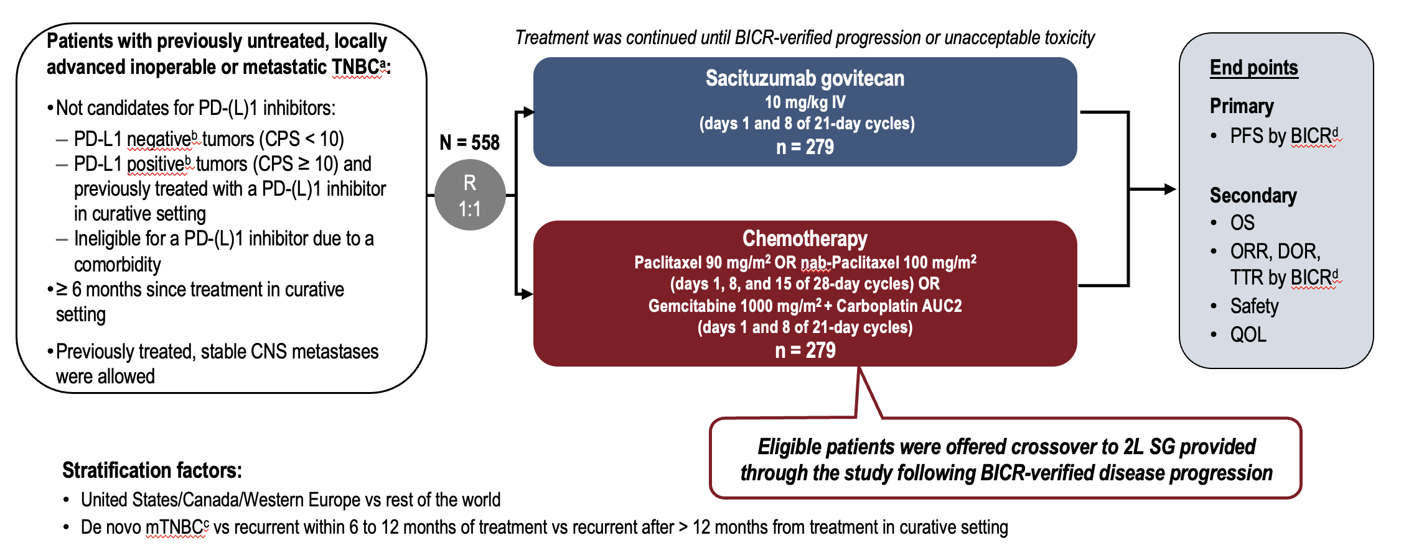
ASCENT-03: Sacituzumab Govitecan (SG) vs
Chemotherapy in mTNBC
Cortes J. ESMO 2025. Abstract LBA20.

Slide 43
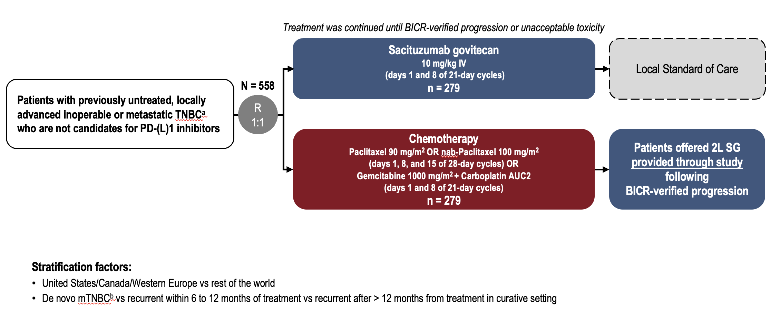
ASCENT-03: Sacituzumab Govitecan (SG) vs
Chemotherapy in mTNBC
Cortes J. ESMO 2025. Abstract LBA20.

Slide 44
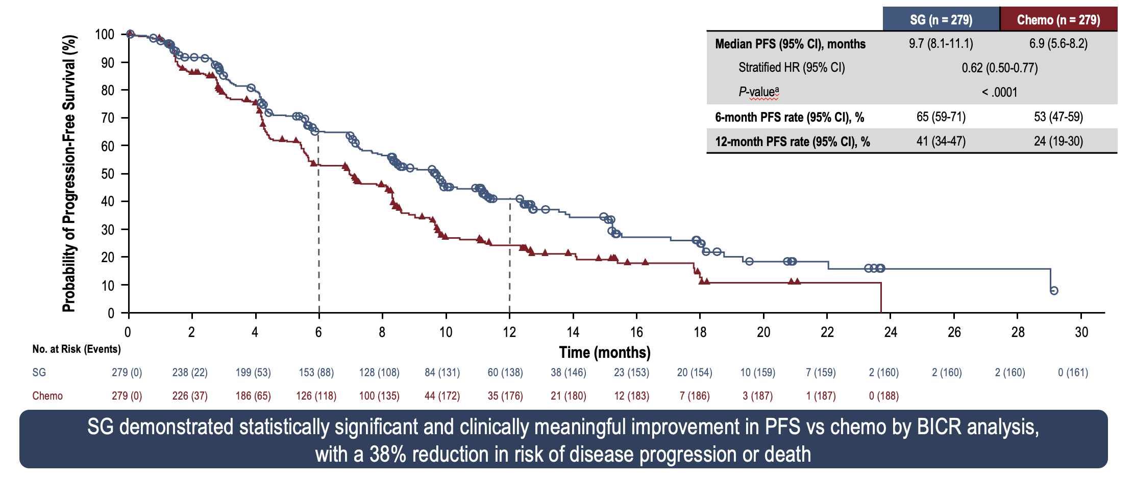
ASCENT-03: Progression-Free Survival by BICR
Cortes J. ESMO 2025. Abstract LBA20.

Slide 45
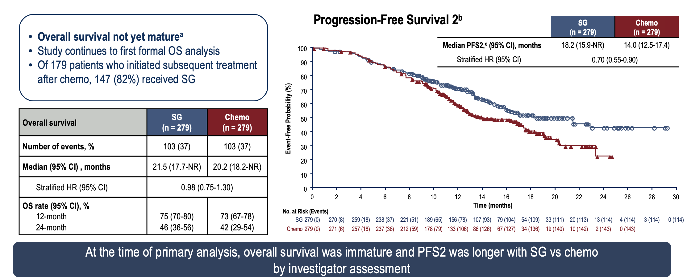
ASCENT-03: Descriptive Overall Survival and PFS2
Cortes J. ESMO 2025. Abstract LBA20.

Slide 46
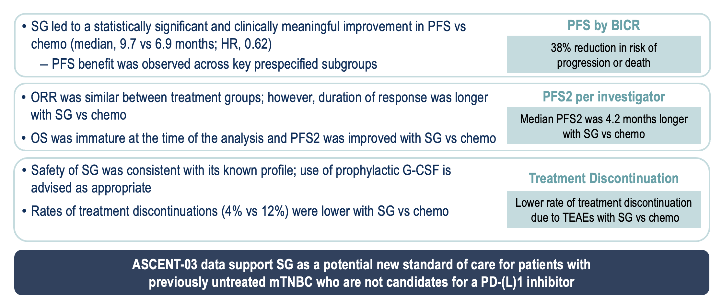
ASCENT-03: Conclusions
Cortes J. ESMO 2025. Abstract LBA20.

Slide 47
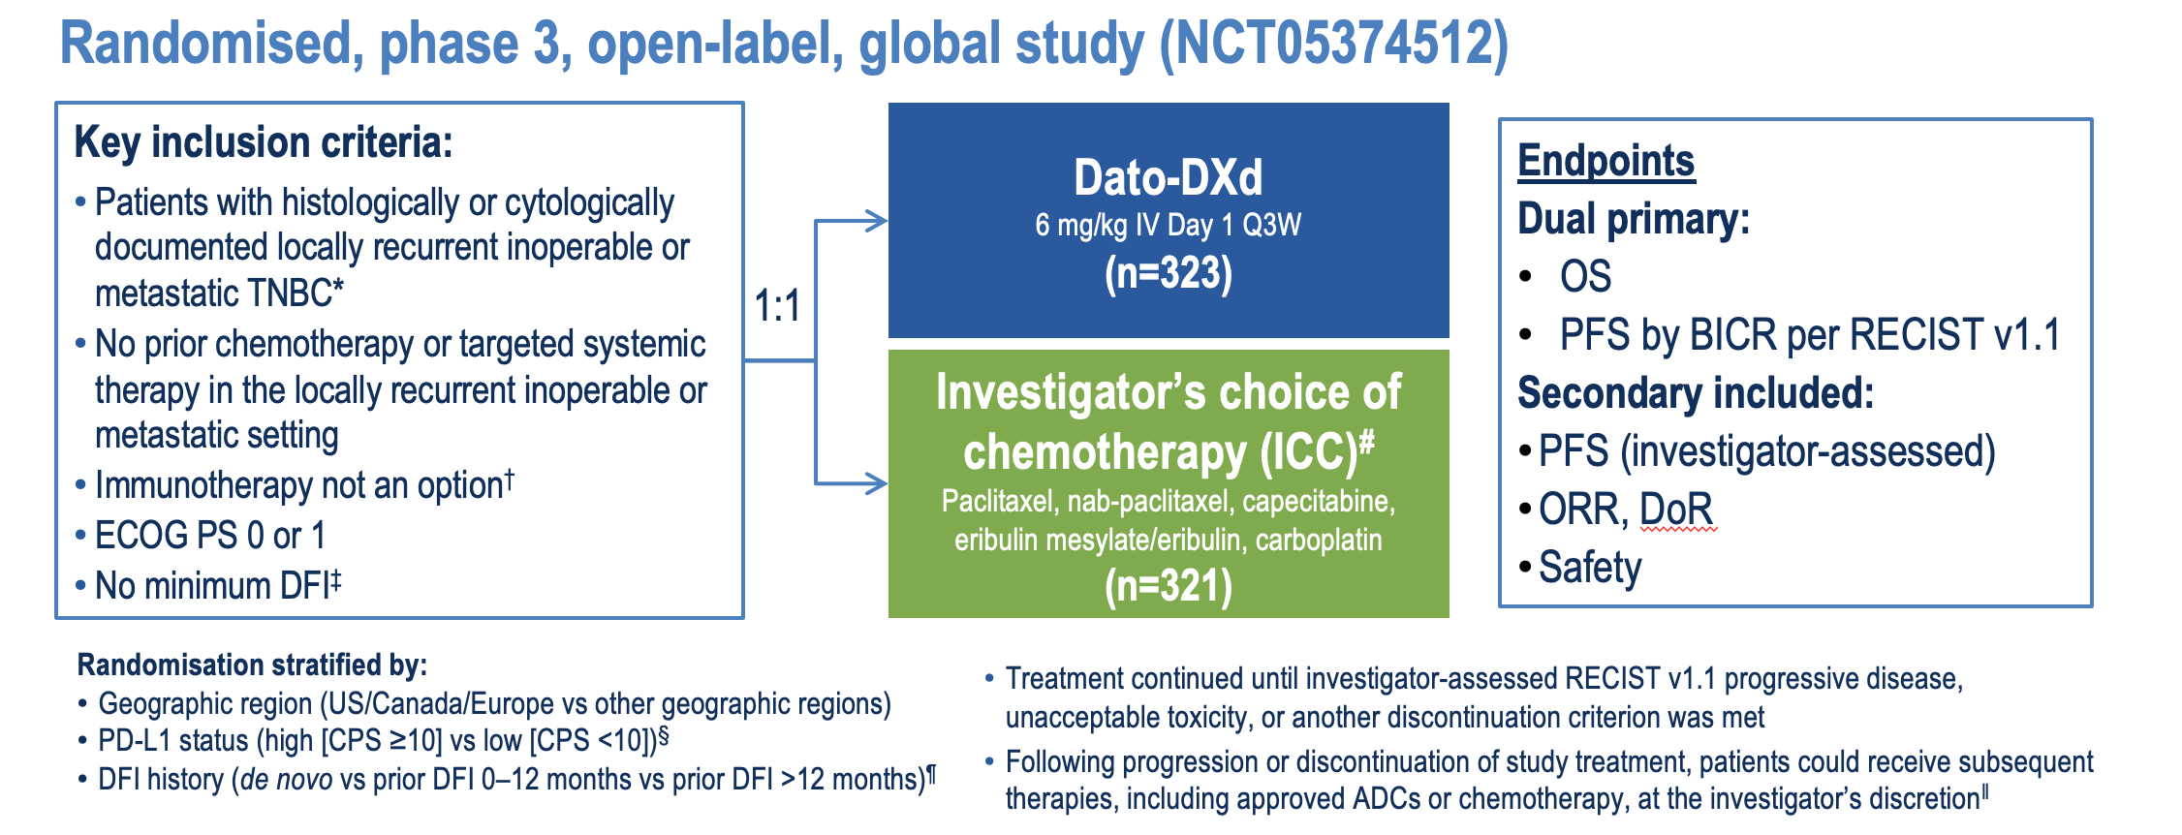
TROPION-Breast02: Study Schema
ER/PR <1%
Dent R. ESMO 2025. Abstract LBA21.

Slide 48
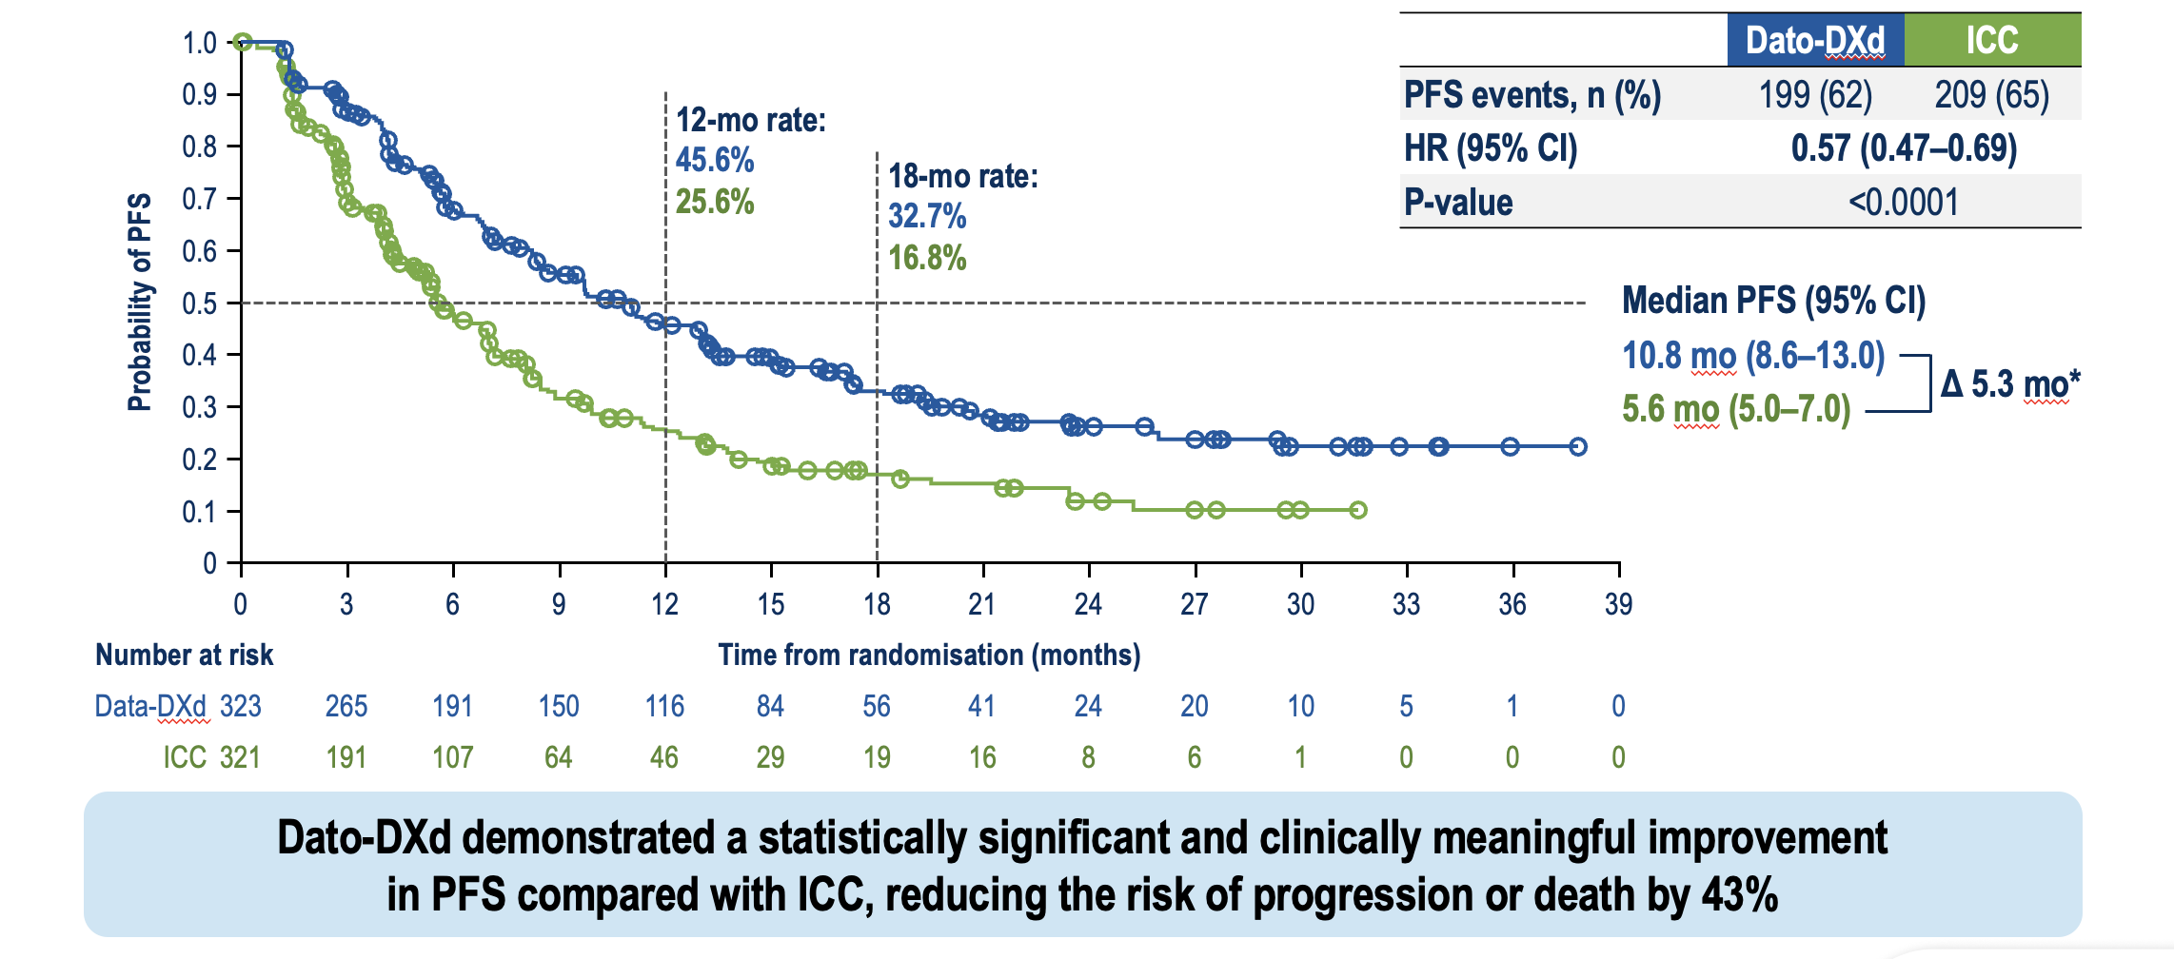
TROPION-Breast02: PFS by BICR
ER/PR <1%
Dent R. ESMO 2025. Abstract LBA21.

Slide 49
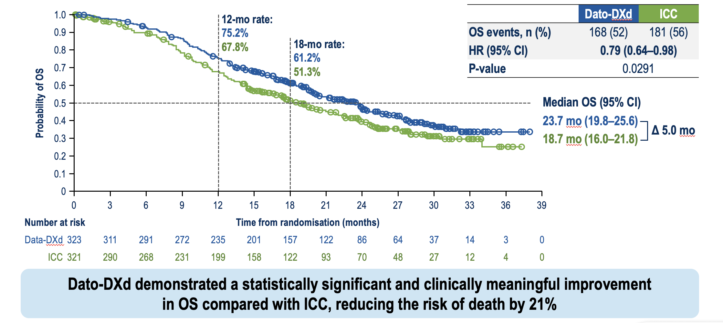
TROPION-Breast02: Overall Survival
ER/PR <1%
Dent R. ESMO 2025. Abstract LBA21.

Slide 50
Most Common Treatment-Related AEs (≥15% of Patients)
Treatment-related AEs, n (%) | Dato-DXd (n=319) |  | ICC (n=309)
 | Any Grade | Grade ≥3 | Any Grade | Grade ≥3
Dry eye* | 76 (24) | 4 (1) | 9 (3) | 0
Stomatitis | 182 (57) | 27 (8) | 27 (9) | 0
Nausea | 142 (45) | 2 (<1) | 53 (17) | 2 (<1)
Constipation | 72 (23) | 1 (<1) | 31 (10) | 0
Vomiting | 65 (20) | 4 (1) | 23 ( 7) | 1 (<1)
Decreased appetite | 49 (15) | 1 (<1) | 20 (6) | 1 (<1)
Neutropenia† | 39 (12) | 10 (3) | 90 (29) | 40 (13)
Anaemia‡ | 48 (15) | 6 (2) | 64 (21) | 10 (3)
Leukopenia§ | 27 (8) | 3 (<1) | 55 (18) | 13 (4)
Peripheral neuropathy¶ | 14 (4) | 0 | 75 (24) | 5 (2)
Alopecia | 130 (41) | 0 | 96 (31) | 1 (<1)^{ǁ}
Fatigue# | 101 (32) | 8 (3) | 86 (28) | 9 (3)
In the Dato-DXd arm only, ophthalmologic assessments were required every 3 cycles while on therapy; this was not required in the ICC arm. For all patients in both arms, ophthalmologic assessments were required at baseline, as clinically indicated, and at end of therapy.
Dent R. ESMO 2025. Abstract LBA21.

Slide 51
Treatment-Related AESIs for Dato-DXd
AESI category, n (%) Preferred term* | Dato-DXd (n=319) |  |  | ICC (n=309)
 | Grade 1 | Grade 2 | Grade ≥3 | Grade 1 | Grade 2 | Grade ≥3
Oral mucositis/stomatitis† | 78 (24) | 87 (27) | 27 (8) | 22 (7) | 8 (3) | 0
Stomatitis | 72 (23) | 83 (26) | 27 (8) | 19 (6) | 8 (3) | 0
Ocular surface events‡§ | 76 (24) | 50 (16) | 23 (7) | 9 (3) | 5 (2) | 1 (<1)
Dry eye | 51 (16) | 21 (7) | 4 (1) | 6 (2) | 3 (1) | 0
Keratitis | 21 (7) | 14 (4) | 7 (2) | 1 (<1) | 0 | 0
Conjunctivitis | 7 (2) | 13 (4) | 1 (<1) | 0 | 0 | 0
Adjudicated drug-related ILD/pneumonitis¶ | 1 (<1) | 7 (2) | 1 (<1)# | 1 (<1) | 1 (<1) | 0
Treatment-related oral mucositis/stomatitis:
In the Dato-DXd arm, events led to dose interruption, reduction, and discontinuation in 11 (3%), 36 (11%), and 0 patients, respectively
Grade ≥2 events resolved to grade ≤1
in 103/114 patients (90%) at data cutoff
Treatment-related ocular surface events:
In the Dato-DXd arm, events led to dose interruption, reduction, and discontinuation in 18 (6%), 14 (4%), and 3 (<1%) patients, respectively
Grade ≥2 events resolved to grade ≤1
in 49/73 patients (67%) at data cutoff
Dent R. ESMO 2025. Abstract LBA21.

Slide 52
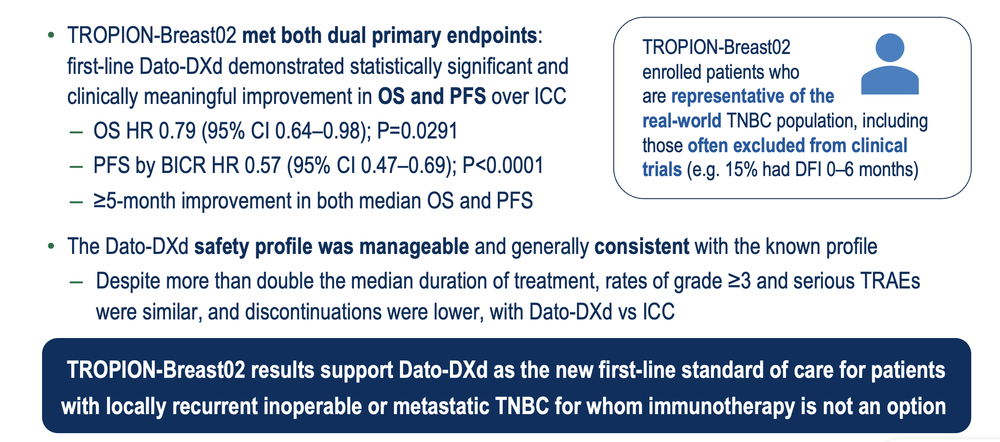
TROPION-Breast02: Conclusions
ER/PR <1%
Dent R. ESMO 2025. Abstract LBA21.

Slide 53
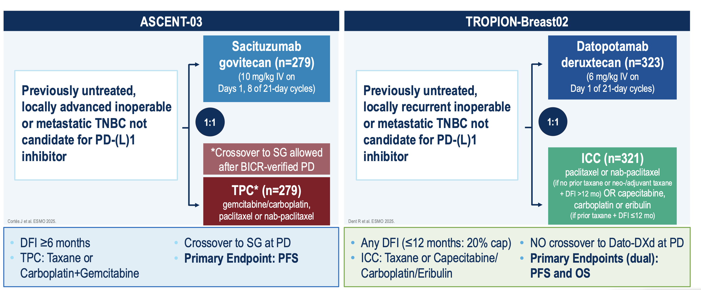
ER/PR <1%
Recurrent 0-6 months: 15%
Garrido-Castro A. ESMO 2025.

Slide 54
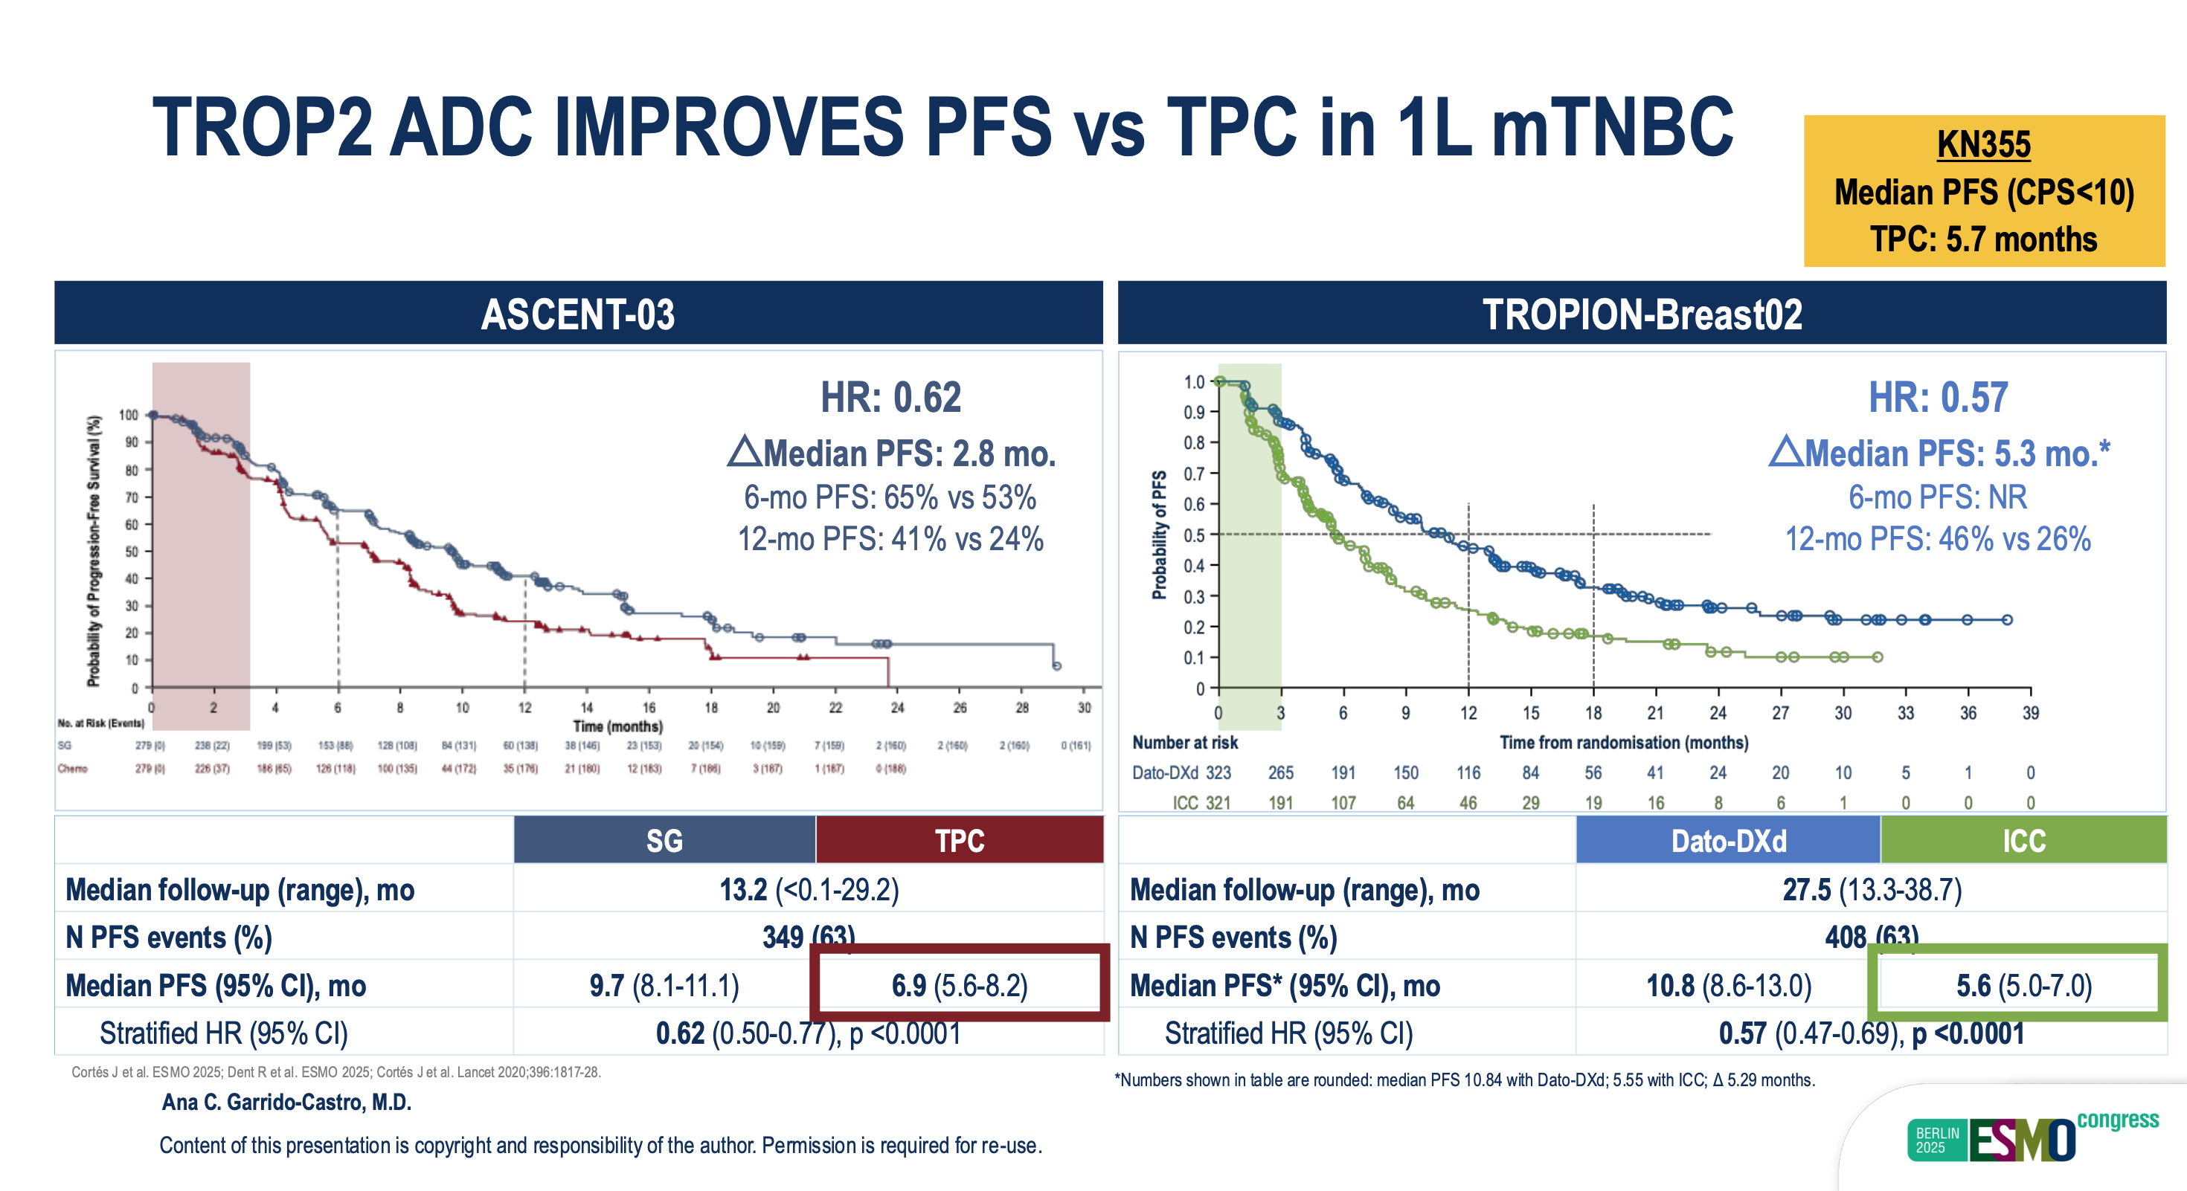
Garrido-Castro A. ESMO 2025.

Slide 55
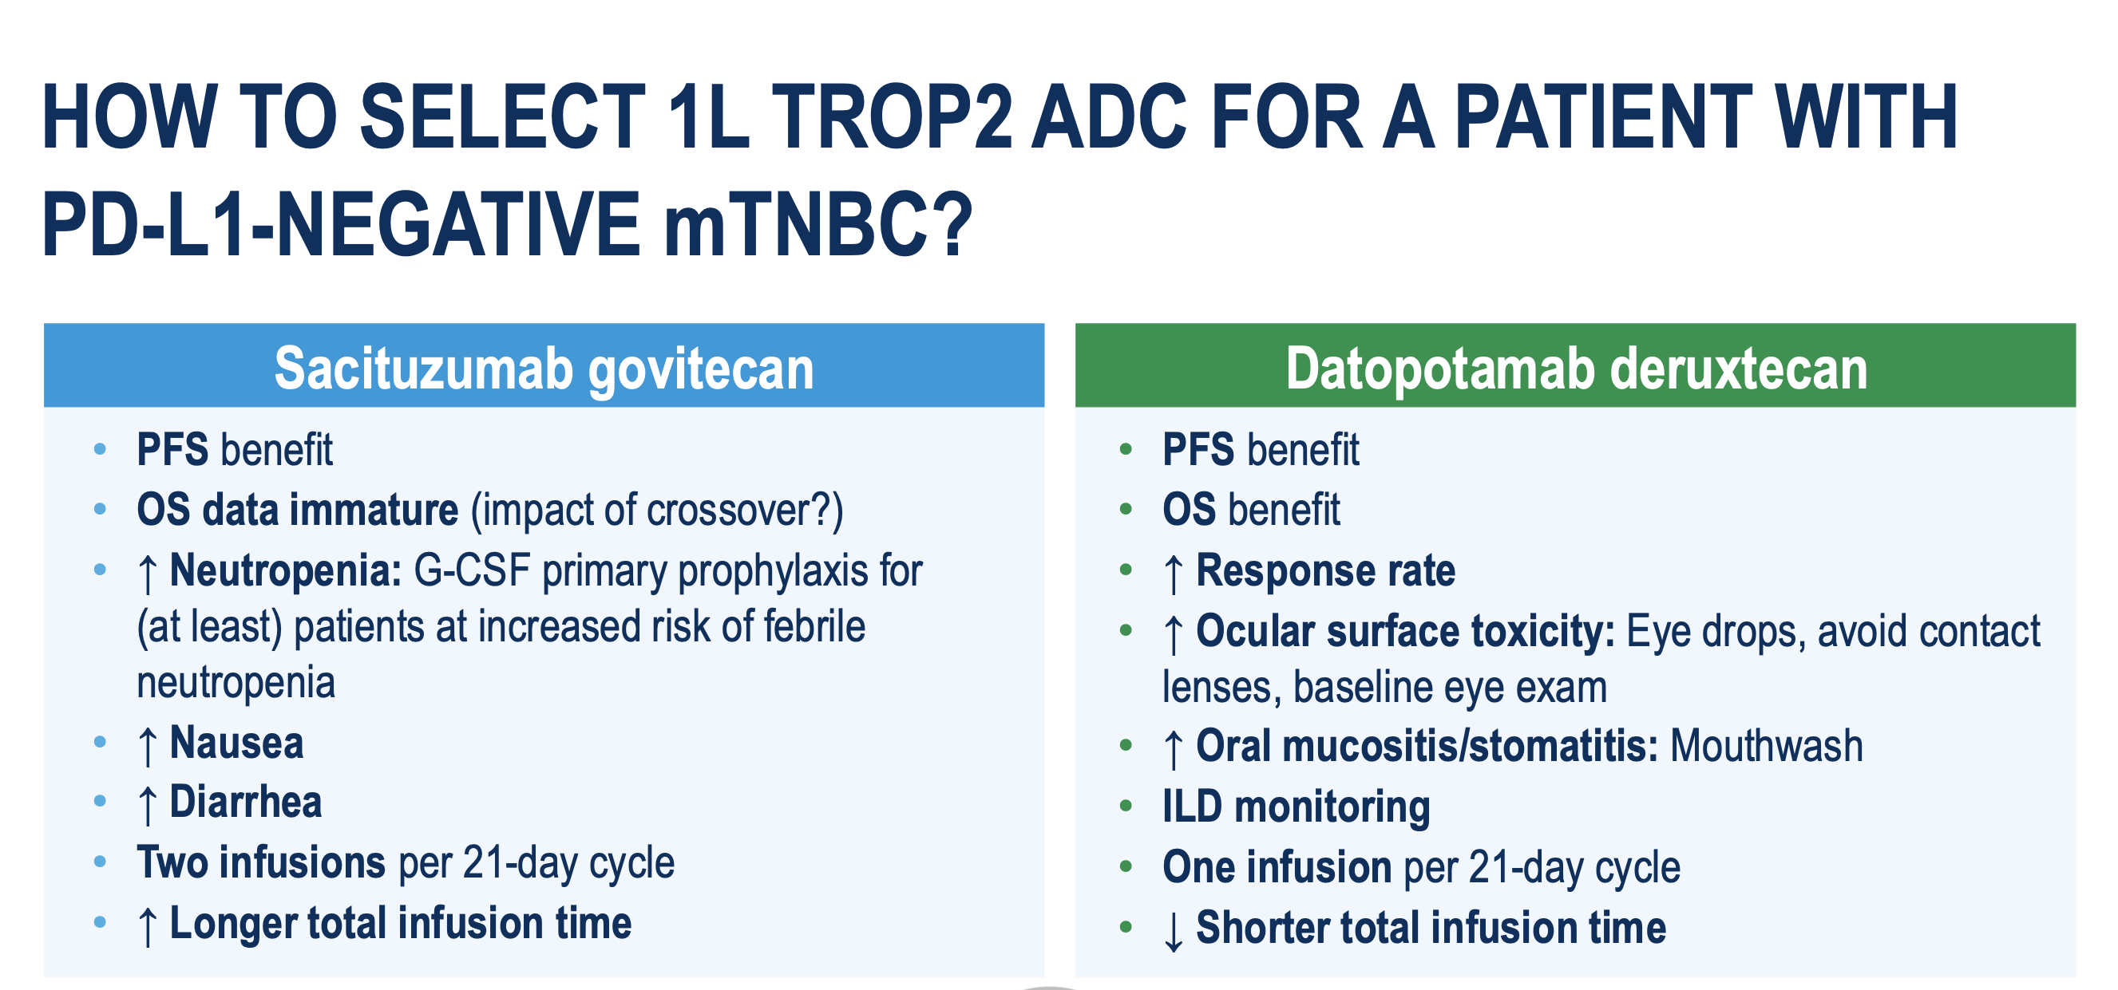
Garrido-Castro A. ESMO 2025.

Slide 56
Treatment Algorithm for mTNBC (post ASCO and ESMO 2025)
PD-L1-positive
PD-L1-negative
Sacituzumab + pembrolizumab
Sacituzumab
Dato-DXd
1L
Chemotherapy + pembrolizumab
Chemotherapy
(e.g., taxane, platinum)
Olaparib or talazoparib (if BRCAm)
Olaparib or talazoparib
(if BRCAm)
Sacituzumab govitecan
T-DXd
(if HER2-low)
Chemotherapy
(e.g., taxane, platinum)
2L
Sacituzumab govitecan
T-DXd
(if HER2-low)
Olaparib or talazoparib
(if BRCAm)
Chemotherapy
(e.g., eribulin, capecitabine, gemcitabine, vinorelbine)
Biomarker positive*
(TMB-H, MSI-H/dMMR, NTRK fusion, RET fusion)
3L+
*TMB-H: Pembrolizumab; MSI-H: Pembrolizumab, Dostarlimab; NTRK fusion: Larotrectinib, Entrectinib, Repotrectinib; RET fusion: Selpercatinib
56

Slide 57
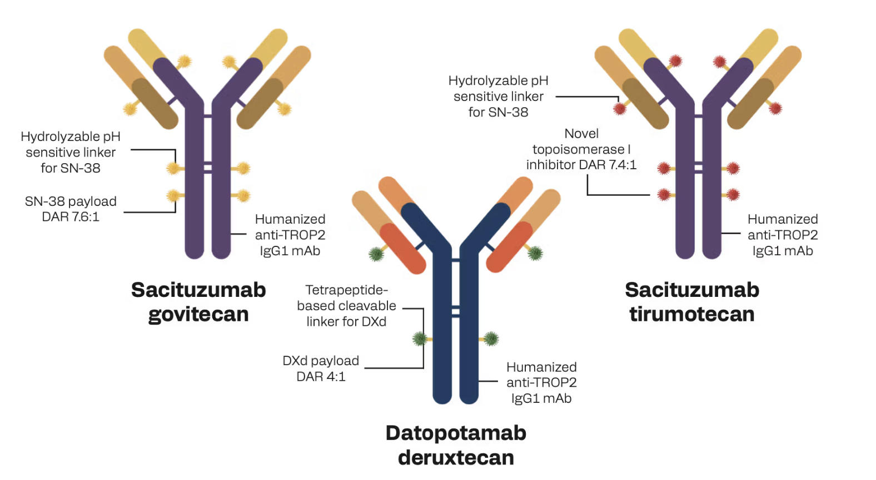
It is an ADC world… TROP2-Targeting ADCs in TNBC
ADC: antibody-drug conjugate; DAR: drug-antibody ratio; mAb: monoclonal antibody
57

Slide 58
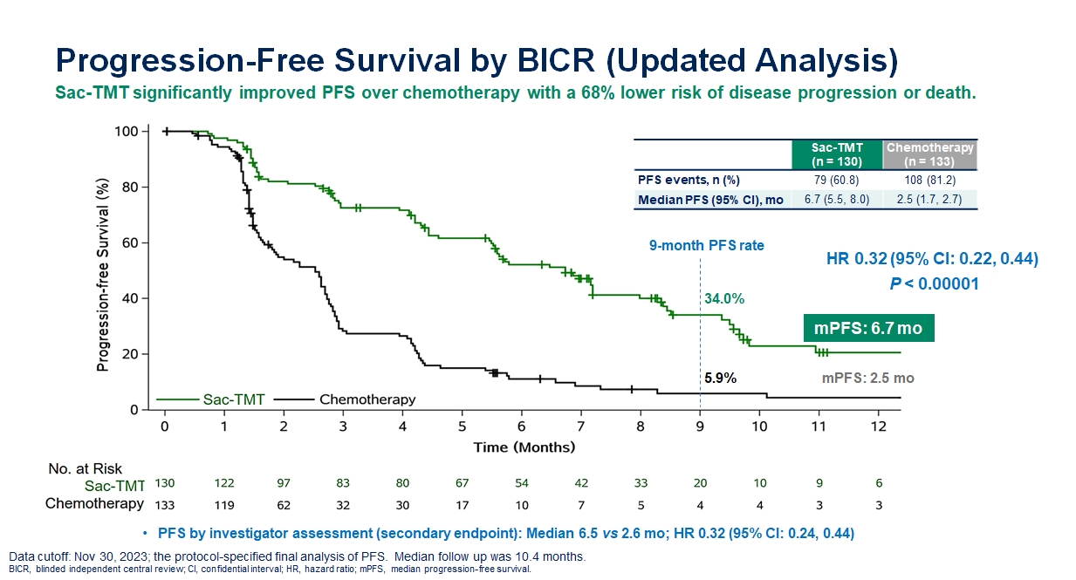
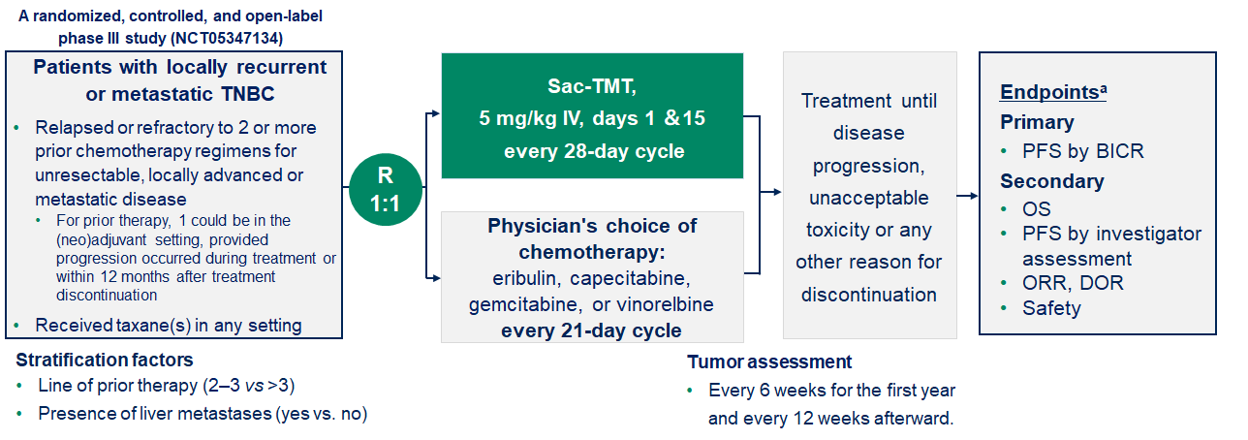
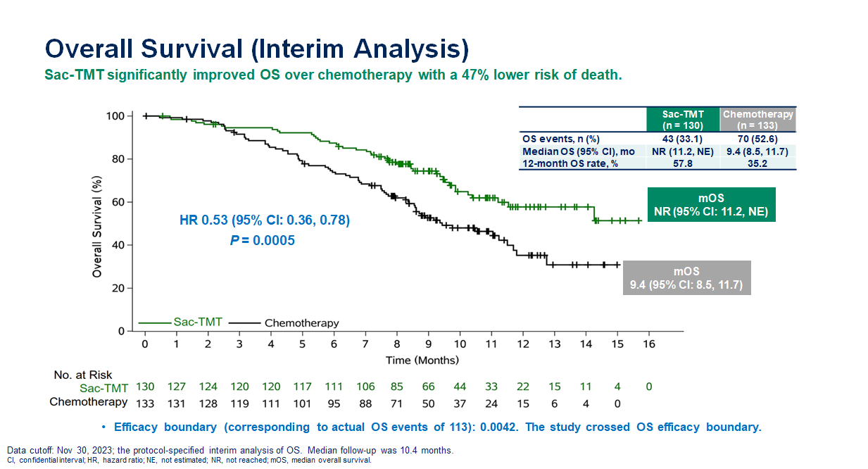
OptiTROP-Breast01: Study design and results
Yin. Nature Medicine 2025
Notes:
The OptiTROP-Breast01 phase 3 trial assessed sacituzumab tirumotecan (sac-TMT) versus chemotherapy in patients with locally recurrent or metastatic TNBC who had received two or more prior therapies, including at least one for metastatic disease. Patients were randomized to sac-TMT (n = 130) or chemotherapy (n = 133). The primary endpoint of progression-free survival (PFS) by blinded independent central review (BICR) was met based on the protocol-specified interim analysis.

Slide 59
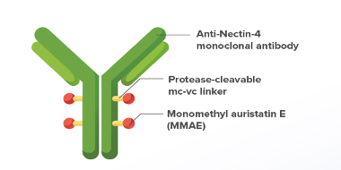
EV-202: Enfortumab vedotin
Patient Population
Locally advanced or metastatic BC
Prior taxanes or anthracyclines
≥ 1 standard-of-care cytotoxic regimen and ≤ 2 lines of cytotoxic therapy for locally advanced or metastatic BC
HR+/HER2- BC
Prior endocrine treatment with or without a CDK4/6 inhibitor
Endpoints
Primary: Investigator-assessed confirmed ORR per RECIST v1.1
Secondary: DOR, DCR, and PFS per RECIST v1.1, OS, safety / tolerability
Exploratory: Nectin-4 expressionª
EV 1.25 mg/kg IV on
Days 1, 8, 15 of each
28-day cycle
TNBC
Prior PD-1/L1 inhibitor based on PD-L1 expression
Treatment until disease progression or discontinuation criteria are met
Giordano A….Traina TA Abstract 1005 ASCO 2024
Notes:
Nectin-4 is a cell-adhesion molecule highly expressed in solid malignancies¹
Enfortumab vedotin (EV) is a Nectin-4–directed antibody–drug conjugate²
EV is indicated for the treatment of adult patients with locally advanced or metastatic urothelial carcinoma³
EV-202 (NCT04225117) is a multicenter, multicohort, open-label, phase 2 study evaluating EV in patients with locally advanced or metastatic solid tumors⁴
Here we present the results for the HR+/HER2− breast cancer and triple-negative breast cancer (TNBC) cohorts

Slide 60
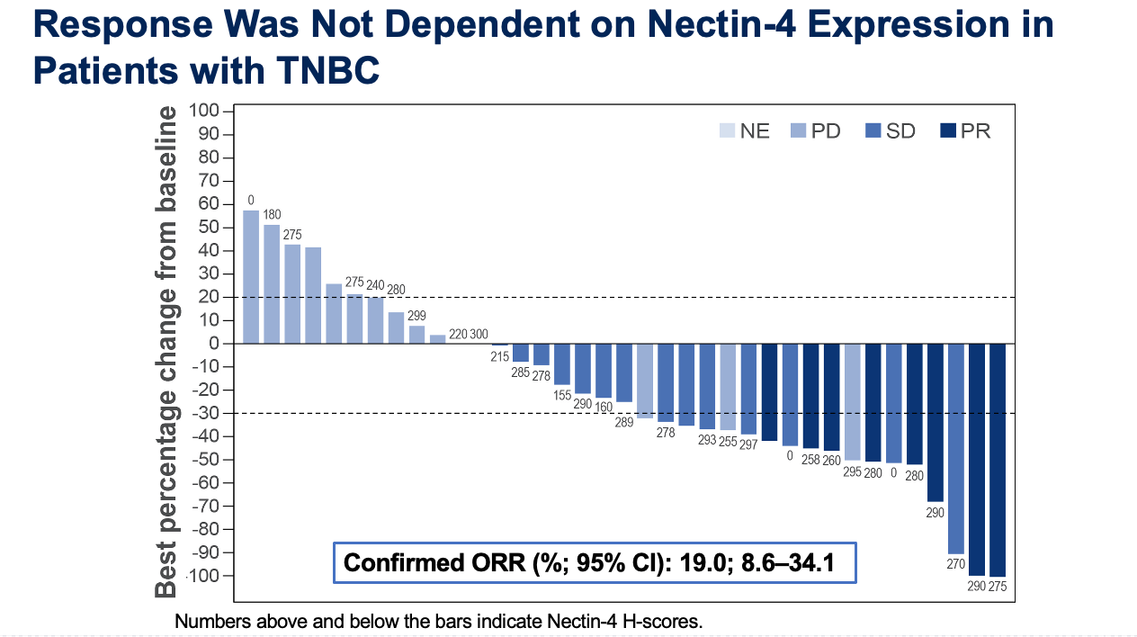
EV-202: Enfortumab vedotin in TNBC
N=42
Median 2 prior lines of chemo
CBR 57%
Median PFS (months; 95% CI): 3.52; 2.10–4.63
Median OS (months; 95% CI): 12.91; 10.28–NE
Giordano A….Traina TA Abstract 1005 ASCO 2024

Slide 61
EV-202: Treatment-Related Adverse Events
Parameter | HR+/HER2- Breast Cancer n=45 |  | Triple-Negative Breast Cancer n=42
 | Any Grade | Grade ≥3 | Any Grade | Grade ≥3
TRAEs, overall, n (%) | 45 (100.0) | 20 (44.4) | 41 (97.6) | 12 (28.6)
TRAEs in ≥15% of participants for either cohort, n (%)
Fatigue | 20 (44.4) | 0 | 12 (28.6) | 0
Pruritis | 19 (42.2) | 3 (6.7) | 14 (33.3) | 1 (2.4)
Rash maculopapular | 18 (40.0) | 7 (15.6) | 13 (31.0) | 1 (2.4)
Nausea | 17 (37.8) | 1 (2.2) | 16 (38.1) | 1 (2.4)
Dysgeusia | 10 (22.2) | 0 | 13 (31.0) | 0
Diarrhea | 10 (22.2) | 1 (2.2) | 5 (11.9) | 0
Dry skin | 10 (22.2) | 0 | 11 (26.2) | 0
Alopecia | 9 (20.0) | 0 | 12 (28.6) | 0
AST increased | 8 (17.8) | 3 (6.7) | 10 (23.8) | 2 (4.8)
ALT increased | 8 (17.8) | 1 (2.2) | 9 (21.4) | 1 (2.4)
Decreased appetite | 7 (15.6) | 0 | 10 (23.8) | 0
Peripheral sensory neuropathy | 7 (15.6) | 1 (2.2) | 9 (21.4) | 0
Constipation | 7 (15.6) | 0 | 3 (7.1) | 0
Anemia | 4 (8.9) | 0 | 7 (16.7) | 0
Giordano A….Traina TA Abstract 1005 ASCO 2024

Slide 62
Outline
Triple-Negative Breast Cancer (TNBC)
Standard of care therapies for Metastatic TNBC
Emerging Therapies in Metastatic TNBC
  Antibody Drug Conjugates (new and not so new!)
  PARP1 selective inhibitors
  Bispecific Antibodies
Questions that remain to be addressed
  Early relapsers during adjuvant therapy or with short DFI
  Sequencing questions
Notes:
Triple Negative Breast Cancer: still an area of unmet need

Slide 63
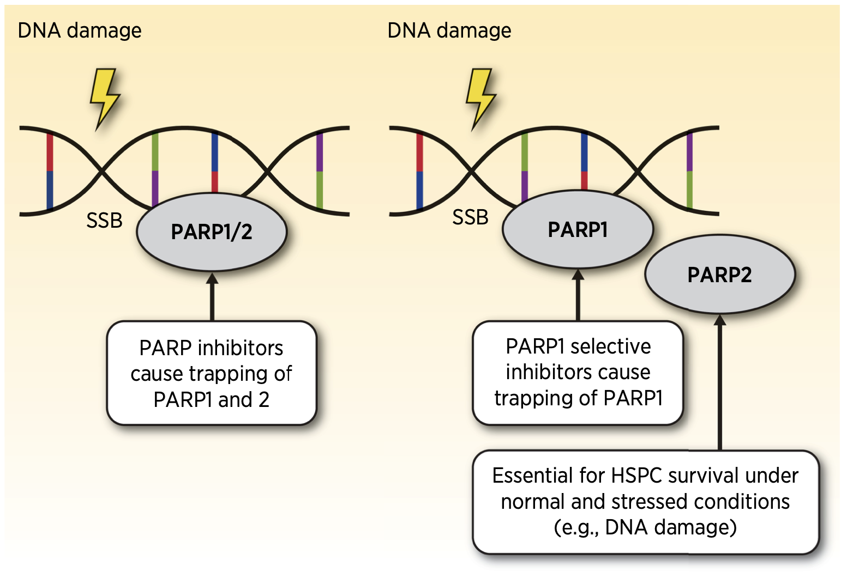
PARP1 Selective Inhibitors
Lynce & Lin. CCR 2024

Slide 64

PETRA: a FIH Phase 1/2a Study of Saruparib
PART A: Dose Escalation
PART B: Dose Expansion*
Key inclusion criteria:
BRCA1, BRCA2, PALB2, RAD51C, or RAD51D mutations
Advanced / metastatic HER2–
breast, ovarian, pancreatic, or
prostate cancer
≤1 prior line PARP inhibitor permitted
B1: HER2– breast cancer
PARP inhibitor-naïve
No limit on prior chemotherapy lines in metastatic setting
Primary endpoint:
Safety and tolerability
Other endpoints:
Pharmacokinetics
Pharmacodynamics in PBMCs
and paired tumor samples
Preliminary efficacy
ctDNA analysis
NTD
140 mg QD
MTD
90 mg QD
90 mg QD
60 mg QD
60 mg QD
40 mg QD
20 mg QD
20 mg QD
10 mg QD
64
Yap T et al. AACR 2024
Notes:
Part B also included patients with ovarian, pancreatic, and prostate cancers; efficacy results from only patients with HER2– breast cancer are reported here. †In the absence of transfusions ≤14 days prior to the first dose of saruparib.
ANC, absolute neutrophil count; BRCA1/2, breast cancer gene 1/2; ctDNA, circulating tumor DNA; ECOG PS; Eastern Cooperative Oncology Group performance status; HER2–, human epidermal growth factor receptor 2 negative; MTD, maximum tolerated dose; NTD, non-tolerated dose; PALB2, partner and localizer of BRCA2; PARP, poly adenosine diphosphate-ribose (ADP-ribose) polymerase; PBMCs, peripheral blood mononuclear cells; QD, once daily; RAD51C/D, RAD51 recombinase homolog C/D

Slide 65
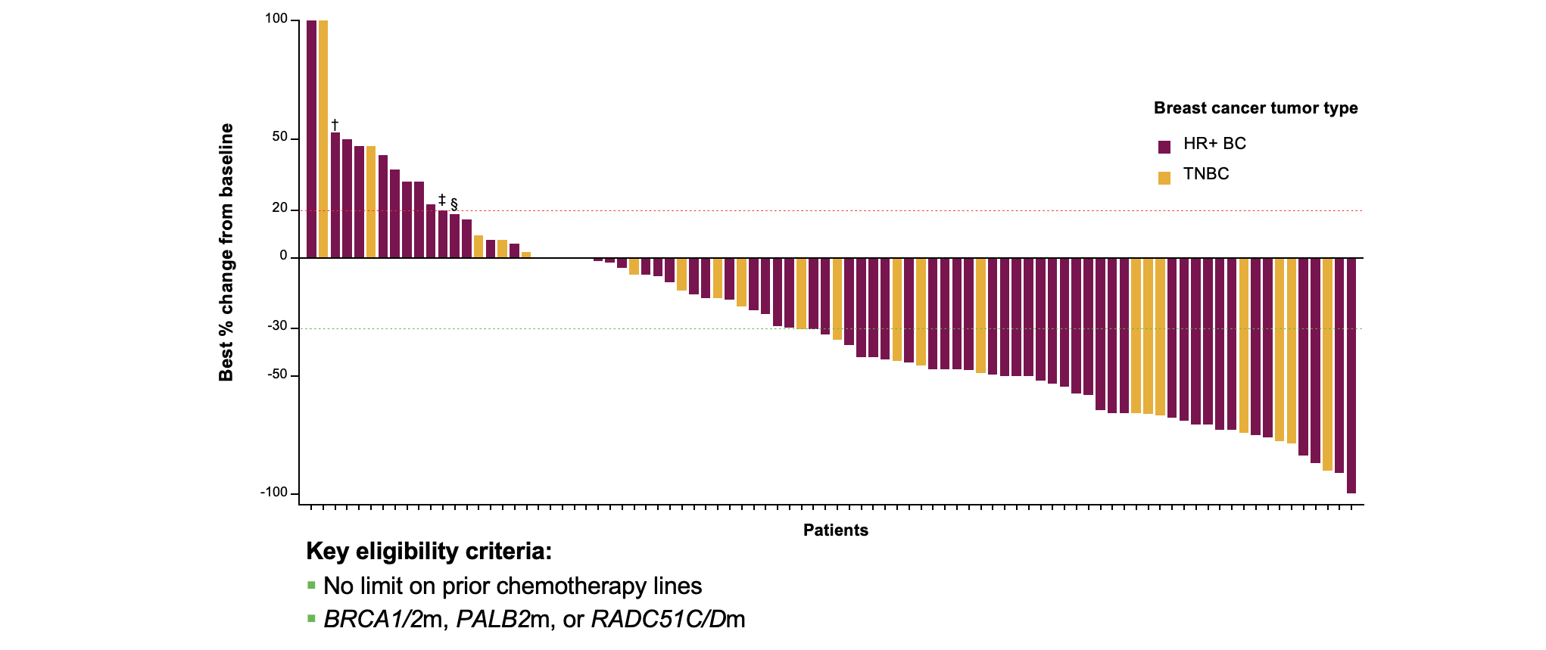
Tumor Responses observed in both HR+ and TNBC
Yap T et al. AACR 2024

Slide 66
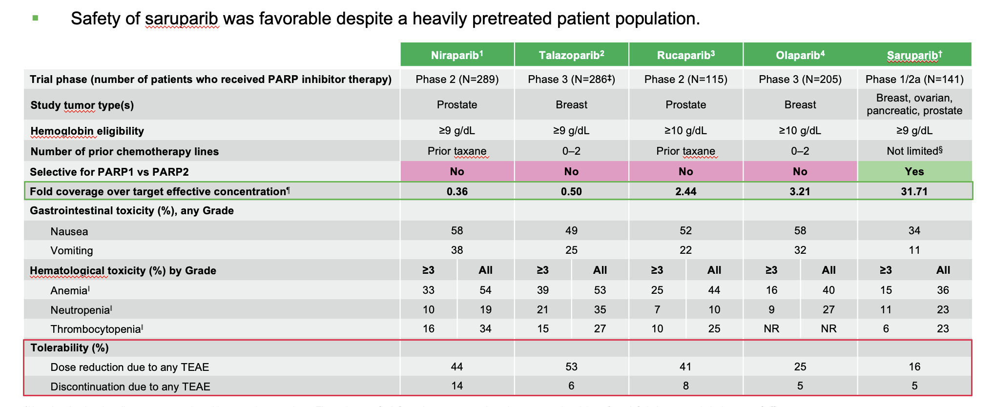
Safety of saruparib compared to PARP inhibitors
Yap T et al. AACR 2024

Slide 67
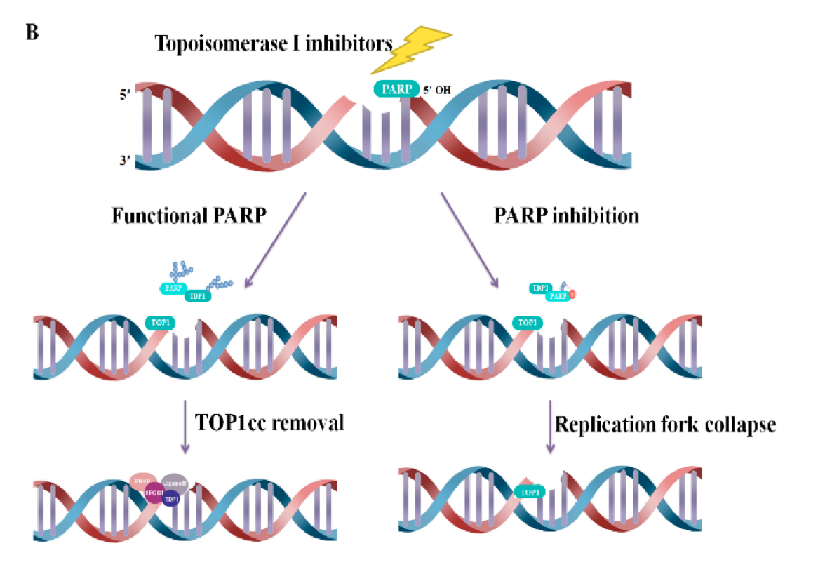
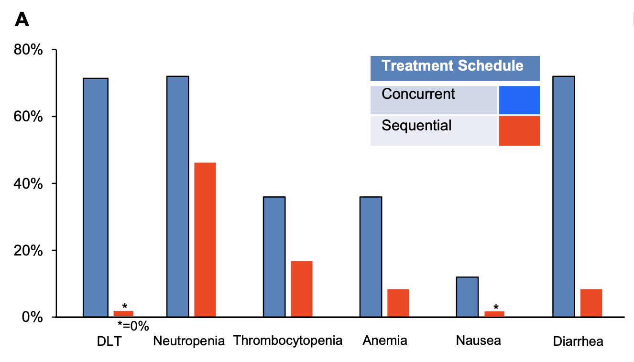
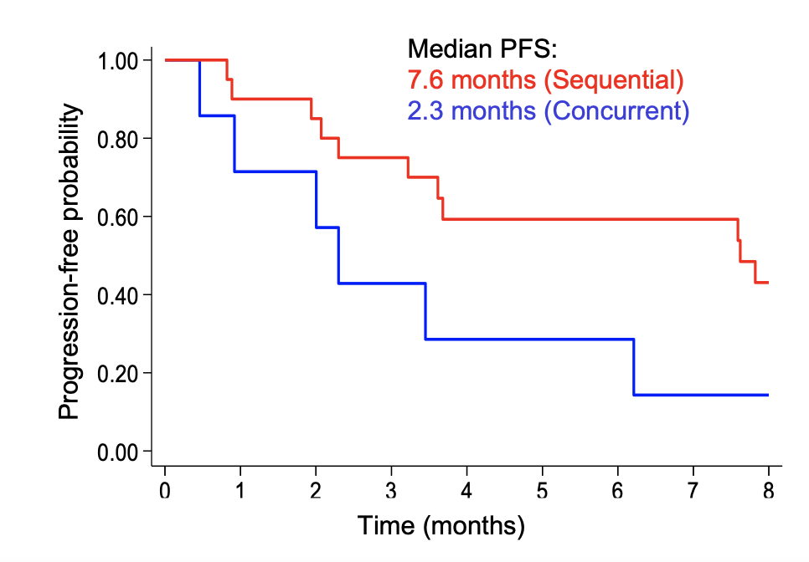
High synergistic potential with topo1i and PARPi
SG + talazoparib
PARP1 + Topo1i -> opportunity to move
PARPi inhibitors beyond BRCA carriers
Min A. Cancers 2020; Bardia A. CCR 2024
Notes:
ADC and PARP1 selective inhibitors as a way to potentiate DNA damage caused by topo1 chemo irrespective of HRD
PARP1 inhibition prevents removal of SN-38 induced TOP1-DNA cleavable complexes (Top1cc)

Slide 68
Outline
Triple-Negative Breast Cancer (TNBC)
Standard of care therapies for Metastatic TNBC
Emerging Therapies in Metastatic TNBC
  Antibody Drug Conjugates (new and not so new!)
  PARP1 selective inhibitors
  Bispecific Antibodies
Questions that remain to be addressed
  Early relapsers during adjuvant therapy or with short DFI
  Sequencing questions
Notes:
Triple Negative Breast Cancer: still an area of unmet need

Slide 69
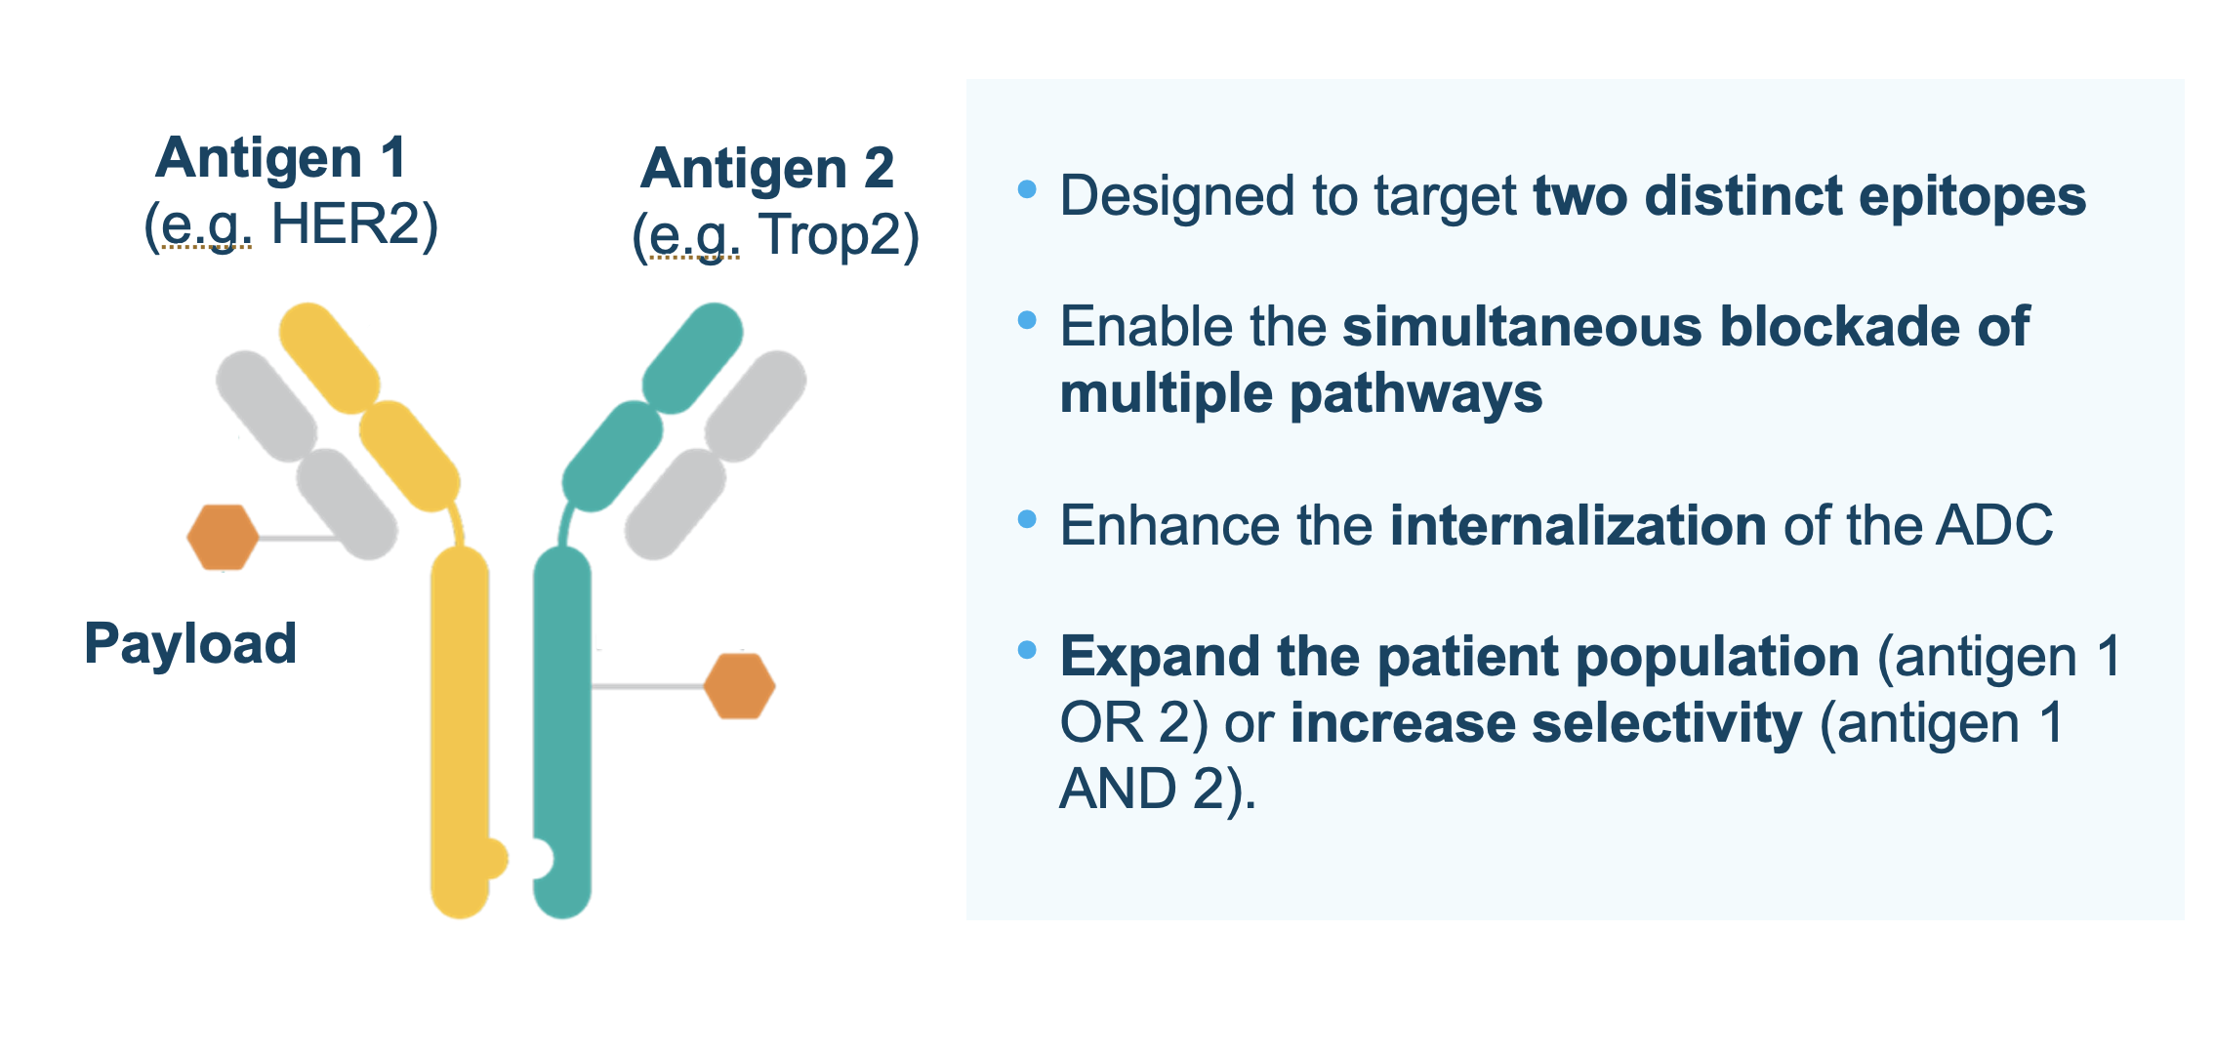
Bispecific Antibodies

Slide 70
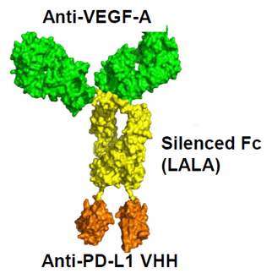
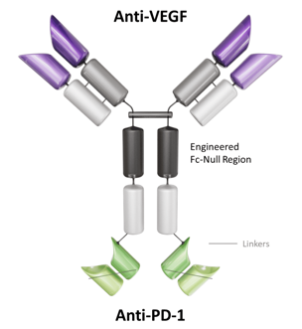
PD-(L)1/VEGF-A bispecifics as an innovative approach to target the TME
PD-L1/VEGF-A Targeting Bispecific Antibodies
PM8002/BNT327
IVONESCIMAB
Targets:
VEGF-A and PD-L1 (tetravalent)
IgG1 based
LALA: L234A/L235A to silence unwanted binding to Fc-γR
T ½ : ~7-10 days
Targets:
VEGF-A and PD-1 (tetravalent)
IgG1 based
Unwanted binding to Fc-γR silenced
T ½ : ~ 5-7 days
Notes:
PD-L1/VEGF-A–targeting bispecific antibody

Slide 71
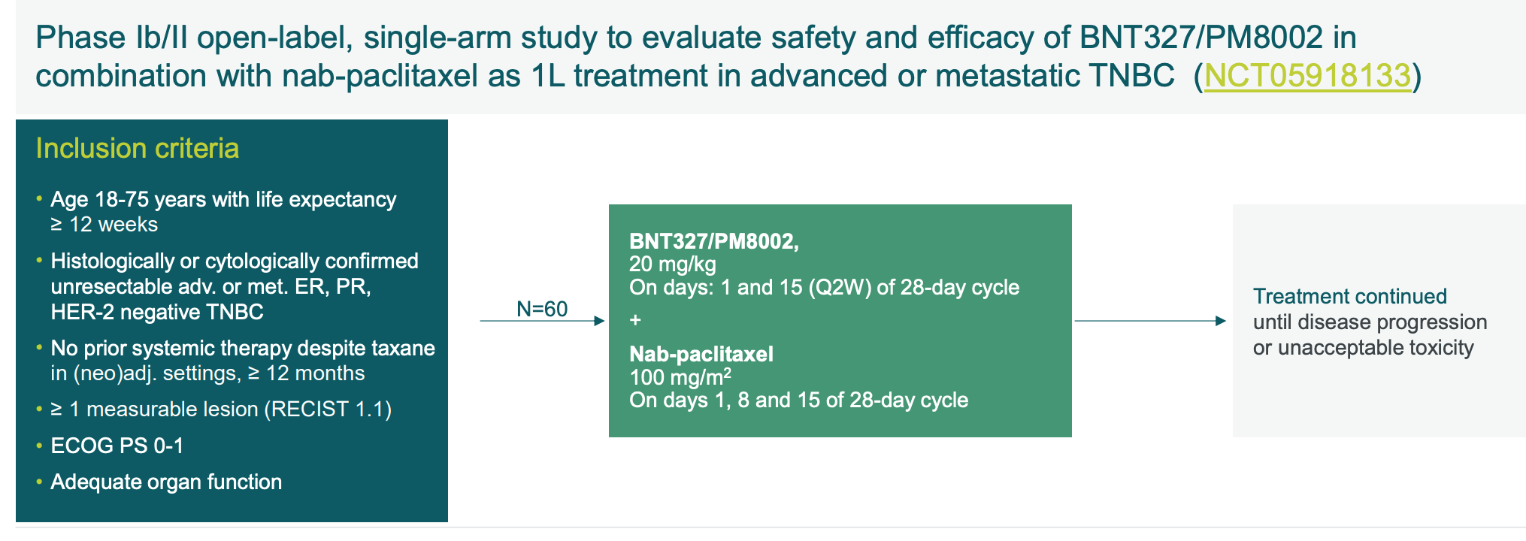
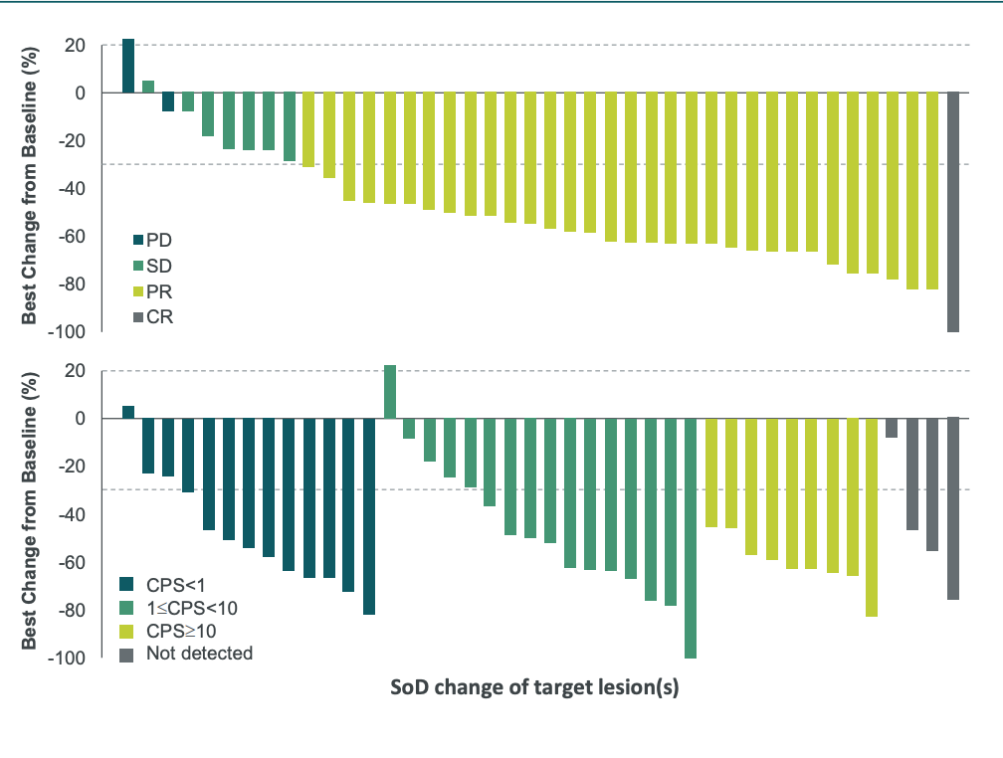
BNT327: Bispecific Anti-VEGF and Anti-PD-L1
Median fu: 16.3mo
~60% of patients received >/= 3L prior tx
Y. Meng et al. Phase Ib/II Study of BNT327/PM8002 with Nab-Paclitaxel as 1L in mTNBC, (NCT05918133), ESMO 2024

Slide 72
BNT327: Safety Summary
Any-grade and grade ≥3 TRAEs of the combination regimen occurred in 100% and 57.1% pts, respectively
TRAEs leading to treatment discontinuation occurred in 4.8% pts
Overall, the safety profile was manageable
Safety Overview | N=42 n (%)
All TRAEs | 42 (100)
Grade ≥3 TRAEs | 24 (57.1)
SAEs | 10 (23.8)
TRAE leading to dose interruption | 27 (64.3)
TRAE leading to dose reduction | 7 (16.7)
TRAEs leading to treatment discontinuation | 2 (4.8)
irAE | 15 (35.7)
Grade ≥3 irAE | 4 (9.5)
Y. Meng et al. Phase Ib/II Study of BNT327/PM8002 with Nab-Paclitaxel as 1L in mTNBC, (NCT05918133), ESMO 2024

Slide 73
Outline
Triple-Negative Breast Cancer (TNBC)
Standard of care therapies for Metastatic TNBC
Emerging Therapies in Metastatic TNBC
  Antibody Drug Conjugates (new and not so new!)
  PARP1 selective inhibitors
  Bispecific Antibodies
Questions that remain to be addressed
  “Early relapsers” during adjuvant therapy or with short DFI
  Sequencing questions
Notes:
Triple Negative Breast Cancer: still an area of unmet need

Slide 74

Retrospective Study of Sequential ADC Use in Patients With HR- HER2-Low MBC: Efficacy
Huppert L, et al. ASCO 2024. Abstract 1083.

Slide 75
TRADE-DXd: TReatment of ADC-Refractory Breast CancEr with Dato-DXd or T-DXd
Study Chair/Overall PI: A. Garrido-Castro
75
Notes:
How to sequence ADCs: payload switch (TOP1 vs MMAE), target switch (HER3, B7H4, Nectin4, etc), and Ab structures (Bicycles peptides)

Slide 76

Key Takeaways
    We must know PDL1 status of tumor and germline BRCA1/2 status of a patient to determine metastatic treatment plan.
    Data supports the use of ADCs +/- pembrolizumab as first line therapy for patients with advanced TNBC
Bispecific inhibitors have emerged as a promising approach to treat advanced TNBC
Understanding mechanisms that drive response and resistance to therapies is key to help inform treatment strategies: combinations, sequencing, duration of therapy
Notes:
How to sequence ADCs: payload switch (TOP1 vs MMAE), target switch (HER3, B7H4, Nectin4, etc), and Ab structures (Bicycles peptides)

Slide 77





Thank You!
filipa_lynce@dfci.harvard.edu
FilipaLynce

