Slide 1


Surgical Pathology Issues
of Practical Importance
Sunil S. Badve, MD, FRCPath
Disclaimer: This presentation is intended for personal use and for informational purposes only and does not replace independent professional judgment. This presentation is the property of Physicians’ Education Resource, LLC (“PER”) and is protected by U.S. and international copyright laws. You may not copy, reproduce, distribute, transmit, modify, or create derivative works of the presentation without the prior written permission from PER.

Slide 2
Disclosures
Collaborations
  Industry (grants applications)
    Mindpeak
    Bristol Myers Squibb
    Augmentiqs
    Alpenglow Biosciences.
  Academic (grants applications)
    Georgia Tech
    Georgia State University
    UC Davis
  Cooperative groups
    ECOG- ACRIN
    Alliance Co-op group (COMET)
    HCRN
Director, ICGA-Foundation, India
  Global health
Editorships
  Deputy Editor in Chief, NPJ Breast Cancer
  Associate Editor, JNCI
  Associate Editor, Clin Breast Cancer
Adv boards
  Agilent, AstraZeneca, Daiichi Sanyo, Bristol Myers Squibb Personalis, Mindpeak (Gmbh), Roche Diagnostics
Research Funds:
  Agilent, AstraZeneca, Bristol Myers Squibb, Daiichi Sanyo, Eli Lilly, Roche Diagnostics

Slide 3
Agenda - topics to be discussed
Tumor issues
  Tumor classification
  Margins
  Biomarkers
    ER/PR
    HER2
    Ki67
Role of AI

Slide 4
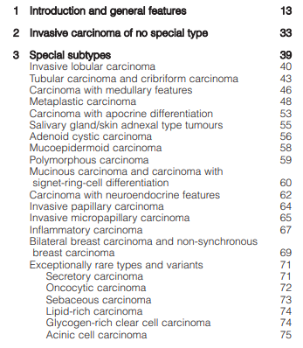
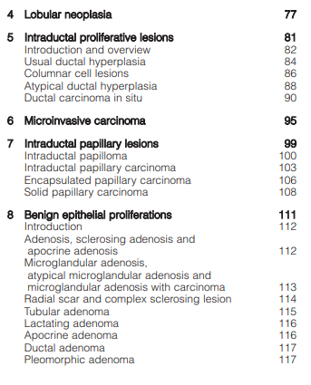
Cancer classification (Breast)
TNM/ AJCC (prognostic)
  Stages I-IV
Histology
Biomarker (prognostic and predictive)
  ER+, HER2+, TNBC
  Ki67 high/ low
WHO Classification of Breast Tumours. 5th Ed, 2019.

Slide 5
Role of histologic classification
Prognostic
  Tubular carcinoma, colloid carcinoma, etc.
  Grade I versus III
Predictive
  Tubular carcinoma – chemotherapy may not be necessary
Indeterminate role
  Invasive (ductal) carcinoma
  Special types

Slide 6
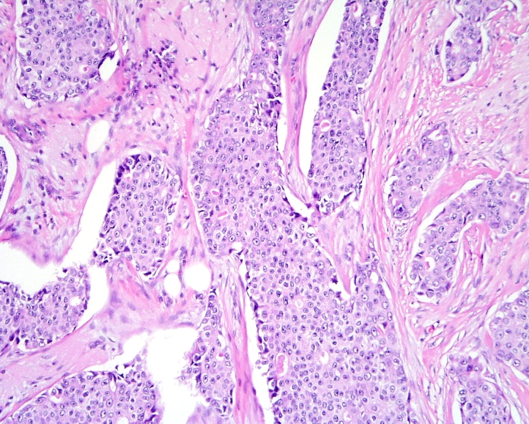
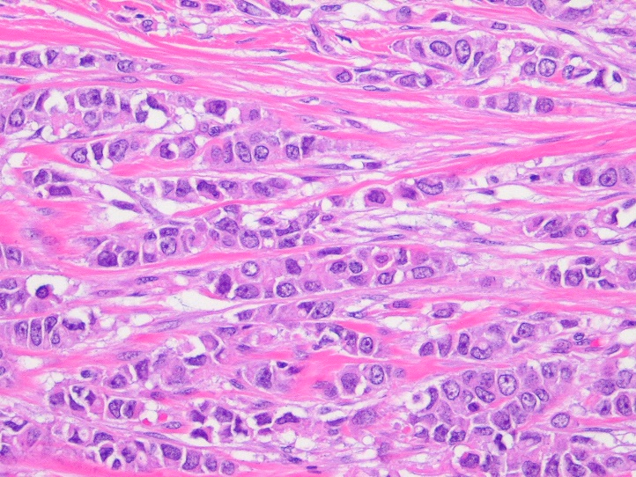
Practical considerations
Two main types
  Ductal
  Lobular
    Diffuse, difficult to palpate the extent
      May need larger excision than imaging might suggest
    Response to aromatase inhibitors

Slide 7

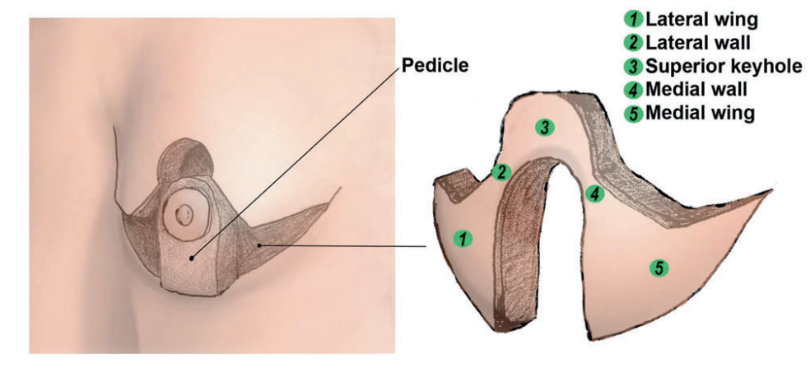
Orientation
Major issue for pathologists
  Assumption of an ovoid Ball
    May originally have a very irregular shape
    Particularly for large oncoplastic excisions
Solution
  Intra-operative marking of margins
    Sutures
    Ink
  Separate submission of margins

Slide 8
Role of Intra-op Frozen sections
Controversial
Fibrotic/ fatty tissue
  Fatty tissue does not freeze well
    Sectioning requires expertise
  Getting entire slice is difficult.
  May be associated false positive

Slide 9
Lesion not represented in frozens

Slide 10
Ancillary techniques
Intra-operative imprint cytology
  A very poor assay
Pre-operative imaging of tumor
  Various ultrasound and MRI based techniques
Device assisted
  Hand-held imaging/sensing probes
  Cellular and subcellular imaging
  Intra-operative mass spectrometry

Slide 11
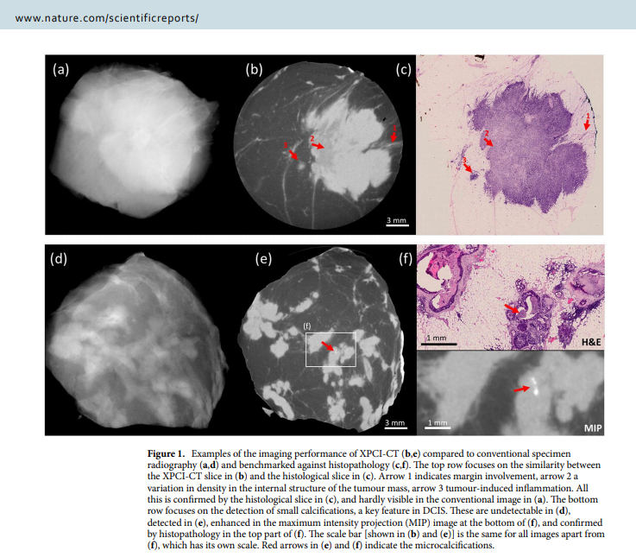
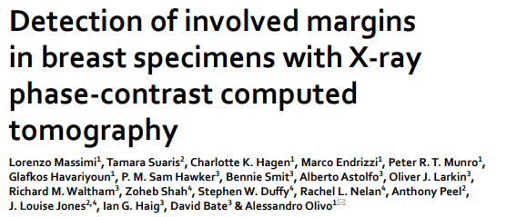
Intra-Op evaluation

Slide 12
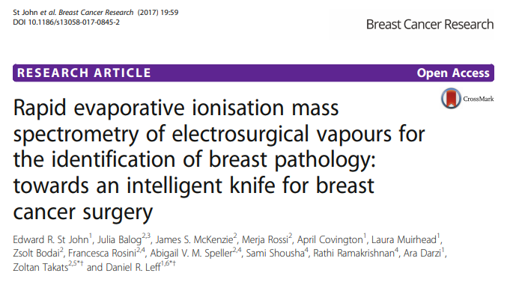
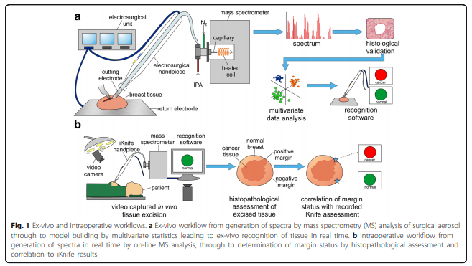
iKnife

Slide 13
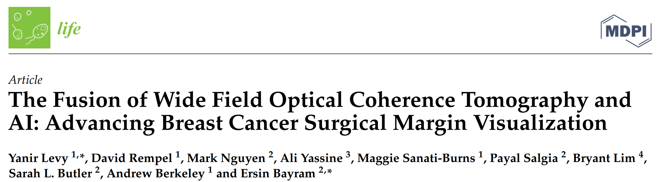
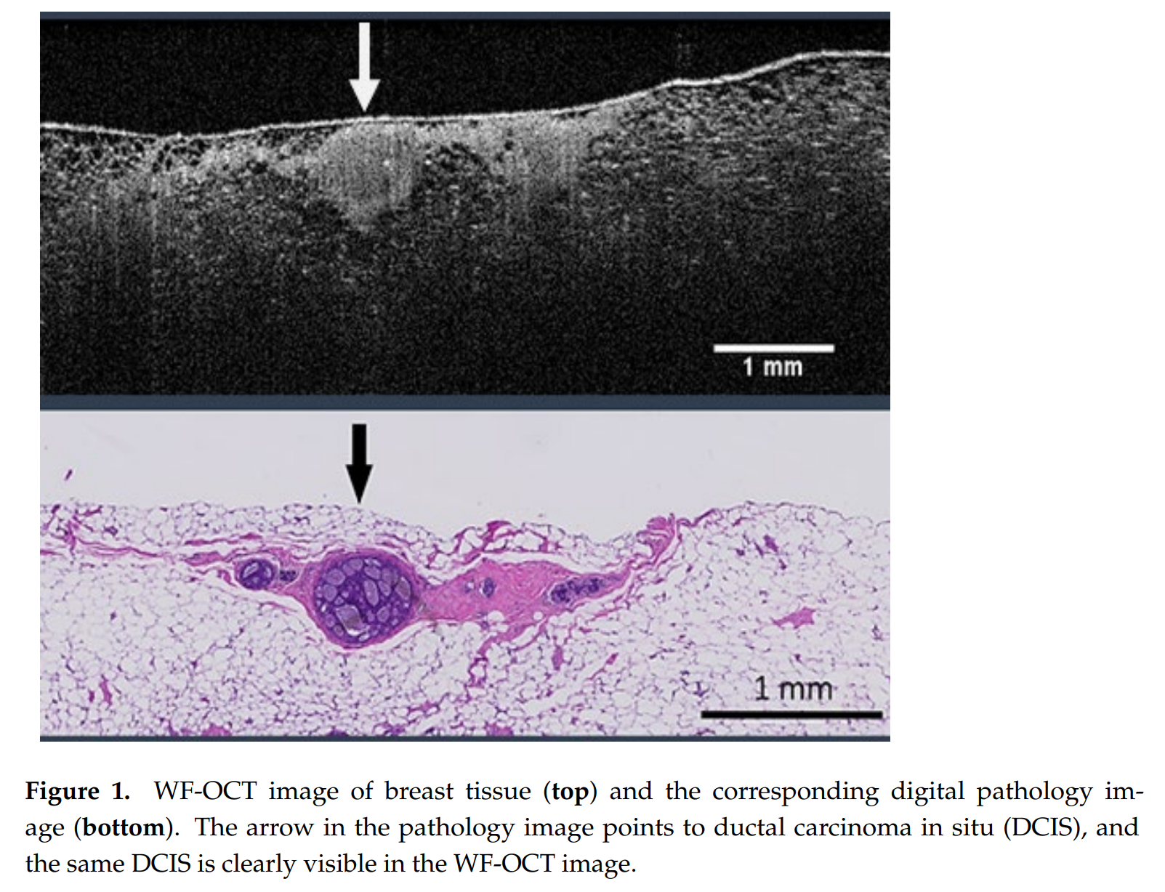
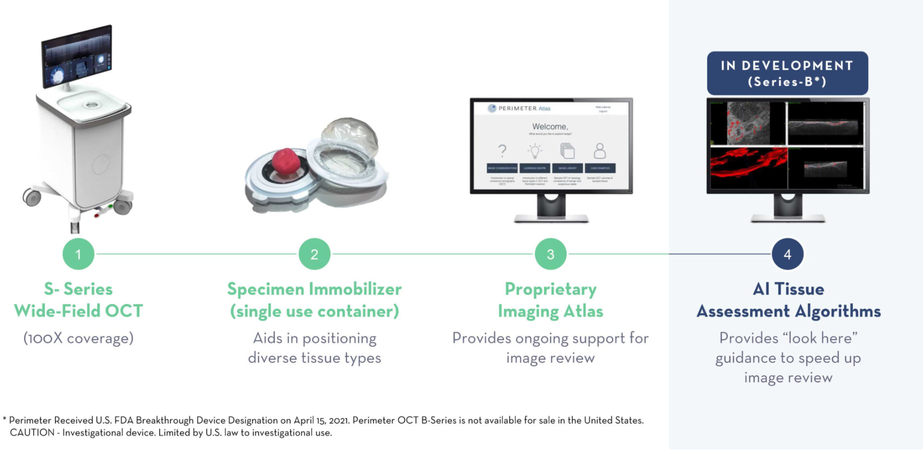

WF-OCT
Life 2023, 13, 2340. https://doi.org/10.3390/life13122340

Slide 14
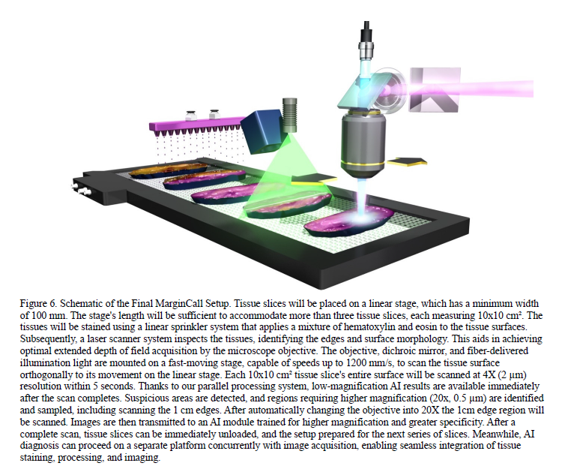
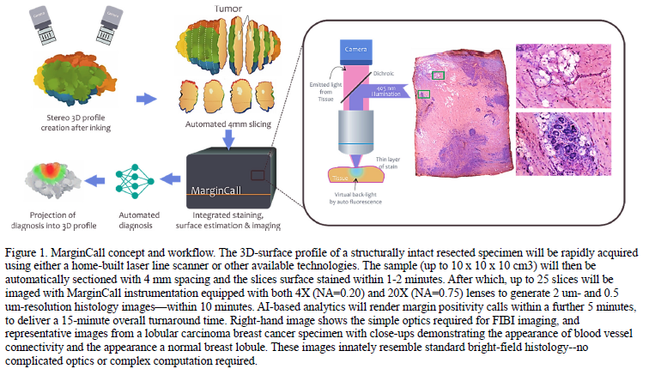
MarginCall
ARPA-H award
Fereidouni et al (Emory)
Courtesy Dr Fereidouni

Slide 15
Biomarkers

Slide 16
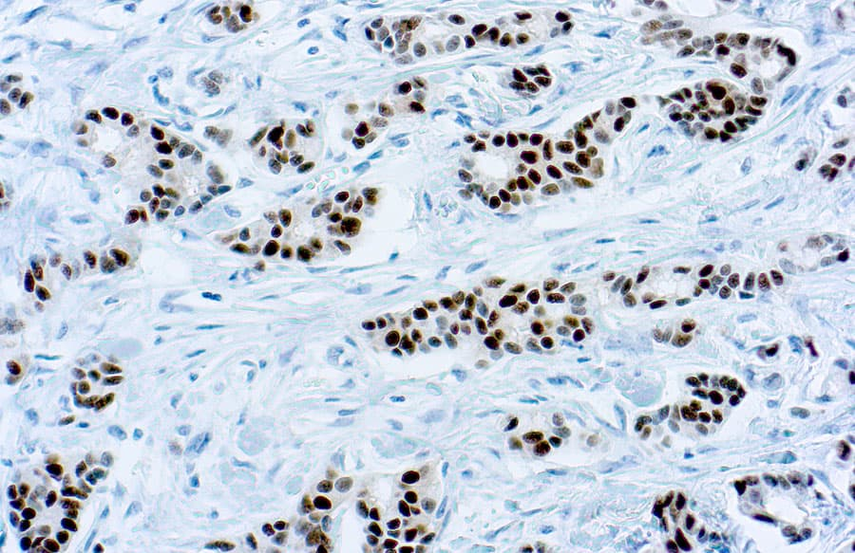
ER/PR- IHC relatively easy to interpret
Single compartment
Confined to the nucleus
Typically strong staining
Weaker/ low frequency staining can be challenging to interpret
  ASCO-CAP ER-Low (1-10%)
    ? Evidence

Slide 17
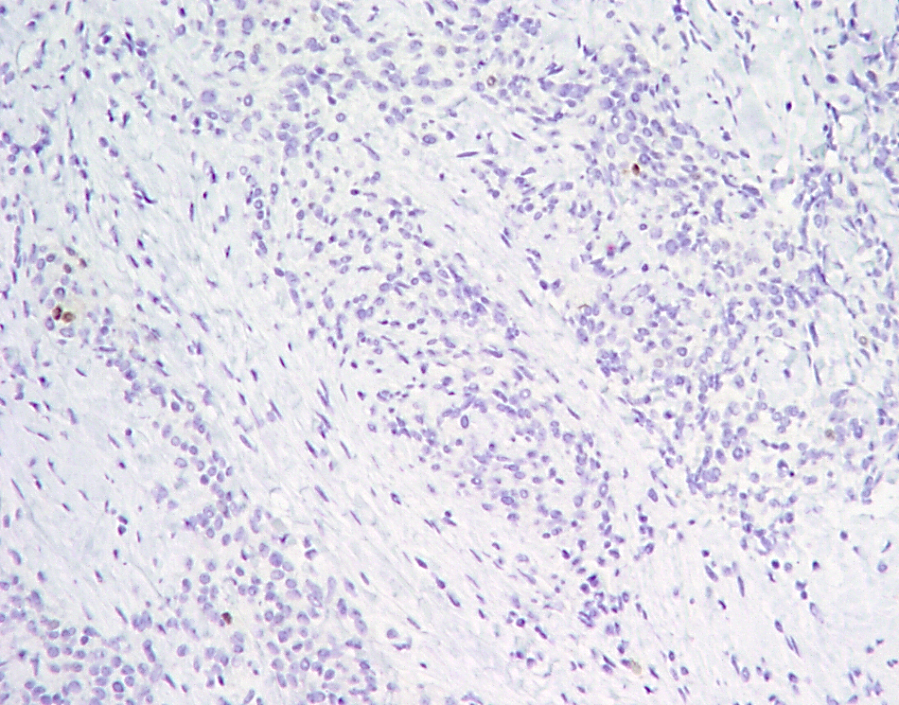
Assessment of tumor markers
Impact of referral cases on IHC
  Staining can be inconsistent
  Staining can be weaker
  False negative staining
Impact of rare positive cells
  Entrapped normal cells or tumor cells?
PR

Slide 18
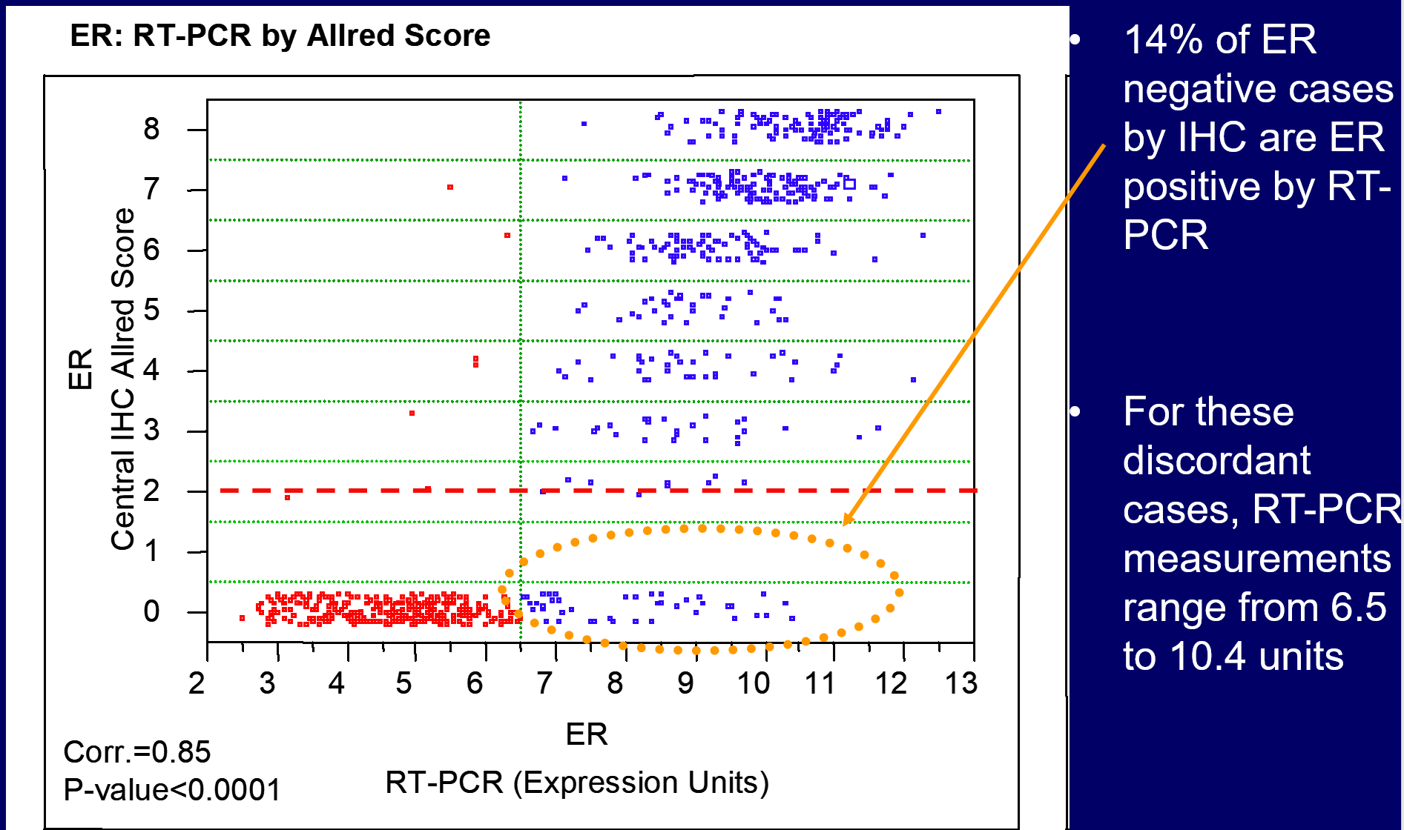
Allred Score vs RT-PCR score
Harvey et al J Clin Oncol 1999

Slide 19
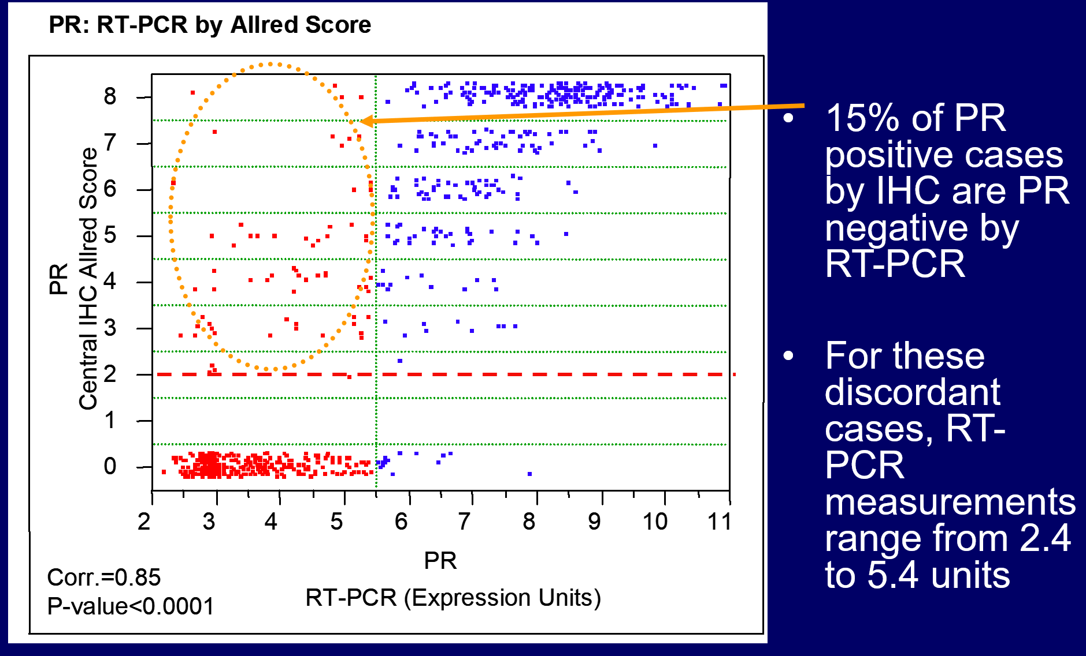
Allred Score vs RT-PCR score
Badve et al J Clin Oncol 2008

Slide 20
ECOG HR Concordance*
HR | Central IHC + | Central IHC – | Oncotype DX Total | Local IHC+ | Local IHC – | Oncotype DX Total
Central RT-PCR + | 432 (94%) | 24 (8%) | 456 | 423 (93%) | 38 (12%) | 461
Central RT-PCR – | 27 (6%) | 286 (92%) | 313 | 32 (7%) | 283 (88%) | 315
IHC Total | 459 | 310 | 769 | 455 | 321 | 776
Concordance 93% Concordance 91%
95% CI (91%, 95%) 95% CI (89%, 93%)
Kappa: 86% Kappa: 81%
95% CI (83%, 90%) 95% CI (77%, 86%)
A high level of concordance for HR status was shown for central RT-PCR by Oncotype DX with both central IHC and local IHC
For comparison, the concordance for ER status between central IHC and local IHC was 90%; 95%CI (88%, 92%)
*HR positive is either ER or PR positive @ 1% cutoff
Badve et al J Clin Oncol 2008

Slide 21
Ki-67

Slide 22
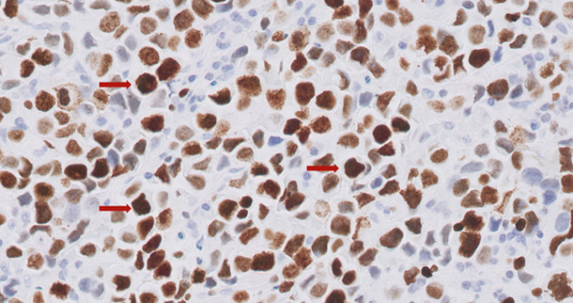
Ki67 quantification
Antigen Kiel 67
  Origin from Kiel University
Pan-cycle proliferation marker
Nuclear marker
Lack of negative control
(relative) lack of concordance

Slide 23
Ki67 quantification
International Ki-67 Working Group recommendations
Pre-analytic considerations in tissue handling/processing for hormone receptor and HER2 testing
Challenges in adopting standardized methodologies
Best practices for quality assurance and quality control in Ki-67 testing
Optimal reporting

Slide 24
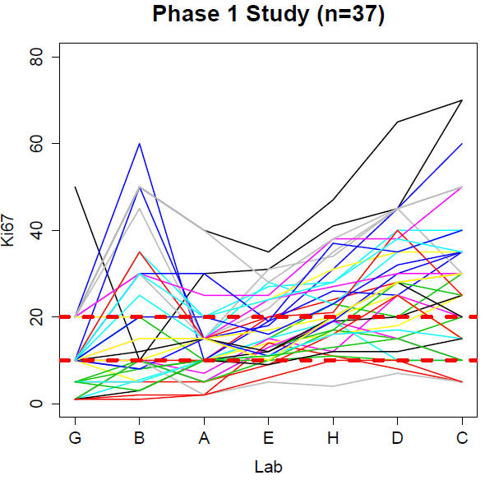
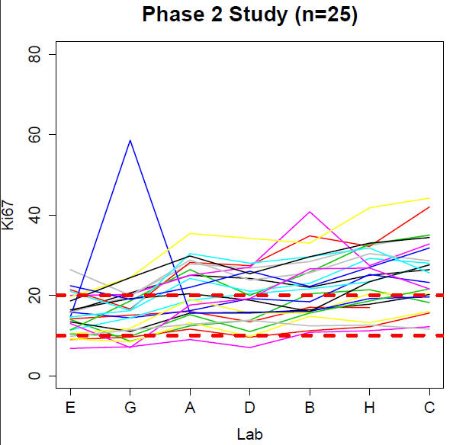
IKWG - Spaghetti Plots:
Ki-67 of 10-20% (7 labs common to both phases)
37 cases scored by ≥ 1 lab as 10-20%
0 of the 37 scored by all labs as 10-20%
25 cases scored by ≥ 1 lab as 10-20%
0 of the 25 scored by all 7 labs as 10-20%
1 case, scored by 5 of the 7 labs, was scored by all 5 labs as 10-20%
Nielsen TO et al. 2013 SABCS.

Slide 25
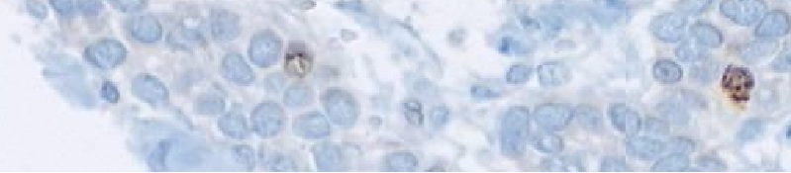
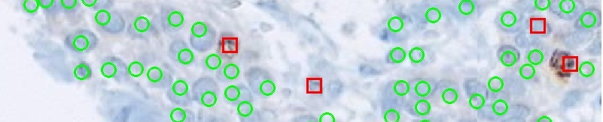
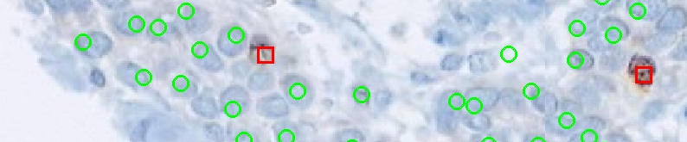
Ki-67: “What Is Brown”
Red = scored as positive Green = scored as negative
Lab E
Lab G
Nielsen TO et al. 2013 SABCS.
Notes:
10-20% inclusive, Labs ordered by lab median Ki67 score

Slide 26
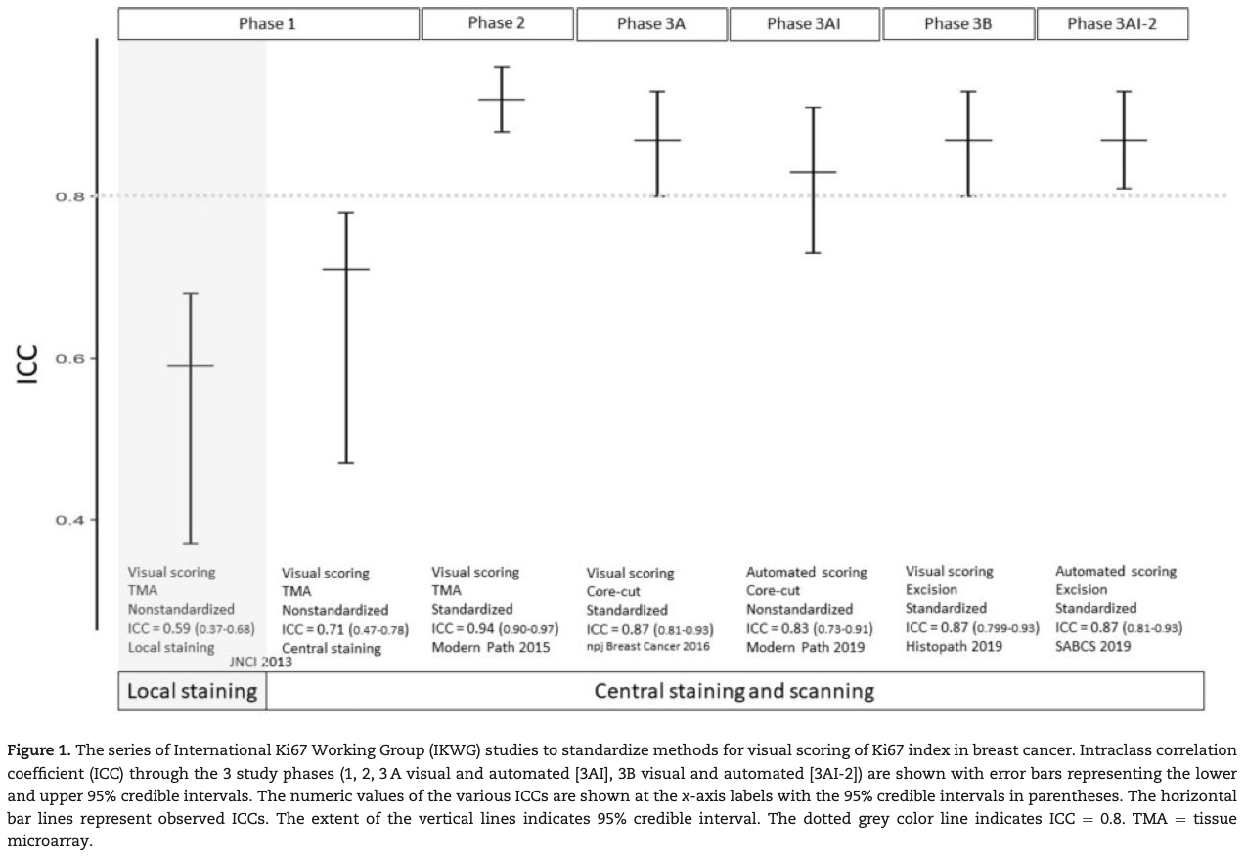
IKWG
Nielsen TO et al. J Natl Cancer Inst. 2021;113(7):808-819.
Notes:
10-20% inclusive, Labs ordered by lab median Ki67 score

Slide 27
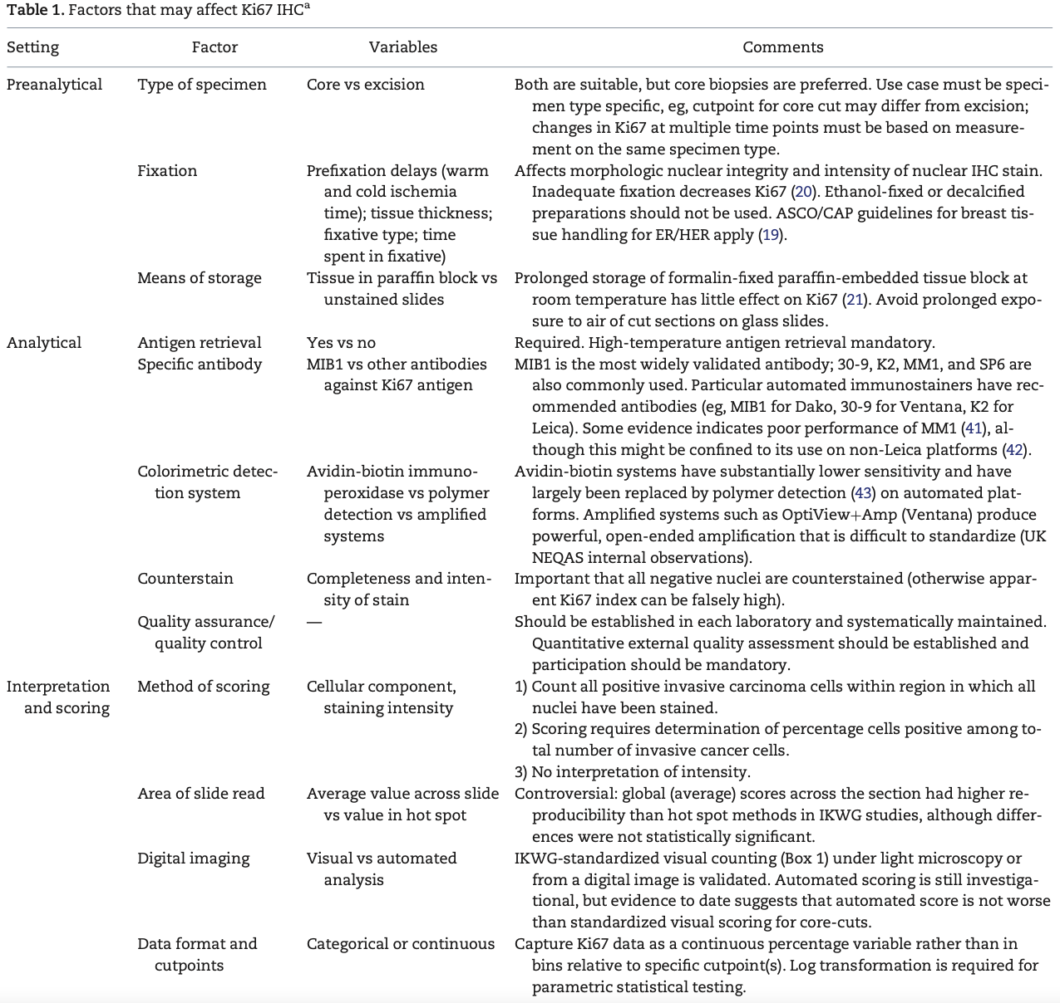
Pre-analytical Factors
Nielsen TO et al. J Natl Cancer Inst. 2021;113(7):808-819.
Notes:
10-20% inclusive, Labs ordered by lab median Ki67 score

Slide 28
Steps to Determine Ki-67 Score
Confirm diagnosis of invasive breast carcinoma
A minimum of 200 viable invasive tumor cells must be present to be considered adequate for evaluation
  For specimens with less than 200 viable tumor cells, use sections from a deeper level or another block
At lower magnification
  Examine all well-preserved tumor areas
  Evaluate overall areas of Ki-67 staining and non-staining tumor cells
  Keep in mind that 1+ nuclear staining may be difficult to see at low magnifications
At higher magnification
  Estimate the total number of viable invasive tumor cells, both Ki-67 staining and non-staining (Ki-67 Score denominator)
  Estimate the number of Ki-67 staining viable invasive tumor cells (Ki-67 Score numerator)
  Determine Ki-67 Score
Ki-67 ICH MIB-1 pharmDX (Dako Omnis) Instructions for Use
Notes:
Ki-67 expression in breast carcinoma is determined by using Proliferation Score (Proliferation Score ), which is the number of Ki-67 staining viable invasive tumor cells divided by the total number of viable invasive tumor cells in the entire specimen, multiplied by
100.

Slide 29
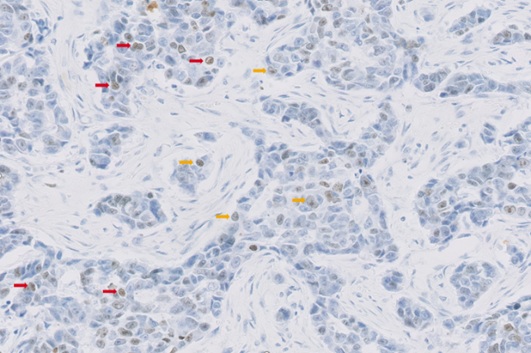
IKWG versus PharmDx Scoring
Cells that exhibit a “grey” color in the nucleus are excluded.
If the nucleus is not unequivocally brown, then the cell is considered to negative
Negative cells show grey hematoxylin counterstaining and are indicated with yellow arrows, and weak 1+ staining indicated with red arrows (arrows) (20× magnification)
Ki-67 ICH MIB-1 pharmDX (Dako Omnis) Instructions for Use

Slide 30
AI

Slide 31
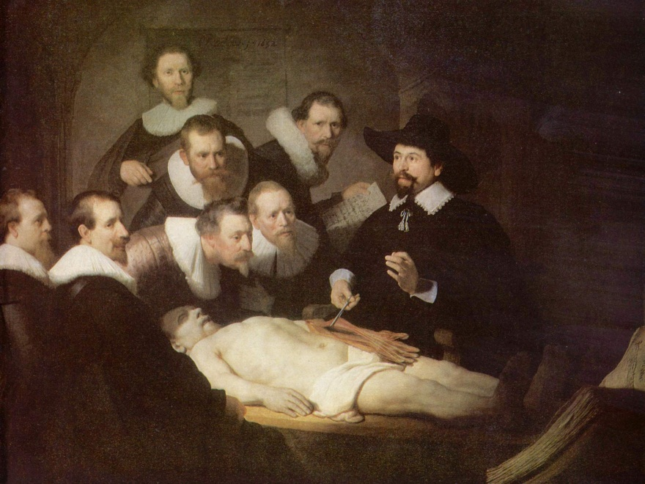

Changing times - Pathomics
Old Masters
NEW Masters
NextGen Masters
The Anatomy Lesson of Dr. Nicolaes Tulp
- Rembrandt (1632)

Slide 32
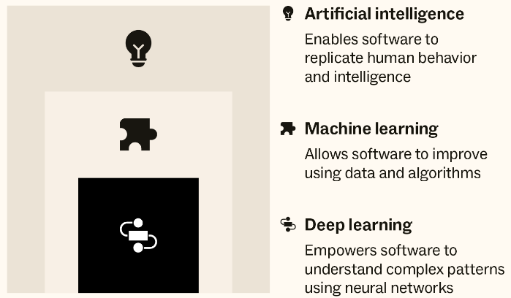
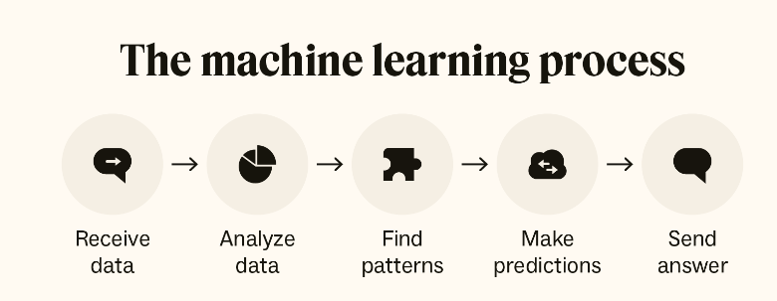
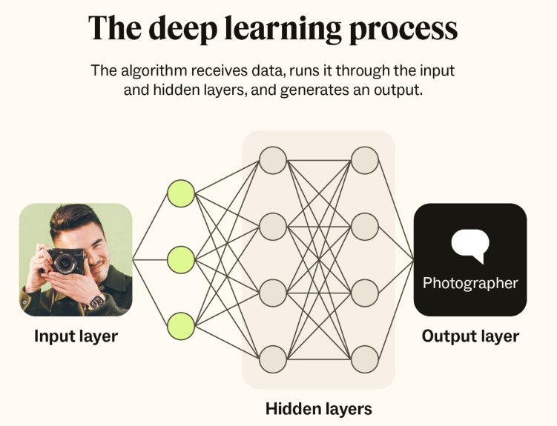
Basic concepts
- AI, Machine learning vs Deep learning
https://www.zendesk.com/blog/machine-learning-and-deep-learning/#

Slide 33
Pathologists uses H&E for
Diagnostic
All surgical pathology diagnoses.
Classification of tumors
Both may be assisted by other techniques (IHC, EM etc)
Prognostic
Tumor type and degree of differentiation
Margin status
TNM classification
Predictive
Type of therapy
Tubular carcinoma of breast does not need chemotherapy
Degree of response to therapy/ residual disease

Slide 34
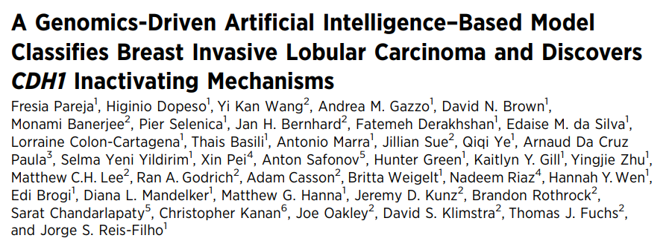
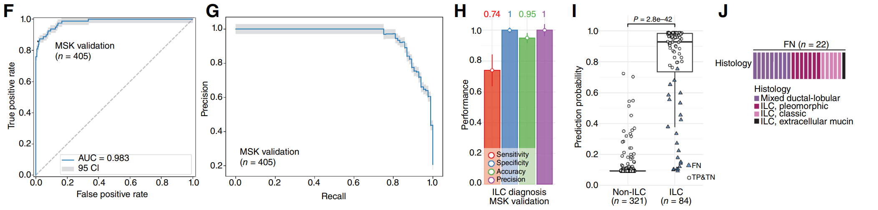
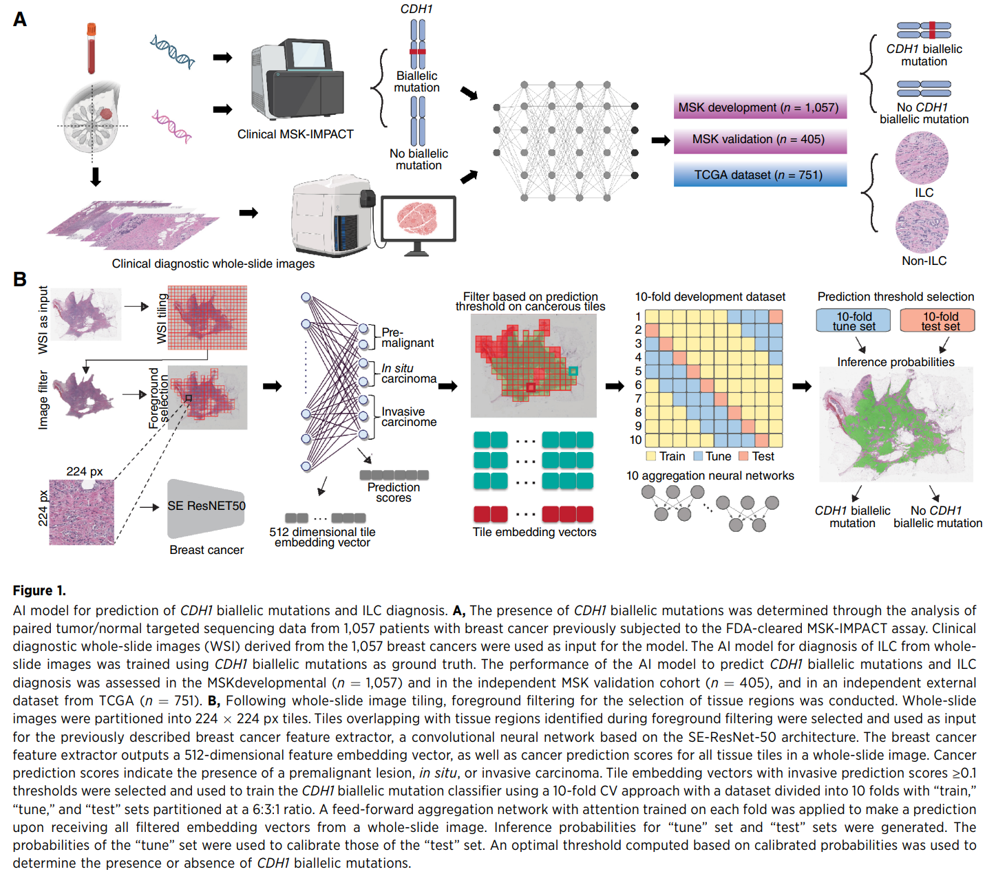
AI for ILC
Cancer Res; 84(20) October 15, 2024
Additional data being presented at SABCS 2025

Slide 35
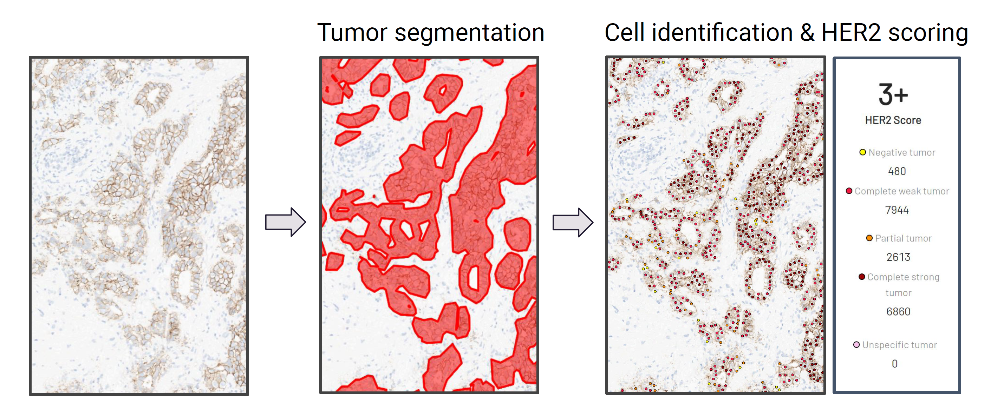
Biomarker analysis

Slide 36
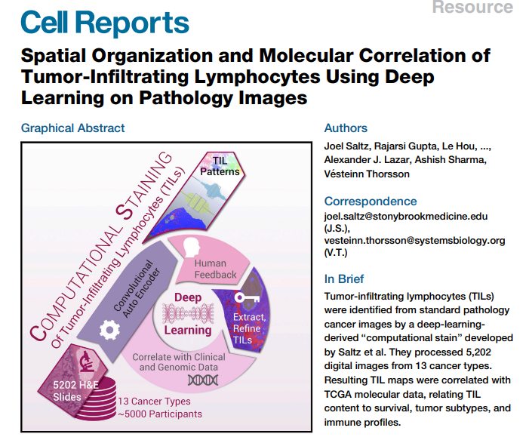
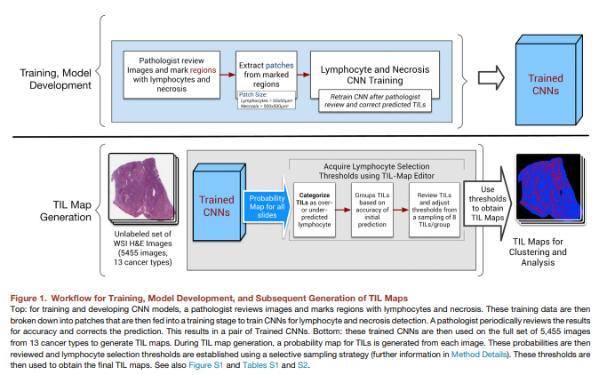
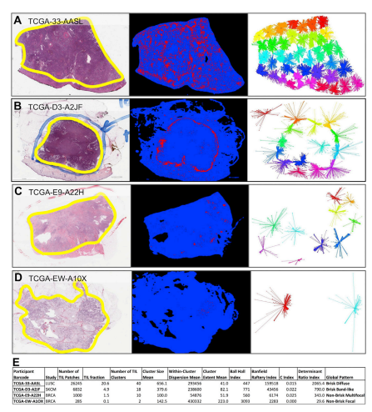
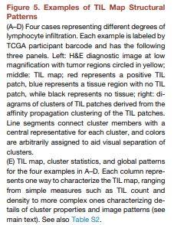
TILs analysis
Cell Reports 23, 181–193, April 3, 2018

Slide 37

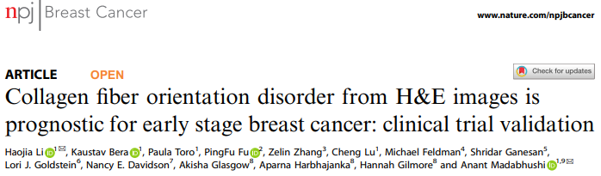
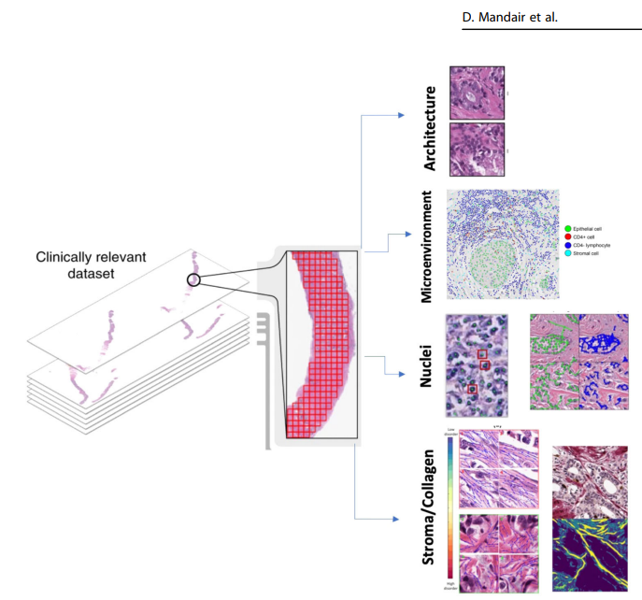
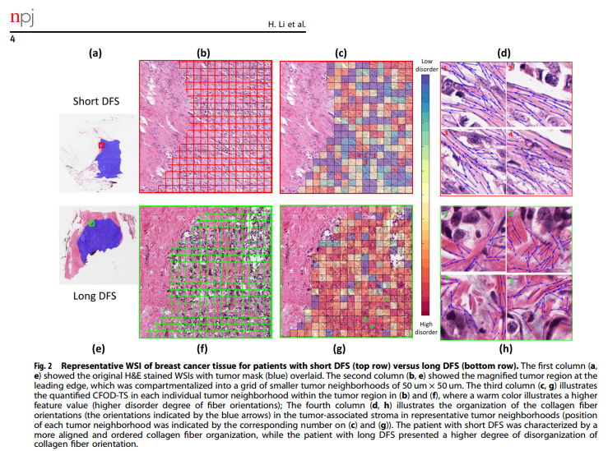
AI for prognostic analysis
npj Breast Cancer (2023) 9:21
npj Breast Cancer (2021) 7:104

Slide 38
Summary
H&E analysis remains the basis of pathology assessment
Biomarker assessment
AI is increasing used for
  Diagnosis
  Tumor classification
  Biomarker assessment
  Prognostication
    TILs
    Other

Slide 39
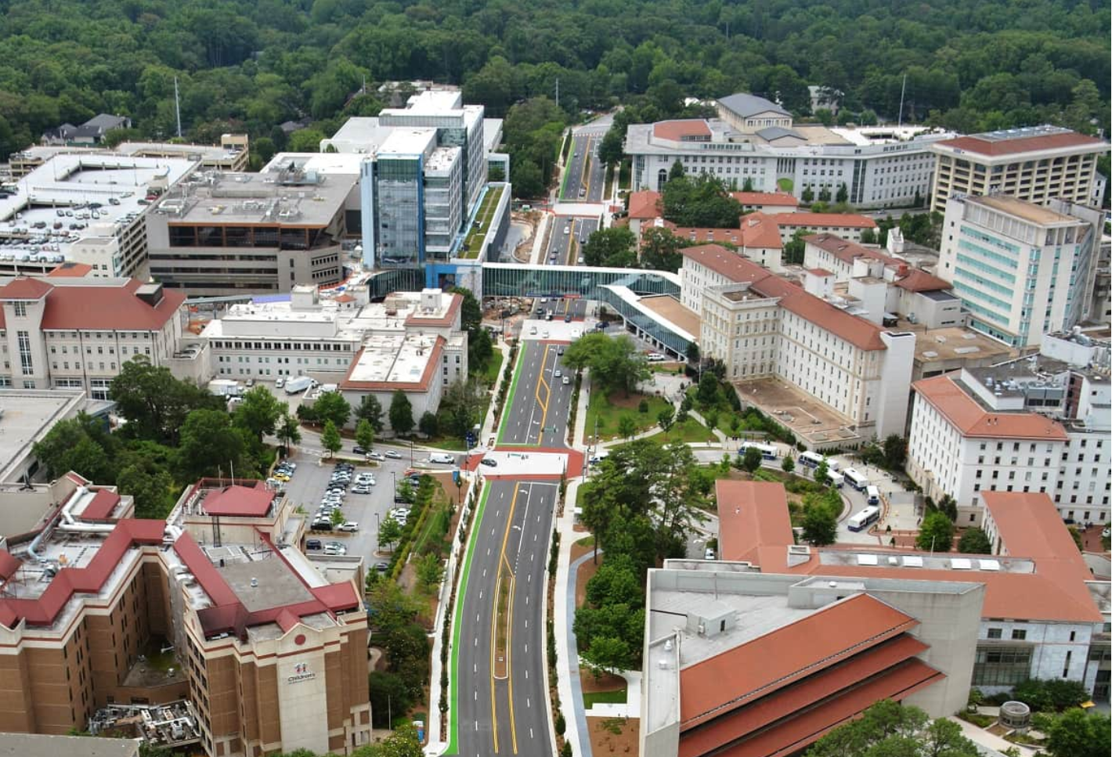
Thank you

