Slide 1


Pathology of Lobular and Ductal
Intraepithelial Neoplasia
Anne Grabenstetter, MD
Breast Pathologist
Memorial Sloan Kettering Cancer Center
Disclaimer: This presentation is intended for personal use and for informational purposes only and does not replace independent professional judgment. This presentation is the property of Physicians’ Education Resource, LLC (“PER”) and is protected by U.S. and international copyright laws. You may not copy, reproduce, distribute, transmit, modify, or create derivative works of the presentation without the prior written permission from PER.

Slide 2
I have nothing to disclose related to the content of this presentation.

Slide 3
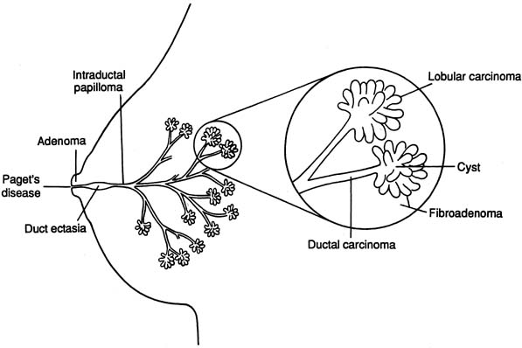
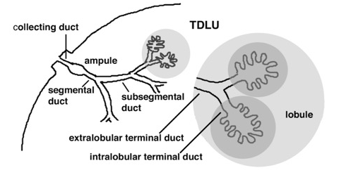
Normal Breast Histology
Lobules
Ducts

Slide 4
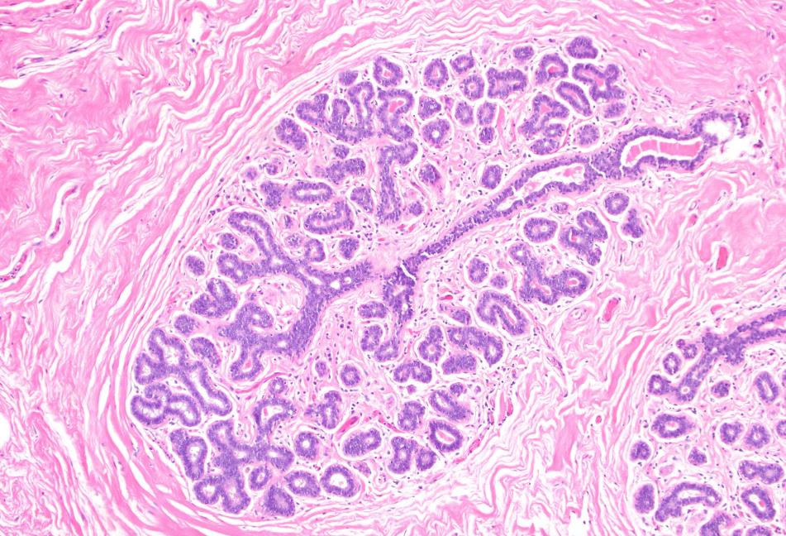
Terminal Ductal Lobular Unit (TDLU)
Terminal duct
Acini

Slide 5
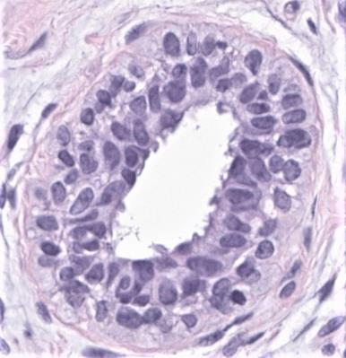
Terminal Ductal Lobular Unit (TDLU)
Terminal duct
Acinus
Myoepithelial cells (outer layer)
Acini
Luminal cells (inner layer)

Slide 6
Intraductal proliferative lesions
Usual ductal hyperplasia (UDH)
Flat epithelial atypia (FEA)
Atypical ductal hyperplasia (ADH)
Ductal carcinoma in situ (DCIS)

Slide 7
Usual ductal hyperplasia
(UDH)

Slide 8
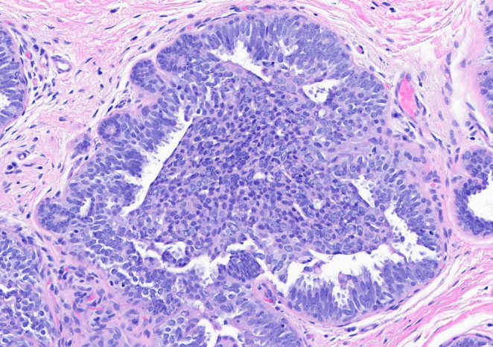
Key Features of UDH
Cytologic Features
Heterogeneous cell population
Variation in cell size, shape and orientation
Areas of overlapping, nuclear grooves and intranuclear inclusions
Architectural Features
Lumens: irregular, variable in size and shape, often slit-like and displaced to periphery
No polarization of cells around lumens
Bridges stretched or twisted
Koerner FC. Semin Diagn Pathol. 2004;21(1):10-7.

Slide 9
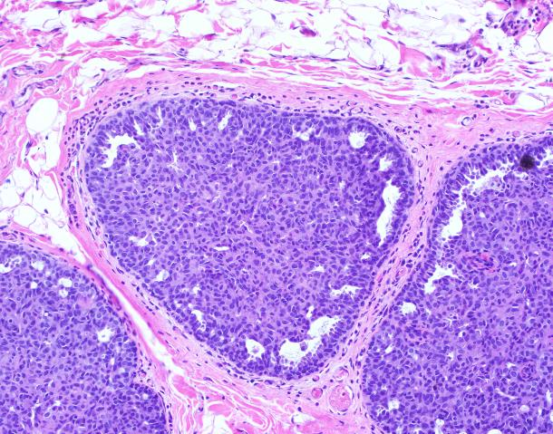
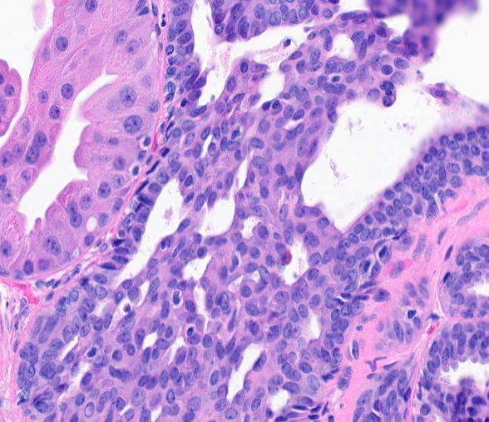
Usual ductal hyperplasia
Irregular spaces at periphery

Slide 10
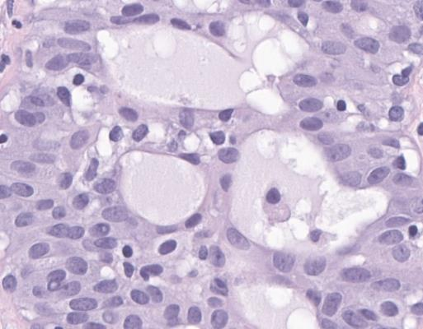
Usual ductal hyperplasia
Irregular spaces at periphery
Lack of polarization

Slide 11
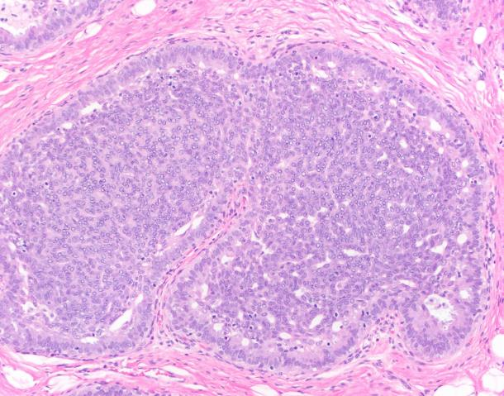
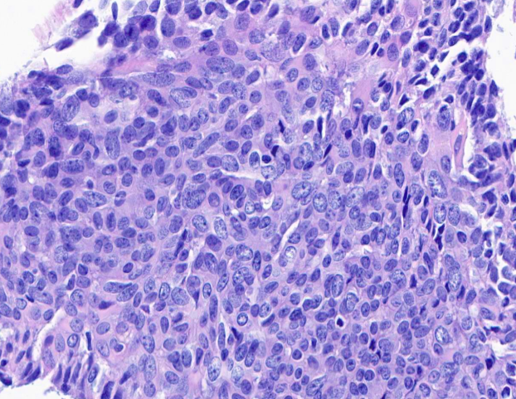
Usual ductal hyperplasia
Streaming of cells

Slide 12
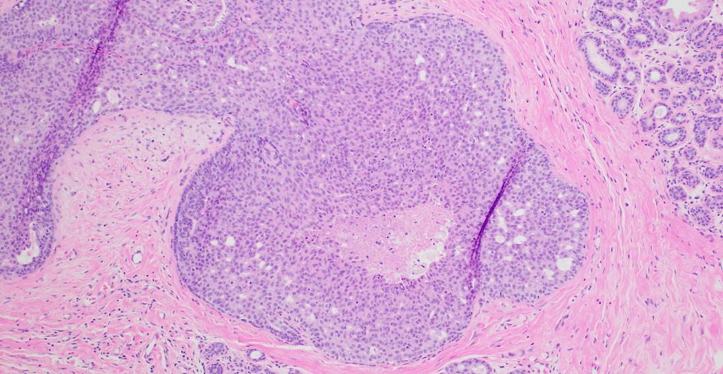
UDH with necrosis
Necrosis

Slide 13
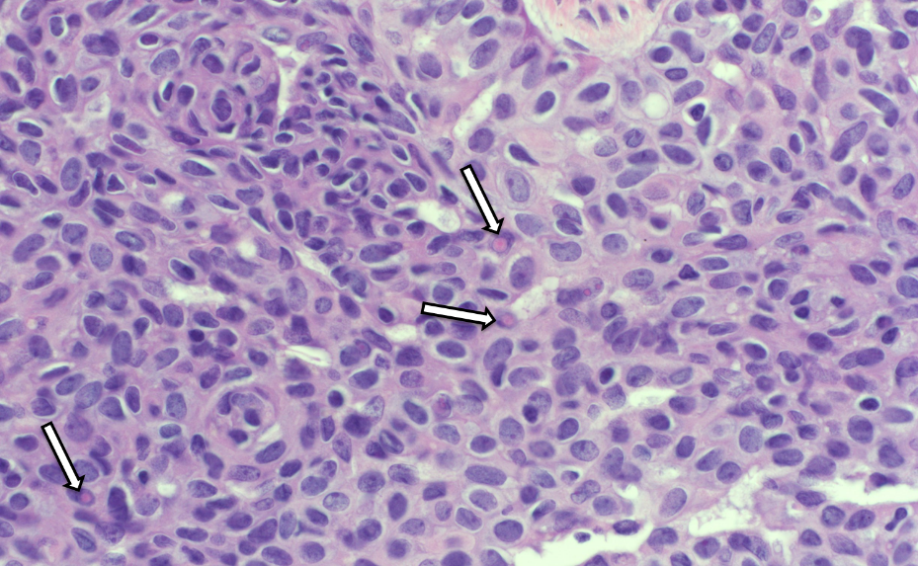
Acidophilic nuclear inclusions
Soft sign for usual ductal hyperplasia

Slide 14
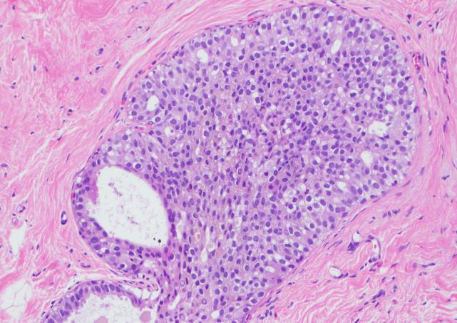
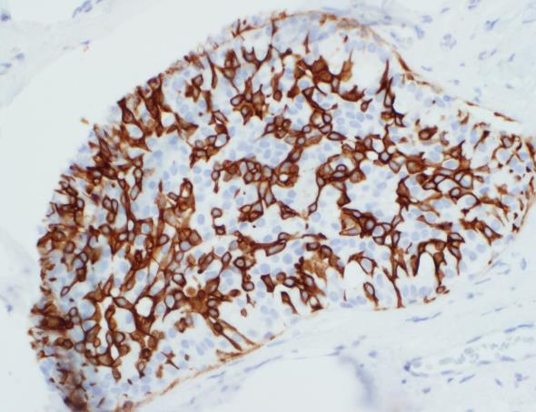
UDH: heterogeneous “mosaic” staining pattern with CK5/6 and other high-molecular weight cytokeratins
CK5/6

Slide 15
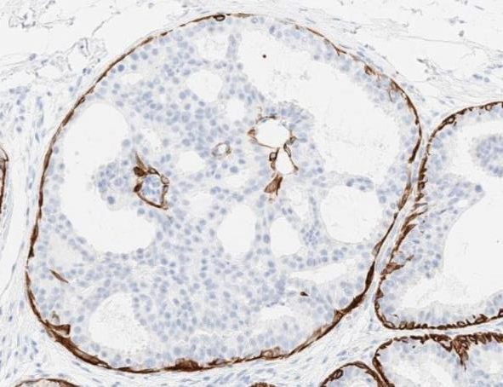
UDH: heterogeneous “mosaic” staining with CK5/6 ADH/DCIS: absence of staining with CK5/6
ADH
UDH

Slide 16
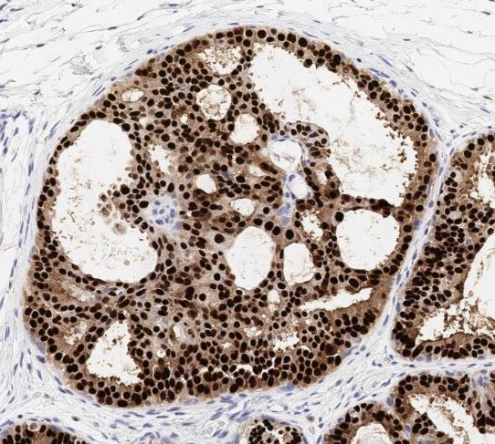
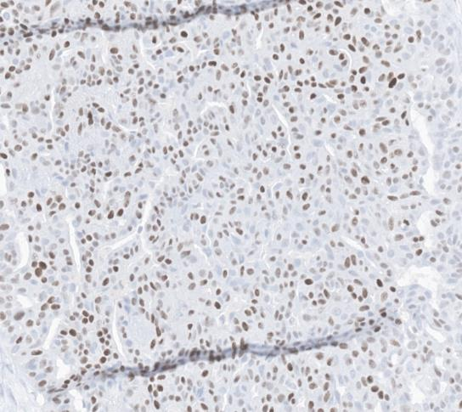
UDH: heterogeneous expression of ER
ADH/LG-DCIS: strong and diffuse expression of ER
ADH
UDH

Slide 17
Follow-up of UDH
Slight increase in subsequent breast cancer risk: 1.5-2x
  Slightly higher among patients with a strong family history of breast cancer
Magnitude of risk is similar to that associated with certain reproductive factors (early menarche and late menopause) – should not alter frequency of mammographic screening
Hartmann et al. N Engl J Med. 2005;353(3):229-37.

Slide 18
Flat epithelial atypia
(FEA)

Slide 19
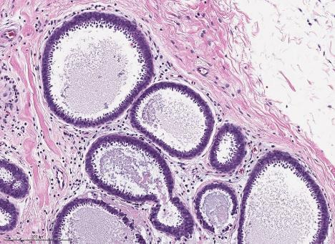
Key Features of FEA
Cytologic Features
Low grade cytologic atypia
Cuboidal to columnar
Frequent apical snouts
Architectural Features
Flat proliferation (1-several layers)
Variably distended TDLUs
Intraluminal secretions and calcifications may be present
No architectural atypia
Grabenstetter A et al. Am J Surg Pathol. 2020;44(2):182-190.

Slide 20
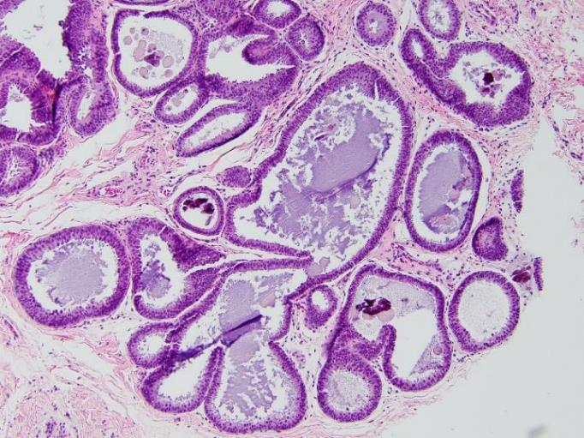
FEA: Variably distended TDLUs
Intraluminal secretions and calcifications

Slide 21
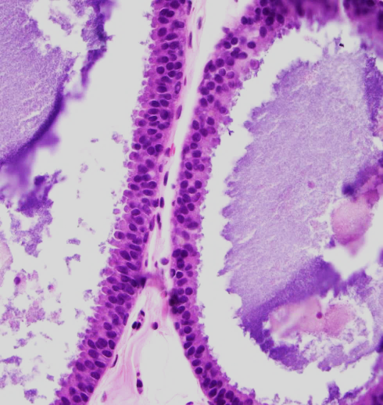
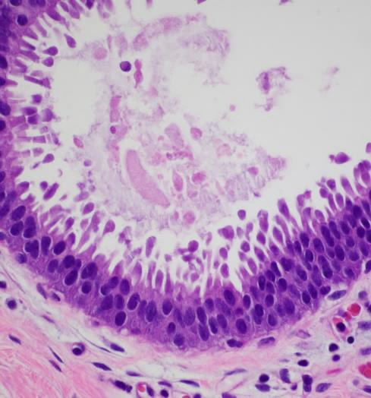
FEA: Low grade cytologic atypia
Cuboidal, monomorphic cells
Apical snouts

Slide 22
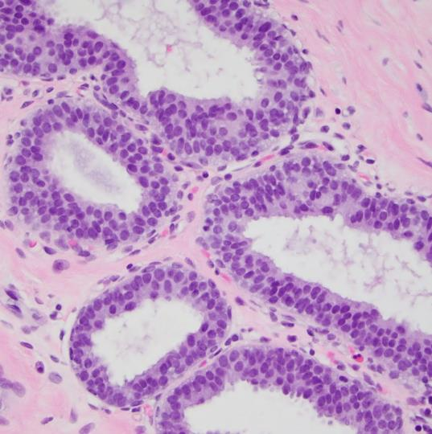
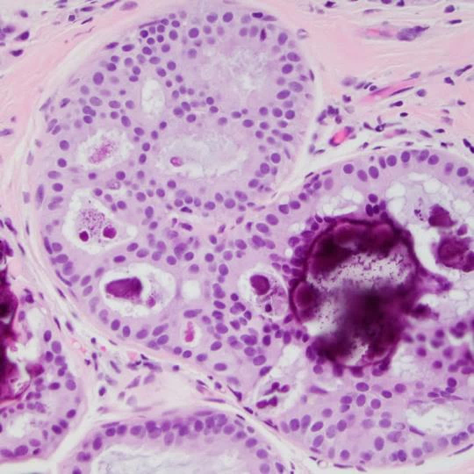
FEA: No architectural atypia
FEA
ADH

Slide 23
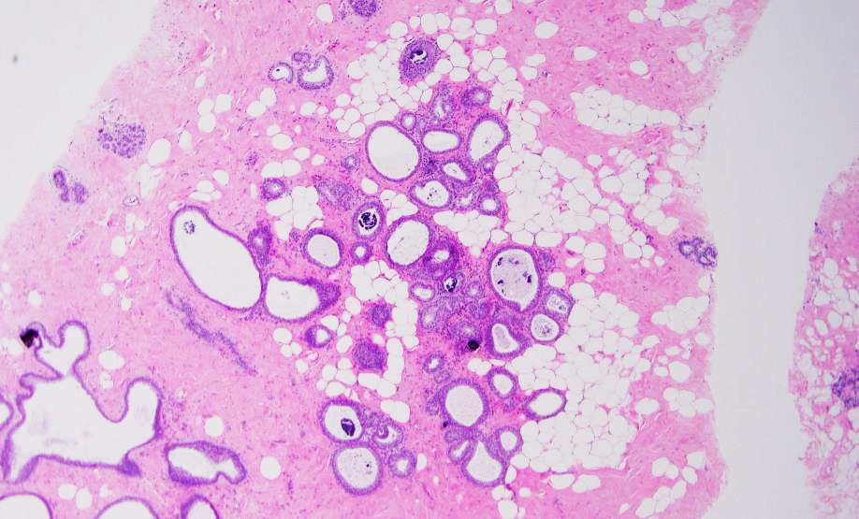
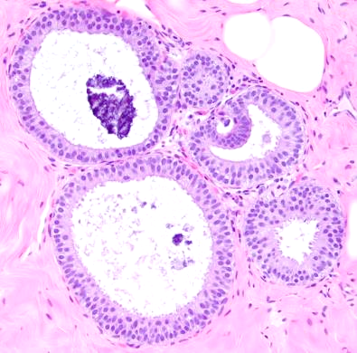
Any architectural atypia ≠ FEA

Slide 24
Any architectural atypia ≠ FEA
ADH
FEA

Slide 25
Upgrade Rate of FEA at Surgical Excision in Selected Series
Study | CNBs with FEA and follow-up EXC | Rad-path correlation | Total Upgrades | Upgrades to Invasive carcinoma | Upgrades to DCIS | Recommend excision
Martel (2007) | 19 | No | 7/19 (36%) | 7 | 0 | No
Kunju and Kleer (2007) | 12 | No | 3/12 (25%) | 2 | 1 | Yes
Piubello (2009) | 20 | Yes | 0/20 (0%) | 0 | 0 | No
Lavoue (2011) | 60 | Yes | 8/60 (13%) | 2 | 6 | Yes
Uzoaru (2012) | 95 | No | 3/95 (3%) | 2 | 1 | No
Dialani (2015) | 29 | Yes | 2/29 (6.9%) | 0 | 2 | Yes
Calhoun (2015) | 94 | Yes | 5/94 (7%) | 2 | 3 | No
McCroskey (2018) | 43 | Yes | 1/43 (2%) | 1 | 0 | No
Ouldamer (2018) | 20 | Yes | 3/20 (15%) | 1 | 2 | No
Hugar (2019) | 111 | Yes | 1/111 (1%) | 1 | 0 | No
Grabenstetter (2020) | 40 | Yes | 2/40 (5%) | 2 | 0 | No
Nakhlis (2025) TBCRC 034 prospective trial | 78 | Yes | 1/78 (1.3%) | 0 | 1 | No

Slide 26
Upgrade Rate of FEA at Surgical Excision in Selected Series
Study | CNBs with FEA and follow-up EXC | Rad-path correlation | Total Upgrades | Upgrades to Invasive carcinoma | Upgrades to DCIS | Recommend excision
Martel (2007) | 19 | No | 7/19 (36%) | 7 | 0 | No
Kunju and Kleer (2007) | 12 | No | 3/12 (25%) | 2 | 1 | Yes
Piubello (2009) | 20 | Yes | 0/20 (0%) | 0 | 0 | No
Lavoue (2011) | 60 | Yes | 8/60 (13%) | 2 | 6 | Yes
Uzoaru (2012) | 95 | No | 3/95 (3%) | 2 | 1 | No
Dialani (2015) | 29 | Yes | 2/29 (6.9%) | 0 | 2 | Yes
Calhoun (2015) | 94 | Yes | 5/94 (7%) | 2 | 3 | No
McCroskey (2018) | 43 | Yes | 1/43 (2%) | 1 | 0 | No
Ouldamer (2018) | 20 | Yes | 3/20 (15%) | 1 | 2 | No
Hugar (2019) | 111 | Yes | 1/111 (1%) | 1 | 0 | No
Grabenstetter (2020) | 40 | Yes | 2/40 (5%) | 2 | 0 | No
Nakhlis (2025) TBCRC 034 prospective trial | 78 | Yes | 1/78 (1.3%) | 0 | 1 | No

Slide 27
Upgrade Rate of FEA at Surgical Excision in Selected Series
Study | CNBs with FEA and follow-up EXC | Rad-path correlation | Total Upgrades | Upgrades to Invasive carcinoma | Upgrades to DCIS | Recommend excision
Martel (2007) | 19 | No | 7/19 (36%) | 7 | 0 | No
Kunju and Kleer (2007) | 12 | No | 3/12 (25%) | 2 | 1 | Yes
Piubello (2009) | 20 | Yes | 0/20 (0%) | 0 | 0 | No
Lavoue (2011) | 60 | Yes | 8/60 (13%) | 2 | 6 | Yes
Uzoaru (2012) | 95 | No | 3/95 (3%) | 2 | 1 | No
Dialani (2015) | 29 | Yes | 2/29 (6.9%) | 0 | 2 | Yes
Calhoun (2015) | 94 | Yes | 5/94 (7%) | 2 | 3 | No
McCroskey (2018) | 43 | Yes | 1/43 (2%) | 1 | 0 | No
Ouldamer (2018) | 20 | Yes | 3/20 (15%) | 1 | 2 | No
Hugar (2019) | 111 | Yes | 1/111 (1%) | 1 | 0 | No
Grabenstetter (2020) | 40 | Yes | 2/40 (5%) | 2 | 0 | No
Nakhlis (2025) TBCRC 034 prospective trial | 78 | Yes | 1/78 (1.3%) | 0 | 1 | No

Slide 28
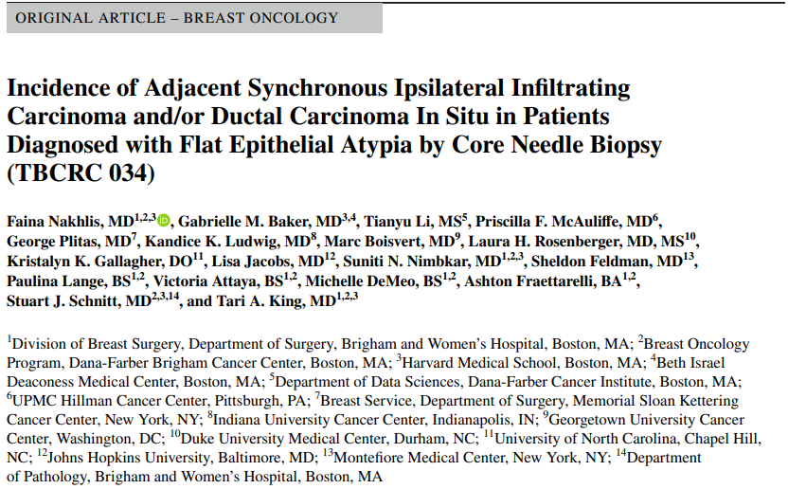
Prospective multicenter study (9 sites)
Inclusion: women with FEA on a rad-path concordant core biopsy
Exclusion: clinical concern (e.g. palpable mass, nipple discharge), ADH or non-classic LCIS in same biopsy, history of DCIS and/or invasive breast cancer
Ann Surg Oncol 2025; 32: 2578-2584.
Primary objective: evaluate the frequency with which FEA diagnosed on core needle biopsy was upgraded to DCIS or invasive breast cancer upon surgical excision

Slide 29
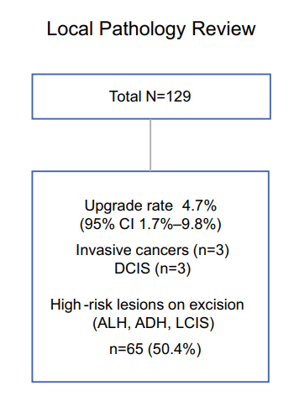
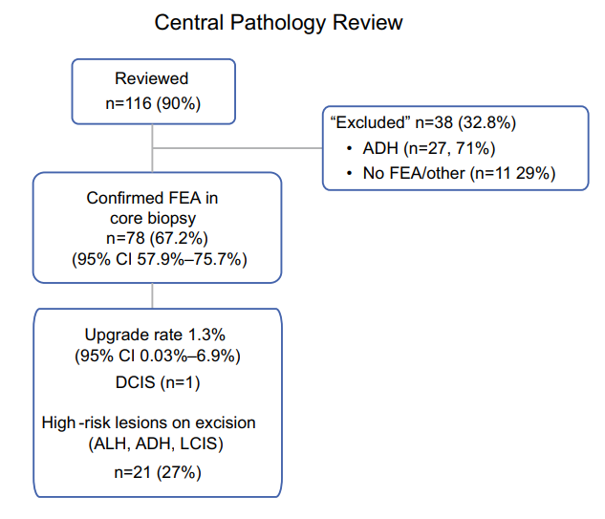
TBCRC 034 Results
Nakhlis et al. Ann Surg Oncol 2025; 32: 2578-2584.

Slide 30
TBCRC 034 Results
Nakhlis et al. Ann Surg Oncol 2025; 32: 2578-2584.

Slide 31
TBCRC 034 Results
Upgrade was one of the 6 locally upgraded cases
Other 5 locally upgraded cases:
ADH found on central review (2)
No FEA on central review (1)
No material for central review (2)
Nakhlis et al. Ann Surg Oncol 2025; 32: 2578-2584.

Slide 32
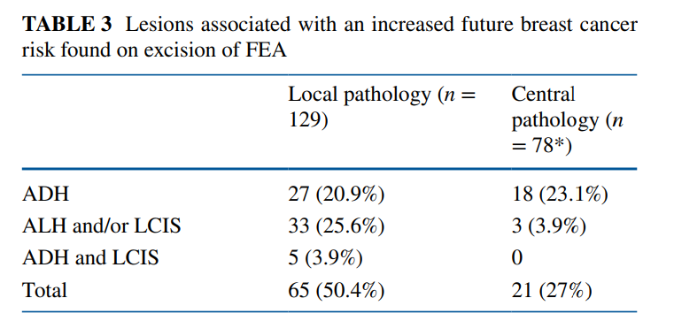
TBCRC 034 Results
High risk lesions were found in 50.4% of cases by local pathology review and in 27% by central review
Nakhlis et al. Ann Surg Oncol 2025; 32: 2578-2584.

Slide 33
TBCRC 034: Conclusions
Central review confirmed FEA in only 78/116 (67.2%) cases
  Recommend obtaining second opinion to confirm
FEA diagnosis is rare and robust prospective data demonstrating the safety of observation are not yet available however shows similar upgrade rates as those seen in classic lobular neoplasia
  Reasonable to infer the safety of observation from the data on ALH and classic LICS
High prevalence of high risk lesions (ADH, ALH, classic LCIS)
  Referral for comprehensive risk assessment may be considered for patients with FEA
Observation may be clinically acceptable, depending on patient’s risk factors. Management discussion with multidisciplinary treatment team is advised.
Nakhlis et al. Ann Surg Oncol 2025; 32: 2578-2584.

Slide 34
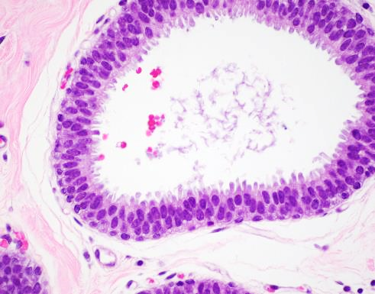
Flat Epithelial Atypia (FEA)
Increase breast cancer risk by ~1.5x
5-7% lifetime risk of developing invasive cancer
  Risk similar to UDH
With radiologic-pathologic concordance, non-operative management is appropriate
Said SM et al. Cancer. 2015;121(10):1548-55.
Boulos et al. Cancer. 2012;118:2372-2377.

Slide 35
Atypical ductal hyperplasia
(ADH)

Slide 36
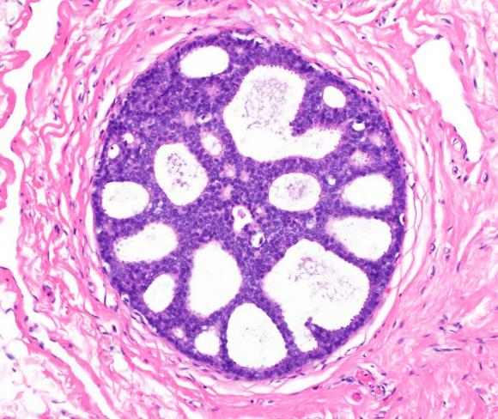
Key Features of ADH
Cytologic Features
Atypical cells – similar to those seen in low grade DCIS
Small uniform cells with well defined borders and generally rounded, evenly spaced nuclei
Architectural Features
Rigid bridges and arcades of uniform thickness
Cribriform pattern with polarization of cells around lumens
Solid pattern
Micropapillations with bulbous tips
Sapino A, Kulka J, eds. Breast Pathology. 1st ed. Springer; 2020.

Slide 37
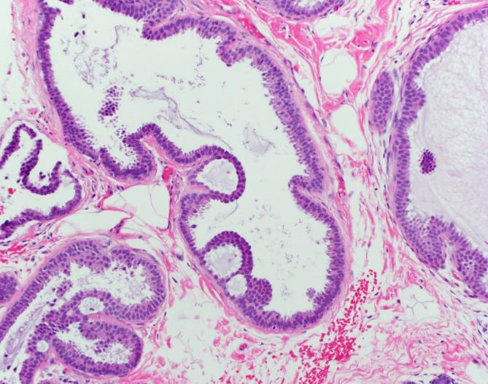
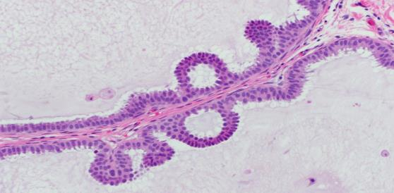
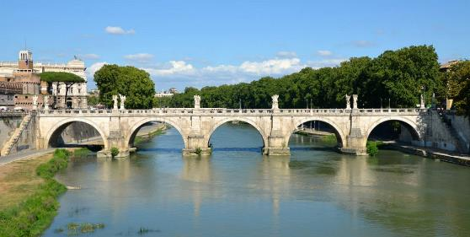
ADH: Rigid arches and bridges
“Roman bridges”

Slide 38
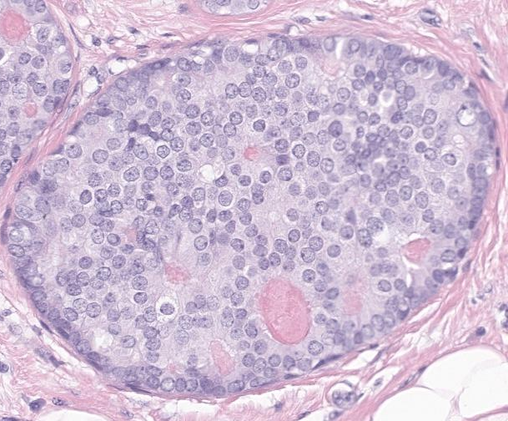
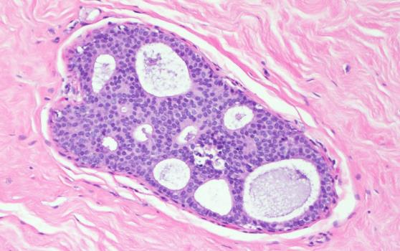
ADH: Cribriform pattern
“Cookie cutter” or “Punched out”
Polarization of cells around lumen

Slide 39
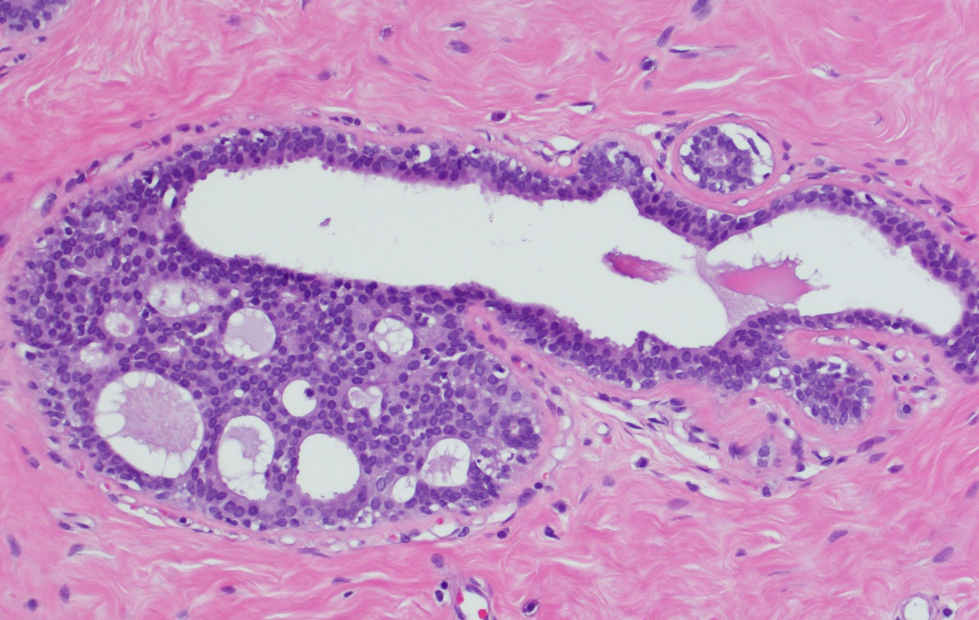
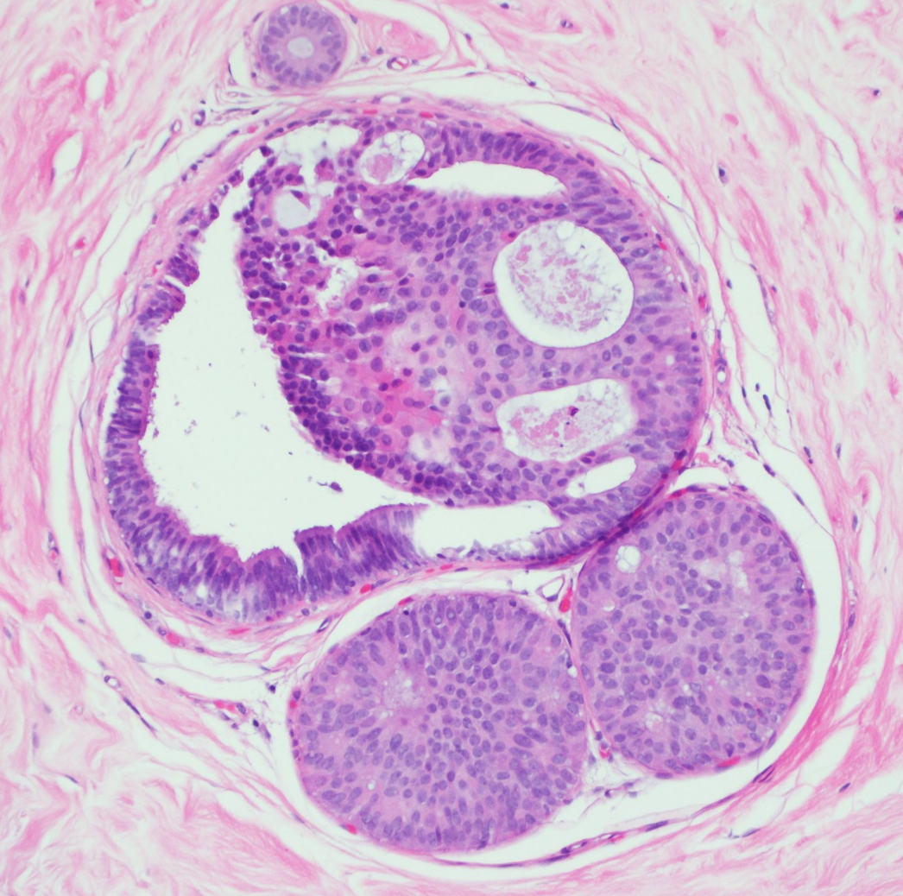
ADH: Partial involvement of ducts by architectural atypia
Residual uninvolved duct

Slide 40
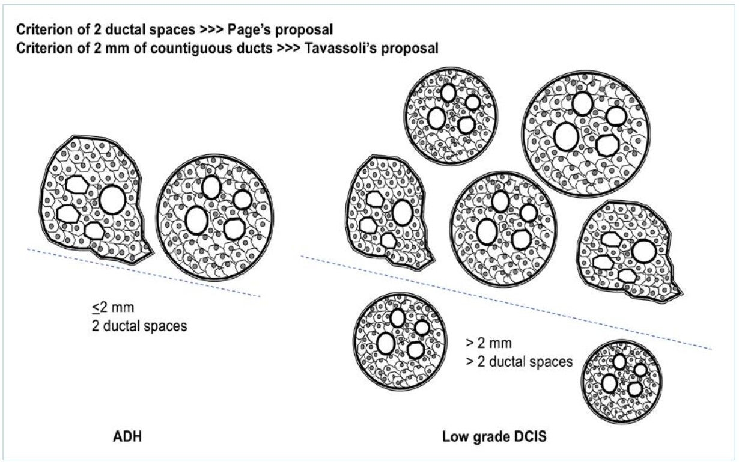
ADH: complete involvement of <2 spaces of ≤2 mm in size
ADH
Low grade DCIS
Sapino A et al. Pathologica, 2021. 113(5): p. 354-359.

Slide 41
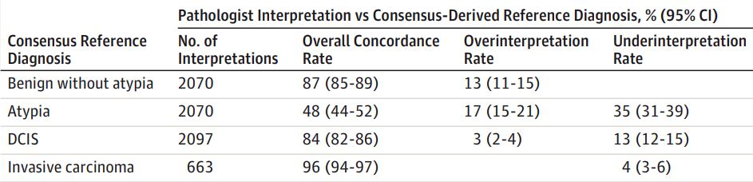
ADH vs low grade DCIS: Diagnostic Issues
Interobserver variability (agreement rates 40-60%)
Special studies (IHC, molecular) not helpful in distinction
Criteria variably used by pathologists
  Involvement of two duct spaces or 2 mm (developed on excisional bx)
  Practical guidelines
  Combination of criteria often used
Elmore JG et al. JAMA. 2015;313(11):1122-32.

Slide 42
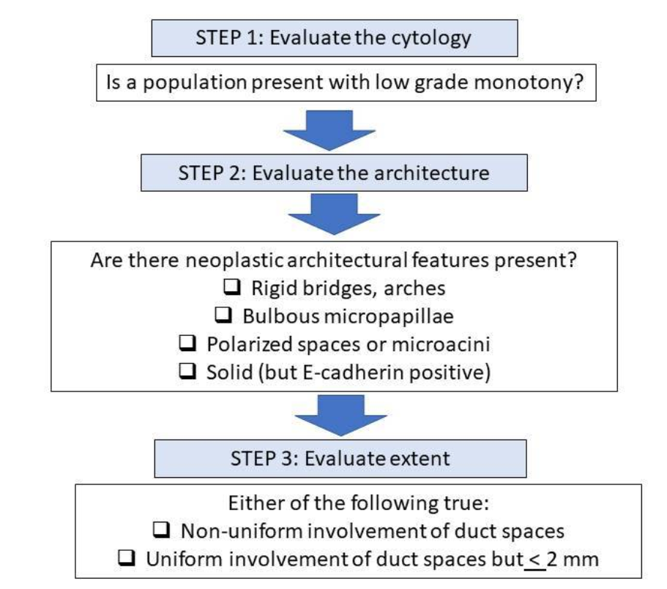
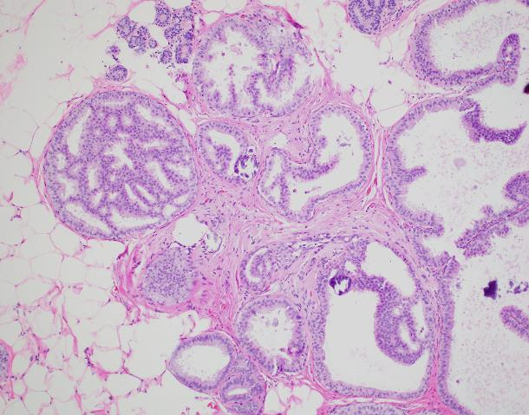
WHO Guide to Evaluation of Atypia in Intraductal Proliferations
Lokuhetty D, White VA, Watanabe R, Cree IA. WHO Classification of Tumours Editorial Board. Breast tumors. IARC, Lyon; 2019.

Slide 43
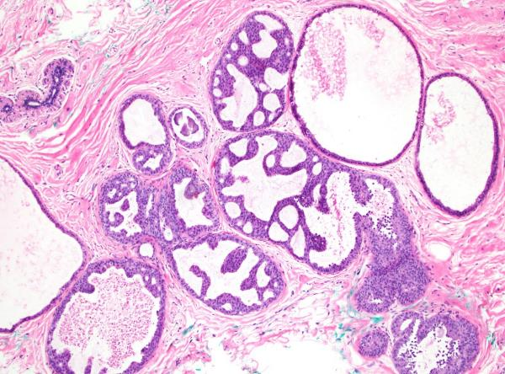
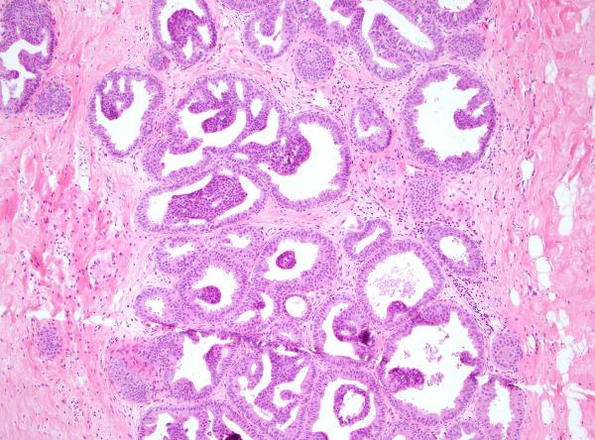
ADH: Diagnostic Dilemmas
2 mm
3 mm
“Borderline lesion”
ADH spanning 3 mm

Slide 44
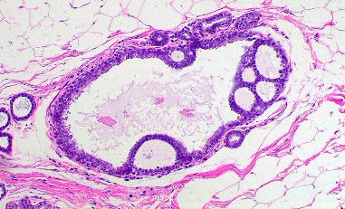
ADH in Core Biopsy
Increased risk: 3-5x
Absolute risk of breast cancer: 1% per year for at least 25 years
Mean latency period: 8-12 years
~30% are “upgraded” on excision
  Reported range: 0-80%
Excisional biopsy generally recommended
  Possible surveillance based on extent
Schiaffino S et al. Radiology. 2020;294(1):76–86.

Slide 45
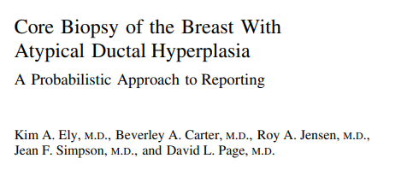
Am J Surg Pathol. 2001;25(8):1017-1021.

Slide 46
47 CNB
with ADH
Extent of ADH
Am J Surg Pathol. 2001;25(8):1017-1021.
1 or 2 foci:
24 (51.1%)
3 foci:
8 (17%)
≥4 foci:
15 (31.9%)

Slide 47
47 CNB
with ADH
Extent of ADH
Am J Surg Pathol. 2001;25(8):1017-1021.
1 or 2 foci:
24 (51.1%)
3 foci:
8 (17%)
≥4 foci:
15 (31.9%)
NO upgrades
0%
13 upgrades
86.6%
12 DCIS, 1 IC

Slide 48
47 CNB
with ADH
Extent of ADH
Am J Surg Pathol. 2001;25(8):1017-1021.
1 or 2 foci:
24 (51.1%)
3 foci:
8 (17%)
≥4 foci:
15 (31.9%)
NO upgrades
0%
4 upgrades
50%
13 upgrades
86.6%
3 DCIS, 1 IC
12 DCIS, 1 IC

Slide 49
47 CNB
with ADH
Extent of ADH
Am J Surg Pathol. 2001;25(8):1017-1021.
1 or 2 foci:
24 (51.1%)
3 foci:
8 (17%)
≥4 foci:
15 (31.9%)
Overall upgrade rate: 36%
NO upgrades
0%
4 upgrades
50%
13 upgrades
86.6%
3 DCIS, 1 IC
12 DCIS, 1 IC
Conclusion: Limited ADH probably do not require further surgical intervention, particularly if the mammographic abnormality has been removed.

Slide 50
ADH in Directional VAB of Breast Microcalcifications: Considerations for Surgical Excision
Cohort: 140 patients
  121 excised, 19 observed
Adapted from Nguyen et al. Ann Surg Oncol. 2011; 18: 752-761.

Slide 51
ADH in Directional VAB of Breast Microcalcifications: Considerations for Surgical Excision
Cohort: 140 patients
  121 excised, 19 observed
Extent of ADH, histologic pattern, significant atypia, presence of necrosis
Adapted from Nguyen et al. Ann Surg Oncol. 2011; 18: 752-761.

Slide 52
ADH in Directional VAB of Breast Microcalcifications: Considerations for Surgical Excision
Variable | Patients | Upgrades | P value
≤95% Ca⁺⁺ removed | 94 | 14 (14.9%) | .0371
>95% Ca⁺⁺ removed | 42 | 1 (2.4%)
≤2 TDLU | 81 | 5 (6.2%) | .0306
>2 TDLU | 59 | 11 (18.6%)
Cytologic atypia | 20 | 12 (60%) | <.0001
No Cytologic atypia | 120 | 4 (3.3%)
Necrosis | 5 | 4 (80%) | .0006
No Necrosis | 135 | 12 (8.9%)
Cohort: 140 patients
  121 excised, 19 observed
Extent of ADH, histologic pattern, significant atypia, presence of necrosis
Upgrade rate: 13.2% (16/121)
  14 DCIS, 2 Invasive
Adapted from Nguyen et al. Ann Surg Oncol. 2011; 18: 752-761.

Slide 53
Long-term safety of observation
Observation criteria: <3 TDLUs, >90% Ca⁺⁺ removed, no necrosis/atypia
Kilgore et al. Ann Surg. 2022; 276(6): e932-e936.

Slide 54
Long-term safety of observation
Expanded criteria: <3 TDLUs, >90% Ca⁺⁺ removed, no necrosis/atypia, no mass lesion or architectural distortion, >50% Ca⁺⁺ removed of well-sampled target
Observation criteria: <3 TDLUs, >90% Ca⁺⁺ removed, no necrosis/atypia
Kilgore et al. Ann Surg. 2022; 276(6): e932-e936.

Slide 55
Long-term safety of observation
Expanded criteria: <3 TDLUs, >90% Ca⁺⁺ removed, no necrosis/atypia, no mass lesion or architectural distortion, >50% Ca⁺⁺ removed of well-sampled target
Observation criteria: <3 TDLUs, >90% Ca⁺⁺ removed, no necrosis/atypia
635 patients with ADH
Male
(n=1)
Diagnosed by excisional bx (n=9)
<1 year follow-up
(n=84)
Upstaged to cancer at excision (n=58)
483 CNB diagnosis of ADH
309 selected for observation
174 surgery with benign findings
Kilgore et al. Ann Surg. 2022; 276(6): e932-e936.

Slide 56
Long-term safety of observation
Expanded criteria: <3 TDLUs, >90% Ca⁺⁺ removed, no necrosis/atypia, no mass lesion or architectural distortion, >50% Ca⁺⁺ removed of well-sampled target
Observation criteria: <3 TDLUs, >90% Ca⁺⁺ removed, no necrosis/atypia
635 patients with ADH
Male
(n=1)
Diagnosed by excisional bx (n=9)
<1 year follow-up
(n=84)
Upstaged to cancer at excision (n=58)
96 had personal hx of breast cancer
483 CNB diagnosis of ADH
Median follow-up: 5.2 years (range 1.1-15.3)
309 selected for observation
174 surgery with benign findings
Kilgore et al. Ann Surg. 2022; 276(6): e932-e936.

Slide 57
Long-term safety of observation
Expanded criteria: <3 TDLUs, >90% Ca⁺⁺ removed, no necrosis/atypia, no mass lesion or architectural distortion, >50% Ca⁺⁺ removed of well-sampled target
Observation criteria: <3 TDLUs, >90% Ca⁺⁺ removed, no necrosis/atypia
635 patients with ADH
Male
(n=1)
Diagnosed by excisional bx (n=9)
<1 year follow-up
(n=84)
Upstaged to cancer at excision (n=58)
96 had personal hx of breast cancer
483 CNB diagnosis of ADH
Median follow-up: 5.2 years (range 1.1-15.3)
Women ≤ 50 y more likely to have surgery
(42.4% vs 33.2%, p=0.04)
309 selected for observation
174 surgery with benign findings
Women dx by stereotactic bx more likely to be observed than if dx by US or MRI bx
(67.2% vs 43.1%, p=0.001)
Kilgore et al. Ann Surg. 2022; 276(6): e932-e936.

Slide 58
Long term safety of observation
483 CNB diagnosis of ADH
309 selected for observation
174 surgery with benign findings
No prior breast cancer hx (n=250)
Prior breast cancer history (n=59)
No prior breast cancer hx (n=137)
Prior breast cancer history (n=37)
Upgrade
4.4% (11/250)
Upgrade
17% (10/59)
Upgrade
7.3% (10/137)
Upgrade
11% (4/37)
Prior history of breast cancer was only factor associated with subsequent breast cancer risk (p=0.04)
Kilgore et al. Ann Surg. 2022; 276(6): e932-e936.

Slide 59
Long term safety of observation
483 CNB diagnosis of ADH
309 selected for observation
174 surgery with benign findings
No prior breast cancer hx (n=250)
No prior breast cancer hx (n=137)
No difference in rate of breast cancer between surgery and observation groups (p=0.2)
Upgrade
4.4% (11/250)
Upgrade
7.3% (10/137)
3 (1.2%) at index site
2 (1.5%) at index site
Conclusion: Risk of cancer at index site (i.e. site of ADH biopsy) is exceedingly low. Observation, rather than surgical excision, is safe in selected women that have a core biopsy diagnosis of ADH.
Kilgore et al. Ann Surg. 2022; 276(6): e932-e936.

Slide 60
Focal ADH on CNB
CNBs with morphologically confirmed ADH and follow-up excision (n = 208)
Focal: 1 focus, ≤2 mm
CNBs with focal ADH
(n = 98)
CNBs with non-focal ADH
(n = 110)
7% Upgrade
(n = 7)
93% No upgrade
(n = 91)
22% Upgrade
(n = 24)
78% No upgrade
(n = 86)
Grabenstetter A et al. Ann Surg Oncol. 2023;30(7):4095-6.

Slide 61
Focal ADH on CNB
CNBs with morphologically confirmed ADH and follow-up excision (n = 208)
Focal: 1 focus, ≤2 mm
CNBs with focal ADH
(n = 98)
CNBs with non-focal ADH
(n = 110)
7% Upgrade
(n = 7)
93% No upgrade
(n = 91)
22% Upgrade
(n = 24)
78% No upgrade
(n = 86)
Non-focal ADH is significantly associated with upgrade to carcinoma on excision (p = 0.01)
Grabenstetter A et al. Ann Surg Oncol. 2023;30(7):4095-6.

Slide 62
Focal ADH on CNB
CNBs with morphologically confirmed ADH and follow-up excision (n = 208)
Focal: 1 focus, ≤2 mm
CNBs with focal ADH
(n = 98)
CNBs with non-focal ADH
(n = 110)
7% Upgrade
(n = 7)
93% No upgrade
(n = 91)
22% Upgrade
(n = 24)
78% No upgrade
(n = 86)
5 DCIS
2 Tubular carcinomas
Non-focal ADH is significantly associated with upgrade to carcinoma on excision (p = 0.01)
Too high to spare surgical excision
Grabenstetter A et al. Ann Surg Oncol. 2023;30(7):4095-6.

Slide 63
Ductal carcinoma in situ
(DCIS)

Slide 64
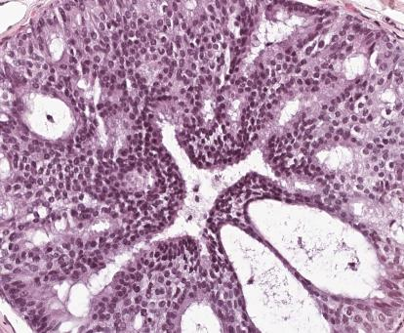
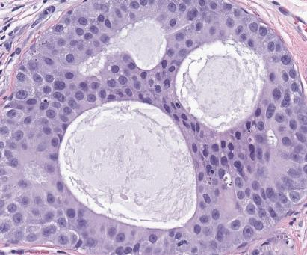
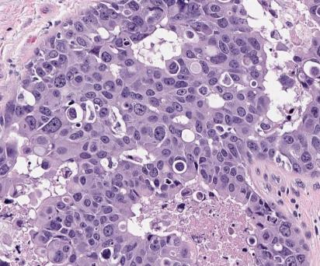
Classification of DCIS
Low
Intermediate
High
DCIS is classified according to nuclear grade
Architectural pattern and presence of absence of necrosis also noted

Slide 65
DCIS on Core Biopsy
Increased risk: 8-10x
Current standard of care is excision
  Clear margins (>2 mm)
  +/- Radiation
  Chemoprevention
Breast cancer specific survival shown to be associated with grade of DCIS
  Active surveillance clinical trials in progress for low grade DCIS
Kanbayashi C et al. J Clin Oncol. 2019;37(15_suppl):TPS603.
Van Maaren MC et at. Eur J Cancer. 2018;101:134-42.

Slide 66
Lobular proliferative lesions:
Atypical lobular hyperplasia (ALH)
Lobular carcinoma in situ (LCIS)

Slide 67
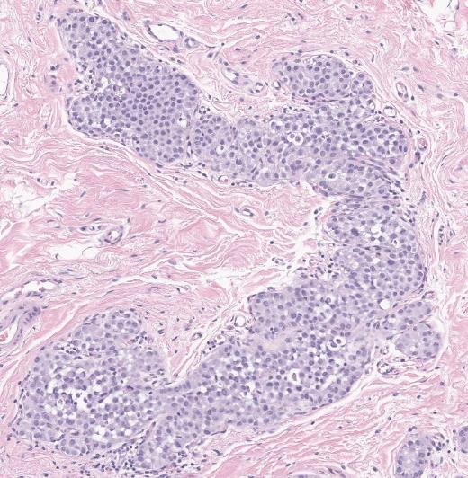
Key Features of Lobular Neoplasia
Cytologic Features
Uniform, loosely cohesive and evenly spaced cells
Cells slightly larger than normal,
Small uniform nuclei, evenly distributed chromatin and inconspicuous nucleoli
Architectural Features
Lobulocentric proliferation, expands lobular unit
+/- pagetoid involvement of terminal ducts
Distinction of ALH and LCIS: percentage of TDLU involved
Calle C et al. Breast J. 2020;26(5):1148-1155.

Slide 68



Classic LCIS
ALH
Uniform, discohesive, evenly spaced cells
Distention of >50% of acini of TDLU
<50% of acini in TDLU
Minimal expansion

Slide 69

Hallmark Feature of Lobular Neoplasia: Loss of cellular cohesion due to dysfunctional cadherin-catenin complex
Inactivation of E-cadherin driven by genomic alterations targeting CDH1 gene (on chromosome 16q22.1)
Dabbs DJ, ed. Breast Pathology. 2nd ed. Elsevier; 2017.

Slide 70
Hallmark Feature of Lobular Neoplasia: Loss of cellular cohesion due to dysfunctional cadherin-catenin complex
IHC for lobular lesions:
E-cadherin
  Absence of membranous expression
p120
  Cytoplasmic expression
Beta-catenin
  Absence of membranous expression
E-cadherin
Inactivation of E-cadherin driven by genomic alterations targeting CDH1 gene (on chromosome 16q22.1)
Dabbs DJ, ed. Breast Pathology. 2nd ed. Elsevier; 2017.

Slide 71

E-cadherin IHC: loss of membranous staining

Slide 72

Inactivation of E-cadherin results in accumulation of p120 in the cytoplasm
LCIS – cytoplasmic staining with p120
Benign glands – membranous staining with p120

Slide 73
Why do we care if a tumor is lobular vs. ductal?
Differentiation of invasive carcinoma:
  Little clinical impact, but still routinely used
Distinguishing DCIS vs. Classic LCIS
  DCIS: local eradication, XRT
  LCIS: follow-up, chemoprevention

Slide 74

Atypical lobular hyperplasia (ALH)
Lobular carcinoma in situ (LCIS), classic type
Lobular neoplasia (LN)
  Bilateral cancer risk
    2/3 ipsilateral, 1/3 contralateral
  Cancers develop >10 years after diagnosis of LN
ALH: relative risk 4-5x
LCIS: relative risk 8-10x
LCIS removed from TNM staging
Ward EM et al. CA Cancer J Clin. 2015;65(6):481-95.

Slide 75

Classic lobular neoplasia on CNB: Upgrade rates
Study | Excised cases | Invasive Carcinoma | DCIS | Upgrade rate | Rad-path correlation
Shah-Khan (2012) | 101 | 1 | 0 | 1% | Yes
Murray (2013) | 72 | 1 | 1 | 3% | Yes
Atkins (2013) | 38 | 0 | 0 | 0% | Yes
Chaudhary (2013) | 87 | 2 | 1 | 3.4% | Yes
Nakhlis (2016) | 74 | 0 | 1 | 1% | Yes
Ibrahim (2012) | 84 | 15 | 13 | 33% | No
Destounis (2012) | 63 | 6 | 14 | 33% | No
Zhao (2012)* | 237 | 4 | 7 | 4.6% | No
*Excluded all cases with imaging findings of a mass or any lesion other than calcifications

Slide 76
Classic lobular neoplasia on CNB: Upgrade rates
Study | Excised cases | Invasive Carcinoma | DCIS | Upgrade rate | Rad-path correlation
Shah-Khan (2012) | 101 | 1 | 0 | 1% | Yes
Murray (2013) | 72 | 1 | 1 | 3% | Yes
Atkins (2013) | 38 | 0 | 0 | 0% | Yes
Chaudhary (2013) | 87 | 2 | 1 | 3.4% | Yes
Nakhlis (2016) | 74 | 0 | 1 | 1% | Yes
Ibrahim (2012) | 84 | 15 | 13 | 33% | No
Destounis (2012) | 63 | 6 | 14 | 33% | No
Zhao (2012)* | 237 | 4 | 7 | 4.6% | No
Routine excision of ALH/classic LCIS is not required if radiologically-pathologically concordant
*Excluded all cases with imaging findings of a mass or any lesion other than calcifications

Slide 77
Non-classic LCIS:
Pleomorphic and Florid

Slide 78



Pleomorphic LCIS (PLCIS)
Florid LCIS (FLCIS)
Variant forms of LCIS recently defined by the WHO
  Pleomorphic
  Florid
Have morphologic and molecular features not present in classic LCIS
Natural history is unknown
  Likelihood of association with (micro)invasion higher than classic type
Lokuhetty D, White VA, Watanabe R, Cree IA. WHO Classification of Tumours Editorial Board. Breast tumors. IARC, Lyon; 2019.

Slide 79


Florid LCIS
Classic LCIS
Need at least 1 of 2 architectural features:
Little to no intervening stroma between distended acini
Minimum diameter of ~40-50 cells
Schnitt SJ et al. Ann Diagn Pathol. 2020;45:151481.

Slide 80

Florid LCIS
Classic LCIS
Need at least 1 of 2 architectural features:
Little to no intervening stroma between distended acini
Minimum diameter of ~40-50 cells
Schnitt SJ et al. Ann Diagn Pathol. 2020;45:151481.

Slide 81


Florid LCIS
Necrosis and calcifications
E-cadherin
Expansion of ducts with low to intermediate grade LCIS cells

Slide 82


Extensive classic LCIS ≠ Florid LCIS

Slide 83


Pleomorphic LCIS
Solid proliferation of discohesive cells with marked nuclear pleomorphism equivalent to high grade DCIS

Slide 84

LCIS with pleomorphic features
WHO 5th Edition: LCIS lesions that are borderline between classic and pleomorphic should be categorized as classic LCIS in excision specimens
Clinical significance in core biopsy is unknown
Lokuhetty D, White VA, Watanabe R, Cree IA. WHO Classification of Tumours Editorial Board. Breast tumors. IARC, Lyon; 2019.

Slide 85
LCIS Clinical Presentation
Classic LCIS
Florid and Pleomorphic LCIS
Premenopausal, mean ~45 years
Incidental
  Less commonly biopsied due to calcifications
Multifocal, multicentric
Virtually all ER-positive, HER2-negative
Postmenopausal, mean ~60 years
Imaging target: calcifications or mass
Unifocal
Commonly seen in association with classic LCIS
Majority ER positive, HER2-negative
  Pleomorphic: HER2 overexpression in ~20% (particularly apocrine type)
Lokuhetty D, White VA, Watanabe R, Cree IA. WHO Classification of Tumours Editorial Board. Breast tumors. IARC, Lyon; 2019.

Slide 86
LCIS Clinical Presentation
Classic LCIS
Florid and Pleomorphic LCIS
Premenopausal, mean ~45 years
Incidental
  Less commonly biopsied due to calcifications
Multifocal, multicentric
Virtually all ER-positive, HER2-negative
Postmenopausal, mean ~60 years
Imaging target: calcifications or mass
Unifocal
Commonly seen in association with classic LCIS
Majority ER positive, HER2-negative
  Pleomorphic: HER2 overexpression in ~20% (particularly apocrine type)
Lokuhetty D, White VA, Watanabe R, Cree IA. WHO Classification of Tumours Editorial Board. Breast tumors. IARC, Lyon; 2019.

Slide 87


Pleomorphic invasive lobular carcinoma and LCIS with apocrine differentiation
HER2

Slide 88
Molecular Features of LCIS
Classic LCIS
16q loss, gain of 1q
CDH1 alteration (up to 81%)
PIK3CA mutation (41%)
Florid LCIS
16q loss, gain of 1q
Greater genomic instability
Increased copy number alterations
Pleomorphic LCIS
16q loss, gain of 1q
Greater genomic instability
Increased copy number alterations
HER2 amplification
Sakr RA et al. Mol Oncol. 2016;10(2):360-70.
Shin SJ et al. Hum Pathol. 2013;44(10):1998-2009.
Shah V et al. Breast Cancer Res. 2017;19(1):7.
Harrison BT et al. Mod Pathol. 2020;33(7):1287-1297.

Slide 89
Non-classic LCIS on CNB should be excised
Study | Excised cases | Invasive carcinoma | DCIS | Upgrade rate
Carder (2010) | 3 | 3 | 0 | 30%
Flanagan (2015) | 23 | 7 | 4 | 47.8%
Susnik (2016) | 15 | 4 | 0 | 26.7%
Guo (2018) | 23 | 14 | 0 | 60%
Fasola (2018) | 20 | 4 | 2 | 30%
Nakhlis (2019) | 76 | 17 | 10 | 36%
Kuba (2021) | 32 | 6 | 0 | 19%
Total | 192 | 55 (29%) | 16 (8%) | 71/192 (37%)

Slide 90
Summary
Diagnosis of intraductal proliferative lesions is based predominantly on H&E findings
Risk is dependent on the degree of atypia (and possibly extent)
DCIS and most ADH should be surgically excised
FEA and Classic LCIS/ALH can be managed conservatively
Non-classic LCIS (florid and pleomorphic) should be excised due to risk of (micro)invasion

