Slide 1


Breast MRI
Connie Lehman MD PHD
Harvard Medical School
Professor of Radiology
Disclaimer: This presentation is intended for personal use and for informational purposes only and does not replace independent professional judgment. This presentation is the property of Physicians’ Education Resource, LLC (“PER”) and is protected by U.S. and international copyright laws. You may not copy, reproduce, distribute, transmit, modify, or create derivative works of the presentation without the prior written permission from PER.

Slide 2
2025 Disclosures:
Institutional Grants/Research Support from: Breast Cancer Research Foundation, National Cancer Institute, GE Healthcare, Inc.
Founder of Clairity, Inc.

Slide 3
Objectives
Understand indications for high-risk screening breast MRI
Explore diagnostic indications for breast MRI
Discuss utility of breast MRI in patients with known breast cancer

Slide 4
Breast MRI
Detection of breast cancer on MRI depends on the administration of intravenous gadolinium
Highly sensitive: >90%
Specificity is variable
MRI is an adjunct to screening mammography and not a substitution

Slide 5
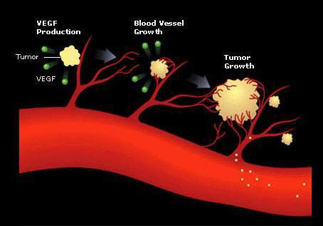
Enhancement
Intravenous contrast results in enhancement of malignancy due to
  Tumor angiogenesis
  Increased vascularity and permeability
Normal fibroglandular breast tissue can also enhance
  Background parenchymal enhancement (BPE)

Slide 6
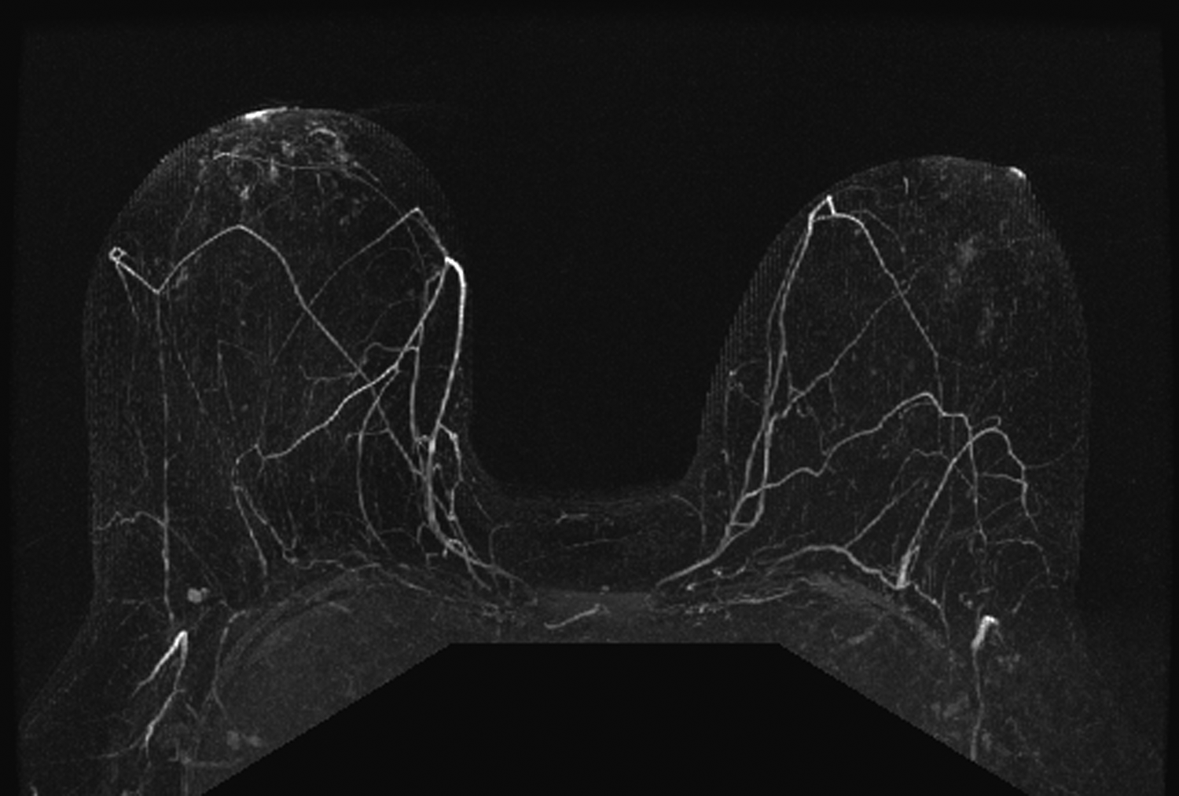
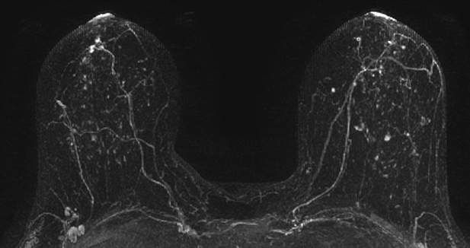
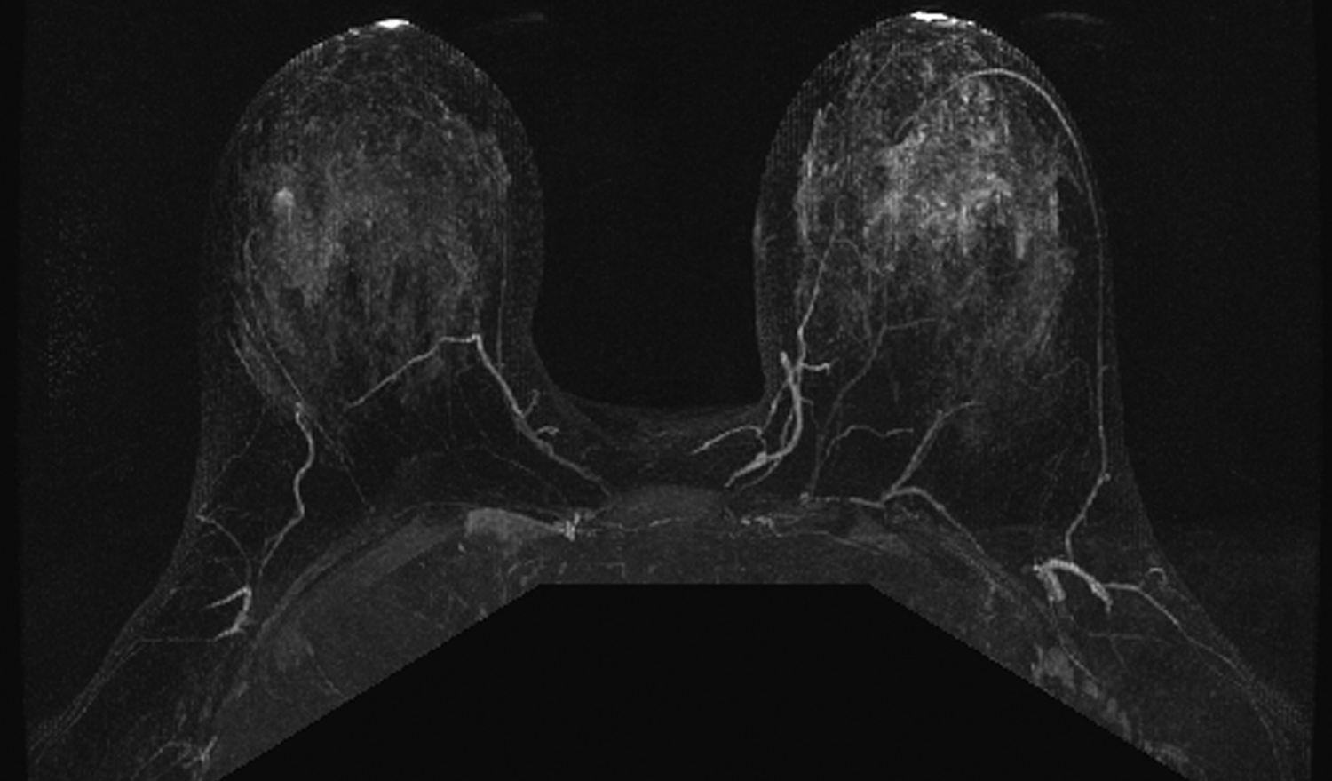
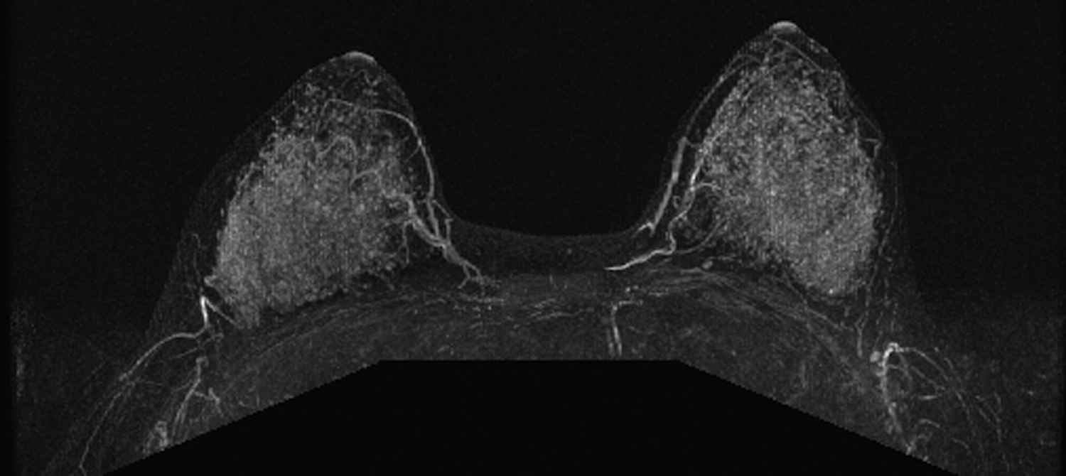
Mild
Minimal
Moderate
Marked
Moderate
Background parenchymal enhancement categories
Notes:
6

Slide 7
BPE
Fluctuates based on
  Menstrual cycle timing
  Menopausal status
  Hormone replacement therapy
  Anti-estrogen therapy
  Radiation therapy
Moderate

Slide 8
BPE and Cancer Risk
Prior case control studies have shown that increased BPE increases high risk women’s chance of cancer
  Dontchos, et al. (2015)¹
    23 high risk women with cancer
    Mild/Mod/Marked 9x more likely to develop CA
  King, et al. (2011)²
    39 high risk women with cancer
    Mod/Marked 3.3 to 10.1x
Dontchos, et al. Radiology. 2015;276(2):371-80.
King, et al. Radiology. 2011;260(1):50-60.

Slide 9
Screening
Kriege et al
1909 women with lifetime breast cancer risk of 15% or more enrolled
  358 BRCA1 or 2 carriers
Underwent screening
  CBE every 6 mos.
  Annual mammography
  Annual MRI
Kriege et al. N Engl J Med. 2004;351(5):427-37.

Slide 10
Screening
Kriege et al
From 11/1/99 through 10/1/03: 51 malignancies detected
  44 invasive cancers
  6 DCIS
  1 non-Hodgkin’s Lymphoma
Overall cancer detection rate 9.5/1000
  In mutation carriers: 26.5/1000
Kriege et al. N Engl J Med. 2004;351(5):427-37.

Slide 11
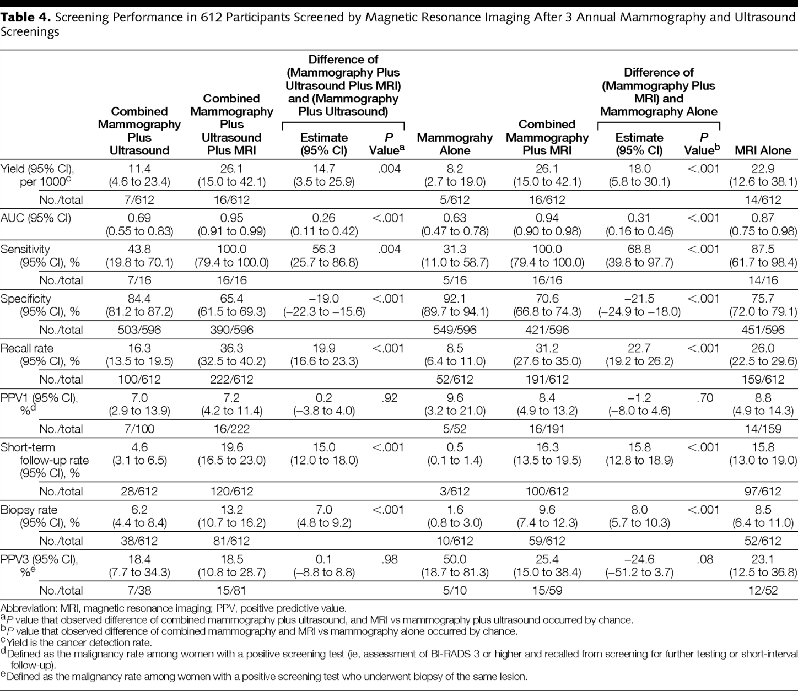

ACRIN 6666---Single MRI performed after multiple rounds of screening ultrasound….
From: Detection of Breast Cancer With Addition of Annual Screening Ultrasound or a Single Screening MRI to Mammography in Women With Elevated Breast Cancer Risk
JAMA. 2012;307(13):1394-1404. doi:10.1001/jama.2012.388. ACRIN 6666: Berg

Slide 12
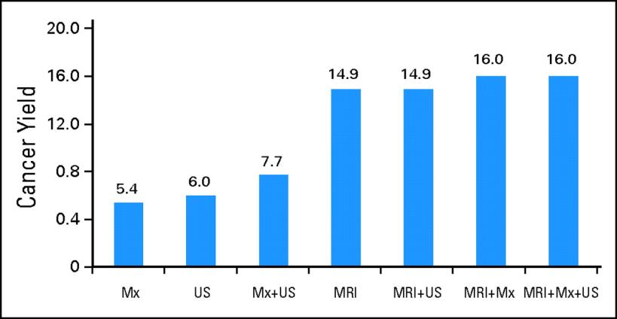
Cancer Yield of Mammography, US, MRI
Kuhl C et al. JCO 2010;28:1450-57
Notes:
Cancer yield of the different imaging methods, used alone or in combination. Number of true-positive diagnoses per 1,000 complete screening rounds. Mx, mammography; US, ultrasound; MRI, magnetic resonance imaging.

Slide 13
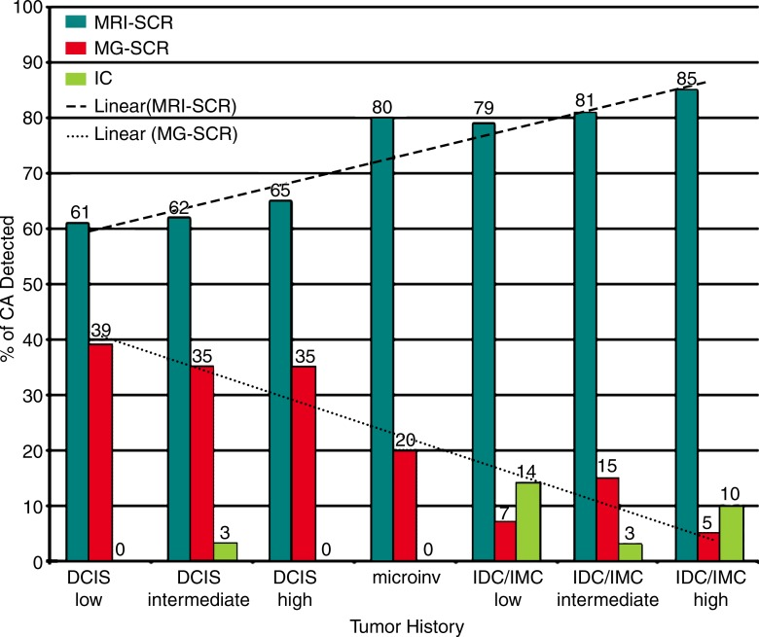
Combined MRI and mammo sensitivity 95%
Sung JS, Stamler S, Brooks J et al. Breast Cancers Detected on High Risk Screening MRI and Mammography: Method of Detection Reflects Tumor Histopathology. Radiology. 2016 Sep;280(3):716-22.

Slide 14
Screening
Lee et al 2017: Performance Benchmarks for Screening Breast MR Imaging in Community Practice
  8387 exams
  CDR 17/1000
  PPV2 19% (PPV3 21%)
  False positive biopsy recommendation 66/1000
  88% of cancers were node negative
  67% Minimal cancer (IDC <10mm or DCIS)
Lee JM, et al. Radiology. 2017;285(1):44-52.

Slide 15
Screening
Strigel et al 2017: Screening Breast MRI Outcomes in Routine Clinical Practice: Comparison to BI-RADS Benchmarks
  860 exams
  CDR 21/1000
  AIR 15.6% (BI-RADS 0, 3, 4, 5)
  AIR 10.2 % (BI-RADS 4, 5)
  PPV2 21.6% (PPV3 23.8%)
  61.5% of cancers were node negative
  71% Minimal cancer
Strigel RM, et al. Acad Radiol. 2017;24(4):411-417.

Slide 16



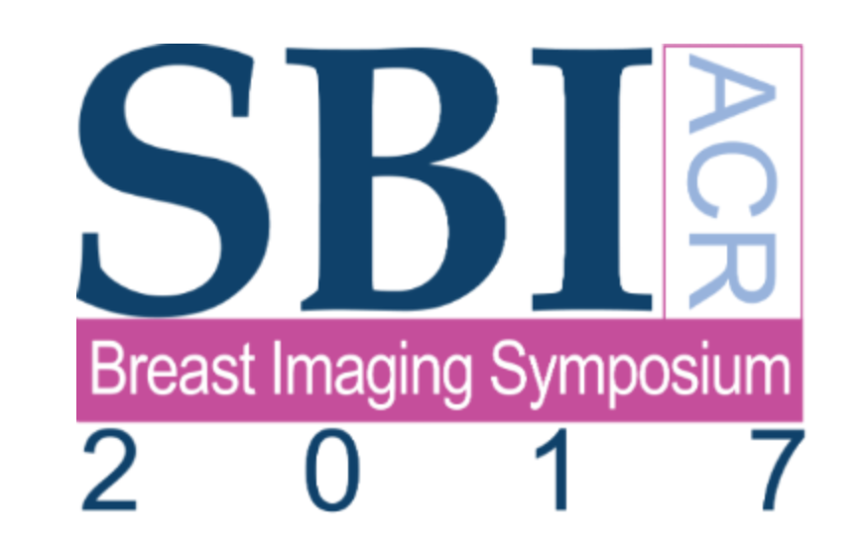
American Cancer Society 2007
“Based on the evidence from studies of MR screening high-risk women, and the limitations of mammography and CBE alone, the American Cancer Society recommends annual MR screening in conjunction with mammography in women at significantly increased risk of breast cancer.”

Slide 17
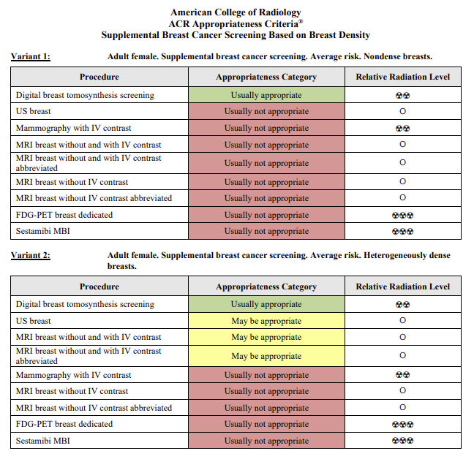
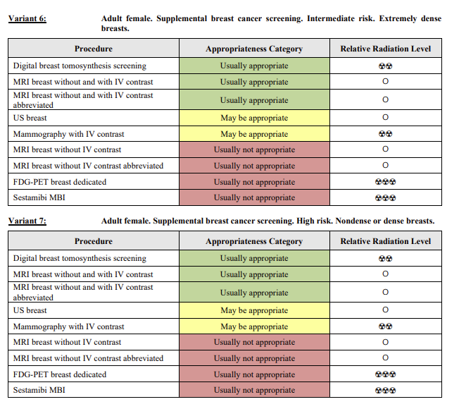
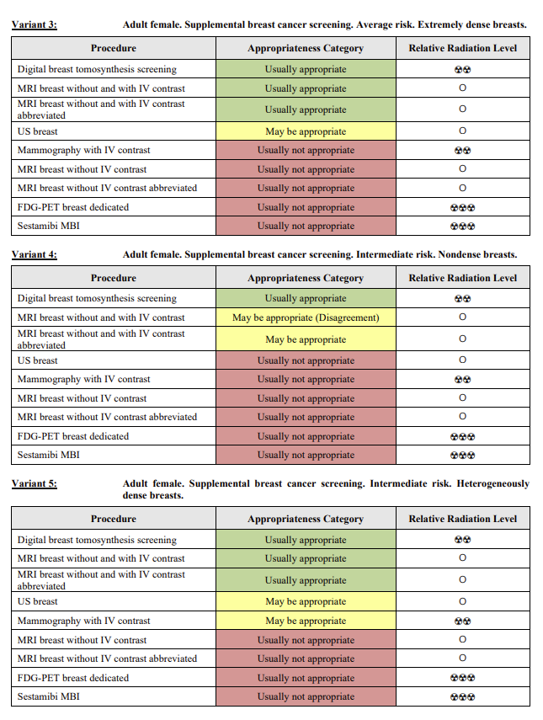
Who may benefit (based on density and risk)as important as the technology itself : ACR Criteria for Supplemental Screening

Slide 18
Supplemental Imaging added to 3D Mammo: Summary of ACR Guidelines
 | AVERAGE RISK | INTERMEDIATE RISK | HIGH RISK
NON DENSE (FATTY OR SCATTERED) | None | ? MRI | MRI ? CEM ? US
HETEROGENEOUSLY DENSE | ? US ? MRI | MRI ? CEM ? US | MRI ? CEM ? US
EXTREME DENSE | MRI ? US | MRI ? CEM ? US | MRI ? CEM ? US

Slide 19
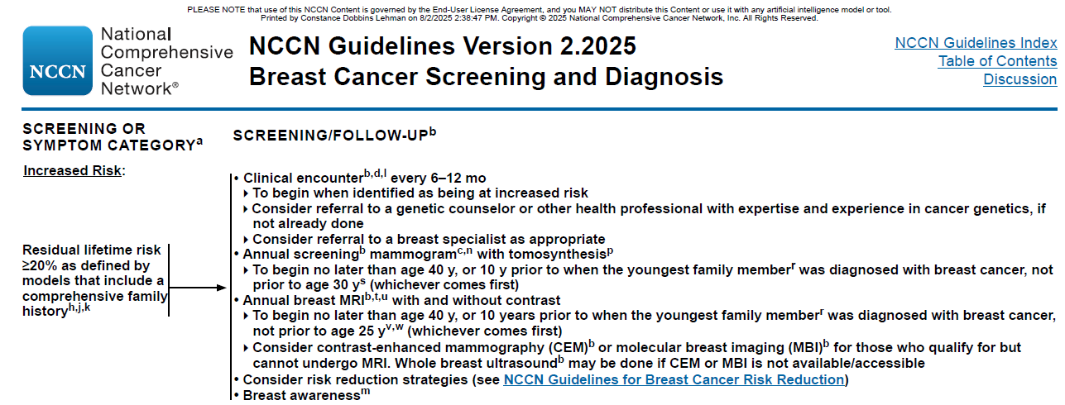
Screening

Slide 20
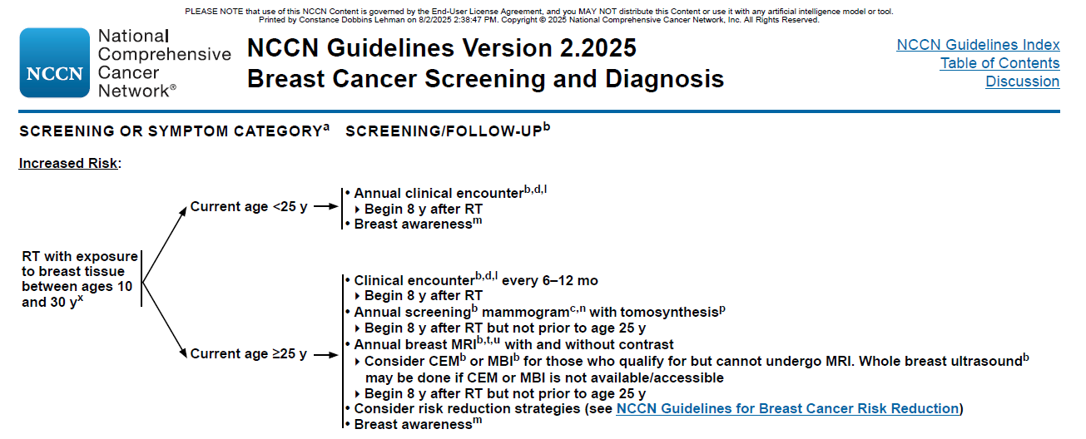
Screening

Slide 21
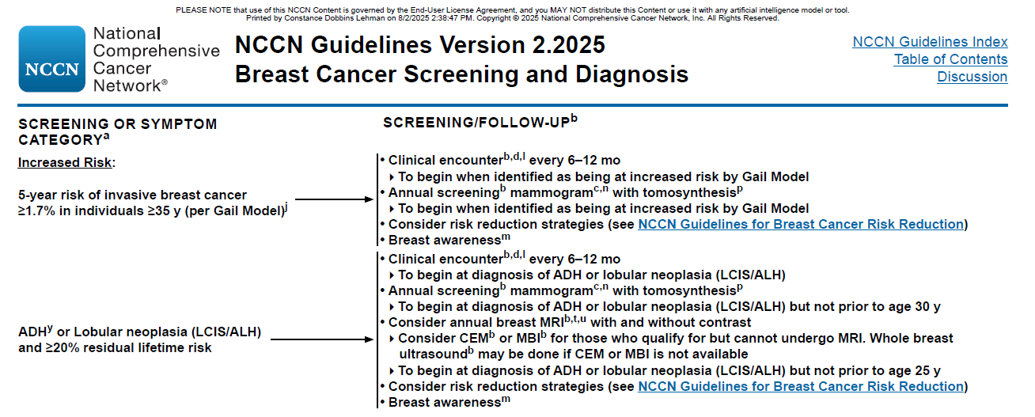
Screening

Slide 22
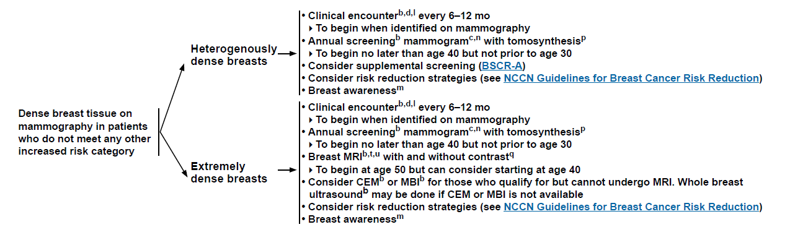
Screening

Slide 23
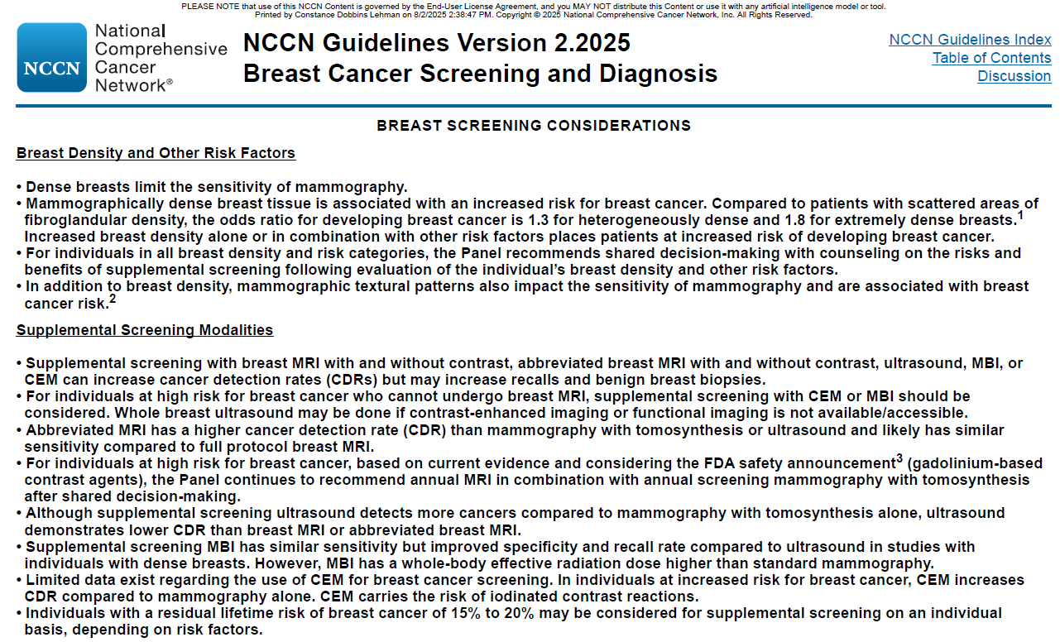
BSCR-A

Slide 24
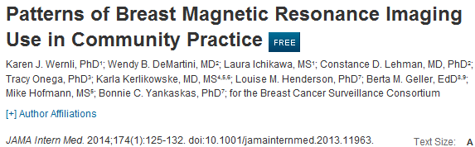
2005-2009 Breast Cancer Surveillance Consortium
1.3 million mammograms, 9,000 breast MRIs

Slide 25
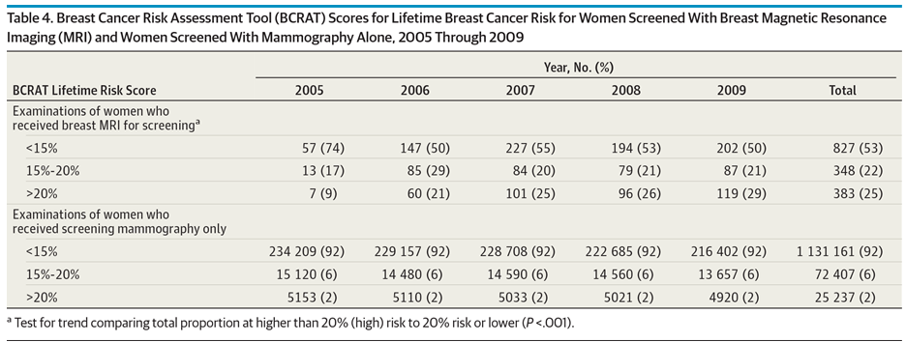
75% of all screening MRIs performed were in women with less than 20% lifetime risk
Of women at greater than 20% lifetime risk, less than 2% had received an MRI
Wernli et al, JAMA int med 2014

Slide 26
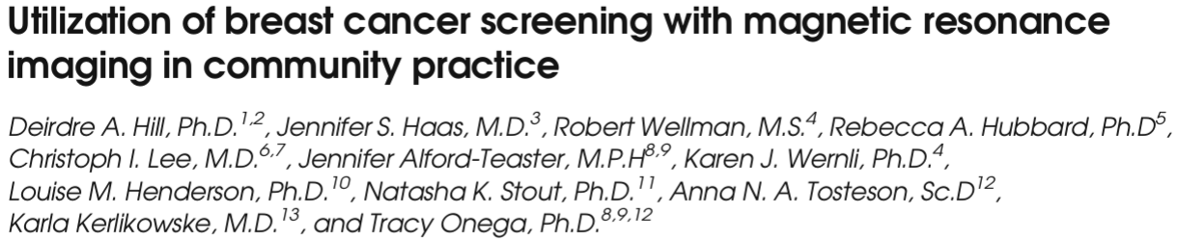
2007-2014
  350,000 women with mammograms
  1500 women had MRI
17% of all screening MRIs performed were guideline appropriate
  83% of all exams performed in average/intermediate risk women
Only 6% of women who met guidelines had received a screening MRI
Journal of General Internal Medicine 2017

Slide 27
Breast MRI
Diagnostic considerationscreening applications

Slide 28
Indications and Utility
New cancer diagnosis extent of disease
  Particularly helpful in patients who are young, with dense breast tissue, lobular histology, genetic mutations
Axillary nodal metastasis with a negative mammogram
Paget’s disease of the nipple with a negative mammogram
Evaluating response to neoadjuvant chemotherapy
Assessing for residual tumor after resection with positive margins
Breast implant evaluation

Slide 29
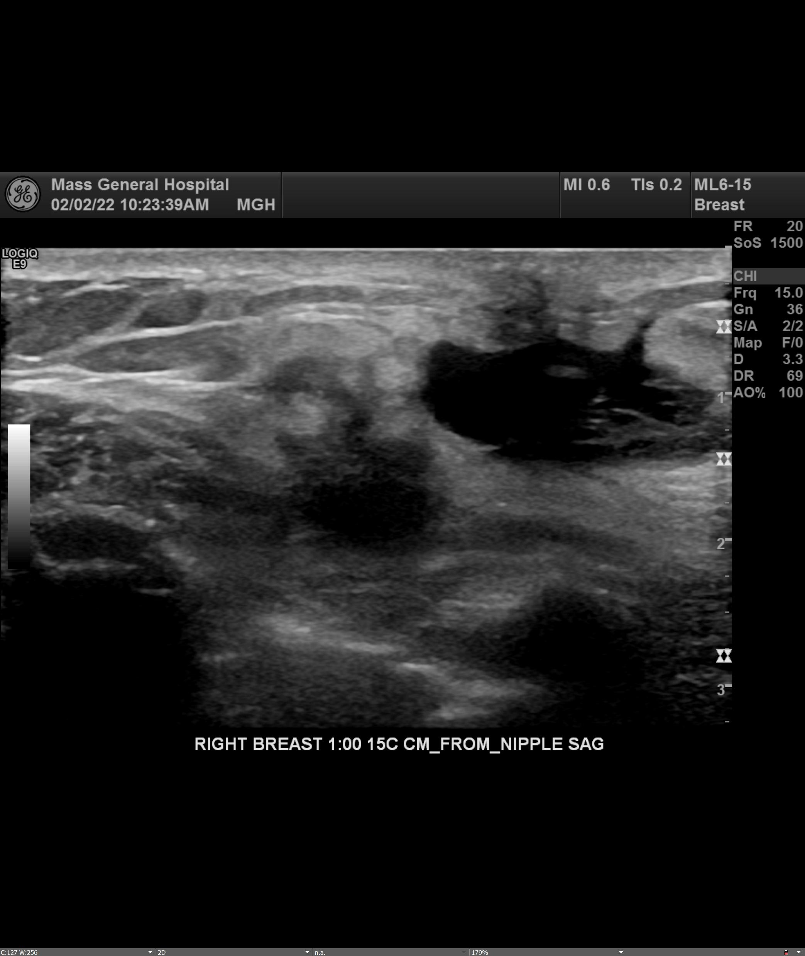
Case 1: Palpable lump at site of recent lumpectomy

Slide 30
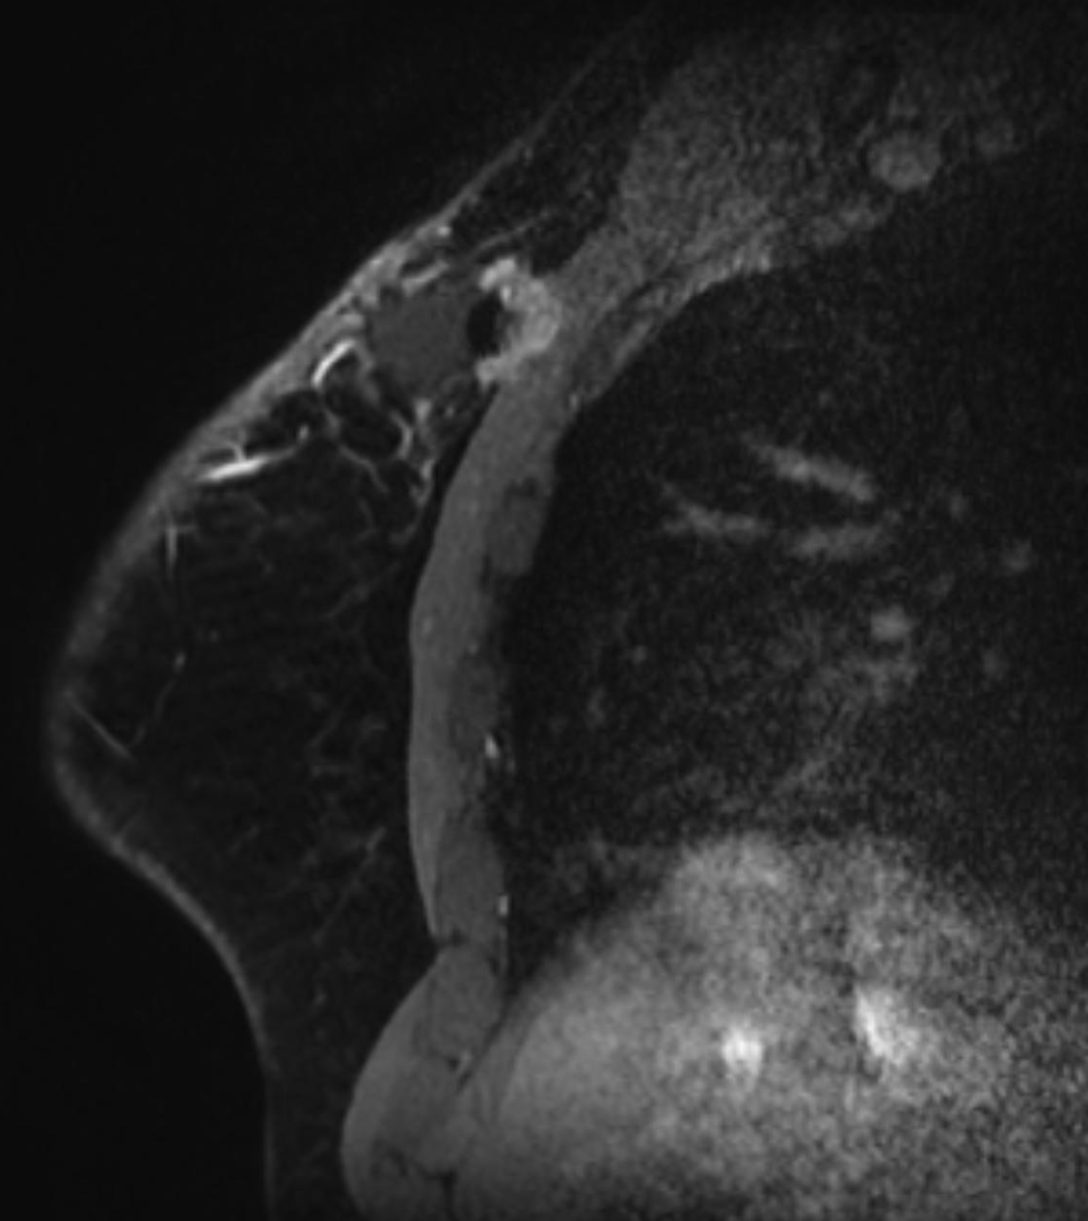
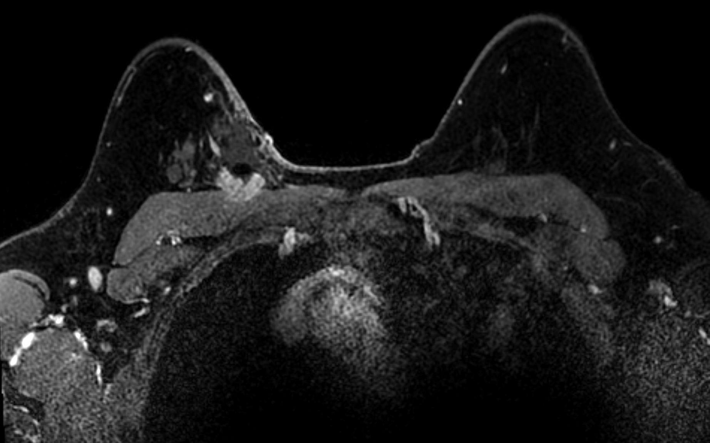
Case 1: Palpable lump

Slide 31
Case 1: Palpable lump

Slide 32
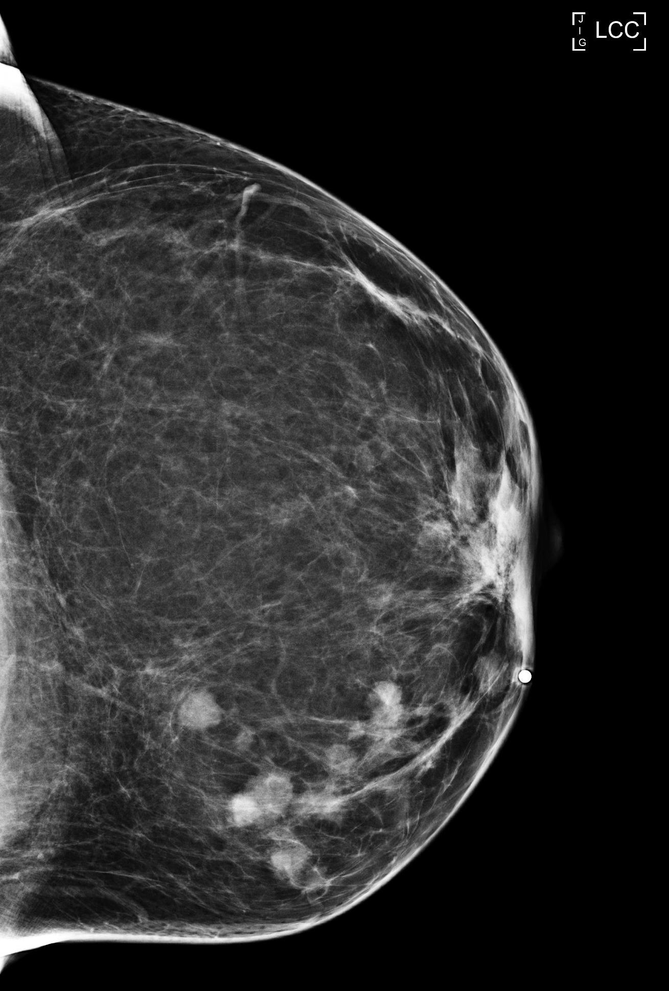
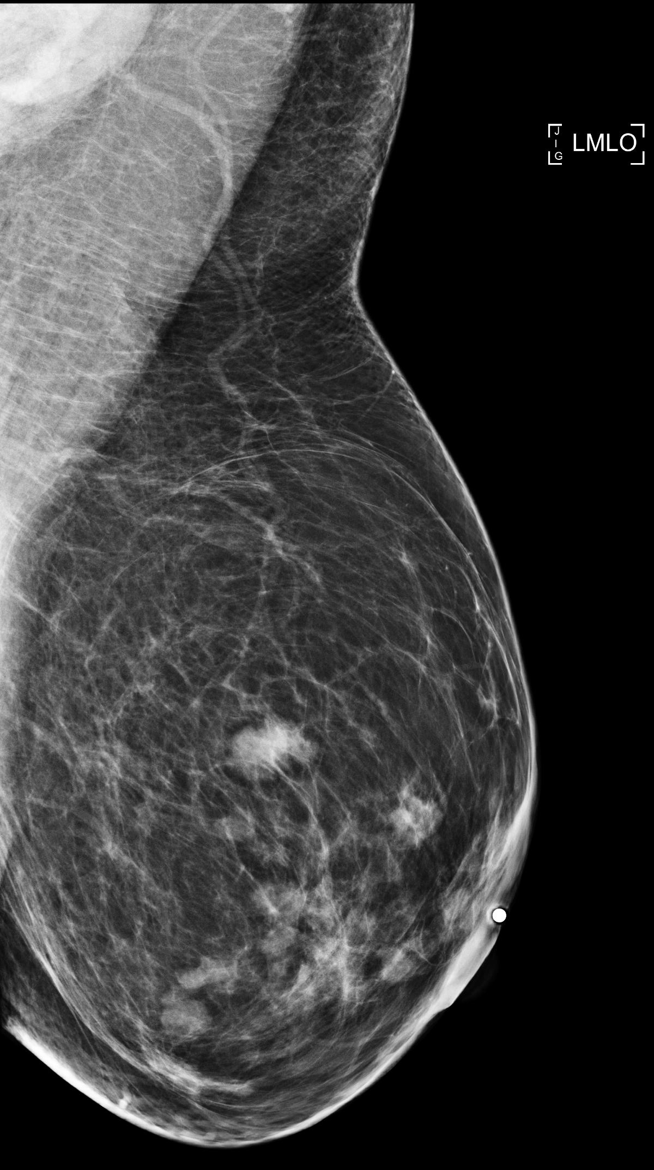
Case 2: Palpable lump

Slide 33
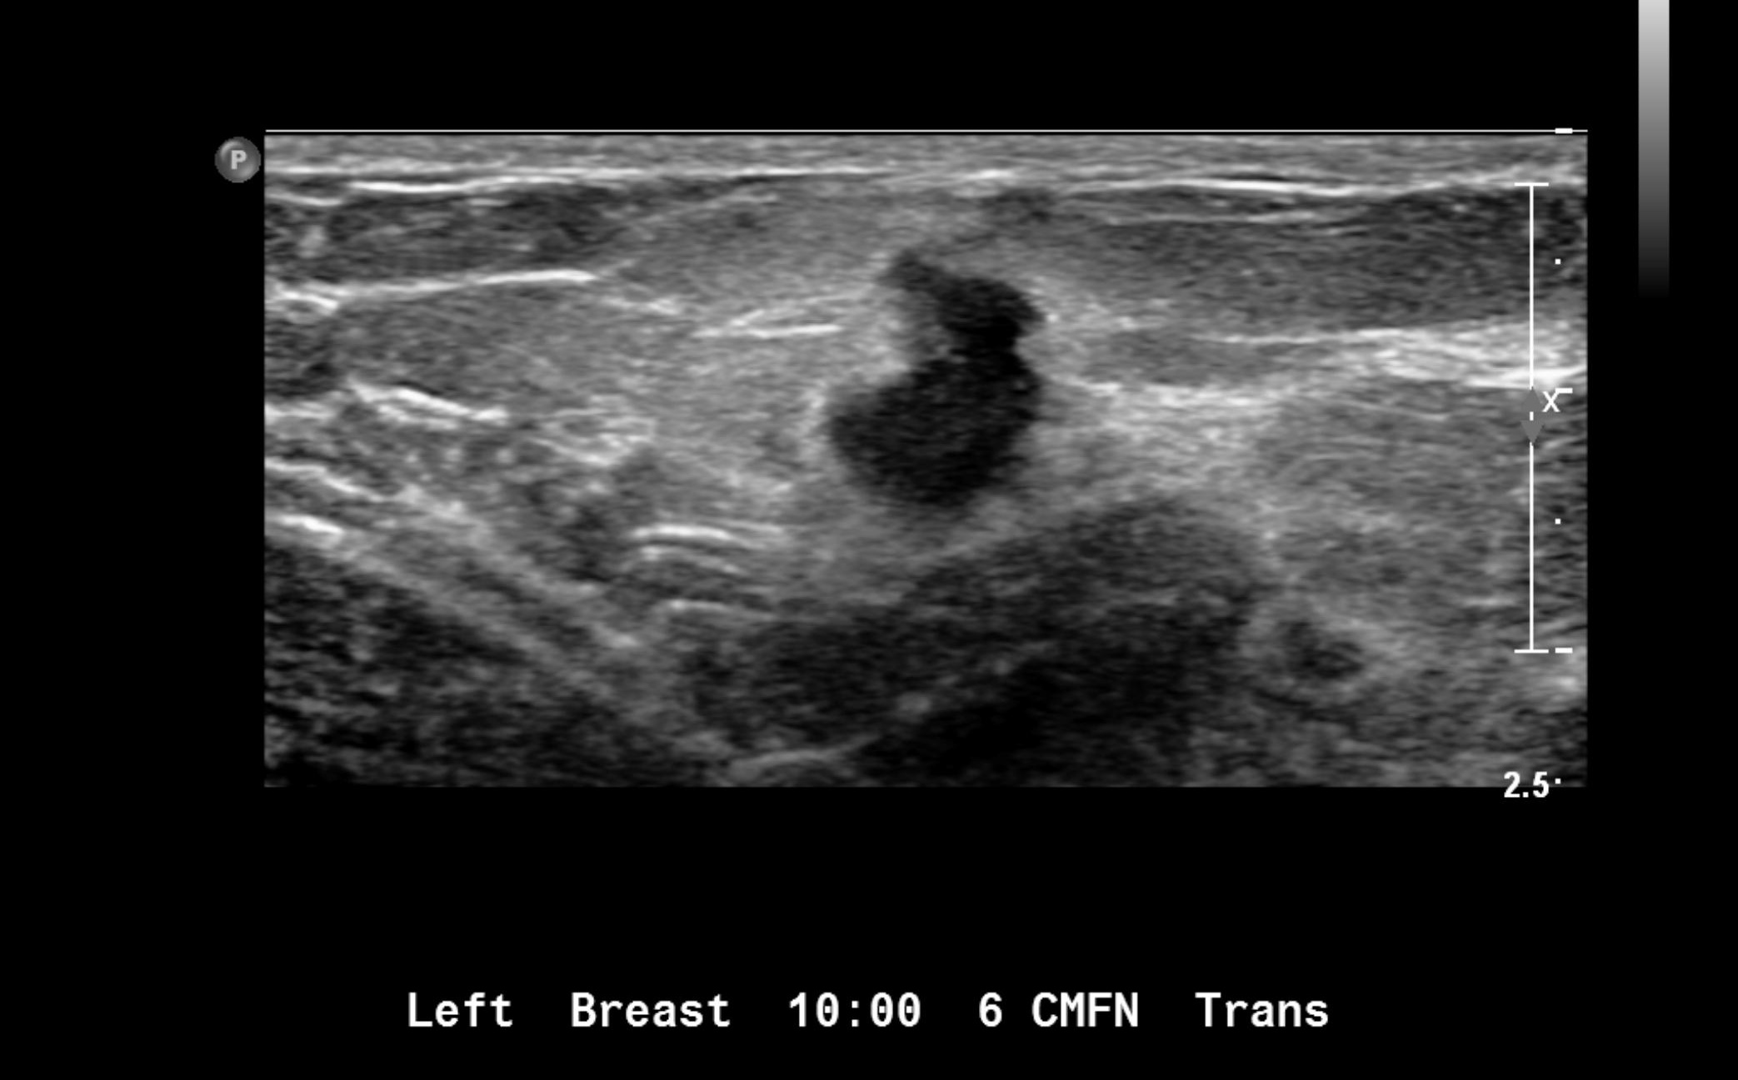

Slide 34
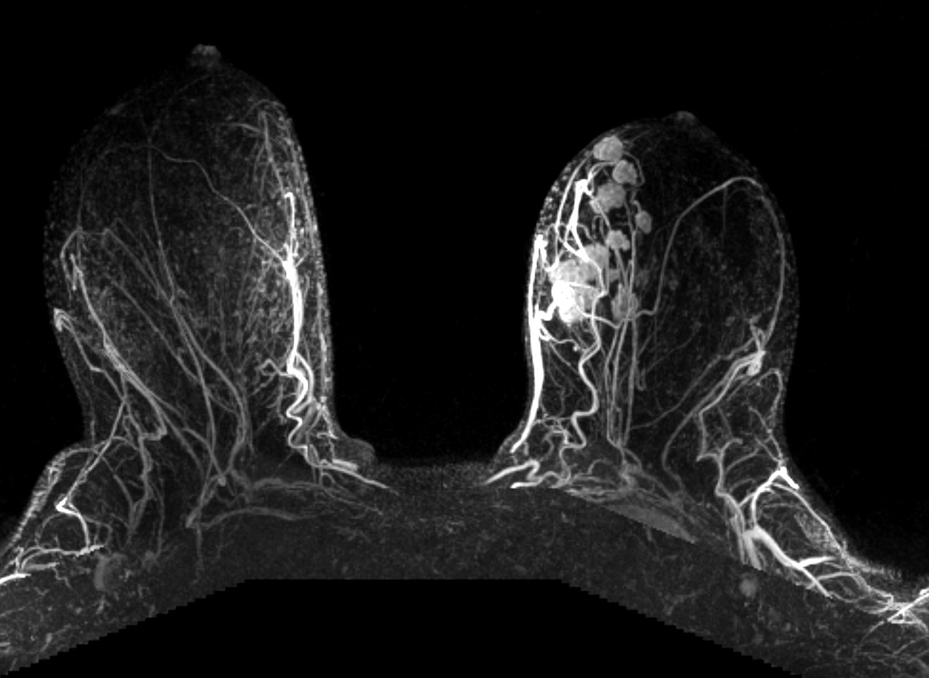

Slide 35
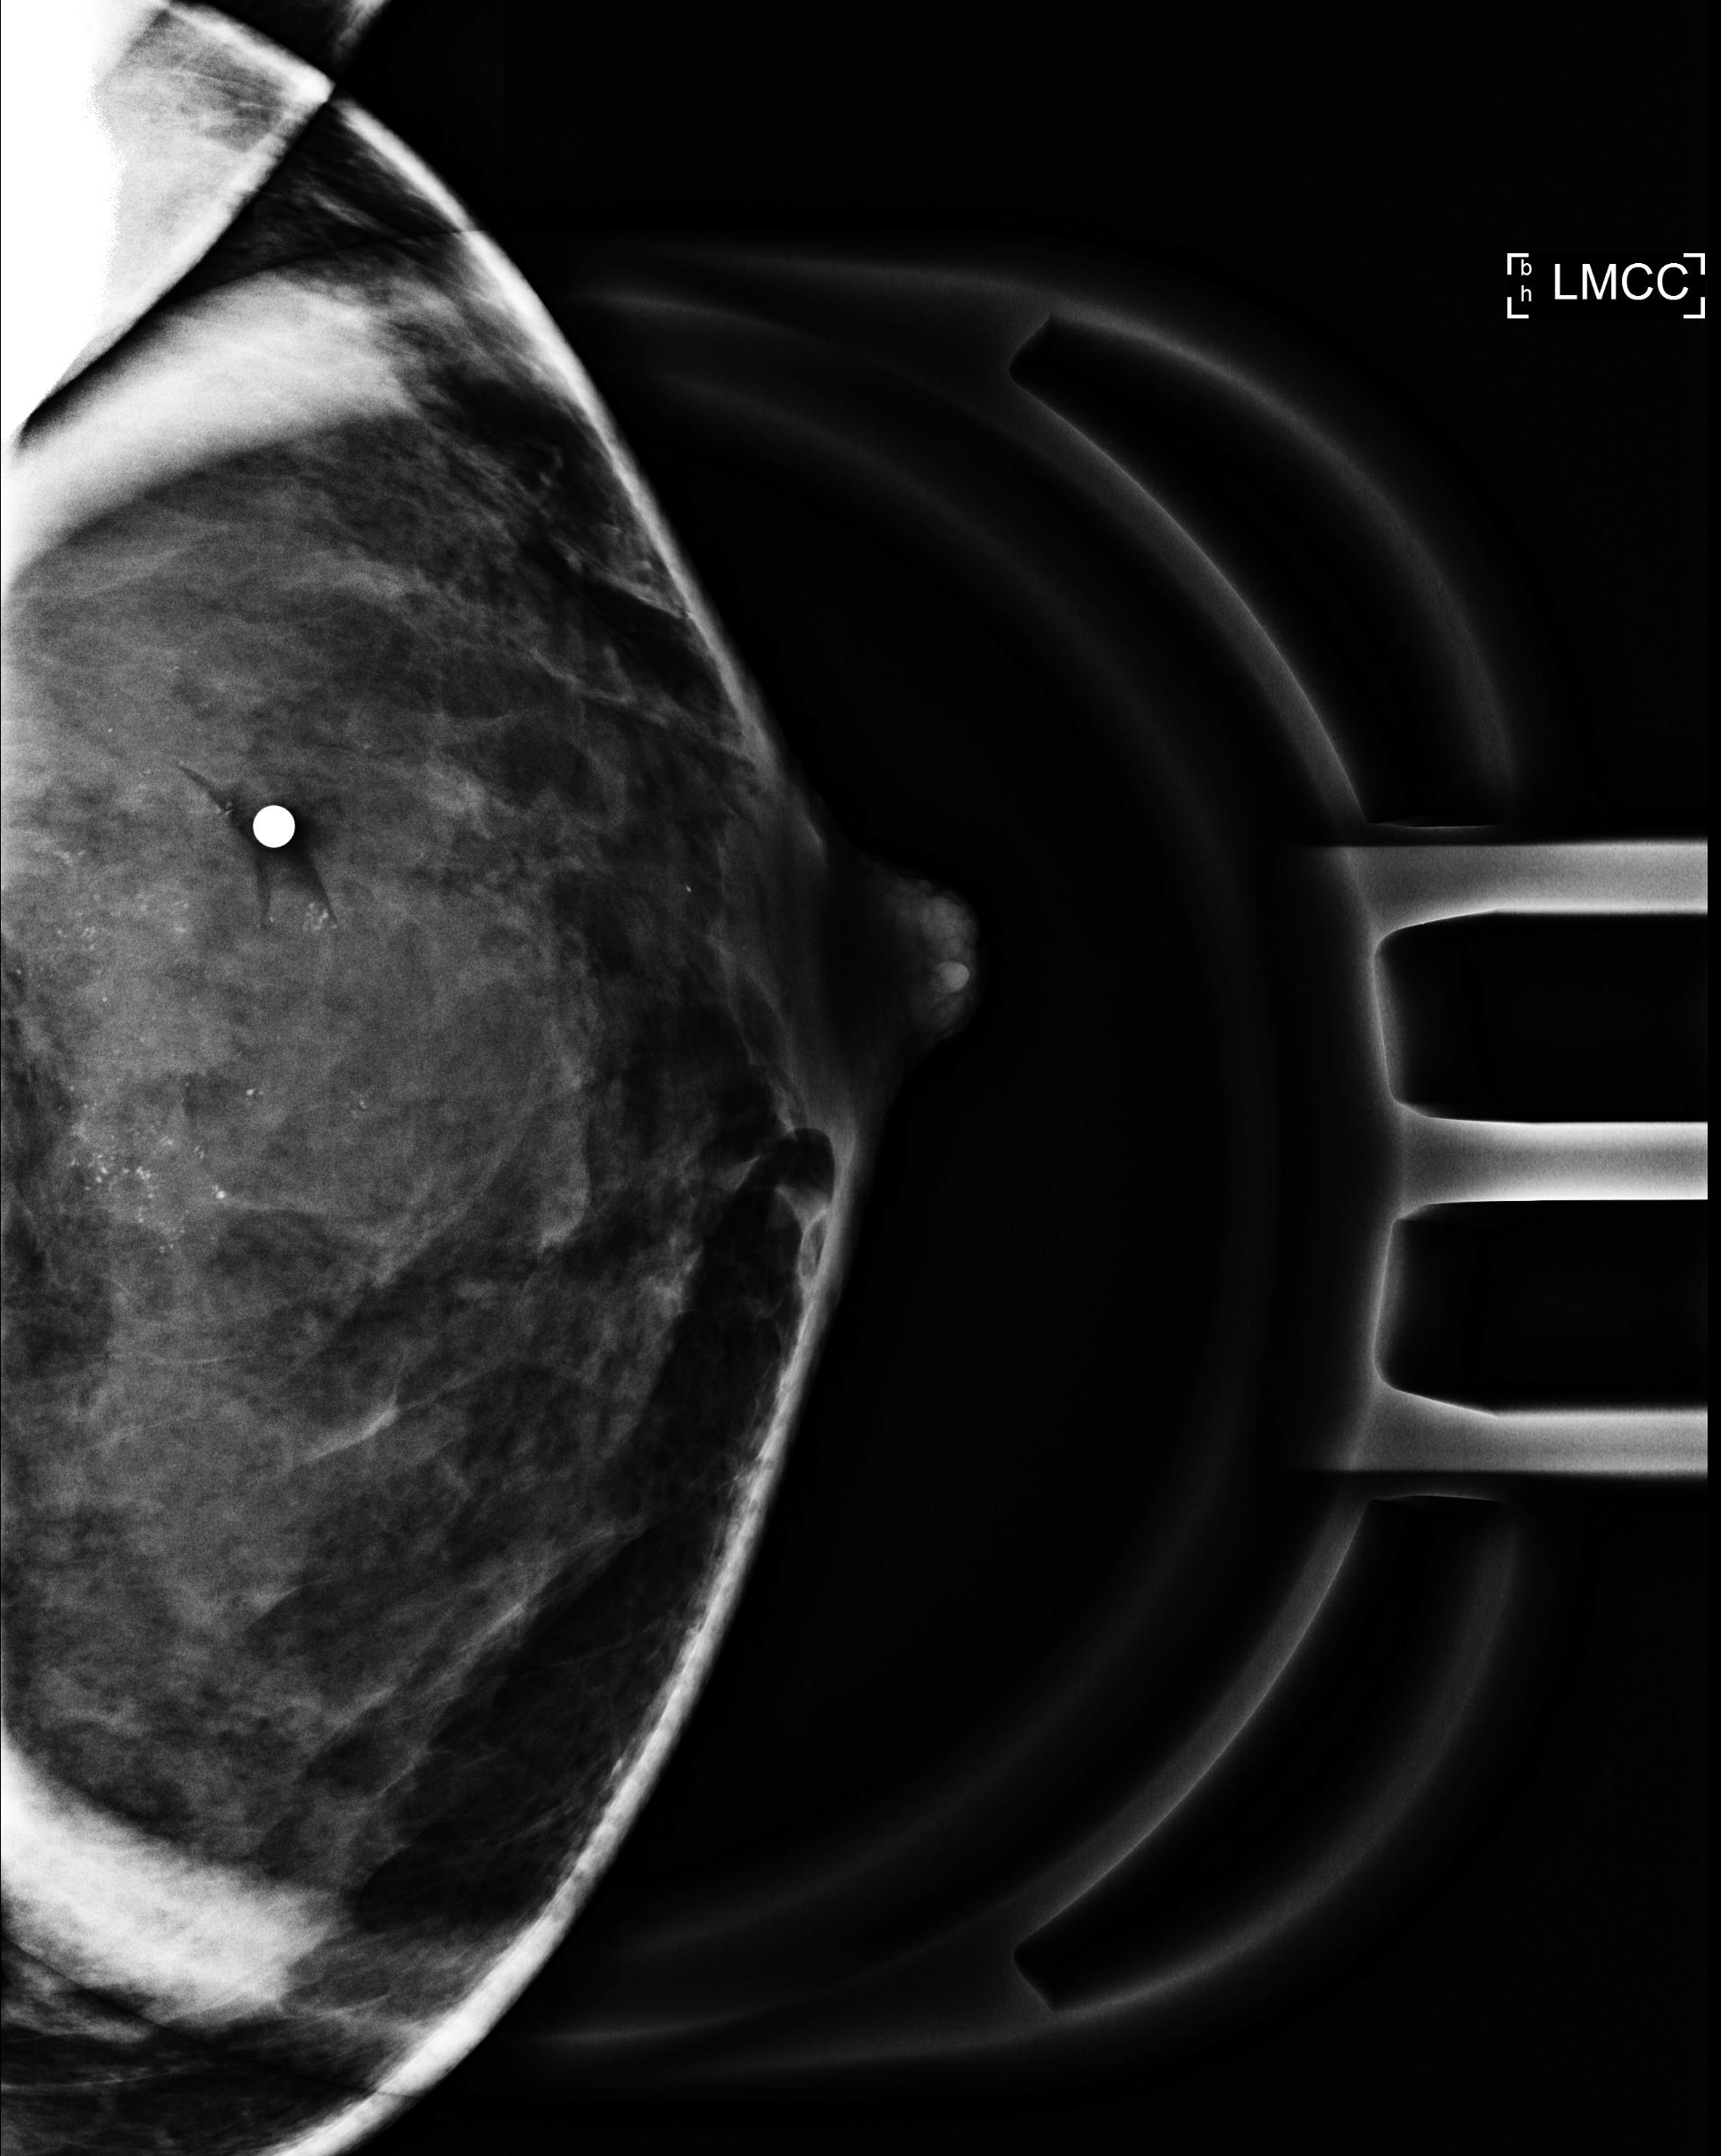
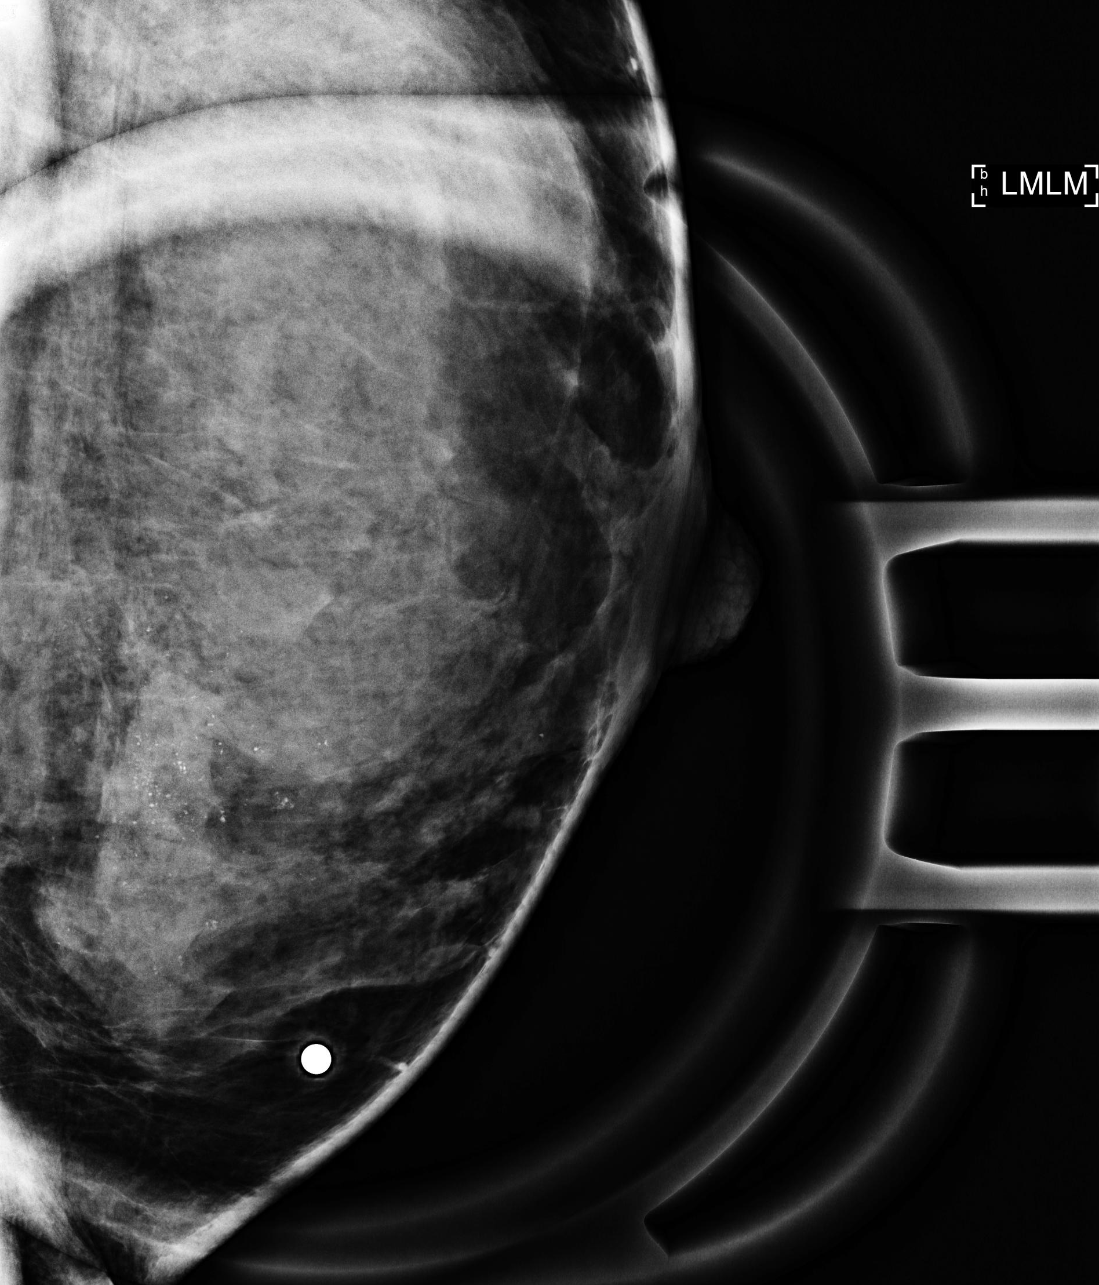
Case 3: Palpable lump

Slide 36
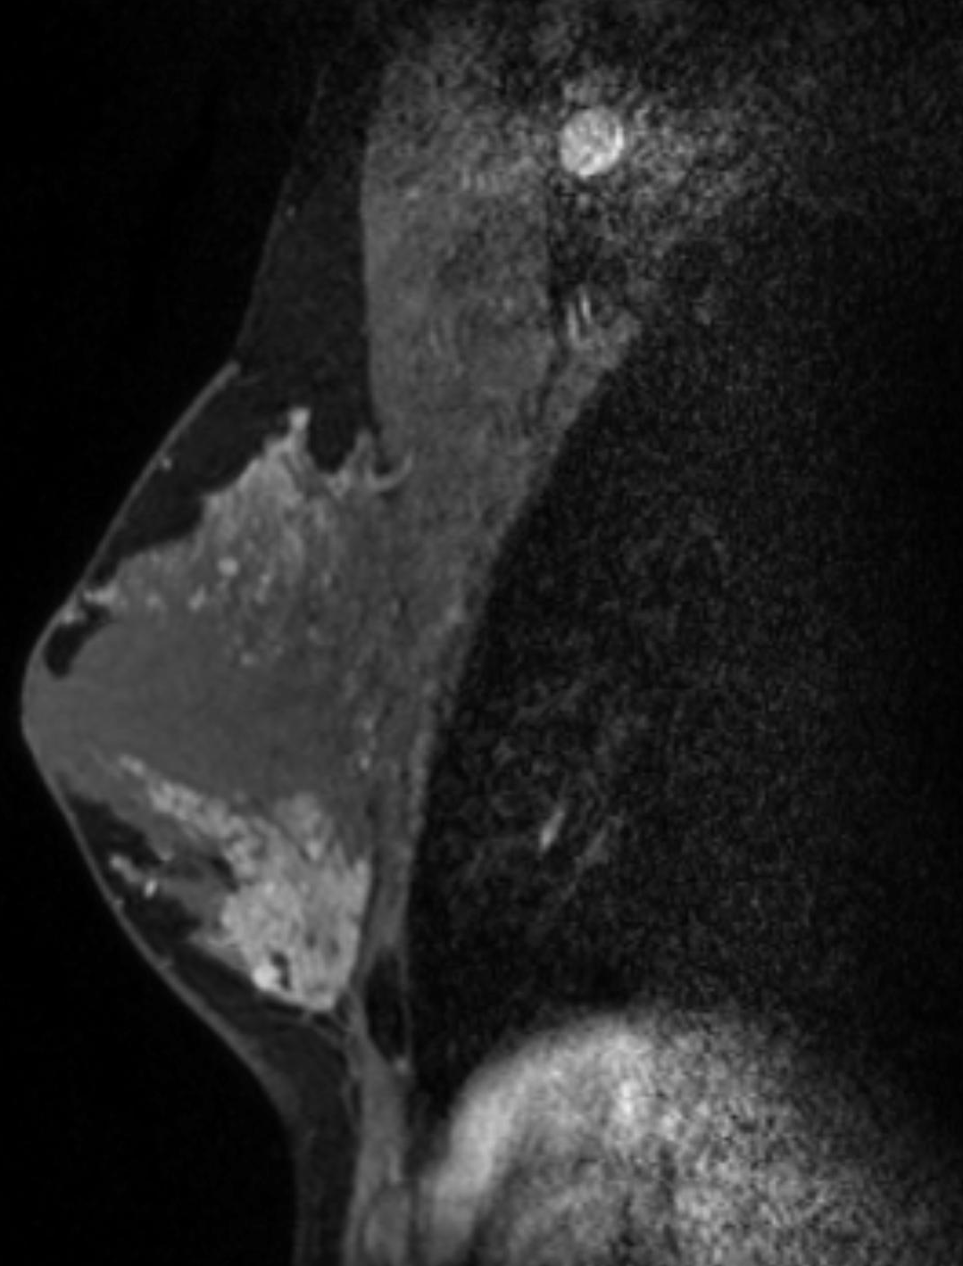
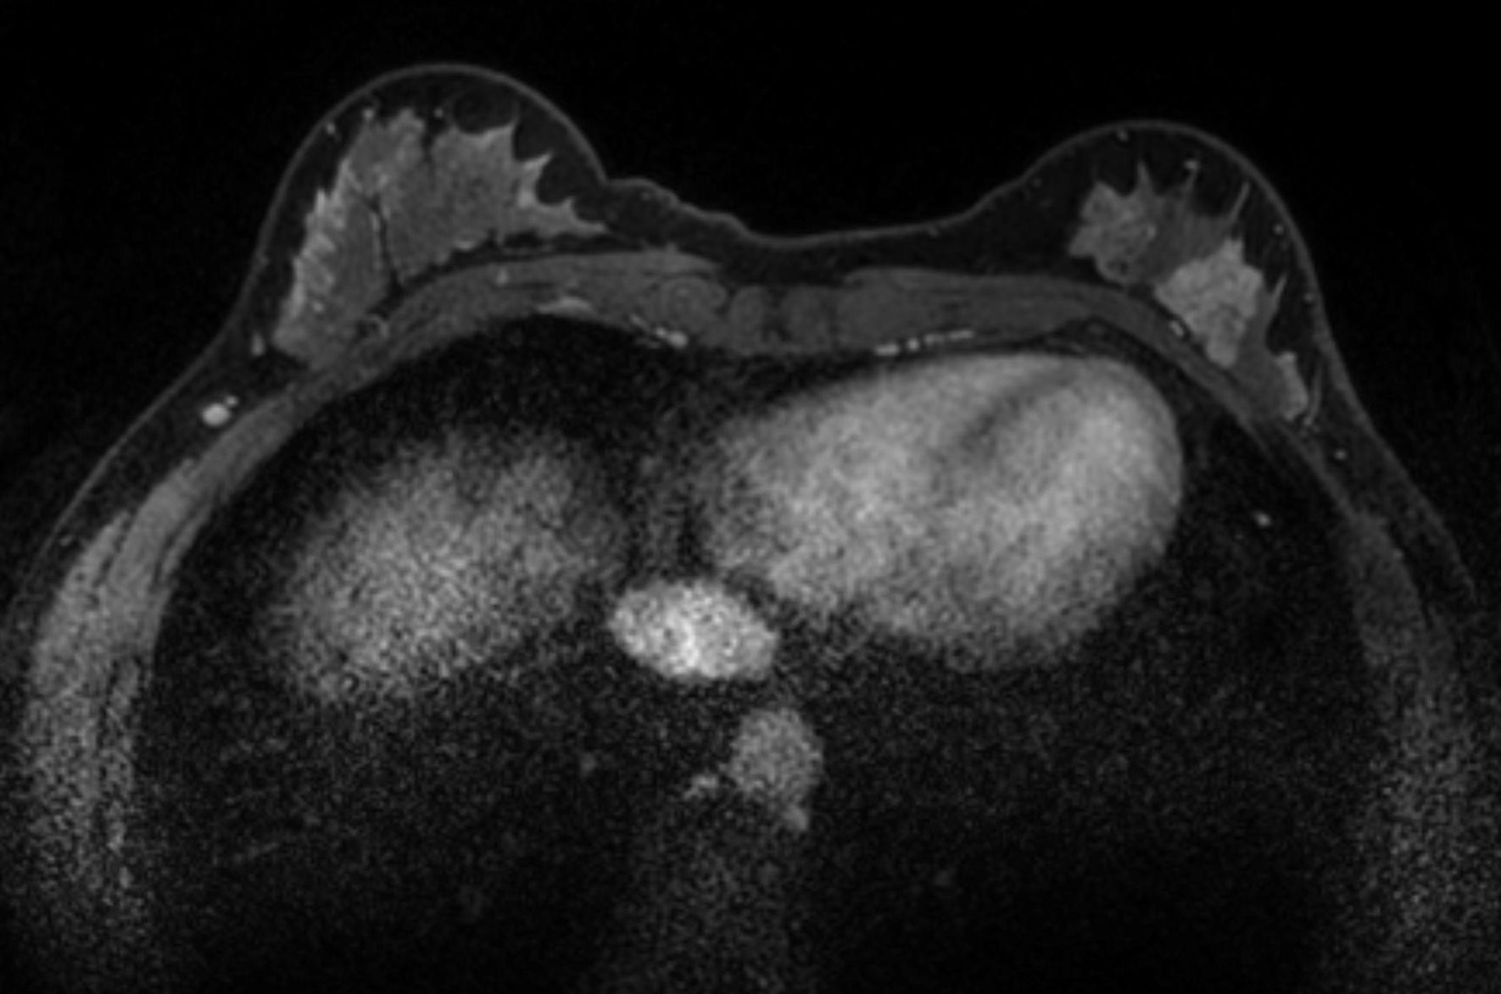

Slide 37
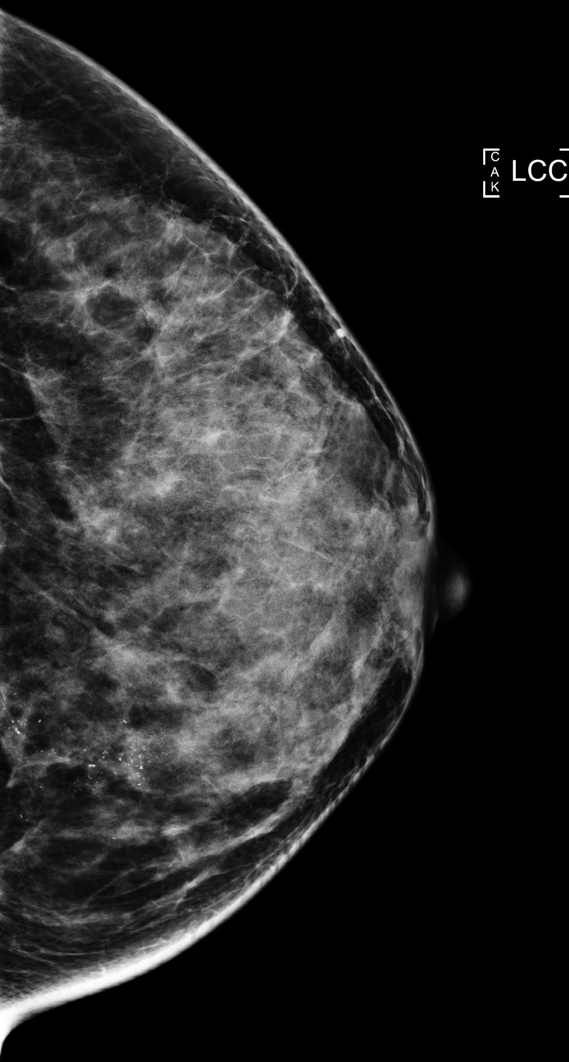
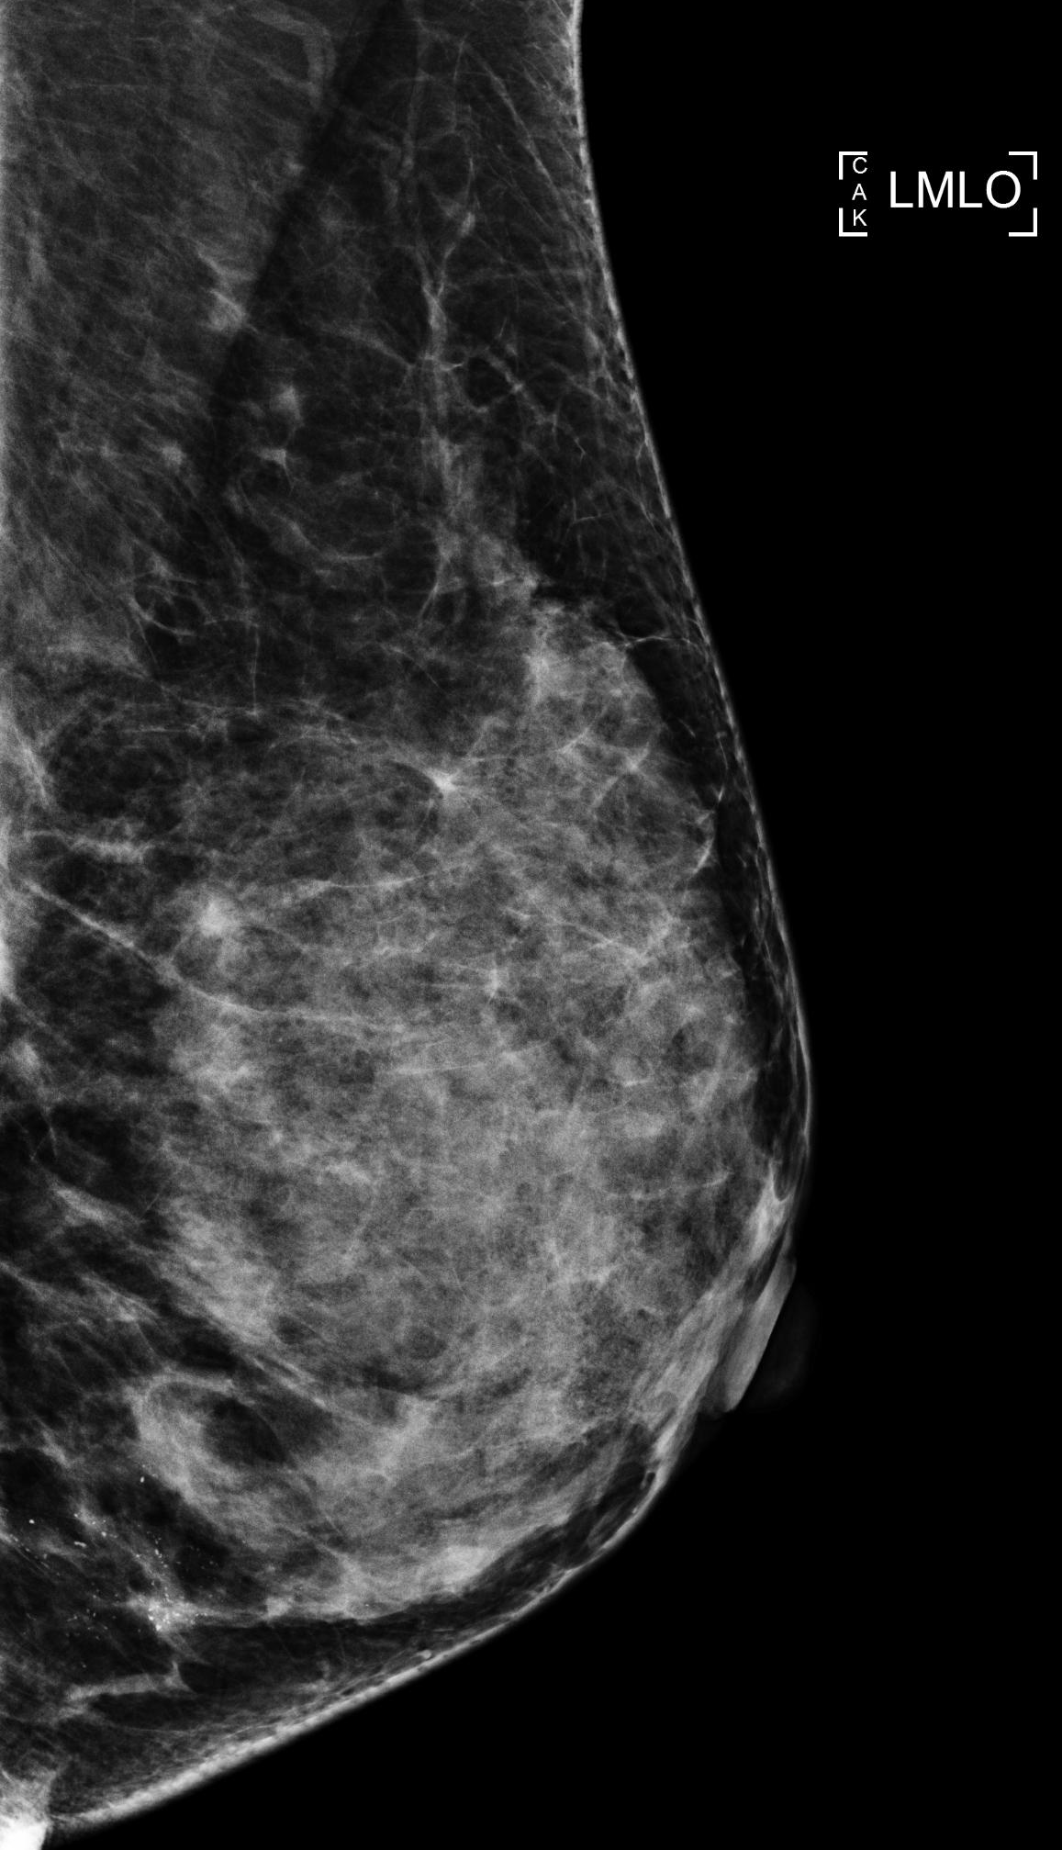
Case 4: Screening (as seen on previous lecture)

Slide 38
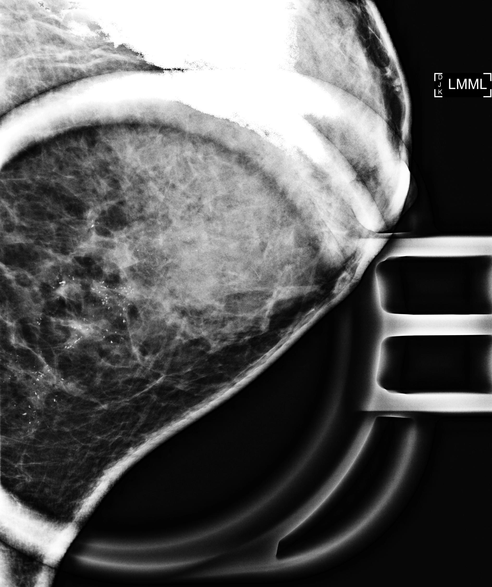

Slide 39
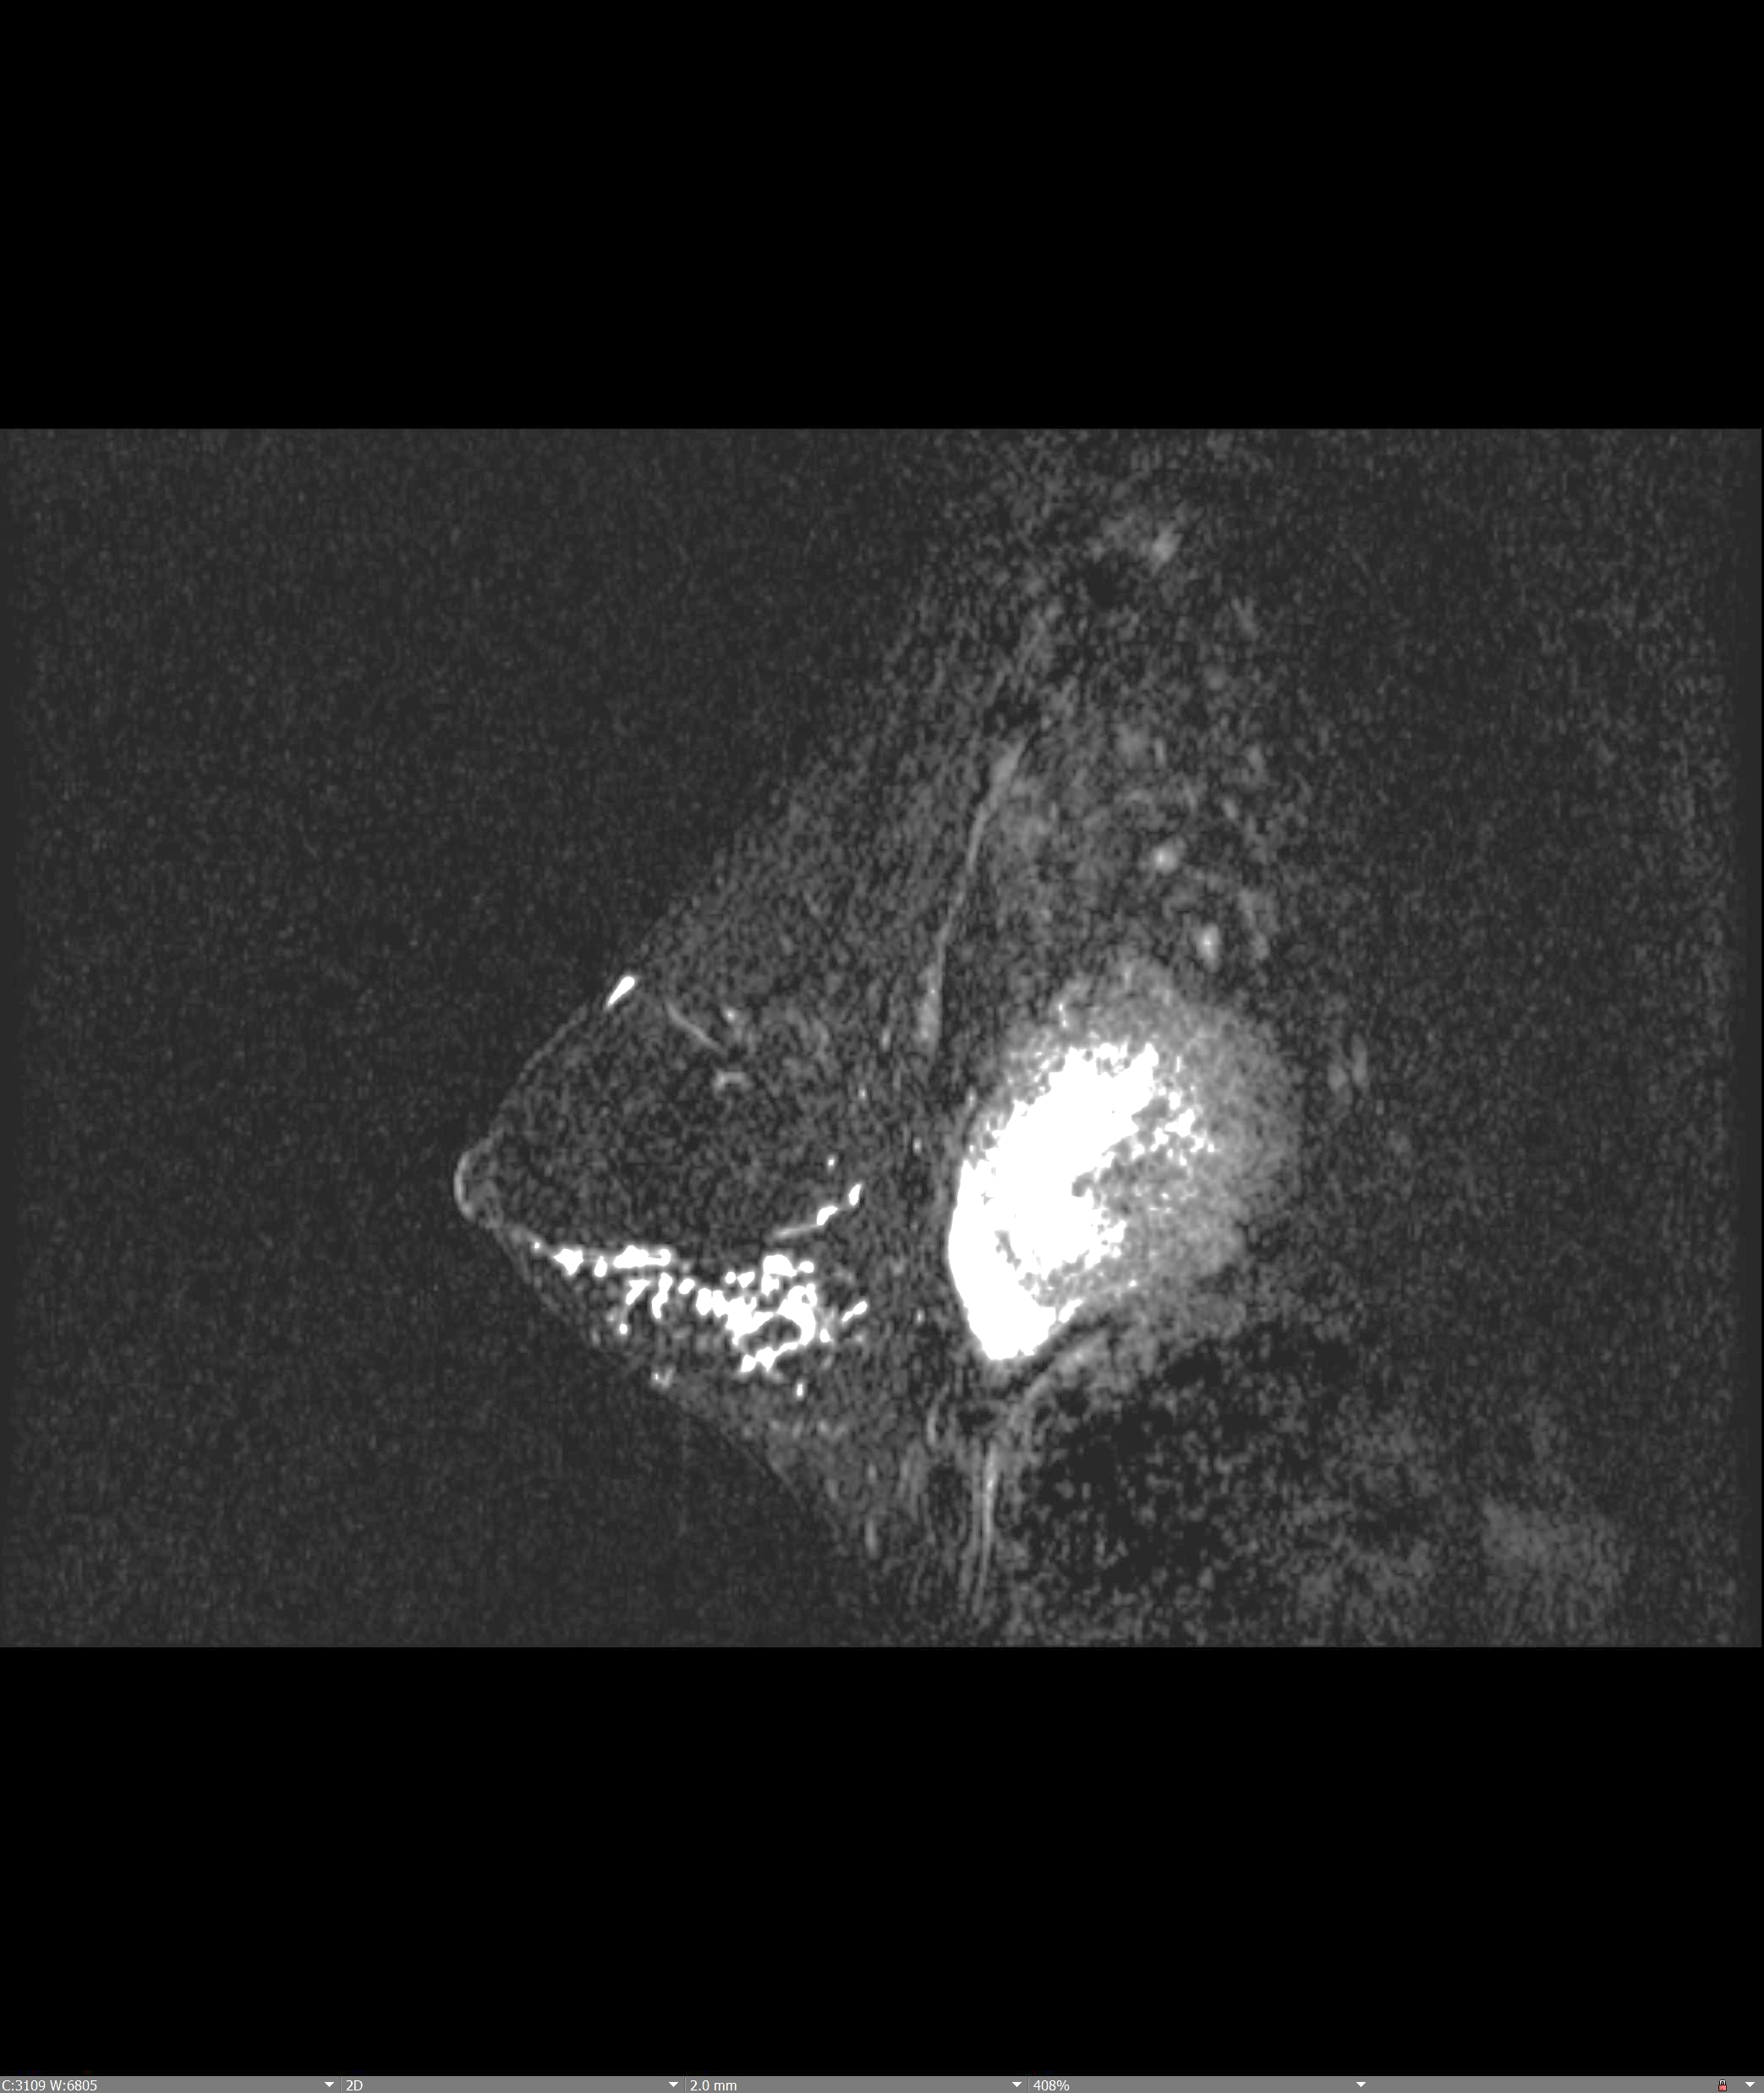
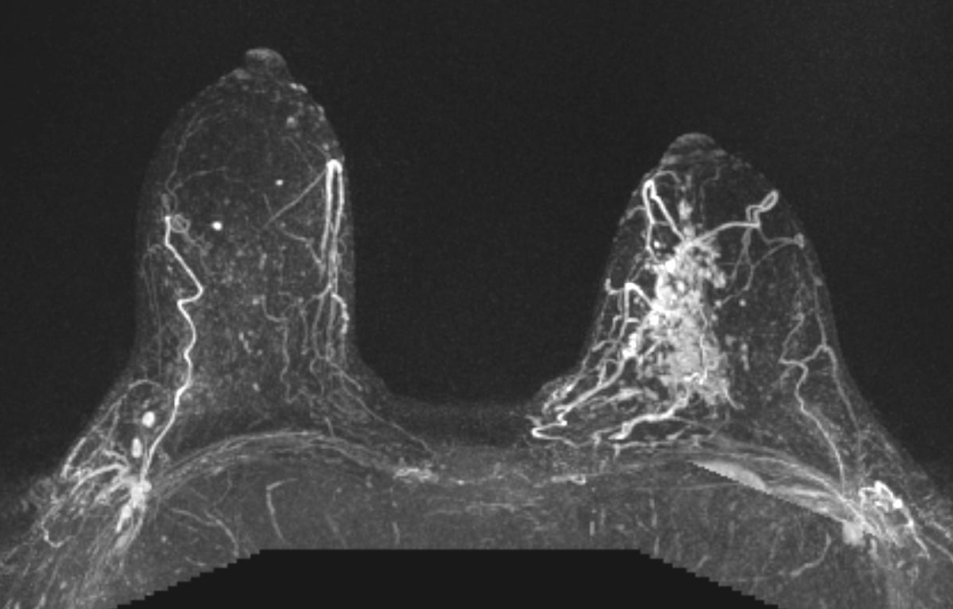

Slide 40
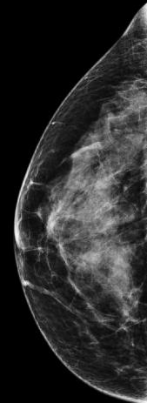
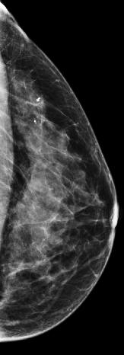
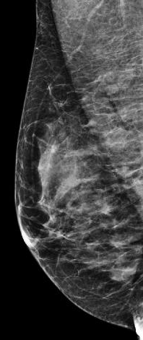
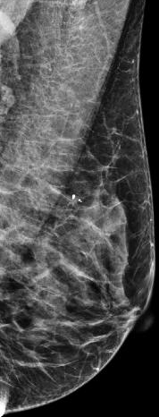
Case 5: 44-year-old woman with a 3-month history of a right nipple plaque-like area

Slide 41
Skin punch biopsy yielded Paget’s disease of the nipple
She went on to MRI since the mammogram was negative

Slide 42
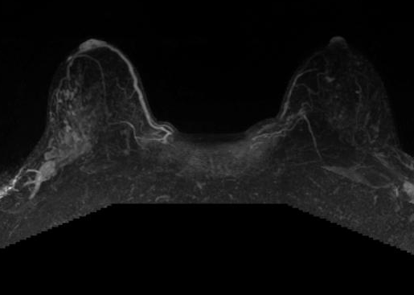

Slide 43
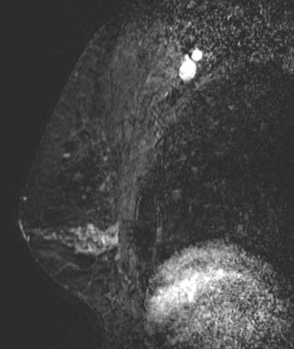
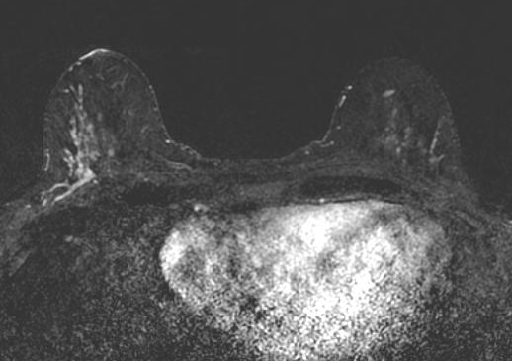

Slide 44
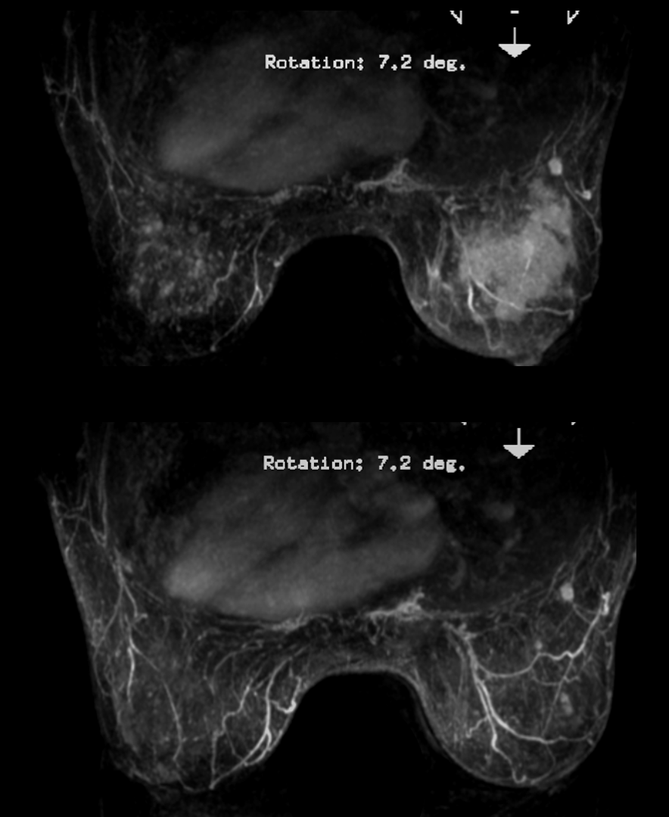
Case 6: Evaluate response to neoadjuvant chemotherapy
Pre NAC
Post NAC
Notes:
2507138 Advanced breast cancer post neoadjuvant chemo

Slide 45
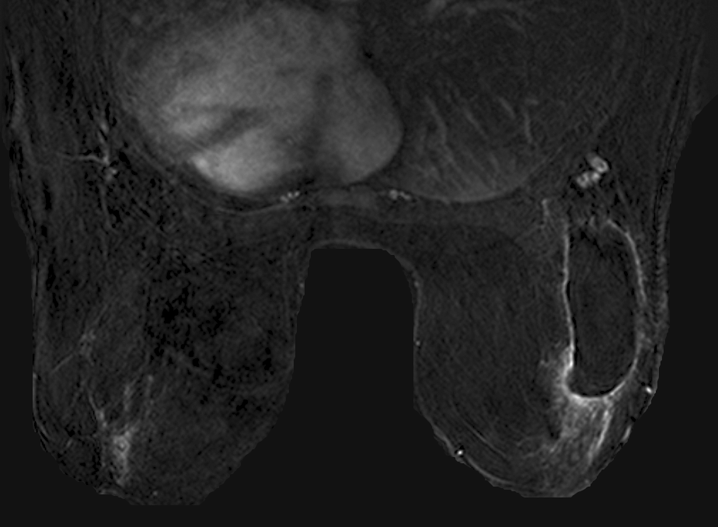
Case 6: Evaluate positive margins after lumpectomy
Case courtesy of Betty Rafferty, MD
Notes:
PRUYN_DEBORAH_K_4368192_positive margins with gross dz anteriorly and additional multifocal and contralateral dz

Slide 46
Case 7: Evaluate positive margins after lumpectomy
Case courtesy of Betty Rafferty, MD
Notes:
PRUYN_DEBORAH_K_4368192_positive margins with gross dz anteriorly and additional multifocal and contralateral dz

Slide 47
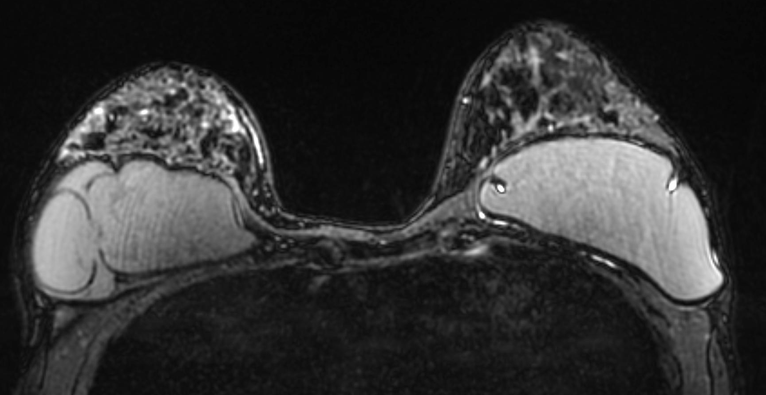
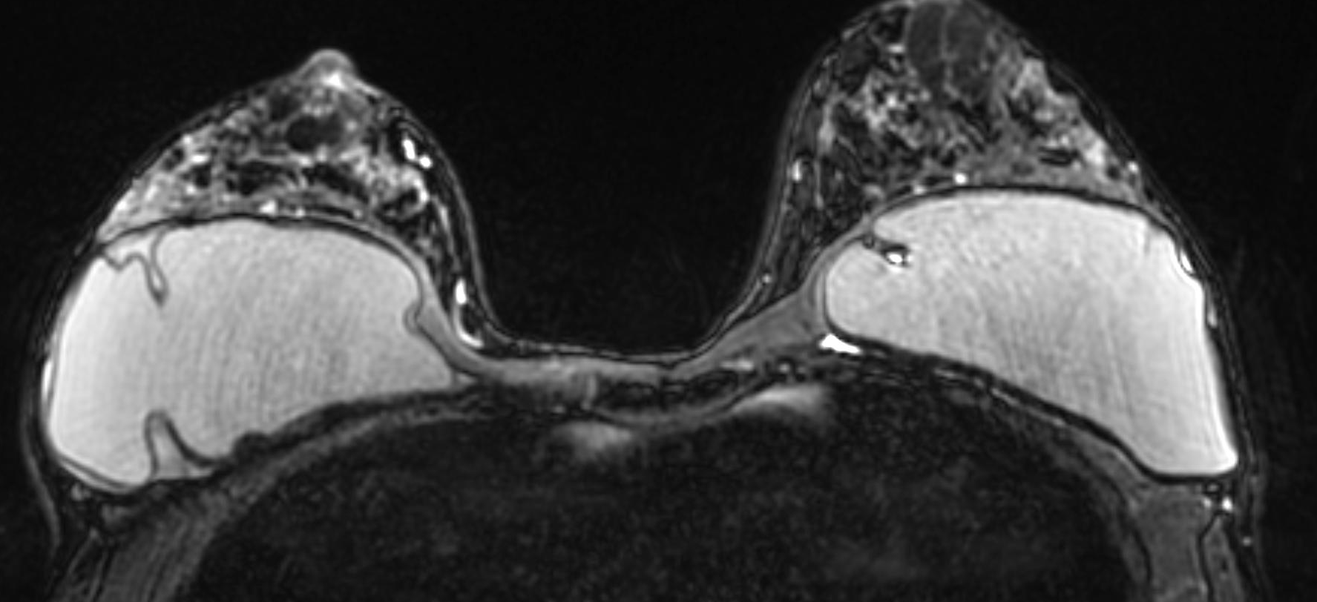
Case 7: Intracapsular silicone implant rupture

Slide 48
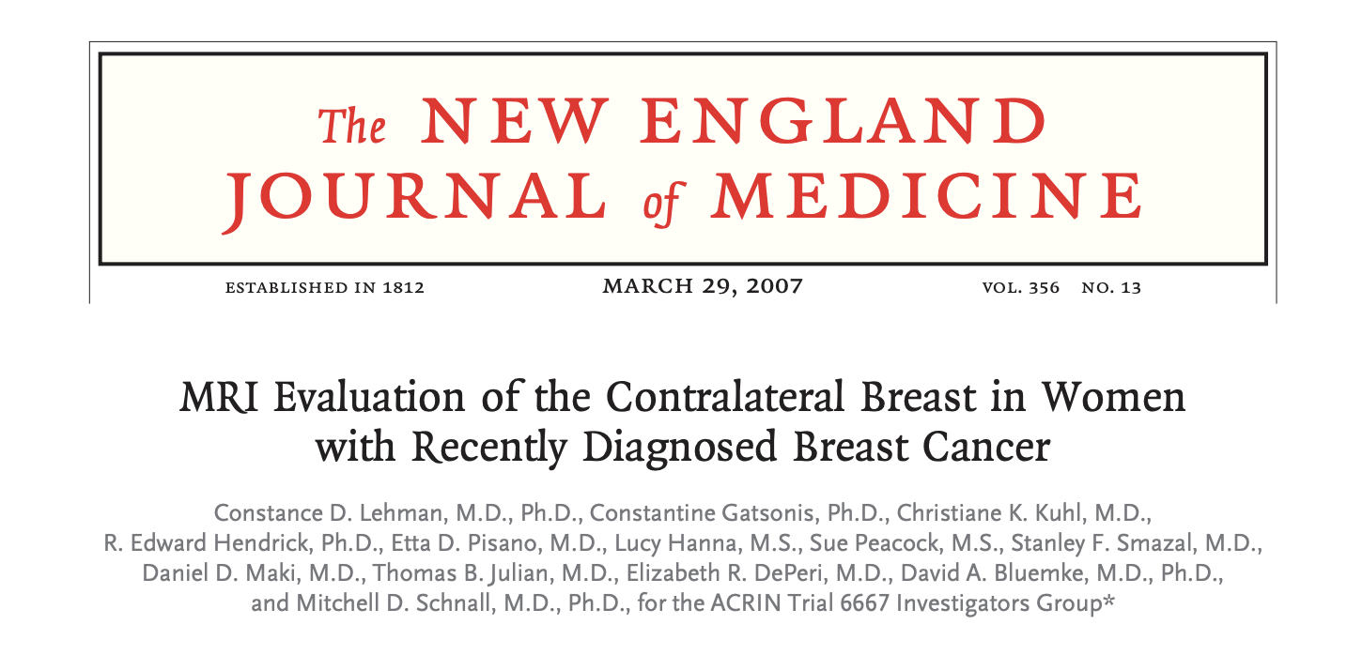
Among women with breast cancer, breast MRI will identify
  Additional ipsilateral cancer in ~12% of patients
  Contralateral cancer in ~4% of patients
Notes:
969 women with newly diagnosed cancer and no evidence of contralateral disease on mammography or clinical exam underwent MRI

Slide 49
Implementation of MRI
Multidisciplinary discussion between radiologists, surgeons, oncologists, high-risk clinics
  Age
  Breast Density
  Histology (ILC, High Grade DCIS)
  Suspicion of multi-centric disease
  Plan for less invasive treatment (e.g., multiple lumpectomies, partial breast irradiation)
Notes:
Low contralateral cancer detection suggests MRI not of US quality. If you take very wide margins, you are less likely to require reexcision, thus rendering MRI less valuable.

Slide 50
Surveillance of Patient Post Cancer Treatment
ACR, ASCO, NCCN all recommend annual mammography for women who have had breast-conserving surgery
  6-12 month after radiation therapy completed
  ACR recommends 3D mammography (tomosynthesis)
MRI reserved for subgroups either by
  High risk (BRCA mutation, significant family history)
  Dense breast tissue and/or high risk of recurrence
US use in surveillance varies across local environments
Notes:
Low contralateral cancer detection suggests MRI not of US quality. If you take very wide margins, you are less likely to require reexcision, thus rendering MRI less valuable.

Slide 51
Looking Ahead
  Fast MRI
  CEM
 | AVERAGE RISK | INTERMEDIATE RISK | HIGH RISK
NON DENSE | None | CEM | CEM
HETEROGENEOUSLY DENSE | None | CEM | CEM
EXTREME DENSE | CEM | CEM | CEM
Notes:
Low contralateral cancer detection suggests MRI not of US quality. If you take very wide margins, you are less likely to require reexcision, thus rendering MRI less valuable.

Slide 52


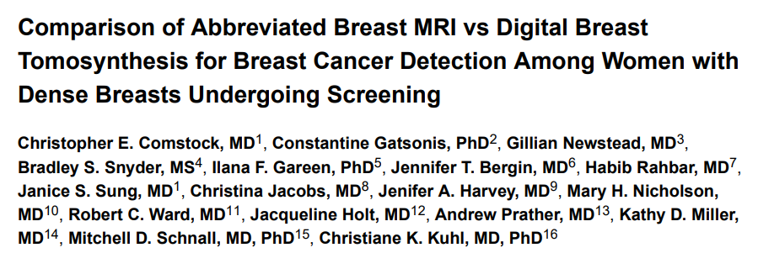
Comparison of Abbreviated Breast MRI and Digital Breast Tomosynthesis in Breast Cancer Screening in Women
with Dense Breasts
Christopher Comstock M.D.
Christiane Kuhl M.D.
Gillian Newstead M.D.

Slide 53
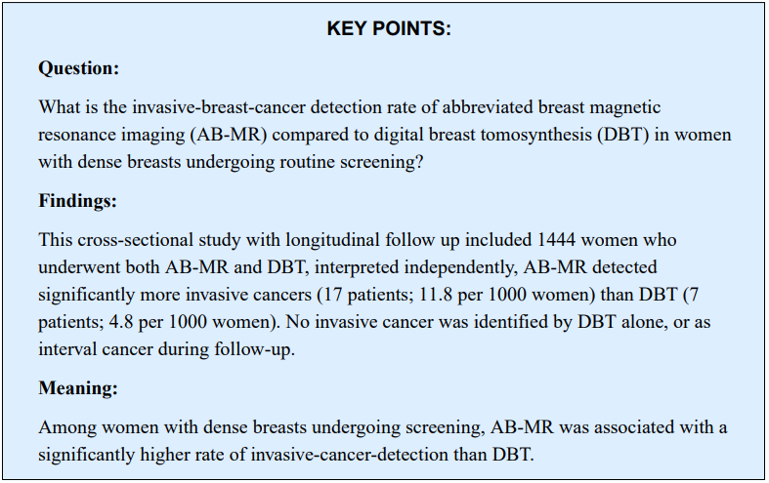
Abbreviated Breast MRI

Slide 54


Modern CEM (iodinated contrast) can replace Breast MRI (gadolinium contrast)
CEM (iodinated contrast)
Notes:
The contrast is not viewed in high or low energy images
Contrast is seen only in the subtraction image
Only the low kV and Subtraction images are archived

Slide 55



Slide 56





Slide 57



Slide 58
Thank you!

