Slide 1

Considerations in Adjuvant Chemotherapy for Hormone Receptor-Positive Breast Cancer
Joyce O’Shaughnessy, MD
Celebrating Women Chair in Breast Cancer Research
Baylor University Medical Center
Texas Oncology
US Oncology
Sarah Cannon Research Institute
Disclaimer: This presentation is intended for personal use and for informational purposes only and does not replace independent professional judgment. This presentation is the property of Physicians’ Education Resource, LLC (“PER”) and is protected by U.S. and international copyright laws. You may not copy, reproduce, distribute, transmit, modify, or create derivative works of the presentation without the prior written permission from PER.

Slide 2
Risk of Recurrence With Early Breast Cancer:
IBCSG Trials I to V
Annual Hazard of BC Recurrence for ER+ BC
Annual Hazard of BC Recurrence for ER- BC
0.40
0 positive nodes
1-3 positive nodes
≥4 positive nodes
0.40
0 positive nodes
1-3 positive nodes
≥4 positive nodes
0.30
0.30
Recurrence Hazard Rate (95% CI)
Recurrence Hazard Rate (95% CI)
0.20
0.20
0.10
0.10
0
0
0
2
4
6
8
10
12
14
16
18
20
22
24
0
2
4
6
8
10
12
14
16
18
20
22
24
Yr From Random Assignment
Yr From Random Assignment
Patients at Risk, n
0 positive nodes
1-3 positive nodes
≥4 positive nodes
Patients at Risk, n
0 positive nodes
1-3 positive nodes
≥4 positive nodes
640
671
497
488
445
226
402
306
120
316
242
77
256
185
60
199
121
43
124
48
20
409
399
340
295
263
99
254
196
67
221
167
50
186
146
41
153
126
35
92
62
21
Colleoni et al. J Clin Oncol. 2016;34:927.

Slide 3
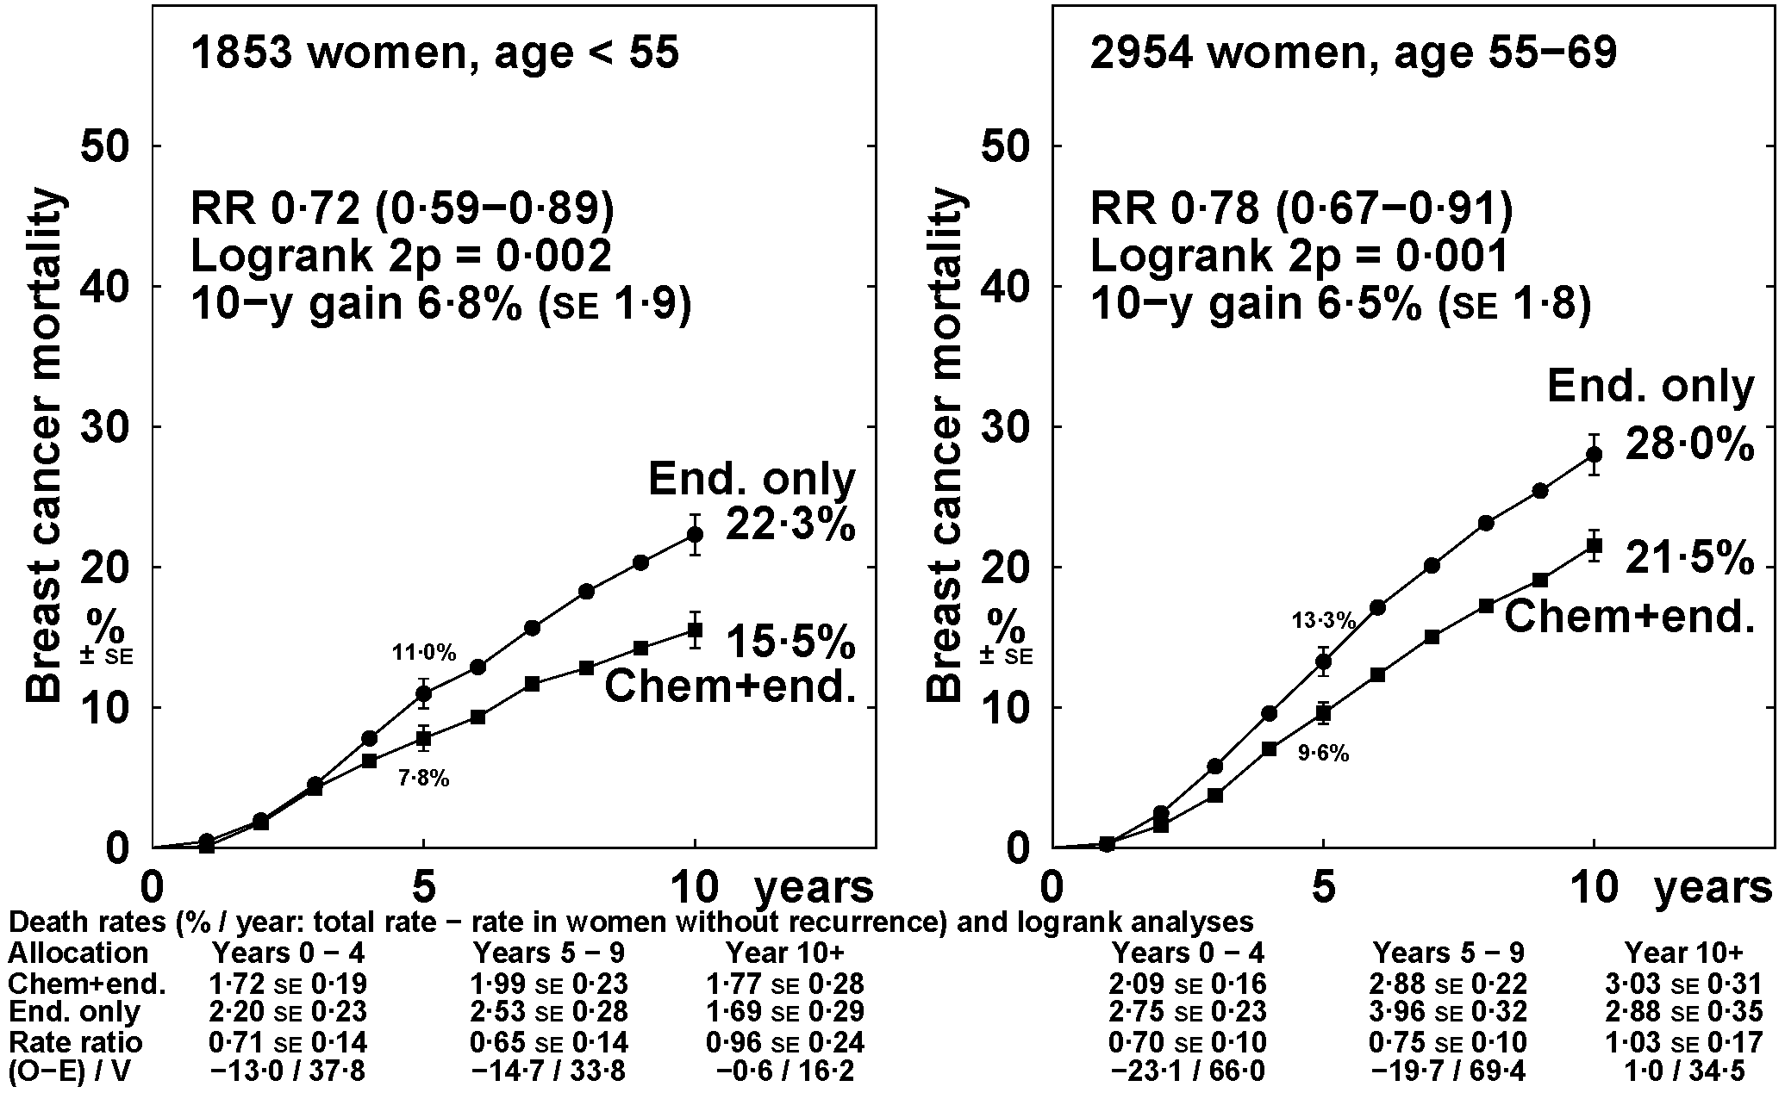
Chemotherapy (anthracycline-based, CMF) + 5 years endocrine therapy versus 5 years endocrine therapy alone
ER+ disease only: by entry age
EBCTCG. Lancet. 2012;379(9814):432-44.

Slide 4
WHICH HR+ HER2- EBC PATIENTS BENEFIT FROM SYSTEMIC CHEMOTHERAPY?

Slide 5
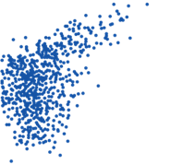
Degree of Dependence on ER/Endocrine Therapy Sensitivity Correlates with 21-Gene Recurrence Score Risk
ER+ NSABP B-14 Node-Negative Early Breast Cancer
10-Year Distant Recurrence Rate
by RS Group
7%
14%
31%
DRFS, %
B14: tamoxifen x 5 y
Multivariate Cox Model
RS prognostic independent of age and tumor size
Low risk (RS <18)
Intermediate risk (RS 18-30)
High risk (RS >30)
33 pts (51%)
149 pts (22%)
181 pts (27%)
Time, y

Slide 6
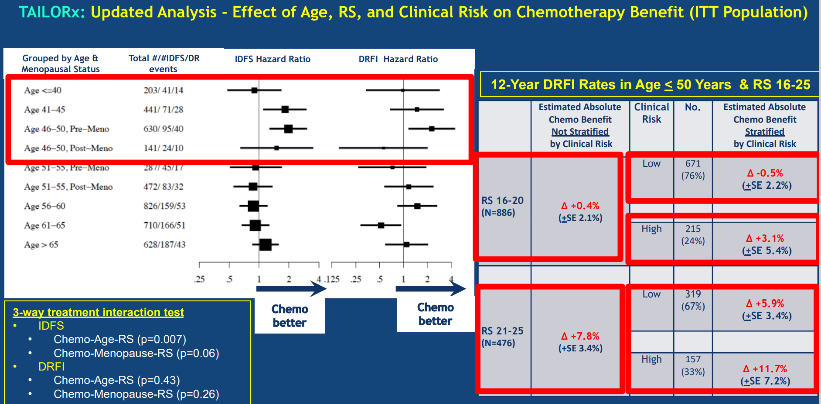
< 20% premen OFS
Sparano J, et al. SABCS 2022. GS1-05 Trial Assigning Individualized Options for Treatment (TAILORx): An update including 12-year event rates.

Slide 7
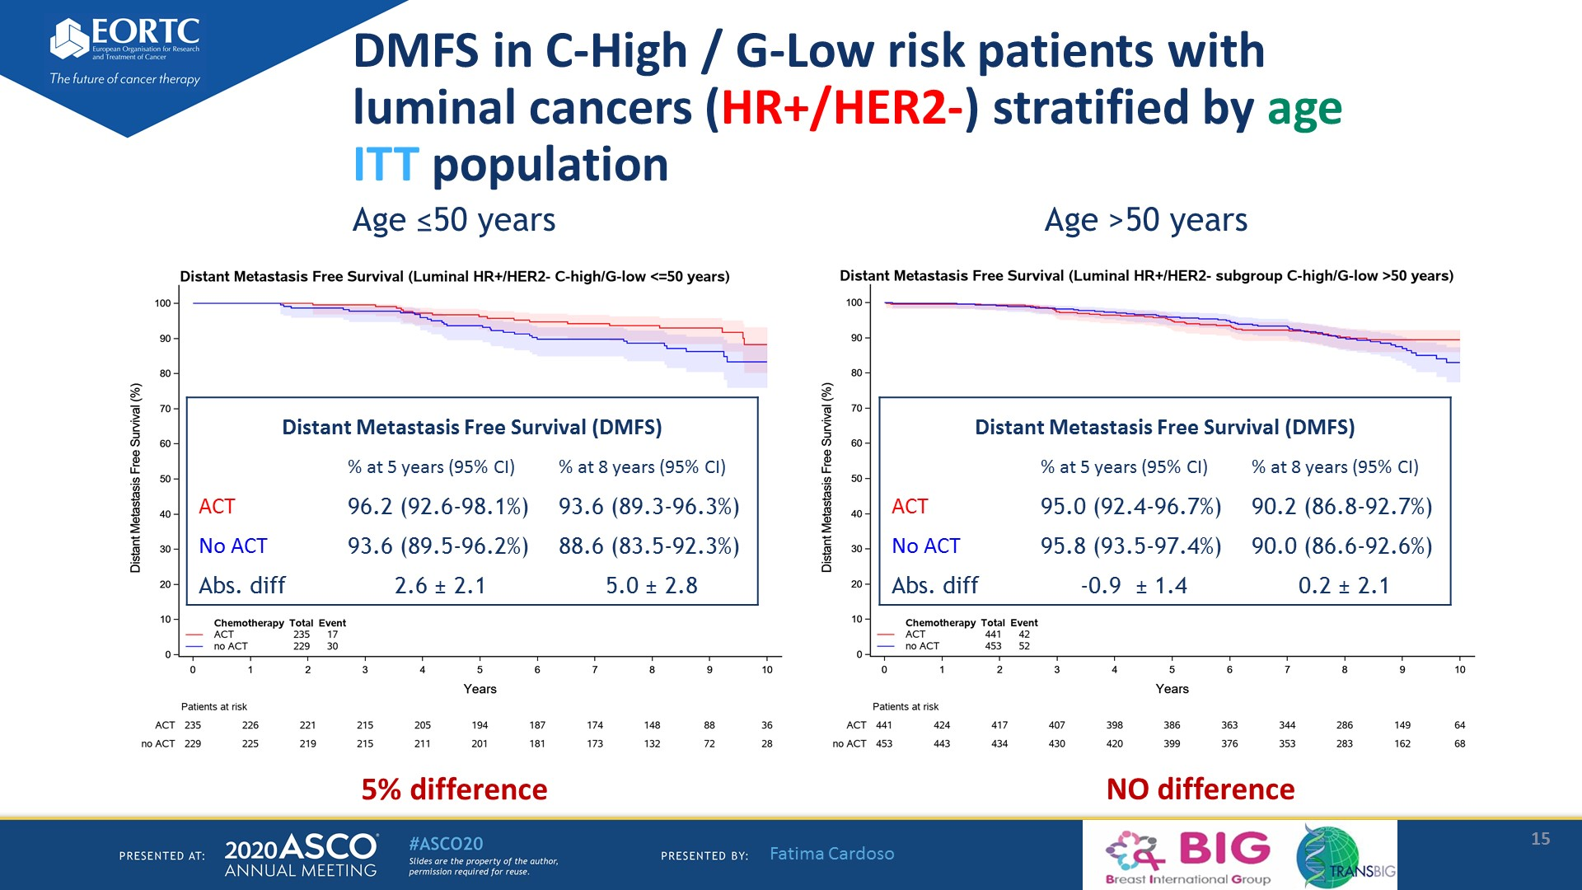
DMFS in C-High / G-Low risk patients with <br />luminal cancers (HR+/HER2-) stratified by age<br />ITT population
Presented By Fatima Cardoso at TBD

Slide 8
San Antonio Breast Cancer Symposium®, December 8-11, 2020
IDFS RxPONDER by Recurrence Score and Menopausal Status
Postmenopausal
Premenopausal
RS 0-13
RS 0-13
No Statistically Significant IDFS Difference
5-year IDFS Absolute Difference 3.9%
RS 14-25
RS 14-25
No Statistically Significant IDFS Difference
5-year IDFS Absolute Difference 6.2%
This presentation is the intellectual property of the author/presenter. Contact him at kkalins@emory.edu for permission to reprint and/or distribute.

Slide 9
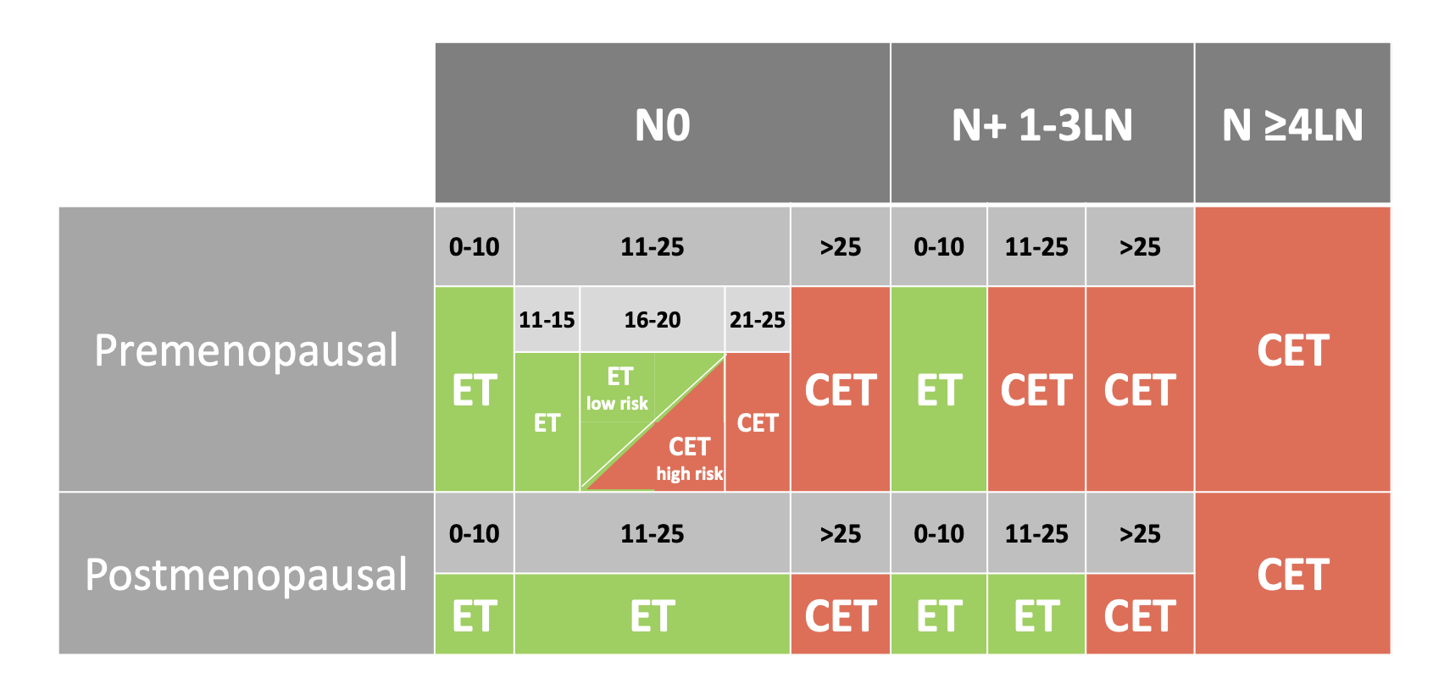

Which HR+ HER2- EBC Patients Benefit from Chemotherapy?
70-gene Signature
Clinical High Risk +
Genomic Low Risk
0-3+ nodes
Postmenopausal ET
Premenopausal CET
Courtesy of Peter Schmid, FRCP, MD, PhD
< 20% premen HR+ pts TAILORx,
RxPonder and MINDACT had
LHRH agonist

Slide 10
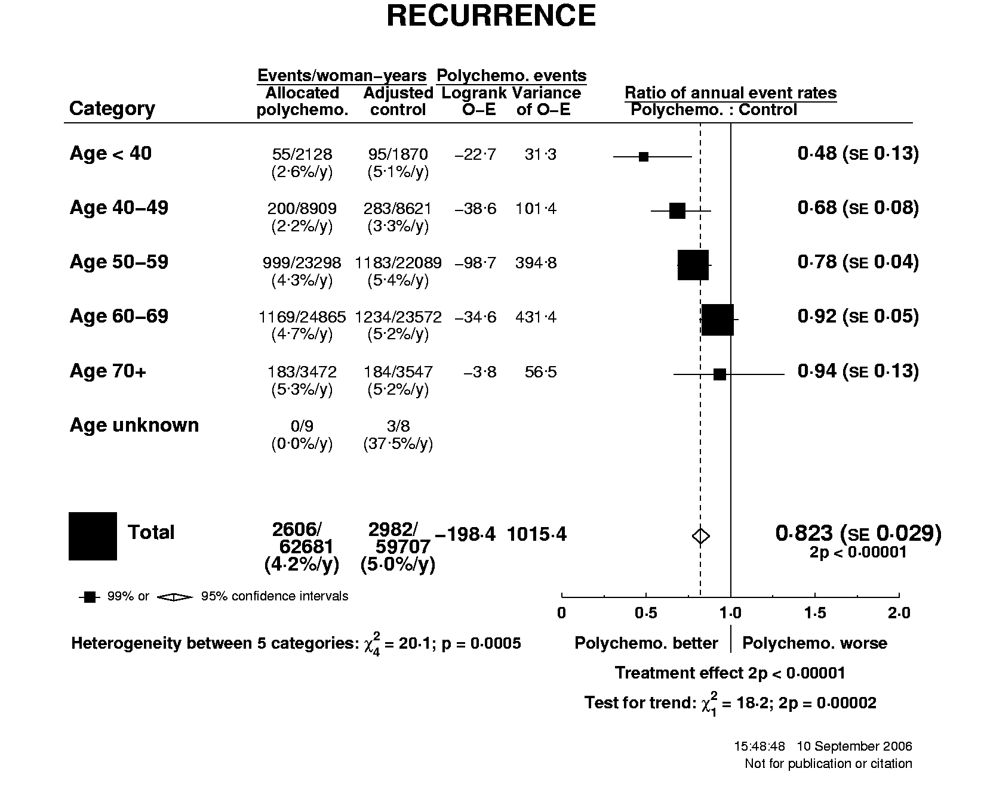
EBCTCG Chemo-Endocrine vs Endocrine Therapy HR+ EBC
DILEMMA: How much chemotherapy benefit
seen in TAILORx, MINDACT, RxPONDER trials
in premenopausal HR+ HER2- EBC pts is due
to chemotherapy-induced ovarian failure
in the absence of LHRH agonist therapy?
EBCTCG. Lancet. 2012;379(9814):432-44.
Notes:
Tama vs, nihil -44%

Slide 11
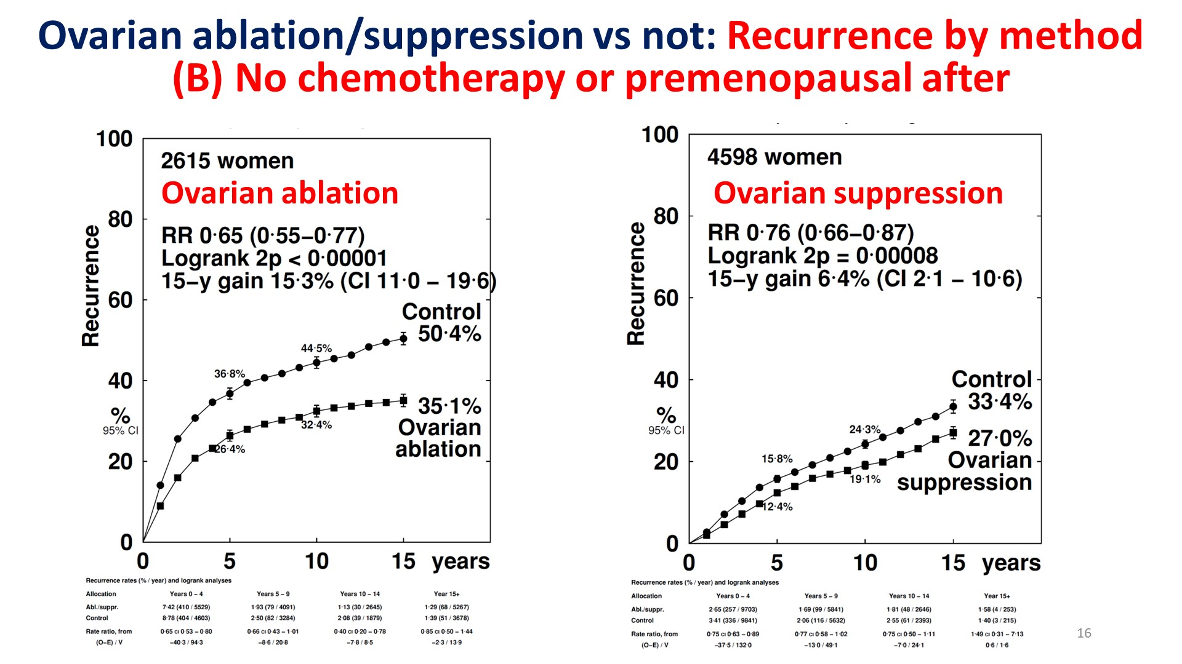
Slide 16
Gray R, et al. EBCTCG, ASCO 2023

Slide 12
BR009 OFSET Trial: Schema
Premenopausal; HR+/HER2- BC
pN0 with RS 16-20 (high clinical risk) or RS 21-25
pN1 with RS 0-25
Stratification
Nodal Status (pN0 vs. pN1)
RS (0-15 vs. 16-25)
N=3,960
Randomization
Chemotherapy +
Ovarian Function Suppression +
Aromatase Inhibitor*
X 5 Years
Ovarian Function Suppression +
Aromatase Inhibitor*
X 5 Years
Tamoxifen can be used if AI is not tolerated
CDK4/6 inhibitors per SOC

Slide 13
ADAPT Trial: ER+/HER2- Pre- and Postmenopausal EBC
n=2984

Slide 14




Prognostic effect of ET response (4 week lead-in) on iDFS in ADAPT¹ (60 months median FU)
All patients
unadjusted: HR 0.59 [0.47-0.75]; p<0.001
*adjusted: HR 0.73 [0.56-0.94]; p=0.017
≤40y (premenopausal)
unadjusted: HR 0.59 [0.27-1.30]; p=0.191
*adjusted: HR 0.63 [0.24-1.65]; p=0.346
41-50y (premenopausal)
Unadjusted: HR 0.51 [0.31-0.84]; p=0.009
*adjusted: HR 0.63 [0.37-1.10]; p=0.105
>50y/postmenopausal
Unadjusted: HR 0.63 [0.46-0.87]; p=0.005
*adjusted: HR 0.78 [0.54-1.12]; p=0.174
¹Nitz et al, JCO 2022; Gluz et al, ESMO 2022

Slide 15
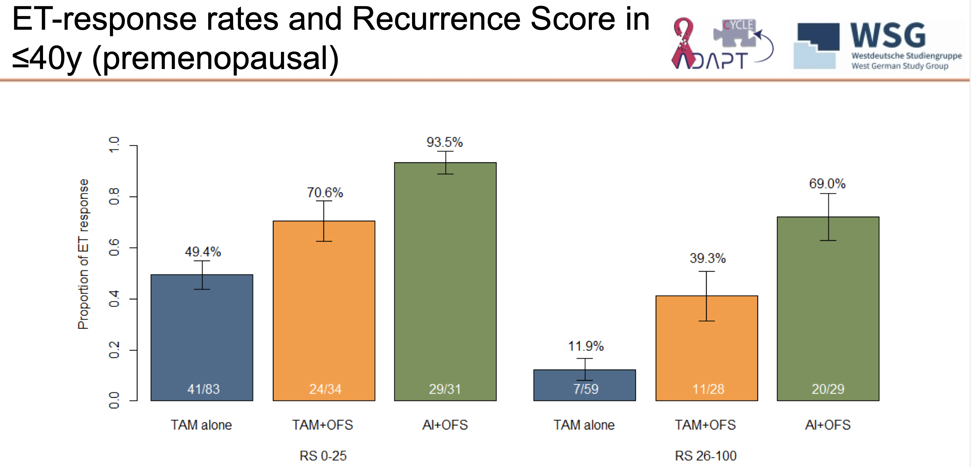

Slide 16
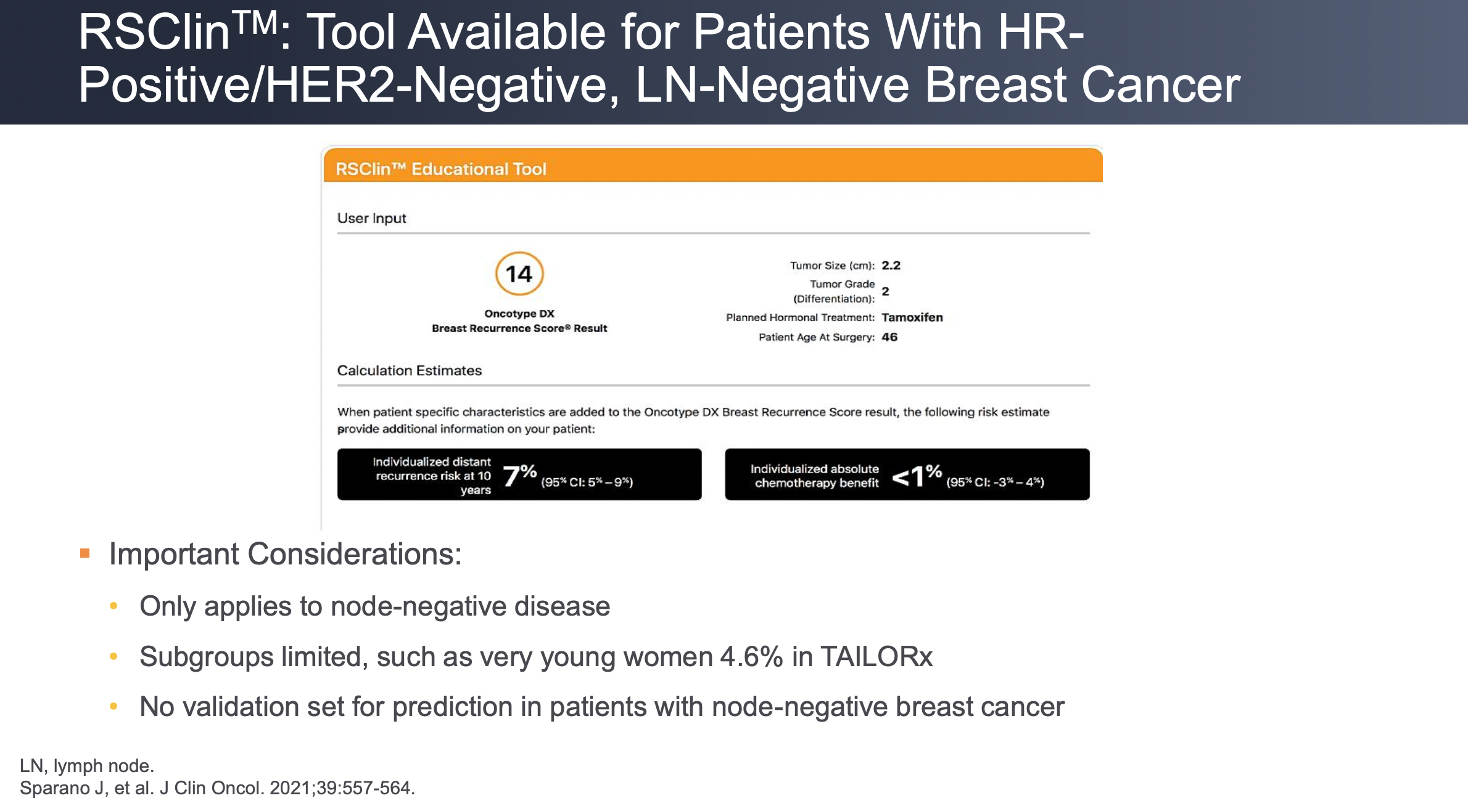
RS Clin N0 HR+ HER2- and Absolute Benefit from Adjuvant ChemoRx
Exact Sciences Physician Portal
Integrates RS with clinical features that influence risk of distant recurrence and benefit from chemoRx
NOW N- or N+

Slide 17
NCCN Guidelines in Use of Biomarkers to Guide Adjuvant Decision-Making in EBC
Biomarker | Prognostic | Predictive | Level of Evidence
21-gene RS (LNN) | Yes | Yes | 1 (Preferred)
21-gene RS (1-3 LN) | Yes | Yes | 1: Postmenopausal (preferred) 2A: Premenopausal
70-gene (MammaPrint) (0-3 LN) | Yes | Not determined | 1
PAM50 ROR Score (0-3 LN) | Yes | Not determined | 2A
Breast Cancer Index | Yes | Predictive of benefit of extended adj ET | 2A
EndoPredict (LNN and 1-3 LN) | Yes | Not determined | 2A
NCCN. Clinical practice guidelines in oncology: breast cancer. v.5.2025. nccn.org.

Slide 18
ASCO Guidelines: Biomarkers for Adjuvant Endocrine Therapy and Chemotherapy for Early Breast Cancer
HR+ HER2-
Premenopausal
Postmenopausal
Andre F et al. J Clin Oncol. 2022;40(16):1816-1837.

Slide 19
IF HR+ HER2- EBC PATIENTS ARE LIKELY TO BENEFIT FROM CHEMOTHERAPY, WHAT IS THE OPTIMAL REGIMEN?

Slide 20
Anthracycline-based chemo vs no chemo:
Breast cancer mortality by ER status, and subsets of ER+
EBCTCG. Lancet. 2012;379(9814):432-44.

Slide 21
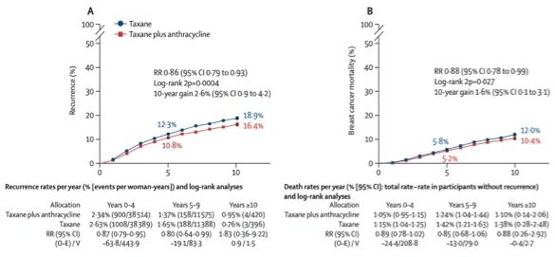
ANTHRACYCLINE + TAXANE VS TAXANE WITHOUT ANTHRACYCLINE
A + T > T regardless of node and ER status
EBCTCG. Lancet. 2023;401(10384):1277-1292.

Slide 22

Anthracyclines in Early Breast Cancer (ABC) Trials (TC/TAC, B-46I, B-49)
Node+ or high-risk node-negative (T2+, T1c+ if TN, ER+ grade 3, high recurrence score)
Stratification variables: nodes (0, 1-3, 4-9, 10+); hormone receptor (ER or PgR+, both negative)
ARM 1 (TaxAC Options)
ARM 2 (TC x 6)
A
TAC q 3 wk
TC q 3 wk
B
AC q 3 wk
PTX q 1 wk
Arm 1 options:
USOR 06-090 - 1A only
NSABP B-46I/USOR 07132 - 1A only
NSABP B-49 - investigator choice 1A-1D
Endocrine therapy x 5+ years if ER+
C
AC q 2 wk
PTX q 1 wk
D
AC q 2 wk
PTX q 2 wk
Designed to prove non-inferiority
of non-anthracycline arm
Blum JL et al. J Clin Oncol. 2017;35(23):2647-2655.

Slide 23
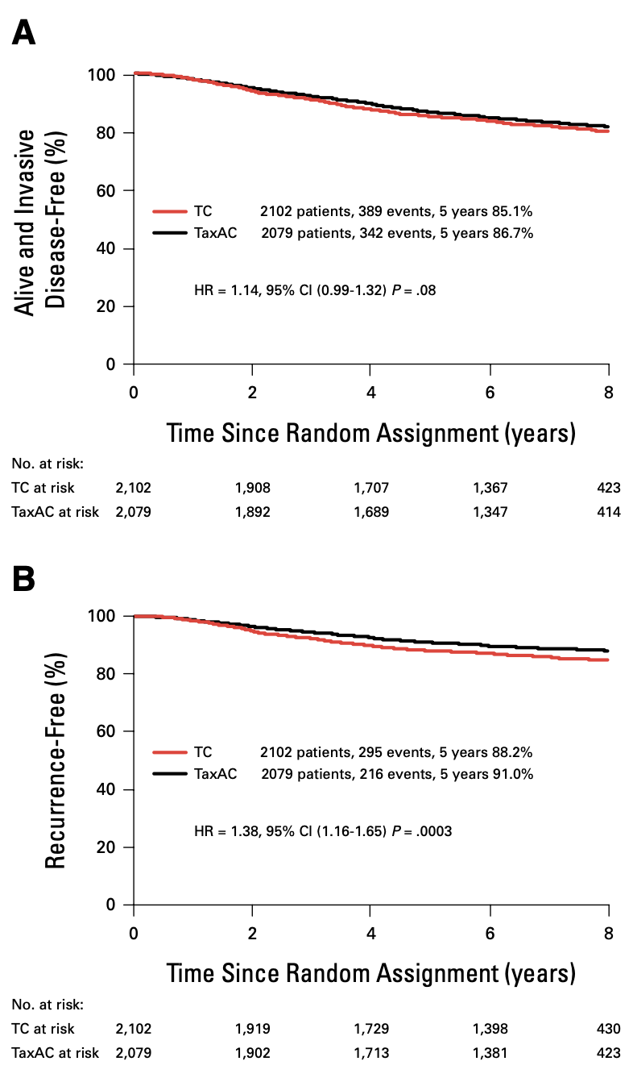
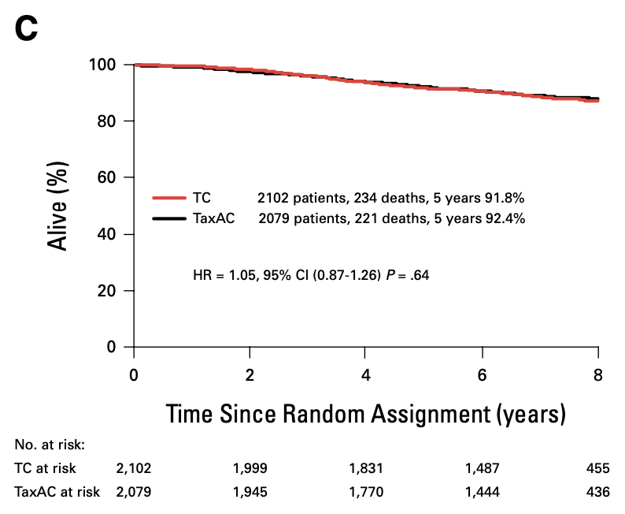
8-year Update on ABC Trials:
Adjuvant TC vs Tax/AC in HER2-
N+ or High Risk N0
TC remained NOT non-inferior to TaxAC
in N+ and high risk N0 EBC pts
Geyer CE, et al. J Clin Oncol. 2024;42(12):1344-1349.

Slide 24
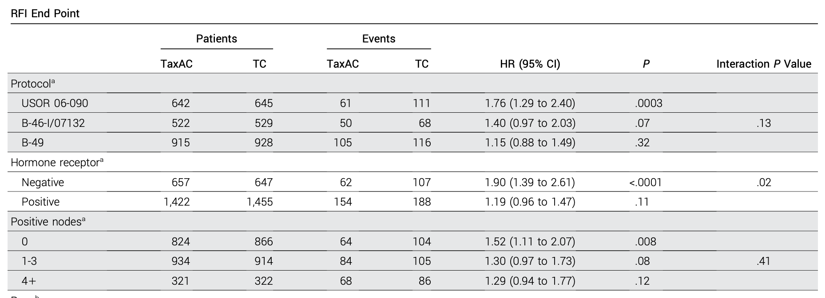
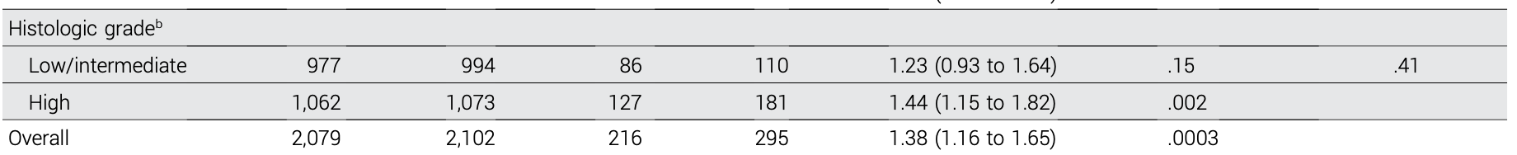
8-year RFI on ABC Trials: TC vs Tax/AC
Geyer CE, et al. J Clin Oncol. 2024;42(12):1344-1349.

Slide 25
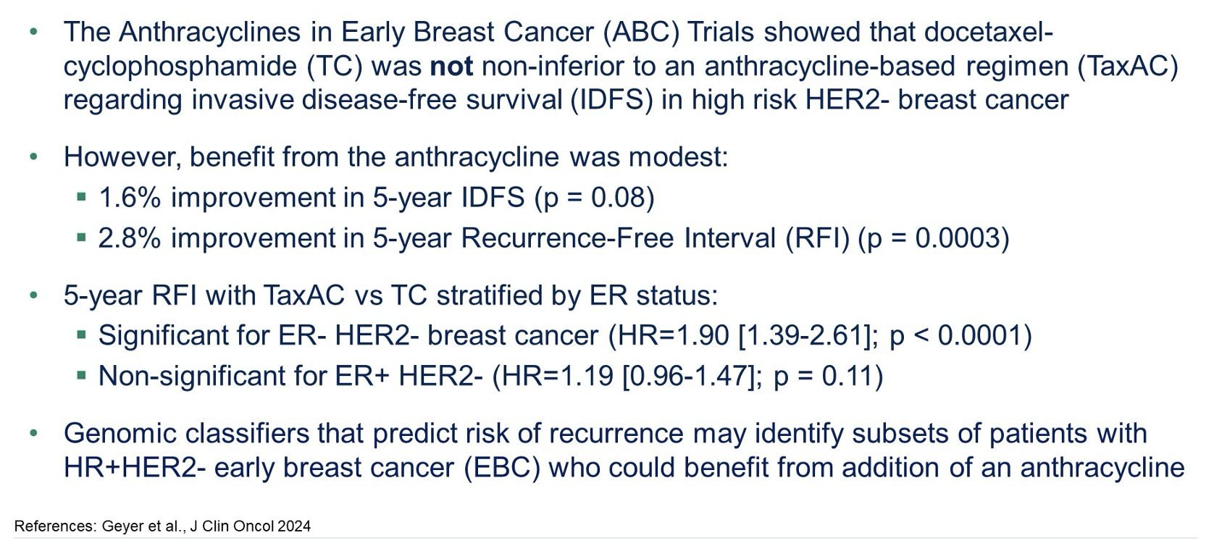
Who Benefits from Anthracycline Therapy?

Slide 26
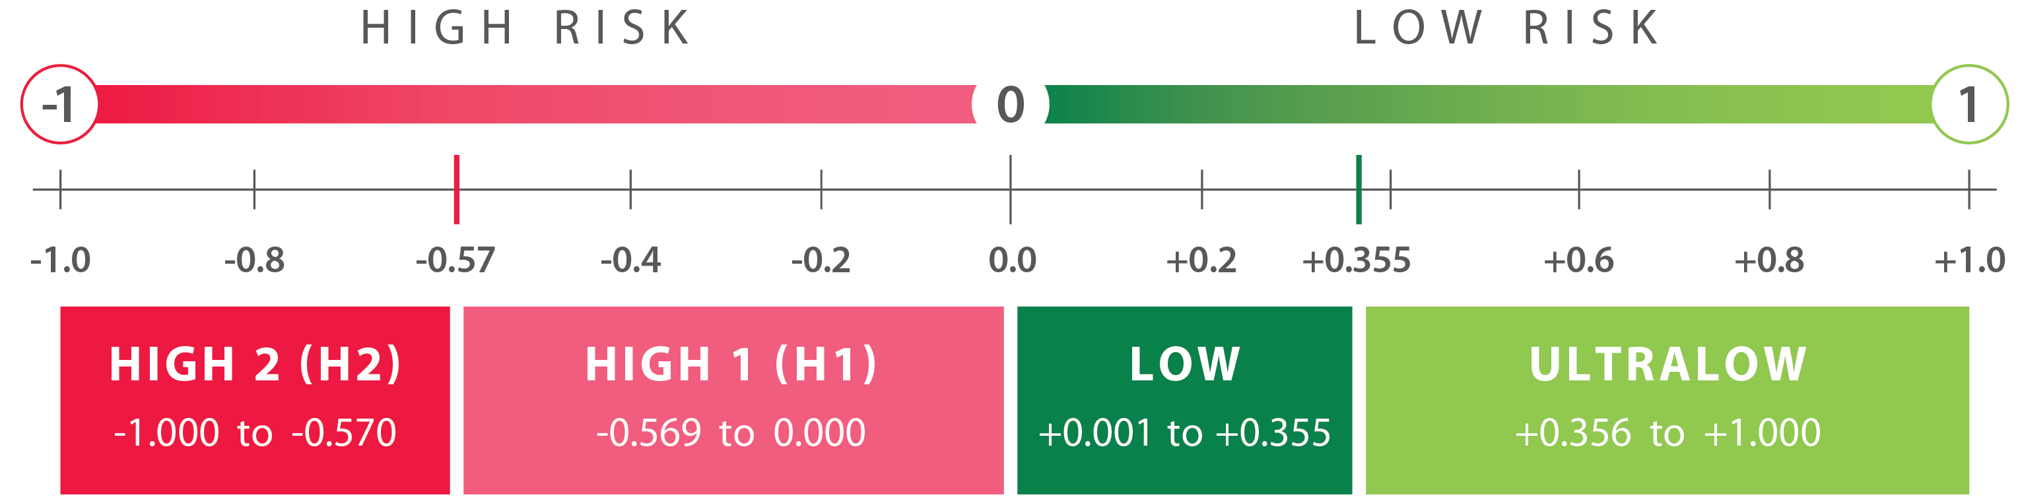
70-gene MammaPrint test: Implications for ET and CT Decisions
MammaPrint classifies patients with HR+HER2- EBC as having an Ultra Low, Low, High 1, or High 2 risk of distant recurrence
(Neo)Adjuvant CT benefit
ET benefit 0-5 yrs
Increased sensitivity to: PARPi, IO, Platinum
(Neo)Adjuvant CT benefit
ET benefit 0-5 yrs
No increased sensitivity to PARPi, IO, Platinum
No CT benefit
ET benefit 0-5 yrs
Extended ET benefit 6-10 yrs
No CT benefit
ET benefit 2 to <5 yrs
Knauer, NBRST,
STO-3, I-SPY2
Knauer, NBRST, STO-3, I-SPY2
MINDACT, STO-3,
NSABP-B42, IDEAL
MINDACT, STO-3
References: Knauer (Breast Cancer Res Treat 2010), NBRST (Whitworth, Ann Surg Oncol 2022), STO-3 (van’t Veer, Breast Cancer Res Treat, 2017; Esserman, JAMA Onc, 2017), I-SPY2 (https://www.ispytrials.org/i-spy-platform/i-spy2; Pusztai, Cancer Cell 2021), MINDACT (Piccart, Lancet Oncol, 2021; Lopes Cardozo, JCO, 2022), NSABP-B42 (Rastogi, ASCO, 2021), IDEAL (Liefers, SABCS, 2022)
O’Shaughnessy et al. ASCO 2024. Abstract 511.

Slide 27
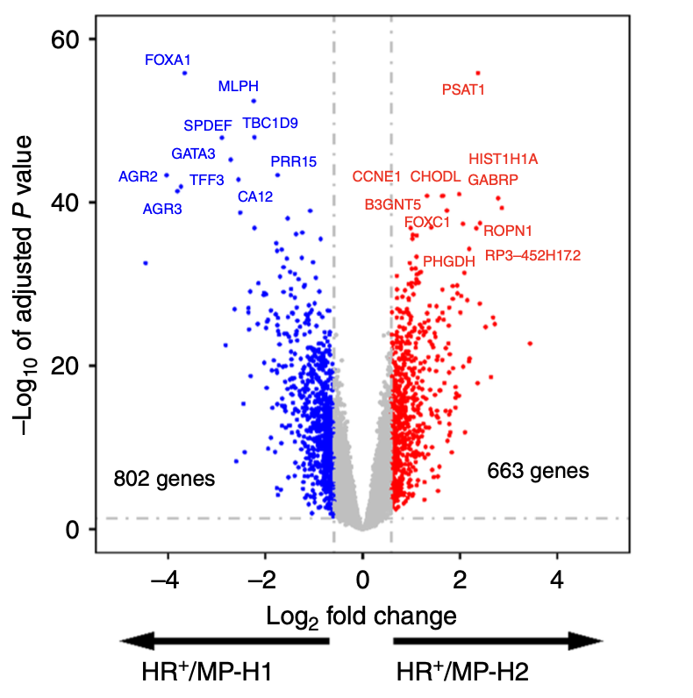
What distinguishes HR+ HER2- MP High2 from MP High1 in I-SPY-2?
DGEA
1465 differentially expressed genes
GSEA
MP2 identifies tumors which upregulate:
DNA repair genes (non-homologous recombination)
  Likely upregulated in response to HR deficiency
PI3K/AKT/mTOR pathway
Downregulate inhibitors of EMT
Upregulation in cell cycle genes
Lopes-Cardazo et al Clin Cancer Res 2025;31:403–13.

Slide 28
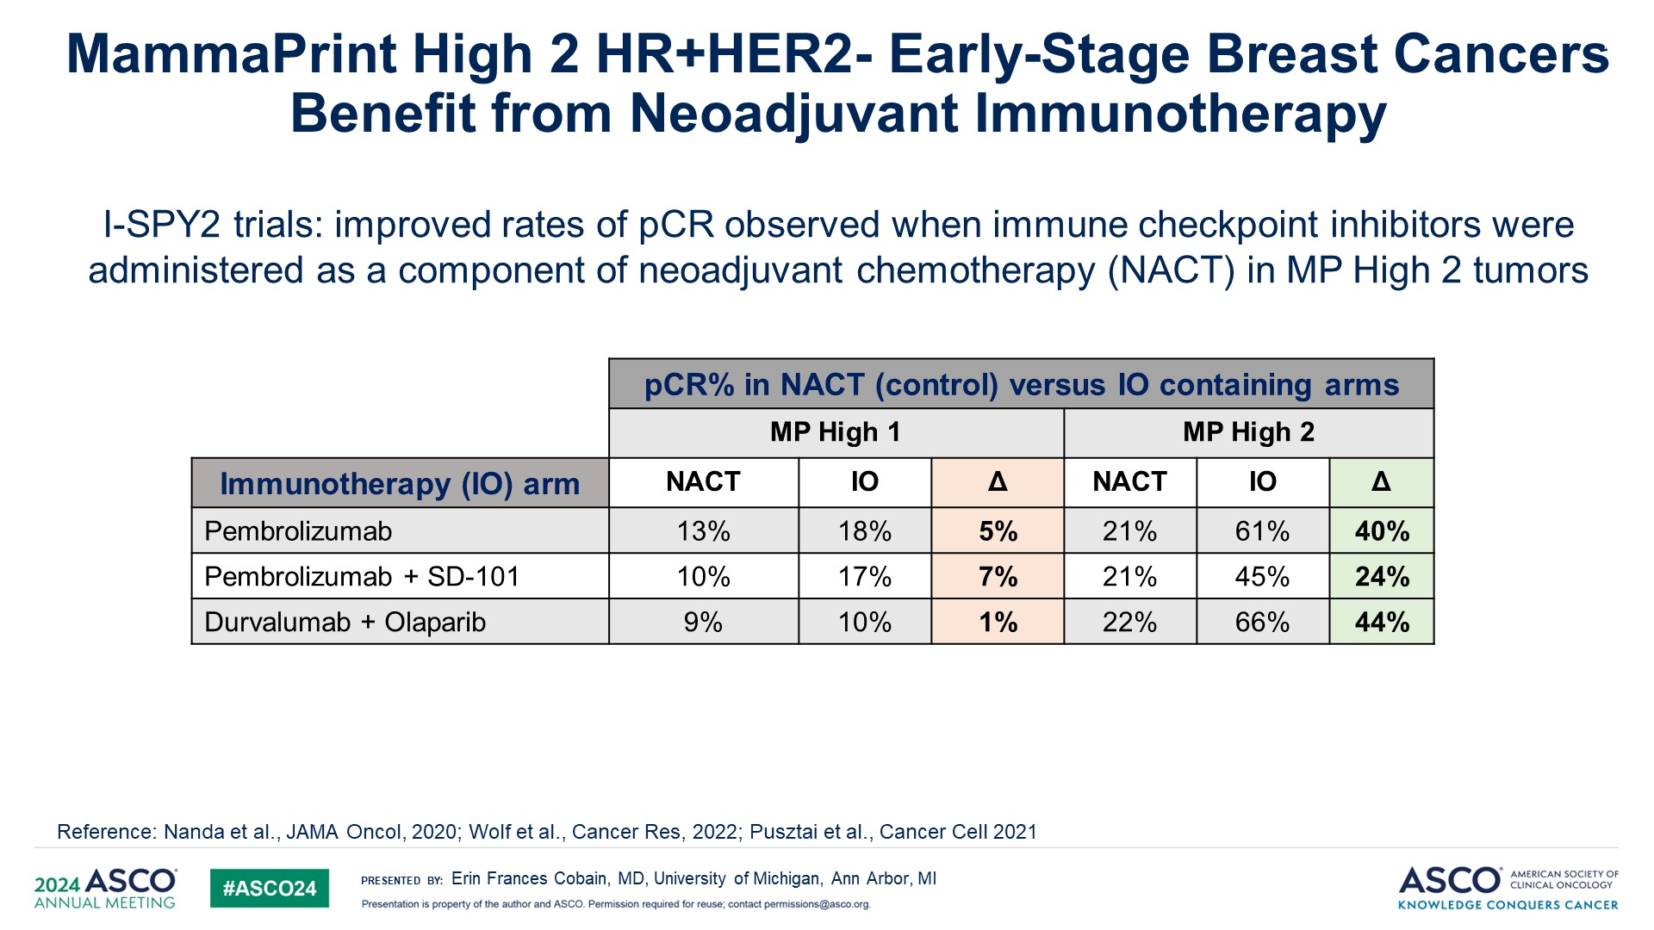
MammaPrint High 2 HR+HER2- Early-Stage Breast Cancers Benefit from Neoadjuvant Immunotherapy
Significantly higher expression of PD-1 and PD-L1 in MP High 2 compared with High 1

Slide 29
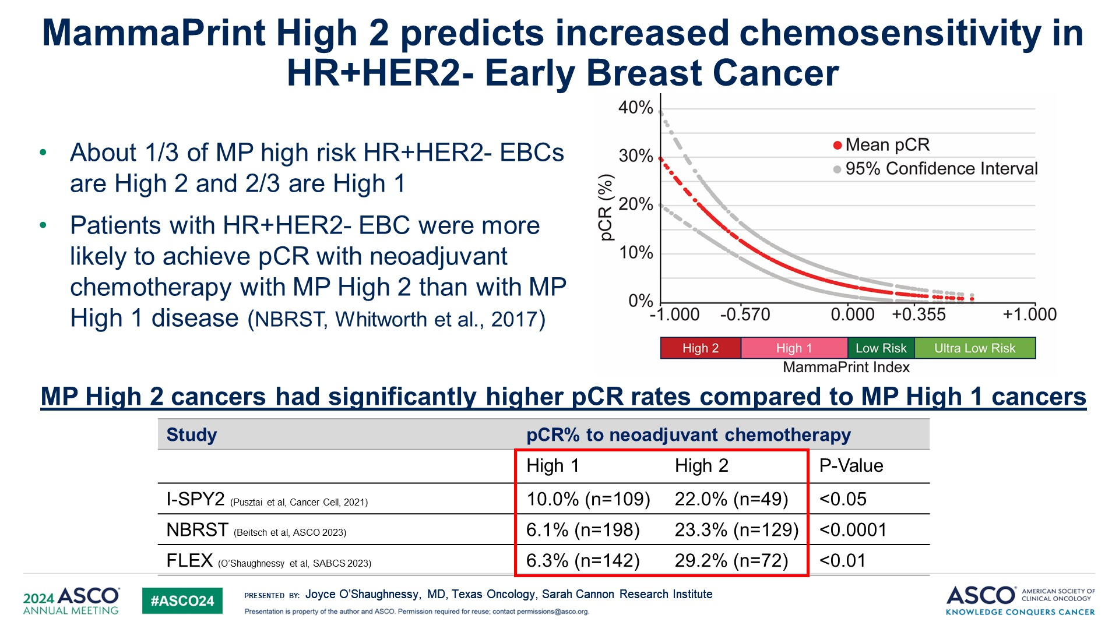
MammaPrint High 2 predicts increased chemosensitivity in HR+HER2- Early Breast Cancer

Slide 30
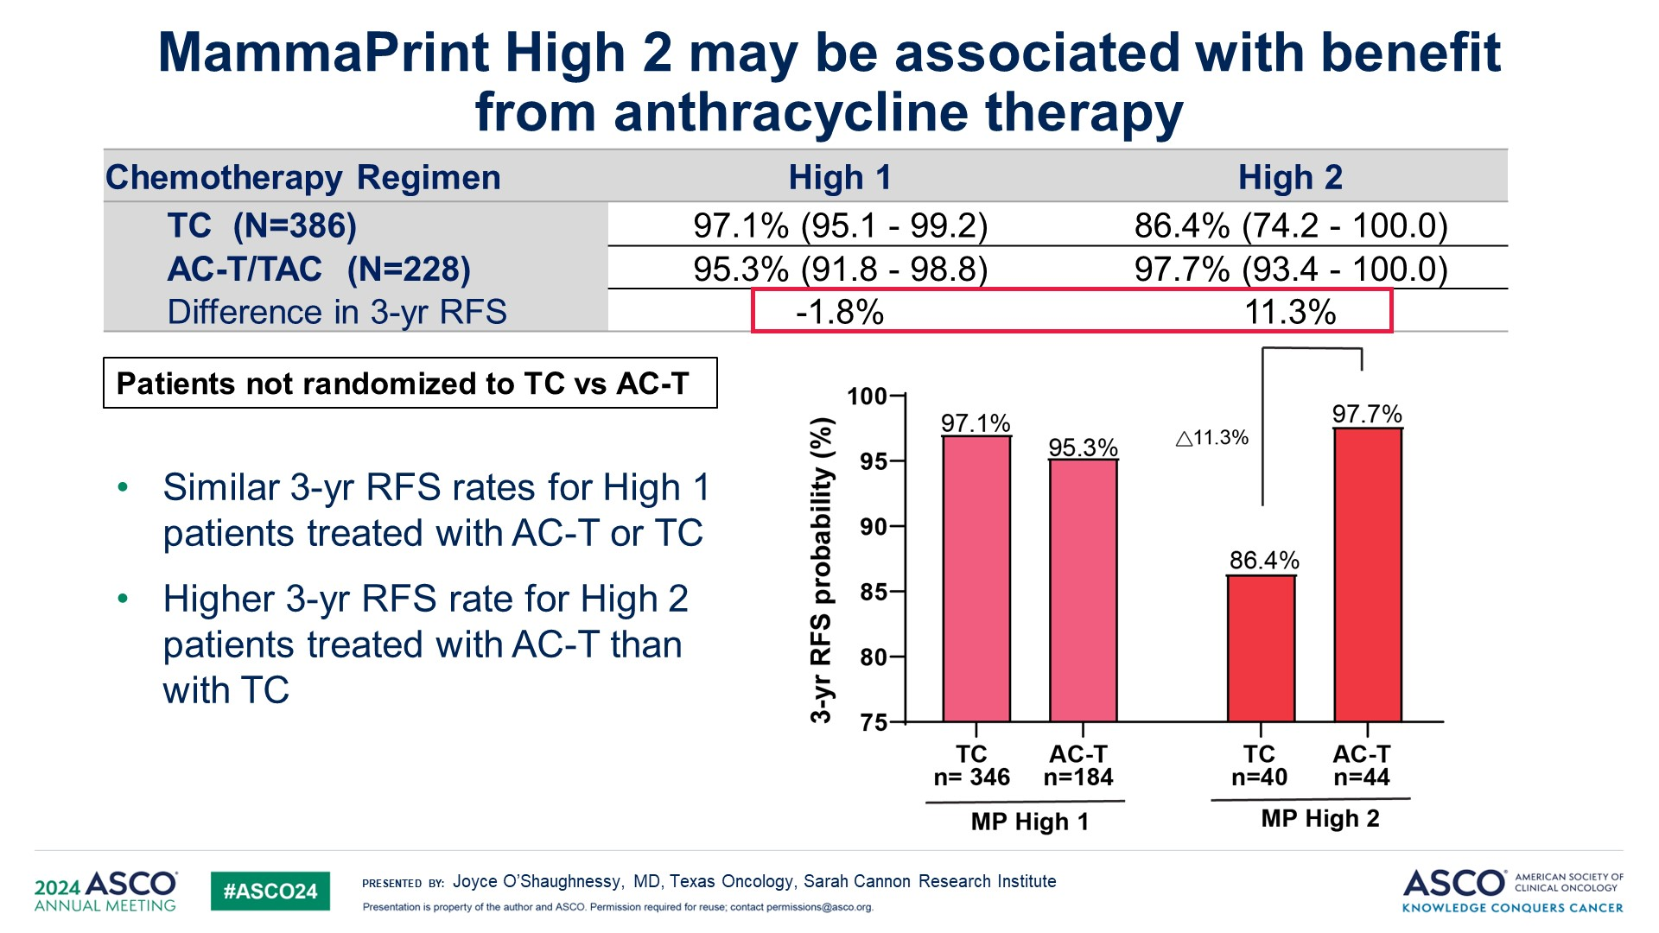
MammaPrint High 2 may be associated with benefit from anthracycline therapy

Slide 31
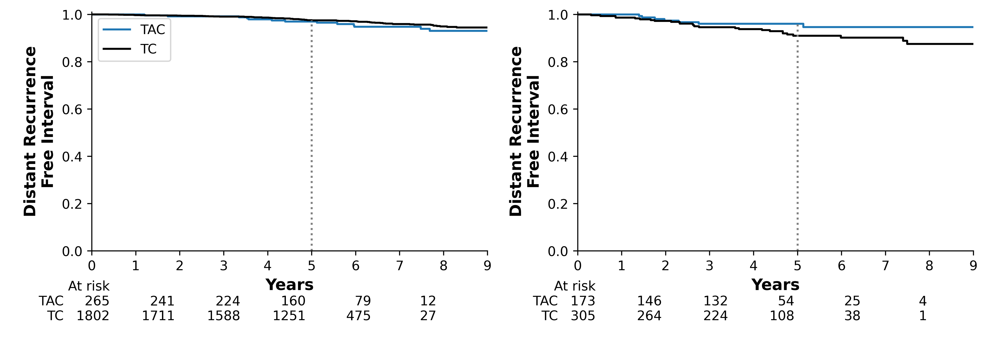
Primary Survival Outcome: Distant Recurrence-Free Interval at 5 years in TAILORx Trial
Pts not randomized to TAC vs TC
RS < 31
RS ≥ 31
 | TAC | TC
5 Year Rate | 97.0 | 97.6
(95% CI) | (93.9 – 98.6) | (96.7 – 98.2)
Adj HR | 1.24, p = 0.484
 | TAC | TC
5 Year Rate | 96.1 | 91.0
(95% CI) | (91.5 – 98.2) | (86.7 – 94.0)
Adj HR | 0.32, p = 0.009
**Interaction p value = 0.009
*Adjusted hazard ratios controlling for age, ER/PR status, RS, tumor size, treatment received, and interaction of treatment with RS
Chen N et al. SABCS 2024

Slide 32
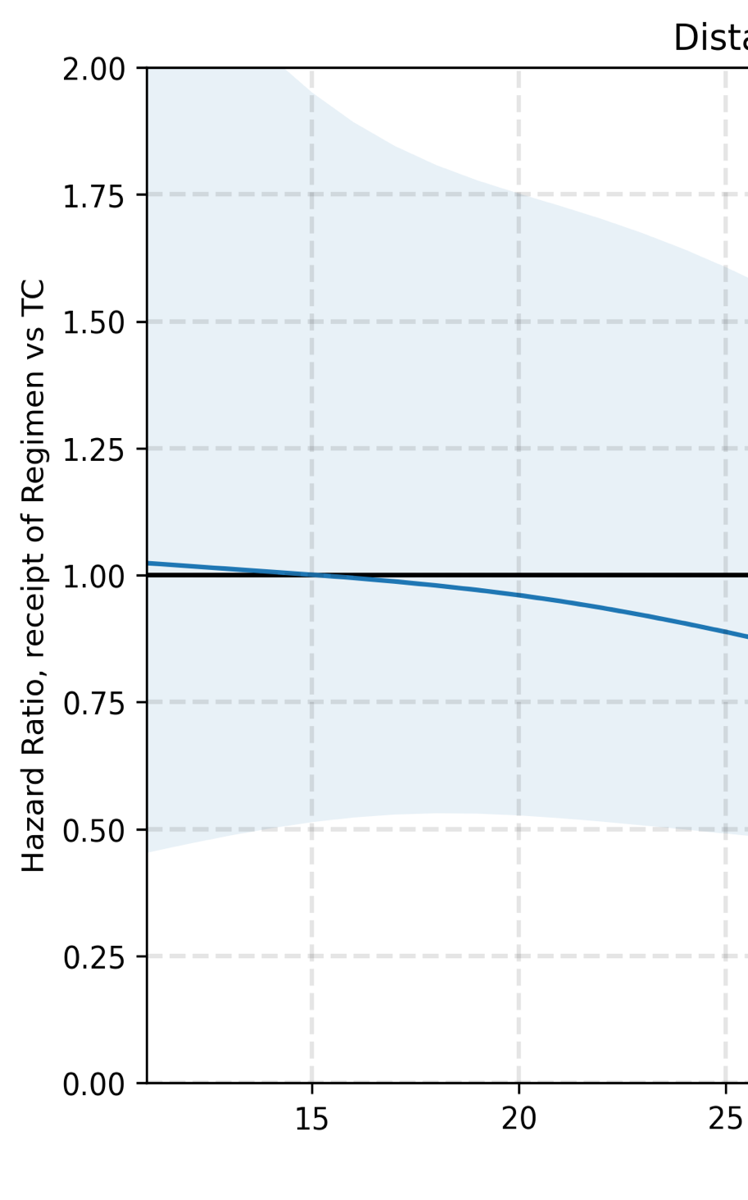
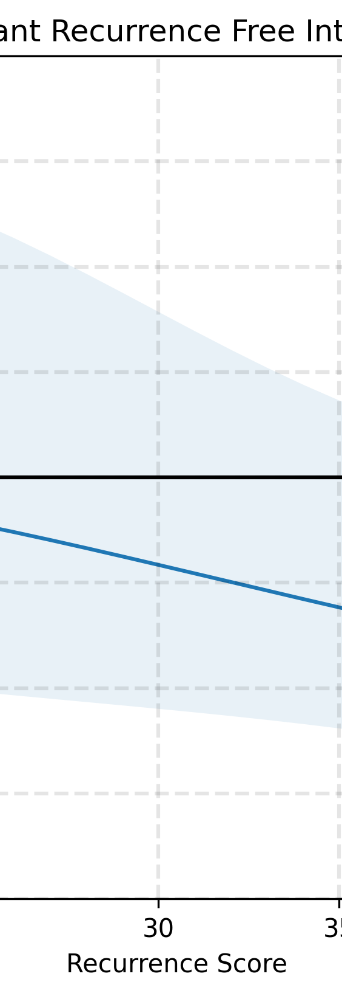
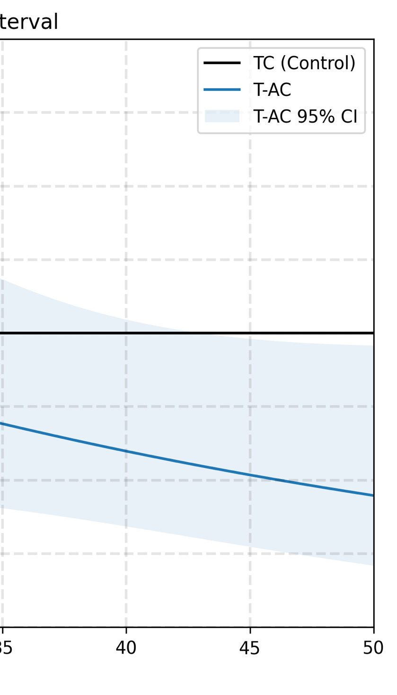
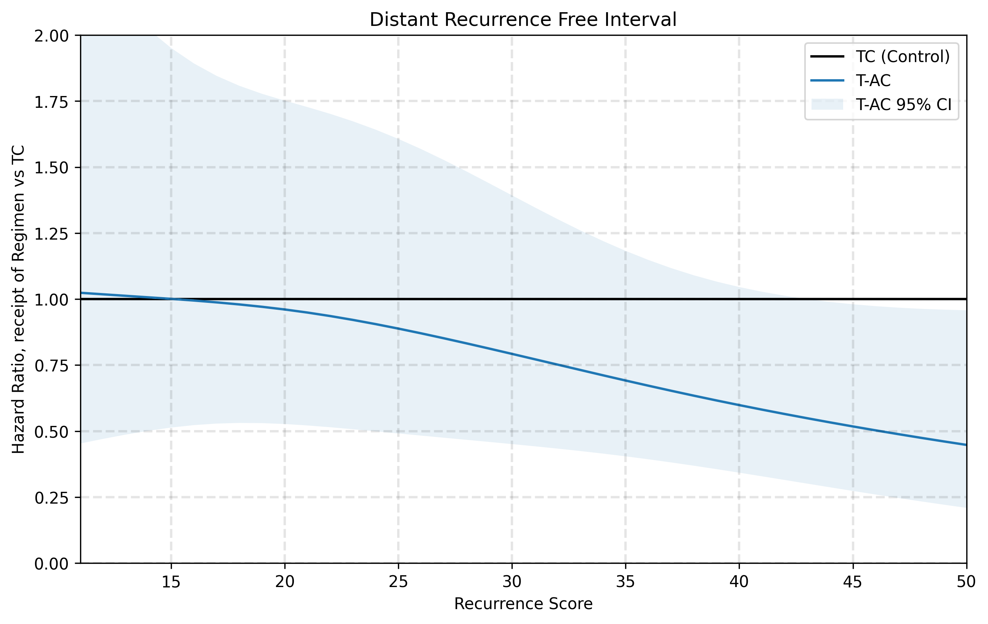
Increasing Benefit of Anthracyclines with Increasing RS
RS | Adj HR, DRFI
15 | 1.00 (0.51 - 1.95)
20 | 0.96 (0.53 - 1.75)
25 | 0.89 (0.49 - 1.61)
30 | 0.79 (0.45 - 1.39)
35 | 0.69 (0.40 - 1.18)
40 | 0.60 (0.34 - 1.05)
45 | 0.52 (0.27 - 0.98)
50 | 0.45 (0.21 - 0.96)
Statistically significant benefit of anthracycline limited to ODx > 40

Slide 33
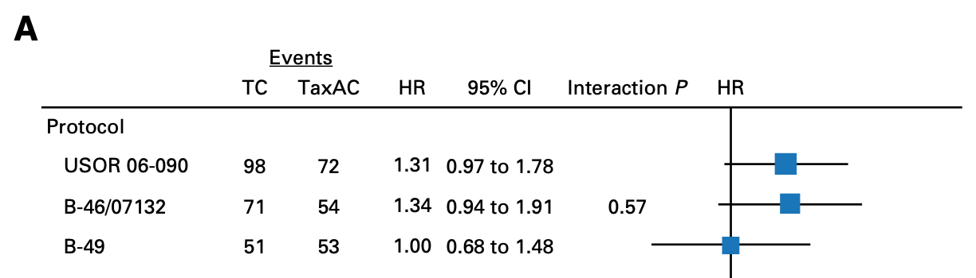
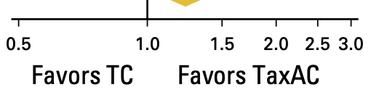
ABC Trials TC vs TaxAC 4-Year IDFS
Concurrent vs Sequential AC/Taxane?
6TAC vs 6TC
B49 6TC vs AC q2w or q3w
then 12 weekly paclitaxel or 4 DD paclitaxel
WGS Plan B Trial 6TC = 4EC then 4Docetaxel 100 in N+ HER2- pts
Blum J et al. J Clin Oncol. 2017;35(23):2647-2655.
Nitz U et al. J Clin Oncol. 2019;37(10):799-808.

Slide 34

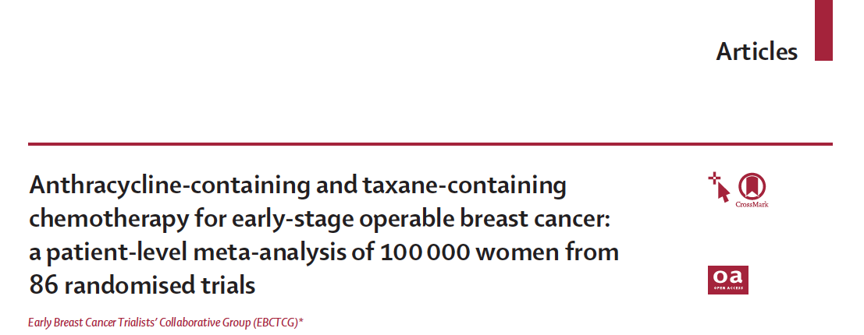
15 trials (N=18,103) evaluating adding anthracycline to taxane
Recurrence rate 14% lower (RR 0.86, p=0.0004) with taxane + anthracycline vs no anthracycline
10-year mortality decreased by 4.2% (p=0.0034)
1 additional case of acute myelogenous leukemia per 700 pts treated
Take a closer look at the data…

Slide 35
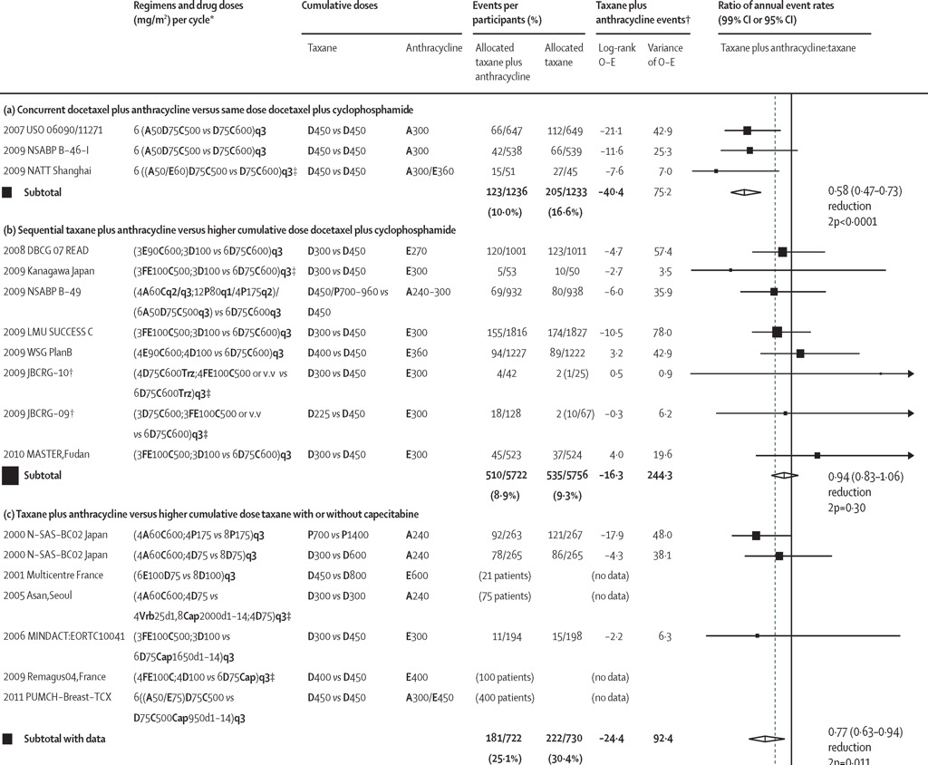
Docetaxel + Cyclophosphamide + concurrent Anthracycline (DAC) is better than Docetaxel/Cyclophosphamide (DC)
(Note: with DAC, pts receive same amount of taxane as they receive with DC)
The Lancet 2023 4011277-1292DOI: (10.1016/S0140-6736(23)00285-4)

Slide 36
No benefit from adding anthracycline when used in regimen with sequential taxane and anthracycline (e.g. AC-T, FEC-D).
(with sequential, less D is given overall)
The Lancet 2023 4011277-1292DOI: (10.1016/S0140-6736(23)00285-4)

Slide 37
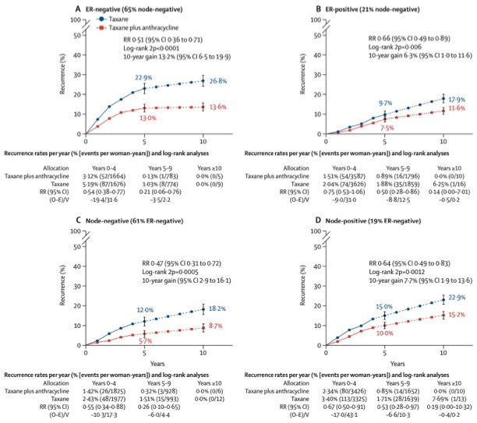
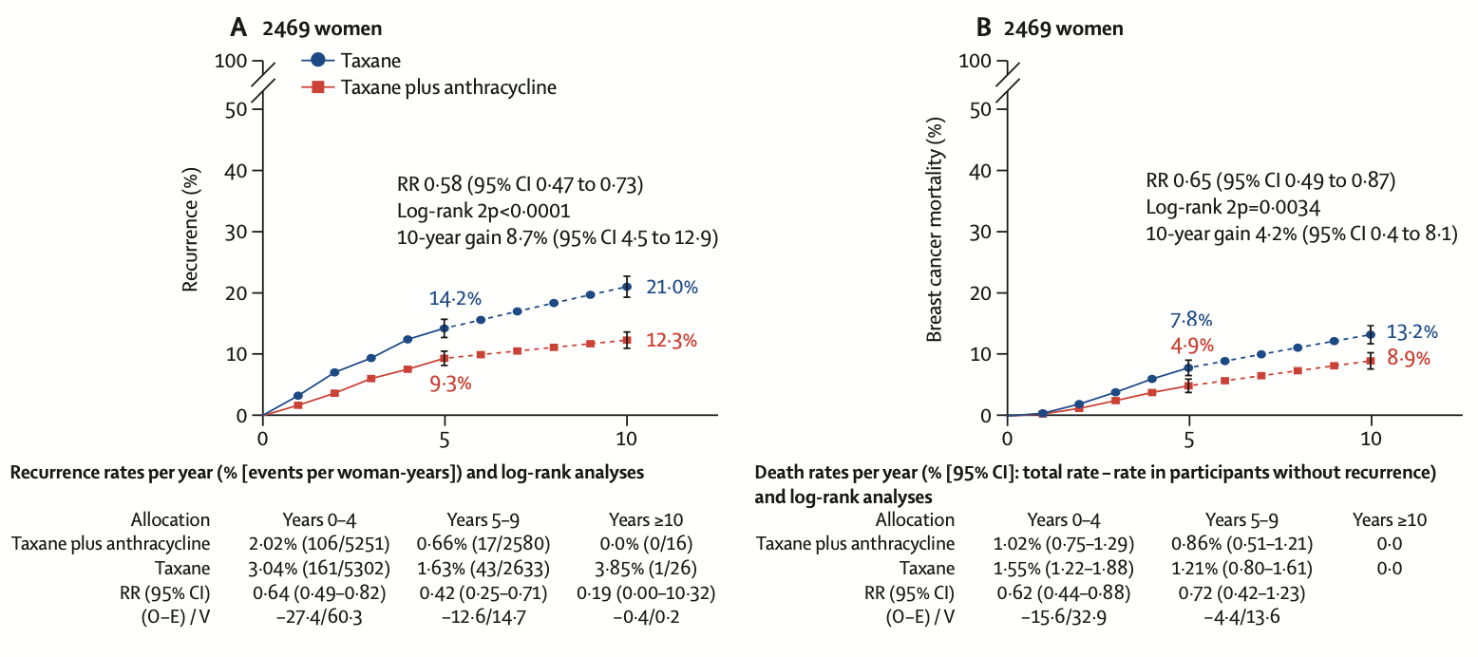
ANTHRACYCLINE + DOCETAXEL/CYCLOPHOSPHAMIDE VS SAME DOCETAXEL/CYCLOPHOSPHAMIDE
Sequential anthracycline then taxane not superior to
6 cycles docetaxel + cyclophosphamide
However, DFS 6TAC = 4DD AC then 4DD Paclitaxel NSABP B38
(All N+, both HR+ and HR-)
EBCTCG. Lancet. 2023;401(10384):1277-1292.

Slide 38
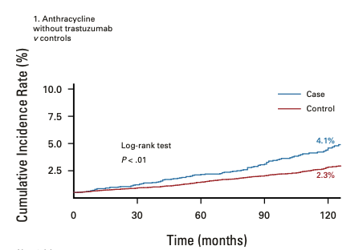
Risk of Cardiovascular Disease in Women With and Without Breast Cancer: The Pathways Heart Study
13,642 women with breast cancer from 2005-2013
compared to 68,202 controls without breast cancer
Greenlee H et al. J Clin Oncol. 2022;40:1647

Slide 39
When to Use Anthracycline Therapy?
    ABC Trials – in depth biomarker analyses of MP, BP, ODx RS and others to identify HR+/HER2- and TN pts who benefit from anthracycline
    In the meantime, MP High 2 or BP Basal or ODx > 30 or grade 3 identifies genomically unstable HR+ HER2- EBC that is poorly ET- sensitive and can benefit from anthracycline therapy
    If we do use an anthracycline, consider either using it concurrently with the taxane (TACx6) with caveats…..
    NSABP B38 N+ HER2- 6TAC = DD AC then DD Paclitaxel
    BCIRG 005 N+ HER2- 6TAC = 4 AC then 4 Docetaxel 100

Slide 40
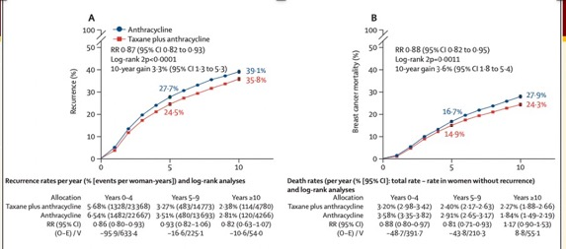
Anthracycline + Taxane More Effective Than Anthracycline without Taxane
EBCTCG. Lancet. 2023;401(10384):1277-1292.

Slide 41
E1199: Adjuvant AC→T q3w vs. q1w
AC
TAXANE
Endocrine/RT
A: 60 mg/m2
C: 600 mg/m2
q3w
dose/cycle (mg/m²) | total dose (mg/m²)
175 | 700
80 | 960
100 | 400
35 | 420
Paclitaxel (q3w vs. q1w)
Stratification:
ER/PR Status
# Nodes
Tumor size
Surgery Type
Docetaxel (q3w vs. q1w)
Sparano J, et al. NEJM 2008;358:1663.

Slide 42
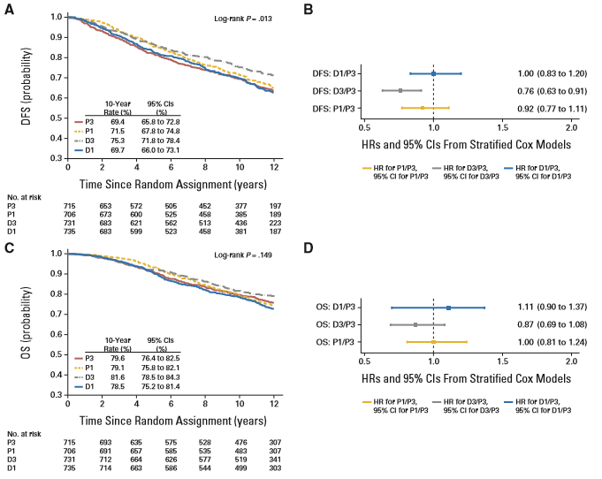
E1199 Ten Year Update – Exploratory Analysis in ER+ HER2- Disease (N=2888)
Sparano J et al. J Clin Oncol. 2015;33(21):2353-60.

Slide 43
EBCTCG dose intense or not pooled analysis: Recurrence and by ER status
TACT2 adjuvant trial
did not show improved
time to tumor
recurrence with DD
epirubicin vs q3 weekly
epirubicin in EBC
phase III trial
Cameron D et al.
Lancet Oncol. 2017;18(7):929-945.
EBCTCG Lancet 2019;393(10179):1440-1452.

Slide 44
Neo/Adjuvant ChemoRx in High Risk HR+ HER2- Patients
Anthracyclines and taxanes incrementally reduce recurrence and death regardless of nodal status, age, ER status, tumor size and grade
Reduction in recurrence with anthracycline added to docetaxel + cyclophosphamide (6 cycles of all 3 agents) vs 6 cycles of docetaxel + cyclophosphamide. No reduction in recurrence with sequential anthracycline then taxane (mostly docetaxel) vs 6 cycles docetaxel + cyclophosphamide
No difference in DFS in NSABP B38 HER2- N+ EBC pts with 6TAC vs DD AC then DD paclitaxel or in BCRIG 005 HER2- N+ 6TAC vs 4 AC then 4 Docetaxel 100 (risk of permanent alopecia with 4 Docetaxel 100 or 6 TAC or TCH +/- P – scalp cooling prevents)
Every 2 weekly and every 3 weekly anthracycline both acceptable. Weekly and dose dense paclitaxel superior to q3w
Longer anthracycline/taxane regimens more effective than shorter, ie, anthracycline/taxane regimens with highest cumulative dose/dose intensity provide most benefit

Slide 45
Optimizing Neo/Adjuvant Chemotherapy in High Risk Patients
Anthracyclines and taxanes incrementally reduce recurrence and death regardless of nodal status, age, ER status, tumor size and grade
Reduction in recurrence with anthracycline added to docetaxel + cyclophosphamide (6 cycles of all 3 agents) vs 6 cycles of docetaxel + cyclophosphamide. No reduction in recurrence with sequential anthracycline then taxane (mostly docetaxel) vs 6 cycles docetaxel + cyclophosphamide
No difference in DFS in NSABP B38 HR+ & HR- N+ EBC pts with 6TAC vs DD AC then DD paclitaxel
Dose dense chemoRx every 2 weekly greater benefit than every 3 weekly (q3w vs q2w anthracycline both acceptable). Weekly and dose dense paclitaxel superior to q3w
Longer anthracycline/taxane regimens more effective than shorter
Anthracycline/taxane regimens with highest cumulative dose/dose intensity provide most benefit
My Conclusions
DD AC then DD paclitaxel or weekly paclitaxel or 6TAC
for high risk HR+ N0 or N+ EBC, regardless of menopausal status
(TAILORx 12 years N0 RS >25 with chemoET
IDFS 65% and DDFS 80%;
MINDACT C high/G high 8-year N0/N1 DMFS 86% with chemoET)
?Role for 4 TC? When benefit from chemotherapy is
equivocal, ie, when benefit from
optimal endocrine therapy +/- CDK4/6i is expected

Slide 46
Neoadjuvant Chemotherapy (NCT) vs Neoadjuvant Endocrine Therapy (NET) for Stage II/III HR+/HER2- Breast Cancer
Most HR+/HER2- BC don’t benefit from adjuvant chemotherapy (TAILORx/RxPONDER/MINDACT)
Adjuvant therapy recommendations not dependent on pCR vs residual disease with NAC
No difference in DFS, DDFS or OS with adjuvant vs neoadjuvant chemotherapy (Mauri et al. JNCI, 2005)
BUT, need for cytoreduction in some HR+ HER2- stage II/III pts to decrease extent of surgery, and in inoperable locally advanced pts
Downstaging rates comparable for NET vs. NCT in unselected HR+/HER2- EBC
  pCR rates are low (< 10-15%) and modest residual cancer burden (RCB) down-shifting with NCT
  pCR not a strong intermediate surrogate for prognosis in HR+/HER- EBC
  21-gene Recurrence Score and 70-gene Signature score may identify tumors sensitive to NET or NCT

Slide 47
Neoadjuvant Chemotherapy (NCT) vs Neoadjuvant Endocrine Therapy (NET) for Stage II/III HR+/HER2- Breast Cancer
Most HR+/HER2- BC don’t benefit from adjuvant chemotherapy (TAILORx/RxPONDER/MINDACT)
Adjuvant therapy recommendations not dependent on pCR vs residual disease with NAC
No difference in DFS, DDFS or OS with adjuvant vs neoadjuvant chemotherapy (Mauri et al. JNCI, 2005)
BUT, need for cytoreduction in some HR+ HER2- stage II/III pts to decrease extent of surgery, and in inoperable locally advanced pts
Downstaging rates comparable for NET vs. NCT in unselected HR+/HER2- EBC
  pCR rates are low (< 10-15%) and modest residual cancer burden (RCB) down-shifting with NCT
  pCR not a strong intermediate surrogate for prognosis in HR+/HER- EBC
  21-gene Recurrence Score and 70-gene Signature score may identify tumors sensitive to NET or NCT
  If postmenopausal genomic low risk, no improvement in outcome with NCT or adjuvant chemotherapy
  Premenopausal cN+ pts may benefit from NCT (as adjuvant chemotherapy is current SOC) Surgery first if operable and if full pathology needed to optimize therapy recommendations
  Premenopausal operable cN- pts generally proceed to surgery first, then assess overall recurrence risk and benefit from chemotherapy based on definitive surgery (consider NET to assess Ki-67 per ADAPT)

Slide 48
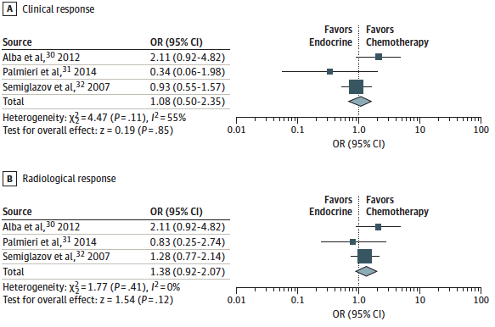
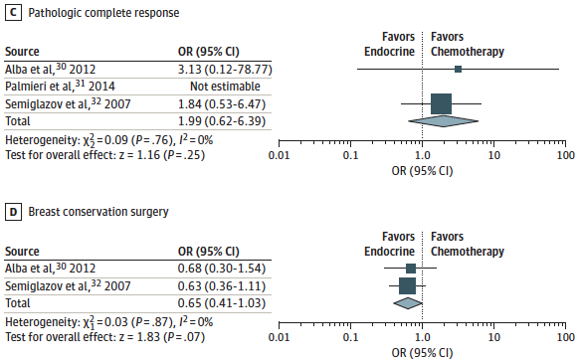
Neoadjuvant Endocrine Therapy vs ChemoRx for HR+ Early Breast Cancer
NET vs. NAC: 3 trials including 378 patients
No difference in clinical response, radiologic response, pathologic response, or breast conservation
Spring et al. JAMA Oncol 2016;2:1477-1486

Slide 49
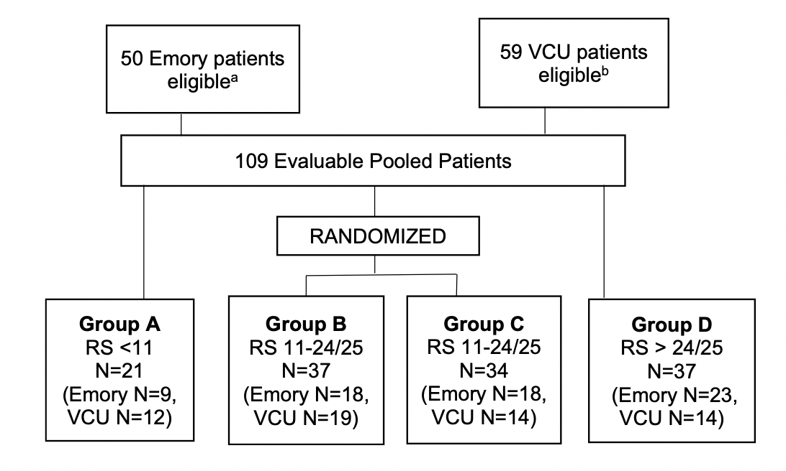
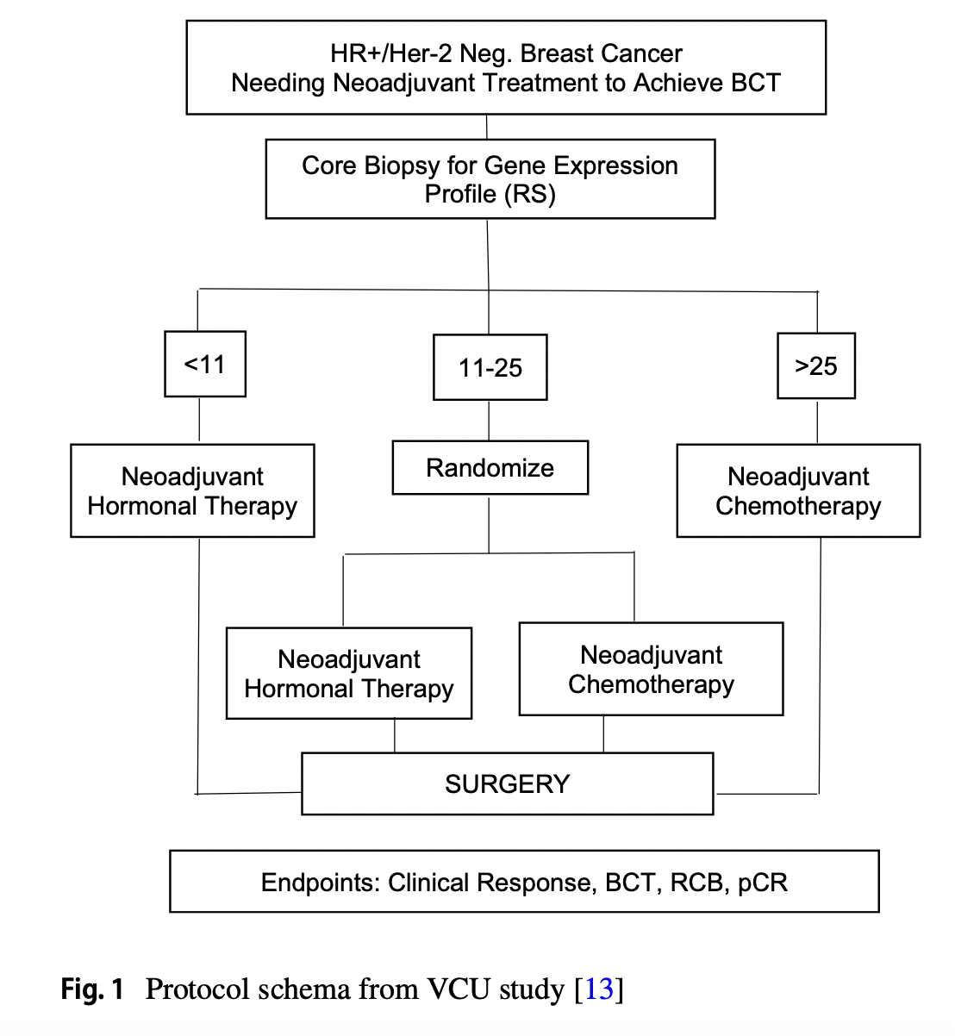
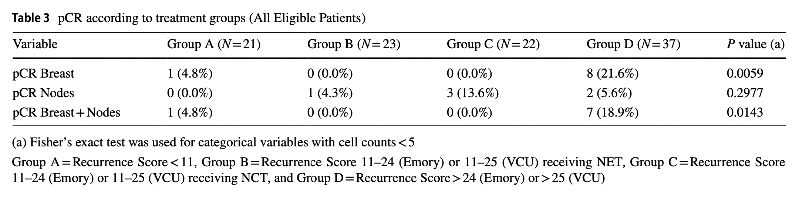
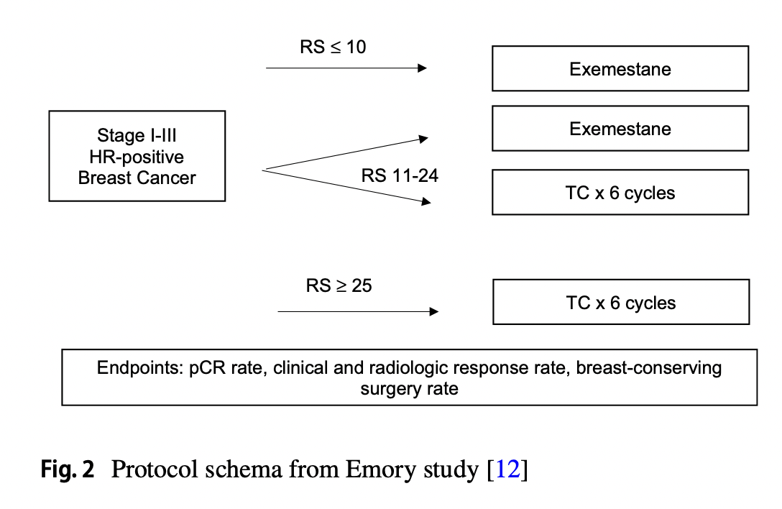
Preoperative ET and 21-gene Recurrence Score
c
Taylor C and O’Regan R et al. Breast Cancer Res Treat. 2023;199(1):91-98.

Slide 50
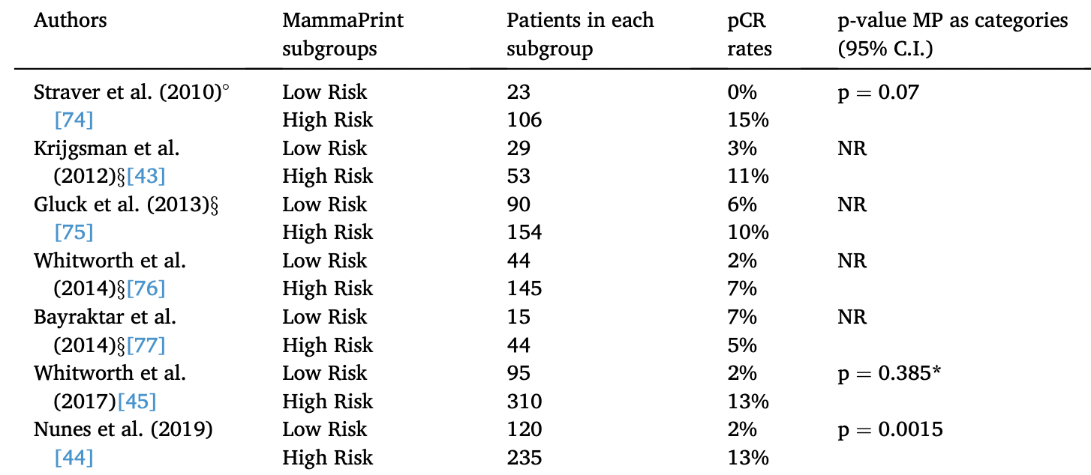
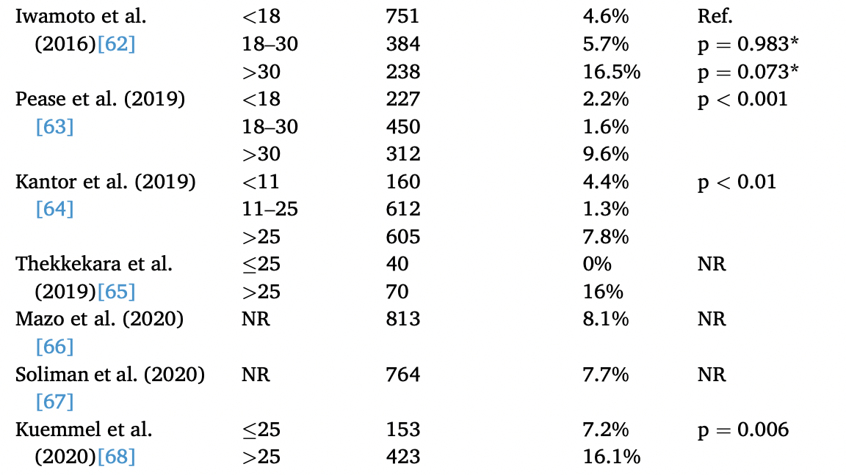
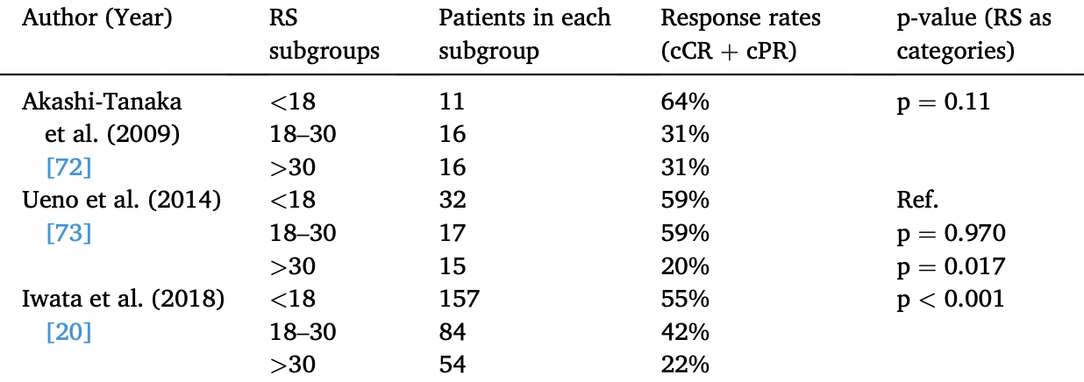
Can 21-Gene RS and 70-Gene Signature Predict pCR with Neoadjuvant Chemo- or Endocrine Therapy (NCT/NET)?
70-Gene Signature and NCT
RS # pts pCR
21-Gene RS and NET
21-Gene Recurrence Score and NCT
Griguolo G et al. Cancer Treat Rev. 2022;102:102323.

Slide 51
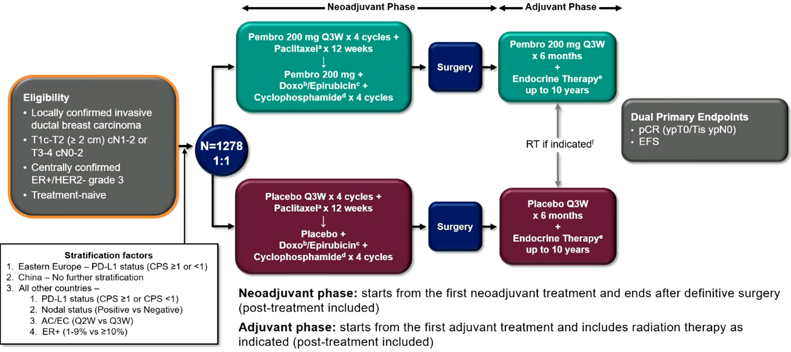
KEYNOTE-756 (Phase 3): Neoadjuvant + adjuvant pembrolizumab vs chemo/endocrine therapy for early-stage high-risk ER+/HER2− breast cancer
Treatment benefit in Cohort 1 was consistent with ITT. Cohort 2 data remain immature
Analyses
Primary:
  pCR (ypT0/Tis ypN0),
  EFS
Secondary:
  pCR (ypT0 ypN0 and ypT0/Tis)
  OS
  pCR, EFS and OS in PD-L1 CPS ≥1
  Safety in all treated patients
Pembro: ITT N=635
Placebo: ITT N=643
Cardoso F, et al. ESMO 2023. Abstract LBA21

Slide 52
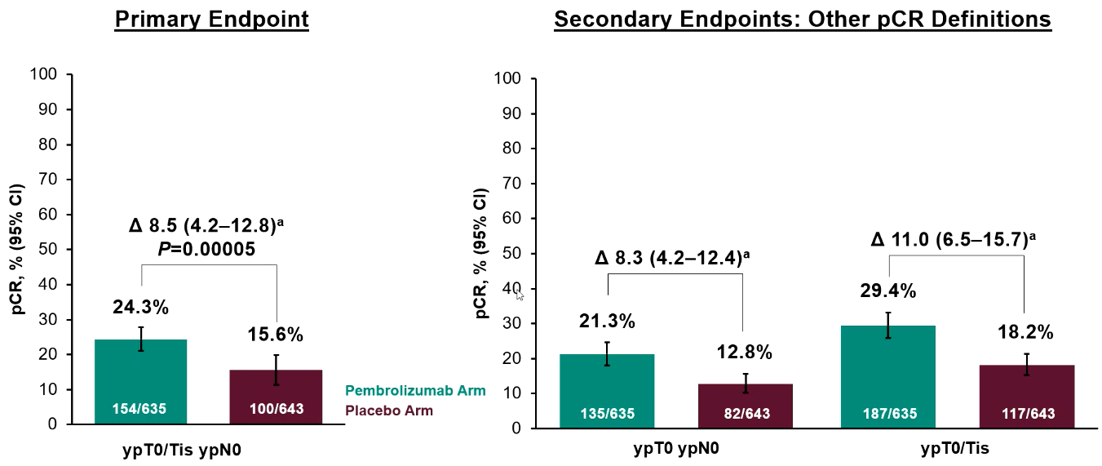
KEYNOTE-756 (Phase 3): Efficacy – pCR
EFS was not presented because it is still immature and continues to be evaluated.
Cardoso F, et al. ESMO 2023. Abstract LBA21

Slide 53
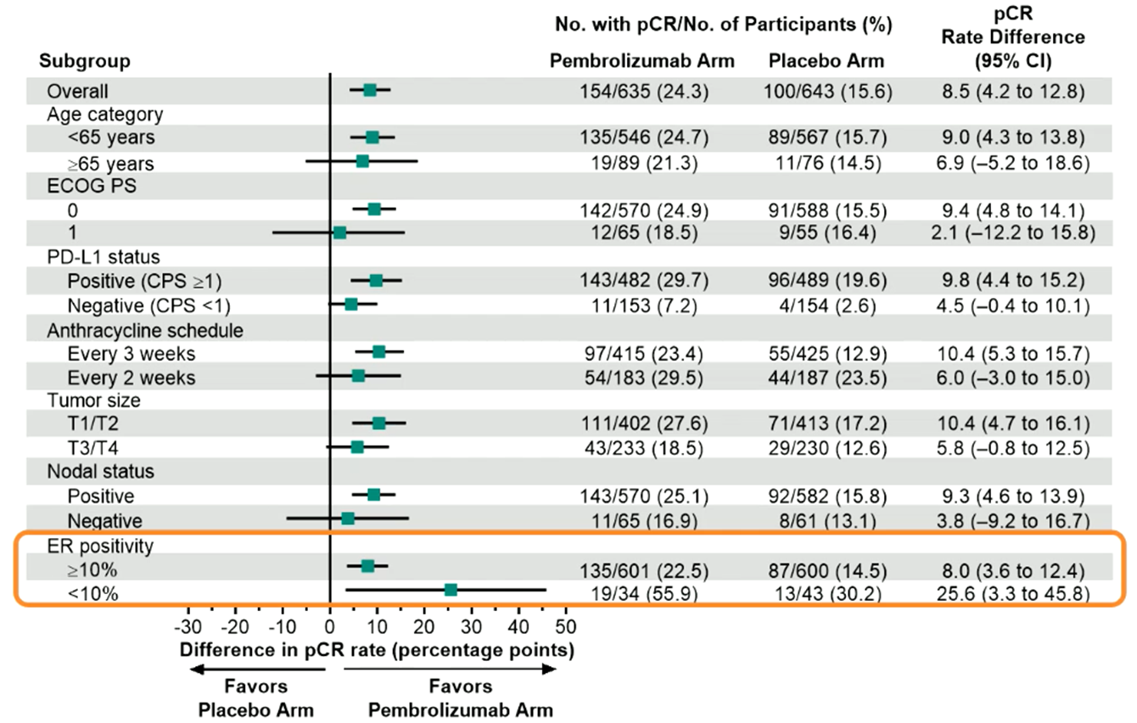
KEYNOTE-756 (Phase 3): Efficacy – pCR by subgroup
NCCN supports KN-522 for ER < 10%
Cardoso F, et al. ESMO 2023. Abstract LBA21

Slide 54
A Subset of ER+ Breast Cancers behave like TNBC (Basal)
Genomic Profiling with 70-gene (MP) and 80-gene Signatures (BP – Intrinsic Subtyping) in Neoadjuvant Therapy
A proportion of ER+ are genomically Basal (15-29%)
No evidence of ER signaling despite IHC up to ER+++
No specific pathology characteristics to identify
High chemosensitivity and pCR rate, like TNBC
Poor outcome if no pCR, like TNBC
Whitworth PW et al. JCO Precis Oncol. 2022 Sep;6:e2200197.

Slide 55
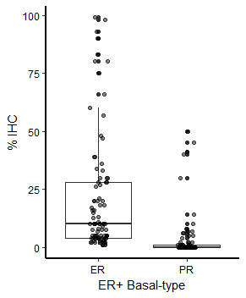
ER+ Basal Breast Cancers (detected by 80-gene assay)
Estrogen Receptor present but not signaling
ER/PR present by IHC
(ER% range 1% to 99%)
(PR% range 0-50%)
TNBC pCR = 37%
ER+ Basal pCR = 34%
Whitworth et al (2017)
Whitworth et al (2018)
Groenendjik et al (2019)

Slide 56
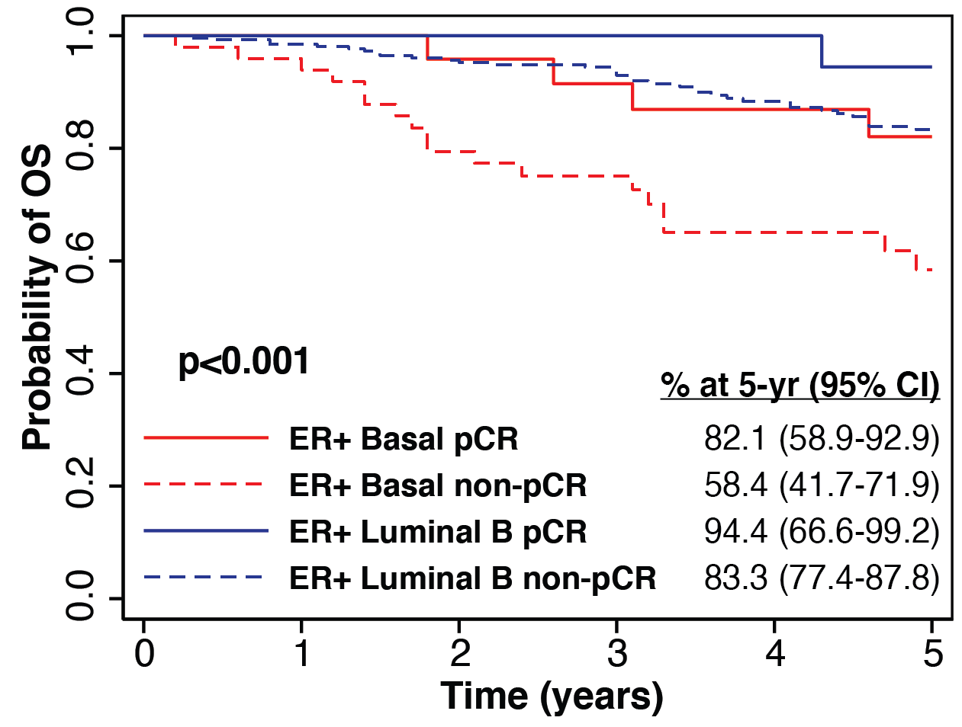
80-gene Assay Identifies the High-Risk ER+ Basal Subtype: pCR rate and 5-year outcomes different from other ER+
70-gene signature High Risk ER+: 80-gene signature Luminal B versus Basal
Poor outcomes for
ER+ basal breast cancer
without pCR
Whitworth PW et al. JCO Precis Oncol. 2022 Sep;6:e2200197.

Slide 57
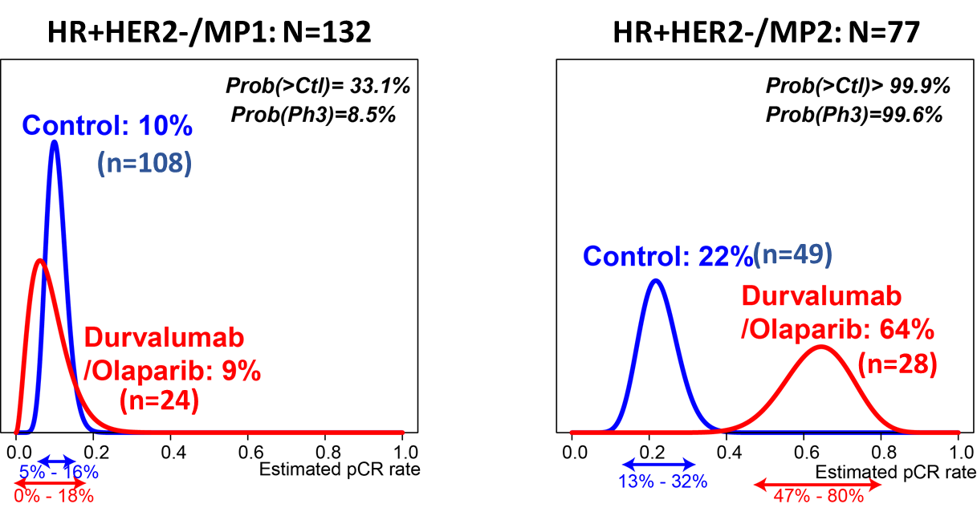
HR+ HER2- EBC with “Ultra-high (MP2)” 70-Gene Scores Benefit From Preoperative Paclitaxel + Durvalumab/Olaparib I-SPY 2 Trial
Pusztai L, et al. Cancer Cell. 2021;39(7):989-998.e5.
Notes:
1/28 Efficacy report did not have the posterior estimates per-subtype that were typically part of previous efficacy reports. The probability curves here are from a simple covariate-adjusted Bayesian model and not the I-SPY 2 Time Machine. Will replace if a more complete version of the efficacy report becomes available. Expect ~+/-1% differences in estimated rates

Slide 58
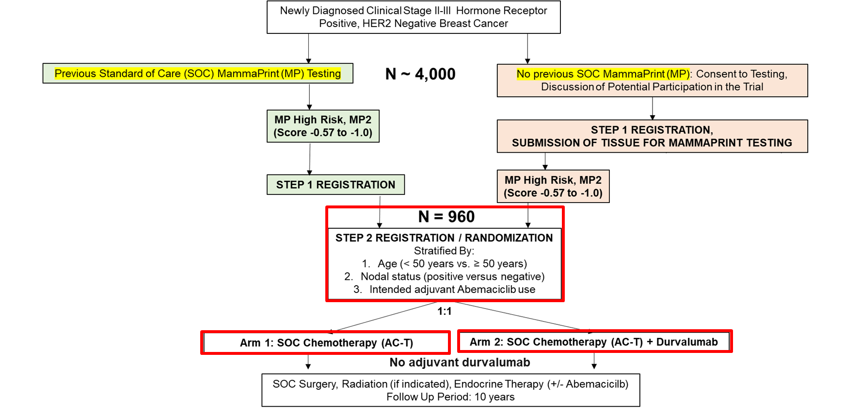
An Important Ongoing Clinical Trial (NCT 06058377):
SWOG S2206 Neoadjuvant Chemotherapy +/- Durvalumab for Stage II/III MP2 ER+ Breast Cancer
NOT NCCN Guideline
ER low but > 10%, grade 3, high Ki-67, stage II/III pt
Consider BP and if basal, KN-522
PI: Lajos Pusztai, MD, PhD

Slide 59
Considerations for Neoadjuvant Chemotherapy (NCT) in Localized HR+/HER2- Breast Cancer
Most HR+/HER2- BC don’t benefit from adjuvant or neoadjuvant chemotherapy (TAILORx/RxPONDER/MINDACT)
BUT, need for cytoreduction in some stage II/III pts to decrease extent of surgery and in inoperable locally advanced pts
Downstaging rates comparable for NET vs NCT in unselected HR+/HER2- EBC
  pCR rates are low (< 10-15%) and modest RCB down-shifting with NCT
Genomic signatures may identify tumors sensitive to NET vs NCT
  If postmenopausal genomic low risk, no improvement in outcome with neo/adjuvant chemotherapy
  Premenopausal cN+ pts may benefit from NCT (as adjuvant chemotherapy is current SOC) Surgery first if operable and if full pathology needed to optimize therapy recommendations
  Premenopausal operable cN- pts generally proceed to surgery first, then assess overall recurrence risk and benefit from chemotherapy based on definitive surgery
  Reasonable to give NET + preop CDK4/6i to inoperable pts with low risk RS or MP who will receive NET
KN-756: NAC + pembrolizumab improves pCR rate in grade 3 HR+ HER2- stage II/III pts vs NAC alone – Which HR+ subsets benefit from pembrolizumab – ER low? PDL1+? MP High 2? Basal?

Slide 60




