Slide 1

Pivotal NSABP Trials: From Local to Systemic Therapy
Terry Mamounas, M.D., M.P.H., F.A.C.S.
Medical Director Breast Program
AdventHealth Cancer Institute
Professor of Surgery, University of Central Florida College of Medicine
Clinical Professor of Clinical Sciences
Florida State University College of Medicine
Disclaimer: This presentation is intended for personal use and for informational purposes only and does not replace independent professional judgment. This presentation is the property of Physicians’ Education Resource, LLC (“PER”) and is protected by U.S. and international copyright laws. You may not copy, reproduce, distribute, transmit, modify, or create derivative works of the presentation without the prior written permission from PER.

Slide 2
NSABP Breast Cancer Trials
Six Broad Research Themes
2
1. Optimizing local-regional management
2. Optimizing adjuvant hormonal therapy in early-stage BC
3. Identifying prognostic and predictive factors for outcome and response to therapy

Slide 3
NSABP Breast Cancer Trials
Six Broad Research Themes
3
4. Optimizing adjuvant chemotherapy in early-stage BC
Evaluating novel targeted therapies
Evaluating neoadjuvant chemotherapy in order to individualize loco-regional and systemic therapy and identify predictive markers of response

Slide 4
4
Optimizing
Loco-Regional Management

Slide 5
5
NSABP B-04
Overall Survival
100
80
60
40
20
0
Operable
Breast Cancer
Global P = .68
Clinically
Node-Negative
Patients Deaths
RM 362 259
TMR 352 274
TM 365 259
Radical
Mast.
Total
Mast.
Total
Mast.
+
XRT
0 5 10 15 20 25
Years
Fisher B et al. N Engl J Med. 2002;347(16):1233-1241.

Slide 6
6
NSABP B-06
Overall Survival
Operable
Breast Cancer
100
80
60
40
20
0
Global P = .57
Clinical Tumor Size < 4 cm
Total Mast.
+
Ax. Diss.
Lump.
+
Ax. Diss.
Lump.
+
Ax. Diss.
+
XRT
Patients Deaths
MAST 589 299
LUMP 634 338
LUMP/XRT 628 317
P < 0.001
0 5 10 15 20
Years
Fisher B et al. N Engl J Med. 2002;347(16):1233-1241.

Slide 7
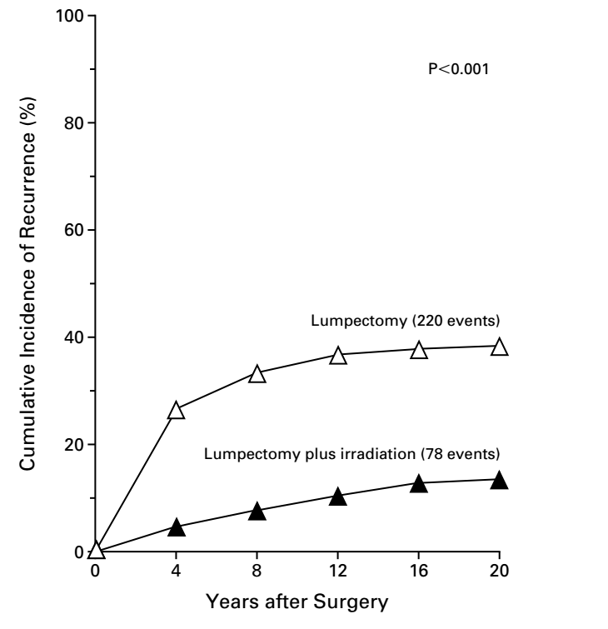
NSABP B-06
Effect of XRT on IBTR (20-Years)
7
 | IBTR %
 | LUMP | LUMP + XRT
All Patients | 39% | 14%
Node-Negative | 36% | 17%
Node-Positive* | 44% | 9%
*Received Adjuvant Chemotherapy
Fisher B et al. N Engl J Med. 2002;347(16):1233-1241.

Slide 8
NSABP B-06
Effect of XRT on IBTR (20-Years)
8
 | IBTR %
 | LUMP | LUMP + XRT
All Patients | 39% | 14%
Node-Negative | 36% | 17%
Node-Positive* | 44% | 9%
*Received Adjuvant Chemotherapy
Fisher B et al. N Engl J Med. 2002;347(16):1233-1241.

Slide 9
9
Tamoxifen and XRT
for Occult Breast Cancer
NSABP B-21
Tumors < 1 cm
Treated with Lumpectomy
Breast XRT
Placebo
Breast XRT
Tamoxifen
Tamoxifen
8-Yr IBTR
9.3%
2.8%
16.5%
Fisher B et al. J Clin Oncol. 2002;20(20):4141-4149.

Slide 10
10
NSABP Trials in Patients with DCIS
B-43:
Lumpectomy + XRT
+ Trastuzumab
B-35:
Lumpectomy + XRT
TAM vs. Anastrozole
B-24:
Lumpectomy + XRT
Placebo vs. TAM
B-17:
Lumpectomy + XRT

Slide 11
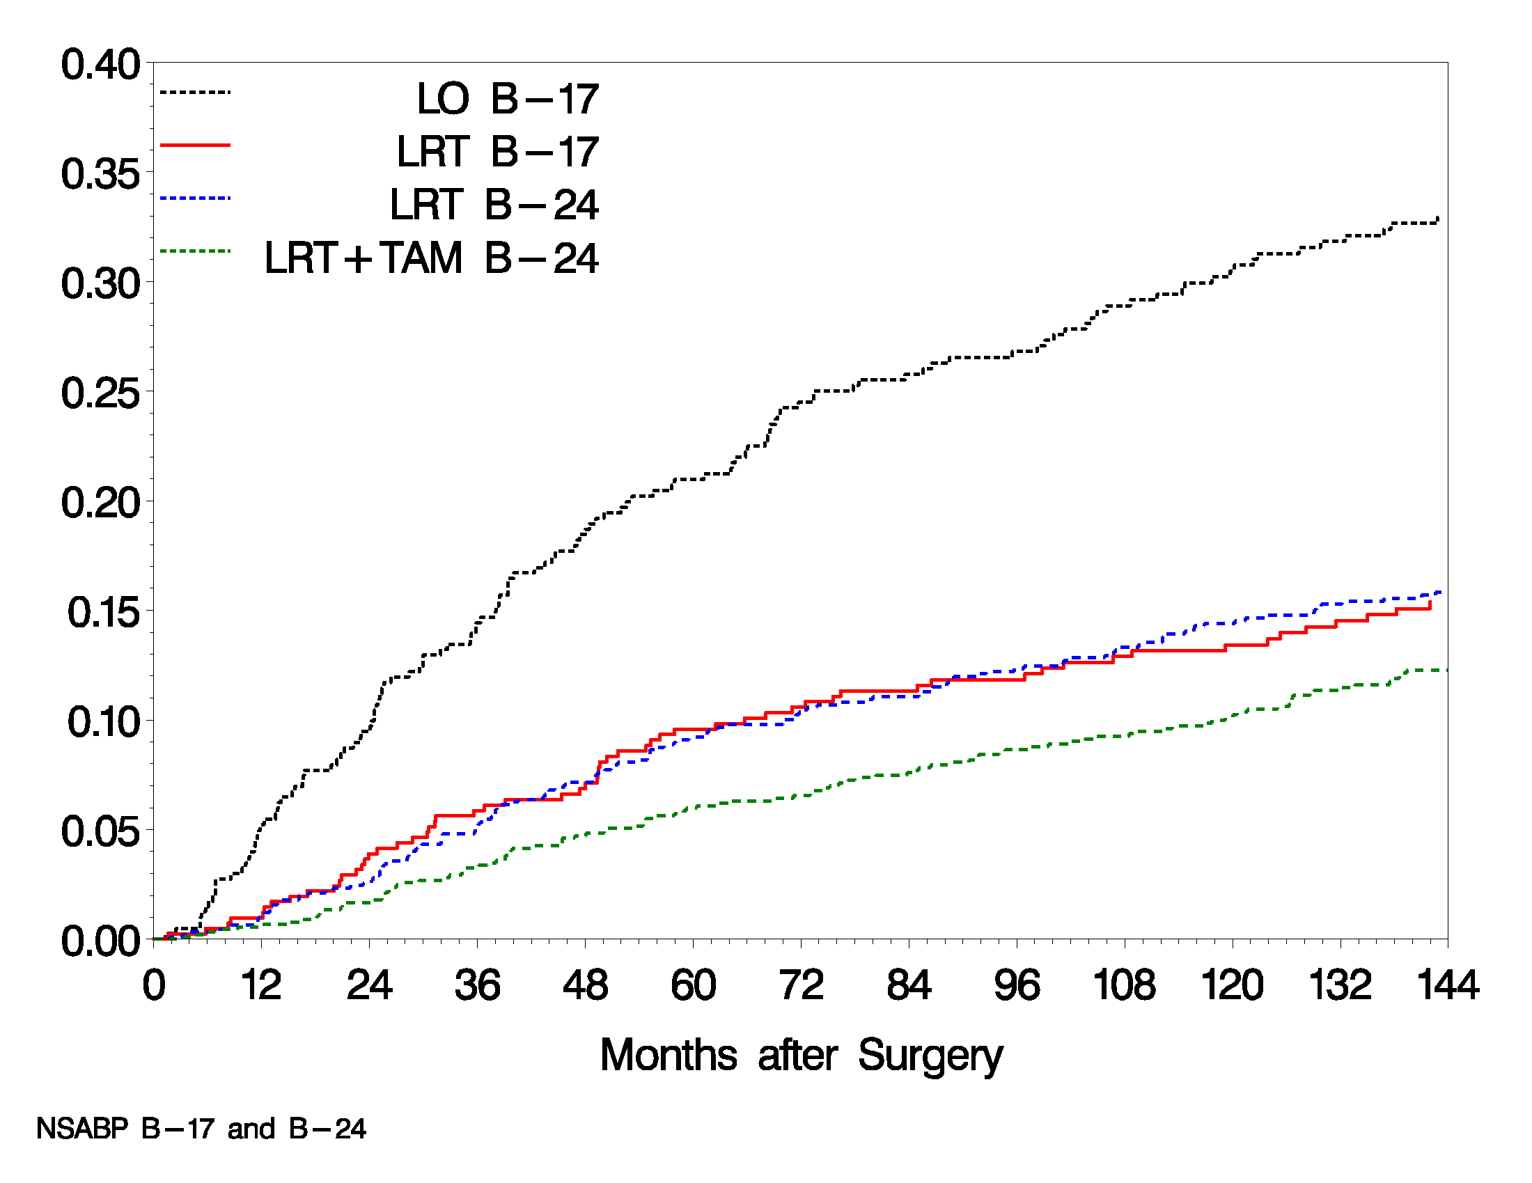
NSABP B-17 and B-24
12-Yr Cumulative Incidence of IBTR
11
33%
16%
12%
Wapnir IL et al. J Natl Cancer Inst. 2011;103(6):478-488.

Slide 12
NSABP B-17 and B-24
12-Yr Cumulative Incidence of IBTR
12
33%
16%
12%
Wapnir IL et al. J Natl Cancer Inst. 2011;103(6):478-488.

Slide 13
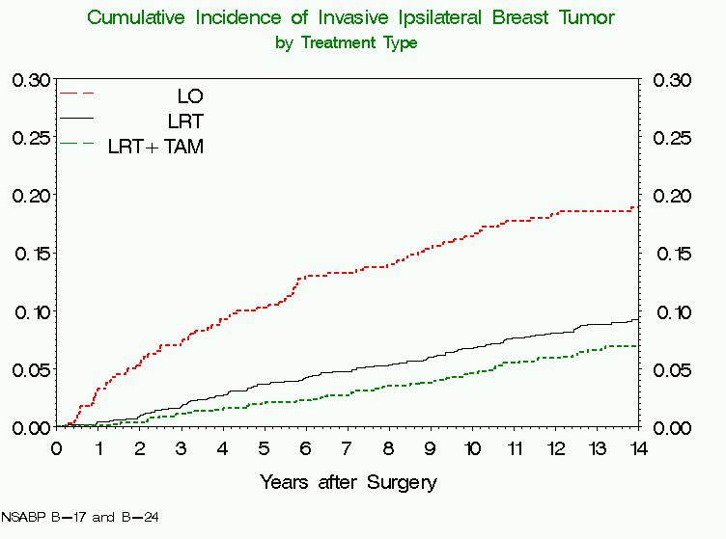
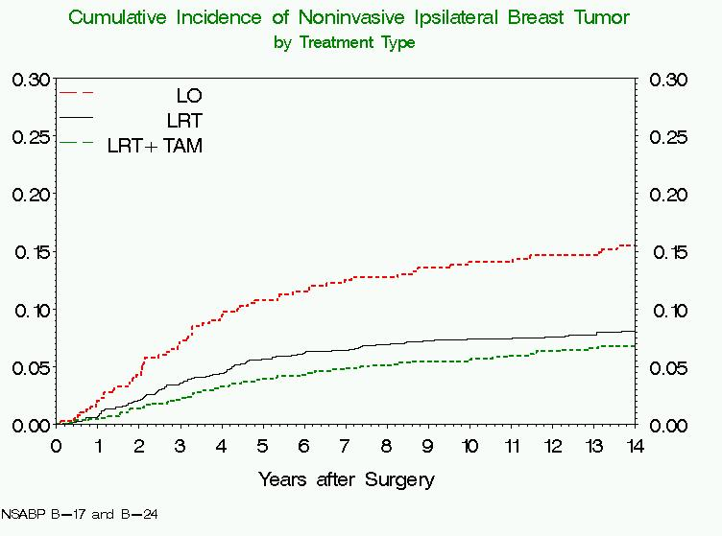
NSABP B-17 and B-24
12-Yr Cumulative Incidence of IBTR
13
Invasive IBTR
Non-Invasive IBTR
Wapnir IL et al. J Natl Cancer Inst. 2011;103(6):478-488.

Slide 14
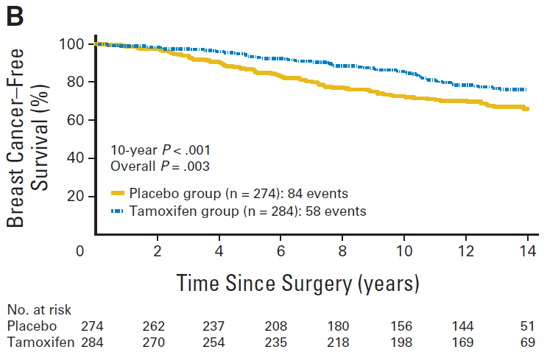
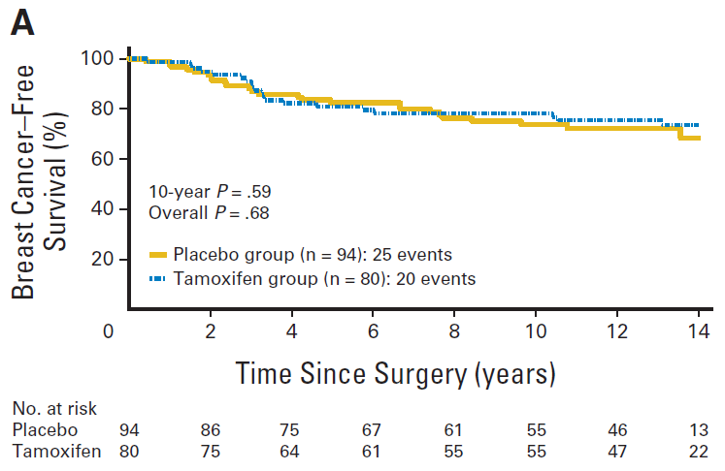
NSABP B-24
Effect of Tamoxifen by ER-Status
14
ER-Positive
ER-Negative
Allred DC et al. J Clin Oncol. 2012;30(12):1268-1273.

Slide 15
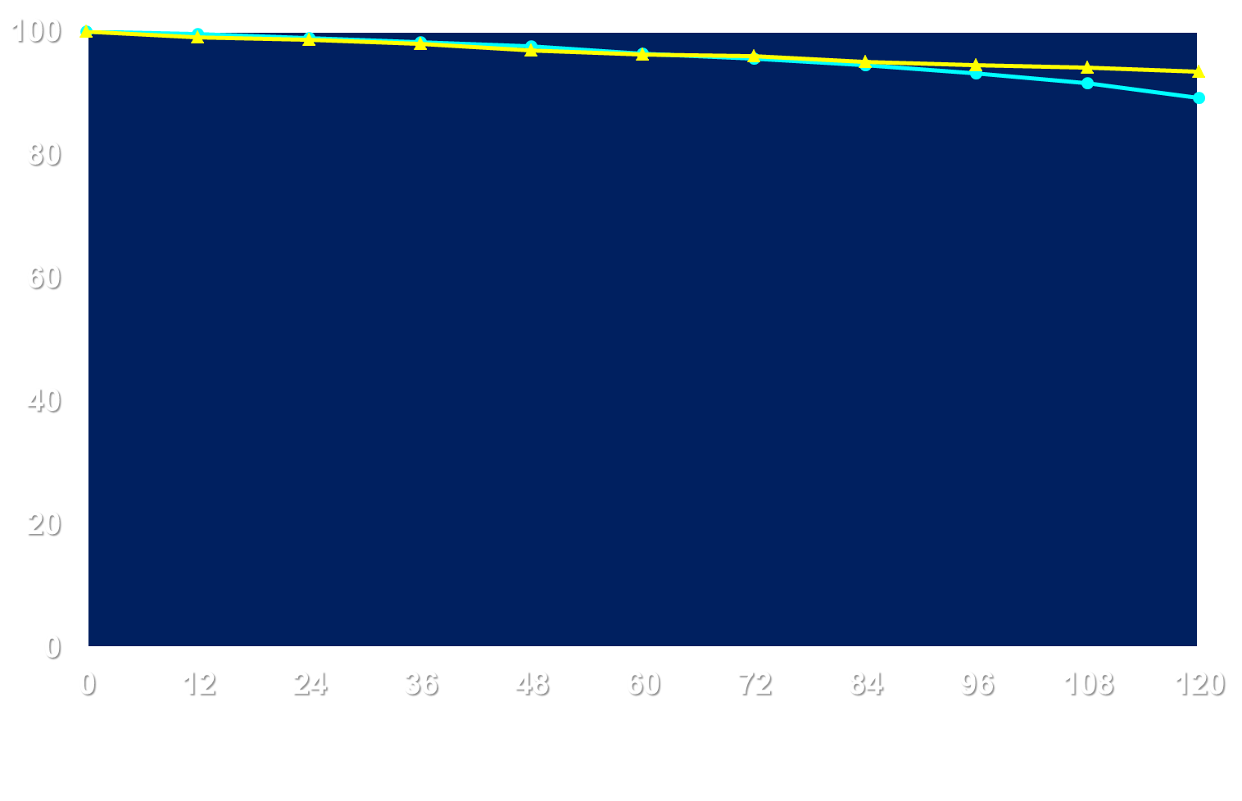
15
B-35:
Anastrozole vs. Tamoxifen
93.5%
89.2%
Breast Cancer-Free Interval
Event-Free %
At Risk by Year # of %
Treatment 0 6 10 Events 10 yrs HR P-value
Tamoxifen 1538 1241 248 114 89.2
Anastrozole 1539 1261 293 84 93.5 0.73 .03
Time from Randomization (months)
Margolese RG et al. Lancet. 2016;387(10021):849-856.

Slide 16

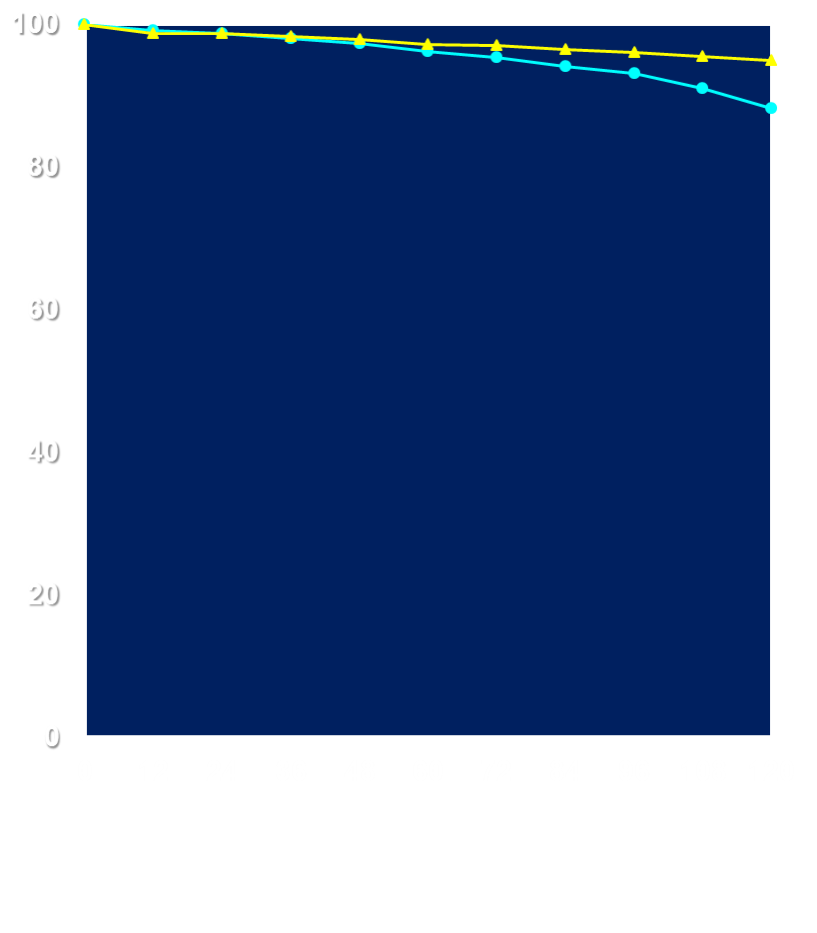
16
B-35: BCFI by Age Group
< 60 years
≥ 60 years
94.9%
92.2%
88.2%
90.2%
Event-Free %
Event-Free %
Treatment N Events HR P-value
Tamoxifen 722 58
Anastrozole 725 31 0.52 .003
Treatment N Events HR P-value
Tamoxifen 816 56
Anastrozole 814 53 0.95 .77
Time From Randomization (months)
Margolese RG et al. Lancet. 2016;387(10021):849-856.

Slide 17
17
B-35: BCFI by Age Group
< 60 years
≥ 60 years
94.9%
92.2%
88.2%
90.2%
Qualitative Treatment
by Age Interaction
P = .04
Event-Free %
Event-Free %
Treatment N Events HR P-value
Tamoxifen 722 58
Anastrozole 725 31 0.52 .003
Treatment N Events HR P-value
Tamoxifen 816 56
Anastrozole 814 53 0.95 .77
Time From Randomization (months)
Margolese RG et al. Lancet. 2016;387(10021):849-856.

Slide 18
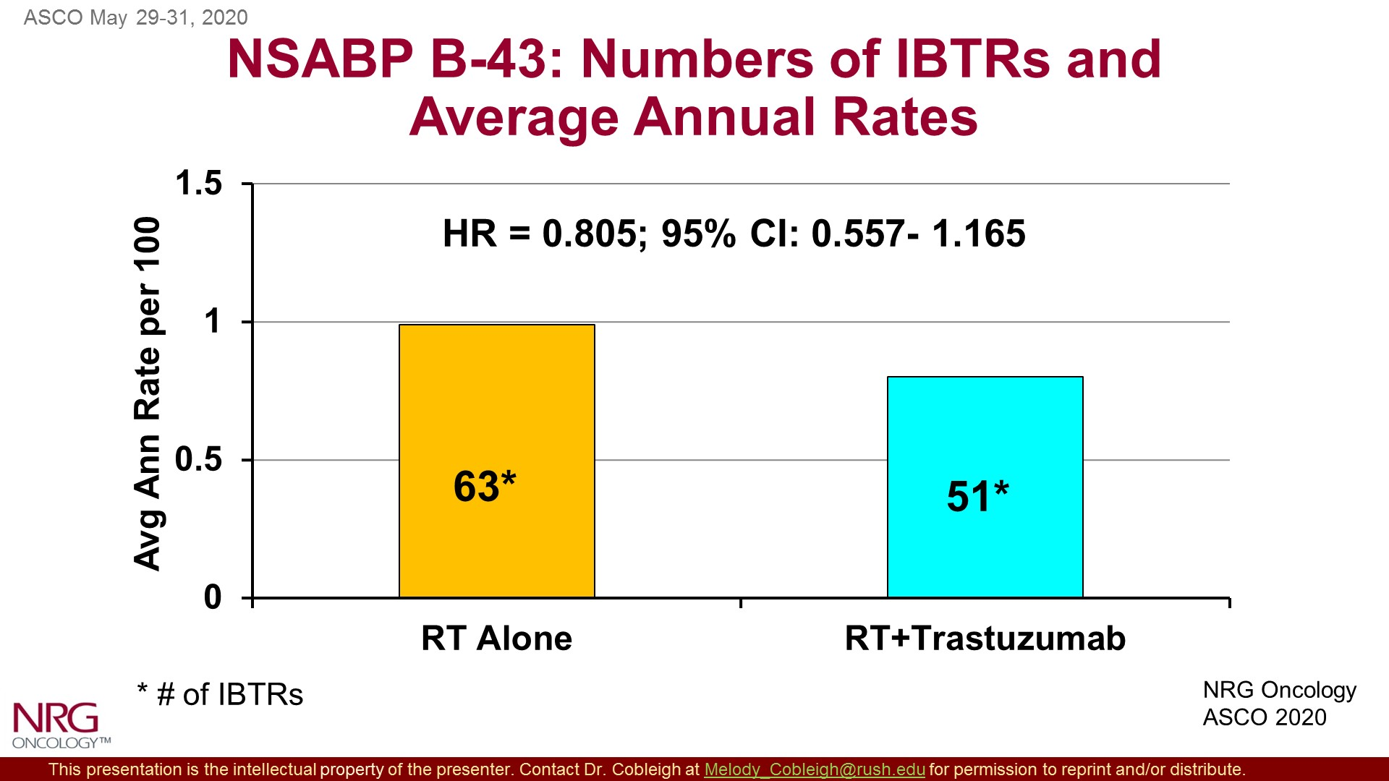
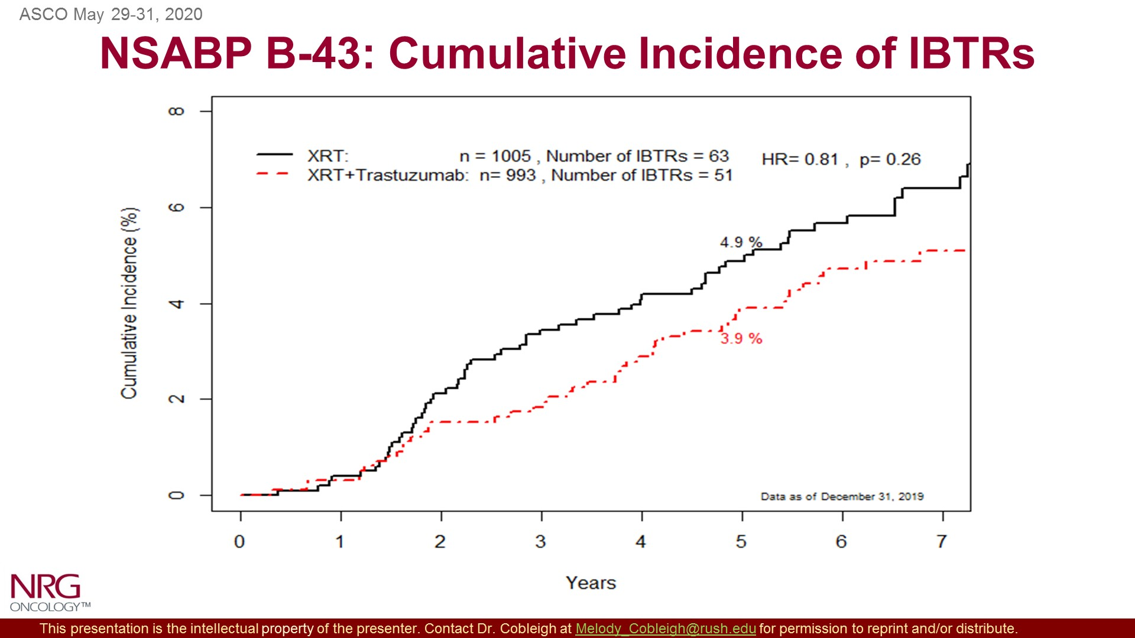
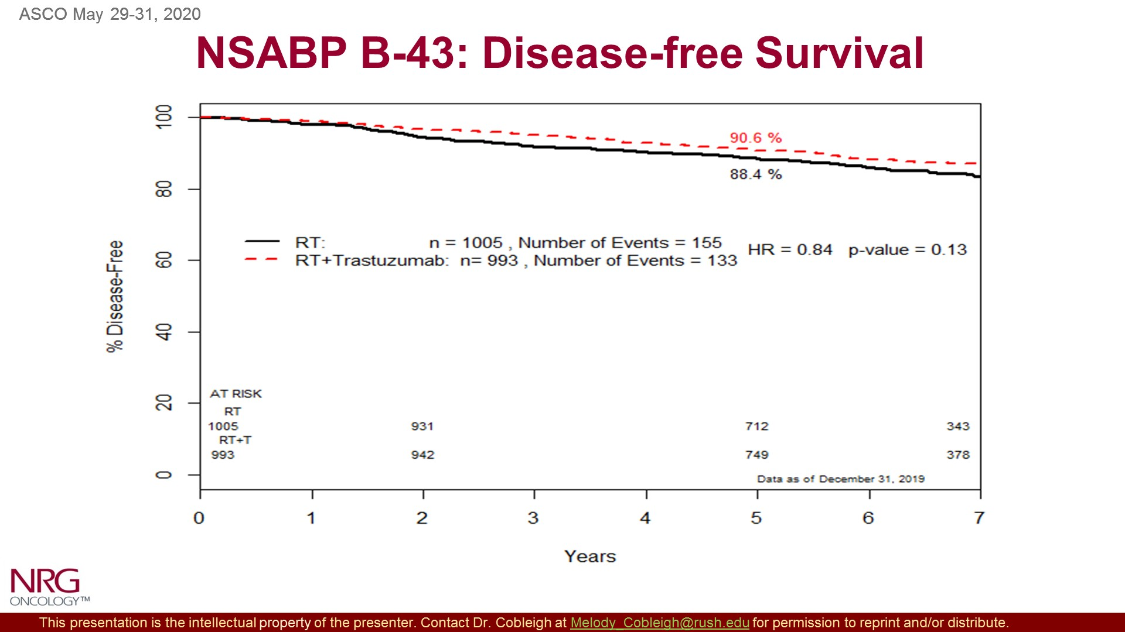
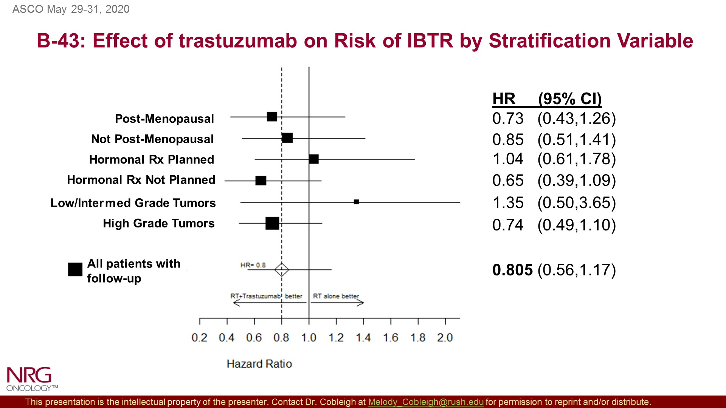
NSABP B-43: Results
18
Cobleigh MA et al. ASCO 2020, Abstract 508; Cobleigh MA et al. J Clin Oncol, 2021;39(21):2367-2374.

Slide 19
NSABP B-43: Results
19
Cobleigh MA et al. ASCO 2020, Abstract 508; ; Cobleigh MA et al. J Clin Oncol, 2021;39(21):2367-2374.

Slide 20
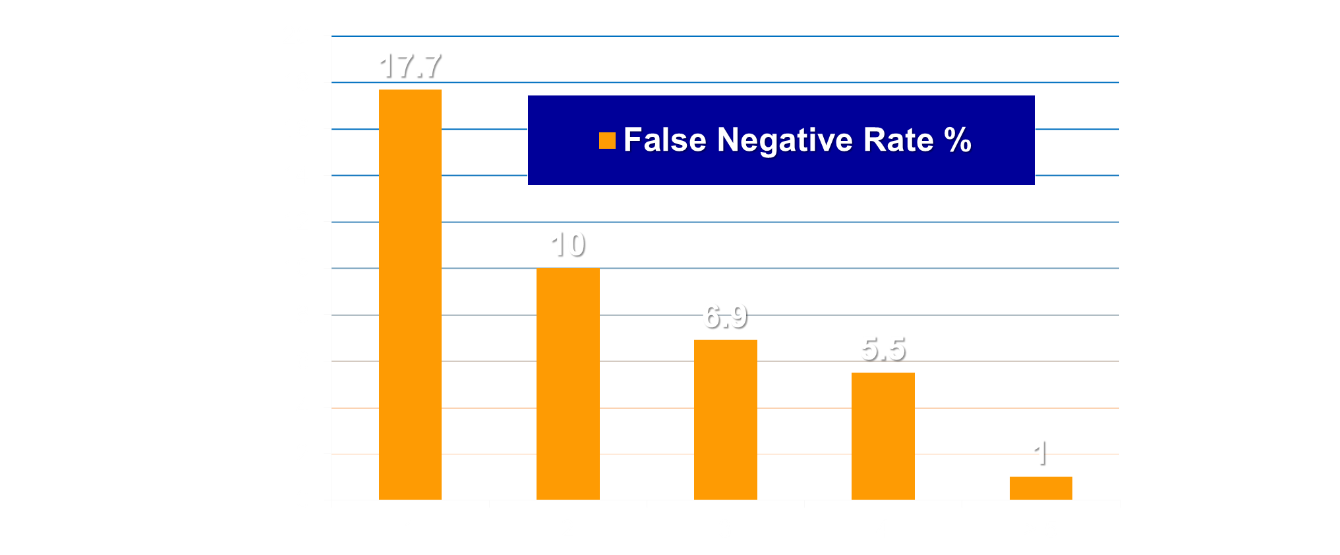
FN Rate According to
Number of Removed SNs
NSABP B-32:
Sentinel Lymph Node Biopsy
20
Clinically Negative Axillary Nodes
N=5611
ID Rate: 97%
FN Rate: 9.8%
Average # SLNS: 2.9
Stratification
Age
Clinical Tumor Size
Type of Surgery
Randomization
GROUP 1
Sentinel Node Biopsy
GROUP 2
Sentinel Node Biopsy*
Axillary Dissection
*Axillary node dissection
only if the SN is positive
Krag DN et al. Lancet Oncol. 2017;8(10):881-888.
Notes:
07/16/96
##
*
*

Slide 21
NSABP B-32 Sentinel Node-Negative Patients
DFS, OS and LRR
21
Treatment N Events
SNR+AD 1975 455
SNR 2011 475
HR = 1.02 P = .72
Treatment N Deaths
SNR+AD 1975 228
SNR 2011 252
HR = 1.09 P = .35
 | SN+AND (N = 1975) | SN (N = 2011)
Local | 75 (3.8%) | 66 (3.3%)
Axillary | 4 (0.2%) | 11 (0.5%)
Extra-axillary | 5 (0.3%) | 4 (0.2%)
Julian T et al. SABCS 2013. Abstract S2-05.

Slide 22
NSABP B-32:
Morbidity With vs. Without ALND
22
P < .001
35
P < .001
30
31
SNR + ALND (n = 1975)
28
SNR (n = 2011)
25
P < .001
20
19
P < .001
Patients (%)
17
15
13
13
10
8
7
5
0
Shoulder
Abduction
Deficit
Arm Volume
Difference
> 5%
Arm
Numbness
Arm
Tingling
Ashikaga T et al. J Surg Oncol. 2010;102(2):111-118.

Slide 23
NSABP B-39/RTOG 0413
Accelerated Partial Breast Irradiation vs. Whole Breast XRT
23
Operable Breast Cancer Treated with Lumpectomy (n=4211)
External Beam
Whole
Breast XRT
Partial
Breast
XRT
  71.0%: 3D Conformal 23.3%: Mammosite
  5.7%: Brachytherapy
Primary endpoint: IBTR rates between whole breast XRT and PBI
Vicini FA et al. Lancet. 2019;394(10215):2155-2164.

Slide 24
B-39: Results
24
RFI
Cumulative Incidence of IBTR
HR 1.33 (95% CI 1.04-1.69); p=0.02
  HR 1.22 90% CI 0.94-1.58
DRFI
HR 1.31 (95% CI 0.91-1.91); p=0.15
Vicini FA et al. Lancet. 2019;394(10215):2155-2164.

Slide 25
B-39: IBTR by PBI Method
25
Treatment Group | # of Pts | # of Events | Hazard Ratio (HR) | HR 95% Confidential Interval | 10-yr Cum Incidence
WBI | 2,011 | 67 | REF |  | 3.8%
PBI
Multi-catheter brachytherapy | 130 | 9 | 2.21 | 1.10 – 4.46 | 7.7%
Single-entry brachytherapy device | 358 | 24 | 2.15 | 1.34 – 3.44 | 7.8%
3DCRT (external beam) | 1,535 | 55 | 1.04 | 0.73 – 1.49 | 3.7%
Analysis used a per-protocol population, which excluded those who did not receive their randomly assigned treatment
Vicini FA et al. Lancet. 2019;394(10215):2155-2164.

Slide 26
26
Optimizing Adjuvant Hormonal Therapy in Early-Stage BC

Slide 27
NSABP ER-Positive Trials
27
B-42:
AI --> LET vs PLAC
B-33:
TAM --> AI vs PLAC
B-20:
TAM vs MFT/CMFT
B-14:
Plac. vs TAM

Slide 28
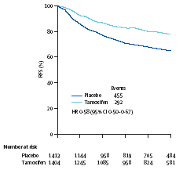
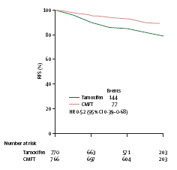
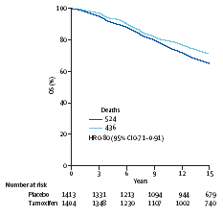
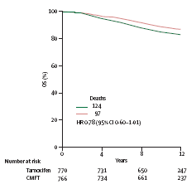
NSABP Node (-), ER (+) Studies
Results
28
B-14
B-20
78%
89%
RFS
RFS
79%
65%
HR: 0.58 (95% CI: 0.50-0.67)
HR: 0.52 (95% CI: 0.39-0.68)
71%
87%
OS
OS
83%
65%
HR: 0.80 (95% CI: 0.71-0.91)
HR: 0.78 (95% CI: 0.60-1.01)
Fisher B et al. Lancet. 2004;364(9437):858-868.

Slide 29
NSABP B-42:
Trial Evaluating Adjuvant AI Duration
29
Postmenopausal, Disease-free,
Stage I, II, or III invasive BC at diagnosis
ER-positive and/or PgR-positive
AI X 5 yrs
Letrozole X 5 yrs
TAM X 2-3 yrs
AI X 3-2 yrs
Placebo X 5 yrs
Primary Endpoint
    Disease-free survival
Secondary Endpoints
Overall survival
Time to treatment failure
Osteoporosis-related fractures
Accrual: 3966 pts

Slide 30
NSABP B-42: 10-Year Results
30
DFS
OS
*P-value at 7-yrs did not reach statistical
significance level of .0418
Mamounas, EP et al. J Natl Cancer Inst. 2023;115(11):1302-1309.

Slide 31
31
NSABP B-42: 10-Year Results
BCFI
DRFI
Mamounas, EP et al. J Natl Cancer Inst. 2023;115(11):1302-1309.

Slide 32
32
Identifying Prognostic and Predictive Factors for Outcome and Response to Therapy

Slide 33
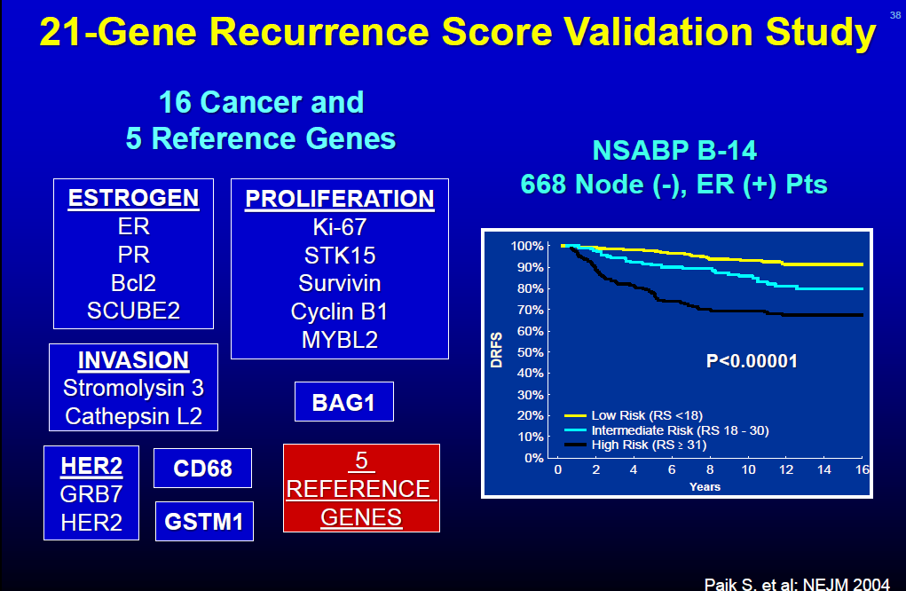
33
21-Gene Recurrence Score Validation Study
Paik S et al. J Clin Oncol. 2006;24(23):3726-3734.

Slide 34
NSABP B-20: Chemotherapy Benefit
By Recurrence Score Category
34
10 yr
96%
95%
89%
Low Risk (RS < 18)
Interm. Risk (RS 18–30)
90%
P = .76
P = .71
88%
High Risk
(RS ≥ 31)
60%
P = .001
Paik S et al. J Clin Oncol. 2006;24(23):3726-3734.

Slide 35
TAM-Treated Patients (B-14/B-20, n=895)
RS and Loco-Regional Failure
35
40
RS < 18
RS 18-30
RS >31
30
P < .0001
Rate of LRF %
20
15.8
10
7.2
4.3
0
0
2
4
6
8
10
Time in Years
Mamounas EP et al. J Clin Oncol. 2010;28(10):1677-1683.

Slide 36
RS in B-28: Effect of RS on LRR
36
0.5
N | LRR Events
386 | 16
364 | 25
315 | 39
RS Low
RS Intermediate
RS High
0.4
0.3
Cumulative Incidence Rate
P < .001
0.2
12.3%
0.1
7.2%
3.3%
0.0
0
2
4
6
8
10
Time in Years
Mamounas EP et al. J Natl Cancer Inst. 2017;109(4):djw259.

Slide 37
MA.39: Tailor RT
37
1-3 (+) axillary nodes*
Post-BCS or mastectomy
ER +ve biomarker low risk**
Rx with endocrine therapy x 5 years
Regional RT
BCS: WBI + regional nodes
Mastectomy: Chest wall + nodes
®
No Regional RT
BCS – WBI
Mastectomy – no RT
    Stratification
Mastectomy or BCS
Axillary dissection – yes/no
Adjuvant chemo – yes/no
Oncotype DX RS (0-10, 11-17)
N = 2140
* Patients may be treated with ALND with 1-3 positive nodes (macro mets) or SLNB alone: post-BCS with 1-2 positive sentinel nodes (macro mets) or post-mastectomy with only 1 positive SN (macro mets).
**Defined as Oncotype DX recurrence score < 18 PI: T. Whelan
Parulekar WR et al. ASCO 2019. Abstract TPS602.

Slide 38
38
Optimizing Adjuvant Chemotherapy in
Early-Stage BC

Slide 39
NSABP: Node-Negative, ER-Negative
Protocols
39
B-36*:
AC vs FEC+/- CEL
*ER-/ER+
B-23:
CMF vs AC+/- TAM
B-19:
MF vs CMF
B-13:
Surg. vs MF

Slide 40
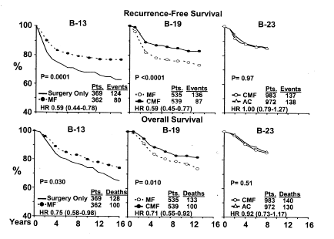
NSABP Node (-), ER (-) Studies
Results
40
Fisher B et al. J Natl Cancer Inst. 2004;96(24):1823-1831.

Slide 41
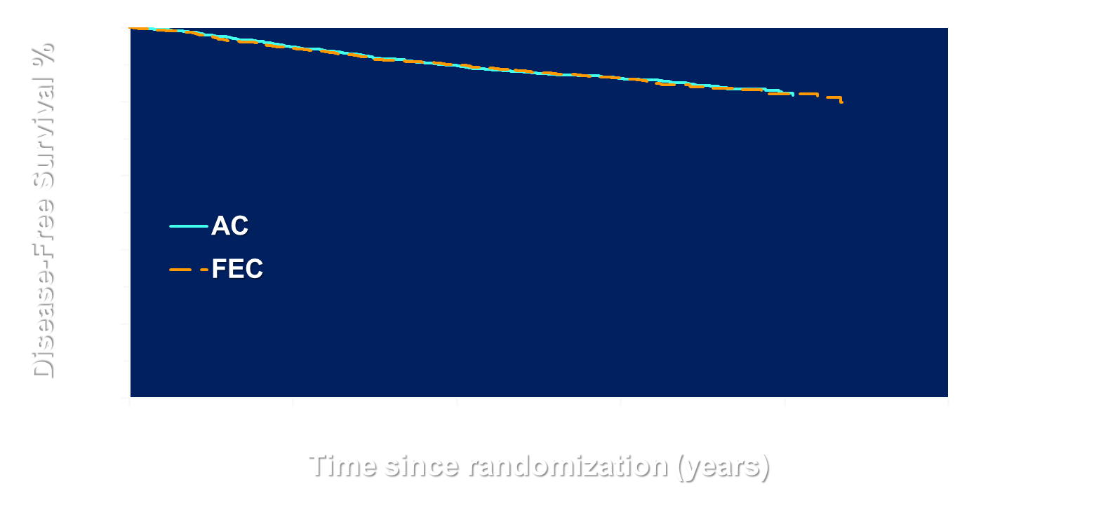
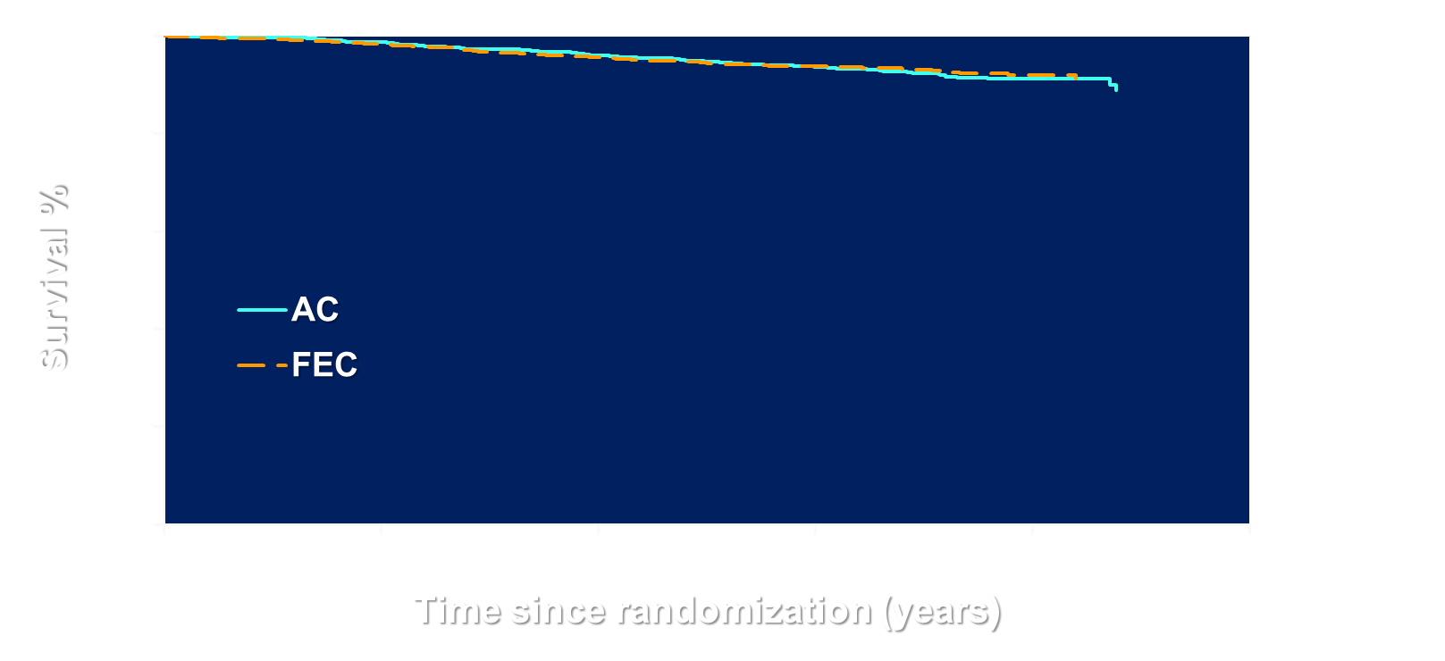
NSABP B-36
Disease Free Survival and Overall Survival
41
N | Events | 8 Yr DFS
1361 | 198 | 82.3%
1361 | 202 | 82.1%
No. | Deaths | 8 Yr OS
1361 | 100 | 91.2%
1361 | 92 | 92.0%
HR | P-value
1.03 | .74
HR | P-value
0.94 | 0.65
Geyer CE et al. SABCS 2014. Abstract S3-02
Geyer CE et al: Breast Ca Res Treat 2022;193:555–564

Slide 42
42
NSABP Node-Positive Trials
Evaluating Adjuvant Taxanes
B-38:
TAC X 6 vs.
dd AC→T vs.
dd AC→TG
N = 5351
B-30:
AC→T vs.
AT X 4 vs. TAC X 4
N = 4800
N = 3059
B-28:
AC vs.
AC→T

Slide 43
ABC Trials Schema
43
Node+ or High-Risk Node-Negative
A
ARM 1 (TaxAC Options)
ARM 2 (TC)
TAC q 3 wk
TC q 3 wk
B
AC q 3 wk
PTX q 1 wk
Arm 1 Options Per Study
USOR 06-090 - 1A only
NSABP B-46I/USOR 07132 - 1A only
NSABP B-49 - investigator choice 1A-1D
Endocrine therapy for ER+ or PgR+ patients for minimum of 5 years
C
AC q 2 wk
PTX q 1 wk
D
AC q 2 wk
PTX q 2 wk
Blum JL et al. J Clin Oncol. 2017;35(23):2647-2655.

Slide 44
ABC Trials: Invasive Disease Free Survival
44
100
80
60
Treatment N Events at 4 yr
Alive and Inv. Disease-free (%)
TC 2094 220 88.2%
Δ=2.5%
TaxAC 2062 179 90.7%
40
HR=1.23, 95% CI (1.01-1.50) P = .04
20
2005 1599 1014 858 594 358 136
1965 1575 1007 847 566 317 132
0
0
1
2
3
4
5
6
7
Years from Randomization
Blum JL et al. J Clin Oncol. 2017;35(23):2647-2655.

Slide 45
Forest Plot of IDFS By Hormone and Nodal Status
45
Nodes(+) ER/PgR Neg
HR 95% CI
Int. P
0
1.31 0.86-1.99
1-3
1.58 0.90-2.79
.71
4+
1.34 0.62-2.91
Nodes(+) ER or PgR (+)
0
0.69 0.39-1.19
1-3
1.14 0.77-1.69
.026
4+
1.46 0.95-2.26
Overall
1.23 1.01-1.50
0.5
0.6
1.0
1.5
2.0
2.5
3.0
HR = Hazard Ratio
HR Favors TC
HR Favors TaxAC
Blum JL et al. J Clin Oncol. 2017;35(23):2647-2655.

Slide 46
46
Evaluating Novel Targeted Therapies

Slide 47
47
U.S. Adjuvant Trastuzumab Trials
NSABP B-31
NCCTG 9831
Operable Breast Cancer
HER-2 neu Positive
Path Node-Positive
HER 2/Neu Positive
NP/High-Risk NN
Randomization
Paclitaxel weekly X 12
AC x 4
AC x 4
Trastuzumab weekly X 52
Paclitaxel x 4
Paclitaxel x 4
+ Trastuzumab
X 1 year
AC x 4
TAM X 5 years for ER+ or PgR+,
Optional for > 50 yrs. With ER– and PgR–
Opened: 2/00
Opened: 5/00

Slide 48
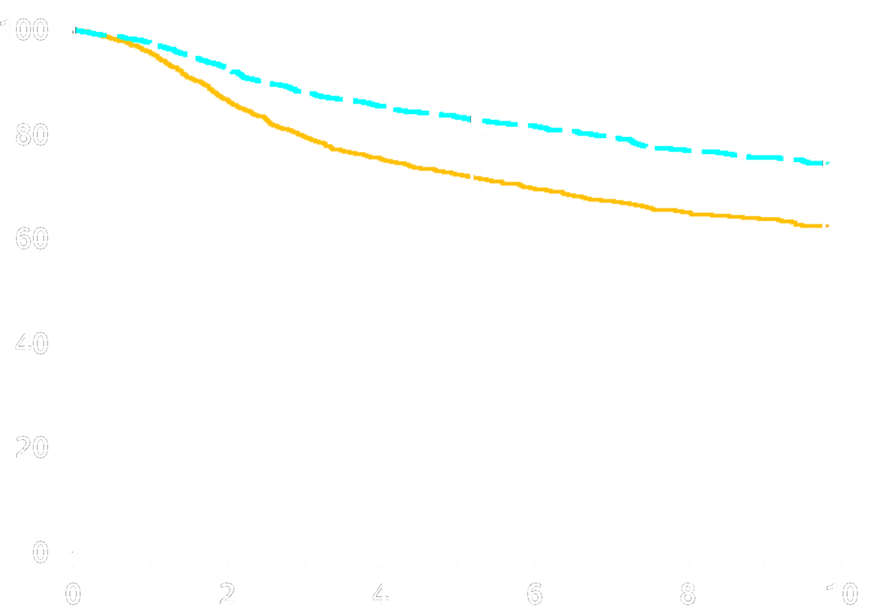
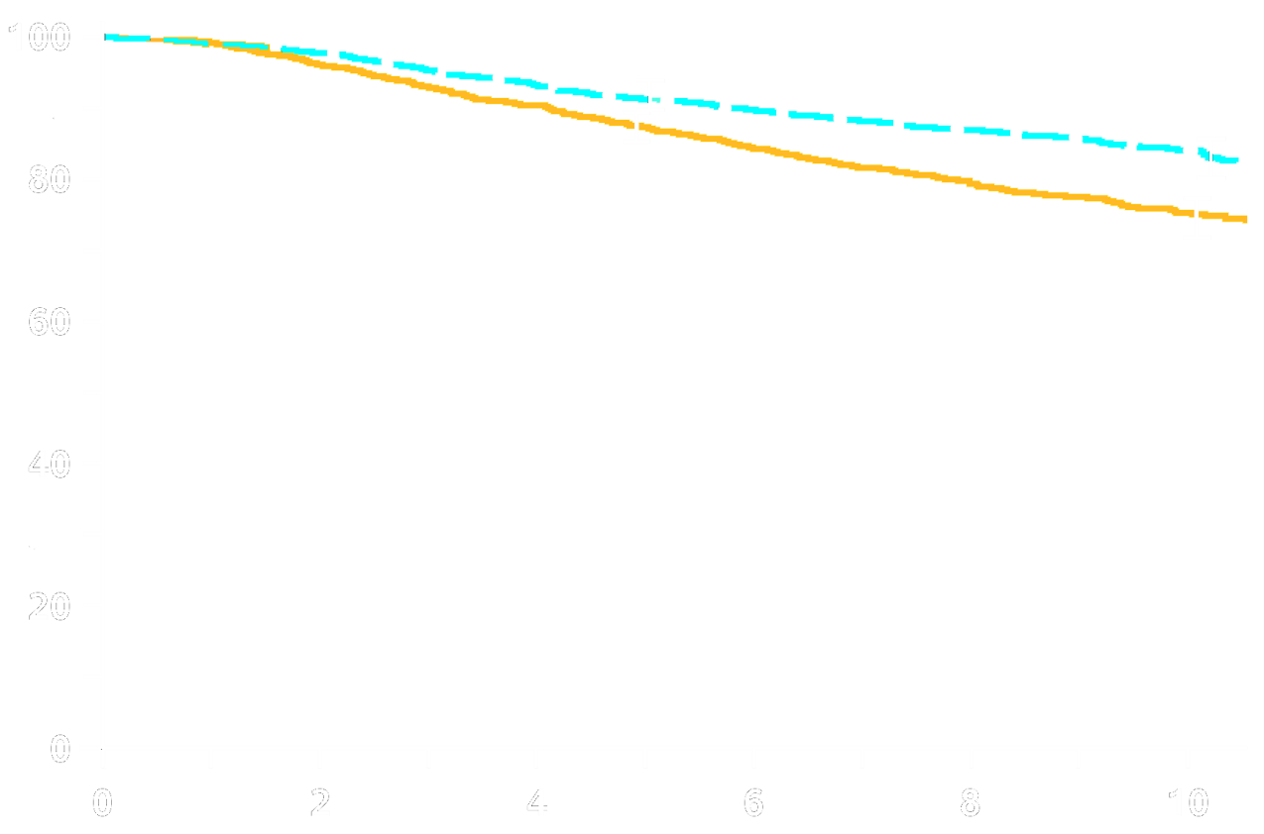
B-31/N9831:
Disease-Free Survival and Overall Survival
48
8.8%
11.5%
N Events
AC→P 2018 418
AC→P+H 2028 286
% Event-Free
N Events
AC→P 2018 680
AC→P+H 2028 473
% Survival
HRadj = 0.60
P < .0001
HRadj = 0.63
P < .0001
Years from Randomization
Years from Randomization
Perez EA et al. J Clin Oncol. 2014;32(33):3744-3752.

Slide 49
49
  Evaluating Neoadjuvant Chemotherapy in Order to Individualize L-R and systemic Therapy and Identify Predictive Markers of Response

Slide 50
50
NSABP Neoadjuvant Trials
B-40/B-41:
Neoadj. Chemo
+/- Biologics
B-27:
Neoadj. AC vs. AC→T
B-18:
Adj. vs.Neoadj. AC

Slide 51
51
B-18: 16-Year Update
DFS
OS
Rastogi P et al. J Clin Oncol. 2008;26(5):778-785.

Slide 52
52
NSABP B-27 Schema
Operable Breast Cancer
(2411 pts)
Randomization
AC x 4
Tam X 5 Yrs
AC x 4
Tam X 5 Yrs
AC x 4
Tam X 5 Yrs
Surgery
Docetaxel x 4
Surgery
Surgery
Docetaxel x 4

Slide 53
53
NSABP B-27 Schema
Operable Breast Cancer
(2411 pts)
Randomization
AC x 4
Tam X 5 Yrs
AC x 4
Tam X 5 Yrs
AC x 4
Tam X 5 Yrs
Surgery
Docetaxel x 4
Surgery
Surgery
Docetaxel x 4
pCR: 13.7%
pCR: 25.6%

Slide 54
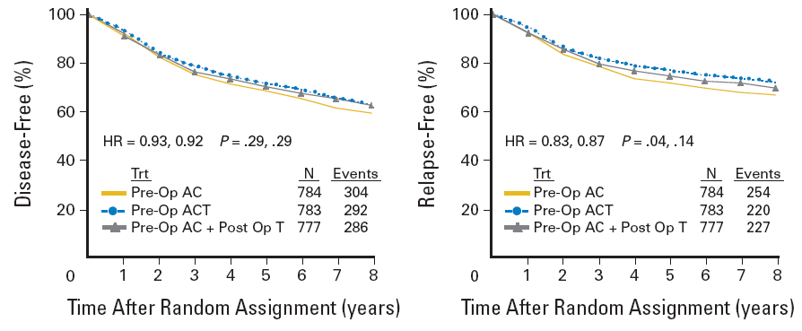
54
B-27: 8-Year Update
DFS
RFS
OS
Rastogi P et al. J Clin Oncol. 2008;26(5):778-785.
Notes:
Rfs PW

Slide 55
Effect of pCR on Overall Survival
55
NSABP B-18
NSABP B-27
Rastogi P et al. J Clin Oncol. 2008;26(5):778-785.

Slide 56
56
NSABP B-18/B-27 Combined Analysis
B-18
B-27
Operable Breast Cancer
Operable Breast Cancer
R
R
Surgery
AC x 4
AC x 4
AC x 4
AC x 4
AC x 4
Surgery
Surgery
Docetaxel x 4
Surgery
Surgery
Docetaxel x 4
Mamounas EP et al. J Clin Oncol. 2012;30(32):3960-3966.

Slide 57
57
NSABP B-18/B-27 Combined Analysis
B-18
B-27
Operable Breast Cancer
Operable Breast Cancer
R
R
Surgery
AC x 4
AC x 4
AC x 4
AC x 4
AC x 4
Surgery
Surgery
Docetaxel x 4
Surgery
Surgery
Docetaxel x 4
3,088 Patients
356 LRR as First Events
Mamounas EP et al. J Clin Oncol. 2012;30(32):3960-3966.

Slide 58
B-18/B-27: Independent Predictors of Loco-regional Recurrence
58
Lumpectomy + XRT (1890 Pts, 190 Events) | Mastectomy (1070 Pts, 128 Events)
Age (>50 years vs. <50 years) | Clinical Tumor Size (>5 cm vs. <5 cm)
Clinical Nodal Status (+) vs. (-) | Clinical Nodal Status (+) vs. (-)
Breast/Nodal Path Status Node(-)/No pCR vs. Node(-)/pCR Node(+) vs. Node(-) /pCR | Breast/Nodal Path Status Node(-)/No pCR vs. Node(-)/pCR Node(+) vs. Node(-) /pCR
Mamounas EP et al. J Clin Oncol. 2012;30(32):3960-3966.

Slide 59
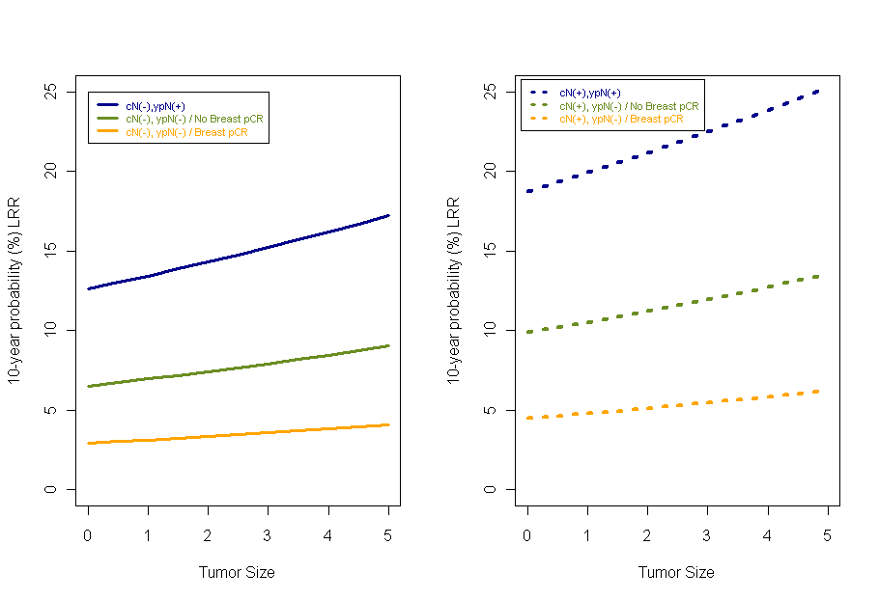
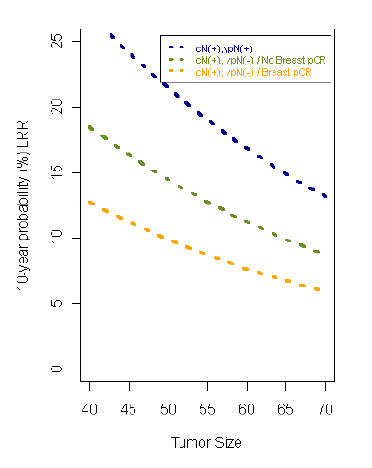
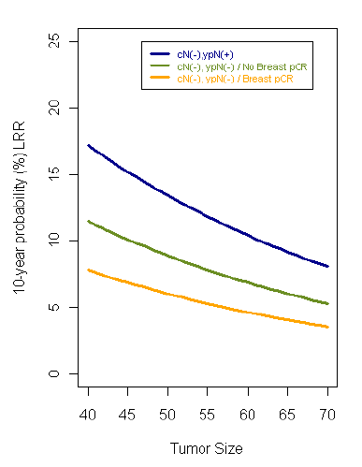
59
Nomogram for Prediction of 10-Year Rate of LRR After Neoadjuvant Chemotherapy:
Lumpectomy + XRT
Mastectomy
Clin N (+)
Clin N (-)
Clin N (-)
Clin N (+)
pN+
pN+
pN+
pN0/No pCR Br
pN+
pN0/No pCR Br
pN0/No pCR Br
pN0/No pCR Br
pN0/pCR Br
pN0/pCR Br
pN0/pCR Br
pN0/pCR Br
Age
Tumor Size
Tumor Size
Age
Age
Age
Mamounas EP et al. J Clin Oncol. 2012;30(32):3960-3966.

Slide 60
NSABP B-51/RTOG 1304
60
Clinical T1-3N1M0 BC
Axillary Nodal Involvement (FNA or Core)
NC (+ Anti-HER-2 Therapy for HER-2 +)
Negative Axillary Nodes at Surgery
Accrual:
1641
Randomization
No Regional Nodal XRT
with Breast XRT if BCS and
No Chest Wall XRT if Mastectomy
Regional Nodal XRT
with Breast XRT if BCS and
Chest Wall XRT if Mastectomy
Mamounas EP, et al: N Engl J Med 2025;392:2113-24.

Slide 61
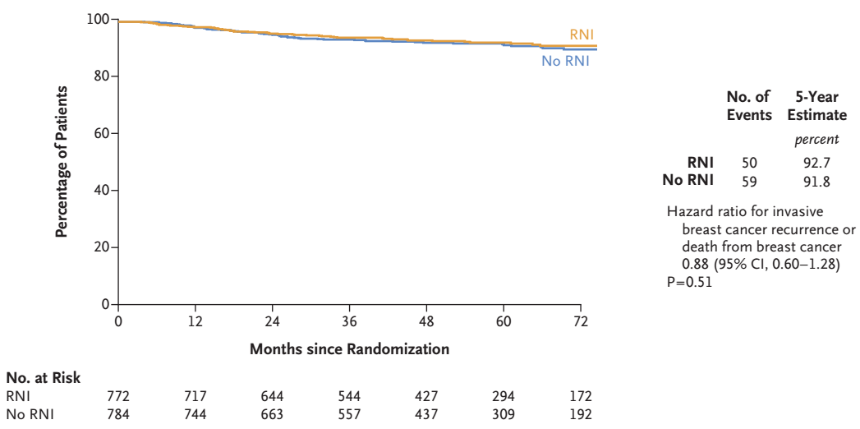
Primary Endpoint
Invasive Breast Cancer Recurrence-Free Interval (IBCRFI)
61
Mamounas EP, et al: N Engl J Med 2025;392:2113-24.

Slide 62
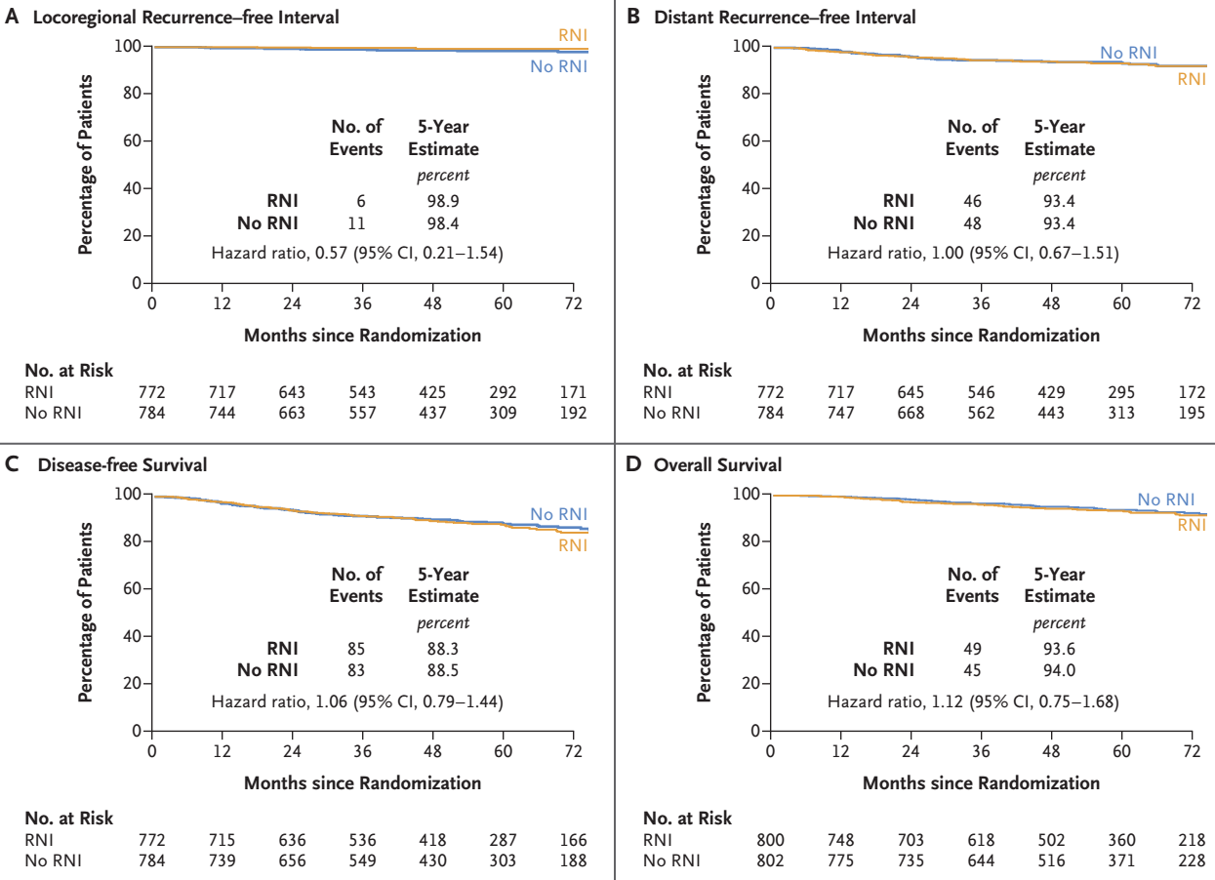
62
Loco-regional Recurrence-Free Interval
Distant Recurrence-Free Interval
Disease-Free Survival
Overall Survival
Mamounas EP, et al: N Engl J Med 2025;392:2113-24.

Slide 63
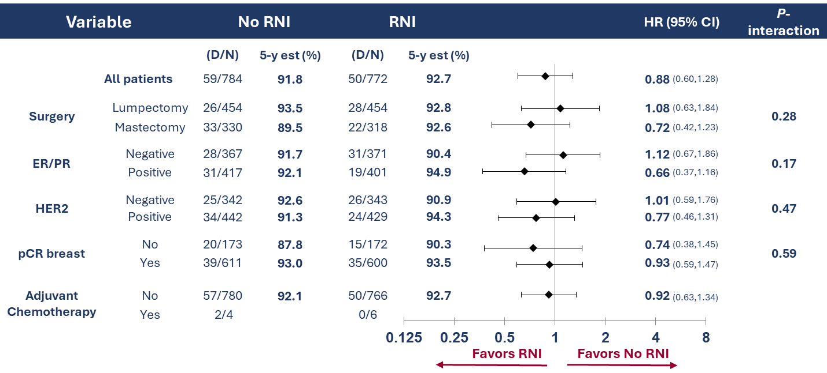
IBCRFI – Subgroup Analysis by Stratification Factors
63
Mamounas EP, et al: N Engl J Med 2025;392:2113-24.

Slide 64
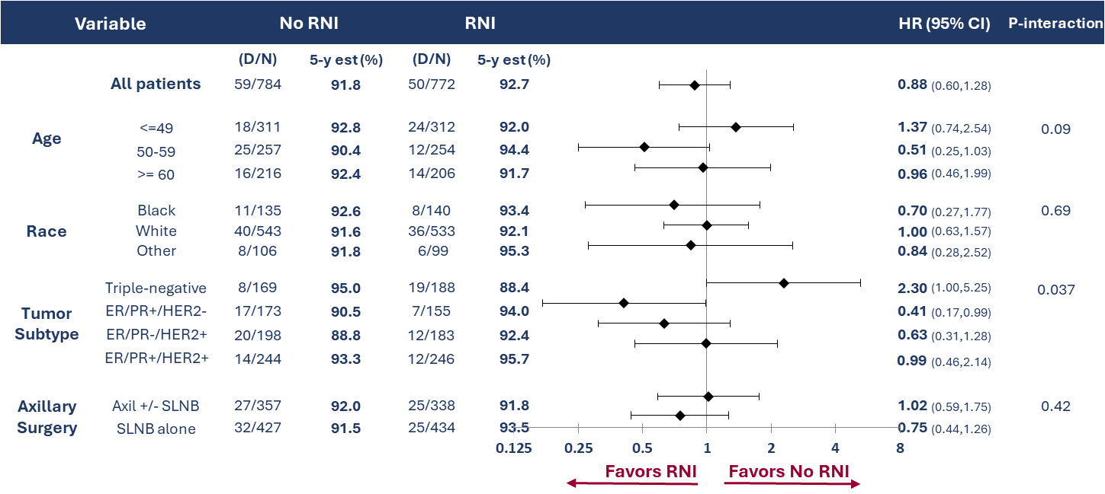
IBCRFI – Exploratory Subgroup Analysis
64
Mamounas EP, et al: N Engl J Med 2025;392:2113-24.

Slide 65
B-51/1304: Conclusions
65
In patients who present with biopsy-proven axillary node involvement (cN+) and convert their axillary nodes to ypN0 after NAC, CWI+RNI after mastectomy, or WBI+RNI after lumpectomy, did not improve the 5-year IBCRFI, LRRFI, DRFI, DFS, or OS
These findings suggest that downstaging involved axillary nodes with neoadjuvant chemotherapy can optimize adjuvant radiotherapy use without adversely affecting oncologic outcomes
Follow-up of patients for long-term outcomes continues
Mamounas EP, et al: N Engl J Med 2025;392:2113-24.

Slide 66
66
NSABP
New Directions with Neoadjuvant Chemotherapy
Use pCR as a correlate of chemotherapy efficacy to test new drugs and regimens (FDA approval pathway)
Utilize NC based on BC subtypes with higher likelihood to achieve pCR such as triple-negative and HER-2 positive
Use the post-neoadjuvant chemotherapy residual disease setting to evaluate novel agents

Slide 67
67
NSABP B-40
Tissue for
Biomarkers
Tissue for
Biomarkers
T
T
T
T
A
A
A
A
C
SURGERY
C
C
C
Operable
Breast
Cancer
T
T
T
T
A
A
A
A
+/-
R
X
X
X
X
C
C
C
C
B
X 10
T
T
T
T
A
A
A
A
G
G
G
G
C
C
C
C
+/-
B
B
B
B
B
B
Accrual:1205 pts
Endpoints: pCR, cCR, DFS, OS, gene expression patterns

Slide 68
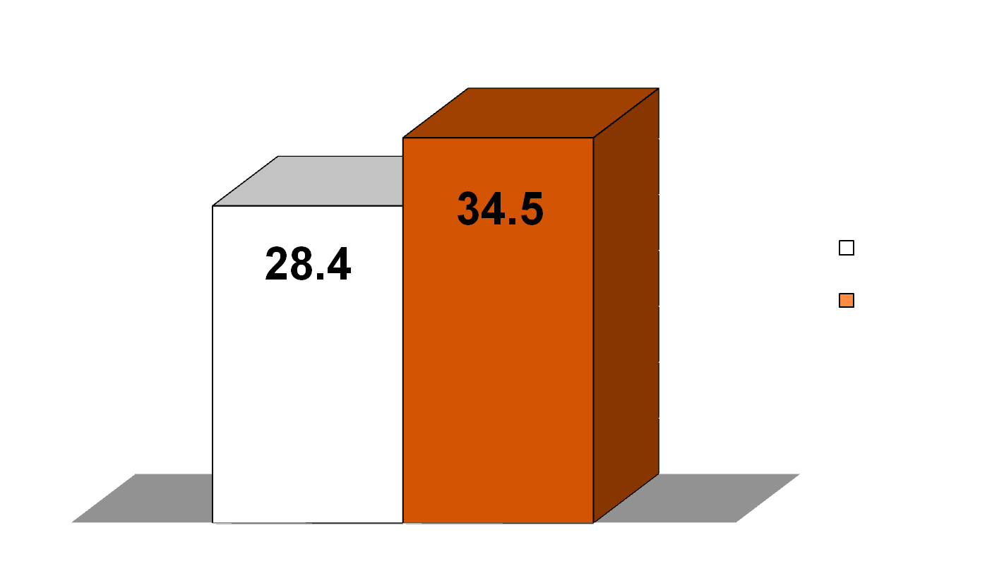
NSABP B-40:
Effect of Bevacizumab on pCR
68
%
N = 592
N = 588
Bear HD et al. N Engl J Med. 2012;366(4):310-320.

Slide 69


69
NSABP B-40:
Effect of Adding Neoadjuvant
and Adjuvant BEV to Neoadjuvant Chemo
Disease-Free Survival
Overall Survival
1.0
1.0
0.8
0.8
P =
.004
0.6
P =
.06
0.6
Proportion of Disease-Free Survival
Proportion of Overall Survival
0.4
0.4
N
Evts
HR (95% CI)
N
Evts
HR (95% CI)
0.2
Without Bevacizumab
With Bevacizumab
593
591
162
136
0.2
Without Bevacizumab
With Bevacizumab
594
592
115
84
0.80 (0.63-1.01)
0.65 (0.49-0.88)
0.0
0.0
0
1
2
3
4
5
0
1
2
3
4
5
Time in Years
Time in Years
Bev marginally increased DFS (HR = 0.80, P = .06)
Bev significantly increased OS (HR = 0.65, P = .004)
Bear HD et al. Lancet Oncol. 2015;16(9):1037-1048.

Slide 70
70
NSABP B-59/GBG 96-GeparDouze
TNBC Diagnosed by Core Needle Biopsy with Palpable Breast Mass ≥ 2.0 cm
RANDOMIZATION
Arm 1
Carbo q3wk x 4 + WP x 12 + Placebo
AC/EC X 4 + Placebo
Arm 2
Carbo q3wk x 4 + WP x 12 + Atezolizumab
AC/EC x 4 + Atezolizumab
SURGERY
(lumpectomy or mastectomy) and axillary staging
Arm 1
Placebo to complete 1 Year
Arm 2
Atezolizumab to complete 1 year
Accrual: 1550
Geyer CE et al: SABCS 2024

Slide 71
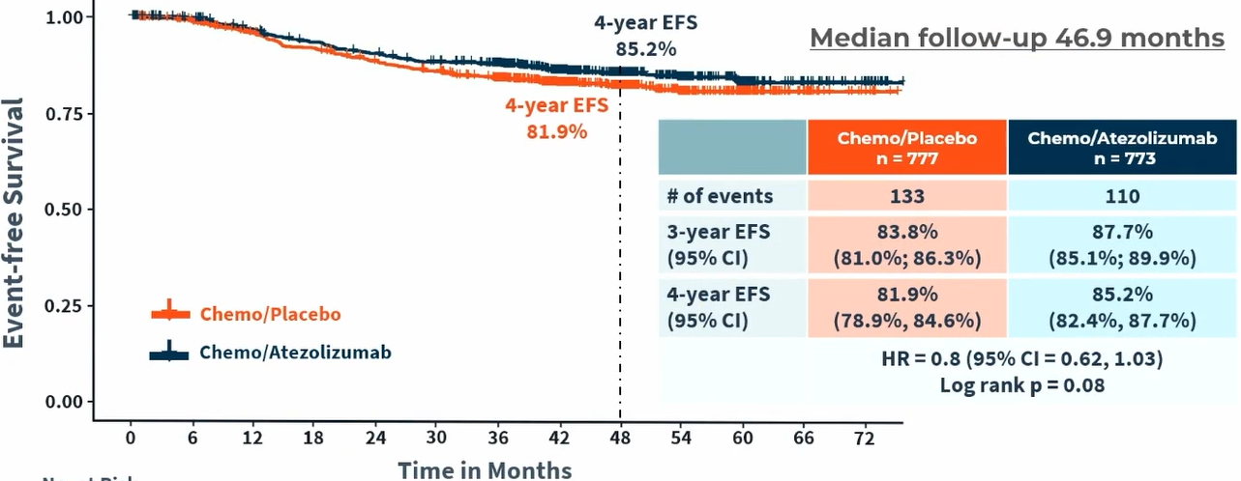
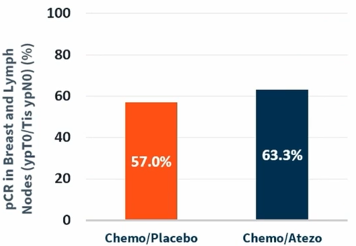
71
NSABP B-59/GBG 96-GeparDouze
pCR
EFS
∆=6.3% P=0.0091
Geyer CE et al: SABCS 2024

Slide 72
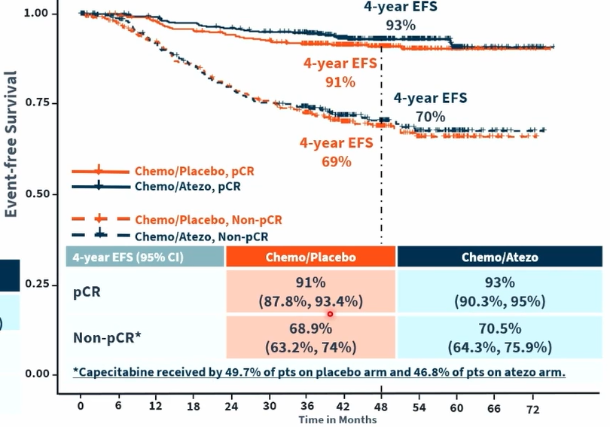
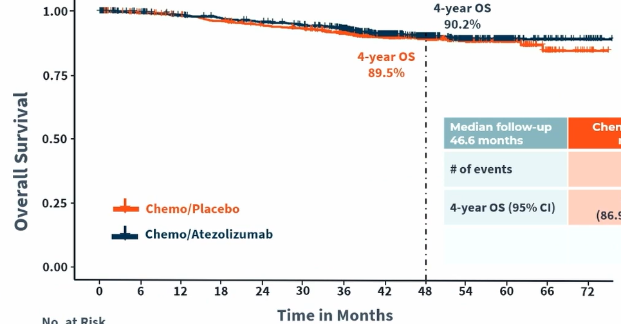
72
NSABP B-59/GBG 96-GeparDouze
EFS by pCR status
Overall Survival
pCR ∆=2%
No-pCR ∆=1%
HR =0.86 ( 95% CI 0.62-1.19)
Geyer CE et al: SABCS 2024

Slide 73
Post-Neoadjuvant Chemo Residual Disease Setting is Ideal for Evaluating New Agents
73
Enroll only high-risk patients with tumors that are proven to be resistant to existing therapies
  Experimental therapy justified
Adjuvant setting with standard clinical endpoints recognized by FDA
High event rate
  Small sample size, short follow up
Prognostic profiling data from cells that matters (chemo-resistant cells)

Slide 74
74
KATHERINE Trial:
T-DM1 in HER2+ BC with Residual Disease after NAC
cT1-4/N0-3/M0 at presentation (cT1a-b/N0 excluded)
Centrally confirmed HER2-positive BC
Neoadjuvant RX:
  Minimum of 6 cycles of chemo
  Minimum of 9 weeks of taxane
  Anthracyclines and alkylating agents allowed
  All chemotherapy prior to surgery
  Minimum of 9 weeks of trastuzumab
  Second HER2-targeted agent allowed
Residual invasive tumor in breast or axillary nodes
Randomization within 12 weeks of surgery
T-DM1
3.6 mg/kg IV Q3W
14 cycles
R
1:1
Trastuzumab
6 mg/kg IV Q3W
14 cycles
N=1486
Radiation and endocrine therapy per protocol and local guidelines
Von Minckwitz G et al: N Engl J Med. 2019;380(7):617-628.

Slide 75
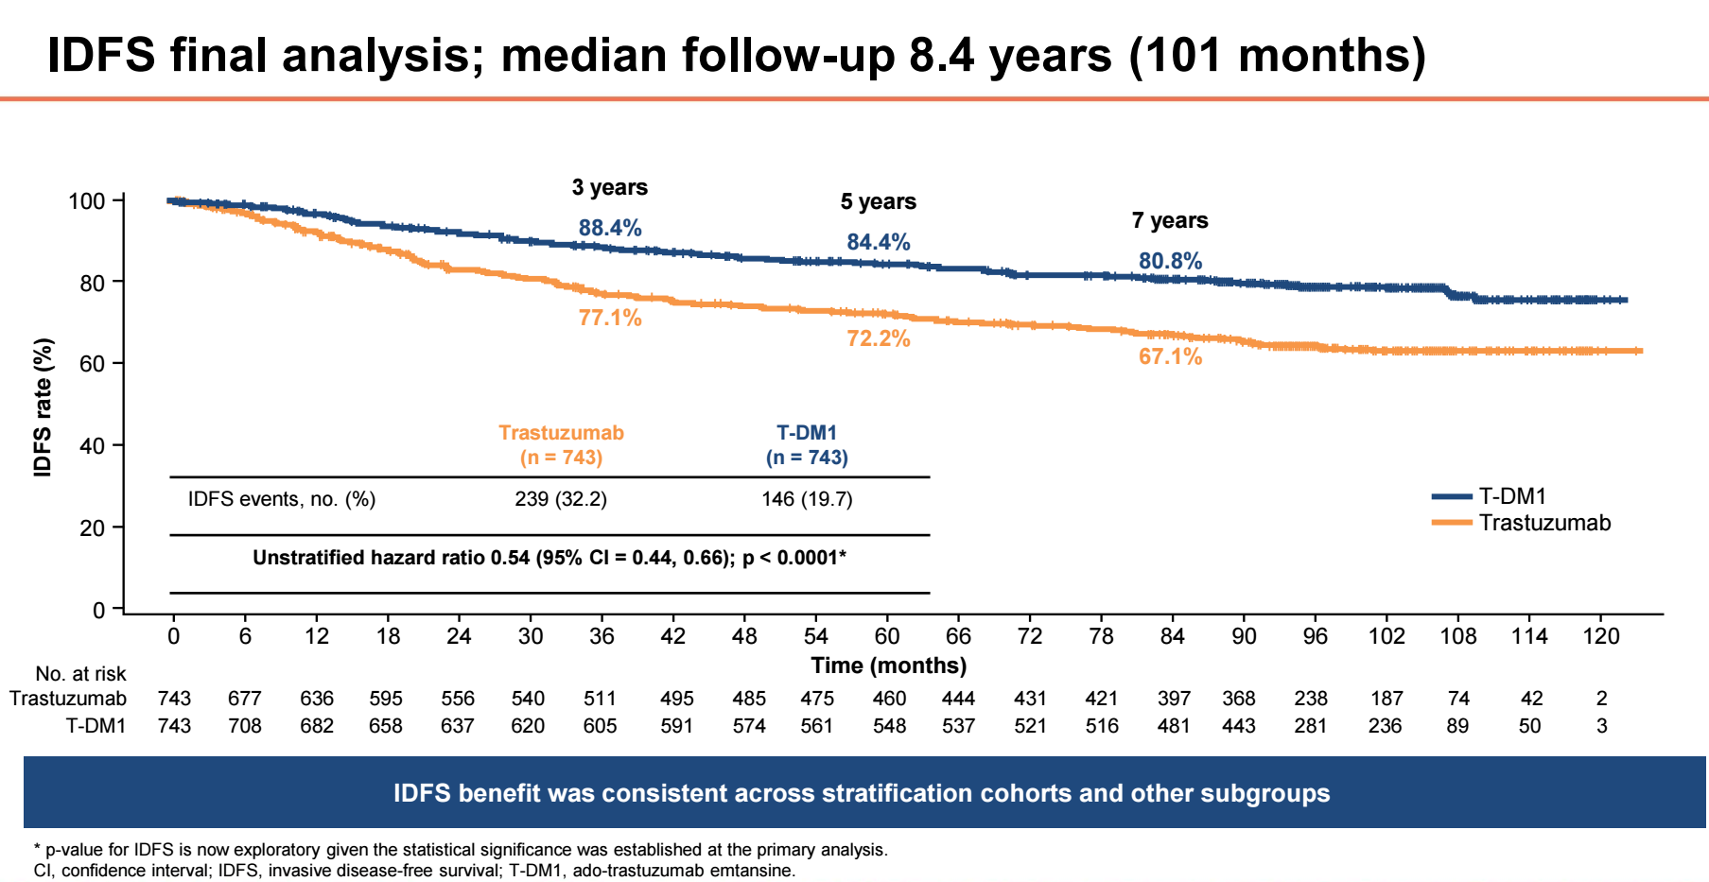
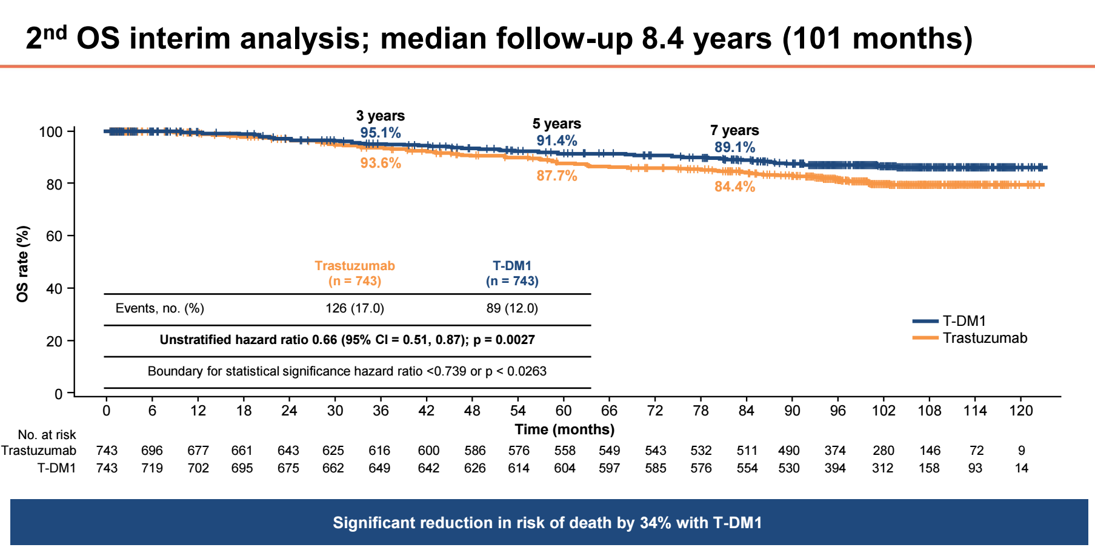
75
KATHERINE:
Updated IDFS and Overall Survival Analysis
Loibl, S, et al: SABCS 2023; Geyer CE, et al: N Engl J Med. 2025;392(3):249-257.

Slide 76





OlympiA Trial:
Adjuvant Olaparib in Patients with BRCA mutations
76
Neoadjuvant group
TNBC: non-pCR
Hormone receptor–positive:
non-pCR and CPS+EG score ≥ 3
Olaparib
300 mg twice daily
for 1 year
Germline pathogenic or likely pathogenic BRCA1/2 mutation
HER2–negative
(HR + or TNBC)
Stage II-III breast cancer or lack of PathCR to NAC
Funder:
Funder:
AstraZeneca
Merck & Co., Inc
≥ 6 cycles
NAC
Surgery
XRT
1:1
randomisation
N = 1836
NCT02032823
Adjuvant group
TNBC: ≥ pT2 or ≥ pN1
Hormone receptor–positive:
≥ 4 positive lymph nodes
BIG 6-13
NSABP B-55
Rest of World
Database
US
Database
Surgery
≥ 6 cycles
Adjuvant
chemotherapy
+/- Radiotherapy
Placebo
twice daily for 1 year
Statistical Center Data Management
Stratification factors
Hormone receptor–positive vs. TNBC
Neoadjuvant vs. adjuvant
Prior platinum-based chemotherapy (yes vs. no)
Consolidated Database

Slide 77
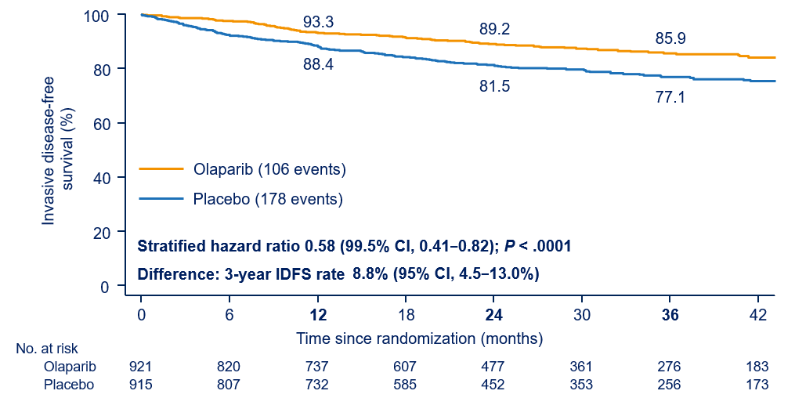
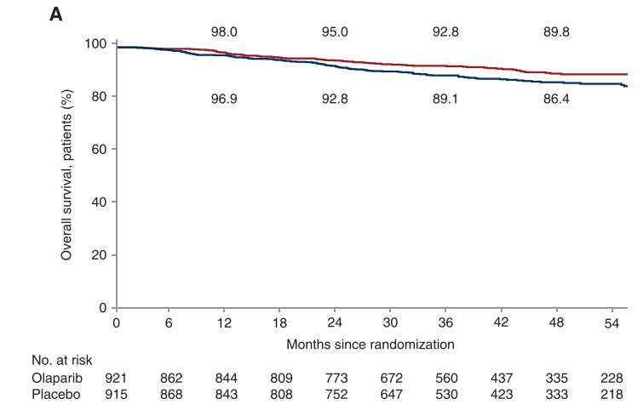
OlympiA: Results IDFS and OS
77
IDFS
OS
HR: 0.68
P=0.009
Difference in 4-year OS: 3.4%
Tutt A, et al: N Engl J Med, 2021
Geyer CE, et al: Ann Oncol, 2022

Slide 78
Adjuvant Trials for HER2 + BC with
Residual Disease after NAC + Anti-HER2 Therapy
78
COMPASS RD
ALLIANCE 11801
DESTINY Breast-05
NSABP B-60
T1-4 N0-3 at presentation
Any ER-, ER+/N+
(n=1,031)
High-risk of Recurrence
Inoperable at Presentation
or N+
(n=1,600)
R
R
T-DM1
T-DM1
+ Tucatinib
T-DM1
T-DXd

Slide 79
Summary/Conclusions
79
Several of the pivotal NSABP breast cancer clinical trials have been instrumental in establishing/changing the standard of care for patients with early-stage breast cancer:
  Loco-regional management
  Adjuvant hormonal therapy
  Adjuvant chemotherapy
  Adjuvant targeted therapy with biologics
  Neoadjuvant chemotherapy and post-neoadjuvant therapy

