Slide 1



Hereditary Breast Cancer
Risk and Management Issues
Claudine Isaacs, MD, FRCPC
Professor of Medicine and Oncology
Director, Clinical Breast Cancer Program
Co-Director Fisher Center for Hereditary Cancer and Clinical Genomics Research
Georgetown University
Disclaimer: This presentation is intended for personal use and for informational purposes only and does not replace independent professional judgment. This presentation is the property of Physicians’ Education Resource, LLC (“PER”) and is protected by U.S. and international copyright laws. You may not copy, reproduce, distribute, transmit, modify, or create derivative works of the presentation without the prior written permission from PER.

Slide 2
Outline
BRCA1 and BRCA2 pathogenic variant-positive (PV)
  Cancer risks and management
Other high penetrance genes
Moderate penetrance genes
Management of mutation carrier with breast cancer
Who to test

Slide 3
What proportion of breast cancer is inherited?
Sporadic
Familial 15-20%
Hereditary 5-10%

Slide 4
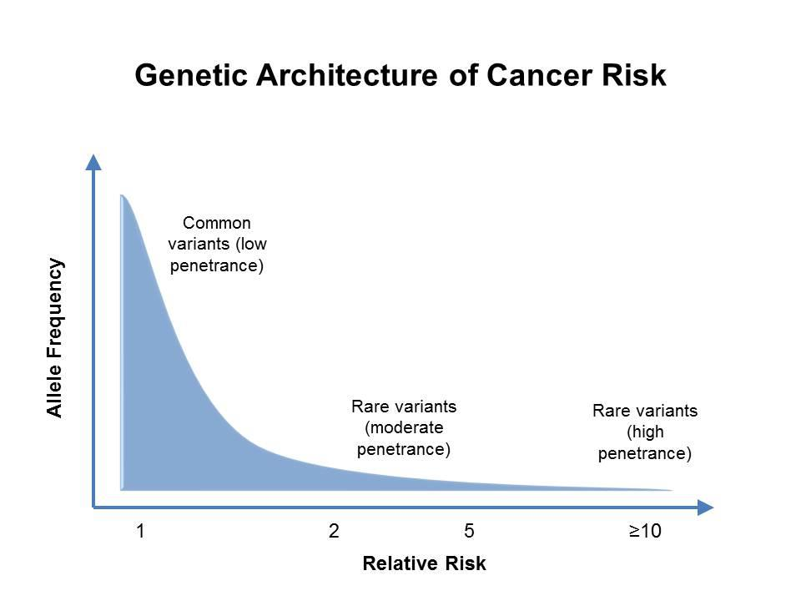
Genes Associated with Breast Cancer Risk
SNPs
2-5 fold increased risk
> 5 fold increased risk

Slide 5
Genes Associated with Breast Cancer Risk
SNPs
ATM, CHEK2, BARD1, RAD51C, RAD51D, NF1
BRCA1, BRCA2, TP53,
CDH1, PTEN, STK11, PALB2

Slide 6
BRCA1 AND BRCA2

Slide 7
BRCA1/2 Carriers: Breast and Ovarian Cancer Risks
Kuchenbaecker KB et al. JAMA. 2017;317(23):2402-2146; Mavaddat N et al. J Natl Cancer Inst. 2013;105(11):812-822.

Slide 8
BRCA1/2 Carriers: Other Cancer Risks
Based on Data from 3,184 BRCA1 and 2,157 BRCA2 families
BRCA1: RR:0.8
BRCA2 RR: 2.2
BRCA1 RR: 4.3
BRCA2 RR: 44.0
Li S et al. J Clin Oncol. 2022;40(14):1529-1541.

Slide 9
BRCA1/2 Carriers: Other Cancer Risks
Based on Data from 3,184 BRCA1 and 2,157 BRCA2 families
BRCA1 RR: 2.36
BRCA2 RR: 3.34
BRCA1 RR: 2.17
BRCA2 RR: 3.69
Absolute risks for pancreatic and stomach CA a bit lower for females than males (above reflect risks in males)
For BRCA1, associations with gallbladder (RR 3.34) and colorectal (RR 1.48) CA also suggested
Li S et al. J Clin Oncol. 2022;40(14):1529-1541.

Slide 10

Management Options: BRCA1/2 Carriers
Screening
Prevention

Slide 11
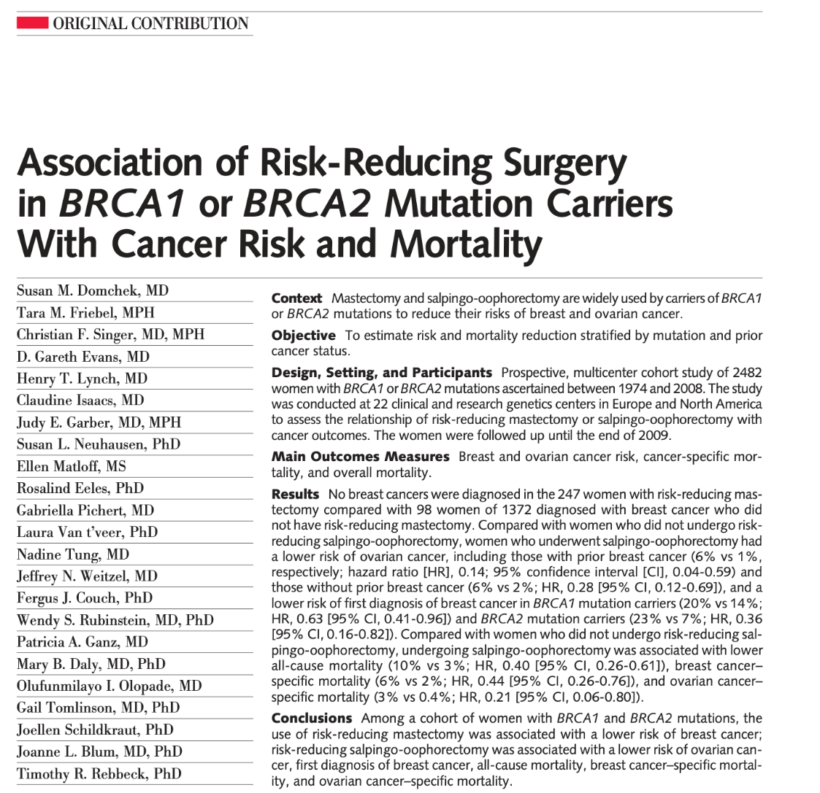

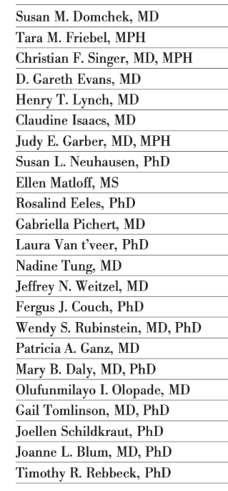
Risk Reducing Salpingo-Oophorectomy (RRSO): Mortality Reduction in BRCA Carriers
Recommended for BRCA1 carriers ages 35-40 and once childbearing complete and for BRCA2 ages 40-45
Currently do not recommend salpingectomy with delayed oophorectomy (awaiting result trials) but consider in certain circumstances
Impact of RRSO on BC risk debated
HR 0.22*
HR 0.47
Domchek SM et al. JAMA. 2010;204(9):967-975.
Notes:
2025 Study from England

Slide 12
Endometrial CA Risk gBRCA – Should rr-hysterectomy be recommended?
gBRCA1/2 carriers now have more effective management for BC/OC risks and improved life expectancy – thus, lifetime risk of EC may be higher than what historic data indicated
Dutch nationwide study cohort
  5980 gBRCA1/2 from HBOC study, Netherlands cohort (HEBON) c/w Dutch general population
 | gBRCA1 | gBRCA2
EC overall | SIR 3.51 (95% CI 2.6-4.7) | SIR 1.70 (95% CI 1.01 -2.87)
Serous-like EC | SIR 12.64 (95% CI 7.6-20.9) | SIR 5.11 (95% CI 1.9-13.6)
TP53-mutated EC | HR 15.71 (95% CI 4.6-53.4)
Low absolute risk EC:
By age 75, overall risk EC 3% and serous-like EC 1.1%
Guidelines do not strongly recommend rr-hysterectomy – but can impact decision about HRT use
Raises questions about not only about preventive surgery, but also genetic testing in those with serous EC
Need more data in racially diverse populations – Black women have high rate of serous EC
SIR: Standardized incidence ratio; HR: Hazard ratio
De Jonge, MM et al JNCI 2021; Vol. 113, 1203-11

Slide 13
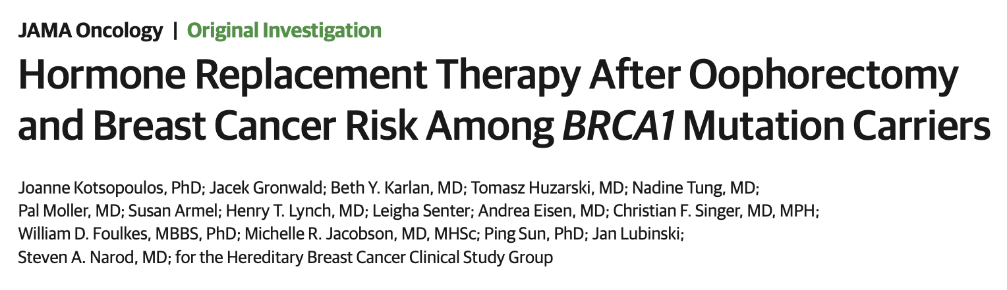
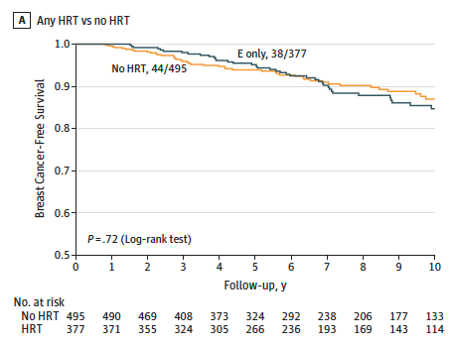
Is HRT Safe Following RRO?
872 BRCA1 carriers prospectively followed post RRO (median F/U 7.6 yrs)
88%
78%
Kotsopoulos J et al. JAMA Oncol 2018;4(8):1059

Slide 14
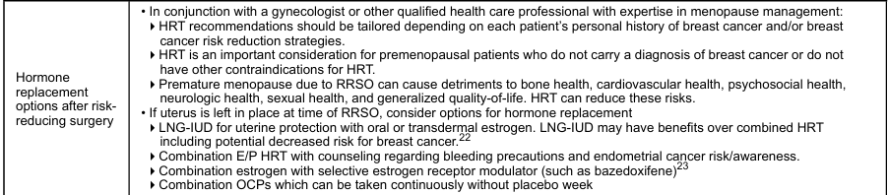
Options for HRT

Slide 15
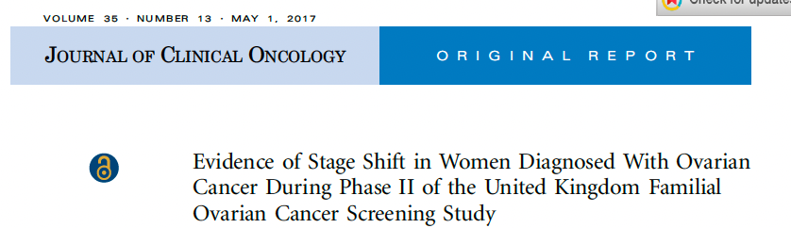
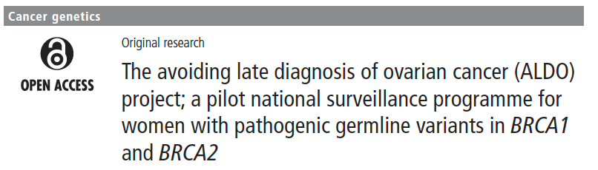
Could Ovarian Cancer Screening Shift Stage at Diagnosis?
Risk of Ovarian Cancer Algorithm (ROCA): Proprietary test evaluating the rate of change of CA-125 over time (instead of single value cut-off); based on the rate of change, TVUS and/or gyn-onc eval recommended
 | Prospective UK FOCSS Study¹ (n=4348; 804 gBRCA) | Real-world UK Study² (n=875 all gBRCA)
% recommended surgery (% OC/FTC diagnosed) | 3.1% (36%) | 2.5% (32%)
Stage | 37% Stage IIIb-IV (c/w 95% post screening phase) | 50% Stage IIIb-IV
UK FOCSS: Sensitivity (94.7%), PPV (10.8%), and NPV (100%) of the screening protocol for detecting ovarian cancer within 1 year
¹ Rosenthal A et al. J Clin Oncol. 2017;35:1411-1420
² Philpott S et al. J Med Genet. 2023;60:440–449.

Slide 16
Management Guidelines BRCA1/2 Carriers
Management Option | Screening Interval/Comments
SCREENING
Breast awareness Clinical breast exam Mammogram* Breast MRI* | Starting age 18 Q6-12 mos beginning age 25 Yearly age 30-75 (then individualize) Yearly (contrast) age 25-75 (then individualize)
Transvaginal ultrasound & CA-125** | Data do not support routine screening but perform prior to rrSO or rrS for operative planning
RISK REDUCTION
rr-Bilateral mastectomy rr-Bilateral salpingo-oophorectomy Consider rr-salpingectomy with delayed ooph rr-Hysterectomy Consider tamoxifen/AI for chemoprevention | Discuss option with patient gBRCA1 35-40 & gBRCA2 consider delay 40-45 when childbearing complete (HRT an option) With delayed oophorectomy for those not ready for rrBSO Consider for rr or for decisions re use of HRT
Consider HT post rrSO: If no uterus, E alone; if uterus intact E+P OCP, LNG-IUD
* If breast CA diagnosis, screen remaining breast tissue with annual MRI and mammo
** If no RRSO
Modified from NCCN HBOP guidelines – v1.2026

Slide 17
Management of gBRCA1/2
For males
  BSE training starting at age 35
  CBE every 12 months starting at age 35
  Consider annual mammo in men with gynecomastia starting at age 50
  Prostate CA screening beginning age 40 for BRCA2 carriers (consider for BRCA1)
Pancreatic CA screening:
  For BRCA2 screening for panc CA recommended (MRI/MRCP or EUS annually age 50 or 10 yrs younger than youngest age at diagnosis; screening done at high volume center).
  For BRCA1, screening recommended if a 1st or 2nd degree relative with exocrine pancreatic CA
Melanoma CA screening: no specific guidelines for melanoma but consider annual skin exams (particularly if FMHx melanoma). Minimize UV exposure
Modified from NCCN guidelines – v1.2026

Slide 18
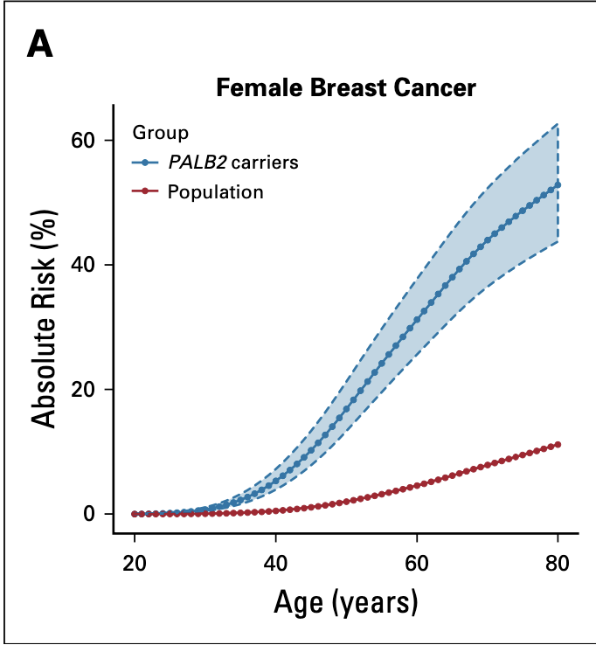
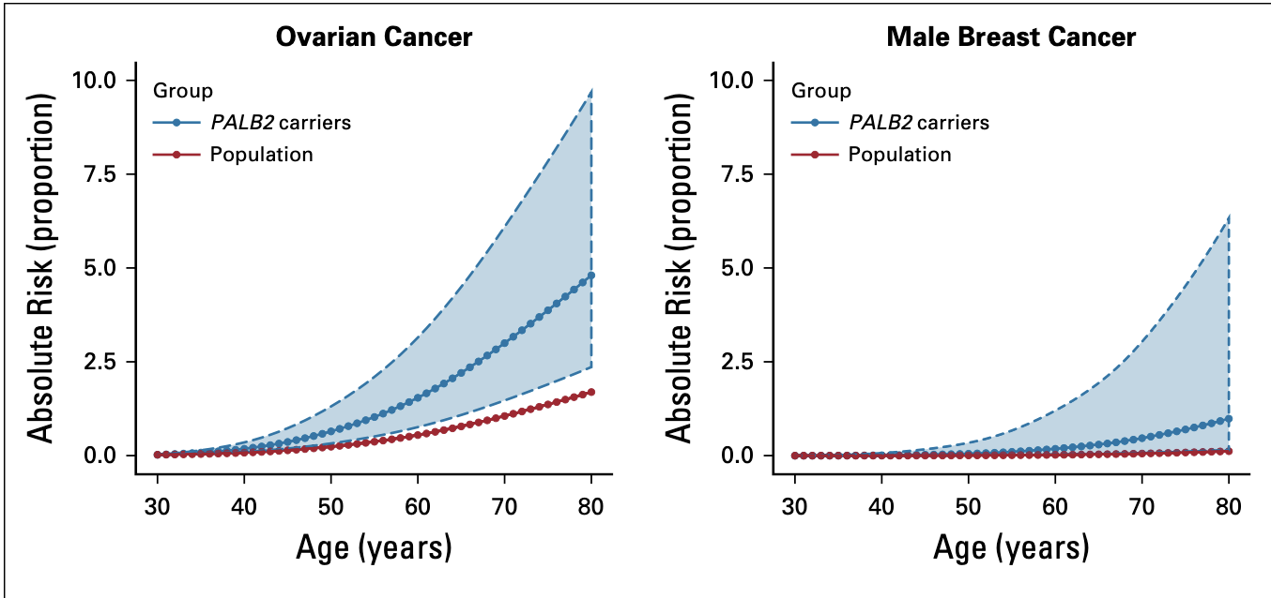
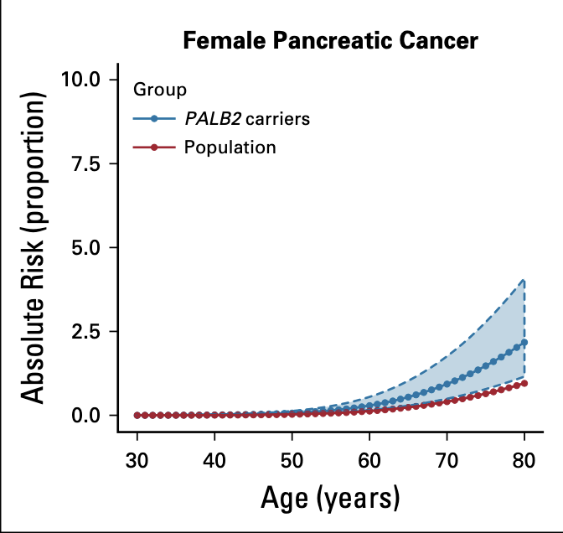
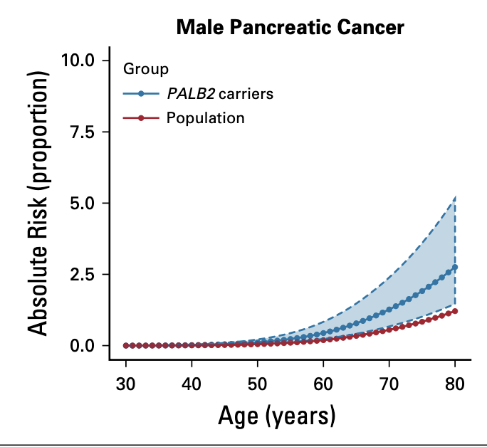
PALB2 – Cancer Risks to Age 80
53% (44-63%*)
RR: 7.18
5% (2-10%*)
RR: 2.91
1% (0.2-5%*)
RR: 7.34
2% (1-4%*)
RR: 2.37
3% (2-5%*)
RR: 2.37
Yang X et al. J Clin Oncol. 2019;38(7):674-685.

Slide 19
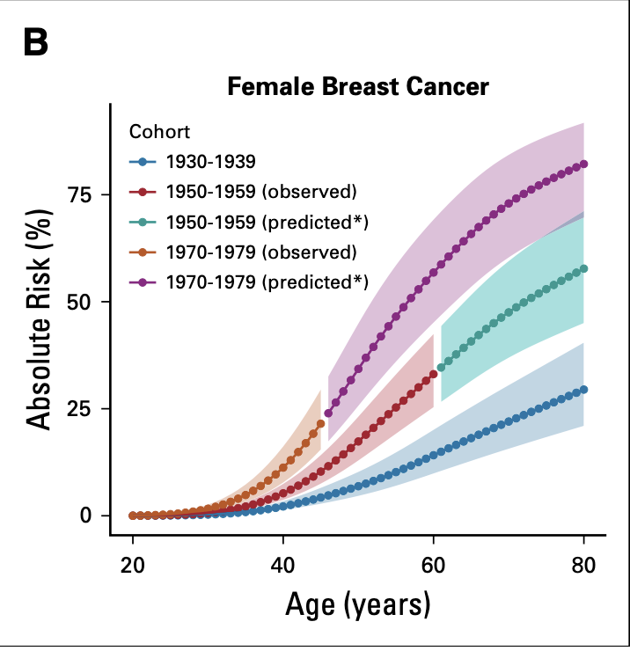
PALB2 – Cancer Risks
Risk of female BC varies by birth cohort and family history
Impact of family history
BC risk to age 80:
  52% if unaffected mother by age 50 and unaffected grandmother by age 70
  76% if 2 first degree relatives (FDR) with BC
OC risk to age 80
  5% if no family history OC in FDR or SDR
  16% if mother and sister with OC by age 50
Yang X et al. J Clin Oncol. 2019;38(7):674-685.

Slide 20
Li-Fraumeni Syndrome (LFS)
Autosomal dominant - due to mutations in TP53
Lifetime cancer risk ~90% for women; ~70% for men
50% risk of cancer by age 35
Breast cancer most frequent cancer
Other cancers: sarcoma, brain, adrenocortical, leukemia, choroid plexus CA
Other hallmarks: Childhood cancers; multiple primaries; risk of second cancers in radiation treatment field
Can see many other malignancies in addition to the characteristic ones
De novo mutation rate ~20%
Note – not all TP53 mutations detected on testing are germline – could be CHIP*
Bilateral Breast, 40
50
Breast, 40
STS, 49
Leukemia
33
Breast, 35
Brain tumor, 32
STS, 7
*CHIP: clonal hematopoiesis of indeterminate potential
McBride KA et al. Nat Rev Clin Oncol. 2014;11(5):260-271.
Notes:
Note: Can have increased risk of virtually any tumors

Slide 21
Management of LFS
Breast Cancer Risk - Women
Breast awareness starting age 18
CBE q6-12 mos starting age 20 (or 5-10 yrs before 1st breast CA in family)
Annual MRI age 20-29; Age 30-75 annual mammo + MRI*
Consider risk reducing mastectomy
Other Cancers:
Avoid therapeutic RT
Comprehensive PE q6-12 months with high index suspicion rare CA and 2nd CA; include neuro exam
Derm exam annually
CBC with differential q3-6 mos in patients with prior cytotoxic chemo or radiation exposure
Colonoscopy and upper endoscopy q2-5 yrs at 25y (or 5 y before 1st colon or gastric CA in family)
Annual whole body MRI (rapid non-contrast) ideally on trial
Annual brain MRI
Annual PSA starting age 40
Pancreatic CA screening if 1st or 2nd degree relative with exocrine panc CA
Discuss pre-implantation genetics
Management of individuals incidentally found to have TP53 PV/LP who don’t meet classic LFS criteria controversial; may have lower cancer risks
* If breast CA diagnosis, screen remaining breast tissue with annual MRI and mammo
NCCN HBOP guidelines v1.2026.

Slide 22
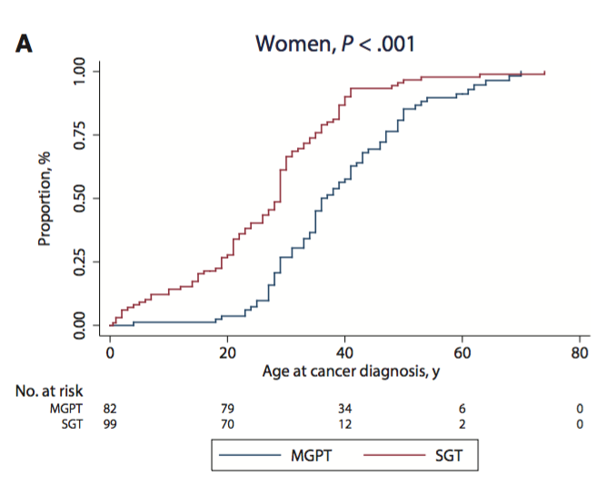
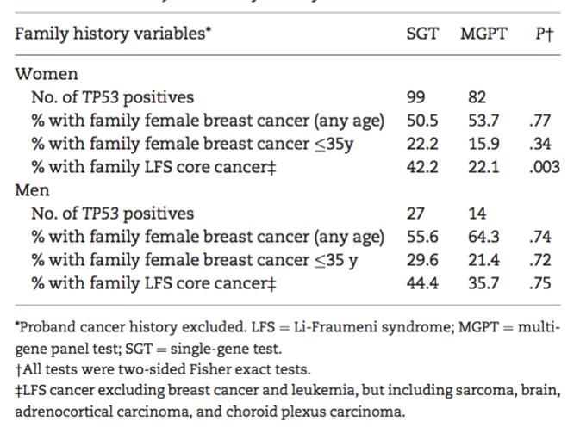
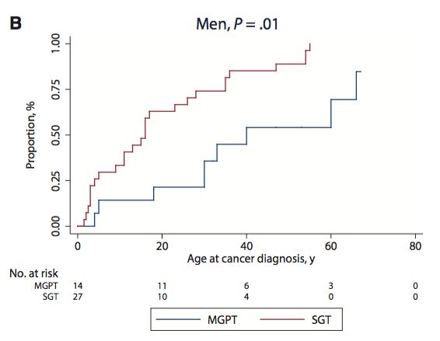
Li Fraumeni Syndrome
Phenotypic Differences in those identified by multigene panel testing vs single gene testing
Age at Diagnosis of First Cancer
Mean age: 36 vs 28 yo
Mean age 1st BC 40 vs 33 (P < .001)
Mean age: 40 vs 15 yo
SGT: Identified on single gene testing
MGPT: Identified on multigene testing
Rana HQ et al. J Natl Cancer Inst. 2018;110(8):863-870.

Slide 23
Li Fraumeni Syndrome
Phenotypic Differences in those identified by multigene panel testing vs single gene testing
Age at Diagnosis of First Cancer
Mean age: 36 vs 28 yo
Mean age 1st BC 40 vs 33 (P < .001)
Not all TP53 P/LP variants detected are germline
  If tested blood/saliva could be CHIP* (age > 60 or cytotoxic chemo prior to testing) – should check CBC/smear for clonal cytopenias/heme malignancy; to r/o CHIP repeat on skin fibroblasts, hair follicles
  Somatic TP53 variants common in malignancies – seen at time of NGS
Mean age: 40 vs 15 yo
SGT: Identified on single gene testing
MGPT: Identified on multigene testing
Rana HQ et al. J Natl Cancer Inst. 2018;110(8):863-870.

Slide 24
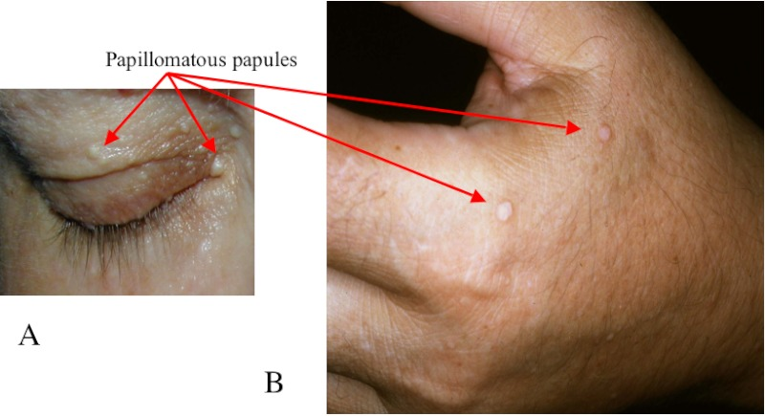
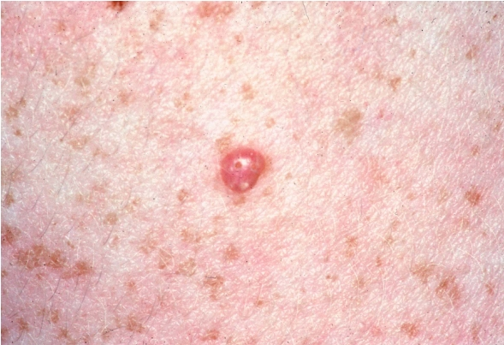
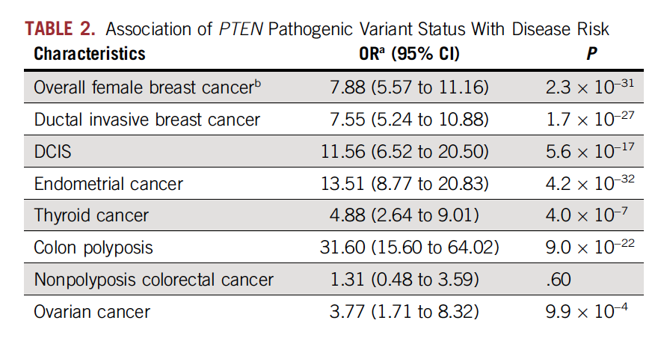
Cowden Syndrome
Pathognomonic mucocutaneous lesions
Macrocephaly
High risk of benign and malignant tumors of thyroid (non-medullary), endometrium, colon, breast
Trichilemmoma
PE including thyroid annually
Mammo and MRI yearly age 30-75
CBE q6-12 months starting age 25
Consider RRM
Cscope age 35 at least q5yrs
Consider hysterectomy after childbearing complete
Consider endometrial Bx q 1-2y starting age 35
Annual thyroid ultrasound beginning age 12
Consider renal US age 40 q1-2 yrs
727,091 individuals undergoing GT at Myriad Genetics 9/2013-2/2022
* If breast CA, screen remaining breast tissue with annual MRI and mammo
Ngeow J et al. J Clin Oncol. 2014;32(17):1818-1824; Cummings S et al. JCO Precis Oncol. 2023;7:e2200415; NCCN HBOP v1.2026.
Notes:
From JCO 2014 – SIR of 2nd malignancy – Breast 8.9; Thyroid 5.8; Uterine 14.8; Renal 4.1; Melanoma 7.4; Colon 6.2

Slide 25
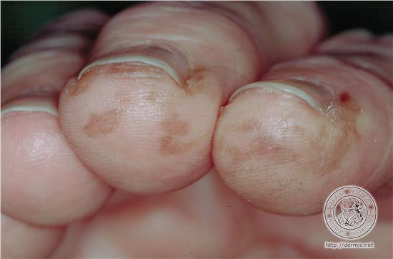
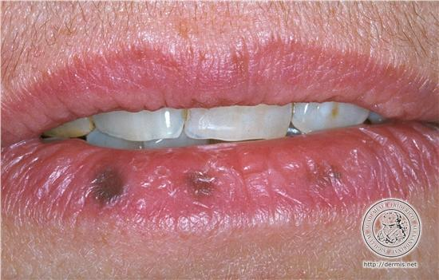
Peutz-Jeghers Syndrome
– Hybrid hereditary CRC and hereditary breast CA
GI hamartomas – polyps characteristic of PJS – “frond-like”
Mucocutaneous pigmentation mouth, lips, nose, eyes, fingers, genitalia – may fade during puberty
Lifetime cancer risk ~80%:
  Breast: ~32-54% risk (manage like BRCA1/2)
  Colorectal: ~40% risk
  Stomach: ~30% risk
  Pancreas: 11-36% risk
  Small bowel: 13% risk
  Ovarian (typically sex cord tumors but adenoCA can occur): > 20%
  Testicular (Sertoli cell tumors): 9%
  Cervix: > 10%
  Uterus: 9%
  Lung: 7-17%
Due to mutations in STK11 gene – autosomal dominant
Clinical Management: Q2-3 yrs Cscope and upper endoscopy (beginning age 8-10) with SB visualization (beginning age 18); pancreatic CA screening for all (age 30-35); annual exam for precocious puberty (♀) or feminizing changes (♂) and testicular exam; endo bx if abnormal bleeding; manage breast CA like BRCA1/2
Adapted NCCN Colon CA genetics guidelines v1.2025
Notes:
Colonoscopy and upper endoscopy every 2-3 years starting in late teens
SB visualization q 2-3 yrs individualized
Screening MRCP and/or endoscopic ultrasound q1-2 years

Slide 26
Other High-Penetrance Hereditary Breast Cancer Syndromes
Gene | Condition | Breast CA Risk/Mngmt | Features in Addition to Female Breast CA
TP53 | Li-Fraumeni syndrome | >90% Mammo age 30-75 & MRI qy age 25-75 Consider RRM | Soft tissue sarcoma, osteosarcoma, brain tumors, leukemia, adrenocortical cancer (see prior slide for risks and mngmt recs)
PTEN | Cowden syndrome | 40-60% Mammo & MRI qy age 30-75 Consider RRM | Macrocephaly, developmental delays, pathognomonic mucocutaneous findings (trichilemmomas, papillomatous papules), benign thyroid disease, autism, thyroid CA (especially follicular), endometrial CA, colon CA.
STK11 | Peutz-Jeghers | 32-54% Mammo & MRI qy age 30-75 Consider RRM | GI hamartomatous polyps, mucocutaneous findings, colon CA, pancreatic CA, gastric CA, small bowel, non epithelial ovarian
CDH1 | Hereditary diffuse gastric cancer | 37-55% Mammo & consider MRI qy age 30-75 Consider RRM | Cleft lip and palate; Diffuse gastric CA, Lobular breast CA Individualized decision re proph gastrectomy age 18-40 vs screening upper endoscopy q6-12 mos with multiple random biopsies
PALB2 | Hereditary breast and pancreatic cancer | 32-53% Mammo & MRI qy age 30-75 Consider RRM | Pancreatic CA (2-5%); Male breast CA (0.9%); Ovarian CA (3-5%); Likely increased prostate CA risk Panc screening if FMH Panc CA; consider rrSO 45-50; consider prostate screening from age 40
NCCN HBOP v1.2026
Notes:
Highlight CDH1

Slide 27
Moderate risk genes

Slide 28
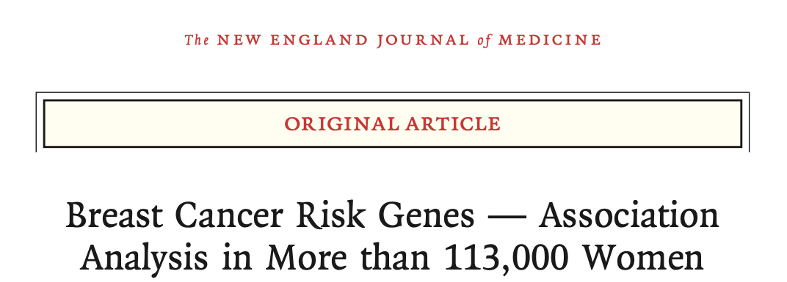

BCAC International
CARRIERS Consortium (n = 64,000)
Breast cancer susceptibility genes:
Definite: BRCA1, BRCA2, PALB2, ATM, CHEK2 (ATM and CHEK2 moderate risk)
Cancer syndrome related (rare): TP53, STK11, PTEN, CDH1
Growing evidence (moderate risk): BARD1, RAD51C, RAD51D (particularly for ER-); NF1
Less clear: MSH6 (only in BCAC study), ?? others (eg: FANCM, FANCC)
No evidence: NBN (incl 675del5), BRIP1, RAD50, MLH1, MSH2, MUTYH (BCAC only)
Stronger association with ER+ BC: ATM, CHEK2
Stronger association with ER- BC: BRCA1, BRCA2, PALB2, BARD1, RAD51C, RAD51D, NF1
Hu et al. NEJM 2021; 384:440-51; Dorling et al. NEJM 2021;384:428-39

Slide 29
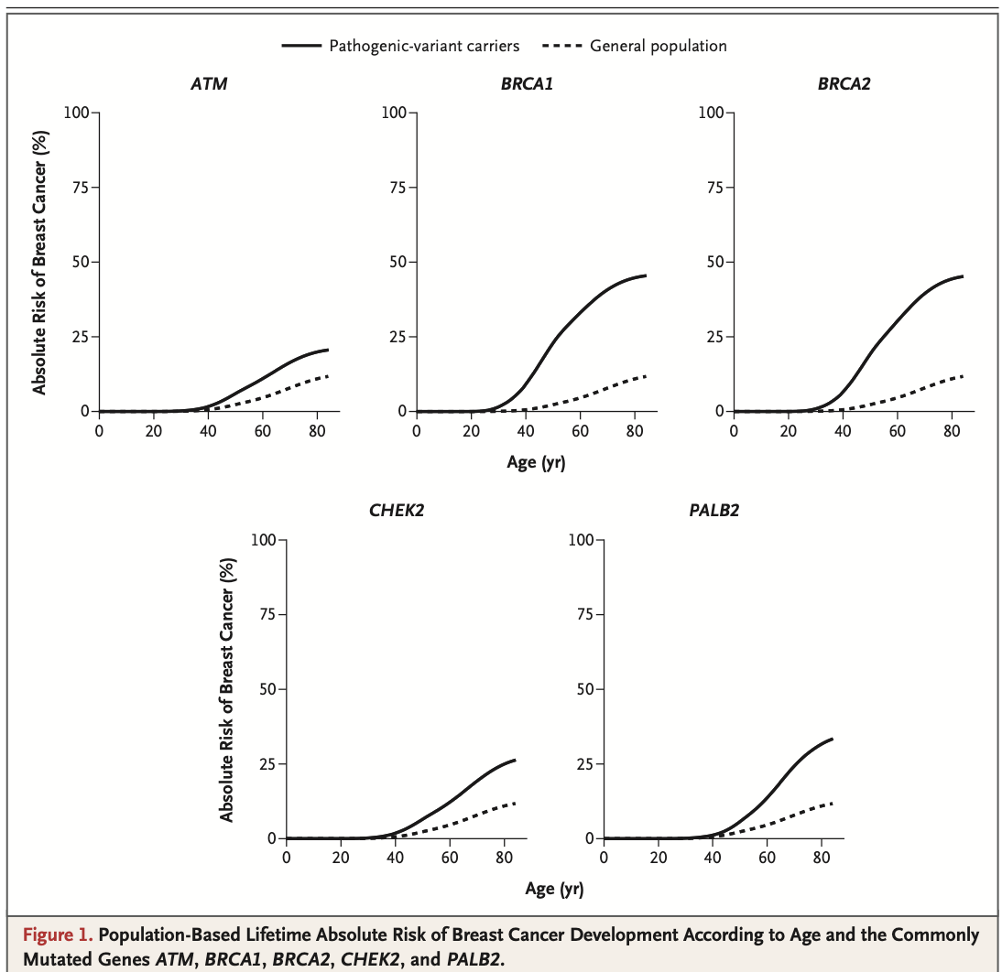
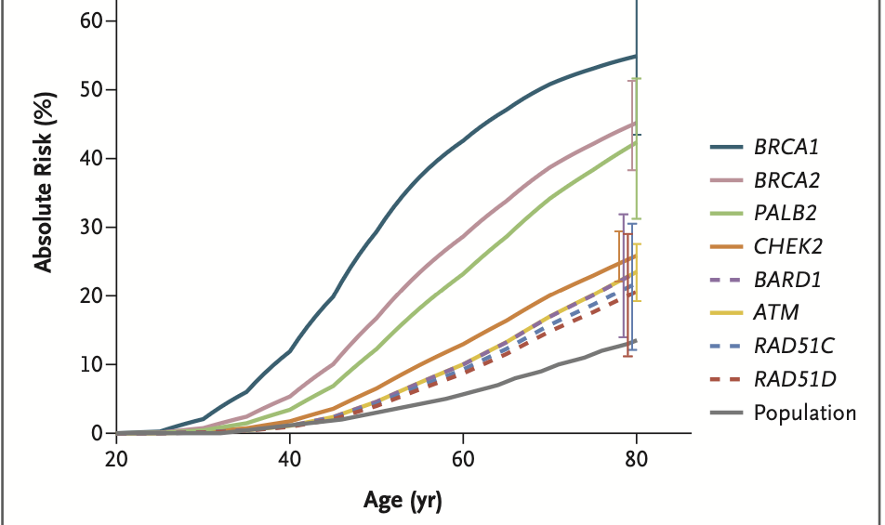
Lifetime Risk of Breast Cancer
CARRIERS Study
~ 20- 25%
~ 50%
~ 50%
~ 25%
~ 32%
BCAC Study
~ 50%
~ 40%
~ 35%
17 -
30%
Hu C et al. New Engl J Med. 2021; 384(5):440-451; Dorling L et al. New Engl J Med. 2021;384(5):428-439.

Slide 30
Polygenic Risk Score Impact on BC Risk in Mutation Carriers
International collaboration with ~26,000 BC cases and ~26,000 controls tested for PV variants and PRS score
Breast Cancer Risk by Age 80
Gao C et al. J Clin Oncol. 2021;39(23):2564-2573

Slide 31
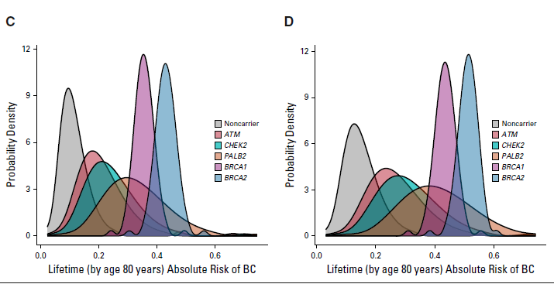
Polygenic Risk Score Impact on BC Risk in Mutation Carriers
By incorporating PRS, substantial number of those with ATM or CHEK2 PV BC risk fell below 20% MRI threshold
No Family History
With Family History
All BRCA1, BRCA2, and most PALB2 carriers above 20% lifetime threshold
47% ATM, 31% CHEK2 carriers below 20% threshold
All BRCA1, BRCA2, and most PALB2 carriers above 20% lifetime threshold
21% ATM, 10% CHEK2 carriers below 20% threshold
Gao C et al. J Clin Oncol. 2021;39(23):2564-2573

Slide 32
Management Moderate Penetrance Genes
Management guidelines typically include mammo beginning at age 40 and consideration for annual MRI
Typically, insufficient risk to recommend risk reducing mastectomy (RRM) (manage based on FMH)
Some genes associated with other cancer risks
 | Breast CA Risk | Breast CA Management | Other
ATM | Risk BC increased: Absolute risk 21-24% | Annual mammo starting at age 40 Consider annual MRI age 30-35 Insufficient risk to support RRM* CBC risk at 10 yr: 4% | Risk ovarian CA ↑: 2-3%; insufficient evidence for RRSO; manage based on FMHx Risk pancreatic CA ↑: ~5-10%; Panc screening recommended regardless of FMHx Risk prostate CA may be ↑: Consider screening at age 40
BARD1 | Risk BC increased (partic TNBC) Absolute risk 17-30% | Annual mammo starting at age 40 Consider annual MRI age 40 Insufficient risk to support RRM* | No established association with ovarian CA Unknown or insufficient evidence for other cancers
CHEK2 frameshift Less clear for missense variants | Increased risk BC (partic ER+) Absolute risk 23-27% | Annual mammo starting at age 40 Consider annual MRI age 30-35 Insufficient risk to support RRM* CBC risk at 10 yr: 6-8% | Possible ↑ risk for CRC CA: 5-10% CRC 1.9 fold for 1100delC; CRC 1.6 fold for I157T Cscope starting age 40 q5yrs Likely ↑ risk prostate CA – Consider screening at age 40
MSH2, MLH1, MSH6, PMS2, EPCAM | Increased risk BC: < 15% | Manage based on FMHx | Manage CRC, GYN/GU per guidelines (see CRC section)
NF1 | Increased risk BC: 20-40% No data for ↑ risk > 50y | Annual mammo starting at age 30 Consider annual MRI age 30-50 Insufficient risk to support RRM* | Peripheral nerve sheath, GIST – refer to NF1 specialist
RAD51C/RAD51D | Increased risk BC (partic TNBC) Absolute risk ~20% | Annual mammo starting at age 40 Consider annual MRI age 40 | Risk ovarian CA increased: 10-20% risk Recommend RRSO age 45-50
*Manage based on FMHx; age; breast density; preference.
Adapted NCCN HBOP Guidelines V1.2026

Slide 33
Management of Mutation Carriers with Breast Cancer

Slide 34
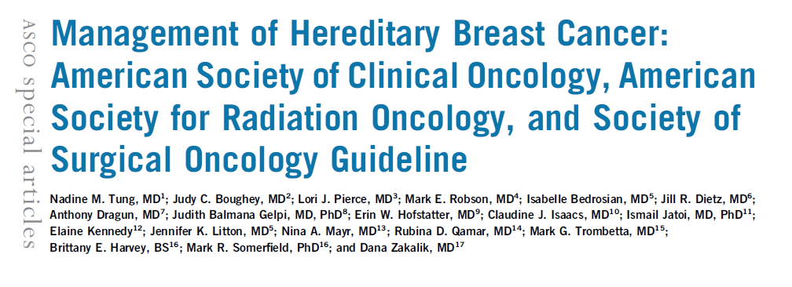

Slide 35
Case
37-year-old recently married nulliparous female presents for treatment recommendations
2.3 cm mass on breast imaging. No suspicious nodes
Core biopsy: TNBC
She reports the following family history:
  Mother breast cancer at age 46
  Maternal aunt ovarian cancer deceased age 50
  No knowledge of paternal family history

Slide 36
Case
37-year-old recently married nulliparous female presents for treatment recommendations
2.3 cm mass on breast imaging. No suspicious nodes
Core biopsy: TNBC
She reports the following family history:
  Mother breast cancer at age 46
  Maternal aunt ovarian cancer deceased age 50
  No knowledge of paternal family history
Referred for preoperative genetic counseling and testing
Stat panel sent – Pathogenic variant in BRCA1 found

Slide 37

Management
Optimal treatment of newly diagnosed breast cancer
  Local therapy
  Systemic therapy
Management for 2nd malignancy
  Screening
  Prevention

Slide 38
Age at Diagnosis of Primary Impacts Risk Contralateral BC
10 yr Risk of CBC
For gPALB2 CBC risk only elevated if have ER- tumor
Yadav S et al. J Clin Oncol. 2023;41(9):1703-1713.

Slide 39
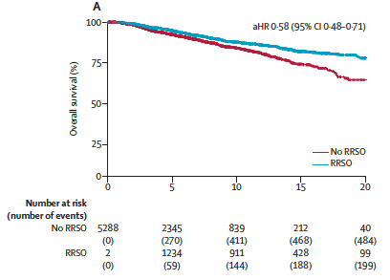
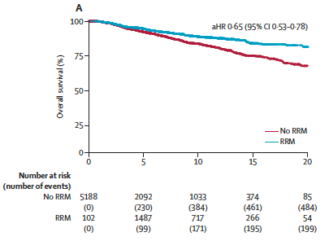
RRSO/RRM in young gBRCA1/2 Carriers with BC impacts OS
International Cohort Study of 5290 gBRCA1/2 carriers diagnosed with breast cancer ≤ 40 yo (2000-2020)
RRSO improves survival
RRM improves survival
adjusted HR: 0.58
(95% CI 0.48-0.71)
adjusted HR: 0.65
(95% CI 0.53-0.78)
Limitations: retrospective; restricted to those ≤ 40; enrolled 2000-2020 so does not include improvements in treatment; median time to RRM ~ 1 y from diagnosis (lead time bias)
Blondeaux E et al. Lancet Oncol 2025; 26: 759–70.

Slide 40
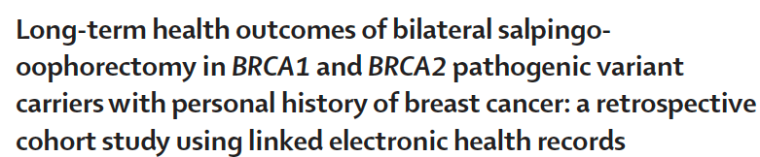
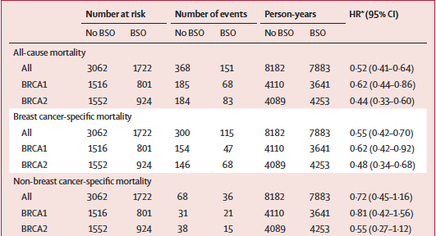
RRSO: Mortality Reduction in BRCA Carriers with Breast Cancer
Linked data from National Cancer Registry in England to genetic testing and other sources to minimize biases
Impact of BSO on all cause and BCS mortality:
more marked in BRCA2 than BRCA1
greatest impact on all cause mortality if BSO performed after age 45
No increased risk of CV disease, non-breast CA specific mortality, contralat BC, or depression
Hassan H et al. SM et al. Lancet Oncol 2025; 26: 771–80
Notes:
2025 Study from England

Slide 41
What about other high-penetrance genes?
TP53
  If possible, avoid radiation therapy given increased risk of malignancy in radiation field
For other high penetrance genes (CDH1, PTEN, STK11, PALB2), little data, but tend to have same approach as for gBRCAm

Slide 42
gBRCA1/2 Status Not an Independent Prognostic Factor – POSH Study
3053 BC pts < 40 yo at diagnosis prospectively recruited 2000-2008; gBRCA1/2 testing in 2016
No difference in OS
Median F/U 8.2 years
Copson ER et al. Lancet Oncol. 2018;19(2):169-180.
Notes:
Recruited from 126 UK NHS oncology clinics from 2000-2008 (n=3053)
Invasive breast cancer diagnosed < age 40
Blood taken during primary treatment period
Management per national guidelines
Research DNA sample in 2857
In 2016 tested for BRCA1 and BRCA2 mutations
12% found to carry PV in B1/2

Slide 43
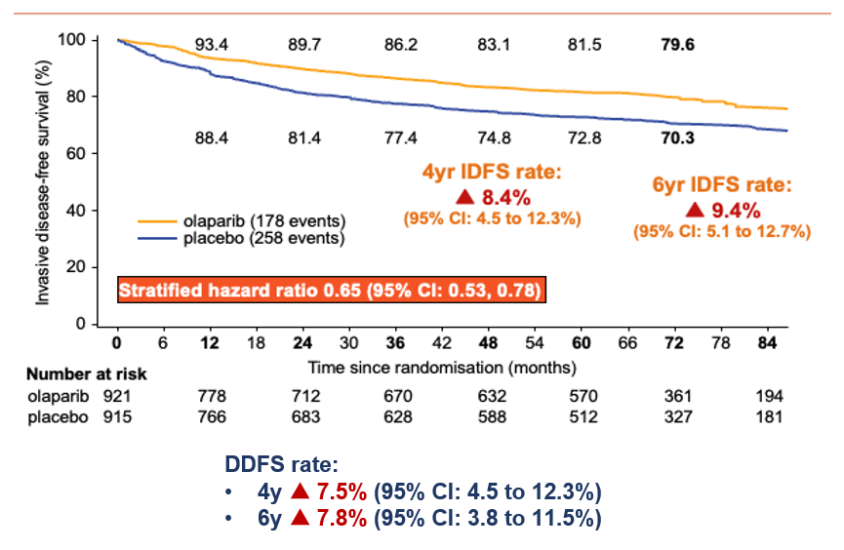
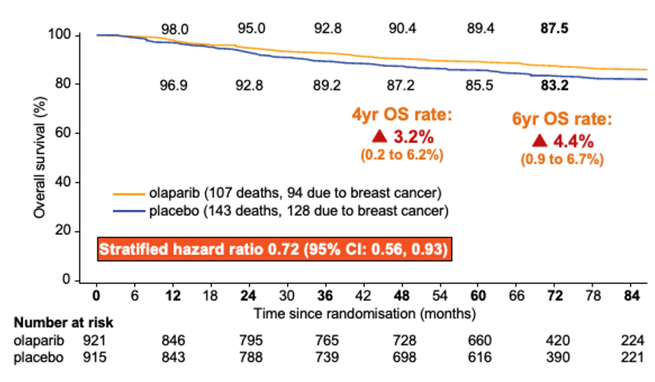
OlympiA Study: High-risk HER2-negative ESB gBRCA1/2
iDFS
OS
Tutt AN et al. N Engl J Med. 2021;384(25):2394-2405; Garber et al. SABCS 2024.
Notes:
Few HR+/HER2 negative but trend for benefit (CI cross 1)
Bit less benefit prior platinum but numbers smaller

Slide 44
Tutt AN et al. N Engl J Med. 2021;384(25):2394-2405.

Slide 45
P3 RCT of PARPi in gBRCA1/2 mBC
Benefit seen across subgroups
gBRCA1 and gBRCA2
ER+ and TNBC
Prior platinum
7.0 mos
4.2 mos
TPC: Capecitabine, Eribulin, Vinorelbine, or Gemcitabine
Robson M et al. N Engl J Med. 2017;377(6):523-533; Robson M et al. Ann Oncol. 2019;30(4):558-566; Litton JK et al. N Engl J Med. 2018;379(8):753-763
TPC: Capecitabine, Eribulin, Vinorelbine

Slide 46
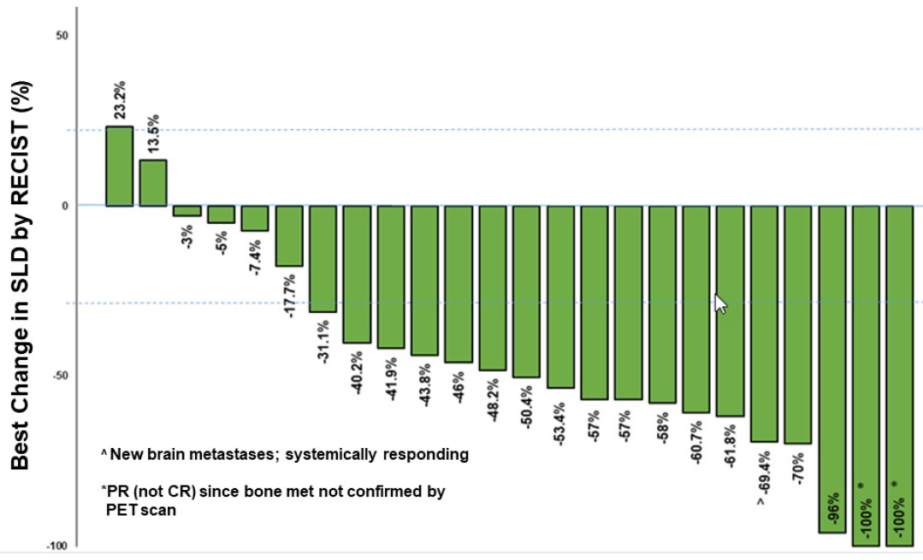
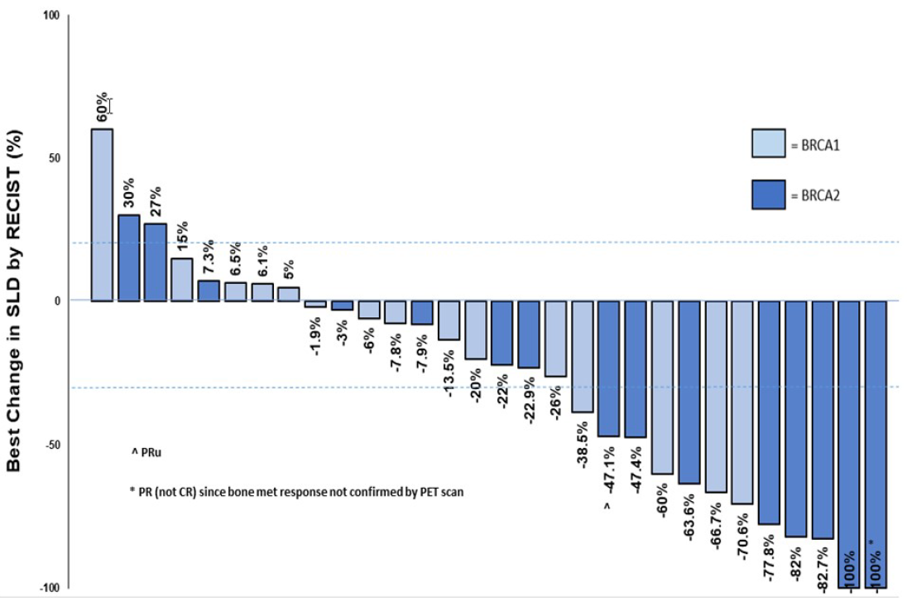
Role of PARP Inhibitors Beyond gBRCA
TBCRC 048: Phase 2 Trial of Single-Agent Olaparib
GERMLINE COHORT
SOMATIC COHORT
gPALB2mut (n=24)
Best Response | Response Rate, n (%)
ORR, n (%) | 75% (80% CI:60-86%)
CBR (18 weeks), n (%) | 83% (90% CI: 66-94%)
sBRCA1/2mut (n=30)
Best Response | Response Rate, n (%)
ORR, n (%) | 37% (80% CI: 25-50%)
CBR (18 weeks), n (%) | 53% (90% CI: 37-69%)
gATM/CHEK2 (n=17): No responses
Some responses very prolonged (1+ yrs)
Tung NM et al. J Clin Oncol. 2020;38(36):4274-4282; Tung N, et al. ASCO 2024. Abstract 1021.

Slide 47
Who to test?

Slide 48
Indications for Genetic Testing in BC Patients (frequently changes)
Diagnosed age < 50
Diagnosed at any age
  TNBC
  Ashkenazi Jewish descent
  Male breast cancer any age
  Multiple primary BC (synchronous or metachronous)
  HER2 negative metastatic disease if candidate for PARPi
  High risk early stage HER2 negative breast cancer if candidate for PARPi
  Lobular BC with personal of FMX diffuse gastric CA
Individuals meeting these criteria with previous limited testing
Known PV or LPV in the family
Diagnosed with BC at any age and following FMHx
  > 1 close relative with breast CA < 50
  > 1 close relative with ovarian, male BC, pancreatic, met prostate CA or intraductal prostate CA any age
  > 3 total diagnoses BC in patient and/or FDR/SDR/TDR
  If none of above, if > 5% probability of PV BRCA1/2 on prior probability model (eg BRCAPro, Tyrer-Cuzick)
Adapted from NCCN HBOP Guidelines V2.2026

Slide 49
Indications for Genetic Testing in BC Patients (frequently changes)
Diagnosed age < 50
Diagnosed at any age
  TNBC
  Ashkenazi Jewish descent
  Male breast cancer any age
  Multiple primary BC (synchronous or metachronous)
  HER2 negative metastatic disease if candidate for PARPi
  High risk early stage HER2 negative breast cancer if candidate for PARPi
  Lobular BC with personal of FMX diffuse gastric CA
Individuals meeting these criteria with previous limited testing
Known PV or LPV in the family
CRITERIA ARE HARD TO REMEMBER
Diagnosed with BC at any age and following FMHx
  > 1 close relative with breast CA < 50
  > 1 close relative with ovarian, male BC, pancreatic, met prostate CA or intraductal prostate CA any age
  > 3 total diagnoses BC in patient and/or FDR/SDR/TDR
  If none of above, if > 5% probability of PV BRCA1/2 on prior probability model (eg BRCAPro, Tyrer-Cuzick)
Adapted from NCCN HBOP Guidelines V2.2026

Slide 50
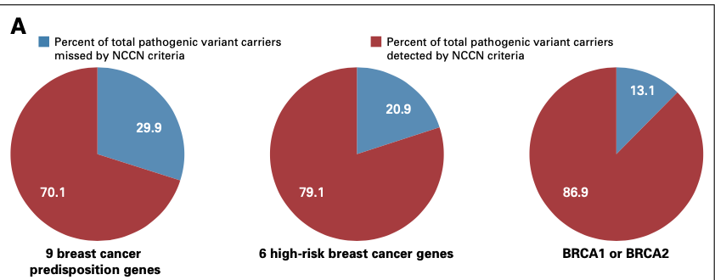
Universal vs NCCN Guideline Based Testing of Breast CA Patients: Mayo Clinic Study
6.2% had PV (3.4% in 6 hi-penetrance and 2.7% in BRCA1/2)
48% met NCCN v1.2020 criteria; 52% did not
All BC pts (2016-2020) offered genetic testing (n=7300); 3,907 had testing and available FHx
Tested for 9 genes
  6 hi penetrance (BRCA1, BRCA2, CDH1, PALB2, PTEN, TP53) + 3 mod (CHEK2, ATM, and NF1)
If included all women dx ≤ 65 as well as NCCN criteria increased sensitivity of detecting:
BRCA1 or BRCA2 PV to 98.1%
6 high penetrance genes to 94.8%
9 actionable genes to 92.1%
Compared to universal testing, 21% of BC patients spared testing and decreased VUS-to-PV ratio
Yadav S et al. J Clin Oncol. 2020;38(13):1409-1418.

Slide 51
Universal vs NCCN Guideline Based Testing of Breast CA Patients: Mayo Clinic Study
All BC pts (2016-2020) offered genetic testing (n=7300); 3,907 had testing and available FHx
Tested for 9 genes - hi penetrance (BRCA1, BRCA2, CDH1, PALB2, PTEN, TP53) + 3 mod (CHEK2, ATM, and NF1)
6.2% had PV (3.4% in 6 hi-penetrance and 2.7% in BRCA1/2); 48% met NCCN v1.2020 criteria; 52% did not
If included all women dx ≤ 65 as well as NCCN criteria:
Compared to universal testing, 21% of BC patients spared testing and decreased VUS-to-PV ratio
Yadav S et al. J Clin Oncol. 2020;38(13):1409-1418.

Slide 52
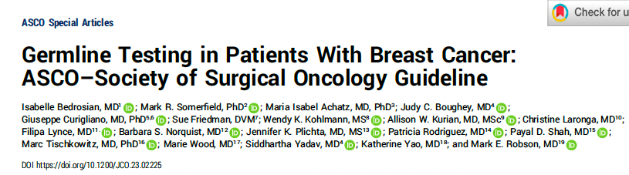

BRCA1/2 testing should be offered to:
ALL newly diagnosed breast cancer patients ≤ 65 y.o.
Select patients ≥ 65 y.o. (TNBC, male BC, Ashkenazi Jewish ancestry, eligible for PARPi, 2nd primary BC, family history, personal history)
Patients with personal history of breast cancer who meet above criteria
Consider testing for other high or moderate penetrance genes
VUS should NOT alter management (need for periodic follow up as can be reclassified)

Slide 53
Case
37-year-old recently married female presents for treatment recommendations
2.3 cm TNBC without suspicious nodes
Found to carry pathogenic variant in BRCA1

Slide 54
Case
37-year-old recently married female presents for treatment recommendations
2.3 cm TNBC without suspicious nodes
Found to carry pathogenic variant in BRCA1
TREATMENT COURSE
Evaluated by fertility specialists and prior to NAC cycle of IVF and froze 3 embryos
Received neoadjuvant paclitaxel/carbo/pembro → DD AC + pembro
Chose to undergo bilateral mastectomy
pCR
RRSO
Tested 1st degree relatives
  32 y.o brother BRCA1+; 34 y.o. sister tested negative ; mother BRCA1+

Slide 55
Other considerations
Discuss family planning
  Fertility issues
  Pre-implantation genetic diagnosis (PGD): IVF and genetic testing of embryo prior to implantation
  Carrier testing of partner when risk of autosomal recessive condition (eg ATM, Fanconi anemia with BRCA2 and other genes)
When do NGS of tumor, can detect germline pathogenic variants
  Important to let patient know and verify with germline testing

Slide 56
Summary
Genetic and genomic testing impacts
  Risk reduction and screening
  Cancer treatment
Now SOC to do universal germline testing on:
  All patients with HER2- metastatic breast cancer
  All patients with HER2- early-stage disease who are candidates for adjuvant olaparib
  All TNBC
  All BC < 50 or ≤ 65 (depending on guidelines)
Importance of cascade testing for family members

Slide 57
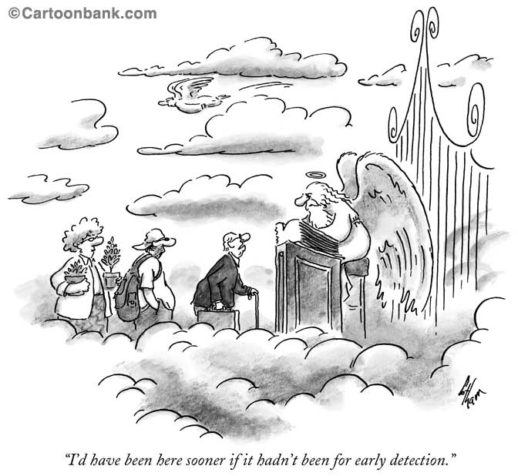



Slide 58

Thank you…

