Slide 1





Managing CNS Disease
Michelle Melisko MD
UCSF Helen Diller Family Comprehensive Cancer Center
11/8/2025
Disclaimer: This presentation is intended for personal use and for informational purposes only and does not replace independent professional judgment. This presentation is the property of Physicians’ Education Resource, LLC (“PER”) and is protected by U.S. and international copyright laws. You may not copy, reproduce, distribute, transmit, modify, or create derivative works of the presentation without the prior written permission from PER.

Slide 2
Overview of presentation
Epidemiology and Prognosis
Guidelines and the role of radiation in 2025
Systemic approaches for Parenchymal Brain Metastases
Leptomeningeal Disease
Clinical Trials and Research Directions
Notes:
With this case in mind, I would like to frame the topic of the next 15 minutes….I will begin by presenting a few of the many challenges we face in the treatment of BCBM, followed by a discussion of subtype predilection to the CNS and prognosis by subtype, a few slides on local approaches followed by advances in systemic approaches and emerging clinical trials.

Slide 3
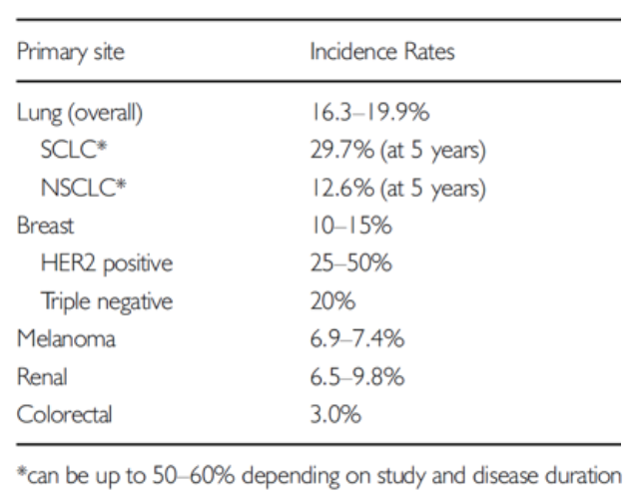
Brain Metastases are a common consequence
of advanced cancer
40 – 50%
Glitza Oliva et al. Ann Oncol 2018;29: 1509–1520
Barnholtz-Sloan et al. J Clin Oncol. 2004;22(14):2865–72
Schouten et al. Cancer. 2002;94(10):2698–705
Chamberalin et al. Neuro-Oncology. 2017;19(1):i1–i24
Notes:
Brain Metastases are a common consequence of advanced cancer. Historically, patients with lung and breast cancer, and melanoma more commonly experience intracranial recurrence -- with rates upward of 30 – 50% for those with Her2+ and Triple negative breast cancer.

Slide 4
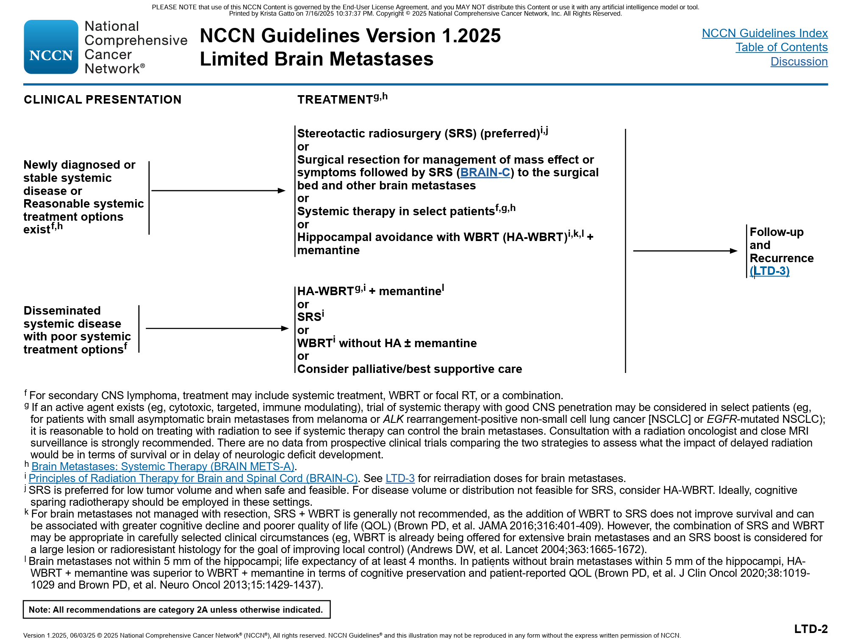
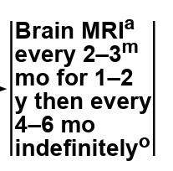
NCCN Clinical Practice Guidelines in Oncology. Central Nervous System Cancers. v1.2025.

Slide 5

Stereotactic radiosurgery for patients with multiple brain metastases (JLGK0901): a multi-institutional prospective observational study.
Overall Survival
Cumulative Incidence of Radiation Complications
Treating fewer brain mets improves survival
and reduces complications
Yamamoto et al. Lancet Oncol 2014;15(4):387-95
Yamamoto et al. Int J Radiat Onc Biol Phys 2017;99(1):31-40
Notes:
It is next to impossible to discuss brain metastases without reviewing the literature on local therapy. Presented here are 4 of the landmark studies reviewing local approaches. In the 1990 Patchell study, OS was improved if surgery was added to WBRT in patients with a single metastases. In the RTOG 9508 study, the addition of SRS to WBRT improved OS among patients with a single metastases. OS was similar in a Japenese study among patients who received WBRT in addition to SRS. Finally, in a recent study in which the primary endpoint was NC decline at 4 mos, pts who received SRS + WBRT experienced higher rates of NC decline at 4 mos compared to SRS alone. Interestingly, OS favored pts who received SRS alone.

Slide 6
Preoperative stereotactic radiosurgery before planned resection of brain metastases
Hypothesis: Preoperative SRS is a feasible alternative to postoperative SRS and may lower the risk of radiation necrosis (RN) and LMD
Preoperative SRS dose was based on lesion size and was reduced 10–20% from standard dosing. Surgery generally followed within 48 hrs
117 pts with 125 lesions treated with single-fraction preoperative SRS and planned resection
Most patients had a single brain met (70.1%); 42.7% NSCLC, 18.8% breast cancer, 15.4% melanoma, and 11.1% renal cell ca
Event cumulative incidence at 2 years: cavity local recurrence (LR), 25.1%; distant brain failure, 60.2%; LMD, 4.3%; and symptomatic RN, 4.8%
Median overall survival (OS) and 2-year OS rate were 17.2 months and 36.7%, respectively
Subtotal resection (STR, n = 6) was significantly associated with increased risk of cavity LR (HR 6.67, p = 0.008) and worsened OS (HR 2.63, p = 0.05) in multivariable analyses.
Prabhu et al. J Neurosurg 2018 Dec 1:1-8.

Slide 7
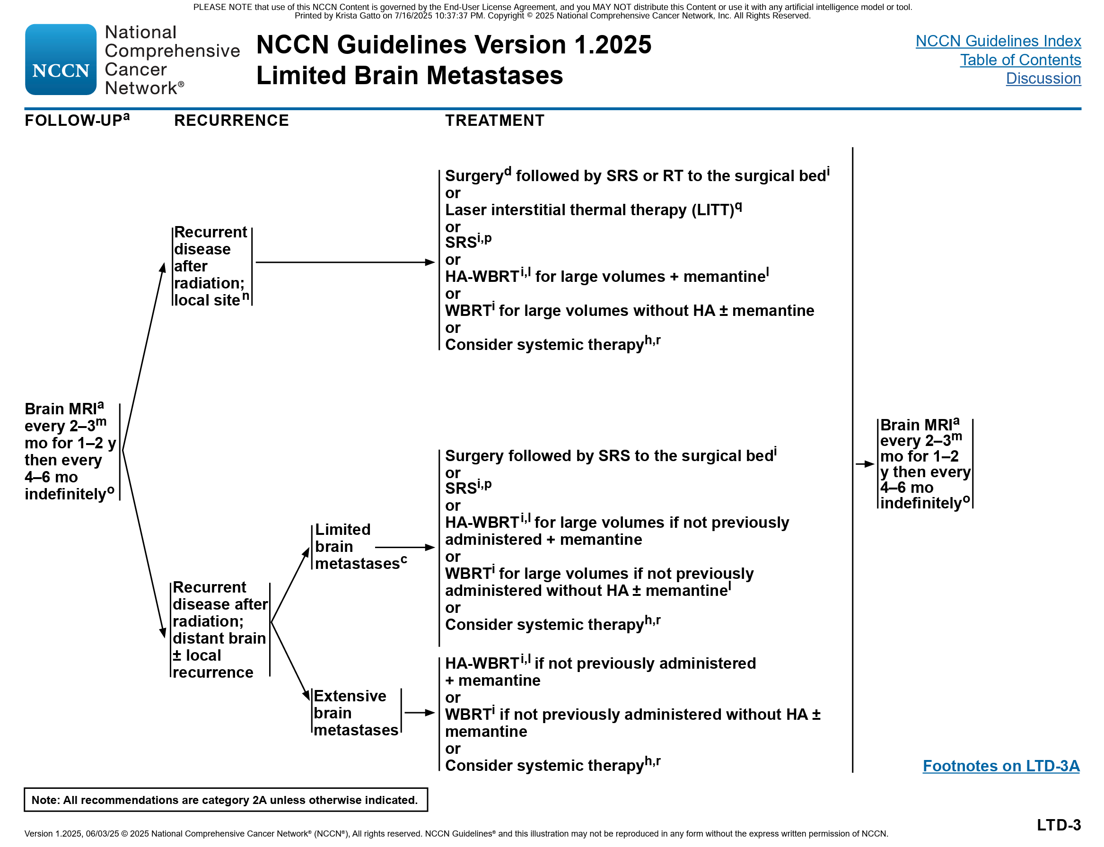
NCCN Clinical Practice Guidelines in Oncology. Central Nervous System Cancers. v1.2025.

Slide 8
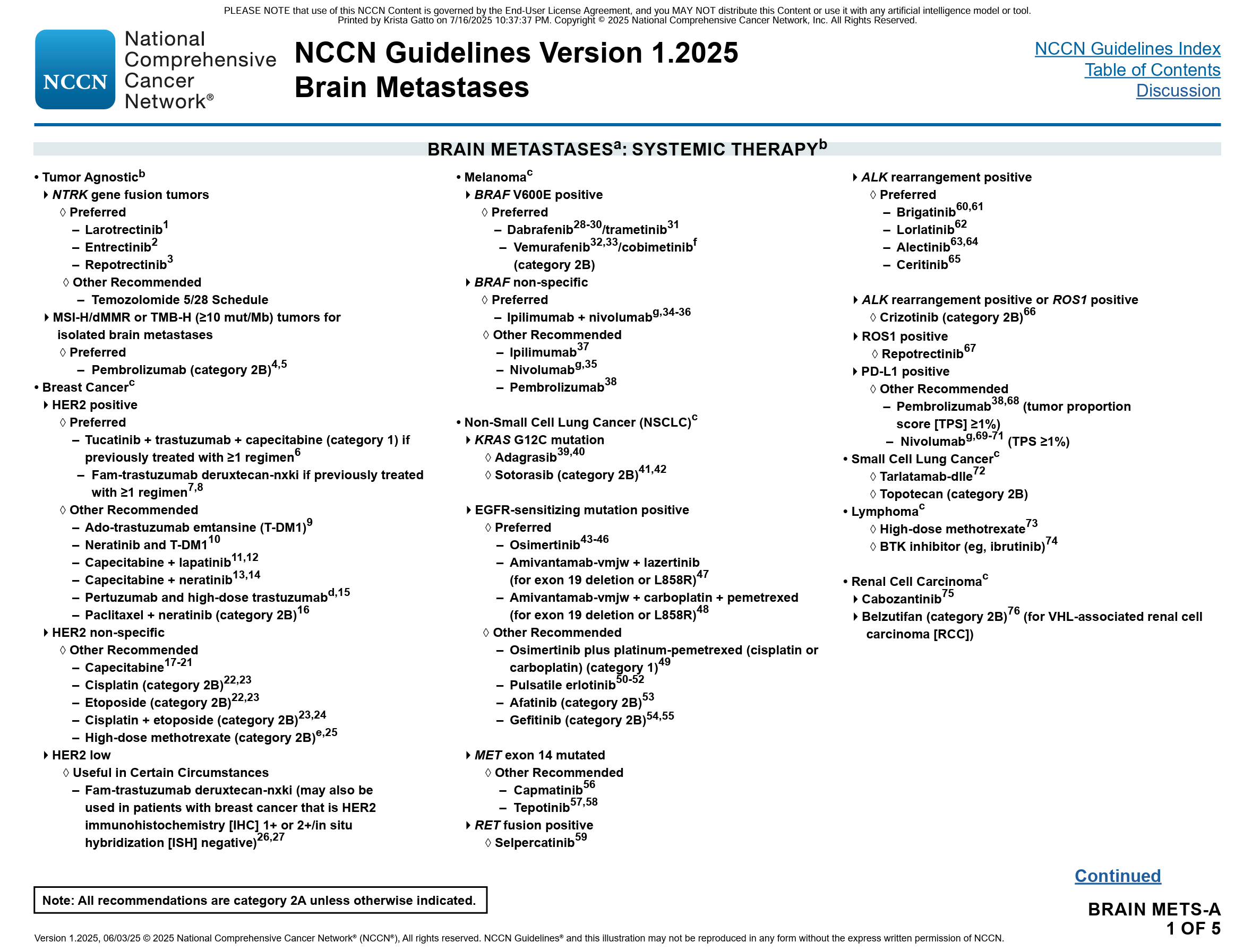

When Should One Consider Systemic Treatment for Brain Mets?
NCCN Clinical Practice Guidelines in Oncology. Central Nervous System Cancers. v1.2025.
Notes:
But when should one consider treatment of brain metastases with systemic therapy? Presented here are the NCCN guidelines for patients with extensive brain metastases – and once confirmed, local therapy or systemic therapy are both listed. There is some fine print that we should discuss when it comes to systemic therapy:

Slide 9
Subtype specific treatments
HER2+ disease
ER+ disease
TN disease

Slide 10
Tucatinib HER2CLIMB Background
Tucatinib is an oral TKI that is highly selective for the kinase domain of HER2 with minimal inhibition of EGFR.
HER2CLIMB Randomized, Double-blind, Pivotal Trial
+
+
21-day cycle
N=410
Tucatinib
300 mg PO BID
Trastuzumab
6 mg/kg Q3W, loading dose 8 mg/kg C1D1
Capecitabine
1000 mg/m² PO BID Days 1-14
Key Eligibility Criteria
HER2+ metastatic breast cancer
Prior treatment with trastuzumab, pertuzumab, and T-DM1
ECOG performance status 0 or 1
Brain MRI at baseline
R*
(2:1)
+
+
21-day cycle
Placebo
Trastuzumab
6 mg/kg Q3W, loading dose 8 mg/kg C1D1
Capecitabine
1000 mg/m² PO BID Days 1-14
*Stratification factors: presence of brain metastases (yes/no), ECOG status (0 or 1), and region (US or Canada or rest of world)
N=202
https://clinicaltrials.gov/ct2/show/NCT02614794

Slide 11
HER2CLIMB Analysis of Patients with Brain Metastases
Brain MRI at baseline for all patients
Brain MRI for brain metastases patients every 6 weeks in first 24 weeks, every 9 weeks thereafter
Eligible brain metastases patients:
  Not requiring immediate local therapy
  Requiring local therapy during screening could be eligible after washout*
All Patients with Brain Metastases
N=291
Active
Brain Metastases
N=174
Treated Stable
Brain Metastases†
N=117
Previously treated and no evidence of progression at baseline
Treated Progressing
N=108
Previously treated but progression of existing lesions, new lesions or untreated lesions at baseline
Untreated
N=66
  †Includes patients requiring immediate local therapy before enrollment. These patients were not considered evaluable for intracranial response.
Lin et al. J Clin Oncol. 2020;38(23):2610-2619.
  *These patients were included in the Treated Stable group for analysis.
Notes:
At ASCO 2020, the Brain Metastases specific results were presented which included 291 of the 612 patients, of which n = 174 had Active brain mets and n = 117 had stable brain metastases at study entry.

Slide 12
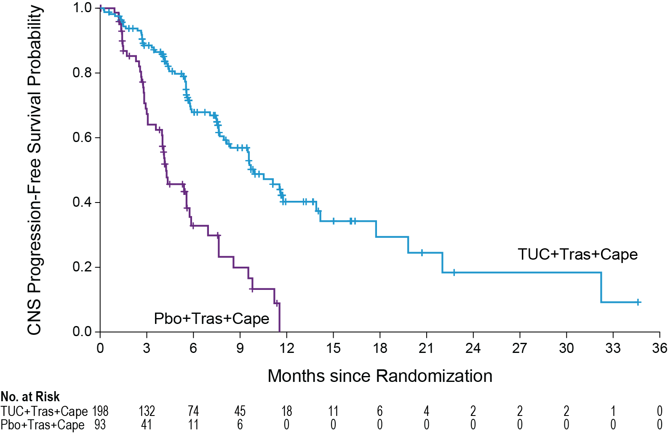
CNS-PFS Benefit in Patients with Brain Metastases
 | Events N=291 | HR (95% CI) | P Value
TUC+Tras+Cape | 71/198 | 0.32 (0.22, 0.48) | <0.00001
Pbo+Tras+Cape | 46/93
Risk of CNS progression or death was reduced by 68% in patients with brain metastases
One-year CNS-PFS (95% CI):
TUC+Tras+Cape 40.2% (29.5, 50.6) | Pbo+Tras+Cape 0%
Median CNS-PFS (95% CI):
9.9 months (8.0, 13.9) | 4.2 months (3.6, 5.7)
Median
40.2%
0%
Stable BrMets: 13.9 mos 5.6 mos
Active BrMets: 9.5 mos 4.1 mos
CNS-PFS: time from randomization to disease progression in the brain or death by investigator assessment.
HR: hazard ratio computed from Cox proportional hazards model using stratification factors (ECOG performance status: 0/1, and Region of world: North America/Rest of World) at randomization. All P values are nominal.
Lin et al. J Clin Oncol. 2020;38(23):2610-2619.
Notes:
Here you will see that the addition of tucatinib to cape/H yielded a 5 month improvement in PFS. The PFS difference among those with stable brain mets was 13.9 vs. 5.6 months and 9.5 vs. 4.1 months for those with active brain metastases. These results were essentially unprecedented and clinically very meaningful.

Slide 13
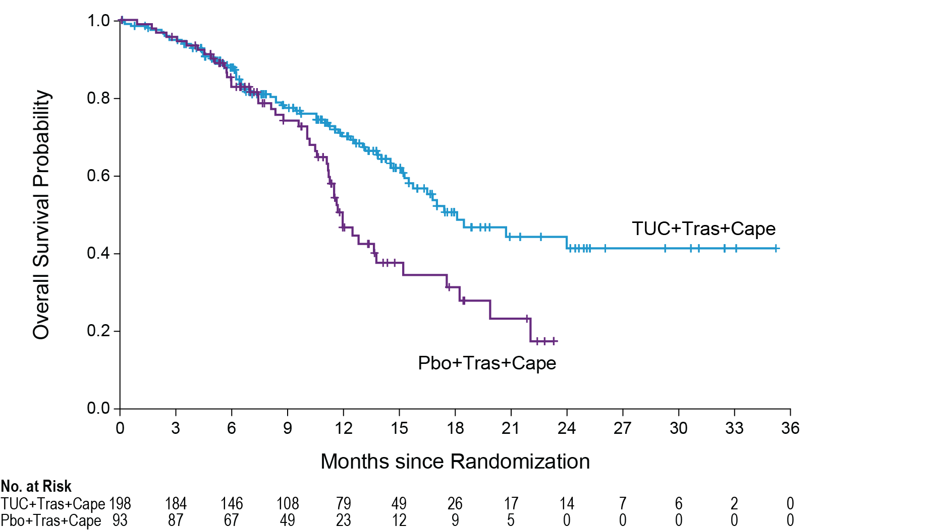
OS Benefit in Patients with Brain Metastases
 | Events N=291 | HR (95% CI) | P Value
TUC+Tras+Cape | 68/198 | 0.58 (0.40, 0.85) | 0.005
Pbo+Tras+Cape | 46/93
Risk of death was reduced by 42% in patients with brain metastases
One-year OS (95% CI):
TUC+Tras+Cape 70.1% (62.1, 76.7) | Pbo+Tras+Cape 46.7% (33.9, 58.4)
Median OS (95% CI):
18.1 months (15.5, NE) | 12.0 months (11.2, 15.2)
70.1%
Median
46.7%
NE: not estimable
Stable BrMets: 15.7 mos 13.6 mos
Active BrMets: 20.7 mos 11.6 mos
HR: hazard ratio computed from Cox proportional hazards model using stratification factors (ECOG performance status: 0/1, and Region of world: North America/Rest of World) at randomization. All P values are nominal.
Lin et al. J Clin Oncol. 2020;38(23):2610-2619.
Notes:
Similarly, OS was improved by the addition of tucatinib to cape/H, 18 months vs. 12 months. Survival benefit was also seen among those with stable and active CNS disease.

Slide 14
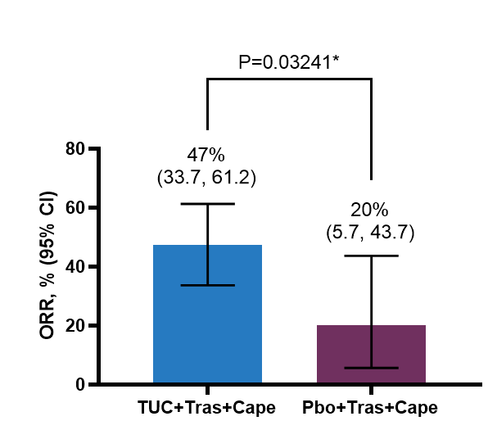
Intracranial Response Rate (ORR-IC) in Patients with Active Brain Metastases and Measurable Intracranial Lesions at Baseline
Confirmed Objective Response Rate (RECIST 1.1)
 | TUC+Tras+Cape (N=55) | Pbo+Tras+Cape (N=20)
Best Overall Intracranial Responseª, n (%)
Complete Response (CR) | 3 (5.5) | 1 (5.0)
Partial Response (PR) | 23 (41.8) | 3 (15.0)
Stable Disease (SD) | 24 (43.6) | 16 (80.0)
Progressive Disease (PD) | 2 (3.6) | 0
Not Available^{b} | 3 (5.5) | 0
Subjects with Objective Response of Confirmed CR or PR, n | 26 | 4
Duration of Intracranial Response (DOR-IC)^{e} (95% CI)^{f}, months | 6.8 (5.5, 16.4) | 3.0 (3.0, 10.3)
(a) Confirmed Best overall response assessed per RECIST 1.1. (b) Subjects with no post-baseline response assessments. (c) Two-sided 95% exact confidence interval, computed using the Clopper-Pearson method (1934). (d Cochran-Mantel-Haenszel test controlling for stratification factors (ECOG performance status: 0/1, and Region of world: North America/Rest of World) at randomization. (e) As estimated using Kaplan-Meier methods. (f) Calculated using the complementary log-log transformation method (Collett, 1994).
P=0.03*
ORR-IC, % (95% CI)
N=55
N=20
*Stratified Cochran-Mantel-Haenszel P value
Lin et al. J Clin Oncol. 2020;38(23):2610-2619.

Slide 15
PFS in Patients with Isolated Progression in the Brain
Who Continued with Assigned Study Treatment
Randomization
First CNS Progression*
Local Therapy
Second Progression (CNS, body or both) or Death
Study treatment
Continue study treatment
Randomization to second progression or death †
First CNS progression to second progression or death‡
 | Median time from randomization to second progression or death | HR | Median time from first CNS progression to second progression or death | HR
TUC+Tras+Cap N=21 | 15.9 months (11.7, 28.2) | 0.292 (0.11, 0.77) P=0.009 | 7.6 months (3.9, 11.3) | 0.332 (0.13, 0.85) P=0.02
Pbo+Tras+Cap N=9 | 9.7 months (4.9, 12.0) |  | 3.1 months (1.2, 4.1)
*Note: First CNS progression was captured as a PFS event in the primary analysis.
† Time from randomization to second progression or death among patients who received local therapy and continued study treatment after isolated CNS progression.
‡Time from first isolated CNS progression to second progression or death among patients who received local therapy and continued study treatment after isolated CNS progression.
Lin et al. J Clin Oncol. 2020;38(23):2610-2619.
Notes:
An interesting analysis was performed among those with first CNS progression. Following local therapy, the triplet therapy with tucatinib/cape/H was continued with an additional 7.6 month PFS till second CNS progression which was superior to Cape/H alone. This data continues to highlight the importance of adhering to the ASCO HER2 CNS Metastases guidelines.

Slide 16
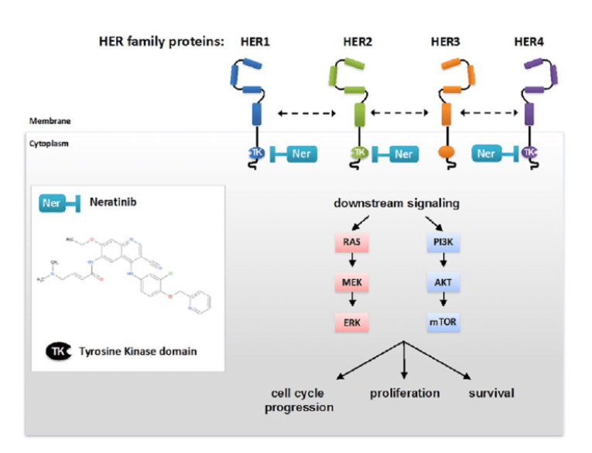
Neratinib
Potent, irreversible-binding inhibitor of the erbB family
  Inhibits signal transduction through EGFR, HER2, HER4
FDA approved for extended adjuvant therapy of early-stage HR+/HER2+ breast cancer (<1 yr from completion of prior adjuvant trastuzumab
Active systemically alone or when combined with chemotherapy¹⁻⁷
On NCCN guidelines for treatment of metastatic disease in combination with capecitabine
¹Burstein et al. J Clin Oncol 2010; ²Awada A et al. JAMA Oncol 2016; ³Chow LW et al Br J Cancer 2013, ⁴Awada A et al. Ann Oncol 2013; ⁵Saura C et al. J Clin Oncol 2014; ⁶ Awada A et al. JAMA Oncol 2016; ⁷Saura C et al. J Clin Oncol 2020
Notes:
LOOK UP TEMODAR TRIAL, LOOK UP TOXICITY TABLE WITH GRADE 2 EVENTS, MAKE SURE NOT COUNTED AS GRADE 3 TOO

Slide 17

TBCRC 022: A Phase II Trial of Neratinib for Patients With Human Epidermal Growth Factor Receptor 2-Positive Breast Cancer and Brain Metastases
Progressive brain mets
Cohort 1 (n=40)
Neratinib (240 mg/day)
Cohort 2 (n=5)
Neratinib (240 mg/day) until surgical resection, then
Neratinib (240 mg/day)
HER2+ Breast Cancer and
Brain Mets
Craniotomy Candidates
Progressive
brain mets
No prior lapatinib (3A)
Prior lapatinib (3B)
Neratinib (240 mg/day) and Capecitabine
(750 mg/m² D1-14 of 3 week cycle)
Cohort 3A (n=37)
Cohort 3B (n=12)
4A: Previously untreated CNS disease, no prior T-DM1 (20)
4B: Progressive CNS disease, no prior T-DM1 (n=20)
4C: Progressive HER2+ CNS disease AND prior T-DM1 (n=23)
Neratinib (160 mg/day) and
T-DM1 3.6 mg/kg q 3wks

Slide 18
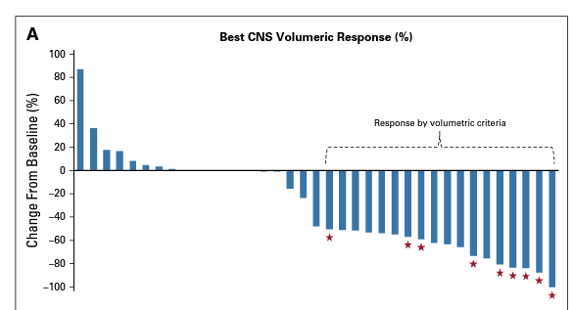
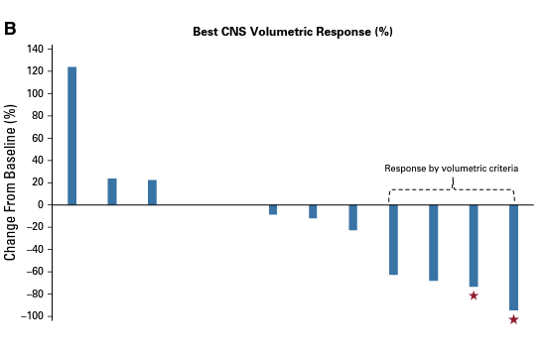
TBCRC22 Cohort 2 – Neratinib/Capecitabine
Cohort 3A (lapatinib naïve)
Cohort 3A (lapatinib exposed)
% reduction in volume of CNS lesions
CNS ORR = 49% (n=37)
CNS ORR = 33% (n=12)
* 6 patients did not reach first re-staging evaluation and are categorized as ‘0’
┼ No patient had clear increase in steroid use, non-target lesions, non-CNS lesions,
or worsening neurological symptoms at time of radiographic response
Freedman et al. J Clin Oncol 2019;37(13):1081-1089

Slide 19
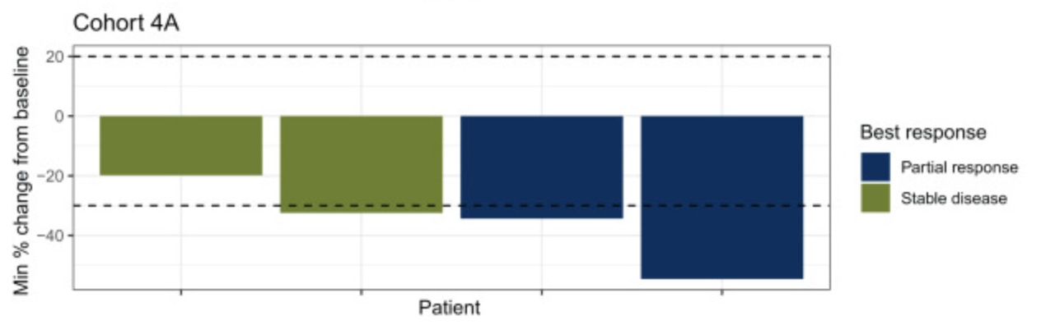
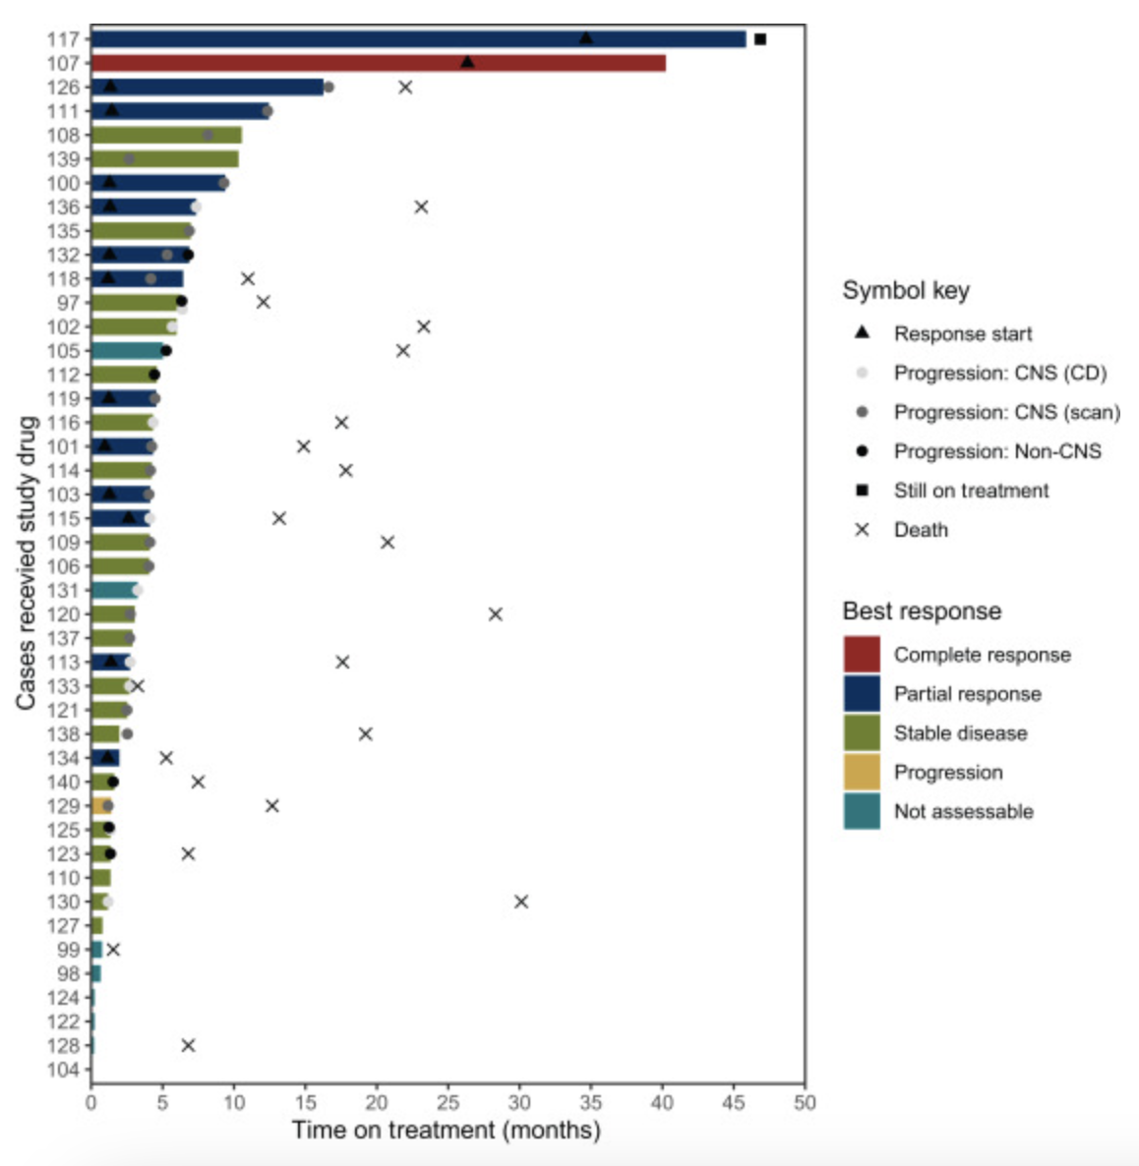
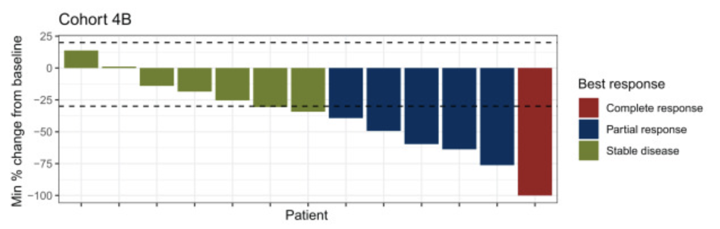
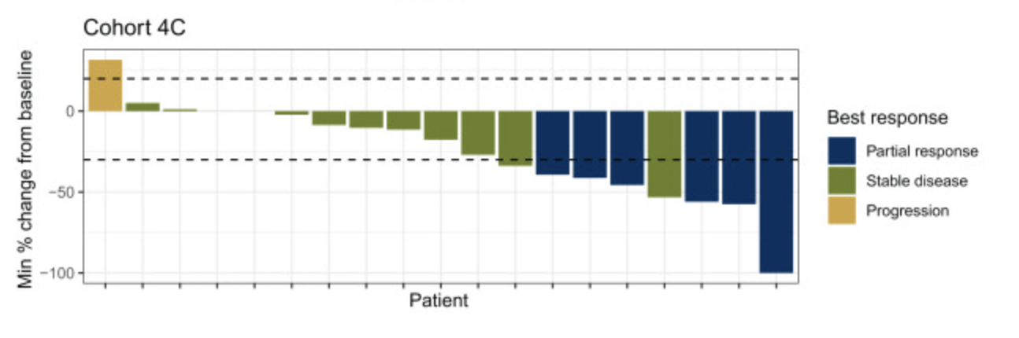
TBCRC 022 Cohort 4 – Neratinib/T-DM1
% reduction in volume of CNS lesions
CNS ORR = 33.3% (4A), 25.3% (4B), 28.6% (4C)
Cohort 4A—previously untreated BCBM
Cohorts 4B and 4C—BCBM progressing after local CNS-directed therapy without (4B and with (4C) prior exposure to TDM-1
OS = 30.2 mo (4A), 23.3 mo (4B, 20.9 mo (4C)
Freedman RA et al. Annals of Oncol 2024; 35(11) : 993-1002

Slide 20
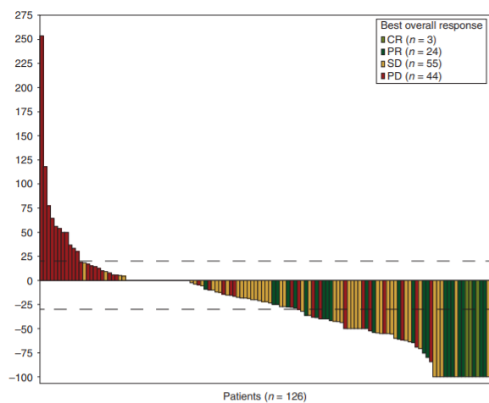
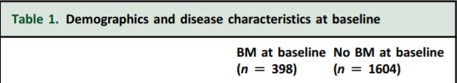
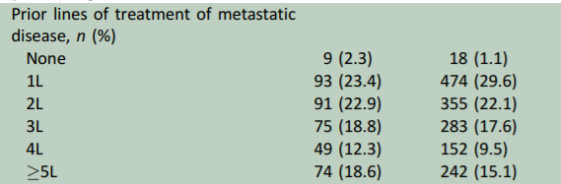
KAMILLA: Phase IIIb study of T-DM1 in Patients with
HER2-positive Breast Cancer Brain Metastases
N = 398 (n = 126 with measureable) brain mets of 2,002 enrolled; all received T-DM1.
CNS ORR: 21.4%
CNS CBR: 42.9%
PFS: 5.5 mos
OS: 18.9 mos
Combination strategies with T-DM1 + HER2 TKI’s are ongoing
Montemurro et al. Ann Oncol. 2020;31(10):1350-1358.
Notes:
Moving onto HER2-directed ADC’s, the KAMILLA study was a phase 3B study of the ADC TDM1 in over 2,000 patients with advanced HER2+ breast cancer, of which 398 had brain mets. The efficacy data in the CNS shows a CNS ORR of 21%, CNS CBR of 42.9%, PFS of 5.5 mos and OS of 18.9 mos. While TDM1 is generally reserved for 2L therapy, in this post-registrational study, nearly 60% of patients were beyond 2nd line, illustrating efficacy for heavily-pretreated pts. As such, TDM1 in combination with other TKI’s, such as neratinib and tucatinib, are currently being investigated.

Slide 21
Trastuzumab deruxtecan in patients with HER2+ advanced/metastatic breast cancer with or without brain metastases: DESTINY-Breast12 primary results
Nancy U Lin, Eva Ciruelos; Guy Jerusalem; Volkmar Müller;
Naoki Niikura; Giuseppe Viale; Rupert Bartsch; Christian Kurzeder;
Roisin M Connolly; Sally Baron-Hay; María Gión; Valentina Guarneri; Giampaolo Bianchini; Hans Wildiers; Santiago Escrivá-de-Romaní; Manoj Prahladan; Helen Bridge; Sunil Verma; Nadia Harbeck. On behalf of the DESTINY-Breast12 investigators
Presented at ESMO Sept 13, 2024

Slide 22
Current evidence base for T-DXd benefit in patients with HER2+ mBC and BMs
Promising preliminary evidence of T-DXd intracranial activity in HER2+ mBC has been observed in small prospective patient cohorts, retrospective studies, and exploratory analyses:^{1–6}
Intracranial ORR
Active BMs
Stable BMs
Retrospective ROSET-BM^{5,6}
(≥1L)
Ph 2 TUXEDO-1¹
(≥2L)
†‡
Ph 1b/2
DESTINY-Breast07²
(1–2L)
Exploratory pooled analysis
DESTINY-Breast01, 02, 03³
(≥2L)
Ph 2 DEBBRAH⁴
(≥2L)
*†
†‡
†‡
†‡
*§
*§
n=15
n=35
n=104
n=44
Untreated BMs
(n=4)
Previously treated /
progressing BMs
(n=9)
n=5
n=37
Nancy U Lin, MD ESMO 2024
Active BMs include patients with untreated and previously treated / progressing BMs, unless otherwise stated
*Per RANO-BM; †per independent central review; ‡per RECIST 1.1; §per investigator
1L, first line; 2L, second line; BM, brain metastasis; HER2+, human epidermal growth factor receptor 2–positive; mBC, metastatic breast cancer; ORR, objective response rate; Ph, Phase; RANO-BM, Response Assessment in Neuro-Oncology Brain Metastases; RECIST 1.1, Response Evaluation Criteria in Solid Tumours version 1.1; T-DXd, trastuzumab deruxtecan
1. Bartsch R, et al. Nat Med. 2022;28:1840–1847; 2. Anders C, et al. Poster presented at ESMO Breast Cancer 2024 (Abstract FPN 185P); 3. Hurvitz SA, et al. Oral presentation at ESMO 2023 (Abstract 377O); 4. Pérez-García JM, et al. Neuro Oncol. 2023;25:157–166; 5. Niikura N, et al. NPJ Breast Cancer. 2023;9:82; 6. Niikura N, et al. NPJ Breast Cancer. 2023;9:82 (Supplementary Appendix)

Slide 23
DESTINY-Breast12 study design
Phase 3b/4, multicenter, single-arm, two-cohort, open-label study of T-DXd in previously treated HER2+ mBC with and without brain metastases (BMs); the largest prospective study of T-DXd in patients with stable or active BMs
Patient population
Aged ≥18 years
Pathologically documented HER2+ advanced or metastatic BC with or without baseline brain metastases
Received ≤2 prior lines of therapy
in the metastatic setting
(tucatinib naïve)
Disease progression on prior
HER2-directed regimens
ECOG PS 0 or 1
No known or suspected leptomeningeal metastases
Baseline brain metastases
(N=263)*
Stable BMs (previously treated)
Active BMs (untreated or previously treated / progressing [not requiring immediate local therapy])
Primary endpoint:
PFS
Additional endpoints included:
CNS PFS
OS
ORR
CNS ORR
Safety and tolerability
T-DXd
5.4 mg/kg IV Q3W†
No baseline brain metastases (N=241)
Primary endpoint:
ORR
Additional endpoints included:
OS
Safety and tolerability
T-DXd
5.4 mg/kg IV Q3W†
Data reported for the full analysis set (all patients enrolled in the study who received at least one treatment dose) and safety analysis set (identical to full analysis set). No hypothesis testing or comparison of cohorts. Response and progression assessed by ICR per RECIST 1.1 in both cohorts. Patients were enrolled from Australia, Canada, Europe, Japan, and United States
*Concomitant use of ≤3 mg of dexamethasone daily or equivalent allowed for symptom control of BMs (baseline BMs cohort only); †until RECIST 1.1-defined disease progression outside the CNS
BC, breast cancer; CNS, central nervous system; ECOG PS, Eastern Cooperative Oncology Group performance status; HER2, human epidermal growth factor receptor 2; HER2+, HER2-positive; ICR, independent central review; IV, intravenous; mBC, metastatic breast cancer; ORR, objective response rate; OS, overall survival; PFS, progression-free survival; Q3W, every 3 weeks; RECIST 1.1, Response Evaluation Criteria in Solid Tumours version 1.1; T-DXd, trastuzumab deruxtecan
NCT04739761. Updated. July 19, 2024. Available from: https://www.clinicaltrials.gov/study/NCT04739761 (Accessed September 9, 2024)
Lin NU, et al. ESMO 2024. Abstract LBA18.

Slide 24
Patient disposition
Baseline BMs (N=263)
No baseline BMs (N=241)
Stable BMs (n=157)*
Active BMs (n=106)
Untreated (n=39)†
Previously treated / progressing (n=67)‡
Discontinued T-DXd (55.1%)
      PD (30.8%)
      AE (11.8%)
      Patient decision (3.4%)
      Death (2.7%)
      Consent withdrawal (2.7%)
      Subjective disease progression (2.3%)
      COVID-19 pandemic (1.1%)
      Investigator decision (0.4%)
      Patient lost to follow up (0.4%)
      Other (0.8%)
Discontinued T-DXd (60.6%)
      PD (35.7%)
      AE (7.5%)
      Patient decision (6.2%)
      Investigator decision (2.9%)
      Subjective disease progression (2.9%)
      Death (1.2%)
      Consent withdrawal (1.2%)
      Patient lost to follow up (0.8%)
      Severe non-compliance to protocol (0.4%)
      COVID-19 pandemic (0.4%)
      Other (1.7%)
Median follow-up duration: 15.4 months (range, 0.1–30.0)
Patients on T-DXd at DCO: 118 (44.9%)
Median follow-up duration: 16.1 months (range, 0.8–28.4)
Patients on T-DXd at DCO: 95 (39.4%)
Final DCO: Feb 8, 2024. Patients may have more than one reason for discontinuation
*Stable BMs: radiographically stable for ≥4 weeks since completion of treatment; †untreated BMs with lesions ≤2.0 cm; ‡previously treated BMs that had progressed since local CNS therapy, with no clinical indication for immediate retreatment with local therapy
AE, adverse event; BM, brain metastasis; CNS, central nervous system; DCO, data cutoff; PD, progressive disease; T-DXd, trastuzumab deruxtecan
Lin NU, et al. ESMO 2024. Abstract LBA18.

Slide 25
Demographics and baseline characteristics
 | Baseline BMs (N=263) | No baseline BMs (N=241)
Age, median (range), years | 52 (28–86) | 54 (24–87)
Female, n (%) | 263 (100.0) | 241 (100.0)
ECOG PS at baseline, n (%)
0 1 | 163 (62.0) 100 (38.0) | 194 (80.5) 47 (19.5)
HER2 status, n (%)
2+ 3+ Positive* | 2 (0.8) 187 (71.1) 74 (28.1) | 5 (2.1) 141 (58.5) 95 (39.4)
HR status, n (%)
Positive† | 165 (62.7) | 150 (62.2)
Liver metastases, n (%) | 58 (22.1) | 66 (27.4)
Lung metastases, n (%) | 67 (25.5) | 67 (27.8)
Measurable disease, n (%) | 198 (75.3) | 215 (89.2)
 | Baseline BMs (N=263) | No baseline BMs (N=241)
Prior regimens of anticancer therapies for metastatic disease
Number of regimens, median (range) | 1.0 (0–4) | 1.0 (0–4)
Number of regimens, n (%) 0 1 2 ≥3 | 20 (7.6) 132 (50.2) 109 (41.4) 2 (0.8) | 18 (7.5) 124 (51.5) 96 (39.8) 3 (1.2)
Prior HER2 inhibitor agents, n (%) | 262 (99.6) | 240 (99.6)
Trastuzumab Pertuzumab T-DM1 Tucatinib‡ Other TKIs§ T-DXd Specific agent not reported | 258 (98.1) 228 (86.7) 106 (40.3) 2 (0.8) 15 (5.7) 1 (0.4) 1 (0.4) | 233 (96.7) 207 (85.9) 94 (39.0) 0 15 (6.2) 0 0
Prior therapies for BMs, n (%)
Intracranial radiotherapy¶ | 158 (60.1) | –
Whole brain radiation therapy Stereotactic radiosurgery | 40 (15.2) 15 (5.7) | – –
Time from last intracranial radiotherapy to treatment initiation, median (range), days | 164 (9–2115) | –
*Specific HER2 status unknown; †HR status positive if either or both of ER/PR status had a positive result; ‡the two patients with prior tucatinib use were recorded as protocol deviations; §lapatinib and neratinib; ¶the type of intracranial radiotherapy was not always recorded by investigators, and only whole brain radiation therapy and stereotactic radiosurgery were reported
BM, brain metastasis; ECOG PS, Eastern Cooperative Oncology Group performance status; ER, estrogen receptor; HER2, human epidermal growth factor receptor 2; HR, hormone receptor; PR, progesterone receptor; T-DM1, trastuzumab emtansine; T-DXd, trastuzumab deruxtecan; TKI, tyrosine kinase inhibitor
Lin NU, et al. ESMO 2024. Abstract LBA18.

Slide 26
Baseline BMs: PFS (primary endpoint)
1.0
Overall population (KM analysis)
N=263
0.9
Data maturity: 42.2%
Median PFS (post-hoc analysis):
17.3 months (95% CI 13.7, 22.1)
0.8
0.7
0.6
Probability of PFS
0.5
0.4
12-month PFS:
61.6%
(95% CI 54.9, 67.6)
0.3
0.2
0.1
0.0
0
1
2
3
4
5
6
7
8
9
10
11
12
13
14
15
16
17
18
19
20
21
22
23
24
25
26
27
Months
At risk
263
257
246
232
225
208
193
185
177
159
130
114
105
100
76
70
50
44
34
31
23
23
11
8
2
2
0
 |  |  |  | Active BM subgroups
 | Overall population (N=263) | Stable BMs (n=157) | Active BMs (n=106) | Untreated (n=39) Post-hoc analysis | Previously treated / progressing (n=67) Post-hoc analysis
Overall no. events | 111 | 64 | 47 | 20 | 27
12-month PFS, % (95% CI) | 61.6 (54.9, 67.6) | 62.9 (54.0, 70.5) | 59.6 (49.0, 68.7) | 47.0 (29.6, 62.7) | 66.7 (53.4, 76.9)
T-DXd showed consistent 12-month PFS in patients with stable and active BMs
PFS assessed by ICR per RECIST 1.1
BM, brain metastasis; CI, confidence interval; ICR, independent central review; KM, Kaplan-Meier; no., number of; PFS, progression-free survival; RECIST 1.1, Response Evaluation Criteria in Solid Tumours version 1.1;
T-DXd, trastuzumab deruxtecan
Lin NU, et al. ESMO 2024. Abstract LBA18.

Slide 27
Baseline BMs: CNS PFS
1.0
Overall population (KM analysis)
N=263
0.9
Data maturity: 38.4%
0.8
0.7
0.6
Probability of CNS PFS
0.5
0.4
12-month CNS PFS:
58.9%
(95% CI 51.9, 65.3)
0.3
0.2
0.1
0.0
0
1
2
3
4
5
6
7
8
9
10
11
12
13
14
15
16
17
18
19
20
21
22
23
24
25
26
27
Months
At risk
263
258
242
229
224
208
192
178
166
132
107
95
85
79
59
52
33
30
24
23
16
15
5
4
2
2
0
 | Overall population (N=263) | Stable BMs (n=157) | Active BMs (n=106)
Overall no. events | 101 | 61 | 40
12-month CNS PFS, % (95% CI) | 58.9 (51.9, 65.3) | 57.8 (48.2, 66.1) | 60.1 (49.2, 69.4)
T-DXd showed consistent 12-month CNS PFS in patients with stable and active BMs
Patients who had systemic progression, but no CNS progression, were censored at the time of the progression assessment; the analysis did not account for systemic progression as a competing event. CNS PFS assessed by ICR per RECIST 1.1
BM, brain metastasis; CI, confidence interval; CNS, central nervous system; ICR, independent central review; KM, Kaplan-Meier; no., number of; PFS, progression-free survival;
RECIST 1.1, Response Evaluation Criteria in Solid Tumours version 1.1; T-DXd, trastuzumab deruxtecan
Lin NU, et al. ESMO 2024. Abstract LBA18.

Slide 28
Baseline BMs: CNS ORR
100
Patients with measurable CNS disease at baseline (post-hoc analysis)
n=138
80
60
40
20
Best percentage change in target CNS lesion size from baseline
0
−20
−40
−60
−80
−100
 |  |  |  | Active BM subgroups
Measurable CNS disease at baseline | All patients (n=138) | Stable BMs (n=77) | Active BMs (n=61) | Untreated (n=23) Post-hoc analysis | Previously treated / progressing (n=38) Post-hoc analysis
Confirmed CNS ORR, % (95% CI) | 71.7 (64.2, 79.3) | 79.2 (70.2, 88.3) | 62.3 (50.1, 74.5) | 82.6 (67.1, 98.1) | 50.0 (34.1, 65.9)
T-DXd showed substantial CNS responses in the overall BMs population, including patients with stable and active BMs
Dashed line indicates a 30% decrease in target tumor size (PR)
*Imputed values: a value of +20% was imputed if best percentage change could not be calculated because of missing data if: a patient had a new lesion or progression of non-target lesions or target lesions, or had withdrawn because of PD and had no evaluable target lesion data before or at PD
BM, brain metastasis; CI, confidence interval; CNS, central nervous system; ORR, objective response rate; PD, progressive disease; PR, partial response; T-DXd, trastuzumab deruxtecan
Lin NU, et al. ESMO 2024. Abstract LBA18.

Slide 29
Overall safety summary
 | Baseline BMs (N=263) | No baseline BMs (N=241)
Median treatment duration, months (range) | 11.5 (0.1–26.9) | 12.0 (0.7–28.4)
Any AE, n (%) Possibly related to treatment* | 259 (98.5) 242 (92.0) | 237 (98.3) 230 (95.4)
Grade ≥3 AE, n (%) Possibly related to treatment* | 134 (51.0) 100 (38.0) | 118 (49.0) 98 (40.7)
Serious AEs, n (%) Possibly related to treatment* | 62 (23.6) 25 (9.5) | 46 (19.1) 25 (10.4)
AEs leading to discontinuation, n (%) | 40 (15.2) | 23 (9.5)
AEs leading to dose interruptions, n (%) | 146 (55.5) | 124 (51.5)
AEs leading to dose reductions, n (%) | 60 (22.8) | 65 (27.0)
AEs leading to death, n (%) Possibly related to treatment* | 8 (3.0) 6 (2.3)† | 6 (2.5) 5 (2.1)‡
*As assessed by the investigator; †ILD/pneumonitis (n=6); ‡IILD/pneumonitis (n=3), bronchopulmonary aspergillosis not associated with ILD/pneumonitis (n=1), and general disorders and administration site conditions (n=1)
AE, adverse event; BM, brain metastasis; ILD, interstitial lung disease
Lin NU, et al. ESMO 2024. Abstract LBA18.

Slide 30
AEs of special interest
Investigator-reported ILD/pneumonitis*
n (%) | Grade 1 | Grade 2 | Grade 3 | Grade 4 | Grade 5 | Any grade
Patients with BMs (N=263) | 26 (9.9) | 8 (3.0) | 1 (0.4) | 1 (0.4) | 6 (2.3) | 42 (16.0)
Reported as co-occurring with opportunistic infection† | 0 | 0 | 0 | 1 (0.4) | 4 (1.5) | 5 (1.9)‡
Patients without BMs (N=241) | 22 (9.1) | 6 (2.5) | 0 | 0 | 3 (1.2) | 31 (12.9)
Reported as co-occurring with opportunistic infection† | 0 | 0 | 0 | 0 | 0 | 0
LVEF decrease from baseline§
n (%) | Grade 1 | Grade 2 | Grade 3 | Grade 4 | Grade 5 | Any grade
Patients with BMs (N=263) | 0 | 29 (11.0) | 2 (0.8) | 0 | 0 | 31 (11.8)
Patients without BMs (N=241) | 4 (1.7) | 22 (9.1) | 0 | 0 | 0 | 26 (10.8)
Median time to first onset of ILD/pneumonitis for patients was 168.0 days (range 35–646) in patients with BMs (n=42) and 169.0 days (range 24–484) in patients without BMs (n=31)
*Grouped term; includes the preferred terms ‘ILD’, ‘lung infiltration’, ‘pneumonitis’, and ‘pulmonary fibrosis’ (patients with BMs) and ‘ILD’, ‘lung opacity’, ‘pneumonitis’, ‘pulmonary fibrosis’, and ‘radiation pneumonitis’ (patients without BMs). There was no adjudication in the study; †no systematic testing for infection during the study; ‡Aspergillus: n=1 (Grade 5 ILD/pneumonitis), PJ infection: n=1 (Grade 4 ILD/pneumonitis), PJ pneumonia: n=3 (Grade 5 ILD/pneumonitis); §includes the preferred terms ‘ejection fraction decreased’, ‘ischemic contracture of the left ventricle’, and ‘left ventricular dysfunction’ (patients with BMs) and ‘cardiac failure chronic’, ‘ejection fraction decreased’, and ‘troponin T increased’ (patients without BMs)
AE, adverse event; BM, brain metastasis; ILD, interstitial lung disease; LVEF, left ventricular ejection fraction; PJ, Pneumocystis jirovecii
Lin NU, et al. ESMO 2024. Abstract LBA18.

Slide 31
Conclusions
In this prospective Phase 3b/4 study, T-DXd exhibited substantial and durable overall and intracranial clinical activity in a large patient cohort with HER2+ mBC with stable and active BMs
  12-month PFS was 61.6% overall (stable BMs: 62.9%; active BMs: 59.6%); estimated median PFS was 17.3 months*
  CNS ORR was 71.7% overall (stable BMs: 79.2%; active BMs: 62.3%)
T-DXd activity in patients without baseline BMs was consistent with previous reports
  ORR was 62.7%
12-month OS was maintained in patients with BMs (90.3%) and without BMs (90.6%)
The safety profile of T-DXd was consistent with previous reports; no new safety signals were identified
  ILD/pneumonitis remains an important identified safety risk of T-DXd
Results from DESTINY-Breast12 support the use of T-DXd for patients with HER2+ mBC,
irrespective of the presence of stable or active BMs
*Post-hoc analysis
BM, brain metastasis; CNS, central nervous system; HER2+, human epidermal growth factor receptor 2–positive; ILD, interstitial lung disease; mBC, metastatic breast cancer; ORR, objective response rate; OS, overall survival; PFS, progression-free survival; T-DXd, trastuzumab deruxtecan

Slide 32
Systemic therapy for HER2 “negative” breast cancer brain metastases
ER/PR positive/HER2 negative:
Endocrine therapy
Chemotherapy (capecitabine)
CDK 4/6 inhibition (abemaciclib > ribociclib > palbociclib)
Triple Negative Breast Cancer
Chemotherapy (capecitabine, platinum)
Topoisomerase inhibitors
  Sacituzumab govitecan
PARP inhibitors
  Olaparib
  Niraparib
  Talazoparib
  Veliparib
? Immunotherapy
*None of these therapies are FDA-approved specifically for breast cancer brain metastases……
**Capecitabine, platinum and etoposide are listed as per www.NCCN.org
Notes:
Switching gears, we will conclude with an overview of the systemic therapy agents that are available to treat HER2-negative breast cancer brain metastases. In the hormone receptor positive space, endocrine therapy, brain permeable chemotherapy – such as capecitabine, and CDK4/6i are the mainstay. There is early data for topoisomerase inhibitors.
In the triple negative space, again chemotherapy including platinums are options. More novel, targeted therapy options include topoisomerase inhibitors, with more recent data for sacituzumab which we will review, and PARP inhibitors for those who harbor a germline BRCA mutations.

Slide 33
Other chemo combinations with some efficacy data
Chemo regimen | Pts (Breast/Other) | ORR/ TTP/PFS* | OS | Author/ Year
Cisplatin/Etoposide | 116 (56/60) | 38% ORR | 31 wks | Franciosi 1999
Cisplatin/TMZ | 32 (15/17) | 40% ORR / 2.9 mo TTP | 5.5 mo | Christodoulou 2005
Capecitabine/TMZ | 24 | 18% ORR/ 12 wk TTP | NR | Rivera 2006
Irinotecan/Iniparib | 34 (All TNBC) | 12% ORR/ 27% CBR/ 2.1 mo TTP | 7.8 mo | Anders 2014
Bevacizumab/Cis/Etoposide | 35 | 77% CNS ORR/ 7.3 mo CNS PFS | 10.5 mo | Lu 2015
Irinotecan/TMZ | 30 (8 with LMD) | 7%/23% CBR/2.3 mo TTP | 4.9 mo | Melisko 2019
Liposomal Irinotecan (MM398) | 10 | 30% | NR | Anders 2020

Slide 34
A Phase 2 Study of Abemaciclib in Patients With Brain Metastases Secondary to Hormone-Receptor-Positive Breast Cancer
Abemaciclib 200 mg bid monotherapy or with endocrine therapy, or 150 mg bid with trastuzumab
Brain metastases concentrations of total active abemaciclib analytes were 96 and 19-fold above in vitro IC50 for CDK4 and CDK, respectively
Study did not meet its primary endpoint
Cohort | Biology | iORR | iCBR | OS
A (n = 58) | HR+/HER2- | 5.2% | 24% | 12.5 mo
B (n=27) | HR+/HER2+ | 0% | 11% | 11 mo
C (n=10) | HR+ LMD | 10% (in BM/SD in LMD) |  | 8.4 mo
D (n=9) | Surgical Resections | N/A | N/A | 31.7 mo
Tolaney et al. Clin Cancer Res. 2020;26(20):5310-5319.

Slide 35
Elacestrant in combination with abemaciclib in pts with brain metastasis from ER+, HER2- breast cancer:
ELECTRA, an open-label, multicenter, phase 1b/2 study
Eligible pts – ER+/HER2-neg advanced or metastatic breast cancer who had received at least 1 line of endocrine therapy, no more than 2 lines of chemotherapy, and no more than two CDK4/6 inhibitors, excluding abemaciclib in the metastatic setting
Brain metastases were not required for phase 1b enrollment; pts who enroll in phase 2 will be required to have brain metastases at baseline
No pts with brain mets were in the Phase 1b cohort
ORR was 26 % (1 CR and 5 PRs) in evaluable pts treated across 3 cohorts in phase 1b (n = 23)
Clinical benefit rate (CBR) at 16 weeks and 24 weeks was 70% and 57%, respectively.
No grade 4 AEs were reported, and no grade 3 diarrhea was observed. Neutropenia was mainly attributed to abemaciclib
Ibrahim NK, et al. ASCO 2024. Abstract 1064.

Slide 36
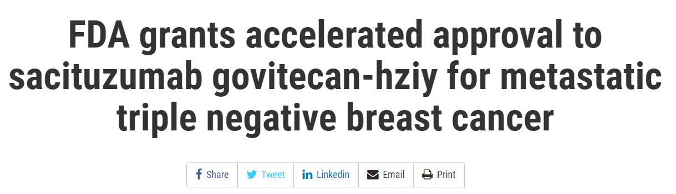
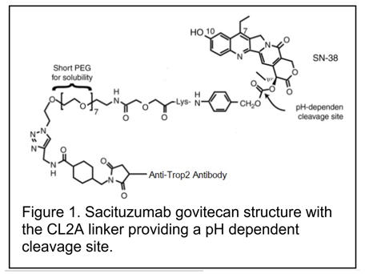
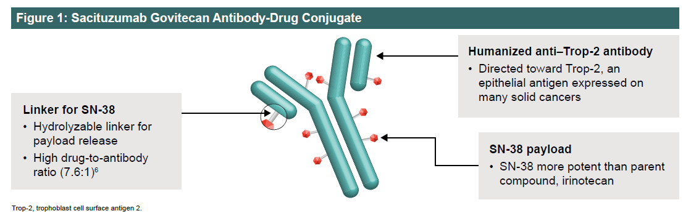
Dieras et al. SABCS 2020. Abstract PD13-07; Brenner et al. SABCS 2020. PD13-05.
Notes:
Moving on to TNBC and in April of 2020, we saw the first accelerated approval of and Ab Drug conjugate, sacituzumab govitecan, for metastatic triple negative breast cancer in the United States. The Ab component of sacituzumab targets the trophoblast cell surface antigen (TROP2) which is expressed on the cell surface of many solid tumor cells. The payload is SN-38, the active metabolite of irinotecan and 1000 times more potent, is known to cross the BBB and has shown efficacy in preclinical mouse models of brain metastases.

Slide 37

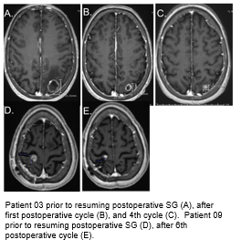
 | CNS Tumor Mean Total SN-38 | CNS Tumor Mean Free [SN-38] | Fold change from IC-50
Breast cancer CNS metastases (N = 4) | 455nM (174-1160) | 73nM (15-198) | 150-fold
Glioblastoma multiforme (N = 6) | 270nM (93-687) | 46nM (20-90) | 40-fold
Of first 10 with Breast Cancer CNS metastases,
2 with ongoing responses, after 4th and 6th cycle
Notes:
At SABCS 2020, Dr. Brenner and colleagues reported the results of concentration of CNS tumor total and free SN38 for patients treated with sacituzumab just prior to standard of care craniotomy. Results are presented here for 4 of the patients with metastatic breast cancer at 455 nM and 73 nM, respectively. This is 150 fold higher than the IC50 at 18 hours post-treatment. Levels for GBM were 270 nM and 46 nM for mean and free CNS tumor SN38, a level 40 fold higher than the report IC50. Of the first 10 pts treated with Breast Cancer CNS metastases, the authors provide serial MRI images with control of intracranial tumor at 4 and 6 cycles of sacituzumab.

Slide 38
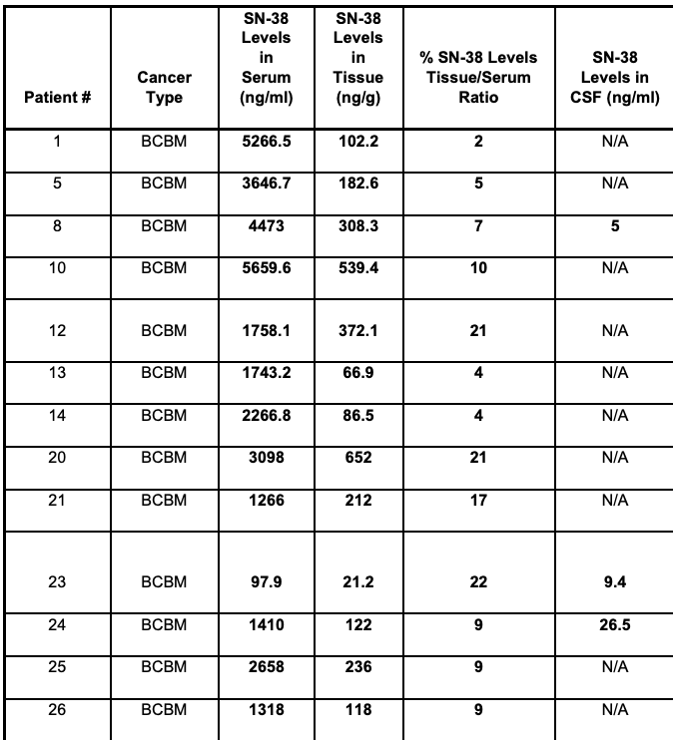
Sacituzumab Govitecan in patients with breast cancer brain metastases and recurrent glioblastoma: a phase 0 window-of-opportunity trial
25 pts with BCBM (n=12) and rGBM received a single IV dose of SG at 10 mg/kg given one day before resection and continued on days 1 and 8 of 21-d cycles
PFS was 8 months (range 2–26.5 mo) in the BCBM cohort
OS for the BCBM cohort was 35.2 months (2.7–37 mo)
Non-planned exploratory endpoint of ORR was 38% for BCBM
In post-surgical tissue, the median total SN-38 was 249.8 ng/g for BCBM
In a very limited sample of CSF samples (n = 3) , SN-38 levels were low (5, 9.4, 26.5 ng/ml)
Balinda HU et al. Nat Commun 15, 6707 (2024).

Slide 39
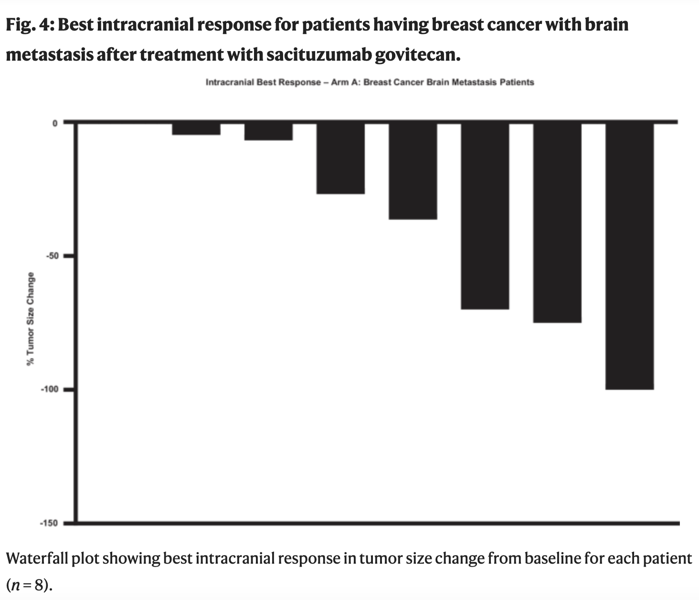
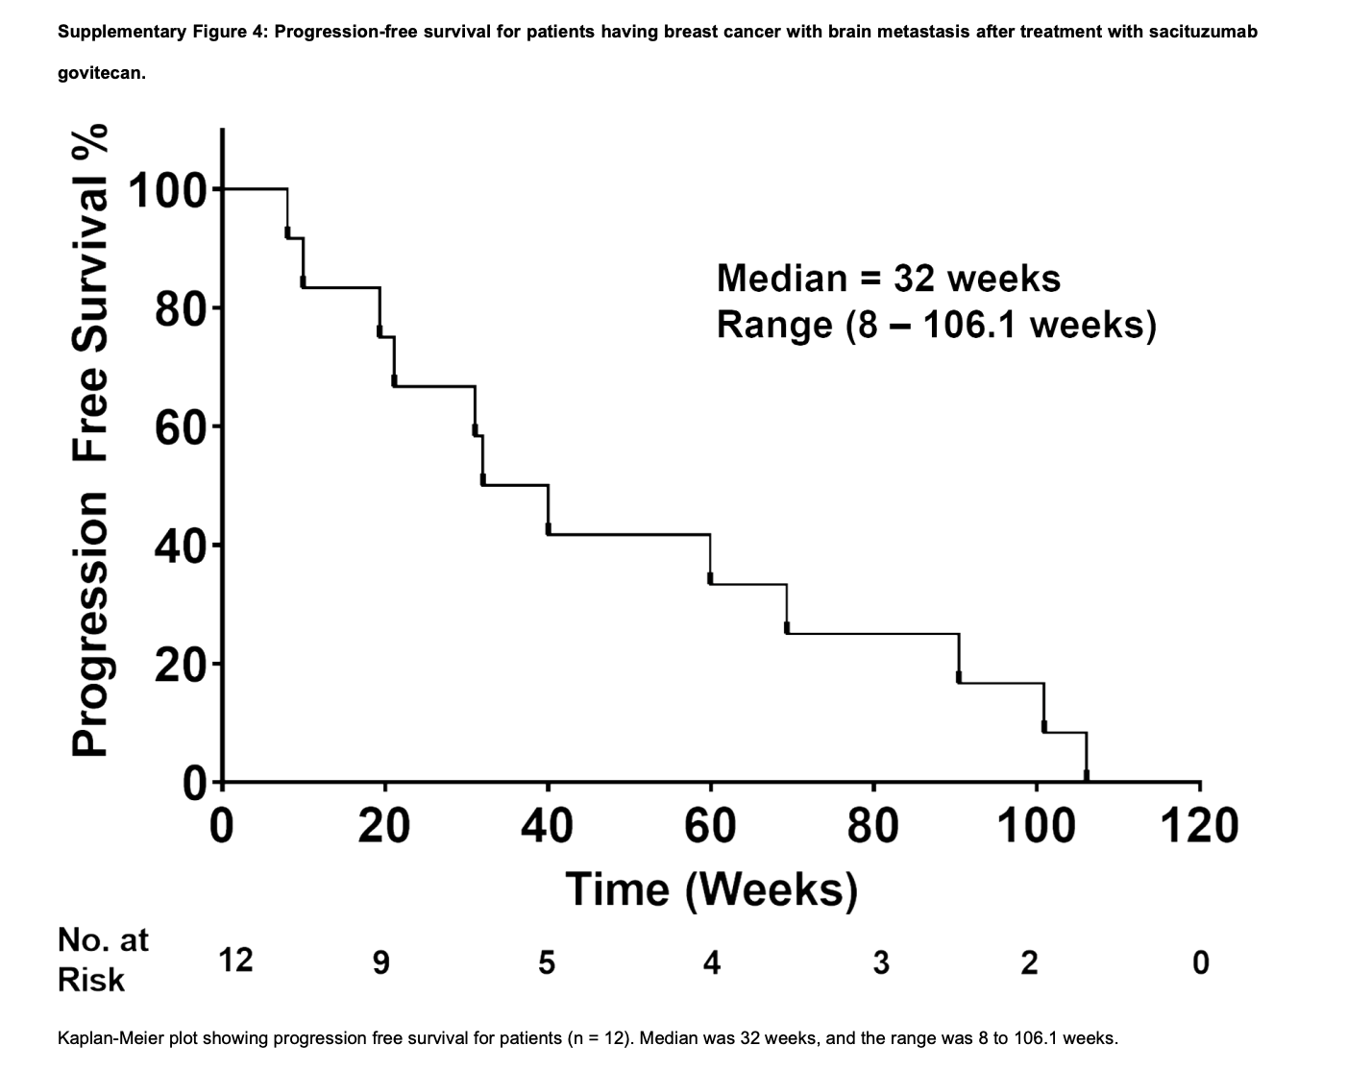
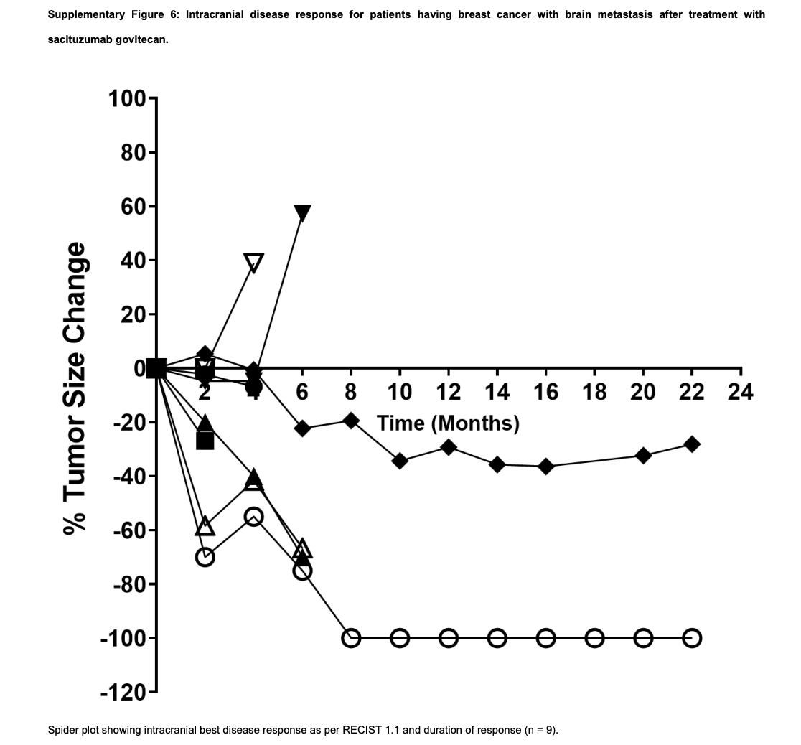
Sacituzumab Govitecan in patients with breast cancer brain metastases – Best IC response and PFS
Await results of SWOG study to see results in a larger population

Slide 40
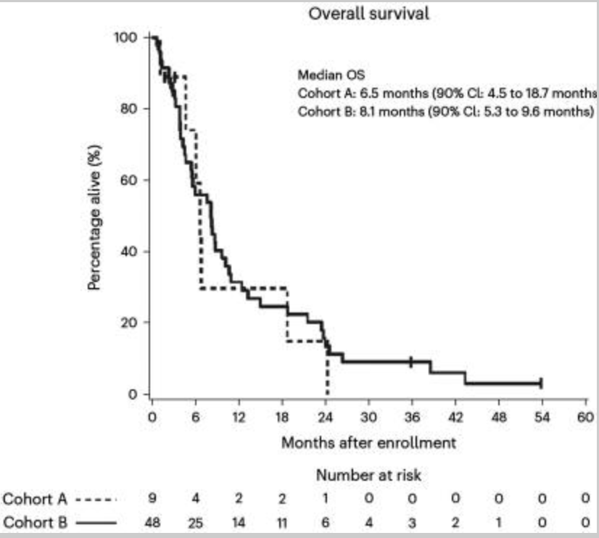
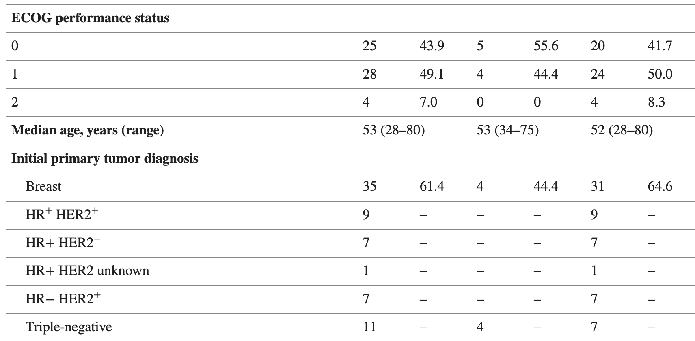
Pembrolizumab in brain metastases of diverse histologies: phase 2 trial results
Single-arm, open-label, phase 2 trial evaluating IC efficacy of pembrolizumab in 9 pts with untreated BMs (cohort A) and 48 pts with recurrent and progressive BMs (cohort B)
TTP_{CNS} was 1.6 months (90% CI: 1.2–4.5 mo) in cohort A and 2.2 mo (90% CI: 1.4–3.1 months)in cohort B
Intracranial benefit rate of 42.1% (90% CI: 31-54%)
Median OS was 6.5 mo (90% CI: 4.5-18.7 mo) for cohort A and 8.1 mo (90% CI: 5.3-9.6 mo) for cohort B
30 pts (52%; 90% CI: 41-64%) had one or more gr-3 or higher AEs that were at least possibly tx related. Two patients had grade-4 AEs (cerebral edema) that were deemed at least possibly tx related
All Cohort A Cohort B
Brastianos et al. Nat Med 2023;29(7):1728-1737

Slide 41
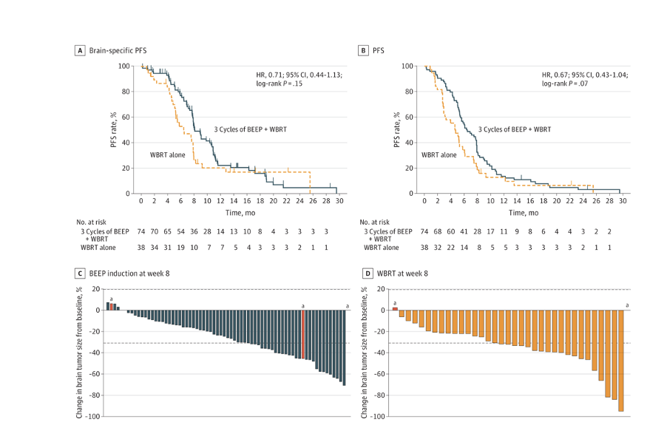
Whole-Brain Radiotherapy Alone vs Preceded by Bevacizumab, Etoposide, and Cisplatin for Untreated Brain Metastases From Breast Cancer: A Randomized Clinical Trial
Open-label, randomized trial assessed patients with brain mets from breast cancer (BMBC) in Taiwan from 2014-2018. Pts randomized 2:1 to 3 cycles of BEEP followed by WBRT or WBRT alone
118 pts with BMBC were randomized (ITT 112 pts)
Median age was 56 years (range, 34-71 years)
61 pts (54.5%) had HER2+ disease
Brain-specific ORR at 2 mo was not significantly different (BEEP vs WBRT, 41.9% vs 52.6%) – BEEP pts had not yet received WBRT
8-month brain-specific PFS rate was significantly higher in the experimental group (48.7% vs 26.3%; P = .03)
Chen et al. JAMA Oncol. 2024 Mar 1;10(3):325-334.

Slide 42
Patritumab Deruxtecan (HER3-DXd) in Active Brain Metastases From Metastatic Breast Cancer, NSCLC, and LMD From Advanced Solid Tumors: The TUXEDO-3 Phase II Trial
Patritumab deruxtecan (HER3-DXd), an ADC combining an anti-HER3 antibody with a topoisomerase I inhibitor
International , multicenter, single-arm, three-cohort, phase II trial (NCT05865990)
Between December 2023 and July 2024, 61 evaluable patients were enrolled, 20 patients in cohort 1 (breast cancer)
Patients received HER3-DXd 5.6 mg/kg IV Q3W until disease progression
Median age was 57 yo (35-75) in cohort 1
Median FUP was 4.4 months (1.4-10.1)
In cohort 1, 5/21 (23.8%) patients had IC response irrespective of BC subtype;
2 (40.0%) responders had received previous topo I based ADCs
No new signals of toxicity were observed and neurological symptoms, QoL and neurocognitive function remained stable or improved over the treatment period
Tumoral HER3 expression did not correlate with treatment response
Preusser M et al. 2025 ASCO Annual Meeting. Abstract 2005.

Slide 43
DATO-Base: A phase II study of DATOpotamab deruxtecan for patients with breast cancer brain metastases or leptomeningeal disease (NCT06176261)
Open label, multicenter phase II trial for patients with HER2-negative MBC with active BCBM and/or LMD
Three cohorts:
  Cohort A (n = 24) for HR+/HER2-negative BCBM
  Cohort B (n = 24) for triple-negative BCBM
  Cohort C (n = 10) for HER2-negative LMD (any ER status)
Patients in Cohort A require prior tx with at least one line of endocrine treatment in the metastatic setting; no prior tx is required for Cohorts B and C
Participants receive Dato-DXd 6 mg/kg IV q 21 days
Primary endpoint for Cohorts A and B is intracranial ORR per RANO-BM criteria
Cohort C is exploratory, with description of overall survival and exploratory endpoints.
Tarantino et al. J Clin Oncol 43, TPS1134 (2025)

Slide 44
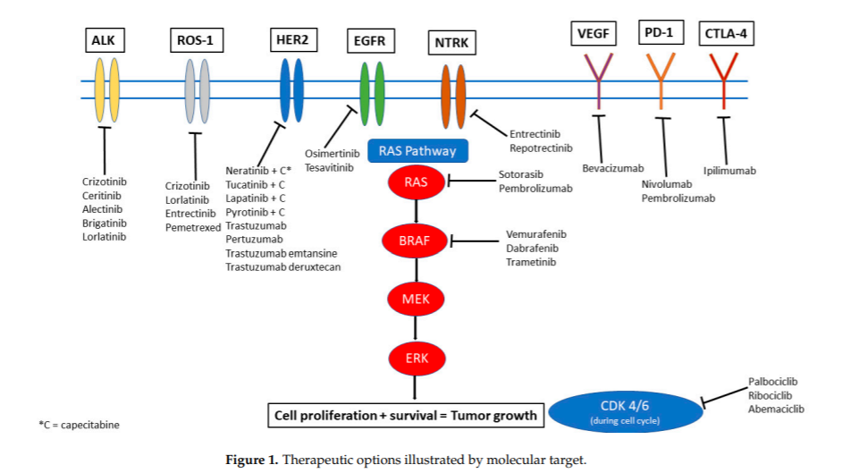
An optimist’s vision of future treatment of CNS disease
More brain penetrant agents needed
Sharma et al. Cancers (Basel). 2021;14(1):17.

Slide 45
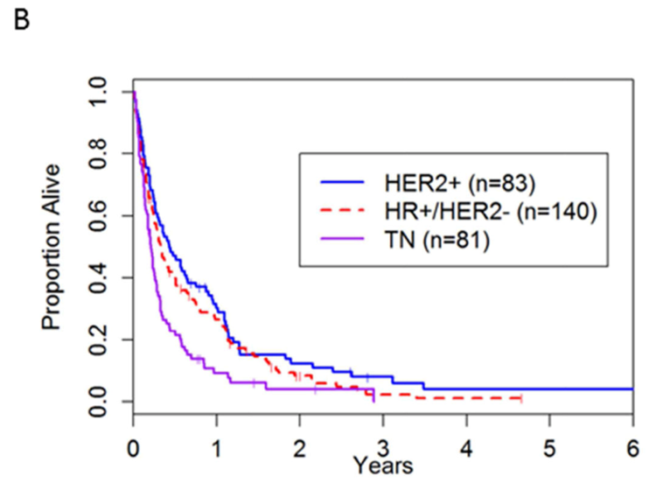
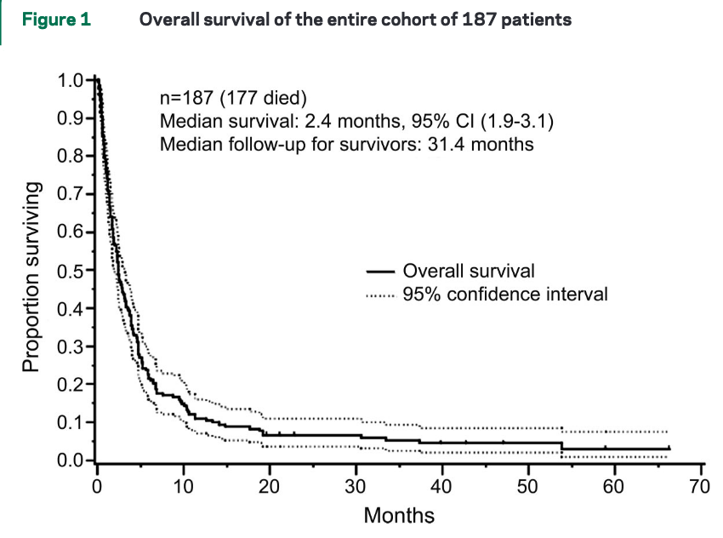
LMD prognosis only modestly changed in over 10 years, except for HER2+ breast cancer and some mutation driven NSCLC
Breast cancer: 2.8 months
Lung cancer: 2.2 months
44% HR+HER2-
18% HR+HER2+
8.5% HR-HER2+
25.5% TNBC
4% missing information
Morikawa et. al. Clin Breast Cancer. 2017;17(1):23-28.
Clarke et. al. Neurology. 2010;74(18):1449-54.
Notes:
Despite advances in cancer therapy, survival remains poor after diagnosis of LMD.
For example, in this retrospective study from Memorial Sloan-Kettering, the authors analyzed outcomes of 187 patients with LMD. 150 had solid and 37 had hematopoietic malignancies. Median survival was 2.4mo after time of LMD diagnosis.
Patients with solid malignancies did worse- with a median survival of 2.3mo compared to 4.7 months for those with hematologic malignancies.
Based on disease-specific cohorts, we have observed that patients with LMD and breast cancer tend to have a slightly longer median OS, whereas patients with lung cancer and melanoma have an even worse prognosis.

Slide 46
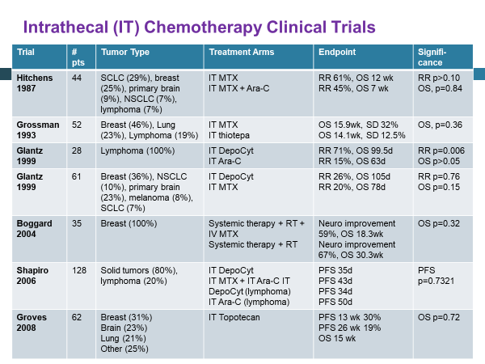
Problem: Essentially NO therapeutic advances since 1990s!

Slide 47
A Phase I/II Study of IT Trastuzumab in HER-2 Positive Cancer with Leptomeningeal Metastases: Safety, Efficacy, and CSF PK
Phase 1 modified 3+3 design to determine RP2D of IT trastuzumab
RP2D= 80 mg intrathecally (one grade 4 arachnoiditis)
Phase 2 was a Simon two-stage design with primary outcome of disease response (n=26 patients)
Pts were treated via Ommaya with IT therapy 2x/weekly for 4 wks, then weekly for 4 wks, then maintenance of q1-2 week
Kumthecar et al. Neuro Oncol 2023;25(3):557-565
Notes:
Despite advances in cancer therapy, survival remains poor after diagnosis of LMD.
For example, in this retrospective study from Memorial Sloan-Kettering, the authors analyzed outcomes of 187 patients with LMD. 150 had solid and 37 had hematopoietic malignancies. Median survival was 2.4mo after time of LMD diagnosis.
Patients with solid malignancies did worse- with a median survival of 2.3mo compared to 4.7 months for those with hematologic malignancies.
Based on disease-specific cohorts, we have observed that patients with LMD and breast cancer tend to have a slightly longer median OS, whereas patients with lung cancer and melanoma have an even worse prognosis.

Slide 48
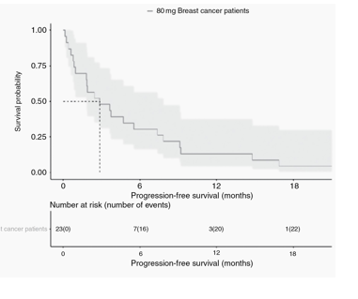
Outcomes for overall and HER2+ breast cancer subset
26 pts at dose level 80mg were included in efficacy evaluation
PR in 5 (19.2%) pts
SD in 13 (50.0%)
PD in 8 (30.8%)
Median overall survival (OS) for Phase 2 dose treated patients was 8.3 months (95% CI 5.2 to 19.6)
Phase II HER2-positive breast cancer patients median OS was 10.5 months (95% CI 5.2 to 20.9).
Median PFS 2.8 months
Primary endpoint of 25% RR was not met, but 69% had clinical benefit
Kumthecar et al. Neuro Oncol 2023;25(3):557-565
Notes:
Make third KM curve grey still…HISTORIC SURVIVAL FOR PATIENTS WITH SPECIFICALLY HER2+ BREAST LMD FROM TIME OF INITIAL DIAGNOSIS
For the 23 breast pts at 80 mg,
PFS6=30%, PFS12=13%
OS6=61%, OS12=52%

Slide 49
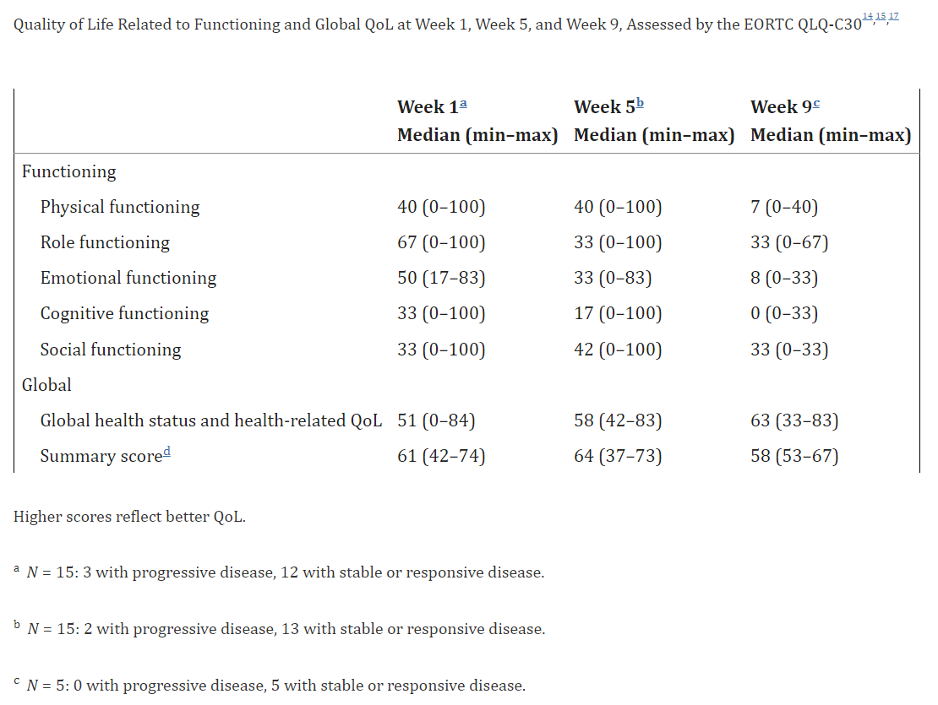
Phase II study of intrathecal administration of trastuzumab in patients with HER2-positive breast cancer with leptomeningeal metastasis
Pts received 150 mg IT trastuzumab weekly
Primary endpoint was clinical neurologic progression-free survival (LM-related-PFS) after 8 weeks
Overall survival, toxicities, and QoL were secondary endpoints
Among 19 pts, 16 (84%) had concomitant brain metastases, 15 had received prior brain radiation, all had received at least one line of systemic anti-HER2 therapy
After 8 weeks, 14 patients (74%) were free of neurological progression
Median LM-related-PFS was 5.9 months and the median OS was 7.9 months
Oberkampf et al. Neuro Oncol. 2023; 25(2): 365–374.

Slide 50
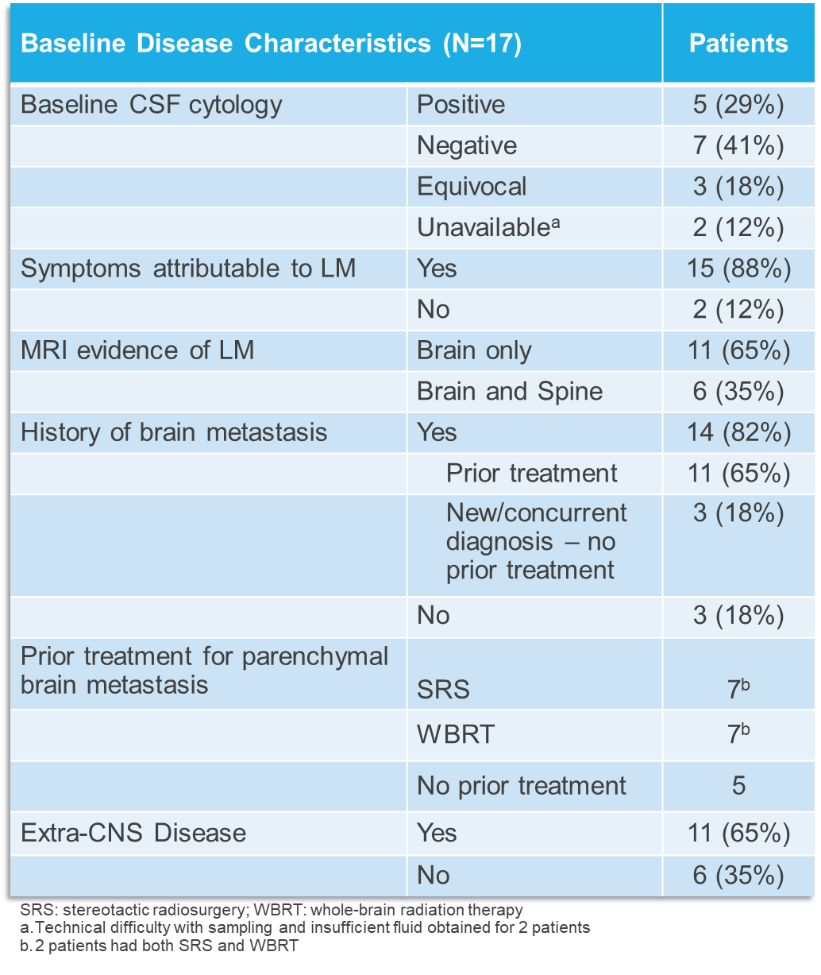
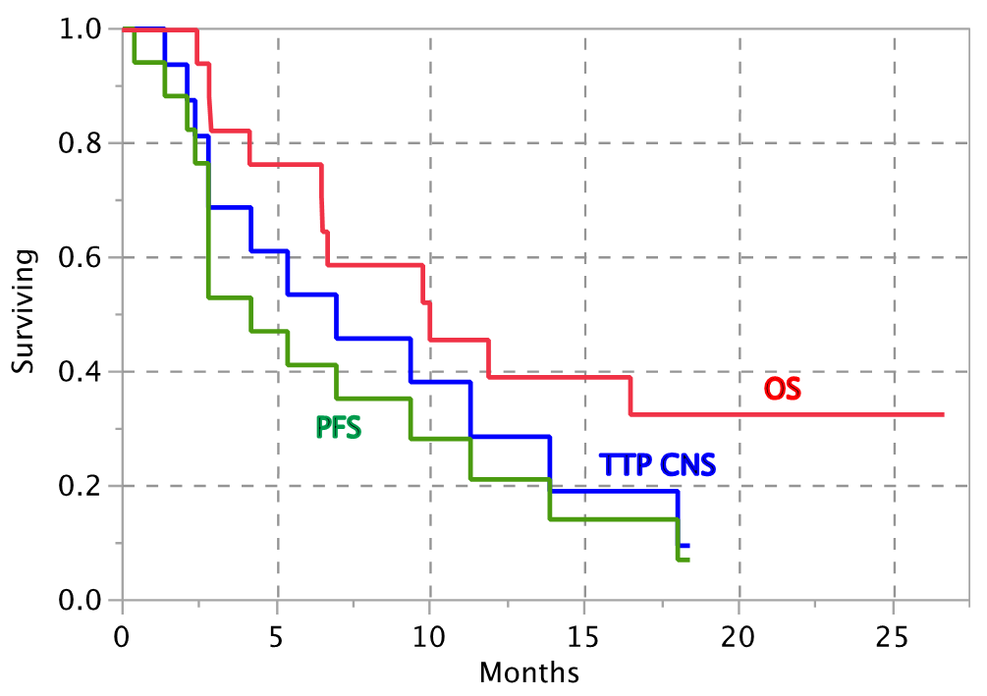
TBCRC 049: Safety and Efficacy of a Tucatinib-Trastuzumab-Capecitabine Regimen for Treatment of Leptomeningeal Metastasis in HER2+ Breast Cancer
At data cutoff (7/20/21), 6 of 17 patients (35%) remained alive
Median follow up: 18.0 months (range: 9.0–26.7)
Median number of treatment cycles received: 5 (range: 2-27)
Median overall survival: 10 months (95% CI: 4.1, NR)
Median time to CNS progression: 6.9 months
Murthy et al. SABCS 2021. Abstract PD4-02.

Slide 51
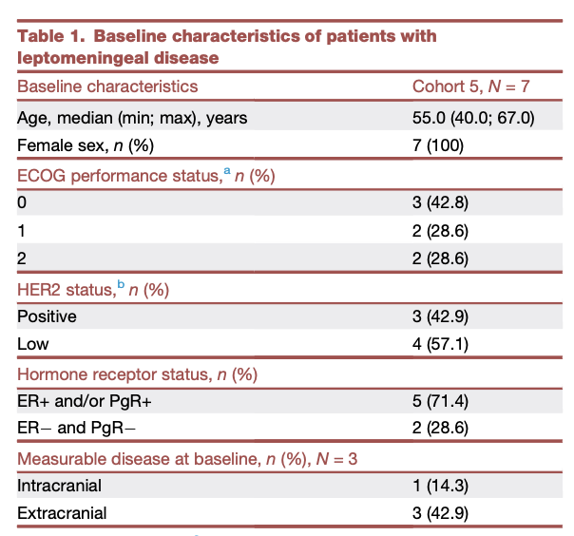
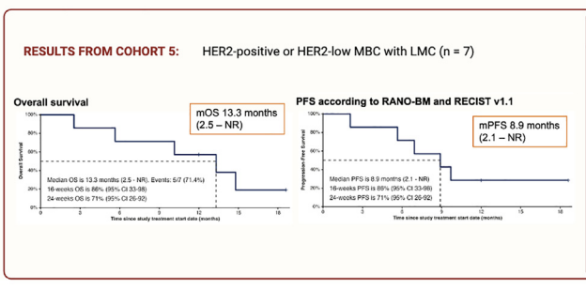
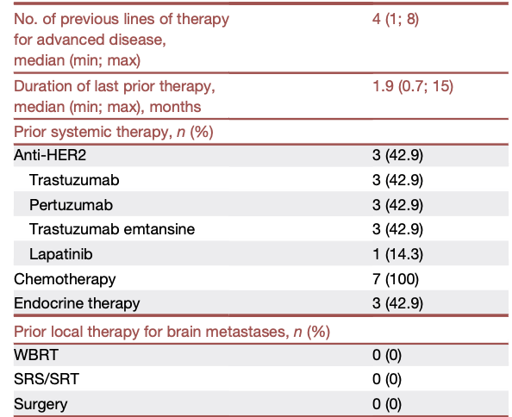
The DEBBRAH trial: T-DXd in HER2-positive and HER2-low breast cancer pts with LMD
Open-label phase 2 trial - 7 pts in cohort 5 (cytology proven LMD)
Median FUP was 12.0 mo (range, 2.5-18.6)
2/7 (28.6%) pts remained on treatment after 18.6 and 11.9 mo, respectively
Of the five pts who progressed and died, none had IC progression or clinical worsening of LMD symptoms
71.4% (95% CI, 29.0-96.3) achieved prolonged stabilization (≥24 wks) by RECIST v.1.1
Vaz Batista M, et al. Med. 2025;6(1):100502.

Slide 52
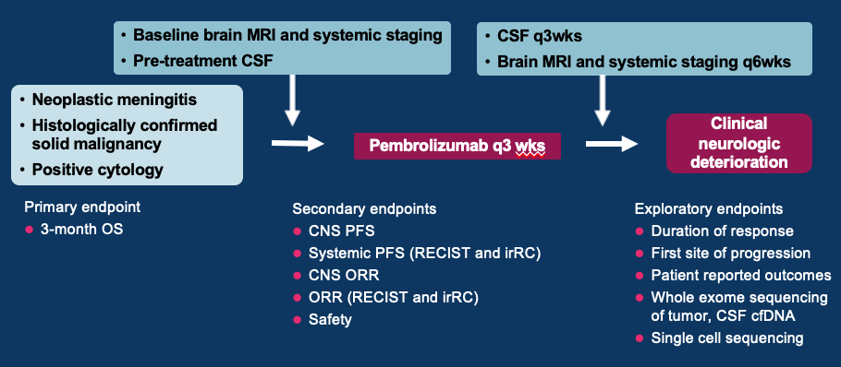
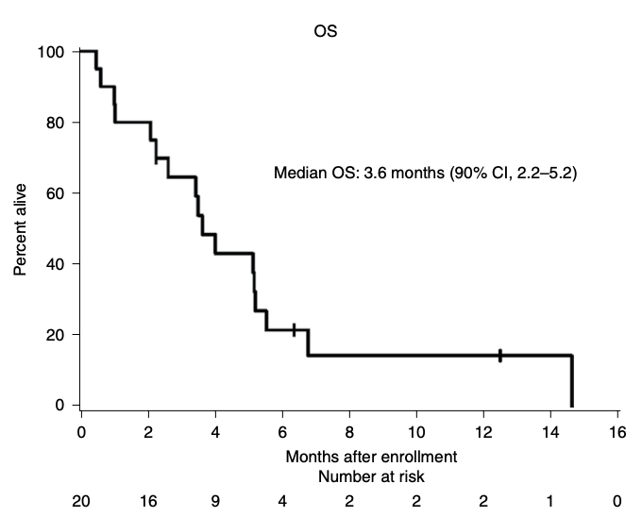
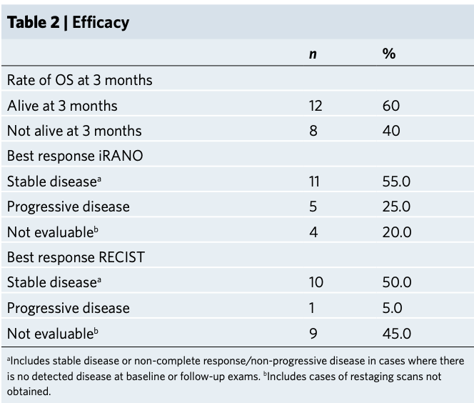
IV Pembrolizumab in Patients with LMD
Primary tumor
Breast (17)
  7 HR+HER2-
  3 HR+HER2+
  3 HR-HER2+
  3 TNBC
  1 unknown
NSCLC (1)
SCLC (1)
Ovarian (1)
Median OS 3.6 months (90% CI 2.2-5.2)
Brastianos et al. Nature Med. 2020;26(8):1280-1284.
Notes:
In a single arm, open label phase II study at Massachusetts General Hospital lead by Dr. Priscilla Brastianos, the authors enrolled patients with solid tumor malignancy and LMD. 17 out of the 20 participants had breast cancer of various subtypes, 1 had NSCLC, 1 had SCLC, and 1 had ovarian cancer. Most patients were heavily pre-treated. They obtained a baseline MRI brain and collected pre-treatment CSF. Then, they started IV pembrolizumab 200mg Q3 weeks and collected serial CSF samples. They evaluated repeat imaging and assessed neurologic status over time. The primary endpoint was three month overall survival. Secondary endpoints were CNS PFS, systemic PFS, CNS ORR, ORR, and safety [click 1].
Among the 20 patients enrolled, 12 patients or 60% were alive at three months. The median overall survival was 3.6 months. Thus they concluded that pembrolizumab was safe with promising activity in patients with LMD. However, the 3.6 month overall survival is not that impressive for patients with breast cancer, who often live longer with LMD, so it is unclear how much of that was due to the efficacy of pembrolizumab vs. the natural course of disease [click 2].

Slide 53
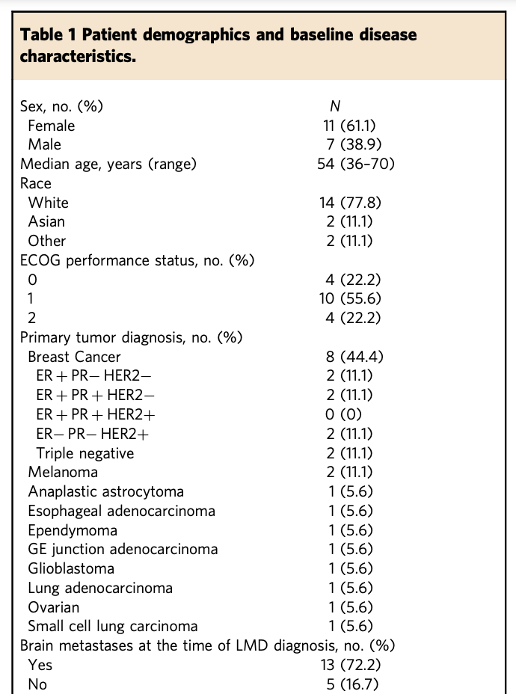
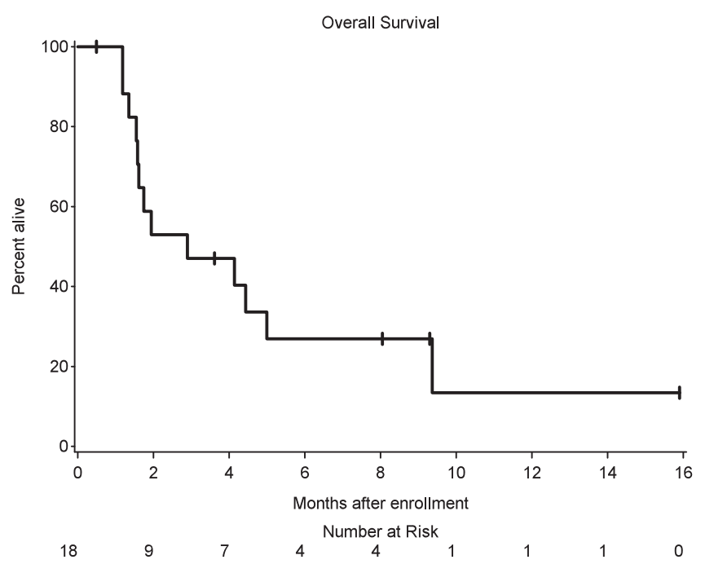
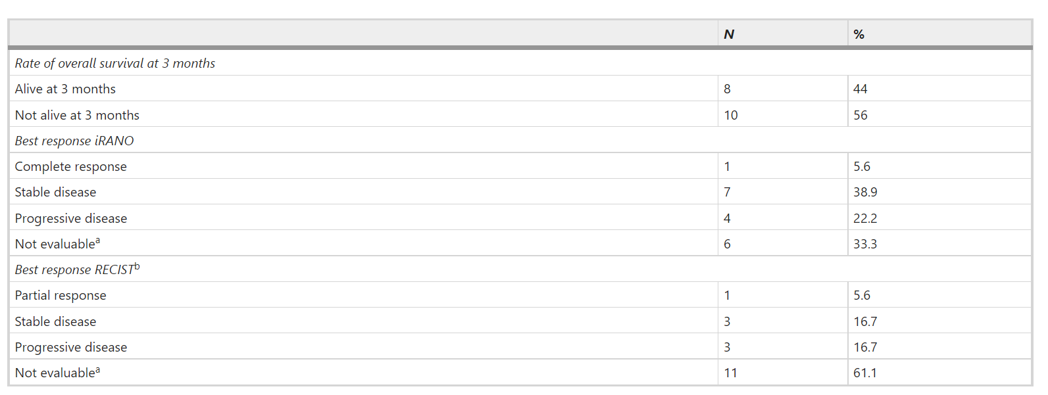
Phase II study of ipilimumab and nivolumab in leptomeningeal carcinomatosis
8 of 18 all pts (not limited to breast) were alive at three months. One third of pts experienced one or more grade 3 or higher AEs
Brastianos et al. Nature Commun. 2021;12(1):5954.
Notes:
In a similar study by the same group at MGH, they also designed a single arm phase II study of 18 patients with LMD and administered the combination of the PD1 inhibitor nivolumab with the CTLA1 inhibitor ipilimumab until progressive disease or unacceptable toxicity, with the primary endpoint of overall survival at three months. The patients had more diverse tumor types in this study, including 8 patients with breast cancer, 2 with melanoma, 2 with GI malignancies, and 2 with primary brain cancers [click 1].
The study met its primary endpoint with 8 of 18 patients alive at three months. One third of patients experienced one or more grade 3 or higher adverse events. Two patients had to discontinue treatment due to unacceptable toxicity, including hepatitis and colitis. Thus, the authors concluded that combined ipi/nivo has an acceptable safety profile and promising activity in patients with LMD [click 2].

Slide 54
Randomized Phase II Trial of Proton CSI Vs Photon Involved-Field RT for Patients With Solid Tumor Leptomeningeal Metastasis
Trial was both randomized and “assigned”. For the randomized groups, pts were assigned (2:1), stratified by histology and systemic disease status, to pCSI or IFRT
Primary end point was CNS PFS. Secondary end points included overall survival (OS) and treatment-related adverse events (TAEs)
Between 4/2020-11/2021, 42 and 21 pts were randomly assigned to pCSI and IFRT
At planned interim analysis, a significant benefit in CNS PFS was observed with pCSI (median 7.5 months; 95% CI, 6.6 months to not reached) compared with IFRT (2.3 months; 95% CI, 1.2 to 5.8 months; P < .001)
OS benefit with pCSI (9.9 months; 95% CI, 7.5 months to not reached) versus IFRT (6.0 months; 95% CI, 3.9 months to not reached; P = .029)
No difference in the rate of grade 3 and 4 TAEs (P = .19)
In the exploratory pCSI group, 35 pts enrolled, the median CNS PFS was 5.8 months (95% CI, 4.4 to 9.1 months) and OS was 6.6 months (95% CI, 5.4 to 11 months)
Yang et al. J Clin Oncol 2022;40(33):3858-3867.

Slide 55
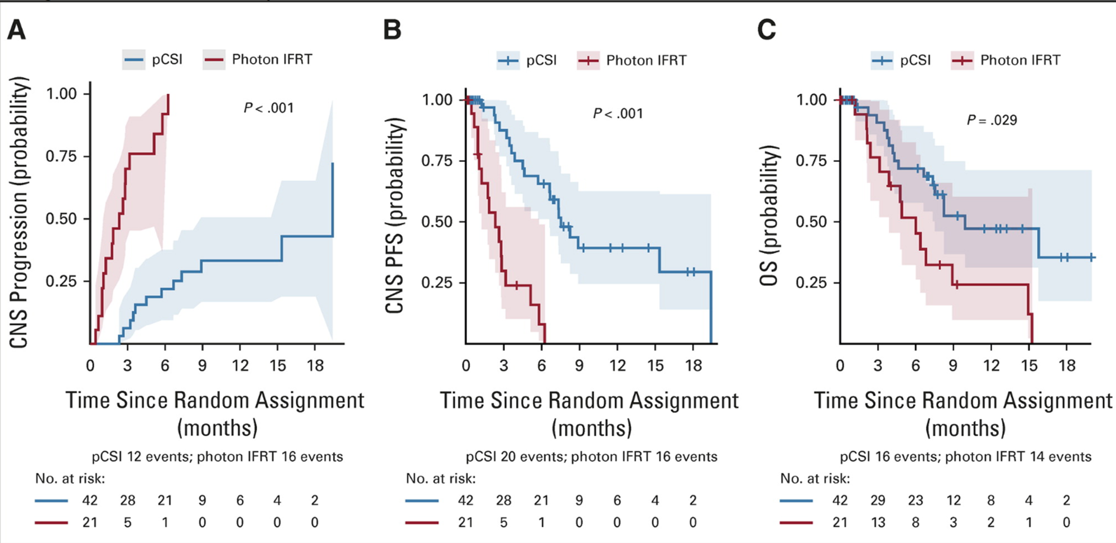
Proton CSI Vs Photon IFRT for Patients With Solid Tumor Leptomeningeal Metastasis
Yang et al. J Clin Oncol 2022;40(33):3858-3867.

Slide 56
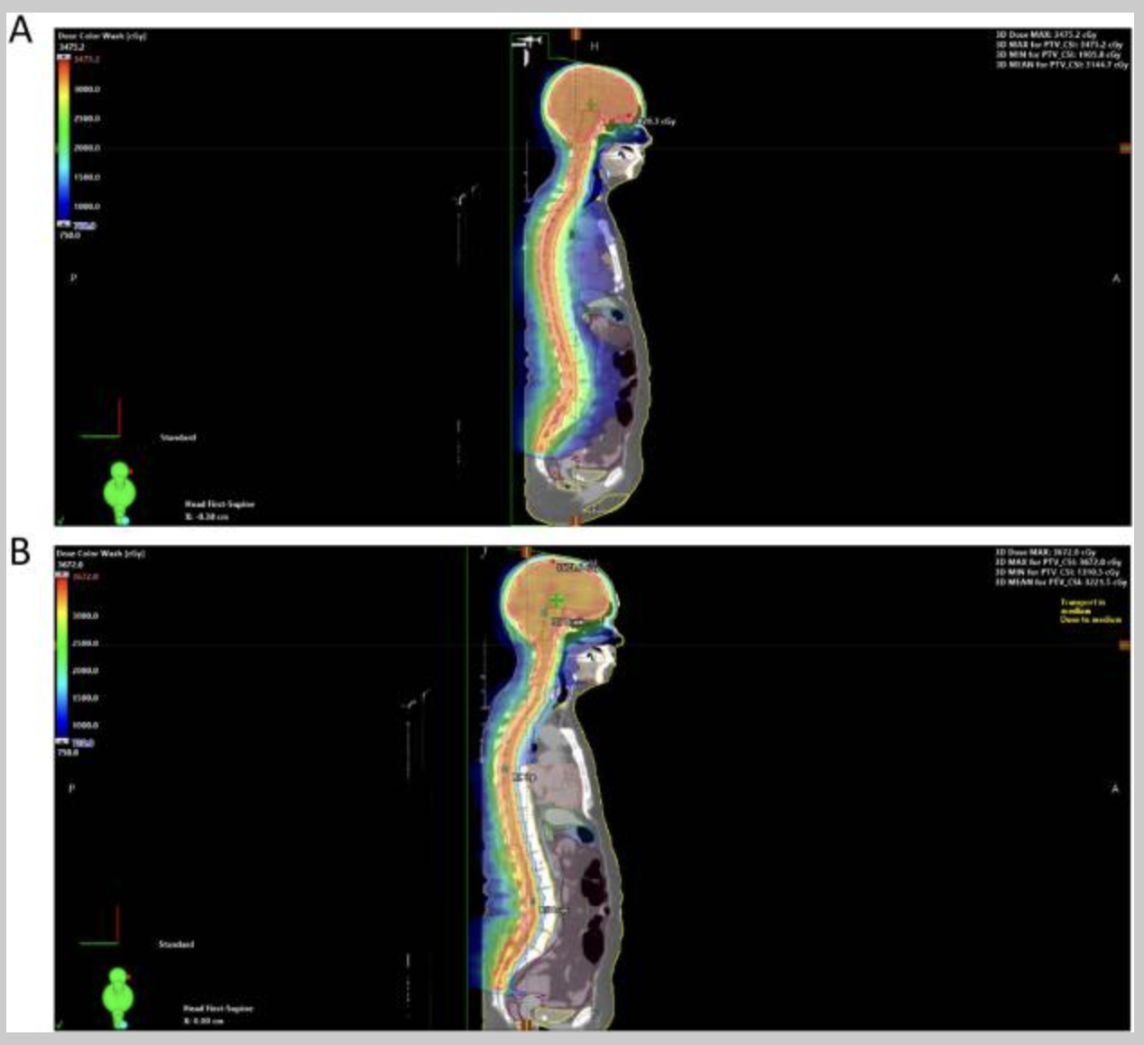
Volumetric Modulated Arc Therapy (VMAT) CSI Utilizing a Vertebral Body Sparing Approach: An Alternative Approach to Improve Access and Minimize Toxicity
. 2023 Dec 14;9(3):101424
. 2023 Dec 14;9(3):101424
. 2023 Dec 14;9(3):101424. d
10 consecutive pts with LMD received VMAT VBS CSI, 30 Gy in 10 fractions, as a part of a prospective registry.
No grade 3+ toxicities
One pt experienced grade 2 neutropenia
9 pts experienced grade 1 hematologic toxicity
3 pts experienced grade 2 GI toxicity
7 pts experienced grade 1 nausea.
One pt experienced a 5-day delay in systemic therapy initiation due to neutropenia
Otherwise all pts planned for systemic therapy started without delay
Perlow et al. Adv Radiation Oncol 2023
(A) Standard CSI plan. (B) Volumetric arc therapy CSI plan.

Slide 57
A Multi-center Phase 2 Study of Hippocampal Avoidance in Craniospinal Irradiation for Leptomeningeal Metastases from Solid Tumors
Study Design: Patients will receive proton (U Wash) or photon VMAT CSI (UCSF) with HA (30 Gy in 3 Gy fractions) Pts will be offered memantine as standard of care
Primary Objective: To assess the CNS-PFS of hippocampal avoidance in CSI for LM from breast cancer or NSCLC
Secondary Objectives:
To evaluate neuro-cognitive outcome (English speaking patients only)
To evaluate overall survival
To assess adverse events associated with CSI with hippocampal avoidance
Neurocognitive and QOL Testing:
Digit Span subtest-WAIS-IV, Brief Test of Attention, Trail Making Test, Controlled Oral Word Association Test (COWAT),Hopkins Verbal Learning Test-Revised (HVLT-R)
Center for Epidemiological Study-Depression (CES-D), Functional Assessment of Chronic Illness Therapy-Fatigue Subscale, Version 4 (FACIT-FS V-4)
Follow up assessments: FUP visits at 3, 6, 9, and 12 months from completing CSI. MRI brain and total spine and at each FUP visit and at CNS disease progression
NCT06518057, PI- Lia M. Halasz, co-PI Steve Braunstein

Slide 58
Intraventricular Administration of Rhenium-186 NanoLiposome for Leptomeningeal Metastases (ReSPECT-LM) (NCT05034497)
Rhenium (¹⁸⁶Re) Obisbemeda
Novel injectable radiotherapy specifically formulated to deliver direct targeted high dose radiation in CNS tumors
Has potential to reduce off target risks and improve outcomes for CNS cancer pts, versus currently approved therapies, with a more targeted and potent radiation dose
Ideal radioisotope for CNS therapeutic applications due to its short half-life, beta energy for destroying cancerous tissue, and gamma energy for real-time imaging.
16 pts treated: 8 breast cancer, 4 lung cancer , 4 other primary
No dose limiting toxicities through cohort 4; MTD not reached
Observed a linear increase in absorbed radiation dose to the spinal fluid and ventricles and cranial subarachnoid space over 4 cohorts
In cohort 4, the mean average absorbed radiation dose to the ventricles and cranial subarachnoid space was 156 Gy vs. 1 Gy to the spleen
The majority of AEs across all 4 cohorts were mild or moderate and unrelated or unlikely related to the study drug
Mean reduction of CSF circulating tumor cells (CTCs) of 53% at 28 days post treatment vs. baseline (CTCs only performed on only Cohorts 1-3 as testing was commercially unavailable during Cohort 4)
Median OS for Cohorts 1-4 was 12 months with 8 of 16 pts alive at the time of analysis
Brenner et al. 2024 Society for NeuroOncology (SNO)/ASCO) CNS Metastases Conference Aug 2024

Slide 59
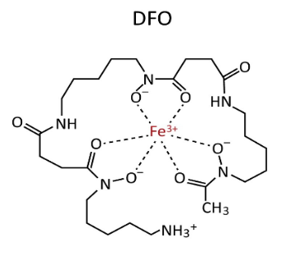
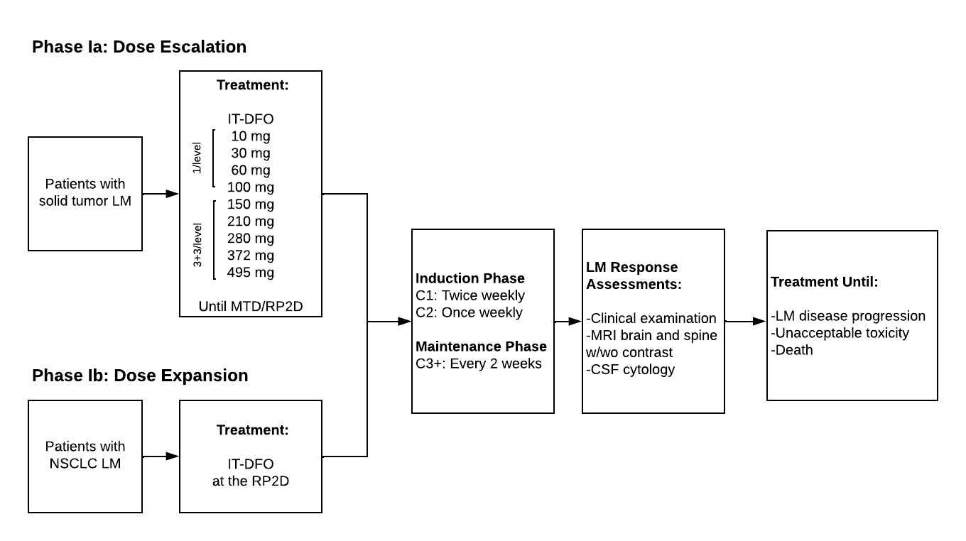
A Phase 1a/1b Study of Intrathecal Deferoxamine in Patients with Leptomeningeal Metastases
OBJECTIVES:
Primary
• To assess the safety and tolerability of IT-DFO in patients with solid tumor LM (DLTs, SAEs, laboratory abnormalities by CTCAE v5.0)
Secondary
• To determine PK/PD properties of IT-DFO in patients with solid tumor LM (AUC, Cmax)
• To obtain early anti-tumor efficacy data of IT-DFO at the RP2D in patients with LM from NSCLC (LM-ORR, LM-CBR, LM-PFS, OS)
Exploratory
• To prospectively correlate CSF CTCs with treatment response and survival
• To characterize the impact of IT-DFO on neoplastic cellular metabolism and the CSF microenvironment
ELIGIBILITY:
• Age ≥ 18 years
• ECOG ≤ 2, KPS ≥ 60
• LM from any solid tumor malignancy (1a) or NSCLC (1b)
• Treated, stable brain metastases allowed
• Functioning Ommaya reservoir
• LM-directed radiation >7 days from first dose
Memorial Sloan Kettering Cancer Center
PI: Adrienne Boire, MD PhD
Co-PI: Jessica Wilcox, MD, Helena Yu, MD
ClinicalTrials.gov: NCT05184816

Slide 60

Study Assessing QBS72S For Treating Brain Metastases of Breast Cancer (NCT05305365)
Primary Objective: Test of the preliminary efficacy of the intracranial anti-tumor activity of QBS72S through ORR in brain metastases.
Secondary Objectives: Assess the intracranial PFS, OS, DOR, safety, systemic PFS of participants. LMD therapeutic response
Exploratory: PK, biomarkers in CSF of QBS72S in LMD cohort. Correlation between LAT1 expression via IHC in primary tumor and response to treatment
PI: Melanie Hayden Gephart (Stanford Cancer Institute)

Slide 61
Takeaway Messages
For brain mets, earlier diagnosis and newer systemic therapies are improving prognosis
For LMD, several systemic and IT therapies appear to be improving outcomes

