Slide 1

Managing Toxicities of Therapy: Fatigue, Bone Health and Alopecia
N. Lynn Henry, MD, PhD
Daniel F. Hayes, MD, Breast Cancer Research Professor
Rogel Cancer Center
University of Michigan Medical School

Slide 2

Patient Case
43 year old female diagnosed with stage 3, ER positive, HER2 negative breast cancer 3 years ago
Bilateral mastectomy
Post-mastectomy radiation therapy
Adjuvant chemotherapy with AC-T
OFS plus exemestane

Slide 3
Patient Case
43 year old female diagnosed with stage 3, ER positive, HER2 negative breast cancer 3 years ago
Fatigue: are there options to improve her symptoms and quality of life?
Endocrine therapy: optimal bone health management?
Chemotherapy and endocrine therapy: can alopecia be prevented?

Slide 4
Cancer-Related Fatigue

Slide 5
Cancer-Related Fatigue (NCCN 2025)
Cancer-related fatigue is a distressing, persistent, subjective sense of physical, emotional, and/or cognitive tiredness or exhaustion related to cancer or cancer treatment that is not proportional to recent activity and interferes with usual functioning.
NCCN Fatigue 2025

Slide 6
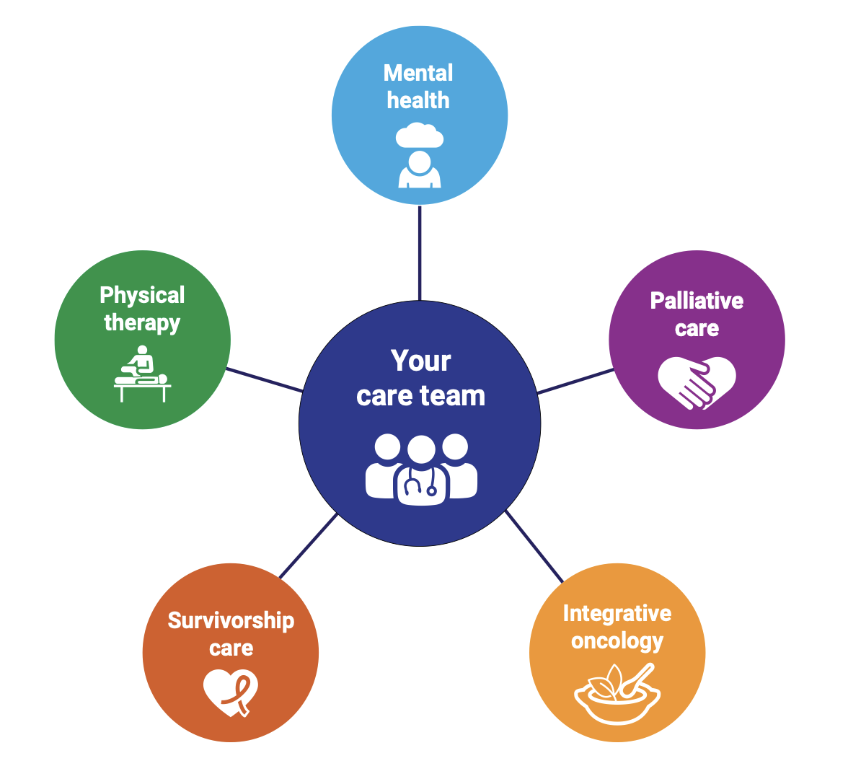
Cancer-Related Fatigue
Not an isolated symptom
Usually occurs in a cluster with other symptoms and signs:
  Pain
  Emotional distress
  Anxiety
  Depression
  Anemia
  Sleep disturbances
NCCN Fatigue 2025

Slide 7
Acute Fatigue - Novel Targeted Agents
Targeted agents contribute to fatigue
  CDK4/6 inhibitors (any grade 22-60%)
  Oral TKIs (any grade ~40%)
  Antibody-drug conjugates (any grade 35-70%)
  Immunotherapy doesn’t seem to add to chemotherapy-related fatigue in absence of irAE
Package inserts for medications
Notes:
We are used to thinking about chemotherapy as causing fatigue, but what about novel agents?

Slide 8
Acute Fatigue
Management strategies
  Identify that a patient has fatigue
    Patient-reported
  Rule out contributing factors
    Anemia
    Thyroid disorders
  Consider dose adjustment or delay

Slide 9
Chronic Cancer-Related Fatigue:
Screening and Evaluation
How would you rate your fatigue (0-10) in the past 7 days?
Focused history of fatigue
Disease status
Medications
Assessment of Treatable Contributing Factors
Pain
Depression/anxiety
Anemia
Sleep disturbance
Nutritional deficits
Physical activity level/deconditioning
Substance use/abuse
Cardiac dysfunction
Endocrine dysfunction
Other organ dysfunction
NCCN Fatigue 2025

Slide 10
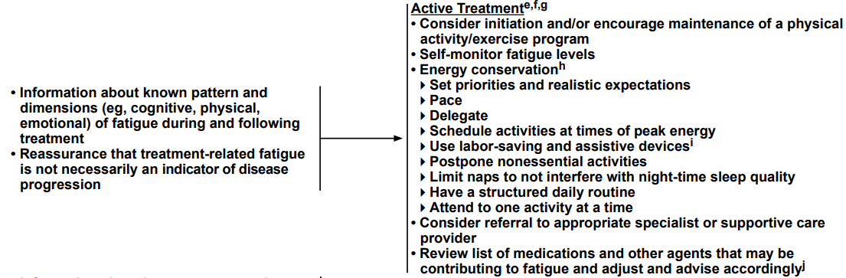
Chronic Cancer-Related Fatigue: Management
Initiation or maintenance of physical activity/exercise program
Self-monitor fatigue levels
Energy conservation
  Priorities
  Realistic expectations
  Pacing
  Delegation
Referrals as appropriate
Review concomitant medications
Consider pattern and dimensions of fatigue (cognitive, physical, emotional)
Reassurance that it is not necessarily an indicator of disease progression
NCCN Fatigue 2025

Slide 11
Chronic Cancer-Related Fatigue:
Management During Active Treatment (NCCN)
Physical activity (category 1)
  Initiation and/or maintenance exercise program
  Consider referral to exercise physiology, PT, OT, PMR
Yoga (category 1)
Massage therapy (category 1)
Acupuncture
Psychosocial interventions
  CBT (category 1), CBT-insomnia
  Psycho-educational therapies (cat. 1), supportive expressive therapies
Bright white light therapy
Consider psychostimulants (i.e., methylphenidate)
NCCN Fatigue 2025

Slide 12
Chronic Cancer-Related Fatigue:
Management Post-Treatment (NCCN)
Physical activity (category 1)
  Initiation and/or maintenance exercise program
  Consider referral to exercise physiology, PT, OT, PMR
Yoga (category 1)
Massage therapy (category 1)
Acupuncture
Psychosocial interventions
  CBT (category 1), CBT-insomnia (cat 1), MBSR (cat 1)
  Psycho-educational therapies (cat. 1), supportive expressive therapies (cat 1)
Bright white light therapy
Consider psychostimulants (i.e., methylphenidate)
NCCN Fatigue 2025

Slide 13




Chronic Cancer-Related Fatigue:
Management During and After Active Treatment (ASCO/SIO)
During treatment
  Exercise
  CBT, Mindfulness-based programs
  Tai chi, qigong
After completion of treatment
  Exercise
  CBT, Mindfulness-based programs
  Yoga, acupressure, moxibustion
  Recommend against routine recommendation of psychostimulants
ASCO/SIO Guidelines, Bower et al JCO 2024

Slide 14

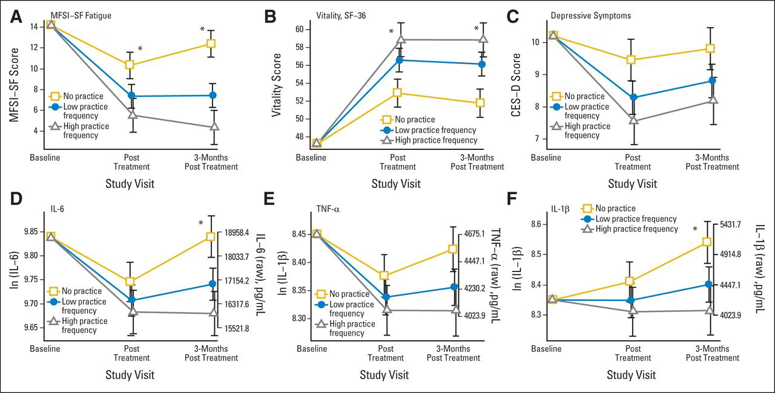
Yoga for Fatigue
Breast Cancer N=200
Hatha yoga vs wait list control
90 min twice week x 12 w
Meta-analysis of 17 studies with 2138 patients
  Yoga: 1112; Control: 1071
Supervised Yoga
  Large effect on fatigue post-treatment
  Marked mitigation of physical fatigue
  Medium impact on cognitive fatigue
  Small effect on mental fatigue
Other RCTs suggest benefit in cognitive function
Lower is better
Kiecolt-Glaser JCO 2014; Dong et al, BCRT 2019; Derry et al, Psychoonc 2015
Notes:
Multidimensional fatigue symptom inventory short form

Slide 15

Psychostimulants and Other
Interventions for Fatigue
Methylphenidate
  Mixed results
  RCT (n=154): post-chemotherapy, improvement with active drug
  Meta-analysis: benefit in patients receiving active treatment
  Phase 3 trial (n=162): patients with incurable cancer
    10 weeks of titrated methylphenidate
    No difference FACT-F at 6 ± 2 weeks
Modafinil - Not recommended (no benefit noted in larger trials)
Dexamethasone
  Consider as short-term palliative intervention at end of life
Hanna et al, 2006; Lower et al, 2009; Qu et al 2016; Minton et al, 2010; Stone et al, JCO 2024

Slide 16
Summary – Cancer-Related Fatigue
Cancer-related fatigue is common
Important to screen for fatigue, evaluate for treatable causes
Most interventions with the strongest supportive evidence are non-pharmacologic
  Physical activity
  Psychosocial interventions
  Integrative therapies

Slide 17
Bone Health

Slide 18

Risk Factors for Fractures
Risk factors: BMD, age (>65), steroids, smoking, low BMI (<20 kg/m²), family history hip fracture, fragility fracture (>50), premature menopause, impaired mobility
Population with breast cancer:
  Chemotherapy
  Ovarian suppression
  Aromatase inhibitor therapy

Slide 19
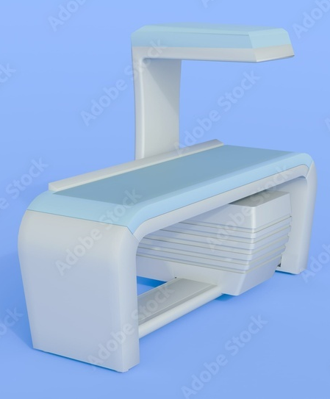
Assessing Bone Health in
At Risk Patients
DEXA:
  Provides a 2-dimensional measure of bone density
  Office-based
  Central DEXA
    Gold standard
    Measures spine, hip, or total body BMD
  Peripheral DEXA
    Measures wrist, heel, or finger BMD
Notes:
DEXA can be used to measure BMD at multiple skeletal sites, including spine, proximal femur, forearm, and total body. DEXA can be performed in the office.
Scanning time is less than 5 minutes and the radiation dose is considerably lower than that for conventional radiography
Central DEXA is considered the “gold standard” in BMD measurement¹
Peripheral BMD measurement techniques include peripheral dual-energy absorptiometry (pDEXA) and single-energy x-ray absorptiometry (SXA).
Measurement sites include the heel, hand, and forearm
The radiation dose delivered with these self-contained x-ray systems is low¹
Both pDEXA and SXA are useful in predicting fracture risk²

Slide 20
Fracture Risk in the Normal Population
16X
WHO Definition of Osteoporosis:
  Fracture risk estimated by bone mineral density
  T-score (comparison to young patient)
    T-score > -1 = normal
    T-score -1 to -2.5 = osteopenia
    T score < -2.5 = osteoporosis
  T-score for age 50+
  Z-score for age <50
8X
Gradient risk of
osteoporosis fracture
4X
2X
Osteoporosis
0.5X
1X
Osteopenia
Normal
+1.0T
0
-1.0T
-2.0T
-3.0T
-4.0T

Slide 21
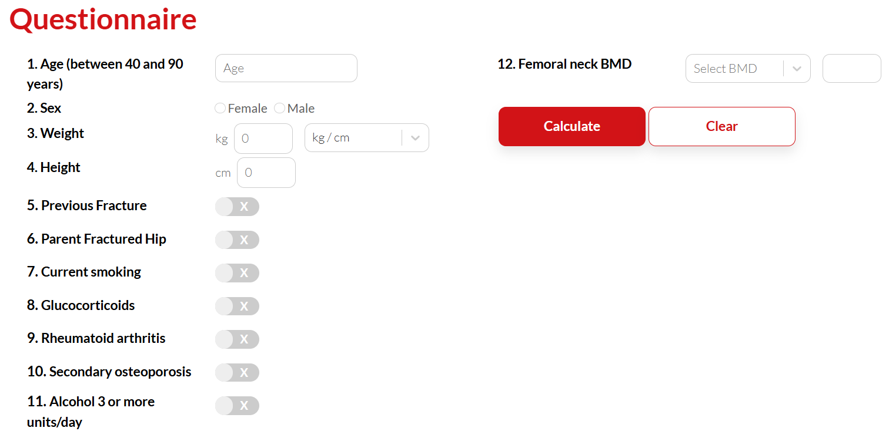
FRAX
Consider intervention if:
  10 year risk major osteoporotic fracture ≥ 20%
  10 year risk hip fracture ≥ 3%
https://fraxplus.org/calculation-tool
Notes:
Select country and race
Can see that most of the risk factors are included on this list
For BMD, can include actual BMD on a specific machine, or can include femoral neck T score

Slide 22
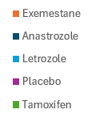
Fracture Rates in AI-Treated Patients
(68 mo)
Percentage with fracture
ATAC
BIG1-98
IES
TEAM
MA.17
(68 mo)
(26 mo)
(58 mo)
(33 mo)
(30 mo – extended)
1. Howell A, et al. Lancet. 2005;365:60-62; 2. Thurlimann B, et al. N Engl J Med. 2005;353:2747-2757; 3. Coleman RE, et al. Lancet Oncol. 2007;8:119-127; 4. Jones SE et al. SABCS 2008, San Antonio, Tex. Abstract 15; 5. Goss PE, et al. J Natl Cancer Inst. 2005;97:1262-1271.
Notes:
All aromatase inhibitors (AIs) have been shown to increase fracture risk
Fracture risk was assessed in several large, independent clinical trials for the AIs anastrozole (ATAC, N = 6,186), letrozole (BIG 1-98, N = 8010; MA.17, N = 5,187), and exemestane (IES, N = 4742) in the treatment of postmenopausal women with hormone receptor-positive breast cancer
The BIG 1-98 trial included analyses at 26 and 51 months (please explain – we don’t want people to think 51 mo is a direct follow up of 26) . The trial study design randomized patients into 4 treatment groups: tamoxifen alone, tamoxifen for 2 years and switched to letrozole, letrozole alone, or letrozole for 2 years and switched to tamoxifen
Fracture incidence shown on this slide for the BIG 1-98 trial of letrozole versus placebo corresponds to 26-month follow-up data, which include all 4 patient groups (analysis occurred before the switch in treatment occurred)
With the exception of the MA.17 trial (which compared letrozole with placebo), each of these independent studies was a head-to-head trial of AI therapy versus tamoxifen, the former standard-of-care adjuvant treatment for hormone receptor-positive breast cancer
These results show that fracture incidence in patients receiving AI therapies (anastrozole, letrozole, or exemestane) is significantly higher compared with tamoxifen

Slide 23
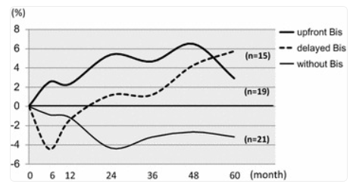
ATAC BMD Substudy
After 5 years, anastrozole is associated with a 6-7% loss in BMD
Important caveats:
  No patient whose bone density was normal at baseline developed osteoporosis in 5 years
  Normal expected bone loss during that period: 2-3%
Greater increases in bone markers were associated with a greater loss of BMD
Upfront bisphos
Delayed bisphos
No bisphos
Lumbar spine
Eastell et al, J Bone Mineral Res 2006, 21:1215-23; J Clin Oncol 2008, 26:1051-8; Ann Oncol 2011, 22:857-62

Slide 24
Reducing Bone Loss: Bisphosphonates
Three studies that demonstrated upfront zoledronic acid helps
ABCSG-12 substudy: Ovarian suppression plus TAM vs AI x 3 years
  Complete abrogation of bone loss in those receiving zoledronic acid (ZA)
Z-FAST and Zo-FAST: postmenopausal women on AI therapy
  Improved BMD if given ZA upfront vs delayed
  No difference fracture rates
CALGB 79809: patients with chemo-induced ovarian failure
  Improved BMD if given ZA upfront vs delayed
Gnant et al, Brufsky et al, JCO 2007, Bundred et al, Cancer 2008, Shapiro et al, Eur J Cancer 2011;47:683

Slide 25
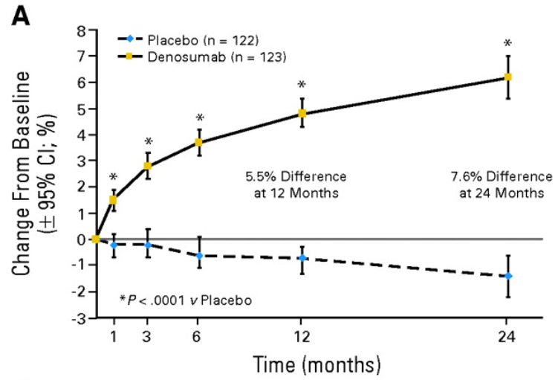
Reducing Bone Loss: Denosumab
245 postmenopausal women with osteopenia, on AI therapy
60 mg SC q6 months
4.7% absolute improvement at 12 mo
Similar improvement regardless of duration of AI therapy
Serious adverse events
  Denosumab 15% Placebo 9%
Calcium replacement is key
Ellis G, et al, J Clin Oncol 2008, 26:4875-82

Slide 26
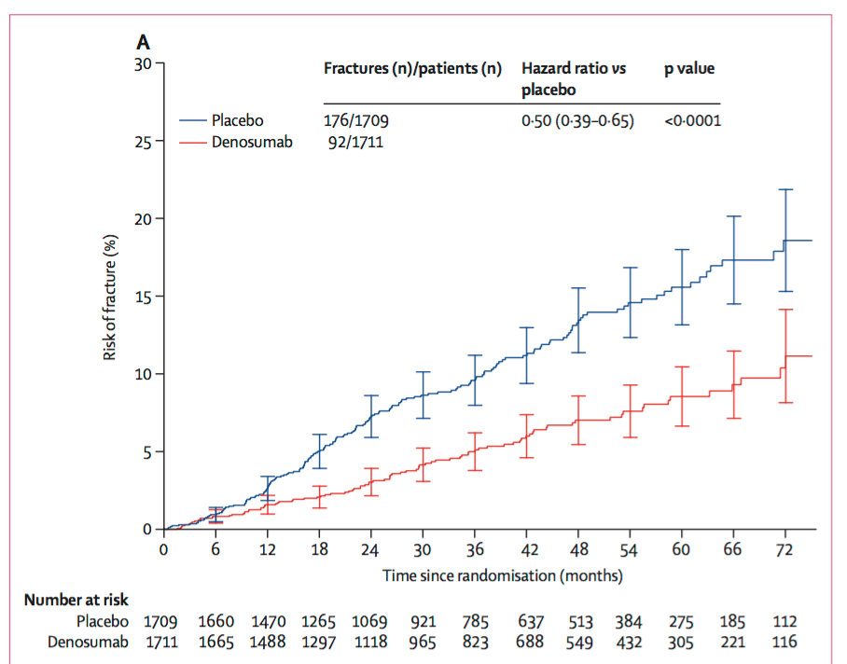
Reducing Bone Loss: Denosumab
ABCSG-18
3420 postmenopausal women receiving AIs
  Denosumab 60 mg q6mo vs placebo
Results:
  Reduction in risk of fracture (HR 0.50, p<.0001)
  Similar benefit, regardless of baseline BMD
  No ONJ (indep adjudication)
Gnant et al, Lancet 2015

Slide 27
Repleting Vitamin D
25(OH) D level
ng/mL | nmol/L | Health status
< 20 | < 50 | Associated with deficiency
21-30 | 52.5-75 | Inadequate for bone or overall health
≥ 30 | ≥ 75 | Desirable
Consistently >200 | Consistently >500 | Potentially toxic (hypercalcemia, hyperphosphatemia)
50,000 IU D₂ weekly x 8 weeks, recheck level. Maintenance: 1000-2000 IU D₃ daily
Malabsorption: 50,000 IU D₂ QOD to normal level. Maintenance: 50,000 IU weekly.
Holick et al, NEJM 2007, 357:266-81.

Slide 28
Considerations for Bone Loss Prevention
Lifestyle changes
  Weight bearing exercise, tobacco cessation, reduce alcohol consumption
Dietary supplements
  Adequate calcium (1000 mg/day)
  Supplementary vitamin D (1000-2000 IU/day)
Prescription medications
  Bisphosphonate therapy, denosumab – dental clearance!
  Concern with denosumab: rebound (BMD drop) after discontinuation
  Avoid raloxifene in combination with AI therapy
Shapiro et al, JCO 2019, 37:2916.

Slide 29
Summary: Bone Health
Osteoporosis and fracture – important potential complication of treatment for early-stage breast cancer
  Screening and recommendations for treatment should be part of oncology practice
  New drugs are under evaluation for prevention of bone loss in postmenopausal women
    Befriend your endocrinologists
Bone loss did not continue after cessation of AI therapy
  Average improvement at 1 year: +2.35% L spine, +0.7% total hip
Shapiro et al, JCO 2019, 37:2916.

Slide 30
Adjuvant Bisphosphonates as Cancer Therapy
EBCTCG meta-analysis
  Included 18,766 women treated with 2-5 yr bisphosphonate
  Outcomes:
    Reduction in breast cancer recurrence: HR 0.94 (2p=.08)
    Reduction in distant recurrence: HR 0.92 (2p=.03)
    Reduction in breast cancer mortality: HR 0.91 (2p=.004)
    Reduction in bone recurrence: HR 0.83 (2p=.004)
  Benefit only seen in postmenopausal women
Coleman et al, Lancet 2015

Slide 31
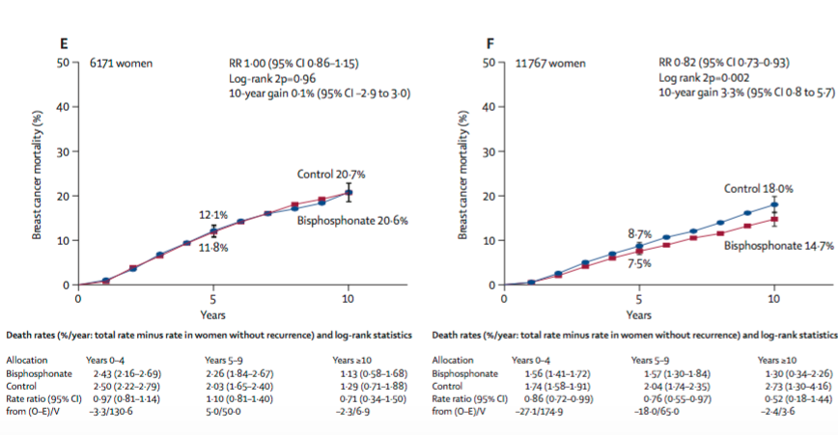
Adjuvant Bisphosphonates as Cancer Therapy
EBCTCG meta-analysis: Breast cancer mortality
Control
Bisphosphonate
Premenopausal
Postmenopausal
Coleman et al, Lancet 2015

Slide 32
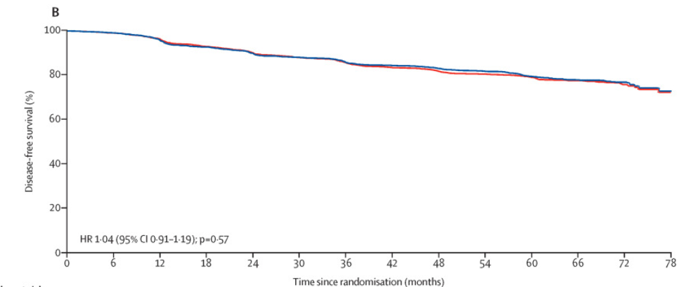
Adjuvant Denosumab as Cancer Therapy
D-CARE
  4500 postmenopausal women, stage 2-3
  Denosumab 120 mg q3-4 weeks x 6 mo, then q3 mo x 54 mo
  No difference bone met-free survival with denosumab vs placebo
    More ONJ and atypical femur fractures
Disease-free survival
Coleman et al, Lancet Oncol 2020;21:60-72

Slide 33
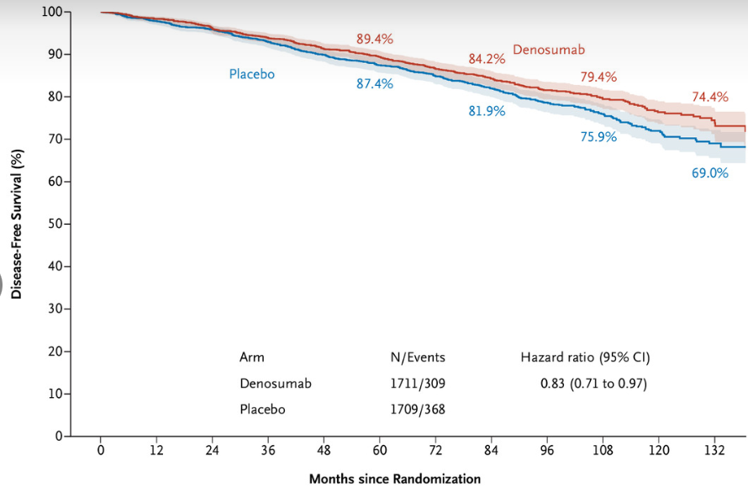
Adjuvant Denosumab as Cancer Therapy
3425 postmenopausal women on AI therapy
Fracture rates at 84 months: 11.1% vs 26.2%
9 yr DFS: 79.4% vs 75.9%, HR 0.83 (95% CI 0.71-0.97)
9 yr OS: 90.9% vs 89.9%, HR 0.80 (95% CI 0.64-1.01)
ABCSG-18
Denosumab 60 mg q6 x 5 yr
vs placebo
Disease-free survival
Gnant et al, NEJM Evidence 2022; 1(12)
Notes:
ABCSG-18 - improvement in distant metastases or second primary cancer (not histologically verified) or to histologically verified second nonbreast cancer primary – follow-up ended early because of improvement in fracture risk
As of last ASCO guideline not recommended, although 9 year follow-up of ABCSG-18 was published after last ASCO guideline

Slide 34
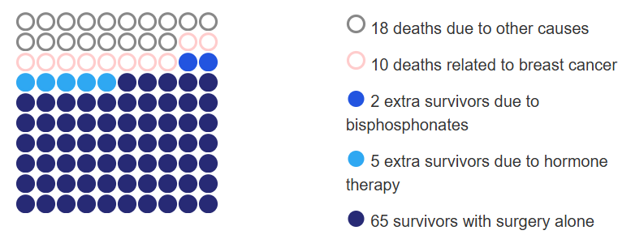
Bisphosphonates as Cancer Therapy
Cancer Care Ontario and ASCO Guideline
Discuss adjuvant bisphosphonate therapy with all postmenopausal patients with primary breast cancer (informal consensus)
Can use PREDICT to assess potential benefit
62 yo with 2.3 cm, grade 2, 1/4 LN+, ER+, HER2-
15 year survival
Eisen et al, J Clin Oncol 2022, 40:787-800; https://breast.predict.cam

Slide 35
Bisphosphonates as Cancer Therapy
Cancer Care Ontario and ASCO Guideline
Recommend consideration of benefits and risks
  Including comorbidities, financial toxicity, life expectancy
Treatment options:
  Oral clodronate (not available in United States)
  Oral ibandronate 50 mg daily x 3 yr
  IV zoledronic acid 4 mg q6mo x 3 yr or 4 mg q3 mo x 2 yr
  (not denosumab)
Should start early in adjuvant therapy
Eisen et al, J Clin Oncol 2022, 40:787-800

Slide 36
Summary: Anti-osteoclast Therapy as Cancer Therapy
Adjuvant bisphosphonates reduce bone metastases, improve survival in postmenopausal women
  Regardless of ER, nodal status, use of chemotherapy
  Clodronate and aminobisphosphonates similar benefit
  Consider to reduce recurrence risk
Denosumab benefit unclear, not currently in guidelines
Eisen et al, J Clin Oncol 2022, 40:787-800

Slide 37
Cancer Therapy-Induced Alopecia

Slide 38
Chemotherapy-induced Hair Loss
Temporary hair loss is distressing and traumatic
Women with chemotherapy-induced alopecia report:
  Lower self-esteem
  Poorer body image
  Lower quality of life
Risk of alopecia can influence agreement to receive chemotherapy
Docetaxel – delayed recovery or permanent alopecia has been reported
  8-10% of patients, dose dependent (more common at 100 mg/m²)
Lemieux Psychonc 2008 17:317-28; Munstedt K Support Care Cancer 1997; McGarvey EL Clinical Pract 2001

Slide 39

Scalp Cooling: Potential Mechanisms of Action
Vasoconstriction
  Reduces blood flow to hair follicles during peak plasma concentrations of chemotherapy
  Reduces cellular uptake of chemotherapy
Reduced biochemical and metabolic activity
  Hair follicles less susceptible to damage from chemotherapy agents
Marks et al JAMA Dermatology 2018

Slide 40

Scalp Cooling/Cold Capping
How many of you recommend scalp cooling or cold capping to your patients?
How many of you offer scalp cooling devices in your infusion room?
How many of you are able to accommodate cold capping in your infusion room?

Slide 41
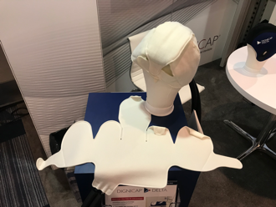
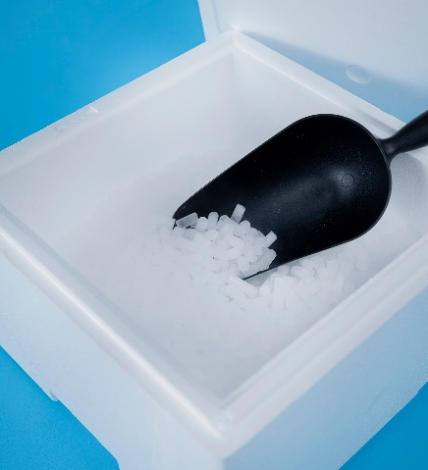
Scalp Cooling/Cold Capping: Devices
Device | Details
Free-standing with circulating coolant (automated)
Dignicap | US FDA cleared
Paxman caps | US FDA cleared
Cooler Heads | US FDA cleared
Frozen cold caps (manual)
Penguin caps | Cap must be frozen, changed every 20-30 minutes
Arctic caps
Many others
Rapunzelproject.org

Slide 42
Scalp Cooling: The Data
Dignicap
  Prospective, stage 1-2 breast cancer
  Not randomized (concurrent matched controls)
  Excluded patients treated with anthracycline
  Patient-assessed alopecia (Dean scale)
Paxman SCALP trial
  Prospective, randomized, stage 1-2 breast cancer
  Control versus scalp cooling (allowed any chemo)
  Provider-assessed alopecia (NCI CTCAE)
Rugo et al JAMA 2017; Nangia et al JAMA 2017

Slide 43
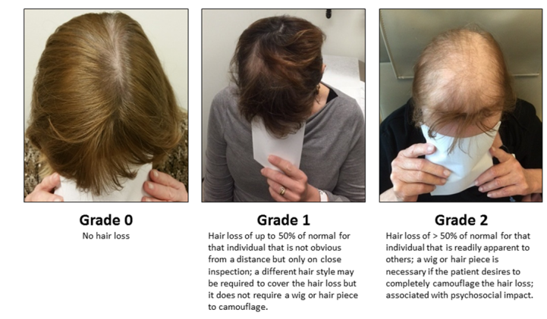
Scalp Cooling: CTCAE grading
Nangia et al JAMA 2017

Slide 44
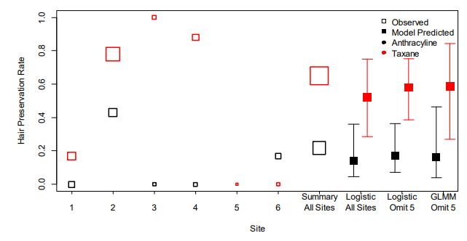
Scalp Cooling: The Data
Higher is better
SCALP Trial
Treatment success (keeping >50% hair)
Chemo regimen | DigniCap | Control
TC | 46/76 (60.5%) | 0/10
TCarbo | 10/12 (83.3%) | 0/3
Paclitaxel | 10/12 (83.3%) | 0/2
Hair preservation rate
Red = Taxane, ~58%
Black = Anthracycline, ~16%
Also improved quality of life
Rugo et al JAMA 2017; Nangia et al JAMA 2017

Slide 45
Scalp Cooling: Additional Data
Dutch registry
  Scalp cooling outcomes are drug and dose dependent
Open-label RCT in Korea
  Scalp cooling reduced persistent chemo-induced alopecia at 6 months after end of chemotherapy (n=139)
    Scalp cooling 13.5% Control 52%
    Improved hair thickness
    Reduced stress from chemo-induced alopecia
Brook et al, Oncologist 2024; 29: e1386–e1395; Kang et al, J Clin Oncol 2024;42:3115-22

Slide 46
Scalp Cooling: Meta-Analysis
23 full-text articles
  10 quantified incidence of scalp metastases
Results
  Scalp cooling: 1959 patients over 43.1 mo follow-up
    Incidence scalp mets 0.61% (95% CI 0.32%-1.1%)
  Non-scalp cooling: 1238 patients over 87.4 mo follow-up
    Incidence scalp mets 0.41% (95% CI 0.13%-0.94%)
  Comparison p=.43
Rugo et al, Breast Cancer Res Treat 2017; 163:199-205

Slide 47
Scalp Cooling: Considerations
Considerations for practices
  Scalp cooling devices:
    Cost of devices
    Chair time and post-cooling time
    Cap fitting – precise fit is critical
  Cold capping: space considerations, assistance changing caps
  Now in NCCN guidelines, AMA introduced a CPT code
Considerations for patients
  Cost
  Cold capping: dry ice, need assistance
  Current methods don’t work well for anthracyclines

Slide 48
Late Alopecia
Late alopecia
  Incomplete regrowth ≥6 mo after end of chemotherapy or from initiation of endocrine therapy
  Affects up to 25-30% of cancer survivors
Minoxidil
  Stimulates ATP-sensitive K+ channels, resulting in vasodilation and premature entry of resting hair follicles into anagen or growth phase
  Trial: treated patients with minoxidil 1.25 mg/day (n=119), most also on endocrine therapy
    74% reported clinical improvement
Kuo et al, Breast Cancer Res Treat 2024

Slide 49
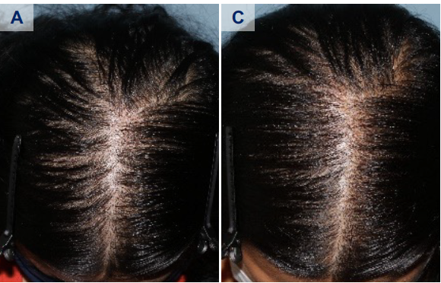
Minoxidil for Endocrine Therapy Induced Alopecia
Results | Topical minoxidil | Oral + topical minoxidil
Treatment response CR PR SD Progression | 0 (0%) 10 (52.6%) 7 (36.9%) 2 (10.5%) | 5 (13.5%) 29 (78.4%) 3 (8.1%) 0 (0%)
Hair density increase | 3.9 (6.4%) | 12.2 (15.7%)
Adverse events Hypertrichosis Edema Palpitation | 0 (0%) 0 (0%) 1 (5%) | 5 (13.5%) 2 (5.4%) 1 (2.7%)
A) Standardized photo of a patient on tamoxifen, before oral minoxidil. C) Standardized photo after 131 days of oral minoxidil 1.25 mg daily.
Retrospective data collection at baseline and 3 mo FU: 1.25 to 5.0 mg daily LDOM and once daily 5% topical minoxidil solution (n=37, 66%)
Kuo et al, ASCO 2022 abst 12022; Kang et al, J Am Acad Dermatol 2023;88:1170-73

Slide 50
Summary: Cancer Therapy-Induced Alopecia
Chemotherapy-induced alopecia
  A small proportion can have permanent alopecia
  Cold caps/scalp cooling can reduce incidence of both acute and late alopecia
    Cost and other considerations
Endocrine therapy-induced alopecia
  Commonly reported by patients
  Can consider topical and low dose oral minoxidil

Slide 51

Questions?

