Slide 1

Rare Breast Tumors and Male Breast Cancer
Michael Alvarado, MD, FACS
Professor of Surgery
Director Breast Surgical Oncology Fellowship
University of California San Francisco
Disclaimer: This presentation is intended for personal use and for informational purposes only and does not replace independent professional judgment. This presentation is the property of Physicians’ Education Resource, LLC (“PER”) and is protected by U.S. and international copyright laws. You may not copy, reproduce, distribute, transmit, modify, or create derivative works of the presentation without the prior written permission from PER.

Slide 2
Topics
Primary angiosarcoma
Benign phyllodes
Malignant phyllodes
Male breast cancer
Metaplastic Breast Cancer
Lobular Breast Cancer

Slide 3
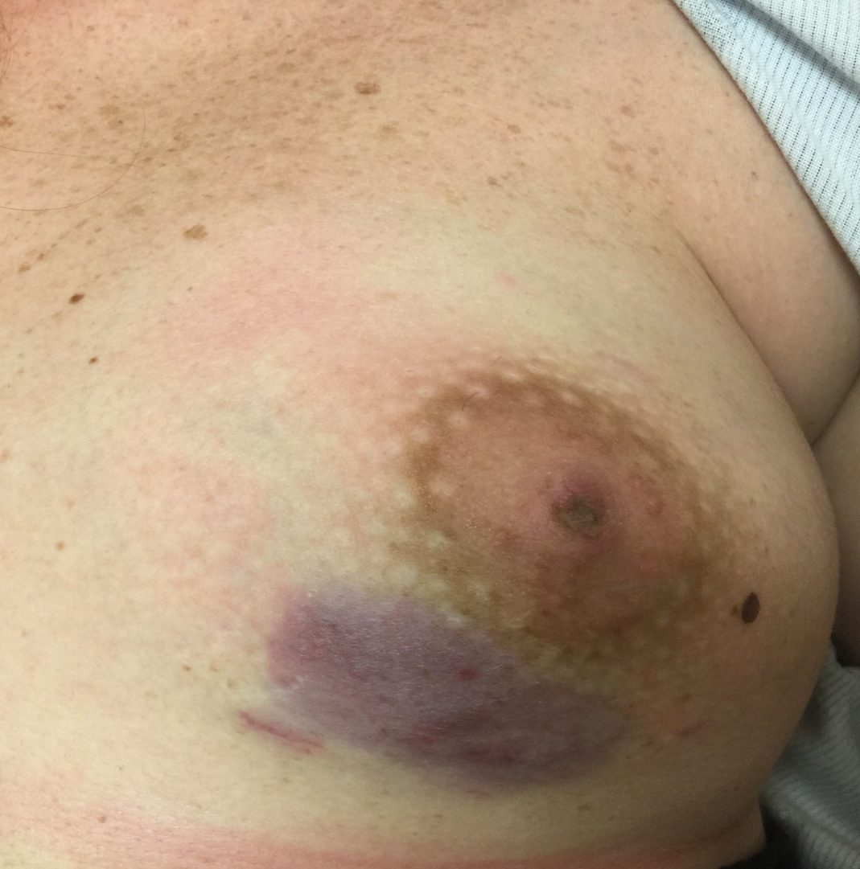
A 30-year-old with a Purple Skin Rash
Outside Hospital Evaluation
October 2015: 5 months pregnant
Sonogram --> 1.5 cm spiculated mass
Sono-core --> bland vascular proliferation
Diagnosed as hemangioma
Family History: Mother- premeno BrCA
mSDR – postmeno BrCA x 2
No history of radiation exposure
February 2016: Presented to surgeon after delivery
Purple patch increasing
Punch Biopsy --> Well-differentiated angiosarcoma
Courtesy of David Euhus

Slide 4
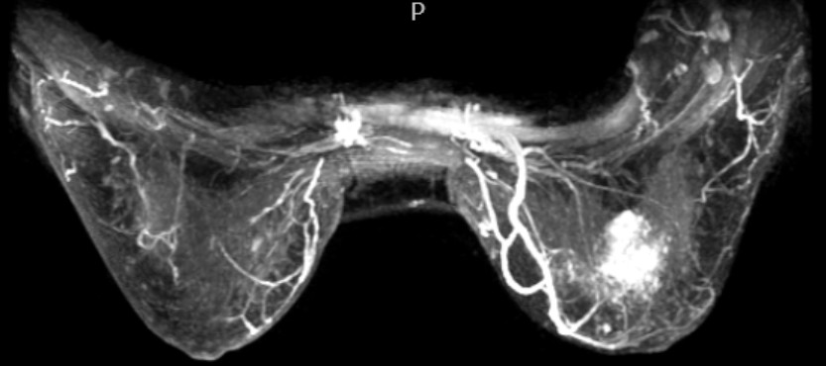

Slide 5
Evaluation and Treatment
Genetic Testing: Multigene panel (including TP53) NEGATIVE
Staging work-up NEGATIVE for distant mets
LEFT Total Mastectomy: pT2b(6.0 cm)N0(0/1)M0 grade 1-2 Stage 1B Angiosarcoma. Margins widely negative
Adjuvant chemotherapy: Docetaxel and gemcitabine (6 cycles)
Post-mastectomy chest wall radiation

Slide 6
Angiosarcoma of the Breast
 | Primary | Secondary
Grade | Not high grade | High grade
cMyc | Rarely amplified | Usually amplified
Risk Factors | Radiation | Lymphedema Radiation BRCA1, BRCA2, TP53
Radiation Therapy | Uncertain benefit | Hyperfractionated re-irradiation +/- hyperthermia = some responses
Chemotherapy | Probably some benefit – doxorubicin + ifosfamide paclitaxel (some exquisitely sensitive) docetaxel thalidomide (some exquisitely sensitive)
Metastatic Sites | Bone, lung, liver (in that order)
Outcome (similar) | Local Recurrence: 54-92% majority within 1 yr Overall Survival: 5-48 months
Bonito et al. Breast J 2020; Depla AL et al. Eur J Cancer. 2014;50(10):1779-1788; Penel N et al. J Clin Oncol. 2008;26:5269-74

Slide 7
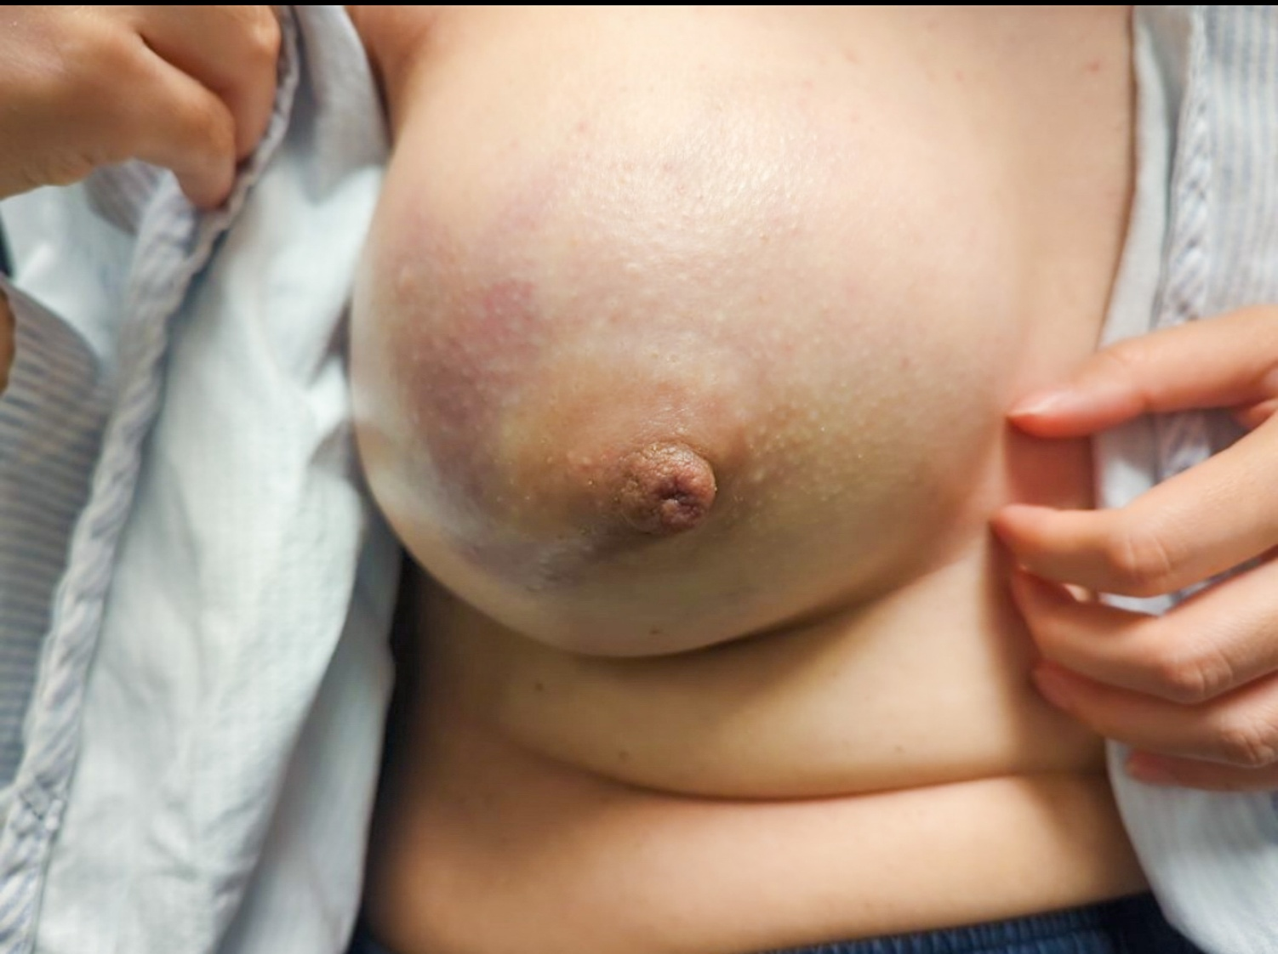
Young woman with a Large Right Breast Mass
Core biopsy revealed likely Phyllodes Tumor
Differential Diagnosis
Benign
Borderline
Malignant

Slide 8
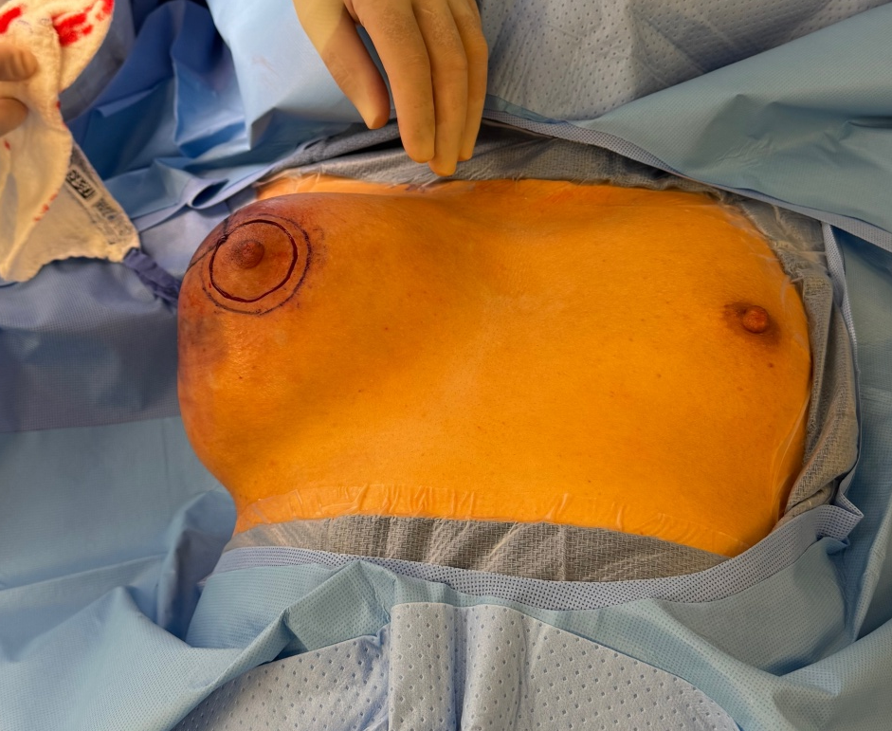
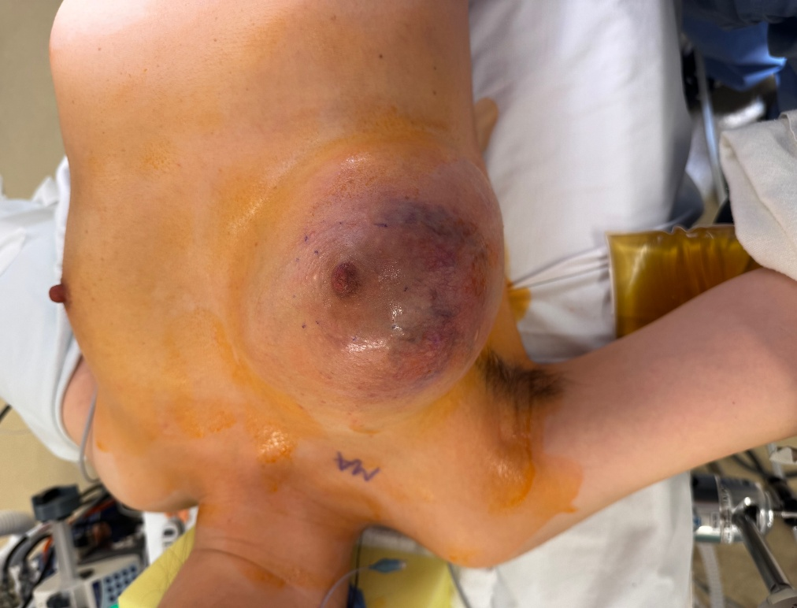
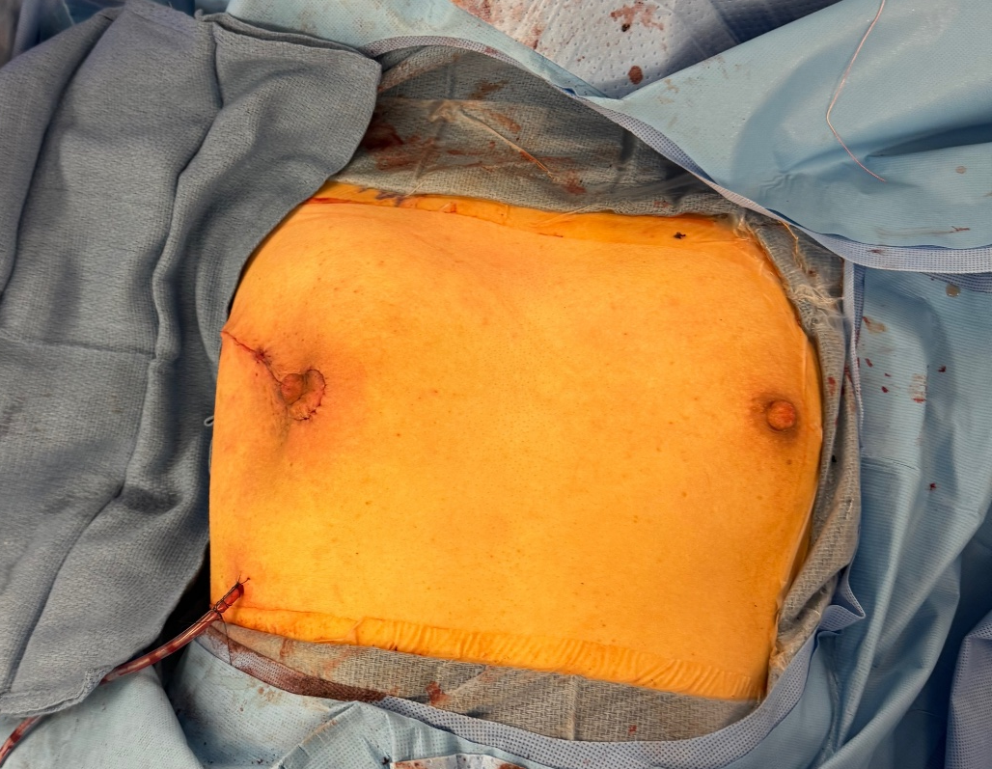
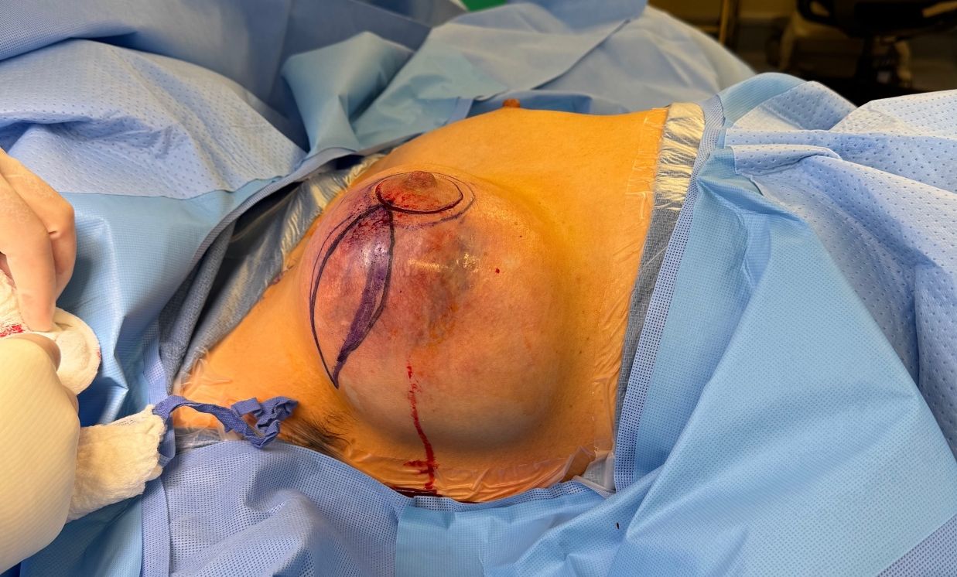
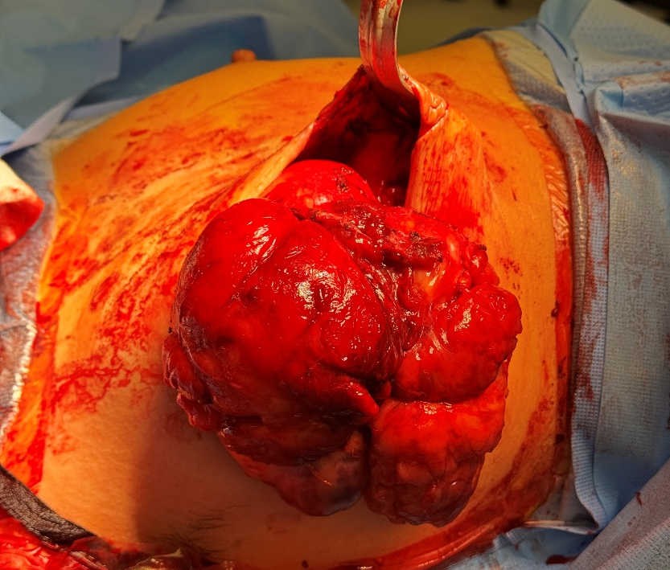

Slide 9
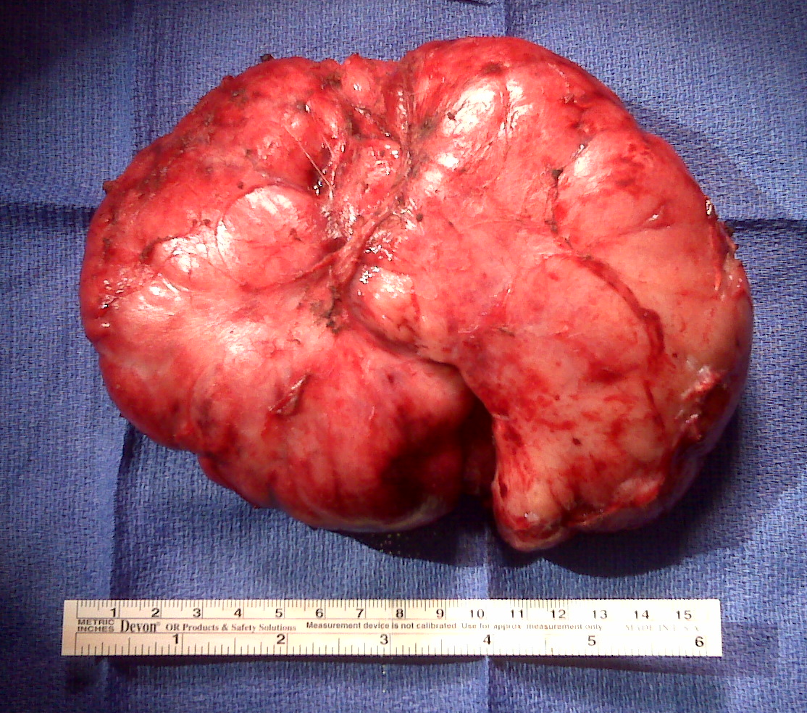
Phyllode Tumors
Cellular
Fibroadenoma
Benign
Phyllodes
Borderline
Phyllodes
Malignant
Phyllodes
Fibroadenoma
MED12
IGFR1….…RB1……..TP53….....EGFR
NCCN Guideline: 1 cm margin (borderline and malignant)
Local recurrence risk very low for benign phyllodes
Margin status inconsistently predictive of local recurrence
  Predicts time course to recurrence; not absolute recurrence risk
Adverse Prognostic Indicators
  ≥ 10 mitoses/10 HPF
  Necrosis
  Fibroepithelial proliferation in neighboring breast
Adjuvant RT gaining popularity for borderline and malignant
Benign phyllodes tumor
Margin focally positive
Tan BY et al. Histopathology. 2016;68(1):5-21; NCCN. Breast Cancer Guidelines. V4.2022.

Slide 10
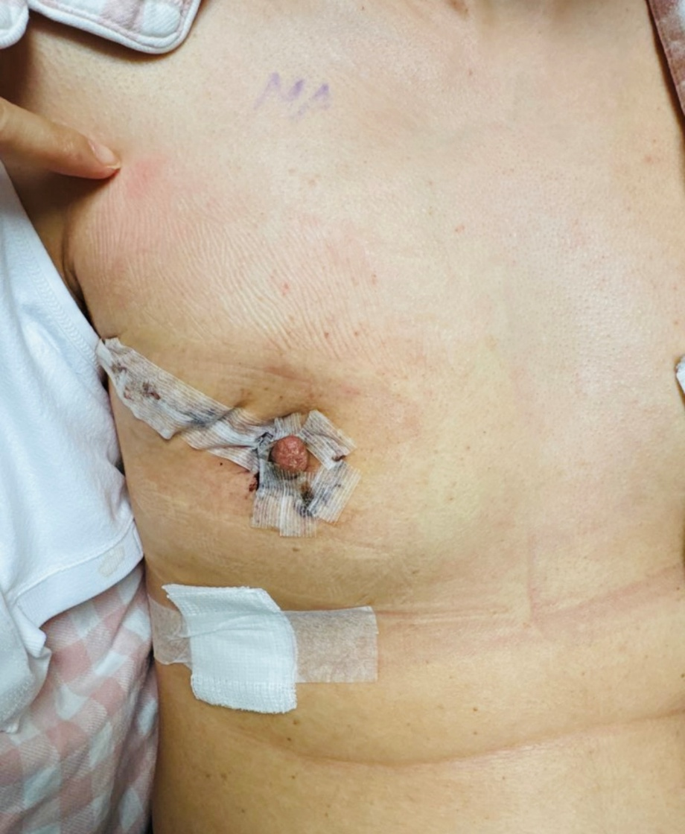
Phyllode Tumor
Avoid disfiguring surgery for benign phyllodes
Surgery can be more aggressive if there is a recurrence
  Grade progression with recurrence is probably not real
  (more a reflection of intratumoral heterogeneity)
Final Pathology Benign Phyllodes

Slide 11
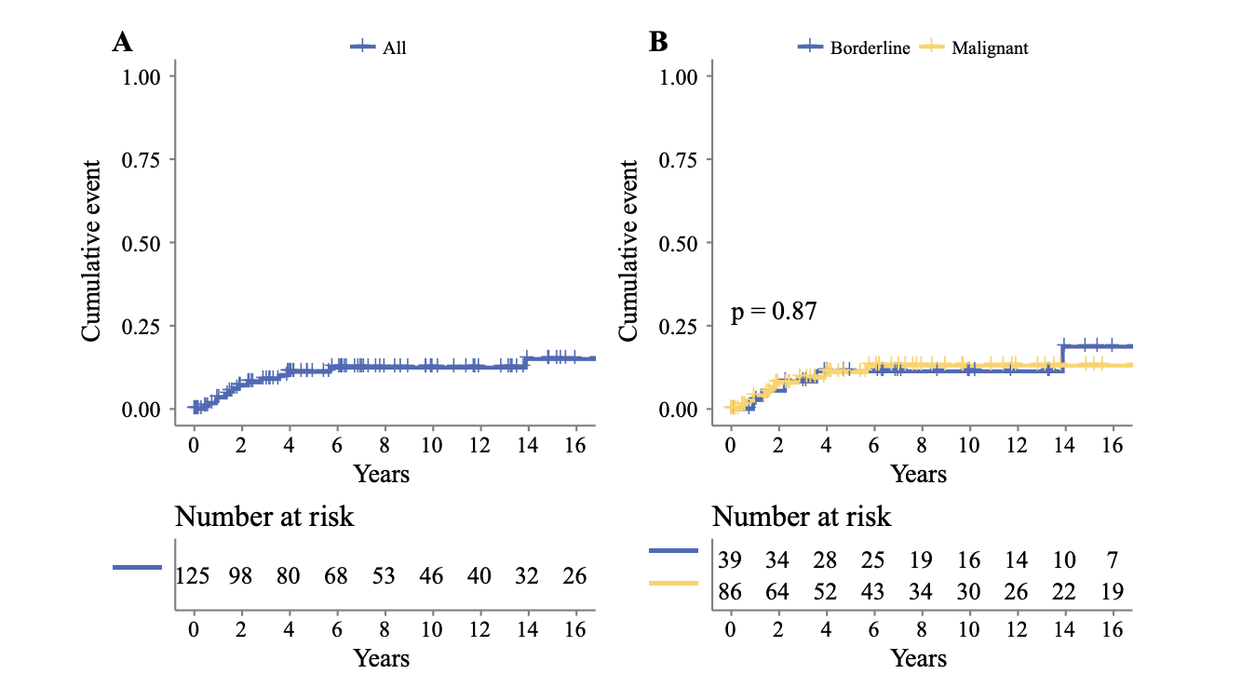
Phyllodes: Recurrence Risk
Spanheimer et al., Ann Surg Oncol 2019
Retrospective Review
MSKCC
125 pts with phyllodes tumors
86 malignant and 39 borderline
10-year cumulative incidence:
33% [close/positive] vs 9% [negative]
Negative margin defined as > 1mm

Slide 12
Male Breast Cancer
< 1% of cancers in males
0.7% of all breast cancers
Incidence is increasing slightly
Major risk factors related to imbalance in testosterone versus estrogen.
  Risk factors for gynecomastia are risk factors for MBC

Slide 13
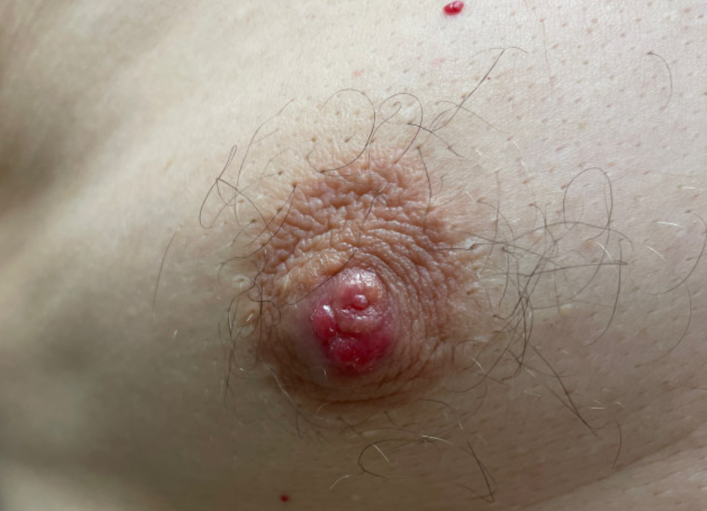
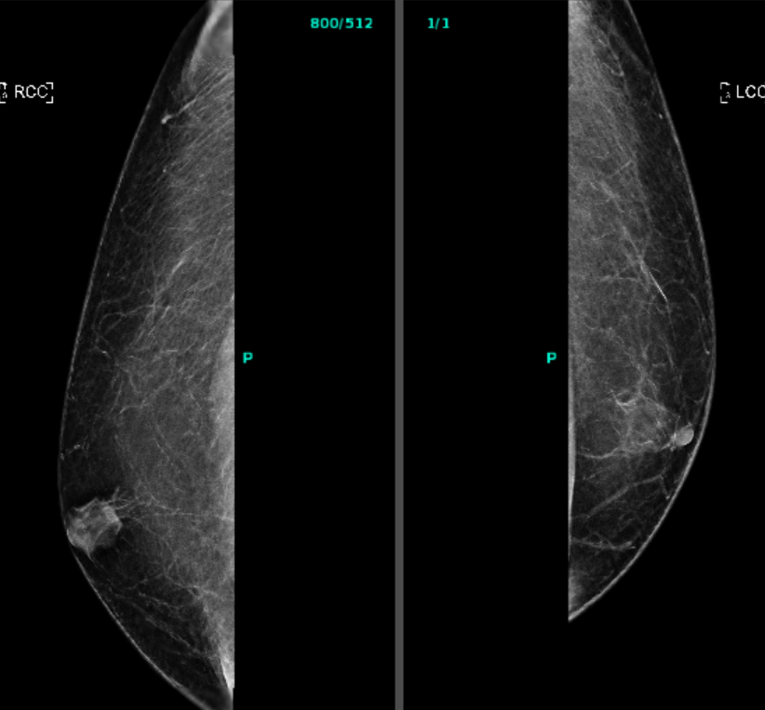
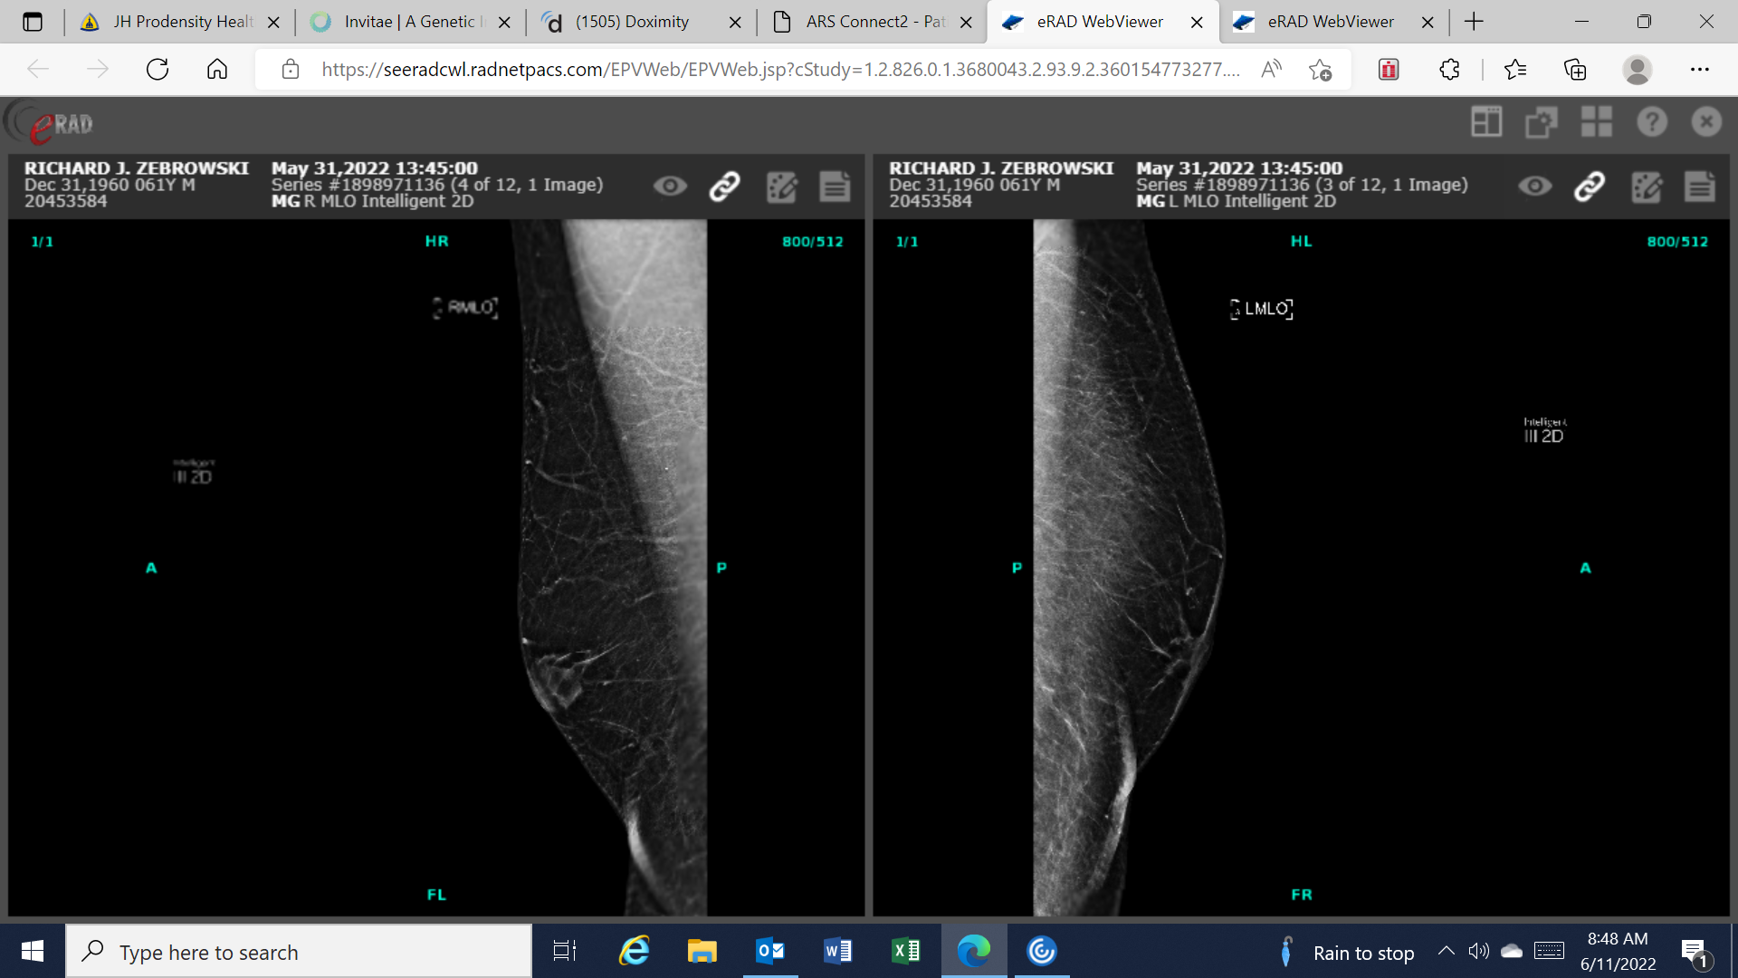
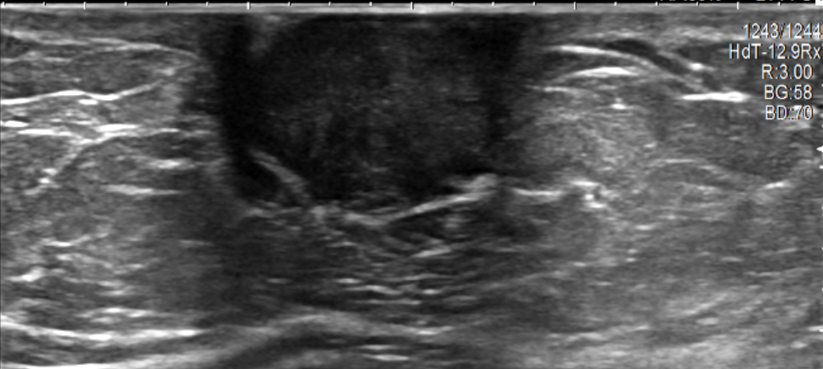

Slide 14
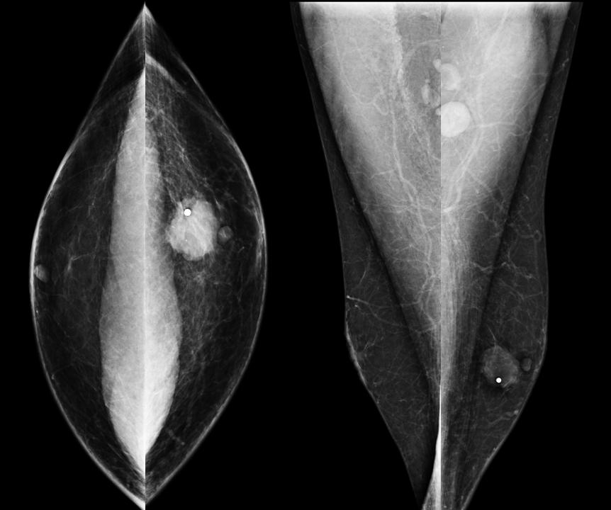

Slide 15
Genetic Landscape of Male Breast Cancer
480 male BC patients with no prior testing undergoing multi-gene panel testing
BRCA2
CHEK2
ATM
BRCA1
18% of tested men carried a pathologic variant
NF1
PALB2
RAD51D
BRIP1
MER11A
NBN
None
Pritzlaff M et al. Breast Cancer Res Treat. 2017;161:575-586.

Slide 16
Breast Cancer Risk for Men
Women (population)
Men BRCA2
Men BRCA1
Men (population)
Tai YC et al. J Natl Cancer Inst. 2007;99:1811-4; SEER*Explorer. National Cancer Institute. https://seer.cancer.gov/statistics-network/explorer/

Slide 17
Mammographic Screening in Men
Retrospective Study
165 men (271 episodes)
  5 cancers detected
    4 men with a personal history of breast cancer
    1 man with genetic predisposition and a strong FHX breast cancer
Cancer Detection Rate 18/1000
ASCO Guidelines
Ipsilateral annual mammography for BCS patients
Consider annual contralateral MGMs in gene mutation carriers
Gao Y et al. Radiology. 2019;293:282-291.
Hassett MJ et al. J Clin Oncol. 2020;38:1849-1863.

Slide 18
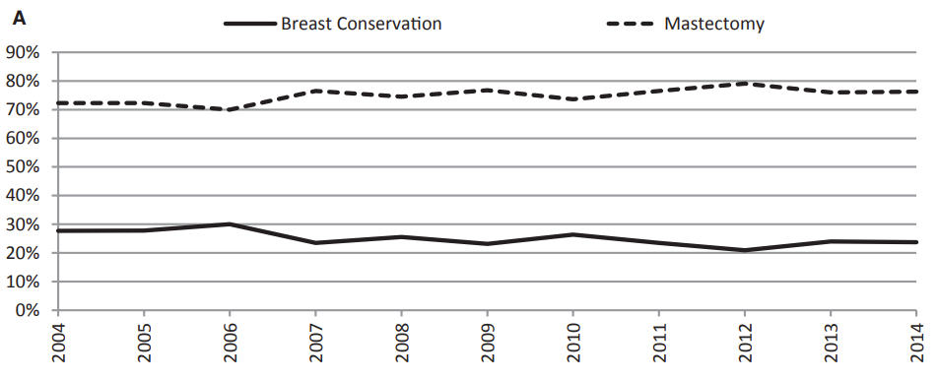
Surgical Management of Male Breast Cancer
Mastectomy
Total
Nipple-sparing
Partial Mastectomy with RT
With SLN Removal
NCDB
Yadav S et al. Cancer. 2020;126:26-36.

Slide 19
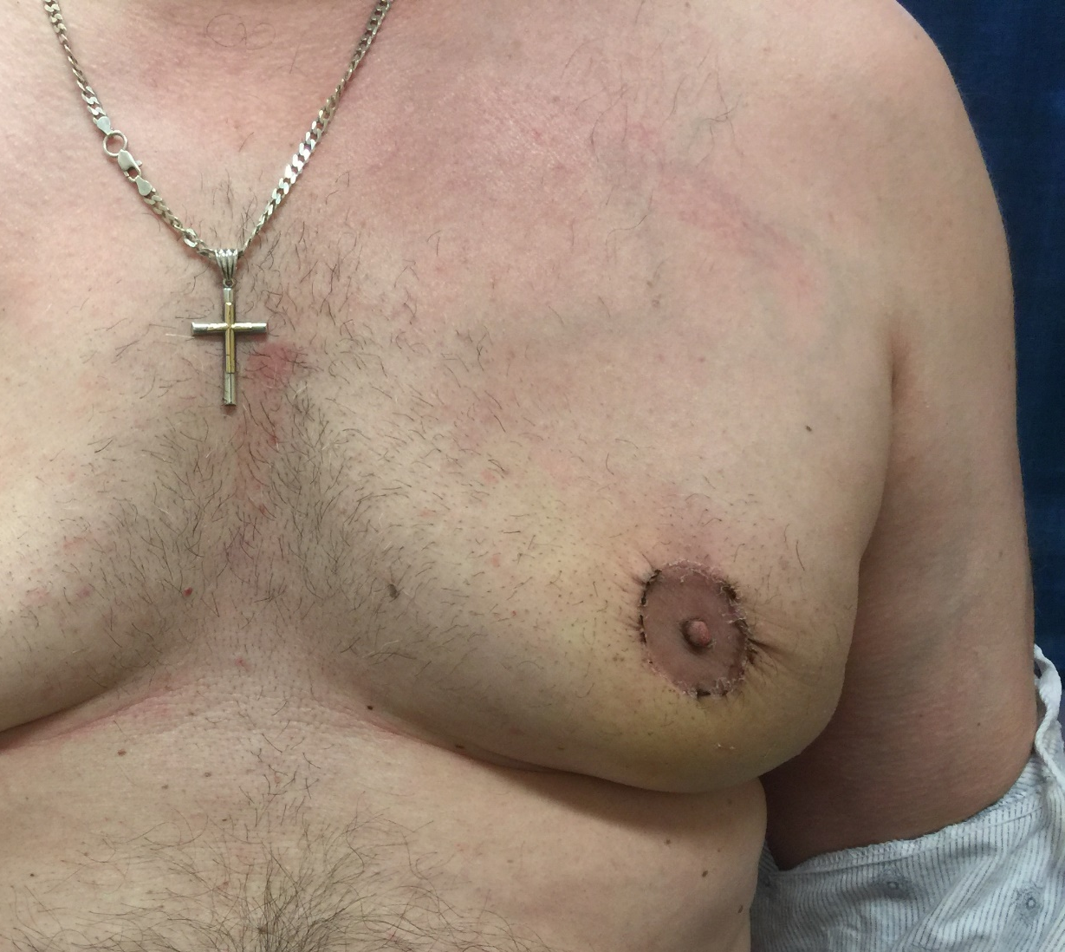
Excision of skin over the tumor combined with circumareolar de-epithelialization facilitated a cosmetic nipple-sparing mastectomy for this 2 cm breast cancer in a man with grade 4 gynecomastia.
Courtesy of David Euhus

Slide 20
Contralateral Breast Cancer Risk
Female BRCA
Female Sporadic
Male BRCA
Male Sporadic
Auvinen A et al. J Natl Cancer Inst. 2002;94(17):1330-1332.
Tai YC et al. J Natl Cancer Inst. 2007;99:1811-1814.
Notes:
MBC contralateral risk is 0.1% - 0.26%/year
Assumptions:
Female BRCA 2% per year
Female sporadic from CBCRisk
Male BRCA 0.2%/yr (same as primary risk)

Slide 21
Metaplastic breast cancer
Heterogenous aggressive group of breast cancers
Defined by the histological presence of at least two cellular types (typically epithelial and mesenchymal)
Most commonly triple negative subtype
Have worse outcome compared to non-metaplastic triple negative breast cancer
Tend to be chemotherapy resistant

Slide 22
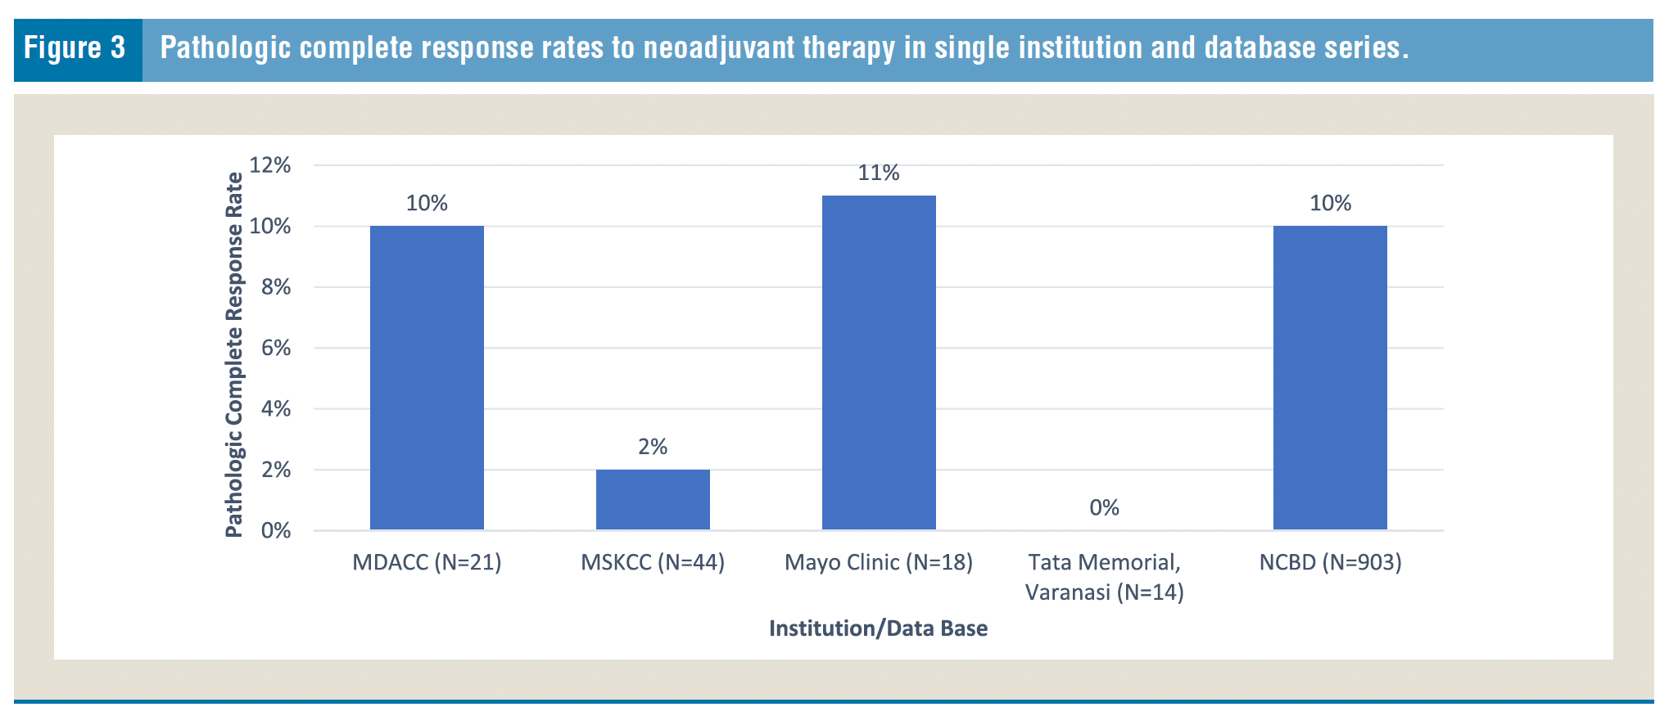
Response to neoadjuvant chemotherapy
Thomas et al., Clin Breast Cancer 2023 Dec;23(8):775-783

Slide 23
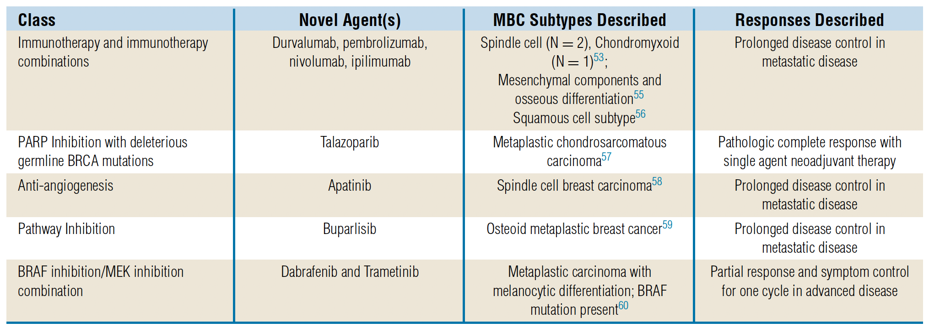
New Therapeutic Approaches
Spectrum of Metaplastic Histologic Subtypes
Thomas et al., Clin Breast Cancer 2023 Dec;23(8):775-783

Slide 24
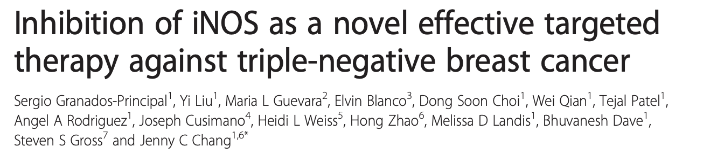
Breast Cancer Research 2015
Selective iNOS inhibitor (L-NMMA) diminished cell proliferation, cancer stem cell self-renewal, and cell migration in vitro

Slide 25
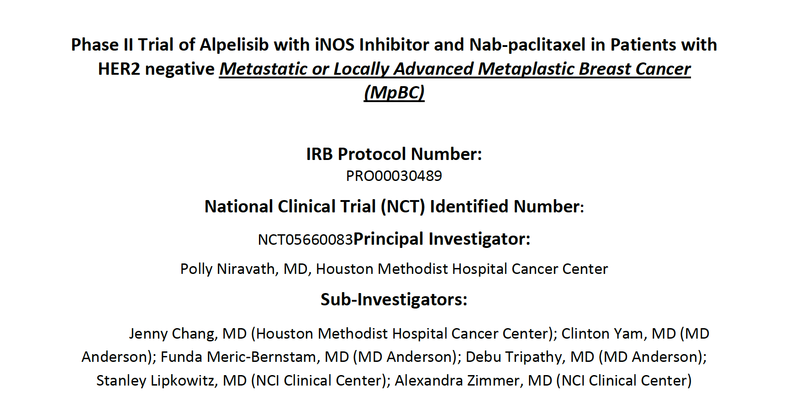

Slide 26
Lobular Breast Cancer

Slide 27
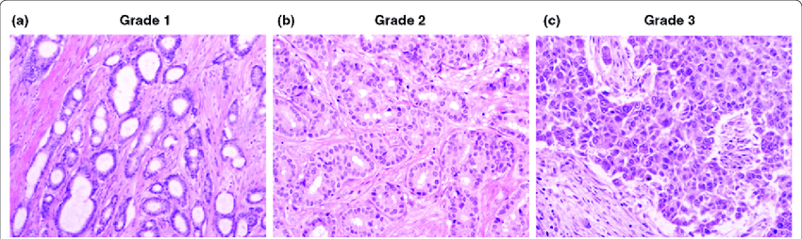
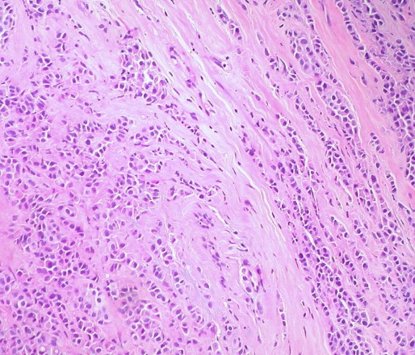
IDC compared to ILC
IDC | ILC
Most common histology of breast cancer (80-90%) | Second most common histology (10-15%)
Originates from epithelial cells of the terminal duct lobular unit | Originates from epithelial cells of the terminal duct lobular unit
Expresses the adhesion protein E-cadherin | LACKS the adhesion protein E-cadherin
Can form ductal like structures | Grows in “single file lines” leading to more diffuse pattern
 | Higher proportion of ER positive, PR positive, HER2 negative tumors
 | Has increased risk of late recurrence
 | Associated with germline mutation in CDH1 gene (Hereditary Diffuse Gastric Cancer Syndrome)
IDC
ILC

Slide 28
Background
Patients with ILC have worse surgical outcomes compared to patients with invasive ductal carcinoma (IDC)
  Measured by positive margin rates, mastectomy rates, and axillary dissection rates
Many potential causes:
  Higher stage at presentation
  Higher discordance between clinical stage and pathologic stage
  Lower sensitivity of standard imaging tools
Johnson K et al. Lobular breast cancer series: imaging. Breast Cancer Res 2015
Sledge G et al. Collective Wisdom: Lobular Carcinoma of the Breast. ASCO Educational Book 2016

Slide 29
Patients with ILC have higher positive margin rates than patients with IDC
Diffuse growth pattern, low imaging sensitivity → higher positive margin rates
Positive margin rates after breast conserving surgery
 | ILC | IDC
Yeatman | 17.5% | 6.9%
Silverstein | 59% | 43%
Moore | 51% | 15%
Yeatman TJ et al. Tumor biology of infiltrating lobular carcinoma. Implications for management. Ann Surg. 1995
Silverstein MJ et al. Infiltrating lobular carcinoma. Is it different from infiltrating duct carcinoma? Cancer. 1994
Moore MM et al. Association of infiltrating lobular carcinoma with positive surgical margins after breast-conservation therapy. Ann Surg. 2000

Slide 30
If a positive margin occurs, what is the chance of success for re-excision?
There is a 74% success rate for clearing a positive margin at re-excision instead of completion mastectomy
Piper M et al. Success rates of re-excision after positive margins for invasive lobular carcinoma of the breast. NPJ Breast Cancer 2019

Slide 31
Higher rates of nodal positivity → axillary dissections and radiation
High rate of nodal positivity: in 692 patients with ILC 35% were node positive
  Of the clinically node negative, 24% were node positive at surgery
Patients with ILC are significantly more likely to upstaged at surgical resection than those with IDC (OR 2.47)
Plichta JK et al. Clinical and pathological stage discordance among 433,514 breast cancer patients. Am J Surg. 2019
Cocco Det al. Invasive Lobular Breast Cancer: Data to Support Surgical Decision Making. Ann Surg Oncol 28, 5723–5729 (2021)

Slide 32
Should we routinely obtain breast MRI in the pre-operative evaluation of patients with ILC?
Maybe
  Data are primarily from single institution retrospective series, with mixed results

Slide 33
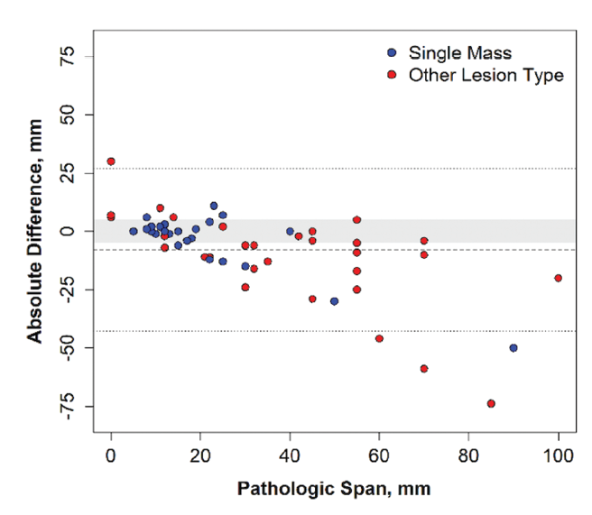
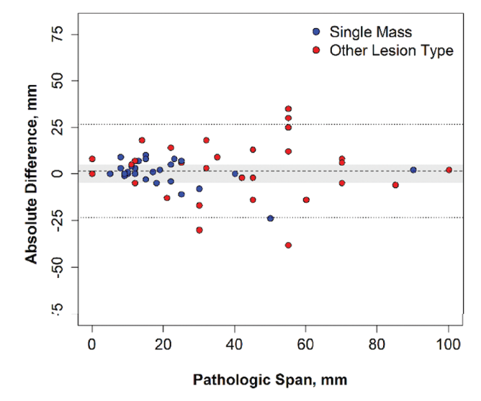
Breast MRI has higher concordance with pathology size than conventional imaging
Conventional imaging versus pathology
MRI versus pathology
Hovis K et al. Accuracy of preoperative breast MRI versus conventional imaging in measuring pathologic extent of invasive lobular carcinoma. Journal of Breast Imaging 2021

Slide 34
Does higher concordance translate to improved surgical outcomes?
Institutional series evaluating outcomes in 166 cases with ILC who obtained pre-operative MRI
MRI was helpful in 28.9% and harmful in 28.9%
  Helpful:
    Identifying contralateral disease or additional ipsilateral disease
    Better size concordance with pathology
  Harmful:
    High rate of benign biopsies
    Overestimation of tumor size compared to pathology
  Overall positive margin rate 6.8%
  Overall mastectomy rate 57%
  28% switched to mastectomy after breast MRI even though BCS technically possible
Amin A et al. Does the addition of breast MRI add value to the diagnostic workup of invasive lobular carcinoma? Journal of Surgical Research 2021

Slide 35
Despite lack of consistent benefit, breast MRI is still recommended by many for ILC evaluation
American Society of Breast Surgeons
National Comprehensive Cancer Network
European Society of Breast Imaging
European Society of Breast Cancer Specialists
Lack of prospective data → selection bias
  MRI likely used in more challenging cases
Lack of better alternative

Slide 36
Conclusions
Patients with ILC have high positive margin rates after both lumpectomy and mastectomy
For lumpectomy:
  Always take shave margins and offer oncoplastic surgery
  Re-excision for positive margin has 74% success rate
For mastectomy:
  Nipple skin sparing mastectomy is safe in ILC
  Even mastectomy has almost 19% positive margin rate for T3 tumors
    Address positive margin with either re-excision or post-mastectomy radiation
Pre-op MRI useful but imperfect test
Potential role of neoadjuvant therapy even if mastectomy is planned

Slide 37
A Few Take Home Points
Purple “rash” on the skin: punch biopsy. Think angiosarcoma
Avoid disfiguring surgery for benign phyllodes
Consider referral to discuss adjuvant radiation for malignant phyllodes
Risk of contralateral breast cancer for male breast cancer survivors is low
TN metaplastic breast cancer treated with standard TN therapies including Keynote 522 in the neoadjuvant setting- also consider clinical trial
Lobular breast cancer- can be underestimated on mammogram, consider MRI

Slide 38
Thank You

