Slide 1


Adjuvant Endocrine Therapy For Postmenopausal Women
William J. Gradishar MD FACP FASCO
Betsy Bramsen Professor of Breast Oncology
Director, Maggie Daley Center for Women’s Cancer Care
Robert H. Lurie Comprehensive Cancer Center
Northwestern University

Slide 2
Disclosures
Consultant: AstraZeneca, Daiichi-Sanyo, Novartis, Lilly, Pfizer, Merck, Stemline-Menarini, Genentech-Roche, Gilead, Carrick, Johnson & Johnson, Ambryx, Veracyte, Totus
DMC: Lilly, Genentech, Pfizer/Seagen, IBCSG, Alliance Foundation Trials (AFT)

Slide 3
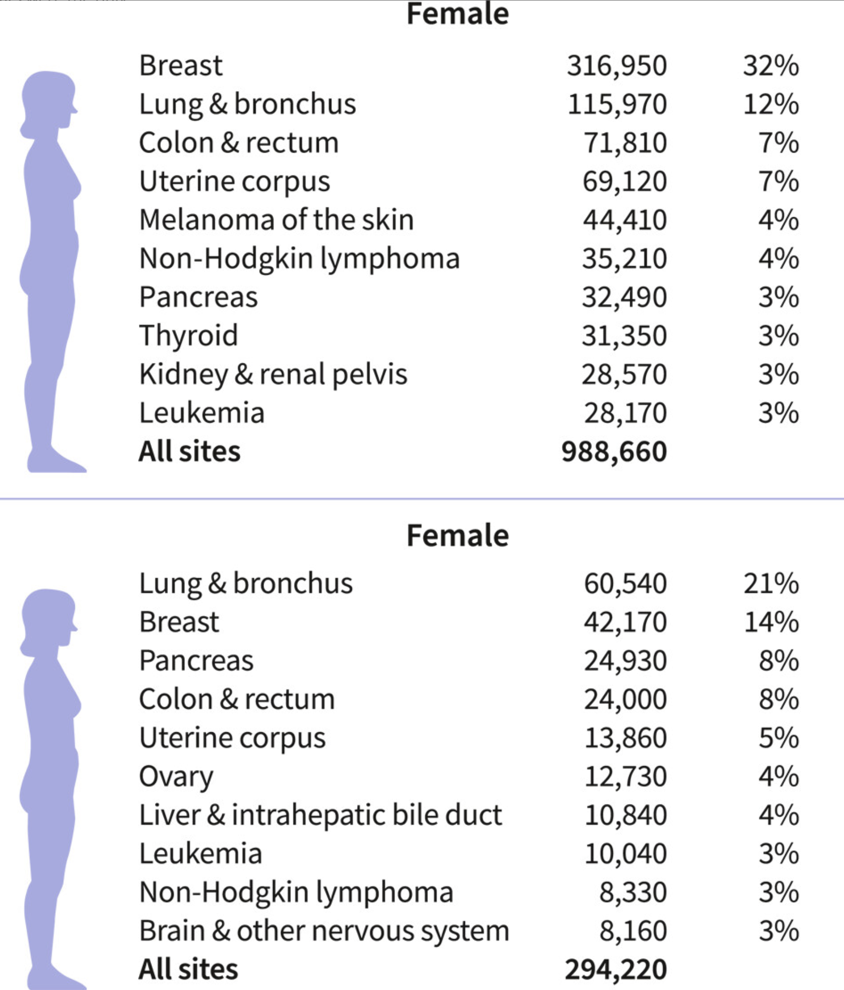
Cancer statistics 2025,
CA 75:2025

Slide 4
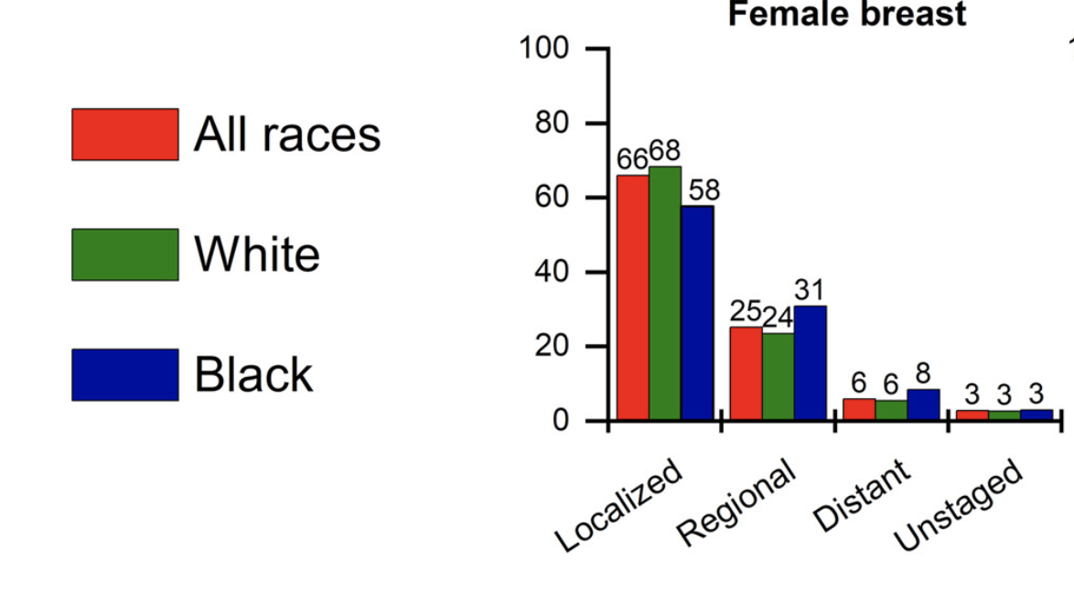
Cancer statistics 2025,
CA 75:2025
Stage Distribution

Slide 5
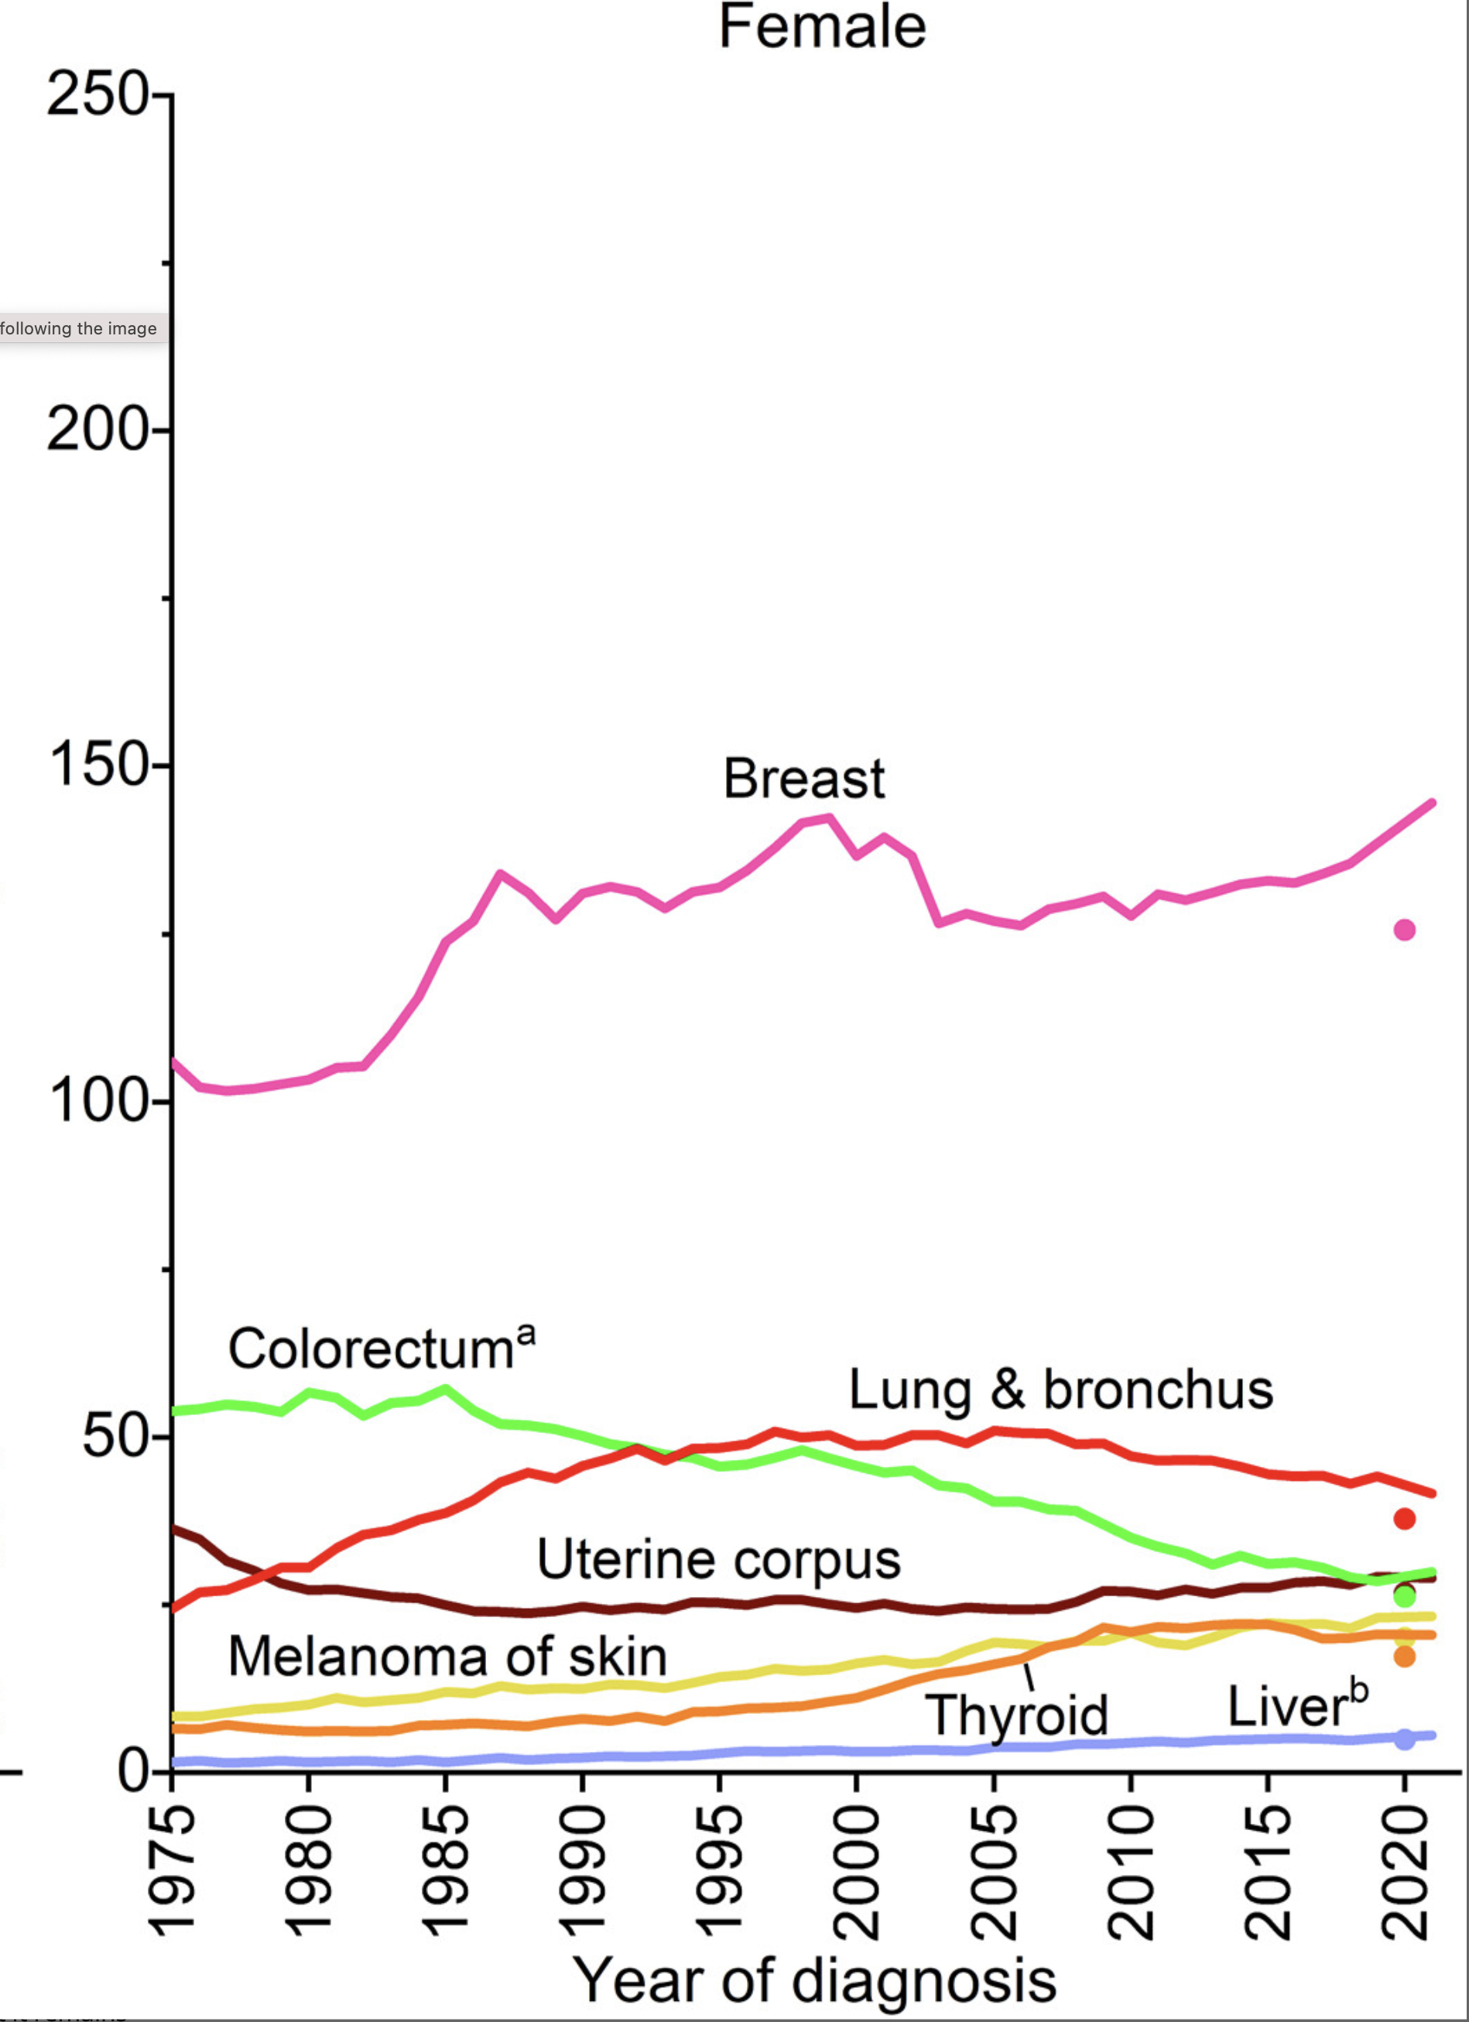
Cancer statistics 2025,
CA 75:2025
Incidence

Slide 6
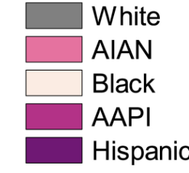
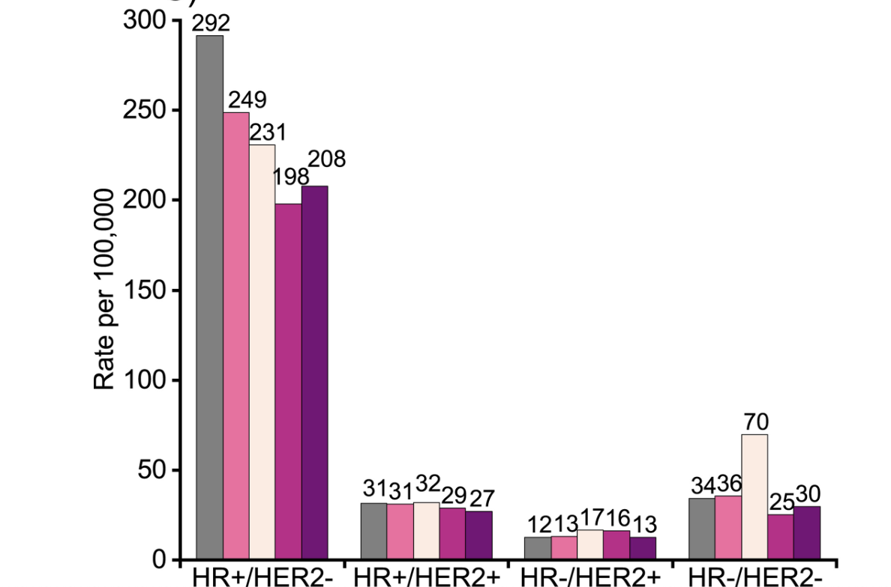
Female BC Incidence
> 50 years
Breast Cancer Statistics. Giaquinto et al. CA Cancer J Clin. 2024 Oct 1. doi: 10.3322/caac.21863. Online ahead of print.

Slide 7
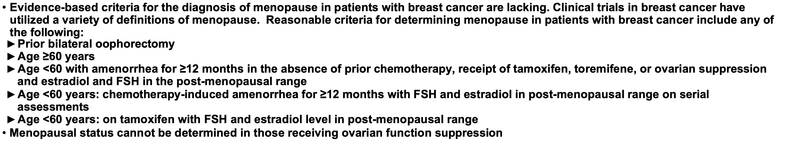
Definitions of Menopause
NCCN Breast GL v.5 2025;BINV-O

Slide 8
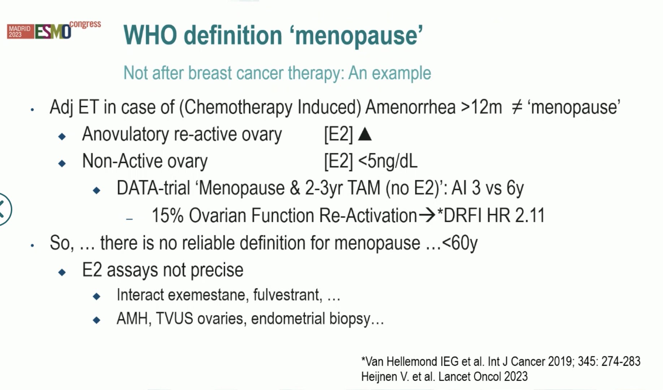

Slide 9
The Long Tail of ER-Positive Breast Cancer
0.3
Initial Peak
ER/PgR+ (n=2257)
ER/PgR– (n=1305)
0.2
Recurrence hazard rate
Long Tail
0.1
0
0
1
2
3
4
5
6
7
8
9
10
11
12
Years
PgR = progesterone receptor.
Saphner et al. J Clin Oncol. 1996;14:2738.

Slide 10
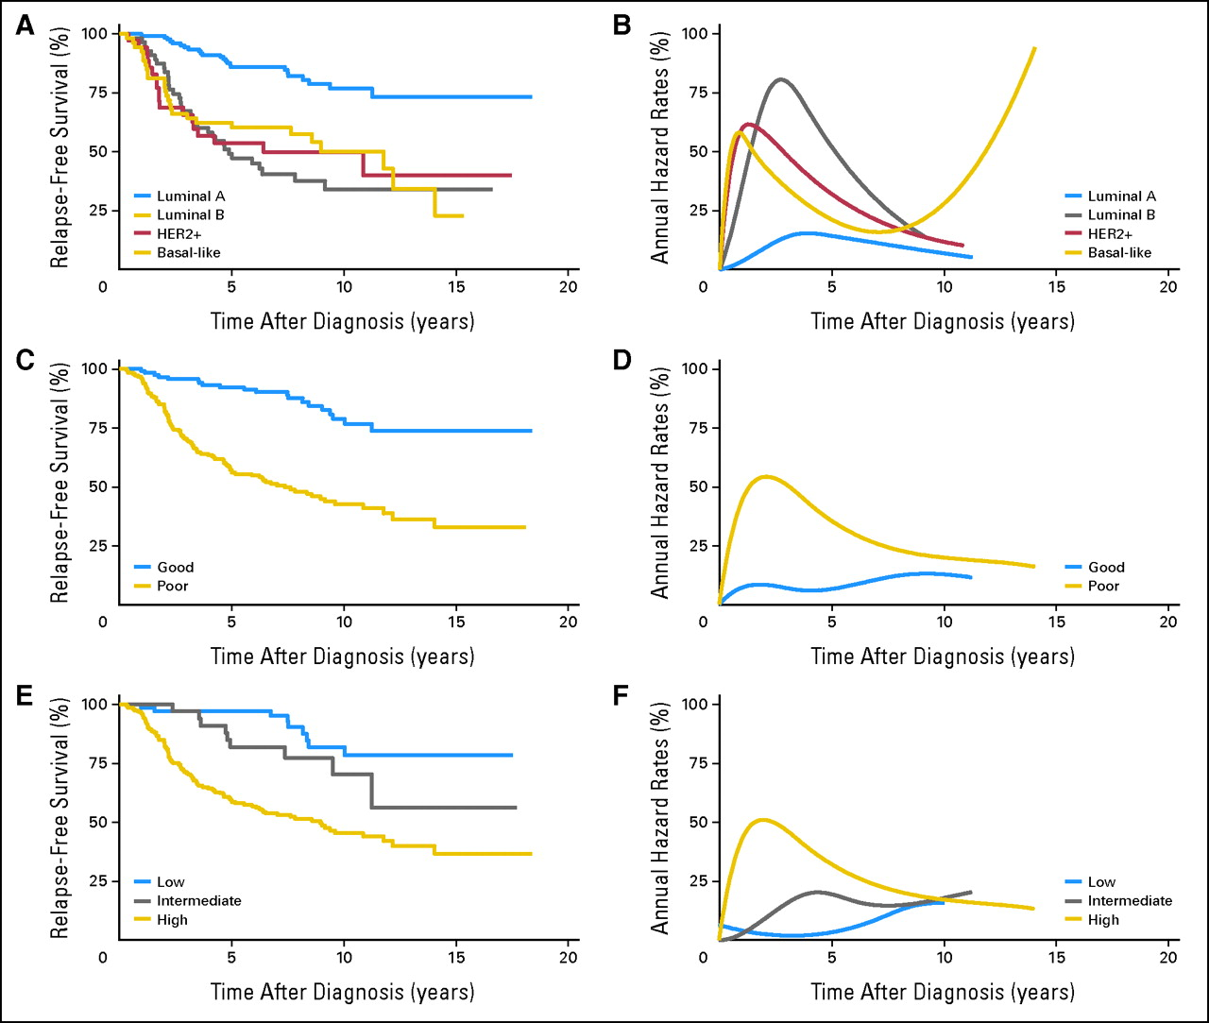
Time Dependence of Breast Cancer Recurrence in
Subsets Defined by Genomic Assays
Intrinsic/
PAM50
70 Gene Signature
21 Gene RS
Jatoi I et al. J Clin Oncol. 2011;29:2301-2304.
Notes:
Percent relapse-free survival (A, C, E) and annual hazard rates for breast cancer relapse (B, D, F) using data that was provided in supplemental Table 1 of Fan et al.6 Relapse-free survival in panels A, C, and E was obtained with the Kaplan-Meier product-limit estimator.7 Percent annual hazard rates for breast cancer relapse in panels B, D, and F were modeled as described in Figure 1.3,4 Plots for relapse-free survival and annual hazard rates for breast cancer relapse are shown for the intrinsic molecular subtypes (A, B),8 MammaPrint prognostic molecular signatures (C, D),9–11 and Oncotype DX prognostic scores (E, F).12 All plots demonstrate nonproportional relapse-free survival and nonproportional annual hazard rates for breast cancer recurrence. (A, B) Unsupervised hierarchal molecular clustering demonstrates two main breast cancer classes according to estrogen receptor (ER) expression and/or epithelial cell of origin (luminal or basal). There are two ER-negative (HER2 and basal-like) and two ER-positive (ie, luminal A and B) molecular signatures.8 Relapse-free survival is most favorable for luminal A and least favorable for non–luminal A tumors (luminal B, HER2 positive, and basal-like breast cancers). (C, D) MammaPrint is a dichotomous 70-gene prognostic signature.9–11 Relapse-free survival is most favorable for a good and least favorable for a poor molecular signature. (E, F) Oncotype DX is a 21-gene prognostic score.12 Relapse-free survival is most favorable for low and least favorable for intermediate and high molecular score.

Slide 11
Dormancy Implications
Therapies targeting proliferating cells may not affect dormant cells
As therapies targeting proliferating cells improve, dormant cells will become the major cause of breast cancer death
Targeting dormant cells will become a major challenge for some (not all) of breast cancer

Slide 12
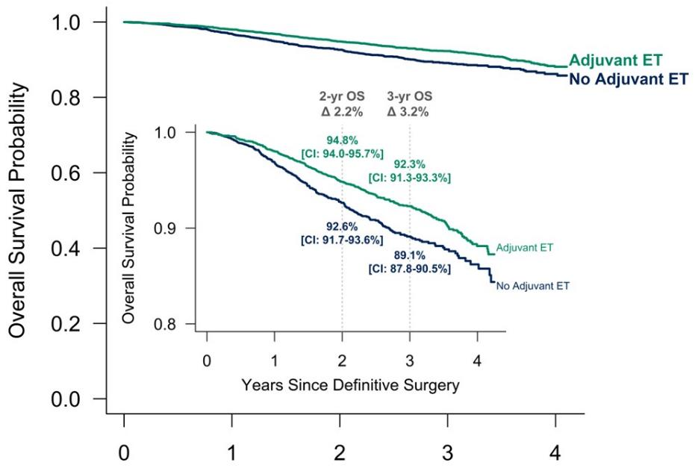
What is HR+ Breast Cancer?
No Benefit in the Group with Lowest ER Expression
Endocrine Therapy Omission in ER Low Disease
EBCTCG, Lancet. 2011;378(9793):771-84.
EBCTCG, Lancet 2011
Choong et al, ASCO 2024. Abstract 513.
Choong et al, ASCO 2024
Notes:
ER < 1% corresponds to about fmol ER/mg of 10

Slide 13
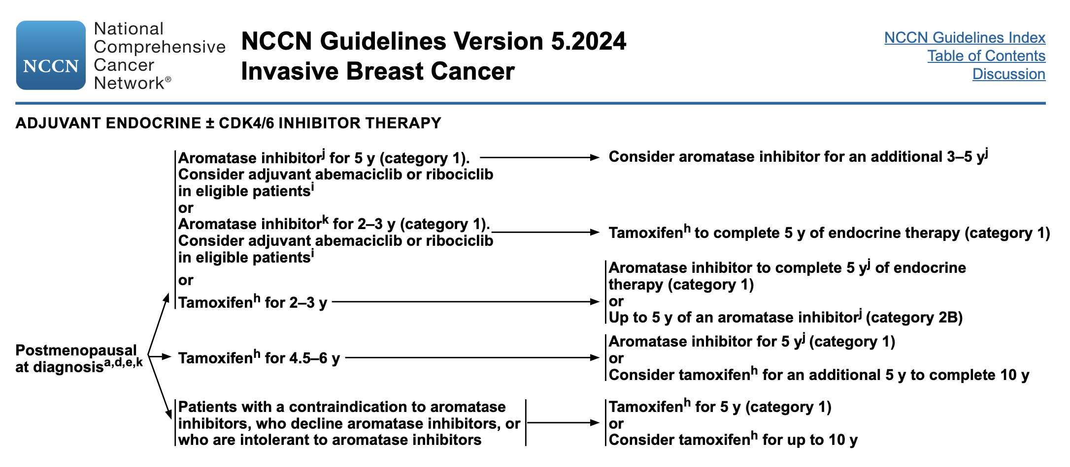
Current recommendations: 5-10 yrs

Slide 14
2010 EBCTCG OVERVIEW: TAMOXIFEN
5 yrs in ER+ disease
● Reduces
● Recurrence by 38%,
● BC death by 30%
● All deaths by 22%
● Contralateral BC by 40%
● Benefits all women with ER+ disease
● Unclear benefits in ER- PgR+ disease
● Benefits women with ER very rich tumors more
● Increases endometrial cancer by 2.3 fold

Slide 15
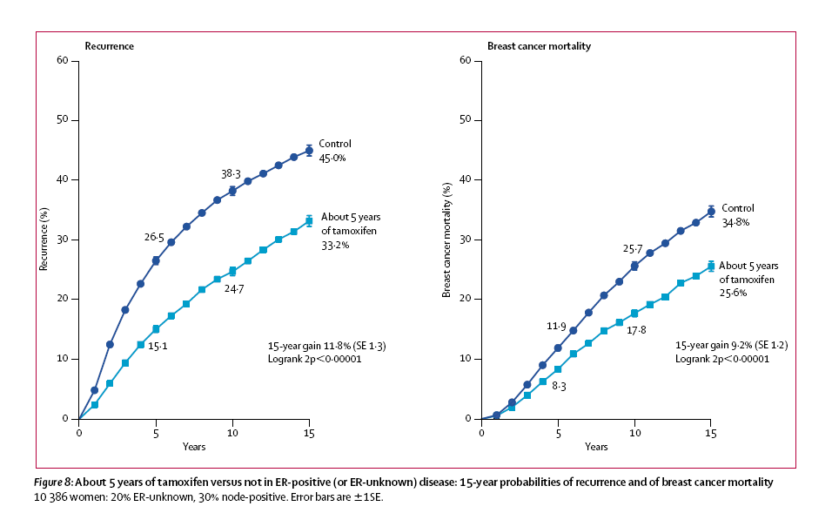
Early Stage Breast Cancer
Tamoxifen: 5 Years Vs. Not
More than half of recurrences and deaths occur post-treatment
EBCTCG, Lancet 2005;365:1687
Notes:
Most of the effect on recurrence comes in the first five years, but most of the effect on mortality comes after this period. There is a persistent benefit after completing 5 years of tamoxifen. The risk of recurrence is similar in years 0-4 and years 5-15.

Slide 16
What is HR+ Breast Cancer?
No Benefit in the Group with Lowest ER Expression
Endocrine Therapy Omission in ER Low Disease
EBCTCG, Lancet 2011
EBCTCG, Lancet 2011
Choong et al, ASCO 2024
Choong et al, ASCO 2024
Notes:
ER < 1% corresponds to about fmol ER/mg of 10

Slide 17
Duration of Tamoxifen: NSABP B-14
Fisher, et al. JNCI 2001

Slide 18
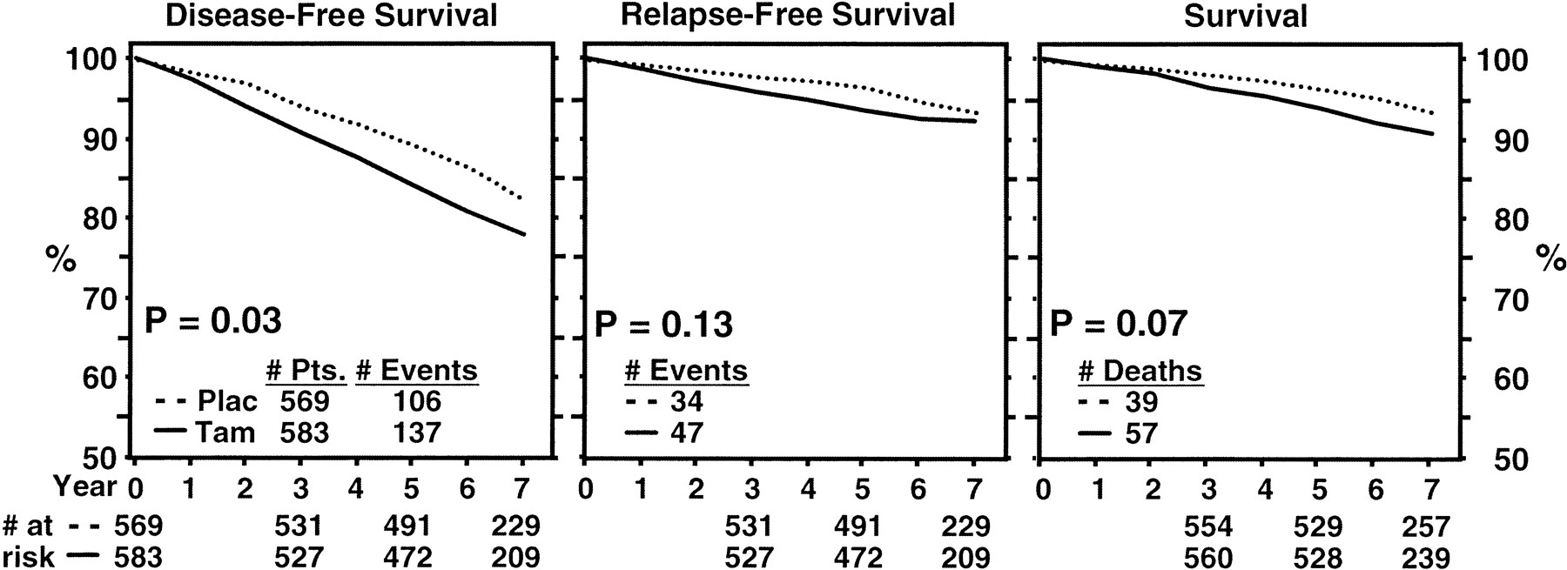
Duration of Tamoxifen: NSABP B-14
Fisher, et al. JNCI 2001;
median f/u 7 years post-rerandomization

Slide 19
EBCTCG Analysis: Relative Risk of Distant Recurrence in Years 5 to 14
Analysis of 91 trials with 46,138 women with ER-positive breast cancer alive and disease free after 5 years of endocrine therapy
Prognostic factor | Relative risk
Nodal status (N1-3 vs N0) | 2.08
Tumor stage (T2N0 vs T1N0) | 1.73
Grade (T1N0, high vs low) | 2.02
Ki67 (≥20% vs 0-13%) | 1.63
Pan H et al. N Engl J Med. 2018;378(9):870-871.

Slide 20
EBCTCG Analysis: Risk of Distant Recurrence by Tumor and Nodal Status
Subgroup | 10 years | 15 years | 20 years
T1N0 | 4% | 9% | 14%
T1N1 (1-3 nodes) | 8% | 15% | 23%
T1N2 (4-9 nodes) | 16% | 30% | 41%
T2N0 | 8% | 14% | 21%
T2N1 (1-3 nodes) | 12% | 20% | 29%
T2N2 (4-9 nodes) | 20% | 35% | 47%
Pan H et al. N Engl J Med. 2018;378(9):870-871.

Slide 21
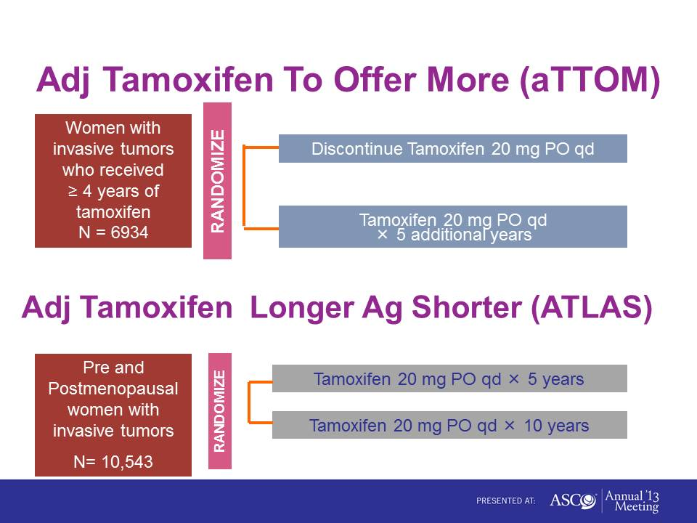
[TITLE]

Slide 22
Combined Outcomes in ATLAS and aTTom
 | Breast Cancer Mortality | Overall Survival
Years 5 - 9 | 0.97 (0.84-1.15) | 0.99 (0.89-1.10)
Years 10+ | 0.75 (0.65-0.86)* | 0.84 (0.77-0.93)*
All Years | 0.85 (0.77-0.94)* | 0.91 (0.84-0.97)*
*p < 0.05 favoring 10 years
Gray et al. ASCO 2013. Abstract 5.

Slide 23
NCCN Guidelines Version 5.2024 Invasive Breast Cancer
  Some SSRIs like fluoxetine and paroxetine decrease the formation of endoxifen, 4-OH tamoxifen, and active metabolites of tamoxifen, and may impact its efficacy. Caution is advised about coadministration of these drugs with tamoxifen. SNRIs(citalopram [Celexa™] and venlafaxine [Effexor]) appear to have minimal impact on tamoxifen metabolism
  Based on current data the panel recommends against CYP2D6 gene testing for pts being considered for tamoxifen therapy.

Slide 24
Is one AI better?
Not Really!

Slide 25
NCCN Guidelines Version 5.2025
Invasive Breast Cancer the small font!
The three selective aromatase inhibitors (ie, anastrozole, letrozole, exemestane) have shown similar anti-tumor efficacy and toxicity profiles in randomized studies in the adjuvant and preoperative settings.
The optimal duration of aromatase inhibitors in adjuvant therapy is uncertain. Patients with lymph node involvement may benefit from extended aromatase inhibitor duration (7.5–10 years total).

Slide 26
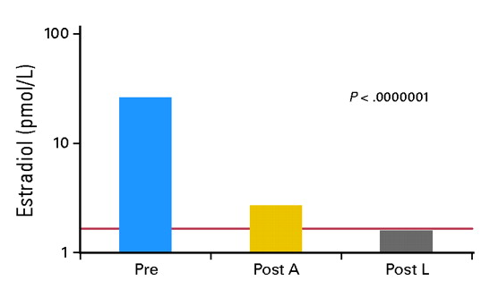
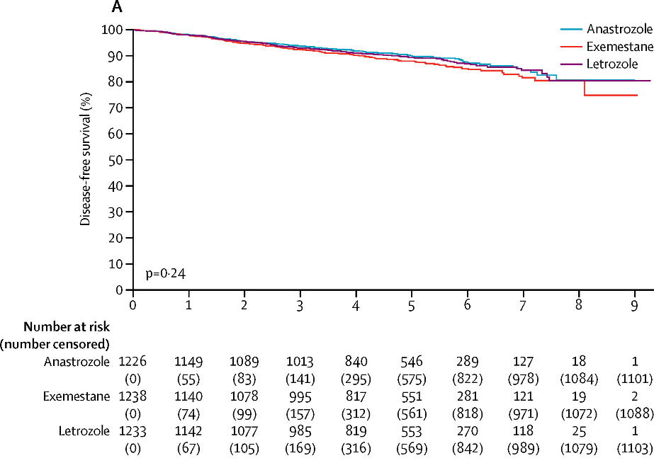
Ideal Endocrine Therapy for Early- Stage Breast Cancer
Most Potent Inhibition of Aromatase with Letrozole
But - No Difference in Outcome with Specific AI
Dixon et al, JCO 2006
Placido et al, Lancet Oncology 2018
Ellis et al. J Clin Oncol. 2006;24(19):3019-25.
De Placido et al. Lancet Oncol. 2018;19(4):474-485.
Notes:
We have three approved aromatase inhibitors – two nonsteroidal / revers ible and one steroidal
Early studies have demonstrated greater reduction in ER activity with letrozole compared to anastrozole, however this has not translated to improvement in outcomes with specific aromatase inhibitors – as shown in the FATA-GIM3 trial which randomized patients to one of the three aromatase inhibitors, all given either upfront or after 2 years of tamoxifen, as well as other trials such as MA.27

Slide 27
Upfront
ATAC
BIG 1-98
ABCSG 12
TEAM
TAM
AI
Sequential
BIG 1-98
IES
ITA
NSAS BC-03
ARNO 95
ABCSG 8*
TAM
AI
TAM
Extended
MA.17
ABCSG 6a
NSABP B-33
Plac
AI
TAM
0
2
3
5
10
Years After Diagnosis

Slide 28
Adjuvant Endocrine Trials: Efficacy
Aromatase Inhibitor Versus Tamoxifen
Strategy | RCTs | Pts | Update | Median FU (mo.) | AI | Efficacy [HR, p]
 |  |  |  |  |  | DFS/EFS | OS
Up-Front | ATAC | 6186 | Lancet Oncol 2008 | 100 | ANA | 0.90 (0.025) | 1.00 (0.99)
 | BIG-1-98 | 4922 | JCO 2007 | 51 | LET | 0.82 (0.007) | 0.91 (>0.05)
“Early” Switch | ITA-1 | 380 | JCO 2001 | 61 | AGT | NR (0.6) | NR (0.005)
 | ITA-2 | 448 | Ann Oncol 2006 | 64 | ANA | 0.57 (0.005) | 0.56 (0.1)
 | IES | 4742 | Lancet 2007 | 56 | EXE | 0.76 (0.0001) | 0.85 (0.08)
 | ARNO 95 | 979 | JCO 2007 | 30 | ANA | 0.66 (0.049) | 0.53 (0.045)
Sequencing | ABCSG 8 | 2926 | SABCS 2005 | 28 | ANA | 0.76 (0.07) | NR
Absolute DFS Reductions at 3-6 years | Up-Front | Early Switch | Sequence
 | 2-4 % | 3-5% | 1.5%

Slide 29
What did we learn?
AI > Tam
Tam ➞AI better Tam (total 5 years)
Tam x 5 ➞AI x 5 better than Tam
Think 2-4%

Slide 30
Best endocrine rx by breast cancer subtype?

Slide 31
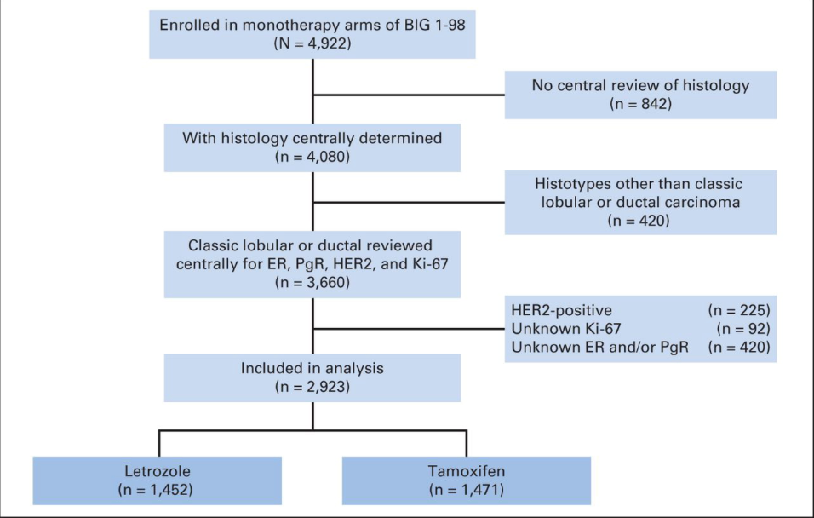
Relative Effectiveness of Letrozole Compared With Tamoxifen for Patients With Lobular Carcinoma in the BIG 1-98 Trial
Filho, J Clin Oncol 33:2772-2779,2015.

Slide 32
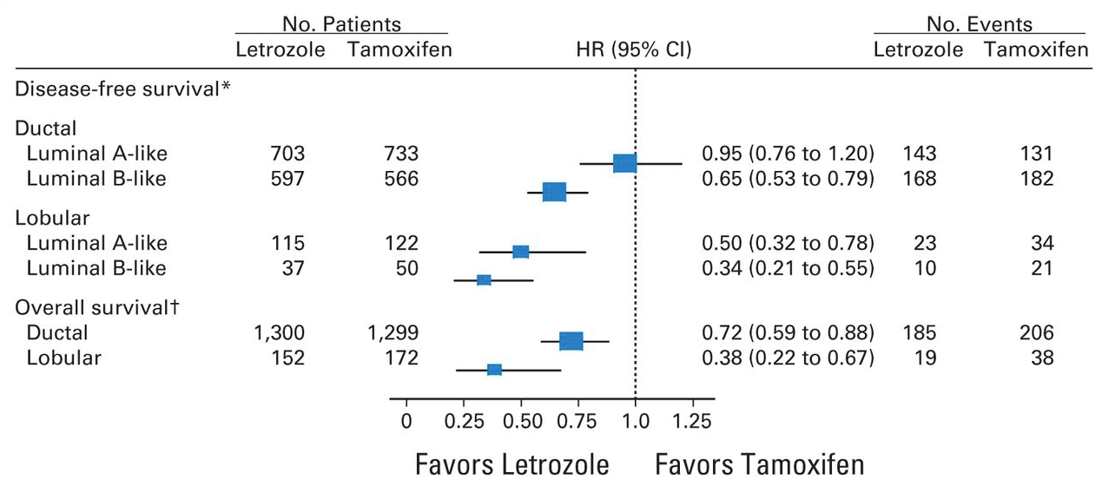
Relative Effectiveness of Letrozole Compared With Tamoxifen for Patients With Lobular Carcinoma in the BIG 1-98 Trial
For lobular or more aggressive Luminal
BC, letrozole better than tamoxifen
Reis-Filho JS et al. J Clin Oncol 2015;33:2772-2779.

Slide 33
Extended Duration of AI Therapy

Slide 34
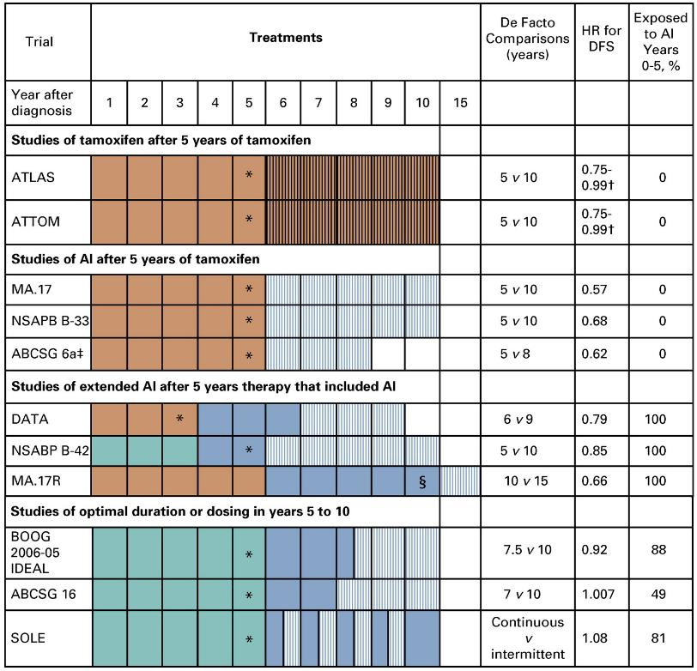
Tailoring Endocrine Therapy - Duration
Tamoxifen
AI or Tamoxifen
AI
Completing 5 years of tamoxifen after 5 years of tamoxifen improves DFS and breast cancer mortality
Completing 3-5 years of AI after tamoxifen improves DFS and overall survival
Completing 5 years of AI after 5 years AI improves DFS but not OS
IDEAL and ABCSG 16 demonstrate similar DFS in patients receiving 2 – 2.5 additional years of AI versus 5 additional years after the first 5 years
Burstein et al, J Clin Oncol. 2019;37(5):423-438.
Notes:
ATLAS and ATTOM trials demonstrated the superiority of 10 years of tamoxifen over 5 years, with improvements in DFS and breast cancer mortality
Subsequently, 3 randomized trials demonstrated improved DFS with 3-5 years of aromatase inhibitor therapy after 5 years of tamoxifen with survival benefit in the two studies which were not prematurely closed
Subsequently, 3 trials evaluated extended AI therapy after 3 – 10 years of prior endocrine therapy including tamoxifen and/or an aromatase inhibitor. DFS improved in all studies except in DATA which had a similar hazard ratio although not reaching statistical significance.
Finally, the results of 3 studies of extending adjuvant aromatase inhibitor to a total of 10 years failed to demonstrate benefit over 2 – 2.5 years of therapy, thus making 7-8 years of total therapy a reasonable goal for all but the highest risk patients.

Slide 35
Selecting Patients for Extended Endocrine Therapy
Low HOXB13/IL17BR
High HOXB13/IL17BR
HR (95% CI)
ATTOM
1.07 (0.69 – 1.65)
0.35 (0.15 – 0.86)
0.58 (0.25 – 1.36)
0.33 (0.15 – 0.73)
0.68 (0.33 – 1.39)
0.29 (0.12 – 0.69)
0.95 (0.58 – 1.56)
0.42 (0.21 – 0.84)
MA.17
B-42
(> 4yr DR)
IDEAL
0.1 0.2 0.5 1.0 2.0
Hazard Ratio, Recurrence Free Interval
Bartlett et al, Ann Oncol 2019
Mamounas et al, Clin Cancer Res 2024 2024
Noordhoek et al, Clin Cancer Res 2021
Sgroi et al, JNCI 2013
Notes:
All genomic recurrence assays have been found to be prognostic specifically for late recurrence, but a few assays have show predictive benefit for extended adjuvant therapy.
The BCI; or ratio of HOXB13 to IL17BR was originally developed as a marker of recurrence on tamoxifen. HOXB13 is known to drive breast cancer migration and proliferation, and IL17BR presumably has some role in anti-cancer immunity but this is not fully elucidated.
Nonetheless, this ratio has been shown to be predictive of late recurrence multiple of the aforementioned randomized studies of extended endocrine therapy, with significant benefit of extended therapy only clearly seen in patients with a high HOXB13/IL17BR.

Slide 36
Selecting Patients for Extended Endocrine Therapy
MP High
MP Low (not ultralow)
MP Ultralow
HR (95% CI)
0.65 (0.34 – 1.24)
0.42 (0.24 – 0.77)
0.53 (0.13 – 2.15)
1.28 (0.62 – 2.67)
0.35 (0.15 – 0.82)
B-42
(DR)
IDEAL
(RFI)
0.1 0.2 0.5 1.0 2.0
Hazard Ratio
Rastogi et al, J Clin Oncol. 2024;42(30):3561-3569.
Liefers et al, SABCS 2022
Notes:
More recent data has demonstrated that MammaPrint may also serve as a comparable biomarker, with MammaPrint high risk tumors demonstrating similar degree of benefit as low HOXB13/IL17BR
It’s really quite interesting as one might expect high HOXB13/IL17BR to be correlated with high MammaPrint – but there’s a suggestion of a bimodal distribution – where the ultralow risk cases seem to have less benefit from extended adjuvant therapy than the low risk cases – but the confidence intervals are wide and hard to tell if there truly is no benefit in the ultralow population.

Slide 37
MA.17 R:
5 vs. 10 Years of Letrozole
After 5 Years of Tamoxifen
Tamoxifen
Letrozole
Plac
Placebo
Tam
Plac
Let
(n=900)
Let
MA.17
(n=900)
MA.17 Extension
0 y
5 y
10 y
15 y
Adapted from Goss et al. N Engl J Med. 2016;375(3):209-19.

Slide 38
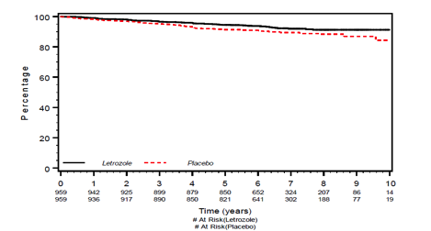

MA.17R:
Extending Adjuvant Letrozole for 5 Years after Completing Either:
5 years of AI alone OR 5 years Tamoxifen followed by 5 years AI
Total of 1918 patients, median FU 6.3 years
  Median age 65
  Median time from diagnosis 10 years
  46% node negative
  70% received at least 4.5 years of prior tamoxifen
5-year DFS:
95% LET vs 91% PLAC
HR DFS 0.66, P=0.01
DFS events:
Distant: 42 vs 53 (11 events)
LRR: 19 vs 30 (11 events)
Bone: 28 vs 37
New CL breast cancer: 13 vs 31
Letrozole
Placebo
Goss et al. N Engl J Med. 2016;375(3):209-19.

Slide 39
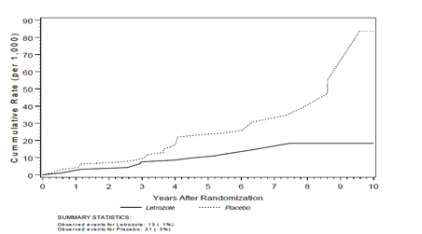
Survival and Toxicity, Contralateral Breast Cancer in MA 17R
5-year OS:
  93% LET vs. 94% PLA (HR 0.97, P = NS)
DFS post-hoc sensitivity analysis including all deaths (not second non breast primary cancers)
    -L: 90% vs P: 88% (HR 0.8, p=0.6)
Fractures
  14 vs 9% (spine, wrist and femur predominated)
New onset osteoporosis
  11 vs 6%
Contralateral new breast cancers
Placebo
HR 0.42
P = 0.007
Letrozole
  Letrozole: 0.21% vs. Placebo: 0.49%
Goss et al. N Engl J Med. 2016;375(3):209-19.

Slide 40
Side Effects
Aromatase Inhibitors
Osteoporosis
Fractures
Hypercholesterolemia
Hypertension
Joint pain/stiffness
Hot flashes
Vaginal dryness/sexual side effects
Hair thinning
Arterial thrombosis?
Tamoxifen
Endometrial Cancer
Blood clots
Stroke
Cataracts
Hot flashes
Vaginal dryness/sexual side effects
In addition, considerations based on patient comorbidities

Slide 41
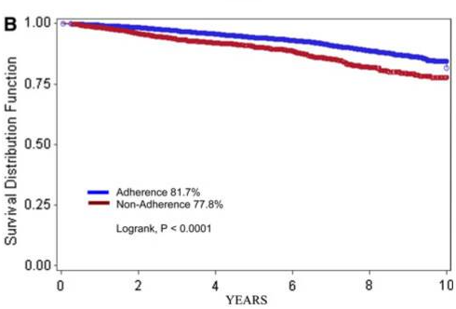
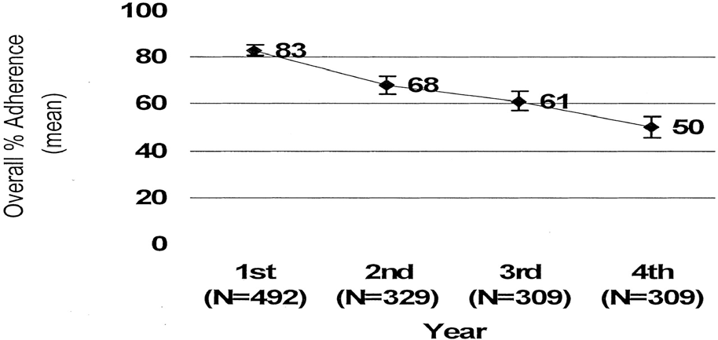
Treatment Compliance
Endocrine therapy adherence and persistence are poor¹⁻⁴
  Discontinuation ranges from 31-73% during the first 5 years²⁻³
  In the extended setting, discontinuation is close to 40%^{4,5}
Side effects are the primary reason for treatment discontinuation⁶
Poor compliance negatively affects outcomes⁷
Figure 1: Adherence rate¹
Figure 2: Impact of Nonadherence on Outcomes⁶
Partridge, A. H. et al. J Clin Oncol; 2003;21:602-606.
Murphy CC, et al Breast Can Res Treat. 2012;134:459-4.
Sheppard VB, et al J Clin Oncol. 2014;32(22):2318-27.
Goss P et al: N Engl J Med. 2016;375(3):209-19.
Mamounas EP et al. San Antonio Breast Cancer Symposium, 2016.
Friese CR et al. Breast Can Res Treat 2013; 138(3):931-39.
Hershman et al. Breast Cancer Res Treat. 2011; 126(2): 529-537.

Slide 42
Adjuvant CDK4/6i

Slide 43
Length of Therapy in Adjuvant Trials in Relation to Risk of Recurrence Rates

Slide 44
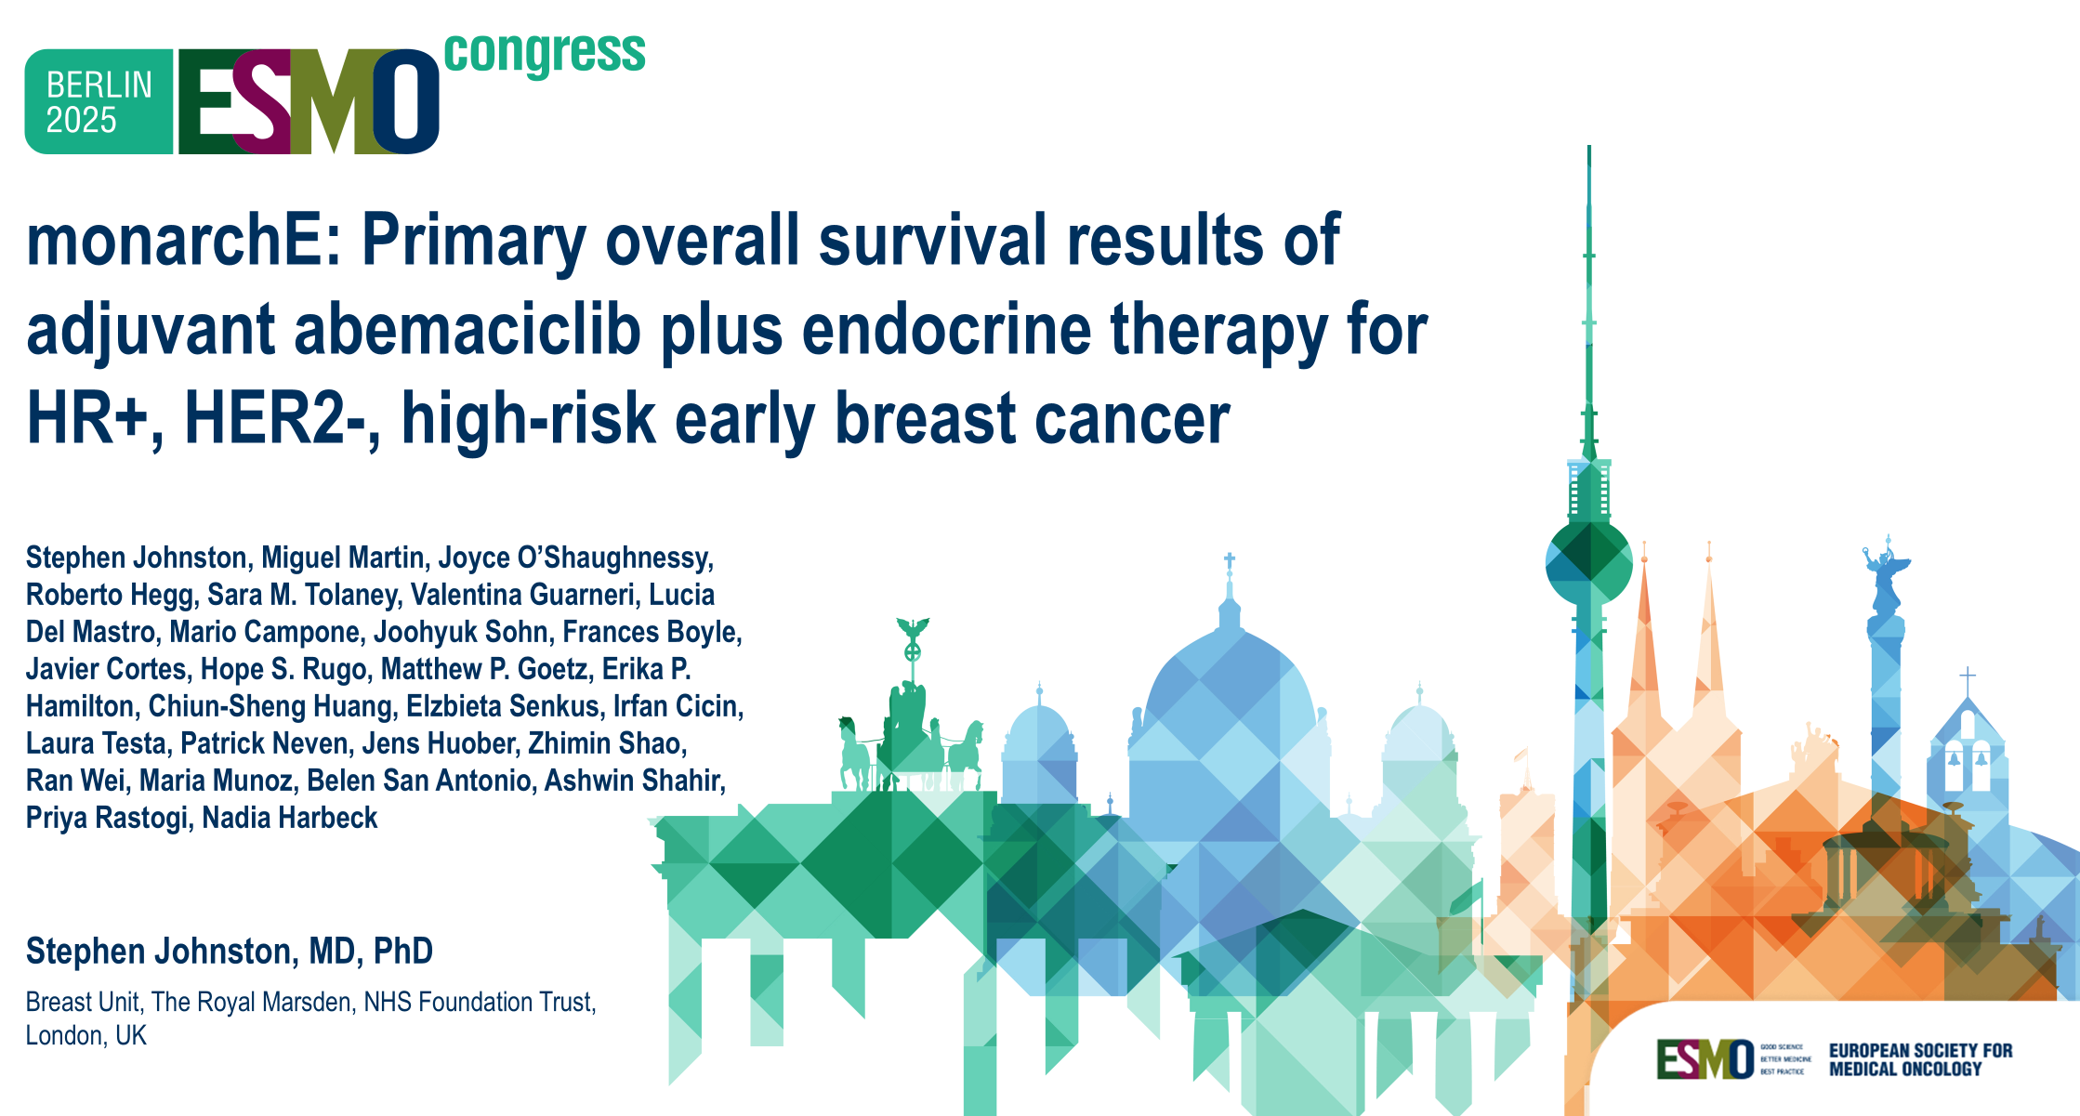

Slide 45
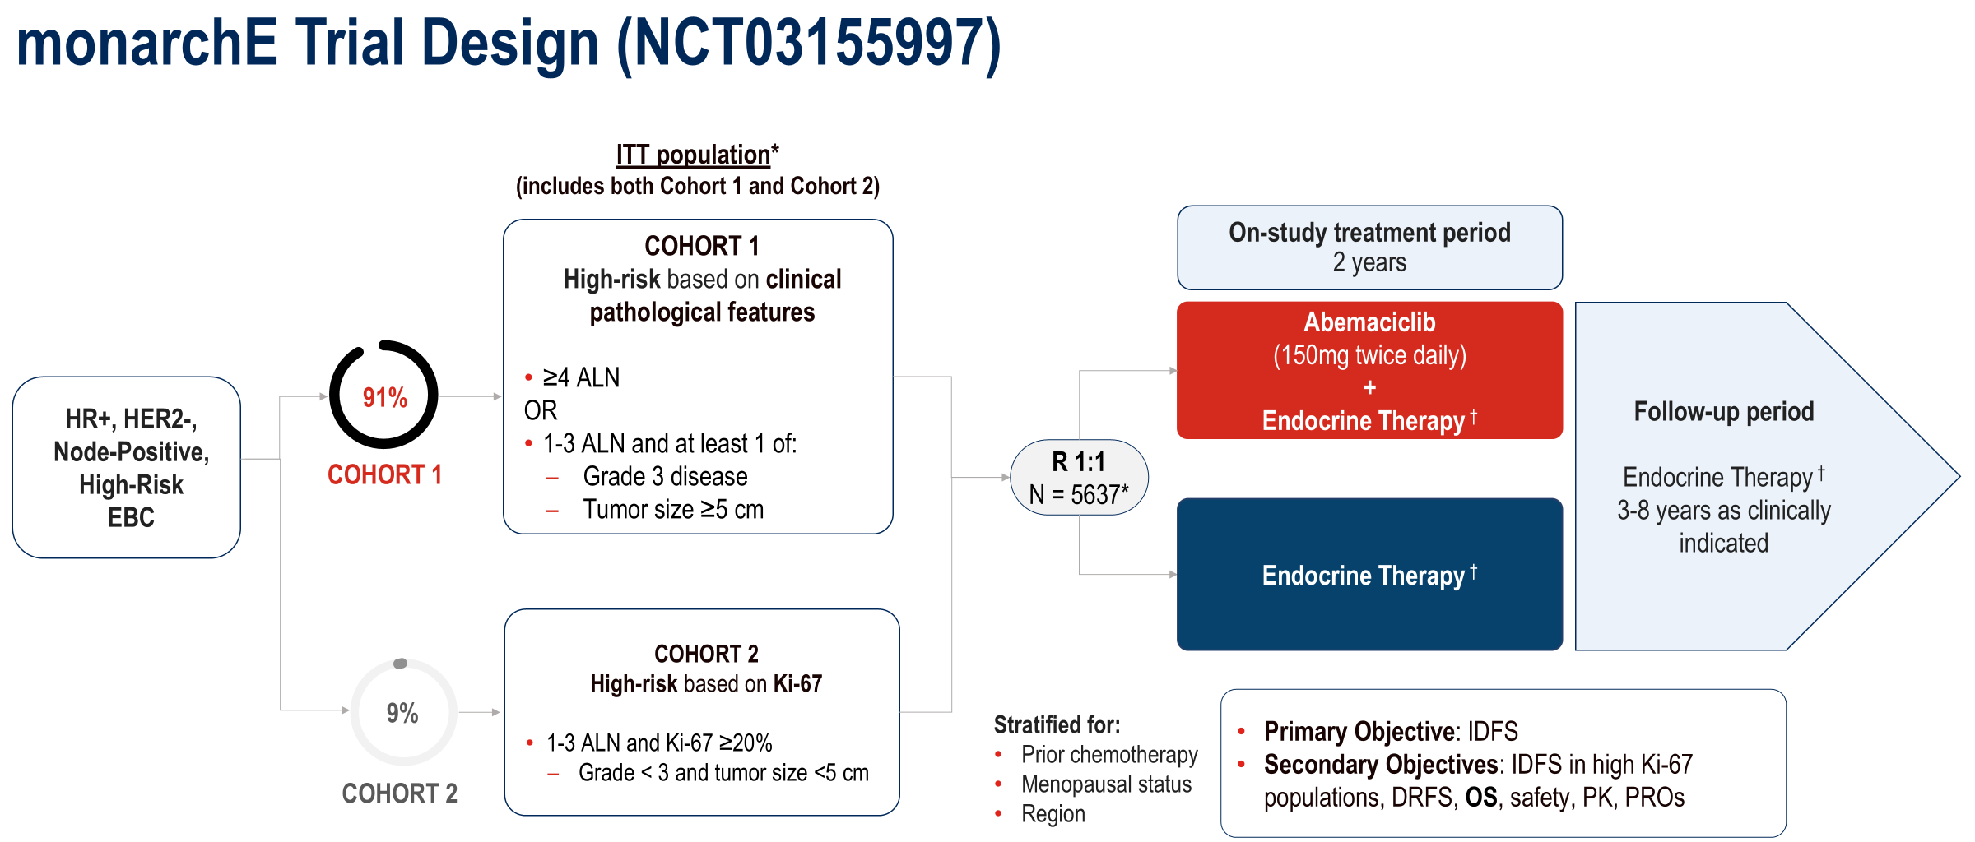
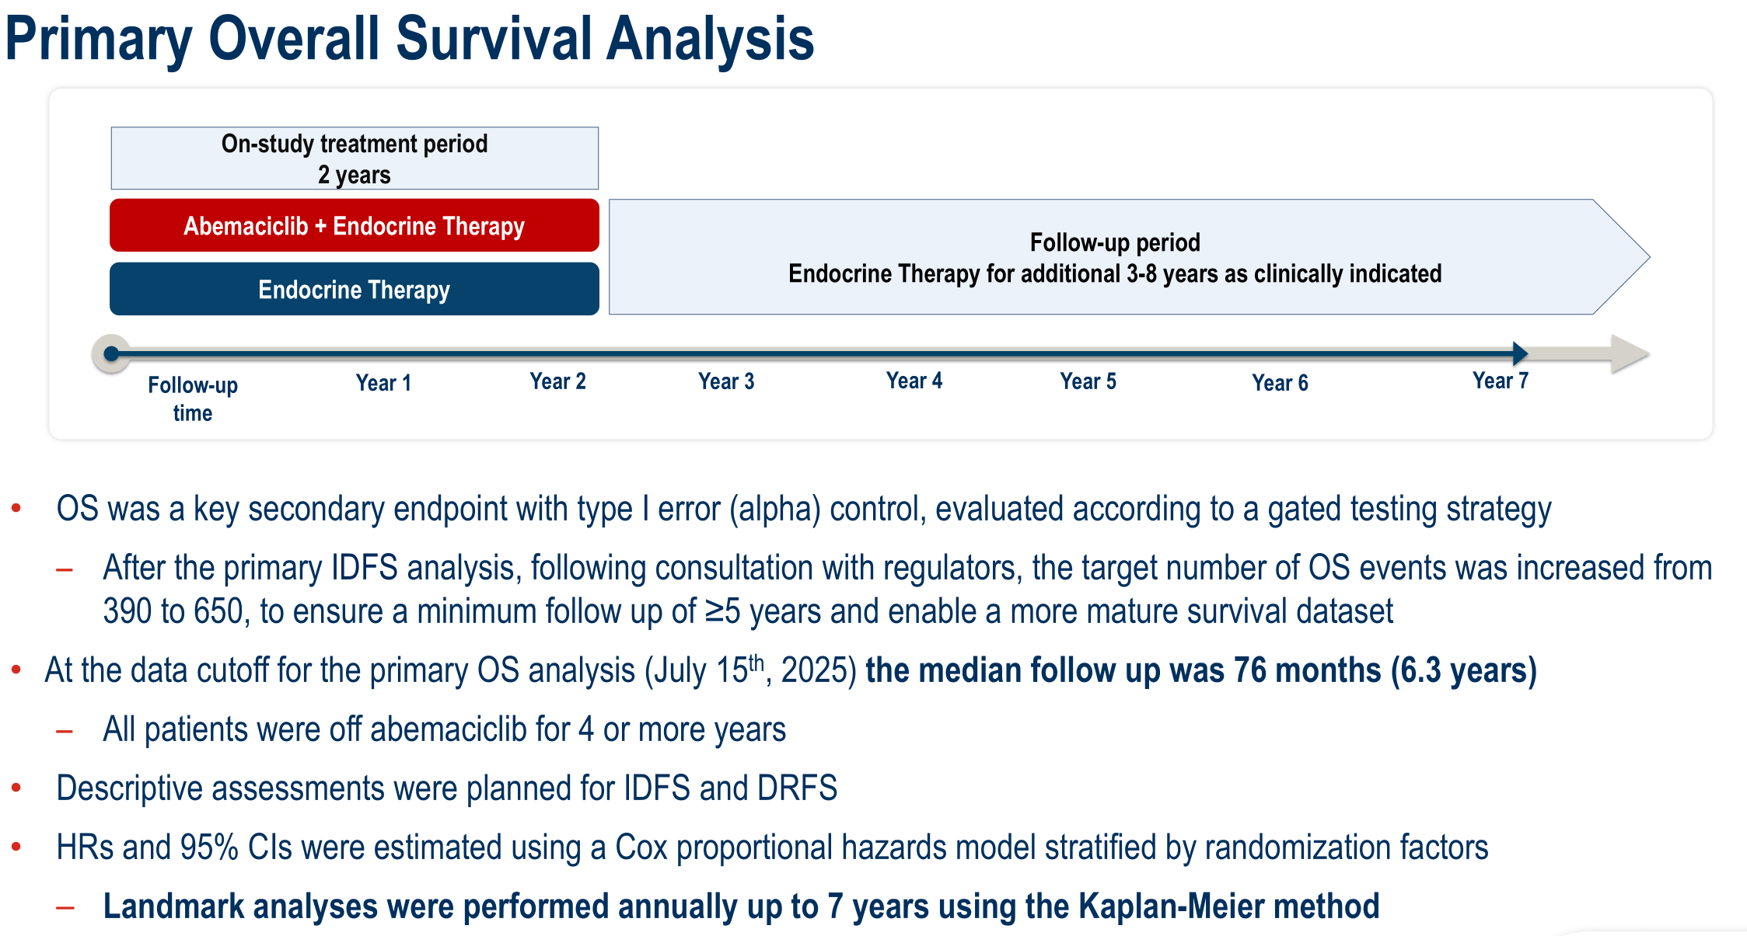
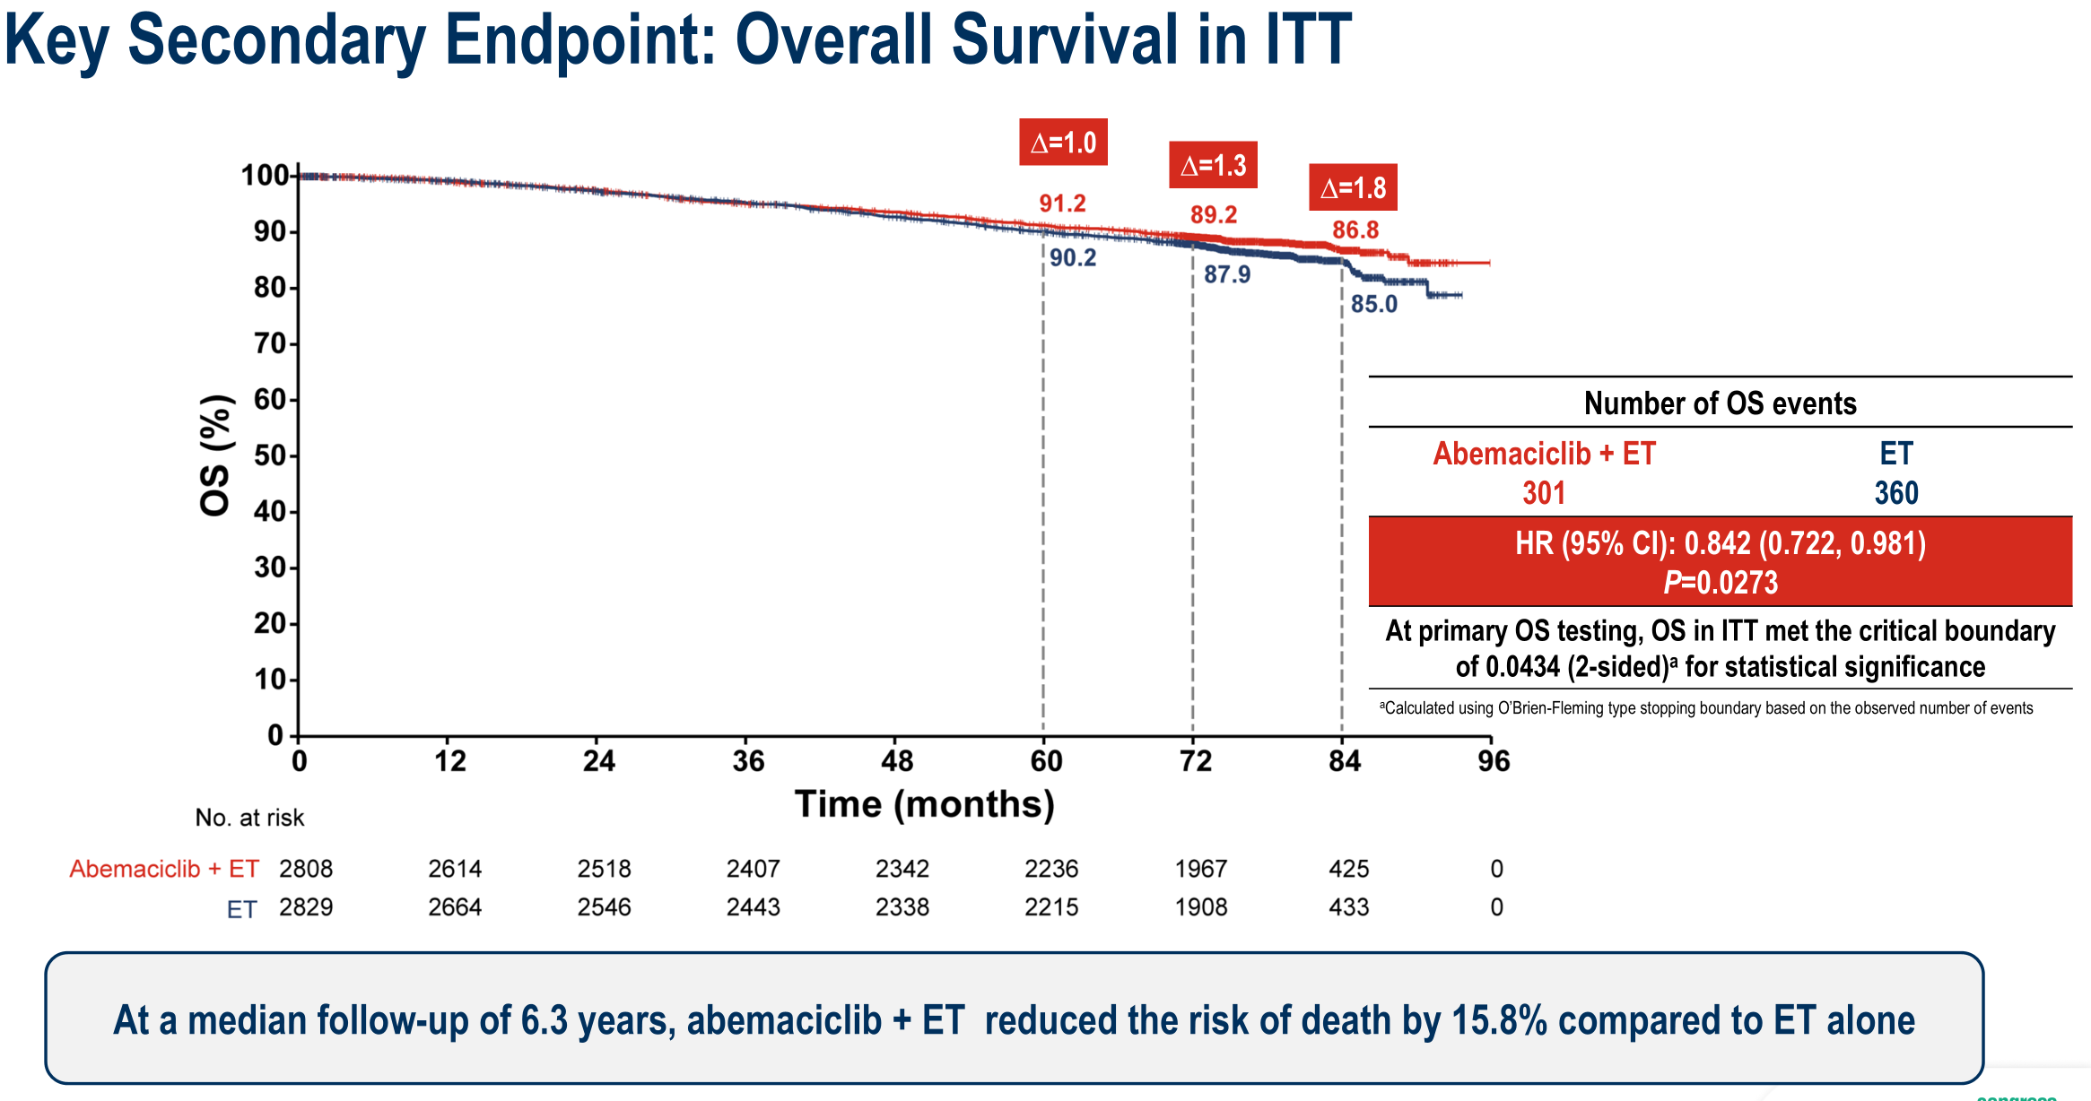
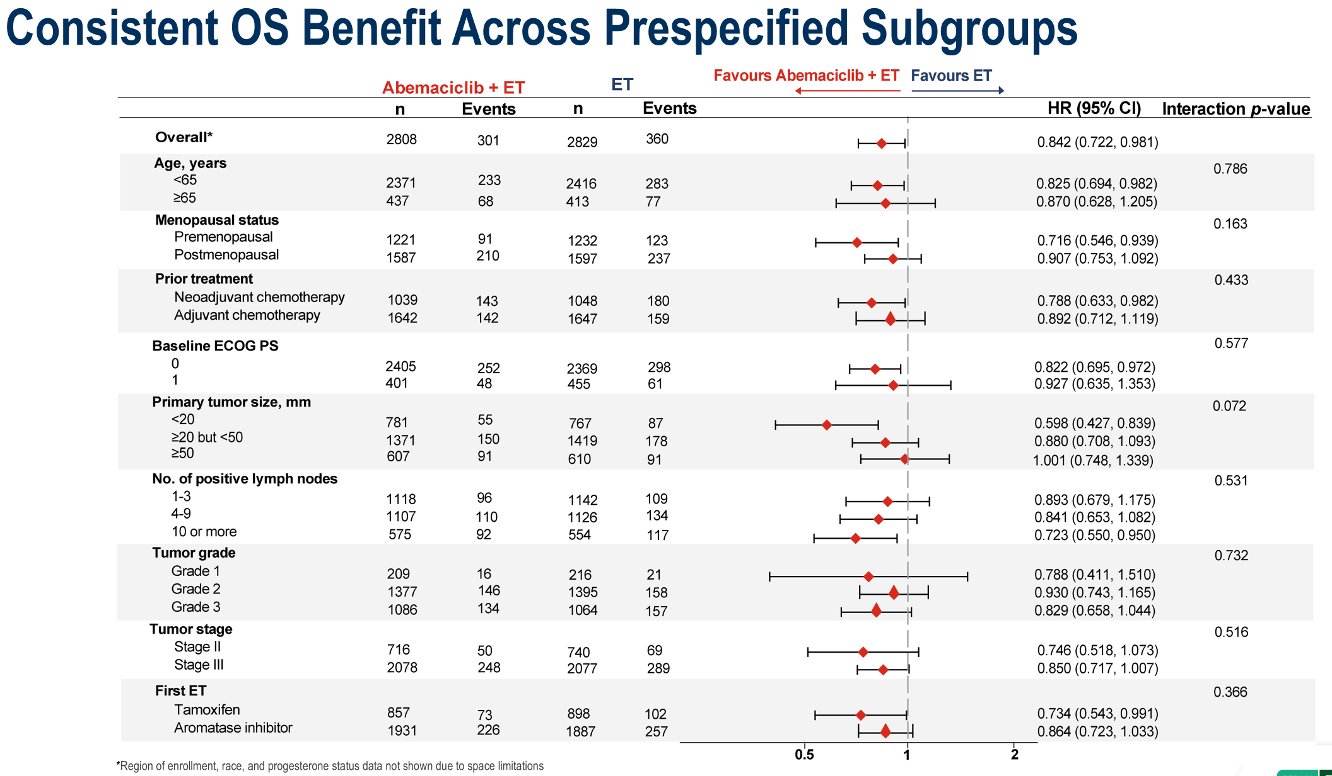

Slide 46
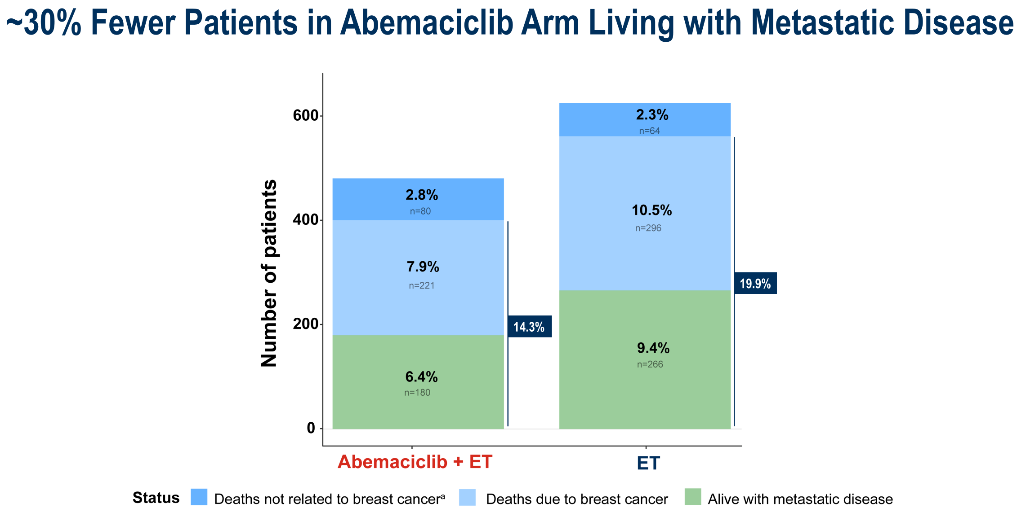
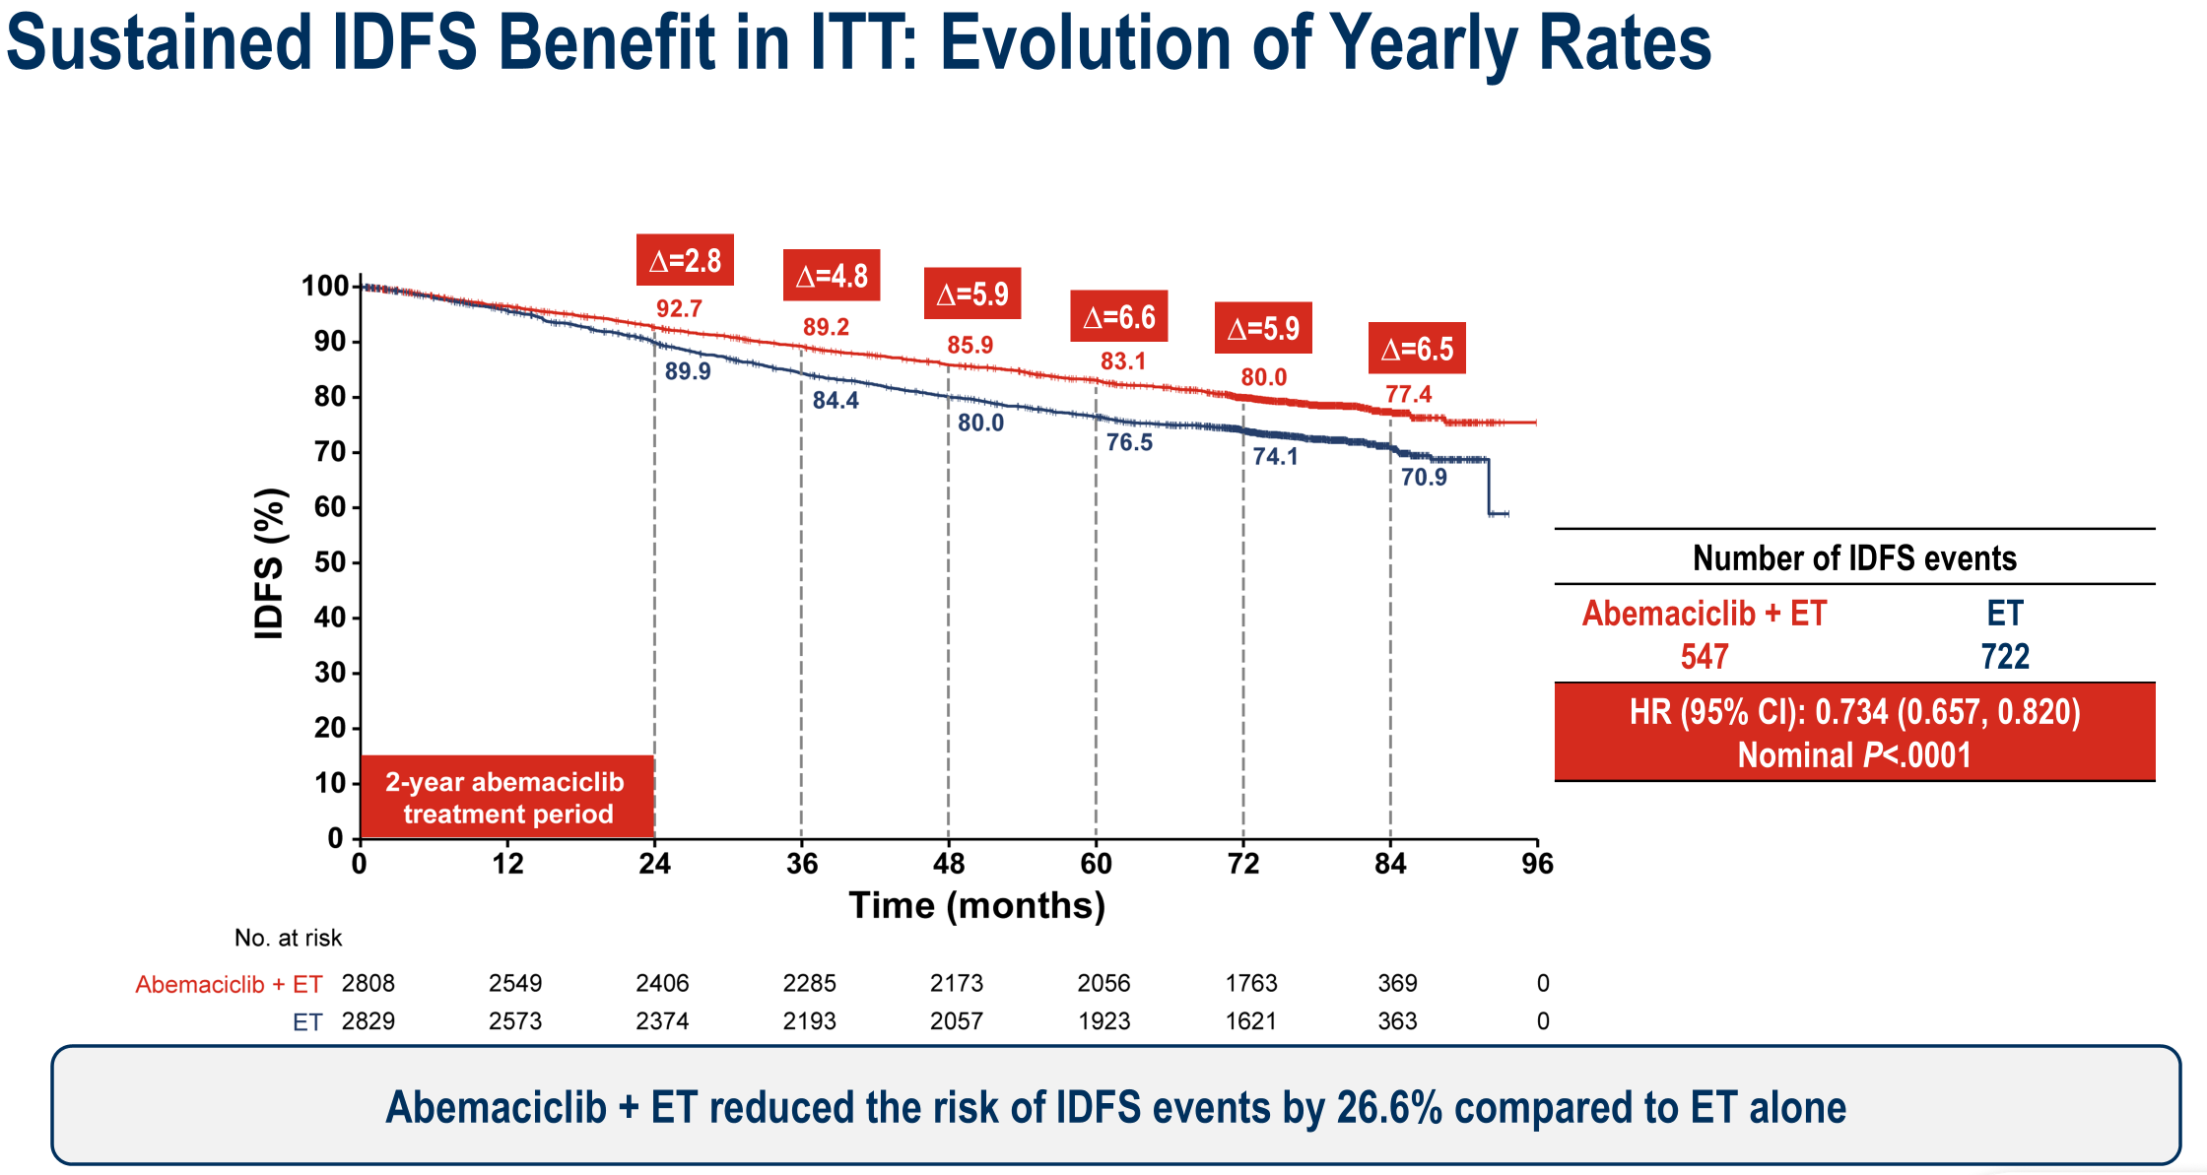
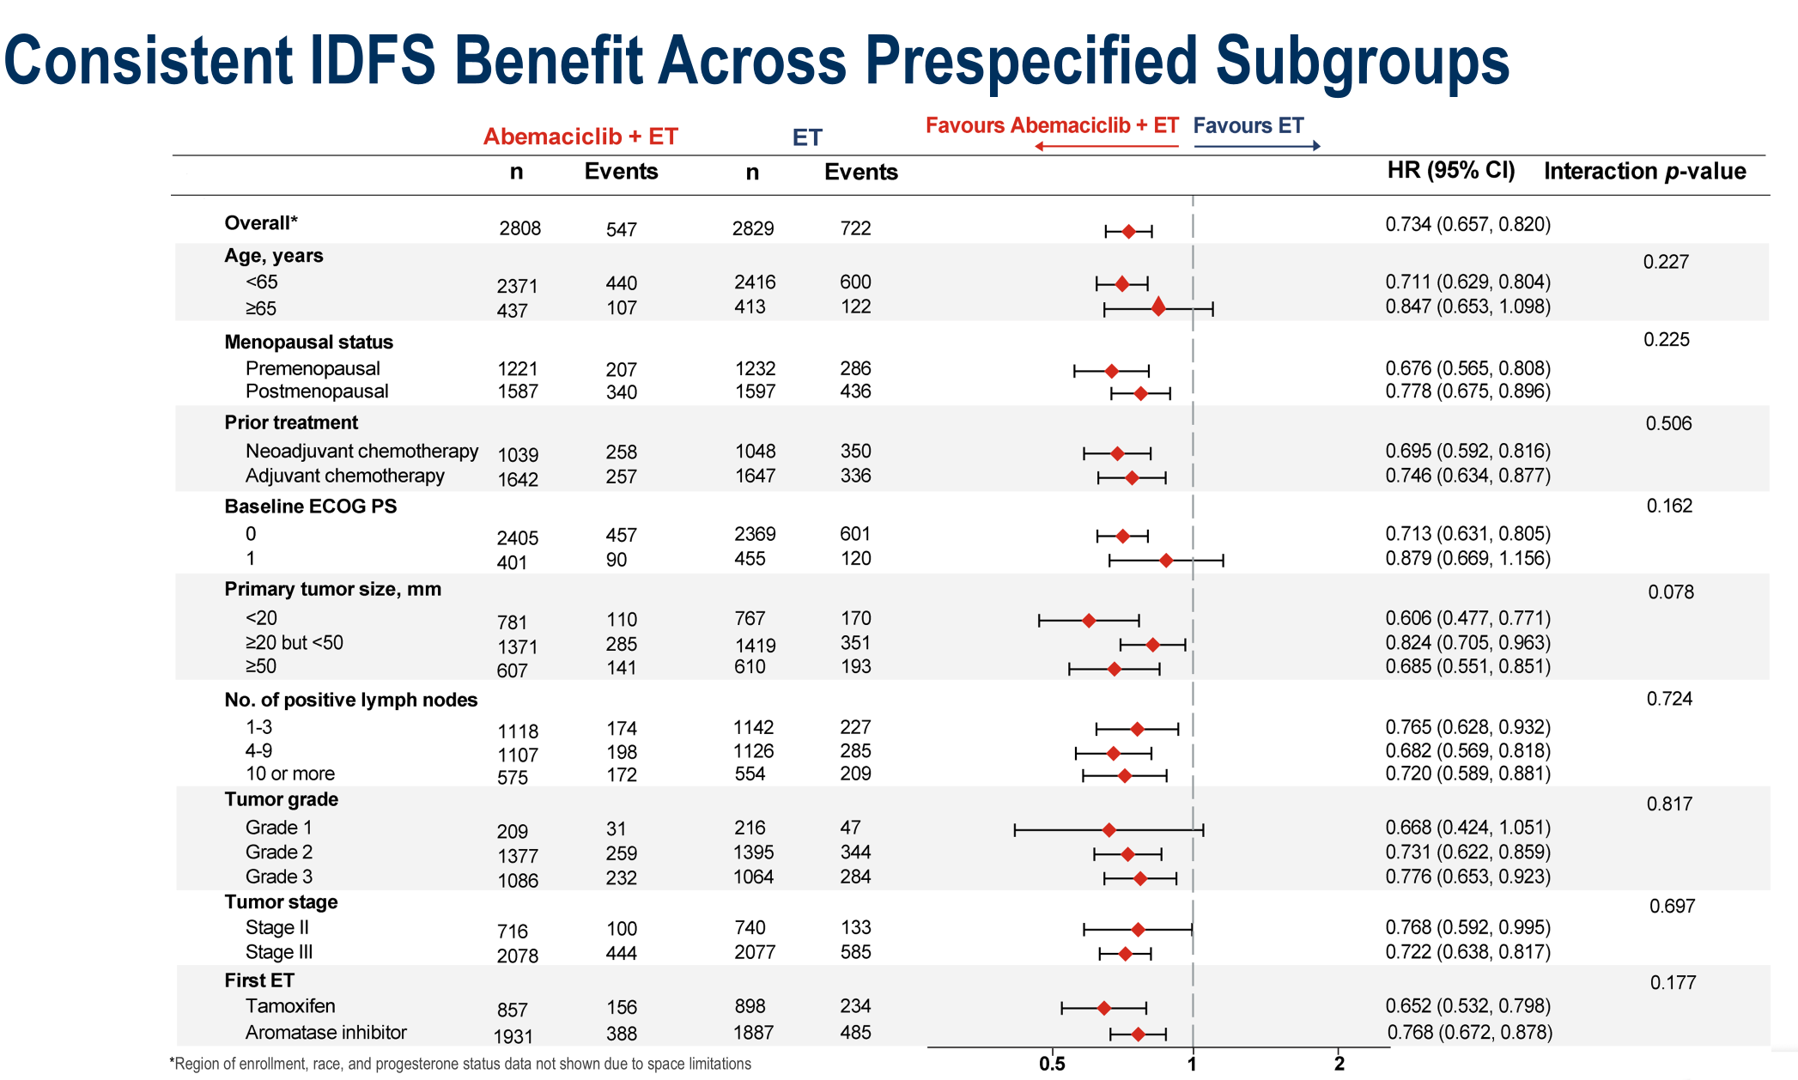
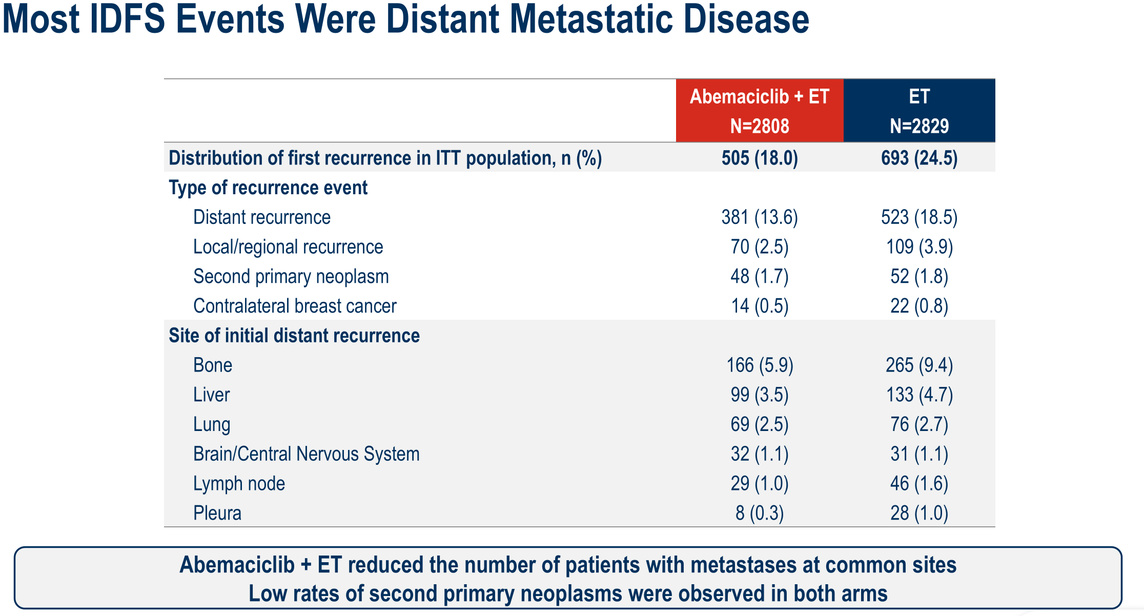

Slide 47
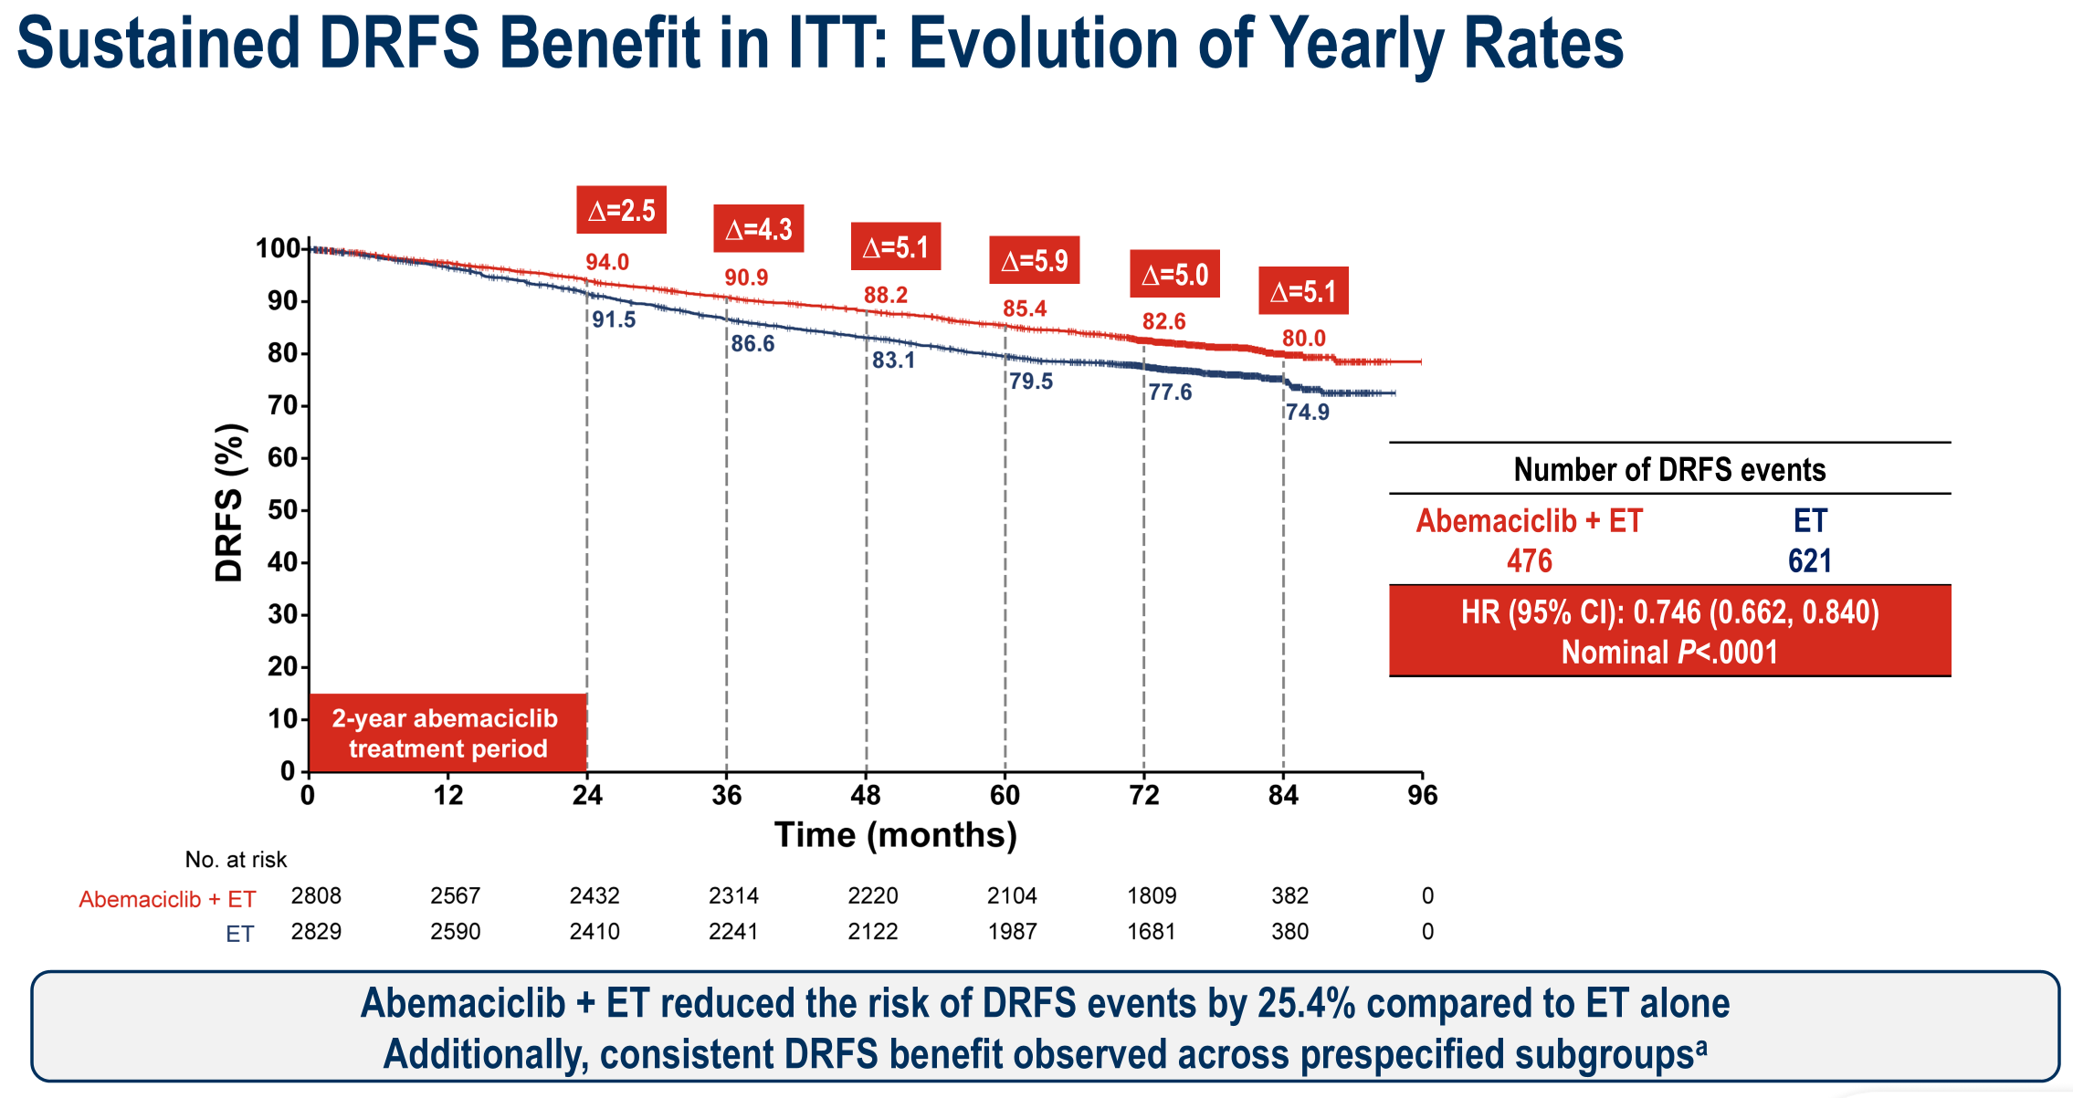
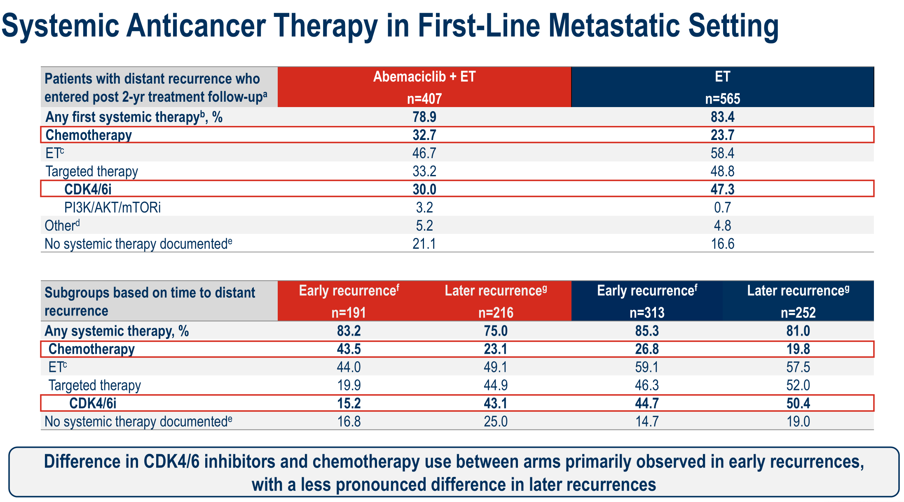
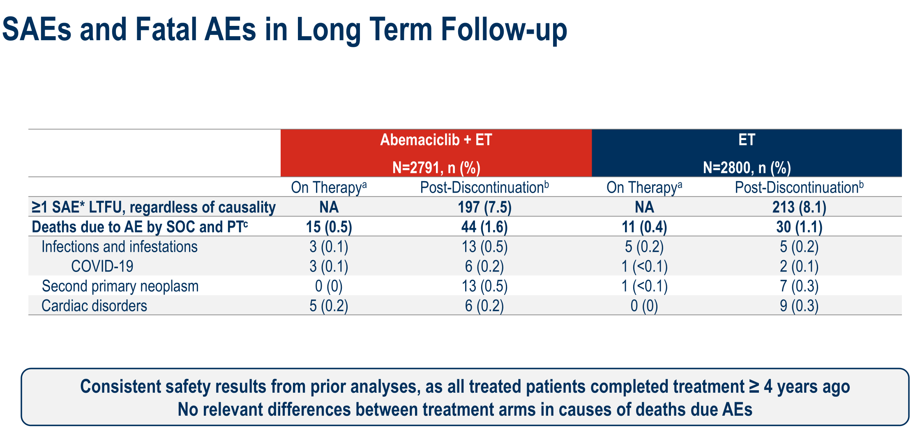

Slide 48
Conclusions
At the primary OS analysis, 2 years of abemaciclib + ET demonstrated a statistically significant and clinically meaningful improvement in OS in the ITT population
  With a median follow-up of 76 months (6.3 years), abemaciclib + ET reduced the risk of death by 15.8% compared to ET in the ITT population
  With ~30% fewer patients in the abemaciclib arm living with metastatic disease, this is expected to lead to larger OS benefit with longer follow-up
At 7-year landmark analyses, abemaciclib + ET continued to demonstrate sustained benefit in IDFS and DRFS reinforcing the consistency and durability of the treatment effect across endpoints
Consistent OS, IDFS, and DRFS benefits observed in the Cohort 1 population and in all prespecified subgroups
Safety was consistent with prior reports, and no new signals related to delayed toxicities were identified
Abemaciclib is the first CDK4/6 inhibitor to achieve a statistically significant improvement in OS for patients with HR+ HER2-, node-positive, high-risk EBC
Stephen Johnston, MD, PhD

Slide 49
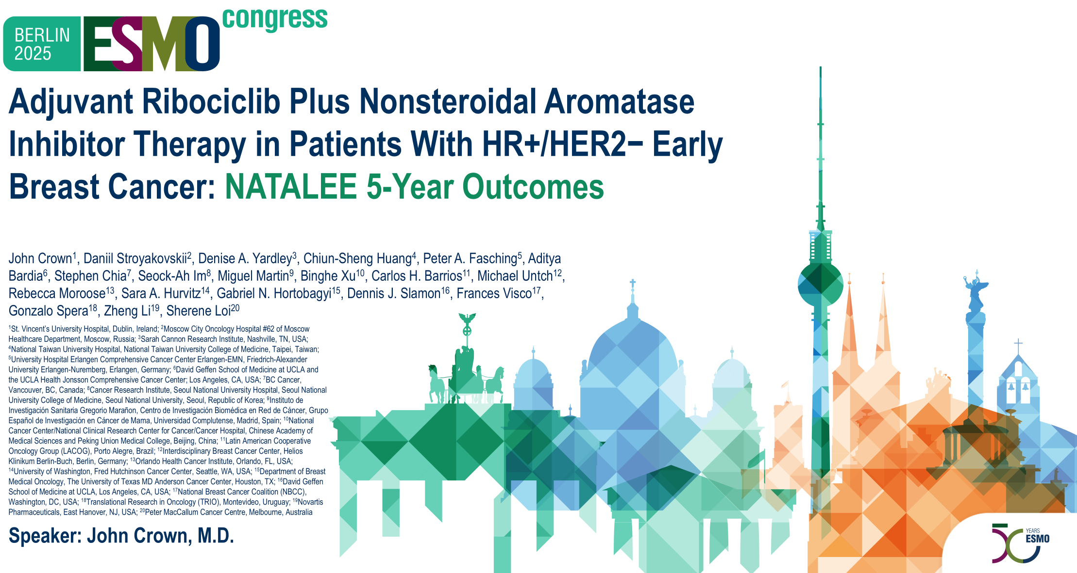

Slide 50
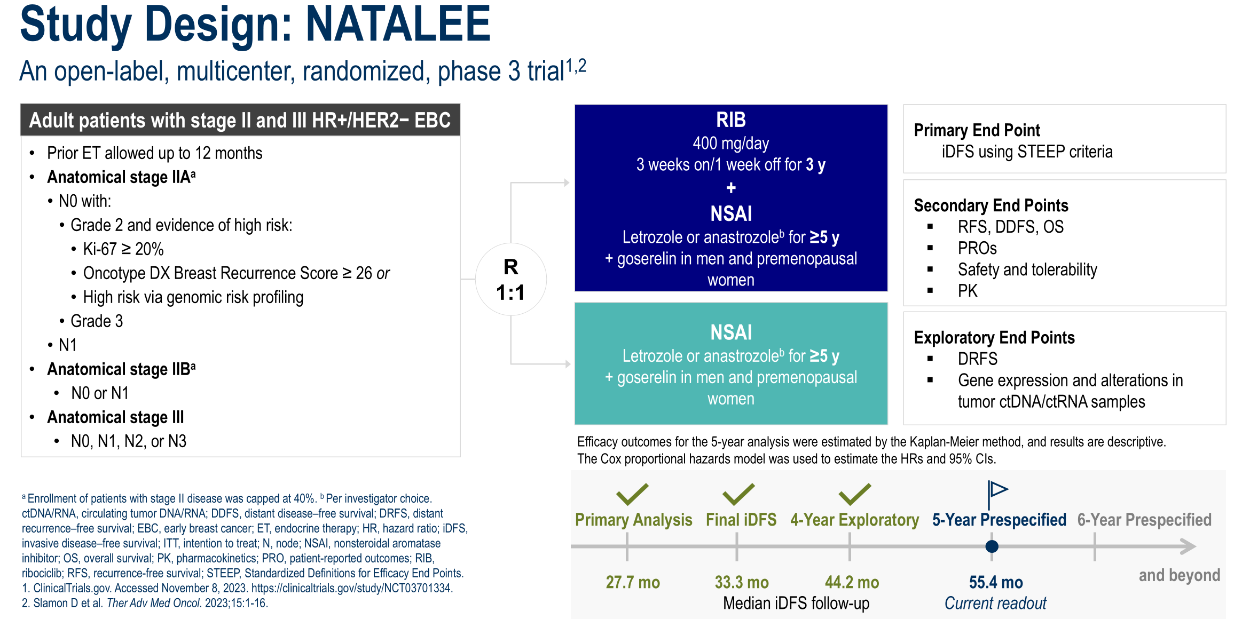
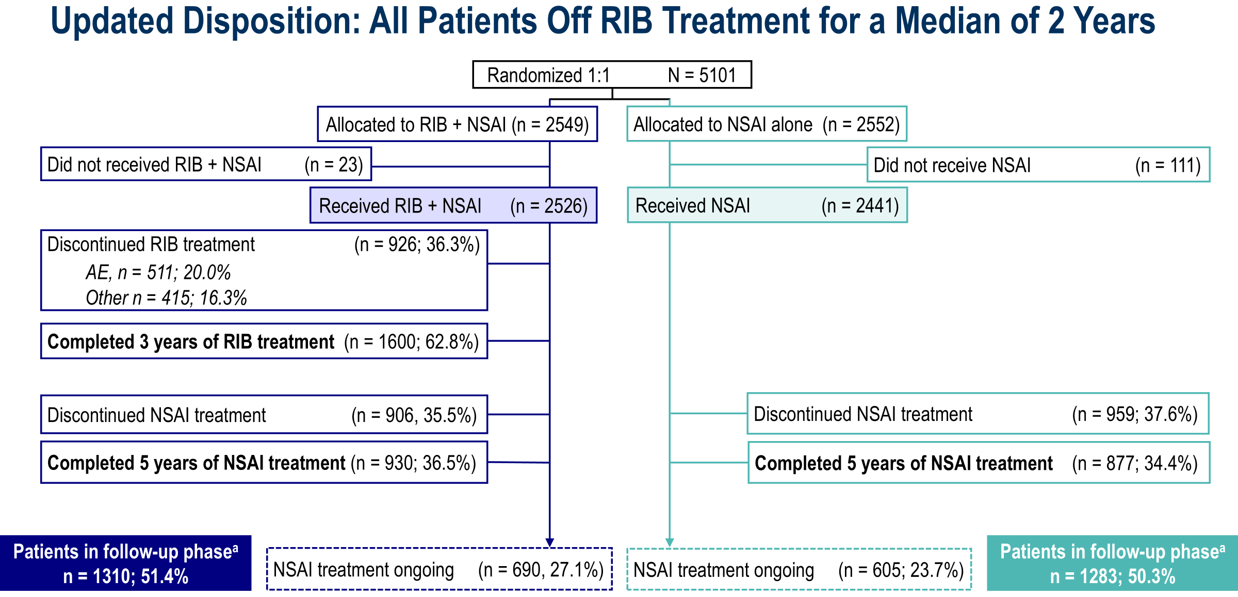
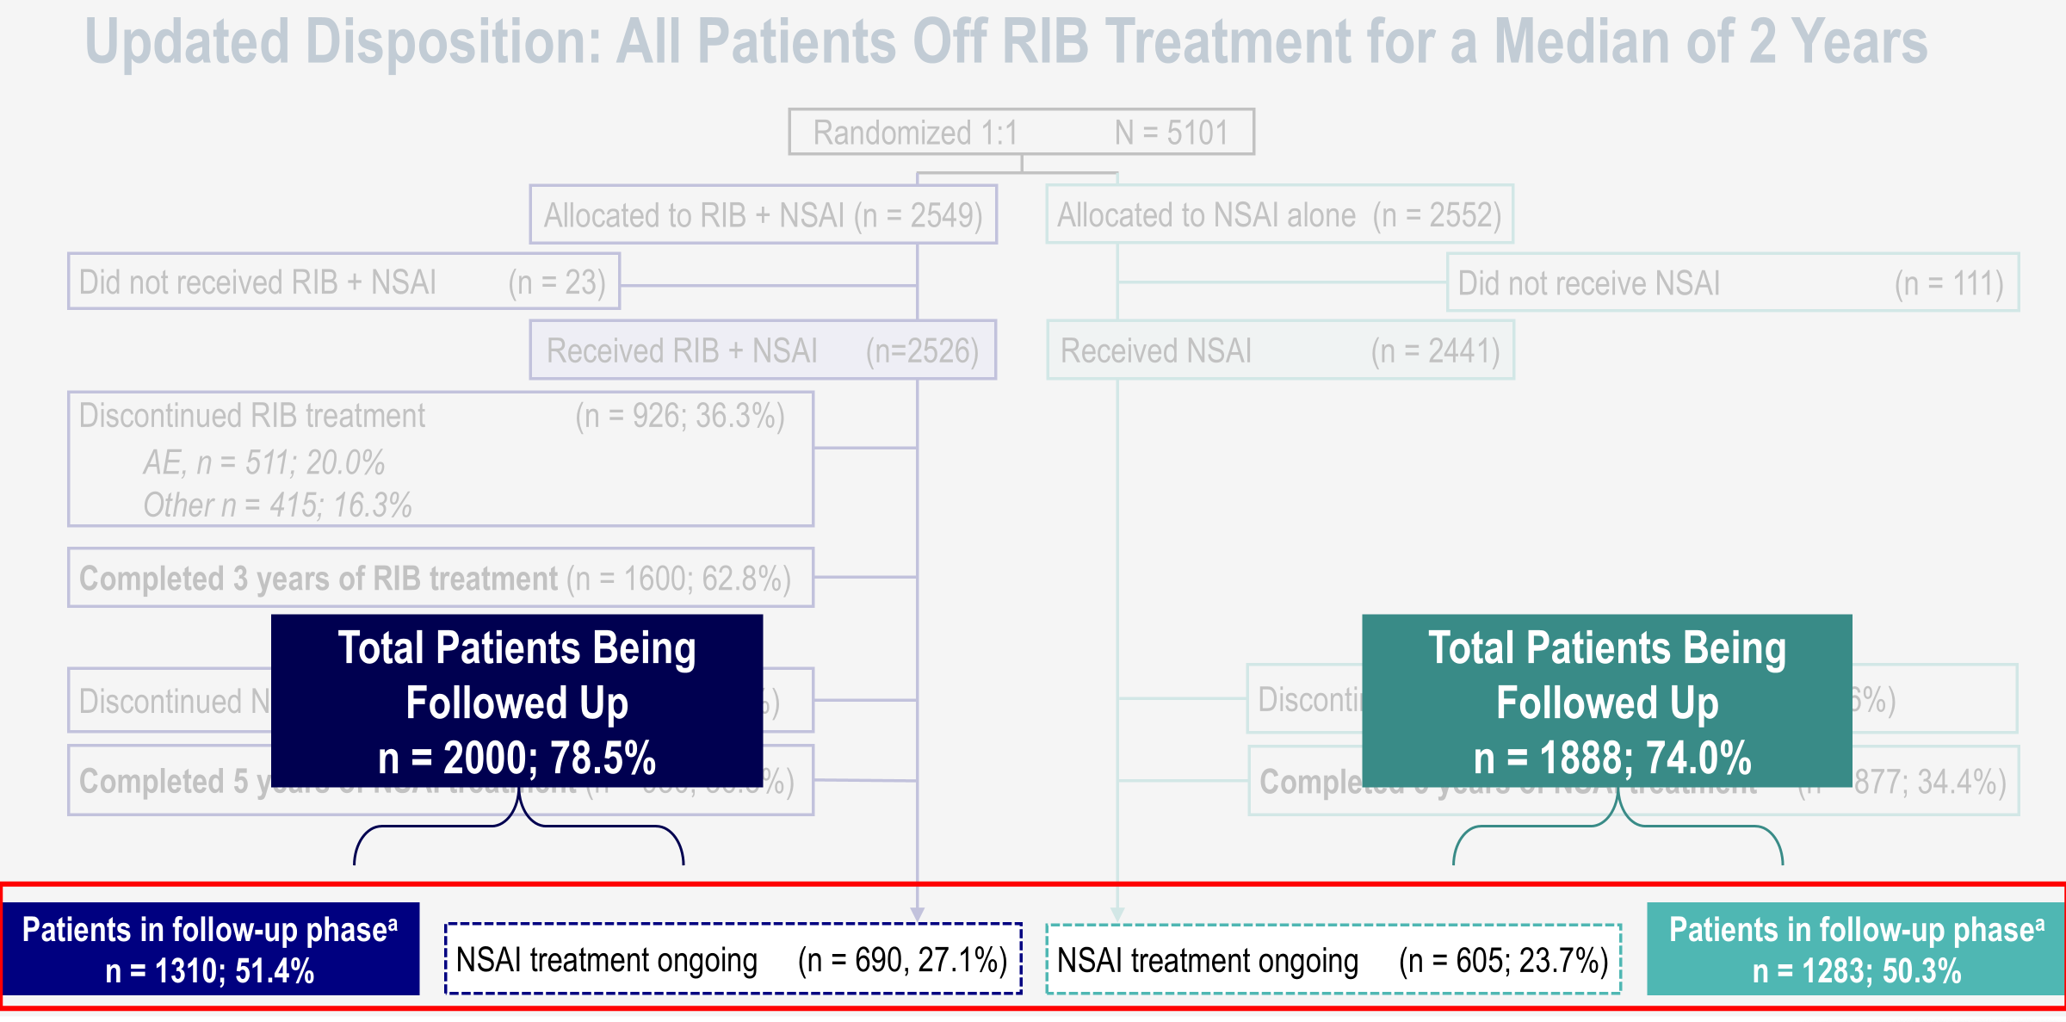

Slide 51
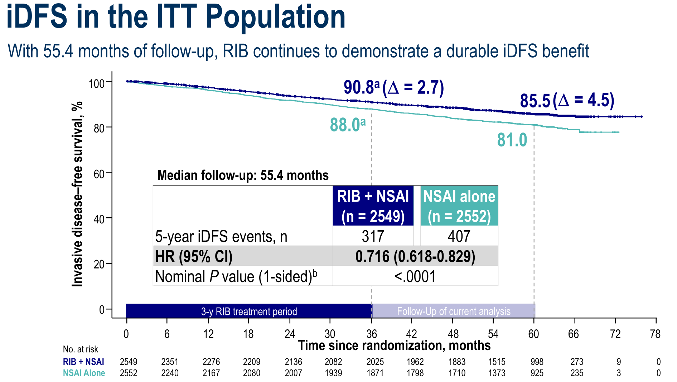
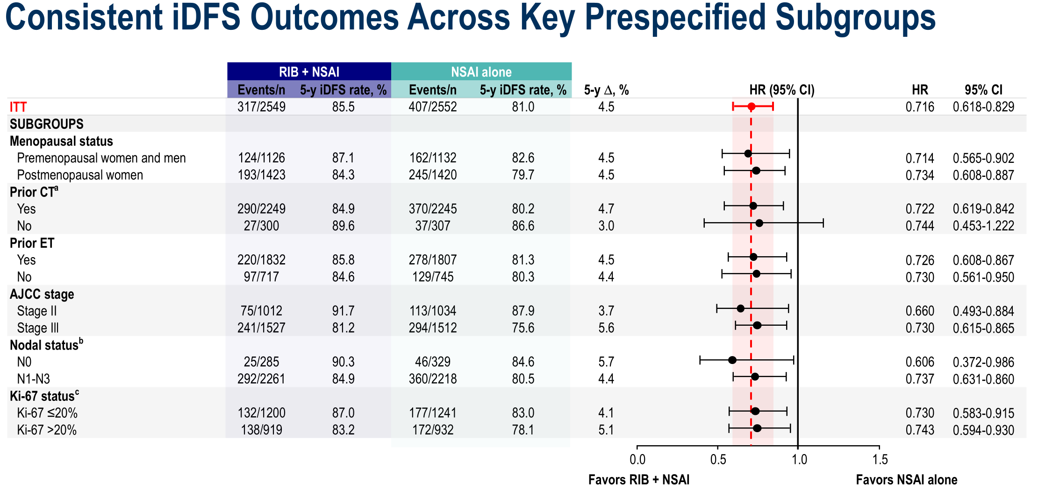
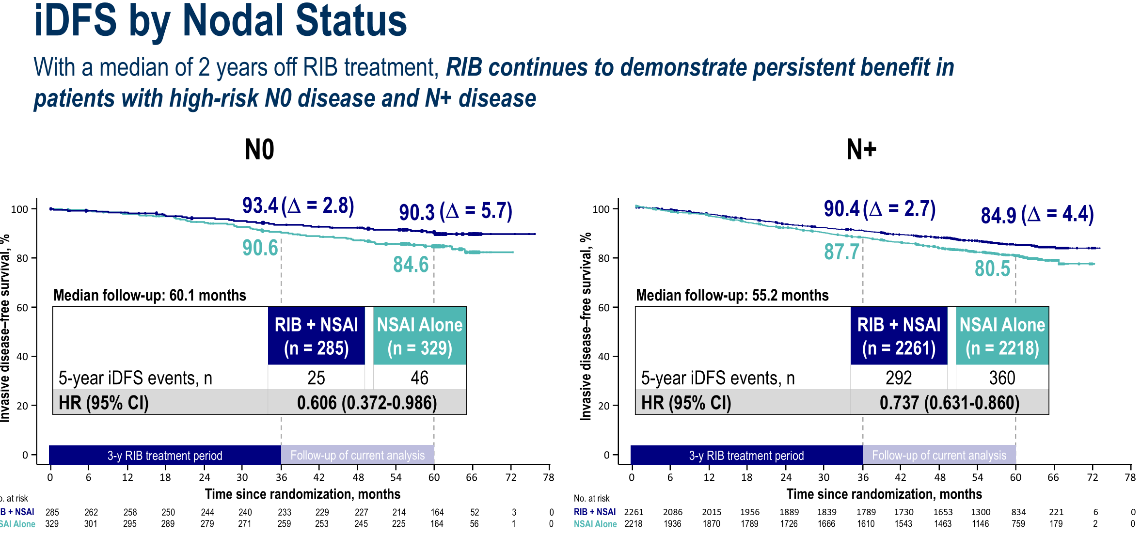
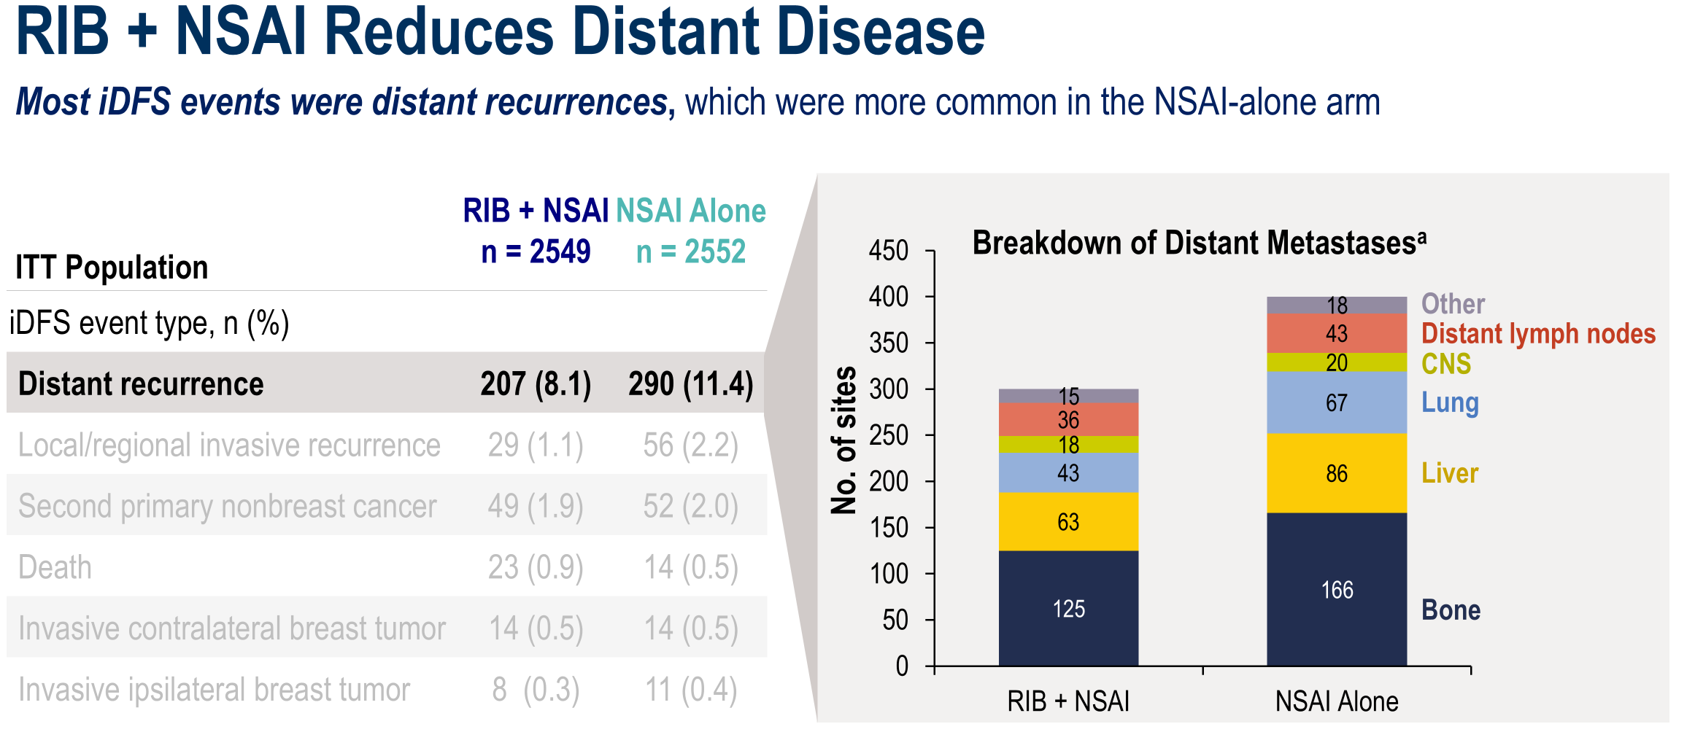

Slide 52
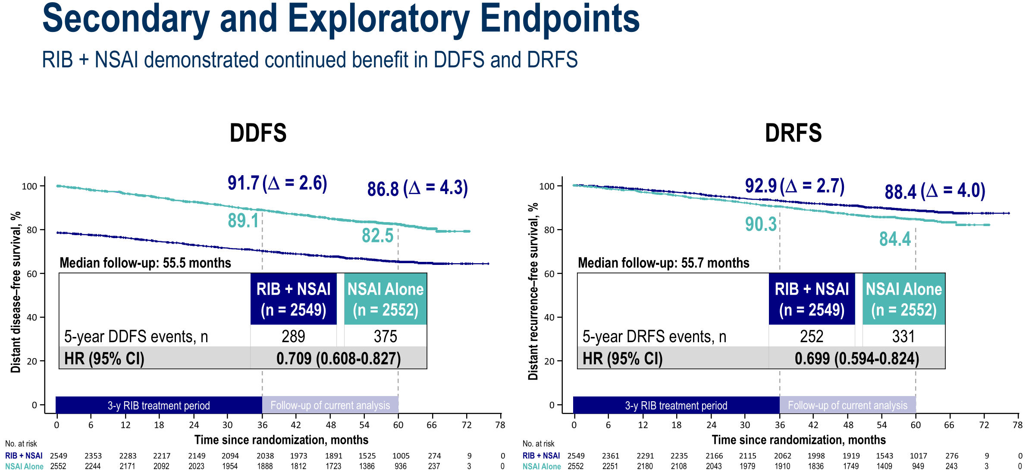
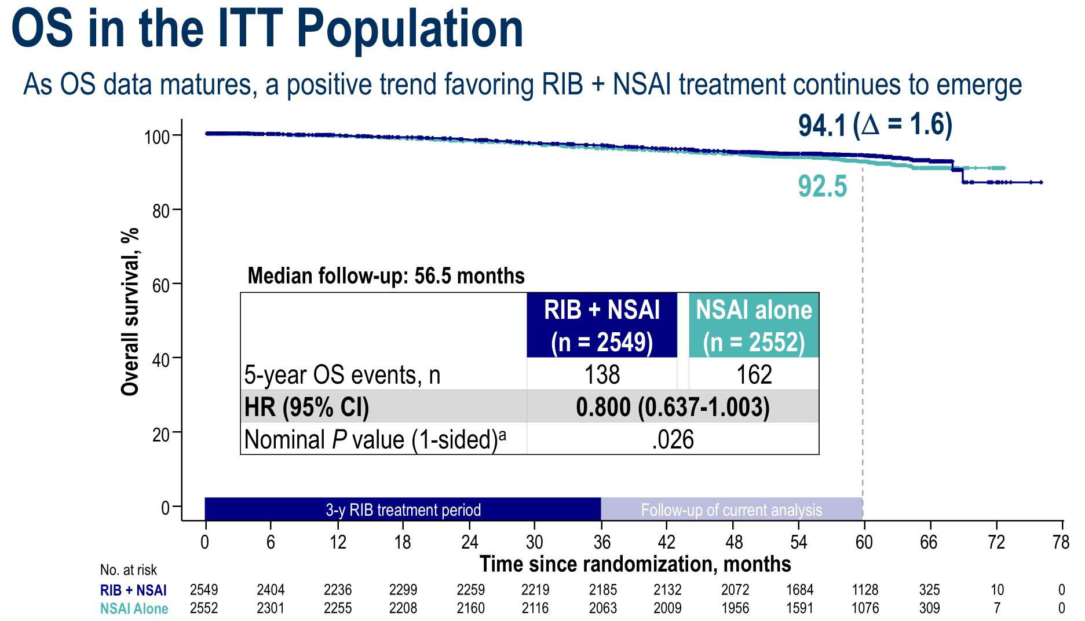
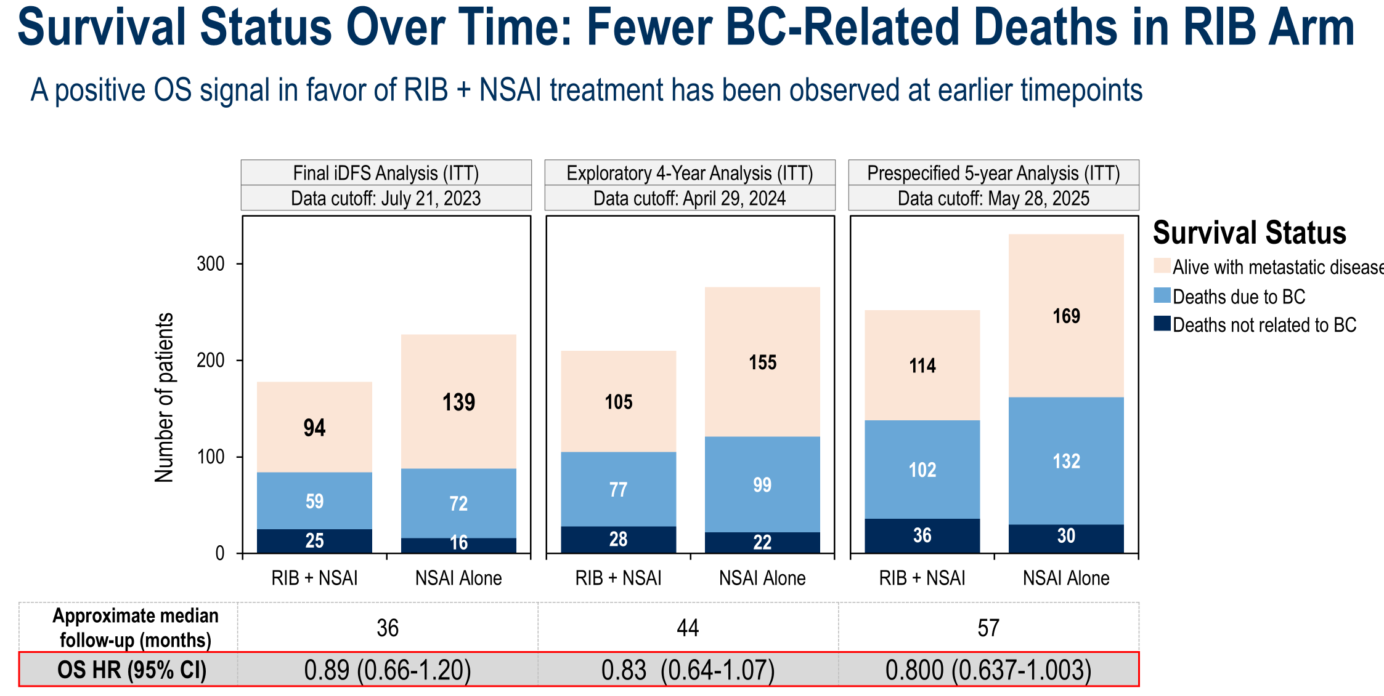
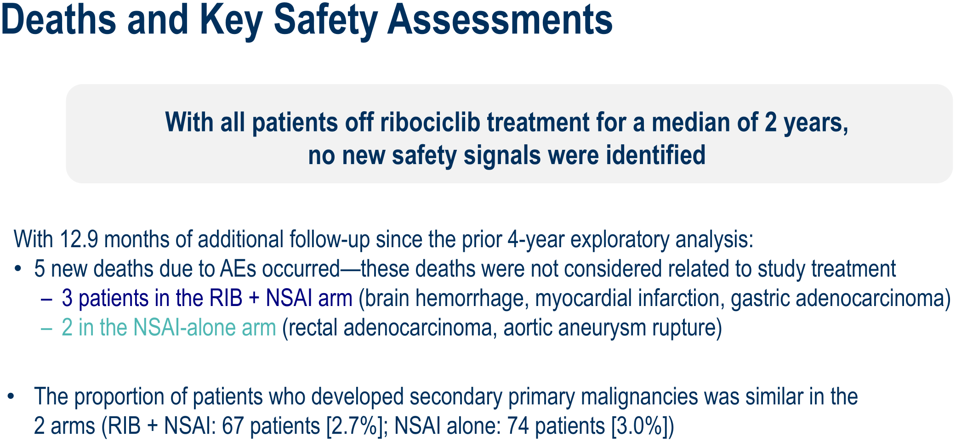

Slide 53
Conclusions
RIB + NSAI demonstrated durable iDFS benefit vs NSAI alone, with a 28% relative reduction in the risk of recurrence or death after a median of 2 years post RIB treatment
  Absolute iDFS improvement between treatment arms was ∆4.5% for 5-year rates
Sustained iDFS benefit with RIB + NSAI was observed across subgroups, including those with high-risk N0 disease, with the upper boundary of the CI for N0 below 1 for the first time
At the 5-year analysis, RIB + NSAI also demonstrated a clinically meaningful reduction in the risk of distant recurrence or death: 29.1% with DDFS and 30.1% for DRFS
RIB + NSAI showed a continued numerical trend for improved OS, as data continue to mature
No new safety signals were identified
At this 5-year follow-up of NATALEE, RIB + NSAI continues to reduce the risk of recurrence beyond the 3-year treatment window, supporting its use as adjuvant therapy in patients with HR+/HER2− EBC at high risk of recurrence​, including those with high-risk N0 disease
DDFS, distant disease–free survival; DRFS, distant recurrence–free survival; EBC, early breast cancer; HR+/HER2−, hormone receptor positive, human epidermal growth factor receptor 2 negative; iDFS, invasive disease-free survival; N, node; NSAI, nonsteroidal aromatase inhibitor; OS, overall survival; RIB, ribociclib.
John Crown, M.D.

Slide 54
Who needs CDK4/6 inhibitors?
Over 30% of Patients with HR+/HER2- Eligible for CDK4/6 Inhibitor per NATALEE
Patients, n (%) | All patients N=7060 | N0 (0 +LN) n=5286 | N1 (1-3 +LN) n=1388 | N2/N3 (≥4 +LN) n=386
NATALEE eligible | 2163 (30.6) | 503 (9.5) | 1274 (91.8)ª | 386 (100)
monarchE eligible | 1023 (14.5) | 0 | 637 (45.9) | 386 (100)
Tarantino et al, ESMO 2024. Abstract 245P.
Notes:
So – who needs CDK4/6 inhibitors? If we look at breast cancer in the united states, approximately 25% of patients are node positive at diagnosis; and similarly in an analysis of a dataset from CONCERTAI found that over 30% of patients with HR+/HER2- breast cancer are eligible for CDK4/6 inhibitors. So it’s a lot of toxicity for a lot of patients.

Slide 55
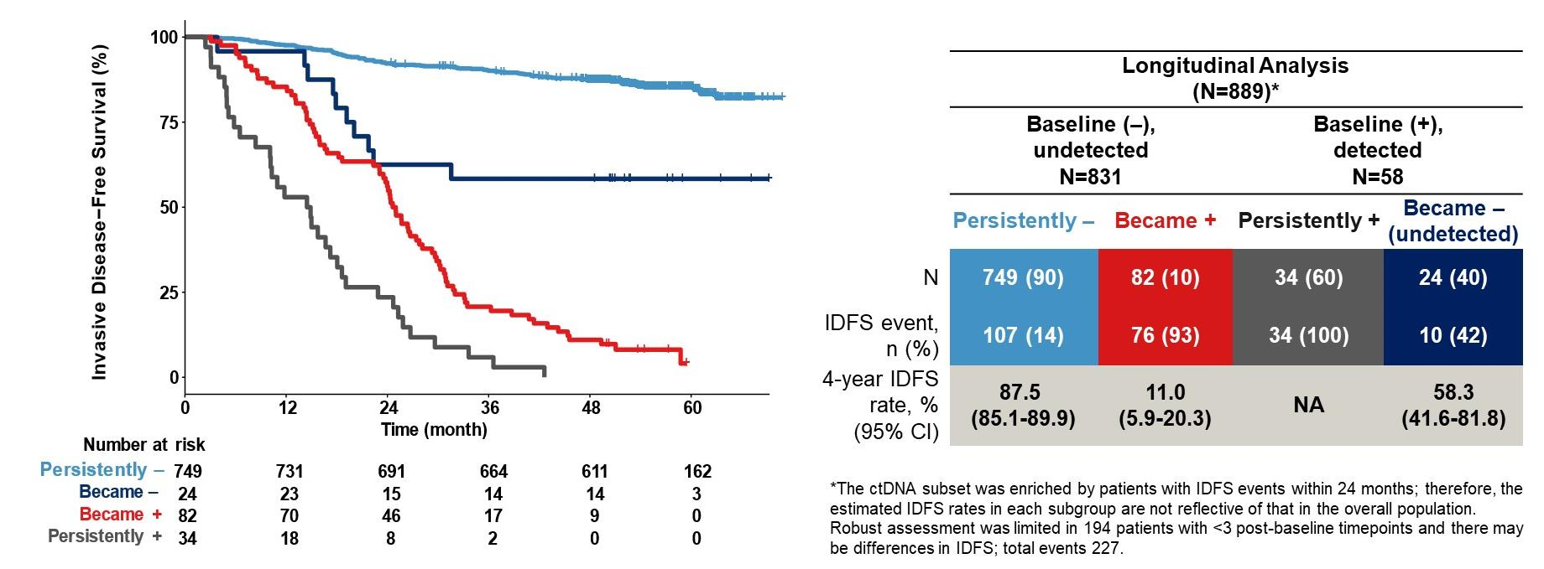
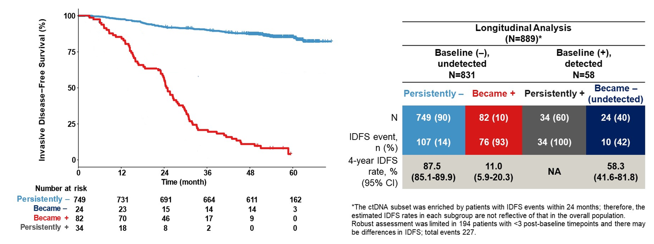
Who needs CDK4/6 inhibitors?
Poor prognosis in baseline (+) cases – but improved with ctDNA clearance
monarchE
Loi et al, ASCO 2024. LBA 507.

Slide 56
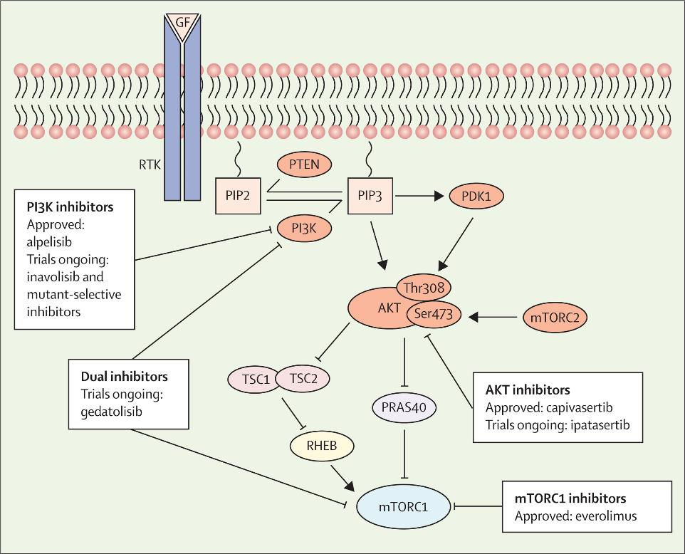
PIK3CA-AKT and mTOR Pathways in Early Breast Cancer
Randomized Phase II Study of Neoadjuvant Everolimus
58%
47%
Browne et al, Lancet Oncology 2024
Baselga et al, J Clin Oncol. 2009;27(16):2630-7.
Notes:
Finally, the PI3K-AKT and mTOR pathway is another commonly altered pathway in ER+ breast cancer, for which there are a number of drugs approved in the metastatic setting – including everolimus, alpelisib, capivasertib, and now inavolisib
There are few randomized controlled studies of these drugs in the early stage settings. A phase II study of neoadjuvant everolimus had demonstrated an improvement in ultrasound-assessed complete response of approximately 10%

Slide 57
Adjuvant Everolimus for HR+/HER2- Breast Cancer
Study | N | Population | Intervention / Control
UNIRAD NCT01805271 | 1,278 | ≥ 4 positive lymph nodes ≥ 1 positive lymph node if post neoadjuvant therapy 1-3 positive lymph nodes and high EndoPredict (EPclin) score 0 – 4 years prior endocrine therapy | Standard ET +/- 2 years of adjuvant everolimus
SWOG1207 NCT01674140 | 1,792 | ≥ 4 positive lymph nodes ≥ 1 positive lymph node if post neoadjuvant therapy T2+ if Oncotype / MammaPrint high; N1+ if grade 3 or Oncotype / MammaPrint high | Standard ET +/- 1 year of adjuvant everolimus
Notes:
There have subsequently been two randomized controlled trials of the mTOR inhibitor everolimus in the adjuvant setting – both enrolled high risk node positive patients with either 4 node positive disease or 1 or more positive nodes with other risk factors.

Slide 58
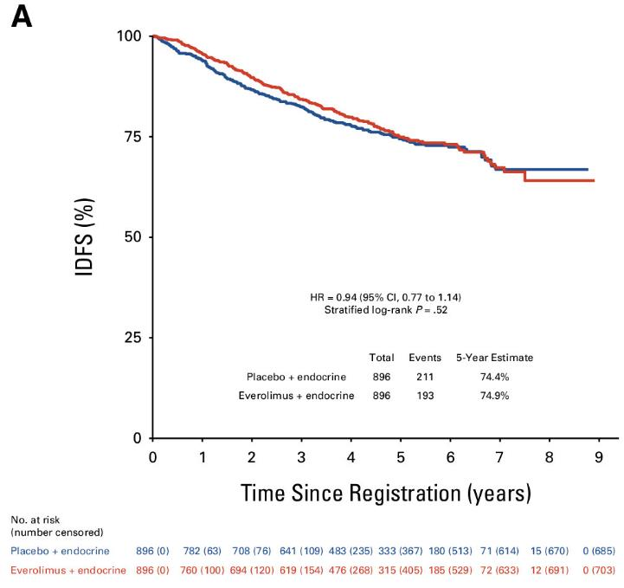

No Improvement in DFS / OS with Everolimus
DFS in UNIRAD
iDFS in SWOG1207
Bachelot et al. J Clin Oncol. 2022;40(32):3699-3708.
Chavez-MacGregor et al. J Clin Oncol. 2024;42(25):3012-3021.
Notes:
Both studies failed to demonstrate a benefit of DFS or OS, demonstrating that everolimus is not beneficial in the adjuvant treatment of HR+ breast cancer.

Slide 59
Ongoing adjuvant studies of SERDs
Trial | NCT | Phase | Treatment | Population
ELEGANT | NCT06492616 | 3 | Elacestrant vs SOC | Post 2 - 5 years Adjuvant ET
EMBER-4 | NCT05514054 | 3 | Imlunestrant vs SOC | Post 2 - 5 years Adjuvant ET
CAMBRIA-1 | NCT05774951 | 3 | Camizestrant vs SOC | Post 2 - 5 years Adjuvant ET
CAMBRIA-2 | NCT05952557 | 3 | Camizestrant vs SOC | Adjuvant
lidERA | NCT04961996 | 3 | Giradestrant vs SOC | Adjuvant
Notes:
There are large phase 3 studies ongoing evaluating oral SERDs – evaluating treatment either as the initial adjuvant treatment or after 2-5 years of adjuvant endocrine therapy. Studies generally are enrolling patients at increased risk based on staging or genomic risk assays. So we will soon see if SERDs are more effective than standard of care endocrine therapy.

Slide 60



Which patients will benefit from adjuvant SERDs?
aceIERA – Giradestrant vs ET in Overall / ESR1mt
EMERALD – Elacestrant vs ET in Overall / ESR1mt
SERENA-2 – Camizestrant vs Fulvestrant in ESR1m/wt
Will adjuvant SERD reduce recurrence in all patients / prevent ESR1mt?
Or will effectiveness be limited to cases with existing ESR1mt after other endocrine therapy?
Oliveira et al, SABCS 2022
Martin et al, J Clin Oncol. 2024;42(18):2149-2160.
Bidard et al, J Clin Oncol. 2022;40(28):3246-3256.
Notes:
So far – all the SERDs have shown the most clear benefit in patients with ESR1m, which are rare in denovo breast cancer but occur in 20-40% of patients who recur after aromatase inhibitors.
Of note, different SERDs may have different binding affinity to specific ESR1 mutations which could be a mechanism of resistance,

Slide 61
CONCLUSIONS (1)
Adjuvant endocrine therapy can be individualized based on clinical risk and emerging molecular tools
Durations of 5-10 years remain the standard
The addition of targeted therapy may provide additional benefit to the highest risk patients over endocrine therapy alone

Slide 62
CONCLUSIONS (2)
High risk patients appropriate for abemaciclib/ribociclib
Consider potential serious toxicity before widespread use when we do not have long term data
  Pulmonary emboli, blood clots
  Pneumonitis
  Diarrhea

Slide 63

Thank You

