Slide 1

Management of Treatment-Related Toxicities
Laura Huppert, MD
Assistant Professor of Medicine
University of California, San Francisco
San Francisco, CA

Slide 2
Conflicts of Interest
Adboard/consulting: AstraZeneca, Pfizer
Research funding to institution: Genentech, Gilead, Greenwich LifeSciences, Johnson&Johnson, Merck, Mersana, Pfizer
Travel to academic meetings: Merck, Gilead, Daiichi Sankyo
Book royalties: McGraw Hill

Slide 3
Outline
Chemotherapy-induced toxicities and management
  Nausea/vomiting
  Myelosuppression
  Neuropathy
  Scalp cooling
Key toxicities of novel agents and management
  Immune-related adverse events
  PIK3CA inhibitors
  ADC toxicities

Slide 4
Chemo-Induced Nausea and Vomiting (CINV): Pathophysiology
Frequency: Occurs in 70-80% of patients receiving chemotherapy, with each chemotherapy agent having different emetogenic potential
Mechanism: Complex interaction between neurotransmitters and receptors in the central and peripheral nervous system. The principal neurotransmitters involved are dopamine, serotonin, acetylcholine, corticosteroid, histamine, cannabinoid, opiate, and neurokinin-1
Definitions:
  Acute CINV: Commonly resolves within the first 24 hours, peaks at 4-6 hr
  Delayed CINV: Occurs during period 24 hr after end of chemo
  Patients receiving multi day chemo are at risk for both acute and delayed nausea/vomiting
GI tract
5HT₃, NK
Chemo Trigger Zone
D₂, 5-HT₃, NK1, M
Cortex
NTS
D₂, H1, 5-HT₃,
NK1, M
Vomiting Center
Salivary Center
Respiratory Center
Vasomotor Center
Cranial Nerves
NTS= nucleus tractus solitarius,
D2= Dopamine type 2 receptor,
5HT3 = serotonin type 3 receptor,
M = muscarininc receptor,
H1 = histamine type 1 receptor,
NK1 = tachykinin neurokinin type 1 receptor
Effector Organ
Adapted from Am J Health-Syst Pharm. 1999; 56;729-64
Notes:
Chemotherapy induced nausea vomiting is one of the most distressing side effects of chemotherapy. It occurs in 70-80% of patients receiving chemotherapy. The mechanism behind chemotherapy induced nausea vomiting is a complex interaction between neurotransmitter and receptors in the central and peripheral nervous system. The principle neurotransmitters involved are dopamine, serotonin, acetylcholine, corticosteroid, histamine, cannabinoid, opiate, and neurokinin-1

Slide 5
Chemo-Induced Nausea and Vomiting (CINV): Timeline
Olanzapine
First NK₁ receptor antagonist
First 5-HT₃ receptor antagonist (serotonin)
Combination of Dex and 5-HT₃ receptor antagonist
High-dose metoclopramide
ABCD
Phenothiazines
1960s
1970s
1980s
1990s
2000s
2010s
Notes:
References
Hesketh PJ.Treatment of chemotherapy-induced emesis in the 1990s: impact of the 5-HT₃ receptor antagonists. Support Care Cancer. 1994;2:286–292.
Gralla RJ, Osoba D, Kris MG, et al, for the American Society of Clinical Oncology. Recommendations for the use of antiemetics: evidence-based, clinical practice guidelines. J Clin Oncol. 1999;17:2971–2994.
Ref. Hesketh
p. 287, A-F
p. 290, A-B
Ref. Hesketh
p. 287, A
p. 287, B
Ref. Hesketh
p. 287, C-E
Ref. Gralla
p. 2977, A
p. 2978, A-C
The evolution of antiemetic agents during the last 20 years parallels advances in understanding the neuropharmacology of emesis.
In the early 1960s, phenothiazines became the first class of agents demonstrated to reduce emesis associated with fluorouracil by targeting the neurotransmitter dopamine and the D₂ receptor.¹
During the late 1970s, the introduction of cisplatin provided stimulus for further antiemetic research because the inevitable side effect of nausea and vomiting threatened the use of this effective agent.¹
Beginning in the 1980s, high-dose metoclopramide provided a new antiemetic option. The value of combination regimens for improving antiemetic efficacy was recognized and our understanding of the pathophysiology of emesis significantly improved. In addition, predictive variables were identified, including such treatment-related factors as the inherent emetogenicity of the chemotherapeutic agent and patient-related factors as well.¹
The first 5-HT₃ receptor antagonist launched in 1991 and continued research led to its combined use with dexamethasone for improved results.² This regimen became the standard of care and served as the basis of comparison with regimens adding a neurokinin-1 (NK₁) receptor antagonist.
The extensive research regarding 5-HT₃ receptor antagonists also clarified the existence and persistence of delayed nausea and vomiting following chemotherapy and helped fuel development of agents active on other neurotransmitters and receptor systems, such as substance P and NK₁ receptors. 2003 marked the launch of a NK₁ receptor, representing the first in a class of antiemetic agents.

Slide 6
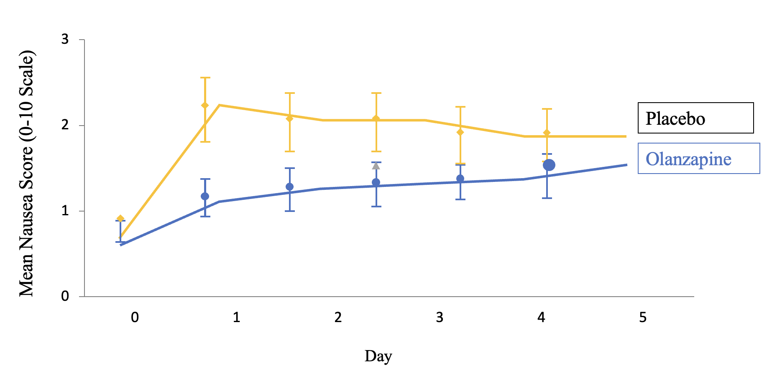
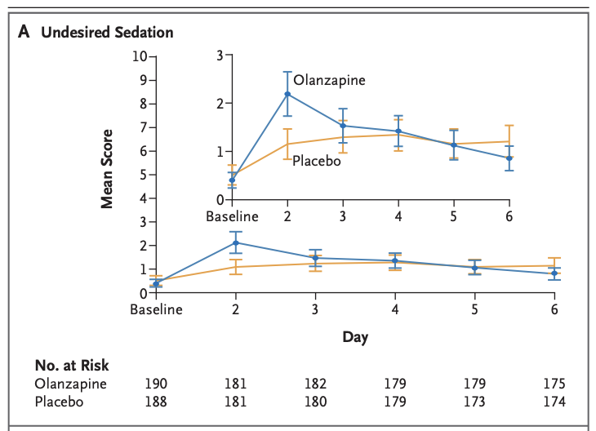
Chemo-Induced Nausea and Vomiting (CINV): Olanzapine
Study design:
  Randomized, double-blind, placebo controlled trial that enrolled 380 patients (majority breast cancer, also lung cancer, other)
Results:
  Olanzapine significantly improved nausea vs. placebo
    Initial 24 hr: 74% vs. 45%, P=0.002
    25-120 hr: 42% vs. 25%, P=0.002
    Overall 120-hour period:37% vs. 22%, P=0.002
  Some increase in undesired sedation
Practical tips:
  2.5mg olanzapine at night often sufficient
    Can decrease further to 1.25 if too drowsy
    Can increase to 5 or 10mg if needed and tolerated
  I typically use for AC, carbo-containing regimens with AUC >=4, T-DXd, or if needed with other regimens
Navari RM, et al. N Engl J Med. 2016

Slide 7
Chemo-Induced Nausea and Vomiting (CINV): Treatment
Prevention of CINV is the goal
High emetogenicity
  NK 1 antagonist + dexamethasone + 5HT3
  Olanzapine + dexamethasone + palonosetron
  Olanzapine + NK1 RA + 5HT3 + dexamethasone
Moderate emetogenicity
  Dexamethasone + 5HT3 ± NK 1 antagonist
  Olanzapine + dexamethasone + 5HT3
  NK 1 antagonist + dexamethasone + 5HT3
Low emetogenicity
  Dexamethasone or metoclopramide or prochlorperazine or 5HT3
Breakthrough CINV
  Add agents from different drug classes and schedule doses
Adapted from NCCN Guidelines, Antiemesis 2025
Notes:
Consider toxicitiy of antiemetics and pt’s prior experiences

Slide 8
Capecitabine Hand-Foot Syndrome (HFS): D-TORCH Study
Study design:
  Randomized double-blind, placebo-controlled study of topical diclofenac in prevention of hand-foot syndrome in patients receiving capecitabine
  Patients with breast or GI cancers on 4+ cycles of capecitabine randomized 1:1 to topical 1% diclofenac on both hands BID vs. placebo on both hands BID
  263 patients randomized, mean capecitabine dose 1881 mg/m2
Results:
  Primary Outcome: Grade 2+ or higher HFS
    3.8% - diclofenac vs. 15.0% - placebo (RR 0.25) – 75% risk reduction!
  Secondary: All grade DFS
    6.1% – diclofenac vs 18.1% - placebo
  Capecitabine dose reductions
    3.8% - diclofenac vs 13.5% - placebo
Santhosh A, et al. JCO 2024

Slide 9
Myelosuppression: Management
Definitions:
  Primary prophylaxis:
    Used from the beginning to prevent febrile neutropenia (FN) in patients at high risk (e.g., ≥20% FN risk)
    Typically used if incidence of neutropenic fever is 20+%
  Secondary prophylaxis:
    Given to patients who have already experienced FN or other neutropenic complications from a prior chemotherapy cycle
Type of growth factor:
  Short-acting granulocyte colony-stimulating factors (G-CSFs): Filgastrim
    Requires adjustment of number of doses based on labs and response
    Cheaper
    Good option for weekly regimens or between D1-8 when cannot use long-acting GF
  Long-acting granulocyte colony-stimulating factors (G-CSFs): Pegfilgastrim
    At least as effective as short acting preparations
    More convenient, less shots, labs and adjustments required
    More expensive to administer
Notes:
Consider toxicitiy of antiemetics and pt’s prior experiences

Slide 10
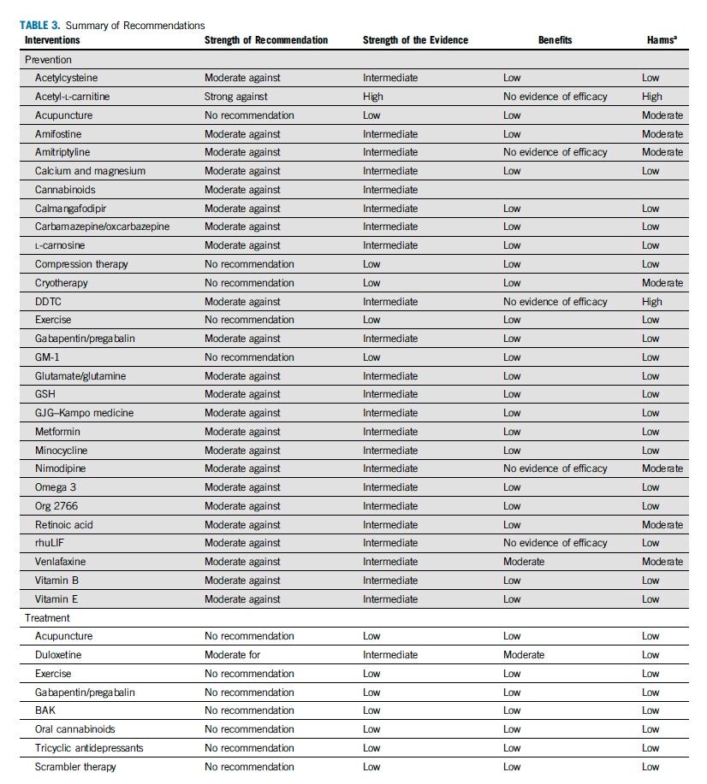
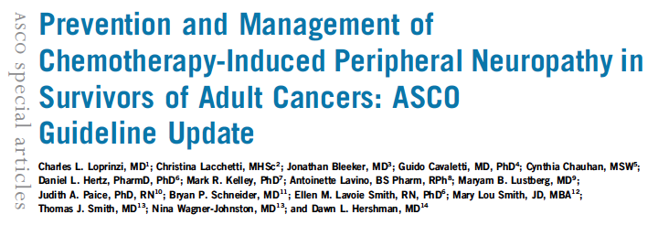
Neuropathy: Management
  Prevention
    Exercise
    Acupuncture
    Cryotherapy
  Treatment
    Gabapentin (no clear data, but used)
    Pre-gabalin
    Duloxetine
Loprinzi et. al. JCO 2020
Notes:
Consider toxicitiy of antiemetics and pt’s prior experiences

Slide 11

Hair Loss: Prevention and Management
  Prevention
    Scalp cooling!
      Clinical trials have demonstrated efficacy of cold caps¹
      Less efficacy with anthracyclines, but can sometimes work
      Study at DFCI suggested less efficacy of scalp cooling with ADCs²
  Treatment
    Topical or oral minoxidil (1.25-2.5mg daily) after chemotherapy is completed
      Induces angiogenesis by upregulating vascular endothelial growth factor expression and activating prostaglandin endoperoxide synthetase 1, which can stimulate hair growth
Kang et. al. JCO 2024
Salehi et. al ASCO 2025
Notes:
Consider toxicitiy of antiemetics and pt’s prior experiences

Slide 12
Outline
Chemotherapy-induced toxicities and management
  Nausea/vomiting
  Myelosuppression
  Neuropathy
  Scalp cooling
Key toxicities of novel agents and management
  Immune-related adverse events
  PIK3CA inhibitors
  ADC toxicities

Slide 13
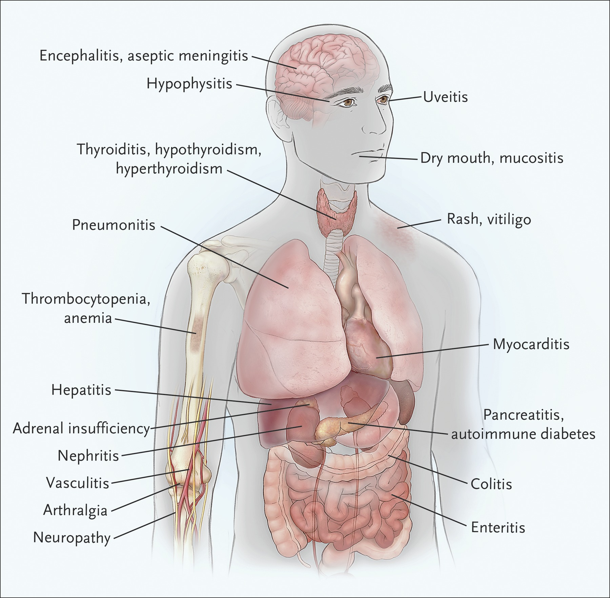
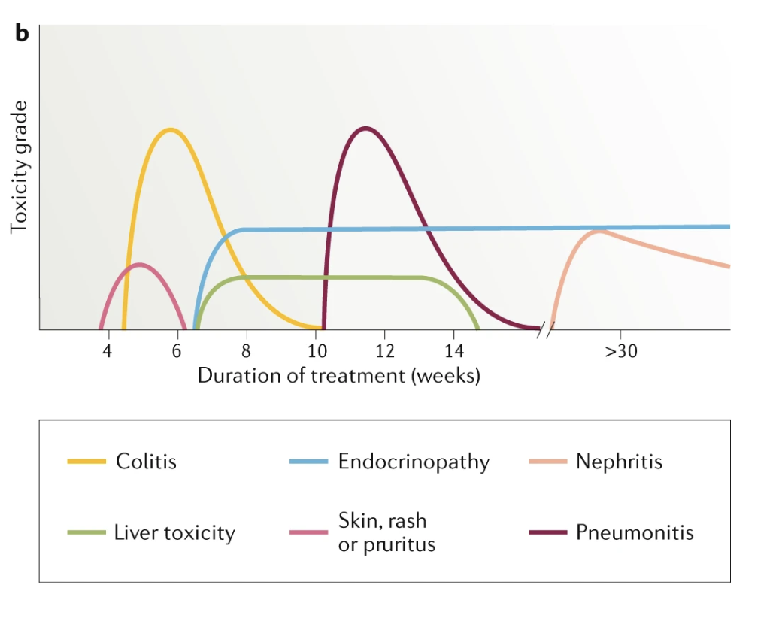
Immune-Related Adverse Events (IRAES)
Postow et al. NEJM 2018
Martins et. al., Nature Reviews Clinical Oncology 2019

Slide 14
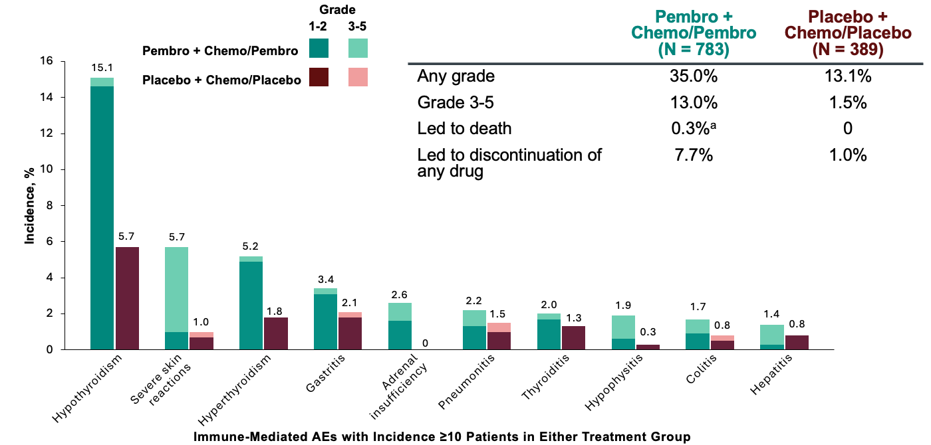
IRAEs: KEYNOTE-522 Safety
IRAEs occurred more frequently in the pembrolizumab arm (35.0%), including more severe (grade 3-5) reactions (13.0%).
Schmid et. al. ESMO 2024
Schmid et. al. NEJM 2024

Slide 15
IRAEs: General Tips
Diagnosis pearls:
  Have a high index of suspicion that new symptoms could be related to an IRAE – early recognition and diagnosis is key!
    E.g., fatigue, hyponatremia, hyperkalemia, hypoglycemia– eval for adrenal insuff
    E.g., Shortness of breath, eval for pneumonitis, myocarditis
  Check TFTs and cortisol ~q6wk during treatment and q12wk for one year after as indicated
  Prior to surgery, check cortisol one last time!
  Late IRAEs can occur (1yr+ after ICI discontinuation)
Management pearls:
  Steroids are the mainstay of treatment if indicated
  Escalation to additional immunomodulatory agents typically in multidisciplinary discussion
  Multidisciplinary collaboration if key
  Guidelines are available for management (e.g., NCCN guidelines very helpful here!)
NCCN Guidelines 2025

Slide 16
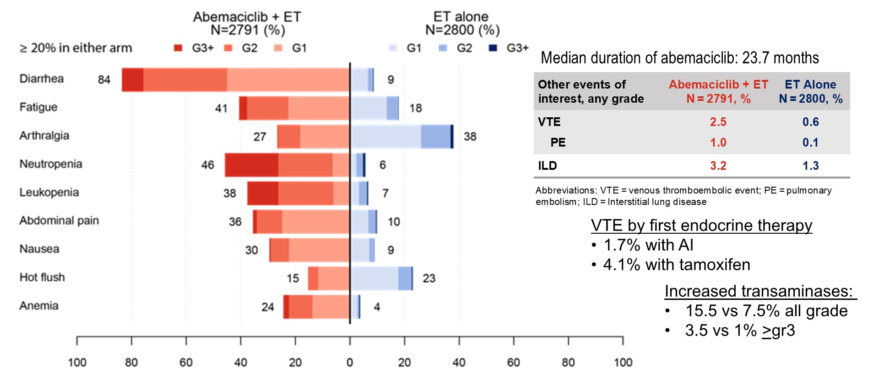
monarchE: Mature Safety Findings
Abemaciclib: MonarchE Safety
Rugo et. al. Annals of Oncology 2022

Slide 17
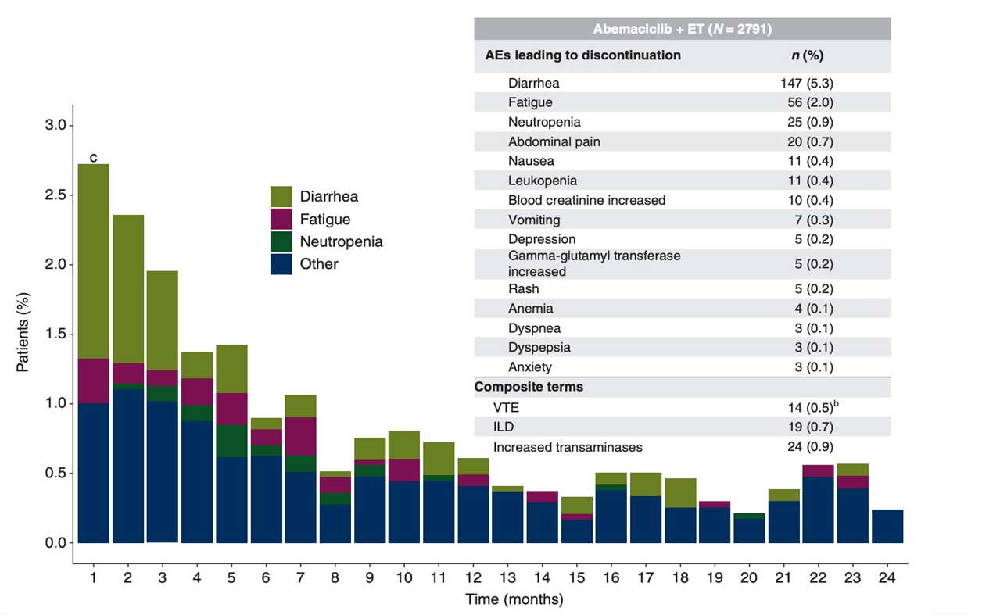
Abemaciclib: MonarchE Safety
Dose reduction:
  43% dose reduction (55% age 65+)
  Most dose reductions occurred early
Discontinuations:
  30.6% discontinuation (18.5% due to AEs, ~50% without a dose reduction)
  Most discontinuations occurred early
Rugo et. al. Annals of Oncology 2022

Slide 18
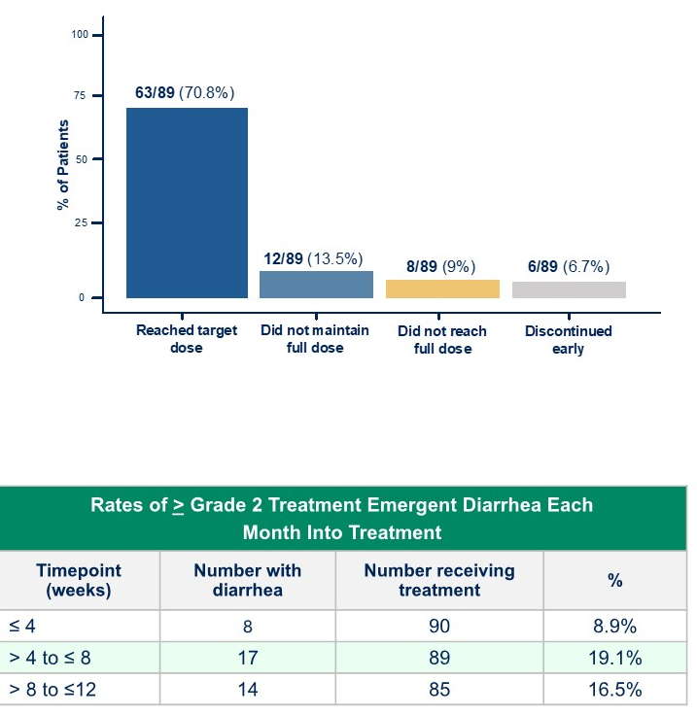
Abemaciclib: Dose Escalation of Abemaciclib?
Question: Would slow escalation of abemaciclib help tolerance and reduce early-discontinuation?
TRADE Trial
  90 patients with stage II/III EBC (89 evaluable)
  Abemaciclib 50mg → 100mg → 150mg BID, each dose for two weeks before final dose
  Landmark analysis at 12 weeks
    29% (n=26) unable to continue or maintain full dose
    Met primary endpoint (70.8% vs. 60% MonarchE maintaining dose)
  Limited by lack of comparison and small numbers, but could be considered an excellent management strategy based on these results
Mayer et. al. ASCO 2025

Slide 19
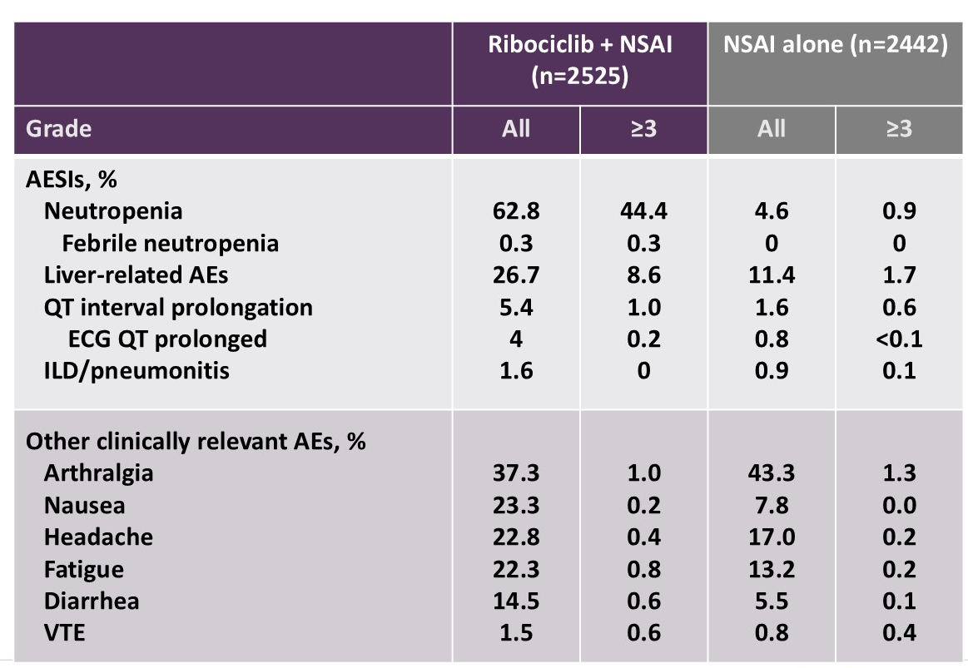
NATALEE: Safety Considerations
Ribociclib: NATALEE Safety
Dose reduction:
  27% dose reduction
Discontinuation:
  36% discontinuation (20% due to AEs, 14% w/o prior dose reduction)
  Most discontinuations were early (9% due to LFT abnormalities)
  Higher SAEs, neutropenia in older patients and more discontinued early
Barrios et. al. ESMO BC 2024

Slide 20
CDK4/6i: General Pearls
Across agents:
Focused, detailed education before starting treatment
Consider dose reduction for older patients (65-75+) or those with comorbidities
Neutropenia: Dose delay, reduction as needed (ok to extend to 10d off for palbo/ribo if needed)
Elevated LFTs: Hold dose (can sometimes take weeks+ to recover); restart at dose reduction if able based on grade. Consider steroids if severe (rare).
Hair loss: Low dose minodixil
Palbociclib:
Often best tolerated- good for older patients and those with comorbidities
Emerging combination options (e.g., INAVO-120, PATINA)
Abemaciclib:
Consider dose escalation strategy!
Counsel about use of loperamide (have at home upon initiation), dose reduction if needed
Ribociclib:
Check for drug-drug interactions (e.g., other drugs that prolong QTc - no ondansetron!)

Slide 21
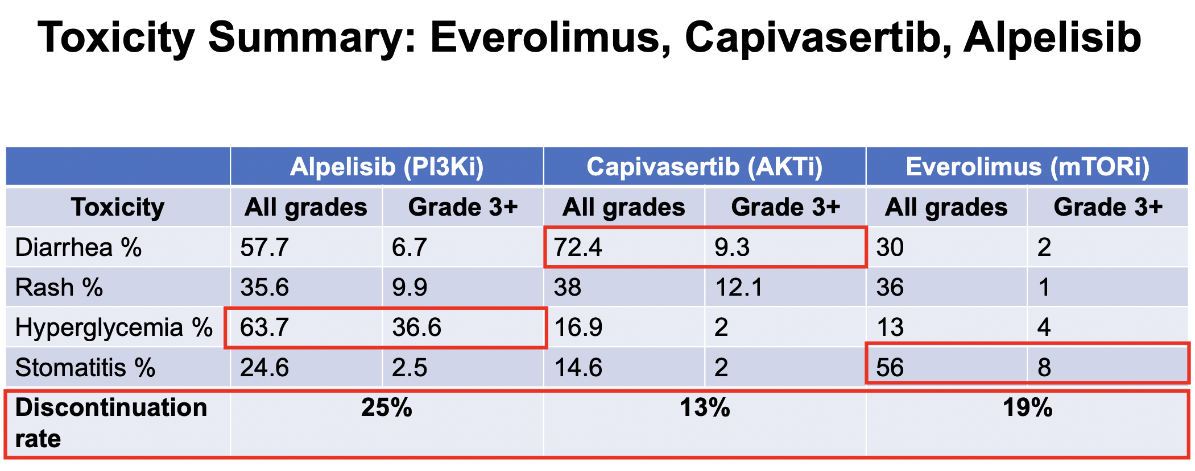
Targeting PIK3CA/AKT/mTOR: Toxicity and Management
SOLAR-1¹
CAPITELLO-291²
BOLERO-2³
André et al. NEJM 2019
Turner et al. NEJM 2023
Hortobagyi et. al. JCO 2016
General pearls:
Focused, detailed education before starting treatment
Diarrhea: Imodium PRN
Rash: Cetirizine (Zyrtec) prophylactically for all! Start the day before treatment and continue daily
Hyperglycemia:
  For capi: Fasting labs on D3 or D4 while on – weeks 0, 1, 2, 4, 6, 8 and monthly or as needed
  Metformin often initial agent of choice, then SGLT2i; involve endocrinology if needed
Stomatitis: Dexamethasone mouthwash PRN

Slide 22
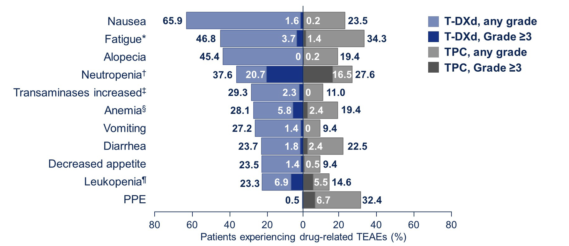
Trastuzumab Deruxtecan (T-DXd): Destiny-Breast 06 Safety
TEAEs leading to death
11 (2.4%) vs 6 (1.4%)
Treatment related: 5 (1.2%) vs 0
Most common TEAE associated
with treatment discontinuation
T-DXd: 5.3%, pneumonitis
TPC: 1.4%, peripheral neuropathy
Left ventricular dysfunction
8.1% any grade
0.7% grade 3
General tips:
For nausea, olanzapine 2.5mg D1-7 at night
Dose reductions if needed for fatigue
Monitor TTE q3mo to start
ILD management: Patient counseling, more frequent CT scans (q9), steroid if needed, ILD rechallenge for G1!
Bardia et. al. NEJM 2024
Curigliano et al. ASCO 2024

Slide 23
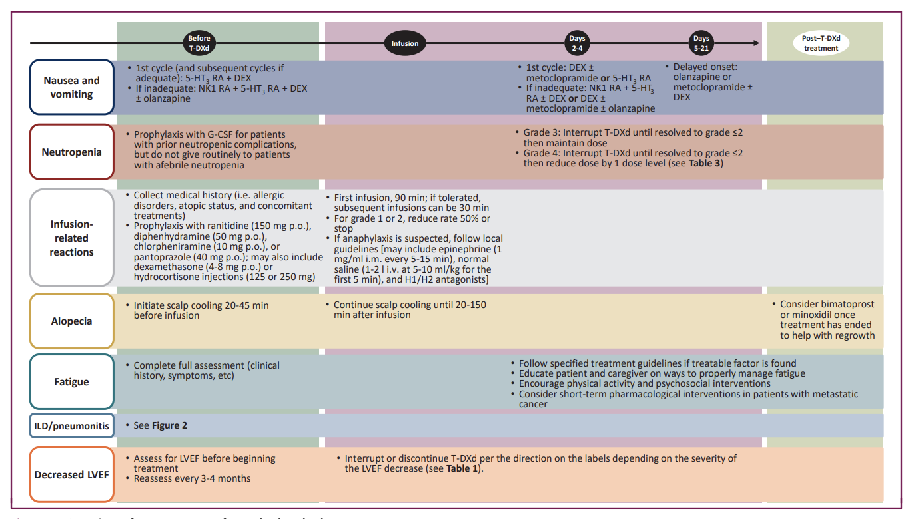
Trastuzumab Deruxtecan (T-DXd): Management Pearls
Rugo et al., ESMO Open 2022

Slide 24
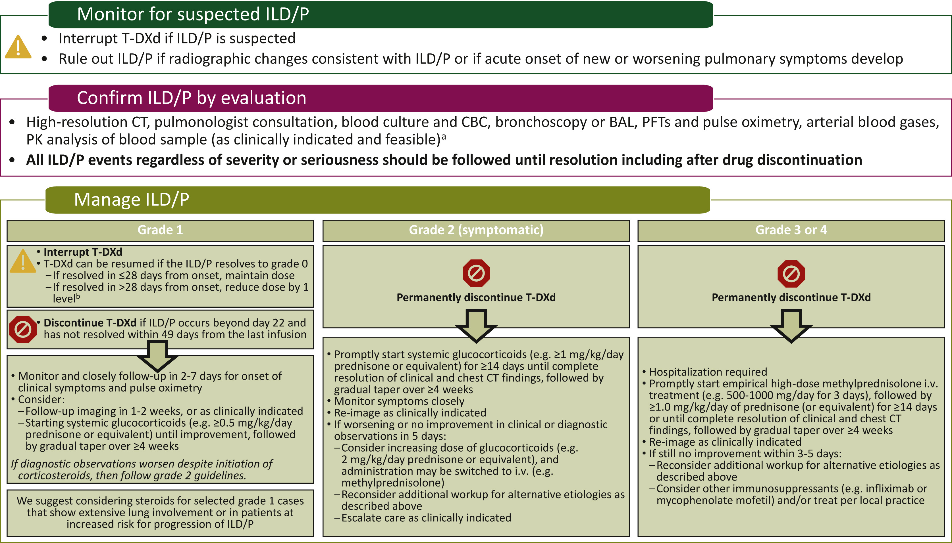
Trastuzumab Deruxtecan (T-DXd): ILD Management
Grade 1 ILD = Asymptomatic
Hold T-DXd
Consider steroids
Consider re-challenge if CT findings resolve
Grade 2+ ILD = Symptomatic
Permanently discontinue T-DXd
Recommend steroids
Rugo et al., ESMO Open 2022

Slide 25
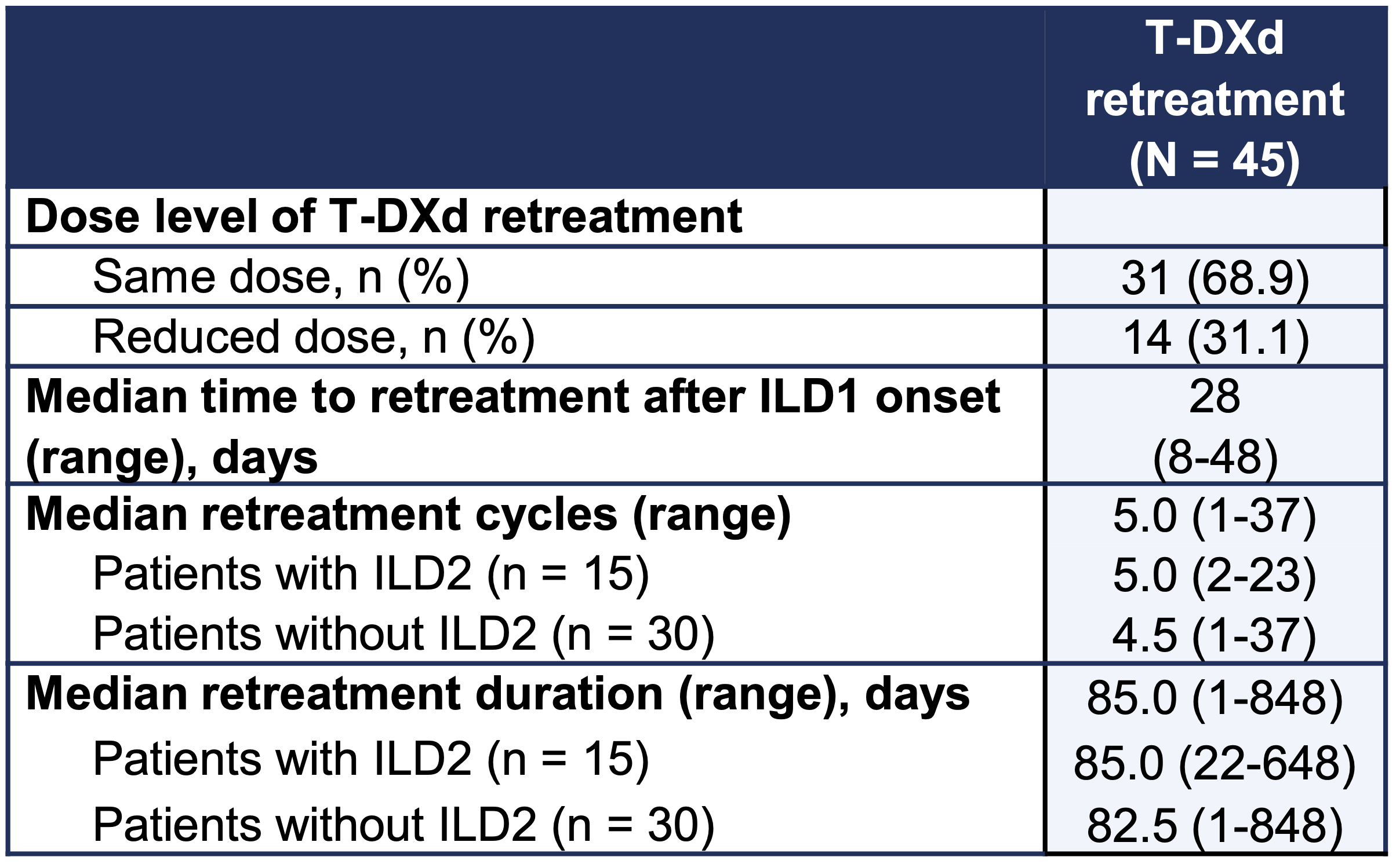
Trastuzumab Deruxtecan (T-DXd): T-DXd Rechallenge for G1 ILD
Pooled data from DESTINY-Breast trials¹ (n=2145)
9.0% rate of any grade ILD (n=193)
45 patients retreated; 50% received steroids
33% rate of recurrent ILD, all grade 1-2
Median time to recurrent ILD 64 days (range 22-391)
Similar findings in real-world studies
French retrospective cohort study²
Median re-treatment duration not reported
33% rate of recurrent ILD (grades not reported)
UCSF retrospective cohort study³
44 pts rechallenged G1 / 19 pts G2 rechallenged; 16-27% rate of recurrent ILD, mostly G1-2, no G5
Median re-treatment duration 215 days (!)
Re-treatment with T-DXd after grade 1 ILD is safe with low rates of recurrent ILD
Patients can have ongoing clinical benefit after re-treatment.
Rugo et al., ESMO Breast 2024
Canellas et al. ESMO 2024
Natsuhara et al., ASCO 2025

Slide 26
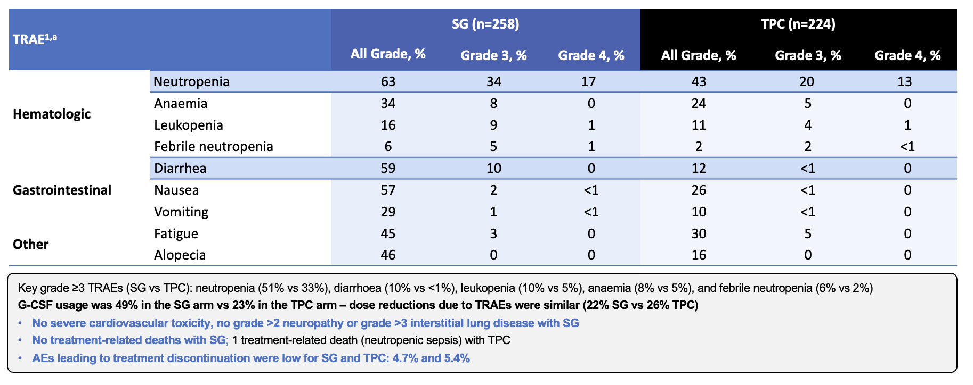
Sacituzumab Govitecan (SG): ASCENT Safety
Bardia et. al. NEJM 2021

Slide 27
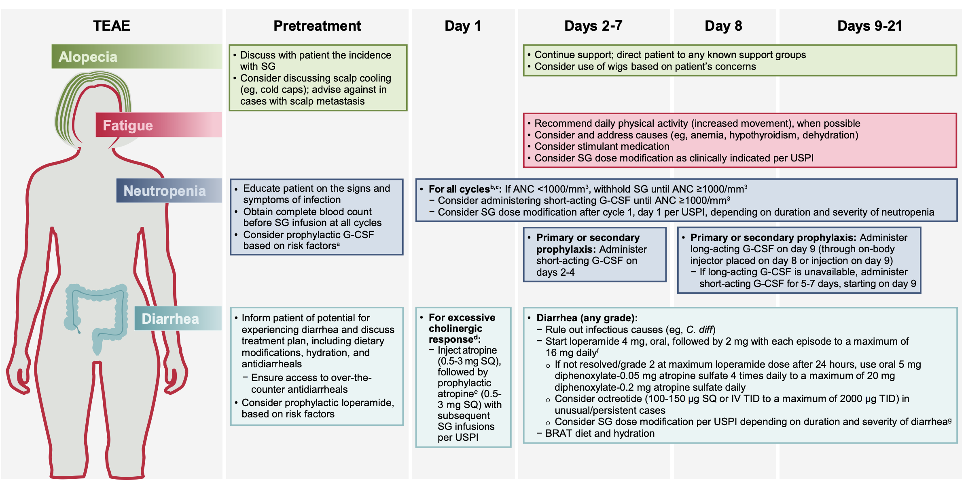
Sacituzumab Govitecan (SG): Management Pearls
Tolaney et al. The Oncologist 2025

Slide 28
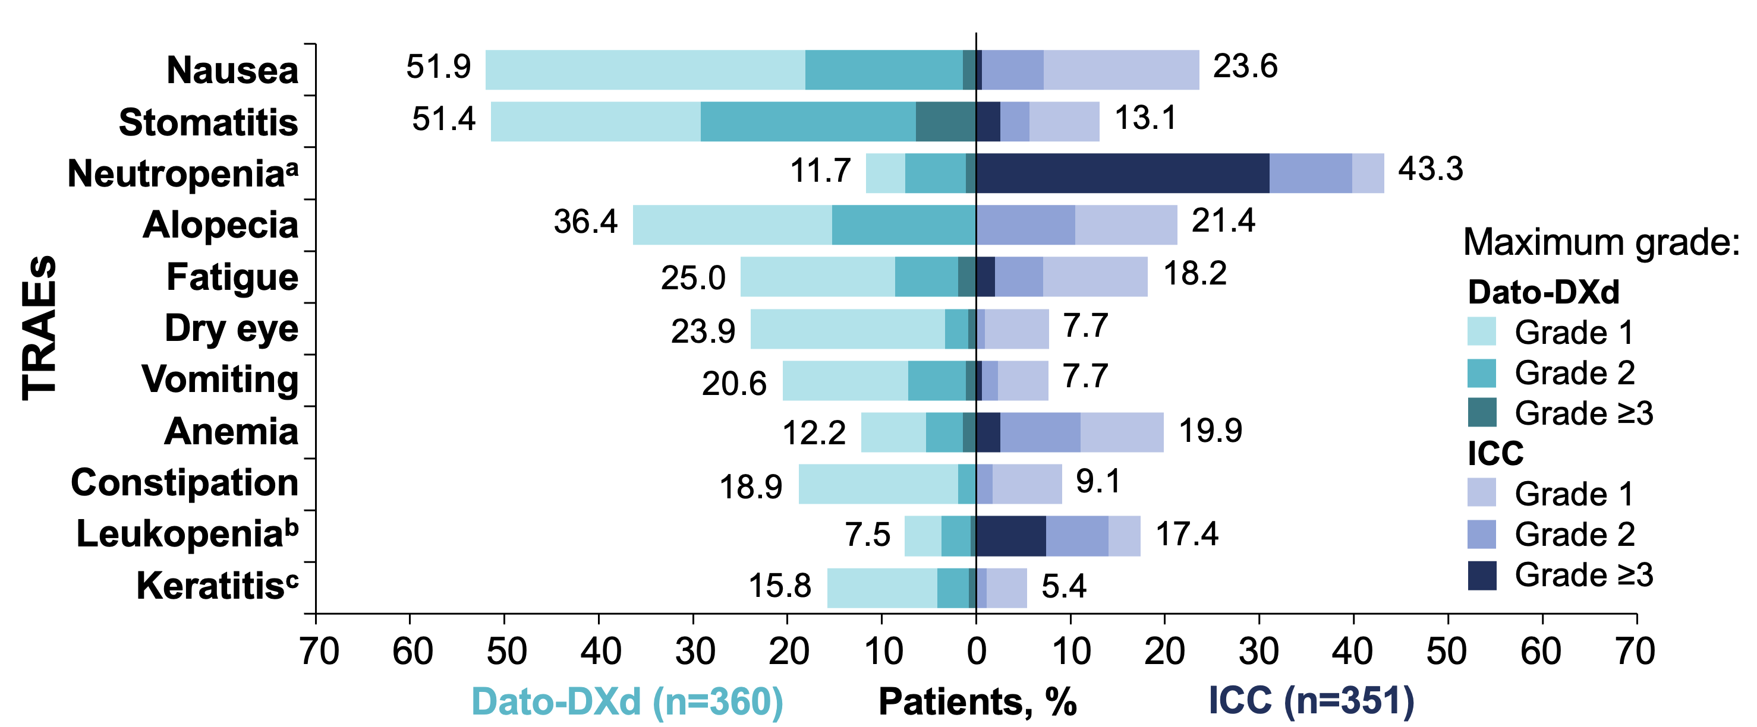
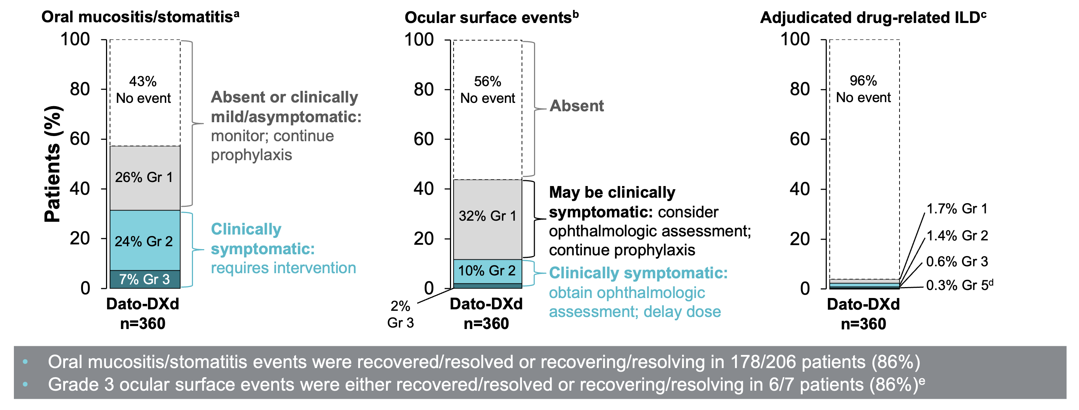
Datopotamab Deruxtecan (Dato-DXd): Tropion-Breast 01 Safety
Bardia et al. JCO 2024

Slide 29
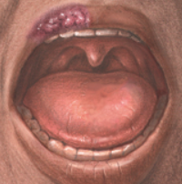

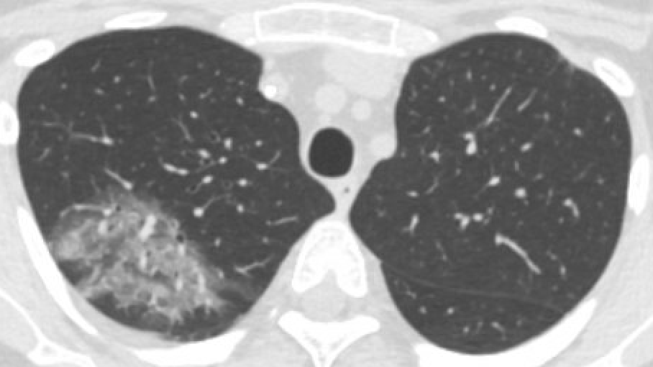
Datopotamab Deruxtecan (Dato-DXd): Tropion-Breast01 Safety
Key AE | Incidence in TB-01 | Prophylaxis, monitoring, & management
Oral mucositis/ stomatitis | G1 26% G2 24% G3 7% | Prophylaxis: Corticosteroid mouthwash (e.g., dexamethasone oral solution 0.1mg/mL) and good oral hygiene Monitoring: Regular oral exams *pain often more than sores* Management: Optimize prophylactic and supportive meds, lidocaine-based mouthwash, dose reduce/delay PRN
Ocular surface events | G1 32% G2 10% G3 2% | Prophylaxis: Preservative-free tears 4x daily; avoid contact lenses Monitoring: Ophthalmology exam at baseline and as needed Management: Per ophthalmology (e.g., steroid eye drops, povidone and tetrahydozoline ophthalmic solution), dose reduce/delay PRN
ILD | G1 1.7% G2 1.4% G3 0.6% G5 0.3% | Counseling: Educate patients about ILD symptoms Monitoring: Contrast-enhanced CT scans (q9-12; on study was q6) Management: Similar to T-DXd- hold treatment, steroids as needed, consider rechallenge for G1
Adapted from Lisberg et al. The Oncologist 2025

Slide 30
Take-Home Messages
Toxicity management is critical to provide safe and effective care, and to maximize tolerability and quality of life for our patients
Educate yourself, your care team, and your patients about key toxicities of novel agents and important prevention, monitoring, and management strategies
Early identification and intervention is key, especially in cases of more severe toxicity
Listen and learn from your patients! What side effects are most bothersome? What has helped, if anything? How can we improve symptom management going forward?
Multidisciplinary teams are key to toxicity identification and management: pharmacists, nurses, APPs, primary care, ER/hospital medicine teams, subspecialty teams

Slide 31

Thank you!
@Laura_Huppert

