Slide 1


Biology of Breast Pathogenesis and
Key Molecular Pathways
Pedram Razavi, MD, PhD
Medical Oncologist, Breast Medicine Service
Director, Breast Translational Program and Breast Molecular Tumor Board
Scientific Director, MSK Global Research Program
Disclaimer: This presentation is intended for personal use and for informational purposes only and does not replace independent professional judgment. This presentation is the property of Physicians’ Education Resource, LLC (“PER”) and is protected by U.S. and international copyright laws. You may not copy, reproduce, distribute, transmit, modify, or create derivative works of the presentation without the prior written permission from PER.

Slide 2
Disclosures
Institutional grant/funding: NIH, Komen, Breast Cancer Alliance, Grail, Illumina, Novartis, AstraZeneca, Epic Sciences, Invitae/ArcherDx, Biothernostics, Tempus, Inivata, Biovica, Guardant, Personalis, Myriad, Foresight
Consultant/Ad board/Advisor: Novartis, AstraZeneca, Pfizer, Lilly/Loxo, Prelude Therapeutics, Epic Sciences, Foundation Medicine, Inivata, Natera, Tempus, SAGA Diagnostics, Paige.ai, Guardant, Myriad

Slide 3

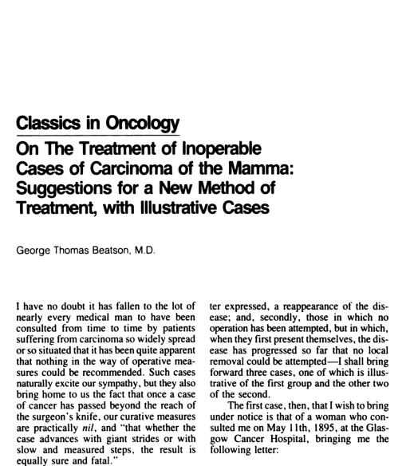
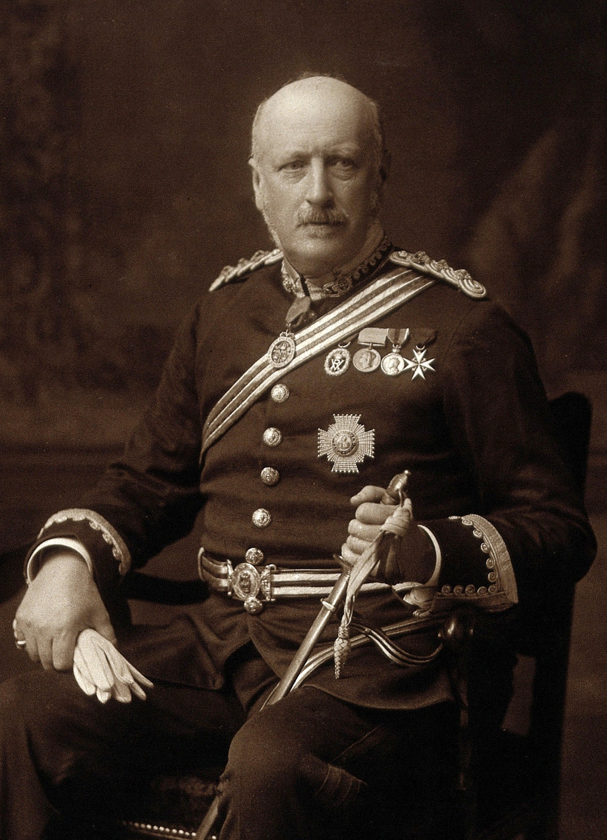
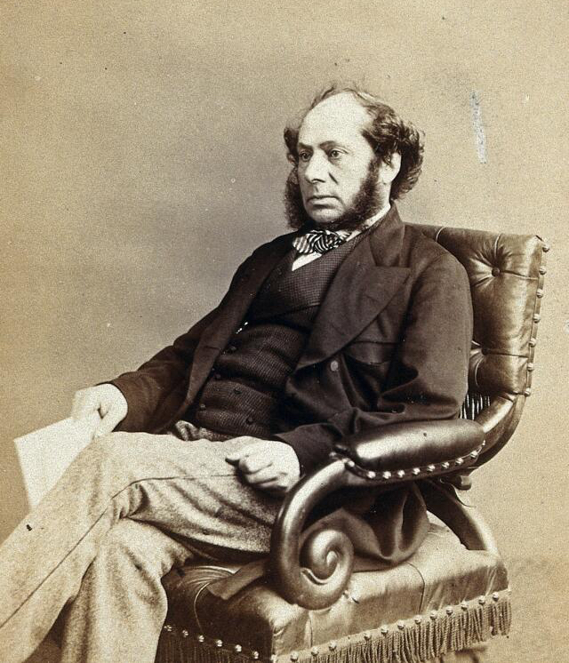
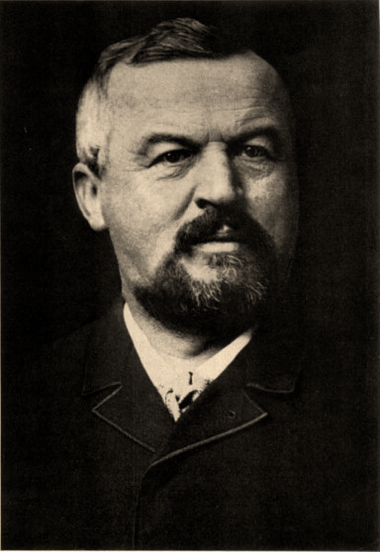
Albert Schinzinger
Notes:
Thomas William Nunn
Albert Schinzinger
George Thomas Beatson

Slide 4
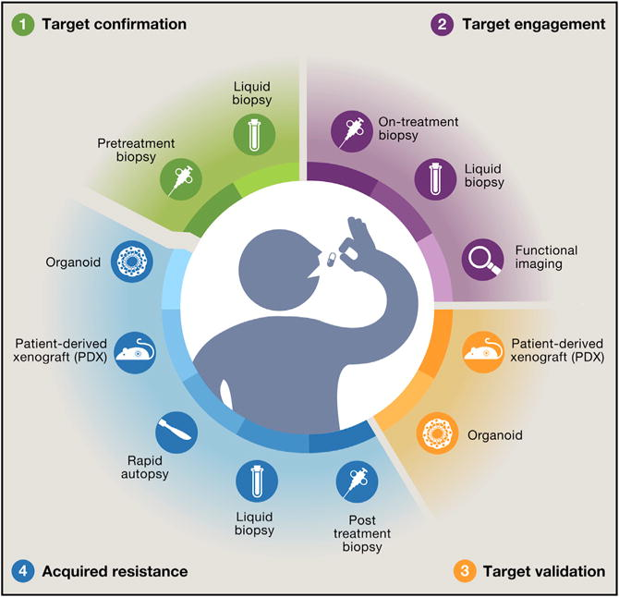
Modern landscape of precision oncology
Hyman DM et al. Cell. 2017;168(4):584-599.

Slide 5
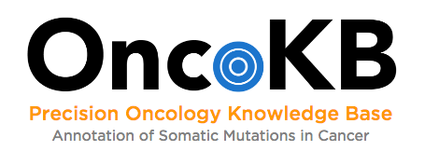
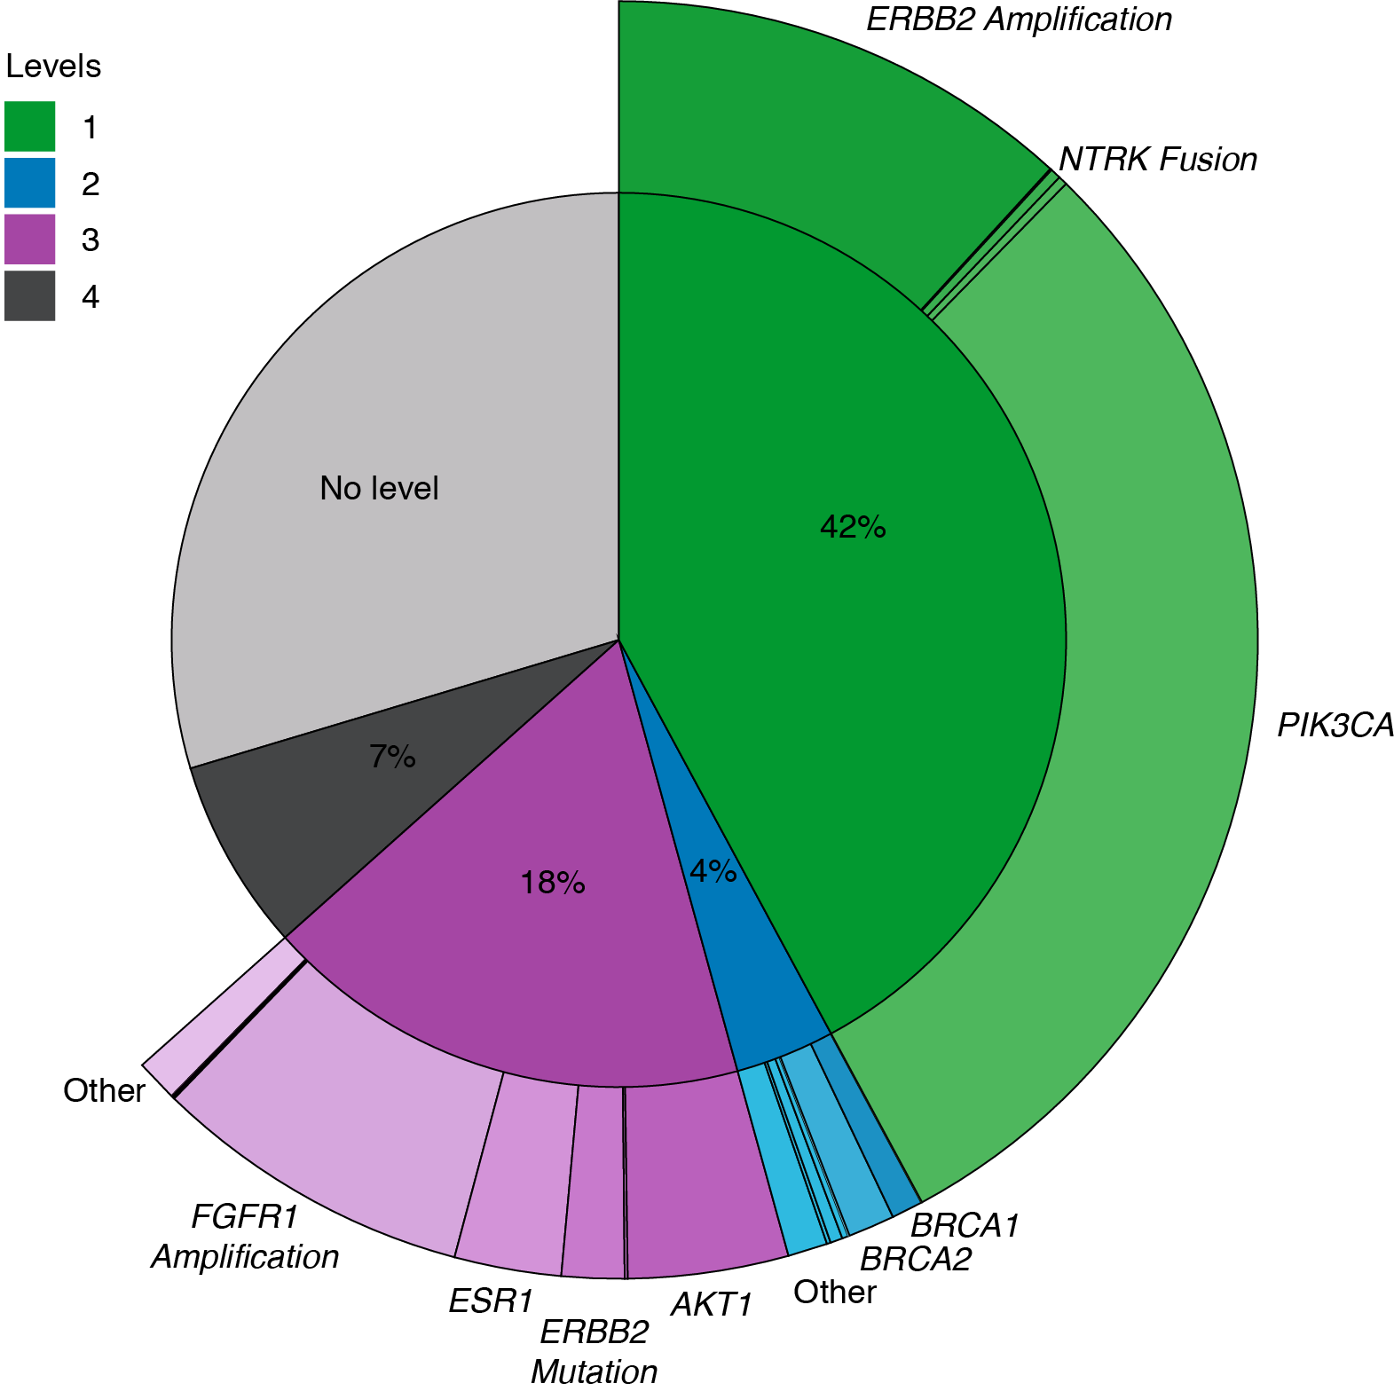
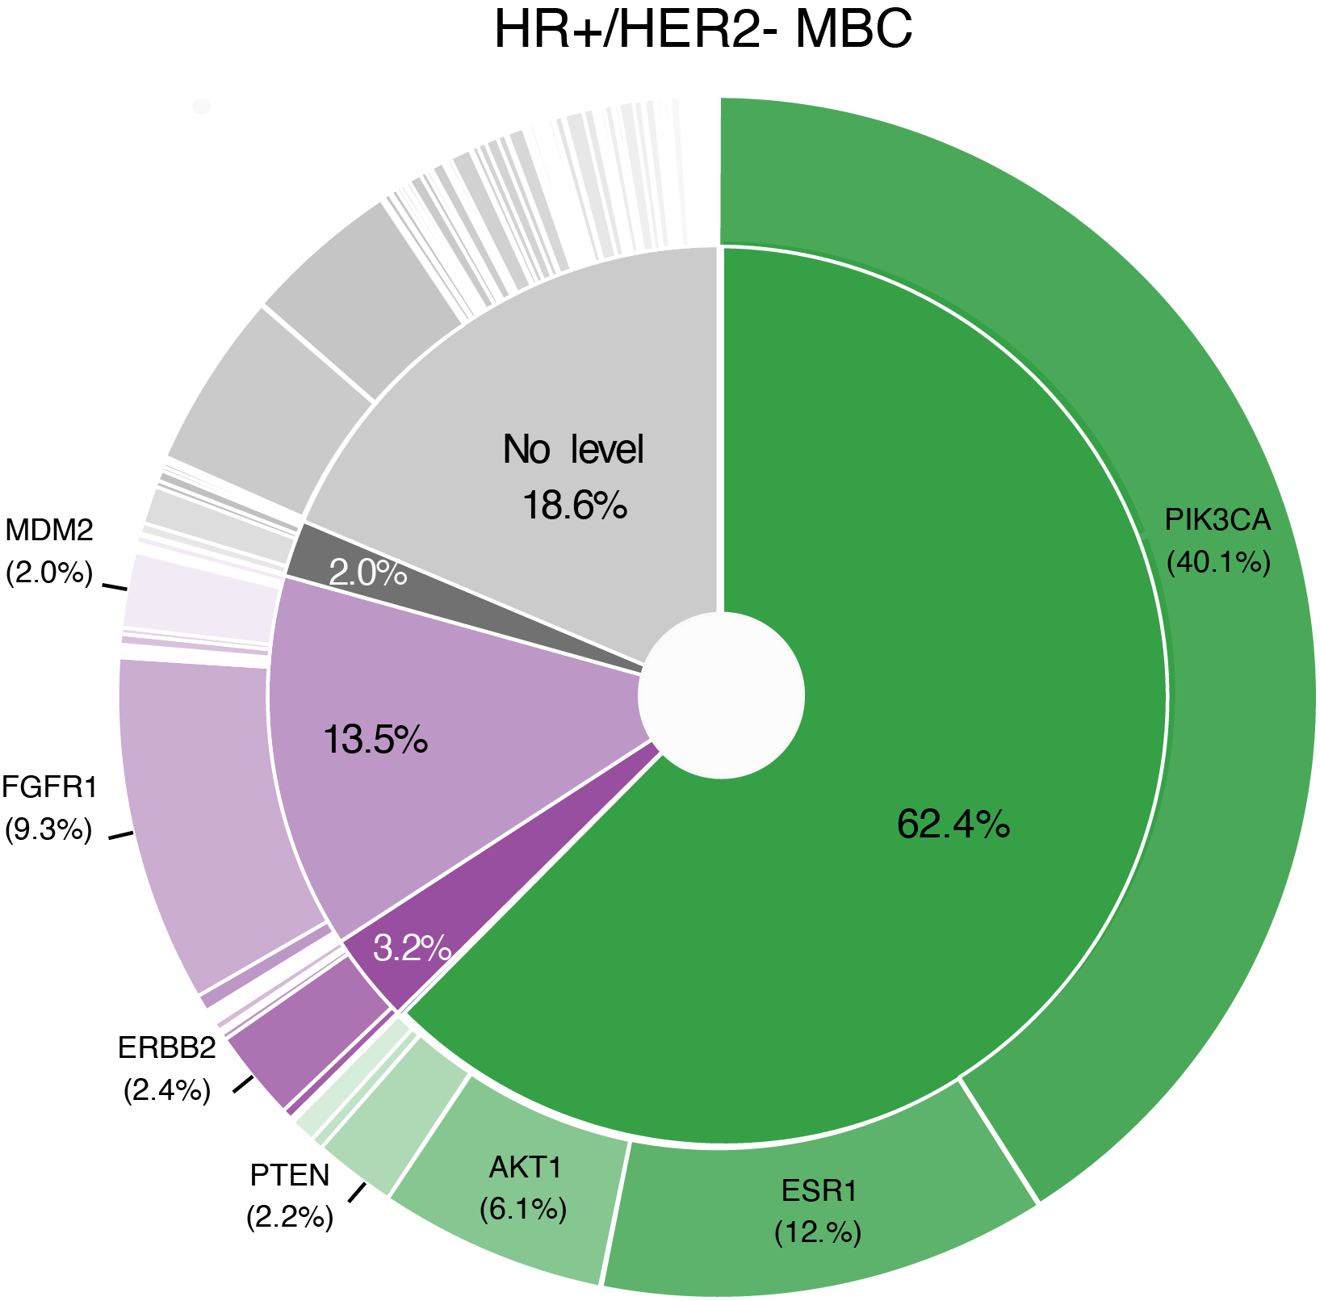
Rapidly evolving landscape of actionable genome in breast cancer
Comprehensive and curated precision oncology knowledge base
oncokb.org
2022
Tissue
MSK-IMPACT
2024
Chakravarty D et al. JCO Precis Oncol. 2017;PO.17.00011.

Slide 6
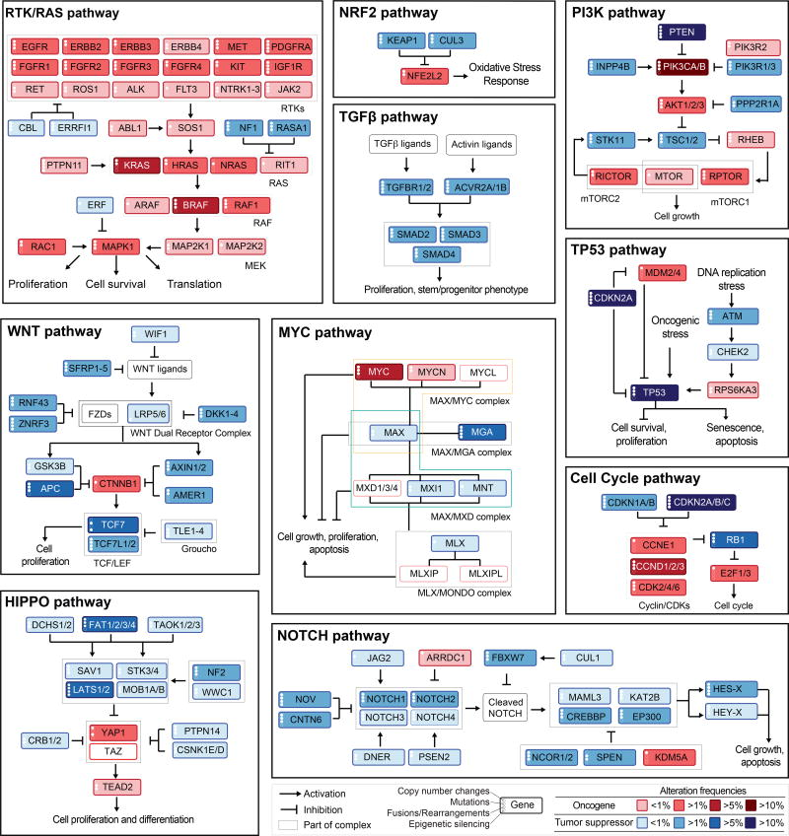
Gene and pathway level interactions
Complicate interpretations of the clinical genomic results
Sanchez-Vega F et al. Cell. 2018;173(2):321-337.e10.

Slide 7
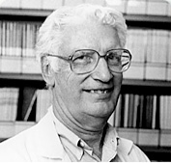
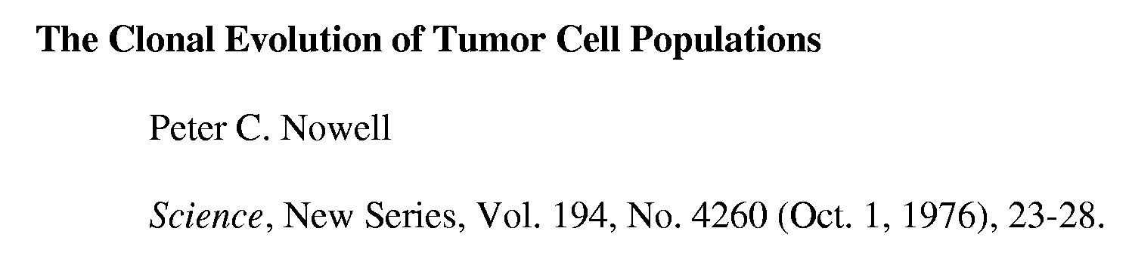
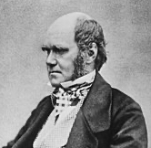
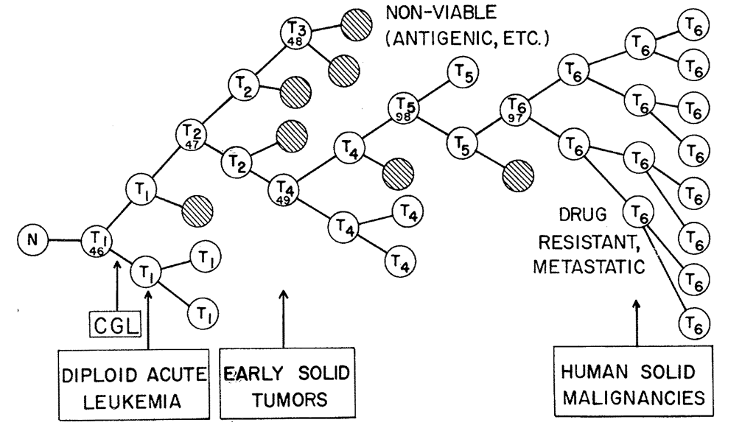
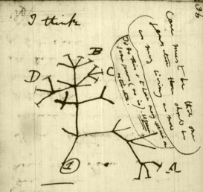
Extensive spatial and temporal heterogeneity

Slide 8
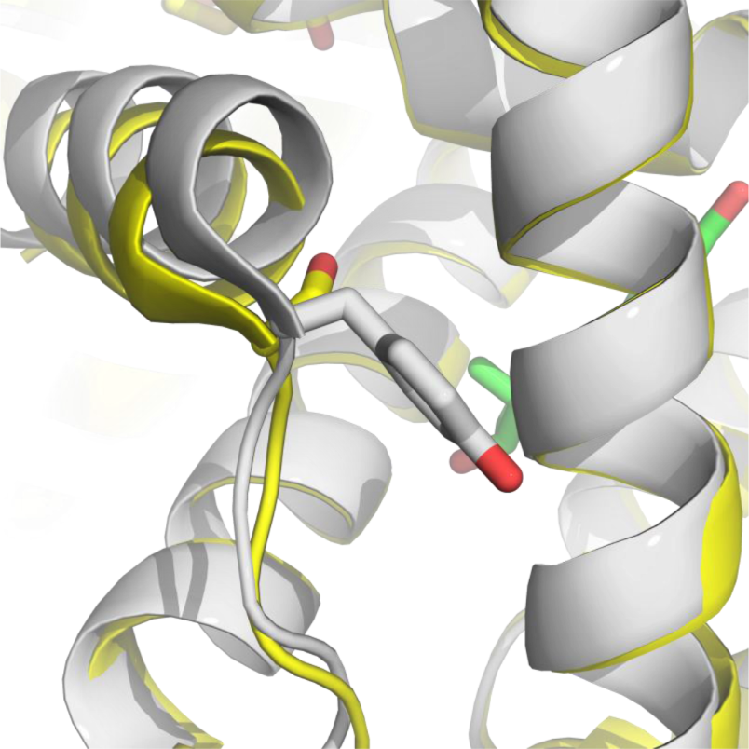
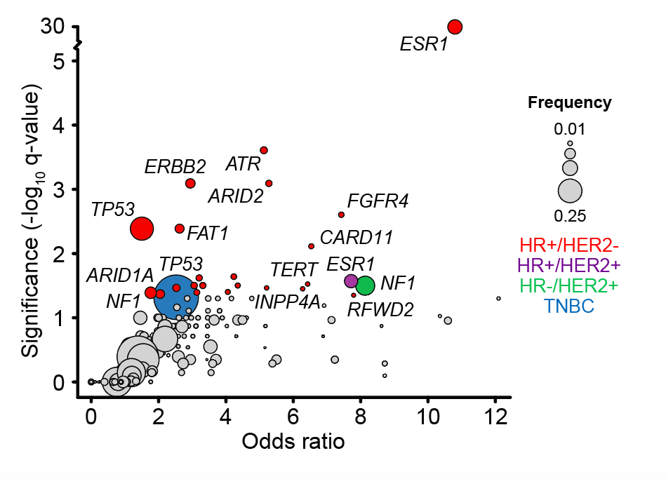

Genomics alterations enriched in metastases
D538/Y537 mutants mimic E2 bound WT
Fanning SW et al. Elife. 2016;5:e12792.
Toy W et al. Nat Genet. 2013;45(12):1439.
Razavi P et al. Cancer Cell. 2018;34(3):427-438.e6.
Weiyi Toy
Sarat Chandarlapaty

Slide 9
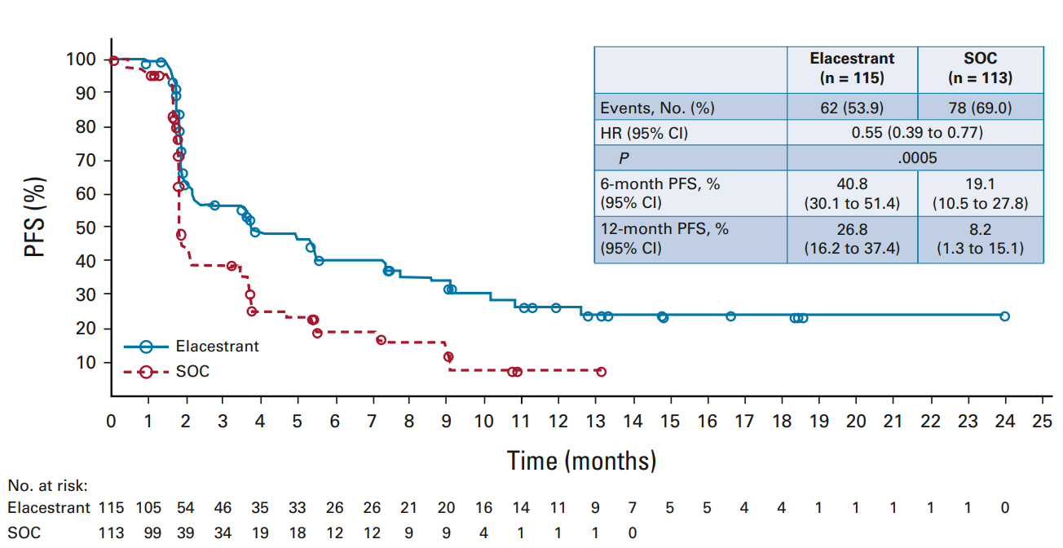
Clinical activity of new oral antagonists
Bidard FC et al. J Clin Oncol. 2022;40(28):3246-56.

Slide 10
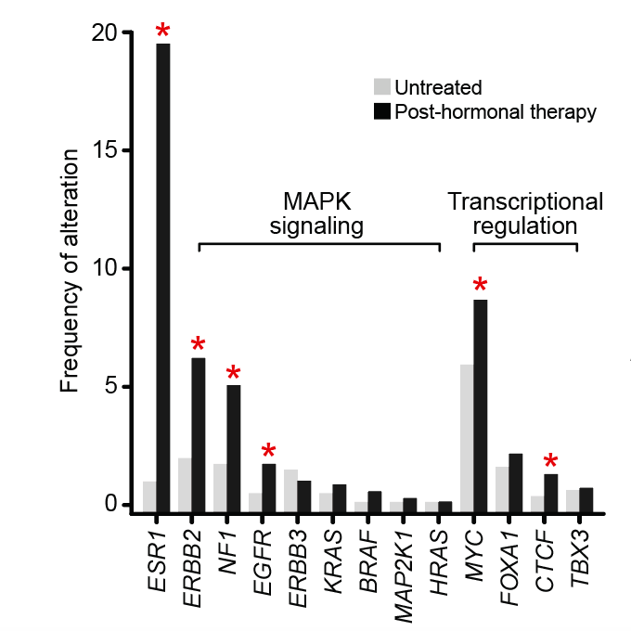
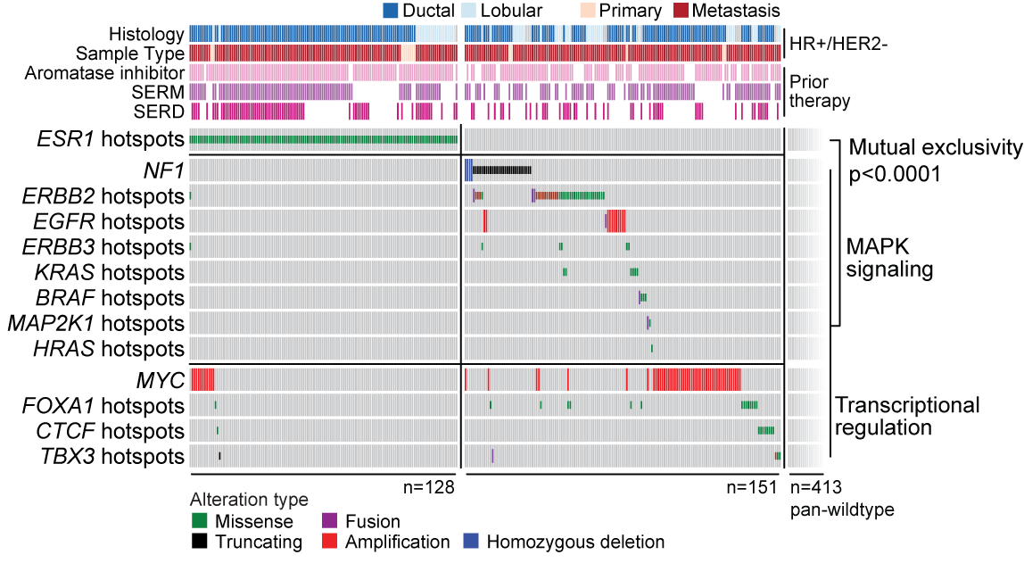
MAPK and transcription factors alterations enriched in endocrine resistant tumors and mutually exclusive with ESR1 hotspots
Endocrine resistance
1501 HR+/HER2-
692 post-endocrine therapy tumors
151/564 of ERS1 WT endocrine resistant tumors harbored alterations in MAPK pathway or TF
Razavi P et al. Cancer Cell. 2018;34(3):427-438.e6.
Notes:
Total of 694 endocrine resistant tumors
ESR1: 18%
MAPK: 16%
151/564: 26%
151/694: Overall 22%

Slide 11
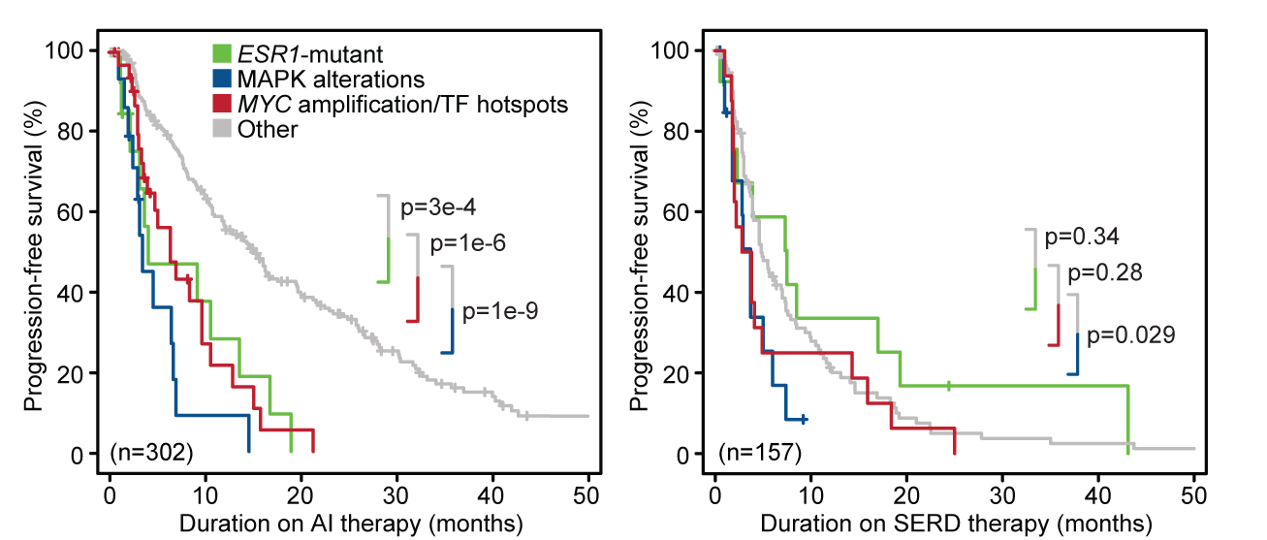
MAPK and TF alterations associated with poor response to endocrine therapy
Razavi P et al. Cancer Cell. 2018;34(3):427-438.e6.

Slide 12
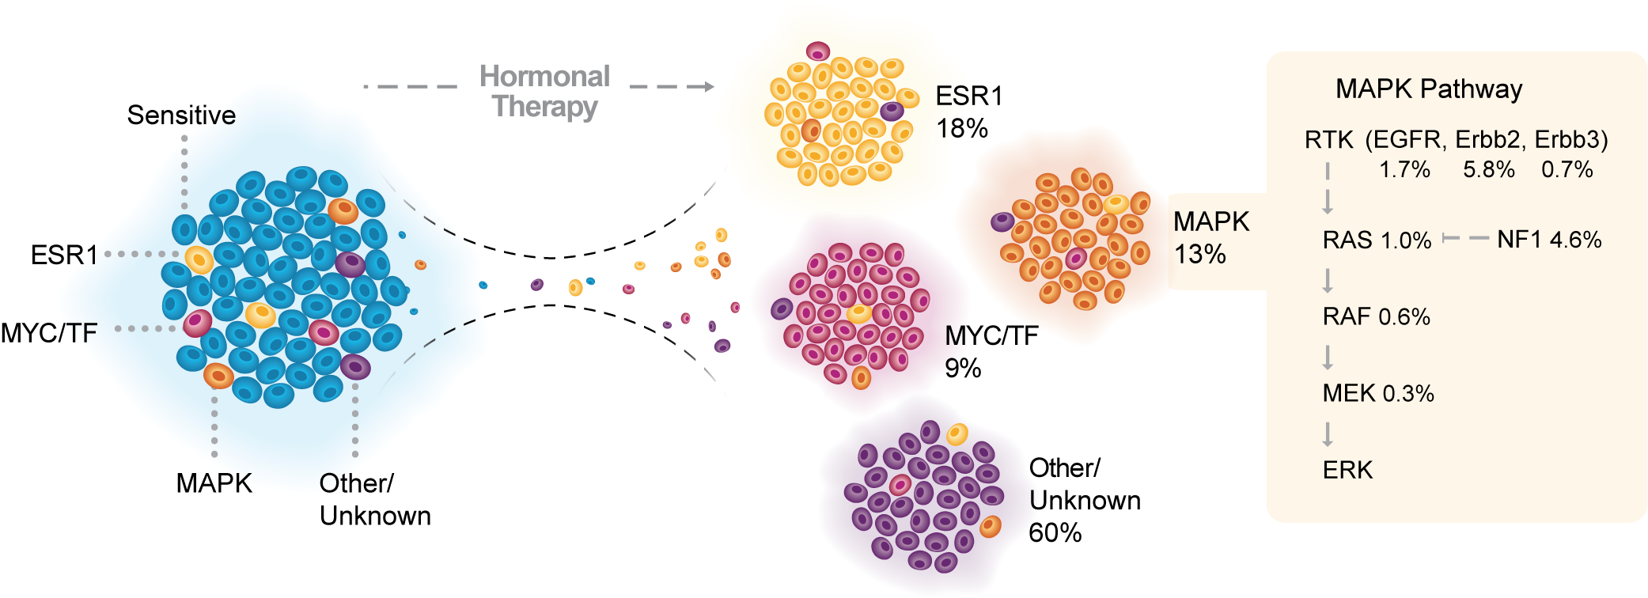
MAPK and TF alterations result in endocrine resistance
Toy et al. Nature Genetics, 2015;
Toy et al. Cancer Discovery, 2017;
Razavi et al. Cancer Cell, 2018;
Xu and Toska et al. Nature Genetics, 2020;
Arruabarrena-Aristorena et al. Cancer Cell, 2020;
Toska et al, in preparation.
Razavi et al., Cancer Cell 2018

Slide 13
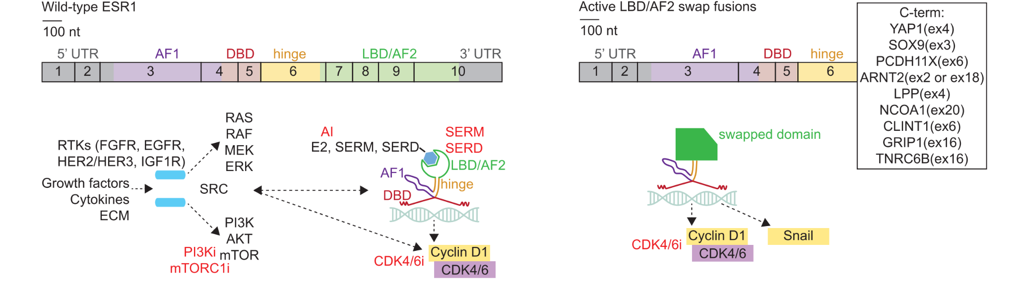
ESR1 fusions in hormone-receptor positive breast cancer
ESR1 LBD swap fusions:
  ER LBD is replaced by the transactivation domain of the partner gene → hyperactivation of ER in estrogen-independent manner
  No binding site for E2/SERM/SERD → ET resistance
ESR1 partner truncating fusions:
  ESR1 promoter and 5′-UTR fuse to CCDC170 producing a truncated CCD170 product → abnormal SRC-HER2-HER3 activation
  Complete resistance to ET
Brett JO et al. Oncologist. 2023;28(2):172-179.

Slide 14
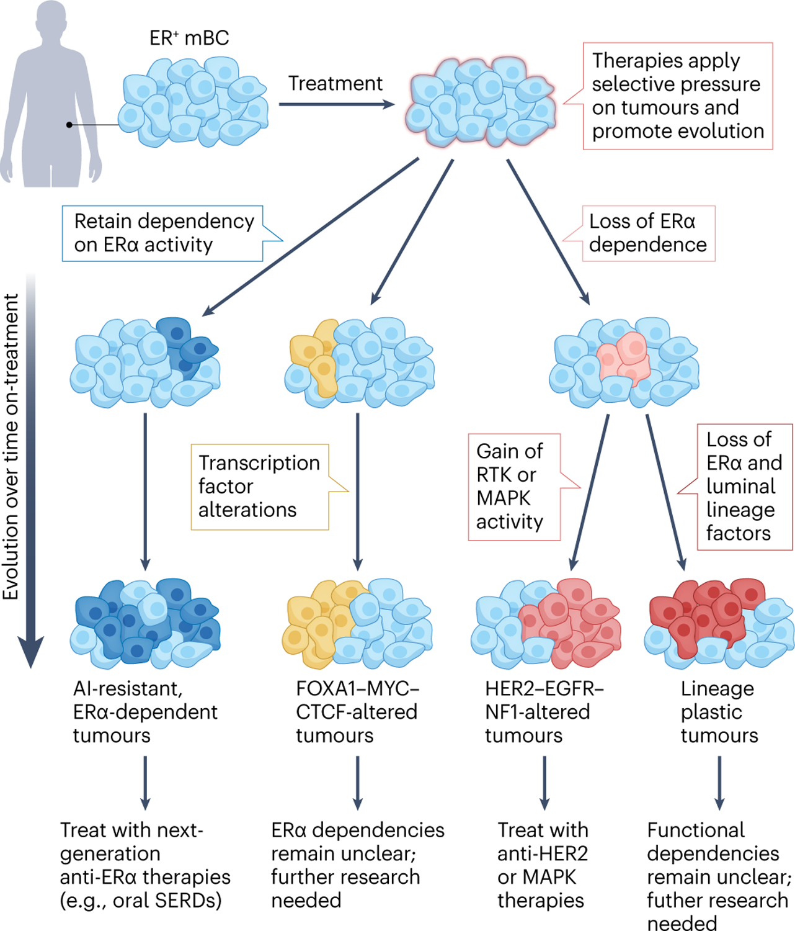
Endocrine resistance mechanisms and their clinical implications
Razavi et al., Cancer Cell 2018
Will M et al. Nat Rev Cancer. 2023;23(10):673-685.

Slide 15
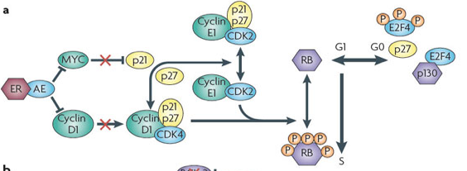
ER and cell cycle
ER signaling output activates Cyclin D and represses p21 promoters
Nature Reviews Cancer 2015
Nature Reviews Cancer

Slide 16
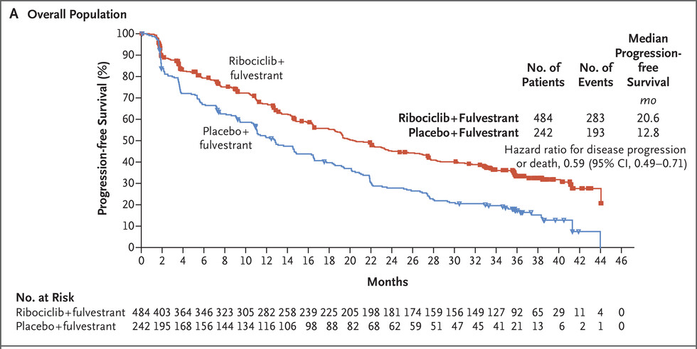
Significant heterogeneity in response
Dual targeting ER & CDK4/6
Slamon DJ et al. N Engl J Med. 2020;382(6):514-524.

Slide 17
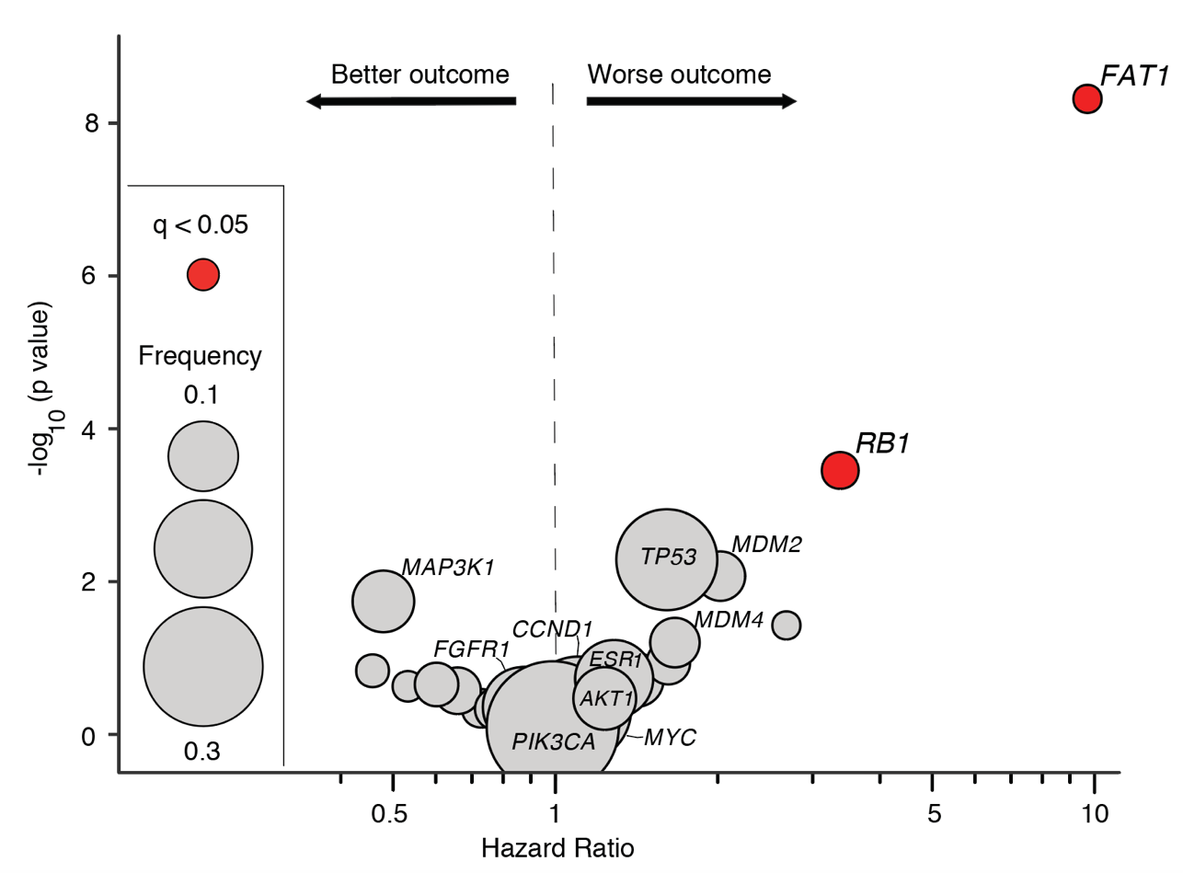
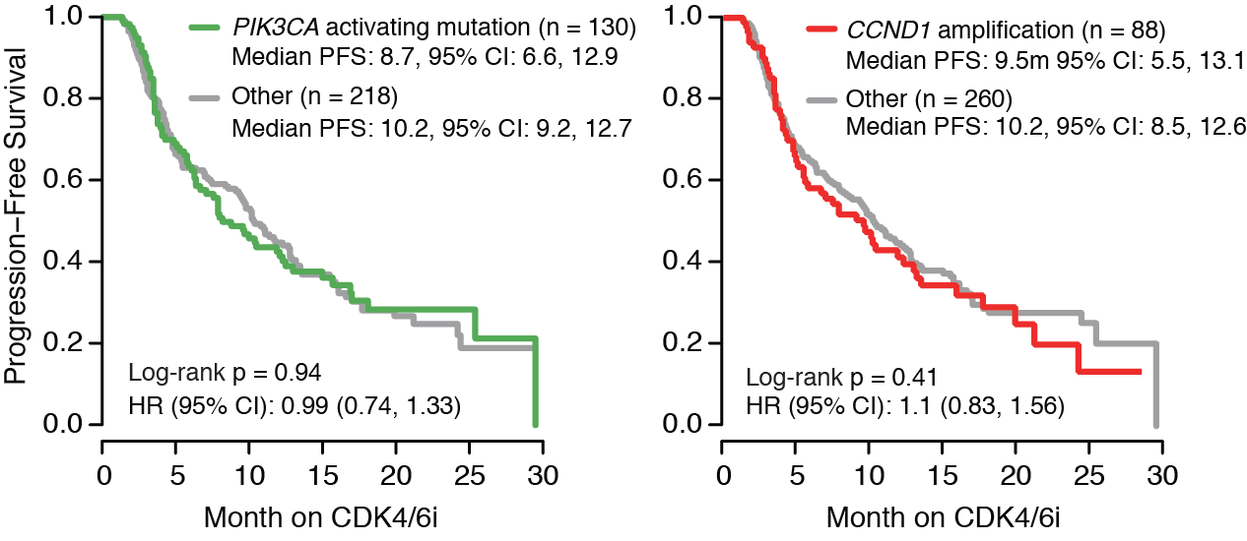
Loss of target
RB1 loss-of-function alterations associated with intrinsic resistance to CDK4/6i
Consistent with PALOMA-2 and MONALEESA-2
Cristofanilli et al, Lancet Oncology 2016, Hortobagyi et al, Annals of Oncology 2018
Li Z, Razavi P, et al. Cancer Cell. 2018;34(6):893-905.e8.

Slide 18
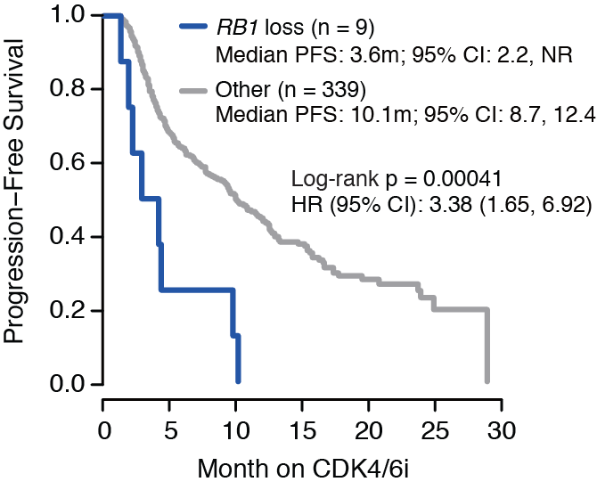
Loss of target
Li Z, Razavi P, et al. Cancer Cell. 2018;34(6):893-905.e8.

Slide 19
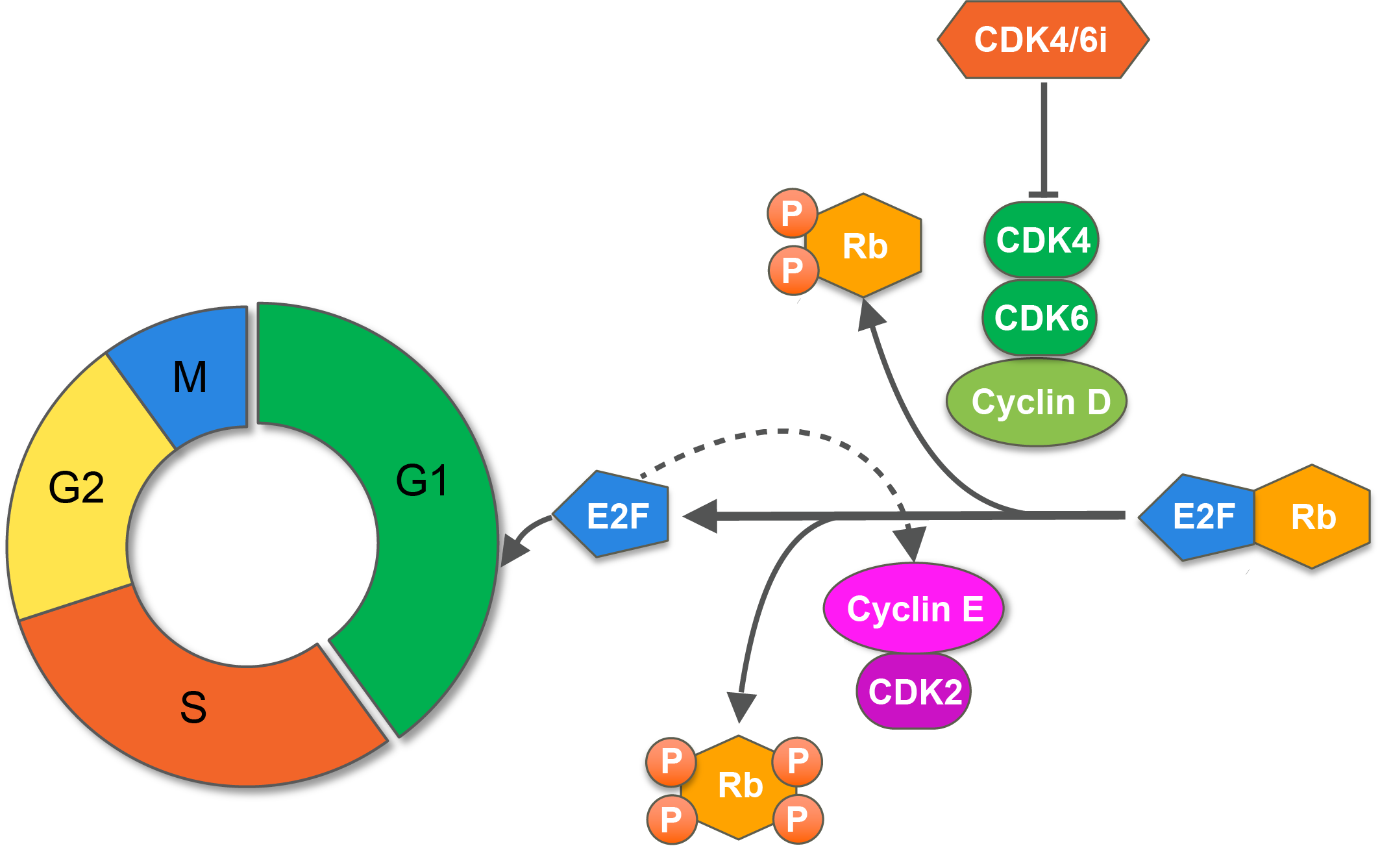
Loss of target
Dean JL et al. Oncogene. 2010;29:4018.
Li Z, Razavi P, et al. Cancer Cell. 2018;34(6):893-905.e8.

Slide 20
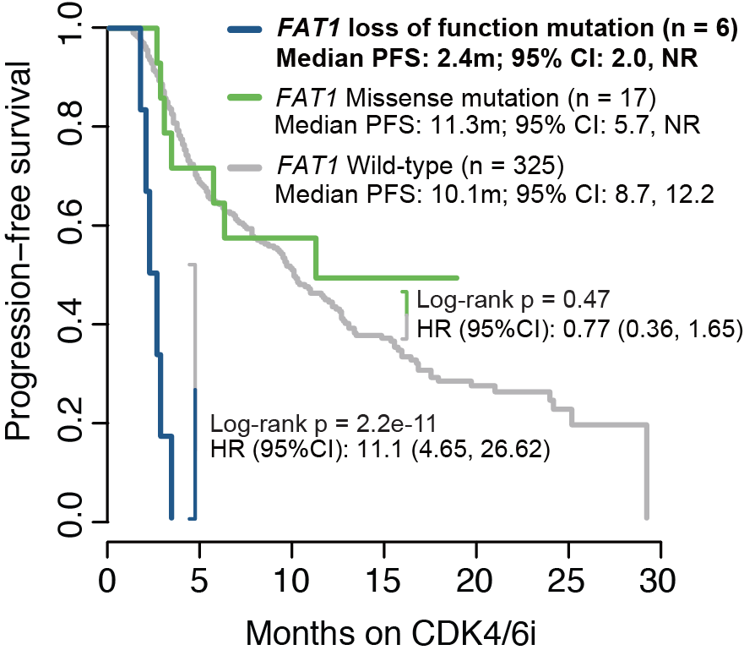
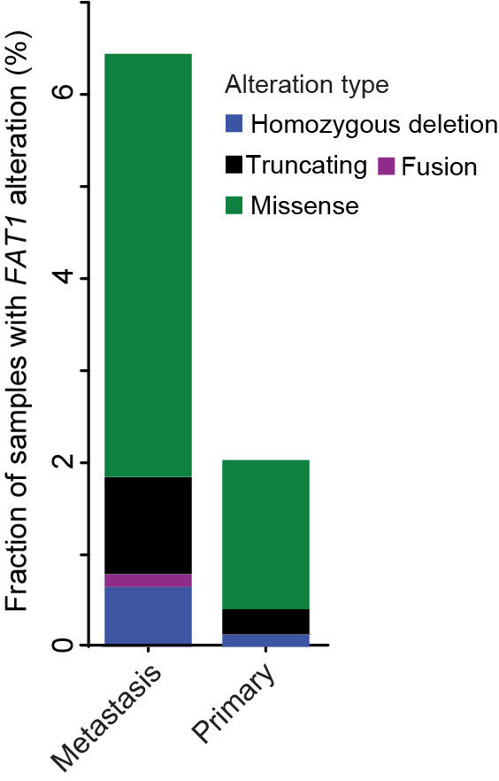
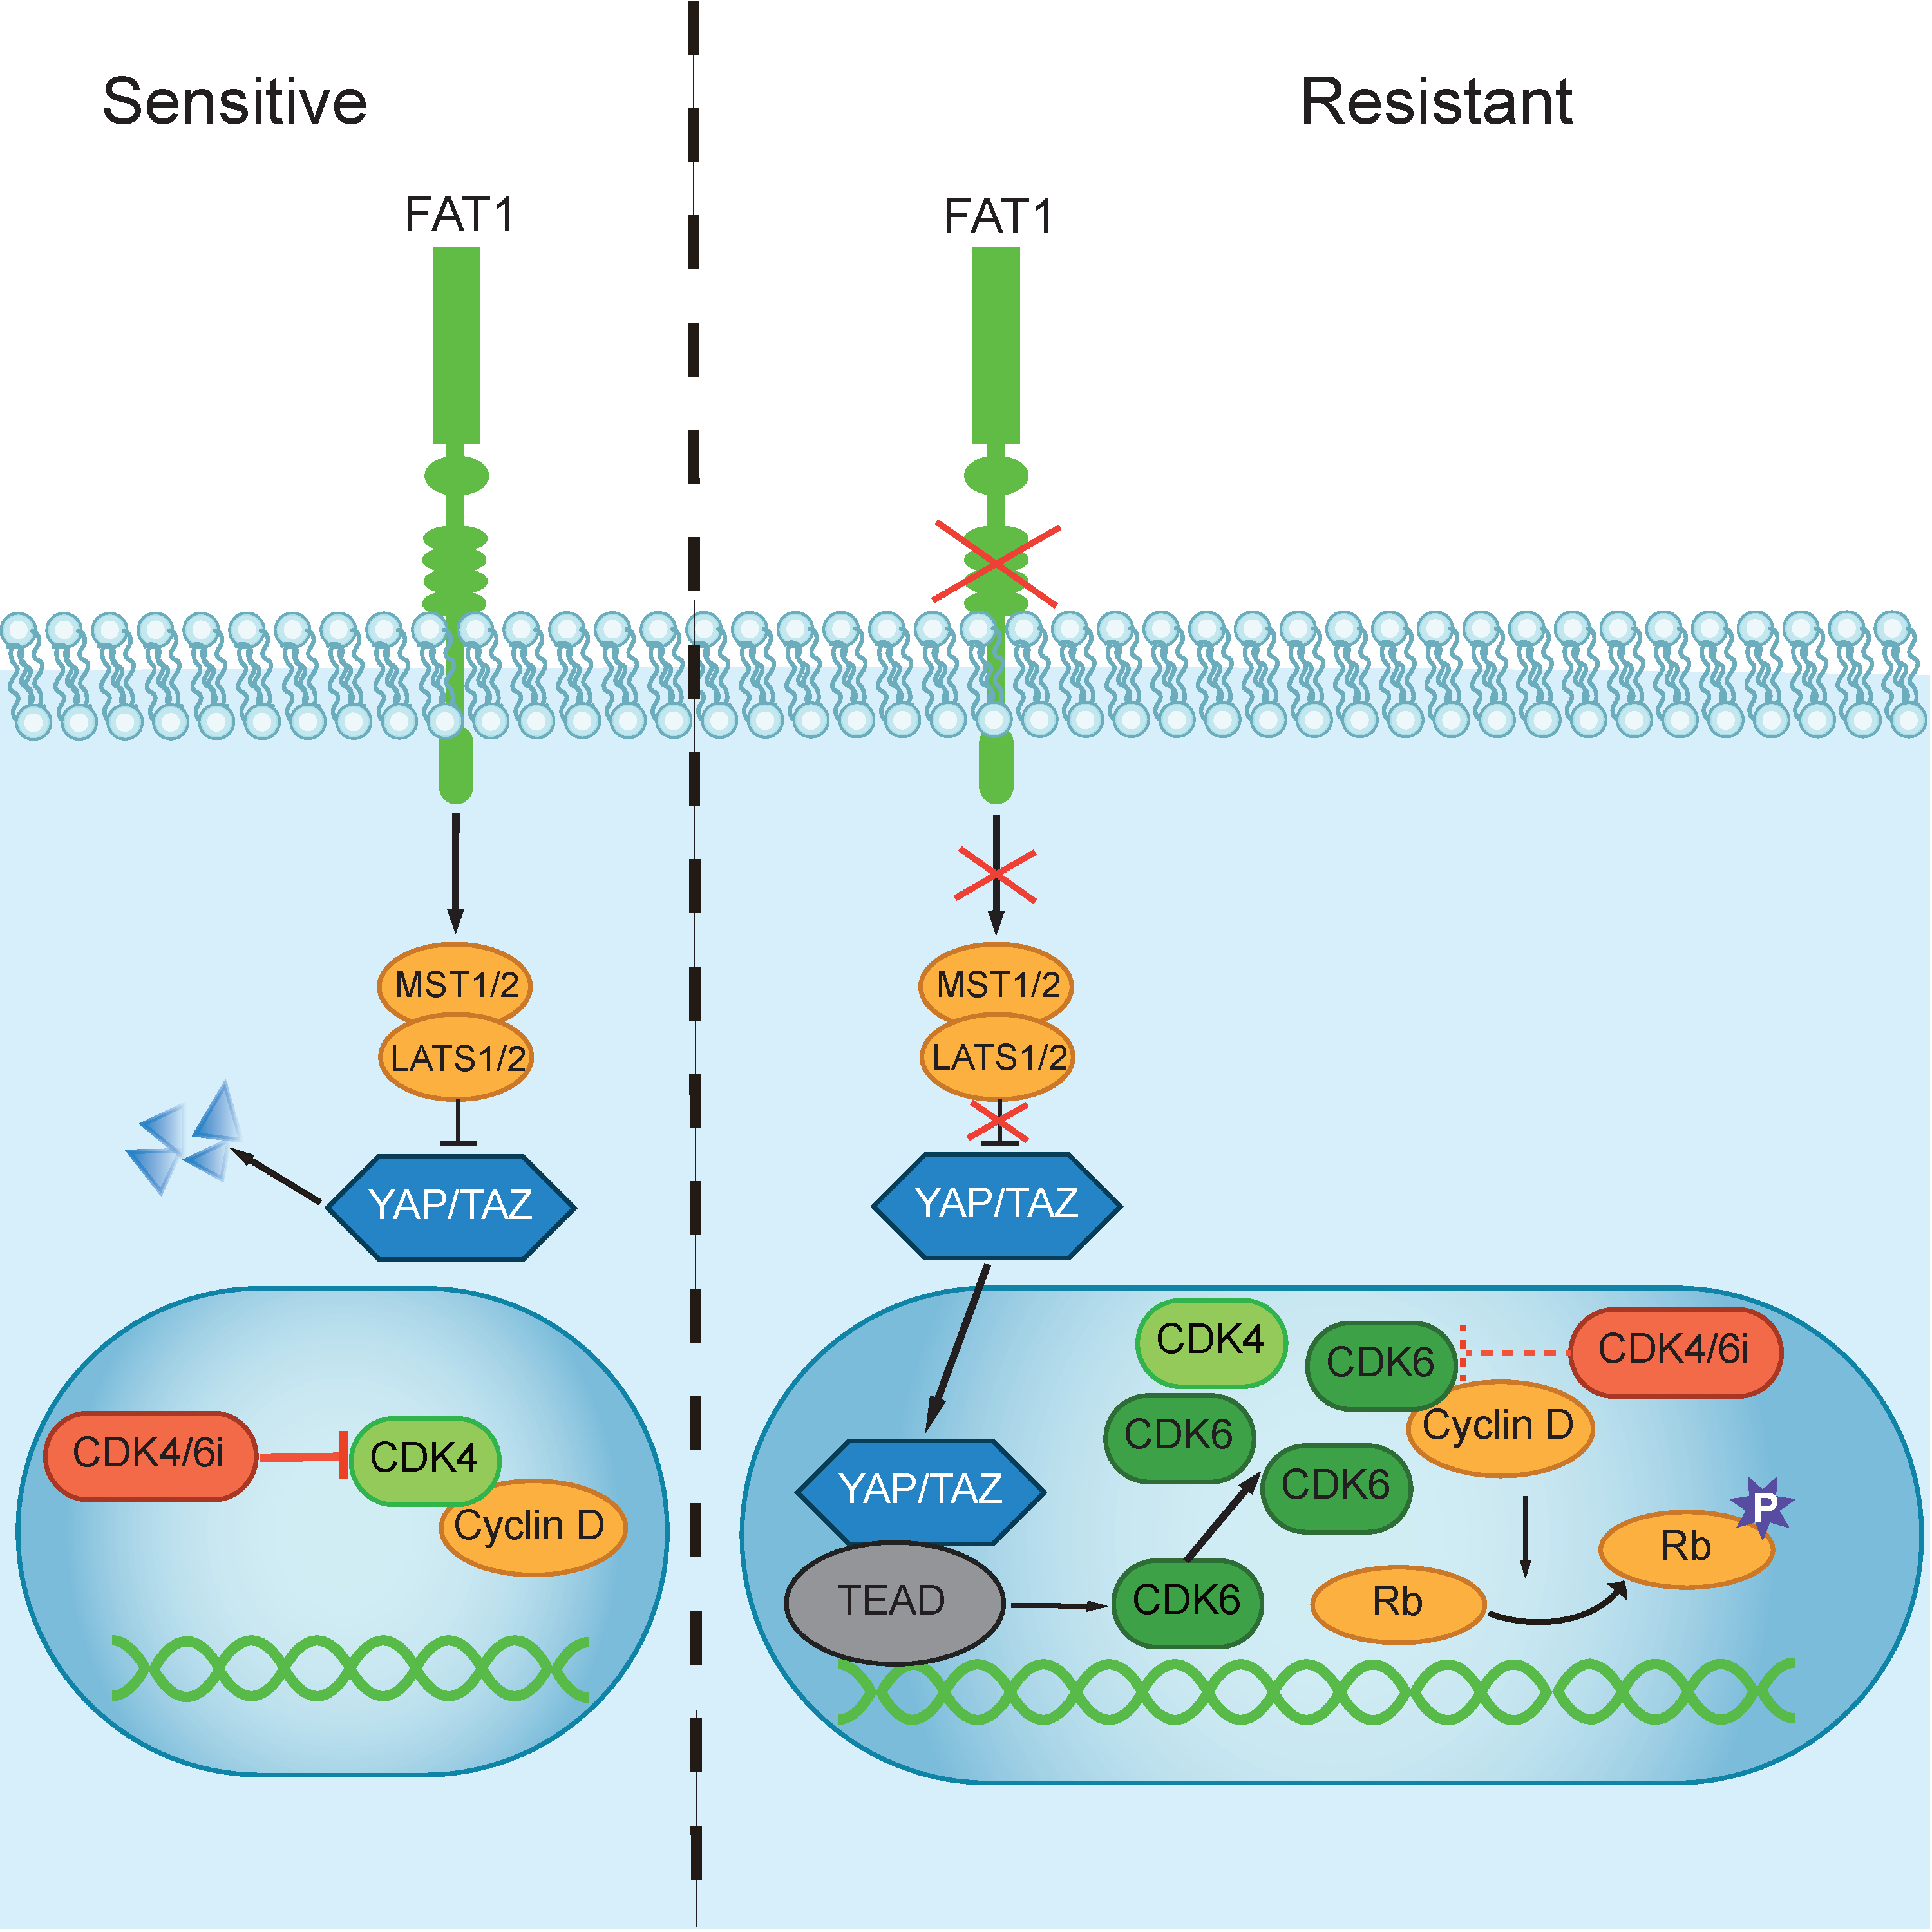
FAT1 loss-of-function alterations results in intrinsic resistance to CDK4/6i
Li Z, Razavi P, et al. Cancer Cell. 2018;34(6):893-905.e8.

Slide 21
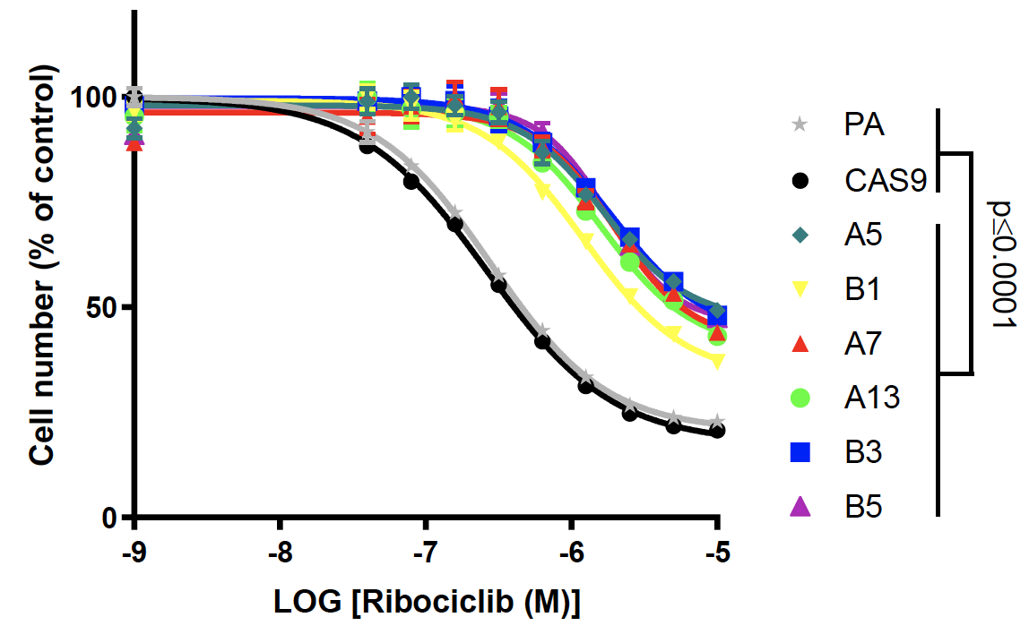
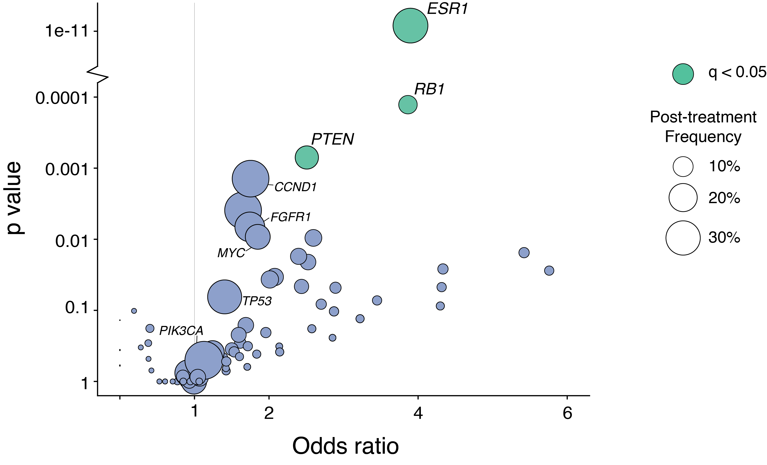
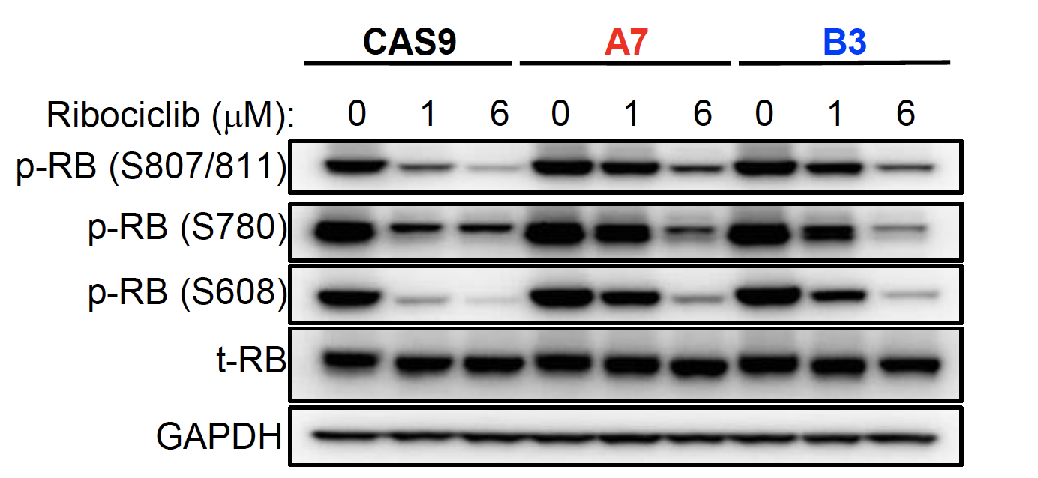
Mechanisms of acquired resistance to CDK4/6i
Beyond RB1, PTEN loss-of-function alterations and ESR1 mutations enriched post-CDK4/6i
n = 838 Pre-CDK4/6i tumors (765 pts)
n = 221 Post-CDK4/6i tumors (185 pts)
PTEN loss drives resistance to CDK4/6i by increasing CDK2 and CDK4 activity through nuclear delocalization of p27
Costa C…Engelman JA et al. Cancer Discov. 2020;10(1):72-85.

Slide 22
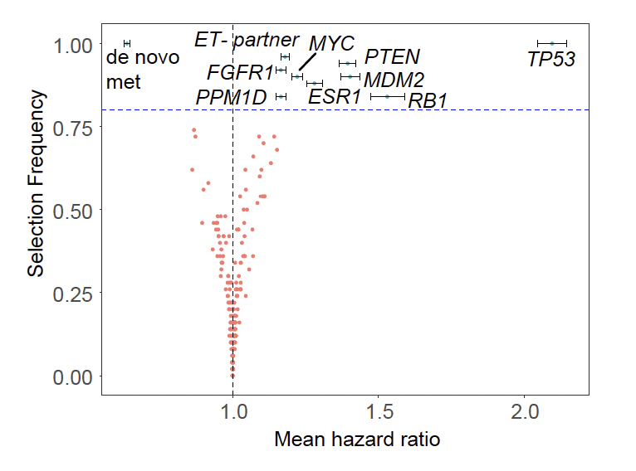
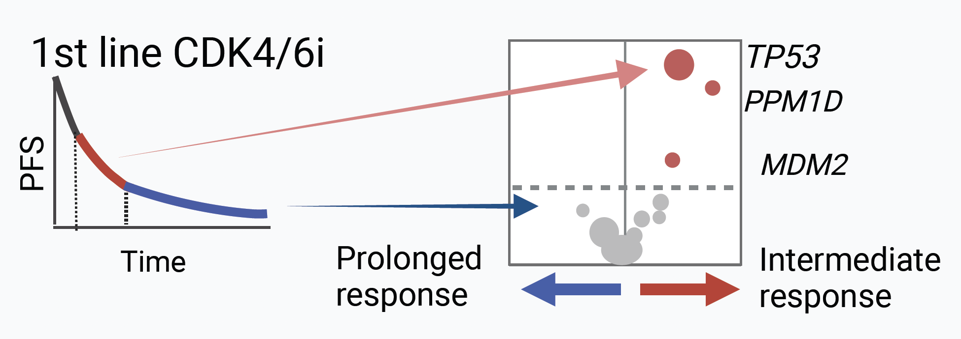
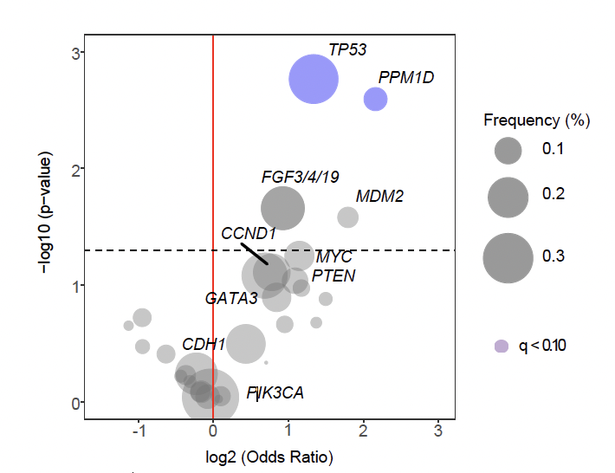
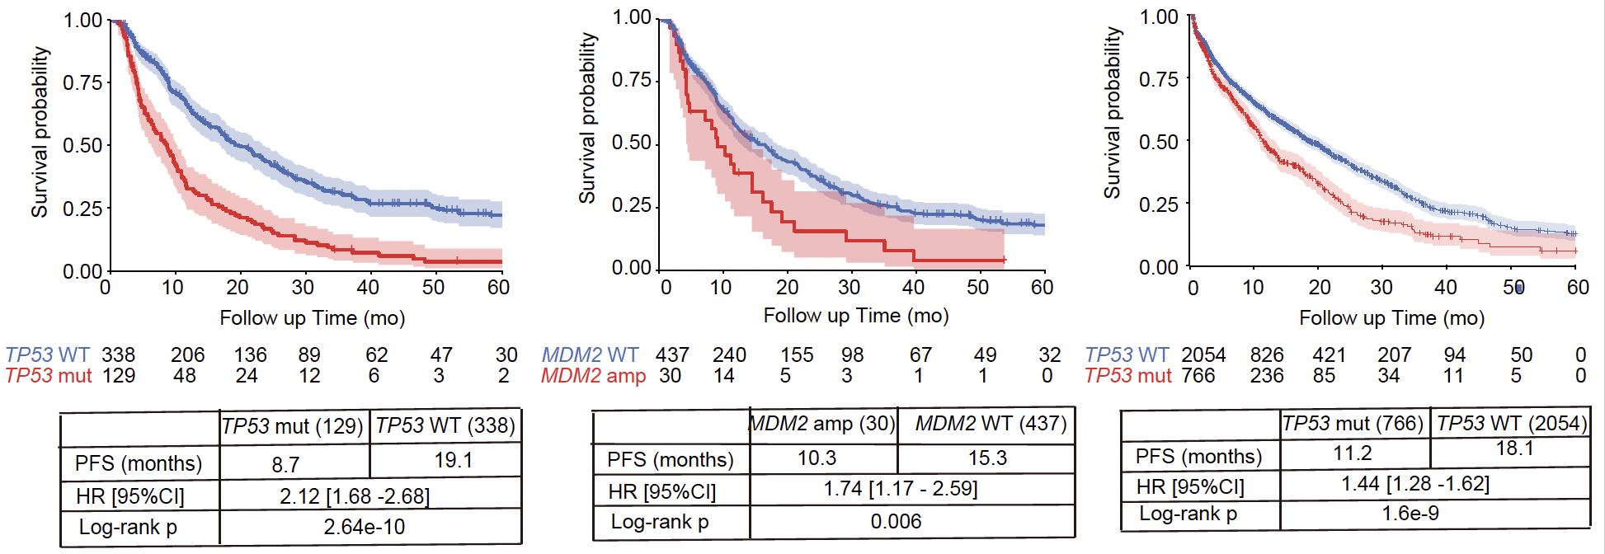
Mechanisms of CDK4/6i resistance among patents failing to achieve long-term responses
Kudo R et al. Cancer Cell. 2024;S1535-6108(24)00357-X.

Slide 23
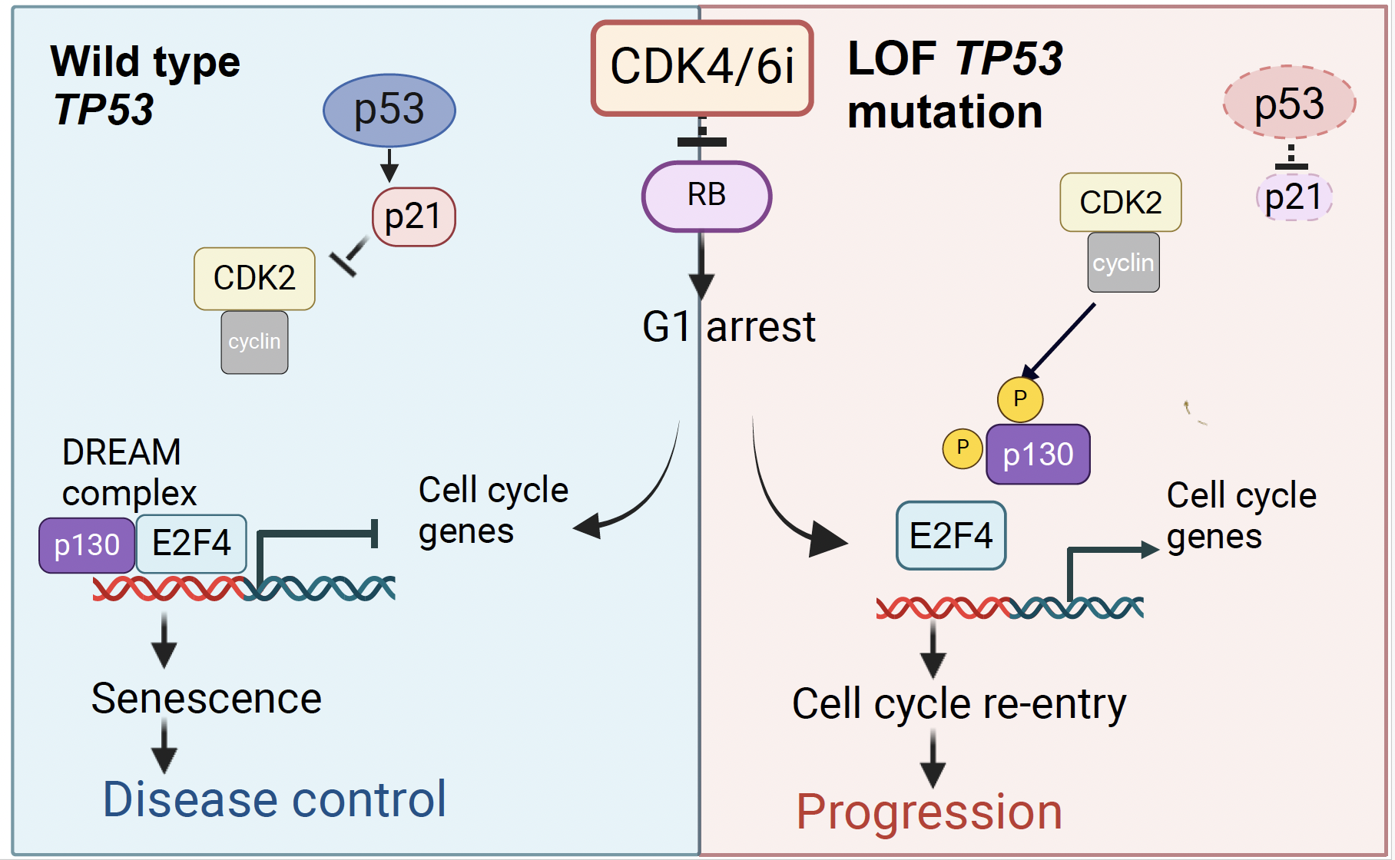
P53 knockout impairs DREAM complex assembly via p21
Kudo R et al. Cancer Cell. 2024;S1535-6108(24)00357-X.

Slide 24
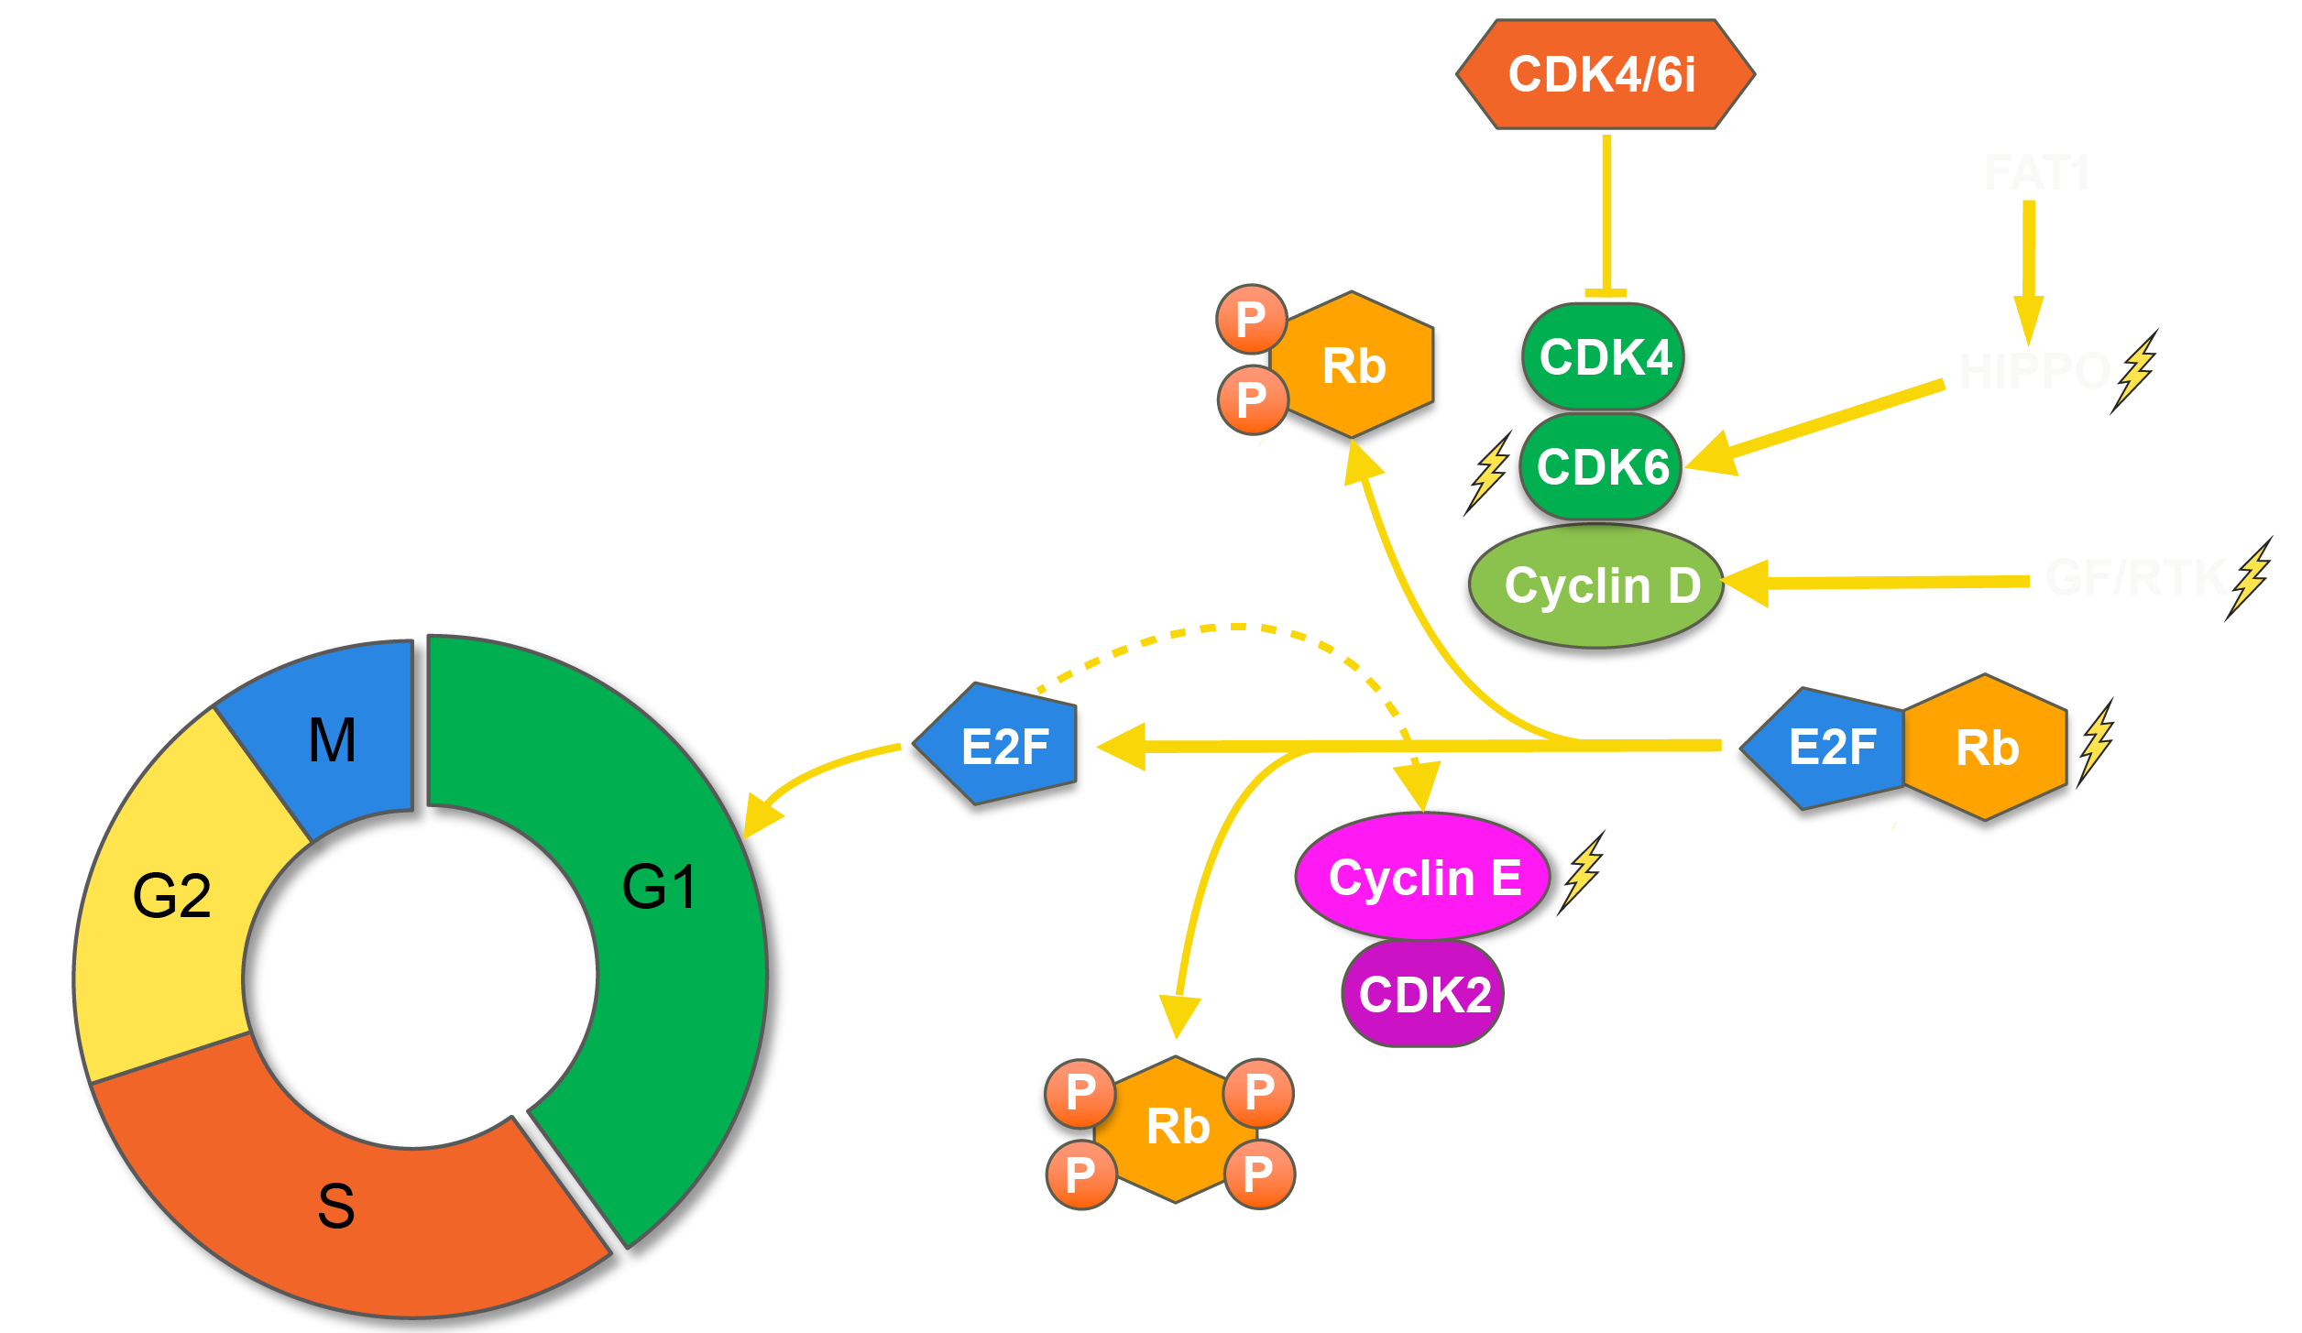
Emerging taxonomy of resistance mechanisms to CDK4/6 inhibitors
3
Bypass mechanisms
(e.g., Cyclin E↑, TP53, MDM2)
1
Hyperactivation
of target
(e.g. FAT1, CDK6↑, PTEN loss, MAPK, FGFR1)
2
Loss of target
(e.g. RB1 loss, HRD)
Li and Razavi et al, Cancer Cell 2018;
Chandarlapaty and Razavi, JCO 2019;
Li et al, Cancer Discovery 2022;
Kudo et al, Cancer Cell 2024;
Safonov et al, SABCS 2021. ASCO 2022;
(In revision Nature)

Slide 25
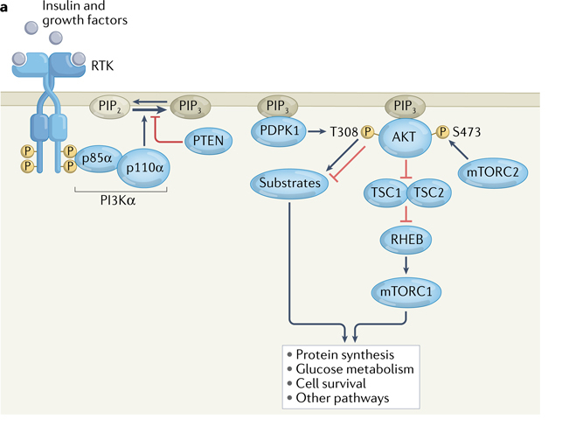
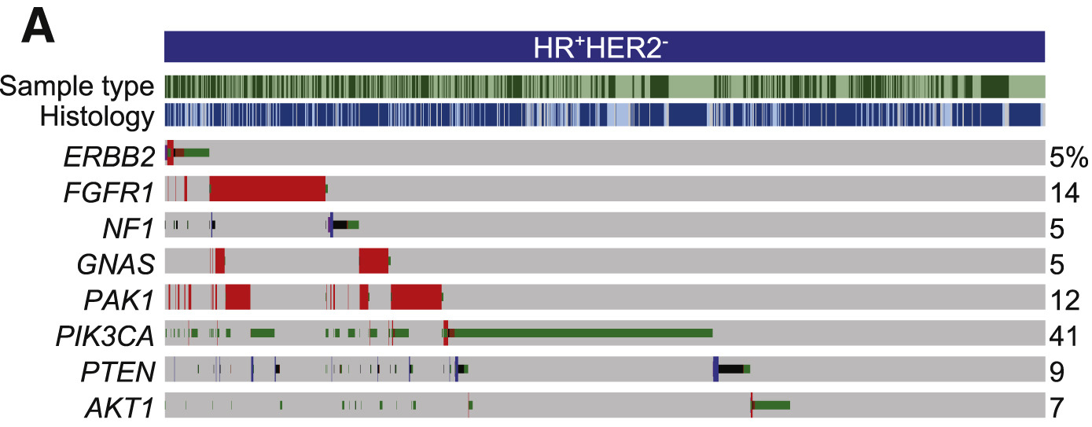
PI3K/AKT is the most commonly mutated oncogenic pathway ER+ MBC
Vasan N, Cantley LC. Nat Rev Clin Oncol.
2022;19(7):471-485.
Razavi P et al. Cancer Cell. 2018;34(3):427-438.e6.

Slide 26

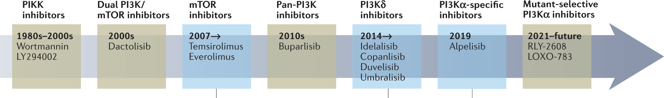
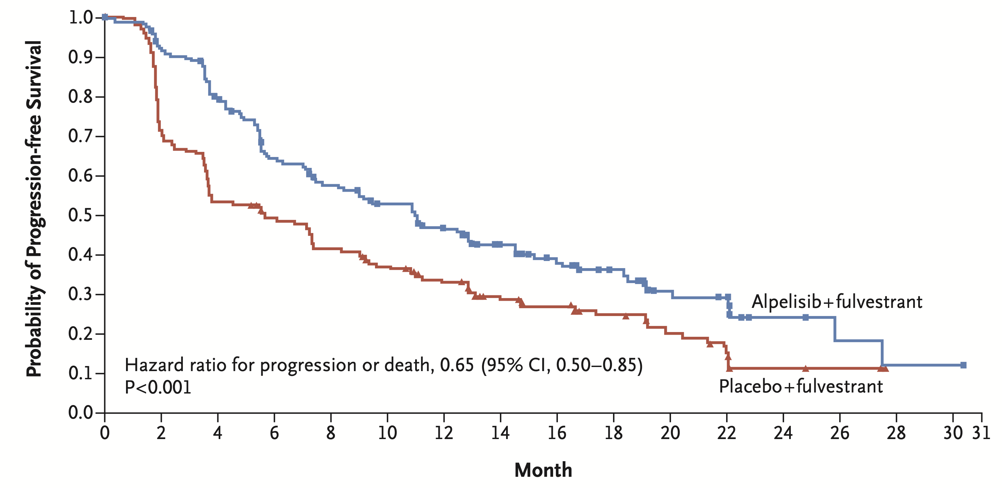
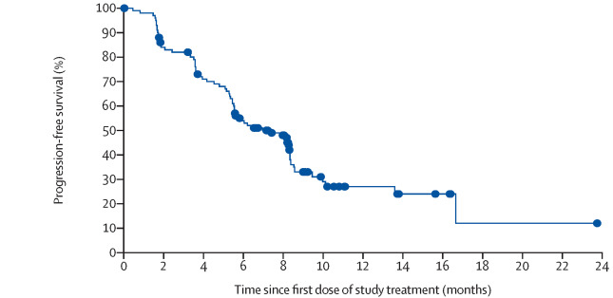
PI3Ki demonstrates clinical efficacy in ER+ MBC
Development of PI3K inhibitors
AKT
inhibitors
2023
Capivasertib
SOLAR-1: Alpelisib + fulvestrant
BYLIEVE: Alpelisib + fulvestrant after CDK4/6i
PFS 11.0 vs 5.7 mo (HR = 0.65)
Median PFS = 7.3 mo
André F et al. NEJM. 2019;380:1929.
1/3 of patients develop > G3 hyperglycemia → challenging in real world
Rugo HS et al. Lancet Oncol. 2021;22:489.
Adopted from Vasan SABCS 20123, with permission.

Slide 27
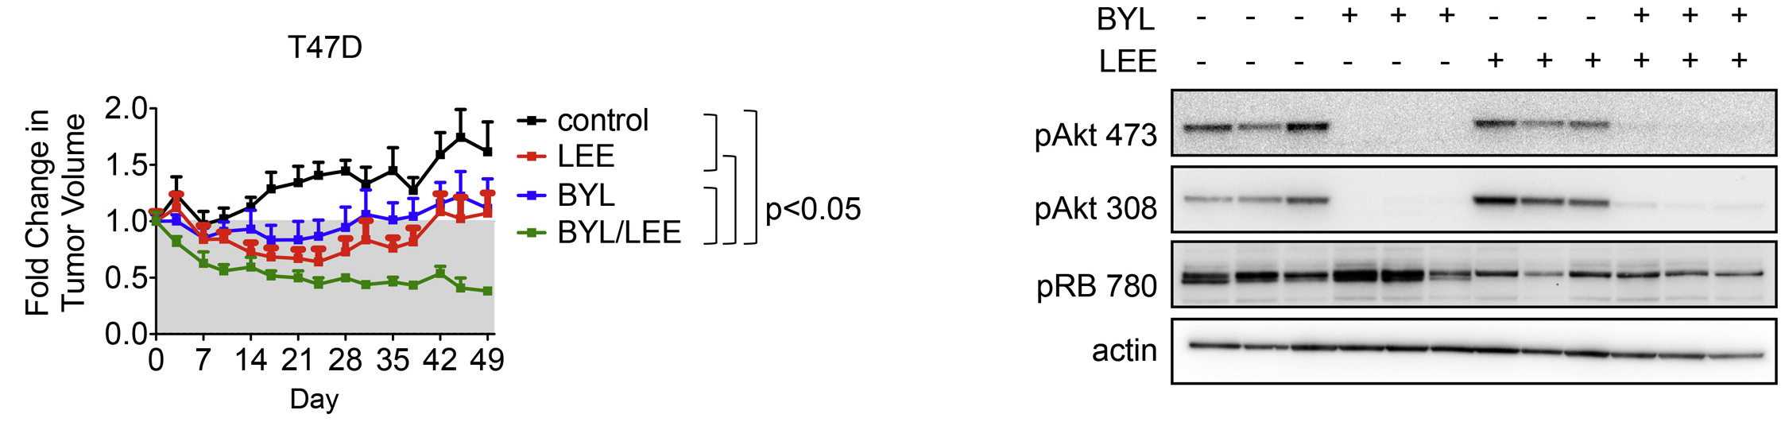
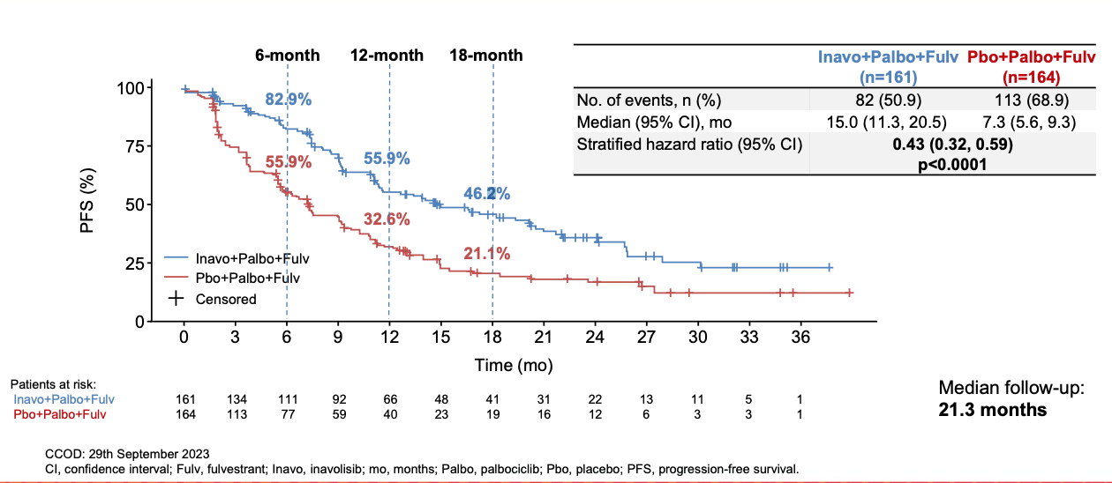
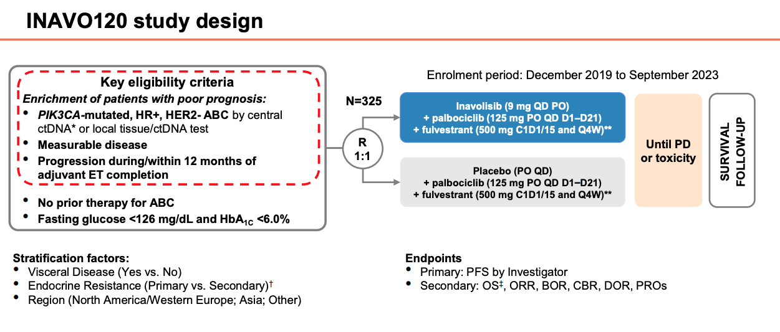
Combination of PI3Ki+CDK4/6i+ET for high-risk patients
Vora SR et al. Cancer Cell. 2014;26:136.
Jhaveri K et al. SABCS 2023. Abstract GS03-13.

Slide 28
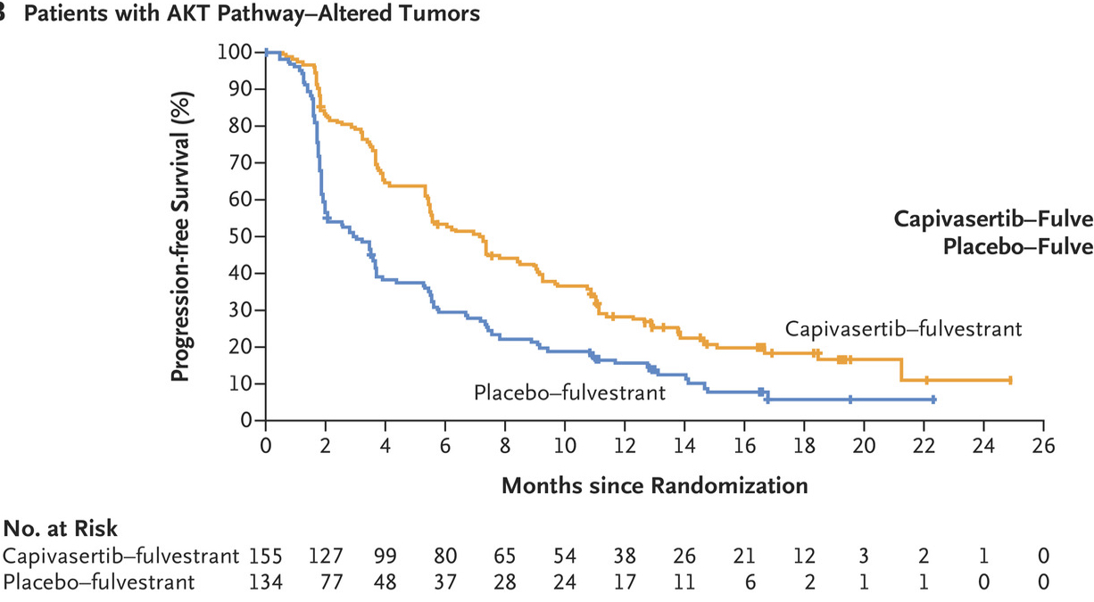

Dual inhibition of AKT and ER
Turner NC et al. N Engl J Med. 2023;388:2058-2070.
Vasan N, Toska E, Scaltriti M. Ann Oncol. 2019;
Toska E et al. Science. 2017;
Bosch A et al. Sci Transl Med. 2015.

Slide 29


Capivasertib provides a meaningful PFS benefit across all the three major categories of PI3K/AKT pathway alterations
Significant benefit in PTEN Alt: Clinically meaningful as PTEN loss results in resistance to both PI3K⍺ and CDK4/6 inhibition.
Howell and Turner et al, SABCS 2023
Costa et al, Cancer Discovery 2020
Razavi et al, Nature Cancer 2020

Slide 30

Cell-free DNA (cfDNA)
Circulating tumor DNA (ctDNA)
Significant gaps in our understanding of cfDNA release, and factors affecting cfDNA shedding and kinetics
Released through apoptosis, necrosis, active secretion, etc.
Fragments have the characteristics of the tissue of origin
Attached to nucleosomes with distinct fragment size
      Normal cfDNA: fragment size of ~167bp
      ctDNA: fragment size of ~147bp
      Fragment size reversely correlated with gene expression
      Abondance of cfDNA from exonic regions
  Rapidly cleared by liver macrophages (Kupffer cells), kidneys, and circulating nucleases, phagocytized by immune cells
Very short half life: Minutes to a few hours → highly dynamic biomarker
cfDNA shedding depends on tissue cell turnover → predominantly from hematopoietic cells in noncancer
ctDNA shedding varies by disease burden, tumor biologic features including tumor proliferation and apoptosis rates, histology, tumor subtype, disease site, tumor vascularization, among others
Lo YM et al. Science. 2021;372.
PMIDs: 33833097, 36681803, 33137955, 32968207, 27392603, 28574818, 28445469

Slide 31
Highly variable and dynamic ctDNA levels require adapting tailored strategies for each indication
30ng cfDNA → 9000 haploid genome equivalents
10%
1%
0.1%
0.01%
<0.01%
Mutant copies:
900
90
9
1
<1

Slide 32

Genomic footprint
Fixed targeted panel
High depth with UMI (barcoding)
Variant allele fraction (log scale)
100%
50%
20%
10%
5%
2%
1%
0.5%
0.2%
0.1%
0.05%
0.02%
Whole genome sequencing 100x
Ultra-deep coverage NGS panels (unique molecular indexes) >20,000x
Small panels
High sequencing depth and sensitivity for robust detection of rare ctDNA mutations
Identify actionable alterations in metastatic setting
Wider utility in tumors with low inter- and intra-tumoral heterogeneity
Broad application of cfDNA, especially for assessment of TMB and MSI, and monitoring tumor evolution to identify mechanisms of resistance requires:
Sufficient genomic coverage to address intra- and inter-patient tumor heterogeneity.
Depth

Slide 33

The genomic landscape of actionable alterations based on ctDNA is comparable to tissue
Tissue
MSK-IMPACT
ctDNA
MSK-ACCESS
04/2024
MSK Breast Translational cohort
Moiso et al, unpublished.
*single highest level of actionable alteration per patient

Slide 34



CH constitutes a significant biological phenomenon and a major source of somatic mutations in cfDNA
Regardless of age, CH was detected in 99% of the cfDNA of the cancer patients and in 94% of the non-cancer controls.
Razavi P et al. Nat Med. 2019;25(12):1928-1937.

Slide 35

Sources of somatic alterations in cfDNA
There is a likelihood of sequencing and biological noise, which can be present in the final calls despite advanced analytics

Slide 36
Estimating the ctDNA fraction is required for accurate interpretation of the ctDNA results
↓ctDNA
False –
False +
Reflex to tissue sequencing
  Incorporating ctDNA fraction assessment assessed by the same assay or orthogonal tests (e.g. sWGS, Methylation) to confirm sufficient ctDNA levels
  Critical to interpret results in the context of ctDNA fraction and to include ctDNA fraction as an essential part of the report
  TMB and MSI assessment requires higher ctDNA fraction and larger panels
  ctDNA TMB can be overestimated in especially when tumor harbors extensive spatial heterogeneity (e.g. APOBEC mutagenesis)

Slide 37

Tissue vs. ctDNA profiling
Detection Challenges
Biological: Detecting certain classes of genomic alterations in ctDNA, such as structural variants, large indels, and copy number alterations (specifically deletions) presents significant challenges due to the low abundance and fragmented nature. of ctDNA.
Technical: Current sequencing technologies may struggle with the sensitivity and specificity required for accurate detection of some of these alterations.
Comprehensive Genomic Landscape
ctDNA provides a more comprehensive genomic landscape of the entire disease as tissue biopsies are subject to sampling bias.
  ctDNA is superior for detecting certain acquired genomic alterations (e.g. ESR1 mutations).
Turnaround Time and Feasibility
ctDNA offers a faster turnaround time and greater feasibility compared to tissue biopsies.
In-Depth Genomic Analysis
Tissue can provide a more detailed and in-depth picture of the genomic landscape.

Slide 38

Proposed ctDNA/tissue clinical profiling in metastatic breast cancer

Slide 39
Can we monitor disease accurately below the ctDNA genotyping LOD thresholds?
Primary resistance
Detectable by genotyping
False Negative
Early resistance
Intermediate response
ctDNA Level
Long-term response
Radiographic POD LOD
ctDNA genotyping LOD
Outstanding response
time

Slide 40



MRD ctDNA assays
Tumor Informed
Identify mutations in tumor tissue => track in plasma (personalized panel)
Generally higher Sensitivity/Specificity
Requires Tumor Tissue (timely first result)
Minimal residual disease detection Surveillance Provide more accurate ctDNA fraction with utility for disease monitoring
Tumor Naïve
Based on copy number, fragment size or methylome
Fast / No Tumor Tissue
Generally, lower sensitivity and specificity
Minimal residual disease detection Surveillance Provide more accurate ctDNA fraction than targeted panels Screening
Wan et al, Cell Med 2022

Slide 41



Detection at the level of <1 PPM is possible
PhasED-seq
LOD95=0.3ppm
Kurtz DM et al. Nat Biotechnol. 2021;39(21):1537-47.
Cabel et al. ESMO 2024, unpublished data.

Slide 42


ctDNA dynamics in early-stage breast cancer
MSK-LINC Breast
Cabel et al. ESMO 2024, unpublished data.

Slide 43
Liquid biopsy to monitor disease burden and intercept resistance before resistance is genotyped
Primary resistance
Detectable by MRD monitoring
Early resistance
Intermediate response
ctDNA Level
Long-term response
Radiographic POD LOD
ctDNA genotyping LOD
ctDNA MRD LOD
Outstanding response
time

Slide 44









Discussed at MTB
1st Line olaparib
CR
Recurrence in brain and liver
Day 1
ctDNA rise
Metabolic CR
Day 360
SBRT to liver
Day 426
Nodular LMD
Systemically NED
Day 761
s/p pCSI &
IT Topotecan
Resection
SRS
2019
45 yo gBRCA1 F with initial Dx
cT3N2 ER+/HER2- G3 IDC in
Neoadjuvant ddAC-T
→ ypT1aN1mi
→ OS/AI + Ribociclib

Slide 45

ctDNA Monitoring in 1L HR+ MBC
-ctDNA is detectable at baseline in >90% of patients (RECIST measurable and non-measurable)
-Changes in ctDNA level were highly correlated with clinical and radiographic assessments
-In responders, ctDNA rise precedes treatment failure
Antras et al. Abstract #3052 (ASCO 2024)
See also Elliott et al, Abstract #1043 (ASCO 2024)

Slide 46









Metastatic carcinoma to brain
s/p resection → SRS
ER 0%, PR 0%, HER2 0, PDL1-
Systemic disease POD
Liver mets
Liver Bx:
ER 0%, PR 0%, HER2 1+, PDL1-
T-DXd
Cont. T-DXd
02/2023
07/2023
08/2023
10/2023
12/2023
02/2024
2020
Initial presentation
54 yo F with cT3N1 G3 TNBC IDC in L breast
Neoadjuvant ddAC-TCarbo
→ ypT1aN0(i+), RCB 1
→ Adjuvant Capecitabine
3/2023
Presented with AMS
Found to have 5x3.9cm left middle cranial fossa brain mets with midline shift
-> s/p urgent craniotomy
-> No systemic disease
-> s/p SRS to tumor bed

Slide 47

ctDNA guided vs image guided monitoring in MBC
ctDNA can potentially be superior in certain scenarios: SD with low disease burden, hard to measure or unmeasurable disease (e.g. bone only, ILC), Stage IV NED, pre and post-localized therapy in oligometastatic setting, etc.

Slide 48
Potential utilities of ctDNA profiling in metastatic breast cancer

Slide 49
Thank you!

