Slide 1


Cancer Survivorship Roadmap
Michelle Mollica, PhD, MPH, RN, OCN
Medical University of South Carolina College of Nursing
Hollings Cancer Center
Notes:
Approx 20 minutes
Please highlight/bold/underline the most important take-home/bottom-line point on individual slides (as well as including a final slide covering practical takeaways for patient management). This helps participants understand the critical points on what can be very dense data slides.
Please use summary tables/slides when possible rather than multiple slides of study details, to help conserve time as well as clarify key points.
In addition, be careful of using confusing terminology, and focus on the big picture and take-away messages to avoid overwhelming participants with details.
Where applicable, try to integrate real-world examples to anchor the material and make it more relevant.
Please include NCCN and ASCO guidelines when feasible and relevant to your lecture – tumor boards and insurance companies increasingly emphasize these.

Slide 2
Overview
Background and definitions
Overview of survivorship care
Considerations for specific breast cancer survivor populations
Resources
MUSC Hollings Cancer Center

Slide 3
Background

Slide 4


Slide 5


Exponential Growth in the Number of Cancer Survivors
Tonorezos et al. JNCI. 2024; 116 (11): 1784-1790.
Notes:
NCI recognizes NCCS’s definition of a cancer survivors as any individual from the time of diagnosis through the balance of life. This includes those living with cancer, and those who are free from cancer.
Collectively, there are 18 M cancer survivors in the US, and an estimated 16 M have been living more than 5 years after their cancer diagnosis.

Slide 6
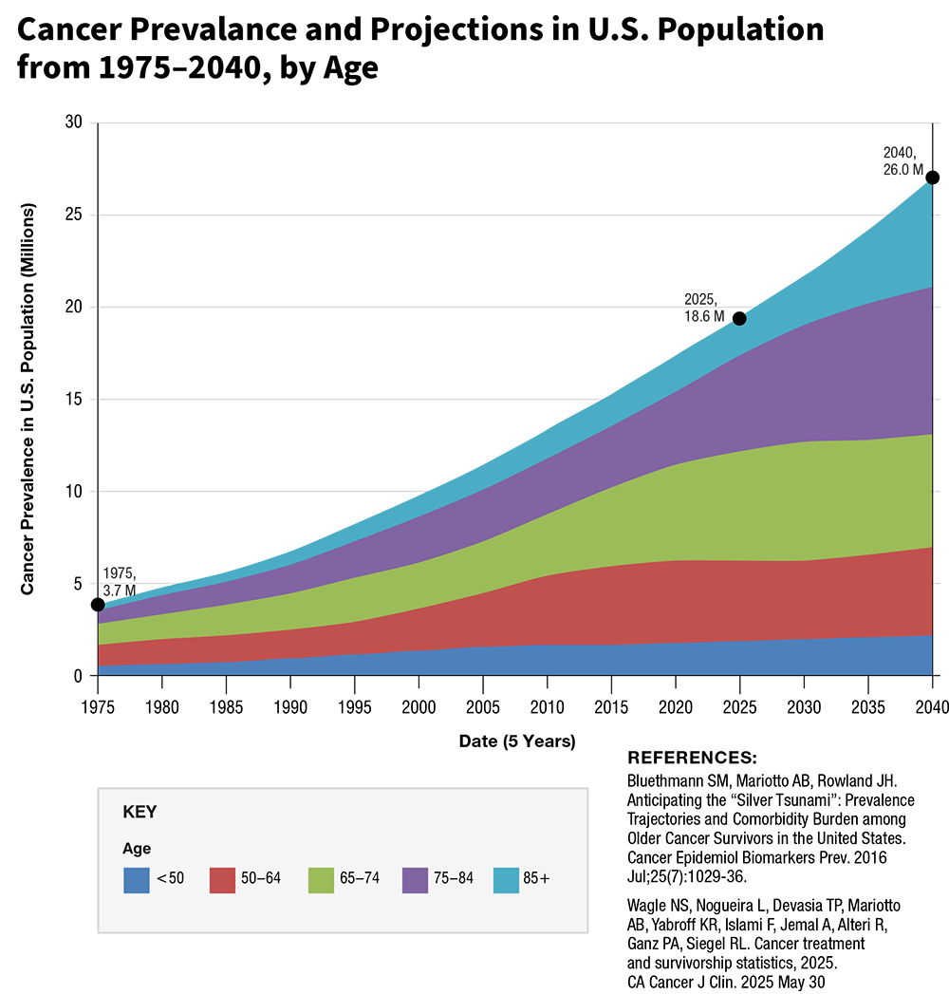
Trends in Survivorship

Slide 7
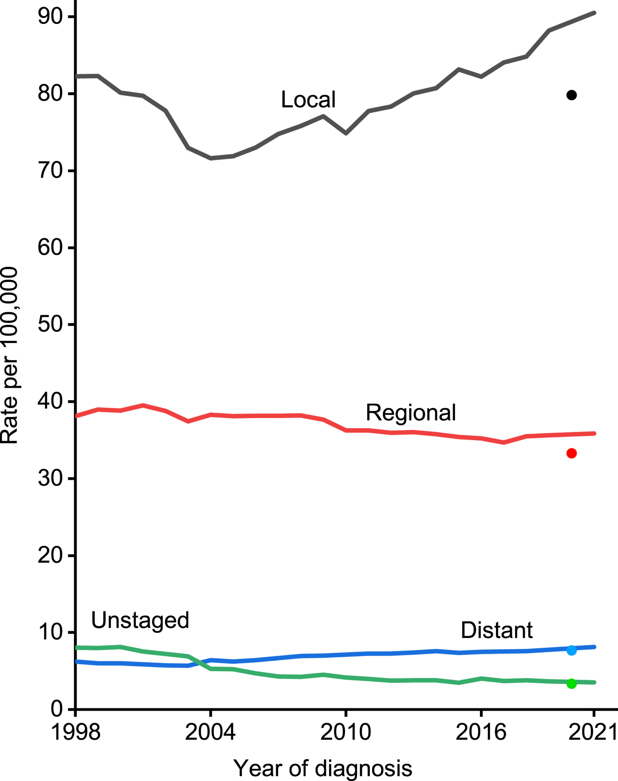
Trends in Female Breast Cancer Rates (age adjusted) by Stage, 1998-2021
Giaquinto et al. CA: A Cancer J Clinicians. 2024; 74 (6): 477-495.
Notes:
Trends in female breast cancer incidence rates by stage, United States, 1998–2021. Rates are age adjusted to the 2000 US standard population and adjusted for delays in reporting.
CA A Cancer J Clinicians, Volume: 74, Issue: 6, Pages: 477-495, First published: 01 October 2024, DOI: (10.3322/caac.21863)
The increase in breast cancer incidence is largely confined to localized-stage diagnosis (Figure 10), which increased by 1.4% per year from 2012 to 2021 in contrast to stable rates for regional-stage disease. Although distant-stage disease rates also increased by 1.1% per year, this likely reflects improved staging because the rate of unstaged disease decreased by a similar magnitude (1.4% per year). The increase in distant stage may also reflect upstaging (from regional to distant) as the growing prevalence of advanced imaging has resulted in increased detection of micrometastases.^{64, 65}

Slide 8
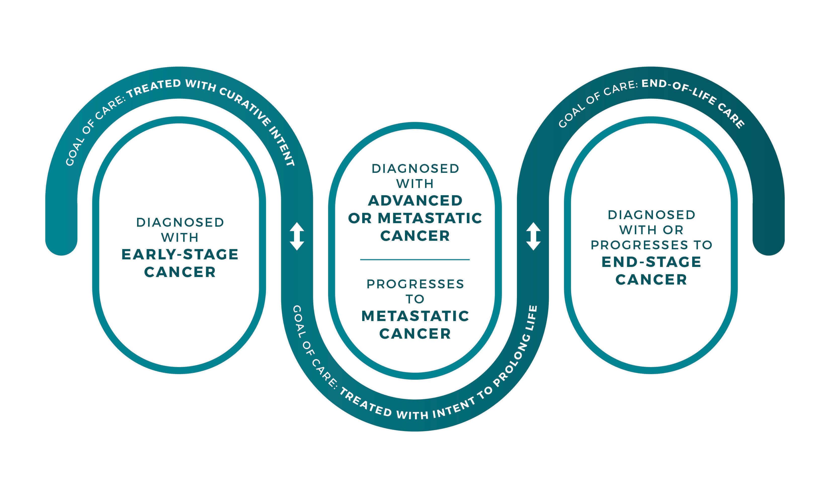
Phases of Cancer Survivorship

Slide 9
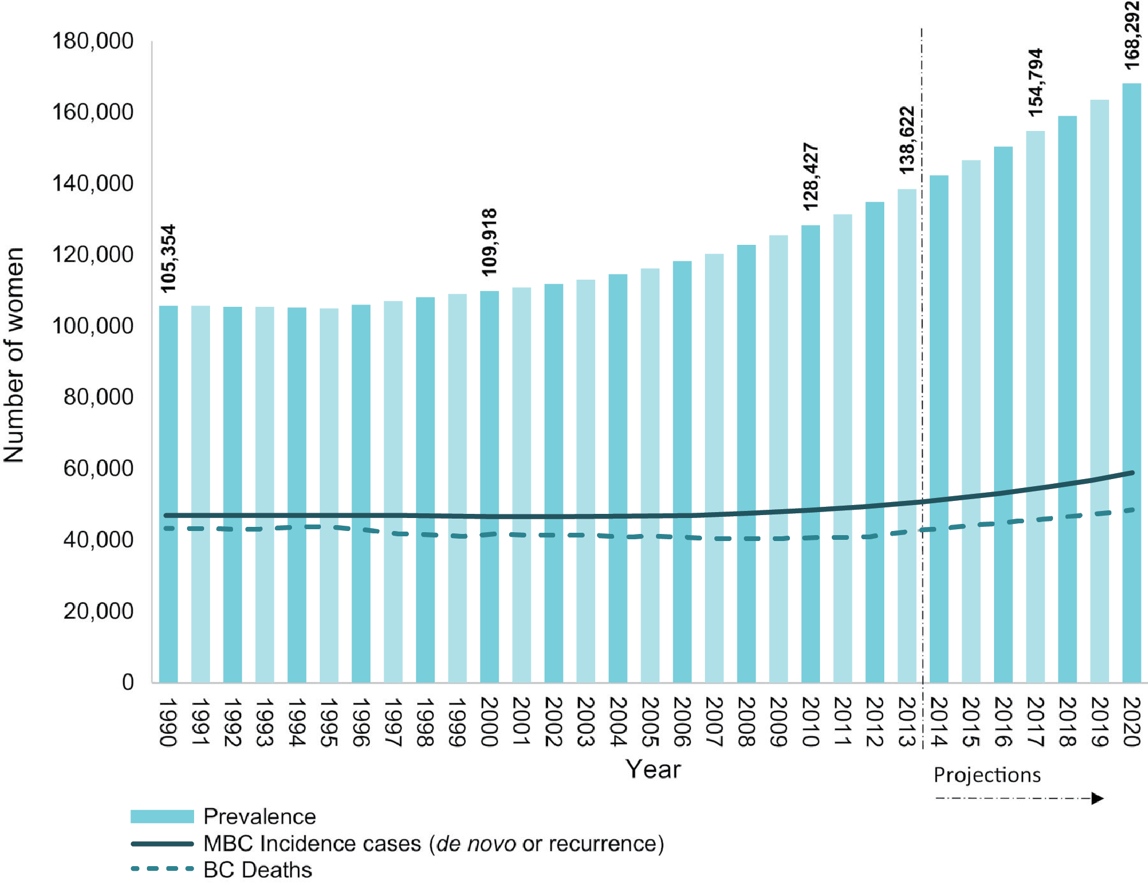
Increasing Prevalence of Metastatic Breast Cancer
Mariotto et al. CEBP. 2017; 26 (6): 809-815.

Slide 10
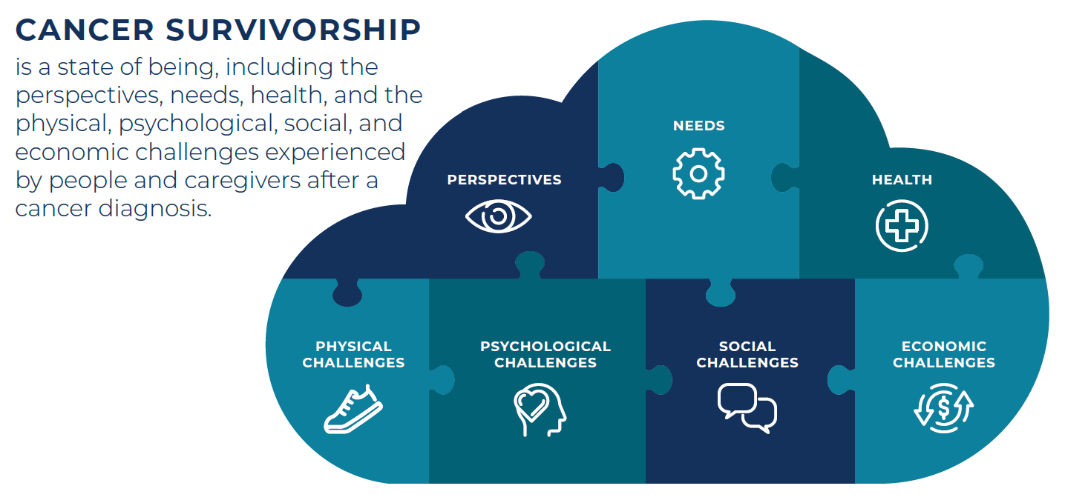
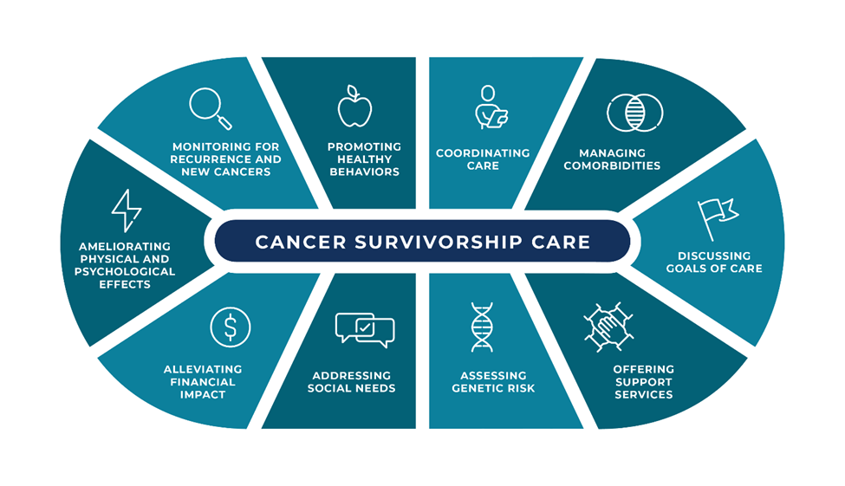

Slide 11
Overview of Survivorship Care

Slide 12
Cancer Survivorship Care: From Diagnosis Forward

Slide 13
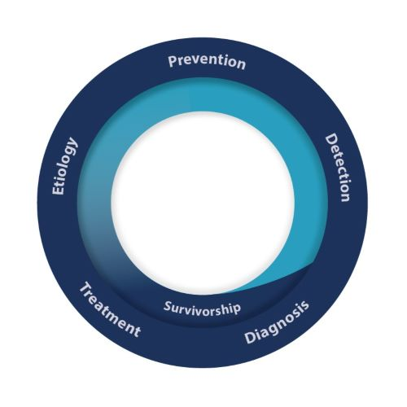
Importance of Survivorship Care
Improves quality of life
Enhances health outcomes
Promotes healthy behaviors
Supports caregivers

Slide 14
Survivorship Guidelines
National Comprehensive Cancer Network (NCCN) survivorship guidelines
American Society of Clinical Oncology (ASCO) guidelines
  Fatigue
  Anxiety and depression
  Chemotherapy-induced peripheral neuropathy
  Fertility preservation
  Cancer specific: prostate, breast, colorectal, head and neck, gynecological malignancies
Key components: surveillance for recurrence and new cancers, managing symptoms, health promotion, managing comorbidities, care coordination
Notes:
Key components: surveillance for recurrence and new cancers, managing symptoms, health promotion, managing comorbidities, care coordination
Please make sure references are updated. The preferred format for references:
Woyach JA et al. N Engl J Med. 2018;379(26):2517-2528.
Shanafelt TD et al. 2019 ASH Annual Meeting. Abstract 33.

Slide 15
ACS/ASCO Breast Cancer Survivorship Guidelines
Runowicz et al. J Clin Oncol. 2016; 34: 611-635.
Category | Recommendation
Surveillance for recurrence | Follow up based on age, diagnosis, treatment History and physical q 3-6 months for 3 years, q 6-12 months for next 2 yrs and then annually Annual mammography for intact breast(s); MRI only for high-risk
Screening for subsequent primary cancers | Screening per general population guidelines Annual gyn assessment for postmenopausal women on selective estrogen receptor modulators (SERMs; e.g., tamoxifen) Offer genetic counseling if hereditary risk factors are suspected
Management of long-term and late-effects | Assess/manage: body image, lymphedema, cardiotoxicity, cognitive impairment, distress, depression, anxiety, fatigue, bone health, infertility, sexual health Refer to specialists
Health promotion | Counsel on healthy weight, physical activity, nutrition, tobacco cessation
Care coordination | Maintain communication between oncology and primary care Include caregivers in survivorship care Communicate survivorship follow up plan
Notes:
Carolyn D. Runowicz et al.
American Cancer Society/American Society of Clinical Oncology Breast Cancer Survivorship Care Guideline. J Clin Oncol 34, 611-635(2016).
DOI:10.1200/JCO.2015.64.3809
* Focused on female adult breast cancer survivors
1. Surveillance for Recurrence
Individualize follow-up based on age, diagnosis, and treatment.
History & physical exam: every 3–6 months for 3 years, every 6–12 months for next 2 years, then annually.
Annual mammography for intact breast(s); MRI only for high-risk patients.
Routine labs/imaging (other than mammography) not recommended for asymptomatic patients.
Educate survivors on signs/symptoms of recurrence.
Offer counselingifpotentialhereditaryriskfactorsaresuspected(eg,womenwithastrongfamilyhistoryofcancer [breast,colon,endometrial]orage60y oryoungerwithtriple-negativebreastcancer
2. Screening for Second Primary Cancers
Screen for other cancers as per general population guidelines.
Annual gynecologic assessment for postmenopausal women on SERMs (e.g., tamoxifen).
3. Management of Long-Term & Late Effects
Assess/manage: body image, lymphedema, cardiotoxicity, cognitive impairment, distress/depression/anxiety, fatigue, bone health, musculoskeletal symptoms, pain/neuropathy, infertility, sexual health, premature menopause/hot flashes.
Refer to specialists as needed (e.g., lymphedema therapist, mental health, reproductive endocrinology).
4. Health Promotion
Counsel on healthy weight, regular physical activity (≥150 min moderate or 75 min vigorous/week + strength training), nutrition (high in vegetables/fruits/whole grains, low in saturated fat, limited alcohol), and smoking cessation.
Assess information needs and provide resources.
5. Care Coordination
Obtain and use a survivorship care plan and treatment summary.
Maintain communication with oncology team.
Include caregivers/family in survivorship care.

Slide 16
National Standards for Cancer Survivorship Care
  Standards: recommendations for health systems that apply to the patients they serve
Developed by the NCI, in partnership with several HHS agencies and subject matter experts
Includes essential health system process and policy components; and assessment of the quality of survivorship care
Can be utilized by health systems to assess the quality of survivorship services and guide the development of new programs
  Toolkit available on NCI OCS website: https://cancercontrol.cancer.gov/ocs/special-focus-areas/national-standards-cancer-survivorship-care
  Mollica et al. JNCI. 2024; 18 (4): 1190-1199.

Slide 17
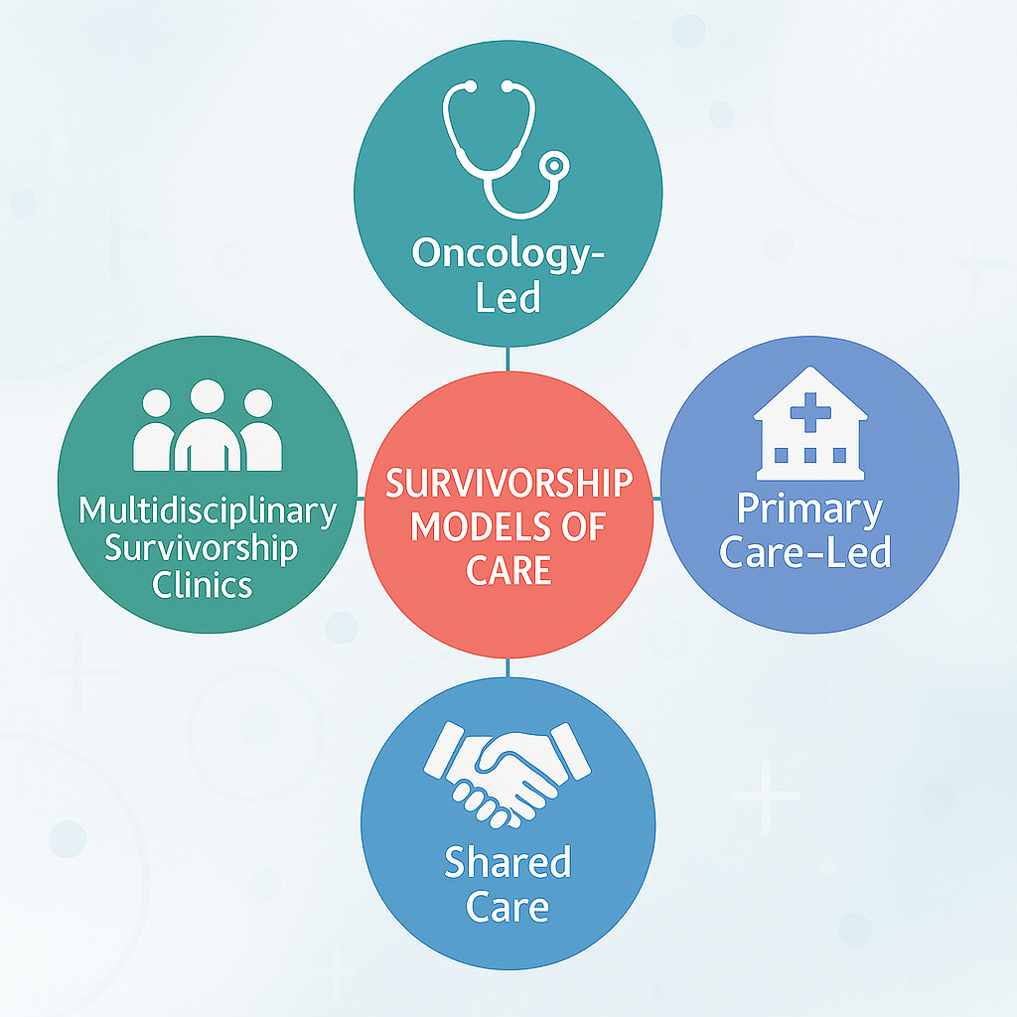
Models of Care
Goal: Precision survivorship care
  Right care
  Right place
  Right time
  Right patient
  Right healthcare team

Slide 18
Physical Effects
Fatigue
Cardiac toxicity
Types of physical effects
  Acute: post-op pain, fatigue
  Long-term: lymphedema, neuropathy
  Late: cardiac toxicity
Clinical role:
  Assess physical symptoms and burden
  Screen for bone health
  Monitor cardiac function
  Refer for rehabilitation
  Address fertility concerns if appropriate
Pain
Fertility issues
Notes:
Types of Effects: Acute (e.g., post-op pain, fatigue), long-term (lymphedema, neuropathy, bone loss), late (cardiac toxicity, secondary malignancies). Clinical Role: Assess and document physical symptoms (pain, lymphedema, neuropathy, arthralgias, cognitive changes).
Screen for bone health (DEXA for those on aromatase inhibitors).
Monitor cardiac function if history of anthracyclines/trastuzumab.
Manage and refer for rehabilitation (PT/OT for lymphedema, mobility).
Address fertility concerns in premenopausal patients.
Bottom Line: Early identification and management of physical effects improves quality of life and adherence to therapy.

Slide 19

Psychosocial Effects
Common psychosocial symptoms: anxiety, depression, fear of recurrence/progression, body image concerns, financial hardship
Clinical role:
  Routinely screen for psychosocial symptoms
  Assess financial and employment issues/challenges
  Refer to psychosocial oncology, counseling as needed
Notes:
Bottom Line: Proactive psychosocial screening and intervention are essential for holistic survivorship care.

Slide 20

Monitoring for Recurrence
History and physical q 3-6 months for 3 years, q 6-12 months for next 2 yrs and then annually
Annual mammography for intact breast(s); MRI only for high-risk
Clinical role:
  Educate patients on signs/symptoms
  Assess adherence to adjuvant therapies and/or risk-reducing strategies
  Follow guidelines for surveillance
Notes:
Bottom Line: Evidence-based surveillance avoids unnecessary tests and focuses on early detection.

Slide 21

Screening for Subsequent Cancers
Risk factors: prior radiation, genetic factors, lifestyle
Screening: follow age-appropriate screening guidelines, assess family history and refer to genetic counseling as appropriate
Clinical role:
  Coordinate screening for subsequent cancers
  Educate survivors on the importance of routine screening
  Reinforce healthy behaviors (physical activity, tobacco cessation)
  Manage anxiety related to screening
Notes:
Bottom Line: Individualized screening and prevention strategies reduce risk of second cancers.

Slide 22
Health Promotion
Physical Activity
Nutrition
Tobacco Cessation
Stress management
Encourage regular physical activity, healthy nutrition, tobacco cessation, weight management
Clinical role:
  Assess lifestyle behaviors
  Refer to dietitian, tobacco treatment programs, exercise programs
  Educate on importance of healthy behaviors
Sun Safety
Vaccines
Notes:
Bottom Line: Health promotion is a cornerstone of survivorship and reduces recurrence risk.

Slide 23

Coordinating Care with Primary Care
Primary care providers are essential survivorship care team members, supporting:
  Screening for subsequent cancers
  Health promotion
  Chronic disease management
Shared care model: co-managed care between oncology and primary care with collaboration and coordination
Clinical role:
  Encourage survivors to continue to see their primary care provider even during cancer treatment
  Provide clear guidance on when to contact PCP versus oncology
Notes:
Bottom Line: Effective coordination ensures comprehensive care and avoids gaps in management.

Slide 24

Communication and Decision-Making
Patient-centered care:
  Elicit survivor goals, preferences, values
  Discuss sensitive topics (sexual health, fertility, end-of-life care)
  Include caregivers/family in discussions as appropriate
Clinical role:
  Use shared decision-making tools
  Maintain respectful, clear communication
  Advocate for survivor needs and preferences
Notes:
Bottom Line: Shared decision-making and open communication improve satisfaction and outcomes.

Slide 25
Survivorship Services to Consider for Breast Cancer Survivors
Supportive care services: financial counseling, social work, OT, PT, psychosocial oncology
Health and wellness promotion
Complementary and integrative services: art therapy, pet therapy, yoga
Support groups
Survivorship clinic
Caregiver support

Slide 26
Considerations for Specific Survivor Populations

Slide 27
Emerging and Young Adult Survivors (18-39)
Physical and psychosocial impact: cardiac, fertility, neurocognitive, body image issues, social relationships
YA survivors may have issues adhering to follow-up care because of their life stage and school or employment demands
Clinical role:
  Educate and empower AYA survivors to manage their health and attend follow-up visits and surveillance
  Assess for symptoms and acknowledge the challenges they may be facing
  Provide referrals as needed

Slide 28
Older Adult Survivors
Often managing cancer along with other comorbidities (e.g., diabetes), which impacts symptoms, treatment tolerance, polypharmacy
Cancer impacts mobility, independence, quality of life
Need to have discussions about goals of care, advanced directives, integrating palliative care
Clinical role:
  Assess physical and psychosocial symptoms
  Educate survivors and their caregivers about symptoms, self-care, and healthy behaviors
  Encourage older adult survivors to continue to see their primary care provider and attend follow up visits with the oncology team

Slide 29

Cancer Caregivers
Caregivers are essential members of the care team, even in long-term survivorship
Clinical role:
  Recognize the important role of cancer caregivers in the care team
  Educate caregivers on the importance of caring for themselves
  Assess for burnout, depression, anxiety, physical health decline
  Encourage caregivers to see their healthcare providers regularly

Slide 30
Resources for Survivors and Caregivers
CancerNation (National Coalition for Cancer Survivorship) Survivorship Checklist: https://canceradvocacy.org/resources/survivorship-checklist/survivor-resources/#guidelines
  Survivorship Resources: https://canceradvocacy.org/resources/survivorship-checklist/survivor-resources/
American Cancer Society Survivorship Resources: https://www.cancer.org/cancer/survivorship.html
National Cancer Institute Survivor and Caregiver Stories: https://cancercontrol.cancer.gov/ocs/resources/survivor-caregiver-stories
Cancer Hope Network peer support: https://cancerhopenetwork.org/

Slide 31
Additional Resources
ASCO Survivorship Compendium: https://www.asco.org/news-initiatives/current-initiatives/cancer-care-initiatives/prevention-survivorship/survivorship-compendium
Association of Cancer Care Centers Survivorship Resources: https://www.accc-cancer.org/projects/supportive-care-resource-hub/survivorship-resources
Commission on Cancer Survivorship Standard: https://www.facs.org/quality-programs/cancer-programs/commission-on-cancer/standards-and-resources/
National Cancer Institute National Standards for Cancer Survivorship Care: https://cancercontrol.cancer.gov/ocs/special-focus-areas/national-standards-cancer-survivorship-care

Slide 32
Takeaways for Clinical Management
Proactive, guideline-based survivorship care improves quality of life, reduces recurrence risk, and supports holistic well-being for survivors
Guidelines include:
  Personalized surveillance for recurrence
  Screening for subsequent malignancies
  Managing long-term and late effects
  Promoting healthy behaviors
  Coordinating care
Notes:
Surveillance:
Individualize follow-up based on age, diagnosis, and treatment.
History & physical: every 3–6 months for 3 years, every 6–12 months for next 2 years, then annually.
Annual mammography for intact breast(s); MRI only for high-risk patients.
Avoid routine labs/imaging for asymptomatic patients.
Screening for Second Cancers:
Follow general population guidelines.
Annual gynecologic assessment for postmenopausal women on SERMs.
Refer for genetic counseling if hereditary risk factors are suspected.
Management of Long-Term & Late Effects:
Routinely assess for lymphedema, cardiotoxicity, cognitive changes, bone health, distress, sexual health, and menopausal symptoms.
Refer to specialists as needed (e.g., lymphedema therapist, mental health, reproductive endocrinology).
Health Promotion:
Counsel on healthy weight, regular physical activity, balanced nutrition, and tobacco cessation.
Provide resources and referrals for lifestyle support.
Care Coordination:
Maintain clear communication between oncology and primary care.
Use survivorship care plans and include caregivers/family in care discussions.
Lymphedema:
Early referral to physical therapy for any swelling or heaviness in the arm/chest wall.
Teach patients self-monitoring and gentle exercises; avoid blood draws/BP on affected side.
Cardiac Toxicity:
Monitor cardiac function in patients with history of anthracyclines or trastuzumab.
Manage cardiovascular risk factors aggressively (hypertension, hyperlipidemia, diabetes).
Bone Health:
For those on aromatase inhibitors, order baseline and periodic DEXA scans.
Recommend calcium, vitamin D, and weight-bearing exercise.
Cognitive Changes (“Chemo Brain”):
Validate symptoms; encourage cognitive rehabilitation strategies and mental stimulation.
Screen for depression/anxiety, which can worsen cognitive complaints.
Menopausal Symptoms/Sexual Health:
Non-hormonal options for hot flashes (SSRIs, SNRIs, gabapentin).
Vaginal moisturizers/lubricants for dryness; refer to sexual health counseling if needed.
Adherence to Endocrine Therapy:
Ask about side effects at every visit; address barriers to adherence.
Use shared decision-making to discuss risks/benefits and duration of therapy.
Psychosocial Support:
Routinely screen for distress, depression, and anxiety.
Connect patients with support groups, counseling, and survivorship resources.
Care Coordination:
Provide a written survivorship care plan to both patient and primary care provider.
Clarify roles for follow-up and symptom management.
Health Promotion:
Encourage ≥150 min/week moderate exercise.
Counsel on plant-based diet, limiting alcohol, and smoking cessation.

Slide 33
Thank you!
Michelle Mollica, PhD, MPH, RN, OCN
mollicam@musc.edu

