Slide 1


The Art and Science of
Managing HER2-Negative Metastatic Breast Cancer
Joseph A. Sparano, MD
Ezra Greenspan MD Professor in Clinical Cancer Therapeutics
Icahn School of Medicine at Mount Sinai
Chief, Division of Hematology/Oncology
Deputy Director, Tisch Cancer Institute
New York, NY, USA
Disclaimer: This presentation is intended for personal use and for informational purposes only and does not replace independent professional judgment. This presentation is the property of Physicians’ Education Resource, LLC (“PER”) and is protected by U.S. and international copyright laws. You may not copy, reproduce, distribute, transmit, modify, or create derivative works of the presentation without the prior written permission from PER.

Slide 2
Themes
  Goals of therapy and monitoring response
  Understanding mechanisms of action
  Mitigation of treatment associated toxicity

Slide 3

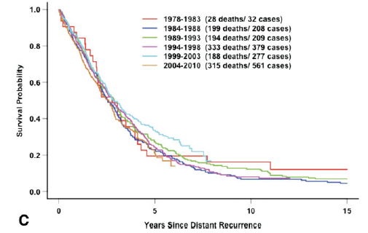
Goals of Therapy in Metastatic Breast Cancer
Balancing Reward and Risk
THEN
NOW
Multiple Agents Improve Overall Survival
ER+, HER2-Neg/Low: CDK4/6 inhibitors, ADCs
HER2-Positive: anti-HER2 antibodies, TKIs, ADCs
ER/PR/HER2-Negative: PD1 inhibitors, ADCs
13,785 patients received adjuvant therapy in 11 ECOG trials 1983-2002, 25% recurrence
No improvement in overall survival over 30 year period
Reward
  Prolong survival
  Palliate symptomatic disease
  Prevent/delay onset of symptomatic disease
Risk
  Treatment-associated morbidity
  Distress
  Disruption of normal life (work, family)
  Financial toxicity
Tevarweerk et al. Cancer 2012 (PMID: 23065954 )

Slide 4
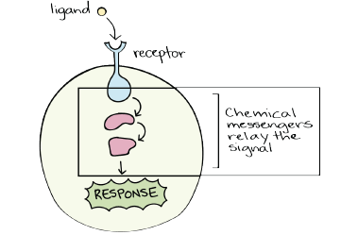

Agents that Prolong Survival
Pathways-based therapies
  PIK3CA/AKT/m-TOR pathway:
    capivasertib, Inavolisib
  CDK4/6 inhibitors:
    ribociclib, abemaciclib
Target-based therapies
  Trop-2: Sacituzumab govitecan
  HER2: Trastuzumab deruxtecan
Trial design may impact OS outcome
  Patient population (1st line vs. beyond)
  Crossover
Combinatorial therapy
  Combined with ET backbone in HR+ disease (eg. fulvestrant)
  Triple therapy now becoming standard in selected circumstance (eg, Inavolisib+ palbociclib + fulvestrant)
  ADCs used as single agents, often sequentially
Patient selection
  Agents may be target (HER2) and/or biomarker specific (PIK3-AKT-mTOR)
  Prior therapy impacts selection

Slide 5
Monitoring Therapeutic Response
Individualized approach: The frequency and choice of imaging should be tailored to the individual patient, considering the dynamics of the disease, type of treatment, and location and extent of metastatic disease.
Methods:
  Diagnostic imaging: NCCN guidelines recommends CT+BS, with PET/CT as optional. RECIST criteria used in clinical research, not practical outside of a clinical trial.
  Physical exam: When clinically evident and assessable disease present.
  Tumor markers (CEA, CA27-29): May be used to supplement other methods, typically every 3 months and/or at time of imaging. PD/treatment changes should not be made based on tumor markers alone, especially based on increase at a single time point.
  Circulating tumor DNA: Use should generally be limited to known disease progression in order to guide therapy based on ESR1 or PIK3CA-AKT-mTOR pathway alterations in ER+, HER2-negative MBC.
Consistency: The same imaging method should be used to monitor disease status,
Frequency: Generally every 9-12 weeks, or every 24 weeks for more indolent disease; in some cases, may be also used to monitor for toxicity (eg, CT chest for ILD due to T-DXd)

Slide 7
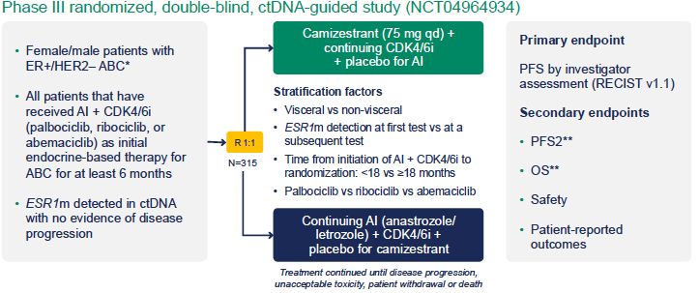
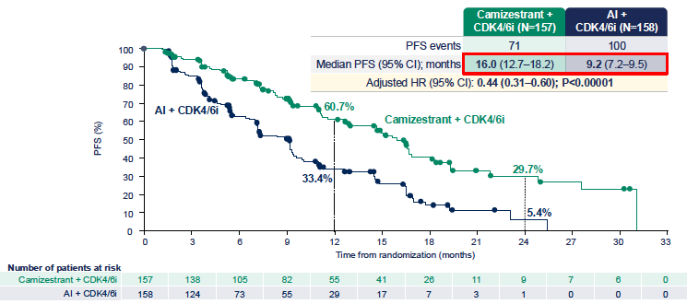
SERENA 6
Screened: 3256
Positive ESR1 ctDNA: 548 (17%)
Randomized: (10%)
Bidard et al. NEJM 2025 (PMID: 40454637)

Slide 8
Pathways

Slide 9
Pathways
 | ORR | PFS | OS | Biomarker | Agents with OS Benefit | Other Agents
ER-mediated signaling | X | X | X | ER+ | Tamoxifen Aromatase Inhibitors | ESR1 mutant: Elacestrant, Imlunestrant
CDK4/6-mediated signaling | X | X | X | ER+ | Ribociclib Abemaciclib | Palbociclib
PI3K/AKT/mTOR signaling | X | X |  | PIK3CA pathway | Inavolisib | PIK3CA pathway alteration: Alpelisib, Inavolisib, Capivasertib No PIK3CA pathway alteration: Everolimus, Gedatolisib
Immune checkpoints | X | X | X | CPS | Pembrolizumab
DNA repair | X | X |  | Germline BRCA |  | Olaparib, Talazoparib
Few/rare alterations NTRK fusions (secretory) HER2 (lobular) dMMR/MSI-H | X X X | X X X |  | NGS |  | Entrectinib Neratinib Pembrolizumab

Slide 10
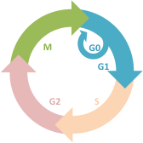
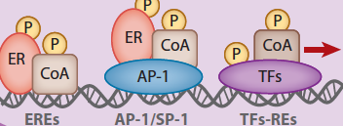
Driver and Escape Mechanisms in ER-Positive Breast Cancer
Provide Rationale for Combinatorial Therapy Targeting CDK 4/6 (First/Second Line) or PI3K/AKT/mTOR (Second Line)
γ
Receptor Tyrosine Kinases
(HER2, EGFR, IGFR1)
E
γ
E
Estrogen
P
PI3K/AKT/M-TOR
Non-Genomic Effects
RAS/MAPK
E2F
E
Genomic Effects
Notes:
There are critical driver and escape mechanisms in ER-positive breast cancer that may be therapeutically exploited to amplify the effects of antiestrogen therapy, and to either prevent or delay primary or secondary resistance.
(ADVANCE) Binding of estrogen to receptor tyrosine kinases induces non-genomic effects, (ADVANCE) resulting in activation of the PI3K-AKT-mTOR pathway and other pathways
(ADVANCE) Estrogen also induces genomic effects by binding to the estrogen receptor or other factors that promote transcription.
(ADVANCE). This drives the production of the E2F transcription factor, which drives transcription of key factors that promote transition of cells from the G0-1 phase of the cell cycle to mitosis.
(ADVANCE). In addition, ER-mediated non-genomic effects may also drive genomic effects.
(ADVANCE) Two of the key players involved in regulating E2F mediated transcription include RB tumor suppressor protein, which binds E2F and preventing transcription, and cyclin dependent kinase 4 and 6.
(ADVANCE ) Upon binding of cyclin D1, CDK4 and 6 phosphorylate RB, (ADVANCE) uncoupling RB from E2F, and hence promoting E2F mediated transcription
(ADAVNCE) By inhibiting CDK4 and 6, (ADVANCE x 3) palbociclib blocks E2F mediated G to S phase transition a, and thus cell division.

Slide 11
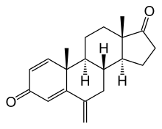
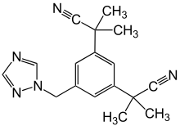
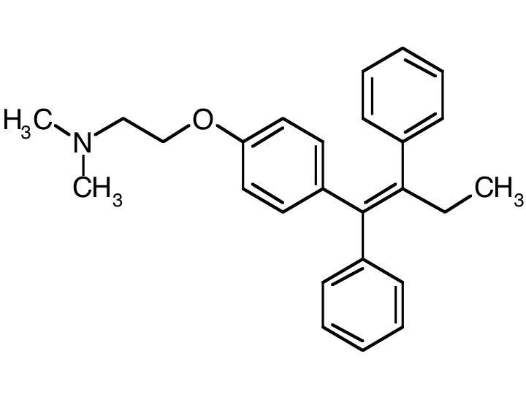
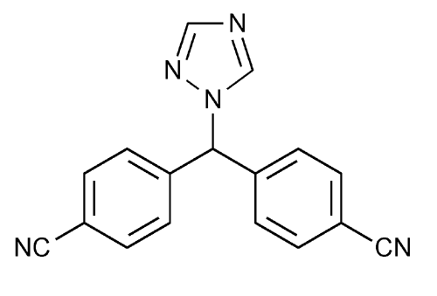
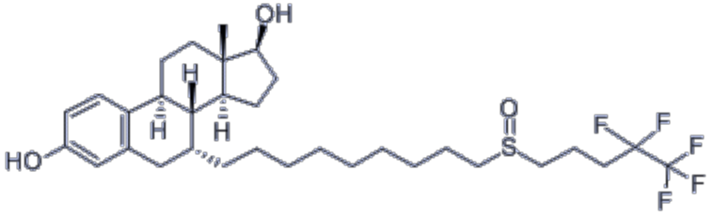
Antiestrogen Therapy and CDK 4/6 Inhibitors
Aromatase in Peripheral Tissues
(subcutaneous fat, muscle, liver, brain
Testosterone
Androstenedione
Anastrozole
SERM:Tamoxifen
Exemestane
γ
E
E
E
E
E
Letrozole
SERD: Fulvestrant
E2F
E
CDK 4/6 Inhibitors
Notes:
As exemplified by the ALLIANCE and LEA trials, antiestrogen therapy is a cornerstone in the management of ER-positive disease.
(Advance) Selective estrogen receptor modulators like tamoxifen or degraders like fulvestrant bind to the estrogen receptor, thus competitively inhibiting binding of estrogen to ER..
(Advance), in contrast, aromatase inhibitors block the conversion of androgens to estrogen (advance x 4). This results in systemic and local estrogen depletion in postmenopausal women for whom this is the major source of endogenous estrogen, more effectively reversing its genomic effects mediated by binding to the estrogen receptor and other transcription factors.

Slide 12
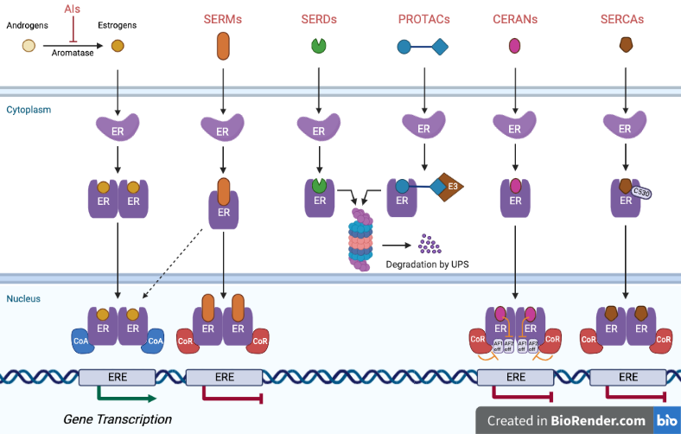
SERM
Tamoxifen
Lasofoxifene
SERM/SERD
Elacestrant
SERD
Giradestrant
Camizestrant
Imlunestrant
PROTAC
Vepdegestrant (ARV-471)
CERAN
Palazestrant (OP-1250)
SERCA
H3B-6545
Patel et al. NPJ Breast Cancer 2023 (PMID: 37019913)

Slide 13
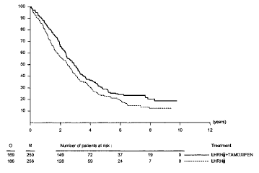
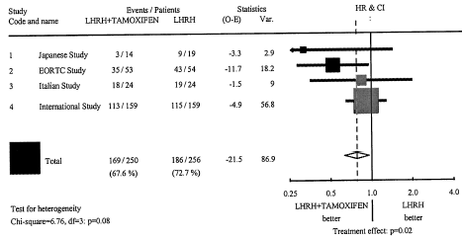
Endocrine Therapy for Hormone Receptor–Pos MBC: ASCO Evidence Based Recommendations
FALCON: Fulvestrant monotherapy marginally improves PFS compared with AI in ET-naïve MBC
Endocrine v chemotherapy (single agent)
  Overall survival (N= 6 trials, 692 patients) – HR 0.94 (p=NS)
  ORR (N=8 trials, 817 patients) – ⇧ ORR 1.25 (p=0.04)
  ET preferred unless rapidly progressive visceral disease
Fulvestrant vs. other agents (N=11 trials, 5,808 patients)
  Fulvestrant 500 mg was superior to fulvestrant 250 mg, megestrol acetate, and tamoxifen for PFS (p<0.05
Aromatase inhibitors vs. tamoxifen (N=6 trials, 2,560 patients)
  AIs were superior to tamoxifen alone for response (ORR; OR, 1.56, P <0.05) and CBR (OR 1.7 ; P <0.05)
Combined Tamoxifen and LHRH Agonist Versus LHRH Agonist Alone in Premenopausal Advanced Breast Cancer: A Meta-Analysis of Four Randomized Trials
Rugo et al. J Clin Oncol 2016 (PMID: 27217461); Klijn et al. J Clin Oncol 2001 (PMID: 11208825)
Robertson et al. Lancet 2016 (PMID: 27908454 .

Slide 14
Backbone Endocrine Therapy for Metastatic Breast Cancer:
Sequential Use of Antiestrogen Therapy
Potentially AI Sensitive
AI Resistant
De Novo or Relapsed >6-12 months off Endocrine Therapy
Aromatase Inhibitor *
Fulvestrant* or
Oral SERD**
Relapse on Tamoxifen
Aromatase Inhibitor*
Fulvestrant* or
Oral SERD**
Relapse on Aromatase Inhibitor
Fulvestrant *
First
Line
AI Resistant
Second
Line
*Plus OFS if premenopausal
**Elacestrant or imlunestrant or giradestrant if ESR1 mutation

Slide 15

Antiestrogen Therapy and CDK 4/6 Inhibitors
Aromatase in Peripheral Tissues
(subcutaneous fat, muscle, liver, brain
Testosterone
Androstenedione
Cyclin D1-CDK 4/6
GAS PEDAL
γ
E
E
E
E
Cyclin D1
E2F
E
E2F
RB
E2F
E2F
E2F
E2F
E
CDK
4/6
E2F
P
P
P
P
RB
RB
P
P
P
P
P
P
P
P
Notes:
As exemplified by the ALLIANCE and LEA trials, antiestrogen therapy is a cornerstone in the management of ER-positive disease.
(Advance) Selective estrogen receptor modulators like tamoxifen or degraders like fulvestrant bind to the estrogen receptor, thus competitively inhibiting binding of estrogen to ER..
(Advance), in contrast, aromatase inhibitors block the conversion of androgens to estrogen (advance x 4). This results in systemic and local estrogen depletion in postmenopausal women for whom this is the major source of endogenous estrogen, more effectively reversing its genomic effects mediated by binding to the estrogen receptor and other transcription factors.

Slide 16

Antiestrogen Therapy and CDK 4/6 Inhibitors
Aromatase in Peripheral Tissues
(subcutaneous fat, muscle, liver, brain
Testosterone
Androstenedione
CKD 4/6 INHIBITORS
BRAKE PEDAL
γ
E
E
E
E
Cyclin D1
E2F
E
E2F
RB
E2F
E2F
RB
E
E2F
E2F
CDK
4/6
P
RB
P
Notes:
As exemplified by the ALLIANCE and LEA trials, antiestrogen therapy is a cornerstone in the management of ER-positive disease.
(Advance) Selective estrogen receptor modulators like tamoxifen or degraders like fulvestrant bind to the estrogen receptor, thus competitively inhibiting binding of estrogen to ER..
(Advance), in contrast, aromatase inhibitors block the conversion of androgens to estrogen (advance x 4). This results in systemic and local estrogen depletion in postmenopausal women for whom this is the major source of endogenous estrogen, more effectively reversing its genomic effects mediated by binding to the estrogen receptor and other transcription factors.

Slide 17
Summary of Characteristics and Adverse Effects of CDK4/6 Inhibitors
 | Palbociclib | Ribociclib | Abemaciclib
Dose/Schedule | 125 mg QD x 21/28 days | 600 mg QD x 21/28 days | 150 mg BID continuous
Efficacy | ORR, PFS | ORR, PFS, OS | OFS, PFS, OS
Toxicity
Neutropenia | +++ | +++ | ++
Nausea | + | ++ | +
Diarrhea | + | + | +++
Transaminase elevation | + | ++ | +
Creatinine elevation |  |  | +
QT prolongation |  | +
Tamoxifen interaction | No | Yes | No
Dose modification Reduction Interruption Discontinuation | 36% vs 1% 70% vs. 42% 10% vs. 6% (Paloma2) | 54% vs. 7% 77% vs. 41% 8% vs. 2% (Monaleesa2) | 43% vs. 6% 56% vs. 19% 20% vs. 3% (Monarch3)

Slide 18
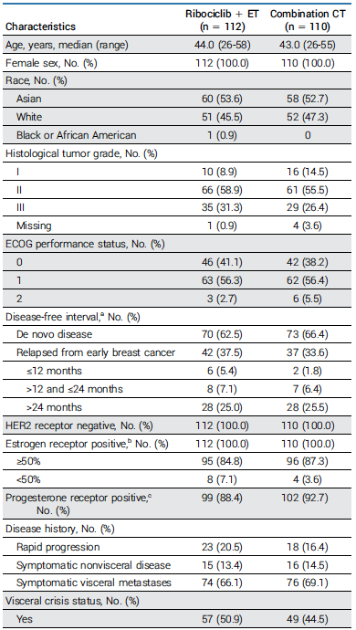
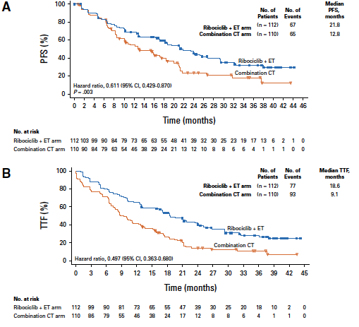
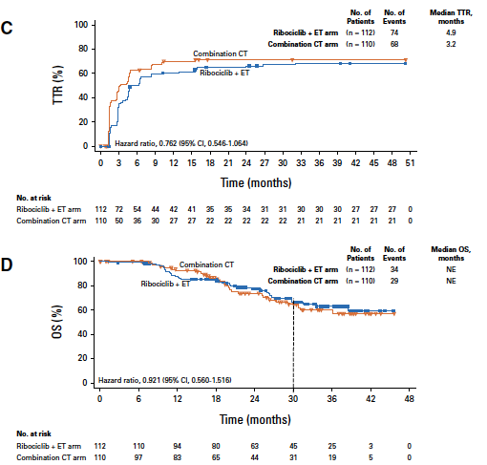
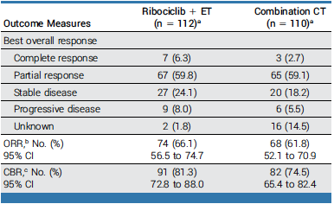
Final Results of RIGHT Choice: Ribociclib Plus Endocrine Therapy Versus Combination Chemotherapy in Premenopausal Women With Clinically Aggressive Hormone Receptor–Positive/Human Epidermal Growth Factor Receptor 2–Negative Advanced Breast Cancer
Lu et al. J Clin Oncol 2024 (PMID: 3877199)

Slide 19
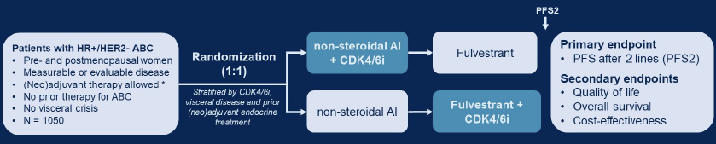
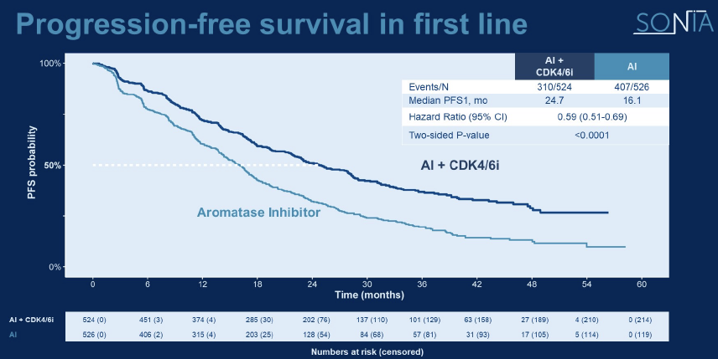
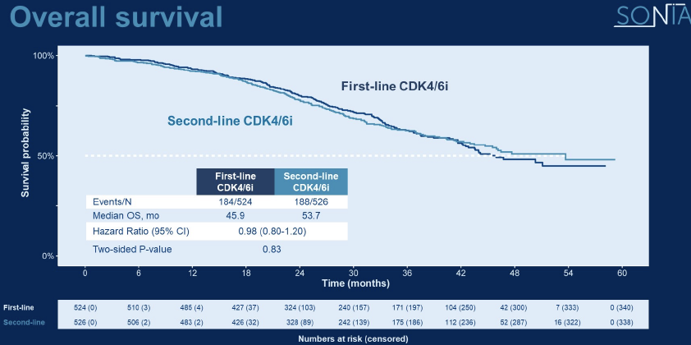
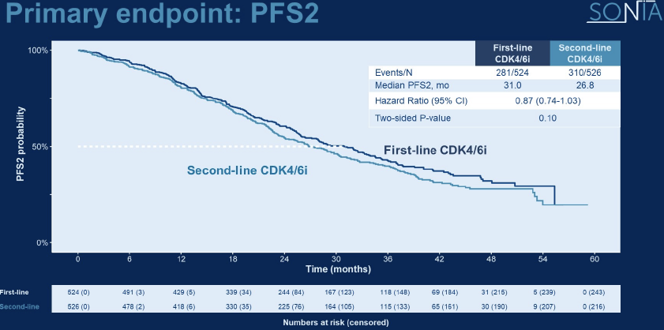
SONIA: Palbociclib for First or Second-Line ET:
Evidence favoring use of palbociclib with 2nd-line rather than 1st-line ET
Median followup 37.3 months
Comparison of 1st vs. 2nd-line palbociclib
  Primary endpoint – PFS2
    Median 31.0 vs. 26.8 mo. (HR 0.87, 95% CI [0.74, 1.03]; P = .10)
  Secondary endpoint – Overall Survival
    Median 45.9 vs. 53.7 mo. (HR 0.98, 95% CI [0.80, 1.20]; P = .83).
  Other findings:
    Longer duration of palbociclib: 24.6 vs. 8.1 months
    $200K higher drug expenditure
    1.7-fold more >/= grade 3 adverse events
    Improved PFS1 - Median 24.7 vs. 16.1 (HR 0.59, [95% CI 0.51-0.69, p<0.0001)
Sonke et al. ASCO 2023 (DOI: 10.1200/JCO.2023.41.17_suppl.LBA1000)

Slide 20
Take Home Messages:
Endocrine Therapy and CDK4/6 Inhibitors for ER+, HER2- MBC
AI-based ET regimen is preferred for first-line therapy
OFS an integral component of therapy for premenopausal women
Fulvestrant the ET backbone for second-line/relapse during adjuvant AI therapy
Addition of CDK4/6 inhibitors to first- or second-line ET improves PFS, and some (ribociclib, abemaciclib) also improve OS
ET + CDK4/6 inhibitor is an effective alternative than chemotherapy, even if advanced visceral disease
ET alone appropriate in certain settings as frontline therapy, or later line therapy in selected patients with ESR1 mutation (eg, elacestrant, imlunestrant, or giradestrant)

Slide 21
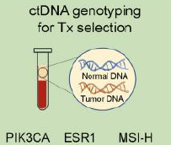
Endocrine Therapy Resistance
Primary Resistance
Secondary Resistance
PI3KCA, AKT,
PTEN, TP53
CCNE, NF1,
FGFR1/2, RB1
ESR1, PI3KCA, AKT, PTEN,
HER2, RB1
Metastatic:
PD < 6 months
PD > 6 months
Adjuvant;
Relapse < 2 years
Relapse ≥2 years
Tumor fraction < 1% vs. > 1%
  Prognostic – reflects tumor burden
  Sensitivity for alterations higher if > 1%
PIK3CA: 40% (truncal – present at baseline)
ESR1 not present at baseline, develop in up to 40% after anti-estrogen therapy at progression
Time (years)
Created from: Cardoso F, et al. Ann Oncol. 2018;29:1634-1657.

Slide 22
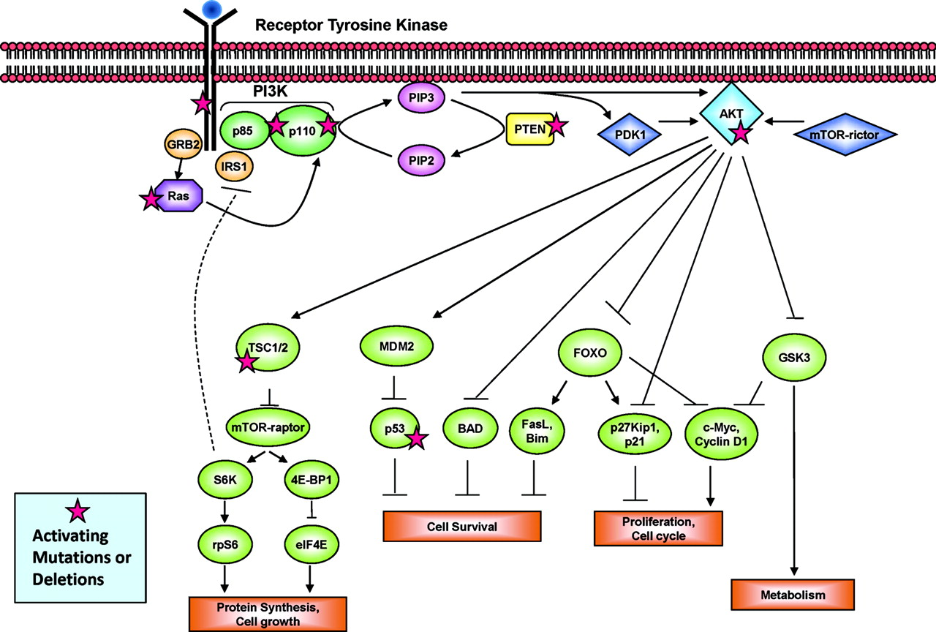
PI3K/AKT/M-TOR Pathway
Most commonly dysregulated pathway in breast cancer
Alpelisib
Inavolisib
Gedatolisib
Capivasertib
Adverse effects:
Hyperglycemia
Stomatitis
Rash
Diarrhea
ILD
Everolimus
Gedatolisib
Baselga J, et al. The Oncologist 2011 (PMID: 21278436)

Slide 23
Agents Targeting PI3K/AKT/M-TOR Pathway
 | Everolimus | Gedatolisib | Inavolisib | Alpelisib | Capivasertib
Target | mTOR | PIK3CA & m-TOR | PICK3CA | PIK3CA | AKT
Biomarker | None | None | PIK3CA | PIK3CA | Pathway alterations
Route | Oral | IV | Oral | Oral | Oral
Combination | Fulvestrant or Exemestane | Fulvestrant plus Palbociclib | Fulvestrant plus Palbociclib | Fulvestrant | Fulvestrant
Most common grade >3 toxicity | Stomatitis (8%) | Hyperglycemia (12%) and diarrhea (16%) | Hyperglycemia & stomatitis (6%) | Hyperglycemia (33%) & rash (20%) | Rash (12%) & diarrhea (9%)

Slide 24
Selected Adverse Events inPI3K/AKT/m-TOR Inhibitor Phase 3 Trials
Selected Adverse Events in PI3K/AKT/m-TOR Inhibitor Phase 3 Trials
% Patients with key AEs | BOLERO2 Everolimus + Exemes N=482 |  | INAVO120 Inavolisib + palbo + fulv N=162 |  | SOLAR-1 Alpelisib + fulv N=284 |  | CAPitello-291 Capivasertib + fulv N=355
 | Any grade | Grade >=3 | Any grade | Grade >=3 | Any grade | Grade >=3 | Any grade | Grade >=3
Hyperglycemia | 13 | 5 | 59 | 6 | 64 | 33 | 16 | 2
Diarrhea | 30 | 3 | 48 | 4 | 58 | 7 | 72 | 9
Rash | 36 | 1 | 25 | 0 | 54 | 20 | 38 | 12
Stomatitis | 56 | 8 | 51 | 6 | 25 | 3 | 15 | 2
Discontinued due to AEs | 19% | N/A | 7% | N/A | 25% | N/A | 13% | N/A
Glycemia eligibility
INAVO120: FBG<126 and HbA1c<6%; SOLAR-1: HbA1c<6.5%; CAPItello-291: HbA1c<8%
Stomatitis
INAVO120: stomatitis rate included mucosal inflammation; SOLAR-1 & CAPItello-291: stomatitis reported as a single term
Baselga et al. NEJM 2012; Andre et al. NEJM 2019; Turner et al. NEJM 2023; Turner et al. NEJM 2024
Notes:
Median f/u 21.3 months

Slide 25
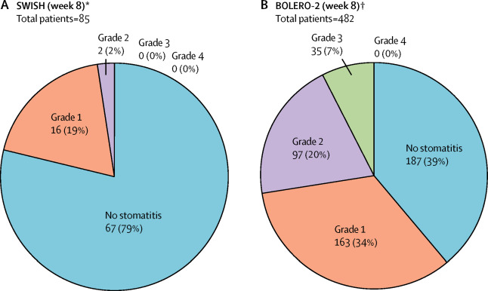
SWISH Trial: Dexamethasone Mouthwash Reduces Everolimus Associated Stomatitis
10 mL dexamethasone 0.5 mg/5mL, 4 times daily for 8 weeks
Compared to historical controls from BOLERO2
13% discontinuation due to treatment-related AE’s
Rugo, et al, Lancet Oncol, 2017

Slide 26
Managing hyperglycemia and rash associated with alpelisib: expert consensus recommendations
Hyperglycemia
Not appropriate: T2DM or HBA1c 6.5-8.0%
Endocrine evaluation: BMI >/=30, >/= 70, HBA1c 5.7-6.4%
Consult dietician: low CHO diet (60-130 gm/day)
Prophylactic metformin (if GFR >/= 45)
  HBA1c 5.7-6.4%
  HBA1c < 5.7% and other risk factors
Discontinue alpelisib if fasting glucose > 250 mg/dl and optimize control
  Optimize metformin dosing
  SGL:2 inhibitors
  Thiazolidinedione (TZD) agents
  Insulin if required
Rash Prophylaxis
Begin prophylactic antihistamines in all patients
Non-sedating H1 antihistamine options, including initial dose and maximum dose:
  Cetirizine 10 mg daily (up to 40 mg)
  Levocetirizine 5 mg daily (up to 15 mg)
  Loratadine 10 mg daily (up to 20 mg)
  Fexofenadine 180 mg daily (up to 360 mg)
  Treatment of Rash
Oral steroid (0.5-1 mg/kg prednisone) x 2 weeks if rash > 10% BSA or angioedema
Topical class I-III steroids (fluocinonide 1%, triamcinolone 0.5%, or betamethasone 0.05%)
Gallagher et al. NPJBC 2024

Slide 27
Take Home Message:
Targeting PIK3CA/AKT/M-TOR Pathway in ER+, HER2- MBC
Targeting the PIK3CA/AKT/mTOR pathway has a role in combination with ET in patients with ET-resistant disease
Adverse event profile includes hyperglycemia, stomatitis, rash, and diarrhea with varying frequency and severity depending on agent
Activating PIK3CA alpha mutations are truncal, and may be detected by somatic testing of baseline tumor specimens or using ctDNA at progression
For the 40% with activating PIK3CA alpha mutations, alpelisib and inavolisib improve PFS when added to fulvestrant (or fulvestrant/palbociclib)
For the 60% lacking such mutations, options include targeting AKT (capivasertib) if other pathway alterations, or m-TOR (everolimus) or pathway (gedatolisib) if there are no alterations

Slide 28
Targets

Slide 29
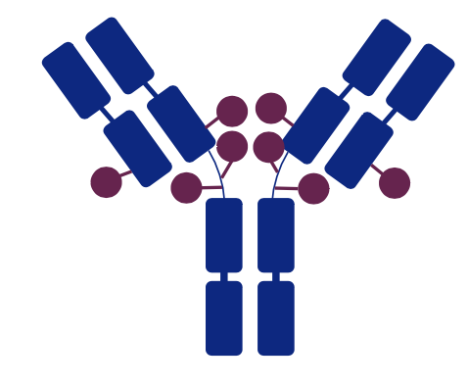
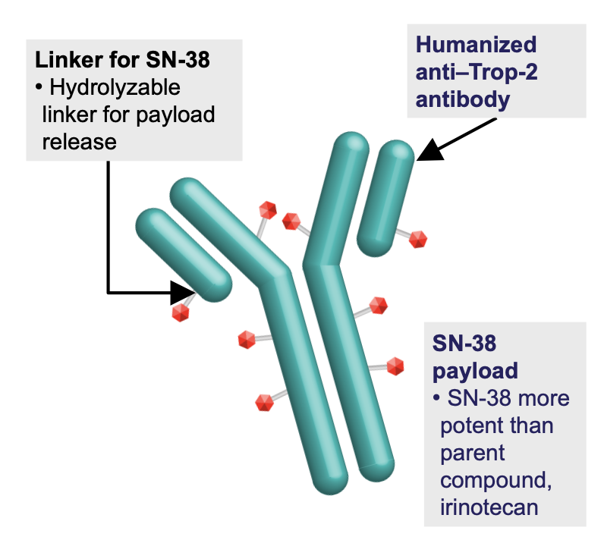
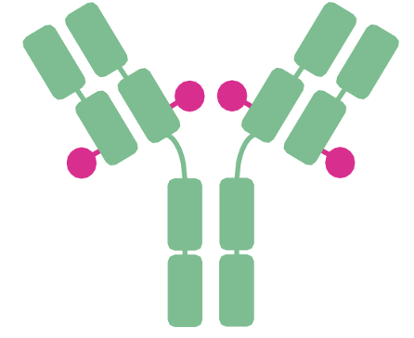
Antibody Drug Conjugates (ADCs): Not Used In Combination
Drug | Trastuzumab Deruxtecan | Sacituzumab Govitecan | Datopotamab Deruxtecan
Structure
Target | HER2 | TROP-2 | TROP2
ER+ MBC Ph3 study | DESTINY-Breast04 | TROPiCS-02 | TROPION-Breast01
Prior lines of chemo | 1-2 | 2-4 | 1-2
mPFS (mo.) | 9.6 vs. 4.2 HR 0.37 (0.30-0.56) | 5.5 vs. 4.0 HR 0.66 (0.53-0.83) | 6.9 vs. 4.5 HR 0.64 (0.53-0.76)
OS (mo.) | 23.9 vs. 17.6 HR 0.69 (0.55-0.87) | 14.4 vs. 11.2 HR 0.79 (0.65-0.96) | 10.6 vs. 10.3
ORR | 52.6% vs. 16.3% | 21% vs. 14% | 36.4% vs. 22.9%
Key adverse events | N/V, ILD | Cytopenias, diarrhea | N/V, stomatitis
Modi S, NEJM 2022; Rugo H, Lancet 2023; Bardia A, SABCS 2023

Slide 30
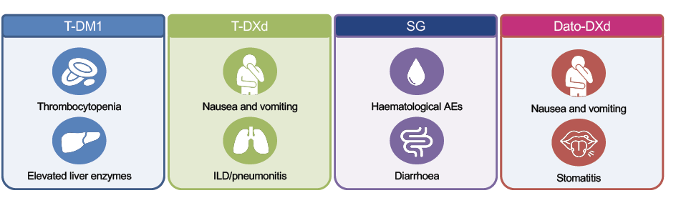
Adverse Events Associated with ADCs

Slide 31
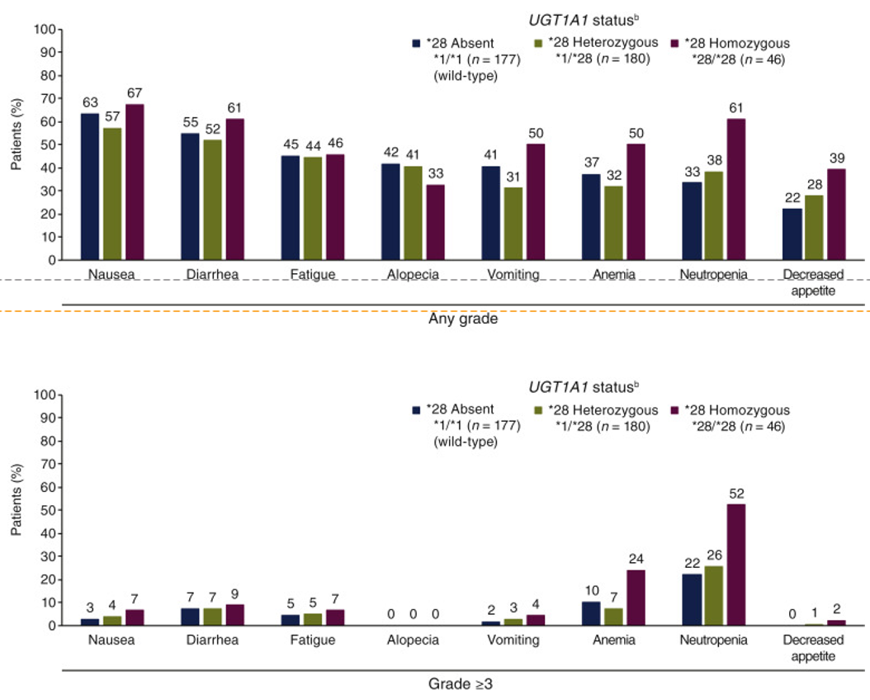
Toxicity of Sacituzumab Govitecan by UGT1A1 Status
UGT1A1 metabolizes the SN-38 payload of SG, and polymorphisms of the gene can lead to decreased enzyme activity and increased toxicity.
Among 495 patients enrolled in a basket trial
of SG, those with UGT1A1 *28/*28 (~10%)
had an increase in the rate of most side effects, with more than double the risk of severe anemia and neutropenia
UGT1A1 testing may allow to adapt the starting dose of SG for patients with *28/*28
Bardia A. et al. Ann Oncol 2021

Slide 33

T-DXd: Nausea and Vomiting
  US Prescribing Information¹
  T-DXd is moderately emetogenic which includes delayed nausea and/or vomiting. Administer prophylactic antiemetic medications per local institutional guidelines for prevention of chemotherapy-induced nausea and vomiting
  NCCN antiemesis guidelines²
  T-DXd is classified as highly emetogenic (>90% frequency of emesis) in V2 2023
  High emetic risk: 4 drug regimen preferred; 3 drug regimens are also
  an option
  Moderate emetic risk: 2 or 3 drug regimen options
Daiichi Sankyo. T-DXd Prescribing Information. November 2022. Available at: https://www.accessdata.fda.gov/drugsatfda_docs/label/2022/761139s024lbl.pdf Accessed October 2023; 2. NCCN Clinical Practice Guidelines in Oncology (NCCN Guidelines®). Antiemesis V2. May 2023. Available at: https://www.nccn.org/professionals/physician_gls/pdf/antiemesis.pdf . Accessed October 2023.

Slide 34
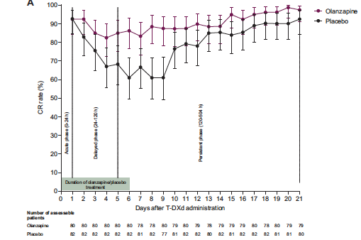
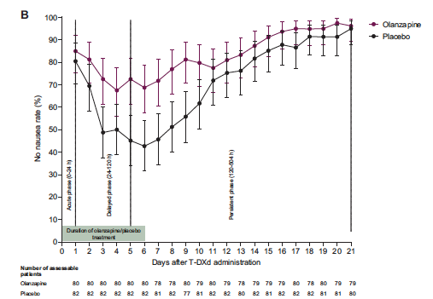
A randomized, double-blind, placebo-controlled phase II study of olanzapine-based prophylactic antiemetic therapy for delayed and persistent nausea and vomiting in patients with HER2-positive or HER2-low breast cancer treated with trastuzumab deruxtecan: ERICA study (WJOG14320B)
CR Rate
No Nausea Rate
N=168 patients
at 43 sites
Olanzapine 5 mg PO QD vs. placebo days 1-6, plus 5-HTRA and dex (6.6 mg IV plus 8 mg PO day 1)
Primary endpoint: complete response (CR) – no emetic events and no rescue
Delayed phase CR rate higher with olanzapine (79% vs. 56%, p=0.047) and no nausea (58% vs. 38%)
Sakai et al. Ann Oncol 2024

Slide 35
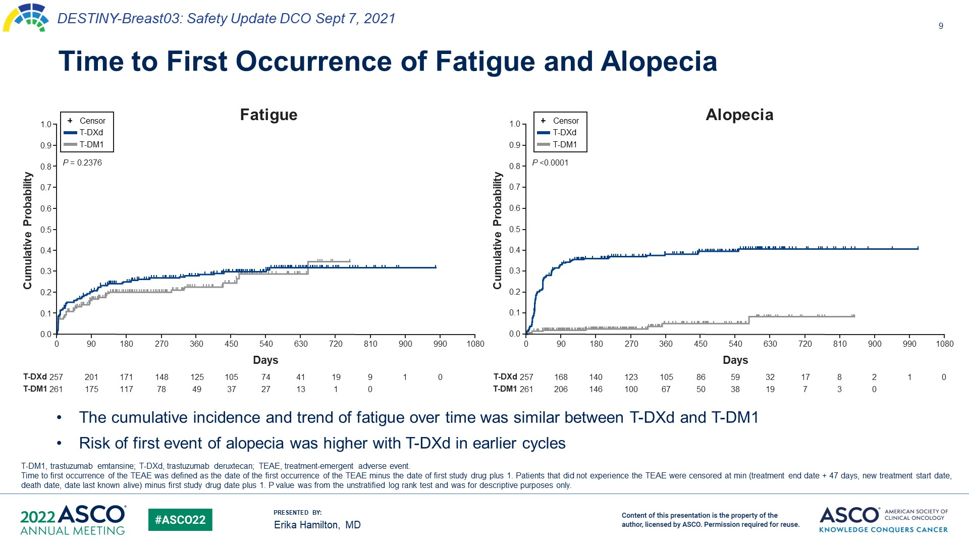
Time to First Occurrence of Fatigue and Alopecia

Slide 36
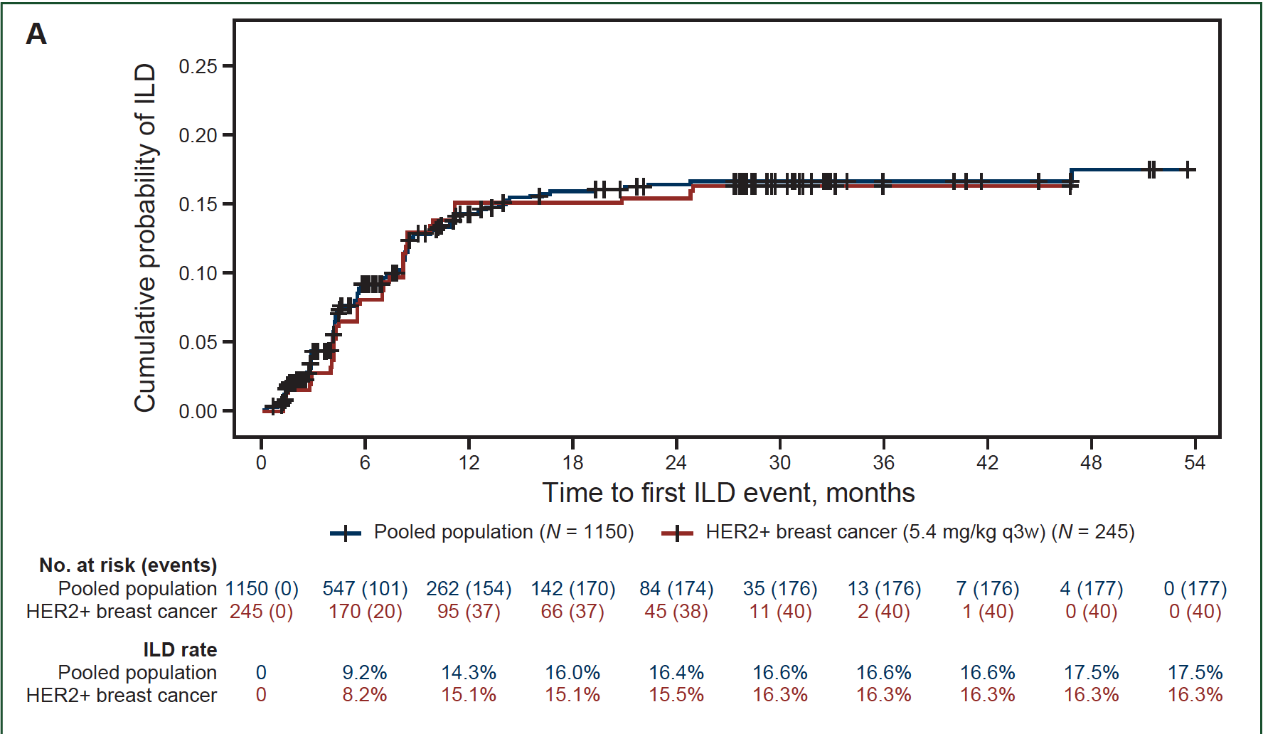
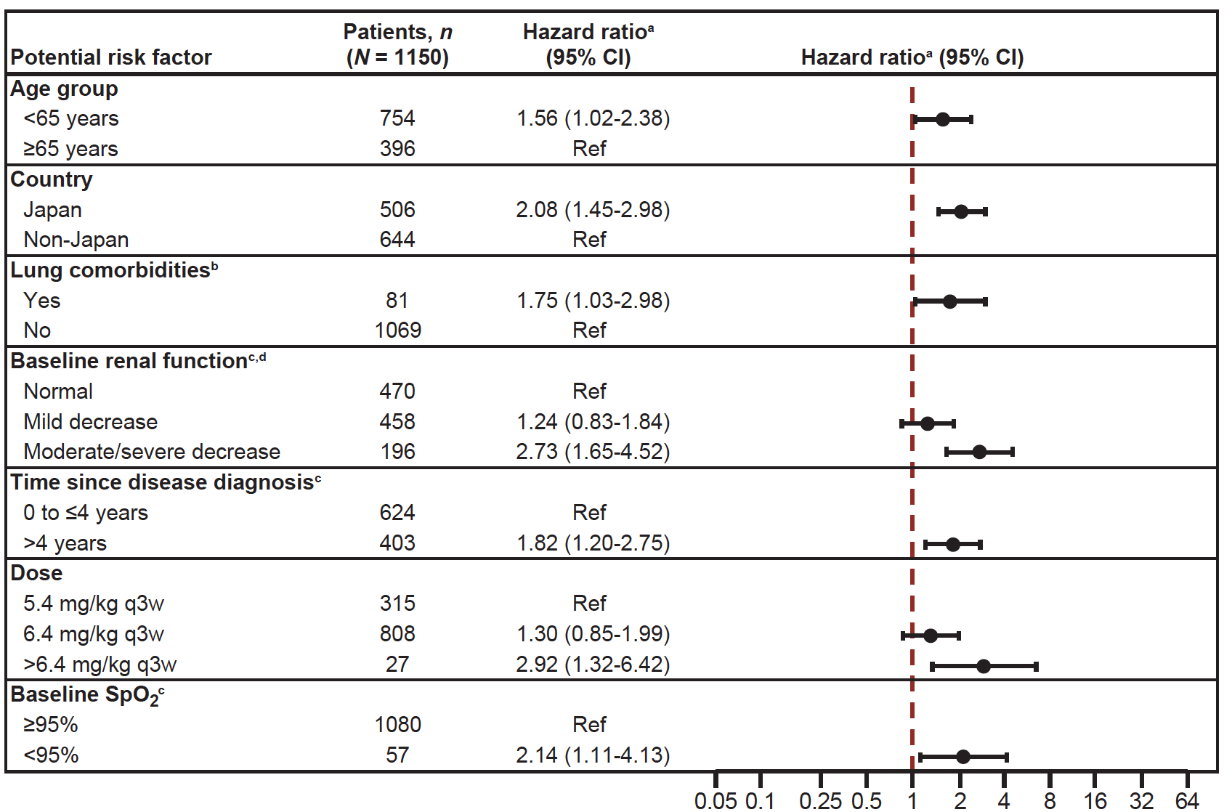
Pooled Analysis of ILD/Pneumonitis in 9 T-DXd Monotherapy Studies
1150 pts (44.3% breast cancer) with a median treatment duration 5.8 mo (0.7-56.3)
Overall incidence: 15.4% (grade 5: 2.2%); grade 1-2: 77.4%
87% had their first event within 12 months of their first dose
Powell et al, ESMO Open 2022

Slide 37
Management of ILD
Interrupt T-DXd and initiate corticosteroid treatment if ILD/pneumonitis is suspected
Screen for ILD HRCT scans at least every 12 weeks and every 6–9 weeks for those with respiratory symptoms Evaluate patients with suspected ILD by radiographic imaging Consider consultation with a pulmonologist | For Asymptomatic ILD (Grade 1) Consider corticosteroid treatment (eg, ≥ 0.5 mg/kg prednisone or equivalent) Withhold trastuzumab deruxtecan until recovery to Grade 0 If resolved in ≤ 28 days from date of onset, maintain dose If resolved in > 28 days from date of onset, reduce dose one level
 | For Symptomatic ILD (Grade ≥ 2) Promptly initiate corticosteroid treatment (eg, ≥ 1 mg/kg prednisone or equivalent) Permanently discontinue trastuzumab deruxtecan
Powell et al, ESMO Open 2022

Slide 38
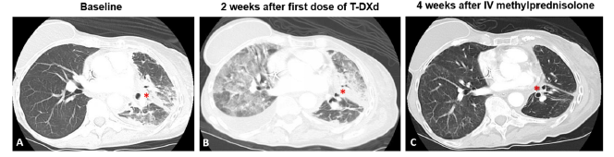
T-DXd ILD
Swain et al. Cancer Treatment Reviews 2022

Slide 39
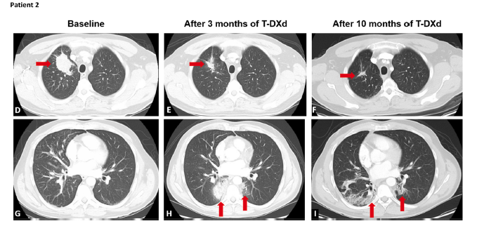
T-DXd ILD
Swain et al. Cancer Treatment Reviews 2022

Slide 40
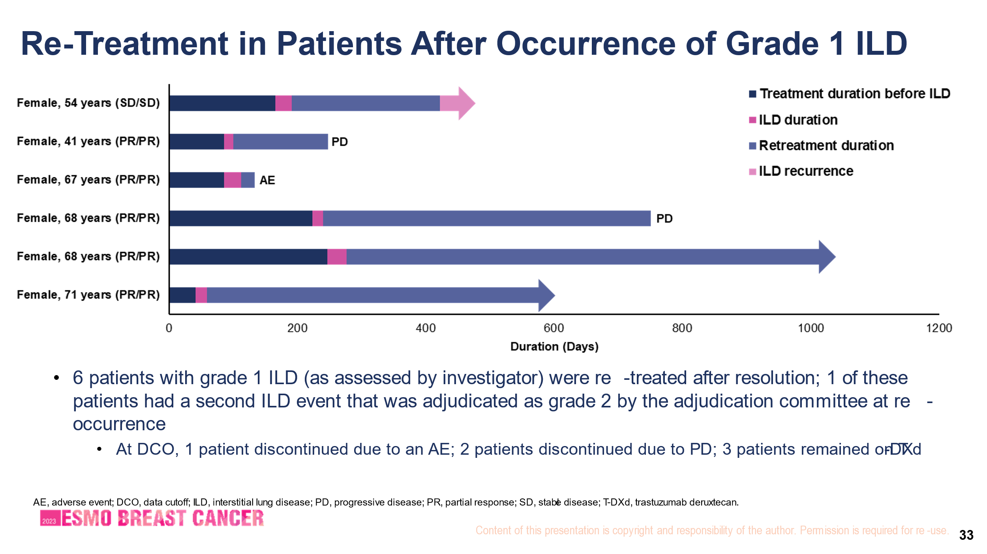
In DESTINY-Breast04: 6 pts with grade 1 ILD were re-treated after resolution
AE, adverse event; DCO, data cutoff; ILD, interstitial lung disease; PD, progressive disease; PR, partial response; SD, stable disease; T-DXd, trastuzumab deruxtecan.
Rugo H, et al. Presented at ESMO Breast 2023. Abstract 185O.
Of the 6 patients treated with Grade 1 ILD/pneumonitis (as assessed by investigator) who were retreated after resolution,
1 of these patients had a second ILD/pneumonitis event that was adjudicated as Grade 2 by the adjudication committee at reoccurrence
At DCO, 1 patient discontinued due to an AE; 2 discontinued due to PD, 3 remained on T-DXd
Rugo H, et al. Presented at ESMO Breast 2023. 11–13 May. Berlin, Germany. Abstract 185O.

Slide 41
TROPION-Breast01 Dato-DXd Toxicity Summary
Most TRAEs were grade 1–2 and manageable
Oral mucositis/stomatitis:
  All grade: 59%, grade 3: 7%, led to treatment discontinuation in 1 patient
  Aphthous ulcer, dysphagia, glossitis, odynophagia, oral mucosal ulceration or blistering, oral pain, oropharyngeal pain, pharyngeal inflammation, stomatitis, tongue ulceration
  Prophylactic dexamethasone mouthwash is recommended +/- cryotherapy
Ocular events:
  Ophthalmologic assessments were required at screening, and then every 3 cycles from C1D1 and at end of therapy; most were dry eye
  all grade: 49%, grade 3: 1%
  Grade 3: 1 dry eye, 1 with punctate keratitis, 1 with dry eye and ulcerative keratitis
  Led to treatment d/c in 1 patient
Adjudicated drug-related ILD: rate was low; mainly grade 1/2
  1 adjudicated drug-related grade 5 ILD event: attributed to disease progression by investigator
Adjudicated drug-related ILD | Dato-DXd | ICC
All grades, n (%) | 9 (3) | 0
Grade ≥3, n (%) | 2 (1)¶ | 0
Bardia et al. ESMO 2023

Slide 42
Take Home Message:
Role of ADCs in HER2-Neg MBC
Both T-DXd and SG improve PFS and OS in patients with disease progression after ET and chemotherapy in ER+ MBC
SG tested in more heavily pretreated population with ER+ MBC with chemo (2-4 lines) than T-DXd (1-2 lines)
SG and T-DXd also effective in TNBC, though more robust evidence for T-DXd
T-DXd requires screening for (HER2) whereas SG does not (for TROP2)
Dato-DXd is another Trop2 targeted ADC with activity in ER+ MBC
Differing adverse event profiles and administration schedules
  Nausea, fatigue, ILD (T-DXd) or diarrhea, nausea, fatigue (SG)
  Every 3 weeks (T-DXd) or day 1 & 8 every 3 weeks (SG)

Slide 43
Simplified Algorithm for Management of ER+/HER-neg MBC
Imaging at baseline and every 12-24 weeks
Tumor markers at baseline and at time of imaging or more frequently
Baseline tumor NGS (to evaluate for PIK3CA pathway alterations
ctDNA and baseline/progression
AI or Fulvestrant +/- CDK 4/6 Inhibitor
Choice depends on prior ET, age, disease burden, & comorbidities
PIK3CA Pathway Alteration
Alpelisib or Capivasertib + Fulvestrant
Gedatolisib or Inavolisib + Palbociclib
+ Fulvestrant
Capecitabine, ADC, or IV Chemotherapy
No PIK3CA or ESR1 Alteration:
Everolimus + Fulvestrant
Gedatolisib (+/- Palbo) + Fulvestrant
First Line
Therapy
Second Line
Therapy
Third Line
Therapy
ESR1 Mutation:
Elacestrant or Imlunestrant
Giradestrant + everolimus

