Slide 1

Management of Endocrine Related Toxicities
Michelle Melisko MD
Clinical Professor of Medicine
University of California San Francisco
Helen Diller Family Comprehensive Cancer Center
11/8/2025
Disclaimer: This presentation is intended for personal use and for informational purposes only and does not replace independent professional judgment. This presentation is the property of Physicians’ Education Resource, LLC (“PER”) and is protected by U.S. and international copyright laws. You may not copy, reproduce, distribute, transmit, modify, or create derivative works of the presentation without the prior written permission from PER.

Slide 2
Topics To Cover
Hot Flashes
  Antidepressants
  Fexolinetant/Elinzanetant
  Acupuncture
Urogenital Atrophy
  Vaginal Dryness Management
  Low libido/decreased sexual desire
Safety of Vaginal Estrogens and Systemic HRT

Slide 3
Overview Of Mayo/NCCTG Randomized Hot Flash Studies
Mean Hot Flash Score % Reduction
Randomized Studies (Positive Trials)
Placebo (n=420)
Clonidine (n=75)
Fluoxetine (n=36)
Citalopram (n=57)
Ven (vs MPA) (n=94)
Venlafaxine (n=48)
Pregabalin (n=63)
MPA 400 mg (n=94)
Oxybutynin
Megestrol (n=74)
Week

Slide 4
Mean Hot Flash Score % Reduction
Randomized Studies (Negative Trials)
Black Cohosh (n=58)
Placebo (n=420)
Flaxseed (n=69)
Soy (n=78)
Vitamin E (n=53)
Mg oxide
Week

Slide 5
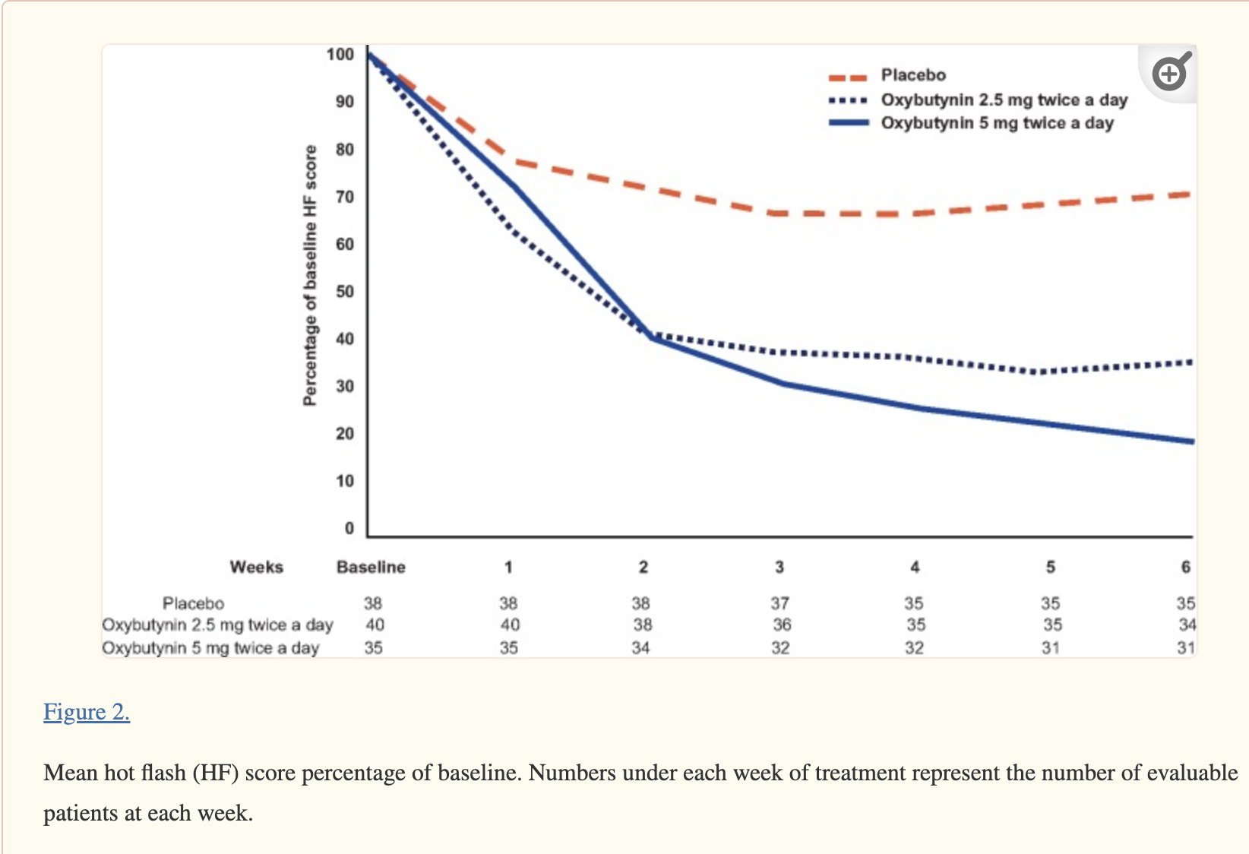
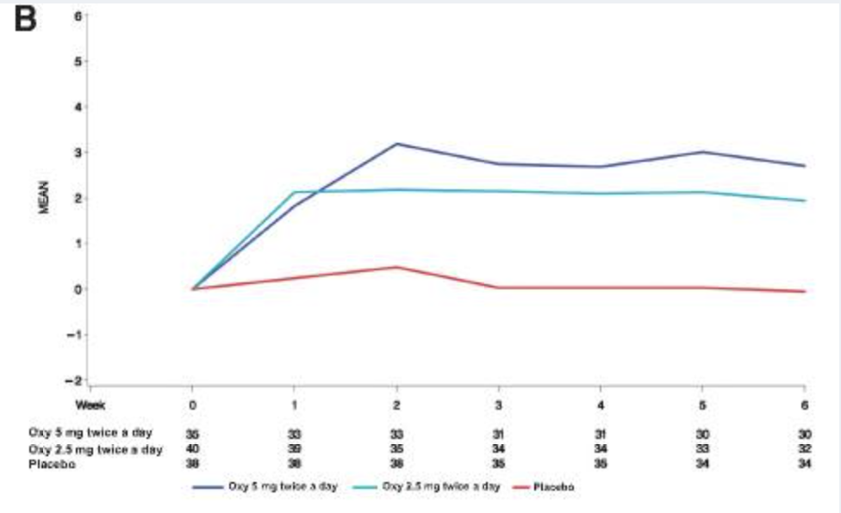
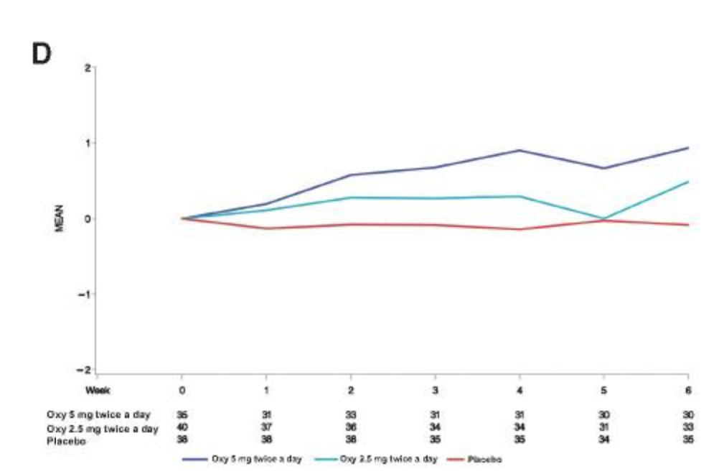
Oxybutynin vs Placebo For Hot Flashes In Women With Or Without Breast Cancer: A Randomized, Double-blind Clinical Trial (ACCRU SC-1603)
Randomized, multicenter, double-blind study, women w/ and w/o breast cancer with 28 or more hot flashes per wk assigned to placebo or oxybutynin (2.5 mg or 5 mg bid) for 6 wks
150 pts randomized; mean (SD) age was 57 (8.2) yrs
65% were taking tamoxifen or an aromatase inhibitor
Patients on both oxybutynin doses reported greater reductions in weekly HF score (5 mg bid: −16.9, 2.5 mg bid: −10.6), placebo −5.7; P < .005)
HF frequency (5 mg bid: −7.5 [SD 6.6], 2.5 mg bid: −4.8 [SD 3.2], placebo: −2.6 [SD 4.3]; P < .003)
Improvement was seen in most HF-related daily interference scales and in overall quality of life
Study discontinuation: 2 of 44 (5%) in placebo arm, 5 of 46 (11%) in the Oxy2.5 arm, and 4 of 46 (9%) in the Oxy5 arm
Dry Mouth
--- Placebo
Difficulty urinating
--- Placebo
Leon-Ferre et al. JNCI Cancer Spect 2020

Slide 6
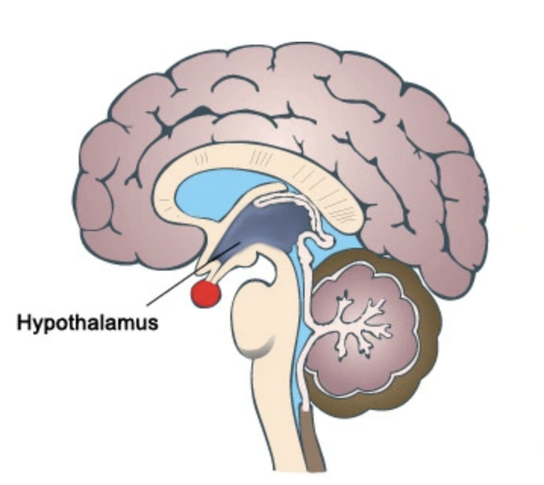
Fezolinetant – NK3 Antagonist
The thermoregulatory center in the hypothalamus is stimulated by neurokinin 3 receptor (NK3R) activation and inhibited by estrogen-negative feedback. Balance is disrupted in menopause, producing vasomotor symptoms
First publication in 2019: “Treatment of Menopausal Vasomotor Symptoms With Fezolinetant, a Neurokinin 3 Receptor Antagonist: A Phase 2a Trial”
  Study conducted between 2015-2016 in Belgium; 87 subjects were randomized (1:1) to 90 mg of fezolinetant bid or placebo for 12 weeks (90% completed study)
  At week 12, fezolinetant significantly reduced total VMS score vs placebo and decreased mean frequency of moderate/severe VMSs by 5 episodes per day vs placebo.
  Severity and frequency of moderate/severe VMSs were reduced from the first day of treatment. Improvements were achieved in all quality-of-life measures. Fezolinetant was well tolerated.
“A phase 2b, randomized, placebo-controlled, double-blind, dose-ranging study of the neurokinin 3 receptor antagonist fezolinetant for vasomotor symptoms associated with menopause” (352 treated participants, 287 completed the study. Doses tested → 15, 30, 60, 90 mg BID or 30, 60, 120 mg QD)
Fezolinetant reduced moderate/severe VMS frequency by -1.9 to -3.5/day at week 4 and -1.8 to -2.6/day at week 12 (all P < 0.05 vs placebo)

Slide 7
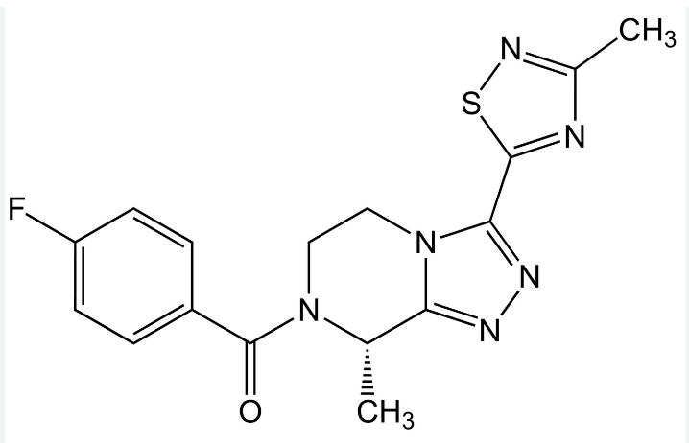
Fezolinetant – So many trials!!
Skylight 1 and 2 - These two 12-week randomized controlled trials (RCTs) were conducted from July 2019 to August 2021 and April 2021, respectively. They were followed by a 40-wk extension phase.
Skylight 4 - This 52-week RCT was designed to investigate the long-term safety of fezolinetant.
Moonlight 1 - This RCT examined the efficacy of a lower 30 mg dose only in an Asian population.
Trial 2693-CL-0301, Trial 2693-CL-0302, and Trial 2693-CL-0304 - These three randomized controlled trials were submitted to the FDA to support their assessment of fezolinetant's safety and effectiveness.
HIGHLIGHT 1 - This Phase 3 randomized placebo controlled clinical study will assess the efficacy and safety of fezolinetant for the treatment of VMS in hormone receptor-positive breast cancer pts
  540 pts and no sites in the US

Slide 8
Fezolinetant For Treatment Of Moderate-To-Severe Vasomotor Symptoms Associated With Menopause (SKYLIGHT 1): A Phase 3 Randomized Controlled Study
Randomized, double-blind, placebo-controlled, 12-wk, phase 3 trial with a 40-week active treatment extension.
Between 7/11/19 and 8/11/21, women aged 40-65 yrs with seven or more moderate-to-severe hot flashes per day were randomized (1:1:1) to placebo (n=175), fezolinetant 30 mg, (n=176) or fezolinetant 45 mg (n= 176
Compared with placebo, fezolinetant 30 mg and fezolinetant 45 mg significantly reduced the frequency AND severity of vasomotor symptoms at week 4 and week 12 → Improvements in frequency/severity of VMS were observed after 1 week and maintained over 52 weeks
During the first 12 weeks, treatment-emergent AEs occurred in 37% of pts in the fezolinetant 30 mg group, 43% in the fezolinetant 45 mg group, and 45% in the placebo group.
Incidence of liver enzyme elevations was low (placebo n=1; fezolinetant 30 mg n=2; fezolinetant 45 mg n=0)
lederman et al. lancet 2023 apr 1;401

Slide 9
Efficacy And Safety Of Fezolinetant For Moderate To Severe Vasomotor Symptoms Associated With Menopause Among Women In East Asia:
A Phase 3 Randomized Study (MOONLIGHT I)
Phase 3, randomized, double-blind study; postmenopausal women with moderate to severe VMS (min avg frequency in the 10 days before randomization, ≥7/day or 50/week) received fezolinetant 30 mg/day or placebo (weeks 1-12), followed by an open-label extension phase with fezolinetant 30 mg/day (weeks 13-24)
Among 301 pts, the difference in the least squares mean change (95% CI) from baseline in the daily frequency of moderate to severe VMS vs placebo was -0.65 (-1.41 to 0.12) at week 4 and -0.55 (-1.35 to 0.26) at week 12
Differences in the least squares mean change from baseline in the VMS severity score vs placebo were -0.06 (-0.14 to 0.03) and -0.13 (-0.27 to 0.01) at weeks 4 and 12, respectively.
Serious adverse events occurred in 0.7% of participants receiving fezolinetant in weeks 1 to 12, compared with 1.3% of those receiving placebo
Fezolinetant was generally safe but did not reduce the frequency or severity of VMS versus placebo in postmenopausal women in this study
Ruan et al. J Int Med Res. 2024 May;52(5):3000605241247684.

Slide 10
Effectiveness And Safety Of Fezolinetant In Alleviating Vasomotor Symptoms Linked To Menopause: A Systematic Review And Meta-analysis
Six studies were included involving 3301 patients
Compared to placebo, fezolinetant reduced frequency of VMS episodes from baseline at wk 4 and at wk 12 and reduced VMS severity score at weeks 4 at 12. Reductions were positively reflected on menopause specific QOL at weeks 4 and 12
Fezolinetant showed increased risk for:
  Drug-related TEAEs (RR = 1.47, 95 %CI [1.06,2.04])
  Serious TEAEs (RR = 1.67, 95 %CI [1.09,2.55])
  Fatigue (RR = 4.05, 95 %CI [1.27,12.88])
  Arthralgia (RR = 2.83, 95 %CI [1.02,7.8])
  ALT or AST > 3 times (RR = 2, 95 %CI [1.12,3.57])
Elnaga et al. Eur J Obstet Gynecol Reprod Biol 2024:297:142-152.

Slide 11
Safety Issues And Takeaway On Fezolinetant
“Risk of neoplasm with the neurokinin 3 receptor antagonist fezolinetant” (Douxfils J et al. Lancet 2023)
  Meta-analysis within the SKYLIGHT program found a statistically significant increase in neoplasm risk, with a 4.25-fold elevation (OR: 4.25, 95% CI: 1.67-10.80) with a daily dosage of fezolinetant 45 mg
  Authors express concern “FDA and the European Medicines Agency (EMA) have not included this risk in the adverse drug reaction sections of the prescribing information. Their assessment, which dismisses the neoplasm risk based on non-causality claims derived from literature on NK1 antagonists, overlooks the distinct pharmacological pathways of specific NK3 receptor antagonists”
  Elinzanetant (another neurokinin-1,3 receptor antagonist) being studied for the treatment of moderate to severe VMS with positive results in two studies (309 pts) did not find any increased cancer risk - “Elinzanetant for the Treatment of Vasomotor Symptoms Associated With Menopause, OASIS 1 and 2 Randomized Clinical Trials” (Pinkerton et al. JAMA 2024 Aug 22)
Careful monitoring of Liver function tests with Fezolinetant is required – FDA Warning Update 9/12/24:
  “new recommendations for patients and health care professionals about increasing the frequency of liver blood testing, adding monthly testing for the next 2 months after starting Veozah, and then at months 3, 6, and 9 of treatment as already recommended”
Insurance coverage is poor, but improving

Slide 12
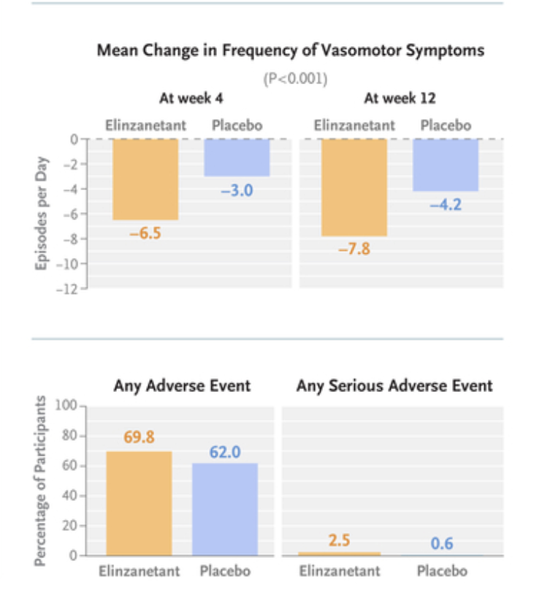
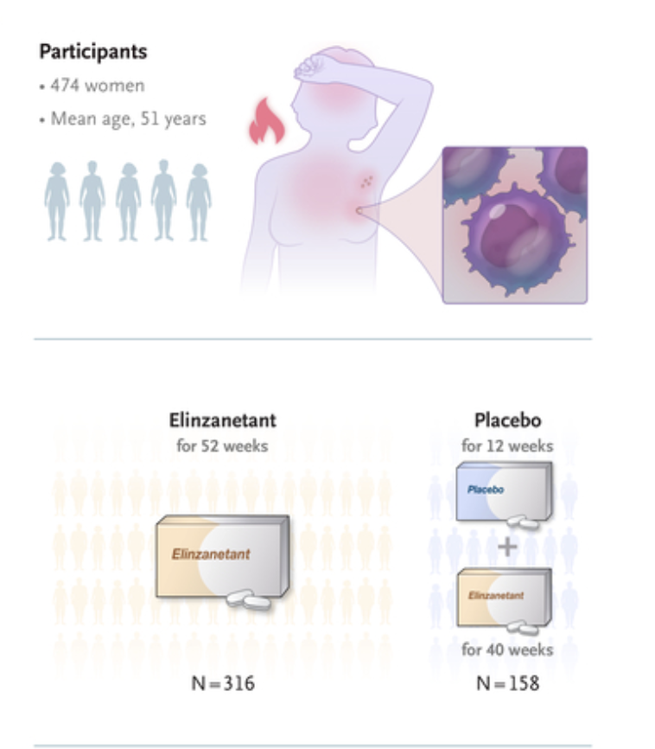
Elinzanetant For Vasomotor Symptoms From Endocrine Therapy For Breast Cancer
52-week, phase 3, double-blind, randomized, placebo-controlled trial at 90 sites in Europe, Canada, Israel, and Kazakhstan (89% of pts were white)
Cardoso et al. N Engl J Med 2025;393:753-763

Slide 13
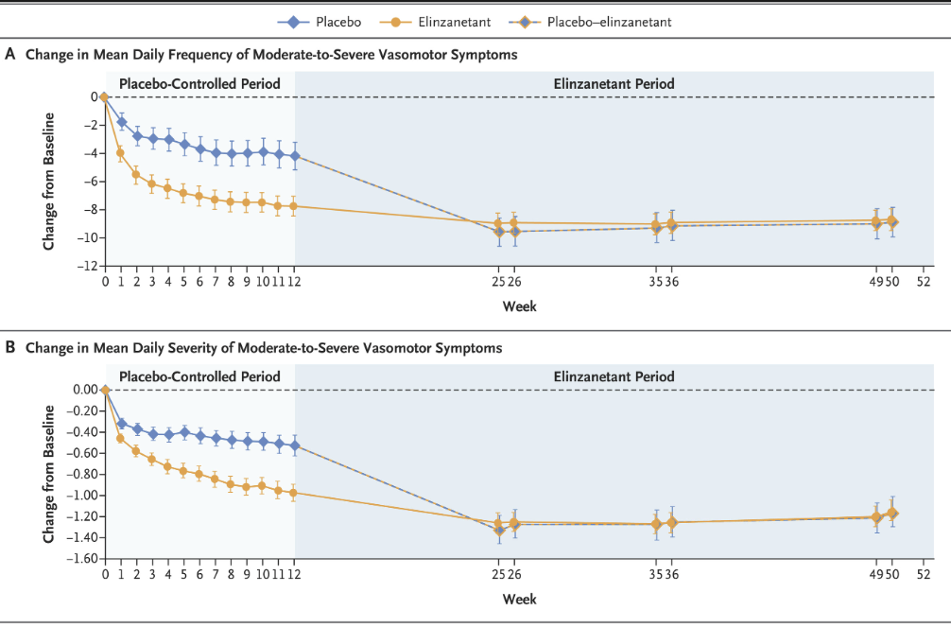
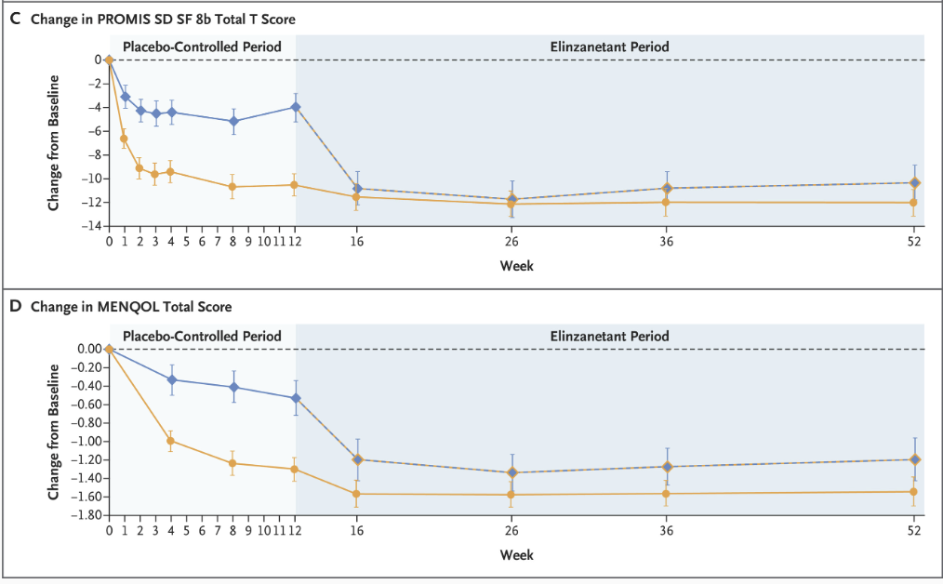
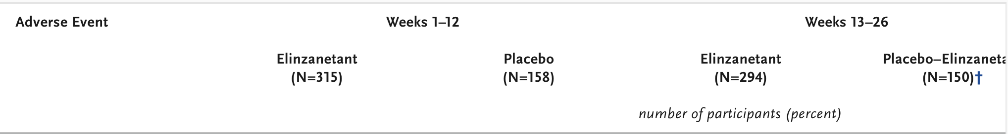
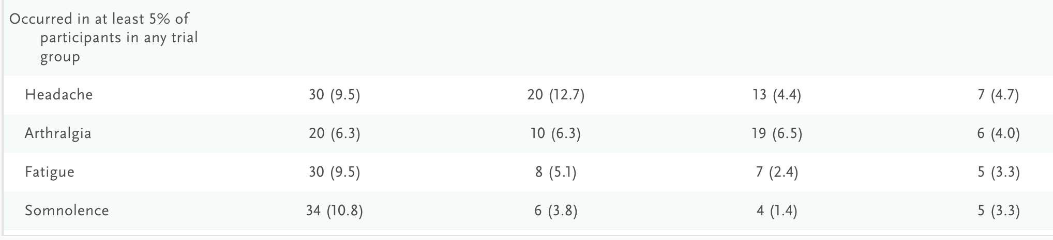
Cardoso et al. N Engl J Med 2025;393:753-763

Slide 14
Lynkuet® (elinzanetant)
FDA approved 10/24/25

Slide 15
Acupuncture For Hot Flashes
Meta-analysis of six RCTs → Acupuncture induced a significant reduction in the overall hot flash score, but not hot flash frequency, compared with controls (Zhang et al. Front Oncol. 2021; 11)
Meta-analysis of 13 RCTs → Acupuncture was found to have a durable effect on overall menopausal symptoms, but no reduction in hot flash frequency (p = .29) or severity (p = .24) (Chien TJ et al. Climacteric. 2020; 23(2))
Challenges in study design due to lack of ideal control arm and differences in technique
Even if “proven” effective, most insurances still do not cover

Slide 16
Topics To Cover
Hot Flashes
  Antidepressants
  Fexolinetant/Elinzanetant
  Acupuncture
Urogenital Atrophy
  Vaginal Dryness Management
  Low libido/decreased sexual desire
Safety of Vaginal Estrogens and Systemic HRT

Slide 17
Vaginal Dryness
Non-estrogenic vaginal moisturizers
Vaginal estrogen
DHEA
Lidocaine
Vaginal laser treatments

Slide 18
Vaginal Moisturizers/Gels
Replens, RepHresh, Luvena, JuvaGyn
  Typically use is 2-3 x per week, but can be daily
  Some claim to restore “healthy” vaginal pH (RepHresh)
Replens vs placebo showed improvement in vaginal itching, irritation and dyspareunia in breast cancer pts, but was no better than placebo (Loprinzi et al. JCO 1997)

Slide 19
Vaginal pH-Balanced Gel For The Control
Of Atrophic Vaginitis Among Breast Cancer Survivors
Breast cancer pts who experienced menopause after chemo or endocrine therapy were randomized to a vaginal topical pH-balanced gel or placebo gel 3x/week for 12 wks
Vaginal dryness and dyspareunia were measured by visual analog scale, vaginal health index, and vaginal pH
pH balanced gel caused more irritation upon application
Lee et al. Obstet Gynecol. 2011;117(4):922-927.

Slide 20
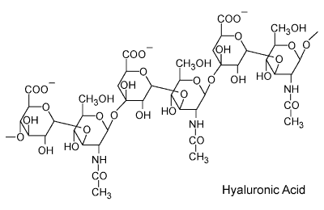
Is Vaginal Hyaluronic Acid As Effective As Vaginal Estriol For Vaginal Dryness Relief?
144 postmenopausal women (<70 yo) randomized to receive hyaluronic acid vaginal gel (5 g per application) OR estriol vaginal cream (0.5 mg estriol per application) every 3 days x 10 applications
After 3 applications, improvement in vaginal dryness was reported by 49% with hyaluronic acid gel vs. 53% using estriol vaginal cream (p = 0.31)
  After final administration, final improvement rates were 84 and 89 % (p = 0.13)
Vaginal itching, burning, and dyspareunia were improved by about 86, 85, and 57 % for hyaluronic acid gel, and 82, 87, and 62 % for estriol cream
Authors report study had multiple shortcomings so non-inferiority of hyaluronic acid was not proven
Stute P. Arch Gynecol Obstet. 2013;288(6):1199-201.

Slide 21
Do Vaginal Estrogens (Estring Or Vagifem) Increase Serum Estradiol In Breast Cancer Patients On AIs?
  Initial study with Vagifem 25 mcg dose suggested yes¹
  Wills 2012 (10 Vagifem 25 mcg and 6 Estring pts on AI)²
    Prior exposure to vaginal estrogen preparation for >3 months
    Post-insertion E2 were significantly higher in the Vagifem group than controls (45 vs 3.72 pmol/L, p < .001)
    No change in mean E2 at 60 days for pts using Estring (15 pmol/L)
Goldfarb 2012 (26 pts Vagifem 10 mcg)³
  E2 measured by Cisbio RIA, high values were repeated
  Median change in E2 from BL to wk 12 was 0.2 (range - 3 to 14.6; p=.29)
  5/26 (19%) had a sporadic one time modest E2 outside of the post-menopausal range
1. Kendall et al. Ann Oncol. 2006;17(4):584-7. 2. Wills et al. J Oncol Pract. 2012;8(3):144-8. 3. Goldfarb et al, SABCS 2012

Slide 22
Does Testosterone Improve Sexual Functioning In Breast Cancer Patients?
21 pts given 300 mcg testosterone vaginal cream daily for 28 days showed benefit in improving sexual functioning without rises in estradiol or testosterone levels (Witherby et al. Oncologist 2011;16:424–431)
13 pts on AIs given 300 μg testosterone vaginal cream daily for 4 weeks showed improvements in FSFI scores (Dahir M et al, Sex Med.2014 Apr;2(1):8-15)
72 breast ca pts received testosterone (T) combined with anastrozole (A) in subcutaneous implants (Glaser et al. ASCO 2014)
    Therapeutic T levels were achieved without elevating E2
    Significant improvement in menopausal symptoms, vaginal dryness, sexual functioning and desire
    Over 950 T/T+A pellet insertions have been performed in breast cancer survivors since 2006

Slide 23
Vaginal Testosterone Cream Vs Estradiol Vaginal Ring For Vaginal Dryness Or Decreased Libido In Women Receiving Aromatase Inhibitors For Early-Stage Breast Cancer: A Randomized Clinical Trial
75 pts on AI randomized to 12 weeks of tx with Estring or vaginal testosterone cream (5000 mcg 3x/wk)
    Serum estradiol (E2) and testosterone (T) measured at baseline, wks 4 and 12
    Sexual QOL surveys at baseline, wks 4 and 12
    Gynecologic exams performed at baseline and week 12
Sexual interest and sexual dysfunction improved in both arms
Objective improvement in vaginal atrophy in both arms
Transient E2 elevation was seen in 4 of 35 (11%) with Estring and in 4 of 34 (12%) with T cream
12% of patients in T arm but none in Estring arm had sustained elevations in E2 outside of postmenopausal range
Melisko et al. JAMA Oncol. 2017;3(3):313-319.

Slide 24
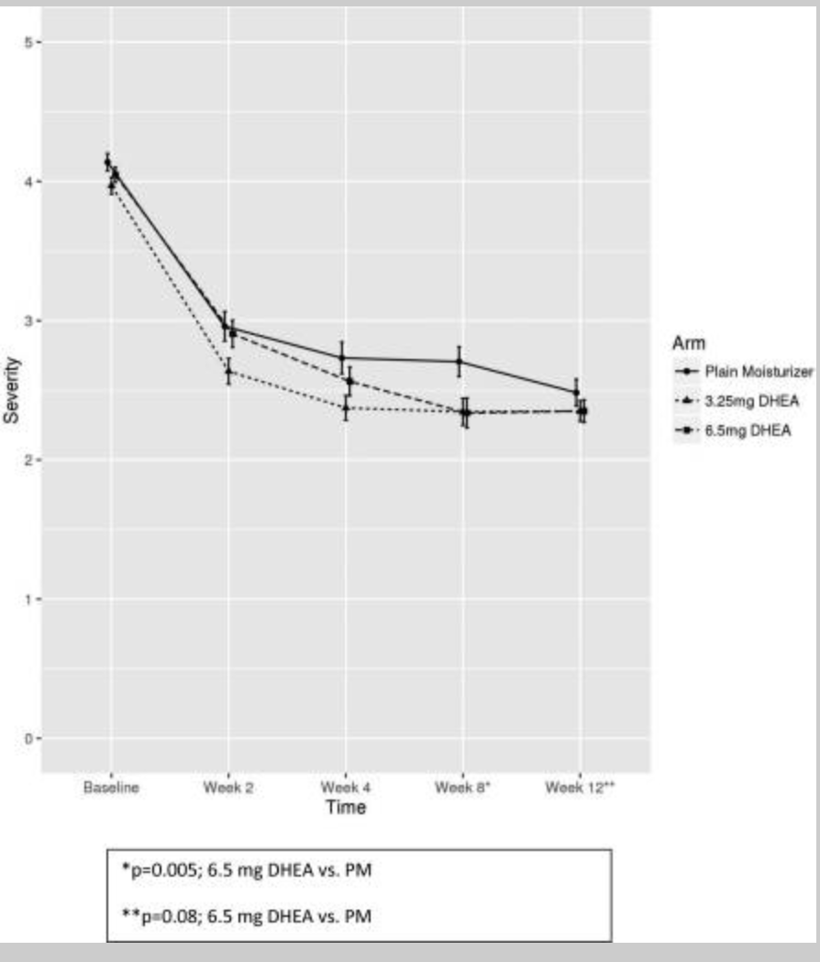
Evaluating The Efficacy Of Vaginal Dehydroepiandosterone For Vaginal Symptoms In Postmenopausal Cancer Survivors: NCCTG N10C1 (Alliance)
Three-arm randomized, controlled trial with 464 women evaluated DHEA 3.25 mg and DHEA 6.5 mg compared to a plain moisturizer over 12 weeks
Postmenopausal women with a hx of breast or gynecologic cancer who had completed surgery and chemo, had no evidence of disease, and reported at least moderate vaginal symptoms were eligible
  About 55% of patients were on AI, 15% on Tamoxifen
Neither DHEA dose was statistically significantly different from moisturizer at 12 weeks in terms of dryness or dyspareunia (6.25 mg, p=.08; 3.25 mg, p=0.48)
Women on the 6.5 mg arm of DHEA reported significantly better sexual health on the FSFI (p<0.001)
Barton D et al. Support Care Cancer 2018;26(2):643-650.

Slide 25
Systemic Or Vaginal Hormone Therapy After Early Breast Cancer: A Danish Observational Cohort Study
Longitudinal data from a national cohort of postmenopausal women, diagnosed 1997-2004 with early-stage ER+ invasive BC, who received no tx or 5 years of adjuvant endocrine tx
Ascertained prescription data on hormone therapy, vaginal estrogen therapy (VET) or menopausal hormonal therapy (MHT) from a national prescription registry
Among 8461 women, 1957 and 133 used VET and MHT, respectively, after diagnosis
Median follow-up was 9.8 years for recurrence and 15.2 years for mortality
Adjusted relative risk of recurrence:
    1.08 (95% CI = 0.89 to 1.32) for VET
    1.39 [95% CI = 1.04 to 1.85 in the subgroup receiving adjuvant aromatase inhibitors]
    1.05 (95% CI = 0.62 to 1.78) for MHT
Adjusted HR for overall mortality were 0.78 (95% CI = 0.71 to 0.87) and 0.94 (95% CI = 0.70 to 1.26) for VET and MHT, respectively
Cold S et al. J Natl Cancer Inst 2022;114(10):1347-1354.

Slide 26
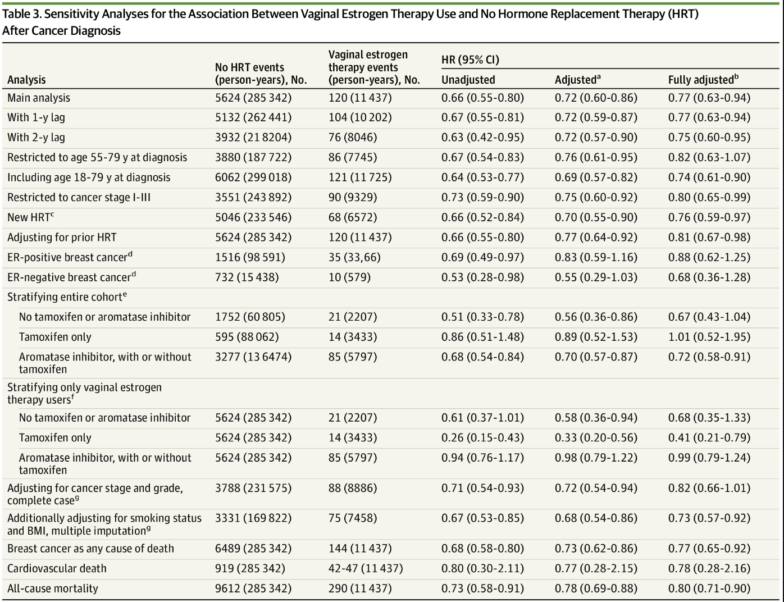
Vaginal Estrogen Therapy Use and Survival in Females With Breast Cancer
Two cohorts (Scotland and Wales), females with newly diagnosed breast cancer identified from national cancer registry records were followed up for breast cancer-specific mortality until 2020
Use of vaginal estrogen therapy (vaginal tablets and creams) was ascertained from pharmacy dispensing records and from general practice prescription records
49,237 females with breast cancer (aged 40-79 yrs) and 5795 breast cancer-specific deaths
A small decrease in mortality was found with vaginal estrogen therapy in the pooled fully adjusted model (HR, 0.77)
Estimate was similar in patients with 5 or more prescriptions (HR, 0.57 and with higher-dose therapy (HR, 0.81
McVicker et al. JAMA Oncol. 2024;10(1):103-108.

Slide 27
Use Of Local Estrogen Therapy Among Breast Cancer Patients In SEER-MHOS Database
Retrospective cohort study of 18,620 female breast cancer pts ≥ 65 yo diagnosed between 2010-2017 in the SEER-MHOS registry
Compared pts who used local vaginal estrogen (n=800) to those who did not (n=17,820)
Primary outcome was overall survival (OS) and secondary outcome was breast cancer specific survival (BCSS)
Multivariate regression models controlled for age, race, cancer stage, treatment (i.e. surgery, radiation, anti-hormonal therapy), and year of diagnosis.
There was a statistically significant increase in OS (HR=0.56, p<0.0001) and BCSS (HR=0.53, p=0.014) among breast cancer pts who used vaginal estrogen compared to those who did not
Among those who used vaginal estrogen, there was a statistically significant increase in OS for those with a duration of use >7 yrs compared to those with a duration of use <7 yrs (HR=0.01, p<0.0001).
Subset analysis restricted to patients with hormone positive breast cancer showed a statistically significant increase in overall survival for those who used vaginal estrogen compared to those who did not (HR=0.62, p=0.0007), and a nonsignificant increase in BCSS (HR=0.62, p=0.08).
Mitchell et al. ASCO 2025 Abstract 538

Slide 28
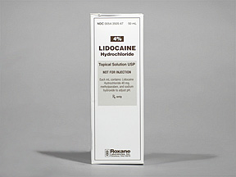
A Practical Solution For Dyspareunia In Breast Cancer Survivors: A Randomized Controlled Trial
46 breast cancer pts with severe dyspareunia were randomized to either saline or 4% aqueous lidocaine to vulvar for 3 minutes before vaginal penetration
All pts received open label lidocaine for 2 mos after 1 mo of blinded study
Lidocaine users reported less pain during intercourse in the blinded phase (1.0 vs. 5.3; P = .007)
After open-label lidocaine use, 37/41 (90%) reported comfortable penetration
17/20 (85%) pts who had abstained from intercourse who completed the study resumed comfortable penetration
Sexual distress decreased and sexual function improved
No penile numbness was reported
Goetsch el al, J Clin Oncol. 2015;33(30):3394-400.

Slide 29

Medical Treatments For Sexual Desire
  Bupropion (Wellbutrin)
      Non-randomized trials of bupropion 150 mg qd in 20 breast ca patients who had received chemo and were on hormonal therapy showed improvement in sexual functioning at 4 and 8 weeks (Mathias et al. Annals of Oncol 2006)
  Sildenafil Citrate (Viagra)
      No data in cancer patients
      Minimal positive data for women in general
  Flibanserin (Addyi)
      Acts to ↑ dopamine and norepinephrine (responsible for sexual excitement) and ↓ serotonin (responsible for sexual satiety/inhibition)
      Now FDA approved for premenopausal women
      Not contraindicated in breast cancer but limited data

Slide 30
Efficacy And Safety Of Flibanserin For The Treatment Of Hypoactive Sexual Desire Disorder In Women:
A Systematic Review And Meta-analysis
In August 2015, FDA approved flibanserin as a treatment for hypoactive sexual desire disorder (HSDD) in premenopausal women
Medical databases and trial registries were searched through 6/17/2015
Randomized clinical trials assessing flibanserin in premenopausal and postmenopausal women were eligible
Five published and 3 unpublished studies including 5914 women included
Risk ratio for study discontinuation due to AEs was 2.19 (95% CI, 1.50-3.20)
Risk ratios for:
      Dizziness was 4.00 (95% CI, 2.56-6.27) in flibanserin vs placebo
      Somnolence was 3.97 (95% CI, 3.01-5.24)
      Nausea was 2.35 (95% CI, 1.85-2.98)
      Fatigue was 1.64 (95% CI, 1.27-2.13)
Saadat et al. Curr Drug Metab. 2017;18(1):78-85.

Slide 31
Meta Analysis Pooled Results
Pooled mean differences for change from baseline were 0.49 (95% CI, 0.32-0.67) between flibanserin and placebo, 1.63 (95% CI, 0.45-2.82) for eDiary desire, and 0.27 (95% CI, 0.17-0.38) for FSFI desire.

Slide 32
Effect Of Flibanserin On Libido In Women With Breast Cancer On Adjuvant Endocrine Therapy
37 women (mean age of 49) with stage 0-III ER+ breast cancer on endocrine therapy for at least 3 mo took flibanserin 100 mg qhs for 24 wks and were followed for 52 wks
Pts met criteria for the diagnosis of HSDD by DSM-IV and other guidelines
Medical exams and questionnaires at baseline, weeks 4, 8, 16, 24 and 52
Feasibility and efficacy of flibanserin was measured by: Female Sexual Function Index (FSFI), Pittsburg Sleep Quality Index (PSQI), PROMIS, and EQ5D.
Statistically significant improvement in desire, arousal, lubrication, orgasm, satisfaction, and pain were seen as measured by the FSFI while on flibanserin, which declined after discontinuing the medication
Patients reported less pain and distress with sexual intercourse throughout the study and an increased number of sexually satisfying events
At baseline, average score for overall state of health was 78/100. At 24 weeks, average score increased to 93 and declined to 82 at week 52 (after medication was discontinued)
Larger randomized placebo-controlled study is needed
Goldfarb S et al. ASCO 2023

Slide 33
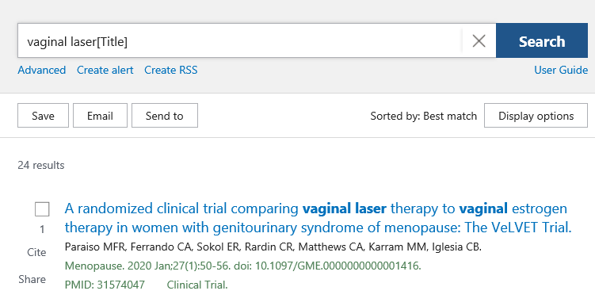
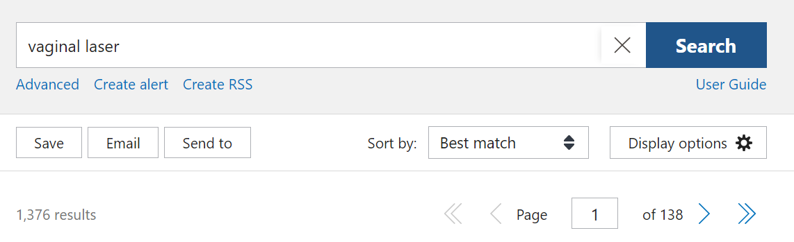
Vaginal Laser Therapy - September 2021-23:
Pubmed Search
2023

Slide 34
Effects Of Local Laser Treatment On Vulvovaginal Atrophy (VVA) Among Women With Breast Cancer: A Prospective Study With Long-term Follow-Up
46 breast cancer pts (mean age 56.5 yrs) with VVA underwent fractional microablative CO₂ laser therapy once per month for 3 months, enrolled between 5/2018-10/2018
Efficacy of laser therapy was assessed at baseline, 6 months and 18 months using Female Sexual Function Index (FSFI) score, Ditrovie score, and vaginal pH
pH level slightly decreased over time, whereas maturation pattern on pap smear did not change
Sexual quality of life was significantly improved at 6 months and 18 months (mean Δ at 6 months 8.3, SD = 6.2 (p < 0.0001) and mean Δ at 18 months 4.3, SD = 8.4 (p = 0.01)). Ditrovie total score improved at 6 months (mean Δ -1.2, SD = 2.7, p = 0.01) but returned to baseline afterwards
Side effects were very mild. Three women developed low (2)- and high (1)-grade HPV-linked cervical lesions during follow-up
Verun et al. Breast Cancer Res Treat. 2021 Jul;188(2):501-509

Slide 35
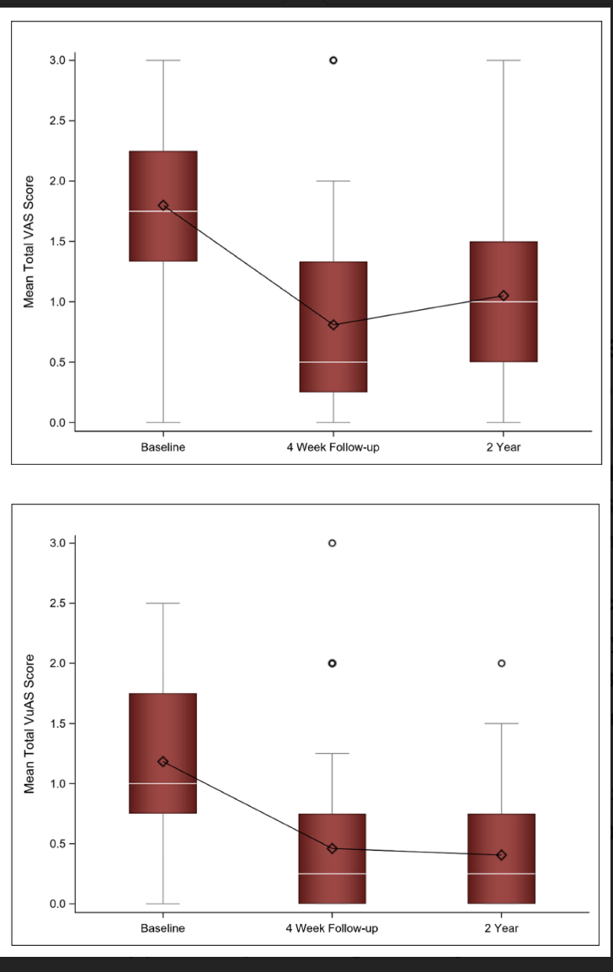
Long-Term Follow-Up of Fractional CO₂ Laser Therapy for Genitourinary Syndrome of Menopause in Breast Cancer Survivors
Single-arm study of breast cancer survivors received 3 treatments of fractional CO₂ laser therapy and returned for a 4 wk FUP
Outcomes: Vaginal Assessment Scale (VAS), the Female Sexual Function Index (FSFI), the Female Sexual Distress Scare Revised (FSDS-R), the Urinary Distress Inventory (UDI)
59 BC survivors completed treatment and 4 wk FUP; 39 and 33 had 1 and 2 yr FUP
After initial improvement in the VAS from baseline to 4 wks, there was no statistically significant difference in the VAS score between the 4 wk and 2 yr FUP
Quick AM et al. J Clin Med. 2022;11(3):774.

Slide 36
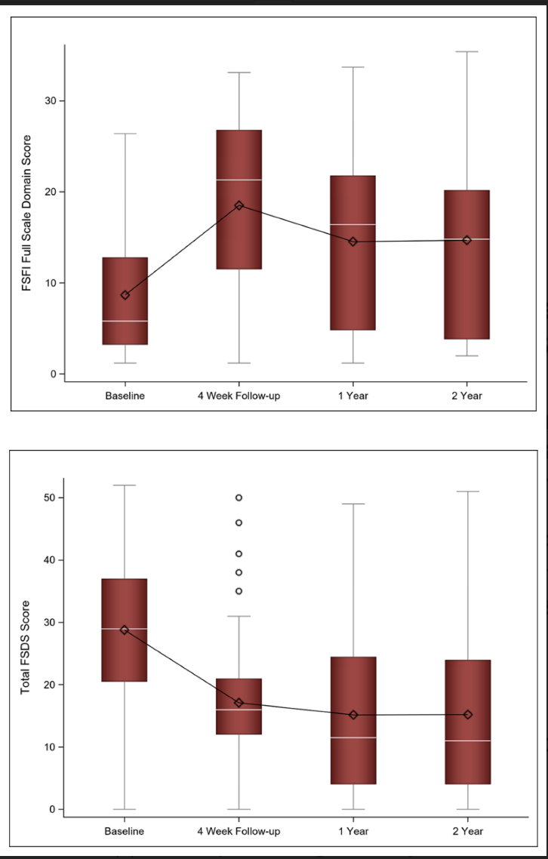
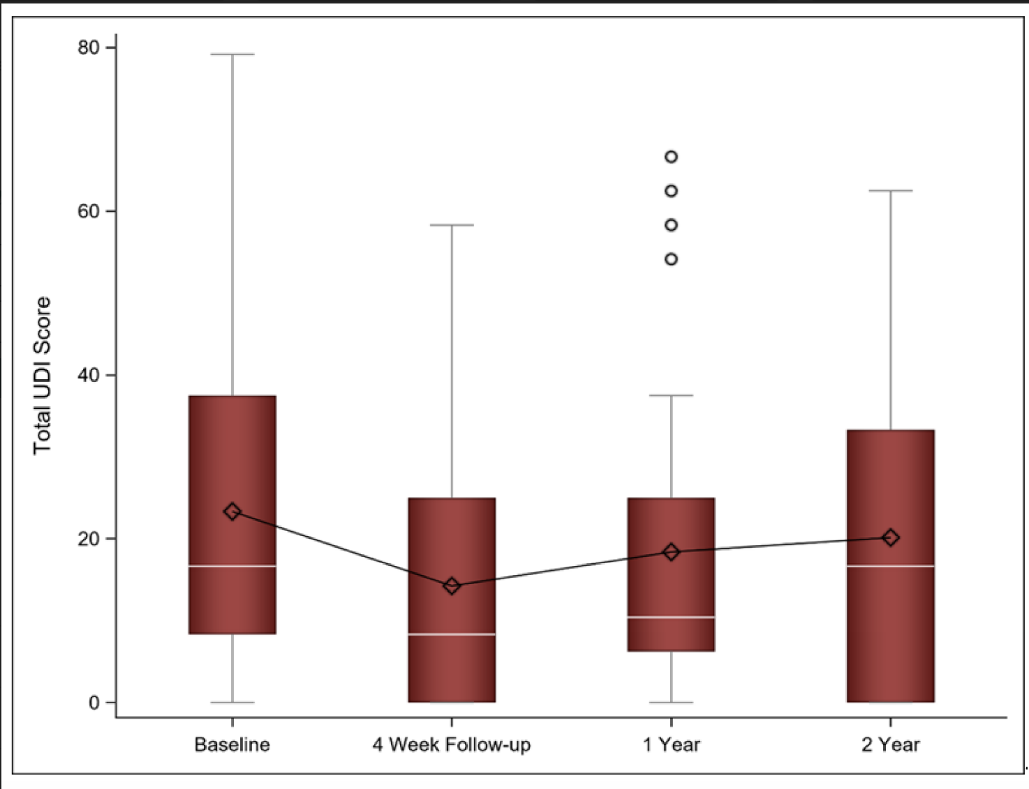
Long-term Follow-up Of Fractional CO₂ Laser Therapy For Genitourinary Syndrome Of Menopause In Breast Cancer Survivors
At 2 yr FUP, the FSFI and FSDS-R scores remained improved from baseline and there was no statistically significant change in the FSFI score or the FSDS-R score from 1 to 2 yr FUP
UDI scores approached baseline at the two-year follow-up
Quick AM et al. J Clin Med. 2022;11(3):774.

Slide 37

In 2021, a double-blind, sham-controlled RCT with 12 months of published Li et al found:
  No difference between fractional carbon dioxide vaginal laser and sham laser therapy for GSM
  Laser appeared safe, but it did not improve symptoms or QOL, and there were no changes in vaginal histology
In 2023, the LIGHT study showed no improvement in FSFI in breast cancer patients on AIs
“It is doubtful that the clinical practice of laser therapy for GSM will halt in the US without FDA intervention, and many practitioners here and around the world will likely continue to use the offensive “vaginal rejuvenation” language to coax patients into paying thousands of dollars to treat GSM for what the most robust current evidence tells us is an ineffective procedure.”

Slide 38
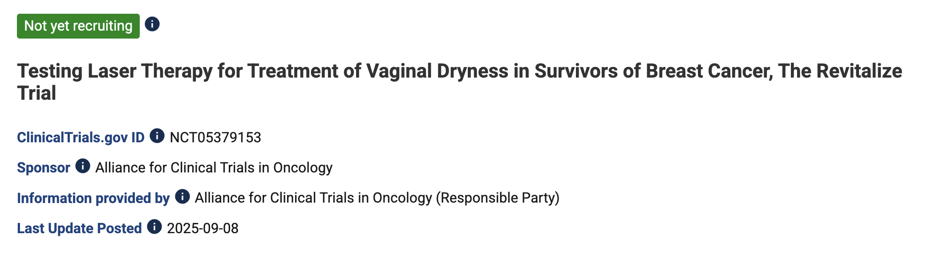

Slide 39
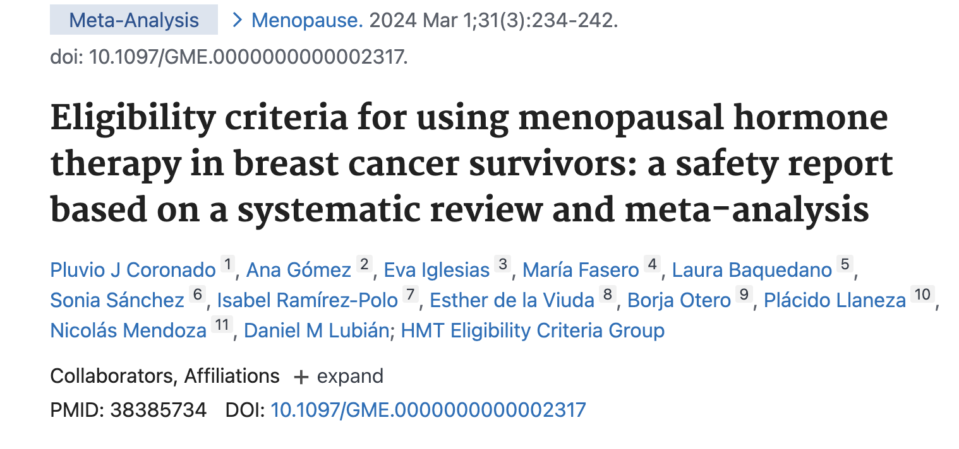
What About HRT In Breast Cancer Survivors?

Slide 40
Eligibility Criteria For Using Menopausal Hormone Therapy In Breast Cancer Survivors: A Safety Report Based On A Systematic Review And Meta-analysis
Search of MEDLINE, Cochrane Library, and EMBASE → 12 studies met the eligibility criteria.
Analysis of the three RCTs (Stockholm and HABITS using combined MHT or LIBERATE using tibolone) revealed no significant differences concerning tumor recurrence (RR 1.46; 95% CI, 0.99-2.24)
Analysis of RCTs, prospective, and retrospective trials found no elevated risk of recurrence (RR, 0.85; 95% CI, 0.54-1.33) or death (RR, 0.91; 95% CI, 0.38-2.19)
Eligibility criteria for pts with hormone receptor (HR)-positive tumors fell into categories 3B and 3C (risks generally outweigh benefits) for combined MHT or estrogen alone and 4A (MHT should not be used) for tibolone. For HR-negative tumors, the category was 2B and 2C (benefits outweigh risks)

Slide 41
Hormone Replacement Therapy After Breast Cancer: 10 Year Follow Up Of The Stockholm Randomized Trial
The Stockholm trial was started in 1997 and designed to minimize the dose of progestogen in the HRT arm. Disease-free breast cancer survivors were randomized to HRT (n=188) or no HRT (n=190)
Trial was stopped in 2003 when the HABITS trial reported increased recurrence
After 10.8 years of FUP there was no difference in new breast cancer events: 60 in the HRT group vs 48 in controls (HR=1.3; 95% CI=0.9-1.9)
Among women on HRT, 11 had local recurrence and 12 distant metastases versus 15 and 12 for the controls.
There were 14 contra-lateral breast cancers in the HRT group and four in the control group (HR=3.6; 95% CI=1.2-10.9; p=0.013)
No differences in mortality or new primary malignancies were found
Fahlén M, Fornander T, Johansson H, et al. Eur J Cancer 2013;49:52–59.

Slide 42
No Increase In Incidence Or Risk Of Recurrence Of Breast Cancer In Ospemifene-Treated Patients With
Vulvovaginal Atrophy (VVA)
Ospemifene is a SERM approved by the FDA in 2013 for the treatment of moderate to severe dyspareunia due to menopause. Also approved in Europe for the treatment of symptomatic VVA in postmenopausal women
Ospemifene evolved from a tamoxifen metabolite and is a weak antiestrogen on the breast tissue
Retrospective matched cohort study→VVA patients were identified from the 2011-2018 US MarketScan® insurance claims database
Incidence of breast cancer (BC) was identified by diagnosis codes, mastectomy, chemotherapy, or radiation procedure
Ospemifene-treated VVA patients without evidence of BC were matched to two untreated VVA controls similarly without history of BC
Process was repeated to estimate BC recurrence in pts WITH a history of BC
Cai B, Simons J et al. Maturitas 2020;142:38-44

Slide 43
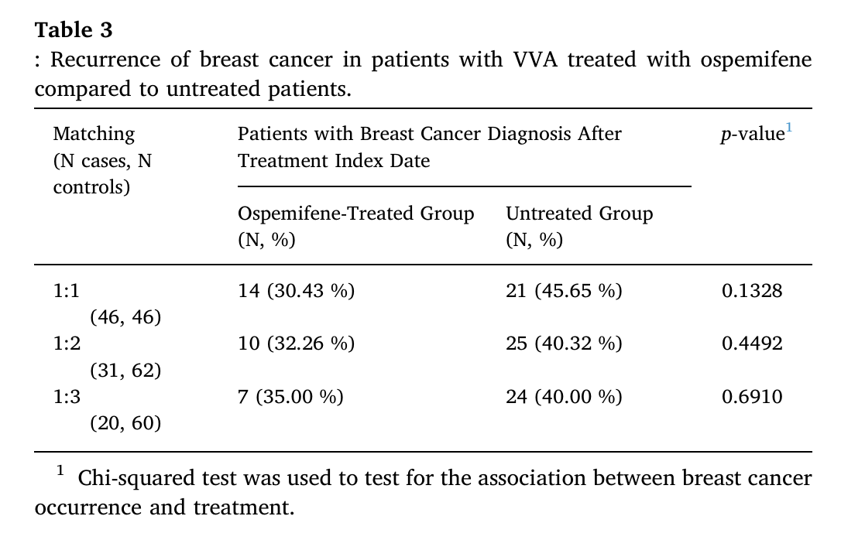
No Increase In Incidence Or Risk Of Recurrence Of Breast Cancer In Ospemifene-treated Patients With
Vulvovaginal Atrophy (VVA)
1728 ospemifene users and 3456 untreated pts met eligibility and matching criteria for assessing incidence
Average days ospemifene was supplied was 314
Average FUP time from index treatment was 937 days for treated patients and 915 days for controls
BC incidence rates per 1000 person-years was 2.03 (95 % CI: 1.06-3.91) for treated pts and 3.53 (95 % CI: 2.49-4.99) for controls (RR = 0.58, 95 % CI: 0.28-1.21)
Cai B, Simons J et al. Maturitas 2020;142:38-44

Slide 44
CP1347589-44

