Slide 1



Breast Cancer:
Weight Loss and Exercise
Jennifer Ligibel, MD
Disclaimer: This presentation is intended for personal use and for informational purposes only and does not replace independent professional judgment. This presentation is the property of Physicians’ Education Resource, LLC (“PER”) and is protected by U.S. and international copyright laws. You may not copy, reproduce, distribute, transmit, modify, or create derivative works of the presentation without the prior written permission from PER.

Slide 2
Objectives
Discuss the growing evidence supporting the role of exercise in breast cancer prevention and control
Review observational data linking obesity to breast cancer risk and outcomes
Discuss emerging evidence that weight loss could lower risk of breast cancer and improve outcomes

Slide 3
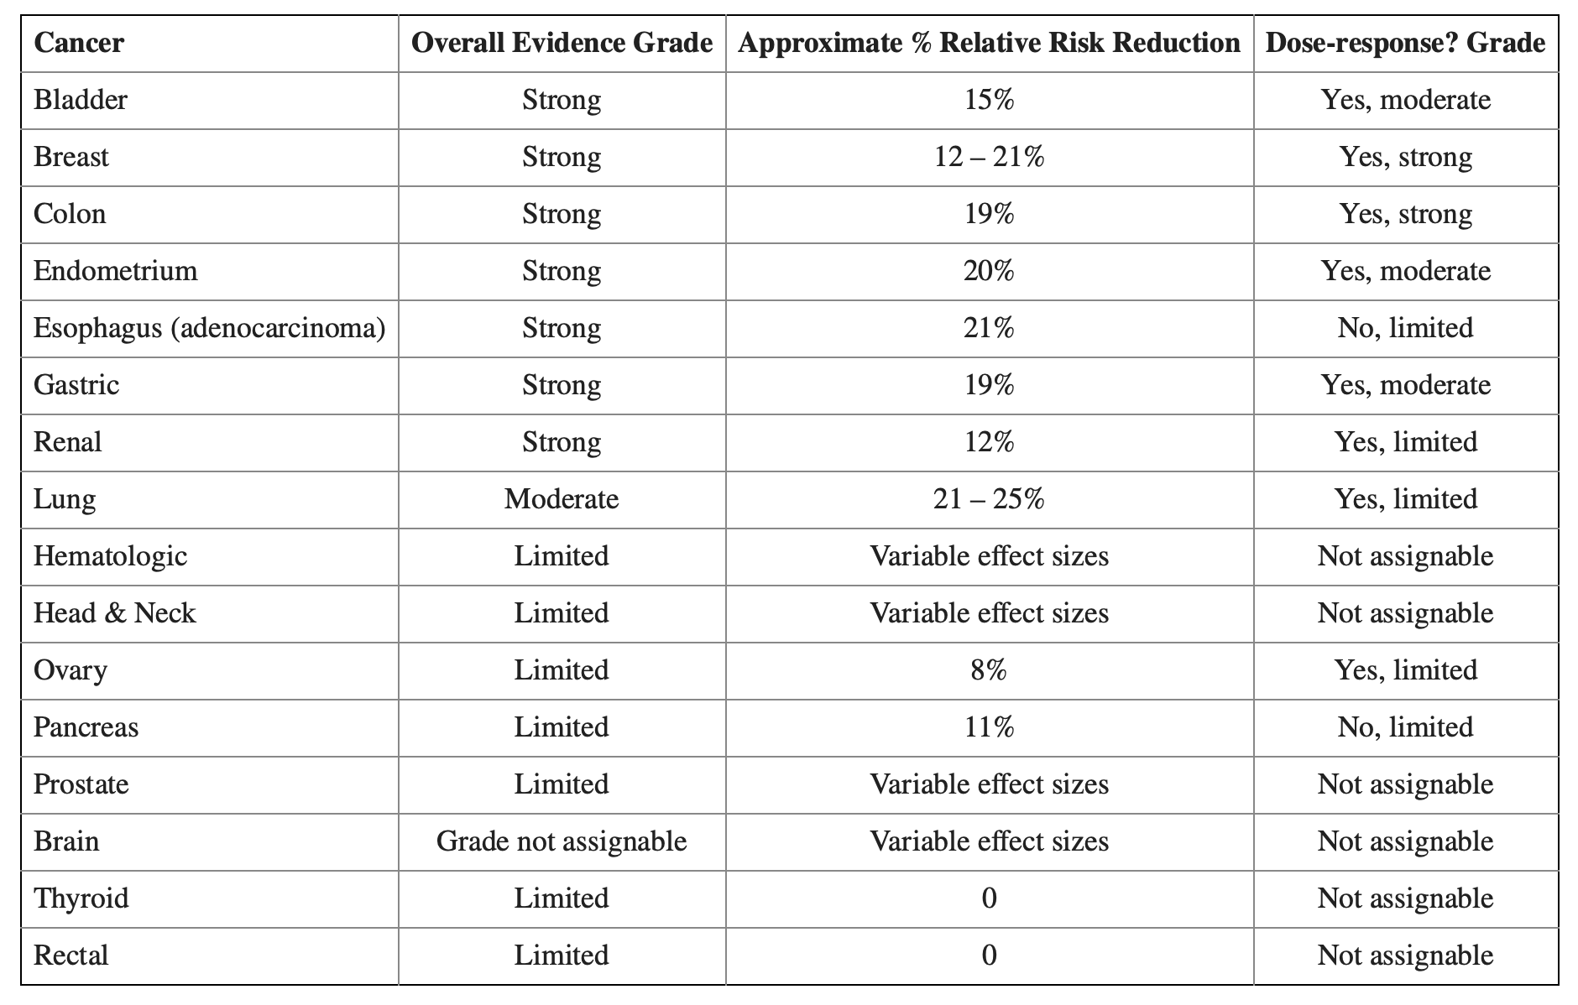
Higher levels of physical activity associated with lower risk of developing breast cancer
2018 US Physical Activity Guideline Review
Physical activity and risk of cancer
50 meta-analyses, systematic reviews and pooled analyses of PA and cancer
    Hundreds of epidemiologic studies
    Several million participants
Self-reported PA from questionnaires
Largely focused on recreational PA
Many studies looked at moderate to vigorous PA, but definitions differed
Breast Cancer: Strong evidence for 12-21% reduction with evidence for dose-response
McTiernan et al. Med Sci Sports Ex 2019
Notes:
2018 Physical Activity Guidelines Advisory Committee Scientific Report.
45 meta-analyses/systematic reviews comprising hundreds of epidemiologic studies with several million study participants

Slide 4
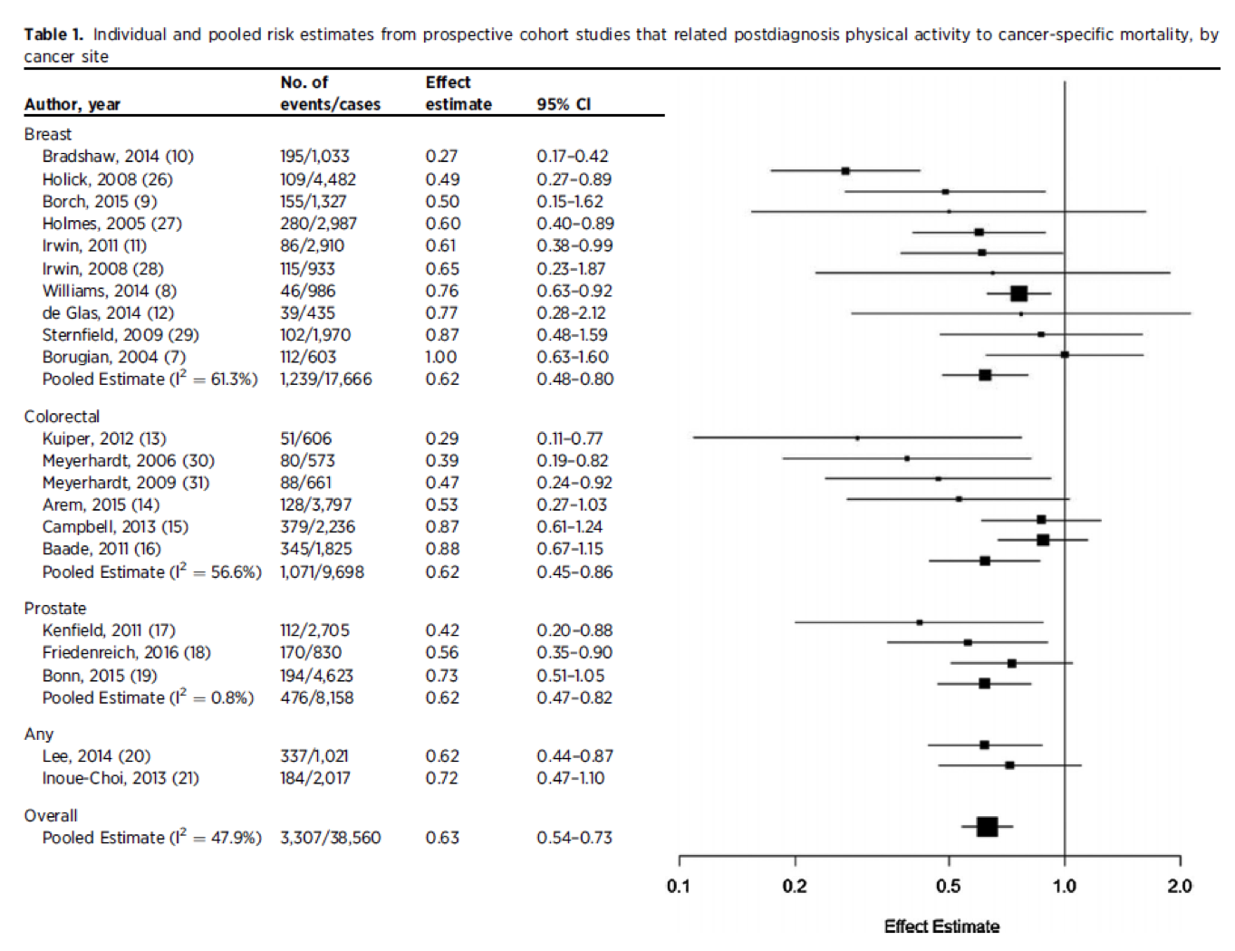
Physical activity also associated with better outcomes in early-stage malignancies
Post-diagnosis physical activity and
cancer mortality
Breast, colon and prostate cancers:
Pooled effect estimate 0.62
(active vs inactive survivors)
Friedenreich et al. Clin Can Res 2016

Slide 5
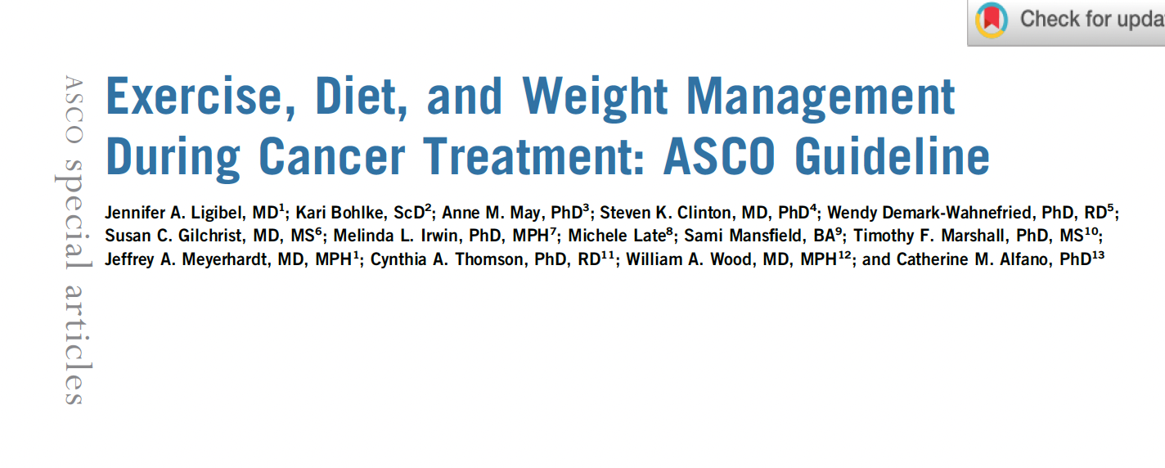
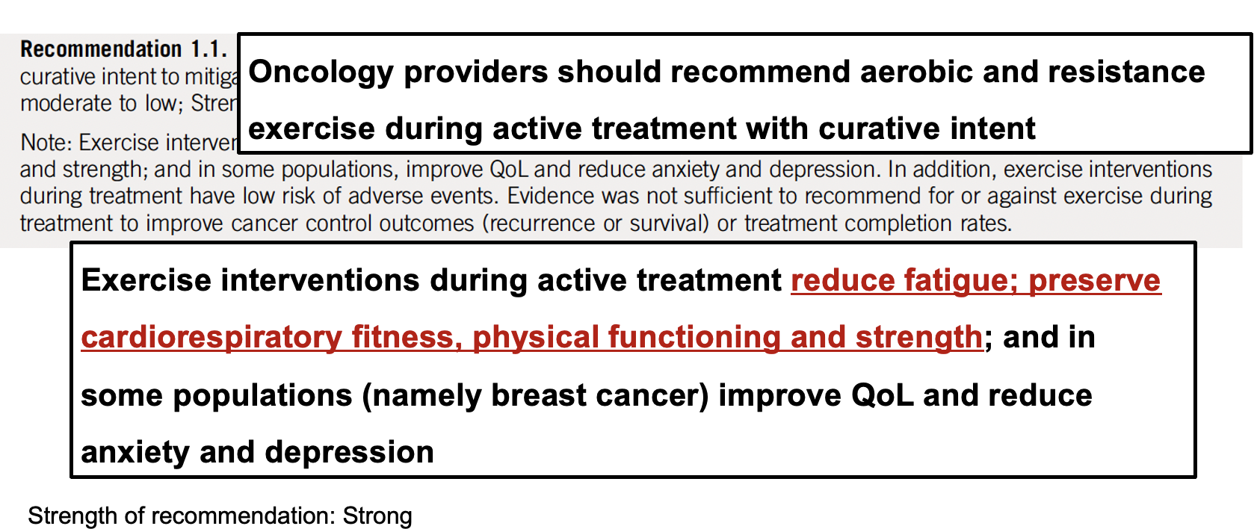

Slide 6
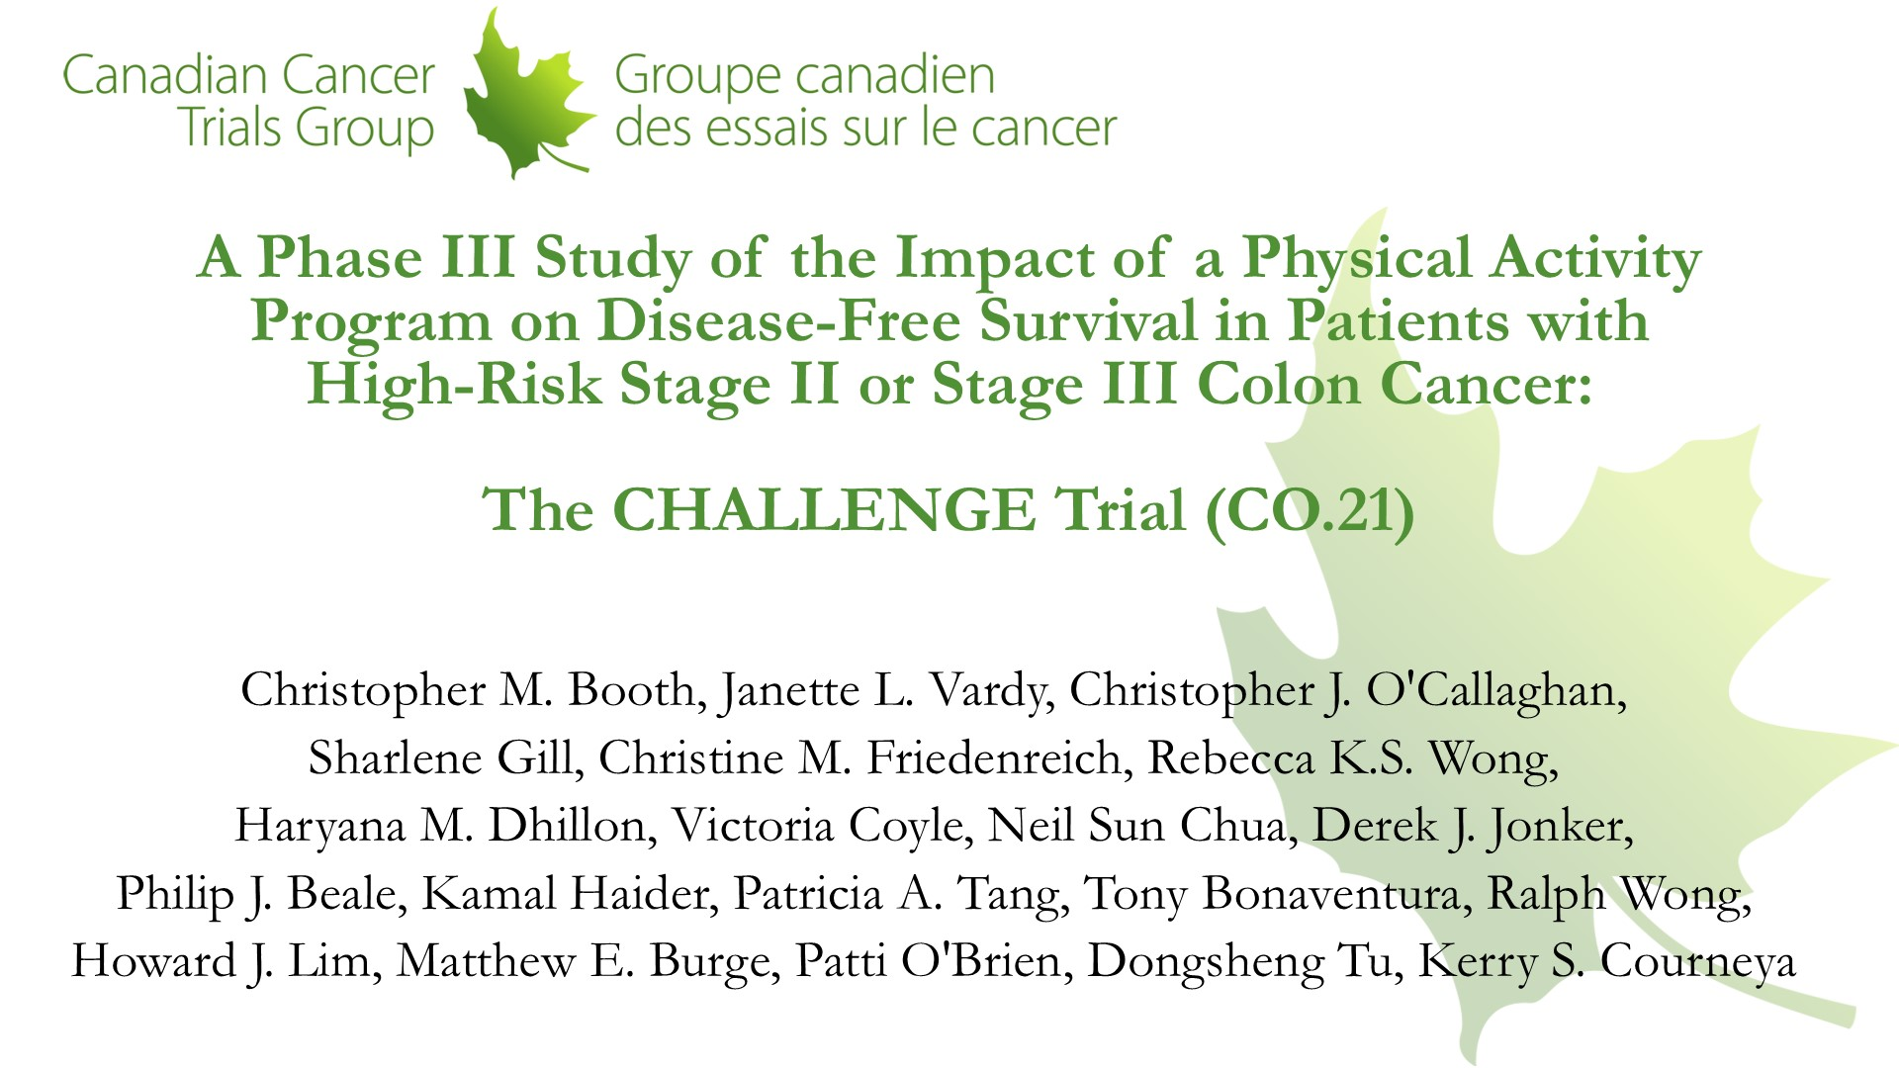
Slide 1
Content of this presentation is the property of the author, licensed by ASCO. Permission required for reuse.

Slide 7
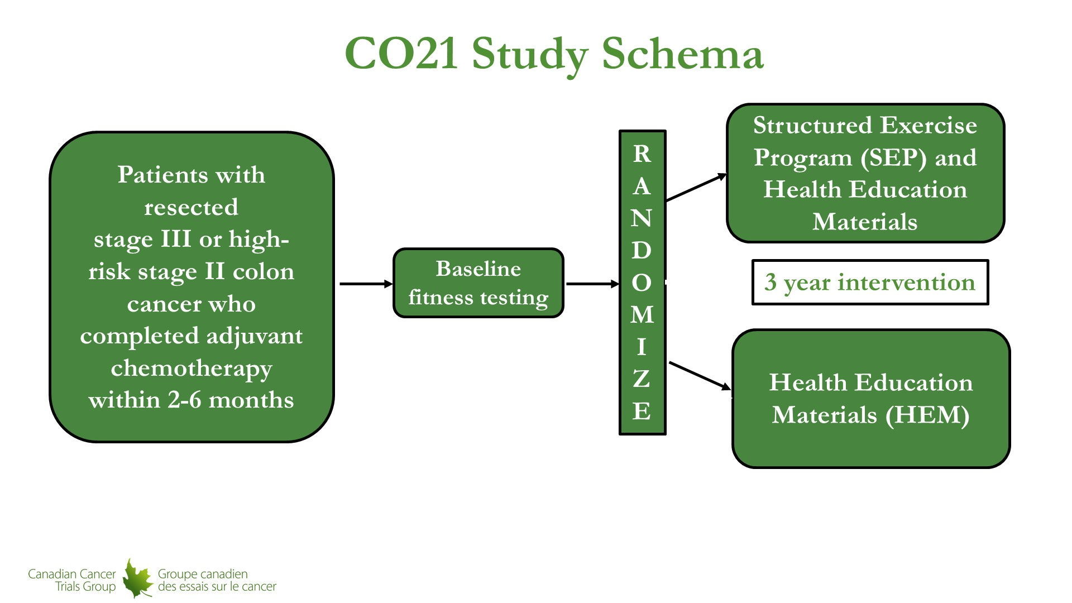
CO21 Study Schema
Content of this presentation is the property of the author, licensed by ASCO. Permission required for reuse.

Slide 8
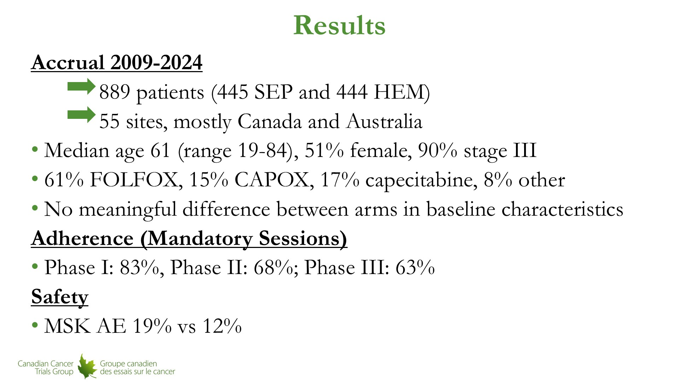
Results
Content of this presentation is the property of the author, licensed by ASCO. Permission required for reuse.

Slide 9
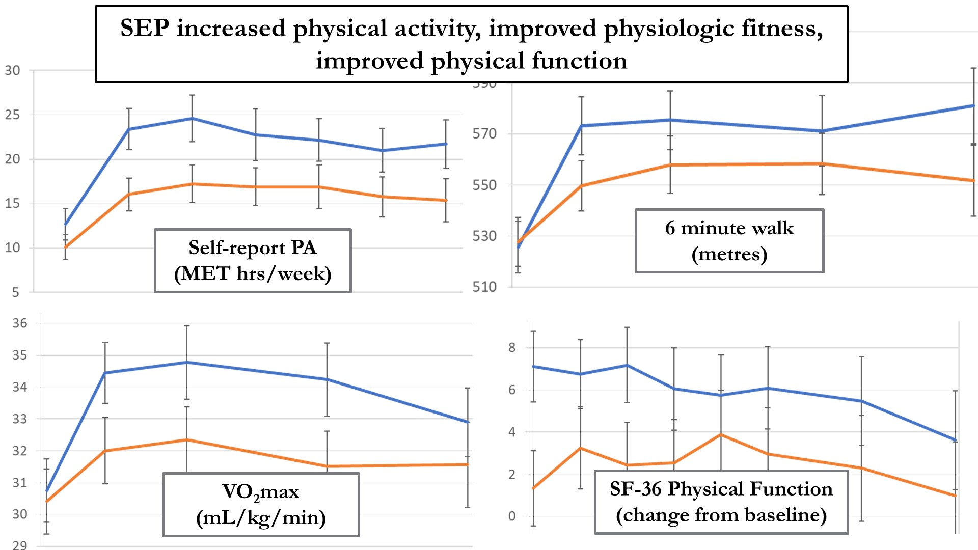
Slide 10
Content of this presentation is the property of the author, licensed by ASCO. Permission required for reuse.

Slide 10
Slide 10

Slide 11
Slide 10

Slide 12
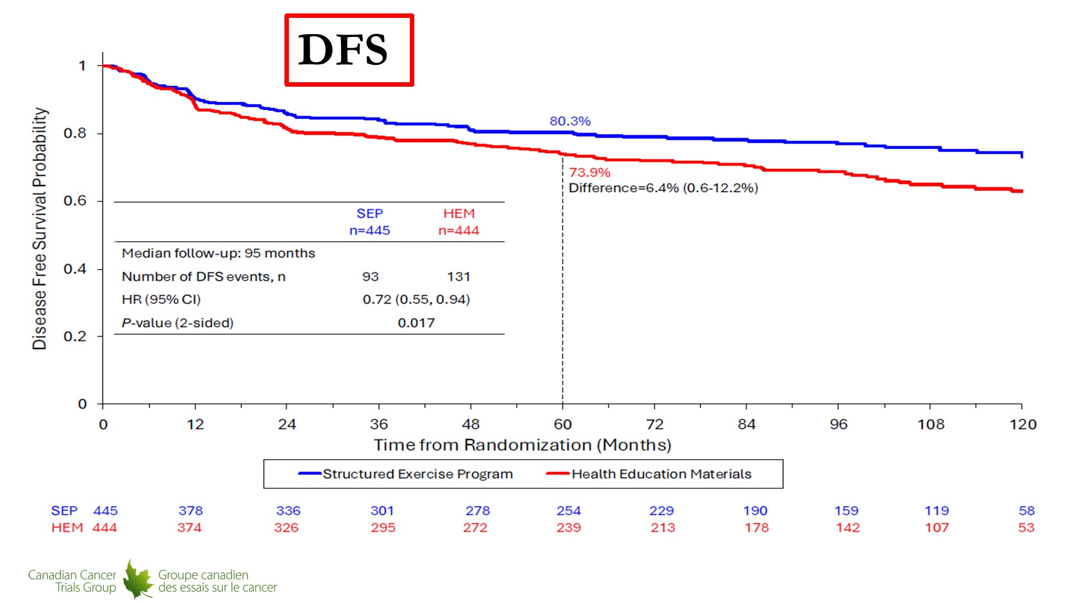
Slide 11
Content of this presentation is the property of the author, licensed by ASCO. Permission required for reuse.

Slide 13
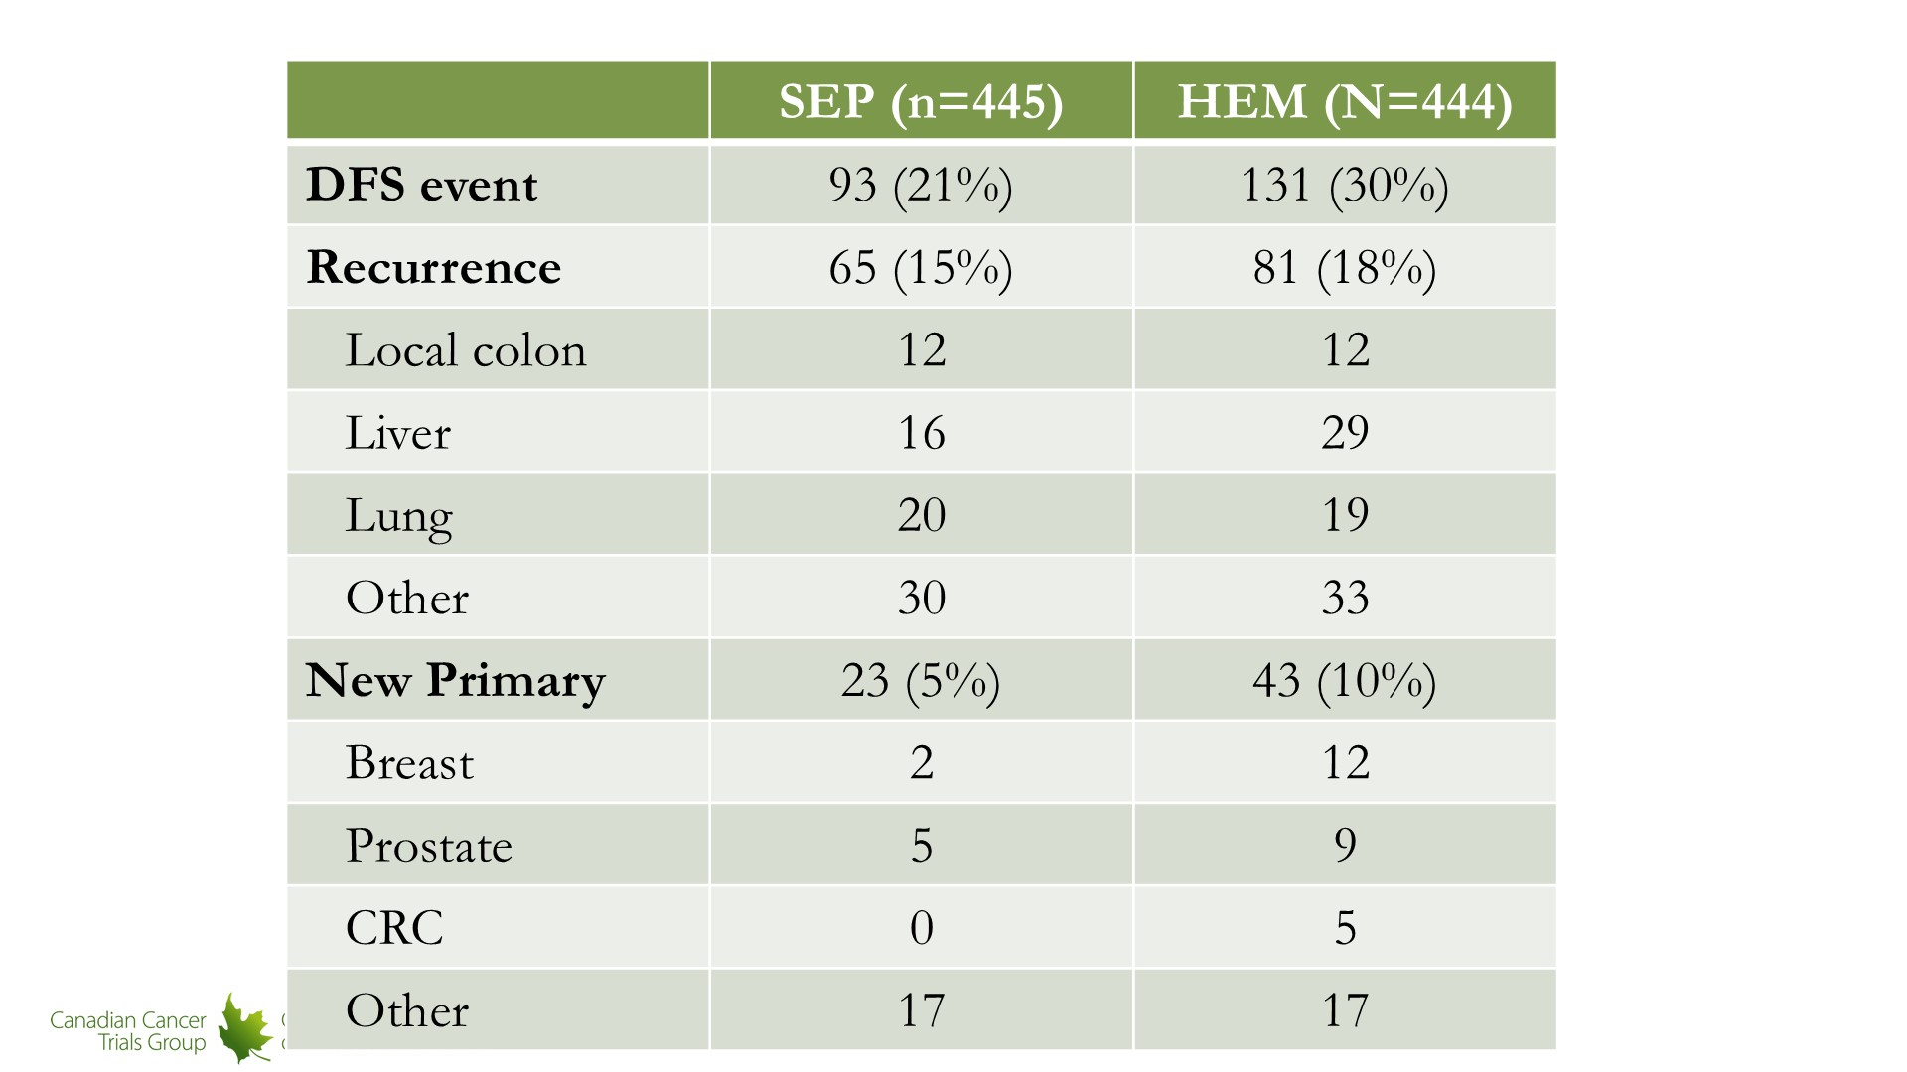
Slide 13
Content of this presentation is the property of the author, licensed by ASCO. Permission required for reuse.

Slide 14
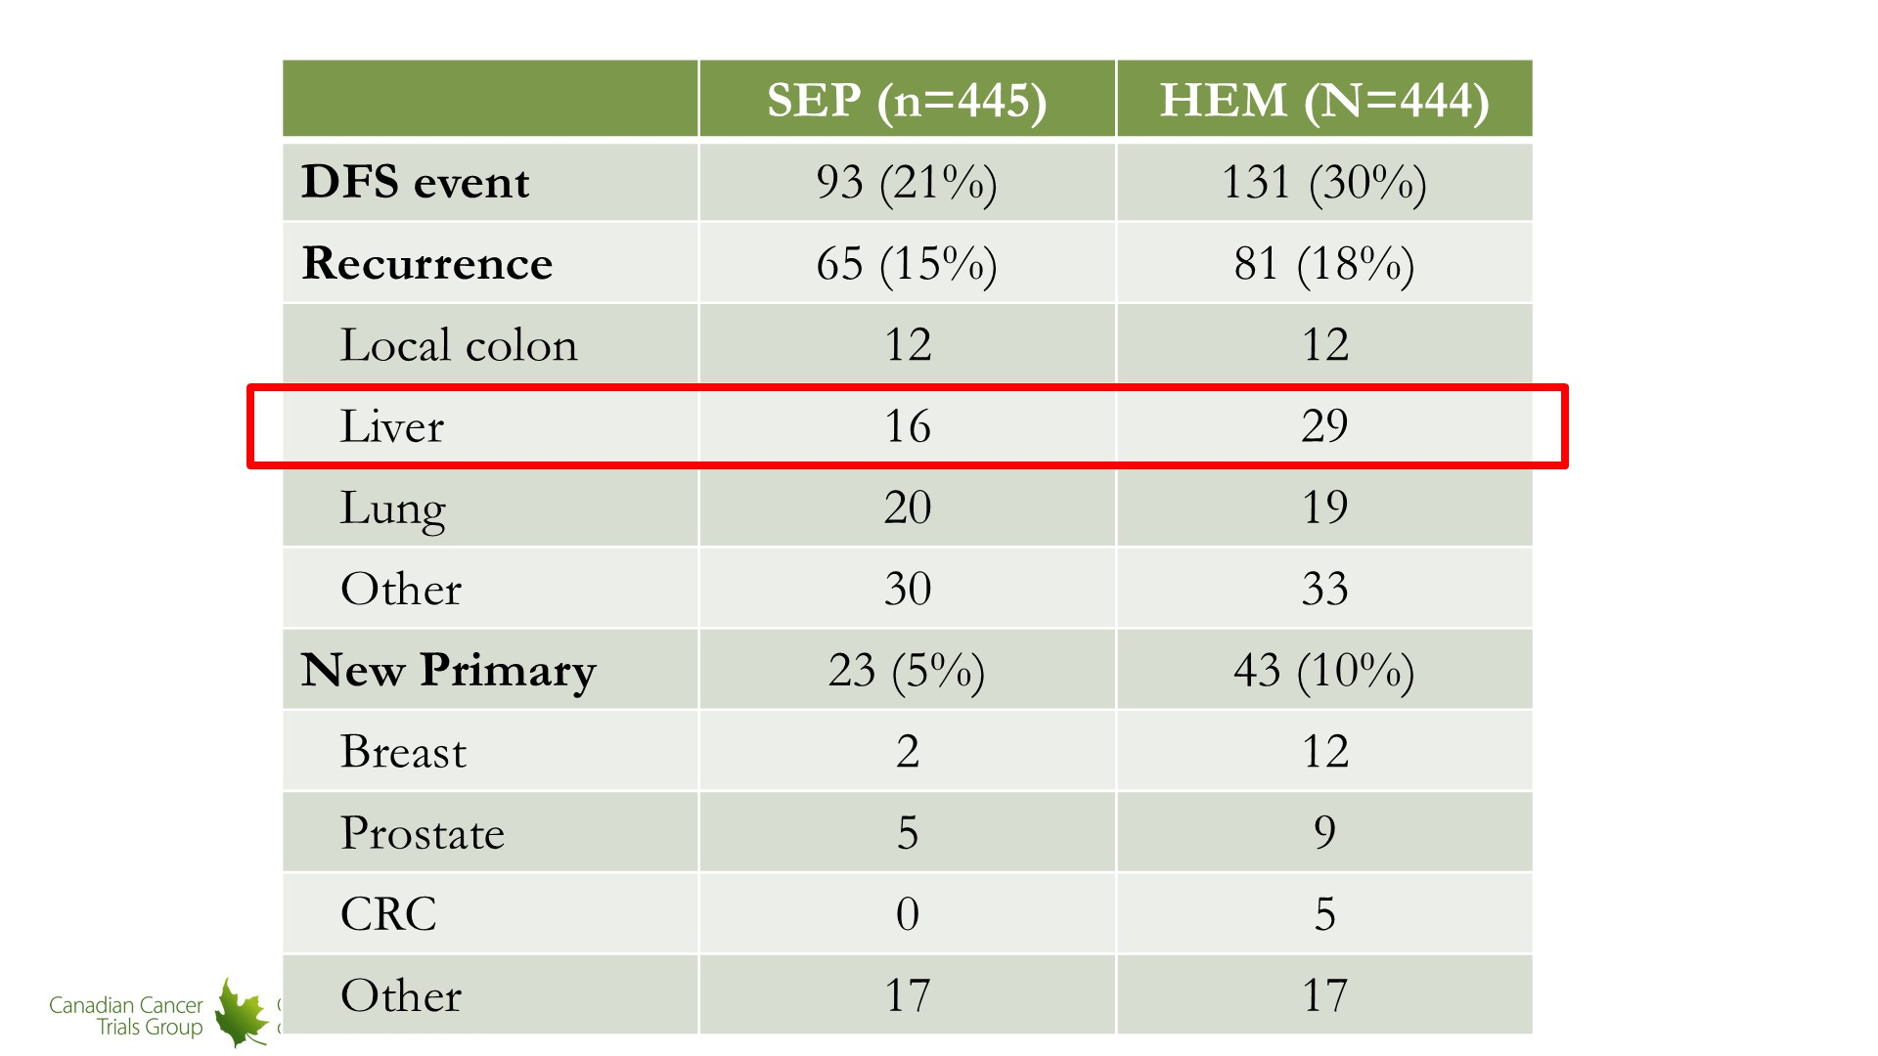
Slide 14
Content of this presentation is the property of the author, licensed by ASCO. Permission required for reuse.

Slide 15
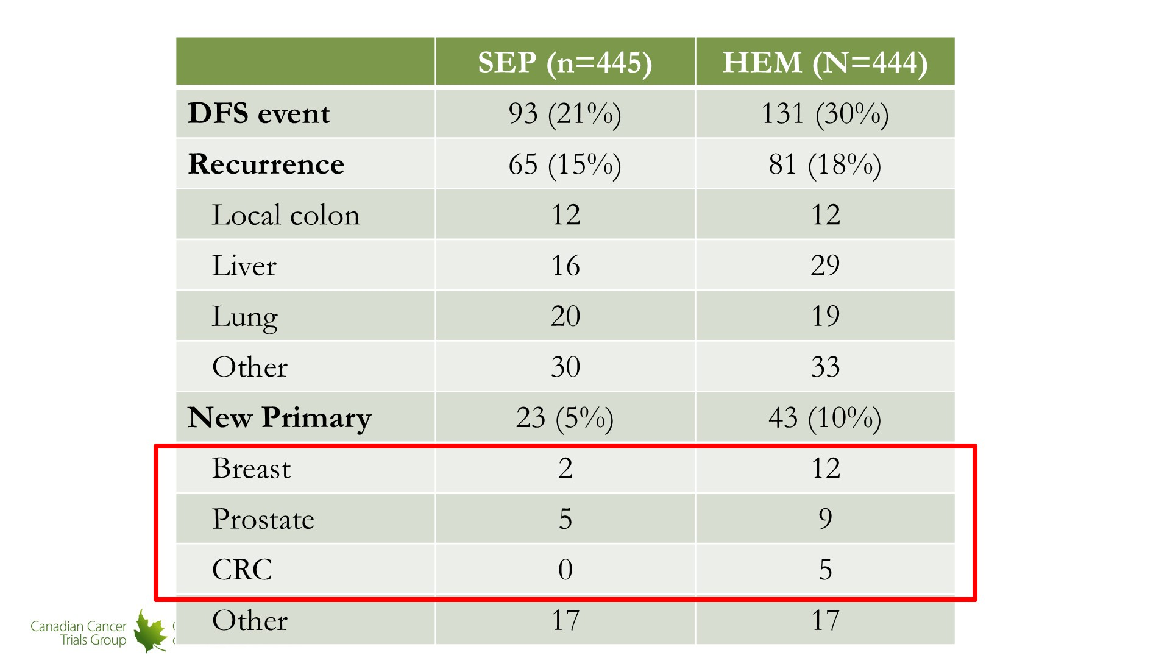
Slide 15
Content of this presentation is the property of the author, licensed by ASCO. Permission required for reuse.

Slide 16
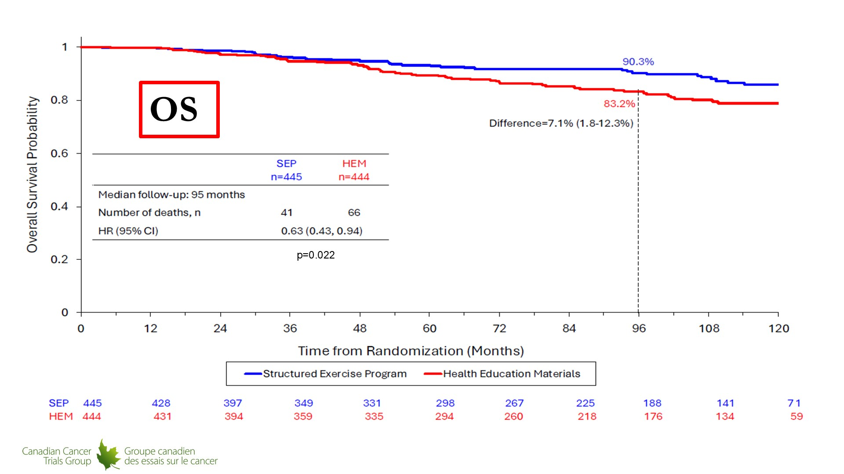
Slide 16
Content of this presentation is the property of the author, licensed by ASCO. Permission required for reuse.

Slide 17
What about obesity in breast cancer?
Are GLP-1 receptor agonists the answer?

Slide 18

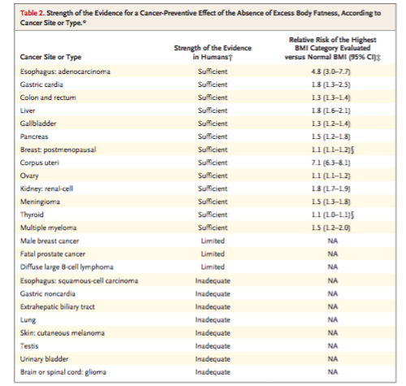
Observational evidence shows strong link between obesity and risk of breast cancer
Esophagus (adenocarcinoma)
Gastric cardia
Colon/rectum
Liver
Gallbladder
Pancreas
Breast (postmenopausal)
Uterus
Ovary
Kidney
Meningioma
Thyroid
Multiple myeloma
Reviewed more than 1000 studies evaluating the relationship between adiposity and cancer risk
Identified 13 malignancies for which there was sufficient evidence that excess adiposity led to increased cancer risk
  Additional 3 malignancies with limited evidence
10% increase in breast cancer risk with each 5kg/m2 increase in BMI
Lauby-Secretan et al. NEJM 2016

Slide 19
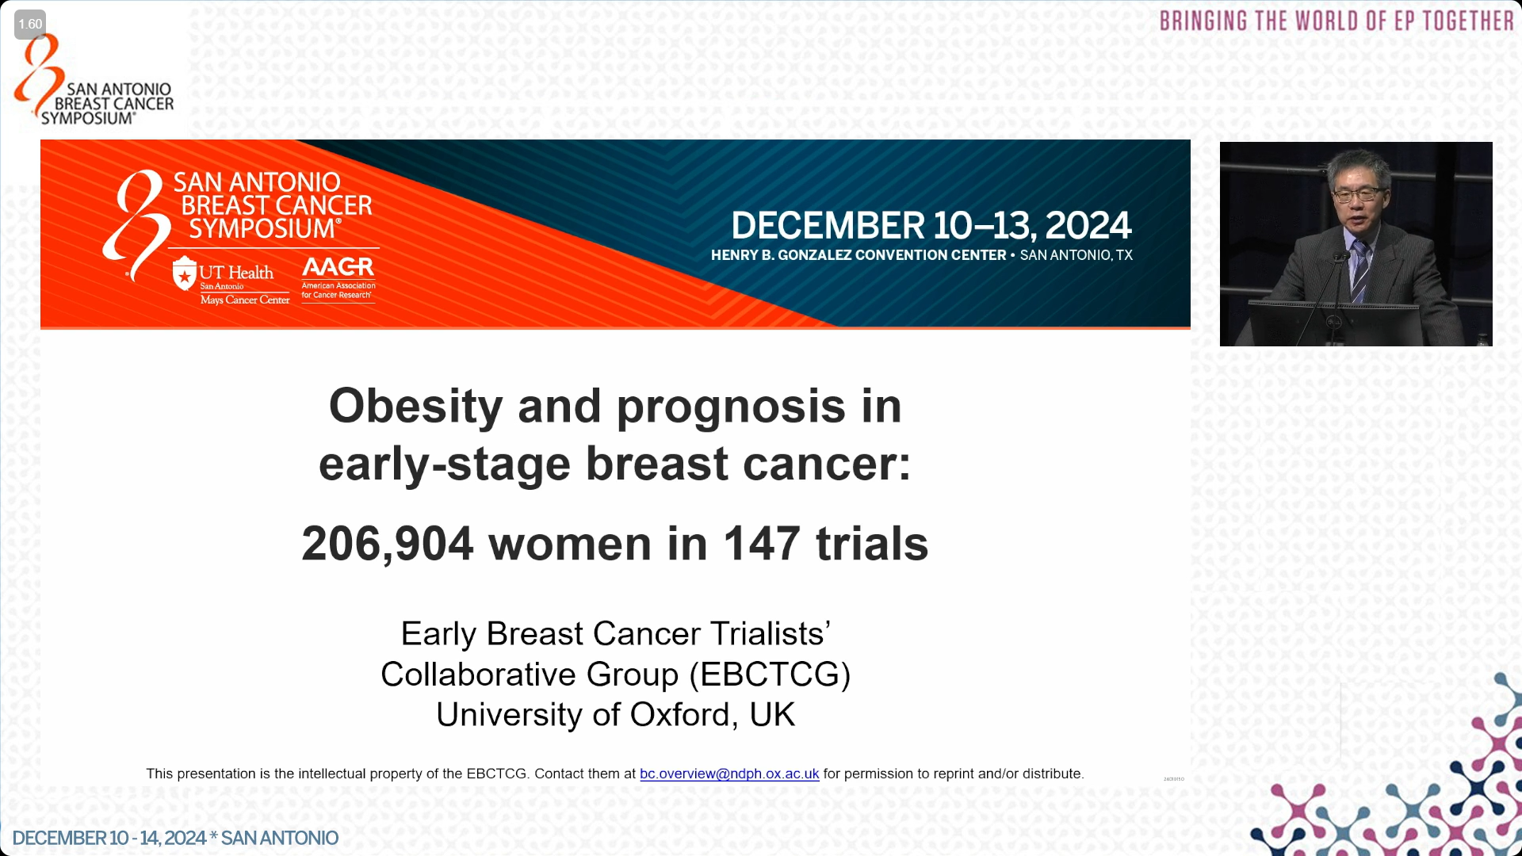

Slide 20
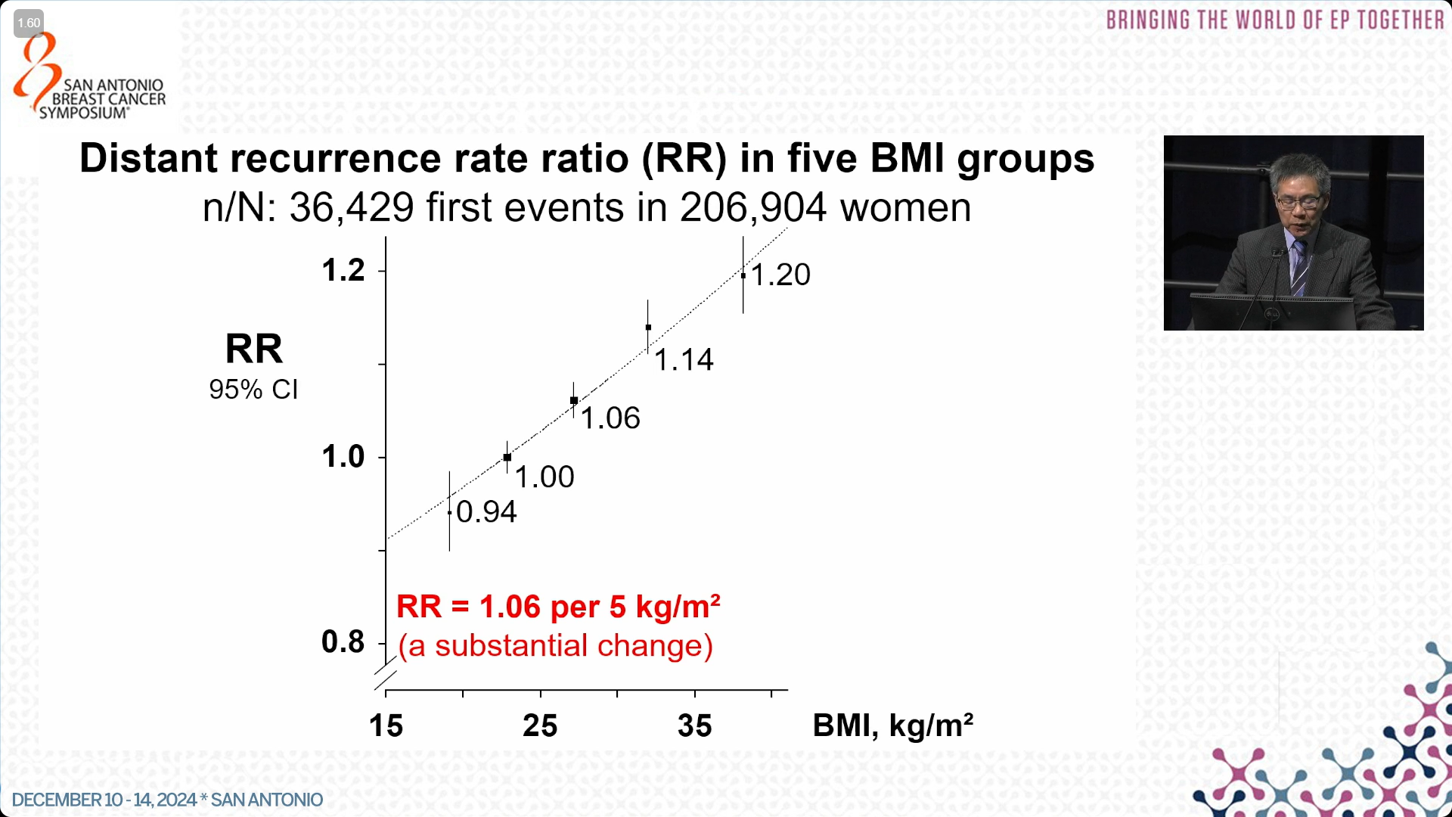

Slide 21
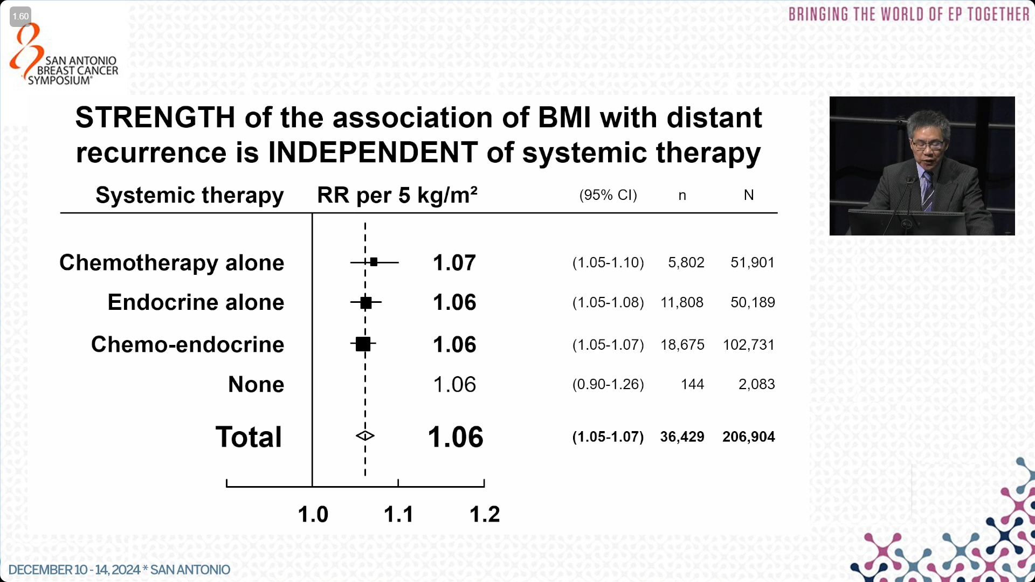

Slide 22
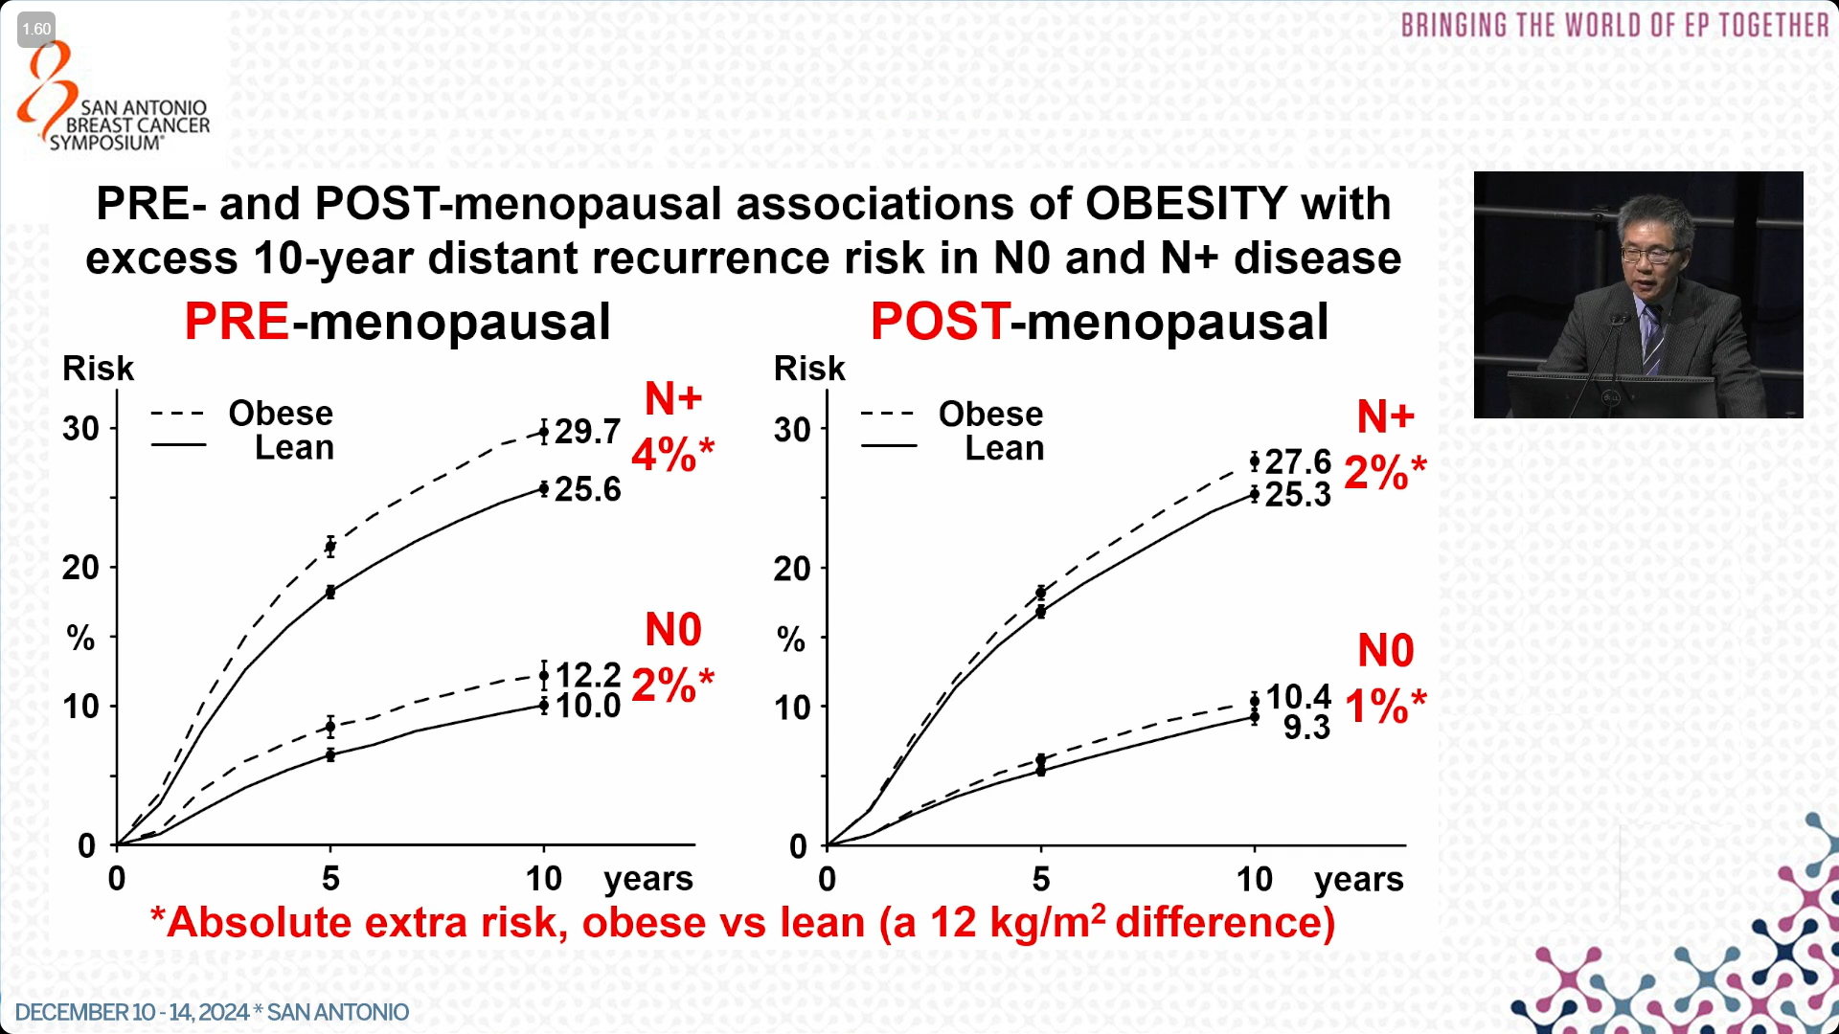

Slide 23
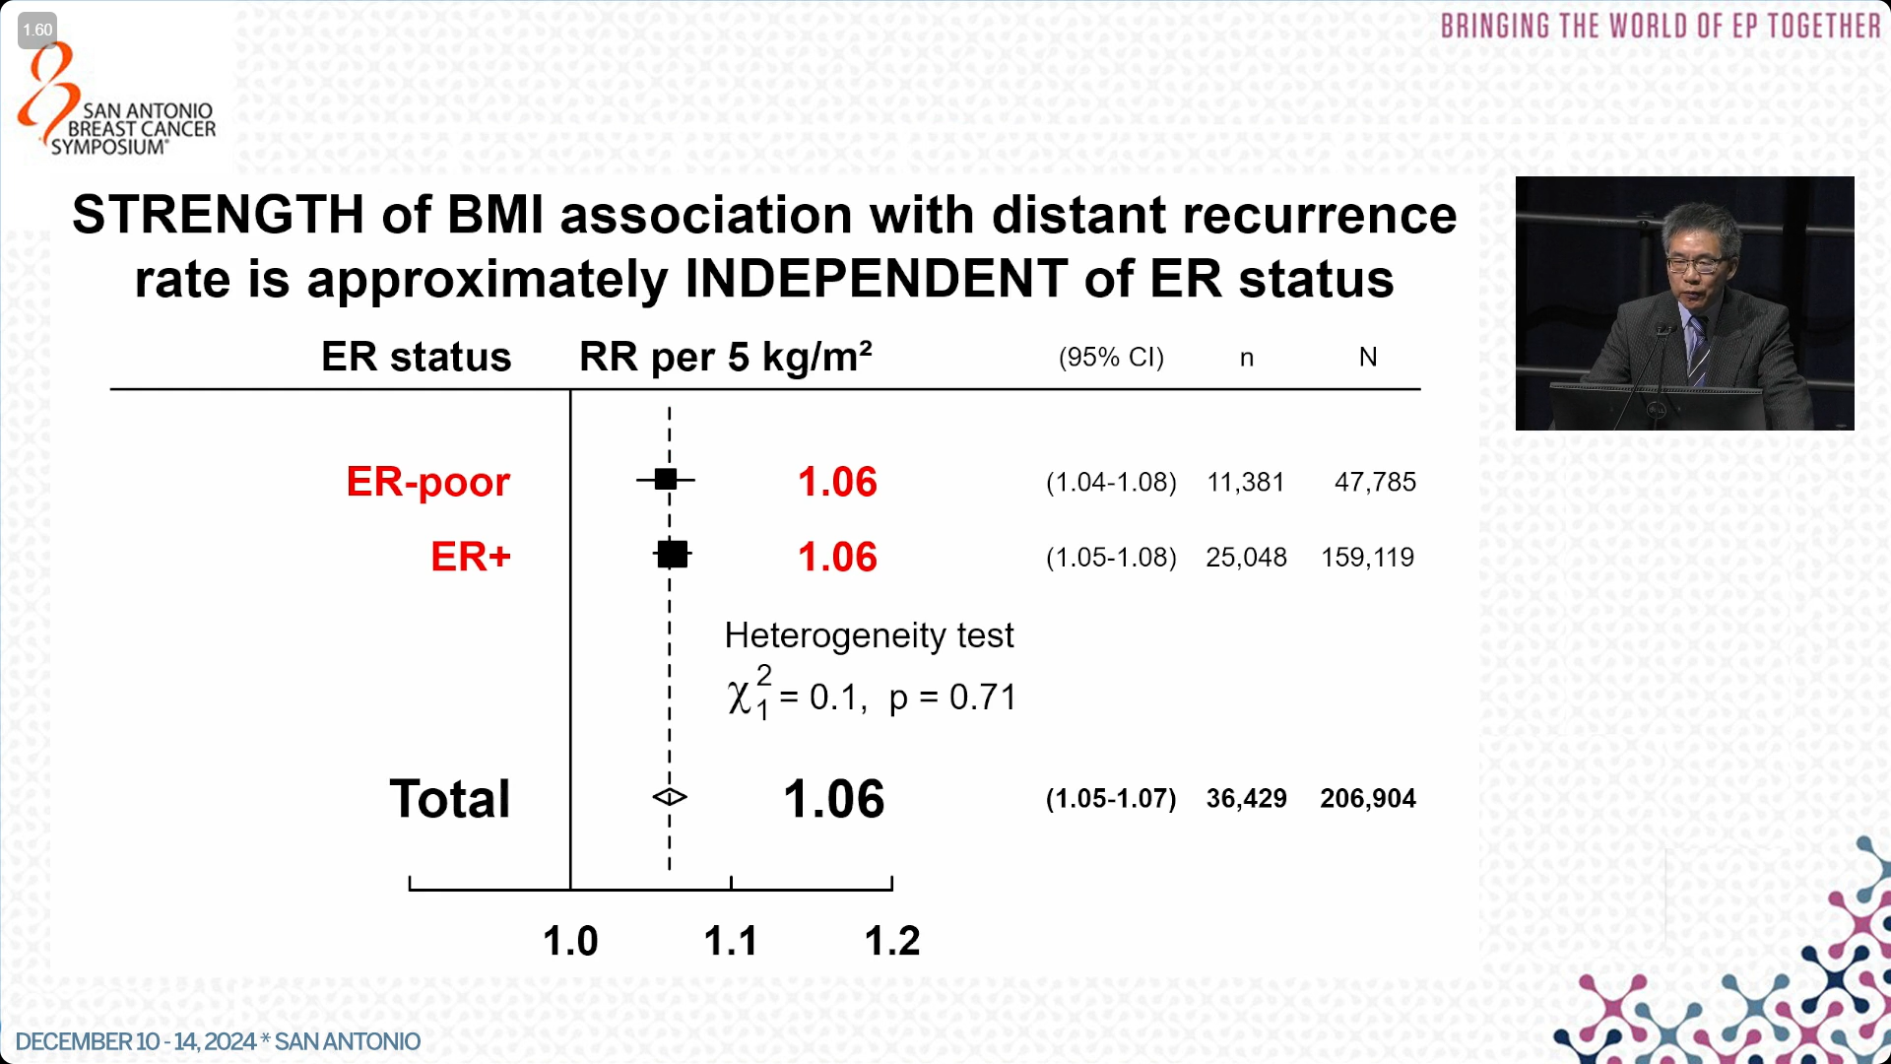

Slide 24
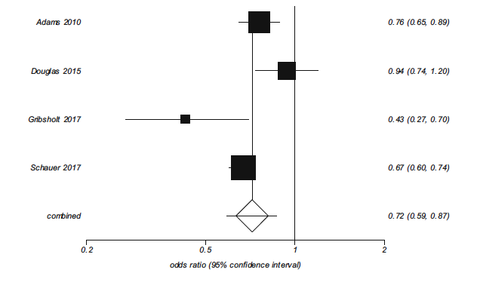
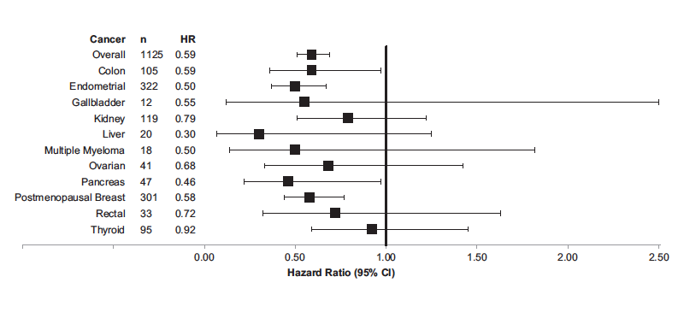
Preliminary evidence also suggests that weight loss could reduce cancer risk
Meta-analysis of cancer risk and bariatric surgery in prospective studies
Cancer risk in 22,000 bariatric surgery patients vs. 66,000 matched controls
Wiggins et al. Obesity Surgery 2019; Schauer at al. Annals of Surgery, 2017
Notes:
22,198 subjects who had bariatric surgery and 66,427 nonsurgical subjects matched on sex, age, study site, body mass index, and Elixhauser comorbidity index
mean follow-up of 3.5 years, we identified 2543 incident cancers

Slide 25
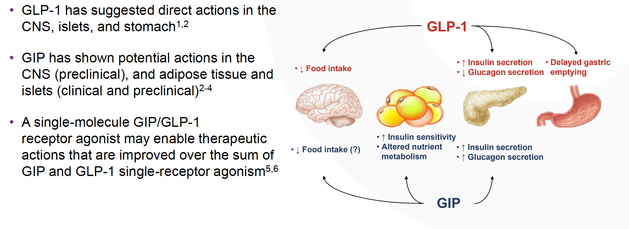
Incretin Mimetics and Cancer
GLP-1 Receptor Agonists:
Dulaglutide
Exenatide
Semaglutide
Liraglutide
Lixisenatide
Slide courtesy of Dr. Tom Wadden

Slide 26
Incretin Mimetics and Cancer
Dual GLP-1/GIP receptor agonist:
Tirzepatide
Triple agonist: GLP/GIP/glucagon:
Retatrutide
Slide courtesy of Dr. Tom Wadden

Slide 27
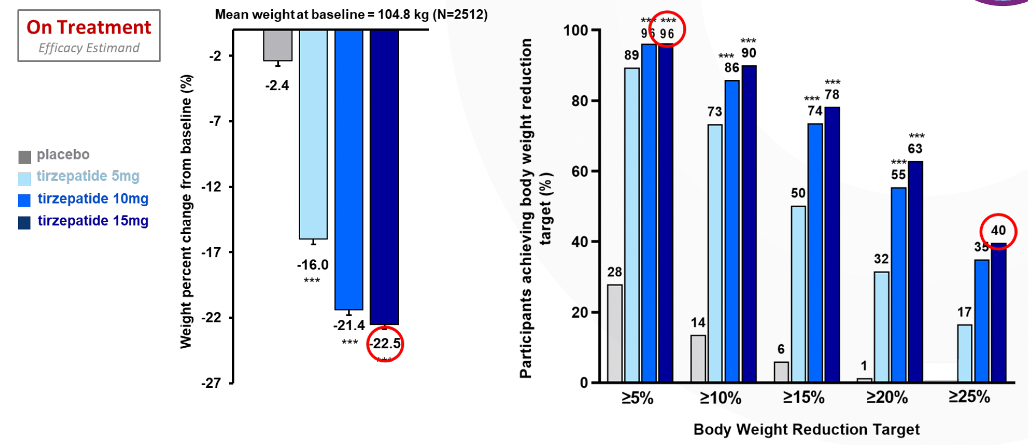
Weight Loss with tirzepatide in the SURMOUNT-1 Trial in patients without DM
500 Kcal/day caloric reduction and 150 min PA/week recommended for all patients
Slide courtesy of Dr. Tom Wadden; Jasterboff et al. NEJM. 2022

Slide 28
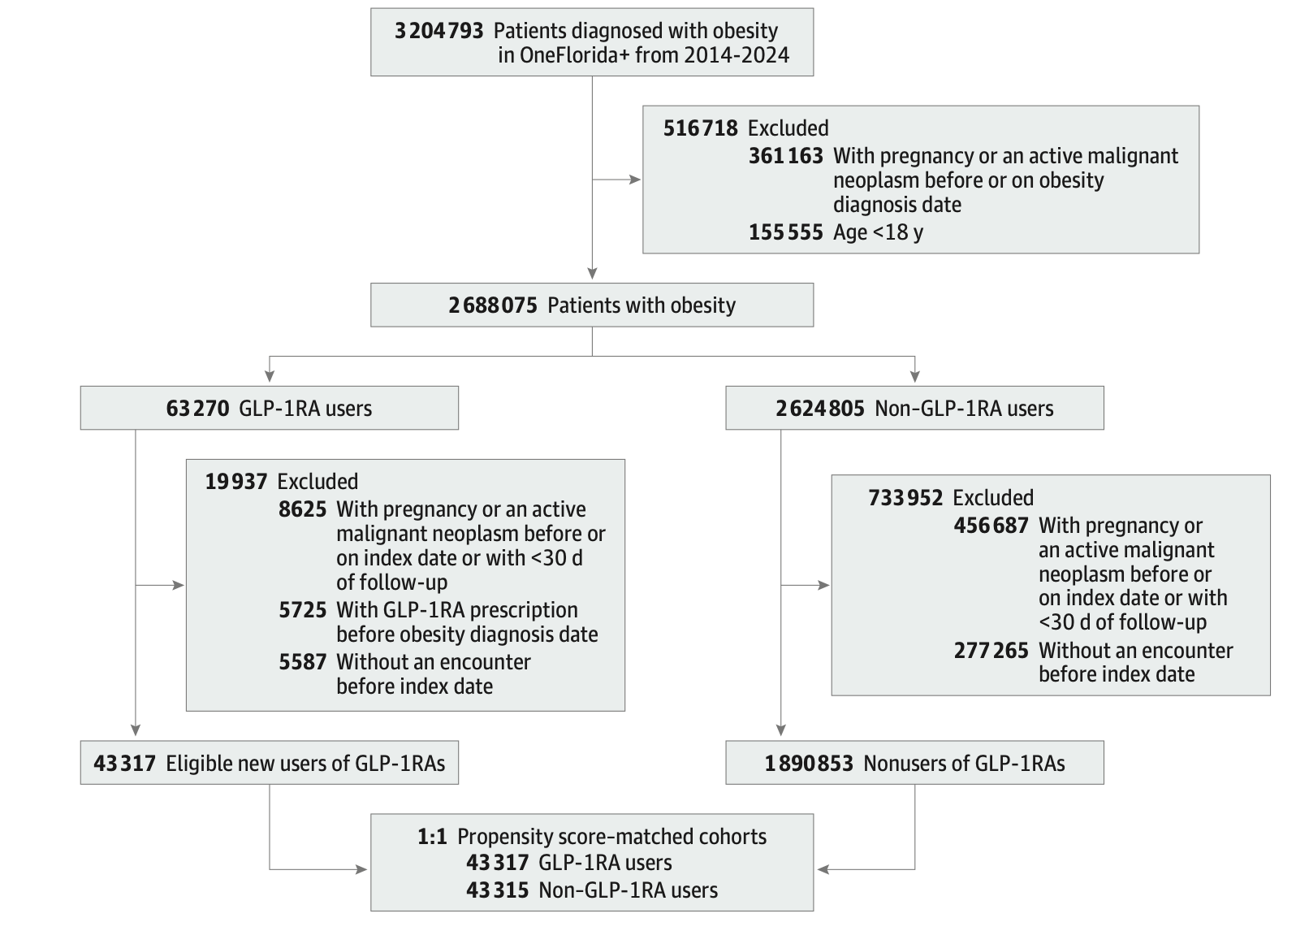
GLP-1’s and cancer risk of obesity-related cancers in individuals eligible for GLP-1 prescription
Target trial emulation study using real-world data from the OneFlorida+ Clinical Research Network
  Data collected 2014-2024
  20 million patients from GA, FL, AB
Patient population: adults eligible for GLP-1 prescription
  BMI ≥30 OR BMI of 27 to 29.9 with 1+ weight- related comorbidity
  No prior cancer
Individuals prescribed GLP-1 matched by propensity score and visit date (index date) to non-users
Follow up to 15 years
1,651,452 pts
Dai et al. JAMA Oncology, 2025

Slide 29
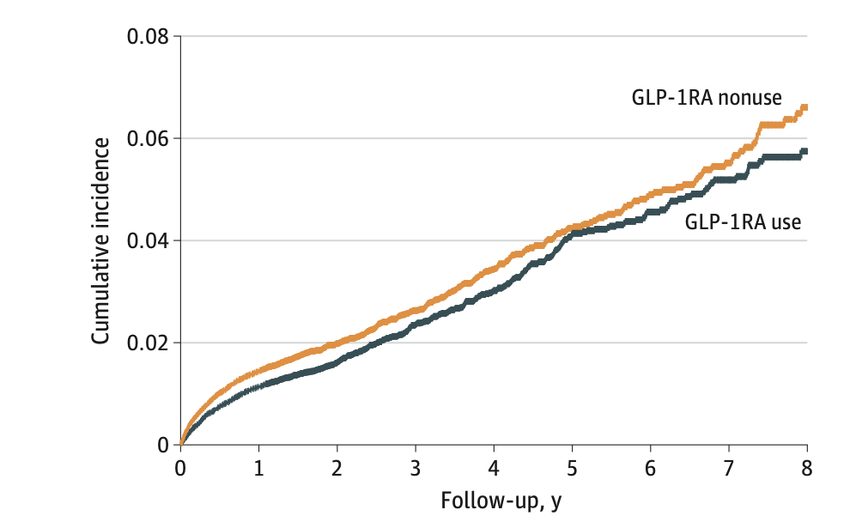
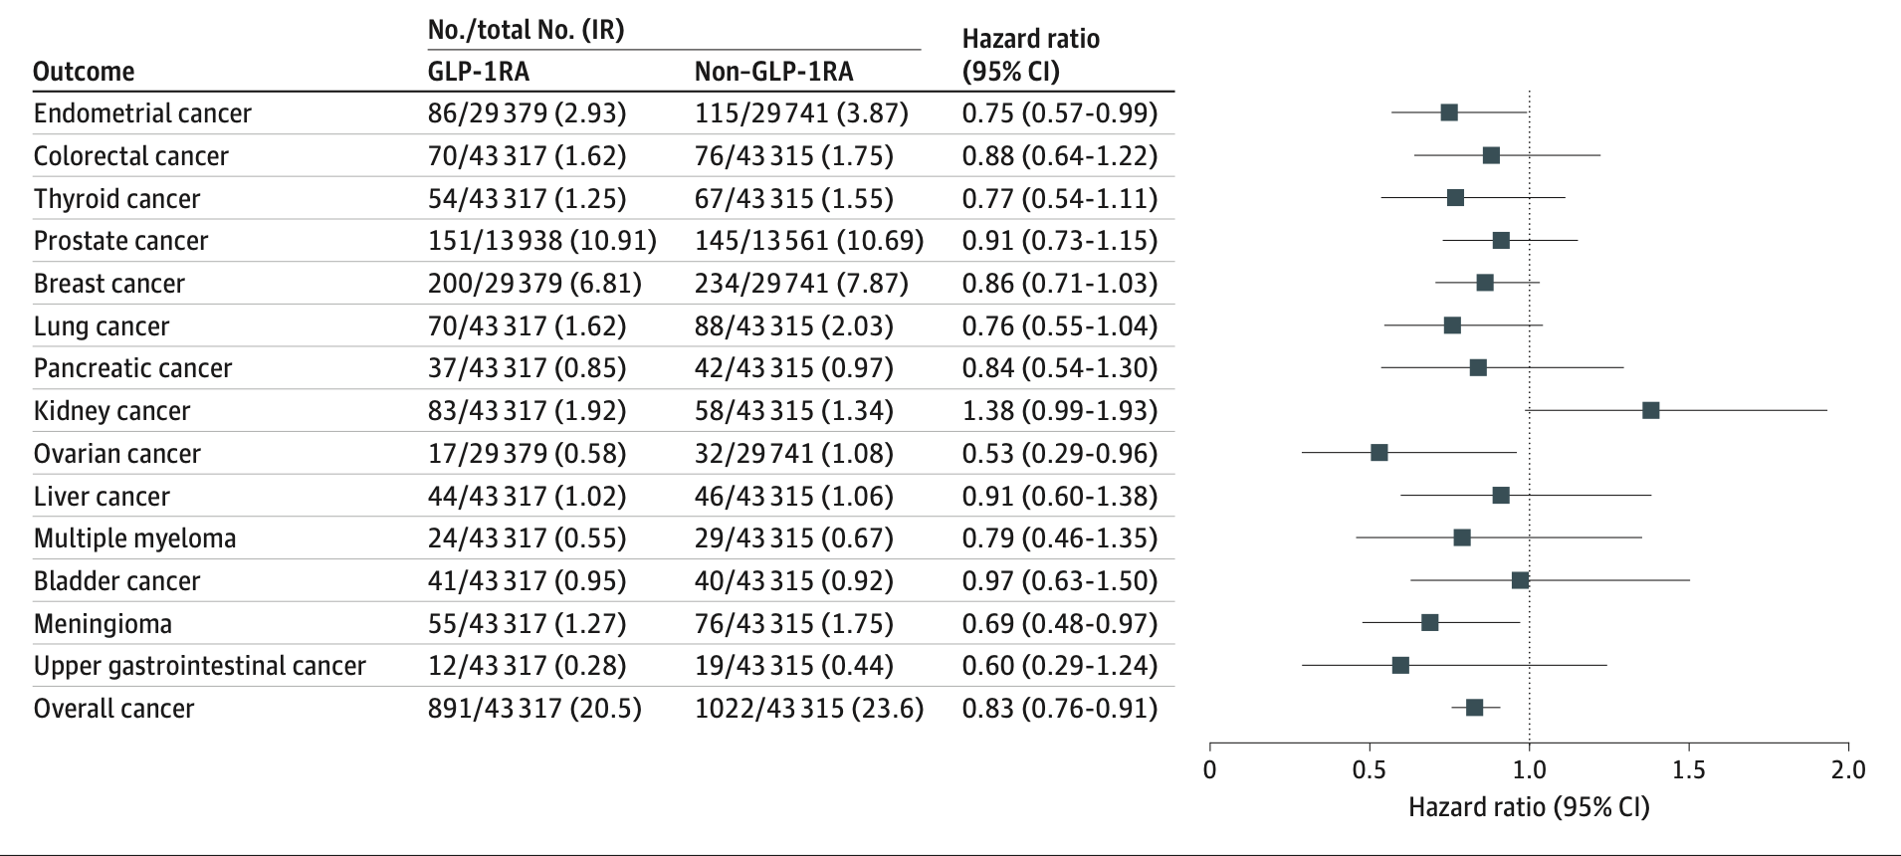
Risk of obesity-related cancers:
GLP-1 users vs non-users
HR 0.83 [95% CI, 0.76-0.91]; P = .002
Cumulative incidence of obesity-related cancers
Dai et al. JAMA Oncology, 2025

Slide 30
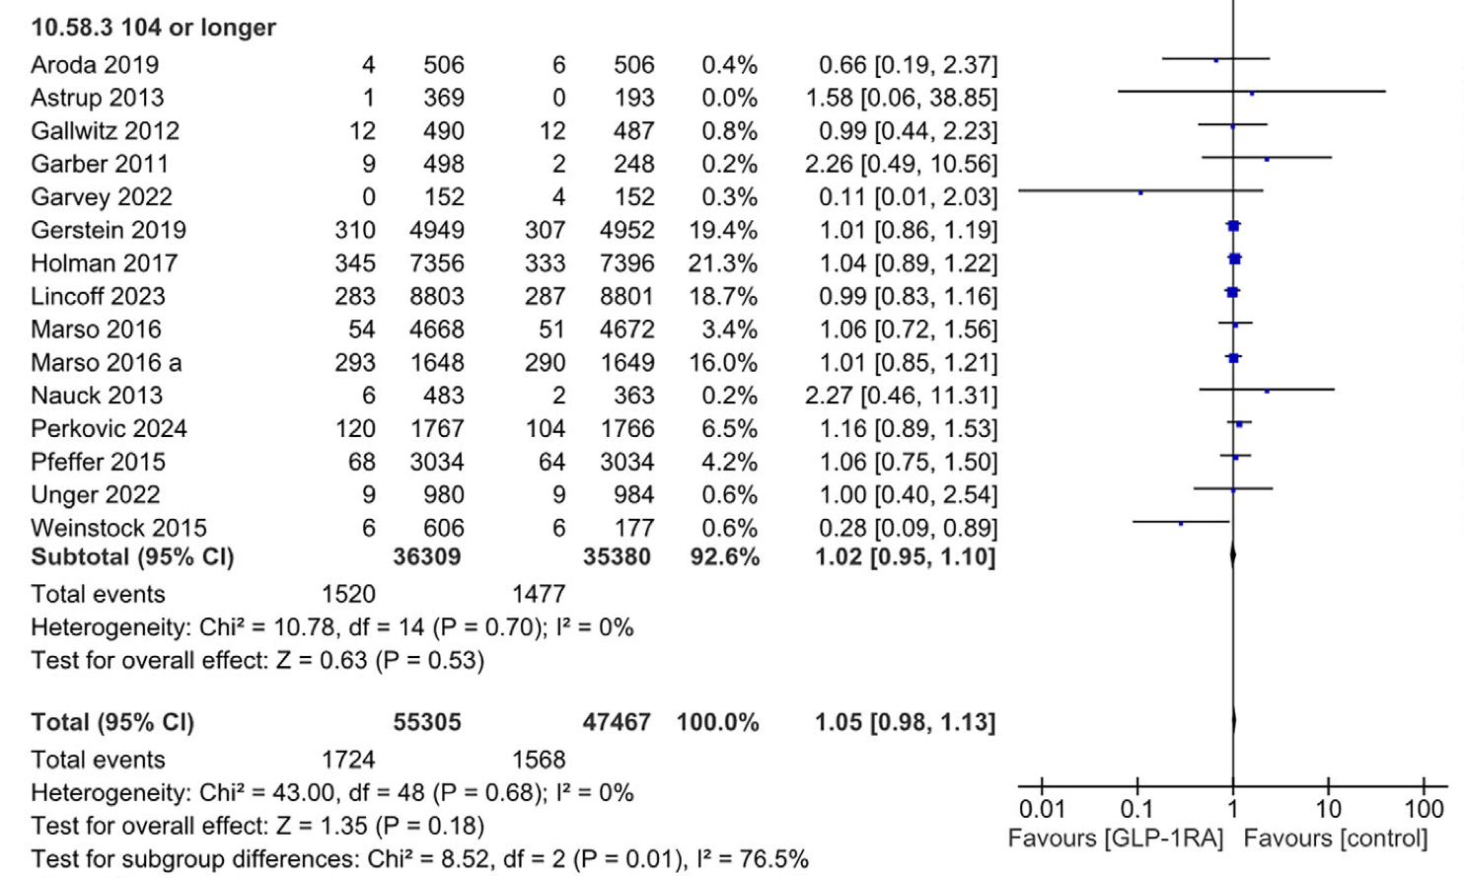
Impact of GLP-1’s on cancer risk in RCTs for DM and obesity
Meta-analysis of RCTs
  Comparing GLP-1s to placebo/comparator
  Treatment of DM and/or obesity
  Treatment duration 52 weeks+
Included 50 RCTs
  37 patients with DM
  13 patients with obesity alone
In trials with exposure 104+ wks
HR 1.02 (0.95, 1.10) for all cancer
Events: 1520 vs 1477
Across all trials:
HR 1.05 (0.98, 1.13) for all cancer
Events: 1724 vs 1568
Silvirii et al. Diabetes Obes Metab. 2025

Slide 31
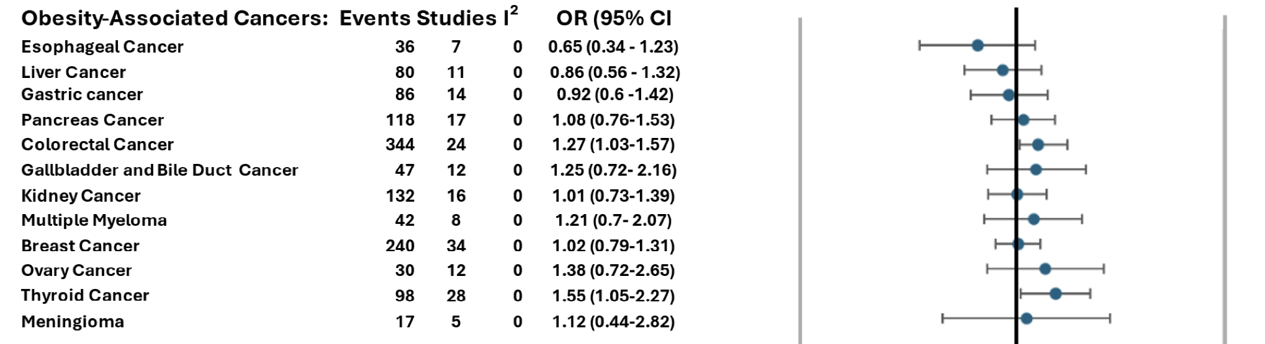
GLP-1’s and cancer risk by malignancy type
Silvirii et al. Diabetes Obes Metab. 2025

Slide 32
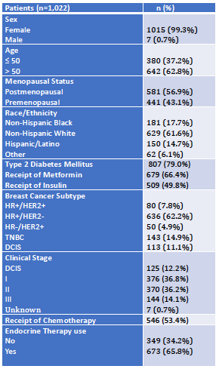
Retrospective study of GLP-1 Receptor Agonists in Breast Cancer Survivors: Weight Loss and Patient Outcomes
PS15-03. Jasmine Sukumar, MD1; Akshara Raghavendra, MD MS; Sarah Pasyar, MS; Roland Bassett, MS; Debu Tripathy, MD; Carlos H Barcenas, MD; Karen Basen-Engquist, PhD MPH; Banu Arun, MD
Patients (n=1,022): Stage 1-3 Breast Cancer, ≥ 3months on GLP-1RA
  Propensity score matched (1:2) to controls (not on GLP-1RA) by BMI, DM2, age, stage, receptors
  Median follow-up: 4.7 (0-30.9) years; median duration of GLP-1RA: 1.2 (0.3-8.1) years
  38.1% (n=389) received semaglutide or tirzepatide; Median weight loss -
    3 months: -2.1% (-13.2%-14.9%)
    6 months: -2.9% (-20.2%-19.0%)
    12 months: -3.1% (-27.8%-11.5%)
  Tamoxifen or AI use associated with weight gain (+2.3kg; p=0.037)
Slide courtesy of Dr. Neil Iyengar

Slide 33

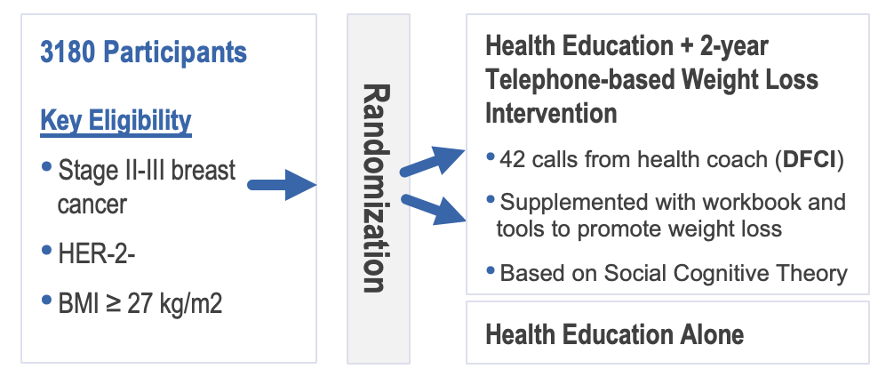

The Breast Cancer Weight Loss Trial
Primary Outcome: Invasive Disease-Free Survival
NCT02750826
Ligibel et al. npj Breast Cancer. 2017

Slide 34
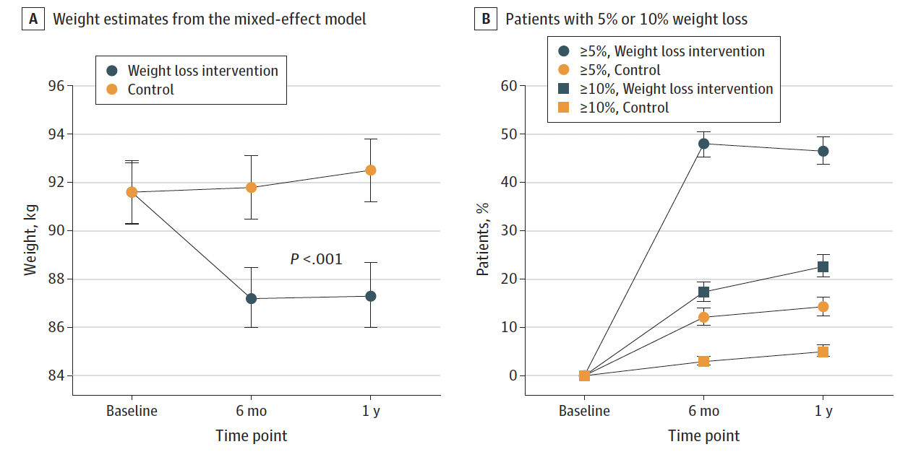
Weight Loss
34
Jennifer Ligibel, MD
Ligibel et al. JAMA Onc 2025

Slide 35
Impact of intervention on metabolic markers
Insulin
Insulin Resistance (HOMA)
uU/ml
Δ 21.8%
Δ 19.4%
Δ 16.3%
Δ 25.6%
Intervention
Control

Slide 36
Conclusions
Exercise is linked to a lower risk of breast cancer and better outcomes in patients with early-stage disease
The Challenge trial for the first time shows exercise can improve disease-free and overall survival in colon cancer
Obesity is a poor prognostic factor in early breast cancer, regardless of tumor subtype or treatment
GLP-1 receptor agonists induce significant weight loss and are associated with reduced cancer risk; more to learn about weight loss and breast cancer

Slide 37

Thank you!

