Slide 1



Accelerated Breast Radiotherapy
Douglas W. Arthur, M.D.
Professor and Chair, Department of Radiation Oncology
Virginia Commonwealth University School of Medicine
Massey Cancer Center
Richmond, VA
Disclaimer: This presentation is intended for personal use and for informational purposes only and does not replace independent professional judgment. This presentation is the property of Physicians’ Education Resource, LLC (“PER”) and is protected by U.S. and international copyright laws. You may not copy, reproduce, distribute, transmit, modify, or create derivative works of the presentation without the prior written permission from PER.

Slide 2
I have no relevant disclosures.
However;
Radiation Oncologist
Partial Breast
Brachytherapy

Slide 3
Where we were
Mastectomy
Early stage
BCS
WBI – 50Gy + 10Gy boost

Slide 4
Traditional Whole Breast Irradiation
WBI – 25-28 daily tx followed by 5-8 boost tx
Ole’-Fractionation?
  Anticipated results :
    In-breast failures rates of ≤1% per year
    85-90% good to excellent cosmetic results
  Goals
  Avoid In-Breast Failure
    Psychologically damaging
    Leads to mastectomy
    Has the potential to negatively impact survival
  Avoid Toxicity
    Negatively impacts cosmesis
    Negatively impacts quality of life
    May lead to mastectomy

Slide 5
Where We Have Been
70’s through 90’s
Transition from Mastectomy to Breast Conservation
Following Lumpectomy –
  All received Whole Breast Irradiation, all a boost, 30-35 fractions
Innovation focused on optimizing Whole Breast dose delivery
  Skin dose reduction
  Energy used, LINAC capabilities
  Optimized dose homogeneity and CT based 3D planning
  Skin reaction, pneumonitis, rib pain, in-breast fibrosis, cosmesis –All Improved

Slide 6
Where We Have Been
In the early 90’s
  Began challenging the target needed to treat
    Whole breast vs Partial breast
  Unlocked the door to explore dose acceleration
  Accelerated Partial Breast Brachytherapy
    Technology innovation
  Accelerated Partial breast with external beam
    Technology application
  Learned more about normal tissue tolerance, radiobiologic effect
    Accelerated whole breast with external beam

Slide 7
Where We Are Now
State of evolution
With a better sense of focus

Slide 8
It has been a bit chaotic
WBI
- photons/electrons
- protons
Position
- prone
- supine
Dose/Fractionation
- conventional
- accelerated
- boost/no boost
Approach
- 3D-CRT
- IMRT
- Tomotherapy
- Arc Therapy
APBI
Brachytherapy
- MultiCatheter
- Intracavitary
- Permanent Seeds
- Precision IORT
External beam
- 3D-CRT
- IMRT
- Tomotherapy
- Protons
Dose Delivery
5Gy X 1
12.5Gy X 1
16 Gy X 1
21 Gy X 1
7.5Gy X 3 - BID
7.0Gy X 4 - BID
28.5 X 5
30Gy X 5 - non consec
32Gy X 8 - BID
34Gy X 10 - BID
38.5Gy x 10 - BID
80Gy over months
Target coverage
- beyond cavity
Whole Breast
2cm
1cm
2mm
IORT
ELIOT – Electrons
TARGIT – soft xrays

Slide 9
Why so many approaches?
Patient preference
Physician preference/philosophy
Physician and facility capability
Facility limitations (patient volume/physician time)
Physician support (physics/dosimetry capability)
Opportunity for innovation
Industry influence

Slide 10
Target and Dose
Target volume definition
  Where does microscopic disease remain?
  Localized vs diffuse?
  Why treat more than we need to?
Dose delivery
  Disease control
    Radiobiological equivalent dose
    ‘Conventional’ vs moderate hypofractionation vs ultra hypofractionation
  Normal tissue impact
    How fast is too fast?
    Dependent on volume? Patient’s normal tissue response?

Slide 11
Why evolve at all?
Historical interest in reducing burden of radiation treatment to increase compliance and reduce recurrence rate
Historical interest in avoiding radiation if possible
  Time (6-7 weeks), Toxicity (skin, breast tissue, cosmesis, etc.)
Evidence that biomarkers can identify
  Patients with sufficiently low risk of recurrence to avoid XRT
What is sufficiently low?
  Added benefit of radiation vs time/toxicity risk
  What local failure rate is acceptable? 10%, 5%, 2%?

Slide 12
Agenda
Accelerated Whole Breast Irradiation
Accelerated Loco-Regional Irradiation
Accelerated Partial Breast Irradiation
Intraoperative radiation therapy ***
Breast conserving surgery only ***
Repeat Lumpectomy and Re-irradiation

Slide 13
Accelerated Whole Breast target – no change dose – RBE slight decrease

Slide 14
Canadian Randomized Trial:
      1234 patients (T1 – T2 )
      Median f/u 144 months
      Accelerated Whole Breast Irradiation
      42.5 Gy in 16 fractions (2.66 Gy/fraction)
      Vs
      50 Gy in 25 fractions (2 Gy/fraction)
      (no boost either arm)
  Local Recurrence
  - short arm – 6.2%
  - long arm - 6.7%
  ** (?) less effective in G3 (15.6% v 4.7%)
  Good/Excellent Cosmesis
  - short arm – 69.8 %
  - long arm - 71.3 %
  Mod/severe Late Toxicity:
  Skin Subcutaneous tissue
  - short arm – 8.9 % short arm – 11.9%
  long arm – 3.2 % - long arm – 10.4%
QOL –
4 weeks, 8 weeks post tx
Hypofractionated WBI was less toxic with improved QOL
Whelan T et al. N Engl J Med. 2010;362:513–520.
Arsenault J et al. Int J Radiat Oncol Biol Phys. 2020;107(5):943-8.

Slide 15

Royal Marsden Randomized Trial Series:
  START A TRIAL
    Pilot of Hypofractionated WBI
    2236 pts, pT1-3a pN0-1 M0, med f/u 5.1 years
    All given over 5 weeks – to equate overall time delivered
50 Gy in 25 fractions (2 Gy/fraction) - LR rate – 7.4%
vs
41.6 Gy in 13 fractions (3.2 Gy/fraction) - LR Rate – 6.3%
vs
39. Gy in 13 fractions (3 Gy/fraction) - LR rate – 8.8 %
  START B Trial
    Parallel initiation with START A
    2215 pts, (pT1-3a pN0-1 M0), Med f/u 6 years
    Delivered daily
50 Gy in 25 fractions (2 Gy/fraction) - LR rate – 5.5%
vs
40 Gy in 15 fractions (2.67 Gy/fraction) - LR Rate – 4.4%
Boost allowed
***START Meta-analysis - subgroup analyses -although numbers are small in some groups –
No difference in regards to patient age, breast size, tumor grade, axillary node status, type of surgery, cytotoxic chemotherapy, tumor bed boost radiotherapy, and lymphatic radiotherapy
Haviland JS et al. Lancet Oncol. 2013;14:1086–94.

Slide 16
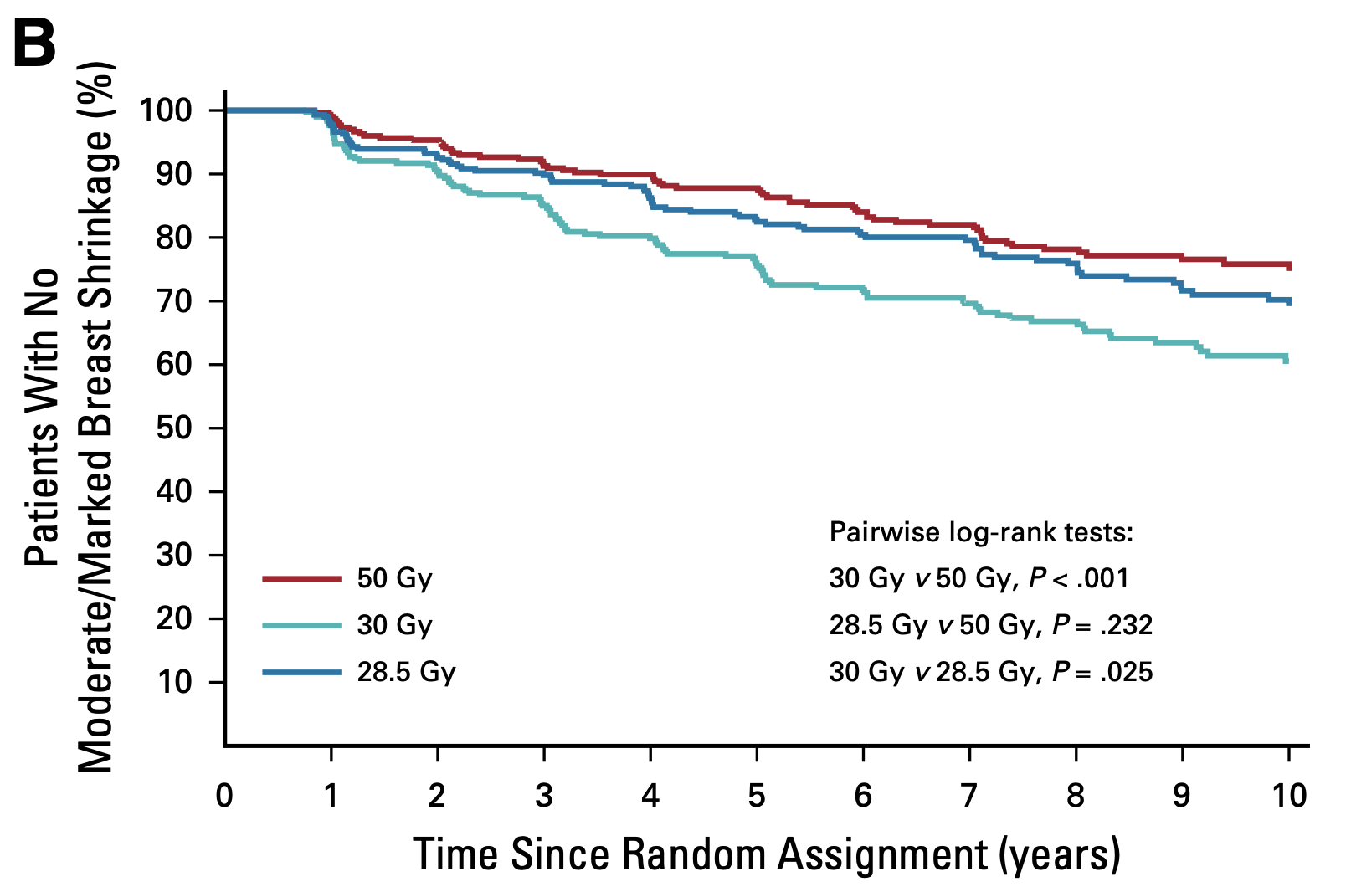
UK Fast Trial
2004-2007, 915 women, age >50
Early-stage invasive breast cancer (tumor size <3 cm, pN0)
s/p BCS not receiving a lumpectomy boost or chemotherapy
Not powered for local control comparison – overall LC 1.3%
Randomly assigned to whole breast schedules:
      50 Gy at 2 Gy/F once daily
      28.5 Gy at 5.7 Gy/F once weekly
      30 Gy at 6 Gy/F once weekly
10-year results:
No significant difference in normal tissue effects with 28.5 Gy at 5.7 Gy/F once weekly.
30 Gy at 6 Gy/F once weekly was worse.
Brunt AM et al. J Clin Oncol. 2020;38(28):3261-3272.

Slide 17
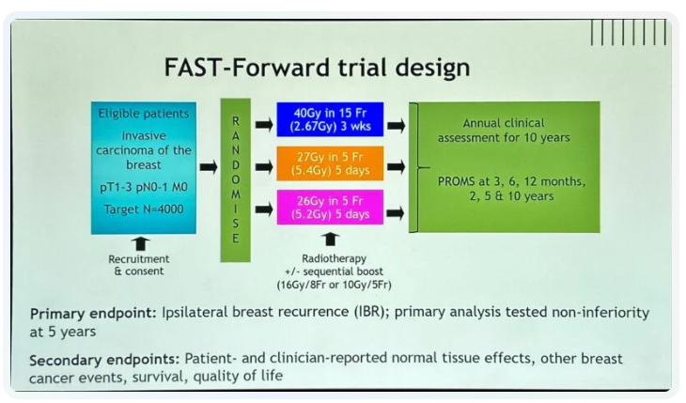
UK Fast Forward Trial
Three arm - Phase III trial – 10-year endpoint
4096 pts, pT1-3, pN0-1, M0 – Lumpectomy or Mastectomy
89.1% received adjuvant endocrine tx
Breast or chest wall
40Gy/15fx (3 wk) vs 27Gy/5fx (1 wk) vs 26Gy/5fx (1 wk)
  25% received 5-8 boost treatments
Med follow up – 71.5 months now 10 year data
26GY / 5.2Gy / 5 Fx - Non-inferior tumor control, safe normal tissue effects
  26OO cGy in 5 fractions +/- boost -
    Boost – will this become a 5 fraction or 10 fraction solution
  ? With chemotx
  ? Application to higher risk disease
Brunt AM et al. Lancet. 2020;395:1613-26.

Slide 18
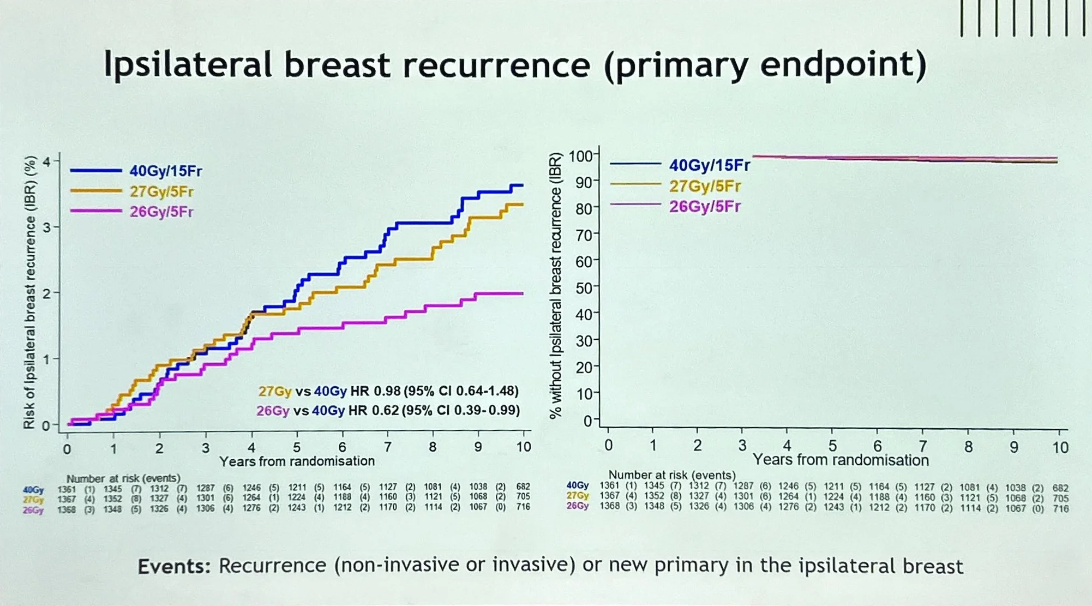
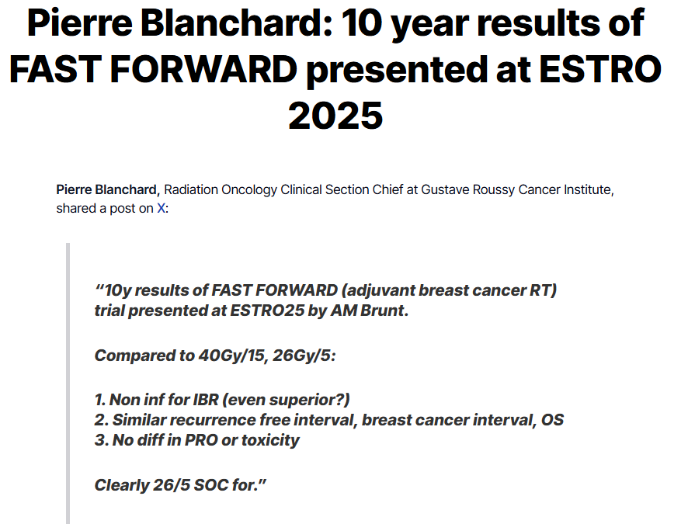
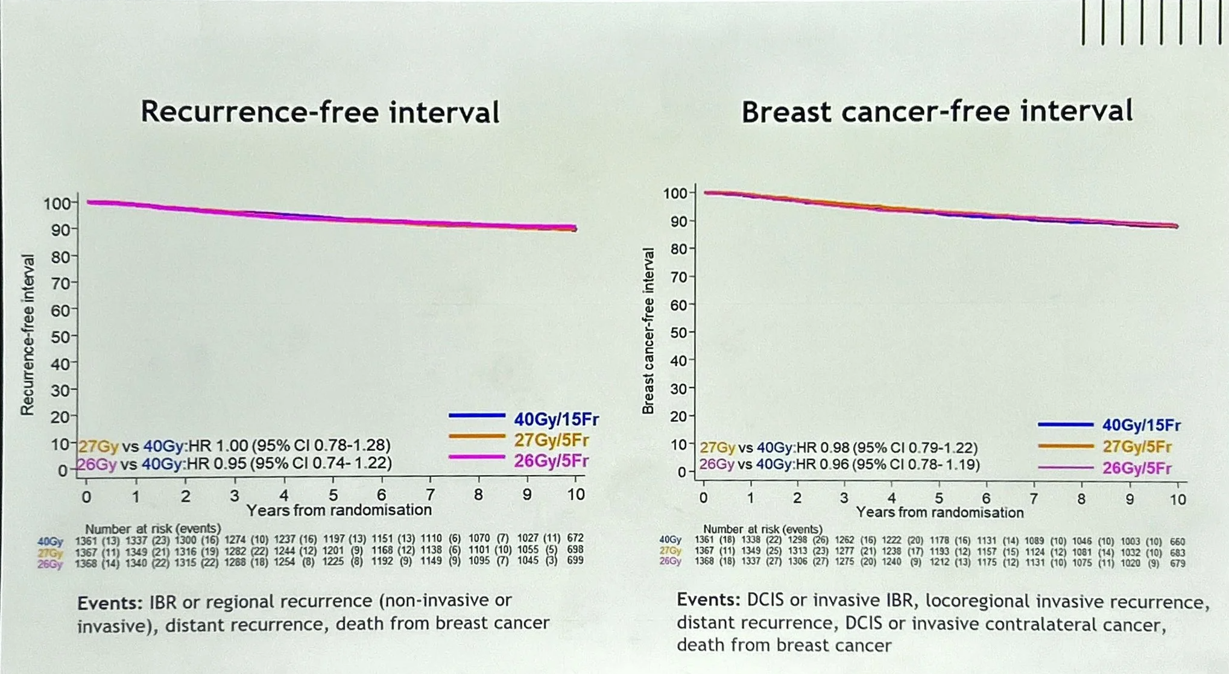
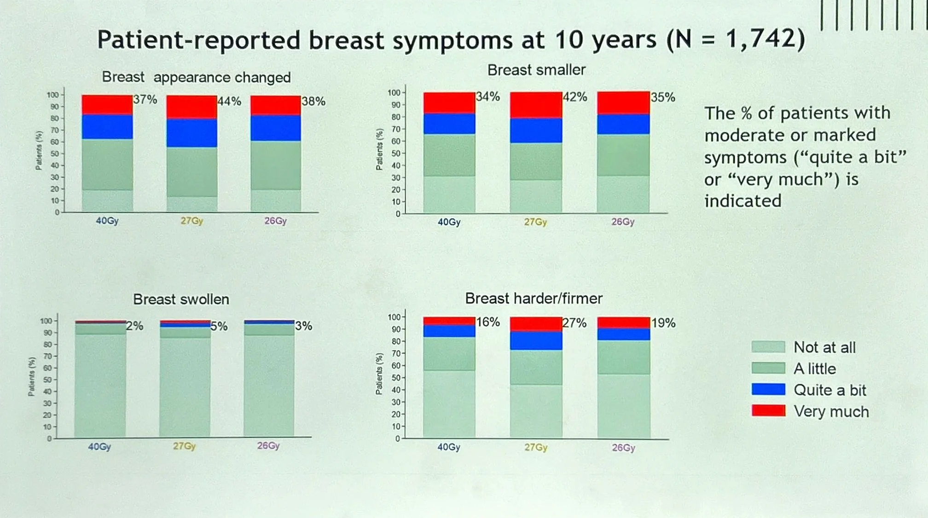

Slide 19

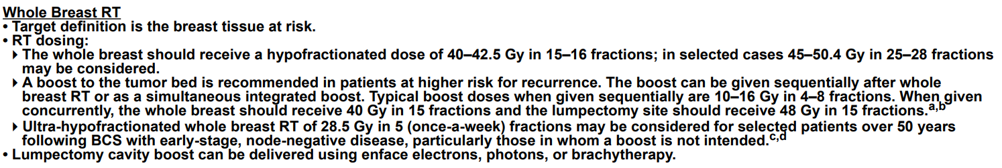
Early stage : Hypofractionation : current status
From ASTRO Guidelines 2018
When to avoid
Regional nodal treatment (?)
Breast reconstruction (?)
Rare tumor types
NCCN Guidelines. Invasive Breast Cancer. V4.2025.

Slide 20
Hypofractionation for Loco-Regional
Concerns raised – lymphedema, brachial plexus

Slide 21
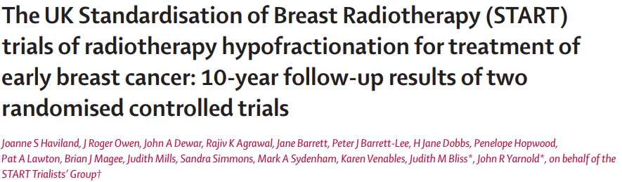
….and 318 (14%) received lymphatic radiotherapy (details of radiation fields?)
…assessments of arm and shoulder effects showed no evidence of a detrimental effect for the hypofractionated schedules
Can we trust basics of radiobiology and the equivalent dose calculations?:
  40 Gy in 15 fractions should be less damaging to the brachial plexus than is 50 Gy in 25 fxns
Haviland JS, Lancet Oncol 2013; 14: 1086–94.

Slide 22
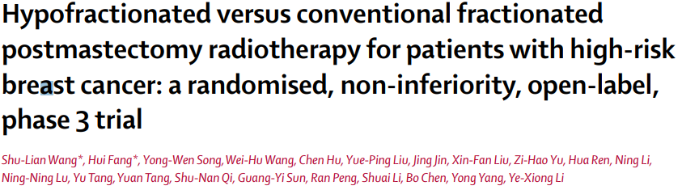
Single institution, Phase III trial
Chest wall and nodal irradiation
  Nodal = supraclav and level III ax
50Gy in 25fx (5 wk) vs 43.5Gy in 15fx (3 wk)
820 pts - Med F/U 58.5 mo
Locoregional recurrence - hypo 8.3% vs conv 8.1%
No sig diff in acute and late toxicity (< G3 acute skin in hypo)
Wang et al. Lancet Oncol. 2019; 20:352-60.

Slide 23
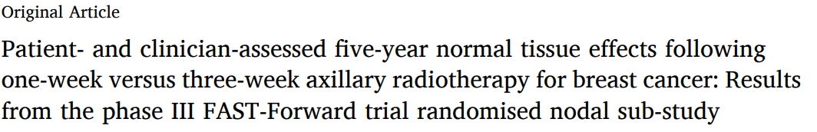
Brunt AM, et al Radiotherapy and Oncology 207 (2025)
469 pts recruited into FAST Forward nodal sub study
#182 – 40Gy/15fx #183 – 26Gy/5fx #104 – 27Gy/5fx
  Stopped 27Gy/5fx
Coverage of level I, level II, level III and SCF reported
55% BCT, 55% axillary dissection, 46% adj chemotx, 26# boost
Med f/u 76 mo’s
No brachial plexopathy reported
Mod or marked hand or arm swelling
  10% 40Gy/15fx vs 11% 26Gy/5fx

Slide 24
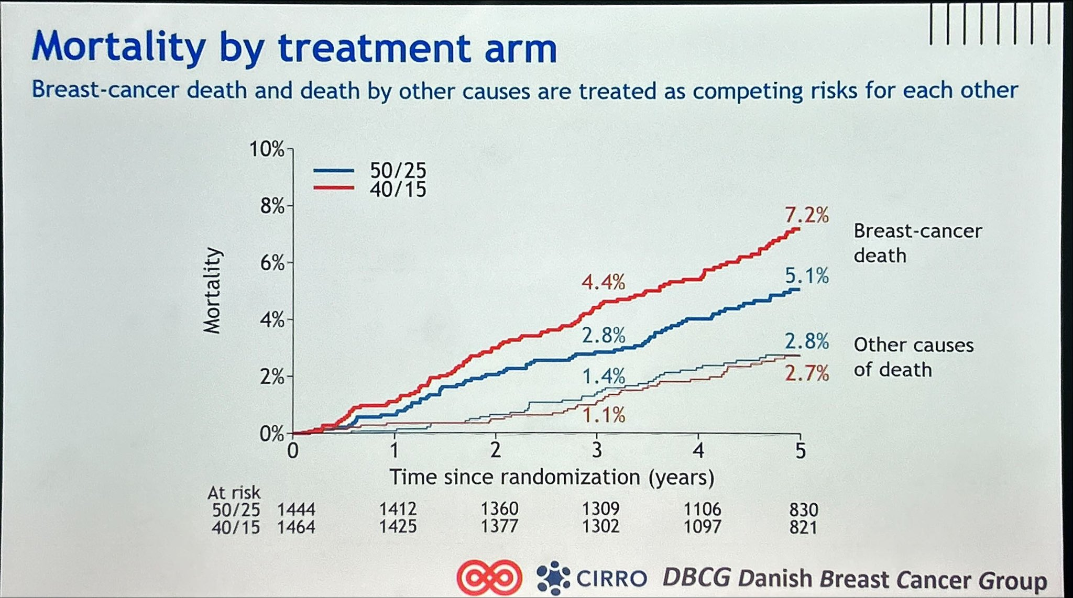
DBCG SKAGEN Trial 1
ESTRO 2025 abstract
Loco-Regional Radiation therapy
50Gy in 25 fx vs 40Gy in 15 fx
2963 patients
Median f/u 4.1 yrs
Lymphedema risk – no difference
Loco-regional recurrence – no difference
Distant recurrence – no difference
Caution Signal – breast cancer mortality worse with 40Gy in 15 fx in all subgroups

Slide 25

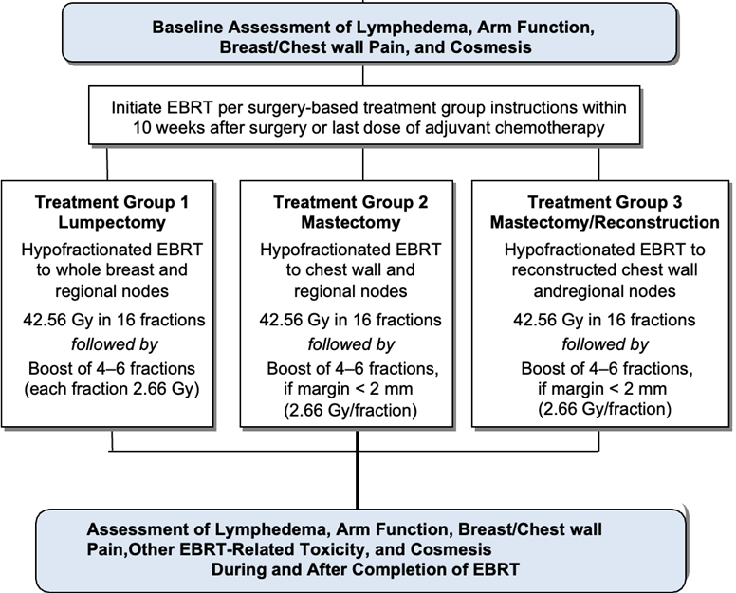
109 patients, all with 5 year follow up
Rates of Lymphedema acceptable
compares to historical rates
Majority of lymphedema – G1
Observation – Patients with reconstruction experienced higher rates of G3 cosmetic outcomes
Urdaneta A et al. ASCO 2024

Slide 26
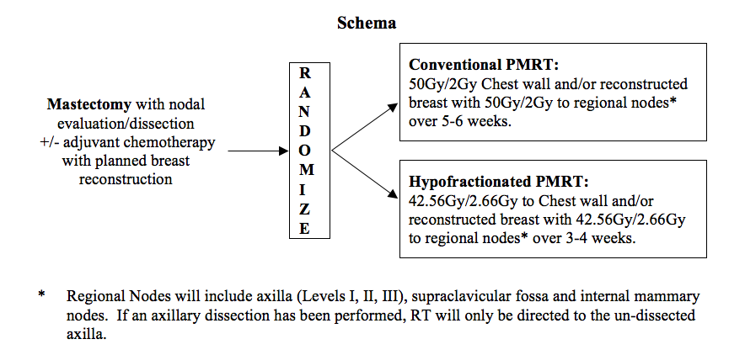
Alliance A221505 – RT CHARM
Phase III Randomized Trial of Hypofractionated Post Mastectomy Radiation with Breast Reconstruction
Poppe MM, et al. ASTRO Plenary 2024
#898 patients
Median f/u – 4.5 years
Acute/Late toxicities equivalent
Locoregional recurrences equivalent and 36 mo – 1.5% hypofractionation vs 2.3% conventional
24 mo incidence of recon complications – 14% hypofractionation vs 11.7% conventional
Decreased complication rate with autologous vs implant
Poppe MM et al. ASTRO 2024. Abstract 1.

Slide 27
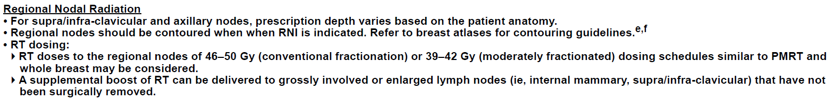
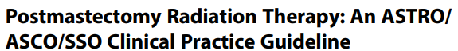
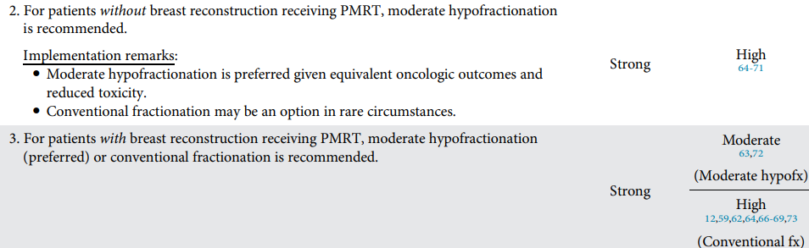
Advanced Stage : Hypofractionation : current status
Jimenez RB, et al.
Practical Radiation Oncology 2025
J Clin Oncol 2025
Ann Surg Oncol 2025

Slide 28
Accelerated Partial Breast Irradiation
How fast?
10 tx in 5 days, bid
3tx in 2 days, bid
1 fxn ?

Slide 29
10-yr results of APBI using sole Multi-catheter Interstitial Brachytx vs WBI after BCS for low-risk IDC and DCIS – a randomized, phase 3, non-inferiority trial
Multi-Catheter Brachytherapy
Randomized Phase III, non-inferiority
16 European centers – GEC-ESTRO
≥40yo, pTis – pT1-2a (≤3cm), ≥2mm margin (5 if ILC), no LVI
Multi Cath APBI vs WBI
1184 patients – med f/u 10.36 years
Toxicity
  Grade 4 toxicities were not observed in either treatment group.
  APBI lower incidence of treatment-related G3 late side-effects (P = .021).
    Fibrosis most common G3
Cosmesis
  Excellent rating
  Patient-rated: APBI 45%, WBI 34%
  Physician-rated: APBI 40%, WBI 33%
APBI – cumulative incidence of LR – 3.51%
WBI – cumulative incidence of LR – 1.93% P = .074
No difference in 10yr DFS, OVS, or contralateral breast cancer
Strnad V et al. Lancet. 2023;24:262-72.

Slide 30
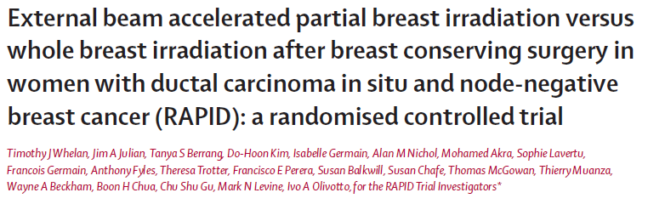
RAPID
Randomized Trial of Accelerated Partial Breast Irradiation using 3-Dimensional Conformal Radiotherapy (3D-CRT)
Whelan TJ et al. Lancet. 2019; 394: 2165–72.

Slide 31

RAPID Trial
2,135 patients
STRATIFICATION
Age (<50, ≥50)
Histology (DCIS only, Invasive disease)
Tumor Size (<1.5, ≥1.5 cm)
ER Status (Pos, Neg)
RANDOMIZED
Whole Breast Irradiation
50 Gy (2.0 Gy/fraction) or
42.5 Gy 16/fraction) followed by optional boost 10 Gy/4-5fx
Partial Breast Irradiation
38.5 Gy in 3.85 Gy fractions
3D Conformal External Beam or IMRT
Inclusion Criteria: IDC or DCIS, ≤ 3 cm in size, Microscopically clear margins, Node neg
Exclusion Criteria: < 40 years of age, Lobular histology only, Multi-centric disease

Slide 32


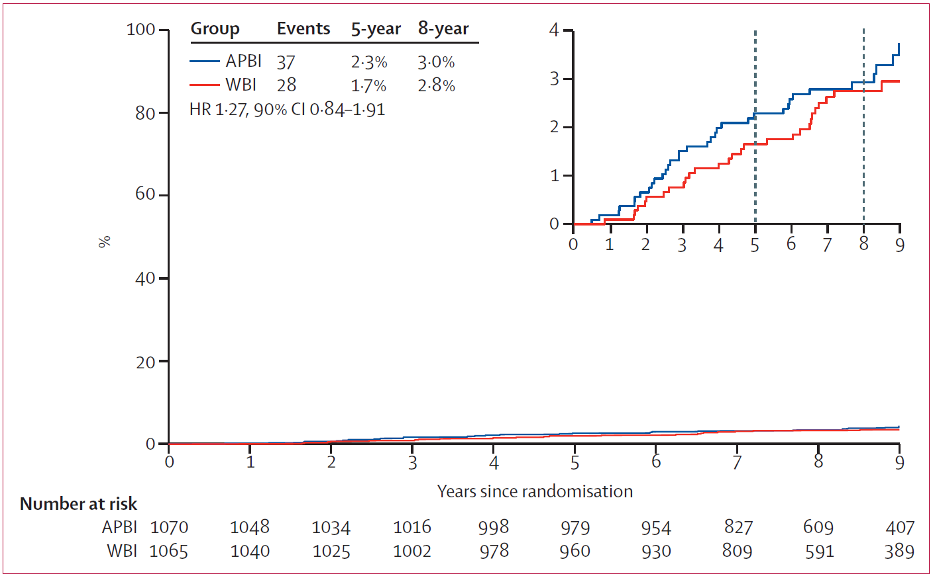
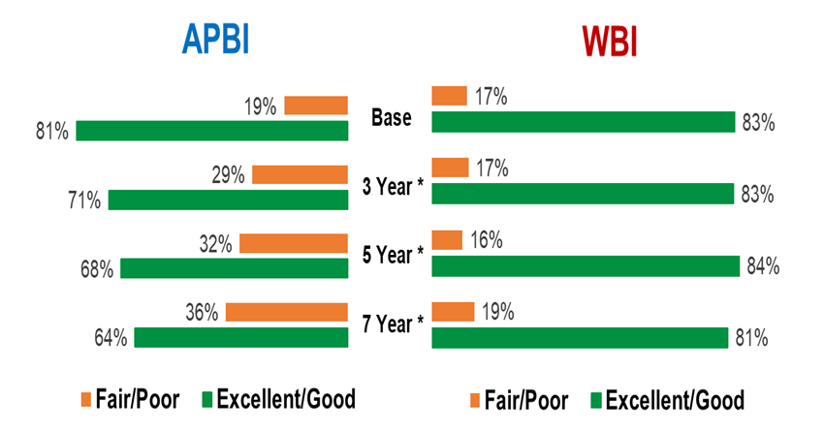

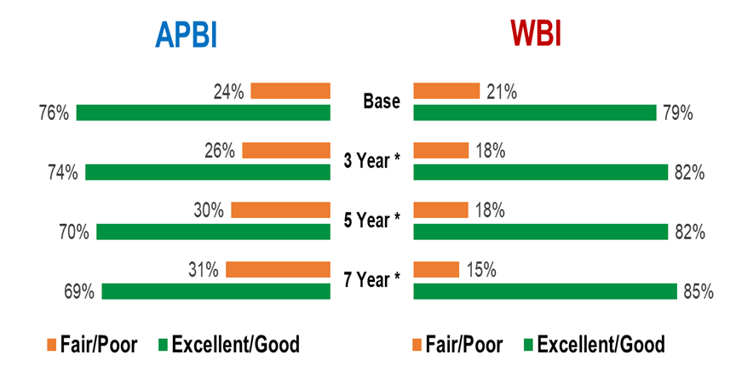
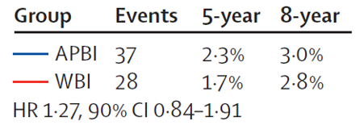

RAPID - IBTR
Years Since Randomization
Whelan et al, Lancet 2019.
Notes:
In this magnified view the failure rate at 5 years was 2.3% for APBI and 1.7% for WBI and at 8 years was 3.0% for APBI and 2.8 % for WBI.
The HR was 1.27 with 90% CI of … meeting the trial criteria for non inferiority of HR < 2.02

Slide 33
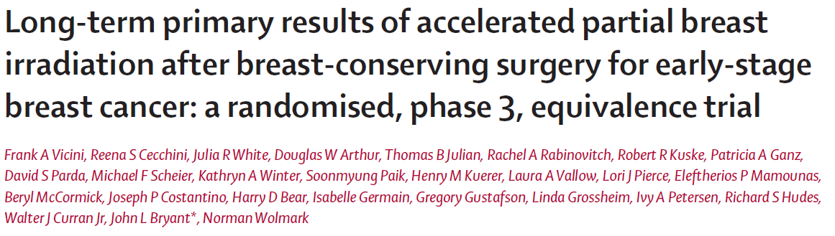
NRG-Oncology B39/0413
Vicini FA et al. Lancet. 2019;394:2155–64.

Slide 34

NRG-Oncology B39/0413
4,216 patients
STRATIFICATION
Disease Stage (DCIS; Invasive N0; Invasive N1)
Menopausal Status (pre- and post-)
Hormone Receptor Status (ER and/or PR+; ER and PR–)
Intention to Receive Chemotherapy
RANDOMIZED
Whole Breast Irradiation after Adjuvant Chemotherapy
50 Gy (2.0 Gy/fraction) or
50.4 Gy (1.8 Gy/fraction) to whole breast, followed by optional boost to ≥ 60 Gy
Partial Breast Irradiation prior to Adjuvant Chemotherapy
For a total of 10 treatments given on
5 days over 5 to 10 days:
34 Gy in 3.4 Gy fractions Interstitial Brachytherapy or Mammosite Balloon Catheter
or 38.5 Gy in 3.85 Gy fractions
3D Conformal External Beam
Inclusion:
Women >18 yo, invasive or in situ disease, ≤ 3 cm, 3 positive ALN, ER+ & ER-, EIC + w/ neg margins

Slide 35
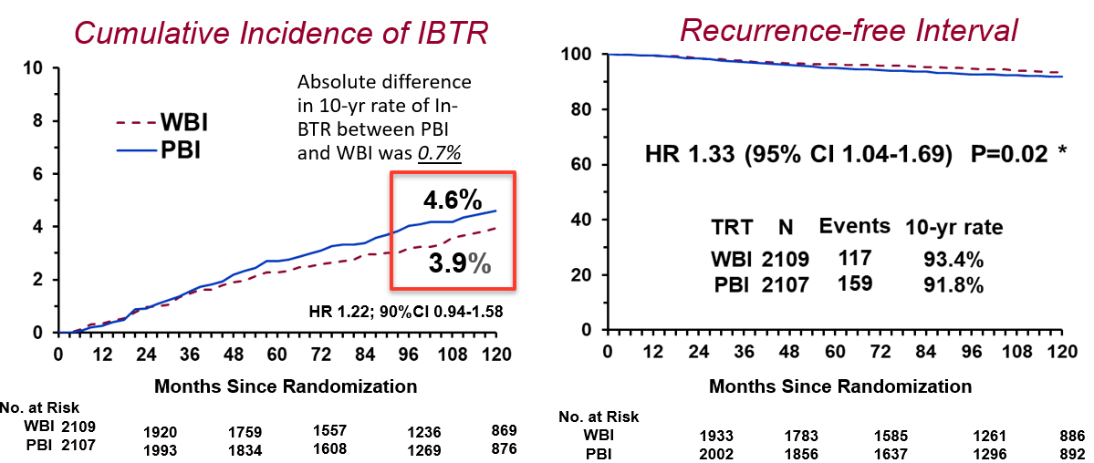
NRG Oncology
NSABP B39/RTOG 0413 Phase III Results
950 pts enrolled with data in QOL substudy
Breast Cancer Treatment Outcomes Scale (BCTOS)
Primary endpoint
  Cosmesis – not difference 3 years
  Vitality or fatigue at EOT –
    non-chemotx - favored APBI
    chemotx, depended on timing – favored WBI
Secondary endpoints
    Treatment-related symptoms – favored APBI (EOT, 3mo’s, 6mo’s)
    Convenience of care – favored APBI
Quality of Life outcomes
Ganz PA et al
JNCI 2025

Slide 36
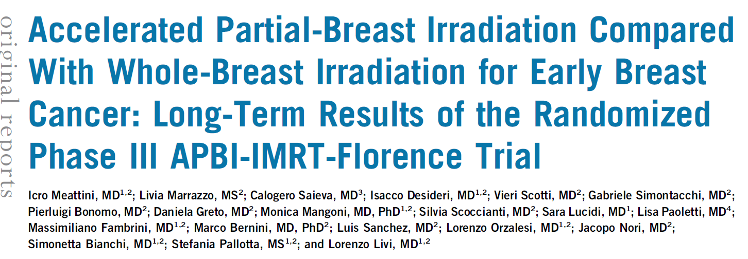
Meattini, I, et al. Journal of Clinical Oncology, ascopubs.org/journal/jco August 2020
WBI 50Gy in 25 fx + 10Gy boost
vs
APBI 30Gy in 5 fx (non-consecutive days)
520 pts, >90% low recurrence risk
Median follow up 10.5 years
IBTR – 2.5% WBI vs. 3.7% APBI
OVS / Breast Ca specific survival – equivalent
Cosmesis/toxicity – favors APBI

Slide 37
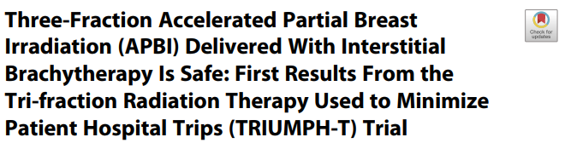
Yashar C, Khan AJ, Chen P, et al. Pract Radiat Oncol. 2023; 13(4):314-320.
Prospective phase II multi-institutional
22.5 Gy in 3 fx (2 days)
Med f/u 3.63 years
  Cosmesis - G/E 94%
  Toxicity –
    32% G1/2, 1.7% G3, no G4 fibrosis
    7.4% G1 hyperpig, 2% G1 telangiectasias, 1.7% symp seromas
  Recurrence – local 1.1%, nodal 1.1%, distant 0%

Slide 38
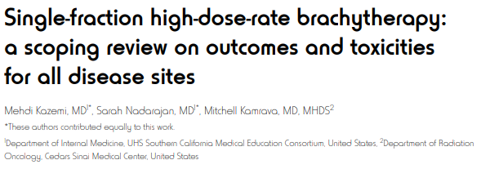
J Contemp Brachytherapy. 2022;14(5):481-494.
268 patients, 2008-2021
64-77 years old
HDR brachytherapy, single fraction, 16-21Gy
Follow-up 60-72 months
6 years: freedom from LR: 100%
DFS: 82-200%
OS: 82-100%
Acute toxicities <5% (16-18Gy)
Excellent to good cosmesis: 76-100%

Slide 39
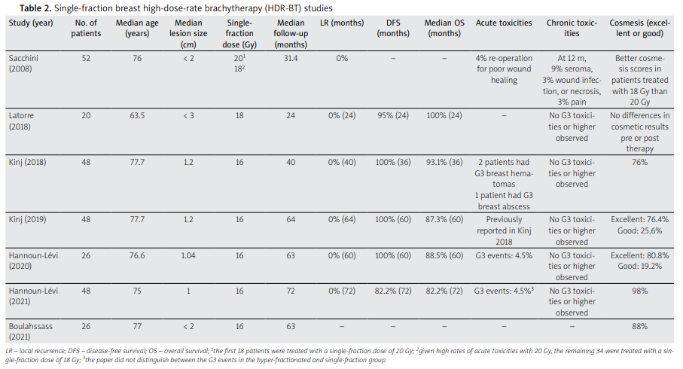
Single fraction
Kazemi M et al. J Contemp Brachytherapy. 2022;14(5):481-494.

Slide 40
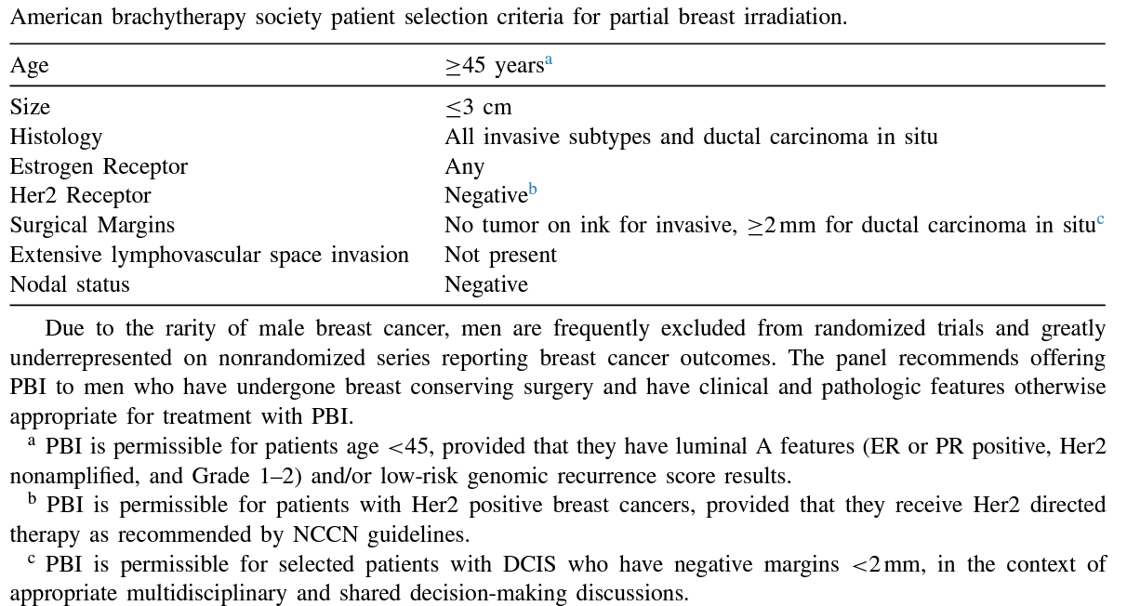
Accelerated Partial Breast Irradiation:
Eligibility?
Guidelines published by ASTRO, GEC-ESTRO, ABS, ASBS and more…
Updated ABS guidelines just published last year.
Anderson B et al. Brachytherapy. 2022;S1538-4721(22)00119-2.

Slide 41
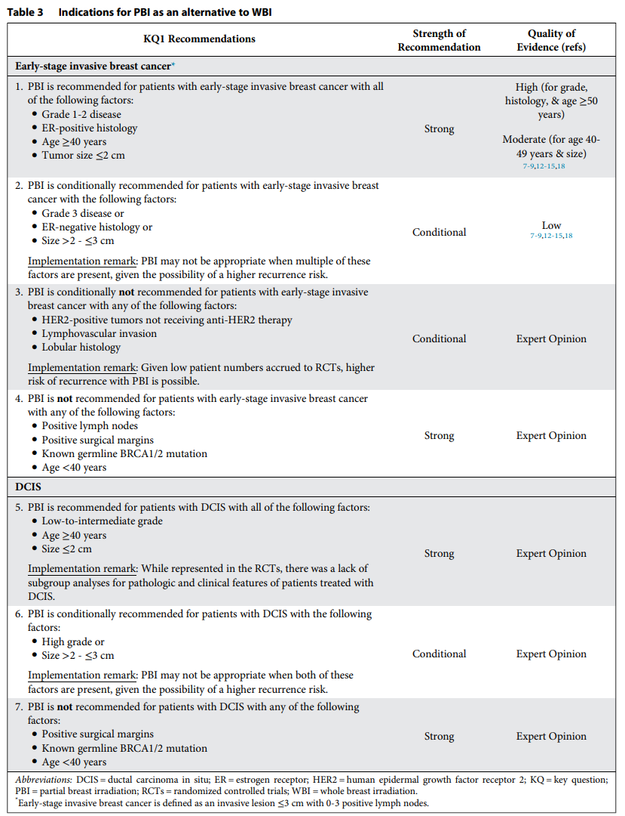
Accelerated Partial Breast Irradiation:
Eligible Patients ASTRO
Current NCCN guidelines endorse current ASTRO guidelines
Guidelines published by ASTRO, GEC-ESTRO, ABS, ASBS and more…
Thoughts:
  The more people → the less logic →
      More complicated guidelines
  Same data → different smart people
      Different conclusions
Shaitelman S et al. Pract Radiat Oncol. 2024;14(2):112-132.

Slide 42
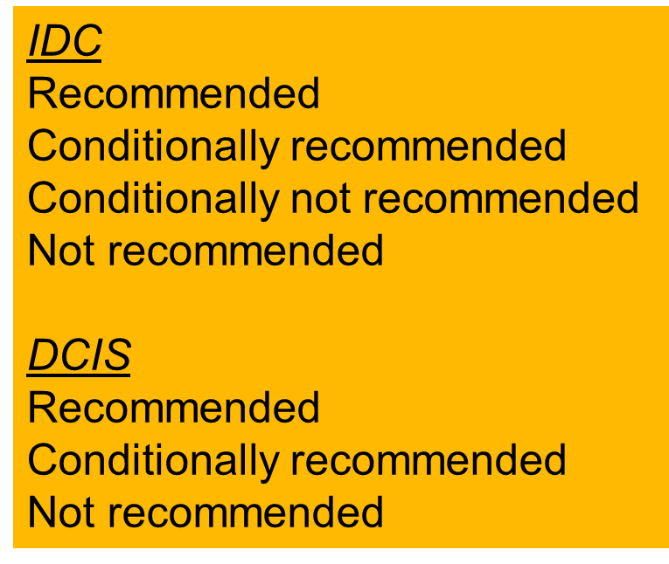
APBI eligibility summary
IDC / DCIS conservative
G1-2
ER+
Age > 40yo
Size < 2cm
IDC real (recommended + conditional)
Lobular
G1-3
ER+ or ER-
Her2+ if anti HER2 therapy
Size < 3cm
No fly zone
- positive nodes
- age <40yo
- Positive margins (but…)
- germline BRCA 1/2 mutation (but….)

Slide 43

Designed to look for patterns of thought disorder in schizophrenia and has evolved to include other areas, like personality, emotional disorders, and intelligence.
The Rorschach has been standardized using the Exner system and is effective in measuring depression, psychosis, and anxiety.

Slide 44
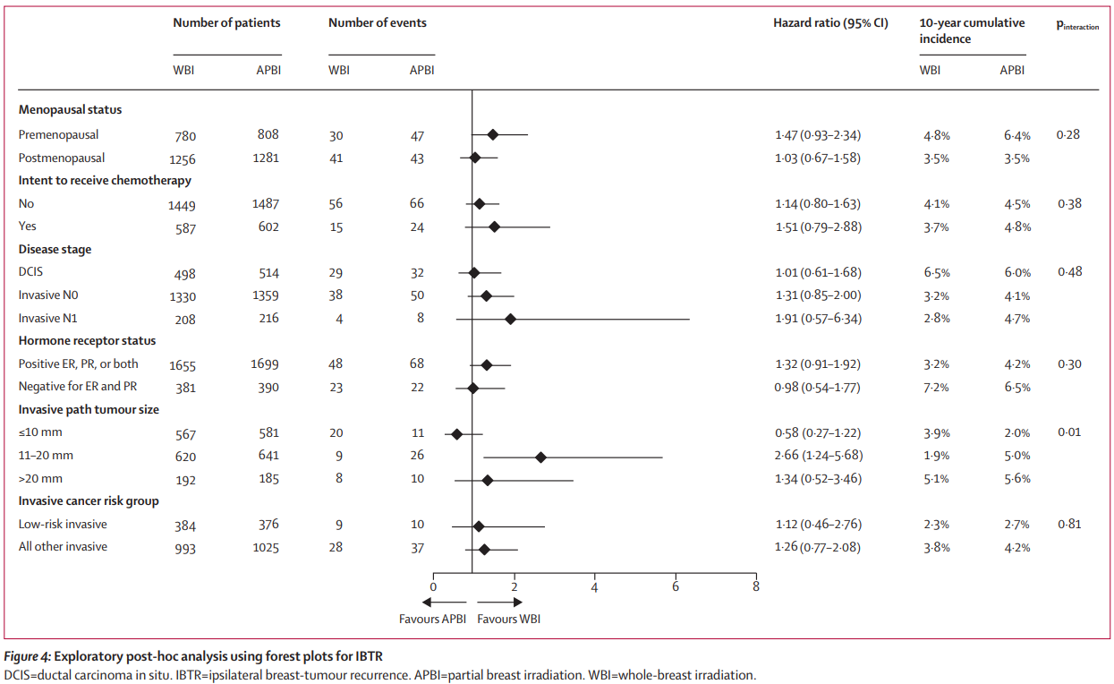

Slide 45
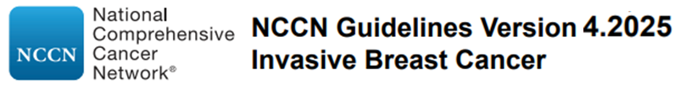
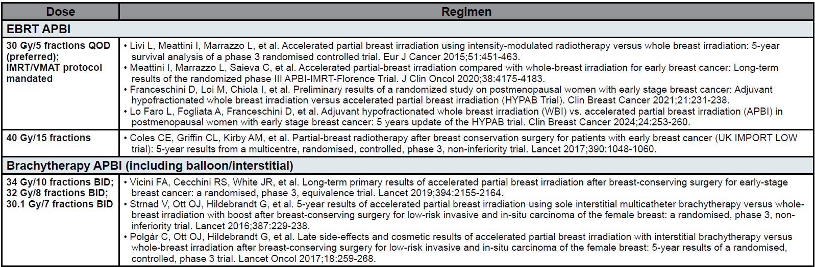
Accelerated Partial Breast Irradiation:
Dose delivered
NCCN Guidelines. Invasive Breast Cancer. V4.2025.

Slide 46
Partial Breast vs Whole Breast
Why deviate from Whole Breast Irradiation?
Evidence-based target volume reduction has transformed how we approach radiation therapy for lymphoma and tumors of the lung, head and neck, GI tract, prostate, and other sites.
Needless irradiation of normal tissue can and should be avoided.
No matter how schedule convenient or safe WBRT becomes, PBI will always offer a greater potential to reduce toxicity simply because of smaller treatment volumes.
Hepel J, Wazer D. J Clin Oncol. 2020;38(20):2268-2272.

Slide 47
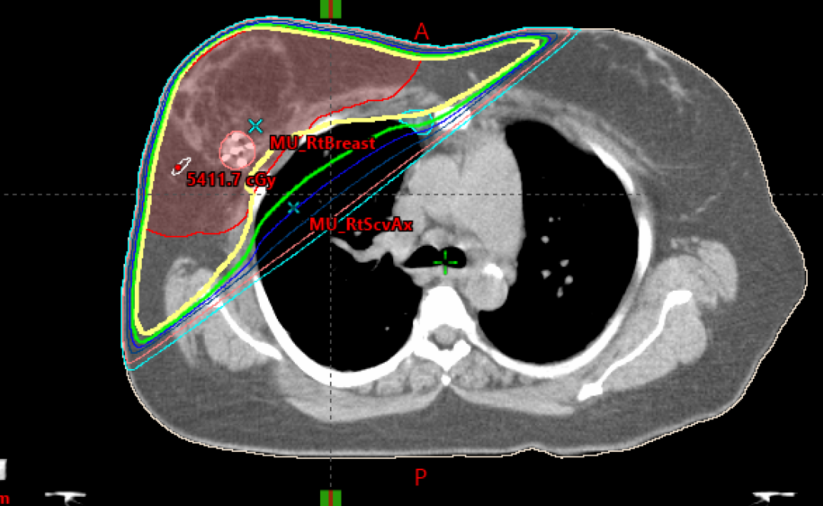

Slide 49
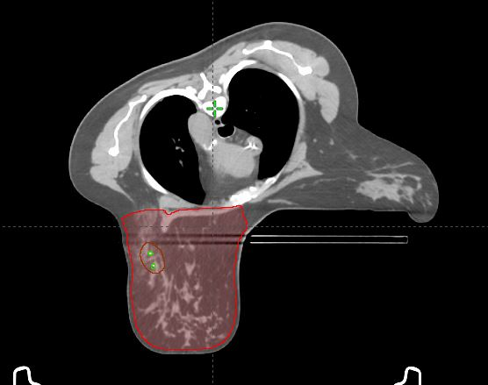
Prone

Slide 50
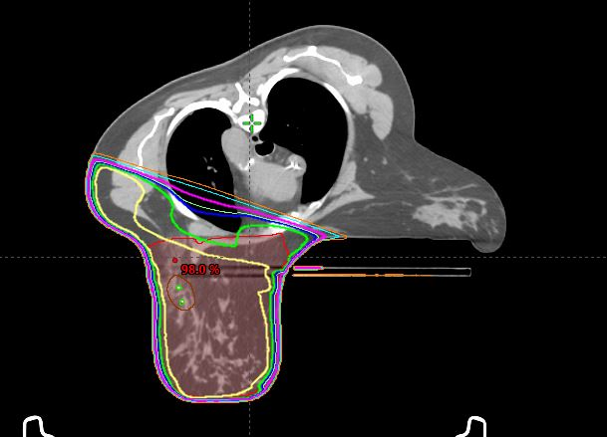
Prone

Slide 51
Prone

Slide 52
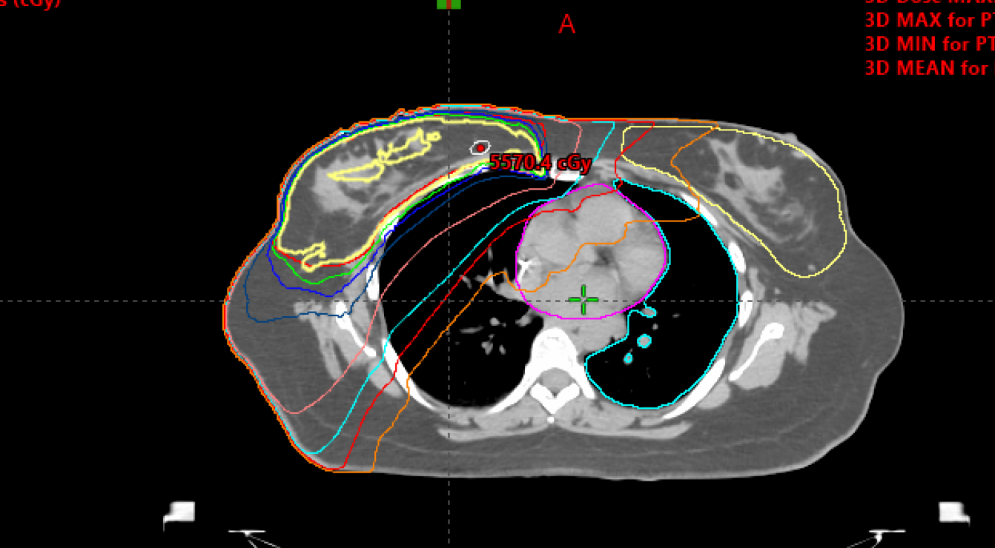
IMRT

Slide 53
IMRT

Slide 54
Summary
PBI – Local control equivalent to WBRT
  Toxicity/Cosmetic outcome – mixed results
  Technique dependent
  Basic concept – smaller irradiated volumes, potential for less toxicity/superior cosmesis
  Multiple RCTs – no difference

Slide 55
Note – must remember as we explore single fraction
Intraoperative Radiotherapy (IORT)
    All radiation at time of surgery
    Surgically manipulated target to fit radiation
    Final pathology unknown
    Target coverage unconfirmed
    ELIOT – Electron Intraoperative Radiotherapy - Milan, Italy
    TARGIT – Targeted Intraoperative Radiotherapy – Photoelectron – UK
    Data yet to support as equivalent alternative
    Future of IORT still uncertain
TARGIT
Vaidya JS et al. Lancet. 2014;383(9917):603-13.
Vaidya JS et al. JAMA Oncol. 2020;6(7):e200249.
Vaidya JS et al. BMJ. 2020;370:m2836.
ELIOT
Orecchia R et al. Lancet. 2021;22:597-608.

Slide 56
Breast Conserving Surgery only

Slide 57
Lumpectomy Only Thoughts
Modest disease control benefit in select patient groups
Patient decision depends on how onerous and toxic radiotherapy may be
Recent advances have minimized the toxicity and reduced the burden of radiation therapy
Are genomic biomarkers able to identify?
To forego radiotherapy forces reliance on endocrine therapy
If question is risk reduction – where does QOL fit in?
Should it be short course XRT vs 5 years endocrine for older patients?
***
Meattini et al. Lancet Oncol. 2025;26 (1):37-50
EUROPA trial—age >70 T1N0 luminal A tumors randomized to PBI alone or endocrine therapy alone
  Patient-reported HRQoL & local control
  DM, BCSS, OS
  At 24 mo interval – ET associated with greater reduction in HRQOL as compared with radiotherapy

Slide 58
Conclusions
We are in an appropriate phase of de-escalation of post-lumpectomy radiation (impact of improved mammography, surgery, pathology)
WBI delivered with 30-35 fractions after lumpectomy should be a rare occurrence
Breast Only
  Moderate hypofractionation as a foundation
  Should (should have?) move towards increased partial breast use – hypofractionated
  Increasingly - appropriately selected early-stage pts should have access to an ultra-short options
Local Regional treatment
  Logic and increasing data suggest Moderate hypofractionation should be safe
    Caution: Phase III data limited, studies did not include advanced (T4) disease, brachial plexus impact <10yrs f/u
  Should be moving towards increased use
  Extreme locoregional fractionation new

Slide 59
Repeat lumpectomy & Partial Breast Re-Irradiation (PBrI) for in-breast recurrence after WBI

Slide 60
Repeat BCS and re-irradiation PBI
Following BCT ( surgery + WBI)
  ~10% (5-15%) will experience in-breast failure
Present standard of care of in-breast failure
  Mastectomy
    Literature – 2-31% chest wall failure – is it necessary?
  Lumpectomy only
    Literature – 19-62% 3rd in-breast event – is it enough?

Slide 61
Repeat BCS and re-irradiation PBI
Limited data, small numbers
  Exception – GEC-ESTRO retrospective series
Varying XRT Techniques
  External beam, Brachytx (Multi-catheter and Balloon based)
Many treatment details lacking
  Surgical margins
  Radiation dose coverage
Suggests improvement in disease control
Suggest acceptable toxicity
Generates hypothesis for study

Slide 62

Salvage Mastectomy vs Second Conservative Treatment for Second Ipsilatieral Breast Tumor Event: A Propensity Score-Matched Cohort Analysis of the GEC_ESTRO Breast Cancer Working Group Database
Hannoun-Levi JM, et al
Int J Radiation Oncol Biol Phys. 2021;110(2):452-461
377 mastectomy vs 377 repeat conservation
Med age 62 yo, Median f/u – 75.4 months
Tumor size 92% <3cm
85% IDC, 34% G3, 76% ER+, 82% Her2-
68% received HT, 22% Chemo
Catheters place intra or post operatively
  6.8% LDR med dose 46Gy
  31.9% PDR med dose 50.4 Gy
  61.3% HDR med dose 32 Gy
5 yr cum incidence 3rd breast event
  2.3% vs 2.8%
5 yr cum incidence of mastectomy
  3.1%
5 yr OVS – 88% vs 87%

Slide 63
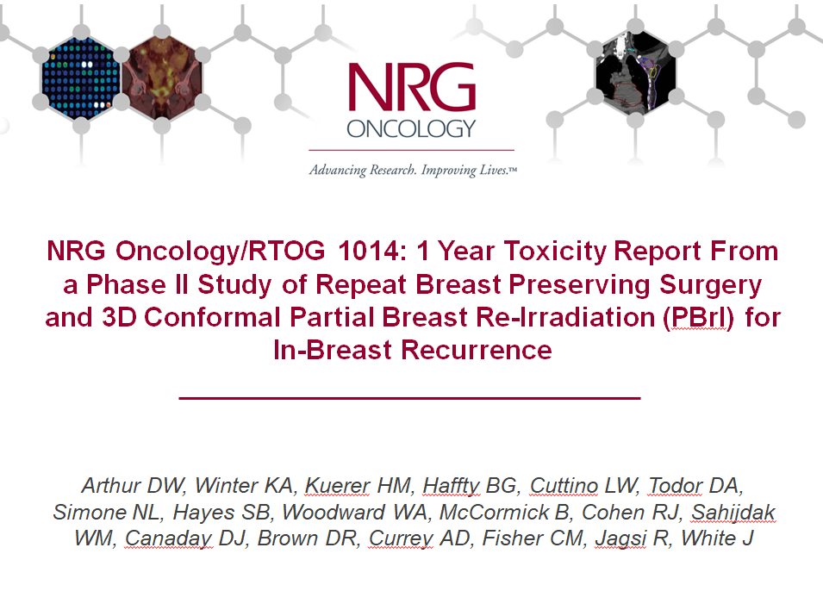

Slide 64
Eligibility
In-breast recurrence/new primary < 3 cm
Occurring >1 year from completion of original whole breast irradiation
Negative margins, negative nodes
Target less than 30% of whole breast reference volume
Treatment Scheme
R E G I S T E R | Partial Breast Re-Irradiation (PBrI) 3D-Conformal External Beam 1.5 GY x 15 (BID) to 45 Gy Total
Technique
- One technique for consistency and analysis
- Maximize homogeneity and widely available for enrollment
Dose fractionation scheme
- Previously used in Head and Neck re-treatment
- Reduces risk of toxicity

Slide 65
NRG Oncology/RTOG 1014
Primary Endpoint
To evaluate skin, breast, and chest wall adverse events occurring within 1 year from the completion of re-irradiation.
Presented ASTRO 2015
Arthur DW, Winter KA, Kuerer HM, et al. Int J Radiat Oncol Biol Phys – 2017;98(5):1028-1035
Partial breast re-irradiation with 3DCRT following second lumpectomy for patients experiencing in-breast failures after WBI is:
  Safe and feasible
  Acceptable treatment quality achieved.
Skin, fibrosis and breast pain toxicity was acceptable
  Primarily G1-2
G3 toxicity was rare (<2%) at the one-yr f/u interval.

Slide 66
NRG Oncology 1014/RTOG
Secondary Endpoints
AEs > 1 yr from completion of PBrI, In-breast control rate, Freedom from mastectomy, DMFS, OVS
Presented ASTRO 2016, 3 year
Arthur DW et al. JAMA ONC. 2019;6:75-82
Median Follow-up: 5 years
Based on the 3-year IBR estimate, it can be concluded with 90% power that the hypothesized reduction from 25% to at least 9% has been met (p=0.0001)
*No patients had distant metastases with their IBR.
Endpoints | # Failures | 3-year |  |  | 4-year
 |  | Estimates | 95% CI | At risk | Estimates | 95% CI | At risk
IBR* | 3 2 inside 1 outside | 3.4% | (0.6%, 10.7%) | 52 | 3.4% | (0.6%, 10.7%) | 50
MF | 6 3 IBR, 2 non-healing 1 contralat | 5.2% | (1.3%, 13.1%) | 51 | 8.7% | (3.2%, 18.8%) | 47
DMFS | 3 | 94.8% | (84.8%, 98.3%) | 53 | 94.8% | (84.8%, 98.3%) | 51
OS | 3 | 94.8% | (84.8%, 98.3%) | 53 | 94.8% | (84.8%, 98.3%) | 51

Slide 67
PRESERVE
Partial Breast Re-irradiation Using Ultra-Hypofractionation: A Phase II Multi-Instutional Study
PI – Danielle Rodin co-PI Anne Koch
Princess Margaret Cancer Centre
safety and effectiveness of 26Gy/5 fx/5 days partial breast re-irradiation
171 pts, global participation (69 as of 8/25)
Eligibility
  Age > 18yo
  In- breast recurrence/new primary after BCT with WBI
  Size ≤ 3 cm, IDC of DCIS, any receptor status
  ≥ 5 years post WBI
  Clinically node negative
  Negative repeat lumpectomy margins

Slide 68
Overall Conclusions
Partial Breast Re-Irradiation
Data supporting as viable option to mastectomy in selected pts
External Beam / Brachytherapy both appropriate
Important to consider
  Patient age
  Time to in-breast failure
  Characteristics of 2nd tumor
  Post WBI breast condition
  Ability to achieve - margins with acceptable cosmesis
  Anticipated size of PBI target
  Technique (EXBT vs Brachy)

Slide 69

Thank You!

