Slide 1




Geriatric Breast Oncology
Rachel A. Freedman, MD, MPH
Dana-Farber Cancer Institute
23rd School of Breast Oncology, 2025
Emory University Conference Center
November 6, 2025
Disclaimer: This presentation is intended for personal use and for informational purposes only and does not replace independent professional judgment. This presentation is the property of Physicians’ Education Resource, LLC (“PER”) and is protected by U.S. and international copyright laws. You may not copy, reproduce, distribute, transmit, modify, or create derivative works of the presentation without the prior written permission from PER.

Slide 2
Disclosures
I have no relevant disclosures
My husband is co-founder and shareholder for a digital primary care company, Firefly Health

Slide 3
Learning Objectives – Breast Cancer in the Elderly
Understand the epidemiology of breast cancer in the older adult
Understand the importance of the geriatric assessment and/or assessments of functional age in the older adult
Describe factors important for predicting chemotherapy toxicity
Appreciate the considerations required for treatment selection, including the benefits and risks of treatment

Slide 4
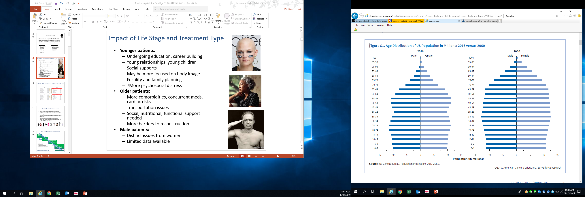
The Number of Older U.S. Adults is Increasing
Numbers Aged 70+ Will Double by 2060
Adapted from Cancer Facts and Figures, 2019 Special Section: Cancer in the Oldest Old
Notes:
https://www.cancer.org/research/cancer-facts-statistics/all-cancer-facts-figures/cancer-facts-figures-2019.html

Slide 5
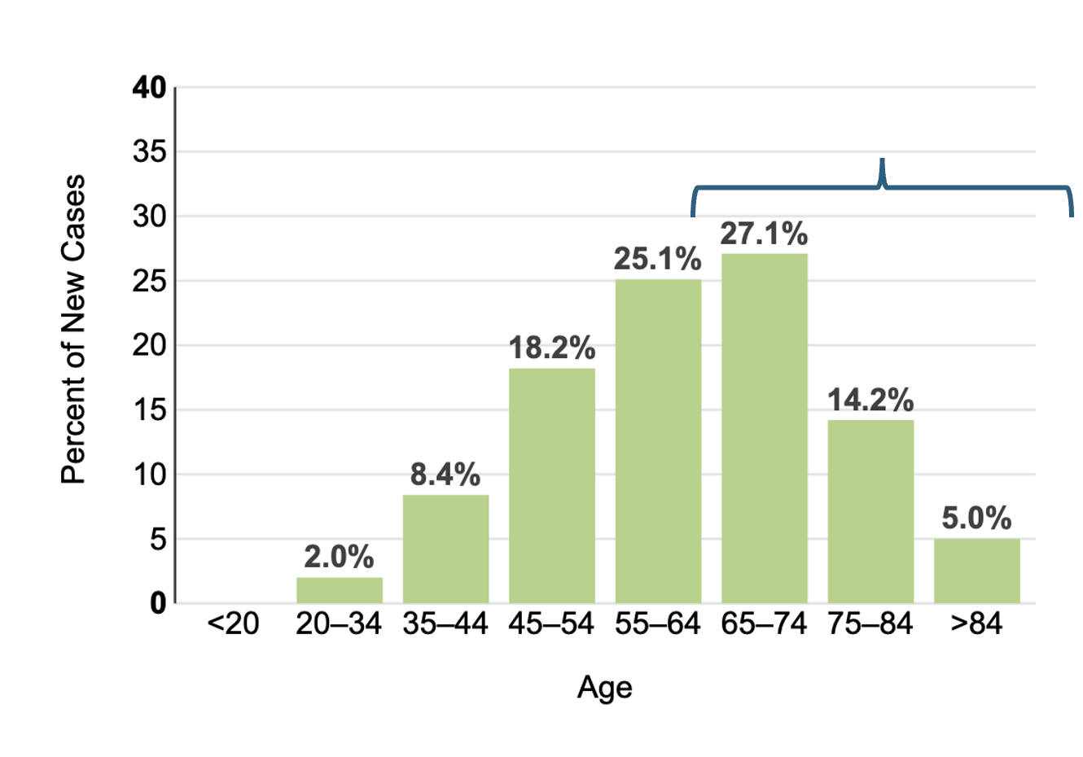

Breast Cancer is Common in Older Women
Total US Cases Estimated for 2025 = 316,9500
≈46% are diagnosed at ages 65+
≈20 % are diagnosed at 75+
Adapted from www.seer.cancer.gov

Slide 6
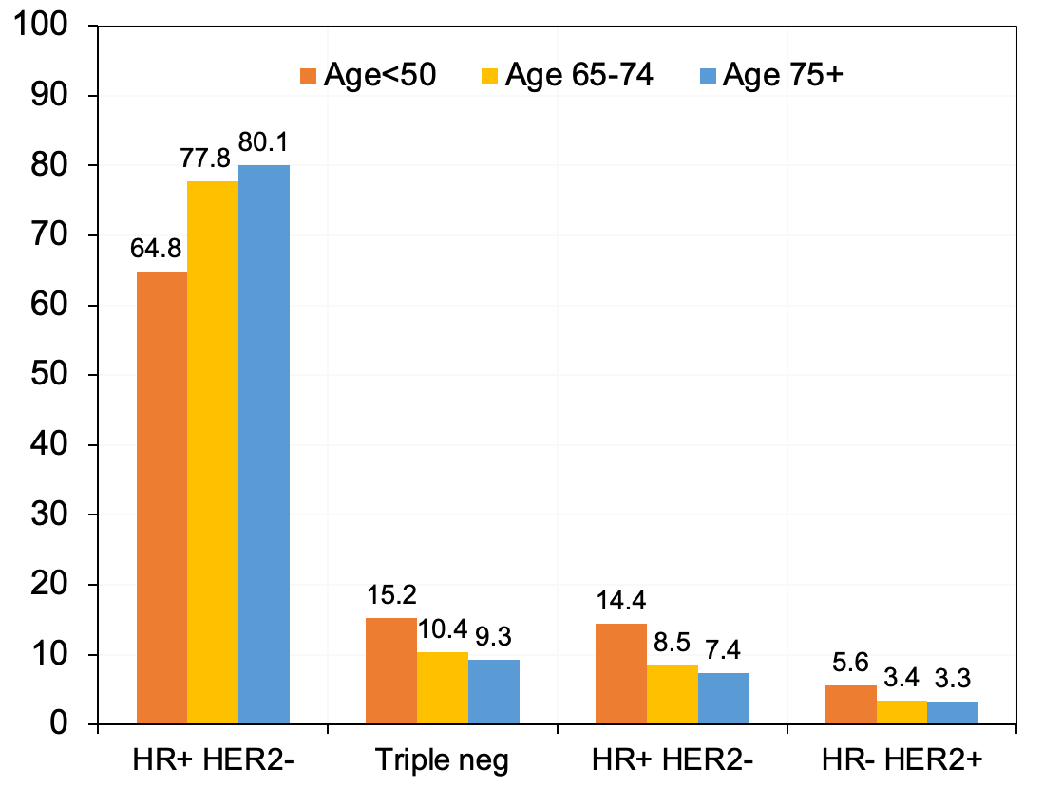
≈ 80% of Breast Cancers in Women 65+ Are HR+HER2-
Percent
+
+
DO NOT POST
DO NOT POST
Howlader JNCI 2012

Slide 7
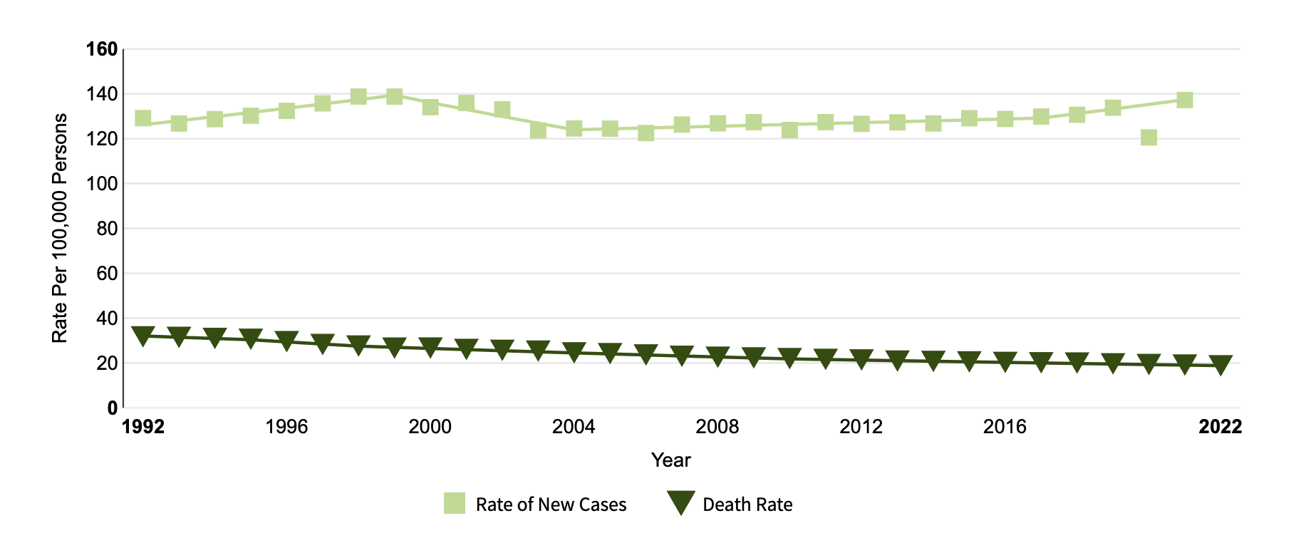
Breast Cancer Mortality Is Improving
32 per 100,000
19 per 100,000
Adapted from www.seer.gov

Slide 8




We Are Seeing More Older Survivors
=
People living longer;
population
growth
Increased
risk for breast cancer with increasing age
Improved
breast cancer mortality

Slide 9
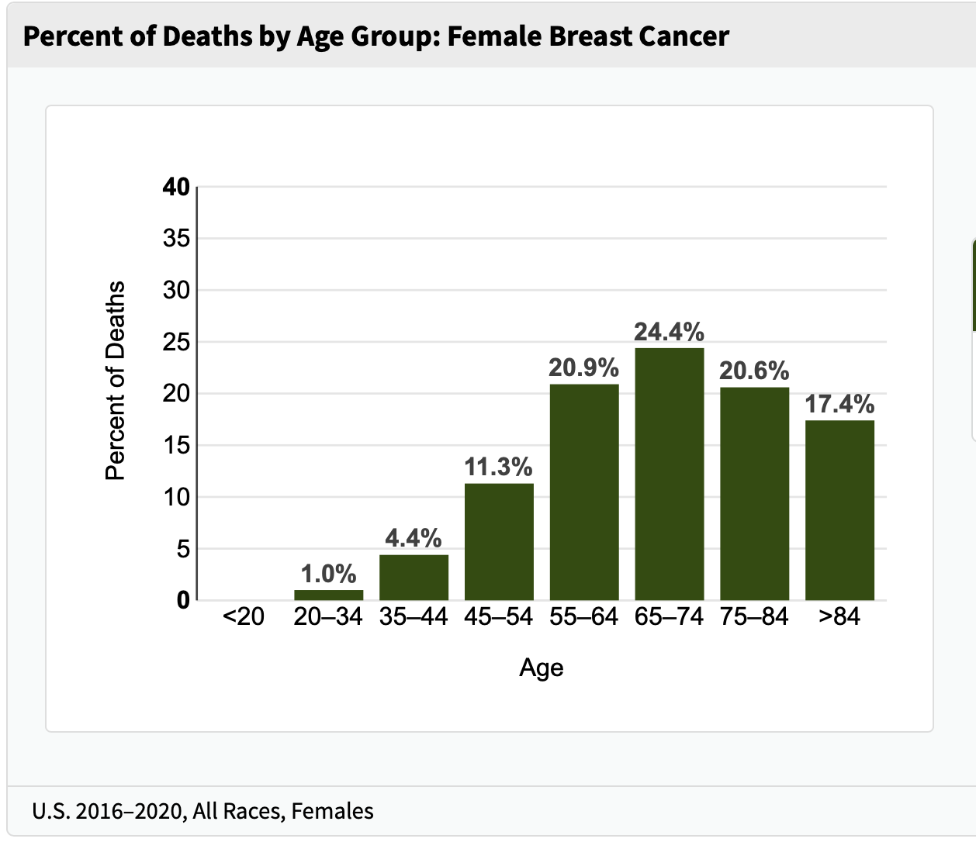
38% Breast Cancer Deaths Occur in Those 75+
*The Pace of Survival Improvements Has Been Slower than in Younger Women*
Many will relapse years after initial diagnosis
Many will live years with MBC, aging during this process
The pace of survival improvements has
been slower than in younger women
38%
5-year Survival by Age:
86% for age <40
90% for ages 40-64
90% for 65-74
87% for ages 75+
Adapted from www.seer.cancer.gov

Slide 10
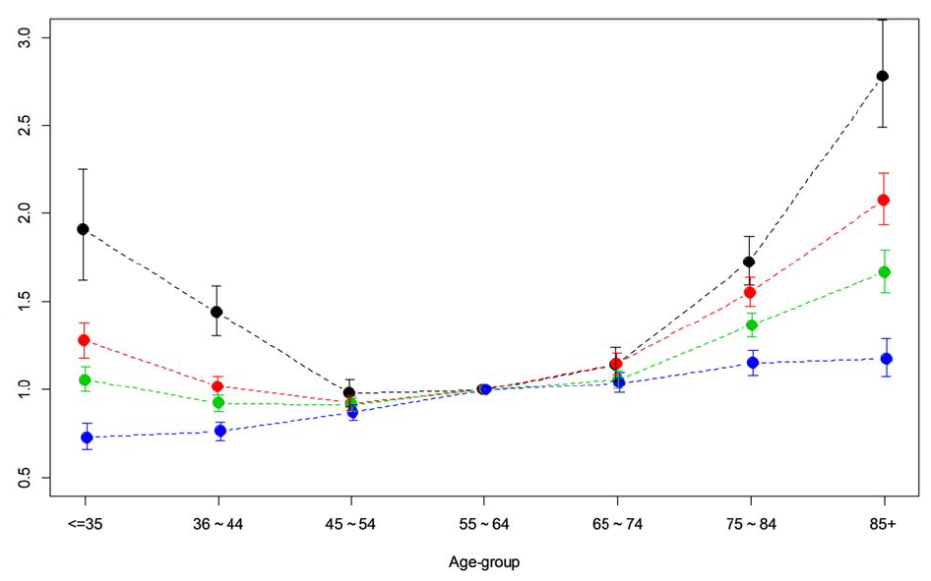
Women Age 75+ Experience
Worse Survival at Every Stage
Stage I
Stage II
Adjusted hazard ratio for breast cancer mortality
Stage III
Stage IV- de novo only
Reference group
≤35 $\text{3}\text{5−}\text{44}$ 45-54 55-64 65-74 75-84 ≥ 85
Age-group
Freedman et al Cancer 2018 (SEER data)
Freedman et al Cancer 2018 (SEER data)

Slide 11
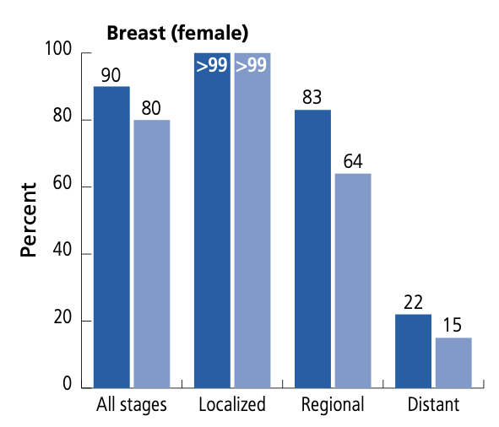

5-Year Survival is Particularly
Worse for the Oldest Old
https://www.cancer.org/content/dam/cancer-org/research/cancer-facts-and-statistics/annual-cancer-facts-and-figures/2019/cancer-facts-and-figures-special-section-cancer-in-the-oldest-old-2019.pdf

Slide 12

Why Are Outcomes Worse for Older Patients?
Older patients with cancer are under-represented in research, have more barriers to care, and are often…
  Under-treated
  (lower receipt, lower intensity,
  non-standard care, worse adherence);
  Underserved
  With less support
They also have …
  Variable biology/genomics of
  their tumors
  More toxicity
  Competing priorities and
  medical conditions
  Unique needs, polypharmacy, functional fragility
Rachel A. Freedman, MD, MPH | 2025
12

Slide 13

Much of What We Know Doesn’t
Come from Prospective Data
Data often come from pooled analyses, registries/claims,
single experience studies
  Variable, sometimes outdated regimens, different patient populations, different tumor types combined in pooled analyses
No granularity, no geriatric/functional assessments
Analyses often underpowered and ad-hoc
Single center reports are often limited in generalizability;
even meta-analyses like EBCTCG are underpowered for older patients
Optimal treatment is not known in many circumstances

Slide 14

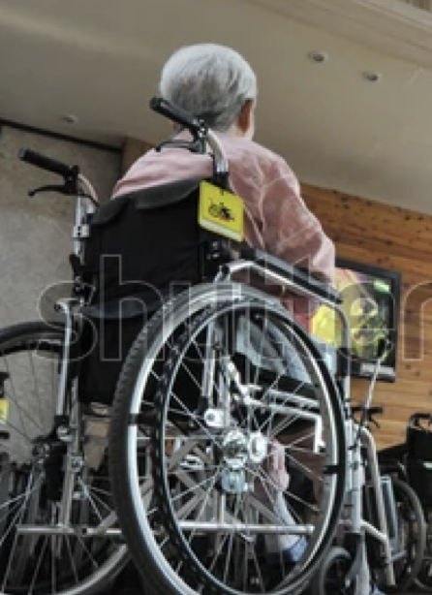
Trial Populations ≠ Populations with Cancer
Clinical trial patient
Patient seen in practice
Breast cancer trial participants are a mean of 7.8 yrs younger
than the ‘true’ U.S. cancer breast cancer population
Slide adapted from Heidi Klepin; Ludmir et al JAMA Oncology 2019

Slide 15

What We Do Know….
Older patients likely derive the same relative benefits with therapy as younger women, but they…
…
…
…
…
are at higher risk for toxicity and severe toxicity
  are at more risk for functional decline (less reserve)
  often have different timeline considerations for risk and benefit
  and their caregivers may have specific preferences, perspectives, priorities
Rachel A. Freedman, MD, MPH | 2025
15

Slide 16
Balancing Cancer Risk vs. Competing Risk
Increased Risk if Undertreated
Mortality from breast cancer
Cancer Recurrence
Increased Risk if Overtreated
Competing causes of death, no impact on breast cancer survival
Decreased functional status
Treatment-related toxicity
Symptoms from recurrence
Rachel A. Freedman, MD, MPH | 2025
16

Slide 17

Decisions on Cancer-Directed Therapy in the Older Patient
Very low risk cancer-
menu of options, de-escalation safe
Very healthy patient, moderate to higher risk cancer, benefits of treatment likely outweigh risks – treat with standard or adapted approaches

Slide 18
Decisions on Cancer-Directed Therapy in the Older Patient
Very low risk cancer-
menu of options, de-escalation safe
Very frail patient, high competing risk, high risk for toxicity– discuss goals of care, consider alternative approaches (dose modification etc)
Very healthy patient, moderate to higher risk cancer, benefits of treatment likely outweigh risks – treat with standard or closely adapted approaches

Slide 19

Decisions on Cancer-Directed Therapy in the Older Patient
Very low risk cancer-
menu of options, de-escalation safe
Very frail patient, high competing risk, high risk for toxicity– discuss goals of care, consider alternative approaches (dose modification etc.)
Very healthy patient, moderate to higher risk cancer, benefits of treatment likely outweigh risks – treat with standard or closely adapted approaches
Advanced, symptomatic disease - proceed with caution

Slide 20

Decisions on Cancer-Directed Therapy in the Older Patient
Very low risk cancer-
menu of options, de-escalation safe
Very frail patient, high competing risk, high risk for toxicity– discuss goals of care, consider alternative approaches (dose modification etc.)
Everything in between
Healthy but advanced chronological age
Pre-frail or mild frailty, any age
Moderate risk disease, modest anticipated benefits of therapy
Very healthy patient, moderate to higher risk cancer, benefits of treatment likely outweigh risks – treat with standard or adapted approaches
Advanced, symptomatic disease - proceed with caution

Slide 21
The Importance of Functional Age –
The Geriatric Assessment Can Help
DOMAIN ASSESSED | TESTS TO BE ADMINISTERED
Functional status | Older American Resources and Services (OARS) MFAQ (IADL) Medical Outcome Study Physical Functioning Karnofsky Performance Status Rated Healthcare Professional* Karnofsky Performance Status Rated by Patient Timed “Up and Go”* Number of falls in last 6 months
Comorbidity | OARS Physical Health Section
Medication Review | Number and names of medications, herbs, or vitamins
Cognition | Blessed Orientation-Memory-Concentration Test*
Psychological Status | Hospital Anxiety and Depression Scale
Nutritional Status | % Unintentional Weight Loss in last 6 months Body Mass Index
Social Functioning and Social Support | Medical Outcomes Study Social Activity Limitation Scale Medical Outcomes Study Social Support Survey Subscale
MFAQ, Multidimensional Functional Assessment Questionnaire; IADL, Instrumental Activities of Daily Living *Items completed by the healthcare professional
Rachel A. Freedman, MD, MPH | 2025
21

Slide 22
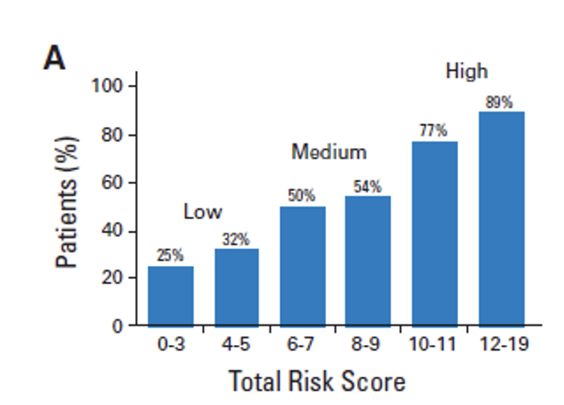
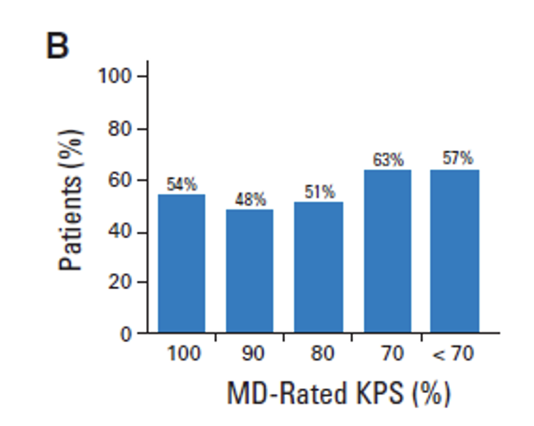
The ‘CARG’ Model Predicts Severe
Chemotherapy Toxicity
500 patients aged 65+ with diagnosis of cancer about to start new chemotherapy regimen
Baseline geriatric assessment, labs, clinical information
Toxicities evaluated at
each visit
  REPEAT GERIATRIC ASSESSMENT
  Toxicities Observed: 53% grade 3, 12% grade 4, 2% grade 5
Hurria et al JCO 2011
Rachel A. Freedman, MD, MPH | 2025
22

Slide 23

Baseline Factors that Predicted for Grade 3-5 Toxicity
Risk Factor | Score
Age ≥72 | 2
Cancer type GI or GU | 2
Standard chemo dose | 2
Hemoglobin <11 g/dL (male), <10 g/dL (female) | 3
Cr clearance <34 mL/min | 3
Hearing, fair or worse | 2
>/= 1 fall in last 6 mos | 3
IADLs: Unable to take medications or need some help | 1
Limited in walking 1 block | 2
Decreased social activity because of emotional health | 1
Low risk:
0-5 points, 30% risk
Intermediate risk:
6-9 points, 52% risk
High risk:
10-19 points, 83% risk
Adapted from Hurria et al JCO 2011
Rachel A. Freedman, MD, MPH | 2025
23

Slide 24
Baseline Factors that Predicted for Grade 3-5 Toxicity
Risk Factor | Score
Age ≥72 | 2
Cancer type GI or GU | 2
Standard chemo dose | 2
Hemoglobin <11 g/dL (male), <10 g/dL (female) | 3
Cr clearance <34 mL/min | 3
Hearing, fair or worse | 2
>/= 1 fall in last 6 mos | 3
IADLs: Unable to take medications or need some help | 1
Limited in walking 1 block | 2
Decreased social activity because of emotional health | 1
Low risk:
0-5 points, 30% risk
Intermediate risk:
6-9 points, 52% risk
High risk:
10-19 points, 83% risk
Adapted from Hurria et al JCO 2011
Rachel A. Freedman, MD, MPH | 2025
24

Slide 25
Bringing the CARG Model to Breast Cancer—
The Hurria Older PatiEnts (HOPE) Cohort Study (n=473)
Magnuson (Hurria)…Freedman et al SABCS 2018 and JCO 2021
Rachel A. Freedman, MD, MPH | 2025
25

Slide 26
CARG-BC: Refining the CARG Model for Breast Cancer
Risk Predictor | Response | Score
Breast cancer stage | II or III I | 3 0
Use of anthracyclines | Yes No | 1 0
Planned treatment duration | >3 months </= 3 months | 4 0
Hemoglobin | </= 12 g/dL >12 g/dL | 3 0
Liver function | Abnormal LFTs Normal | 3 0
How many falls in last 6 months | >/= 1 0 | 4 0
Does your health limit you in walking for >1 mile? | Somewhat/very limited Not limited at all | 3 0
How often is someone available to you in a crisis | None/little/some of time Most of the time | 3 0
SUM to calculate
toxicity risk:
Low </=5
Intermediate 6-10
High 11+
Magnuson …Freedman et al J Clin Oncol Jan 2021
Rachel A. Freedman, MD, MPH | 2025
26

Slide 27
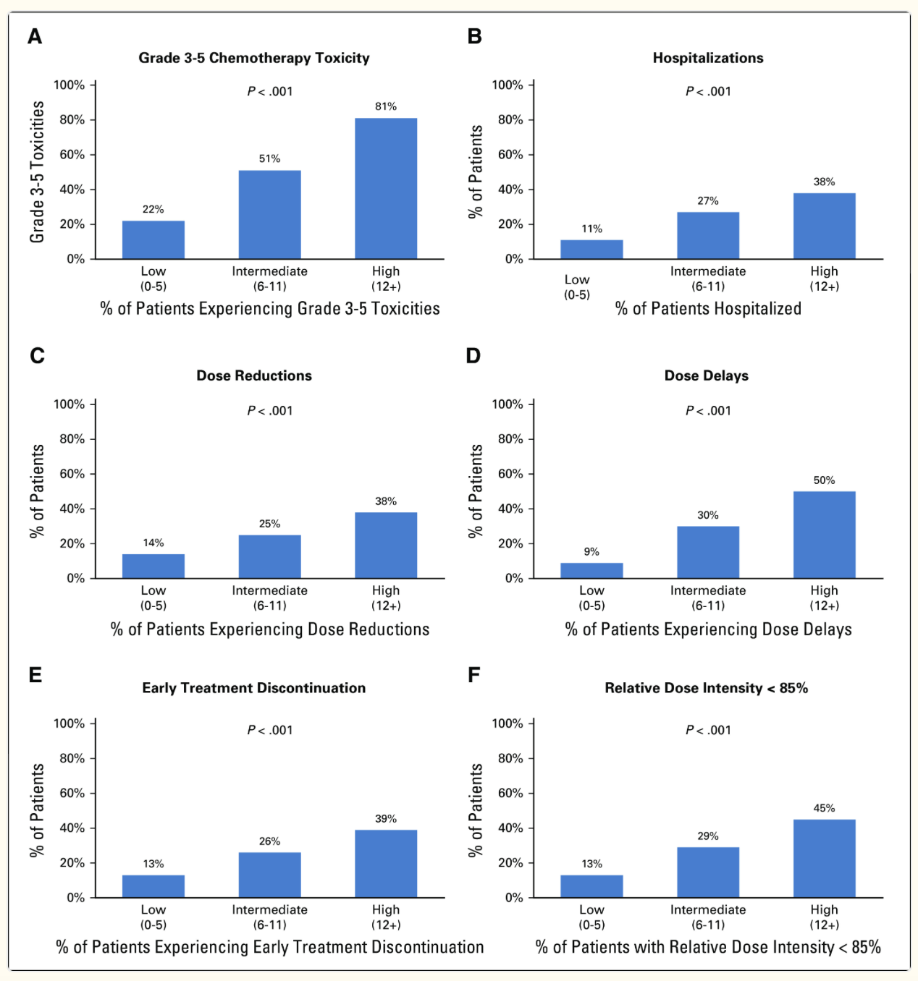
CARG-BC Predicted Clinical Outcomes
98% started with standard doses
24% required a dose reduction
26% had 1+ dose delay
24% discontinued therapy
25% received RDI of <85%
23% were hospitalized
Toxicity
Hospitalizations
Dose reductions
Dose delays
Early treatment d/c
RDI
Magnuson et al JCO 2021

Slide 28
Benefits of Geriatric Assessment
for Older Patients with Cancer
Uncovers problems not detected by routine H&P
Predicts for severe toxicity
Predicts hospitalizations
Predicts survival
Feasible in oncology practice
Helps clinicians with decision-making, impacts care plans
Helps teams mitigate toxicity
Personalizes referrals
Improves communication
No detrimental effects on survival
2018 ASCO Guidelines for Geriatric Oncology: Systematic Review and Rosoft et al J Clin Oncol 2021

Slide 29
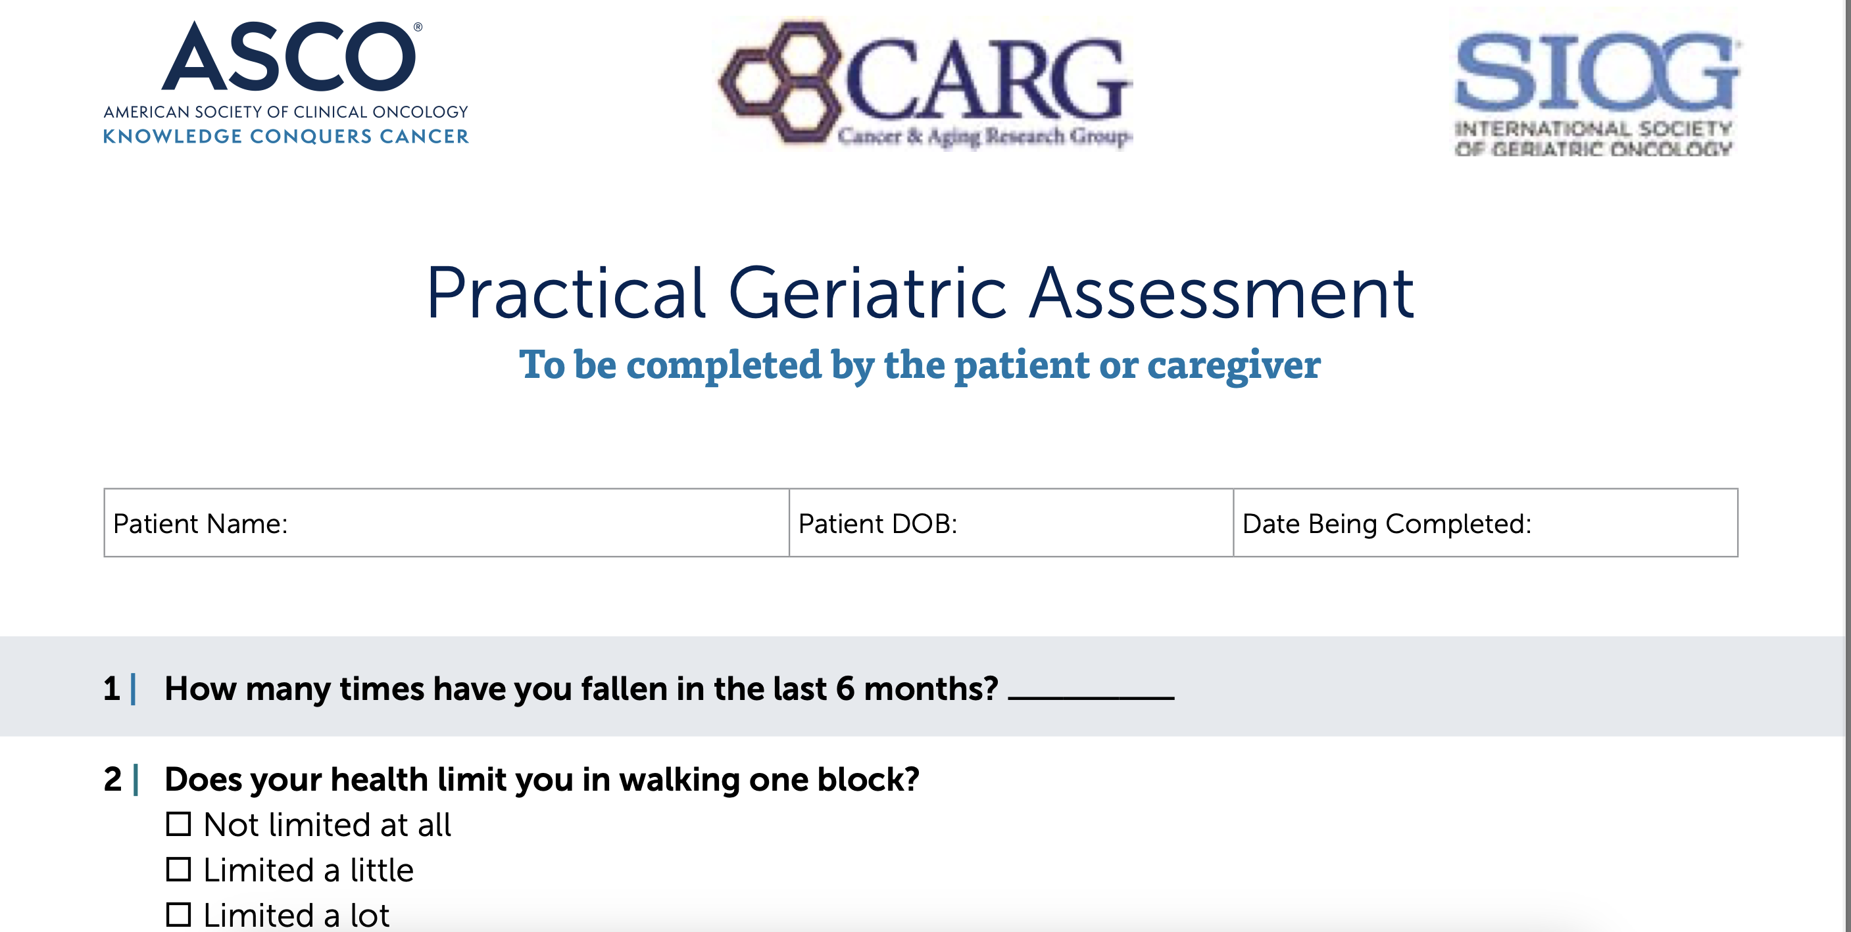
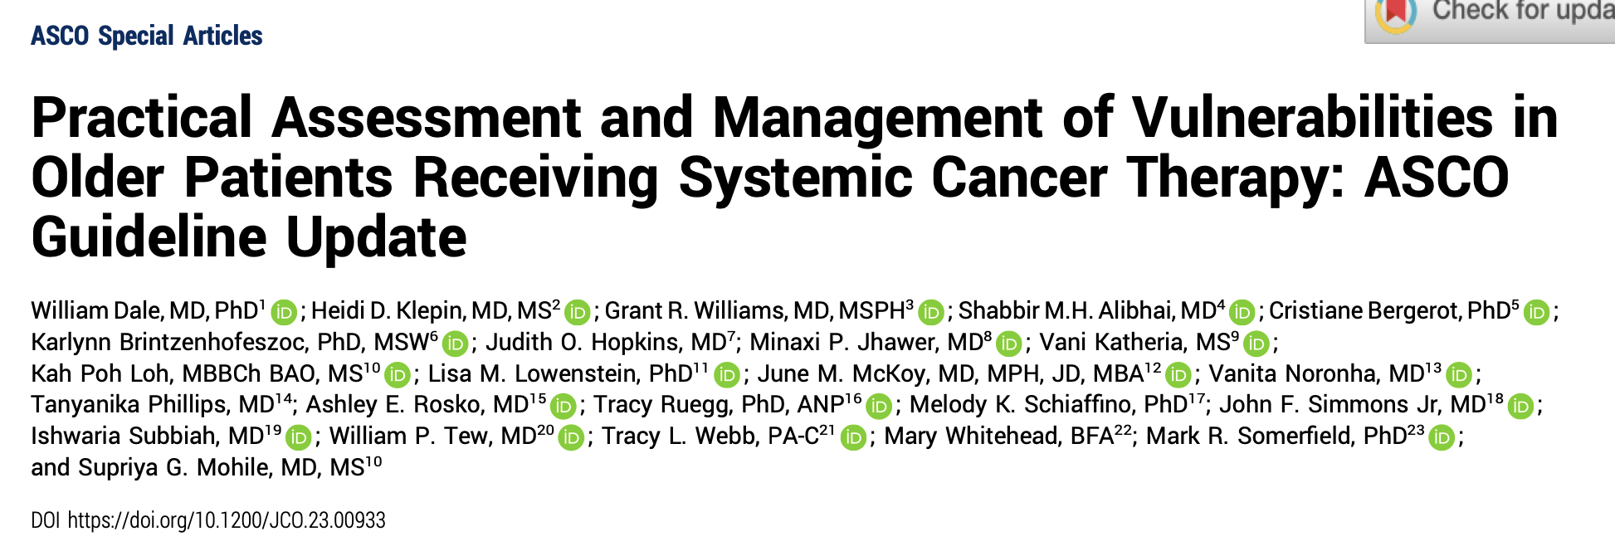
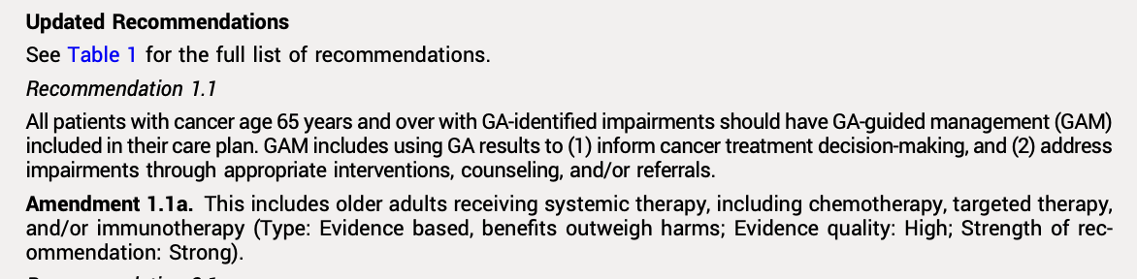
National Efforts to Do Better
Dale, et al JCO 2023 and https://society.asco.org/sites/new-www.asco.org/files/content-files/practice-patients/documents/2023-PGA-Final.pdf

Slide 30
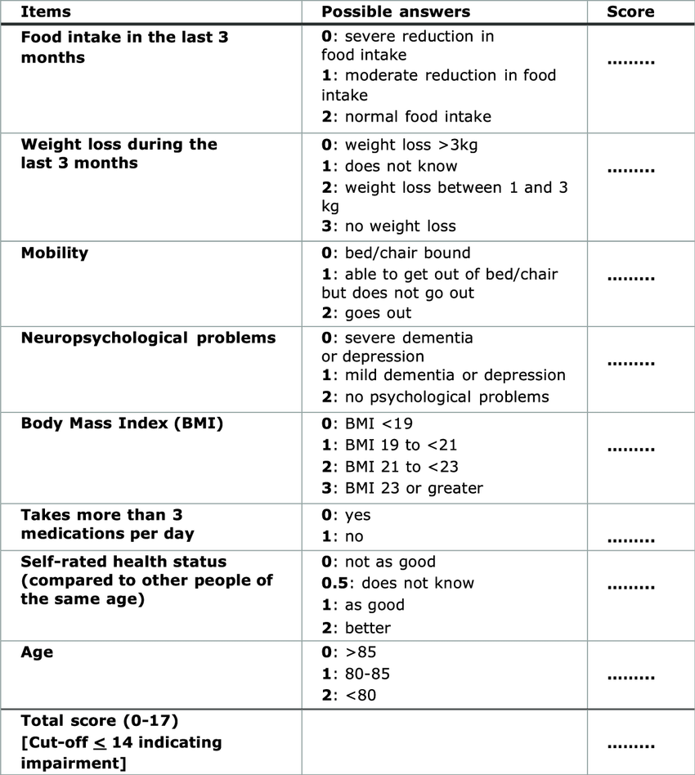
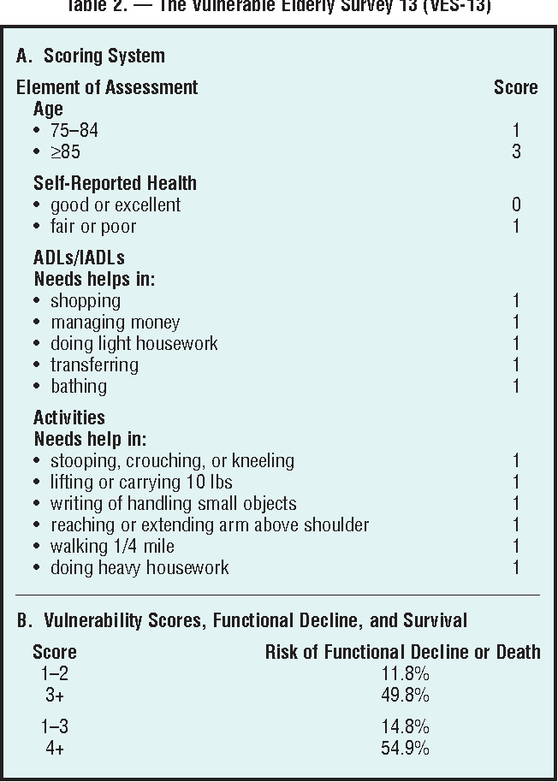
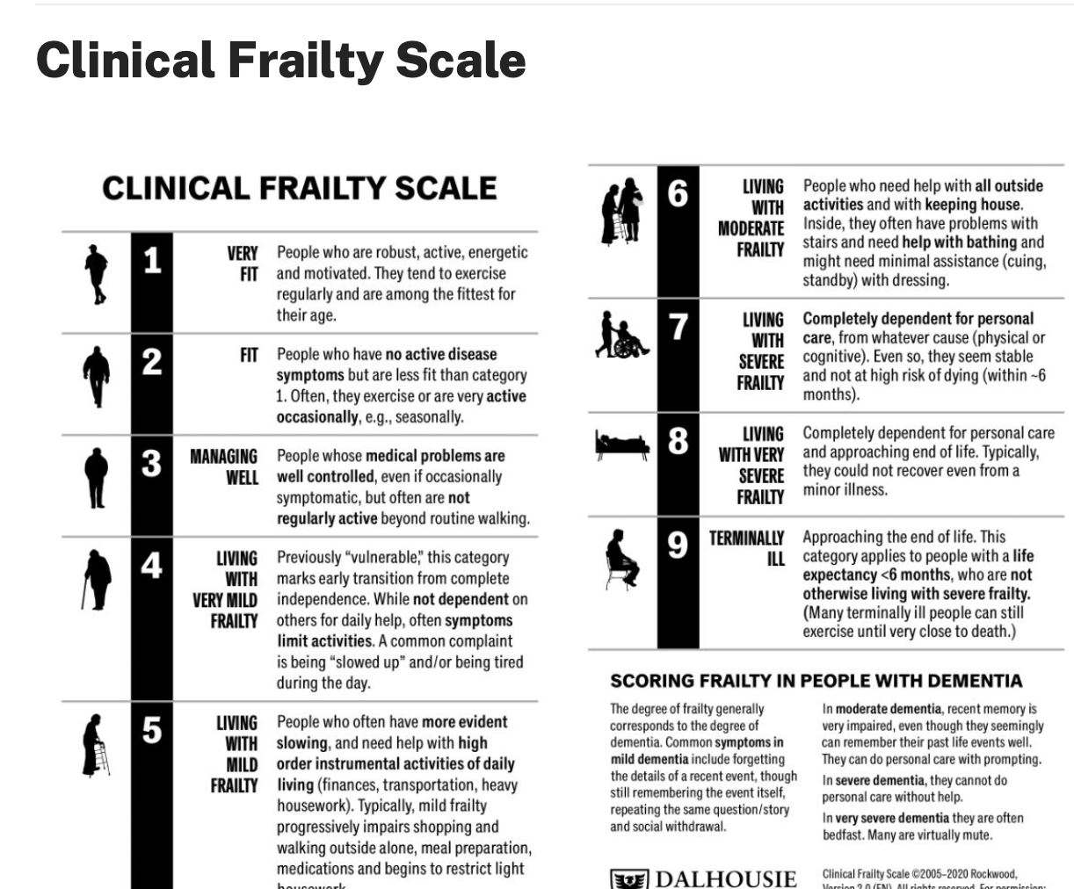
Other Assessments of ‘Functional Age’
Geriatric-8 (G8) Screening Tool
Vulnerable Elders Survey (VES-13)
Frailty Scale

Slide 31
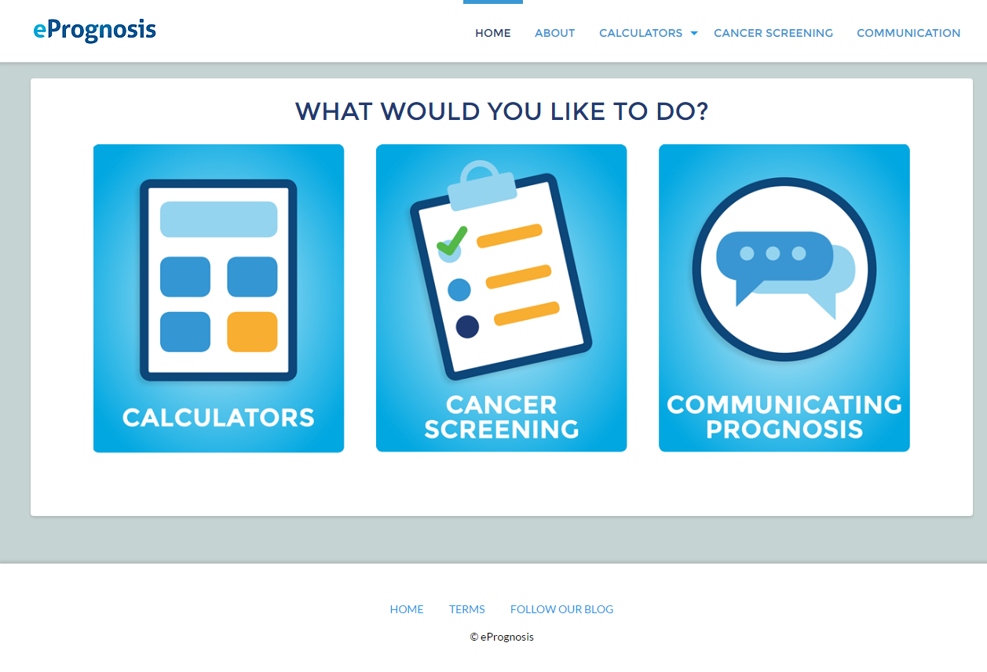
Calculating Life Expectancy
Based on Comorbidity, Function, and Behaviors: ePrognosis
www.ePrognosis.ucsf.edu

Slide 32
A Case to Consider….
Risk Predictor – CARG BC | Response | Score
Stage | II | 3
Anthracyclines planned? | No | 0
Planned tx duration | >3 months </= 3 months | 4 0
Hgb | >12 g/dL | 0
LFTs | Normal | 0
Falls in 6 mos? | >/= 1 | 4
Limited in walking >1 mile? | Somewhat/very limited | 3
Someone avail to you in a crisis | Most of the time | 0
If longer chemo = 14 = high risk If shorter chemo = 10 = high end of intermediate
84 yo woman presents to you with a 4.5 cm, clinical N2 TNBC. She has HTN, had an MI 3 years ago, fell once in the last 6 months, and remotely smoked for 30 years.
You do a GA with her and are considering treatment options:
Depending on duration of treatment, she has a 51-81% chance of having grade 3+ toxicity during treatment

Slide 33
A Case to Consider, cont.
Schonberg Index Factor | Score
Age | 4
Weight | 0
Overall health- Fair | 2
No COPD | 0
Other cancer | 0
DM | 0
Help w/ routine needs | 2
Cigarette use-remote | 2
Hospitalizations | 0
Risk of 5-year mortality Risk of 10-year mortality | 26-29% 53-60%
This patient has HTN, had an MI 3 years ago, fell once in the last 6 months, and remotely smoked for 30 years.
You calculate a Schonberg Index for her:
Competing risk present (for mortality outside of breast cancer)
An average 84 yr old woman in the US has a 7-year additional life expectancy

Slide 34

What Should You Do?
Calculate what you anticipate the absolute benefits of treatment to be
Let patient know your concerns and recommendations
Elicit preferences
Given high toxicity risk, is there a way to modify therapy?
  Dosing, schedule, agent selection?
How might you optimize her health if you pursue chemotherapy and/or immunotherapy?
  PT?
  Pharmacy evaluation?
  Added nurse check-ins?
  Extra visits?
  Early consideration of growth factor

Slide 35
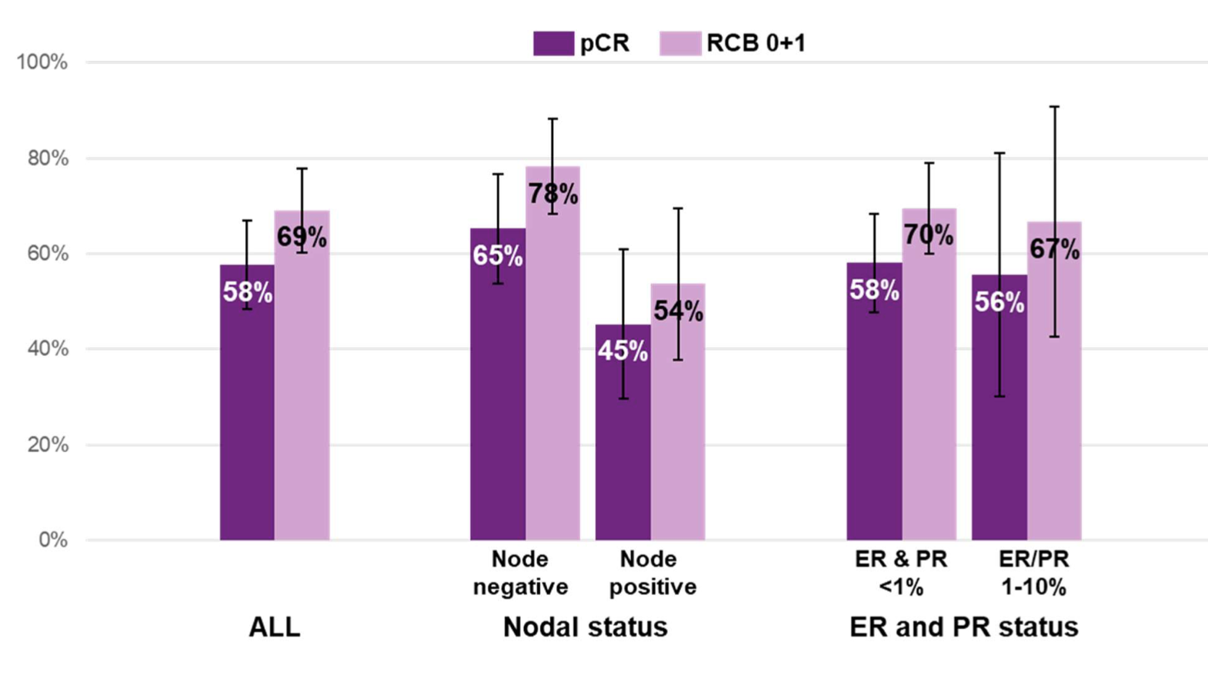

Anthracycline-Free Regimen for Higher Risk TNBC?
NeoPACT
SWOG 2212 (SCARLET) NCT05929768
TNBC or low ER< 5%
T2-4N0 or T1-3N1-2
No T4/N+ or any N3 or IBC
invasive breast caner or positive LN N=2400
Keynote 522
End points
Primary: EFS
Secondary:
pCR
RCB
DRFS
RFS
OS
Safety
QOL
NeoPACT
Docetaxel/Carbo
+Pembrolizumab
X 6 cycles
Overall pCR rate = 58% (95% CI, 48%-67%)
Overall RCB 0-I = 69% (95% CI, 60%-78%)
Sharma et al JAMA Oncol 2024

Slide 36
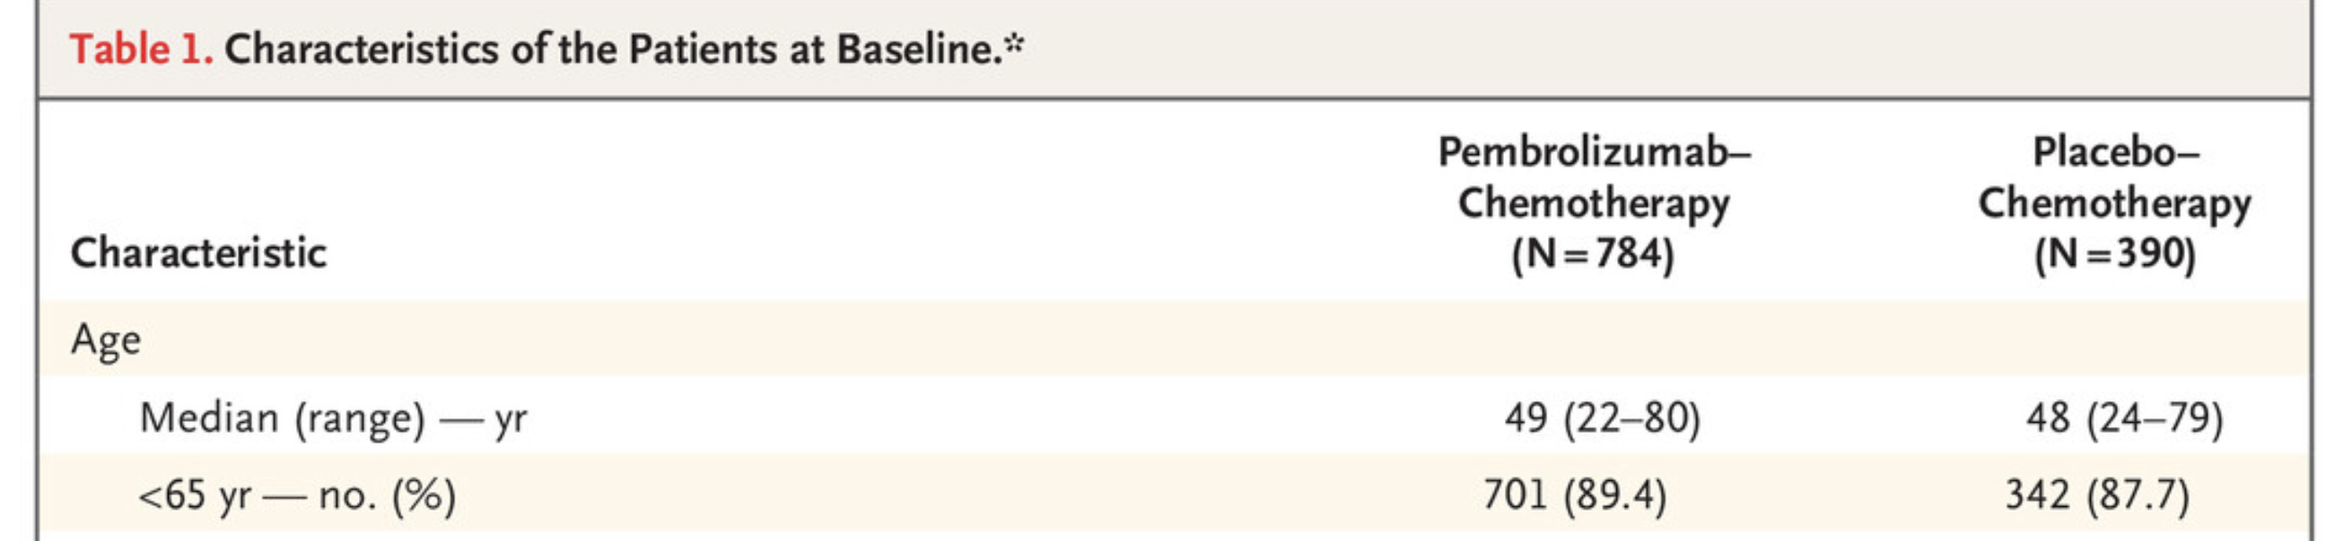
Considerations for TNBC
Keynote 522 (Schmid, NEJM, 2020)
88-90% were ages <65 years on Keynote 522
Of note: NeoPACT trial: Median age 50; all were ≤ age 70

Slide 37
Neoadjuvant Pembrolizumab in Older Adults:
More Toxic than Anticipated?
In real-world analysis of older adults receiving neoadjuvant pembrolizumab, pCR rates were lower than anticipated and toxicity was higher than anticipated, including a high frequency of immune related AEs and hospitalizations; deaths also seen
Smith…Freedman, SABCS 2025

Slide 38
Carboplatin-Paclitaxel for Older Patients with TNBC
The ‘ADVANCE’ Trial – Feasibility Pilot in Age 70+
Age 70+
TN breast cancer
Recommended for neo/adjuvant chemotherapy
N=20
Baseline GA
Correlative blood and tumor samples
Carboplatin AUC 2 weekly and paclitaxel 80 mg/m2 weekly x 12 weeks
Primary endpoint- Feasibility of treatment administration as planned
PRO, GA, CTCAE assessments
Only 40% (95% CI 19-64%) of patients met feasibility (with 10+ weeks of therapy, as planned)
65% had grade 3-4 neutropenia (grade 3 events were otherwise rare except for anemia in 15%)
  Growth factor not mandated
Treatments tolerated well outside of myelosuppression
JGO Freedman, et al 2022
JNCI Mayerhofer…Freedman, Miller 2023

Slide 39
A Potential Approach for TNBC
Tmic, T1a, T1b
N0
T1b / T1c
N0
≥T2 or Lymph Node +
Consider observation
Consider:
Clinical judgement, Anticipated benefit,
Patient Preference
Toxicity risk (CARG-BC score), Frailty,
Functional status
Competing mortality risk
Low/Intermediate Risk of Toxicity, Robust
High Risk of Toxicity, Frail or Pre-frail
Consider Neoadjuvant Therapy
(or up-front surgery if patient is frail and unlikely to tolerate chemotherapy
Adjuvant TC, CMF, weekly paclitaxel-carboplatin
Consider omission of chemotherapy or adapted approaches
Low/Intermediate Risk of Toxicity, Robust
High Risk of Toxicity, Frail or Pre-frail
For higher risk disease in fit patients:
KEYNOTE522
For lower risk disease (T2N0), cardiac risk factors, or less fit:
Weely carbo/taxol/ pembrolizumab or NeoPACT regimen
Consider adapted approaches: up front dose reduction, adapted schedules with close monitoring

Slide 40
Other Considerations By Disease Subtype

Slide 41
Chemotherapy Considerations for HR+HER2- Disease
In ER+, we have Oncotype, HT, extended HT, CDK 4/6i, adjuvant bisphosphonates
Alternative chemotherapy regimens haven’t proven efficacious (e.g., capecitabine) compared with standard treatment, so the options remain similar to younger patients
  Docetaxel-cyclophosphamide (TC)
  Cyclophosphamide-methotrexate-5-FU (CMF)
  Doxorubicin-cyclophosphamide-paclitaxel (ACT) in highest risk patients

Slide 42
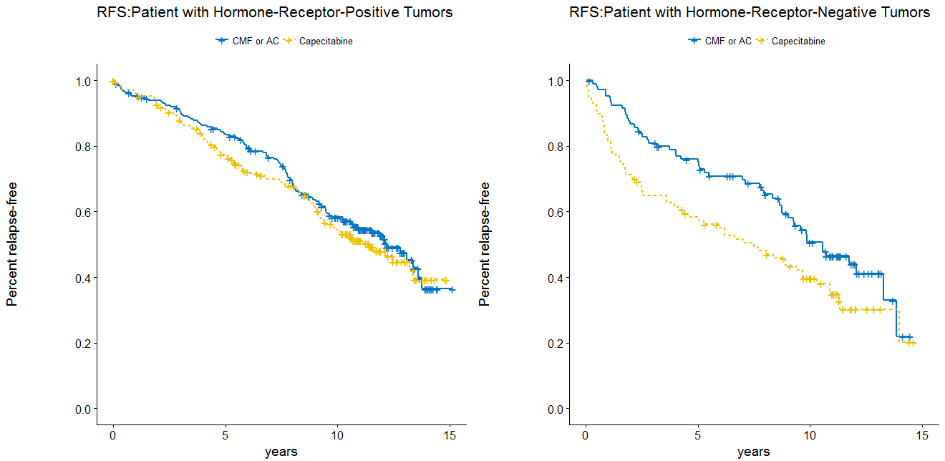
CALGB/Alliance 49907
Stratification
Age 65-69,70-80,80+; PS 0-1 vs 2;HER-2 +/-/unk
Randomize
CMF 6 cycles or AC 4 cycles
Capecitabine for 6 cycles
Capecitabine also no better than ibandronate on ICE
Capecitabine + nab-paclitaxel more toxic than EC/CMF
Weekly docetaxel not equivalent and more toxic than CMF
Carboplatin-paclitaxel and paclitaxel-cyclophosphamide with high rates of neutropenia (ADVANCE trial, age 70+)
Capecitabine (Still) Inferior at 11+ yrs of Follow-up
Muss et al N Engl J Med 2009; 360:2055-206; J Clin Onc 2019;37(26):2338-2348.; von Minckwitz et al. Perrone et al Ann Oncol 2015
Notes:
The trail design is shown above
Patients were stratified by age, performance status and HER-2 status,.
and then randomized to standard chemotherapy with either CMF or AC or capecitabine.
For patients randomized to standard chemotherapy the patient and her physician selected whether to use CMF or AC.
CMF was given for 6 cycles repeated every 4 weeks and used oral cyclophosphamide.
AC was given for 4 cycles every 3 weeks. Both regimens used standard doses as defined in previous randomized trials.
Capecitabine 2000 mg/m2 in 2 divided doses was given every 3 weeks for 6 cycles.

Slide 43
Now Enrolling: the DOROTHY Study (HR+HER2- and TNBC)
Cycle 1, 2, 3, 4
Pembrolizumab allowed for TNBC, per provider discretion
PRIMARY
* RDI
80% of standard dose Docetaxel
Eligibility
Age > 65
Stage I-III BC
HER2-neg
Neo/Adj TC chemo per physician and patient decision
Immunotherapy allowed in TN dz
Baseline GA
Docetaxel 60 mg/m²
+
Cyclophosphamide 600 mg/m²
SECONDARY
* 3-year dRFS
* iDFs
* OS
* Treatment success
* Was It Worth It (WIWI) questionnaire
* Patient-reported toxicities (PRO-CTCAEs)
* Clinician-reported toxicities (NCI CTCAE v5)
* Changes in GA over time
R
100% of standard dose Docetaxel
Docetaxel 75 mg/m²
+
Cyclophosphamide 600 mg/m²
Beyond Cycle 1, TC dose de-escalation is allowed per discretion of the treating physician.
Dose escalation of docetaxel in intervention arm is not allowed for cycles 2, 3, and 4.
Funded by Rising Tide to City of Hope, PI Freedman

Slide 44
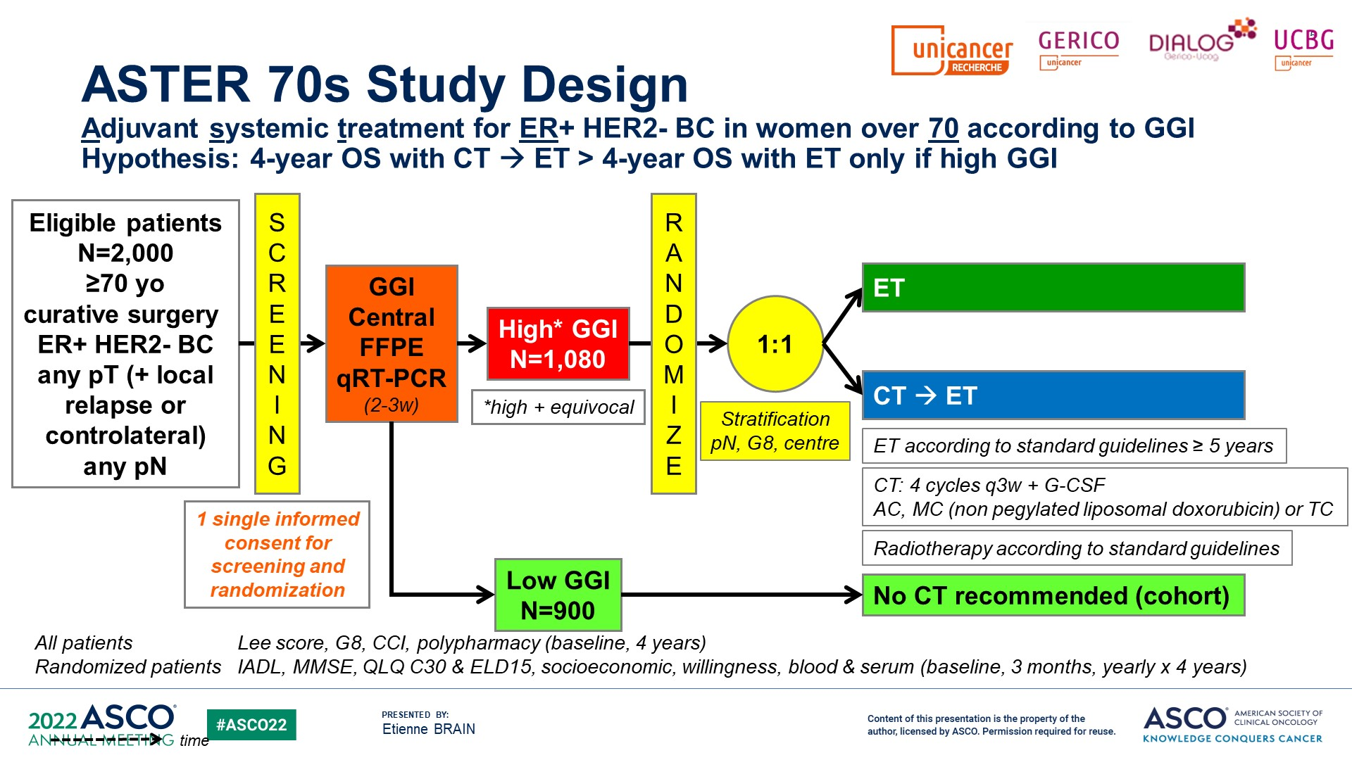
Who Needs Chemotherapy for HR+HER2- Disease?
(GGI=Genomic grade index)
SLIDE PROVIDED BY DR. ETIENNE BRAIN, ASCO 2022

Slide 45
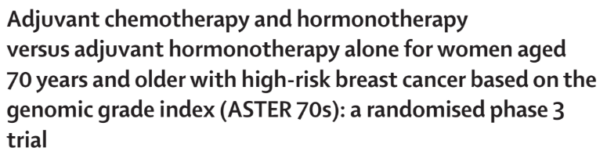

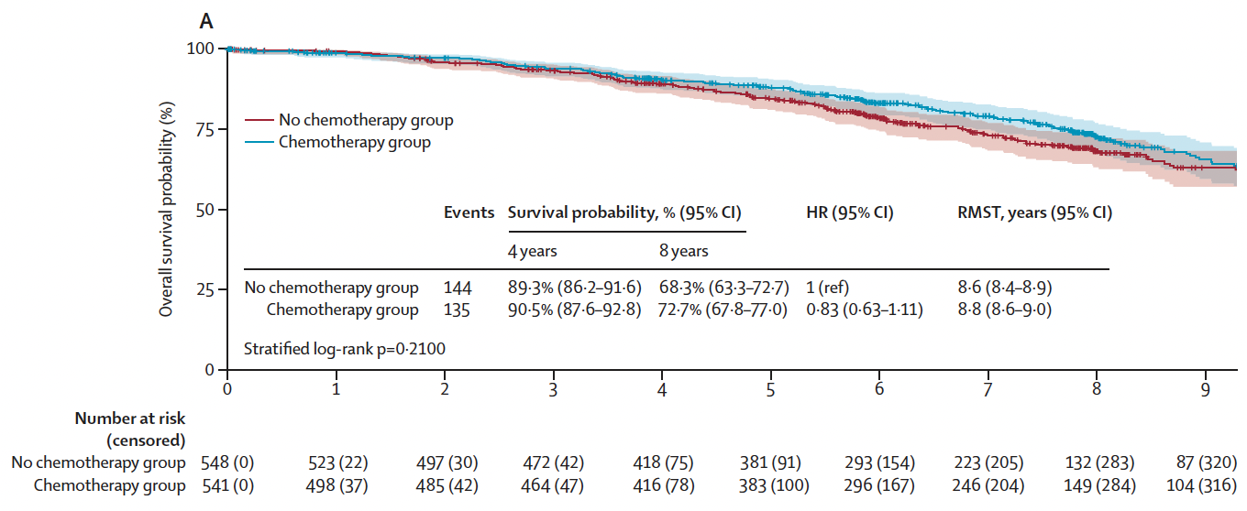
ASTER 70s
Overall Survival – Intent to Treat Analysis

Slide 46
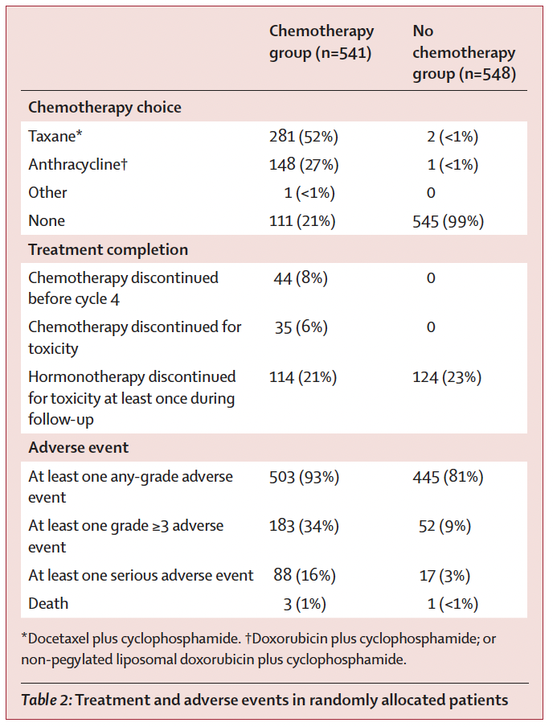
ASTER 70s – Treatments and Adverse Events
Most common grade 3 AE:
hematologic
gastrointestinal
skin
infections
3 deaths in the chemo group:
peritonitis
cardiac event
general deterioration
1 death in the no chemo group (stroke)
Patients randomly assigned to chemotherapy but declined chemo were more likely to have:
Worse ECOG
Worse G8 scores
Worse Charlston Comorbidity Index
Notes:
In terms of treatment received, around 21% of patients randomized to chemotherapy did not end up receiving this treatment. These patients who declined chemo were more likely to have worse ECOG scores, worse G8 scores, and worse comorbidity index.
TC x4 was the most common chemotherapy regimen received.
In terms of adverse events, only 8% of patients discontinued chemotherapy early, while 34% experienced a grade 3 adverse event- most commonly hematologic, GI, skin, infections. There were 3 deaths in the chemo group during treatment, 1 in the non-chemo group.

Slide 47
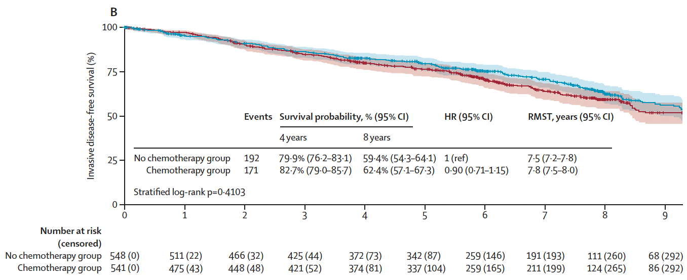
ASTER 70s – There was no statistically significant difference in DFS at 8 years
(absolute 3% benefit favoring the chemo group, NS)
Invasive Disease-Free Survival – Intent to Treat
Notes:
Here is the intent to treat analysis of disease free survival showing similar findings, no statistically significant difference

Slide 48
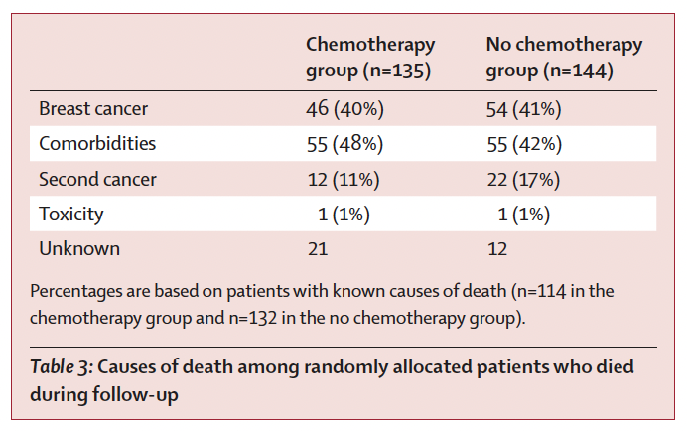
ASTER 70s – Causes of Death
My takeaway: Findings do not rule out a small benefit for some patients but are reassuring for many - the benefits of chemotherapy in this population, if any, are likely very small and limited to a selected group of TBD patients
Notes:
This table is illustrating that there was a fair amount of death from other causes during the 8 year follow up period, 42-48%, demonstrating that despite these being 70yo patients considered well enough to participate in this trial, that age still is a significant predictor of mortality.

Slide 49
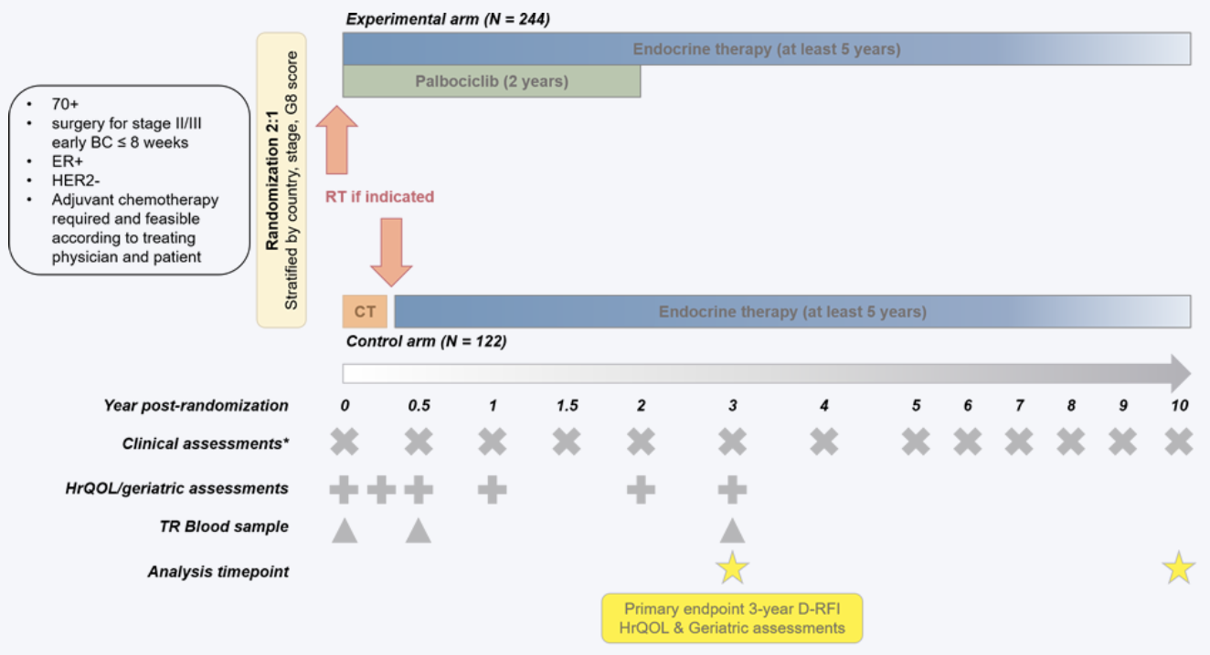
Adjuvant PALbociclib as an Alternative to CHemotherapy in Elderly patientS with high-risk ER+/HER2- early breast cancer (‘APPALACHES’) [EORTC/IBCSG]
Planned N = 366

Slide 50
Adjuvant CDK 4/6 Inhibitors- NATALEE in Older Adults
*Subgroup Analysis*
EFFICACY
Consistent benefit seen with ribo + NSAI:
  iDFS:
  < 65 yo 2.9%, HR 0.769 (0.633-0.935) vs.
  > 65 yo 4.2%, HR 0.671 (0.449-1.003)
  DDFS:
  < 65 yo 2.4%, HR 0.781 (0.636-0.959) vs. > 65 yo 4.1%, HR 0.630 (0.412-0.961)
ADVERSE EVENTS
Rate and type of AEs were similar across age groups:
  Neutropenia: 45.6% vs. 37.1% G3/G4 in ribo + NSAI for those < 65 vs. > 65 yo
Similar % ribo dose reduction due to AE (~22%), primarily due to neutropenia
Higher % discontinuation due to AE for those > 65 yo in ribo + NSAI (28.6% vs. 19.3%), primarily due to LFT elevation (despite similar rates of LFT AEs)
Untch et. al. ESMO 2024
Notes:
3 yr data
Keep in mind the n value for those > 65 yo is a smaller number
LFT elevation 10-11%. Then arthralgias, then neutropenia/Cr elevation
QOL measures slightly higher in RIB + NSAI groups, for both old and young, with HR 0.97-1.15 but all CI crossed 1

Slide 51
A Potential Approach for HR+ Disease
Low anatomical risk, favorable biology
High anatomical risk, favorable biology
Low anatomical risk, aggressive biology
High anatomical risk, aggressive biology
Endocrine Therapy alone
Send Recurrence Score (RS)
Endocrine therapy alone, or send RS
Send RS and/or proceed with chemotherapy
If low or intermediate RS, endocrine therapy alone +/- CDK4/6 inhibitor
If high RS, weigh chemotherapy
Weigh chemo; Endocrine therapy, CDK 4/6 inhibitor
Consider:
Toxicity risk (CARG-BC), Frailty,
Functional status, anticipated benefit
Clinical judgement, Patient preferences
Competing risk for mortality
Low/Intermediate Risk for Toxicity, Robust
High Risk of Toxicity, Pre-frail or frail
Consider standard regimens:
TC (preferred)
CMF
Consider adapted approaches:
-Dosing or schedule modification
-Non-chemotherapy approaches

Slide 52
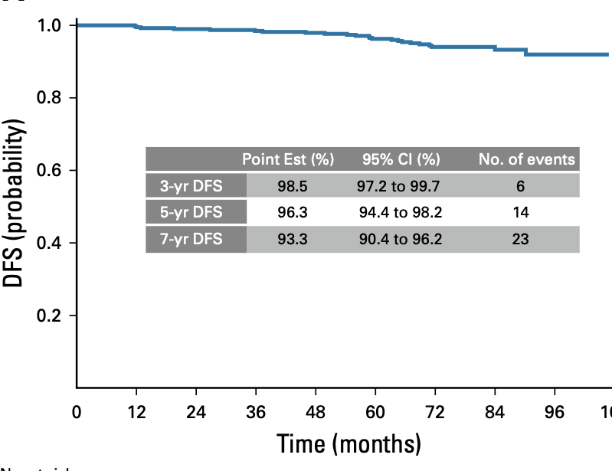
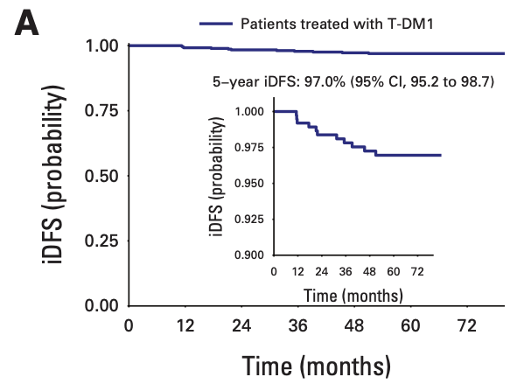
Considerations for HER2+ Disease
APT TRIAL
paclitaxel-trastuzumab
ATEMPT TRIAL
Paclitaxel-trastuzumab vs. T-DM1
Tolaney et al J Clin Oncol, 2019
Tarantino et al JCO 2024
7-year DFS = 93% with 4 (1.0%) distant recurrences
5-year iDFS = 97.0% with 3 distant recurrences

Slide 53
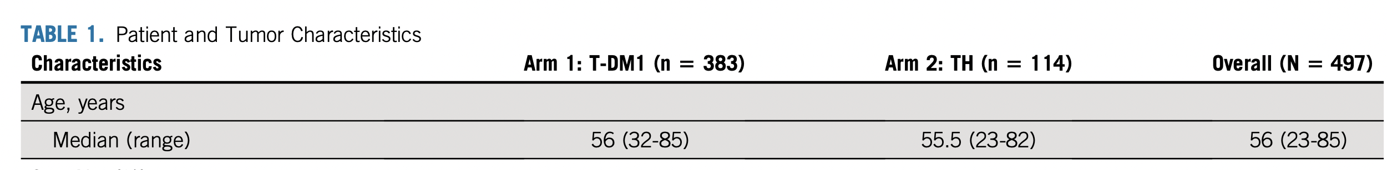
Older Patients (Age 50+) on ATEMPT
Early T-DM1 discontinuation was higher for those aged >50 vs (</=50 (23% vs 9%, p=0.003)
Among those 50+:
  T-DM1 (vs. paclitaxel) had superior QOL and less activity impairment
  Less neuropathy with T-DM1 (vs. paclitaxel)
Sella NPJ Breast Cancer, 2022

Slide 54
Other De-Escalation Considerations—
Can We Omit Carboplatin in Pre-Op HER2+ Setting?
HELEN-006 (Lancet Oncol 2025)
  RCT (China) for those 18-70 yo with stage II-III HER2+ breast cancer
    Nab-paclitaxel or docetaxel alone or plus carboplatin x 6 cycles (all with trastuzumab)
    pCR with carbo 57.6% vs 66.3% without carbo
    Numerically higher AEs with carbo
neoCARHP (ASCO 2025, LBA500, Gao et al)
  RCT (China) for those with stage II-III HER2+ breast cancer
    Taxane plus H and P vs. with carboplatin (x 6 cycles)
    pCR 65.9% with carbo vs 64.1 with THP
    Less AEs with THP

Slide 55
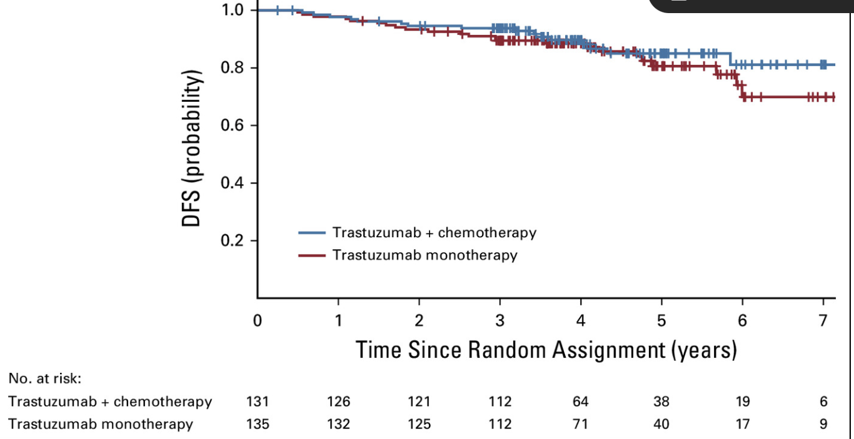
RESPECT Trial – Chemo + Trastuzumab vs. Trastuzumab in Early Stage HER2+ Disease, Ages 70-80
Noninferiority for trastuzumab monotherapy was not met.
“However, the observed loss of survival without chemotherapy was < 1 month at 3 years.”
Sawaki et. al, JCO 2020

Slide 56

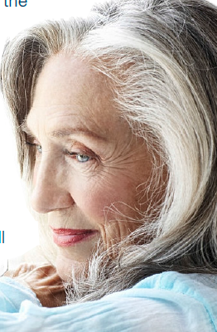
ATOP- Adjuvant T-DM1 in the Older Patient
Abstract Number: 1079
Presentation Number: PS3-11-04
Stage I-III HER2+ breast cancer; age 60+
*unfit for/preference to avoid standard
trastuzumab-based chemotherapy*
Abstract to be presented at SABCS 2025
(Abstract #1079, PS3-11-04)
Baseline geriatric assessment (GA), biomarkers, PROs, QOL
T-DM1 for one year, administered every 3 weeks as 3.6 mg/kg IV
Serial PROs and QOL in iPads, biomarkers of aging, cardiac evaluations
Onetime 6-12 month follow-up with GA, biomarkers, EF, PROs, QOL
PI= Rachel Freedman
Funded by Gateway for Cancer Research, Genentech, Susan G. Komen, Gloria Spivak Award
Follow-up per routine care
**Primary endpoint: 5-year IDFS**

Slide 57
A Potential Approach for HER2+ Disease
Tmic / T1a
and N0
T1b/ T1c
and N0
≥T2 and/or
lymph node-positive
Consider observation + endocrine therapy if hormone receptor (HR)-positive
Consider:
Clinical judgement, Anticipated benefit, Patient Preference,
Toxicity risk (CARG-BC score), Frailty Functional status,
Competing mortality risk
Low/Intermediate Risk of Toxicity, Robust
High Risk of Toxicity, Frail or Pre-frail
Low/Intermediate Risk of Toxicity Robust
High Risk of Toxicity, Frail or Pre-frail
Adjuvant paclitaxel-trastuzumab
T-DM1
endocrine therapy if HR+
No treatment
T-DM1
Trastuzumab monotherapy?
endocrine therapy if HR+
Neoadjuvant -taxane-trastuzumab-pertuzumab
-Reserve multiagent chemotherapy for highest anatomic risk patients who are fit
Consider adapted approaches such as:
- Dose modification of standard neo-adjuvant regimens
T-DM1 +/- pertuzumab
Upfront surgery if needed
Endocrine therapy for HR+

Slide 58

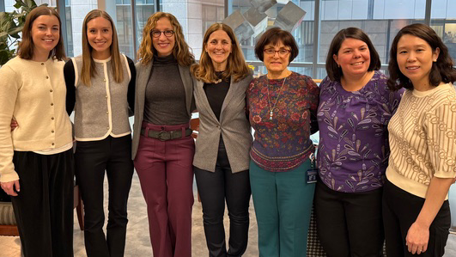
Building a Clinical Program for Older Adults with
Breast Cancer (OABC) at Dana-Farber Cancer Institute
Mission: ​
To optimize treatment, clinical outcomes and quality of life for older patients with breast cancer throughout their cancer journey. We provide personalized, supportive care that addresses the unique needs of older adults and their caregivers and is integrated with state-of-the-art, team-based, patient-centered medical care.​
(617) 632-4300
oabc@dfci.harvard.edu
https://www.dana-farber.org/oabc

Slide 59
OABC’s Core Services for Patients
Geriatric Assessment; summary with recommendations provided to patients
Collaborative Action Plan with patient + caregiver based on GA recommendations
Facilitation of referrals (until completion) and navigation assistance
Geriatrician available for further assessment when recommended by GA
Longitudinal follow-up – customized support, check-ins as needed; annual reassessment
Single point of contact for patients for non-medical issues

Slide 60
Geriatric Assessment in OABC
Geriatrician
PT/OT
GERIATRIC ASSESSMENT
Functional Status Mobility/ ADLs
Mental Health/ Substance Use
Resource Needs
Physical Health
What Matters
Cognition
Nutrition
Social Support & Activities
Medications
Social Work
Spiritual Care
Peer Mentor
Social Work
Psychiatry
Psychology
Spiritual Care
Zakim Center
Pharmacist
Patient Navigation
Resource Specialists
Financial Services
Technology Assistance
Nutrition
Zakim Center
Med Onc Team
Geriatrician
Palliative Care
Geriatrics
Neurology
Social Work
Psychiatry
Psychology
Spiritual Care

Slide 61
Putting it All Together – What We Can Do Now…
Ask a few extra questions.
Consider some (any) form of life expectancy and functional screening as you make decisions
  Use it as platform to confirm, re-consider, or change therapy plans along with patient input and preferences
  Consider avoidance of chemotherapy if toxicity risk is exceedingly high
If you choose to include this information in discussions, many patients are comfortable having these conversations, but how you frame them has great impact
Consider clinical trial enrollment whenever possible
Consider early interventions → growth factor, exercise?, geriatrician, GA-led interventions and referrals

Slide 62

Thank you!
Collaborators and Mentors
Dr. O’Shaughnessy and SOBO staff
Susan Peck
Our OABC Program
Mara Schonberg
Nancy Keating
Hy Muss
Eric Winer
Sara Tolaney
Nancy Lin
Arti Hurria
Claire Smith
Funders of this work:
NIA
NCI
Susan G Komen
Gateway for Cancer Research
Rising Tide
The Alliance

