Slide 1

Hormone receptor-positive metastatic breast cancer
Ruth O’Regan, MD
Chair and Charles A. Dewey Professor,
Department of Medicine
Associate Director for Education and Mentoring,
Wilmot Cancer Institute
University of Rochester

Slide 2
Changing landscape of targeted agents in ER-positive metastatic breast cancer
Tamoxifen
Fulvestrant
Alpelisib
Inavolisib
AIs
Elacestrant/
Capivasertib
Fulvestrant HD/
everolimus
CDK 4/6i
Imlunestrant
1970/80
1996
2002
2012
2015/17
2019
2023
2024
2025

Slide 3
Topics to cover
First-line approaches:
  Endocrine therapy alone
  Endocrine therapy with CDK 4/6 inhibitors
Endocrine-pretreated/refractory cancers
  No actionable mutations
  Actionable mutations
  Other investigational endocrine agents
Antibody-drug-conjugates

Slide 4
Primary Endpoint: PFS
FALCON: PFS
1.0
PFS Without Visceral Disease
1.0
0.9
Fulvestrant (n = 95)
0.8
HR 0.59
(95% CI 0.42, 0.84)
Median PFS
Fulvestrant: 22.3 months
Anastrozole: 13.8 months
Anastrozole (n = 113)
0.9
0.7
Fulvestrant (n = 230)
0.6
0.8
Proportion of Patients Alive and Progression Free
Anastrozole (n = 232)
0.5
0.7
0.4
0.3
0.6
HR 0.797
(95% CI 0.637, 0.999)
P = .0486
Median PFS
Fulvestrant: 16.6 months
Anastrozole: 13.8 months
0.2
Proportion of Patients Alive
and Progression Free
0.1
0.5
0.0
0
5
10
15
20
25
30
35
40
0.4
Time, Months
0.3
1.0
PFS With Visceral Disease
0.9
0.2
0.8
Fulvestrant (n = 135)
0.1
0.7
Anastrozole (n = 119)
HR 0.99
(95% CI 0.74, 1.33)
Median PFS
Fulvestrant: 13.8 months
Anastrozole: 15.9 months
0.6
0.0
Proportion of Patients Alive and Progression Free
0
3
6
9
12
15
18
21
24
27
30
33
36
39
0.5
Time, Months
0.4
0.3
0.2
0.1
0.0
0
5
10
15
20
25
30
35
40
Robertson JF, et al. Lancet. 2016;388(10063):2997-3005.
Time, Months

Slide 5
Combination fulvestrant and anastrozole in first-line setting
 | FULV* + ANAST | ANAST | HR | P value
SWOG S0226
PFS | 15 months | 13.5 months | 0.80 | 0.007
OS | 47.7 months | 41.3 months | 0.81 | 0.049
FACT
PFS | 10.8 | 10.2 | 0.72 | 0.91
OS | 37.8 | 38.2 |  | 1.00
* Fulvestrant 250mg q 4 weeks
Mehta et al. N Engl J Med. 2012;367(5):435-44; Bergh et al. J Clin Oncol. 2012;30(16):1919-1925

Slide 6
Overview of first-line trials
Trial | PFS △ | HR/P value | OS △ | HR/P value
PALOMA 1 | 10 mos. | 0.49/.004 | 3 mos. | 0.9/.28
PALOMA 2 | 10 mos. | 0.58/SS | 3 mos. | 0.34
FLIPPER* | 10 mos. | 0.52/.002 | NR | NA
MONALEESA 2 | 9 mos. | 0.57/SS | 12.5 mos. | 0.76/.004
MONARCH 3 | 28/15 mos. | 0.54/.000021 | 13 mos. | 0.03
MONALEESA 3 | 15 mos. | 0.55/SS | NR/52 mos. | 0.64/SS
MONALEESA 7 | 10 mos. | 0.55/SS | NR/41 mos. | 0.71/.01
SONIA** | 8.6 mos. | 0.59/.0001 | NR
* FLIPPER evaluated addition of palbociclib to fulvestrant, ** any CDK 4/6 inhibitor
Slamon et al Ann Oncol 2021, Hortobagyi et al ESMO 2021, Im et al NEJM 2019, Johnston et al NPJ Breast Cancer 2019,
Finn et al BCRT 2020, Albanell et al ESMO 2020, Goetz ESMO 2022, Sonke et al ASCO 2023

Slide 7
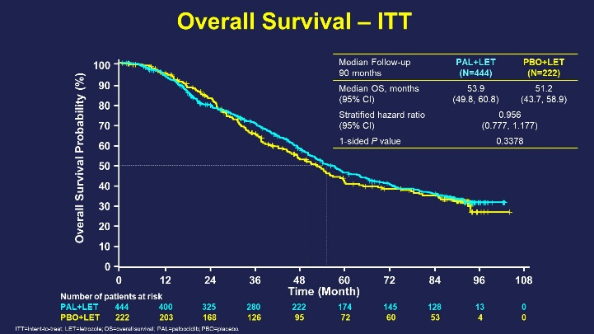
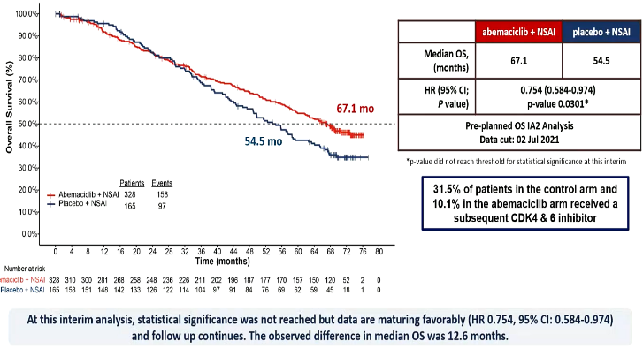
Survival comparison across first-line trials
Trial | CDKi + ET | ET | P value
MONALEESA 2 | 64 months | 51 months | 0.004
PALOMA 2 | 54 months | 51 months | 0.338
MONARCH 3 | 67 months | 54 months | 0.03
Hortobagyi et al N Eng J Med 2022, Finn et al ASCO 2022, Goetz et al ESMO 2022

Slide 8
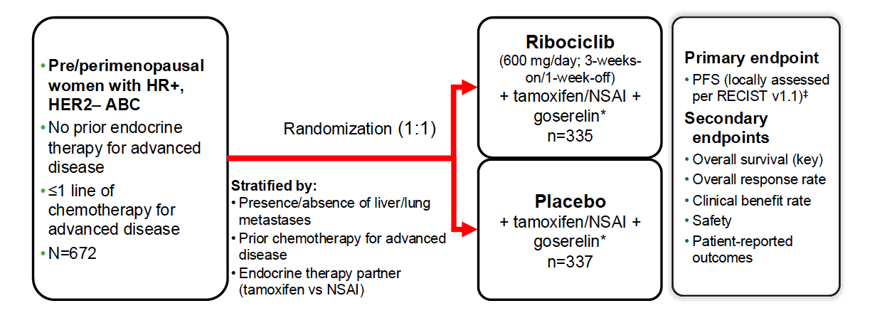
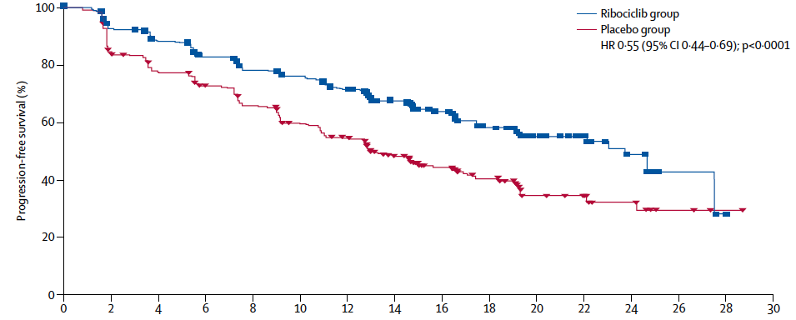
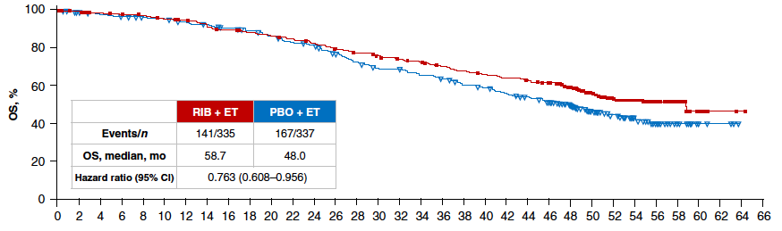
MONALEESA-7: Phase III placebo-controlled study of ribociclib and tamoxifen/NSAI + goserelin
Progression-free survival
Overall survival
Tripathy et al Lancet Onc 2018:19:904, Lu et al Clin Cancer Res 2022:28:8511

Slide 9
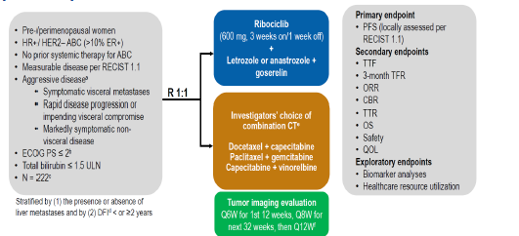
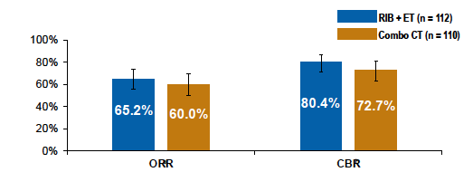
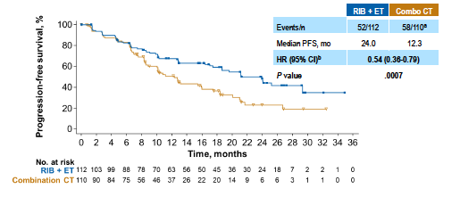
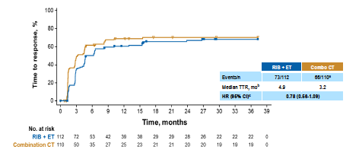
RIGHT Choice (Phase 2): Ribociclib + endocrine therapy vs chemotherapy for patients with HR+/HER2− advanced breast cancer
Progression-free survival
Time to response
Lu et al J Clin Oncol 2024:42:2812

Slide 10
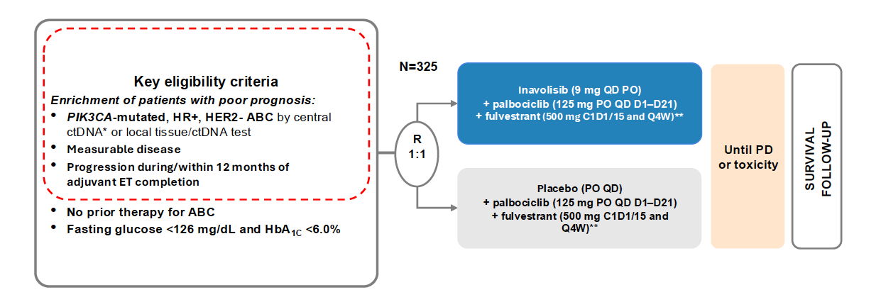
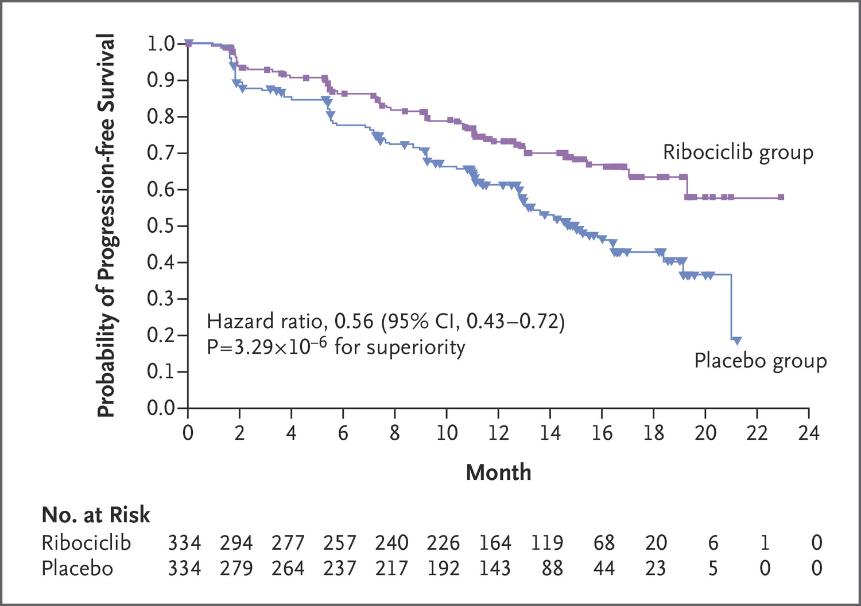
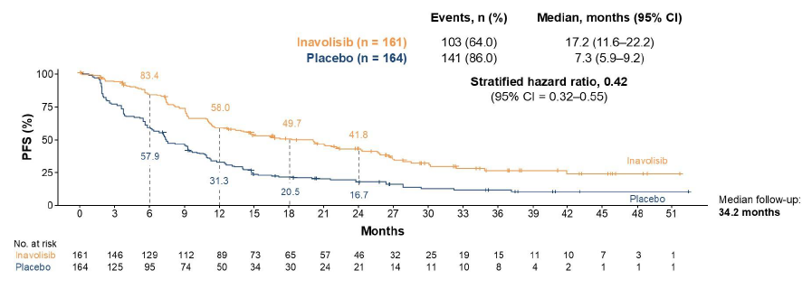

INAVO 120 Trial: Fulvestrant and palbociclib$±$ inavolisib
MONALEESA 2
Despite patients being off ET for at least 12-months
NCCN Category 1
Turner et al N Engl J Med 2024, Jhaveri et al N Engl J Med 2025

Slide 11
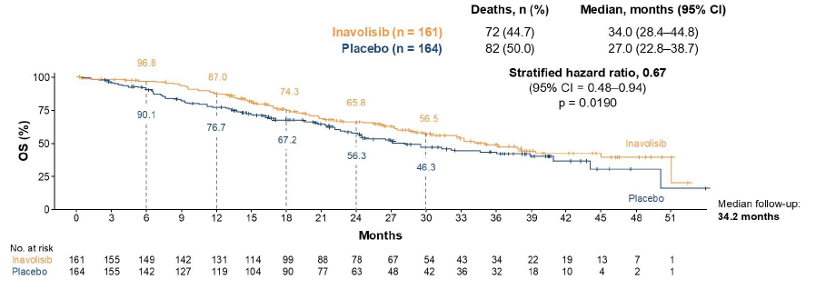
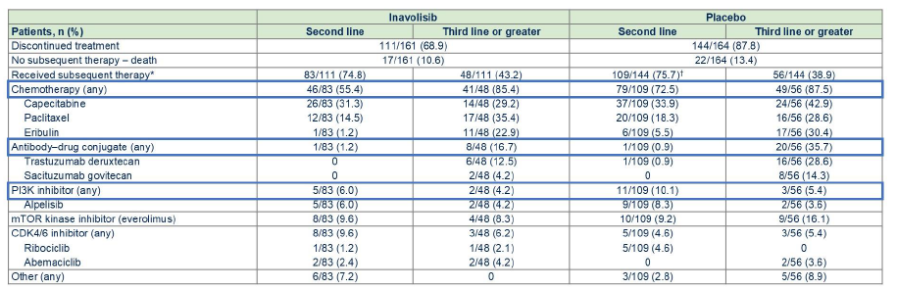
INAVO 120: Final overall survival
Jhaveri et al N Engl J Med 2025

Slide 12
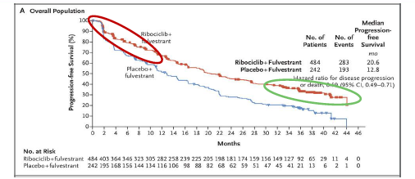
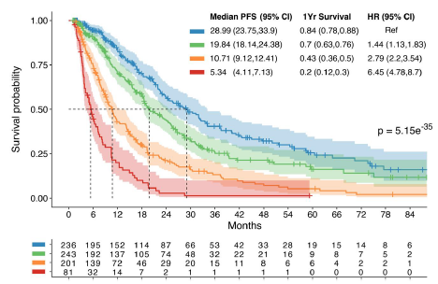
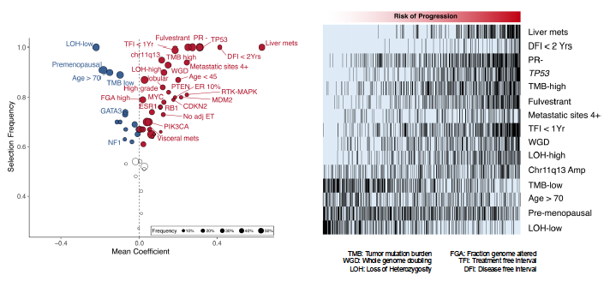
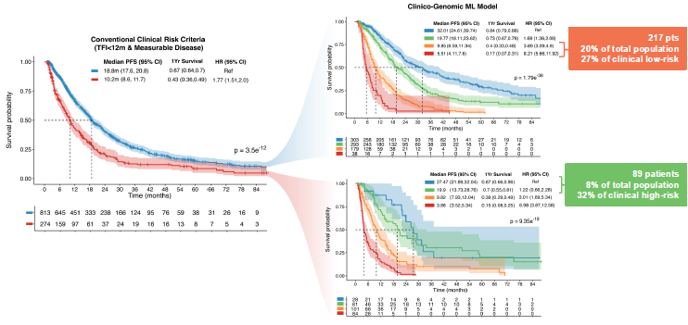
Machine-learning model of clinical and genomic data to predict outcome from CDK 4/6i
Razavi et al SABCS 2024
1087 patients split 70/30 between training and test sets

Slide 13
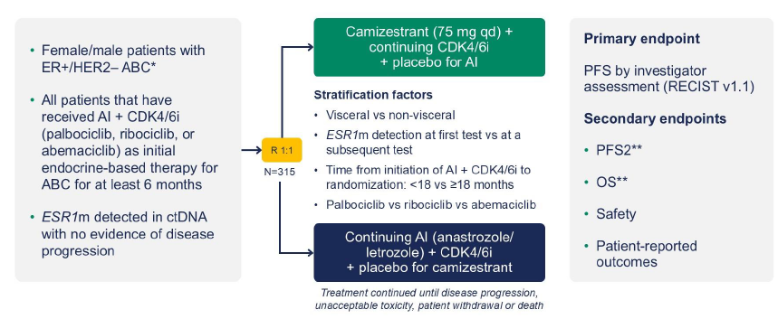
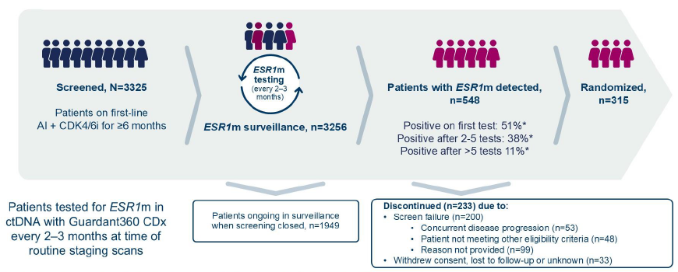
SERENA 6: Camizestrant versus AI upon detection of ESR1 mutation
Bidard et al N Engl J Med 2025

Slide 14
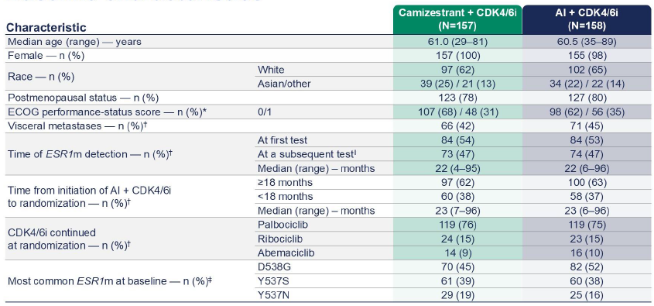
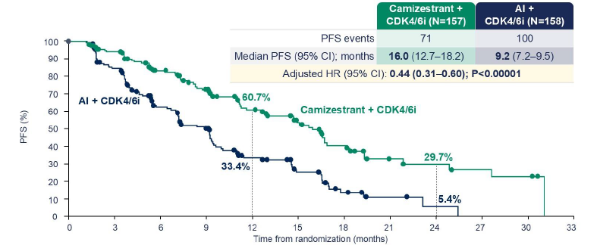
SERENA 6: Camizestrant versus AI upon detection of ESR1 mutation
PFS2 events 38 C versus 47 AI
HR 0.52 p=.0038
Bidard et al N Engl J Med 2025

Slide 15
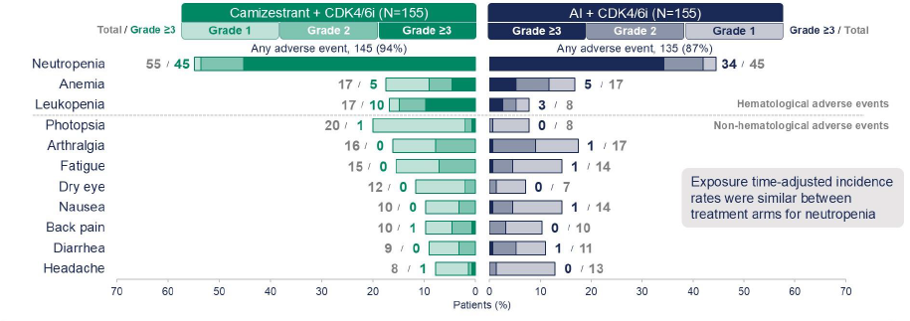
SERENA 6: Camizestrant versus AI: Adverse events
Bidard et al N Engl J Med 2025

Slide 16
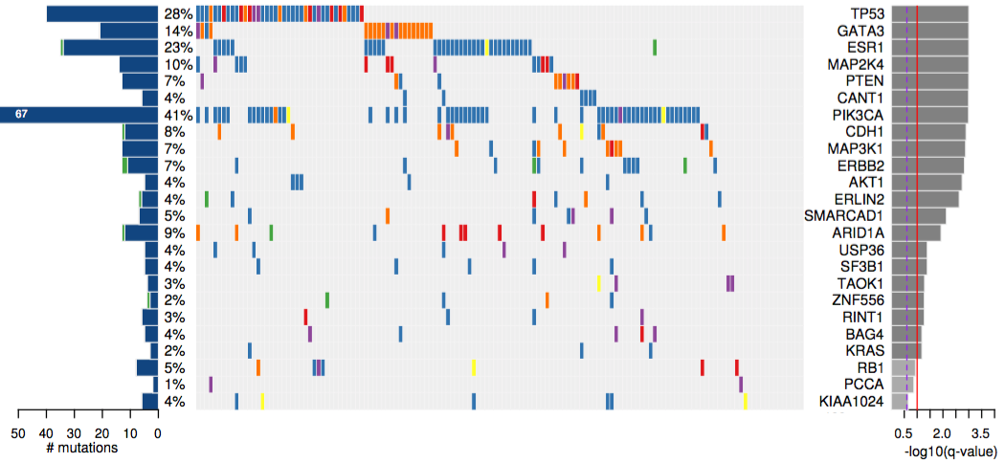
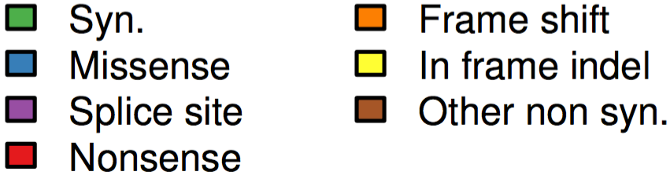
Genomic landscape of metastatic HR-positive breast cancer
Present at diagnosis
Acquired
Angus et al Nat Genet 2019

Slide 17
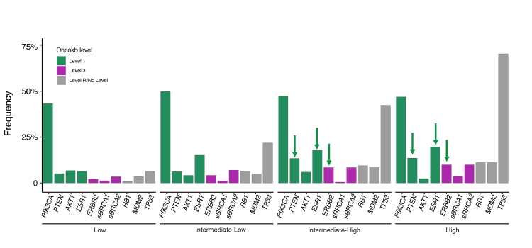
Increase in actionable mutations in higher risk disease
Razavi et al SABCS 2024

Slide 18
When and how should we check tumor genomics?
Check genomics on metastatic tissue or via ctDNA
  Tumor genomics on biopsy from diagnosis of metastatic disease
  Recheck genomics in ctDNA at disease progression
    Looking for acquired alterations: ESR1, ERB2, AKT1
  If needed can test genomics on primary tissue for non-acquired alterations
    PI3-kinase
  Determine combinational partner with endocrine therapy based on presence or absence of genomic alterations

Slide 19
CDK 4/6 Inhibitors: Post-Progression trials
Trial | Agent | Setting | Phase | N | Prior CDKi | Study Design
MAINTAIN NCT02632045 | Ribociclib | HR+/HER2- locally advanced or MBC following progression on a CDK 4/6 inhibitor | 2 | 132 | PFS at 24-weeks | Fulvestrant or exemestane/ribociclib vs fulvestrant or exemestane/placebo
PACE NCT03147287 | Palbociclib | Endocrine pre-treated ER+/HER2- MBC; after CDK and endocrine therapy | 2 | 220 | PFS | Fulvestrant vs fulvestrant/palbociclib vs fulvestrant/palbociclib/ avelumab
PALMIRA NCT03809988 | Palbociclib | HR+/HER2- locally advanced or MBC following progression on palbociclib | 2 | 198 | PFS | Fulvestrant or letrozole vs fulvestrant or letrozole + palbociclib
PostMONARCH NCT05169567 | Abemaciclib | HR+/HER2- locally advanced or MBC following progression CDKi | 3 | 368 | PFS | Fulvestrant/abemaciclib vs fulvestrant/placebo
Kalinsky et al J Clin Oncol 2023:41:4004, ASCO 2024, Mayer et al. J Clin Oncol 2024:42:2050, Llombart Cussac ASCO 2022

Slide 20
Post progression CDKi trials
 | postMONARCH | MAINTAIN | PALMIRA | PACE
Phase | 3 | 2 | 2 | 2
Patient # | 368 | 132 | 198 | 220
Prior chemo | 0% | 9% | 0% | 16%
Prior Palbo | 60% | 85% | 100% | 91%
Prior Ribo | 33% | 12% | 0% | 4.5%
Prior Abema | 8% | 2% | 0% | 4.1%
Second-line | 100% | 65% | 100% | 77%
> Second-line | 0% | 18.5% | 0% | 17%
CDKi on trial | ABEMA | RIBO | PALBO | PALBO
ET on trial | FULV | FULV or EXEM | LET or FULV | FULV
Kalinsky et al J Clin Oncol 2023:41:4004, ASCO 2024, Mayer et al. J Clin Oncol 2024:42:2050, Llombart Cussac ASCO 2022

Slide 21
Post progression CDKi trials
 | postMONARCH |  | MAINTAIN |  | PALMIRA |  | PACE
ARM | ABEMA | PLAC | RIBO | PLAC | PALBO | CONT | PALBO | CONT
PFS | 6.0 mos. | 5.3 mos. | 5.3 mos. | 2.8 mos. | 4.9 mos. | 3.6 mos. | 4.6 mos | 4.8 mos.
▲ | 0.7 mos. |  | 2.5 mos. |  | 1.3 mos |  | -0.2 mos
HR | 0.73 |  | 0.57 |  | 0.84 |  | 1.11
P value | 0.02 |  | 0.006 |  | 0.149 |  | 0.06
Kalinsky et al J Clin Oncol 2023:41:4004, ASCO 2024, Mayer et al. J Clin Oncol 2024:42:2050, Llombart Cussac ASCO 2022

Slide 22
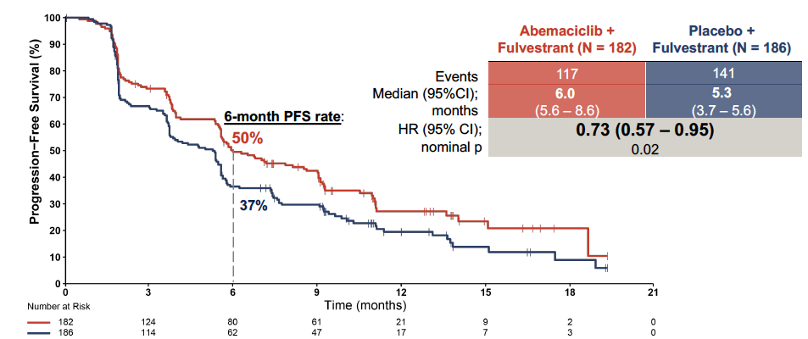
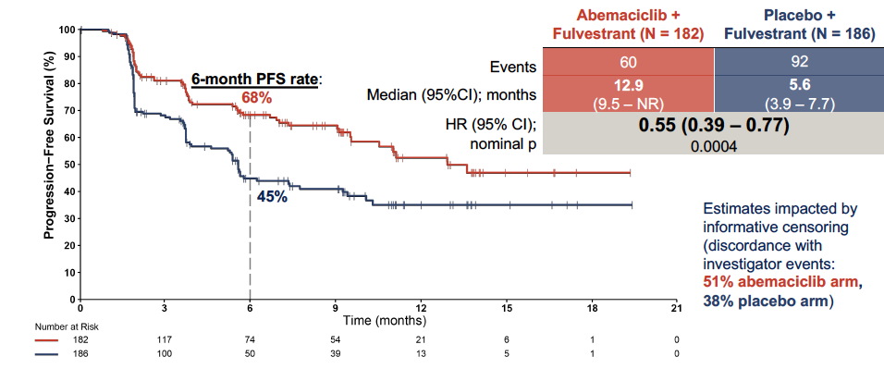
postMONARCH: Fulvestrant and abemaciclib post first-line CDKi
Investigator-assessed PFS
BICR-assessed PFS
 | ABEMA | PLAC | HR | P value
Interim PFS | 5.6 mos. | 3.9 mos. | 0.66 | 0.01
Investigator-assessed | 6.0 mos. | 5.3 mos. | 0.73 | 0.02
BICR-assessed | 12.9 mos. | 5.6 mos. | 0.55 | 0.004
Kalinsky et al ASCO 2024

Slide 23
Growth factor pathways in endocrine resistance
MoAb
IGF1R
TKI
EGFR/HER2
Increased upstream
signaling through
growth factor receptors
VEGFR
MoAb
P
P
AB
P
P
TKI
P
P
SOS
PI3-K
TKI
RAS
RAF
Akt
MEK
p90^{RSK}
MAPK
SERD
AI
T
ER
CCI
RAD
E2
Increased signaling
through PI3-K pathway
P
P
P
P
Basal
Transcription
Machinery
Cytoplasm
ER
ER
p160
CBP
ERE
ER Target Gene Transcription
Cell
Growth
Nucleus
Plasma
Membrane
From Johnston CCR 2005

Slide 24
Everolimus in hormone-refractory MBC
1.0
TAM 4.5 mo.
TAM + RAD 8.6 mo.
0.9
0.8
0.7
Hazard Ratio (HR) = 0.53 (95% CI: 0.35-0.81)
Exploratory log-rank: P = .0026
0.6
0.5
Probability of survival
0.4
0.3
0.2
0.1
0.0
0
2
4
6
8
10
12
14
16
18
20
22
24
26
28
Months
100
HR = 0.36 (95% CI: 0.27–0.47)
80
Log rank P value = 3.3 x 10 ⁻¹⁵
EVE + EXE: 10.6 Months
60
PBO + EXE: 4.1 Months
Probability of Event (%)
40
20
Everolimus + Exemestane (E/N=114/485)
0
Placebo + Exemestane (E/N=104/239)
0
6
12
18
24
30
36
42
48
54
60
66
72
78
Time (weeks)

Slide 25
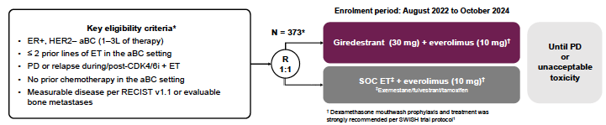
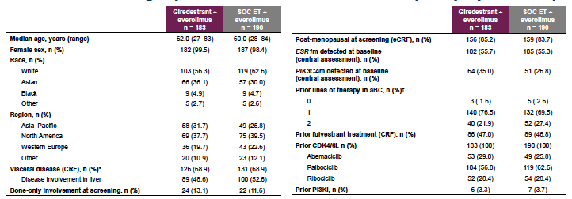
Giredestrant + everolimus versus SOC endocrine therapy + everolimus in pretreated HR+ MBC
Mayer et al ESMO 2025. LBA16.

Slide 26
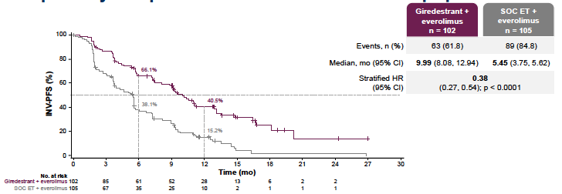
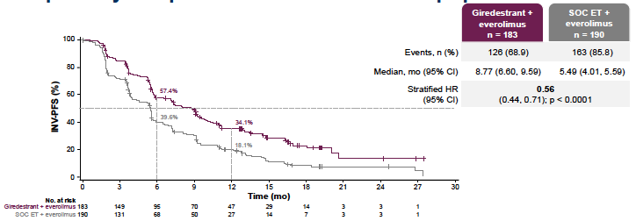
Giredestrant + everolimus versus SOC endocrine therapy + everolimus in pretreated HR+ MBC: PFS
ESR1mutant population
ITT
Mayer et al ESMO 2025. LBA16.

Slide 27
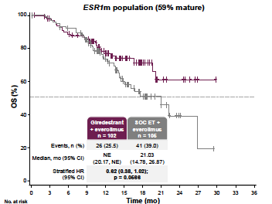
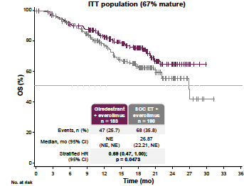
Giredestrant + everolimus versus SOC endocrine therapy + everolimus in pretreated HR+ MBC: OS
Mayer et al ESMO 2025. LBA16.

Slide 28
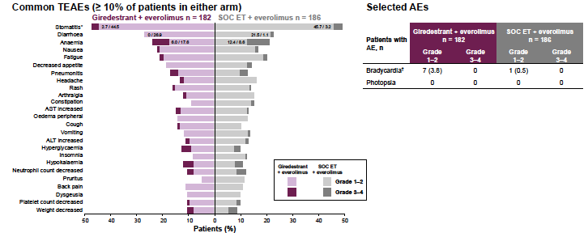
Giredestrant + everolimus versus SOC endocrine therapy + everolimus in pretreated HR+ MBC: AEs
Mayer et al ESMO 2025. LBA16.

Slide 29
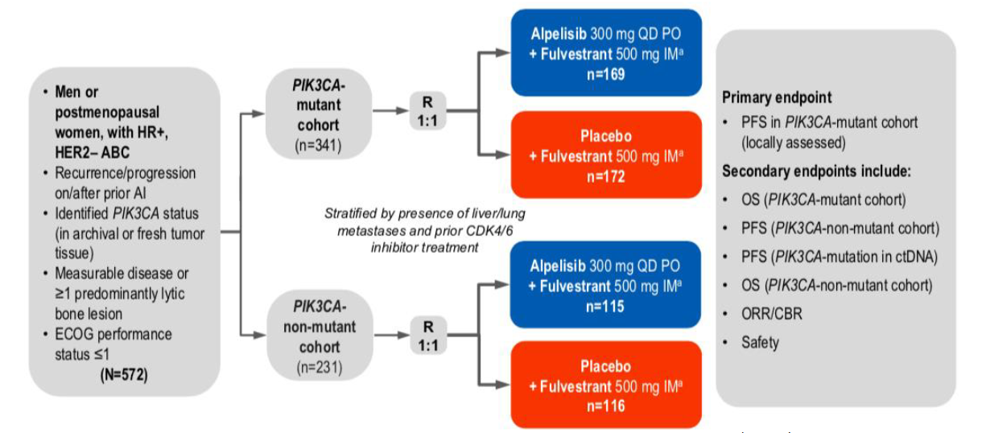
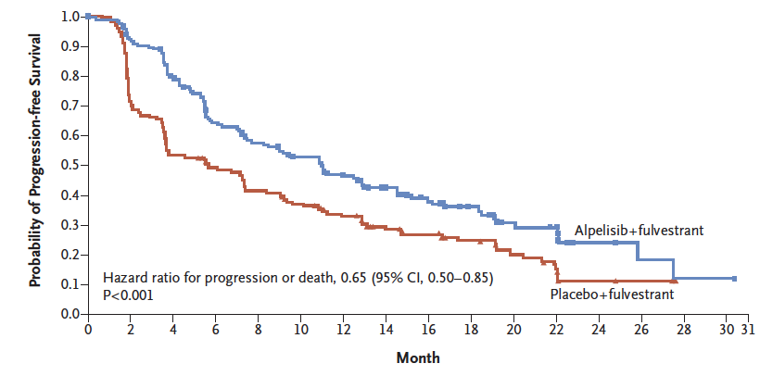
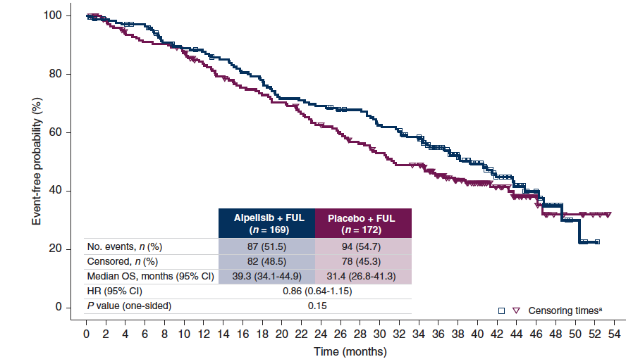
SOLAR 1: Addition of alpelisib to fulvestrant in PIK3ca-mutated cancers
Progression-free survival in PIK3ca-mutated cancers
Overall survival in PIK3ca-mutated cancers
NCCN Category 1
Andre et al N Engl J Med 2019:380:1929, Andre et al Ann Oncol 2021:32:208

Slide 30
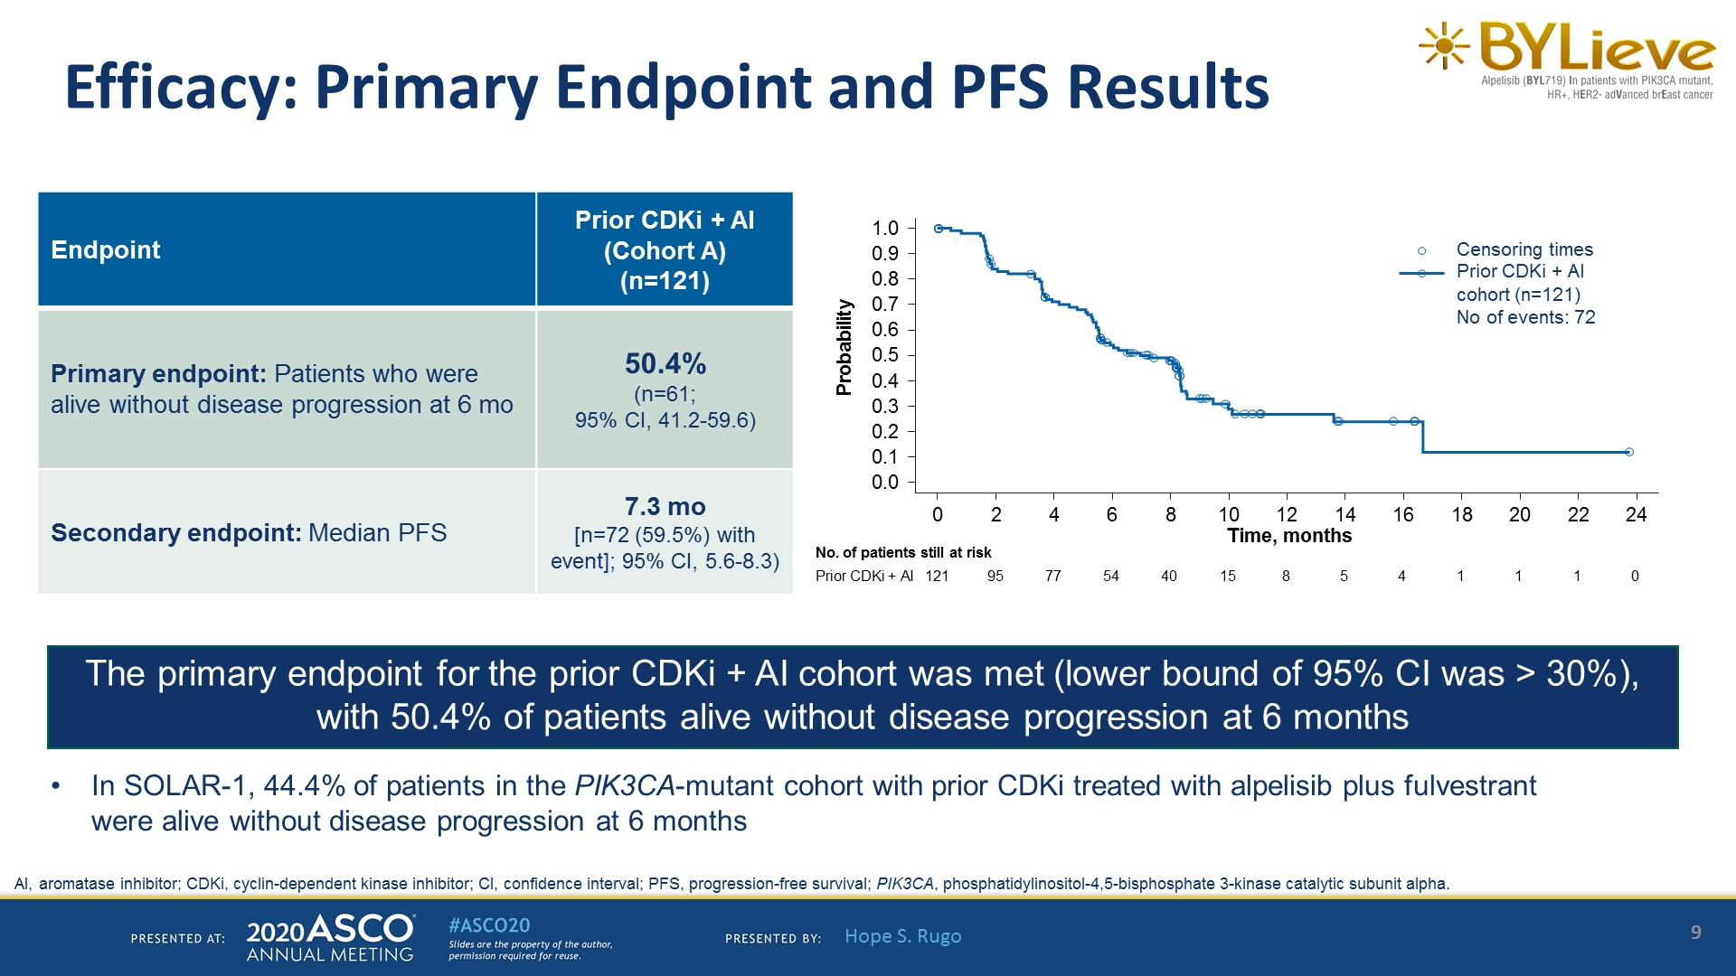
<br />Efficacy: Primary Endpoint and PFS Results<br /><br />
Rugo et al Lancet Oncol 2022:22:489

Slide 31
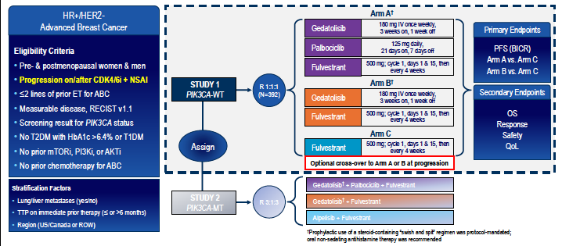
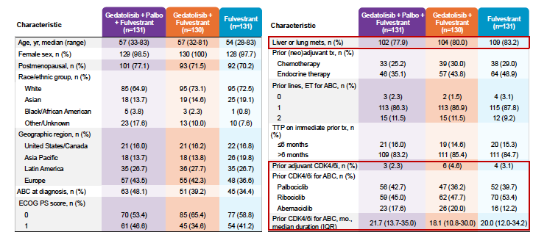

VIKTORIA1: Gedatolisib + fulvestrant $±$ palbociclib
Hurvitz et al ESMO 2025

Slide 32
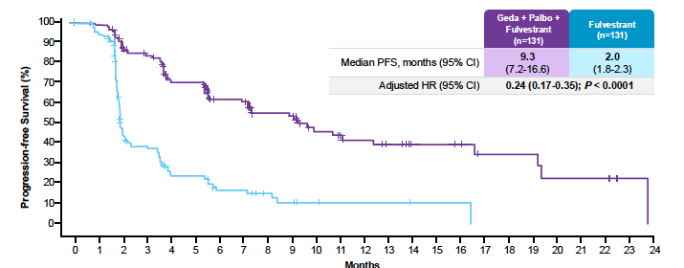
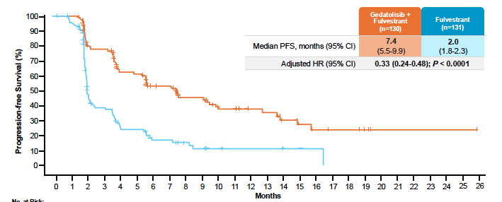
VIKTORIA1: PFS by BICR in PI3-kinase wt
Triplet versus fulvestrant
Doublet versus fulvestrant
Hurvitz et al ESMO 2025

Slide 33
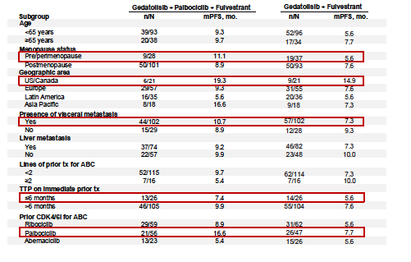
VIKTORIA1: Triplet versus doublet PFS
Hurvitz et al ESMO 2025

Slide 34
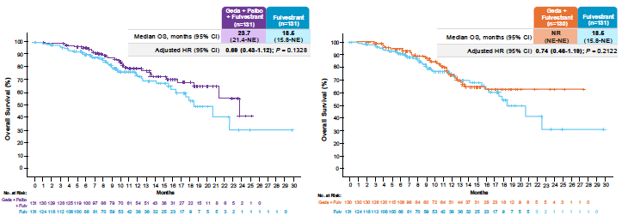
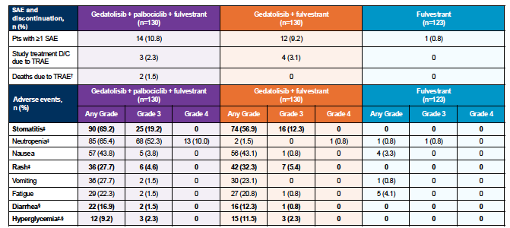
VIKTORIA1: Interim OS and adverse events
Hurvitz et al ESMO 2025

Slide 35
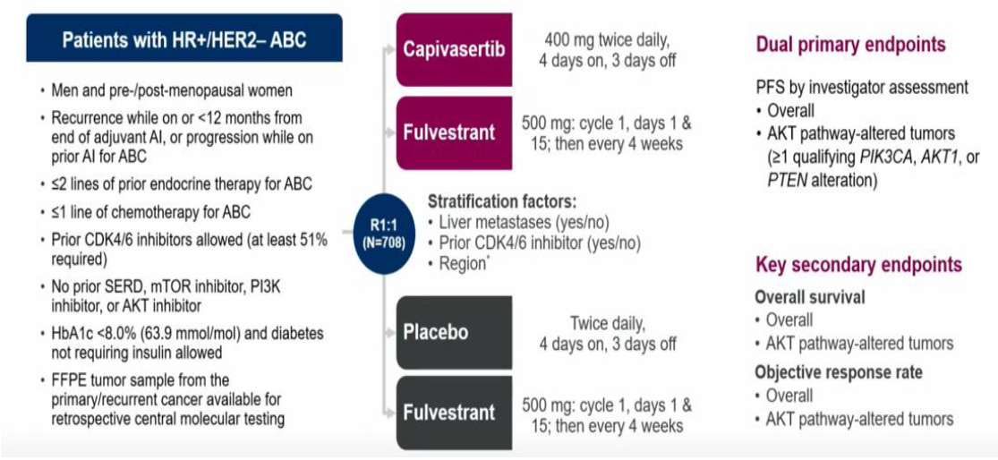
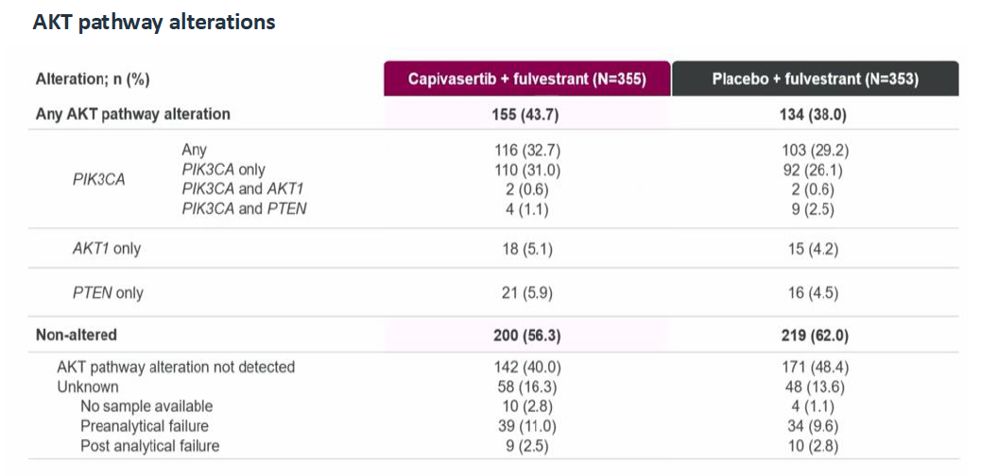
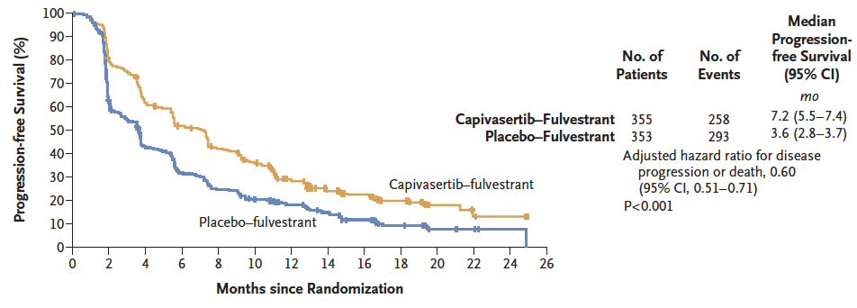
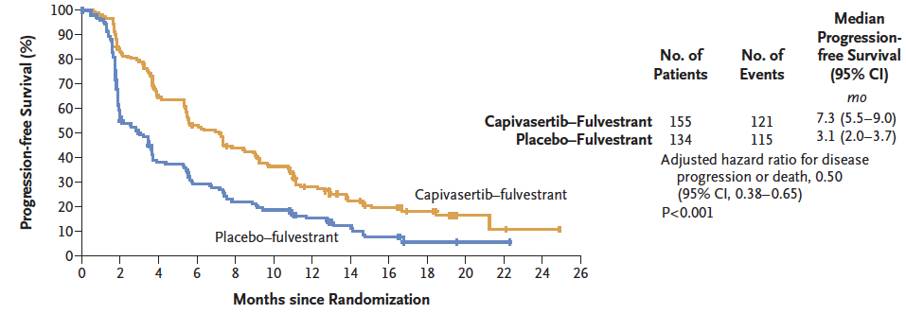
CAPItello-291: Phase III trial of capivasertib in HR+ metastatic breast cancer
PFS Overall population
PFS AKT-altered population
NCCN Category 1
Turner et al N Engl J Med 2023:388:2058

Slide 36



Ipatasertib + fulvestrant versus fulvestrant in pre-treated ER+ MBC
PFS in ITT population
Results similar in ITT and patients
with AKT-altered cancers
Chia et al ASCO 2025

Slide 37



EMERALD trial: Elacestrant vs endocrine therapy in HR+ metastatic breast cancer
NCCN Category 2A
Bidard et al J Clin Oncol 2022:40:3246,

Slide 38
Patients with ESR1-mut Tumors: PFS by Duration of CDK4/6i (exploratory analysis)
At least 6 mo CDK4/6i
At least 12 mo CDK4/6i
At least 18 mo CDK4/6i
100
100
100
80
80
80
60
60
60
Probability of PFS (%)
Probability of PFS (%)
Probability of PFS (%)
40
40
  40
20
20
20
0
Elacestrant
Standard of Care
0
Elacestrant
Standard of Care
0
Elacestrant
Standard of Care
0
5
10
15
20
25
30
0
5
10
15
20
25
30
0
5
10
15
20
25
30
Time (months)
Time (months)
Time (months)
Elacestrant
SOC
103
102
50
34
33
16
25
11
20
9
16
5
11
2
9
1
8
1
7
0
6
5
5
1
1
0
Elacestrant
SOC
78
81
42
26
31
12
24
10
20
9
16
5
11
2
9
1
8
1
7
0
6
5
5
1
1
0
Elacestrant
SOC
55
56
30
21
23
9
18
8
16
7
12
4
8
1
8
1
7
1
6
0
6
5
5
1
1
0
 | Elacestrant | SOC Hormonal Therapy
Median PFS, months (95% CI) | 4.14 (2.20 - 7.79) | 1.87 (1.87 - 3.29)
PFS rate at 12 months, % (95% CI) | 26.02 (15.12 - 36.92) | 6.45 (0.00 - 13.65)
Hazard ratio (95% CI) | 0.517 (0.361 - 0.738)
 | Elacestrant | SOC Hormonal Therapy
Median PFS, months (95% CI) | 8.61 (4.14 - 10.84) | 1.91 (1.87 - 3.68)
PFS rate at 12 months, % (95% CI) | 35.81 (21.84 - 49.78) | 8.39 (0.00 - 17.66)
Hazard ratio (95% CI) | 0.410 (0.262 - 0.634)
 | Elacestrant | SOC Hormonal Therapy
Median PFS, months (95% CI) | 8.61 (5.45 - 16.89) | 2.10 (1.87 - 3.75)
PFS rate at 12 months, % (95% CI) | 35.79 (19.54 - 52.05) | 7.73 (0.00 - 20.20)
Hazard ratio (95% CI) | 0.466 (0.270 - 0.791)
Bardia et al Clin Cancer Res 2024:30:4299

Slide 39


EMBER3: Schema
Jhaveri et al. N Engl J Med. 2025;392(12):1189-1202.

Slide 40


EMBER3: Imlunestrant versus SOC
PFS in ESR1-mutated population
PFS in ITT population
Jhaveri et al. N Engl J Med. 2025;392(12):1189-1202.
NCCN Category 2A

Slide 41


EMBER3: Imlunestrant + abemaciclib versus imlunestrant
PFS in ITT population
Jhaveri et al. N Engl J Med. 2025;392(12):1189-1202.

Slide 42


EMBER3: Safety and toxicities
Jhaveri et al. N Engl J Med. 2025;392(12):1189-1202.

Slide 43



VERITAC-2: Vepdegestrant versus fulvestrant

Slide 44



VERITAC-2: Vepdegestrant versus fulvestrant
ESR1 mutated
ITT
Campone et al. N Engl J Med. 2025;393(6):556-568.

Slide 45
Fulvestrant + Alisertib (Aurora Kinase A Inhibitor):
HR+ MBC
 | Alisertib | Fulvestrant + Alisertib
Objective Response Rate | 17.8% (90% CI: 9.2-29.8%%) | 20% (90% CI: 10.9-32.3%)
Clinical Benefit Rate 24-week | 42.2% (90% Cl: 29.7-55.6%) | 28.9% (90% Cl: 18.0-42.0%)
Median PFS (months) | 5.6 (95%CI: 3.9 - 9.3) | 5.1 (95%CI: 3.8 - 7.6)
Deaths | n=10 | n=14
6-month OS rate | 90. 6% (95% Cl: 82.2-99.8%) | 75.6% (95% Cl: 63.9-90.2%)
Haddad TC et al. SABCS 2020. Abstract PD2-05.

Slide 46
Antibody-drug conjugates in HR+ metastatic breast cancer
 | Target | Phase (HR+ Breast)
Fam-trastuzumab deruxtecan | HER2 | Approved
Sacituzumab govitecan | TROP2 | Approved
Datopotamab deruxtecan | TROP2 | Approved
Sacituzumab tirumotecan | TROP2 | Phase 3
Patritumab deruxtecan | HER3 | Phase 3

Slide 47



DESTINY-Breast04: T-DXd versus chemotherapy in HER2-low metastatic breast cancer
HR+ 88% TNBC 12%
Median line prior chemo 1
Median lines prior ET 2
70% prior CDK 4/6 inhibitor
Response rate 52%
Hormone receptor-positive
PFS
OS
Modi et al New Engl J Med 2022

Slide 48

DESTINY-Breast04: Long-term survival in patients with HR+ MBC
Modi et al Nature Med 2025

Slide 49


DESTINY-Breast06: T-DXd versus chemotherapy in HER2-low and ultralow HR+ MBC
HER2 low 82% ultralow 18%
Median line prior chemo 0
Median lines prior ET 2
89% prior CDK 4/6 inhibitor
30% prior targeted therapy
Bardia et al N Engl J Med. 2024;391(22):2110-2122.

Slide 50



DESTINY-Breast06: Outcome for HER2-low and ITT population
PFS
OS*
*40% maturity
Bardia et al N Engl J Med. 2024;391(22):2110-2122.

Slide 51

DESTINY-Breast06: Outcome for HER2-ultralow population (preplanned exploratory analyses)
Bardia et al N Engl J Med. 2024;391(22):2110-2122.

Slide 52



TROPICS-02: Sacituzumab versus chemotherapy in HR+ MBC
PFS
OS
Rugo et al J Clin Oncol 2022, Rugo et al Lancet 2023

Slide 53



TROPION-Breast01: Dato-DXd versus chemotherapy in HR+ MBC
Bardia et al J Clin Oncol. 2025;43(3):285-296.

Slide 54




OptiTROP-Breast02: Sacituzumab tirumotecan versus chemotherapy in HR+ MBC
ORR 41%
ORR 24%
Prior CDK 4/6i 100%
1 Prior chemo MBC 43%
2 Prior chemo MBC 40%
PFS
OS
Fan et al ESMO 2025

Slide 55

ICARUS-Breast01: Phase 2 trial of Patritumab deruxtecan in HR+/HER2- MBC
Pistilli B et al. ESMO Breast 2023.

Slide 56
HR-positive metastatic breast cancer
CDK 4/6 inhibitors prolong PFS and overall survival (in selected 1st line trials)
  No robust biomarkers as yet
Treatment decisions in the second-line setting should be made based on the presence or absence of actionable mutations
  Important to recheck at progression to look for acquired mutations
Antibody-drug conjugates are supplanting standard chemotherapy in patients with endocrine-resistant disease

Slide 57
PI3K
mutation
Alpelisib/Inavolisib
Actionable
mutation
AKT1/PTEN
alteration
Capivasertib
ET
+
CDKi
($±$Inavo)
ESR1
mutation
Elacestrant
Imlunestrant
Everolimus + ET
or
switch CDKi + ET
No actionable
mutation
Chemotherapy
Genomics
ADCs

Slide 58


