Slide 1




Fertility and Pregnancy
Ann H. Partridge, MD, MPH
Dana-Farber Cancer Institute
Presentation is not for distribution without permission
Notes:
Improving Care and Outcomes for Young Women with Breast Cancer
As a result of attending this session, participants will be able to:
identify difference in breast cancer by age at diagnosis, when young age should influence the care of a woman with breast cancer and how;
recognize the unique and significant supportive care needs of young women and understand how to address them;
demonstrate understanding of fertility issues and concerns of premenopausal women with breast cancer
incorporate recent data into the evolving understanding of the safety and feasibility of pregnancy following breast cancer

Slide 2

FERTILITY IS A MAJOR ISSUE FOR YOUNG WOMEN WITH BREAST CANCER AT DIAGNOSIS AND BEYOND
N=1026
Ruddy et al, JCO 2014; Poorvu et al, Cancer, 2020
Ann H. Partridge, MD, MPH | 2025
2
Notes:
In weighing the benefits and risks of CPM, one must consider the absolute risk reduction of a new primary BC (usually relatively modest in the average risk survivor), the long and short-term risks of this additional surgery including potential complications (bilateral mastectomy is associated with a greater risk of surgical complications^{12,13}) and the impact on QOL. At the same time, one must consider the competing risk of systemic recurrence of a woman’s initial BC.² Young women, in particular, have the greatest risk of systemic recurrence and death from their original cancer,⁷ lowering the likelihood of benefit of CPM in preventing a new primary BC.

Slide 3

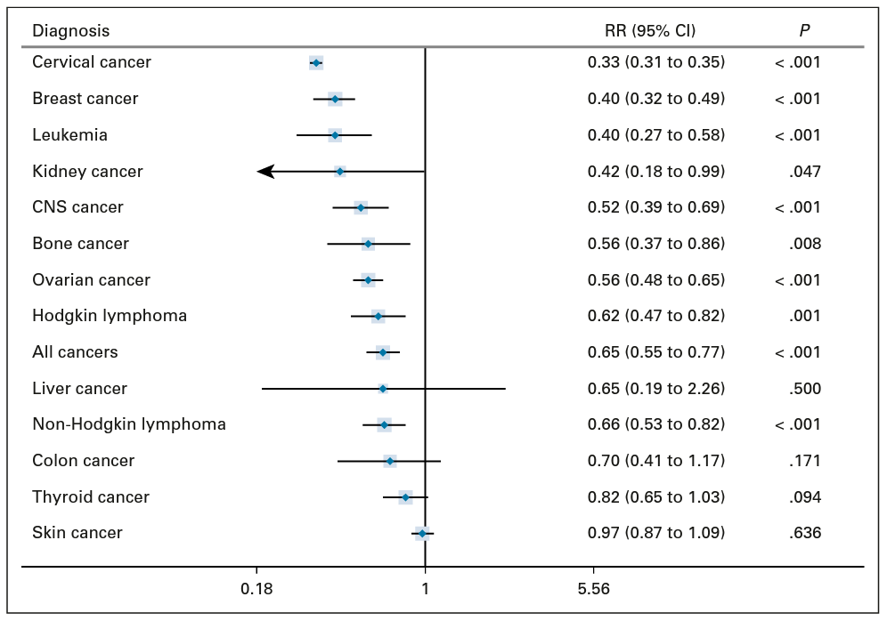


DESPITE WELL-DOCUMENTED INTEREST, YOUNG BREAST CANCER SURVIVORS HAVE LOWER PREGNANCY RATES
Lambertini M, et al. JCO. 2021
Ann H. Partridge, MD, MPH | 2025
3
Notes:
Lambertini M, et al. J Clin Oncol. 2021;39:3293-3305.
doi: 10.1200/JCO.21.00535.

Slide 4
MAJOR QUESTIONS
Feasibility of fertility/pregnancy after breast cancer?
Safety of pregnancy after breast cancer?
  Long-standing concerns about the effect of a subsequent pregnancy on recurrence and survival in young breast cancer survivors
  Particular concern in HR+ setting where mainstay of treatment has been anti-estrogen strategies (for standard 5-10 years)
  Most outcomes data retrospective, many factors unmeasured, and hampered by “Healthy Mother Bias”
Ann H. Partridge, MD, MPH | 2025
4
Notes:
Not a good idea given potential differences in tumor initiation and promotion factors in these two populations

Slide 5
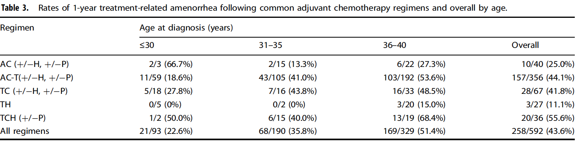
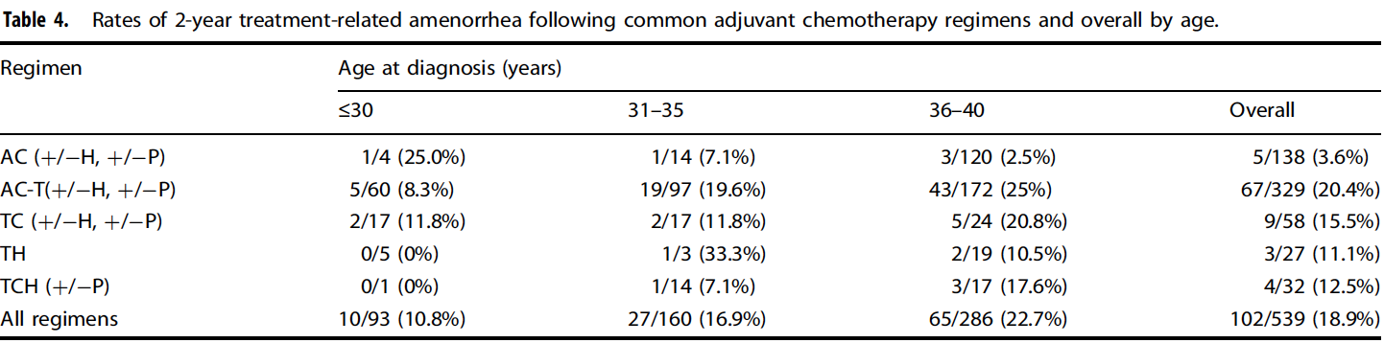
TREATMENT RELATED AMENORRHEA BY AGE & REGIMEN
Poorvu et al, JNCI Cancer Spectrum, 2018; Poorvu et al, NPJ Breast, 2021
Ann H. Partridge, MD, MPH | 2025
5
Ann H. Partridge, MD, MPH | 2025
5
Ann H. Partridge, MD, MPH | 2025
5
Notes:
Amenorrhea at 1 year often used as proxy for fertility
Rates of amenorrhea increase with increasing age and specific chemotherapy regimens, hormonal therapy

Slide 6

FEASIBILITY OF PREGNANCY AFTER CANCER
Limited data with newer agents and treatment regimens
ASCO research statement recommendations:
01
02
03
  Measurement of
  ovarian toxicity
  in relevant clinical
  trials
  Collection of ovarian
  function measures at
  baseline and 1-2 years
  after treatment
  completion
  Assessment of both
  clinical measures and
  biomarkers of ovarian
  function (e.g., AMH)
Cui et al, Lancet, 2023
Ann H. Partridge, MD, MPH | 2025
6
Notes:
Corollary - contraception

Slide 7
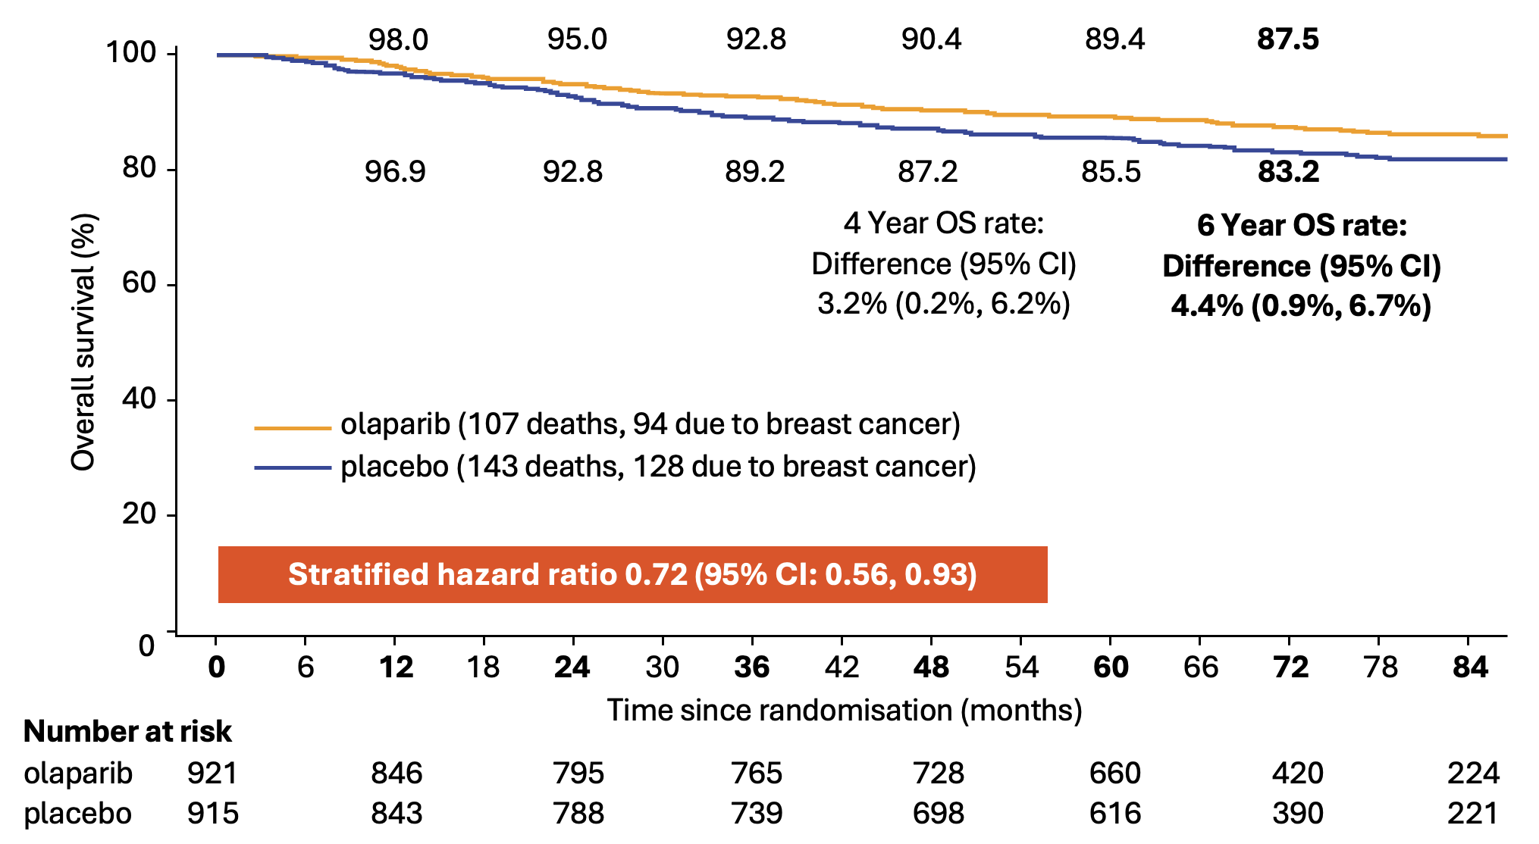
REPORTED ON-STUDY PREGNANCIES AND OUTCOMES
 | Olaparib (N=911) | Placebo (N=904)
Number of patients (%) | 41 (4.5%) | 40 (4.4%)
Number of pregnancies* | 51 | 51
Pregnancy outcomes
Full Term | 32 | 39
Premature Birth | 2 | 3
Spontaneous Miscarriage | 8 | 6
Termination | 6 | 3
Missing | 3 | 0
Garber et al, SABCS 2024
Ann H. Partridge, MD, MPH | 2025
7
Notes:
*In the olaparib arm 8 patients had 2 pregnancies and 1 patient had 3 pregnancies
In the placebo arm 7 patients had 2 pregnancies and 1 patient had 5 pregnancies
Exploratory

Slide 8
AMH AS A BIOMARKER AFTER CANCER TREATMENT
Anti-Müllerian hormone (AMH) is the most reliable marker of ovarian reserve, but its interpretation in oncology is complex due
to heterogeneity of treatment type and timing
Chemotherapy, radiation, surgery, and GnRH agonists all affect AMH differently, with some effects reversible and others permanent
Little is known about newer therapies such as immune checkpoint inhibitors, CDK4/6 inhibitors, and
PARP inhibitors
Standardized AMH assays, development of alternative biomarkers, and inclusion of fertility outcomes in clinical trials are essential
Sorouri et al, Cancer, 2025
Ann H. Partridge, MD, MPH | 2025
8
Notes:
for better ovarian toxicity assessment and informed fertility preservation counseling

Slide 9



ADDITIONAL IMPORTANT CONSIDERATIONS:
Pre-implantation genetic diagnosis (PGD) if PV carrier
If HR+ disease, ovarian function suppression may be part of tx plan
Timing of future pregnancy with regard to fertility, risk of disease
Ann H. Partridge, MD, MPH | 2025
9

Slide 10

PREGNANCY IN BREAST CANCER SURVIVORS
108 women reported at least one pregnancy in first 5 years
~ 70% of those who attempted became pregnant
Some who weren’t interested and/or didn’t attempt became pregnant
Only 32 patients used infertility treatment (75% successful)
Majority who became pregnant had ER- disease
Poorvu PD, et al. Cancer 2021
Ann H. Partridge, MD, MPH | 2025
10
Notes:
Poorvu PD, et al. Cancer. 2021;127:1021-1028.
DOI: 10.1002/cncr.33342

Slide 11
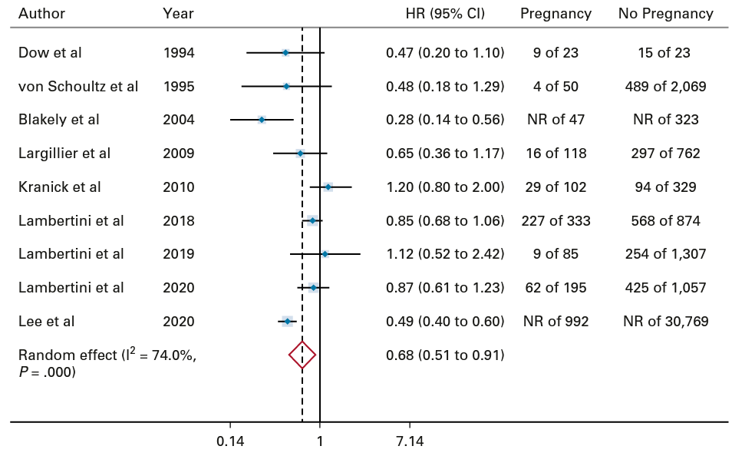

SAFETY OF PREGNANCY AFTER BREAST CANCER:
Disease-Free Survival After Pregnancy
No Pregnancy
vs
Lambertini M, et al. JCO 2021
Ann H. Partridge, MD, MPH | 2025
11

Slide 12
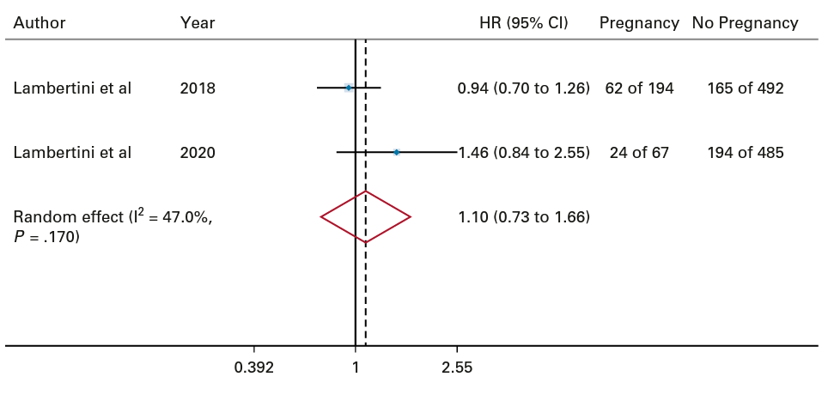
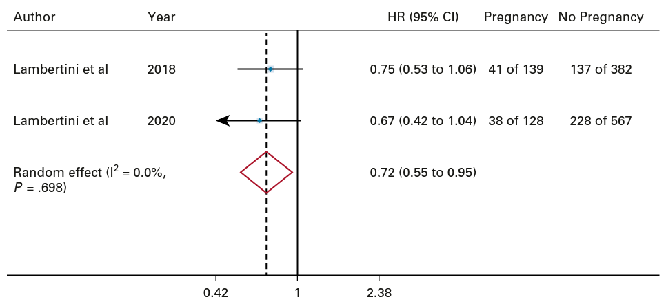
DISEASE-FREE SURVIVAL AFTER
PREGNANCY VS NO PREGNANCY
VS
ER-
ER+
Lambertini M, et al. JCO 2021
Ann H. Partridge, MD, MPH | 2025
12

Slide 13

CLINICAL CONUNDRUM:
Standard endocrine therapy for premenopausal women with HR+ early breast cancer entails 5-10 years
of treatment and
women want children
Cucciniello L et al., Cancer Treatment Reviews, 2022
Ann H. Partridge, MD, MPH | 2025
13

Slide 14
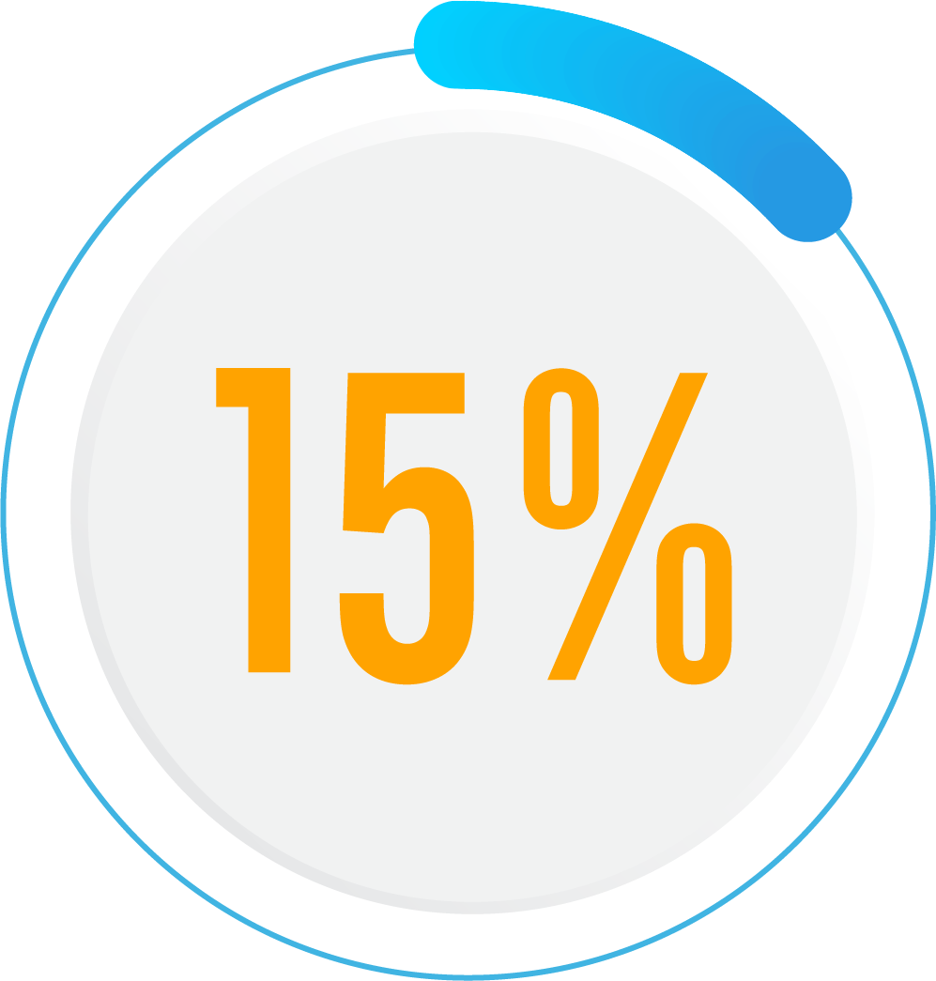
FERTILITY CONCERNS IMPACT BREAST CANCER TREATMENT DECISIONS
In YWS, 160 women (26%) reported that concerns about fertility affected
treatment decisions
90 provided specific details about how their decisions were affected (some chose >1):
  4 (1%) chose not to receive chemotherapy; 12 (2%) chose regimen over another
  6 (1%) considered not receiving endocrine therapy
  19 (3%) decided not to receive endocrine therapy
  71 (11%) considered receiving endocrine therapy for < 5 years
of study population
Ruddy et al, JCO 2014
Ann H. Partridge, MD, MPH | 2025
14

Slide 15
Younger Patients Have Lower Endocrine Therapy Persistence: French Health System
Younger age have lower ET persistence
(no break in ET supply > 30 day)
Younger patients have worse DFS if HR+ BC
121,852 patients with HR+ BC from 2011-2017!
Dumas et al, ESMO 2024; Dumas et al, JCO 2025
Persistence: how long patient continues to take a medication as prescribed
Ann H. Partridge, MD, MPH | 2025
15
Notes:
In weighing the benefits and risks of CPM, one must consider the absolute risk reduction of a new primary BC (usually relatively modest in the average risk survivor), the long and short-term risks of this additional surgery including potential complications (bilateral mastectomy is associated with a greater risk of surgical complications^{12,13}) and the impact on QOL. At the same time, one must consider the competing risk of systemic recurrence of a woman’s initial BC.² Young women, in particular, have the greatest risk of systemic recurrence and death from their original cancer,⁷ lowering the likelihood of benefit of CPM in preventing a new primary BC.

Slide 16
Younger Patients, Age <35 Would Have The Greatest DFS Benefit With Improved Persistence: French Health System
5.6 %-points at 5 yrs (95% CI: 2.5-8.8)
Hypothetical scenario in which patients are prevented from discontinuing endocrine therapy
Dumas et al, ESMO 2024; Dumas et al, JCO 2025
Ann H. Partridge, MD, MPH | 2025
16
Notes:
In weighing the benefits and risks of CPM, one must consider the absolute risk reduction of a new primary BC (usually relatively modest in the average risk survivor), the long and short-term risks of this additional surgery including potential complications (bilateral mastectomy is associated with a greater risk of surgical complications^{12,13}) and the impact on QOL. At the same time, one must consider the competing risk of systemic recurrence of a woman’s initial BC.² Young women, in particular, have the greatest risk of systemic recurrence and death from their original cancer,⁷ lowering the likelihood of benefit of CPM in preventing a new primary BC.

Slide 17
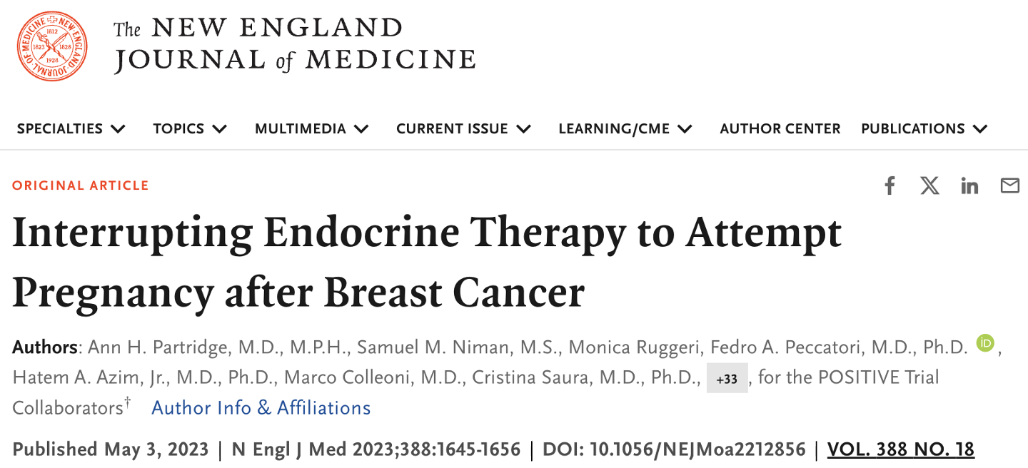
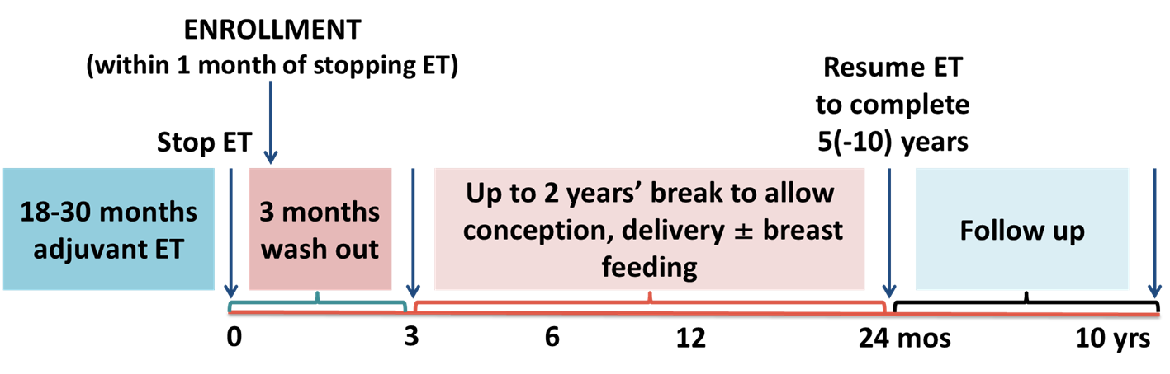

Partridge et al, NEJM, 2023
Notes:
Led by the IBCSG

Slide 18

PATIENTS AND TREATMENT CHARACTERISTICS
Pagani et al, ESMO, 2025
Ann H. Partridge, MD, MPH | 2025
18

Slide 19

RESULTS AT 71 MONTHS OF MEDIAN FOLLOW-UP PREGNANCY- MOST PARTICIPANTS HAD A LIVE BIRTH
Of the 497 evaluable patients, 377 (76%) reported becoming pregnant at least once with a total of 589 pregnancies
Of the 589 pregnancies, 392 (67%) were full term and 30 (5%) preterm,
with a total of 440 live births, including 18 sets of twins and 75 patients
with more than one live birth
The most frequent complication of pregnancy was hypertension (2.5%)
8.6% of offspring had low birth weight, and 1.8% had birth defects
Pagani et al, ESMO, 2025
Ann H. Partridge, MD, MPH | 2025
19

Slide 20
PREGNANCY OUTCOMES – MOST PARTICIPANTS
HAD A LIVE BIRTH
 | N | % of 497 | % of 368
Secondary endpoint population | 497 | 100%
At least one on trial pregnancy | 368 | 74% | 100%
At least one live birth (full-term or preterm) | 317 | 64% | 86%
At least one miscarriage | 93 | 19% | 25%
At least one elective abortion | 16 | 3% | 4%
At least one stillbirth/neonatal death | 1/1 | 0.2% / 0.2% | 0.3% / 0.3%
NOTE: 110 women had more than one pregnancy, and may contribute information to more than one row
Partridge et al, NEJM, 2023
Ann H. Partridge, MD, MPH | 2025
20

Slide 21
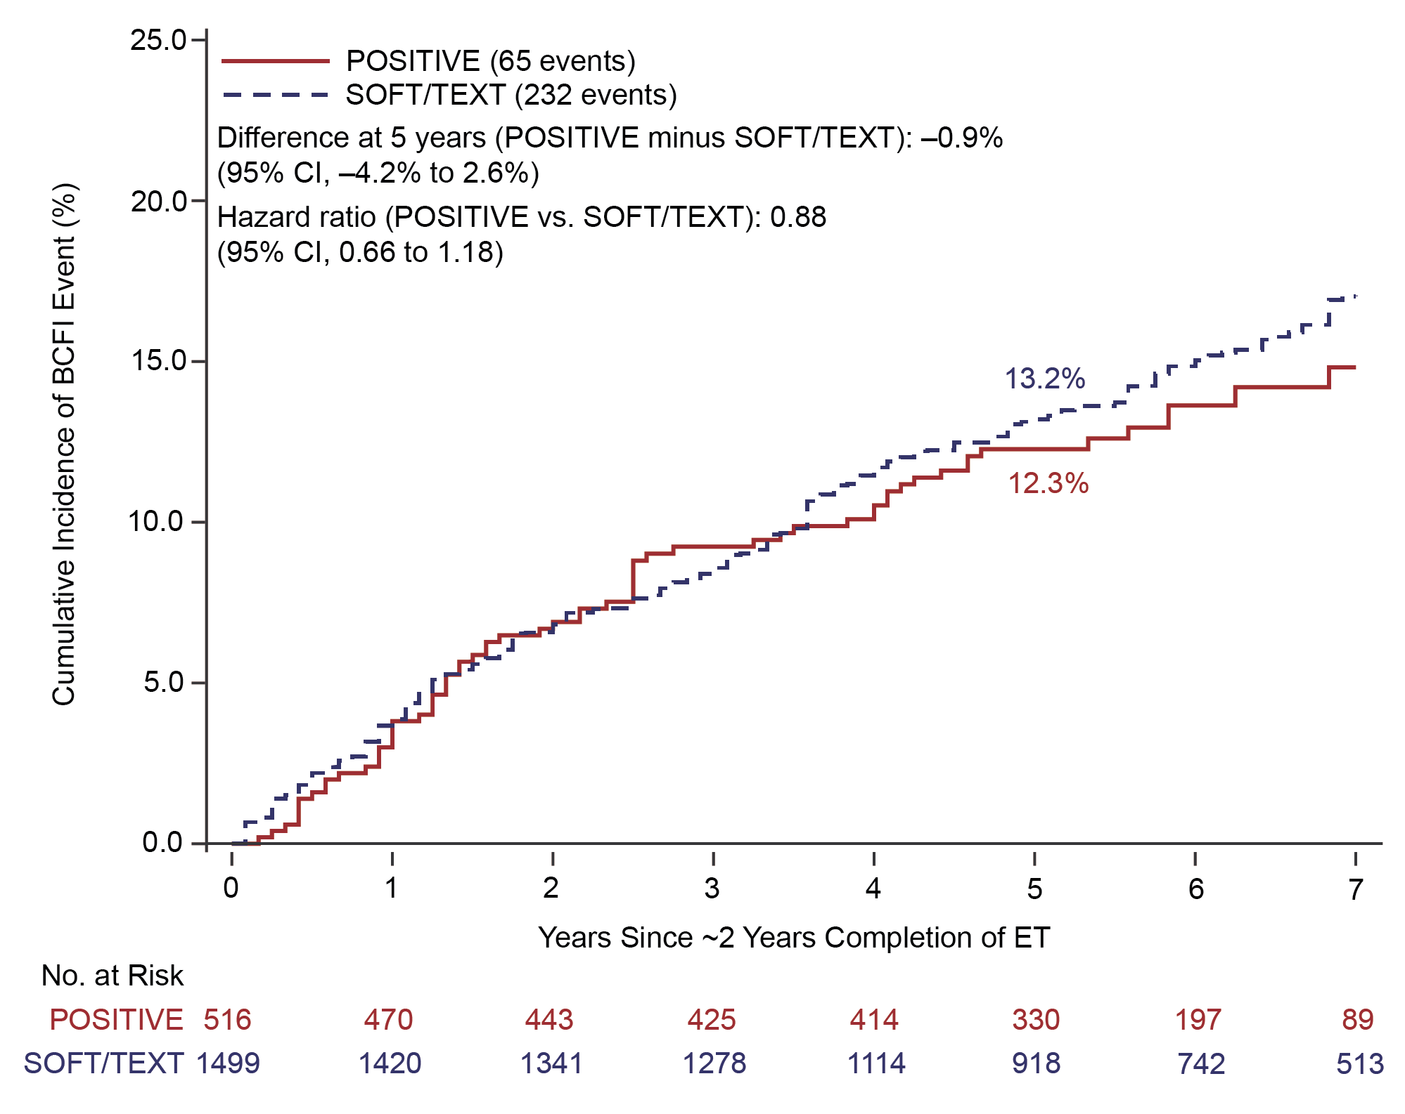
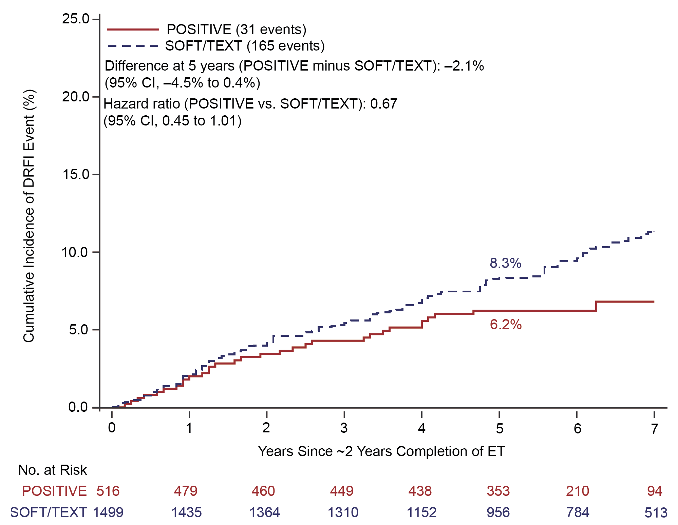
RESULTS AT 71 MONTHS OF MEDIAN FOLLOW-UP
Positive & Soft/Text (Bootstrap Matching Method)
BCFI
DRFI
Median F-UP POSITIVE: 71 months | Median F-UP SOFT/TEXT: 80 months
Pagani et al, ESMO, 2025
Ann H. Partridge, MD, MPH | 2025
21
Notes:
After 71 months of median follow-up, temporary interruption of ET for pregnancy was not associated with worse BC outcomes

Slide 22
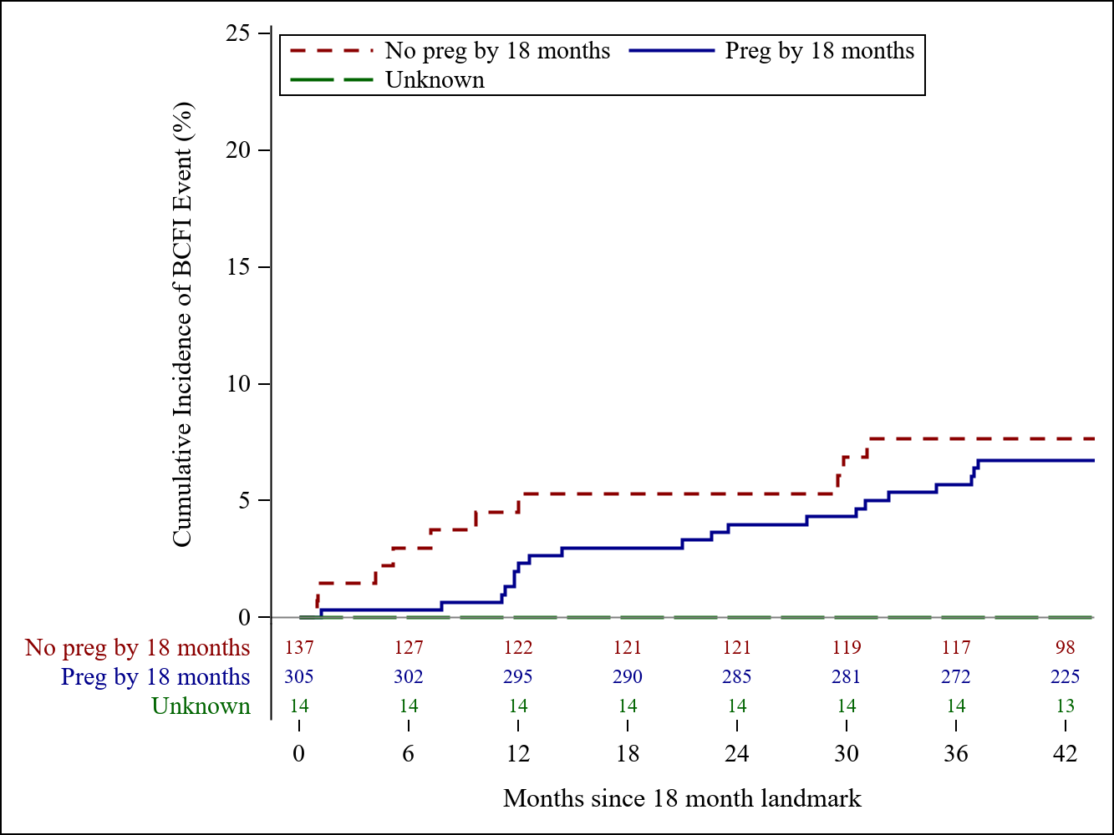

RESULTS AT 71 MONTHS OF MEDIAN FOLLOW-UP
18 months landmark analysis of BCFI for pregnant vs non-pregnant patients
VS
No statistically significant difference in BCFI events between pregnant and non-pregnant patients (HR=0.64; 95% CI: 0.37-1.11)
Pagani et al, ESMO, 2025
Ann H. Partridge, MD, MPH | 2025
22

Slide 23

ON STUDY ASSISTED REPRODUCTIVE TECHNOLOGY (ART) USE
 | N | %
All Evaluable Patients | 497 | 100.0
Used IUI
Yes | 37 | 7.4
No | 460 | 92.6
Clomiphene/Letrozole
Yes | 19 | 3.8
No | 478 | 96.2
Ovarian stimulation/FIVET/ICSI
Yes | 66 | 13.3
No | 431 | 86.7
Egg/Embryo donation
Yes | 17 | 3.4
No | 480 | 96.6
Ovarian tissue transfer
Yes | 2 | 0.4
No | 495 | 99.6
Embryo transfer from previously harvested eggs/embryos
Yes | 113 | 22.7
No | 384 | 77.3
Surrogacy autologous
No | 497 | 100.0
Other ART
Yes | 19 | 3.8
No | 478 | 96.2
Of the 497 evaluable patients, 214 (43%) used any ART in the first two years on trial
Embryo transfer was associated with higher pregnancy rates
(OR 2.41 95% CI: 1.17-4.95)
Pagani et al, ESMO, 2025
Ann H. Partridge, MD, MPH | 2025
23
Notes:
Fertility preservation at BC diagnosis – AT 41 MONTHS
252 / 497 (51%) underwent fertility preservation *
179 (36%) ovarian stimulation for embryo/oocyte cryopreservation
67 (13%) GnRHa during chemotherapy
30 (6%) ovarian tissue cryopreservation
ART use after enrollment
215 / 497 (43%) underwent ART on POSITIVE *
80 (16%) ovarian stimulation for IVF
68 (14%) cryopreserved embryo transfer
37 (7%) intrauterine insemination
19 (4%) clomiphene
397 patients alive and BC free at
24-months (landmark analysis)
2 BC events amongst 71 patients in
the ovarian stimulation group
8 BC events amongst 326 patients in
the non-ovarian stimulation group
Azim, et al. SABCS 2023; JCO 2024

Slide 24
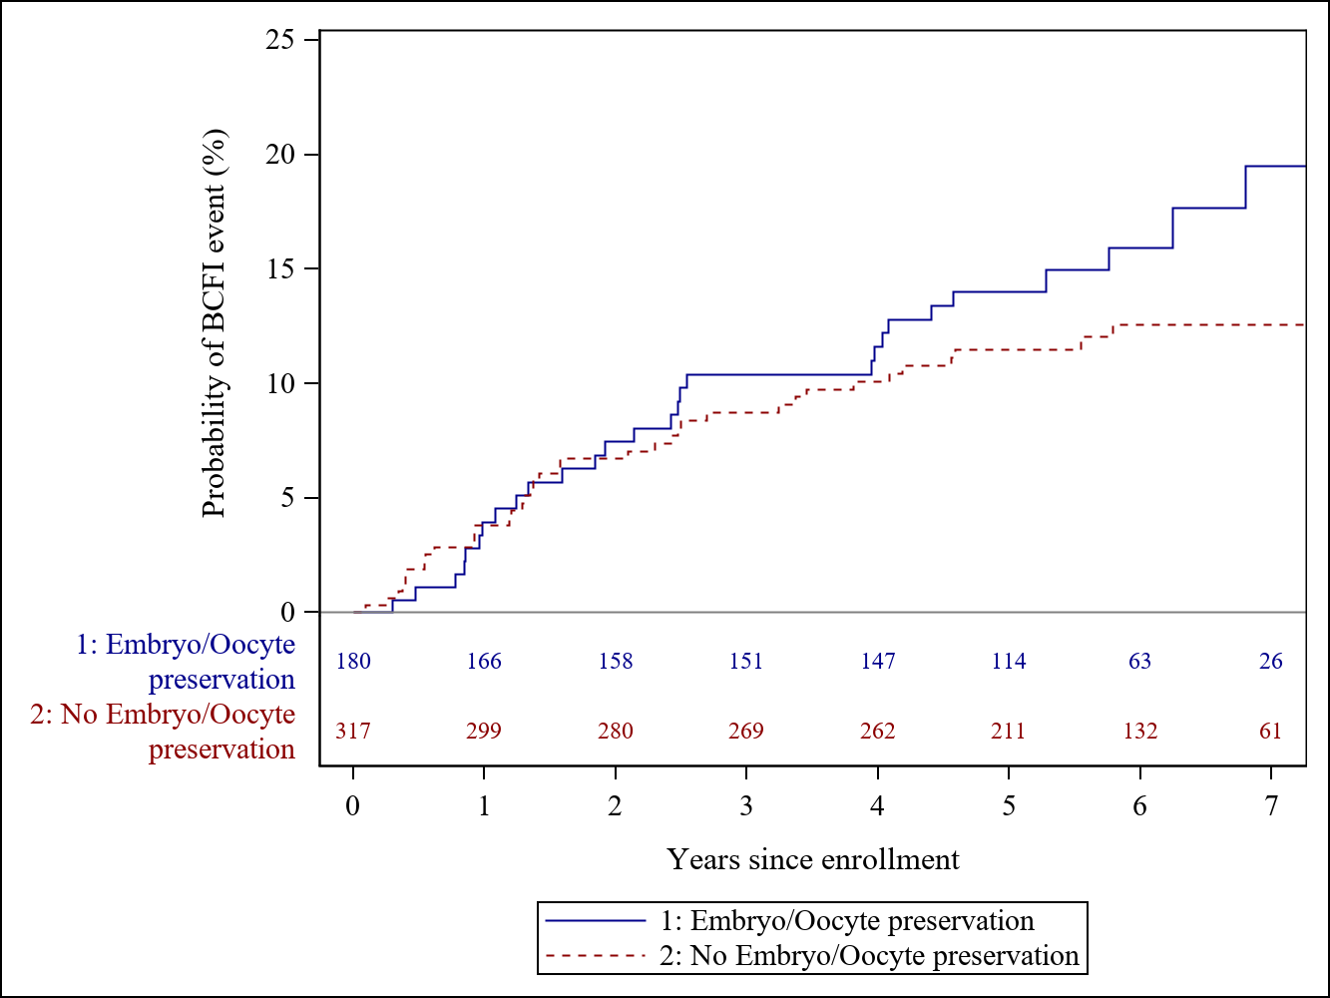
RESULTS AT 71 MONTHS OF MEDIAN FOLLOW-UP
Fertility Preservation
Of the 497 evaluable patients,
180 (36%) had pre-trial ovarian stimulation with embryo/oocyte cryopreservation
5-year BCFI was 14.0% (9.6-20.2%) vs 11.5% (8.4-15.7%), respectively
Pagani et al, ESMO, 2025
Ann H. Partridge, MD, MPH | 2025
24
Notes:
Fertility preservation at BC diagnosis – AT 41 MONTHS
252 / 497 (51%) underwent fertility preservation *
179 (36%) ovarian stimulation for embryo/oocyte cryopreservation
67 (13%) GnRHa during chemotherapy
30 (6%) ovarian tissue cryopreservation
ART use after enrollment
215 / 497 (43%) underwent ART on POSITIVE *
80 (16%) ovarian stimulation for IVF
68 (14%) cryopreserved embryo transfer
37 (7%) intrauterine insemination
19 (4%) clomiphene
397 patients alive and BC free at
24-months (landmark analysis)
2 BC events amongst 71 patients in
the ovarian stimulation group
8 BC events amongst 326 patients in
the non-ovarian stimulation group
Azim, et al. SABCS 2023; JCO 2024

Slide 25
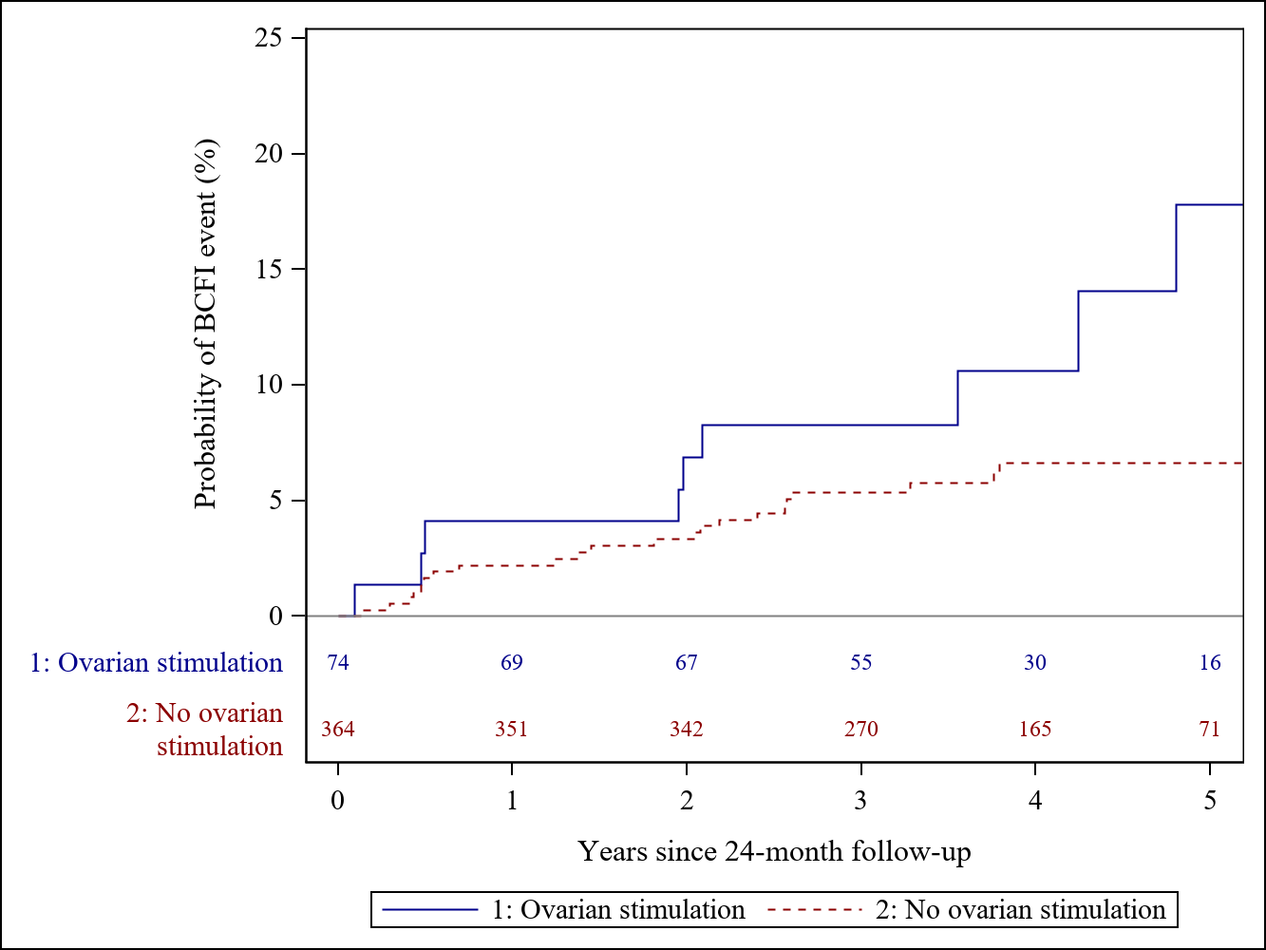
24-MONTHS LANDMARK ANALYSIS AT 71 MONTHS
Ovarian Stimulation on Trial for IVF
Of 438 evaluable patients,
74 (17%) had ovarian stimulation on trial
3-year post landmark BCFI was 8.3% (95%CI: 3.8% to 17.5%) vs 5.3% (95% CI:3.4% to 8.2%), respectively
CAVEAT:
  Uncontrolled analysis, not designed nor powered to address this question
Pagani et al, ESMO, 2025
Ann H. Partridge, MD, MPH | 2025
25
Notes:
Fertility preservation at BC diagnosis – AT 41 MONTHS
252 / 497 (51%) underwent fertility preservation *
179 (36%) ovarian stimulation for embryo/oocyte cryopreservation
67 (13%) GnRHa during chemotherapy
30 (6%) ovarian tissue cryopreservation
ART use after enrollment
215 / 497 (43%) underwent ART on POSITIVE *
80 (16%) ovarian stimulation for IVF
68 (14%) cryopreserved embryo transfer
37 (7%) intrauterine insemination
19 (4%) clomiphene
397 patients alive and BC free at
24-months (landmark analysis)
2 BC events amongst 71 patients in
the ovarian stimulation group
8 BC events amongst 326 patients in
the non-ovarian stimulation group
Azim, et al. SABCS 2023; JCO 2024

Slide 26
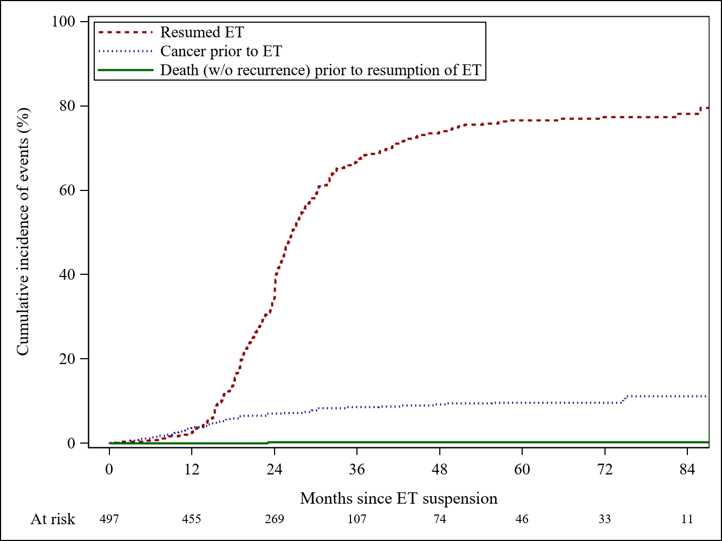
RESULTS AT 71 MONTHS OF MEDIAN FOLLOW-UP
ET Resumption
Of the 497 evaluable patients, 360 (72%) resumed ET at some point
Amongst the 429 patients that had at least 2 years of disease-free follow-up, 352 (82%) resumed ET
at some point
Pagani et al, ESMO, 2025
Ann H. Partridge, MD, MPH | 2025
26

Slide 27
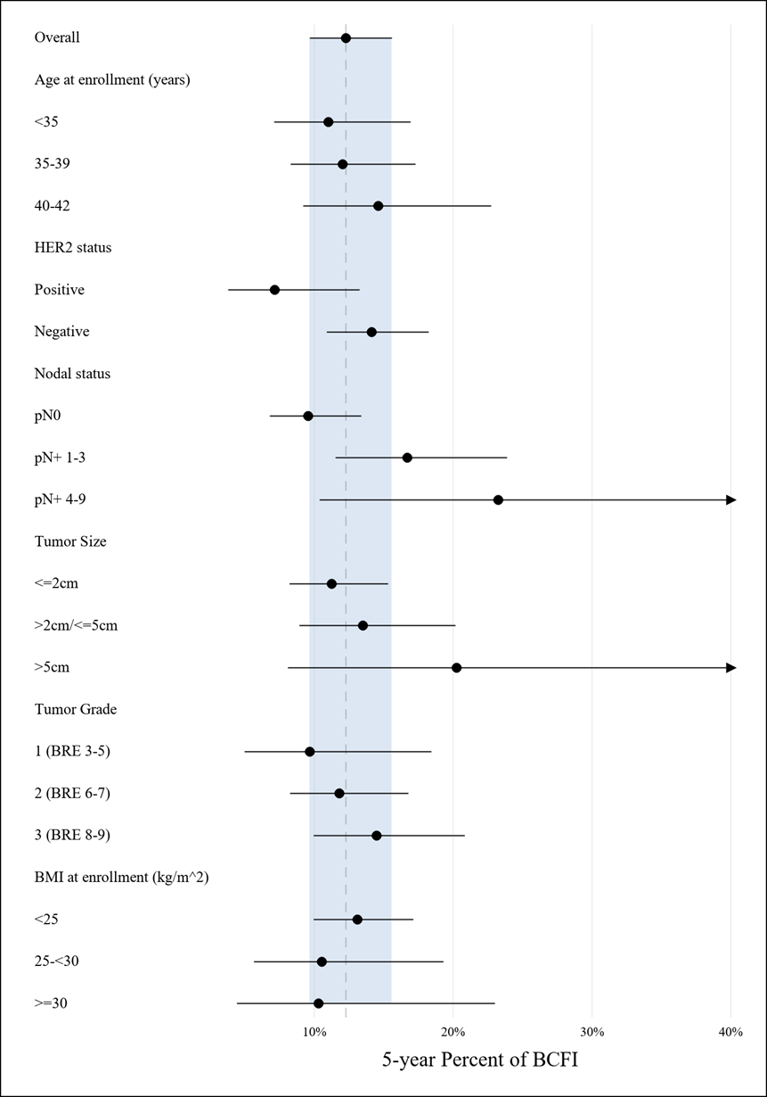

RESULTS AT 71 MONTHS OF MEDIAN FOLLOW-UP
POSITIVE ONLY: 5-year BCFI according to patient and tumor characteristics
OVERALL
Age (years)
<35
35-39
40-42
HER 2 status
Positive
Negative
HER2+: 7.1%
(95% CI: 3.8% -13.2%)
Nodal status
pN0
pN+ 1-3
pN+ 4-9
pN+ 4-9: 23.2%
(95% CI:10.4% - 47.2%)
Tumor size
<2cm
>2cm/< 5cm
>5cm
pT >5cm: 20.2%
(95% CI:8.1% - 45.6%)
Tumor grade
1 (BRE 3-5)
2 (BRE 6-7)
3 (BRE 8-9)
BMI
<25
25-<30
>=30
Pagani et al, ESMO, 2025
Ann H. Partridge, MD, MPH | 2025
27
Notes:
After 71 months of median follow-up, temporary interruption of ET for pregnancy was not associated with worse BC outcomes
Pregnancy rates were high, and complications and birth defects were low, in line with the general population
Most patients resumed ET within 5 years from enrollment
These findings provide critical safety data to counsel young women with HR+ early BC interested in pregnancy
Further follow-up is planned until 2029

Slide 28

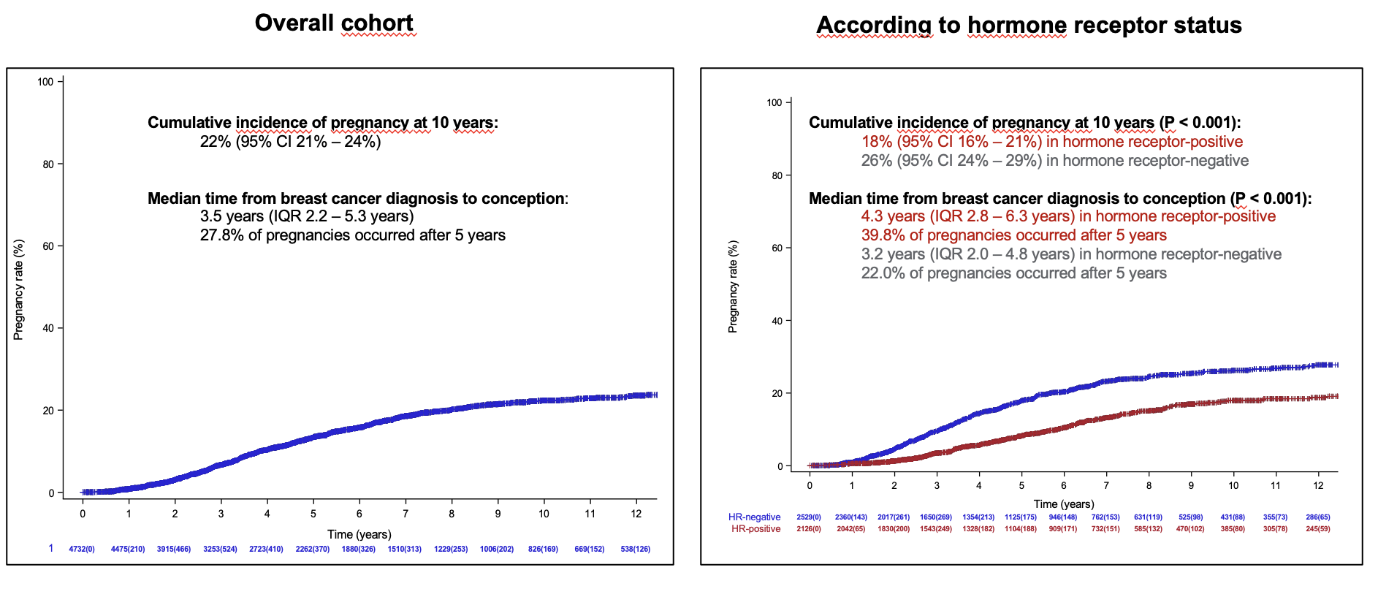
FEASIBILITY, SAFETY AND OUTCOMES OF PREGNANCY AFTER CANCER IN BRCA 1 AND 2- CUMULATIVE INCIDENCE OF PREGNANCY
International, multicenter, hospital-based, retrospective cohort study (N=4732 BRCA 1 and 2 carriers)
Overall Cohort
According to Hormone Receptor Status
Lambertini, et al. SABCS 2023; JAMA 2023
Ann H. Partridge, MD, MPH | 2025
28
Notes:
Corollary - contraception

Slide 29
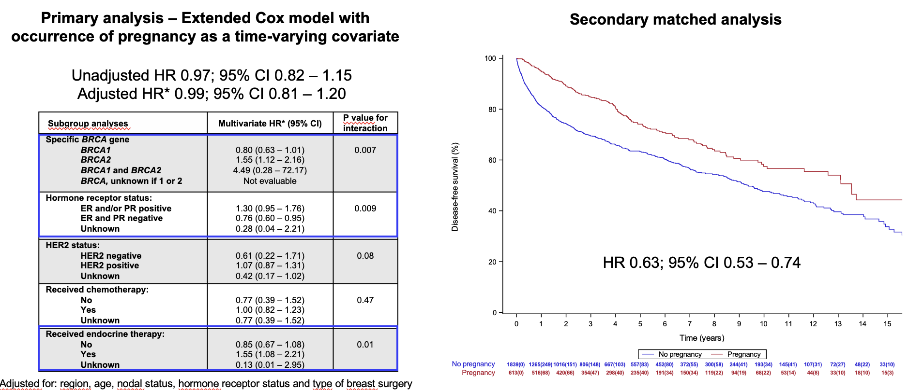
FEASIBILITY, SAFETY AND OUTCOMES OF PREGNANCY AFTER CANCER IN BRCA 1 AND 2 STUDY RESULTS – DISEASE-FREE SURVIVAL
Primary analysis – Extended Cox model with occurrence of pregnancy as a time-varying covariate
Secondary matched analysis
Subgroup analyse
P value for interaaction
Adjusted for: region, age, nodal status, hormone receptor status and type of breast surgery
Partridge + ASRM | 2025
Lambertini, et al. SABCS 2023; JAMA 2023
Ann H. Partridge, MD, MPH | 2025
29
Notes:
This global study including 4732 young BRCA carriers from 78 centers worldwide provides reassuring evidence for the oncofertility counseling of young BRCA carriers interested in conceiving following diagnosis and treatment for breast cancer
More than one out of five (22%) young BRCA carriers became pregnant within 10 years after a breast cancer diagnosis
The rate of pregnancy, fetal and obstetric complications was low and in line with the expectations in a population of women with similar age and no history of breast cancer
No detrimental prognostic effect of pregnancy after breast cancer was observed, particularly in BRCA1 carriers

Slide 30
PREGNANCY AND FERTILITY IN THE YOUNG WOMEN'S BREAST CANCER STUDY (YWS)
YWS (NCT01468246) is a prospective cohort study of young women who were newly-diagnosed
with breast cancer enrolled across 13 sites in the US & Canada 2006-2016
Data on attempting pregnancy and fertility outcomes were obtained from serial surveys collected
over a median follow-up of 11 years (range: 3-17 years)
Multivariable logistic regression with stepwise model selection was used to identify factors associated with pregnancy and live birth
Key Substudy Eligibility Criteria
Age ≤ 40 years
Stage 0-III breast cancer
No metastatic disease at diagnosis
No prior hysterectomy or oophorectomy before breast
cancer diagnosis
Reported attempting to conceive after breast cancer diagnosis within the last 12 months on a follow-up survey
N = 197
Fertility Outcomes
Pregnancy (including miscarriage, abortion, stillbirth, live birth)
Live birth
N =
1213
Sorouri et al, ASCO 2024
Ann H. Partridge, MD, MPH | 2025
30
Notes:
This analysis was conducted within the Young Women’s Breast Cancer Study, a prospective cohort study of young women who were newly diagnosed with breast cancer and were enrolled across 13 sites in the US and Canada from 2006 to 2016. Data on attempting pregnancy and fertility outcomes were obtained from serial surveys collected over a median follow-up of 11 years, with follow-up ranging from 3 to 17 years. Study participants were eligible for this analysis if 40 years or younger at the time of diagnosis with stage 0 to 3 breast cancer. Women with metastatic disease at time of diagnosis and prior hysterectomy or oophorectomy were excluded. Among the 1213 women who met this criteria, 197 reported trying to get pregnancy after their breast cancer diagnosis within the last 12 months on a follow-up survey. Fertility outcomes included pregnancies and live births after diagnosis. Any pregnancies that resulted in miscarriage, abortion, stillbirth, and live birth were included. Multivariable logistic regression with stepwise model selection was used to identify factors associated with pregnancy and live birth.

Slide 31

PREDICTORS OF FERTILITY IN THE YOUNG
WOMEN'S BREAST CANCER STUDY (YWS)
73% reported ≥1 pregnancy and 65% reported ≥1 live birth after diagnosis
Median time from diagnosis to first pregnancy was 48 months (range: 6-125)
Variables significantly associated
with pregnancy
Variables significantly associated
with live birth
Variable | aOR | 95% CI | p-value
Age at diagnosis | 0.82 | 0.74-0.90 | <0.0001
Financial comfort | 2.04 | 1.01-4.12 | 0.047
Variable | aOR | 95% CI | p-value
Age at diagnosis | 0.82 | 0.76-0.90 | <0.0001
Fertility preservation | 2.78 | 1.29-6.00 | 0.009
Older age at diagnosis associated with lower odds of pregnancy, while financial comfort at diagnosis predictive of pregnancy
Older age at diagnosis associated with lower odds of live birth, while having undergone fertility preservation at diagnosis predictive of live birth
Other patient, cancer, and treatment factors were not associated with either outcome
aOR, adjusted odds ratio; CI, confidence interval
Ann H. Partridge, MD, MPH | 2025
31
Notes:
73% of women reported one or more pregnancies and 65% reported one ore more live births after their breast cancer diagnosis with a median time from diagnosis to first pregnancy of 48 months, ranging from 6 months to 125 months. In a multivariable logistic regression model, older age at diagnosis was associated with lower odds of pregnancy, while financial comfort at diagnosis was predictive of pregnancy. Older age at diagnosis was also associated with lower odds of a live birth, while having undergone fertility preservation at diagnosis prior to receiving cancer treatment was predictive of live birth. The other patient, cancer, and treatment factors collected were not associated with either outcome.

Slide 32

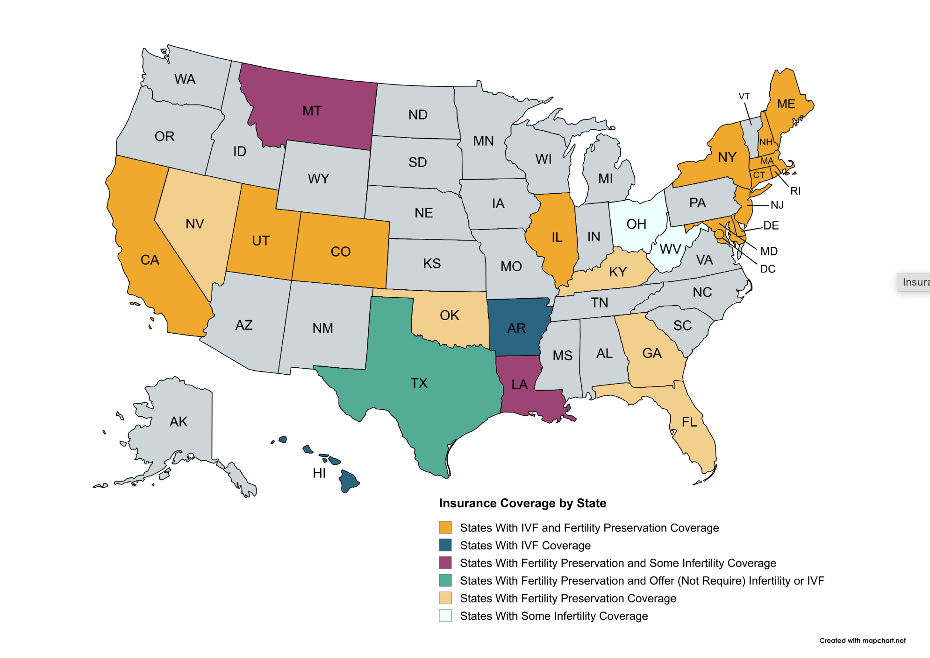
FERTILITY PRESERVATION SIGNED INTO LAW IN U.S.
  https://resolve.org/learn/financial-resources/insurance-coverage/insurance-coverage-by-state/
Ann H. Partridge, MD, MPH | 2025
32
Notes:
As of April 2025, the National Infertility Association reports that 20 states have fertility preservation laws requiring insurance to cover treatments for medically induced infertility, with 22 states plus Washington D.C. having some form of fertility insurance coverage law on the books. The specific coverage, which can include egg, embryo, or sperm cryopreservation, varies by state and may be limited to specific circumstances, such as for cancer patients.

Slide 33
CANCER DURING PREGNANCY
~1/1000 pregnancies complicated by cancer
Most common malignancies observed during pregnancy:
Type of cancer | Number of cancers diagnosed prenatally per 100,000 deliveries
Breast | 3.7
Thyroid | 3.3
Cervix | 1.6
Ovary | 1.5
CNS | 1.2
Hodgkin Lymphoma | 1.0
Leukemia | 1.0
Stensheim H, et al. J Clin Oncol 2009
Ann H. Partridge, MD, MPH | 2025
33

Slide 34
DEFINITIONS: Cancer During Pregnancy vs. Pregnancy-Associated Breast Cancer
Pregnancy-associated breast cancer can refer to:
  Cancer diagnosed during pregnancy, may have arisen prior to initiation of pregnancy (PrBC)
  Cancer diagnosed post-partum, developing within the pregnant hormonal milieu (PPBC)
  This talk will focus on PrBC, not PrBC
Published studies describing outcomes and management of pregnancy and breast cancer OFTEN contain both populations (PABC)
  Not scientifically prudent given potential differences in tumor initiation, promotion, growth factors
  Likely accounts for mixed results of outcome data for pregnancy and breast cancer patients
  Most robust data demonstrate no differences in outcomes for PrBC but worse outcomes for PPBC
Amant F et al, Lancet Onc 2021; Amant et al, JCO 2013; Goddard et al, Jama Network Open 2019
Ann H. Partridge, MD, MPH | 2025
34

Slide 35
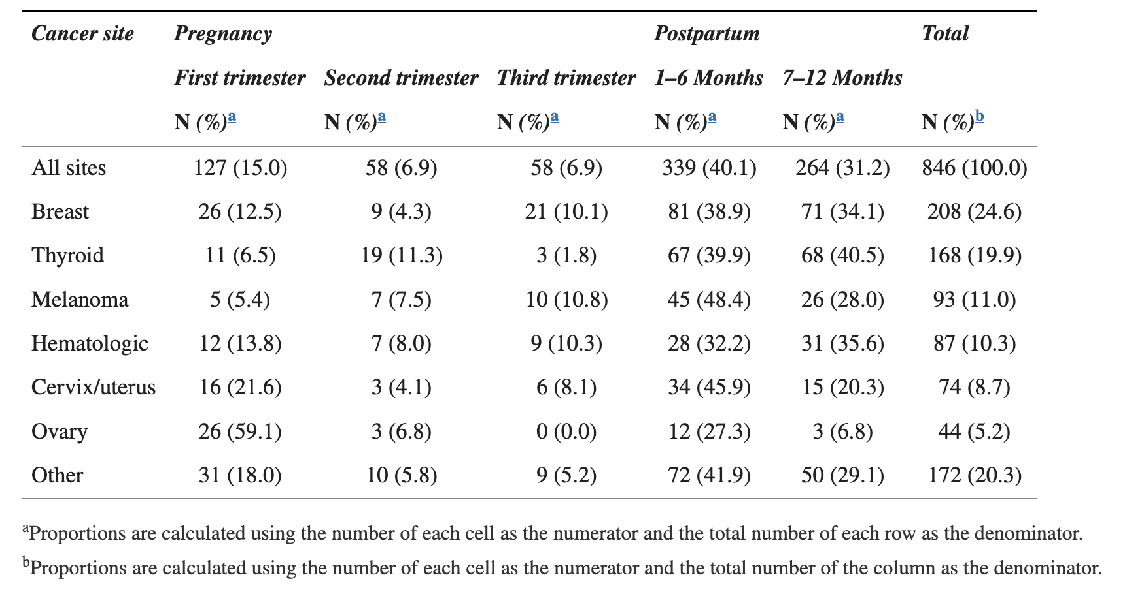
CANCER DURING PREGNANCY
U.S. Women aged 10-54 years between 2001 and 2013*
*Incidence per 100,000 pregnancies
Cottreau et al, J Womens Health 2019
Ann H. Partridge, MD, MPH | 2025
35

Slide 36
TREATING PATIENTS WITH
CANCER DURING PREGNANCY
Complex therapeutic and ethical challenges
  Mother is beneficiary of treatment; fetus may be put at risk
  Patient autonomy is primary guiding principle supporting shared decision-making- may be at odds with medical values
  Fetal wellbeing dependent on maternal wellbeing in short term
  Difficult to avoid some element of compromise
Lack of randomized treatment data to support safety and efficacy of standards
  Small numbers, ethically difficult to randomize, few prospective studies
Data from case reports, observational cohorts, retrospective analyses
  Subject to variable quality, heterogeneity, bias
Often requires modifying standard treatment algorithms: aiming for most effective treatment for the women with cancer while minimizing risks to fetus
Walsh et al, Oncologist 2017; Linkeviciute et al, Cancers 2022
Ann H. Partridge, MD, MPH | 2025
36
Notes:
Not a good idea given potential differences in tumor initiation and promotion factors in these two populations

Slide 37

INDIVIDUALIZING CANCER CARE IN PREGNANCY
Risks to fetus
  Risk from maternal illness (symptomatic vs. NIPT)
  Risks from treatment
  Risks from preterm delivery
Risks to woman
  Risks from cancer
  Risks from pregnancy
  Risks from treatment
Fetal Risk
Maternal Risk
Other important factors
Disease phenotype and stage
Gestational age
Patient preferences
Ann H. Partridge, MD, MPH | 2025
37

Slide 38
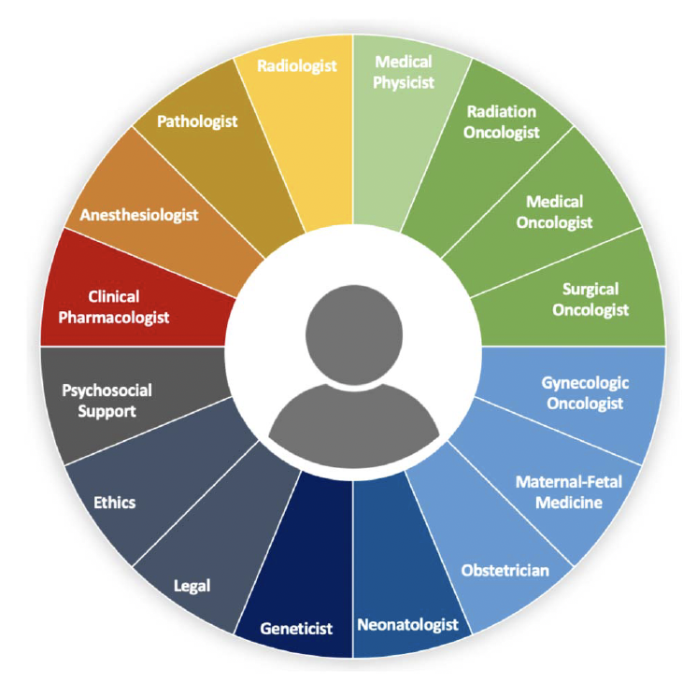
MULTIDISCIPLINARY CARE IS REQUIRED TO MANAGE PATIENTS WITH CANCER DURING PREGNANCY
Sorouri et al, ASCO Ed Book, 2023
Ann H. Partridge, MD, MPH | 2025
38

Slide 39
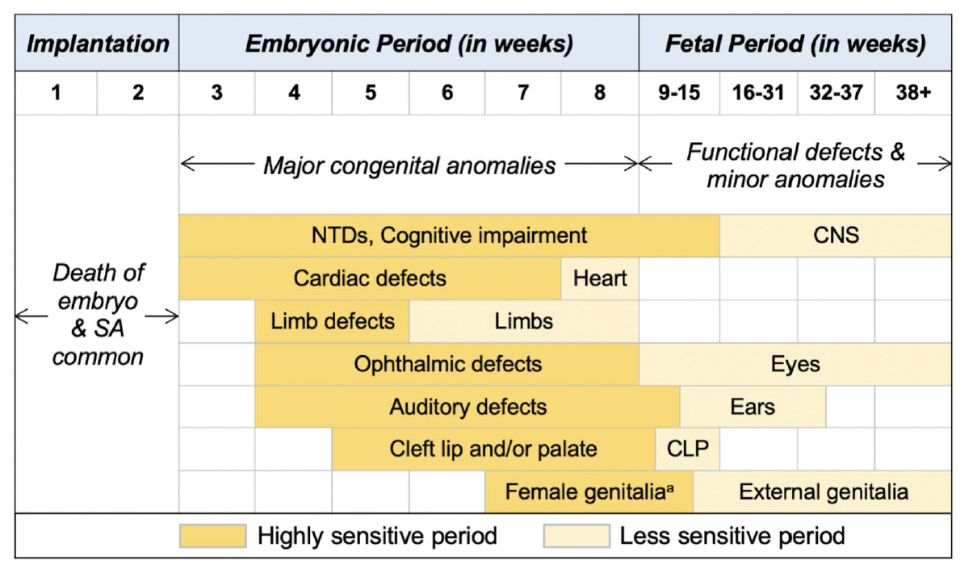
POTENTIAL IMPACT OF ANTI-CANCER TREATMENT ON EMBRYO/FETUS
Sorouri et al, ASCO Ed Book, 2023
Ann H. Partridge, MD, MPH | 2025
39

Slide 40
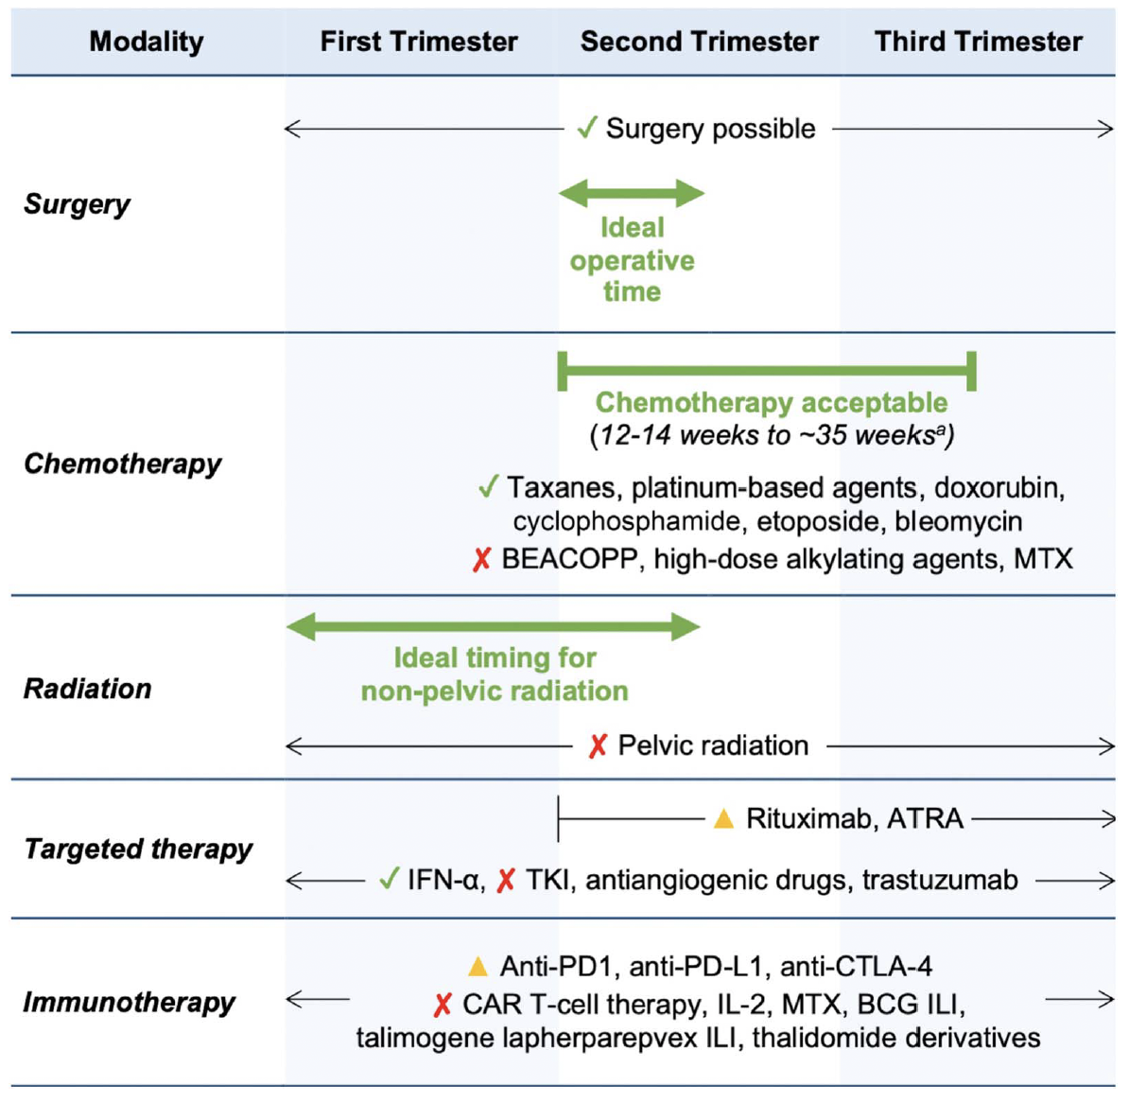
SUMMARY OF TREATMENT SAFETY BY TRIMESTER
Sorouri et al, ASCO Ed Book, 2023
Ann H. Partridge, MD, MPH | 2025
40

Slide 41
SPECIFIC CONSIDERATIONS FOR TREATMENT OF BREAST CANCER DURING PREGNANCY (I)
Diagnosis and staging
  Ultrasound, mammogram, MRI without contrast (avoid CT, PET/CT, bone scan)
  Biopsy as appropriate, SLNB with technetium-99m preferred
Treatment- goal to bring to full term if feasible/safe for patient*
  Surgery reasonable as needed throughout pregnancy with careful monitoring
  Systemic therapy after 1st trimester: anthracycline, cyclophosphamide, taxanes, platinum agents with careful monitoring
  No hormonal, anti-HER2, ICI, PARP, CDK 4/6i agents
Sorouri et al, ASCO Ed Book, 2023
Ann H. Partridge, MD, MPH | 2025
41

Slide 42
SPECIFIC CONSIDERATIONS FOR TREATMENT OF BREAST CANCER DURING PREGNANCY (II)
Supportive Care
  Limited data, odansetron and G-CSF appear ok
  If steroids needed use pred or methyl pred to avoid long-term concerns in progeny
  Involve MFM, perinatal specialists early
Post-partum Survivorship
  Neonatal, placental evaluation
  (Re-) Start systemic therapy
  Breastfeeding- by situation
  Optimize psychosocial supports throughout
Sorouri et al, ASCO Ed Book, 2023
Ann H. Partridge, MD, MPH | 2025
42

Slide 43
FRAMEWORK FOR APPROACHING
CANCER DURING PREGNANCY
Yes
No
Yes
No
Sorouri et al,
ASCO Ed Book, 2023
Ann H. Partridge, MD, MPH | 2025
43

Slide 44

CONCLUSION
  Young women with breast cancer have lower rates of fertility than non-cancer and cancer populations
  New data support the feasibility and safety of pregnancy and ART in survivor populations
  Care of women with breast cancer during pregnancy requires:
  Multidisciplinary team
  Attention to two potential patients if pregnancy is continued
  Awareness of most recent data re: safety of management/treatments during pregnancy
  Continued focused research is needed to address unanswered questions regarding cancer after and during pregnancy
  2nd kid?
  Prognostic implications of post-partum
  Patient preferences vital
Ann H. Partridge, MD, MPH

