Slide 1


Post-mastectomy Radiation: Patient Selection and Treatment Planning
Eleanor E. R. Harris, MD, FASTRO
Associate Cancer Center Director
Chief of Radiation Oncology
St. Luke’s University Health Network
Easton, PA
Disclaimer: This presentation is intended for personal use and for informational purposes only and does not replace independent professional judgment. This presentation is the property of Physicians’ Education Resource, LLC (“PER”) and is protected by U.S. and international copyright laws. You may not copy, reproduce, distribute, transmit, modify, or create derivative works of the presentation without the prior written permission from PER.

Slide 2
Post-mastectomy Radiation (PMRT) Outline
Classic studies establishing PMRT indications with Adjuvant Chemotherapy
PMRT after Neoadjuvant Chemotherapy
Genomic assays in PMRT
Radiation techniques and use of hypofractionation
Guidelines References
Pending & Ongoing trials

Slide 3
Local Regional Recurrence Classic Risk Groups
High Risk (> 20% risk LRR - PMRT indicated)
  ≥ 4 positive LNs on ALND, T4 disease, T3N+ disease
  ypN+ after neoadjuvant chemotherapy
Intermediate Risk (10-20% risk LRR - use clinical judgement & shared decision making)
  1-3+ LNs with other factors:
    Age <50/premenopausal, >20% LNs positive, SLNB only, hormone receptor negative, positive margins, high grade, lymphovascular invasion, multicenter/multifocal disease, medial location, ECE, high molecular risk or high risk genomic score
  T3N0
Low Risk (< 10% risk LRR - usually not indicated)
  T1-2N0 with negative margins
    ? triple negative
Notes:
Triple negative: Wang J, Radiother Oncol 100, 2011; Abdulkarim JCO, 29 2011

Slide 4
Effect of RT After Mastectomy and Axillary Surgery on 10-year Recurrence and 20-year BC Mortality
Meta-analysis of Individual Patient Data for 8135 Women in 22 RCTs
Meta-analysis of pooled data including 8135 women in trials conducted 1964-1986 from 22 trials with mastectomy and axillary surgery randomized to +/- PMRT
Node Negative:
  10-year LR recurrence not significantly reduced
  20-year overall mortality significantly increased from 42% to 48% with PMRT
Node 1-3+:
  10-year LR recurrence significantly reduced from 20% to 4% and any recurrence from 46% to 34%
  20-year breast cancer mortality was reduced from 50% to 42% and overall mortality from 56.5% to 53.5%
Nodes 4+:
  10-year LR recurrence significantly reduced from 32% to 13% and any recurrence from 75% to 66%
  20-year breast cancer mortality significantly reduced from 80% to 71% and overall mortality from 83% to 75%
EBCTCG. Lancet. 2014;383(9935).

Slide 5
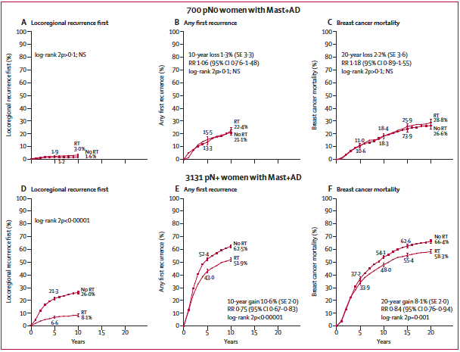
Effect of RT After Mastectomy and Axillary Surgery on 10-year Recurrence and 20-year BC Mortality
Meta-analysis of Individual Patient Data for 8135 Women in 22 RCTs
EBCTCG. Lancet. 2014;383(9935).

Slide 6
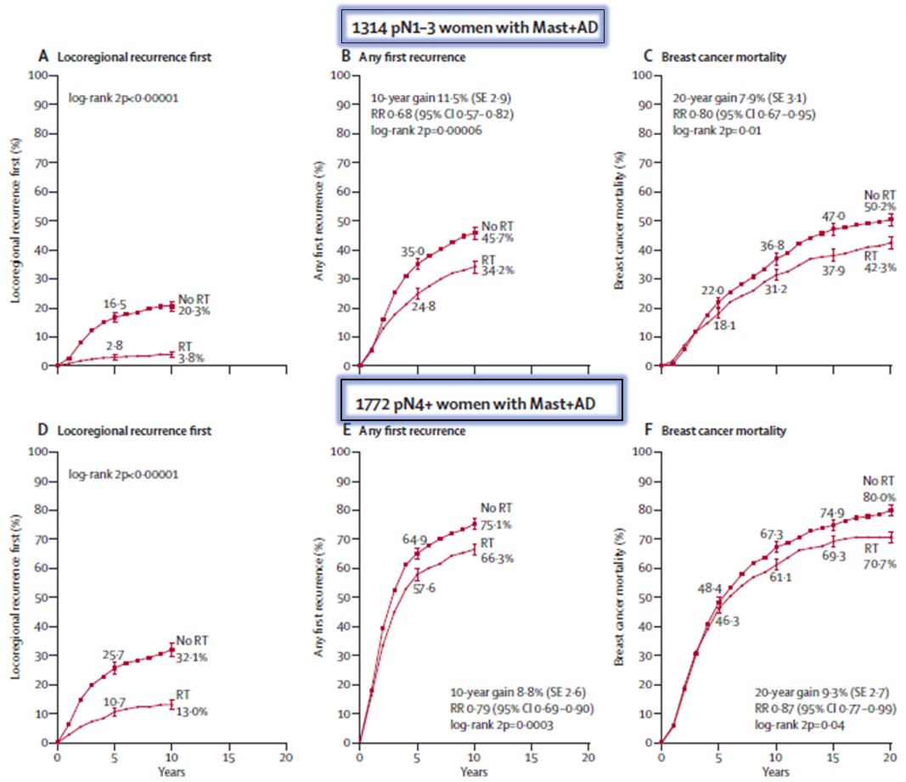
Effect of radiotherapy (RT) after mastectomy and axillary dissection (Mast+AD) on 10-year risks of locoregional and overall recurrence and on 20-year risk of breast cancer mortality in 1314 women with one to three pathologically positive nodes (pN1-3) and in 1772 women with four or more pathologically positive nodes (pN4+)
EBCTCG. Lancet. 2014;383(9935).

Slide 7
Effect of RT After Mastectomy and Axillary Surgery on 10-year Recurrence and 20-year BC Mortality
Meta-analysis of Individual Patient Data for 8135 Women in 22 RCTs
Conclusions:
In node negative disease, PMRT has no benefit
PMRT benefits all groups of patients with N+ disease:
  1-3 N+
  ≥ 4 N+ even with systemic therapy
For every 1.5% decrease in any recurrence at 10 years there is a 1% decrease in BC-specific mortality
Limitations:
  Chemo was CMF, and only 55% received chemo; No neoadjuvant chemo
  Only 3% had ER status known; Only 24% got tamoxifen
  Changes in lymph node sampling & stage migration (SLNB, serial sectioning)
EBCTCG. Lancet. 2014;383(9935).

Slide 8
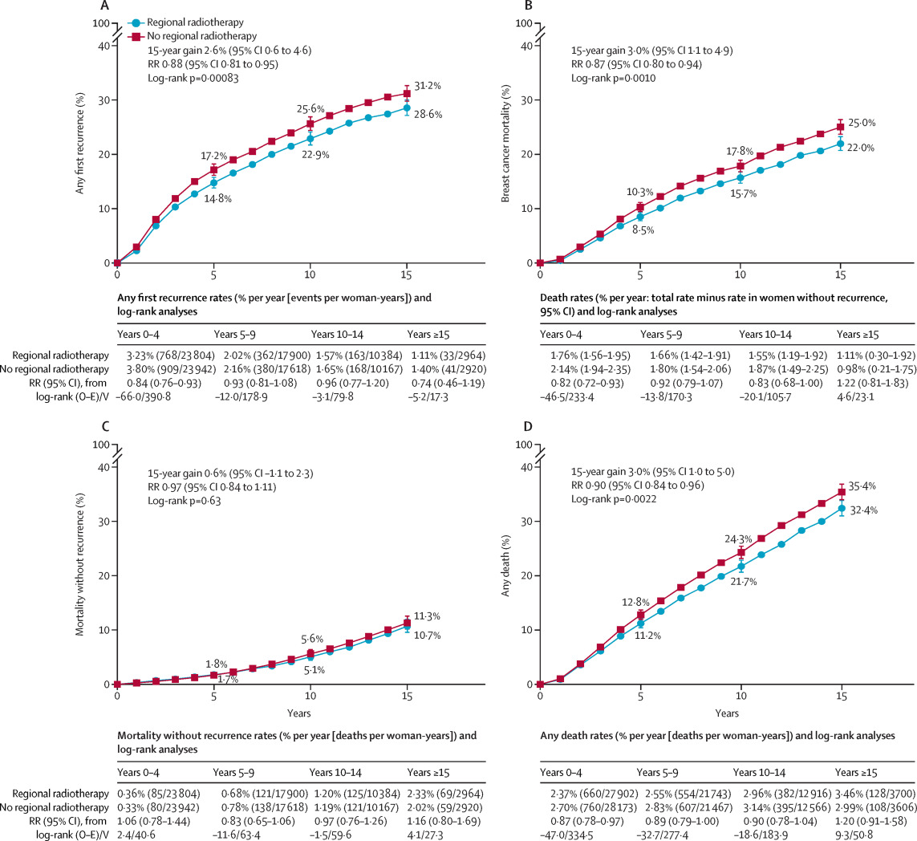
EBCTCG: Radiotherapy to regional nodes in early breast cancer: an individual patient data meta-analysis of 14 324 women in 16 trials
Randomized trials of regional LN irradiation
(RNI) vs. No RNI:
  RT significantly reduced recurrence rate (RR = 0.88, P = .0008), breast cancer mortality (RR 0.87, P = .001), mainly through decreased distant metastases
  No effect on non-breast cancer mortality, to reduce all cause mortality (RR = 0.9, P = .002)
  Absolute reduction in 15-year breast cancer mortality by 1.6% for N0, 2.7% for 1-3 +LN and 4.5% for 4+ LN+ (trials done after 1990)
  EBCTCG. Lancet. 2023;402(10416):1991-2003

Slide 9
SUPREMO TRIAL
(Selective Use of Postoperative Radiotherapy aftEr MastectOmy)
Scottish Cancer Trials Breast Group
Closed 2014
Phase III trial of +/- PMRT in intermediate risk breast cancer (N=1607):
pT₁N₁ or pT₂ N₀₋₁or pT3N0
1-3 positive nodes or N₀ with grade 3 histology or LVI
PMRT arm gave “chest wall radiation”
  “Axillary irradiation was not allowed, but medial periclavicular or internal mammary chain irradiation was permitted according to local policy of the centres.”
Patient Characteristics: 98% T1-2; 26% N0 and 59% 1-2 LN+: 76% HR+
10 Yr OS:
  PMRT = 81.4%
  No PMRT = 82%
  2% absolute reduction in chest wall recurrence (RR not reported)
Kunkler I, San Antonio Breast Cancer Symposium, Abstract GS2-03. 2024

Slide 10
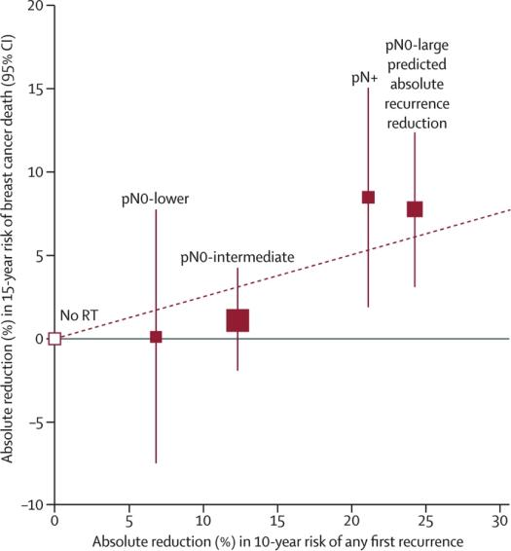
Post-mastectomy Radiation:
Summary of Classic Studies
Improved local-regional control leads to improved overall survival
  Danish trials 82B & 82C, British Columbia trials of +/- PMRT and subgroup analyses showed significant reduction in LRR and improved OS in PMRT arms
  EBCTCG meta-analysis showed similar proportional reduction in LRR regardless of age & tumor characteristics, with absolute benefit dependent upon risk level
Overgaard M et al. Radiother Oncol. 2022;170.
EBCTCG. Lancet. 2014;383(9935).

Slide 11
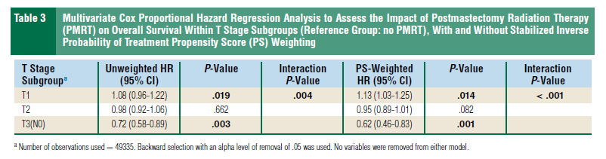
Post-mastectomy Radiation: Benefit of
PMRT in Intermediate Risk Patients
  Some node negative patients are at increased risk of LRR >15%
    Positive margin, large tumor size, triple negative
  Data from MA20 and EORTC trials after breast conserving surgery +/- nodal radiation suggest possible benefit of nodal radiation after mastectomy for high-risk node negative (T3 size, upper inner quadrant)
  Controversy regarding PMRT for T3N0
    Danish 82b/c included 267 T3N0 patients; PMRT lowered LRR & improved OS in premenopausal women only
    Other institutional series show LRR < 10% in this group without PMRT
    Assess constellation of risk factors and individualize treatment recommendations
NCDB survey of pT1-2N1 or pT3N0 or pT2N0 +LVI/grade 3 (intermediate risk per SUPREMO (2006-13) with mastectomy
N=49335 (6882 +PMRT)
Better OS in T3N0 + PMRT
Kulkarni S., Clin Breast Ca, 2025: 25
doi.org/10.1016/j.clbc.2025.03.007

Slide 12
Indications for Post-mastectomy Radiation after Neoadjuvant Chemotherapy (NAC)

Slide 13
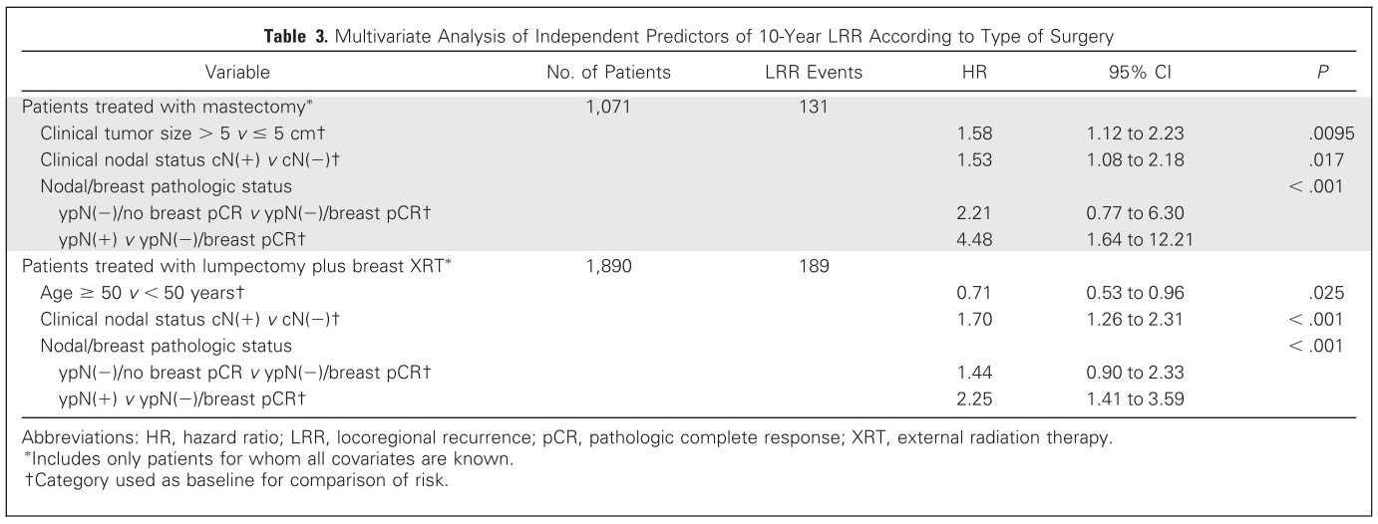
Predictors of Locoregional Recurrence After Neoadjuvant Chemotherapy: Results From Combined Analysis of
National Surgical Adjuvant Breast and Bowel Project B-18 and B-27
Mamounas EP et al. J Clin Oncol. 2012;30(32).
Notes:
When lumpectomy and mastectomy pts were separated, tumor size was MV predictor for mastectomy pts, and age was MV predictor for lumpectomy+RT pts.

Slide 14
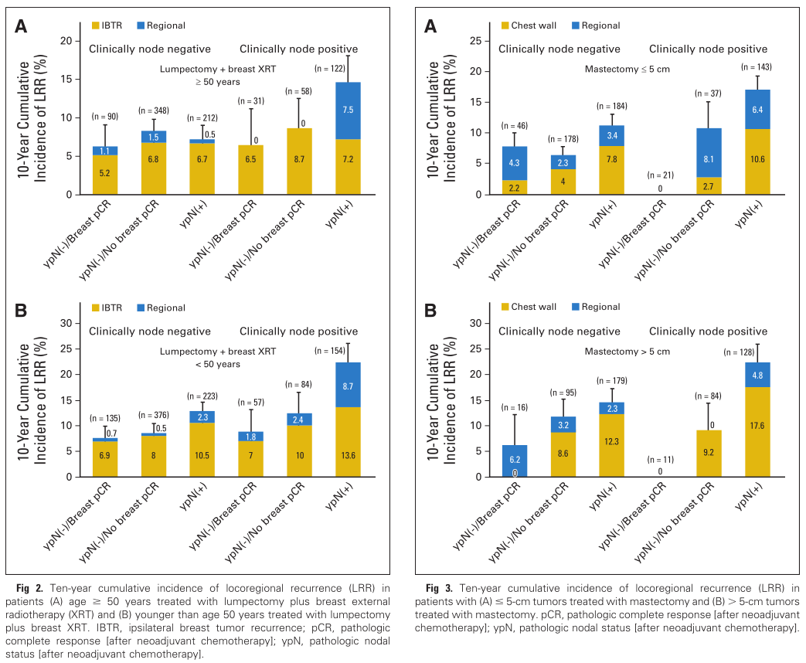
Predictors of Locoregional Recurrence After Neoadjuvant Chemotherapy: Results From Combined Analysis of
National Surgical Adjuvant Breast and Bowel Project B-18 and B-27
Age ≥50 treated with BCS+ WBI
Tumor ≤5 cm treated with mastectomy
Age <50 treated with BCS+ WBI
Tumor >5 cm treated with mastectomy
Mamounas EP et al. J Clin Oncol. 2012;30(32).
Notes:
Patterns and predictors of LRR after NAC,Mastectomy pts had no PMRT
NAC: AC alone, or AC with neoadjuvant or adjuvant docetaxel
3088 pts with10 year follow up

Slide 15

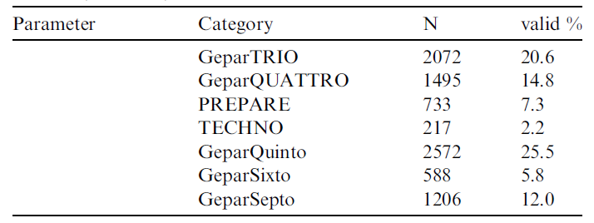
Locoregional Recurrence Risk After Neoadjuvant Chemotherapy: A Pooled Analysis of Nine German Prospective Neoadjuvant BC Trials
Pooled analysis of 9 neoadjuvant trials, 10,075 women included
  Primary endpoint of cumulative incidence LRR as first event
  Median FU = 67 months
  BCS in 68%; Mastectomy no PMRT in 32%
  Path CR (ypT0 ypN0) in 20%
    All patients received anthracycline/taxane based chemo
    Her2+ patients also received neoadjuvant/adjuvant trastuzumab
    HR negative received bevacuzimab
Overall LRR = 9.5%
  pCR = 4.1%
  Non-pCR = 9.5%
Multivariate independent predictors of LRR:
  Younger age
  cN+
  Grade 3
  Non-pCR
  Triple negative
  NOT surgery type
Werutsky G et al. Eur J Cancer. 2020;130:92-101.
Notes:
Patterns and predictors of LRR after NAC,Mastectomy pts had no PMRT
NAC: AC alone, or AC with neoadjuvant or adjuvant docetaxel
3088 pts with10 year follow up

Slide 16
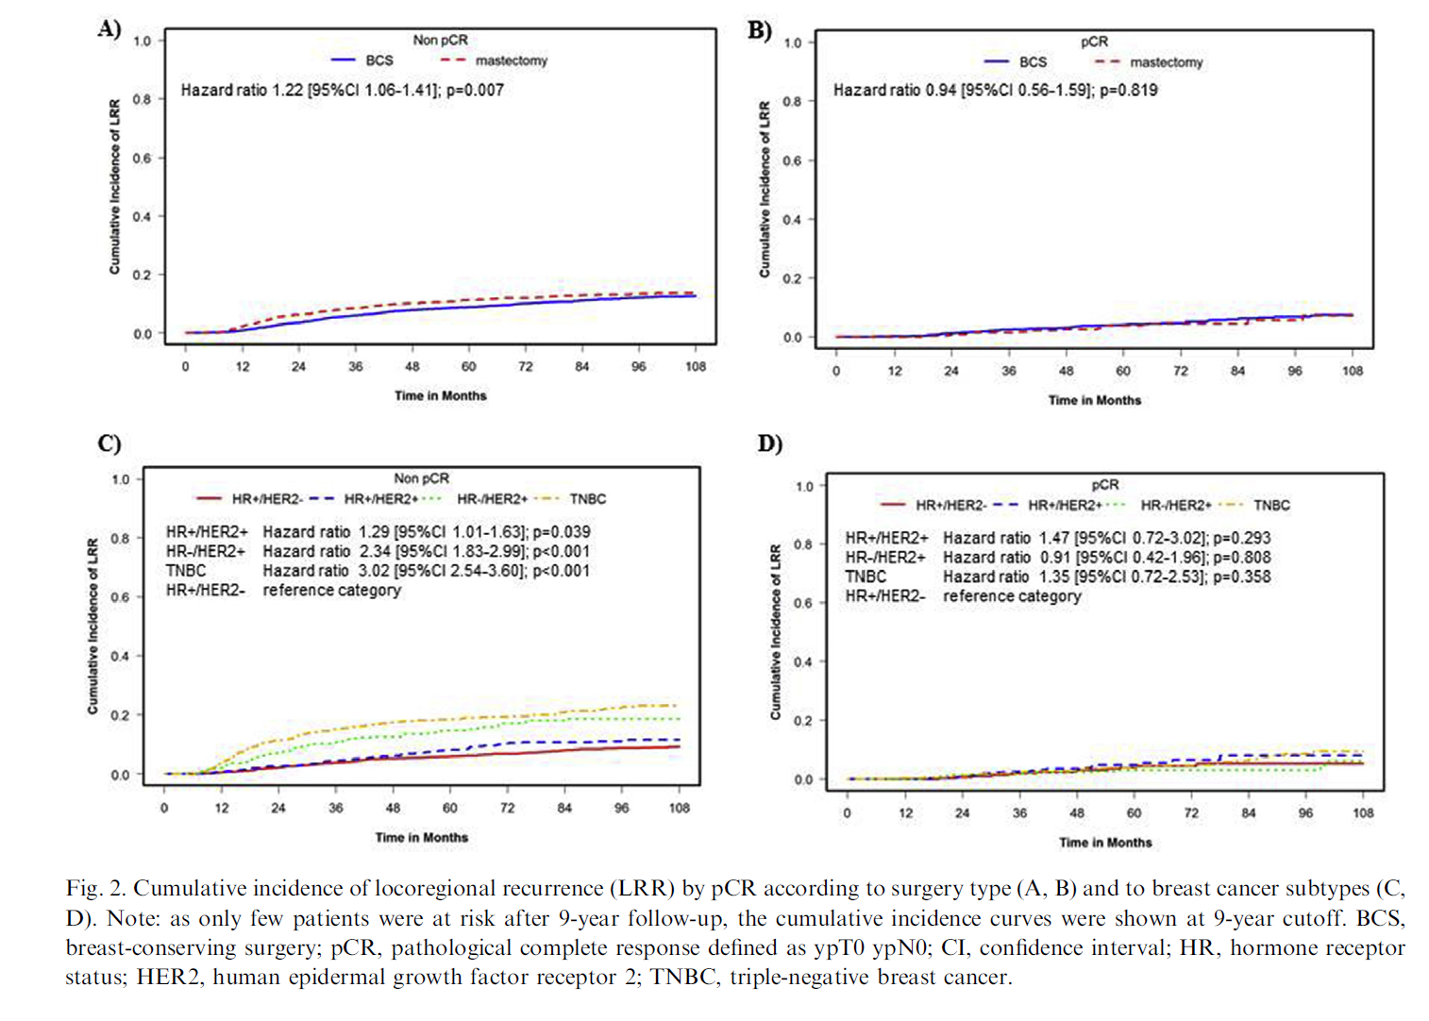
Locoregional Recurrence Risk After Neoadjuvant Chemotherapy: A Pooled Analysis of Nine German Prospective Neoadjuvant BC Trials
Werutsky G et al. Eur J Cancer. 2020;130:92-101.
Notes:
Patterns and predictors of LRR after NAC,Mastectomy pts had no PMRT
NAC: AC alone, or AC with neoadjuvant or adjuvant docetaxel
3088 pts with10 year follow up

Slide 17
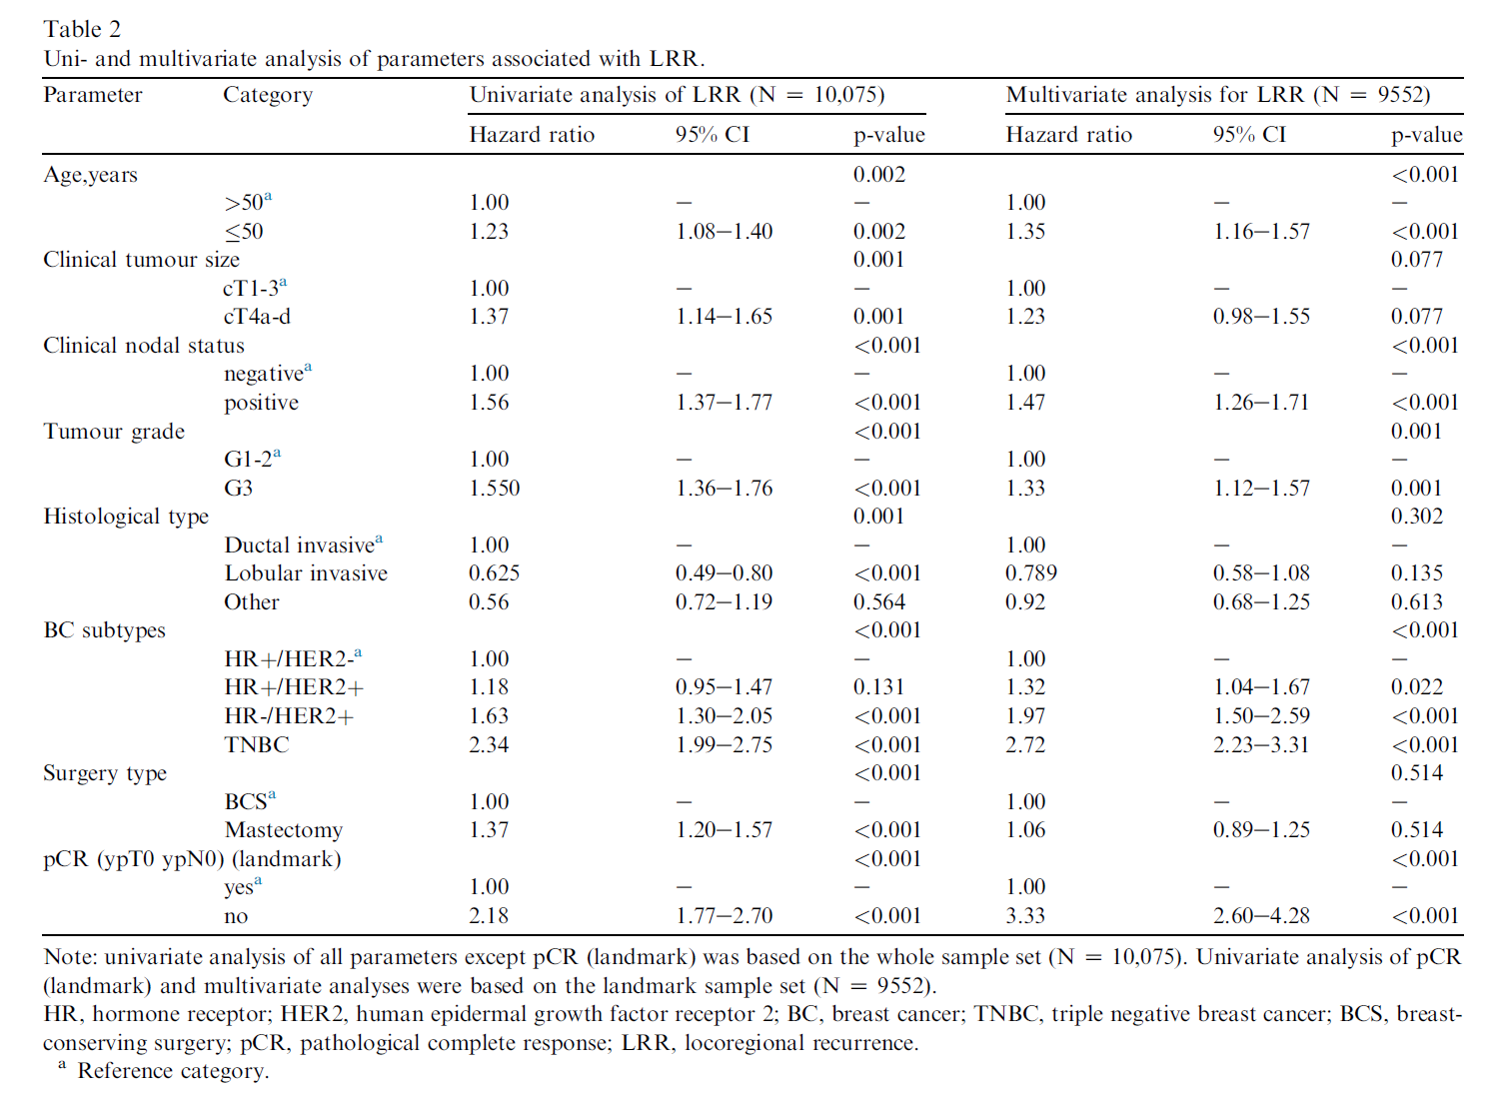
Locoregional Recurrence Risk After Neoadjuvant Chemotherapy: A Pooled Analysis of Nine German Prospective Neoadjuvant BC Trials
Werutsky G et al. Eur J Cancer. 2020;130:92-101.
Notes:
Patterns and predictors of LRR after NAC,Mastectomy pts had no PMRT
NAC: AC alone, or AC with neoadjuvant or adjuvant docetaxel
3088 pts with10 year follow up

Slide 18
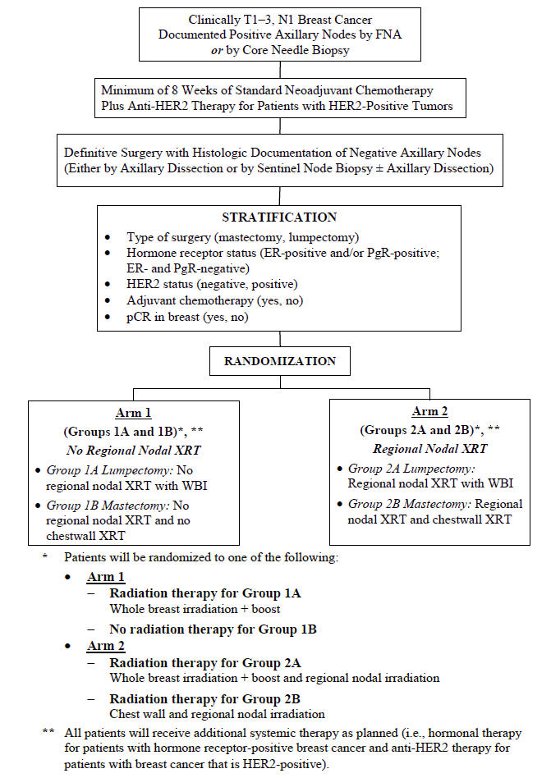
NSABP B51/RTOG 1304: Randomized Phase III Trial Evaluating Postmastectomy Chest Wall and Regional Nodal XRT and Post-lumpectomy RNRT in Pts With Positive Ax Nodes Before NC Who Convert to Pathologically Negative Ax Nodes After NAC
Clinical stages cT1-3 cN1
Completed accrual 12/28/20
Endpoint: IBC-RFI, defined as time from randomization until invasive local, regional, or distant recurrence, or death from breast cancer
N= 1641 cN+ → pN0
BCT (58%) or mastectomy (42%)
  T3 < 20%; HR+ 53%; HR+/Her2- 20%; Her2+ 56%; pCR breast 78%; ALND 44%
Randomized to RNI vs. No RNI (observe after mastectomy)
Conclusion: Downstaging LN+ disease with NAC may allow omission of RNI without affecting cancer outcomes
5 Year Outcomes | IBC-RFI | FFDM | Overall
No RNI | 91.8% | 93.4% | 94%
RNI | 92.7% | 93.4% | 93.6%
Mamounas EP. N Engl J Med. 2025 Jun 5;392(21):2113-2124.
doi: 10.1056/NEJMoa2414859.

Slide 19
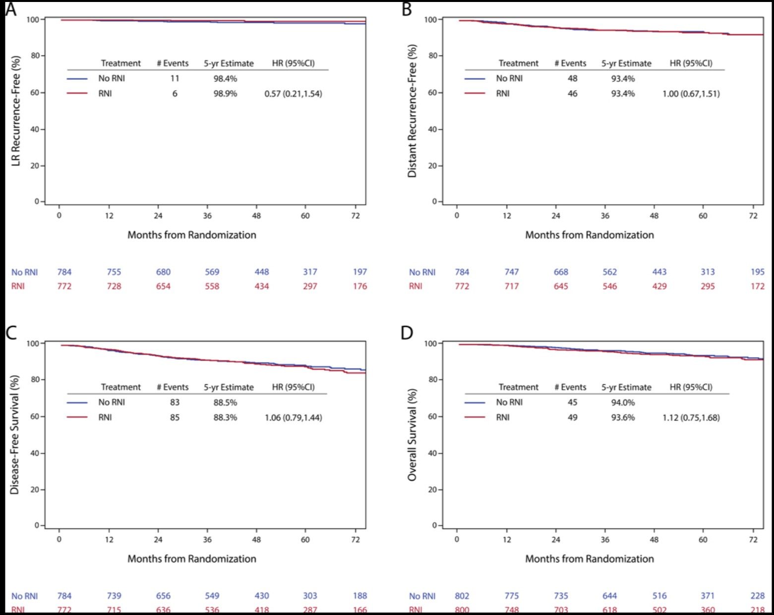
NSABP B51/RTOG 1304: Randomized Phase III Trial Evaluating Postmastectomy Chest Wall and Regional Nodal XRT and Post-lumpectomy RNRT in Pts With Positive Ax Nodes Before NC Who Convert to Pathologically Negative Ax Nodes After NAC, Clinical stages cT1-3 cN1
Figure 2:. Effects of Regional Nodal Irradiation on Secondary End Points.
Effects on locoregional recurrence–free interval (Panel A),
distant recurrence–free interval (Panel B), disease-free survival (Panel C),
overall survival (Panel D).
Mamounas EP. N Engl J Med. 2025 Jun 5;392(21):2113-2124. doi: 10.1056/NEJMoa2414859.

Slide 20
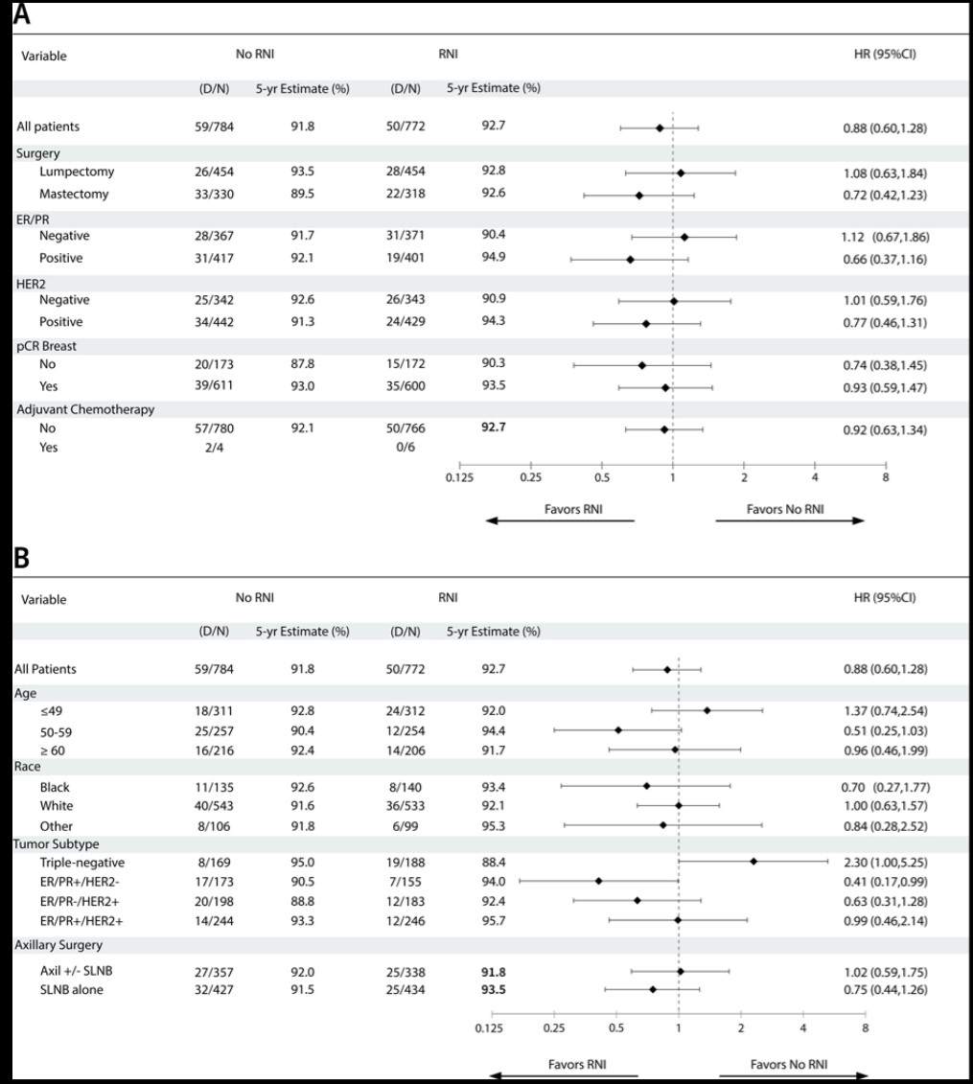
NSABP B51/RTOG 1304
Figure 3:. Subgroup Analysis of Invasive Breast Cancer Recurrence-Free Interval.
Results from the main subgroup analysis of invasive cancer recurrence-free interval among patients categorized by prespecified subgroups (Panel A) and from an exploratory analysis categorized by additional variables (Panel B)
Mamounas EP.
N Engl J Med. 2025 Jun 5;392(21):2113-2124. doi: 10.1056/NEJMoa2414859.

Slide 21
IJROBP Gray Zone: B-51 and Omission of Nodal Radiation: One Size Fits All?
Case scenario: 56 year old perimenopausal woman with palpable right breast mass
  Diagnostic imaging with 2.9 cm mass right UIQ
  MRI with 3.2 cm mass, 3.6 cm NME extends anteriorly to nipple & 9 mm level 1 abnl node
    4 mm right IMN node
  Biopsy: grade 3 invasive ductal cancer, ER++/PR++/Her2 3+
    Axillary LN biopsy negative
  Metastatic work up negative (no PET)
    Clinical stage cT2 (vs T3?) cN0 (vs N1 vs N3?) cM0
  NAC: TCHP
    Restaging breast MRI shows complete clinical resolution of enhancement
  Patient elected bilateral skin sparing mastectomy with TE placement
  Pathology: 2 mm residual focus IDC, +LVI, grade 3 DCIS (no size given); 2/4 SLN with post-treatment effect
    Pathologic stage ypT1a ypN0 cM0
  Adjuvant Kadcyla recommended
  PMRT???
Jhawar, Sachin R. et al. Int J Radiat Oncol Biol Phys, 2025: Vol 123 (3), 610

Slide 22
IJROBP Gray Zone: B-51 and Omission of Nodal Radiation: One Size Fits All?
Response #1: PMRT Yes (Arbab & Rahimi)
  PMRT 50 Gy in 25 fx + 10 Gy IMN boost
    Possible IMN+; Extensive NME on MRI not biopsied; LVI+; No ALND/SLN FN rate after NAC; OS benefit for PMRT in clinical stage III reported in Danish trials
    Conventional fractionation due to placement of TEs
Response #2: Favor PMRT (Moran & Buchholz)
  Discuss omission of PMRT, but favor PMRT to CW/axilla/ SC/IMNs; conventional or hypofractionated
    Residual IDCa in breast, LVI+; 30% reduction LRR with PMRT in cN+; NCCN states consider PMRT for cN+
    Impact of B51?: Not designed to evaluate non-inferiority of PMRT omission; PMRT gave 3% improvement in IRFS (HR 0.72); Only 5-year FU of concern for younger patients
Response #3: Favor PMRT (Meattini & Coles)
  Discuss patient preference but favor PMRT; Benefit outweighs risks; Hypofractionation appropriate
    Short FU on B51, EBCTCG RNI curves separate after 5 years; Medial tumor & possible IMN; High grade; cN+; Residual breast IDCa; LVI+
Response #4: PMRT Yes (Kaidar-Person & Poortmans)
  PMRT 40 Gy in 15 fractions
  Systemic therapy failure: residual IDCa/DCIS breast disease & LVI+; High risk features (grade 3, Her2+; probable cN+; possible IMN (probability > 30%); Use of skin sparing mastectomy; EBCTCG RNI MA showed OS benefit in pN0 high risk medial tumors
                Gray Zone, IJROBP, Volume 123, Issue 3, p613-614, November 01, 2025

Slide 23
Genomic Assays for PMRT Indications

Slide 24
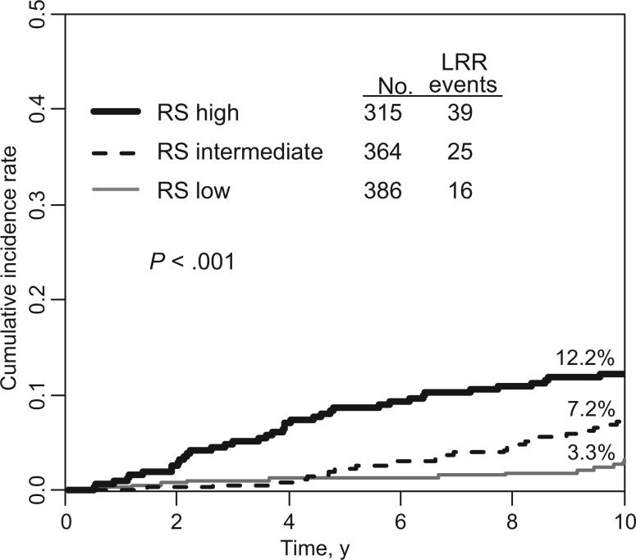
21-Gene Recurrence Score and Locoregional Recurrence in Node-Positive/ER-Positive Breast Cancer Treated With Chemo-Endocrine Therapy
NSABP B-28
Patterns of Recurrence after Mastectomy:
21-Gene recurrence score predicts LRR in node+, ER+ breast cancers treated with chemotherapy and endocrine therapy on NSABP B28
LRR occurred in 7.5%
RS predicted 10-year incidence of LRR
May help select patients for PMRT
Mamounas EP et al. JNCI. 2017;109(4).

Slide 25
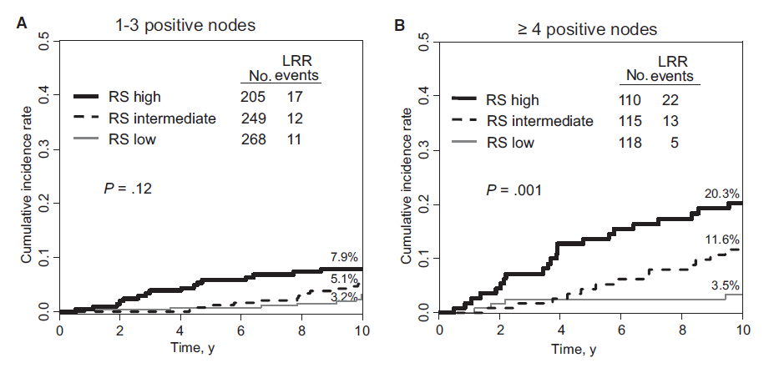
21-Gene Recurrence Score and Locoregional Recurrence in Node-Positive/ER-Positive Breast Cancer Treated With Chemo-Endocrine Therapy
NSABP B-28
Mamounas EP et al. JNCI. 2017;109(4).

Slide 26
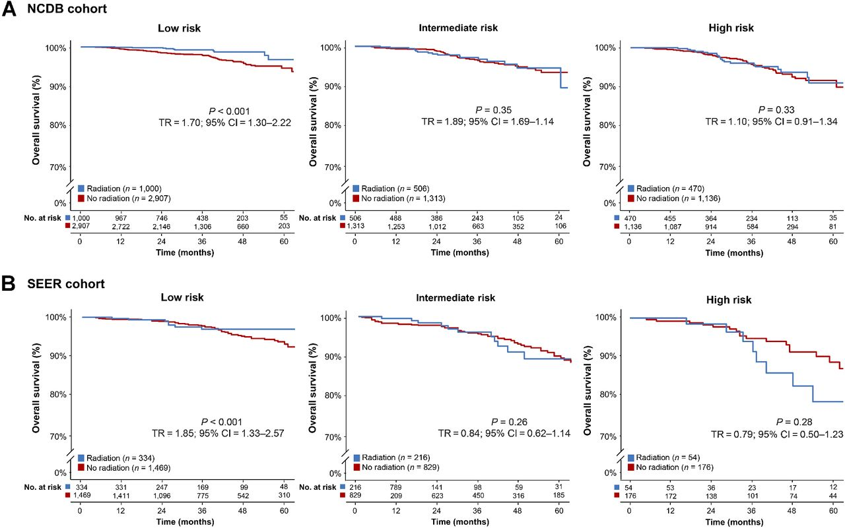
21-Gene Recurrence Score Assay Predicts Benefit of Post-Mastectomy Radiotherapy in T1-2 N1 Breast Cancer
Patterns of Recurrence after Mastectomy:
National Cancer Database and SEER cohort
10,419 cases
PMRT improved overall survival in women with low RS, who are also at lowest risk for distant metastases
Goodman CR et al. Clin Cancer Res. 2018;24(16).

Slide 27
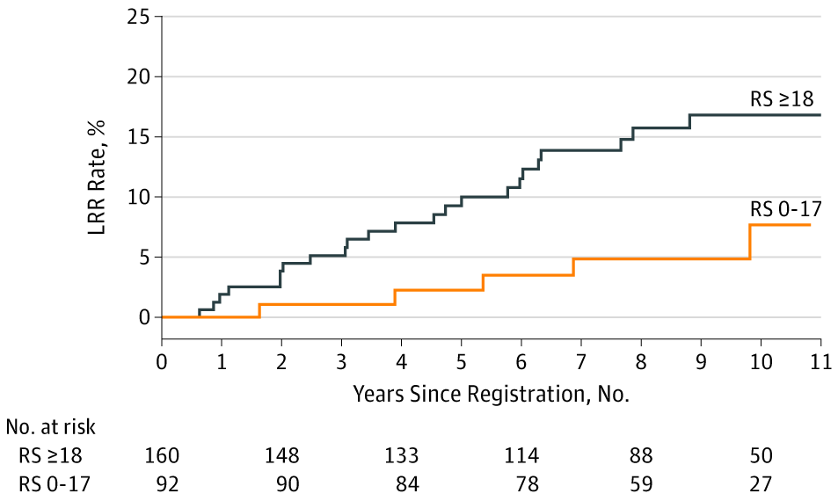
Association of 21-gene RS and LRR in N+ Breast Cancer
  Retrospective analysis of SWOG S8814: RCT for post-menopausal women ER/PR+, node+ of Tam alone vs. chemo→ Tam vs. chemo+Tam
  N=316 with evaluable 21-gene RS
  Median FU = 8.7 years
  Higher RS was prognostic for LRR in MVA, HR = 2.36
10 Year LRR | Low RS | Int/High RS | P value
Overall | 9.7% | 16.5% | .02
No PMRT | 7.7% | 16.8% | .03
No PMRT, 1-3 LN+ | 1.5% | 11.1% | .05
10-year actuarial LRR rates for all patients treated with mastectomy without adjuvant RT were 7.7% for those with low RS and 16.8% for those with intermediate or high RS (P = .03)
Woodward WA et al. JAMA Oncol. 2020;694:505-11.

Slide 28
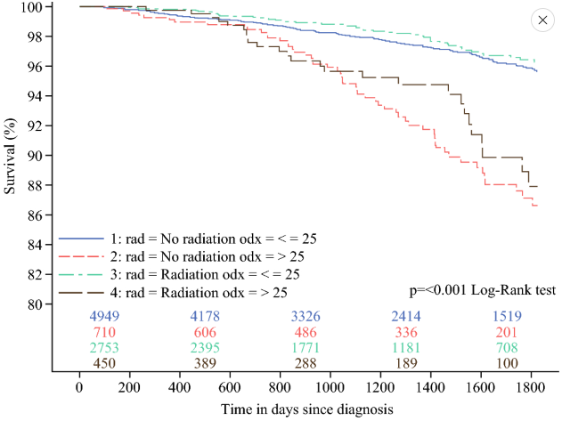
NCDB Analysis of 21-gene RS and PMRT Benefit
NCDB: ≤ 75 years, T1-3 N1 (1-3 +LN) M0, HR+/Her2-, RS available, undergoing mastectomy and axillary staging from 2010-2016
  N = 8907; PMRT in 36%, No PMRT in 64%
  5-year OS:
    PMRT = 97.5%
    No PMRT = 98%
    No improvement in OS for RS ≤ 25 with PMRT
    Also no benefit of axillary dissection or chemotherapy
Halfteck GG et al. Ann Surg Oncol. 2023; 30: 8335-43

Slide 29
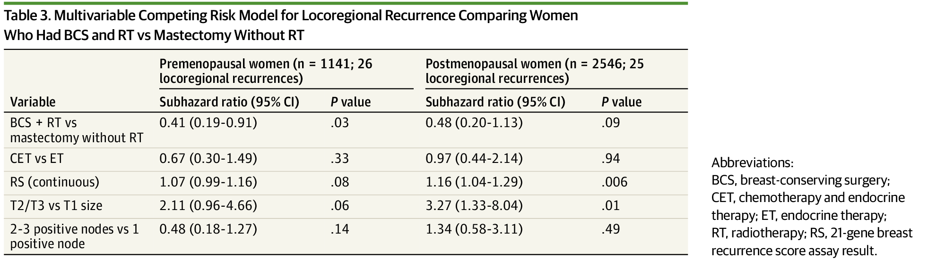
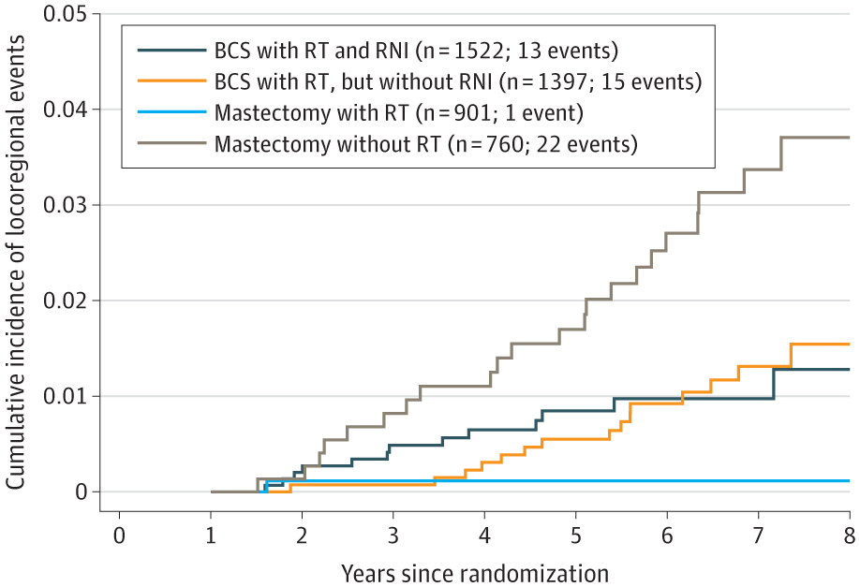
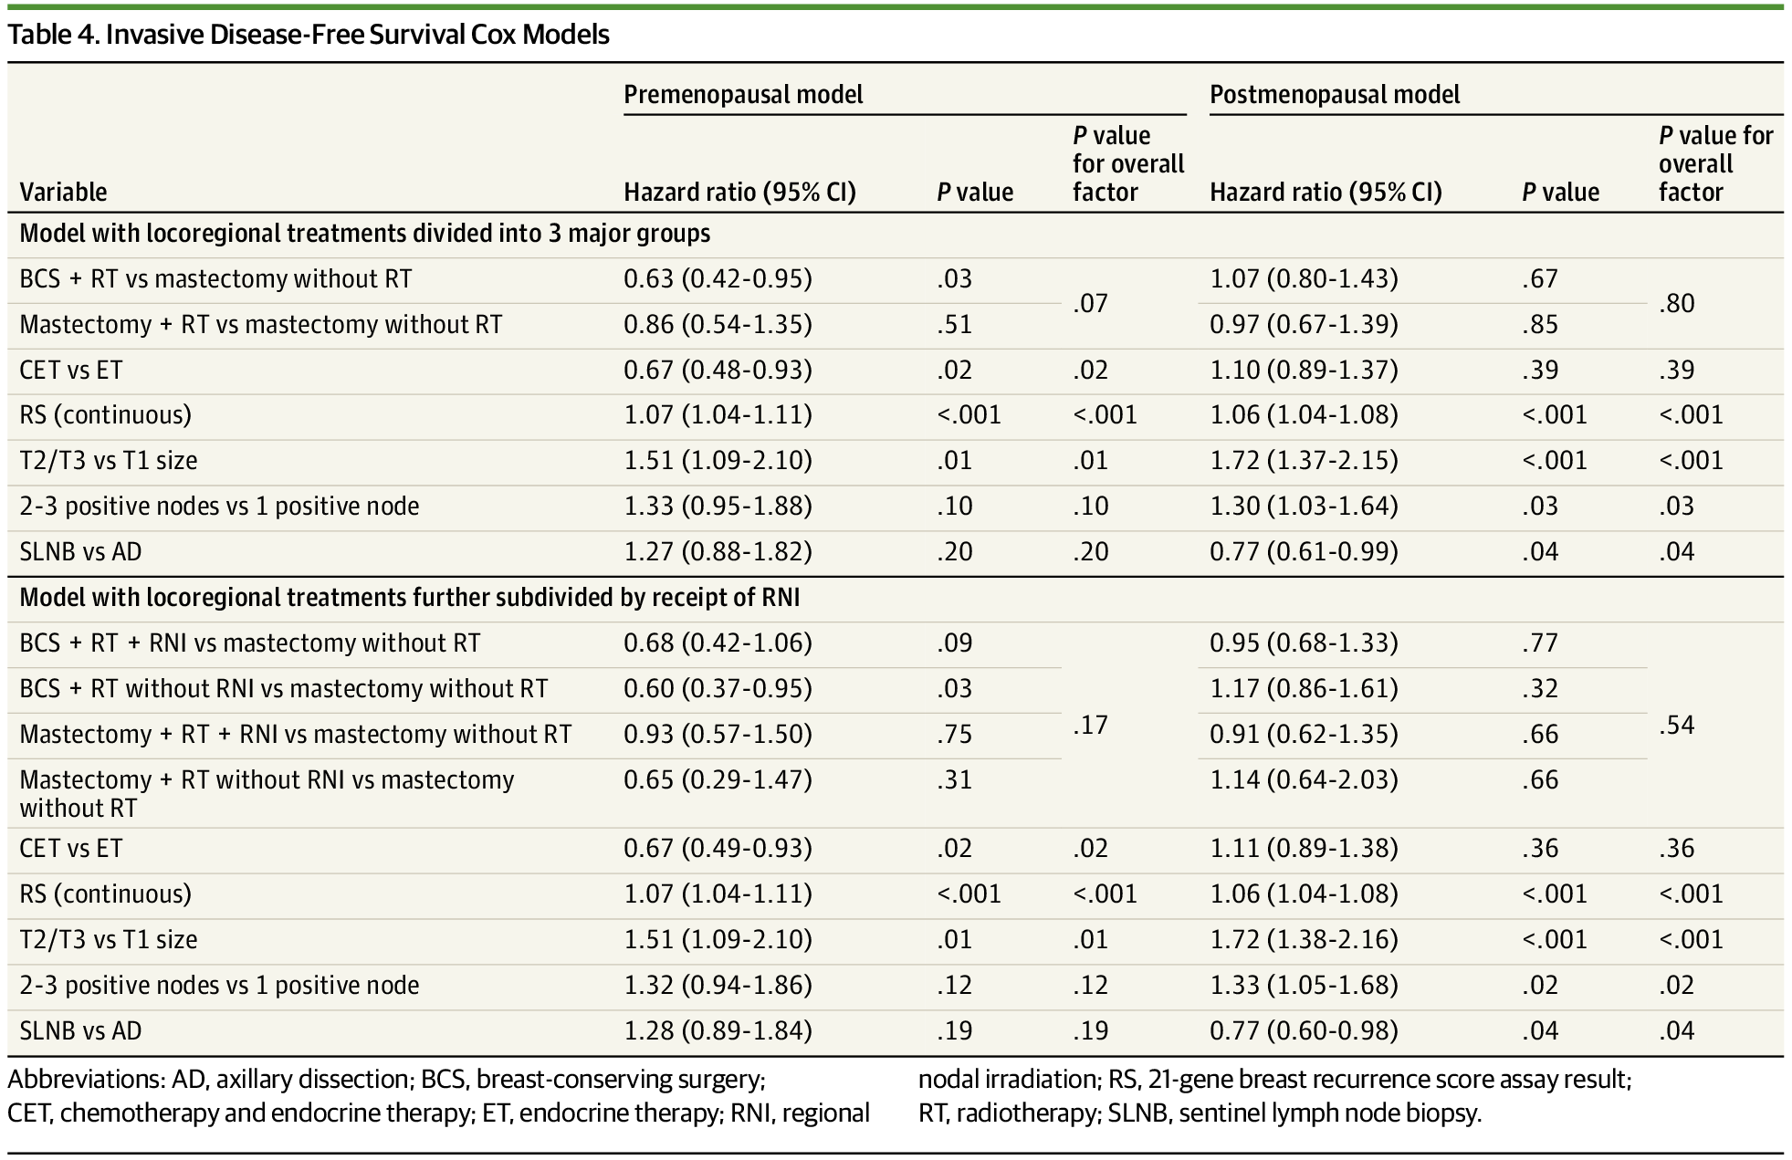
Radiotherapy Use and Incidence of Locoregional Recurrence in Patients With Favorable-Risk, Node-Positive Breast Cancer Enrolled in the SWOG S1007 Trial
JAMA Oncol. 2023;9(8):1083-1089. doi:10.1001/jamaoncol.2023.1984
SWOG S1007:
*21-Gene RS ≤ 25 -> ET vs CT-ET
HR+/Her2-; 1-3 + LNs
*Mast 790; Mast + RT 934
*Med FU 6 years
*Secondary analysis of IDFS & LRR by use of RNI
*N = 3852 with sufficient RT information
59% received RNI
Results:
No overall LRR difference +/- RNI or +/- CT
5-year LRR in PMRT patients
    PMRT = 0.11%
    No PMRT = 1.7%
    Similarly low +/- chemotherapy
Highest LRR risk in premenopausal with mastectomy only (no RT)
IDFS significantly better in premenopausal for BSC+RT compared to mastectomy only

Slide 30
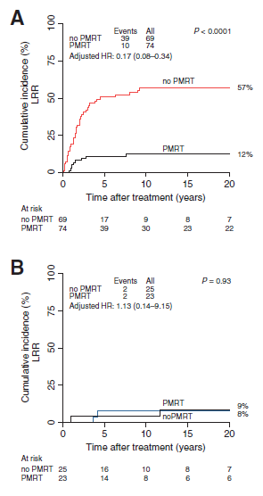
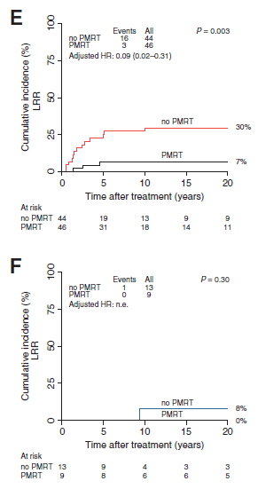
Development and Validation of a Gene Profile Predicting Benefit of
Post-mastectomy RT in Patients w/ High-risk BC:
Study of Gene Expression in the DBCG82bc Cohort
Seven-gene profile from FFT allowed separation into “high LRR risk” and “low LRR risk” in training set (A&B) such that PMRT was only beneficial in HR. Four-gene profile from FFPE in validation cohort predictive of PMRT benefit.
Results need to be tested in a prospective study.
Tramm T et al. Clin Cancer Res. 2014;20(20).

Slide 31
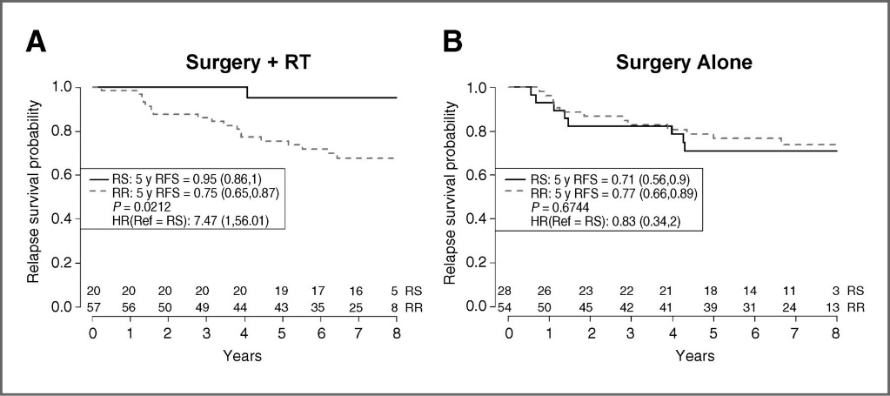
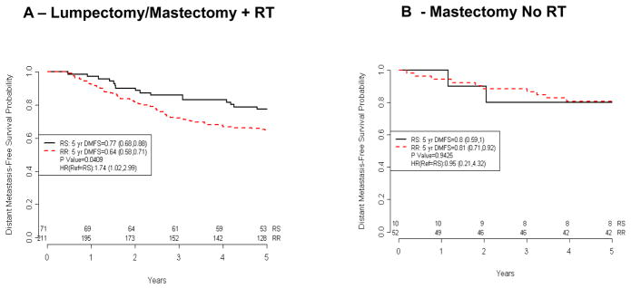
Validation of a Radiosensitive Molecular Signature in Breast Cancer
Association of the Radiosensitivity Signature with Clinical Outcome (Karolinksa dataset)
RSI identifies a radiosensitive population (25th percentile) that has an improved 5-year RFS in patients treated with surgery (lumpectomy) and RT. An interaction model between RSI and RT is consistent with RSI being RT-specific (P = .05).
Kaplan–Meier curves of predicted radiosensitive and radioresistant patients treated with mastectomy and no RT.
Association of the Radiosensitivity Signature with Distant Metastasis-Free Survival (Erasmus dataset).
Kaplan–Meier curves of 282 patients treated with surgery + RT.
Kaplan–Meier curves of 62 patients treated with mastectomy alone.
Eschrich SA et al. Clin Cancer Res. 2012;18(18).

Slide 32
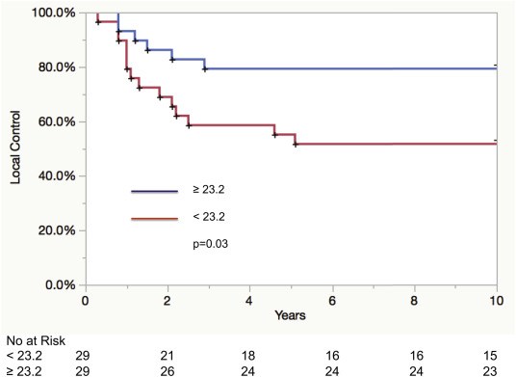
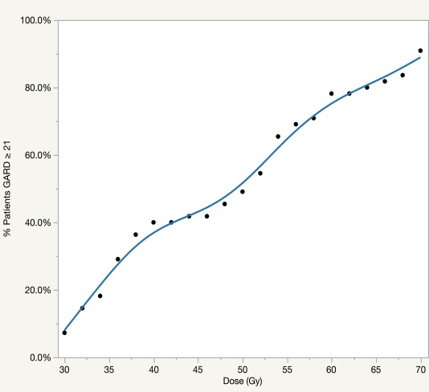
Utilizing the genomically adjusted radiation dose (GARD) to personalize adjuvant radiotherapy in triple negative breast cancer management
Kaplan Meier for local control in triple negative patients with GARD high/sensitive (> 23) and GARD low/resistant (<23)
Model for the percentage of triple negative patients achieving GARD high with doses between 30 and 70 Gy. 91% of patients LRC optimized with 70 Gy
Ahmed K., EBioMed, 2019: 47

Slide 33
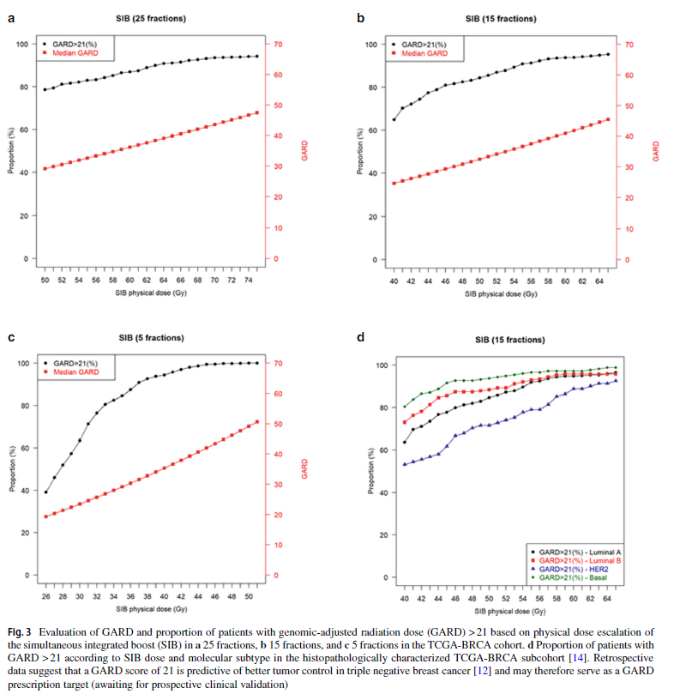
Genomic analysis of radiosensitivity in breast cancer
Cancer Genome Atlas (TCGA) RNA-seq data from 1284 breast cancers analyzed and RSI calculated and GARD computed
Validated in METABRIC cohort (N=1981)
Results:
*RSI was significantly lower in TNBC & Luminal B subtypes; Also with necrosis, tumor inflammation & high mitoses
*GARD High (> 21) associated with improved LRC
-Without RT boost, 78% patients would achieve GARD>21 after 50 Gy/25 fx versus 65% of patients after 40 Gy/15 fx
-With boost achieve GARD high achieved 95% of patients at 64 Gy/28 fx and 82% of patients at 48 Gy/15 fx
-TNBC had greatest benefit of moderate dose escalation: 95% achieve GARD high at 53 Gy/15 fx
Loap P., Strahlen Onkol, 2025
https://doi.org/10.1007/s00066-025-02454-4

Slide 34
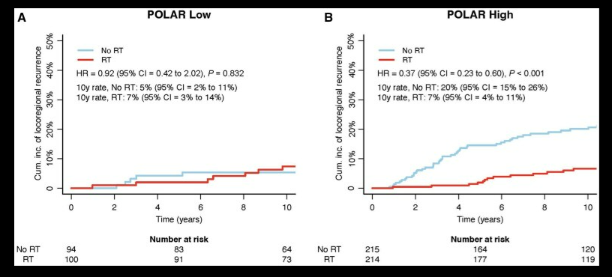
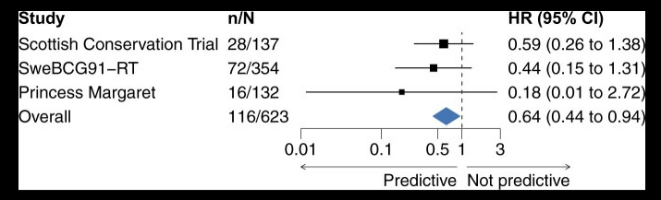
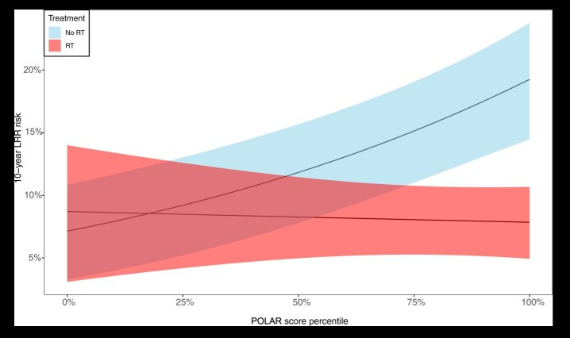
Profile for the Omission of Local Adjuvant Radiotherapy (POLAR)
*16 gene signature to identify low risk breast cancers without RT benefit
*Meta-analysis of 623 node negative HR+/Her2- BC from 3 RCTs
POLAR high in 69%, POLAR low in 31%
10 year LRR POLAR High:
  No RT = 20%
  RT = 7%
10 year LRR POLAR Low
  No RT = 5%
  RT = 7%
Karlsson P., JNCI 2025: 117(3)

Slide 35
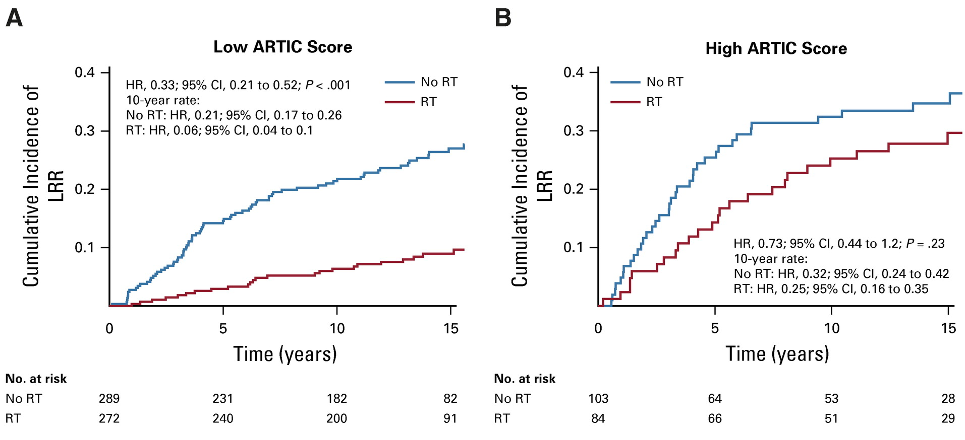
Performance of ARTIC
Predicted to be sensitive
Predicted to be resistant
Performance of ARTIC for prognostication of locoregional recurrence and treatment prediction for adjuvant radiotherapy in the SweBCG91-RT validation cohort.
Cumulative incidence of locoregional recurrence for high and low classifier scores (as split by the 75th percentile score) and interaction with RT.
Sjöström M et al. J Clin Oncol. 2019;37(35):3340-9.

Slide 36
Additional genomically stratified clinical trials for radiation omission in N+ patients
For whom is radiation omission appropriate?
Tailored Regional External Beam Radiotherapy in Clinically Node-negative Breast Cancer Patients With 1-2 Sentinel Node Macrometastases (TREX) – ARTIC and POLAR test (PI: Dr. Per Karlsson on behalf of Nordic Countries) Randomized phase III, 1350 pts
  ≥18 yo w/ T1-2 with 1-3 positive axillary nodes (macrometastases, > 2 mm)
  Breast or CW RT +/- regional nodal RT (supraclavicular, non-dissected axillary, and internal mammary)
  Primary endpoint: RFS at 5 years
Customizing Radiotherapy in Select Patients with High-Risk Breast Cancer: The CRISP Trial, NRG Research Strategy approved
  - Hypothesis: RT dose delivered per GARD will be associated with superior LRC compared to standard of care RT among high-risk TNBC patients with residual disease (RCB II-III) after neoadjuvant chemotherapy
  - Primary endpoint: 5 year rates of local-regional control with and without GARD radiation dose

Slide 37
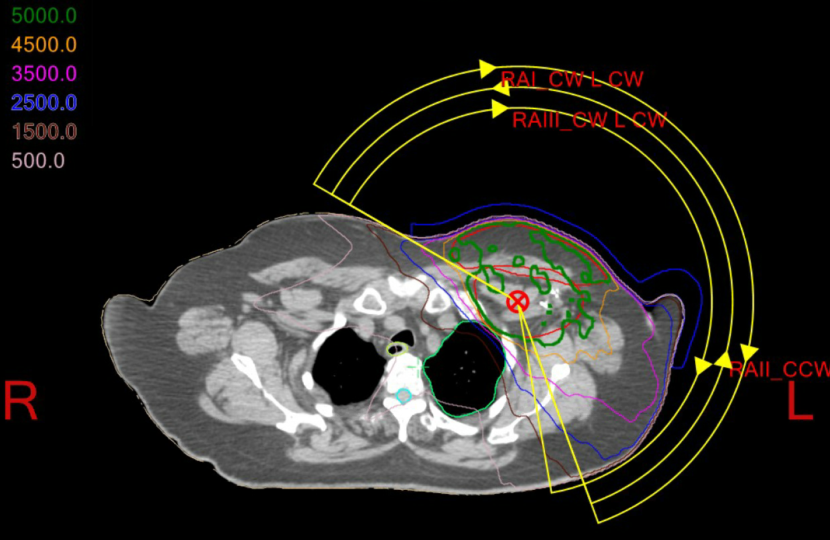
Radiation Treatment Planning for Breast Cancer
Treatment Planning Techniques

Slide 38
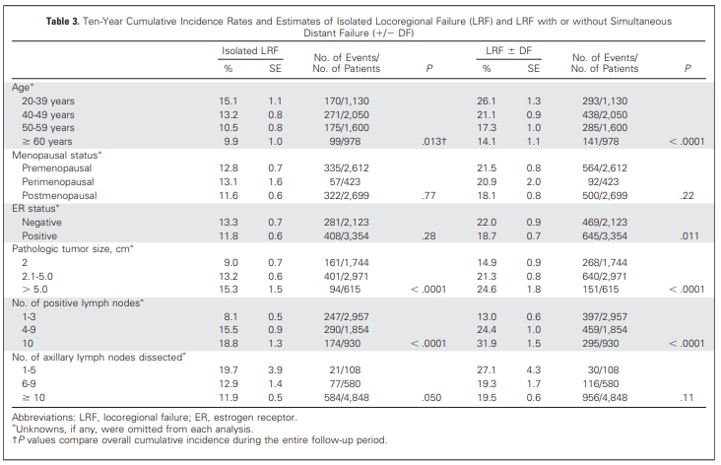
Patterns of Locoregional Failure in Patients w/ Operable BC Treated by
Mastectomy and Adj Chemo ± Tamoxifen and w/o RT
Results from Five National Surgical Adjuvant Breast and Bowel Project RCTs
*Meta-analysis of NSABP B-15, -16, -18, -22, and -25
*5,758 patients, s/p MRM, ≥ 1 axillary LN and no PMRT
*Included doxorubicin-based chemotherapy
Local Regional Recurrence:
  *Majority occurred in the chest wall/mastectomy scar (57%)
  *Supraclavicular LN RR = 23%
  *Axillary LN RR = 17%
  *Parasternal & subclavicular LN RR <1%
  *Age, number of LN+, and number of dissected LNs were statistically significant independent predictors for isolated LRR, LRR ± DM, and DM
Taghian A. et al. J Clin Oncol. 2004;22(21).

Slide 39
Radiation Treatment Planning Techniques
Photon (Megavoltage) Techniques:
  2D fluoroscopic based (no longer used)
  3D conformal CT-anatomy based
    Target volumes and Organs at Risk (OARs) should be contoured
    Often incorporates multiple modulation techniques
  Intensity modulated radiotherapy (IMRT)
    Step and shoot multiple beam angles
    Volumetric modulated arc therapy (VMAT)
    Forward planned and Inverse planned
Proton beam therapy
No one planning technique is uniquely superior for all cases. Individualized treatment planning is critical to minimize radiation-associated long-term toxicities.

Slide 40
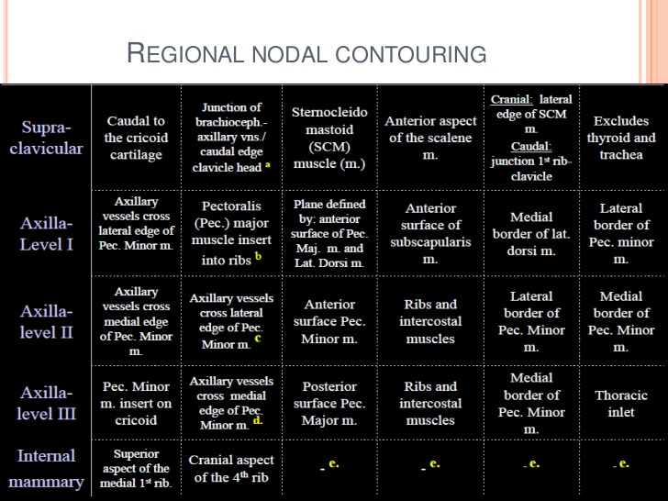
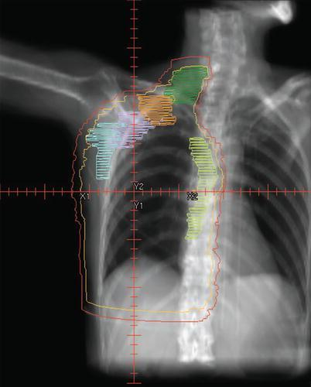
Post-mastectomy Radiation: RTOG Atlas
Also published: ESTRO and RADCOMP atlases

Slide 41
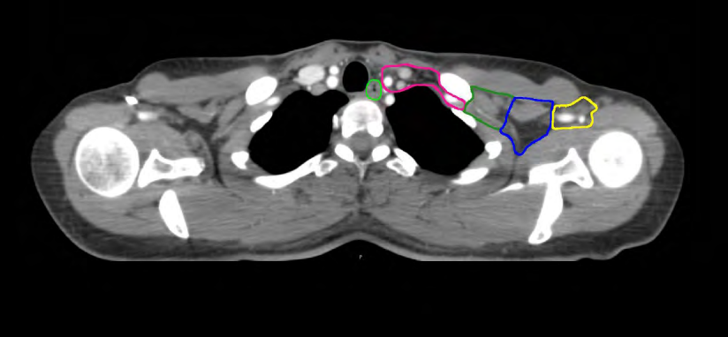
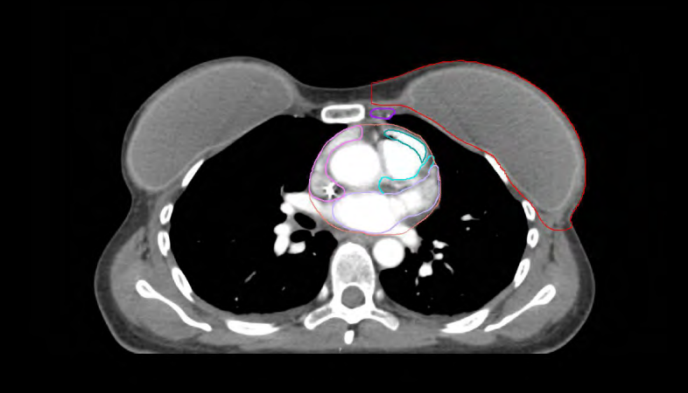
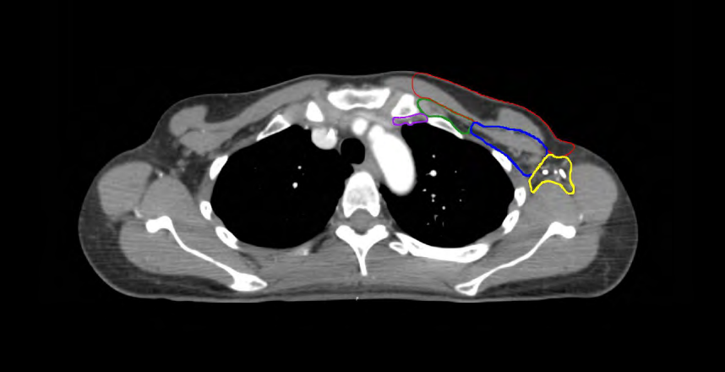
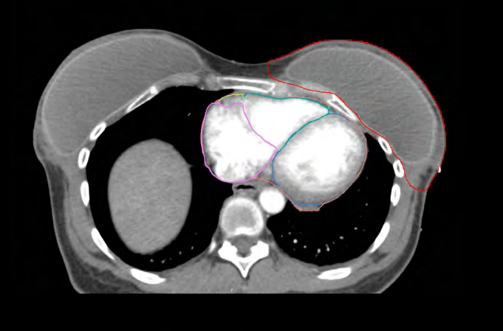
NRG RADCOMP Breast Atlas
RADCOMP Breast Atlas

Slide 42
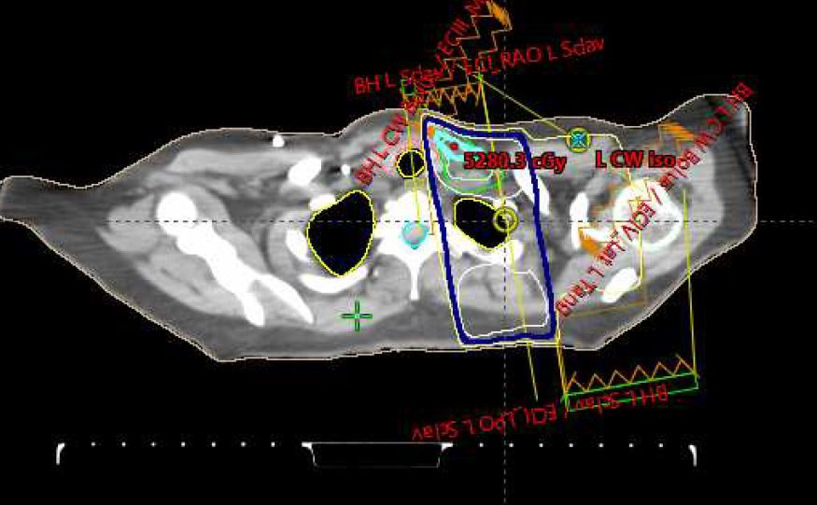
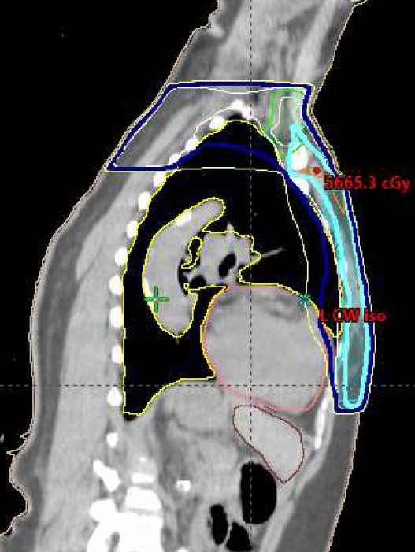
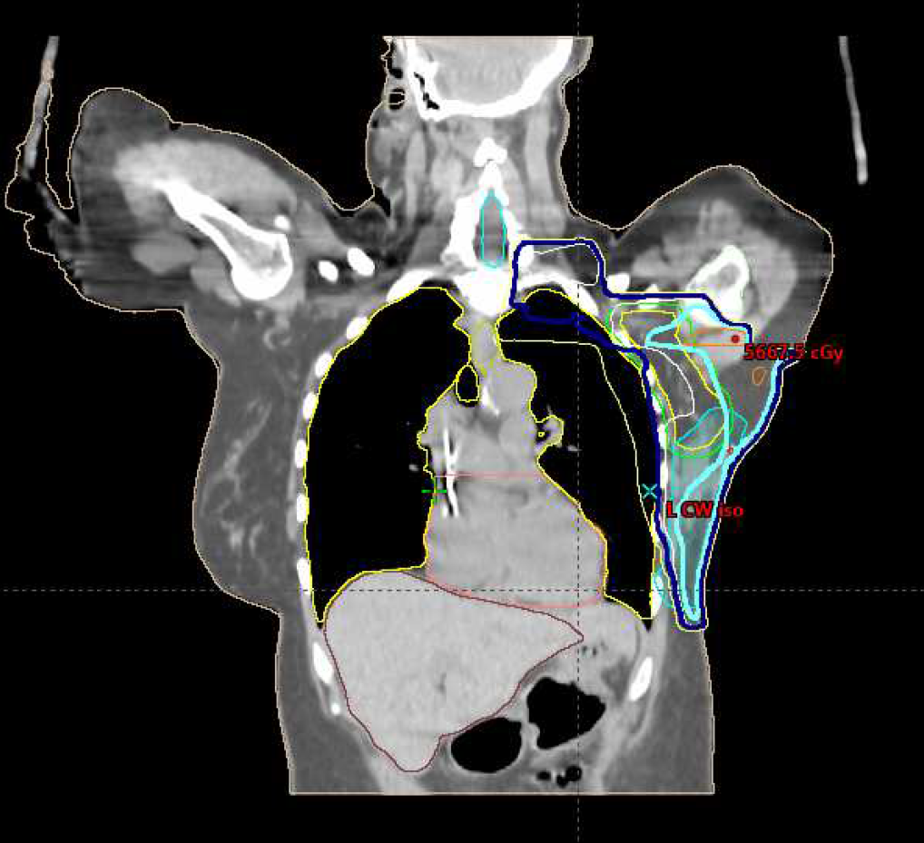
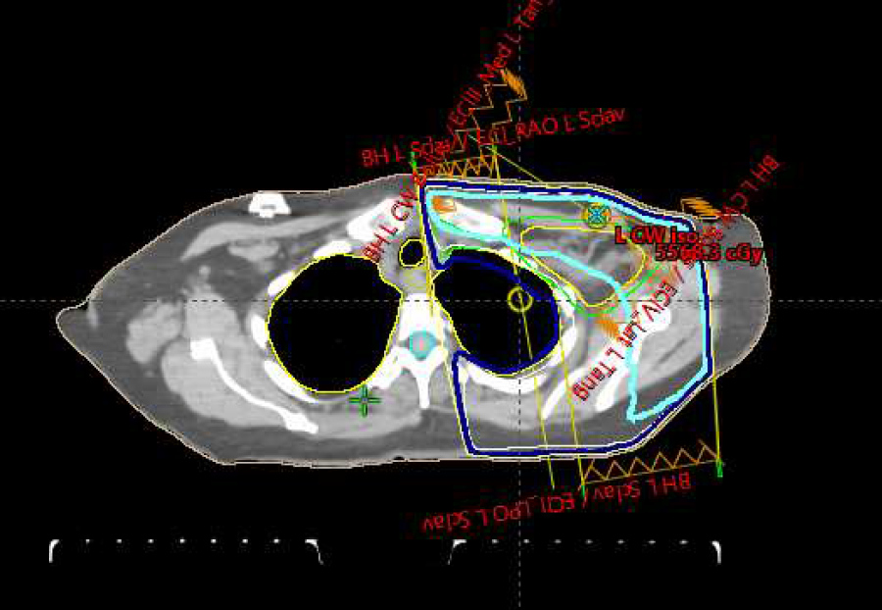
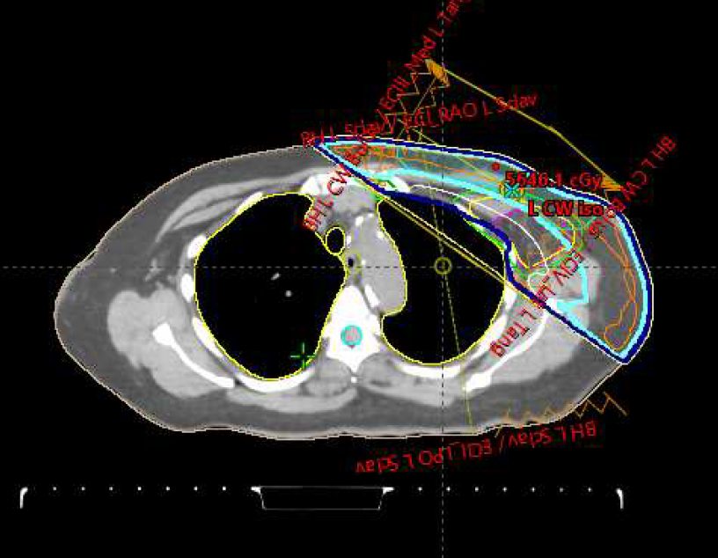
Radiation Treatment Planning
3D Conformal CT-Based Treatment Planning

Slide 43
Radiation Treatment Planning
Intensity Modulated Radiation Therapy (IMRT)
  Uses CT-based 3D anatomy
  Rather than one uniform intensity across a field, the intensity can vary to achieve a more conformal plan
  Target volumes are contoured for dose coverage and organs at risk are contoured for avoidance using evidence-based dose constraints related to organ toxicity risk
    Max dose to a point or volume
    Minimum dose to target volumes and percent covered by 95-100% of prescribed dose
  Multiple techniques: Step and Shoot; VMAT

Slide 44
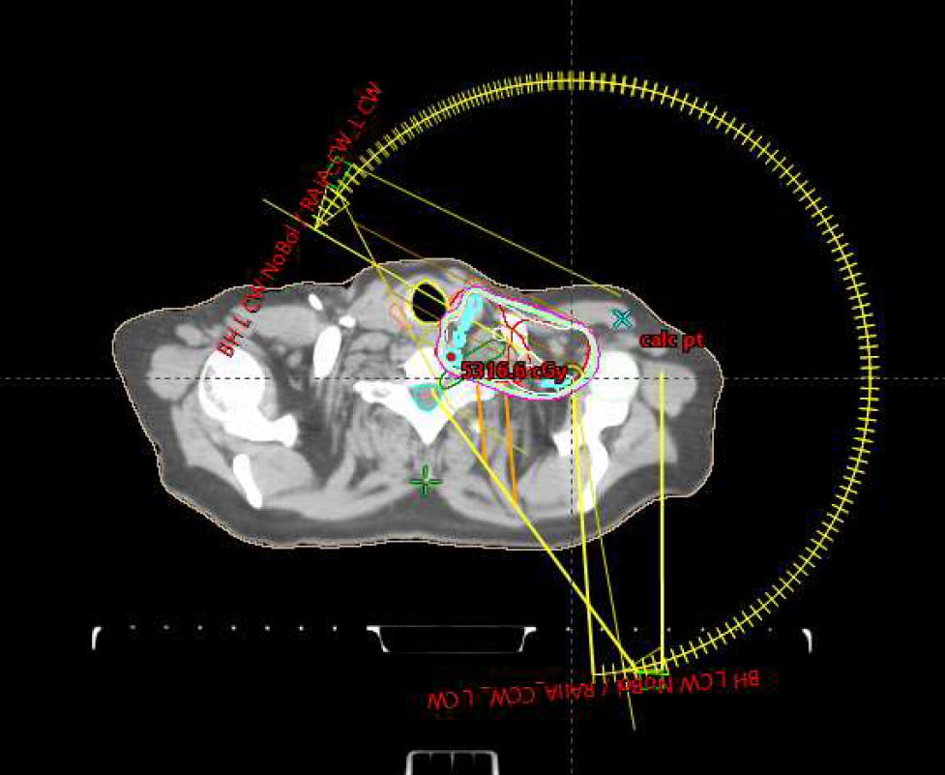
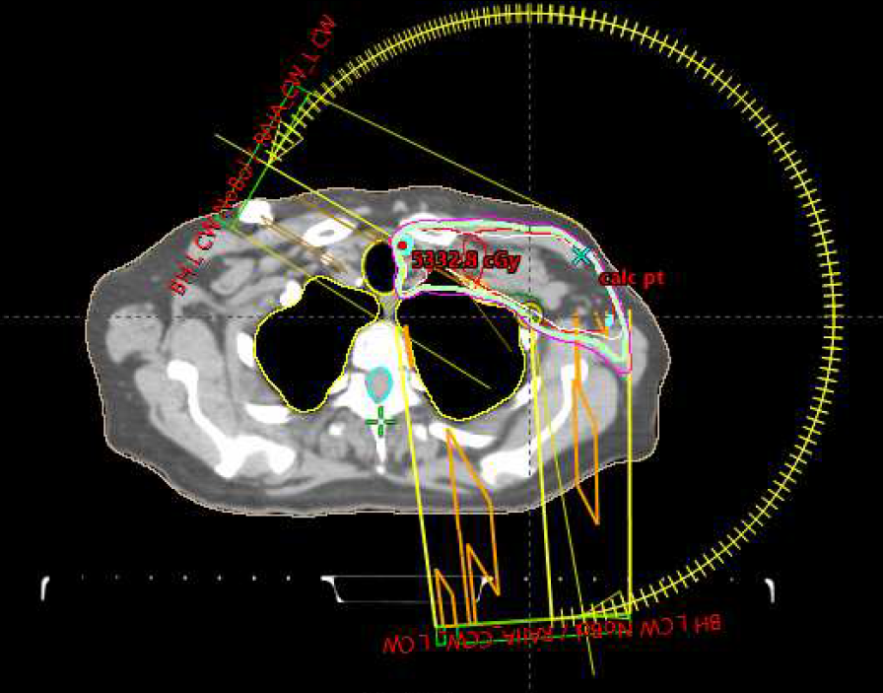
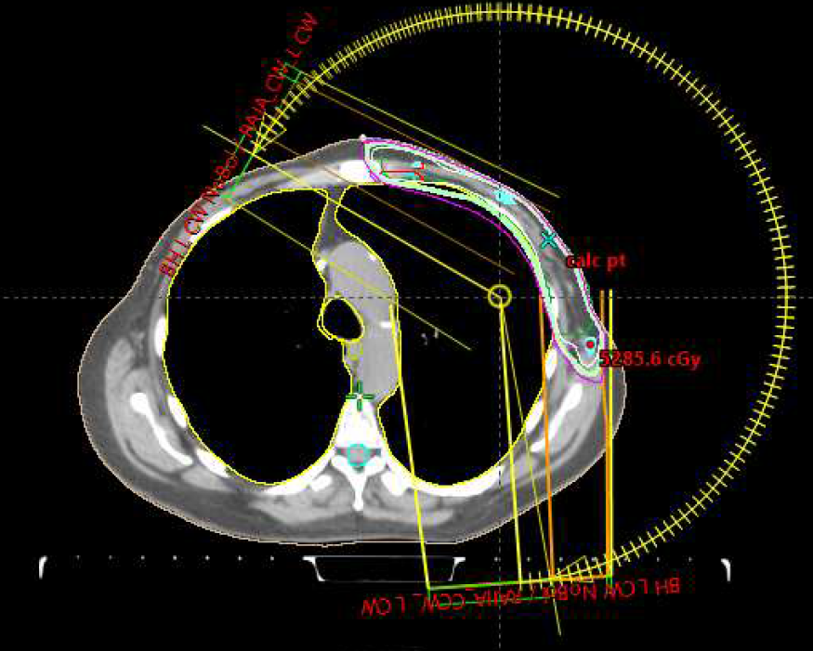
Radiation Treatment Planning
Intensity Modulated Radiation Therapy (IMRT) / Volumetric Arc Therapy (VMAT)

Slide 45
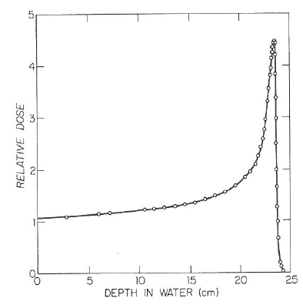
Proton Beam Therapy
Positively charged particles with mass 2,000 x that of electrons thus require more expensive equipment to accelerate to useful energies
Potential Benefits
Reduced exposure to heart, lung and contralateral breast
May allow dose escalation, where indicated
Potential concerns
High cost and variable insurance coverage policies
Motion could lead to under-dosing of target and over-dosing of heart
Increased skin dose

Slide 46
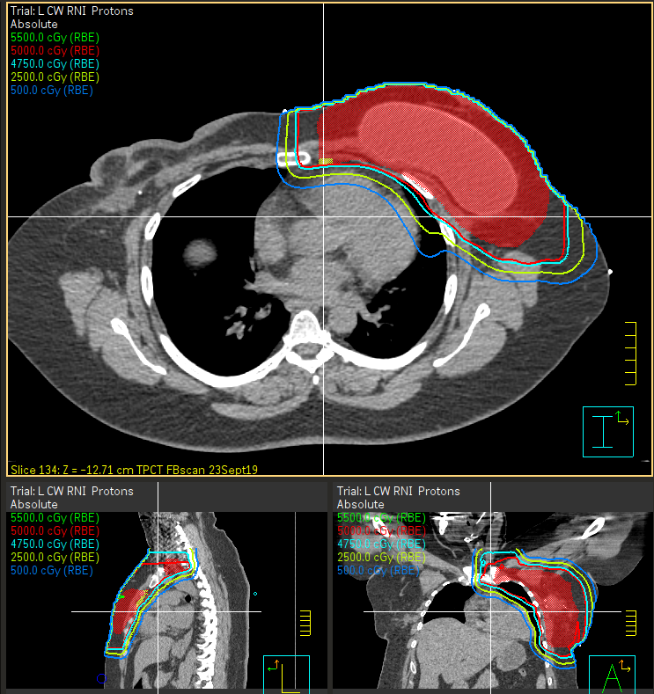

Protons Photons
Same CT

Slide 47

FABREC Study
Multicenter RCT Hypofractionation (HF) Vs. Conventional (CF) PMRT after Implant Reconstruction
  N = 400 Stage 0-III BC with immediate tissue expander (TE) or Implant (I); Median FU = 32 months; Median age = 47
  Primary outcome: 6 month change in Primary Well Being (PWB) domain of FACT-B QOL tool; Secondary toxicity & recurrence
  HF: 42.56 Gy to chest wall (CW), 39.9 Gy to supraclav (SC)
  CF: 50 Gy to CW, 46-50 Gy to SC
    Pre-op chemotx in 68%; Pre-op ET in 22%
  CW toxicity similar in each arm
  Factors associated with CW toxicity: Prior post-op infection, RT to TE vs. I, Preop ET, # nodes removed
  Fractionation was NOT associated with toxicity
  No difference by arm in PWB scores or among age groups
    Less bother from toxicity in HF arm in women < 45 years
    Less unpaid time off in HF arm
  1 LRR is each arm
Kaplan-Meier Plot for Freedom From Chest Wall Toxic Effects by Treatment Arm
Wong JS., JAMA Oncol. 2024: 10(10)

Slide 48

Alliance 221505 RT-CHARM: Hypofractionated Radiation Therapy After Mastectomy in Preventing Recurrence in Patients With Stage IIa – IIIa BC
Closed to accrual September 2021
Presented ASTRO 2024
Eligibility:
T0-3N1-2a M0, negative margins
Mastectomy with reconstruction or planning to have reconstruction
Plan for treatment to regional nodes including IMNs, no chest wall boost
Reconstruction within 18 months after radiation
Objectives:
Primary: Whether reconstruction rate at 24 months is non-inferior with hypofx
Secondary: Acute and late radiation toxicity
Local-regional recurrence rates
Reconstruction complication rates

Slide 49
ASTRO 2024: Alliance 221505 RT-CHARM: Hypofractionated Radiation Therapy After Mastectomy in Preventing Recurrence in Patients With Stage IIa – IIIa BC
N= 898; Median FU =4.5 years
Non-inferiority margin set at 10% difference in complications, assuming 25% with conventional RT
Characteristics:
  67% BMI > 25; 51% NAC
  Reconstruction:
    45% immediate; 55% delayed;
    57% implant only; 43% flap + implant
Results:
  Implant complications at 24 months: hypofx = 14% vs. conventional = 11.7% (p=0.0005)
  Complications less for flap+implant vs. implant only regardless of RT arm
  No difference in acute or late toxicity
  3 year LRR: 1.5% hypofx vs. 2.3% conventional
Conclusions:
  A 16-fraction course of hypofractionated PMRT appears safe and effective for pts undergoing breast reconstruction and is non-inferior to traditional 25-fraction course of PMRT
Poppe, M.M. et al. IJROBP, 120 (2) S11, 2024

Slide 50
ASTRO 2024: Primary Outcome Analysis for Shortening Adjuvant Photon Irradiation to Reduce Edema (SAPHIRE): A Randomized, Phase III Trial of Hypo- vs. Conventionally Fractionated Regional Nodal Irradiation (RNI)
Eligibility: cT0-T3 N0-N3a invasive breast cancer randomized to conventional STD-RNI (50 Gy breast/CW + 45 Gy RN) vs. shorter SH-RNI (40 Gy breast/CW + 37.5 Gy RN)
  N = 324, 2017-2022; Median FU = 4.75 years
  RNI targets: IMN, infra & supraclavicular, level I-II axilla if no ALN
Primary endpoint was lymphedema difference of 10% difference in post-RT arm circumference ne perometry assessment (normalized by pre-op circumference)
Results:
  Perometry assessed lymphedema lower for SH-RNI (29%) than STD-RNI (36%); p=0.24
  Physician assessed lymphedema was lower for SH-RNI (15%) than STD-RNI (27%); p=0.009
  SH-RNI overall lower any grade 2 toxicity, 52% vs 78%, p<0.001
  No brachial plexopathy events
  5 year LRR was similar (SH-RNI 3% vs STD-RNI 2%)
            Hoffman K, et al. IJROBP, 120 (2) S14-15, 2024

Slide 51

ESMO 2024: HypoG-01 Phase III UNICANCER: Locoregional hypo vs normofractionated RT in early breast cancer
Hypo (HF; 40 Gy/15 fx)) vs. Normo (NF; 50 Gy/25 fx) fractionated RT randomized non-inferiority trial
  Eligibility: > 18 year, T1-3N0-3 M0 breast cancer with RT to breast or chest wall and regional nodes
  Primary endpoint: Time to arm lymphedema; Secondary: LRFS, DDFS, OS
  N= 1265; Median FU = 4.8 years
    Mastectomy 45%; ALND 83%
  Results:
    Lymphedema occurred in 2.2% (N=275)
    HF non-inferior to NF (HR =1.02)
    Survival outcomes showed “no concerns”
Conclusions: Moderately HF loco-regional RT is non-inferior to NF RT in terms of arm lymphedema risk in eBC and did not lead to unfavorable safety nor LRFS, DDFS, OS concerns.
                Brian T, Radioth Oncol, 2025: 207

Slide 52


Comparison of hypofractionation and conventional fractionation in postmastectomy radiotherapy after immediate breast reconstruction: A meta-analysis of complications, Hayashi et al., Eur J Cancer, 2025: 227

Slide 53
Magnitude of Cardiac Risk with RT
Dose effect on the heart
Darby SC et al. N Engl J Med. 2013;368(11).

Slide 54

Deep Inspiration Breath Hold

Slide 55
Summary of PMRT Indications
High risk (PMRT Indicated)
  4+ lymph nodes after axillary dissection
  N2 or N3 disease
  T4
  T3N1
  N+ after neoadjuvant chemotherapy
  Positive margin(s)
Intermediate risk (Consider PMRT)
  1-3+ lymph nodes w/ one or more risk factors
    Increased nodal ratio, LVSI, young age, HR-, high grade, triple negative, multicentric/multifocal, medial tumor location, ECE (≥ 2 mm)
  T3N0
  pCR after NAC
Low risk (PMRT usually not indicated)
  T1-2N0, margin negative
  Controversial for large TNBC, metaplastic, malignant phyllodes, sarcoma

Slide 56
Guidelines for Post-mastectomy Radiation Patient Selection and Techniques

Slide 57


Figure 1
Postmastectomy Radiation Therapy: An ASTRO/ASCO/SSO Clinical Practice Guideline
RB Jiminez, et al. Practical Radiation Oncology,
DOI: 10.1016/j.prro.2025.05.001
Notes:
Indications for PMRT.
Abbreviation: PMRT = postmastectomy radiation therapy. *See implementation remarks in Table 3 for details. †See implementation remarks in Table 4 for details. ‡PMRT may be omitted in the setting of complete pathological response in the breast and lymph nodes (ypT0N0).

Slide 58

Postmastectomy Radiation Therapy: An ASTRO/ASCO/SSO Clinical Practice Guideline

Slide 59

Postmastectomy Radiation Therapy: An ASTRO/ASCO/SSO Clinical Practice Guideline

Slide 60

Postmastectomy Radiation Therapy: An ASTRO/ASCO/SSO Clinical Practice Guideline

Slide 61
American Radium Society Appropriate Use Criteria Guideline for Post-mastectomy Radiation
PMRT is recommended for patients with stage III disease (T3N1, T4N1, and T4N2 primary tumors as well as stage T1-2 disease with 4 or more positive LNs).
The role of PMRT in patients with stage II node positive disease (T1-2 disease and with one to three positive LNs) is not supported by the data, particularly for patients who have received contemporary systemic therapy. Individualized recommendations are appropriate in some cases.
Patients with negative lymph nodes but intermediate risk disease, including stage pT3N0 tumor, positive margins or triple negative disease, may benefit from PMRT in terms of locoregional control, although its impact on survival is unclear.
The role of PMRT with pCR after NAC is actively being studied. Most patients presenting with clinical stage III disease or having residual disease after mastectomy should receive PMRT.
Novick K et al. Int J Rad Oncol Bio Phys. 2023:S0360-3016(23)07638-1. https://www.americanradiumsociety.org/page/docsbypanel. Updated 2022.

Slide 62
American Radium Society Appropriate Use Criteria Guideline for Post-mastectomy Radiation
Hypofractionated radiation to the chest wall and regional lymph nodes may be feasible, but longer follow up is required before it can be recommended for routine use. Hypofractionated radiation to the reconstructed breast should only be done on study.
PMRT to the reconstructed breast may increase the risk of failure of the reconstructed flap, capsular contracture and poor cosmetic outcome. Additional studies are needed to determine whether outcomes are improved by radiation post-implant versus pre-implant exchange.
The benefit of IM irradiation in addition to the chest wall and supraclavicular/axillary apex region is unclear, and long-term results from several trials will be important in defining which patients should receive treatment to the IM LNs. Treatment should be considered for patients at risk of IM involvement, such as those with medial or centrally located tumors and multiple positive axillary LNs.
Three-dimensional treatment planning is standard of care in breast radiotherapy to minimize dose to the lung and heart, particularly the left ventricle and left-anterior descending artery, in order to assure that improvements in breast-cancer-specific survival are not offset by non-breast-cancer mortality.
Novick K et al. Int J Rad Oncol Bio Phys. 2023:S0360-3016(23)07638-1. https://www.americanradiumsociety.org/page/docsbypanel. Updated 2022.

Slide 63

NCCN v4.2025 Guidelines for Invasive Breast Cancer

Slide 64

NCCN v4.2025 Guidelines for Invasive Breast Cancer

Slide 65

NCCN v4.2025 Guidelines for Invasive Breast Cancer

Slide 66

NCCN v4.2025 Guidelines for Invasive Breast Cancer

Slide 67
Pending and Ongoing Trials of Post-Mastectomy Radiotherapy

Slide 68

Alliance 011202: Randomized Phase III Trial Comparing Axillary Lymph Node Dissection to Axillary Radiation in BC (cT1-3N1) With Positive SLN Disease After Neoadjuvant Chemotherapy
Closed to accrual July 1, 2022
Primary objective is to evaluate whether radiation to the undissected axilla and regional lymph nodes is not inferior to ALND with RNI in terms of invasive breast cancer recurrence-free interval
The 5-year invasive breast cancer recurrence-free interval among the subset of B-18 and B-27 patients with clinically positive nodes found to have pathologically node positive disease following neoadjuvant chemotherapy was 58.1%
  Reducing this estimate of the hazard rate by 15% to account for the fact that these legacy trials tend to over-estimate the hazard rates in today’s patient population brings the estimate of the expected annual hazard rate to 0.0923 or a 5-year RFI of 63%
Radiation to the undissected axilla and regional lymph nodes will be considered non-inferior to ALND and radiation to the regional lymph nodes but not to the dissected axilla if 5-year DFI is at least 57%.

Slide 69
RF2-01: Factors Influencing Additional Nodal Disease and Pathologic Nodal Upstaging with Axillary Dissection in Patients with Residual Node Positive Breast Cancer After Neoadjuvant Chemotherapy Enrolled on Alliance A011202 Clinical Trial
J Boughey, SABCS 2024
Descriptive statistics of pathologic findings from A011202
  N= 1672 with +SLN; 785 (48%) → ALND and 842 (52%) → AxRT
  Median # LNs examined = 4 (range 1-8); 79% had 3-8 LNs examined
  53% had 1 + SLN; 26% had 2+ SLNs; 19% had ≥3 +SLNs
  Nodal disease was macroscopic in 83%
  In ALND arm, 46% had additional positive LNs (47% of macromets & 37% of micromets)
    No difference based on subtype
    Additional LNs based on # SLNs+: 1+ SLN = 33%; 2+ SLNs = 53%; ≥3 +SLNs = 76%
    Number additional LNs +: 1 = 36%; 2 = 19%; ≥3 = 45%
    Upstaging ypN stage in 25%: ypN1→ ypN2 = 19%; ypN1 → ypN3 = 4%; ypN2 → ypN3 = 2%
    Upstaging of ypN stage lower for Her2+ (17%) than HR+/Her2- (27%) or TNBC (27%)
  Conclusions: In patients with residual nodal positive disease after NAC, the rate of additional nodepositive disease on completion ALND is high (46%) and increases with presence of SLN macrometastases and as the number of positive SLNs increases.

Slide 70

MA.39 Tailor RT:
Randomized Trial of Regional RT in Biomarker Low-risk Node- positive BC
Will this trial show that biology is more important than regional treatment?
Completion in 2027

Slide 71
Radiotherapy Comparative Effectiveness (RADCOMP) Consortium Randomized Trial
1,716 patients with N+
Stage II or III BC
photons protons
Treatment to breast/chest wall and regional nodes including IMNs
Primary Outcome Measures
Difference in major cardiovascular events (10 years)
  Atherosclerotic coronary heart disease or other heart disease death
  MI
  Coronary revascularization
  Hospitalization for major heart events
Secondary Outcome Measures
Disease control (5 years)
QOL (5 years)
BCSS and OS (15 years)
Completed accrual March 2024, N=1239
Published PRO validation report 9/2024

Slide 72
Thank you!
Acknowledgements:
Lori Pierce, MD

