Slide 1



Treatment of Early Stage
HER2+ Breast Cancer
Sara M. Tolaney
Dana-Farber Cancer Institute
Disclaimer: This presentation is intended for personal use and for informational purposes only and does not replace independent professional judgment. This presentation is the property of Physicians’ Education Resource, LLC (“PER”) and is protected by U.S. and international copyright laws. You may not copy, reproduce, distribute, transmit, modify, or create derivative works of the presentation without the prior written permission from PER.

Slide 2


Disclosures
Disclaimer: This presentation is the property of Physicians’ Education Resource, LLC (“PER”) and is protected by U.S. and international copyright laws. You may not copy, reproduce, distribute, transmit, modify, or create derivative works of the presentation without the prior written permission from PER.
Consulting or Advisory Role: Novartis, Pfizer/SeaGen, Merck, Eli Lilly, AstraZeneca, Genentech/Roche, Eisai, Sanofi, Bristol Myers Squibb/Systimmune, Daiichi Sankyo, Gilead, Zymeworks, Zentalis, Blueprint Medicines, Reveal Genomics, Sumitovant Biopharma, Artios Pharma, Menarini/Stemline, Aadi Bio, Bayer, Incyte Corp, Jazz Pharmaceuticals, Natera, Tango Therapeutics, eFFECTOR, Hengrui USA, Cullinan Oncology, Circle Pharma, Arvinas, BioNTech, Launch Therapeutics, Zuellig Pharma, Johnson&Johnson/Ambrx, Bicycle Therapeutics, BeiGene Therapeutics, Mersana, Summitt Therapeutics
Research Funding (to institute): Genentech/Roche, Merck, Exelixis, Pfizer, Lilly, Novartis, Bristol Myers Squibb, AstraZeneca, NanoString Technologies, Gilead, SeaGen, OncoPep, Daiichi Sankyo, Menarini/Stemline, Jazz Pharma
Travel: Eli Lilly, Gilead, Jazz, Pfizer, Arvinas

Slide 3
Trastuzumab Has Changed the Natural History of HER2+ Breast Cancer
Overall Survival for HER2+ Trastuzumab-Treated Early Disease
Similar to or Better Than HER2-Normal
Study | Median F/U | HER2+/+Tras | HER2+/-Tras | HER2 –
BCIRG 005^{[a]}/006^{[b]} | 10 yr | (1841/2149) 86% | (870/1073) 81% | (2647/3298) 80%
NOAH^{[c]} | 5 yr | (87/117) 74% | (74/118) 63% | (75/99) 76%
Italian Registry^{[d]} | 4.1 yr | (52/53) 98% | (140/161) 87% | (1108/1186) 93%
GeparQuattro^{[e]} | 5.4 yr | (392/446) 88% |  | (889/1049) 85%
FinHer^{[f]} | 5 yr | (12/115) 90% | (21/116) 82% | (61/778) 92%
F/U = follow-up
a. Mackey JR, et al. Ann Oncol. 2016;27:1041-1047; b. Slamon DJ, et al. Cancer Res. 2015;76(4 Suppl):Abstract S5-04;c. Gianni L, et al. Lancet Oncol. 2014;15:640-647; d. Musolino A, et al. Cancer. 2011;117:1837-1846; e. von Minckwitz G, et al. Ann Oncol. 2014;25:81-89; f. Joensuu H, et al. J Clin Oncol. 2009;27:5685-5692.
Notes:
F/U = follow-up
I have compiled those studies that included patients with both HER2 positive (trastuzumab treated and trastuzumab-non treated) and HER2 negative disease. The BCIRG-005 (HER2 negative) and BCIRG-006 (HER2 positive) trials are included as these studies were conducted at the same sites during similar time periods. Patients with HER2 positive disease were referred to BCIRG-006 and those with HER2 negative to BCIRG-005),
Keep in mind that in the pre-trastuzumab era, HER2+ breast cancer had worse outcome compared to HER2 normal disase. In most of these studies, this still holds true such that patients with HER2+ disease did worse than those with HER2 negative breast cancer in the absence of trastuzumab.
However, patients with trastuzumab-treated HER2+ disease have a simlilar or better (bolded) outcome than HER2 negative disease.

Slide 4
How can we personalize therapy?
Disclaimer: This presentation is the property of Physicians’ Education Resource, LLC (“PER”) and is protected by U.S. and international copyright laws. You may not copy, reproduce, distribute, transmit, modify, or create derivative works of the presentation without the prior written permission from PER.
De-escalate for those with lower risk
  Substitute with less toxic chemotherapy or with targeted agents
  Decrease amount of chemotherapy
  Decrease duration of therapy
Escalate for those with increased risk
  Add additional targeted agents
  Replace therapy with more effective agents
Notes:
These differences in outcomes really highlight the need for us to develop strategies to individualize therapy for patients in order to provide the right amount of therapy to the right patient to optimize outcomes while also trying to limit toxicity
Some strategies to would be to use biomarkers to help us determine which patients we may be able to de-escalate therapy for, and which patients with high risk may benefit from escalation of therapy, many of the current biomarkers of interest require further validation, and so another strategy would be to use clinical predictors to help us individualize care.
When considering methods for de-escalation of care, there are several strategies one could take to decrease toxicity:
Substitute with less toxic chemotherapy or with targeted agents
Decrease amount of chemotherapy
Decrease duration of therapy
When escalating therapy, we can take an add-on approach by adding additional targeted agents, or replacing chemotherapy with more effective biologic therapy

Slide 5
How can we personalize therapy?
Disclaimer: This presentation is the property of Physicians’ Education Resource, LLC (“PER”) and is protected by U.S. and international copyright laws. You may not copy, reproduce, distribute, transmit, modify, or create derivative works of the presentation without the prior written permission from PER.
De-escalate for those with lower risk
  Substitute with less toxic chemotherapy or with targeted agents
  Decrease amount of chemotherapy
  Decrease duration of therapy
Escalate for those with increased risk
  Add additional targeted agents
  Replace therapy with more effective agents
Notes:
These differences in outcomes really highlight the need for us to develop strategies to individualize therapy for patients in order to provide the right amount of therapy to the right patient to optimize outcomes while also trying to limit toxicity
Some strategies to would be to use biomarkers to help us determine which patients we may be able to de-escalate therapy for, and which patients with high risk may benefit from escalation of therapy, many of the current biomarkers of interest require further validation, and so another strategy would be to use clinical predictors to help us individualize care.
When considering methods for de-escalation of care, there are several strategies one could take to decrease toxicity: we could decrease the amount of chemotherapy, or replace standard chemotherapy with less toxic chemotherapy or with targeted agents, or we could decrease the duration of therapy
When escalating therapy, we can take an add-on approach by adding additional targeted agents, or replacing chemotherapy with more effective biologic therapy

Slide 6
Can Anthracyclines be substituted by taxanes?
Disclaimer: This presentation is the property of Physicians’ Education Resource, LLC (“PER”) and is protected by U.S. and international copyright laws. You may not copy, reproduce, distribute, transmit, modify, or create derivative works of the presentation without the prior written permission from PER.

Slide 7
Disclaimer: This presentation is the property of Physicians’ Education Resource, LLC (“PER”) and is protected by U.S. and international copyright laws. You may not copy, reproduce, distribute, transmit, modify, or create derivative works of the presentation without the prior written permission from PER.
IS ANTHRACYCLINE-BASED CHEMOTHERAPY NECESSARY?
BCIRG006: 10.3 YRS FOLLOW-UP
TCH ASSOCIATED WITH LESS CARDIAC TOXICITY AND NUMERICALLY FEWER CASES OF SECONDARY LEUKEMIA
Slamon D et al. SABCS 2015. Abstract S5-05.
Notes:
While N9831/NSABP B-31 utilized an anthracycline backbone, there is data from BCIRG 006 in which patients were randomized to received ACT with or without trastuzumab or to received TCH.
And while the study was not powered to compared ACTH to TCH, results demonstrated very similar outcomes in terms of both DFS and OS, but found fewer cardiac events and numerically fewer cases of secondary leukemia with TCH , suggesting that TCH is a very reasonable alternative to ACTH, and may be associated with less toxicity

Slide 8
BCIRG 006: DFS Lymph Node Positive
No ADVANTAGE FOR ANTHRACYCLINES EVEN IN THE HIGH RISK GROUP
69.6%
68.4%
62.2%
Slamon D et al. SABCS 2015. Abstract S5-05.
Notes:
When looking at the differences within the higher risk node-positive patients on this study, treatment related outcomes were similar to the overall study population, suggesting that there was no larger advantage for anthracyclines in the higher risk group

Slide 9
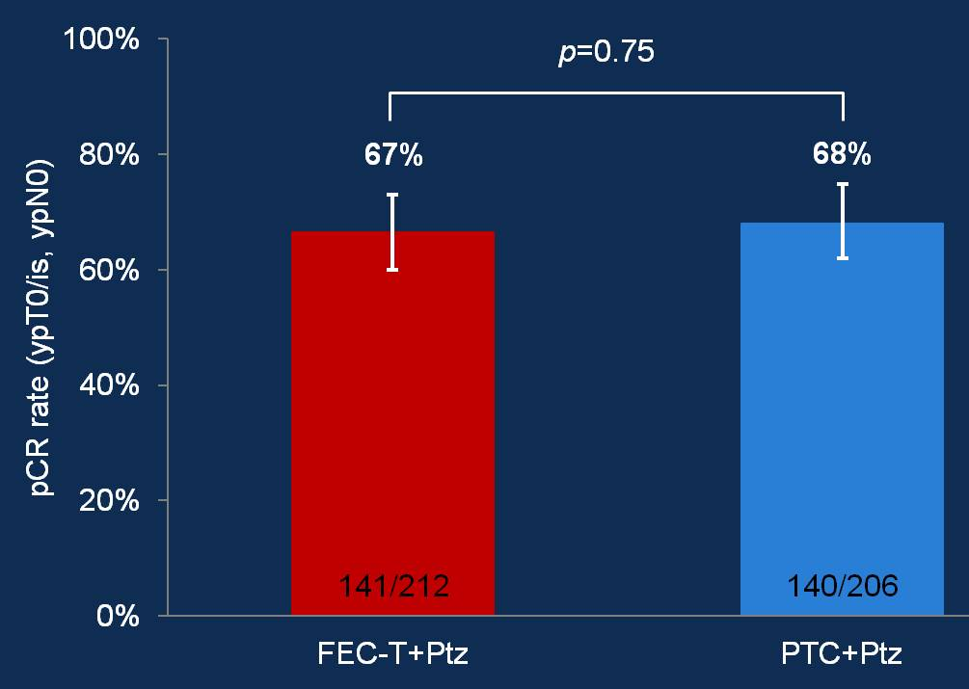
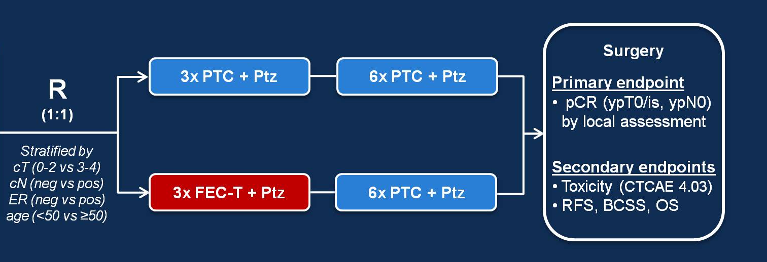
SUBSTITUTING ANTHRACYCLINE WITH TAXANE: TRAIN-2
Disclaimer: This presentation is the property of Physicians’ Education Resource, LLC (“PER”) and is protected by U.S. and international copyright laws. You may not copy, reproduce, distribute, transmit, modify, or create derivative works of the presentation without the prior written permission from PER.
64% node positive, 42% HR negative
pCR was consistent across all subgroups
More pts completed 1 year trastuzumab in PTC/Ptz arm (97% vs 89%)
Significantly more grade 3/4 febrile neutropenia (10% vs 1%) in anthracycline arm
Van Ramshorst MS, et al. ASCO 2017. Abstract 507.
Van Ramshorst MS, et al. Lancet Oncol. 2018;19(12):1630-1640.
Notes:
We also have data from the TRAIN-2 trial.
In this randomized, phase 3 trial patients with stage II/III HER2-positive breast cancer were randomly assigned in a 1:1 ratio to receive neoadjuvant chemotherapy with either 3 cycles of 5-fluorouracil, epirubicin, cyclophosphamide (FEC) followed by 6 cycles of paclitaxel plus carboplatin (219 patients) or 9 cycles of paclitaxel plus carboplatin (219 patients). HER2-targeted therapy with both trastuzumab and pertuzumab were coadministered with chemotherapy, with patients completing 1 year of adjuvant trastuzumab with radiotherapy and adjuvant endocrine therapy as indicated.
At a median follow-up of 19 months, a previously published analysis of results from 418 patients in this trial showed no difference in the primary study end point of pathologic complete response (pCR) rate when patients treated with an anthracycline (67%) and without an anthracycline (68%) were compared (P =.95).
In addition, a significantly higher rate of at least grade 3 febrile neutropenia were observed in the anthracycline-containing arm (10%) compared with the anthracycline-free arm (1%; P =.0001).²

Slide 10
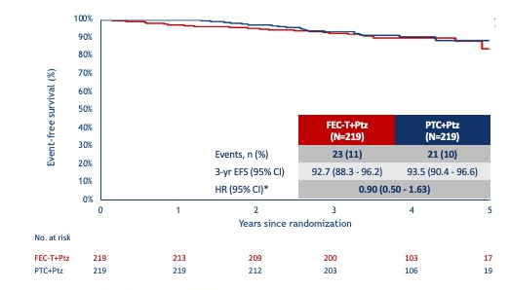
TRAIN-2: EFS
Disclaimer: This presentation is the property of Physicians’ Education Resource, LLC (“PER”) and is protected by U.S. and international copyright laws. You may not copy, reproduce, distribute, transmit, modify, or create derivative works of the presentation without the prior written permission from PER.
Significantly less cardiac toxicity PTCPtz
2 leukemia in FEC-arm
Van der Voort A et al. ASCO 2020. Abstract 501.
Notes:
At ASCO we saw data with a median follow-up of 49 months, which revealed no significant difference between the two arms in event-free-survival (EFS
c/w a 3-years EFS rates were 93.5% and 92.7%, respectively.

Slide 11

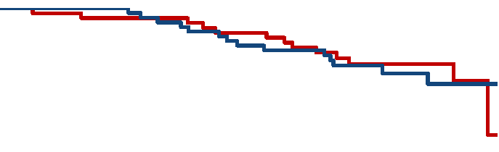

EFS TRAIN-2 by nodal status
Disclaimer: This presentation is the property of Physicians’ Education Resource, LLC (“PER”) and is protected by U.S. and international copyright laws. You may not copy, reproduce, distribute, transmit, modify, or create derivative works of the presentation without the prior written permission from PER.
cN0
cN1
cN2/3
Event-free survival (%)
HR (95% CI)* | 0.53 (0.10 - 2.90)
HR (95% CI)* | 1.04 (0.49 – 2.21)
HR (95% CI)* | 0.75 (0.23 – 2.44)
No. at risk
FEC-T-Ptz | 82 | 80 | 79 | 78 | 41 | 8 | 104 | 102 | 101 | 95 | 47 | 5 | 33 | 31 | 29 | 27 | 15 | 4
PTC-Ptz | 76 | 76 | 75 | 73 | 40 | 7 | 109 | 109 | 104 | 100 | 52 | 8 | 34 | 34 | 33 | 30 | 14 | 4
*HR <1 favors PTC+Ptz
Van der Voort A et al. ASCO 2020. Abstract 501.
Notes:
Subgroup analysis showed similar results regardless, nodal status suggesting there is “no evidence that higher-risk patients require anthracyclines,”
There was also no significant difference between the two groups in overall survival (OS
Of note, significantly more patients in the non-anthracycline group completed a full year of trastuzumab treatment than in the anthracycline group (97 vs 89%), which was attributed to a higher rate of cardiotoxicity with the latter regimen.
The proportion of patients with left ventricular ejection fraction decline of at least 10% and an absolute value below 50% was 3.2% in the group that did not receive anthracyclines and 8.6% in the group that did, a statistically significant difference.

Slide 12
ANTHRACYCLINE CAN BE SUBSTITUTED WITH TAXANE-BASED HER2-DIRECTED THERAPY
Disclaimer: This presentation is the property of Physicians’ Education Resource, LLC (“PER”) and is protected by U.S. and international copyright laws. You may not copy, reproduce, distribute, transmit, modify, or create derivative works of the presentation without the prior written permission from PER.
BCIRG006 and TRAIN-2 demonstrate similar long term outcomes with taxane-based therapy as with anthracycline-based therapy, even in high-risk node-positive patients
Less cardiac toxicity and numerically less leukemia
Hard to justify use of anthracyclines in era of HER2-directed therapies

Slide 13
How can we personalize therapy?
Disclaimer: This presentation is the property of Physicians’ Education Resource, LLC (“PER”) and is protected by U.S. and international copyright laws. You may not copy, reproduce, distribute, transmit, modify, or create derivative works of the presentation without the prior written permission from PER.
De-escalate for those with lower risk
  Substitute with less toxic chemotherapy or with targeted agents
  Decrease amount of chemotherapy
  Decrease duration of therapy
Escalate for those with increased risk
  Add additional targeted agents
  Replace therapy with more effective agents

Slide 14
Can CARBOPLATIN BE OMITTED?
Disclaimer: This presentation is the property of Physicians’ Education Resource, LLC (“PER”) and is protected by U.S. and international copyright laws. You may not copy, reproduce, distribute, transmit, modify, or create derivative works of the presentation without the prior written permission from PER.

Slide 15
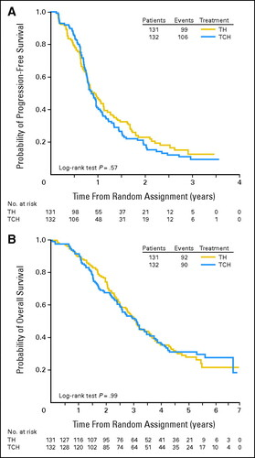

BCIRG007: Is carbo really necessary?
Randomized phase 3 trial
of docetaxel/trastuzumab with or without carboplatin for
1L HER2+ MBC
No improvement in PFS, ORR, or OS with the addition of carboplatin
TH vs TCH
Valero V et al. J Clin Oncol.
2011;29(2):149-56.
Slide courtesy of Ada Waks
Notes:
In metastatic setting, carbo was NOT necessary
But nonetheless, incorporation of carbo was the most evidence-based regimen in the curative setting, and so use of carbo has been maintained for pts with early stage disease

Slide 16

HELEN-006 Phase 3 RCT:
Is the carbo really necessary?
Preop TCHP vs THP
Population Enrolled:
64% stage II
36% stage III
73% node-positive
Stage II-III HER2+ BC
Age 18-70 yo
N=669
Docetaxel/carbo/HP
x18 weeks
1:1
Weekly nab-paclitaxel/HP
x18 weeks
Primary Endpoint: pCR (ypT0/is N0)
Superiority design
(hypothesis: nab-paclitaxel > docetaxel arm)
Chen X-C et al. Lancet Oncol. 2025;26(1):27-36.
Slide courtesy of Ada Waks

Slide 17
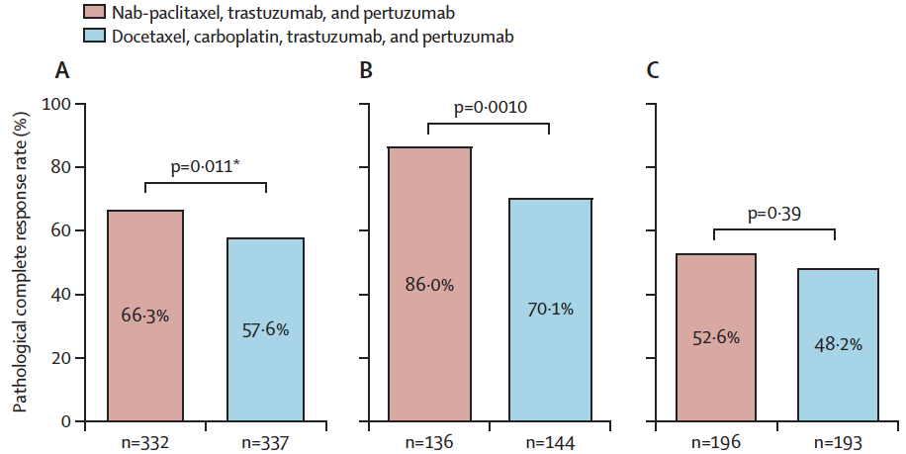
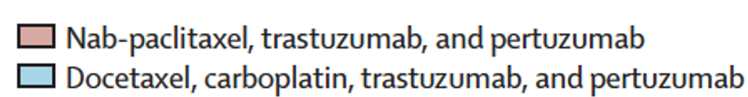
HELEN-006 Phase 3 RCT: is the Carbo Really Necessary?
HR-
Overall
HR+
Primary Endpoint was Met: pCR rate superior in the nab-paclitaxel arm (vs TCHP)
Chen X-C et al. Lancet Oncol. 2025;26(1):27-36.
Notes:
Control arm pCR rates are nearly identical to the pCR rates in the TCHP arm of KRISTINE

Slide 18

Superiority Endpoint Met: Why Might This Be?
pCR rates in the TCHP arm are nearly identical to KRISTINE trial results
More treatment reductions and/or discontinuations with TCHP?
  Not the case:
  Discontinuations = 9% in nab-P arm vs 7% in TCHP arm
  Dose reductions = 17% in nab-P arm vs 26% in TCHP arm
Weekly nab-paclitaxel leads to higher pCR rate than q3wk docetaxel?
Higher pCR rates with nab-paclitaxel established in multiple other trials (WSG-ADAPT HR+ high risk; GeparSepto) but impact on iDFS mixed
Outstanding question: EFS - secondary endpoint
Slide courtesy of Ada Waks

Slide 19
NeoCARHP Phase 3 RCT:
Is the carbo really necessary?
Stage II-III HER2+ BC
N=774
Taxane/HP
x18 weeks
Population Enrolled:
~75% stage II
~25% stage III
64% node-positive
1:1
Taxane/carbo/HP
x18 weeks
Taxane choice per investigator discretion
Primary Endpoint: pCR (ypT0/is N0)
Non-inferiority design
(Non-inferiority margin: -10% absolute difference)
Taxanes Used:
Nab-paclitaxel q3wk: 45%
Docetaxel q3wk: 36%
Paclitaxel q3wk: 19%
Gao H-F et al. ASCO 2025. Abstract LBA500.
Slide courtesy of Ada Waks

Slide 20
Efficacy Analysis: pCR by Hormone Receptor Status
DIFFERENCE (95% CI): 0.4 (-9.2, 10.0)
78.2%
77.8%
DIFFERENCE (95% CI): -3.0 (-11.7, 5.9)
55.8%
58.8%
Pathological complete response rates
111/142
112/144
134/240
141/240
Gao H-F et al.. ASCO 2025. Abstract LBA500.
Notes:
In hormone-receptor–negative tumors, pCR was 78.2% with THP and 77.8% with TCbHP. In hormone-receptor–positive tumors, pCR was 55.8% with THP and 58.8% with TCbHP.

Slide 21
Toxicity Comparison: TCHP vs THP
NON-NEUROPATHY:
 | TCHP | THP
HELEN-006 docetaxel q3wk vs nab-pac wkly | • More hematologic tox • More GI tox (N/V/D) • More grade 3-4 AEs overall
NeoCARHP mix of taxanes q3wk – balanced b/n arms | • More hematologic tox • More GI tox
NEUROPATHY:
 | TCHP | THP
HELEN-006 docetaxel q3wk vs nab-pac wkly | • 69% grade 1-2 • 2% grade 3 | • 80% grade 1-2 • 13% grade 3
NeoCARHP mix of taxanes q3wk – balanced b/n arms | • 48% grade 1-2 neuropathy • 1% grade 3+ | • 44% grade 1-2 • <1% grade 3+
Slide courtesy of Ada Waks
Notes:
Looking at NON neuropathy tox, everything looks worse in the TCHP arm
Looking at neuropathy specifically, in HELEN-006 neuropathy is definitely worse in the THP arm (reflecting that weekly nab-pac for 18 weeks causes HIGH neuropathy rates) whereas in NeoCARHP (where taxanes are balanced between arms and all taxanes are q3wks), neuropathy rates are about the same across the two arms (numerically slightly higher in TCHP actually)

Slide 22

CompassHER2-pCR Secondary Endpoint:
Largest-yet Demonstration of THP pCR Rates
pCR
8% stage IIIA
Preoperative Phase
ARM A: pCR (no invasive disease)
Eligibility: *
Stage II or IIIA
HER2+ BC
cN0 eligible if T ≥ 2 cm*
cN1-2 eligible, any
T1-3
T4, N3 NOT eligible
THP x 4 Cycles
paclitaxel
80 mg/m2 qwk x12
OR docetaxel
75 mg/m2 q3 wk x4
COMBINED WITH
trastuzumab (H)
& pertuzumab (P)
q3 wk x4
pCR
(ypT0/Tis ypN0)
Complete 1 year HP
Radiation and endocrine therapy
(if appropriate)
Follow-up for recurrence and survival
REGISTRATION
SURGERY
No pCR
Additional chemo and anti-HER2 therapy per treating physician
ARM B: no pCR
(residual invasive disease)
*ER+ cT 2-3 cm, cN0 capped
at 20% of study population
ER+ defined as ≥1% ER+
N=2175
Primary Objective: determine if 3y RFS >92% in Arm A, separately for ER+/HER2+ and ER-/HER2+ cohorts
Tung N et al ASCO 2025

Slide 23
TAXANES:
Selected per investigator discretion
63% weekly paclitaxel
34% q3wk docetaxel
Paclitaxel was associated with significantly higher pCR rate (vs docetaxel)
* Patients receiving ≥1 THP dose
Tung N et al ASCO 2025
Notes:
But note: this is NOT a head to head randomized comparison of paclitaxel vs docetaxel!!!

Slide 24

Summary
For patients with stage III HER2+ breast cancer, neoadjuvant TCHP remains the standard
  For patients who are older, with comorbidities, etc – can consider dropping carbo on a case-by-case basis
For patients with stage II HER2+ breast cancer, neoadjuvant THP is possible alternative, but need to consider optimal duration of therapy (12 vs 18 wks)
  Two phase 3 RCTs in HER2+ EBC showing carbo doesn’t improve pCR rates in setting of 18 wks of therapy, and adds tox
  Multiple phase 2 trials show excellent long-term outcomes with taxane chemo alone in HER2+ EBC (APT, DAPHNe, WSG-ADAPT, etc)
  RFS/EFS data from CompassHER2-pCR, HELEN-006, and NeoCARHP are needed

Slide 25
pCR rates across trials
 |  | Overall | HR- | HR+
Taxane-HP x12 wks | Tax-HP (CompassHER2-pCR) | 44% | 64% | 33%
 | THP (DAPHNe) | 57% | 85% | 42%
 | THP (WSG-TP-II) | - | - | 56%
 | DHP (NeoSphere) | 39% | - | -
Taxane-HP x18 wks | nab-THP (HELEN006) | 66% | 86% | 53%
 | Tax-HP (NeoCARHP) | 64% | 78% | 56%
Taxane-Cb-HP x18 wks | DCbHP (TRYPHAENA) | 52% | - | -
 | DCbHP (KRISTINE) | 56% | 73% | 44%
 | DCbHP (HELEN006) | 58% | 70% | 48%
 | Tax-CbHP (NeoCARHP) | 66% | 78% | 59%
Cb: carboplatin; D: docetaxel; T: paclitaxel; Tax: mix of taxanes
Waks AG et al Nat Rev Clin Oncol 2025. Gao H-F et al. ASCO 2025. Chen X-C et al. Lancet Oncol. 2025.
Notes:
Any cohort with <50 pts is not included in the table

Slide 26
TCHP vs THP: Discussions with our patients
  We know that carboplatin does not improve outcomes in the short-term in predominantly stage 2 pts getting 18 wks of therapy – and adds toxicity
    Hematologic and GI toxicity
  We don’t know whether carboplatin improves outcomes in the long-term
  18 wks of treatment will cause higher neuropathy rates
    Extremity cooling/compression may offset this
  Longer treatment will increase pCR likelihood

Slide 27
Next steps
We need assays to help us choose between neoadjuvant regimens:
  Stage III: who gets carbo vs no carbo
  Stage II: who gets 4 vs 6 cycles
  Future direction: who gets HER2-directed tx without chemotherapy?
Promising assays:
  HER2DX biomarker?
  Breast MRI?
  Early on-treatment PET CT? (EA1211/DIRECT trial to potentially inform this)
  Early on-treatment ctDNA monitoring?

Slide 28
Can we give less to small node-negative tumors?
Disclaimer: This presentation is the property of Physicians’ Education Resource, LLC (“PER”) and is protected by U.S. and international copyright laws. You may not copy, reproduce, distribute, transmit, modify, or create derivative works of the presentation without the prior written permission from PER.

Slide 29
APT Trial: Study Design
Disclaimer: This presentation is the property of Physicians’ Education Resource, LLC (“PER”) and is protected by U.S. and international copyright laws. You may not copy, reproduce, distribute, transmit, modify, or create derivative works of the presentation without the prior written permission from PER.
Enroll
P
P
P
P
P
P
P
P
P
P
P
P
HER2+
ER+ or ER-
Node Negative
< 3 cm
T
T
T
T
T
T
T
T
T
T
T
T
PACLITAXEL 80 mg/m² + TRASTUZUMAB 2 mg/kg x 12
Planned N=400
T
T
T
T
T
T
T
T
T
T
T
T
T
FOLLOWED BY 13 EVERY 3 WEEK DOSES
OF TRASTUZUMAB (6 mg/kg)*
Tolaney SM et al. N Engl J Med. 2015;372(2):134-41.
Tolaney SM et al. J Clin Oncol. 2019;37(22):1868-1875.
Notes:
One group of pts for whom it may make sense to decrease the amount of chemotherapy is a group of lower risk pts, such as those with stage I breast cancer
We have seen data from the APT trial which looked at 12 wks of paclitaxel with trastuzumab followed by 9 mo of trastuzumab

Slide 30
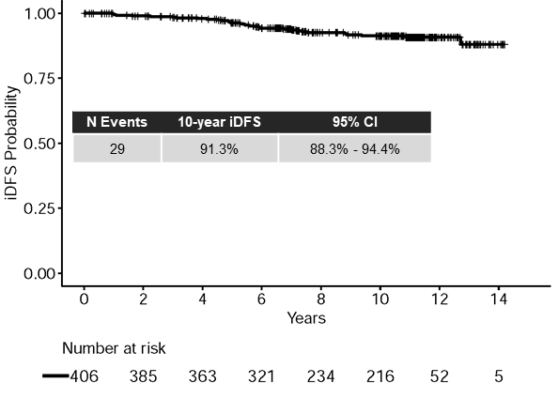
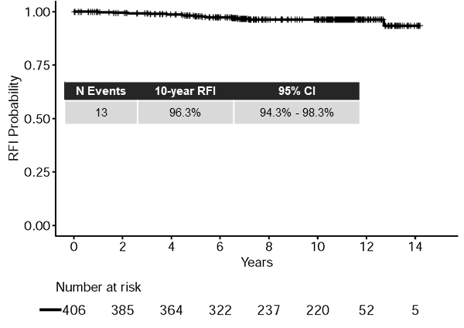
APT: 10-Year RESULTS
 | Point Est. | 95% Conf. Interval
3-yr RFI | 99.2% | 98.4% to 99.9%
5-yr RFI | 98.1% | 96.8% to 99.5%
7-yr RFI | 97.5% | 95.9% to 99.1%
10-yr RFI | 96.3% | 94.3-98.3%
 | Point Est. | 95% Conf. Interval
3-yr iDFS | 98.5% | 97.2% to 99.7%
5-yr iDFS | 96.3% | 94.4% to 98.2%
7-yr iDFS | 93.3% | 90.4% to 96.2%
10-yr iDFS | 91.3% | 88.3-94.4%
RFI Events=
Invasive Local/Regional Recurrence
Distant Recurrence
Death from Breast Cancer
6 Distant Events
Tolaney SM et al. SABCS 2022.
Tolaney SM et al. Lancet Oncol. 2023;24(3):273-285.

Slide 31
Does T-DM1 have a role for Stage I HER2+ Disease?
ATEMPT Trial
Disclaimer: This presentation is the property of Physicians’ Education Resource, LLC (“PER”) and is protected by U.S. and international copyright laws. You may not copy, reproduce, distribute, transmit, modify, or create derivative works of the presentation without the prior written permission from PER.
N = 383
Key Eligibility Criteria
Stage 1 HER2+ breast cancer
  HER2 centrally tested (ASCO CAP 2013 guidelines)
N0 or N1mic
Left Ventricular EF ≥ 50%
No prior invasive breast cancer
≤90 days from last surgery
T-DM1
3.6 mg/kg IV q3 wks x 17
3
N = 497
R
3:1
N = 114
1
TH
Paclitaxel 80 mg/m² IV + Trastuzumab 2 mg/kg IV wkly x12 → Trastuzumab 6 mg/kg every 3 wks x13
Stratification factors:
Age (<55, ≥55)
Planned radiation (Yes/No)
Planned hormonal therapy (Yes/No)
*Radiation and endocrine therapy could be initiated after 12 weeks on study therapy
Tolaney S et al. SABCS 2019. GS1-05.
Notes:
In an effort to try and develop a potentially even less toxic treatment approach for patients with stage I disease, the ATEMPT trial looked to see if T-DM1 may be an alternative approach to TH
This study randomized pts with Stage I disease in a 3:1 fashion to 1 yr of T-DM1 or to the TH regimen as had been administered in the APT trial.
The primary endpt was to evaluate the 3 yr DFS of 1 yr of T-DM1 and to compare clinically relevant toxicities between the two arms.

Slide 32
5-year outcomes with T-DM1: iDFS and RFI
Disclaimer: This presentation is the property of Physicians’ Education Resource, LLC (“PER”) and is protected by U.S. and international copyright laws. You may not copy, reproduce, distribute, transmit, modify, or create derivative works of the presentation without the prior written permission from PER.
5-year iDFS
5-year RFI
Arm | N | No. of events | 5-year iDFS | 95% CI
T-DM1 | 383 | 11 | 97.0% | (95.2-98.7%)
Arm | N | No. of events | 5-year RFI | 95% CI
T-DM1 | 383 | 5 | 98.3% | (97.0-99.7%)
3 Distant Events
Tolaney S et al. SABCS 2022

Slide 33
ATEMPT: Clinically Relevant Toxicity
Clinically Relevant Toxicity | T-DM1 (n = 383) N (%) | TH (n = 114) N (%)
Grade ≥3 non-hematologic toxicity | 37 (10%) | 13 (11%)
Grade ≥ 2 neurotoxicity | 42 (11%) | 26 (23%)
Grade ≥4 hematologic toxicity | 4 (1%) | 0 (0%)
Febrile neutropenia | 0 (0%) | 2 (2%)
Any toxicity requiring dose delay | 106 (28%) | 30 (26%)
Any toxicity requiring early discontinuation | 67 (17%) | 7 (6%)
Total | 176 (46%) | 53 (46%)
p=0.91
Tolaney S et al. SABCS 2019. GS1-05.
Notes:
There was not however a difference in clinically relevant toxicities between the 2 arms, but there were differences in the types of toxicity that were seen
There was more neurotoxicity among pts receiving TH while there were more early discontinuations of therapy among pts receiving T-DM1

Slide 34
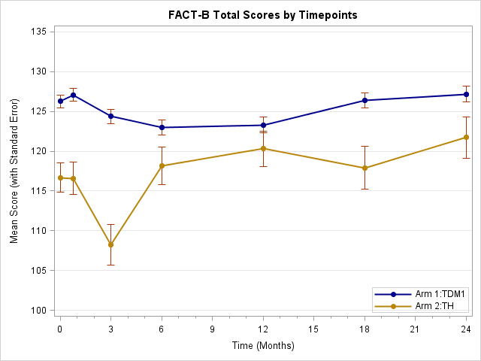
Disclaimer: This presentation is the property of Physicians’ Education Resource, LLC (“PER”) and is protected by U.S. and international copyright laws. You may not copy, reproduce, distribute, transmit, modify, or create derivative works of the presentation without the prior written permission from PER.
ATEMPT Trial: PROs
QUALITY OF LIFE
Alopecia
This presentation is the intellectual property of N. Lynn Henry, MD. Contact her at norahh@umich.edu for permission to reprint and/or distribute.
Partridge et al, SABCS 2019. Abstract PD10-02.
Notes:
One challenge however was that the clinically releavant toxicities did not take into account several toxicities that are meaningful to patients, that perhaps may be better captured by patient reported outcomes.
These data were also collected though and suggesting a sharp decline in quality of life among patients receiving TH compared to T-DM1, as well as more alopecia with TH, and a larger impact of work productivity

Slide 35
WHICH PATIENTS with Stage I HER2+ disease should get T-DM1?
Disclaimer: This presentation is the property of Physicians’ Education Resource, LLC (“PER”) and is protected by U.S. and international copyright laws. You may not copy, reproduce, distribute, transmit, modify, or create derivative works of the presentation without the prior written permission from PER.
T-DM1 for 1 year was associated with very few recurrences in patients with Stage I HER2+ disease
T-DM1 was not associated with significantly fewer clinically relevant toxicities than TH
No difference seen in the overall incidence of clinically relevant toxicities (CRT) between the two arms, but there were differences in toxicity profiles between T-DM1 and TH
Not all toxicities are captured in the CRT endpoint, including alopecia, and patient reported outcomes (PROs) should be considered when assessing tolerability (generally favored T-DM1)
Given the low event rate seen in this trial, T-DM1 may be an alternative to TH
Notes:
Taking this altogether then, which pts with stage I disease should receive T-DM1?
We know that giving a year of T-DM1 was associated with excellent outcomes, but was not associated with fewer clinically relevant toxicities, but was associated with better quality of life and less alopecia
Given this, we have felt that T-DM1 may be a reasonable approach for those pts with concerns re TH toxicity such as neuropathy/neutropenia/alopecia, and may particularly be attractive during the current COVID-19 pandemic given less immunosuppressin

Slide 36
ONGOING STUDY: ATEMPT 2.0
Disclaimer: This presentation is the property of Physicians’ Education Resource, LLC (“PER”) and is protected by U.S. and international copyright laws. You may not copy, reproduce, distribute, transmit, modify, or create derivative works of the presentation without the prior written permission from PER.
N = 375
Key Eligibility Criteria
Stage 1 HER2+ breast cancer
  HER2 centrally tested (ASCO CAP 2013 guidelines)
N0 or N1mic
Left Ventricular EF ≥ 50%
No prior invasive breast cancer
≤90 days from last surgery
T-DM1→ H
3.6 mg/kg IV q3 wks x 6 cycles→ SQ Trastuzumab every 3 wks x 11
3
N = 500
R
3:1
N = 125
1
TH
Paclitaxel 80 mg/m² IV + Trastuzumab every 3 wks x4 → SQ Trastuzumab every 3 wks x13
Stratification factors:
Age (<55, ≥55)
Planned radiation (Yes/No)
Planned hormonal therapy (Yes/No)
*Radiation and endocrine therapy could be initiated after 12 weeks on study therapy
PI: Sara Tolaney
Notes:
There is interest in exploring shorter duration therapy of T-DM1, and there is a planned study to look at 6 cycles of T-DM1 followed by subcutaneous trastuzumab to complete a year of therapy and compare toxicity to the TH regimen, and the hope is this trial will activate in the next few months

Slide 37
Disclaimer: This presentation is the property of Physicians’ Education Resource, LLC (“PER”) and is protected by U.S. and international copyright laws. You may not copy, reproduce, distribute, transmit, modify, or create derivative works of the presentation without the prior written permission from PER.
ADEPT
phase II study of ADjuvant Endocrine therapy, subcutaneous Pertuzumab, and Trastuzumab fixed-dose combination STAGE I HER2+ Breast CANCER
Eligibility:
• Stage I HER2+ breast cancer (AJCC 8th edition, anatomic staging)
• ER or PR >=10%
• Post-surgery
Endocrine therapy of physician’s choice
+
SQ Trastuzumab + Pertuzumab
N = 375
Ada Waks/Sara Tolaney
Notes:
Our group is also interested in exploring a chemo-free regimen for those with Stage I HR+ HER2+ disease and we have a currently enrolling study called the ADEPT trial in which pts with stage I HR+ HE2+ disease will receive 1 yr of SQ HP + and a minimum of 5 yrs of endocrine therapy

Slide 38
Which stage I HER2+ breast cancer patients should get systemic therapy (TH or T-DM1)?
Disclaimer: This presentation is the property of Physicians’ Education Resource, LLC (“PER”) and is protected by U.S. and international copyright laws. You may not copy, reproduce, distribute, transmit, modify, or create derivative works of the presentation without the prior written permission from PER.
Hormone Receptor Status | <0.5 cm | 0.5-1.0cm | >1.0-2.0cm
HR+ | NO | YES | YES
HR- | Sometimes* | YES | YES
*if high risk features (high grade with LVI), and relatively larger size

Slide 39
If response to therapy is so critical, should ALL patients, including stage 1 patients get preop therapy?
Disclaimer: This presentation is the property of Physicians’ Education Resource, LLC (“PER”) and is protected by U.S. and international copyright laws. You may not copy, reproduce, distribute, transmit, modify, or create derivative works of the presentation without the prior written permission from PER.
Notes:
So while we now have a new treatment paradigm for our aptients with early HER2+ breast cancer, the question remains where may we be headed?

Slide 40
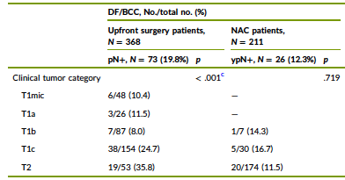
Should small HER2+ tumors get preop therapy?
Disclaimer: This presentation is the property of Physicians’ Education Resource, LLC (“PER”) and is protected by U.S. and international copyright laws. You may not copy, reproduce, distribute, transmit, modify, or create derivative works of the presentation without the prior written permission from PER.
Pathologic nodal status with upfront surgery in HER2+ cancers
Up to 25% of T1c tumors will be node positive, and therefore should be getting preoperative therapy
Should we do axillary US upfront on all clinically node-negative patients and if negative, then take to surgery, and give adjuvant TH, or give preop TH for these pts?
  RFI 97.5% suggests may not need more than TH for almost all pts, so could lead to overtreatment
Axillary Ultrasound for clinically node-negative stage I patients is critical for decision-making
Weiss A et al, Cancer. 2023;129(12):1836-1845.

Slide 41
How can we personalize therapy?
Disclaimer: This presentation is the property of Physicians’ Education Resource, LLC (“PER”) and is protected by U.S. and international copyright laws. You may not copy, reproduce, distribute, transmit, modify, or create derivative works of the presentation without the prior written permission from PER.
De-escalate for those with lower risk
  Substitute with less toxic chemotherapy or with targeted agents
  Decrease amount of chemotherapy
  Decrease duration of therapy
Escalate for those with increased risk
  Add additional targeted agents
  Replace therapy with more effective agents

Slide 42
Disclaimer: This presentation is the property of Physicians’ Education Resource, LLC (“PER”) and is protected by U.S. and international copyright laws. You may not copy, reproduce, distribute, transmit, modify, or create derivative works of the presentation without the prior written permission from PER.
Neoadjuvant Pertuzumab/Trastuzumab
(3 regimens FDA approved 9/2013)
 | NEOSPHERE¹ | TRYPHAENA² | TRYPHAENA²
Treatment | Pertuzumab, Trastuzumab, Docetaxel THP x 4 FEC x 3 post-op) | Docetaxel/Carbo/ Trastuzumab/ Pertuzumab TCHP x 6 | FEC x 3 → THP x 3
N | 107 | 77 | 75
ypT0/is ypN0 (%) | 39.3 | 63.6 | 54.6
Gianni L, et al. Lancet Oncol. 2012;13(1):25-32.
Schneeweiss A, et al. Ann Oncol. 2013;24(9):2278-84.
Notes:
One escalation strategy is to add on additional HER2 directed thereapies, such as perrtuzumab.
We know that the the addition of pertuzumab to preoperative chemotherapy in both NeoSPHERE and Tryphaena demonstrated significant improvements in pathologic complete response rates
With an approximate 40% pCR rate with THP and ~64% with TCHP, leading to FDA approval of pertuzumab back in 2013 for preoperative therapy

Slide 43
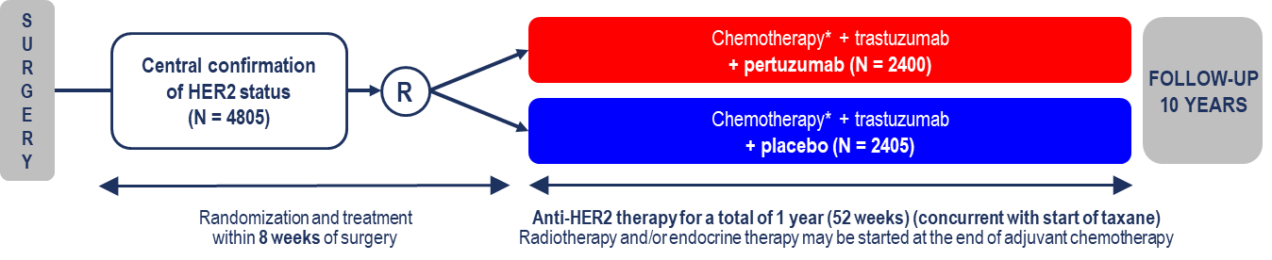
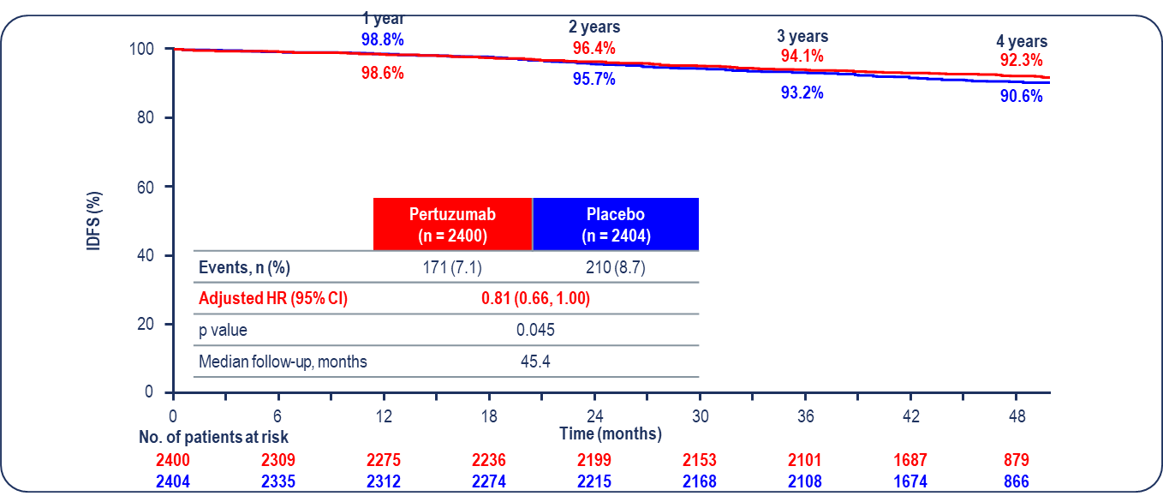
Can we increase the efficacy of adjuvant trastuzumab? APHINITY Trial
Primary endpoint: IDFS (APHINITY definition differs from STEEP definition)
Secondary endpoint: IDFS with 2nd primary non-breast primary cancers included, DFS, OS, RFI, DRFI, safety, and HRQoL
Node involvement
Node negative | 38%
1-3 nodes | 37%
≥4 nodes | 25%
Adapted from von Minckwitz G, et al. NEJM 2017
Slide courtesy of Javier Cortes

Slide 44
APHINITY UPDATED descriptive IDFS Analysis at 11.3 years’ Median FOLLOW-UP by Treatment Regimen (ITT Population)
3 years
6 years
8 years
100
94.1%
10 years
90.6%
88.5%
87.2%
93.2%
80
87.8%
85.8%
83.8%
60
 | Pertuzumab (n = 2400) | Placebo (n = 2404)
Events, n (%) | 303 (12.6) | 379 (15.8)
Adjusted HR (95% CI) | 0.79 (0.68, 0.92)
10-year duration
Difference in event-free rate, % | 3.4
95% CI for difference | (1.27, 5.42)
IDFS (%)
40
20
0
0
1
2
3
4
5
6
7
8
9
10
11
12
No. of patients at risk
 | 2400 | 2277 | 2198 | 2123 | 2056 | 1995 | 1957 | 1894 | 1821 | 1746 | 1646 | 1351 | 424
 | 2404 | 2312 | 2215 | 2135 | 2044 | 1986 | 1909 | 1842 | 1785 | 1704 | 1589 | 1327 | 415
Time (years)
CI, confidence interval; HR, hazard ratio; IDFS, invasive disease-free survival; ITT, intention-to-treat.
Loibl S et al ESMO Breast 2025

Slide 45
APHINITY Updated Descriptive Analysis AT 11.3 years’ Median follow-up:
Site of First Occurrence of an IDFS event
 | Pertuzumab (n = 2400) | Placebo (n = 2404)
Total patients with an IDFS event, n (%) | 303 (12.6) | 379 (15.8)
Category of 1st IDFS event, n (%)
Distant recurrence | 150 (6.3) | 211 (8.8)
CNS metastases | 51 (2.1) | 53 (2.2)
Locoregional BC recurrence | 35 (1.5) | 61 (2.5)
Contralateral invasive BC recurrence | 43 (1.8) | 29 (1.2)
Death without prior event | 75 (3.1) | 78 (3.2)
Hierarchy applied if a patient experienced additional IDFS event(s) within 61 days of their first IDFS event. Fewer patients randomised to the pertuzumab arm received HER2-targeted therapy as a first-line treatment for distant recurrence than those randomised to the placebo arm
(50.4% [57/113] vs 54.7% [93/170], respectively). BC, breast cancer; CNS, central nervous system; IDFS, invasive disease-free survival.
Loibl S et al ESMO Breast 2025

Slide 46
APHINITY UPDATED descriptive IDFS Analysis at 11.3 years’ Median FOLLOW-UP by Treatment Regimen, NODAL status and hormone receptor status
 |  | Pertuzumab (n = 2400) |  | Placebo (n = 2404)
Baseline risk factors | Total patients, n | Patients per group, n | Events, n | Patients per group, n | Events, n | HR (95% CI)
All patients* | 4804 | 2400 | 303 | 2404 | 379 | 0.80 (0.69, 0.93)
Nodal status
Node-positive | 3005 | 1503 | 224 | 1502 | 299 | 0.74 (0.62, 0.88)
Node-negative | 1799 | 897 | 79 | 902 | 80 | 1.01 (0.74, 1.38)
Nodal and hormone receptor status
Node-positive, hormone receptor-positive | 1912 | 947 | 131 | 965 | 193 | 0.68 (0.55, 0.85)
Node-positive, hormone receptor-negative | 1093 | 556 | 93 | 537 | 106 | 0.83 (0.63, 1.10)
Node-negative, hormone receptor-positive | 1170 | 589 | 52 | 581 | 52 | 1.03 (0.70, 1.51)
Node-negative, hormone receptor-negative | 629 | 308 | 27 | 321 | 28 | 0.98 (0.58, 1.66)
Pertuzumab
better
Placebo
better
0.5
1
2.0
Hormone receptor status was centrally assessed. * Unadjusted analysis of the ITT population.
CI, confidence interval; HR, hazard ratio; IDFS, invasive disease-free survival; ITT, intention-to-treat.
Loibl S et al ESMO Breast 2025

Slide 47
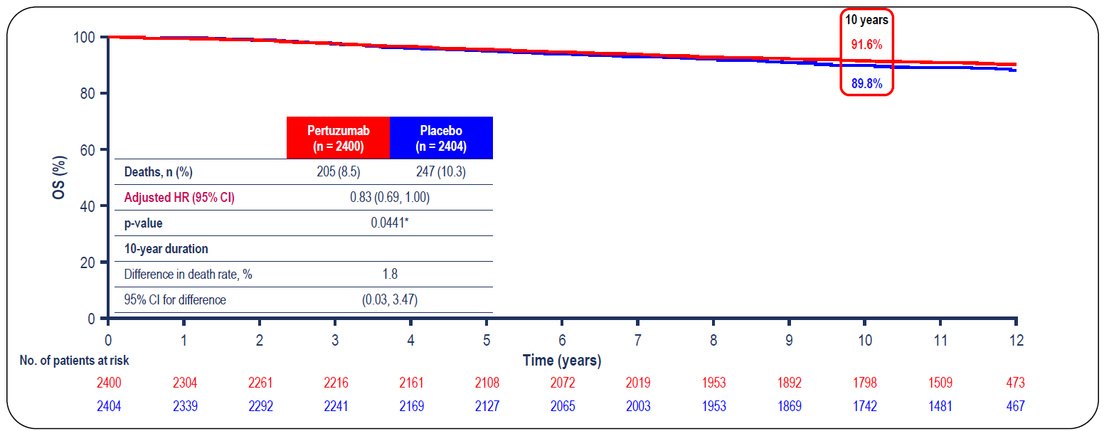
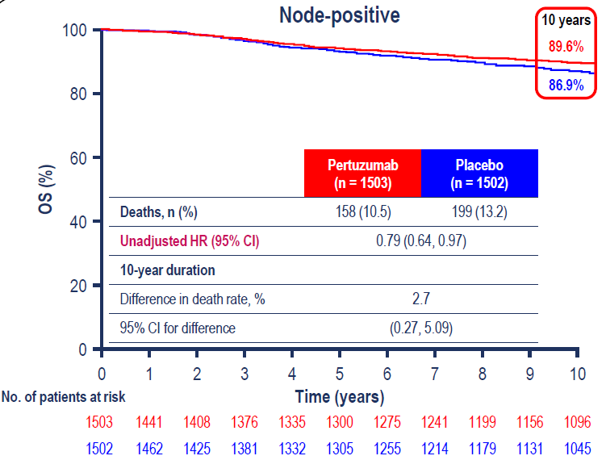
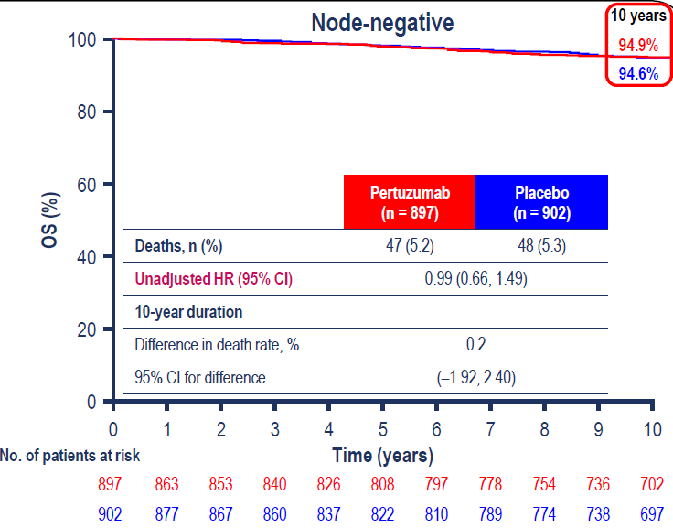
Updated results of APHINITY at 11.3 years median follow up (Final OS)
ITT
∆ 1.8%
Node positive
Node negative
∆ 2.7%
∆ 0.2%
Loibl S, et al. ESMO Breast 2025

Slide 48
When do we then give pertuzumab?
Most patients with HER2+ tumors >2cm or clinically node positive disease receive preoperative therapy
The addition of pertuzumab improves pCR, but will not improve DFS in all patients (ie. not node negative patients)
Administration of preoperative pertuzumab to all patients may result in some overtreatment, but challenging to discern which patients need pertuzumab upfront
Adjuvant HP is reasonable for pts achieving pCR given APHINITY administered one year of HP therapy, given uncertainty of upfront nodal status in pts recv’ing preop therapy
Notes:
So when then thinking about how we use pertuzumab,
Since we generally approach patients with tumors>2cm or clinically node positive disease with preoperative therapy, we know the addition of pertuzumab to chemotherapy and trastuzumab will improve rates of pathologic complete response and therefore may have an impact on local therapy, but will not improve DFS in all patients, particulary those with node-negative disease
So administering pertuzumab to all pts recv’ing preoperative therapy may result in some overtreatment, but it is challenging to know which patients need pertuzumab upfront as we won’t know nodal status in many pts

Slide 49
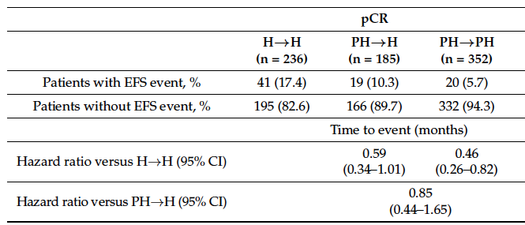
ROLE OF ADJUVANT PERTUZUMAB IN PATIENTS WITH PCR?
Disclaimer: This presentation is the property of Physicians’ Education Resource, LLC (“PER”) and is protected by U.S. and international copyright laws. You may not copy, reproduce, distribute, transmit, modify, or create derivative works of the presentation without the prior written permission from PER.
Swain S et al, Cancers (Basel). 2022;14(20):5051.

Slide 50
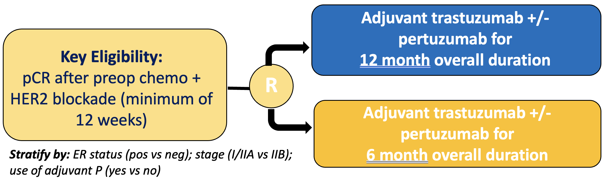


Disclaimer: This presentation is the property of Physicians’ Education Resource, LLC (“PER”) and is protected by U.S. and international copyright laws. You may not copy, reproduce, distribute, transmit, modify, or create derivative works of the presentation without the prior written permission from PER.
ShortStop-HER2 (A012303) Shortened duration of adjuvant therapy in patients with early-stage HER2+ breast cancer who achieve pCR after neoadjuvant chemotherapy with HER2 blockade
N=1524
cT1c-T3 and cN0-N1
except cT3N1
Stratify by:
• ER status (pos vs neg)
• stage (I/IIA vs IIB)
• use of adjuvant P (yes vs no)
Primary endpoint:
Recurrence-free survival
PI: Ada Waks
Notes:
Here I am showing the updated, current schema. Thank you very much for your attention.

Slide 51
ADDING NERATINIB: ExteNET Study
Disclaimer: This presentation is the property of Physicians’ Education Resource, LLC (“PER”) and is protected by U.S. and international copyright laws. You may not copy, reproduce, distribute, transmit, modify, or create derivative works of the presentation without the prior written permission from PER.
Neratinib × 1 yr
240 mg/day
n=1420
2 years
Randomize
1:1
N=2840
Primary analysis
iDFSª
Extended follow-up:
5-yr for iDFS &
overall survival
Prior adjuvant trastuzumab
Placebo × 1 yr
n=1420
Primary endpoint: invasive disease-free survival (iDFS)ª
Secondary endpoints: overall survival, DFS-DCIS, distant DFS, time to distant recurrence, CNS metastases, safety,
Stratification: nodes 0, 1-3 vs 4+, ER/PR status, concurrent vs sequential trastuzumab
Study blinded: Until primary analysis; OS remains blinded
Notes:
And we had seen data from the Extenet trial looking at extended adjuvant therapy of neratinib
This study randomized pts after completion of one year of adjuvant trastuzumab to receive one year of neratinib or placebo

Slide 52
ExteNET iDFS and OS Intent-To-Treat Population (N=2,840)
ITT iDFS at 5 yrs
ITT OS (264 events)
100
97.9%
1.0
98.4%
94.1%
94.3%
92.2%
90.1%
95.5%
91.2%
90.2%
0.9
98.1%
93.3%
90
2.4%
91.7%
90.2%
0.8
0.3%
0.8%
90.2%
2.6%
89.1%
87.7%
-0.1
80
2.0%
2.1%
0.7
  HR = 0.95
  8-year estimate: ∆ -0.11%
0.6
Invasive disease-free survival (%)
HR = 0.73, ∆ 2.5%
Overall Survival Probability
70
0.5
0.4
60
0.3
50
0.2
HR (95% CI)=0.73
(0.57-0.92 P-value = 0.0008)
Neratinib
Placebo
0.1
Neratinib
Placebo
HR (95% CI)=0.95
(0.74−1.21) P-value=0.6914
0
0
0
6
12
18
24
30
36
42
48
54
60
0
1
2
3
4
5
6
7
8
9
10
Months after randomization
Years after randomization
No. at risk
Neratinib | 1420 | 1316 | 1272 | 1225 | 1106 | 978 | 965 | 949 | 938 | 920 | 885
Placebo | 1420 | 1354 | 1298 | 1248 | 1142 | 1029 | 1011 | 991 | 978 | 958 | 927
No. at risk
Neratinib | 1420 | 1364 | 1309 | 1213 | 1118 | 1168 | 1123 | 1041 | 746 | 218 | 0
Placebo | 1420 | 1384 | 1341 | 1249 | 1223 | 1199 | 1166 | 1086 | 796 | 221 | 0
Martin et al. Lancet Oncol. 2017;18(12):1688-1700.

Slide 53
ExteNET: No pCR Post Neoadjuvant Therapy
HR+, ≤1 Year from Trastuzumab (N=295)
Disclaimer: This presentation is the property of Physicians’ Education Resource, LLC (“PER”) and is protected by U.S. and international copyright laws. You may not copy, reproduce, distribute, transmit, modify, or create derivative works of the presentation without the prior written permission from PER.
iDFS at 5 yrs
Overall Survival
100
98.4%
1.0
98.4%
96.8%
94.2%
90.8%
97.5%
91.3%
95.0%
88.9%
88.0%
0.9
90
85.0%
0.8
89.6%
83.6%
82.2%
80
85.5%
0.7
81.6%
80.0%
77.6%
0.6
HR = 0.47
8-year estimate: ∆ 9.1%
Invasive disease-free survival (%)
Overall Survival Probability
70
HR = 0.60, ∆ 7.4%
0.5
0.4
60
0.3
50
0.2
HR (95% CI)=0.60 (0.33−1.07)
Neratinib
Placebo
0.1
Neratinib
Placebo
HR (95% CI)=0.47 (0.22−0.92)
0
0
0
6
12
18
24
30
36
42
48
54
60
0
1
2
3
4
5
6
7
8
9
10
Months after randomization
Years after randomization
No. at risk
Neratinib | 131 | 126 | 121 | 113 | 100 | 94 | 93 | 91 | 91 | 88 | 84
Placebo | 164 | 159 | 151 | 143 | 125 | 107 | 103 | 99 | 99 | 98 | 94
No. at risk
Neratinib | 131 | 126 | 121 | 116 | 113 | 110 | 106 | 100 | 60 | 14 | 0
Placebo | 164 | 161 | 156 | 143 | 135 | 129 | 123 | 115 | 65 | 12 | 0
Chan A, et al. Clin Breast Cancer. 2021;21(1):80-91.e7.
.
Notes:
Speaker notes are for internal use only and are not to be shown or disseminated outside of Puma Biotechnology, Inc.

Slide 54
Antidiarrheal Prophylaxis Reduces Diarrhea with Neratinib: CONTROL TRIAL
Disclaimer: This presentation is the property of Physicians’ Education Resource, LLC (“PER”) and is protected by U.S. and international copyright laws. You may not copy, reproduce, distribute, transmit, modify, or create derivative works of the presentation without the prior written permission from PER.
PREVENTIVE STRATEGIES REDUCED grade ≥3 diarrhea compared to EXTENET
Chan et al. SABCS 2019. Abstract P5-14-03.
Chan at al. Lancet Oncol. 2016;17(3):367-377.
Hurvitz S, et al. SABCS 2017.
Notes:
The challenge however was that in the Extenet trial, where no anti-diarrheal prophylaxis was administered, there was a 40% rate of grade ¾ diarrhea
Further work has been done within the CONTROL trial looking at various strategies to mitigate diarrhea, suggesting that alternative strategies such combination of budesonide with loperamide or colestipol plus loperamide or a dose escalation approach of neratinib work well

Slide 55
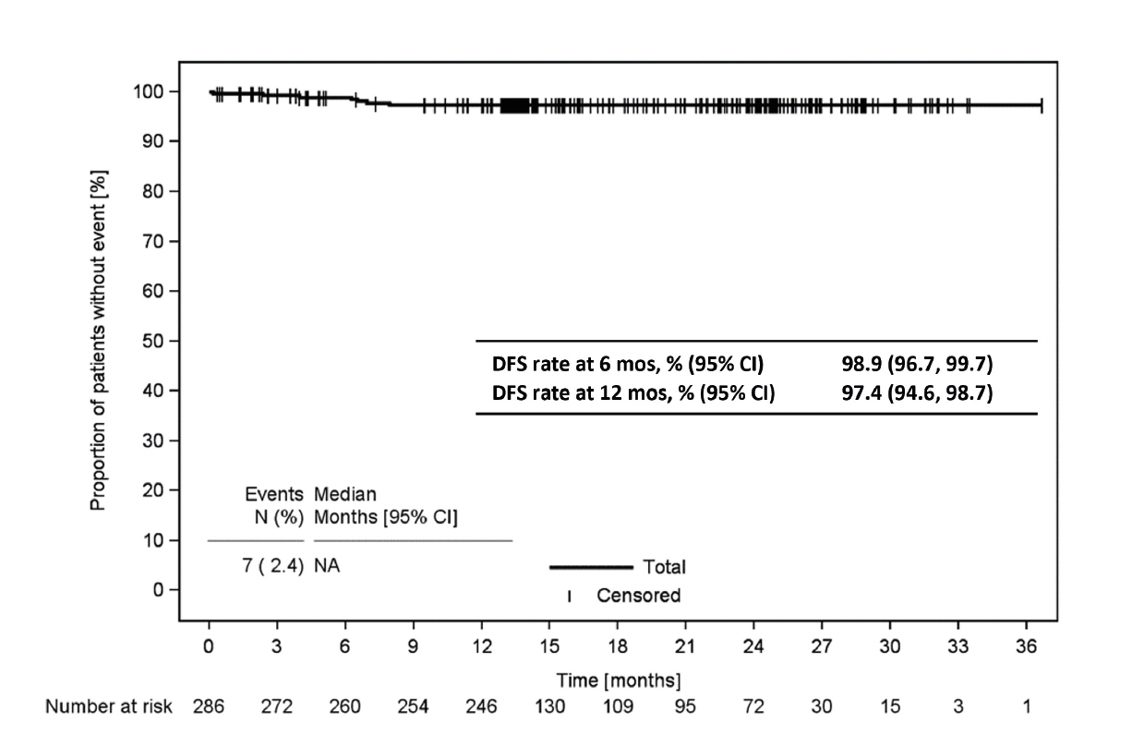
ELEANOR: Real world adjuvant neratinib (n=286)
Disclaimer: This presentation is the property of Physicians’ Education Resource, LLC (“PER”) and is protected by U.S. and international copyright laws. You may not copy, reproduce, distribute, transmit, modify, or create derivative works of the presentation without the prior written permission from PER.
Disease-free Survival
37.4% trastuzumab monotherapy
31.8% HP
22.4% T-DM1
79.4% recv’d preop therapy
49% with residual disease
20% g≥3 diarrhea, 87% diarrhea prophylaxis
Median f/u 14 months
Luftner D et al, SABCS 2024

Slide 56
When SHOULD WE GIVE NERATINIB?
Disclaimer: This presentation is the property of Physicians’ Education Resource, LLC (“PER”) and is protected by U.S. and international copyright laws. You may not copy, reproduce, distribute, transmit, modify, or create derivative works of the presentation without the prior written permission from PER.
Benefit seen in patients with high-risk HR+ HER+ disease (larger benefit in patients with residual disease after preoperative therapy)
Challenge is lack of sufficient data in patients who have previously received pertuzumab and/or T-DM1
Must also weight potential benefit with toxicity (~40% grade 3/4 diarrhea)
  All patients should receive prophylactic anti-diarrheals (OR can consider a dose escalation approach)
CONSIDER NERATINIB IN HIGH-RISK MULTI-NODE-POSITIVE HR+ HER2+ PATIENTS AFTER COMPLETION OF HP or T-DM1
Notes:
So who then should receive extended adjuvant therapy with neratinib?
We saw the benefit is really restricted to pts with HR+ disease with larger benefits seen amongst those pts with residual disease
However the challenge is that this trial was conducted when pertuzumab and T-DM1 were not given for early stage HER2+ disease, so it is unclear what the benefits of neratinib are in pts receiving these current treatments
Additionally, one has to weight the benefits of treatment against toxicity, with diarrhea being an issue
Therefore I have generally reserved neratinib for the rare patient with residual node + HR+ disease after preoperative therapy

Slide 57
How can we personalize therapy?
Disclaimer: This presentation is the property of Physicians’ Education Resource, LLC (“PER”) and is protected by U.S. and international copyright laws. You may not copy, reproduce, distribute, transmit, modify, or create derivative works of the presentation without the prior written permission from PER.
De-escalate for those with lower risk
  Substitute with less toxic chemotherapy or with targeted agents
  Decrease amount of chemotherapy
  Decrease duration of therapy
Escalate for those with increased risk
  Add additional targeted agents
  Replace therapy with more effective agents
Notes:
These differences in outcomes really highlight the need for us to develop strategies to individualize therapy for patients in order to provide the right amount of therapy to the right patient to optimize outcomes while also trying to limit toxicity
Some strategies to would be to use biomarkers to help us determine which patients we may be able to de-escalate therapy for, and which patients with high risk may benefit from escalation of therapy, many of the current biomarkers of interest require further validation, and so another strategy would be to use clinical predictors to help us individualize care.
When considering methods for de-escalation of care, there are several strategies one could take to decrease toxicity: we could decrease the amount of chemotherapy, or replace standard chemotherapy with less toxic chemotherapy or with targeted agents, or we could decrease the duration of therapy
When escalating therapy, we can take an add-on approach by adding additional targeted agents, or replacing chemotherapy with more effective biologic therapy

Slide 58
DESTINY-Breast11 study design
A randomized, global, multicenter, open-label, Phase 3 study (NCT05113251)
Data cutoff:
March 12, 2025
n=321
T-DXd* → THP†
4 + 4 cycles
Recommended
post-neoadjuvant treatment per study protocol║
pCR: radiotherapy and concomitant trastuzumab ± pertuzumab for up to 1 year
No pCR: radiotherapy and
T-DM1 for up to 14 cycles
HR-positive: endocrine therapy
Primary endpoint
pCR (ypT0/is ypN0) by blinded central review
Secondary endpoints
pCR (ypT0 ypN0) by blinded central review
EFS
Safety
Pharmacokinetics and immunogenicity
Invasive disease-free survival
Overall survival
Health-related quality of life
Additional outcome measures
Residual cancer burden (RCB)
Patient population
Previously untreated HER2+ eBC
HR-positive or
HR-negative
High-risk defined as:
  ≥cT3 and N0−3 or
  cT0–4 and N1−3
  Inflammatory BC
Randomized
1:1:1
n=320
ddAC‡ → THP§
4 + 4 cycles
Surgery ¶
n=286
T-DXd*
8 cycles
Stratification factors
HR status: ER and/or
PR-positive or negative
HER2 status: (IHC 3+ or
ISH+ in the absence of
IHC 3+ status)
The T-DXd alone arm closed on March 13 2024, following
Independent Data Monitoring Committee recommendation
The reasons were multifactorial, including a lower pCR rate, low likelihood that T-DXd alone would be superior to ddAC-THP, and the timing of surgery
High-resolution computed tomography chest scans were performed every 6 weeks during treatment; if ILD/pneumonitis was suspected while receiving T-DXd, treatment was interrupted and a full investigation completed. Echocardiograms or multigated acquisition scans were performed during screening (<28 days prior to randomization), during treatment (<3 days before Cycle 5), and at end of treatment to assess left ventricular ejection fraction. *5.4 mg/kg Q3W; †paclitaxel (80 mg/m² QW) + trastuzumab (6 mg/kg Q3W) + pertuzumab (840 mg loading dose followed by 420 mg Q3W); ‡doxorubicin (60 mg/m² Q2W) + cyclophosphamide (600 mg/m² Q2W); §paclitaxel (80 mg/m² QW) + trastuzumab (8 mg/kg loading dose followed by 6 mg/kg Q3W) + pertuzumab (840 mg loading dose followed by 420 mg Q3W); ¶the recommended window for surgery was 3–6 weeks following administration of the last dose of neoadjuvant study treatment; ║administered as part of the patient’s SOC at the investigator’s discretion. cT, clinical tumor stage; ER, estrogen receptor; IHC, immunohistochemistry; ILD, interstitial lung disease; ISH+, in situ hybridization–positive; N, nodal stage; PR, progesterone receptor; QXW, every X weeks; T-DM1, trastuzumab emtansine; ypT0/is ypN0, absence of invasive cancer in the breast and axillary nodes; ypT0 ypN0, absence of invasive and in-situ cancer in the breast and axillary nodes
Nadia Harbeck, MD

Slide 61
EFS
Hazard ratio
0.56
(95% CI 0.26, 1.17)
At data cutoff (March 12, 2025),
EFS event maturity was 4.5%; at final cutoff, maturity is predicted to be ~10%*
1.0
96.9%
(95% CI 93.5, 98.6)
EFS events: 18/320
0.9
Probability of EFS
93.1%
(95% CI 88.7, 95.8)
EFS events: 11/321
0.8
0
0
3
6
9
12
15
18
21
24
27
30
33
36
39
Number of
patients at risk
Time from randomization (months)
T-DXd-THP
ddAC-THP
321
320
315
303
313
296
305
285
248
231
220
199
208
187
189
163
141
124
93
72
50
35
14
14
2
1
0
0
An early positive trend in EFS was observed, favoring T-DXd-THP vs ddAC-THP
The median duration of follow up was 24.3 months with T-DXd-THP and 23.6 months with ddAC-THP. *Predicted maturity assumes that the observed EFS hazard ratio continues after data cutoff (March 12, 2025)
Nadia Harbeck, MD

Slide 62
Post-neoadjuvant treatments
 | Patients with pCR* |  |  |  | Patients without pCR*
n (%) | T-DXd-THP (n=226) |  | ddAC-THP (n=190) |  | T-DXd-THP (n=95) |  | ddAC-THP (n=130)
Any adjuvant treatment† | 224 | (99.1) | 187 | (98.4) | 85 | (89.5) | 107 | (82.3)
Any cytotoxic chemotherapy-containing regimen | 13 | (5.8) | 11 | (5.8) | 10 | (10.5) | 12 | (9.2)
Any T-DM1-containing regimen | 4 | (1.8) | 4 | (2.1) | 50 | (52.6) | 74 | (56.9)
Any trastuzumab-containing regimen | 213 | (94.2) | 174 | (91.6) | 37 | (38.9) | 34 | (26.2)
Post-neoadjuvant treatments were generally well balanced between T-DXd-THP and ddAC-THP arms
In both arms, more than half of patients without pCR received post-neoadjuvant T-DM1
Patients may have had at least one anti-cancer therapy and were counted once per therapy. *By local pCR result; †excludes patients who withdrew consent or did not receive surgery; also excludes treatment given in the metastatic setting
Nadia Harbeck, MD

Slide 63
Interstitial Lung Disease Rates Similar Across Arms and Lower than in T-DXd-Treated Metastatic BC
(But…only 4-8 doses of T-DXd given)
ILD | T-DXd→THP | T-DXd | AC-THP
Total | 14 (4.4%) | 14 (4.9%) | 16 (5.1%)
Grade >3 | 2 (0.6%) | 0 | 6 (1.9%)
Grade 5 | 1 (0.3%) | 0 | 1 (0.3%)
141/212
140/206
High resolution CT performed at baseline, Q6W until end of tx,
at the 40-day safety follow-up, and if ILD was suspected.
Is this costly imaging necessary if it becomes standard?

Slide 64
KATHERINE: Study Design
Disclaimer: This presentation is the property of Physicians’ Education Resource, LLC (“PER”) and is protected by U.S. and international copyright laws. You may not copy, reproduce, distribute, transmit, modify, or create derivative works of the presentation without the prior written permission from PER.
cT1-4/N0-3/M0 at presentation (cT1a-b/N0 excluded)
Centrally confirmed HER2-positive breast cancer
Neoadjuvant therapy must have consisted of
  Minimum of 6 cycles of chemotherapy
    Minimum of 9 weeks of taxane
    Anthracyclines and alkylating agents allowed
    All chemotherapy prior to surgery
  Minimum of 9 weeks of trastuzumab
    Second HER2-targeted agent allowed
Residual invasive tumor in breast or axillary nodes
Randomization within 12 weeks of surgery
KATHERINE Study Design
T-DM1
3.6 mg/kg IV Q3W
14 cycles
R
1:1
N=1486
Trastuzumab
6 mg/kg IV Q3W
14 cycles
Radiation and endocrine therapy per protocol and local guidelines
Stratification factors:
Clinical presentation: Inoperable (stage cT4 or cN2–3) vs operable (stages cT1-3N0-1)
Hormone receptor: ER or PR positive vs ER negative and PR negative/unknown
Preoperative therapy: Trastuzumab vs trastuzumab plus other HER2-targeted therapy
Pathological nodal status after neoadjuvant therapy: Positive vs negative/not done
Geyer C, et al. SABCS 2018. Abstract GS1-10.
von Minckwitz G, et al. N Engl J Med. 2019;380(7) 617-628.
Notes:
The KATHERINE Trial looked at substituting trastuzumab with T_DM1 in pts who failed to achieve a pathologic complete response to preoperative therapy

Slide 65
KATHERINE IDFS Final Analysis; Median Follow-up 8.4 Years (101 months)
Disclaimer: This presentation is the property of Physicians’ Education Resource, LLC (“PER”) and is protected by U.S. and international copyright laws. You may not copy, reproduce, distribute, transmit, modify, or create derivative works of the presentation without the prior written permission from PER.
Absolute IDFS benefit of 13.7 % at 7 years
100
3 years
5 years
88.4%
84.4%
7 years
80.8%
80
77.1%
72.2%
60
67.1%
IDFS rate (%)
40
 | Trastuzumab (n = 743) | T-DM1 (n = 743)
IDFS events, no. (%) | 239 (32.2) | 146 (19.7)
Unstratified hazard ratio 0.54 (95% CI = 0.44, 0.66); p < 0.0001*
T-DM1
Trastuzumab
20
0
0
6
12
18
24
30
36
42
48
54
60
66
72
78
84
90
96
102
108
114
120
No. at risk
Time (months)
Trastuzumab
743
677
636
595
556
540
511
495
485
475
460
444
431
421
397
368
238
187
74
42
2
T-DM1
743
708
682
658
637
620
605
591
574
561
548
537
521
516
481
443
281
236
89
50
3
* p-value for IDFS is now exploratory given the statistical significance was established at the primary analysis.
CI, confidence interval; IDFS, invasive disease-free survival; T-DM1, ado-trastuzumab emtansine.
This presentation is the intellectual property of the authors. Contact Sibylle.Loibl@gbg.de for permission to reprint and/or distribute
Loibl S et al. 2023 SABCS. GS03-12.

Slide 66
Site of First Occurrence of an IDFS Event: No Reduction in CNS Recurrence
Disclaimer: This presentation is the property of Physicians’ Education Resource, LLC (“PER”) and is protected by U.S. and international copyright laws. You may not copy, reproduce, distribute, transmit, modify, or create derivative works of the presentation without the prior written permission from PER.
239
32.2%
160
21.5%
146
19.7%
109
14.7%
Trastuzumab
T-DM1
T-DM1
Trastuzumab
46
6.2%
CNS*
(7.0%)
16
2.2%
19
2.6%
14
1.9%
14
1.9%
CNS*
(5.1%)
7
0.9%
Total patients with
IDFS event
Distant
recurrence
Locoregional
recurrence
Contralateral
breast cancer
Death without
prior event
* CNS metastases as component of distant recurrence (isolated or with other sites).
CNS recurrence after first IDFS event: 19 patients (2.6%) in the trastuzumab arm and four patients (0.5%) in the T-DM1 arm.
CNS, central nervous system; IDFS, invasive disease-free survival; T-DM1, ado-trastuzumab emtansine.
Loibl S et al. 2023 SABCS. GS03-12.

Slide 67
KATHERINE: Adjuvant T-DM1 Improves Overall Survival
Disclaimer: This presentation is the property of Physicians’ Education Resource, LLC (“PER”) and is protected by U.S. and international copyright laws. You may not copy, reproduce, distribute, transmit, modify, or create derivative works of the presentation without the prior written permission from PER.
Absolute OS benefit of 4.7 % at 7 years
3 years
5 years
100
95.1%
91.4%
7 years
89.1%
93.6%
87.7%
80
84.4%
60
OS rate (%)
 | Trastuzumab (n = 743) | T-DM1 (n = 743)
Events, no. (%) | 126 (17.0) | 89 (12.0)
Unstratified hazard ratio 0.66 (95% CI = 0.51, 0.87); p = 0.0027
Boundary for statistical significance hazard ratio <0.739 or p < 0.0263
40
T-DM1
Trastuzumab
20
0
0
6
12
18
24
30
36
42
48
54
60
66
72
78
84
90
96
102
108
114
120
No. at risk
Time (months)
Trastuzumab
743
696
677
661
643
625
616
600
586
576
558
549
543
532
511
490
374
280
146
72
9
T-DM1
743
719
702
695
675
662
649
642
626
614
604
597
585
576
554
530
394
312
158
93
14
Significant reduction in risk of death by 34% with T-DM1
CI, confidence interval; OS, overall survival; T-DM1, ado-trastuzumab emtansine.
This presentation is the intellectual property of the authors. Contact Sibylle.Loibl@gbg.de for permission to reprint and/or distribute
Loibl S et al. 2023 SABCS. GS03-12.

Slide 68
What if There is a Small Amount of Residual Disease in the Breast?
Disclaimer: This presentation is the property of Physicians’ Education Resource, LLC (“PER”) and is protected by U.S. and international copyright laws. You may not copy, reproduce, distribute, transmit, modify, or create derivative works of the presentation without the prior written permission from PER.
Trastuzumab (n = 743)
T-DM1 (n = 743)
Total
n
Patients per group
7-year
IDFS
Patients per group
7-year
IDFS
Hazard
ratio
95% CI
T-DM1
better
Trastuzumab
better
Baseline risk factors
n events
n events
All
Primary tumor stage (at definitive surgery)
ypT0, ypT1a, ypT1b, ypT1mic, ypTis
ypT1, ypT1c
ypT2
ypT3
ypT4*
Regional lymph node stage (at definitive surgery)
ypN0
ypN1
ypN2
ypN3
ypNX
Residual disease ≤1 cm with negative axillary lymph nodes
ypT1a, ypT1b or ypT1mic and ypN0
Age group (years)
<40
40–64
≥65
1486
637
359
359
108
23
673
432
189
67
125
328
296
1064
126
743
306
184
185
57
11
332
212
103
30
66
160
153
522
68
239
78
60
67
28
6
83
76
47
19
14
36
46
170
23
67.1
74.6
66.8
62.9
46.4
33.8
74.0
63.6
52.4
32.1
79.1
76.7
67.2
66.7
69.4
743
331
175
174
51
12
341
220
86
37
59
168
143
542
58
146
59
22
41
19
5
48
47
28
21
2
25
28
104
14
80.8
82.0
87.4
78.4
62.0
70.0
87.1
78.0
69.5
38.6
98.2
85.7
81.2
80.9
78.6
0.54
0.65
0.35
0.55
0.59
0.49
0.53
0.50
0.56
0.67
0.13
0.62
0.56
0.52
0.67
(0.44, 0.66)
(0.46, 0.90)
(0.21, 0.56)
(0.37, 0.80)
(0.33, 1.06)
(0.15, 1.61)
(0.37,0.75)
(0.35, 0.72)
(0.35, 0.89)
(0.36, 1.24)
(0.03, 0.59)
(0.37, 1.03)
(0.35, 0.90)
(0.41, 0.66)
(0.34, 1.30)
1/100
1/10
1
10
100
* Includes all ypT4 and one patient with ypTX.
CI, confidence interval; IDFS, invasive disease-free survival; T-DM1, ado-trastuzumab emtansine.
This presentation is the intellectual property of the authors. Contact Sibylle.Loibl@gbg.de for permission to reprint and/or distribute
Loibl S et al. 2023 SABCS. GS03-12.

Slide 69
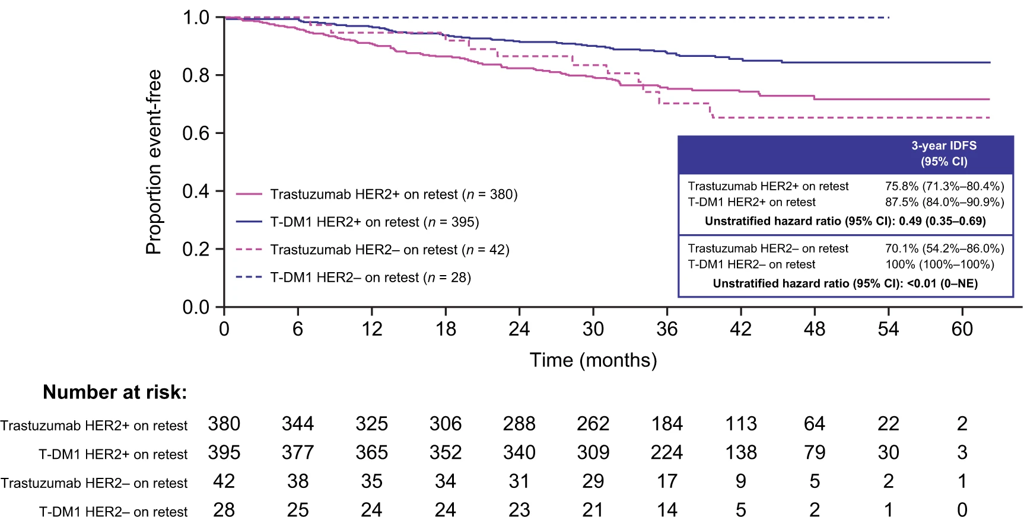
What if Disease is HER2-Negative at Time of Surgery?
Disclaimer: This presentation is the property of Physicians’ Education Resource, LLC (“PER”) and is protected by U.S. and international copyright laws. You may not copy, reproduce, distribute, transmit, modify, or create derivative works of the presentation without the prior written permission from PER.
Loibl S et al. NPJ Breast Cancer. 2022;8(1):106.

Slide 70

PRACTICE CHANGING RESULTS FROM KATHERINE
KATHERINE: HIGH RISK PATIENTS STILL AT RISK
WHILE IMPACTFUL THERE IS STILL ROOM FOR IMPROVEMENT:
1. High risk of recurrence if LN+ at time of surgery (7-year iDFS: 72%)
2. High risk of recurrence if inoperable at baseline (7-year iDFS: 67%)
3. Less benefit seen in HER2 IHC 2+ compared to IHC 3+ (7-year iDFS: 72% vs 83%)
4. No improvement in rates of CNS recurrence (7.0% vs 5.1%)
Geyer C et al, NEJM 2025

Slide 71


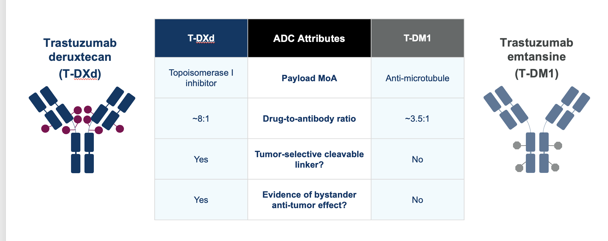
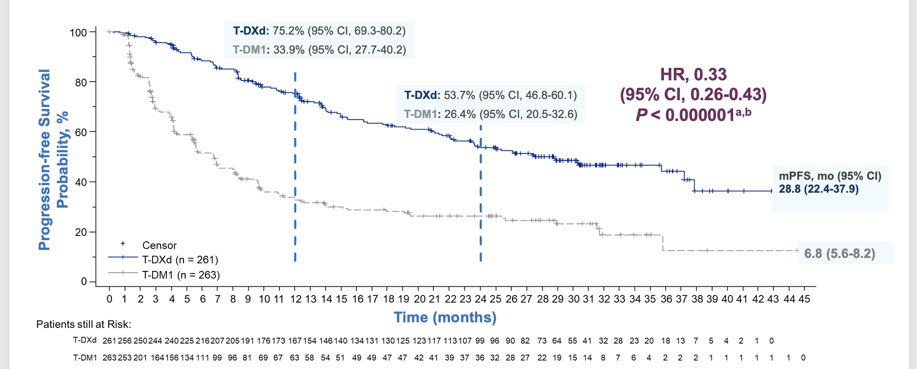
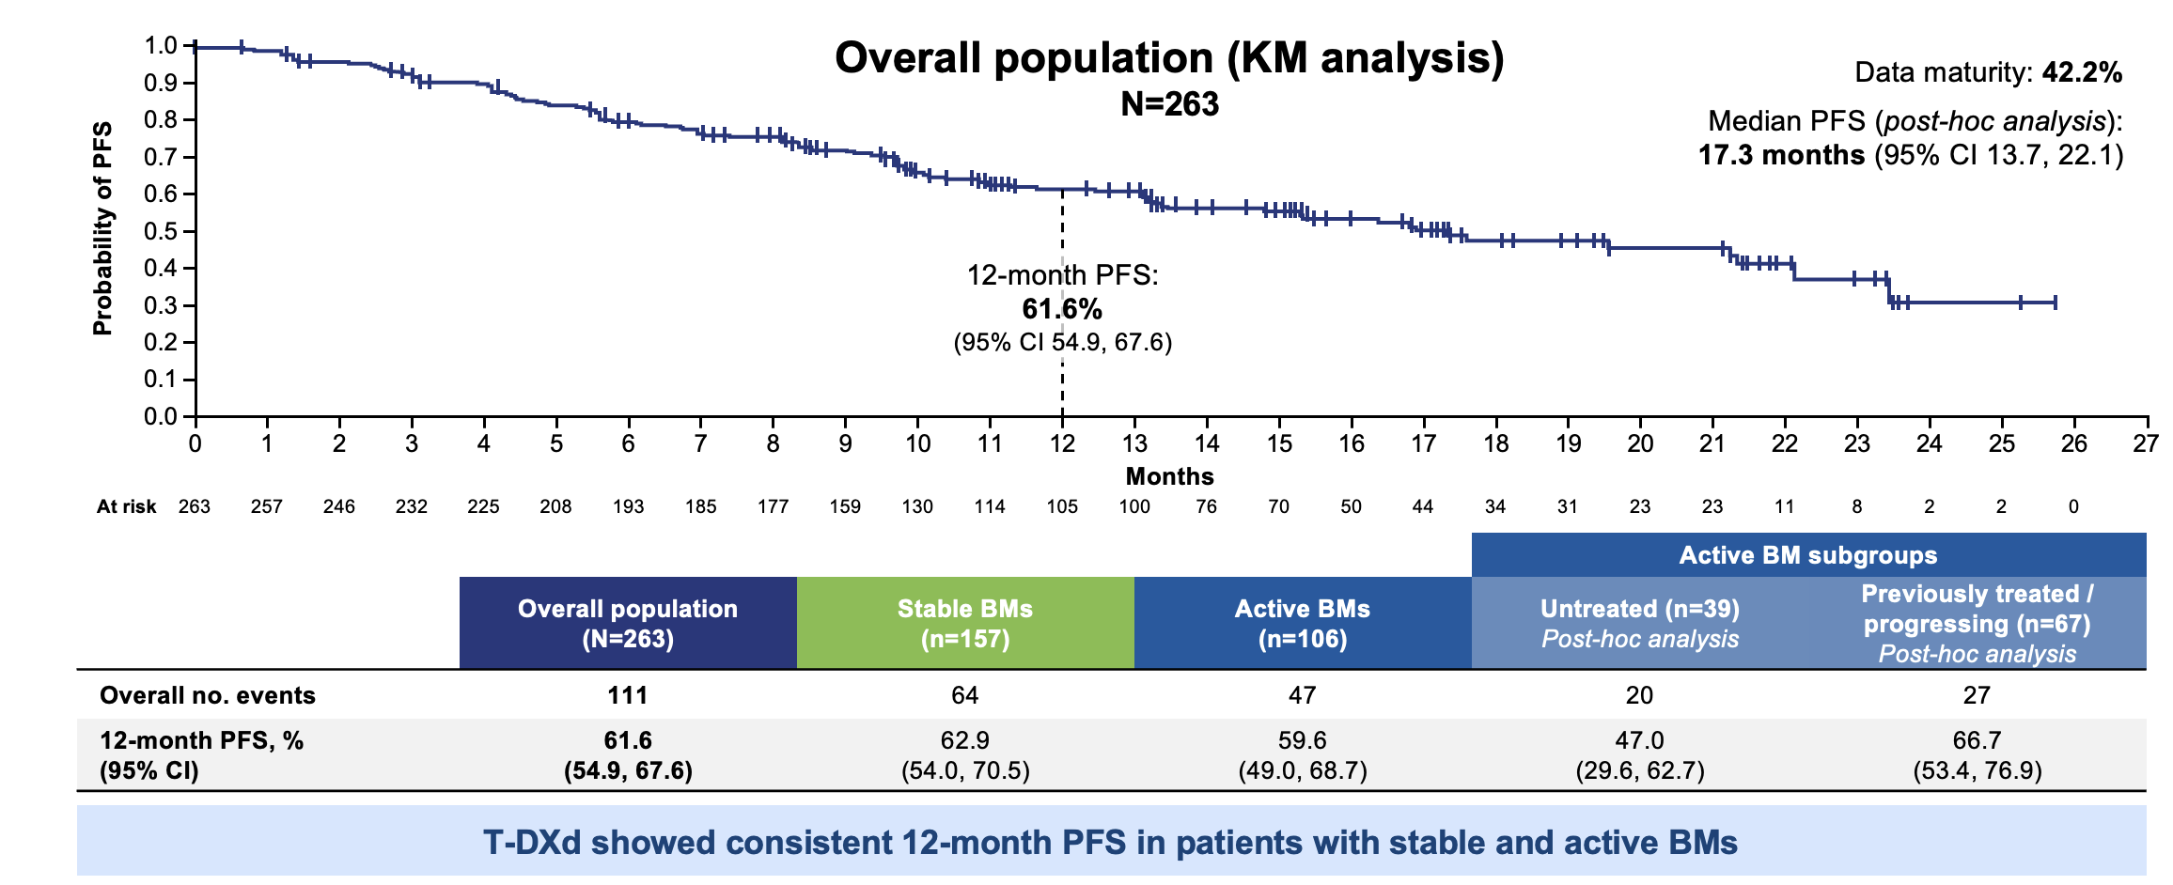
POST-KATHERINE MOMENTUM
RAISING THE BAR: CAN T-DXD OUTPERFORM T-DM1?
DB-03: T-DXd led to 4x longer PFS than T-DM1 in HER2+ MBC
More payload with different mechanism
Cleavable linker
Bystander effect overcomes issues
with HER2 heterogeneity
DB-12: T-DXd has robust efficacy in brain metastases
Cortes J et al, Nat Med 2024, Lin NU et al, ESMO 2024, Harbeck N et al, Nat Med 2024

Slide 72


D DESTINY-BREAST 05: OPTIMIZING OUTCOMES IN HIGH-RISK PATIENTS
KATHERINE’S DIRECT SUCCESSOR: DESTINY-BREAST 05
A global, multicenter, randomized, open-label, phase 3 trial (NCT04622319)
Population
T-DXd 5.4 mg/kg IV Q3W
for 14 cycles
N = 800
40-day safety follow-up
Primary endpoint
  IDFS
  Key secondary endpoint
  DFS
  Other secondary endpoints
  OS
  DRFI
  BMFI
  Safety
Residual invasive disease in the breast and/or axillary
lymph nodes after neoadjuvant chemotherapy and
HER2-directed treatmentª
High-risk
  Non-operable eBC (cT4, N0-3 or cT1-3, N2-3) prior
  to NAT or
  Operable eBC (cT1-3, N0-1) prior to NAT with axillary node-positive disease (ypN1-3) after NAT
Centrally confirmed HER2+ (IHC 3+ or ISH+) eBC
ECOG PS 0 or 1
N = ~1600
R
1:1
T-DM1 3.6 mg/kg Q3W
for 14 cycles
N = 800
Stratification Factors
Extent of disease prior to NAT (non operable, operable)
HER2-targeted NAT (single, dual)
Hormone receptor status (either positive, both negative)
Post-NAT pathologic nodal status (positive, negative)
Geyer C et al, ESMO 2025

Slide 73
D DESTINY-BREAST 05: OPTIMIZING OUTCOMES IN HIGH-RISK PATIENTS
DESTINY-BREAST05 DESIGNED TO INCLUDE A HIGHER RISK PATIENT POPULATION THAN KATHERINE
DESTINY-Breast05
Statistical assumption:
T-DM1: 3-year iDFS 83%
T-DXd: 3-year iDFS: 88%
Target HR ~0.675
KATHERINE DATA¹
Number |  | Subgroup Description | 3-year IDFS (%) |  | HR | Events/ Subjects in Subgroup: N/N (%) |  | Subjects per Subgroup
 |  |  | T-DM1 | Tras |  | T-DM1 | Tras | N (%)
All Patients |  |  | 88.3 | 77.0 | 0.50 | 91/743 (12.2) | 165/743 (22.2) | 1486 (100)
KATHERINE SUBGROUPS
1 | Inoperable irrespective of node & HR status |  | 76.0 | 60.2 | 0.54 | 42/185 (22.7) | 70/190 (36.8) | 375 (25.2)
2 | Operable with node-pos & HR-negative |  | 76.0 | 69.5 | 0.72 | 14/58 (24.1) | 15.52 (28.8) | 110 (7.4)
3 | Operable with node pos & HR-positive |  | 91.4 | 77.2 | 0.43 | 19/168 (11.3) | 37/167 (22.2) | 335 (22.5)
4 | Operable with node neg & HR-negative |  | 91.1 | 77.2 | 0.43 | 7/69 (10.1) | 14/68 (20.6) | 137 (9.2)
5 | Operable with node-neg & HR-positive |  | NR | NR | NR | 9/263 (3.4) | 29/266 (10.9) | 529 (35.6)
DB-05 Target
Population
55% of KATHERINE population
3-year iDFS: 81%
KATHERINE
High Risk Groups
KATHERINE
Full Population
Low-Risk
Groups
Groups 1 and 2 had low 3-year IDFS rates. Although groups 3 and 4 had high 3-year IDFS rates, nodal involvement is a known risk factor for recurrence, and from APHINlTY, these patients tend to recur later, so group 3 was included but not group 4.
DB-05 restricted to high-risk groups 1+2+3 that have high unmet medical need, as T-DM1 is the only approved treatment
in the HER2+ post­ neoadjuvant residual disease setting.
¹Mano et al, SABCS, 13 Dec 2019 IDFS=Invasive disease-free survival; NR=not reported;Tras=trastuzmab

Slide 74
DESTINY-BREAST05 KATHERINE: BASELINE CHARACTERISTICS
D DESTINY-BREAST 05: OPTIMIZING OUTCOMES IN HIGH-RISK PATIENTS
VS
DESTINY-BREAST05
KATHERINE
ITT Population | T-DXd (n=818) | T-DM1 (n=817)
Median age (range), years | 50.3 (24-78) | 50.6 (21-83)
Hormone Receptor status
HR+ | 581 (71.0) | 583 (71.4)
HR- | 237 (29.0) | 234 (28.6)
HER2 IHC
HER2 3+ | 676 (82.6) | 670 (82.0)
HER2 1+/2+ | 142 (17.4) | 147 (18.0)
Operative Status at Presentation
Operable | 387 (47.3) | 393 (48.1)
Inoperable | 431 (52.7) | 424 (51.9)
Post-neoadj tx nodal status
Positive | 660 (80.7) | 658 (80.5)
Negative | 158 (19.3) | 159 (19.5)
Neoadjuvant HER2 Therapy Approach
Single HER2 targeting | 176 (21.5) | 171 (20.9)
Dual HER2 targeting | 642 (78.5) | 646 (79.1)
Neoadjuvant Anthracycline use | 423 (51.7) | 399 (48.8)
ITT Population | T-DM1 (n=743) | Trastuzumab (n=743)
Median age (range), years | 49 (24-79) | 49 (23-80)
Hormone Receptor status
HR+ | 534 (71.9) | 540(72.7)
HR- | 209 (28.1) | 203 (27.3)
HER2 IHC
HER2 3+ | 573 (77.1) | 559 (75.2)
HER2 0/1+/2+ ISH amplified | 170 (22.9) | 181 (24.3)
Unknown | 0 (0) | 3 (0.4)
Operative Status at Presentation
Operable | 558 (75.1) | 554 (74.4)
Inoperable | 185 (24.9) | 190 (25.6)
Post-neoadj tx nodal status
Positive | 343(46.1) | 346 (46.6)
Negative | 400 (53.8) | 397(53.4)
Neoadjuvant HER2 Therapy Approach
Single HER2 targeting | 600 (80.8) | 171 (20.9)
Dual HER2 targeting | 143 (19.2) | 147 (19.8)
Neoadjuvant Anthracycline use | 579 (77.9) | 564 (75.9)
Enrolled 12/2020-2/2024
Enrolled 4/2013-12/2015

Slide 75

DESTINY-BREAST05 KATHERINE: BASELINE CHARACTERISTICS
D DESTINY-BREAST 05: OPTIMIZING OUTCOMES IN HIGH-RISK PATIENTS
VS
DESTINY-BREAST05
KATHERINE
ITT Population | T-DXd (n=818) | T-DM1 (n=817)
Median age (range), years | 50.3 (24-78) | 50.6 (21-83)
Hormone Receptor status
HR+ | 581 (71.0) | 583 (71.4)
HR- | 237 (29.0) | 234 (28.6)
HER2 IHC
HER2 3+ | 676 (82.6) | 670 (82.0)
HER2 1+/2+ | 142 (17.4) | 147 (18.0)
Operative Status at Presentation
Operable | 387 (47.3) | 393 (48.1)
Inoperable | 431 (52.7) | 424 (51.9)
Post-neoadj tx nodal status
Positive | 660 (80.7) | 658 (80.5)
Negative | 158 (19.3) | 159 (19.5)
Neoadjuvant HER2 Therapy Approach
Single HER2 targeting | 176 (21.5) | 171 (20.9)
Dual HER2 targeting | 642 (78.5) | 646 (79.1)
Neoadjuvant Anthracycline use | 423 (51.7) | 399 (48.8)
ITT Population | T-DM1 (n=743) | Trastuzumab (n=743)
Median age (range), years | 49 (24-79) | 49 (23-80)
Hormone Receptor status
HR+ | 534 (71.9) | 540(72.7)
HR- | 209 (28.1) | 203 (27.3)
HER2 IHC
HER2 3+ | 573 (77.1) | 559 (75.2)
HER2 0/1+/2+ ISH amplified | 170 (22.9) | 181 (24.3)
Unknown | 0 (0) | 3 (0.4)
Operative Status at Presentation
Operable | 558 (75.1) | 554 (74.4)
Inoperable | 185 (24.9) | 190 (25.6)
Post-neoadj tx nodal status
Positive | 343(46.1) | 346 (46.6)
Negative | 400 (53.8) | 397(53.4)
Neoadjuvant HER2 Therapy Approach
Single HER2 targeting | 600 (80.8) | 171 (20.9)
Dual HER2 targeting | 143 (19.2) | 147 (19.8)
Neoadjuvant Anthracycline use | 579 (77.9) | 564 (75.9)
~2x as many patients
were inoperable at baseline
ENROLLED 12/2020-2/2024
Enrolled 4/2013-12/2015
Sara M. Tolaney
Content of this presentation is copyright and responsibility of the author. Permission is required for re-use.

Slide 76
DESTINY-BREAST05 KATHERINE: BASELINE CHARACTERISTICS
D DESTINY-BREAST 05: OPTIMIZING OUTCOMES IN HIGH-RISK PATIENTS
VS
DESTINY-BREAST05
KATHERINE
ITT Population | T-DXd (n=818) | T-DM1 (n=817)
Median age (range), years | 50.3 (24-78) | 50.6 (21-83)
Hormone Receptor status
HR+ | 581 (71.0) | 583 (71.4)
HR- | 237 (29.0) | 234 (28.6)
HER2 IHC
HER2 3+ | 676 (82.6) | 670 (82.0)
HER2 1+/2+ | 142 (17.4) | 147 (18.0)
Operative Status at Presentation
Operable | 387 (47.3) | 393 (48.1)
Inoperable | 431 (52.7) | 424 (51.9)
Post-neoadj tx nodal status
Positive | 660 (80.7) | 658 (80.5)
Negative | 158 (19.3) | 159 (19.5)
Neoadjuvant HER2 Therapy Approach
Single HER2 targeting | 176 (21.5) | 171 (20.9)
Dual HER2 targeting | 642 (78.5) | 646 (79.1)
Neoadjuvant Anthracycline use | 423 (51.7) | 399 (48.8)
ITT Population | T-DM1 (n=743) | Trastuzumab (n=743)
Median age (range), years | 49 (24-79) | 49 (23-80)
Hormone Receptor status
HR+ | 534 (71.9) | 540(72.7)
HR- | 209 (28.1) | 203 (27.3)
HER2 IHC
HER2 3+ | 573 (77.1) | 559 (75.2)
HER2 0/1+/2+ ISH amplified | 170 (22.9) | 181 (24.3)
Unknown | 0 (0) | 3 (0.4)
Operative Status at Presentation
Operable | 558 (75.1) | 554 (74.4)
Inoperable | 185 (24.9) | 190 (25.6)
Post-neoadj tx nodal status
Positive | 343(46.1) | 346 (46.6)
Negative | 400 (53.8) | 397(53.4)
Neoadjuvant HER2 Therapy Approach
Single HER2 targeting | 600 (80.8) | 171 (20.9)
Dual HER2 targeting | 143 (19.2) | 147 (19.8)
Neoadjuvant Anthracycline use | 579 (77.9) | 564 (75.9)
Almost 2x as many patients were
node-positive at time of surgery
ENROLLED 12/2020-2/2024
Enrolled 4/2013-12/2015
Sara M. Tolaney
Content of this presentation is copyright and responsibility of the author. Permission is required for re-use.

Slide 77

DESTINY-BREAST05 KATHERINE: BASELINE CHARACTERISTICS
D DESTINY-BREAST 05: OPTIMIZING OUTCOMES IN HIGH-RISK PATIENTS
VS
DESTINY-BREAST05
KATHERINE
ITT Population | T-DXd (n=818) | T-DM1 (n=817)
Median age (range), years | 50.3 (24-78) | 50.6 (21-83)
Hormone Receptor status
HR+ | 581 (71.0) | 583 (71.4)
HR- | 237 (29.0) | 234 (28.6)
HER2 IHC
HER2 3+ | 676 (82.6) | 670 (82.0)
HER2 1+/2+ | 142 (17.4) | 147 (18.0)
Operative Status at Presentation
Operable | 387 (47.3) | 393 (48.1)
Inoperable | 431 (52.7) | 424 (51.9)
Post-neoadj tx nodal status
Positive | 660 (80.7) | 658 (80.5)
Negative | 158 (19.3) | 159 (19.5)
Neoadjuvant HER2 Therapy Approach
Single HER2 targeting | 176 (21.5) | 171 (20.9)
Dual HER2 targeting | 642 (78.5) | 646 (79.1)
Neoadjuvant Anthracycline use | 423 (51.7) | 399 (48.8)
ITT Population | T-DM1 (n=743) | Trastuzumab (n=743)
Median age (range), years | 49 (24-79) | 49 (23-80)
Hormone Receptor status
HR+ | 534 (71.9) | 540(72.7)
HR- | 209 (28.1) | 203 (27.3)
HER2 IHC
HER2 3+ | 573 (77.1) | 559 (75.2)
HER2 0/1+/2+ ISH amplified | 170 (22.9) | 181 (24.3)
Unknown | 0 (0) | 3 (0.4)
Operative Status at Presentation
Operable | 558 (75.1) | 554 (74.4)
Inoperable | 185 (24.9) | 190 (25.6)
Post-neoadj tx nodal status
Positive | 343(46.1) | 346 (46.6)
Negative | 400 (53.8) | 397(53.4)
Neoadjuvant HER2 Therapy Approach
Single HER2 targeting | 600 (80.8) | 171 (20.9)
Dual HER2 targeting | 143 (19.2) | 147 (19.8)
Neoadjuvant Anthracycline use | 579 (77.9) | 564 (75.9)
had received dual HER2-directed therapy preop
ENROLLED 12/2020-2/2024
Enrolled 4/2013-12/2015
Sara M. Tolaney
Content of this presentation is copyright and responsibility of the author. Permission is required for re-use.

Slide 78

DESTINY-BREAST05 KATHERINE: BASELINE CHARACTERISTICS
D DESTINY-BREAST 05: OPTIMIZING OUTCOMES IN HIGH-RISK PATIENTS
VS
DESTINY-BREAST05
KATHERINE
ITT Population | T-DXd (n=818) | T-DM1 (n=817)
Median age (range), years | 50.3 (24-78) | 50.6 (21-83)
Hormone Receptor status
HR+ | 581 (71.0) | 583 (71.4)
HR- | 237 (29.0) | 234 (28.6)
HER2 IHC
HER2 3+ | 676 (82.6) | 670 (82.0)
HER2 1+/2+ | 142 (17.4) | 147 (18.0)
Operative Status at Presentation
Operable | 387 (47.3) | 393 (48.1)
Inoperable | 431 (52.7) | 424 (51.9)
Post-neoadj tx nodal status
Positive | 660 (80.7) | 658 (80.5)
Negative | 158 (19.3) | 159 (19.5)
Neoadjuvant HER2 Therapy Approach
Single HER2 targeting | 176 (21.5) | 171 (20.9)
Dual HER2 targeting | 642 (78.5) | 646 (79.1)
Neoadjuvant Anthracycline use | 423 (51.7) | 399 (48.8)
ITT Population | T-DM1 (n=743) | Trastuzumab (n=743)
Median age (range), years | 49 (24-79) | 49 (23-80)
Hormone Receptor status
HR+ | 534 (71.9) | 540(72.7)
HR- | 209 (28.1) | 203 (27.3)
HER2 IHC
HER2 3+ | 573 (77.1) | 559 (75.2)
HER2 0/1+/2+ ISH amplified | 170 (22.9) | 181 (24.3)
Unknown | 0 (0) | 3 (0.4)
Operative Status at Presentation
Operable | 558 (75.1) | 554 (74.4)
Inoperable | 185 (24.9) | 190 (25.6)
Post-neoadj tx nodal status
Positive | 343(46.1) | 346 (46.6)
Negative | 400 (53.8) | 397(53.4)
Neoadjuvant HER2 Therapy Approach
Single HER2 targeting | 600 (80.8) | 171 (20.9)
Dual HER2 targeting | 143 (19.2) | 147 (19.8)
Neoadjuvant Anthracycline use | 579 (77.9) | 564 (75.9)
Less anthracycline use
in preop setting
ENROLLED 12/2020-2/2024
ENROLLED 4/2013-12/2015
Sara M. Tolaney
Content of this presentation is copyright and responsibility of the author. Permission is required for re-use.

Slide 79
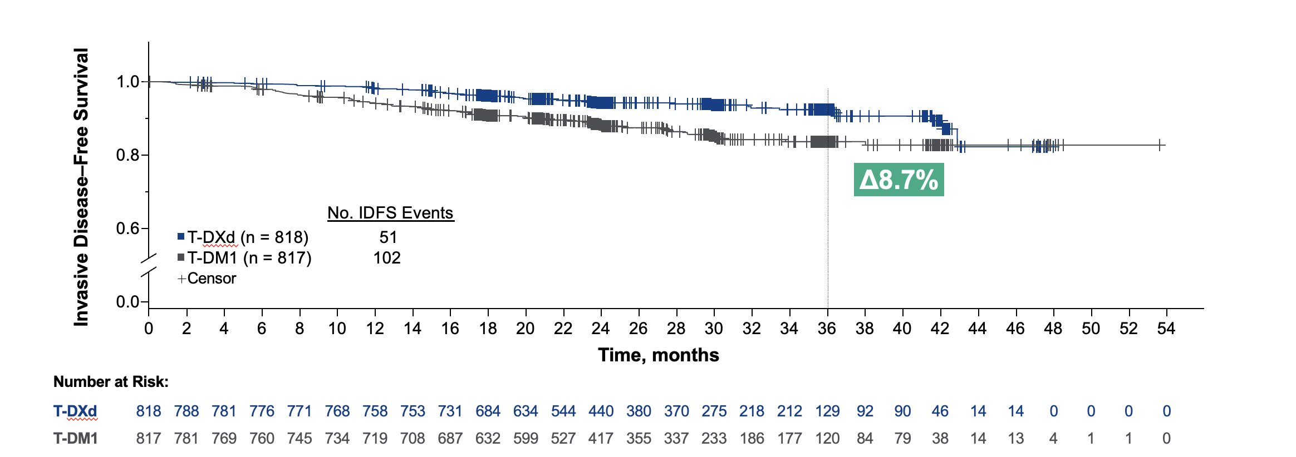
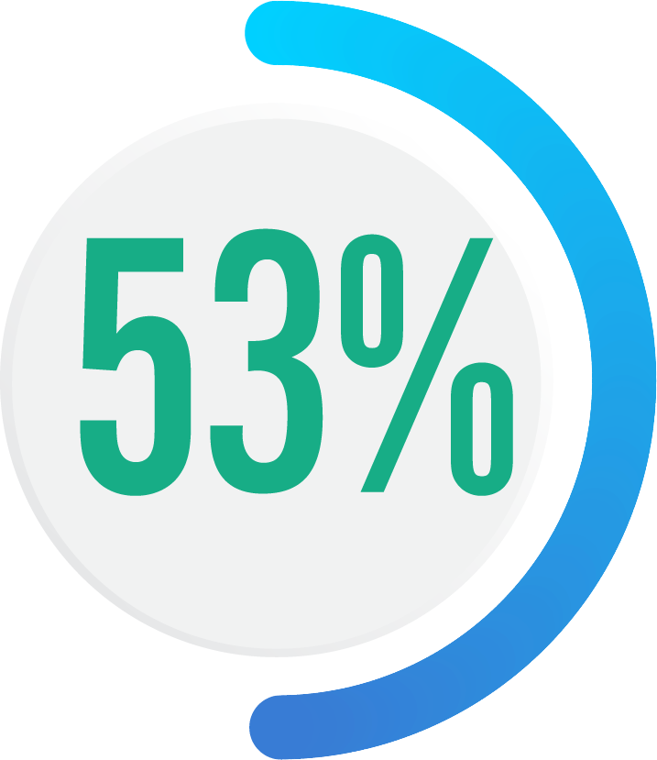
DB-05: T-DXd REDUCED RISK OF RECURRENCE BY HALF IN A HIGH-RISK
RESIDUAL DISEASE POPULATION
D DESTINY-BREAST 05: OPTIMIZING OUTCOMES IN HIGH-RISK PATIENTS
3-year IDFS
 | T-DXd n = 818 | T-DM1 n = 817
IDFS, % (95% CI) | 92.4 (89.7-94.4) | 83.7 (80.2-86.7)
HR (95 % CI) | 0.47 (0.34-0.66)
P-value | <0.0001^{b}
Control arm PERFORMED
EXACTLY
as predicted
reduction in the risk of invasive disease recurrence or death for T-DXd compared with T-DM1
HR, hazard ratio; IDFS, invasive disease–free survival; T-DM1, trastuzumab emtansine; T-DXd, trastuzumab deruxtecan. Efficacy stopping boundary, P = 0.0183. ªIDFS is defined as the time from randomization until the date of first occurrence of one of the following events: recurrence of ipsilateral invasive breast tumor, recurrence of ipsilateral locoregional invasive breast cancer, contralateral invasive breast cancer, a distant disease recurrence, or death from any cause. ^{b}Two-sided P value from stratified log-rank test. Hazard ratio and 95% CI from stratified Cox proportional hazards model with stratification factor of operative status at disease presentation.
Sara M. Tolaney
Geyer CE et al. ESMO 2025
Content of this presentation is copyright and responsibility of the author. Permission is required for re-use.

Slide 80


DB-05: T-DXd SIGNIFICANTLY REDUCES DISTANT RECURRENCES
D DESTINY-BREAST 05: OPTIMIZING OUTCOMES IN HIGH-RISK PATIENTS
DESTINY-Breast05 (30 months FU)
 | T-DXd (n=818) | T-DM1 (n=817)
Distant recurrence CNS, n (%) | 17 (2.1) | 25 (3.1)
Distant recurrence (non-CNS) | 25 (3.1) | 52 (6.4)
Local invasive recurrence | 1 (0.1) | 5 (0.6)
Regional recurrence | 1 (0.1) | 6 (0.7)
Contralateral invasive recurrence | 0 | 6 (0.7)
Death without prior event | 7 (0.9) | 8 (1.0)
of patients had
distant recurrence
as first iDFS event
reduction in the
risk of distant
recurrence
No mandatory CNS imaging required at baseline or in follow-up
(CNS recurrence assessed per standard of care practice)
Are we preventing
CNS events?
Median follow-up time: 30 months
Geyer CE et al. ESMO 2025

Slide 81

D DESTINY-BREAST 05: OPTIMIZING OUTCOMES IN HIGH-RISK PATIENTS
DB-05: T-DXd SIGNIFICANTLY REDUCES DISTANT RECURRENCES. TREND TOWARDS FEWER CNS LESIONS, BUT LONGER FOLLOW-UP IS NEEDED.
DESTINY-Breast05 (30 months FU)
KATHERINE (40 months FU)
KATHERINE (101 months FU)
 | T-DXd (n=818) | T-DM1 (n=817)
Distant recurrence CNS, n (%) | 17 (2.1) | 25 (3.1)
Distant recurrence (non-CNS) | 25 (3.1) | 52 (6.4)
Local invasive recurrence | 1 (0.1) | 5 (0.6)
Regional recurrence | 1 (0.1) | 6 (0.7)
Contralateral invasive recurrence | 0 | 6 (0.7)
Death without prior event | 7 (0.9) | 8 (1.0)
 | T-DM1 (n=743) | Trastuzumab (n=743)
Distant recurrence CNS, n (%) | 44 (5.9) | 32 (4.3)
Distant recurrence (non-CNS) | 34 (4.6) | 86 (11.6)
Local invasive recurrence | 8 (1.1) | 34 (4.6)
Contralateral invasive recurrence | 3 (0.4) | 10 (1.3)
Death without prior event | 2 (0.3) | 3 (0.4)
 | T-DM1 (n=743) | Trastuzumab (n=743)
Distant recurrence CNS, n (%) | 52 (7.0) | 38 (5.1)
Distant recurrence (non-CNS) | 57 (7.7) | 122 (16.4)
Local invasive recurrence | 16 (2.2) | 46 (6.2)
Contralateral invasive recurrence | 7 (0.9) | 19 (2.6)
Death without prior event | 14 (1.9) | 14 (1.9)
Median follow-up time: 30 months
Median follow-up time: 40 months
Median follow-up time: 101 months
    Early and encouraging signal for numerically fewer CNS events, but longer follow-up needed
Geyer CE et al, NEJM 2025
Geyer CE et al. ESMO 2025
Von Mickwitz G et al, NEJM 2019
Mamounas EP et al, Ann Oncol 2021

Slide 82
D DESTINY-BREAST 05: OPTIMIZING OUTCOMES IN HIGH-RISK PATIENTS
THE CHALLENGE OF PREVENTING CNS EVENTS:
CNS AS FIRST SITE OF RELAPSE ACROSS EARLY STAGE HER2+ TRIALS
Trial and Population |  | Analysis timepoint | N | Neoadjuvant population
 |  |  |  |  | Comparator (%) | Treatment (%)
Adjuvant trastuzumab Meta-analysis |  | – | 9020 | N/A | 1.94 | 2.56
ALTTO |  | 3 years | 5190 | ~8% | 2 | 2
ExteNET | ITT | 5 years | 2840 | 26% | 1.8 | 1.3
 | HR+/≤1yr post trastuzumab | 5 years | 1334 | 27% | 2.1 | 0.7
APHINITY |  | 11 years | 4805 | 0 | 2.2 | 2.1
No pCR Post neoadjuvant treatment
KATHERINE High-risk |  | 8 years | 1486 | N/A | 5.1 | 7.0
ExteNET HR+/≤1year Post trastuzumab |  | 5 years | 295 | N/A | 3.6 | 0.8
DESTINY-Breast05 |  | 3 years | 1635 | N/A | 3.1 | 2.1
Olson EM et al, Ann Oncol 2013; Lambertini M et al, BCRT 2019; Martin M et al Lancet Oncol 2017; Loibl S et al, ESMO Breast 2025; Geyer CE et al NEJM 2025; Geyer CE et al ESMO 2025
Slide adapted from Nancy Lin

Slide 83



D DESTINY-BREAST 05: OPTIMIZING OUTCOMES IN HIGH-RISK PATIENTS
MRI SCREENING FOR BRAIN METASTASES (BrM) AMONG PATIENTS WITH TRIPLE NEGATIVE OR HER2+ STAGE IIb OR III BREAST CANCER: A MULTI-CENTRE, SINGLE ARM, PROSPECTIVE TRIAL “INSIGHT” TRIAL [NCT06247449]
co-PIs: K. Jerzak and G. Watson
HER2+
expansion cohort now recruiting
(n=100)
HER2+ COHORT (N=30):
Patients age ≥18y diagnosed with stage IIb or III HER2+ breast cancer within the past 18 months.
INTERVENTIONS:
*One time brain MRI & blood draw within 4 weeks of enrolment. **Questionnaire completed within 2 weeks after brain MRI.
2-Stage Design:
If at least 1/30 patients is diagnosed with BrM (3.3% incidence) expand to n=100 patients
Contrast-enhanced brain MRI*
Blood draw
(ctDNA)*
Testing
Morbidities Index
Questionnaire**
TNBC COHORT (N=30):
Patients age ≥18y diagnosed with stage IIb or III TNBC within the past 18 months.
TNBC data pending
Co-primary Endpoints: (1) Proportion of eligible patients with newly diagnosed HER2+ stage IIb or III BC who have asymptomatic BrM; (2) Proportion of eligible patients with newly diagnosed triple negative stage IIb or III BC who have asymptomatic BrM.
Sara M. Tolaney
Content of this presentation is copyright and responsibility of the author. Permission is required for re-use.

Slide 84
D DESTINY-BREAST 05: OPTIMIZING OUTCOMES IN HIGH-RISK PATIENTS
DB-05: HIGHER RATES OF ADVERSE EVENTS WITH T-DXd, HOWEVER PATIENTS COMPLETED THE SAME NUMBER OF TREATMENT CYCLES AS IN KATHERINE
 | T-DXd (n=806) | T-DM1 (n=801)
Grade ≥3 TEAEs, n (%) | 408 (50.6) | 416 (51.9)
Serious TEAEs | 140 (17.4) | 109 (13.6)
TEAEs associated with discontinuation | 144 (17.9) | 103 (12.9)
TEAEs associated with drug interruptions | 400 (49.6) | 329 (41.1)
TEAEs associated with deaths* | 3 (0.4) | 5 (0.6)
Treatment-related deaths | 2 (0.2) | 1 (0.1)
Median treatment duration (months) | 9.8 | 9.7
Patients completed 14 cycles (%) | 72.3 | 76.3
ILD (adjudicated), n (%) | 77(9.6) | 13 (1.6)
grade ≥3 ILD | 9 (1.1) | 0 (0)
grade 5 ILD | 2 (0.3%) | 0 (0)
LV dysfunction | 23 (2.9) | 14 (1.7)
More SAEs
More early discontinuations
due to toxicity
More dose interruptions
2 vs 1 treatment related deaths
*Cause of death in T-DXd arm: pneumonitis, respiratory tract infection (adjudicated as not ILD), and ILD
Causes of death in T-DM1 arm: leiomyosarcoma, aneurysm, sepsis, ovarian cancer, pneumothorax
Geyer CE et al. ESMO 2025
Among all pts who recv’d at least one dose of study drug

Slide 85
D DESTINY-BREAST 05: OPTIMIZING OUTCOMES IN HIGH-RISK PATIENTS
DB-05: HIGHER RATES OF ADVERSE EVENTS WITH T-DXd, HOWEVER PATIENTS
COMPLETED THE SAME NUMBER OF TREATMENT CYCLES AS IN KATHERINE
 | T-DXd (n=806) | T-DM1 (n=801)
Grade ≥3 TEAEs, n (%) | 408 (50.6) | 416 (51.9)
Serious TEAEs | 140 (17.4) | 109 (13.6)
TEAEs associated with discontinuation | 144 (17.9) | 103 (12.9)
TEAEs associated with drug interruptions | 400 (49.6) | 329 (41.1)
TEAEs associated with deaths* | 3 (0.4) | 5 (0.6)
Treatment-related deaths | 2 (0.2) | 1 (0.1)
Median treatment duration (months) | 9.8 | 9.7
Patients completed 14 cycles (%) | 72.3 | 76.3
ILD (adjudicated), n (%) | 77(9.6) | 13 (1.6)
grade ≥3 ILD | 9 (1.1) | 0 (0)
grade 5 ILD | 2 (0.3%) | 0 (0)
LV dysfunction | 23 (2.9) | 14 (1.7)
Similar duration of treatment
*Cause of death in T-DXd arm: pneumonitis, respiratory tract infection (adjudicated as not ILD), and ILD
Causes of death in T-DM1 arm: leiomyosarcoma, aneurysm, sepsis, ovarian cancer, pneumothorax
Geyer CE et al. ESMO 2025
Among all pts who recv’d at least one dose of study drug

Slide 86
D DESTINY-BREAST 05: OPTIMIZING OUTCOMES IN HIGH-RISK PATIENTS
DB-05: HIGHER RATES OF ADVERSE EVENTS WITH T-DXd, HOWEVER PATIENTS COMPLETED THE SAME NUMBER OF TREATMENT CYCLES AS IN KATHERINE
 | T-DXd (n=806) | T-DM1 (n=801)
Grade ≥3 TEAEs, n (%) | 408 (50.6) | 416 (51.9)
Serious TEAEs | 140 (17.4) | 109 (13.6)
TEAEs associated with discontinuation | 144 (17.9) | 103 (12.9)
TEAEs associated with drug interruptions | 400 (49.6) | 329 (41.1)
TEAEs associated with deaths* | 3 (0.4) | 5 (0.6)
Treatment-related deaths | 2 (0.2) | 1 (0.1)
Median treatment duration (months) | 9.8 | 9.7
Patients completed 14 cycles (%) | 72.3 | 76.3
ILD (adjudicated), n (%) | 77(9.6) | 13 (1.6)
grade ≥3 ILD | 9 (1.1) | 0 (0)
grade 5 ILD | 2 (0.3%) | 0 (0)
LV dysfunction | 23 (2.9) | 14 (1.7)
More ILD (9.6% vs 1.0%), 2 grade 5 ILD events
Rate of ILD higher than seen in DB11 (4.4%), but consistent with rates seen in pretreated patients with longer exposure
*Cause of death in T-DXd arm: pneumonitis, respiratory tract infection (adjudicated as not ILD), and ILD
Causes of death in T-DM1 arm: leiomyosarcoma, aneurysm, sepsis, ovarian cancer, pneumothorax
Among all pts who recv’d at least one dose of study drug
Geyer CE et al. ESMO 2025

Slide 87
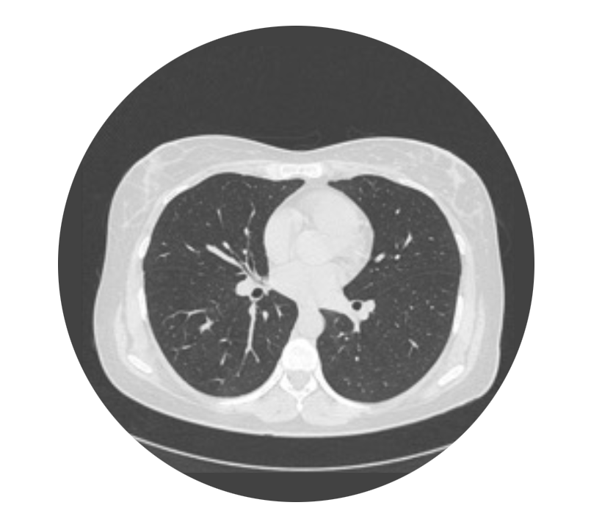
D DESTINY-BREAST 05: OPTIMIZING OUTCOMES IN HIGH-RISK PATIENTS
DB-05: RADIATION TIMING AND SAFETY - SEQUENTIAL VS CONCURRENT RADIATION?
RT was given concurrently with study
therapy (concurrent RT) or completed prior
to the start of study therapy (sequential RT)
Baseline non-contrast Chest CT, then
at 6 weeks, and then every 12 weeks
during treatment, with one after completion
of therapy
Extra CT prior to C1D1 if sequential RT
Allowed to maintain dose and schedule through grade 1 RTpneumonitis on study
BEFORE
CYCLE 3
BEFORE
CYCLE 11
BASELINE
CHEST CT
(Required if Sequential RT)
BEFORE
CYCLE 7
AFTER
LAST DOSE
 | T-DXd (n=806) | T-DM1 (n=801)
Radiotherapy Treatment, n (%) | 763 (93.4) | 759 (92.9)
Investigator-assessed Radiation Pneumonitis | 232 (28.8%) | 216 (27.0%)
Grade 1 | 24.2% | 20.8%
Grade 2 | 4.6% | 6.2%
Similar iDFS with Sequential RT c/w Concurrent
RT for pts receiving TDXd (93.8% vs 92.8%)
Important to note that rates are higher than we have previously seen with T-DM1 due to CT screening (KATHERINE T-DM1 arm: radiation pneumonitis 1.5%, overall pneumonitis: 2.6%)
Geyer CE et al. ESMO 2025

Slide 88

CLINICAL APPLICATIONS
How to Balance Risk and Benefit in Practice
PROs
CONs
Reduces risk of recurrence by half
Benefit seen across all subgroups
May reduce risk of CNS recurrence
Similar # of pts complete 14 doses
as T-DM1
Similar rate of radiation pneumonitis as T-DM1
Risk of ILD (with 2 grade 5 ILD events)
Requires CT monitoring (cost)
More dose holds/discontinuations
Unknown impact on QOL/PROs
Limited North American enrollment, few black pts
OS benefit not yet known (only 2.9% maturity)
Benefits outweigh risks in
high-risk patients
T-DXd should be considered a standard option for patients with residual node-positive disease and those with inoperable disease at baseline (T4 tumors or N2/N3) with residual disease
T-DM1 is standard of care for patients with operable disease at baseline and are node-negative at time of surgery

Slide 89

CLINICAL APPLICATIONS
SHOULD WE GIVE T-DXd PREOP OR POST-OP?
Preoperative
Post-operative
Improve pCR rate→ less axillary surgery
Shorter course T-DXd (4 cycles)
vs 14 cycles
Less toxicity given just 4 cycles
May result in better QOL for patients
1. Could allow de-escalated preoperative therapy (THP), sparing those patients with pCR T-DXd (but those with RD end up with 14 cycles)
pCR
in 44-64*%
HP
THP
Surgery
*If HER2Dx med/high: pCR ~60-70%
RD
T-DXd

Slide 90
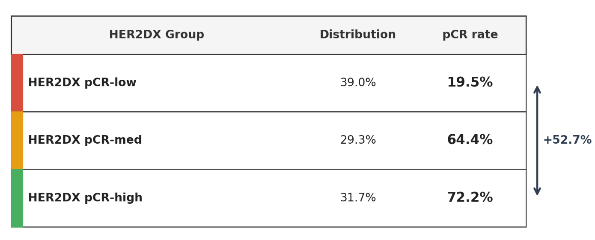
HER2DX pCR score predicts response to THP (12–15 weeks)
✅ Validated in 3 Studies, 👥 732 Patients, 💉 THP x 12–15 Weeks
Odds Ratio High vs Low = 10.7, 95% CI 7.1–16.2, p<0.001
Waks et al. JAMA Oncol 2023; Villacampa et al. Ann Oncol 2023; Tung et al. ASCO 2025

Slide 91

FUTURE STUDIES NEEDED
HOW COULD WE INTEGRATE DB11 AND DB05?
pCR
HP
x 14 cycles
Stege 2/3
HER2+ BC
Any HR status
Breast MRI response
Surgery
THP
x12 wks
response
RD
TDXd
x14 cycles
Baseline breast MRI
for all patients
If no response
pCR
HP
x 14 cycles
T-DXd for 4 cycles
Surgery
RD
RCB2/3
ACx4→T-DM1x 14 cycles
RCB1
T-DM1 x 14 cycles or T-DXd x 14 cycles
Slide adapted from Elia Sequi/Ada Waks

Slide 92
CAN ASTEFANIA AND COMPASSHER2 RD IMPROVE ON THE KATHERINE REGIMEN BY COMBINING T-DM1 WITH ATEZOLIZUMAB OR TUCATINIB?
FUTURE RESEARCH DIRECTIONS
ASTEFANIA (Phase III)^{1,2}
High-risk, HER2+ eBC
RD in the breast/lymph nodes following neoadjuvant
therapy and surgery:
T4, any N
any T, N2–3
T1–3, N0–1*
N = 1,700 (closed early)
T-DM1 + atezolizumab x14
Preclinical and clinical evidence provide proof of concept for combining immunotherapy with
T-DM1,^{3,4} which may increase the potency of the immune response in HER2+ eBC²
R
1:1
T-DM1 + placebo x14
Primary endpoint: IDFS in the full analysis set
CompassHER2 RD (Phase III)⁵
High-risk, HER2+ eBC
T1‒4, N0–3 disease at presentation and RD following neoadjuvant therapy and surgery (T1a/b, N0 tumours
not eligible)†
Prior neoadjuvant treatment with T-DM1 not allowed
N = 1,031
T-DM1 + tucatinib x14
CompassHER2 RD is evaluating the combination of two distinct HER2-targeted treatment modalities (ADC + TKI); could
TKI help reduce CNS events?
R
1:1
T-DM1 + placebo x14
Primary endpoint: Modified IDFS‡
* Patients with cT1–3, N0–1 disease must have pathological evidence of residual invasive carcinoma in axillary lymph node(s) at surgery; † Patients with residual HR–, HER2+ disease in the breast and/or lymph nodes are eligible; however, patients with HR+, HER2+ cancers must have node-positive residual disease. The presence of RD in the breast is not mandatory for these patients; ‡ If clinically significant imbalances of baseline variables appear between treatment arms, a secondary analysis of the primary endpoint (stratified Cox model) will compare treatment effects using imbalanced variables as the adjusting variables. The model will use the randomisation stratification factors as the stratified variables.
ADC, antibody–drug conjugate; eBC, early breast cancer; IDFS, invasive disease-free survival; R, randomisation; RD, residual invasive disease; TKI, tyrosine kinase inhibitor.
1. https://www.clinicaltrials.gov/study/NCT04873362 (accessed March 2025); 2. Hurvitz SA, et al. Future Oncol 2022; 18:3563–3675; 3. Muller P, et al. Sci Transl Med 2015; 7:315ra188;
4. Emens LA, et al. Lancet Oncol 2020; 21:1283–1295; 5. https://www.clinicaltrials.gov/study/NCT04457596 (accessed March 2025).

Slide 93
Summary
Disclaimer: This presentation is the property of Physicians’ Education Resource, LLC (“PER”) and is protected by U.S. and international copyright laws. You may not copy, reproduce, distribute, transmit, modify, or create derivative works of the presentation without the prior written permission from PER.
Understanding that we can change long term outcomes by adapting adjuvant therapy based on response to preoperative therapy is a paradigm shift for HER2+ breast cancer
  End of an era of purely adjuvant trials for developing novel strategies to improve outcomes for stage 2/3 disease
Ongoing studies are looking at both escalation and de-escalation strategies for HER2+ breast cancer
  Need to move beyond clinical-pathologic risk alone for selection of therapy with desire for biomarker integration for personalizing therapy
Notes:
In summary, we have learned that we can change long term outcomes for our pts with HER2+ dz by adapting adjuvant therapy based on response to preoperative therapy – and this really is a paradigm shift, stressing the importance of utilizing a preoperative systemic approach with dual HEr2 directed therapy for pts with stage 2/3 disease, and administering T-DM1 in pts with residual disease; and this adapative treatment approach really puts an end to future development of novel treatments in a pure adjuvant setting
And while extended adjuvant thearpy with neratinib can have benefit, it is unknown what the benefits may be in pts with prior pertuzumab and T-DM1, and should be restricted to those pts with very high risk HR+ dz
For those pts with Stage I dz, either TH or T-DM1 can be considered, though perhaps T-DM1 may be preferable during the current COVD-19 pandemic
And the improvements we have seen in development of HER2 targeted agents makes it important for us to continue to study ways to de-escalate therapy for those with lower risk disease, and escalate therapy for those with higher risk disease, and is the current focus of multiple ongoing studies

Slide 94
Thank You!

