Slide 1
Integrative Medicine for Breast Cancer Patients
Ting Bao MD, MS
Co-Director
Zakim Center for Integrative Therapies and Healthy Living
Dana-Farber Cancer Institute
Past President, Past Co-Chair, Education Committee, Co-Chair, Research Committee
Society for Integrative Oncology
ting_bao@dfci.Harvard.edu
11/8/2025

Slide 2
Disclosure
Consultant: None

Slide 3
Objectives
By the conclusion of the presentation, attendees should be able to:
Distinguish between integrative medicine, complementary and alternative medicine
Explain common integrative medicine approaches
Describe the application of integrative medicine approaches to mitigate typical breast cancer-related symptoms

Slide 4
Outline
Case
Definition
Different types of Integrative therapies
  Mind-body therapies
  Massage
  Acupuncture
  Diet, Exercise
  Dietary supplements
Integrative medicine to manage some adverse events
  Aromatase inhibitor-associated musculoskeletal symptoms
  Vasomotor symptoms
  Insomnia
  Fatigue
Summary

Slide 5
Case
45 y.o. woman with recent diagnosis of ER+/HER2- breast cancer (T1N0M0), BRCA2 mutation carrier, s/p bilateral mastectomy, bilateral oophorectomy, on letrozole.
Main Symptoms:
  Significant AI-induced joint muscle pain: unable to get up from the floor after playing with her 5 y.o. son
  Significant hot flashes
  Significant insomnia, fatigue
Main questions:
  Shall I stop taking the medication and use some herbs or supplements?
  What can I do to reduce this pain? What about hot flashes, insomnia and fatigue?

Slide 6
What is Integrative Oncology?
A patient-centered, evidence-informed field of comprehensive cancer care that utilizes mind-body practices, natural products, and lifestyle modifications from different traditions alongside conventional cancer treatments
Witt et al. J Natl Cancer Inst Monogr 2017

Slide 7
Integrative Medicine Use Among Cancer Patients and Survivors Has Grown Significantly
Horneber. ICT. 2012;11(3):187-203.
Notes:
Now, in the past few decades, complimentary medicine use in cancer patients has increased significantly. As you can see, in the 1970s, complementary medicine use in cancer survivors was about 25% percent and by the 2000s, it had doubled to nearly 50%.

Slide 8
Growth of Integrative Medicine Services at NCI-Designated Comprehensive Cancer Centers
2009
2016
(%)
30.3%
30.7%
32.8%
30.6%
Yun H et al. JNCI Monographs. 2017;52
Notes:
At the same time, there has been a significant increase in integrative oncology programs at National Cancer Institute Designated Comprehensive Cancer Centers. You can see here that in 2009, the blue columns, compared to 2016 (represented by the orange columns), the number of cancer centers providing information on their websites about integrative medicine approaches including acupuncture, massage, meditation, and yoga increased about 30%.
Yun H...Mao J, Growth of Integrative Medicine at Leading Cancer Centers Between 2009 and 2016: A Systematic Analysis of NCI-Designated Comprehensive Cancer Center Websites,

Slide 9
The Rising Trend in Integrative Oncology Research
Notes:
We did a PubMed search using "integrative oncology" key words and found that there has also been a significant spike in the number of publications since 2010. As we can see, research in this field has been taking off since that time and has increased greatly over the past decade.

Slide 10
Integrative Medicine | Alternative Medicine
Used alongside conventional treatments; complimentary | Promoted for use instead of conventional treatment
Evidence-based | Unsubstantiated claims
Non-invasive | Often biologically invasive
Relatively inexpensive | Often very costly
Focused on side effects and pain management | Touted as curative
Notes:
Integrative Medicine brings “complementary” treatments into the plan of care along with treatment from doctors, nurses, and other providers
The main difference lies in where the care is provided as well as the communication between providers (including documentation in the medical record)

Slide 11
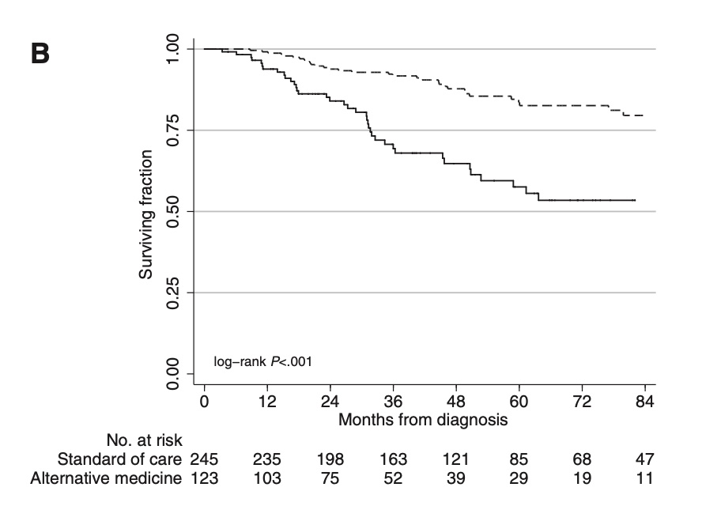
Using Alternative Medicine (AM) Increases Risk of Death in Breast Cancer Patients
Patients receiving alternative medicine (solid lines)
Patients receiving conventional cancer treatment CCT (dashed lines)
Alternative Medicine use was independently associated with a greater risk of death compared with conventional cancer treatment for breast cancer (HR: 5.68, 95% CI: 3.22 to 10.04)
Johnson S. et al. J Natl Cancer Inst 2018
Notes:
Use of Alternative Medicine for Cancer and Its Impact on Survival
Skyler B. Johnson, Henry S. Park, Cary P. Gross, James B. Yu
Affiliations of authors: Department of Therapeutic Radiology, Yale School of Medicine, New Haven, CT (SBJ, HSP, JBY); Cancer Outcomes, Public Policy, and Effectiveness Research (COPPER) Center, Yale School of Medicine, New Haven, CT (CPG, JBY).
Correspondence to: Skyler B. Johnson, MD, Department of Therapeutic Radiology, Yale School of Medicine, HRT 138, 333 Cedar St, New Haven, CT 06520 (e-mail: skyler. johnson@yale.edu).
Abstract
There is limited available information on patterns of utilization and efficacy of alternative medicine (AM) for patients with cancer. We identified 281 patients with nonmetastatic breast, prostate, lung, or colorectal cancer who chose AM, administered as sole anticancer treatment among patients who did not receive conventional cancer treatment (CCT), defined as chemotherapy, radiotherapy, surgery, and/or hormone therapy. Independent covariates on multivariable logistic regression associated with increased likelihood of AM use included breast or lung cancer, higher socioeconomic status, Intermountain West or Pacific location, stage II or III disease, and low comorbidity score. Following 2:1 matching (CCT 1⁄4 560 patients and AM 1⁄4 280 patients) on Cox proportional hazards regression, AM use was independently associated with greater risk of death compared with CCT overall (hazard ratio [HR] 1⁄4 2.50, 95% confidence interval [CI] 1⁄4 1.88 to 3.27) and in subgroups with breast (HR 1⁄4 5.68, 95% CI 1⁄4 3.22 to 10.04), lung (HR 1⁄4 2.17, 95% CI 1⁄4 1.42 to 3.32), and colorectal cancer (HR 1⁄4 4.57, 95% CI 1⁄4 1.66 to 12.61). Although rare, AM utilization for curable cancer without any CCT is associated with greater risk of death.

Slide 12
Quote from the Authors:
“It is important to note that complementary and integrative medicine are not the same as alternative medicine as defined in our study. Whereas complementary and integrative medicine incorporate a wide range of therapies that complement conventional medicine, AM is an unproven therapy that was given in place of conventional treatment.”
Johnson S. et al. J Natl Cancer Inst 2018

Slide 13
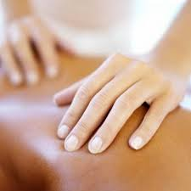
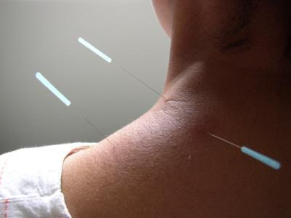
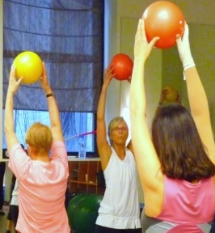
Types of Integrative Therapies
Mind-body therapies
Massage therapies
Acupuncture
Diet, Nutrition, Supplements
Exercise/fitness

Slide 14

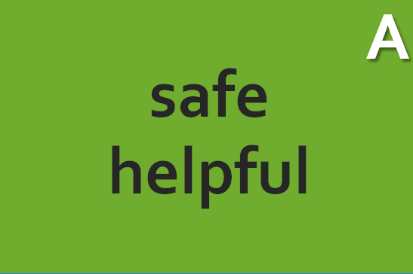
Mind-Body Therapies
Meditation
Hypnosis
Guided imagery
Biofeedback
Breathing exercises
Progressive muscle relaxation
Yoga
Qigong
Mindfulness-based intervention (MBI)

Slide 15
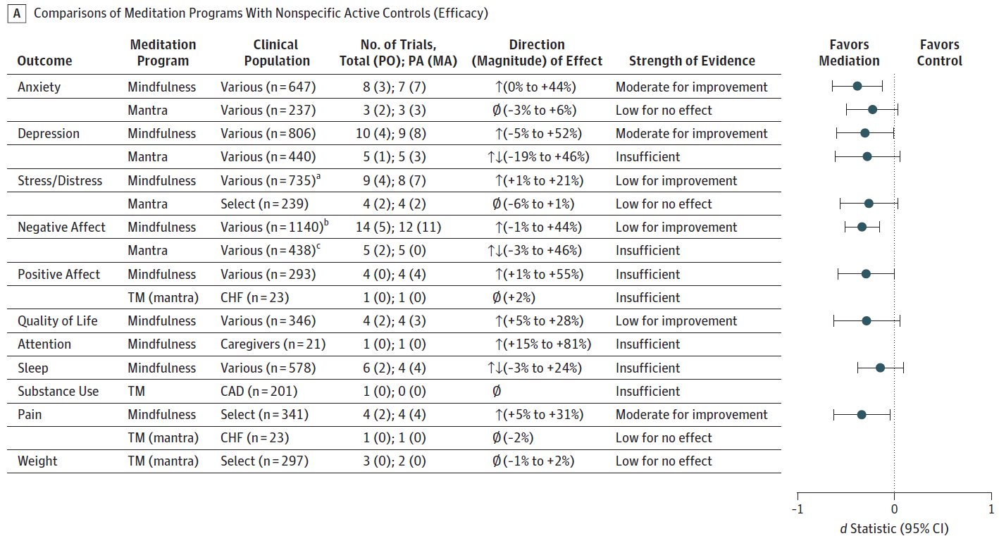
Meditation Reduces Anxiety
Systematic Review/Meta-Analysis 47 trials • 3515 participants
Goyal M, et al. Meditation programs for psychological stress and well-being: a systematic review and meta-analysis. JAMA Intern Med. 2014;174:357-368.

Slide 16
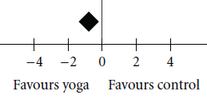
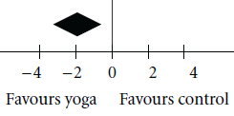
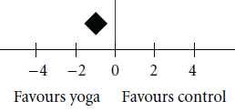
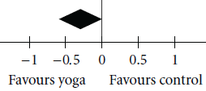
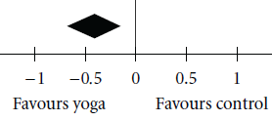
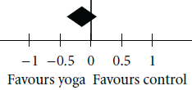
Yoga Reduces Symptoms and Improves QoL
Anxiety
Stress
Depression
QoL
Distress
Fatigue
Lin KY, et al. Effects of yoga on psychological health, quality of life, and physical health of patients with cancer: a meta-analysis. Evid Based Complement Alternat Med. 2011;2011:659876.

Slide 17
Mindfulness-Based Interventions (MBI)
Therapeutic approaches that incorporate mindfulness practices, such as meditation and yoga, to promote mental health and well-being
MBIs are typically offered in a group format with weekly meetings (either in person or virtually) over 6-9 weeks
Participants learn skills of mindfulness through the daily home practice of various forms of meditation, breathing exercises, and gentle movement
Participants also commonly receive didactic teaching about coping with stress and the mind-body connection; this is typically supported by dialogue within group settings
Notes:
MBSR is the original parent program of the other MBIs, stemming from Buddhist Vipassana (insight) meditation, developed by Jon Kabat-Zinn in 1979. It consists of 8 weekly 2.5hr group sessions focused on learning practices from mindfulness meditation (body scan, sitting meditation, walking meditation, loving kindness) and gentle Hatha yoga. Teaching about concepts around mindfulness, attitudes, stress and other topics as well as personal sharing and inquiry are also included. Participants are assigned meditation and yoga homework practice of 45 minutes/day, 6 days/week.^{b}

Slide 18
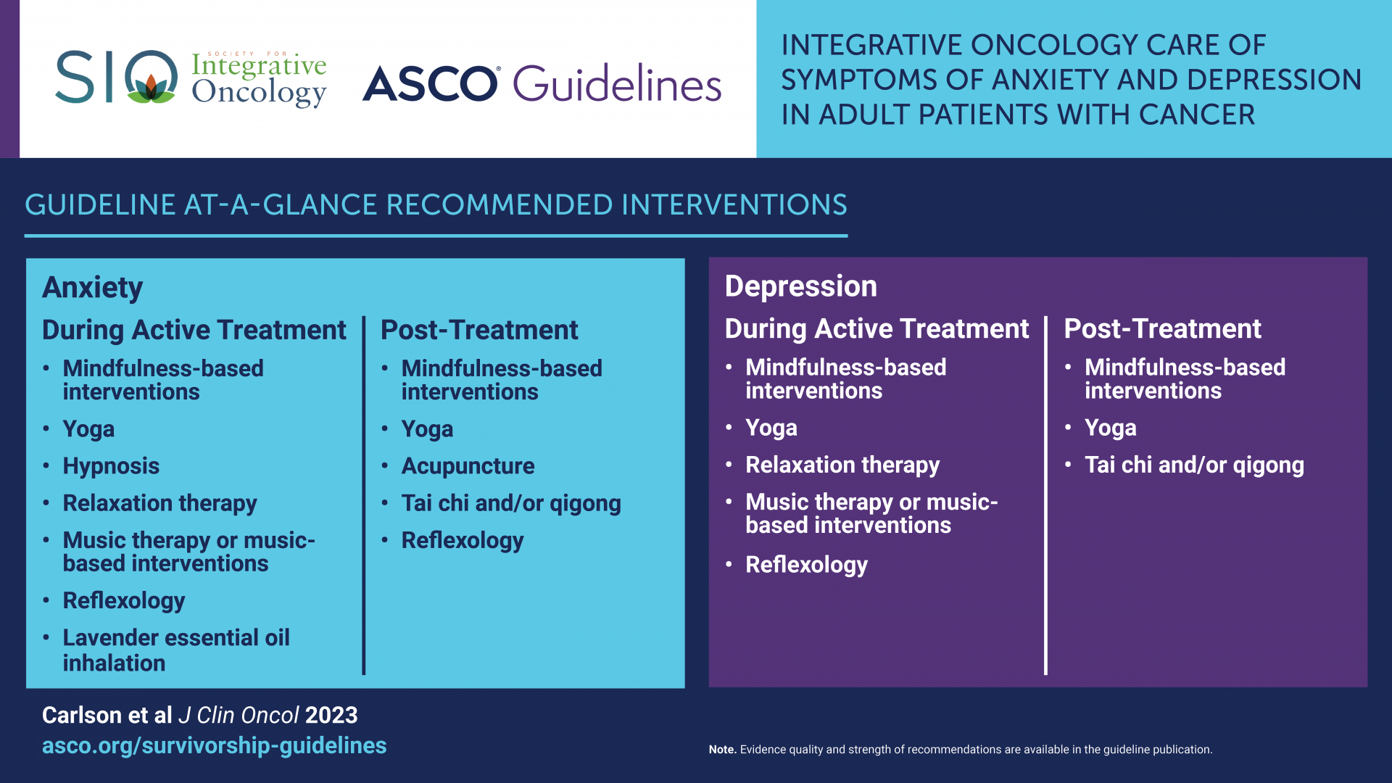
MBIs should be offered to people with cancer both during active treatment and post-treatment for anxiety and depression
Based on several meta-analyses and systematic reviews that included up to 29 individual RCTs

Slide 19
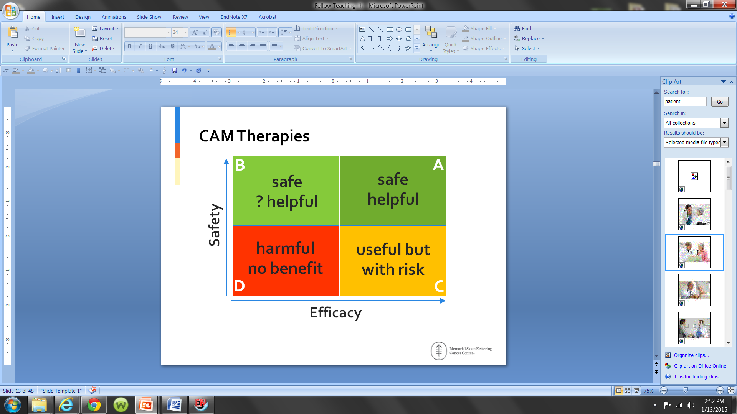
Massage Therapies
to

Slide 20

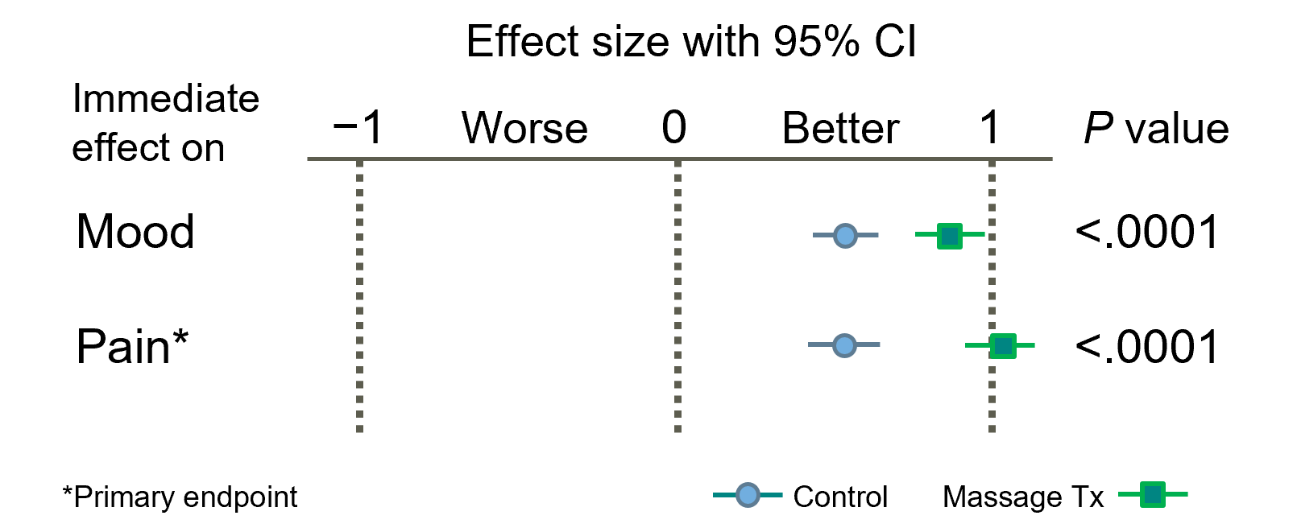
Massage for Pain and Mood During Palliative and Hospice Care
Massage Therapy Versus Simple Touch to Improve Pain and Mood in Patients with Advanced Cancer: A Randomized Trial
Advanced cancer patients with moderate-to-severe pain
Immediate pain reduction
Mean difference, 0.90; P < .001
No side effects observed
Provided short-term pain relief and enhanced coping
Based on 2 SRs, 7 RCTs
LOE: Intermediate
SOR: Moderate
Benefit outweighs risk
N=380; Massage, 188; Simple touch control, 192
Kutner et al. Ann Intern Med 2008; 149: 369–79
Notes:
FROM CS: Took out LOE and OR define since have previously
Recommendation 1.13. Massage may be offered to patients experiencing pain during palliative and hospice care
A high-quality large multicenter trial included in a recent systematic review: 380 adults with advanced cancer with moderate-to-severe pain were included, 90% of whom were enrolled in hospice. Patients were randomly assigned to massage or simple touch control for six 30-minute sessions over 2 weeks. The active intervention included gentle gliding stroke; squeezing, rolling, and kneading the muscles; and trigger point release.
Immediate outcomes were obtained before and after each treatment using the Memorial Pain Assessment Card, a 0 to 10-point scale. Sustained outcomes including BPI were obtained at baseline and weekly for 2 weeks.
Massage had immediate benefits on pain reduction (mean difference, 0.90; P < .001) with no side effects observed, providing short-term pain relief and enhanced coping.
In advanced cancer patients with moderate to severe pain, massage therapy provides short-term pain relief and enhances coping. Therefore, massage therapy should be offered to advanced cancer patients, particularly those with pain during palliative and hospice care.

Slide 21
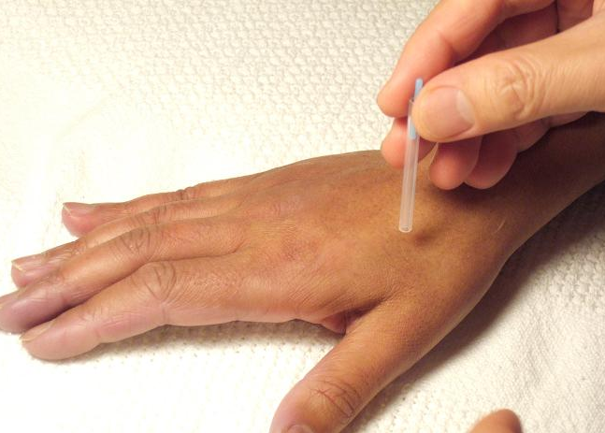
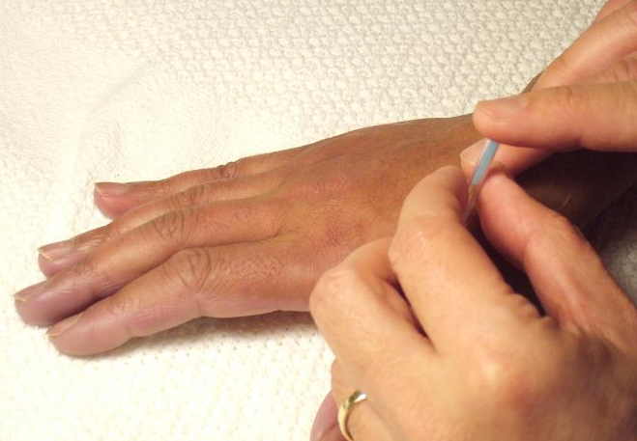
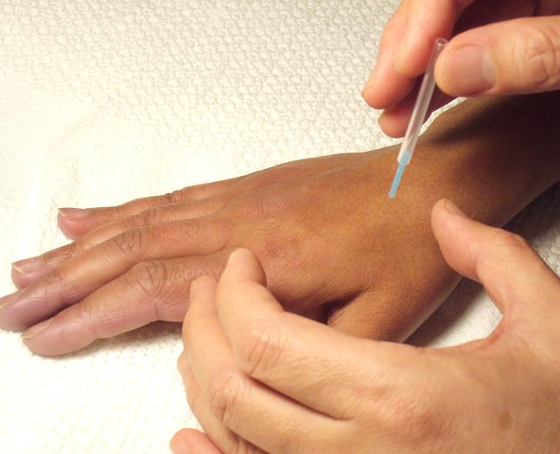
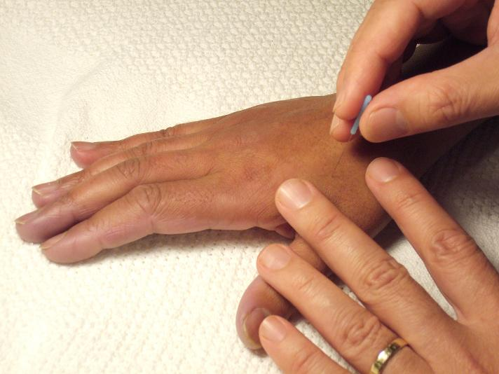
Locating
the point
Tapping in the
needle
Acupuncture
to
Removing the
guide tube
Manipulating
the needle

Slide 22

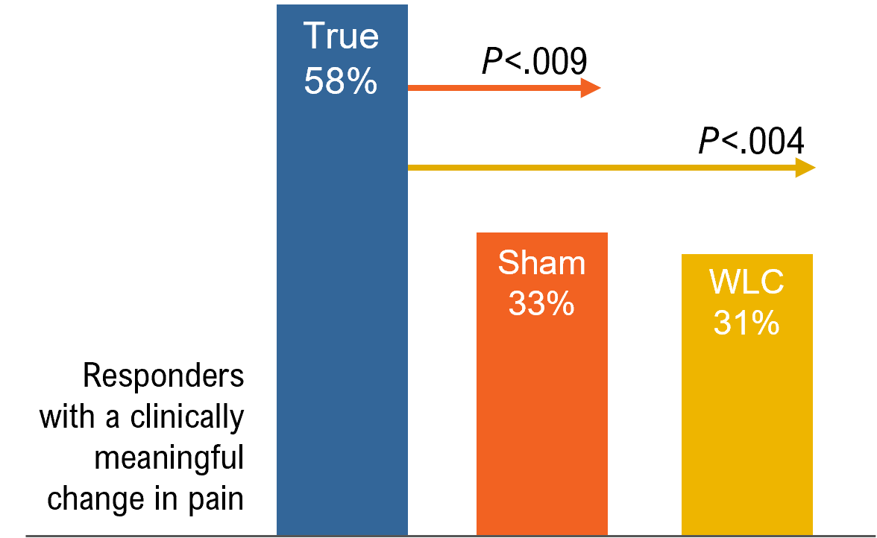
Acupuncture Should Be Offered to Patients With AI-related Joint Pain
Effect of Acupuncture vs Sham Acupuncture or Waitlist Control on Joint Pain
Related to Aromatase Inhibitors Among Women With Early-Stage Breast Cancer
A Randomized Clinical Trial
True acupuncture significantly reduced moderate to severe pain more than sham and WLC after 6 weeks:
2.05 vs 1.07 and 0.99 points on a
0–10 numeric rating scale (NRS)
Based on 4 systematic reviews (SRs), 5 randomized controlled trials (RCTs)
LOE: Intermediate
SOR: Moderate
Benefit outweighs risk
N=226; 2:1:1 Randomization
LOE, Level of evidence; SOR, Strength of recommendation; WLC, Waitlist control
Hershman et al. JAMA 2018; 320: 167–76

Slide 23

Lifestyle Recommendations for Cancer Prevention
Be a Healthy Weight
Be Physically Active
Eat a diet rich in whole grains, vegetables, fruit, beans
Limit fast foods & processed foods
Limit red & processed meat
Limit sugar-sweetened drinks
Limit alcohol
Do not rely on supplements
Breastfeed if possible
After cancer diagnosis, follow recommendations if feasible
Notes:
Adherence to the WCRF/AICR 2018 recommendations for cancer prevention and risk of cancer: prospective cohort studies of men and women (: 10.1038/s41416-020-0806-x)
- each 1-score increment in recommendation adherence was associated with 3% (95% CI = 1–5%) and 4% (95% CI = 2–5%) decreased risk, respectively

Slide 24
Dietary Supplement Use Among Cancer Survivors
High usage among cancer survivors
  64-81% use vitamins and minerals
  26-77% use multivitamins
  24% use herbal and non-vitamin supplement
Weak evidence
  Current clinical practice guidelines now regularly mention dietary supplements
  None of the recommendations are strong with high levels of evidence
High demand among patients
  ~50% IM patients ask about dietary supplements
Velicer J Clin Oncol 2008
Miller CA Cancer J Clin 2016
Greenlee CA Cancer J Clin 2017
Mao J Clin Oncol 2022
Notes:
ASCO Peripheral Neuropathy → no strong recommendations
NCCN Supportive Care → no strong recommendations
NCCN Survivorship → no strong recommendations
SIO Breast Cancer (Endorsed by ASCO)
Ginseng for fatigue
SIO Pain → no strong recommendations
SIO Depression/Anxiety → no strong recommendations

Slide 25
Herbs or Supplement Interactions with Medications
Direct | High-dose antioxidants can interfere with RT Some supplements raise bleeding risk in anti-coagulated patients Phytoestrogens counteracting anti-estrogen therapy
Indirect | May alter activity of drugs that metabolize CYP enzymes, leading to higher or lower blood levels of the drug than what was intended

Slide 26
Check for Interactions & Contraindications
Staff: Clinical Pharmacist
Interactions:
  Drug-supplement
  Supplement-supplement
Contraindications
  Based on tumor histology
Document in standardized format in EHR so that it is findable

Slide 27
Websites to check for interactions
Name | Cost | URL
Memorial Sloan Kettering Cancer Center’s About Herbs | No cost | mskcc.org/cancer-care/diagnosis-treatment/symptom-management/integrative-medicine/herbs
National Cancer Institute PDQ Cancer Information Summary: Integrative, Alternative, and Complementary Therapies | No cost | cancer.gov/publications/pdq/information-summaries/cam
National Institutes of Health Office of Dietary Supplements | No cost | ods.od.nih.gov
Natural Medicines | Access fee, some institutions have licenses | naturalmedicines.therapeuticresearch.com
UpToDate | Access fee, many institutions have licenses | uptodate.com
Consumer Labs | Access fee | consumerlab.com

Slide 28
How can integrative medicine help reduce the common side effects of breast cancer treatment?

Slide 29
Case
45 y.o. woman with recent diagnosis of ER+/HER2- breast cancer (T1N0M0), BRCA2 mutation carrier, s/p bilateral mastectomy, bilateral oophorectomy, on letrozole.
Main Symptoms:
  Significant AI-induced joint muscle pain: unable to get up from the floor after playing with her 5 y.o. son
  Significant hot flashes
  Significant insomnia, fatigue
Main questions:
  Shall I stop taking the medication and use some herbs or supplements?
  What can I do to reduce this pain? What about hot flashes, insomnia and fatigue?

Slide 30
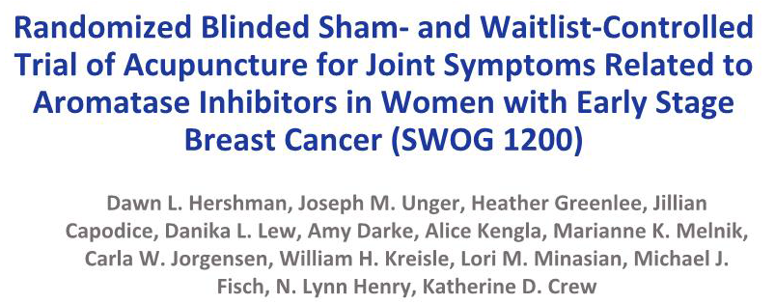
Hershman DL, et al JAMA 2018

Slide 31
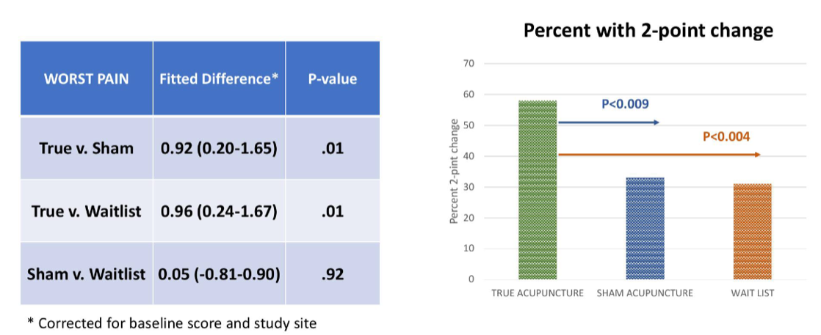
Biweekly Acupuncture for 6 Weeks Significantly Reduced AIMSS vs Placebo + Usual Care
Intervention: 12 Acupuncture sessions over 6 weeks,
followed by once weekly sessions for 6 additional weeks

Slide 32
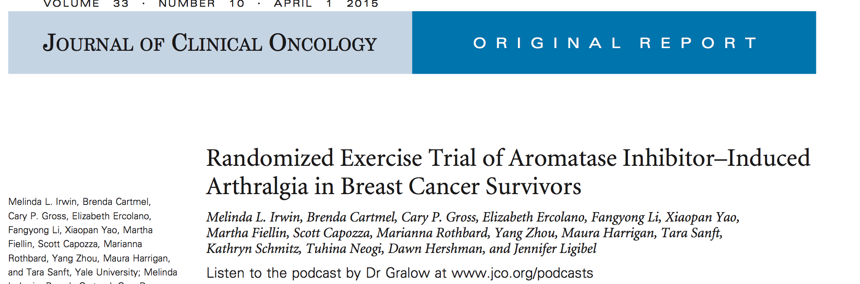
Intervention: Aerobic exercise 150 min/wk + 2x/wk supervised strength training OR usual care
Irwin ML, et al. J Clin Oncol 2015;33: 1104-11

Slide 33
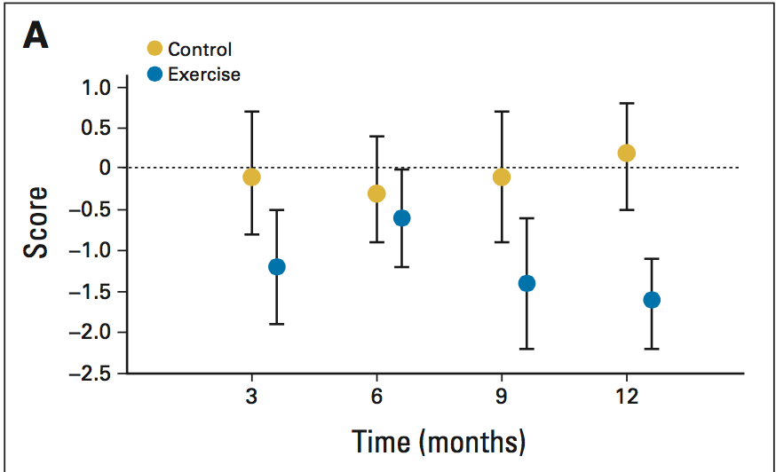
Exercise Significantly Reduced AIMSS Pain
Score
Time (months)

Slide 34
Yoga Therapy for AIMSS
Pilot study: A yoga program twice weekly for 8 weeks significantly improved balance and flexibility, and reduced pain for patients with AIMSS without significant side effects ¹
Multisite RCT secondary analysis: Yoga improves AIMSS by reducing pain and physical discomfort ²
It is reasonable to recommend exercise and yoga to
patients experiencing AIMSS
Galantino ML, et al. Integr Cancer Ther 2012;11: 313–20
Peppone LJ, et al. Breast Cancer Res Treat 2015;150:597–604

Slide 35
Omega-3 for AIMSS
2015 RCT of O3FAs vs PBO in breast cancer survivors with moderate to severe AIMSS (SWOG S0927, N=262):
Both groups had >50% sustained reductions in AIMSS with
no significant between-group differences ¹
2018 ASCO exploratory analysis: Obese patients (n=110) benefit more from Omega-3 than PBO ²
Ongoing trial: Can Omega-3 prevent AIMSS? ³
Hershman DL, et al. J Clin Oncol 2015;33:1910-7
Shen S, et al. J Clin Oncol 2018;36 (suppl; abstr 10000)
https://clinicaltrials.gov/ct2/show/NCT02831582
Notes:
http://abstracts.asco.org/214/AbstView_214_221581.html

Slide 36
Vitamin D Supplementation for AIMSS
DB-RCT in 60 breast cancer survivors with AIMSS and low serum vitamin D levels (<30 ng/mL)
  High-dose supplementation significantly improved AIMSS pain and bone mineral density vs PBO
  Beneficial effect stronger in the stratum with lower
  vitamin D levels (10–19 ng/ml vs 20–29 ng/ml)
Rastelli AL, et al. Breast Cancer Res Treat 2011;129:107-60

Slide 37
Sub-Summary
IM Approaches for AIMSS
Consider Nonpharmacological Tx
Monitor
Evidence Lacking
Vit D Levels
Supplements
Acupuncture
Exercise
Yoga
But O3FA supple-mentation may help obese patients

Slide 38
Vasomotor Symptoms
Hot flashes and night sweats commonly result from endocrine therapy
Symptom management is challenging
    Estrogen therapy, the most effective treatment: Associated with increased risk of recurrence and development of new breast cancers
IM therapies are needed

Slide 39
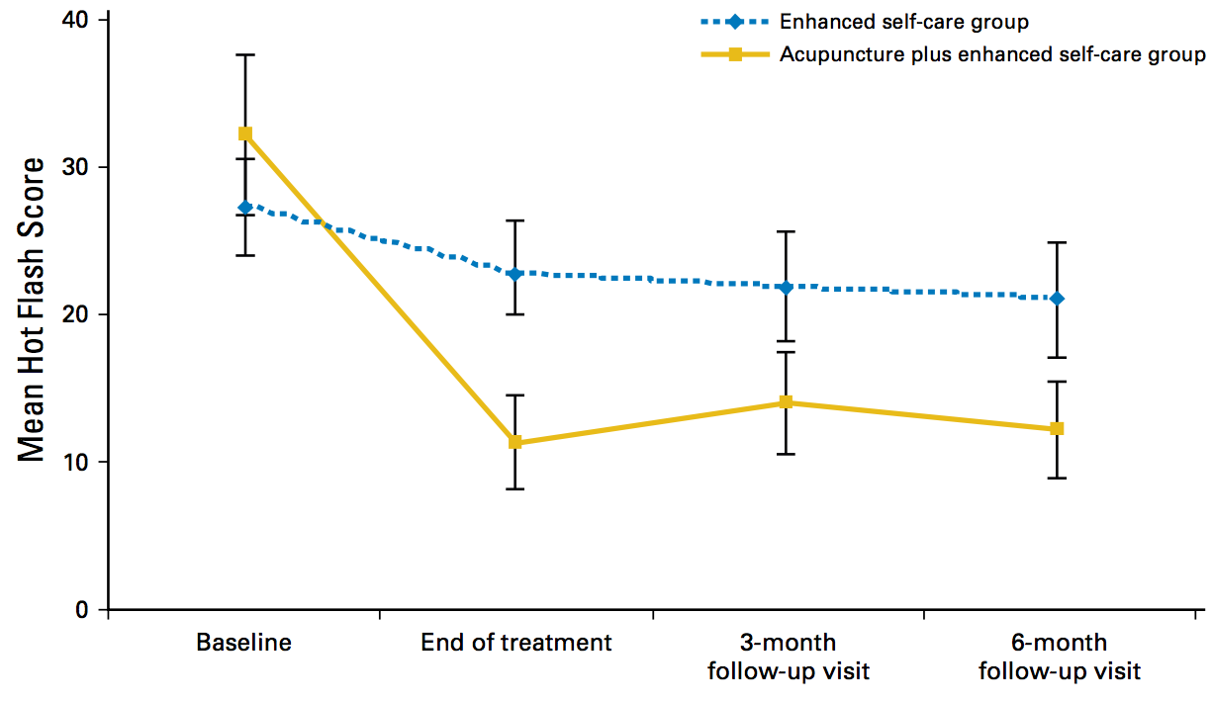
Acupuncture and Vasomotor Symptoms
AcCliMaT Trial (n=190)
2016 pragmatic RCT compared individualized acupuncture plus an enhanced self-care regimen with enhanced self-care alone
Combination therapy
was superior in reducing hot flash scores both at treatment end and
3- and 6-mo follow-up
Lesi G, et al. J Clin Oncol 2016;34:1795-802

Slide 40
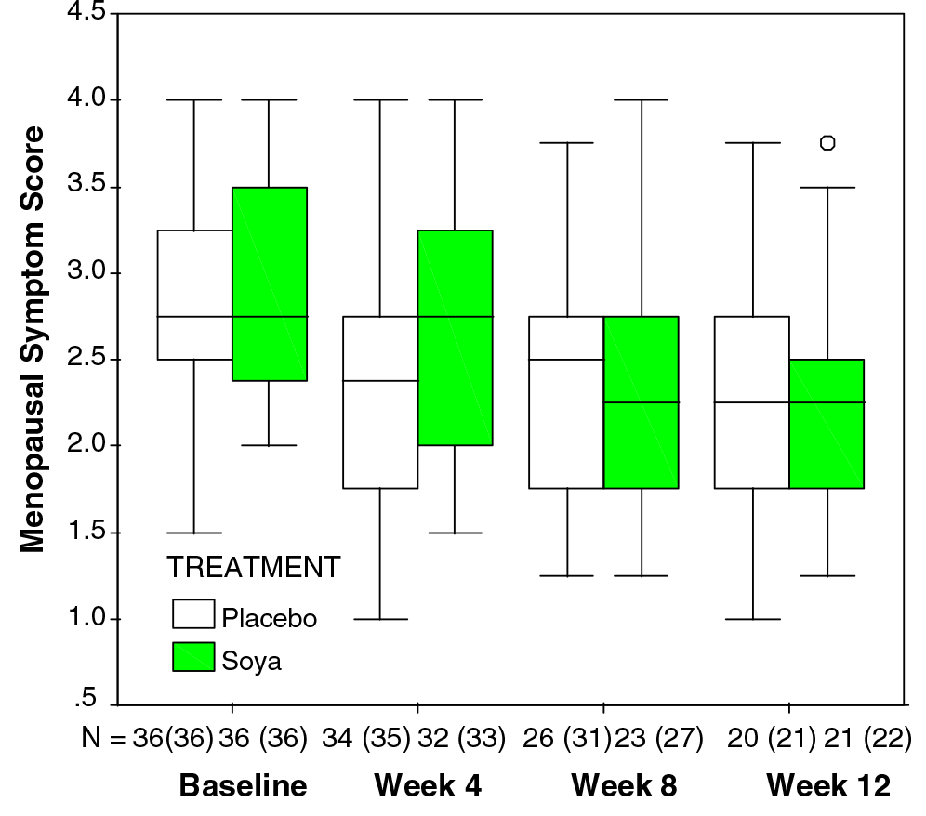
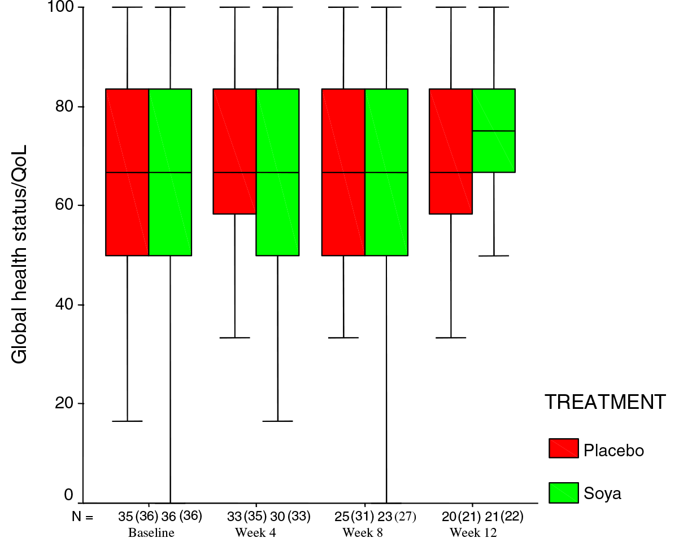
Soy and Hot Flashes
In 3 RCTs, soy supplements were not better than placebo to alleviate menopausal symptoms in breast cancer survivors
MacGregor CA, et al. Eur J Cancer. 2005;41:708-14. Quella SK, et al. J Clin Oncol. 2000;18:1068-74.
Van Patten CL, et al. J Clin Oncol. 2002;20:1449-55.

Slide 41
Sub-Summary
IM Approaches for Hot Flashes
Consider
Acupuncture
Not Recommended
Soy, due to lack
of effect
Other IM therapies
should be
investigated

Slide 42

CHoosing Options for Insomnia in Cancer Effectively
Insomnia has deleterious effects and occurs in up to 60% of cancer survivors
Cognitive behavior therapy for insomnia (CBT-I) ^{1,2}
Effective
Poor adherence and non-response
Not accessible
Acupuncture ^{3,4}
  Modulates brain regions involved in cognition and emotion
  Increasing evidence for pain, hot flashes,
  and related sleep disturbance
  At 73% of US cancer centers
Johnson et al. Sleep Med Rev 2016 27:20-28
Matthews et al. Behav Sleep Med 2012;10:217-229
Yun et al. J Natl Cancer Inst Monogr 2017, 2017
Zia et al. J Natl Cancer Inst Monogr 2017, 2017

Slide 43
Primary Results
20
Mean ISI Score
ACU
CBT-I
18
16
14
P =.0007
12
−8.3
10
8
6
−10.9
4
2
Bars denote mean SE.
0
0
4
8
12
16
20
Treatment Weeks
Weeks Post Treatment
J Natl Cancer Inst. 2019 Dec; 111(12): 1323–1331.

Slide 44
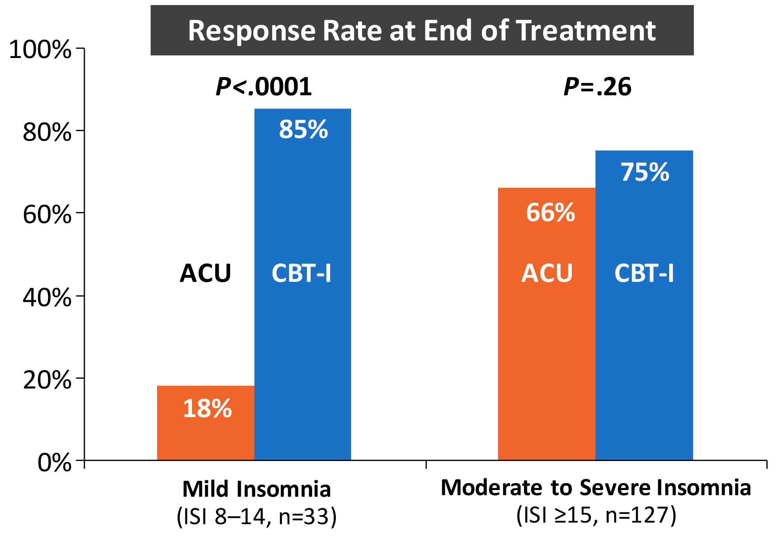

Slide 45
Taichi for Insomnia
90 were randomly assigned (CBT-I: n = 45; TCC: n = 45).
The proportion of participants who showed insomnia treatment response at 15 months was 43.7% and 46.7% in CBT-I and TCC, respectively.
Tests of noninferiority showed that TCC was noninferior to CBT-I at 15 months (P = .02) and at months 3 (P = .02) and 6 (P < .01).
For secondary outcomes, insomnia remission was 46.2% and 37.9% in CBT-I and TCC, respectively.
Irwin et al, JCO 2017

Slide 46
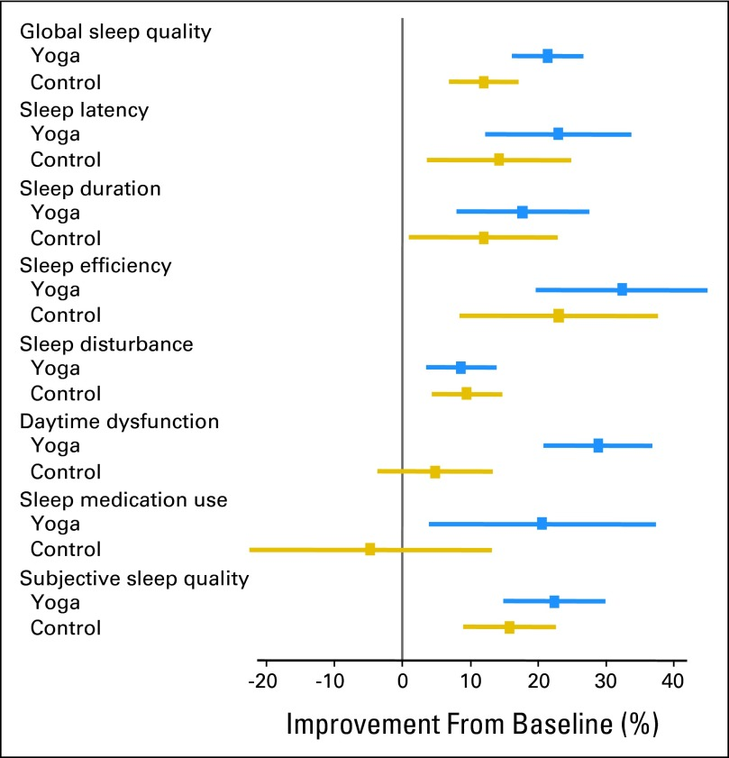
Yoga Improved Sleep Quality Among Cancer Survivors
410 survivors w/ moderate to severe sleep disruption
standard care or standard care plus the 4-week yoga intervention
pranayama (breathing exercises), 16 Gentle Hatha and Restorative yoga asanas (postures), and meditation
two 75-minute sessions per week
Sleep quality was assessed by using the Pittsburgh Sleep Quality Index and actigraphy pre- and postintervention
Yoga participants demonstrated greater improvements in global sleep quality and, secondarily, subjective sleep quality, daytime dysfunction, wake after sleep onset, sleep efficiency, and medication use at postintervention (all P ≤ .05) compared with standard care participants.
Mustian, K et al. JCO 2013

Slide 47
Sub-Summary
IM Approaches for Insomnia
Consider
CBT-I
Taichi
Acupuncture
Yoga

Slide 48
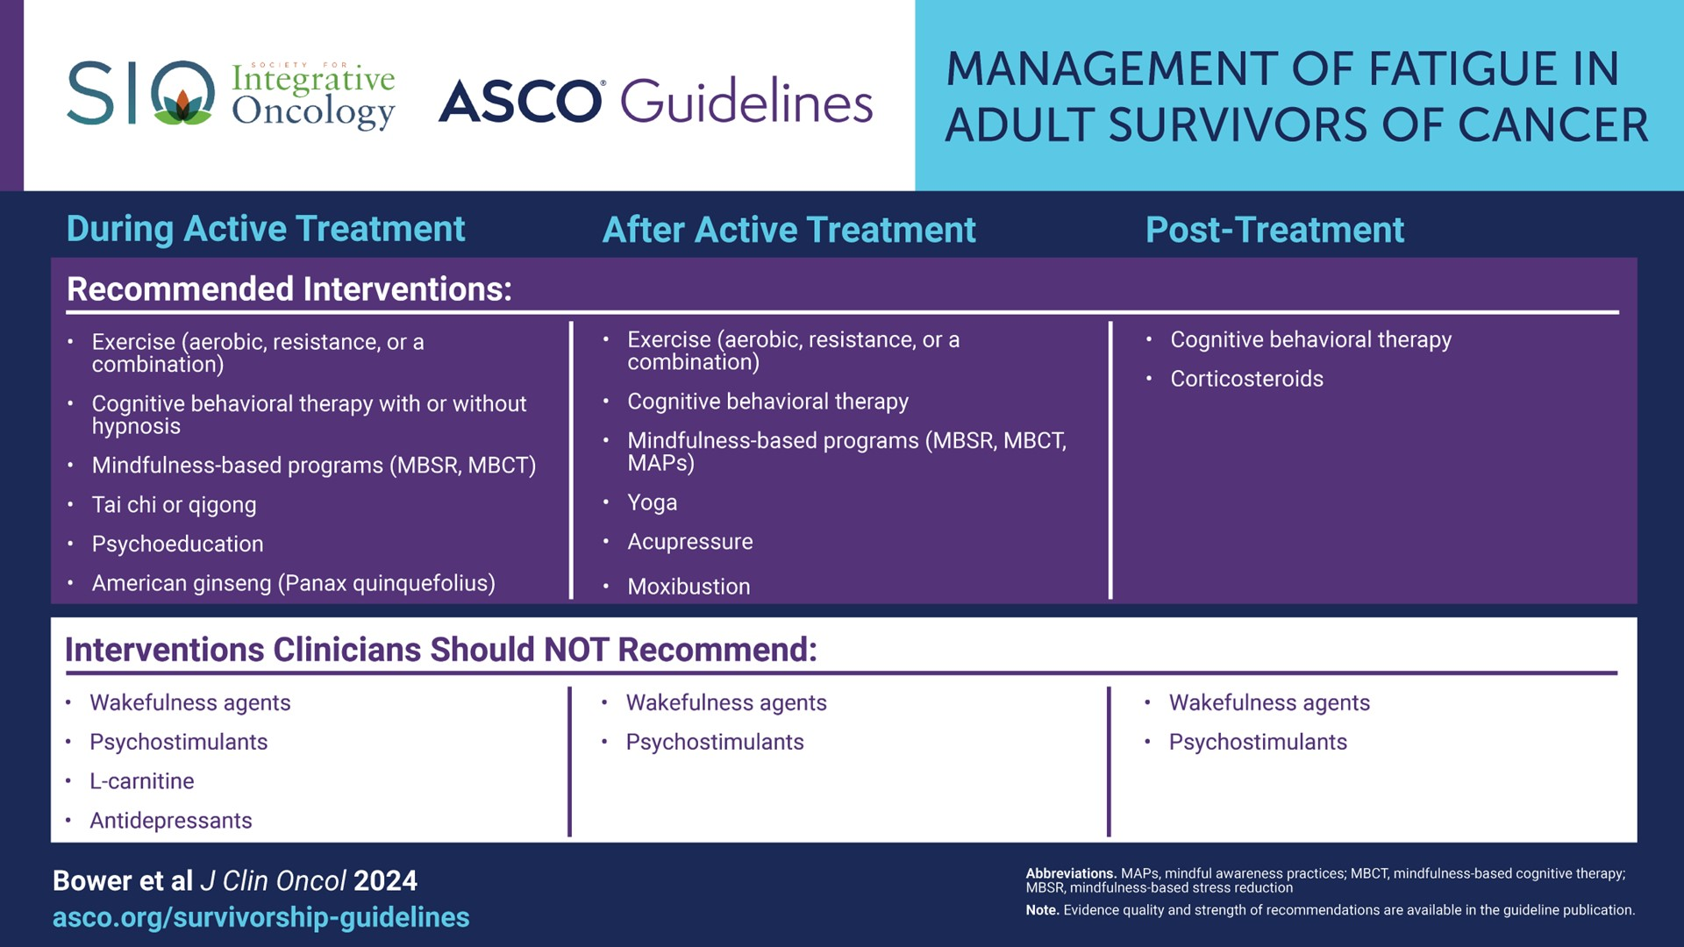
Slide 26
Content of this presentation is the property of the author, licensed by ASCO. Permission required for reuse.

Slide 49
Summary
Integrative medicine is a valuable approach to managing side effects and improving the quality of life in breast cancer patients
Oncology professionals should be aware of evidence-based integrative therapies
Ongoing research will continue to inform the role of integrative medicine in cancer care

Slide 50
Questions
?

