Slide 1


Management of HER2+ MBC
SOBO 2025
William J. Gradishar MD FACP FASCO
Betsy Bramsen Professor of Breast Oncology
Chief, Hematology/Oncology
Director, Maggie Daley Center for Women’s Cancer Care
Robert H. Lurie Comprehensive Cancer Center
Northwestern University

Slide 2
Disclosures
Consultant: AstraZeneca, Daiichi-Sanyo, Novartis, Lilly, Pfizer, Merck, Stemline-Menarini, Genentech-Roche, Gilead, Carrick, Johnson & Johnson, Ambryx, Veracyte, Totus
DMC: Lilly, Genentech, Pfizer/Seagen, IBCSG, Alliance Foundation Trials (AFT)

Slide 3
Outline
Who should get HER2 directed therapy?
Early lessons in HER2-positive MBC
Treatment beyond disease progression
Dual HER2/ER targeting
ER+/HER2+ disease

Slide 4
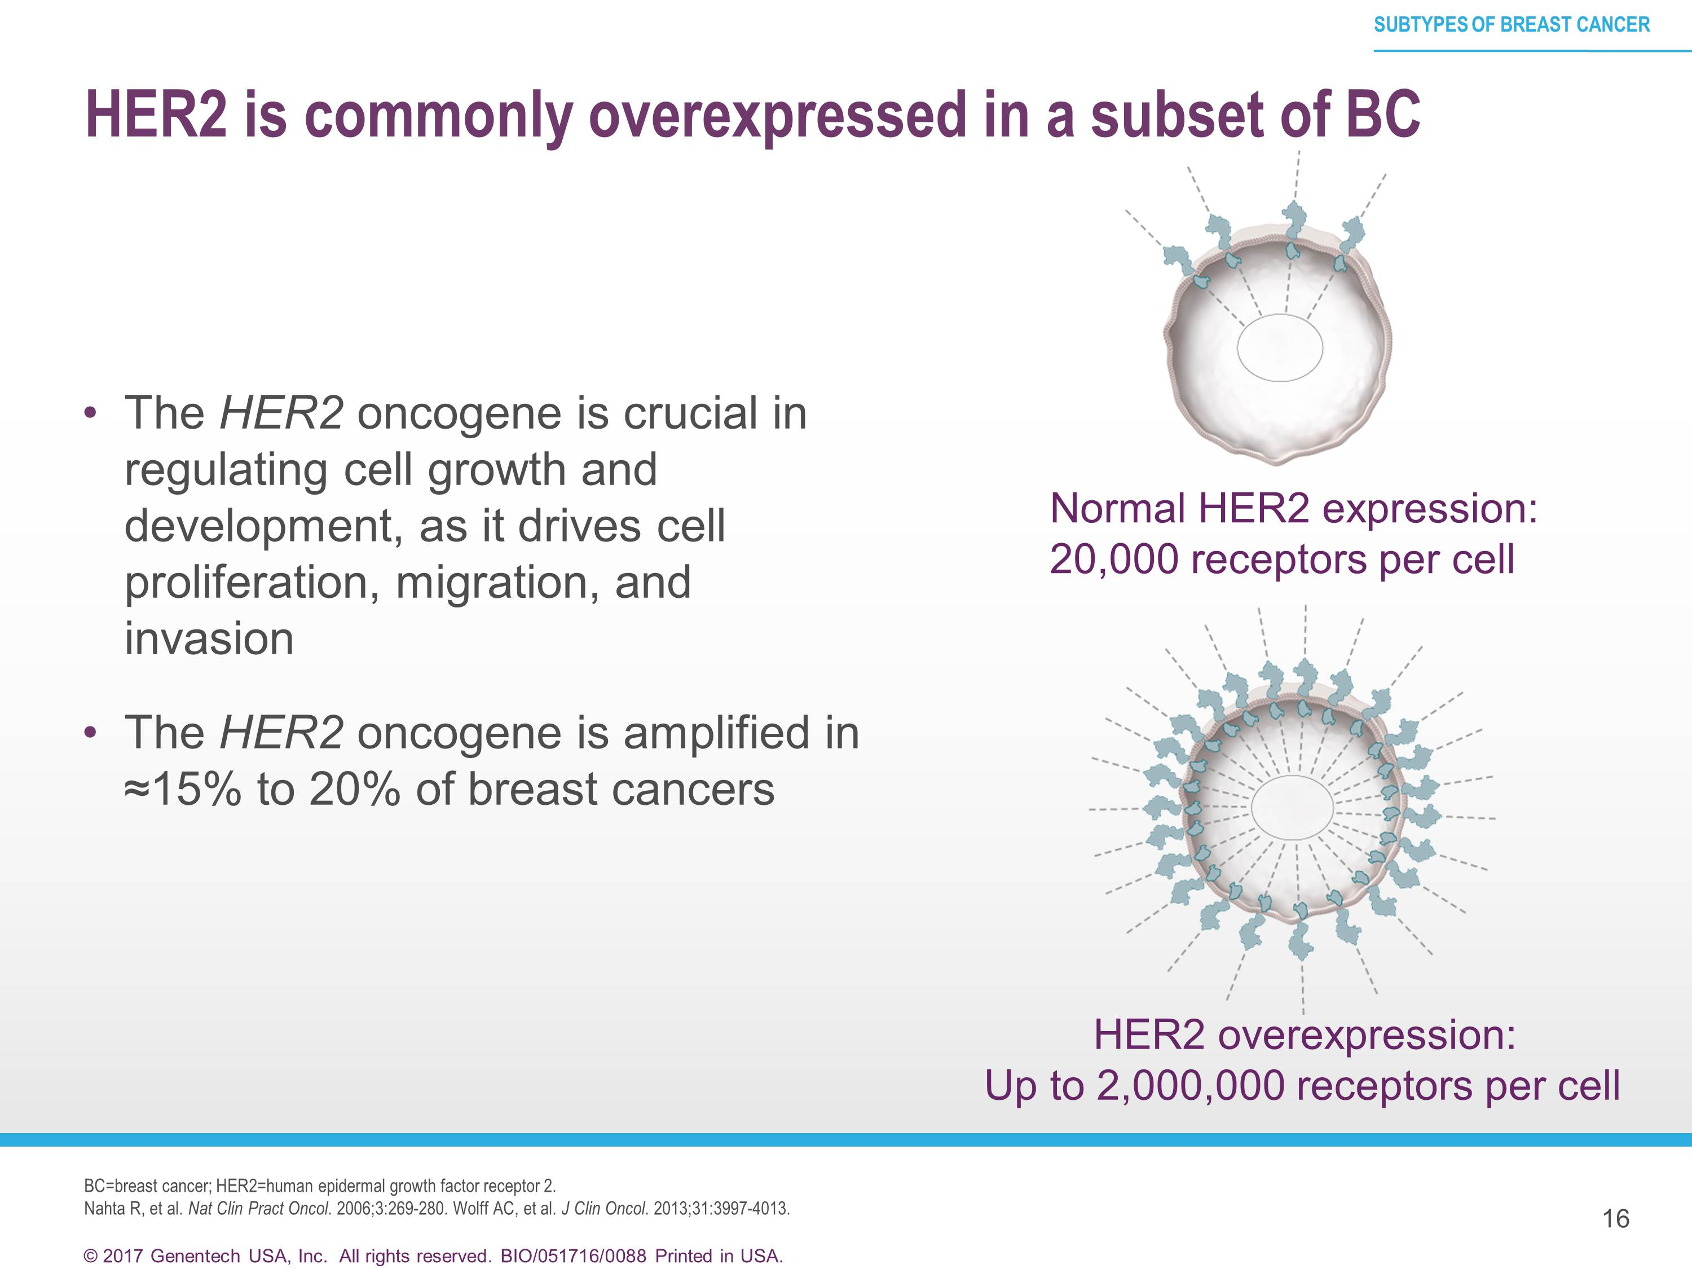
HER2 is commonly overexpressed in a subset of BC

Slide 5
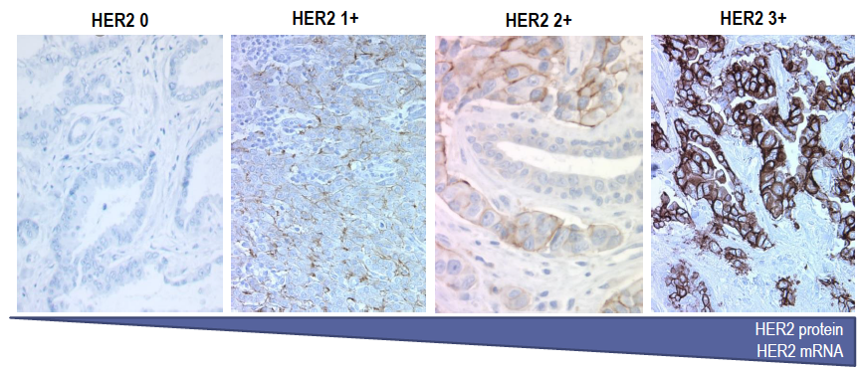
Expression of HER2 is Continuous
Notes:
HER2 testing has long been thought of as a dichotomous outcome, but I think we are all beginning to realize that perhaps we should no longer consider tumors as either HER2 + or HER2 negative, but rather think of expression of HER2 being continuous, ranging from no expression to strong expression

Slide 6
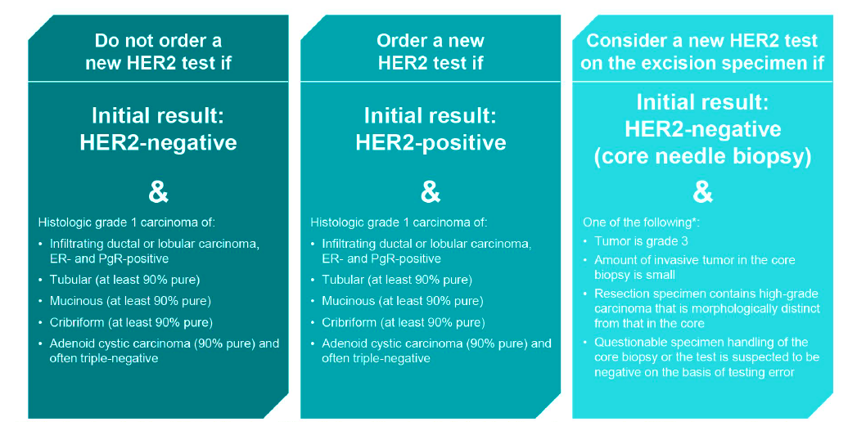
ASCO/CAP Guidelines: Histopathologic Discordance and When to Order a New HER2 Test
Wolff AC, et al. J Clin Oncol. 2018;36(20):2105-2122.
Notes:
Why the clarification?
Several data sets show excellent concordance for HER2 testing in paired samples, up to 98.8% in one series. Panel agreed it’s appropriate to allow pathologist and oncologist to exercise clinical judgment and grade 3 alone did not suffice as a criterion for mandatory re-testing.

Slide 7
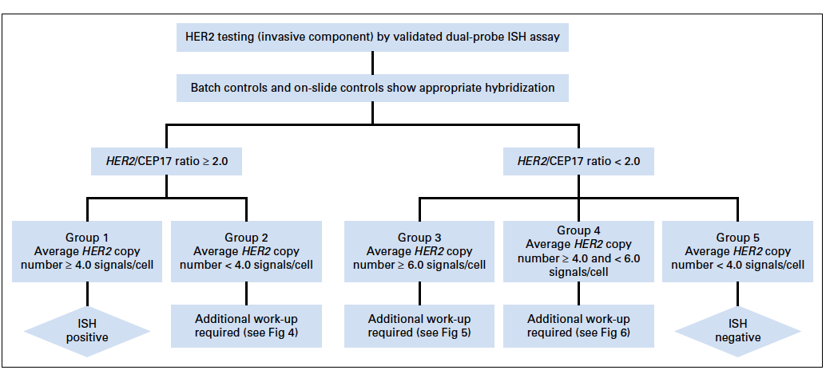
Algorithm for evaluation of HER2 gene amplification by ISH assay using dual-probe (HER2 gene) assay
Wolff AC, et al. J Clin Oncol. 2018;36(20):2105-2122.

Slide 8
The 2023 ASCO/CAP guidelines reaffirm the 2018 recommendations on HER2 testing in BC
ASCO/CAP Guidelines for HER2 classification
This updates the clinical relevance of HER2-targeted therapy in HER2-low BC
Additional guidance for reporting HER2 IHC 1+ and IHC 2+/ISH- results and best practices for differentiating between IHC 1+ and IHC 0 (with or without staining) tumours are included in the updated guidelines
HER2 testing (invasive component) by validated IHC assay
Batch controls and on-slide controls show appropriate staining
No staining observed
Incomplete membrane staining that is
faint or barely perceptible in >10%
of tumour cells
Weak to moderate complete membrane staining observed in >10% of tumour cells
Circumferential membrane staining that is complete, intense and in >10% of tumour cells*
OR
Incomplete membrane staining that is
faint or barely perceptible in ≤10%
of tumour cells
IHC 0
without staining^{2,3}
IHC 0
with staining^{2,3}
IHC 1+
IHC 2+
IHC 3+
Although HER2 expression was classified as positive or negative, the 2023 ASCO/CAP guidelines recognise the importance of accurately identifying and reporting semiquantitative IHC scores, and distinguishing IHC 0 (with or without staining) from 1+ tumours^{1–3}
Negative
Reflex ISH test †
Positive
HER2-zero
HER2-low
HER2-positive
Additional
research required
May benefit from
targeting HER2
May benefit from
HER2-targeting therapies
Adapted from: Wolff AC, et al. J Clin Oncol. 2023
1. Wolff AC, et al. J Clin Oncol. 2023;41:3867–3872; 2. Denkert C, et al. Pathologie (Heidelb). 2022;43:457–466; 3. Viale G, et al. ESMO Open. 2023;8:101615.

Slide 9
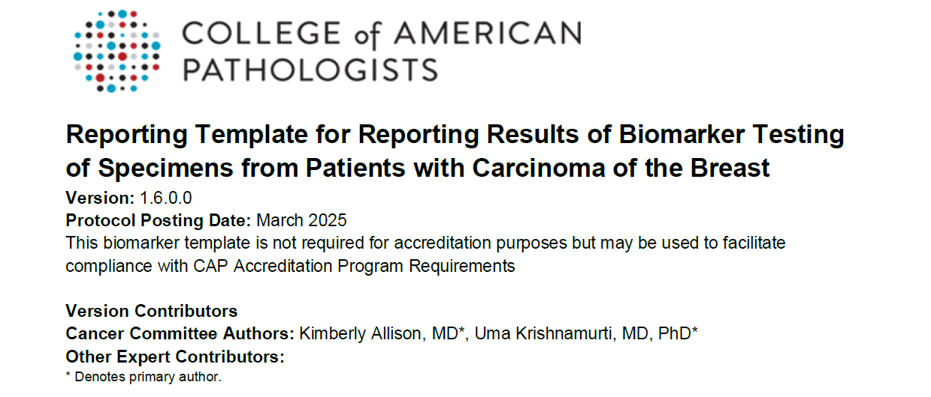
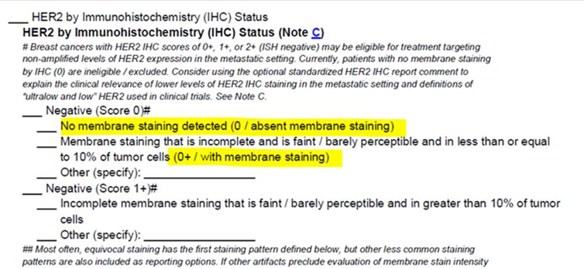
March 2025: updated CAP reporting template with HER2 null and ultralow definition
Summary of changes :
"Specimen / Block tested” moved to the top of the report and testing methodology details moved to the bottom of the report
• HER2 IHC and ISH reporting updated to include detailed characteristics of result categories including IHC staining pattern in each Score, ISH Groups, and heterogeneity details
• Standardized report comments added as options to include in reports with specific ER and HER2 results (e.g., ER low, HER2 ISH groups 2-4, definitions of HER2 “low” and “ultralow” used in clinical trials and their relevance to HER2 IHC reporting categories)
# An optional standardized reporting comment for HER2 0, 0+, 1+ or 2+ IHC results can be included as follows: “In the DESTINY-Breast 04 and 06 trials, “HER2 low” was considered IHC Score 1+ or 2+/ISH negative, and “HER2 ultralow” was HER2 IHC Score of 0 (pattern 0+) with membrane staining that is incomplete and faint/barely perceptible in less than or equal to 10% of tumor cells. Breast cancers with these staining patterns may be eligible for treatment with trastuzumab-deruxtecan in the metastatic setting (but those with no staining, IHC 0, are currently excluded).”

Slide 10
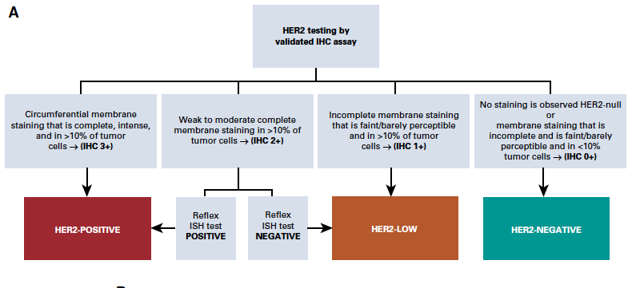
Definition of HER2-Low Breast Cancer
Tarantino P et al. J Clin Oncol. 2020;38(17):1951-1962.
Notes:
What exactly do we mean by HER2 low breast cancer?
We have traditionally thought of breast cancer as either HER2+ or HER2-negative, and using the ASCO CAP guidelines from 2018, we have thought of HER2 positive cancers when there is evidence of HER2 overexpression by IHC with a score of 3+ or gene amplification on an in situ hydridization assay on at least one tumor sample
In the case of 2+ IHC score, reflex ISH testing is required to define HER2 status
Whereas in the case of IHC 0-1+ (or HER2 2+ and FISH non-amplified and copy number <4), the tumor is considered HER2 negative.
More recently however, a new nomenclatures has been proposed for those cases with IHC 1+ or 2+ and not-amplified by FISH as HER2 low positive.
This recommendations has arisen given activity of novel HER2-targeted agents among these low HER2 tumors

Slide 11
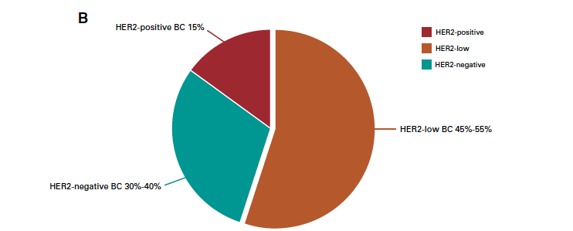
Prevalence of HER2-Low Breast Cancer
Tarantino P et al. J Clin Oncol. 2020;38(17):1951-1962.
Notes:
Using this definition of HER2low, approximately half of all breast cancers are HER2 low, with about 15% HER2+, and 30-40% HER2 0+

Slide 12
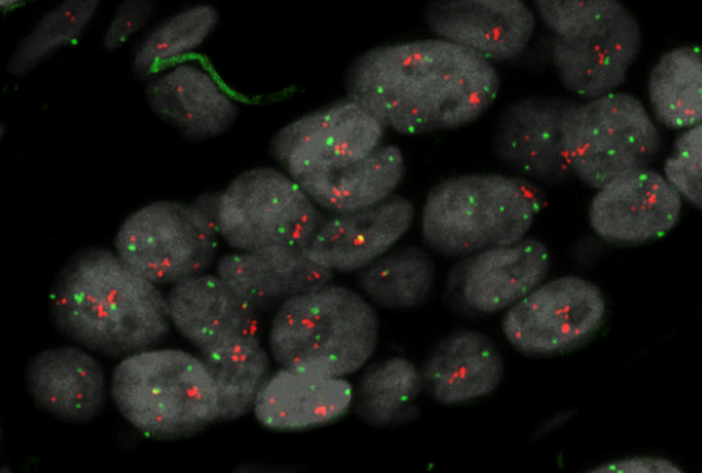
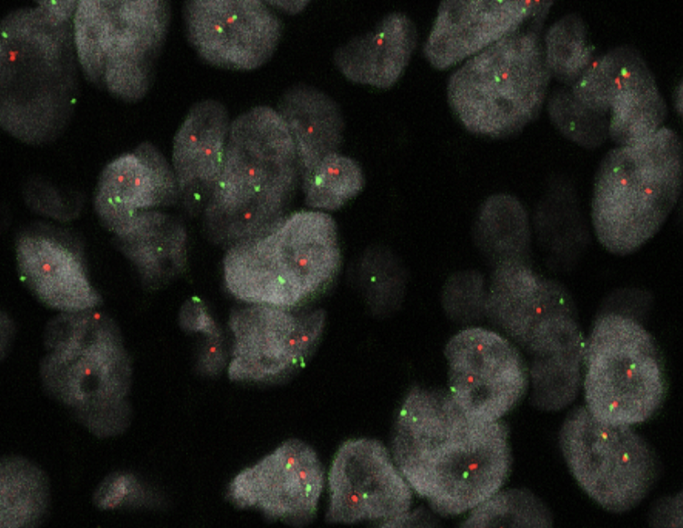
HER2 “low” (i.e., “not positive”) and HER2 “heterogeneity” (i.e., observed within HER2+ tumors) mean different things …
Core biopsy site 1 amplified and site 2 non-amplified
FISH ratio = 3.85 FISH ratio = 1.1
Metzger, ASCO 2019.
Hurvitz et al. J Clin Oncol. 2019;37(25):2206-2216.
Slide courtesy of Antonio Wolf
Notes:
It is however important to remember that a HER2 low tumor is not the same as a tumor that is heterogeneous for HER2 expression
A heterogeneous tumor is one where there is a site within the tumor that is truly HER2 positive, where there can be other areas that are HER2 negative.
We have seen data suggesting that heterogeneous tumors may not be as sensitive to agents like T-DM1, an ADC which is not known to be able to have bystander effect
We have seen data from a preoperative trial run by Otto Metzger and Ian Krop demonstrating that tumors with HER2 heterogeneity did not achieve pCR to preop T-DM1 + pertuzumab, and we also say data from KRISTINE suggesting higher rates of localregional progression during preop T-DM1 + pertuzumab compared to TCHP

Slide 13
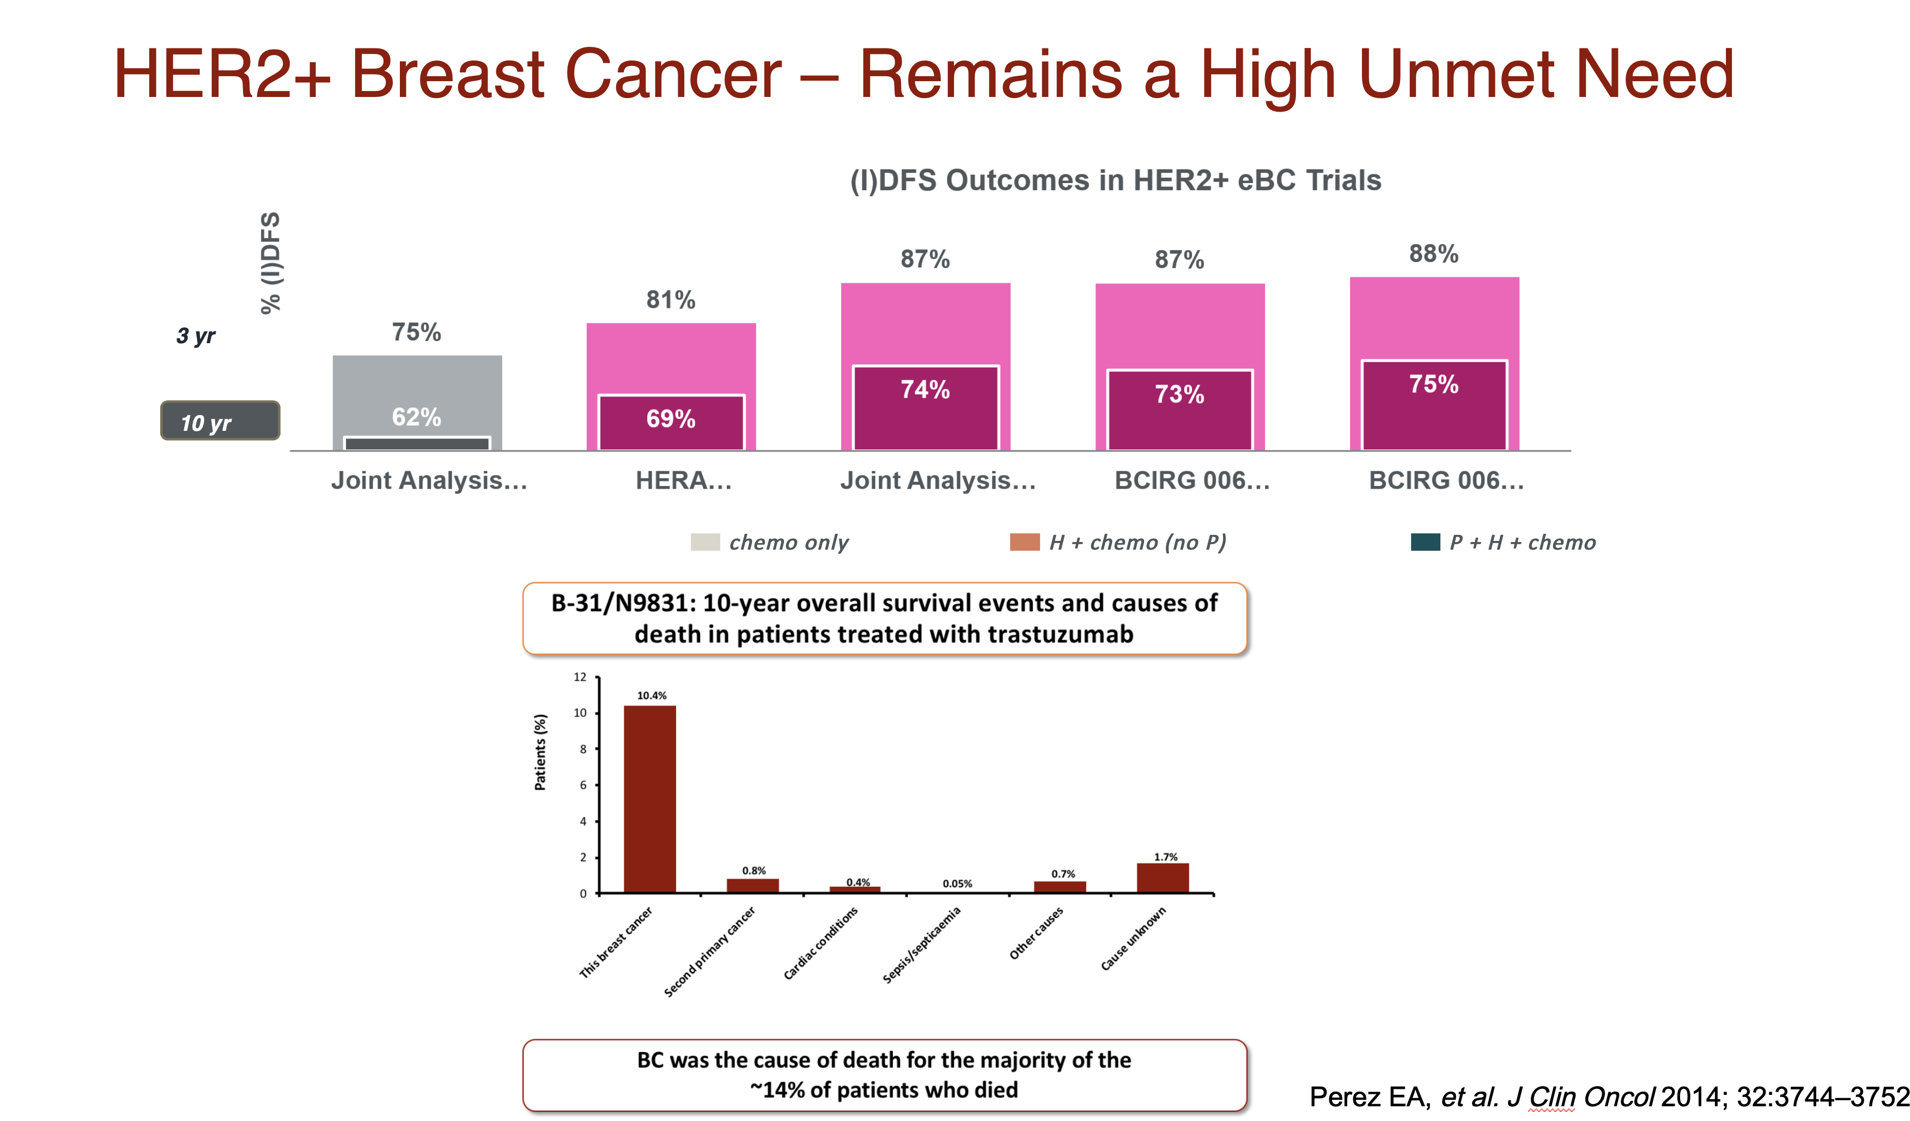

Slide 14
FDA Approved HER2-Targeted Therapeutics for HER2+ Metastatic Breast Cancer
Agent | MOA
Lapatinib | HER-selective TKI
Neratinib | HER-selective TKI
Tucatinib | HER2-selective TKI
Pertuzumab | HER2/neu receptor antagonist
Trastuzumab | HER2/neu receptor antagonist
Margetuximab | HER2/neu receptor antagonist
Trastuzumab deruxtecan | HER2-targeted ADC
Ado-trastuzumab emtansine (T-DM1) | HER2-targeted ADC

Slide 15


NCCN Guidelines Version 5.2025 Invasive Breast Cancer
SYSTEMIC THERAPY REGIMENS FOR RECURRENT UNRESECTABLE (LOCAL OR REGIONAL) OR STAGE IV (M1) DISEASE^{k}
HR-Positive or -Negative and HER2-Positive^{j,k}
Setting | Regimen
First Line | Pertuzumab + trastuzumab + docetaxel (Category 1, preferred)
 | Pertuzumab + trastuzumab + paclitaxel (preferred)
Second Line | Fam-trastuzumab deruxtecan-nxki^{m} (Category 1, preferred)
Third Line | Tucatinib + trastuzumab + capecitabine^{n} (Category 1, preferred)
 | Ado-trastuzumab emtansine (T-DM1)º
Fourth Line and Beyond (optimal sequence is not known) | Trastuzumab + docetaxel or vinorelbine
 | Trastuzumab + paclitaxel ± carboplatin
 | Capecitabine + trastuzumab or lapatinib
 | Trastuzumab + lapatinib (without cytotoxic therapy)
 | Trastuzumab + other chemotherapy agents^{q,r}
 | Neratinib + capecitabine
 | Margetuximab-cmkb + chemotherapy (capecitabine, eribulin, gemcitabine, or vinorelbine)
 | Additional Targeted Therapy Options see BINV-Q (6)
^{j}
BINV-Q 3 OF 14

Slide 16
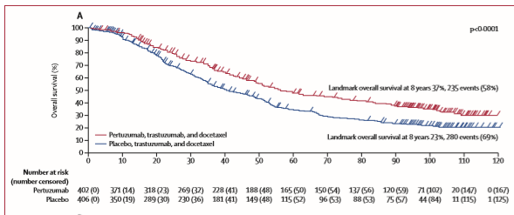
CLEOPATRA: End-of Study Results
Median follow-up was 99·9 months in the pertuzumab group (IQR 92·9–106·4) and 98·7 months (90·9–105·7) in the placebo group
End-of-Study OS in ITT Population*
Median OS,
Mos (95% CI)
Pertuzumab + Trastuzumab/Doc | 57.1
Placebo + Trastuzumab/Doc | 40.8
*Crossover patients were analyzed in the placebo arm.
Swain SM et al. Lancet Oncol 2020; 21: 519–30.

Slide 17
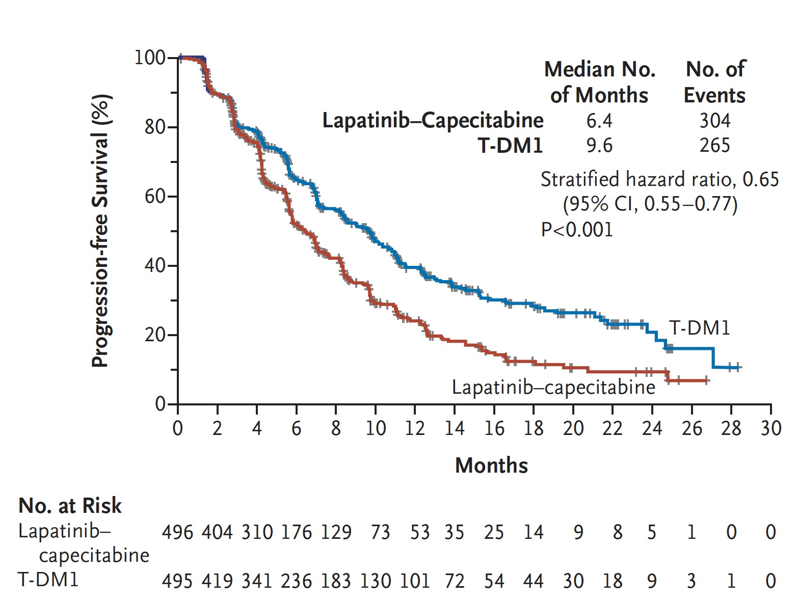
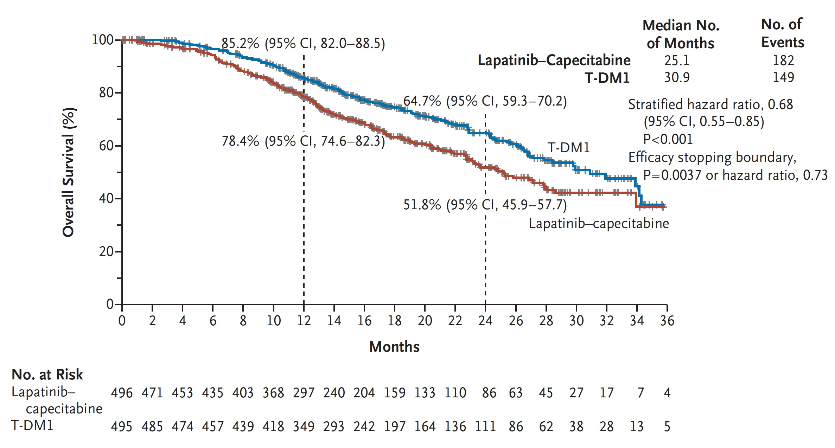
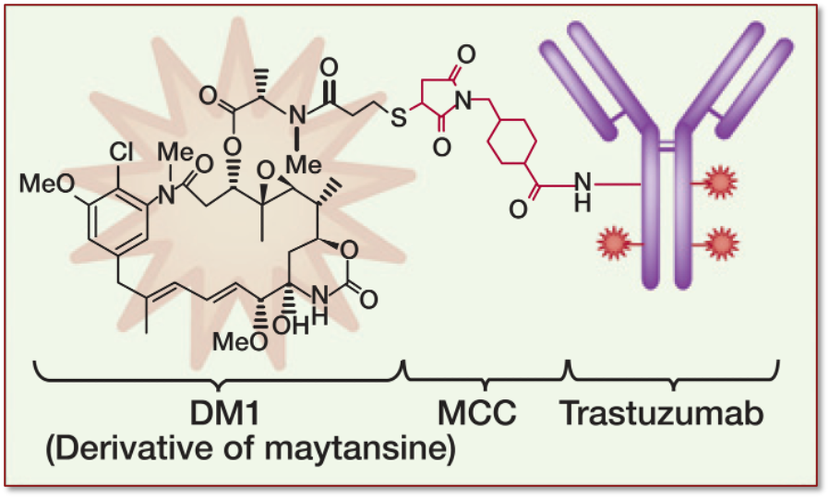
Phase 3 EMILIA: T-DM1 in HER2+ MBC
In EMILIA, T-DM1 was superior to lapatinib + capecitabine in HER2+ MBC
In 991 randomized patients, median PFS was 9.6 months with T-DM1 vs 6.4 months with lapatinib + capecitabine (HR 0.65; 95% CI, 0.55-0.77; P <.001), and median OS was 30.9 months vs 25.1 months (HR, 0.68; 95% CI, 0.55-0.85; P <.001)
Verma S et al. N Engl J Med. 2012;367:1783.

Slide 18
ADC Characteristic Differences Between T-DXd and T-DM1
Trastuzumab deruxtecan
(T-DXd)¹
T-DXd^{1-4,a} | ADC Attributes | T-DM1³⁻⁵
Topoisomerase I inhibitor | Payload MoA | Anti-microtubule
~8:1 | Drug-to-antibody ratio | ~3.5:1
Yes | Tumor-selective cleavable linker? | No
Yes | Evidence of bystander anti-tumor effect? | No
Trastuzumab emtansine
(T-DM1)⁵
ADC, antibody-drug conjugate; MoA, mechanism of action.
ªThe clinical relevance of these features is under investigation.
1. Nakada T et al. Chem Pharm Bull (Tokyo). 2019;67:173-85. 2. Ogitani Y et al. Clin Cancer Res. 2016;22:5097-108. 3. Trail PA et al. Pharmacol Ther. 2018;181:126-42.
4. Ogitani Y et al. Cancer Sci. 2016;107:1039-46. 5. LoRusso PM et al. Clin Cancer Res. 2011;17:6437-47.

Slide 19
DESTINY-Breast01 Study Design:
An Open-Label, Multicenter, Phase 2 Study
PART 1
PART 2
Population
≥18 years of age
Unresectable and/or metastatic BC
HER2+ (centrally confirmed on archival tissue)
Prior T-DM1
Excluded patients w/ history of significant ILD
Stable, treated brain met allowed
PK Stage
(n = 65)
Dose-Finding Stage
(n = 54)
Continuation Stage
(n = 134)
T-DM1
Resistant/Refractory
(n=249)
5.4 mg/kg
(n = 22)
R
1:1:1
5.4 mg/kg
(n = 22)
5.4 mg/kg
(n = 28)
5.4 mg/kg
(n = 28)
PART 2a
5.4 mg/kg
(n = 130)
6.4 mg/kg
(n = 22)
R
1:1
PART 2a
5.4 mg/kg
(n = 130)
6.4 mg/kg
(n = 26)
7.4 mg/kg
(n = 21)
T-DM1
Intolerant
(n=4)
PART 2b
5.4 mg/kg
(n = 4)
PART 2b
5.4 mg/kg
(n = 4)
184 patients
enrolled at 5.4 mg/kg
Baseline Characteristics of Note
53% HR+
HER2 IHC 3+ 84%; 1+/2+ (FISH+) 16%
92% visceral disease; 13% h/o brain mets
Median 6 prior lines of therapy (range 2-27)
Primary: confirmed ORR by independent central imaging facility review per RECIST v1.1
Secondary: investigator-assessed ORR, DCR, DOR, CBR, PFS, OS, PK and safety
Modi S, et al. N Engl J Med. 2020;382(7):610-621.
Notes:
CBR, clinical benefit rate; DCR, disease control rate; DOR, duration of response; ORR, objective response rate; OS, overall survival; PFS, progression-free survival; PK, pharmacokinetics; RECIST, Response Evaluation Criteria In Solid Tumors

Slide 20
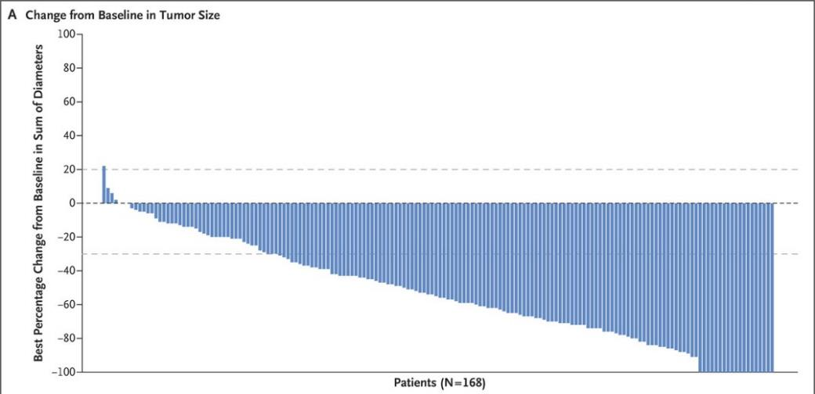
Modi S, et al. N Engl J Med. 2020;382(7):610-621.
Phase II DESTINY-Breast01: Response to T-DXd,
According to Tumor Size and Subgroup Analyses
ORR: 60.9%
Complete Response Rate: 6%
Duration of Response: 14.8 mos
Primary
Endpoint
Dec 2019 - FDA accelerated approval for HER2+ MBC ≥2 prior lines of antiHER2-based regimens
Feb 2020 – Added to NCCN Breast Cancer guidelines (V2.2020)
Notes:
Figure 2. Response to Trastuzumab Deruxtecan, According to Tumor Size and Subgroup Analyses. Panel A shows the best percentage change from baseline in the sum of the largest diameters of measurable tumors in 168 of 184 patients for whom data from both baseline and postbaseline assessments of target lesions by independent central review were available. The upper dashed horizontal line indicates a 20% increase in tumor size in the patients who had disease progression, and the lower dashed line indicates a 30% decrease in tumor size (partial response). Panel B shows the objective partial or complete response to trastuzumab deruxtecan therapy in all the enrolled patients who received 5.4 mg per kilogram, according to subgroup. Data for patients with an immunohistochemical (IHC) score indicated as 1+ (IHC negative) or 2+ (IHC borderline) include data for patients for whom the result was equivocal or could not be evaluated; a score of 3+ indicates positivity for HER2 (human epidermal growth factor receptor 2). HER2 positivity is also indicated by an IHC score of 1+ or 2+ and positive results on in situ hybridization (ISH). The vertical dashed line at the 61% mark indicates the median response to therapy in the overall population. ECOG denotes Eastern Cooperative Oncology Group.

Slide 21
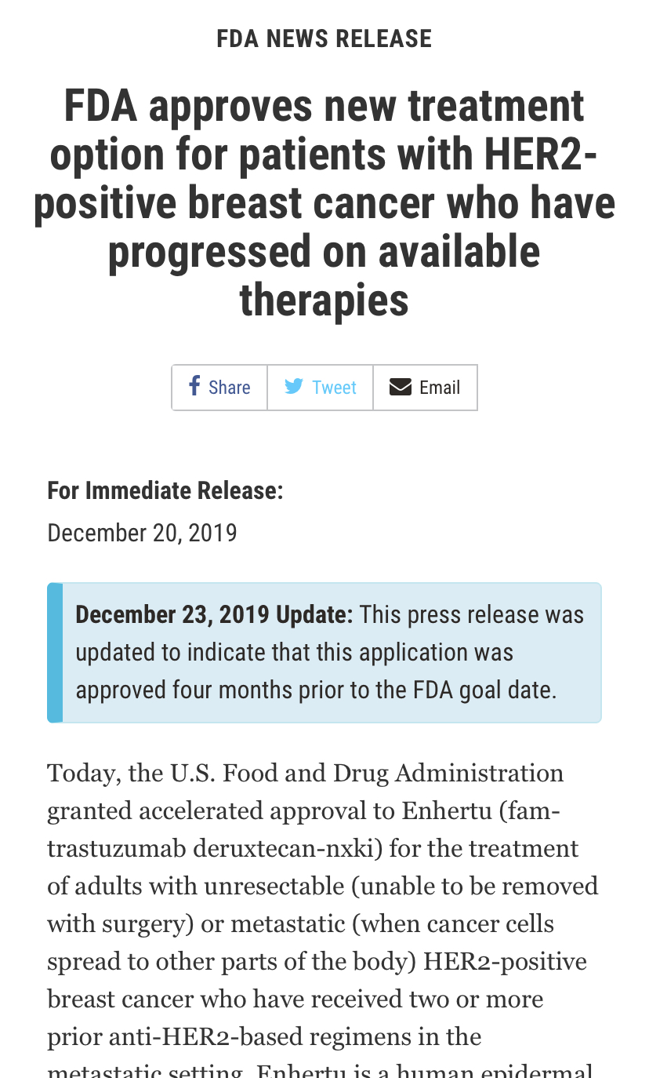
December 20, 2019: Trastuzumab Deruxtecan granted accelerated approval by the FDA based on DESTINY-Breast01 Trial
Durable benefit in heavily pre-treated patients
Confirmed ORR, 61%
Median DOR, 15 months
Median PFS, 16 months
Boxed Warning about risk of ILD and Pneumonitis
Monitor and promptly investigate cough, dyspnea, fever, or other new/worsening respiratory symptoms
Consider withholding, dose-reducing, or permanently discontinuing drug

Slide 22
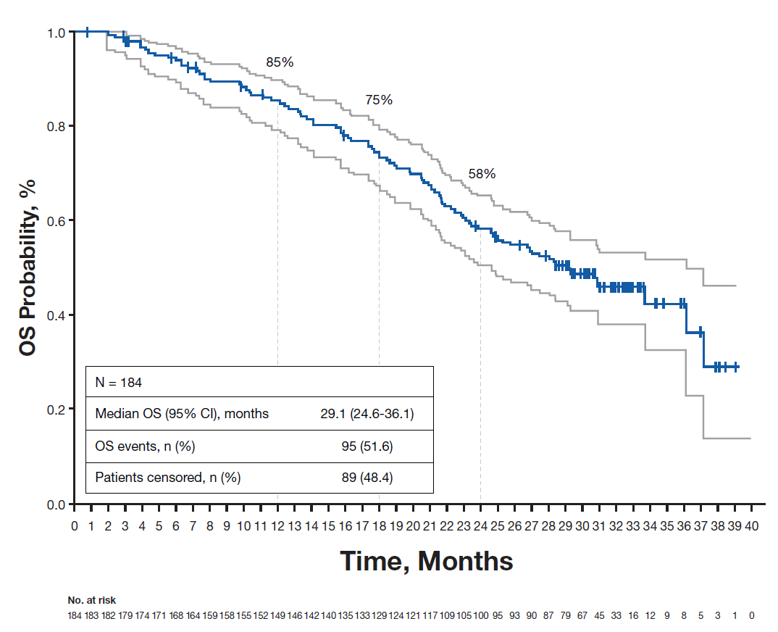
DESTINY-Breast01: Updated OS
Saura C et al. 2021 ESMO

Slide 23
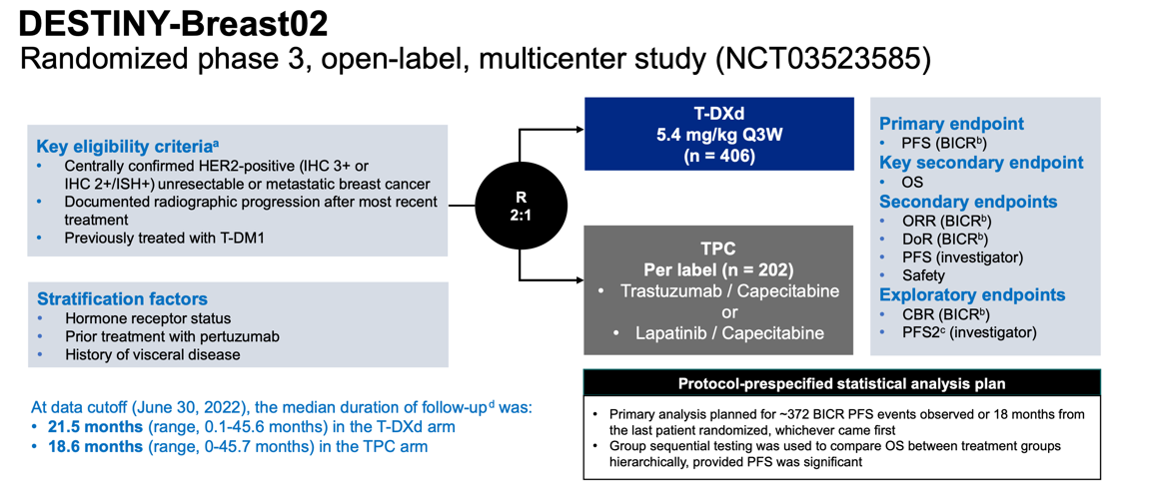
Majority with 2-3 lines of prior therapy
PFS
OS
Toxicity
ILD 10.4% (0.5% gr 5)
Nausea 72.5%
Alopecia 37.1%
Krop et al, SABCS 2022; Andre et al, Lancet 2023

Slide 24
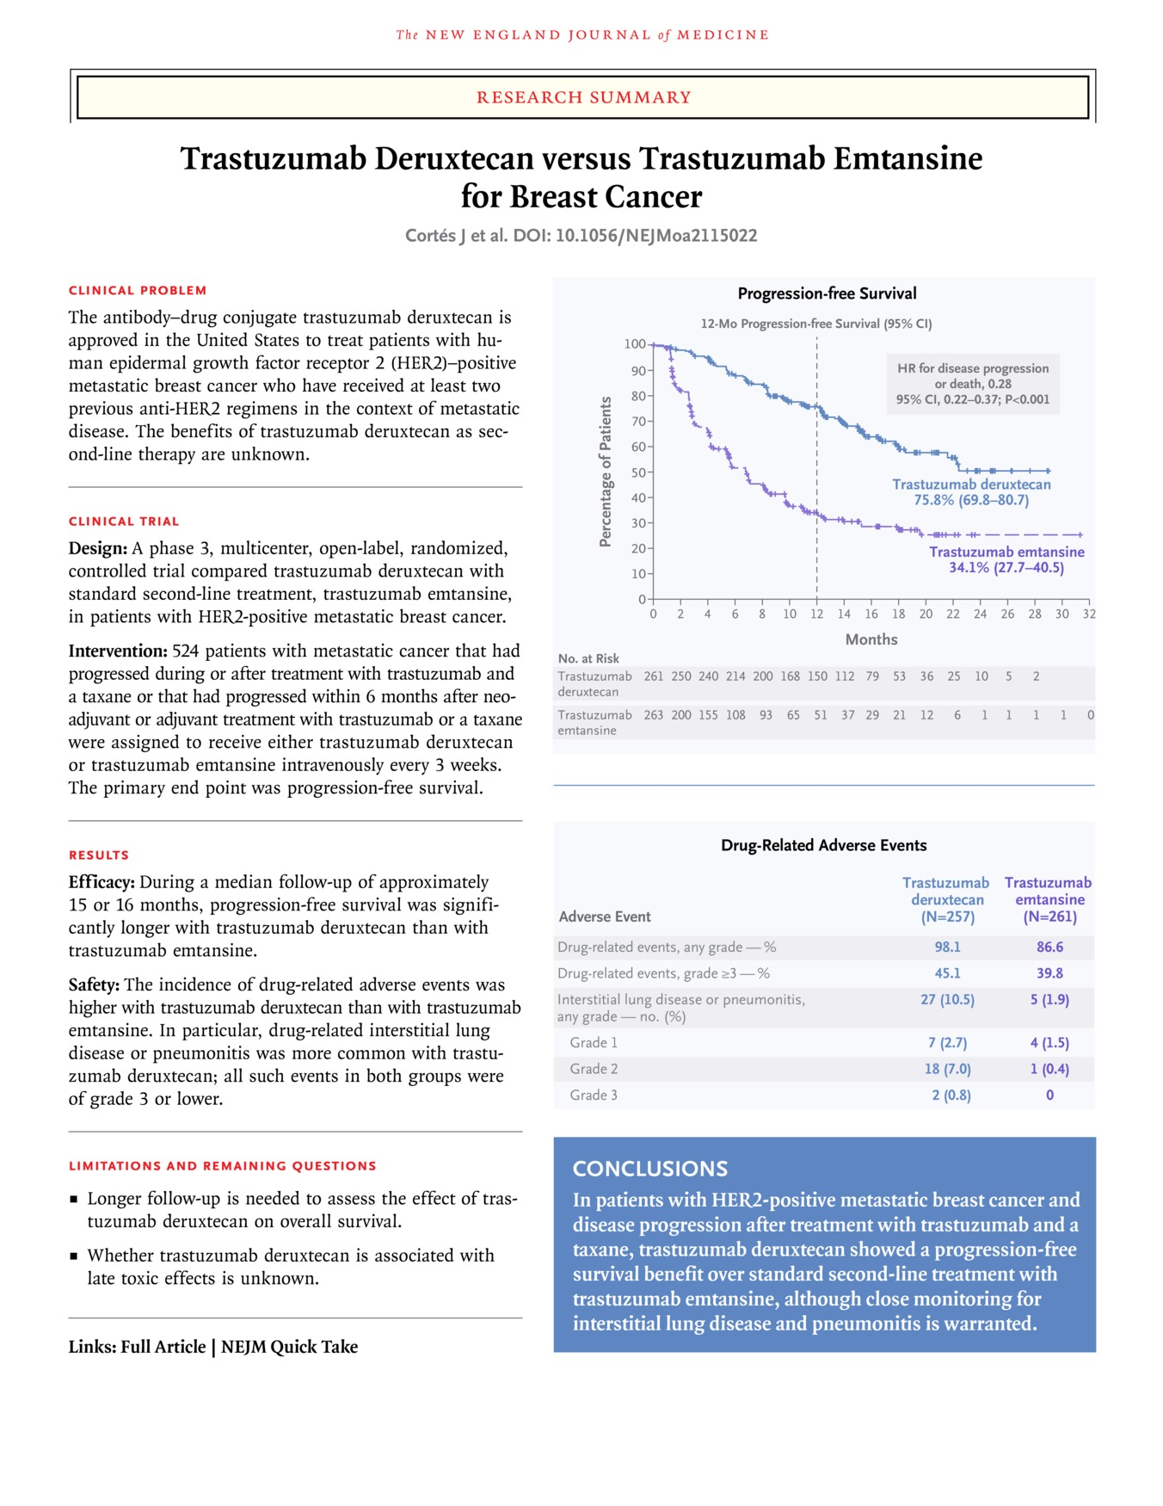
Cortés J et al. N Engl J Med 2022;386:1143-1154
Cortes et al. N Engl J Med. 2022;386(12):1143-1154.
Notes:
Download a PDF of the Research Summary.

Slide 25
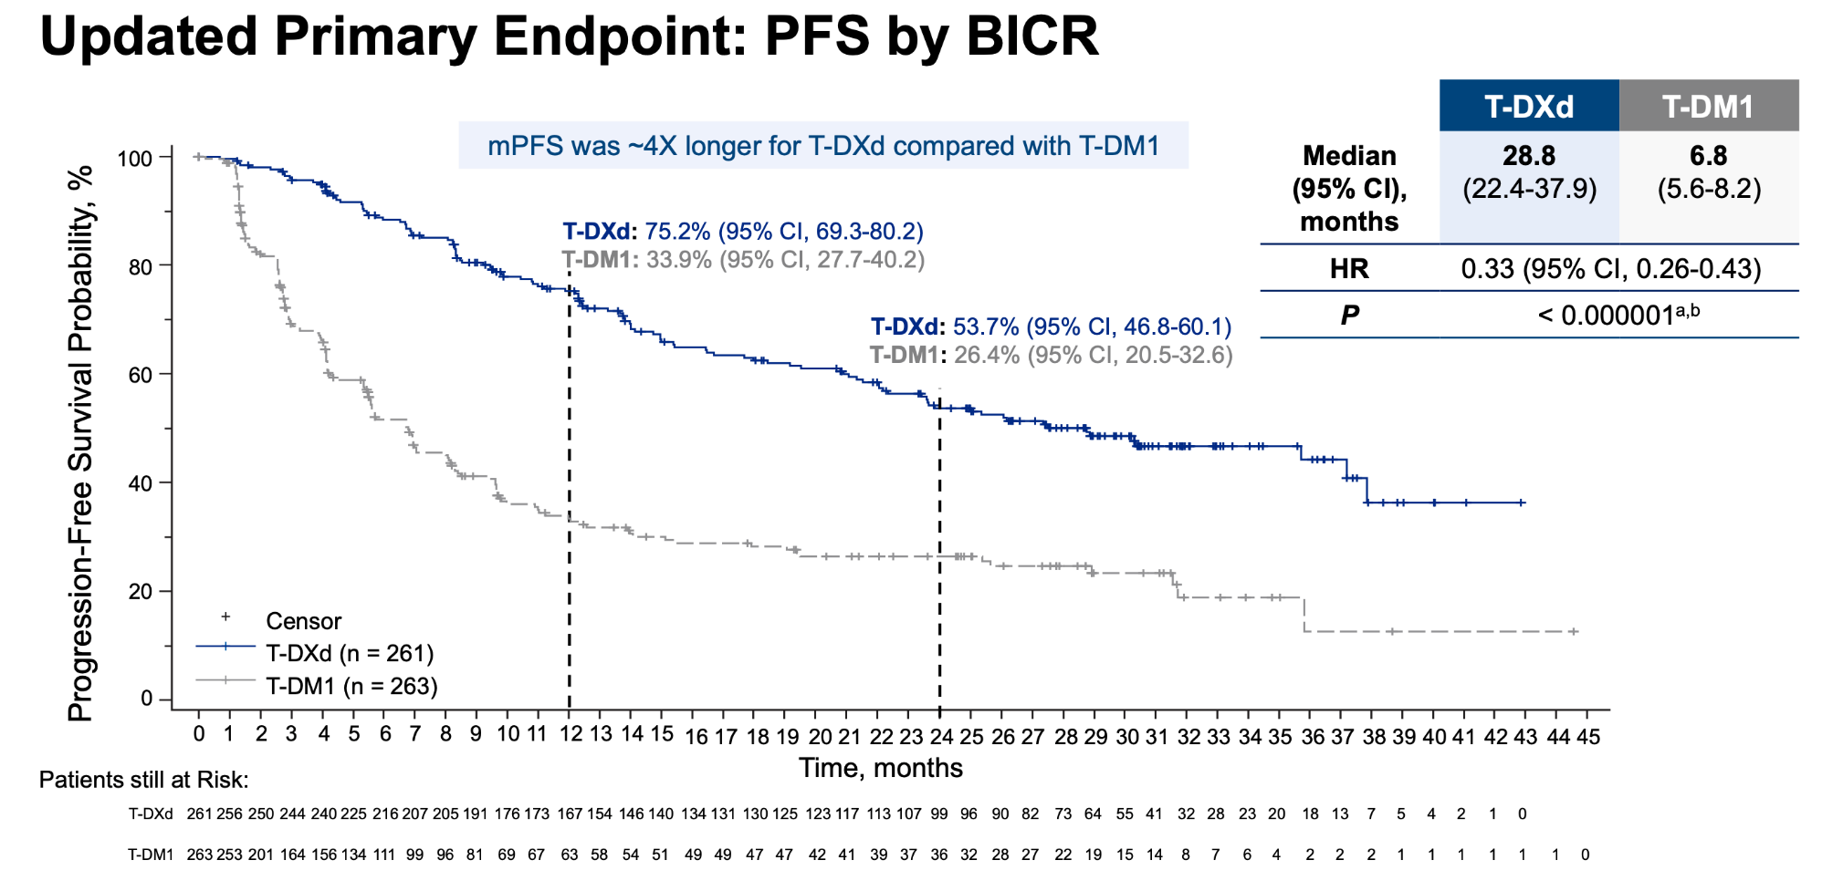
DESTINY-Breast03
Presented by Sara Hurvitz at SABCS 2022
Notes:
These PFS results were updated at SABCS 2022…mPFS for T-DXd has now been reached

Slide 26
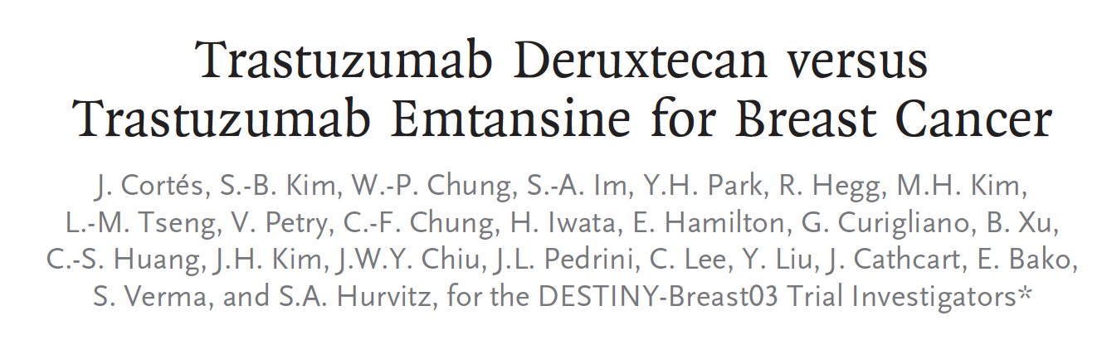
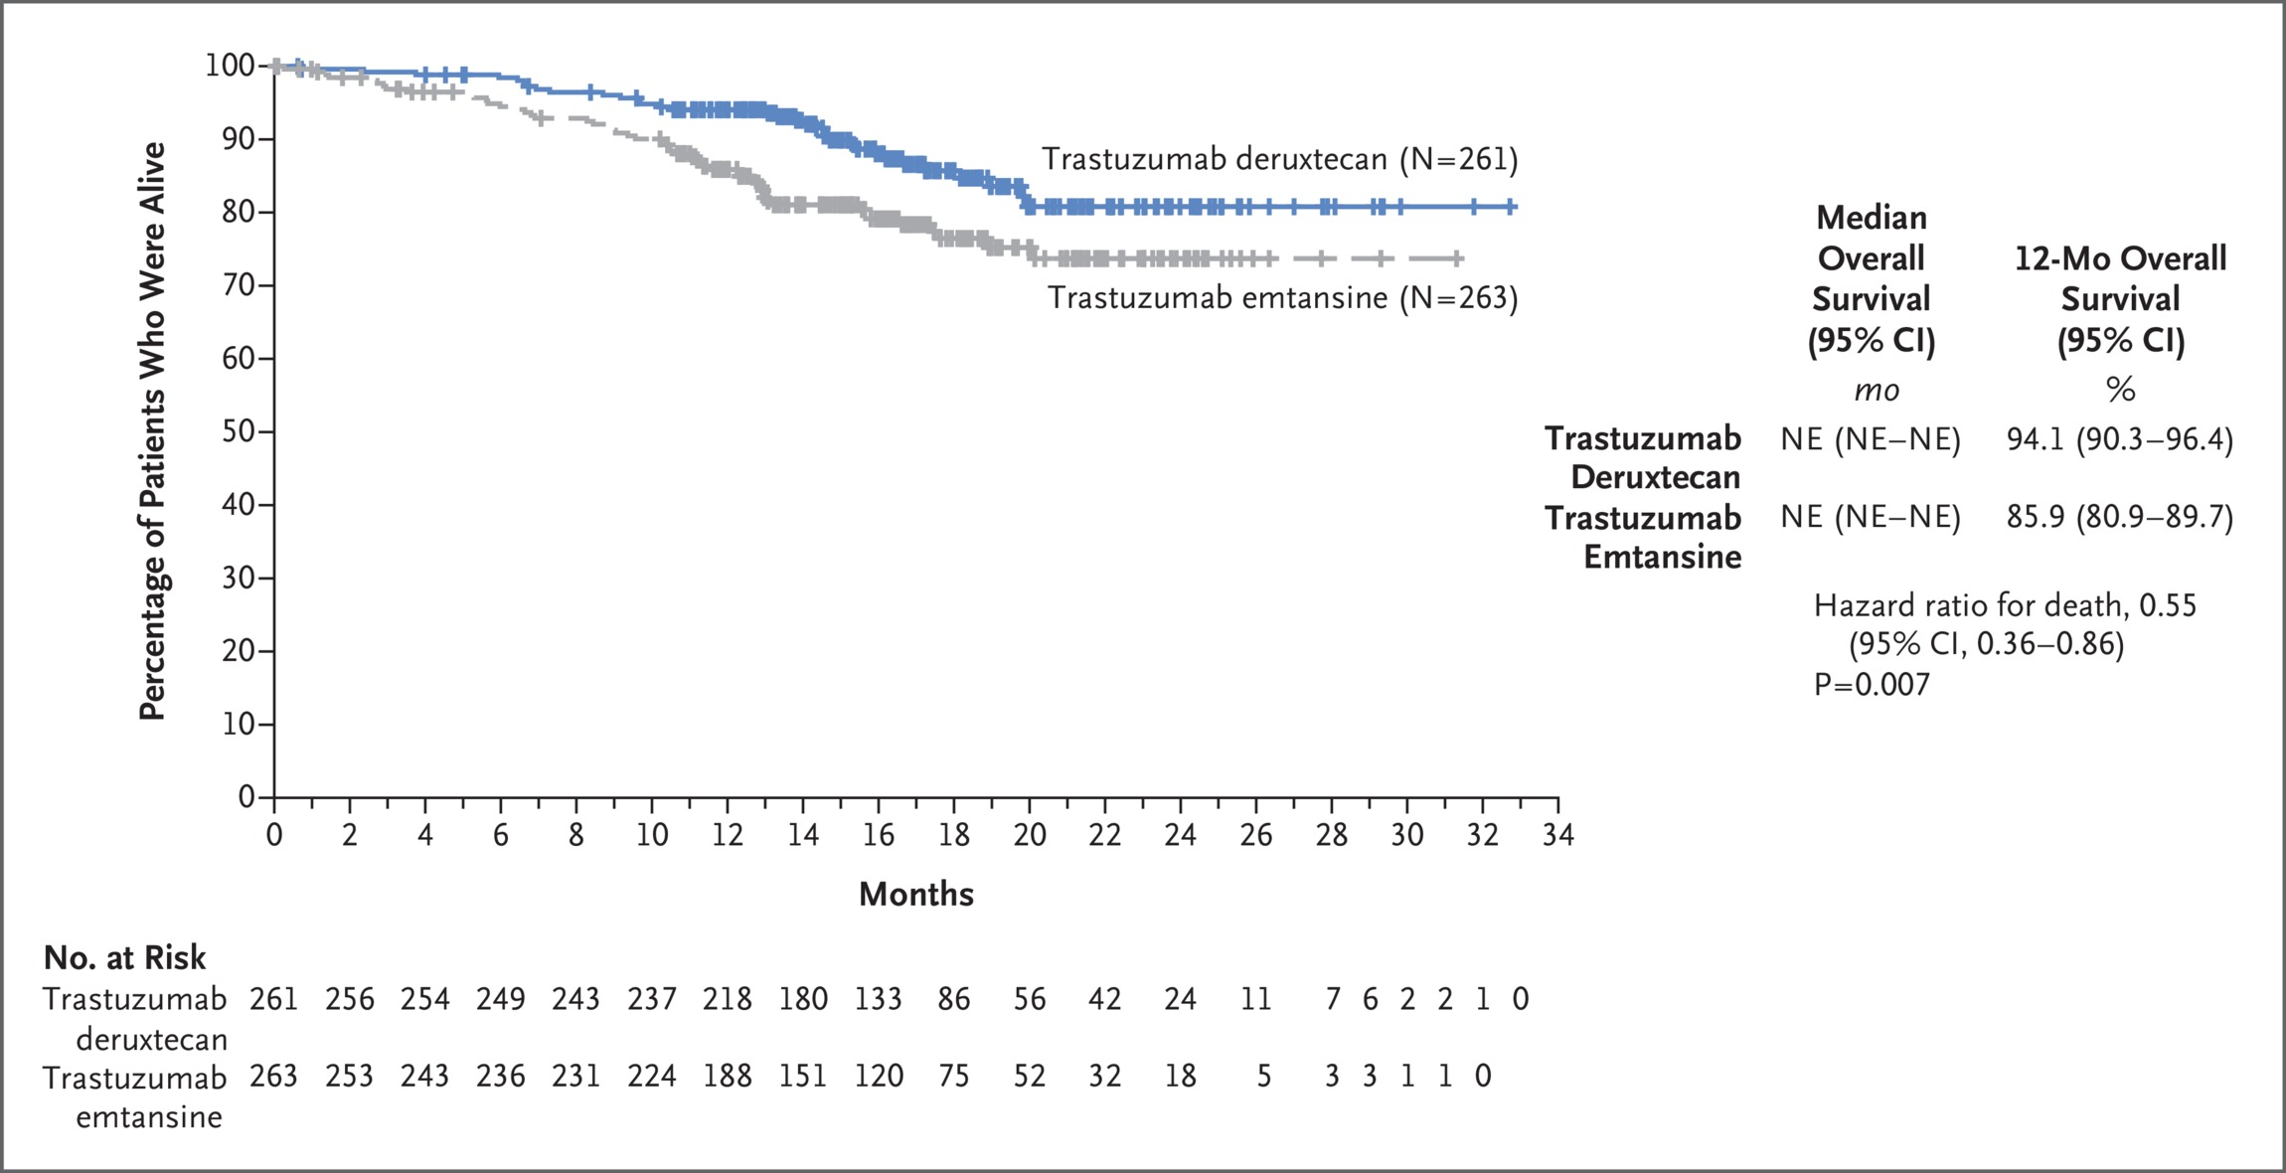

First Interim Analysis of Overall Survival.
Cortés J et al. N Engl J Med 2022;386:1143-1154
Cortes et al. N Engl J Med. 2022;386(12):1143-1154.
Notes:
Figure 2 First Interim Analysis of Overall Survival. Shown are Kaplan–Meier estimates of overall survival at 12 months in the intention-to-treat population, stratified according to hormone-receptor status, previous treatment with pertuzumab, and history of visceral disease. At the time of the data cutoff date of May 21, 2021, a total of 86 deaths had occurred; this analysis was performed on the basis of a progression-free survival benefit with trastuzumab deruxtecan. The median overall survival was not reached in either treatment group (hazard ratio, 0.55; 95% CI, 0.36 to 0.86; P=0.007). The percentage of patients who were alive at 12 months was 94.1% (95% CI, 90.3 to 96.4) with trastuzumab deruxtecan and 85.9% (95% CI, 80.9 to 89.7) with trastuzumab emtansine. The tick marks indicate censored data.

Slide 27
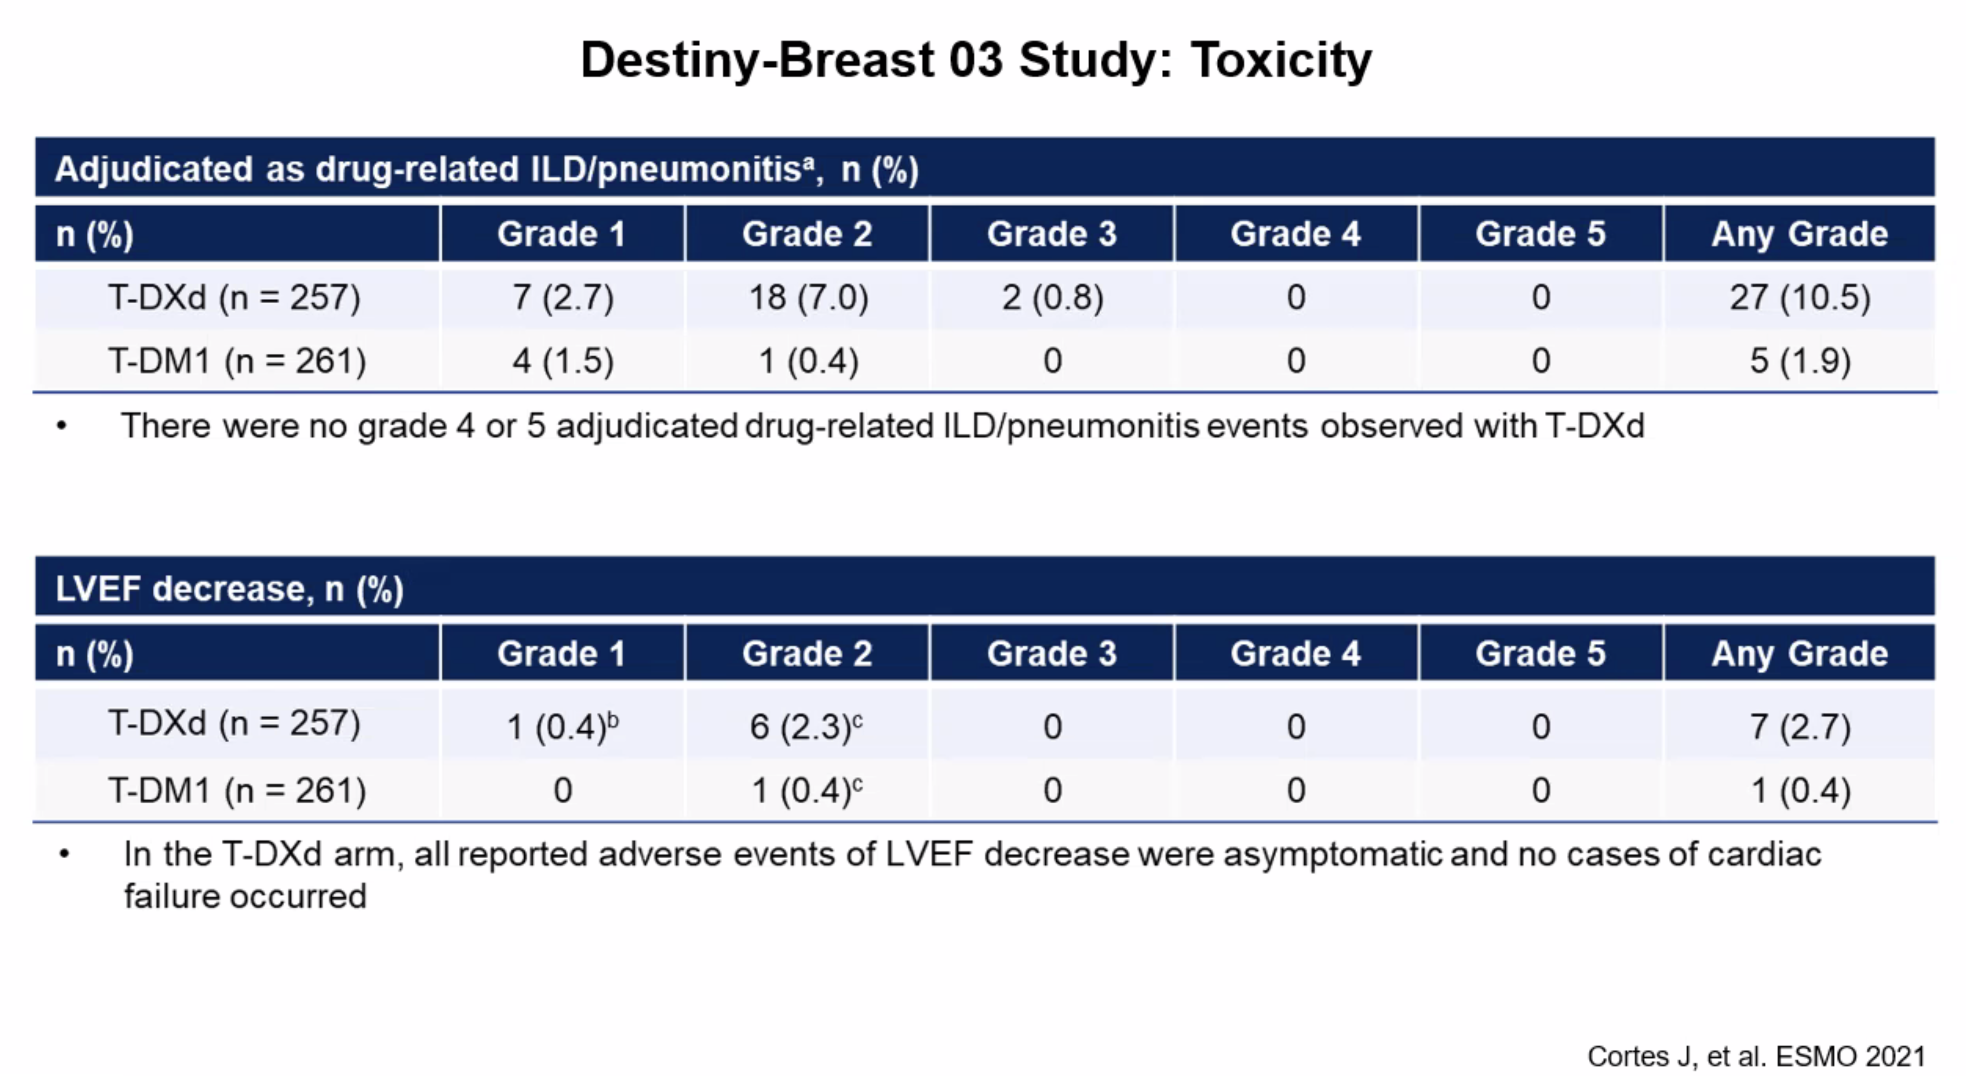

Slide 28
Trastuzumab deruxtecan (T-DXd) + pertuzumab vs taxane
+ trastuzumab + pertuzumab (THP) for first-line treatment of patients with human epidermal growth factor receptor 2–positive (HER2+) advanced/metastatic breast cancer: interim results from DESTINY-Breast09
Sara M Tolaney, MD, MPH
Dana-Farber Cancer Institute, Boston, MA, US
Monday, June 2, 2025
Additional authors: Zefei Jiang, Qingyuan Zhang, Romualdo Barroso-Sousa, Yeon Hee Park, Mothaffar F Rimawi, Cristina Saura, Andreas Schneeweiss, Masakazu Toi, Yee Soo Chae, Yasemin Kemal, Mukesh Chaudhari,
Toshinari Yamashita, Monica Casalnuovo, Michael A Danso, Jie Liu, Jagdish Shetty, Pia Herbolsheimer, Sibylle Loibl
On behalf of the DESTINY-Breast09 investigators
Confidential. For internal use only.
28

Slide 29
Evolution of T-DXd in HER2+ a/mBC
Observed mPFS*
1L
DESTINY-Breast09 (Phase 3)
T-DXd + P
CLEOPATRA (Phase 3)¹
Standard of care THP: 18.5 mo
~1 in 3 patients do not receive a subsequent treatment after 1L²
2L
DESTINY-Breast03
(Phase 3)³
T-DXd: 28.8 mo
T-DM1: 6.8 mo
3L+
DESTINY-Breast02
(Phase 3)⁴
T-DXd: 17.8 mo
TPC:† 6.9 mo
DESTINY-Breast01
(Phase 2)⁵
T-DXd: 16.4 mo
*Comparisons are hypothesis-generating only as it is not possible to directly compare the studies due to differences in trial population and design; †capecitabine plus trastuzumab or lapatinib
1L, first line; 2L, second line; 3L, third line; a/mBC, advanced/metastatic breast cancer; CTx, chemotherapy; HER2+, human epidermal growth factor receptor 2–positive; mo, months; mPFS, median progression-free survival; P, pertuzumab;
T-DM1, trastuzumab emtansine; T-DXd, trastuzumab deruxtecan; TPC, treatment of physician’s choice; THP, taxane + trastuzumab + pertuzumab
1. Baselga J, et al. N Engl J Med. 2012;366:109–119; 2. Cottu P, et al. Breast Cancer Res Treat. 2024;209:419–430; 3. Hurvitz SA, et al. Lancet. 2023;401:105–117; 4. André F, et al. Lancet. 2023;401:1773–1785;
5. Modi S, et al. N Engl J Med. 2020;382:610–621
Confidential. For internal use only.
29

Slide 30
DESTINY-Breast09 study design
A randomized, multicenter, open-label,* Phase 3 study (NCT04784715)
Eligibility criteria
HER2+ a/mBC
Asymptomatic/inactive brain mets allowed
DFI >6 mo from last chemotherapy or HER2-targeted therapy in neoadjuvant/ adjuvant setting
One prior line of ET for mBC permitted
No other prior systemic treatment
for mBC†
T-DXd‡ + placebo
Endpoints
Primary
PFS (BICR)
Key secondary
OS
Secondary
PFS (INV)
ORR (BICR/INV)
DOR (BICR/INV)
PFS2 (INV)
Safety and tolerability
n=387
Blinded until final PFS analysis
n=383
T-DXd‡ + pertuzumab§
R
1:1:1
THP
Taxane (paclitaxel or docetaxel)¶ + trastuzumab║ + pertuzumab§
n=387
Stratification factors
De-novo vs recurrent mBC
HR+ or HR−
PIK3CAm (detected vs non-detected)
At this planned interim analysis (DCO Feb 26, 2025), results are reported for the T-DXd + P and THP arms
*Open label for THP arm. Double blinded for pertuzumab in experimental arms; †HER2-targeted therapy or chemotherapy; ‡5.4 mg/kg Q3W; §840 mg loading dose, then 420 mg Q3W; ¶paclitaxel 80 mg/m² QW or 175 mg/m² Q3W, or docetaxel 75 mg/m² Q3W for a minimum of six cycles or until intolerable toxicity; ║8 mg/kg loading dose, then 6 mg/kg Q3W
a/mBC, advanced/metastatic breast cancer; BICR, blinded independent central review; DCO, data cutoff; DFI, disease-free interval; DOR, duration of response; HER2, human epidermal growth factor receptor 2; HER2+, HER2-positive;
HR+/−, hormone receptor–positive/–negative; INV, investigator; mBC, metastatic breast cancer; mets, metastases; mo, months; ORR, objective response rate; OS, overall survival; P, pertuzumab; PFS, progression-free survival;
PFS2, second progression-free survival; PIK3CAm, phosphatidylinositol-4,5-bisphosphate 3-kinase catalytic subunit alpha mutation; Q3W, every 3 weeks; QW, once every week; R, randomization; T-DXd, trastuzumab deruxtecan
NCT04784715. Updated. May 6, 2025. Available from: https://clinicaltrials.gov/study/NCT04784715 (Accessed May 29, 2025)
Confidential. For internal use only.
30

Slide 31
Patient demographics and key baseline characteristics
 | T-DXd + P (n=383) | THP (n=387)
Age, median (range), years | 54 (27–85) | 54 (20–81)
Female, n (%) | 383 (100) | 387 (100)
Geographical region, n (%)
Asia | 188 (49.1) | 191 (49.4)
Western Europe and North America | 87 (22.7) | 78 (20.2)
Rest of World | 108 (28.2) | 118 (30.5)
ECOG performance status, n (%)
0 (normal activity) | 256 (66.8) | 246 (63.6)
1 (restricted activity) | 127 (33.2) | 141 (36.4)
HER2 score by central test, n (%)
IHC 3+ | 318 (83.0) | 315 (81.4)
IHC <3 / ISH+ | 62 (16.2) | 71 (18.3)
IHC NR / ISH+ | 3 (0.8) | 1 (0.3)
HR status, n (%)
Positive* | 207 (54.0) | 209 (54.0)
Negative | 176 (46.0) | 178 (46.0)
De-novo disease at diagnosis, n (%) | 200 (52.2) | 200 (51.7)
PIK3CA mutations detected, n (%) | 116 (30.3) | 121 (31.3)
Brain metastases, n (%)† | 25 (6.5) | 22 (5.7)
Visceral metastases, n (%) | 281 (73.4) | 268 (69.3)
*Defined as estrogen receptor–positive and/or progesterone receptor–positive (≥1%); †participants were eligible if they had brain metastases that were clinically inactive or treated/asymptomatic
ECOG, Eastern Cooperative Oncology Group; HER2, human epidermal growth factor receptor 2; HR, hormone receptor; IHC, immunohistochemistry; ISH, in situ hybridization; NR, not recorded; P, pertuzumab; T-DXd, trastuzumab deruxtecan;
THP, taxane + trastuzumab + pertuzumab
Confidential. For internal use only.
31

Slide 32
PFS (BICR): primary endpoint
 | T-DXd + P (n=383) | THP (n=387)
Median, mo (95% CI) | 40.7* (36.5, NC) | 26.9 (21.8, NC)
Hazard ratio (95% CI) | 0.56 (0.44, 0.71)
P-value | <0.00001†
1.0
93.0%
(95% CI 89.9, 95.2)
85.9%
(95% CI 81.9, 89.1)
T-DXd + P
mPFS: 40.7 mo† (95% CI 36.5, NC)
0.8
70.1%
(95% CI 64.8, 74.8)
87.8%
(95% CI 84.0, 90.7)
0.6
72.4%
(95% CI 67.4, 76.8)
Δ 13.8 mo
Probability of PFS
THP
mPFS: 26.9 mo
(95% CI 21.8, NC)
0.4
Hazard ratio 0.56
95% CI 0.44, 0.71
P-value <0.00001*
52.1%
(95% CI 46.4, 57.5)
Hazard ratio 0.56
95% CI 0.44, 0.71
P-value <0.00001*
0.2
0
0
3
6
9
12
15
18
21
24
27
30
33
36
39
42
45
48
No. at risk
Time from randomization (months)
T-DXd + P
383
358
355
321
293
275
242
208
175
153
82
49
21
10
3
0
387
353
312
273
241
215
187
160
124
106
51
32
12
5
1
0
THP
Statistically significant and clinically meaningful PFS benefit with T-DXd + P (median Δ 13.8 mo)
*Median PFS estimate for T-DXd + P is likely to change at updated analysis; †stratified log-rank test. A P-value of <0.00043 was required for interim analysis superiority
BICR, blinded independent central review; CI, confidence interval; mo, months; (m)PFS, (median) progression-free survival; NC, not calculable; P, pertuzumab; T-DXd, trastuzumab deruxtecan; THP, taxane + trastuzumab + pertuzumab
Confidential. For internal use only.
32

Slide 33
PFS (BICR): subgroup analyses
 | No. of events / no. of patients |  | mPFS, months (95% CI) |  | Hazard ratio (95% CI)
 | T-DXd + P | THP | T-DXd + P | THP
Prior treatment status
De novo | 52/200 | 85/200 | NC (36.5, NC) | 31.2 (23.5, NC) |  | 0.49 (0.35, 0.70)
Recurrent | 66/183 | 87/187 | 38.0 (26.9, NC) | 22.5 (18.1, NC) |  | 0.63 (0.46, 0.87)
HR status
Positive | 65/207 | 87/209 | 38.0 (36.0, NC) | 27.7 (22.4, NC) |  | 0.61 (0.44, 0.84)
Negative | 53/176 | 85/178 | 40.7 (40.7, NC) | 22.6 (17.3, 32.7) |  | 0.52 (0.37, 0.73)
PIK3CA mutation status
Detected | 41/116 | 64/121 | 36.0 (29.7, NC) | 18.1 (15.1, 25.6) |  | 0.52 (0.35, 0.77)
Not detected | 76/266 | 108/266 | 40.7 (38.0, NC) | 32.7 (24.4, NC) |  | 0.57 (0.43, 0.77)
Age at randomization
<65 years | 90/315 | 139/315 | 40.7 (36.5, NC) | 27.4 (22.4, NC) |  | 0.50 (0.38, 0.65)
≥65 years | 28/68 | 33/72 | 27.6 (14.9, NC) | 21.5 (13.9, NC) |  | 0.92 (0.55, 1.51)
Geographical region
Asia | 62/188 | 87/191 | 40.7 (36.5, NC) | 27.2 (21.5, NC) |  | 0.60 (0.43, 0.83)
Western Europe and North America | 27/87 | 31/78 | 36.0 (30.6, NC) | 31.2 (15.8, NC) |  | 0.60 (0.35, 1.01)
Rest of World | 29/108 | 54/118 | NC (38.0, NC) | 24.4 (14.8, NC) |  | 0.48 (0.30, 0.76)
Brain metastases at baseline
Present | 10/25 | 15/22 | 31.8 (18.5, NC) | 9.5 (5.6, 13.3) |  | 0.30 (0.12, 0.68)
Not present | 108/358 | 157/365 | 40.7 (36.5, NC) | 27.6 (22.6, NC) |  | 0.58 (0.45, 0.74)
Prior exposure to anti-HER2 therapies
Yes | 39/115 | 51/112 | 38.0 (26.9, NC) | 21.5 (15.3, NC) |  | 0.55 (0.36, 0.83)
No | 79/268 | 121/275 | 40.7 (36.5, NC) | 27.6 (22.5, NC) |  | 0.56 (0.42, 0.74)
Prior exposure to pertuzumab
Yes | 5/31 | 12/26 | 40.8 (25.4, NC) | 19.8 (7.5, NC) |  | NC
No | 113/352 | 160/361 | 40.7 (36.0, NC) | 27.4 (22.4, NC) |  | 0.61 (0.48, 0.77)
Size of circle is proportional to the number of events
BICR, blinded independent central review;
CI, confidence interval; HER2, human epidermal growth factor receptor 2; HR, hormone receptor;
NC, not calculable; P, pertuzumab;
(m)PFS, (median) progression-free survival;
T-DXd, trastuzumab deruxtecan;
THP, taxane + trastuzumab + pertuzumab
0.125
0.25
0.5
1
2
Favors T-DXd + P
Favors THP
PFS benefit with T-DXd + P vs THP was consistently observed across prespecified subgroups, including stratification factors
Confidential. For internal use only.
33

Slide 34
ORR and DOR (BICR)
Confirmed ORR*
85.1%
(95% CI 81.2, 88.5)
78.6%
(95% CI 74.1, 82.5)
15.1
(n=58)
8.5
(n=33)
 | T-DXd + P (n=383) | THP (n=387)
Median DOR, mo (95% CI) | 39.2 (35.1, NC) | 26.4 (22.3, NC)
Remaining in response at 24 mo (%) | 73.3 | 54.9
Stable disease, n (%) | 38 (9.9) | 56 (14.5)
70.0
70.0
(n=268)
(n=271)
 | CR |  | PR
 | CR |  | PR
Response rates were greater with T-DXd + P vs THP and were durable
*Based on RECIST v1.1; response required confirmation after 4 weeks
BICR, blinded independent central review; CI, confidence interval; CR, complete response; DOR, duration of response; mo, months; NC, not calculable; ORR, objective response rate; P, pertuzumab; PR, partial response;
RECIST, Response Evaluation Criteria in Solid Tumours; T-DXd, trastuzumab deruxtecan; THP, taxane + trastuzumab + pertuzumab
Confidential. For internal use only.
34

Slide 35
PFS2 (investigator assessment) and post-trial treatments
 | T-DXd + P (n=383) | THP (n=387)
Received post-discontinuation therapy in second line, n (%)† | 124 (32.4) | 181 (46.8)
Targeted therapy, n (%)† | 111 (29.0) | 166 (42.9)
T-DXd | 6 (1.6) | 39 (10.1)
T-DM1 | 7 (1.8) | 47 (12.1)
Trastuzumab-containing regimen‡ | 78 (20.4) | 51 (13.2)
Pertuzumab-containing regimen‡ | 53 (13.8) | 34 (8.8)
Chemotherapy, n (%)† | 68 (17.8) | 57 (14.7)
Docetaxel | 24 (6.3) | 8 (2.1)
Paclitaxel | 18 (4.7) | 4 (1.0)
Capecitabine | 24 (6.3) | 35 (9.0)
Endocrine therapy, n (%)† | 19 (5.0) | 13 (3.4)
1.0
0.8
0.6
Probability of PFS
 | T-DXd + P (n=383) | THP (n=387)
Data maturity | ~20% | ~30%
Median, mo (95% CI) | NC | 36.5 (36.1, NC)
Hazard ratio (95% CI) | 0.60 (0.45, 0.79)
Nominal P-value | 0.00038*
0.4
0.2
0
0
3
6
9
12
15
18
21
24
27
30
33
36
39
42
45
48
No. at risk
Time from randomization (months)
No. at risk
383
T-DXd + P
T-DXd + P
387
370
356
343
331
320
290
254
209
180
101
59
28
12
3
0
THP
THP
373
358
341
319
292
252
212
174
143
80
48
15
5
0
0
Clinically meaningful improvement in PFS2 with T-DXd + P vs THP
PFS2 was defined by investigators according to local standard clinical practice as the time from randomization to second progression (earliest progression event following first subsequent therapy) or death
*Stratified log-rank test; †percentages are based on the overall population. Therapies listed are not exhaustive. Patients may have received more than one type of therapy; ‡patients may have received trastuzumab and pertuzumab concurrently
CI, confidence interval; NC, not calculable; P, pertuzumab; PFS2, second progression-free survival; T-DM1, trastuzumab emtansine; T-DXd, trastuzumab deruxtecan; THP, taxane + trastuzumab + pertuzumab
Confidential. For internal use only.
35

Slide 36
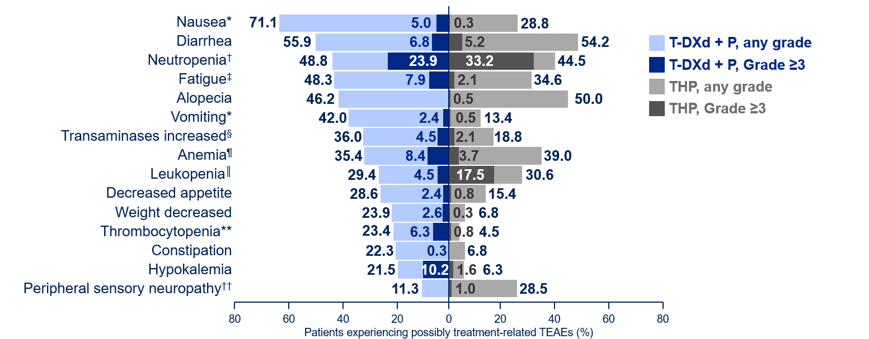
Possibly treatment-related (investigator assessed) TEAEs in ≥20% of patients (either arm)
*Antiemetic prophylaxis was recommended but not mandated by protocol; †neutropenia (grouped term) includes: neutropenia and neutrophil count decreased; ‡fatigue (grouped term) includes: fatigue, asthenia, malaise, and lethargy; §transaminases increased (grouped term) includes: transaminases increased, aspartate aminotransferase increased, alanine aminotransferase increased, gamma-glutamyltransferase increased, liver function test abnormal, hepatic function abnormal, and liver function test increase; ¶anemia (grouped term) includes: anemia, hemoglobin decreased, hematocrit decreased, and red blood cell count decreased; ║leukopenia (grouped term) includes: leukopenia and white blood cell count decreased; **thrombocytopenia (grouped term) includes: platelet count decreased and thrombocytopenia; ††peripheral sensory neuropathy (grouped term) includes: neuropathy peripheral, peripheral sensory neuropathy, and polyneuropathy
P, pertuzumab; T-DXd, trastuzumab deruxtecan; TEAE, treatment-emergent adverse event; THP, taxane + trastuzumab + pertuzumab
Confidential. For internal use only.
36

Slide 37
Conclusions
  T-DXd + P demonstrated a statistically significant and clinically meaningful PFS benefit by BICR vs THP, which was consistently
  observed across subgroups
    Hazard ratio of 0.56 vs THP (P<0.00001)
    Median PFS was 40.7 months (T-DXd + P) vs 26.9 months (THP)
  Median DOR of >3 years with T-DXd + P, with CRs in 15.1% (T-DXd + P)
  vs 8.5% (THP)
  Early OS data suggest a positive trend favoring T-DXd + P,
  with a supportive hazard ratio of 0.60 for PFS2
  T-DXd + P safety data were consistent with known profiles of
  individual treatments
PFS by BICR
44%
Reduction in risk of disease progression
or death with
T-DXd + P vs THP
  T-DXd + P demonstrated a statistically significant and clinically meaningful
  PFS benefit vs THP and may represent a new first‑line standard of care
  for patients with HER2+ a/mBC
a/mBC, advanced/metastatic breast cancer; BICR, blinded independent central review; CR, complete response; DOR, duration of response; HER2+, human epidermal growth factor receptor 2–positive; OS, overall survival; P, pertuzumab;
PFS, progression-free survival; PFS2, second progression-free survival; T-DXd, trastuzumab deruxtecan; THP, taxane + trastuzumab + pertuzumab
Confidential. For internal use only.
37

Slide 38
 | Grade 1 | Grade 2 | Grade 3/4
Description¹ | Asymptomatic, clinical, or diagnostic observations only | Symptomatic, limiting instrumental activities of daily living | Grade 3: Severe symptoms, limiting self-care activities of daily living; oxygen indicated Grade 4: Life-threatening respiratory compromise
Workup² | If a patient develops radiographic changes potentially consistent with ILD/pneumonitis or develops an acute onset of new or worsening pulmonary or other related signs/symptoms such as dyspnea, cough, or fever, rule out ILD/pneumonitis Evaluations should include: High-resolution CT Pulmonologist consultation (infectious disease consultation as clinically indicated) Blood culture and CBC. Other blood tests could be considered as needed Consider bronchoscopy and bronchoalveolar lavage if clinically indicated and feasible Pulmonary function tests and pulse oximetry Arterial blood gases if clinically indicated One blood sample collection for PK analysis as soon as ILD/pneumonitis is suspected, if feasible If the AE is confirmed to have an etiology other than treatment-related ILD/pneumonitis, follow routine clinical practice If another etiology for the AE cannot be identified and it could be related to T-DXd, then follow the ILD/pneumonitis management guidance as outlined on the next slide All events of ILD/pneumonitis, regardless of severity or seriousness, should be followed until resolution
Notes:
Modi S, Saura C, Yamashita T, et al. PD3-06. Updated results from DESTINY-breast01, a phase 2 trial of trastuzumab deruxtecan (T-DXd ) in HER2 positive metastatic breast cancer. San Antonio Breast Cancer Symposium;December 8-11, 2020; San Antonio, TX. PD3-06.

Slide 40


Trastuzumab Deruxtecan (T-DXd)-Associated Interstitial Lung Disease (ILD) in a Large Real-World French Cohort of Patients with HER2 Driven Breast Cancer and Other Malignancies
A. Canellas, L. Elu, P. Du Rusquec, M. A. Benderra, L. Drouin, I. Cojean-Zelek, A. Vozy, E. Assaf, A. Benmaziane, J. Medioni, R. Cohen, L. Zelek, M. Wislez, J. Gligorov, P. Y. Brillet, N. Girard, K. Bihan, J. Cadranel
Lana Elu, Pulmonology Resident
Paris, France, 15th September 2024

Slide 41
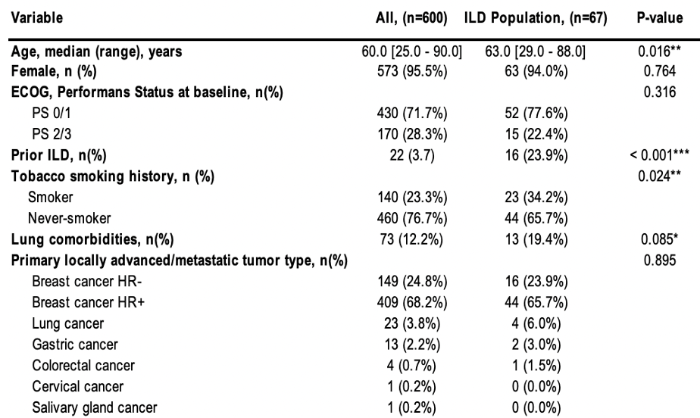
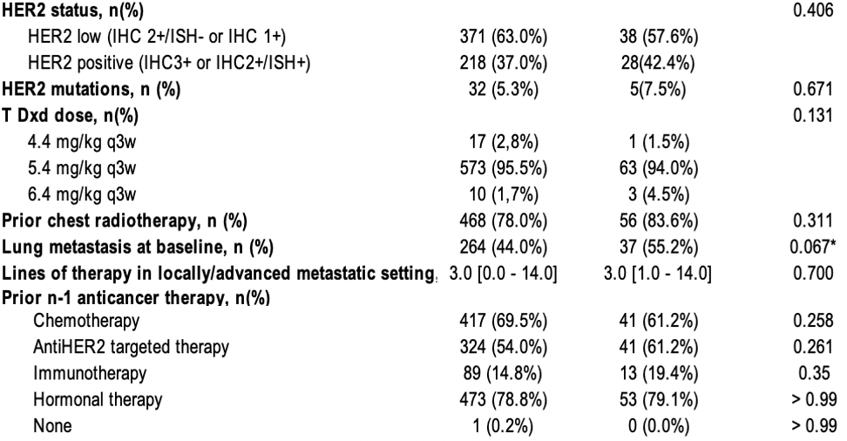
Results (1) : Patients characteristics
Incidence of T-DXd- ILD : 67 out of 600 patients (11.2%)
Median onset time :
. Pooled population : 83 days (60;125)
. HER2 Breast Cancer population : 60 days (51;168)
. Cycle of T-DXd : 7 (range 1-78)
. Previous therapy before T-DXd : 3 (range, 1-14)
. Controlled tumor response at ILD onset : 80.6% (n=54)
Notes:
Incidence of ILD : 67 out of 600 patients (11.2%)
Demographics :
. At the start of T-DXd initiation : median age was 60 years in the overall population vs 63 years in the ILD population.
. Majority of female and ECOG PS 0/1 in both groups.
Cancer Distribution:
. Predominantly HR+ breast cancer in both groups then lung cancer.
. HER2 low status is most common.
Clinical Factors:
. Over 2/3 had prior thoracic radiotherapy
. The common T-DXd dose was 5.4 mg/kg every 3 weeks.
. Anti-HER2 therapy and chemotherapy were the most frequent prior n-1 treatments.
Prior ILD, lung metastases, smoking history, and history of lung disease were more prevalent in the ILD population.
Despite 55% with lung metastasis, 80% had controlled primary cancer at ILD onset.

Slide 42
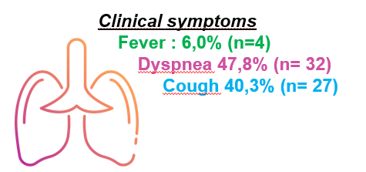
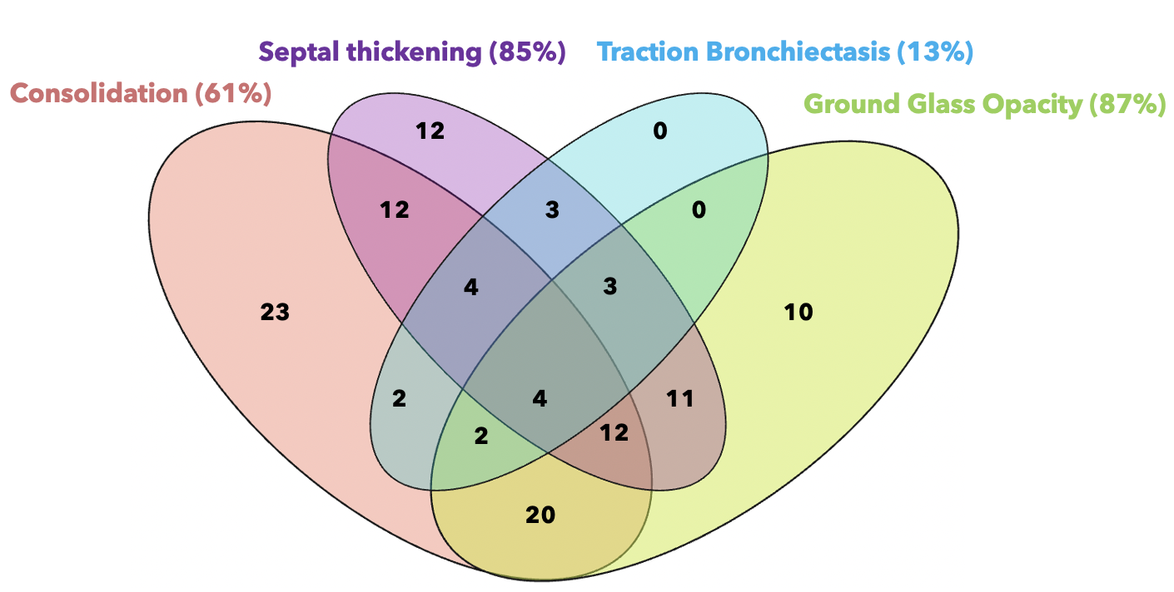
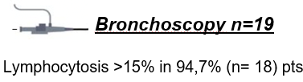
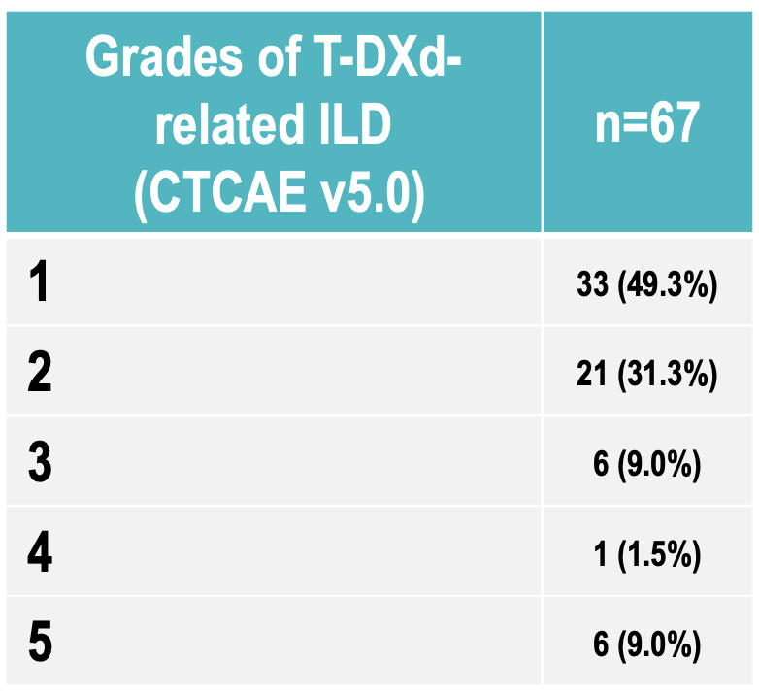
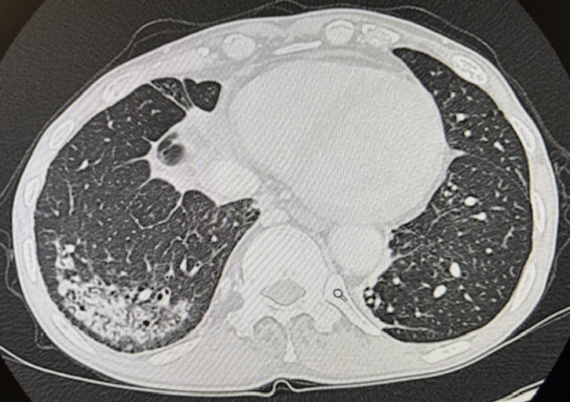
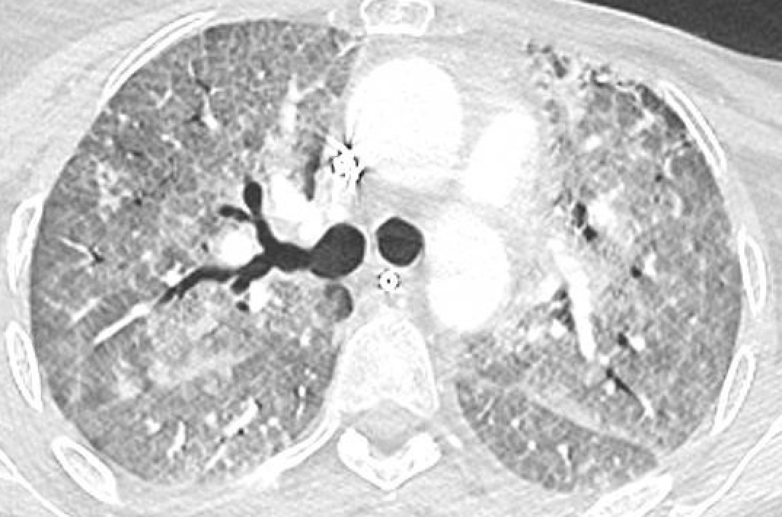
Results (2) : clinical and radiological data
Radiological features
Fever : 6.0% (n=4)
Dyspnea 47.8% (n=32)
Cough 40.3% (n=27)
Lymphocytosis > 15% in 94,7% (n=18)
Organizing Pneumonia : 52%
Diffuse alveolar damage : 9%
PATTERN
⟹
n=4
Atypical « ovoid-shaped » consolidations in 25%
Notes:
ILD occured earlier in diffuse alveolar damage (DAD) pattern with a median time of 51 days (range, 40-55) (à l’oral)

Slide 43
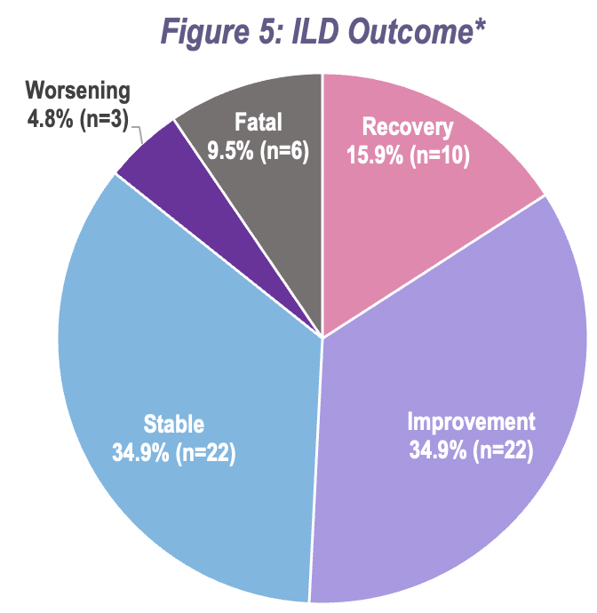
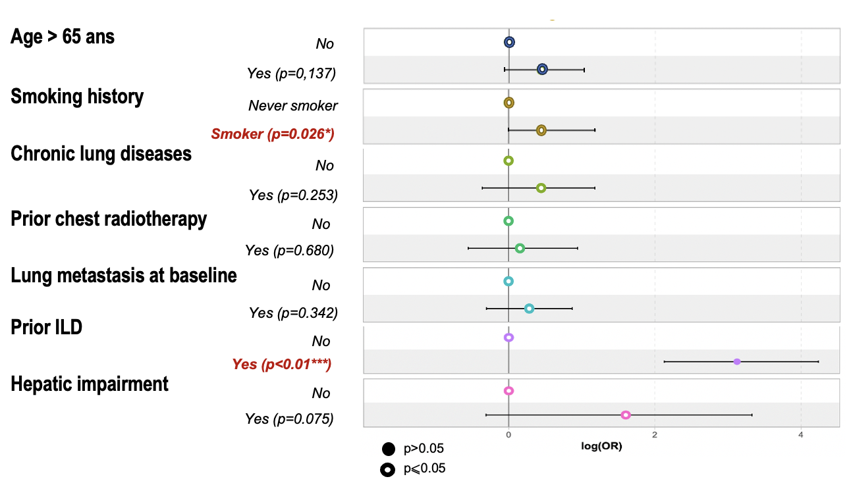
Results (3) : risk factors and management
Multivariate Analysis
* n= patient, missing progression data for 4 patients
Management :
T-DXd withdrawn in 75% (n=50) of patients.
Corticosteroids given to 49% of patients (n=33), with 58% (n=19) improving.
T-DXd rechallenged in 29.5% (n=18), with 42.9% (n=6) relapsing into ILD.
Prior ILD is the strongest risk factor
16 of 67 ILD pts vs 6 of 533 non ILD pts, p<0.01

Slide 44
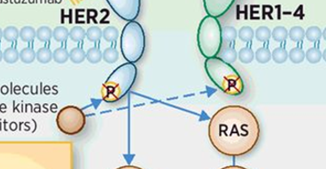
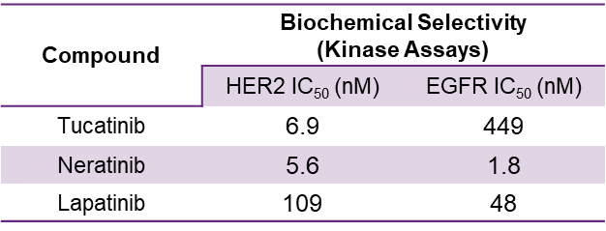
Let’s go inside…the TKIs

Slide 45
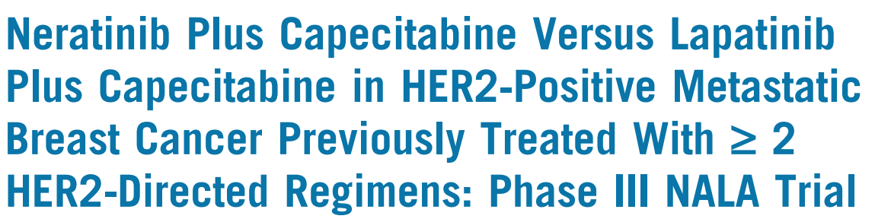
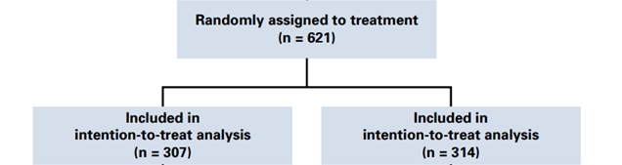
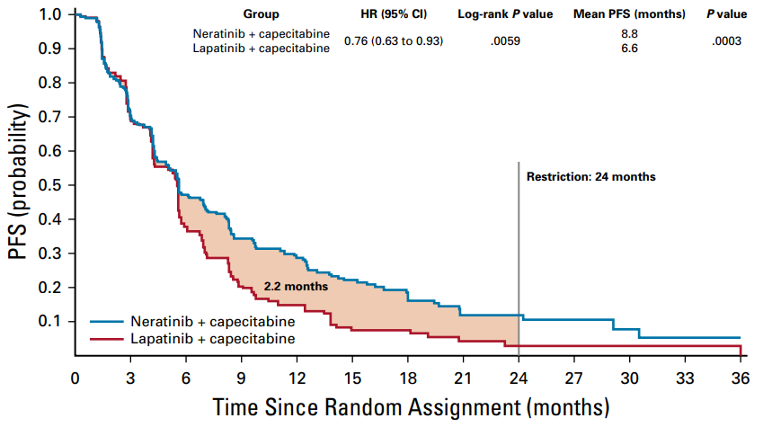
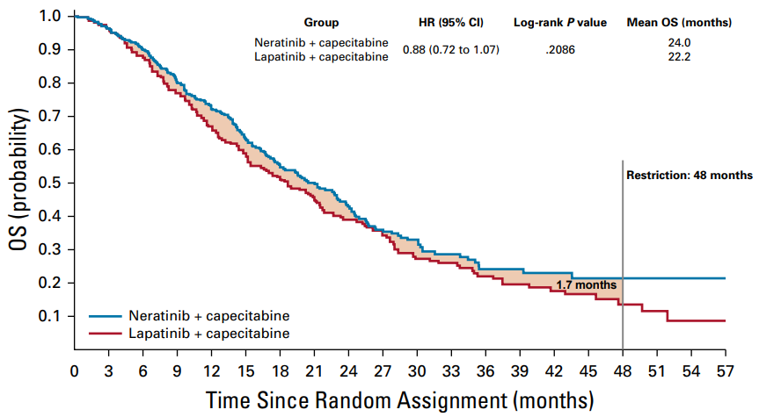
Inclusion criteria
Metastatic breast cancer (MBC)
Centrally confirmed HER2+ disease
≥2 lines of HER2-directed therapy for MBC
Asymptomatic and stable brain
metastases permitted
Saura et al. J Clin Oncol. 2020;38(27):3138-3149.

Slide 46
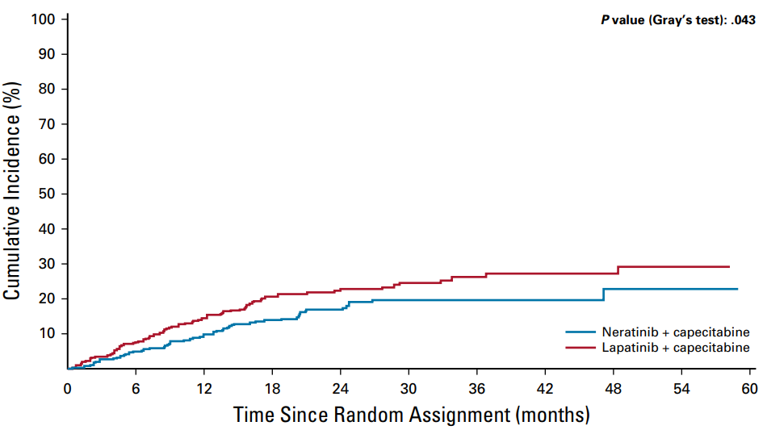
Neratinib: CNS protection
Hurvitz et al. Oncologist. 2021;26(8):e1327-e1338.

Slide 47
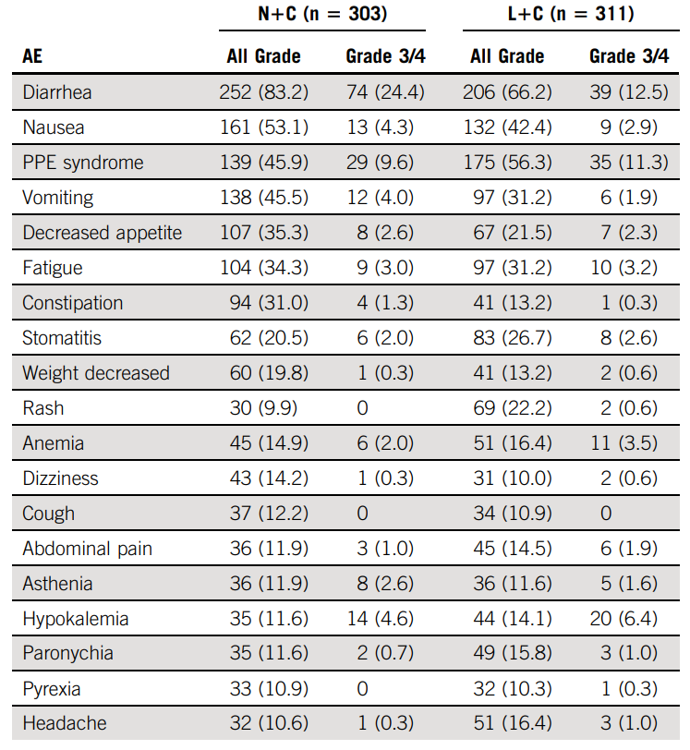
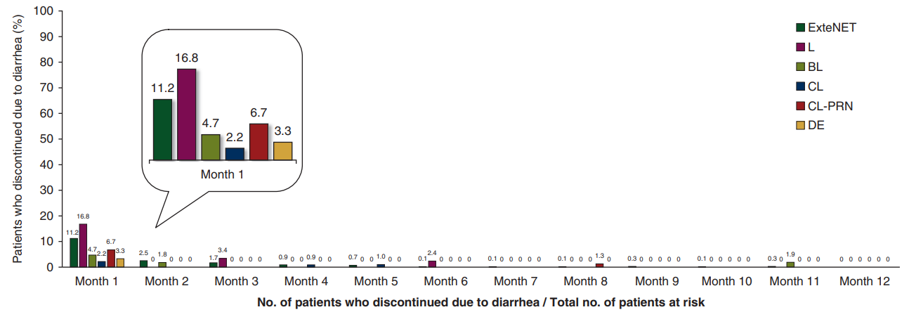
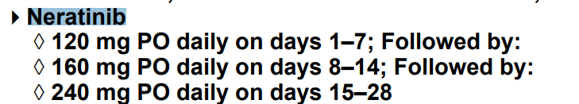
Neratinib: Toxicity and NCCN Update
Barcenas et al. Ann Oncol. 2020;31(9):1223-1230.

Slide 48
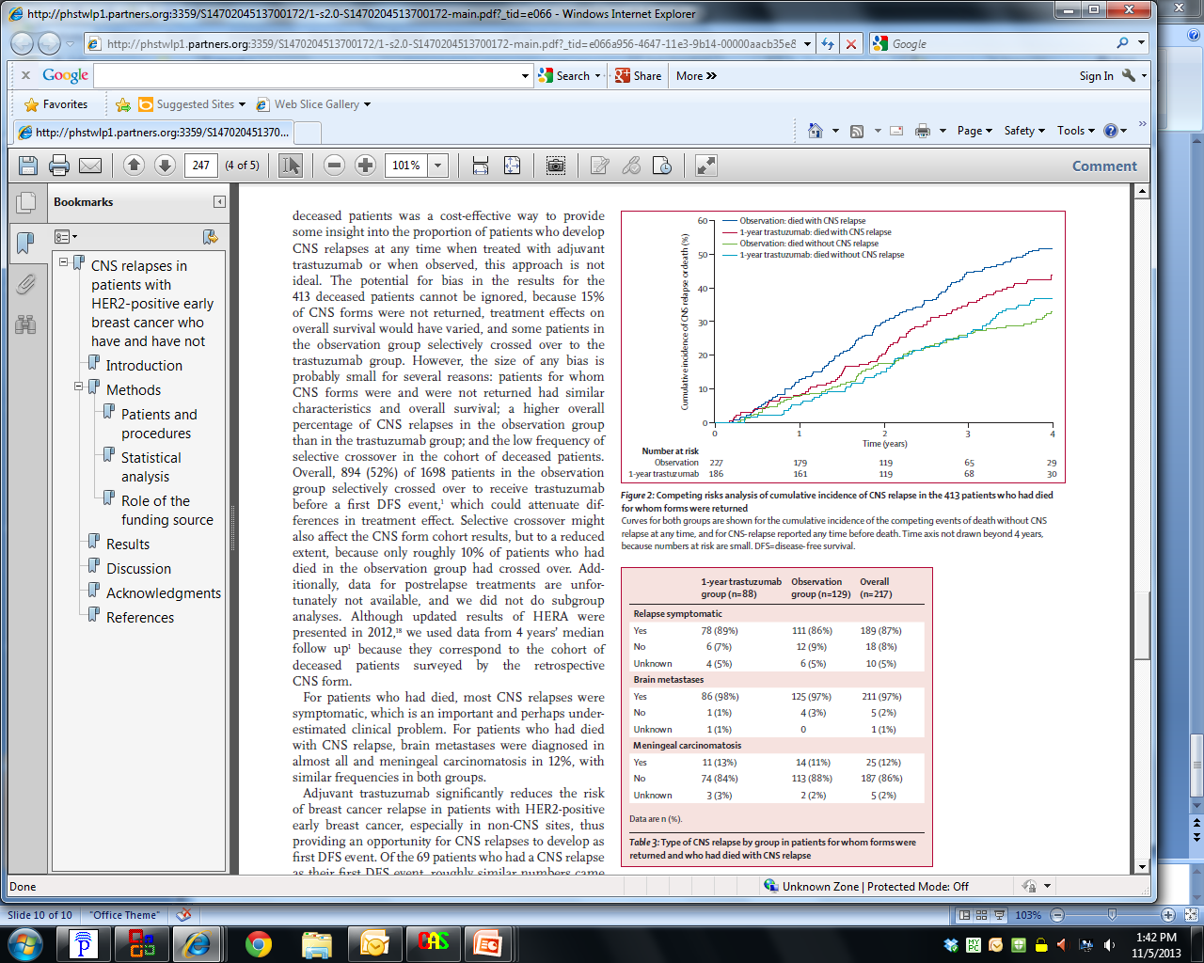
Brain Metastases May Go Undetected
Asymptomatic brain metastases occur in 15-36% of patients with HER2+ mBC¹⁻³
Up to 50% of patients with HER2+ MBC may develop brain metastases during the course of their disease⁴⁻⁷
Continuous risk over time
HER, human epidermal growth factor receptor; MBC, metastatic breast cancer.
1. Brufsky AM, et al. Clin Cancer Res. 2011;17:4834–4843. 2. Miller KD, et al. Ann Oncol. 2003;14:1072-1077. 3. Niwińska A, et al. Int J Radiat Oncol Biol Phys. 2010;77:1134-1139.
4. Olson EM et al. Breast. 2013;22:525-531. 5. Bendell JC et al. Cancer. 2003;97:2972-2977. 6. Freedman RA et al. J Clin Oncol. 2019;37:1081-1089.
7. Pestalozzi BC et al. Lancet Oncol. 2013;14:244-248.

Slide 49
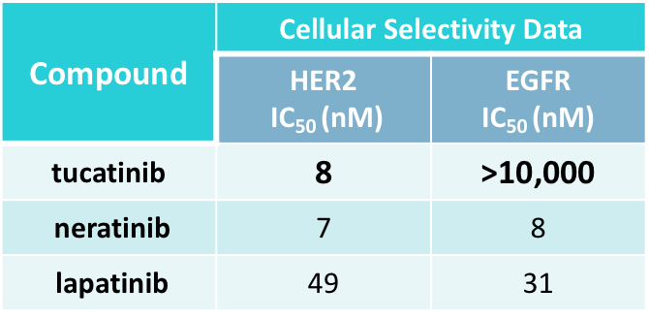
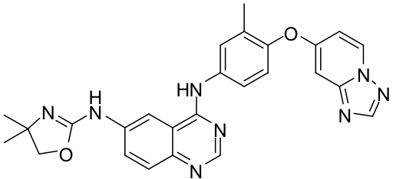
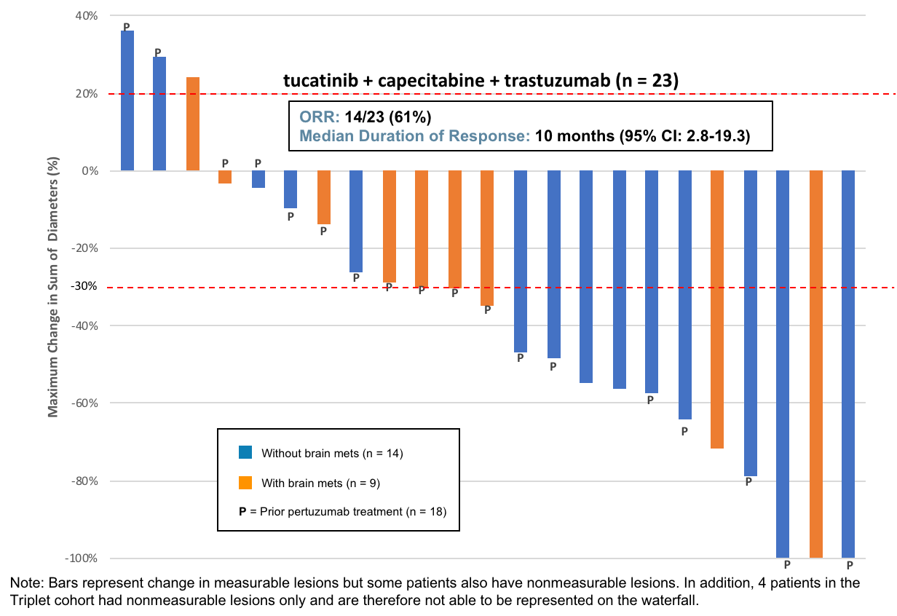
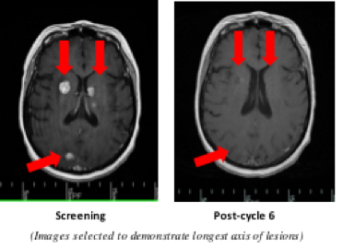
HER2CLIMB Pivotal Trial Design: Capecitabine/Trastuzumab +/- Tucatinib
Tucatinib
Patient Population
Metastatic HER2+ breast cancer with progression after pertuzumab, trastuzumab, and T-DM1
Patients with and without brain metastases
Primary endpoint:
PFS in all pts
Secondary endpoints:
PFS in pts w/ brain metastases
OS in all pts
capecitabine + trastuzumab
+ tucatinib
2:1
n=480
capecitabine + trastuzumab
+ placebo
Sample size ↑’ed to N = 612 [NCT02614794]
Data from Phase Ib Trial
*CNS metastases = 48%
Untreated 22% and Treated, progressing 18%
Murthy R, et al. Lancet Oncol. 2018;19(7):880-888.

Slide 50

Progression-Free Survival with Tucatinib Added to Capecitabine and Trastuzumab in HER2+ MBC (Including with Brain Metastases): HER2CLIMB Study Results
Treatment arm with Trastuzumab + Capecitabine | Events, N=480 | HR (95% CI) | P Value
Tucatinib | 178/320 | 0.54 (0.42, 0.71) | <0.00001
Placebo | 97/160
63%
Risk of progression or death was reduced by 46% in the primary endpoint population
One-year PFS (95% CI):
Tucatinib 33% (27, 40) | Placebo 12% (6, 21)
Median PFS (95% CI):
7.8 months (7.5, 9.6) | 5.6 months (4.2, 7.1)
Median
46%
33%
12%
  Prespecified efficacy boundary for PFS: P=0.05
  Data cut off: Sep 4, 2019
Murthy R, et al. N Engl J Med. 2020;382(7):597-609.

Slide 51

Overall Survival with Tucatinib Added to Capecitabine and Trastuzumab in HER2+ MBC (Including with Brain Metastases): HER2CLIMB Study Results
Treatment arm with Trastuzumab + Capecitabine | Events N=612 | HR (95% CI) | P Value
Tucatinib | 130/410 | 0.66 (0.50, 0.88) | 0.00480
Placebo | 85/202
76%
Risk of death was reduced by 34% in the total population
Two-year OS (95% CI):
Capecitabine 45% (37, 53) | Placebo 27% (16, 39)
Median OS (95% CI):
21.9 months (18.3, 31.0) | 17.4 months (13.6, 19.9)
62%
45%
Median
27%
  Prespecified efficacy boundary for OS (P=0.0074) was met at the first interim analysis.
  Data cut off: Sep 4, 2019
Murthy R, et al. N Engl J Med. 2020;382(7):597-609.

Slide 52


Intracranial CNS-Specific Outcomes: HER2CLIMB Study Results
Patient with Brain Metastases (active or treated/stable)
Intra-Cranial CNS Response (RECIST) N=75 | Tucatinib N=55 N (%) | Placebo N=20 N (%)
CR | 3 (5.5) | 1 (5.0)
PR | 23 (41.8) | 3 (15.0)
SD | 24 (43.6) | 16 (80.0)
PD | 2 (3.6) | 0
Not Available | 3 (5.5) | 0
Confirmed ORR | 26 (47.3) | 4 (20.0)
95% CI | 33.7-61.2% | 5.7-43.7%
Stratified p-value | 0.03
DOR (months) | 6.8 | 3.0
Patient with Brain Metastases (active)
CR=complete response; PR=partial response; SD=stable disease; PD=progressive disease; ORR=objective response rate (CR+PR); DOR=duration of intracranial response
Lin NU, et al. J Clin Oncol. 2020;38(23):2610-2619.

Slide 53



Time to New Brain Lesions or Death in All HER2CLIMB Patients
Time to new brain lesion-free survival was defined as time from randomization to new lesion in the brain or death by investigator assessment.
Lin NU, et al. Society for NeuroOncology Oral Presentation.

Slide 54

HER2Climb Safety: It’s mostly the cape…

Slide 55

HER2CLIMB-02

Slide 56
HER2CLIMB-02: Prior Systemic Therapies
 | TUC + T-DM1 (N=228) | PBO + T-DM1 (N=235)
Median prior lines of systemic therapy in metastatic setting (range) | 1 (0-8) | 1 (0-6)
Prior lines of systemic therapy in metastatic setting, n (%)
0 | 29 (12.7) | 33 (14.0)
1 | 146 (64.0) | 150 (63.8)
2 | 36 (15.8) | 31 (13.2)
≥3 | 17 (7.5) | 21 (8.9)
Received prior pertuzumab treatment, n (%) | 202 (88.6) | 214 (91.1)
Received prior anti-HER2 TKIs, n (%) | 3 (1.3) | 5 (2.1)
Hurvitz S, et al. SABCS 2023
San Antonio Breast Cancer Symposium® | @SABCSSanAntonio

Slide 57

HER2CLIMB-02: Progression-Free Survival
 | TUC + T-DM1 (N=228) | PBO + T-DM1 (N=235)
# of events | 151 | 182
Median PFS (95% CI) | 9.5 months (7.4, 10.9) | 7.4 months (5.6, 8.1)
 | HR (95% CI): 0.76 (0.61, 0.95) P=0.0163
HR, hazard ratio; PBO, placebo; PFS, progression-free survival; T-DM1, trastuzumab emtansine; TUC, tucatinib.
Date of data cutoff: Jun 29, 2023.
Hurvitz S, et al. SABCS 2023

Slide 58
HER2CLIMB-02: Adverse Events of Interest
Hepatic TEAEs
  Grade ≥3 hepatic TEAEs greater in TUC + T-DM1 arm (28.6% vs 7.3%), primarily due to AST/ALT elevations
  No Hy’s law cases were identified
  85% of all-grade hepatic TEAEs in TUC + T-DM1 arm resolved or returned to grade 1, with median of 22 days to resolutionª
Diarrhea
  Grade ≥3 events reported in 4.8% of TUC + T-DM1 arm and 0.9% of PBO + T-DM1 arm
Dose modifications Due to Hepatic TEAEs
Dose modifications Due to Diarrhea
 | TUC + T-DM1 (N=231) n (%) | PBO + T-DM1 (N=233) n (%)
TUC/PBO dose holds | 76 (32.9) | 26 (11.2)
TUC/PBO dose reductions | 46 (19.9) | 12 (5.2)
Treatment discontinuation
TUC/PBO | 16 (6.9) | 5 (2.1)
T-DM1 | 18 (7.8) | 5 (2.1)
 | TUC + T-DM1 (N=231) n (%) | PBO + T-DM1 (N=233) n (%)
TUC/PBO dose holds | 9 (3.9) | 2 (0.9)
TUC/PBO dose reductions | 9 (3.9) | 1 (0.4)
Treatment discontinuation
TUC/PBO | 1 (0.4) | 0
T-DM1 | 0 | 0
a For PBO + T-DM1 arm, 75% of all-grade hepatic TEAEs resolved or returned to grade 1, with median of 22 days to resolution.
ALT, alanine aminotransferase; AST, aspartate aminotransferase; PBO, placebo; T-DM1, trastuzumab emtansine; TEAEs, treatment-emergent adverse events; TUC, tucatinib.
Date of data cutoff: Jun 29, 2023.
Hurvitz S, et al. SABCS 2023
San Antonio Breast Cancer Symposium® | @SABCSSanAntonio

Slide 59

HER2CLIMB-05
HER2CLIMB-05 (NCT05132582) is a phase 3, randomized, double-blind study evaluating tucatinib or placebo in combination with trastuzumab plus pertuzumab as maintenance therapy in the 1L setting for patients with unresectable LA or metastatic HER2+ breast cancer following SOC induction therapy

Slide 60
Current evidence base for T-DXd benefit in patients with HER2+ mBC and BMs
Promising preliminary evidence of T-DXd intracranial activity in HER2+ mBC has been observed in small prospective patient cohorts, retrospective studies, and exploratory analyses:^{1–6}
Intracranial ORR
Active BMs
Stable BMs
Retrospective ROSET-BM^{5,6}
(≥1L)
Ph 2 TUXEDO-1¹
(≥2L)
Ph 1b/2
DESTINY-Breast07²
(1–2L)
†‡
Exploratory pooled analysis
DESTINY-Breast01, 02, 03³
(≥2L)
Ph 2 DEBBRAH⁴
(≥2L)
*†
*§
†‡
†‡
†‡
*§
n=15
n=35
n=104
n=44
Untreated BMs
(n=4)
Previously treated /
progressing BMs
(n=9)
n=5
n=37
Nancy U Lin, MD

Slide 61

CNS Activity of T-DXd in MBC¹⁻³
1. Bartsch R et al. Nat Med. 2022;28:1840-1847. 2. Vaz-Batista M et al. Neuro Oncol. 2023;14:701-702.
3. Niikura N et al. NPJ Breast Cancer. 2023;9(1):82.

Slide 62
DESTINY-Breast01, 02, and 03: Pooled Analysis of T-DXd in HER2+ MBC With Brain Metastases¹
DESTINY-Breast01 (N = 253)^{a,b}
Phase 2 study
Patients previously treated with T-DM1
Patients with asymptomatic and previously locally treated BM eligible
Prior BM therapy within 60 days prohibited
T-DXd^{e}
(total n = 184;
with BM n = 19)
T-DXd^{e}
(total n = 406;
with BM n = 83)
T-DXd pool (N = 851)
T-DXd BM pool (n = 148)
T-DXd non-BM pool (n = 703)
DESTINY-Breast02 (N = 608)^{a,c}
Phase 3 study
Patients previously treated with T-DM1
Patients with asymptomatic and previously treated/untreated BM eligible
Prior BM therapy within 14 days of randomization prohibited
2:1
Endpoints
IC-ORR (CR + PR
in brain) per BICR per RECIST v1.1
IC-DOR per BICR
CNS-PFS per BICR
Safety and tolerability
R
TPC per label
trastuzumab/capecitabine
or lapatinib/capecitabine
(total n = 202;
with BM n = 41)
Comparator pool (N = 465)
Comparator BM pool (n = 83)
Comparator non-BM pool (n = 382)
DESTINY-Breast03 (N = 524)^{a,d}
Phase 3 study
Patients previously treated with trastuzumab and a taxane in metastatic or (neo)adjuvant setting with recurrence within 6 months of therapy
Patients with asymptomatic and previously treated/untreated BM eligible
Prior BM therapy within 14 days of randomization prohibited
T-DXd^{e}
(total n = 261; with BM n = 46)
1:1
R
T-DM1^{f}
(total n = 263; with BM n = 42)
The BM and non-BM pools were determined by BICR at baseline among all patients based on mandatory brain CT/MRI screening

Slide 63
Pooled Analysis of DESTINY-Breast01, 02, and 03:
Exploratory Best IC Response, ORR, and DOR per BICR¹
T-DXd BM Pool
Comparator BM Pool
45.2
45.4
45.4
16.3
(n = 17)
15.9
(n = 7)
27.6
28.8
(n = 30)
29.5
(n = 13)
3.4 (n = 2)
24.1
(n = 14)
12
12
(n = 3)
 | Treated/Stable BMs (n = 104) | Untreated/Active BMs (n = 44) | Treated/Stable BMs (n = 58) | Untreated/Active BMs (n = 25)
Best overall IC response, n (%) Stable disease Progressive disease Not evaluable/missing | 48 (46.2) 3 (2.9) 6 (5.8) | 15 (34.1) 1 (2.3) 8 (18.2) | 28 (48.3) 7 (12.1) 7 (12.1) | 15 (60) 5 (20) 2 (8)
IC-DOR, median, mo (95% CI) | 12.3 (9.1-17.9) | 17.5 (13.6-31.6) | 11 (5.6-16) | N/A^{b}
T-DXd consistently demonstrated superior rates of IC responses over comparator in patients with treated/stable and untreated/active BMs
A trend in prolonged median IC-DOR was most pronounced in the untreated/active BMs subgroup

Slide 64

Pooled Analysis DESTINY Breast-01/02/03
CNS-ORR for T-DXd vs Control Arm
Andre F et al. Ann Oncol. 2024;36:1169-1118.

Slide 65

Pooled Analysis DESTINY Breast-01/02/03
CNS-PFS Treated Stable (left) and Untreated/Active (right)
Andre F et al. Ann Oncol. 2024;36:1169-1118.

Slide 66


Evidence of Activity T-DXd in Active CNS Metastases
DEBBRAH trial
Vaz Batista et al. Neuro Oncol. 2023.
TUXEDO-1 trial
Bartsch et al. Nat Med. 2022.
DFCI/Duke/MDACC series
Kabraji et al. Clin Cancer Res. 2022.
ORR-IC = 73% in pts with active BM
ORR-IC = 44% in pts with active BM
ORR-IC = 73%
(70% in pts with active BM)

Slide 67
DESTINY-Breast12 study design
Phase 3b/4, multicenter, single-arm, two-cohort, open-label study of T-DXd in previously treated HER2+ mBC with and without brain metastases (BMs); the largest prospective study of T-DXd in patients with stable or active BMs
Patient population
Aged ≥18 years
Pathologically documented HER2+ advanced or metastatic BC with or without baseline brain metastases
Received ≤2 prior lines of therapy
in the metastatic setting
(tucatinib naïve)
Disease progression on prior
HER2-directed regimens
ECOG PS 0 or 1
No known or suspected leptomeningeal metastases
Baseline brain metastases
(N=263)*
Stable BMs (previously treated)
Active BMs (untreated or previously treated / progressing [not requiring immediate local therapy])
Primary endpoint:
PFS
Additional endpoints included:
CNS PFS
OS
ORR
CNS ORR
Safety and tolerability
T-DXd
5.4 mg/kg IV Q3W†
No baseline brain metastases (N=241)
T-DXd
5.4 mg/kg IV Q3W†
Primary endpoint:
ORR
Additional endpoints included:
OS
Safety and tolerability
Harbeck N, et al. Nature Medicine 2024 https://doi.org/10.1038/s41591-024-03261-7

Slide 68

DB-12: PFS and CNS-PFS in Patients With Baseline BMs
Median PFS 17.3 mos
Harbeck N et al. Nat Med. 2024;30:3717-3727.

Slide 69


DB-12: IC-ORR in Patients With Baseline Measurable BMs
Harbeck N et al. Nat Med. 2024;30:3717-3727.

Slide 70
AEs of special interest
Investigator-reported ILD/pneumonitis*
n (%) | Grade 1 | Grade 2 | Grade 3 | Grade 4 | Grade 5 | Any grade
Patients with BMs (N=263) | 26 (9.9) | 8 (3.0) | 1 (0.4) | 1 (0.4) | 6 (2.3) | 42 (16.0)
Reported as co-occurring with opportunistic infection† | 0 | 0 | 0 | 1 (0.4) | 4 (1.5) | 5 (1.9)‡
Patients without BMs (N=241) | 22 (9.1) | 6 (2.5) | 0 | 0 | 3 (1.2) | 31 (12.9)
Reported as co-occurring with opportunistic infection† | 0 | 0 | 0 | 0 | 0 | 0
LVEF decrease from baseline§
n (%) | Grade 1 | Grade 2 | Grade 3 | Grade 4 | Grade 5 | Any grade
Patients with BMs (N=263) | 0 | 29 (11.0) | 2 (0.8) | 0 | 0 | 31 (11.8)
Patients without BMs (N=241) | 4 (1.7) | 22 (9.1) | 0 | 0 | 0 | 26 (10.8)
Median time to first onset of ILD/pneumonitis for patients was 168.0 days (range 35–646) in patients with BMs (n=42) and 169.0 days (range 24–484) in patients without BMs (n=31)
*Grouped term; includes the preferred terms ‘ILD’, ‘lung infiltration’, ‘pneumonitis’, and ‘pulmonary fibrosis’ (patients with BMs) and ‘ILD’, ‘lung opacity’, ‘pneumonitis’, ‘pulmonary fibrosis’, and ‘radiation pneumonitis’ (patients without BMs). There was no adjudication in the study; †no systematic testing for infection during the study; ‡Aspergillus: n=1 (Grade 5 ILD/pneumonitis), PJ infection: n=1 (Grade 4 ILD/pneumonitis), PJ pneumonia: n=3 (Grade 5 ILD/pneumonitis); §includes the preferred terms ‘ejection fraction decreased’, ‘ischemic contracture of the left ventricle’, and ‘left ventricular dysfunction’ (patients with BMs) and ‘cardiac failure chronic’, ‘ejection fraction decreased’, and ‘troponin T increased’ (patients without BMs)
AE, adverse event; BM, brain metastasis; ILD, interstitial lung disease; LVEF, left ventricular ejection fraction; PJ, Pneumocystis jirovecii
Nancy U Lin, MD

Slide 71
Conclusions RE: QOL evaluations
DESTINY-Breast12: February 8, 2024, DCO
Estimated deterioration-free rates at 12 months were above 50% for cognitive, emotional, physical, and social functioning, and pain scores, regardless of the presence or absence of BMs at baseline
  Majority of patients had neurological stability at baseline, which was maintained throughout treatment in 55.1% of patients in the baseline BMs cohort and 72.9% of patients without baseline BMs.
  In the baseline BMs cohort, mean severity in the last 24 hours scores for the majority of brain-tumor-specific MDASI symptom items were <3 at all timepoints with assessments for >10 patients, on a 0–10 scale where 0 was ‘not present’, and 10 was ‘as bad as you can imagine’
The findings for HRQoL and neurological function complement the overall clinical efficacy and safety profile of T-DXd in patients with HER2+ mBC, irrespective of the presence of BMs, and further support T-DXd as a valuable treatment option in this population
Results from DESTINY-Breast12 support the use of T-DXd for patients
with HER2+ mBC, irrespective of the presence of stable or active BMs
Harbeck N, et al. Presented at: San Antonio Breast Cancer Symposium (SABCS) Meeting 2024. Dec 10-13, 2024. PS14-10.

Slide 72
SYSTEMIC THERAPY FOR ER- AND/OR PR-POSITIVE
RECURRENT UNRESECTABLE (LOCAL OR REGIONAL) OR STAGE IV (M1) DISEASE
HER2-Positive and Postmenopausal or Premenopausal Receiving Ovarian Ablation or Suppression
Aromatase inhibitor ± trastuzumab
Aromatase inhibitor ± lapatinib
Aromatase inhibitor ± lapatinib + trastuzumab
Fulvestrant ± trastuzumab
Tamoxifen ± trastuzumab

Slide 73

HER2+ Subsets and Overall Survival in Metastatic Breast Cancer:
Netherlands Cancer Registry Real World Data 2007-2009
Patients with ER+HER2+ MBC have different biology and better prognosis than ER-HER2+ MBC
In this era patients likely to have received endocrine therapy concurrent with trastuzmab following completion of taxane-based first-line chemotherapy
Lobbezoo DJ, et al. BCRT 2013; 141:507-514.

Slide 74
HER2 positivity conferS resistance to endocrine therapy
HER2+ (n=164)
39%
HER2- (n=398)
32%
26%
17%
HER2 positive tumours are less responsive to hormonal treatment in the absence of anti-HER2 therapy
ORR (%)
13%
15%
Letrozole
(n=283)
Tamoxifen
(n=279)
Letrozole or
tamoxifen
(n=562)
Lipton et al. J Clin Oncol. 2003;21(10):1967-72.

Slide 75


Mono-HER2 Therapy + Endocrine Therapy compared to
Endocrine Therapy alone in ER+ HER2+ MBC
TAnDEM
EGF 30008
CALGB 40302
1st Line Anastrozole vs
Anastrozole + Trastuzumab
1st Line Letrozole vs
Letrozole + Lapatinib
2nd Line Fulvestrant vs
Fulvestrant + Lapatinib
5.9 mo
3.3 mo
Kaufman B et al, JCO 2009 27; 5529-37
Johnston SRD et al, JCO 2009 27; 5538-46
Burstein HJ et al, JCO 2014 32; 3959-66

Slide 76
Dual vs Mono-HER2 Therapy combined with
Endocrine Therapy in ER+ HER2+ MBC
PERTAIN
ALTERNATIVE
Postmenopausal
HER2-positive and
hormone receptor-positive advanced BC (LA or MBC)
(N = 258)
Arm A
Pertuzumab + trastuzumab + AI*
LAP (1000 mg/day) +TRAS + AI
(n=120)
(N=355)
Postmenopausal women with confirmed ER+ HER2+ MBC
Prior Trastuzumab for EBC or MBC
R
1:1:1
R
TRAS + AI (n=117)
Trastuzumab + AI*
Arm B
LAP (1500 mg/day) + AI (n=118)
Stratification factors:
Induction chemotherapy (yes/no)
Time since adjuvant hormone therapy (<12 months/≥12 months/no prior therapy)
Choice of chemotherapy must have been specified before randomization
Stratification factors:
  Prior TRAS in neo/adjuvant or metastatic setting
  Investigator’s choice of AI (steroidal/nonsteroidal)
Rimawi M et al JCO 2018 36; 2826-35
Johnston SRD et al, JCO 2021 39; 79-89

Slide 77
Dual vs Mono-HER2 Therapy combined with
Endocrine Therapy in ER+ HER2+ MBC
PERTAIN
ALTERNATIVE
77% prior Tras naïve
55% induction CT prior to
randomisation
18.9 15.8
11.0 5.6
Prior Tras (75% EBC / 25% MBC)
No induction CT
Rimawi M et al JCO 2018 36; 2826-35
Johnston SRD et al, JCO 2021 39; 79-89

Slide 78


MonarchHER: Abemaciclib + Trastuzumab +/- Fulvestrant in ER+ HER2+ MBC
PFS 1
Eligibility Criteria
HR+, HER2+ ABC
≥2 prior HER2-directed therapies for ABC
prior T-DM1 and taxane required
ECOG PS ≤1
CDK4 & 6 inhibitor naive
No untreated or symptomatic CNS metastases
Arm A
abemaciclib 150 mg PO BID + trastuzumab IV q21d +
fulvestrantª IM q28d
Statistically significant PFS improvement (Δ = 2.6 months A vs. C)
N = 237
1:1:1
Arm B
abemaciclib 150 mg PO BID + trastuzumab IV q21d
Arm C
trastuzumab IV q21d + investigator’s choice chemotherapy^{b}
OS 2
 | Arm A | Arm B | Arm C
Events | 50 | 54 | 53
mOS, (mo) | 31.1 | 29.2 | 20.7
HR (95% CI) | 0.71 (0.48, 1.05) | 0.84 (0.57, 1.23) | N/A
2-sided P value | 0.086 A vs. C | 0.365 B vs. C
Stratification Factors:
number of previous systemic regimens (2‒3 vs. >3)
measurable vs nonmeasurable
1. Tolaney S et al, Lancet Oncol. 2020 21; 763-775
2. Andre F et al, ESMO 2022

Slide 79
AFT-38 PATINA Study Design
Registration
Histologically confirmed HR+,HER2+ mBC
No prior treatment in the advanced setting beyond induction treatment
6-8 cycles of treatment, including trastuzumab ± pertuzumab and taxane/vinorelbine
Key eligibility criteria
Completion of induction chemotherapy and no evidence of disease progression (i.e., CR, PR, or SD)
Palbociclib (125 mg PO QD
D1-D21)
Trastuzumab ± pertuzumab + endocrine therapy*
N=518
Until PD
or toxicity
R
1:1
SURVIVAL
FOLLOW-UP
Trastuzumab ± pertuzumab + endocrine therapy*
Stratification factors
Pertuzumab use (yes vs no)
  The non-pertuzumab option is limited to up to 20% of the population
Prior anti-HER2 therapy in the (neo)adjuvant setting (yes vs no, including de novo)†
Response to induction therapy (CR or PR vs SD) by investigator assessment†
Type of endocrine therapy (fulvestrant vs aromatase inhibitor)
*Trastuzumab and pertuzumab were administered per SOC. Endocrine therapy options include an aromatase inhibitor or fulvestrant. †Factors used in stratified analyses. CR=complete response; D=day; HER2=human epidermal growth factor receptor 2; HR=hormone receptor; mBC=metastatic breast cancer; PD=progressive disease; PO=orally; PR=partial response; QD=once a day; R=randomization; SD=stable disease; SOC=standard of care.

Slide 80

Primary Endpoint: PFS (Investigator-Assessed)
 | Palbo + anti-HER2 and ET | Anti-HER2 and ET
Events | 126/261 | 136/257
Median PFS, months (95% CI) | 44.3 (32.4-60.9) | 29.1 (23.3-38.6)
Hazard ratio (95% CI) | 0.74 (0.58-0.94)
Nominal 1-sided P value | 0.0074
Percent alive and disease-free
Median follow-up on patients who are alive and disease-free, 52.6 months
Time (months)
CI=confidence interval; ET=endocrine therapy; HER2=human epidermal growth factor receptor 2; palbo=palbociclib.

Slide 81

Secondary Endpoint: Overall Survival
(Interim Analysis)
Percent alive
 | Palbo + Anti-HER2 and ET | Anti-HER2 and ET
Events | 58/261 | 61/257
Median OS, months (95% CI) | NE (71.6-NE) | 77 (72-NE)
3-yr OS, % (95% CI)* | 87.0 (82.8-91.2) | 84.7 (80-89.3)
5-yr OS, % (95% CI)* | 74.3 (67.7-80.9) | 69.8 (62.4-77.2)
Hazard ratio (95% CI)† | 0.86 (0.6-1.24)
*Kaplan-Meier method.
†Unstratified Cox model.
CI=confidence interval; ET=endocrine therapy; HER2=human epidermal growth factor receptor 2; NE=not evaluable; OS=overall survival; palbo=palbociclib.
Time (months)

Slide 82


Ongoing trials

Slide 83


Ongoing trials
DEMETHER: T-DXd induction
Elegibility criteria
HER2+ aBC
1L setting
Primary endpoints: 1yPFS; 3yOS

Slide 84
Summary
Gold standard of care 1st line: THP…T-DXd coming
  Endocrine therapy plus HER2-targeted therapy if HR+; would still do induction chemo in most
2nd line: T-DXd; tucatinib for some
New 3rd line options
  T-DXd (T-DM1 after T-DXd?)
  Tucatinib/capecitabine/trastuzumab
  Neratinib/capecitabine (benefit after tucatinib??)
  Combinations with targeted agents and I/O
Notes:
monoclonal antibody-like bispecific protein targeting the tumor target human epidermal growth factor receptor 2 (HER2) and the immune receptor CD137.

Slide 85
Take Home Messages/Conclusions
Multiple HER2-targeting agents are available with more on the horizon
Treatment strategy for HER2 disease should continue to utilize HER2 agents even after progression
Strategies to overcome resistance to HER2 therapy are being explored

