Slide 1


HER2 Testing Considerations
Michael F. Press, MD, PhD
Professor
Harold E. Lee Chair for Cancer Research
Department of Pathology
Norris Comprehensive Cancer Institute
University of Southern California
Disclaimer: This presentation is intended for personal use and for informational purposes only and does not replace independent professional judgment. This presentation is the property of Physicians’ Education Resource, LLC (“PER”) and is protected by U.S. and international copyright laws. You may not copy, reproduce, distribute, transmit, modify, or create derivative works of the presentation without the prior written permission from PER.

Slide 2
Faculty Disclosure
Commercial Interest | Nature of Relevant Financial Relationship | Nature of Relevant Financial Relationship
 | What was received | For what role
Ambrx | Research contract | Fee-for-Service Agreement
Eli Lilly & Company | Research contract Consulting Fee | Investigator
Novartis Pharmaceuticals | Research contract Consulting Fee | Investigator Scientific Advisory Board
TORL Biotherapeutics | Research contract Private Equity | Fee-for-Service Agreement Consultant
TRIO (Translational Research in Oncology) | Research contract | Fee-for-Service Agreement
Zymeworks, Inc. | Research contract | Fee-for-Service Agreement

Slide 3
Genomic Alterations in HER2 / ERBB2 and HER3 / ERBB3 in Breast, Esophagogastric, Colorectal and Lung Cancers
Alterations | Breast | Gastro-esophageal | Colorectal | Lung (NSCLC)
HER2-amplification* | 18%¹ | 16%² | 2.8%³ | 1.1% -3%⁵
HER2 KD mutations | 2.2%⁴ | 1.5%⁴ | 1.6%⁴ | 0.8%⁴- 3%⁵
HER2 ECD mutations | 0.4% | - | 0.5%³ | -
HER3-amplification | 0.2%⁶ | 0.5% - 4.8%⁶ | 0.4%³ | 1.3%⁶
HER3 mutations | 0.8%⁶-1.2%⁷ | 3.8%⁶-12%⁸ | 1.5%³-4.5%⁶ | 0.4%⁶-1%⁸
¹Press MF et al., Journal of Clinical Oncology, 15: 2894-2904, 1997.
²Press MF et al.,. Molecular Cancer Therapeutics 16: 228-238, 2017.
³Ross JS et al. Targeting HER2 in Colorectal Cancer. Cancer 124: 1358-1378, 2018.
⁴Wenn WH et al., Mutations in the kinase domain of the HER2 / ERBB2 gene. Journal of Molecular Diagnostics 5: 487-495, 2015.
⁵Cox et al., Int J Cancer 92: 480-483, 2001; Li BT et al., Journal of Thoracic Oncology 11 (3): 414-419, 2015.
⁶Mishra R., et al., Genomic alterations of ERBB receptors in cancer. Oncotarget 8: 1144371-114392, 2017.
⁷TCGA. Nature 2012.
⁸Jaiswal BS, Kljavin NM, Stawiski EW, et al. Oncogenic ERBB3 mutations in human cancers. Cancer Cell. 23:603-617, 2013.
*Other adenocarcinomas with HER2 gene amplification and overexpression: endometrial carcinomas, salivary gland carcinomas, and ovarian carcinomas.
Notes:
Approximately 25% of the heavily pretreated patients had stable disease, and disease stabilization was more probable among those patients with HER3 overexpression [as assessed by fluorescence in situ hybridization (FISH) and immunohistochemistry (IHC)] [62].
62. LoRusso P, Janne PA, Oliveira M, Rizvi N, Malburg L, Keedy V, et al. Phase I study of U3-1287, a fully human anti-HER3 monoclonal antibody, in patients with advanced solid tumors. Clin Cancer Res. 2013;19(11):3078–87. doi:10.1158/1078-0432.CCR-12-3051.
HER2 mutations in Lung Cancer:
Shigematsu H, Takahashi T, Nomura M, et al. Somatic mutations of the HER2 kinase domain in lung adenocarcinomas. Cancer Res. 2005;65:1642-1646.
Buttitta F, Barassi F, Fresu G, et al. Mutational analysis of the HER2 gene in lung tumors from Caucasian patients: mutations are mainly present in adenocarcinomas with bronchioloalveolar features. Int J Cancer. 2006;119:2586-2591.
Greulich H, Kaplan B, Mertins P, et al. Functional analysis of receptor tyrosine kinase mutations in lung cancer identifies oncogenic extracellular domain mutations of ERBB2. Proc Natl Acad Sci USA. 2012;109:14476-14481.
Alterations in the HER2 dimerization partner HER3, encoded by ERBB3, can also activate HER2 signaling and underlie sensitivity to targeted therapies.11,26-28
11. Tebbutt N, Pedersen MW, Johns TG. Targeting the ERBB family in cancer: couples therapy. Nat Rev Cancer. 2013;13:663-673.
26. Jaiswal BS, Kljavin NM, Stawiski EW, et al. Oncogenic ERBB3 mutations in human cancers. Cancer Cell. 2013;23:603-617.
27. Karachaliou N, Lazzari C, Verlicchi A, Sosa AE, Rosell R. HER3 as a therapeutic target in cancer. BioDrugs. 2017;31:63-73.
28. Gala K, Chandarlapaty S. Molecular pathways: HER3 targeted therapy. Clin Cancer Res. 2014;20:1410-1416.
ERBB2 amplification and sequence mutations in colorectal cancer (CRC) suggest that HER2 is a therapy target in this disease,29-33
29. Bai J, Gao J, Mao Z, et al. Genetic mutations in human rectal cancers detected by targeted sequencing. J Hum Genet. 2015;60:589-596.
30. El-Deiry WS, Vijayvergia N, Xiu J, et al. Molecular profiling of 6,892 colorectal cancer samples suggests different possible treatment options specific to metastatic sites. Cancer Biol Ther. 2015;16:1726- 1737.
31. Richman SD, Southward K, Chambers P, et al. HER2 overexpression and amplification as a potential therapeutic target in colorectal cancer: analysis of 3256 patients enrolled in the QUASAR, FOCUS and PICCOLO colorectal cancer trials. J Pathol. 2016;238:562-570.
32. Jauhri M, Bhatnagar A, Gupta S, Shokeen Y, Minhas S, Aggarwal S. Targeted molecular profiling of rare genetic alterations in colorectal cancer using next-generation sequencing. Med Oncol. 2016;33:106.
33. Dienstmann R, Tabernero J. Spectrum of gene mutations in colorectal cancer: implications for treatment. Cancer J. 2016;22:149-155.
high-level ERBB3 amplification being a negative prognostic factor within the context of CRC suggest that HER3 may also be a target in this tumor type.27,39,40
27. Karachaliou N, Lazzari C, Verlicchi A, Sosa AE, Rosell R. HER3 as a therapeutic target in cancer. BioDrugs. 2017;31:63-73.
39. Bai JW, Xue HZ, Zhang C. Down-regulation of microRNA-143 is associated with colorectal cancer progression. Eur Rev Med Pharmacol
Sci. 2016;20:4682-4687.
40. Ledel F, Hallstrom M, Ragnhammar P, Ohrling K, Edler D. HER3 expression in patients with primary colorectal cancer and corresponding lymph node metastases related to clinical outcome. Eur J Cancer. 2014;50:656-662.

Slide 4
HER2 Testing Considerations
Human Epidermal Growth Factor Receptor 2 (HER2).
  HER2 gene amplification is directly related to HER2 overexpression in breast cancer
  Correlation with shorter DFS and OS.
  Therapeutic target for multiple antibody-directed therapies
HER2 laboratory testing assays.
  Fluorescence in situ hybridization (FISH) for gene amplification
  Immunohistochemistry (IHC) for membrane protein assessment
Drugs and clinical trials
  HER2 amplification / overexpression and outcomes
  HER2-Low expression and outcomes
Conclusion

Slide 5
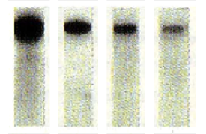

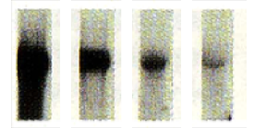

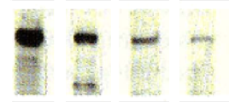

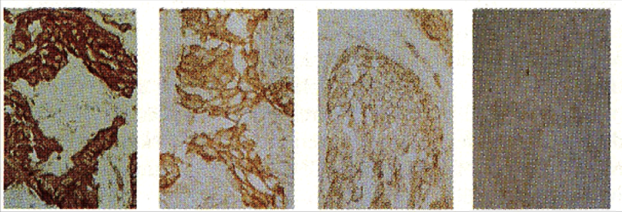
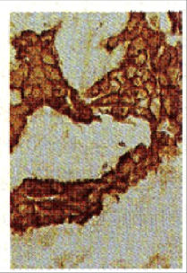
HER2 Biology
Correlation of HER2 Gene Amplification and Overexpression
HER2 amplification: HER2 / MPO ratio > 2.0
5 - 10
Amplification Level :
> 10
2 - 5
1
1
12.5 kb -
Southern
(DNA)
4.4 kb -
Northern
(mRNA)
p185 -
Western
(protein)
Uniform IHC staining throughout each tumor
Frozen
IHC
27%
63%
% Women
10%
Slamon DJ et al. Science. 1989;244(4905):707-12.
Notes:
Many methods used to assess alteration in her2. Discuss difference between solid matrix/grind and bind methods vs histochemistry -> dilution issue provides explanation for sign. Numbers of earlier single copy overexpressors
Use it to link amp and overexpression
follow on to this:
1. Show fish data on 10% that are single copy overexpressors
2. When these cases are processed and embedded in paraffin some of these lose their detectable overexpression - we will come back to this later
3. Solid matrix dilution issue
Keypoints:
HER2 amplification is directly associated with HER2 protein overexpression
HER2 protein overexpression is directly associated with HER2 amplification
Discordant results in clinical material due to assay errors rather than true biologic phenotypes

Slide 6
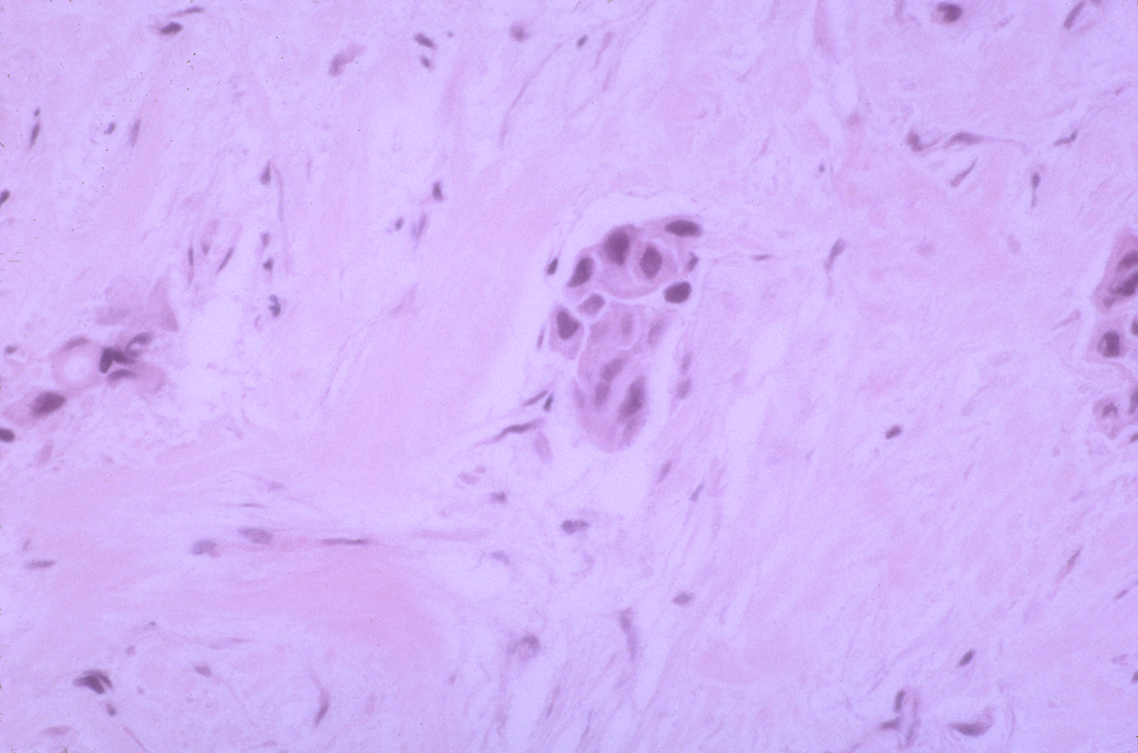
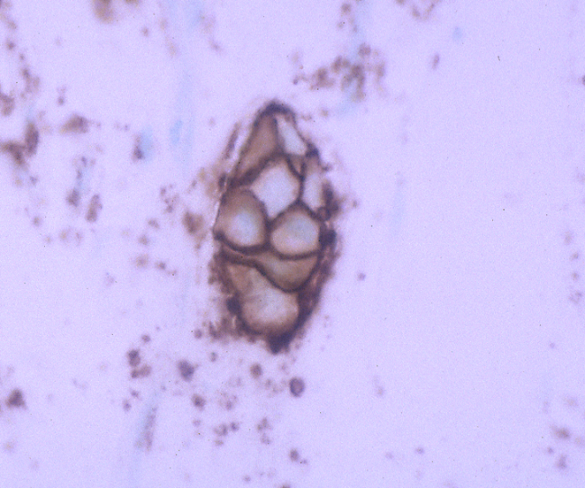

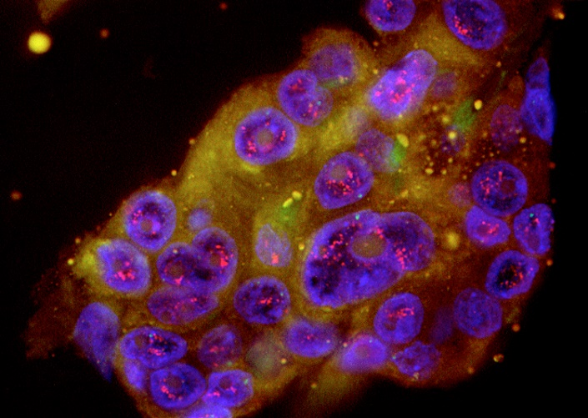
HER2 Biology
Southern Blot “Single Copy or Not-amplified”
Overexpression: Actually HER2-amplified by FISH
IHC
Southern blot
H & E
FISH
Slamon DJ et al. Science. 1989;244(4905):707-12; Pauletti G et al. Oncogene. 1996;13(1):63-72.
Notes:
Show break down of previous slides single copy overexpressors when evaluated by FISH

Slide 7
HER2 Gene Amplification is Responsible for Overexpression
Gene amplification
HER2 genes
HER2 genes
mRNA
mRNA
©Medscape, LLC
©Medscape, LLC
HER2 receptor
Protein
overexpression
Image courtesy Michael Press, MD, PhD in collaboration with Medscape.

Slide 8
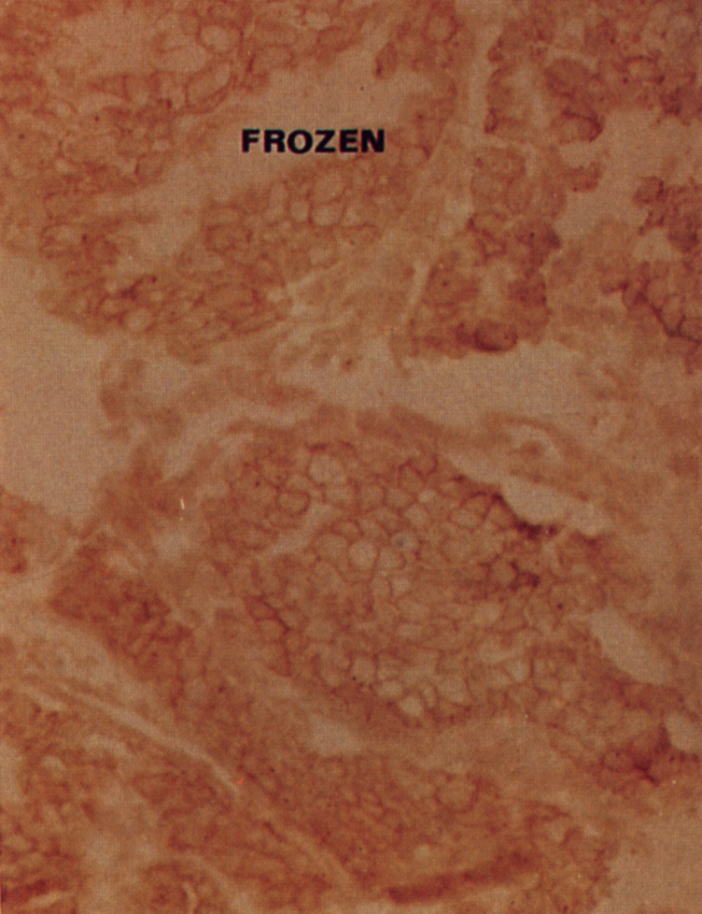

Immunohistochemistry in Formalin-Fixed, Paraffin-Embedded Tissues
Fixation and Paraffin Embedding Result in Decreased Antigenicity (Variable False-Negatives)
2 to 5-fold HER2 Amplified / Frozen IHC
2 to 5-fold HER2 Amplified / FFPE IHC
Slamon DJ et al. Science. 1989;244(4905):707-12.

Slide 9
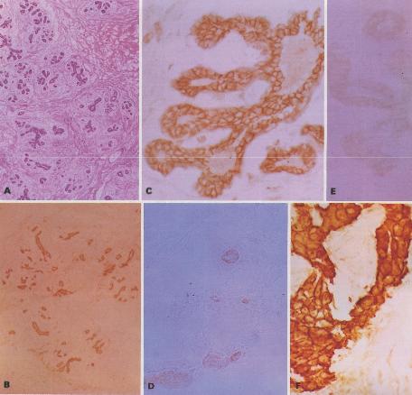
HER2 Protein Expression by IHC in Frozen Normal Breast Tissues
Hematoxylin & Eosin
HER2 IHC: Frozen tissue
HER2 IHC: FFPE
150x.
1450x.
1450x.
HER2 IHC:
Frozen tissue, HER2 Immune serum
HER2 IHC: Pre-immune serum control
HER2 IHC:
Frozen tissue,
HER2 Immune serum,
human breast cancer with HER2 amplification
150x.
1450x.
Press MF, Cordon-Cardo C, Slamon DJ. Oncogene. 1990;5(7):953-62.
Notes:
Figure 1. Normal adult breast. All normal breast specimens had at least weak membrane immunostaining in frozen tissue sections. This illustrative case, obtained at reduction mammoplasty, had the strongest HER-2/neu membrane immunostaining (2+) in our series of 21 normal breast samples. (A.) Hematoxylin-and-eosin stained section showing normal breast lobules and ducts. Magnification, 150x. (B.) Immunohistochemical localization of HER-2/neu demonstrates immunostaining throughout the ductal and lobular epithelial cells in a frozen tissue section. Magnification, 150x. (C.) Immunostaining of epithelial cell membranes in a terminal duct lobular unit. Frozen tissue section. Magnification, 1450 x. (D.) Negative control section in which pre-immune serum was used instead of HER-2/neu-immune serum. Frozen tissue section. Magnification, 1450x. (E.) A portion of the same-specimen, fixed in formalin and processed for paraffin-embedding, was sectioned and processed for HER-2/neu localization as in C. Note the relative lack of immunostaining. Magnification, 1450x. (F.) A breast carcinoma know to have 5 to 20-fold amplification and overexpression of the HER-2/neu gene demonstrates strong (3+) membrane staining for comparison with C and E. Frozen tissue section. Magnification, 1450x.

Slide 10






FISH Assay Method:
Schematic Fluorescence In Situ Hybridization
Key Features:
Probes
  Directly labeled with fluorescence
  HER2 sequence (red)
  Chromosome 17 centromere (green)
Interpretation
  Signal enumeration
  Ratio of HER2: Chr 17 signals
Tissue sample on slide
FISH probe
Magnified view of nucleus
with chromosomes
Fluorescent signal
FISH probe attaching
to section of DNA molecule
Magnified view of portion
of DNA chromosome
©Medscape, LLC
Courtesy: MF Press in collaboration with Medscape.

Slide 11
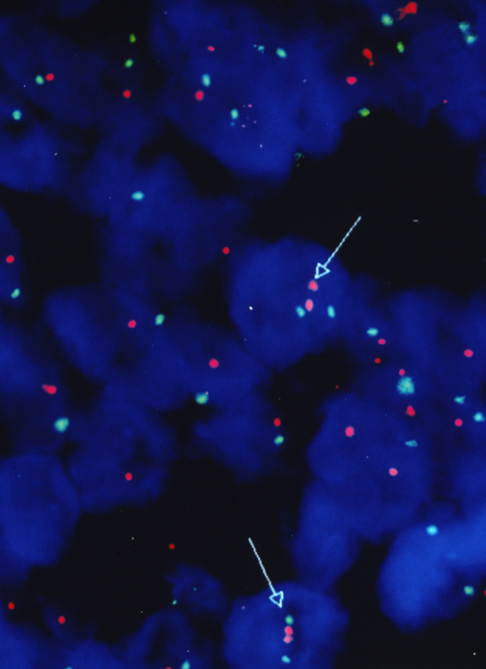
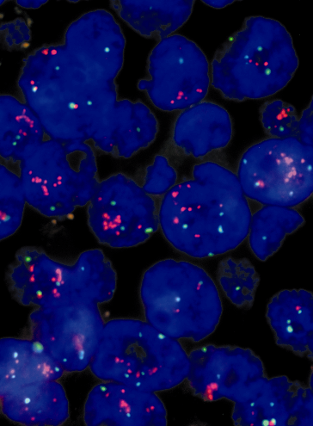
HER2 Gene Assessment by FISH
Key Features:
Probes
  Direct labeled
  HER2 sequence (red)
  Chrom 17 centromere (green)
Interpretation
  Signal enumeration
  Ratio of HER2:Chr 17 signals
Ratio <2.0 Not Amplified
(FISH-)
Ratio >2.0 Amplified
(FISH+)
HER2 “positive”: FISH ratio = HER2 / CEP17 >2.0

Slide 12
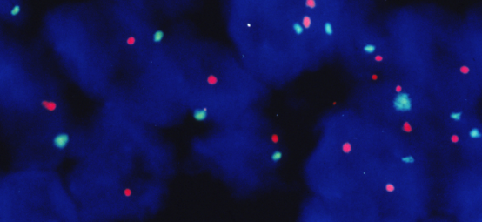
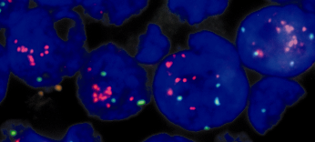
Association with Poor Outcome in
Node-Negative Breast Cancer Patients
HER2 Gene Amplification by FISH
1.00
FISH-
0.75
Probability of survival
FISH+
0.50
0.0
0
24
48
72
96
120
144
Time to Death (months)
HER2 “positive”: FISH ratio = HER2 / CEP17 >2.0,
Average HER2 gene copy number >4.0
Press MF et al. J Clin Oncol. 1997;15(8):2894-2904.
Notes:
Role in normal biological processes
Key POINT:
amplification = overexpression

Slide 13
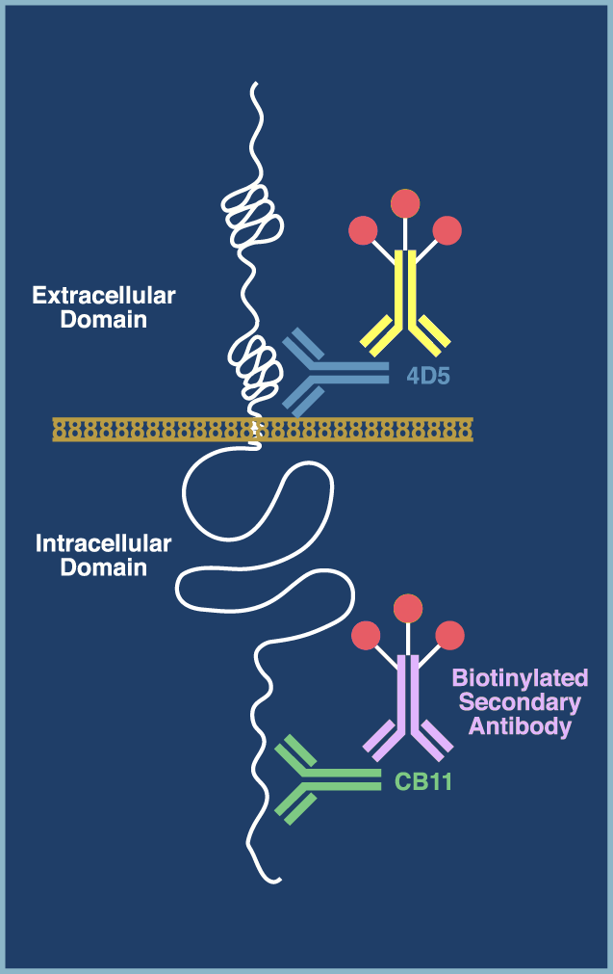
Immunohistochemistry: Clinical Trial Assay
IHC
Key Features:
Primary antibody - two different monoclonals
  4D5 and CB11
Procedure - indirect avidin-biotin for each antibody
Antigen retrieval
  4D5 - protease digestion
  CB11 - microwave
Dybdal N et al. Breast Cancer Res Treat. 2005;93:3-11.
Notes:
Noel needs to discuss cartoon w/Jim Ligos -
delete ‘herceptin’
delete aa sequence for 4D5 epitope
show secondary antibodies as different colors (two different secondaries are used)
show biotin ‘balloons’ all the same color on both secondary antibodies

Slide 14
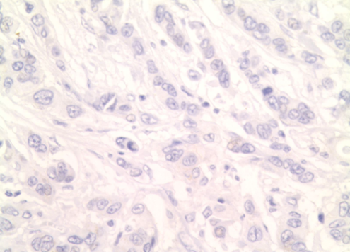
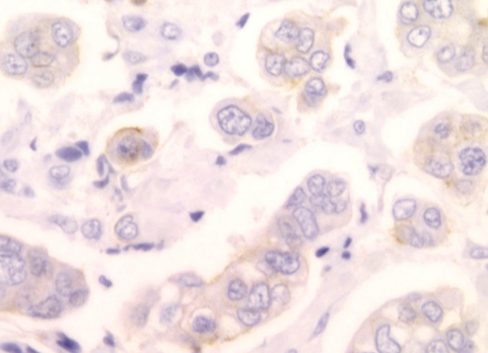
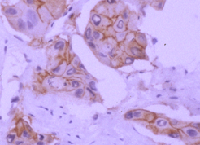
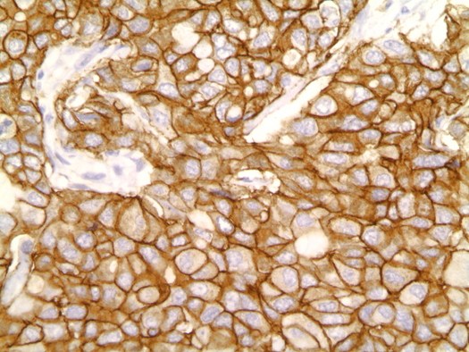
HER2 Immunohistochemistry (IHC)
HER2 Overexpression Detection by IHC
Negative or, 0+
1+
2+
3+
IHC is a standard assay method in most anatomical pathology laboratories which is easily performed and easily interpreted.

Slide 15
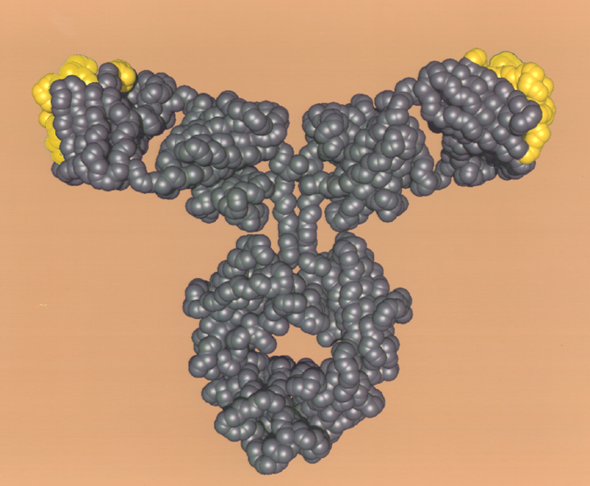
Trastuzumab
HER2 epitopes recognized by hypervariable murine
sequences
Monoclonal anti-HER2 antibody
Humanized to:
  Avoid immunogenicity (95% human, 5% murine)
  Activate tumor-directed immune response
Possible mechanisms of action:
  Inhibition of abnormal signaling
  Interaction (synergy) with chemotherapy
  Enhancement of antibody-dependent cellular cytotoxicity (ADCC)
Human
IgG1
Carter et al. Proc Natl Acad Sci U S A. 1992;89:4285.

Slide 16
Pivotal Trial of Trastuzumab in Metastatic Breast Cancer Demonstrates the Importance of HER2 Amplification for Responsiveness
 | Median Survival (mo) | Odds Ratio | P Value
IHC+(2+/3+)
H + CT | 25.1 | 0.80 | .05
CT | 20.3
1.0
0.8
FISH+
H + CT | 26.2 | 0.71 | .007
CT | 20.0
0.6
Probability of survival
0.4
0.2
0
0
10
20
30
40
50
Months
Mass R, Press MF et al. Clin Breast Cancer. 2005;6:240-246.
IHC 2+/3+ and FISH-Pos
Slamon DJ et al. N Engl J Med. 2001;344:783-92.
IHC 2+/3+ but FISH-Neg
Notes:
Evaluation of median OS according to IHC test results (2+/3+) determined that Herceptin® plus CT improved median OS significantly compared with CT alone (25.1 vs 20.3 months, respectively; P=0.05).¹
Retrospective analyses of the pivotal Herceptin plus CT combination trial indicate that the median OS, estimated by Kaplan-Meier analysis, was significantly improved in both FISH-positive and IHC-positive (2+/3+) patients who received Herceptin plus CT, compared with patients who received CT only.²
Median survival was 26.2 months (H + CT) vs 20.0 months for CT alone in FISH-positive patients (P=0.007).
The risk of mortality for FISH-positive patients receiving Herceptin plus CT was decreased by 29% compared with FISH-positive patients receiving CT alone; for IHC-positive patients, the decrease was 20%.
The majority of patients benefiting from Herceptin treatment were FISH-positive or
IHC 3+.¹⁻³
1. Herceptin® (Trastuzumab) PI, February 2005.
2. Mass et al. Proc Am Soc Clin Oncol. 2001;20:22a. Abstract 85.
3. Slamon et al. N Engl J Med. 2001;344:783.

Slide 17
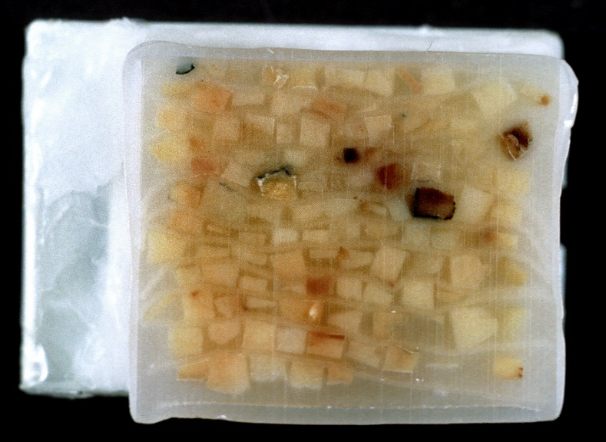
Correlation of HER2/neu Gene Amplification with Overexpression in Frozen and FFPE tissues
Evaluation of HER2 testing in paraffin-embedded tissues
5 - 10
Amplification Level :
> 10
2 - 5
1
12.5 kb -
Southern
(DNA)
4.4 kb -
Northern
(mRNA)
p185 -
Western
(protein)
Multi-Tumor
Paraffin-Embedded
Tissue Block
Frozen
IHC
Paraffin-Embedded
Tissue
(protein)
% Women
27%
63%
Frozen Tissue
Press MF et al. Cancer Res. 1993;53:4960-4970.
Press MF et al. Cancer Res. 1994;54:2771-2777.
Press MF et al. J Clin Oncol. 2002;20:3095-3105.
Slamon DJ et al. Science. 1989;244(4905):707-12.
Notes:
Many methods used to assess alteration in her2. Discuss difference between solid matrix/grind and bind methods vs histochemistry -> dilution issue provides explanation for sign. Numbers of earlier single copy overexpressors
Use it to link amp and overexpression
follow on to this:
1. Show fish data on 10% that are single copy overexpressors
2. When these cases are processed and embedded in paraffin some of these lose their detectable overexpression - we will come back to this later
3. Solid matrix dilution issue
Keypoints:
HER2 amplification is directly associated with HER2 protein overexpression
HER2 protein overexpression is directly associated with HER2 amplification
Discordant results in clinical material due to assay errors rather than true biologic phenotypes
Press MF, Pike MC, Chazin VR, Hung G, Udove JA, Markowicz M, Danyluk J, Godolphin W, Sliwkowski M, Akita R, Brandeis J, Paterson MC, Slamon DJ. HER-2/neu expression in node-negative breast cancers: Direct tissue quantitation by computerized image analysis and association of overexpression with increased risk of recurrent disease. Cancer Research 53: 4960-4970, 1993.
Press MF, Hung G, Godolphin W, Slamon DJ. Sensitivity of HER-2/neu antibodies in archival tissue samples: Potential source of error in immunohistochemical studies of expression. Cancer Research 54: 2771-2777, 1994.
Press MF, Slamon DJ, Flom KJ, Park J, Zhou J-Y, Bernstein L. Evaluation of HER-2/neu Gene Amplification and Overexpression: Comparison of Frequently Used Assay Methods in a Molecularly Characterized Cohort of Breast Cancer Specimens. Journal of Clinical Oncology 20: 3095-3105, 2002

Slide 18
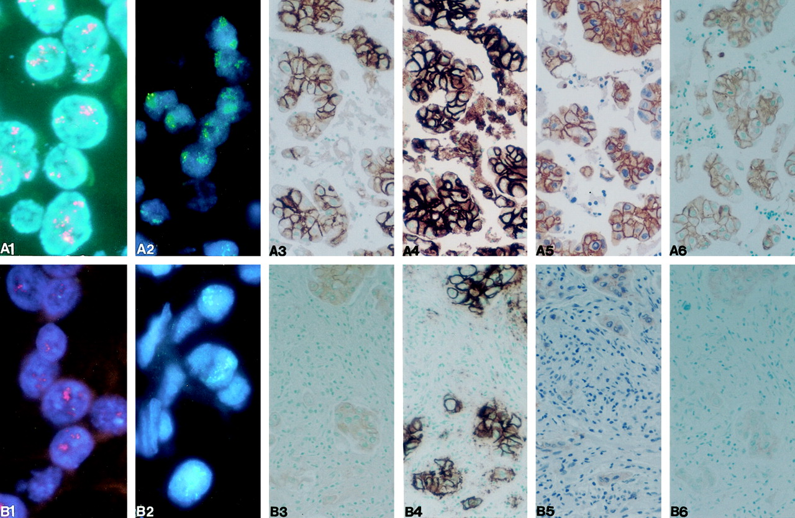
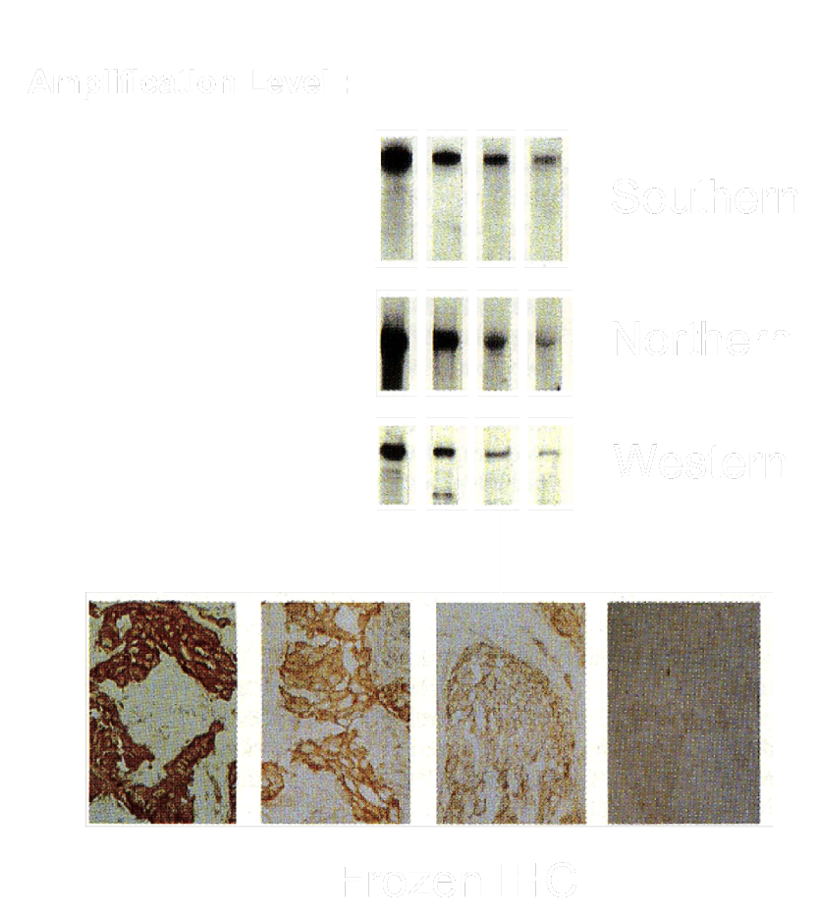
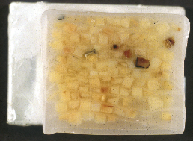
Comparison of Six Different HER-2 Assays in HER2 Molecularly Characterized Breast Cancers
Concordance with Known Molecular HER2 Status
Molecular Status as Determined by Southern, Northern, Western blots and Frozen IHC
97.4%
95.7%
89.7%
88.9%
R60
10H8
R60
10H8
HER2 amplification: HER2 / MPO ratio > 2.0
FDA-Approved FISH Assays
Lab-Dev IHC Assays
FDA-Approved IHC Assays
HER2 “positive”: FISH ratio >2.0 (FDA-approved criteria).
Press MF et al. J Clin Oncol. 2002;20:3095-3105.

Slide 19
Prevalence of HER2 Gene Amplification (%) in Each IHC Immunostaining Category (0, 1+, 2+ and 3+) by Study* (2000 – 2007)
HER2 Gene Amplification Rate (%) according to IHC Score
0 | 1+ | 2+ | 3+ | Number | IHC Method | Reference
0% | 0% | 17% | 89% | 100 | DAKO HercepTest | Hoang et al, Am J Clin Pathol, 2000
1.8% |  | 35.9% | 100% | 750 | DAKO Ab, Unspecified | Ridolfi et al, Mod Pathol, 2000
3.5% | 66.2% | 97.1% | 99% | 2857 | DAKO HercepTest | Simon et al, JNCI, 2001
0% | 2.2% | 38.2% | 91.4% | 189 | DAKO A0485 Ab | Wang et al, Am J Clin Pathol, 2001
0% | 5.7% | 18.2% | 100% | 170 | Homebrew Ab | Kobayashi et al, Hum Pathol, 2002
3.8% | 8.5% | 42.2% | 100% | 198 | DAKO HercepTest | McCormick et al, Am J Clin Pathol, 2002
0% | 0% | 0% | 89.8% | 119 | DAKO HercepTest | Roche et al, JNCI, 2002
0.7% |  | 48.1% | 94.1% | 426 | DAKO HercepTest | Dowsett et al, J Pathol, 2003
4.2% |  | 6.1% | 49% | 102 | DAKO HercepTest | Hammock et al, Hum Pathol, 2003
1.1% | 3.1% | 26.5% | 89.7% | 2279 | DAKO HercepTest | Lal et al, Am J Clin Pathol, 2004
0% |  | 20% | 90% | 360 | DAKO HercepTest | Mrozkowiak et al, Pol J Pathol, 2004
0% |  | 15% | 79% | 600 | DAKO HercepTest | Varshney et al, Am J Clin Pathol, 2004
2.8% |  | 17% | 91.6% | 2913 | DAKO A0485 Ab | Yaziji et al, JAMA, 2004
3% | 7% | 24% | 89% | 529 | Clinical Trials Assay | Dybdal et al, Br Ca Res Treatment, 2005
6.9% |  | 31.8% | 90% | 114 | DAKO HercepTest | Ellis et al, J Clin Pathol, 2005
2.4% |  | 72% | 100% | 215 | DAKO HercepTest | Lottner et al, J Pathol, 2005
3.6% | 6.1% | 16.7% | 78.1% | 2249 | DAKO HercepTest | Press et al, Clin Cancer Res, 2005
12.5% | 6.7% | 7% | 52.4% | 108 | DAKO HercepTest | Ciampa et al, Appl Im Mol Morphol, 2006
0% | 0% | 12.2% | 91.6% | 289 | DAKO HercepTest | Hofmann et al, J Clin Pathol, 2007
2.2% | 9.6% | 28.6% | 87.5% |  | Average Percentages
*IHC and FISH in at least 100 cases (2000-2007).
Less than 95% Agreement of IHC with FISH assay results.

Slide 20
ASCO-CAP Guidelines: 2007
Wolff A et al. Arch of Pathol Lab Invest. 2007;131:18-43.
Wolff A et al. J Clin Oncol. 2007;25.

Slide 21
Concordance between IHC and FISH:
Prevalence of HER2 Gene Amplification in each IHC Category, 2008 - 2014
HER2 Gene Amplification Rate (%) in Each IHC Staining Category by Study
IHC 0 (%) | IHC 1+ (%) | IHC 2+ (%) | IHC 3+ (%) | Number | IHC Method | Reference
0% | 8.3% | 22.9% | 56.3% | 661 | Dako HercepTest (FDA) | Rasmussen BB et al Acta Oncol., 2008
1.6% |  | 29.1% | 86.4% | 697 | A0485 (Dako) | Grimm et al, AJCP, 2010
12.2% |  | 66.6% | 93.9% | 175 | 3B5 antibody (LDT) | Panjwani et al, Indian J Med Res., 2010
3.3% |  | 57.9% | 95.2% | 100 | Dako HercepTest (FDA) | Tsuda et al, BMC Cancer, 2010*
0% | 3.3% | 15.2% | 84.1% | 200 | 4B5 antibody, LDT | Lambein et al, J Clin Pathol., 2011
0% | 3.2% | 21.5% | 91% | 681 | Dako HercepTest (FDA) | Jorgenson JT, AJCP, 2011
12.8% |  | 43.8% | 97.8% | 291 | A0485 (Dako), LDT | Bernasconi B et al, Br Ca Res Treat., 2012
0% | 23% | 38.8% | 100% | 216 | CB11 antibody | Martin V et al, Patholog Res Int., 2012
3.3% | 7.1% | 49.2% | 88.4% | 543 | CB11 antibody | Lee et al, Arch Med Res., 2012
0% | 12.5% | 76.5% | 97.3% | 125 | Dako HercepTest (FDA) | Kiyose et al, Pathol Int., 2012
2.4% |  | 39.9% | 98.1% | 1437 | Dako HercepTest (FDA) | Vergara-Lluri ME et al, Mod Pathol, 2012*
9.6% |  | 38.9% | 87.2% | 396 | CB11 (Biogenix) | Kokate P et al, Genetic Test Mol Biomark, 2012
2.6% | 4.8% | 28.1% | 93.8% | 950 | A0485 (Dako), LDT | Park S et al, Cancer, 2012
0% | 1% | 19% | 92% | 154 | Dako HercepTest (FDA) | Minot DM et al, AJCP, 2012
10% | 5% | 13% | 69% | 2546 | CB11 (Ventana) | Varga Z et al, BMC Cancer, 2013
0% | 2.6% | 29.4% | 100% | 150 | 4B5 (Ventana) (FDA) | Lambein K et al., AJCP, 2013
9.4% | 6.4% | 13.5% | 55.1% | 628 | A0485 (Dako), LDT | Fasching P et al., BCRT, 2014
1.7% | 3.3% | 12.4% | 81.1% | 2590 | Dako HercepTest (FDA) | Schalper KA et al, Arch Pathol Lab Med, 2014
Less than 95% Concordance of IHC with FISH assay results.

Slide 22
Concordance between IHC and FISH:
Prevalence of HER2 Gene Amplification in each IHC Category, 2014 - 2019
HER2 Gene Amplification Rate (%) in Each IHC Staining Category by Study
IHC 0 (%) | IHC 1+ (%) | IHC 2+ (%) | IHC 3+ (%) | Number | IHC Method | Reference
0.8% | 0.7% | 5.8% | 84.3% | 1528 | Dako HercepTest (FDA) | Varga Z et al, PLoS One, 2015
1.5% |  | 16.4% | 98.9% | 811 | 4B5 (Ventana) | Green IF et al, Hum Pathol, 2015*
31.3% |  | 50.5% | 95.2% | 174 | A0485 (Dako) (LDT) | Pu X et al, Pathol Res Pract, 2015
1% | 0.6% | 16.8% | 49.1% | 3605 | Dako HercepTest (FDA) | Morey AL, Pathology, 2016
5.6% |  | 40.3% | 100% | 314 | 4B5 rabbit, Ventana (FDA) | Overcast WB et al, Virchows Arch, 2016⁸²
5.8% | 6.2% | 36.0% | 96.4% | 368 | 4B5 rabbit, Ventana (FDA) | Solomon JP et al, Am J Clin Pathol, 2017
0% | 3.3% | 23.5% | 100% | 129 | 4B5 rabbit, Ventana (FDA) | Qi L, Biochem Biophys Res Commun, 2017*
4.2% |  | 31.1% | 93% | 432 | Dako HercepTest (FDA) | Eswarachary V et al, J Clin Diagn Res, 2017
3.2% |  | 37.0% | 97.8% | 498 | Dako HercepTest (FDA) | Furrer D et al, Anticancer Res, 2017*
0% | 0% | 12.% | 95.7% | 153 | 4B5 rabbit, Ventana (FDA) | Zoppoli G et al., J Transl Med, 2017
25% |  | 48% | 87.2% | 149 | Dako HercepTest (FDA) | Harit AP et al. TJPM, 2019
2.5% | 7.1% | 31.3% | 85.8% |  | Averages by Studies with 4 IHC categories
5.1% |  | 36.5% | 91.2% |  | Averages by Studies with 3 IHC categories
Less than 95% Concordance of IHC with FISH assay results.

Slide 23
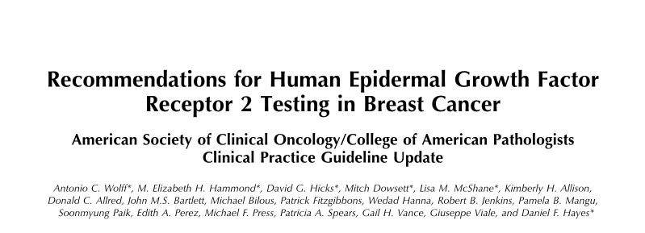
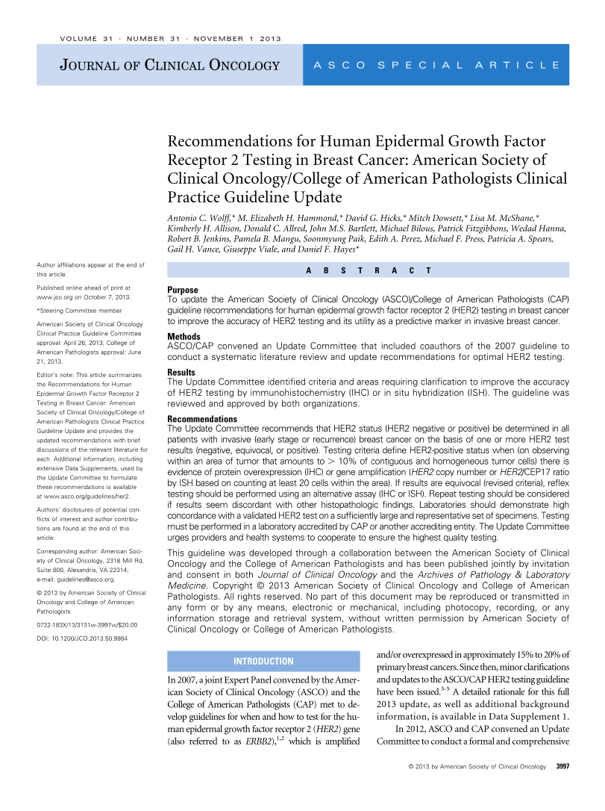
ASCO-CAP Guidelines: 2013 / 2014
Wolff A et al. Arch of Pathol Lab Invest. 2014;138:241–256.
Wolff A et al. J Clin Oncol. 2013;31:3997-4013.

Slide 24
ASCO-CAP Guidelines: 2018
Archives of Pathology and Laboratory Medicine 2018;142(11):1364-1382.
Journal of Clinical Oncology 2018;36(20):2105-2122.

Slide 25
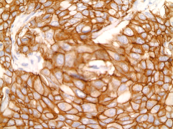
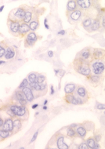
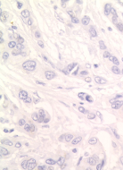
Algorithm for HER2 Testing by IHC in 2018:
Unchanged from 2013 / 2014
2007, 2013/2014 and 2018 Guidelines largely ignore both the IHC 0/1+ false-negative and the IHC3+ false-positives
Wolff AC et al. J Clin Oncol. 2018;36(20):2105-2122.

Slide 26
ASCO-CAP Algorithm for HER2 Testing by FISH: 2018
Wolff A et al. JCO, 2018.
“problematic issues” with chromosome 17
“alternative control probes” (e.g. TP53, D17S122, SMS, RARA, TOP2A) for ISH

Slide 27
Assessment of HER2 by FISH According to 2014 ASCO-CAP Guidelines by Group
Consultation Study
BCIRG Trials Study
Group | Description of FISH category | No. of Cases | Overall % | No. of Cases | Overall %
1 | Ratio >2.0, HER2 average >4.0 | 1328 | 17.7% | 4269 | 40.8%
2 | Ratio >2.0, HER2 average <4.0 | 31 | 0.4% | 71 | 0.7%
3 | Ratio <2.0, HER2 average >6.0 | 48 | 0.6% | 55 | 0.5%
4 | Ratio <2.0, HER2 average >4.0, <6.0 | 345 | 4.6% | 432 | 4.1%
5 | Ratio <2.0, HER2 average <4.0 | 5774 | 76.7% | 5641 | 53.9%
Totals |  | 7526* | 100% | 10468 | 100%
*86 cases (1.1%) with HER2 Genomic Heterogeneity were excluded.
Press MF et al. J Clin Oncol. 2016;34(29):3518-3528.

Slide 28
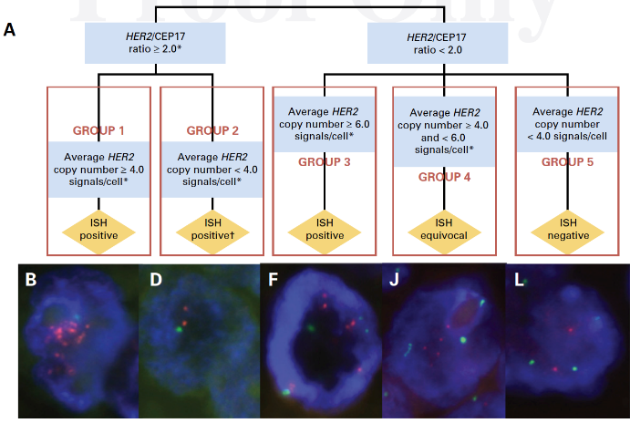
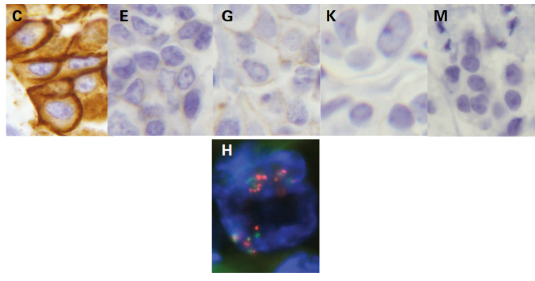

ASCO-CAP FISH Groups: Comparison of HER2 Gene / CEP17 Status (FISH) with HER2 Protein Expression (IHC)
*
Press MF et al. J Clin Oncol. 2016;34(29):3518-3528.

Slide 29
HER2-Low Breast Cancer
Tarantino P et al. J Clin Oncol. 2020;38(17):1951-62.

Slide 30
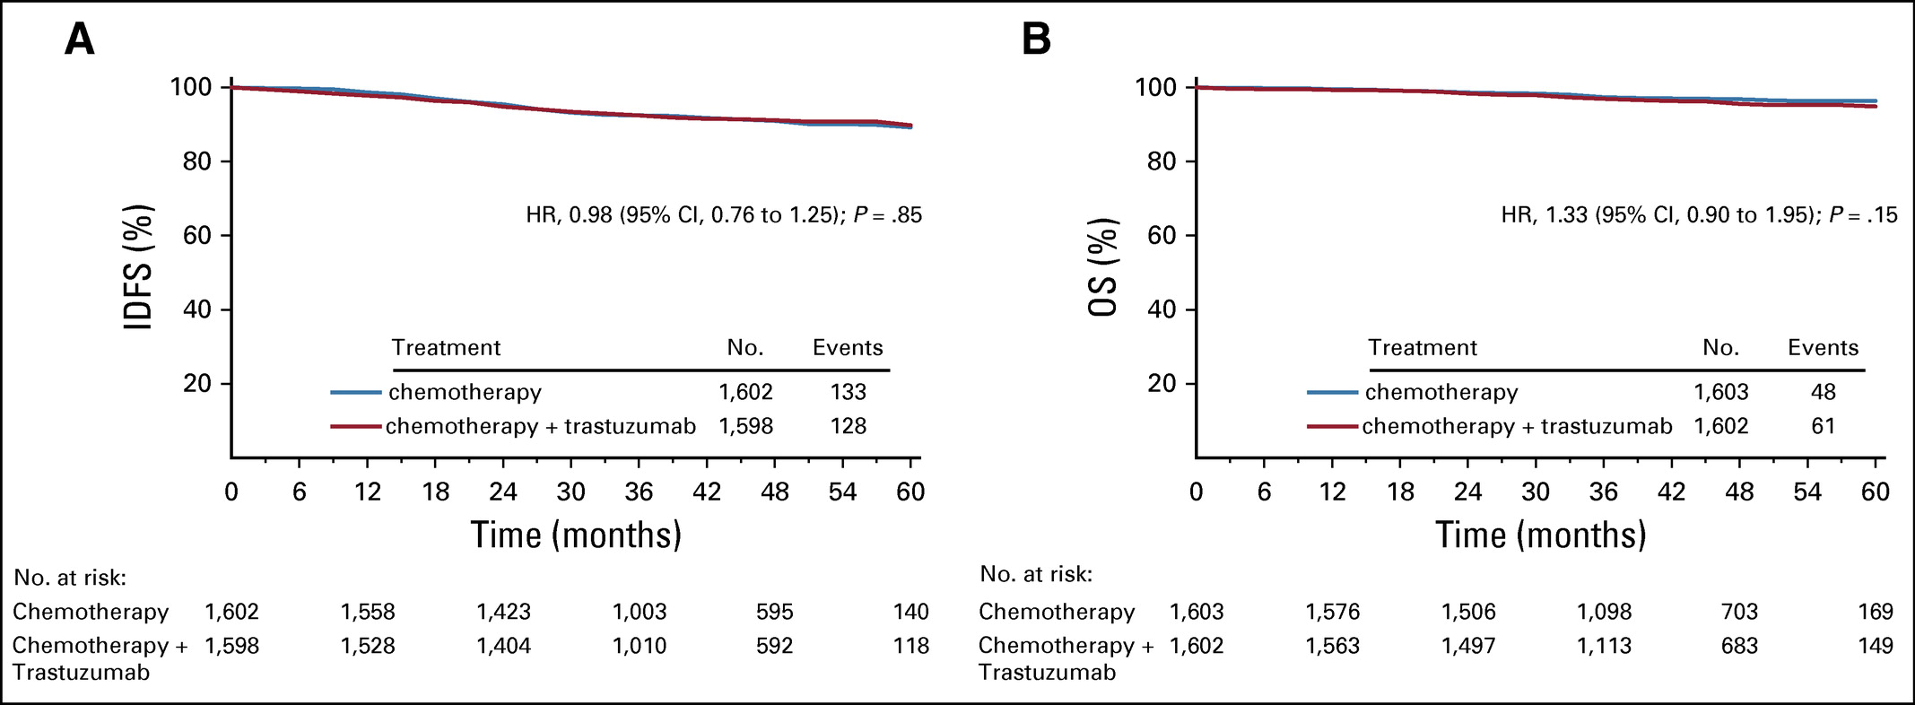
NSABP B-47: Randomized Trial Comparing Adjuvant Chemotherapy with or without Trastuzumab in “HER2-Low” Breast Cancer Patients
Results of Kaplan-Meier analyses for (A) invasive disease–free survival (IDFS) and (B) overall survival (OS) in the NSABP B-47 trial. HR, hazard ratio.
Fehrenbacher L et al. J Clin Oncol. 2020;38(5):444-53.

Slide 31
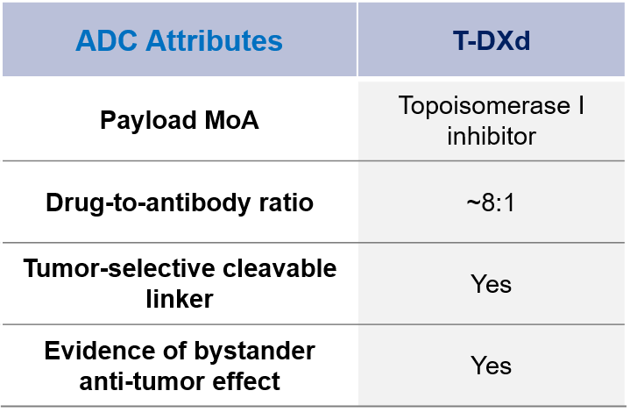
Trastuzumab Deruxtecan (T-DXd)
Trastuzumab deruxtecan
(T-DXd)
T-DXd has membrane-permeable payload which can attack neighboring cancer cells (bystander effect)
Nakada T, Chem Pharm Bull 2019; Ogitani Y, Clin Cancer Res 2016; Trail PA, Pharmacol Ther 2018; Ogitani Y, Cancer Sci 2016.
Slide courtesy of Reva Basho, MD

Slide 32
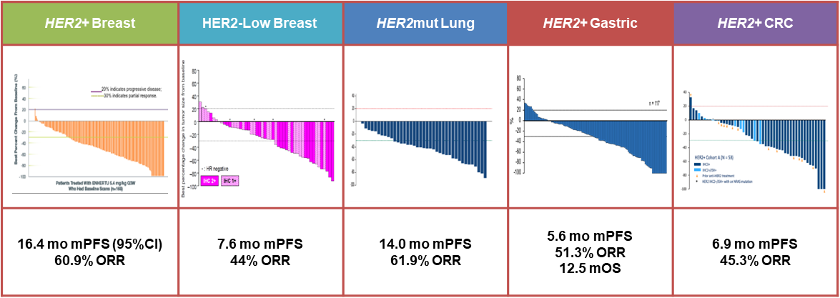
HER2 ADC: T-DXd Has Shown
Transformative Clinical Activity¹⁻⁵
1. Krop IE et al. SABCS 2019. Abstract GS1-03. 2. Tamura K et al. Lancet Oncol. 2019;20:816-826. 3. Smit EF et al. ASCO 2020. Abstract 9504. 4. Shitara K et al. ASCO 2020. Abstract 4513. 5. Siena S et al. ASCO 2020. Abstract 4000.

Slide 33
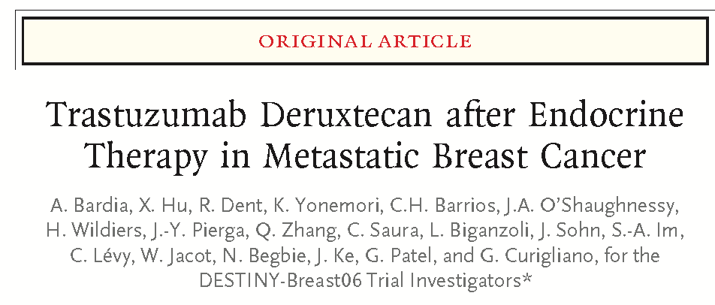
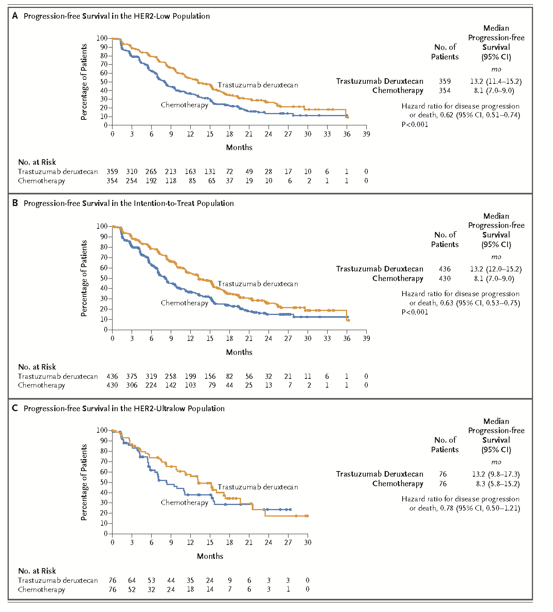
Entire Study Population
HER2-Low (IHC 1+ or 2+ / -ISH
New England Journal of Medicine 391:2110-22, 2024
HER2-Ultra-Low (IHC 0+)

Slide 34
J Clin Oncol. 2023;41:3867-3872.

Slide 35
HER2 by Immunohistochemistry (IHC) Status
IHC (Score 0)#
No membrane staining detected (0/absent membrane staining)
Membrane staining that is incomplete and is faint/barely perceptible and in ≤10% of tumor cells (0+/with membrane staining).
# Comment(s) on HER2 IHC Results#
#Breast cancers with HER2 IHC scores of 0+, 1+, or 2+ (ISH negative) may be eligible for treatment targeting non-amplified levels of HER2 expression in the metastatic setting. Currently, patients with no membrane staining by IHC (0) are ineligible/excluded. Consider using the optional standardized HER2 IHC report comment to explain the clinical relevance of lower levels of HER2 IHC staining in the metastatic setting and definitions of "ultralow and low" HER2 used in clinical trials.
______In the DESTINY-Breast04 and 06 trials, "HER2 low" was considered IHC Score 1+ or 2+/ISH negative, and "HER2 ultralow" was HER2 IHC Score of 0 (pattern 0+) with membrane staining that is incomplete and faint/barely perceptible in less than or equal to 10% of tumor cells. Breast cancers with these staining patterns may be eligible for treatment with trastuzumab-deruxtecan in the metastatic setting (but those with no staining, IHC 0, are currently excluded)

Slide 36
Conclusions
Development of biomarkers for patient management decision-making is a complex process.
In spite of more than three decades of research, biomarker testing for selection of patients to HER2 targeted therapies is in a continuous state of modification.
  Implementation of 2018 / 2023 ASCO-CAP guidelines for HER2 FISH testing result in no changes for approximately 90%-95% of cases.
  Changes in ASCO-CAP guidelines for “groups 2-4” result in potential disagreements for approximately 5% of cases.
  Variable HER2 immunohistochemical staining related to fixation processing artifacts is common
  Assessment of “HER2-Low” breast cancer is a work in progress.

Slide 37
Acknowledgements
USC (Press Laboratory)
  Yanling Ma, MD
  Simon Davenport
  Roberta Guzman
  Olivia Franco
  Ivonne Villalobos
  Bin Xie, MD, PhD
  Angela Santiago*
  Armen Gasparyan*
  Armen Gasparyan*
  Caihong Xia, PhD*
  Michael Gordon, PhD*
  Brandon Li, MD*
  Mariana Keshmeshian, PhD*
  Jinha Park, MD, PhD*
  Melinda Epstein, PhD*
  Anamaria Ioan, MD, PhD *
  Jian-Yuan Zhou, MD*
Stanford U
  Christina Curtis, PhD
  Jose Seoane, PhD
Memorial Sloan Kettering
  Malcolm Pike, PhD
M. D. Anderson Cancer Center
  Adel El-Naggar, MD
  Lovell Jones, PhD
City of Hope National Medical Center
  Leslie Bernstein, PhD
UCLA
  Dennis Slamon, MD, PhD
  Richard Finn, MD
  Gottfried Konecny, MD
  Zev Wainberg, MD
  Sara Hurvitz, MD
University of Hamburg
  Guido Sauter, MD
  Martina Mirlacher
  Tobias Grob, MD
Cancer International Research Group / TRIO
  Valerie Bee
  Henry Taupin
  Karen Afenjar
Erlangen University (Bavarian Breast Cancer Research Group)
  Peter Fasching, MD
Ventana Medical Systems, Inc.
  Michael Barnes, MD
  Leigh Ann Henricksen, PhD
  Larry Morrison, PhD
Abbott-Vysis, Inc.
  Kerry Flom, PhD
  Steven Seelig, MD, PhD
Genentech, Inc.
  Robert Mass, MD
  Pam Klein, MD
GlaxoSmithKline
  Cathy Ellis, PhD
  Maria Koehler, MD, PhD
  Anne Marie Martin, PhD
Caris Life Sciences, Inc.
  Wenhsiang Wen, MD, PhD*
  Wangjuh (Sting) Chen, PhD
Cepheid, Inc.
  Michael Bates, MD
  Natalie C. Wu, PhD
  Wendy Wong
  Kenneth E. Ho
  Victor C. Chu, PhD
  Analiza Rizo
  Jodi M. Weidler, PhD
Grant Support:
  National Cancer Institute
  California Breast Cancer Research Program
  DOD Breast Cancer Research Program
  Breast Cancer Research Foundation
  Tower Cancer Research Foundation
  Adelson Medical Research Foundation
The Women who participated in the Clinical Trials

Slide 38
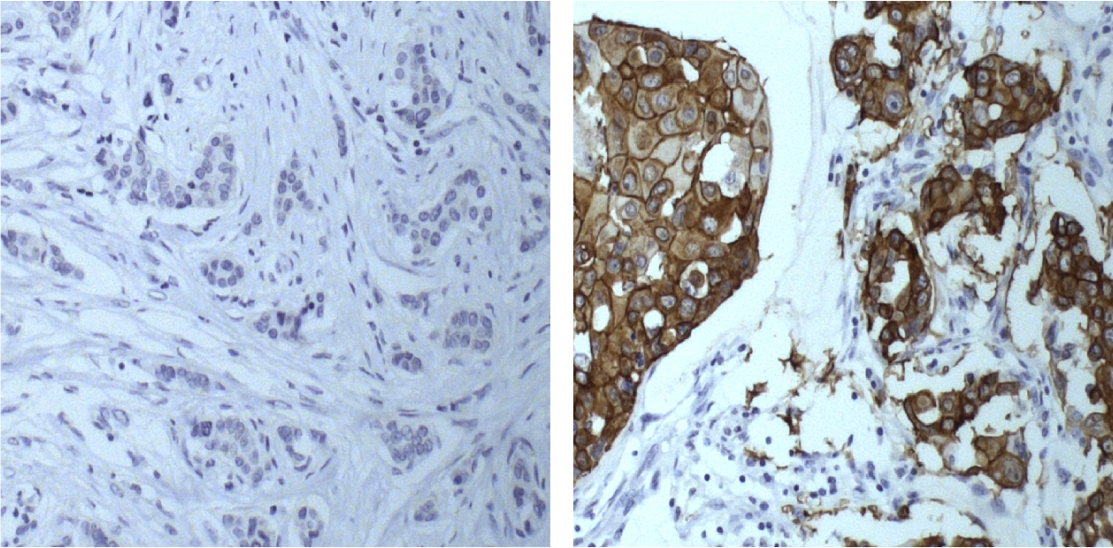
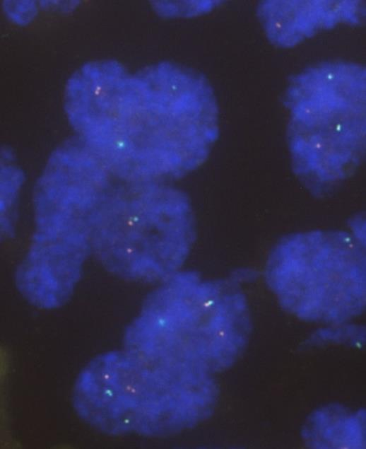
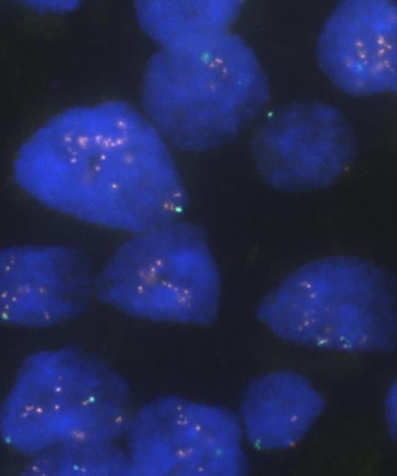
Does Heterogeneity of HER2 Status Exist?
IHC 0
IHC 3+
FISH: Not Amplified
FISH: Amplified
Heterogeneity = carcinoma cells with HER2 amplification and carcinoma cells lacking HER2 amplification in the same cancer
Low prevalence in these trials: 3 / 714 (0.4%)
Press MF et al. Clin Cancer Res. 2008;14:7861-7870.
Notes:
The photomicrographs (IHC and FISH) are in preparation and are not yet available.
Case No. FISH Ratios ICH Scores GSK Trial No.
GSK 584 9.90 1. 3+ 0 100151
GSK 774 1.07 9.06 0 3+ 100151
GSK 373 1.29 3.93 0 2+ 30001

Slide 39
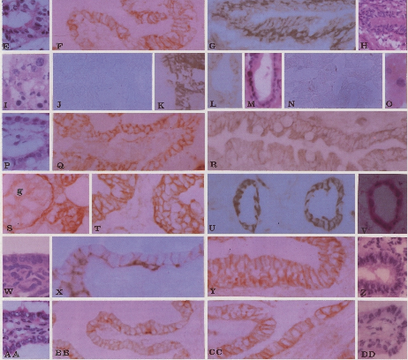
HER2 Expression in Normal Adult and Fetal Epithelium: Basal and Lateral, not Lumenal Immunostaining
Fetal
Adult
Bronchus
Bronchus
Liver
Bile Duct
Small Intestine
Small Intestine
Kidney
Kidney Tubules
Endometrium
Endometrium
Fallopian Tube
Press MF, Cordon-Cardo C, Slamon DJ. Expression of the HER-2/neu Proto-oncogene in Normal Adult and Fetal Tissues. Oncogene 5: 953-962, 1990

Slide 40
Doximity: sponsored by Daiichi Sankyo / AstraZeneca

