Slide 1










BREAST CANCER
Thursday, March 30, 2023

Slide 2
Welcome
Noelle Stango
Manager, Strategic Alliance Partnerships
MJH Life Sciences™

Slide 3




Thank You to Our Supporters:

Slide 4


Slide 5
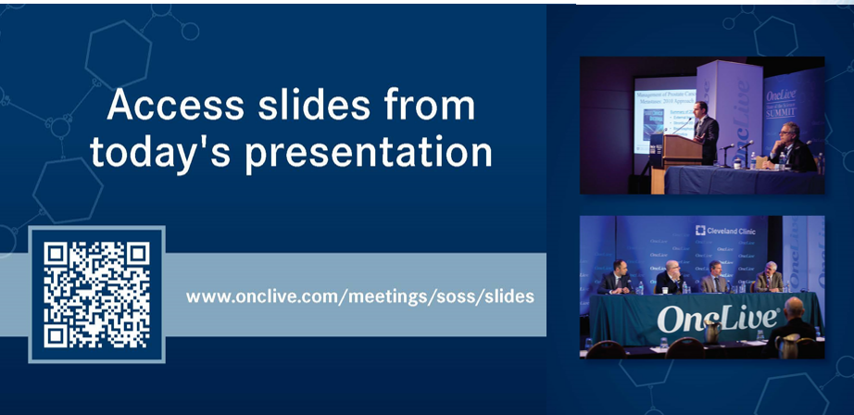

Slide 6
OncLive® is launching
a new app called
Meet MY MSL!
Visit https://cloud.email.onclive.com/referrals to be one of the first health care professionals to gain access to Meet My MSL
Meet My MSL has been created to provide oncologists the opportunity to initiate direct contact with the Medical Science Liaison (MSL) in their area of expertise. It has never been easier to meet, locate, and contact the MSL you need.
Find any MSL from any company for any tumor

Slide 7


Slide 8


Slide 9
Program Chairs
Cynthia X. Ma, MD, PhD
Professor of Medicine
Washington University School of Medicine
St. Louis, MO

Slide 10
Program Chairs
Foluso Bisi Ademuyiwa, MD, MPH, MSCI
Professor of Medicine
Washington University School of Medicine
St. Louis, MO

Slide 11

SABCS 2022 Updates in the Management of
HER2 positive Breast Cancer
Nusayba A. Bagegni, M.D.
Assistant Professor of Medicine
Washington University in St. Louis School of Medicine
St. Louis, MO

Slide 12
Financial Disclosures
Institutional research funding:
Sermonix Pharmaceuticals, Inc
Xcovery Holding Company, LLC
Seattle Genetics, Inc
Ambrx, Inc
Novartis Pharmaceuticals Incorporation
Atossa Therapeutics, Inc
Daiichi Sankyo
AstraZeneca Pharmaceuticals LP
Pfizer Inc
Sarah Cannon Development Innovations, LLC

Slide 13
Objectives
Review updates for key early-stage breast cancer trials:
APT – Final 10-year analysis (PD18-01)
ATEMPT – 5-year update (PD18-02)
TRAIN-3 (PD18-06)
To review updates for key metastatic breast cancer trials:
DESTINY-Breast02 (GS-2)
DESTINY-Breast03 (GS-2)
DESTINY-Breast07 (PD18-11)
ACE-Breast 03 (PD18-09)
Real-world analysis of tucatinib use (P4-03-30)
B-PRECISE-01 (PD18-05)
DETECT V trial (PD18-07)

Slide 14
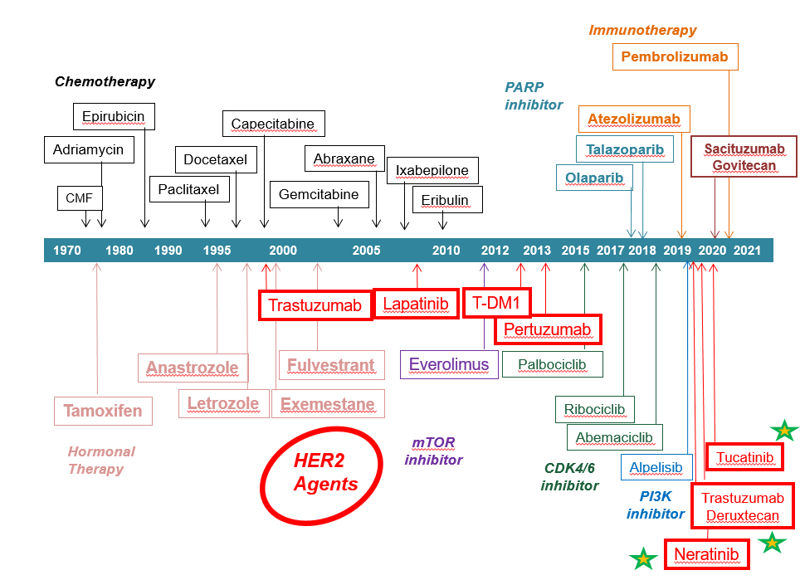
Dramatic improvement in outcomes over time with advancements
in HER-2 directed therapies
FDA Drug Approvals for Breast Cancer Over Time

Slide 15
The Current State of HER2+ Early Breast Cancer
Patients are doing better - Therapeutic advancements have improved outcomes
  Emphasizes need to balance risk of overtreatment and toxicity
  Determine how to best select those who will do well and those who need more aggressive strategies
Not all HER2+ BCs are alike – Significant biologic heterogeneity exists within HER2+ clinical phenotype
  Differential responses exist within this group
    HR status: HR+ versus HR- with dual mAbs in neoadjuvant setting
    Presence HER2 intratumoral heterogeneity (association with lack of pCR)
    Intrinsic molecular subtype

Slide 16
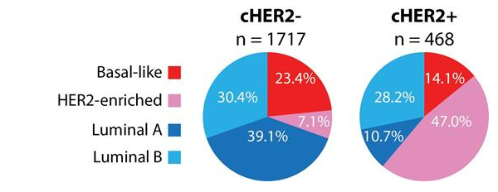
Molecular Heterogeneity of Intrinsic Subtypes within HER2+ BC
Molecular Heterogeneity of Intrinsic Subtypes within HER2+ BC
Molecular Heterogeneity of Intrinsic Subtypes within HER2+ BC
Figure. Distribution of intrinsic molecular subtypes of breast cancer in clinical HER2 negative (cHER2-) and positive (cHER2+) disease in combined cancer genome atlas and METABRIC datasets
HER2+ BC comprises all the four PAM50 molecular subtypes
HER2-Enriched (HER2-E) subtype is associated with highest pCR rates post anti-HER2-based regimens, and may serve as biomarker for therapy selection.
Prat, et al. JNCI 2014
Schettini et al. Cancer Treat Rev. 2020.

Slide 17
The Current State of HER2+ Early Breast Cancer
So…not a ‘one-size-fits-all’ approach
Who would be best served with de-escalating therapy strategies?
  Preserve QoL, spare risk of long term toxicity and reduce financial burden while maintaining excellent long term outcomes
  Could we use chemotherapy-free, HER2 based regimens in tumors identified to be highly sensitive to anti-HER2 agents?
Who needs therapy escalation?
  New insight from the KATHERINE trial
  Need for more biomarker-driven and response-adapted strategies
Remaining challenge: CNS relapse!

Slide 18
SABCS 2022 Abstract Updates:
Early-Stage HER2+ Breast Cancer

Slide 19
What is the best approach for small HER2+ tumors?

Slide 20
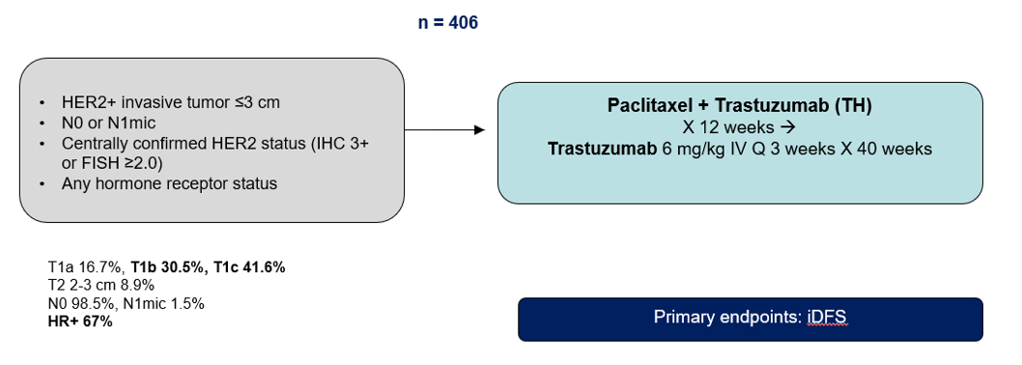
APT: Phase II Trial of Adjuvant TH for HER2+ Early Breast Cancer
Oct 2007 – Sep 2010
Tolaney et al. NEJM 2015
Tolaney et al. JCO 2019

Slide 21
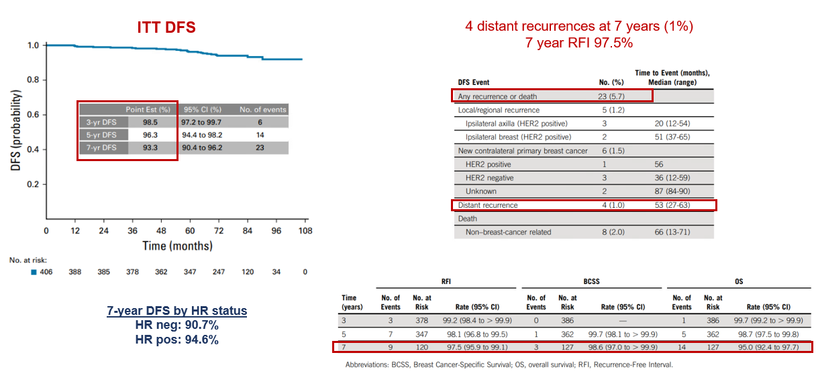
APT: Phase II Trial of Adjuvant TH for HER2+ Early Breast Cancer
7 year OS 95%

Slide 22
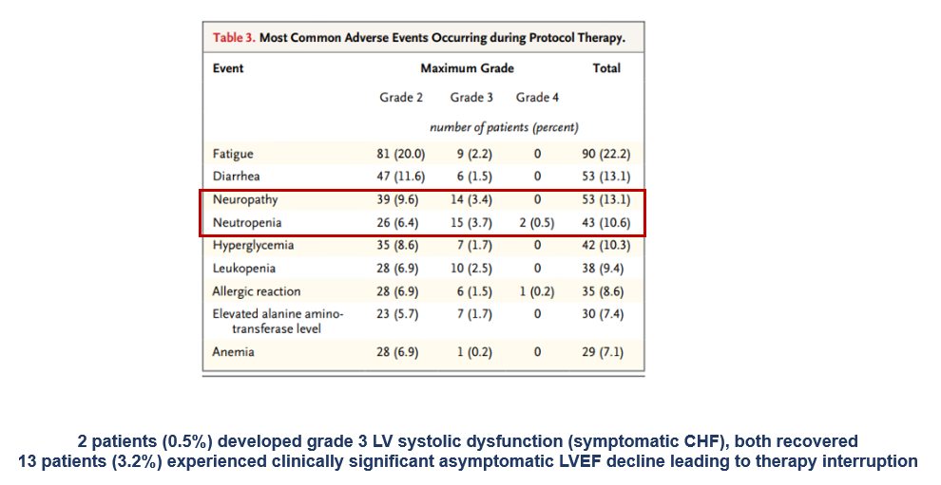
APT: Toxicity Profile

Slide 23
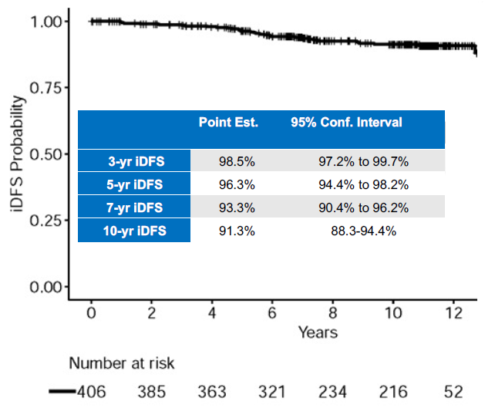
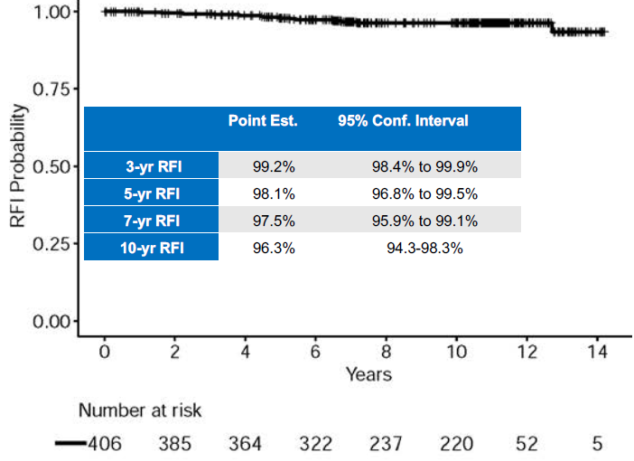
APT: Final 10-year analysis
Tolaney et al SABCS 2022
iDFS
6 distant events
RFI
RFI: invasive local/regional, distant recurrence and death from breast cancer

Slide 24
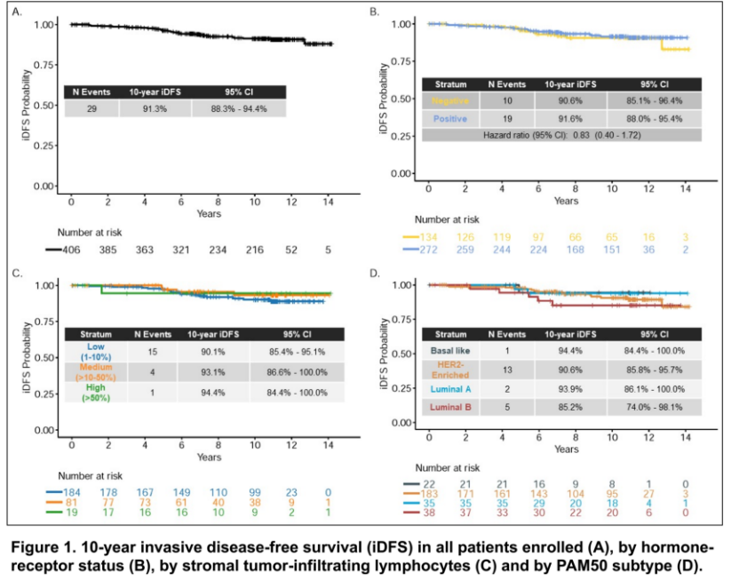
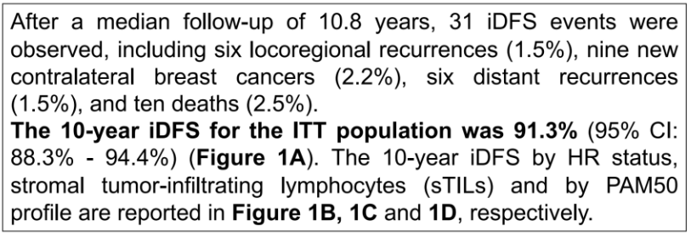
APT: Final 10-year analysis
Tolaney et al SABCS 2022
No difference by HR status
Luminal B lower iDFS

Slide 25
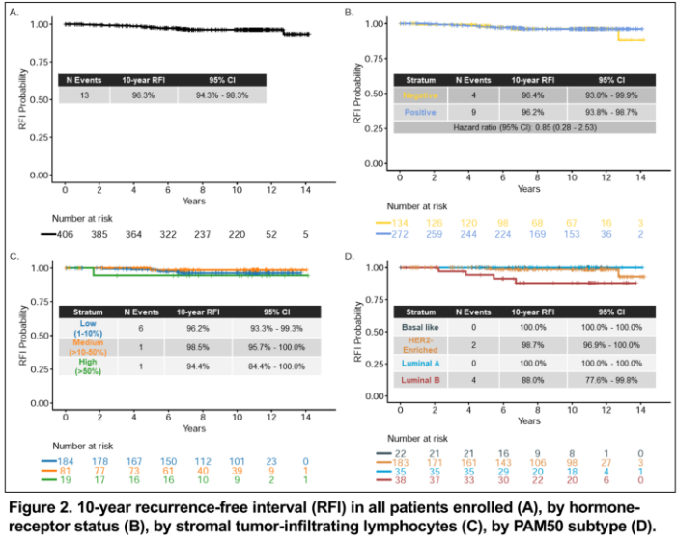
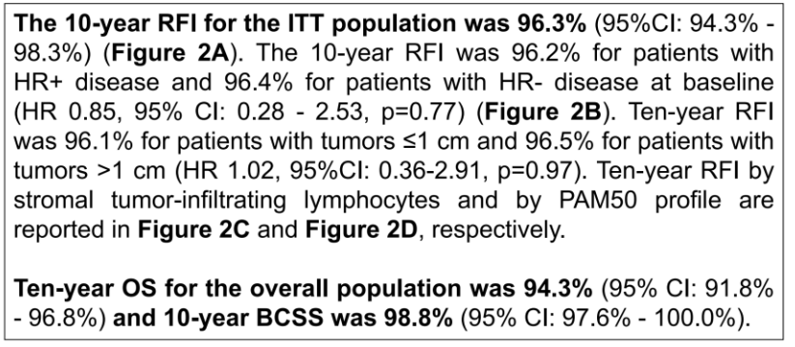
APT: Final 10-year analysis
Tolaney et al SABCS 2022
No difference by HR status
~Similar by TIL level
Luminal B lower RFI

Slide 26
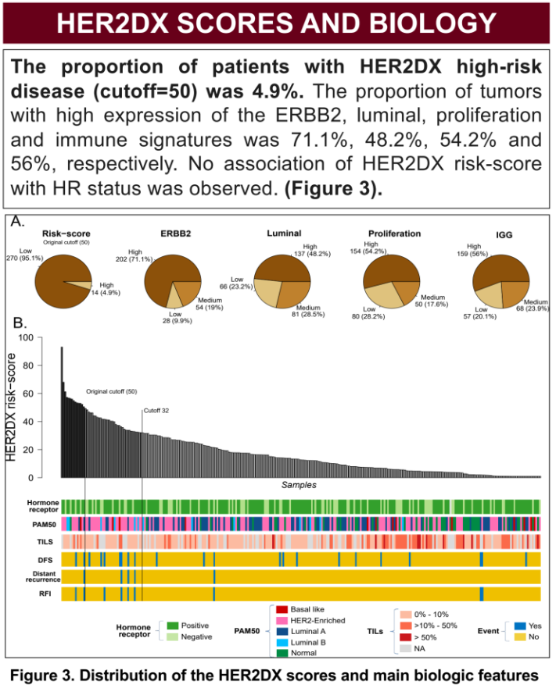
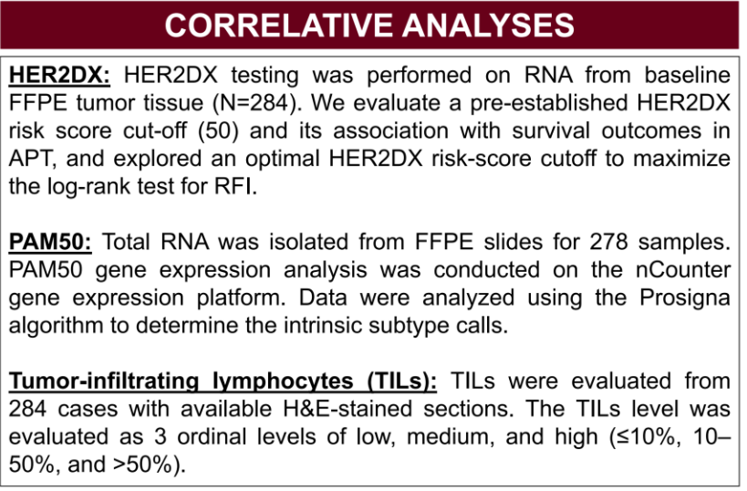
APT: Final 10-year analysis
Tolaney et al SABCS 2022

Slide 27
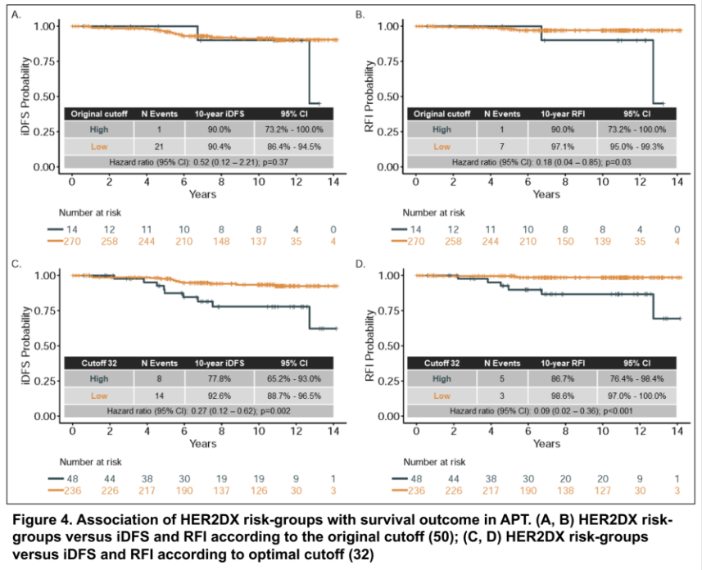
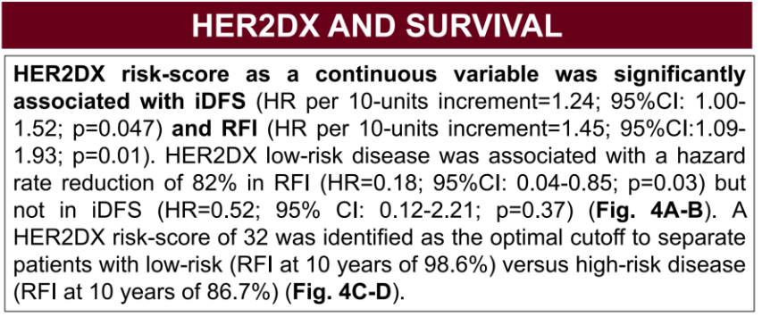
APT: Final 10-year analysis
10-yr iDFS using HER2DX cut off 50
10-yr RFI using HER2DX cut off 50
10-yr iDFS probability using HER2DX cut off 32
10-yr RFI probability using HER2DX cut off 32
Tolaney et al SABCS 2022

Slide 28
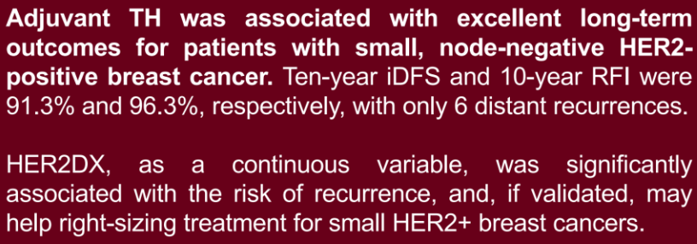
APT: Final 10-year analysis
10-yr iDFS
10-yr RFI
10-yr iDFS probability using HER2DX cut off 32
10-yr RFI probability using HER2DX cut off 32
Tolaney et al SABCS 2022

Slide 29
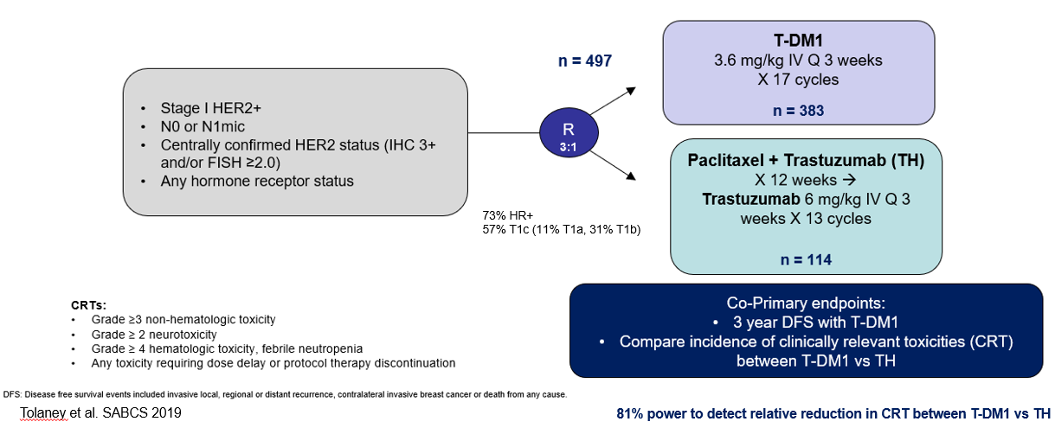
ATEMPT/TBCRC 033:
Phase II Trial of Adjuvant T-DM1 vs TH for Stage I HER2+ Breast Cancer
N=375
N=125

Slide 30
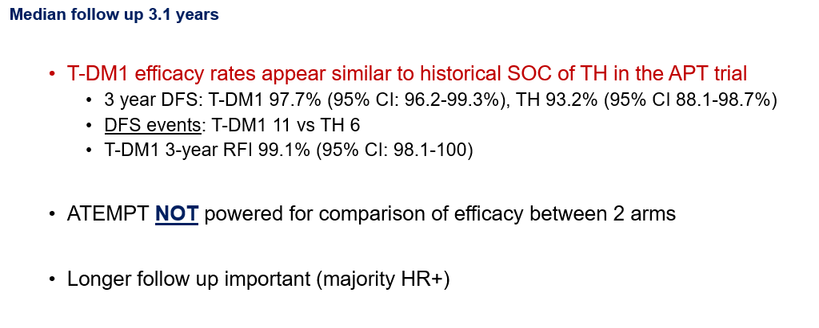
ATEMPT/TBCRC 033:
Phase II Trial of Adjuvant T-DM1 vs TH for Stage I HER2+ Breast Cancer

Slide 31
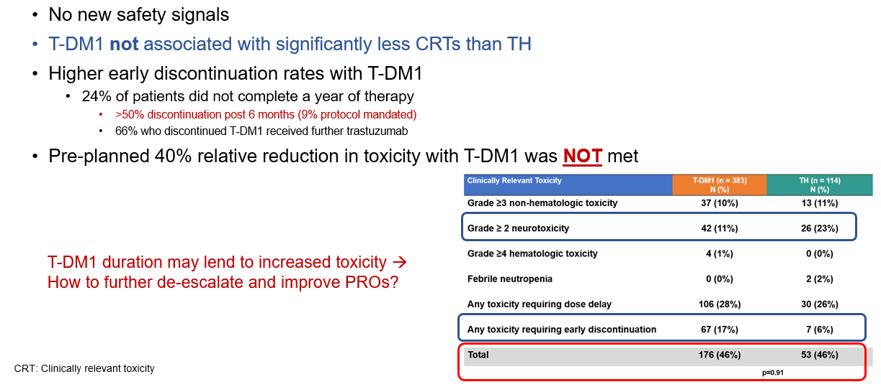
ATEMPT/TBCRC 033:
Phase II Trial of Adjuvant T-DM1 vs TH for Stage I HER2+ Breast Cancer

Slide 32
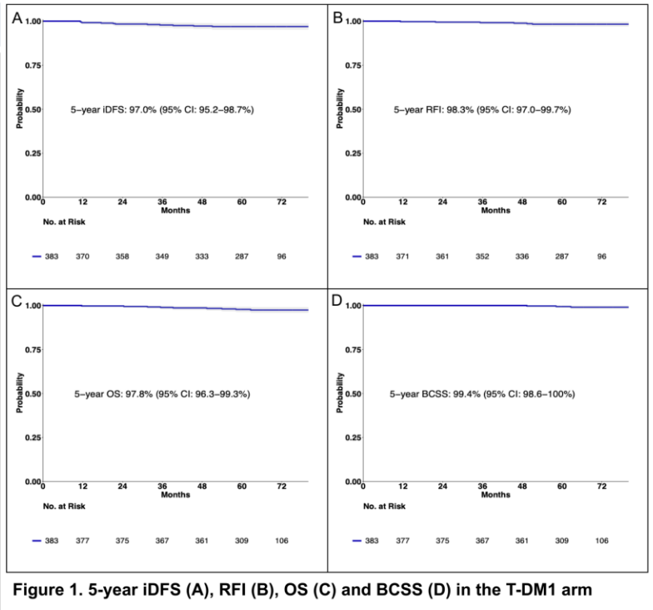
ATEMPT/TBCRC 033:
5-year results and correlative analyses
Tarantino et al SABCS 2022
Median 5.8 year follow-up
  n=383 T-DM1 treated
11 iDFS events (3 distant) in T-DM1 treated patients
  5-yr iDFS 97.0% (95% CI, 95.2-98.7)
Study not powered to evaluate TH efficacy:
  5-yr iDFS 91.3% (9 events, 2 distant)
  5-yr RFI 93.2%
  5-yr OS 97.9%

Slide 33
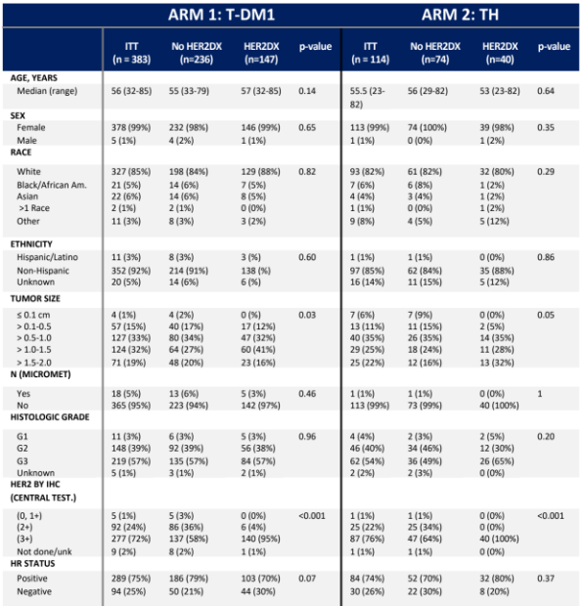
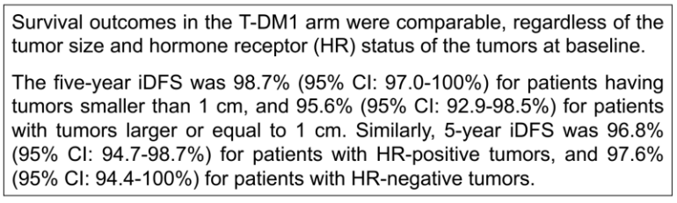
ATEMPT/TBCRC 033:
5-year results and correlative analyses
Tarantino et al SABCS 2022
Median 5.8 year follow-up
  n=383 T-DM1 treated
11 iDFS events (3 distant) in T-DM1 treated patients
  5-yr iDFS 97.0% (95% CI, 95.2-98.7)
Study not powered to evaluate TH efficacy:
  5-yr iDFS 91.3% (9 events, 2 distant)
  5-yr RFI 93.2%
  5-yr OS 97.9%

Slide 34
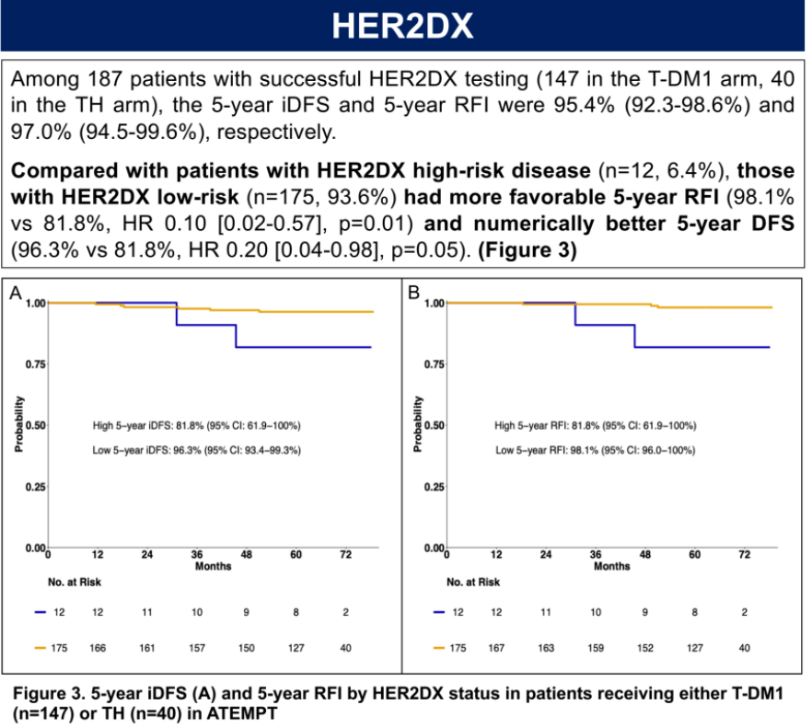
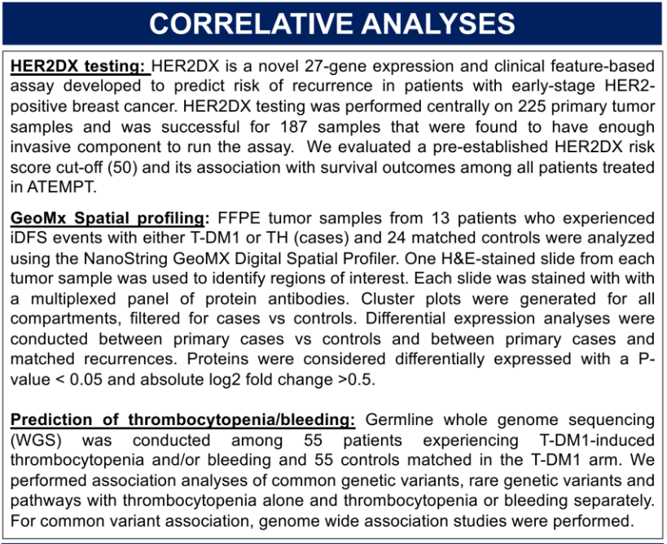
ATEMPT/TBCRC 033:
5-year results and correlative analyses
Tarantino et al SABCS 2022
iDFS
RFI

Slide 35
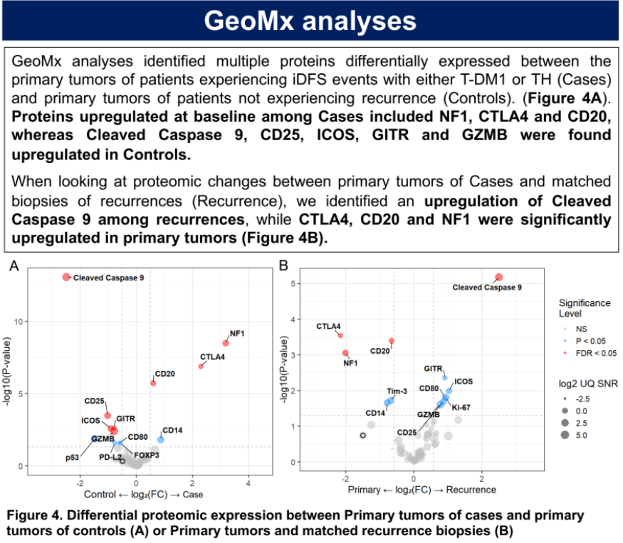
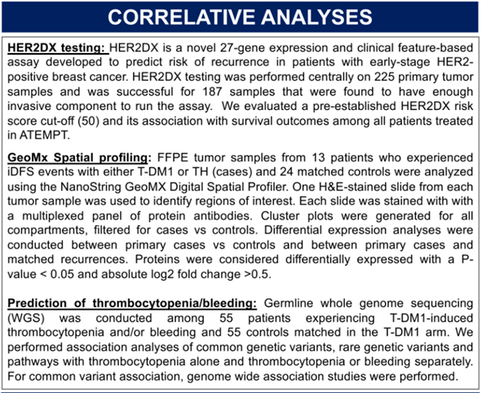
ATEMPT/TBCRC 033:
5-year results and correlative analyses
Tarantino et al SABCS 2022
No genes were significantly associated with thrombocytopenia or bleeding in this analysis

Slide 36
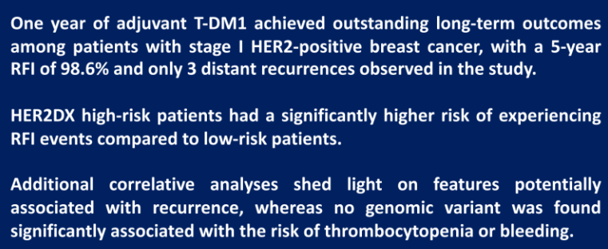
ATEMPT/TBCRC 033:
5-year results and correlative analyses
Tarantino et al SABCS 2022
No genes were significantly associated with thrombocytopenia or bleeding in this analysis

Slide 37

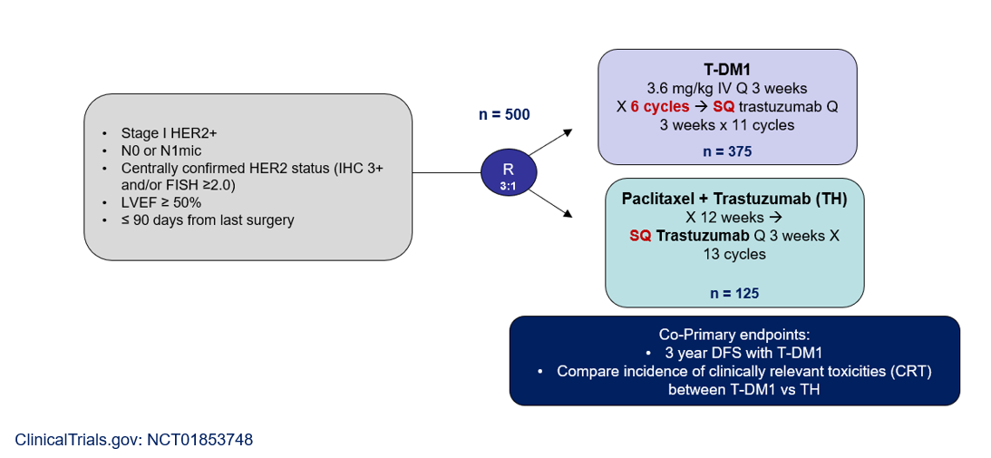
ATEMPT 2.0:
Phase II Trial of Adjuvant T-DM1 vs TH for Stage I HER2+ Breast Cancer

Slide 38
Image-adaptive strategies to assess neoadjuvant therapy response …

Slide 39
Image-adaptive strategies to assess neoadjuvant therapy response … and determine therapy duration?

Slide 40
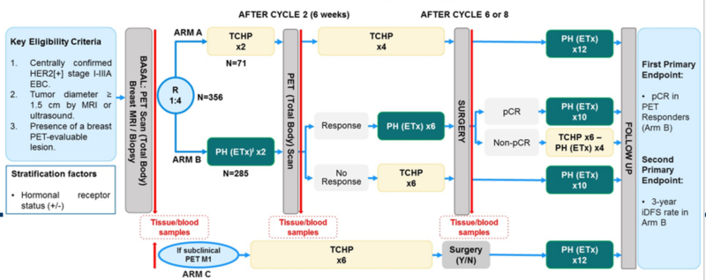
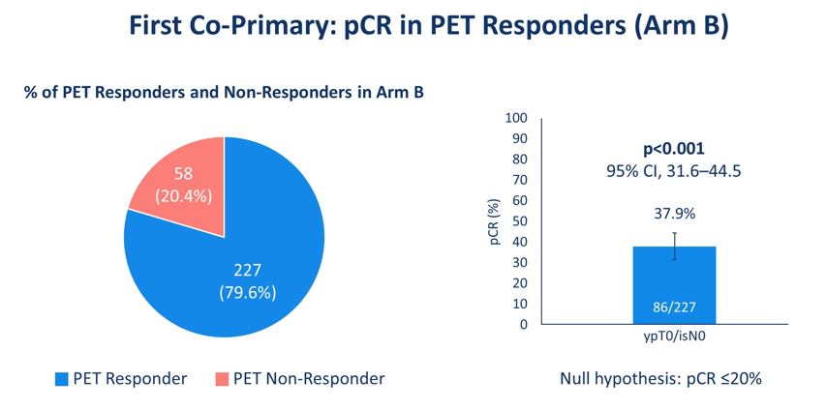
PHERGain:
Chemo De-Escalation using PET response-adapted strategy
Cortes et al ASCO 2020
Dual anti-HER-2 mAb plus chemotherapy improves pCR rates and survival in operable HER2+ breast cancer, but combinations regimens are associated with toxicity.
PHERGain randomized (4:1) Stage I-III HER2+ BC patients to HP +/- ET or SOC TCHP, with incorporation of PET as an early measure of treatment response
  ~40% of patients treated with chemo-free regimen [HP ± ET] and were early PET-responders post 2 cycles achieved a pCR
  PET identifies patients who are more likely to achieve a pCR with HP-based therapy

Slide 41
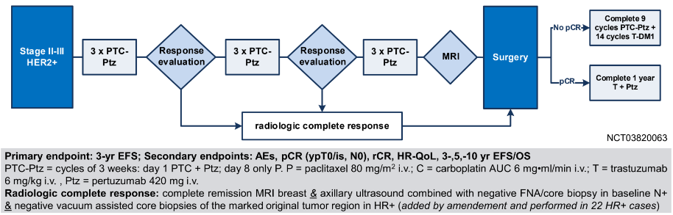
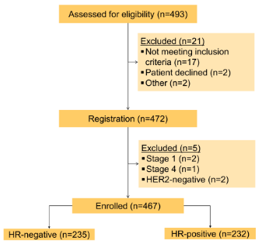
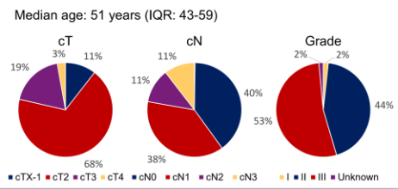
TRAIN 3 (BOOG 2018-01):
A phase II image-guided approach to optimize chemotherapy duration
Van Ramshorst et al SABCS 2022

Slide 42
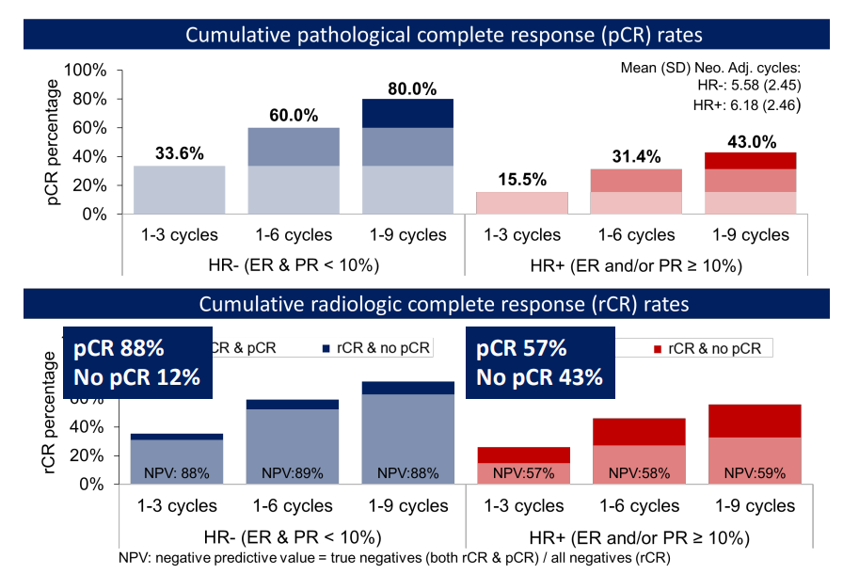
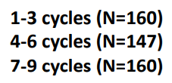
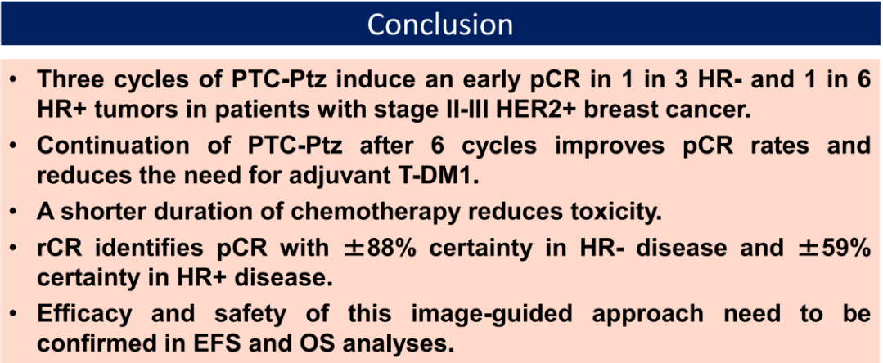
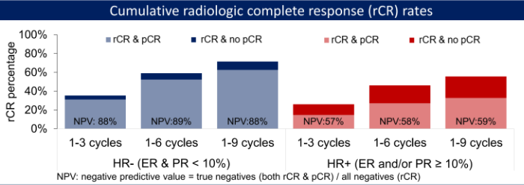
TRAIN 3 (BOOG 2018-01):
A phase II image-guided approach to optimize chemotherapy duration
Van Ramshorst et al SABCS 2022
pCR
rCR
pCR 88%
No pCR 12%
pCR 57%
No pCR 43%

Slide 43
SABCS 2022 Updates:
Metastatic HER2+ Breast Cancer Abstracts

Slide 44
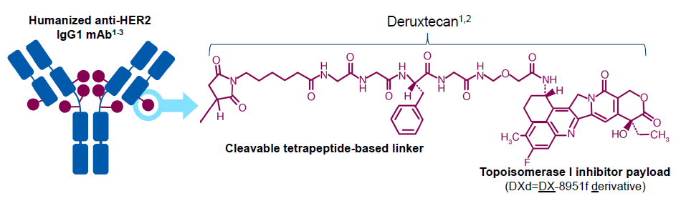
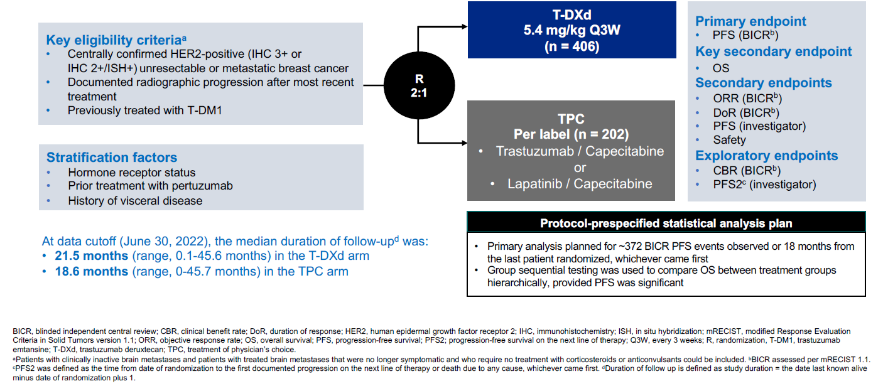
DESTINY-Breast02:
Updated Analysis
Krop et al SABCS 2022

Slide 45
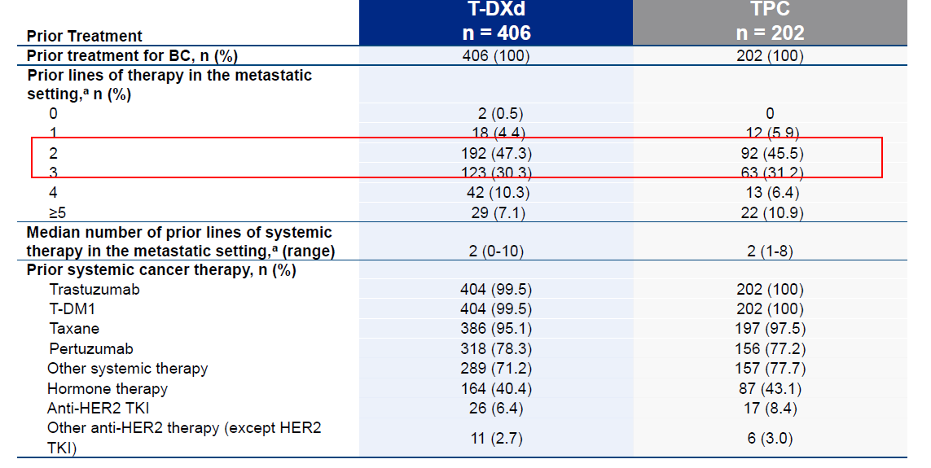
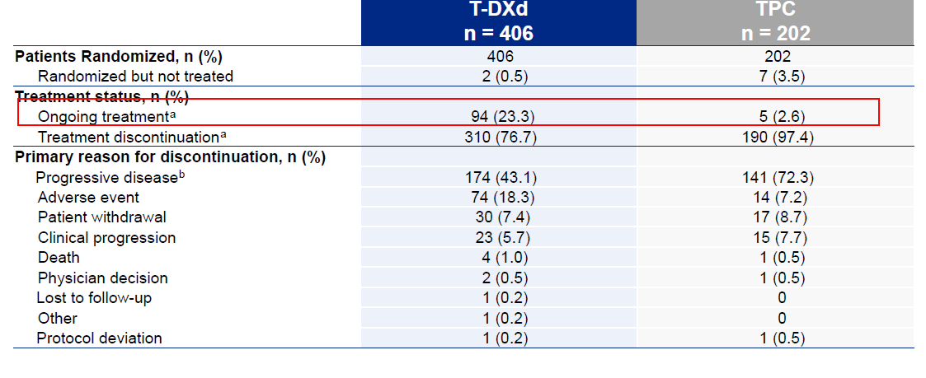
DESTINY-Breast02
Krop et al SABCS 2022

Slide 46
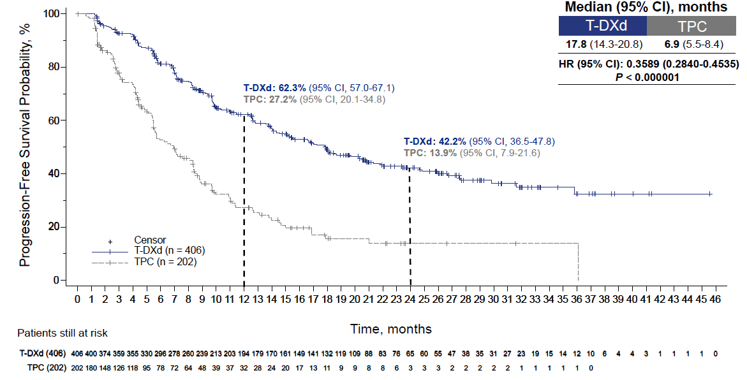
DESTINY-Breast02:
PFS by BICR
Krop et al SABCS 2022
∆ 10.9 mths
∆35.1%
∆28.3%

Slide 47

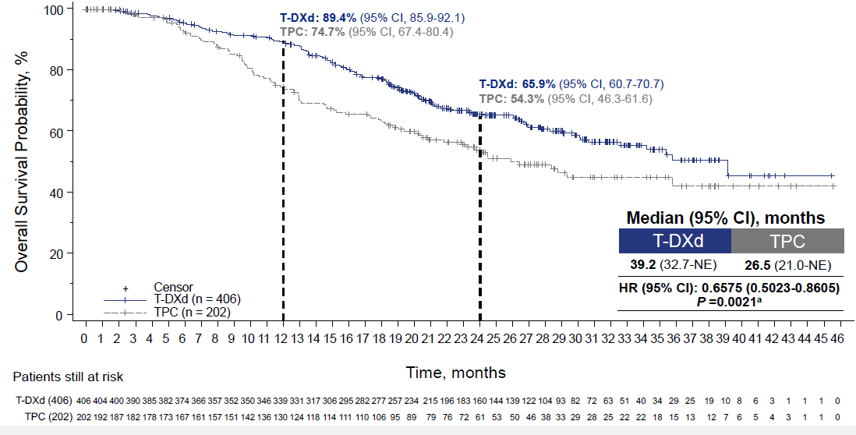
DESTINY-Breast02:
Key Secondary Endpoint: OS
Krop et al SABCS 2022
∆14.7%
∆11.6%
∆ 12.7 mths

Slide 48
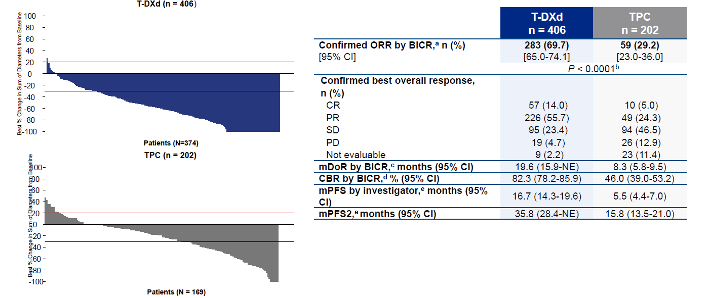
Krop et al SABCS 2022
DESTINY-Breast02:
Secondary & Exploratory Efficacy Endpoints

Slide 49
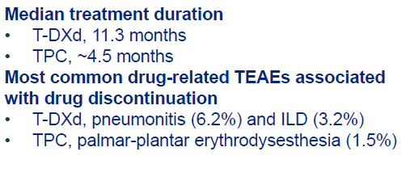
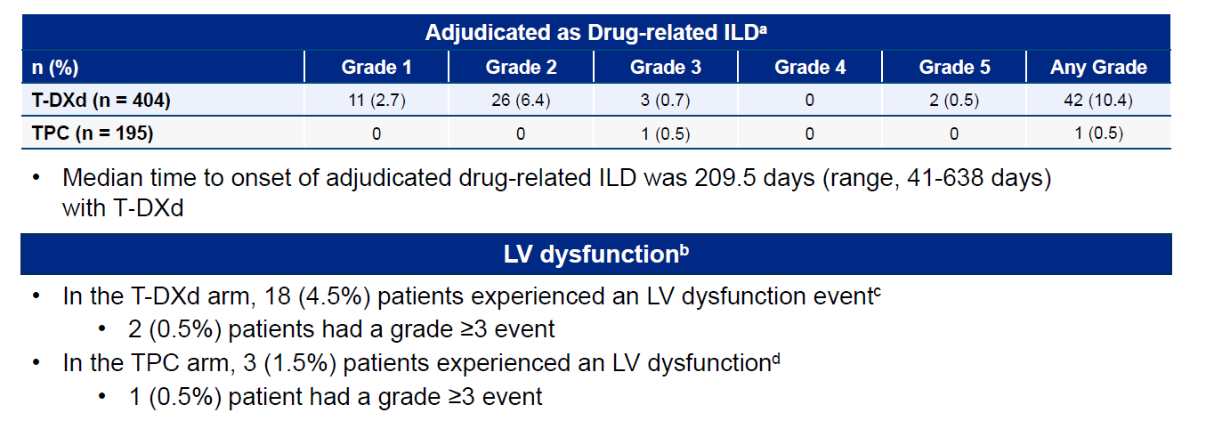
Krop et al SABCS 2022
DESTINY-Breast02:
TEAEs & Drug-Related ILD/LV dysfunction

Slide 50
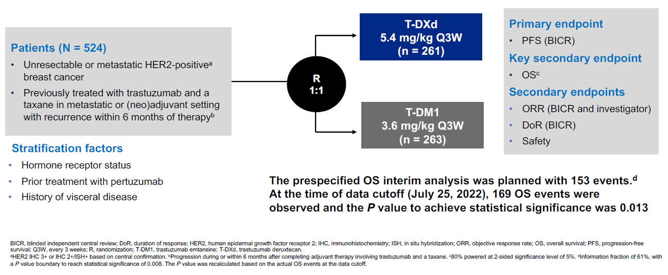
DESTINY-Breast03:
Updated Analysis
Hurvitz et al SABCS 2022

Slide 51
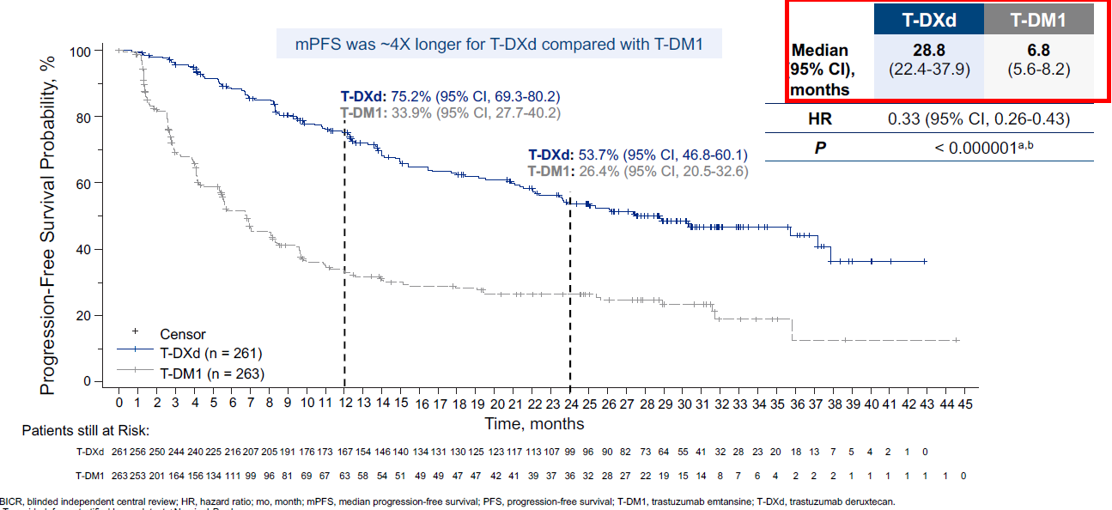
Hurvitz et al SABCS 2022
DESTINY-Breast03:
Updated Primary Endpoint: PFS by BICR
∆ 22 mths
EMILIA,
T-DM1 PFS
9.6 mths
∆41.3%
∆27.3%

Slide 52
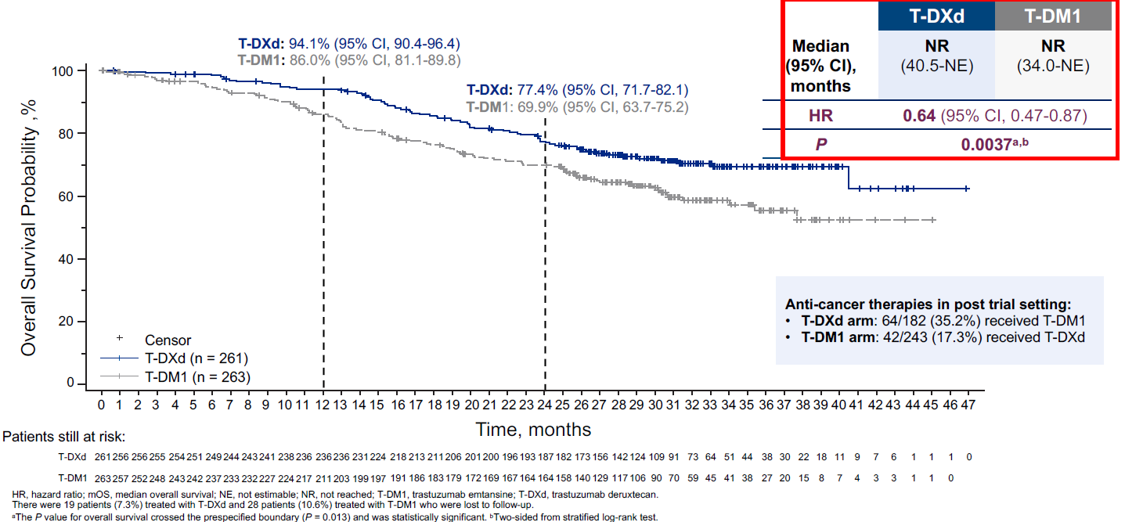
Hurvitz et al SABCS 2022
DESTINY-Breast03:
Key Secondary Endpoint: OS
∆8.1%
∆7.5%

Slide 53

Hurvitz et al SABCS 2022
DESTINY-Breast03:
OS by Subgroups
Consistent OS benefit was observed across key pre-specified subgroups

Slide 54

Hurvitz et al SABCS 2022
DESTINY-Breast03:
Confirmed ORR and Other Efficacy Endpoints
ORR 78.5%
CR 21.1%
ORR 35.0%
CR 9.5%

Slide 55


Hurvitz et al SABCS 2022
DESTINY-Breast03:
TEAEs & Adjudicated Drug-Related ILD/Pneumonitis
Similar rates of grade ≥3 TEAEs with T-DXd (56.4%) and T-DM1 (51.7%)

Slide 56

DESTINY-Breast09
Primary endpoint: PFS

Slide 57
What about T-DXd combinations?

Slide 58


Hamilton et al SABCS 2022
DESTINY-Breast07
Preclinical data suggest T-DXd combined with other anticancer therapy may lead to improved efficacy
Pertuzumab may induce greater T-DXd internalization and mediate HER2-driven signaling inhibition

Slide 59

Hamilton et al SABCS 2022
DESTINY-Breast07
SABCS 2022: Prelim data from phase I/II DB-07 dose expansion for 1st line T-DXd vs T-DXd + Pertuzumab
Primary endpoint: AEs, serious AEs
Secondary endpoints: ORR, PFS, PFS2, DoR, OS

Slide 60


Hamilton et al SABCS 2022
DESTINY-Breast07
SABCS 2022: Prelim data from DB-07 dose expansion for 1st line T-DXd vs T-DXd + Pertuzumab

Slide 61


Hamilton et al SABCS 2022
DESTINY-Breast07
SABCS 2022: Prelim data from DB-07 dose expansion for 1st line T-DXd vs T-DXd + Pertuzumab

Slide 62




ACE-Breast-03:
Efficacy and safety of ARX788 in HER2+ MBC previously treated with T-DM1Cancer
Hurvitz et al SABCS 2022
As of data cut off 7/11/2022, 7 patients enrolled with PD post
T-DM1 and response-evaluable.
Notes:
Amberstatin 269 payload

Slide 63


Hurvitz et al SABCS 2022
ACE-Breast-03:
Efficacy and safety of ARX788 in HER2+ MBC previously treated with T-DM1

Slide 64


ACE-Breast-03:
Efficacy and safety of ARX788 in HER2+ MBC previously treated with T-DM1Cancer
Hurvitz et al SABCS 2022

Slide 65



ACE-Breast-03:
Efficacy and safety of ARX788 in HER2+ MBC previously treated with T-DM1Cancer
Hurvitz et al SABCS 2022

Slide 66

ACE-Breast-03:
Efficacy and safety of ARX788 in HER2+ MBC previously treated with T-DM1Cancer
Hurvitz et al SABCS 2022

Slide 67


ACE-Breast-03:
Efficacy and safety of ARX788 in HER2+ MBC previously treated with T-DM1Cancer
Hurvitz et al SABCS 2022

Slide 68
Recent CNS-specific outcomes from the metastatic setting…
HER2CLIMB trial: tucatinib, capecitabine plus trastuzumab
NALA trial: neratinib plus capecitabine
Trastuzumab-deruxtecan trials – brain-specific trials
  DESTINY-Breast03
  TUXEDO
  DEBBRAH (also includes HER2-low cohorts)

Slide 69



HER2CLIMB: Intracranial ORR in patients with active brain metastases and measurable baseline intracranial disease
Murthy et al 2019
Nancy Lin et al, ASCO 2020 Virtual Meeting Oral Abstract #1005
Lin et al JCO 2020

Slide 70

Kaufman et al SABCS 2022
Patient Characteristics, Treatment Patterns & Clinical Outcomes Associated with Tucatinib in HER2+ MBC
Real-world clinical use of tucatinib (n=183 pts)

Slide 71

Kaufman et al SABCS 2022
Proportion of patients with and without brain metastases receiving tucatinib by line of therapy
Tucatinib-based regimen were more likely to be initiated earlier in those with brain metastases than without

Slide 72
Kaufman et al SABCS 2022
Treatment Patterns
Most patients (n=135; 74%) received tucatinib combined with trastuzumab + capecitabine.
  7.4% (n=10) of these patients discontinued capecitabine ≥1 month prior to discontinuing tucatinib.
Of the 48 patients who did not receive tucatinib, trastuzumab, plus capecitabine:
  20 (42%) received tucatinib + trastuzumab
  14 (29%) received tucatinib + capecitabine
  7 (15%) tucatinib monotherapy
  7 (15%) other tucatinib combinations
When tucatinib-based regimen given in the 2nd line setting:
  Most common regimens pre-treatment were trastuzumab plus pertuzumab-based
  Most common regimens post-treatment were trastuzumab-based and T-DXd.
When tucatinib-based given in the 3rd line setting:
  Most common regimens pre-treatment were T-DM1
  Most common regimens post-treatment were T-DXd

Slide 73

Kaufman et al SABCS 2022
OS, TTNT, TTD among patients receiving tucatinib
6-mth survival 86.1% (81-91.6)
12-mth survival 74.2% (67.3-81.9)
OS
26.1 mths
In 2nd & 3rd line setting, 12-mth survival:
84.1% (75.6-93.5) for any tucatinib-regimen
83.5% for FDA-labeled triplet
TTNT
9.4 mths
(proxy for PFS)
TTD
8.1 mths

Slide 74
Kaufman et al SABCS 2022
Outcomes post T-DXd (n=29)
 |  | 95% CI
Median OS | 12.6 months | 11.9 – NR
12-month survival probability | 61.8% | 43.2-88.5%
Median TTNT | 8.1 months | 4.0 - NR
Median TTD | 8.1 months | 3.6 - 11.9
Followup ≥12 mths (n=16) | 69% persisted on tucatinib

Slide 75



HER2CLIMB-04
Krop et al ASCO 2022
N = 70
N = 60

Slide 76


HER2CLIMB-05:
Phase 3 study of tucatinib or placebo combined with maintenance trastuzumab/pertuzumab in HER2+ MBC

Slide 77

BRIDGET/BRE21-516

Slide 78


InTTercePT (UCBG/GINECO)

Slide 79

B-PRECISE-01:
Phase 1b trial of MEN1611 with trastuzumab +/- fulvestrant in
HER2+ PIK3CA mutated MBC
Piccart et al SABCS 2022
MEN1611: oral PI3K inhibitor active on the p110α mutant and wild type, β and γ isoforms, while sparing the δ
HER2+/PIK3CA-mutated
MBC (centrally confirmed
PIK3CA mutation status)
≥ 2 prior lines anti-HER2 based therapy in met setting
ECOG PS ≤2
RP2D: 48 mg PO BID
Primary Endpoint:
MTD/RP2D
Secondary Endpoints:
ORR, DCR, DoR
PFS
OS

Slide 80

B-PRECISE-01:
Patient Demographics
Piccart et al SABCS 2022

Slide 81

B-PRECISE-01:
Efficacy (n=41)
Piccart et al SABCS 2022

Slide 82


B-PRECISE-01:
Best Tumor Response
Piccart et al SABCS 2022

Slide 83


B-PRECISE-01:
Time on Treatment & Response
Piccart et al SABCS 2022

Slide 84

B-PRECISE-01:
PFS
Piccart et al SABCS 2022

Slide 85



DETECT V trial:
Interim results on chemotherapy omission in HR+/HER2+ MBC
Janni et al SABCS 2022
1:1
Added ribociclib to both tx arms
after 124 pts had been randomized
Data cut-off 6/21/2022

Slide 86

DETECT V trial:
Interim results on chemotherapy omission in HR+/HER2+ MBC
Janni et al SABCS 2022
Data cut-off 6/21/2022:
153 pts
120 pts randomized before
& 33 pts randomized
after ribo addition
115 pts 1st line
77 chemo-free regimen
76 chemo-containing regimen

Slide 87
Summary
Early-stage setting:
  Excellent outcomes in those with small HER2+ tumors (Stage I)
    ATEMPT 2.0 aims to improve toxicity from ATEMPT 1.0
  The search for biomarkers for therapy selection is ongoing
    HER2DX analysis may be a future tool
    Image-adaptive measures may inform personalized therapy duration
  CNS relapse remains a challenge!
Metastatic setting:
  2nd generation ADCs have altered the treatment landscape for HER2+ (and HER2-low) MBC, with combination strategies and newer ADC technologies under investigation
    TDXd yields longer survival than T-DM1 and is being investigated in the 1st line and early disease settings
  Additional trials of chemotherapy-free and mutation-specific agents are encouraging and may provide more selective treatment options

Slide 88

Thank you

Slide 89
Role of CDK 4/6 Inhibitors in
HR+/HER2- Management
Katherine Clifton, MD
Assistant Professor
Washington University School of Medicine
Saint Louis, Missouri

Slide 90
Role of CDK4/6 Inhibitors
Metastatic Setting Updates
  PALOMA-2
  MONARCH-3
  MAINTAIN
  PACE
  RIGHT Choice
Adjuvant Setting Updates
  MonarchE
Case Based Discussion

Slide 91

Oral cyclin-dependent kinase inhibitors
CDK4 and CDK6—control cell cycle progression from G1 to S phase by regulating Rb activity
CDK inhibitors do not allow cyclin D-CDK 4/6 complex to phosphorylate Rb so cell can not proceed through cell cycle
Vidula 2016

Slide 92



3 CDK4/6 Inhibitors in Clinical Use
Palbociclib
(FDA Approved 2/2015)
(2) Ribociclib
(FDA Approved 3/2017)
(3) Abemaciclib
(FDA Approved 9/2017)
Similar PFS in 1st and 2nd line metastatic trials but emerging divergent outcomes in adjuvant setting and OS in metastatic trials

Slide 93
Metastatic Setting Updates
  PALOMA-2
  MONARCH-3
  MAINTAIN
  PACE
  RIGHT Choice

Slide 94
Metastatic CDK4/6 inhibitor 1st Line Trials
Trial | CDK4/6i | ET partner | PFS HR | Statistically Significant? | OS HR | Statistically Significant? | Ref.
PALOMA-2 | Palbo | AI | 0.56 | Yes | 0.96 | No | Finn NEJM 2016 Finn ASCO 2022
MONALEESA-2 | Ribo | AI | 0.57 | Yes | 0.76 | Yes | Rugo BCRT 2019 Hortabagyi NEJM 2016
MONALEESA-3 | Ribo | Fulvestrant | 0.59 | Yes | 0.72 | Yes | Slamon JCO 2018 Slamon NEJM 2020
MONALEESA-7 | Ribo | AI/tamoxifen | 0.55 | Yes | 0.70 | Yes | Tripathy Ann Oncol 2018 Im NEJM 2019
MONARCH-3 | Abema | AI | 0.54 | Yes | 0.75* | No* | Johnston NPJ Br Can 2019 Goetz ESMO 2022
*Preliminary Data: Data from MONARCH-3 still immature

Slide 95

PALOMA 2
Finn et al., ASCO 2022

Slide 96

Finn et al., ASCO 2022

Slide 97

Finn et al., ASCO 2022

Slide 98

Finn et al., ASCO 2022

Slide 99

Finn et al., ASCO 2022

Slide 100

Finn et al., ASCO 2022

Slide 101

Finn et al., ASCO 2022

Slide 102

Finn et al., ASCO 2022

Slide 103
Conclusions
OS numerically longer in palbo+AI arm but not statistically significant
Potential explanations:
  CDK4/6 inhibitors are drugs with different binding sites
    Abemaciclib trial (MonarchE) positive in adjuvant setting while palbociclib trial (PALLAS) negative
  High percentage (22%) with DFI of <12 mo
  Missing survival data
    13% in experimental arm and 21% in placebo arm
  Differences in post-study therapies
    27% in placebo arm received CDK4/6 inhibitors

Slide 104

MONARCH-3
Goetz ESMO 2022

Slide 105

Goetz ESMO 2022

Slide 106
Continuing CDK4/6 inhibitors at progression
Mechanisms of resistance to CDK4/6 inhibitors are under study—unclear if progression represents resistance to ET, CDK4/6 or both
Whether CDK4/6 inhibitors should be continued at time of progression under question
Retrospective studies support use

Slide 107

MAINTAIN
Kalinsky et al., ASCO 2022
Notes:
Mechanisms of resistance to cDK4/6 in are under study—unclear if progression represents resistance to ET, CDK4/6 or both
Whether cdk4/6 should be continued at time of progression under question
Retrospective studies support

Slide 108

Demographics
Kalinsky et al., ASCO 2022

Slide 109

PFS
Kalinsky et al., ASCO 2022

Slide 110

Subgroup Analysis
Kalinsky et al., ASCO 2022

Slide 111

PACE: Palbociclib after CDKi and Endocrine Therapy
Mayer et al., SABCS 2022
Notes:
Pdl1 inhibitor avelumab

Slide 112

Patient Demographics
Mayer et al., SABCS 2022

Slide 113

Prior Treatment Characteristics
Mayer et al., SABCS 2022

Slide 114

PFS
Mayer et al., SABCS 2022
Notes:
No improve in PFS

Slide 115

PFS
Mayer et al., SABCS 2022

Slide 116

Subgroup Analysis
Mayer et al., SABCS 2022
Notes:
Trend towards benefit in intervening therapy
ET resistance—trend towards benefit

Slide 117

OS
Mayer et al., SABCS 2022

Slide 118

Exploratory analysis
Mayer et al., SABCS 2022
Notes:
Patients with baseline mutations appear to benefit more for addition of CDK4/6 and immunotherapy, may suggest underlying Endocrine resistance

Slide 119

Exploratory Analysis
Mayer et al., SABCS 2022

Slide 120
Conclusions
Two randomized phase II trials of CDK4/6 in after progression
  Benefit in ribociclib seen while no benefit in palbociclib
    Difference in CDK4/6 inhibitors, patient characteristics?
Longer PFS with PD-L1 + fulvestrant+palbociclib is an intriguing signal
No new safety concerns (other experiences with immunotherapy and CDK4/6 inhibitors have had safety concerns)
Baseline mutation status may help predict benefit
Outcomes of endocrine therapy alone after progression on CDK4/6 inhibitors are generally poor
Practice changing?
  Phase II data with some conflicting results; will likely await results of larger phase III trials

Slide 121
RIGHT Choice Trial
Randomized Phase II trial of premenopausal patients with aggressive HR+/HER2- Advanced Breast Cancer treated with Ribociclib + Endocrine Therapy vs Physician’s Choice Combination Chemotherapy

Slide 122

RIGHT Choice
Lu et al., SABCS 2022

Slide 123

Demographics
Lu et al., SABCS 2022

Slide 124

Time on Treatment
Lu et al., SABCS 2022

Slide 125

PFS
Lu et al., SABCS 2022
Notes:
Rib+ET achieved statistically sig PFS benefit of ~1 yr over combo CT

Slide 126

Subgroup Analysis
Lu et al., SABCS 2022
Notes:
Benefit of Ribo consistent across most subgroups

Slide 127

Time to onset of response (TTR)
Lu et al., SABCS 2022
Notes:
similar

Slide 128

Time to treatment failure (TTF)
Lu et al., SABCS 2022
Notes:
Long with ribo

Slide 129

Overall Response Rate (ORR) and Clinical Benefit Rate (CBR)
Lu et al., SABCS 2022
Notes:
similar

Slide 130

Treatment-related AEs
Lu et al., SABCS 2022
Notes:
Fewer treatment related serious Aes with ribo

Slide 131
Conclusions
First prospective study to demonstrate PFS superiority of Ribo + ET over combo chemo in HR+ HER2- ABC with aggressive clinical features
Ribo + ET demonstrated longer TTF and similar TTR and ORR compared to combo chemo
Chemo associated with higher TRAEs
Important treatment consideration for patients presenting with aggressive disease

Slide 132
Adjuvant Setting Updates
MonarchE

Slide 133

MonarchE: OS interim analysis
Johnston et al., SABCS 2022

Slide 134

IDFS
Johnston et al., SABCS 2022
Notes:
Curves continue to separate – representing potential carry over effect

Slide 135

IDFS by Ki 67
Johnston et al., SABCS 2022
Notes:
Ki 67 prognostic but not predictive
Tx effect seen regardless of ki 67

Slide 136

Subgroup Analysis
Johnston et al., SABCS 2022
Notes:
Consistent in all subgroups

Slide 137

IDFS and DRFS
Johnston et al., SABCS 2022
Notes:
DFRS—excludes local recurrence
Magnitude increases beyond tx period suggesting carryover

Slide 138

OS
Johnston et al., SABCS 2022
Notes:
Numerical difference, no statistical diff

Slide 139

Survival Status
Johnston et al., SABCS 2022
Notes:
Half as many pts alive with met dz in abema+ET group

Slide 140

Adverse Events
Johnston et al., SABCS 2022
Notes:
the safety profile of abemaciclib is considered manageable and acceptable for this high-risk population

Slide 141
Recent Change in FDA approval
Original approval (10/21): adjuvant treatment of adult patients with hormone receptor (HR)-positive, human epidermal growth factor receptor 2 (HER2)-negative, node-positive, early breast cancer at high risk of recurrence and a Ki-67 score ≥20%, as determined by an FDA approved test.

Slide 142
Recent Change in FDA approval
Update (3/23): adjuvant treatment of adult patients with hormone receptor (HR)-positive, human epidermal growth factor receptor 2 (HER2)-negative, node-positive, early breast cancer at high risk of recurrence. Patients defined as high risk included those having either ≥4 pALN (pathologic axillary lymph nodes) or 1-3 pALN and either tumor grade 3 or a tumor size ≥50 mm. Removes the Ki-67 testing requirement.

Slide 143
Conclusions
 | MonarchE | PALLAS | PENELOPE-B | NATALEE
Number of pts | 5,637 | 5,760 | 1,250 | Estimated 4000
Eligibility | ≥N2 or N1 with at least one of the following: grade 3, tumor size ≥ 5 cm or ki-67 ≥ 20% | Anatomic stage II/III | Lack of pCR after NACT, CPS-EG score ≥ 3 or ≥ 2 with ypN+ | Anatomic stage II/III
Study treatment | Abemaciclib continuous for 2 years | Palbociclib (3 weeks on, 1 week off) for 2 years | Palbociclib (3 weeks on, 1 week off) for 1 year | Riboociclib (3 weeks on, 1 week off) for 3 years
Timing of initiation of CDK4/6i in relation to ET | Within 12 weeks of beginning adjuvant ET | Within 6 mo of beginning adjuvant ET | NA | Within 12 mo of beginning adjuvant ET
Discontinuation rate | 27.7% | 42.0% | 19.5% | ongoing
IDFS | 85.8% vs 79.4% (HR 0.7, p<0.0001) at 4 years | 84.2% vs 84.5% (HR 0.96, p= .65) at 4 years | 73.0 % vs 72.4 % (HR 0.93, p>0.05) at 4 years
DRFS | 88.4% vs 82.5% (HR 0.7, p<0.0001) at 4 years | 86.2% versus 87.8% (HR 1.05, p>0.05) at 4 years
Notes:
DFRS—distant relapse free survival--defined as the time from randomization to distant recurrence or death from any cause, whichever occurred first
IDFS—invasive disease free survival--date of randomization to the date of first occurrence of ipsilateral invasive breast tumor recurrence, local/regional invasive breast cancer recurrence, distant recurrence, death attributable to any cause, contralateral invasive breast cancer, or second primary nonbreast invasive cancer

Slide 144
Case Based Discussion: Case 1
42 year-old premenopausal female presents with two months of worsening back pain. Imaging reveals concern for a 5 cm breast mass and metastatic bone lesions in the lumbar spine. Biopsy of L5 shows an ER+ HER2- (0) breast cancer. What therapy do you offer her?
Combination chemotherapy with carbo/taxol
Ribociclib + tamoxifen
Ribociclib + AI + Ovarian Suppression
Abemaciclib + tamoxifen

Slide 145
Case 1
Combination chemotherapy with carbo/taxol
RIGHT Choice Trial: Combination chemotherapy in first-line metastatic ER+ HER2- symptomatic disease associated with shorter PFS and TTF as well as more TRAEs
B) Ribociclib + tamoxifen
Ribociclib not indicated for concomitant use with tamoxifen. In MONALEESA-7, the observed mean QTcF increase from baseline was ≥10 ms higher in the tamoxifen + placebo subgroup compared with the non-steroidal aromatase inhibitor (NSAI) + placebo subgroup
C) Ribociclib + AI + zoladex
MONALEESA-7: OS at 42 months was 70.2% vs 46.0% (P=0.00973)
Abemaciclib + tamoxifen
No Phase III data

Slide 146
Case Based Discussion: Case 2
60 year-old postmenopausal female with a prior history of a T1cN0 ER+ HER2- breast cancer s/p lumpectomy, radiation and 5 years of anastrozole which was completed 2 years ago now presents with new onset headaches and right sided weakness. MRI brain reveals concern for 3 CNS lesions. She undergoes gamma knife treatment. CT CAP and bone scan reveal diffuse bone mets. Biopsy of bone lesion shows ER+ HER2- (1+) breast cancer. Which therapy do you offer?
T-DXd
Palbociclib + AI
Abemaciclib + AI
Paclitaxel

Slide 147
Case 2
T-DXd
DESTINY-BREAST04: HER2-low metastatic breast cancer who had received one or two previous lines of chemotherapy
Palbociclib + AI
No OS in PALOMA 2
Abemaciclib + AI
Phase II study: Abemaciclib associated with an iCBR of 24% in pts with heavily pretreated HR⁺, HER2⁻ MBC and achieved therapeutic concentrations in brain metastases tissue (Tolaney et al., CCR 2020)
Paclitaxel
Chemotherapy options with better CNS penetration include capecitabine, cisplatin, etoposide, high dose MTX

Slide 148
Case Based Discussion: Case 3
55 year-old postmenopausal female presents with a pT2N1a ER+ HER2- breast cancer. On review of the surgical pathology, she is found to have a 4.5 cm grade 3 IDC with 1 positive LN and ki 67 30%. In addition to adjuvant anastrozole, you recommend 2 years of abemaciclib. What rare side effects do you counsel discuss with the pt?
Diarrhea and fatigue
Alopecia and neutropenia
VTE and ILD
Nausea and Arthalgias

Slide 149
Case 3
Diarrhea and fatigue
Diarrhea is commonly reported (84% in MonarchE) and fatigue is common as well (41%)
Alopecia and neutropenia
Neutropenia is commonly reported (46% in MonarchE)
Nausea and Arthalgias
Arthalgias are commonly reported (27% in MonarchE)
D) VTE and ILD
VTEs and ILD are rare but serious reported side effects on Abemaciclib of which patients should be informed. VTE was reported in 2.5% of patients in MonarchE and ILD in 3.3% of patients.

Slide 150
Case Based Discussion: Case 4
65 year-old postmenopausal female with a history of metastatic ER+ HER2- (1+) breast cancer is found to have progression after 20 months on palbociclib + AI. CtDNA testing reveals an ESR1 mutation. What next line therapy do you recommend?
Ribociclib + fulvestrant
Elacestrant
T-DXd
Abemaciclib

Slide 151
Case 4
Ribociclib + fulvestrant
Encouraging phase II data from MAINTAIN trial however awaiting further phase III date on continuing CDK4/6 in after progression
Elacestrant
January 27, 2023, the FDA approved elacestrant in postmenopausal women or adult men with ER-positive, HER2-negative, ESR1-mutated advanced or metastatic breast cancer who have progressed on at least 1 line of endocrine therapy (Emerald Trial)
C) T-DXd
DESTINY-BREAST04: HER2-low metastatic breast cancer who had received one or two previous lines of chemotherapy
D) Abemaciclib
Approved as monotherapy after progression on prior endocrine therapy and prior chemotherapy in the metastatic setting.

Slide 152
Question-and-Answer

Slide 153
Networking Reception
We will begin at 7:45pm

Slide 154


B R E A S T C A N C E R
Thursday, March 30, 2023

Slide 155


What’s new in Triple Negative Breast Cancer
Foluso Olabisi Ademuyiwa, MD MPH MSCI
Professor Washington University
St Louis, MO

Slide 156
Disclosures
Advisory Boards/Consulting- Teladoc Health, Pfizer, AstraZeneca, Gilead, Cardinal Health, Biotheranostics.
Research funding- Pfizer, RNA Diagnostics, Astellas.

Slide 157
Outline
Immunotherapy updates
Biomarkers of response to immunotherapy
Identification of symptoms of irAEs
ADCs in advanced TNBC

Slide 158



Slide 159


Slide 160
Outline
Immunotherapy updates
Biomarkers of response to immunotherapy
Identification of symptoms of irAEs
ADCs in advanced TNBC

Slide 161
Association of TNBC-DX scores with outcomes in TNBC treated with neoadjuvant pembrolizumab and chemotherapy: a correlative analysis from NeoPACT and NeoSTOP
NeoPACT (pCR 58%)
  Carboplatin, docetaxel, and pembrolizumab x 6
NeoSTOP (pCR 53%)
  Carboplatin and docetaxel x 6

Slide 162

TNBC-DX risk score includes the 14-gene immunoglobulin immune signature, T size, and N status and has shown survival prognostic value in eTNBC
Evaluated pCR prediction and long-term outcomes with neoadjuvant anti-PD1 treatment.
14-gene IGG signature significantly associated with improved pCR
14-gene IGG signature not prognostic on EFS.
TNBC-DX score strongly associated with EFS.

Slide 163
Outline
Immunotherapy updates
Biomarkers of response to immunotherapy
Identification of symptoms of irAEs
ADCs in advanced TNBC

Slide 164


Slide 165


Single institution experience with KEYNOTE522 regimen
Hofherr et al. SABCS 2022.

Slide 166

Identification of Symptoms Associated with irAEs in the I-SPY Trial

Slide 167


Slide 168


Slide 169


Slide 170
Outline
Immunotherapy updates
Biomarkers of response to immunotherapy
Identification of symptoms of irAEs
ADCs in advanced TNBC

Slide 171
Current clinical Impact of ADCs in Breast Cancer
ADCs in TNBC
  Sacituzumab Govitecan in TNBC and HR+ MBC
  Trastuzumab Deruxtecan for HER2+ and HER2 Low BC
  Datopotamab Deruxtecan – in development
HER2-directed ADCs
  Trastuzumab Emtansine for HER2+ BC
  Trastuzumab Deruxtecan for HER2+ and HER2 Low BC
ADCs in development with novel targets

Slide 172


Slide 173


Slide 174


HR negative
PFS
HR positive

Slide 175


OS
HR positive
HR negative

Slide 176

Phase 2 DAISY Trial of T-DXD: Activity seen in HER2 IHC 0 Cohort

Slide 177

Disitamab Vedotin (RC-48): HER2 ADC for HER2+/Low BC
HER2+ BC, N=70
HER2 Antibody:
Hertuzumab
different antigen recognition
regions v Tras
Preferable affinity v Tras
ORR= 33%
Linker:
Cleavable
Bystander Effect
HER2 Low BC, N=48
ORR= 40%
Randomized Phase 3 Study: RC48-ADC vs TPC for HER2-Low MBC
Payload:
MMAE
Blocks polymerization of tubulin
Centrally HER2 Low
RC-48 2 mg/kg IV Q2W
R
(IHC 1+ 2+)
1-2 prior chemos
Physician's choice single agent
N = 366
(capecitabine/paclitaxel/docetaxel/vinorelbine)
Primary Endpoint = PFS
Wang J et al, ASCO 2021

Slide 178

- DAR of 4
Bardia et al, ESMO 2021

Slide 179


TROPION-PanTumor01: Datopotamab in TNBC Cohort
Patients without prior
Topo I inhibitor-based ADC N=27
All patients N=44
ORR = 34%
ORR = 52%
Median prior lines of therapy = 3
Prior Topo1 inhibitor-based ADC= 30%
ª Includes response evaluable patients who had ≥1 postbaseline tumor assessment or discontinued treatment. Postbaseline tumor assessments were not yet available for 2 patients at the data cutoff. Three patients were not confirmed to have a target lesion per BICR and, therefore, had a best overall response of non-CR/non-PD.
^{b} Includes patients with an unconfirmed response but are ongoing treatment.
Krop I, et al. Presented at: SABCS Annual Meeting; December 7-11, 2021; San Antonio, TX. Abstract GS1-05. ^{Krop I SABC 2021}
Krop et al, SABC 2021

Slide 180

TROPION-PanTumor01: TNBC Cohort
Krop et al, SABC 2021

Slide 181

BEGONIA: Phase 1b/2 Platform Study of durvalumab (D) combinations in TNBC
Preliminary Results: D + DATO-Dxd in 1st Line, unselected for PDL1 status
Schmid P Et al ESMO Breast 2022

Slide 182


TROP2 ADC Trials: 1st Line mTNBC
ASCENT-03
TROPION B-02
Un-treated mTNBC
Not eligible for PD-1/PD-L1 Tx
N=600
1:1
DATO-DXd
R
Investigator’s choice
Pacl/nab-pacl,Cape, carbo, eribulin
Dual Primary Endpoints: PFS/OS
TROP2 ADC Trials: 1st Line mTNBC, PDL1+
ASCENT-04

Slide 183



Ladiratuzumab Vedotin: ADC Targeting LIV-1
ORR 28%
LIV1, transmembrane cell adhesion molecule
LV induces immunogenic cell death
Tsai, et al, ESMO 2021; Han et al, SABC 2019; Meisel J et al, ASCO 2022

Slide 184

The Emerging Problems of Selection and Sequencing
Multiple overlapping targets and payloads……….
ADC
ADC
Datopotamab
Deruxtecan
HER2 neg vs HER2 Low
Sacituzumab Trastuzumab
Govitecan Deruxtecan
Patritumab
ADC
ADC
Deruxtecan
Ladiratuzumab
Vedotin
ADC

Slide 185
Treatment paradigm for mTNBC
PDL1 positive PDL1 negative
1st line
  pembrolizumab + chemotherapy
  clinical trials
1st line
  chemotherapy
  clinical trials
2nd line and beyond
2nd line and beyond
clinical trials
sacituzumab govitecan
trastuzumab deruxtecan (HER2 low)
PARPi (BRCA1/2 mutation)
chemotherapy
clinical trials
sacituzumab govitecan
trastuzumab deruxtecan (HER2 low)
PARPi (BRCA1/2 mutation)
chemotherapy

Slide 186
Thank you

Slide 187
The Role of SERDs in Breast Cancer
Cynthia X. Ma, MD, PhD
Professor of Medicine
Washington University in St. Louis
St. Louis, MO

Slide 188
Disclosure
Consulting:
  Novartis, Pfizer, Seattle Genetics, Agendia, AstraZeneca, Biovica, Eisai, Olaris, Sanofi, Inivata
Research funding:
  Pfizer, Puma

Slide 189


Estrogen Receptor Signaling and Endocrine Resistance Mechanisms
Endocrine Resistance
Growth factor receptor signaling pathways
HER mutation
FGFR amplification
PI3K pathway: PIK3CA, PTEN, AKT mutations etc
MAPK pathway: NF1, KRAS, RAF alteration etc
ESR1 mutation
Alterations of ER CoActivators
Cell Cycle machinery
Alterations in Cyclin and CDKs and CDK inhibitors
Others
Estrogen independence but still ER dependent growth
ER Independent growth
ERα: Estrogen Receptor
ERE: Estrogen Response Element
CoA: CoActivator
Hanker et al Cancer Cell 2020
Notes:
In ER pos breast cancer, estrogen receptor signaling is the key driver of tumor growth. In its classical mode of action, ER functions as a transcription factor and it is activated by binding to its ligand estrogen, this leads to ER dimerization, binds to coactivators to form transcriptionally active ER complex to promote the expression of genes important for tumor growth. These include cyclin D which leads to activation of CDK4/6i. Endocrien therapy drugs are designed to target this pathway. However, ER can also be regulated by other pathways altered in ER+ breast cancer. For example. Cross talk between ER and their downstream signaling molecules including PI3K and MAPK pathway, could lead to phosphorylations or other mechanisms of ER activation, leading to estrogen independent tumor growth.
aromatase inhibitors (AI) such as letrozole or anastrozole, or steroidal, irreversible AIs such as exemestane, block estrogen production by inhibiting the aromatization of androgens to estrogens. (C) Selective estrogen receptor modulators (SERMs) such as tamoxifen and raloxifene competitively inhibit the binding of estrogen to ER. SERM-bound ER dimers interact with the chromatin at estrogen response elements (ERE). However, SERM-bound ER dimers associate with corepressors (CoR), which inhibit ER transcriptional activity in the breast. (D) Selective estrogen receptor downregulators (SERDs) are the newest addition of endocrine therapy. These agents are designed to bind to ER, leading to its degradation.

Slide 190
Estrogen Receptor Signaling and Mechanism of Action of Approved Endocrine Therapy
Endocrine Therapy:
Aromatase inhibitors (AI)
Reversible AI
(letrozole or anastrozole)
Irreversible AI
(exemestane)
Selective ER modulator (SERM)
Tamoxifen
Raloxifene
Selective ER Degrader (SERD)
Fulvestrant
Elacestrant
Limitations of Tamoxifen
Partial agonist
Reduced activity for ESR1 mutation
Toxicity
Limitations of Fulvestrant
IM injection
Poor PK
Incomplete ER degradation
Reduced activity for ESR1 mutation
Limitations of AI
Acquire ESR1 mutations
Ineffective for estrogen independent ER signaling
Toxicity
Hanker et al Cancer Cell 2020
Notes:
Estrogen receptor signaling is the key driver of tumor growth in ER positive breast cancer. As shown in this simplified diagram, Estrogen binds to ER, which then dimerization, binds to coactivators to form transcriptionally active ER complex to promote the expression of genes important for tumor growth. These include cyclin D which leads to activation of CDK4/6. in premenopausal women
aromatase inhibitors (AI) such as letrozole or anastrozole, or steroidal, irreversible AIs such as exemestane, block estrogen production by inhibiting the aromatization of androgens to estrogens. (C) Selective estrogen receptor modulators (SERMs) such as tamoxifen and raloxifene competitively inhibit the binding of estrogen to ER. SERM-bound ER dimers interact with the chromatin at estrogen response elements (ERE). However, SERM-bound ER dimers associate with corepressors (CoR), which inhibit ER transcriptional activity in the breast. (D) Selective estrogen receptor downregulators (SERDs) are the newest addition of endocrine therapy. These agents are designed to bind to ER, leading to its degradation.

Slide 191


Slide 192

Elacestrant

Slide 193


Slide 194


PFS (Primary Endpoint): Elacestrant vs. SOC
All patients
All patients
ESR1 Mutation
PFS Outcomes | All Patients |  | Patients With ESR1 mutation
 | Elacestrant (n = 239) | SoC (n = 238) | Elacestrant (n = 115) | SoC (n = 113)
Median PFS, mo | 2.79 | 1.91 | 3.78 | 1.87
HR (95% CI) P value | 0.697 (0.552-0.880) .0018 |  | 0.546 (0.387-0.768) .0005
PFS rate, % (95% CI)
6 mo 12 mo | 34.3 (27.2-41.5) 22.3 (15.2-29.4) | 20.4 (14.1-26.7) 9.4 (4.0-14.8) | 40.8 (30.1-51.4) 26.8 (16.2-37.4) | 19.1 (14.1-26.7) 8.2 (1.3-15.1)

Slide 195

PFS: Elacestrant vs. Fulvestrant
All patients
ESR1 Mutation
PFS Outcomes | All Patients |  | Patients With ESR1 mutation
 | Elacestrant (n = 239) | Fulvestrant (n = 165) | Elacestrant (n = 115) | Fulvestrant (n = 83)
Median PFS, mo | 2.79 | 1.94 | 3.78 | 1.87
HR (95% CI) P value | 0.684 (0.521-0.897) .0049 |  | 0.504 (0.341-0.741) .0005

Slide 196

Kaklamani V. SABCS 2022

Slide 197

Kaklamani V. SABCS 2022

Slide 198


Slide 199
Ongoing trials with Elacestrant
ECLIN: Elacestrant in CDK4/6 Inhibitor-Naive ER+, HER2- MBC: An Open-Label Phase 2 Study
  Received 1-2 prior hormonal therapies in the advanced/metastatic setting
  No prior CDK4/6i
ELECTRA: Phase 1b-2 Study of Elacestrant + Abemaciclib in Brain Metastasis from ER+, HER2- MBC
ELEVATE: Phase 1b/2, Umbrella Study to Evaluate Safety and Efficacy of Elacestrant in Various Combinations in ER+, HER2- MBC
  Elacestrant plus alpelisib
  Elacestrant plus everolimus
  Elacestrant plus palbociclib
  Elacestrant plus ribociclib
  Elacestrant plus abemaciclib

Slide 200


Slide 201


Slide 202



Lasofoxifene (SERM) : ELAINE 1 and ELAINE 2
ELAINE 1 in ESR1m: Lasofoxifene vs Fulvestrant (N= 103)
Progressed on prior (≥12 months) aromatase inhibitors plus CDK4/6i
ELAINE 2: Lasofoxifene with Abemaciclib in ESR1 m (N= 29)
96.6% prior CDK4/6i ; 66% visceral mets
Best response in patients with measurable lesions
Median PFS
LAS: 6.04 mos (2.82–8.04)
Fulv: 4.04 mos (2.93–6.04)
x
Progression-Free Survival (PFS)
x
Lasofoxifene
Fulvestrant
x
x
HR, 0.699 (95% CI, 0.445–1.125); P = 0.138
x
x
Survival Probability
x
x
x
x
x
ORR: 50% (95% CI, 29.0‒71.0)
Median TTR: 169 days
Median DoR: 164 days
x
x
x
x
x
x
x
Kaplan–Meier analysis of progression-free survival
Fulv
LAS
51
37
24
15
6
6
2
2
1
1
1
1
0
52
43
27
25
20
13
11
9
8
2
1
1
1
1
1
1
0
Months
ORR: 13.2% vs 2.9% (P=0.12)
CBR: 36.5% vs 21.6% (P=0.12)
ctDNA: Median relative change in MAF at 8 week: 87.1% vs 14.1%
Crosses indicate censored subjects; 1 month = 4 weeks.
Fulv, fulvestrant; LAS, lasofoxifene; PFS, progression-free survival.
Median PFS: 55.7 weeks (13 months) (95% CI 32.0‒NE)
Phase 3 - ELAINE 3: Lasofoxifene + Abemaciclib vs Fulvestrant + Abemaciclib is planned
Goetz et al ESMO 2022; Damodaran et al ASCO 2022

Slide 203

ARV-471
H3B-6545
OP-1250
Notes:
H3B-6545

Slide 204
Summary
Fulvestrant IM was the first SERD approved for HR+/HER2- MBC, but activity is limited by its PK property and has reduced efficacy in ESR1 mutated breast cancer.
Elacestrant is the first orally available SERD for ESR1 mutated advanced/metastatic HR+/HER2- breast cancer.
Elacestrant is being tested in combination with targeted therapies
Several other SERDs are being developed in both adjuvant and metastatic settings
There are also other novel ER targeted drugs in early stages of development

Slide 205
HER2-low
Breast Cancer
Andrew Davis, MD
Assistant Professor of Medicine
Washington University
St. Louis, MO

Slide 206
Overview
What are the limitations of defining HER2 with IHC?
What is HER2-low breast cancer?
Is HER2 low a distinct subtype of breast cancer?
How are patients with HER2-low advanced breast cancer treated?

Slide 207

HER2 by IHC
HER2 “negative” may still express HER2
Wolff et al. JCO 2018

Slide 208

HER2 “negative” patients have some HER2 expression
Marchio et al. Seminars in Cancer Biology 2021

Slide 209

How is HER2 low currently defined?
HER2 1+ or HER2 2+ with negative FISH
Often defined based evaluation of primary or metastatic biopsy
Tarantino et al. JCO 2020

Slide 210

Difficult to distinguish HER2 0 and 1+
Fernandez et al. JAMA Onc 2022

Slide 211

Is HER2 low a distinct subtype?
At least 4 main subtypes based on gene expression profiling
  Luminal A, luminal B, basal, HER2-positive
  Disease biology has not changed since that time
Sorlie et al. PNAS 2001

Slide 212

Comparison of HER2 low and HER2 0
HER low vs. HER2 0
  Lower probability of pCR for HR+ patients
  HER2 low significantly more likely to be HR+, lower grade, lower Ki-67, and lobular histology
Denkert et al. Lancet Oncology 2021

Slide 213

HER2 low varies by ER status
The percentage of HER2-low tumors increases as ER expression increases
Tarantino et al. JAMA Onc 2022

Slide 214

HER2 status can vary from primary and metastatic biopsies
Miglietta et al. NPJ Breast Cancer 2021

Slide 215


HER2 heterogeneity within the same patient
Geukens et al. SABCS 2022

Slide 216

HER2 heterogeneity within the same organ!
Geukens et al. SABCS 2022

Slide 217
Is HER2 low a separate subtype?
From my perspective, NO
Not biologically distinct or stable within patients (or organs)
This is a subset of patients defined by drug delivery of novel antibody-drug conjugates (ADC)
We need to re-define IHC assays or develop novel assays to evaluate levels of HER2 expression

Slide 218
Treatment of HER2-low
Breast Cancer

Slide 219


Trastuzumab does NOT improve outcomes for
HER2-low patients
Fehrenbacher et al. JCO 2019

Slide 220

Trastuzumab deruxtecan (T-DXd)
T-DXd is FDA approved for HER2+ amplified breast and gastric cancers, HER2-low breast cancer, and HER2 mutated NSCLC.
Mechanism:
1. T-DXd binds and is internalized.
2. Linker is cleaved and topoisomerase I inhibitor is released.
3. The inhibitor enters the nucleus leading to cell death.
4. Membrane-permeable payload leads to bystander effect of nearby cells.
Prat et al. JAMA Onc 2022

Slide 221


DESTINY BREAST-04: T-DXd improves PFS/OS
HER2-low HR+
and HER2-low TNBC
Comparator arm:
capecitabine, eribulin, gemcitabine, paclitaxel, or nab-paclitaxel
Modi et al. NEJM 2022

Slide 222
FDA Approval for T-DXd in
HER2-low breast cancer
Patients are eligible if they have received a prior chemotherapy in the metastatic setting or the cancer recurred within 6 months of completing adjuvant chemotherapy

Slide 223
Metastatic TNBC Treatment Paradigm
PD-L1+
Pembrolizumab + taxane or gem/carbo
ADCs
  Sacituzumab govitecan
  T-DXd (if HER2-low)
PD-L1 negative
Taxanes, platinums, or anthracyclines
ADCs
  Sacituzumab govitecan
  T-DXd (if HER2-low)
Later line options: eribulin, capecitabine, gemcitabine, and others
PARP inhibitor if germline BRCA1/2 mutant
Clinical trials

Slide 224
Metastatic HR+ HER2 low treatment paradigm
Incorporate T-DXd after completion of endocrine-based therapy
A prior line of chemotherapy may be required
Consider a repeat biopsy if previously HER2 0

Slide 225

Questions?

Slide 226
Question-and-Answer

Slide 227
Concluding Remarks
Thank you for attending!

Slide 228
Thank You to Our Supporters:

