Slide 1









PROSTATE/RCC/BLADDER
Tuesday, December 12, 2023

Slide 2
Role of PARP inhibitors in prostate cancer
Tian Zhang, MD, MHS
Associate Professor
Director of Clinical Research
UT Southwestern Medical Center
Harold C. Simmons Comprehensive Cancer Center
Dallas, TX

Slide 3
Disclosures/confluences of interest
PI/research funding - Pfizer, Eli Lilly, Tempus, ALX Oncology, Exelixis, Merck
Advisory Board – Merck, Exelixis, Sanofi-Aventis, Janssen, Astra Zeneca, Pfizer, BMS, SeaGen, Eisai, Aveo, Eli Lilly, Bayer, Novartis, Gilead, EMD Serono
Consultant – Pfizer, MJH Associates, Vaniam, Aptitude Health, PeerView, Aravive, Caris

Slide 4
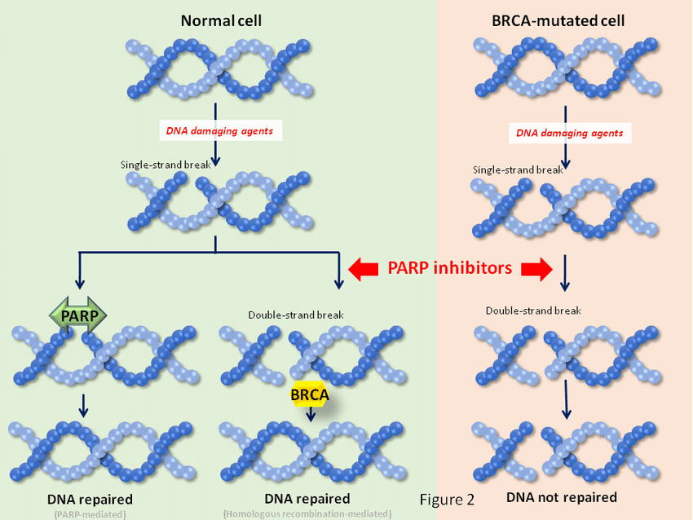
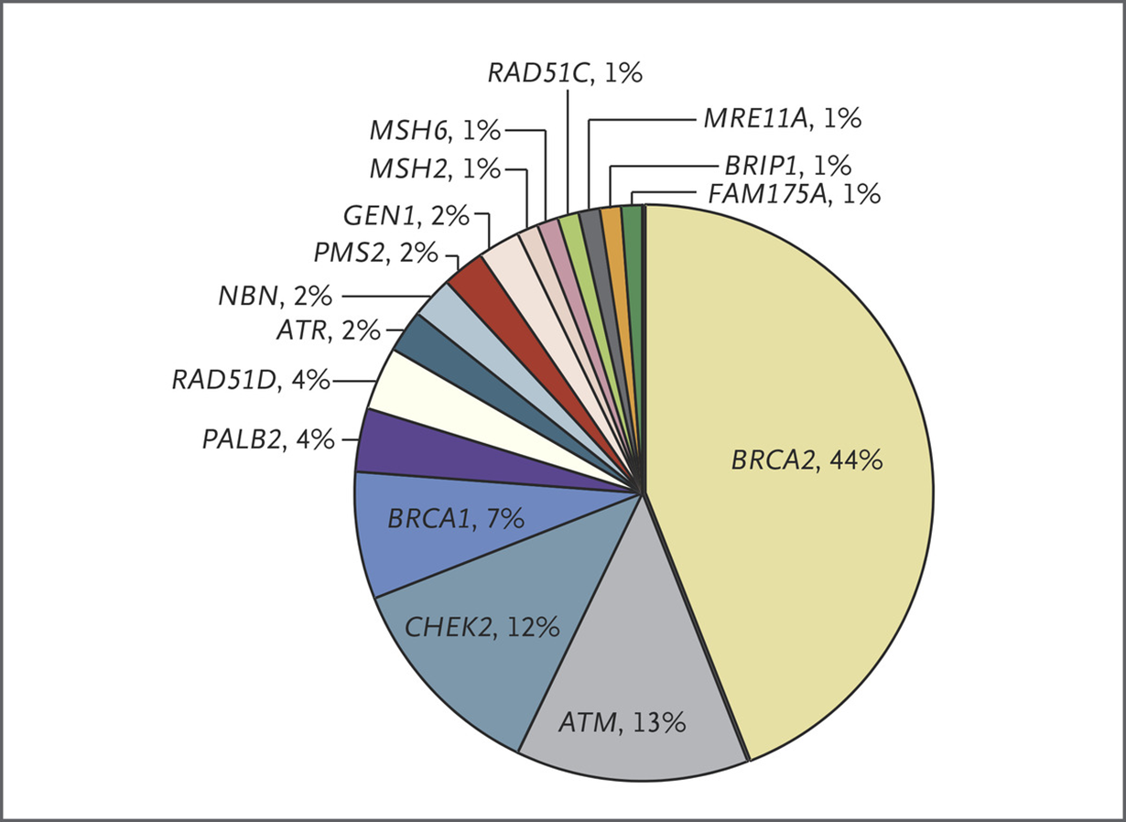
PARP Inhibition – Synthetic Lethality With HRR Alterations
Germline DNA damaging alterations in prostate cancer
Cell cycle/Replication preserved
Cell death
HRR, homologous recombination repair.
Ocana A et al. Oncotarget. 2017;8(13):22218-22234.
Pritchard CC et al. N Engl J Med. 2016;375:443-453.

Slide 5
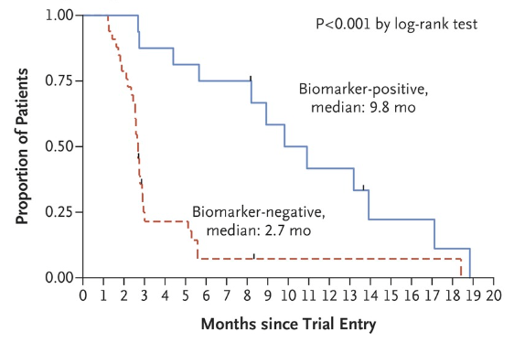
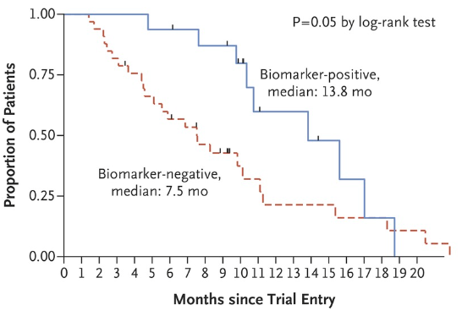
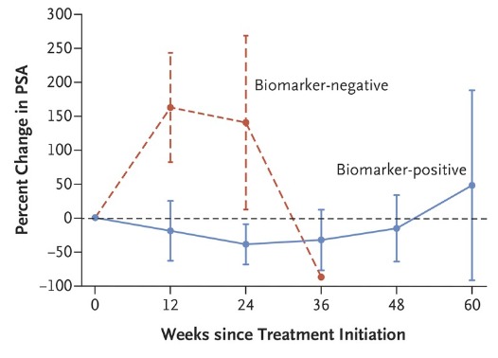
Phase 2 Olaparib in mCRPC
Radiographic PFS
Overall Survival
Single cohort mCRPC
49 evaluable patients
16 patients HRR positive
14/16 patients with responses
PFS and OS both better for patients with HRR alterations than without HRR alterations
HRR, homologous recombination repair; OS, overall survival; PFS, progression-free survival. ​
Mateo J et al. N Engl J Med. 2015;373(18):1697-1708.

Slide 6
Subsequent phase 2 PARP monotherapy trials
Study/ HRR altered | Treatment | Sample size | Objective responses in HRR altered | PSA50 responses | Median radiographic PFS
TOPARP-A | Olaparib | 16 | 87% | 63% | 9.8 months
TRITON-2 | Rucaparib | 115 | 44% | 55% | 9.0 months
Galahad | Niraparib | 76 | 34% | 41% | 5.5 months
TALAPRO- | Talazoparib | 61 | 46% | 64% | 11.2 months
HRR, homologous recombination repair; PFS, progression-free survival. ​
Mateo J et al. N Engl J Med. 2015;373(18):1697-1708.
Abida W et al. J Clin Oncol. 2020;38(32):3763-3772.
Smith MR et al. Lancet Oncol. 2022;23(3):362-373.
de Bono J et al. Lancet Oncol. 2021;22(9):1250-1264.

Slide 7

PROFOUND Trial: Phase 3 Trial Design
Olaparib 300 mg BID
n = 162
Primary endpoint:
rPFS by BICR in Cohort A
(alpha=0.05)
Key eligibility criteria
mCRPC
Disease progression on prior NHA, eg enzalutamide and/ or abiraterone treatment
Alterations in ≥1 of any qualifying gene with a direct or indirect role in HRR*
Cohort A:
BRCA1, BRCA2 or ATM
N=245
Physician's choice of enza or abi†
n = 83
Confirmed ORR by BICR in Cohort A
(alpha=0.05)
2:1 randomization
Open-label
Upon BICR progression, Physician's choice patients were eligible for crossover to olaparib
rPFS by BICR in Cohorts A+B
(alpha=0.05)
Olaparib 300 mg BID
n = 94
Time to pain progression
in Cohort A
(alpha=0.05)
Cohort B:
Other HRR alterations
N=142
Stratification Factors
Previous taxane
Measurable disease
Physician's choice of enza or abi†
n = 48
OS in Cohort A → Interim
(alpha=0.01)
OS in Cohort A → Final
(alpha=0.047)
Statistical assumption for primary endpoint: Target hazard ratio = 0.53 (assumed 9.5 vs 5 months), 95% power, 2-sided 5% alpha (60% maturity, 143 events)
*BRCA1, BRCA2, ATM, BARD1, BRIP1, CDK12, CHEK1, CHEK2, FANC, PALB2, PPP2R2A, RAD51B, RAD51C, RAD51D RAD54L; †Physician choice of either enzalutamide (160 mg qd) or abiraterone (1000 mg qd plus prednisone [5 mg bid]); BICR, blinded independent central review; bid, twice daily; ORR, objective response rate; OS, overall survival; rPFS, radiographic progression-free survival.
de Bono J et al. N Engl J Med. 2020;382:2091–2102.

Slide 8
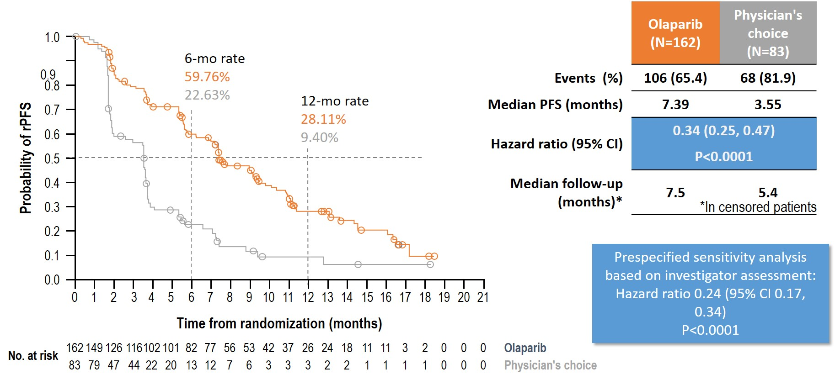
Primary Endpoint: rPFS by BICR in Patients With Alterations in
BRCA1, BRCA2, or ATM (Cohort A)
Olaparib (n=84)
Physician's choice (n=43)
Odds ratio: 20.86
(95% CI 4.18, 379.18); P<.0001
rPFS, radiographic progression-free survival. ​
de Bono J et al. N Engl J Med. 2020;382:2091–2102.

Slide 9
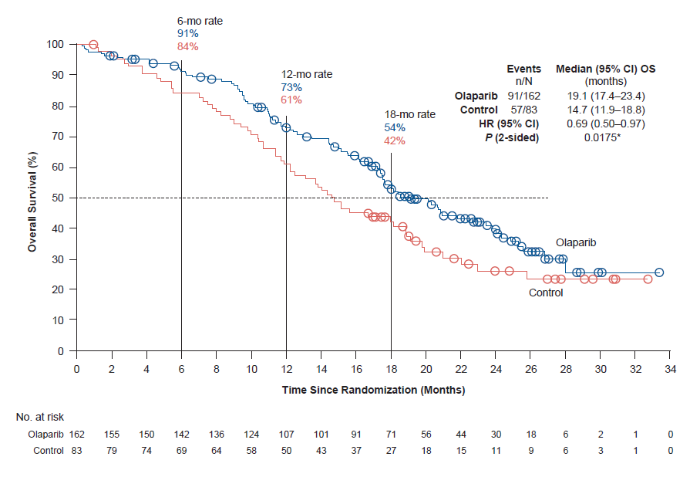
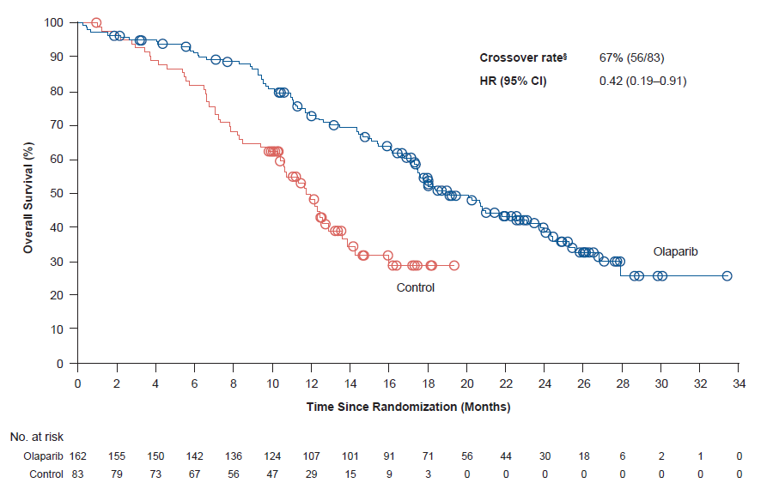
Final OS in Cohort A (BRCA1, BRCA2 and/or ATM mCRPC)
 | Olaparib (N=162) | Control (N=83)
Events (%) | 91 (56) | 57 (68)
Median OS | 19.1 months | 14.7 months
HR (95% CI) | 0.69
 | (0.50‒0.97); P=.0175
Cohort A
Cohort A with adjustment for crossover*
Crossover rate | 67% (56/83)
HR (95% CI) | 0.42
 | (0.19‒0.91)
Median follow-up duration for censored patients was 21.9 months for the olaparib arm and 21.0 months for the control arm
*Re-censored; conducted using RPSFTM to demonstrate the impact on OS of crossover of patients from the control arm to receive olaparib as a first subsequent anticancer therapy
CI, confidence interval; HR, hazard ratio; OS, overall survival; RPSFTM, rank-preserving structural failure time model.
de Bono J et al. N Engl J Med. 2020;382:2091–2102.

Slide 10
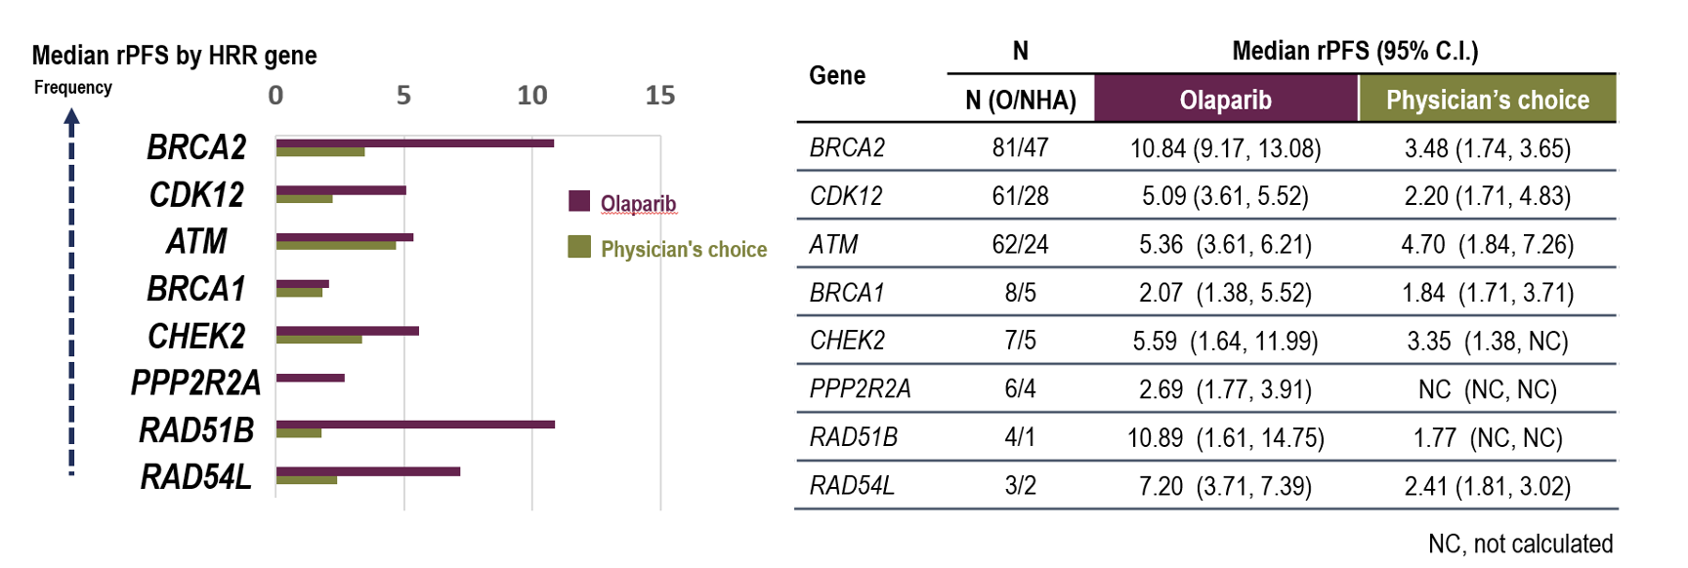
The affected gene matters for PARP effect
CI, confidence interval; NC, not calculated; rPFS, radiographic progression-free survival. ​
de Bono J et al. N Engl J Med. 2020;382:2091–2102.

Slide 11
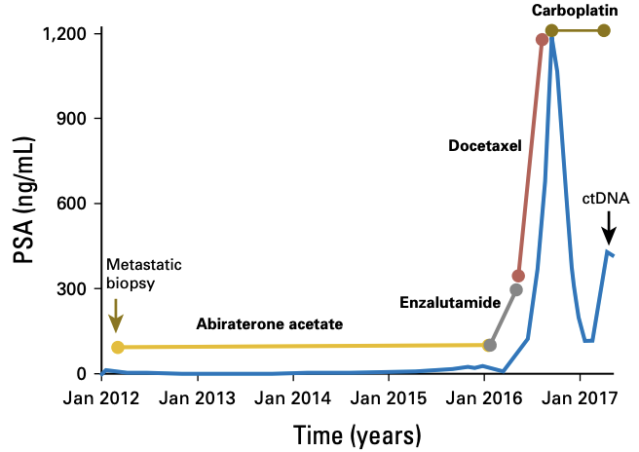
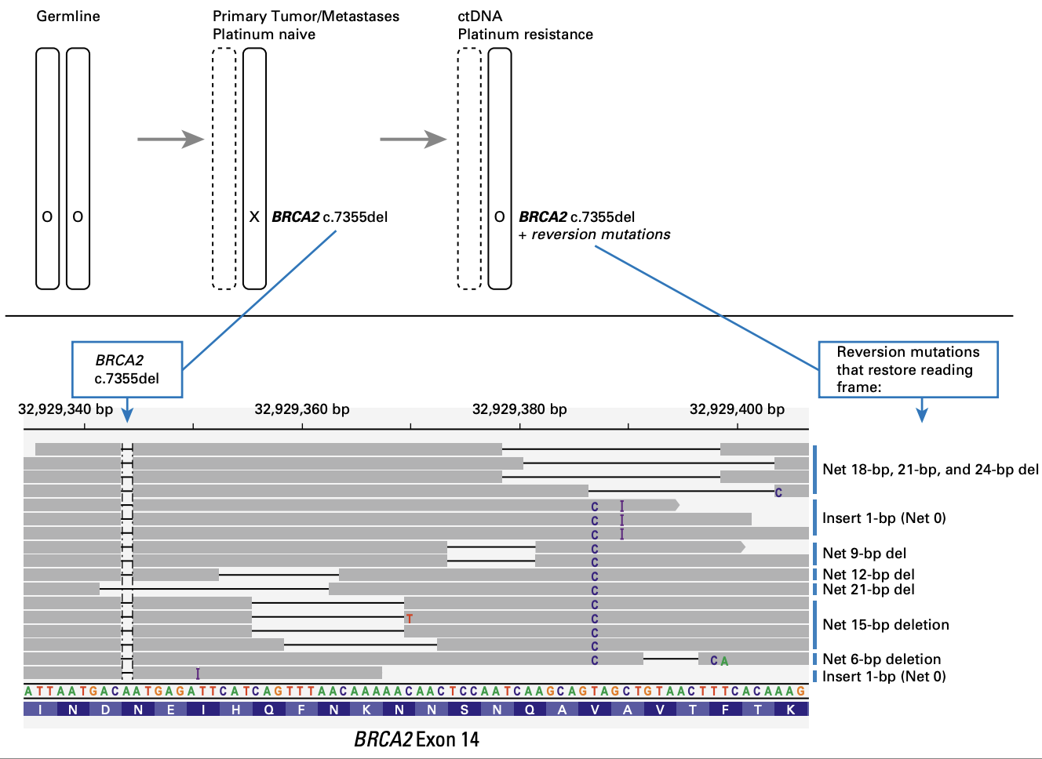
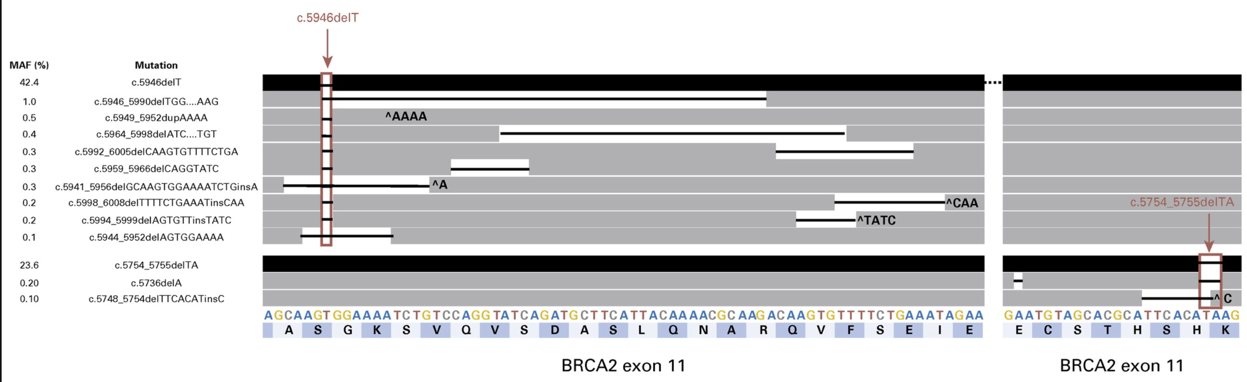
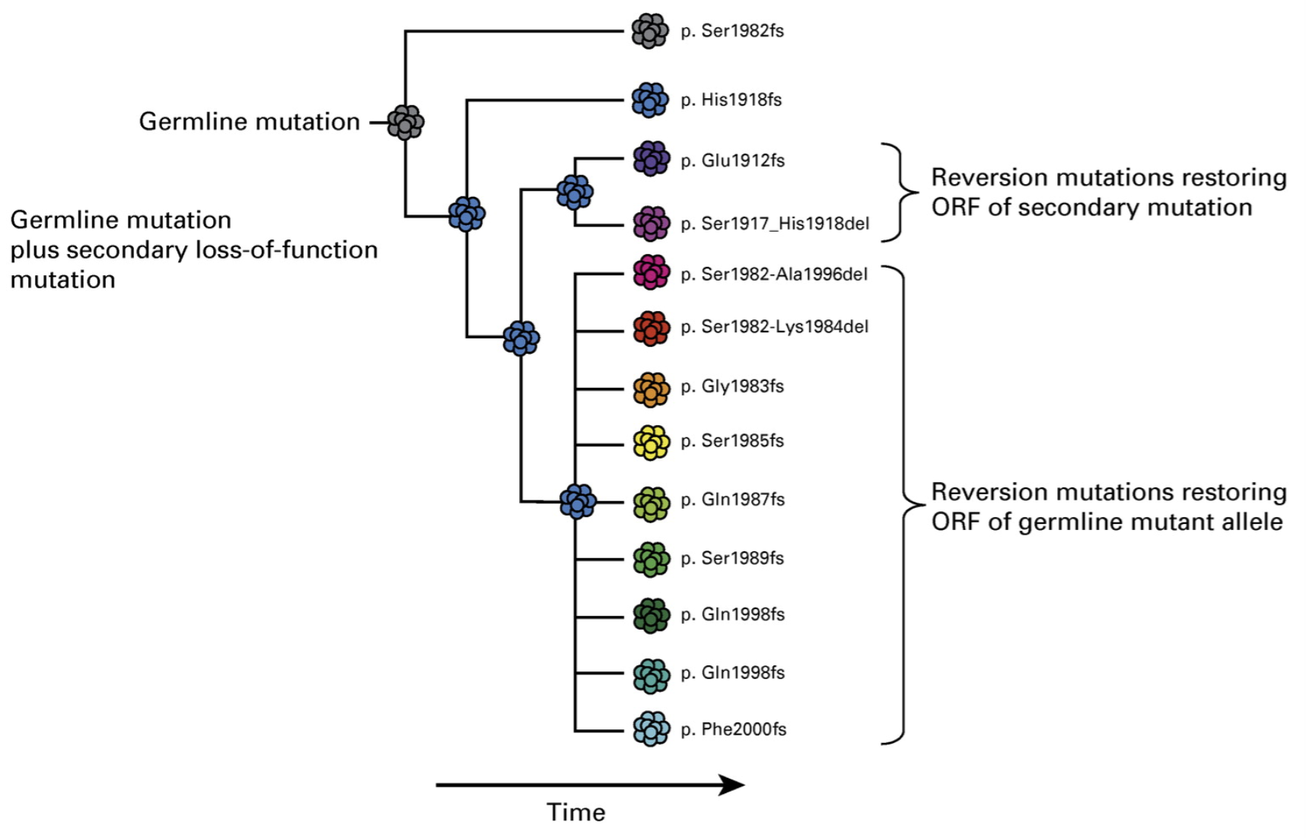
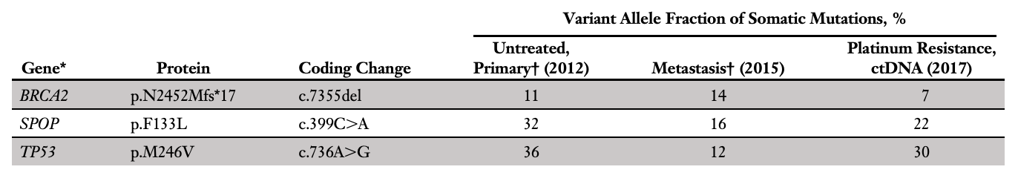
BRCA2 reversion mutations as resistance mechanisms
Previously described for ovarian cancer populations
Somatic mutations restoring open reading frame (ORF) of BRCA gene → makes functional protein →
tumor cells restore homologous repair for DNA breaks → resistant to platinum and PARP inhibitors
Patient 1 at UW: mCRPC treated with platinum
Patient 2: mCRPC treated with olaparib
Germline BRCA2 mutation
11 somatic alterations
2 in cis to germline, restoring ORF
At time of progression, 17/90 BRCA2 mutations detected on ctDNA restored ORF
Guardant360 experience:
24/1534 pts with BRCA2 mutation
5/24 patients receiving PARPi or platinum
2/5 patients had BRCA2 reversion mutations
Carneiro BA et al, JCO Precis Oncol, 2018
Cheng HH et al, JCO Precis Oncol, 2018

Slide 12
What about all those combinations?
Olaparib-abiraterone
Talazoparib-enzalutamide
PROPEL
TALAPRO
Niraparib-abiraterone
MAGNITUDE

Slide 13


Combination PARPi trials
PROpel: Abiraterone + Olaparib¹
mCRPC
Published
MAGNITUDE: Abiraterone + Niraparib²
Published
TALAPRO-2: Enzalutamide + Talazoparib
Published
CASPAR: Enzalutamide + Rucaparib Enrolling
Closing
mCSPC
TALAPRO-3: Enzalutamde + Talazoparib Enrolling
AMPLITUDE: Abiraterone + Niraparib Enrolling
1. Clarke NW et al. NEJM Evidence. 2022;1(9):EVIDoa2200043. 2. Chi KN et al. J Clin Oncol. 2022;40(suppl 6):12.

Slide 14
PROpel: Phase III Trial Design
Least selected – all comers with mCRPC
N=796
Patients
Key eligibility
Progressive mCRPC
First-line setting (may have previously received docetaxel at mCSPC stage)
ECOG performance ≤ 1
Stratification
Metastasis: bone only vs. visceral vs. other
Docetaxel treatment at mCSPC stage: yes vs. no
HRR status by circulating tumor DNA testing
R
A
N
D
O
M
I
Z
E
D
1:1
Olaparib tablets
300 mg bid
+
* Abiraterone
1000 mg qd
(N=399)
Efficacy end points
Primary:
rPFS assessed by investigator
Secondary:
Time to subsequent therapy or death
Time to pain progression
Overall survival
Safety:
Safety and tolerability
Placebo
+
* Abiraterone
1000 mg qd
(N=397)
*Prednisone/prednisolone (5 mg) to be administered alongside abiraterone as indicated
www.clinicaltrials.gov: (NCT03732820)
Notes:
The second study, PROpel is investigating the combination of olaparib with abiraterone in the first line Mcrpc setting. This study plans to include a total of 720 patients . The primary endpoint is radiographic PFS, and OS is a key secondary endpoint. The study does not have a selected cohort of patients positive for HRR mutations.

Slide 15
MAGNITUDE: Phase III Trial Design
Cleanest prospective selection HRR-positive vs HRR-negative
Patients
Key eligibility
DNA repair gene defects (DRD) status
  Cohort 1: Positive for DRD
  Cohort 2: Negative for DRD
Progressive mCRPC
Score ≤ 3 on brief pain inventory-short form (BPI-SF)
Prior history of 2nd gen ARi or taxanes in mCSPC is allowed
≤ 4 months on abiraterone (in mCRPC) prior to randomization
R
A
N
D
O
M
I
Z
E
D
1:1
Niraparib capsules
200 mg qd
+
* Abiraterone
1000 mg qd
Efficacy end points
Primary:
rPFS by PCWG3 assessed per blinded independent central review
Secondary:
Overall survival
Time to symptomatic progression
Time to initiation of cytotoxic chemotherapy
Placebo
+
* Abiraterone
1000 mg qd
*Prednisone (10 mg) to be administered alongside abiraterone as indicated
www.clinicaltrials.gov: (NCT03748641)
Notes:
The last study, MAGNITUDE, is investigating the combination of niraparib with abiraterone in first line metastatic CRPC setting. The primary endpoint is radiographic PFS, and OS is a secondary endpoint. This study does include separate cohorts of patients unselected and selected for HRR mutations. While we are anxiously awaiting the results from these trials in mCRPC setting, the AMPLITUDE study has already moved this combinatorial regimen to the earlier setting of metastatic castration sensitive prostate cancer

Slide 16
TALAPRO-2: Phase III Trial Design
Hybrid population – all comers for cohort 1,
HRR altered enrichment in cohort 2
First-line mCRPC patients
Stratification:
Previous abiraterone or taxane-based chemotherapy for CSPC
HRR alteration status
Two patient populations for final analyses:
R
A
N
D
O
M
I
Z
E
D
1:1
Talazoparib
0.5 mg qd
+
Enzalutamide
160 mg qd
(N=509)
Efficacy end points
Primary:
rPFS per RECIST 1.1 and PCWG3 in Cohort 1 and Cohort 2
Secondary:
Overall survival
Soft tissue OR per RECIST 1.1
Duration of soft tissue response per RECIST 1.1
Proportion of patients with PSA response ≥ 50%
Time to PSA progression
Time to initiation of cytotoxic chemotherapy
(1) All comers (HRR agnostic)
HRRm
Placebo
+
Enzalutamide
160 mg qd
(N=509)
Unselected
(2) HRR deficient only
Unselected
HRRm
www.clinicaltrials.gov: (NCT03395197)
Agarwal N et al. Future Oncol. 2022;18(4):425-436.
Notes:
The next study, TALAPRO-2, is a combination of talazoparib with enzalutamide versus placebo plus enzalutamide. This study plans to recruit a total of 860 mCRPC patients with documented disease progression at study entry, no prior systemic therapy for CRPC, no prior history of receiving a PARP inhibitor, 2nd generation AR inhibitor, and prior therapy with taxane, immunotherapy, or radium in CSPC is acceptable if discontinued prior to Day 1 randomization. Patients will be randomized 1:1 to either arm. Two cohorts will be used for stratification; the first will consist of 560 patients which are unselected for DDR status, and the second will include patients known to harbor DDR deficiencies. The primary endpoint is radiographic PFS, with co-secondary endpoints of OS, soft tissue objective response, duration of soft tissue response, proportion of patients with PSA response ≥ 50%, time to PSA progression, and time to initiation of cytotoxic chemotherapy.

Slide 17
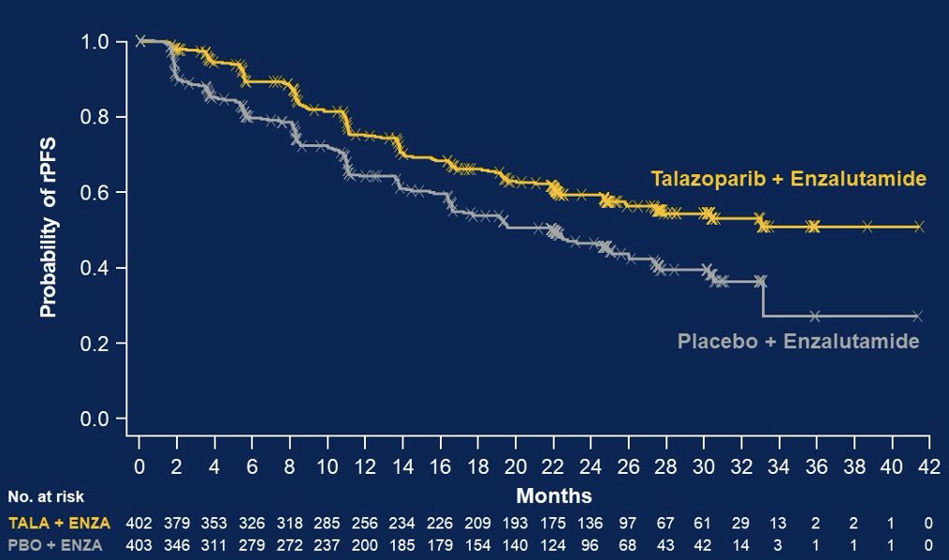
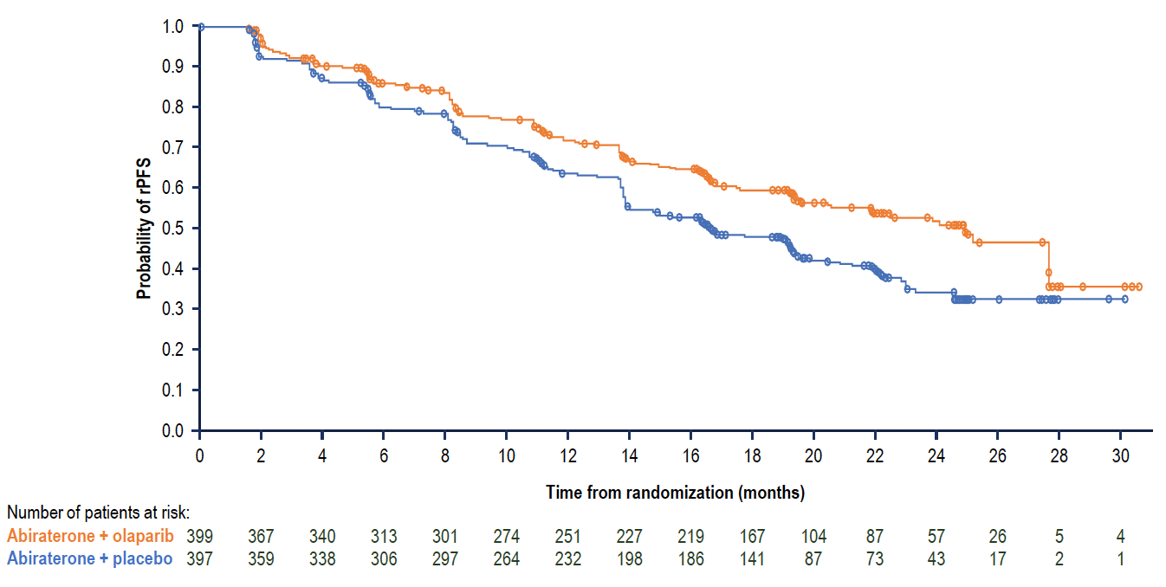
Radiographic Progression Free Survival in unselected populations
PROPEL: Olaparib/abiraterone rPFS
TALAPRO-2: Talazoparib/enzalutamide rPFS cohort 1
De bono J et al, ESMO 2022
Agarwal N et al, GU ASCO 2023
Chi KN et al, JCO 2023

Slide 18
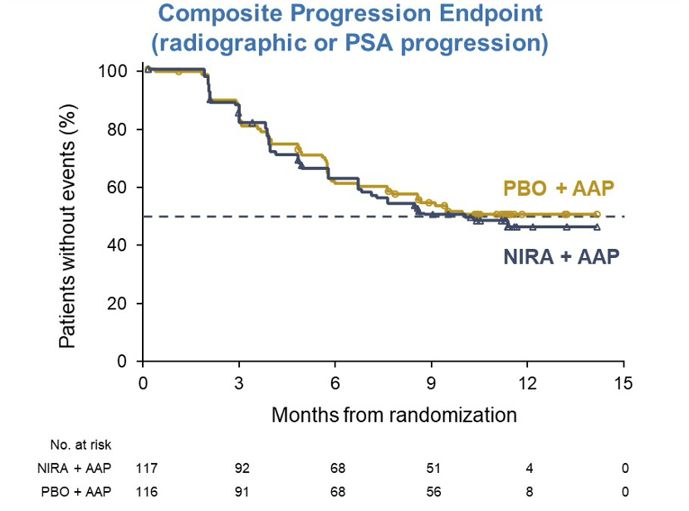
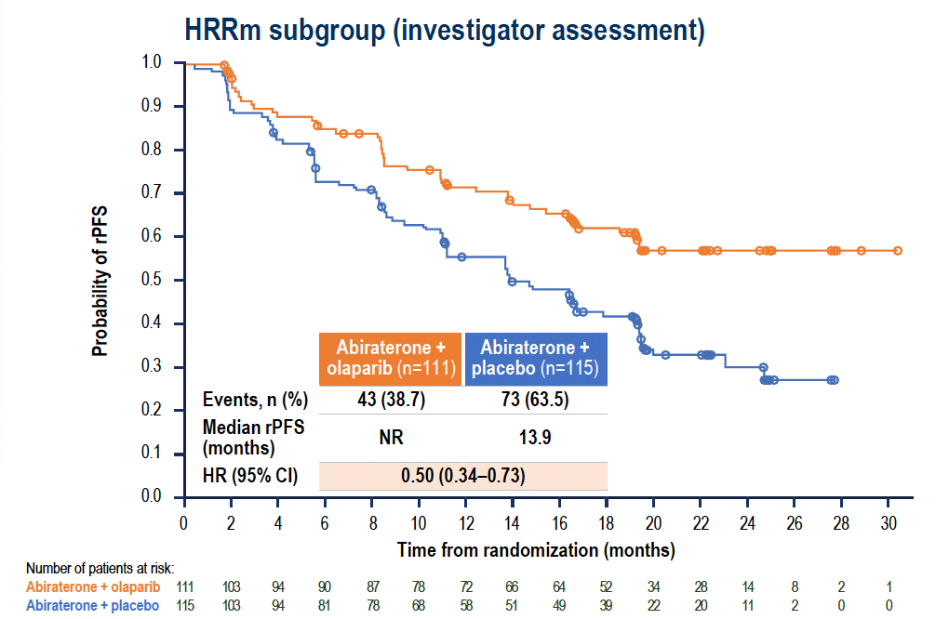
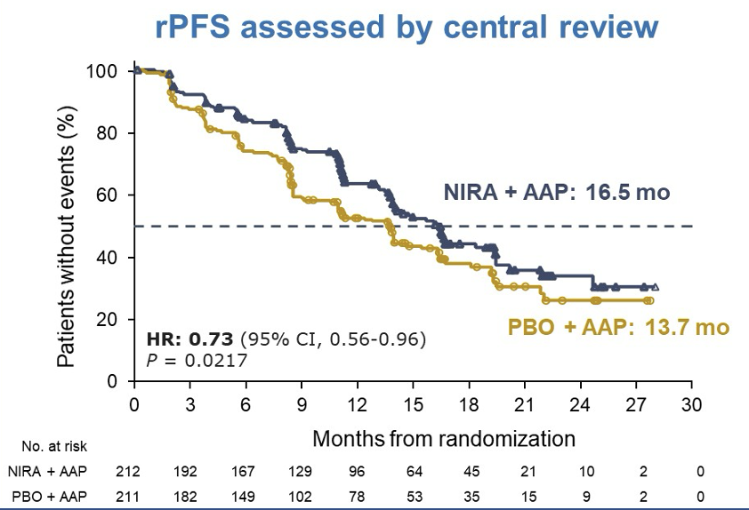
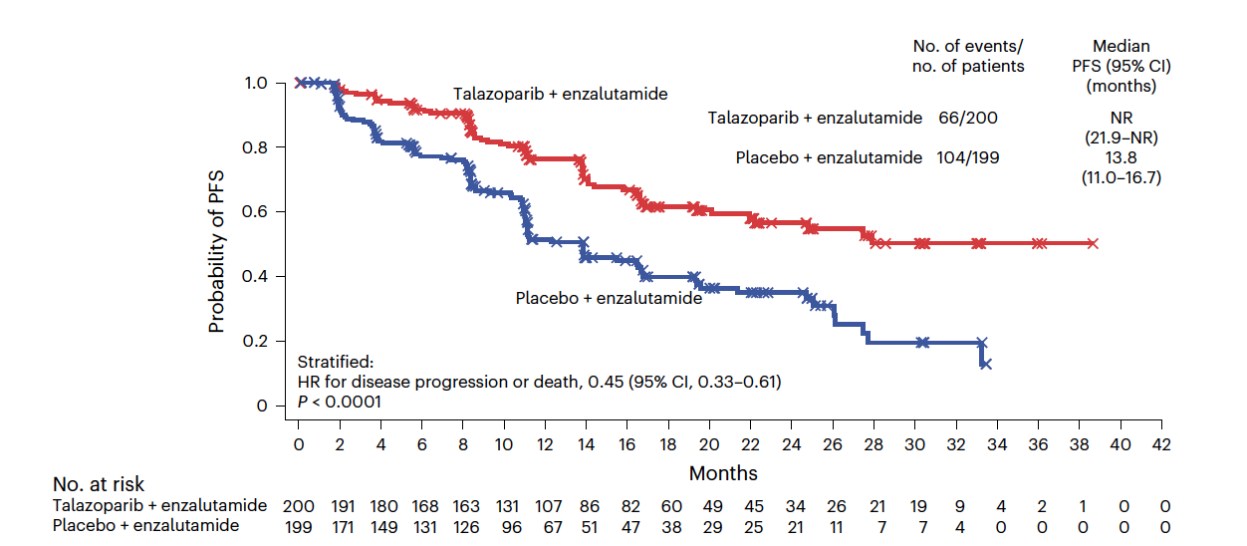
MAGNITUDE: rPFS in HRR- patients
rPFS benefit driven by HRR-altered groups
PROPEL: Olaparib/abiraterone rPFS
MAGNITUDE: Niraparib/abiraterone rPFS
TALAPRO-2: Talazoparib/enzalutamide rPFS
De bono J et al, ESMO 2022
Chi KN et al, GU ASCO 2022
Chi KN et al, JCO, 2023
Fizazi K et al, Nat Med, 2023

Slide 19
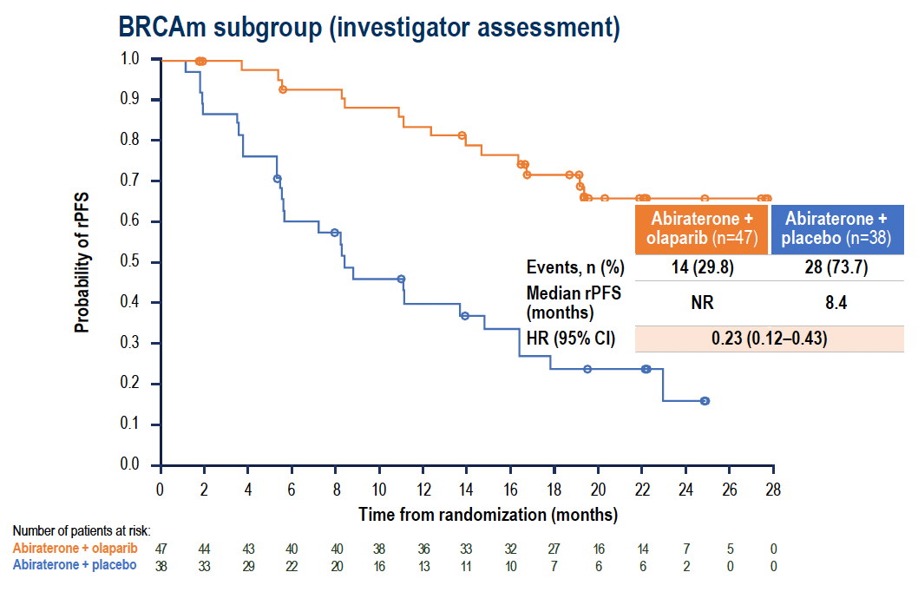
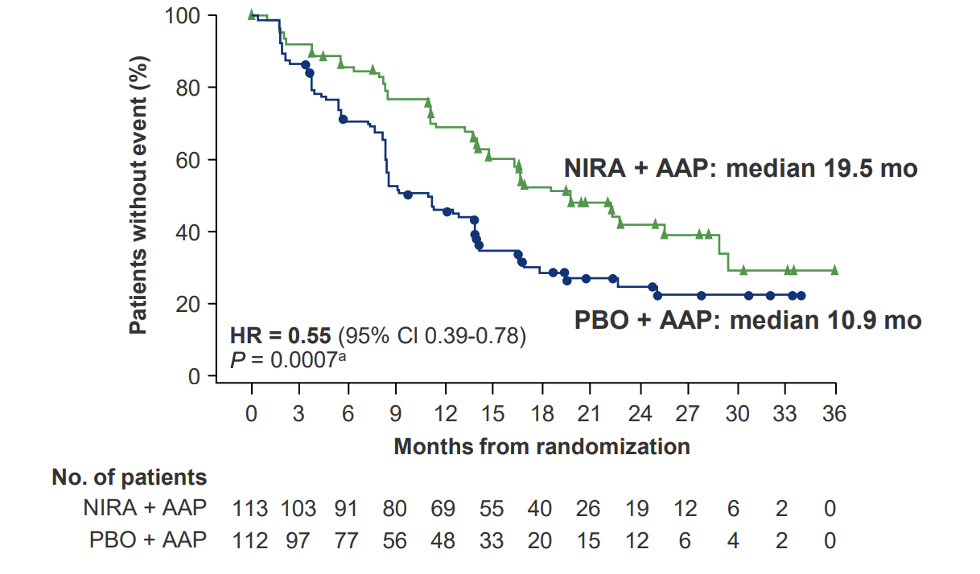
rPFS benefit driven in particular by BRCA1/BRCA2-altered subgroups
PROPEL: Olaparib/abiraterone rPFS
MAGNITUDE: Niraparib/abiraterone rPFS
De bono J et al, ESMO 2022
Agarwal N et al, GU ASCO 2023
Chi KN et al, Ann of Onc, 2023

Slide 20
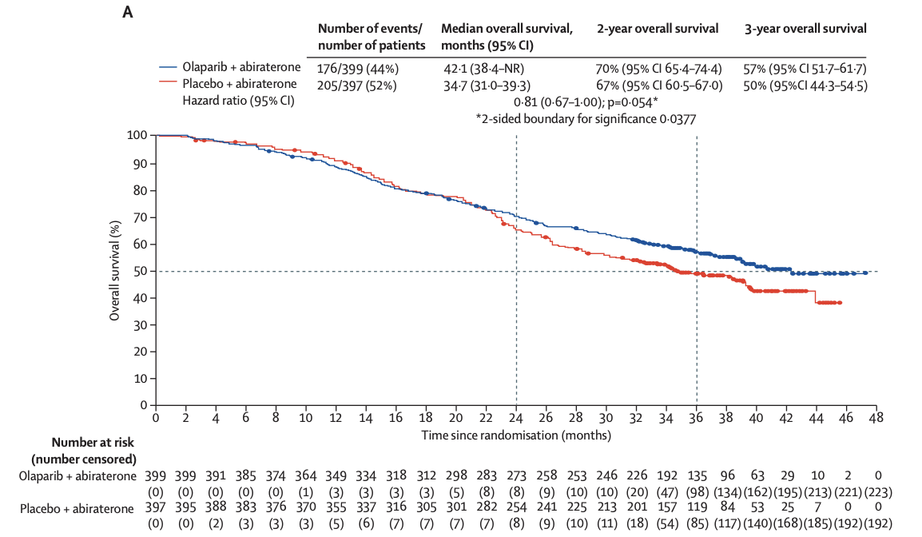
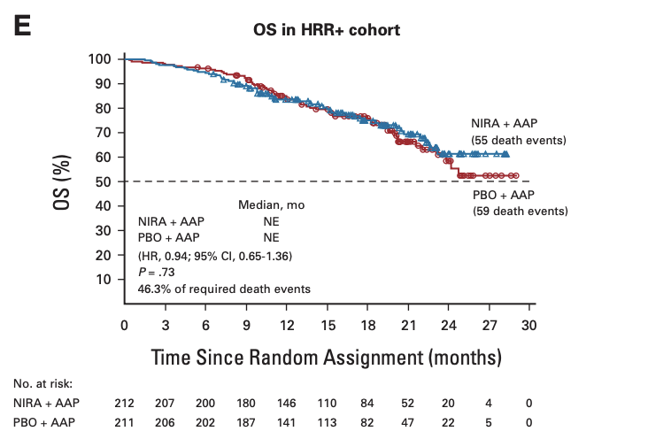
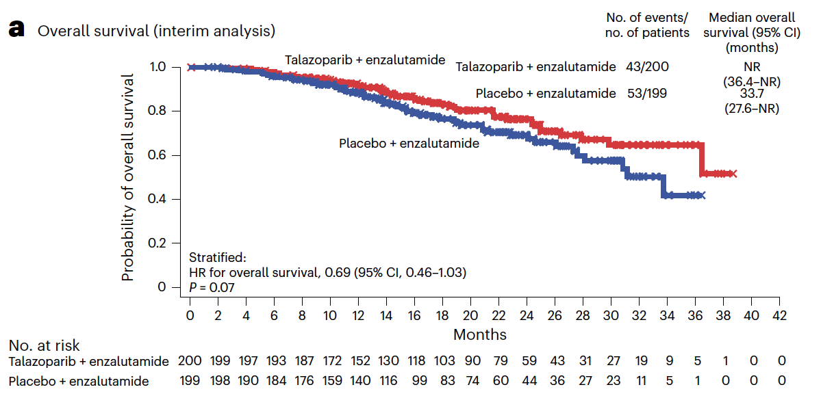
Overall survival – not quite there across combination trials
PROPEL: Olaparib/abiraterone OS
MAGNITUDE: Niraparib/abiraterone OS
TALAPRO-2: Talazoparib/enzalutamide OS
Saad F et al, Lancet Oncol, 2023
Chi KN et al, GU ASCO 2022
Chi KN et al, JCO, 2023
Fizazi K et al, Nat Med, 2023
Overall survival as endpoint may not be met
if patients in control cohort have access to
PARP inhibitors and cross over after study

Slide 21
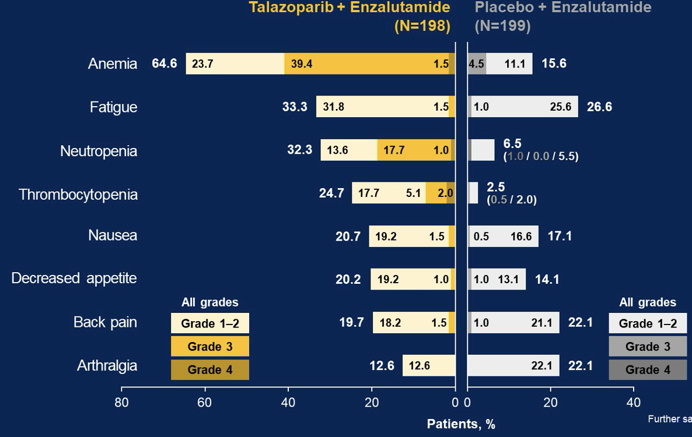
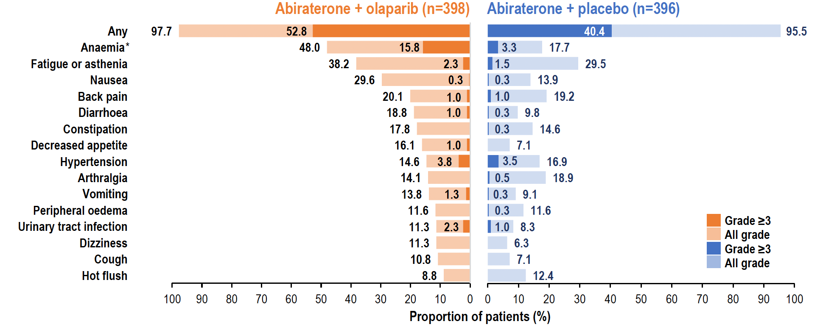
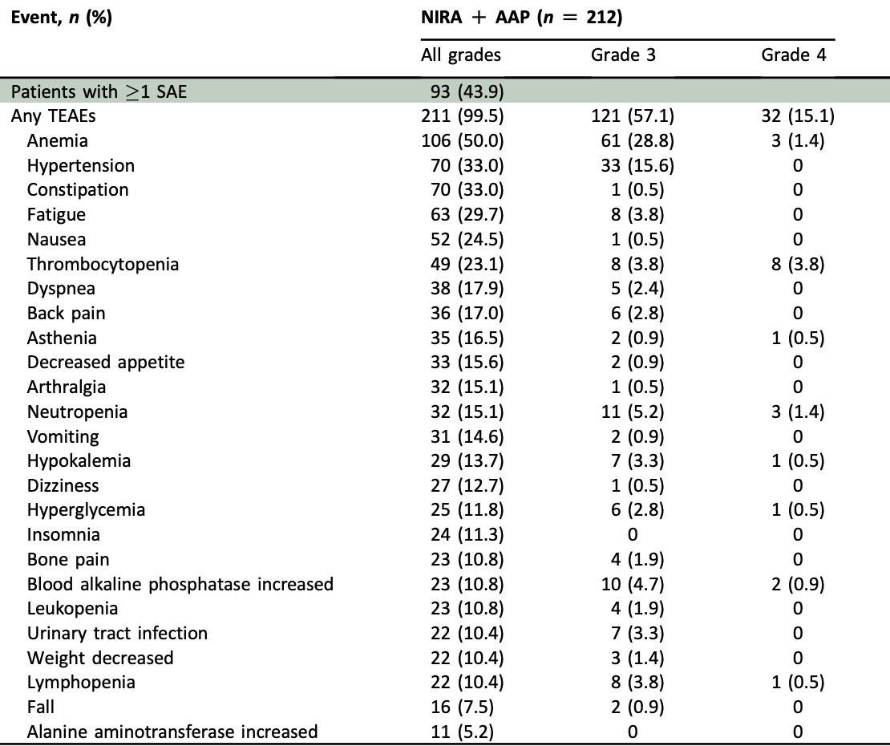
Adverse events across combination trials
TALAPRO-2: Talazoparib/enzalutamide AEs
PROPEL: Olaparib/abiraterone AEs
MAGNITUDE:
Niraparib/abiraterone AEs
De bono J et al, ESMO 2022
Agarwal N et al, GU ASCO 2023
Chi KN et al, Ann of Onc, 2023

Slide 22
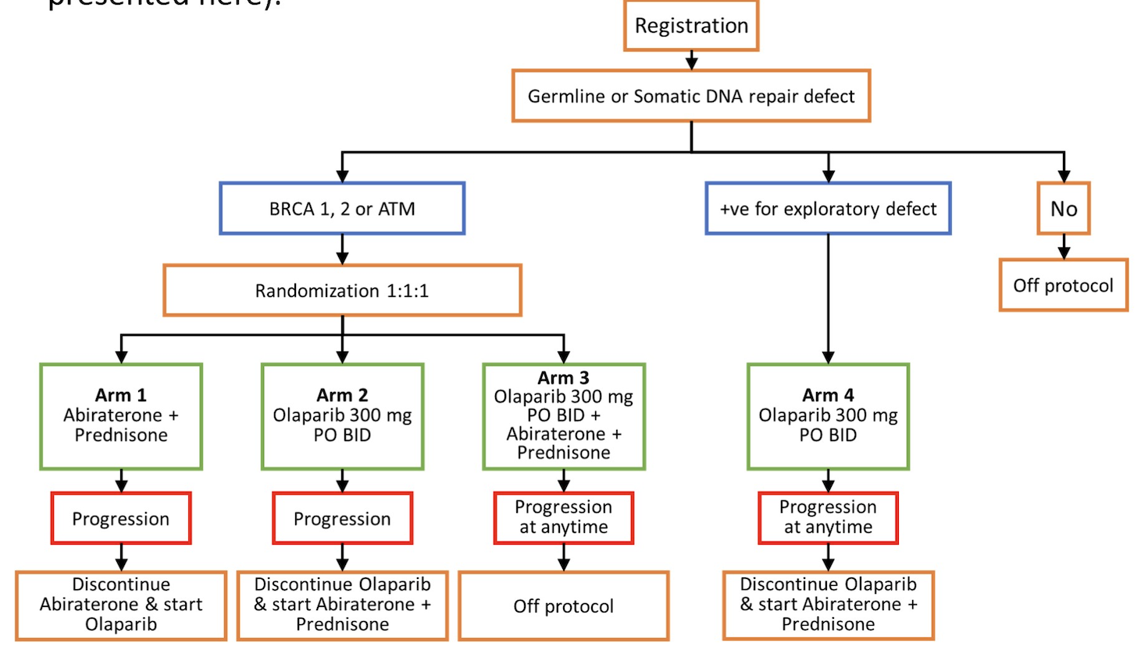
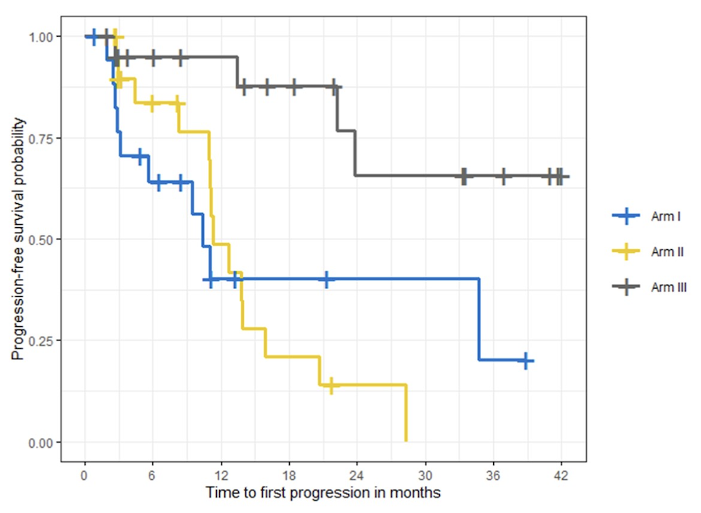
BRCAAway trial – investigator-led trial asking the contribution of each treatment
Progression free survival
N=161
N=61
Olaparib+abiraterone
Olaparib
Abiraterone
Awaiting overall survival data
Hussain M et al, GU ASCO 2022

Slide 23
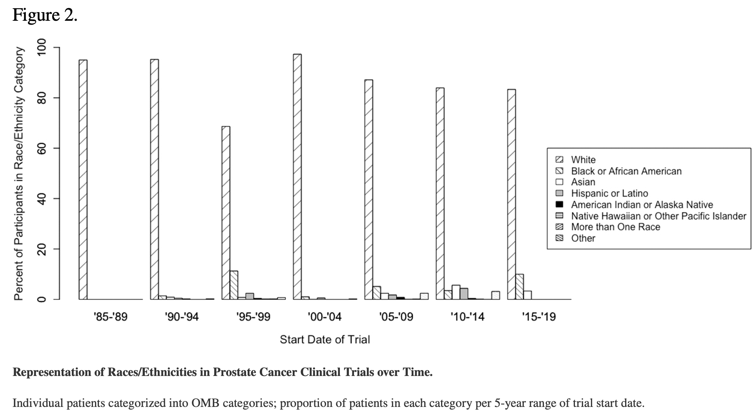
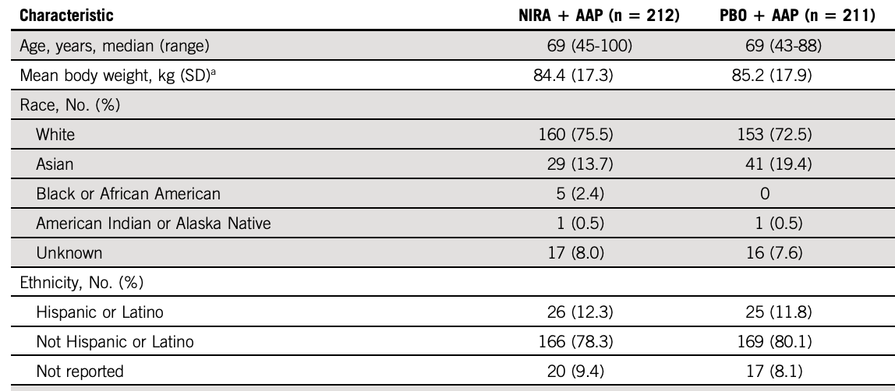
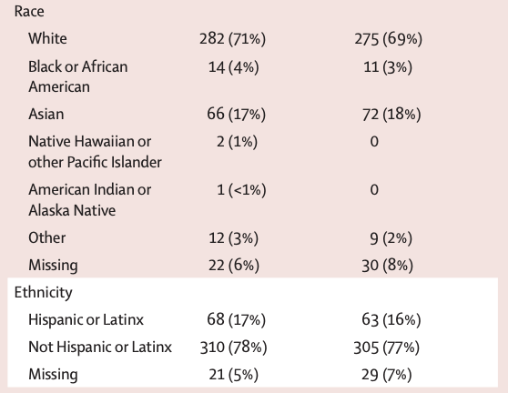
How are we doing on generalizability of treatment to underrepresented populations?
Races/ethnicities in prostate cancer trials over time
MAGNITUDE baseline characteristics
PROPEL baseline
Year of trial start
So as any clinical trialist would do,
we designed a trial…
Chi KN et al, JCO 2023
Rencsok et al, Cancer Epidemiol Biomarkers Prev, 2020

Slide 24

Schema – new investigator initiated trial through UTSW/Hoosiers network
HARMONY
HARMONY: Hispanic/Latino and non-hispanic blAck patients treated with niRaparib plus abiraterone/prednisone for Metastatic hOrmone sensitive prostate cancer with deleterious homologous recombinatioN repair alterations studY
Primary endpoint:
PSA < 0.2 decline rate
Key Eligibility Criteria
Adenocarcinoma of the prostate
Metastatic, hormone sensitive, treatment naïve
Any deleterious HRR alteration(s)
ECOG =< 2
No co-morbidities that preclude ADT, niraparib, AAP, and docetaxel
N= 30 per ethnic/racial background:
  Hispanic/Latino
  Non-Hispanic Black
Cohort A
ADT + AAP + 6 doses of docetaxel⁺
ADT
+
Niraparib
+
AAP
x 24 weeks
PSA > 4
ADT + niraparib + AAP
Registration
Adapted for PSA response
2 years total (or progression/unacceptable toxicity]
PSA > 0.2
ADT + niraparib + AAP
Cohort B
ADT + niraparib + AAP
x 28 weeks
PSA < 4
Stop at 1 year*
PSA < 0.2
AAP: abiraterone/prednisone; ADT: androgen deprivation therapy; HRR: Homologous Recombination Repair
+optional
*Optional.
For patients who stop at 1 year, option restart ADT +/- AAP +/- niraparib at PSA and/or radiographic progression
Adapted for treatment
discontinuation
Janie Qin, MD

Slide 25
Takeaways
PARP inhibitors are established treatment for mCRPC with HRR alterations
Genomic testing is important to find HRR alterations when we can for early patient selection
Disease effect is highest in patients with BRCA1/2 alterations, some disease stability with ATM alterations
  BRCA2 reversion mutations can occur as resistance mechanisms
Jury may be out on when to use combination vs monotherapy
More data on horizon for mHSPC (TALAPRO-3 and AMPLITUDE)
HARMONY trial launching in 2024 – evaluate treatment benefit in underrepresented populations in mHSPC

Slide 26



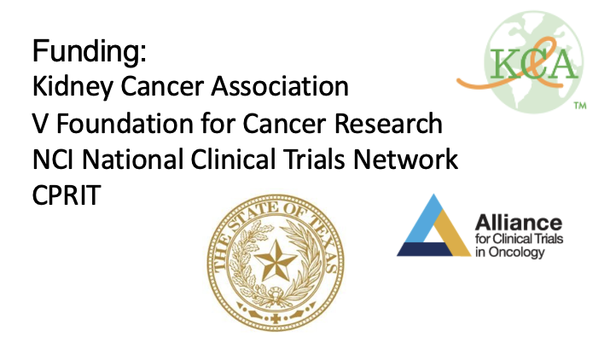

Thank you for your attention!
Thanks to our patients who teach us.
UT Southwestern GU
James Brugarolas Neil Desai Yair Lotan
Hans Hammers Aurelie Garant Vitaly Margulis
Kevin Courtney Raquibul Hannan Sol Woldu
Janie Qin Andrew Wang Jeff Cadeddu
Waddah Arafat Daniel Yang Claus Roehrborn
Jue Wang Kris Gaston
Isamu Tachibana
Petros, Evan, and Fred Hutch colleagues
@tiansterzhang
tian.zhang@utsouthwestern.edu

Slide 27
PROSTATE/RCC/BLADDER
Tuesday, December 12, 2023

Slide 28
‘Treatment Crossroads’: How to Choose the Best PARP inhibitor and Why in Prostate Cancer
Michael Schweizer, MD
Associate Professor
University of Washington/Fred Hutch Cancer Center
Seattle, WA

Slide 29
Disclosures
Paid consultant and/or received Honoria from Sanofi, AstraZeneca, Janssen and Pfizer.
Received research funding to his institution from Novartis, Zenith Epigenetics, Bristol Myers Squibb, Merck, Immunomedics, Janssen, AstraZeneca, Pfizer, Hoffman-La Roche, Tmunity, SignalOne Bio, Epigenetix, Xencor, Incyte and Ambrx, Inc.

Slide 30
Consideration when choosing a PAPR inhibitor
Current FDA label for each agent
Toxicity profile
Next-generation sequencing results

Slide 31
PARP inhibitors in mCRPC: monotherapy
Olaparib monotherapy^{1,2}
  Approved Pre- or post-taxane chemotherapy
  Qualifying mutations: BRCA1/2, ATM, BARD1, BRIP1, CDK12, CHEK1, CHEK2, FANCL, PALB2, RAD51B, RAD51C, RAD51D, or RAD54L
Rucaparib monotherapy³
  Post-taxane
  Qualifying mutations: BRCA1/2
de Bono, et al. N Engl J Med 2020;382:2091-102.
Hussain, et al. N Engl J Med 2020;383:2345-57.
Fizazi, et al. N Engl J Med 2023; 388:719-732

Slide 32
PARP inhibitors in mCRPC: combination therapy
Talazoparib plus enzalutamide¹
  Approved Pre- or post-taxane chemotherapy
  Qualifying mutations: BRCA1/2, ATM, ATR, CDK12, CHEK2, FANCA, MLH1, MRE11A, NBN, PALB2, or RAD51C
Niraparib plus abiraterone²; Olaparib plus abiraterone³
  Approved Pre- or post-taxane chemotherapy
  Qualifying mutations: BRCA1/2
Agarwal, et al. Lancet. 2023 Jul 22;402(10398):291-303.
Chi, et al. J Clin Oncol. 2023 Jun 20;41(18):3339-3351
Clarke, et al. NEJM Evid 2022;1(9)

Slide 33
PARP Inhibitor Monotherapy: Grade 1/2 AEs
Clinical Trial | PROfound phase 3 | GALAHAD phase 2 | TALAPRO-1 phase 2 | TRITON3 phase 3
Agent | Olaparib | Niraparib | Talazoparib | Rucaparib
Most common AEs grade 1 / 2
Anemia | 25% | 21.1% | ~ 19% | 23%
Fatigue | 38% | 30.1% | ~ 19% | 54%
Constipation | 18% | 32.9% | 18% | 26%
Thrombocytopenia | NF | 18.0% | ~ 11% | 13%
Nausea | 40% | 53.3% | ~ 32% | 47%
Vomiting | 16% | 34.9% | ~ 15% | 23%
Decreased appetite | 29% | 29.4% | ~ 26% | 16%
Neutropenia | NF | 9.3% | ~ 8% | 7%
Back pain | 13% | NR | ~ 16% | 19%
Dyspnea | 8% | NR | ~ 15% | 15%
Dizziness | NR | NR | ~ 14% | 12%
NR=not reported
de Bono J et al. N Engl J Med. 2020;382:2091-2102; Smith MR et al. Lancet Oncol. 2022; 23(3):362-373; Fizazi K et al. N Engl J Med. 2023;388:719-32; de Bono J et al. Lancet Oncol. 2021; 22:1250-64

Slide 34
PARP Inhibitor Monotherapy: Grade 3/4 AEs
Clinical Trial | PROfound phase 3 | GALAHAD phase 2 | TALAPRO-1 phase 2 | TRITON3 phase 3
Agent | Olaparib | Niraparib | Talazoparib | Rucaparib
Most common AEs grade 3 / 4
Anemia | 21% | 32.5% | 30% | 24%
Fatigue | 3% | 6.6% | ~2% | 7%
Constipation | 0% | 2% | ~1% | 1%
Thrombocytopenia | 3.5% | 16.3% | 8% | 6%
Nausea | 1% | 5.2% | ~3% | 3%
Vomiting | 2% | 3.5% | ~2% | 1%
Decreased appetite | 1% | 2.8% | 2% | <1%
Neutropenia | 3.9% | 9.7% | ~9% | 7%
Back pain | <1% | NR | <1% | 3%
Dyspnea | 2% | NR | ~2% | 1%
Dizziness | NR | NR | 0.0% | <1%
NR=not reported
de Bono J et al. N Engl J Med. 2020;382:2091-2102; Smith MR et al. Lancet Oncol. 2022; 23(3):362-373; Fizazi K et al. N Engl J Med. 2023;388:719-32; de Bono J et al. Lancet Oncol. 2021; 22:1250-64
Notes:
Niraparib has more platelet decrease

Slide 35
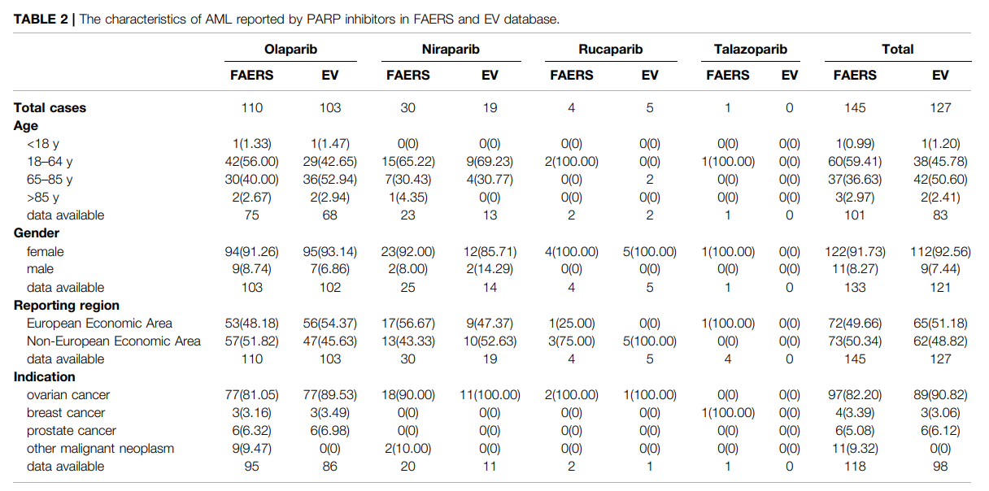
AML and PARP Inhibitors
Zhao Q et al. Front Pharmacol. 2022;13:912256.

Slide 36
Serious Side Effects and PARP Inhibitors
Clinical Trial | PROfound phase 3 | TRITON3 phase 3 | GALAHAD phase 2 | TALAPRO-1 phase 2
Agent | Olaparib | Rucaparib | Niraparib | Talazoparib
No. of cases occurring in the trial (%)
AML/MDS | 0 | 0 | NF | 0
DVT | NF | 3 (1%) | 6 (2%) | NF
PE | 11 (4%) | 9 (3%) | 4 (1.4%) | 8 (6.3%)
NF=not found
de Bono J et al. N Engl J Med. 2020;382:2091-2102; Smith MR et al. Lancet Oncol. 2022; 23(3):362-373; Fizazi K et al. N Engl J Med. 2023;388:719-32; de Bono J et al. Lancet Oncol. 2021; 22:1250-64

Slide 37
PARP Inhibitor Plus AR Inhibitors: Grade 1/2 AEs
Clinical Trial | MAGNITUDE phase 3 | QUEST phase 2 | PROpel phase 3 | TALAPRO-2 phase 3
Agent(s) | Niraparib + Abiraterone | Niraparib + Abiraterone | Olaparib + Abiraterone | Talazoparib + Enzalutamide
Most common AEs grade 1 / 2
Anemia | 17.9% | 12.5% | 30.9% | 19.3%
Fatigue | 23.1% | 37.5% | 34.9% | 29.6%
Constipation | 30.7% | 50.0% | 16.5% | NR
Thrombocytopenia | 21.2% | 20.8% | NR | 17.3%
Nausea | 23.1% | 37.5% | 27.8% | 20.1%
Vomiting | 12.7% | 33.3% | 12.1% | NR
Decreased appetite | 13.7% | 33.3% | 13.6% | 20.4%
Neutropenia | 7.1% | 8.4% | NR | 17.3%
Back pain | 12.2% | 20.8% | 16.3% | 19.6%
Dyspnea | 14.1% | 12.5% | NR | NR
Dizziness | 10.8% | 16.7% | 10.8% | NR
NR=not reported
Chi KN et al. J Clin Oncol. 2023;JCO2201649. Ahead of print; Fiazzi K et al. N Engl J Med. 2023;388(8):719-732; Clarke NW et al. N Engl J Med Evid. 2022;1(9); Agarwal N et al. J Clin Oncol. 2023;41(6_suppl ):LBA17-LBA17

Slide 38
PARP Inhibitor Plus AR Inhibitors: Grade 3/4 AEs
Clinical Trial | MAGNITUDE phase 3 | QUEST phase 2 | PROpel phase 3 | TALAPRO-2 phase 3
Agent(s) | Niraparib + Abiraterone | Niraparib + Abiraterone | Olaparib + Abiraterone | Talazoparib + Enzalutamide
Most common AEs grade 3 / 4
Anemia | 29.7% | 41.7% | 15.1% | 47.5%
Fatigue | 3.3% | 16.7% | 2.3% | 4.0%
Constipation | 0.0% | 0.0% | 0.0% | NR
Thrombocytopenia | 6.6% | 20.9% | NR | 7.3%
Nausea | 0.5% | 0.0% | 0.3% | 0.5%
Vomiting | 0.5% | 0.0% | 1.0% | NR
Decreased appetite | 0.5% | 0.0% | 1.0% | 1.3%
Neutropenia | 6.6% | 12.5% | NR | 18.4%
Back pain | 2.4% | 0.0% | 0.8% | 2.5%
Dyspnea | 1.9% | 4.2% | NR | NR
Dizziness | 0.5% | 0.0% | 0.0% | NR
NR=not reported
Chi KN et al. J Clin Oncol. 2023;JCO2201649. Ahead of print; Fiazzi K et al. N Engl J Med. 2023;388(8):719-732; Clarke NW et al. N Engl J Med Evid. 2022;1(9); Agarwal N et al. J Clin Oncol. 2023;41(6_suppl ):LBA17-LBA17

Slide 39
PROpel: Most Common Adverse Events
Olaparib + abiraterone (n=399)
Placebo + abiraterone (n=399)
16% vs 4% required pRBC transfusion
7% vs 2% VTEs
Grade ≥3
All grade
Grade ≥3
All grade
Saad F, et al. GU ASCO 2022.
Notes:
16% of patients in abi+ola arm required pRBC transfusion

Slide 40
Combo vs. Monotherapy?
Suggestion that there is more toxicity with combination
  Unknown how combo toxicity profile would compare to PARP inhibitor monotherapy
Control group was an ARSI → Unknown how combo would compare to PAPR inhibitor monotherapy
  PFS benefit implies additive benefit... is this enough when combining two active therapies?

Slide 41
Combo vs. Monotherapy?
These trials mainly enrolled patients exposed to ADT monotherapy
Unclear if combos are appropriate in patients progressing on abi/enza
ARSi
AR inhibition:
Upregulates PARP activity
Downregulates HRR gene expression
PARPi
AR
PARP
Schweizer Editorial: Current data is insufficient to recommend PARP inhibitor combinations for most patients
PARP inhibition:
Suppresses AR transcriptional activity
May attenuate resistance to ARSi
Suppresses AR activity
Disrupts SSB repair leading to DSB
Co-inhibition of AR and PARP may result in enhanced benefit in tumors with or without HRR gene alterations
Agarwal N, et al. J Clin Oncol. 2023;41(suppl 6):LBA17
Agarwal, et al. Lancet. 2023 Jul 22;402(10398):291-303.
Chi, et al. J Clin Oncol. 2023 Jun 20;41(18):3339-3351
Clarke, et al. NEJM Evid 2022;1(9)

Slide 42
Which patients should we offer PARP inhibitors to?

Slide 43
PROFound: Olaparib vs. abiraterone or enzalutamide
Cohort A: BRCA 1/2 or ATM
Cohort A + B: Any HR mutation
PFS
OS
de Bono, et al. N Engl J Med 2020;382:2091-102.
Hussain, et al. N Engl J Med 2020;383:2345-57.

Slide 44
PROFound: Benefit in those without BRCA1/2 alterations is unclear
>80% of cases had a mutation in BRCA1/2 (36%), CDK12 (23%) and ATM (22%)
BRCA1/2 Cohort
ATM Cohort
CDK12 Cohort
de Bono, et al. N Engl J Med 2020;382:2091-102.
Hussain, et al. N Engl J Med 2020;383:2345-57.

Slide 45
TRITON-2: Phase 2 Rucaparib Trial
Characteristic | By HRR Gene With Alteration
 | BRCA1/2 (n = 57) | ATM (n = 21) | CDK12 (n = 9) | CHEK2 (n = 5) | Other (n = 13)
ORR, n (%)ª | 25 (43.9) | 2 (9.5) | 0 | 0 | 5 (38.5)
Complete response, n (%) | 3 (5.3) | 0 | 0 | 0 | 1 (7.7)^{b}
Partial response, n (%) | 22 (38.6) | 2 (9.5) | 0 | 0 | 4 (30.8)^{c}
Stable disease, n (%) | 26 (45.6) | 10 (47.6) | 5 (55.6) | 3 (60.0) | 6 (46.2)
Progressive disease, n (%) | 5 (8.8) | 8 (38.1) | 3 (33.3) | 2 (40.0) | 1 (7.7)
Not evaluable, n (%) | 1 (1.8) | 1 (4.8) | 1 (11.1) | 0 | 1 (7.7)
Confirmed PSA response rate (all evaluable patients) | 51/98 (52%) | 2/57 (3.5%) | 1/14 (7.1) | 1/7 (14.3) | 5/14 (35.7%)
rPFS in BRCA1/2 Population
PARP inhibitors clearly work for patients with BRCA1/2 mutations. Limited data in other mutational subgroups.
ª Per modified RECIST/PCWG3 criteria. ^{b} One patient had FANCA alteration. ^{c} Two patients had a PALB2 alteration; 1 patient each had a BRIP1 or RAD51B alteration.
1. Abida W et al. ESMO 2019. Abstract 846PD.
43.9% confirmed objective responses were reported in 57 patients with BRCA1/2 mutation
52.0% confirmed PSA response in 98 PSA-evaluable patients with BRCA1/2 mutation
Notes:
TRITON2 led to accelerated approval for rucaparib post-docetaxel and only if BRCA alteration

Slide 46
How do we find PARP inhibitor eligible patients in the first place?
metastatic tissue vs. ctDNA vs. primary tissue

Slide 47
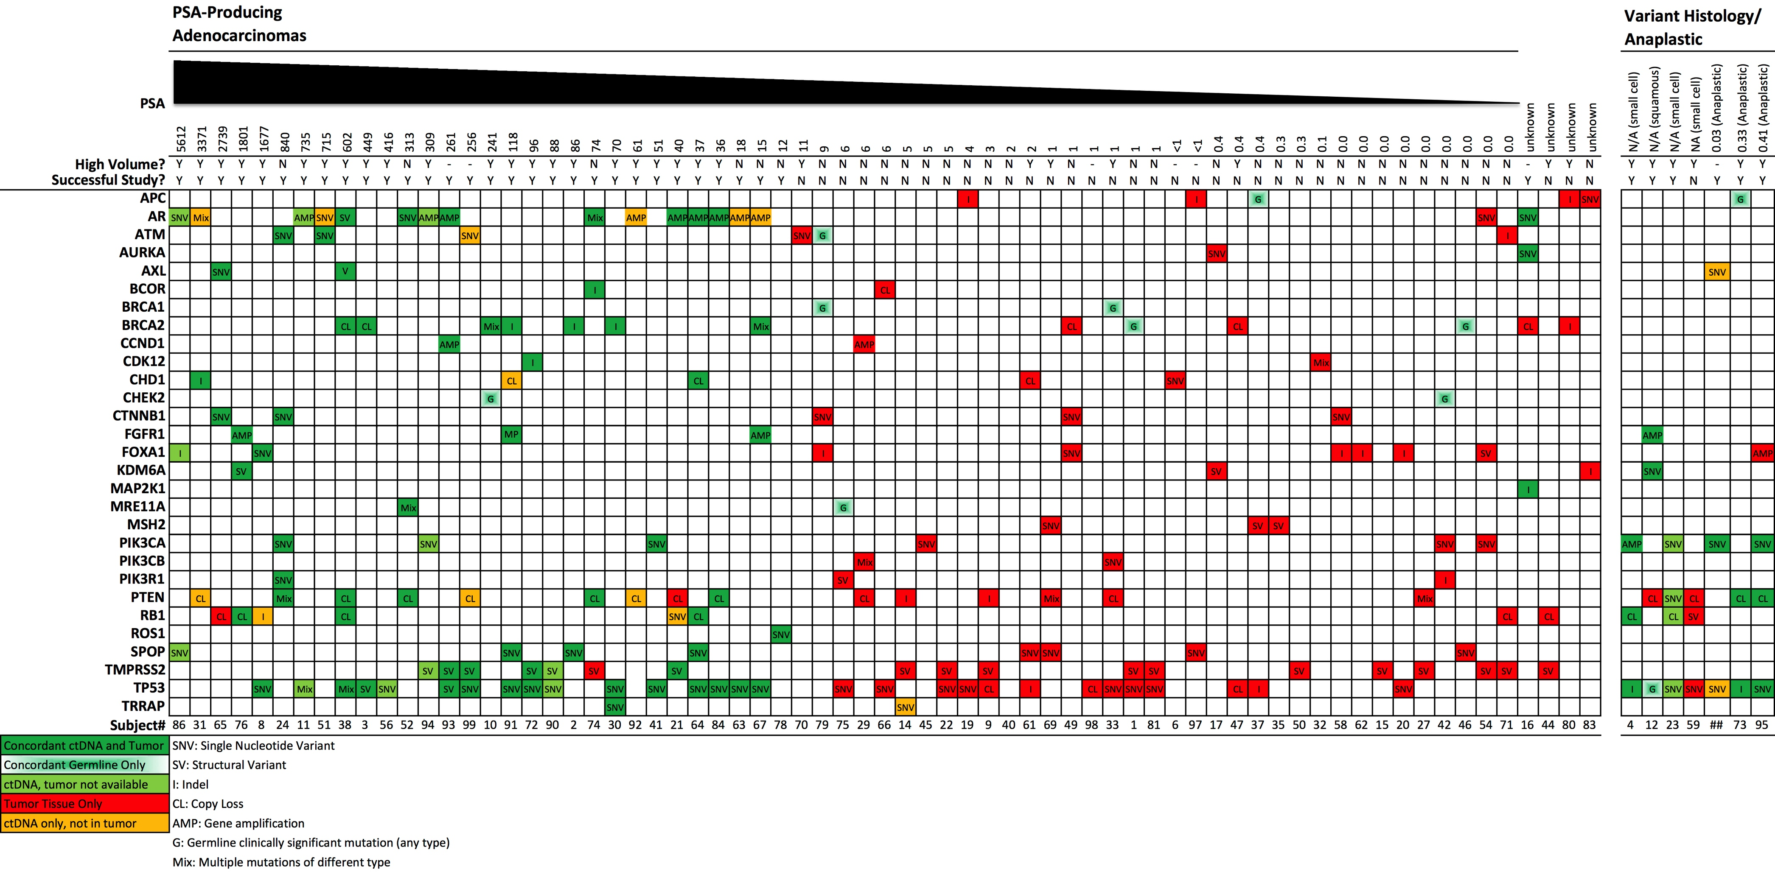
Sequencing concordance landscape
Many false negatives when sequencing cfDNA in those with low volume disease
Schweizer, et al. The Prostate. 2019;1–8.

Slide 48
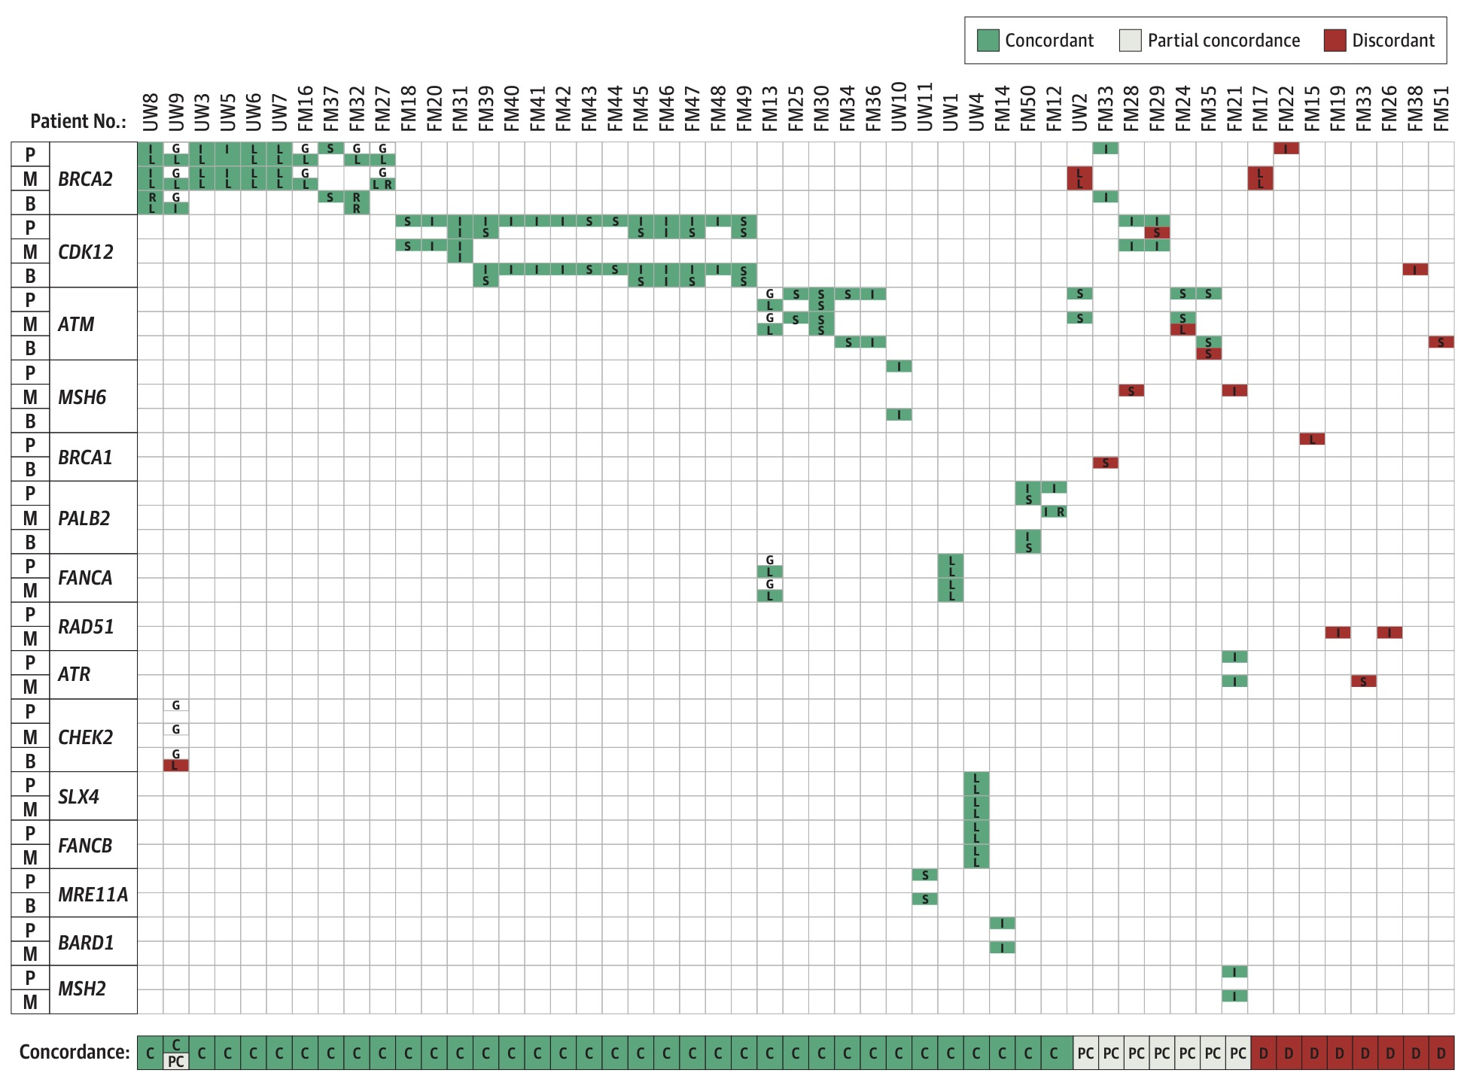
DNA Damage Repair Gene Mutations are Early Events
84% of cases with a DNA damage repair gene mutation were detectable in primary tissue
My approach:
Sequence metastatic tissue if easily accessible
ctDNA sequencing if high volume/PSA
Primary tissue if all else fails
Schweizer, et al. JAMA Oncol. 2021 Jun 4;7(9):1-5.
Mateo, et al. JCI 2020

Slide 49
Summary
Favor monotherapy over combination
  Combos show more hematologic toxicity and no clear OS benefit
  No data in patients who have progressed on an ARSI
Similar toxicity between PARP inhibitors
Typically give PARP inhibitors pre-chemo → olaparib only approved monotherapy in this space
Non-BRCA1/2 mutations: trials preferred
  Unclear benefit in ATM or CDK12 altered cases

Slide 50
Thank You! schweize@uw.edu

Slide 51



Recent Advances in the Management of Metastatic Urothelial Carcinoma
Petros Grivas, MD PhD
Professor, Dept. of Medicine, Division of Hematology Oncology
Clinical Director, Genitourinary Cancers Program
University of Washington
Professor, Clinical Research Division
Fred Hutchinson Cancer Center
Twitter/X: @PGrivasMDPhD

Slide 52
Disclosures
Institutional research funding: Acrivon Therapeutics; ALX Oncology, Bavarian Nordic; Bristol-Myers Squibb; Debiopharm; Merck KGaA; Gilead; Pfizer; MSD; QED Therapeutics; GlaxoSmithKline; G1 Therapeutics; Mirati Therapeutics
Consulting: 4D Pharma PLC, Aadi Bioscience; AstraZeneca; Asieris Pharmaceuticals, Astellas Pharma, BMS; Boston Gene, CG Oncology, Dyania Health; Lucence Health; Fresenius Kabi, G1 Therapeutics; Gilead; Guardant Health; ImmunityBio; Infinity Pharmaceuticals; Janssen; Merck KGaA; MSD; Pfizer; PureTech; Roche, Seattle Genetics, Strata Oncology, Silverback Therapeutics, UroGen

Slide 53
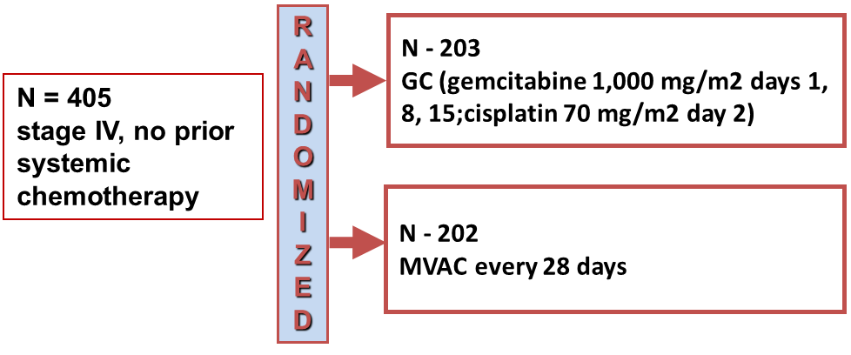
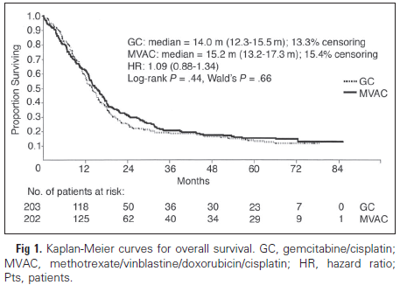
Metastatic UC (1st line): a standard for a long time…
Comparable ORR between GC & ‘classic’ MVAC
Median PFS: 7.7m (GC) and 8.3 m (MVAC)
Median OS (14 vs. 15 months)
Similar 5-y OS rate (13-15%) (p=0.53)
Less G ¾ AEs with GC, e.g. neutropenia (71 vs. 82%), neutropenic sepsis (2% vs 14%), mucositis (1% vs 22%)
Trial was designed to assess if GC is superior and was not powered to demonstrate non-inferiority
Most patients get GC (dose dense MVAC easier & better than older ‘classic’ MVAC)
Von der Maase H et al, JCO, 2000 (17): 3068-77

Slide 54
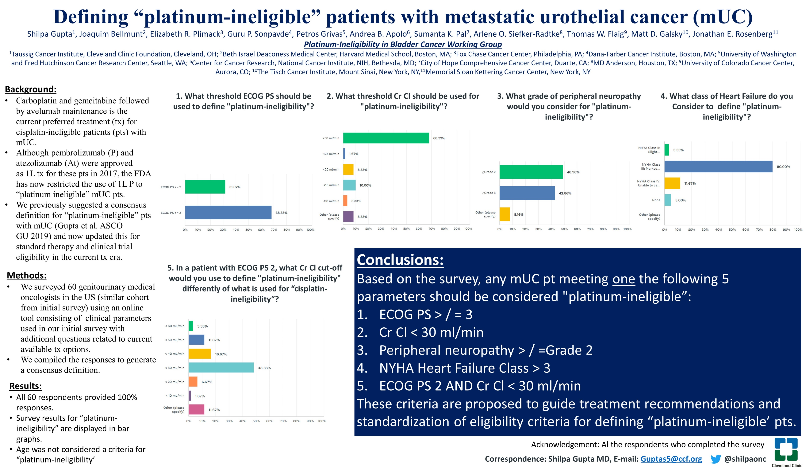
Slide 1

Slide 55
Different strategies aiming to impact 1L SoC
Metastatic UC
CR / PR / SD following platinum-based treatment
Metastatic UC
Cisplatin eligible / ineligible
Metastatic UC
Cisplatin eligible / ineligible
R
R
R
IO
    Placebo / BSC
IO
    IO + chemo
    Chemo
IO
    IO + IO or ADC
    Chemo
JB100 [NCT02603432] | avelumab | BSC | OS
HOOSIER [NCT02500121] | pembro | placebo | 6-mo PFS
KN361 [NCT02853305] | pembro | pembro + chemo | chemo | OS, PFS
CM901 [NCT03036098] | -- | nivo + chemo* | chemo | OS, PFS
IMvigor130 [NCT02807636] | atezo | atezo + chemo | chemo | OS, PFS, safety
DANUBE [NCT02516241] | durva | durva + treme | chemo | OS
CM901 [NCT03036098] | -- | nivo + ipi | chemo | OS, PFS
EV-302 [NCT04223856] | -- | pembro + EV | chemo | OS, PFS
*For cisplatin-eligible patients only

Slide 56
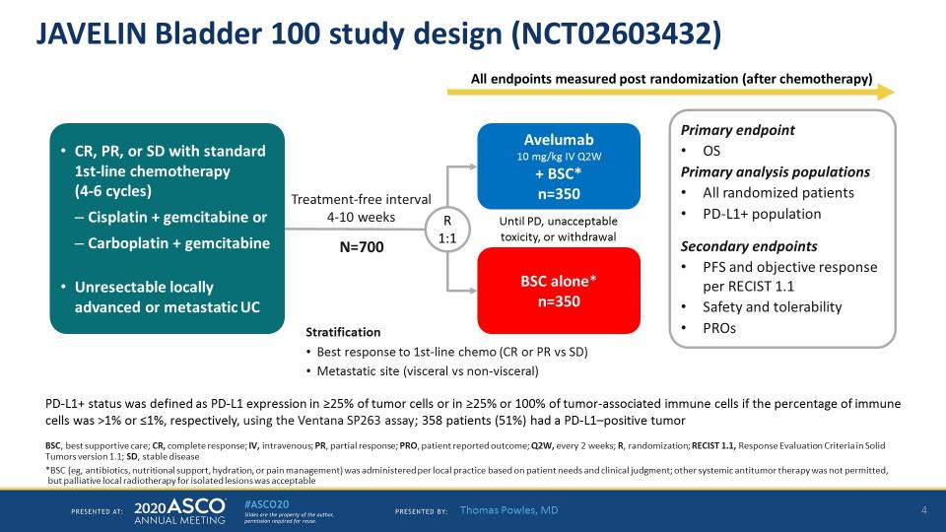
JAVELIN Bladder 100 study design (NCT02603432)

Slide 57
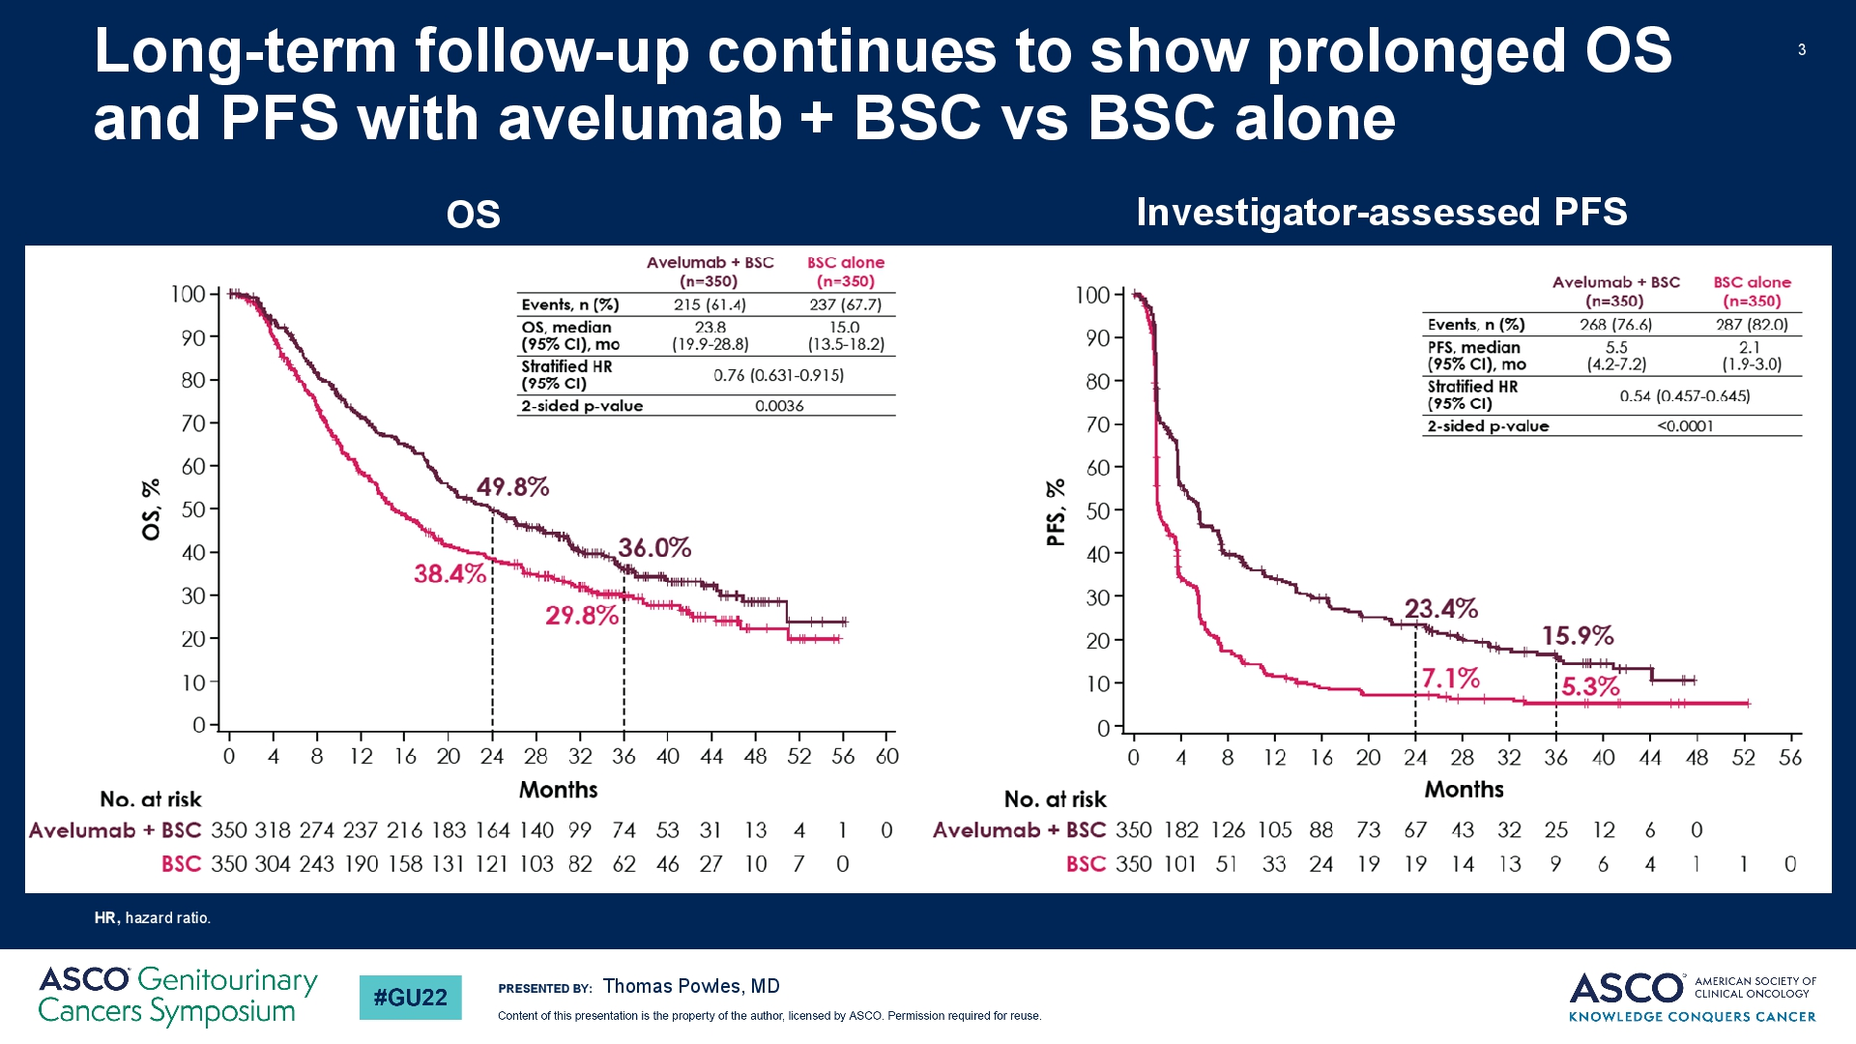
$Title$

Slide 58
Study design (NIVO+GC vs GC in cisplatin-eligible patients)ª
Stratification factors:
Tumor PD-L1 expression (≥ 1% vs < 1%)
Liver metastases (yes vs no)
Combination phase
Monotherapy phase
Key inclusion criteria
  Age ≥ 18 years
  Previously untreated unresectable
  or mUC involving the renal pelvis, ureter, bladder, or urethra
  Cisplatin eligible^{b}
  ECOG PS of 0-1
NIVO 360 mg + GC^{c}
Q3W (up to 6 cycles)
N = 304
NIVO 480 mg
Q4W (until progression, unacceptable toxicity, withdrawal, or up to 24 months^{e})
3 weeks^{d}
R
1:1
GC^{c}
Q3W (up to 6 cycles)
N = 304
Primary endpoints: OS, PFS per BICR
Key secondary endpoints: OS and PFS by PD-L1 ≥ 1%, HRQoL
Key exploratory endpoints: ORR per BICR, safety
Median (range) study follow-up 33.6 (7.4–62.4) months
ªFurther CheckMate 901 study design details are available at https://clinicaltrials.gov/ct2/show/NCT03036098. ^{b}Cisplatin eligibility was determined in the study population by a GFR ≥ 60 mL/min (assessed by direct measurement, ie, creatinine clearance, or, if not available, using the Cockcroft-Gault formula), and absence of CTCAE v.4 grade ≥ 2 hearing loss and grade ≥ 2 peripheral neuropathy. ^{c}Patients who discontinued cisplatin alone could be switched to gemcitabine-carboplatin for the remainder of the platinum doublet cycles (up to six cycles in total). ^{d}NIVO monotherapy should begin 3 weeks after the last dose of NIVO+GC combination. ^{e}Represents a maximum of 24 months from the first dose of NIVO administered as part of the NIVO+GC combination.
BICR, blinded independent central review; CTCAE, Common Terminology Criteria for Adverse Events; ECOG PS, Eastern Cooperative Oncology Group performance status; GFR, glomerular filtration rate; HRQoL, health-related quality of life; ORR, objective response rate; PD-L1, programmed death ligand 1; PFS, progression-free survival; Q×W, every × weeks; R, randomization.

Slide 59
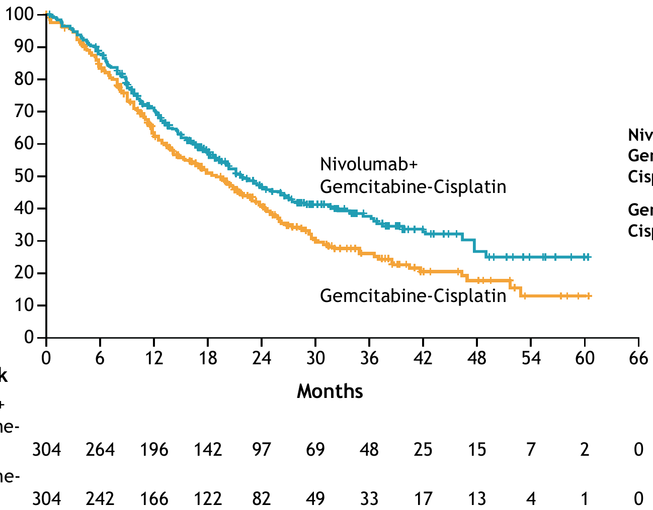
OS (primary endpoint)
OS final analysis statistical boundaries:
P value boundary, 0.0311
Critical HR, 0.7980
12-month rate:
70.2%
62.7%
Treatment | Events/patients | Median OS (95% CI), months
NIVO+GC | 172/304 | 21.7 (18.6-26.4)
GC | 193/304 | 18.9 (14.7–22.4)
HR (95% CI), 0.78 (0.63–0.96) P = 0.0171
24-month rate:
46.9%
40.7%
Probability (%)
No. at risk
NIVO+GC
GC
Median (range) study follow-up was 33.6 (7.4–62.4) months. OS was estimated in all randomized patients and defined as the time from date of randomization to date of death from any cause. For patients without documented death, OS was censored on the last date the patient was known to be alive. For randomized patients with no follow-up, OS was censored at the date of randomization.

Slide 60
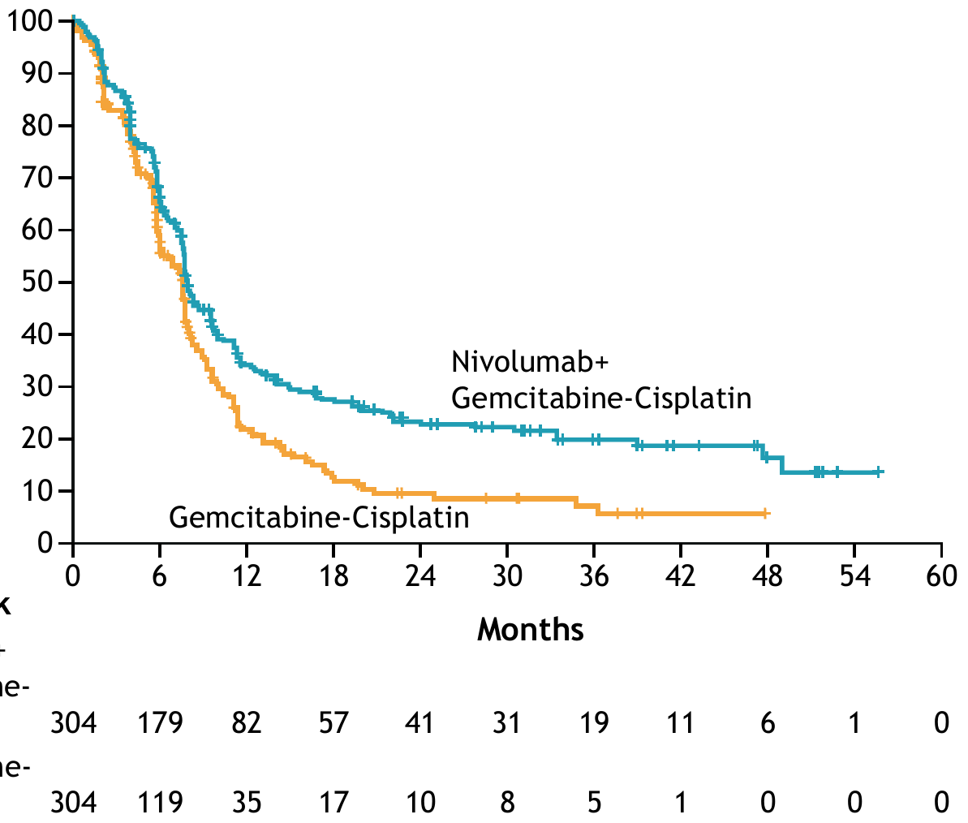
PFS per BICR (primary endpoint)
PFS final analysis statistical boundaries:
P value boundary, 0.01
Critical HR, 0.7734
Treatment | Events/patients | Median PFS (95% CI), months
NIVO+GC | 211/304 | 7.9 (7.6-9.5)
GC | 191/304 | 7.6 (6.1–7.8)
HR (95% CI), 0.72 (0.59–0.88) P = 0.0012
12-month rate:
34.2%
21.8%
Probability (%)
24-month rate:
23.5%
9.6%
No. at risk
NIVO+GC
GC
Median (range) study follow-up was 33.6 (7.4–62.4) months. PFS was estimated in all randomized patients and defined as the time from date of randomization to date of first documented disease progression (per BICR assessments using RECIST v1.1) or death due to any cause, whichever occurred first. Patients who died without reported progression were considered to have progressed on the date of death. Patients who did not progress or die were censored on the last evaluable tumor assessment date. Patients without on-study tumor assessments who did not die were censored on the date of randomization. Patients who started any subsequent anticancer therapy without prior reported progression were censored at the last evaluable tumor assessment before initiation of subsequent anticancer therapy.
RECIST, Response Evaluation Criteria in Solid Tumors.

Slide 61
Treatment-related AEs in all treated patients
NIVO+GC (n = 304)
GC (n = 288)
Treatment-related AE, %ª | Any grade | Grade ≥ 3^{b} | Any grade | Grade ≥ 3^{b}
Any | 97 | 62 | 93 | 52
Leading to DC | 21 | 11 | 17 | 8
Anemia
57
22
18
48
Nausea
47
< 1
1
48
Neutropenia
31
19
15
30
Decreased neutrophil count
25
14
11
21
Fatigue
24
2
1
24
Decreased appetite
22
1
< 1
16
Decreased platelet count
22
8
5
15
Decreased WBC count
21
10
4
14
Vomiting
18
1
2
17
Asthenia
15
1
2
16
Thrombocytopenia
15
7
5
12
Pruritus
14
1
0
3
Grade 1–2
Constipation
14
0
< 1
14
Rash
13
1
< 1
3
Diarrhea
13
1
0
9
Grade ≥ 3
Hypothyroidism
13
0
0
Increased blood creatinine
13
< 1
0
12
Leukopenia
13
2
2
11
60
40
20
0
20
40
60
Incidence, %
ªIncludes events that occurred in treated patients between first dose and 30 days after last dose of study therapy. Tornado plot displays individual treatment-related AEs occurring at any grade in ≥ 10% of treated patients in either arm. ^{b}One grade 5 event occurred in each arm (sepsis in the NIVO+GC arm and acute kidney injury in the GC arm).
DC, discontinuation; WBC, white blood cell.

Slide 62
Summary
  NIVO+GC demonstrated statistically significant and clinically meaningful improvements in OS and PFS versus GC alone as first-line treatment for unresectable or mUC
  ORR and CR rates were notably higher with NIVO+GC and the concurrent ICI and chemotherapy combination was associated with deep and durable responses
    The CR rate was almost double (21.7% vs 11.8%) and the DoCR almost 3 times longer (37.1 vs
    13.2 months) with NIVO+GC, despite a maximum of 2 years of NIVO treatment
  The combination of NIVO plus GC resulted in no new toxicity signals, and the safety profile was consistent with the established safety of either agent in prior UC trials
  NIVO+GC is the first frontline concurrent ICI plus chemotherapy combination to improve OS in this setting, with results supporting NIVO plus cisplatin-based chemotherapy as a new SOC for patients with unresectable or mUC
ICI, immune checkpoint inhibitor

Slide 63
Cohort K: Overall Response Rate by BICR
EV+P: 64.5% confirmed ORR with rapid responses
 | EV+P (N=76) | EV Mono (N=73)
Confirmed ORR, n (% ) (95% CI) | 49 (64.5) (52.7, 75.1) | 33 (45.2) (33.5, 57.3)
Best overall response, n (%)
Complete Response | 8 (10.5) | 3 (4.1)
Partial Response | 41 (53.9) | 30 (41.1)
Stable Disease | 17 (22.4) | 25 (34.2)
Progressive Disease | 6 (7.9) | 7 (9.6)
Not Evaluable | 3 (3.9) | 5 (6.8)
No Assessment | 1 (1.3) | 3 (4.1)
Median time to objective response (range), mos | 2.07 (1.1, 6.6) | 2.07 (1.9, 15.4)
Median number of treatment cycles (range) | 11.0 (1, 29) | 8.0 (1, 33)
EV+P
41/49 (85.7%) of responses observed at first assessment (week 9±1 wk)
cORRs were consistent across all pre-specified subgroups
  7/13 (53.8%) cORR observed in patients with liver metastases
EV monotherapy
Activity is consistent with prior results in 2L+ la/mUC
Data cutoff: 10Jun2022
BICR: Blinded Independent Central Review; cORR: Confirmed Objective Response Rate; NR: Not Reached
Jonathan E. Rosenberg, MD

Slide 64
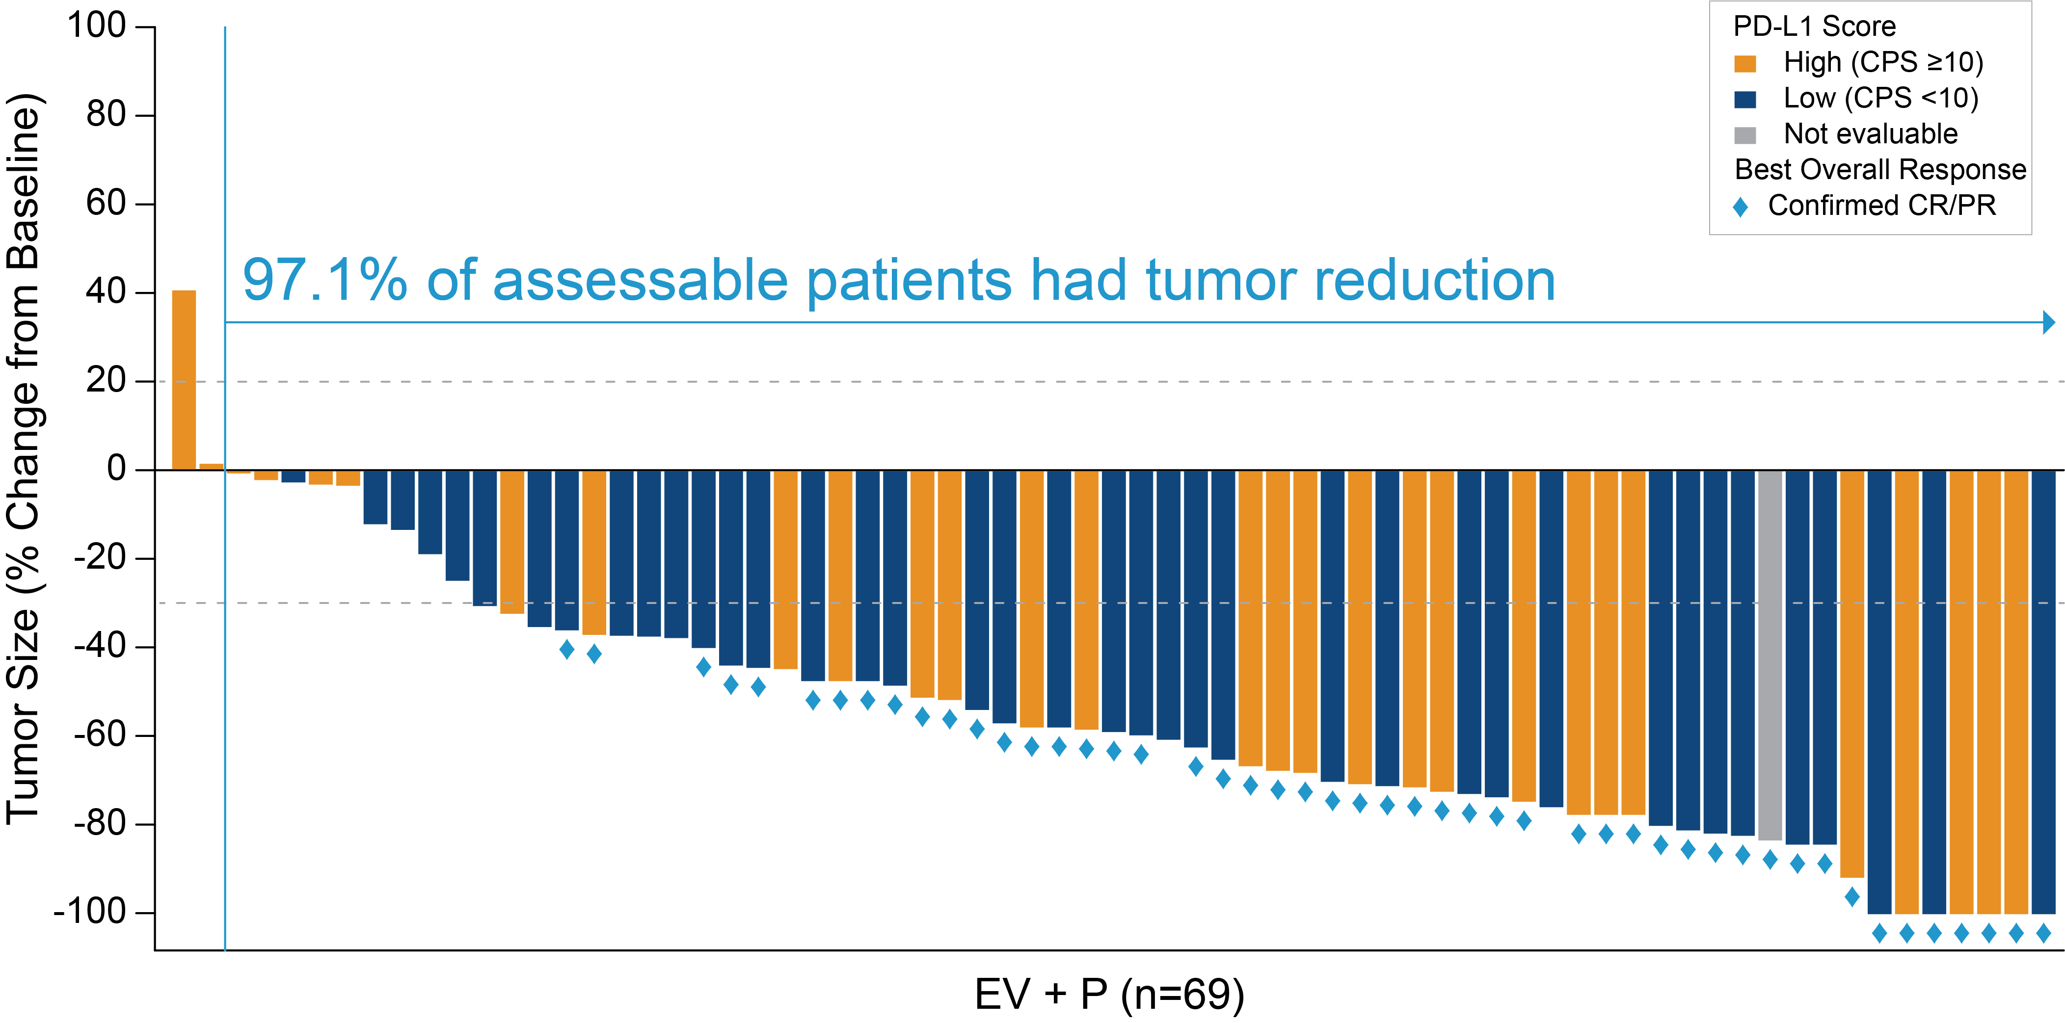
EV+P: Maximum Percent Reduction from Baseline of Target Lesion by BICR
Activity seen regardless of PD-L1 status
  27/44 (61.4%) cORR in CPS<10
                21/31 (67.7%) cORR in CPS≥10
BICR: Blinded Independent Central Review; CPS: Combined Positive Score; CR: Complete Response; PD-L1: Programmed Death-Ligand 1 PR: Partial Response
Jonathan E. Rosenberg, MD

Slide 65
EV-302/KEYNOTE-A39 (NCT04223856)
Patient population
Previously untreated la/mUC
Eligible for platinum, EV, and P
PD-(L)1 inhibitor naïve
GFR ≥30 to <60mL/minª
ECOG PS ≤2^{b}
EV + Pembrolizumab
No maximum treatment cycles for EV, maximum 35 cycles for P
Dual primary endpoints:
PFS by BICR
OS
Select secondary endpoints:
ORR per RECIST v1.1 by BICR and investigator assessment
Safety
N=886
R
1:1
Treatment until disease progression per BICR, clinical progression, unacceptable toxicity, or completion of maximum cycles
Chemotherapy^{c}
(Cisplatin or carboplatin + gemcitabine)
Maximum 6 cycles
Stratification factors: cisplatin eligibility (eligible/ineligible), PD-L1 expression (high/low), liver metastases (present/absent)
Cisplatin eligibility and assignment/dosing of cisplatin vs carboplatin were protocol-defined; patients received 3-week cycles of EV (1.25 mg/kg; IV) on Days 1 and 8 and P (200 mg; IV) on Day 1
Statistical plan for analysis: the first planned analysis was performed after approximately 526 PFS (final) and 356 OS events (interim); if OS was positive at interim, the OS interim analysis was considered final
Data cutoff: 08 Aug 2023; FPI: 7 Apr 2020, LPI: 09 Nov 2022
BICR, blinded independent central review; ECOG PS, Eastern Cooperative Oncology Group performance status; GFR, glomerular filtration rate; ORR, overall response rate; PFS, progression-free survival; R, randomization; RECIST, Response Evaluation Criteria in Solid Tumors
ªMeasured by the Cockcroft-Gault formula, Modification of Diet in Renal Disease, or 24-hour urine
^{b}Patients with ECOG PS of 2 were required to also meet the additional criteria: hemoglobin ≥10 g/dL, GFR ≥50mL/min, may not have NYHA class III heart failure
^{c}Maintenance therapy could be used following completion and/or discontinuation of platinum-containing therapy
Powles et al.

Slide 66
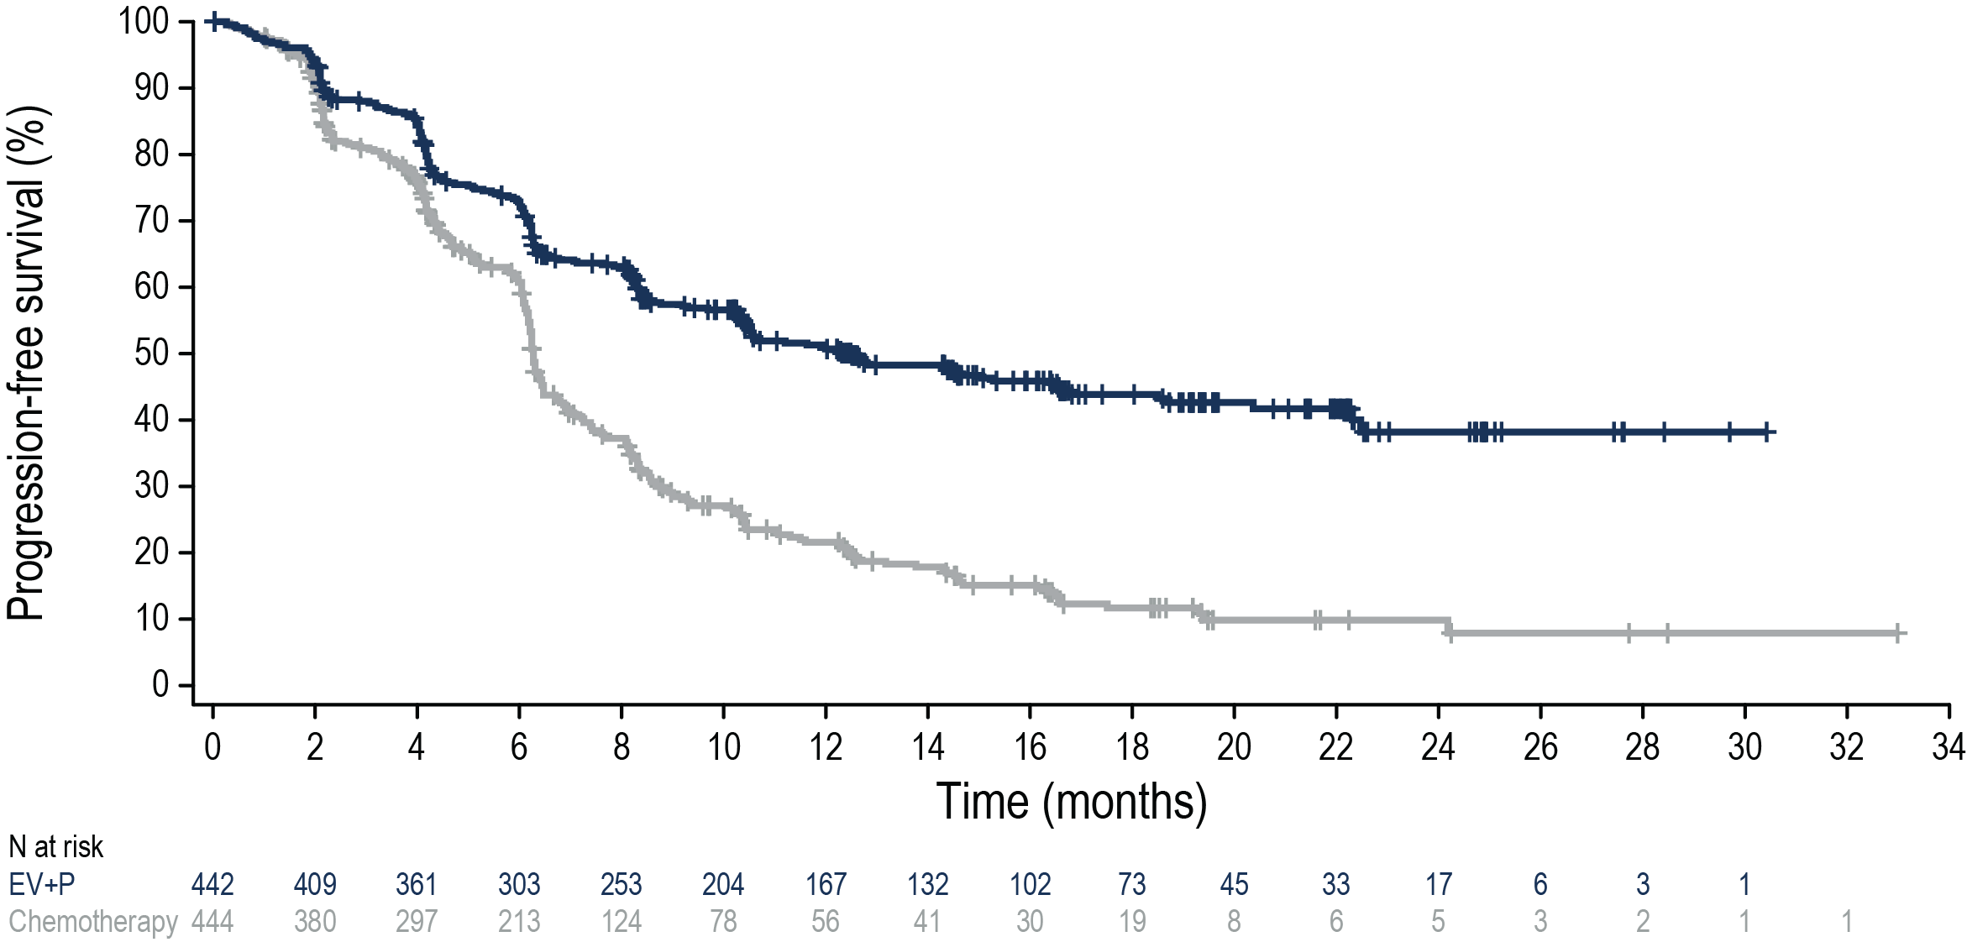
Progression-Free Survival per BICR
Risk of progression or death was reduced by 55% in patients who received EV+P
 | N | Events (%) | HRª (95% CI) | 2-sided P value | mPFS (95% CI), months
EV+P | 442 | 223 (50.5) | 0.45 (0.38-0.54) | <0.00001 | 12.5 (10.4-16.6)
Chemotherapy | 444 | 307 (69.1) |  |  | 6.3 (6.2-6.5)
50.7%
43.9%
21.6%
11.7%
Data cutoff: 08 Aug 2023
PFS at 12 and 18 months as estimated using Kaplan-Meier method
HR, hazard ratio; mPFS, median progression-free survival
ªCalculated using stratified Cox proportional hazards model; a hazard ratio <1 favors the EV+P arm
Powles et al.

Slide 67
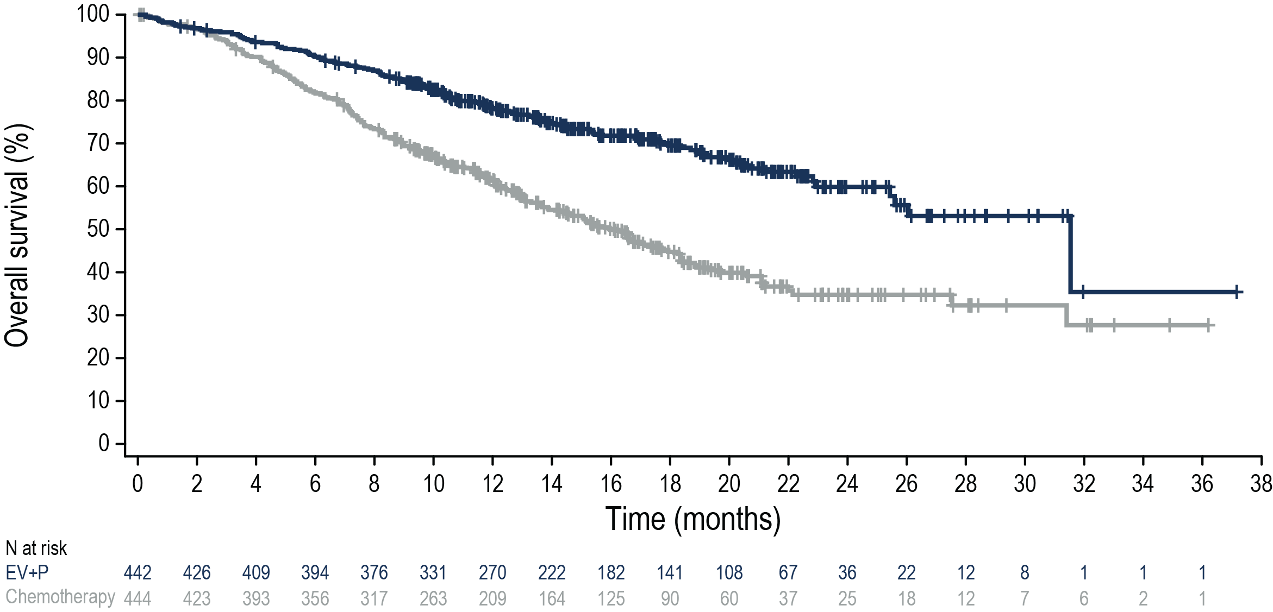
Overall Survival
Risk of death was reduced by 53% in patients who received EV+P
 | N | Events (%) | HRª (95% CI) | 2-sided P value | mOS (95% CI), months
EV+P | 442 | 133 (30.1) | 0.47 (0.38-0.58) | <0.00001 | 31.5 (25.4-NR)
Chemotherapy | 444 | 226 (50.9) |  |  | 16.1 (13.9-18.3)
78.2%
69.5%
Median survival follow-up: 17.2 months
61.4%
44.7%
Data cutoff: 08 Aug 2023
OS at 12 and 18 months was estimated using Kaplan-Meier method
mOS, median overall survival; NR, not reached
ªCalculated using stratified Cox proportional hazards model. A hazard ratio <1 favors the EV+P arm
Powles et al.

Slide 68
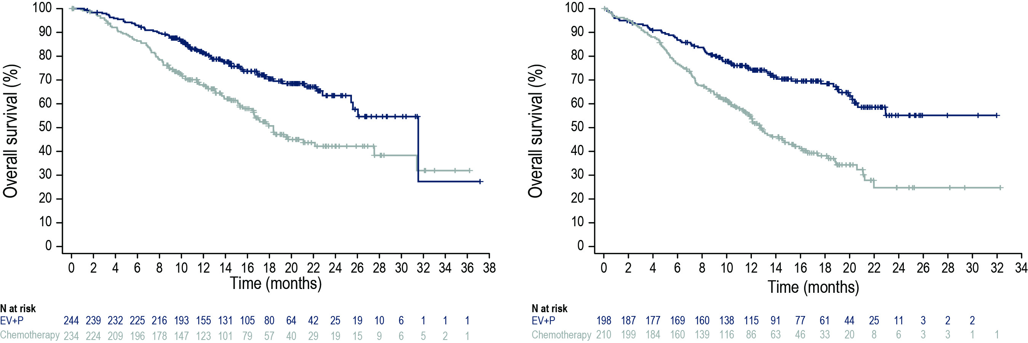
OS Subgroup Analysis: Cisplatin Eligibility
OS benefit was consistent with overall population regardless of cisplatin eligibility
Cisplatin-eligible
Cisplatin-ineligible
 | Events, n | HR (95% CI) | mOS (95% CI), months
EV+P | 69 | 0.53 (0.39-0.72) | 31.5 (25.4-NR)
Chemotherapy | 106
 |  |  | 18.4 (16.4-27.5)
 | Events, n | HR (95% CI) | mOS (95% CI), months
EV+P | 64 | 0.43 (0.31-0.59) | NR (20.7-NR)
Chemotherapy | 120
 |  |  | 12.7 (11.4-15.5)
Data cutoff: 08 Aug 2023
Powles et al.

Slide 69
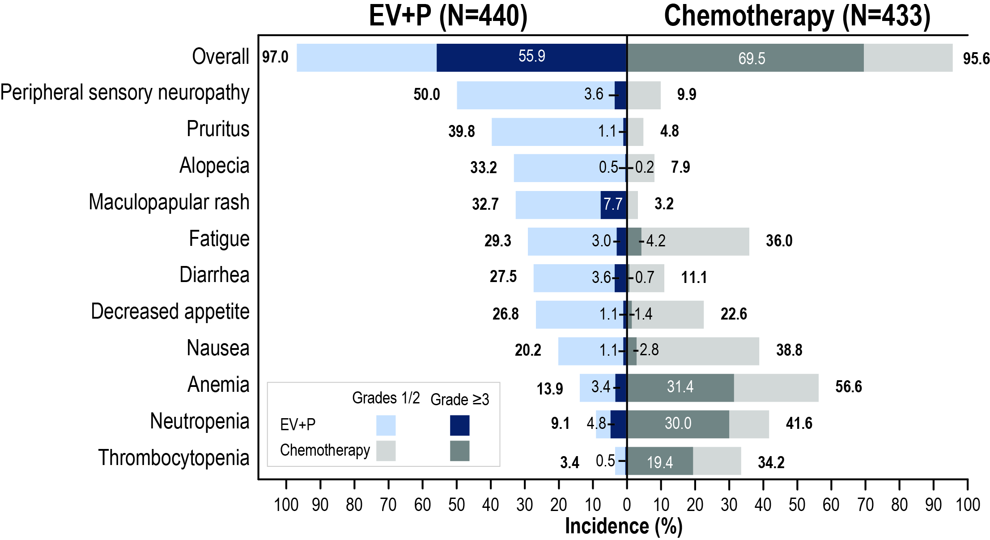
Treatment-Related Adverse Events
Grade ≥3 events were 56% in EV+P and 70% in chemotherapy
Serious TRAEs:
122 (27.7%) EV+P
85 (19.6%) chemotherapy
TRAEs leading to death (per investigator):
EV+P: 4 (0.9%)
Asthenia
Diarrhea
Immune-mediated lung disease
Multiple organ dysfunction syndrome
Chemotherapy: 4 (0.9%)
Febrile neutropenia
Myocardial infarction
Neutropenic sepsis
Sepsis
Median number of cycles (range): 12.0 (1,46) for EV+P; 6.0 (1,6) for chemotherapy
Data cutoff: 08 Aug 2023
TRAEs shown in figure are any grade by preferred term in ≥20% of patients for any grade in either arm
TRAEs, treatment-related adverse events
Powles et al.

Slide 70
Conclusion
Two phase 3 trials in the first-line treatment of advanced/metastatic urothelial carcinoma have demonstrated an improvement in overall survival:
Nivo+GemCis and EV+Pembro
The combination of Nivo+GemCis is the first chemo/IO combination to show a survival benefit with a mOS 21.7 months, however, the combination of EV+Pembro almost doubled the mOS vs chemo (OS 31.5 months), making it the New Standard of Care for patients in this setting.
Many challenges and questions arise when “Welcoming EV+Pembro as a new SOC”, including
1] What treatment then becomes the best second-line therapy?
2] Can we dose deescalate EV, in EV+Pembro?
3] What is the underlying biology leading to the great response and OS and how do we build on this?
4] What is the efficacy of EV+Pembro in earlier states of disease (MIBC and NMIBC)?
5] EV+Pembro is expensive, will patients, insurance, and public systems be able to afford this treatment?
6] What about patients who received anti-PD(L)1 in prior therapy setting? Timing of progression matters?
Presented by Andrea B. Apolo, MD
@apolo_andrea

Slide 71
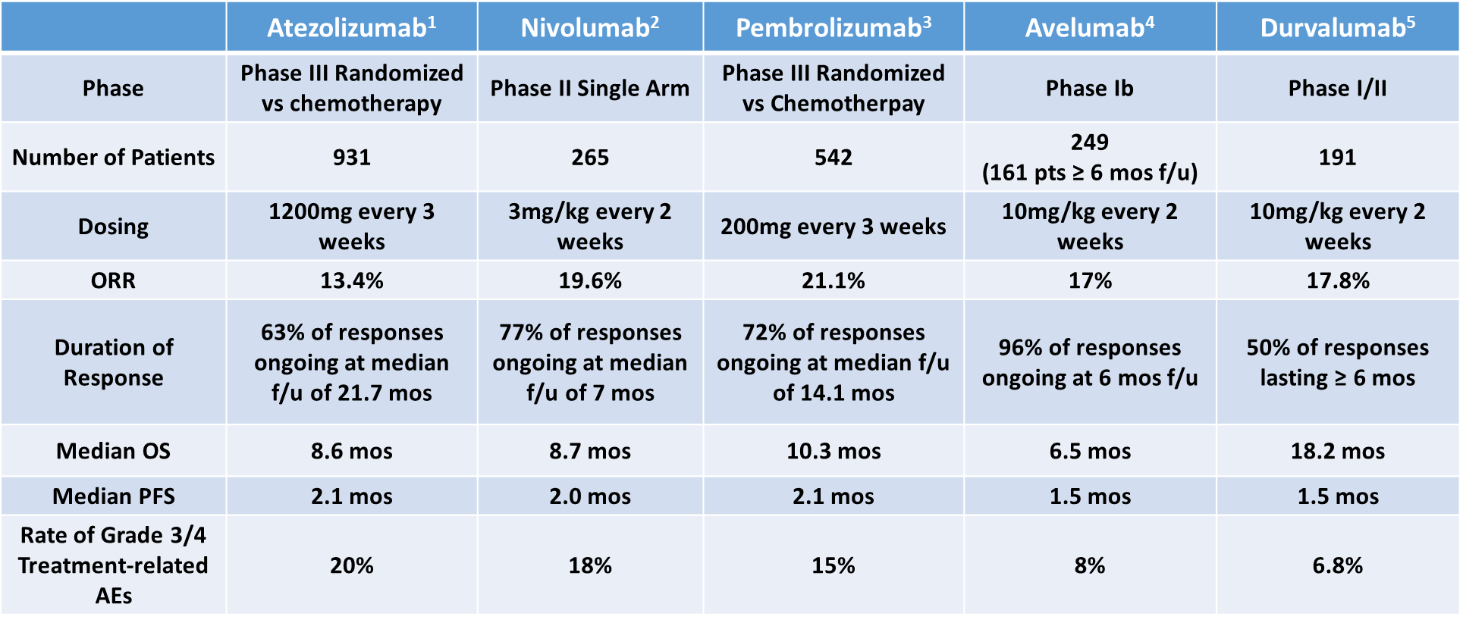

1Powles T, et al. Lancet. 2018;391(10122):748-757.; 2Sharma P, et al. Lancet Oncol. 2017;18(3):312-322.; 3Bellmunt J, et al. N Engl J Med. 2017;376(11):1015-1026.; 4Patel MR, et al. Lancet Oncol. 2018;19(1):51-64.; 5Powles T, et al. JAMA Oncol. 2017;3(9):e172411

Slide 72
BLC2001: Phase 2 Trial of Erdafitinib¹
15-20% of patients with MIBC have FGFR alterations²
Unresectable la/mUC with prespecified FGFR3/2 alterations
ECOG PS 0-2
History of disease progression during or after ≥1 line of prior systemic chemotherapy, or within 12 months after receiving (neo)adjuvant chemotherapy in the metastatic setting
(chemo-refractory patients)
Cisplatin ineligible (for impaired renal function or
peripheral neuropathy)
Chemotherapy-naïve
Regimen 3
Erdafitinib 10 mg/d
7 days on/7 days off
Locally advanced UC
Erdafitinib 8 mg/d with potential for uptitration to
9 mg/d
(n=99)
Regimen 1
Screening for FGFR fusions/mutations
Randomized 1:1
Erdafitinib 6 mg/d
Regimen 2
Primary endpoint
Confirmed ORR
Secondary endpoints
PFS, DOR, OS, safety, predictive biomarker evaluation, PK
FGFR Alterations (n=99)
FGFR2 or FGFR3 fusion, No. (%) | 25 (25)
FGFR3 mutation, No. (%) | 74 (75)
FGFR2/3 fusions and mutations | 0
1. Loriot Y, et al. N Engl J Med. 2019;381(4):338-348.
2. Helsten T, et al. Clin Cancer Res. 2016;22(1):259-267.

Slide 73


BCL2001: Efficacy
 | All Patients (N=99) | FGFR3 Mutation (n=74) | FGFR2/3 Fusion (n=25)
ORR, n (%) (95% CI) | 40 (40) (31-50) | 36 (49) (37-60) | 4 (16) (2-30)
Confirmed response rate 40% (3% CR; 37% PR)
Among 22 pts with prior ICI, confirmed response rate 59%
1. Loriot Y, et al. N Engl J Med. 2019;381(4):338-48
2. Necchi A, et al. ESMO 2020. Presentation 750P
Notes:
Response rates much higher for mutations than fusions. And 0/6 FGFR2 mutation patients responded.
ORR 59% impressive for prior ICI exposed

Slide 74
THOR Cohort 1: Erdafitinib s Investigator’s Choice of Chemotherapy in Patients With FGFR-altered mUC
THOR cohort 1 study design
Erdafitinib demonstrated superior efficacy versus chemotherapy in patients with FGFR-altered mUC¹
Key eligibility criteria
Age ≥18 years
Metastatic or unresectable UC
Confirmed disease progression
Prior tx with anti–PD-(L)1
1-2 lines of systemic tx
Select FGFR3/2alt (mutation/
fusion)ª
ECOG PS 0-2
Erdafitinib
(n=136)
Once-daily erdafitinib 8 mg with
pharmacodynamically guided uptitration to 9 mg
Primary
end point:
OS
Key secondary end points:
PFS
ORR
Safety
100
Erdafitinib
1:1
N=266^{b}
Chemotherapy
80
R
  Median OS: 12.1 vs 7.8 months
  (HR, 0.64; 95% CI, 0.47-0.88; P = 0.005)^{c}
Chemotherapy of choice
(n=130)
Docetaxel or vinflunine once Q3W
60
OS, %
  Median follow-up: 15.9 months
40
20
Stratification factors: region (North America vs European Union vs rest of world), ECOG PS (0 or 1 vs 2), and disease distribution (presence vs absence of visceral [lung, liver, or bone] metastases)
NCT03390504
0
0
3
6
9
12
15
18
21
24
27
30
33
36
39
42
45
48
51
Months Since Randomization
No. at risk
Erdafitinib
136
117
97
74
46
35
25
17
15
9
5
3
3
2
2
2
1
0
Chemotherapy
130
87
66
43
30
18
13
9
8
3
2
2
1
0
0
0
0
0
  Based on superior efficacy at a preplanned interim analysis, the IDMC recommended to stop the trial, unblind data, and cross over patients from chemotherapy to erdafitinib
  Median PFS: 5.6 vs 2.7 months (HR, 0.58; 95% CI, 0.44-0.78; P = 0.0002)
  ORR: 45.6% vs 11.5% (relative risk, 3.94; 95% CI, 2.37-6.57; P < 0.001)

Slide 75
Phase 3 THOR Study: Erdafitinib Versus Pembrolizumab in Patients With Metastatic Urothelial Carcinoma and Select FGFR Alterations
Cohort 2
Key eligibility criteria
Age ≥18 years
Metastatic or unresectable UC
Confirmed disease progression on 1 prior tx
Naive to anti–PD-(L)1 tx
Select FGFR3/2alt (mutation/fusion)ª
ECOG PS 0-2
Erdafitinib
(n=175)
Once-daily erdafitinib 8 mg with
pharmacodynamically guided uptitration to 9 mg
Primary end point
OS
1:1
N=351^{b}
R
Secondary end points
PFS
ORR
Safety
Pembrolizumab
(n=176)
200 mg once every 3 weeks
Stratification factors: region (North America vs European Union vs rest of world), ECOG PS (0 or 1 vs 2), and disease distribution (presence vs absence of visceral [lung, liver, or bone] metastases)
NCT03390504

Slide 76
No Significant Difference Was Found in Overall Survival Between Erdafitinib and Pembrolizumab
100
  Primary end point was not met
  Median OS 10.9 months (95%CI 9.2-12.6) for erdafitinib and 11.1 months (95%CI 9.7-13.6) for pembrolizumab
    HR 1.18 (95%CI 0.9-1.5; P = 0.18)
Erdafitinib
Median OS:
10.9 months (95% CI, 9.2-12.6)
11.1 months (95% CI, 9.7-13.6)
80
60
OS, %
Pembrolizumab
40
20
0
0
3
6
9
12
15
18
21
24
27
30
33
36
39
42
45
48
51
54
57
Months Since Randomization
No. at risk
Erdafitinib
175
160
131
100
78
60
52
41
30
28
23
21
13
9
7
2
1
1
1
0
Pembrolizumab
176
148
119
103
84
72
60
52
43
34
29
23
19
11
8
8
1
1
0
0

Slide 77
Median PFS: 4.4 Months With Erdafitinib and 2.7 Months With Pembrolizumab
100
  Median PFS 4.4 months (95%CI 4.1-5.5) for erdafitinib and 2.7 months (95%CI 1.6-3.0) for pembrolizumab
    HR 0.88 (95%CI 0.70-1.10; P = 0.26)ª
Median PFS:
4.4 months (95% CI, 4.1-5.5)
2.7 months (95% CI, 1.6-3.0)
80
Erdafitinib
60
PFS, %
40
20
Pembrolizumab
0
0
3
6
9
12
15
18
21
24
27
30
33
36
39
42
45
48
51
Months Since Randomization
No. at risk
Erdafitinib
175
107
57
34
23
19
14
10
7
6
4
4
3
1
0
0
0
0
Pembrolizumab
176
75
50
36
30
23
16
13
12
11
9
5
3
2
2
2
1
0

Slide 78
ORR: 40.0% With Erdafitinib and 21.6% With Pembrolizumab
  ORR 40.0% (95%CI 32.7-47.7) for erdafitinib and 21.6% (95%CI15.8-28.4) for pembrolizumab
  Median DOR 4.3 months
  (95%CI 3.7-6.9) for erdafitinib and 14.4 months (95%CI 7.4-27.8) for pembrolizumab
ORR 40.0%
  Relative risk, 1.85 (95% CI, 1.32-2.59;
  P < 0.001ª)^{b}
Patients, %
CR 6.3%
(n=11)
ORR 21.6%
PR 33.7%
(n=59)
CR 4.5% (n=8)
PR 17.0%
(n=30)
Erdafitinib
(n=175)
Pembrolizumab (n=176)

Slide 79
Safety Profiles Were Consistent With the Known Profiles Of Erdafitinib and Pembrolizumab
  Most Frequentª Treatment-Related AEs in the Erdafitinib Group
Patients with events, n (%)ª | Erdafitinib (n=173) |  | Pembrolizumab (n=173)
Patients with event, n (%) | Any grade | Grade 3-4 | Any grade | Grade 3-4
≥1 treatment-related AE | 169 (97.7) | 75 (43.4) | 105 (60.7) | 21 (12.1)
Hyperphosphatemia | 126 (72.8) | 1 (0.6) | 0 | 0
Stomatitis | 78 (45.1) | 15 (8.7) | 5 (2.9) | 0
Diarrhea | 77 (44.5) | 6 (3.5) | 10 (5.8) | 0
Dry mouth | 61 (35.3) | 1 (0.6) | 5 (2.9) | 0
Onycholysis | 41 (23.7) | 10 (5.8) | 0 | 0
Palmar-plantar erythrodysesthesia syndrome | 38 (22.0) | 16 (9.2) | 0 | 0
Hyponatremia | 13 (7.5) | 9 (5.2) | 1 (0.6) | 1 (0.6)
  In the erdafitinib group:
    26 (15.0%) of patients discontinued erdafitinib due to treatment-related AEs^{b}
    23 (13.3%) patients had serious treatment-related AEs
    No deaths due to treatment-related AEs occurred
    Treatment-related AEs with erdafitinib were mostly manageable with dose modifications and supportive care

Slide 80
Enfortumab Vedotin for Previously Treated Advanced UC
The 5-year relative survival rate for metastatic bladder cancer is ≈8%¹
Enfortumab vedotin (EV), an antibody–drug conjugate directed against Nectin-4, demonstrated overall survival (OS) and progression-free survival (PFS) benefit in patients with locally advanced or metastatic (la/m) urothelial carcinoma (UC) in the open-label, confirmatory phase 3 EV-301 trial (NCT03474107) at the prespecified interim analysis²
Efficacy and safety are presented for EV vs chemotherapy over a median follow-up period of ≈2 years
Key eligibility criteria:
Histologically/Cytologically confirmed UC
Radiographic progression/
relapse during or after PD-1/L1 treatment for advanced UC
Prior platinum-containing regimen for advanced UC
ECOG PS 0–1
Enfortumab vedotin
(N=301)
1.25 mg/kg
on days 1, 8, and 15 of each 28-d cycle
Primary end point: Overall survival
Secondary end points:
Progression-free survival
Disease control rate
Overall response rate
Safety
Findings from the prespecified, event-driven
OS analysis when 439 deaths occurred are presented
1:1 randomization
with stratification
Investigator-assessed per RECIST v1.1
Preselected chemotherapy
(N=307)
Docetaxel 75 mg/m² or paclitaxel 175 mg/m² or vinflunine 320 mg/m²
on day 1 of each 21-d cycle
ECOG PS, Eastern Cooperative Oncology Group performance status; EV, enfortumab vedotin; la/m, locally advanced or metastatic; OS, overall survival; PD-1/L1, programmed cell death protein-1/programmed death-ligand 1; RECIST, Response Evaluation Criteria In Solid Tumors; UC, urothelial carcinoma.
1. National Cancer Institute. https://seer.cancer.gov/statfacts/html/urinb.html. 2. Powles T, et al. N Engl J Med. 2021;384:1125-1135.
Jonathan E. Rosenberg, MD

Slide 81

Overall Survival
Data shown for intention-to-treat population.
HR, hazard ratio.
Data cutoff date: July 30, 2021
Jonathan E. Rosenberg, MD

Slide 82

Progression-Free Survival
Data shown for intention-to-treat population.
HR, hazard ratio.
Data cutoff date: July 30, 2021
Jonathan E. Rosenberg, MD

Slide 83
TROPHY-U-01 Is a Registrational, Open-Label, Multicohort Phase 2 Trial in Patients With mUC
Cohort 1* (~100 patients): patients with mUC who progressed after prior platinum-based and CPI-based therapies
SG 10 mg/kg
Days 1 and 8, every 21 days
Continue treatment in the absence of unacceptable toxicity or disease progression
Primary Endpoint:
Objective response rate per RECIST 1.1 criteria
Key Secondary Endpoints: Safety/tolerability, DOR, PFS, OS
Cohort 2 (~40 patients): patients with mUC ineligible for platinum-based therapy and who progressed after prior CPI-based therapies
SG 10 mg/kg
Days 1 and 8, every 21 days
Cohort 3ª (up to 61 patients): mUC CPI naïve patients who progressed after prior platinum-based therapies
SG 10 mg/kg
Days 1 and 8, every 21 days
Pembrolizumab 200 mg
day 1 every 21 days
SG
Days 1 and 8, every 21 days
Cohort 4 (up to 60 patients): mUC platinum-naïve patients
Continue until a maximum of 6 cycles has been completed,^{d} disease progression, lack of clinical benefit, toxicity, or withdrawal of consent
Maintenance avelumab (800 mg every 2 weeks) with SG (Days 1 and 8 every 21 days) for those without disease progression
Cisplatin^{b}
Cohort 5 (up to 60 patients): mUC platinum-naïve patients
SG
Days 1 and 8, every 21 days
Cisplatin^{c}
Avelumab 800 mg every 2 weeks
Key Inclusion Criteria: Age ≥18 years, ECOG of 0/1, creatinine clearance (CrCl) ≥30 mL/min,^{b,c} adequate hepatic function
Key Exclusion Criteria: Immunodeficiency, active Hepatitis B or C, active secondary malignancy, or active brain metastases
*Accelerated FDA approval for treatment of patients with locally advanced or mUC who previously received platinum-containing chemotherapy and PD-1/L1 inhibitor¹
ªExclusions for Cohort 3 only: active autoimmune disease or history of interstitial lung disease. ^{b}In patients with CrCl ≥60 mL/min; ^{c}In patients with creatinine clearance 50–60 mL/min. ^{d}For patients who have not progressed, maintenance therapy will begin with infusions of avelumab (800 mg every 2 weeks beginning cycle 1, day 1 and every 2 weeks thereafter) followed by SG on days 1 and 8 every 21 days.
CBR, clinical benefit rate; CPI, checkpoint inhibitor; CrCl, creatinine clearance; DOR, duration of response; ECOG PS, Eastern Cooperative Oncology Group performance status; mUC, metastatic urothelial cancer; NR, not reached; ORR, objective response rate; OS, overall survival; PFS, progression-free survival; RECIST, Response Evaluation Criteria in Solid Tumors; SG, sacituzumab govitecan.
1. TRODELVYTM (sacituzumab govitecan-hziy). Prescribing Information. Immunomedics, Inc.; April 2021; EudraCT Number: 2018-001167-23; ClinicalTrials.gov Number: NCT03547973. IMMU-132-06 study.

Slide 84
TROPHY-U-01 Cohort 1 Response & Reduction in Tumor Size
Endpoint | Cohort 1 (N=113)
ORR, n (%) [95% CI] | 31 (27) [19, 37]
CR, n (%) | 6 (5)
PR, n (%) | 25 (22)
Median duration of response, mos [95% CI] (Range) | 5.9 [4.70, 8.60] (1.4–11.7)
Median time to onset of response, mos (Range) | 1.6 (1.2–5.5)
76%
0
0
0
ª71/94 patients with at least one post-baseline target lesion measurement and accepted for central review.
Fourteen patients had no post-treatment imaging, 1 patient lacked measurable lesions by central review, and 4 patients had poor image quality.
Tagawa ST, et al. J Clin Oncol 2021; 39:2474-85
ªAssessments were per Blinded Independent Review Assessment, RECIST 1.1.
CI, confidence interval; CR, complete response; ORR, objective response rate; PR, partial response; TTR, time to response.

Slide 85


TROPHY-U-01 Cohort 1 Durability of Response
Tagawa ST, et al. J Clin Oncol 2021; 39:2474-85

Slide 86
TROPHY-U-01 Cohort 1 Treatment-Related Adverse Events >20% any grade or >5% Grade >3 (n=113)
Category | Event | All Grades (%) | Grade 3 (%) | Grade 4 (%)
Hematologicª | Neutropenia | 46 | 22 | 12
 | Leukopenia | 26 | 12 | 5
 | Anemia | 34 | 14 | 0
 | Lymphopenia | 12 | 5 | 2
 | Febrile neutropenia | 10 | 7 | 3
Gastrointestinal | Diarrhea^{b} | 65 | 9 | 1
 | Nausea | 58 | 4 | 0
 | Vomiting | 28 | 1 | 0
General disorders & administrative site conditions | Fatigue | 50 | 4 | 0
Skin & subcutaneous tissue | Alopecia | 47 | 0 | 0
Metabolism & nutrition | Decreased appetite | 36 | 3 | 0
Infections & infestations | Urinary tract infection | 8 | 6 | 0
7 (6%) pts discontinued due to TRAEs
  3 discontinued due to neutropenia or its complications
30% G-CSF usage
1 treatment-related death (sepsis d/t febrile neutropenia)
Median treatment cycles: 6 (range: 1–22); worst grade CTCAE reported
Tagawa ST, et al. J Clin Oncol 2021; 39:2474-85
Notes:
More neutropenia and diarrhea, which makes sense given that payload is SN-38.
I’d like to see the Gilbert’s patients, as it is common and if there is more toxicity there due to SN-38. I think they may want to exclude those patients…until they show me data it is safe, I will have concern.

Slide 87
TROPiCS-04 Study Design
Study Population
Locally advanced unresectable or mUC
Upper/lower tract tumors
Mixed histologic types are allowed if urothelial is predominant
Progression after platinum-based and anti–PD-1/PD-L1 therapy
OR
Platinum in neo/adj setting if progression within 12 months and subsequent CPI
SG
Sacituzumab govitecan
10 mg/kg
D1/8 of 21-day cycle
Continue treatment until loss of clinical benefit or unacceptable toxicity
Endpoint (EP)
Primary EP:
OS
Secondary EP:
PFS by PI assessment using RECIST 1.1
ORR, DOR, and CBR by PI assessment using RECIST 1.1
EORTC QLQ C30 score and EuroQOL EQ-5D-5L QOL score
N=482
TPC
Docetaxel @ 75 mg/m²
OR
Paclitaxel @ 175 mg/m²
OR
Vinflunine @ 320 mg/m²
on D1 of 21-day cycle
Grivas et al. 10.1200/JCO.2021.39.6_suppl.TPS498 JCO 39, no. 6_suppl

Slide 88
Advanced Urothelial Ca Tx Algorithm after ESMO 2023
Disease State | Preferred Option | Other Options
Metastatic, no prior therapy (1L) | Pembrolizumab/Enfortumab-vedotin | Gem/Cis + nivolumab (cisplatin-fit)
Metastatic, no prior chemotherapy (1L) | Pembrolizumab/Enfortumab-vedotin | -Gem/Cis or Carbo f/b avelumab switch maintenance (if no progression) -Pembrolizumab (platinum/EV-unfit) -Single agent chemo (platinum/EV-unfit)
Metastatic (prior therapy) | Platinum-based chemotherapy (after EV/P) OR Erdafitinib (tumors with FGFR2/3 activating mutation or fusion) OR Enfortumab-vedotin (if not used prior) OR Pembrolizumab (if IO not used prior) | Sacituzumab-govitecan
Metastatic (≥2 prior therapies) | Erdafitinib (tumors with FGFR2/3 activating mutation or fusion) OR Enfortumab-vedotin (if not used prior) OR Sacituzumab-govitecan | Taxane (US) Vinflunine (EU)
Clinical trials are critical throughout disease spectrum & treatment settings!
Petros Grivas

Slide 89






Thanks☺
Patient & families!
Collaborators, sponsors, institutions, foundations, colleagues, research, admin & clinical staff: TEAMS! @PGrivasMDPhD

Slide 90
PROSTATE/RCC/BLADDER
Tuesday, December 12, 2023

Slide 91
Resected RCC: Adjuvant strategies
Lisa Tachiki, MD
Assistant Professor, Renal/Melanoma Program
University of Washington/Fred Hutch Cancer Center
Seattle, WA

Slide 92
Disclosures
Research grant funding (to institution) from Seagen and Merck

Slide 93
RCC often presents as localized disease
7th most common cancer in US
70% present with localized disease that can be resected
~40% of patients will recur after nephrectomy
High clinical need for effective adjuvant therapy
SEER. Cancer Stat Facts: Kidney and Renal Pelvis Cancer.
Marconi, L. Clinical Genitourinary Cancer. 2021
Notes:
High clinical need for adjuvant treatment options that prevent recurrent disease in the treatment of patients with renal cell carcinoma.

Slide 94

Risk stratification prior to adjuvant therapy
Leibovich score – stage, size, grade, and necrosis (SSIGN)
UISS – TNM stage, grade, ECOG
ASSURE RCC Prognostic Nomogram (below)
Correa, Andres F., et al. European urology 80.1 (2021)
Notes:
Given these outcomes, risk stratification tools have been developed to identify patients at high risk of recurrence. There are a number of different nomograms that are available, with a few of them listed here. the factors used in these nomograms have been the same for decades, including TNM staging, grade, UISS includes performance status. . So they're all variations around the theme.
I tend to use The Fox Chase uses data from the ASSURE study, the adjuvant TKI study that ECOG did. So it uses outcome data from the most recent dataset.
age at diagnosis, presence or absence of vascular invasion, coagulative necrosis, or sarcomatoid features—generates 3 predictions (early disease progression, DFS, and OS) for patients with kidney cancer post-nephrectomy.¹⁷

Slide 95
Adjuvant therapy: Lessons from TKIs
Trial | Arms | Years | N | Primary Endpoint | Clear Cell Only | Eligibility | Hazard Ratio (Confidence Interval)
S-TRAC | Sunitinib vs. Placebo | 1 | 615 | DFS | Yes | pT3-4GxN0-x, TxGxN1-2 | 0.76 (95% CI 0.59–0.98), p = 0.03
ASSURE | Sunitinib vs. Sorafenib vs. Placebo | 1 | 1943 | DFS | No | pT1bG3-4N0, pT2-4GxN0, TxGxN + | Sunitinib –1.02 (97.5% CI 0.85–1.23), p = 0.8038 Sorafenib –0.97 (97.5% CI 0.80 –1.17), p = 0.7184
PROTECT | Pazopanib vs. Placebo | 1 | 1538 | DFS | Yes | pT2G3-4N0, pT3-4N0, pTxN1 | 0.86 (95% CI 0.70–1.06), p = 0.165
ATLAS | Axinitib vs. Placebo | 1–3 | 724 | DFS | Yes | pT2-GxN0, pTxN1 | 0.870 (95% CI 0.66–1.147), p = 0.3211
SORCE | Sorafenib vs. Placebo | 1–3 | 1711 | DFS | No | Leibovich scores 3–11 | 1.01 (95% CI 0.83–1.23), p = 0.95
Wang, L. Kidney Cancer. Jan 2023.
Notes:
In terms of adjuvant agents, Historically, the first trials in the adjuvant RCC space were cytokine-based treatments, but these have failed to demonstrate improvements in disease-free survival for patients at high risk of recurrence following definitive surgical resection.
Thereafter, Given the success of targeted therapies for metastatic disease in the early 2000s, a series of studies investigating adjuvant therapy with VEGF–targeting agents were conducted. These trials (S-TRAC with sunitinib, ASSURE [Adjuvant Sorafenib or Sunitinib], PROTECT [Pazopanib], ATLAS [Axitinib], and SORCE [Sorafenib]) These trials differed regarding patients enrolled, duration of therapy, agents used and incorporation of non-clear cell features.
Although the studies in aggregate have been negative, with the exception of the STRAC study, there are important takeaways from conducting studies in the adjuvant space
With the exception of the phase III S-TRAC study, which tested the adjuvant use of sunitinib in patients with locally advanced (pT3–4) or node-positive clear cell renal cell carcinoma, these studies in aggregate have not shown significant DFS benefit and none have shown OS benefit. There are several reasons proposed as to why adjuvant TKI therapy failed to demonstrate consistent benefit

Slide 96
High toxicity rates leading to discontinuation may compromise efficacy in adjuvant setting
Trial | Arms | Years | Primary Endpoint | Clear Cell Only | Eligibility | Hazard Ratio (Confidence Interval) | Discontinuation Rate due to AE
S-TRAC | Sunitinib vs. Placebo | 1 | DFS | Yes | pT3-4GxN0-x, TxGxN1-2 | 0.76 (95% CI 0.59–0.98), p = 0.03 | 28% vs 6%
ASSURE | Sunitinib vs. Sorafenib vs. Placebo | 1 | DFS | No | pT1bG3-4N0, pT2-4GxN0, TxGxN + | Sunitinib –1.02 (97.5% CI 0.85–1.23), p = 0.8038 Sorafenib –0.97 (97.5% CI 0.80 –1.17), p = 0.7184 | 44% vs 45% vs 11%
PROTECT | Pazopanib vs. Placebo | 1 | DFS | Yes | pT2G3-4N0, pT3-4N0, pTxN1 | 0.86 (95% CI 0.70–1.06), p = 0.165 | 35% vs 5%
ATLAS | Axinitib vs. Placebo | 1–3 | DFS | Yes | pT2-GxN0, pTxN1 | 0.870 (95% CI 0.66–1.147), p = 0.3211 | 23% vs 11%
SORCE | Sorafenib vs. Placebo | 1–3 | DFS | No | Leibovich scores 3–11 | 1.01 (95% CI 0.83–1.23), p = 0.95 | 44% vs 49% vs 12%
Wang, L. Kidney Cancer. Jan 2023.; Mattila, K. Cancers. Jan 2022.
Notes:
The toxicity experienced in these trials led to high rates of TKI discontinuation. Given the significant toxicity, several trials (ASSURE, PROTECT, and SORCE) required modification of the starting dose of therapy, potentially decreasing efficacy. In SOURCE, only 13% of patients received the full starting dose. As expected with high toxicity rates, patients also reported worse QoL outcomes with adjuvant tKI therapy, emphasizing the Need for less toxic adjuvant options for our patients

Slide 97
Specific patient selection with high-risk disease may affect success of trial outcomes
Trial | Arms | Years | Primary Endpoint | Clear Cell Only | Eligibility | Hazard Ratio (Confidence Interval) | Discontinuation Rate due to AE
S-TRAC | Sunitinib vs. Placebo | 1 | DFS | Yes | pT3-4GxN0-x, TxGxN1-2 | 0.76 (95% CI 0.59–0.98), p = 0.03 | 28% vs 6%
ASSURE | Sunitinib vs. Sorafenib vs. Placebo | 1 | DFS | No | pT1bG3-4N0, pT2-4GxN0, TxGxN + | Sunitinib –1.02 (97.5% CI 0.85–1.23), p = 0.8038 Sorafenib –0.97 (97.5% CI 0.80 –1.17), p = 0.7184 | 44% vs 45% vs 11%
PROTECT | Pazopanib vs. Placebo | 1 | DFS | Yes | pT2G3-4N0, pT3-4N0, pTxN1 | 0.86 (95% CI 0.70–1.06), p = 0.165 | 35% vs 5%
ATLAS | Axinitib vs. Placebo | 1–3 | DFS | Yes | pT2-GxN0, pTxN1 | 0.870 (95% CI 0.66–1.147), p = 0.3211 | 23% vs 11%
SORCE | Sorafenib vs. Placebo | 1–3 | DFS | No | Leibovich scores 3–11 | 1.01 (95% CI 0.83–1.23), p = 0.95 | 44% vs 49% vs 12%
Wang, L. Kidney Cancer. Jan 2023.; Mattila, K. Cancers. Jan 2022.
Notes:
The second proposed rationale negative trials were potentially weakened by inclusion of lower risk patients.
Of the trials discussed in this domain, the ASSURE and S-TRAC trials are most frequently highlighted. The ASSURE trial was a phase III randomized, double-blind, placebo-controlled study evaluating sunitinib, sorafeninb, and placebo in patients with non-metastatic RCC (including non-clear cell histologies) after complete resection. It was the largest of the adjuvant studies to date. The primary endpoint, disease-free survival, was not met among the treatment arms . For example, 34–35% of patients in the treatment arms of ASSURE were AJCC stage I or II. subset analyses in patients with clear cell renal cell carcinoma with pT3–4 or node-positive disease failed to demonstrate a benefit with adjuvant sunitinib
Unlike the ASSURE trial, which included patients with lower risk tumors, the S-TRAC trial selected for patients with only clear cell histology and high-risk locoregional disease (tumor stage 3 or higher, regional lymph-node metastasis, or both). The primary endpoint of disease-free survival was longer in the sunitinib treatment arm (median 6.8 vs 5.6 years, Hazard Ratio [HR] 0.76, 95% Confidence Interval [CI] 0.59–0.98; p = 0.03). However, sunitinib did not result in improvement in overall survival and was associated with increased incidence of grade 3 and 4 adverse events and decreased quality of life
However, sunitinib did not result in improvement in overall survival and was associated with increased incidence of grade 3 and 4 adverse events and decreased quality of life. However, sunitinib as adjuvant tx has not been adopted as routine practice, however, by many clinicians given the significant toxicity profile from this therapy and lack of overall survival benefit after longer term follow-up
Furthermore, subgroup analyses in patients with only clear cell histology or those with pT3 or pN1 disease showed no benefit to treatment. Of the patients randomly assigned to sunitinib, 2/3 received the full starting dose of 50 mg, and 193 (44%) of them discontinued the drug over toxicity issues. Because of this high rate of discontinuation, the dose was reduced to 37.5 mg for the remaining patients, which resulted in a lower rate of withdrawal (34%).
The S-TRAC trial was the only positive trial of the targeted therapy studies. It was a phase III randomized, double-blind, placebo-controlled study evaluating sunitinib in patients with locoregional high-risk clear cell RCC. Unlike the ASSURE trial, which included patients with lower risk tumors, the S-TRAC trial selected for patients with only clear cell histology and high-risk locoregional disease (tumor stage 3 or higher, regional lymph-node metastasis, or both). The primary endpoint of disease-free survival was longer in the sunitinib treatment arm (median 6.8 vs 5.6 years, Hazard Ratio [HR] 0.76, 95% Confidence Interval [CI] 0.59–0.98; p = 0.03).
The study demonstrated an improvement in disease-free survival (6.2 months vs 4.0 months, hazard ratio [HR] = 0.76, 95% confidence interval [CI] = 0.55–0.99, P = .04) with adjuvant sunitinib over placebo, with no benefit in overall survival (HR = 0.92, 95% CI = 0.66–1.28) and increased toxicity. The results of the S-TRAC trial contrasted with those of the large phase III ASSURE trial, which tested the efficacy of sunitinib vs sorafenib vs placebo in patients with renal cell carcinoma at high risk of recurrence
Although the ASSURE trial enrolled a heterogeneous patient population, including those with either clear cell or variant histology renal cell carcinoma and either pT1b grade 3–4, pT2–T4, or node-positive disease, subset analyses in patients with clear cell renal cell carcinoma with pT3–4 or node-positive disease failed to demonstrate a benefit with adjuvant sunitinib.⁵ Neither sunitinib nor sorafenib improved overall survival vs placebo in the overall population.

Slide 98
Adjuvant therapy: Lessons from TKIs
Clinical need for less toxic adjuvant options.
Risk stratification prior to treatment is key.
Mechanistically, TKIs may lack ability to eliminate micrometastatic disease.
Wang, L. Kidney Cancer. Jan 2023.
Notes:
Three, it is possible that from a mechanistic standpoint, TKIs do not eliminate micrometastatic disease., VEGFR TKIs fundamentally work by limiting vascular supply to tumors, and micrometastatic tumor cells aren’t very constrained by their vascular supply until they reach a certain size.
So the lessons from adjuvant TKI trials laid the groundwork for development of adjuvant checkpoint inhibitor studies

Slide 99

Keynote-564 led to FDA approval of adjuvant pembrolizumab
McKay, R. ASCO 2021.
Notes:
The first phase III checkpoint inhibitor trial to be reported was Keynote 564. The study enrolled patients had intermediate-high risk (pT2N0M0 grade 4 or sarcomatoid, or pT3N0M0 any grade) or high-risk (pT4N0M0 any grade, or pTxN1M0 any grade) after definitive radical or partial nephrectomy.
In the case of patients with M1 NED status, M1 disease was present in addition to the primary tumor at diagnosis, and metastases had to be completely resected at the time of nephrectomy or within 1 year after nephrectomy.

Slide 100


Baseline characteristics: Majority of patients had M0 intermediate-high risk disease
Powles, T. Lancet Oncology. Sept 2022

Slide 101

Disease Free Survival improved with pembrolizumab with median follow up 30 months
Choueiri, T. ASCO GU 2022 Cancer Symposium.
Notes:
With a median follow-up of 30 months, DFS was improved with adjuvant pembrolizumab compared with placebo (HR 0.63, 95% CI [0.50, 0.80]; nominal P < .00001). With a 37% reduction in the risk of recurrence

Slide 102


Greater benefit for those with higher-risk disease
Choueiri, T. ASCO GU 2022 Cancer Symposium.
Notes:
subset analysis from patients with intermediate high risk, high risk, and M1 NED were presented at GU ASCO and the hazard ratios, there were 0.68, 0.60, 0.28.

Slide 103


Press release report significant OS benefit; data has not yet been released
Choueiri, T. ASCO GU 2022 Cancer Symposium.
https://www.merck.com/news/
Notes:
We do see a trend in overall survival but with the last data that has been shared publicly, The p value did not cross the one-sided p value boundary of 0·000095,

Slide 104

Adjuvant pembrolizumab comes with real risk of toxicity
Immune-mediated adverse events of grade 3 or 4 occurred in 18.9%
20.7% discontinued due to treatment-limiting toxicity
1 – 5% develop severe/chronic immune-related adverse events
Choueiri, T. ASCO GU 2022 Cancer Symposium.
Notes:
With regards to safety, toxicity rates appear similar to what we have seen in other PD-1 blocking agents
severe events such as type 1 diabetesor adrenal insufficiency
So while pembrolizumab is generally well tolerated, management of adverse events is an important consideration. Patient counselling around risks and benefits of adjuvant pembrolizumab is necessary especially when 1-5% of patients can develop severe long-term complications such as T1DM or adrenal insufficiency

Slide 105
Summary of Keynote-564 Outcomes
KN-564 data supports the use of adjuvant pembrolizumab in patients with high risk RCC after nephrectomy
Reported OS benefit with pembrolizumab in RCC adjuvant setting, pending data release
Adjuvant pembrolizumab must be weighed against risk of possible severe or chronic side effects
Individualized approach includes assessment of disease recurrence risk, other comorbidities, and patient preferences

Slide 106
Adjuvant immunotherapy trials for localized or locally advanced RCC
Notes:
Most recently, a number of parallel studies investigating perioperative/adjuvant immune checkpoint blockage were conducted.

Slide 107
Clinical Trial | Treatment Arms | Tumor Features | Histology | Duration of Treatment | DFS or RFS | OS | Grade 3 or Worse AEs
KEYNOTE-564 | Pembrolizumab | ≥pT2aG4 | Clear-cell | 1 year | HR 0.63 (95% CI 0.50–0.80 p < 0.0001) | HR 0.52 (95% CI 0.31–0.86, p = 0.0048) | 32%
 | Placebo | M1 NED |  |  |  |  | 38% d/c rate
IMmotion010 | Atezolizumab | ≥pT2aG4 | Clear-cell | 1 year | HR 0.93 (95% CI 0.75–1.15, p = 0.50) | HR 0.97 (95% CI 0.67–1.42) | 28%
 | Placebo | M1 NED
Checkmate-914 | Nivolumab + Ipilimumab | ≥pT2aG3 | Clear-cell | 6 months | HR 0.92 (95% CI 0.71–1.20) | NA | 28.50%
 |  | N+ |  |  |  |  | 43% d/c rate
 |  |  |  |  | HR = 0.29, 95% CI: 0.09–0.91
 | Placebo |  | (sarcomatoid)
PROSPER | Nivolumab neoadjuvant and adjuvant | Clinical T2 N+ OligoM1 | Any | 9 months (one dose before and 9 after) | HR: 0.97 (95% CI: 0.74–1.28; P = 0.43) | HR: 1.48; (95% CI: 0.89–2.48; P = 0.93). | 20%
 | Placebo
RAMPART | Durvalumab vs Durva+ tremelimumab vs placebo | Leibovich scores 3–11 | Any | 1 year | DFS | Pending | Pending
Cosso F, Int J Mol Sci. 2023 Feb.; Choueri, T. N Engl J Med 2021
Notes:
The following is a table of the studies evaluated checkpoint inhibitors in the adjuvant or perioperative setting
Point out heterogeneity of design in patient selection, tumor histology and duration of treatment in adjuvant studies
Currently, the results of these trials are pending or negative
At the moment, reasons for failure of the IMmotion010, CheckMate 914 and PROSPER trials are unclear, but could reflect the heterogeneity in methology in trial design
differences in the patient populations, such as the proportions of patients with very advanced or resected metastatic disease, the different mechanism of action of the respective immunotherapy agents tested or differences in follow-up times.

Slide 108
Clinical Trial | Treatment Arms | Tumor Features | Histology | Duration of Treatment | DFS or RFS | OS | Grade 3 or Worse AEs
KEYNOTE-564 | Pembrolizumab | ≥pT2aG4 | Clear-cell | 1 year | HR 0.63 (95% CI 0.50–0.80 p < 0.0001) | HR 0.52 (95% CI 0.31–0.86, p = 0.0048) | 32%
 | Placebo | M1 NED |  |  |  |  | 38% d/c rate
IMmotion010 | Atezolizumab | ≥pT2aG4 | Clear-cell | 1 year | HR 0.93 (95% CI 0.75–1.15, p = 0.50) | HR 0.97 (95% CI 0.67–1.42) | 28%
 | Placebo | M1 NED
Checkmate-914 | Nivolumab + Ipilimumab | ≥pT2aG3 | Clear-cell | 6 months | HR 0.92 (95% CI 0.71–1.20) | NA | 28.50%
 |  | N+ |  |  |  |  | 43% d/c rate
 |  |  |  |  | HR = 0.29, 95% CI: 0.09–0.91
 | Placebo |  | (sarcomatoid)
PROSPER | Nivolumab neoadjuvant and adjuvant | Clinical T2 N+ OligoM1 | Any | 9 months | HR: 0.97 (95% CI: 0.74–1.28; P = 0.43) | HR: 1.48; (95% CI: 0.89–2.48; P = 0.93). | 20%
 | Placebo
RAMPART | Durvalumab vs Durva+ tremelimumab vs placebo | Leibovich scores 3–11 | Any | 1 year | DFS | Pending | Pending
Cosso F, Int J Mol Sci. 2023 Feb.; Choueri, T. N Engl J Med 2021
Notes:
Unlike pembrolizumab, atezolimumab is a programmed death ligand 1 (PD-L1) monoclonal antibody, and does not have approval in the metastatic setting. Hence the negative results may be partly explained by differing mechanism of action of atezolizumab compared to other PD-1 targeting monoclonal antibodies.
CM 214. There are multiple possible explanations for these study results including selection of patients at lower risk of recurrence, duration of therapy of 6 months alone, and toxicity that may have limited therapy exposure (despite delayed ipilimumab dosing schedule). Notably, 43% of patients discontinued therapy for all causes and 33% discontinued therapy due to drug toxicity, and this could additionally exert the effect of biasing the results towards the null
Prosper
50% with clinical T2 disease
(1) the study including patients based on clinical stage as opposed to pathologic stage, (2) imbalance in delays during the biopsy portion of the trial, (3) toxicity in response to starting nivolumab preoperatively, (4) not all patients undergoing surgery, (5) surgical complications and other potential issues with restarting nivolumab after surgery, (6) possibility of inadequate duration of neoadjuvant nivolumab (1 cycle), 7) inclusion of non-clear cell histology (13% of cohort), and (8) relatively short median followup of 16 months

Slide 109
Trial outcomes demonstrate further understanding of localized RCC biology is needed
Additional adjuvant studies have not shown similar efficacious outcomes
Heterogeneity in trial design (including tx duration), patient selection, and drug agents may account for results in other adjuvant trials
Clinical factors are likely insufficient to select truly high-risk disease—Gene expression profiles (GEP); ctDNA
Possible greater anti-tumor effect with tumor in-situ (NeoAvAx single arm with 30% partial response)
Future trials will elucidate whether IO will benefit of non-ccRCC histologies
Bex, A. ASCO GU 2022

Slide 110
Questions
Twitter: @LisaTachiki
Email: ltachiki@uw.edu

Slide 111









PROSTATE/RCC/BLADDER
Tuesday, December 12, 2023

Slide 112
Frontline Treatment of Metastatic RCC
Scott S. Tykodi, MD, PhD
Associate Professor
University of Washington and
Fred Hutchinson Cancer Center
Seattle, WA
stykodi@fredhutch.org

Slide 113
Disclosures
Research Funding
  AVEO, Bristol-Myers Squibb, Clinigen Group, Exelixis, Genentech, Merck, Nektar Therapeutics, Pfizer
  Honoraria
  FirstWord Pharma, Targeted Oncology, Natera
Consulting
  AVEO, Bristol-Myers Squibb, Exelixis, Merck

Slide 114
Overview
Selecting a front-line doublet regimen
Front-line triplets – COSMIC 313
Special populations – sarcomatoid ccRCC
Non-clear cell histology – papillary

Slide 115
Front-line phase 3 trials with IO agents (efficacy summary)
 | CheckMate 214¹ 2018 | KEYNOTE-426² 2019 | CheckMate 9ER³ 2021 | CLEAR⁴ 2021
Intervention | Nivolumab + Ipilimumab N=550 | Pembrolizumab + Axitinib N=432 | Nivolumab + Cabozantinib N=323 | Pembrolizumab + Lenvatinib N=355
Fav/Int/Poor % | 23/61/17 | 32/55/13 | 23/58/19 | 31/58/9
Comparator | Sunitinib | Sunitinib | Sunitinib | Sunitinib
Primary Endpoint | OS, PFS, ORR in int/poor risk | OS, PFS | PFS | PFS
mOS (ITT), months | (median 67.7 mo FU) 55.7 vs 38.4 HR 0.72 | (median 42.8 mo FU) 45.7 vs 40.1 HR 0.73 | (median 44 mo FU) 49.5 vs 35.5 HR 0.70 | (median 49.8 mo FU) 53.7 vs 54.3 HR 0.79
PFS (ITT), months | 12.3 vs 12.3 HR 0.86 | 15.7 vs 11.1 HR 0.68 | 16.6 vs 8.4 HR 0.58 | 23.3 vs 9.2 HR 0.47
ORR (ITT), % | 39% vs 33% | 60% vs 40% | 56% vs 28% | 71% vs 37%
CR rate (ITT) | 12% vs 3% | 10% vs 4% | 12% vs 5% | 18% vs 5%
Primary PD | 18% vs 14% | 11% vs 17% | 6% vs 14% | 5% vs 14%
¹Motzer et al. ESMO 2021. Abstract 661P; Albiges et al. ESMO Open 2020; ²Rini et al. ASCO 2021 abstract 4500; Powles et al. Lancet Oncol. 2020;21:P1563-1573. ³Choueiri et al. N Engl J Med. 2021;384:829-41. Apolo et al. ASCO 2021 abstract 4553; Burotto et al. GU Ca Symp 2023 Abstract 603; ⁴Porta et al.ESMO 2022 abstract 1449MO; Motzer et al. N Engl J Med. 2021;384:1289-1300; Motzer, RJ et al. ASCO GU 2023, abstract 4502.

Slide 116

IMDC (Heng) Risk Model for mRCC Treated by Targeted Therapy
International Metastatic Renal Cell Carcinoma Database Consortium (IMDC) Risk Model:
6 Baseline Risk Factors Predict
Diminished Overall Survival (OS)
in mRCC:
  Diagnosis to systemic treatment < 1 year* (DxTx<1yr)
  Diminished performance status (PS)*
  Elevated corrected calcium*
  Anemia*
  Elevated neutrophils (new)
  Elevated platelets (new)
0
1-2
≥3
Median OS by IMDC risk group:
  Favorable risk: 43 months
  Intermediate risk: 22.5 months
  Poor risk: 7.8 months
*Same as MSKCC risk model³
Notes:
With the introduction of targeted therapies over the past several years, Dr. Daniel Heng from the Alberta Cancer Center and researchers from 12 other global RCC centers, including Dana Farber and the Cleveland Clinic, developed a revised RCC risk model which now includes a total of 6 baseline risk factors as depicted here on the left, which characterize risk and predict expected survival in patients treated with today’s standard treatments, including sunitinib and other TKIs as well as the mTOR inhibitors. This recently validated model is referred to as the Heng risk model and is presently being used in ongoing RCC studies involving today’s targeted therapies.
As depicted on the right, progress with various targeted therapies introduced over the past several years is evident, particularly in those with favorable or good risk disease and no risk factors at presentation of mRCC. However, patients who present with 1 or more risk factors have greatly diminished survival expectations ranging from less than 1 year to less than 2 years at best, compared to those favorable risk disease.
Note: All AGS-003 study patients to date and those to be enrolled onto the pivotal phase 3 pivotal ADAPT study, will ALL present with at least 1 RCC risk factor. They will present with synchronous, mRCC and all will have a time from diagnosis to treatment of much less than 1 year. In past studies, the vast majority of AGS-003 treated subjects presented with 2, 3 or 4 total RCC risk factors at baseline.
As indicated beneath the survival graph, results obtained directly from Dr. Heng and the International metastatic RCC Database Consortium, indicate that even with more effective targeted therapy, such as sunitinib, patients who present with a time from diagnosis to treatment of < 1 year (eg., newly diagnosed, synchronous mRCC patients), who may also have additional risk factors which would classify them as intermediate or poor risk at baseline, have substantially lower OS and PFS expectations. As depicted here, the median OS for a group of combined, unfavorable risk patients (intermediate or poor risk) treated with sunitinib as 1st line targeted therapy, is approximately 15 months, while their expected progression-free survival is approximately 6 months overall. This analysis encompasses nearly 900 patients included within the International metastatic RCC database as of November of 2011.

Slide 117
CheckMate 214 (RCC): Pivotal Phase III Study of
IPI + NIVO vs Sunitinib
N=550
Key Eligibility Criteria
Clear cell histology
No prior treatment
Tumor tissue available for PD-L1 testing
Stratification
  - IMDC Risk
  - Geographic location
NIVO 3 mg/kg + IPI 1 mg/kg
Q3W x 4 doses
Followed by NIVO 3 mg/kg Q2W
1:1
N=546
Sunitinib
50 mg PO daily, d1-28 Q6W
IMDC RFs (6)
Diagnosis to tx < 1yr
PFS < 70%
Elevated Ca
Elevated neutrophil
Anemia
Elevated plt
IMDC Risk Group
Good (0 RF)
Intermediate (1-2 RF)
Poor (≥ 3 RF)
Co-primary end points: OS, ORR, PFS in Intermediate and Poor Risk patients
Motzer, RJ et al. NEJM (2018) 378:1277-90.

Slide 118
CheckMate 214: Overall Survival by IMDC Risk
42-Month Follow-Up
Intermediate/poor risk
Favorable risk
1.0
1.0
93%
0.9
0.9
85%
0.8
74%
0.8
88%
73%
SUN
0.7
60%
0.7
80%
0.6
52%
NIVO+IPI
0.6
70%
NIVO+IPI
Overall survival (probability)
60%
Overall survival (probability)
0.5
0.5
0.4
47%
0.4
0.3
39%
SUN
0.3
0.2
0.2
0.1
0.1
0.0
0.0
0
3
6
9
12
15
18
21
24
27
30
33
36
39
42
45
48
51
54
57
0
3
6
9
12
15
18
21
24
27
30
33
36
39
42
45
48
51
54
57
Months
Months
Minimum follow-up | OS | NIVO+IPI N = 425 | SUN N = 422
42 mo | Median, mo (95% CI) | 47.0 (35.6–NE) | 26.6 (22.1–33.5)
 | HR (95% CI) | 0.66 (0.55–0.80) P < 0.0001
Minimum follow-up | OS | NIVO+IPI N = 125 | SUN N = 124
42 mo | Median, mo (95% CI) | NR (NE) | NR (NE)
 | HR (95% CI) | 1.19 (0.77–1.85) P = 0.4383
Presented By Nizar Tannir at 2020 Genitourinary Cancers Symposium

Slide 119
Efficacy Outcomes for IMDC Favorable Risk ccRCC
With Front-Line IO Regimens
Regimen | Follow Up | ORR | PFS | OS
Nivo + Ipi¹ CheckMate 214 | 42.0 mo min | 29% vs 54% | 17.0 vs 28.8 mo HR=1.65 | NR vs NR HR = 1.19
Pembro + Axitinib² KeyNote 426 | 42.8 mo median | 69% vs 50% | 20.7 vs 17.8 mo HR=0.76 | NR vs NR HR=1.17
Nivo + Cabo³ CheckMate 9ER | 44.0 mo median | 68% vs 46% | 21.4 vs 13.9 mo HR=0.72 | NR vs 47.6 mo HR = 1.07
Pembro + Len⁴ CLEAR | 49.8 mo median | N/A | 28.6 vs 12.9 HR=0.50 | NR vs 59.9 mo HR 0.94
¹Motzer et al. JITC (2020) 8(2):e000891. ²Rini et al. ASCO 2021 abstract 4500. ³Burotto et al. GU Ca Symp 2023 Abstract 603; ⁴Motzer, RJ et a. ASCO GU 2023, abstract 4502

Slide 120
Front-line phase 3 trials with IO agents (efficacy summary)
 | CheckMate 214¹ | KEYNOTE-426² | CheckMate 9ER³ | CLEAR⁴
Intervention | Nivolumab + Ipilimumab N=550 | Pembrolizumab + Axitinib N=432 | Nivolumab + Cabozantinib N=323 | Pembrolizumab + Lenvatinib N=355
Fav/Int/Poor % | 23/61/17 | 32/55/13 | 23/58/19 | 31/58/9
Comparator | Sunitinib | Sunitinib | Sunitinib | Sunitinib
Primary Endpoint | OS, PFS, ORR in int/poor risk | OS, PFS | PFS | PFS
mOS (ITT), months | (median 67.7 mo FU) 55.7 vs 38.4 HR 0.72 | (median 42.8 mo FU) 45.7 vs 40.1 HR 0.73 | (median 44 mo FU) 49.5 vs 35.5 HR 0.70 | (median 49.8 mo FU) 53.7 vs 54.3 HR 0.79
PFS (ITT), months | 12.3 vs 12.3 HR 0.86 | 15.7 vs 11.1 HR 0.68 | 16.6 vs 8.4 HR 0.58 | 23.3 vs 9.2 HR 0.47
ORR (ITT), % | 39% vs 33% | 60% vs 40% | 56% vs 28% | 71% vs 37%
CR rate (ITT) | 12% vs 3% | 10% vs 4% | 12% vs 5% | 18% vs 5%
Primary PD | 18% vs 14% | 11% vs 17% | 6% vs 14% | 5% vs 14%
¹Motzer et al. ESMO 2021. Abstract 661P; Albiges et al. ESMO Open 2020; ²Rini et al. ASCO 2021 abstract 4500; Powles et al. Lancet Oncol. 2020;21:P1563-1573. ³Choueiri et al. N Engl J Med. 2021;384:829-41. Apolo et al. ASCO 2021 abstract 4553; Burotto et al. GU Ca Symp 2023 Abstract 603; ⁴Porta et al.ESMO 2022 abstract 1449MO; Motzer et al. N Engl J Med. 2021;384:1289-1300; Motzer, RJ et al. ASCO GU 2023, abstract 4502.

Slide 121
Front-line phase 3 trials with IO agents (efficacy summary)
 | CheckMate 214¹ | KEYNOTE-426² | CheckMate 9ER³ | CLEAR⁴
Intervention | Nivolumab + Ipilimumab N=550 | Pembrolizumab + Axitinib N=432 | Nivolumab + Cabozantinib N=323 | Pembrolizumab + Lenvatinib N=355
Fav/Int/Poor % | 23/61/17 | 32/55/13 | 23/58/19 | 31/58/9
Comparator | Sunitinib | Sunitinib | Sunitinib | Sunitinib
Primary Endpoint | OS, PFS, ORR in int/poor risk | OS, PFS | PFS | PFS
mOS (ITT), months | (median 67.7 mo FU) 55.7 vs 38.4 HR 0.72 | (median 42.8 mo FU) 45.7 vs 40.1 HR 0.73 | (median 44 mo FU) 49.5 vs 35.5 HR 0.70 | (median 49.8 mo FU) 53.7 vs 54.3 HR 0.79
PFS (ITT), months | 12.3 vs 12.3 HR 0.86 | 15.7 vs 11.1 HR 0.68 | 16.6 vs 8.4 HR 0.58 | 23.3 vs 9.2 HR 0.47
ORR (ITT), % | 39% vs 33% | 60% vs 40% | 56% vs 28% | 71% vs 37%
CR rate (ITT) | 12% vs 3% | 10% vs 4% | 12% vs 5% | 18% vs 5%
Primary PD | 18% vs 14% | 11% vs 17% | 6% vs 14% | 5% vs 14%
¹Motzer et al. ESMO 2021. Abstract 661P; Albiges et al. ESMO Open 2020; ²Rini et al. ASCO 2021 abstract 4500; Powles et al. Lancet Oncol. 2020;21:P1563-1573. ³Choueiri et al. N Engl J Med. 2021;384:829-41. Apolo et al. ASCO 2021 abstract 4553; Burotto et al. GU Ca Symp 2023 Abstract 603; ⁴Porta et al.ESMO 2022 abstract 1449MO; Motzer et al. N Engl J Med. 2021;384:1289-1300; Motzer, RJ et al. ASCO GU 2023, abstract 4502.

Slide 122
Selecting Between First-Line Checkpoint Containing Regimens
 | Favors IO/IO | Favors IO/TKI
Risk Category |  | IMDC Good Risk
Disease Phenotype | “Late” efficacy endpoints: Strong median OS Treatment-free survival Favors small volume / asymptomatic | “Early” efficacy endpoints: Low primary refractory disease incidence High ORR Stronger PFS Favors bulky / symptomatic
Toxicity | Patient tolerance

Slide 123

Front-line Triplet Therapy: COSMIC 313 Study Design
Powles et al. ASCO GU 2023

Slide 124

COSMIC 313: Primary Outcome - PFS
Powles et al. ASCO GU 2023

Slide 125
Front-line phase 3 trials with IO agents (efficacy summary for I/P risk)
 | CheckMate 214¹ | CheckMate 9ER² | COSMIC³
Intervention | Nivolumab + Ipilimumab (ITT) N=550 (I/P) N=425 | Nivolumab + Cabozantinib (ITT) N=323 (I/P) N=249 | Nivolumab + Ipilimumab + Cabo (ITT) N=855
(ITT) Fav/Int/Poor % | 23/61/17 | 23/58/19 | 75/25
Comparator | Sunitinib | Sunitinib | Nivo + Ipi
Primary Endpoint | OS, PFS, ORR in int/poor risk | PFS | PFS
mOS (ITT), months | (median 67.7 mo FU) 47.0 vs 26.6 HR 0.68 | (median 44 mo FU) 49.5 vs 25.2 HR 0.65 | (median ~25 mo FU) N/A
PFS (ITT), months | 11.6 vs 8.3 HR 0.73 | 15.6 vs 7.1 HR 0.56 | 15.3 vs 11.3 HR 0.74
ORR (ITT), % | 42% vs 26% | 53% vs 23% | 43% vs 36%
CR rate (ITT) | 10% vs 1% | 12% vs 4% | 3% vs 3%
Primary PD | 20% vs 17% | N/A | 14% vs 27%
¹Motzer et al. Cancer. 2022 128:2085; Motzer et al. JITC 2020 Jul;8(2):e000891; ²Burotto et al. ASCO GU 2023. ³Choueiri et al ESMO 2022; Powles et al ASCO GU 2023.

Slide 126
Treatment Exposure and Discontinuation (Safety Population)
Choueiri et al. ESMO 2022

Slide 127
First front-line phase III triplet: COSMIC 313 Summary
COSMIC-313 demonstrated a significant benefit in PFS with Cabo+Nivo+Ipi vs Pbo+Nivo+Ipi in previously untreated patients with advanced RCC of IMDC intermediate or poor risk
This was the first study to use an immuno-oncology doublet standard of care as the control
Subgroup analyses of PFS suggested greater benefit with Cabo+Nivo+Ipi in IMDC intermediate vs poor risk
Efficacy endpoints achieved may have been blunted by toxicity and treatment disruptions with this multi-agent regimen
Follow-up for the secondary endpoint of OS is ongoing

Slide 128

What’s coming? Another front-line phase III triplet study
LITESPARK-012
Choueiri et al. ASCO GU 2022

Slide 129
Efficacy Outcomes for Sarcomatoid ccRCC
Historical
Contextual
Treatment | Chemo | Targeted Tx |  | Ipi/Nivo vs Sun |  | Other Immunotherapy
Regimen (N) | Dox+Gem¹ 39 | Sun+Gem² 39 |  | CM214³ 74/65 |  | Avelumab/Ax⁴ 47 | Pembro/Ax⁵ 51 | Pembro⁶ 11
ORR, % | 16 | 26 |  | 61 vs 23 |  | 47 | 59 | 64
CR, % | 3 | 3 |  | 23 vs 6 |  | 4 | 12 | 0
PR, % | 13 | 23 |  | 38 vs 17 |  | 43 | 47 | 64
Median PFS, mo | 3.5 | 5 |  | 26.5 vs 5.5 |  | 7.0 | NR | 16.3
Median OS, mo | 8.8 | 10 |  | 48.6 vs 14.2 HR = 0.46 |  | NR HR vs SUN 0.78 | NR HR vs SUN 0.58 | 32.2
¹Haas, NB et al. Med Oncol (2012); ²Michaelson, MD et al. Cancer (2015); ³Rini, BI et al. JITC (2022); ⁴Chouriri, TK et al. ESMO Open (2021); ⁵ASCO 2019, abstr #4500; ⁶McDermott, DF et al. JCO (2021)

Slide 130
Front-line data for metastatic papillary RCC
 | PAPMET¹ | KEYNOTE-427² | Nivo + Cabo³ | KeyNote B61⁴
Intervention | Cabozantinib vs Sunitinib N=44/46 | Pembrolizumab N=118 | Nivolumab + Cabozantinib N=32 | Pembrolizumab + Lenvatinib N=93
Comparator | Sunitinib | None | None | None
Primary Endpoint | PFS | ORR | ORR | ORR
mOS (ITT), months | 20.0 vs 16.4 HR 0.84 | (median 31.5 mo FU) 31.5 | (median 13.1 mo FU) 28.0 | (median 14.9 mo FU) Not reported
PFS (ITT), months | 9.0 vs 5.6 HR 0.60 | 5.5 | 12.5 (cohort 1) | 17.9 (all histologies) Pap not reported
ORR (ITT), % | 23% vs 4% | 29% | 47% | 54%
CR rate (ITT) | 5% vs 0% | 6% | 0% | 9%
Primary PD | 14% vs 28% | 32% | 3% | 10%
¹Pal, SK et al. Lancet (2021) 397:695; ²McDermnott, DF et al. JCO (2021) 39:1029; ³Lee, CH et al. JCO (2022) DOI https://doi.org/10.1200/JCO.21.01944; ⁴Lee, C-H et al. ASCO 2023 abstract 4518.

Slide 131
Conclusions: Sarcomatoid and non-clear cell RCC
Immune checkpoint inhibitors appear to be the drug class of choice for sarcomatoid (cc) RCC tumors
Cabozantinib had better activity by PFS and ORR versus sunitinib for advanced papillary RCC
Single agent (cabozantinib, pembrolizumab) or IO/TKI combination regimens are rationale first-line options for metastatic papillary RCC.

Slide 132

SWOG S2200: PAPMET2

Slide 133
SWOG S2200: PAPMET2
Clinical equipoise??

Slide 134
Questions and Follow-up
stykodi@fredhutch.org

Slide 135
PROSTATE/RCC/BLADDER
Tuesday, December 12, 2023

Slide 136
Second-Line Treatment (and Beyond) of Metastatic Renal Cell Carcinoma
Evan Hall, MD MPhil
Assistant Professor, Medical Oncology
University of Washington/Fred Hutchinson Cancer Center
Seattle, WA

Slide 137
Disclosures
Institutional research funding:
  NiKang Therapeutics, Bristol Myers Squibb, Neoleukin Therapeutics, Replimune, Checkmate Pharmaceuticals, Nektar Therapeutics, ImCheck Therapeutics, Pfizer
Consultant: Eisai

Slide 138

Two current pillars of advanced RCC treatment
Checkpoint inhibitors
VEGF TKIs

Slide 139
Overview of talk
Role of immunotherapy in 2+ line in the contemporary era
Activity of VEGF-targeted strategies in the 2+ line
HIF-2-alpha inhibitors in 2+ line

Slide 140
Immune checkpoint inhibitors in 2+ Line
Does CTLA-4/PD-1 combination (e.g. ipilimumab/nivolumab) offer benefit in post-PD-1 setting?
Does continued or resumed PD-1/PDL-1 add benefit in later lines after progression on 1st line?

Slide 141
PD-1/CTLA-4 after progression on PD-1?
HCRN GU16-260: Salvage ipi/nivo after progression on nivo monotherapy (35 pts, 4 responses, ORR 11.4%)¹
TITAN-RCC: Salvage ipi/nivo after nivo monotherapy (108 pts, 18 responses, ORR 17%)²
FRACTION-RCC: ipi/nivo combination after progression on prior IO regimen (46 pts, 8 responses, ORR 17%)³
¹Atkins M et al, J Clin Oncol, 2022; 40:2913-2923.
²Grimm MO, et al, Lancet Oncol, 2023; 24:1252-1265
³Choueiri TC et al, J Immunother Cancer, 2022; 10:e005780

Slide 142
Continuing PD-1/PDL-1 Post-Progression: CONTACT-03 Study
Open label, phase 3 study of 522 pts at 135 sites
Patients required to have progression on prior ICI regimen; had to have ICI in most recent regimen
Treatment Arms
  Atezolizumab 1200 mg q3wks + cabozantinib 60 mg daily
  Cabozantinib 60 mg daily
Exclusions: prior cabozantinib, >2 lines of systemic therapy

Slide 143

Continued IO after PD-1 progression: CONTACT-03
Pal S et al, Lancet, 2023; 402:185-95

Slide 144

Continued IO after PD-1 progression: CONTACT-03
Pal S et al, Lancet, 2023; 402:185-95

Slide 145
Cabozantinib monotx in the post-IO setting
Cabozantinib
  CaboPoint trial¹
    Post-ipi/nivo: 60 pts, ORR 32%
    Post-IO/TKI doublet: 28 pts, ORR 25%
  CONTACT-03 control arm²
    Median PFS 10.8 mo, ORR 41%
  BREAKPOINT trial³
    31 pts, ORR 38%, median PFS 8 months
¹Albiges L et al, 2023 ASCO GU
²Pal S et al, Lancet, 2023; 402:185-95
³Procopio G et al, Tumori, 202; 109:129-137

Slide 146


VHL, HIF-2-alpha and clear cell RCC
Bratslavsky G et al, Pseudohypoxic pathways in renal cell carcinoma. Clin Cancer Res, 2007;13(16)

Slide 147

HIF-2-alpha inhibition in refractory RCC

Slide 148

LITESPARK-005: Belzutifan vs Everolimus in refractory RCC
ORR
22% belzutifan vs 3.5% everolimus
Presented by Laurence Albiges at ESMO 2023 Meeting

Slide 149
Combining HIF-2-alpha inhibition with VEGF TKIs
LITESPARK-003: Belzutifan + cabozantinib
52 pts, ORR 31% (32% in VEGF naïve pts, 29% in those with prior VEGF tx)
Median PFS 13.8 mo
Presented by Dr. Toni Choueiri at ESMO 2023

Slide 150
How much can HIF-2-alpha inhibition synergize with VEGF TKIs?
LITESPARK-011 study (Lenvatinib + belzutifan vs cabozantinib) – completed accrual

Slide 151
Summary
PD-1/CTLA-4 combination has some but limited activity after progression on prior IO
Cabozantinib has most benchmark efficacy data in 2nd line among modern regimens
HIF-2-alpha inhibition (belzutifan) is active in later line therapy; may combine well with existing strategies due to non-overlapping toxicity profile

Slide 152
What will the fourth pillar be in RCC treatment?
Checkpoint inhibitors
VEGF TKIs
HIF-2-alpha inhibitors
?????
Cytokines, ADCs, cellular therapy, BITEs?

Slide 153
Thank you!
Questions?
ehall2@fredhutch.org

