Slide 1
Leukemia / Lymphoma
Thursday, June 13, 2024

Slide 2
Management of Myelofibrosis
Tsewang Tashi, MD
Associate Professor,
Huntsman Cancer Institute, University of Utah
Salt Lake City, UT

Slide 3
Myelofibrosis
Myelofibrosis is a chronic MPN with progressive bone marrow fibrosis, leading to bone marrow failure.
Most common driver mutations – JAK2V617F, CALR and MPL
Patients have cytopenia, progressive splenomegaly, constitutional symptoms, and overall poor prognosis.
JAK inhibitors are the mainstay of therapy, provides spleen volume reduction and symptom improvement.
Allogeneic stem cell transplant remains the only therapy with curative potential
Currently available JAK inhibitors – ruxolitinib, fedratinib, pacritinib and momelotinib

Slide 4
Treatment algorithm for myelofibrosis
Risk stratification
DIPSS
DIPSS-plus
MIPSS-70
Low risk / Intermediate-1
Disease progression
Intermediate-2 / High risk
Asymptomatic
Symptomatic
Transplant Eligible
Transplant ineligible
JAK inhibitor bridging
Observation
Or
Clinical trial
Symptom directed therapy
JAK inhibitors
Clinical trials
JAK inhibitor
Or
Clinical trial
Allogeneic SCT
NCCN guidelines

Slide 5
Timeline for JAK inhibitor therapy in Myelofibrosis
2011
2019
2022
2023
ruxolitinib
fedratinib
pacritinib
momelotinib
COMFORT-I
COMFORT-II
JAKARTA-I
JAKARTA-2
PERSIST-I
PERSIST-II
SIMPLIFY-I
MOMENTUM

Slide 6
SIMPLIFY-1: Momelotinib versus ruxolitinib in JAKi-naïve myelofibrosis patients
Phase 3, randomized, double-blind trial of momelotinib vs ruxolitinib for primary, post-PV/ET MF; intermediate-2 or higher; platelets ≥50 K/mcl (n=432; 215/217)
Momelotinib 200mg Qday
JAKi naïve MF
Int-2 or higher
Spleen > 5cm LCM
Plt > 50 K/mcl
Optional open-label
Momelotinib 200mg Qday
1:1 randomization
Ruxolitinib 20mg BID
Double blinded portion
24 weeks
Primary Endpoint: 35% Spleen volume reduction at week 24
Secondary Endpoint: TSS improvement at week 24; RBC transfusion rate/dependence/independence rate at week 24
Mesa. JCO. 2017;35:3844.

Slide 7
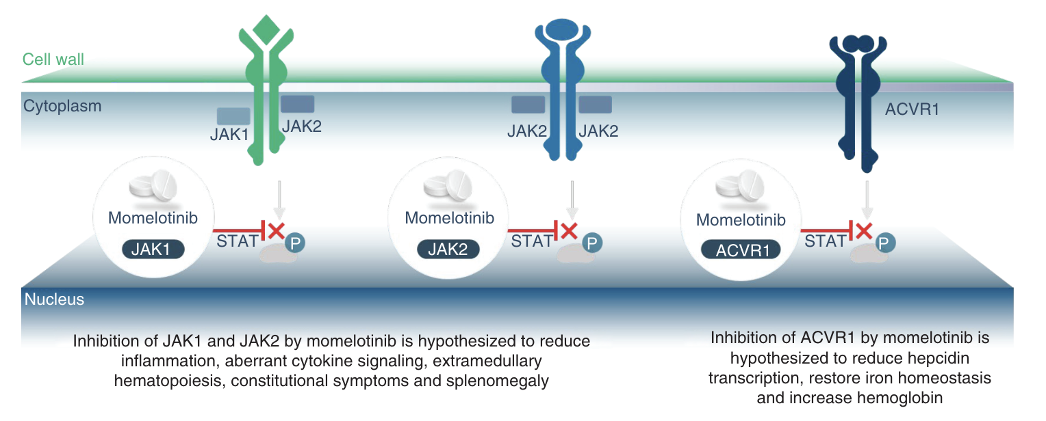
Mechanism of Action - momelotinib
Verstovsek S et al, Future Oncol. (2021) 17(12), 1449–1458

Slide 8
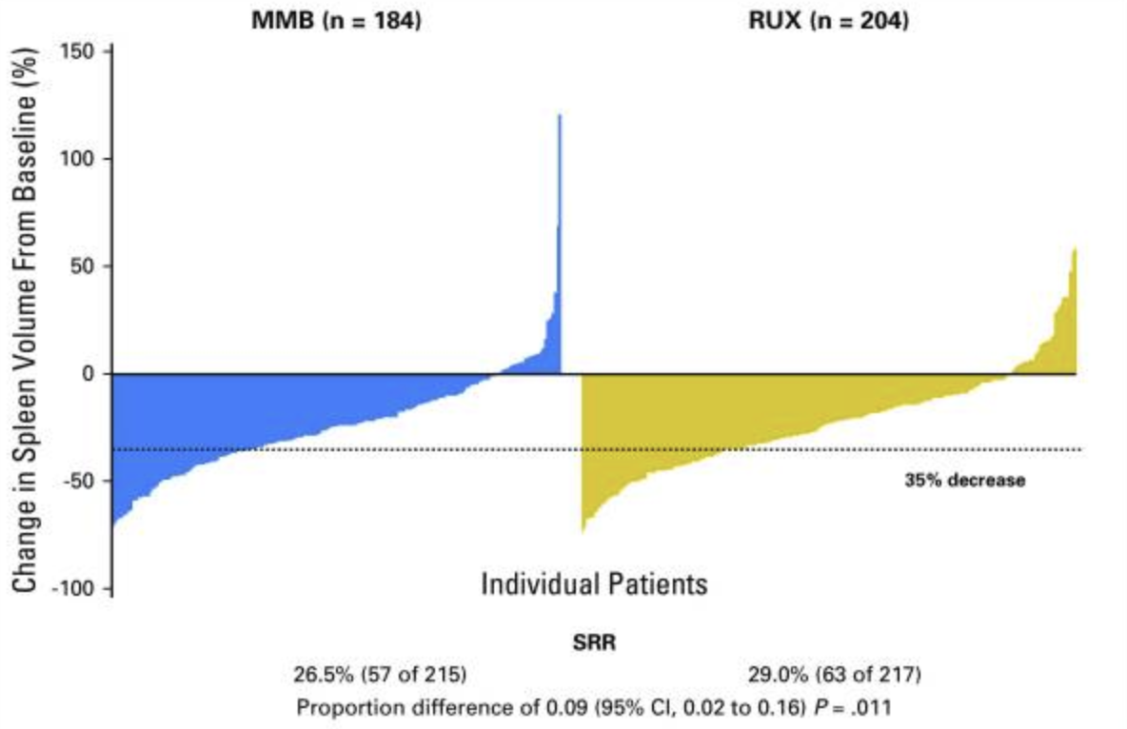
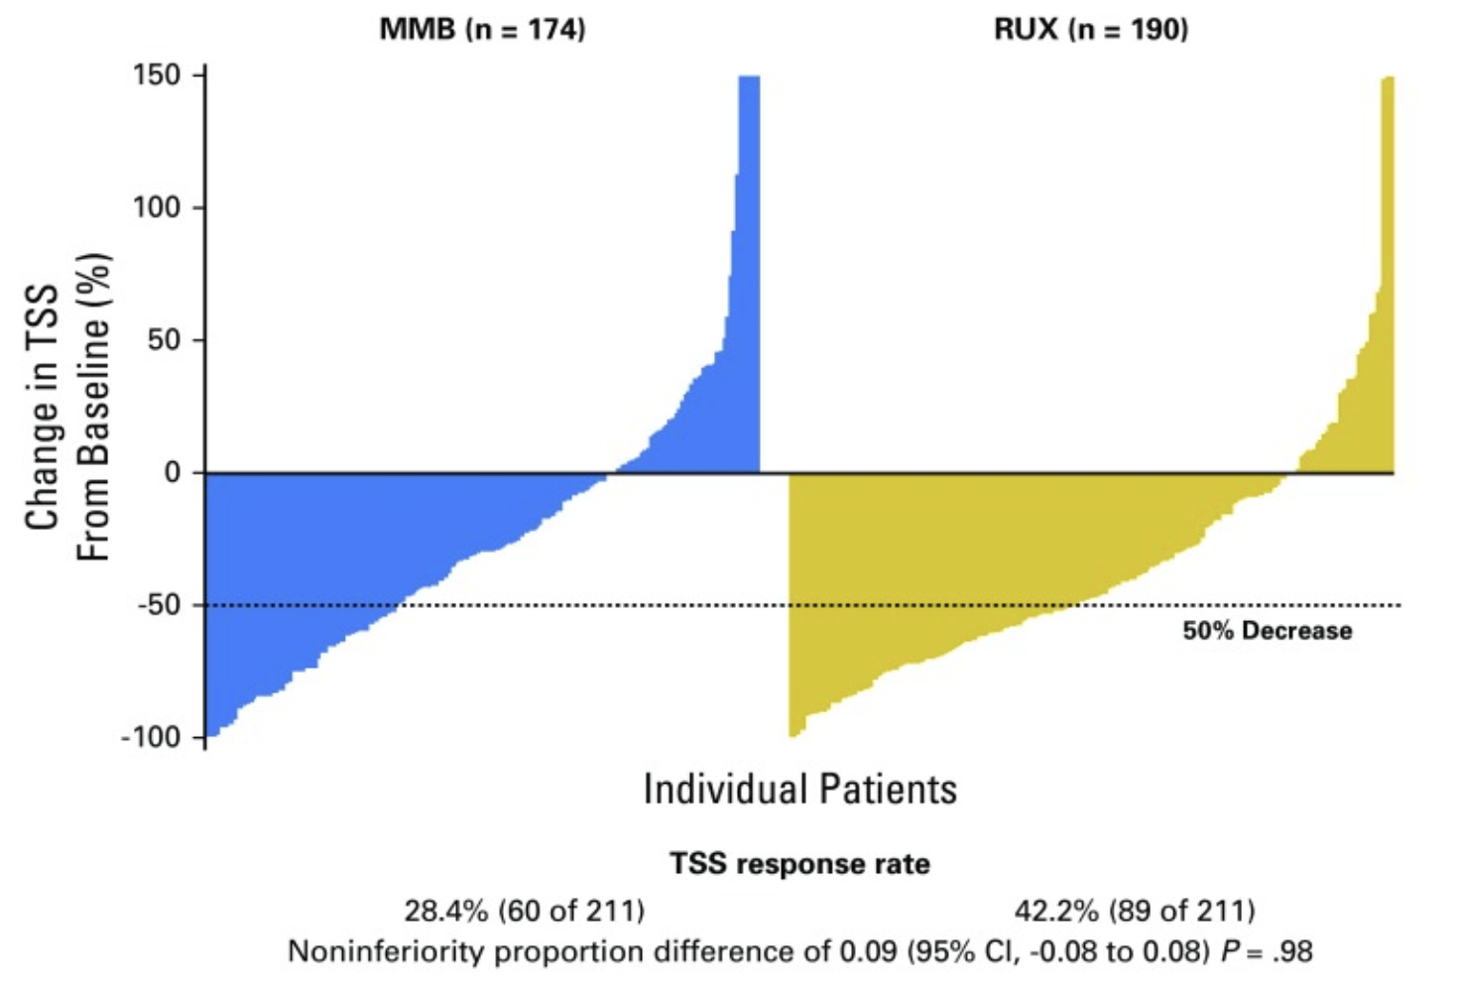
SIMPLIFY-1: Primary and Secondary Endpoints
35% Spleen volume reduction at week 24
50% reduction in TSS response at week 24
Primary Endpoint – met (non-inferiority)
Mesa. JCO. 2017;35:3844.

Slide 9
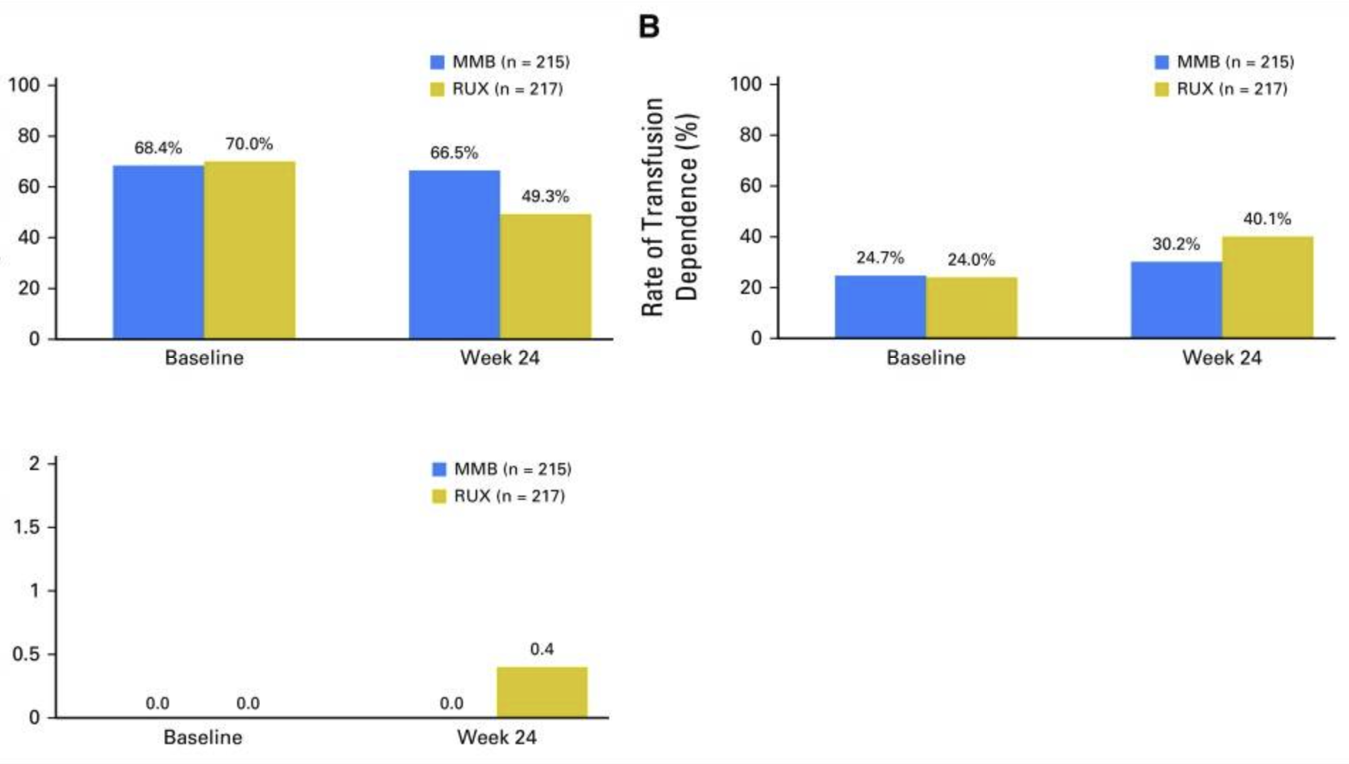
SIMPLIFY-1: Transfusion requirements by week 24
Mesa. JCO. 2017;35:3844.

Slide 10
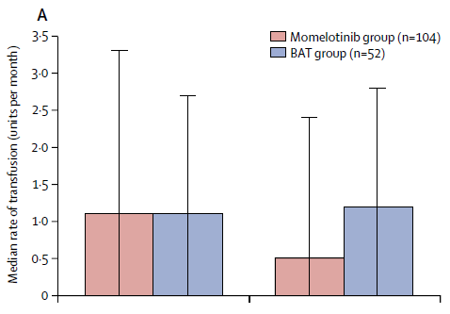
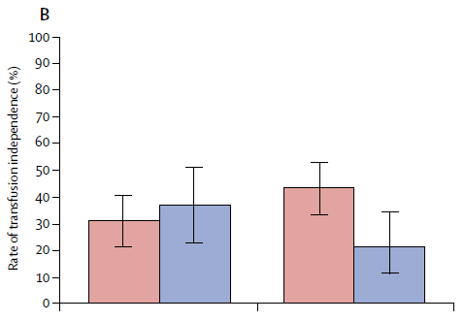
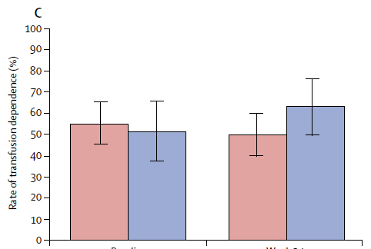
SIMPLIFY-2: Momelotinib versus BAT in JAKi-pretreated myelofibrosis patients
Phase 3, randomized, open-label trial of momelotinib vs BAT for prior JAKi-treated, primary, post-PV/ET MF; intermediate-2 or higher; platelets ≥50 K/mcl (n=156)
Transfusion requirements by week 24
Transfusions
Transfusion independence
Transfusion dependence
Baseline
Week 24
Baseline
Week 24
Baseline
Week 24
Harison C et al, Lancet Heamatol. 2018; 5:e73-81

Slide 11
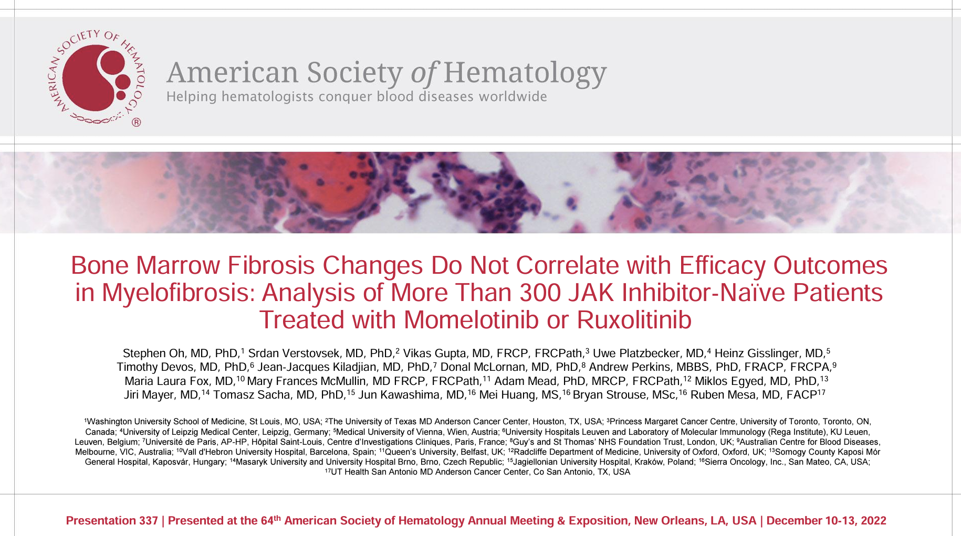
Bone marrow fibrosis changes and efficacy outcomes

Slide 12
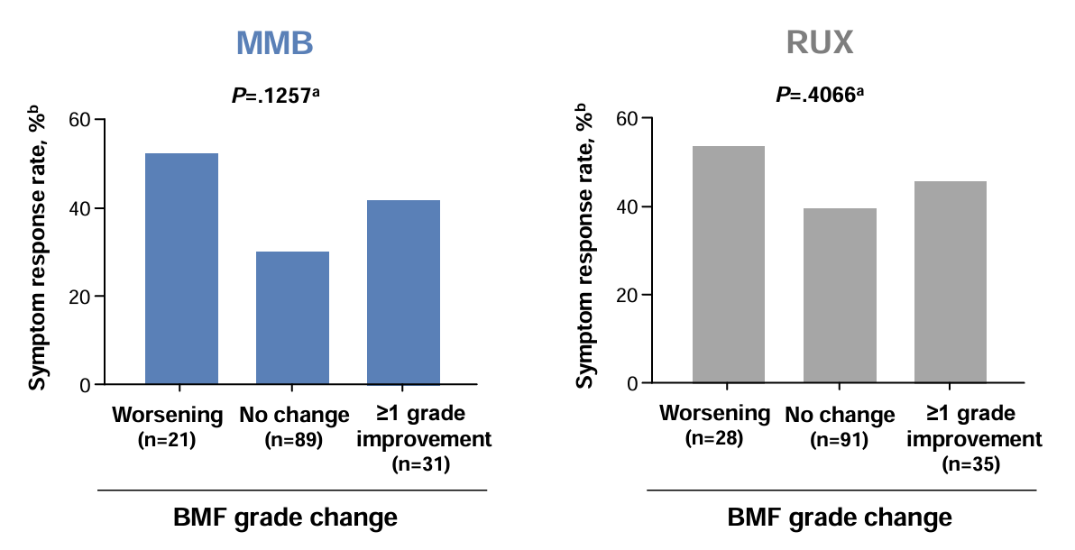
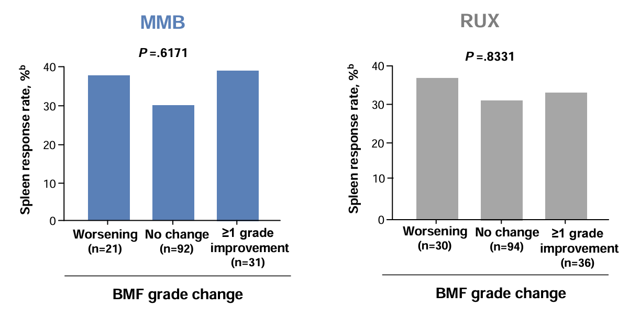
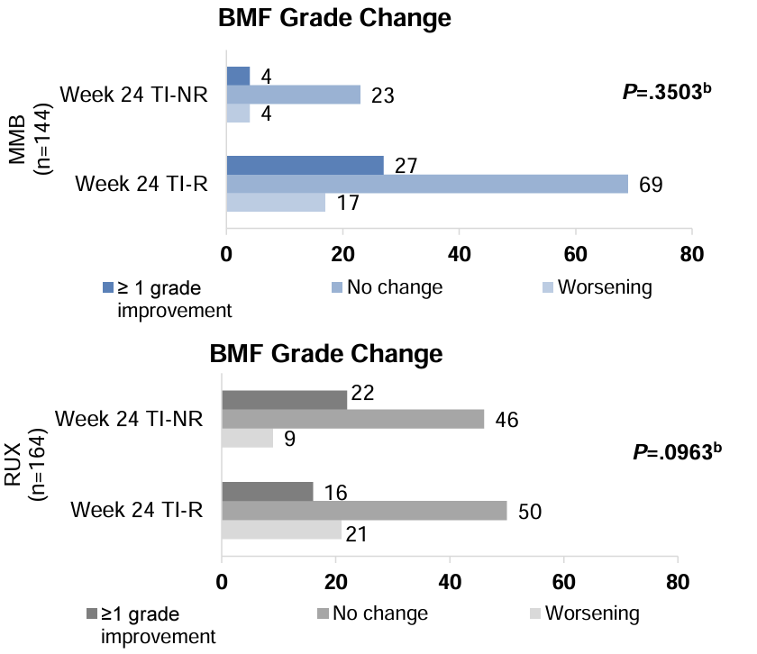
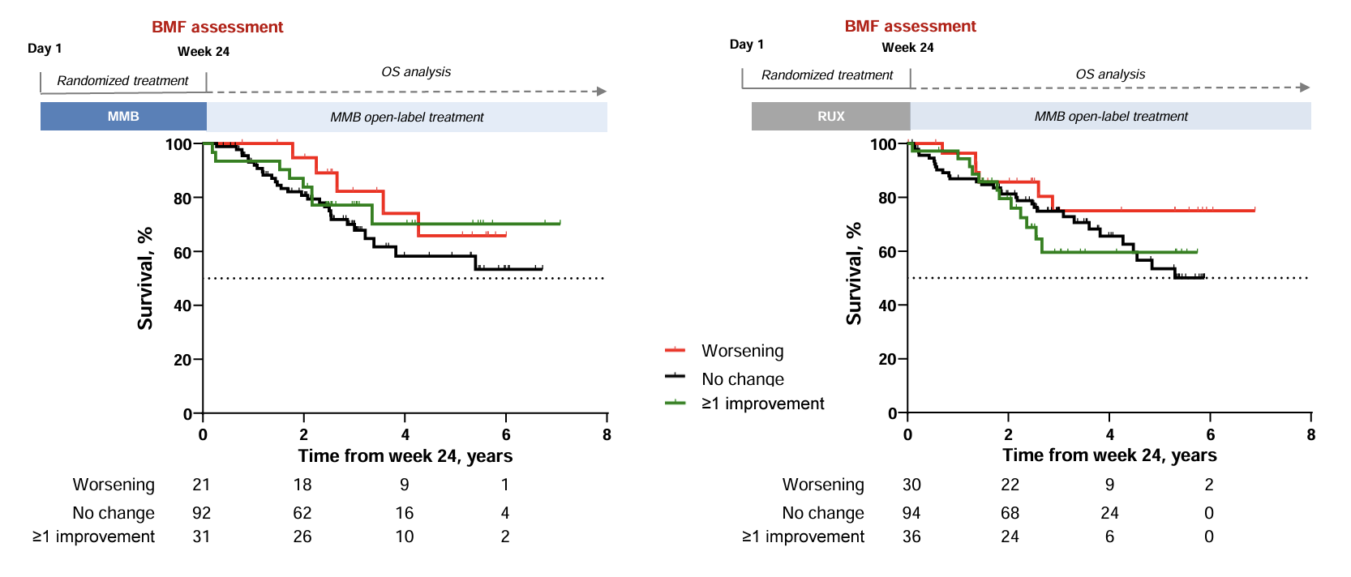
SIMPLIFY-1: No association of BM fibrosis changes and outcomes at wk 24
Oh S et al, ASH 2022, Abstract 337

Slide 13
MOMENTUM: Momelotinib versus Danazol in JAKi-pretreated myelofibrosis with symptomatic anemia
Phase 3, randomized, double-blind trial of momelotinib vs danazol for primary, post-PV or post-ET MF; int-2* or higher; Hb<10 g/dl, previously JAKi treated (n=195)
Momelotinib 200mg Qday + Placebo
(n=130)
Pre-treated JAKi MF
TSS> 10
Hb < 10 g/dl
Plt > 50 K/mcl
N=93
Momelotinib 200mg Qday
(n=134)
2:1 randomization
Early crossover if progression (n=5)
N=41
Danazol 600mg Qday +
Placebo
(n=65)
N=36
Long-term follow-up
Double blinded portion
Open label crossover
24 weeks
Gerds A, et al., Lancet Hematol. 2023;10:e735.

Slide 14
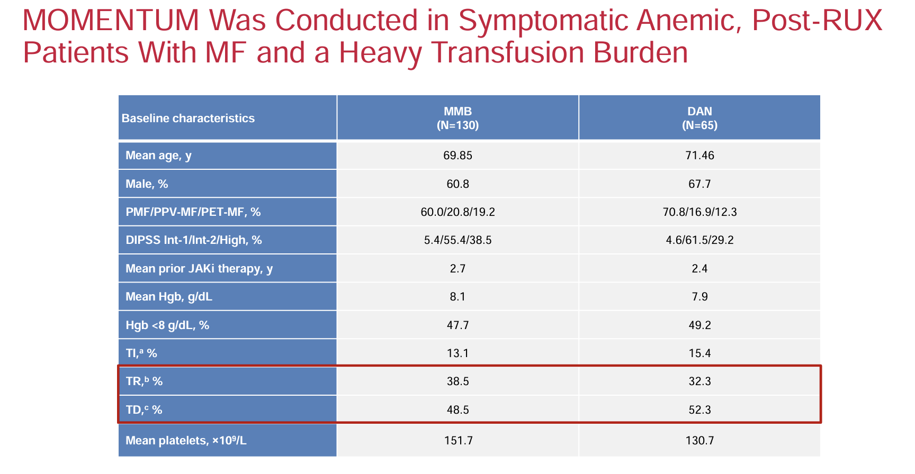
Gerd A et al, ASH 2022, Presentation 627.

Slide 15
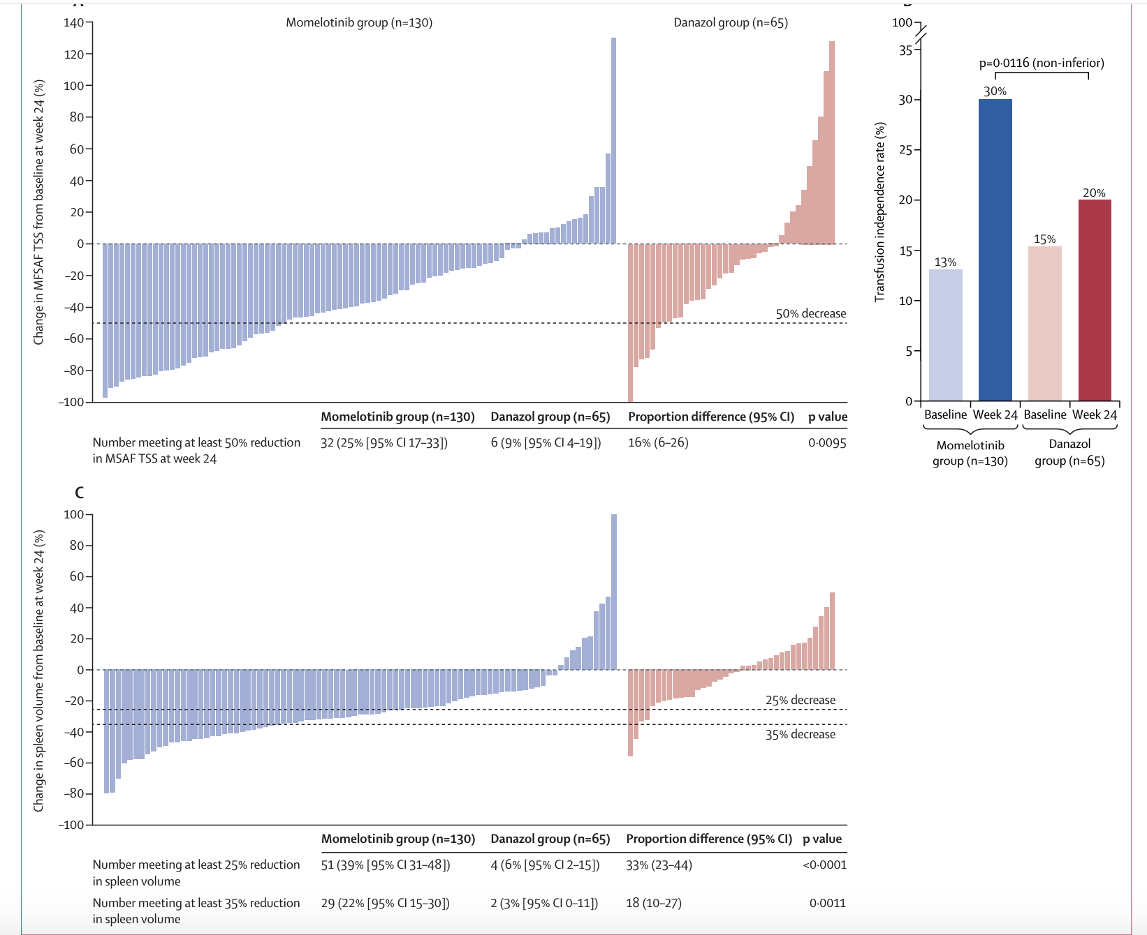
MOMENTUM: Primary and Secondary Endpoints
Change in TSS
25%
p=0.0095
9%
35% SVR
TI rate
22%
p=0.0011
3%
Verstovsek S et al, Lancet 2023: 401; 269-80.

Slide 16
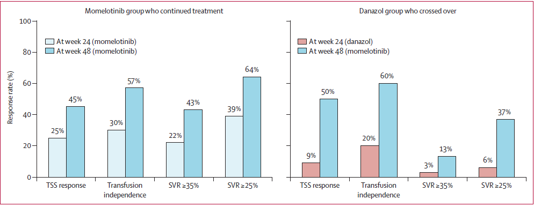
MOMENTUM: Updated results – week 48 and beyond
Gerd A et al, Lancet Heamatol 2023: 10:e735-46.

Slide 17
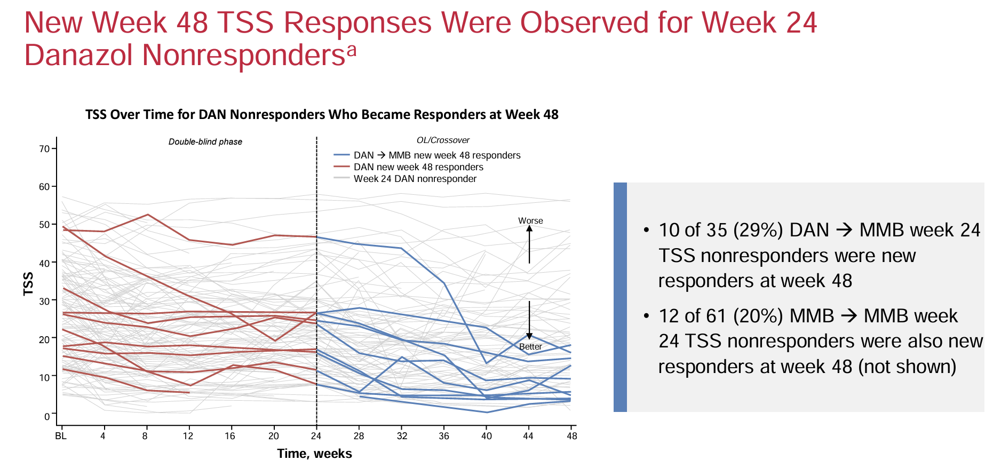
MOMENTUM: Primary and Secondary Endpoints
Gerd A et al, ASH 2022, Presentation 627.

Slide 18
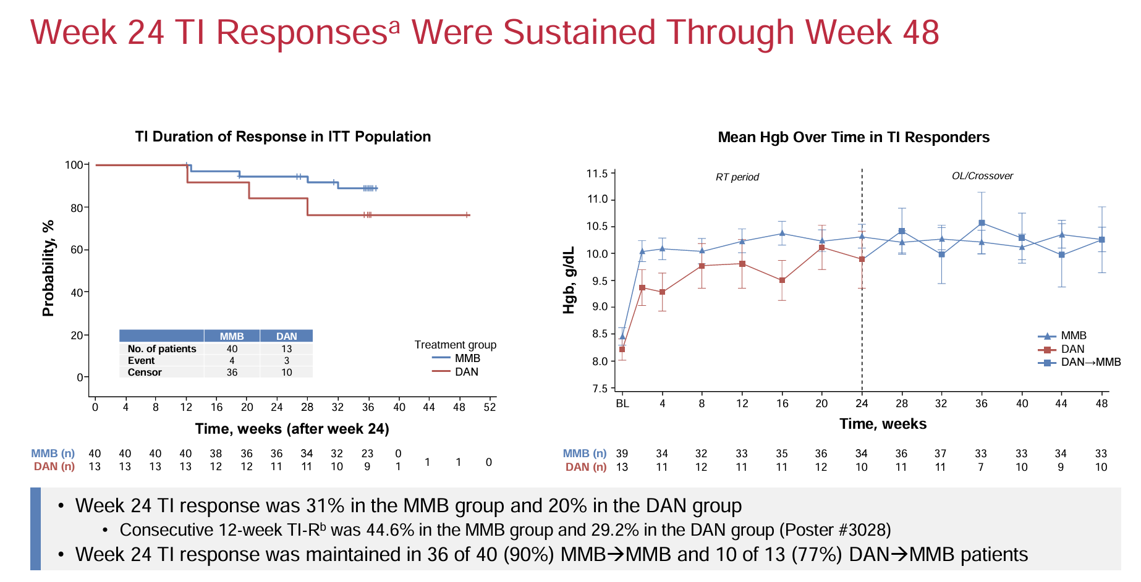
MOMENTUM: Primary and Secondary Endpoints
Gerd A et al, ASH 2022, Presentation 627.

Slide 19
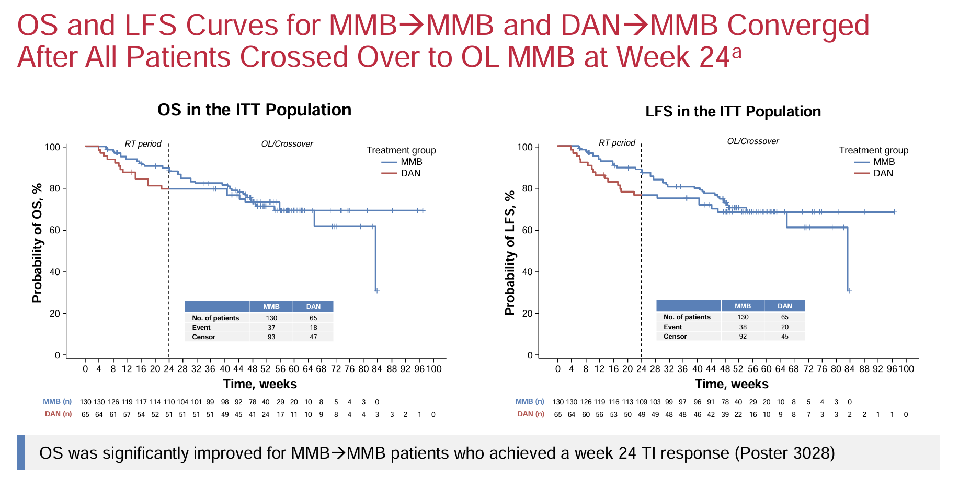
MOMENTUM: Primary and Secondary Endpoints
Gerd A et al, ASH 2022, Presentation 627.

Slide 20
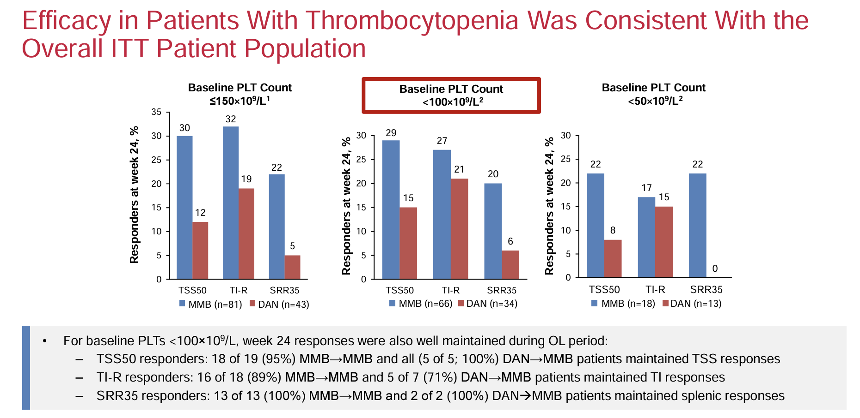
Gerd A et al, ASH 2022, Presentation 627.

Slide 21
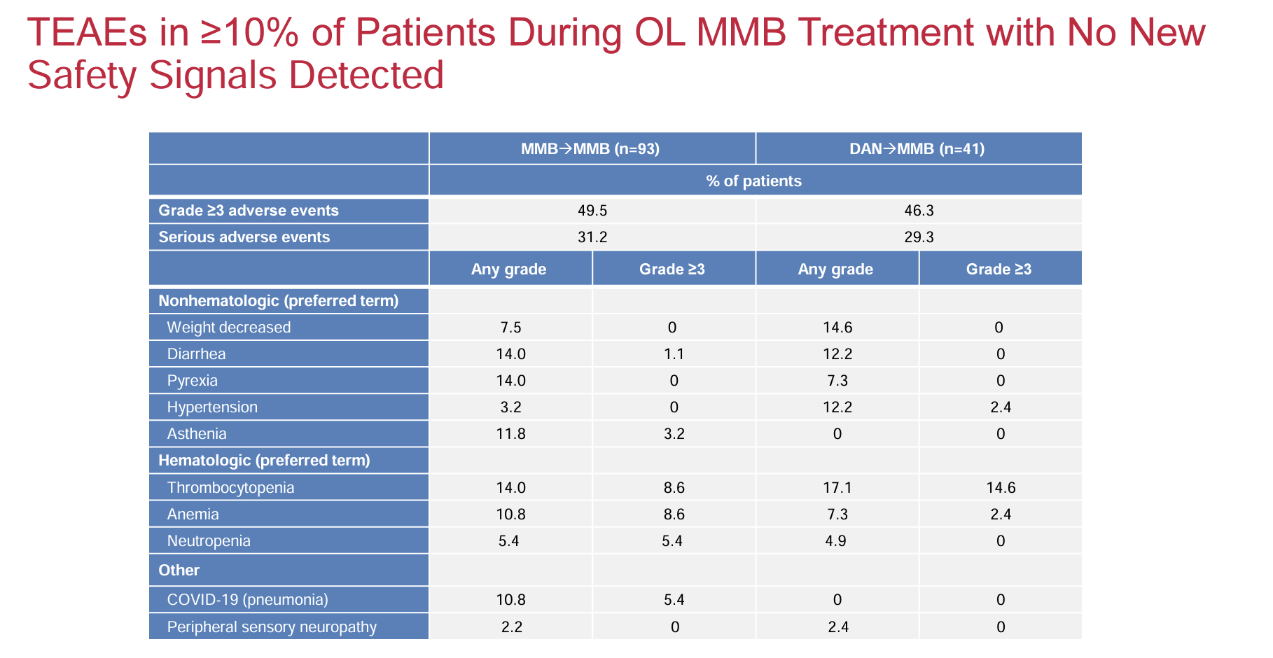
Gerd A et al, ASH 2022, Presentation 627.

Slide 22
Ongoing studies

Slide 23
XPORT-MF-034: Selinexor + Ruxolitinib in Treatment-Naive MF
Phase I/II portion of trial evaluated selinexor 40 mg or 60 mg once weekly + ruxolitinib in 28-day cycles
Variable, n (%) | Selinexor 40 mg (n = 8) | Selinexor 60 mg (n = 14)
SVR ≥35% at Wk 24 | 3 (38) | 11 (79)
TSS ≥50% at Wk 24 | 2 (25) | 7 (58)*
Most common AEs included nausea, anemia, fatigue; AEs reversible with dose modification
Ali H et al, ASCO 2023. Abstr 7063

Slide 24
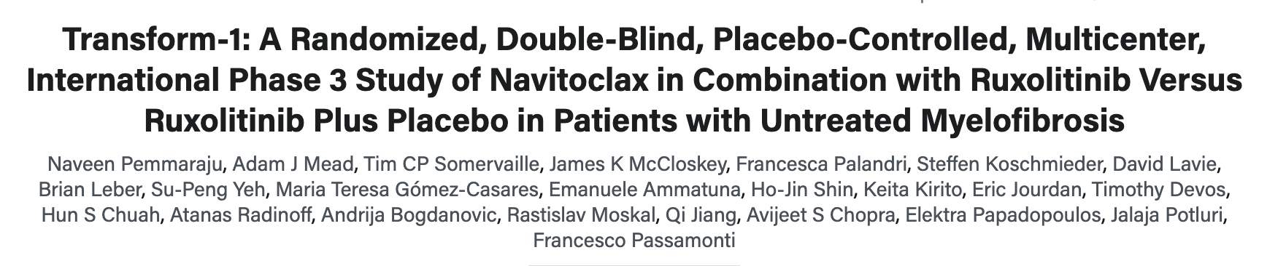
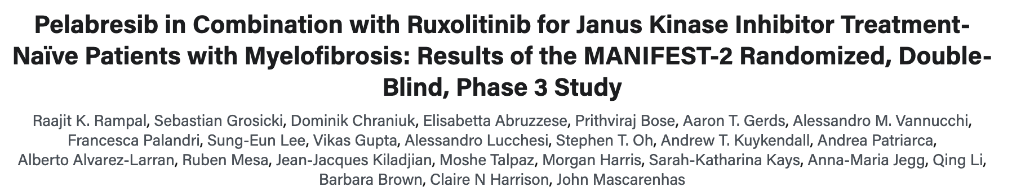

Slide 25
MANIFEST-2 & TRANSFORM-1 - Primary outcomes
35% spleen volume reduction at week 24
ITT population
 | Combination | Rux monotherapy | P value
MANIFEST-2 | 65.9% | 35.2% | <0.001
TRANSFORM-1 | 63.2% | 31.5% | <0.001
TSS 50% at week 24
 | Combination | Rux monotherapy | P value
MANIFEST-2 | 52.3% | 46.3% | 0.216
TRANSFORM-1 | 39.2% | 41.7% | NS
Rampal R, et al, ASH 2023, San Diego; Pemmaraju, N, et al, ASH 2023, San Diego.

Slide 26
Other ongoing studies
Phase III Trial of Imetelstat for Patients With MF and Previous JAK Inhibitor Therapy
Navtemadlin: MDM2 inhibitor
  Multiple trials in MF ongoing
Phase I study of INCA033989 (CALR antibody) in patients with MF or ET with CALR exon-9 mutation
Luspatercept in Patients With MF and Anemia Receiving JAK Inhibitor Therapy
And many more…

Slide 27
Conclusions
The choice of JAK inhibitors is individualized - depending on the patient's needs and symptoms, and toxicity profile
Ruxolitinib has the most data and usually the first choice for most patients
Pacritinib has indications in patients with thrombocytopenia (platelets < 50 k/uL)
Momelotinib has good safety & efficacy, especially for those with anemia
  TSS rate, splenic response, and transfusion independence rate superior to danazol and the response maintained beyond week 24 to through week 48
  Efficacy and safety are equally seen in patients with thrombocytopenia (platelets < 100 K/ul)
Studies of novel agents and new combination therapies ongoing
We still need treatment that is disease-modifying, and reverses fibrosis

Slide 28
Emerging Evidence in The Treatment of Myelodysplastic Syndromes (MDS)
Afaf Osman, MD

Slide 29
Myelodysplastic neoplasms (MDS)
Low Risk MDS
High Risk MDS
IPSS-R ≤3.5
IPSS-R ≥3.5
IPSS ≤1
IPSS-R ≥1
Anemia +/- other cytopenias
Severe cytopenias
Higher risk of AML

Slide 30
IPSS-M – New Risk model
New risk model incorporating recurrent genetic mutations
Better risk discrimination than IPSS-R
Underscores the importance of comprehensive molecular profiling
Molecular profiling of MDS affects management
Notes:
IPSS-M had better discrimination than IPSS-R for LFS (C-index 0.72 [95% CI: 0.67 - 0.78] vs. 0.68 [95% CI: 0.62 - 0.75]) and for OS (C-index 0.74 [95% CI: 0.68 - 0.81] vs. 0.70 [95% CI: 0.63 - 0.78]).

Slide 31
Lower Risk MDS
SYMPTOMATIC?
YES
ISOLATED ANEMIA
OTHER CYTOPENIAS
NO
MONITORING

Slide 32
ISOLATED ANEMIA IN LOWER RISK MDS
Del 5q
MDS-Ring Sideroblasts
EPO < 500
Lenalidomide
Luspatercept
ESAs

Slide 33

Erythropoiesis-stimulating agents (ESAs)
>NOT effective if erythropoietin level is more than 500 u/l
>Median duration of response about 20-24 months
>Most patients eventually lose response

Slide 34
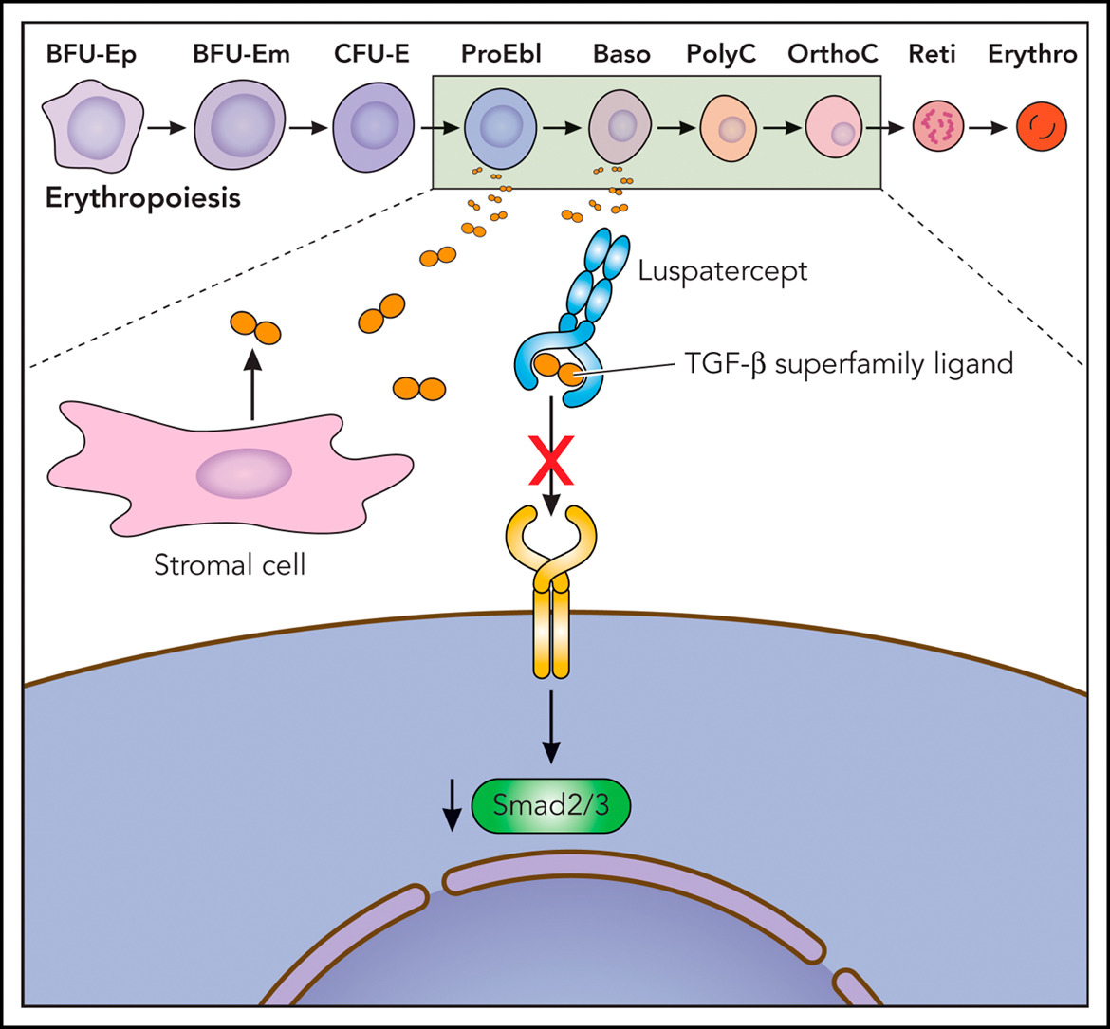
Luspatercept
Notes:
Luspatercept acts as an activin receptor type IIB fusion protein ligand trap that targets the altered transforming growth factor beta pathway in MDS, which is associated with impaired terminal erythroid maturation. Treatment with luspatercept results in decreased SMAD signaling, which enables erythroid maturation by means of late-stage erythroblast differentiation and thus improves anemia. ESAs, the current standard first-line therapeutic option for anemic lower-risk patients with MDS, also improve red cell parameters mainly by expanding proliferation of early erythroid progenitor cells. However, erythropoietin (EPO) and its receptor (EPO-R) are also required for survival of late-stage definitive erythroid cells, and they play an essential role in promoting proliferation, survival, and appropriate timing of terminal maturation of primitive erythroid precursors. Thus, luspatercept joins the mechanism of ESAs in promoting erythroid maturation

Slide 35
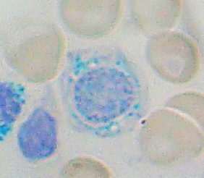
Luspatercept- MEDALIST trial
Phase III, randomized, placebo controlled
Transfusion dependent L-MDS with ringed sideroblasts (RS) who were refractory, intolerant, or ineligible to for ESAs.
MDS-RS: sideroblasts constituting ≥15% erythroid precursors in bone marrow, or ≥5% and <15%, respectively, if a mutation of SF3B1 is present

Slide 36
Luspatercept- COMMANDS trial
Phase III, open-label, randomized
Luspatercept or epoetin alfa
ESA naïve, transfusion dependent LR-MDS
73% had ring sideroblasts.

Slide 37
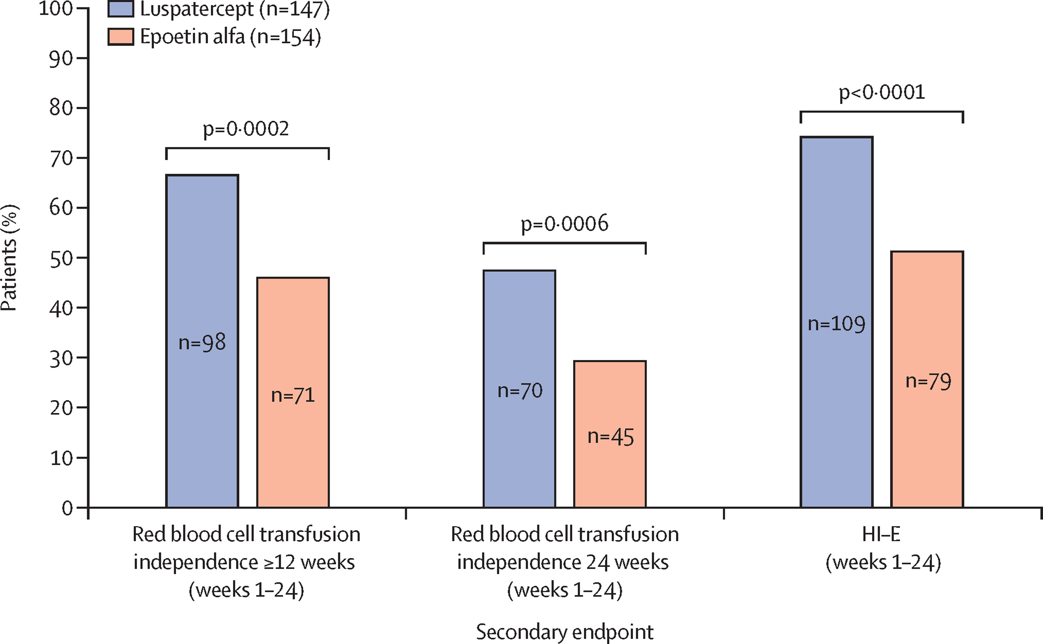
Commands- interim analysis
Notes:
Luspatercept- COMMANDS trial

Slide 38
imetelstat
First in class telomerase inhibitor
FDA Approved last week!
LR- MDS with TD anemia who failed/ineligible to ESAs
Can cause neutropenia and thrombocytopenia (transient)

Slide 39
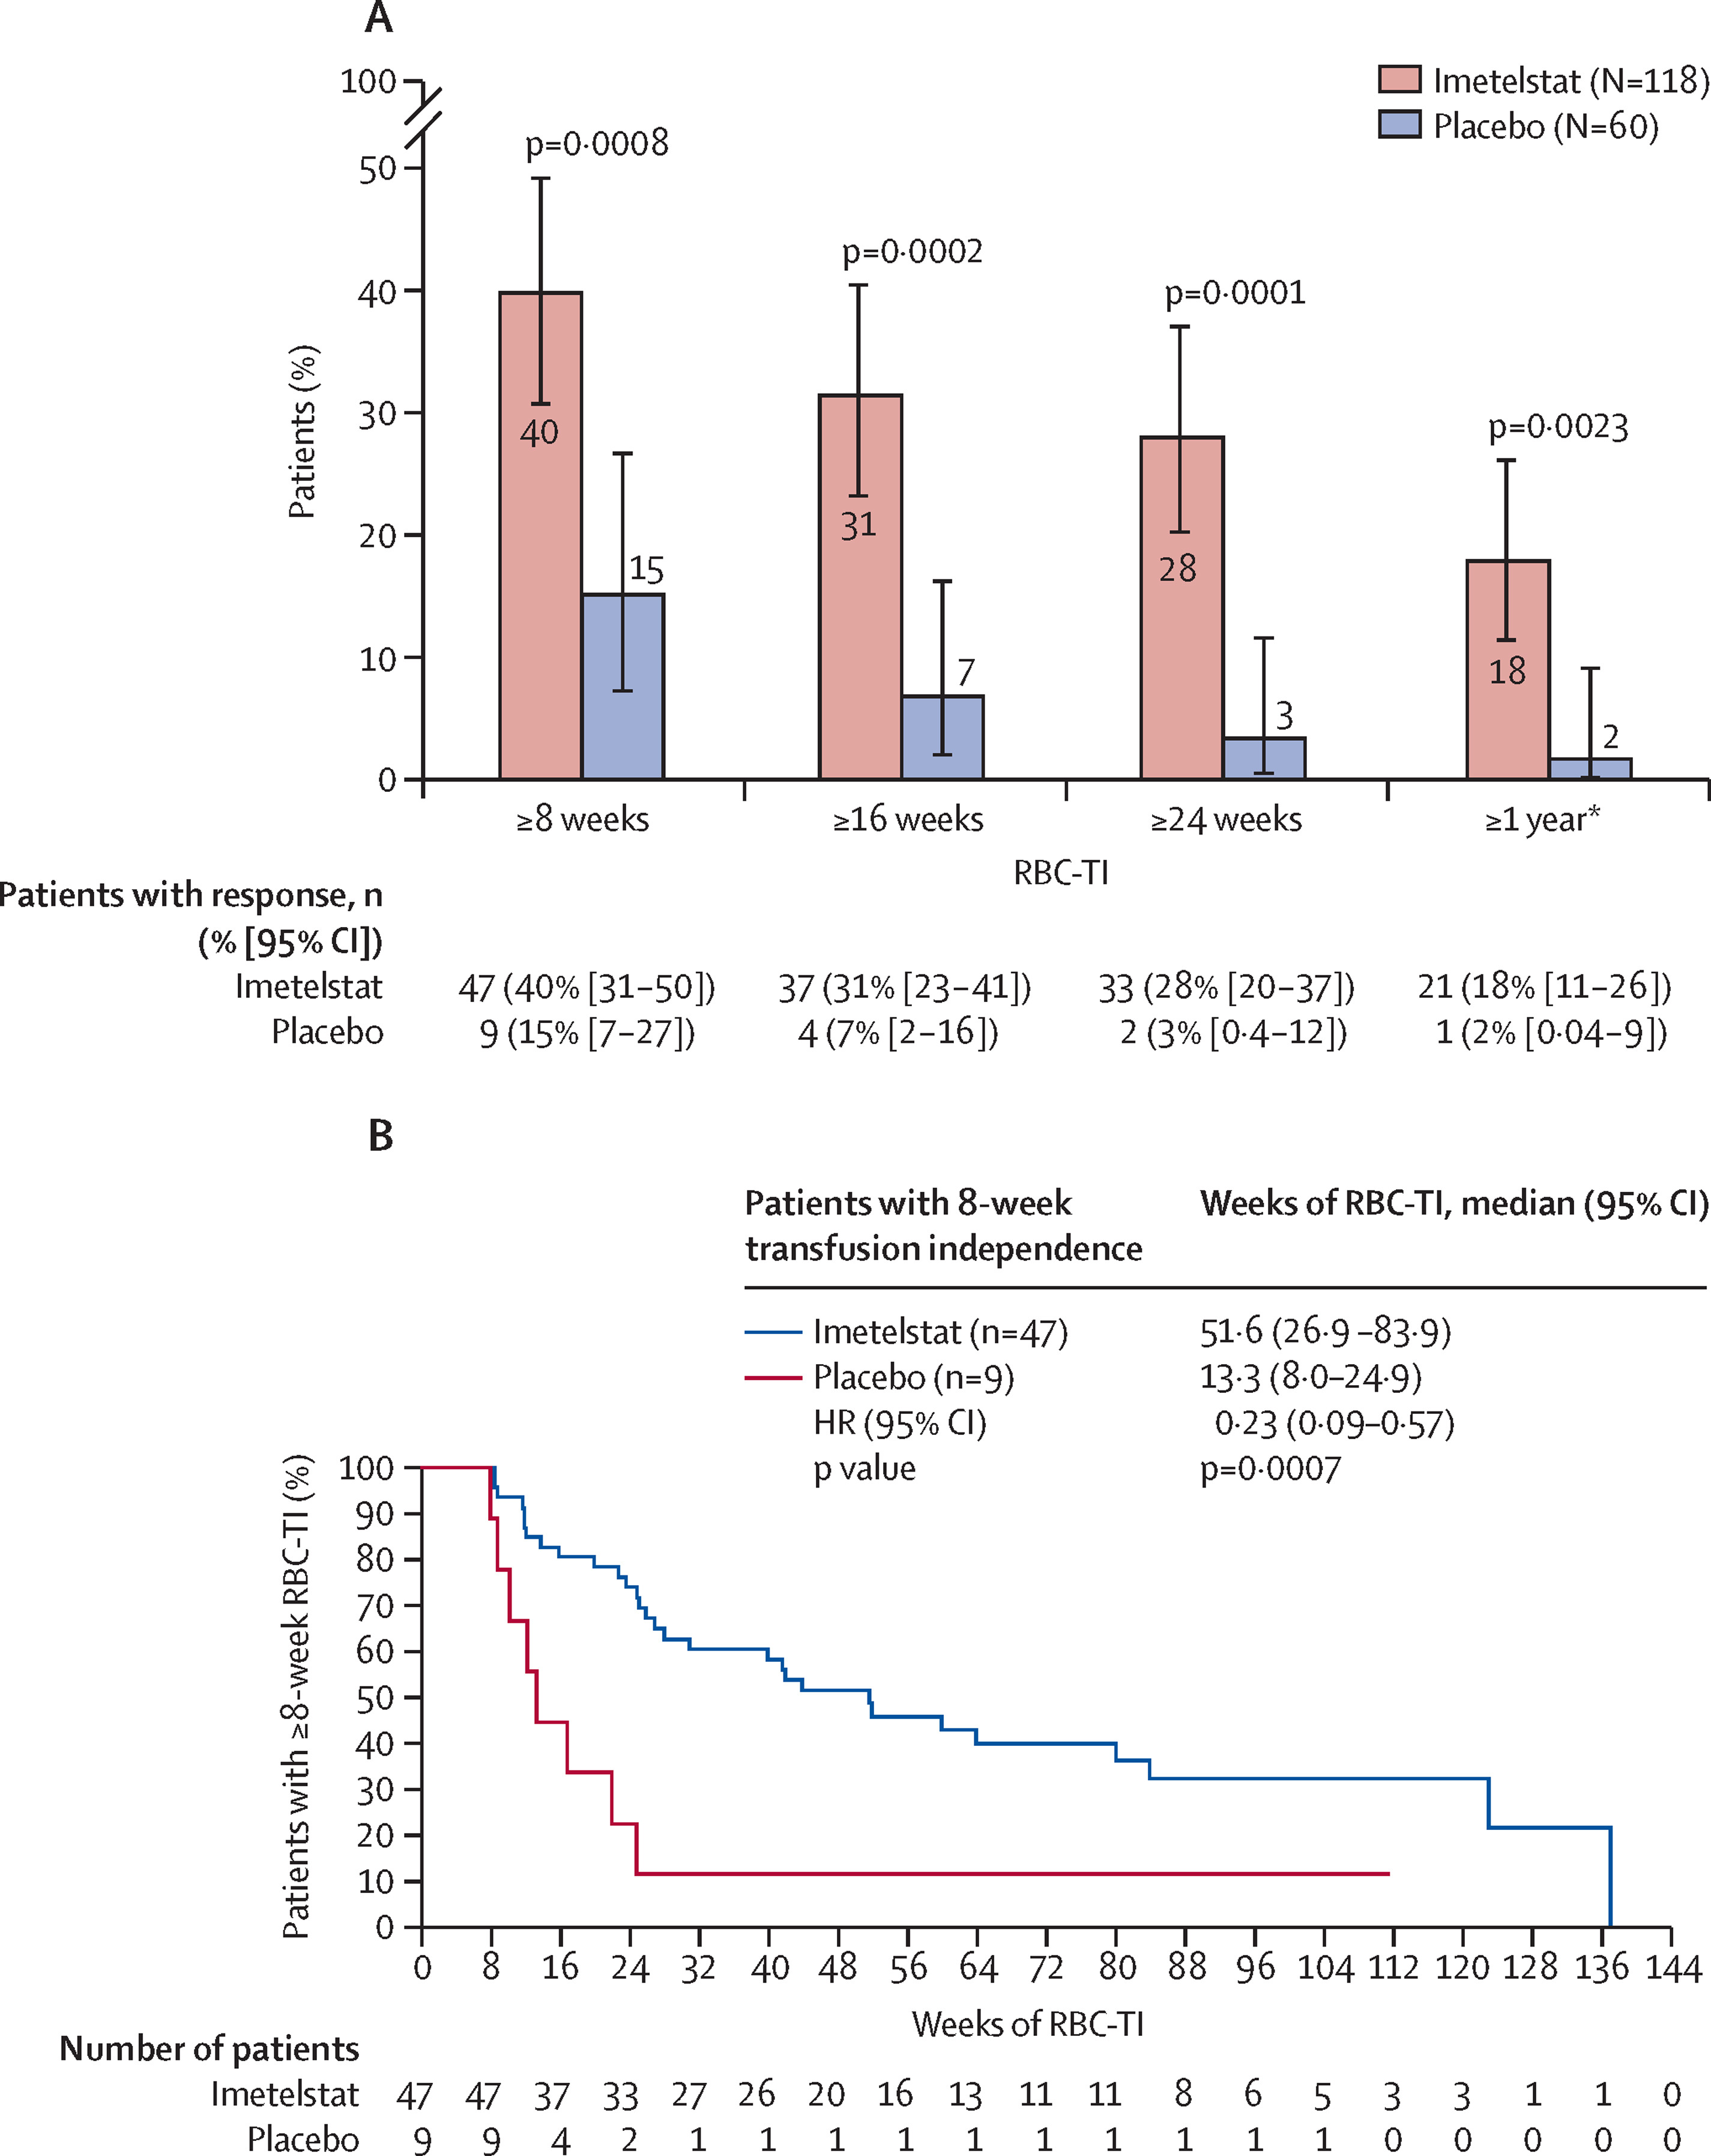
imetelstat - IMERGE

Slide 40
Hematologic Malignancies
Thursday, June 13, 2024

Slide 41
Case presentation: Myelofibrosis
Gliceida Galarza Fortuna, MD
Hematology and Medical Oncology Fellow
University of Utah, Huntsman Cancer Institute
SLC, UT

Slide 42

Case Overview
A 63-year-old female presented to her PCP with a chief complaint of ongoing fatigue, night sweats, early satiety, and bone pain for the last 4 months.
Physical exam is pertinent for splenomegaly – spleen palpable 9-10 cm below the left costal abdomen and pallor.
She has no known past medical history.
Denies any alcohol or tobacco use.
She was last seen by her PCP 2 years ago with a normal physical exam and work up.

Slide 43
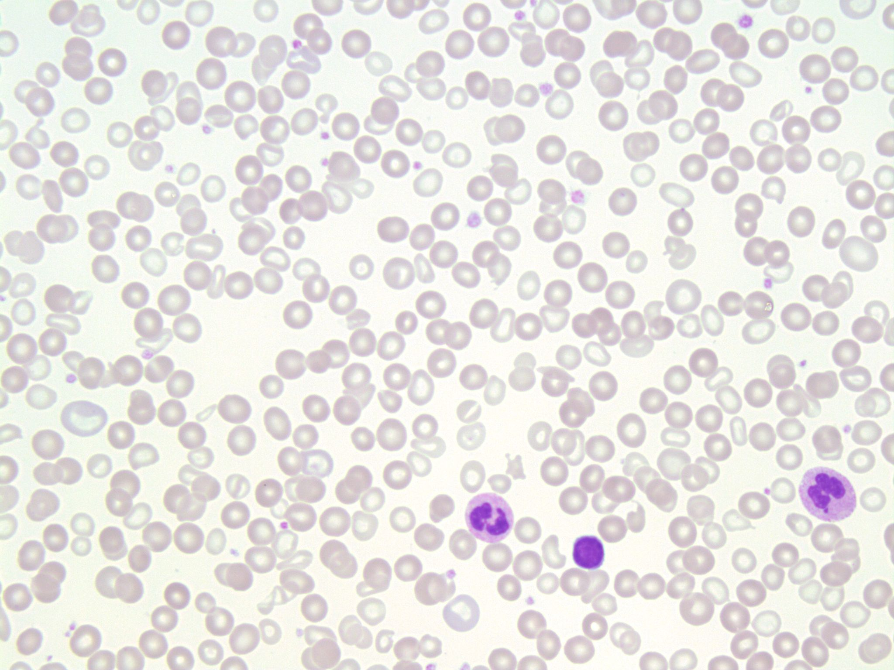
Laboratory Work-Up
Hb – 6.9 g/dL
Plt – 138 k/uL
WBC - 3.8 k/uL
  No blasts appreciated on peripheral smear.
  Early myeloid forms identified
  Nucleated RBC
This Photo by Unknown Author is licensed under CC BY-NC

Slide 44
Bone Marrow Biopsy
Bone marrow biopsy:
- JAK2 positive myeloproliferative neoplasm with features of primary myelofibrosis.
- Hypercellular marrow (90%) with decreased trilineage hematopoiesis with megakaryocyte hyperplasia, myeloid hyperplasia, and marked reticulin fibrosis, and dense collagen fibrosis (MF-3)
- JAK2 V617F mutation by digital PCR (VAF – 49%)

Slide 45
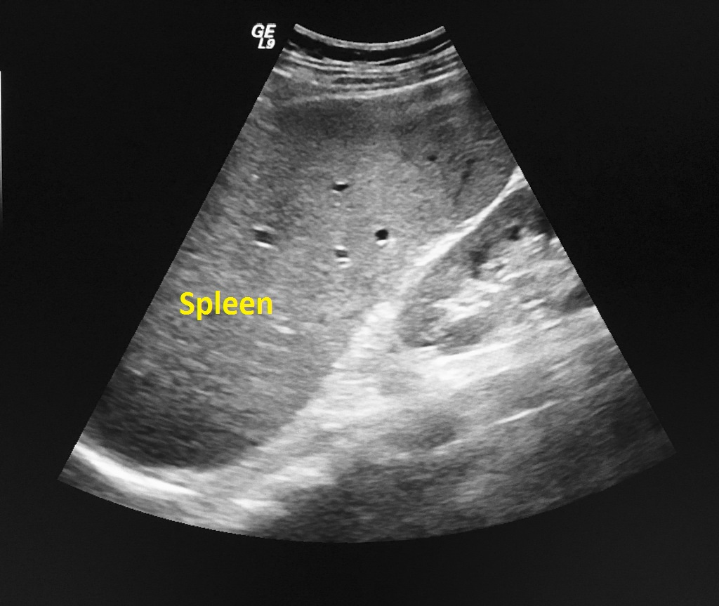
Imaging studies
Abdominal ultrasound showed splenomegaly to 24 cm craniocaudal
This Photo by Unknown Author is licensed under CC BY-SA

Slide 46
Disease Stratification
Scoring System | Risk Group | OS
DIPSS | Intermediate-2 | mOS -4 years
MIPSS70 | Intermediate | 5-year OS: 67%
MIPSS70-plus version 2.0 | High | 10-year OS: 13%

Slide 47
Treatment decision and initiation
She was seen at an outside hospital and was started on ruxolinitinb 5 mg BID, which was then increased to 10 mg BID.
Repeat labs 6 weeks after therapy initiation:
  WBC: 3.8 K/uL
  Hg – 7.5 g/dL (Required 4 transfusions in a 6 weeks spam)
  Plt – 90 k/uL
Spleen still palpable at 9-10 cm below the left costal margin
She describes having multiple ecchymoses, nausea, abdominal discomfort, a 5-pound weight gain, new-onset headaches, and ongoing fatigue.

Slide 48

Patient sees you in the office for 2nd opinion
What would be your treatment recommendation?

Slide 49
FDA approved JAK inhibitors for the treatment of Myelofibrosis
Drug | Ruxolitinib | Fedratinib | Pacritinib | Momelotinib
Indication | Intermediate/high risk MF, including primary MF, post-PV MF, post-ET MF | Intermediate-2/high-risk primary or secondary MF | Intermediate/high-risk primary or secondary MF with platelet count < 50 x 10^{9 /}L | Intermediate/ high-risk MF in patients with anemia.
MOA | JAK1/JAK 2 inhibitor | JAK2 and FLT3 inhibitor | JAK2, IRAK1, and ACVR1 inhibitor | JAK1/JAK2 and ACVR1 inhibitor
Adverse events | Cytopenias, weight gain, infections, shingles reactivation, ecchymosis, dizziness and headaches | Nausea and diarrhea | Nausea and diarrhea | Thrombocytopenia, hemorrhage, bacterial infection, fatigue, dizziness, diarrhea, and nausea.
Unique Concerns | Avoid abrupt discontinuation | Concern for Wernicke’s encephalopathy | Associated with CV events | Peripheral Neuropathy
Notes:
There are four FDA–approved JAK inhibitors (JAKis) for the treatment of myelofibrosis.
Ruxolitinib, approved in 2011 for intermediate-2 and high-risk myelofibrosis, this option leads to significant clinical benefits by reducing spleen size and relieving disease-related symptoms. Clinical trials comparing ruxolitinib to placebo and the best available therapy have showed spleen size reduction greater than 35% at 24 and 48 weeks, respectively. However, treatment with ruxolitinib may result in a suboptimal response, loss of efficacy and response over time or intolerance as a result of hematologic complications, such as progressive anemia and thrombocytopenia.
For those patients in whom ruxolitinib is not effective, there are now three additional treatment options: fedratinib and pacritinib and momelotinib. Fedratinib was approved in 2019 as a first-line or second-line agent for patients with platelet counts ≥ 50 × 10⁹/L.³ Although fedratinib is an effective first-line option, ruxolitinib is most often used in clinical practice because of increased experience and familiarity with its use. As a result, fedratinib is mainly used as salvage therapy following ruxolitinib.
In 2022, pacritinib was approved as the first-line treatment for patients with platelet counts ≤ 50 × 10⁹/L and as second-line use irrespective of the platelet count. In the PERSIST-1 and PERSIST-2 randomized controlled clinical trials, pacritinib resulted in less myelosuppression as well as improvement in transfusion independence and hemoglobin, respectively.
Clinical improvement in hemoglobin is speculated to be a result of increased erythropoiesis through inhibition of IRAK1 and ACVR1.^{3,4}
On September 15, the U.S. Food and Drug Administration (FDA) approved momelotinib (Ojjaara) for the treatment of intermediate- or high-risk myelofibrosis, including primary myelofibrosis or secondary myelofibrosis (post–polycythemia vera and post–essential thrombocythemia), in adults with anemia. The FDA approval of momelotinib is supported by data from the pivotal MOMENTUM study. designed to evaluate the safety and efficacy of momelotinib vs danazol for the treatment and reduction of key manifestations of myelofibrosis in an anemic, symptomatic, JAK inhibitor–experienced patient population. This study showed improved symptoms controlled along with anemia and spleen response.

Slide 50
Case Continues
She is transitioned to momelotinib 200 mg daily.
She is seen in clinic 4 weeks later and describes feeling better with increased energy and no GI symptoms.
Repeat labs:
  WBC 7.84 k/uL
  Hg 8.7 g/dL (transfusion independent)
  Plt 90 k/uL

Slide 51
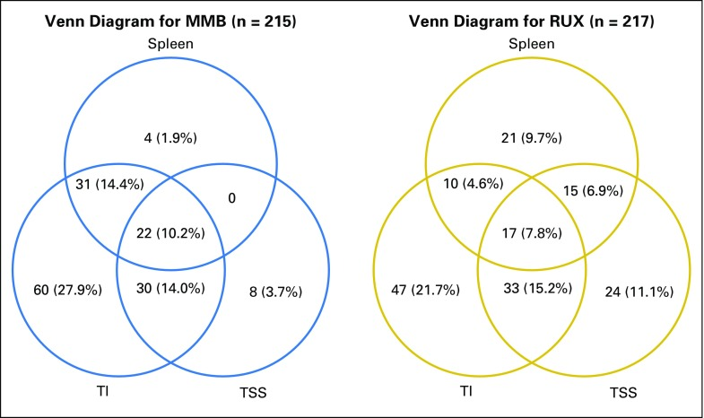
SIMPLIFY-1

Slide 52
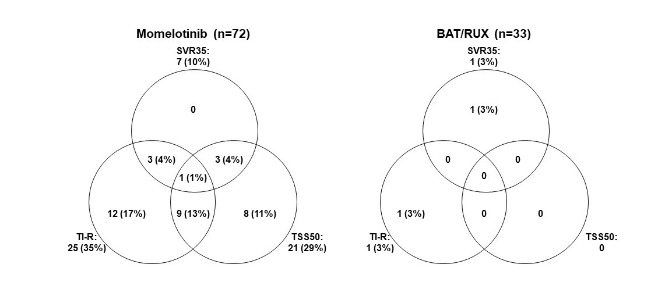
SIMPLIFY-2
Notes:
One interesting observation from both these studies was that approximately 35% to 40% of patients receiving momelotinib who were transfusion dependent developed transfusion independence. There may be a unique niche for momelotinib in the treatment of patients with myelofibrosis; namely, those who have severe anemia and are transfusion dependent.

Slide 53
How would your management change if the patient’s baseline platelet count had been 20K?

Slide 54
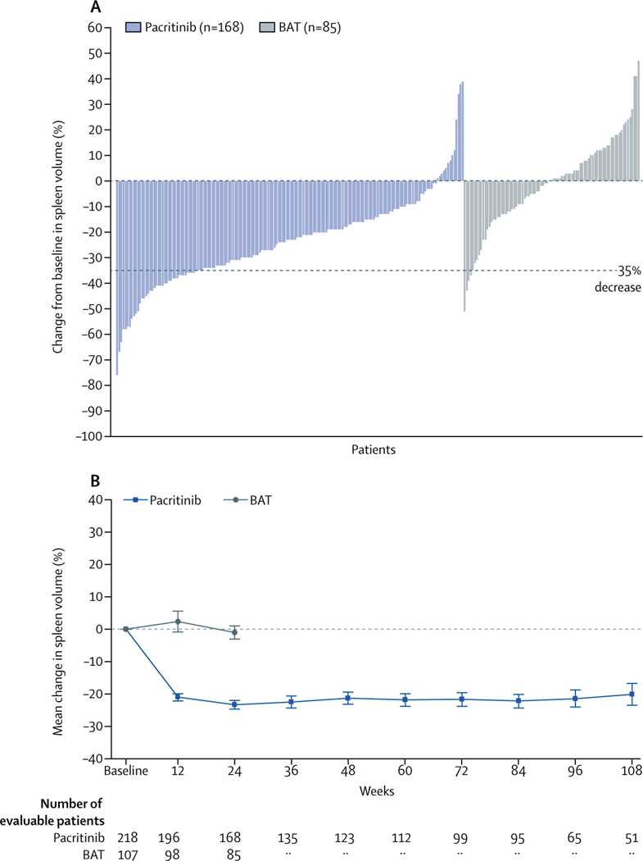
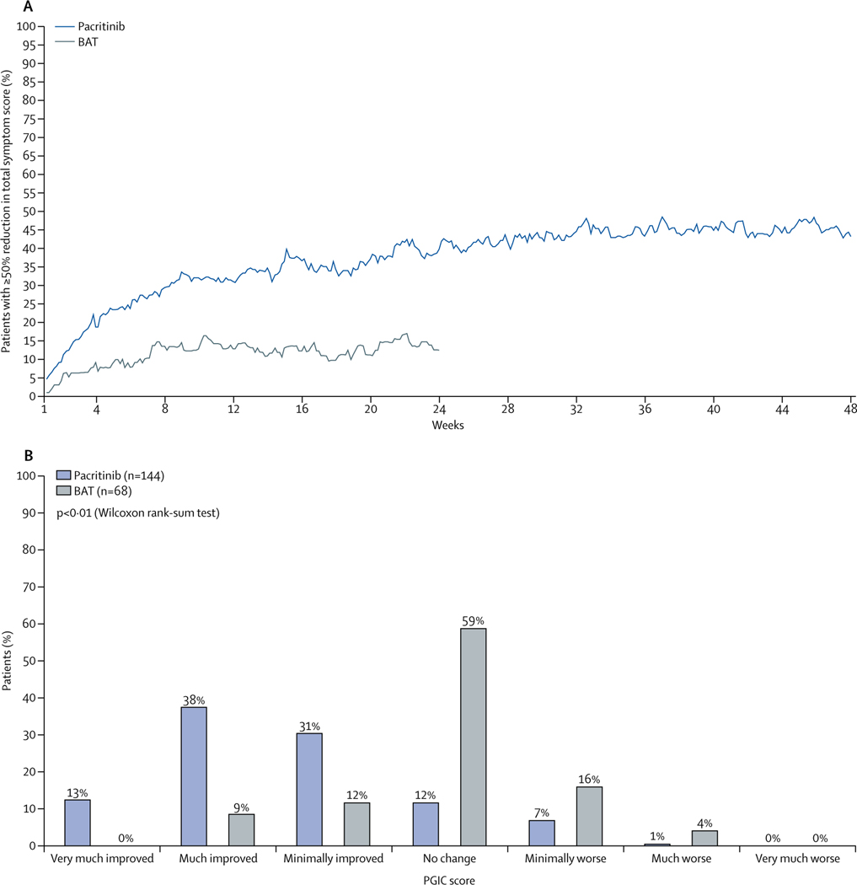
PERSIST-1
Notes:
Pacritinib earned FDA approval for the treatment of patients with myelofibrosis following the results of the PERSIST 1 and 2 trials. The PERSIST-1 trial was a multicenter phase 3 randomized trial that evaluated the efficacy and safety of PAC 400 mg daily vs best available therapy [BAT]: watchful waiting or any symptom-directed therapy excluding JAK2 inhibitors in patients with MF.
The primary endpoint of SVR35% at week 24 and a key secondary endpoint was TSS50 was assessed by MPN-SAF v2.0. In the intent-to-treat population, SVR35% was significantly higher in the PAC-treated patients (19.1% vs 4.7% with BAT, P = .003), and this benefit was consistent regardless of baseline platelet counts. In patients evaluable for response, 36% of patients treated with PAC achieved a ≥50% reduction in symptom score vs 14% in the BAT group (P = .029). Most common nonhematologic toxicities were primarily gastrointestinal, namely grade ≤ 2 diarrhea (58%) and nausea (31%) managed with supportive care.

Slide 55
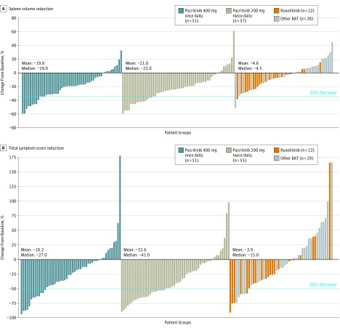
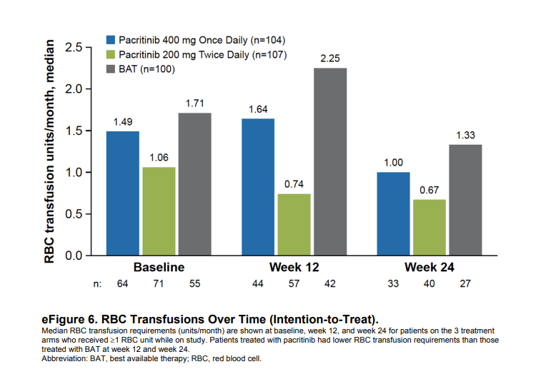
PERSIST-2
Notes:
Similarly, in the phase 3 randomized international multicenter study, Patients were randomized 1:1:1 to pacritinib 400 mg once daily, pacritinib 200 mg twice daily, or BAT, including the JAK2 inhibitor ruxolitinib. As we can observe Pacrinitnib led to a significant higher number of patients achieving a reduction of both symptoms burden and spleen size. Imporantly, among patients who were not transfusion independent at baseline, a significantly greater proportion achieved TI on pacritinib compared with those treated on best available therapy (37% vs 7%, P = .001),

Slide 56
She is continued on momelotinib with tolerable side effects.
On exam, the spleen is non-palpable.
Repeat labs
  WBC 6.5 k/uL
  Hg 8.2 g/dL (transfusion independent)
  Plt 80 k/uL

Slide 57
Case Continues
The patient, however, is interested in a curative approach.
What is the role of transplant in Primary Myelofibrosis?
Notes:
Current consensus recommends HSCT for patients with MF with a DIPSS intermediate-2 and high-risk score and age <70 years.

Slide 58
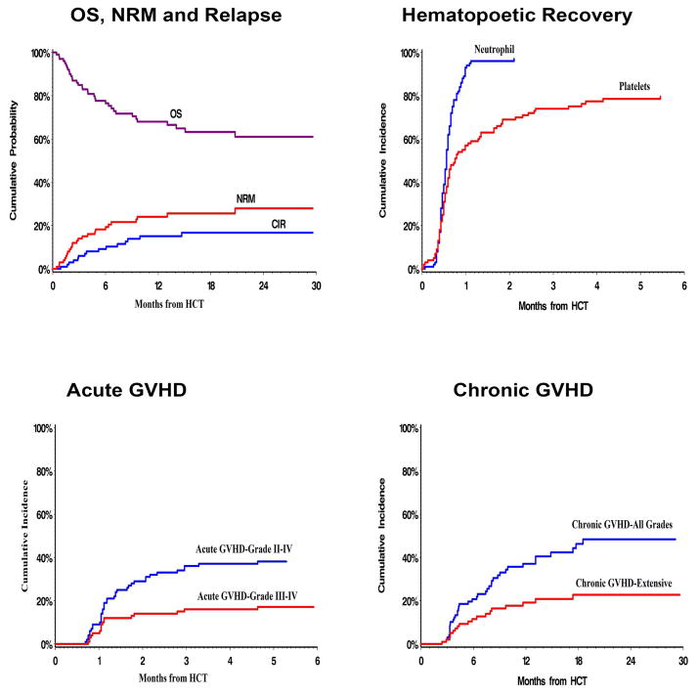
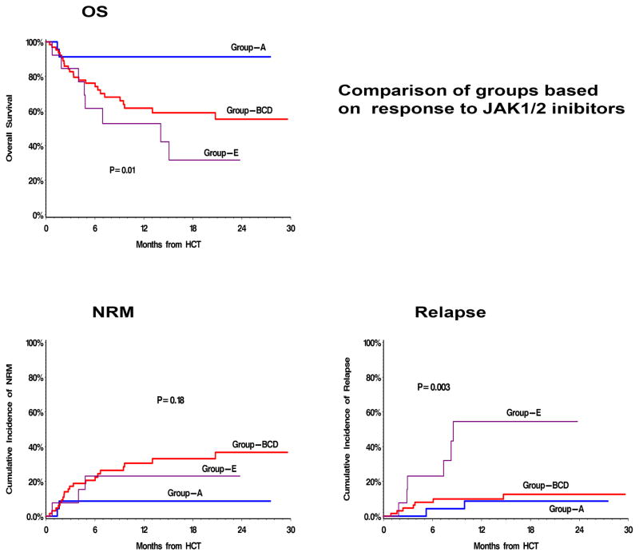
Allogeneic Transplant for PMF
Notes:
Group-A: Clinical improvement; defined as ≥50% improvement in palpable spleen length for spleen palpable by ≥10 cm, or complete resolution of splenomegaly for palpable spleen <10 cm.
Group-B: Stable disease.
Group-C: Increase in blasts to 10–19%, intolerance to treatment due to hematologic / non-hematologic side effects, or new onset transfusion-requiring anemia.
Group-D: Disease progression manifesting as; appearance of new splenomegaly palpable ≥5 cm below costal margin (BCM), or ≥100% increase in palpable distance BCM for baseline splenomegaly of 5–10 cm BCM, ≥50% increase in palpable distance BCM for baseline splenomegaly of ≥10 cm BCM, loss of spleen response, or symptomatic splenomegaly requiring splenectomy.
Group-E: Disease progression manifesting as leukemic transformation defined as a peripheral blood or bone marrow blast count of ≥20%.

Slide 59
Take home points
For Patients who have a suboptimal response to therapy with ruxolitinib, transitioning to either pacritinib, fedratinib, or momelotinib is an appropriate therapeutic option.
The choice between pacritinib, fedratinib or momelotinib should be made based on toxicity profile.
Pacritinib and momelotinib are less myelosuppressive and should be considered when counts are a concern.
Allo-HSCT should be considered in eligible patients with DIPSS intermediate-2/high and MIPSS 70 high-risk scores at the time of best spleen response.
Thrombocytopenia is associated with worse survival outcomes and non-relapse mortality.

Slide 60
References
Bosques, L; Bell,C and Hobbs, G Evaluating Approved JAK Inhibitors for the Treatment of Myelofibrosis. ASCO Daily News. 10/30/2023.
Venugopal S, Mascarenhas J. Novel therapeutics in myeloproliferative neoplasms. J Hematol Oncol. 2020;13(1):162.
Oh ST, Mesa R, Harrison C, et al. Pacritinib is a potential ACVR1 inhibitor with significant anemia benefit in patients with myelofibrosis. Blood. 2022;140(suppl 1):1518-1521.
Chifotides HT, Bose P, Verstovsek S. Momelotinib: an emerging treatment for myelofibrosis patients with anemia. J Hematol Oncol. 2022;15(1):7.
Kroger, N., C. Wolschke, and N. Gagelmann, How I treat transplant-eligible patients with myelofibrosis. Blood, 2023. 142(20): p. 1683-1696.
Shanavas, M., et al., Outcomes of Allogeneic Hematopoietic Cell Transplantation in Patients with Myelofibrosis with Prior Exposure to Janus Kinase 1/2 Inhibitors. Biol Blood Marrow Transplant, 2016. 22(3): p. 432-40.
Mascarenhas, J., et al., Pacritinib vs Best Available Therapy, Including Ruxolitinib, in Patients With Myelofibrosis: A Randomized Clinical Trial. JAMA Oncol, 2018. 4(5): p. 652-659.
Mesa, R.A., et al., Pacritinib versus best available therapy for the treatment of myelofibrosis irrespective of baseline cytopenias (PERSIST-1): an international, randomised, phase 3 trial. Lancet Haematol, 2017. 4(5): p. e225-e236.
Mesa, R.A., et al., SIMPLIFY-1: A Phase III Randomized Trial of Momelotinib Versus Ruxolitinib in Janus Kinase Inhibitor-Naive Patients With Myelofibrosis. J Clin Oncol, 2017. 35(34): p. 3844-3850.
Harrison, C.N., et al., Momelotinib versus best available therapy in patients with myelofibrosis previously treated with ruxolitinib (SIMPLIFY 2): a randomised, open-label, phase 3 trial. Lancet Haematol, 2018. 5(2): p. e73-e81.

Slide 61
Updates in CLL
Harsh Shah, DO
Assistant Professor
University of Utah

Slide 62
Disclosures
I have research funding from Incyte, Loxo Oncology, New-Wave, Seattle Genetics, BeiGene, Epizyme.

Slide 63
Objectives
Updates in Frontline CLL management
  CLL14
  CLL13
  Long-Term follow up of ELEVATE-TN
Updates in R/R CLL management
  Long-Term follow up on ALPINE study
  Update on BRUIN study with regards to BCL2i exposure
  Liso-cel (TRANSCEND)

Slide 64
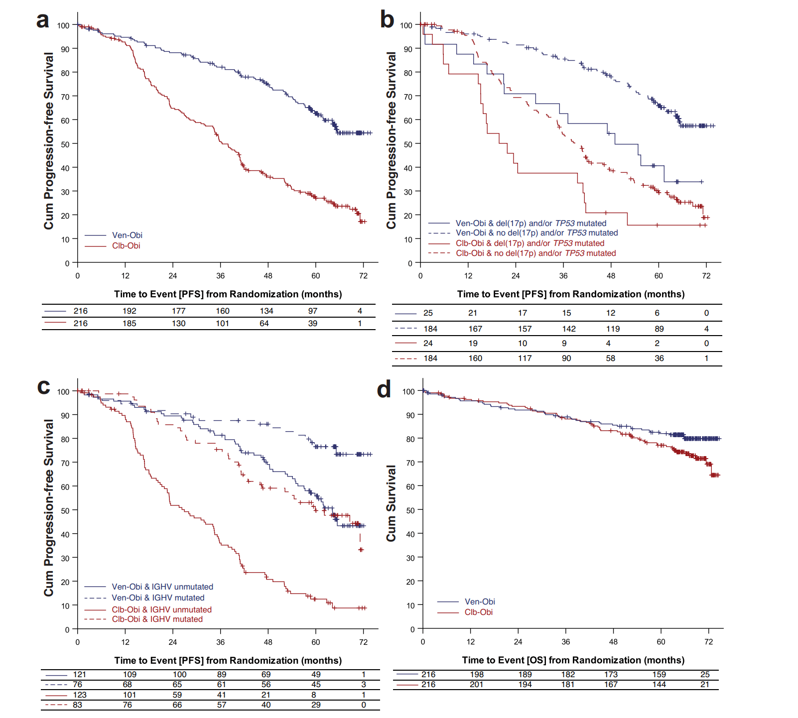
6-year follow up of CLL-14
mPFS in Ven-O 17p/TP53 = 51.9 months
mPFS of 76.2 vs 36.4 months favoring Obi-Ven
6-year PFS of 53.1% vs 21.7%
Within Ven-O arm, mPFS worse in patients treated with 17p/TP53 mutation
With in Ven-O arm, mPFS worse in patients treated with IGHV unmutated status
mPFS in Ven-O IGHV unmutated status= 64.8 months
Al-Sawaf et al. VENETOCLAX-OBINUTUZUMAB FOR PREVIOUSLY UNTREATED CHRONIC LYMPHOCYTIC LEUKEMIA: 6-YEAR RESULTS OF THE RANDOMIZED CLL14 STUDY, EHA 2023
Notes:
mPFS of TP53/17p patients is 51.9 months while those with non-17p/T53 is not reached

Slide 65
CLL13
Eligibility
Treatment-naive, fit patients with CLL, no TP53 aberrations (centrally screened)
CIT FCR ≤65y, BR >65y
Primary Endpoints
uMRD rate at MO15
Progression-free survival
alpha split (0.025 each)
97.5% CI for primary/ secondary endpoints
RV rituximab, venetoclax | FD 12 months
GV obinutuzumab, venetoclax | FD 12 months
GIV obinutuzumab, ibrutinib, venetoclax |
12-36 months
Key patient characteristics
Follow-up analysis (data cut-off: 01/2023)
Randomized patients (=ITT population): n= 926
Median age: 61 years (range: 27-84)
Median CIRS score: 2 (range: 0-7)
Unmutated IGHV: 56% of all patients
Complex karyotype: 17% of all patients
Median observation time
50.7 months (IQR: 44.6-57.9)
Median observation time after end of treatment
40.7 months (IQR: 34.5-47.9)
First-Line Venetoclax Combinations in Fit Patients with CLL: 4-Year Follow-up and NGS-Based MRD Analysis from the Phase 3 GAIA/CLL13 Trial, ASH 2023

Slide 66
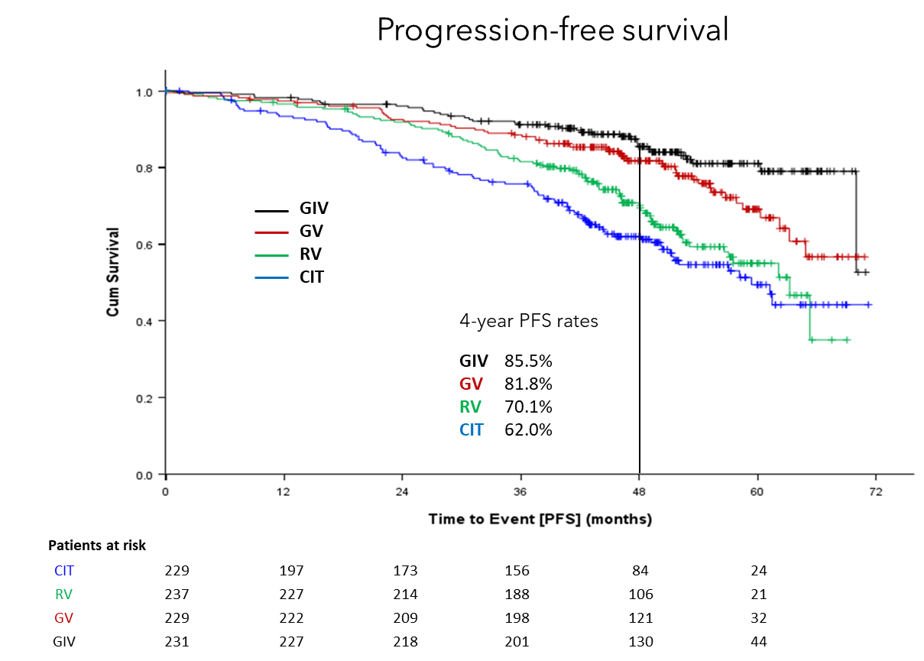
Efficacy – PFS
Median observation time: 50.7 months
PFS comparisons
GIV vs CIT: HR 0.30, 97.5%CI: 0.19-0.47, p<0.001
GIV vs RV: HR 0.38, 97.5%CI: 0.24-0.59, p<0.001
GIV vs GV: HR 0.63, 97.5%CI: 0.39-1.02, p=0.03
GV vs CIT: HR 0.47, 97.5%CI: 0.32-0.69, p<0.001
GV vs RV: HR 0.57, 97.5%CI: 0.38-0.84, p=0.001
RV vs CIT: HR 0.78, 97.5%CI: 0.55-1.10, p=0.1
First-Line Venetoclax Combinations in Fit Patients with CLL: 4-Year Follow-up and NGS-Based MRD Analysis from the Phase 3 GAIA/CLL13 Trial, ASH 2023

Slide 67
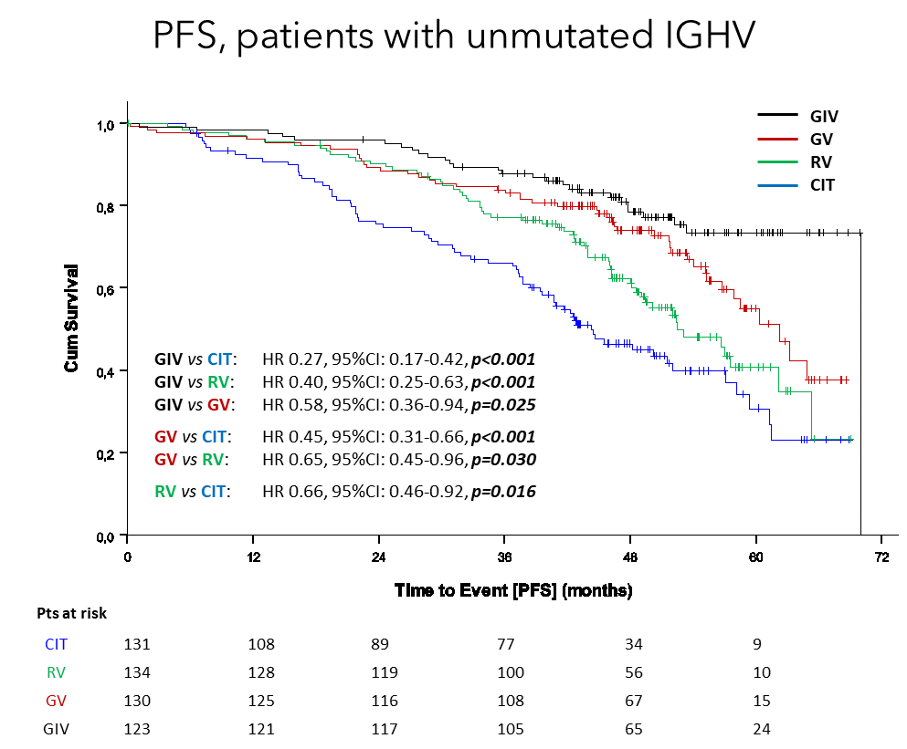
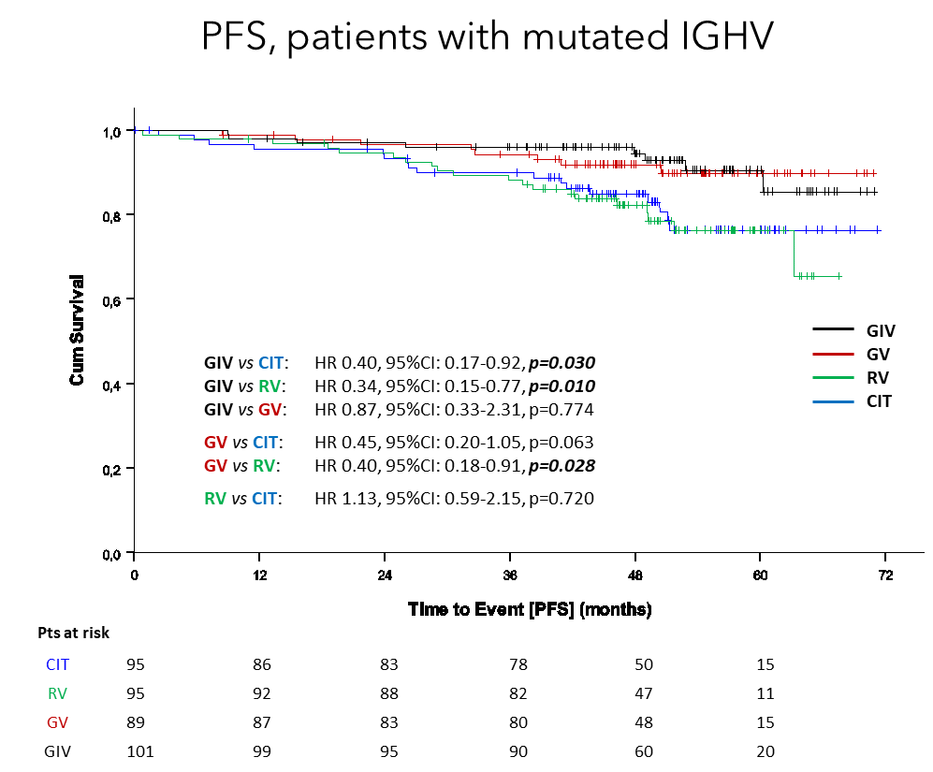
Efficacy – PFS
First-Line Venetoclax Combinations in Fit Patients with CLL: 4-Year Follow-up and NGS-Based MRD Analysis from the Phase 3 GAIA/CLL13 Trial, ASH 2023
Notes:
It is helpful to add Ibrutinib in Patients with IGHV unmutated status

Slide 68
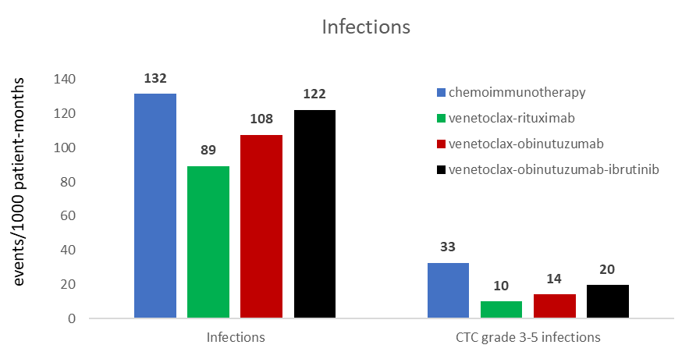
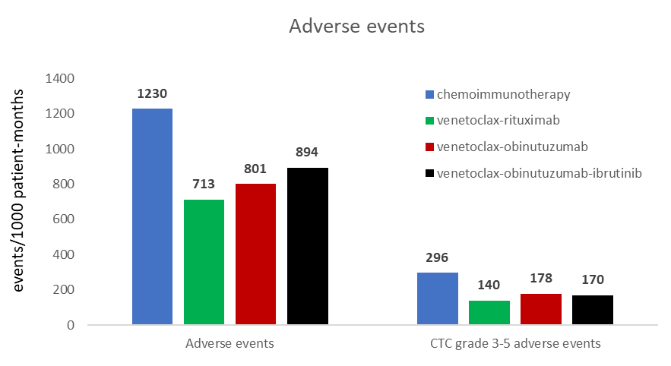
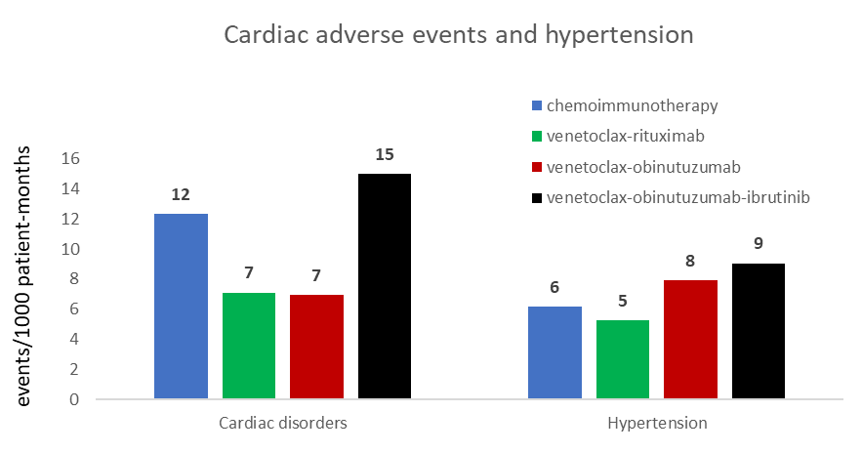
Safety
Exposure-adjusted incidence rates
Events per 1000 patient-months based on the treatment period
Treatment period = start of treatment until the end of treatment + 84 days or until start of first subsequent treatment whichever occurred first
Notes:
No difference in OS and more toixicty in terms of cardiac events and infection

Slide 69
ELEVATE-TN
TN CLL (N=535)
Key inclusion criteria
Age ≥65 years, or >18 to <65 years with:
  Creatinine clearance 30–69 mL/min
  (by Cockcroft-Gault equation)
  CIRS-G score >6
TN CLL requiring treatment per iwCLL 2008 criteria⁶
ECOG PS ≤2
Key exclusion criteria
Significant cardiovascular disease
Stratification
del(17p), yes vs no
ECOG PS 0–1 vs 2
Geographic region
Aª + O^{b}
RANDOMIZE
Primary endpoint
PFS (IRC-assessed): A+O vs O+Clb
Secondary/other endpoints
PFS (IRC-assessed): A vs O+Clb
PFS (INV-assessed)
ORR (IRC- and INV-assessed)
TTNT
OS
uMRD
Safety
Aª
O^{b} + Clb^{b}
1:1:1
Crossover from O+Clb to A was allowed after IRC-confirmed progression
Note: After interim analysis, PFS assessments were by investigator only.³ All analyses are ad-hoc and P-values are descriptive.
NCT02475681. Data cutoff: March 3, 2023. Patients were enrolled between September 2015 and February 2017.
ªContinued until disease progression or unacceptable toxicity at 100 mg PO BID.
^{b}Treatments were fixed duration and administered for 6 cycles.
Sharman et al Presented at the American Society of Hematology (ASH) Annual Meeting; December 9–12, 2023
Notes:
^Study design and endpoints: ACE-CL-007 PA5 final_Dec 4 clean p43AB, 42A-E
^Key inclusion and exclusion criteria: ACE-CL-007 PA5 final_Dec 4 clean.pdf p46AB, 47A, 48A; Hallek 2008 p5A
^Note: Min_query response_26JUL2023 p1A; Sharman Lancet 2020 p1282A
^NCT #: https://clinicaltrials.gov/study/NCT02475681?term=NCT02475681
^Data cutoff: t_ad_disp
^Footnotes a&b: ACE-CL-007 PA5 final_Dec 4 clean p44A-D
^Patient enrollment: Sharman Lancet 2020 p1283B
Sharman et al Presented at the American Society of Hematology (ASH) Annual Meeting; December 9–12, 2023

Slide 70
Demographics and baseline characteristics
Characteristic | A+O (n=179) | A (n=179) | O+Clb (n=177)
Age, median (range), y | 70 (41–88) | 70 (44–87) | 71 (46–91)
Male sex | 111 (62.0) | 111 (62.0) | 106 (59.9)
ECOG PS score
0–1 | 169 (94.4) | 165 (92.2) | 167 (94.4)
2 | 10 (5.6) | 14 (7.8) | 10 (5.6)
Bulky disease ≥5 cm | 46 (25.7) | 68 (38.0) | 54 (30.5)
Rai stage
III | 47 (26.3) | 51 (28.5) | 40 (22.6)
IV | 38 (21.2) | 37 (20.7) | 38 (21.5)
Cytogenetic subgroup
del(17p) | 17 (9.5) | 16 (8.9) | 17 (9.6)
del(17p) and/or mutated TP53 | 25 (13.9) | 23 (12.8) | 25 (14.1)
Complex karyotypeª | 28 (15.6) | 31 (17.3) | 32 (18.1)
Mutated TP53 | 21 (11.7) | 19 (10.6) | 21 (11.9)
Unmutated IGHV | 103 (57.5) | 118 (65.9) | 116 (65.5)
Data are n (%) unless otherwise specified.
ªPatients with ≥3 abnormalities with at least one structural abnormality excluding inversion of chromosome 9.
Sharman et al Presented at the American Society of Hematology (ASH) Annual Meeting; December 9–12, 2023
Notes:
^Table: t_demog p1A-C, 2A; t_basechar p1AB, 2BCD; t_ad_km_subgp_del17ptp53_m p1C
^Footnote a: ELEVATE_TN Complex Karyotype definition 5 yr MA p1A
^complex karyotype: t_basechar p 3B

Slide 71
Median PFS was significantly higher for A-containing arms vs O+Clb
100
78%
80
Median PFS=NR
A+O vs O+Clb
HRª (95% CI): 0.14 (0.10, 0.20); P<0.0001^{b}
A vs O+Clb
HRª (95% CI): 0.24 (0.17, 0.32); P<0.0001^{b}
A+O vs A
HRª (95% CI): 0.58 (0.39, 0.86); P=0.0229^{b}
60
62%
Progression-Free Survival, %
Median PFS=NR
40
17%
Median PFS=27.8 mo
20
A+O
A
0
O+Clb
0
3
6
9
12
15
18
21
24
27
30
33
36
39
42
45
48
51
54
57
60
63
66
69
72
75
78
81
84
87
90
Months
No. at risk
A+O
A
O+Clb
179 | 175 | 170 | 168 | 164 | 163 | 160 | 157 | 156 | 156 | 153 | 152 | 151 | 146 | 144 | 141 | 140 | 138 | 136 | 133 | 127 | 124 | 119 | 116 | 99 | 54 | 39 | 25 | 10 | 2 | 0
179 | 167 | 163 | 158 | 156 | 155 | 153 | 150 | 149 | 146 | 142 | 141 | 137 | 135 | 133 | 130 | 129 | 124 | 121 | 115 | 113 | 103 | 100 | 95 | 85 | 56 | 37 | 22 | 7 | 2 | 0
177 | 163 | 156 | 153 | 139 | 125 | 110 | 100 | 86 | 82 | 67 | 66 | 56 | 49 | 44 | 41 | 38 | 30 | 29 | 28 | 24 | 21 | 21 | 18 | 14 | 8 | 6 | 3 | 1 | 0 | 0
Median PFS was significantly higher for A+O vs A
ªHazard ratio based on stratified Cox proportional-hazards model.
^{b}P-value based on stratified log-rank test.
Sharman et al Presented at the American Society of Hematology (ASH) Annual Meeting; December 9–12, 2023
Notes:
I tend to use Obin when there is an ongoing autoimmune cytopenia, although technically you can still use it

Slide 72
IGHV status impacts PFS for patients treated with O+Clb, but not with acalabrutinib regimens
100
80
uIGHV: A+O vs O+Clb
HRª (95% CI): 0.08 (0.05, 0.12); P<0.0001^{b}
uIGHV: A vs O+Clb
HRª (95% CI): 0.12 (0.08, 0.18); P<0.0001^{b}
uIGHV: A+O vs A
HRª (95% CI): 0.63 (0.39, 1.01); P=0.2586^{b}
60
Progression-Free Survival, %
40
uIGHV, A+O
20
mIGHV, A+O
uIGHV, A
mIGHV, A
O+Clb uIGHV: Median PFS=22.2 mo
uIGHV, O+Clb
5%
0
mIGHV, O+Clb
0
3
6
9
12
15
18
21
24
27
30
33
36
39
42
45
48
51
54
57
60
63
66
69
72
75
78
81
84
87
90
Months
No. at risk
uIGHV, A+O
mIGHV, A+O
uIGHV, A
mIGHV, A
uIGHV, O+Clb
mIGHV, O+Clb
103 | 101 | 99 | 97 | 95 | 95 | 94 | 92 | 91 | 91 | 90 | 89 | 89 | 85 | 84 | 81 | 81 | 80 | 79 | 78 | 74 | 72 | 70 | 70 | 60 | 28 | 22 | 13 | 6 | 1
74 | 72 | 69 | 69 | 67 | 66 | 64 | 63 | 63 | 63 | 61 | 61 | 60 | 59 | 58 | 58 | 57 | 56 | 55 | 53 | 51 | 50 | 47 | 44 | 37 | 24 | 16 | 12 | 4 | 1
118 | 111 | 108 | 106 | 106 | 105 | 104 | 103 | 102 | 100 | 97 | 96 | 93 | 92 | 91 | 88 | 87 | 82 | 80 | 75 | 74 | 68 | 65 | 63 | 56 | 35 | 21 | 13 | 4 | 1
59 | 54 | 53 | 50 | 48 | 48 | 47 | 45 | 45 | 44 | 43 | 43 | 42 | 42 | 41 | 41 | 41 | 41 | 40 | 39 | 38 | 34 | 34 | 31 | 29 | 21 | 16 | 9 | 3 | 1
116 | 105 | 101 | 99 | 85 | 75 | 62 | 55 | 43 | 41 | 28 | 27 | 19 | 14 | 11 | 9 | 8 | 6 | 6 | 6 | 4 | 3 | 3 | 3 | 2 | 0
59 | 56 | 53 | 52 | 52 | 48 | 46 | 43 | 41 | 39 | 37 | 37 | 36 | 34 | 32 | 31 | 29 | 23 | 22 | 21 | 19 | 17 | 17 | 14 | 11 | 7 | 5 | 3 | 1 | 0
ªHazard ratio based on unstratified Cox proportional-hazards model.
^{b}P-value based on unstratified log-rank test.
72
Sharman et al Presented at the American Society of Hematology (ASH) Annual Meeting; December 9–12, 2023
Notes:
^Figure: f_ad_km_pfsinvus_ighv
^Median pfs: t_ad_km_subgp_pfsinvus_ighv p1A
^HRs: t_ad_km_subgp_pfsinvus_ighv p1BD
^Estimates: t_ad_km_subgp_pfsinvus_ighv p2A
^Footnote: t_ad_km_subgp_pfsinvus_ighv p1C

Slide 73
IGHV status impacts PFS for patients treated with O+Clb, but not with acalabrutinib regimens
100
80
uIGHV: A+O vs O+Clb
HRª (95% CI): 0.08 (0.05, 0.12); P<0.0001^{b}
uIGHV: A vs O+Clb
HRª (95% CI): 0.12 (0.08, 0.18); P<0.0001^{b}
uIGHV: A+O vs A
HRª (95% CI): 0.63 (0.39, 1.01); P=0.2586^{b}
60
60%
Progression-Free Survival, %
A uIGHV: Median PFS=NR
40
uIGHV, A+O
20
mIGHV, A+O
uIGHV, A
mIGHV, A
O+Clb uIGHV: Median PFS=22.2 mo
uIGHV, O+Clb
5%
0
mIGHV, O+Clb
0
3
6
9
12
15
18
21
24
27
30
33
36
39
42
45
48
51
54
57
60
63
66
69
72
75
78
81
84
87
90
Months
No. at risk
uIGHV, A+O
mIGHV, A+O
uIGHV, A
mIGHV, A
uIGHV, O+Clb
mIGHV, O+Clb
103 | 101 | 99 | 97 | 95 | 95 | 94 | 92 | 91 | 91 | 90 | 89 | 89 | 85 | 84 | 81 | 81 | 80 | 79 | 78 | 74 | 72 | 70 | 70 | 60 | 28 | 22 | 13 | 6 | 1
74 | 72 | 69 | 69 | 67 | 66 | 64 | 63 | 63 | 63 | 61 | 61 | 60 | 59 | 58 | 58 | 57 | 56 | 55 | 53 | 51 | 50 | 47 | 44 | 37 | 24 | 16 | 12 | 4 | 1
118 | 111 | 108 | 106 | 106 | 105 | 104 | 103 | 102 | 100 | 97 | 96 | 93 | 92 | 91 | 88 | 87 | 82 | 80 | 75 | 74 | 68 | 65 | 63 | 56 | 35 | 21 | 13 | 4 | 1
59 | 54 | 53 | 50 | 48 | 48 | 47 | 45 | 45 | 44 | 43 | 43 | 42 | 42 | 41 | 41 | 41 | 41 | 40 | 39 | 38 | 34 | 34 | 31 | 29 | 21 | 16 | 9 | 3 | 1
116 | 105 | 101 | 99 | 85 | 75 | 62 | 55 | 43 | 41 | 28 | 27 | 19 | 14 | 11 | 9 | 8 | 6 | 6 | 6 | 4 | 3 | 3 | 3 | 2 | 0
59 | 56 | 53 | 52 | 52 | 48 | 46 | 43 | 41 | 39 | 37 | 37 | 36 | 34 | 32 | 31 | 29 | 23 | 22 | 21 | 19 | 17 | 17 | 14 | 11 | 7 | 5 | 3 | 1 | 0
ªHazard ratio based on unstratified Cox proportional-hazards model.
^{b}P-value based on unstratified log-rank test.
73
Sharman et al Presented at the American Society of Hematology (ASH) Annual Meeting; December 9–12, 2023
Notes:
^Figure: f_ad_km_pfsinvus_ighv
^Median pfs: t_ad_km_subgp_pfsinvus_ighv p1A
^HRs: t_ad_km_subgp_pfsinvus_ighv p1BD
^Estimates: t_ad_km_subgp_pfsinvus_ighv p2A
^Footnote: t_ad_km_subgp_pfsinvus_ighv p1C

Slide 74
IGHV status impacts PFS for patients treated with O+Clb, but not with acalabrutinib regimens
100
75%
A+O uIGHV: Median PFS=NR
80
uIGHV: A+O vs O+Clb
HRª (95% CI): 0.08 (0.05, 0.12); P<0.0001^{b}
uIGHV: A vs O+Clb
HRª (95% CI): 0.12 (0.08, 0.18); P<0.0001^{b}
uIGHV: A+O vs A
HRª (95% CI): 0.63 (0.39, 1.01); P=0.2586^{b}
60
60%
Progression-Free Survival, %
A uIGHV: Median PFS=NR
40
uIGHV, A+O
20
mIGHV, A+O
uIGHV, A
mIGHV, A
O+Clb uIGHV: Median PFS=22.2 mo
uIGHV, O+Clb
5%
0
mIGHV, O+Clb
0
3
6
9
12
15
18
21
24
27
30
33
36
39
42
45
48
51
54
57
60
63
66
69
72
75
78
81
84
87
90
Months
No. at risk
uIGHV, A+O
mIGHV, A+O
uIGHV, A
mIGHV, A
uIGHV, O+Clb
mIGHV, O+Clb
103 | 101 | 99 | 97 | 95 | 95 | 94 | 92 | 91 | 91 | 90 | 89 | 89 | 85 | 84 | 81 | 81 | 80 | 79 | 78 | 74 | 72 | 70 | 70 | 60 | 28 | 22 | 13 | 6 | 1
74 | 72 | 69 | 69 | 67 | 66 | 64 | 63 | 63 | 63 | 61 | 61 | 60 | 59 | 58 | 58 | 57 | 56 | 55 | 53 | 51 | 50 | 47 | 44 | 37 | 24 | 16 | 12 | 4 | 1
118 | 111 | 108 | 106 | 106 | 105 | 104 | 103 | 102 | 100 | 97 | 96 | 93 | 92 | 91 | 88 | 87 | 82 | 80 | 75 | 74 | 68 | 65 | 63 | 56 | 35 | 21 | 13 | 4 | 1
59 | 54 | 53 | 50 | 48 | 48 | 47 | 45 | 45 | 44 | 43 | 43 | 42 | 42 | 41 | 41 | 41 | 41 | 40 | 39 | 38 | 34 | 34 | 31 | 29 | 21 | 16 | 9 | 3 | 1
116 | 105 | 101 | 99 | 85 | 75 | 62 | 55 | 43 | 41 | 28 | 27 | 19 | 14 | 11 | 9 | 8 | 6 | 6 | 6 | 4 | 3 | 3 | 3 | 2 | 0
59 | 56 | 53 | 52 | 52 | 48 | 46 | 43 | 41 | 39 | 37 | 37 | 36 | 34 | 32 | 31 | 29 | 23 | 22 | 21 | 19 | 17 | 17 | 14 | 11 | 7 | 5 | 3 | 1 | 0
PFS was not significantly different by IGHV status in patients treated with A+O and A
ªHazard ratio based on unstratified Cox proportional-hazards model.
^{b}P-value based on unstratified log-rank test.
74
Sharman et al Presented at the American Society of Hematology (ASH) Annual Meeting; December 9–12, 2023
Notes:
^Figure: f_ad_km_pfsinvus_ighv
^Median pfs: t_ad_km_subgp_pfsinvus_ighv p1A
^HRs: t_ad_km_subgp_pfsinvus_ighv p1BD
^Estimates: t_ad_km_subgp_pfsinvus_ighv p2A
^Footnote: t_ad_km_subgp_pfsinvus_ighv p1C
New text in title: see previously FCd slide 12 that is marked for deletion (here is backup if needed: f_ad_km_pfsinvus_ighv_2; f_ad_km_pfsinvus_ighv_3

Slide 75
Median PFS was significantly higher for A-containing arms vs O+Clb in patients with del(17p) and/or TP53m
100
80
w/ del(17p) and/or TP53m
A+O vs O+Clb
HRª (95% CI): 0.28
(0.13, 0.59); P=0.0009^{b}
A vs O+Clb
HRª (95% CI): 0.23
(0.10, 0.52); P=0.0002^{b}
A+O vs A
HRª (95% CI): 1.21
(0.51, 2.87); P=0.7966^{b}
60
Progression-Free Survival, %
56%
w/ del(17p) and/or TP53m: Median PFS=NR
56%
40
w/ del(17p) and/or TP53m:
Median PFS=73.1 mo
w/ del(17p) and/or TP53m, A+O
w/ del(17p) and/or TP53m:
Median PFS=17.5 mo
20
w/o del(17p) and/or TP53m, A+O
w/ del(17p) and/or TP53m, A
w/o del(17p) and/or TP53m, A
18%
w/ del(17p) and/or TP53m, O+Clb
0
w/o del(17p) and/or TP53m, O+Clb
0
3
6
9
12
15
18
21
24
27
30
33
36
39
42
45
48
51
54
57
60
63
66
69
72
75
78
81
84
87
90
Months
No. at risk
w/ del(17p) and/or TP53m, A+O
w/o del(17p) and/or TP53m, A+O
w/ del(17p) and/or TP53m, A
w/o del(17p) and/or TP53m, A
w/ del(17p) and/or TP53m, O+Clb
w/o del(17p) and/or TP53m, O+Clb
25 | 24 | 23 | 22 | 22 | 22 | 22 | 22 | 21 | 21 | 21 | 21 | 21 | 20 | 19 | 18 | 18 | 18 | 18 | 17 | 16 | 15 | 14 | 13 | 10 | 5 | 5 | 3 | 2 | 0
154 | 151 | 147 | 146 | 142 | 141 | 138 | 135 | 135 | 135 | 132 | 131 | 130 | 126 | 125 | 123 | 122 | 120 | 118 | 116 | 111 | 109 | 105 | 103 | 89 | 49 | 34 | 22 | 8 | 2
23 | 22 | 21 | 21 | 20 | 20 | 20 | 19 | 18 | 18 | 18 | 18 | 18 | 17 | 16 | 16 | 16 | 15 | 15 | 15 | 14 | 14 | 13 | 11 | 11 | 7 | 7 | 4 | 2 | 1
156 | 145 | 142 | 137 | 136 | 135 | 133 | 131 | 131 | 128 | 124 | 123 | 119 | 118 | 117 | 114 | 113 | 109 | 106 | 100 | 99 | 89 | 87 | 84 | 74 | 49 | 30 | 18 | 5 | 1
25 | 21 | 19 | 19 | 18 | 15 | 10 | 9 | 9 | 9 | 6 | 6 | 5 | 5 | 4 | 4 | 4 | 4 | 4 | 4 | 3 | 3 | 3 | 3 | 3 | 3 | 1 | 0
152 | 142 | 137 | 134 | 121 | 110 | 100 | 91 | 77 | 73 | 61 | 60 | 51 | 44 | 40 | 37 | 34 | 26 | 25 | 24 | 21 | 18 | 18 | 15 | 11 | 5 | 5 | 3 | 1 | 0
ªHazard ratio based on unstratified Cox proportional-hazards model.
^{b}P-value based on unstratified log-rank test.
Sharman et al Presented at the American Society of Hematology (ASH) Annual Meeting; December 9–12, 2023
Notes:
^Figure: f_ad_km_pfsinvus_del17ptp53
^Median pfs: t__ad_km_subgp_del17ptp53_m p1A
^HRs: t__ad_km_subgp_del17ptp53_m p1BD
^Estimates: t__ad_km_subgp_del17ptp53_m p2A
^Footnote: t__ad_km_subgp_del17ptp53_m p1E

Slide 76
How to Choose Between Ven/Obi vs cBTKi in Frontline Treatment of CLL
Venetoclax + obinutuzumab
cBTKi
Renal insufficiency
No access to facilities for TLS monitoring
Presence of 17p deletion or TP53 mutation
History of ventricular arrhythmia with ongoing risk
History of major bleeding with ongoing risk
Concurrent dual antiplatelet therapy or use of coumadin
Strong preference for time-limited therapy

Slide 77
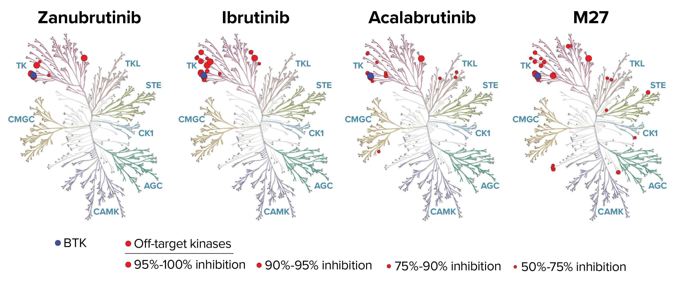
Zanubrutinib
Zanubrutinib is highly selective for BTK and has potent inhibitory activity against BTK¹
Zanubrutinib has no active metabolite; ibrutinib and acalabrutinib each have an active metabolite (PCI-45227 and M27, respectively) with activity on kinases other than BTK¹
Zanubrutinib has continuous exposure coverage above its IC50 compared with ibrutinib² and acalabrutinib³
  Higher drug-concentration/IC₅₀ ratios would be expected to lead to more sustained and complete BTK inhibition to improve efficacy
Figure adapted from Shadman et al. Lancet Haematol. 2023.
1. Tam et al. Blood Cancer J. 2023; 2. Ou, et al. Leuk Lymphoma. 2021; 3. Marostica et al. Cancer Chemother Pharmacol. 2015.
IC₅₀=half-maximal concentration, QD=once daily.
Brown, JR et al. Oral Presentation at ASH 2023; abstract number 202.

Slide 78
ALPINE (NCT03734016)
R/R CLL/SLL with ≥1 prior treatment
(N=652)
Key Inclusion Criteria
R/R to ≥1 prior systemic therapy for CLL/SLL
Measurable lymphadenopathy by CT or MRI
Requires treatment per iwCLL
Key Exclusion Criteria
Prior BTK inhibitor therapy
Treatment with warfarin or other vitamin K antagonists
Zanubrutinib 160 mg BID
R
1:1
Ibrutinib 420 mg QD
Stratification factors:
Age, geographic region, refractoriness, del(17p)/TP53
Treatment until disease progression or unacceptable toxicity
Brown JR, Eichhorst B, Hillmen P, et al. N Engl J Med. 2023;388:319-332.
BID=twice daily, CLL=chronic lymphocytic leukemia, CT=computed tomography, MRI=magnetic resonance imaging, QD=once daily, R=randomized, R/R=relapse/refractory, SLL=small lymphocytic lymphoma.
Brown, JR et al. Oral Presentation at ASH 2023; abstract number 202.

Slide 79
Baseline Characteristics
 | Zanubrutinib (n=327) | Ibrutinib (n=325)
Age, median (range) ≥65 years, n (%) | 67 (35-90) 201 (61.5) | 68 (35-89) 200 (61.5)
Male, n (%) | 213 (65.1) | 232 (71.4)
ECOG PS ≥1, n (%) | 198 (60.6) | 203 (62.5)
Prior lines of systemic therapy, median (range) >3 prior lines, n (%) | 1 (1-6) 24 (7.3) | 1 (1-12) 30 (9.2)
del(17p) and/or TP53^{mut}, n (%) del(17p) TP53^{mut} without del(17p) | 75 (22.9) 45 (13.8) 30 (9.2) | 75 (23.1) 50 (15.4) 25 (7.7)
IGHV mutational status, n (%) Mutated Unmutated | 80 (24.5) 240 (73.4) | 70 (21.5) 241 (74.2)
Complex karyotypeª | 56 (17.1) | 70 (21.5)
Bulky disease (≥5 cm), n (%) | 145 (44.3) | 149 (45.8)
Data cutoff: 15 Sep 2023.
aComplex karyotype is defined as having ≥3 abnormalities
Brown, JR et al. Oral Presentation at ASH 2023; abstract number 202.

Slide 80
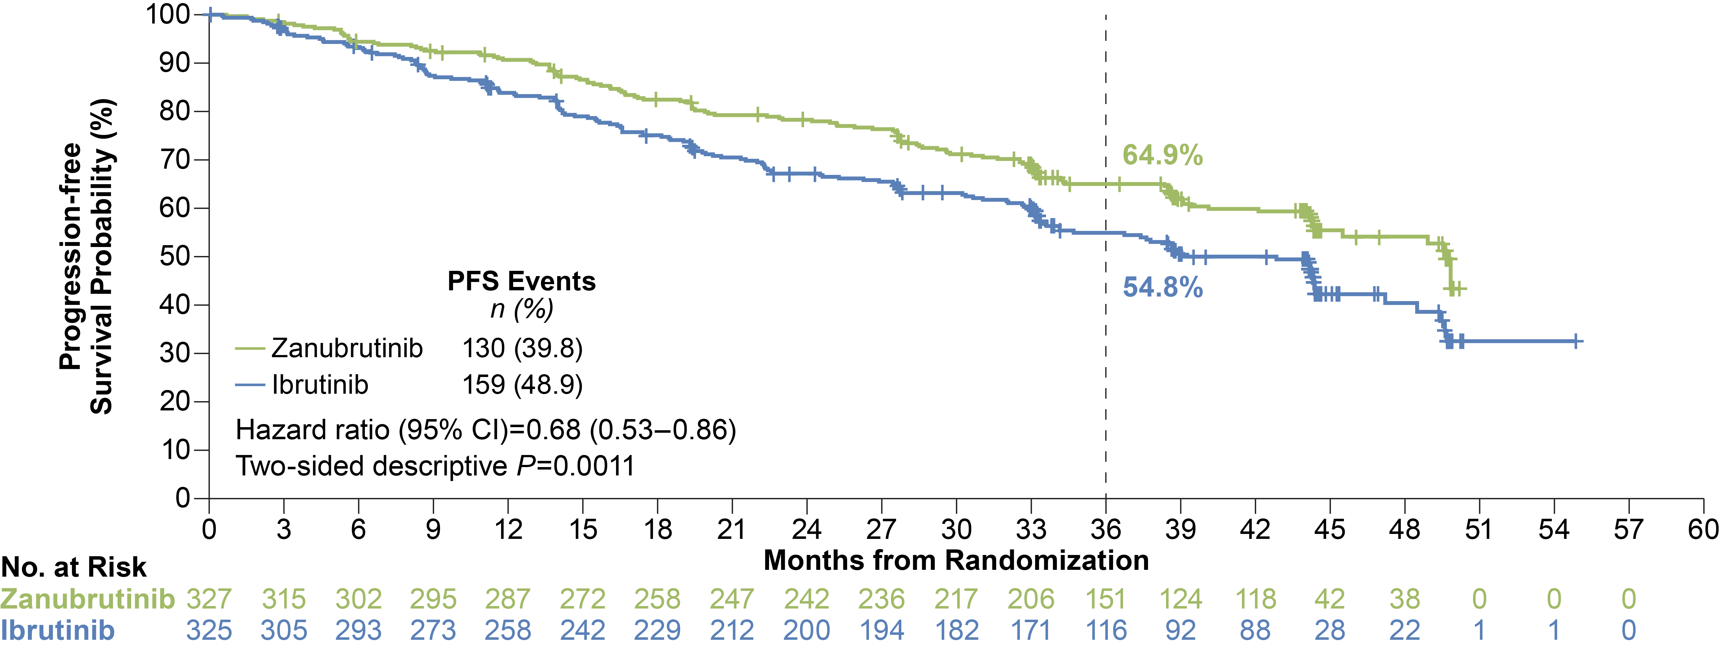
Zanubrutinib Sustains PFS Benefit Over Ibrutinib At Extended Follow-up
Median study follow-up of 39.0 months
Data cutoff: 15 Sep 2023.
CI=confidence interval, PFS=progression-free survival.
Brown, JR et al. Oral Presentation at ASH 2023; abstract number 202.

Slide 81
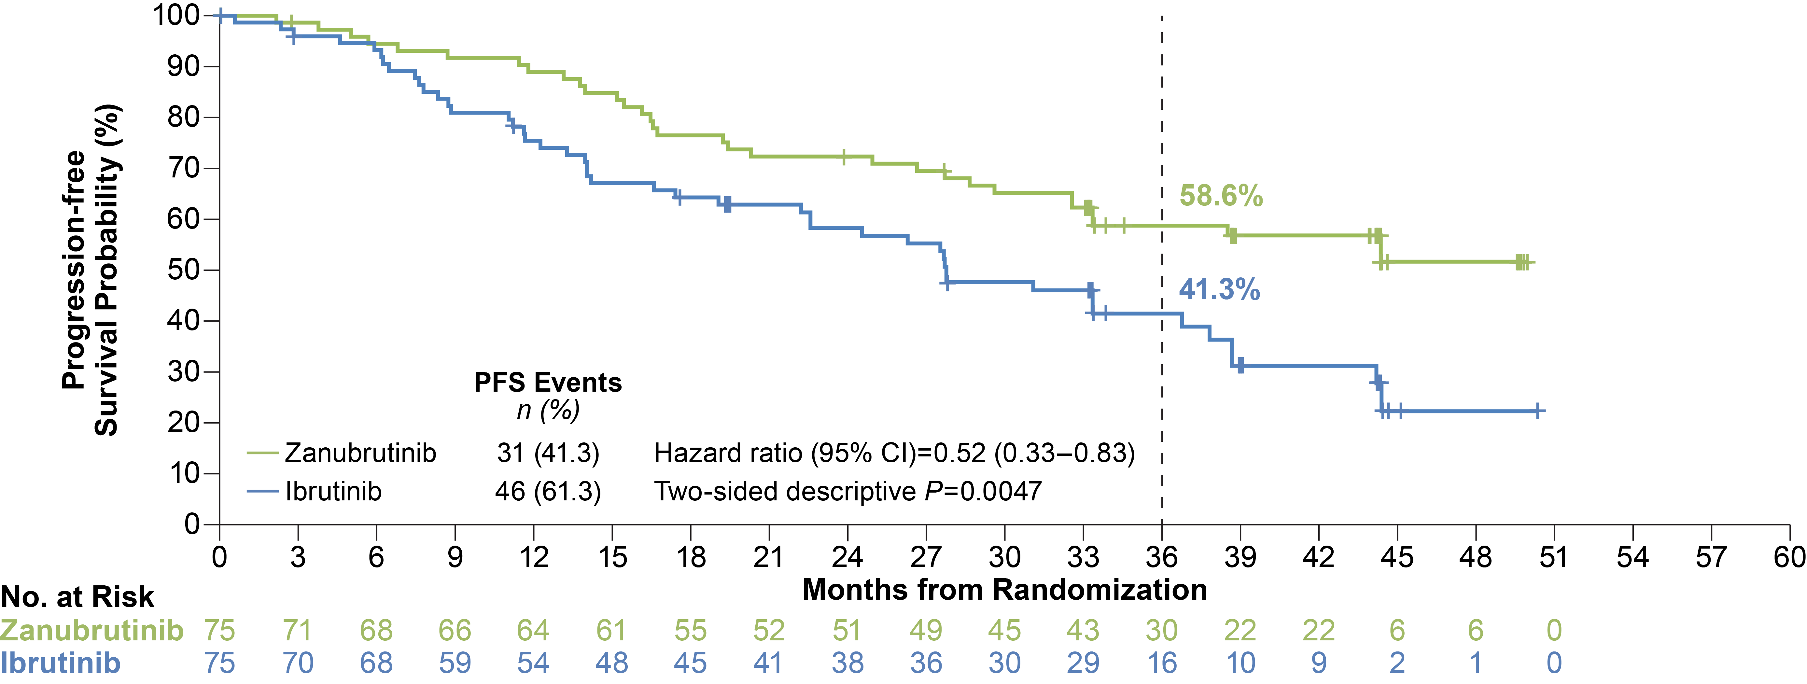
Improved PFS Was Demonstrated with Zanubrutinib in Patients with del(17p)/TP53^{mut}
Data cutoff: 15 Sep 2023.
CI=confidence interval, HR=hazard ratio, PFS=progression-free survival.
Brown, JR et al. Oral Presentation at ASH 2023; abstract number 202.

Slide 82
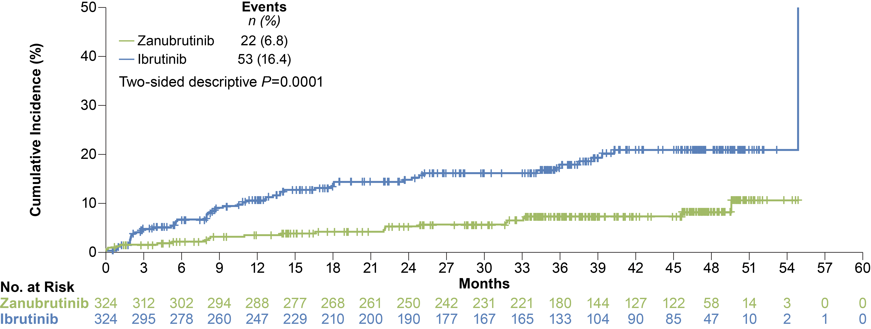
Atrial Fibrillation
Median study follow-up 39.0 months
Data cutoff: 15 Sep 2023
Brown, JR et al. Oral Presentation at ASH 2023; abstract number 202.

Slide 83
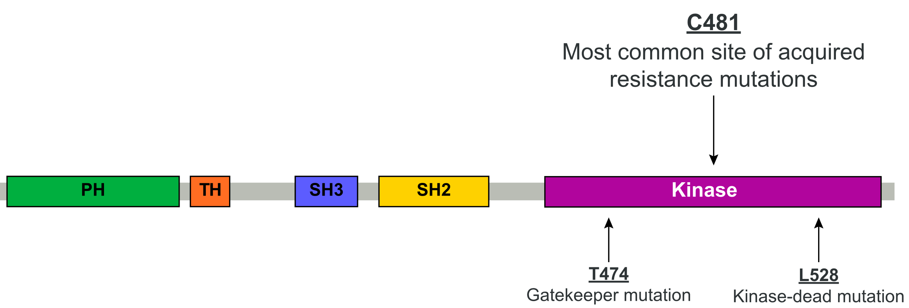
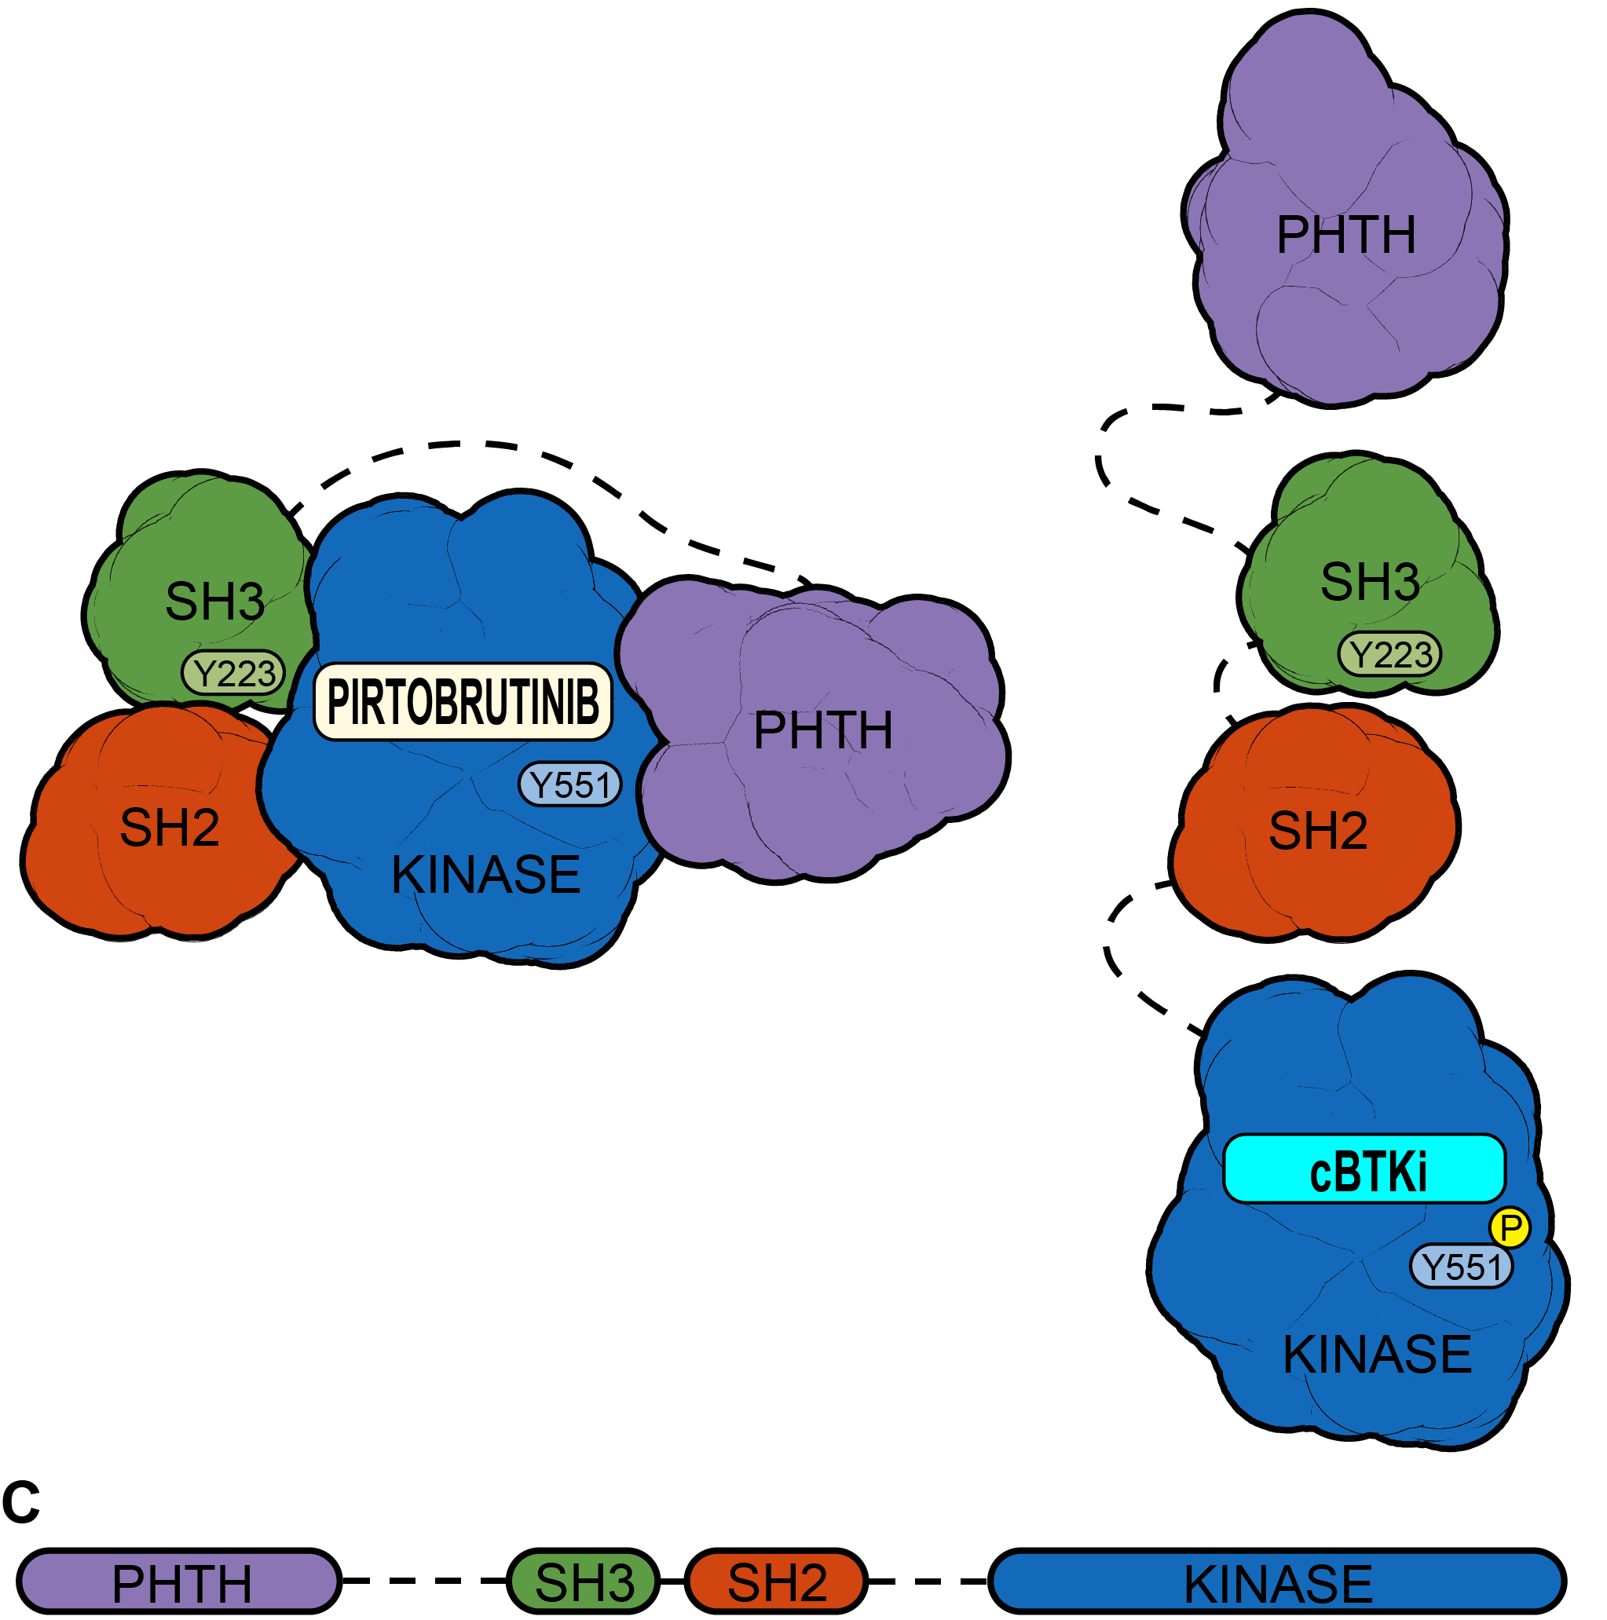
Pirtobrutinib Non-covalent Binding Inhibits both WT and C481-mutated BTK
BTK sites with known cBTKi resistance mutations
Pirtobrutinib may stabilize BTK in a closed inactive conformation⁹
cBTKi
Pirtobrutinib
  The majority of patients discontinue covalent BTK inhibitors (cBTKi) due to intolerance or progression^{1,2,3}
  BTK C481 substitutions are the most common resistance mechanism to cBTKi^{4,5,6}
  Acquired mutations have been identified in a limited number of patients treated with pirtobrutinib^{7,8}
Inactive conformation of BTK by pirtobrutinib:
  blocks access to upstream kinases and phosphorylation of Y551
  inhibits both WT and C481-mutant BTK with equal low nM potency^{7,9}
  may inhibit kinase-independent BTK signaling⁹
¹Woyach et al. J Clin Oncol. 2017. ²Barr et al. Blood Adv. 2022. ³Byrd et al. ASH Annual Meeting. 2022. ⁴Estupinan et al. Leukemia. 2021. ⁵Handunnetti et al. ASH Annual Meeting. 2019. ⁶Blombery et al. Blood Advances. 2022. ⁷Wang et al. NEJM. 2022 ⁸Naeem et al. Blood Advances. 2023. ^{​9}Gomez et al. Blood.2023.
Brown et al.; ASH 2023

Slide 84
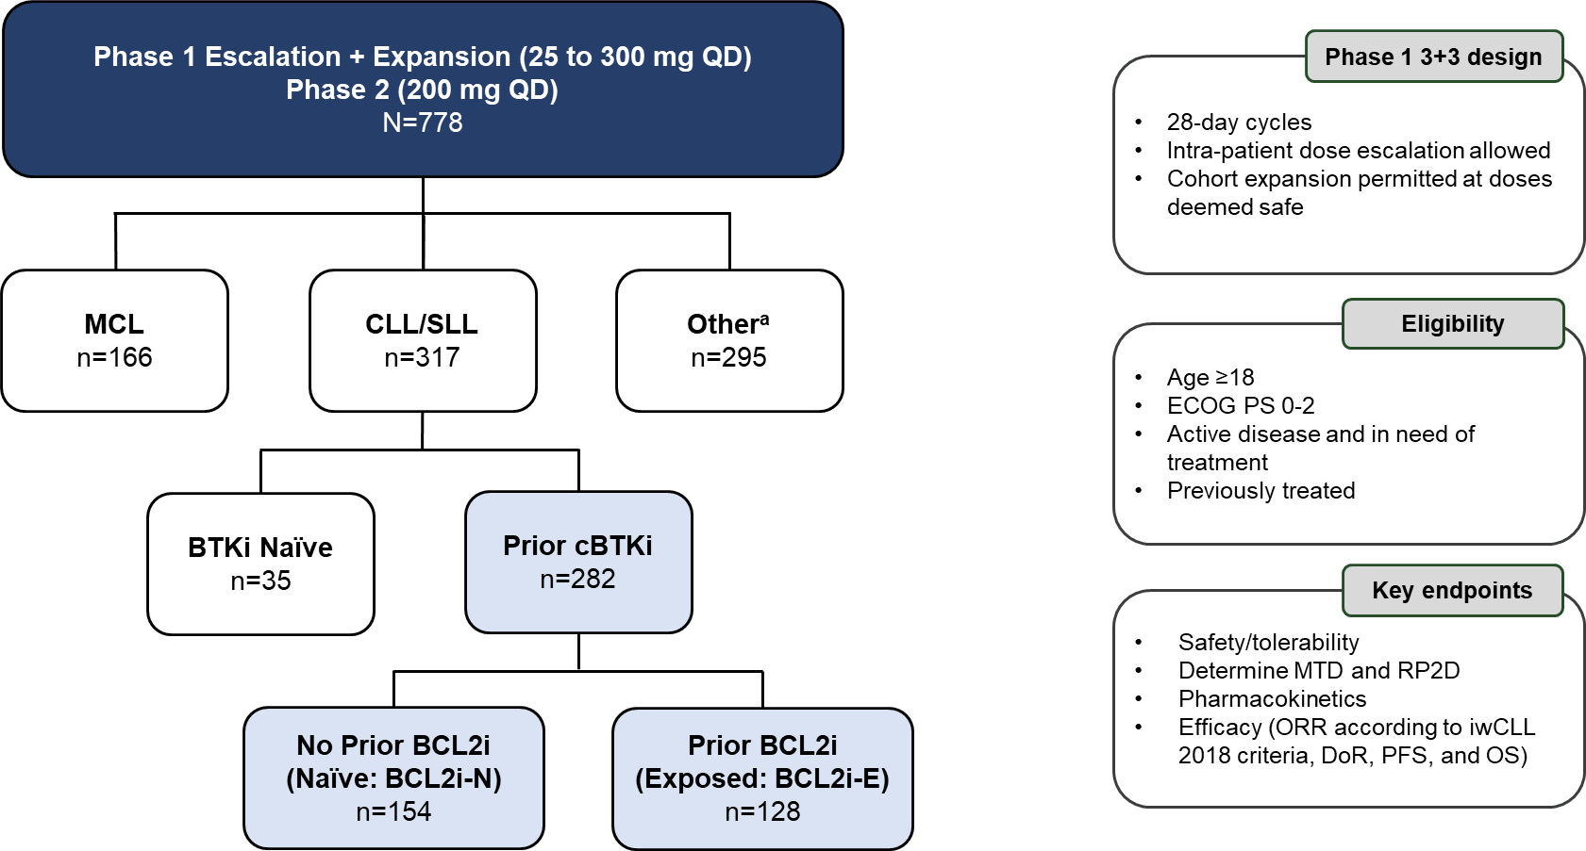
Phase 1/2 BRUIN Study: Design, Eligibility and Enrollment
Data cutoff of 05 May 2023 (NCT03740529); ªOther includes DLBCL, WM, FL, MZL, Richter transformation, B-PLL, Hairy Cell Leukemia, PCNSL, and other transformation.
Woyach et al.; ASH 2023

Slide 85
Baseline Characteristics of Patients with CLL/SLL who Received Prior cBTKi
Characteristics | Prior cBTKi (n=282) | BCL2i-N (n=154) | BCL2i-E (n=128)
Median age, years (range) | 69 (36-88) | 69 (36-87) | 68 (41-88)
Male, n (%) | 192 (68) | 106 (69) | 86 (67)
Rai staging, n (%)
0-II | 147 (52) | 94 (61) | 53 (41)
III-IV | 120 (43) | 58 (38) | 62 (48)
Missing | 15 (5) | 2 (1) | 13 (10)
Bulky Lymphadenopathy ≥5 cm, n (%) | 88 (31) | 42 (27) | 46 (36)
ECOG PS, n (%)
0 | 144 (51) | 89 (58) | 55 (43)
1 | 118 (42) | 56 (36) | 62 (48)
2 | 20 (7) | 9 (6) | 11 (9)
Median number of prior lines of systemic therapy, (range) | 4 (1-11) | 3 (1-9) | 5 (1-11)
Prior therapy, n (%)
BTK inhibitor | 282 (100) | 154 (100) | 128 (100)
Anti-CD20 antibody | 251 (89) | 127 (83) | 124 (97)
Chemotherapy | 228 (81) | 114 (74) | 114 (89)
BCL2 inhibitor | 128 (45) | 0 (0) | 128 (100)
PI3K inhibitor | 71 (25) | 17 (11) | 54 (42)
CAR-T | 17 (6) | 2 (1) | 15 (12)
Allogeneic stem cell transplant | 7 (3) | 1 (1) | 6 (5)
Characteristics | Prior cBTKi (n=282) | BCL2i-N (n=154) | BCL2i-E (n=128)
Median time from diagnosis to first dose, years (IQR) | 11 (8-15) | 11 (7-15) | 12 (8-15)
Reason for any prior BTKi discontinuationª, n (%)
Progressive disease | 217 (77) | 110 (71) | 107 (84)
Toxicity/Other | 64 (23) | 43 (28) | 21 (16)
Baseline Molecular Characteristics^{b} | Prior cBTKi (n=282) | BCL2i-N (n=154) | BCL2i-E (n=128)
Mutation status, n/n available (%)
BCL2 mutated | 19/246 (8) | 0/133 (0) | 19/113 (17)
BTK C481-mutant | 96/245 (39) | 57/138 (41) | 39/107 (36)
PLCG2-mutant | 18/245 (7) | 10/138 (7) | 8/107 (8)
High Risk Molecular Features, n/n available (%)
17p deletion and/or TP53 mutation | 104/217 (48) | 57/123 (46) | 47/94 (50)
IGHV unmutated | 193/225 (86) | 100/125 (80) | 93/100 (93)
Complex Karyotype | 33/73 (45) | 17/41 (42) | 16/32 (50)
11q deletion | 47/202 (23) | 28/115 (24) | 19/87 (22)
ªIn the event more than one reason was noted for discontinuation, disease progression took priority. ^{b}Molecular characteristics were determined centrally and are presented based on data availability, in those patients with sufficient sample to pass assay quality control.
Woyach et al.; ASH 2023

Slide 86

Pirtobrutinib Progression-Free Survival in Patients with Prior cBTKi
All Prior cBTKi
Median: 95% CI: Median Follow-up: Events/Total: | 19.4 months 16.6-22.1 27.5 months 160/282
Woyach et al.; ASH 2023

Slide 87


Pirtobrutinib Progression-Free Survival with Prior cBTKi,
with or without Prior BCL2i
BCL2i-N
BCL2i-E
Median: 95% CI: Median Follow-up: Events/Total: | 23.0 months 19.6-28.4 27.6 months 79/154
Median: 95% CI: Median Follow-up: Events/Total: | 15.9 months 13.6-17.5 22.2 months 81/128
Woyach et al.; ASH 2023
Notes:
Comparable PFS regardless of BCL2 exposure
Although I still tend to use Pirto only in double refractory patient population

Slide 88
TRANSCEND CLL 004: phase 1/2, open-label, multicenter study
Key eligibility criteria
Age ≥ 18 years
R/R CLL/SLL
Previously failed or ineligible
for BTKi
Failure of ≥ 2 (high risk) or
≥ 3 (standard risk) lines of
prior therapy
ECOG PS ≤ 1
Adequate bone marrow,
organ, and cardiac function
No Richter transformation
nor active CNS involvement
by malignancy
Leukapheresis
Eligibility reconfirmed
Day 1
Day 30
Follow-up
Liso-cel
manufacturing
Lymphodepletion
Liso-cel
2—7 days after
FLU/CY
On-study:
24 or 48 months
Long-term
(NCT03435796):
up to 15 years after
liso-cel infusion
Screening
FLU 30 mg/m² and
CY 300 mg/m² × 3 days
First disease assessment
Bridging therapy optional
DL1
50 × 10⁶ CAR⁺ T cells
Recommended
phase 2 dose: DL2
Dose
expansion
DL2
100 × 10⁶ CAR⁺ T cells
Primary endpoint (PEAS at DL2)
CR/CRi rate per iwCLL 2018 by IRC assessment
Key secondary endpoints (PEAS at DL2)
ORR, uMRD rate in blood
Post hoc analyses
Median time to next treatment
ClinicalTrials.gov: NCT03331198.
CY, cyclophosphamide; DL, dose level; FLU, fludarabine; IRC, independent review committee; iwCLL, International Workshop on Chronic Lymphocytic Leukemia; PEAS, primary efficacy analysis set (prespecified subset of patients with BTKi progression and venetoclax failure); uMRD, undetectable minimal residual disease.
88
Siddiqi T, et al. ASH 2023 [Presentation #330]

Slide 89
Demographics and baseline characteristics
 | Full study population (n = 118) | BTKi progression/venetoclax failure subset (n = 71)
Median (range) age, y | 65.0 (49—82) | 66.0 (49—78)
Median (range) prior lines of systemic therapy | 5 (2—14) | 5 (2—14)
Bulky lymph nodes,ª n (%)
Yes | 53 (45) | 33 (46)
Unknown | 9 (8) | 8 (11)
High-risk cytogenetics,^{b} n (%) | 98 (83) | 61 (86)
Prior BTKi, n (%) | 118 (100) | 71 (100)
BTKi refractory^{c} | 104 (88) | 71 (100)
BTKi relapsed^{d} | 2 (2) | 0
BTKi intolerant only | 12 (10) | 0
Prior venetoclax, n (%) | 95 (81) | 71 (100)
Venetoclax refractory | 90 (76) | 68 (96)
Venetoclax relapsed^{d} | 0 | 0
Venetoclax intolerant only | 4 (3) | 3 (4)
Prior BTKi and venetoclax, n (%) | 95 (81) | 71 (100)
BTKi progression/venetoclax failure,^{e} n (%) | 71 (60) | 71 (100)
Received bridging therapy, n (%) | 90 (76) | 56 (79)
ªDefined as ≥ 1 lesion with the longest diameter of ≥ 5 cm; ^{b}Includes del(17p), TP53 mutation, unmutated immunoglobulin heavy-chain variable region, and complex cytogenetics; ^{c}Defined as no response or progression ≤ 6 months from last dose of therapy; ^{d}Defined as disease progression in a patient who previously had CR/CRi or PR/nPR for ≥ 6 months; ^{e}Including patients who progressed on a BTKi and met one of the following: (1) discontinued venetoclax due to disease progression or intolerability and patient’s disease met indications for further therapy per iwCLL 2018, or (2) failed to achieve an objective response ≤ 3 months of initiating therapy.
nPR, nodular partial response/remission.
89
Siddiqi T, et al. ASH 2023 [Presentation #330]

Slide 90
Efficacy outcomes: DL2 only
 | Full study population at DL2 (n = 88) | BTKi progression/venetoclax failure subset at DL2 (n = 50)
Primary endpoint: IRC-assessed CR/CRi rate per iwCLL 2018, n (%) [95% CI] | 17 (19) [12—29] | 10 (20) [10—34]
Key secondary endpoints
IRC-assessed ORR, n (%) [95% CI] | 42 (48) [37—59] | 22 (44) [30—59]
uMRD rate in blood, n (%) [95% CI] | 58 (66) [55—76] | 32 (64) [49—77]
Exploratory endpoint: uMRD rate in marrow, n (%) [95% CI] | 53 (60) [49—71] | 30 (60) [45—74]
Other secondary endpoints
Best overall response, n (%)
CR/CRi | 17 (19) | 10 (20)
PR/nPR | 25 (28) | 12 (24)
SD | 34 (39) | 21 (42)
PD | 6 (7) | 4 (8)
Not evaluable | 6 (7) | 3 (6)
Time to first response, months, median (range) | 1.3 (0.8—17.4) | 1.1 (0.8—17.4)
Time to first CR/CRi, months, median (range) | 5.5 (0.8—18.0) | 2.1 (0.8—18.0)
  uMRD was achieved in MRD-evaluable patients in the full population at DL2 by:
    15/15 (100%) patients with CR/CRi in blood and 15ª/16 (94%) in marrow
    24/24 (100%) patients with PR/nPR in blood and 23/23 (100%) in marrow
    19/32 (59%) patients with SD in blood and 15/32 (47%) in marrow
90
ªOne patient had an indeterminate status for MRD, which was considered positive as per FDA guidelines. SD, stable disease.
Siddiqi T, et al. ASH 2023 [Presentation #330]

Slide 91
Progression-free survival by best overall response
(A) Full study population at DL2 (n = 88)
(B) PEAS (BTKi progression/venetoclax failure subset)
at DL2 (n = 50)
Median (95% CI) follow-up: 24.3 mo (24.0—30.2)
Median (95% CI) follow-up: 24.2 mo (23.6—25.2)
100
NR (30.1—NR)
100
90
90
NR
80
80
70
70
26.2 (10.3—NR)
60
26.9 (17.9—NR)
60
Progression-free survival, %
Progression-free survival, %
50
50
40
40
30
17.9 (9.4—26.9)
30
11.9 (5.7—26.2)
20
20
10
3.7 (2.4—6.1)
10
3.7 (2.1—6.1)
0
0
0
6
12
18
24
30
36
42
48
0
6
12
18
24
30
36
42
Time from liso-cel infusion, months
Time from liso-cel infusion, months
No. at risk
CR/CRi
No. at risk
CR/CRi
17
25
46
88
17
24
12
53
15
21
4
40
14
15
2
31
10
11
1
22
5
6
1
12
2
3
0
5
0
1
0
1
0
0
0
0
10
12
28
50
10
11
7
28
9
8
2
19
9
6
1
16
5
5
0
10
1
2
0
3
0
1
0
1
0
0
0
0
PR/nPR
PR/nPR
Nonresponder
Nonresponder
Total
Total
91
Data on KM curves are expressed as median (95% CI, if available).
Siddiqi T, et al. ASH 2023 [Presentation #330]

Slide 92
Safety: full study population (n = 118)
Other AESIs, n (%)
  Prolonged cytopenias^{d}: 64 (54%)
  Grade ≥ 3 infections^{e}: 21 (18%)
  Hypogammaglobulinemia^{f}: 18 (15%)
  Tumor lysis syndrome: 13 (11%)
  SPM^{f}: 11 (9%)
  MAS: 4 (3%)
CRS^{a,b}
NEs^{a,c}
55%
no events (n = 65)
15%
no events (n = 18)
11%
grade 1 (n = 13)
36%
grade 1 (n = 43)
85%
45%
15%
grade 2 (n = 18)
any grade
n = 100
40%
grade 2 (n = 47)
any grade
n = 53
18%
grade 3 (n = 21)
8%
grade 3 (n = 10)
1%
grade 4 (n = 1)
No grade 4 or 5 events
No grade 5 events
 | Total (n = 118)
 | CRS | NE
Patients with an event, n (%) | 100 (85) | 53 (45)
Median (range) time to onset, days | 4 (1—18) | 7 (1—21)
Median (range) time to resolution, days | 6 (2—37) | 7 (1—83)
Received tocilizumab and/or corticosteroids for CRS and/or NE | 82 (69)
Deaths due to TEAEs, n = 5 (4%)
  4 (3%) considered unrelated to
  liso-cel by investigators (respiratory failure, sepsis,
  Escherichia coli infection, and invasive aspergillosis)
  1 (1%) considered related to
  liso-cel by investigators (MAS)
ªSummed percentages for grouped grades within each graph may not equal the any-grade percentage due to rounding; ^{b}CRS was graded based on the Lee 2014 criteria; ^{c}NEs were defined as investigator-identified neurological AEs related to liso-cel; ^{d}Defined as grade ≥ 3 laboratory abnormalities of neutropenia, anemia, or thrombocytopenia at Day 30 after liso-cel infusion; ^{e}Includes grade ≥ 3 TEAEs from infections and infestations (System Organ Class) by AE high-level group term; ^{f}AEs from the 90-day treatment-emergent period, posttreatment-emergent period, and long-term follow-up were included.
AESI, adverse event of special interest; MAS, macrophage activation syndrome; NE, neurological event; SPM, second primary malignancy.
Siddiqi T, et al. ASH 2023 [Presentation #330]

Slide 93
Current CLL Treatment Landscape
CLL needing treatment
Fixed duration of Venetoclax plus Obinutuzumab (1 year)
cBTKi (Ibrutinib, Acalabrutinib, Zanubrutinib) +- mAB
Fixed duration of Venetoclax Plus Rituximab (2 years)
cBTKi (Ibrutinib, Acalabrutinib, Zanubrutinib) +- mAB
Pirtobrutinib
Pirtobrutinib
Liso-cel
Liso-cel
PI3K Inhibitors
PI3K Inhibitors
Notes:
I also often re-treat with venetoclax if they have been priovusly sensitive
If someone progresses on CBTKi then I don’t switch to another CBTKi but ok to switch for toxicity issues
Pirto vs Liso-cel
I refer all patietns who are double refractory for CAR T/ alloSCT evaluation
Young, fit, patients in whom CRS. Is less of a risk

Slide 94
Updates in Multiple Myeloma: Time to revise Treatment Pathways?
Aman Godara, MD
Assistant Professor
Division of Hematology & Hematologic Malignancies
Huntsman Cancer Institute, University of Utah
Email: amandeep.godara@hci.utah.edu

Slide 95
Disclosure
Consultancy: Janssen, Sanofi

Slide 96
Clonal Plasma Cell Disorders
Clonal plasma cell disorders
Monoclonal gammopathy of undetermined significance
POEMS syndrome
Plasma cell leukemia
Systemic light-chain amyloidosis
WaldenstromMacroglobulinemia
Multiple myeloma
Facts about Multiple Myeloma
1.8% of all new cancer cases in the U.S.
2nd most common blood cancer.
Over 30,000 new cases per year.
Median age of patients is 69 years.
Two-fold higher incidence in African Americans.
https://seer.cancer.gov

Slide 97
Drugs in Multiple Myeloma: A Golden Age
VAD
Ciltacabtagene
Autoleucel
Teclistamab-cqyv
Carfilzomib
Daratumumab
Ixazomib
Elotuzumab
Panobinostat*
Isatuximab
Belantamab*
High-dose melphalan
Bortezomib
Idecabtagene
Vicleucel
Melflufen*
Talquetamab
Elranatamab
High-dose
Dexamethsone
Lenalidomide
Thalidomide
MP
Pomalidomide
Selinexor
1962 1983 1984 1986 2003 2006 2012 2013 2015 2019 2020 2021 2022 2023
Doublet
Triplet
MP: melphalan, prednisone
VAD: vincristine (V), doxorubicin (A), dexamethasone
Quadruplet
*Withdrawn

Slide 98
Survival in Multiple Myeloma
5-year relative survival rate: 58%
5-Year Relative Survival: Age <65: 63% | Age >65: 41%
N=3783
Year | OS (years) | P
2014-2018 | Not reached | 0.0001
2009-2013 | 7.3
2004-2008 | 5.5
2014-2018
2009-2013
2004-2008
https://www.cancer.net/cancer-types/multiple-myeloma/statistics
SEER Cancer Statistics Review (CSR) 1975-2015
Nandkumar et al, ASH 2020
Notes:
2004-2008; n=1045
2009-2013; n=1237
2014-2018; n=1501
The median OS from diagnosis has improved over time with the groups 1, 2, and 3 having a median OS (95% CI) of 5.5 years (5.1, 6.1), 7.3 years (6.7, 8.0) and NR respectively(P=0.0001)

Slide 99

Use of Combinations of Novel Agents during Induction Improves Survival
2
1
Combinations of at least two novel agents improved response
rates and overall survival in all patients, including >70-age group
0
Puertas et al. Cancers 2023, 15(5), 1558

Slide 100
Treatment for Newly Diagnosed Multiple Myeloma
Proteasome Inhibitor (PI)
Anti-CD38 monoclonal antibody
Immunomodulatory imid drug (IMiD)
Dexamethasone
Proteasome Inhibitor (PI)
Dexamethasone
Immunomodulatory imid drug (IMiD) /Alkylator
Proteasome Inhibitor (PI) or Immunomodulatory imid drug (IMiD)
Dexamethasone
 | RVd vs. Rd | KRd vs. RVd | DRd vs. Rd | D-VMP vs. VMP | D-VTd vs. VTd | D-RVd vs. RVd
Number | 242/229 | 545/542 | 368/369 | 350/356 | 543/542 | 104/103
ORR (%) | 82/72 | 86/83 | 93/82 | 91/74 | 93/90 (EOC) | 99/93
>CR (%) | 24/12 | 17/15 | 51/29 | 46/25 | 39/26 | 82/61 (24 MoM)
PFS (mos) | 43/30 | 33/32 | 62/34 | 36/19 | NR/47 | NR
OS (mos) | 75/64 | 3-yr OS%: 86/84 | 5-yr OS%: 66/53 | 42m OS%: 75/62 | NR | NR
Ref | SWOG S0777 trial Durie et al, Lancet 2017 | ENDURANCE trial Kumar et al, Lancet 2020 | MAIA trial Facon et al. Lancet 2021 | ALCYONE trial Mateos, NEJM 2018 | CASSIOPEIA trial Moreau et al. Lancet 2021 | GRIFFIN trial Laubach et al. ASH 2021
TRANSPLANT?
Age
Frailty/PS
Comorbidities
Disease
Personal Choice
Notes:
As we compare different treatment combinations, we want efficacy but without compromising the safety of our patients
Stand the test of time

Slide 101

GRIFFIN Trial: Adding Daratumumab to RVD Backbone
Deep responses and high rates of MRD
Primary endpoint: sCR after consolidation
INDUCTION*
CONSOLIDATION*
MAINTENANCE
D-VRd
Dara 16 mg/kg qwk, Len 25 d1-14,
Vel 1.3 mg/m2 2x wk, Dex 40 qwk
TRANSPLANT
D-VRd
Dara 16 mg/kg d1, Len 25 d1-14, Vel 1.3 mg/m2 d1,4,8,11, Dex 20 mg
DR
Dara qmonth
Rev 10 mg
GRIFFIN²
[P2 (n=207)]
R
VRd
As above
VRd
As above
R
As above
*21-day cycles
Response after 24 mo of maintenance
Response | D-RVd | RVd
ORR | 99% | 93%
> VGPR | 96% | 79%
sCR | 67% | 48%
MRD negative (10⁻⁵) | 64% | 30%
36-mo PFS | 89% | 81%
36-mo OS | 93% | 92%
Voorhes, Lancet Hematology 2023

Slide 102


IsKia – Phase 3 of KRd +/- isatuximab
Primary Endpoint: Rate of MRD- post-consolidation
INDUCTION
4 – 28-day cycles
CONSOLIDATION
4 – 28-day cycles
LIGHT CONSOLIDATION
12 – 28-day cycles
Isa-KRd
Isa 10 mg/kg qwk C1 → q2w thereafter KRd as below
Isa-KRd
Isa 10 mg/kg q2w
KRD as below
Isa-KRd
Isa 10 mg/kg q4w
KRD as below
IsKia
Isa-KRd vs KRd
[P3 (N = 302)]
RANDOMIZATION
TRANSPLANT
KRd
Carfilzomib 20/56 d1,8,15
Len 25 mg d1-21, Dex 40 mg qweek
KRd
Carfilzomib 20/56 d1,8,15
Len 25 mg d1-21, Dex 40 mg qweek
KRd
Carfilzomib 56 d1, 15
Len 10 mg d1-21, Dex 20 mg q2week
Patient characteristics
Cytoxan mobilization
Characteristic | D-RVd | RVd
Median age (range) | 61 (55-66) | 60 (54-63)
R-ISS 2/3 | 65.0% | 66.0%
hrFISH per IMWG | 18.0% | 19.0%
2+ hrFISH per R2-ISS | 9.0% | 11.0%
Gay, ASH, 2023
*Defined as del17p, t(4;14), t(14;16) per IMWG, + 1q21 per R2-ISS

Slide 103


PERSEUS: D-VRd + D-R vs. VRd + R
Improved PFS and higher MRD negativity rates
Abstract # 7502, Paula Rodríguez-Otero et al

Slide 104
D-VRd + D-R vs. VRd + R
Twice as many with MRD negativity at 10⁻⁶
Benefit seen across all sub-groups
MRD Negativity Rates 10^{–5} and 10⁻⁶
Sustained MRD Negativity Rates 10^{–5} and 10⁻⁶
Abstract # 7502, Paula Rodríguez-Otero et al

Slide 105
D-VRd + D-R vs. VRd + R
PFS by MRD status
High-Risk Patients did well but did not maintain MRDneg status
MRD-negativity (10⁻⁶) in Patients with High-Risk MM
Overall: 58% vs.31%
Sustained ≥12 Months: 30% vs. 14%
Abstract # 7502, Paula Rodríguez-Otero et al

Slide 106

Take Home Points
Clinically relevant?
Depth of response including MRD neg rates is unprecedented
Immediately practice changing?
Confirms role of quadruplet therapy in upfront treatment of MM
Impact on value/cost of care, long-/short-term side effects, etc.?
Majority of patients were able to stop dara during maintenance
Weakness: High-risk patients couldn’t maintain MRD negativity
Notes:
Updated slide 4

Slide 107
IMROZ: Isatuximab-VRd + Isa-Rd vs. VRd + Rd
For Transplant Ineligible Patients
Who’s included
Newly diagnosed MM ≥ 65 years patients
Or < 65 years with comorbidities affecting transplant eligibility
Patient characteristics
Characteristic | D-RVd | RVd
Median age (range) | 72 (60-80) | 72 (55-80)
Age >75 (%) | 26 | 31
R-ISS 1 or 2 (%) | 88 | 87
hrFISH* (%) | 15 | 18
*Defined as del17p, t(4;14), t(14;16)
Abstract # 7500, Thierry Facon et al

Slide 108

IMROZ: Isa-VRd + Isa-Rd vs. VRd + Rd
Reduction in the risk of progression or death by 40%
Progression-Free Survival by MRD
Progression-Free Survival
Overall Survival
Abstract # 7500, Thierry Facon et al

Slide 109
IMROZ: Isa-VRd + Rd vs. VRd + Rd
Higher risk of infection, malignancy and death
TEAE overview, n (%) | Isa-VRd (n=263) | VRd (n=181)
Any TEAE | 262 (99.6) | 178 (98.3)
Grade ≥3 TEAEs | 241 (91.6) | 152 (84.0)
Grade 5 TEAEs* | 29 (11.0) | 10 (5.5)
Serious TEAEs | 186 (70.7) | 122 (67.4)
Any TEAE leading to definitive treatment discontinuation | 60 (22.8) | 47 (26.0)
Isa-RVD vs. VRd
G3 infection (45% vs. 38%)
Pneumonia (30% vs. 19%)
Secondary malignancies (9.5% vs. 5.5%)
Deaths were caused mainly by infection, Isa-VRd group (17, 6.5%) vs. VRd group (7, 3.9%)
Quality of life measurements by EORTC QLQ-C30 GHS, remained stable over time in both groups
Abstract # 7500, Thierry Facon et al

Slide 110
Take Home Points
Clinically relevant?
Response rates and PFS are unmatched especially as duration of velcade is limited
Abstract #7501
BENEFIT-IFM 2020-05
IsaRd vs. Isa-VRd
18-month MRD negativity rates at 10⁻⁵ 26% vs. 53%
95% CI 1.89–5.28, P < 0.0001
Immediately practice changing?
Yes, even transplant ineligible patients should receive a quadruplet therapy, caveat being age >80 yrs, frail status, comorbidities
Impact on value/cost of care, long-/short-term side effects, etc.?
Higher risk of infections (in COVID era) & death when continuing therapy
Weakness: Isatuximab requires iv administration and higher risk of death from infections
Notes:
Updated slide 4

Slide 111
Treatment of Relapsed Multiple Myeloma: Factors in Decision-Making
Approach to High Dose Chemotherapy and Stem Cell Rescue
1st
2nd
3rd
4th or more
Decision Making:
Prior Therapies
Treatment-free interval
Patient preference
Frailty
Disease Characteristics
Organ function
Relapse
Anti-CD38 sensitive/naïve:
Anti-CD38 + IMid/PI
DRd
DKd
IsaKd
DPd
IsaPd
Anti-CD38 refractory:
Combinations of IMiD and PI
RVd
KRd
KPd
PVd
EloPd
EloKd
BCMA-based therapies
CAR T
Bispecific antibodies
Others:
Selinexor
Choosing wisely
Better drug combinations
Best response
Best progression-free survival
Improved overall survival

Slide 112
A B C of Immunotherapy in Multiple Myeloma
Bispecific T-Cell Engagers
Talquetamab
CAR T-Cell Therapies
MCARH109
Antibody–Drug Conjugates (A)
Belantamab mafodotin
MEDI2228
CC-99712
Bispecific T-Cell Engagers (B)
Teclistamab
TNB-383B
REGN-5458
Pavurutamab/AMG 701
Elranatamab
CAR T-Cell Therapies (C)
Idecabtagene vicleucel
Ciltacabtagene autoleucel
Zevor-cel (CT053)
P-BCMA-101
ALLO-715
FasTCAR-T GC012F
CART-ddBCMA
GPRC5D
BCMA
FcRH5
Bispecific T-Cell Engagers
Cevostamab
FDA approved

Slide 113

Life of an Antibody-Drug Conjugate and its Rebirth in MM
Belantamab mafodotin (Belamaf)
Humanized, afucosylated IgG1 anti-BCMA antibody conjugated to monomethyl auristatin (MMAF)
Internalized -> binds to tubulin -> induces G2/M cell cycle arrest
MaleimidocaproylLinker
MMAF
> 3 prior lines & TCR, N = 196
mPFS 2.9-4.9 mos, DOR 11 mos
>2 prior lines-PI and IMid, N=338
ORR: Belamaf 41% vs. Pd 36%
PFS: Belamaf 11.2 mos vs. 7 mos, NSS
ORR 31-34%, >VGPR 19-20%
DREAMM 2¹
DREAMM 3²
No significant difference in PFS/OS
Belamaf withdrawn from US
¹Lonial et al. Lancet Oncology 2020
²Dimopoulos et al, Lancet Hematology 2023

Slide 114
DREAMM-7 for in relapsed/refractory multiple myeloma
Belantamab mafodotin + bortezomib and dexamethasone (BVd)
vs.
Daratumumab, bortezomib and dexamethasone (DVd)
DREAMM-7
Phase 3, N= 494
Primary Endpoint: PFS
>80% with prior bortezomib exposure
~ 50% with prior lenalidomide exposure (~30% refractory)
Abstract # 7503, Maria-Victoria Mateos et al

Slide 115
DREAMM 7: BVd vs. DVd in R/R Multiple Myeloma
More VGPR and CR seen with Belamaf, 31%/35% than DVd, 29%/17%
PFS benefit also seen in high-risk disease
Belamaf special adverse events
Ocular events: all 79%, grade-3 34%
Blurred vision: 66%
Leading to reductions/delays/discontinuations in 44%, 78%, 9%.
Also, higher rates of G3 thrombocytopenia and infections
Longer median PFS of 37 mos with BVd vs. DVd 13 mos
HR: 0.41 (0.31-0.53), p <.00001
Trend favoring OS for BVd vs. DVd
HR: 0.57, (0.4-0.8), p .00049
Abstract # 7503, Maria-Victoria Mateos et al

Slide 116
Take Home Points
Clinically relevant?
Three year long PFS irrespective of cytogenetic risk is excellent
Immediately practice changing?
Needs to be seen as Belamaf is not available in the US market but anti-BCMA space is quite competitive
Impact on value/cost of care, long-/short-term side effects, etc.?
Ocular toxicities remain a challenge but are manageable
Weakness: Belamaf only available on EAP, unique toxicity profile, comparison with DRd or DKd/Isa-Kd more apt
Notes:
Updated slide 4

Slide 117



Impact of Extramedullary Multiple Myeloma on Outcomes with Idecabtagene vicleucel
Retrospective cohort of 84 patients, 11 sites
Progression-Free Survival
Overall Survival
Abstract #7508, Saurabh Zanwar et al

Slide 118
RedirecTT-1: Phase 1b trial
Dual Targeting via Teclistamab + Talquetamab
Primary objectives
  Evaluate safety
  Identify RP2R(s) and schedule for the combination
Triple refractory: 80%
High –risk cytogenetics: 33%
Extramedullary plasmacytoma, ≥1: 37.6%
Cohen et al, ASCO 2023

Slide 119
RedirecTT-1: Efficacy
All:
Median PFS: 20.9 (13.0–NE)
Extramedullary MM:
≥CR: 28.6%
DOR: NE (4.17–NE)
Cohen et al, ASCO 2023

Slide 120
RedirecTT-1: Safety and Efficacy
TEAEª (≥25% overall), n (%) | All Dose Levels N=93 |  | Tec 3.0 mg/kg + Tal 0.8 mg/kg Q2W n=34
AE (≥20%), n (%) | Any Grade | Grade 3/4 | Any Grade | Grade 3/4
Nonhematologic TEAEs
CRS | 71 (76.3) | 3 (3.2) | 25 (73.5) | 0
Dysgeusia^{b,c} | 57 (61.3) | -- | 16 (47.1) | --
Pyrexia | 47 (50.5) | 2 (2.2) | 13 (38.2) | 1 (2.9)
Skin toxicity^{d} | 50 (53.8) | 0 | 18 (52.9) | 0
Nail disorders^{e} | 43 (46.2) | 0 | 14 (41.2) | 0
Diarrhea | 38 (40.9) | 2 (2.2) | 14 (41.2) | 1 (2.9)
Cough | 36 (38.7) | 0 | 8 (23.5) | 0
Dry mouth | 35 (37.6) | 0 | 11 (32.4) | 0
Rash^{f} | 32 (34.4) | 1 (1.1) | 10 (29.4) | 1 (2.9)
COVID-19 | 31 (33.3) | 9 (9.7) | 14 (41.2) | 1 (2.9)
Pneumonia | 25 (26.9) | 10 (10.8) | 4 (11.8) | 2 (5.9)
Fatigue | 24 (25.8) | 7 (7.5) | 6 (17.6) | 2 (5.9)
Cohen et al, ASCO 2023
Cohen et al, ASCO 2023

Slide 121

Thank you
Physician
Amandeep Godara
Douglas Sborov
Brian McClune
Ghulam Mohyuddin
APC
Mary Steinbach
Sam Shewan
Lindsey Maxwell
Meghan Vigil
Eliza Parkin
Pharmacy team
Kelley Julian
Charlotte Wagner
Baylee Bryan
Maren Campbell
RN
Katelyn Pulsipher
Melanie Murphy
Briana Peterson
Amanda Smith
Max Edmiston
Grace Reins
Questions
Email: amandeep.godara@hci.utah.edu

Slide 122
Hematologic Malignancies
Thursday, June 13, 2024

Slide 123
Newly diagnosed MM cases
Lindsay Maxwell, APRN
Multiple Myeloma Nurse Practitioner
Huntsman Cancer Institute
Salt Lake City, UT

Slide 124
Patient #1 G.A.
64 year old female who presented with fatigue x 2 years and right shoulder pain x 1 month. A right shoulder X-ray and subsequent MRI showed large osteolytic lesion involving proximal R humeral shaft with pathologic fracture. A biopsy showed plasma cell neoplasm and initially thought this could be an isolated plasmacytoma.

Slide 125
Patient #1 G.A.
PET/CT: 5-10 hypermetabolic lesions involving T4 vertebral body, right zygomatic bone, right humerus and sternum. Noted to have hypermetabolic mass involving right thyroid gland as well as the right vocal cord and the overlying right sternocleidomastoid muscle.
Bmbx: 5% monoclonal PC involvement , no high-risk cytogenetics
Baseline labs: Hgb 10.6, Cr 0.72, Calcium 9.1, LDH 172, B2M 1.9, albumin 3.7, M-spike 0.55, LLC 26.5, L/K ratio 1.36, urine IFE neg.
Right neck mass biopsy: PC neoplasm

Slide 126
Patient #1 G.A.
She was diagnosed with R-ISS stage I IgG-L MM with extramedullary disease. Started therapy with RVD locally and achieved VGPR with start of treatment. We recommended low threshold to add dara if treatment response plateaus. With induction she did achieve a CR. She then proceeded to autologous HSCT upfront and will soon be starting doublet maintenance therapy with revlimid and velcade.
How do we approach a patient with favorable stage MM but high risk feature of extramedullary disease?

Slide 127
Extramedullary Multiple Myeloma (EMM)
Can be present at initial diagnosis (de novo) or at disease relapse (secondary) with incidence is 3-7% and 20-30% respectively per prior studies and is thought to be associated with worse prognosis.
Definition: Visceral and soft tissue plasma cell deposition that is noncontiguous to adjacent bony lesions likely represents a different biologic entity and is being recognized as true EMD.
Zanwar et al. (2023).

Slide 128
EMM
Higher incidence of R-ISS stage III disease (34% de novo, 37% secondary)
Higher incidence of high-risk cytogenetics, especially 1q duplication (26% de novo, 31% secondary) and 17p deletion (18% de novo and 16% secondary).
Presence of visceral disease, especially in secondary EMM, was associated with poor prognosis.
Better than expected response rates to CAR-T and bispecifics but short PFS and this is supported by numerous 2024 ASCO abstracts.

Slide 129
EMM
Conclusion: Patients with EMM (either de novo or secondary) are a unique subclass of patients with a higher incidence of R-ISS stage III disease, higher incidence of high-risk cytogenetics and a poorer prognosis. There is an unmet need for this group of patients in terms of durable treatment options and therapy with a longer PFS is needed.

Slide 130
Patient #2 L.S.
76 year old female who presented with compression fracture of L3 and L5 after a fall. Reported worsening of chronic fatigue and weight loss x several months. Initial labs notable for calcium level 11.1 mg/dL and Hgb 9.6 g/dL which raised suspicion for MM. M-spike of 4.2 g/dL.
Other medical issues include HF with low EF (30-35%) and atrial fibrillation s/p multiple ablations, cardioversion and pacemaker placement. At time of diagnosis, she was admitted for COVID-19 infection and heart failure exacerbation. ECOG score of 3.

Slide 131
Patient #2 L.S.
Baseline labs: Hgb 9.6 (iron studies, folate and B12 normal), Cr 1.3, Calcium 11.1, LDH 194, B2M 6.3, albumin 3.4, monoclonal protein 4.2 IgG-K, KLC 205, K/L ratio 50, urine IFE positive for Bence-Jones protein
Bmbx: 70% monoclonal PC involvement, no high-risk cytogenetics.
PET: No lytic lesions or EMD, no evidence of active MM.

Slide 132
Patient #2 L.S.
Patient diagnosed with R-ISS stage II IgG-K MM and started on DRd with close monitoring given her age and significant comorbidities.
Initially poor tolerability to steroid but no significant infectious complications or pancytopenia (anemia improved with start of treatment). Good response with PR based on IMWG criteria (>50% reduction in M-protein) and less marrow involvement on repeat bmbx.
Did we meet goals of treatment?

Slide 133
Patient #2 L.S.
DRd chosen based on MAIA data with some modifications. C1 was dara only with revlimid added during C2 at reduced dose 10 mg and increased to 15 once tolerability confirmed. Dexamethasone started at 20 mg (rather than 40 mg) and soon after treatment response confirmed decreased to 12 mg then stopped.
Patient achieved good disease control and has ongoing response based on serum markers. She has been on therapy for 18 months and is tolerating well without any worsening of other comorbidities.

Slide 134
Treatment for tiNDMM
MAIA trial looks at DRd vs Rd for newly diagnosed patients who are transplant ineligible.
Regimen: Standard dose dara, revlimid 25 mg day 1-21 of a 28 day cycle, dexamethasone 40 mg q week.
Patients: Median age 73 (age range 50-90).
Results: Higher CR rate (47% vs 24%), higher rate of MRD negativity (24% vs 7%). At 5 year follow up the mPFS not reached in DRd group vs 34 months in Rd group. Median OS not reached in either group.
Adverse effects: Higher incidence of grade 3 or 4 neutropenia (50% vs 35%) and pneumonia (13% vs 7%)
Facon, et al. (2019)

Slide 135
Treatment for tiNDMM
Conclusion: MAIA trial shows DRd should be SOC for this patient population. Addition of dara results in higher rates of CR and MRD negativity which improves patient outcome. We are awaiting final PFS and OS results. As treatment is ongoing monitor closely for neutropenia and infectious complications in this patient group.

Slide 136
Hematologic Malignancies
Thursday, June 13, 2024

Slide 137
How to treat CLL
Kelsey Baron, MD
Huntsman Cancer Institute
Salt Lake City, Utah

Slide 138
Case 1
2014: 40 year old woman with no medical history diagnosed with CLL
2014: FCR x 6C → CR
3/2021: Obinutuzumab + Venetoclax (BCL2i) → CR
2/2021: progressive LAD, B-symptoms
2/2023: progressive LAD, biopsy confirms CLL and shows del (17p) and TP53 mutation

Slide 139
How would you treat this patient after chemo-immuno and BCL2i?
Re-challenge with FCR (chemo-immuno)
Ibrutinib
CAR-T
Zanubrutinib

Slide 140
APLINE Study Extended Follow Up:
Zanubrutinib is superior to Ibrutinib
Brown. ASH. 2023

Slide 141

Zanubrutinib is superior to Ibrutinib in patients with del(17p) or TP53 mutation
Brown. ASH. 2023

Slide 142

What about Acalabrutinib?
Acalabrutinib gained FDA approval for CLL in 2019
In the phase III trial, ELEVATE-RR, Acalabrutinib was non-inferior to Ibrutinib and had a more favorable cardiac risk profile
Acalabrutinib and Zanubrutinib have never been compared head-to-head.
Choosing between the two is often based on side effects
mPFS 38 months

Slide 143


HTN is more common with Zanubrutinib
Ibrutinib 23%
23%
Acalabrutinib 9%
Neutropenia also more common with Zanu
Cough and Headache more common with Acala
J Brown. NEJM. 2023
J Byrd. JCO. 2021

Slide 144
Case 1 Continued:
Jan, 2023: Zanubrutinib → PR
Referred to BMT for consideration of CAR-T in the future

Slide 145
Case 1 Take Aways
Zanubrutinib received FDA approval for CLL in Jan, 2023
Zanubrutinib demonstrates superiority to Ibrutinib in long term follow up, including in patients with del(17p) and TP53 mutation.
The decision to use Zanubrutinib versus acalabrutinib largely comes down to side effect profile and provider preference.

Slide 146
Case 2:
2012: 58 year old man with OSA and arthritis diagnosed with CLL
IgHV unmutated, del(11q)
5/2012-6/2013: FCR x 6C →PR
8/2013: splenomegaly, bulky lymphadenopathy
10/2013-3/2014: BR x 6C → PR
4/2015: bulky lymphadenopathy, B-symptoms
5/2015-5/2019: Acalabrutinib (BTKi) → response → POD
5/2019-10/2021: Obinutuzumab + Venetoclax (BCL2i) → response → POD

Slide 147
Which of the following treatment options would you choose for this patient previously treated with a BTKi and BCL2i?
Zanubrutinib
Pirtobrutinib
Chemo because he previously responded to chemo
PI3Ki (Idelalisib, Duvelisib)
CAR-T
Clinical trial
A, D or E
Notes:
PI3Ki mPFS 5 months in double refractory, lots of AEs

Slide 148

Double Refractory CLL
CLL refractory to both BTKi and BCL2i
Historically, limited treatment options with poor outcomes
  mOS 3.6 months
Lew TE. Blood Adv. 2021

Slide 149
Case 2
12/15/2021: CAR-T as part of a clinical trial → PR (splenomegaly improved but persists)
Remains in a PR to date

Slide 150

CAR-T approval for CLL
March, 2024, Liso-cel was approved by the FDA for treatment of patients with CLL after 2 or more lines of therapy, including a BTKi and BCL2i.
TRANSCEND CLL004
  CR 18%, ORR 43%
  mDOR 35 months
T Siddiqui. Lancet. 2023
Notes:
C

Slide 151

Who is the ideal candidate for CAR-T?
Double refractory
Young, fit patients
  CRS and neuro events are common
DLBCL CRS 38%
DLBCL Neuro events 31%
T Siddiqui. Lancet. 2023

Slide 152
Case 2 Take Aways
Prognosis for double refractory CLL has been historically poor with mOS 3.6 months
Liso-cel is approved for patients with R/R CLL after 2 or more lines of therapy including a BTKi and a BCL2i.
Nearly half of patients respond and responses are durable, especially in those with a CR.
CRS and neuro events are common.

Slide 153
Case 3
2012: 49 yo man with hypothyroidism diagnosed with CLL after routine labs showed leukocytosis
IgHV unmutated, del(13q), RAI Stage I
6/2014-11/2014: platelets <100, symptomatic LAD. Treated with FCR x 6C →PR.
7/2015-2/2019: B-symptoms, symptomatic LAD. Treated with Acalabrutinib (BTKi) as part of a clinical trial → PR→ POD with a C418S $∆$
7/2015-2/2019: B-symptoms, symptomatic LAD. Treated with Acalabrutinib (BTKi) as part of a clinical trial → PR→ POD with a C418S ∆
2/2019-2/2021: Venetoclax (BCL2i) + Rituximab → PR
6/2024: symptomatic LAD, B-symptoms

Slide 154

How would you treat this double refractory patient with a C418S $∆$ ?
Pirtobrutinib (non-covalent BTKi)
Zanubrutinib
Ibrutinib
Re-challenge with FCR

Slide 155

Pirtobrutinib approval for CLL
In Jan, 2024, Pirtobrutinib gained FDA approval for patients with CLL after 2 or more lines of therapy including BTKi and BCL2i
ORR 73%, mPFS 19.6 months
  Heavily pre-treated (median 3 prior line of therapy)
  40.5% were double refractory
Efficacious in patients with BTK C418S mutations.
AR Mato. NEJM. 2023
Notes:
Less efficacious in patients with PLCG2 mutation

Slide 156
CAR-T vs Pirtobrutinib?
Optimal sequence of therapy has not been studied
Pirto → CAR-T?

Slide 157
Case 3 Take aways
Pirtobrutinib (non-covalent BTKi) is approved for patients with CLL after treatment with a BCL2i and a covalent BTKi.
Non-covalent BTKis are effective in patients with C418S mutations.

Slide 158
Questions?

