Slide 1
Lung Malignancies
Tuesday, June 11th, 2024

Slide 2
Welcome
Mike DiGrazia
National Accounts Associate
MJH Life Sciences™

Slide 3



Thank You to Our Supporters:

Slide 4
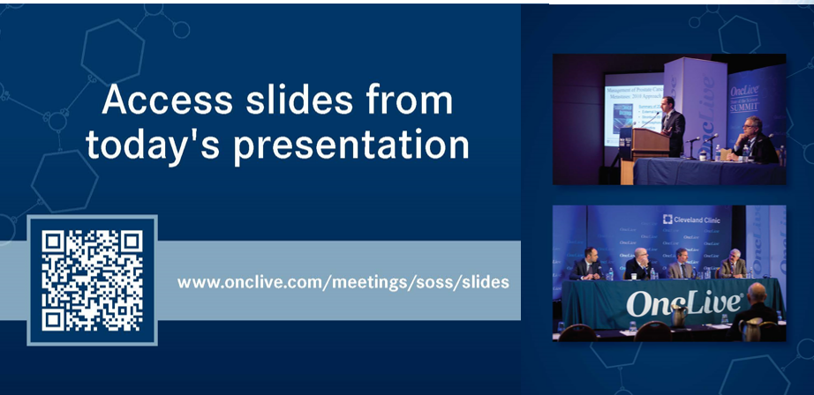

Slide 5
2024 Events
Pan Tumor: October, Miami, FL
Gastrointestinal: November, Washington, DC
Breast: December, San Antonio, TX

Slide 6



Slide 7
Program Chair
Edward B. Garon, MD, MS
Professor, Department of Medicine, Hematology/Oncology Director, Thoracic Oncology Program
Co-Director, Signal Transduction and Therapeutics
UCLA Health Jonsson Comprehensive Cancer Center
Los Angeles, CA

Slide 8
Lung Cancers
Tuesday, June 11th, 2024

Slide 9
Exploring Advances in Targeted Therapies for NSCLC
Karen Reckamp, MD, MS
Division Director, Medical Oncology
Professor of Medicine
Cedars Sinai
Los Angeles, CA

Slide 10
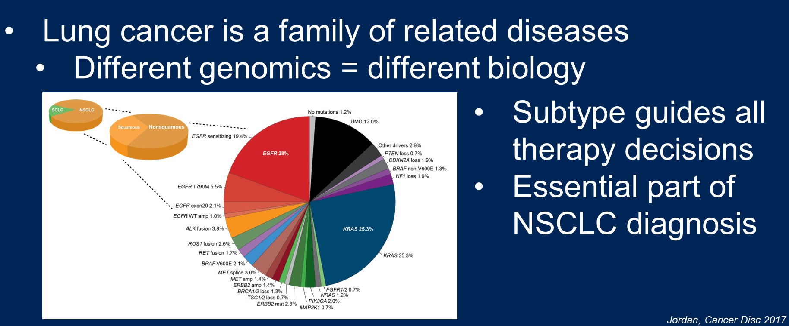
Molecular subtypes of NSCLC

Slide 11
Approved Targeted Therapies in NSCLC
Molecular Subtype | FDA Approved Targeted Therapy
EGFR | Erlotinib, gefitinib, afatinib, dacomitinib, osimertinib +/- chemotherapy
EGFR exon 20 | Amivantamab +/- chemotherapy
ALK | Crizotinib, ceritinib, alectinib, brigatinib, lorlatinib
ROS1 | Crizotinib, entrectinib, repotrectinib
RET | Selpercatinib, pralsetinib
NTRK | Entrectinib, Larotrectinib
BRAF V600E | Dabrafenib + trametinib, encorafenib + binimetinib
MET exon 14 | Capmatinib, tepotinib
HER2 | Trastuzumab deruxtecan
KRAS G12C | Sotorasib, adagrasib

Slide 12
ALK

Slide 13
ALK Targeted Therapies in NSCLC
Crizotinib
Ceritinib, Alectinib, Brigatinib, Ensartinib
Lorlatinib
NVL-655
1G ALK TKI
2G ALK TKI
3G ALK TKI
4G ALK TKI
Inhibit ALK WT
Inhibit ALK WT
Inhibit ALK WT
Inhibit ALK WT
Inhibit single ALK mutation
Inhibit single ALK mutation
Inhibit single ALK mutation
~25 – 50% of patients develop compound mutations (e.g., G1202R/L1196M) after progression on sequential 2G to 3G TKIs^{1,2}
TRK inhibition in the brain is linked to neurologic adverse events and dose-limiting toxicities^{3,4}
CNS penetration
CNS penetration
CNS penetration
Inhibit ALK solvent-front mutation
Inhibit ALK solvent-front mutation
Inhibit ALK dual cis- mutations
Avoiding TRK
Figure adapted from: Lee and Ou, Lung Cancer (Auckl) 2024, in press.
¹ Dagogo-Jack, I. et al. Clin Cancer Res. 2019; ² Shiba-Ishii et al., Nature Cancer 2022;
³ Cocco, E. et al. Nat Rev Clin Oncol. 2018; ⁴ Shaw, A. et al. N Engl J Med. 2020.

Slide 14
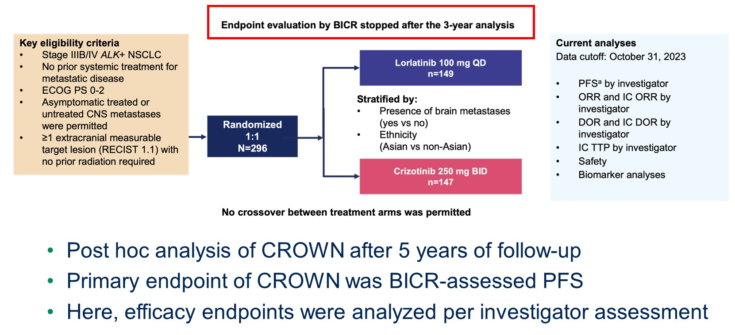
Evaluating CROWN: Analysis Overview
CROWN at 5 years: Lorlatinib vs. Crizotinib in treatment-naïve advanced ALK NSCLC
Solomon et al ASCO 2024, LBA8503

Slide 15
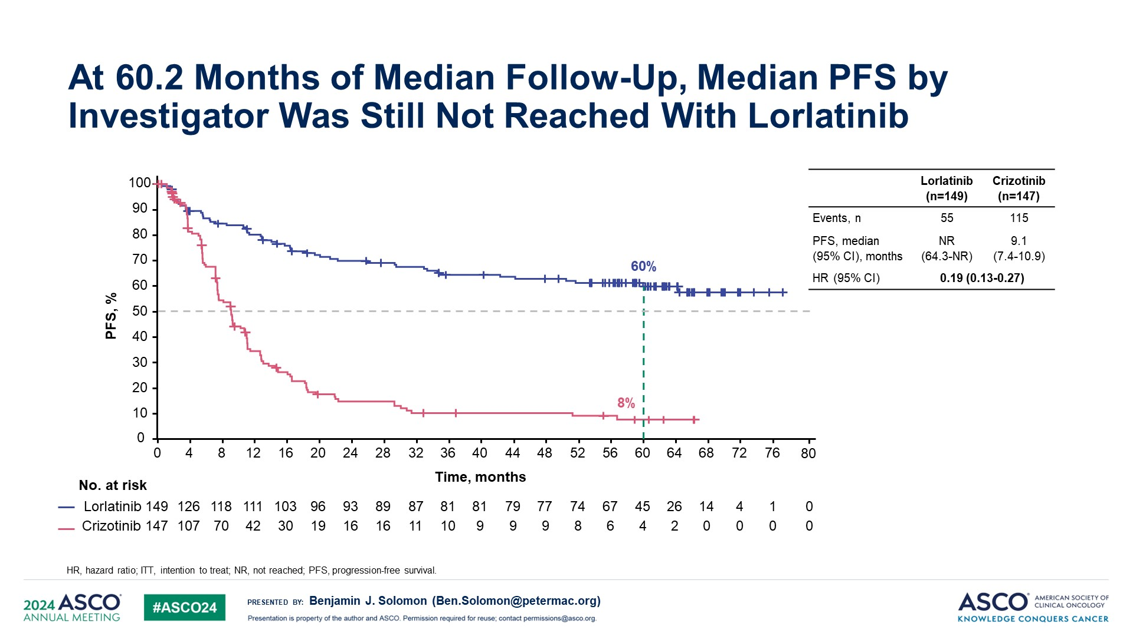
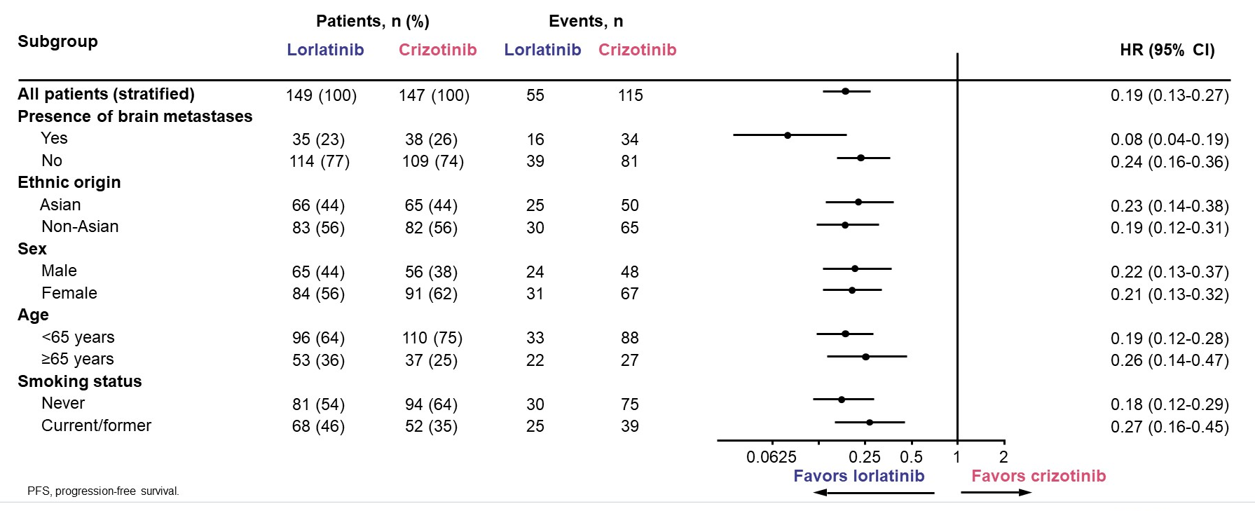
CROWN at 5 years: Lorlatinib vs. Crizotinib in treatment-naïve advanced ALK NSCLC
Solomon et al ASCO 2024, LBA8503

Slide 16
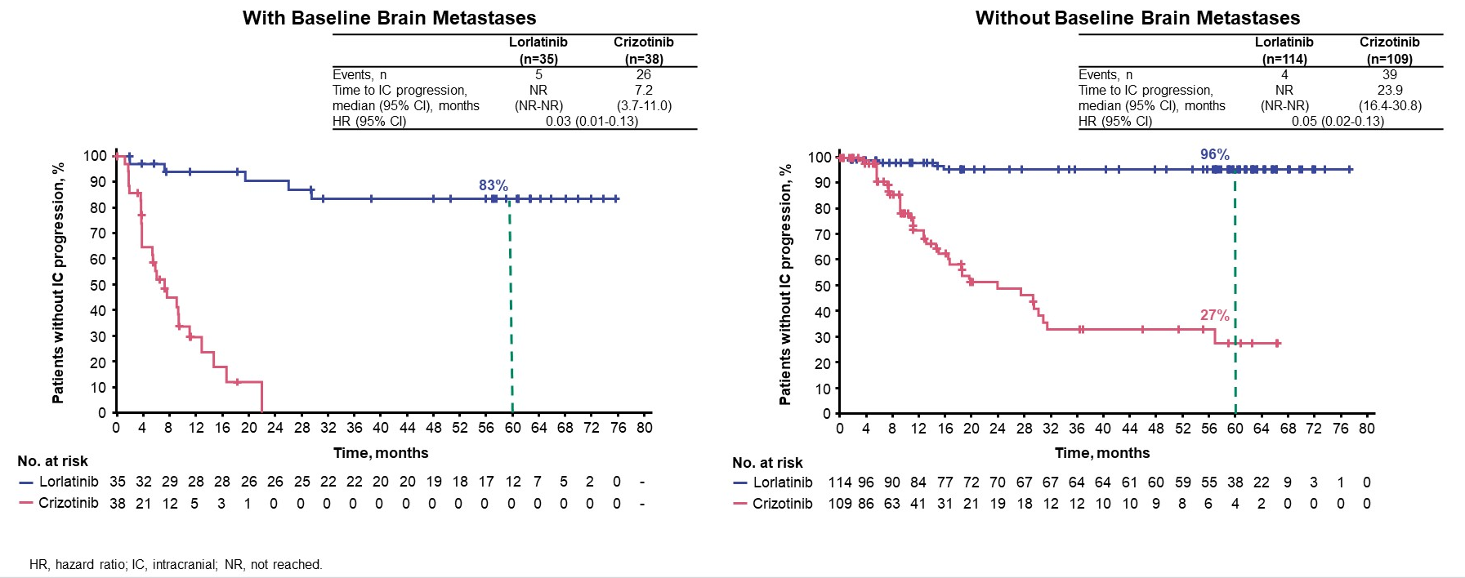
Time to IC Progression Was Longer With Lorlatinib in Presence or Absence of Baseline Brain Metastases
CROWN at 5 years: Time to IC progression with and without baseline brain metastases

Slide 17
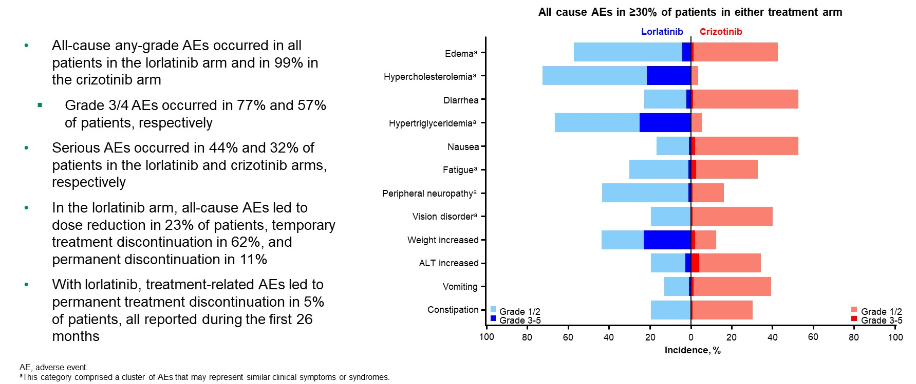
Safety Profile of Lorlatinib Was Consistent With That Observed in Prior Analyses
CROWN at 5 years: Safety
Solomon et al ASCO 2024, LBA8503

Slide 18
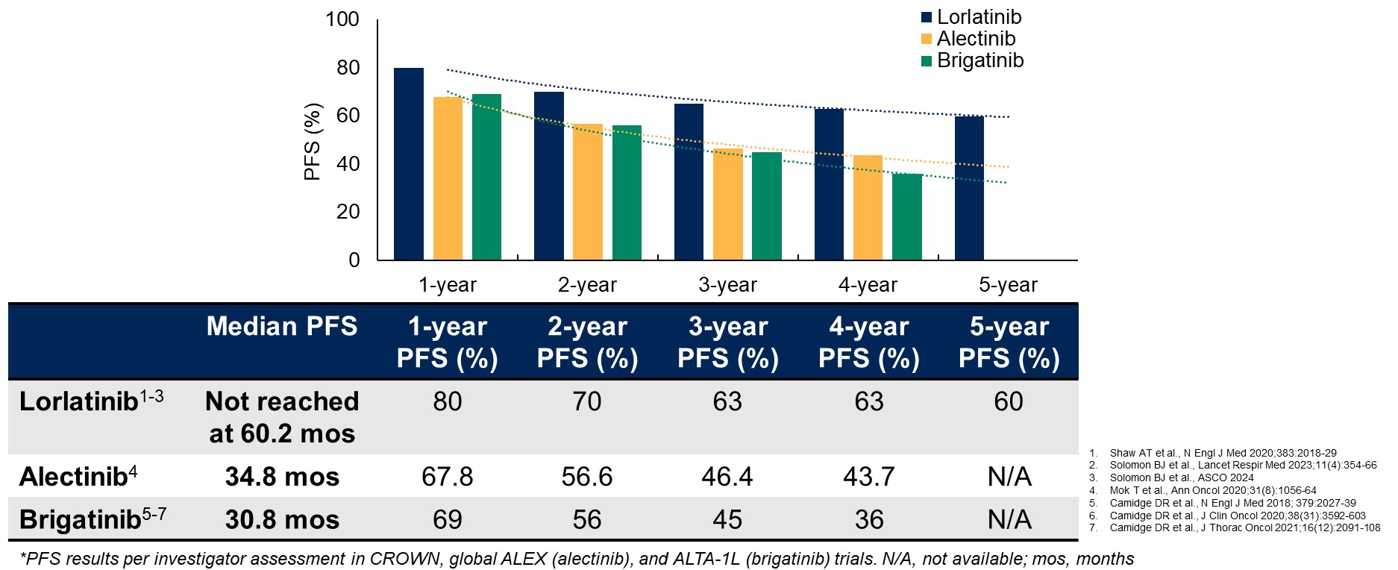
Evaluating CROWN in the Context of ALK Treatment Landscape: Systemic Efficacy
CROWN at 5 years: % PFS put into context

Slide 19
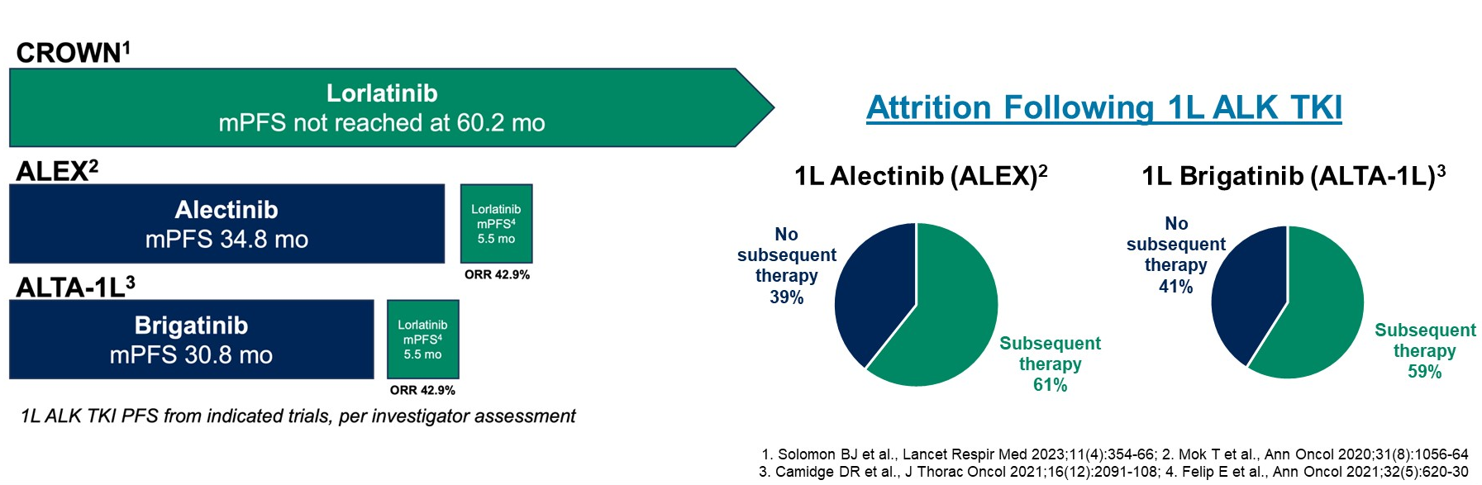
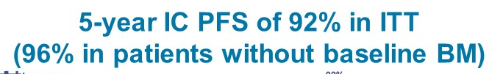
CROWN: My Conclusions and Implications for Practice
Frontline lorlatinib is standard of care for most patients with advanced ALK NSCLC

Slide 20
ALINA: Adjuvant Alectinib vs Chemotherapy in Resectable Stage IB-IIIA ALK+ NSCLC
Patient Characteristics |  | Alectinib (n=130) | Chemo (n=127)
Median age, years |  | 54 | 57
<65/≥65 years, % |  | 79/21 | 73/27
Smoking status, % | Never | 65 | 55
 | Former | 32 | 43
 | Current | 4 | 2
ECOG PS, % | 0 | 55 | 56
 | 1 | 45 | 44
Stage at diagnosis, % | IB | 11 | 9
 | II | 36 | 35
 | IIIA | 53 | 55
Histology, % | Nonsquamous | 5 | 2
 | Squamous | 95 | 98
Surgical procedure, % | Lobectomy | 97 | 92
 | Other | 3 | 8
Key Eligibility Criteria
Resectable stage IB (≥4 cm) to IIIA ALK+ NSCLC (per AJCC 7th Ed)
Eligible to receive platinum-based chemotherapy
No prior systemic anticancer therapy
ECOG PS 0 or 1
Alectinib
600 mg BID
2 years
Recurrence
Further treatments at investigator’s choice and survival follow-up
Randomized 1:1
Platinum-based chemotherapyª
Q3W; 4 cycles
Recurrence
Primary endpoints: DFS (by INV)
Other endpoints: CNS disease-free survival, OS, safety
ª Cis + Pem, Cis + Vin, or Cis + Gem; Cis could be switched to Carbo in case of intolerability.
Solomon BJ, et al. ESMO 2023. Abstract LBA2.

Slide 21
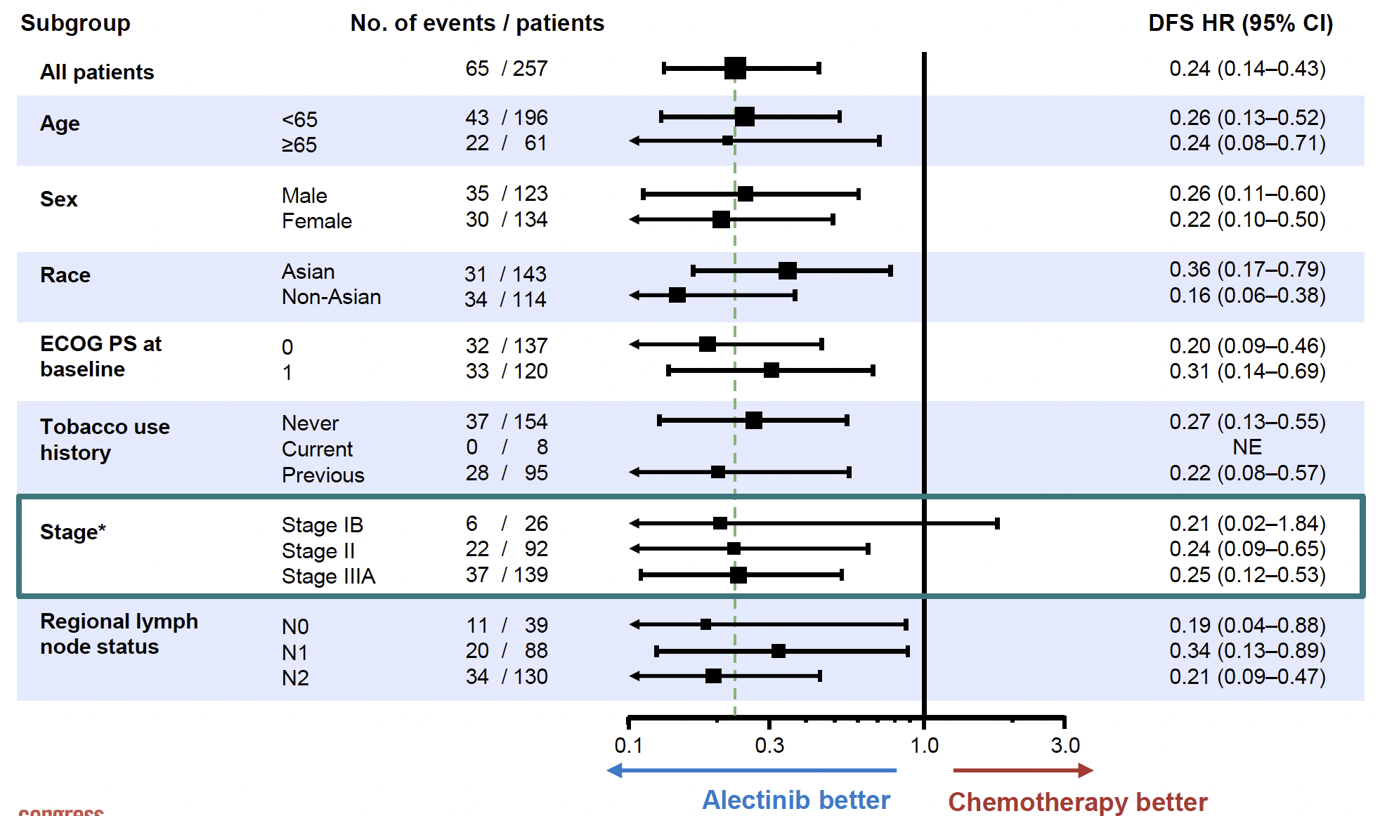
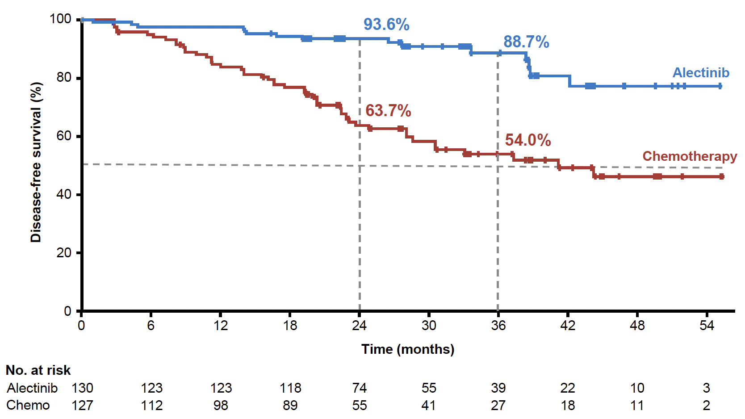
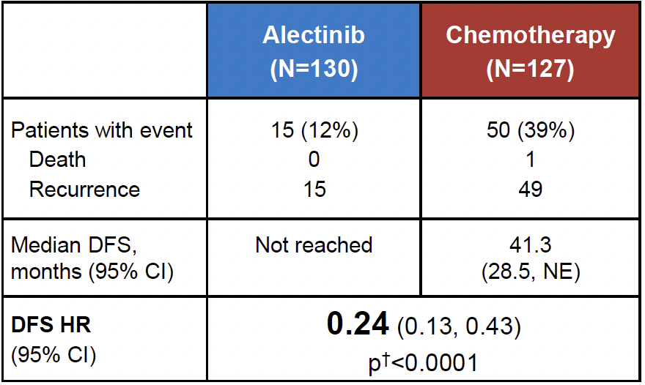
ALINA: Disease-Free Survival
DFS Subgroup Analysis (ITT)
DFS: ITT (Stage IB-IIIA)
(Median follow-up: alectinib, 27.8 months; chemo, 28.4 months)
At data cutoff date, OS data were immature with only 6 (2.3%) OS events reported
Solomon BJ, et al. ESMO 2023. Abstract LBA2.

Slide 22
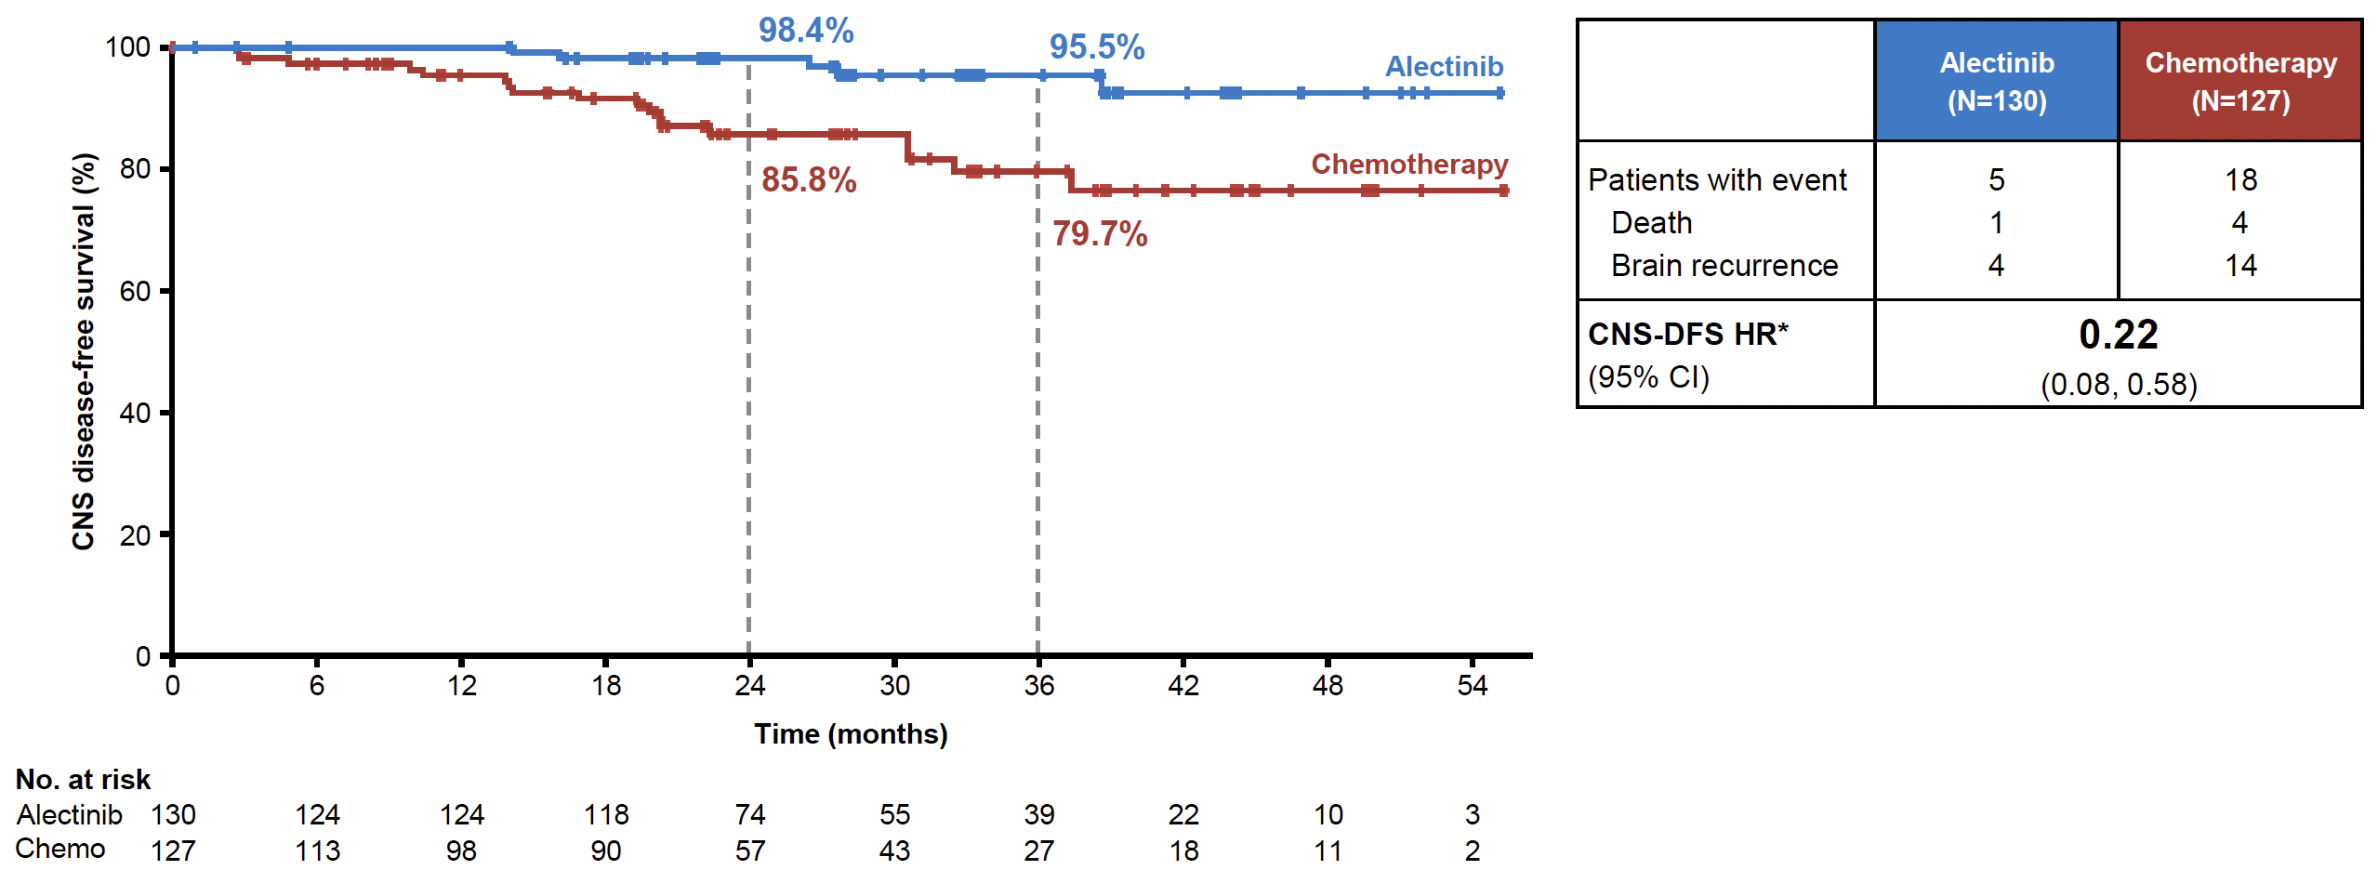
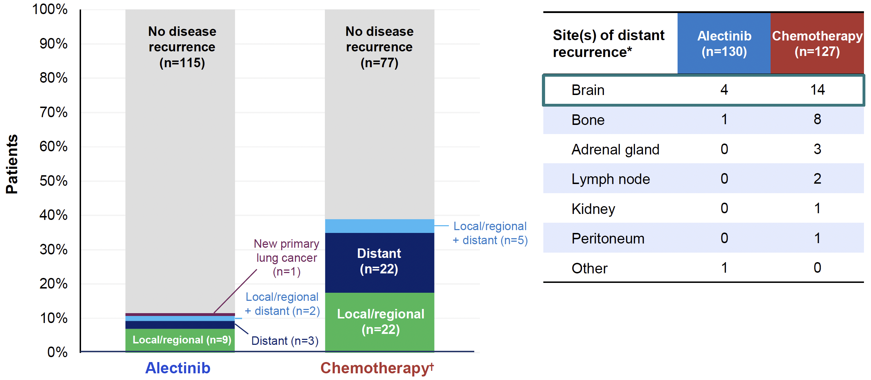
ALINA: CNS DFS and Recurrence
Sites of Recurrence (ITT)
CNS DFS (ITT)
(Median follow-up: alectinib, 27.8 months; chemo, 28.4 months)
Solomon BJ, et al. ESMO 2023. Abstract LBA2.

Slide 23
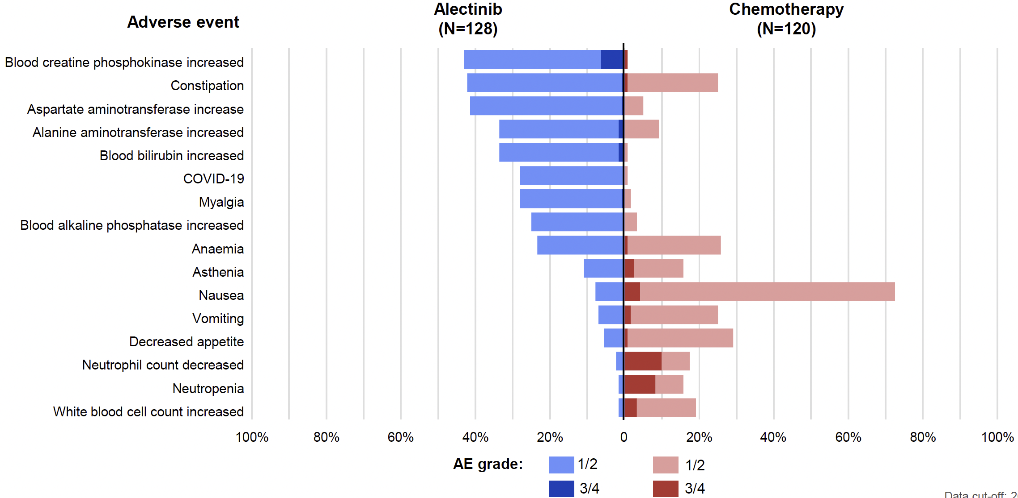
ALINA: Safety and Summary
Safety Summary | Alectinib (n=128) | Chemo (n=120)
Median treatment duration, months | 23.9 | 2.1
Patients with any AEs, % | 98 | 93
Grade 3/4 | 30 | 31
Grade 5 | 0 | 0
Serious AEs | 13 | 8
Treatment-related serious AEs | 2 | 7
AEs leading to dose reduction | 26 | 10
AEs leading to dose interruption | 27 | 18
AEs leading to treatment withdrawal | 5 | 13
AEs (≥15% of patients)
At data cutoff, 20.3% of patients in the alectinib arm were ongoing treatment
Solomon BJ, et al. ESMO 2023. Abstract LBA2.

Slide 24
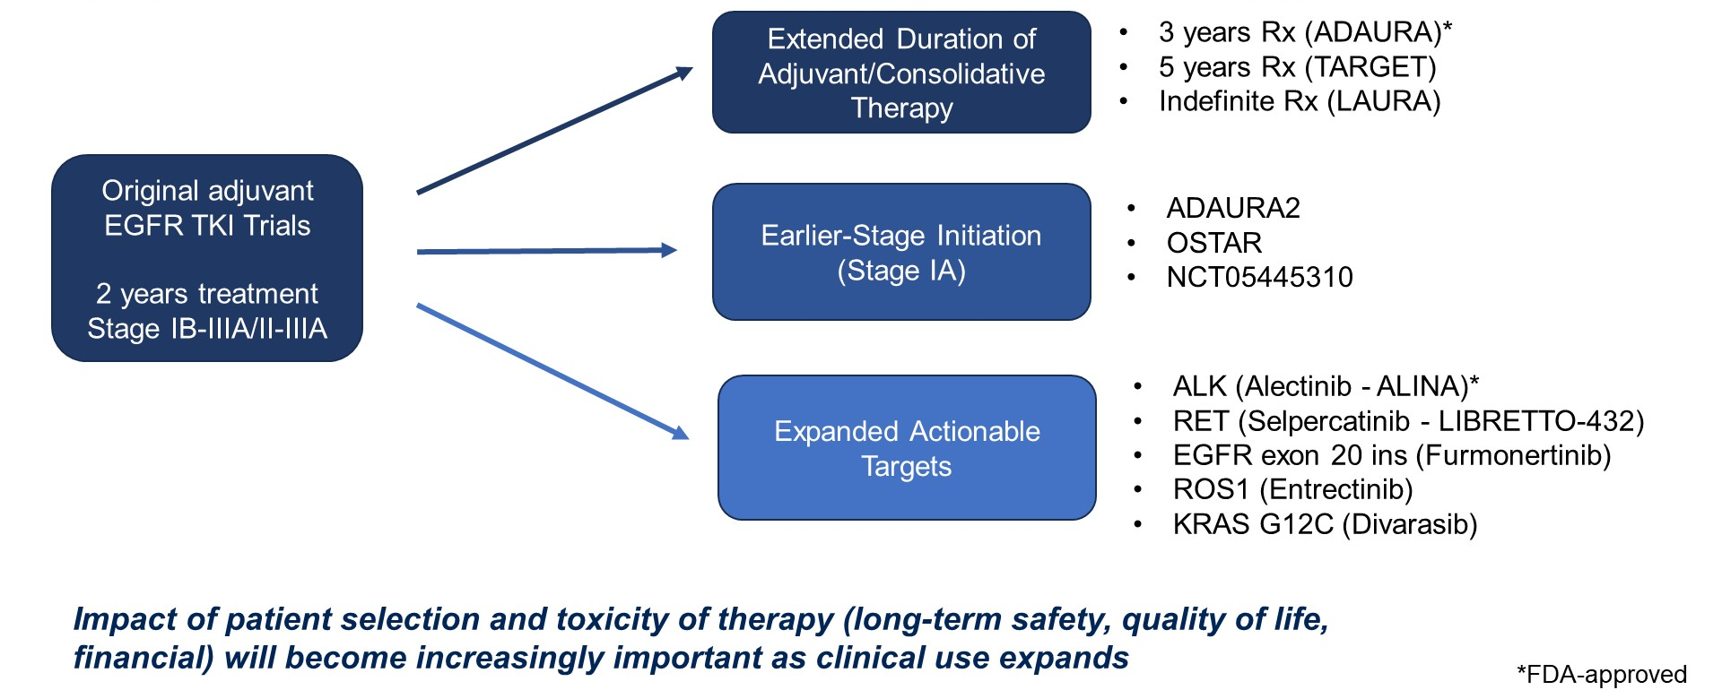
Ongoing studies are investigating expanded applications of adjuvant targeted therapy
Targeted Therapy in the Adjuvant Setting

Slide 25
ROS1

Slide 26
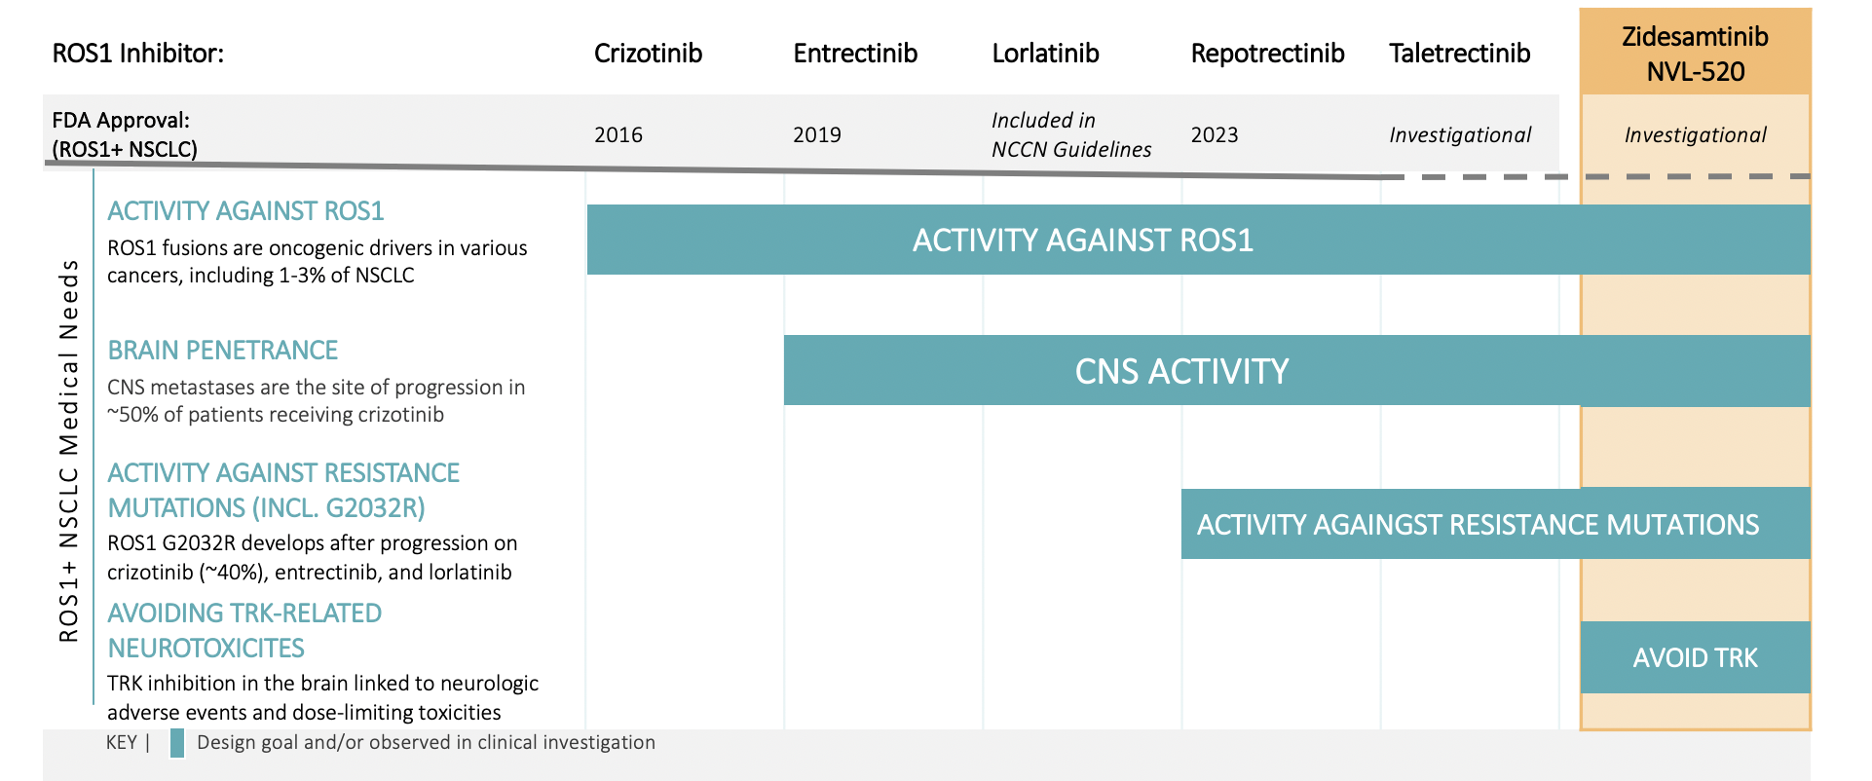
ROS1 inhibition
Gene fusions involving ROS1 in ~1-2% of NSCLC
Currently approved agents include, crizotinib, entrectinib and repotrectinib
Acquired resistance mutations such as solvent front mutation G2032R have been identified
CNS, central nervous system; NCCN, National Comprehensive Cancer Network®; NSCLC, non-small cell lung cancer; ROS1+, ROS1-positive. Sources: Drilon et al. JTO Clinical and Research Reports, 2022; Drilon et al., Nat. Rev. Clin. Oncol. 2021; Jordan et al., Cancer Discovery. 2017; Patil et al., J. Thorac. Oncol. 2018; Gainor et al., JCO Precision Oncol. 2017; Lin et al., CCR 2021; Cocco et al., Nat. Rev. Clin. Oncol. 2018; Drilon et al., Lancet Oncol. 2020; Doebele et al., Ann. Oncol. 2019; Shaw et al., NEJM 2020; Li et al., JCO 2022; Drilon et al., Ann. Oncol. 2019; Papadopoulos et al., Clin Cancer Res. 2020; crizotinib prescribing information; entrectinib prescribing information.

Slide 27
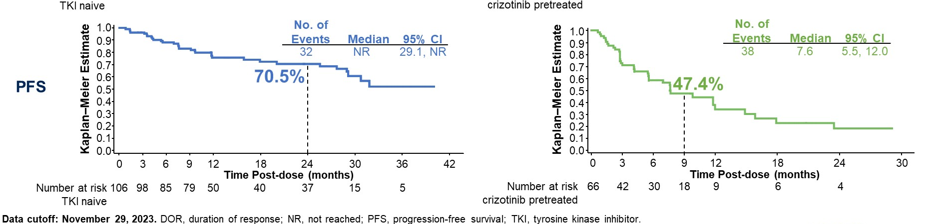
Frontline TKI treatment in advanced ROS1 NSCLC
>>53.7 months??—ASCO 2024
Taletrectinib—ASCO 2024
months
Shaw et al, Ann Oncol 2019, Wu et al, JCO 2018; Lim et al, JCO 2017; Drilon et al, JTO CRR 2022; Shaw et al, Lancet Oncol 2019; Drilon et al, NEJM 2024; Ahn et al, ASCO 2024; Li et al, ASCO 2024

Slide 28
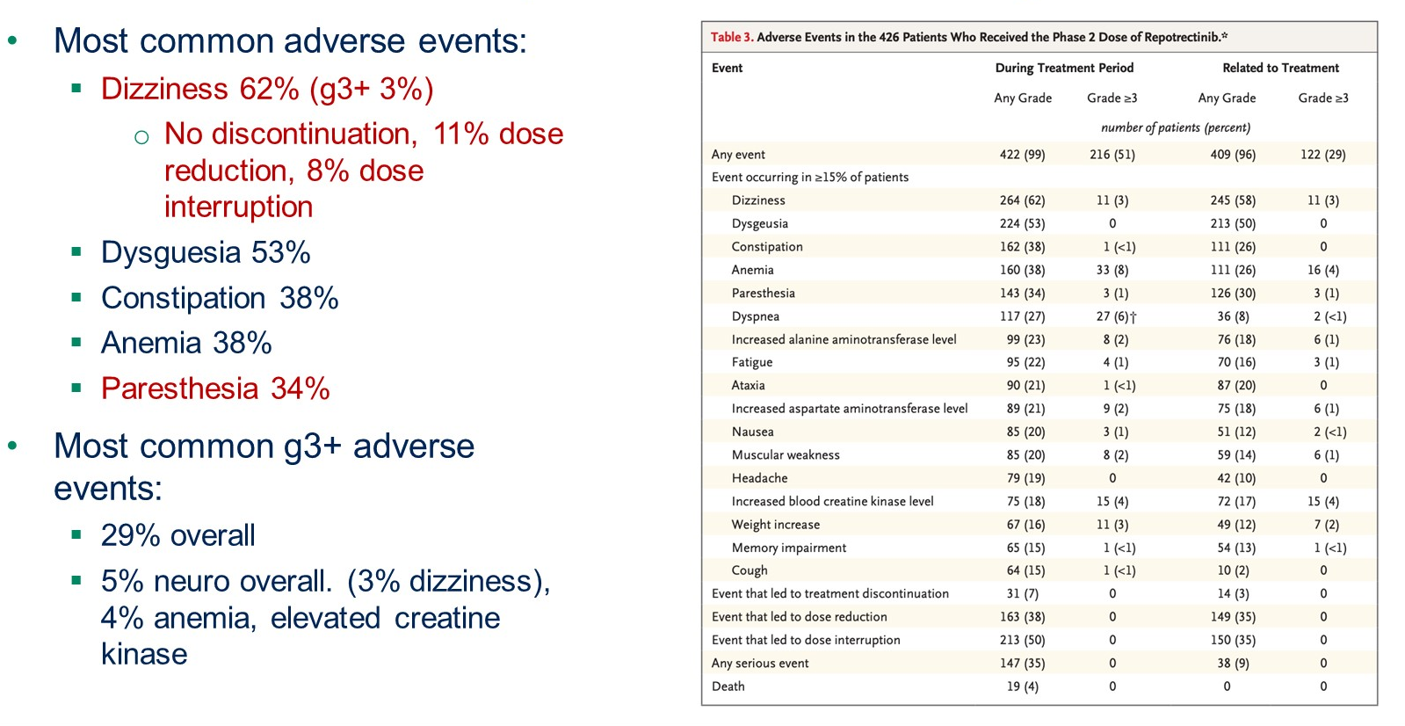
ROS1 Fusion: Repotrectinib safety
Repotrectinib safety

Slide 29
HER2

Slide 30
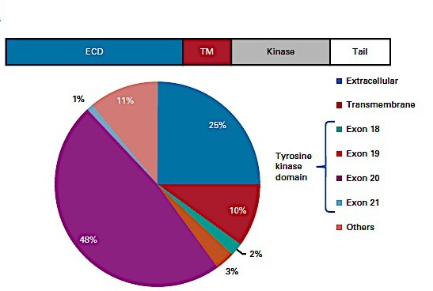
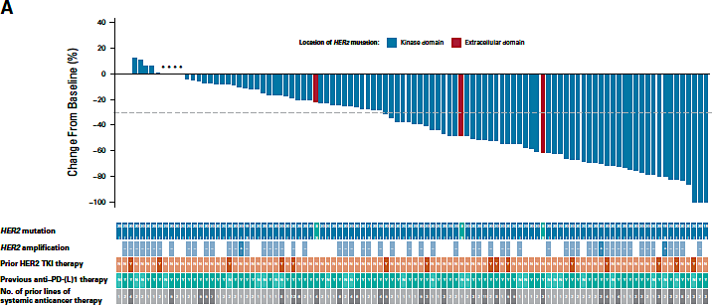
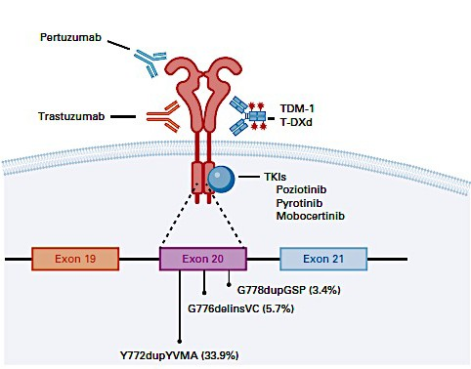
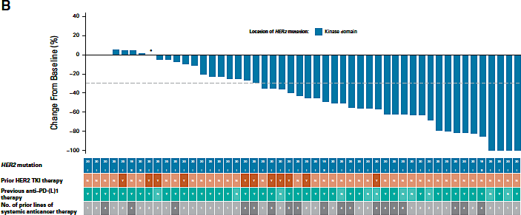
Trastuzumab deruxtecan for HER2 Mutations
5.4 mg/kg Dose
ORR 49%
mPFS 9.9 mo
DOR 16.8
6.4 mg/kg Dose
ORR 56%
mPFS 15.4 mo
DOR NE
Cooper A, Gainor JF, J Clin Oncol 2022; Goto K, et al. J Clin Oncol 2023

Slide 31
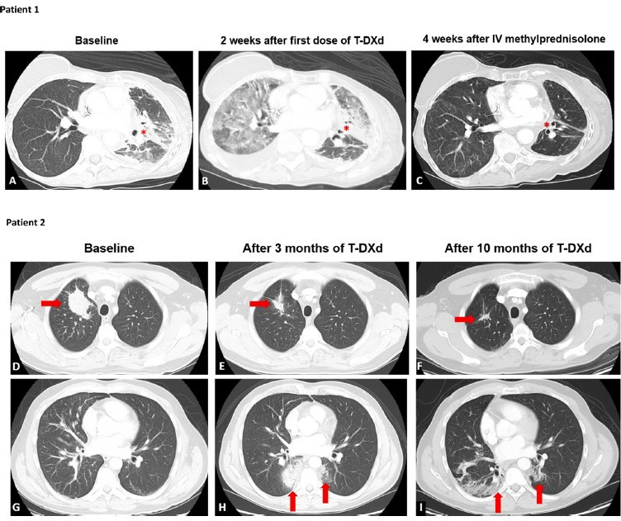
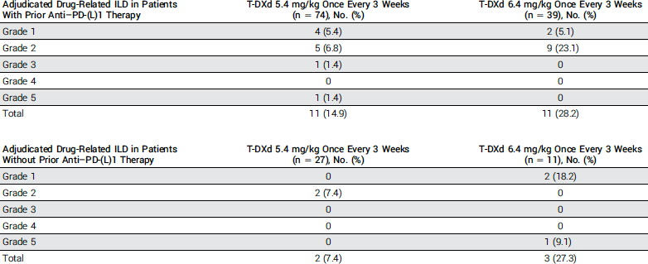
Trastuzumab deruxtecan for HER2 Mutations: ILD
Goto K, et al. J Clin Oncol 2023; Swain SM, et al. Cancer Treatment Reviews 2022

Slide 32
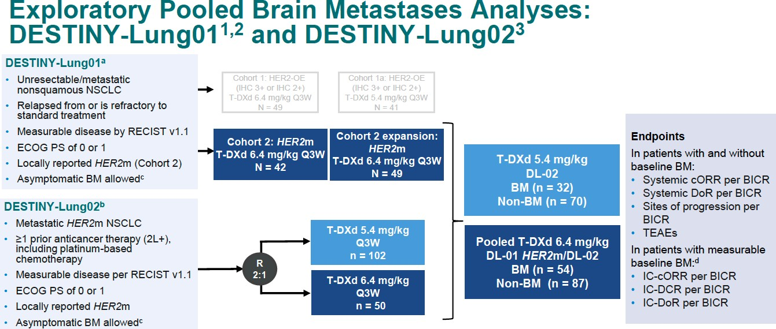
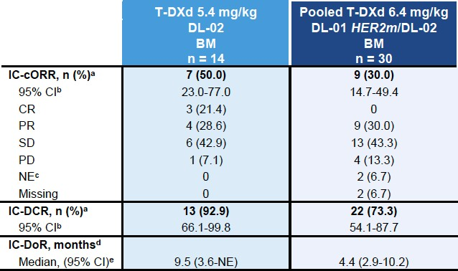
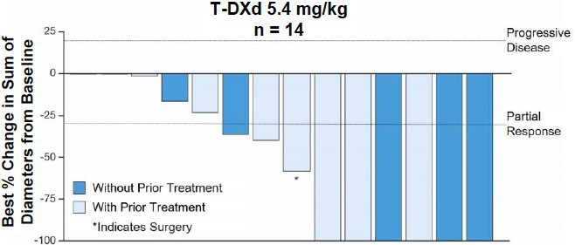
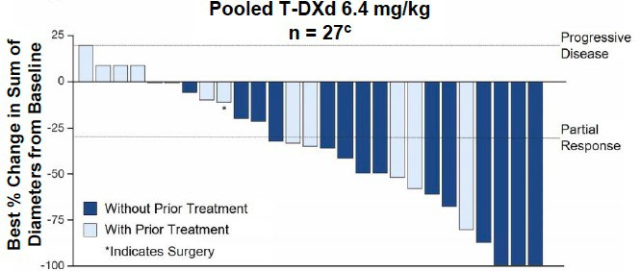
Intracranial response—trastuzumab deruxtecan
Planchard D, et al. ESMO 2023

Slide 33
DESTINY-Lung01 Study Design
Multicenter, international, 2-cohort phase 2 trial (NCT03505710)
DESTINY-Lung01
Key eligibility criteria
Unresectable/metastatic nonsquamous NSCLC
Relapsed from or is refractory to standard treatment
Measurable disease by RECIST v1.1
Asymptomatic CNS metastases at baselineª
ECOG PS of 0 or 1
HER2 IHC 2+ or 3+
Cohort 1: HER2-overexpressing^{c}
(IHC 3+ or IHC 2+)
T-DXd 6.4 mg/kg q3w N = 49
Cohort 1a: HER2-overexpressing^{c}
(IHC 3+ or IHC 2+)
T-DXd 5.4 mg/kg q3w N = 41
Primary end point
Confirmed ORR by ICR^{d}
Secondary end points
DOR
PFS
OS
DCR
Safety
Exploratory end point
Biomarkers of response
Cohort 2:
HER2-mutated
T-DXd 6.4 mg/kg q3w N = 42
Cohort 2 expansion:
HER2-mutated
T-DXd 6.4 mg/kg q3w N = 49
ªPatients with asymptomatic brain metastases not requiring ongoing steroid or anticonvulsant therapy were allowed to enroll ^{b}HER2 mutation documented solely from a liquid biopsy could not be used for enrolment ^{c}HER2 overexpression without known HER2 mutation was assessed by local assessment of archival tissue and centrally confirmed ^{d}Per RECIST v1.1
DCR, disease control rate; DOR, duration of response; ECOG, Eastern Cooperative Oncology Group; HER2, human epidermal growth factor receptor 2; ICR, independent central review; IHC, immunohistochemistry; ORR, objective response rate; OS, overall survival; PFS, progression-free survival; PS, performance status; q3w, every 3 weeks; RECIST v1.1, Response Evaluation Criteria in Solid Tumours version 1.1.
Smit EF et al Lancet Oncol 2024

Slide 34
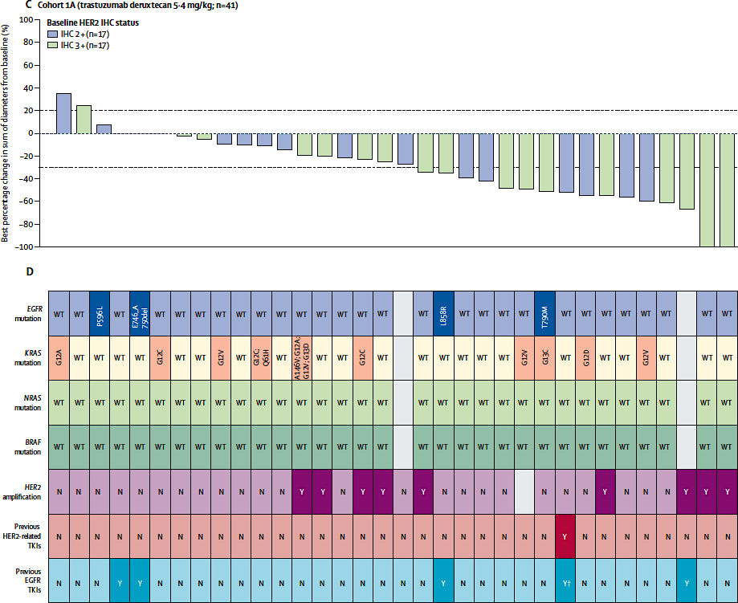
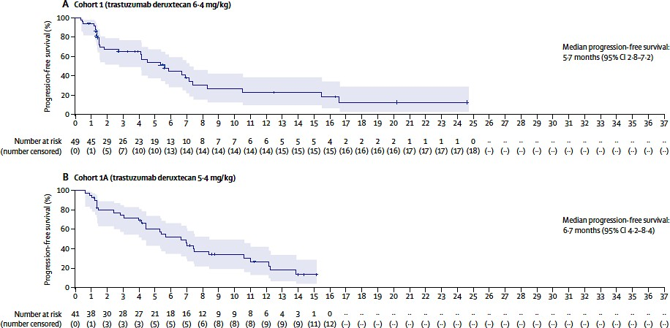
Trastuzumab deruxtecan for HER2 Overexpression
ORR: 13 (26.5%; 15.0-41.1)
DOR: 5.8 mo (4.3-NE)
mPFS: 5.7 mo (2.8-7.2)
mOS: 12.4 (7.8-17.2)
ORR: 14 (34.1%; 20.1-50.6)
DOR: 6.2 mo (4.2-9.8)
mPFS: 6.7 mo (4.2-8.4)
mOS: 11.2 (8.4-NE)
HER2 IHC 3+:
ORR 52.9%
mDOR 6.9 months
Smit E, et al. Lancet Oncol 2024
April 4, 2024—FDA Grants Accelerated Approval to Fam-Trastuzumab-Deruxtecan-Nxki for Unresectable or Metastatic HER2-Positive Solid Tumors

Slide 35
KRAS G12C

Slide 36
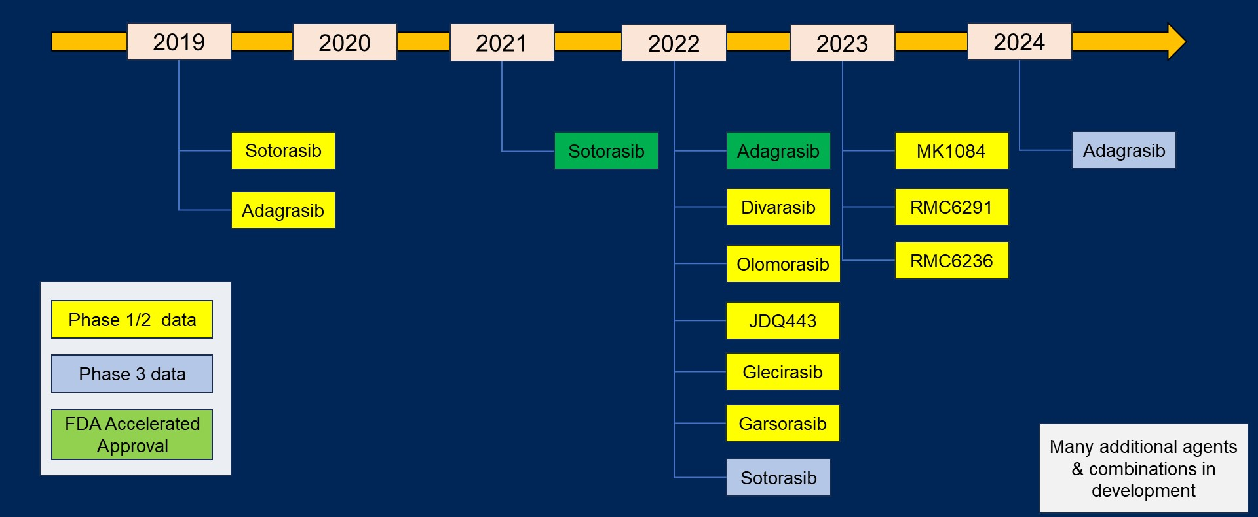
KRAS G12C Inhibitors – State of the Field
KRAS G12C inhibitors

Slide 37
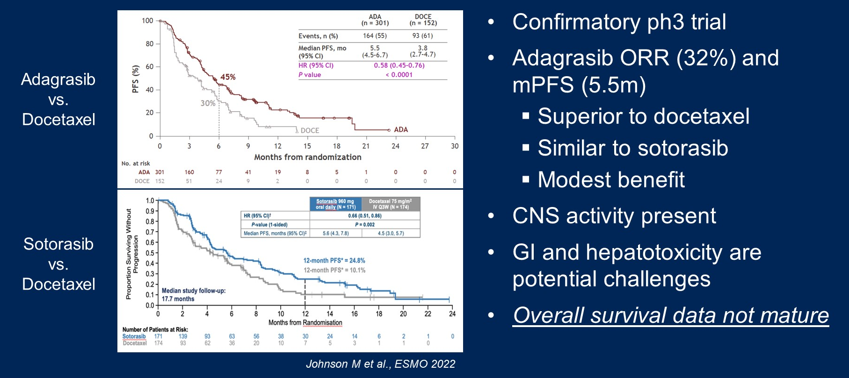
KRYSTAL-12: adagrasib vs docetaxel
KRAS G12C inhibitors—Phase III results
KRYSTAL-12
CodeBreaK-200
Mok et al ASCO 2024

Slide 38
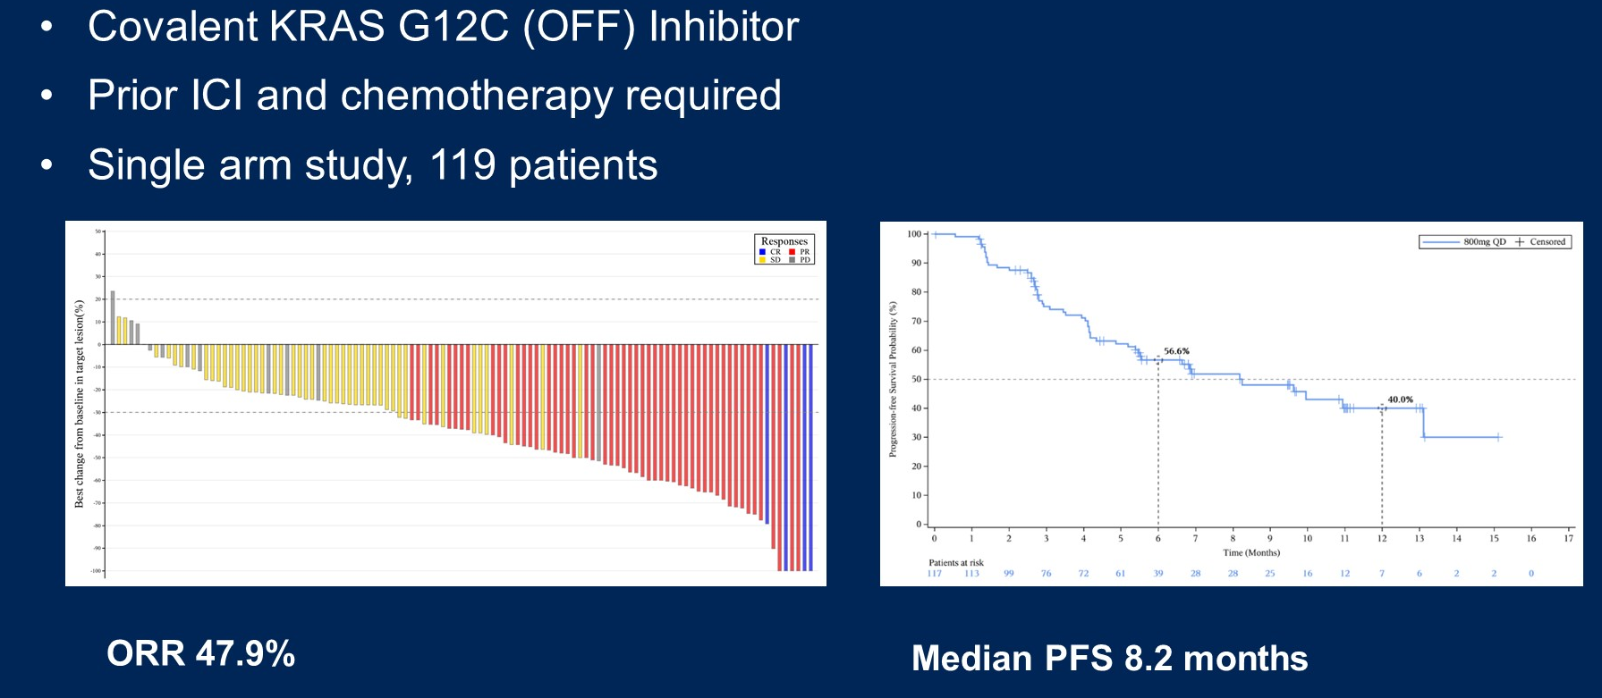
Glecirasib for KRAS G12C+ NSCLC
Glecirasib for KRAS G12C NSCLC

Slide 39
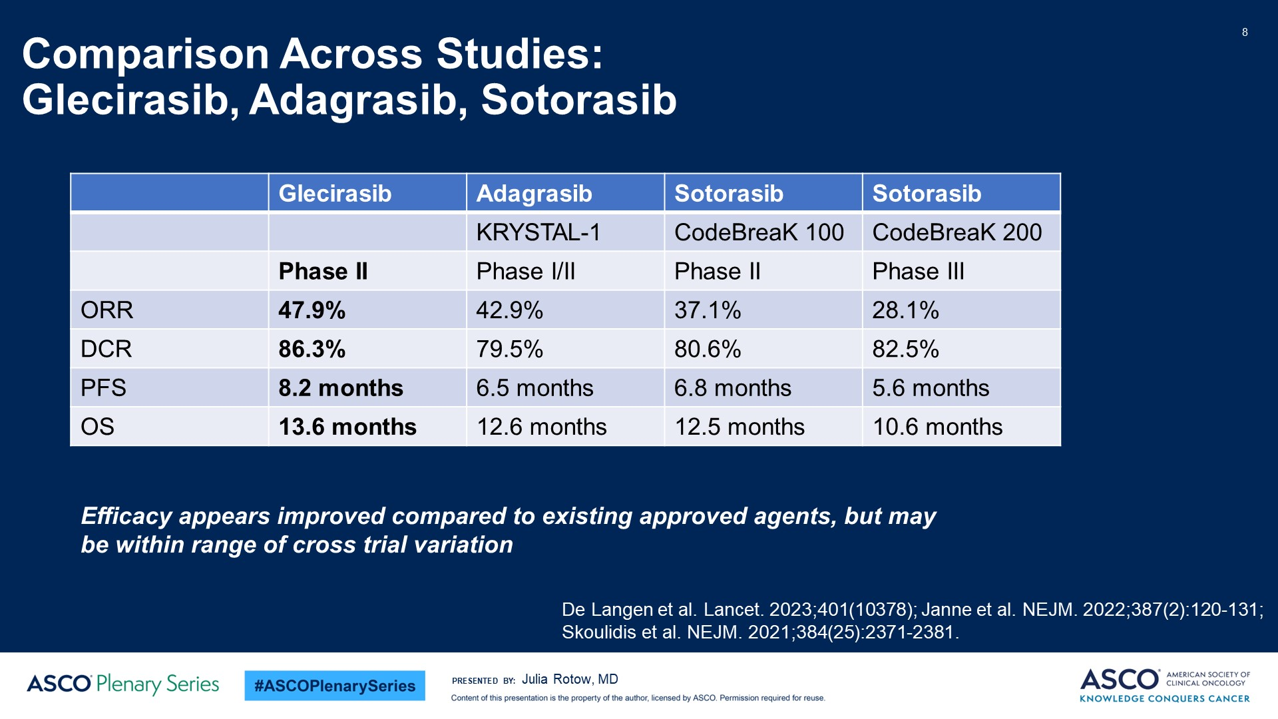
Comparison Across Studies:<br />Glecirasib, Adagrasib, Sotorasib
KRAS G12C inhibition in NSCLC
Adagrasib
KRYSTAL-12
Phase III
32%
78%
5.5 months
NA
Mok et al ASCO 2024

Slide 40
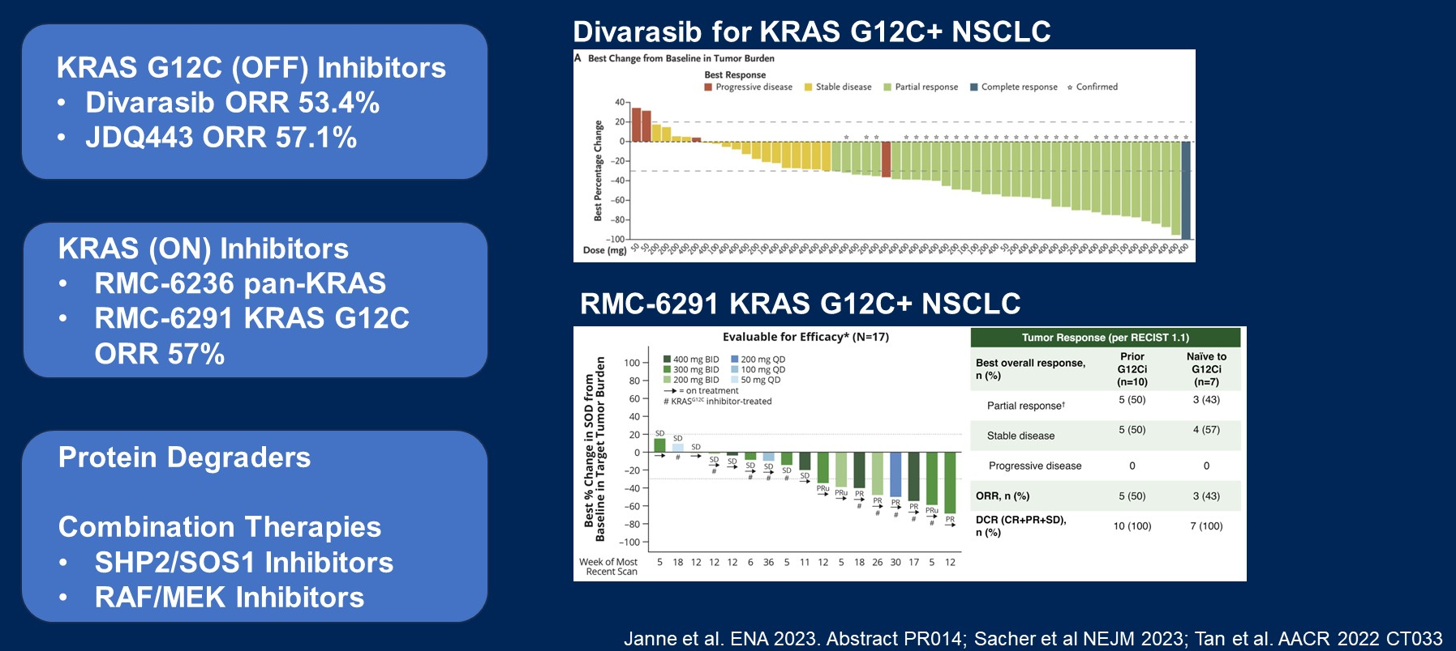
How will this compare to other KRAS-targeted strategies in clinical development?
Evolving landscape for KRAS inhibition in NSCLC

Slide 41
Targeted therapy updates—remaining questions
Should we use TKIs to target all oncogenic drivers in the adjuvant setting?
What is the optimal timing and duration of TKI therapy in the perioperative setting?
Do some patients benefit from adjuvant chemotherapy?
Can detection of MRD identify patients to intensify or de-intensify therapy?
What are the mechanisms of resistance?
How do we best identify rational combinations?

Slide 42
Lung Cancers
Tuesday, June 11th, 2024

Slide 43
Targeted EGFR-Mutated
Non-Small Cell Lung Cancer
Jonathan W. Goldman, MD
Associate Professor, UCLA Hematology & Oncology
Director of Clinical Trials in Thoracic Oncology
Associate Director of Drug Development
Santa Monica, CA

Slide 44
Conflict of Interest Disclosure
Jonathan W. Goldman, MD
Research Grants: AbbVie, Advaxis, AstraZeneca, BMS, Eli Lilly, Genentech, GSK, Janssen, Merck, Pfizer, Puma, Spectrum, Vaccinex
Consulting: AbbVie, AstraZeneca, BMS, Genentech, Gilead, Gritstone, Janssen, Jazz, Lilly, Pfizer, Puma, Regeneron

Slide 45
Landmark Studies
EGFRm NSCLC
Osimertinib
ADAURA
FLAURA1
FLAURA2
Amivantamab
MARIPOSA
MARIPOSA-2
PAPILLON

Slide 46
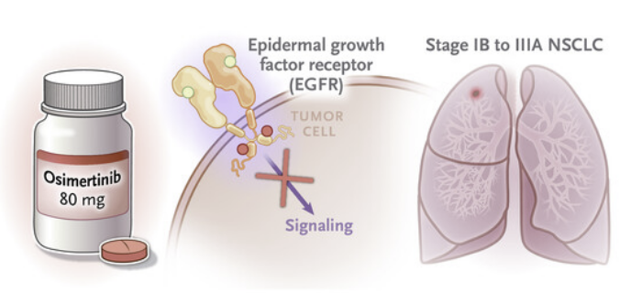
ADAURA: Osimertinib in resected EGFR-mutated NSCLC
Wu Y-L, Tsuboi M, He J, et al. NEJM 2020;383:1711-23

Slide 47
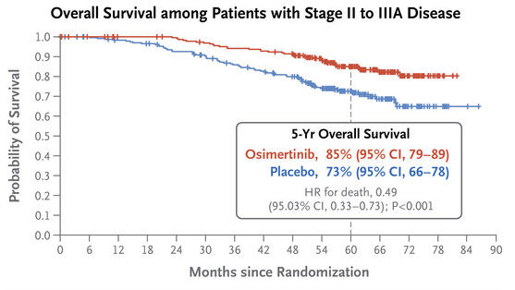
ADAURA: OS in Stage II-IIA Disease
5-year OS with Osimertinib was 85% compared to placebo at 73%
Median follow up: 5+ years for both arms
mOS was not reached
Wu Y-L, Tsuboi M, He J, et al. NEJM 2020;383:1711-23

Slide 48
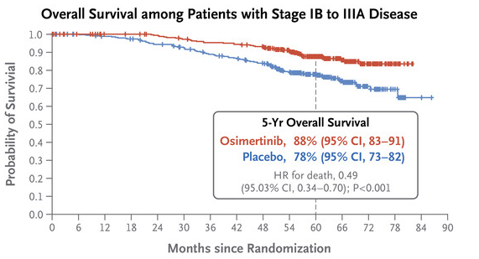
ADAURA: OS in overall population
5-year OS with Osimertinib was 88% compared to placebo at 78%
Median follow up for OS: 60.4 months with osimertinib and 59.4 with placebo
Wu Y-L, Tsuboi M, He J, et al. NEJM 2020;383:1711-23

Slide 49
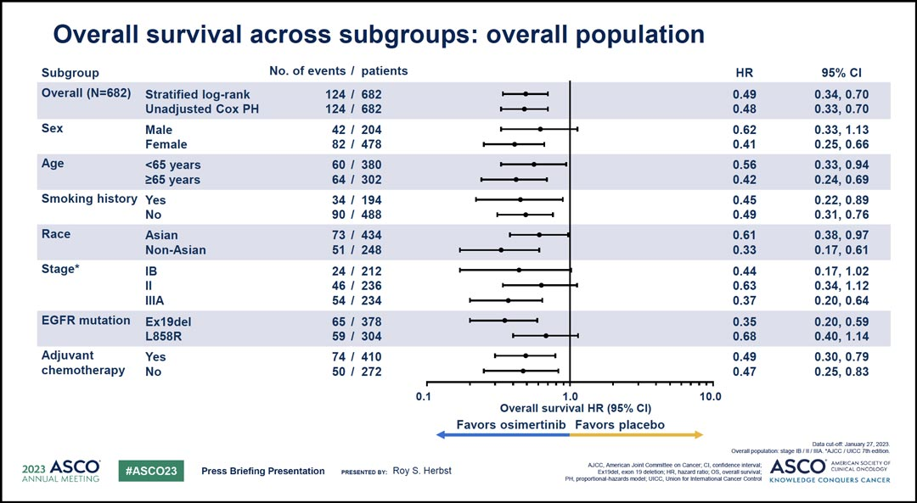
Herbst RS et al. ASCO 2023;Abstract LBA3.

Slide 50
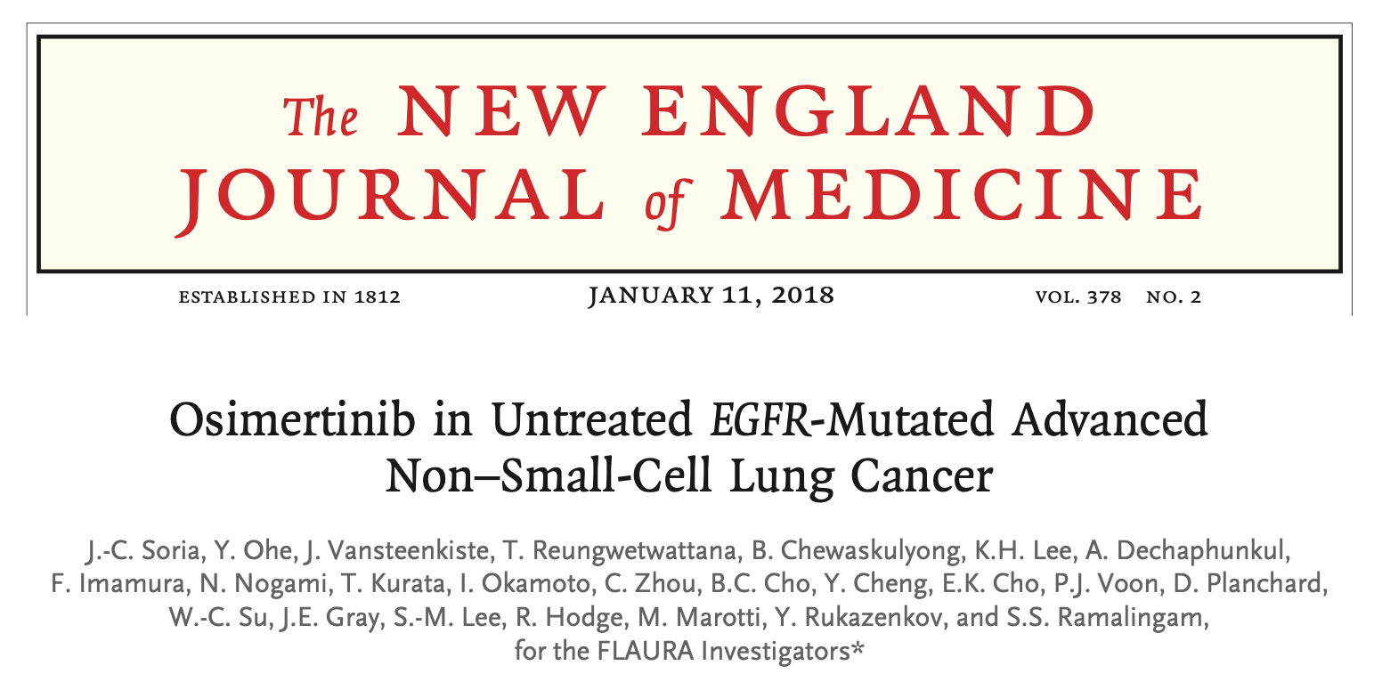
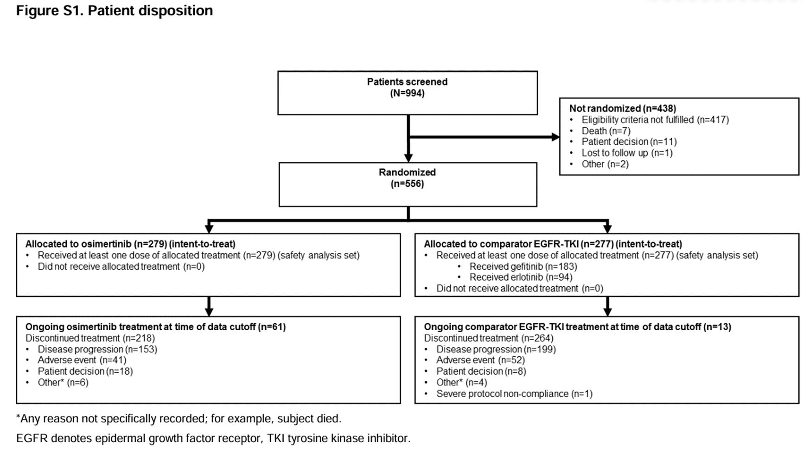
FLAURA Trial: osimertinib vs 1st Gen TKI
Soria JC, Ohe Y, Vansteenkiste J, et al. NEJM 2018;378:113-125.
Ramalingam SS, Vansteenkiste J, Planchard D, et al. NEJM 2020 0;382:41-50.

Slide 51
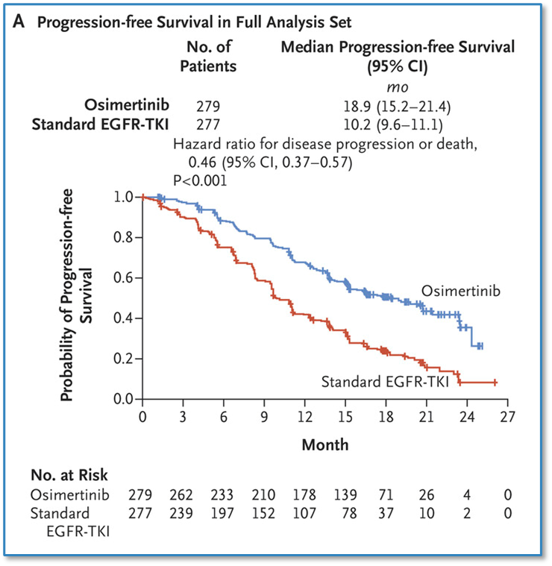
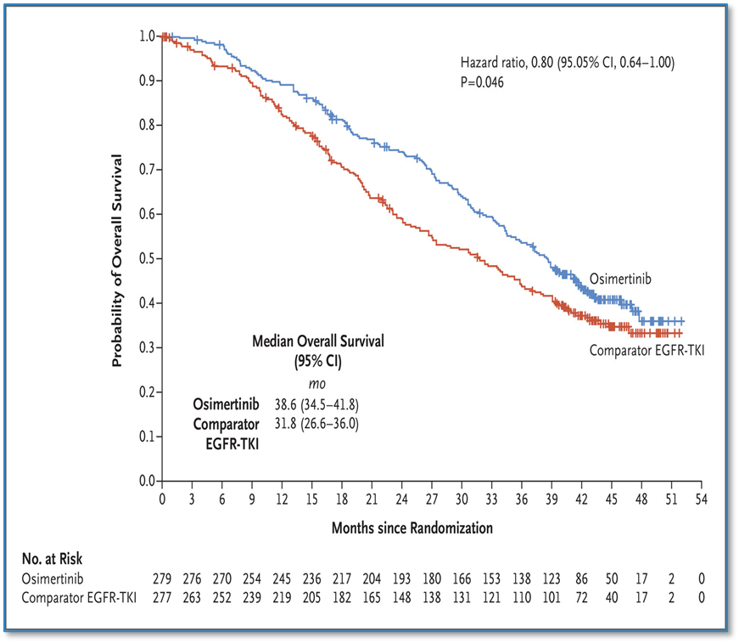
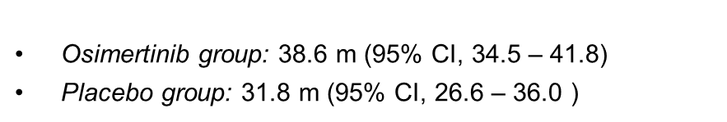
FLAURA: PFS and OS Benefit

Slide 52
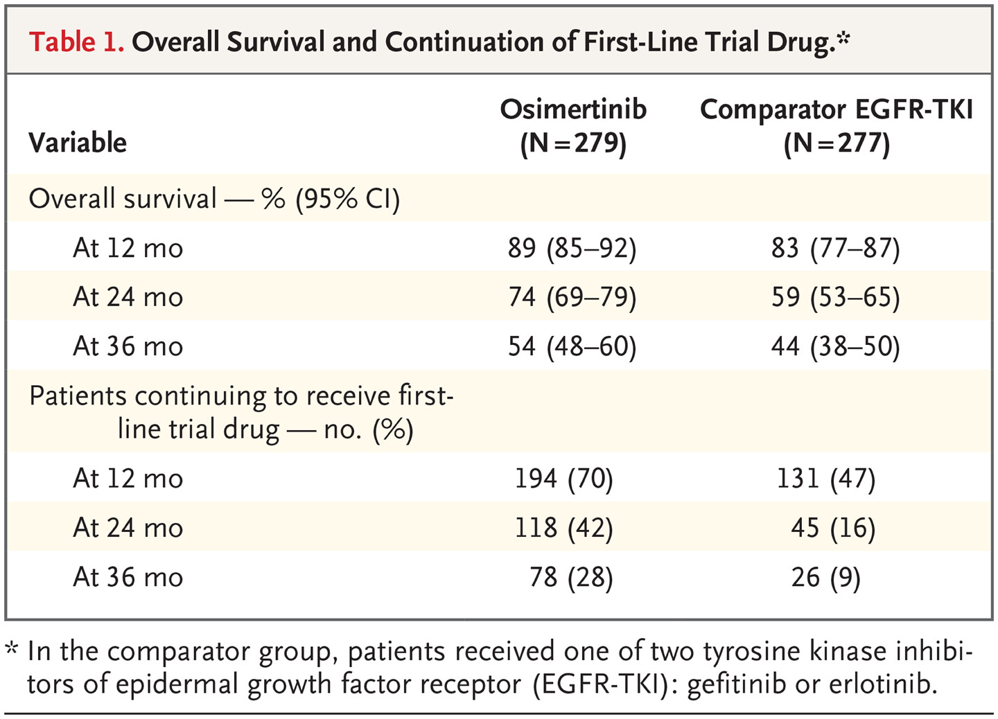
FLAURA: Landmark survival rates and the number of patients continuing to receiving the first-line trial drug were consistently higher in the osimertinib group.
Grade 3 AE rate also favored osimertinib: 42% vs 47%.
Ramalingam SS, Vansteenkiste J, Planchard D, et al. NEJM 2020 0;382:41-50.

Slide 53
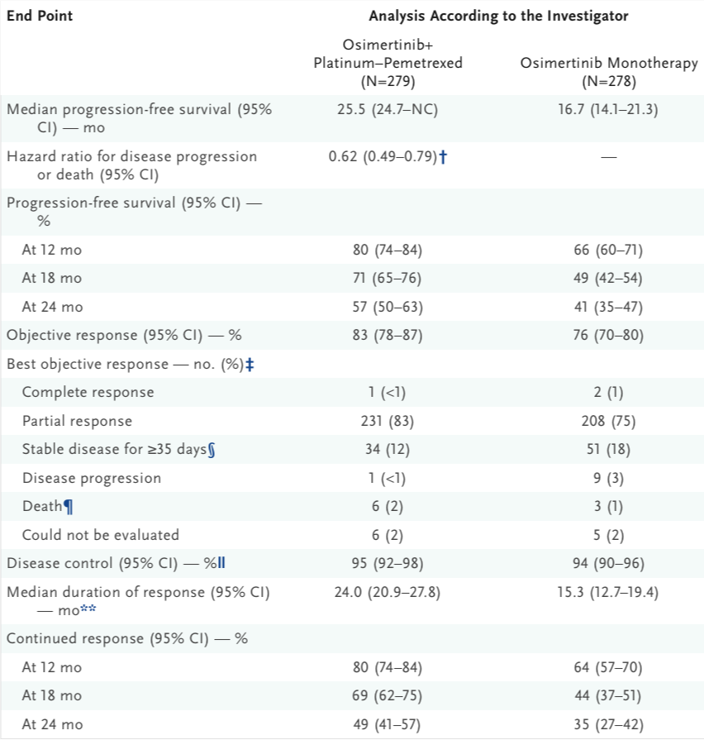
FLAURA2: osimertinib with chemo vs osimertinib
Addition of platinum and pemetrexed improved:
  ORR from 76 to 83%
  Duration of Response from 15.3 to 24.0 m
  mPFS from 16.7 to 25.5 months (HR 0.62)
Planchard D, Jänne P, Cheng Y, et al. NEJM 2023;389:1935-1948.

Slide 54
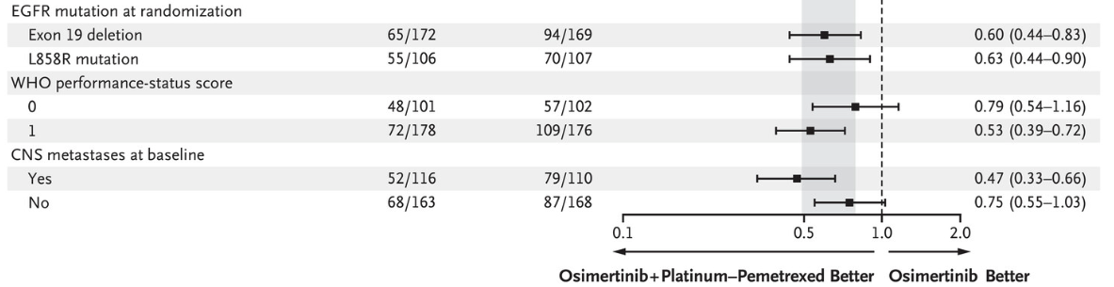
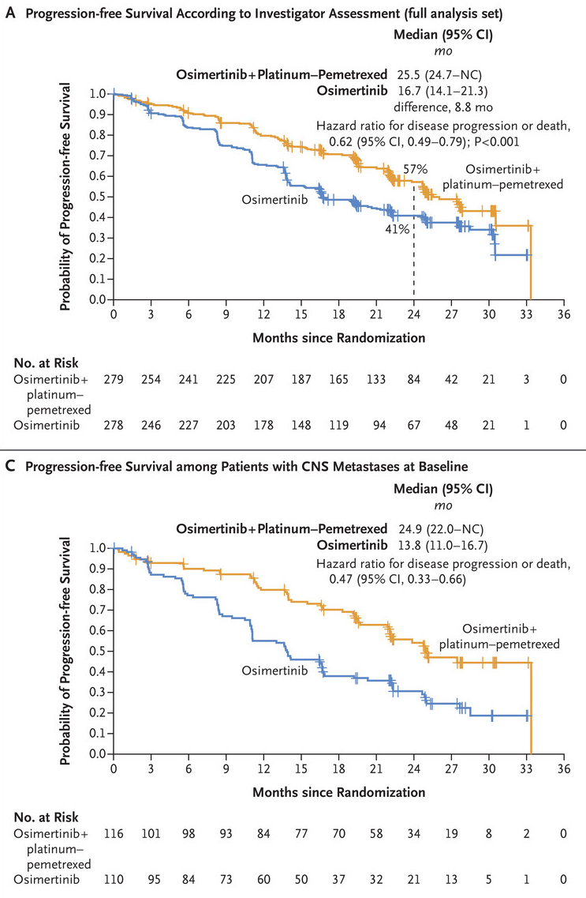

FLAURA2: benefits
Planchard D, Jänne P, Cheng Y, et al. NEJM 2023;389:1935-1948.
Tagrisso package insert, released 4/29/24, accessdata.fda.gov.

Slide 55


FLAURA2: outstanding questions
First interim OS analysis at 27% data maturity.
Second interim OS Analysis: at 41% data maturity, the OS interim results NR (38-NC) vs 36.7 m (33.2-NC)(HR 0.75; 95% confidence interval [CI] 0.57-0.97), not significant.
Planchard D, Jänne P, Cheng Y, et al. NEJM 2023;389:1935-1948.
Planchard, et al, NEJM Research Summary. DOI: 10.1056/NEJMoa2306434
AstraZeneca, https://www.astrazeneca.com/media-centre/press-releases/2024/, 3/21/2024.

Slide 56

MARIPOSA: Amivantamab Plus Lazertinib Versus Osimertinib as First-line Treatment in EGFR-mutated Advanced NSCLC
Cho BC, Felip E, Spira A. ESMO Congress, Madrid 2023.

Slide 57

Amivantamab: Mechanism of Action
Vyse A, et al. Expert Rev Vaccines. 2021;20(10):1311-1325.

Slide 58


Anti-tumor activity of amivantamab + lazertinib combination in Chrysalis trial (part 2 expansion cohort E):
Cho, B.C., Kim, DW., Spira, A.I. et al. 2023 Nat Med 29, 2577–2585. Cho BC, Felip E, Spira A. ESMO Congress, Madrid 2023.

Slide 59
MARIPOSA: PFS Benefit
For a contribution of components analysis, lazertinib performed similarly to osimertinib.
Cho BC, Felip E, Spira A. ESMO Congress, Madrid 2023.

Slide 60
MARIPOSA: PFS Benefit
Primary endpoint: amivantamab + lazertinib vs osimertinib
Cho BC, Felip E, Spira A. ESMO Congress, Madrid 2023.

Slide 61
MARIPOSA: outstanding questions
Cho BC, Felip E, Spira A. ESMO Congress, Madrid 2023.

Slide 62
MARIPOSA: outstanding questions
Toxicities and QOL may determine if the benefit is “worth it.”
Cho BC, Felip E, Spira A. ESMO Congress, Madrid 2023.

Slide 63


MARIPOSA-2
Passaro A, Cho B.C., Wang Y, et al. ESMO Congress, Madrid 2023.

Slide 64


MARIPOSA-2: Efficacy Endpoints
Passaro A, Cho B.C., Wang Y, et al. NEJM 2024 1:35;77-90

Slide 65



MARIPOSA-2: PFS Benefit
Significantly longer mPFS with ami+chemo and ami+laz+chemo than with chemo alone
Passaro A, Cho B.C., Wang Y, et al. ESMO Congress, Madrid 2023
Passaro A, Cho B.C., Wang Y, et al. NEJM 2024 1:35;77-90

Slide 66


MARIPOSA-2: Improved PFS vs chemo
Passaro A, Cho B.C., Wang Y, et al. NEJM 2024 1:35;77-90

Slide 67

PAPILLON: Amivantamab Plus Chemotherapy vs Chemotherapy as First-Line Treatment in EGFR Exon 20 Insertion-mutated Advanced NSCLC
C. Zhou, KJ. Tang, B.C. Cho, et al. NEJM 2023 389:2039-2051

Slide 68

PAPILLON: Key Efficacy Outcomes
C. Zhou, K. Tang, B.C. Cho, et al. NEJM 2023 389:2039-2051

Slide 69



PAPILLON: PFS Benefit
Primary endpoint: amivantamab + chemotherapy vs chemotherapy
Girard N, K. Park, K. Tang, et al. ESMO Congress, Madrid 2023.

Slide 70
Thank You

Slide 71
Lung Cancers
Tuesday, June 11th, 2024

Slide 72
Antibody-Drug Conjugates in NSCLC
Edward B. Garon, MD, MS
Professor
Director of Thoracic Oncology
Jonsson Comprehensive Cancer Center at UCLA
Los Angeles, CA

Slide 73
Antibody-Drug Conjugates in NSCLC
A large number of antibody drug conjugates are currently in development for NSCLC, so not all can be addressed
Will discuss the one approved agents
Will discuss data on the only agent with positive phase III data
Will address some of the agents being developed in specific biomarker subsets

Slide 74
Antibody-Drug Conjugate Schema
ADCs improve delivery of highly potent chemotherapeutics to malignant cells and reducing delivery to non-malignant tissues
Thomas A, et al. Lancet Oncol. 2016;17(6):e254-e262.

Slide 75

Trastuzumab Deruxtecan in HER2 Mutation Positive NSCLC
Li BT et al. N Engl J Med. 2022 Jan 20;386(3):241-251.

Slide 76
DESTINY-Lung02
Best Percent Change in Tumor Size by BICR
T-DXd 5.4 mg/kg (n = 52) T-DXd 6.4 mg/kg (n = 28)
Best % Change in Sum of Diameters from Baseline
Best % Change in Sum of Diameters from Baseline
100 100
Both prior platinum therapy and PD-(L)1 therapy (n = 22) Prior platinum therapy but no PD-(L)1 therapy (n = 6) Patient with best percent change of zero
Both prior platinum therapy and PD-(L)1 therapy (n = 37) Prior platinum therapy but no PD-(L)1 therapy (n = 15) Patient with best percent change of zero
80 80
60 60
40 40
20 20
Best (minimum) change | T-DXd 6.4 mg/kg
n | 26
Mean, % | -34.6
SD (range), % | 25.8 (-100, 7.0)
Best (minimum) change | T-DXd 5.4 mg/kg
n | 49
Mean, % | -38.6
SD (range), % | 26.9 (-100, 6.0)
0
0
-20
-20
-40
-40
-60
-60
-80
-80
-100
-100
Patients
Patients
Data cutoff: Mar 24, 2022.
The red line at 20% indicates progressive disease, and the green line at −30% indicates a partial response.

Slide 77
TROPION-Lung01 Study Design
Randomized, Phase 3, Open-Label, Global Study (NCT04656652)
Key Eligibility Criteria
NSCLC (stage IIIB, IIIC, or IV)
ECOG PS of 0 or 1
No prior docetaxel
Without actionable genomic alterationsª
1 or 2 prior lines, including platinum CT and
anti–PD-(L)1 mAb therapy
With actionable genomic alterations
Positive for EGFR, ALK, NTRK, BRAF, ROS1,
MET exon 14 skipping, or RET
1 or 2 prior approved targeted therapies + platinum-based CT, and ≤1 anti–PD-(L)1 mAb
Dato-DXd
6 mg/kg Q3W
(N=299)
Dual Primary Endpoints
PFS by BICR
OS
Secondary Endpoints
ORR by BICR
DOR by BICR
Safety
R 1:1
Docetaxel
75 mg/m² Q3W
(N=305)
Stratified by: histology,^{b} actionable genomic alteration,^{c}
anti–PD-(L)1 mAb included in most recent prior therapy, geography^{d}
Enrollment period: 19 February 2021 to 7 November 2022.
BICR, blinded independent central review; CT, chemotherapy; DOR, duration of response; ECOG PS, Eastern Cooperative Oncology Group performance status; mAb, monoclonal antibody; NSCLC, non-small cell lung cancer; ORR, objective response rate; OS, overall survival; PD-(L)1, programmed cell death 1 (ligand 1); PFS, progression-free survival; Q3W, every 3 weeks; R, randomized.
ªPatients with KRAS mutations in the absence of known actionable genomic alterations are eligible; must meet prior therapy requirements for patients without actionable genomic alterations. ^{b}Squamous vs non-squamous. ^{c}Presence vs absence. ^{d}United States/Japan/Western Europe vs rest of world.
Aaron Lisberg

Slide 78
Progression-Free Survival: ITT
100
Median (95% CI), monthsª | Dato-DXd | Docetaxel
 | 4.4 (4.2-5.6) | 3.7 (2.9-4.2)
HR | 0.75 (0.62-0.91)
P-value | 0.004 | 12.8
Prespecified boundary (2-sided) | 0.008 | 5.6
80
60
40.8
PFS probability, %
40
30.1
28.2
20
17.8
0
+ Censored
0
2
4
6
8
10
12
14
16
18
No. at risk:
Time since randomization, months
Dato-DXd
299
216
156
96
74
46
24
10
2
0
Docetaxel
305
186
 | Dato-DXd | Docetaxel
ORR (95% CI), %^{b} | 26.4 (21.5-31.8) | 12.8 (9.3-17.1)
DOR (95% CI), mo | 7.1 (5.6-10.9) | 5.6 (5.4-8.1)
120
63
42
19
14
7
0
0
CR, complete response; DOR, duration of response; HR, hazard ratio; ITT, intention to treat; ORR, objective response rate; PFS, progression-free survival; PR, partial response.
ªMedian PFS follow-up was 10.9 (95% CI, 9.8-12.5) and 9.6 (95% CI, 8.2-11.9) months for Dato-DXd and docetaxel, respectively. ^{b}Included 4 CRs and 75 PRs for Dato-DXd and 39 PRs for docetaxel.
Aaron Lisberg

Slide 79
PFS by Histology
Non-squamous
(with and without AGAs)
Squamous
(with and without AGAs)
100
100
Median (95% CI), months | Dato-DXd | Docetaxel
 | 5.6 (4.4-7.0) | 3.7 (2.9-4.2)
HR | 0.63 (0.51-0.78)
ORR, % | 31.2 | 12.8
DOR, months | 7.7 | 5.6
Median (95% CI), months | Dato-DXd | Docetaxel
 | 2.8 (1.9-4.0) | 3.9 (2.8-4.5)
HR | 1.38 (0.94-2.02)
ORR, % | 9.2 | 12.7
DOR, months | 5.9 | 8.1
80
80
60
60
PFS probability, %
PFS probability, %
40
40
20
20
+ Censored
+ Censored
0
0
0
2
4
6
8
10
12
14
16
18
0
2
4
6
8
10
12
14
16
18
No. at risk
Time since randomization, months
No. at risk
Time since randomization, months
Dato-DXd
229
178
134
86
68
41
20
7
1
0
Dato-DXd
70
38
22
10
6
5
4
3
1
0
Docetaxel
232
135
90
50
32
14
10
4
0
0
Docetaxel
73
51
30
13
10
5
4
3
0
0
PFS HR for non-squamous without AGAs: 0.71 (0.56, 0.91)
AGA, actionable genomic alteration; DOR, duration of response; HR, hazard ratio; ORR, objective response ratel PFS, progression-free survival.
Squamous subset included 3 patients with AGAs
Aaron Lisberg

Slide 80
Overall Safety Summary
TRAEs, n (%) | Dato-DXd N=297 | Docetaxel N=290
All grades | 257 (87) | 252 (87)
Grade ≥3 | 73 (25) | 120 (41)
Associated with dose reduction | 58 (20) | 85 (29)
Associated with dose delay | 49 (17) | 31 (11)
Associated with discontinuation | 23 (8) | 34 (12)
Associated with deathª | 3 (1) | 2 (1)
Serious TRAEs | 30 (10) | 36 (12)
Grade ≥3 | 25 (8) | 33 (11)
The median treatment durations for Dato-DXd and docetaxel were 4.2 and 2.8 months, respectively
Fewer grade ≥3 TRAEs were observed with Dato-DXd compared with docetaxel
Fewer TRAEs leading to dose reductions or discontinuations were seen with Dato-DXd compared with docetaxel
ILD, interstitial lung disease; TRAE, treatment-related adverse event.
ªInvestigator assessed. Dato-DXd: 2 cases of ILD/pneumonitis and 1 case of sepsis; docetaxel: 1 case of ILD/pneumonitis and 1 case of septic shock.
The safety analysis set included all randomized patients who received ≥1 dose of the study drug.
Aaron Lisberg

Slide 81
Adverse Events of Special Interest
AESI, n (%) | Dato-DXd N=297 | Docetaxel N=290
Stomatitis/oral mucositisª
All grades | 160 (54) | 59 (20)
Grade ≥3 | 19 (6) | 4 (1)
Ocular events^{b}
All grades | 57 (19) | 27 (9)
Grade ≥3 | 5 (2)^{c} | 0
Adjudicated drug-related ILD^{d}
All grades | 25 (8) | 12 (4)
Grade ≥3 | 10 (3) | 4 (1)
Grade 5 | 7 (2) | 1 (0.3)
Stomatitis/oral mucositis associated with Dato-DXd resulted in a low rate of discontinuation (0.7%)
Dry eye was the most common ocular event seen with Dato-DXd (6.1%; primarily grade ≤2), followed by increased lacrimation (5.4%)
Seven adjudicated drug-related grade 5 ILD events
Primary cause of death in 4 out of 7 was attributed to disease progression by investigator
          Non-squamous: 4 of 232 patients (1.7%); Squamous: 3 of 65 patients (4.6%)^{e}
IRRs were observed in 8% of patients in each arm, all were grade ≤2 with the exception of 1 grade 3 event with Dato-DXd
AESI, adverse event of special interest; ILD, interstitial lung disease; IRR, infusion-related reaction; MedDRA, Medical Dictionary for Regulatory Activities; PT, preferred term; SMQ, standardized MedDRA query; SOC, system organ class. AESIs listed in this slide are treatment emergent and include all PTs that define the medical concept.
ªEvents included the selected PTs oral mucositis/stomatitis, oropharyngeal pain, mouth ulceration, odynophagia, dysphagia, oral pain, glossitis, pharyngeal inflammation, aphthous ulcer, and oral mucosa erosion. ^{b}Ocular events included selected PTs from the corneal disorder SMQ and selected relevant PTs from the eye disorder SOC. ^{c}Included 4 cases of keratitis and 1 case of ulcerative keratitis. ^{d}ILD includes events that were adjudicated as ILD and related to use of Dato-DXd or docetaxel (includes cases of potential ILD/pneumonitis based on MedDRA v26.0 for the narrow ILD SMQ, selected terms from the broad ILD SMQ, and PTs of respiratory failure and acute respiratory failure). ^{e}Among treated patients, histology information per the case report form.
Aaron Lisberg

Slide 82

Sacituzumab Govitecan in NSCLC
Heist RS et al. J Clin Oncol. 2017;35(24):2790-2797.

Slide 83


EVOKE-01
Paz-Ares LG, et al.. J Clin Oncol. 2024 May 31:JCO2400733

Slide 84
HERTHENA-Lung01 Study Design¹
HER3-DXd IV Q3W
Fixed dose
5.6 mg/kg
Enrollment continued
(N=225)^{b}
Patient population
Advanced EGFR-mutated NSCLC
Progression on most recent systemic therapy
Prior EGFR TKI and prior platinum-based chemotherapy (amended protocol required prior osimertinib)
Inactive or previously treated asymptomatic brain metastases allowed
Pretreatment tumor tissue required​ª
5.6 mg/kg
Primary endpoint
cORR by BICR​
Key secondary endpoint
DOR by BICR
February 18, 2021
February 18, 2022
R
1:1
Decision point
A benefit-risk assessment of phase 1 data supported the closure of the uptitration arm
Uptitration
C1D1: 3.2 mg/kg
C2D1: 4.8 mg/kg
C3D1 and later cycles: 6.4 mg/kg
Enrollment discontinued (N=50)^{c}
January 18, 2021
September 16, 2021
Primary data cutoff, 21 Nov 2022^{d}
Snapshot data cutoff, 18 May 2023 (additional 6 months follow-up)
Data are presented for the 5.6-mg/kg fixed-dose arm
Efficacy from snapshot data cutoff—median study follow-up, 18.9 (range, 14.9-27.5) months
Safety from primary data cutoff—median treatment duration, 5.5 (range, 0.7-18.2) months
BICR, blinded independent central review; C, cycle; cORR, confirmed objective response rate (complete or partial response confirmed ≥4 weeks after initial response [RECIST version 1.1]); D, day; DOR, duration of response; HER, human epidermal growth factor receptor; IV, intravenous; Q3W, every 3 weeks; RECIST, Response Evaluation Criteria in Solid Tumors; TKI, tyrosine kinase inhibitor.
ª Inclusion not based on detection of HER3 expression. ^{b} 226 patients were enrolled; 225 received ≥1 dose. ^{c} 51 patients were enrolled; 50 received ≥1 dose. ^{d} Data cutoff for the primary analysis occurred when all enrolled patients had either ≥9 months of follow-up or had discontinued from the study earlier.
1. Yu HA, et al. Future Oncol. 2023;19:1319-1329.
Presented by: Helena A. Yu, Memorial Sloan Kettering Cancer Center, USA
84
Notes:
Eligible patients had EGFR-mutated NSCLC which had progressed after EGFR TKI and PBC, so HER3-DXd was the third or later line of therapy
Patients with clinically inactive or treated brain metastases (who were asymptomatic) were eligible
Primary endpoint was confirmed ORR by BICR
The initial study design was randomized across fixed-dose and uptitration cohorts
Soon after initiation, a benefit/risk analysis of Phase 1 study data supported continuing with the 5.6 mg/kg arm fixed-dose arm and closing the uptitration arm
The focus of this presentation is the 5.6 mg/kg fixed-dose arm
Information for possible questions:
Asymptomatic brain metastases?
This meant without neurologic signs or symptoms and not requiring treatment with corticosteroids or anticonvulsants
Patient disposition?
Treatment continued until disease progression, death, unacceptable toxicity, loss to follow-up, or withdrawal
At primary data cutoff:
Discontinued from study treatment: 197 (87.6)
Primary reason for discontinuation
Death: 14 (6.2)
Adverse event: 17 (7.6)
Progressive disease: 146 (64.9)
Clinical progression: 8 (3.6)
Withdrawal by patient: 11 (4.9)
Physician decision: 1 (0.4)

Slide 85

Clinically Meaningful Efficacy Was Observed in the Overall Population and Across Subgroups
Confirmed responses and survival |  | Prior EGFR TKI (any) and PBC (N=225) | Subset with prior 3G EGFR TKI and PBC (n=209)
cORR​ (95% CI), % |  | 29.8 (23.9-36.2) | 29.2 (23.1-35.9)
Best overall response (BICR), n (%) | CR | 1 (0.4) | 1 (0.5)
 | PR | 66 (29.3) | 60 (28.7)
 | SD​ª | 99 (44.0) | 91 (43.5)
 | PD | 43 (19.1) | 41 (19.6)
 | NE^{​b} | 16 (7.1) | 16 (7.7)
DCR (95% CI), % |  | 73.8 (67.5-79.4) | 72.7 (66.2-78.6)
DOR, median (95% CI), mo |  | 6.4 (4.9-7.8) | 6.4 (5.2-7.8)
PFS, median (95% CI), mo |  | 5.5 (5.1-5.9) | 5.5 (5.1-6.4)
OS, median (95% CI), mo |  | 11.9 (11.2-13.1) | 11.9 (10.9-13.1)
cORR by Patient and Disease Characteristics at Study Entry
Snapshot data cutoff, 18 May 2023.
Median study follow-up, 18.9 (range, 14.9-27.5) months.
3G, third generation; BICR, blinded independent central review; cORR, confirmed objective response rate (CR or PR confirmed ≥4 weeks after initial response [RECIST v1.1]); CR, complete response; DCR, disease control rate;
DOR, duration of response; NE, not evaluable; OS, overall survival; PBC, platinum-based chemotherapy; PD, progressive disease; PFS, progression-free survival; PR, partial response; SD, stable disease; TKI, tyrosine kinase inhibitor.
ª Includes non-CR/non-PD. ^{b} No adequate postbaseline tumor assessment (n=12); SD too early (SD <5 weeks after start of study treatment [n=4]).
Presented by: Helena A. Yu, Memorial Sloan Kettering Cancer Center, USA
85
Notes:
[Verbalize]
cORR was 29.8 %
DCR was 73.8 %
DOR was 6.4 months
PFS was 5.5 months
OS was 11.9 months
HER3-DXd demonstrated benefit in all subgroups assessed
Information for possible questions:
How do these data compare to prior reports?
Real-world data from Flatiron study of pts with EGFR-mutated NSCLC post EGFR TKI and PBC
Real-world PFS: 3.3 months (95% CI, 2.8-4.4 months)
Real-world OS: 8.6 months (95% CI, 7.4-9.8 months)
REVEL (2L, NSCLC) ramucirumab plus docetaxel group
Confirmed ORR, 22.9% (95% CI, 19.7%-26.4%)

Slide 86

Tumor Reduction Across Diverse Mechanisms of EGFR TKI Resistance
HER3-DXd 5.6 mg/kg (N=225)ª
Snapshot data cutoff, 18 May 2023.
Median study follow-up, 18.9 (range, 14.9-27.5) months.
BICR, blinded independent central review; CR, complete response; HER, human epidermal growth factor receptor; IHC, immunohistochemistry; NE, not evaluable; PD, progressive disease; PR, partial response; SD, stable disease; TKI, tyrosine kinase inhibitor.
ª 210 patients had evaluable target lesion measurements at both baseline and post baseline and are included. ^{b} T790M was not included as an EGFR-dependent mechanism of EGFR TKI resistance.
Presented by: Helena A. Yu, Memorial Sloan Kettering Cancer Center, USA
86
Notes:
This is waterfall plot showing the best change in the sum of target lesion diameters
Below is a table showing mutation status
The majority of patients had tumor shrinkage
We saw comparable responses in patients with diverse mechanisms of EGFR TKI resistance, including known EGFR-dependent and/or EGFR-independent mechanisms and unidentified mechanisms
25 patients had EGFR C797S mutations (11 PR [cORR, 44%], 7 SD) and 16 patients had MET amplifications (5 PR [cORR, 31%], 6 SD)
Confirmed ORR was 32.4% (11/34) in patients with only EGFR-dependent resistance mechanisms, 27.2% (22/81) in patients with only EGFR-independent resistance mechanisms, and 37.5% (12/32) in patients with both--In patients with no identified EGFR TKI resistance–associated genomic alterations, confirmed ORR was 27.3% (21/77)

Slide 87
Efficacy Observed Across a Broad Range of Pretreatment
Tumor HER3 Membrane Expression Levels
Association of Baseline Tumor HER3 Membrane H-Score With Confirmed BOR by BICR
Following Treatment With HER3-DXd 5.6 mg/kg (N=225)ª
Baseline tumor HER3 membrane H-score
Confirmed BOR (BICR)
CR/PR
SD
PD
NE
Biomarker-evaluable patients, n/n
54/67
89/99
35/43
15/16
H-score, median
(range)
205
(0-300)
205
(0-300)
179
(0-300)
195
(15-295)
Response data are for the snapshot data cutoff, 18 May 2023.
Medians are indicated by horizontal lines; means are indicated by X.
BICR, blinded independent central review; BOR, best overall response; CR, complete response; HER, human epidermal growth factor receptor; NE, not evaluable; PD, progressive disease; PR, partial response; SD, stable disease.
ª 193 patients had tumor tissue evaluable for H-score. Baseline was the sample on or before the first dose date and not earlier than 90 days before the first dose date. Highest HER3 membrane H-score value was used if multiple records were available.
Presented by: Helena A. Yu, Memorial Sloan Kettering Cancer Center, USA
87
Notes:
We observed no association between baseline tumor membrane HER3-expression and response to HER3-DXd

Slide 88


Intracranial Responses (by CNS BICR) Observed With HER3-DXd
Intracranial Efficacy of HER3-DXd in Patients With Brain Metastases at Baseline
Intracranial response by CNS BICR per CNS RECIST | Patients with brain metastasis at baseline and no prior radiotherapy (N=30)ª
Confirmed ORR (95% CI), % | 33.3 (17.3-52.8)
CR, n (%) | 9 (30.0)​^{b}
PR, n (%) | 1 (3.3)
SD, n (%)^{c} | 13 (43.3)
PD, n (%) | 4 (13.3)
NE, n (%) | 3 (10.0)
DCR (95% CI), % | 76.7 (57.7-90.1)
DOR, median (95% CI), mo | 8.4 (5.8-9.2)
Partial CNS Response in a Patient With a Measurable CNS BICR Target Lesion
Screening
Day 167
Snapshot data cutoff, 18 May 2023.
Median study follow-up, 18.9 (range, 14.9-27.5) months.
BICR, blinded independent central review; CNS, central nervous system; CR, complete response; DCR, disease control rate (CR+PR+SD); DOR, duration of response; MRI, magnetic resonance imaging; ORR, objective response rate; PD, progressive disease; PR, partial response; RECIST, Response Evaluation Criteria in Solid Tumors; SD, stable disease.
ª 7 patients had measurable target lesions; 23 patients had only nontarget lesions. ^{b} 8 patients had only nontarget lesions. ^{c} Includes non-CR/non-PD.
Presented by: Helena A. Yu, Memorial Sloan Kettering Cancer Center, USA
88
Notes:
Because more than half of patients with EGFR-mutated NSCLC develop CNS metastases, we were interested in the intracranial efficacy of HER3-DXd
The intracranial imaging was reviewed by a group of neuroradiologists who implemented CNS BICR
Among patients that had brain lesions at baseline without prior radiotherapy
Intracranial cORR was 33.3%
Intracranial DCR was 76.7%
Intracranial DOR was 8.4 months
A more detailed analyses for brain metastases will be presented in the upcoming ESMO 2023
Information for possible questions:
What imaging was used to determine the responses (the slide shows contrast-enhanced CT scans)?
Responses were based on CT imaging alone (5 CRs and 1 PR), MRI alone (2 CRs), or CT imaging with MRI confirmation (2 CRs)
For the patient with CR in a measurable target lesion: CR confirmed by MRI at week 18; CNS PD at 31 weeks
What were the CNS RECIST criteria?
CNS RECIST (2 primary readers plus 1 adjudicator)
Lesion definition
Target Up to 5 lesions in CNS not previously irradiated or with progression following treatment.
Enhancing intraparenchymal brain metastases that can be measured in ≥1 dimension; minimum size of 10 mm or 2× the MRI slice thickness, whichever is larger.
Nontarget All others not selected as a target.
Response assessment
Complete response Disappearance of all target and nontarget lesions.
Partial response ≥30% decrease in sum of diameters of target lesions from baseline and no progression of target lesions.
Stable disease Non-PR/non-PD
Progressive disease Increase of 20% from nadir in target lesions, unequivocal progression in nontarget lesion, or unequivocal new lesion.

Slide 89


Teliso-V (MET)
Safety Profile
Gr 3+ TEAE in 53.5%
  Pneumonia 6.5%
  Hyponatremia 5.4%
  Neuropathy
  Edema
TEAE led to drug discontinuation 20-30%
Camidge DR, et al. Presented at: ASCO;2022. Camidge DR, et al. Presented at: AACR;2021.

Slide 90
Summary
A large number of antibody drug conjugates are currently in development for NSCLC
Only one ADC is currently approved for NSCLC
Toxicities differ from traditional chemotherapeutic agents
Despite the mechanism, development of biomarkers has been surprisingly unsuccessful

Slide 91
Lung Cancers
Tuesday, June 11th, 2024

Slide 92
“Perioperative Therapies for Resectable Non-Small Cell Lung Cancer”
Jay M. Lee, MD
Thoracic Surgery | UCLA
June 11, 2024

Slide 93
DISCLOSURES
Advisory Board/Consultant: AstraZeneca, Bristol Myers Squibb, Foundation Medicine Institute, Genentech, Merck, Novartis, Regeneron Pharmaceuticals, Roche
Research support: Bristol Myers Squibb, Genentech, Novartis, Roche, Tempus
Steering Committee: Genentech, Novartis, Merck, Roche
Speaker’s Bureau: AstraZeneca, Bristol Myers Squibb, Genentech
Invited speaker: DAVA Oncology, eCancer, Medscape, Meetings Events & Conference Coordinators (MECC), OncLive, Roche, Targeted Oncology
Patents: UCLA
Presenter: Jay M. Lee, M.D.

Slide 94
Current landscape in early stage NSCLC (eNSCLC): Phase 3 immunotherapy (IO) trials
Presenter: Jay M. Lee, M.D.

Slide 95
Phase 3 IO trials in eNSCLC (completed and reported)
Neoadjuvant
Adjuvant
CHECKMATE 816
Perioperative
IMpower 030 pending (Periop, Phase 3)
AEGEAN
CHECKMATE 77T
KEYNOTE 671
NEOTORCH (stage III)
RATIONALE-315
IMPOWER 010
KEYNOTE 091
Presenter: Jay M. Lee, M.D.

Slide 96
Phase 3 IO trials in eNSCLC: Protocol Schema
Study | Neoadjuvant (CT-IO vs. CT) | N | EGFR/ALK | Adjuvant (IO 1Y vs. placebo) | Stage
Neoadjuvant only
CheckMate 816 (ELCC 2023) | Nivolumab + CT (3 cycles) | 358 | Excluded (if known) | None | IB-IIIA (7th ed.) II-IIIB (8th ed.)
CheckMate 816 (ESMO 2023) | Ipilimumab + Nivolumab (1 & 3 cycles) | 221 | Excluded (if known) | None | IB-IIIA (7th ed.) II-IIIB (8th ed.)
Perioperative (neoadjuvant + adjuvant)
AEGEAN (AACR 2023) | Durvalumab + CT (4 cycles) | 802 | Excluded | Durvalumab | IIA-IIIB (8th ed.)
Keynote-671 (ASCO 2023) (ESMO 2023) | Pembrolizumab + CT (4 cycles) | 786 | Included | Pembrolizumab | II-IIIB (8th ed.)
CheckMate 77T (ESMO 2023) | Nivolumab + CT (4 cycles) | 461 | Excluded (if known) | Nivolumab | II-IIIB (8th ed.)
Neotorch (ASCO 2023) | Toripalimab + CT (3 cycles) | 500 | Excluded | Toripalimab + CT (1 cycle), Toripalimab | II-III
RATIONALE-315 (ESMO 2023) | Tislelizumab + CT (3-4 cycles) | 453 | Excluded | Tislelizumab (8 cycles) | II-IIIA
Adjuvant only
IMpower 010 (WCLC 2022) | N/A | 1280 | Included | CT mandatory Atezolizumab | II-IIIA (8th ed.)
Keynote-091 (ESMO 2022) | N/A | 1177 | Included | CT optional Pembrolizumab | II-IIIA (8th ed.)
Global
Trials
IMpower 030 pending (Periop, Ph 3)
Presenter: Jay M. Lee, M.D.

Slide 97
Phase 3 IO trials in eNSCLC: Protocol Schema
Study | Neoadjuvant (CT-IO vs. CT) | N | EGFR/ALK | Adjuvant (IO 1Y vs. placebo) | Stage
Neoadjuvant only
CheckMate 816 (ELCC 2023) | Nivolumab + CT (3 cycles) | 358 | Excluded (if known) | None | IB-IIIA (7th ed.) II-IIIB (8th ed.)
CheckMate 816 (ESMO 2023) | Ipilimumab + Nivolumab (1 & 3 cycles) | 221 | Excluded (if known) | None | IB-IIIA (7th ed.) II-IIIB (8th ed.)
Perioperative (neoadjuvant + adjuvant)
AEGEAN (AACR 2023) | Durvalumab + CT (4 cycles) | 802 | Excluded | Durvalumab | IIA-IIIB (8th ed.)
Keynote-671 (ASCO 2023) (ESMO 2023) | Pembrolizumab + CT (4 cycles) | 786 | Included | Pembrolizumab | II-IIIB (8th ed.)
CheckMate 77T (ESMO 2023) | Nivolumab + CT (4 cycles) | 461 | Excluded (if known) | Nivolumab | II-IIIB (8th ed.)
Neotorch (ASCO 2023) | Toripalimab + CT (3 cycles) | 500 | Excluded | Toripalimab + CT (1 cycle), Toripalimab | II-III
RATIONALE-315 (ESMO 2023) | Tislelizumab + CT (3-4 cycles) | 453 | Excluded | Tislelizumab (8 cycles) | II-IIIA
Adjuvant only
IMpower 010 (WCLC 2022) | N/A | 1280 | Included | CT mandatory Atezolizumab | II-IIIA (8th ed.)
Keynote-091 (ESMO 2022) | N/A | 1177 | Included | CT optional Pembrolizumab | II-IIIA (8th ed.)
KN-671 and both adjuvant IO trials included known EGFR/ALK alterations
Presenter: Jay M. Lee, M.D.

Slide 98
Phase 3 IO trials in eNSCLC: Protocol Schema
Study | Neoadjuvant (CT-IO vs. CT) | N | Pneumonectomy | Invasive T4 | Chemotherapy (CT)
Neoadjuvant only
CheckMate 816 (ELCC 2023) | Nivolumab + CT (3 cycles) | 358 | Allowed | Allowed | Investigator choice
CheckMate 816 (ESMO 2023) | Ipilimumab + Nivolumab (1 & 3 cycles) | 221 | Allowed | Allowed | Investigator choice
Perioperative (neoadjuvant + adjuvant)
AEGEAN (AACR 2023) | Durvalumab + CT (4 cycles) | 802 | Excluded (@ enrollment) | Excluded (@ enrollment) | Investigator choice
Keynote-671 (ASCO 2023) (ESMO 2023) | Pembrolizumab + CT (4 cycles) | 786 | Allowed | Allowed | Cisplatin based only
CheckMate 77T (ESMO 2023) | Nivolumab + CT (4 cycles) | 461 | Allowed | Not reported | Investigator choice
Neotorch (ASCO 2023) | Toripalimab + CT (3 cycles) | 500 | Allowed | Not reported | Investigator choice
RATIONALE-315 (ESMO 2023) | Tislelizumab + CT (3-4 cycles) | 453 | Not reported | Not reported | Investigator choice
Adjuvant only
IMpower 010 (WCLC 2022) | N/A | 1280 | Allowed | Not reported | Cisplatin based only
Keynote-091 (ESMO 2022) | N/A | 1177 | Allowed | Not reported | Investigator choice
AEGEAN: excluded invasive T4 and intended pneumonectomy at enrollment
Presenter: Jay M. Lee, M.D.

Slide 99
Phase 3 IO trials in eNSCLC: Protocol Schema
Study | Neoadjuvant (CT-IO vs. CT) | N | EGFR/ALK | Adjuvant (IO 1Y vs. placebo) | Stage
Neoadjuvant only
CheckMate 816 (ELCC 2023) | Nivolumab + CT (3 cycles) | 358 | Excluded (if known) | None | IB-IIIA (7th ed.) II-IIIB (8th ed.)
CheckMate 816 (ESMO 2023) | Ipilimumab + Nivolumab (1 & 3 cycles) | 221 | Excluded (if known) | None | IB-IIIA (7th ed.) II-IIIB (8th ed.)
Perioperative (neoadjuvant + adjuvant)
AEGEAN (AACR 2023) | Durvalumab + CT (4 cycles) | 802 | Excluded | Durvalumab | IIA-IIIB (8th ed.)
Keynote-671 (ASCO 2023) (ESMO 2023) | Pembrolizumab + CT (4 cycles) | 786 | Included | Pembrolizumab | II-IIIB (8th ed.)
CheckMate 77T (ESMO 2023) | Nivolumab + CT (4 cycles) | 461 | Excluded (if known) | Nivolumab | II-IIIB (8th ed.)
Neotorch (ASCO 2023) | Toripalimab + CT (3 cycles) | 500 | Excluded | Toripalimab + CT (1 cycle), Toripalimab | II-III
RATIONALE-315 (ESMO 2023) | Tislelizumab + CT (3-4 cycles) | 453 | Excluded | Tislelizumab (8 cycles) | II-IIIA
Adjuvant only
IMpower 010 (WCLC 2022) | N/A | 1280 | Included | CT mandatory Atezolizumab | II-IIIA (8th ed.)
Keynote-091 (ESMO 2022) | N/A | 1177 | Included | CT optional Pembrolizumab | II-IIIA (8th ed.)
Perioperative trials have postop. IO monotherapy
Presenter: Jay M. Lee, M.D.

Slide 100
Phase 3 IO trials in eNSCLC: Patient/Tumor demographics
Study | Stage IB/II | Stage III | PD-L1 < 1% | PD-L1 ≥ 1% | PD-L1 1-49% | PD-L1 ≥ 50% | Non-SQ
Neoadjuvant only
CheckMate 816 (ELCC 2023) | 36 | 63 | 44 | 50 | 28 | 21 | 51
CheckMate 816 (ESMO 2023) | 37 | 63 | 43 | 53 | 33 | 20 | 51
Perioperative (neoadjuvant + adjuvant)
AEGEAN (AACR 2023) | 28 | 71 | 33 | NR | 37 | 30 | 54
Keynote-671 (ASCO 2023) (ESMO 2023) | 30 | 70 | 35 | NR | 32 | 33 | 57
CheckMate 77T (ESMO 2023) | 35 | 64 | 41 | 56 | 36 | 20 | 49
Neotorch (ASCO 2023) | NA | 100 | 34 | 66 | NR | NR | 22
RATIONALE-315 (ESMO 2023) | 41 | 58 | 39 | 58 | NR | NR | 20
Adjuvant only
IMpower 010 (WCLC 2022) | 59 | 41 | 43 | 54 | 28 | 26 | 66
Keynote-091 (ESMO 2022) | 70 | 30 | 40 | 60 | 32 | 29 | 68
Stage III pts:
Neoadj./Periop. > Adjuvant
Presenter: Jay M. Lee, M.D.

Slide 101
Phase 3 IO trials in eNSCLC: Patient/Tumor demographics
Study | Stage IB/II | Stage III | PD-L1 < 1% | PD-L1 ≥ 1% | PD-L1 1-49% | PD-L1 ≥ 50% | Non-SQ
Neoadjuvant only
CheckMate 816 (ELCC 2023) | 36 | 63 | 44 | 50 | 28 | 21 | 51
CheckMate 816 (ESMO 2023) | 37 | 63 | 43 | 53 | 33 | 20 | 51
Perioperative (neoadjuvant + adjuvant)
AEGEAN (AACR 2023) | 28 | 71 | 33 | NR | 37 | 30 | 54
Keynote-671 (ASCO 2023) (ESMO 2023) | 30 | 70 | 35 | NR | 32 | 33 | 57
CheckMate 77T (ESMO 2023) | 35 | 64 | 41 | 56 | 36 | 20 | 49
Neotorch (ASCO 2023) | NA | 100 | 34 | 66 | NR | NR | 22
RATIONALE-315 (ESMO 2023) | 41 | 58 | 39 | 58 | NR | NR | 20
Adjuvant only
IMpower 010 (WCLC 2022) | 59 | 41 | 43 | 54 | 28 | 26 | 66
Keynote-091 (ESMO 2022) | 70 | 30 | 40 | 60 | 32 | 29 | 68
Adjuvant trials have > Non-SQ Ca
Presenter: Jay M. Lee, M.D.

Slide 102
AEGEAN
Presenter: Jay M. Lee, M.D.

Slide 103

Heymach AACR 2023

Slide 104

Heymach AACR 2023

Slide 105

Heymach AACR 2023

Slide 106

Heymach AACR 2023

Slide 107

Heymach AACR 2023

Slide 108

Harpole WCLC 2023

Slide 109

Harpole WCLC 2023

Slide 110

Harpole WCLC 2023

Slide 111

Harpole WCLC 2023

Slide 112
Efficacy (EFS) in Neoadjuvant, Perioperative (neoadjuvant + adjuvant), and Adjuvant IO Trials
Presenter: Jay M. Lee, M.D.

Slide 113
Study | Neoadjuvant (CT-IO vs. CT) | N | EGFR/ALK | Adjuvant (IO 1Y vs. placebo) | Stage | Primary Endpoint | DFS/EFS HR | OS HR | DFS/EFS | OS
Neoadjuvant
CheckMate 816 (ELCC 2023) | Nivolumab + CT (3 cycles) | 358 | Excluded (if known) | None | IB-IIIA (7th ed.) II-IIIB (8th ed.) | pCR EFS | 0.68 | 0.62 | 65% 2Y 57% 3Y | 83% 2Y 78% 3Y
Perioperative (neoadjuvant + adjuvant)
AEGEAN (AACR 2023) | Durvalumab + CT (4 cycles) | 802 | Excluded | Durvalumab | IIA-IIIB (8th ed.) | pCR EFS | 0.68 | NR | 63% 2Y | NR
Keynote-671 (ASCO 2023) (ESMO 2023) | Pembrolizumab + CT (4 cycles) | 786 | Included | Pembrolizumab | II-IIIB (8th ed.) | EFS OS | 0.58 | 0.72 | 62% 2Y | 67% @4Y
CheckMate 77T (ESMO 2023) | Nivolumab + CT (4 cycles) | 461 | Excluded (if known) | Nivolumab | II-IIIB (8th ed.) | EFS | 0.58 | NR | 70%1.5Y | NR
Neotorch (ASCO 2023) | Toripalimab + CT (3 cycles) | 500 | Excluded | Toripalimab + CT (1 cycle), Toripalimab | II-III | EFS MPR | 0.40 (stage3) | NR | 65% 2Y (stage3) | NR
RATIONALE -315 (ESMO Virtual 2024) | Tislelizumab + CT (3-4 cycles) | 453 | Excluded | Tislelizumab (8 cycles) | II-IIIA | pCR | 0.56 | 0.62 | 68% 2Y | 89% 2Y
Adjuvant
IMpower 010 (WCLC 2022) | N/A | 1280 | Included | CT mandatory Atezolizumab | II-IIIA (8th ed.) | DFS | 0.66 (PD-L1 ≥1%) | NR | 75% 2Y | NR
Keynote-091 (ESMO 2022) | N/A | 1177 | Included | CT optional Pembrolizumab | II-IIIA (8th ed.) | DFS | 0.76 | 0.87 | 73% 1.5Y | 92%
Early EFS % are all similar
62-75% @ 2Y
Jay M. Lee, M.D.
Presenter: Jay M. Lee, M.D.

Slide 114




EFS in Ph 3 Neoadjuvant or Perioperative IO global trials
Presenter: Jay M. Lee, M.D.
CheckMate 816: HR 0.68; 65% @2Y
AEGEAN: HR 0.68
63% @2Y
Clear separation of EFS curves (PD-L1 all comers)
HR 0.58-0.68 and EFS 62-70% @1.5-2Y
Keynote 671: HR 0.58; 62% @2Y
CheckMate 77T: HR 0.58; 70% @1.5Y

Slide 115
EFS in Ph 3 Neoadjuvant or Perioperative IO global trials
Presenter: Jay M. Lee, M.D.
CheckMate 816: HR 0.68; 65% @2Y
AEGEAN: HR 0.68
63% @2Y
Keynote 671: HR 0.58; 62% @2Y
CheckMate 77T: HR 0.58; 70% @1.5Y

Slide 116



Neotorch (stage III only): HR 0.40 and EFS 65% @ 2Y
EFS in Ph 3 Perioperative IO trials from China only
RATIONALE-315: HR 0.56 and EFS 68% @ 2Y
Yue D et al. ESMO Virtual Plenary 2024
Lu S et al. ASCO 2023

Slide 117


DFS in Ph3 Adjuvant IO trials (PD-L1 all comers)
Keynote 091: HR 0.76; DFS 73% @1.5Y
IMpower 010: HR 0.79; DFS 70% @2Y
O’Brien M et al. ASCO 2022
Felip E et al. WCLC 2022
Ph3 adjuvant IO trials: EFS benefit is less in PD-L1 all comers; HR 0.76-0.79 and EFS 70-73% @1.5-2Y

Slide 118
DFS in Ph3 Adjuvant IO trials (PD-L1 all comers)
Keynote 091: HR 0.76; DFS 73% @1.5Y
IMpower 010: HR 0.79; DFS 70% @2Y
O’Brien M et al. ASCO 2022
Felip E et al. WCLC 2022

Slide 119

DFS in Ph3 Adjuvant IO trials (PD-L1 ≥ 1%; positive)
Keynote 091: HR & DFS – Not reported
IMpower 010: HR 0.66; DFS 75% @2Y
O’Brien M et al. ASCO 2022
Felip E et al. WCLC 2022
Ph3 adjuvant IO DFS HR benefit reaches 0.66 only in PD-L1 ≥ 1% cohort
(similar to EFS HR in neoadj./periop. IO trials)

Slide 120
Study | Neoadjuvant (CT-IO vs. CT) | N | EGFR/ALK | Adjuvant (IO 1Y vs. placebo) | Stage | Primary Endpoint | DFS/EFS HR | OS HR | DFS/EFS | OS
Neoadjuvant
CheckMate 816 (ELCC 2023) | Nivolumab + CT (3 cycles) | 358 | Excluded (if known) | None | IB-IIIA (7th ed.) II-IIIB (8th ed.) | pCR EFS | 0.68 | 0.62 | 65% 2Y 57% 3Y | 83% 2Y 78% 3Y
Perioperative (neoadjuvant + adjuvant)
AEGEAN (AACR 2023) | Durvalumab + CT (4 cycles) | 802 | Excluded | Durvalumab | IIA-IIIB (8th ed.) | pCR EFS | 0.68 | NR | 63% 2Y | NR
Keynote-671 (ASCO 2023) (ESMO 2023) | Pembrolizumab + CT (4 cycles) | 786 | Included | Pembrolizumab | II-IIIB (8th ed.) | EFS OS | 0.58 | 0.72 | 62% 2Y | 67% @4Y
CheckMate 77T (ESMO 2023) | Nivolumab + CT (4 cycles) | 461 | Excluded (if known) | Nivolumab | II-IIIB (8th ed.) | EFS | 0.58 | NR | 70%1.5Y | NR
Neotorch (ASCO 2023) | Toripalimab + CT (3 cycles) | 500 | Excluded | Toripalimab + CT (1 cycle), Toripalimab | II-III | EFS MPR | 0.40 (stage3) | NR | 65% 2Y (stage3) | NR
RATIONALE -315 (ESMO 2023) | Tislelizumab + CT (3-4 cycles) | 453 | Excluded | Tislelizumab (8 cycles) | II-IIIA | pCR | NR | NR | NR | NR
Adjuvant
IMpower 010 (WCLC 2022) | N/A | 1280 | Included | CT mandatory Atezolizumab | II-IIIA (8th ed.) | DFS | 0.66 (PD-L1 ≥1%) | NR | 75% 2Y | NR
Keynote-091 (ESMO 2022) | N/A | 1177 | Included | CT optional Pembrolizumab | II-IIIA (8th ed.) | DFS | 0.76 | 0.87 | 73% 1.5Y | 92%
Neoadjuvant or perioperative IO and Adjuvant IO are all acceptable standards of care in eNSCLC (FDA approved in USA)
Jay M. Lee, M.D.
Presenter: Jay M. Lee, M.D.

Slide 121
Study | Neoadjuvant (CT-IO vs. CT) | N | EGFR/ALK | Adjuvant (IO 1Y vs. placebo) | Stage | Primary Endpoint | DFS/EFS HR | OS HR | DFS/EFS | OS
Neoadjuvant
CheckMate 816 (ELCC 2023) | Nivolumab + CT (3 cycles) | 358 | Excluded (if known) | None | IB-IIIA (7th ed.) II-IIIB (8th ed.) | pCR EFS | 0.68 | 0.62 | 65% 2Y 57% 3Y | 83% 2Y 78% 3Y
Perioperative (neoadjuvant + adjuvant)
AEGEAN (AACR 2023) | Durvalumab + CT (4 cycles) | 802 | Excluded | Durvalumab | IIA-IIIB (8th ed.) | pCR EFS | 0.68 | NR | 63% 2Y | NR
Keynote-671 (ASCO 2023) (ESMO 2023) | Pembrolizumab + CT (4 cycles) | 786 | Included | Pembrolizumab | II-IIIB (8th ed.) | EFS OS | 0.58 | 0.72 | 62% 2Y | 67% @4Y
CheckMate 77T (ESMO 2023) | Nivolumab + CT (4 cycles) | 461 | Excluded (if known) | Nivolumab | II-IIIB (8th ed.) | EFS | 0.58 | NR | 70%1.5Y | NR
Neotorch (ASCO 2023) | Toripalimab + CT (3 cycles) | 500 | Excluded | Toripalimab + CT (1 cycle), Toripalimab | II-III | EFS MPR | 0.40 (stage3) | NR | 65% 2Y (stage3) | NR
RATIONALE -315 (ESMO 2023) | Tislelizumab + CT (3-4 cycles) | 453 | Excluded | Tislelizumab (8 cycles) | II-IIIA | pCR | NR | NR | NR | NR
Adjuvant
IMpower 010 (WCLC 2022) | N/A | 1280 | Included | CT mandatory Atezolizumab | II-IIIA (8th ed.) | DFS | 0.66 (PD-L1 ≥1%) | NR | 75% 2Y | NR
Keynote-091 (ESMO 2022) | N/A | 1177 | Included | CT optional Pembrolizumab | II-IIIA (8th ed.) | DFS | 0.76 | 0.87 | 73% 1.5Y | 92%
FDA approval in USA for IMpower 010 (PD-L1 ≥ 1%) and Keynote-091 (PD-L1 all comers)
Jay M. Lee, M.D.
Presenter: Jay M. Lee, M.D.

Slide 122
Study | Neoadjuvant (CT-IO vs. CT) | N | EGFR/ALK | Adjuvant (IO 1Y vs. placebo) | Stage | Primary Endpoint | DFS/EFS HR | OS HR | DFS/EFS | OS
Neoadjuvant
CheckMate 816 (ELCC 2023) | Nivolumab + CT (3 cycles) | 358 | Excluded (if known) | None | IB-IIIA (7th ed.) II-IIIB (8th ed.) | pCR EFS | 0.68 | 0.62 | 65% 2Y 57% 3Y | 83% 2Y 78% 3Y
Perioperative (neoadjuvant + adjuvant)
AEGEAN (AACR 2023) | Durvalumab + CT (4 cycles) | 802 | Excluded | Durvalumab | IIA-IIIB (8th ed.) | pCR EFS | 0.68 | NR | 63% 2Y | NR
Keynote-671 (ASCO 2023) (ESMO 2023) | Pembrolizumab + CT (4 cycles) | 786 | Included | Pembrolizumab | II-IIIB (8th ed.) | EFS OS | 0.58 | 0.72 | 62% 2Y | 67% @4Y
CheckMate 77T (ESMO 2023) | Nivolumab + CT (4 cycles) | 461 | Excluded (if known) | Nivolumab | II-IIIB (8th ed.) | EFS | 0.58 | NR | 70%1.5Y | NR
Neotorch (ASCO 2023) | Toripalimab + CT (3 cycles) | 500 | Excluded | Toripalimab + CT (1 cycle), Toripalimab | II-III | EFS MPR | 0.40 (stage3) | NR | 65% 2Y (stage3) | NR
RATIONALE -315 (ESMO 2023) | Tislelizumab + CT (3-4 cycles) | 453 | Excluded | Tislelizumab (8 cycles) | II-IIIA | pCR | NR | NR | NR | NR
Adjuvant
IMpower 010 (WCLC 2022) | N/A | 1280 | Included | CT mandatory Atezolizumab | II-IIIA (8th ed.) | DFS | 0.66 (PD-L1 ≥1%) | NR | 75% 2Y | NR
Keynote-091 (ESMO 2022) | N/A | 1177 | Included | CT optional Pembrolizumab | II-IIIA (8th ed.) | DFS | 0.76 | 0.87 | 73% 1.5Y | 92%
Keynote-671 is the only ph3 IO trial in eNSCLC to show statistically significant OS benefit to date
Jay M. Lee, M.D.
Presenter: Jay M. Lee, M.D.

Slide 123

Keynote 671 (Perioperative pembrolizumab)
10/16/23 FDA approval in USA

Slide 124
pCR after neoadjuvant CT-IO:
Importance of PD-L1 status
Presenter: Jay M. Lee, M.D.

Slide 125





pCR is similar in neoadjuvant vs. perioperative ph3 IO trials
Presenter: Jay M. Lee, M.D.
CT-IO X 3 cycles
CT-IO X 4 cycles
CheckMate 816: pCR 24% (ITT)
Keynote 671: pCR 18% (ITT)
AEGEAN: pCR 17% (mITT)
VS.
3 (neoadjuvant) vs. 4 cycles (perioperative) of preop. CT-IO did not change pCR: 24 vs. 17-25% (all stages)
RATIONALE-315: pCR 41% (ITT): Stage III only; 3-4 cycles
CheckMate 77T: pCR 25% (ITT)
Forde AACR 2020. Heymach AACR 2023. Wakelee ASCO 2023. Cascone ESMO
2023, Lu ASCO 2023

Slide 126

CheckMate 816 (neoadjuvant nivolumab)

Slide 127

CheckMate 816 (neoadjuvant nivolumab)
PD-L1 < 1% have poor EFS and OS HR

Slide 128

CheckMate 816 (neoadjuvant nivolumab)
pCR in PD-L1 < 1% have same EFS as no pCR (and Chemo alone arm)
Provencio-Pulla. ASCO 2022

Slide 129
Efficacy signals of adjuvant IO in perioperative trials
Presenter: Jay M. Lee, M.D.

Slide 130
Phase 3 IO trials in eNSCLC: Subset Hazard Ratios for EFS
Study | Neoadjuvant (CT-IO vs. CT) | Stage II | Stage IIIA | Stage IIIB | PD-L1 < 1% | PD-L1 1-49% | PD-L1 ≥ 50% | SQ | Non-SQ | TMB <12.3 m/mb | TMB ≥ 12.3 m/mb
Neoadjuvant
CheckMate 816 (ELCC 2023) | Nivolumab + CT (3 cycles) | 0.87 (IB/II 7th) | 0.54 | NA | 0.85 | 0.58 | 0.24 | 0.77 | 0.50 | 0.86 | 0.69
CheckMate 816 (ESMO 2023) | Ipilimumab + Nivolumab (1 & 3 cycles) | NR | NR | NR | NR | NR | NR | NR | NR | NR | NR
Perioperative (neoadjuvant + adjuvant)
AEGEAN (AACR 2023) | Durvalumab + CT (4 cycles) | 0.76 | 0.57 | 0.83 | 0.76 | 0.70 | 0.60 | 0.71 | 0.69 | NR | NR
Keynote-671 (ASCO 2023) (ESMO 2023) | Pembrolizumab + CT (4 cycles) | 0.65 | 0.54 | 0.52 | 0.77 | 0.51 | 0.42 | 0.57 | 0.58 | NR | NR
CheckMate 77T (ESMO 2023) | Nivolumab + CT (4 cycles) | 0.81 | 0.51 |  | 0.73 | 0.76 | 0.26 | 0.46 | 0.72 | NR | NR
Neotorch (ASCO 2023) | Toripalimab + CT (3 cycles) | NA | 0.40 |  | 0.59 | 0.31 | 0.31 | 0.35 | 0.54 | NR | NR
RATIONALE-315 (ESMO2023; ESMOVirtual2024) | Tislelizumab + CT (3-4 cycles) | 0.47 | 0.62 | NR | 0.80 | 0.34 | 0.71 | 0.56 | 0.64 | NR | NR
Poor responders to Neoadj. CT-IO:
Stage IB/II(7th ed.); stage II (8th ed.)
PD-L1 <1%
Squamous
Low TMB
Presenter: Jay M. Lee, M.D.

Slide 131
Phase 3 IO trials in eNSCLC: Subset Hazard Ratios for EFS
Study | Neoadjuvant (CT-IO vs. CT) | Stage II | Stage IIIA | Stage IIIB | PD-L1 < 1% | PD-L1 1-49% | PD-L1 ≥ 50% | SQ | Non-SQ | TMB <12.3 m/mb | TMB ≥ 12.3 m/mb
Neoadjuvant
CheckMate 816 (ELCC 2023) | Nivolumab + CT (3 cycles) | 0.87 (IB/II 7th) | 0.54 | NA | 0.85 | 0.58 | 0.24 | 0.77 | 0.50 | 0.86 | 0.69
CheckMate 816 (ESMO 2023) | Ipilimumab + Nivolumab (1 & 3 cycles) | NR | NR | NR | NR | NR | NR | NR | NR | NR | NR
Perioperative (neoadjuvant + adjuvant)
AEGEAN (AACR 2023) | Durvalumab + CT (4 cycles) | 0.76 | 0.57 | 0.83 | 0.76 | 0.70 | 0.60 | 0.71 | 0.69 | NR | NR
Keynote-671 (ASCO 2023) (ESMO 2023) | Pembrolizumab + CT (4 cycles) | 0.65 | 0.54 | 0.52 | 0.77 | 0.51 | 0.42 | 0.57 | 0.58 | NR | NR
CheckMate 77T (ESMO 2023) | Nivolumab + CT (4 cycles) | 0.81 | 0.51 |  | 0.73 | 0.76 | 0.26 | 0.46 | 0.72 | NR | NR
Neotorch (ASCO 2023) | Toripalimab + CT (3 cycles) | NA | 0.40 |  | 0.59 | 0.31 | 0.31 | 0.35 | 0.54 | NR | NR
RATIONALE-315 (ESMO2023; ESMOVirtual2024) | Tislelizumab + CT (3-4 cycles) | 0.47 | 0.62 | NR | 0.80 | 0.34 | 0.71 | 0.56 | 0.64 | NR | NR
Presenter: Jay M. Lee, M.D.

Slide 132
Phase 3 IO trials in eNSCLC: Subset Hazard Ratios for EFS
Study | Neoadjuvant (CT-IO vs. CT) | Stage II | Stage IIIA | Stage IIIB | PD-L1 < 1% | PD-L1 1-49% | PD-L1 ≥ 50% | SQ | Non-SQ | TMB <12.3 m/mb | TMB ≥ 12.3 m/mb
Neoadjuvant
CheckMate 816 (ELCC 2023) | Nivolumab + CT (3 cycles) | 0.87 (IB/II 7th) | 0.54 | NA | 0.85 | 0.58 | 0.24 | 0.77 | 0.50 | 0.86 | 0.69
CheckMate 816 (ESMO 2023) | Ipilimumab + Nivolumab (1 & 3 cycles) | NR | NR | NR | NR | NR | NR | NR | NR | NR | NR
Perioperative (neoadjuvant + adjuvant)
AEGEAN (AACR 2023) | Durvalumab + CT (4 cycles) | 0.76 | 0.57 | 0.83 | 0.76 | 0.70 | 0.60 | 0.71 | 0.69 | NR | NR
Keynote-671 (ASCO 2023) (ESMO 2023) | Pembrolizumab + CT (4 cycles) | 0.65 | 0.54 | 0.52 | 0.77 | 0.51 | 0.42 | 0.57 | 0.58 | NR | NR
CheckMate 77T (ESMO 2023) | Nivolumab + CT (4 cycles) | 0.81 | 0.51 |  | 0.73 | 0.76 | 0.26 | 0.46 | 0.72 | NR | NR
Neotorch (ASCO 2023) | Toripalimab + CT (3 cycles) | NA | 0.40 |  | 0.59 | 0.31 | 0.31 | 0.35 | 0.54 | NR | NR
RATIONALE-315 (ESMO2023; ESMOVirtual2024) | Tislelizumab + CT (3-4 cycles) | 0.47 | 0.62 | NR | 0.80 | 0.34 | 0.71 | 0.56 | 0.64 | NR | NR
Periop. IO improves EFS HR subsets who are poor responders to Neoadj. CT-IO only
Presenter: Jay M. Lee, M.D.

Slide 133

CheckMate 816 (neoadjuvant nivolumab)
No pCR after neoadjuvant CT-Nivo has nearly same EFS and OS as CT alone.

Slide 134

Keynote-671 (perioperative pembrolizumab)
Who are the responders with adjuvant IO?
PD-L1 status
TMB
Persistent TMB
NGS (driver mutations)
ctDNA
Aneuploidy
“Rescue effect non-pCR group after neoadjuvant CT-IO and adjuvant IO”: Improvement of EFS in No pCR after neoadjuvant CT-pembrolizumab vs. No pCR after CT alone
Wakelee ASCO 2023.

Slide 135
Safety / Adverse Events in Perioperative Trials
Presenter: Jay M. Lee, M.D.

Slide 136
Neoadjuvant vs. Adjuvant Treatment Related Adverse Events (TRAE)
Presenter: Jay M. Lee, M.D.
 | Neoadjuvant |  |  |  | Adjuvant
Study | CT-IO TRAE Gr. 3-4 | CT TRAE Gr. 3-4 | CT-IO Mortality | CT Mortality | IO TRAE Gr. 3-4 | PBO TRAE Gr. 3-4 | IO Mortality | PBO Mortality
Neoadjuvant only
CheckMate 816 (ELCC 2023) | 36% | 38% | 0% | 2% | NA | NA | NA | NA
CheckMate 816 (ESMO 2023) | 14% (Ipi/Nivo) | 36% | 0% (Ipi/Nivo) | 0% | NA | NA | NA | NA
Perioperative
AEGEAN (AACR 2023) | NR | NR | NR | NR | NR | NR | NR | NR
Keynote-671 (NEJM 2023) | 41% | 37% | 0.8% | 0.8% | 10% | 5.6% | 0.3% | 0%
CheckMate 77T (ESMO 2023) | 27% | 23% | 1% | 0% | 8% | 3% | 0% | 0%
Neotorch (ASCO 2023) | NR | NR | NR | NR | NR | NR | NR | NR
RATIONALE-315 (ESMO 2023) | NR | NR | NR | NR | NR | NR | NR | NR
Adjuvant only
IMpower 010 (Lancet 2021) | NA | NA | NA | NA | 11% | 12% | 0.8% | 0.6%
Keynote-091 (Lancet 2022) | NA | NA | NA | NA | 15% | 5% | 1% | 0%
In Periop. Trials, Gr. 3/4 TRAE are greater in Neoadjuvant vs. Adjuvant IO phase (Concurrent CT-IO vs. CT then IO)

Slide 137
Neoadjuvant vs. Adjuvant Treatment Related Adverse Events (TRAE)
Presenter: Jay M. Lee, M.D.
 | Neoadjuvant |  |  |  | Adjuvant
Study | CT-IO TRAE Gr. 3-4 | CT TRAE Gr. 3-4 | CT-IO Mortality | CT Mortality | IO TRAE Gr. 3-4 | PBO TRAE Gr. 3-4 | IO Mortality | PBO Mortality
Neoadjuvant only
CheckMate 816 (ELCC 2023) | 36% | 38% | 0% | 2% | NA | NA | NA | NA
CheckMate 816 (ESMO 2023) | 14% (Ipi/Nivo) | 36% | 0% (Ipi/Nivo) | 0% | NA | NA | NA | NA
Perioperative
AEGEAN (AACR 2023) | NR | NR | NR | NR | NR | NR | NR | NR
Keynote-671 (NEJM 2023) | 41% | 37% | 0.8% | 0.8% | 10% | 5.6% | 0.3% | 0%
CheckMate 77T (ESMO 2023) | 27% | 23% | 1% | 0% | 8% | 3% | 0% | 0%
Neotorch (ASCO 2023) | NR | NR | NR | NR | NR | NR | NR | NR
RATIONALE-315 (ESMO 2023) | NR | NR | NR | NR | NR | NR | NR | NR
Adjuvant only
IMpower 010 (Lancet 2021) | NA | NA | NA | NA | 11% | 12% | 0.8% | 0.6%
Keynote-091 (Lancet 2022) | NA | NA | NA | NA | 15% | 5% | 1% | 0%

Slide 138
Systemic treatment disposition
Presenter: Jay M. Lee, M.D.

Slide 139
Phase 3 IO trials in eNSCLC: Systemic therapy disposition
Presenter: Jay M. Lee, M.D.
 | Neoadjuvant Therapy |  |  |  | Adjuvant Therapy
 | Received |  | Completed |  | Received |  | Completed |  | On-going
Study | CT-IO | CT | CT-IO | CT | IO | PBO | IO | PBO | IO | PBO
Neoadjuvant only
CheckMate 816 (NEJM 2022) | 98% | 98% | 94% (C3) | 85% (C3) | NA | NA | NA | NA | NA | NA
CheckMate 816 (ESMO 2023) | 98% (Ipi/Nivo) | 96% | 91% (Ipi/Nivo) | 86% | NA | NA | NA | NA | NA | NA
Perioperative (neoadjuvant + adjuvant)
AEGEAN (AACR 2023) | 100% | 99% | 87% | 89% | 66% | 64% | 24% | 21% | 23% | 24%
Keynote-671 (ASCO 2023) | 99% | 99% | 75% | 74% | 73% | 67% | 40% | 35% | 11% | 11%
CheckMate 77T (ESMO 2023) | 99% | 99% | 85% | 89% | 62% | 66% | 37% (ITT) | 40% (ITT) | 3% (ITT) | 3% (ITT)
Neotorch (ASCO 2023) | 100% | 100% | 87% (C3) | 92% (C3) | 71% | 65% | 44% | 33% | 12% | 10%
RATIONALE-315 (ESMO2023; ESMOVirtual2024) | 100% | 99% | 93% | 93% | 74% | 65% | 47% | 45% | 5% | 4%
Adjuvant only
IMpower 010 (Lancet 2021) | NA | NA | NA | NA | 98% | 99% | 64% | 75% | 0% | 0%
Keynote-091 (Lancet 2022) | NA | NA | NA | NA | 98% | 99% | 51% | 65% | 0% | 0%
Neoadj./Periop. Trials: nearly 100% of patients will start intended neoadjuvant therapy

Slide 140
Phase 3 IO trials in eNSCLC: Systemic therapy disposition
Presenter: Jay M. Lee, M.D.
 | Neoadjuvant Therapy |  |  |  | Adjuvant Therapy
 | Received |  | Completed |  | Received |  | Completed |  | On-going
Study | CT-IO | CT | CT-IO | CT | IO | PBO | IO | PBO | IO | PBO
Neoadjuvant only
CheckMate 816 (NEJM 2022) | 98% | 98% | 94% (C3) | 85% (C3) | NA | NA | NA | NA | NA | NA
CheckMate 816 (ESMO 2023) | 98% (Ipi/Nivo) | 96% | 91% (Ipi/Nivo) | 86% | NA | NA | NA | NA | NA | NA
Perioperative (neoadjuvant + adjuvant)
AEGEAN (AACR 2023) | 100% | 99% | 87% | 89% | 66% | 64% | 24% | 21% | 23% | 24%
Keynote-671 (ASCO 2023) | 99% | 99% | 75% | 74% | 73% | 67% | 40% | 35% | 11% | 11%
CheckMate 77T (ESMO 2023) | 99% | 99% | 85% | 89% | 62% | 66% | 37% (ITT) | 40% (ITT) | 3% (ITT) | 3% (ITT)
Neotorch (ASCO 2023) | 100% | 100% | 87% (C3) | 92% (C3) | 71% | 65% | 44% | 33% | 12% | 10%
RATIONALE-315 (ESMO2023; ESMOVirtual2024) | 100% | 99% | 93% | 93% | 74% | 65% | 47% | 45% | 5% | 4%
Adjuvant only
IMpower 010 (Lancet 2021) | NA | NA | NA | NA | 98% | 99% | 64% | 75% | 0% | 0%
Keynote-091 (Lancet 2022) | NA | NA | NA | NA | 98% | 99% | 51% | 65% | 0% | 0%
Neoadj./Periop. Trials: 6-25% of patients will not be able to complete intended neoadjuvant therapy

Slide 141
Phase 3 IO trials in eNSCLC: Systemic therapy disposition
Presenter: Jay M. Lee, M.D.
 | Neoadjuvant Therapy |  |  |  | Adjuvant Therapy
 | Received |  | Completed |  | Received |  | Completed |  | On-going
Study | CT-IO | CT | CT-IO | CT | IO | PBO | IO | PBO | IO | PBO
Neoadjuvant only
CheckMate 816 (NEJM 2022) | 98% | 98% | 94% (C3) | 85% (C3) | NA | NA | NA | NA | NA | NA
CheckMate 816 (ESMO 2023) | 98% (Ipi/Nivo) | 96% | 91% (Ipi/Nivo) | 86% | NA | NA | NA | NA | NA | NA
Perioperative (neoadjuvant + adjuvant)
AEGEAN (AACR 2023) | 100% | 99% | 87% | 89% | 66% | 64% | 24% | 21% | 23% | 24%
Keynote-671 (ASCO 2023) | 99% | 99% | 75% | 74% | 73% | 67% | 40% | 35% | 11% | 11%
CheckMate 77T (ESMO 2023) | 99% | 99% | 85% | 89% | 62% | 66% | 37% (ITT) | 40% (ITT) | 3% (ITT) | 3% (ITT)
Neotorch (ASCO 2023) | 100% | 100% | 87% (C3) | 92% (C3) | 71% | 65% | 44% | 33% | 12% | 10%
RATIONALE-315 (ESMO2023; ESMOVirtual2024) | 100% | 99% | 93% | 93% | 74% | 65% | 47% | 45% | 5% | 4%
Adjuvant only
IMpower 010 (Lancet 2021) | NA | NA | NA | NA | 98% | 99% | 64% | 75% | 0% | 0%
Keynote-091 (Lancet 2022) | NA | NA | NA | NA | 98% | 99% | 51% | 65% | 0% | 0%
Periop. Trials:
26-38% of patients do not start intended adjuvant therapy

Slide 142
Phase 3 IO trials in eNSCLC: Systemic therapy disposition
Presenter: Jay M. Lee, M.D.
 | Neoadjuvant Therapy |  |  |  | Adjuvant Therapy
 | Received |  | Completed |  | Received |  | Completed |  | On-going
Study | CT-IO | CT | CT-IO | CT | IO | PBO | IO | PBO | IO | PBO
Neoadjuvant only
CheckMate 816 (NEJM 2022) | 98% | 98% | 94% (C3) | 85% (C3) | NA | NA | NA | NA | NA | NA
CheckMate 816 (ESMO 2023) | 98% (Ipi/Nivo) | 96% | 91% (Ipi/Nivo) | 86% | NA | NA | NA | NA | NA | NA
Perioperative (neoadjuvant + adjuvant)
AEGEAN (AACR 2023) | 100% | 99% | 87% | 89% | 66% | 64% | 24% | 21% | 23% | 24%
Keynote-671 (ASCO 2023) | 99% | 99% | 75% | 74% | 73% | 67% | 40% | 35% | 11% | 11%
CheckMate 77T (ESMO 2023) | 99% | 99% | 85% | 89% | 62% | 66% | 37% (ITT) | 40% (ITT) | 3% (ITT) | 3% (ITT)
Neotorch (ASCO 2023) | 100% | 100% | 87% (C3) | 92% (C3) | 71% | 65% | 44% | 33% | 12% | 10%
RATIONALE-315 (ESMO2023; ESMOVirtual2024) | 100% | 99% | 93% | 93% | 74% | 65% | 47% | 45% | 5% | 4%
Adjuvant only
IMpower 010 (Lancet 2021) | NA | NA | NA | NA | 98% | 99% | 64% | 75% | 0% | 0%
Keynote-091 (Lancet 2022) | NA | NA | NA | NA | 98% | 99% | 51% | 65% | 0% | 0%
Periop. Trials:
Only 24-47% of patients complete adjuvant therapy
In Adj. Trials: completion rates are higher

Slide 143
Conclusions
Neoadjuvant, Perioperative, and Adjuvant IO approaches are all acceptable standards of care.
Interpretation of pCR after neoadjuvant therapy may need to be considered by PD-L1 expression.
Immune biomarker and molecular testing for driver mutations should be used to predict response to preoperative CT-IO and impact on medical operability (patient) and surgical resectability (tumor).
Preoperative and postoperative AE and treatment disposition should guide where to introduce new drugs.
In perioperative trials, the benefit of adjuvant IO is controversial. However, there are efficacy signals (i.e. EFS subsets and non-pCR patients) that support the superiority of a perioperative IO approach.
Presenter: Jay M. Lee, M.D.

Slide 144
Thank you to the patients, families, and caretakers that support clinical trials
Contact:
Jay M. Lee, M.D.
Thoracic Surgery | UCLA
jaymoonlee@mednet.ucla.edu

Slide 147
Applying Clinical Evidence to Practice: NSCLC
Edward B. Garon, MD, MS
Professor, Department of Medicine, Hematology/Oncology
Director, Thoracic Oncology Program
Co-Director, Signal Transduction and Therapeutics
UCLA Jonsson Comprehensive Cancer Center
Los Angeles, CA

Slide 148

Polling Question
On an annual basis how many patients do you see with newly diagnosed NSCLC?
0 – 15
15 – 30
30 – 45
> 45
We would love your participation throughout
the entirety of the program!

Slide 149
Navigating Treatment Strategies in Early Stage NSCLC

Slide 150
Polling Question
What type of molecular testing do you perform in patients with early-stage (I-III) NSCLC?
EGFR, ALK, and PD-L1
NGS and PD-L1
PD-L1 only
Other
Please Discuss the Rationale for Your Selection

Slide 151
Patient Case 1: Description
A 57-year-old plumber with a 25 pack-year smoking history presents to your office with unexpected weight loss, blood-streaked sputum, and low-grade fevers for the past couple of months.
He had been relatively healthy previously and quit smoking 15 years ago.

Slide 152


Patient Case 1: Follow-up
CT thorax shows a 5-cm mass in the right upper lobe abutting the major fissure and posterior minor fissure without obvious hilar or mediastinal adenopathy.

Slide 153
Patient Case 1: Follow-up (cont)
A CT guided biopsy shows moderately differentiated lung adenocarcinoma (TTF1+, CK7+, CK20-).
Patient has a PET-CT, which shows a single FDG avid 1.5 cm right hilar lymph node (SUV max 6.4 ). MRI brain is negative. PFTs are within normal limits.
Molecular testing is negative.
Tumor PD-L1 is 55%

Slide 154
Polling Question
Which of the following would be the next step to discuss with the patient?
Staged mediastinoscopy followed by lobectomy
Endobronchial ultrasound and needle aspiration (EBUS-NA)
Endoscopic ultrasound and needle aspiration (EUS-NA)
Video-assisted thoracoscopic surgical (VATS) mediastinoscopy
Please Discuss the Rationale for Your Selection

Slide 155
Patient Case 1: Follow-up (cont)
The patient is scheduled for a staged VATS mediastinoscopy followed by lobectomy.
Frozen section pathology from the mediastinoscopy reveals two right level 4 lymph nodes, and a right level 2 paratracheal lymph node involved by metastatic adenocarcinoma. Lymph nodes at 4L and level 7 are negative.
This confirms N2 disease and the lobectomy is aborted.
At clinic follow-up he has recovered from surgery and his ECOG performance status is 0.

Slide 156
Polling Question
What do you recommend as your next step?
Concurrent chemoradiation followed by durvalumab (PACIFIC)
Neo-adjuvant cisplatin-pemetrexed-pembrolizumab (with plan for resection and adjuvant pembro (KN671)
Neo-adjuvant carboplatin-paclitaxel-nivolumab (CM816) then surgery
Proceed to surgery with plans for adjuvant chemotherapy and atezolizumab (IMpower010)
Other
Please Discuss the Rationale for Your Selection

Slide 157

Discussion
How do you select patients for resectability in stage III NSCLC within your institutions?
In patients with resectable stage III NSCLC, what factors influence your decision for a neoadjuvant vs perioperative treatment approach?
When is additional IO adjuvant therapy needed/warranted?
Group 1

Slide 158
Discussion
In patients deemed borderline resectable, do you re-assess for resectablility after neoadjuvant chemoimmunotherapy?
How do you manage scenarios involving the loss of surgical eligibility/candidacy?
What is your general management approach in patients who do not undergo surgery after neoadjuvant chemoimmunotherapy?
Group 2

Slide 159
Patient Case 2: Description
54-year-old female, previous good health, presents with persistent cough
Smoking history: 5 pack years, quit 25 years ago
CT CAP and PET/CT: 2.8 cm left hilar mass, small left hilar LN, no distant mets
EBUS with Biopsy: LUL mass and hilar node positive for adenocarcinoma (lepidic subtype), TTF1+; PD-L1 TPS: 75%
PFTs adequate for surgery

Slide 160
Patient Case 2: Description (cont)
Brain MRI: Negative for metastases
Clinical Stage IIB, pT1cN1M0, 8th ed. Staging
NGS: EGFR mutation (Ex19del) + TP53 mutation (p.V157G)

Slide 161
Polling Question
In view of this information, how would you now proceed in this 54-year-old female with Stage IIB (T1cN1M0) lung adenocarcinoma, EGFR-mutated,
PD-L1 75%?
Surgical resection and mediastinal LN dissection, with adjuvant therapy afterwards
Neoadjuvant therapy with chemotherapy-IO → Surgery, no adjuvant therapy
Peri-operative therapy: Neoadjuvant chemo-IO→ Surgery→ Adjuvant therapy
Neoadjuvant chemotherapy only → Surgery
Please Discuss the Rationale for Your Selection

Slide 162
Patient Case 2: Follow-up
The patient undergoes surgical resection with LUL lobectomy and mediastinal LN dissection
Pathology shows adenocarcinoma (2.8 cm), predominately lepidic pattern
  No Lymphovascular invasion; Margins uninvolved
  I hilar LN involved; 0/9 mediastinal LN involved
Pathological stage IIB, pT1cN1M0. EGFR ex19del, TP53, PD-L1 75%

Slide 163
Polling Question
How would you proceed now for adjuvant therapy?
Adjuvant platinum-based chemotherapy alone
Adjuvant single agent IO: atezolizumab or pembrolizumab
Adjuvant chemo-IO: platinum/pemetrexed + pembrolizumab
Adjuvant osimertinib alone
Adjuvant platinum-based chemotherapy → osimertinib
Please Discuss the Rationale for Your Selection

Slide 164
Polling Question
The patient completes 4 cycles of adjuvant platinum-based chemotherapy. You proceed to adjuvant osimertinib. What duration of therapy would you plan for?
1 year
3 years
5 years
Until progressive disease
Please Discuss the Rationale for Your Selection

Slide 165
Discussion
What is considered the optimal duration of adjuvant targeted therapy? Immunotherapy?
When may you consider prolonged duration of therapy? What factors influence your decision?
Group 3

Slide 166
Discussion
How may your treatment approach be similar or different in a patient with early stage unresectable NSCLC with EGFR or ALK mutations?
How do you treat patients who progress on adjuvant targeted therapy? Adjuvant immunotherapy?
Group 4

Slide 167
Polling Question
In view of the ALINA data with adjuvant alectinib, what approach would you use in do in a surgically resected Stage IIB ALK+ case?
Surgical resection → adjuvant alectinib
Surgical resection → adjuvant platinum-based chemotherapy → alectinib
Please Discuss the Rationale for Your Selection

Slide 168
Navigating Treatment Options in Advanced EGFR-Mutant NSCLC

Slide 169
Polling Question
What type of molecular testing do you perform in patients with advanced NSCLC?
  NGS (tissue)
  NGS (liquid and tissue)
  IHC and NGS (tissue)
  IHC and NGS (liquid and tissue)
  Other
Please Discuss the Rationale for Your Selection

Slide 170
Patient Case 3: Description
56-year-old male never smoker
C/A/P CT: revealed a 4.1 cm x 3.8 cm mass in the left upper lobe
MRI Brain: shows baseline brain metastases (2 lesions ~1-2 cm in size) with no signs of edema
Liver biopsy: adenocarcinoma of pulmonary origin (TTF-1 positive, Napsin A positive), PD-L1 25%.
ECOG PS 1
Concurrent Tissue and Plasma NGS: Positive for EGFR Exon21 L858R mutation
Staging: (pT2bN1M1b), Stage IVb

Slide 171
Polling Question
What are you most likely to offer this patient with baseline brain metastasis and a classical EGFR driver-mutation of exon 21 L858Rmut+ NSCLC as first-line therapy?
  Osimertinib single agent
  Osimertinib + carboplatin + pemetrexed
  Amivantamab + lazertinib
  Chemotherapy + PD-L1 inhibitor
  Clinical trial
Please Discuss the Rationale for Your Selection

Slide 172
Discussion
What is your general approach to frontline treatment of advanced EGFR-mutant NSCLC?
How may treatment approaches differ based on:
  Age
  PS
  Disease volume/burden
  Presence of baseline metastasis (brain vs visceral)
Group 5

Slide 173
Patient Case 2: Follow-up
Patient is initiated on the FLAURA2 regimen (osimertinib + carboplatin and pemetrexed)
12 months after initiating therapy - patient reports dyspnea on mild exertion, anorexia, and unintentional weight loss of 15 pounds.
Follow-Up imaging:
  CT CAP - Reveals multifocal systemic progression
Performance status is preserved: ECOG 1
Follow-up molecular testing is negative for any new alterations

Slide 174
Polling Question
What would you most likely select as second-line therapy for this patient?
Amivantamab + carboplatin + pemetrexed
Chemotherapy
Clinical trial with HER3-DXd
Other
Please Discuss the Rationale for Your Selection

Slide 175
Discussion
In which patients would you consider using amivantamab + chemo in the 2L setting?
How may the availability of subcutaneous amivantamab impact it’s future role in the treatment landscape?
How do you incorporate proactive management strategies into your overall treatment approach for patients receiving amivantamab?
Group 6

Slide 176
Discussion
How do you approach treatment for patients who progress on 1L osimertinib or osi + chemo who are not candidates for amivantimab?
How do you manage patients with multifocal disease or brain metastasis in the 2L setting and beyond?
In which patients may you consider ADC based therapy and how would you choose among potential options?
Group 7

Slide 177
Discussion
What are some of your key takeaways from tonight’s discussion?
How do you anticipate the future treatment landscape to evolve early-stage NSCLC? Advanced/Metastatic NSCLC?
What are the greatest remaining unmet needs early-stage NSCLC? Advanced/Metastatic NSCLC?

Slide 178
Questions?

