Slide 1
Multiple Myeloma
Wednesday, June 19, 2024

Slide 2
Myeloma Precursor Conditions
Monoclonal Gammopathy of Undetermined Significance (MGUS) and Smoldering Myeloma (SMM)
Jennifer Hanle, MSN, AGPCNP-BC
Nurse Practitioner
Myeloma, BMT, Cell Therapy
Tampa General Hospital
Tampa, Florida

Slide 3
MGUS
M-spike < 3g/dL
Clonal marrow plasma cells < 10%
Smoldering Myeloma
M-spike ≥ 3g/dL (serum) or ≥ 500mg/24h (urine)
Active Myeloma
≥ 10% plasma cells AND ≥ 1 SLiM-CRAB criteria
No myeloma-defining events
Clonal marrow plasma cells ≥ 10% to 59%
No myeloma-defining events
S ≥ Sixty percent (60%) clonal marrow PCs
Li Serum free light chain ratio ≥ 100
M > 1 focal lesion detected by MRI studies
Calcium elevation (> 11 or > 1 mg/dL above ULN)
Renal insufficiency (CrCl < 40 mL/min or sCr > 2mg/dL)
Anemia (Hb < 10 or > 2g/dL below the LLN)
Bone disease (≥ 1 lytic lesions on skeletal survey, CT, or PET/CT)

Slide 4
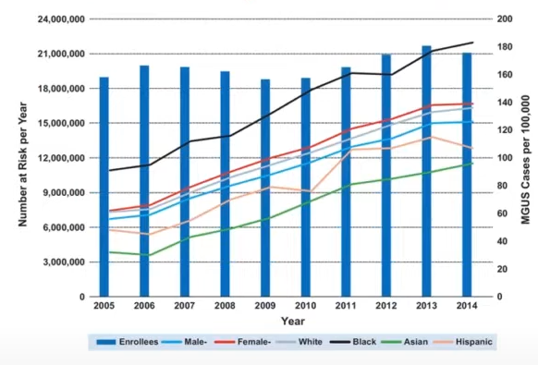
How Common is MGUS?
3-4% of population over age 50
Incidence increases with age
3 times more common in African Americans
Go, R.S. Leukemia 2016

Slide 5
Mayo Clinic MGUS Risk Stratification Model
3 risk factors:
Risk of Progression at 20 years:
M-spike > 1.5g/dL
Non-IgG subtype
Abnormal SFLC ratio
Low Risk
0 risk factors 5%
Low-Intermediate Risk
1 risk factor 21%
High-Intermediate Risk
2 risk factors 37%
High Risk
3 risk factors 58%
Rajkumar SV et al., Blood. 2005; 106;812–817.

Slide 6
Management of MGUS
Based on risk factors and presentation
If high risk, obtain bone marrow biopsy and PET-CT scan*
Follow-up
6 months after initial visit, then annually if stable
High risk patients may need to be followed more frequently (q3-6mos)
Consider other plasma cell dyscrasias (AL amyloidosis, POEMS, Waldenstrom’s)
*Probability of finding BMPCs ≥10% in patients with an IgG MGUS and M-spike ≤1.5 g/dL is 4.7%.
*Probability of finding bone lesions with M-spike ≤1.5 g/dL is 2.5%.
Go RS & Rajkumar SV et al., 2018, 131 (2): 163–173..

Slide 7
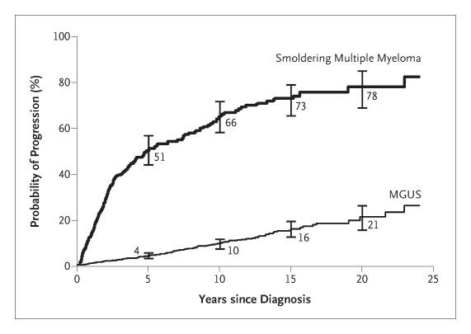
Probability of Progression in Asymptomatic Myeloma
1%
SMM:
Risk of progression is 51% at 5 years
3%
10%
10% per yr for the first 5 yrs
3% per yr for the next 5 yrs
1% per yr thereafter
MGUS:
Risk of progression is ~ 0.5-1% per year
Risk increases with each risk factor
Kyle, R.A et.al. N Engl J Med 2007;356:2582-2590

Slide 8
Management of Smoldering Myeloma
Diagnosis
BMPCs 10-59%
Risk Stratification
IMWG 2020
Management
Low/Intermediate Risk
M-spike ≥ 3
No SLiM-CRAB criteria
Mayo 20/2/20
PETHEMA 2007
Surveillance (q3-6mos)
High Risk
Revlimid
Rev/Dex
Clinical trials
Imaging
BMBx
Whole Body PET/CT, low-dose CT or MRI at diagnosis, annually, and at concern for progression
At diagnosis and at progression to symptomatic myeloma (with FISH and NGS)

Slide 9
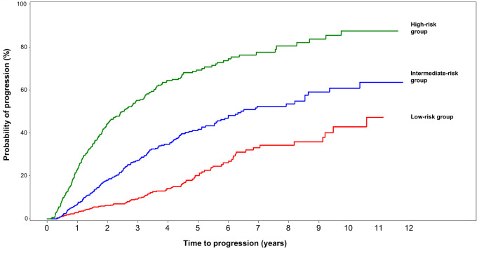
Mayo Clinic 20/2/20 Risk Stratification Model (2018)
3 Risk Factors:
BMPC > 20%
M-spike > 2
Involved to uninvolved SFLC ratio > 20
Risk Stratification Group | Number of Risk Factors | Risk of Progression at 2 years
Low | 0 | 5%
Intermediate | 1 | 18%
High | 2-3 | 44%
Mateos, MV, et al. Blood Cancer J 2020 Oct 16;10(10):102

Slide 10

Myeloma Spectrum
MGUS
SMM
Low risk
Low risk
Intermediate risk
Intermediate risk
High risk
Low risk
Intermediate risk
High risk
High risk
MM
Surveillance
Treatment

Slide 11
Rationale for Treating High-Risk Smoldering Myeloma

Slide 12
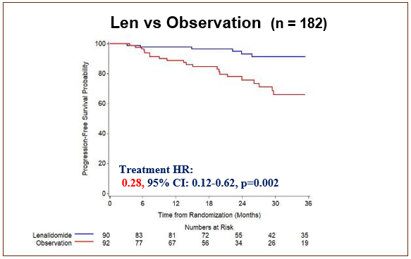
E3A06: Phase III Randomized Trial of Lenalidomide vs. Observation in High-Risk Smoldering Myeloma
  Lenalidomide vs. Observation
  Patients received Lenalidomide 25mg d1-21/28d
Arm | 1-year PFS | 2-year PFS | 3-year PFS
Lenalidomide | 98% | 93% | 91%
Observation | 89% | 76% | 66%
Lonial et al. J Clin Oncol. 2020 Apr 10;38(11):1126-1137

Slide 13
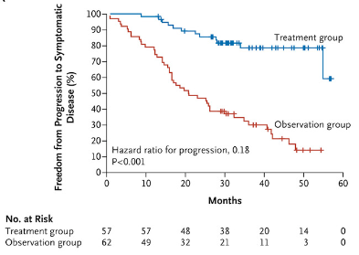
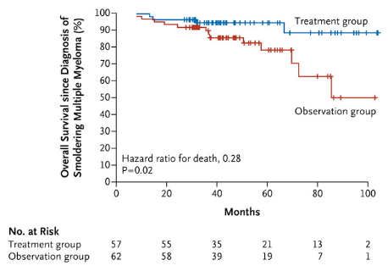
Phase III Randomized Spanish trial comparing LenDex to Observation
Patients received lenalidomide 25mg d1-21 plus dex 20mg on days 1 to 4 and days 12 to 15 q28d x 9 cycles, followed by a maintenance len 10mg d1-21/28d for 2 years
At 40 months, PFS was 21 months in the observation group and not reached in the LenDex group.
The 3-year survival rate was 94% in the LenDex group vs. 80% in the observation group
Mateos et al. N Engl J Med. 2013 Aug 1;369(5):438-47

Slide 14
Future Directions

Slide 15
Clinical Trials
>30 actively recruiting trials for SMM on clinicaltrials.cov
Delay progression or curative intent?
Various agents/regimens are being studied:
Selinexor
Daratumumab
DaraRVd
DaraKRd (ASCENT)
Elotuzumab + Rd
Ixazomib + Rd
Isatuximab + Rd (Ithaca)
Bispecifics (Immuno-PRISM)
CAR T (CAR-PRISM)
KRd + ASCT (GEM-CESAR)

Slide 16
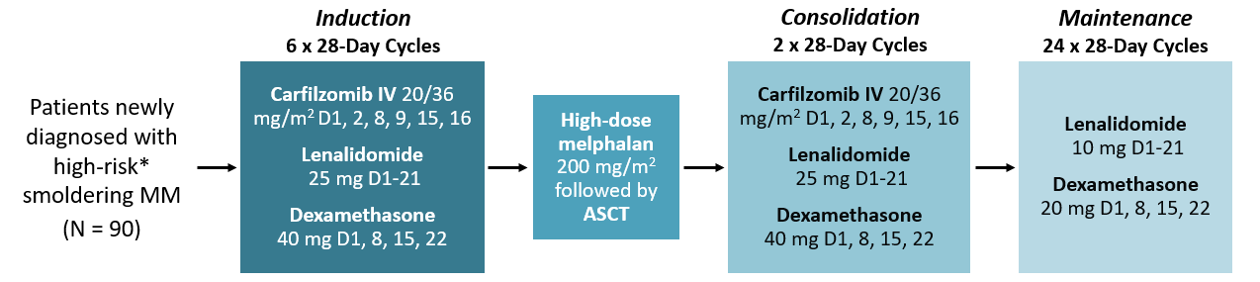
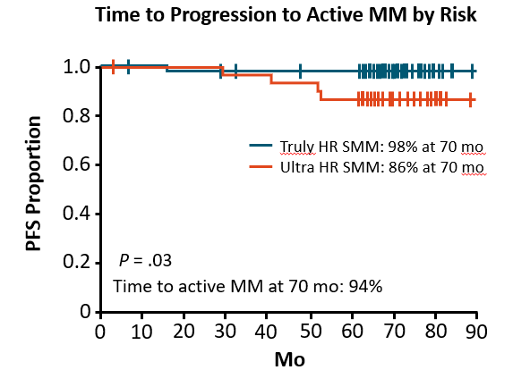
GEM-CESAR
Schema
 | ≥CR | 10⁻⁵ | 10⁻⁶
After induction | 51% | 40% | 27%
After ASCT | 65% | 63% | 43%
After Consolidation | 72% | 68% | 57%
After Maintenance | 63% | 52% | 43%
Results
Mateos. ASH 2022. Abstr 118

Slide 17
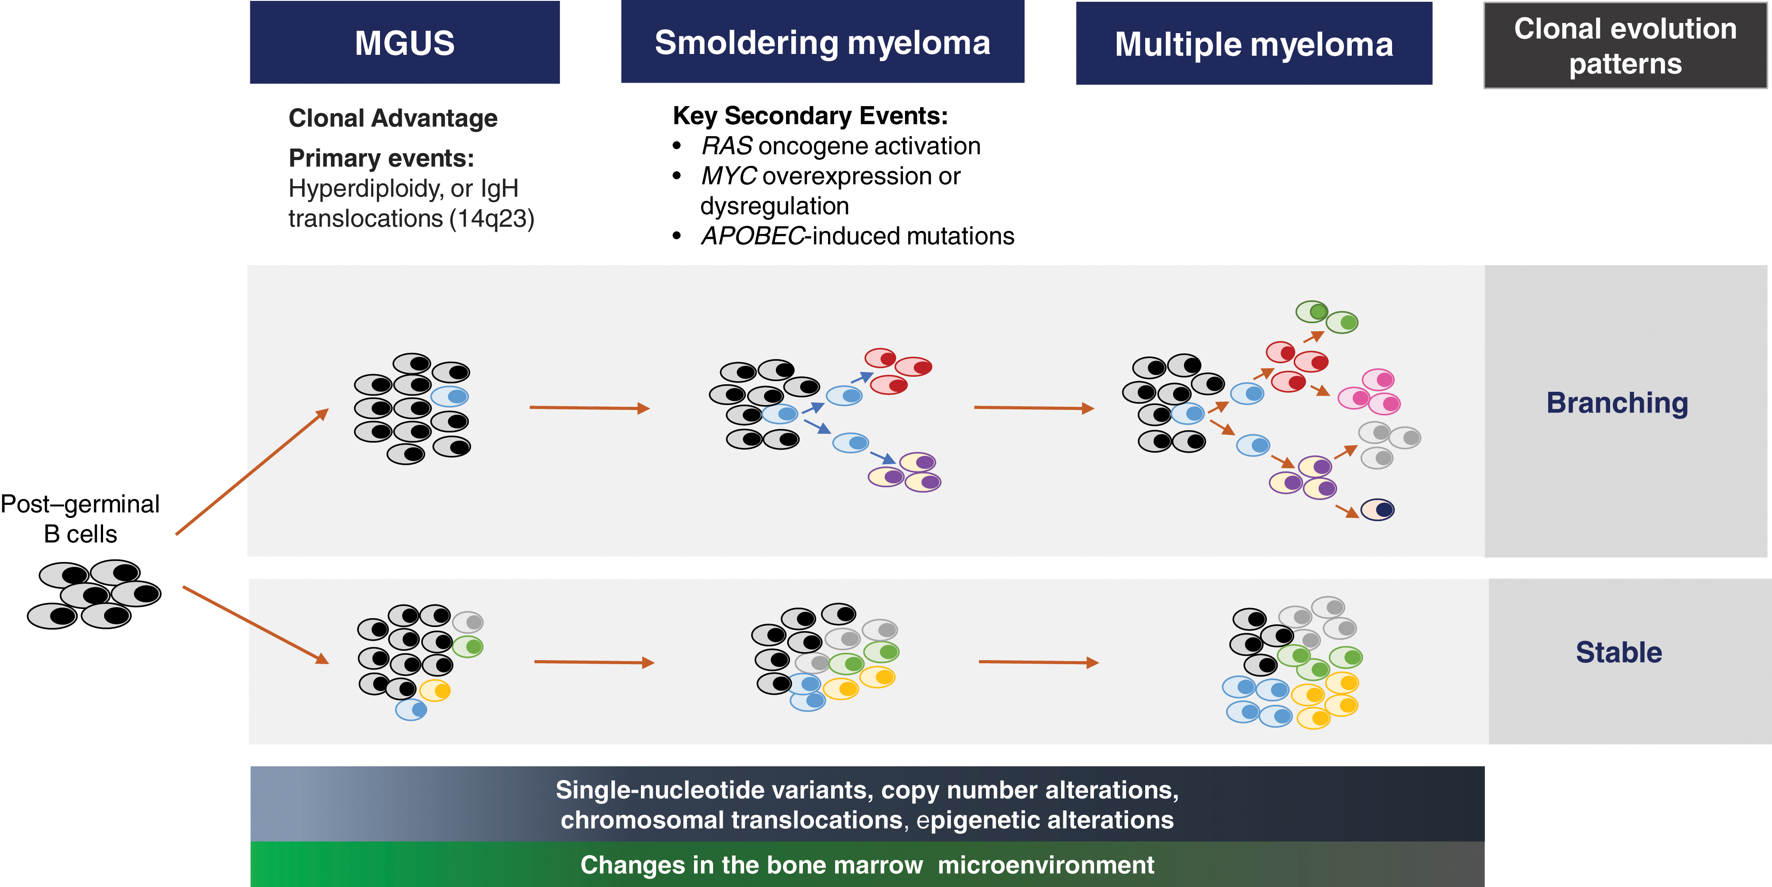
- Using whole gene sequencing to identify progressive vs. stable precursor states.
- Examining the immune microenvironment to determine best type of treatment and identify markers of response and resistance.
Monoclonal Gammopathy of Undetermined Significance?
Image: Visram, A, et al. Hematology Am Soc Hematol Educ Program (2021) 2021 (1): 673–681

Slide 18
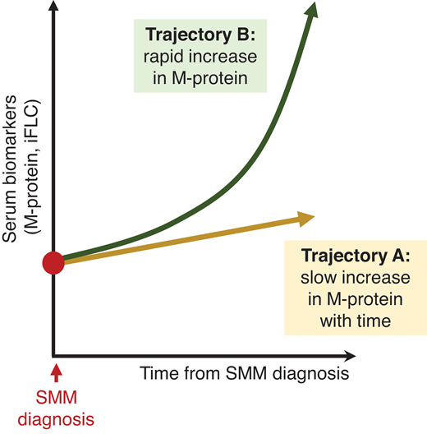
Which trajectory will your patient take?
Visram, A, et al. Hematology Am Soc Hematol Educ Program (2021) 2021 (1): 673–681

Slide 19
Case Study
69 y.o. female had labs through her rheumatologist in 3/2023 showing IgG 1923.
6 months later in 9/2023, the IgG increased to 3800.
She was referred to oncology in 3/2024:
  Labs showed WBC 5.4, Hgb 11.2, HCT 33, Pls 252, ANC 2.99, total protein 10.7, albumin 3.6, calcium 9.5, creatinine 1.1, IgG 5256, IgA 95, IgM 24, Kappa 351.12, Lambda 4.28, SFLC ratio 82.04, M-spike 4.09
  BMBx showed 25% kappa-restricted plasma cells. FISH showed 17p deletion, monosomy 13, trisomy 9, and a t(4;14).
  PET-CT showed no lytic bone disease.

Slide 20
Risk Stratification
Mayo 20/2/20:
BMPCs 25% = 1
M-spike 4.09 = 1
SFLC ratio 82.04 = 1
__________________
Total = 3 → HIGH RISK
IMWG 2020:
SFLC ratio 82.04 = 5
M-spike 4.09 = 4
BMPC 25% = 3
High-risk FISH = 2
__________________
Total = 14 → HIGH RISK
2 year risk of progression = 44%
2 year risk of progression = 73%

Slide 21
The patient was referred to us 1 month later and labs showed:
WBC 4.52, Hgb 11.0, Plts 187, ANC 2.99, total protein 10.7, albumin 3.5, Cr 1.2, calcium 9.4, IgG 5103, IgA 76, IgM 25, kappa 392, lambda 2.17, SFLC ratio 180.93, M-spike 4.2.
Patient meets SLiM criteria for active myeloma

Slide 22


Slide 23
Multiple Myeloma
Wednesday, June 19, 2024

Slide 24
Anti-CD38 Monoclonal Antibodies in the First Line Setting for Multiple Myeloma
Ricardo D. Parrondo, MD
Assistant Professor of Medicine
Mayo Clinic Florida
Jacksonville, Florida

Slide 25
Objectives
Review data on Anti-CD38 MoAb in the First Line Setting In Multiple Myeloma: Isatuximab and Daratumumab
Transplant Eligible
Transplant Ineligible
2. Review updates from ASCO and EHA 2024 regarding Anti-CD38 MoAb in First Line Setting

Slide 26
Case #1
A 67 yo male with a history of well-controlled hypertension is diagnosed with an ISS I, standard risk, IgG Lambda multiple myeloma with t(11;14). Bone marrow biopsy showed 80% kappa restricted plasma cells. Serum creatinine is 0.76 mg/dL, hemoglobin is 9.1 g/dL, calcium is 9.0 mg/dL, m-spike is 4.7 g/dL, lambda light chain is 11.0 mg/dL, and PET-CT reveals innumerable FDG-avid lytic bone lesions.
Which of the following is the most appropriate first line treatment:
Bortezomib-Lenalidomide-Dexamethasone followed by autologous stem cell transplant
Daratumumab-Lenalidomide-Dexamethasone
Daratumumab-Bortezomib-Lenalidomide-Dexamethasone followed by autologous stem cell transplant
Daratumumab-Bortezomib-Lenalidomide-Dexamethasone alone until disease progression

Slide 27
C. Daratumumab-Bortezomib-Lenalidomide-Dexamethasone followed by autologous stem cell transplant
Patient appears to be transplant-eligible thus based on PERSEUS trial (and GRIFFIN trial), Dara-VRd + ASCT is superior to VRd + ASCT.
DRd is for transplant-ineligible patients and Dara-VRd without transplant has not yet been evaluated in transplant-ineligible patients (CEPHEUS trial is ongoing).

Slide 28
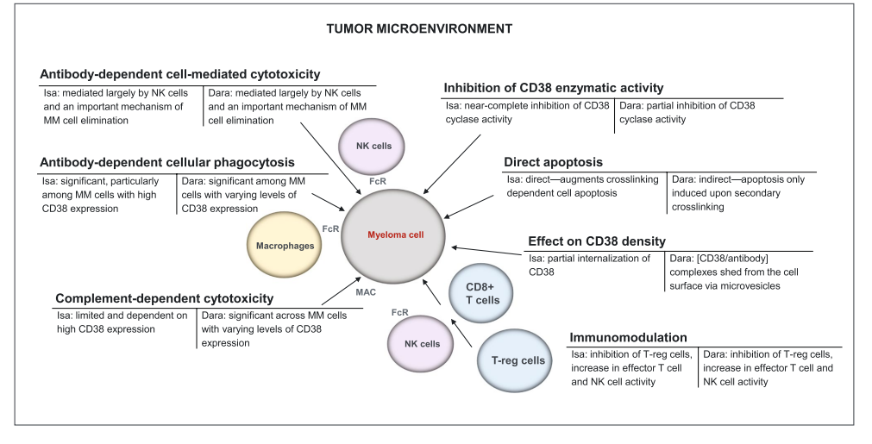
Daratumumab vs. Isatuximab

Slide 29
Transplant Eligible
Daratumumab
CASSIOPEIA: Dara-VTd vs. VTd
PERSEUS: Dara-VRd vs. VRd
Isatuximab
GMMG-HD7: Isa-VRd vs. VRd
ISKIA: Isa-KRd vs. KRd

Slide 30
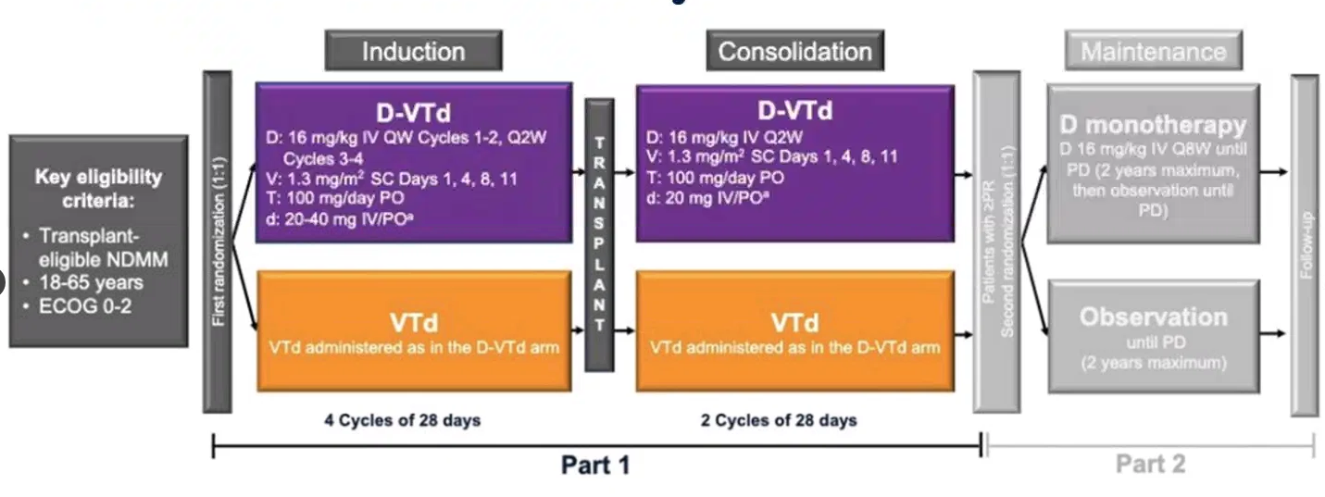
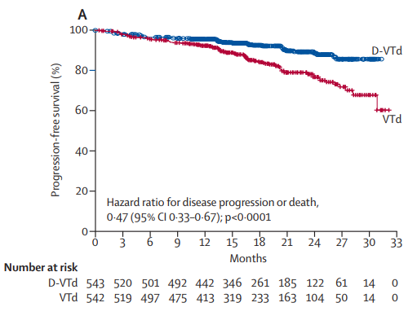
Phase III CASSIOPEIA Trial: D-VTd vs. VTd
Primary endpoint: sCR at Day 100
Median age 58-59 y/o, 15% had high risk cytogenetics
29% in the D-VTd group and 20% of patients in the VTd group achieved an sCR after consolidation (p=0.0010)
64% of D-VTd group compared to 44% of VTd group achieved MRD⁻ via NGF to 10⁻⁵ and 57% of D-VTd vs. 37% of VTd achieved MRD- via NGS
The probability of PFS at 18 months was 93% in the D-VTd group and 85% in the VTd group
Moreau P, et al. Bortezomib, thalidomide, and dexamethasone with or without daratumumab before and after autologous stem-cell transplantation for newly diagnosed multiple myeloma (CASSIOPEIA): a randomised, open-label, phase 3 study. Lancet. 2019;394(10192):29-38.

Slide 31
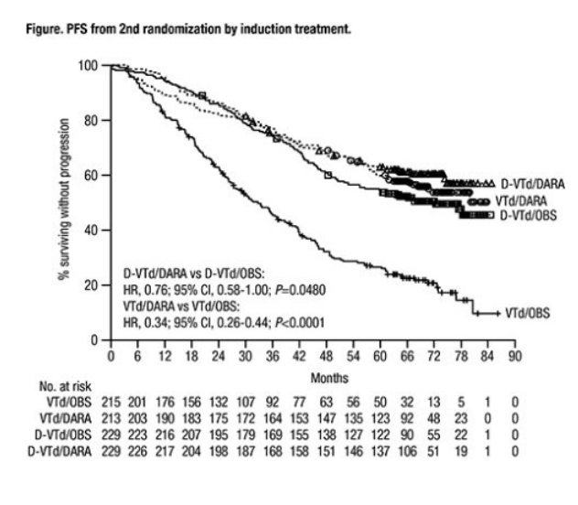
Phase III CASSIOPEIA: >6-Year Update
Median follow-up was 80.1 months from 1st randomization and 70.6 months from 2nd randomization
Median PFS from 1st randomization regardless of 2nd randomization was 83.7 months for D-VTd vs 52.8 months for VTd (HR, 0.61; P<0.0001)
Overall survival from 1st randomization regardless of 2nd randomization was also significantly improved with D-VTd vs VTd (HR, 0.55; P<0.0001)
PFS from 2nd randomization was significantly improved in the DARA group vs the OBS group (HR, 0.49; P<0.0001); 72-month PFS rate was substantially higher for DARA vs OBS (57.1% vs 36.5%)→PFS difference now with longer follow-up
PFS benefit was observed both in pts who received D-VTd/DARA vs D-VTd/OBS and VTd/DARA vs VTd/OBS
Moreau P, et al. Daratumumab (Dara) + Bortezomib/Thalidomide/Dexamethasone (D-VTD) Followed by Dara Maintenance in Transplant-Eligible (TE) Newly Diagnosed Multiple Myeloma (NDMM: > 6-year update of CASSIOPEIA. Abstract S204. EHA 2024.

Slide 32
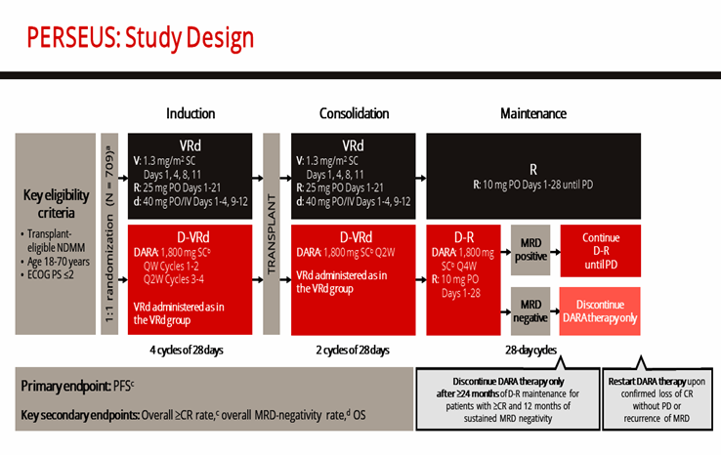
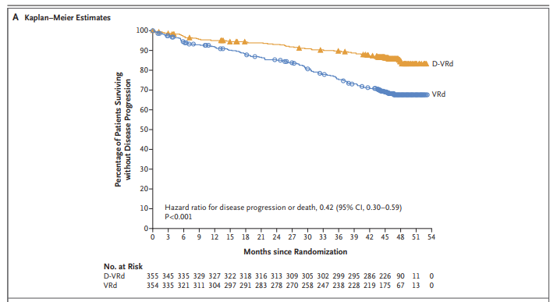
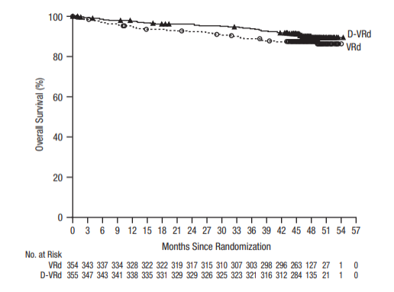
Phase III PERSEUS Trial: D-VRd vs. VRd
Primary Endpoint: PFS
Median age was 59-61 y/o, 21-22% had high risk cytogenetics
At a median follow-up of 47.5 months, the estimated percentage of patients with PFS at 48 months was 84.3% in the D-VRd group and 67.7% in the VRd group
ORR was 96.6% with DVRd vs. 93.8% with VRd
MRD- to 10⁻⁵ was 75.2% with D-VRd vs. 47.5% with VRd (P<0.001) and MRD to 10⁻⁶ was 65.1% with D-VRd vs. 32.2% with VRd (P<0.001)
Data regarding overall survival are immature

Slide 33
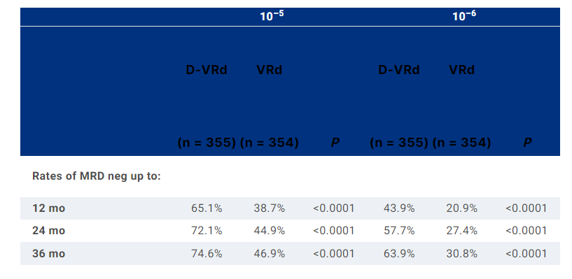
ASCO 2024 PERSEUS UPDATE
Responses deepened over time with D-VRd vs VRd, including rates of ≥CR (end of consol: 44.5% vs 34.7%; P= 0.0078 and overall: 87.9% vs 70.1%; P<0.0001)
MRD-neg rates increased over time and were higher with D-VRd vs VRd at 12, 24, and 36 mo after Cycle 1 Day 1 (Table)
Rates of sustained MRD neg for ≥12 mo were higher for D-VRd vs VRd (10^{–5}: 64.8% vs 29.7%; P<0.0001; 10^{–6}: 47.3% vs 18.6%; P<0.0001)
End of consol and overall MRD neg at both 10⁻⁵ and 10^{–6} were associated with improved PFS
Rodriguez Otero P, et al. Daratumumab (DARA) + bortezomib/lenalidomide/dexamethasone (VRd) in transplant-eligible (TE) patients (pts) with newly diagnosed multiple myeloma (NDMM): Analysis of minimal residual disease (MRD) in the PERSEUS trial. J Clin Oncol 42, 2024 (suppl 16; abstr 7502).

Slide 34
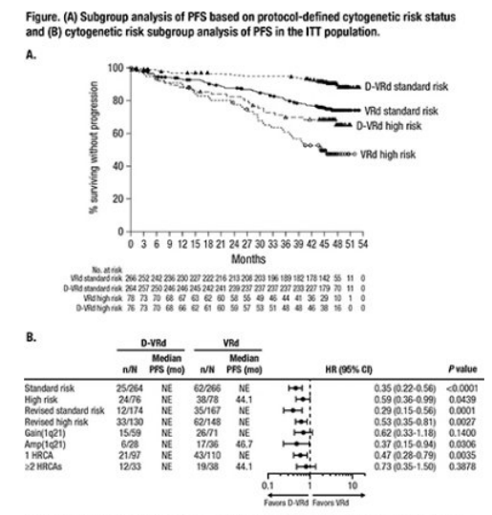
EHA 2024 PERSEUS UPDATE
Expanded analysis of PERSEUS (PFS, overall MRD negativity, and sustained MRD negativity) based on the presence of high-risk cytogenetic abnormalities (HRCAs) including 1q abnormalities
MRD-negativity rates (10^{–5}) were higher with D-VRd vs VRd across subgroups: standard risk, high risk revised standard risk, revised high risk, gain(1q21), amp(1q21),1 HRCA, and ≥2 HRCAs (66.7% vs 47.4%; P=0.1044)
Sustained MRD to 10⁻⁵ and 10⁻⁶ were also higher across all subgroups

Slide 35
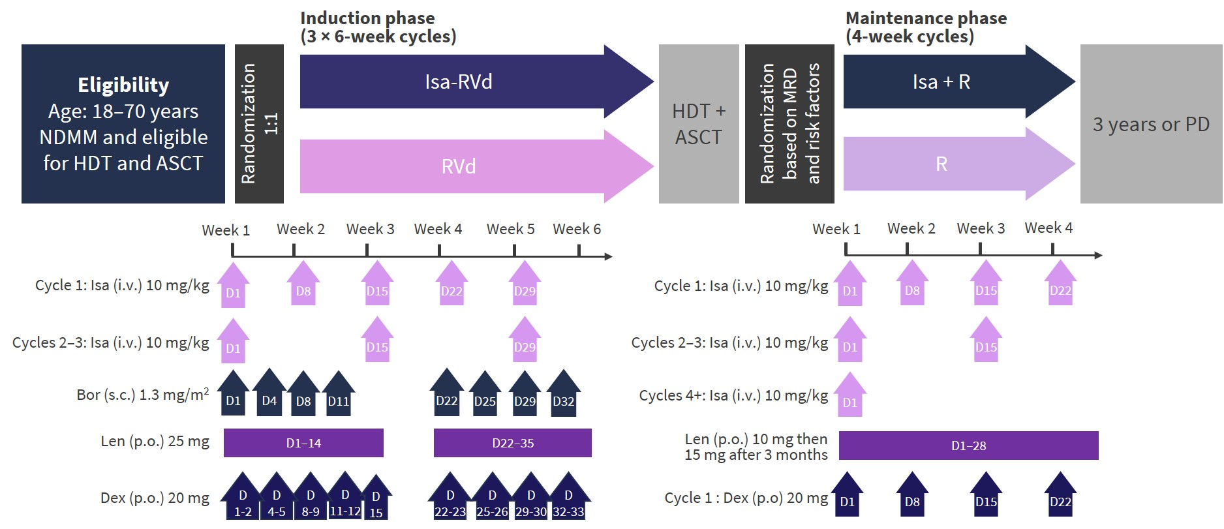
Phase III GMMG-HD7 Trial: Isa-VRd vs. VRd
N=331
N=329
Primary Endpoint: MRD by NGF to 10⁻⁵
Median age was 59-60 y/o, 18-20% had high risk cytogenetics
MRD negativity after induction therapy was reached in 50% in the Isa-VRd vs. 36% in the VRd group (OR 1.82; p=0·00017)
Goldschmidt H, et al. Addition of isatuximab to lenalidomide, bortezomib, and dexamethasone as induction therapy for newly diagnosed, transplantation-eligible patients with multiple myeloma (GMMG-HD7): part 1 of an open-label, multicentre, randomised, active-controlled, phase 3 trial. Lancet Haematol. 2022;9(11):e810-e821.

Slide 36
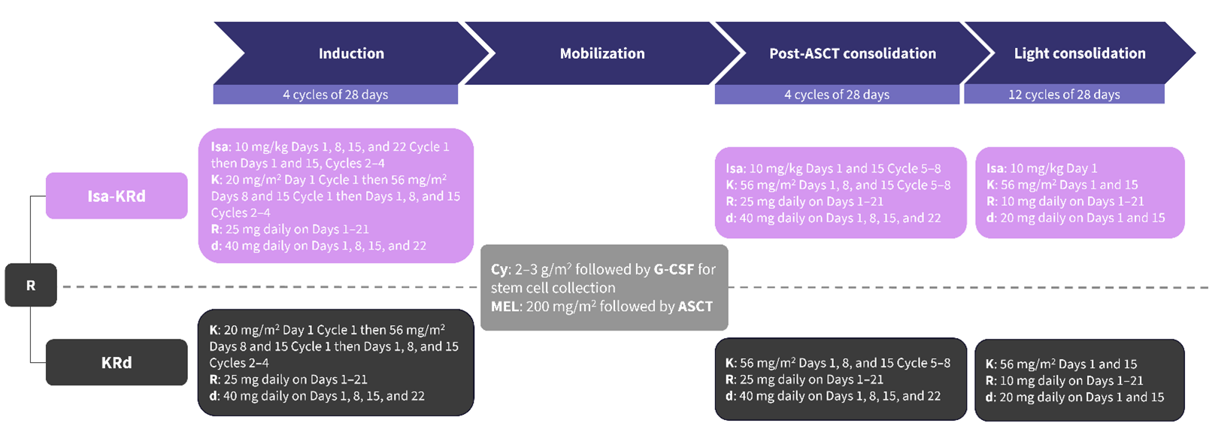
Phase III ISKIA Trial: D-KRd vs. KRd
Primary endpoint: MRD- rate by NGS (10⁻⁵) after consolidation
Median age was 60-61, 18-19% had high risk cytogenetics
The rates of MRD negativity at the 10⁻⁵ after consolidation were 77% for Isa-KRd vs 67% for KRd (OR 1.67; p=0.049)
The respective rates of MRD negativity at the 10⁻⁶ cut-off were 67% for Isa-KRd vs 48% for KRd (OR 2.29; p<0.001)
At median follow up of 20 months there was no difference in PFS (95% at 1 year in both arms)
Discontinuation for toxicity was 6% in IsaKRd vs 5% in KRd arms
N=302 patients, 151 in each arm
Gay F, et al. Results of the Phase III Randomized Iskia Trial: Isatuximab-Carfilzomib-Lenalidomide-Dexamethasone Vs Carfilzomib-Lenalidomide-Dexamethasone As Pre-Transplant Induction and Post-Transplant Consolidation in Newly Diagnosed Multiple Myeloma Patients Blood (2023) 142 (Supplement 1): 4.

Slide 37
CD-38 MoAb in First Line, Transplant Eligible Setting
Trial | ORR |  | ≥CR |  | PFS |  | OS |  | MRD- ≥10⁻⁵ |  | Infections (Any Grade) |  | Serious AEs |  | D/C due to AEs
 | Quad | Triplet | Quad | Triplet | Quad | Triplet | Quad | Triplet | Quad | Triplet | Quad | Triplet | Quad | Triplet | Quad | Triplet
Daratumumab
CASSIOPEIA: D-VTd vs. VTd | 94.7% | 94.1% | 53.8% | 35.5% | 93% (18 mo) | 85% (18 mo) | - | - | 64% | 44% | 65% (Any Gr) | 57% (Any Gr) | 47% | 47% | 7% | 8%
PERSEUS: D-VRd vs. VRd | 96.6% | 93.8% | 87.9% | 70.1% | 84.3% (48 mo) | 67.7% (48 mo) | - | - | 75.2% | 47.5% | 86.9% (Any Gr) | 76.7% (Any Gr) | 57% | 49.3% | 8.8% | 21.3%
Isatuximab
ISKIA: Isa-KRd vs. KRd | 94% ≥VGPR | 94% ≥VGPR | 74% | 72% | 95% (20 mo) | 95% (20 mo) | - | - | 77% | 67% | 16% (Any Gr) | 12% (Any Gr) | - | - | 6% | 5%
GMMG-HD7: Isa-VRd vs. VRd | 90% | 84% | 24% | 22% | - | - | - | - | 50% | 36% | 26.2% (Any Gr) | 22.8% (Any Gr) | 28% | 28% | 2.1% | 2.4%

Slide 38
Transplant Ineligible
Daratumumab
MAIA Trial: Dara-Rd Vs. Rd
CEPHEUS Trial: trial is ongoing; Dara-VRd vs. VRd
GEM2017FIT Trial: Dara-KRd vs. KRd vs. VMP + Rd
Isatuximab
IMROZ Trial: Isa-VRd vs. VRd
BENEFIT Trial: Isa-VRd vs. IsaRd

Slide 39
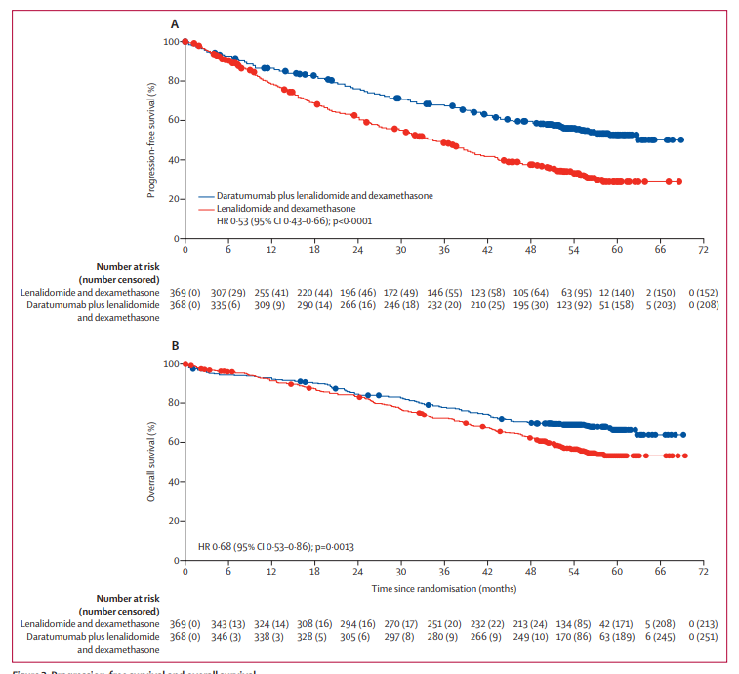
Phase III MAIA Trial: DRd vs. Rd
Patients were randomized 1:1 to DRd or Rd until disease progression
Primary Endpoint: PFS
43-44% of patients were ≥ 75 y/o and 14-15% had high risk cytogenetics
ORR was 92.9% with DRd vs. 81.6% with Rd (OR; 3.0, P<0.0001)
At a median follow-up of 56.2 months, the median PFS was not reached for DRd and was 34.4 months with Rd (HR 0.53; p<0·0001)
The median OS was not reached in either group but OS was superior in DRd (HR 0.68, p=0.0013)
MRD- to 10⁻⁵ (via NGS) was 31% for DRd and 10% for Rd (OR: 3.91, P<0.0001)

Slide 40
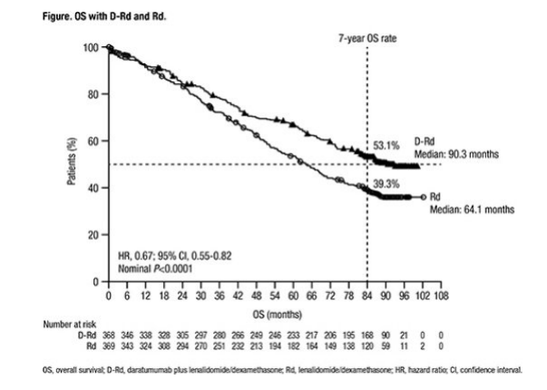
EHA 2024 Final Analysis of MAIA Trial
Long-term follow-up of MAIA after a median follow-up of 7.5 years
A 33% reduction in the risk of death was observed with D-Rd versus Rd. Median OS was 90.3 months in the D-Rd group versus 64.1 months in the Rd group
The median time to subsequent therapy was longer in the D-Rd versus Rd group (not reached vs 42.4 months; HR, 0.51; P<0.0001)

Slide 41
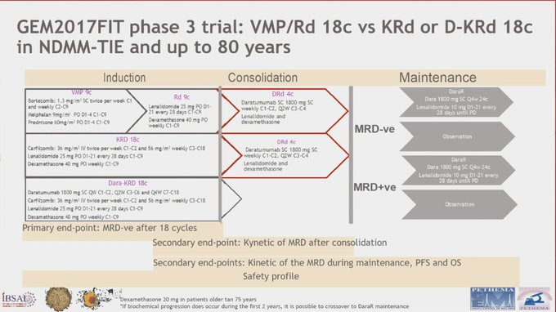
GEM2017FIT Trial: Dara-KRd vs. KRd vs. VMP + Rd
Primary endpoint: MRD- rate (via NGF 10⁻⁵) at the end of induction
154 patients in each arm
The MRD(-) rate at 10⁻⁵ was 32% for VMP-Rd, 69% for KRd (p<0.0001) and 79% for D-KRd (p<0.0001)
ORR were comparable but ≥CR rate was superior for K-based regimens compared to VMP+Rd
At 18 mo, the proportion of pts alive and progression-free was 79% for VMP-Rd and 87% for KRd and D-KRd
Death occurred in 12 pts treated with D-KRd; 5 pts in the KRd arm; and 6 pts in VMP-Rd arm mostly due to infections

Slide 42
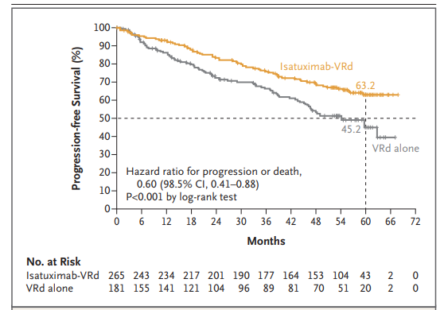
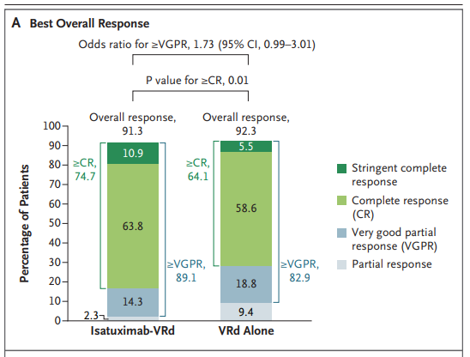
Phase III IMROZ Trial: Isa-VRd vs. VRd
Four induction cycles (with 6 weeks per cycle) were followed by 4-week cycles of continuous treatment with Isa-Rd (in the Isa-VRd* group; n=265) or Rd (in the VRd* group; n=181) until the occurrence of disease progression. Crossover from the Rd regimen to the Isa-Rd regimen during continuous treatment was allowed according to the investigator’s discretion
Primary endpoint: PFS
95-97% of patients were between 65-80 y/o, 15-19% had high risk cytogenetics
At 60 months (median follow-up), PFS was 63.2% in the Isa-VRd group, as compared with 45.2% in the VRd group
≥CR with Isa-VRd was 74.7% vs. 64.1% with VRd (P=0.01)
The percentage of patients with MRD-negative status (10⁻⁵ via NGS) was higher in the Isa-VRd group than in the VRd group (58.1% vs. 43.6%)
*Bortezomib administered twice weekly
Facon T, et al. Isatuximab, Bortezomib, Lenalidomide, and Dexamethasone for Multiple Myeloma. NEJM

Slide 43
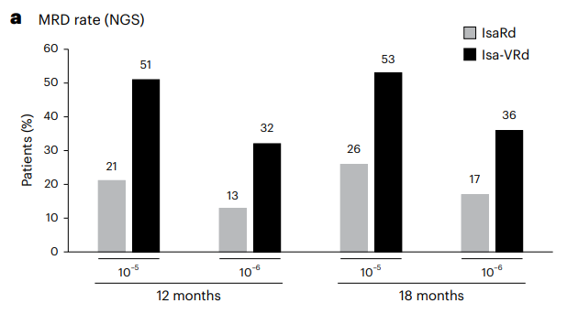
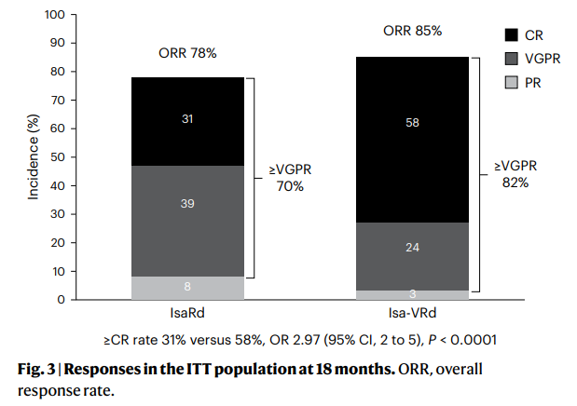
Phase III BENEFIT Trial: Isa-VRd vs. Isa-Rd
270 patients enrolled, 135 received IsaRd for 12 months then monthly Isa with R (21d on, 7d off) until disease progression and 135 received IsaVRd with weekly V (days 1,8,15) for 12 months then monthly Isa with R (21d on, 7d off) and V on days 1,15 for cycles 13-18 then from cycle 18 onwards, monthly Isa and R (21d on 7d off)
Primary endpoint: MRD negativity rate at 10⁻⁵ by NGS at 18 months
31-36% of patients were ≥ 75 y/o, 8-10% had high risk cytogenetics
The 18-month MRD negativity rate at 10⁻⁵ was significantly higher in the Isa-VRd arm, at 53% compared with 26% in the IsaRd arm.
With a median follow-up of 23.5 months, estimated 24 months PFS and OS were 80.0% and 91.5 for IsaRd, and 85.2% and 91.1% for Isa-VRd, respectively

Slide 44
CD-38 MoAb in First Line, Transplant Ineligible Setting
Trial | ORR |  | ≥CR |  | PFS |  | OS |  | MRD- ≥10⁻⁵ |  | Infections (Any Grade) |  | Serious AEs |  | D/C due to AEs
Daratumumab
 | Triplet | Doublet | Triplet | Doublet | Triplet | Doublet | Triplet | Doublet | Triplet | Doublet | Triplet | Doublet | Triplet | Doublet | Triplet | Doublet
MAIA: DRd vs. Rd | 92.9% | 81.6% | 51% | 30% | 52.5% (60 mo) | 28.7% (60 mo) | 66.3% (60 mo) | 53.1% (60 mo) | 31% | 10% | 41% (≥Gr 3) | 29% (≥Gr 3) | 77% | 70% | 13% | 22%
 | Quad | Triplet | Quad | Triplet | Quad | Triplet | Quad | Triplet | Quad | Triplet | Quad | Triplet | Quad | Triplet | Quad | Triplet
GEMFIT: DRKd vs. KRd vs. VMP+Rd | 89% | 87% | 61% | 59% | 87% (18 mo) | 87% (18 mo) | 90% (18 mo) | 95% (18 mo) | 79% | 69% | 15% (≥Gr 3) | 16% (≥Gr 3) | - | - | 3.9% | 9.0%
Isatuximab
 | Quad | Triplet | Quad | Triplet | Quad | Triplet | Quad | Triplet | Quad | Triplet | Quad | Triplet | Quad | Triplet | Quad | Triplet
IMROZ: IsaVRd vs. VRd | 91.3% | 92.3% | 74.7% | 64.1% | 63.2% (60 mo) | 45.2% (60 mo) | 72.3% (60 mo) | 66.3% (60 mo) | 58.1% | 43.6% | 44.9% (≥Gr 3) | 38.1% (≥Gr 3) | 70.7% | 67.4% | 22.8% | 26%
BENEFIT: IsaVRd vs. IsaRd | 85% | 78% | 58% | 31% | 85.2% (24 mo) | 80% (24 mo) | 91.1% (24 mo) | 91.5% (24 mo) | 53% | 26% | 68.8% (Any Gr) | 61.4% (Any Gr) | NR | NR | 14.8% D/C at least one tx | 22.2% D/C at least one tx

Slide 45
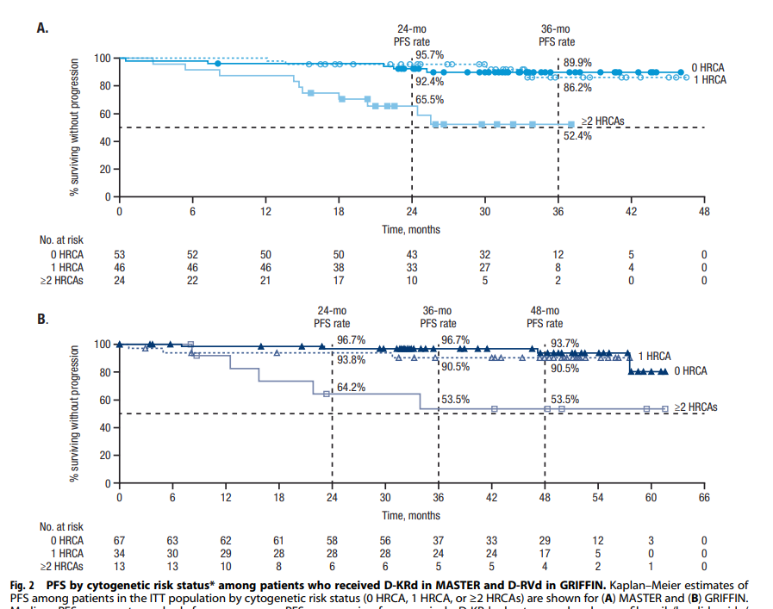
Dara-Based Quadruplets in High-Risk Disease
Anti-CD38-based Quadruplets result in sustained PFS for patients with high-risk abnormalities
Additional strategies are needed for ultra-high–risk disease (≥2 HRCA
Callander NS, et al. Daratumumab-based quadruplet therapy for transplant-eligible newly diagnosed multiple myeloma with high cytogenetic risk. Blood Cancer J. 14, 69 (2024).

Slide 46
Conclusions and Unanswered Questions
Anti-CD38+ PI+ IMiD containing quadruplets result in superior PFS, OS (some), ≥CR rates and MRD- rates compared to triplets (PI + IMiD and Anti-CD38 + IMiD triplets) in newly diagnosed, transplant eligible and ineligible, multiple myeloma patients: 4 is better than 3!
I/D-VRd vs. I/D-KRd: likely equivalent; caution with K-based quadruplets in transplant ineligible patients
Emerging role of Daratumumab maintenance: need to wait for S1803 (DR vs. R maintenance)
Future outlook: How will Anti-CD38-based Quadruplet + ASCT fare against anti-BCMA CAR-T in the first line?

Slide 47
Thank you!
Questions?

Slide 48
Multiple Myeloma
Wednesday, June 19, 2024

Slide 49
Use of Ninlaro, Selinexor and Blenrep in Myeloma Practice
Ivan Borrello, MD
Director Myeloma, BMT, Cell Therapy
Tampa General Hospital
Tampa, Florida

Slide 50
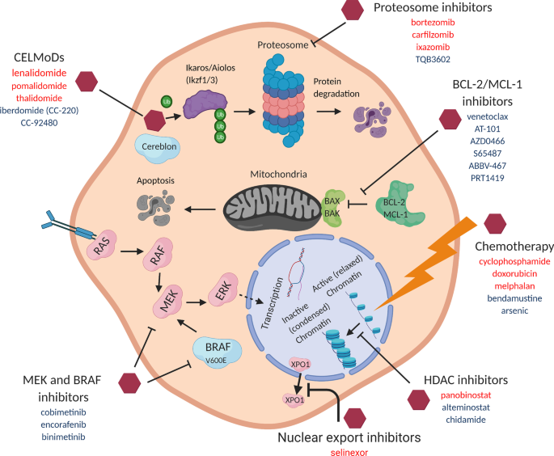
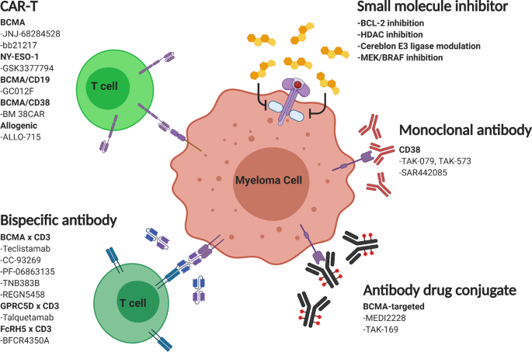
Myeloma Targets
Su, C.T., Ye, J.C. J Hematol Oncol 14, 115 (2021).

Slide 51
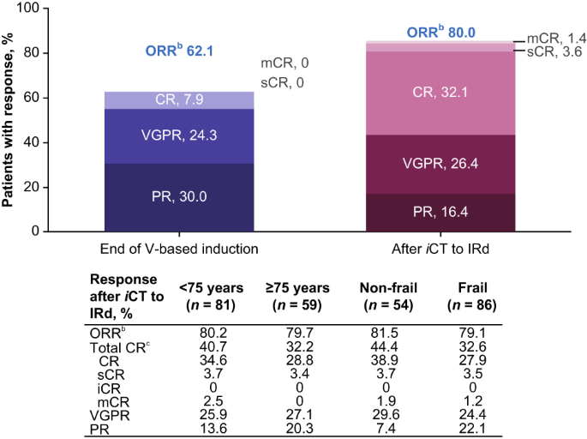
Ixazomib: In-class Transition
iCT: transitioning to another drug within the same class with different activity
Transplant Ineligible
VRD (3 cycles) ->IRD
ORR increased from 62% to 80%
Is a viable all oral regimen
Rifkin, R.M., Girnius, S.K., Noga, S.J. et al. Blood Cancer J. 13, 147 (2023).

Slide 52
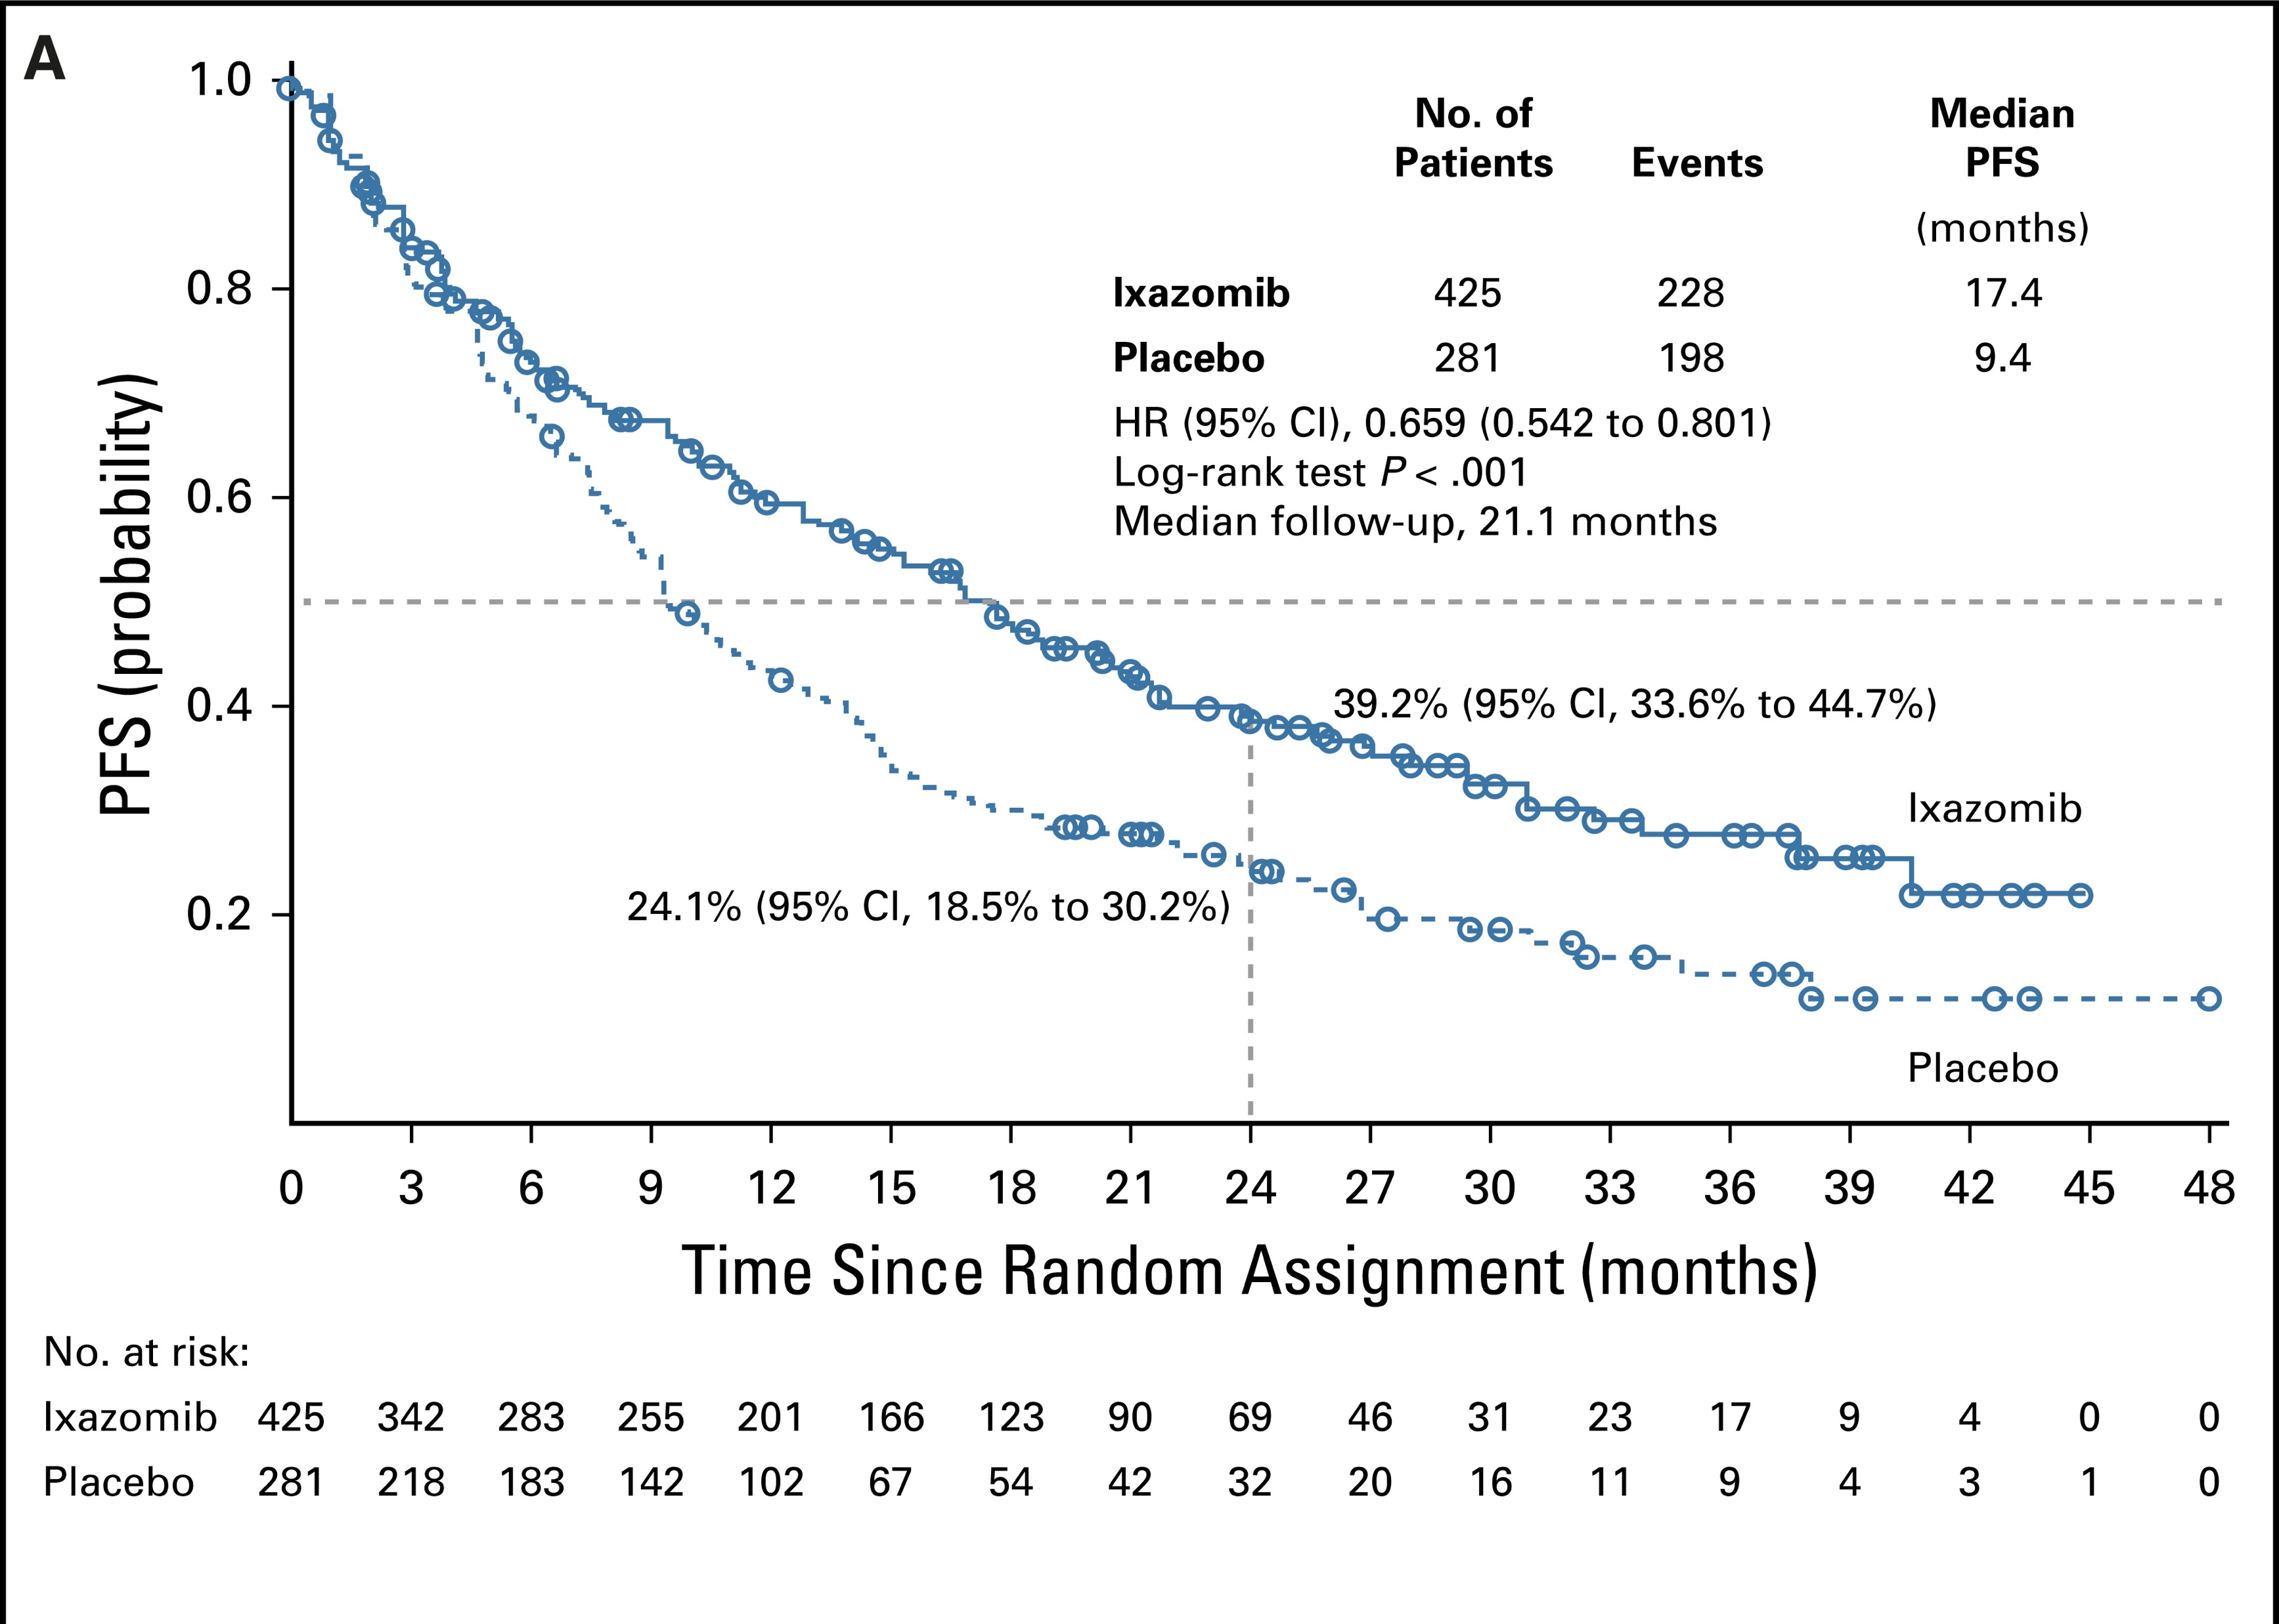
Tourmaline-MM4: Ixa v Placebo maintenance
Maintenance therapy for NDMM that were
non-transplant eligible
Patients randomized in 3:2 after 6-12 mos of
induction therapy
Maintenance with ixazomib vs placebo
for 24 mos
Median PFS, 25.6 v 12.9 months;
HR, 0.586; P < .001
36.6% versus 23.2% grade ≥ 3 TEAEs
Dimopoulos et at JCO 2020

Slide 53
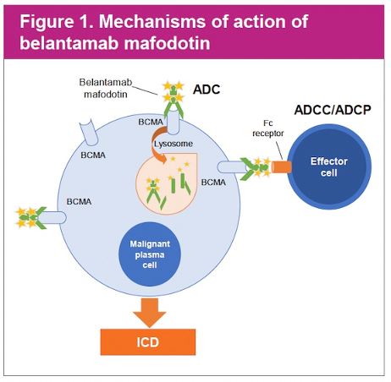
Belantumab: BCMA-ADC
Anti-tumor efficacy multifactorial
DLT: corneal dyskeratosis
FDA removed from US market following lack of efficacy in DREAMM-3: Belantumab vs Pom/dex: PFS 21.2 mos v 21.2

Slide 54
DREAMM-7: study design
DREAMM-7: study design
Recruitment period
≈13 months from FPI (May 7, 2020) to LPI (June 28, 2021)
Treatment period
Until end of study, withdrawal of consent, PD, death, or
unacceptable toxicity
Follow-up period
Cycles 1-8
Cycle 9+
Eligibility criteria
Arm A (BVd)
Belamaf
2.5 mg/kg IV q3w
+
Belamaf monotherapy
2.5 mg/kg IV q3w
End-of-treatment visit
Follow-up for PFS
q3w
(for patients who discontinue due to reasons other than PD)
Disease assessments q3w
Follow-up for OS q12w
(for patients who discontinue due to PD or other reasons)
Adults with MM
≥1 prior line of MM therapy and documented PD during or after most recent therapy
No prior treatment with anti-BCMA
Not refractory to or intolerant of daratumumab or bortezomib
1:1 randomization
bortezomib 1.3 mg/m² SC on days 1, 4, 8, and 11 of cycles 1-8
(21-day cycles)
+
dexamethasone 20 mg on the day of and day after bortezomibª in cycles 1-8
Arm B (DVd)
Daratumumab
16 mg/kg IV qw in cycles 1-3; and q3w in cycles 4-8
+
Daratumumab monotherapy
16 mg/kg IV q4w in cycle 9+
bortezomib 1.3 mg/m² SC on days 1, 4, 8, and 11 of cycles 1-8
(21-day cycles)
+
dexamethasone 20 mg on the day of and day after bortezomibª in cycles 1-8
Median follow-up (ITT)
28.2 months (range, 0.1-40.0 months)
Stratification:
Prior lines of treatment (1 vs 2 or 3 vs ≥4)
R-ISS stage (I vs II/III)
Prior bortezomib (yes vs no)
Disease assessment visits: q3w from cycle 1 day 1 until PD
Primary endpoint:
PFS (IRC assessed)
Key secondary endpoints:
OS, DOR, and MRD
Additional secondary endpoints:
CRR, ORR, CBR, TTR, TTP, PFS2, AEs, ocular findings, and QOL
AE, adverse event; BCMA, B-cell maturation antigen; CBR, clinical benefit rate; CRR, complete response rate; DOR, duration of response; FPI, first patient in; IRC, independent review committee; ITT, intent-to-treat; IV, intravenous; LPI, last patient in; MM, multiple myeloma; MRD, minimal residual disease; ORR, overall response rate; OS, overall survival; PD, progressive disease; PFS, progression-free survival; q3w, every 3 weeks; q4w, every 4 weeks; q12w, every 12 weeks; QOL, quality of life; qw, once weekly; R-ISS, Revised International Staging System; SC, subcutaneous; TTP, time to progression; TTR, time to response.
ª Starting dose of dexamethasone may be reduced to 10 mg for patients aged >75 years, who have a body-mass index of less than 18.5, who had previous unacceptable side effects associated with glucocorticoid therapy, or who are unable to tolerate the starting dose.
María Victoria Mateos, MD, PhD

Slide 55
DREAMM-7: ITT population (responders only)
Longer DOR with BVd vs DVd
18 months
1.0
76%
DORª | BVd (n=201) | DVd (n=179)
Events, n (%) | 68 (34) | 105 (59)
Patients with ongoing response, n (%) | 106 (53) | 52 (29)
DOR, median (95% CI), months^{b} | 35.6 (30.5-NR) | 17.8 (13.8-23.6)
0.8
Median
35.6 months
0.6
Ongoing response probability, %
0.4
Median
17.8 months
0.2
BVd
49%
DVd
0.0
0
1
2
3
4
5
6
7
8
9
10
11
12
13
14
15
16
17
18
19
20
21
22
23
24
25
26
27
28
29
30
31
32
33
34
35
36
37
38
39
No. at risk
Time since randomization, months
BVd
201
199
196
193
189
180
172
166
160
156
151
148
145
142
135
132
130
127
126
122
119
116
113
107
104
100
91
76
67
53
36
29
23
15
9
8
4
3
1
0
DVd
179
179
176
172
168
153
145
134
128
125
117
109
101
98
90
89
85
83
75
74
72
67
66
64
61
54
48
37
31
25
16
12
9
6
2
1
1
1
1
0
A separate analysis of restricted mean DOR using the ITT population comparing DOR between arms showed a statistically significant benefit in favor of BVd (P<.00001).^{1,c}
BVd led to greater response durability, with a longer median DOR vs DVd (35.6 vs 17.8 months)
DOR, duration of response; ITT, intent to treat; NR, not reached.
^{\a} Two patients in the ITT population were randomized, not treated, rescreened, and rerandomized. They are counted as 4 unique patients in this output. ^{b} CIs estimated using the Brookmeyer-Crowley method. ^{c} One-sided P value from mean DOR test.
1. Huang B, Tian L. Pharm Stat. 2022;21(5):865-878.
María Victoria Mateos, MD, PhD

Slide 56
DREAMM-7: subgroup by lenalidomide refractory status
MRD negativity rates
Lenalidomide refractory
Not lenalidomide refractoryª
MRD negativity^{b}:
MRD negativity^{b}:
MRD negativity^{b}:
MRD negativity^{b}:
25.3%
(95% CI, 16.2%-36.4%)
24.4%
(95% CI, 18.0%-31.7%)
11.6%
(95% CI, 7.1%-17.5%)
5.7%
(95% CI, 1.9%-12.9%)
Patients, %
Patients, %
41.8%
(95% CI, 30.8%-53.4%)
12.6%
(95% CI, 6.5%-21.5%)
37.2%
(95% CI, 29.8%-45.1%)
19.5%
(95% CI, 13.7%-26.4%)
In patients with positive lenalidomide refractory status, BVd led to a nearly 5-fold increase in MRD negativity in those with ≥ CR
Post hoc analyses.
CR, complete response; MRD, minimal residual disease; NGS, next-generation sequencing; ORR, overall response rate; PR, partial response; sCR, stringent complete response; VGPR, very good partial response.
ª Includes patients who are lenalidomide exposed but not refractory and patients who have not been exposed to lenalidomide. ^{b} MRD negativity rate was defined as percentage of patients who were MRD negative by NGS based on sensitivity of 10⁻⁵.
María Victoria Mateos, MD, PhD

Slide 57
DREAMM-7: grade ≥3 AEs of special interest by lenalidomide refractory status
Occurring in ≥5% of patients in any subgroup
Preferred term, n (%) | BVd (N=242) |  |  | DVd (N=246)
 | Lenalidomide refractory |  | Total | Lenalidomide refractory |  | Total
 | Yes (n=79) | No (n=163) | N=242 | Yes (n=87) | No (n=159) | N=246
Any | 65 (82) | 133 (82) | 198 (82) | 55 (63) | 65 (41) | 120 (49)
Thrombocytopenia | 41 (52) | 93 (57) | 134 (55) | 40 (46) | 47 (30) | 87 (35)
Platelet count decreased | 19 (24) | 25 (15) | 44 (18) | 13 (15) | 13 (8) | 26 (11)
Vision blurred | 18 (23) | 35 (21) | 53 (22) | 1 (1) | 1 (<1) | 2 (1)
Visual impairment | 6 (8) | 7 (4) | 13 (5) | 0 | 1 (<1) | 1 (<1)
Dry eye | 4 (5) | 13 (8) | 17 (7) | 0 | 0 | 0
Eye irritation | 4 (5) | 8 (5) | 12 (5) | 0 | 0 | 0
The rates of grade ≥3 AEs of special interest in the BVd arm were similar regardless of lenalidomide refractory status and consistent with those reported in the overall population
Post hoc analyses. AEs were graded according to NCI-CTCAE version 5.0.
AE, adverse event; NCI-CTCAE, National Cancer Institute Common Terminology Criteria for Adverse Events.
María Victoria Mateos, MD, PhD

Slide 58
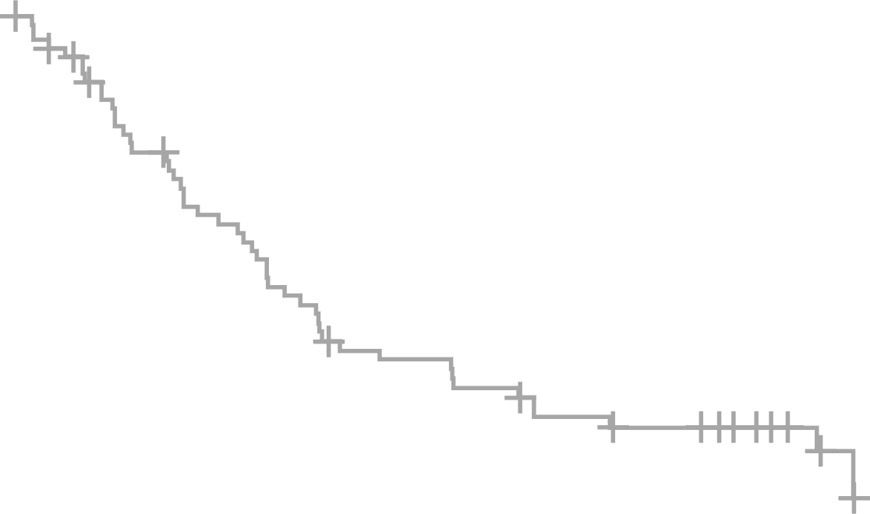
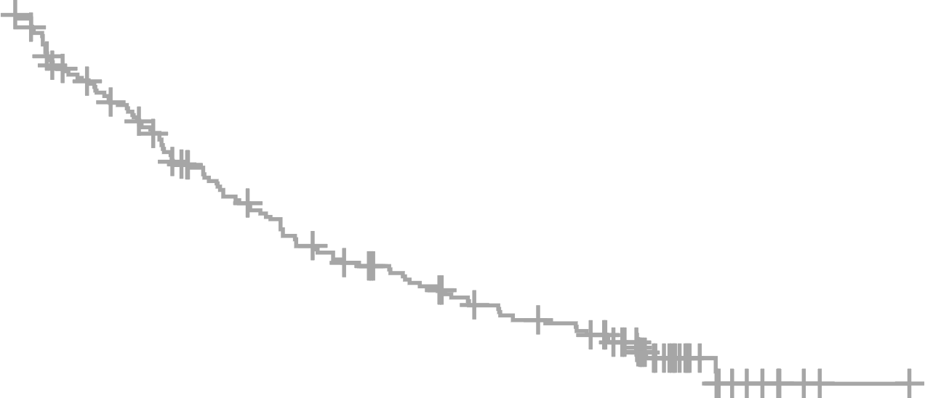

DREAMM-7: subgroup by cytogenetic risk
Progression-free survival (high risk and standard risk)
High Risk
Standard Risk
PFSª | BVd (N=67) | DVd (N=69) | HR^{c} (95% CI)
Events, n (%) | 26 (39) | 48 (70) | 0.31 (0.18-0.52)
mPFS (95% CI),^{b} mo | 33.2 (20.3-NR) | 10.5 (7.6-13.4)
PFSª | BVd (N=175) | DVd (N=175) | HR^{c} (95% CI)
Events, n (%) | 65 (37) | 106 (61) | 0.44 (0.32-0.60)
mPFS (95% CI),^{b} mo | 36.6 (28.4-NR) | 15.3 (11.8-20.1)
1.0
1.0
0.8
18-months
0.8
18-months
Median
33.2 months
Median
36.6 months
0.6
0.6
69%
PFS probability, %
67%
PFS probability, %
0.4
Median
10.5 months
0.4
Median
15.3 months
45%
0.2
35%
0.2
BVd
BVd
DVd
DVd
0.0
0.0
No. at Risk
0
1
2
3
4
5
6
7
8
9
10
11
12
13
14
15
16
17
18
19
20
21
22
23
24
25
26
27
28
29
30
31
32
33
34
35
36
37
38
39
40
41
42
No. at Risk
0
1
2
3
4
5
6
7
8
9
10
11
12
13
14
15
16
17
18
19
20
21
22
23
24
25
26
27
28
29
30
31
32
33
34
35
36
37
38
39
40
41
42
BVd
DVd
Time since randomization, months
BVd
DVd
Time since randomization, months
67
64
62
60
60
59
57
54
51
50
47
45
44
43
42
39
39
37
36
36
36
33
31
29
29
28
27
25
22
19
15
13
11
9
4
3
2
2
1
0
0
0
0
175
165
157
150
144
140
134
128
123
120
115
112
110
107
105
101
98
94
92
91
89
89
89
89
86
82
78
69
57
53
41
28
20
16
11
8
6
4
2
2
1
0
0
69
62
60
55
51
45
45
38
37
36
33
29
27
22
21
21
20
20
20
17
17
15
13
13
13
11
11
11
11
10
8
7
5
5
2
0
0
0
0
0
0
0
0
175
161
147
143
136
131
124
111
106
101
95
91
84
81
78
74
70
68
64
61
59
56
53
52
50
48
46
40
27
22
13
12
7
6
3
2
1
1
1
1
0
0
0
BVd led to strong PFS benefit (more than double to triple the median PFS) regardless of cytogenetic risk status compared with DVd
ª Two patients in the ITT population were randomized, not treated, rescreened, and rerandomized. They are counted as 4 unique patients in this output. ^{b} CIs were estimated using the Brookmeyer-Crowley method. 95% CIs were not adjusted for multiplicity and cannot be used for hypothesis testing. ^{c} HRs were estimated using a Cox proportional hazards model stratified by the number of lines of prior therapy (1 vs 2 or 3 vs ≥4), prior bortezomib, and R-ISS stage at screening (I vs II/III), with a covariate of treatment.
María Victoria Mateos, MD, PhD

Slide 59
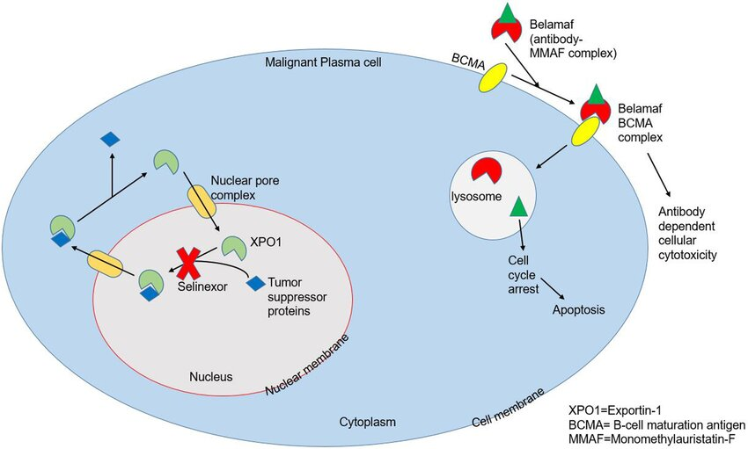
Mechanisms of Action
Selinexor
Belantumab

Slide 60

Treatment Schedule and Dose Levels with SPd
Pooled Analysis of Select Patients from STOMP (SPd arm) and XPORT-MM-028 (SPd-40)
Dose Levels | Selinexor (PO QW) | Pomalidomide (PO QD; days 1–21) | Dexamethasone (PO QW) | Patients Enrolled
SPd-40ª | 40 mg | 4 mg | 40 mg | 28
SPd-60^{b} | 60 mg | 4 mg | 40 mg | 20
ªSPd-40: Cohort enrolled patients from the SPd arm of STOMP and the XPORT-MM-028 Study, a parallel study with similar objectives and eligibility criteria* with an arm evaluating SPd (NCT04414475).
^{b}SPd-60: Cohort enrolled patients from the SPd arm of STOMP.
The aim of this analysis was to identify the optimal dose of SPd by comparing the safety and efficacy of SPd-60 (from STOMP Phase 1/2) and SPd-40 (from STOMP Phase 2 and XPORT-MM-028)
*XPORT-MM-028 excluded patients who were previously treated with pomalidomide.
QD, once daily; PO, by mouth; QW, once weekly; RP2D, recommended phase 2 dose; SPd, selinexor + pomalidomide + dexamethasone.
White D, et al. Front Immunol. 2024;14:1352281.
Notes:
Note:
Results from a Phase 2 study of the selinexor + pomalidomide + dexamethasone (SPd) in patients with heavily pretreated MM showed that:
The recommended phase 2 dose (RP2D) was selinexor 60 mg once weekly + pomalidomide 4 mg daily (days 1-21) + once weekly dexamethasone 40 mg (SPd-60) administered in 28-day cycles.
A post-hoc analysis analyzed the RP2D expansion cohort (60 mg dose) and a combined SPd group who received 40 mg from two trials: STOMP (n= 15) and XPORT-MM-28 (n=12). XPORT-MM-28 was a parallel study with similar objectives and eligibility criteria (NCT04414475).
Reference: White D, et al. Presented at: 63rd American Society of Hematology Annual Meeting; Dec 10-14, 2021; Atlanta, GA. Abstract 2748

Slide 61
Selinexor Exposure and Dose Modifications with SPd Arm
Exposure and Dose Modifications in Evaluable Patients Treated With SPd
 | SPd-40 (N=28) | SPd-60 (N=20)
Patients with selinexor dose delay/interruption, n (%) | 17 (60.7) | 15 (75.0)
Patients with selinexor dose modification, n (%) | 19 (67.9) | 15 (75.0)
Duration of exposureª, median weeks (range) | 28.0 (2–113) | 22.0 (7–114)
Selinexor dose^{b}, median mg/week (range) | 37.7 (9.3–45.7) | 46.6 (28.3–60.0)
Relative selinexor dose intensity^{c}, median % (range) | 94.3 (23–114) | 77.6 (47–100)
ªCalculated as (date of last dose - date of first dose + 1)/7, rounded up to the nearest integer.
^{b}Calculated as (total dose received)/(duration of exposure).
^{c}Calculated as (average selinexor dose received per week)/(planned selinexor dose per week)*100.
Nineteen patients (67.9%) in the SPd-40 cohort and 15 patients (75.0%) in the SPd-60 cohort had a dose modification in selinexor after a median of 23.0 days (range 8–694) and 37.0 days (range 8–183), respectively

Slide 62
Treatment Response With SPd
Response Rates* in Evaluable Patients Treated With SPd
 | N | ORR, n (%) [95% CI] | ≥VGPR, n (%) [95% CI] | CBR, n (%) [95% CI]
SPd-40 | 28 | 14 (50.0) [30.6, 69.4] | 8 (28.6) [13.2, 48.7] | 19 (67.9) [47.6, 84.1]
SPd-60 | 20 | 13 (65.0) [40.8, 84.6] | 6 (30.0) [11.9, 54.3] | 15 (75.0) [50.9, 91.3]
Treatment response and CBR were numerically higher in the SPd-60 cohort
These subgroup analyses were exploratory in nature, not included in the study objectives and do not control for type 1 error. The analyses were not powered or adjusted for multiplicity to assess efficacy outcomes across these subgroups.

Slide 63
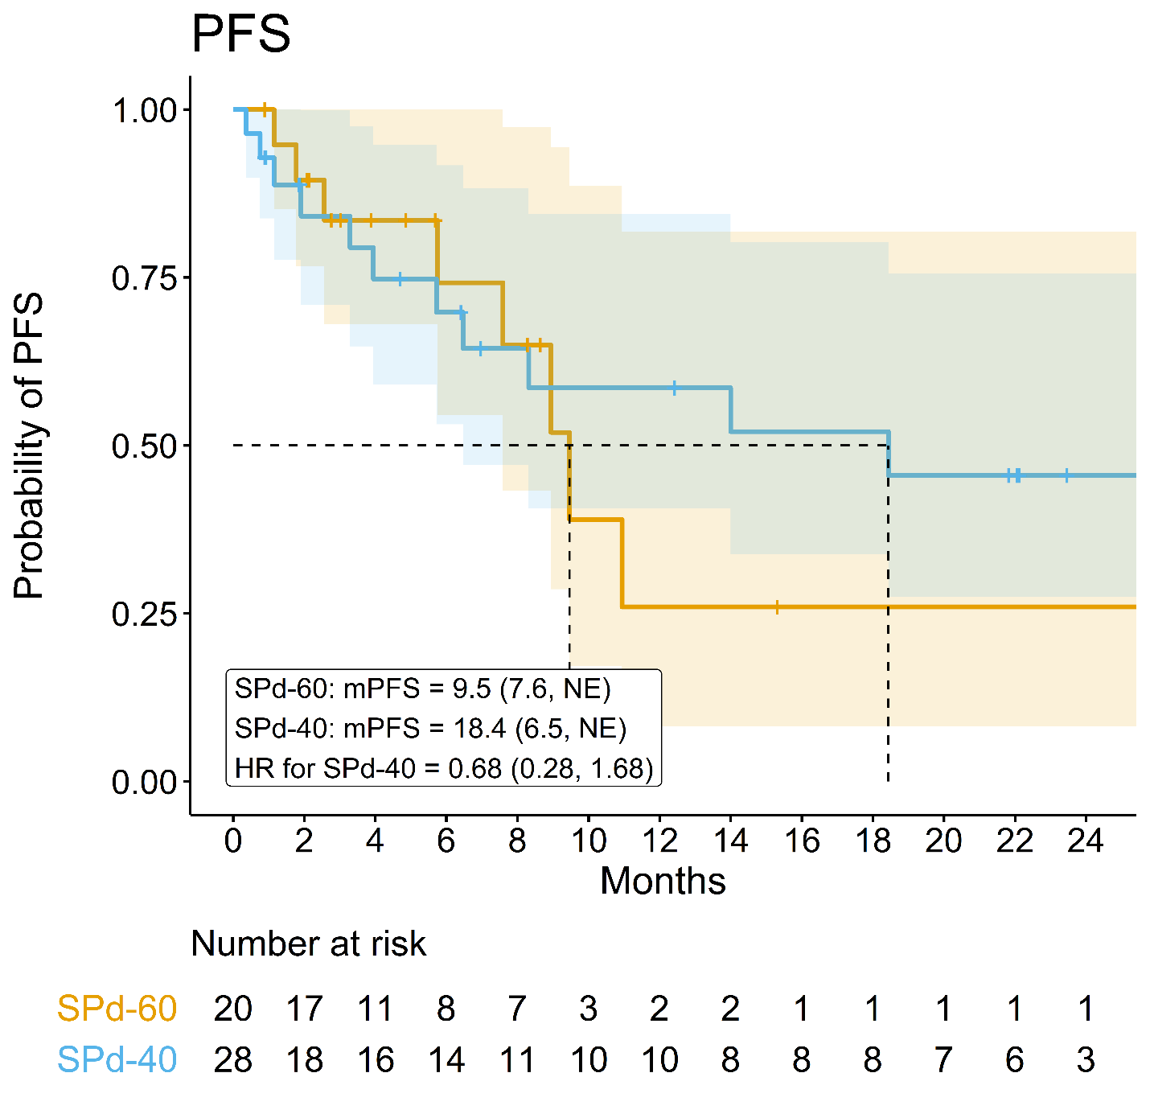
Median Progression-Free Survival with SPd
PFS by SPd Cohort
 | N | mPFS, months (95% CI)*
All Evaluable Patients
SPd-40 | 28 | 18.4 (6.5, NE)
SPd-60 | 20 | 9.5 (7.6, NE)
18.4 months
9.5 months
PFS was longer in the SPd-40 cohort
Months
*HR for SPd-40 = 0.68 [95% CI 0.28, 1.68]
Data cutoff June 30, 2023. CI, confidence interval; HR, hazard ratio; mPFS, median progression-free survival;
NE, not evaluable; PFS, progression-free survival; SPd, selinexor, pomalidomide, and dexamethasone.
White D, et al. Front Immunol. 2024;14:1352281.

Slide 64
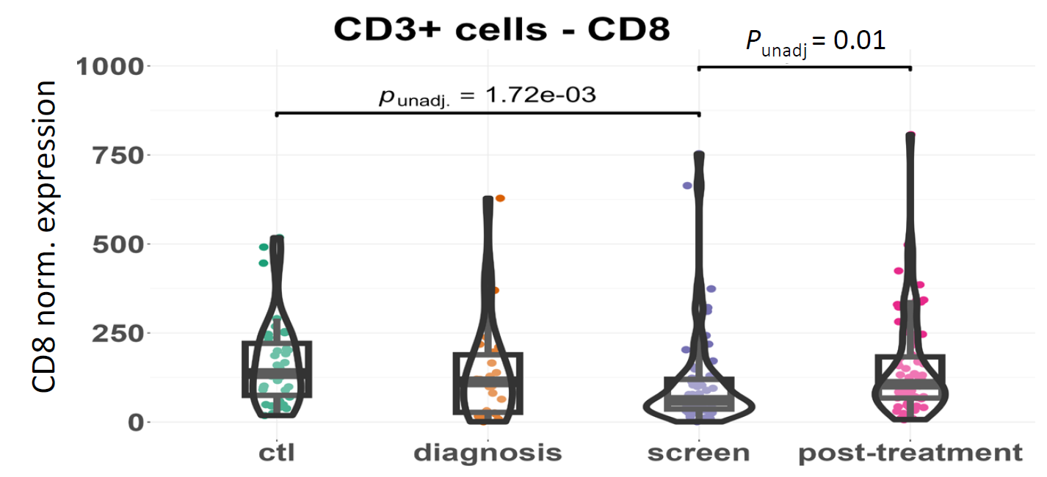
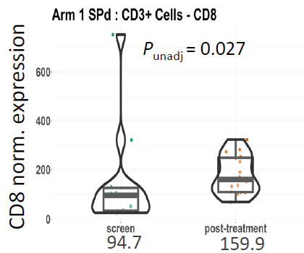
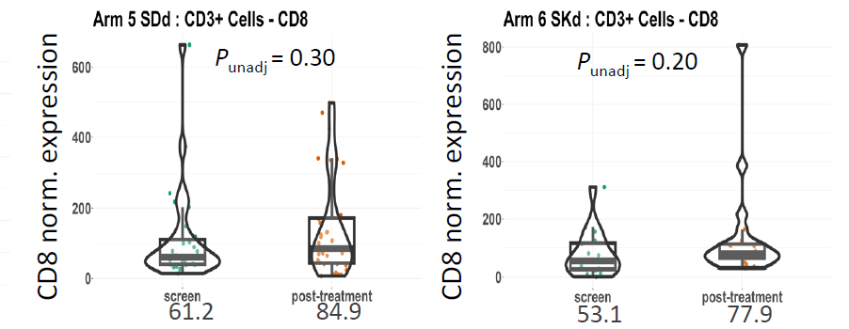
Impact of Selinexor on CD8 Marker Expression
The STOMP trial is a multi-arm, open-label, phase 1/2b study evaluating selinexor in combination with backbone treatments in MM
A single-center, retrospective, exploratory biomarker study was conducted to investigate selinexor with different combinations on MM-cell immune markers and bone marrow microenvironment using paired samples from patients in the STOMP trial at initial diagnosis, immediately before selinexor treatment, and at the end of the trial (EOT), as well as normal control BM samples from other individuals​​
Results: Inhibitory Markers
CD3+ cell expression of CD8 (a) overall and (b) by treatment arm at different time points
(a)
(b)
There was increased CD8 expression in the post-selinexor treatment samples vs screening samples ​
  Highest increase was observed in the SPd arm compared with the SDd and SKd arms ​
These findings support the ongoing evaluation of the combination of selinexor and IMiDs to determine their potential to be additive in nature​
Notes:
Synergy effect with SPd
Can this be modified into something more visualizable?

Slide 65
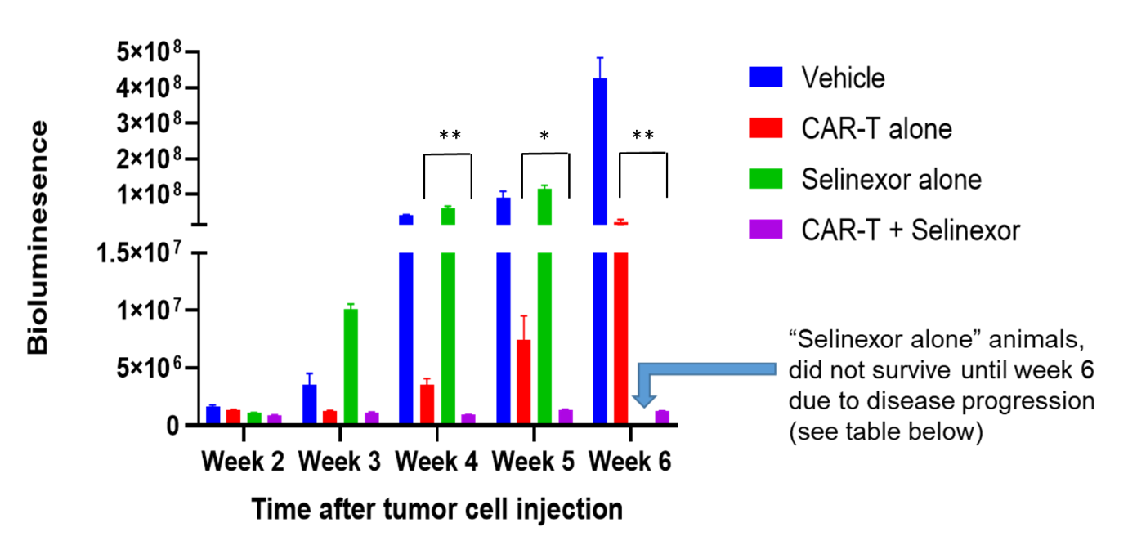
Sequential Administration Of Selinexor Prior To CAR-T In Mice
In a preclinical mouse model of Non-Hodgkin lymphoma, mice were treated with selinexor alone (10 mg/kg gavage 2x week), CD19 CAR-T alone or a concurrent combination
Mice were imaged weekly for bioluminescence to monitor tumor progression
Results: Sequential Administration
Sequential administration of selinexor (10 mg/kg BIW) followed by CD19 CAR-T injection showed reduction in tumor burden at weeks 4–6 in the sequential group compared with CAR-T alone
Administration of selinexor alone, CAR-T alone, sequentially
and vehicle (control) in a mouse model of NHL
Results in this murine model suggest that tumor cells became sensitized to CD19
CAR-T-mediated cell killing following selinexor administration
65
Notes:
Shows synergistic effect of CART and seli

Slide 66
Conclusions
Ixazomib can deepen responses of Velcade-containing regimens and further deepen responses
Belantumab-containing regimens show significant activity in high-risk disease, especially in lenalidomide-refractory patients
Ocular toxicity remains an active concern with belantumab
Selinexor 40mg has significant clinical activity in the RR-MM setting with a more favorable toxicity profile compared to 60mg
Selinexor may be an ideal agent to use as bridging therapy prior to CAR T-cell therapy

Slide 67
Multiple Myeloma
Wednesday, June 19, 2024

Slide 68
Bispecifics in Relapsed/Refractory Myeloma
Ivan Borrello, MD
Director Myeloma, BMT, Cell Therapy
Tampa General Hospital

Slide 69
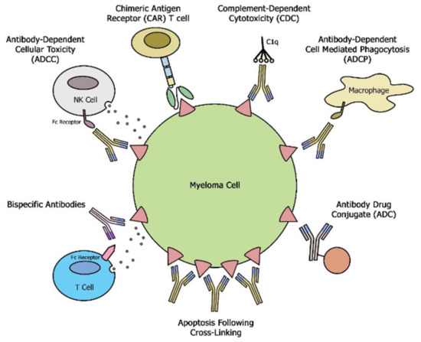

Slide 70
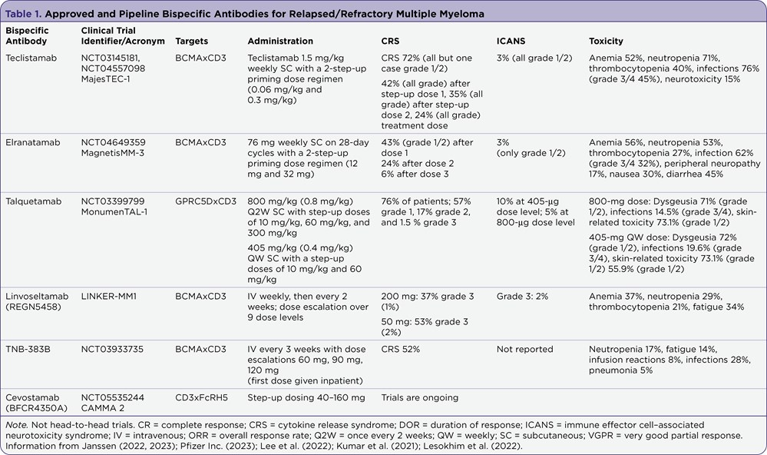
Myeloma Bispecifics

Slide 71
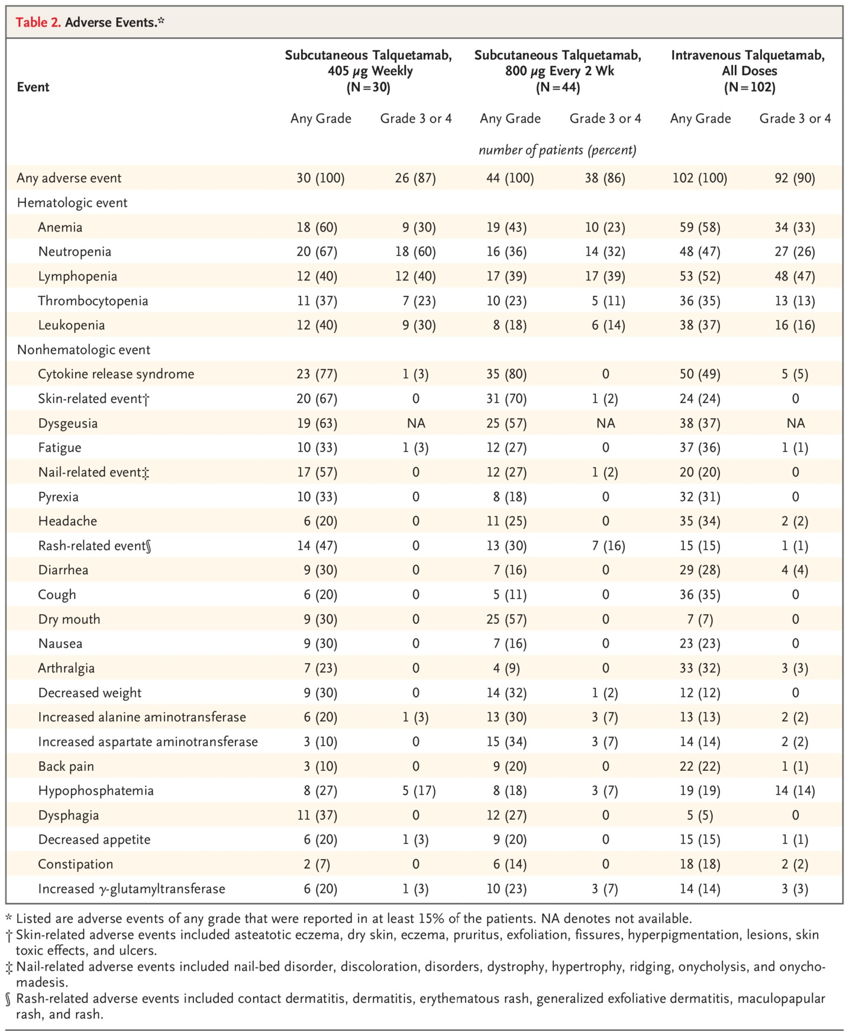
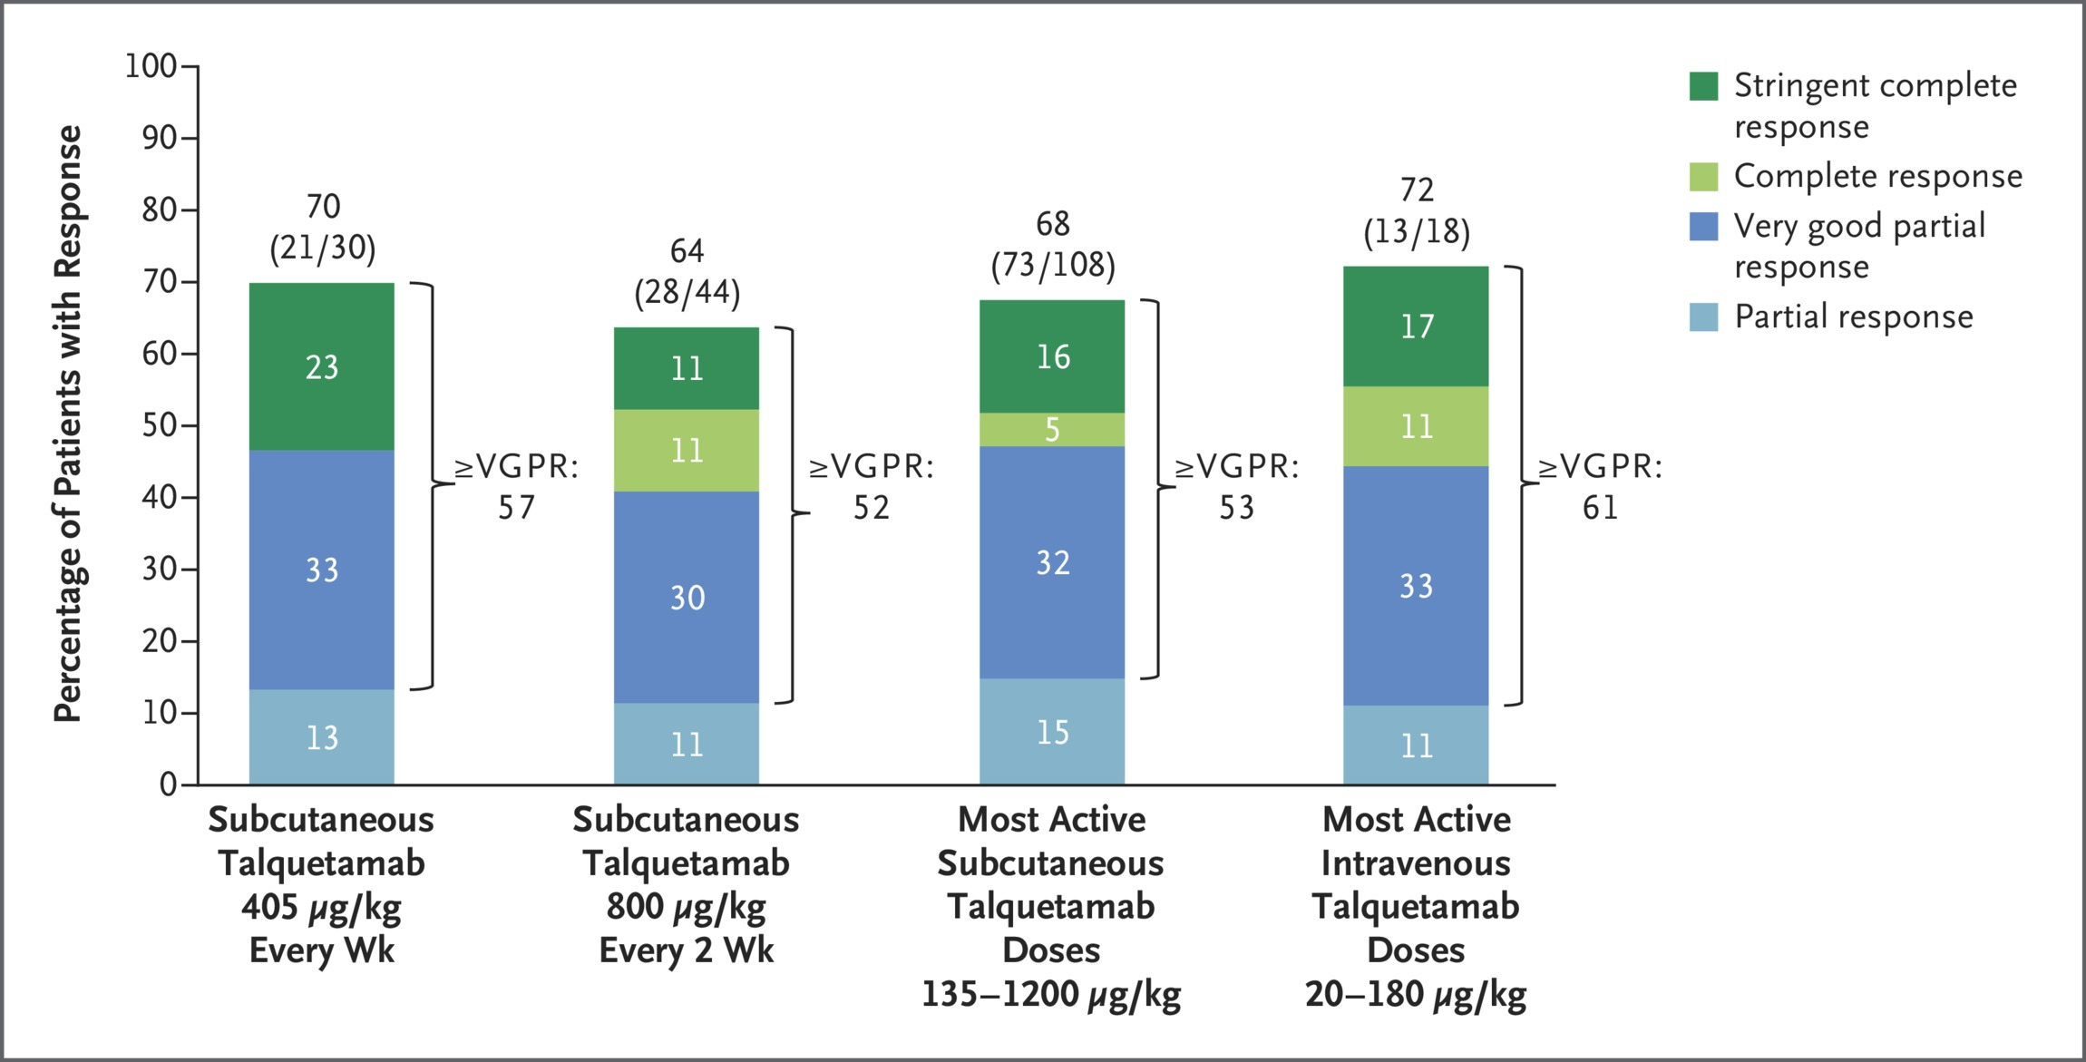
Talquetamab: GPRC5D
Chari A et al. N Engl J Med2022;387:2232-2244

Slide 72
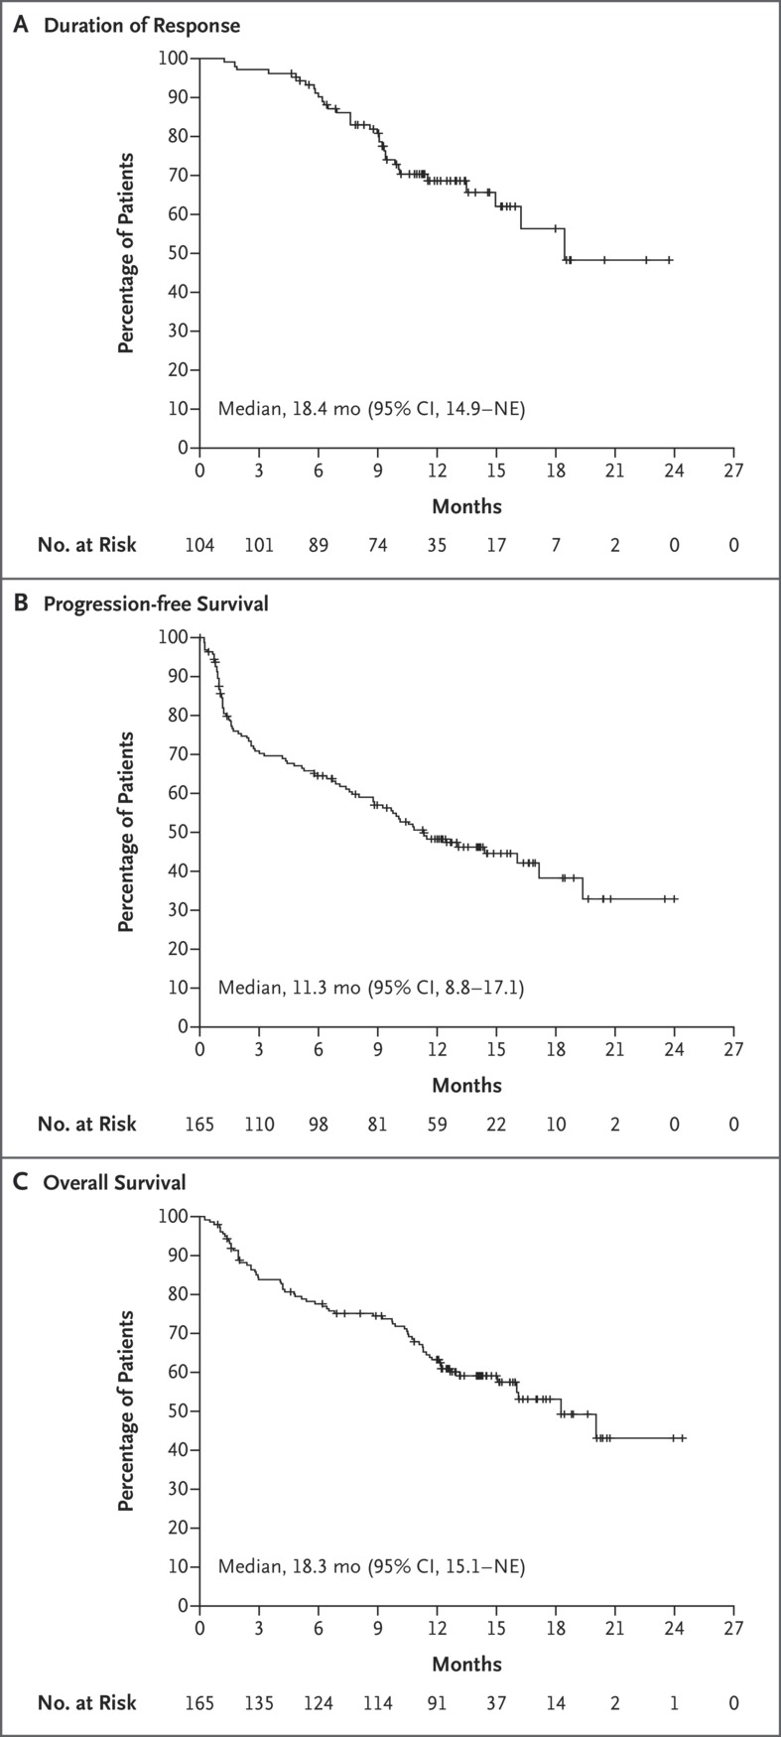
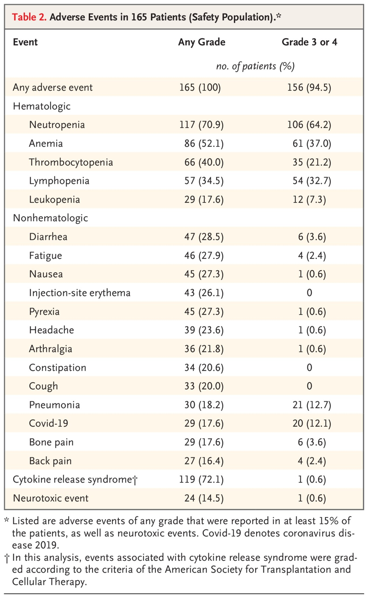
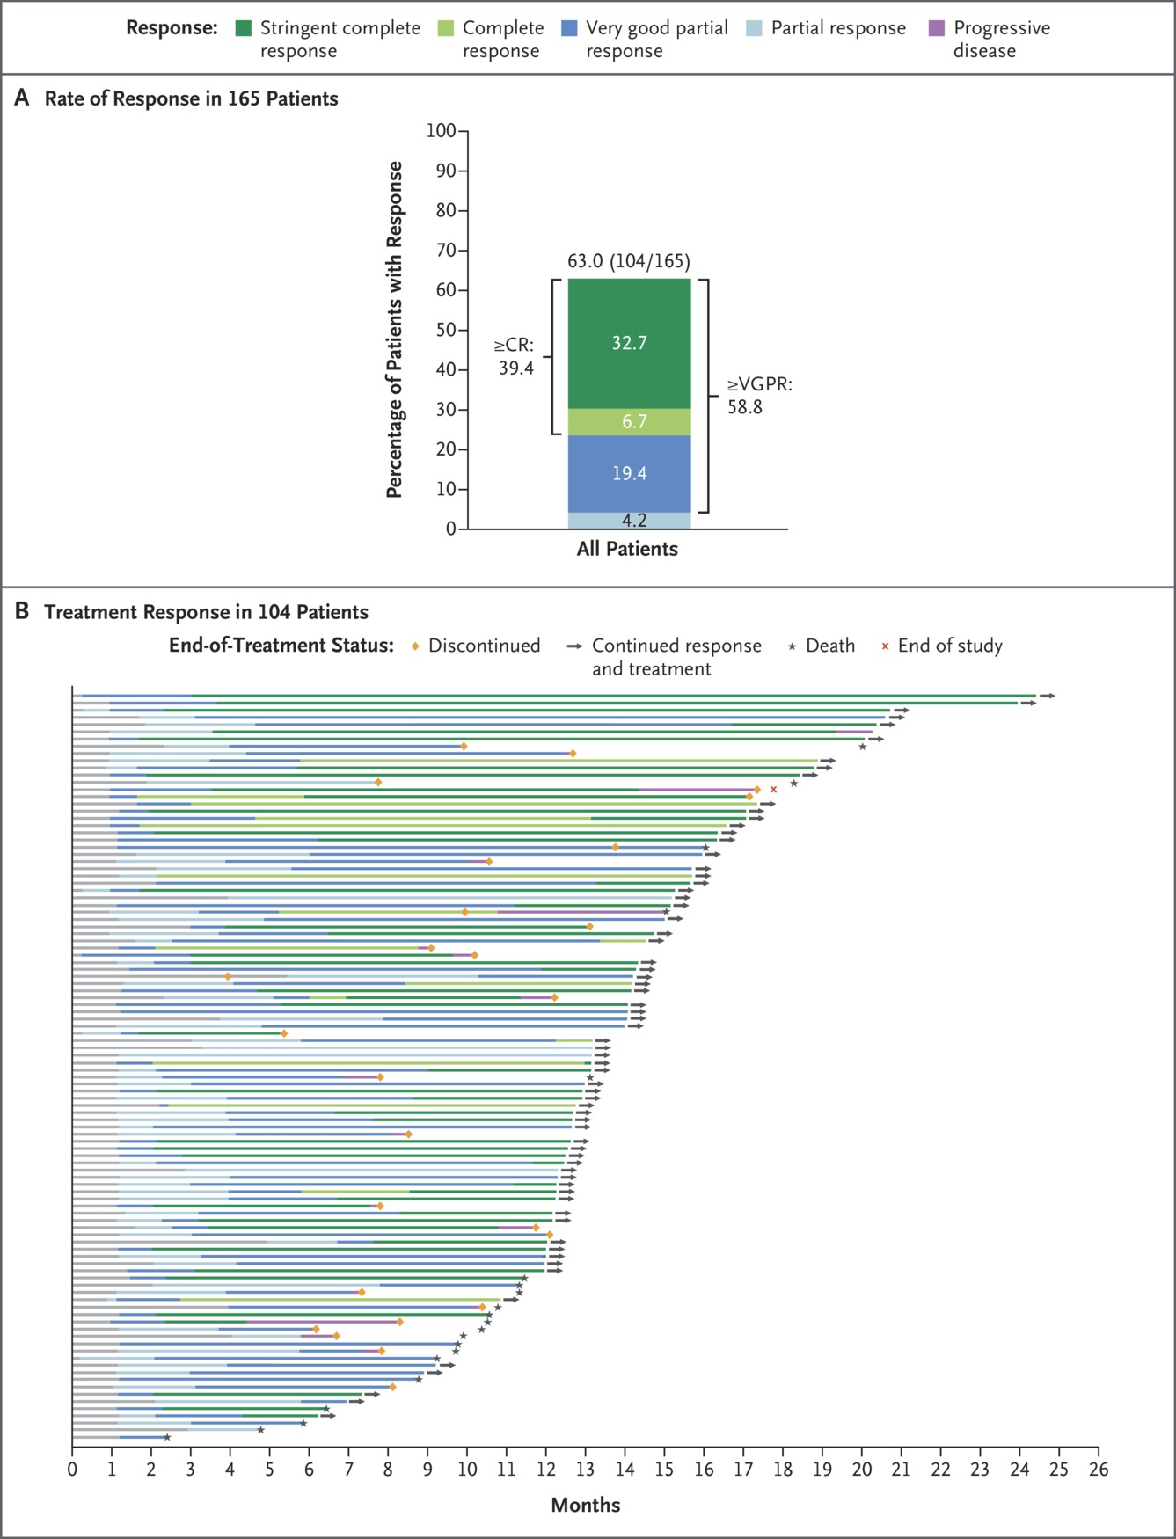
Teclistamab: BCMA
Moreau P et al. N Engl J Med2022;387:495-505
Chari A et al. N Engl J Med2022;387:2232-2244
Notes:
Figure 1 Response to Talquetamab Therapy in Patients with Relapsed or Refractory Multiple Myeloma. The investigator-assessed response is shown for patients who received the doses of talquetamab recommended for a phase 2 study and who had a response that could be evaluated. These doses were the following: 405 μg per kilogram of body weight per week subcutaneously (median follow-up, 11.7 months; range, 1.0 to 21.2) and 800 μg per kilogram every other week subcutaneously (median follow-up, 4.2 months; range, 0.7 to 13.7). The most active subcutaneous doses were 135, 405, and 800 μg per kilogram weekly and 800 and 1200 μg per kilogram every other week (median follow-up, 7.7 months; range, 0.7 to 24.0). The most active intravenous doses were 20, 60, and 180 μg per kilogram weekly (median follow-up, 10.2 months; range, 0.9 to 22.6). The percentage of patients with a response, which includes unconfirmed responses, is shown at the top of each column. A stringent complete response was defined as a complete response with a normal serum free light-chain ratio and an absence of clonal plasma cells according to the International Myeloma Working Group response criteria. Differences in percentage totals are due to rounding.

Slide 73
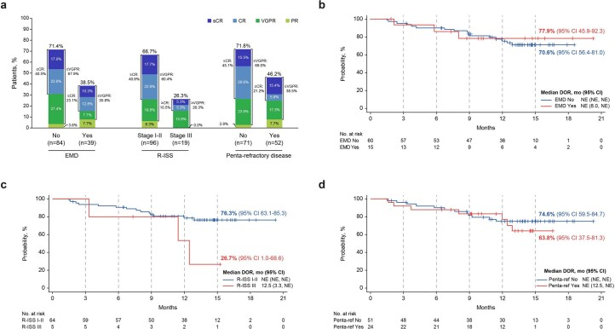
Elranatamab: BCMA
Lesokhin, A et al Nat Med 2023

Slide 74
Elra: Subgroup Efficacy in Therapy Naïve Cohort
Efficacy in BCMA-targeted therapy naïve cohort
ORR was 61.0%; ≥CR was 37.4%
  MRD negativity 90.0% in sCR/CR patients
ORRs were lower in patients with poor prognostic factors
  54.8%v 63.9% with high-risk cytogenetics
  38.5% vs 71.4% with EMD vs 71.4%
  46.2% vs 67.4% ≥50% BMPCs
  46.2% vs 71.85 with penta-drug refractory disease t
Within the poor prognosis subgroup, the lower response rate was mainly driven by patients with ISS III

Slide 75
Elra: Prior BCMA Treatment
ORR in patients who received previous treatment
ORR
≥CR:
18.4%
52.8%
Patients (%)
46.0%
2.8
4.6
42.4%
≥CR:
19.4%
≥CR:
18.6%
5.1
16.7
≥VGPR:
47.2%
13.8
13.6
≥VGPR:
39.0%
≥VGPR:
42.5%
27.8
24.1
96
20.3
3.4
3.4
5.6

Slide 76
Impact of hypogammaglobulinemia on infections
IgG levels of ≥400 mg/dL or Ig replacement therapy were associated with decreased infection rates, including rates of Grade ≥3 infections
BCMA-directed bispecifics require continued close monitoring of Ig levels during treatment.
Ig replacement therapy when appropriate reduces incidence and severity of infections
Leleu X, et al: 2023 International Myeloma Society Meeting; Athens, Greece. .

Slide 77



Impact of BiAbs on Infections
Lecman et al Blood Cancer Discov. 2023;4(6):440-451.

Slide 78
Impact of IVIG on Infections
Lower monthly IR’s observed “on” Ig replacement vs “off”
(0.22 v 0.36)
Similar trends in infections observed regardless of infection type

Slide 79
Infection characteristics | All infections (n = 118) | Grade 3–5 infections (n = 26)
CTCAE grade 1/2/3/4/5 | 8%/69%/19%/2%/2%
Bacterial/Viral/Fungal | 43%/46%/11% | 65%/31%/4%
Site (may overlap)
Upper respiratory tract | 33% | 8%
Lower respiratory tract | 22% | 42%
Urinary tract | 14% | 4%
Skin/soft tissue | 14% | 0%
Gastrointestinal | 9% | 12%
Bloodstream | 4% | 27%
Dental | 3% | 4%
Catheter-related | 3% | 12%
Cytomegalovirus | 8/37 (22%) | 2/37 (5%)
COVID-19 | 16/37 (43%) | 4/37 (11%)
Disease status at time of infection
PD/SD/MR | 16% | 23%
PR | 9% | 19%
VGPR | 19% | 8%
CR/sCR/sCR MRD negative | 57% | 50%
Immune deficiencies | Grade 1–2 infections (n = 92) | Grade 3–5 infections (n = 26)
Hypogammaglobulinemia
Any (IgG <700 mg/dL) | 74% | 88%
Moderate (200–399 mg/dL) | 17% | 16%
Severe (IgG <200 mg/dL) | 33% | 42%
Median IgG level, mg/dL (interquartile range) | 522 (301–701) | 216 (92–364)
Mean IgG level, mg/dL (standard deviation) | 529 (314) | 294 (320)
ANC
≤0.5 × 10³/μL | 3% | 9%
≤1.0 × 10³/μL | 13% | 27%
ALC
≤0.5 × 10³/μL | 48% | 24%
≤1.0 × 10³/μL | 60% | 52%
Incidence of infection does not necessarily
correlate with disease response
Severity of infection does trend with degree
of hypogammaglobulinemia

Slide 80
Infection Prevention for BiAbs
 | Infection prevention before BCMA bispecific | Infection prevention during BCMA bispecific | Treatment of infection during BCMA bispecificª
Bacterial | Vaccinate if appropriate | IVIg q4 weeks | Based on sensitivities
Viral
Zoster | Vaccinate if appropriate | VZV prophylaxis | Anti VZV therapeutic dosing
Influenza | Vaccinate if due | Hygiene | Antiviral
Hepatitis | Vaccinate if appropriate | Prophylaxis if evidence of Hep B exposure | Per ID input
CMV | N/A | Monitor CMV PCR q monthly | Treat if rising significantly or symptomatic
RSV | N/A | Hygiene | Consider inhaled ribavirin
COVID-19 | Vaccinate/Boost | ? Preventative monoclonal antibodies based on viral patterns Hygiene
 |  | Consider monitoring Ab response and continue boosting | Oral or parenteral agents
Fungal | N/A | N/A | As indicated
PCP | N/A | PCP prophylaxis | Per ID Input

Slide 81
Conclusions
Several targets now exist for BiAB therapy in MM
The ORR with 4 prior lines of therapy >60%
Infectious complications are major comorbidity with BCMA BiAbs
IVIg can significantly reduce the incidence and severity of infectious complications

Slide 82
Multiple Myeloma
Wednesday, June 19, 2024

Slide 83

CAR-T cell therapy for relapsed myeloma
Melissa Alsina,MD
Head, Myeloma BMT-CI Program
H. Lee Moffitt Cancer Center

Slide 84
Milestones in Multiple Myeloma Drug Approvals
2015: daratumumab
2015: ixazomib
2022: ciltacabtagene autoleucel
2015: elotuzumab
2015: panobinostat
2023: Talquetamab
1983: aHCT
2012: carfilzomib
First documented case
2020: isatuximab
2003: bortezomib
2020: belantamab
1840
1960
1980
1990
2000
2010
2020-Present
2023: Elranatamab
1958: melphalan
2007: doxorubicin
2019: selinexor
1962: prednisone
1986: high-dose dexamethasone
2006:
lenalidomide
thalidomide
2022:
Teclistamab
2013: pomalidomide
2021: idecabtagene vicleucel
Image adapted from Kyle R, et al. Blood. 2008;111:2962; Raje N, et al. N Engl J Med. 2019;380:1726; Li W, et al. Circulation. 2016;133:908.
Notes:
aHCT, autologous hematopoietic cell transplantation;

Slide 85

FDA approved CAR-T for Relapsed/Refractory Myeloma
Chimeric Antigen Receptor T-Cells
Ide-cel/KarMMa 1
ORR/CR-74%/33
PFS -9.2 months
Cilta-cel/Cartitude 1
ORR/CR-98%/80%
PFS -22.8 months
BCMA-Targeting CAR-T
Ide-cel: Approved Mar 2021
Cilta-cel: Approved Feb 2022
Image Adapted from: Yu B, et al. J Hematol Oncol. 2020;13(1):125.

Slide 86
Real World Outcomes with Idecabtagene Vicleucel (Ide-cel) CAR-T cell Therapy for Relapsed/Refractory Multiple Myeloma
Study Population: Patients with RRMM treated with commercial Ide-cel as SOC in United States who enrolled in the CIBMTR registry for long-term safety and effectiveness follow-up
Primary Outcome: Effectiveness
(Response Rate and PFS)
Secondary Outcomes
CRS
ICANS
Cytopenias
Infections
Overall Survival
Second Primary Malignancies
Non-relapsed mortality (NRM)
CAR-T with conforming product and have at least 1 follow-up timepoint at day 100 (or earlier if patient was deceased before day 100)
N=821*
N=801* with data for PFS
Median follow-up: 11.6 months
(Range 1.1- 26.7 months)
* Overall cohort, N=821, Effectiveness cohort (with available disease specific follow-up forms), N=801
Sidana et al, ASH 2023

Slide 87
Baseline Characteristics and Treatment History
N=821 | N (%) or Median (Range)
Median age, years | 66 years (29-90)
Age > 70 years | 251 (31%)
Sex, female | 334 (41%)
Race, White Race, Black | 652 (79%) 120 (15%)
Ethnicity, Hispanic | 55 (7%)
ECOG Performance Status 0-1 | 728 (89%)
Clinically significant co-morbidity | 631 (77%)
ISS Stage (N=420) Stage I Stage II Stage III | 210 (50%) 142 (34%) 68 (16%)
Bone marrow plasma cells > 50% | 71/508 (14%)
Non-secretory disease | 17 (2%)
High-risk cytogenetics | 196/727 (27%)
High-risk cytogenetics including 1q | 381/727 (52%)
Extramedullary disease | 85/488 (17%)
Plasma cell leukemia | 13 (1.6%)
N=821 | N (%) or Median (Range)
Prior lines of therapy | 7 (4-21)
Triple class exposed | 776 (97%)
Penta class exposed | 490 (60%)
Prior BCMA Therapy Prior ADC (Belantamab) Prior CAR-T Prior bispecific | 150 (18%) 116 (14%) 36 (4%) 3 (0.4%)
Bridging therapy | 442/799 (54%)
Lymphodepletion Chemotherapy Fludarabine/Cyclophosphamide Bendamustine Cyclophosphamide + Other Cyclophosphamide Other/unknown | 741 (90%) 51 (6%) 18 (2%) 8 (1%) 3 (0.3%)
CAR-T cell dose in million cells | 409 (307-460)
CAR-T cell dose > 400 million | 475 (58%)
High-risk cytogenetics include del17p, t(4;14) and t(14;16)
Sidana et al, ASH 2023

Slide 88
Effectiveness: Response Rate
 | ORR | CR rate
Age > 70 years < 70 years | 77% 70% | 27% 23%
Cytogenetic Risk High risk Standard risk | 70% 74% | 25% 26%
ISS stage Stage I Stage II Stage III | 81% 70% 62% | 36% 31% 13%
ECOG PS 0-1 2 or more | 72% 60% | 26% 9.5%
Lymphodepletion Therapy Flu/Cy Bendamustine Others | 74% 43% 72% | 26% 10% 25%
Prior BCMA therapy No Prior BCMA therapy Prior BCMA therapy | 74% 58% | 26% 16%
ORR: 73%
> VGPR rate: 56%
Response data available in 810 patients.
Sidana et al, ASH 2023

Slide 89


Survival Outcomes after Ide-cel
Progression-free Survival
Overall Survival
Median PFS: 9 months
Median OS not reached
1 year estimate: 67%
*Total cohort included 821 patients; one patient was not included in the overall survival analysis due to missing survival status.
Progression data was only available in 801 patients

Slide 90


Sub-group Analysis: Cytogenetic Risk
Progression-free Survival
Overall Survival
High-risk cytogenetics include del17p, t(4;14) and t(14;16)

Slide 91


Sub-group Analysis: Prior BCMA Therapy
Progression-free Survival
Overall Survival
Prior BCMA therapy: Primarily belantamab mafodotin
This analysis excludes prior CAR-T therapy

Slide 92
Safety
N=821 | N (%) or Median
CRS, Any grade Grade ≥ 3 | 657 (80%) 24 (3%)
CRS Grades 1 2 3 4 5 Not reported | 470 (57%) 155 (19%) 9 (1%) 11 (1%) 4 (0.5%) 8 (1%)
Time to CRS onset, median | 2 days (1-26)
Time to resolution of CRS | 3 days
ICANS, Any grade Grade ≥ 3 | 231 (28%) 39 (5%)
ICANS Grades 1 2 3 4 5 Not reported | 104 (13%) 43 (5%) 26 (3%) 12 (1.5%) 1 (0.1%) 45 (5.5%)
Time to ICANS onset | 3 days (1-33)
Time to resolution of ICANS | 4 days (1-61)
N=821 | N (%) or Median
IEC-HS/HLH | 9 (1%)
Tumor Lysis Syndrome | 8 (1%)
Clinically significant infections Bacterial Fungal Viral Not Specified | 367 (45%) 189 (23%) 20 (2%) 215 (26%) 78 (10%)
Prolonged cytopenia Neutropenia Thrombocytopenia | 228 (28%) 92 (11%) 197 (24%)
Second primary malignancies Myeloid neoplasms/acute leukemia | 33 (4%) 8 (1%)
No cases of any T cell malignancies
Prolonged Cytopenias: Defined as non-recovery of counts by day 30 to the following threshold among alive patients
Neutrophil recovery: Neutrophil count recovery is defined as achieving a neutrophil count of >500/µL for 3 consecutive days and the first day is the recovery day
Platelet recovery: Platelets of 20,000/µL without platelet transfusion in the last 7 days
Time to resolution of CRS, ICANS only reported in patients where these events resolved.

Slide 93
Ide-cel in MM: Real World Evidence and Trial Data
 | CIBMTR N=821 | KarMMa¹ N=128 | US RWE² N=159
CRS - Any grade Grade 3 or higher | 80% 3% | 84% 5% | 82% 3%
ICANS– Any grade Grade 3 or higher | 28% 5% | 18% 3% | 18% 6%
Overall response rate | 73% | 73% | 84%
Very good partial response rate | 56% | 52% | 62%
Complete response rate | 25% | 33% | 42%
Progression free survival, median | 9.0 months | 8.8 months | 8.5 months
Median follow-up | 11.6 months | 13.3 months | 6.1 months
US RWE: United States MM Consortium Real-World Evidence²
1. Munshi et al. NEJM 2021;384(8):705-716 ; 2. Hansen, Sidana et al. JCO 2023 DOI: 10.1200/JCO.22.01365.

Slide 99



KARMMA-3 and CARTITUDE-4, CAR-T outperforms SOC
P Rodriguez-Otero et al. N Engl J Med 2023;388:1002-1014.
J San-Miguel et al. N Engl J Med 2023;389:335-347.
Parameter | KarMMa-3 |  | CARTITUDE-4
 | Ide-Cel | SOC | Cilta-Cel |  | SOC
Inclusion criteria | 2-4 prior lines including PI + IMiD + Dara |  | 1-3 prior lines, Len-refractory
Prior lines of therapy, n, median (range) | 3 (2-4) | 3 (2-4) | 2 (1-3) | 2 (1-3) | 2 (1-3)
Refractory to anti-CD38 antibodies, n (%) | 242 (95) | 123 (93) | 50 (24) | 46 (22) | 46 (22)
Triple-class refractory, n (%) | 164 (65) | 89 (67) | 30 (14) | 33 (16) | 33 (16)
ORR, n (%) | 181 (71) | 55 (42) | 176 (85) | 142 (67) | 142 (67)
::: CR, n (%) | 98 (39) | 7 (5) | 152 (73) | 46 (22) | 46 (22)
::: VGPR, n (%) | 153 (60) | 20 (16) | 169 (81) | 96 (46) | 96 (46)
MRD-negative 10⁻⁵, n (%) | 51/254 (20) | 1 (1) | 126/144 (88) | 33/101 (33) | 33/101 (33)
DOR, mo, median | 14.8 | 9.7 | Not reached; 85% at 12 mo | Not reached; 63% at 12 mo | Not reached; 63% at 12 mo
PFS, mo, median | 13.3 | 4.4 | Not reached; 76% at 12 mo | 11.8 49% at 12 mo | 11.8 49% at 12 mo
Notes:
Figure 2. Progression-free Survival (Intention-to-Treat Population). Progression-free survival was assessed by the independent response committee on the basis of International Myeloma Working Group criteria.²³ The P value was based on a stratified two-sided log-rank test. Data at the dashed lines show the probability of progression-free survival at 6 months and 12 months. Tick marks indicate censored data.

Slide 100


Revised indications for CAR-T in relapsed MM
Binding Domains
Ide-Cel
Cilta-Cel
Triple class exposed: PI, IMID & anti-CD38+
monoclonal antibody
Relapsed disease after > 2 prior lines of therapy
Lenalidomide Refractory
Relapsed disease after > 1 prior lines of therapy

Slide 101

KarMMa-3 study design (NCT03651128)-Updated Analysis
PFS analysisª
Objectives
KarMMa-3
Leukapheresis
LDC^{b}
Endpoints
Primary endpoints
PFS (ITT population by IRC)
Key secondary endpoints
ORR (by IRC), OS
Other secondary endpoints
CR rate,^{i} MRD, PFS2, TTNT
Safety
Exploratory endpoints
PROs
386 patients
Ide-cel
n = 254
Single ide-cel infusion
150 to 450 x 10⁶
CAR+ T cells^{d}
n = 225
Inclusion criteria
Aged ≥ 18 years
ECOG PS 0–1
2–4 previous regimens (including an IMiD agent, PI, and daratumumab)
Refractory to the last regimen
Stratification factors
Age (< 65 vs ≥ 65 years)
Number of previous regimens (2 vs 3 or 4)
High-risk cytogenetics (yes vs no/unknown)
Optional bridging therapy
≤1 cycle^{c}
Ide-cel subsequent therapy
allowed after confirmed PD
PFS follow-up^{f};
3-month safety follow-up^{g}
Survival
follow-up^{h}
R 2:1
Standard regimens^{e}
(DPd, DVd, IRd,
Kd, or EPd)
n = 132
Standard regimens^{e}
Continuous treatment until PD, unacceptable toxicity or consent withdrawal
n = 126
Data cutoff:
April 28, 2023 (PFS)
June 23, 2023 (OS)
Median (range) duration of
follow-up: 30.9 (12.7–47.8) months
Ide-cel arm: treated population (patients who underwent either leukapheresis, bridging therapy, LDC, or ide-cel treatment) was used to assess AEs; the safety population (patients who received ide-cel) was used to assess TRAEs, iiNT, and CRS; standard regimens arm: the treated and safety populations included those patients who received any treatment. ªTime from randomization to the first occurrence of disease progression or death from any cause according to IMWG criteria; ^{b}3 days fludarabine 30 mg/m² and cyclophosphamide 300 mg/m²; ^{c}Up to 1 cycle of DPd, DVd, IRd, Kd, or EPd may be given as bridging therapy ^{d}Doses ≤ 540 x 10⁶ cells permitted; ^{e}Based on most recent treatment regimen and investigator discretion; ^{f}PFS assessed monthly for patients randomized to ide-cel for 24-months then every 3 months until PD, and monthly until PD for patients randomized to standard regimens; ^{g}Patients randomized to standard regimens and who went on to receive subsequent ide-cel therapy; ^{h}Every 3 months after PD until end of trial; 5 years after last patient randomized; ^{i}By IRC.
AE, adverse event; CRS, cytokine release syndrome; DOR, duration of response; DPd, daratumumab/pomalidomide/dexamethasone; DVd, daratumumab/bortezomib/dexamethasone; EFS, event-free survival; EPd, elotuzumab/pomalidomide/dexamethasone; IRC, Independent Response Committee; IRd, ixazomib/lenalidomide/dexamethasone; Kd, carfilzomib/dexamethasone; LDC, lymphodepleting chemotherapy; MRD, minimal residual disease; PD, progressive disease; PROs, patient-reported outcomes; PS, performance status; R, randomization; TRAE, treatment-related adverse events; TTR, time to response.
Rodríguez-Otero P, et al. ASH 2023 Abstract 1028

Slide 102
Overall response rate (ITT population)
Difference in ORR, 29%
OR, 3.36ª (95% CI, 2.17–5.22)^{b}
sCR
Patients achieving ≥ CR and MRD-negative status | Ide-cel (n = 254) | Standard regimens (n = 132)
MRD negativity, n (%)^{e} | 57 (22) | 1 (1)
95% CI | 17.3–27.6 | 0.0–2.2
ORR, 71%^{c}
(95% CI, 66–77)
CR
OR, 13.86ª
(95% CI, 6.22–30.87)^{b}
VGPR
PR
CR rate,^{d}
44% (95% CI, 38–50)
vs
5% (95% CI, 2–9)
ORR, 42%^{c}
(95% CI, 34–51)
Patients (%)
With extended follow-up, ide-cel continued to demonstrate higher ORR versus standard regimens¹
CR rate increased by 5% in the ide-cel arm but was unchanged for standard regimens
1
3
26
10
Ide-cel
(n = 254)
Standard regimens
(n = 132)
  Per IMWG criteria. Individual responses may not sum to ORR due to rounding.
  ªOR is for ORR, calculated based on the observed response rate with two-sided Wald CI; ^{b}Two-sided Wald interval; ^{c}Patients with ≥ PR; ^{d}Patients with CR or sCR; ^{e}≥ 1 negative MRD value within 3 months prior to achieving ≥ CR until PD or death. MRD was assessed by NGS at a sensitivity of 10⁻⁵ per IMWG Uniform Response Criteria and as specified by the protocol. 95% CI was calculated using 2-sided Wald interval. OR, odds ratio; NGS, next generation sequencing; PR, partial response; sCR, stringent complete response; VGPR, very good partial response.
  1. Rodríguez-Otero P, et al. N Engl J Med 2021;384:705-716.
Rodríguez-Otero P, et al. ASH 2023 Abstract 1028
Notes:
Data source: Table 14.2.4.1.1

Slide 103
Final PFS (ITT population)
100
Ide-cel
Standard regimens
Median PFSª
Hazard ratio^{b}
18-month PFS rate
80
13.8 months
HR 0.49
41%
19%
4.4 months
(95% CI, 0.38–0.63)
60
PFS (%)
41%
40
20
19%
0
0
3
6
9
12
15
18
21
24
27
30
33
36
39
Patients at risk:
Months since randomization
Ide-cel
254 | 206 | 177 | 153 | 131 | 111 | 94 | 77 | 54 | 25 | 14 | 7 | 7 | 2
132 | 76 | 43 | 34 | 31 | 21 | 18 | 12 | 9 | 6 | 5 | 3 | 2 | 1
Standard regimens
Ide-cel continued to show longer PFS than standard regimens, with a 51% reduction in risk of PD or death, consistent with the KarMMa-3 interim analysis¹
  PFS was analyzed in the ITT population of all randomized patients in both arms and included early PFS events occurring between randomization and ide-cel infusion. PFS based on IMWG criteria per IRC. ªBased on Kaplan-Meier approach; ^{b}Statified HR based on univariate Cox proportional hazard model. CI is two-sided. IMWG, International Myeloma Working Group; mITT, modified intent-to-treat; SE, standard error.
  1. Rodríguez-Otero P, et al. N Engl J Med 2021;384:705-716.
Rodríguez-Otero P, et al. ASH 2023 Abstract 1028

Slide 104


PFS2 and TTNT (ITT population)
KarMMa-3 updated analysis
100
Ide-cel
Standard regimens
Median PFS2ª
Hazard ratio^{b}
24-month PFS2 rate^{c}
23.5 months
HR 0.79
50%
35%
80
16.7 months
(95% CI, 0.60–1.04)
60
57%
PFS2 (%)
50%
40
46%
35%
20
0
0
3
6
9
12
15
18
21
24
27
30
33
36
39
42
45
48
Patients at risk:
Months since randomization
Ide-cel
254 | 236 | 213 | 195 | 175 | 151 | 142 | 127 | 110 | 71 | 47 | 24 | 21 | 11 | 5 | 2 | 0
132 | 124 | 109 | 92 | 77 | 67 | 57 | 49 | 36 | 24 | 19 | 16 | 13 | 9 | 4 | 3 | 0
Standard regimens
Median (range) TTNT was 20.9 (16.6–24.2) months with ide-cel versus 7.0 (5.3–8.5) months with standard regimens
Ide-cel provided ongoing benefit and improved long-term disease control versus standard regimens
  ªBased on Kaplan-Meier approach; ^{b}Statified HR based on univariate Cox proportional hazard model. CI is two-sided; ^{c}Based on the Greenwood formula.
Rodríguez-Otero P, et al. ASH 2023 Abstract 1028

Slide 105

Interim overall survival analyses (ITT population)
KarMMa-3 updated analysis
ITT population
Ide-cel
Standard regimens
Sensitivity analysis corrected for crossover^{d}
100
Median (95% CI) OSª
Piecewise HR (95% CI)^{b}
100
41.4 (30.9-NR) mo
≤ 6 months
1.86 (0.88-3.91)
Median (95% CI) OSª
Hazard ratio^{c}
80
37.9 (23.4-NR) mo
> 6 months
0.85 (0.59-1.23)
80
41.4 (30.9-NR) mo
HR 0.69
23.4 (17.9-NR) mo
(95% CI, 0.45–1.09)
HR (95 % CI)^{c}
60
1.01 (0.73-1.40)
60
OS (%)
OS (%)
40
40
56% of patients in the standard regimens arm crossed over to ide-cel
Median time (range) from randomization to ide-cel infusion was 8.1 (2.9–36.7) months
20
20
0
0
0
3
6
9
12
15
18
21
24
27
30
33
36
39
42
45
48
0
3
6
9
12
15
18
21
24
27
30
33
36
39
42
45
48
Patients at risk:
Months since randomization
Months since randomization
Ide-cel
254 | 240 | 223 | 208 | 190 | 175 | 169 | 161 | 143 | 103 | 75 | 48 | 44 | 30 | 13 | 4 | 0
132 | 128 | 120 | 114 | 103 | 91 | 81 | 75 | 59 | 45 | 32 | 24 | 18 | 11 | 4 | 3 | 0
254 | 240 | 223 | 208 | 190 | 175 | 169 | 161 | 143 | 103 | 75 | 48 | 44 | 30 | 13 | 4 | 0
132 | 126 | 118 | 93 | 67 | 50 | 42 | 34 | 21 | 14 | 9 | 8 | 4 | 2 | 1 | 1 | 0
Standard regimens
Patient-centric design allowed crossover from standard regimens to ide-cel upon confirmed PD and was underpowered to provide definitive conclusions on OS
A prespecified crossover-adjusted analysis suggested OS benefit for ide-cel versus standard regimens.
Additional OS sensitivity analyses (prespecified and post hoc) showed a similar trend in favor of ide-cel
  ªStratified time-dependent Cox model. HRs are ide-cel arm versus standard regimens arm; ^{b}Based on Kaplan–Meier approach; ^{c}Stratified HR is based on the univariate Cox proportional hazards model. CI is two-sided and calculated by bootstrap method; ^{d}Weibull model (prespecified analysis). mo, month; NR, not reached.
Rodríguez-Otero P, et al. ASH 2023 Abstract 1028

Slide 106
CARTITUDE-4 Subgroup Analysis: Patient Population
136 had 1 prior LOT in CARTITUDE-4
Cilta-cel
68 underwent apheresis/bridging
SOC
68 received SOC
Functionally high-risk MM
40 underwent apheresis/bridging
Functionally high-risk MM
39 received SOC
  Functionally high-risk MM defined as PD ≤18 months after receiving ASCT or the start of initial frontline therapy in patients with no ASCT

Slide 107
CARTITUDE-4 Subgroup Analysis:
Baseline Disease Characteristics Were Generally Balanced Between Treatment Arms in Patients With 1 Prior LOT and Those With 1 Prior LOT and Functionally High-Risk MM
Baseline characteristic | Patients with 1 prior LOT |  | Patients with 1 prior LOT and functionally high-risk MM
 | Cilta-cel (n=68) | SOC (n=68) | Cilta-cel (n=40) | SOC (n=39)
Age, median (range), years | 60.5 (27–78) | 60.0 (35–78) | 60.0 (27–71) | 60.0 (40–78)
Male, n (%) | 36 (52.9) | 42 (61.8) | 18 (45.0) | 27 (69.2)
ISS stage II/III,ª n (%) | 20 (29.4) | 22 (32.4) | 12 (30.0) | 14 (35.9)
Prior ASCT, n (%) | 56 (82.4) | 60 (88.2) | 33 (82.5) | 33 (84.6)
Prior anti-CD38 antibody exposure,^{b} n (%) | 2 (2.9) | 3 (4.4) | 2 (5.0) | 1 (2.6)
High-risk cytogenetics,^{c} n (%) | 39 (57.4) | 45 (66.2) | 22 (55.0) | 27 (69.2)
del17p | 14 (20.6) | 15 (22.1) | 9 (22.5) | 9 (23.1)
t(4;14) | 13 (19.1) | 10 (14.7) | 8 (20.0) | 6 (15.4)
t(14;16) | 1 (1.5) | 3 (4.4) | 0 | 2 (5.1)
Gain/amp(1q) | 34 (50.0) | 38 (55.9) | 20 (50.0) | 23 (59.0)
With ≥2 high-risk abnormalities | 20 (29.4) | 20 (29.4) | 13 (32.5) | 12 (30.8)
High tumor burden,^{d} n (%) | 9 (13.2) | 8 (11.8) | 5 (12.5) | 4 (10.3)
Soft tissue plasmacytoma,^{e} n (%) | 12 (17.6) | 7 (10.3) | 6 (15.0) | 4 (10.3)

Slide 108
CARTITUDE-4 Subgroup Analysis:
Consistently Deeper Responses Achieved With Cilta-cel vs SOC in Patients
With 1 Prior LOT and Those With 1 Prior LOT and Functionally High-Risk MM
Overall MRD negativity (10^{–5} threshold)
Overall response
CR or better odds ratioª:
4.4 (95% CI, 2.1–9.0)
P<0.0001^{b}
CR or better odds ratioª:
3.3 (95% CI, 1.3–8.4)
P=0.0102^{b}
Odds ratioª:
7.3 (95% CI, 3.3–15.9)
P<0.0001^{b}
Odds ratioª:
16.3 (95% CI, 4.8–55.1)
P<0.0001^{b}
100
ORR: 89.7
(61/68)
ORR: 87.5
(35/40)
ORR: 79.4
(54/68)
ORR: 79.5
(31/39)
sCR
80
Cilta-cel
CR
SOC
VGPR
PR
60
Patients, %
Patients, %
40
20
0
(n=68)
(n=68)
(n=40)
(n=39)
Cilta-cel
SOC
Cilta-cel
SOC
Patients with 1 prior LOT
Patients with 1 prior LOT and
functionally high-risk MM
Patients with
1 prior LOT
Patients with 1 prior LOT and
functionally high-risk MM

Slide 109
CARTITUDE-4 Subgroup Analysis:
Consistently Improved PFS Observed With Cilta-cel vs SOC in Patients
With 1 Prior LOT and Those With 1 Prior LOT and Functionally High-Risk MM
 | Patients with 1 prior LOT
 | Cilta-cel (n=68) | SOC (n=68)
Median PFS (95% CI), moª | NR (NE–NE) | 17.41 (11.10–NE)
HR (95% CI); P value^{b,c} | 0.35 (0.19–0.66); 0.0007
 | Patients with 1 prior LOT and functionally high-risk MM
 | Cilta-cel (n=40) | SOC (n=39)
Median PFS (95% CI), moª | NR (18.00–NE) | 11.79 (8.44–NE)
HR (95% CI); P value^{b,c} | 0.27 (0.12–0.60); 0.0006
12-mo rate
77.7% (95% CI, 65.8–85.9)
58.5% (95% CI, 45.5–69.4)
12-mo rate
77.0% (95% CI, 60.3–87.3)
49.1% (95% CI, 32.4–63.8)
100
100
75
75
Patients progression free and alive, %
50
50
Patients progression free and alive, %
25
25
0
0
0
3
6
9
12
15
18
21
24
27
0
3
6
9
12
15
18
21
24
27
Progression-free survival, mo
Progression-free survival, mo
No. at risk
No. at risk
Cilta-cel:
68
61
58
56
48
28
16
8
1
0
Cilta-cel:
40
36
34
33
26
16
7
5
1
0
SOC:
68
60
52
48
35
22
8
1
0
0
SOC:
39
34
28
24
18
11
3
1
0
0

Slide 110
CARTITUDE-4 Subgroup Analysis:
AEs of Special Interest Were Consistent With the Known Safety Profile of Cilta-cel in Patients With 1 Prior LOT and Those With 1 Prior LOT and Functionally High-Risk MM
 | Patients with 1 prior LOT |  | Patients with 1 prior LOT and functionally high-risk MM
 | Cilta-cel (n=68) |  | Cilta-cel (n=40)
 | All | Grade 3 or 4 | All | Grade 3 or 4
AEs of special interest,ª n (%)
CRS | 44 (64.7) | 1 (1.5) | 25 (62.5) | 0
ICANS | 2 (2.9) | 0 | 2 (5.0) | 0
CNP | 6 (8.8) | 2 (2.9) | 3 (7.5) | 0
MNTs | 1 (1.5) | 0 | 0 | 0
Peripheral neuropathy | 2 (2.9) | 0 | 2 (5.0) | 0
  AEs of special interest
    Consistent with the known safety profile of cilta-cel
    Generally low grade in severity; no grade 4 events occurred
    Second primary malignancies occurred in 3 patients in the cilta-cel arm, and
    2 patients in the SOC arm among
    those with 1 prior LOT; all occurred in patients with functionally high-risk MM
      1 patient in the cilta-cel arm had peripheral T-cell lymphoma unspecified¹

Slide 111



KarMMa-2 cohort 2c: efficacy and safety of idecabtagene vicleucel in patients with clinical high-risk multiple myeloma due to inadequate response to frontline autologous stem cell transplantation
MRD negativity in all patients and those in ≥ CR
In patients who achieved ≥ CR, sustained MRD negativity at 10⁻⁵ was observed in 69.6% (16 of 23, 95% CI 49.1–84.4) at 12 months; of these 16 patients, 11 sustained MRD negativity at 24 months (2 patients had no MRD data available, and 3 were indeterminate)
In all evaluable patients, sustained MRD negativity at 10⁻⁵ was observed in 60.7% (17 of 28; 95% CI 42.4–76.4) at 12 months
24 months PFS of 83.1%
Madhav Dhodapkar, Melissa Alsina,ASH 2023

Slide 112
Future of CAR-T in MM
  Newly diagnosed transplant eligible
  Newly diagnosed transplant ineligible*
  Novel CAR-T (GPRC5D CAR/Dual BCMA-GPRC5D CAR-T, ddBCMA CAR)*
  Consolidation post Auto in suboptimal response and >=1 prior lines
  Maintenance strategies
* Trials available at Moffitt

Slide 113
melissa.alsina@moffitt.org

Slide 114
Multiple Myeloma
Wednesday, June 19, 2024

Slide 115
AL Amyloidosis & Friends
Craig Hofmeister
Professor
Emory University
Atlanta, GA

Slide 116

AL Amyloidosis | TTR Amyloidosis
light chains that misfolds | Vit. A transport protein (transthyretin) that misfolds
Foamy urine (proteinuria) Macroglossia Purpura (periorbital, neckline) Hepatosplenomegaly | Bilateral carpal tunnel syndrome Biceps tendon rupture
Autonomic dysfunction (intestinal motility, orthostatic hypotension) Unexplained weight loss (dysphagia, malabsorption) Polyneuropathy

Slide 117




Three steps to diagnose systemic AL Amyloidosis
Get a biopsy
  Abdominal fat aspirate / bx
  Kidney
  Heart
  Gut
  Liver
Immunohistochemistry
  Unreliable with commercial antibodies
Immunogold electron microscopy
  Gold-labeled anti-fibril protein antibodies
  This is the only test needed on renal biopsy
Laser microdissection and mass spectrometry
  For everything but the kidneys
Amorphous pink material
Immunoelectron microscopy
Falk Circulation 2011
Notes:
While this already exists on this slide, congo red staining is not required on a renal biopsy; corollary, the kidney is the ONLY organ where you don’t need to send for mass spec at Mayo or another reference lab.
Remember, congo red staining is institution specific, and fat aspirates are easy to perform and even easier to misread.

Slide 118
Three steps for the diagnosis of AL Amyloidosis
Check for a clonal plasma cell disorder
SIFE and UIFE
SPEP and UPEP
Serum Free Light Chains
Bone marrow biopsy with plasma cell FISH panel
Evaluate for myeloma, LPL, and other lymphomas
Typically see < 10% clonal plasma cells on the bone marrow, usually FISH shows t(11;14).
>20% of patients have no measurable M-spike
Non-secretory AL Amyloidosis is very rare, requiring a very amyloidogenic light chain and a hypoproductive pathologic plasma cell
Bochtler, et al J Clin Oncol 2015
Kourelis, et al J Clin Oncol 2013

Slide 119
Three steps for the diagnosis of AL Amyloidosis
Find out which organs are involved
Kidney (common organ involved)
Heart (most common cause of morbidity and mortality)
Autonomic nervous system
Peripheral nervous system
GI tract
Soft tissue, including muscle
Liver
Coagulopathy (Factor X deficiency)
Notes:
So patients with

Slide 120

Cardiac amyloid involvement
Low voltage ECG
Imaging & biomarkers
Wall thickening, diastolic dysfunction on TTE
Delayed myocardial enhancement on cardiac MRI
A normal BNP almost rules out amyloid cardiomyopathy
Troponin elevations common and persist w/o symptoms
10-20% of patients with HFpEF have undiagnosed AL and/or TTR amyloid cardiomyopathy

Slide 121
So what if you start with heart failure?
First, think for a second about the DDx for infiltrative HFpEF?
Thick LV walls: amyloidosis, storage diseases --> abnormal cardiac biomarkers
Thick LV walls: HOCM, hypertensive cardiomyopathy → normal cardiac biomarkers
Normal LV wall thickness: Sarcoidosis, hemochromatosis
Second, check serum free light chains and serum immunofixation
  If negative → check pyrophosphate (^{99m}Tc-PYP)
  If positive → “Sutton’s Law”
Notes:
PYP scan compares cardiac uptake to rib uptake at 1 or 3 hours after tracer injection both qualitatively and quantitatively; single-photon emission computed tomography using a gamma camera has the added advantage of facilitating 3-dimentionsal reconstruction and ensuring that radiotracer is out of the blood pool. In the Perugini grading system, grade 0 indicated no cardiac uptake, grade 1 indicates mild uptake less than the rib, grade 2 indicates moderate uptake equal to the rib, and grade 3 indicates higher uptake compared to the rib. Grade 2 or 3 is considered diagnostic of TTR cardiomyopathy. Reference Minutoli F, et al (PMID 35031838) and Hanna M et al (PMID 32498813).
A famous apocryphal story is that Willie Sutton was asked by reporter Mitch Ohnstad why he robbed banks. According to Ohnstad, he replied, "Because that's where the money is”. In his autobiography, Willie Sutton denied this. However, he did say this: Why did I rob banks? Because I enjoyed it. I loved it. I was more alive when I was inside a bank, robbing it, than at any other time in my life. I enjoyed everything about it so much that one or two weeks later I'd be out looking for the next job. But to me the money was the chips, that's all.

Slide 122
When the monoclonal is the problem (MGCS)
Antibodies highly destructive, yet
abnormal clonal cells are rare (<5%)
5-10% abnormal cells
Abnormal cells ≥10%,
antibodies not potent
Immunotactoid / Type 1 cryoglobulinemic MPGN
Proliferative Glomerulonephritis with Monoclonal Immunoglobulin deposits (PGNMID)
Light chain proximal tubulopathy (LCPT)
Acquired von Willebrand (aVWS) et al
Cold agglutinin disease
Anti-MAG / Anti-ganglioside IgM neuropathy
Telangiectasias, erythrocytosis, elevated erythropoietin level, MGUS, perinephric fluid collections, and intrapulmonary shunting (TEMPI)
MGRS
AL Amyloidosis
Polyneuropathy + lambda-monoclonal along with VEGF, endocrinopathy, ± Castleman’s [POEMS]
Light chain deposition disease (LCDD)
Multiple myeloma ± cast nephropathy
Waldenstrom Macroglobulinemia (Lymphoplasmacytic lymphoma)
The symptoms are related to the dangerous B-cell clones producing destructive antibodies, but the plasma cells themselves are not causing symptoms.
Lytic bone disease, hypercalcemia, high LDH, extensive adenopathy
Notes:
POEMS
Polyneuropathy, Organomegaly, Endocrinopathy, Monoclonal plasma cell disorder, Skin changes requires the following (Dispenzieri, Am J Hem 2021):
Mandatory criteria include both polyradiculopathy (usually demyelinating, symmetrical, peripheral, ascending, sensorimotor) AND monoclonal plasma cell disorder (almost always lambda) AND
One of the following major criteria including HHV8 -ve Castleman disease (angiofollicular hyperplasia), sclerotic bone lesions, or VEGF elevation (200 pg/mL is 95% specific and 68% sensitive while 1920 pg/mL is 98% specific and 73% sensitive); AND
One of the following minor criteria including organomegaly (splenomegaly, hepatomegaly, or lymphadenopathy), extravascular volume overload (edema, pleural effusion, or ascites), endocrinopathy (adrenal, thyroid, pituitary, gonadal, parathyroid, pancreatic), skin changes (hyperpigmentation, hypertrichosis, glomeruloid hemangiomata, plethora, acrocyanosis, flushing, white nails), papilledema (33% of patients), thrombocytosis/polycythemia. Because of the high prevalence of diabetes mellitus and thyroid abnormalities, this diagnosis alone is not sufficient to meet this minor criterion.
Tempi
Sykes DB et al. Complete Responses in the TEMPI Syndrome after Treatment with Daratumumab. 2018 Jun 7;378(23):2240-2242. doi: 10.1056/NEJMc1804415. PMID: 29874534 DOI: 10.1056/NEJMc1804415
Schroyens W et al. Complete and partial responses of the TEMPI syndrome to bortezomib. N Engl J Med. 2012 Aug 23;367(8):778-80. doi: 10.1056/NEJMc1205806. PMID: 22913703.
aVWS / AHA
20% of acquired hemophilia associated with lymphoproliferative disorders (PMID 28960809). Bleeding pattern is generally large subcutaneous or muscle bleeding, not joint bleeding.
50% have a lymphoproliferative disorder, 20% cardiovascular cause (including AS and LVAD placement), 15% due to ET. aVWS results in a severe bleeding diathesis, not only due to the reduced VWF level, but also due to the concomitant decrease of FVIII. Therefore, the bleeding spectrum ranges from mucosal bleeding, including nose bleeds, cutaneous hematomas, hematuria, and gastrointestinal bleeding, to joint and muscle bleeds. Treatment with IVIG for ”pathologic” IgG MGUS is effective, but is NOT effective in IgM secreting lymphoproliferative disease.

Slide 123
Monoclonal gammopathy of renal significance (MGRS)
AL Amyloidosis | Congo red fibrils | AL Amyloid Rx towards cell of origin
MIDD (LCDD, LHCDD, HCDD) | 2 g proteinuria, CKD, hematuria, linear deposits along GBM. Look for deposits in liver & heart. Abnormal serum free light chain ratio always | Myeloma or AL Amyloid Rx to cell of origin
Monoclonal immunotactoid GN | 3-6 g proteinuria, CKD; These are identical pathologically, usually IgG, but cryoglobulinemia leads to low C4, purpuric rash, skin ulcers, peripheral neuropathy, etc. | Treat underlying LPD if you find it; if nothing, start with Rituxan; if that fails, move to D-VCd
Type 1 cryoglobulinemia GN
Light chain proximal tubulopathy | 2 g proteinuria, mild CKD, ± Fanconi syndrome (aminoaciduria, normoglycemic glycosuria, low PO4, low urate) | AL Amyloid Rx
Proliferative GN with monoclonal Ig deposits (PGNMID) | 6 g proteinuria, CKD. IgG3-kappa deposits | Treat underlying LPD, but you won’t find it; if nothing, start with Rituxan; if that fails, move to D-VCd
C3 glomerulopathy with monoclonal gammopathy | 3 g proteinuria, mild CKD, hematuria. Test for C3, C4, CH50, AH50; if low, look for auto-antibodies to factors H, I, C3 nephritic factor (C3NeF), and MAC. | Unless you find an LPD, don’t touch.
MGRS represents any B-cell clonal disorder that does not meet other criteria for treatment but produces a nephrotoxic monoclonal immunoglobulin that directly or indirectly results in kidney disease or injury per Nelson Leung
Notes:
- Whenever there is a concern for cryoglobulinemia and pathologic immune complexes, make sure to check HIV, hep C, and Hep B
May need to add a column for goals of treatment as treatment with light chain proximal tubulopathy and deposition disease may not improve kidney lifespan
FYI – heavy chain deposition disease is NOT the same as the ultra-rare and malignant heavy chain disease (gamma, hu, etc)
Gumber R et al. A clone-directed approach may improve diagnosis and treatment of proliferative glomerulonephritis with monoclonal immunoglobulin deposits. 2018.
Kourelis T et al. Outcomes of patients with renal monoclonal immunoglobulin deposition disease. 2016.

Slide 124
Pathologic monoclonal protein → Pathologic cells
Renal tubule
LCDD
Bone
Lytic lesions
Sclerotic lesions
Muscle
AL Amyloidosis
Skin
Xanthomatosis
Scleromyxedema
Marrow
Anemia
Thrombocytopenia
Leukopenia
Nerves
POEMS
Anti-MAG
Anti-ganglioside
CANOMAD
AL Amyloidosis
Plasma
Coagulopathy
Glomerulus
MPGN/MN
AL Amyloidosis
LCDD
Vessels
AL Amyloidosis
Type 1 Cryoglobulins
Cold agglutinin
Platelet dysfunction
 | Who is to blame?
Green | Immunoglobulin or light chain
Purple | Plasma cells
Bone | Cytokines+plasma cells

Slide 125




AL Amyloid Diagnosis Remains Challenging
Don’t wait for rare pathognomonic signs
High level of suspicion: think about TTR cardiac amyloidosis in:
16% with degenerative aortic stenosis
15% with HFpEF
10% with carpal tunnel syndrome
HR 12 with ruptured biceps tendon
Fatigue | 68%
Peripheral edema | 62%
Orthostatic hypotension | 27%
Paresthesias | 23%
Dysgeusia | 18%
Most troubling myth: “If this were amyloidosis, the light chains would be more elevated and increase over time”

Slide 126
Revised IMWG Diagnostic Criteria
MGUS
Smoldering Myeloma
Multiple Myeloma
AL Amyloidosis
  M protein < 3 g/dL
  Clonal plasma cells in marrow
  < 10%
  No SLiM-CRAB criteria
  M protein ≥ 3 g/dL (serum) or ≥ 500 mg/24 hrs (urine)
  Clonal plasma cells in marrow 10-60%
  No SLiM-CRAB criteria
  Clonal marrow plasma cells
  ≥ 10% or ≥ 1 biopsy-proven plasmacytoma
  SLiM-CRAB criteria
  Amyloid-related systemic syndrome (renal, liver, heart, GI, PNS)
  Congo red in any tissue established to be light-chain related (mass spec or immunoelectron microscopy)
  SPEP+ve, UPEP+ve, abnl SFLC-R, or clonal marrow plasma cells
SLiM | CRAB
S Clonal plasma cells in BM ≥ 60% Li Serum FLC ratio ≥ 100 M >1 MRI focal lesion ≥ 5 mm on MRI Any of these criteria is associated with 75-95% risk of progression to development of CRAB criteria in 2 years | C Calcium elevation (> 11 mg/dL or > 1 mg/dL higher than ULN) R Renal insufficiency (CrCl < 40 mL/min or serum creatinine > 2 mg/dL) A Anemia (Hb < 10 g/dL or 2 g/dL < normal) B Bone disease (≥ 1 lytic lesions on skeletal radiography, CT, or PET/CT)
Myeloma and AL Amyloidosis are still clinical diagnoses so don’t get stuck with the numbers.
8% clonal plasma cells with extensive lytic lesions is obviously myeloma.
Rajkumar SV, et al. Lancet Oncol. 2014;15(12):e538-e548.
Notes:
BM, bone marrow; CrCl ,creatinine clearance; CT, computed tomography; FLC, free light chain; Hb, hemoglobin; IMWG, International Myeloma Working Group; MGUS, monoclonal gammopathy of undetermined significance; MM, multiple myeloma; MRI, magnetic resonance imaging; PET, positron emission tomography; ULN, upper limit of normal.

Slide 127

iStopMM – new reference range for CKD (FreeLite)
https://www.nature.com/articles/s41408-022-00732-3.epdf?sharing_token=be_jyr5_H0n0KX4Ae9Tl4tRgN0jAjWel9jnR3ZoTv0OhZ7TA_7WiBKrFOCJxMthJbyzHLTvYped-D9O_r3sEwUciwYize6yB4vNfAdOUgpUowNt8hvVF0HRLK5VyCU63JAo6rUjGdycaq4FC3pxeL8hc33kkWkxAJpLGZAd_nw4%3D
Notes:
= A total of 75,422 participants of the iStopMM (Iceland) study were screened with serum FLC, serum protein electrophoresis and immunofixation.
- Central 99% reference intervals were determined, and 95% confidence intervals calculated.
- New reference intervals for the FLC ratio were 0.46–2.62, 0.48–3.38, and 0.54–3.30 for eGFR 45–59, 30–44, and < 30 mL/
min/1.73m2 groups, respectively.
- Conclusion that the current reference intervals for FLC and FLC ratio are inaccurate in CKD patients and propose new eGFR based reference intervals to be implemented.
--------

Slide 128

iStopMM – new reference range for age (FreeLite)
https://ash.confex.com/ash/2023/webprogram/Paper188547.html

Slide 129

iStopMM – Light Chain MGUS Work-up

Slide 130


Diagnosis games for plasma cell disorders
66 y.o. female presents with fatigue, hemoglobin 11 g/dL, eGFR 41 mL/min. eGFR 2 years ago 54 mL/min. Bone marrow biopsy shows 10-15% lambda clonal plasma cells. KLC 90 mg/L, LLC 20 mg/L, IgA 2200 mg/dL, IgA-K 2300 mg/dL. Kidney biopsy shows lambda light chains, congo red positivity predominantly around the glomerulus with concomitant cast nephropathy. Cardiac MRI normal.
Myeloma due to cast nephropathy along with renal AL Amyloidosis
Notes:
AL amyloidosis with acellular, pale, eosinophilic, silver-negative material typical of amyloid deposits in the arteriole (asterisk), mesangium (red arrow), and peripheral capillary (black arrow) loops within the glomerulus (Jones silver stain). In this case, there was also concomitant light chain cast nephropathy, with metachromatic cast on left (periodic acid–Schiff stain).
Location of amyloid deposits: glomerulus (97%), vascular (85%), interstitial (58%). Said et al. CJASN 2014
Answer: MM (due to cast nephropathy) with renal AL Amyloidosis

Slide 131


Diagnosis games for plasma cell disorders
55 y.o. male presents to nephrology with foamy urine and 4 grams proteinuria, creatinine 1.6 mg/dL. Renal biopsy is shown below. He is referred to hematology, total protein 11 g/dL, and myeloma labs are pending. X-rays revealed extensive lytic bone disease with lesions in the skull, bilateral humeri, pelvis, and right femur. Bone marrow biopsy showed 8% lambda clonal cells and myeloma FISH panel revealed 1q gain and t(11;14).
Myeloma with light chain deposition disease
Notes:
light chain–restricted staining in glomeruli, arteries, and interstitium (immunofluorescence microscopy, staining for [A] k and [B] l light chains).
What’s the diagnosis: MM with light chain deposition disease

Slide 132



Diagnosis games for plasma cell disorders
45 y.o. presents with shortness of breath, weight gain, leg swelling, SBP 86/60, and was admitted to the cardiac ICU. Patient was started on lasix and dobutamine drips and hematology was consulted. ECHOcardiogram (shown below) demonstrates LVEF 35%, increased LV wall thickness, and myocardial ‘sparkling’. BmBx showed 8% clonal plasma cells, normal serum immunoglobulins, kappa light chains 150 mg/L, and lambda light chains 20 mg/L. Endomyocardial biopsy was congo red positive; mass spec showed kappa light chains.
RV
RV
LV
LV
RV
LV
LA
RA
LA
MGUS with AL Amyoidosis involving the heart
Notes:
2D echocardiography. (a) (parasternal long axis) and (b (parasternal short axis) demonstrate increased LV wall thickness with a sparkling
texture of the myocardium (yellow arrows) in a patient with primary (AL) cardiac amyloidosis. Also, note the small pericardial effusion (white arrows), which is often seen in patients with cardiac amyloidosis. (c ) (apical 4-chamber view) demonstrates increased biventricular wall thickness, biatrial enlargement, and increased thickening of the interatrial septum (yellow arrow)
What’s the diagnosis: MGUS with AL cardiac amyloidosis. Patient died 2 weeks from diagnosis.

Slide 133

The presence of a monoclonal protein does not guarantee a diagnosis of AL Amyloidosis

Slide 134


AL Amyloidosis Staging is Focused on the Heart
Boston University 2019
Mayo Clinic 2012
BU Stage 1: Not reached
BU Stage 2: 9.4 yrs
Stage 1: OS 94.1 mos
BU Stage 3: 4.3 yrs
Stage 2: OS 40.3 mos
BU Stage 3b: 1 yr
Stage 3: OS 14 mos
Stage 4: OS 5.8 mos
NT Pro-BNP <1800pg/mL OR BNP <400pg/L;
cTnT <0.025ng/mL, Serum dFLC <180mg/L
BNP >81pg/mL, TnI >0.1mcg/L, BNP >700pg/mL
Lilleness B, et al. Blood. 2019;133:215-223.
Kumar S, et al. J Clin Oncol. 2012;30:989-995.
Notes:
How to define the stages and models?
BUMC: Stage 0 met no criteria, stage 1 met either BNP and TnI, stage 2 meets both BNP and TnI, and stage 3b meets stage 3 plus BNP>700.
Mayo: Stage 1 is no criteria met, while each subsequent stage is defined by total # of points with one point for cTnT, NT-ProBNP, and ∆FLC
MAYO 2012 model can use cTnT ≥ 0.025 mcg/L OR ≥ Hs-cTnT < 40 ng/L based on subsequent analysis
MAYO ASCT troponin risk marker: cTnT < 0.06 mcg/L OR Hs-cTnT < 75 ng/L (25% vs 4%)

Slide 135
Response assessment in AL Amyloidosis
Italian 2012 Hematologic response (Palladini et al)
Heme CR | Normalization of FLC-R OR uninvolved FLC > involved FLC (Sidana et al, 2020) Negative serum IFE Negative urine IFE
Heme VGPR | dFLC to < 40 mg/L
Heme PR | >50% reduction in dFLC
If dFLC at baseline is 20-50 mg/L, then a hematologic response is reached when dFLC < 10 mg/L.
Mayo 2023 Cardiac graded response (Muchtar et al, 2023)
Car CR | Nadir NT-proBNP ≤ 350 pg/mL (≤ 41.39 pmol/L) OR BNP ≤ 80 pg/mL (≤ 9.46 pmol/L)
Car VGPR | > 60% reduction in NT-proBNP/BNP from baseline level not meeting CarCR
Car PR | 31%-60% reduction in NT-proBNP from baseline level not meeting CarCR
Notes:
Palladini G et al. New criteria for response to treatment in immunoglobulin light chain amyloidosis based on free light chain measurement and cardiac biomarkers: impact on survival outcomes. J Clin Oncol. 2012 Dec 20;30(36):4541-9.
Sidana S. et al. Revisiting complete response in light chain amyloidosis. Leukemia. 2020 May;34(5):1472-1475.
Oligosecretory AL Amyloidosis references → Milani P et al, Blood, 2017 and Dittrich T. et al, Blood 2017
Muchtar E. et al. Graded Cardiac Response Criteria for Patients with Systemic Light Chain Amyloidosis. J Clin Oncol. 2023 Mar 1;41(7):1393-1403.

Slide 136
AL Amyloidosis Treatment
2003
Thalidomid
2004 Bortezomib
M-Dexa
2005
Lenalidomide
1996
Auto
SCT
2011
CyBorD
VMd
2019
RVd
1975
Melphalan Prednison
1995
Dexa
2014
PomD
1980
2000
2010
2011
2014
2019
1980
DMSO
1998
VAD
2021
Venetoclax
Dara-VCd
Notes:
Lentzsch S, Lagos GG, Comenzo RL, et al.Bendamustine with dexamethasone inrelapsed/refractory systemic light-chainamyloidosis: Results of a phase II study. J ClinOncol 2020;38:1455-1462.
•Manwani R, Mahmood S, Sachchithanantham S,et al. Carfilzomib is an effective upfront treatmentin AL amyloidosis patients with peripheral andautonomic neuropathy. Br J Haematol2019;187:638-641.
•Premkumar VJ, Lentzsch, Pan S, et al.Venetoclax induces deep hematologic remissionsin t(11;14) relapsed/refractory AL amyloidosis.Blood Cancer J 2021;11:10.

Slide 137


It started with melphalan + dexamethasone
Regimen | HR (CR) | OR | 100-day mortality
MDex¹ | 67% (33%) | 48% | 4%
MDex vs. ASCT² | 68% (32%) 67% (41%) | 39% 45% | 2% 24%
Hematologic Response:
CR: 31%
VGPR: 29%
PR: 16%
NR: 24%
Organ response
heart: 37%
kidney: 24%
Deaths at 3 months 0%,
SAE 16%
76%
Survival of 68 patients achieving CR after MDex
93%@5y
63%@10y
119 patients, median survival 7.3 years
Palladini et al, Blood 2004
Jaccard et al, NEJM 2007
Palladini, et al. Haematologica 2014

Slide 138

Then we added bortezomib to the mix, albeit not well

Slide 139
Andromeda: Design
Treatment Phase
Post-treatment Phase
Key eligibility criteria:
AL amyloidosis with ≥1 organ impacted
No prior therapy for AL amyloidosis or MM
Cardiac stage I-IIIA (Mayo 2004)
eGFR ≥20 mL/min
DARA SC 1800mg QW Cycles 1-2, Q2W Cycles 3-6 + CyBorDª
weekly × 6 cycles
n=195
DARA SC 1800mg Q4W until
MOD-PFS or maximum of
24 total cycles
Observation until MOD-PFS
(if DARA SC discontinued prior to MOD-PFS)
1:1 Randomization
(N=388)
Screening (Day −28)
CyBorDª
weekly × 6 cycles
n=193
Observation until MOD-PFS
Stratification criteria:
Cardiac stage (I vs II vs IIIA)
Transplant typically offered in local country (yes vs no)
Creatinine clearance (≥60mL/min vs <60mL/min)
Primary endpoint: Overall hematologic CR rate
Secondary endpoints: MOD-PFS, organ response rate, time to haematologic response, overall survival, safety
MOD-PFS, major organ deterioration progression-free survival; CR, complete response; IV, intravenous; PO, oral.
ªDexamethasone 40mg IV or PO, followed by cyclophosphamide 300mg/m² IV or PO, followed by bortezomib 1.3mg /m² SC on Days 1, 8, 15, and 22 in every 28-day cycle for a maximum of 6 cycles. Patients will receive dexamethasone 20mg on the day of DARA SC dosing and 20mg on the day after DARA SC dosing.

Slide 140


Andromeda: Hematologic Response
Overall Response
Hematologic CR
92%
77%
53%
≥VGPR:
79%
≥VGPR:
49%
CR
18%
VGPR
PR
n=195
n=193
n=195
n=193
This was a modified CR definition that did not require normal FLC ratio
Details about CR → Comenzo RL, et al. Leukemia. 2012;26(11):2317-2325. Sidana S, et al. Leukemia. 2019;34(5):1472-1475.

Slide 141
Andromeda: Major Organ Dysfunction-PFS
100
MOD-PFS defined as hematologic progression, end-stage cardiac or renal disease, or death
At a median follow-up of
11.4 months, MOD-PFS was
improved with DARA-CyBorDª
DARA SC + CyBorD
75
CyBorD
% surviving without progression
50
 | DARA-CyBorD vs CyBorD
HR (95% CI) | 0.58 (0.37-0.93)
P value | 0.0230
25
0
0
2
4
6
8
10
12
14
16
18
20
22
Months
ªAfter adjusting for dependent censoring due to subsequent therapy.

Slide 142
AL Amyloidosis & Autologous Stem Cell Transplant
Induction therapy needs to achieve VGPR or better to deliver organ response
Pre-transplant therapy improves response and prolongs survival even in patients that move towards transplant.
Most AL Amyloidosis patients undergo autologous transplant as second line given the risk:benefit of taking a patient with morbidities (irritable myocardium, poor PS, etc) to high dose melphalan which increases risk for SVT & sepsis
Our consensus requirements to proceed with transplant are similar to others:
cTnT >0.06ng/mL (hs-cTnT >75 ng/L), LVEF >40%, SBP > 90 mm Hg
Afrough A et al. Impact of Induction Therapy on the Outcome of Immunoglobulin Light Chain Amyloidosis after Autologous Hematopoietic Stem Cell
Transplantation. 2018.
Sidiqi MH. Stem Cell Transplantation for Light Chain Amyloidosis: Decreased Early Mortality Over Time. JCO. 2018
Wechalekar AD et al: A European collaborative study of treatment outcomes in 346 patients with cardiac stage III AL amyloidosis. Blood 121:3420-3427, 2013
Muchtar E et al. Staging systems use for risk stratification of systemic amyloidosis in the era of high-sensitivity troponin T assay. 2019
Notes:
Achieving a hematologic complete response was associated with a significantly higher probability of achieving an organ response (P = .02).
Afrough A, et al. Impact of Induction Therapy on the Outcome of Immunoglobulin Light Chain Amyloidosis after Autologous Hematopoietic Stem Cell Transplantation. Biol Blood Marrow Transplant. 2018 Nov;24(11):2197-2203. doi: 10.1016/j.bbmt.2018.07.010. Epub 2018 Aug 9. PMID: 30016656.

Slide 143

Delayed organ response despite hematologic response
Median time to organ response from start of treatment 10.4 months (range, 8.7-12.8 mos)
Kaufman GP et al, Kinetics of organ response and survival following normalization of the serum free light chain ratio in AL amyloidosis. AJH 2015

Slide 144
Localized vs Systemic Amyloidosis
Localized amyloidosis is still AL amyloidosis and will type as kappa or lambda
In localized amyloidosis, the precursor immunoglobulin light chain is made at the site of amyloid deposition
Abnormal serum free light chain values or M proteins can be seen in localized amyloidosis patients
Bone marrow should not have clonal plasmacytosis
Fat should be negative and organs are spared
Classic examples of localized amyloidosis
  Tracheobronchial
  Bladder
  Lymph node
  cutaneous
Treat with
resection,
radiation,
observation

Slide 145
Thank you for your time & attention
Craig Hofmeister
Text 614-282-6804
Craig.Hofmeister@emory.edu

Slide 146
Multiple Myeloma
Wednesday, June 19, 2024

Slide 147
Case Presentation
Jennifer Hanle, MSN, AGPCNP-BC
Nurse Practitioner
Myeloma, BMT, Cell Therapy
Tampa General Hospital
Tampa, Florida

Slide 148
A 67 y.o. female with PMHx of HTN and MGUS (diagnosed in 2007) was transferred from an OSH for evaluation of new lytic lesions and complaint of 2-month history of neck pain, lightheadedness, and weakness.
Labs on arrival:
CBC: WBC 5.04, Hgb 6.9, HCT 23.3, Plts 426, ANC 4.20
CMP: Total protein 10.5, albumin 2.8, calcium 10.5, sCr 0.7

Slide 149
MM labs:
IgM 6500, IgA 13, IgG < 320
Lambda light chains 80.14, kappa light chains 3.95, SFLC ratio 0.05
M-spike 5.1, SIFE: IgM lambda
B2M 2.04, LDH 183, plasma viscosity 7.3
PET scan:
Multiple hypermetabolic lesions, including the right femur, L5, and left anterior 6th rib.
BMBx:
40% lambda-restricted, CD38 and CD138 positive plasma cells.
NGS negative for CXCR4 or MYD88.
FISH notable for t(11;14).
Pt was diagnosed with IgM lambda myeloma.

Slide 150
She was started on daratumumab, bortezomib, dexamethasone with plans to add lenalidomide as an outpatient
Required zoledronic acid x 2 for recurrent hypercalcemia
Due to delays in getting lenalidomide, cyclophosphamide was added to DaraVd.
gamma gap 8.3 → 8.9 → 9.1.
lambda light chains 118 → 130, M-spike 5.2 → 5.2
She had refractory hypercalcemia requiring denosumab.
She was then switched to carfilzomib, lenalidomide, cyclophosphamide, dexamethasone for refractory disease.
On C1D15, she presented with persistent epistaxis and viscosity level of 4.6. She was admitted for plasmapheresis.
Post-pheresis M-spike was 3.0 and subsequently rose to 3.9 after another cycle of treatment.
lambda light chains 80 → 118, M-spike 5.1 → 5.2
After one cycle:
After one cycle:

Slide 151
What to do next?
Pomalidomide
Bispecific antibody
Selinexor
Elotuzumab
CAR T
Hospice
Clinical trial

Slide 152
After one week, her total protein improved from 10.3 to 9.1.
After one cycle, her M-spike improved from 3.9 to 1.3.
She completed 4 cycles and proceeded to autologous stem cell transplant in a VGPR:
    undetectable m-spike, positive immunofixation
    negative bone marrow
    residual low grade PET positivity
Patient was started on daratumumab + venetoclax + dexamethasone

Slide 153
D60 post-BMT:
M-spike undetectable, positive IFE, BMBx with MRD 116 copies.
Patient started consolidation daratumumab, venetoclax, dexamethasone.
D100 post-BMT:
PET negative for active lytic bone disease
End of consolidation:
IgM 22, M-spike undetectable, negative IFE, normal SFLCs and K/L ratio
Patient achieved an MRD+ sCR and proceeded to Venetoclax maintenance and remains in an MRD+ sCR at 10 months post-BMT.

Slide 154

Role of Venetoclax in t(11;14) Myeloma
NCCN Guidelines®, Multiple Myeloma (Version 2.2024)

Slide 155
Phase I/II trial of Venetoclax/Dara/Dex (VenDd) vs Bortezomib/Dara/Dex (DaraVd) in t(11;14) R/R MM:
 | VenDd | DaraVd
ORR | 96% | 65%
≥CR | 67% | 19%
33 mos. PFS | 73.4% | 38.8%
MRD negativity (10⁻⁵) | 40% | 8%

Slide 156


