Slide 1










LEUKEMIA/LYMPHOMA
Thursday, November 16, 2023

Slide 2
Welcome
Jack Nirenberg
National Accounts Associate, OncLive
MJH Life Sciences™

Slide 3


Thank You to Our Supporters:

Slide 4
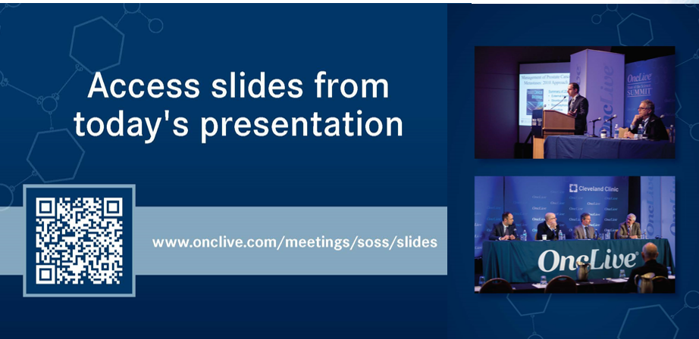

Slide 5


Slide 6
2023 Events
Precision Medicine: November 16,
Washington, DC
Breast: December 4, San Antonio, TX
2024 Events
Genitourinary: January 24, San Francisco, CA
Lung: March, Atlanta, GA
Gyn-Onc: May, Austin, TX
Lung: June, Chicago, IL
Gastrointestinal: November, Washington, DC
Breast: December, San Antonio, TX

Slide 7
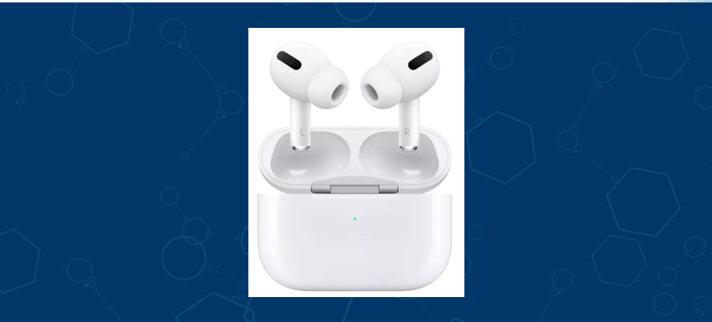

Slide 8
Program Chair
Debbie Stephens, DO
Associate Professor
Lineberger Comprehensive Cancer Center
Chapel Hill, North Carolina

Slide 9
LEUKEMIA/LYMPHOMA
Thursday, November 16, 2023

Slide 10
Current Standards and
Future Directions in CLL
Debbie Stephens, DO
Associate Professor
Lineberger Comprehensive Cancer Center
Chapel Hill, North Carolina

Slide 11
Overview
Frontline Therapy for CLL
Subsequent Therapy for CLL
A Peek at Future CLL Therapy

Slide 12
Frontline Therapy for CLL

Slide 13
More Detailed Algorithm for Patients with CLL/SLL Requiring Frontline Therapy
by IWCLL Criteria
YES
Discuss/ consider FCR x 6
Del13q +
only
Age < 65
Enroll on
Clinical Trial
YES
NO
Check CLL FISH
Clinical Trial
Available
Mutated
Check IGHV Status
Uncontrolled afib, require anticoagulation
Venetoclax + Obin (12m)
Others
Consider Comorbidities
NO
Unmutated
Check CLL FISH/TP53 mutation
Acalabrutinib/
Zanubrutinib
CrCl < 30ml/min, inability to monitor TLS
Del17p + or TP53m

Slide 14
How to Choose Between Ven + Obin and BTKi?
Venetoclax + Obinutuzumab
BTK Inhibitor
History of atrial fibrillation or hypertension
Need for systemic anticoagulation
Strong preference for time-limited therapy
Renal insufficiency
Consider for extensive infections (ibrutinib)
No access to facilities for TLS monitoring

Slide 15
Case
Mr. Red: 56M Requiring Frontline CLL Therapy d/t Progressive Anemia
Unmutated IGHV; Trisomy 12, TP53 wild type (unmutated)
Clinical Trial
Available
Check IGHV Status
Uncontrolled afib, require anticoagulation
Venetoclax + Obin (12m)
NO
TP53wt
Consider Comorbidities
Unmutated
Check CLL FISH/TP53 mutation

Slide 16
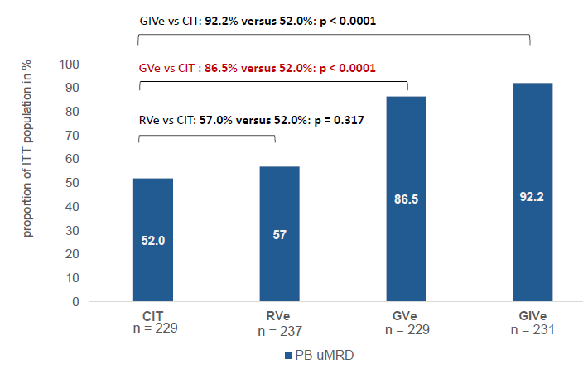
CLL13
FCR/BR x 6
CLL13
Treatment-naïve CLL
-Fit
-No del17p
Ven + R x 12m
Ven + O x 12m
N = 920
O + Ven (12m) + Ibr (up to 36m)
Eichhorst, EHA 2022

Slide 17
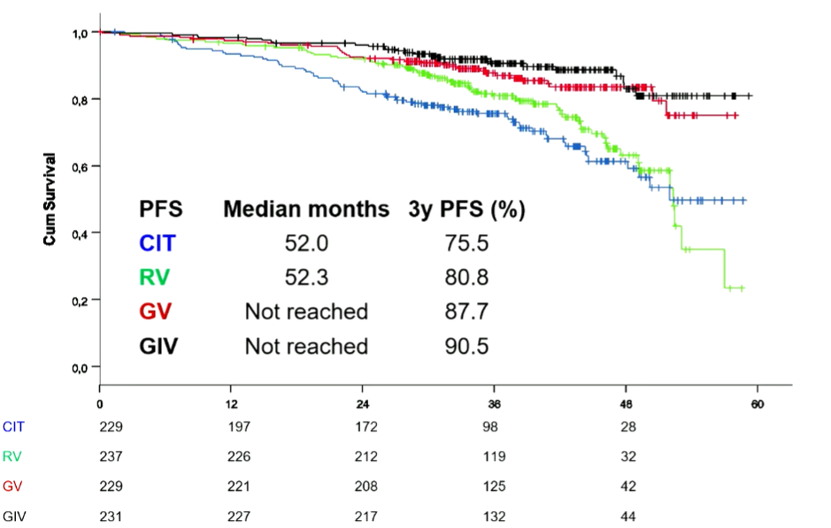
CLL13
Median follow-up 38.8 mos
Significant benefit to adding ibrutinib?
At this point, no.
Longer follow-up may show benefit as ibrutinib can extend to 36 mo.
Will toxicity of adding ibrutinib outweigh any efficacy benefit?
Unclear, longer follow-up needed.
A041702 (I+O vs I+V+O) recently reported interim analysis with no PFS benefit of I+V+O.
CLL17 ongoing: I vs V+O vs I+V
Eichhorst, EHA 2022

Slide 18
GLOW
Ibrutinib + Venetoclax ↑ PFS –
Approved for TN CLL patients in Europe
PROS
CONS
Ibrutinib (15m) + Venetoclax (12m)
Limits risk of TLS with venetoclax
Allows for a time-limited frontline BTKi treatment
Evidence of responses to ibrutinib following relapse
Toxicity (better with acalabrutinib/zanubrutinib?)
Cost/insurance coverage
Unclear which population may benefit most
As of yet, no clear evidence of functional cure
GLOW
-TN CLL
->65 years
Obinutuzumab + Chlorambucil (12m)
Where to use? Young? High-risk? Awaiting CLL17
Kater, NEJM 2022

Slide 19
Subsequent Therapy for CLL

Slide 20
Algorithm for CLL Patients Requiring Subsequent Therapy by IWCLL Criteria
Uncontrolled afib, require anticoagulation
Venetoclax + Obin (24m)
Enroll on
Clinical Trial
No Prior BTKi or Venetoclax
Consider Comorbidities
YES
CrCl < 30ml/min, inability to monitor TLS, del17p, TP53m
Clinical Trial
Available
Acalabrutinib or Zanubrutinib
Acalabrutinib or Zanubrutinib
Review Prior Tx
NO
Prior Venetoclax
If > 12m prior: Venetoclax + Obin (24m)
NO
Acalabrutinib or Zanubrutinib
BTKi Resistance Mutations Present?
Prior BTKi
Venetoclax + Obin (24m)
YES
Clinical Trial
Idelalisib
Referral CART/ AlloSCT
Prior BTKi AND Venetoclax

Slide 21
Case
Mr. Red: 58M Requiring Second-line CLL Therapy d/t Progressive B-symptoms
~12 months after completion of frontline therapy with venetoclax + obinutuzumab
Clinical Trial
Available
Acalabrutinib or Zanubrutinib
Review Prior Tx
Prior Venetoclax
NO
If > 12m prior: Venetoclax + Obin (24m)

Slide 22
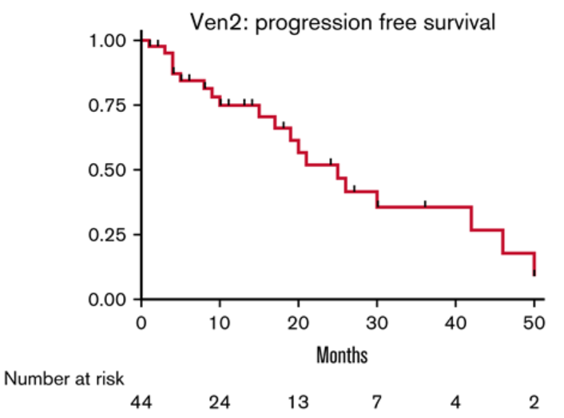
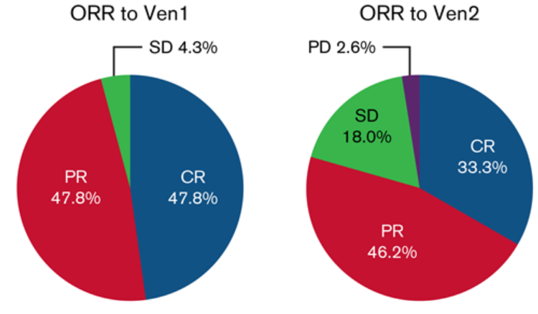
Retreatment with Venetoclax?
Recommend: ≥12 mo Ven1 response to consider retreatment. More data needed here.
46 patients retreated with venetoclax
Median prior therapies: 2 (0-10)
ORR similar but less CR with Ven2
Median PFS to Ven2: 25 months
Median time Ven2-Ven1: 16 months
  ~60% had been >12 months
Median follow-up: 10 mos
Thompson, Blood Adv 2022

Slide 23
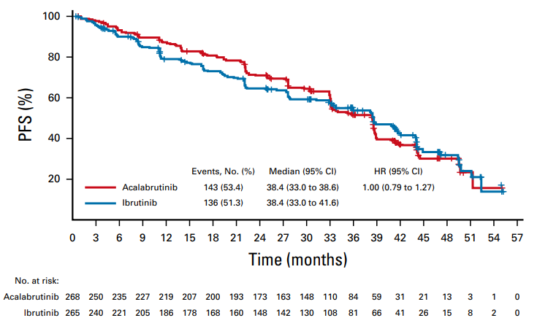
ELEVATE-RR
Primary endpoint met: Non-inferiority of PFS
Median follow-up 41 months
Acalabrutinib 100mg PO BID
ELEVATE-RR
-RR CLL
-Del17p or del11q
Ibrutinib
420mg PO QD
N = 533
Byrd, JCO 2021

Slide 24
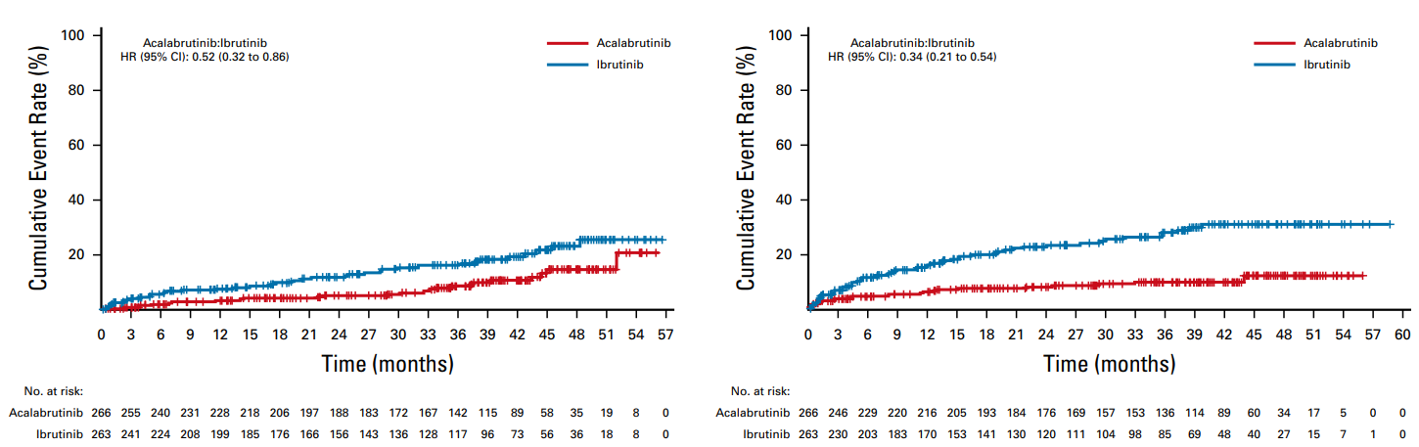
ELEVATE-RR
Acalabrutinib associated with lower cumulative:
Rates of atrial fibrillation and hypertension
Incidences of bleeding, diarrhea, arthralgia
Afib/Aflutter
Hypertension
Byrd, JCO 2021

Slide 25
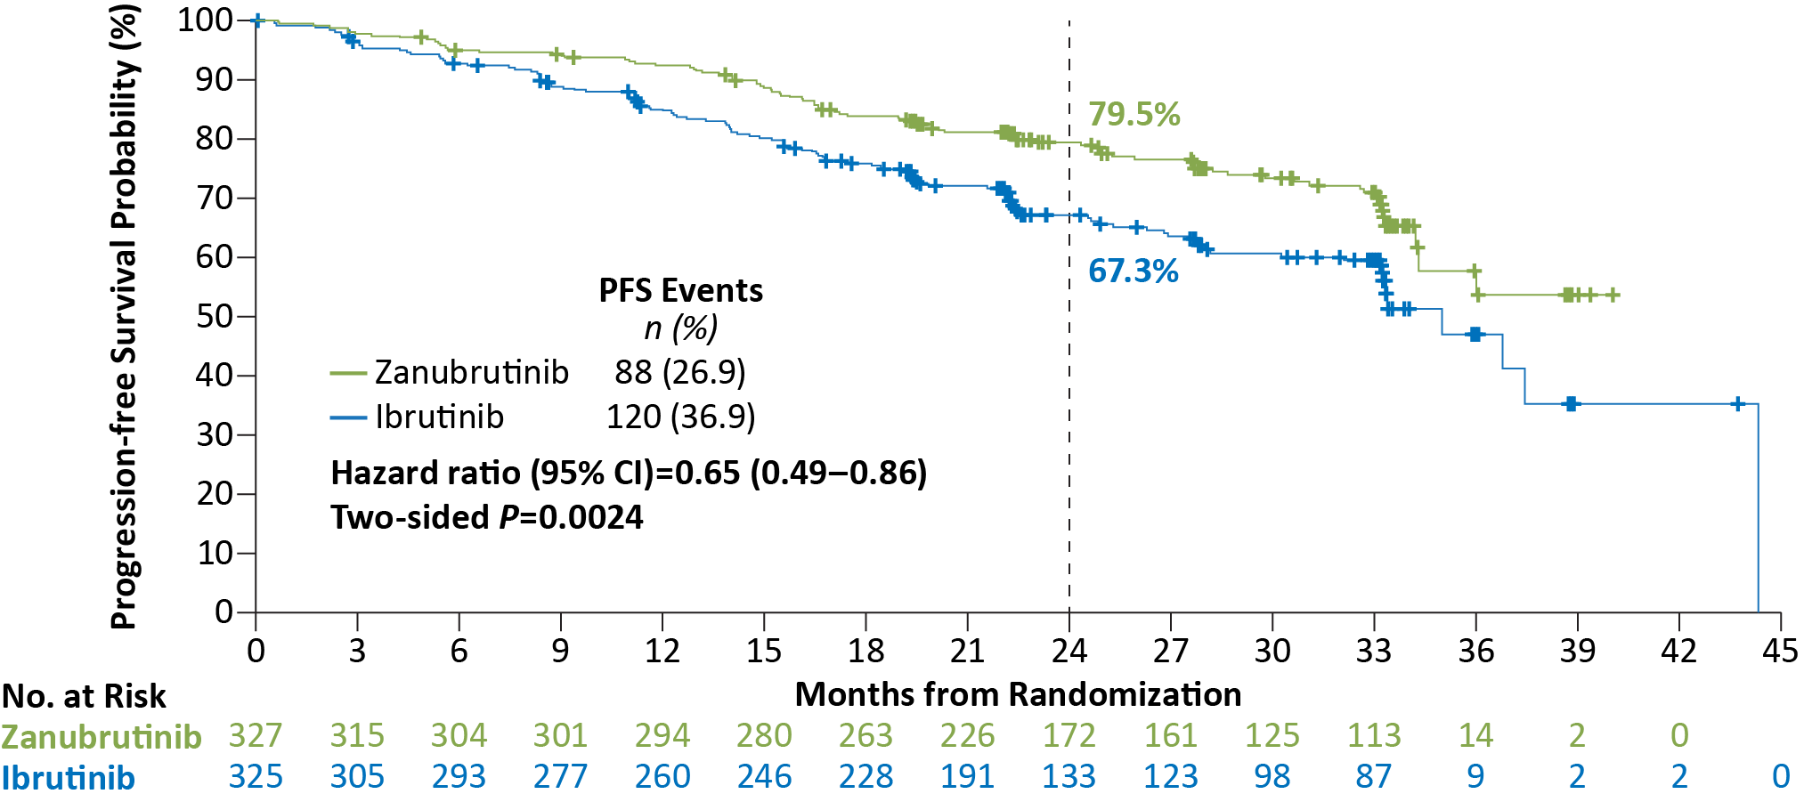
ALPINE
Primary endpoint met: Superiority of zanubrutinib in terms of overall response rate
ORR at 15 months: Z vs I = 78% vs 63% (P 0.0006)
PFS at 24 Months: Z vs I = 80% vs 67% (P 0.0024)
Zanubrutinib 160mg PO BID
ALPINE
-RR CLL
N = 415
Ibrutinib
420mg PO QD
Median Follow-up: 29.6 months
Brown, NEJM 2023

Slide 26
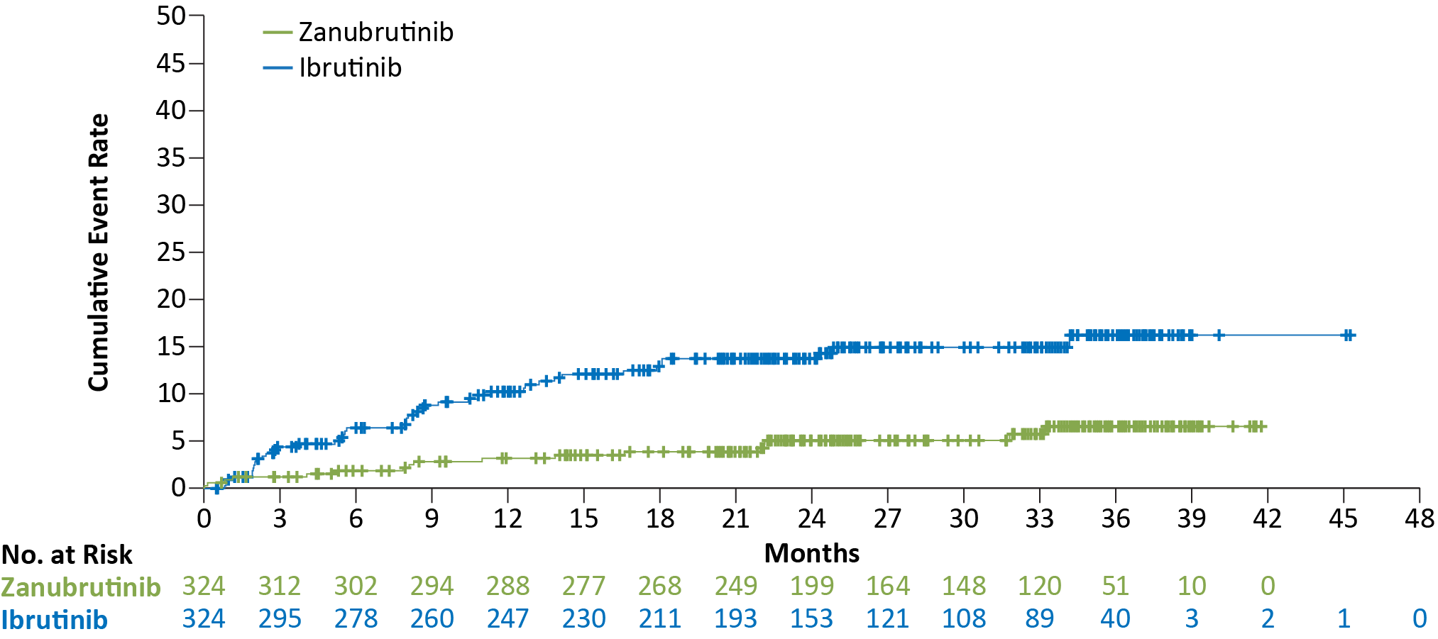
ALPINE
Zanubrutinib associated with:
  Significantly lower rates of afib
  Similar rates of hypertension
  Numerically less major bleeding and events leading to discontinuation
  Higher rates of neutropenia but lower rates of grade 3+ infections
5.2% vs 13.3%
nominal, 2-sided P=.0004
Brown, NEJM 2023

Slide 27
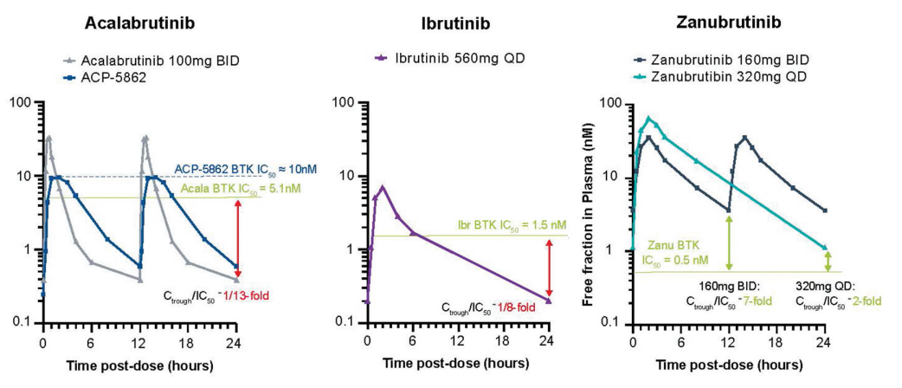
Is Zanubrutinib More Potent?
IC50: How much drug is needed to inhibit a biologic process (BTK signaling) by half?
Above IC50 for ~8/24 hours
Above IC50 for ~6/24 hours
Above IC50 for 24/24 hours
Tam, Expert Rev Clin Pharmacol 2021

Slide 28
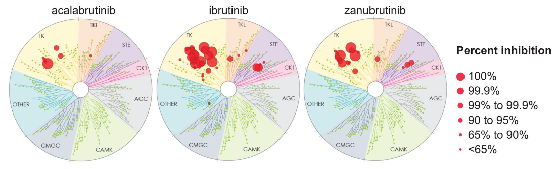
Is Acalabrutinib the Least Toxic?
Munoz, Ther Adv Hematol 2022

Slide 29
How to Choose Between BTKi?
ACALABRUTINIB
ZANUBRUTINIB
Older patients
Patients with hypertension
No longer has formulary issue with proton-pump inhibitors
Option for once daily dosing
Most others
IBRUTINIB
Patients already tolerating the drug
Patients with extensive history of other cancers?

Slide 30
A Peek At Future CLL Therapy

Slide 31
Case
Mr. Red: 61M treated with zanubrutinib and presents with progressive lymphocytosis and LAD. Next generation sequencing reveals a C481S BTK mutation.
Clinical Trial
Idelalisib
Referral CART/ AlloSCT
Review Prior Tx
Prior BTKi AND Venetoclax

Slide 32
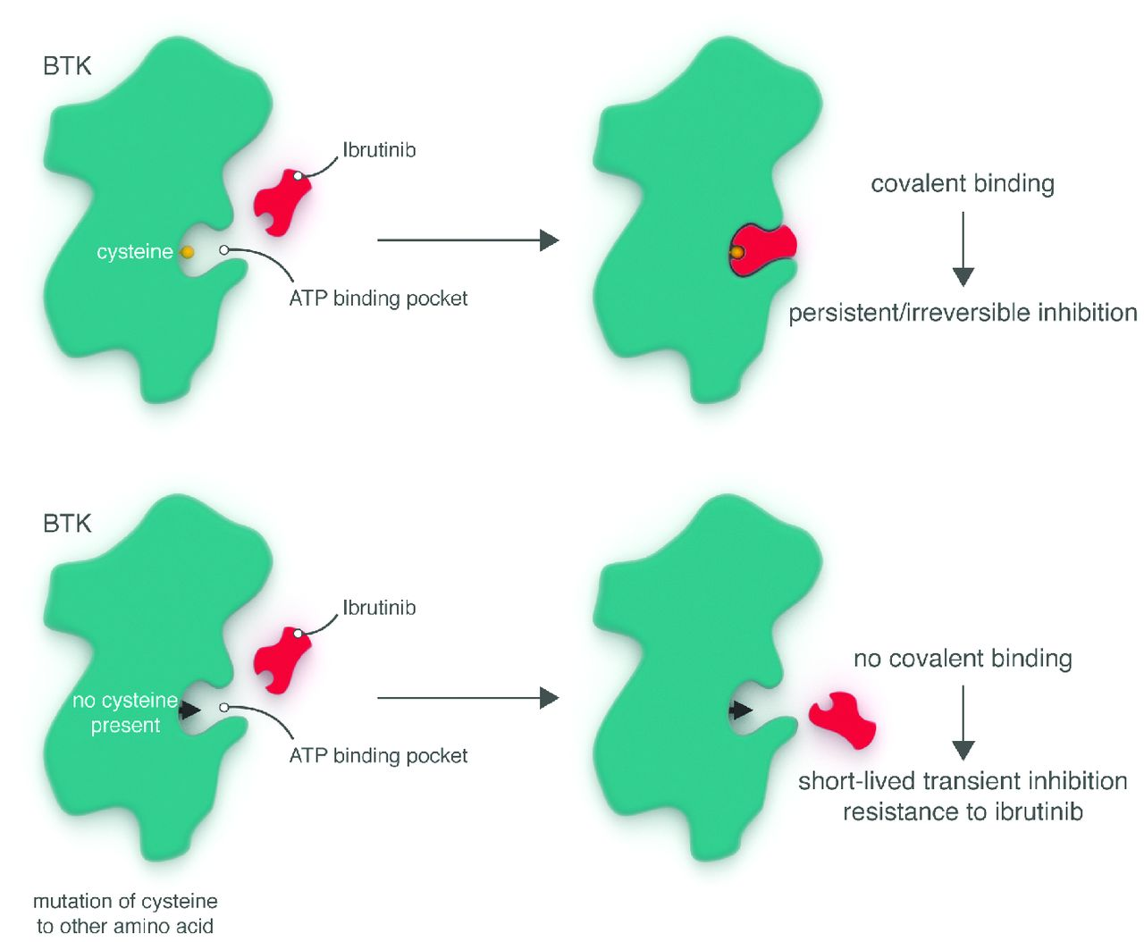
Resistance to Ibrutinib/Acalabrutinib/Zanubrutinib
Occurs more frequently 2-3 years
BTK (C481S)
Allows transient BTK inhibition
Rapid relapse after BTKi d/c
DO NOT D/C BTKi wo another plan!
Wiestner, Haematologica 2015.

Slide 33
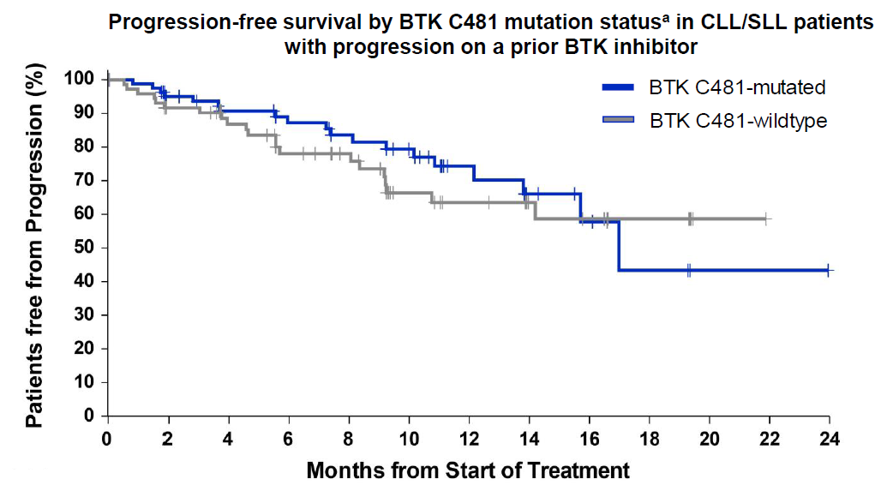
Pirtobrutinib
Pirtobrutinib–
FDA approved for RR MCL patients
Novel oral non-covalent very selective BTKi
  Does not require binding at C481
BRUIN: Phase ½ w 261 heavily pretreated CLL
ORR = 68%
PFS was independent of BTK mutation status
Notable for minimal toxicity:
  Fatigue, diarrhea, bruising (almost all grade 1/2)
  Grade 3 (<2%): fatigue, hemorrhage, HTN
  No atrial fibrillation
RP2D = 200mg daily PO
Study Ongoing
Slides adapted from Mato, ASH 2022

Slide 34
Select Other Treatments to Watch
Nemtabrutinib
Combination Therapy
Bi-Specific Antibodies
CART

Slide 35
Summary
Always enroll on clinical trial if available
Key factors in selecting frontline therapy for CLL/SLL:
  IGHV status, del (17p)/TP53 mutation status, age, comorbidities
Key factors in selecting subsequent therapy for CLL/SLL:
  Prior therapy, comorbidities, resistance mutations

Slide 36
THANK YOU
EMAIL: Deborah_Stephens@med.unc.edu
Twitter: @Debbiemstephens

Slide 37
LEUKEMIA/LYMPHOMA
Thursday, November 16, 2023

Slide 38
Sequencing Standards in MCL
Natalie Grover, MD
Associate Professor of Medicine
University of North Carolina
Chapel Hill, NC

Slide 39
Disclosures
Advisory Boards/Consulting: Kite, Novartis, ADC Therapeutics, Caribou, Genentech, Seagen, BMS, Janssen

Slide 40
Case Example
75 yo M newly diagnosed stage IV mantle cell lymphoma with extensive disease above and below the diaphragm
Presented with enlarged left inguinal lymph node
Has some symptoms from his lymphadenopathy as well as fatigue
Overall fit, retired but active

Slide 41

Frontline Management – No Consensus
Standard of care for “fit” patients: Induction regimen including rituximab and high dose cytarabine with consolidation with autoSCT and rituximab maintenance
Less “fit” patients: rituximab-bendamustine (although caution if high risk patient who may be candidate or need CAR-T soon)
  Rituximab-lenalidomide in some
Wilson et al, BJH 2023

Slide 42
What about tp53 mutation?
Present in about 10% of MCL patients
Test all newly diagnosed patients for tp53 mutation using NGS-> preferred over just deletion 17p on FISH or karyotyping
Worse outcomes with conventional chemotherapy
  Consider avoiding traditional cytotoxic chemo or pivot quickly to reduce toxicity
  Usually don’t recommend auto transplant in this setting
Clinical trial preferred
BTK inhibitor in frontline if feasible
Early CAR-T referral
  Caution with bendamustine
OS in Nordic MCL trials
Lew et al, Lancet Haematology 2023; Eskelund et al, Blood 2017

Slide 43
Case Example
Patient was negative for tp53 mutation
Initially treated with 6 cycles of rituximab-bendamustine
End of treatment scan showed CR

Slide 44
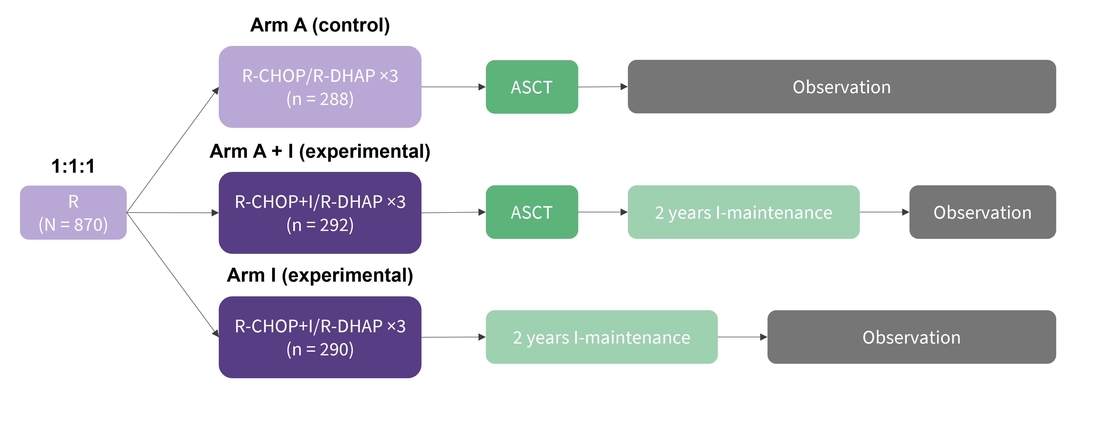
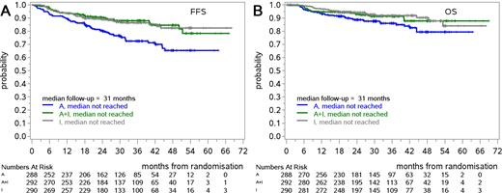
Role of AutoSCT- Triangle Study
Preliminary results: Arm I non-inferior to Arm A – maybe don’t need ASCT if ibrutinib used in induction and maintenance
ECOG study randomizing MRD negative patients in CR1 to ASCT + rituximab vs maintenance rituximab alone ongoing
Dreyling et al, ASH 2022

Slide 45
Role of autoSCT
Awaiting longer follow up/peer reviewed publication of Triangle study
Can we use newer BTK inhibitors instead of ibrutinib? Is there benefit to BTK inhibitor as maintenance vs at progression?
Currently offer ECOG clinical trial to patients
Still see role of transplant (for now) but less enthusiastic than before

Slide 46
Back to Case
Patient not interested in transplant
A few weeks after receiving first dose of maintenance rituximab, patient presents with new skin nodules
Biopsy consistent with relapsed MCL
PET/CT shows multiple hypermetabolic subcutaneous nodules in lower abdomen/thigh and back as well as BL axillary LNs

Slide 47
What do you do?
Comorbidities include HTN, HLD and type 2 DM but overall fit
Nodules appear to be growing quickly and are quite symptomatic

Slide 48
BTK Inhibitors in R/R MCL
Ibrutinib- 1st BTK inhibitor approved for MCL
  ORR 68% (CR 21%) with median DOR of 17.5 months and median 2 year OS of 47%
  11% discontinued due to AEs
  MCL indication recently withdrawn
2nd generation BTK inhibitors (acalabrutinib and zanubrutinib) - better toxicity profile with lower rates of discontinuation
  Acalabrutinib – ORR 81% with 50% CR and median PFS 19.5 months
  Zanubrutinib – ORR 84% with 78% CR and median PFS 33 months; more neutropenia but not correlated with increased infections
Wang et al, NEJM 2013; Wang et al Blood 2015; Wang et al, Lancet 2018; Tam et al, Blood Advances 2021

Slide 49
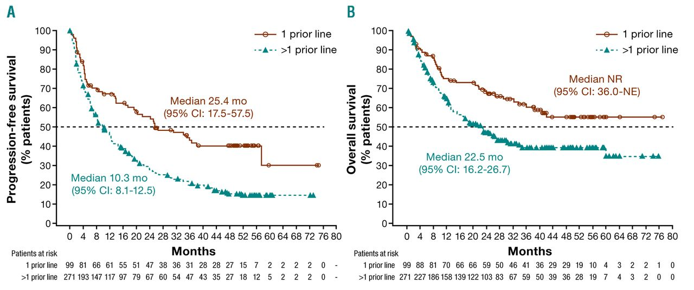
When to use BTK inhibitors
Usually first relapse especially if BTK naïve
Receiving BTK inhibitors 2nd line – higher median PFS and OS
Rule et al, Haematologica 2019

Slide 50
Case Discussion
Started on 2nd generation BTKi and also started insurance work up and preparation for CAR-T cells
After 1 month, patient felt that nodules were getting smaller
At 2 months, he noted several nodules were enlarging again
PET/CT with stable to progressive disease

Slide 51
CAR-T Cells for MCL (Brexu-cel)
68 patients treated – high risk, heavily pre-treated population
  All prior BTK inhibitors
  81% 3 or more prior lines of therapy
  6 of 36 tested had TP53 mutation
ORR 91% with 68% CR
At 3 year follow up – median DOR 28.2 months
Small numbers but similar response rates and duration of response based on TP53 mutation status
CRS in 91%- 15% grade 3 or higher
ICANS 63% - 31% grade 3 or higher
Wang et al, NEJM 382:1331-42, 2020; Wang et al JCO 2022

Slide 52
Recent Bendamustine Exposure before CAR-T
Prior bendamustine exposure (especially more recent) may be associated with inferior outcomes
Wang et al, JCO 2023

Slide 53
Back to Case
Patient proceeded with CAR-T cells
Continued BTKi as bridging therapy given slow progression
Course complicated by grade 2 CRS (received tocilizumab) and grade 3 ICANS (treated with dexamethasone)

Slide 54
Patient’s Response
1 month follow up PET/CT scan shows complete response to therapy (Deauville 2) which was maintained at 3 month follow up- continues to be in CR 2.5 years later

Slide 55
What about post CAR-T relapse (or ineligible)?
Pirtobrutinib – FDA approved
  Non-covalent BTK inhibitor - inhibits both wild type and C481-mutant BTK
  ORR 58% (20% CR), median PFS 7.4 months in 164 pts
Other CAR-T – liso-cel – may be more feasible for older/frail pts
BiTEs
ROR1 antibody/ADCs
Wang et al, JCO 2023, Kumar et al ASCO Education Book 2022

Slide 56
What about AlloSCT?
Advantages
Challenges
Graft vs Lymphoma Effect
Some durable remissions – 5 year OS 40-60%, 5 year PFS 30-50%
Long term disease free survival – 30%
In select fit, high risk patients may provide durable disease control (even in patients with TP53 mutations)
Need to control disease prior to transplant
Transplant related mortality ~20%
Risk of GVHD: 40% grade 2-4 GVHD, 30% extended chronic GVHD
Marangon et al, Cancers 13:291 2021; Yassine et al., TCT 27:363-70, 2021

Slide 57
How I Sequence Therapy in MCL
Induction chemotherapy in most patients (with high dose cytarabine if fit)
BTK inhibitor for most in 2nd line – generally 2nd generation
If aggressive/high risk disease -> early referral/consideration of CAR-T
CAR-T in 3rd line for most patients -> generally continue BTK inhibitor past progression as bridging unless rapidly progressing
Consider allo transplant in young, fit patients with high risk disease who relapse post CAR-T
If TP53 mutated -> consider avoiding bendamustine, try BTK inhibitor or less intensive regimen in 1st line and early CAR-T referral

Slide 58
LEUKEMIA/LYMPHOMA
Thursday, November 16, 2023

Slide 59

Acute Myeloid Leukemia: Updated Classification & New Approvals in 2023
Joshua Zeidner, MD
Associate Professor of Medicine
Chief, Leukemia Research
Director, Clinical Cancer Research, Commercial Integration
Associate Chief of Research, Hematology
University of North Carolina, Lineberger Comprehensive Cancer Center
@LeukDocJZ

Slide 60
Disclosures
Consultancy: AbbVie, Foghorn, Gilead, Novartis, Sellas, Servier, Sumitomo Dainippon
Honoraria (Advisory Boards): AbbVie, Bristol Myers Squibb, Daiichi Sankyo, Gilead, Immunogen, Servier, Shattuck Labs
Grants/Research Funding: AbbVie, Arog, Astex, Jazz, Gilead, Loxo, Merck, Newave, Shattuck Labs, Stemline, Sumitomo Dainippon Pharma, Takeda

Slide 61
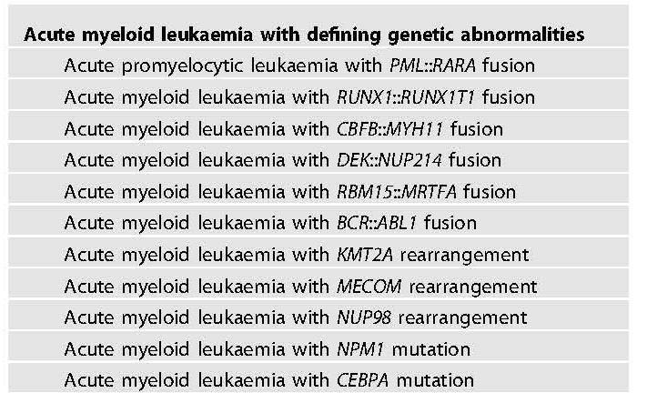
Diagnostic Classification of AML in 2023
AML traditionally defined as >20% myeloblasts in PB or BM
Evolution of Dx classification-> increasingly incorporating genomic factors
2022 WHO and ICC recognize the subjectivity of blast %
  MDS/AML- 10-19% blasts in ICC
WHO Classification (irrespective of blast %) ICC/ELN Criteria- >10% blasts
Khoury, Leukemia 2022; Arber, Blood 2022; Dohner, Blood 2022

Slide 62
Evolving Criteria of AML with Myelodysplasia
Secondary AML: therapy-related AML (t-AML) or AML from preexisting myeloid neoplasm
AML-MRC: WHO-defined subgroup in 2008 & refined in 2016
  AML from preexisting MDS/CMML
  AML with specific MDS-related cytogenetic abnormalities
  AML with multilineage dysplasia
    >50% dysplasia in >2 lineages in diagnostic BM Bx
    No NPM1 or biallelic CEBPA mutation
25-30% of newly dx AML pts classified as AML-MRC
Poor outcomes with conventional therapy
Arber, Blood 2016

Slide 63
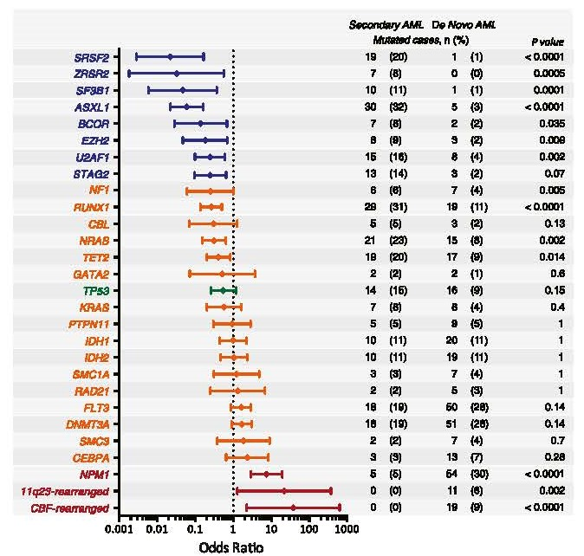
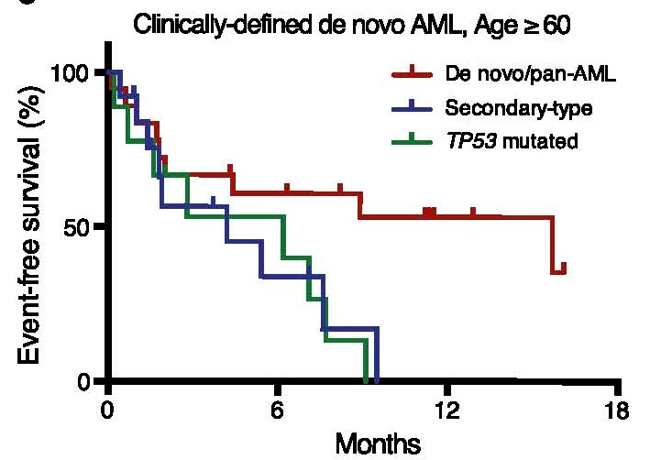
Mutations Highly Specific for Secondary AML
Lindsley, Blood 2015

Slide 64
Updated AML-MR Classification in 2022
Diagnostic Entity | International Consensus Classification (ICC) 2022 | World Health Organization (WHO) 2022
Multilineage dysplasia | Not included | Not included
Therapy-related AML | Qualifier only | Not included
Preexisting MDS or MDS/MPN | Qualifier only | Included in AML-MR
AML with MDS-related cytogenetics | AML w/ MDS-related cytogenetics Complex, del(5q)/t(5q)/add(5q), -7/del(7q), +8, del(12p)/t(12p)/add(12p), i(17q), -17/add(17p) or del(17p), del(20q), idic(X)(q13) | AML-MR Complex, del(5q)/t(5q), -7/del(7q)/t(7q), del(11q), del(12p)/t(12p), -13/del(13q), i(17q), del(17p)/t(17p), idic(X)(q13)
AML with MDS-Related Mutations | AML w/ MDS-Related Gene Mutations ASXL1, BCOR, EZH2, RUNX1, SF3B1, SRSF2, STAG2, U2AF1, ZRSR2 | AML-MR ASXL1, BCOR, EZH2, SF3B1, SRSF2, STAG2, U2AF1, ZRSR2
Khoury, Leukemia 2022; Arber, Blood 2022

Slide 65
MR Mutations Associated with Worse Outcomes
>60 years from ALFA-1200
- n= 509
- 48% had AML-MR
RWD newly Dx AML from Taiwan
- n=1213
- 33% had AML-MR
Gardin, Blood Adv 2020; Tsai, Blood Cancer J 2023

Slide 66
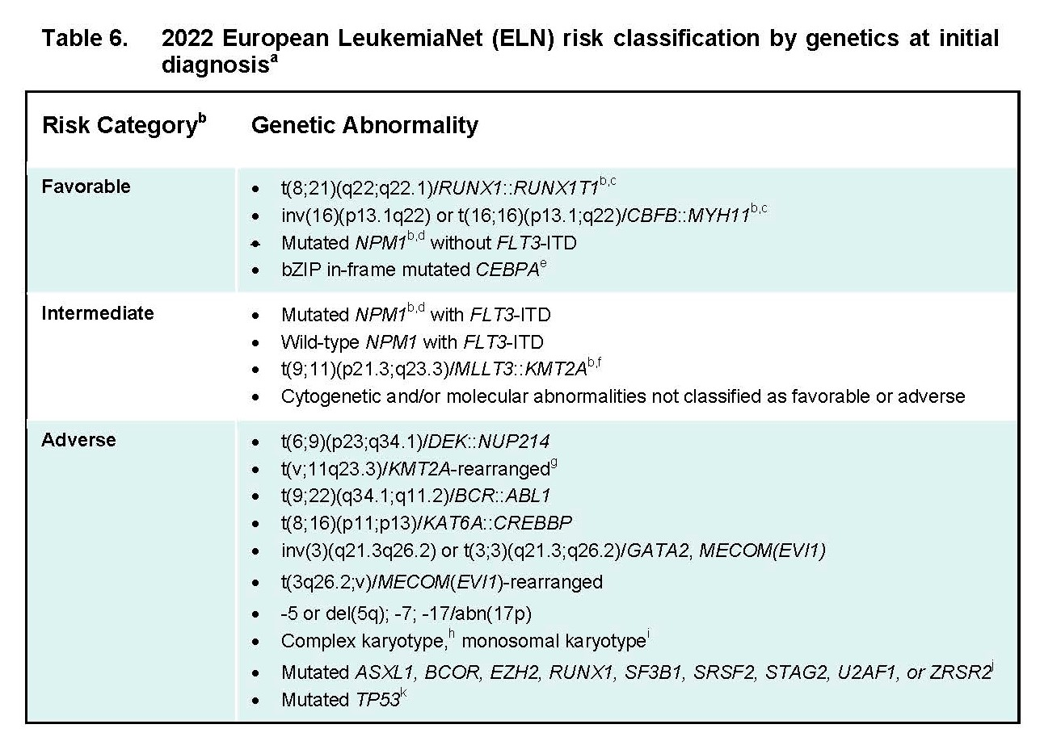
ELN Genomic and Risk Classification of AML
Dohner, Blood 2022

Slide 67
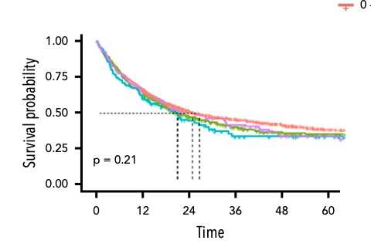
Can you Wait for Diagnostic Testing in AML?
Retrospective database from international AML Registry (n=2,263)
 | Time from Diagnosis to Treatment
 | 0–5 Days (n = 1547) | 6–10 Days (n = 447) | 11–15 Days (n = 106) | > 15 Days (n = 163)
CR/CRi | 79% | 76% | 72% | 77%
Early Mortality | 4% | 5% | 4% | 5%
Clinical outcomes are similar in all four subgroups including younger and older patients
Waiting for full diagnostic testing is feasible for most newly diagnosed AML cases
Rollig, Blood 2020

Slide 68
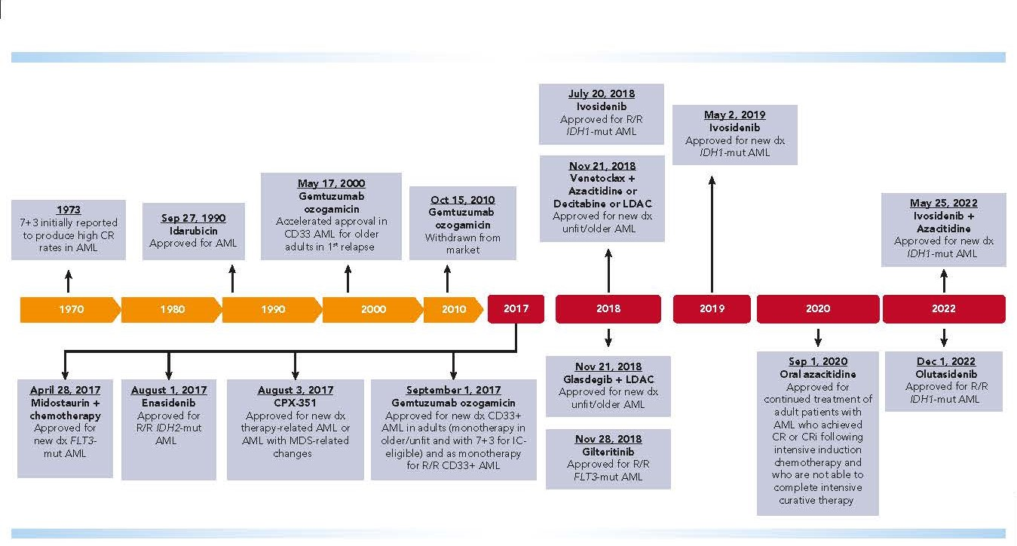
Treatment Landscape of AML in 2023
July 20, 2023
Quizartinib + 7+3
Approved for newly Dx AML w/ FLT3-ITD
2023
El Chaer, Blood 2023

Slide 69
Frontline Management of AML
Age is most significant factor when assessing for fitness for 1L Tx
Younger AML (<60 years)
  Induction therapy remains SOC- Tx regimen specific to genomic profile & risk group
  Exceptions include poor ECOG PS, prior anthracyclines, TP53 mutations
Older AML (60-75 years)
  Most controversial area in AML-> Individualized Tx
  Treatment landscape is shifting to less intensive therapies
Elderly AML (>75 years)
  Not intensive chemo candidates or BMT candidates (very few exceptions)
  Aza/Ven- paradigm shift as SOC (some exceptions- still mini-intensive)

Slide 70
FLT3 mutations: A New Era of Targeted Tx Approaches
FLT3-ITD mutation (~25% of newly Dx AML)
    Most common FLT3 mutation-> constitutive activation of FLT3
    Presentation: Younger pts, proliferative disease, monocytic phenotypes, most commonly w/ normal karyotype
    Relapse can be rapid
    Intermediate or Adverse-risk-> Should be referred for alloBMT
FLT3-TKD mutation (~5% of newly Dx AML)
    Most common = D835 mutation
    Neutral prognostically
    Heterogeneous subgroup, can also be associated w/ FLT3-ITD mutation

Slide 71
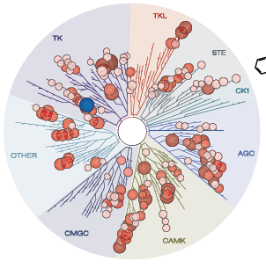
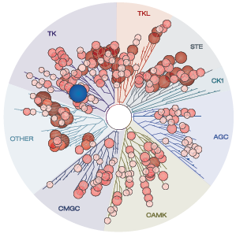
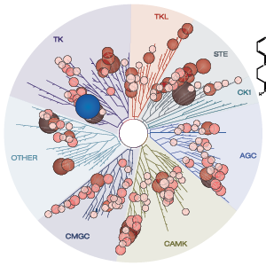
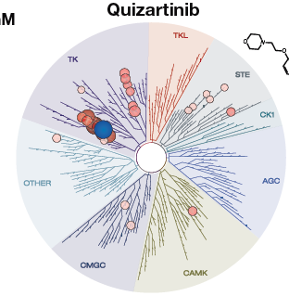
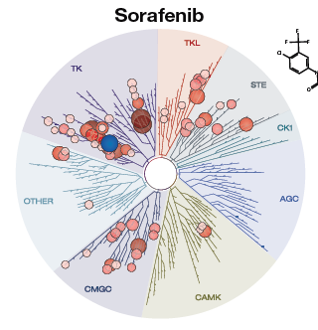
FLT3 inhibitors
Type 1- active against TKD and ITD
Type 2- active only against ITD
Midostaurin
Gilteritinib
Crenolanib
Quizartinib
Sorafenib
Aikawa, Cancer Res 2018; Daver, Leukemia 2019

Slide 72
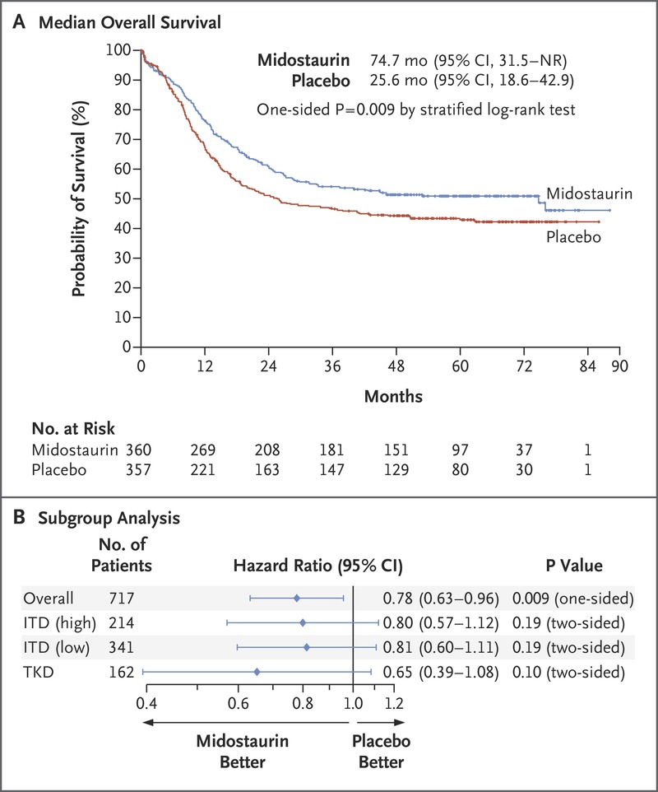
7+3 + Midostaurin (RATIFY)
 | 7+3 + Midostaurin (n=360) | 7+3 + Placebo (n=357)
Median OS | 74.7 months | 25.6 months
CR | 58.9% | 53.5%
Median EFS | 8.2 months | 3.0 months
Newly Dx AML w/ FLT3 mutation
18-60 years
7+3 + Midostaurin
N=360
N=717
N=357
7+3 + Placebo
23% of pts enrolled had FLT3-TKD mutation
7+3 + Midostaurin led to new SOC for newly Dx AML with FLT3 mutation in 2017
Stone, N Engl J Med 2017

Slide 73
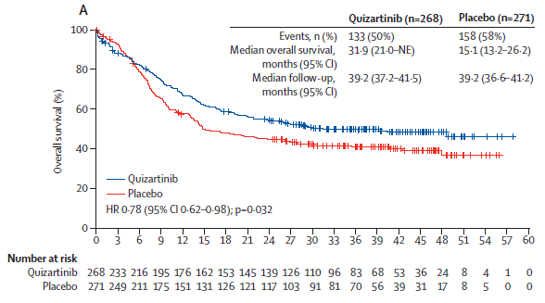
7+3 + Quizartinib (QUANTUM-First)
7+3 + Quizartinib
 | 7+3 + Quizartinib N=268 | 7+3 + Placebo N=271
Median OS | 31.9 months | 15.1 months
CR + CRi | 71.6% | 64.9%
Median duration of CR | 38.6 months | 12.4 months
Newly Dx AML w/ FLT3-ITD mut
18-75 years
N=268
N=539
N=271
7+3 + Placebo
Main AE = QTcF prolongation & myelosuppression
Quiz FDA-approved in combination with 7+3 in July, 2023 for Newly Dx FLT3-ITD mut AML
Erba, Lancet 2023

Slide 74
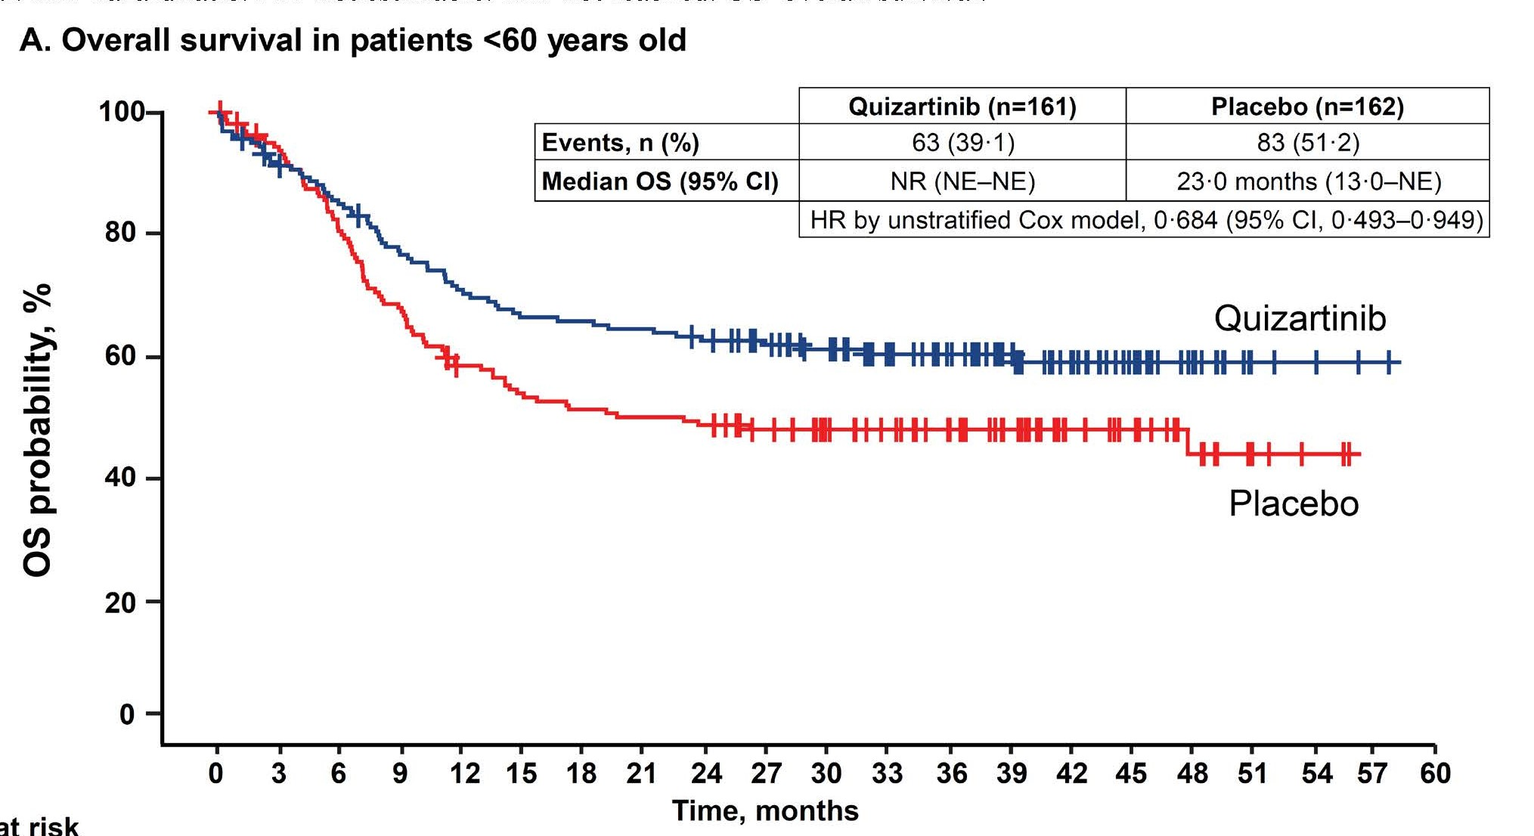
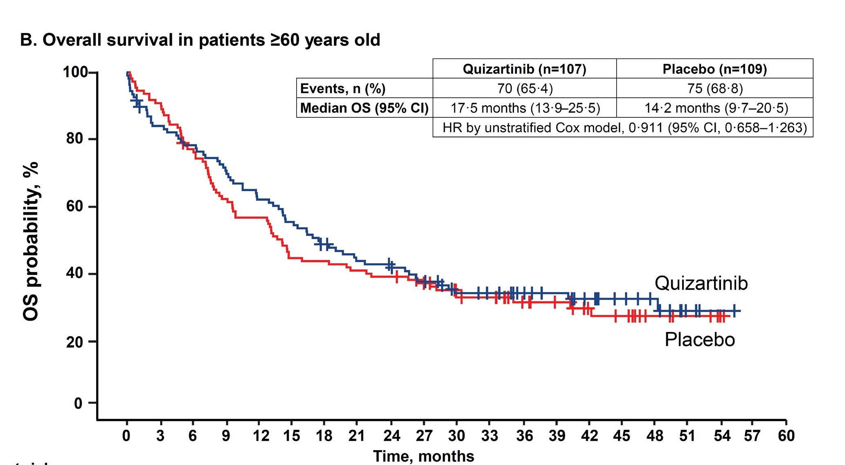
7+3 + Quizartinib OS Stratified by Age
Erba, Lancet 2023

Slide 75
Frontline Management of FLT3-Mut AML Summary
Critical to get molecular data prior to induction-> Rapid FLT3 assay
FLT3 inhibitors should be added to 7+3 induction for all FLT3 mutations
FLT3-TKD mutation-> 7+3 + Midostaurin should be used in pts <60-70 years
FLT3-ITD mutation-> 7+3 + Quizartinib (preferred) or 7+3 + Midostaurin
  7+3 + Quizartinib favorable outcomes compared w/ 7+3 + Midostaurin in FLT3-ITD Quizartinib should be used with caution in >60 years, those w/ cardiac comorbidities or prolonged QTcF
All FLT3-ITD mutated AML patients should be considered and prioritized for alloBMT given high relapse rates w/o alloBMT
  FLT3 inhibitors should be considered post-alloBMT for maintenance Tx
Dohner, Blood Adv 2022

Slide 76
LEUKEMIA/LYMPHOMA
Thursday, November 16, 2023

Slide 77
Current Standards in Myelofibrosis
Brandi Reeves, MD
Assistant Professor of Medicine
University of North Carolina
Chapel Hill, NC

Slide 78
Disclosures
I have received consulting fees from:
  BMS
  CTI BioPharma
  Incyte
  MorphoSYS
  PharmaEssentia
  Protagonist Therapeutics

Slide 79
Disclosures
I will discuss off-label use of:
  Luspatercept (NCCN guidelines)
  Hydroxyurea (NCCN guidelines)
  Pegylated interferon alfa 2a (NCCN guidelines)

Slide 80
Case: 56yo man w/anemia
Delayed annual examination
Hgb 8.7, WBC 11, Plts 249
nRBCs, tear drops, no blasts
Spleen is 4cm below LCM
Mild fatigue

Slide 81
Case: 56yo man w/anemia
(+) depression/anxiety, not well-controlled
LDH 1.5x ULN
BMBX w/80% cellularity, TLH, increased megakaryocytes w/atypia & clustering, moderate reticulin fibrosis, MF-2. 1% blasts. Normal iron stores.
CALR Type 1, 46,XY [20]

Slide 82
How should this patient with newly diagnosed primary myelofibrosis be managed?
: 75yo F w/
Pegylated interferon alfa
Observation
Ruxolitinib
Hydroxyurea
Momelotinib

Slide 83
Goals of Treatment
Cure: presently only with AHSCT
Palliation: in 2023, all MF drug therapy
  Splenomegaly, Constitutional sx, anemia
Disease modification: improving clinically important outcomes
  Overall survival, leukemia-free survival
  Normalizing bone marrow

Slide 84
Risk Stratification
Prognostic Risk Models
  MIPSS-70+ v2.0
  DIPSS
  DIPSS-Plus
  MYSEC-PM
Lower-risk
Higher-risk
Accelerated/blast phase
NCCN v.3.2023 MF

Slide 85
DIPSS/DIPSS-Plus
>65yo – 0
Hgb 8-10 – 2
WBC <25 – 0
Circulating blasts >1% - 0
Constitutional sx – 0
Plts <100 – 0
TD-anemia – 0
Unfavorable karyotype - 0
MIPSS 70 v2.0
Hgb 8-10 or <8
WBC >25
Plts <100
Circulating blasts >2%
BM fibrosis >2
Constitutional sx
No CALR Type 1 mutation
HMR 1 or >2
Karyotype – bad or worse
Int-1, Low-risk

Slide 86
Heterogenous Survival
DIPSS-Plus
MIPSS 70 v2.0
Pts | Group | Med OS (<60yo) | Med OS (all)
0 | Low | 20 | 15.4
1 | Int-1 | 14.3 | 6.5
2-3 | Int-2 | 5.3 | 2.9
4-6 | High | 1.7 | 1.3
Pts | Group | Med OS (<70yo)
0 | Very Low | NR
1-2 | Low | 10.3
3-4 | Int | 7
5-8 | High | 3.5
>9 | Very High | 1.8

Slide 87
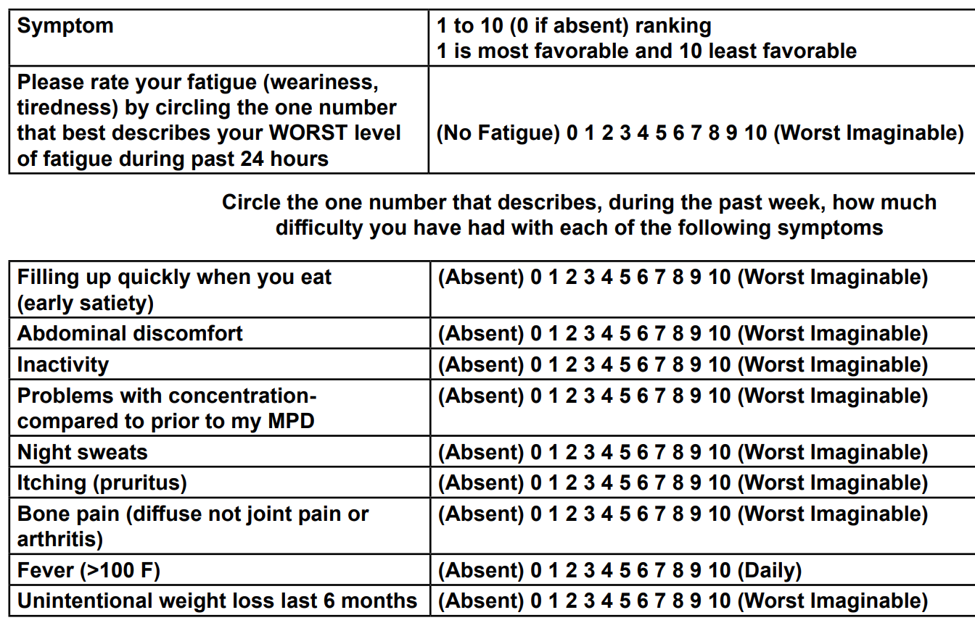
Lower-risk MF Management
Assess symptom burden (MPN-10)
NCCN v.3.2023 MF

Slide 88
Lower-risk MF Management
Clinical Trial
or
Observation
Assess symptom burden (MPN-10)
(-)
Clinical Trial
or
Ruxolitinib
or
PegIFN α
or
Hydroxyurea
or
Momelotinib
(+)
(2B)
NCCN v.3.2023 MF

Slide 89

JAK inhibitors can be used in all MF – do NOT require JAK2 mutation
 | Ruxolitinib | Momelotinib
MOA | JAK1/2 | JAK1/2, ACVR1
FDA Labeling | Int or High w/plts >50 | Int or High w/anemia (w/plts >25)
Main Side Effects | TCP, anemia, bruising, dizziness, HA, diarrhea | TCP, bleeding, bacterial infxn, fatigue, dizziness, diarrhea, nausea

Slide 90
 | Ruxolitinib | Momelotinib
Main Side Effects | TCP, anemia, bruising, dizziness, HA, diarrhea | TCP, bleeding, bacterial infxn, fatigue, dizziness, diarrhea, nausea
Drug-Drug Interactions | Fluconazole, CYP3A4 inhibitors | OATP 1B1/B3, BRCP
Dosing | Based on platelet count | 200mg po daily

Slide 91
 | Ruxolitinib | Momelotinib
SVR 35 | JAKi naïve: 42%, 29% | JAKi naïve: 31% JAKi prior: 22%
Sx Improved >50% | 46% | 40%*
Anemia response | ▼ 1g/dL | ▲ 1.3 g/dL
There is a separate pathway for anemia management in NCCN guidelines

Slide 92
NCCN Treatment Nodes
PMF or PPV-MF or PET-MF
Lower-risk
Higher-risk
Accelerated/blast phase
Anemia
NCCN v.3.2023 MF

Slide 93
Anemia Management
Rule out & treat co-existing causes
ESA
or
Clinical Trial
EPO <500
No response or Loss of response
Clinical Trial
or
Momelotinib
or
Danazol, Len+pred, Thal+pred
or
Luspatercept (Cat 3)
EPO >500
NCCN v.3.2023 MF

Slide 94
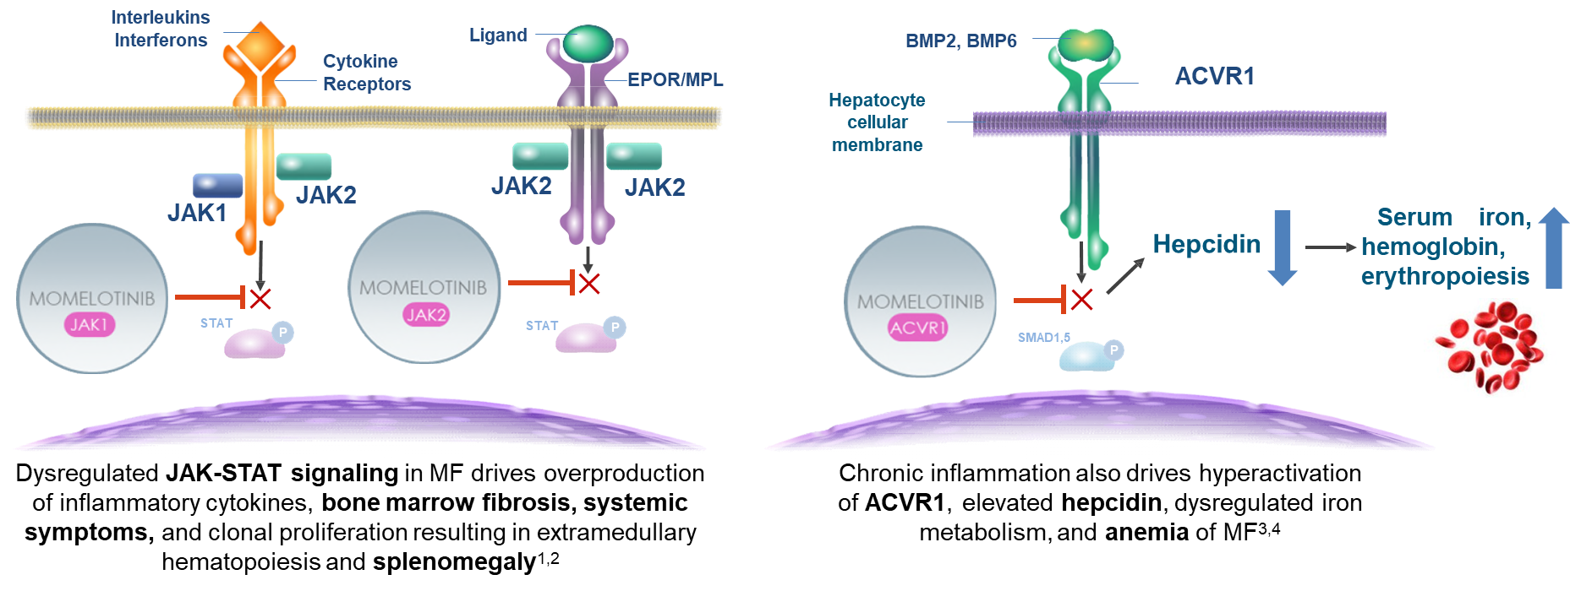
Momelotinib inhibits JAK1, JAK2, ACVR1
ACVR1, activin A receptor type 1; BMP, bone morphogenetic protein; EPOR, erythropoietin receptor; JAK, Janus kinase; MF, myelofibrosis; MPL, myeloproliferative leukemia protein; SMAD1/5, mothers against decapentaplegic homolog 1/5; STAT, signal transducer and activator of transcription.
1. Chifotides HT, et al. J Hematol Oncol. 2022;15(1):7. 2. Verstovsek S, et al. Future Oncol. 2021;17(12):1449-1458. 3. Asshoff M, et al. Blood. 2017;129(13):1823-1830. 4. Oh ST, et al. Blood Adv. 2020;4(18):4282-4291.
https://presentations.gsk.com/orals/5659/

Slide 95
Momelotinib 200mg qD
n=215
@ 24wk
1֯ Endpoint: SVR 35
2֯ Endpoints: TSS improvement rate, RBC transfusion rate, RBC TI rate, RBC TD rate
MF; Int-2, High Risk, or Int-1 w/sx; (+) splenomegaly; Plt >50; <10% PB blasts
SIMPLIFY-1
Ruxolitinib 20mg BID
n=217
JAKi naive
Momelotinib 200mg qD
n=104
@ 24wk
1֯ Endpoint: SVR 35
2֯ Endpoints: TSS improvement rate, RBC transfusion rate, RBC TI rate, RBC TD rate
MF; Int-2, High Risk, or Int-1 w/sx; (+) splenomegaly; Plt >50; <10% PB blasts
SIMPLIFY-2
BAT
n=52
Rux intolerant or suboptimal response

Slide 96
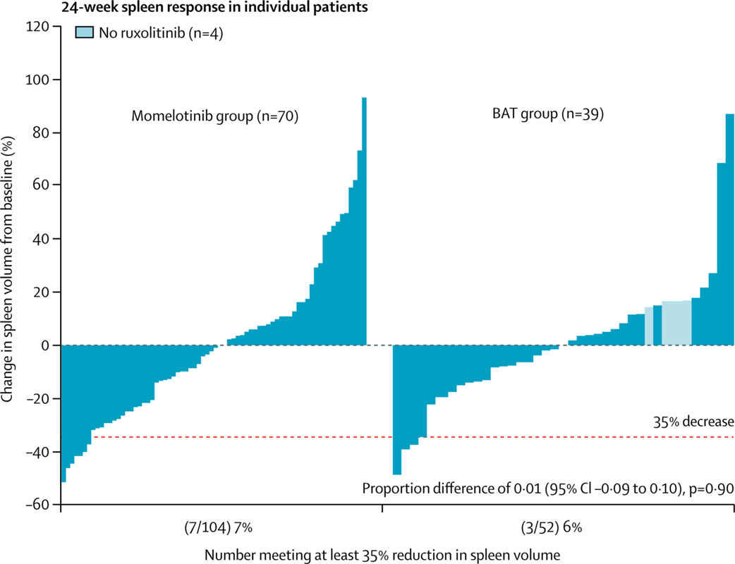
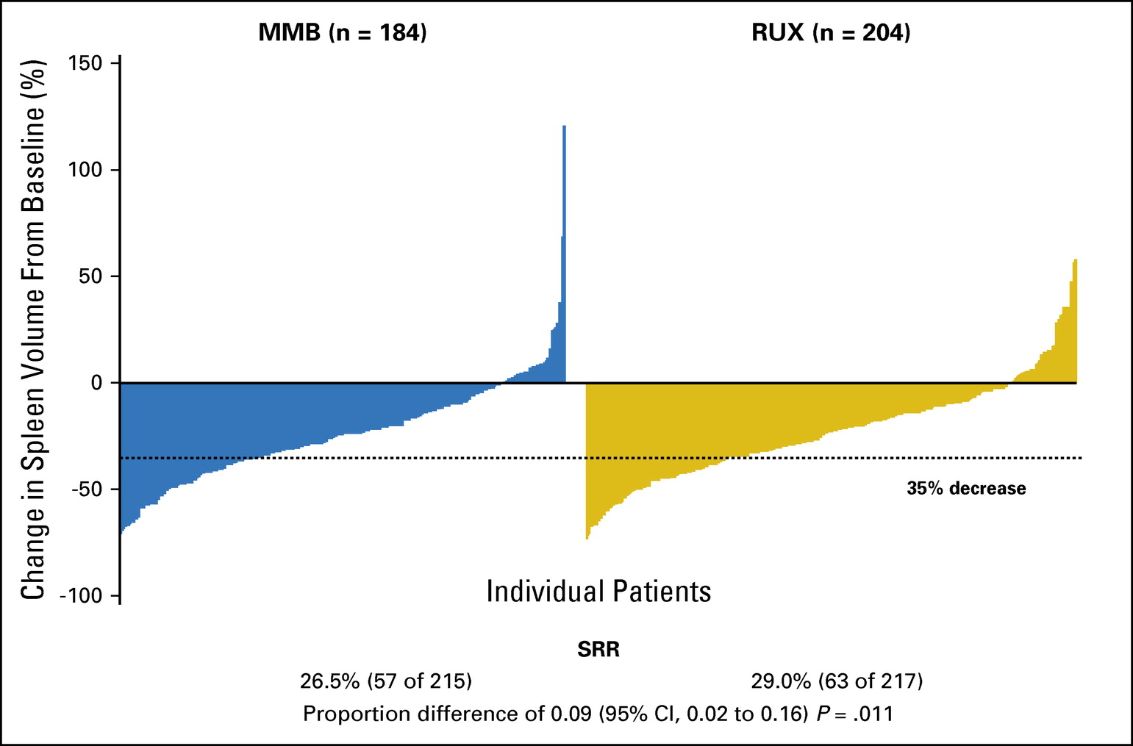
Spleen Reduction
SIMPLIFY-1
SIMPLIFY-2
27%
29%
7%
6%
J Clin Oncol. 2017 Dec 1;35(34):3844-3850.
Lancet Haematol. 2018 Feb;5(2):e73-e81.

Slide 97
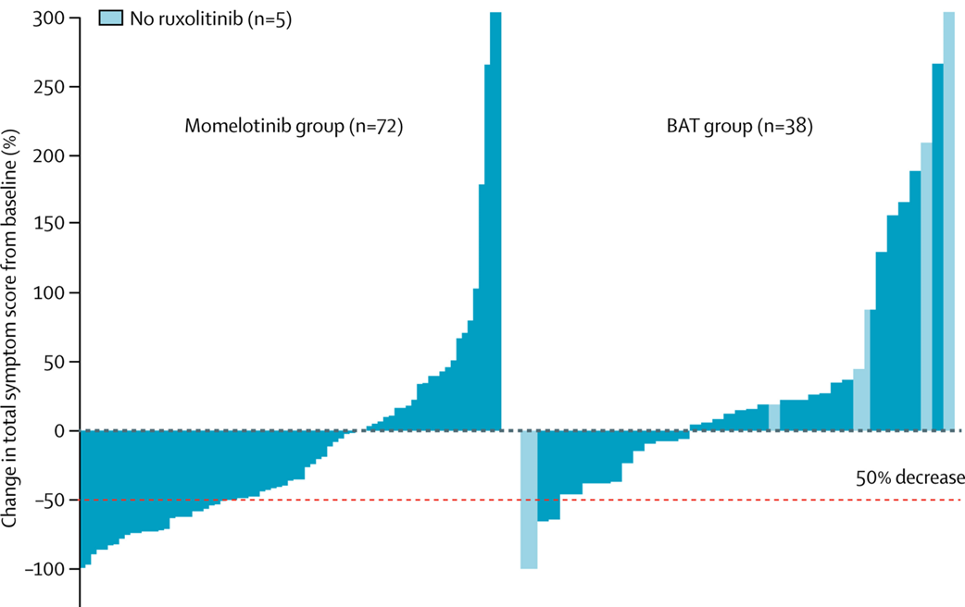
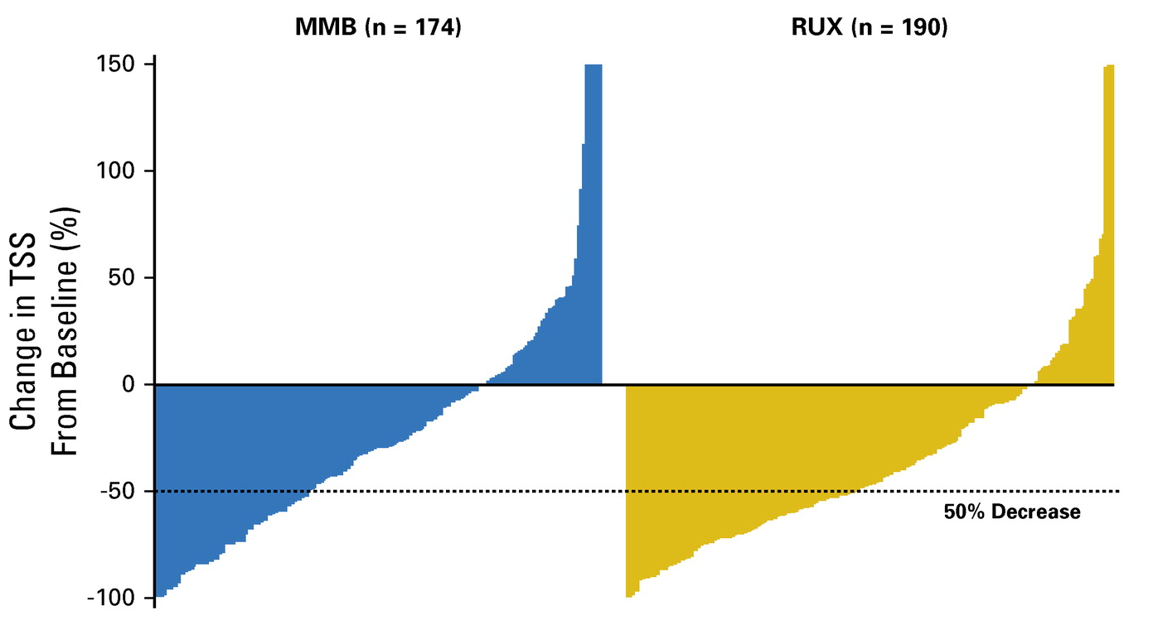
Symptom Response
SIMPLIFY-1
SIMPLIFY-2
28%
42%
26%
6%
J Clin Oncol. 2017 Dec 1;35(34):3844-3850.
Lancet Haematol. 2018 Feb;5(2):e73-e81.

Slide 98
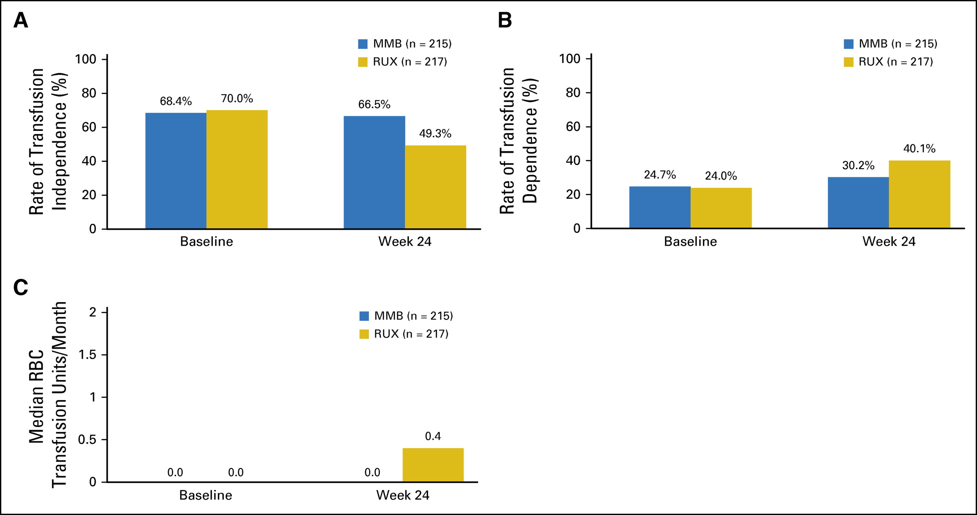
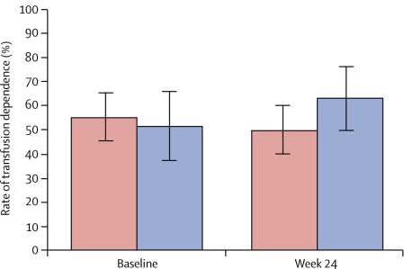
Transfusion Dependence Rate
SIMPLIFY-1
SIMPLIFY-2
+12%
-3%
+16%
+6%
MMB
BAT
MMB
BAT
MMB
RUX
MMB
RUX
J Clin Oncol. 2017 Dec 1;35(34):3844-3850.
Lancet Haematol. 2018 Feb;5(2):e73-e81.

Slide 99
Momelotinib 200mg qD
n=130
JAKi Experienced
Symptomatic
Anemic (Hgb <10)
Plts >25x10⁹/L
MOMENTUM
24wk
Momelotinib 200mg qD
Danazol 600mg qD
n=65
@24 wk 1֯ 2֯
 | TSS response rate | TI rate | SVR 35
MMB | 25% | 30% | 22%
DAN | 9% | 20% | 3%
 | P=0.0095 (superior) | P=0.0064 (noninferior) | P=0.0006 (superior)
Lancet. 2023 Jan 28;401(10373):269-280.

Slide 100
CASE REVISITED: How should this patient with newly diagnosed primary myelofibrosis be managed?
: 75yo F w/
Pegylated interferon alfa
Observation
Ruxolitinib
Hydroxyurea
Momelotinib
+depression that is not well-controlled
Symptomatic
Could consider at reduced dose
No need for cytoreduction
Can improve spleen size, symptoms, and anemia

Slide 101
Case: 80yo F w/leukoerythroblastosis
WBC 30, ANC 24, Hgb 9.2, Plts 49
nRBCs, teardrops, 2% blasts
Spleen tip 12cm below LCM
Amiodarone for afib
Early satiety, night sweats
KPS 70

Slide 102
Case: 80yo F w/leukoerythroblastosis
LDH is 2.5x ULN
BMBX w/80% cellularity, TLH, increased megakaryocytes w/atypia & clustering, moderate reticulin fibrosis, MF-2. 1% blasts.
JAK2 V617F, TET2, 46,XX [20]

Slide 103
How should this patient with newly diagnosed primary myelofibrosis be managed?
Allogeneic stem cell transplant
Ruxolitinib
Hydroxyurea
Pacritinib
Momelotinib

Slide 104
DIPSS/DIPSS-Plus
>65yo – 1
Hgb 8-10 – 2
WBC <25 – 1
Circulating blasts >1% - 1
Constitutional sx – 1
Plts <100 – 1
TD-anemia – 0
Unfavorable karyotype - 0
MIPSS 70 v2.0
Hgb 8-10 or <8
WBC >25
Plts <100
Circulating blasts >2%
BM fibrosis >2
Constitutional sx
No CALR Type 1 mutation
HMR 1 or >2
Karyotype – bad or worse
High, High

Slide 105
Heterogenous Survival
DIPSS-Plus
MIPSS 70 v2.0
Pts | Group | Med OS (<60yo) | Med OS (all)
0 | Low | 20 | 15.4
1 | Int-1 | 14.3 | 6.5
2-3 | Int-2 | 5.3 | 2.9
4-6 | High | 1.7 | 1.3
Pts | Group | Med OS (<70yo)
0 | Very Low | NR
1-2 | Low | 10.3
3-4 | Int | 7
5-8 | High | 3.5
>9 | Very High | 1.8

Slide 106
Higher-risk MF Management
Yes
Allogeneic HCT
Transplant Candidate
<50,00/uL
Platelet Count
No
>50,00/uL

Slide 107

Allogeneic HSCT
Cure
HIGH RISK
median OS <3yr
20% NRM @ 2yr
Am J Hematol. 2022 Nov;97(11):1464-1477

Slide 108
Higher-risk MF Management
Platelet Count
>50,00/uL
<50,00/uL
Clinical Trial
or
Ruxolitinib
or
PegIFN α
or
Hydroxyurea
or
Momelotinib
Clinical Trial
or
Pacritinib (1)
or
Momelotinib (2B)

Slide 109
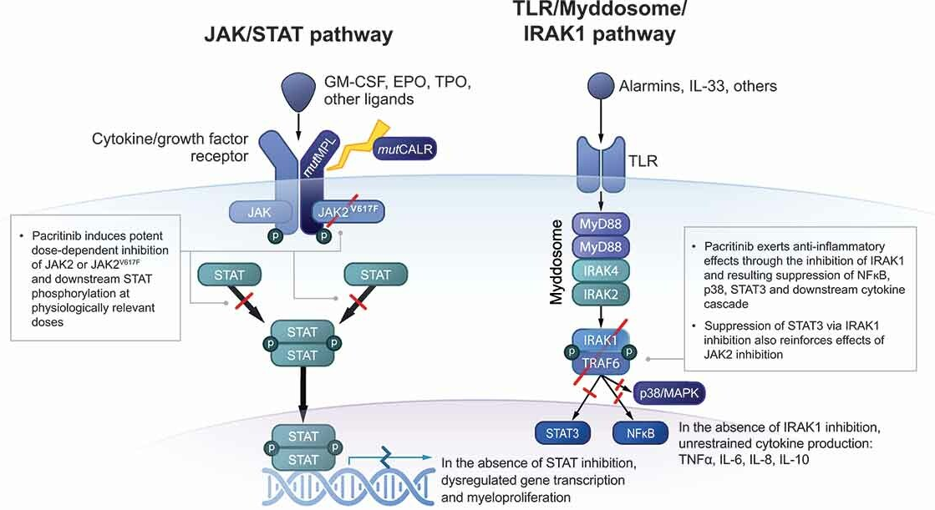
Pacritinib MOA
Expert Rev Hematol. 2022 Aug;15(8):671-684.

Slide 110
Pacritinib 400mg qD
n=220
@ 24wk
1֯ Endpoint: SVR 35
2֯ Endpoints: TSS improvement rate, hematologic parameters
MF; Int-High Risk;
(+) splenomegaly;
any plt count
PERSIST-1
JAKi naive
BAT (no JAKi)
n=107
Pacritinib 200mg BID or 400mg qD
n=211
@ 24wk
1֯ Endpoints: SVR 35, TSS improvement
2֯ Endpoints: Hematologic parameters, PROs
MF; Int-High Risk;
(+) splenomegaly;
Plts <100
PERSIST-2
BAT
n=100
+/- prior JAKi
Expert Rev Hematol. 2022 Aug;15(8):671-684.

Slide 111
 |  | SVR 35 | TSS | Heme
PERSIST-1 | PAC | 19% | 19% | 25% RBC TD to TI
 | BAT | 5% | 10% | 0%
PERSIST-2 | PAC | 22% | 32% | 25% w/Hgb <10 improved
 | BAT | 3% | 14% | 12%
Expert Rev Hematol. 2022 Aug;15(8):671-684.

Slide 112
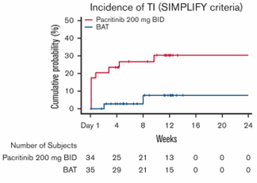
Pacritinib inhibits ACVR1, improves anemia
Blood Adv. 2023 Oct 10;7(19):5835-5842.
Notes:
Proportion of patients with transfusion-independent status defined as not requiring red blood cell transfusion for the last 12 weeks of the 24-week randomised period, with all haemoglobin concentrations during the 12-week interval of 8 g/dL or more.

Slide 113

How to choose between JAKi
CML

Slide 114
 | Ruxolitinib | Fedratinib | Pacritinib | Momelotinib
MOA | JAK1/2 | JAK2, FLT3 | JAK2, FLT3, IRAK1, ACVR1, CSF1R | JAK1/2, ACVR1
FDA Labeling | Int or High w/plts >50 | Int-2 or High w/plts >50 | Int or High w/plts <50 | Int or High w/anemia (w/plts >25)
Main Side Effects | TCP, anemia, bruising, dizziness, HA, diarrhea | N/V, anemia, diarrhea | Diarrhea, TCP, nausea, anemia, peripheral edema | TCP, bleeding, bacterial infxn, fatigue, dizziness, diarrhea, nausea

Slide 115
 | Ruxolitinib | Fedratinib | Pacritinib | Momelotinib
Main Side Effects | TCP, anemia, bruising, dizziness, HA, diarrhea | N/V, anemia, diarrhea | Diarrhea, TCP, nausea, anemia, peripheral edema | TCP, bleeding, bacterial infxn, fatigue, dizziness, diarrhea, nausea
Drug-Drug Interactions | Fluconazole, CYP3A4 inhibitors | CYP3A4 inhibitors | CYP3A4, P-gp, CYP1A2, BCRP, OCT1 | OATP 1B1/B3, BCRP
Dosing | Based on platelet count | 400mg po daily | 200mg po BID | 200mg po daily
Other Notes |  | Thiamine deficiency | Bleeding risk, QTc prolongation

Slide 116
 | Ruxolitinib | Fedratinib | Pacritinib | Momelotinib
SVR 35 | JAKi naïve: 42%, 29% | JAK naïve: 37% | JAKi naïve & prior: 29% | JAKi naïve: 31% JAKi prior: 22%
Sx Improved >50% | 46% | 40% | 29% | 40%
Anemia response | ▼ 1g/dL | ▼ 1.5g/dL | ▲ 20% | ▲ 1.3 g/dL
Haematologica. 2015 Apr; 100(4): 479–488.
JAMA Oncol. 2015;1(5):643-651.

Slide 117
How should this patient with newly diagnosed primary myelofibrosis be managed?
Allogeneic stem cell transplant
Ruxolitinib
Hydroxyurea
Pacritinib
Momelotinib
Poor PS; older
Plts <50
No need for cytoreduction
Drug-drug interaction (amiodarone), QTc prolongation
No drug-drug interaction, ok for plts >25

Slide 118
Summary
Allogeneic HSCT for higher-risk MF
JAKi remain backbone of therapy for MF
  4 FDA-approved JAKi as of 11/2023
    Ruxolitinib, Fedratinib, Pacritinib, Momelotinib
Both pacritinib & momelotinib can be used in “cytopenic” MF
  Pacritinib FDA-labeled for thrombocytopenia
  Momelotinib FDA-labeled for anemia

Slide 119
LEUKEMIA/LYMPHOMA
Thursday, November 16, 2023

Slide 120
Future Directions in Myelofibrosis
Brandi Reeves, MD
Assistant Professor of Medicine
University of North Carolina
Chapel Hill, NC

Slide 121
Disclosures
I have received consulting fees from:
  BMS
  CTI BioPharma
  Incyte
  MorphoSYS
  PharmaEssentia
  Protagonist Therapeutics

Slide 122
Overview
JAKi are currently the backbone of MF therapy & are largely palliative
Increasing focus on “disease-modifying” drugs
  Target the MPN clone and/or HSC niche to restore normal hematopoiesis and improve clinically meaningful outcomes
Updates from MOMENTUM study (ASH 22 abstr 627)
Bone marrow fibrosis response as a marker of disease-modification (ASH 22 abstr 337)
Combination therapies in MF

Slide 123
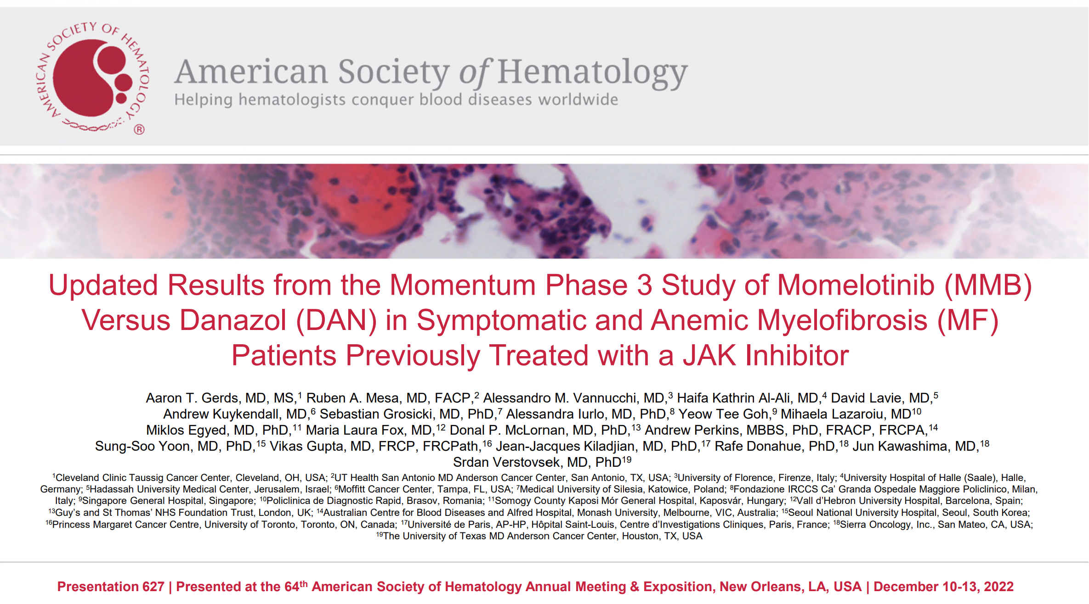
https://presentations.gsk.com/orals/5659/

Slide 124
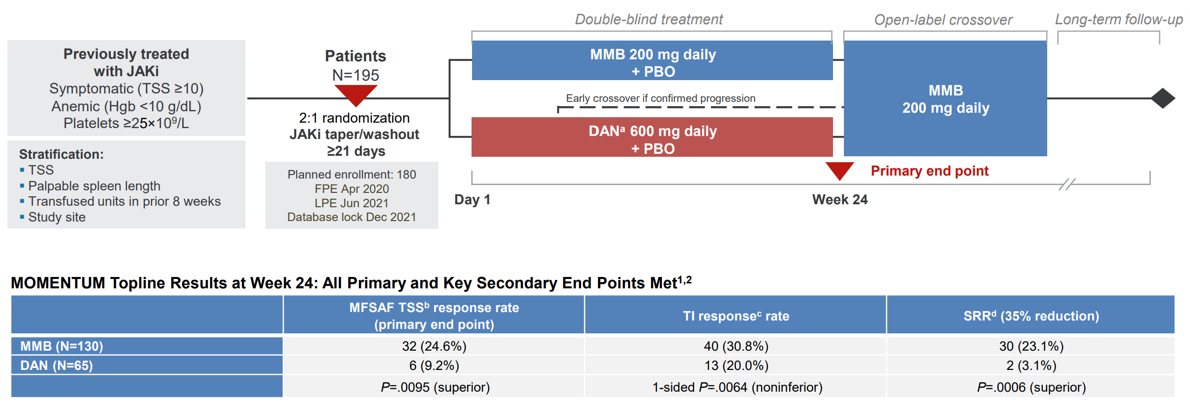
MOMENTUM Trial Design: Phase III, Double-Blind, Open-Label Crossover
https://presentations.gsk.com/orals/5659/

Slide 125
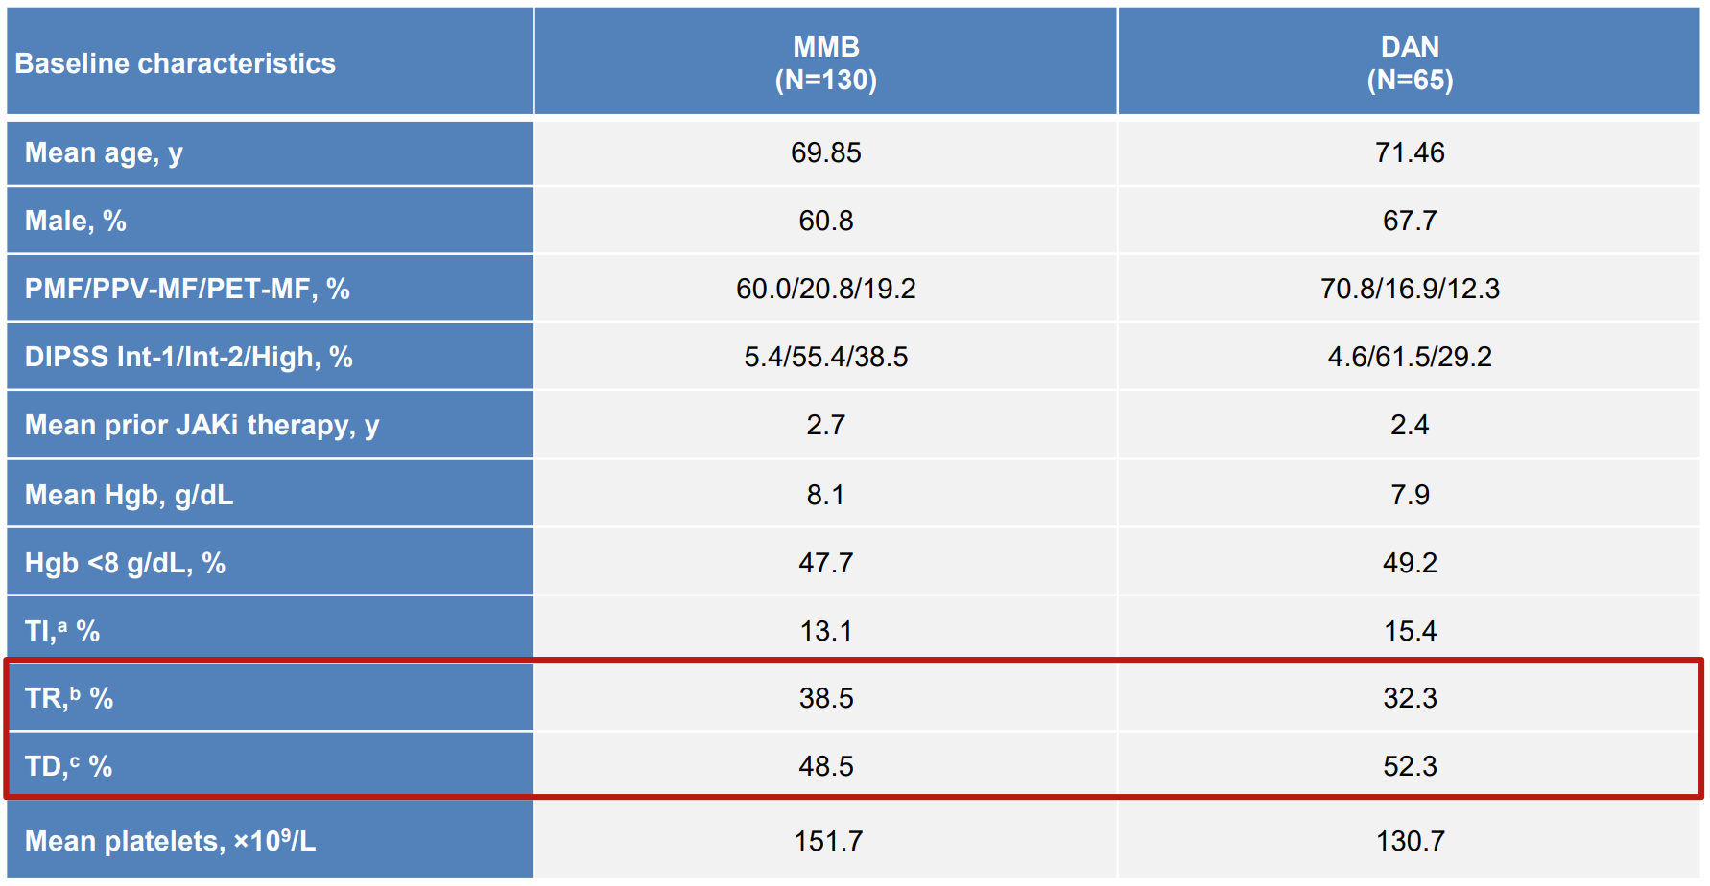
Higher risk, post-ruxolitinib, symptomatic, transfusion-dependent
https://presentations.gsk.com/orals/5659/

Slide 126
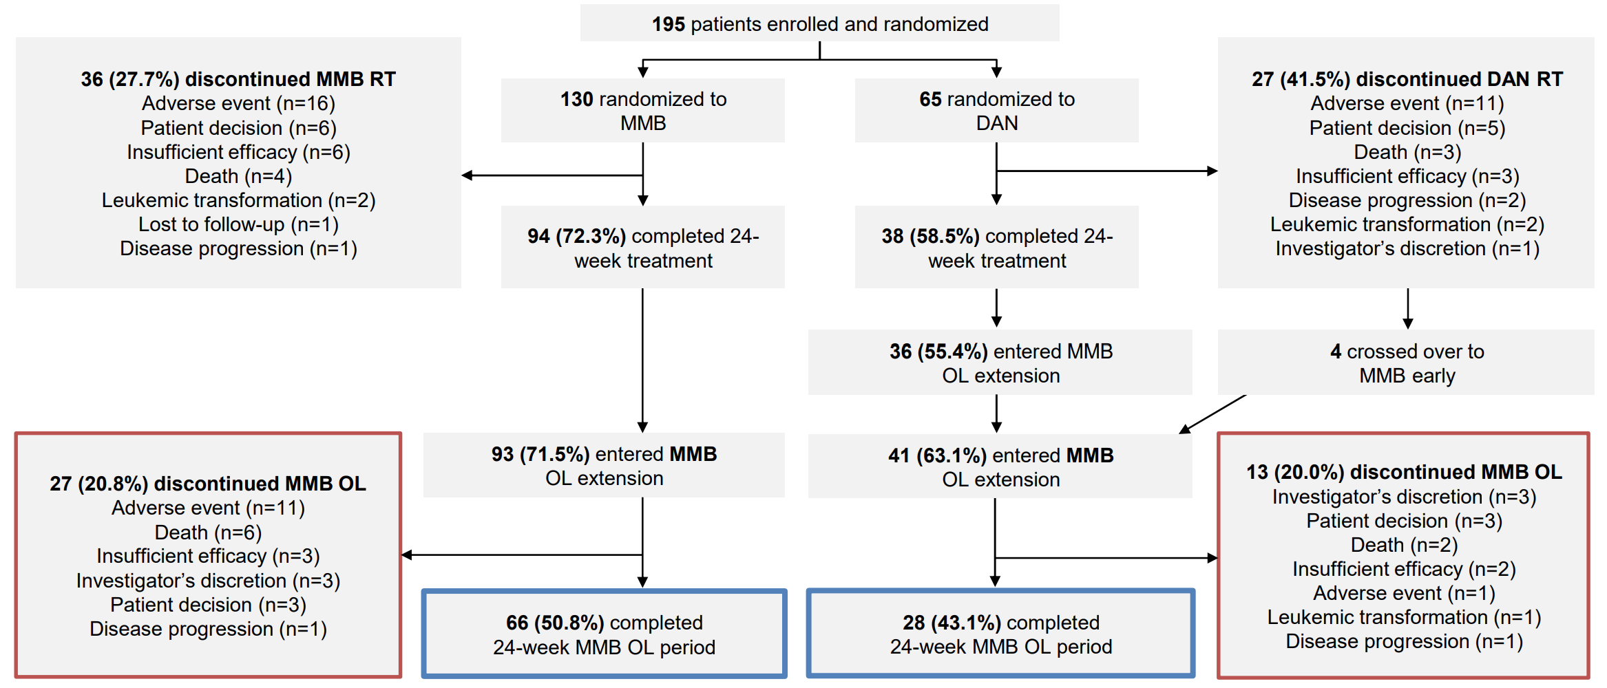
https://presentations.gsk.com/orals/5659/

Slide 127
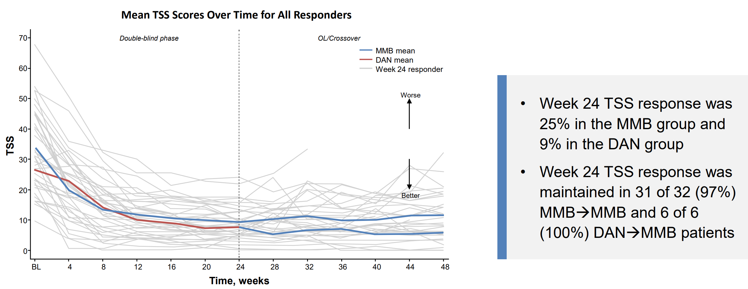
50% TSS Reduction at 24wks sustained at 48wks
https://presentations.gsk.com/orals/5659/

Slide 128
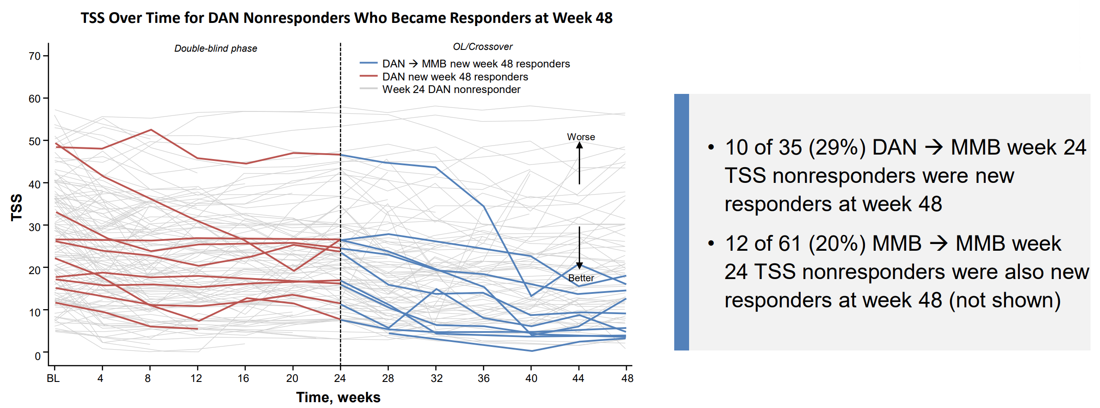
New TSS Responders at 48wks
https://presentations.gsk.com/orals/5659/

Slide 129
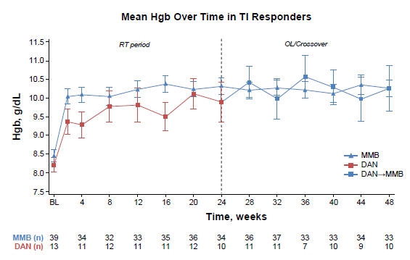
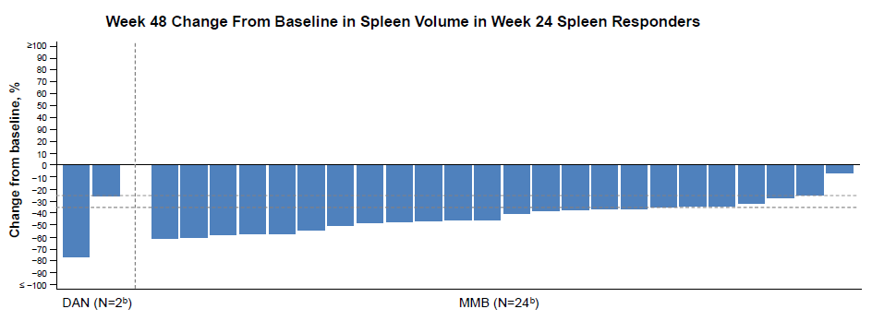
Durable Anemia & Spleen Response
https://presentations.gsk.com/orals/5659/

Slide 130

OS and LFS converged after MMB crossover
https://presentations.gsk.com/orals/5659/

Slide 131

Improved OS in those w/baseline PLT <50 x 10⁹/L
https://presentations.gsk.com/orals/5659/

Slide 132

No new adverse events at 48 weeks
https://presentations.gsk.com/orals/5659/

Slide 133
Summary
Momelotinib responses @ 48 wks were durable
Momelotinib mproved OS for pts with plts <50
Clinically significant bleeding in ~15%, no new adverse events seen

Slide 134


Slide 135
Rationale
Bone marrow fibrosis (BMF) is a cardinal feature of MF
Increasing BMF is associated with poor prognosis
BMF reduction is being reported in recent clinical trials, but the impact on clinical outcomes has not been well-defined
This study investigated the impact of 2 different JAKi, momelotinib & ruxolitinib, on BMF and assessed correlations between BMF and clinical outcomes in subjects from the SIMPLIFY-1 study in JAKi-naïve MF
https://presentations.gsk.com/orals/5658/

Slide 136

SIMPLIFY-1: Phase 3, Double-Blind RCT of momelotinib vs ruxolitinib in JAKi-naïve MF
WHO BMF Scale 0-3
https://presentations.gsk.com/orals/5658/

Slide 137


Ruxolitinib & Momelotinib similarly improved BMF
MMB
RUX
https://presentations.gsk.com/orals/5658/

Slide 138



No association of BMF with clinical outcomes
SVR – no difference
TSS – no difference
Anemia response – no difference
https://presentations.gsk.com/orals/5658/

Slide 139

BMF changes did not associate with OS
https://presentations.gsk.com/orals/5658/

Slide 140
Summary
20% of JAKi-naïve pts had >1 grade BMF improvement at 24-wk of MMB or RUX
BMF changes from baseline to 24-wk did not correlate with clinical outcomes

Slide 141


Blood Cancer J. 2019 Sep 11;9(9):74

Slide 142




BET inhibition + JAK inhibition reduces NFKB, fibrosis, spleen size, clonal cells
Reduced BM Fibrosis
BETi
BRD2/3/4
Spleen Response
Reduced Clonal Burden
NFKB1
NFKB activation
Pro-inflammatory cytokines
Adapted from Cancer Cell. 2018 Jan 8;33(1):3-5.
Cancer Cell. 2018 Jan 8;33(1):29-43.e7.

Slide 143
MANIFEST: P2 BETi + Ruxolitinib
24 weeks
Second-line MF
No longer on rux
Refractory/intolerant/ineligible
SVR35
TSS50
TD
TD → TI
ARM 1
Pelabresib
Non-TD
SVR35
TSS50
Second-line MF
Add on to rux
Suboptimal response or MF progression
SVR35
TSS50
Pelabresib + ruxolitinib
TD
TD → TI
ARM 2
Non-TD
SVR35
TSS50
First-line MF
No prior JAKi
DIPSS Int-2/High
Pelabresib + ruxolitinib
ARM 3
Non-TD
SVR35
TSS50
Arm 4: Essential throbmocythemia
Journal of Clinical Oncology 2023 41:32, 4993-5004

Slide 144


Deep Spleen Response
Symptom Response
SVR35 68%
TSS50 56%
Journal of Clinical Oncology 2023 41:32, 4993-5004

Slide 145


Reduced BM Fibrosis
28% had >1 grade improvement in BMF.
No association between BMF improvement and clinical endpoints
Megakaryocyte declustering
Correlated with SVR
Journal of Clinical Oncology 2023 41:32, 4993-5004
Reduced Clonal Burden
30% had JAK2 VAF reduction of >25%
Correlated with SVR

Slide 146

Hemoglobin Response
Journal of Clinical Oncology 2023 41:32, 4993-5004

Slide 147

Decreased hepcidin, inflammatory cytokines, NFKB cytokines
Journal of Clinical Oncology 2023 41:32, 4993-5004

Slide 148
Summary
Bone marrow fibrosis response to MF therapies may not be predictive of clinical outcomes
Combination therapies (JAKi +) hold significant promise towards “disease-modification” in MF

Slide 149
LEUKEMIA/LYMPHOMA
Thursday, November 16, 2023

Slide 150
Bispecific Antibodies for Diffuse Large
B-Cell Lymphoma
Christopher Dittus, DO, MPH
Associate Professor of Medicine
University of North Carolina at Chapel Hill
Chapel Hill, NC

Slide 151

Immunotherapy for Lymphoma
Modi, Cancers, 2021

Slide 152

What is a bispecific antibody?
Falchi, Blood, 2023

Slide 153
Why DLBCL?
Most common type of lymphoma
  30% of NHL
40% relapse after frontline treatment
30% over age 75
Need new and tolerable therapies
Sehn, NEJM, 2021

Slide 154
Relapsed DLBCL
Intensive Treatment
Non-Intensive Treatment
Relapse after 1 year:
  Traditional Salvage
  R-ICE, R-DHAX, R-GDP
  Autologous Stem Cell Transplant
Relapse within 1 year:
  Bridging therapy (+/-)
  CD19 CAR-T therapy
Tafasitamab-Len (TR) (Salles, Lancet Oncol, 2020)
  N=81; ORR: 60%; CR: 43% (CD19)
Rituximab-Len (R²) (Wang, Leukemia, 2013)
  N=45; ORR: 33%; CR: 22.2% (CD20)
Polatuzumab vedotin-BR (PBR) (Sehn, JCO, 2020)
  N=80; ORR: 45%; CR: 40% (CD79B ADC)
Loncastuximab tesirine (Caimi, Lancet Oncol, 2021)
  N=145; ORR: 48.3%; CR: 24% (CD19 ADC)

Slide 155
Where do bispecific antibodies fit in?
FDA-Approved Bispecific T-Cell Engagers for DLBCL NOS:
  Glofitamab-gxbm (also DLBCL from FL)
  Epcoritamab-bysp (also DLBCL from indolent lymphoma and high-grade B-cell lymphoma)
Both approved after 2 lines of systemic therapy; including after CAR T-cell therapy or transplant

Slide 156
Recent Bispecifics and Responses
Falchi, Blood, 2023

Slide 157
Rates of CRS by Bispecific
Falchi, Blood, 2023

Slide 158
How are these agents given?
Glofitamab (21-day Cycle)
  C1D1: OP Obi
  C1D8: IP Glo IV 2.5mg (monitor 24 hrs)
  C1D15 OP Glo 10mg (admit if Gr 2+ w/ D8)
  C2+ (D1 only): OP Glo 30mg
  Up to 12 cycles
Epcoritamab (28-day Cycle)
  C1D1: OP Epco SQ 0.16mg
  C1D8: OP Epco 0.8mg
  C1D15: IP Epco 48mg
  C1D22: OP Epco 48mg
  C2-3 (D1,8,15,22) OP Epco 48mg
  C4-9 (D1,15) OP Epco 48mg
  C10+ (D1 only) OP Epco 48mg

Slide 159


Phase 2
CD3xCD20 BiTE
R/R DLBCL; 2+ prior lines
N=155
ECOG 0-1
Age 21-90 (m 66y)
Prior CART 33%
Primary Endpoint: CR
Dickinson, NEJM, 2022

Slide 160

Glofitamab Response Rates
Dickinson, NEJM, 2022

Slide 161


PFS and Duration of Complete Response
mPFS: 4.9m
mDOR: NR
CR at 12m: 78%
Dickinson, NEJM, 2022

Slide 162

Hematologic Toxicity
-Feb Neu >3: 3%
-Infect: 38%
-Infect Gr >3: 15%
Dickinson, NEJM, 2022

Slide 163

CRS by Cycle and Grade
-Any CRS: 63%
-CRS Gr >3: 4%
-Any ICANS: 8%
-ICANS Gr>3: 3%
Dickinson, NEJM, 2022

Slide 164


Phase 1/2
CD3xCD20 BiTE (SubQ)
R/R DLBCL; 2+ prior lines
N=157
ECOG 0-2
Age 20-83 (m 64y)
Prior CART 38.9%
Primary Endpoint: ORR
Thieblemont, JCO, 2022

Slide 165

Epcoritamab Response Rates
ORR: 63.1%
CR: 38.9%
Thieblemont, JCO, 2022

Slide 166

Duration of Response and PFS
mDOR: 12m
mPFS: 4.4m
Thieblemont, JCO, 2022

Slide 167


Adverse Events
Thieblemont, JCO, 2022

Slide 168

CRS by dose and grade
Thieblemont, JCO, 2022

Slide 169

Frontline Studies
SkyGlo Study: Phase III, randomized study evaluating glofitimab with Pola-R-CHP vs Pola-R-CHP in DLBCL
Falchi, Blood, 2023

Slide 170
So, which one should you use?
Similar efficacy and toxicity profile
Glofitamab
  Easier dosing schedule
  Fixed Duration
  Approved for tDLBCL from FL
Epcoritamab
  Subcutaneous administration
  Approved for high-grade B-cell lymphoma
  Approved for tDLBCL from any indolent lymphoma

Slide 171
Future Directions
Odronextamab under FDA priority review
Moving glofitamab and epcoritamab to 1st and 2nd line
New agents targeting CD20/CD3
Trispecific agents and Novel Targets

